Slide 1
Year in Review: Therapeutic Targets Beyond EGFR for Non-Small Cell Lung Cancer
A CME/MOC-Accredited Live Webinar
Thursday,​ May 15, 2025 5:00 PM – 6:00 PM ET
Faculty
Jessica J Lin, MD
Joel W Neal, MD, PhD
Moderator
Neil Love, MD

Slide 2



Faculty
Jessica J Lin, MD
Attending Physician
Massachusetts General Hospital
Associate Professor of Medicine
Harvard Medical School
Boston, Massachusetts
MODERATOR
Neil Love, MD Research To Practice
Miami, Florida
Joel W Neal, MD, PhD
Professor of Medicine, Division of Oncology
Stanford University School of Medicine
Medical Director, Cancer Clinical Trials Office
Stanford Cancer Institute
Medical Director, Informatics Technology
Stanford Medicine Cancer Center
Stanford, California

Slide 3
Commercial Support
This activity is supported by educational grants from AstraZeneca Pharmaceuticals LP, Daiichi Sankyo Inc, and Nuvalent.
Research To Practice CME Planning Committee Members, Staff and Reviewers
Planners, scientific staff and independent reviewers for Research To Practice have no relevant conflicts of interest to disclose.

Slide 4
Dr Lin — Disclosures
Advisory Committees | Bristol Myers Squibb, Genentech, a member of the Roche Group, Nuvalent
Consulting Agreements | AnHeart Therapeutics, AstraZeneca Pharmaceuticals LP, Bayer HealthCare Pharmaceuticals, Blueprint Medicines, Bristol Myers Squibb, C4 Therapeutics, CLaiM Therapeutics, Daiichi Sankyo Inc, Elevation Oncology, Ellipses Pharma, Genentech, a member of the Roche Group, Gilead Sciences Inc, Janssen Biotech Inc, Lilly, Merus, Mirati Therapeutics Inc, Novartis, Nuvalent, Nuvation Bio, Pfizer Inc, Regeneron Pharmaceuticals Inc, Roche Laboratories Inc, Takeda Pharmaceuticals USA Inc, Turning Point Therapeutics Inc, Yuhan USA
Contracted Research (Received Institutional Research Funds) | Bayer HealthCare Pharmaceuticals, BioNTech SE, Elevation Oncology, Hengrui Therapeutics Inc, Linnaeus Therapeutics, Novartis, Nuvalent, Relay Therapeutics, Roche Laboratories Inc, Turning Point Therapeutics Inc
Travel Support | Bristol Myers Squibb, Merus, Pfizer Inc, Takeda Pharmaceuticals USA Inc

Slide 5
Dr Neal — Disclosures
Advisory Committees (Consulting or Advisory Roles) | AbbVie Inc, Amgen Inc, AnHeart Therapeutics, AstraZeneca Pharmaceuticals LP, Blueprint Medicines, Bristol Myers Squibb, D2G Oncology Inc, Daiichi Sankyo Inc, Exelixis Inc, Genentech, a member of the Roche Group, Gilead Sciences Inc, Iovance Biotherapeutics, Janssen Biotech Inc, Lilly, Mirati Therapeutics Inc, Natera Inc, Novartis, Novocure Inc, Nuvation Bio, Regeneron Pharmaceuticals Inc, Sanofi, Summit Therapeutics, Surface Oncology, Takeda Pharmaceuticals USA Inc, Turning Point Therapeutics Inc
Contracted Research | Adaptimmune, Boehringer Ingelheim Pharmaceuticals Inc, Exelixis Inc, Genentech, a member of the Roche Group, GSK, Janssen Biotech Inc, Merck, Nektar Therapeutics, Novartis, Nuvalent, Revolution Medicines, Takeda Pharmaceuticals USA Inc.

Slide 6
This educational activity contains discussion of non-FDA-approved uses of agents and regimens. Please refer to official prescribing information for each product for approved indications.

Slide 7
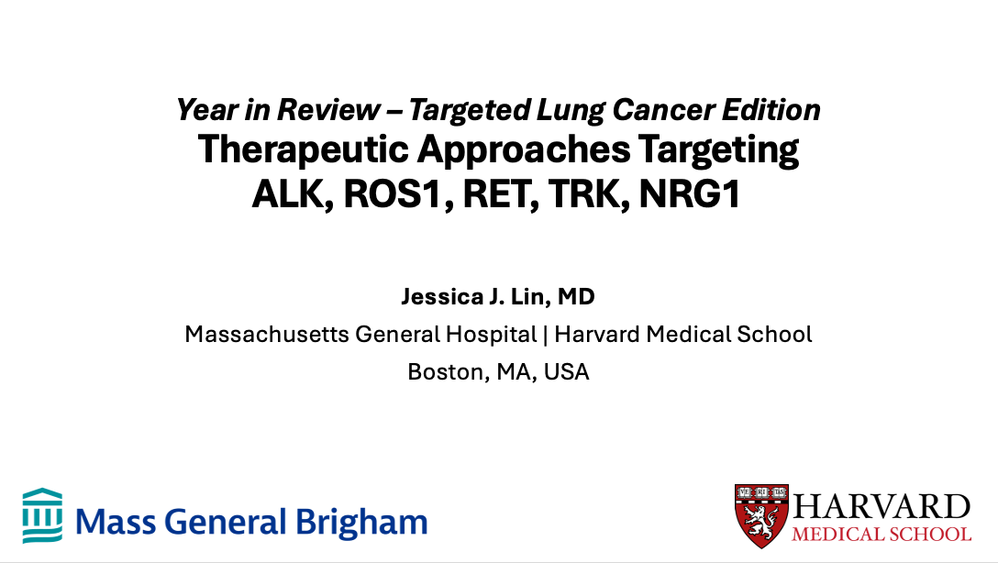
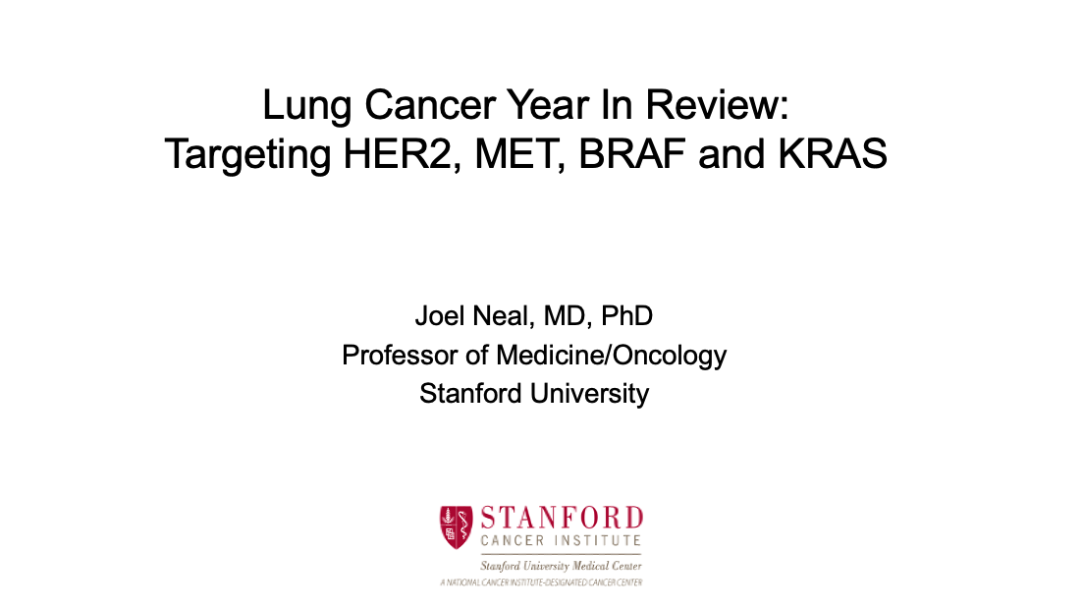

Slide 8
Key Datasets
Jessica J Lin, MD
Wu YL et al. Alectinib in Resected ALK-Positive Non-Small-Cell Lung Cancer. N Engl J Med 2024;390(14):1265-76.
Horinouchi H et al. ALINA Safety Results; Adjuvant Alectinib vs Chemotherapy in Patients with Resected ALK+ Non-Small Cell Lung Cancer (NSCLC). WCLC 2024;Abstract OA13.04.
Solomon BJ et al. Lorlatinib versus Crizotinib in Patients with Advanced ALK-Positive Non-Small Cell Lung Cancer: 5-Year Outcomes from the Phase III CROWN Study. J Clin Oncol 2024;42(29):3400-9.
Bauer T et al. Kinetics and Management of Adverse Events Associated with Lorlatinib after 5 Years of Follow-Up in the CROWN Study. WCLC 2024;Abstract MA06.08.
Hill L et al. Predictors of Long-Term Ensartinib Response from the eXalt3 Trial. WCLC 2024;Abstract MA06.09.
Drilon AE at al. Phase I/II ALKOVE-1 Study of NVL-655 in ALK-Positive (ALK+) Solid Tumours. ESMO 2024;Abstract 1253O.
Drilon AE et al. Repotrectinib in Tyrosine Kinase Inhibitor (TKI)-Naïve Patients (pts) with Advanced ROS1 Fusion-Positive (ROS1+) NSCLC in the Phase 1/2 TRIDENT-1 Trial: Clinical Update, Treatment Beyond Progression and Subsequent Therapies. ASCO 2024;Abstract 8522.

Slide 9
Key Datasets
Jessica J Lin, MD (continued)
Besse B et al. Phase I/II ARROS-1 Study of Zidesamtinib (NVL-520) in ROS1 Fusion-Positive Solid Tumours. ESMO 2024;Abstract 1256MO.
Liu G et al. Efficacy and Safety of Taletrectinib in Patients with ROS1+ Non-Small Cell Lung Cancer: The Global TRUST-II Study. WCLC 2024;Abstract MA06.03.
Pérol M et al. CNS Protective Effect of Selpercatinib in First-Line RET Fusion-Positive Advanced Non-Small Cell Lung Cancer. J Clin Oncol 2024;42(21):2500-5.
Lin JJ et al. Updated Efficacy, Safety, and Biomarker Analysis in Patients with TRK Fusion Lung Cancer Treated with Larotrectinib. WCLC 2024;Abstract MA06.12.
Schram AM et al. Efficacy of Zenocutuzumab in NRG1 Fusion-Positive Cancer. N Engl J Med 2025;392(6):566-76.

Slide 10
Key Datasets
Joel W Neal, MD, PhD
Janne PA et al. Trastuzumab Deruxtecan (T-DXd) in Patients with HER2-Mutant Metastatic Non-Small Cell Lung Cancer (mNSCLC): Final Analysis Results of DESTINY-Lung02. ASCO 2024;Abstract 8543.
Smit EF et al. Trastuzumab Deruxtecan in Patients with Metastatic Non-Small-Cell Lung Cancer (DESTINY-Lung01): Primary Results of the HER2-Overexpressing Cohorts from a Single-Arm, Phase 2 Trial. Lancet Oncol 2024;25(4):439-54.
Planchard D et al. Trastuzumab Deruxtecan Monotherapy in Pretreated HER2-Overexpressing Nonsquamous Non-Small Cell Lung Cancer: DESTINY-Lung03 Part 1. WCLC 2024;Abstract OA16.05.
Ruiter G et al. Primary Phase Ib Analysis of Beamion LUNG-1: Zongertinib (BI 1810631) in Patients with HER2 Mutation-Positive NSCLC. WCLC 2024;Abstract PL04.04.
Le X et al. Safety and Efficacy of BAY 2927088 In Patients with HER2-Mutant NSCLC: Expansion Cohort from the Phase I/II SOHO-01 Study. WCLC 2024;Abstract PL04.03.
Wolf J et al. Capmatinib in MET Exon 14-Mutated Non-Small-Cell Lung Cancer: Final Results from the Open-Label, Phase 2 GEOMETRY mono-1 Trial. Lancet Oncol 2024;25(10):1357-70.

Slide 11
Key Datasets
Joel W Neal, MD, PhD (continued)
Camidge DR et al. Telisotuzumab Vedotin Monotherapy in Patients with Previously Treated c-Met Protein-Overexpressing Advanced Nonsquamous EGFR-Wildtype Non-Small Cell Lung Cancer in the Phase II LUMINOSITY Trial. J Clin Oncol 2024;42(25):3000-11.
Riley GJ et al. Updated Efficacy and Safety from the Phase II PHAROS Study of Encorafenib plus Binimetinib in Patients with BRAF V600E-Mutant Metastatic NSCLC (mNSCLC). ESMO 2024;Abstract LBA56.
Waterhouse DM et al. Patient-Reported Outcomes in CodeBreaK 200: Sotorasib versus Docetaxel for Previously Treated Advanced NSCLC with KRAS G12C Mutation. Lung Cancer 2024;196:107921.
Mok TSK et al. KRYSTAL-12: Phase 3 Study of Adagrasib versus Docetaxel in Patients with Previously Treated Advanced/Metastatic Non-Small Cell Lung Cancer (NSCLC) Harboring a KRASG12C Mutation. ASCO 2024;Abstract LBA8509.
Sacher A et al. Divarasib Single-Agent Long-Term Follow-Up and Atezolizumab Combination Treatment in Patients with KRAS G12C-Positive NSCLC. WCLC 2024;Abstract OA14.06
Fujiwara Y et al. Efficacy and Safety of Olomorasib with Pembrolizumab + Chemotherapy as First-Line Treatment in Patients with KRAS G12C-Mutant Advanced NSCLC. WCLC 2024;Abstract OA14.04.

Slide 12
Year in Review: Targeted Therapies Beyond EGFR for Non-Small Cell Lung Cancer (NSCLC)
INTRODUCTION: AGAs (Actionable Genomic Alterations)
MODULE 1: ALK
MODULE 2: ROS1
MODULE 3: HER2
MODULE 4: RET
MODULE 5: NTRK
MODULE 6: MET
MODULE 7: BRAF
MODULE 8: KRAS G12C
MODULE 9: NRG1
MODULE 10: Novel Targeted Strategies

Slide 13
Year in Review: Targeted Therapies Beyond EGFR for Non-Small Cell Lung Cancer (NSCLC)
INTRODUCTION: AGAs (Actionable Genomic Alterations)
MODULE 1: ALK
MODULE 2: ROS1
MODULE 3: HER2
MODULE 4: RET
MODULE 5: NTRK
MODULE 6: MET
MODULE 7: BRAF
MODULE 8: KRAS G12C
MODULE 9: NRG1
MODULE 10: Novel Targeted Strategies

Slide 14
Disease Subtypes
Lymphomas
Breast Cancer
Lung Cancer

Slide 15
Select AGAs Among Patients with Metastatic NSCLC
EGFR EXON 19 and 21
EGFR EXON 20
ALK
ROS1
HER2
RET
NTRK
MET EXON 14
c-MET
BRAF
KRAS G12C
NRG1

Slide 16
Neil’s Top 20+ Questions

Slide 17
What is an AGA?

Slide 18
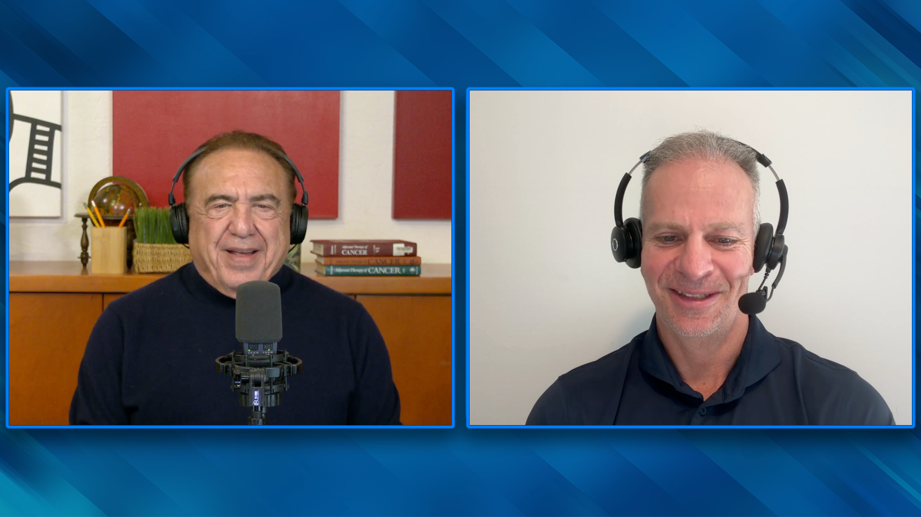

Slide 19
Other than HER2, RET, BRAF, KRAS G12C NTRK and NRG1, which actionable genomic alterations would be a reasonable target outside of lung cancer (eg, EGFR and ALK)?

Slide 20
For which of these alterations is first-line targeted treatment a reasonable consideration? What about checkpoint inhibition?

Slide 21
Why is the PFS for lorlatinib so long compared to other ALK inhibitors and other targeted treatments?

Slide 22
Year in Review: Targeted Therapies Beyond EGFR for Non-Small Cell Lung Cancer (NSCLC)
INTRODUCTION: AGAs (Actionable Genomic Alterations)
MODULE 1: ALK
MODULE 2: ROS1
MODULE 3: HER2
MODULE 4: RET
MODULE 5: NTRK
MODULE 6: MET
MODULE 7: BRAF
MODULE 8: KRAS G12C
MODULE 9: NRG1
MODULE 10: Novel Targeted Strategies

Slide 23
Evolution of First- and Next-Generation ALK Inhibitors for ALK+ NSCLC
First-Generation (1G)
Second-Generation (2G)
Third-Generation (3G)
Crizotinib
Ceritinib
Alectinib
Brigatinib
Ensartinib
Lorlatinib
Increased potency, selectivity
Increased CNS penetration & activity
Coverage of on-target resistance mutation(s)
Note: Only the FDA-approved ALK inhibitors are shown, with others in development
Courtesy of Jessica J Lin, MD
Lin JJ, ASCO 2024

Slide 24
FDA approves ensartinib for ALK-positive locally advanced or metastatic non-small cell lung cancer Press Release: December 18, 2024
The Food and Drug Administration approved ensartinib for adult patients with anaplastic lymphoma kinase (ALK)-positive locally advanced or metastatic non-small cell lung cancer (NSCLC) who have not previously received an ALK inhibitor.
Efficacy was evaluated in eXalt3 (NCT02767804), an open-label, randomized, active-controlled, multicenter trial in 290 patients with locally advanced or metastatic ALK-positive NSCLC who had not previously received an ALK-targeted therapy. Patients were randomized 1:1 to receive ensartinib or crizotinib.
The main efficacy outcome measure was progression-free survival (PFS) as evaluated by blinded independent central review. The key secondary efficacy outcome measure was overall survival (OS). Ensartinib demonstrated a statistically significant PFS improvement compared to crizotinib with a hazard ratio (HR) of 0.56 (95% CI: 0.40, 0.79; p-value 0.0007). The median PFS was 25.8 months (95% CI: 21.8, not estimable) in the ensartinib arm and 12.7 months (95% CI: 9.2, 16.6) in the crizotinib arm. There was no statistically significant difference in OS (HR 0.88 [95% CI: 0.63, 1.23], p-value 0.4570).
The most common adverse reactions (≥20%) were rash, musculoskeletal pain, constipation, cough, pruritis, nausea, edema, pyrexia, and fatigue.
https://www.fda.gov/drugs/resources-information-approved-drugs/fda-approves-ensartinib-alk-positive-locally-advanced-or-metastatic-non-small-cell-lung-cancer
Courtesy of Jessica J Lin, MD

Slide 25
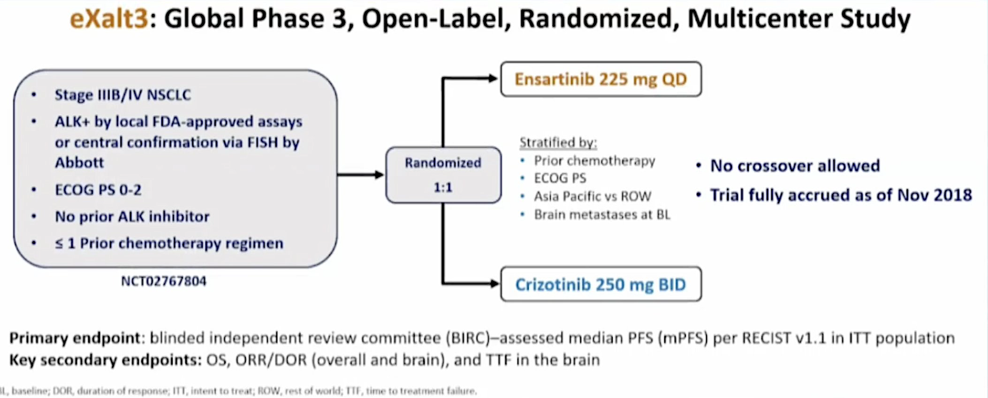
eXalt3 Study Design
Courtesy of Jessica J Lin, MD
Horn L., WCLC 2020

Slide 26
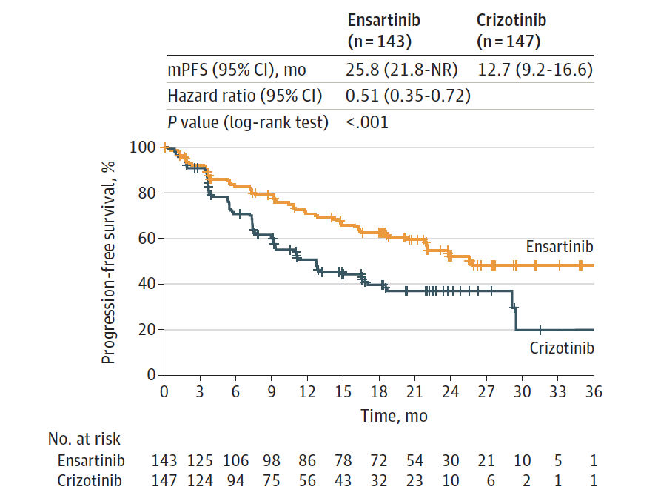
Ensartinib in Metastatic ALK+ NSCLC: PFS Results, Phase III eXalt3 Trial
Courtesy of Jessica J Lin, MD

Slide 27
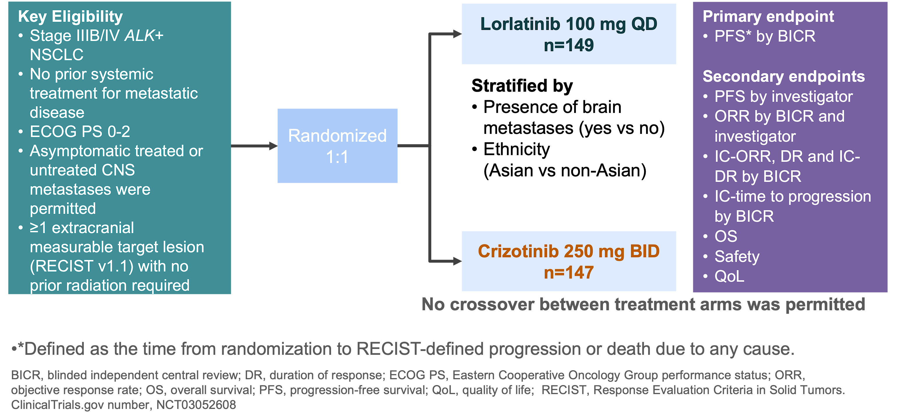
Lorlatinib in Metastatic ALK+ NSCLC: Phase III CROWN Trial
Courtesy of Jessica J Lin, MD
Solomon B et al., ESMO 2020

Slide 28
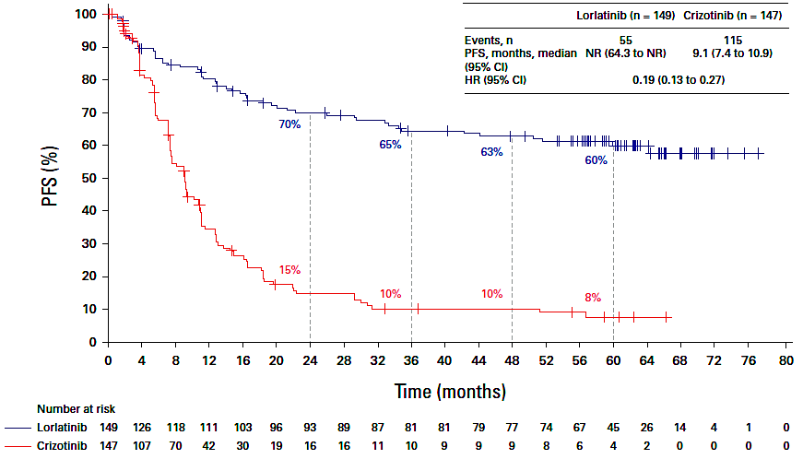
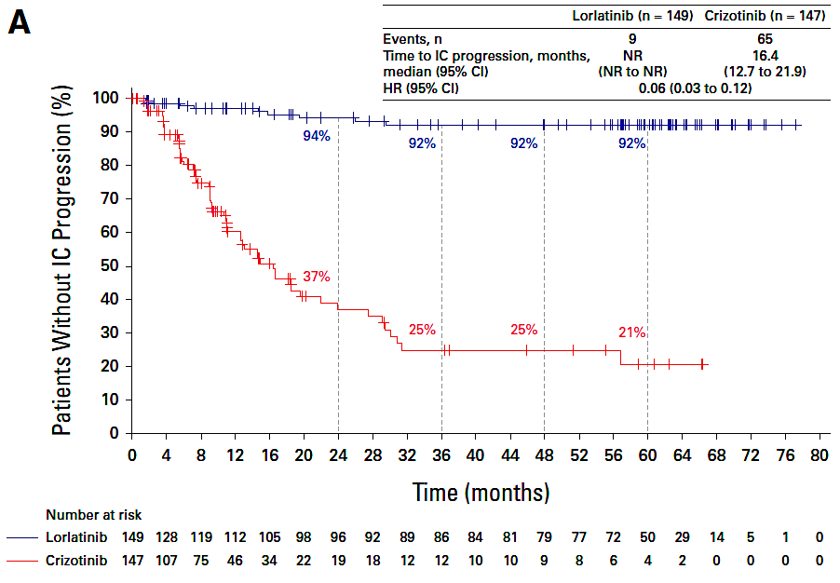
Lorlatinib in Metastatic ALK+ NSCLC: CROWN Trial 5-Year Outcomes Update
PFS
(investigator assessment)
Time to intracranial progression
(investigator assessment)
Courtesy of Jessica J Lin, MD
Solomon B et al., J Clin Oncol 2024;42(29):3400-9

Slide 29

Lorlatinib in Metastatic ALK+ NSCLC: CROWN Trial 5-Year Outcomes Update
PFS
(investigator assessment)
Time to intracranial progression
(investigator assessment)
Courtesy of Jessica J Lin, MD
Solomon B et al., J Clin Oncol 2024;42(29):3400-9

Slide 30
Lorlatinib in Metastatic ALK+ NSCLC: CROWN Trial 5-Year Safety Update
With long exposure to lorlatinib, no new safety signals emerged, and treatment discontinuation remained low after 5 years of follow-up
With lorlatinib, all-cause AEs led to permanent discontinuation in 11% of patients; in 5%, these AEs were treatment related¹
In patients who did not discontinue, AEs were efficiently managed with active measures including dose modifications
Dose reduction (in the first 16 weeks) did not affect efficacy of lorlatinib¹
Solomon B et al., J Clin Oncol 2024;42(29):3400-9
Bauer T et al., WCLC 2024
Courtesy of Jessica J Lin, MD

Slide 31
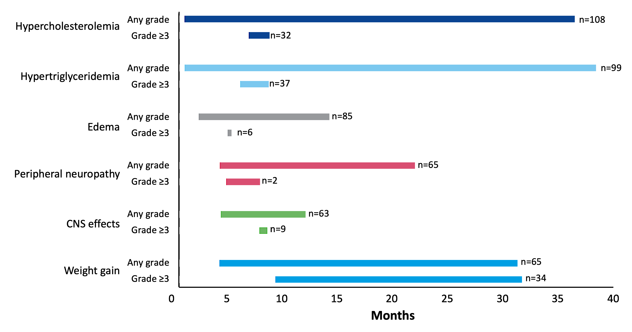
Lorlatinib in Metastatic ALK+ NSCLC: CROWN Trial 5-Year Safety Update, AE Kinetics
Courtesy of Jessica J Lin, MD
Bauer T et al., WCLC 2024

Slide 32
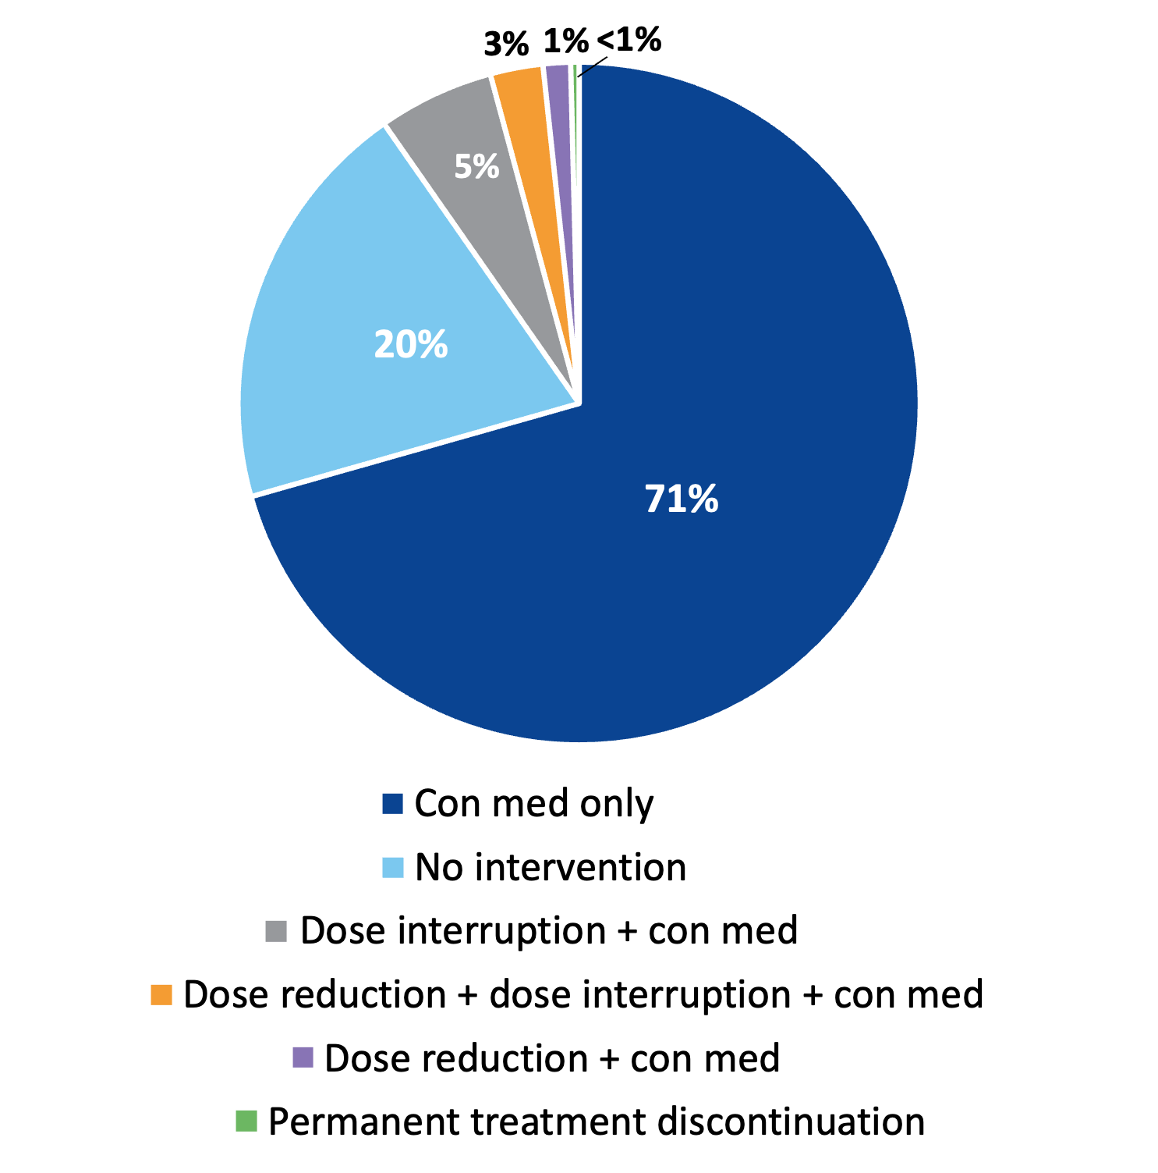
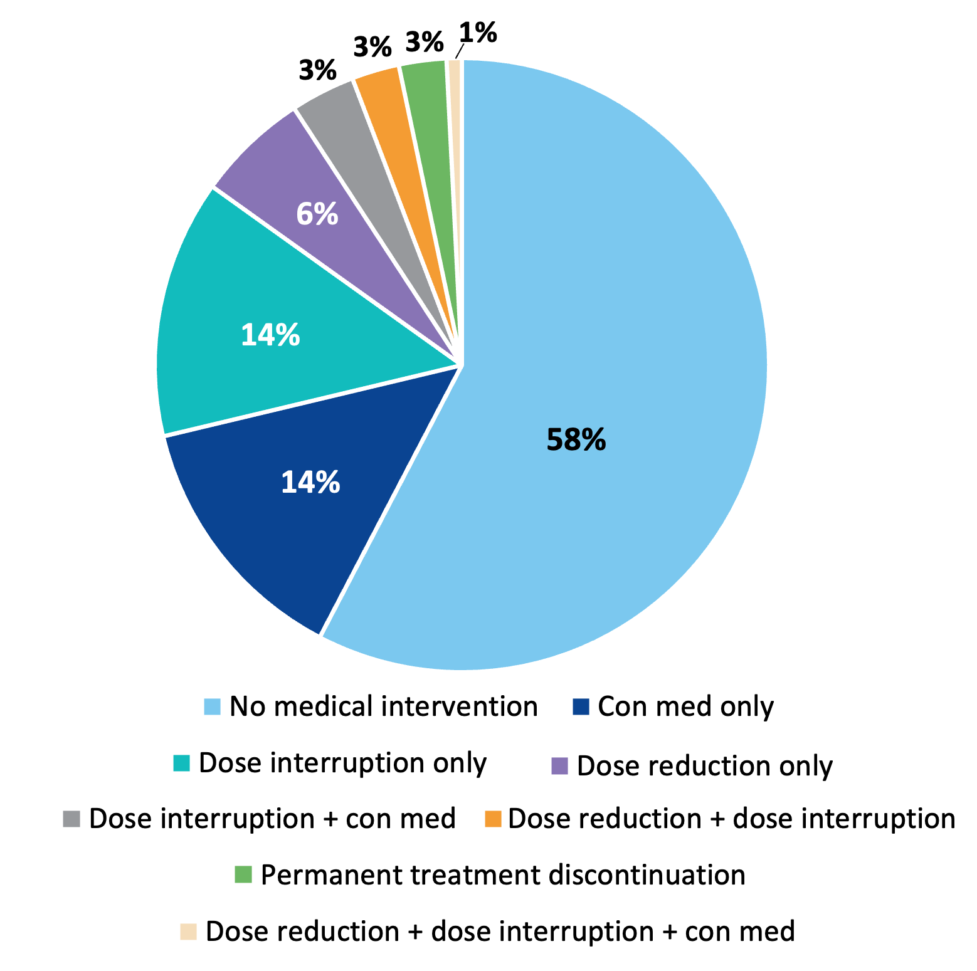
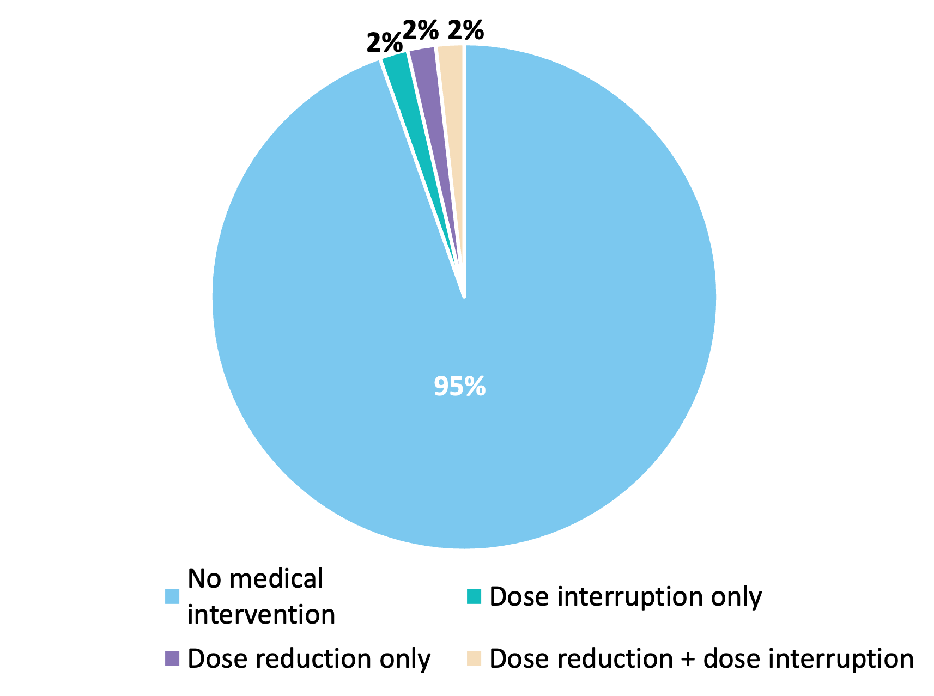
Lorlatinib in Metastatic ALK+ NSCLC: CROWN Trial 5-Year Safety Update, AE Management
Hyperlipidemia
CNS Adverse Events
Weight gain
Courtesy of Jessica J Lin, MD
Bauer T et al., WCLC 2024

Slide 33
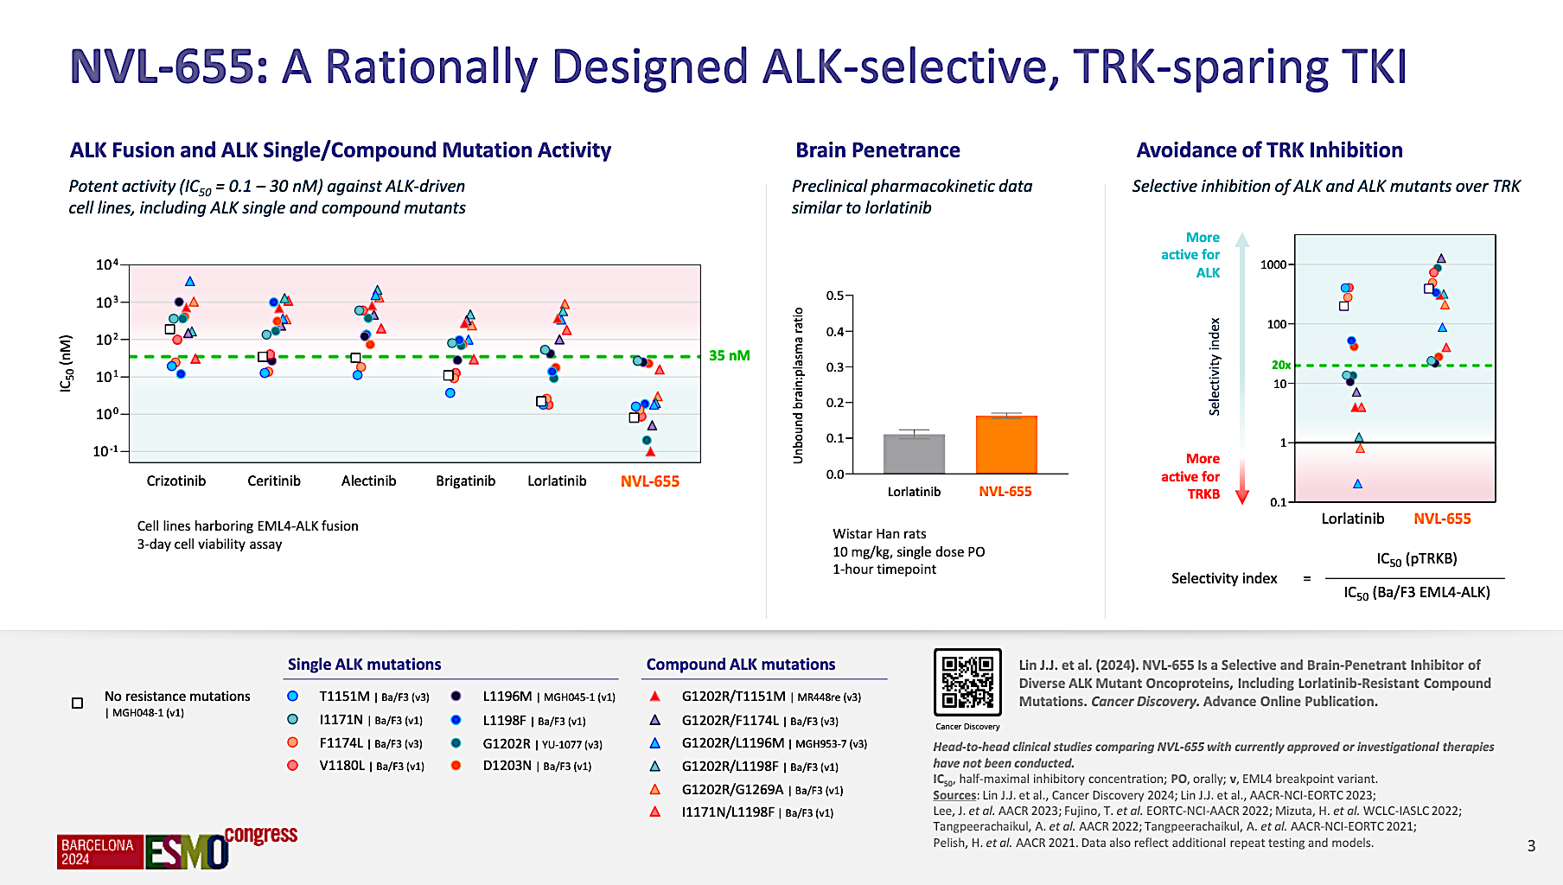
Drilon A et al. ESMO 2024;Abstract 1253O.

Slide 34
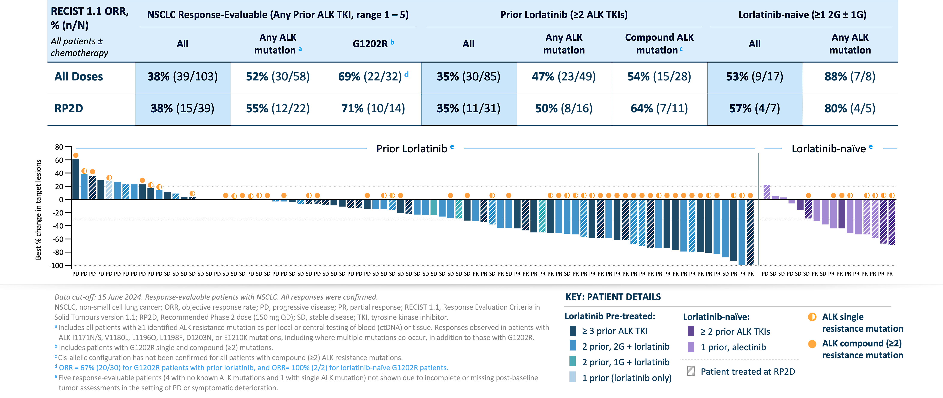
NVL-655 (Neladalkib) in Metastatic ALK+ NSCLC: Phase I/II ALKOVE-1 Trial
Courtesy of Jessica J Lin, MD
Drilon A et al., ESMO 2024

Slide 35
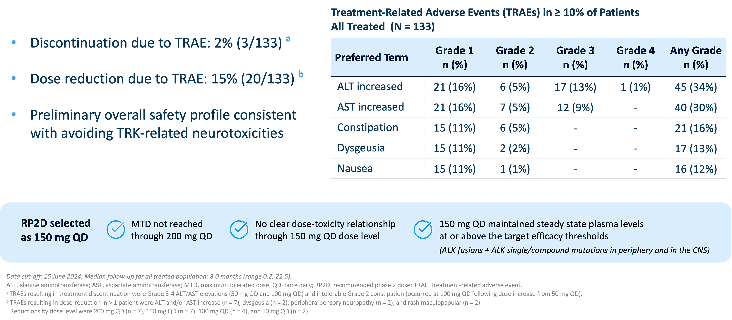
NVL-655 (Neladalkib) in Metastatic ALK+ NSCLC: Phase I/II ALKOVE-1 Trial
Courtesy of Jessica J Lin, MD
Drilon A et al., ESMO 2024

Slide 36
Treatment of Metastatic ALK+ NSCLC: My Take
Multiple 2nd-/3rd-generation ALK TKIs are FDA-approved (and listed as NCCN category 1) as initial therapy for metastatic ALK+ NSCLC
The 5-year analyses of CROWN affirm lorlatinib as SOC first-line treatment for metastatic ALK+ NSCLC, with the longest PFS and time to intracranial progression reported to date amongst ALK inhibitors
4th-generation ALK TKI NVL-655 is demonstrating encouraging activity and tolerability in a heavily pre-treated patient population
Remaining questions:
How will the prolonged PFS outcomes impact OS outcomes on ALK TKIs in patients?
What is the landscape of mechanisms of resistance to first-line lorlatinib therapy and how does this shape subsequent treatments post-lorlatinib?
Courtesy of Jessica J Lin, MD

Slide 37
Bringing ALK-Targeted Therapy to Early-Stage Disease: Phase III ALINA Trial of Alectinib
Resected Stage IB (≥4cm)–IIIA ALK+ NSCLC
per UICC/AJCC 7th edition
Other key eligibility criteria:
ECOG PS 0–1
Eligible to receive platinum-based chemotherapy
Adequate end-organ function
No prior systemic cancer therapy
Stratification factors:
Stage: IB (≥ 4cm) vs II vs IIIA
Race: Asian vs non-Asian
Alectinib 600 mg BID
2 years
Recurrence
Further treatments at investigator’s choice and survival follow-up
R 1:1
Platinum-based chemotherapy†
Q3W; 4 cycles
Recurrence
N=257
Primary endpoint
DFS per investigator,‡ tested hierarchically:
Stage II–IIIA → ITT (Stage IB–IIIA)
Other endpoints
CNS disease-free survival
OS
Safety
Disease assessments (including brain MRI)§ were conducted: at baseline, every 12 weeks for year 1–2, every 24 weeks for year 3–5, then annually
Courtesy of Jessica J Lin, MD
Solomon B et al., ESMO 2024

Slide 38
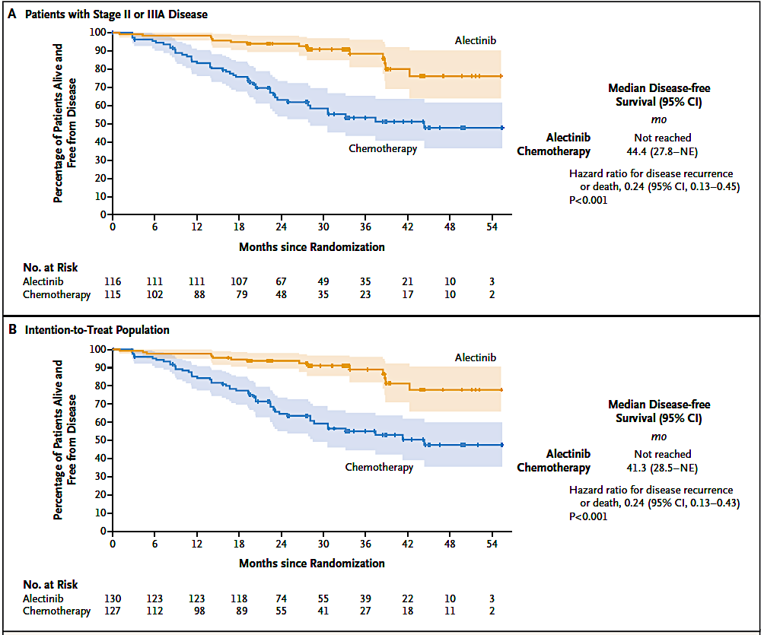
Bringing ALK TKI Alectinib to Early-Stage Disease: ALINA Trial DFS Results
Courtesy of Jessica J Lin, MD
Wu YL et al., N Engl J Med 2024;390(14):1265-76

Slide 39
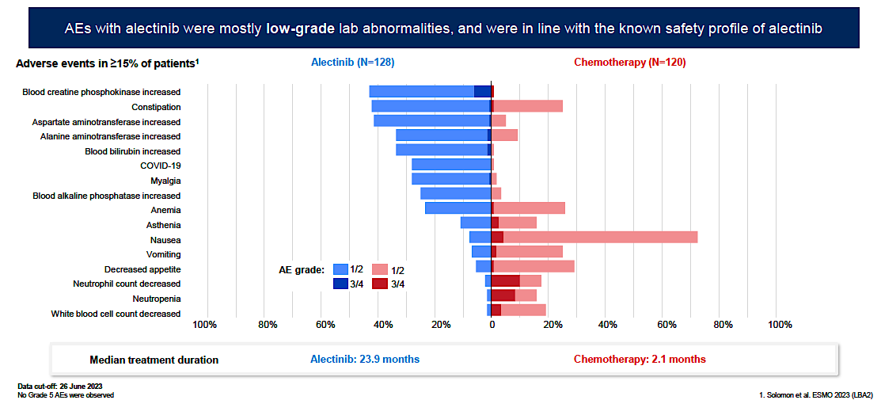
Safety Data from ALINA
 | Alectinib (n=128) | Chemotherapy (n=120)
AEs leading to dose reduction, % | 26 | 10
AEs leading to dose interruption, % | 27 | 18
AEs leading to treatment withdrawal, % | 5 | 13
Median dose intensity, % | 99.4 | 100
Courtesy of Jessica J Lin, MD
Horinuchi H et al., WCLC 2024

Slide 40
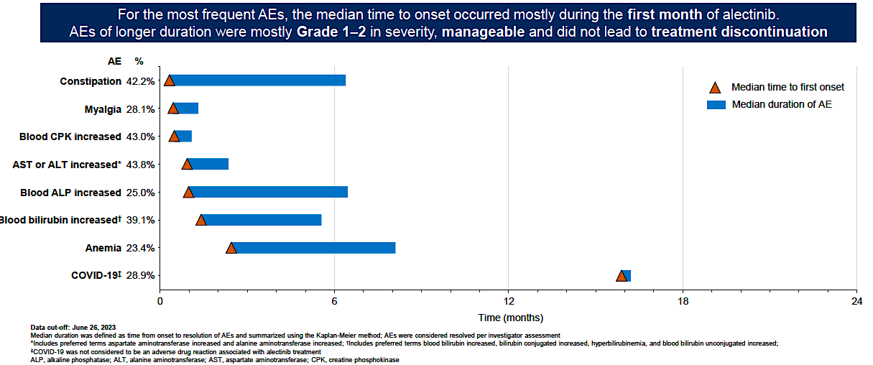
Safety Data from ALINA
Blood
Courtesy of Jessica J Lin, MD
Horinuchi H et al., WCLC 2024

Slide 41
Adjuvant ALK TKI for Resected ALK+ NSCLC: My Take
Adjuvant alectinib is SOC for resected ALK+ NSCLC (FDA- and EMA-approved; NCCN category 1 recommendation)
Biomarker testing is essential for all stages of NSCLC
Remaining questions:
What is the optimal duration of adjuvant ALK TKI?
Who should receive adjuvant chemotherapy prior to (or with) an ALK TKI: all, a subset, or none?
Is there a role for ALK-targeted therapy in the neoadjuvant/perioperative setting or after concurrent chemoradiation?
Courtesy of Jessica J Lin, MD

Slide 42
What is the current role of ensartinib?

Slide 43
Is alectinib still being used in first-line treatment, and in what situations is that reasonable?

Slide 44
Which preexisting neurologic or psychiatric conditions should preclude the use of lorlatinib? How do neurologic toxicities of lorlatinib present, and how can these be prevented or ameliorated?

Slide 45
Why do people gain weight on lorlatinib, and how can this be prevented and managed?

Slide 46
Regulatory and reimbursement issues aside, which systemic therapy would you most likely recommend for a patient with PD-L1-negative, ALK-positive metastatic NSCLC who experienced disease progression on first-line lorlatinib?

Slide 47
In the adjuvant setting, what stage disease will lead you to recommend adjuvant alectinib? What about chemotherapy?

Slide 48
What duration of adjuvant therapy is optimal? Where does dose reduction fit in?

Slide 49
For which of these alterations (other than ALK and EGFR) is targeted treatment a reasonable consideration for localized disease? For which alterations would you use targeted therapy in the adjuvant setting? What about postchemoradiation for unresectable locally advanced disease?

Slide 50
For which of these alterations (other than ALK and EGFR) is targeted treatment without radiation therapy a reasonable consideration for a patient with untreated brain metastases?

Slide 51
Year in Review: Targeted Therapies Beyond EGFR for Non-Small Cell Lung Cancer (NSCLC)
INTRODUCTION: AGAs (Actionable Genomic Alterations)
MODULE 1: ALK
MODULE 2: ROS1
MODULE 3: HER2
MODULE 4: RET
MODULE 5: NTRK
MODULE 6: MET
MODULE 7: BRAF
MODULE 8: KRAS G12C
MODULE 9: NRG1
MODULE 10: Novel Targeted Strategies

Slide 52
NCCN Recommendations For the Management of Metastatic ROS1+ NSCLC
ROS1 Fusion Identified
ROS1 fusion identified prior to 1L systemic therapy
ROS1 fusion identified during 1L systemic therapy
Preferred
Crizotinib
Entrectinib
Repotrectinib
Other recommended
Ceritinib
Complete planned systemic therapy (including maintenance therapy), or interrupt then→
Crizotinib (preferred)
Entrectinib (preferred)
Repotrectinib (preferred)
Ceritinib
Courtesy of Jessica J Lin, MD
NCCN Guidelines: NSCLC, version 3.2025. nccn.org.

Slide 53
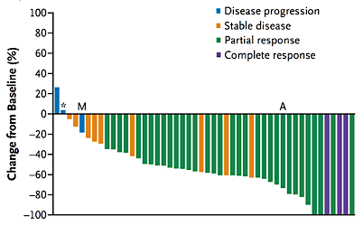
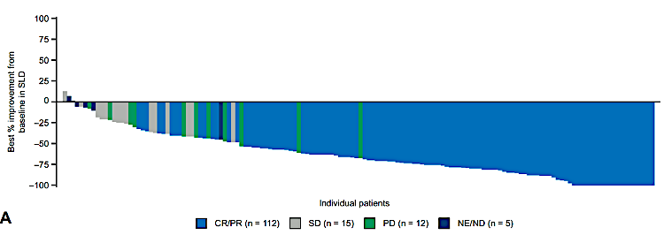

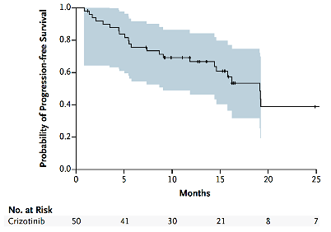
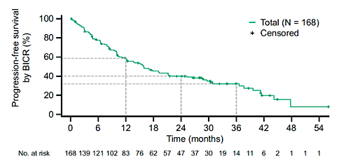
First-Generation ROS1 TKIs Crizotinib and Entrectinib
Crizotinib^{1,2}
Entrectinib³
ORR | 72% (58-83)
mDOR | 24.7 mos (15.2-45.3)
mPFS | 19.3 mos (15.2-39.1)
ORR | 68% (60-75)
mDOR | 20.5 mos (14.8-34.8)
mPFS | 15.7 mos (12.0-21.1)
1. Shaw AT et al. N Engl J Med. 2014;371(21):1963-1971. 2. Shaw AT et al. Ann Oncol. 2019;30(7):1121-1126. 3. Drilon A et al. JTO Clin Res Rep. 2022;3(6):100332
Courtesy of Jessica J Lin, MD

Slide 54
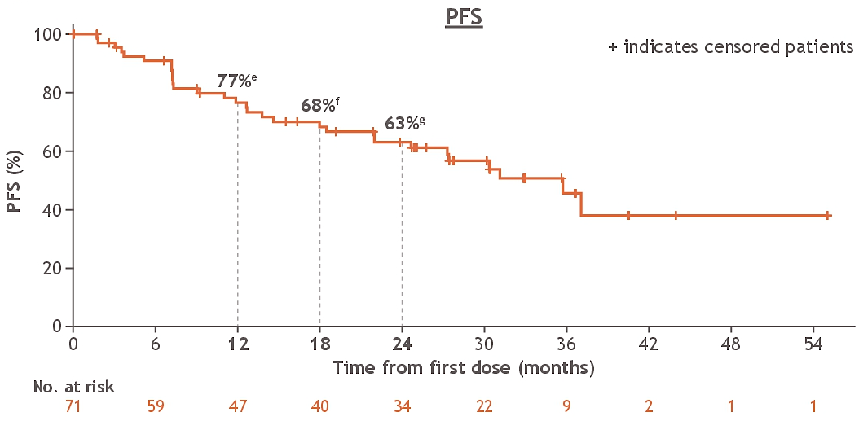
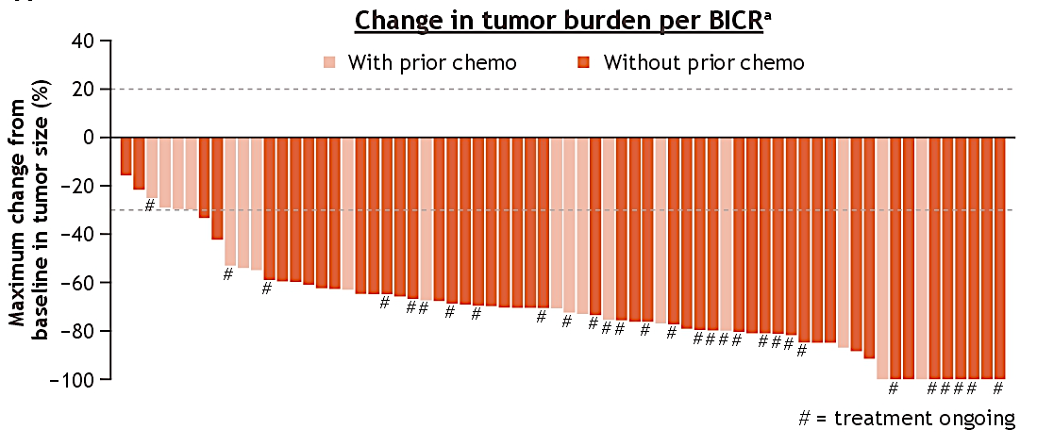
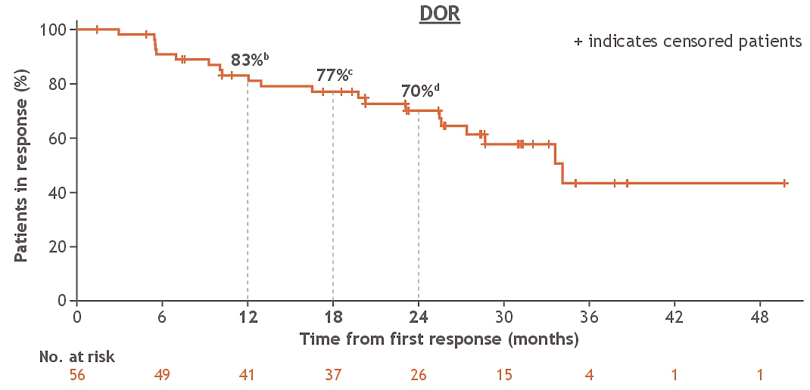
Repotrectinib in Metastatic ROS1+ NSCLC: Phase I/II TRIDENT-1 Update (median follow-up 33.9 mo)
PFS
Median: 35.7 mo (24.6-NE)
Change in tumor burden per BICR
DOR
Median: 34.1 mo (27.4-NE)
CNS Efficacy
IC-ORR 89% (95% CI, 52-100) (n=9)
For n=53 without baseline brain metastases, 91% alive and free of IC progression at 12 months; 86% alive and free of IC progression at 24 months
Courtesy of Jessica J Lin, MD
Drilon A et al., ASCO 2024

Slide 55
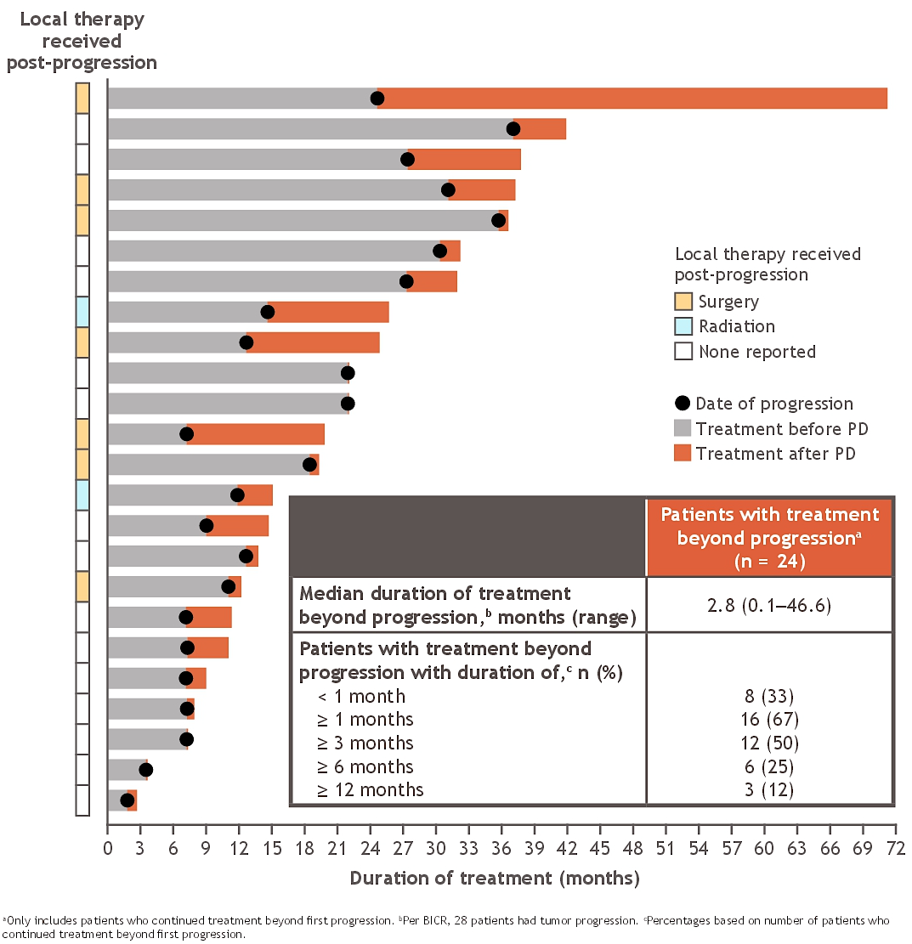
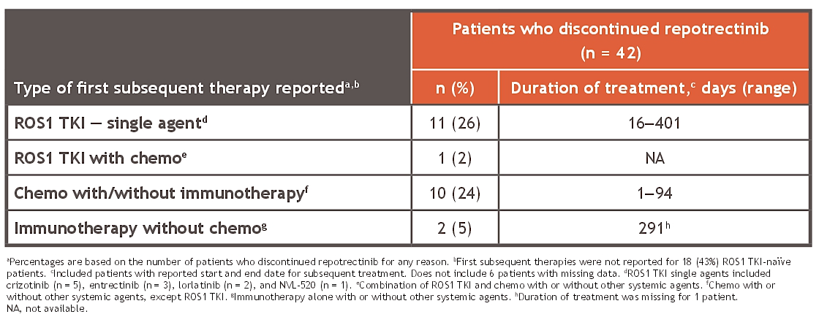
Treatment Patterns After First-Line Repotrectinib in TRIDENT-1
Of 42 patients who discontinued repotrectinib for any reason, 24 received a subsequent therapy
Courtesy of Jessica J Lin, MD
Drilon A et al., ASCO 2024

Slide 56
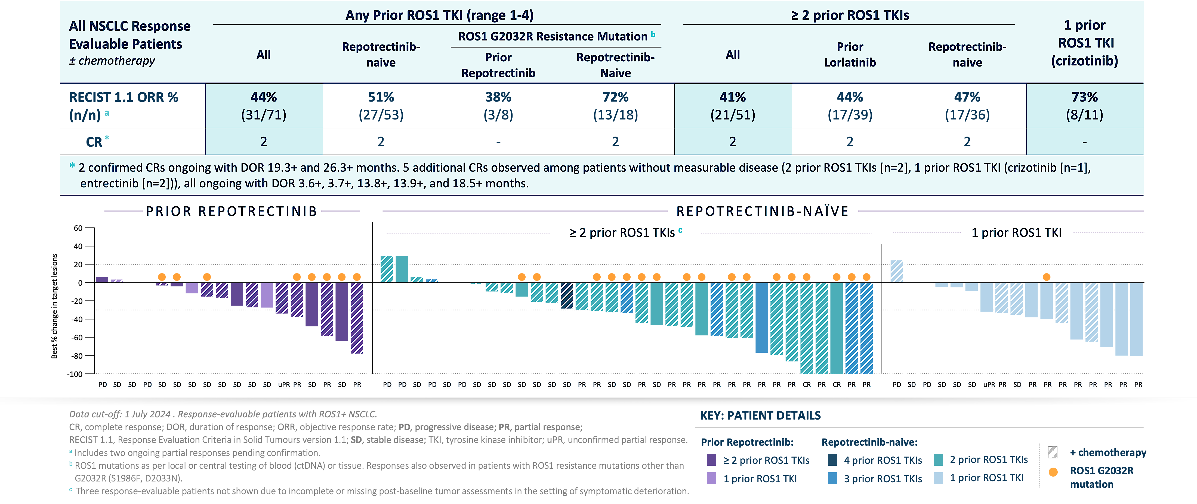
Zidesamtinib (NVL-520) in ROS1+ NSCLC: Phase I/II ARROS-1 Trial, Preliminary Efficacy
Courtesy of Jessica J Lin, MD
Besse B et al., ESMO 2024

Slide 57
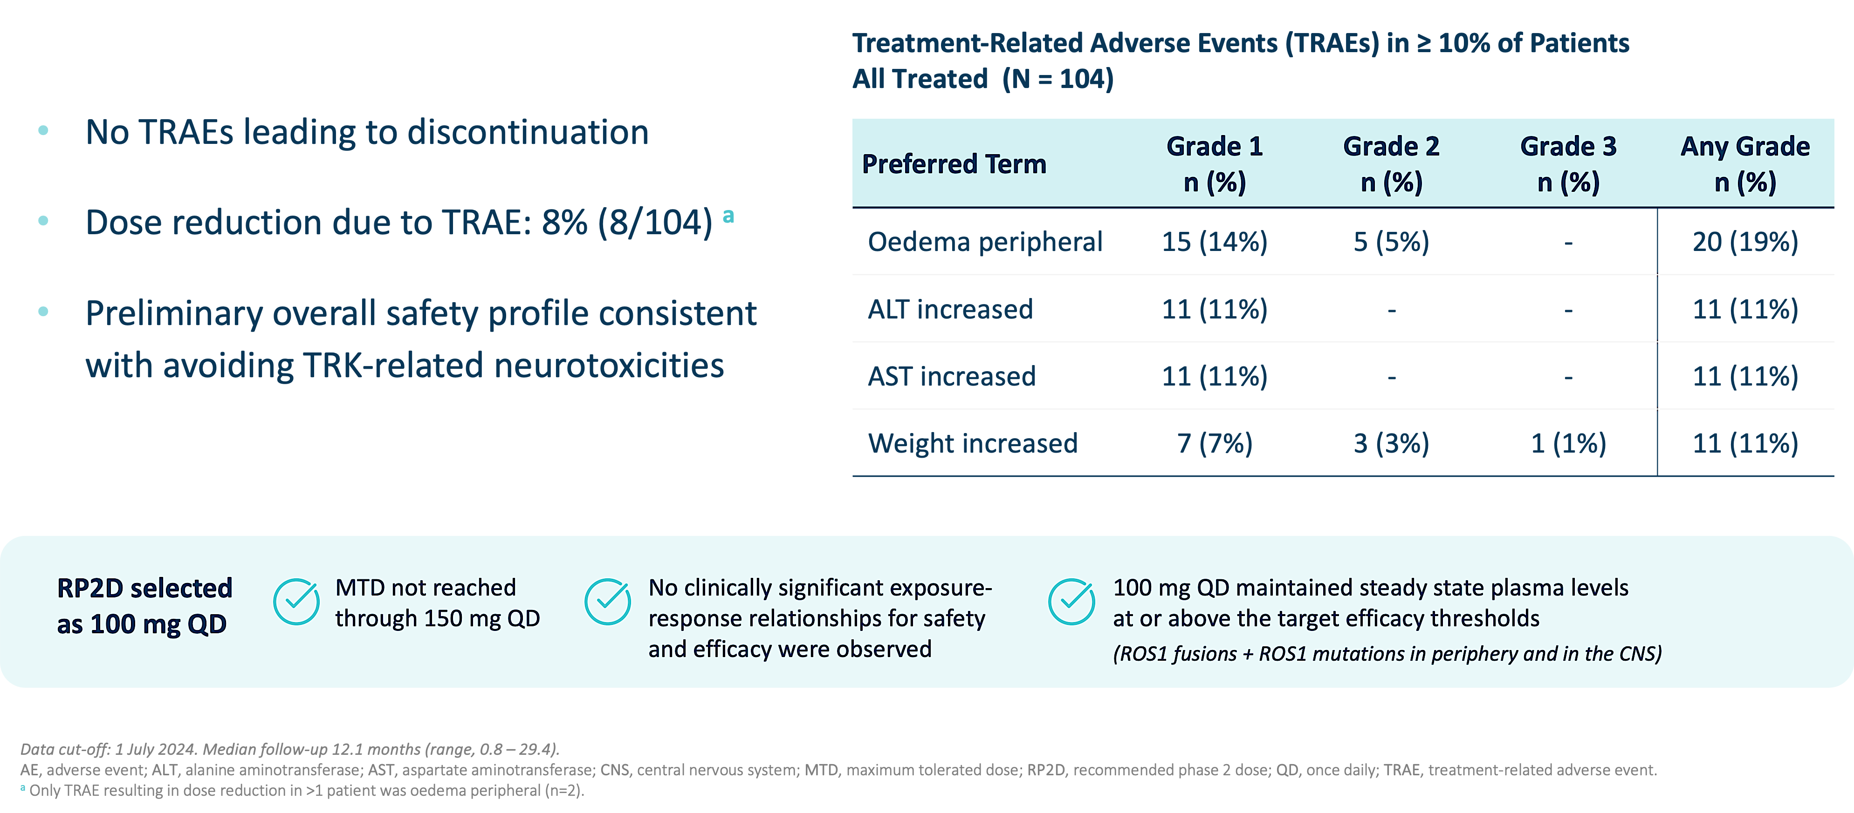
Zidesamtinib (NVL-520) in ROS1+ NSCLC: Phase I/II ARROS-1 Trial, Safety Profile
Courtesy of Jessica J Lin, MD
Besse B et al., ESMO 2024

Slide 58
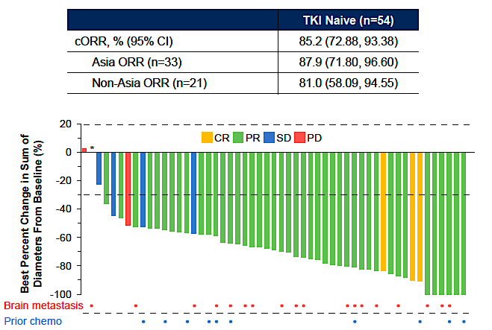
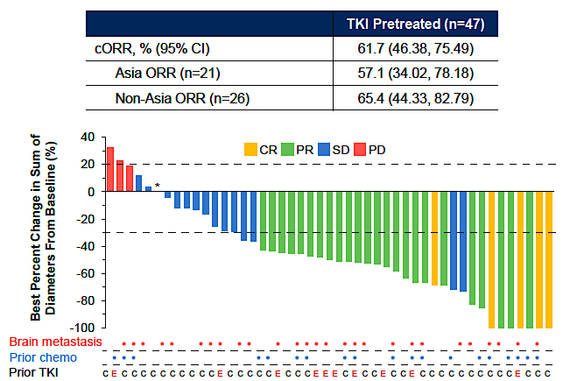
Taletrectinib in Metastatic ROS1+ NSCLC: Global Phase II TRUST-II Trial
TKI-Naive
TKI-Pretreated
Courtesy of Jessica J Lin, MD
Liu G et al., WCLC 2024

Slide 59
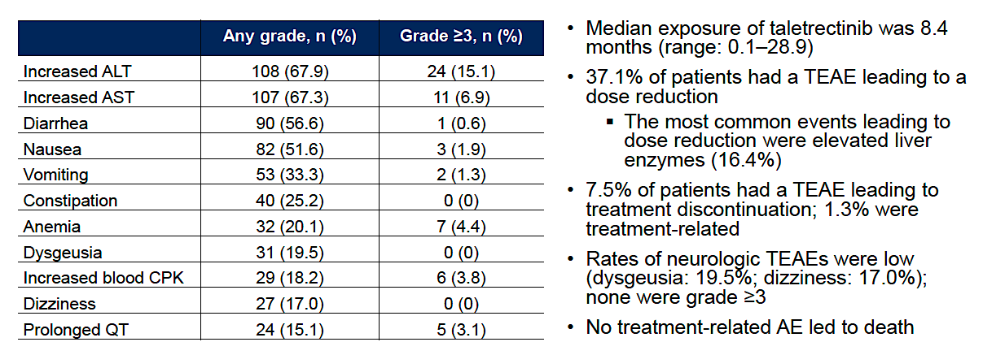
Taletrectinib in Metastatic ROS1+ NSCLC: Safety Data from TRUST-II
TEAEs in ≥15% of Patients (N=159)
Courtesy of Jessica J Lin, MD
Liu G et al., WCLC 2024

Slide 60
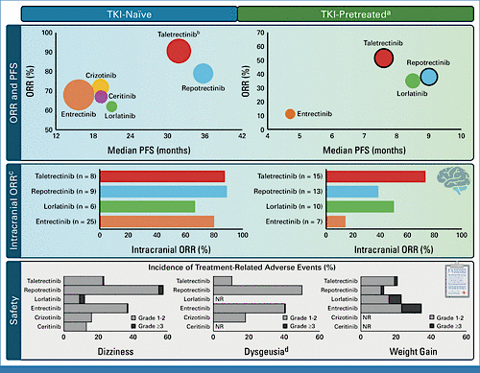
Treatment of Metastatic ROS1+ NSCLC: My Take
Currently, repotrectinib is the only FDA-approved next-generation ROS1 TKI for ROS1+ NSCLC
The landscape of first- and later-line ROS1 TKIs continues to actively evolve with next-generation agents
Considerations in selecting the first-line agent include systemic and CNS efficacy, tolerability (such as TRK inhibition-mediated side effects), and access to therapy
Waliany S et al., J Clin Oncol 2024;42(22):2622-7
Courtesy of Jessica J Lin, MD

Slide 61
How do you select first-line therapy currently, and how do you indirectly compare approved agents?

Slide 62
How do zidesamtinib and taletrectinib compare to available agents?

Slide 63
Regulatory and reimbursement issues aside, which systemic therapy would you most likely recommend for a patient with ROS1-positive metastatic NSCLC who progressed on first-line repotrectinib?

Slide 64
Year in Review: Targeted Therapies Beyond EGFR for Non-Small Cell Lung Cancer (NSCLC)
INTRODUCTION: AGAs (Actionable Genomic Alterations)
MODULE 1: ALK
MODULE 2: ROS1
MODULE 3: HER2
MODULE 4: RET
MODULE 5: NTRK
MODULE 6: MET
MODULE 7: BRAF
MODULE 8: KRAS G12C
MODULE 9: NRG1
MODULE 10: Novel Targeted Strategies

Slide 65
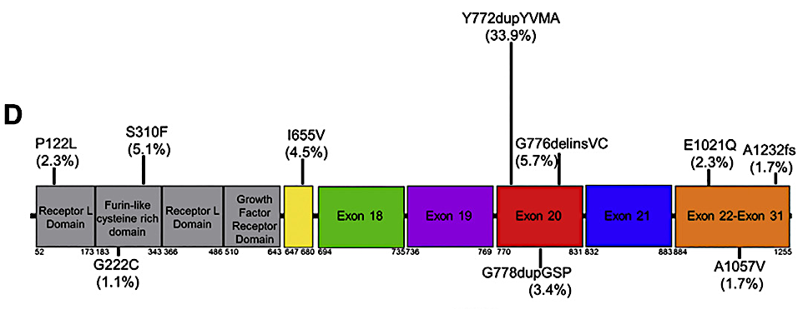
ERBB2 (HER2) mutations in NSCLC
Courtesy of Joel W Neal, MD, PhD
Robichaux, et al. Cancer Cell 2019

Slide 66
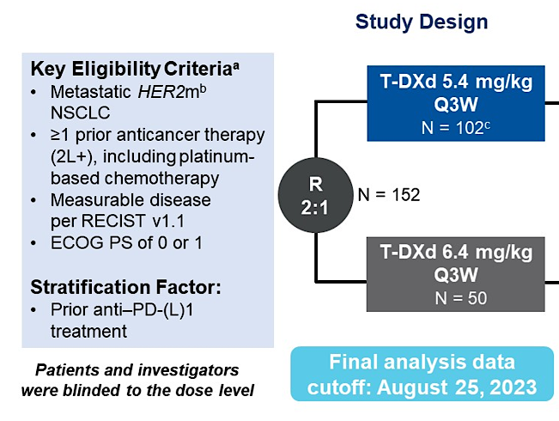
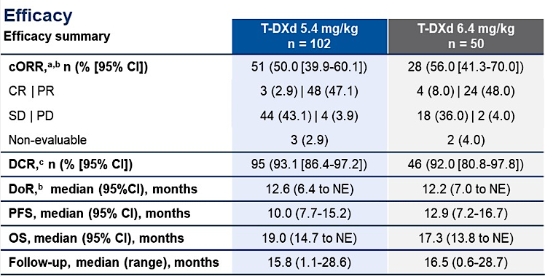
T-DXd for HER2-mutant (DESTINY-Lung02)
Courtesy of Joel W Neal, MD, PhD
Janne ASCO 2024

Slide 67
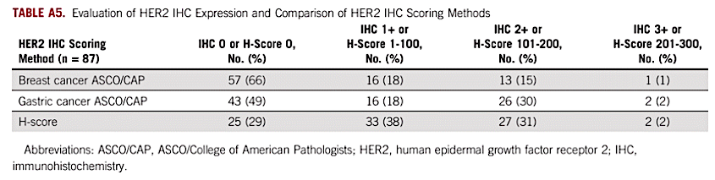
HER2 immunohistochemistry in LUAD
Ref | N | 0 | 1+ | 2+ | 3+ | (2+ or 3+)
Hirsch et al, BJC 2002 | 125 | 62% | 8% | 23% | 7% | 30%
Yoshizawa et al, Lung Cancer 2014 | 243 | 42% | 42% | 13% | 3% | 16%
Reis et al Lung Cancer 2015 *(stage 3/4) | 176 | 42% | 28% | 23% | 7% | 30%
Kim et al PLoS One 2017 (0-3+) | 321 | 77% | 31% | 7% | 1% | 8%
Kim et al PLoS One 2017 (H-Score) | 321 | 60% | 15% | 8% | 2% | 10%
Courtesy of Joel W Neal, MD, PhD
Tan et al, JCO Precision Oncol 2022

Slide 68
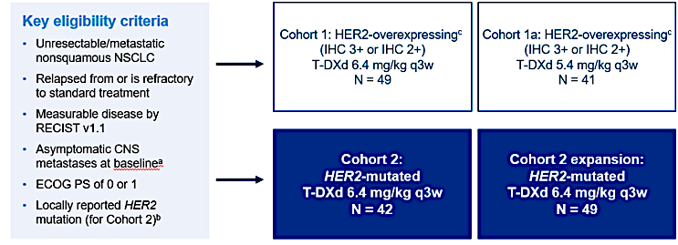

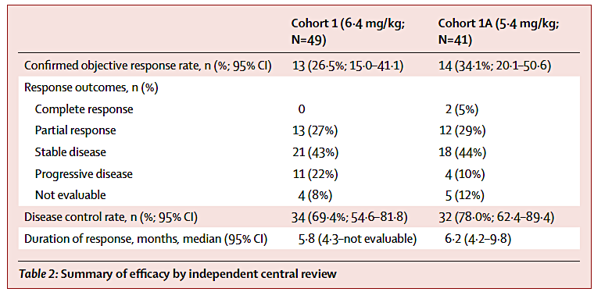
T-DXd for HER2-IHC+ (DESTINY-Lung01)
Courtesy of Joel W Neal, MD, PhD
Smit Lancet Oncol 2024

Slide 69
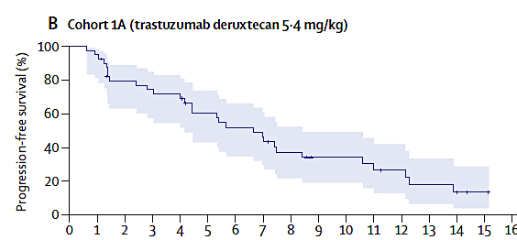
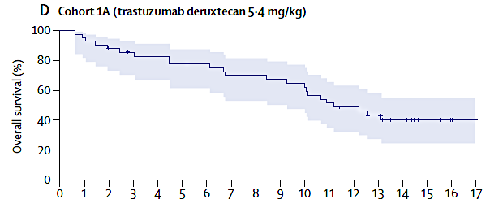


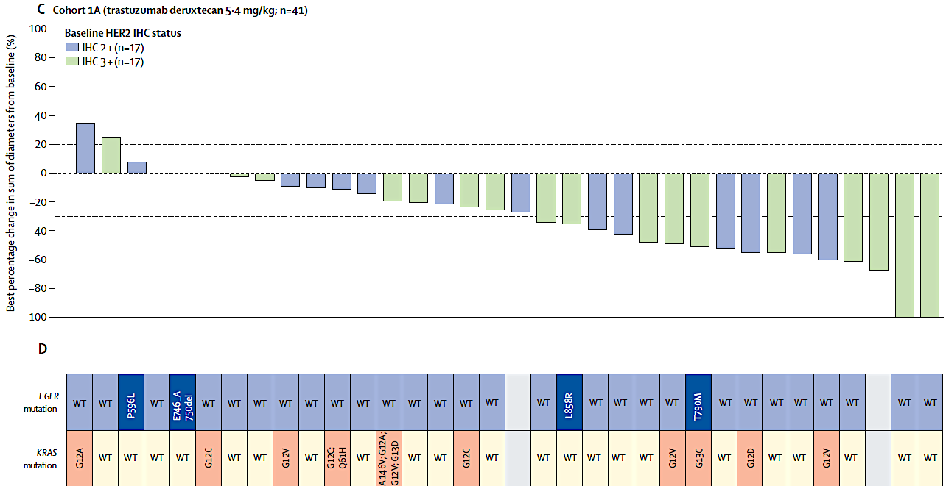
T-DXd for HER2-IHC+ (DESTINY-Lung01)
Courtesy of Joel W Neal, MD, PhD
Smit Lancet Oncol 2024

Slide 70
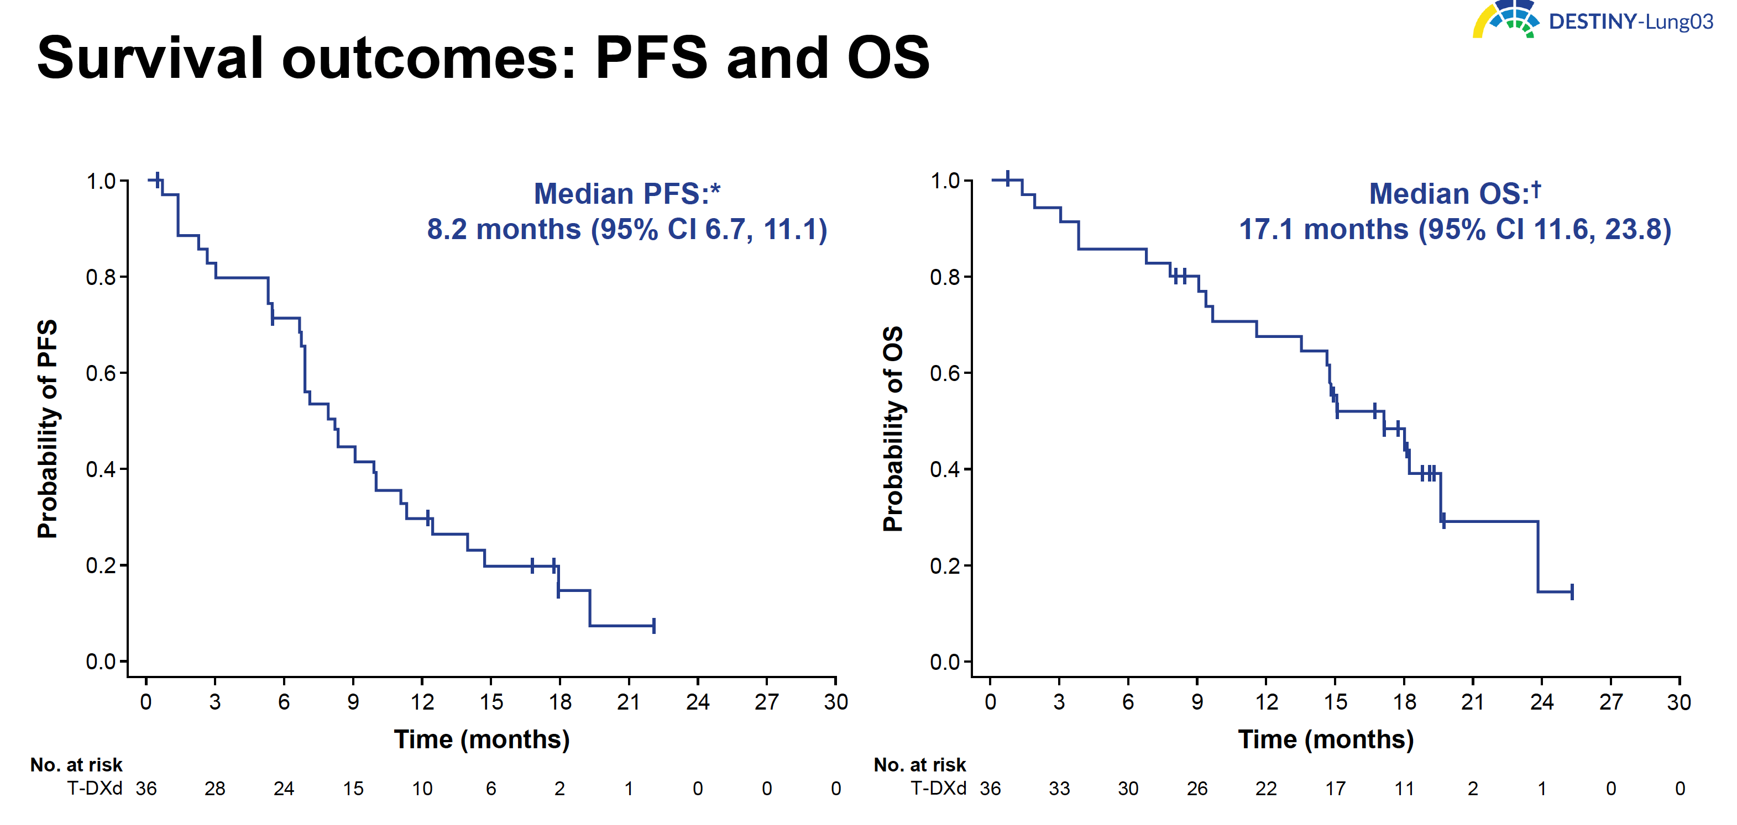
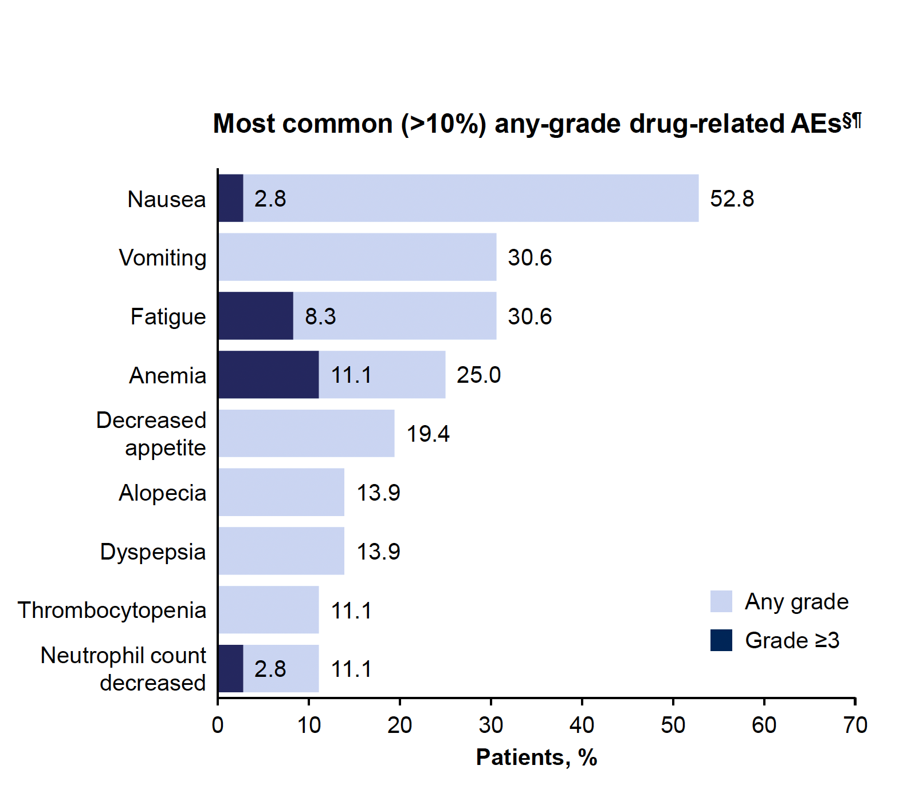
T-DXd for HER2 Overexpression (DESTINY-Lung03)
Courtesy of Joel W Neal, MD, PhD
PLANCHARD WCLC 2024

Slide 71
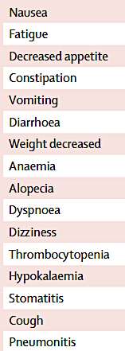
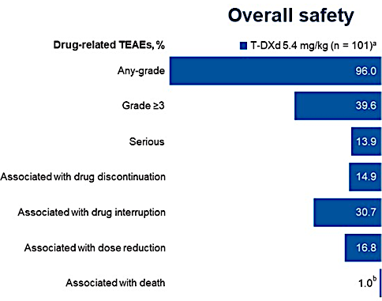
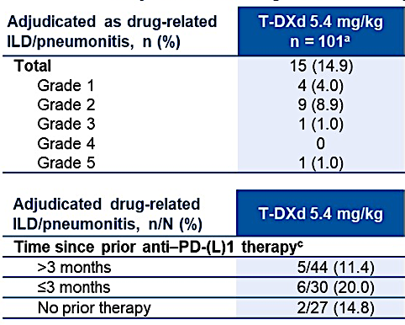
Trastuzumab deruxtecan (T-DXd) - Safety
~70%
~10%
Courtesy of Joel W Neal, MD, PhD
Janne ASCO 2024 and Smit Lancet Oncol 2024

Slide 72
Zongertinib for HER2-mutant (Beamion LUNG-1)
 | RR (%) | DCR (%) | DOR (m) | PFS (m)
Cohort 1 | 71% | 96% | 14.1m | 12.4m
Cohort 5 | 48% | 97% | - | -
Cohort 3 | 30% | 65% | - | -
Courtesy of Joel W Neal, MD, PhD
Heymach NEJM 2025

Slide 73
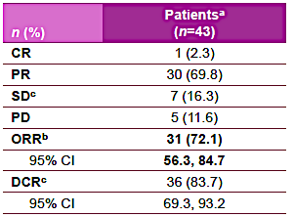
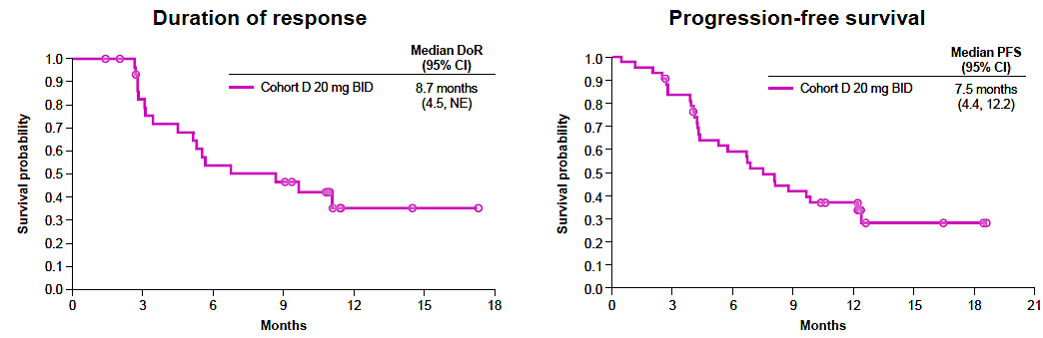
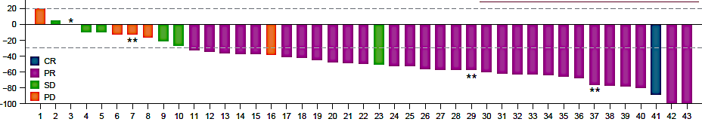
BAY2927088 for HER2-mutant (SOHO-01Cohort D, HER2-mutant, TKI/ADC naïve)
Courtesy of Joel W Neal, MD, PhD
Le WCLC 2024

Slide 74


Safety and tolerability of new HER2-TKIs
BAY2927088
Zongertinib
~90%
~50%
~10%
~10%
16% Grade 3
7% dose reduction
3% discontinuation
43% Grade 3
32% dose reduction
7% discontinuation
Courtesy of Joel W Neal, MD, PhD
Heymach NEJM 2025 and Le WCLC 2024

Slide 75
ERBB2/HER2 Conclusions:
Clinical Implications:
The ADC T-DXd is FDA-approved for ERBB2/HER2 mutant NSCLC after prior therapy
T-DXd works pan-tumor for HER2 IHC 2+/3+ (even in EGFR mutant NSCLC)
The HER2-TKIs are emerging - zongertinib appears most effective and tolerable --- so far
Future Directions:
Many other emerging HER2 TKIs are in development as well as bispecific antibodies and ADCs
Courtesy of Joel W Neal, MD, PhD

Slide 76

NVL-330: A Novel Selective HER2 Tyrosine Kinase Inhibitor (TKI)
Nützinger J et al. Lung Cancer 2023;186:107385.

Slide 77
NVL-330, a Selective HER2 Tyrosine Kinase Inhibitor, in Patients with Advanced or Metastatic HER2-Altered Non-Small Cell Lung Cancer: The Phase 1 HEROEX-1 Study
Le X et al.
ASCO 2025;Abstract TPS8655.
May 31, 2025
Hall A | 1:30 PM – 4:30 PM CT

Slide 78
HEROEX-1: An Ongoing Phase I Study of NVL-330 for Patients with Advanced or Metastatic HER2-Altered NSCLC
Trial Identifier: NCT06521554
Estimated Enrollment: 120
Eligibility
Histologically or cytologically confirmed locally advanced or metastatic NSCLC Phase 1a: Documented oncogenic HER2 mutation such as HER2 exon 20 insertion mutations or single nucleotide variants or HER2 amplification Phase 1b: Documented oncogenic HER2 mutation
Phase 1a Dose Escalation
NVL-330 oral daily dosing
Phase 1b Dose Expansion
NVL-330 oral daily dosing
Primary outcome measures: Recommended Phase II dose, maximum tolerated dose, treatment-emergent adverse events
Le X et al. ASCO 2025;Abstract TPS8655; www.clinicaltrials.gov. Accessed May 2025.

Slide 79
How do you use trastuzumab deruxtecan (T-DXd) for HER2-mutant disease? HER2-overexpressed disease? What about HER2-low? (IHC1+ or 2+)? HER2-amplified disease?

Slide 80
How do you prevent and manage acute GI toxicities with T-DXd?

Slide 81
How do you screen for interstitial lung disease in patients treated with T-DXd? How do you manage Grade 1 toxicity? Grade 2? Will you rechallenge?

Slide 82
How do you factor in the presence of coexisting cardiopulmonary morbidities (COPD, CAD) in decisions about T-DXd, and how problematic are nonspecific pulmonary densities on imaging?

Slide 83
In the wake of the DESTINY-Breast09 breast cancer trial, what other ongoing trials and strategies that include T-DXd are being investigated?

Slide 84
What are the risks and benefits of HER2-directed tyrosine kinase inhibitors for HER2-mutant disease, and how do available agents compare to newer ones (eg, zongertinib, BAY 2927088, NVL-330)?

Slide 85
Year in Review: Targeted Therapies Beyond EGFR for Non-Small Cell Lung Cancer (NSCLC)
INTRODUCTION: AGAs (Actionable Genomic Alterations)
MODULE 1: ALK
MODULE 2: ROS1
MODULE 3: HER2
MODULE 4: RET
MODULE 5: NTRK
MODULE 6: MET
MODULE 7: BRAF
MODULE 8: KRAS G12C
MODULE 9: NRG1
MODULE 10: Novel Targeted Strategies

Slide 86
Selpercatinib and Pralsetinib in RET+ NSCLC
 | Platinum-Pretreated |  | Treatment-Naïve
 | Selpercatinib (LIBRETTO-001) | Pralsetinib (ARROW) | Selpercatinib (LIBRETTO-001) | Pralsetinib (ARROW)
Patients | N=247 | N=136 | N=69 | N=75
ORR (95% CI) | 61% (55-67) | 59% (50-67) | 84% (73-92) | 72% (60-82)
Median PFS (95% CI) | 24.9 months (19.3-NE) | 16.5 months (10.5-24.1) | 22.0 months (13.8 months-NE) | 13.0 months (9.1-NR)
Median duration follow-up | 24.7 months | 18.4 months (13.2-19.8) | 21.9 months | 9.2 months (8.6-11.0)
Median DOR (95% CI) | 28.6 months (20.4-NE) | 22.3 months (15.1-NR) | 20.2 months (13.0-NE) | NR (9.0 months-NR)
Median duration follow-up | 21.2 months | 16.7 months (12.9-18.5) | 20.3 months | 7.4 months (6.4-9.5)
Intracranial ORR (95% CI) | 85% (65-96) (n=26 – pretreated + treatment-naïve) | 70% (35-93) (n=10; 1/10 received prior non-platinum therapy)
Reference | Drilon A et al., J Clin Oncol. 2022 | Griesinger F et al., Ann Oncol. 2022 | Drilon A et al., J Clin Oncol. 2023 | Griesinger F et al., Ann Oncol. 2022
Courtesy of Jessica J Lin, MD

Slide 87

Selpercatinib in RET+ NSCLC: CNS Efficacy, Data from the Phase III LIBRETTO-431 Trial
Courtesy of Jessica J Lin, MD
Pérol M et al., J Clin Oncol 2024;42(21):2500-5

Slide 88


Selpercatinib in RET+ NSCLC: CNS Protective Effect, Data from the Phase III LIBRETTO-431 Trial
Cumulative incidence rate (CIR) of CNS-PD
CNS-pembrolizumab-nonmets population (n=150)
Intracranial PFS
CNS-pembrolizumab-nonmets population
Pérol M et al., J Clin Oncol 2024;42(21):2500-5
Courtesy of Jessica J Lin, MD

Slide 89
Treatment of Metastatic RET+ NSCLC: My Take
Selpercatinib and pralsetinib are FDA-approved, NCCN guideline-recommended first-line therapies for metastatic RET+ NSCLC
Both RET inhibitors have demonstrated CNS efficacy
CNS outcome analyses from the LIBRETTO-431 phase III trial further support that a CNS-active TKI like selpercatinib can delay CNS progression and may prevent new brain metastases
Courtesy of Jessica J Lin, MD

Slide 90
How do you select first-line therapy currently, and how do you indirectly compare approved agents?

Slide 91
Year in Review: Targeted Therapies Beyond EGFR for Non-Small Cell Lung Cancer (NSCLC)
INTRODUCTION: AGAs (Actionable Genomic Alterations)
MODULE 1: ALK
MODULE 2: ROS1
MODULE 3: HER2
MODULE 4: RET
MODULE 5: NTRK
MODULE 6: MET
MODULE 7: BRAF
MODULE 8: KRAS G12C
MODULE 9: NRG1
MODULE 10: Novel Targeted Strategies

Slide 92


Entrectinib in TRK+ NSCLC: Update
PFS
Median 28.0 mo (15.7-30.4)
Patients
remaining
at risk
OS
Median 41.5 mo (30.9-NE)
N=14 with measurable or nonmeasurable baseline CNS metastases by BICR
IC-ORR 64.3% (35.1-87.2)
IC-DOR 55.7 mo (8.0-NE), IC-PFS 32.7 mo (5.9-NE)
Median survival follow-up time 26.3 mo (21.0-34.1)
Courtesy of Jessica J Lin, MD
Cho BC et al., Lung Cancer 2024 Feb:188:107442

Slide 93
Larotrectinib in TRK+ NSCLC: Update
 | Patients with known CNS metastases at BL | Total
IRC-eligible patients, n | 12 | 32
ORR, % (95% CI) | 67 (35–90) | 66 (47–81)
Best response, n (%) Complete response Partial response Stable disease Progressive disease Not evaluable | 0 8 (67) 2 (17) 2 (17) 0 | 4 (13) 17 (53) 7 (22) 2 (6) 2 (6)
100
90
DoR
Median DoR, months (95% CI) | 34 (10–NE)
Median follow-up, months | 26
48-month DoR, % (95% CI) | 47 (19–76)
80
70
100
60
90
50
80
40
70
30
60
20
DoR (%)
47%
10
50
Maximum change in target lesion size (%)†
40
0
30
−10
20
−20
10
−30
0
−40
0
12
24
36
48
60
−50
Months since start of response
−60
No. at risk
−70
21
13
7
3
1
0
−80
−90
−100
PFS
Median PFS, months (95% CI) | 22 (10–NE)
Median follow-up, months | 28
48-month PFS, % (95% CI) | 34 (11–56)
OS
Median OS, months (95% CI) | 39 (17–NE)
Median follow-up, months | 33
48-month OS, % (95% CI) | 38 (13–64)
100
100
90
90
80
80
70
70
60
60
38%
OS (%)
PFS (%)
50
50
34%
40
Censored
40
30
Median
30
20
20
10
48-month rate
10
0
0
0
12
24
36
48
60
72
84
96
0
12
24
36
48
60
Months since start of treatment
Months since start of treatment
No. at risk
Lin JJ et al., WCLC 2024
No. at risk
32
15
8
3
2
0
32
22
14
8
4
2
1
1
0
Courtesy of Jessica J Lin, MD

Slide 94
Larotrectinib in TRK+ NSCLC: Safety Update
All AEs
TRAEs (AEs related to larotrectinib)
100.0
59.4
28.1
93.8
TRAEs were predominantly Grade 1/2
Grade 3/4 TRAEs were reported in 9 patients
One patient discontinued treatment due to TRAEs (increased ALT, AST, and gamma-glutamyl transferase)
There were no treatment-related deaths
46.9
9.4
46.9
18.8
3.1
3.1
43.8
3.1
3.1
28.1
40.6
6.3
6.3
40.6
40.6
9.4
9.4
34.4
40.6
3.1
3.1
25.0
34.4
3.1
15.6
31.3
3.1
28.1
3.1
3.1
28.1
9.4
9.4
25.0
25.0
3.1
9.4
25.0
9.4
21.9
3.1
21.9
9.4
21.9
12.5
21.9
3.1
9.4
21.9
3.1
Grade
Grade ≥3
Any grade
21.9
21.9
9.4
18.8
18.8
6.3
3.1
18.8
15.6
Patients (%)
AE, adverse event; ALT, alanine aminotransferase; AST, aspartate aminotransferase; SAE, serious adverse event; TRAE, treatment-related adverse event.
Courtesy of Jessica J Lin, MD
Lin JJ et al., WCLC 2024

Slide 95

Repotrectinib in TRK+ Solid Tumors: Phase I/II TRIDENT-1 Trial, NTRK1-3 Cohorts
TKI-pretreated patient population (n=48)
cORR 50% (95% CI, 35-65)
Median PFS 7.4 months (3.9-9.7), Median DOR 9.8 months (7.4-12.9)
cORR 60% in patients with solvent front TRK mutation (n=25; 95% CI 39-79)
Cholangiocarcinoma
6/2024: Received FDA accelerated approval for adult and pediatric patients 12 years or older with advanced NTRK fusion+ solid tumors
Solomon B et al. ESMO 2023
Courtesy of Jessica J Lin, MD

Slide 96
Treatment of Metastatic TRK+ NSCLC: My Take
Larotrectinib, entrectinib, and repotrectinib are all FDA-approved, NCCN guideline-recommended first-line therapies for metastatic TRK+ NSCLC
With longer follow-up, both entrectinib and larotrectinib continue to demonstrate significant clinical activity and favorable tolerability in patients
Repotrectinib is a next-generation TKI that has shown activity in TKI-naïve and -pretreated patients with TRK+ solid tumors
Knowledge of TKI-associated toxicities and optimal management strategies are critical for clinicians
Courtesy of Jessica J Lin, MD

Slide 97
How do you select first-line therapy currently, and how do you indirectly compare approved agents?

Slide 98
Year in Review: Targeted Therapies Beyond EGFR for Non-Small Cell Lung Cancer (NSCLC)
INTRODUCTION: AGAs (Actionable Genomic Alterations)
MODULE 1: ALK
MODULE 2: ROS1
MODULE 3: HER2
MODULE 4: RET
MODULE 5: NTRK
MODULE 6: MET
MODULE 7: BRAF
MODULE 8: KRAS G12C
MODULE 9: NRG1
MODULE 10: Novel Targeted Strategies

Slide 99
FDA Grants Accelerated Approval to Telisotuzumab Vedotin-tllv for NSCLC with High c-Met Protein Overexpression Press Release: May 14, 2025
“On May 14, 2025, the Food and Drug Administration granted accelerated approval to telisotuzumab vedotin-tllv, a c-Met-directed antibody and microtubule inhibitor conjugate, for adults with locally advanced or metastatic, non-squamous non-small cell lung cancer (NSCLC) with high c-Met protein overexpression [≥50% of tumor cells with strong (3+) staining], as determined by an FDA-approved test, who have received a prior systemic therapy. The FDA also approved a companion diagnostic test to aid in detecting c-Met protein overexpression in patients with non-squamous NSCLC who may be eligible for treatment with telisotuzumab vedotin.
Efficacy was evaluated in the LUMINOSITY study (NCT03539536), a multicenter, open label, multi-cohort trial. The trial included 84 patients with epidermal growth factor receptor (EGFR) wild-type, non-squamous NSCLC with high c-Met protein overexpression who had received prior systemic therapy. The major efficacy outcome measures were confirmed overall response rate (ORR) and duration of response (DOR), determined by blinded independent central review (BICR) according to RECIST 1.1. ORR was 35% (95% CI: 24, 46) and median DOR was 7.2 months (95% CI: 4.2, 12).”
https://www.fda.gov/drugs/resources-information-approved-drugs/fda-grants-accelerated-approval-telisotuzumab-vedotin-tllv-nsclc-high-c-met-protein-overexpression

Slide 100
MET NSCLC Conclusions:
Clinical Implications:
Capmatinib and tepotinib are approved preferred first line therapies for MET ex14 NSCLC
Teliso-V is newly approved for MET overexpressed NSCLC
MET gene amplified NSCLC is potentially actionable with TKIs
Future Directions:
Many other MET ADC’s and TKIs are in development
Courtesy of Joel W Neal, MD, PhD

Slide 101
Year in Review: Targeted Therapies Beyond EGFR for Non-Small Cell Lung Cancer (NSCLC)
INTRODUCTION: AGAs (Actionable Genomic Alterations)
MODULE 1: ALK
MODULE 2: ROS1
MODULE 3: HER2
MODULE 4: RET
MODULE 5: NTRK
MODULE 6: MET
MODULE 7: BRAF
MODULE 8: KRAS G12C
MODULE 9: NRG1
MODULE 10: Novel Targeted Strategies

Slide 102



BRAF V600E mutations in NSCLC
Courtesy of Joel W Neal, MD, PhD
Dagogo-Jack et al. CCR. 2018; Hanrahan et al. Nature Reviews Clinical Oncology. 2024

Slide 103


Encorafenib and binimetinib for BRAF V600E (PHAROS)
Courtesy of Joel W Neal, MD, PhD
Riley ESMO 2024

Slide 104



Encorafenib and binimetinib for BRAF V600E (PHAROS)
~52%
~10%
Courtesy of Joel W Neal, MD, PhD
Riley ESMO 2024

Slide 105
BRAF Conclusions:
Clinical Implications:
Encorafenib and binimetinib is reasonable FDA approved option in BRAF V600E NSCLC (alternative to dabrafenib/trametinib)
Future Directions:
Type II and Type III BRAF mutations are currently not actionable with approved therapies, but options are in development
Courtesy of Joel W Neal, MD, PhD

Slide 106
How do you find the tolerability/toxicity of encorafenib/binimetinib compared to dabrafenib/trametinib?

Slide 107
Year in Review: Targeted Therapies Beyond EGFR for Non-Small Cell Lung Cancer (NSCLC)
INTRODUCTION: AGAs (Actionable Genomic Alterations)
MODULE 1: ALK
MODULE 2: ROS1
MODULE 3: HER2
MODULE 4: RET
MODULE 5: NTRK
MODULE 6: MET
MODULE 7: BRAF
MODULE 8: KRAS G12C
MODULE 9: NRG1
MODULE 10: Novel Targeted Strategies

Slide 108

KRAS G12C mutations in NSCLC
Courtesy of Joel W Neal, MD, PhD
Chen, Y., Liu, Qp., Xie, H. et al. Acta Pharmacol Sin (2023).

Slide 109
KRAS Conclusions:
Clinical Implications:
Adagrasib and sotorasib are FDA approved for KRAS G12C; adagrasib may be modestly more active
Divarasib and Olomorasib maybe more compatible with immunotherapy for 1L combinations
Zoldonrasib is a novel KRAS G12D inhibitor with promising efficacy
Future Directions:
Other Ras-ON inhibitors (for Pan-RAS, G12C, and G12D) are in development
Courtesy of Joel W Neal, MD, PhD

Slide 110
Year in Review: Targeted Therapies Beyond EGFR for Non-Small Cell Lung Cancer (NSCLC)
INTRODUCTION: AGAs (Actionable Genomic Alterations)
MODULE 1: ALK
MODULE 2: ROS1
MODULE 3: HER2
MODULE 4: RET
MODULE 5: NTRK
MODULE 6: MET
MODULE 7: BRAF
MODULE 8: KRAS G12C
MODULE 9: NRG1
MODULE 10: Novel Targeted Strategies

Slide 111



Zenocutuzumab in NRG1+ Cancer: eNRGy Phase II Trial
HER2/HER3 bispecific antibody
Dosing: 750 mg (i.v. infusion every 2 weeks)
Schram AM et al., N Engl J Med 2025;392(6):566-76; Schram AM et al., ASCO 2022
Courtesy of Jessica J Lin, MD

Slide 112

Zenocutuzumab in NRG1+ Cancer: Safety
Most common grade 3/4 treatment-related AEs: diarrhea and anemia
One patient with treatment discontinuation due to drug-related AE (grade 2 pneumonitis)
AEs resulting in treatment delay: 31% (6% with treatment-related delay)
AEs resulting in dosing interruption: 10%
Infusion-related reactions: 14%, all grades 1-2
Schram AM et al., N Engl J Med 2025;392(6):566-76
Courtesy of Jessica J Lin, MD

Slide 113
Treatment of Metastatic NRG1+ NSCLC: My Take
Zenocutuzumab represents a new SOC, FDA-approved treatment option for patients with advanced NRG1 fusion+ NSCLC
The ORR (31%) is more modest relative to other targeted therapies in NSCLC, and therefore, I would reserve zenocutuzumab as later-line therapy
Courtesy of Jessica J Lin, MD

Slide 114
When do you use zenocutuzumab, and what are the tolerability/toxicity issues?

Slide 115
How, if at all, has the availability of zenocutuzumab impacted your approach to biomarker testing in patients with NSCLCL?

Slide 116
How, if at all, does the association between NRG1 fusions and mucinous adenocarcinoma of the lung influence your approach to biomarker testing and treatment selection in NSCLC?

Slide 117
Year in Review: Targeted Therapies Beyond EGFR for Non-Small Cell Lung Cancer (NSCLC)
INTRODUCTION: AGAs (Actionable Genomic Alterations)
MODULE 1: ALK
MODULE 2: ROS1
MODULE 3: HER2
MODULE 4: RET
MODULE 5: NTRK
MODULE 6: MET
MODULE 7: BRAF
MODULE 8: KRAS G12C
MODULE 9: NRG1
MODULE 10: Novel Targeted Strategies

Slide 118

J Clin Oncol 2025;43:1254-65.

Slide 119

TROPION-Lung05: Antitumor Activity of Datopotamab Deruxtecan in Metastatic NSCLC with Actionable Genomic Alterations
CR = complete response; PR = partial response; SD = stable disease; PD = disease progression; NE = not estimable
Sands J et al. J Clin Oncol 2025;43:1254-65.

Slide 120
Fang W et al. Ivonescimab plus Chemotherapy in Non-Small Cell Lung Cancer with EGFR Variant. JAMA 2024 May 31;332(7):561-70. Fang W et al. HARMONi: Randomized, Double-Blind, Multi-Center, Phase III Clinical Study of Ivonescimab or Placebo Combined with Pemetrexed and Carboplatin in Patients with EGFR-Mutant Locally Advanced or Metastatic Non-Squamous NSCLC Who Have Progression Following EGFR-TKI Treatment. ESMO 2023;Abstract 1504TiP.

