Slide 1


Year in Review – Targeted Lung Cancer Edition
Therapeutic Approaches Targeting
ALK, ROS1, RET, TRK, NRG1
Jessica J. Lin, MD
Massachusetts General Hospital | Harvard Medical School
Boston, MA, USA

Slide 2
ALK+ NSCLC

Slide 3
Evolution of First- and Next-Generation ALK Inhibitors for ALK+ NSCLC
First-Generation (1G)
Second-Generation (2G)
Third-Generation (3G)
Crizotinib
Ceritinib
Alectinib
Brigatinib
Ensartinib
Lorlatinib
Increased potency, selectivity
Increased CNS penetration & activity
Coverage of on-target resistance mutation(s)
Note: Only the FDA-approved ALK inhibitors are shown, with others in development
Lin JJ, ASCO 2024

Slide 4
FDA approves ensartinib for ALK-positive locally advanced or metastatic non-small cell lung cancer
Press Release: December 18, 2024
The Food and Drug Administration approved ensartinib for adult patients with anaplastic lymphoma kinase (ALK)-positive locally advanced or metastatic non-small cell lung cancer (NSCLC) who have not previously received an ALK inhibitor.
Efficacy was evaluated in eXalt3 (NCT02767804), an open-label, randomized, active-controlled, multicenter trial in 290 patients with locally advanced or metastatic ALK-positive NSCLC who had not previously received an ALK-targeted therapy. Patients were randomized 1:1 to receive ensartinib or crizotinib.
The main efficacy outcome measure was progression-free survival (PFS) as evaluated by blinded independent central review. The key secondary efficacy outcome measure was overall survival (OS). Ensartinib demonstrated a statistically significant PFS improvement compared to crizotinib with a hazard ratio (HR) of 0.56 (95% CI: 0.40, 0.79; p-value 0.0007). The median PFS was 25.8 months (95% CI: 21.8, not estimable) in the ensartinib arm and 12.7 months (95% CI: 9.2, 16.6) in the crizotinib arm. There was no statistically significant difference in OS (HR 0.88 [95% CI: 0.63, 1.23], p-value 0.4570).
The most common adverse reactions (≥20%) were rash, musculoskeletal pain, constipation, cough, pruritis, nausea, edema, pyrexia, and fatigue.
https://www.fda.gov/drugs/resources-information-approved-drugs/fda-approves-ensartinib-alk-positive-locally-advanced-or-metastatic-non-small-cell-lung-cancer

Slide 5
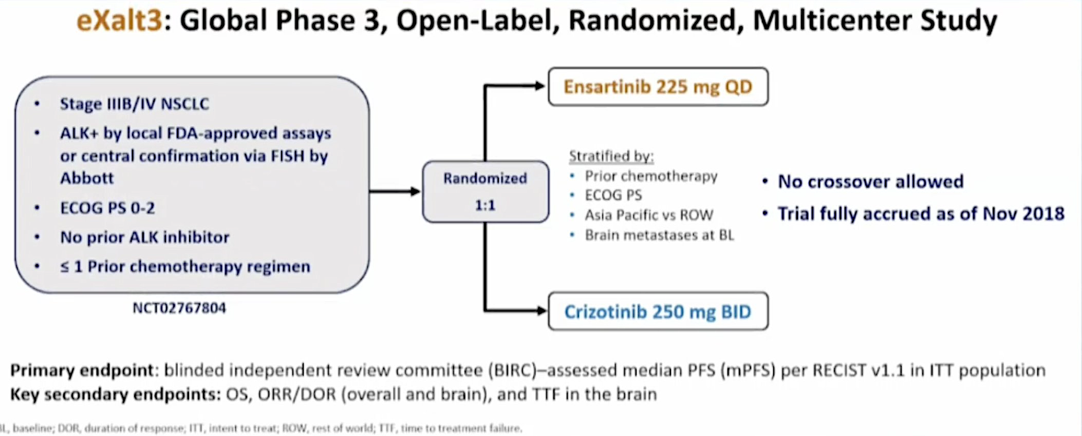
eXalt3 Study Design
Horn L., WCLC 2020

Slide 6
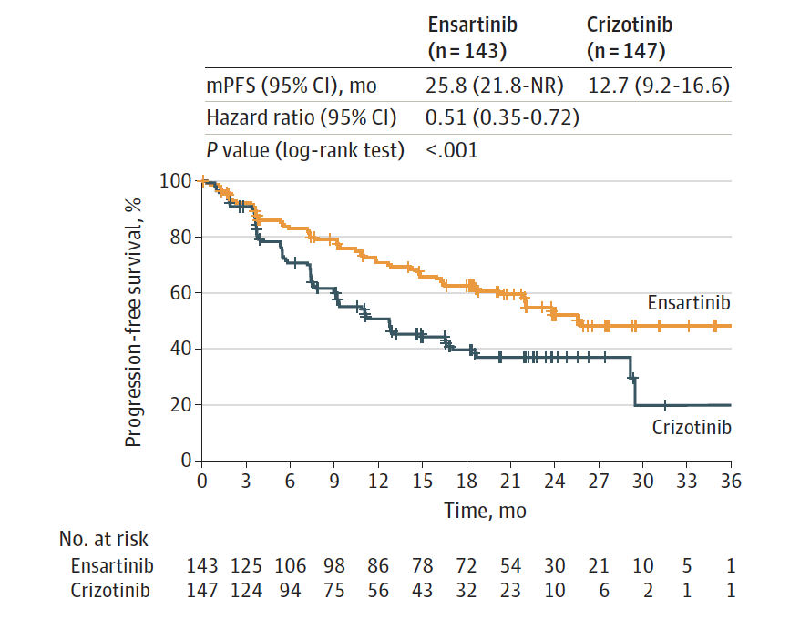
Ensartinib in Metastatic ALK+ NSCLC:
PFS Results, Phase III eXalt3 Trial

Slide 7
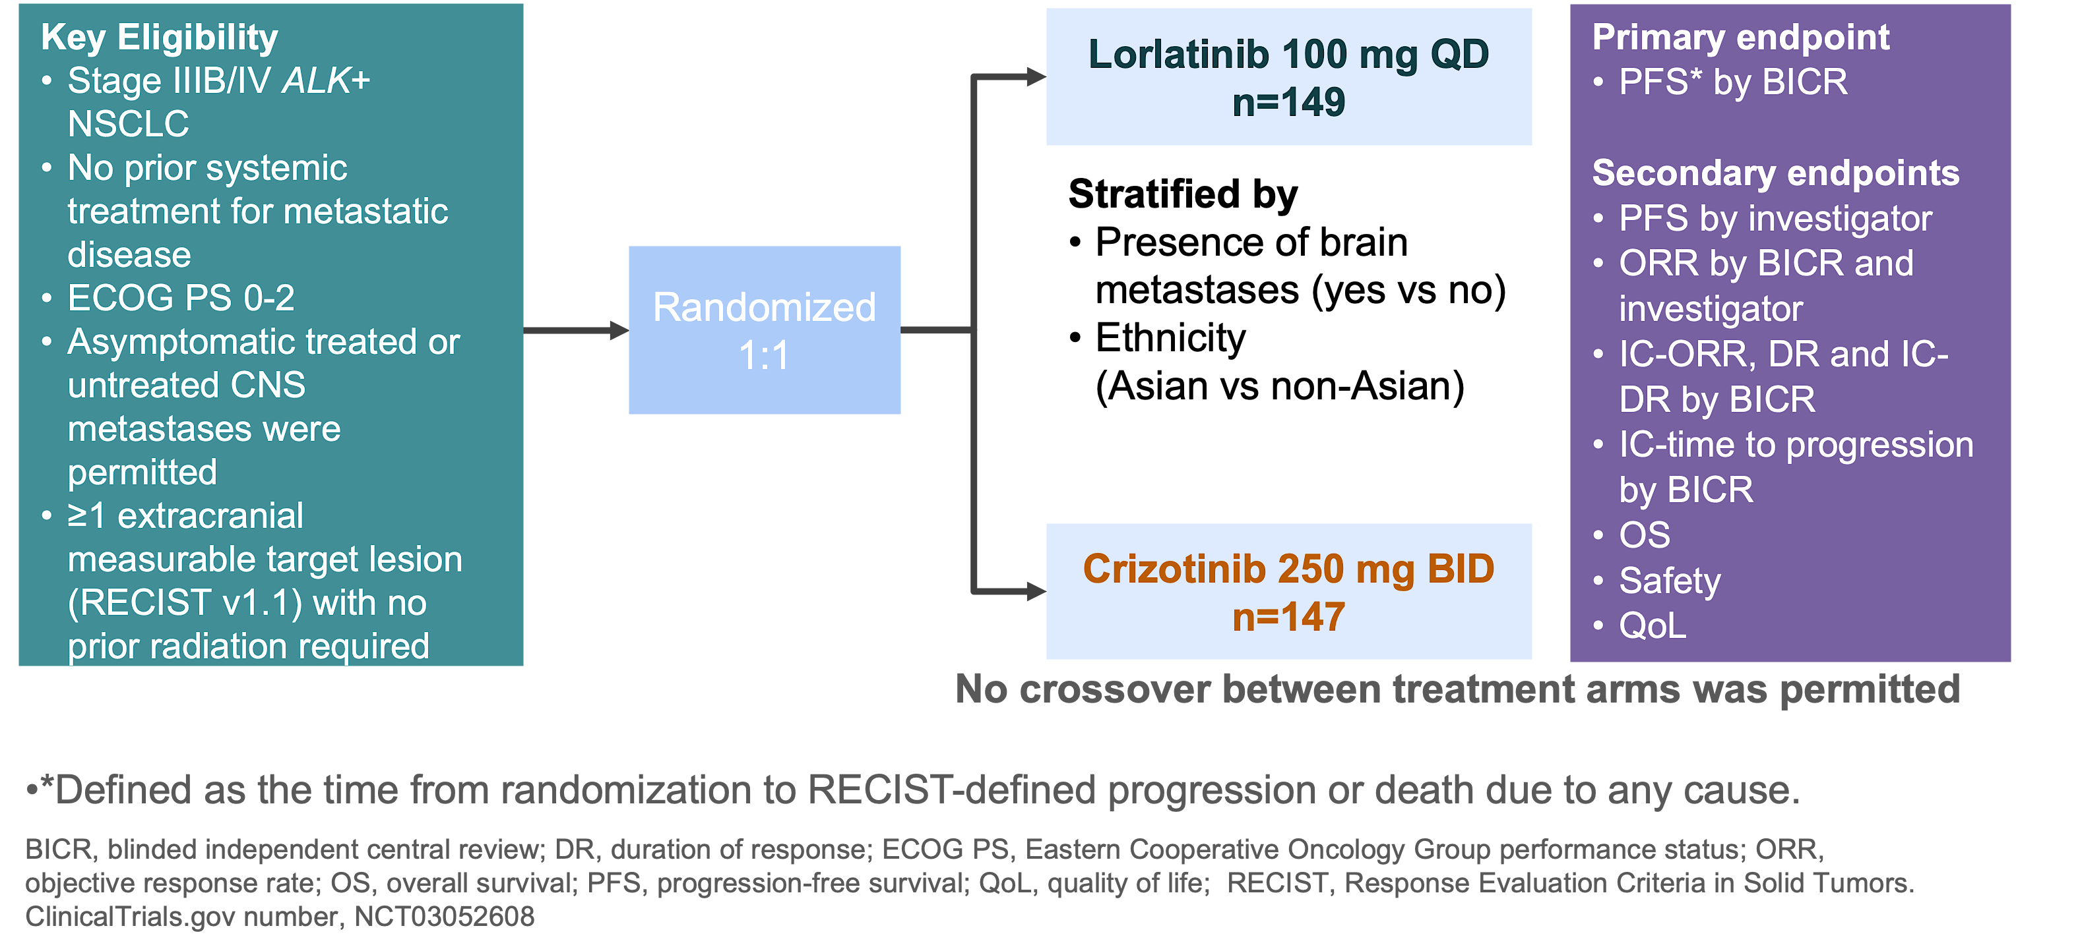
Lorlatinib in Metastatic ALK+ NSCLC:
Phase III CROWN Trial
Solomon B et al., ESMO 2020

Slide 8
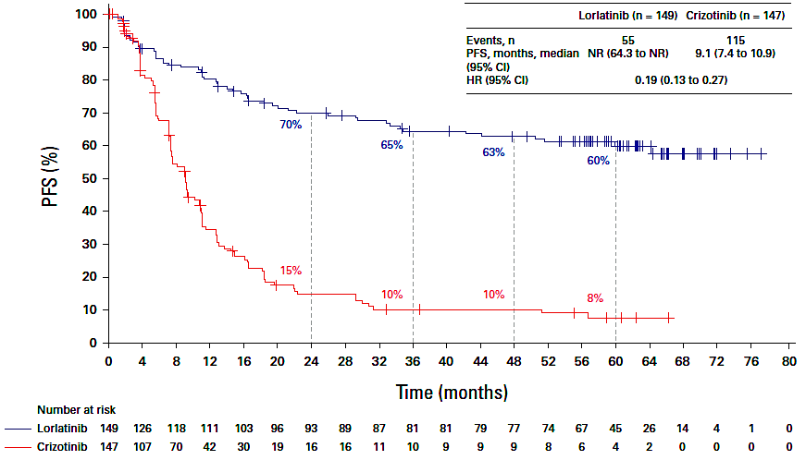
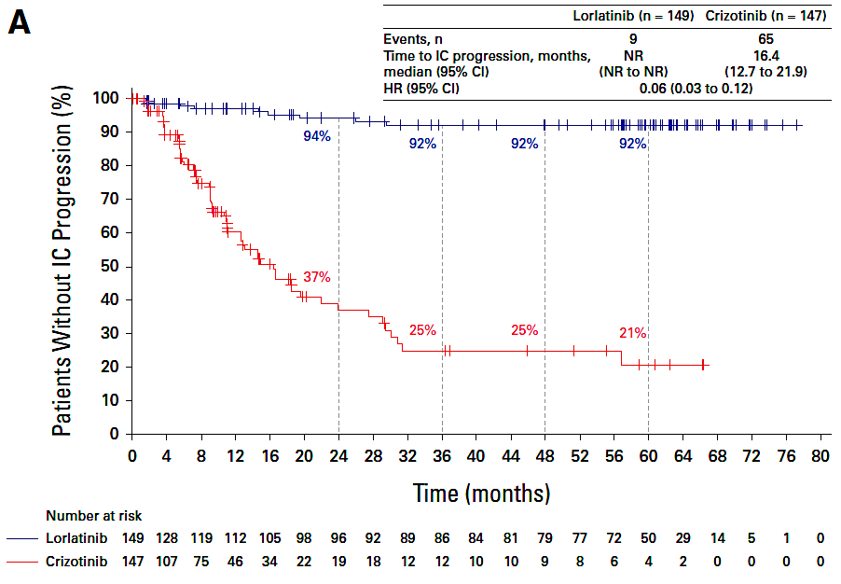
Lorlatinib in Metastatic ALK+ NSCLC:
CROWN Trial 5-Year Outcomes Update
PFS
(investigator assessment)
Time to intracranial progression
(investigator assessment)
Solomon B et al., J Clin Oncol 2024;42(29):3400-9

Slide 9
Lorlatinib in Metastatic ALK+ NSCLC:
CROWN Trial 5-Year Safety Update
With long exposure to lorlatinib, no new safety signals emerged, and treatment discontinuation remained low after 5 years of follow-up
With lorlatinib, all-cause AEs led to permanent discontinuation in 11% of patients; in 5%, these AEs were treatment related¹
  In patients who did not discontinue, AEs were efficiently managed with active measures including dose modifications
Dose reduction (in the first 16 weeks) did not affect efficacy of lorlatinib¹
Solomon B et al., J Clin Oncol 2024;42(29):3400-9
Bauer T et al., WCLC 2024

Slide 10
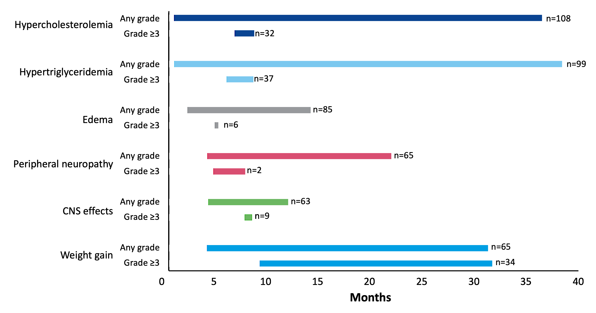
Lorlatinib in Metastatic ALK+ NSCLC:
CROWN Trial 5-Year Safety Update, AE Kinetics
Bauer T et al., WCLC 2024

Slide 11
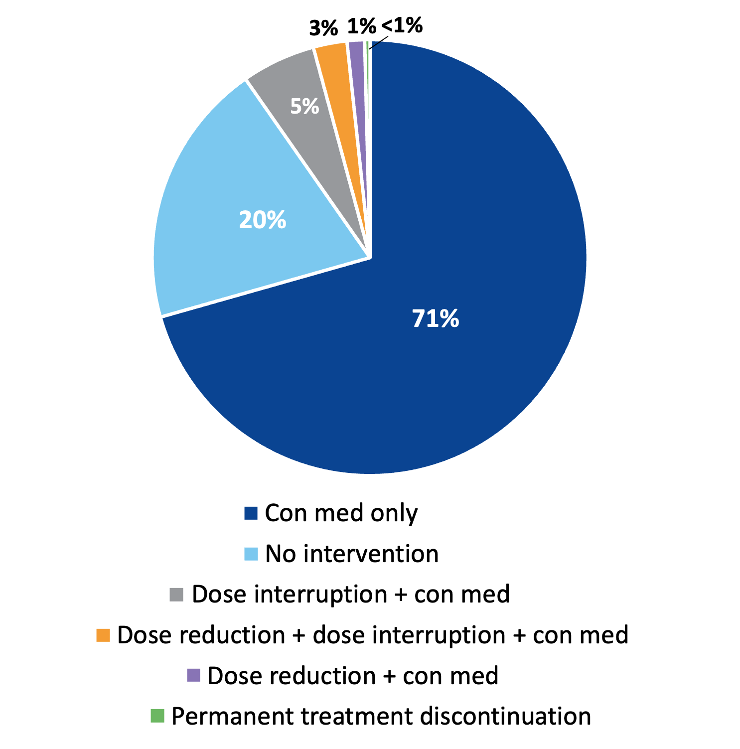
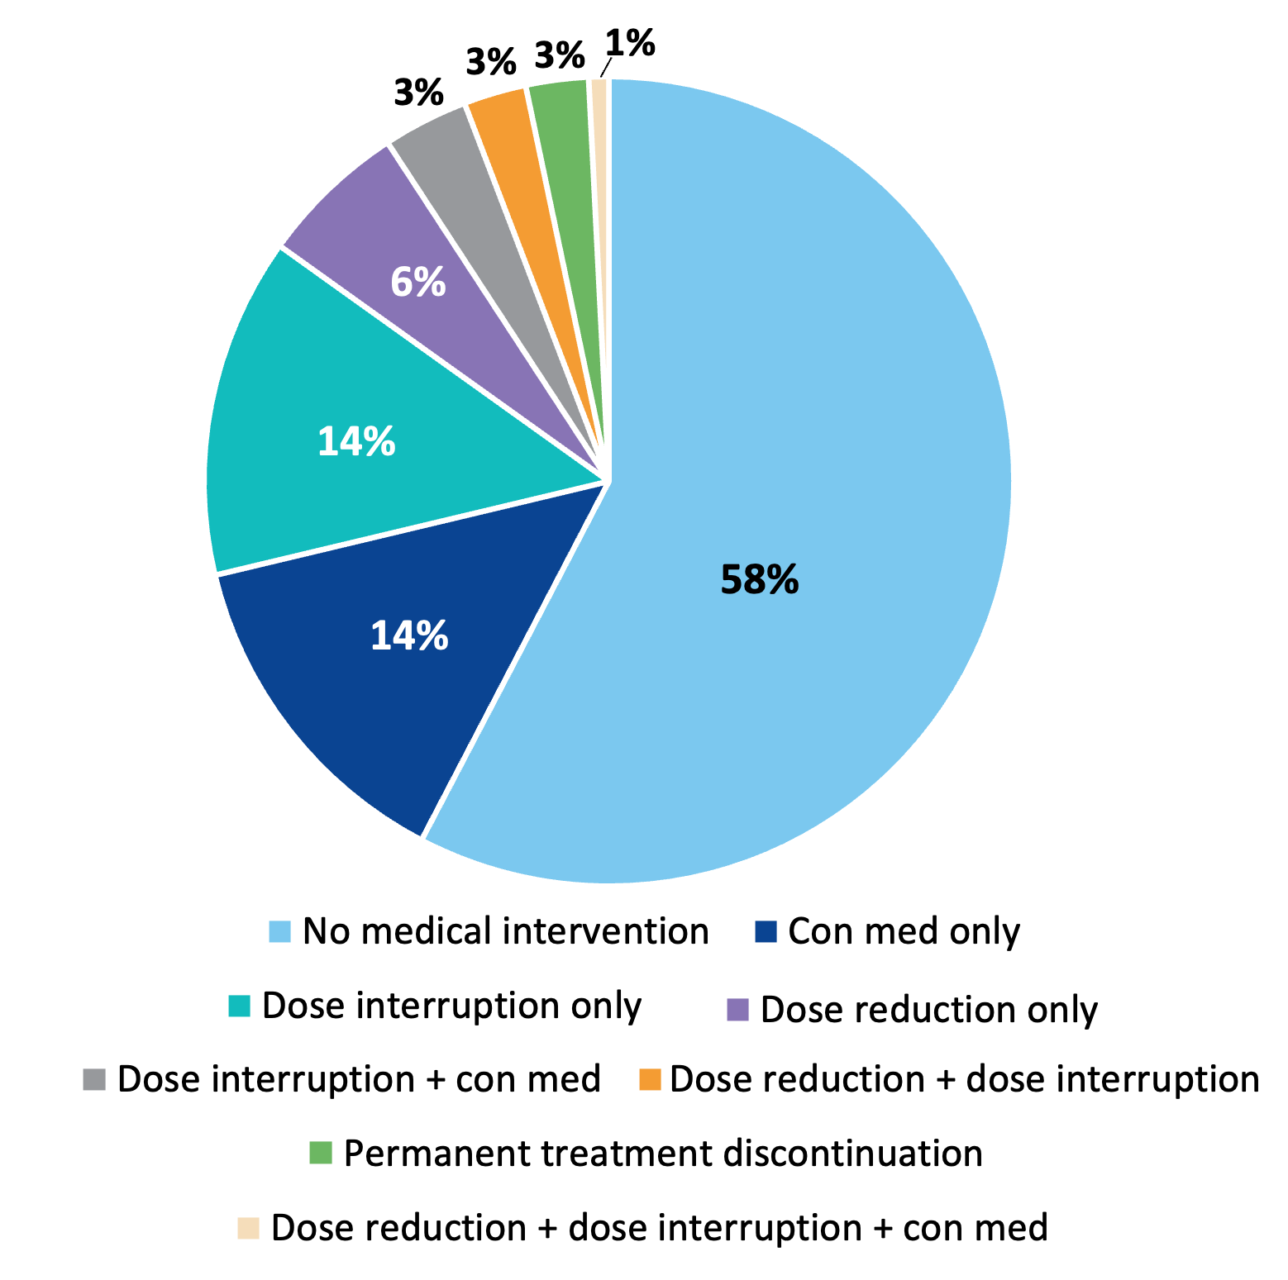
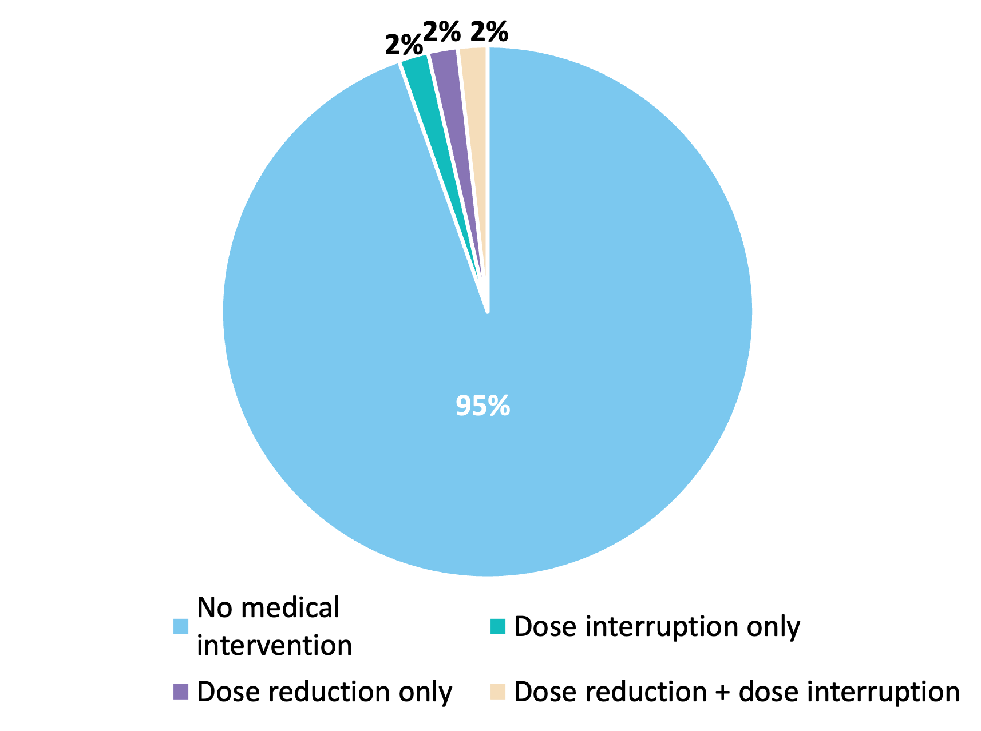
Lorlatinib in Metastatic ALK+ NSCLC:
CROWN Trial 5-Year Safety Update, AE Management
Hyperlipidemia
CNS Adverse Events
Weight gain
Bauer T et al., WCLC 2024

Slide 12
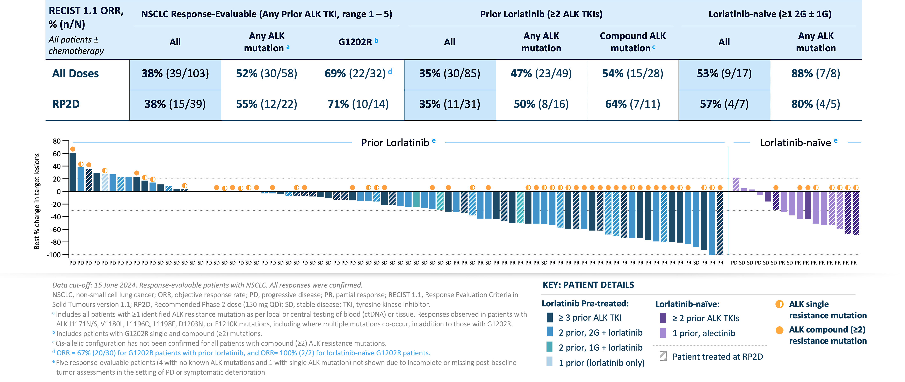
NVL-655 (Neladalkib) in Metastatic ALK+ NSCLC:
Phase I/II ALKOVE-1 Trial
Drilon A et al., ESMO 2024

Slide 13
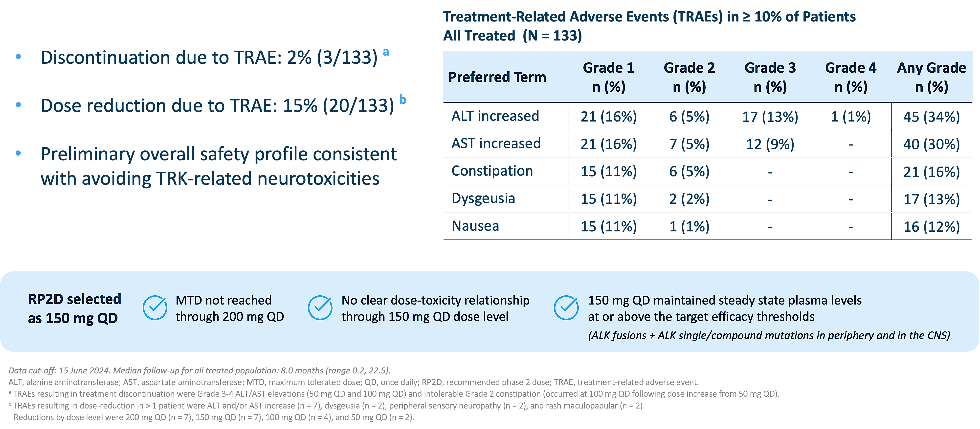
NVL-655 (Neladalkib) in Metastatic ALK+ NSCLC:
Phase I/II ALKOVE-1 Trial
Drilon A et al., ESMO 2024

Slide 14
Treatment of Metastatic ALK+ NSCLC: My Take
Multiple 2nd-/3rd-generation ALK TKIs are FDA-approved (and listed as NCCN category 1) as initial therapy for metastatic ALK+ NSCLC
The 5-year analyses of CROWN affirm lorlatinib as SOC first-line treatment for metastatic ALK+ NSCLC, with the longest PFS and time to intracranial progression reported to date amongst ALK inhibitors
4th-generation ALK TKI NVL-655 is demonstrating encouraging activity and tolerability in a heavily pre-treated patient population
Remaining questions:
  How will the prolonged PFS outcomes impact OS outcomes on ALK TKIs in patients?
  What is the landscape of mechanisms of resistance to first-line lorlatinib therapy and how does this shape subsequent treatments post-lorlatinib?

Slide 15
Bringing ALK-Targeted Therapy to Early-Stage Disease: Phase III ALINA Trial of Alectinib
Resected Stage IB (≥4cm)–IIIA ALK+ NSCLC
per UICC/AJCC 7th edition
Other key eligibility criteria:
ECOG PS 0–1
Eligible to receive platinum-based chemotherapy
Adequate end-organ function
No prior systemic cancer therapy
Stratification factors:
Stage: IB (≥ 4cm) vs II vs IIIA
Race: Asian vs non-Asian
Alectinib
600 mg BID
2 years
Recurrence
Further treatments at investigator’s choice and survival
follow-up
R
1:1
Platinum-based chemotherapy†
Q3W; 4 cycles
Recurrence
N=257
Primary endpoint
  DFS per investigator,‡ tested hierarchically:
        Stage II–IIIA → ITT (Stage IB–IIIA)
Other endpoints
  CNS disease-free survival
  OS
  Safety
Disease assessments (including brain MRI)§ were conducted: at baseline, every 12 weeks for year 1–2, every 24 weeks for year 3–5, then annually
Solomon B et al., ESMO 2024

Slide 16
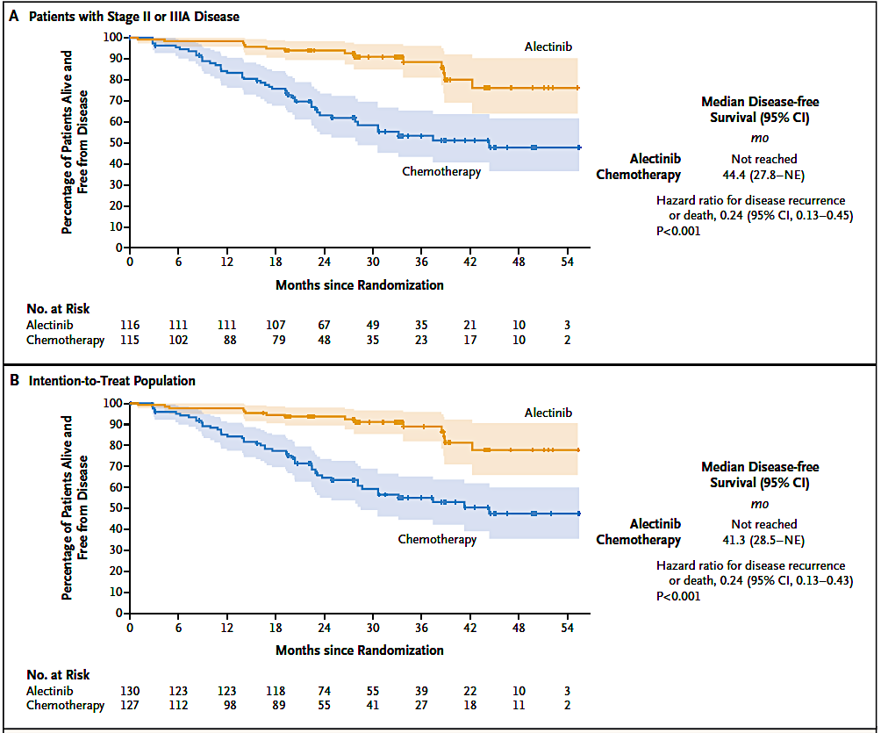
Bringing ALK TKI Alectinib to Early-Stage Disease: ALINA Trial DFS Results
Wu YL et al., N Engl J Med 2024;390(14):1265-76

Slide 17
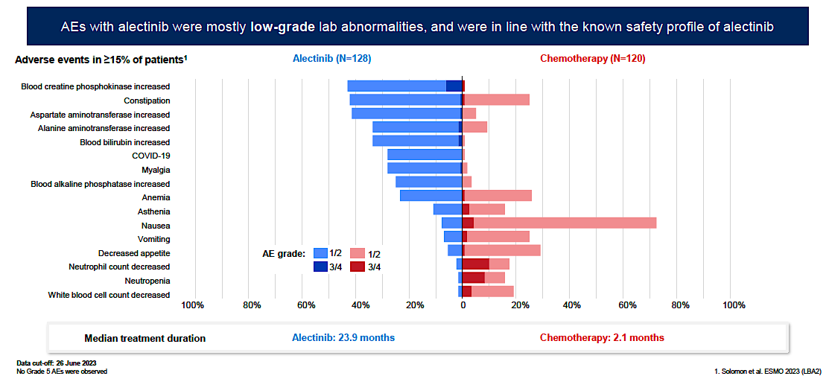
Safety Data from ALINA
 | Alectinib (n=128) | Chemotherapy (n=120)
AEs leading to dose reduction, % | 26 | 10
AEs leading to dose interruption, % | 27 | 18
AEs leading to treatment withdrawal, % | 5 | 13
Median dose intensity, % | 99.4 | 100
Horinuchi H et al., WCLC 2024

Slide 18
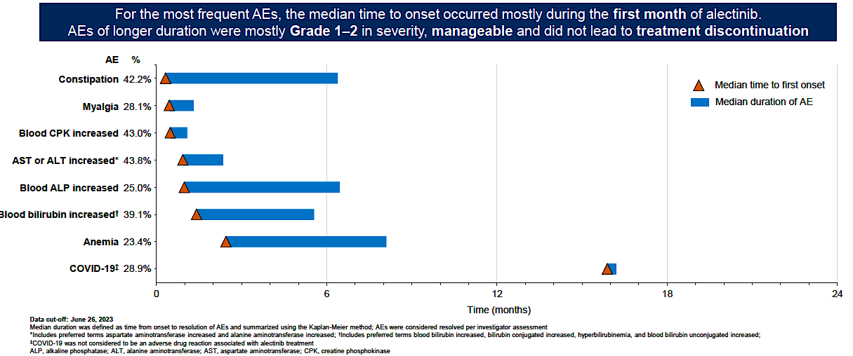
Safety Data from ALINA
Blood
Horinuchi H et al., WCLC 2024

Slide 19
Adjuvant ALK TKI for Resected ALK+ NSCLC:
My Take
Adjuvant alectinib is SOC for resected ALK+ NSCLC (FDA- and EMA-approved; NCCN category 1 recommendation)
Biomarker testing is essential for all stages of NSCLC
Remaining questions:
  What is the optimal duration of adjuvant ALK TKI?
  Who should receive adjuvant chemotherapy prior to (or with) an ALK TKI: all, a subset, or none?
  Is there a role for ALK-targeted therapy in the neoadjuvant/perioperative setting or after concurrent chemoradiation?

Slide 20
ROS1 Fusion-Positive (ROS1+) NSCLC

Slide 21
NCCN Recommendations For the Management of Metastatic ROS1+ NSCLC
  ROS1 Fusion Identified
ROS1 fusion identified prior to 1L systemic therapy
ROS1 fusion identified during 1L systemic therapy
  Preferred
  Crizotinib
  Entrectinib
  Repotrectinib
  Other recommended
  Ceritinib
  Complete planned systemic therapy (including maintenance therapy), or interrupt then→
  Crizotinib (preferred)
  Entrectinib (preferred)
  Repotrectinib (preferred)
  Ceritinib
NCCN Guidelines: NSCLC, version 3.2025. nccn.org.

Slide 22
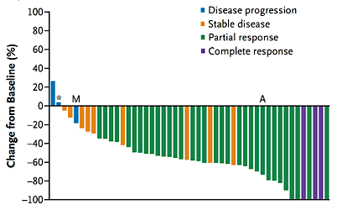
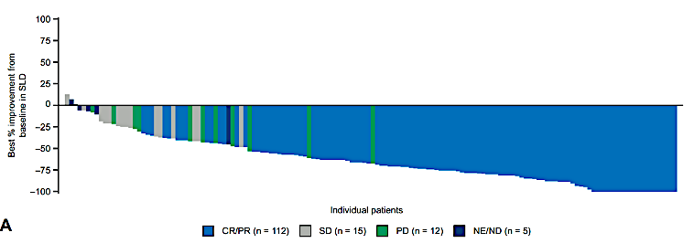

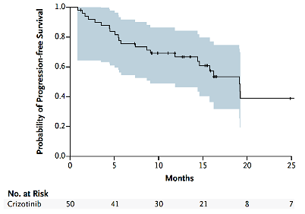
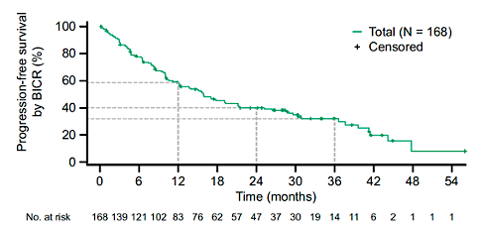
First-Generation ROS1 TKIs Crizotinib and Entrectinib
Crizotinib^{1,2}
Entrectinib³
ORR | 72% (58-83)
mDOR | 24.7 mos (15.2-45.3)
mPFS | 19.3 mos (15.2-39.1)
ORR | 68% (60-75)
mDOR | 20.5 mos (14.8-34.8)
mPFS | 15.7 mos (12.0-21.1)
1. Shaw AT et al. N Engl J Med. 2014;371(21):1963-1971. 2. Shaw AT et al. Ann Oncol. 2019;30(7):1121-1126. 3. Drilon A et al. JTO Clin Res Rep. 2022;3(6):100332

Slide 23
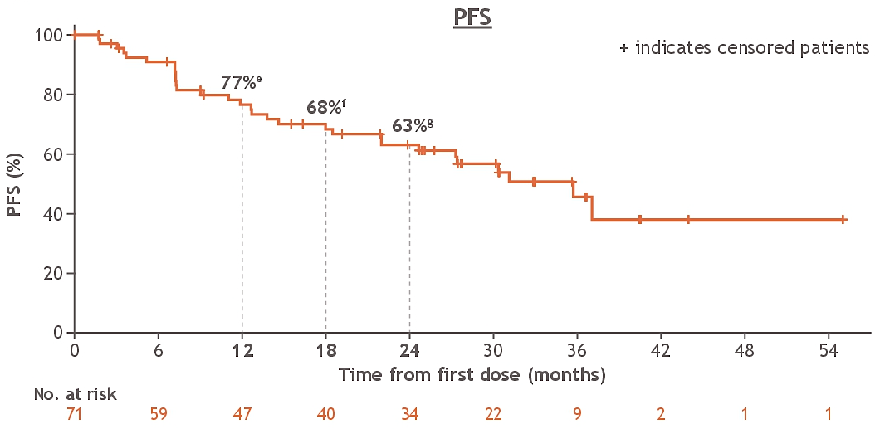
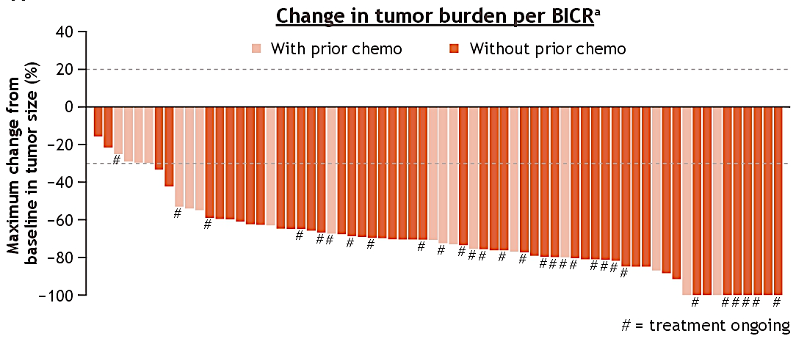
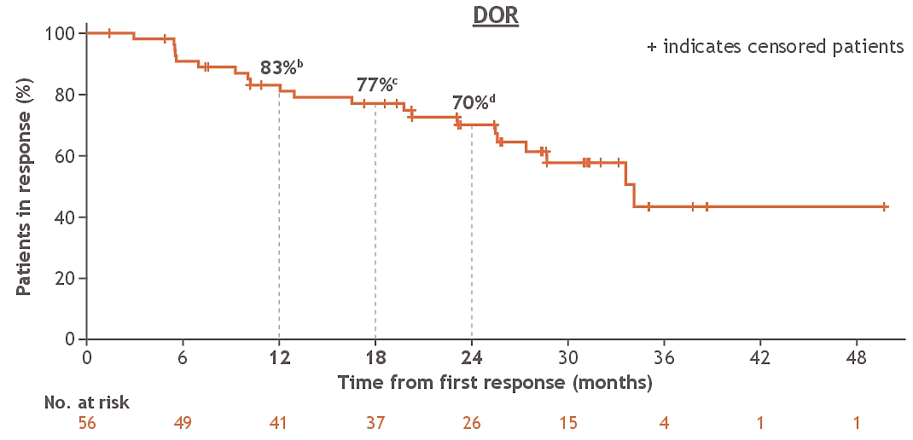
Repotrectinib in Metastatic ROS1+ NSCLC:
Phase I/II TRIDENT-1 Update
(median follow-up 33.9 mo)
PFS
Median: 35.7 mo (24.6-NE)
Change in tumor burden per BICR
DOR
Median: 34.1 mo (27.4-NE)
CNS Efficacy
IC-ORR 89% (95% CI, 52-100) (n=9)
For n=53 without baseline brain metastases, 91% alive and free of IC progression at 12 months; 86% alive and free of IC progression at 24 months
Drilon A et al., ASCO 2024

Slide 24
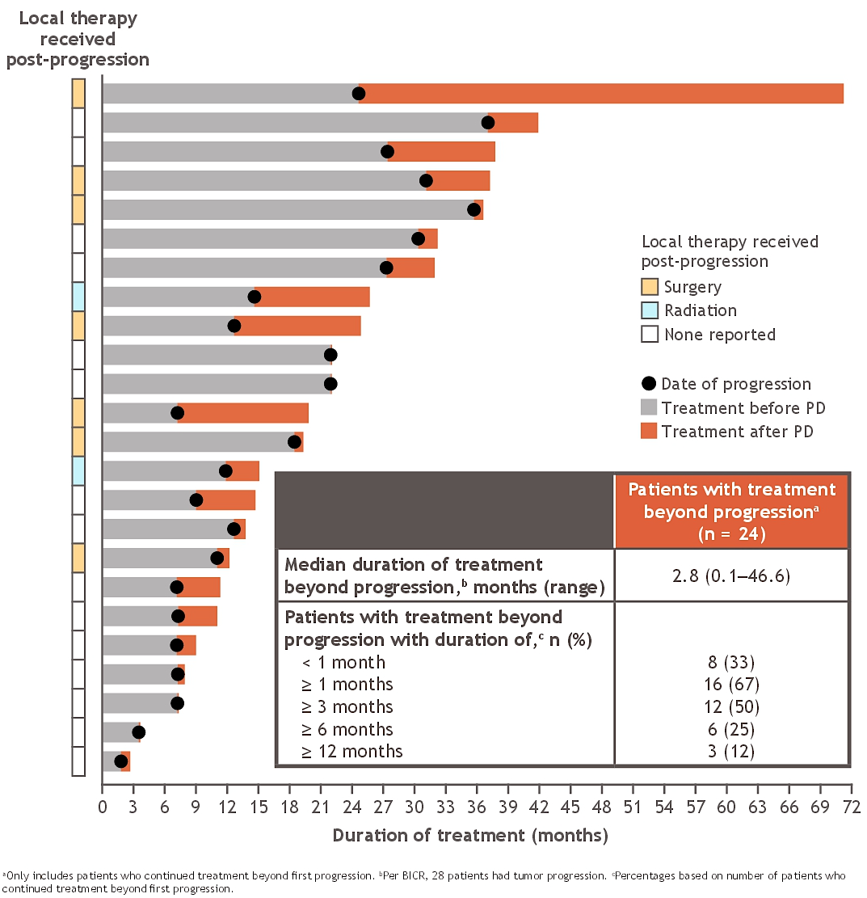
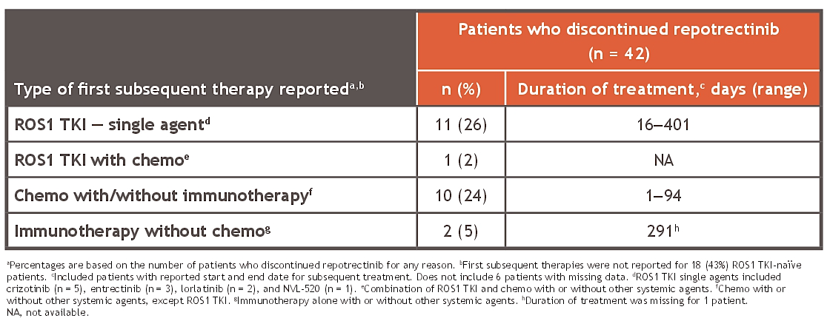
Treatment Patterns After First-Line Repotrectinib in TRIDENT-1
Of 42 patients who discontinued repotrectinib for any reason, 24 received a subsequent therapy
Drilon A et al., ASCO 2024

Slide 25
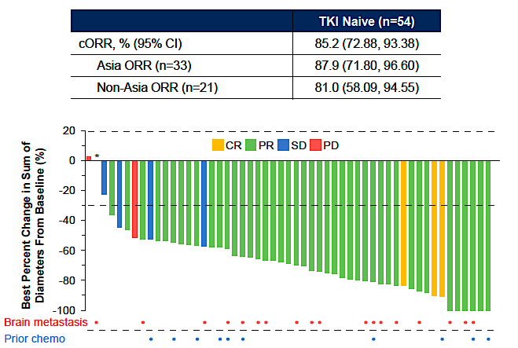
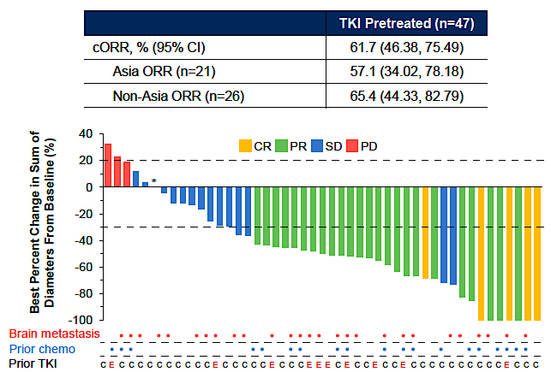
Taletrectinib in Metastatic ROS1+ NSCLC:
Global Phase II TRUST-II Trial
TKI-Naive
TKI-Pretreated
Liu G et al., WCLC 2024

Slide 26
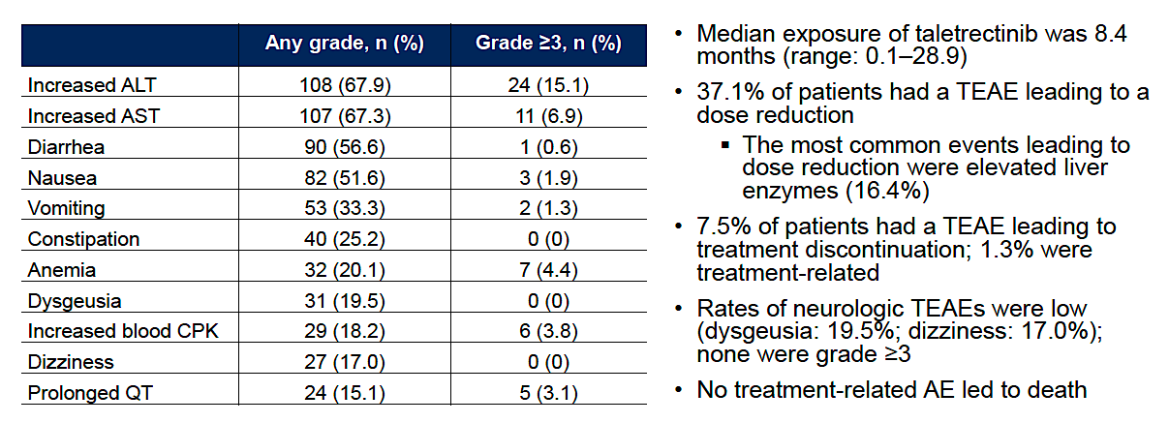
Taletrectinib in Metastatic ROS1+ NSCLC:
Safety Data from TRUST-II
TEAEs in ≥15% of Patients (N=159)
Liu G et al., WCLC 2024

Slide 27
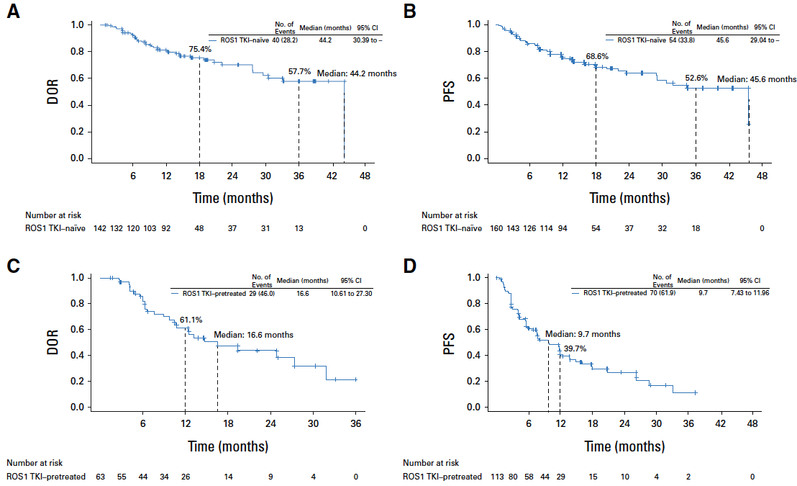
Taletrectinib in ROS1+ NSCLC:
Pooled Efficacy Data from TRUST-I & TRUST-II
TKI-Naive
Median: 44.2 mo
Median: 45.6 mo
TKI-Pretreated
Median: 16.6 mo
Median: 9.7 mo
Pérol M et al., J Clin Oncol 2025 Apr 3 (in press)

Slide 28
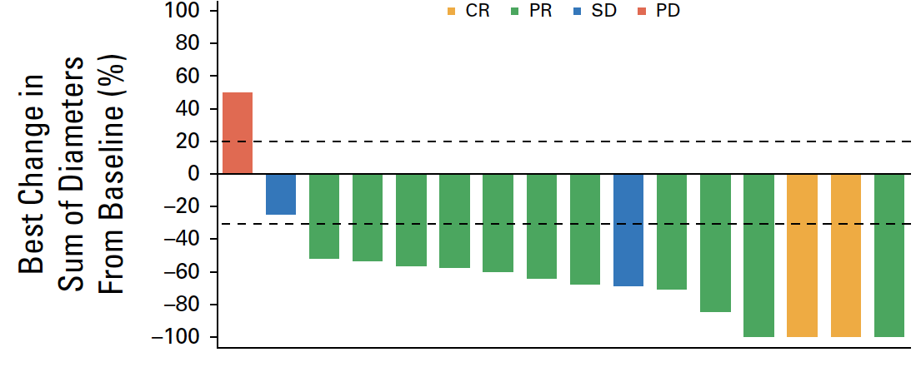
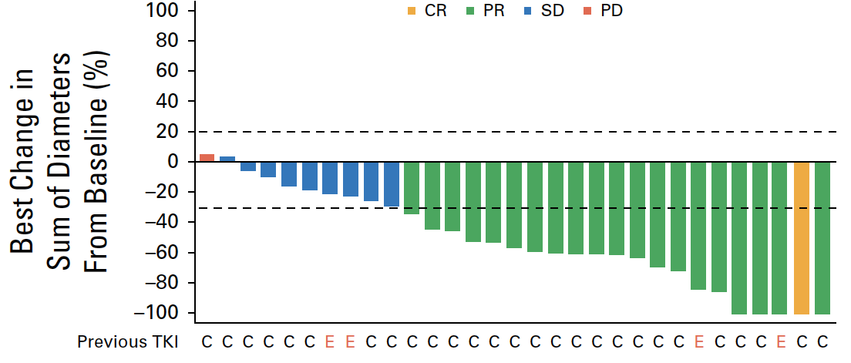
Taletrectinib in ROS1+ NSCLC: Pooled CNS Efficacy
TKI-Naive
IC-ORR 76.5% (50.1-93.2)
IC DOR 14.7 mo (4.2-30.2)
TKI-Pretreated
IC-ORR 65.6% (46.8-81.4)
IC DOR 11.9 mo (6.9-23.4)
Pérol M et al., J Clin Oncol 2025 Apr 3 (in press)

Slide 29
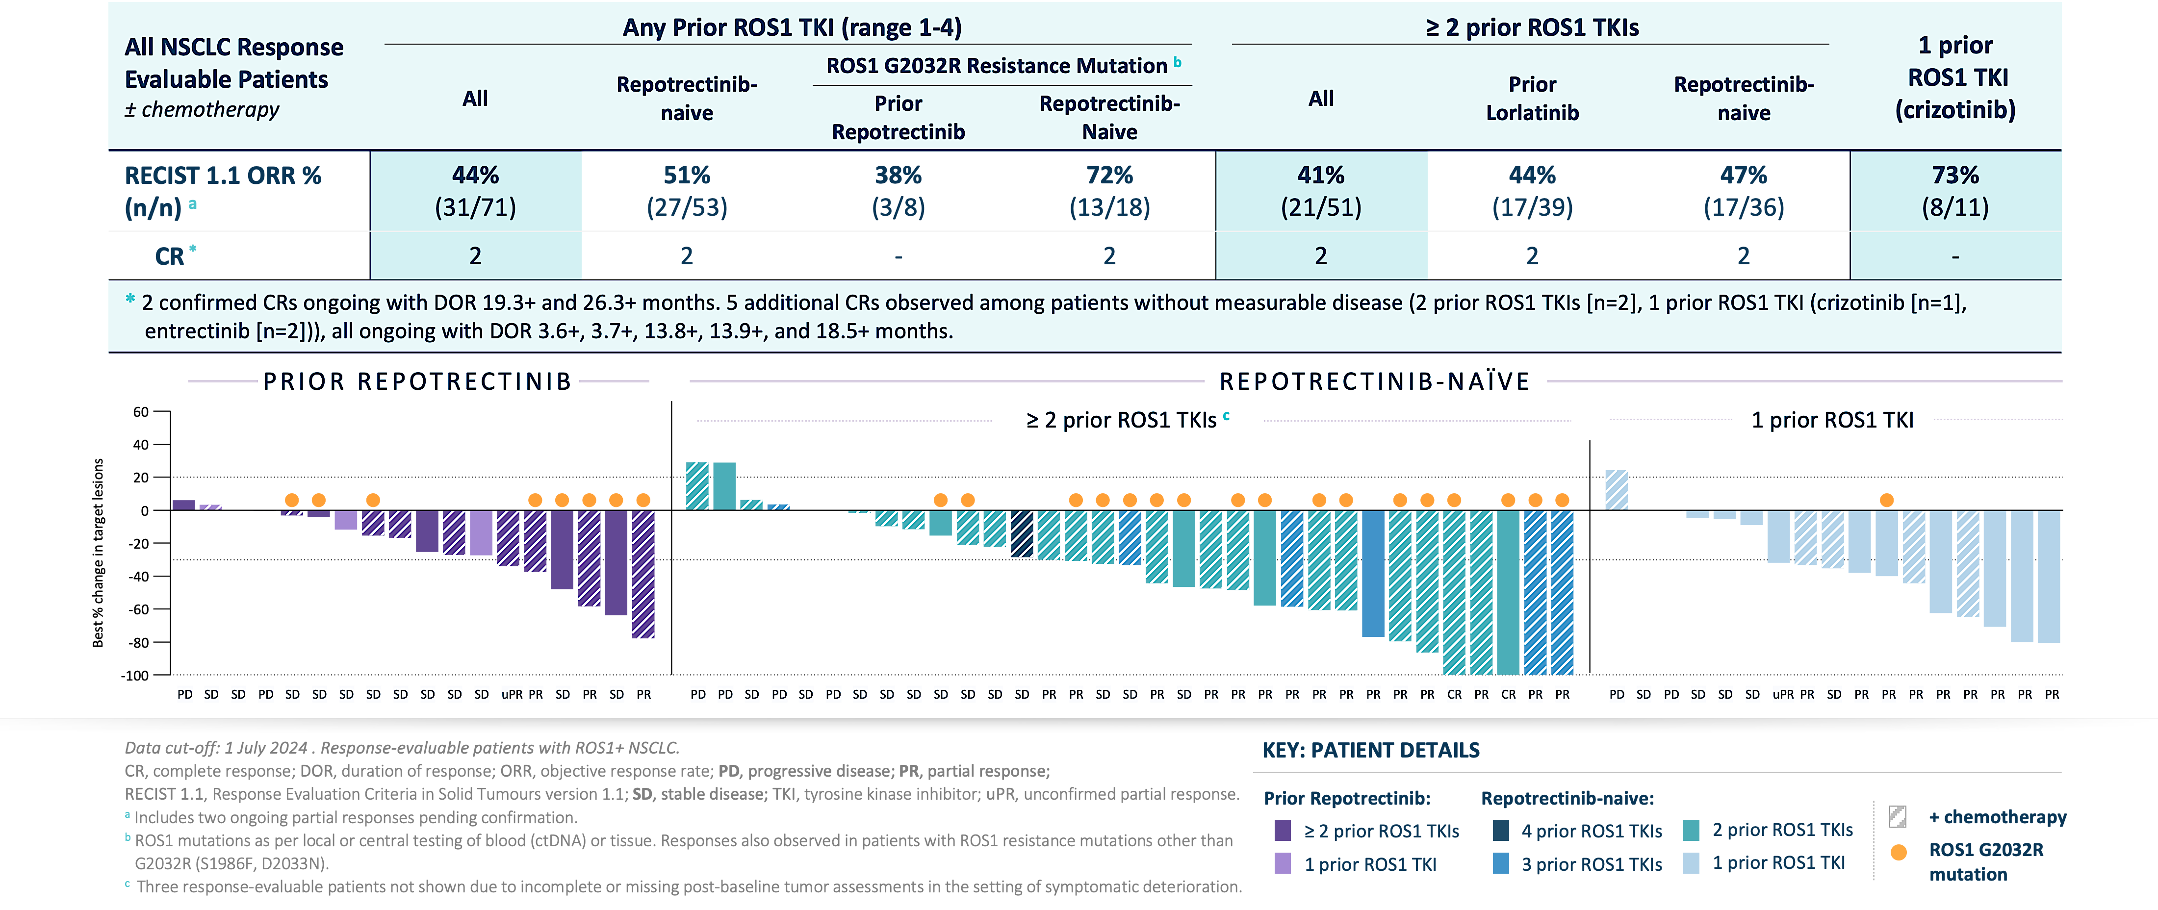
Zidesamtinib (NVL-520) in ROS1+ NSCLC:
Phase I/II ARROS-1 Trial, Preliminary Efficacy
Besse B et al., ESMO 2024

Slide 30
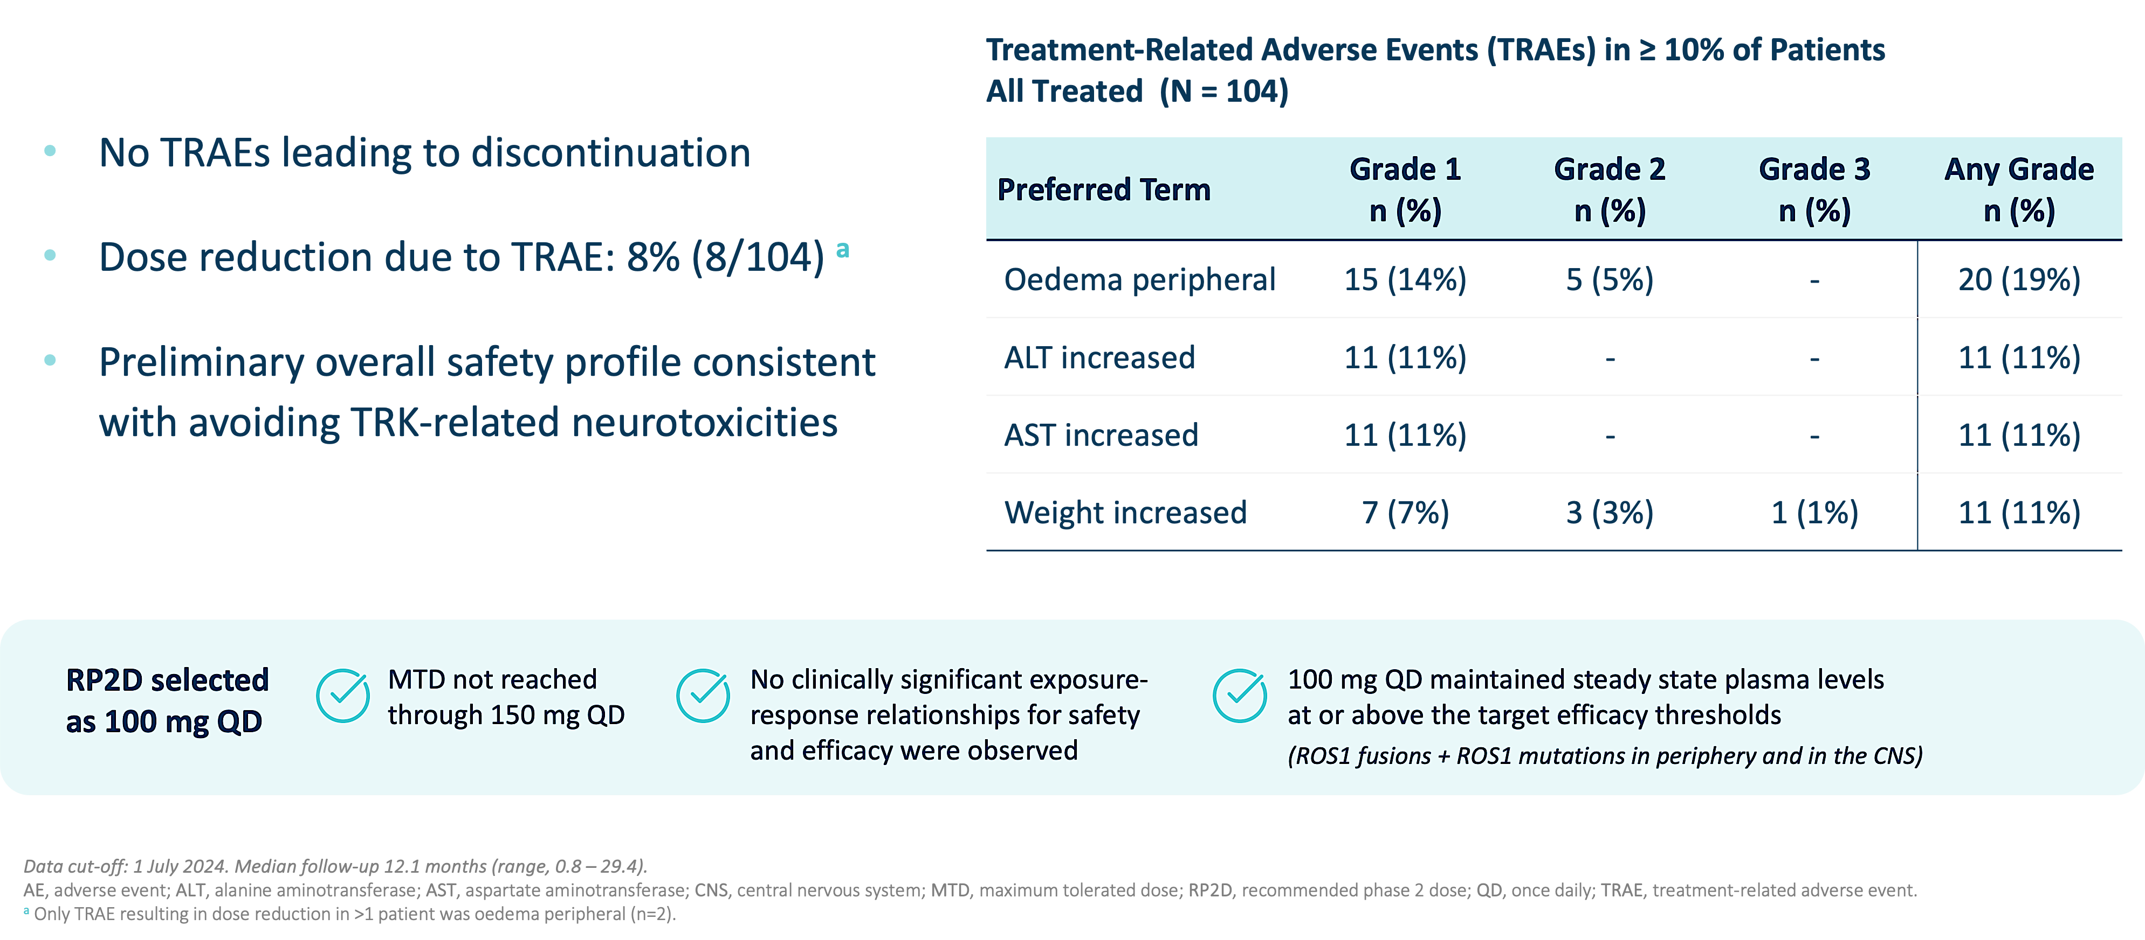
Zidesamtinib (NVL-520) in ROS1+ NSCLC:
Phase I/II ARROS-1 Trial, Safety Profile
Besse B et al., ESMO 2024

Slide 31
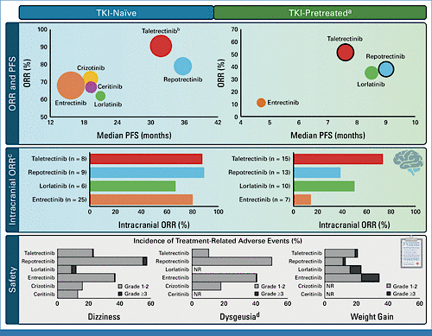
Treatment of Metastatic ROS1+ NSCLC: My Take
Currently, repotrectinib is the only FDA-approved next-generation ROS1 TKI for ROS1+ NSCLC
The landscape of first- and later-line ROS1 TKIs continues to actively evolve with next-generation agents
Considerations in selecting the first-line agent include systemic and CNS efficacy, tolerability (such as TRK inhibition-mediated side effects), and access to therapy
Waliany S et al., J Clin Oncol 2024;42(22):2622-7

Slide 32
RET Fusion-Positive (RET+) NSCLC

Slide 33
Selpercatinib and Pralsetinib in RET+ NSCLC
 | Platinum-Pretreated |  | Treatment-Naïve
 | Selpercatinib (LIBRETTO-001) | Pralsetinib (ARROW) | Selpercatinib (LIBRETTO-001) | Pralsetinib (ARROW)
Patients | N=247 | N=136 | N=69 | N=75
ORR (95% CI) | 61% (55-67) | 59% (50-67) | 84% (73-92) | 72% (60-82)
Median PFS (95% CI) | 24.9 months (19.3-NE) | 16.5 months (10.5-24.1) | 22.0 months (13.8 months-NE) | 13.0 months (9.1-NR)
Median duration follow-up | 24.7 months | 18.4 months (13.2-19.8) | 21.9 months | 9.2 months (8.6-11.0)
Median DOR (95% CI) | 28.6 months (20.4-NE) | 22.3 months (15.1-NR) | 20.2 months (13.0-NE) | NR (9.0 months-NR)
Median duration follow-up | 21.2 months | 16.7 months (12.9-18.5) | 20.3 months | 7.4 months (6.4-9.5)
Intracranial ORR (95% CI) | 85% (65-96) (n=26 – pretreated + treatment-naïve) | 70% (35-93) (n=10; 1/10 received prior non-platinum therapy)
Reference | Drilon A et al., J Clin Oncol. 2023 | Griesinger F et al., Ann Oncol. 2022 | Drilon A et al., J Clin Oncol. 2023 | Griesinger F et al., Ann Oncol. 2022

Slide 34
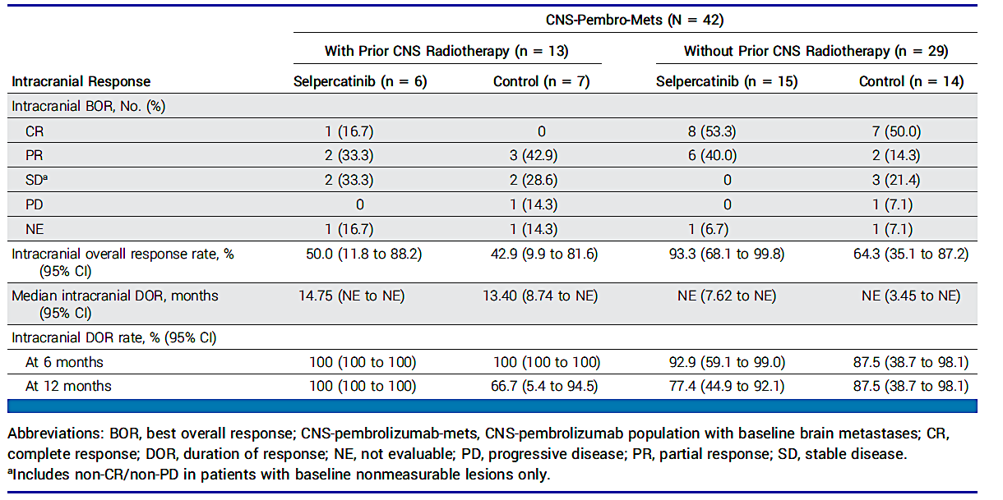
Selpercatinib in RET+ NSCLC: CNS Efficacy, Data from the Phase III LIBRETTO-431 Trial
Pérol M et al., J Clin Oncol 2024;42(21):2500-5

Slide 35
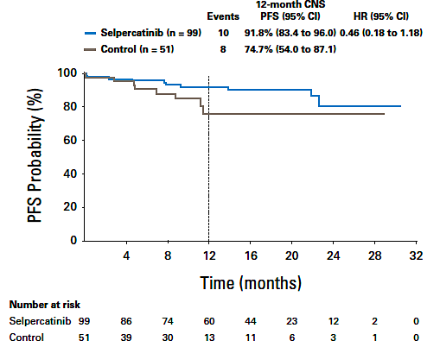
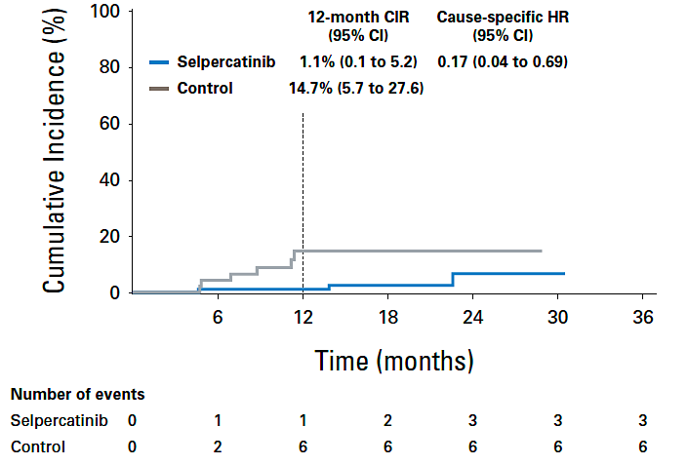
Selpercatinib in RET+ NSCLC: CNS Protective Effect, Data from the Phase III LIBRETTO-431 Trial
Cumulative incidence rate (CIR) of CNS-PD
CNS-pembrolizumab-nonmets population (n=150)
Intracranial PFS
CNS-pembrolizumab-nonmets population
Pérol M et al., J Clin Oncol 2024;42(21):2500-5

Slide 36
Treatment of Metastatic RET+ NSCLC: My Take
Selpercatinib and pralsetinib are FDA-approved, NCCN guideline-recommended first-line therapies for metastatic RET+ NSCLC
Both RET inhibitors have demonstrated CNS efficacy
CNS outcome analyses from the LIBRETTO-431 phase III trial further support that a CNS-active TKI like selpercatinib can delay CNS progression and may prevent new brain metastases

Slide 37
NTRK1-3 Fusion-Positive (TRK+) NSCLC

Slide 38
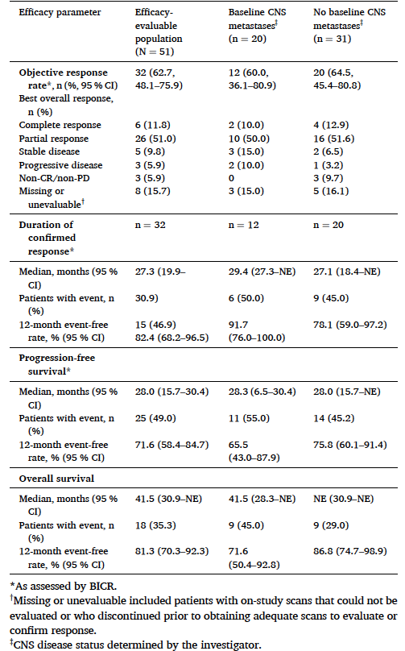
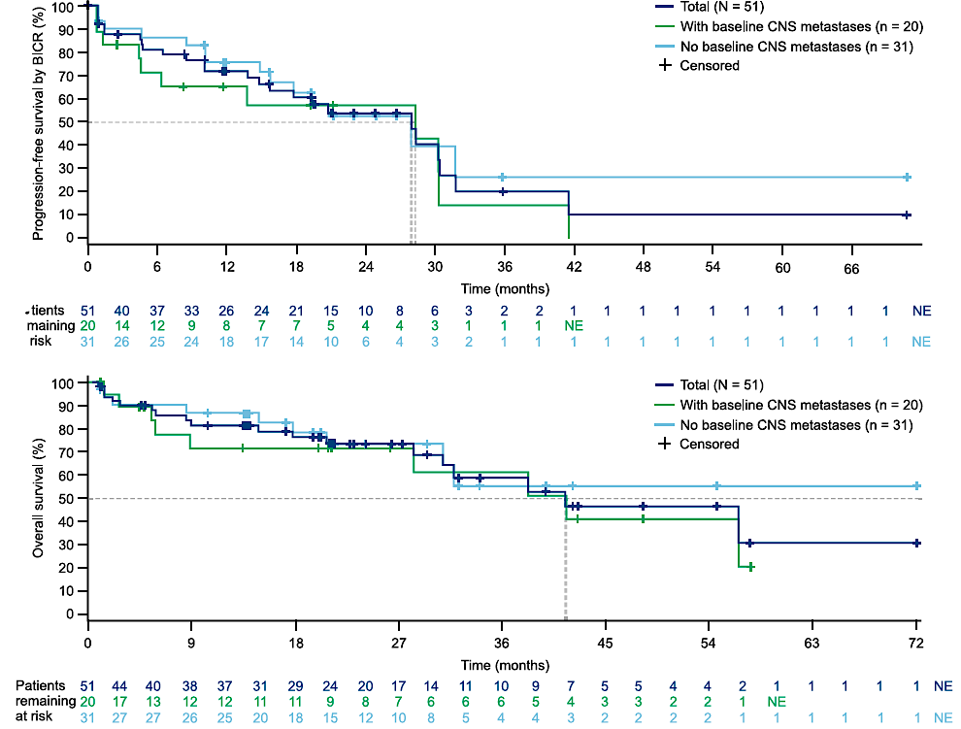
Entrectinib in TRK+ NSCLC: Update
PFS
Median 28.0 mo (15.7-30.4)
Patients
remaining
at risk
OS
Median 41.5 mo (30.9-NE)
N=14 with measurable or nonmeasurable baseline CNS metastases by BICR
IC-ORR 64.3% (35.1-87.2)
IC-DOR 55.7 mo (8.0-NE), IC-PFS 32.7 mo (5.9-NE)
Median survival follow-up time 26.3 mo (21.0-34.1)
Cho BC et al., Lung Cancer 2024 Feb:188:107442

Slide 39
Larotrectinib in TRK+ NSCLC: Update
 | Patients with known CNS metastases at BL | Total
IRC-eligible patients, n | 12 | 32
ORR, % (95% CI) | 67 (35–90) | 66 (47–81)
Best response, n (%) Complete response Partial response Stable disease Progressive disease Not evaluable | 0 8 (67) 2 (17) 2 (17) 0 | 4 (13) 17 (53) 7 (22) 2 (6) 2 (6)
100
90
DoR
Median DoR, months (95% CI) | 34 (10–NE)
Median follow-up, months | 26
48-month DoR, % (95% CI) | 47 (19–76)
80
70
100
60
90
50
80
40
70
30
60
20
DoR (%)
47%
10
50
Maximum change in target lesion size (%)†
40
0
30
−10
20
−20
10
−30
0
−40
0
12
24
36
48
60
−50
Months since start of response
−60
No.
at risk
−70
21
13
7
3
1
0
−80
−90
−100
PFS
Median PFS, months (95% CI) | 22 (10–NE)
Median follow-up, months | 28
48-month PFS, % (95% CI) | 34 (11–56)
OS
Median OS, months (95% CI) | 39 (17–NE)
Median follow-up, months | 33
48-month OS, % (95% CI) | 38 (13–64)
100
100
90
90
80
80
70
70
60
60
38%
OS (%)
PFS (%)
50
50
34%
40
Censored
40
30
Median
30
20
20
10
48-month rate
10
0
0
0
12
24
36
48
60
72
84
96
0
12
24
36
48
60
Months since start of treatment
Months since start of treatment
No.
at risk
No.
at risk
32
22
14
8
4
2
1
1
0
32
15
8
3
2
0
Lin JJ et al., WCLC 2024

Slide 40
Larotrectinib in TRK+ NSCLC: Safety Update
All AEs
TRAEs (AEs related to larotrectinib)
100.0
59.4
28.1
93.8
TRAEs were predominantly
Grade 1/2
Grade 3/4 TRAEs were reported in 9 patients
One patient discontinued treatment due to TRAEs (increased ALT, AST, and gamma-glutamyl transferase)
There were no
treatment-related deaths
46.9
9.4
46.9
18.8
3.1
3.1
43.8
3.1
3.1
28.1
40.6
6.3
6.3
40.6
40.6
9.4
9.4
34.4
40.6
3.1
3.1
25.0
34.4
3.1
15.6
31.3
3.1
28.1
3.1
3.1
28.1
9.4
9.4
25.0
25.0
3.1
9.4
25.0
9.4
21.9
3.1
21.9
9.4
21.9
12.5
21.9
3.1
9.4
21.9
3.1
Grade
Grade ≥3
Any grade
21.9
21.9
9.4
18.8
18.8
6.3
3.1
18.8
15.6
Patients (%)
AE, adverse event; ALT, alanine aminotransferase; AST, aspartate aminotransferase; SAE, serious adverse event; TRAE, treatment-related adverse event.
Lin JJ et al., WCLC 2024

Slide 41
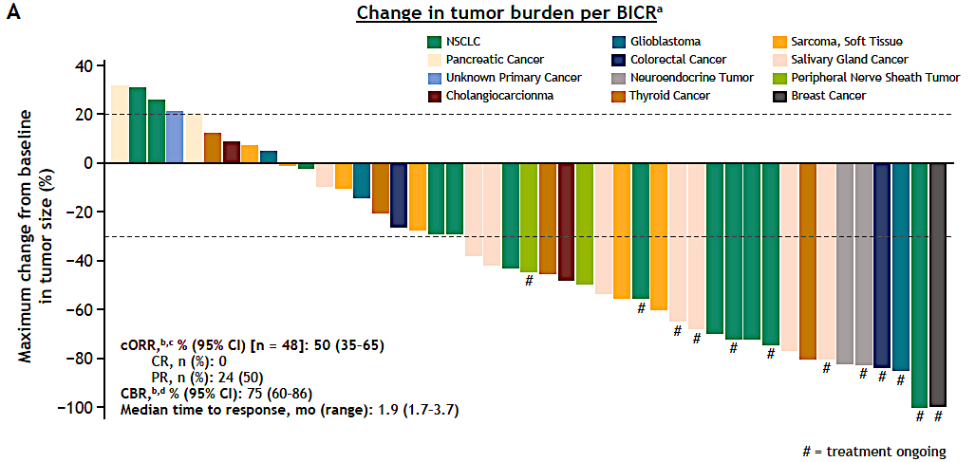
Repotrectinib in TRK+ Solid Tumors:
Phase I/II TRIDENT-1 Trial, NTRK1-3 Cohorts
TKI-pretreated patient population (n=48)
cORR 50% (95% CI, 35-65)
Median PFS 7.4 months (3.9-9.7), Median DOR 9.8 months (7.4-12.9)
cORR 60% in patients with solvent front TRK mutation (n=25; 95% CI 39-79)
Cholangiocarcinoma
6/2024: Received FDA accelerated approval for adult and pediatric patients 12 years or older with advanced NTRK fusion+ solid tumors
Solomon B et al. ESMO 2023

Slide 42
Treatment of Metastatic TRK+ NSCLC: My Take
Larotrectinib, entrectinib, and repotrectinib are all FDA-approved, NCCN guideline-recommended first-line therapies for metastatic TRK+ NSCLC
With longer follow-up, both entrectinib and larotrectinib continue to demonstrate significant clinical activity and favorable tolerability in patients
Repotrectinib is a next-generation TKI that has shown activity in TKI-naïve and -pretreated patients with TRK+ solid tumors
Knowledge of TKI-associated toxicities and optimal management strategies are critical for clinicians

Slide 43
NRG1 Fusion-Positive (NRG1+) NSCLC

Slide 44
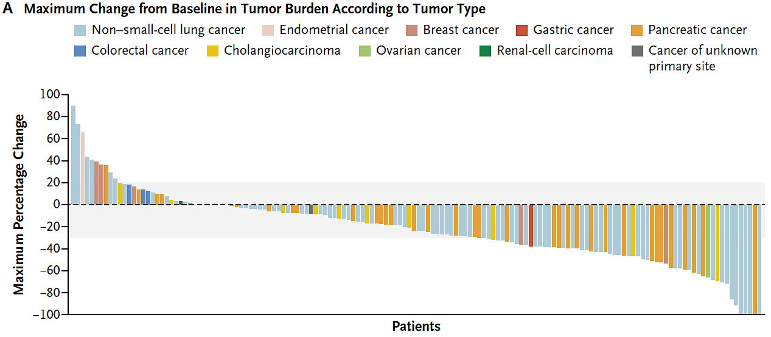
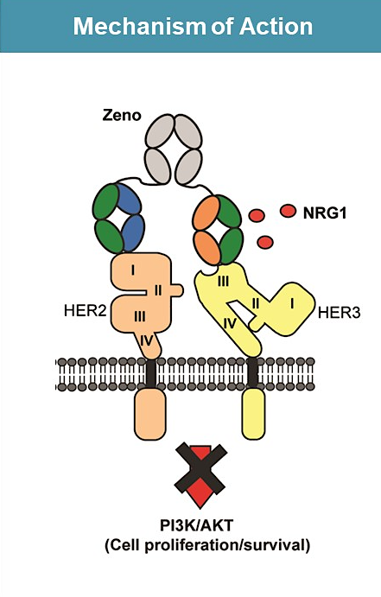
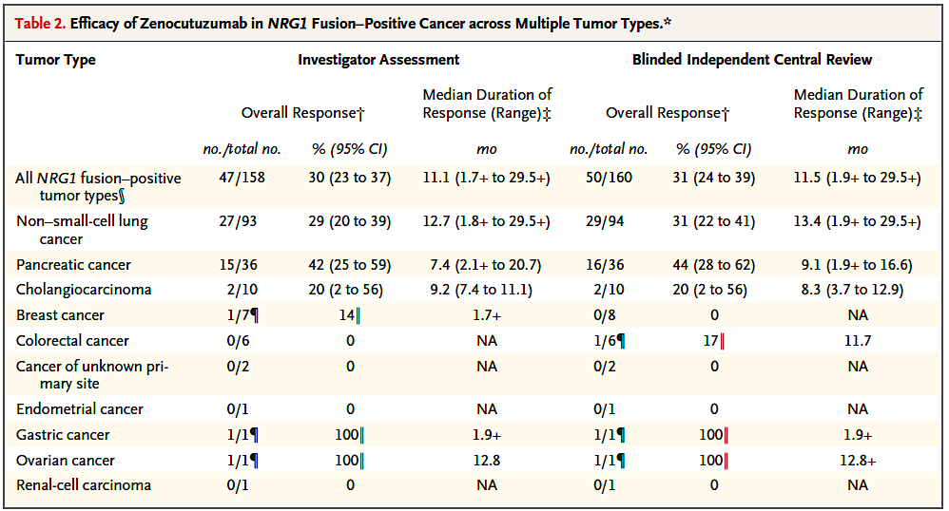
Zenocutuzumab in NRG1+ Cancer: eNRGy Phase II Trial
HER2/HER3 bispecific antibody
Dosing: 750 mg (i.v. infusion every 2 weeks)
Schram AM et al., N Engl J Med 2025;392(6):566-76; Schram AM et al., ASCO 2022

Slide 45
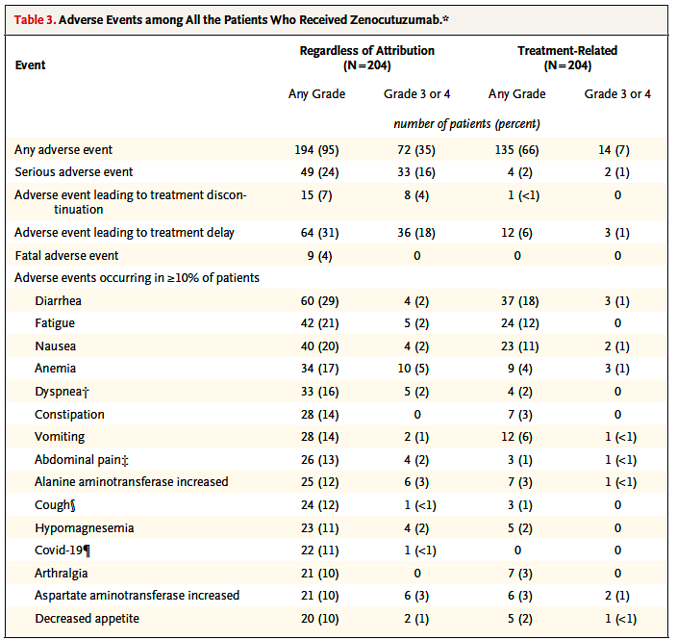
Zenocutuzumab in NRG1+ Cancer: Safety
Most common grade 3/4 treatment-related AEs: diarrhea and anemia
One patient with treatment discontinuation due to drug-related AE (grade 2 pneumonitis)
AEs resulting in treatment delay: 31% (6% with treatment-related delay)
AEs resulting in dosing interruption: 10%
Infusion-related reactions: 14%, all grades 1-2
Schram AM et al., N Engl J Med 2025;392(6):566-76

Slide 46
Treatment of Metastatic NRG1+ NSCLC: My Take
Zenocutuzumab represents a new SOC, FDA-approved treatment option for patients with advanced NRG1 fusion+ NSCLC
The ORR (31%) is more modest relative to other targeted therapies in NSCLC, and therefore, I would reserve zenocutuzumab as later-line therapy

