Slide 1
Year in Review: Nontargeted Approaches for Lung Cancer
A CME/MOC-Accredited Live Webinar
Tuesday,​ June 24, 2025 5:00 PM – 6:00 PM ET
Faculty
Benjamin Levy, MD
Moderator
Neil Love, MD

Slide 2


Faculty
Benjamin Levy, MD
Associate Professor, Johns Hopkins School of Medicine
Clinical Director
Medical Director, Thoracic Oncology Program
Johns Hopkins Sidney Kimmel Cancer Center
at Sibley Memorial
Washington, DC
MODERATOR
Neil Love, MD Research To Practice
Miami, Florida

Slide 3
Commercial Support
This activity is supported by educational grants from AstraZeneca Pharmaceuticals LP and Genmab US Inc.
Research To Practice CME Planning Committee Members, Staff and Reviewers
Planners, scientific staff and independent reviewers for Research To Practice have no relevant conflicts of interest to disclose.

Slide 4
Dr Levy — Disclosures
Advisory Committees and Consulting Agreements | Amgen Inc, AstraZeneca Pharmaceuticals LP, Daiichi Sankyo Inc, Genentech, a member of the Roche Group, Gilead Sciences Inc, Guardant Health, Janssen Biotech Inc, Jazz Pharmaceuticals Inc, Lilly, Merck, Mirati Therapeutics Inc, Pfizer Inc, Sanofi, Takeda Pharmaceuticals USA Inc

Slide 5
This educational activity contains discussion of non-FDA-approved uses of agents and regimens. Please refer to official prescribing information for each product for approved indications.

Slide 6
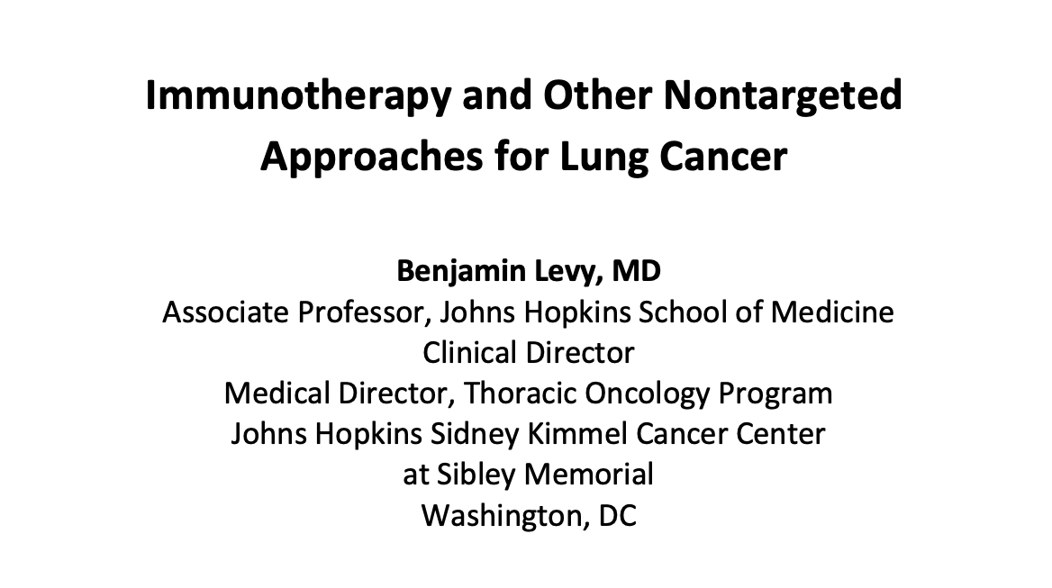

Slide 7
Key Datasets
Benjamin Levy, MD
Forde PM et al. Overall survival with neoadjuvant nivolumab (NIVO) + chemotherapy (chemo) in patients with resectable NSCLC in CheckMate 816. ASCO 2025;Abstract LBA8000.
Heymach JV et al. Perioperative durvalumab for resectable NSCLC (R-NSCLC): Updated outcomes from the Phase 3 AEGEAN trial. WCLC 2024;Abstract OA13.03.
Spicer JD et al. Neoadjuvant pembrolizumab plus chemotherapy followed by adjuvant pembrolizumab compared with neoadjuvant chemotherapy alone in patients with early-stage non-small-cell lung cancer (KEYNOTE-671): A randomised, double-blind, placebo-controlled, phase 3 trial. Lancet 2024;404(10459):1240-52.
Provencio M et al. Perioperative nivolumab (NIVO) vs placebo (PBO) in patients (pts) with resectable NSCLC: Updated survival and biomarker analyses from CheckMate 77T. ASCO 2025;Abstract LBA8010.
Filippi AR et al. Real-world 5-year survival outcomes with durvalumab (D) after chemoradiotherapy (CRT) in unresectable, stage III NSCLC (urNSCLC): Final data extraction from PACIFIC-R. ELCC 2025;Abstract 190P.
Reck M et al. Five-year outcomes with first-line nivolumab plus ipilimumab with 2 cycles of chemotherapy versus 4 cycles of chemotherapy alone in patients with metastatic non-small cell lung cancer in the randomized CheckMate 9LA trial. Eur J Cancer 2024;211:114296.
Peters S et al. Durvalumab with or without tremelimumab in combination with chemotherapy in first-line metastatic NSCLC: Five-year overall survival outcomes from the phase 3 POSEIDON trial. J Thorac Oncol 2025;20(1):76-93.

Slide 8
Key Datasets
Benjamin Levy, MD (continued)
Garassino MC et al. Normalized membrane ratio of TROP2 by quantitative continuous scoring is predictive of clinical outcomes in TROPION-Lung 01. WCLC 2024;Abstract PL02.11.
Levy BP et al. TROPION-Lung02: Datopotamab deruxtecan (Dato-DXd) plus pembrolizumab (pembro) with or without platinum chemotherapy (Pt-CT) as first-line (1L) therapy for advanced non-small cell lung cancer (aNSCLC). ASCO 2025;Abstract 8501.
Xiong A et al. Ivonescimab versus pembrolizumab for PD-L1-positive non-small cell lung cancer (HARMONi-2): A randomised, double-blind, phase 3 study in China. Lancet 2025;405(10481):839-49.
Aerts J et al. Acasunlimab (DuoBody-PD-L1x4-1BB) alone or in combination with pembrolizumab (pembro) in patients (pts) with previously treated metastatic non-small cell lung cancer (mNSCLC): Initial results of a randomized, open-label, phase 2 trial. ASCO 2024;Abstract 2533.
Paz-Ares L et al. ABBIL1TY NSCLC-06: A global, randomized, open-label, phase III trial of acasunlimab in combination with pembrolizumab (pembro) vs docetaxel in checkpoint inhibitor (CPI)-experienced patients with PD-L1+ metastatic non-small cell lung cancer (mNSCLC). ELCC 2025;Abstract 128TiP.
Mamdani H. Bispecific antibodies in action: Engineering immunity to target thoracic malignancies. ASCO 2025 Clinical Science Symposium.

Slide 9
Year in Review: Nontargeted Approaches for Lung Cancer
INTRODUCTION: The Boards
MODULE 1: Immune Checkpoint Inhibition for Localized Non-Small Cell Lung Cancer (NSCLC)
MODULE 2: Immunotherapy for Metastatic NSCLC
MODULE 3: Antibody-Drug Conjugates
MODULE 4: Novel Bispecific Antibodies
MODULE 5: Journal Club with Dr Levy

Slide 10
Year in Review: Nontargeted Approaches for Lung Cancer
INTRODUCTION: The Boards
MODULE 1: Immune Checkpoint Inhibition for Localized Non-Small Cell Lung Cancer (NSCLC)
MODULE 2: Immunotherapy for Metastatic NSCLC
MODULE 3: Antibody-Drug Conjugates
MODULE 4: Novel Bispecific Antibodies
MODULE 5: Journal Club with Dr Levy

Slide 11
Superior vena cava syndrome

Slide 12
Metastatic NSCLC with no actionable mutation and a PD-L1 TPS (tumor proportion score) between 1% and 50%

Slide 13
Metastatic NSCLC with an activating
EGFR mutation and brain metastases

Slide 14
FDA Grants Accelerated Approval to Datopotamab Deruxtecan-dlnk for EGFR-Mutated NSCLC Press Release: June 23, 2025
“On June 23, 2025, the Food and Drug Administration granted accelerated approval to datopotamab deruxtecan-dlnk for adults with locally advanced or metastatic epidermal growth factor receptor (EGFR)-mutated non-small cell lung cancer (NSCLC) who have received prior EGFR-directed therapy and platinum-based chemotherapy.
Efficacy was evaluated in a pooled subgroup of 114 patients with locally advanced or metastatic EGFR-mutated NSCLC who had received prior treatment with an EGFR-directed therapy and platinum-based chemotherapy and received datopotamab deruxtecan-dlnk at the recommended dose across two clinical trials: TROPION-Lung05 and TROPION-Lung01. TROPION-Lung05 (NCT04484142) was a multicenter, single-arm trial, while TROPION-Lung01 (NCT04656652) was a multicenter, open-label, randomized controlled trial.
The recommended datopotamab deruxtecan-dlnk dose is 6 mg/kg (up to a maximum of 540 mg for patients ≥ 90 kg), as an intravenous infusion once every 3 weeks, until disease progression or unacceptable toxicity.”
https://www.fda.gov/drugs/resources-information-approved-drugs/fda-grants-accelerated-approval-datopotamab-deruxtecan-dlnk-egfr-mutated-non-small-cell-lung-cancer

Slide 15
Year in Review: Nontargeted Approaches for Lung Cancer
INTRODUCTION: The Boards
MODULE 1: Immune Checkpoint Inhibition for Localized Non-Small Cell Lung Cancer (NSCLC)
MODULE 2: Immunotherapy for Metastatic NSCLC
MODULE 3: Antibody-Drug Conjugates
MODULE 4: Novel Bispecific Antibodies
MODULE 5: Journal Club with Dr Levy

Slide 16
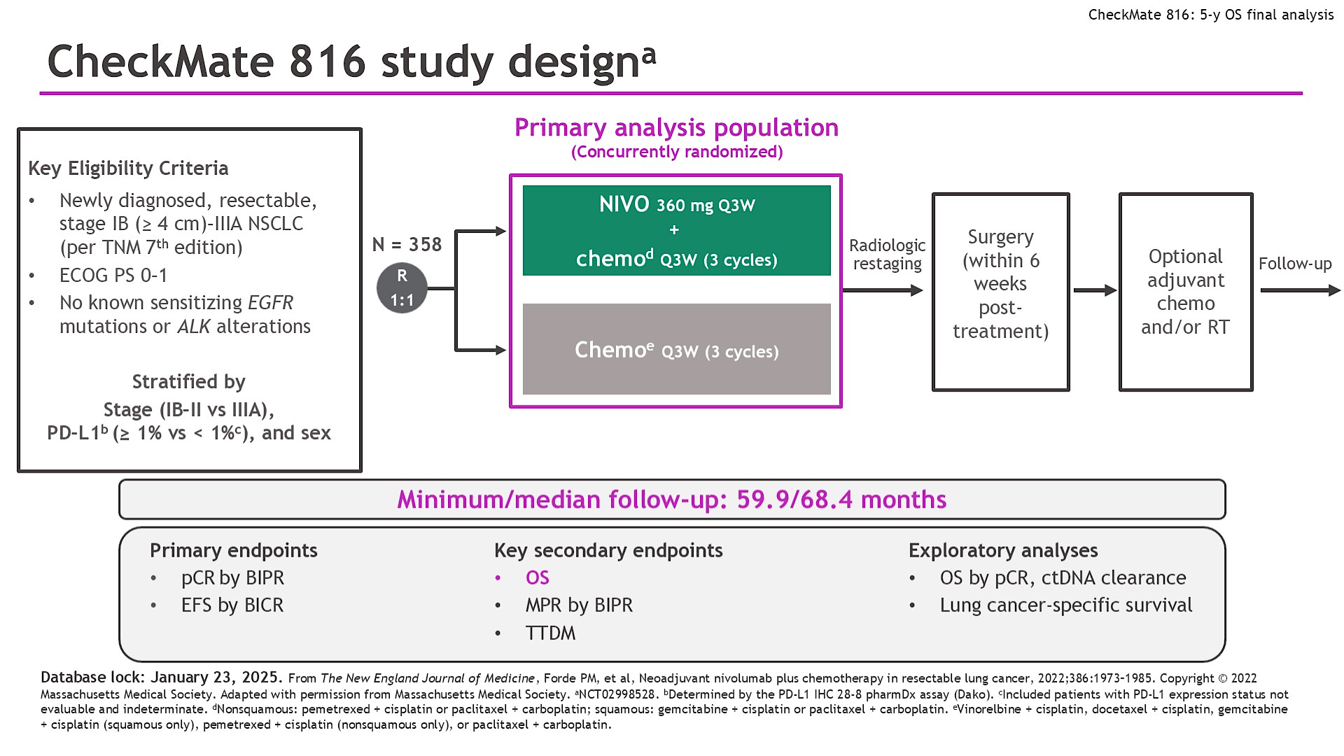
CheckMate 816 study designa
Frode ASCO 2025;Abstract LBA8000

Slide 17
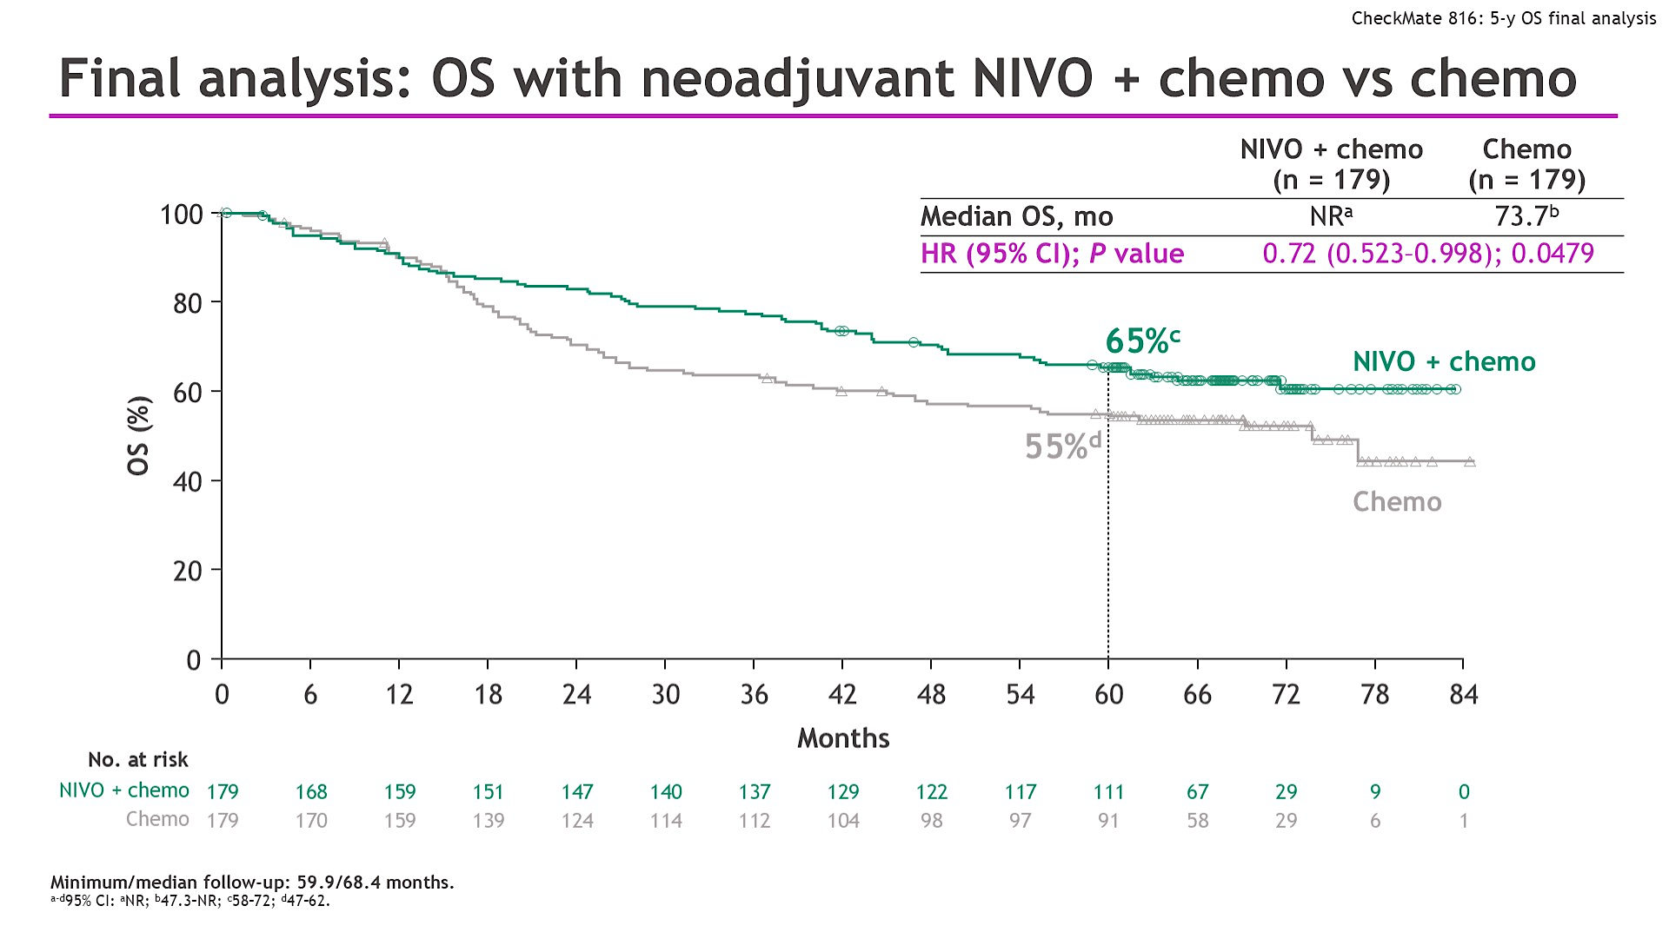
Final analysis: OS with neoadjuvant NIVO + chemo vs chemo
Frode ASCO 2025;Abstract LBA8000

Slide 18
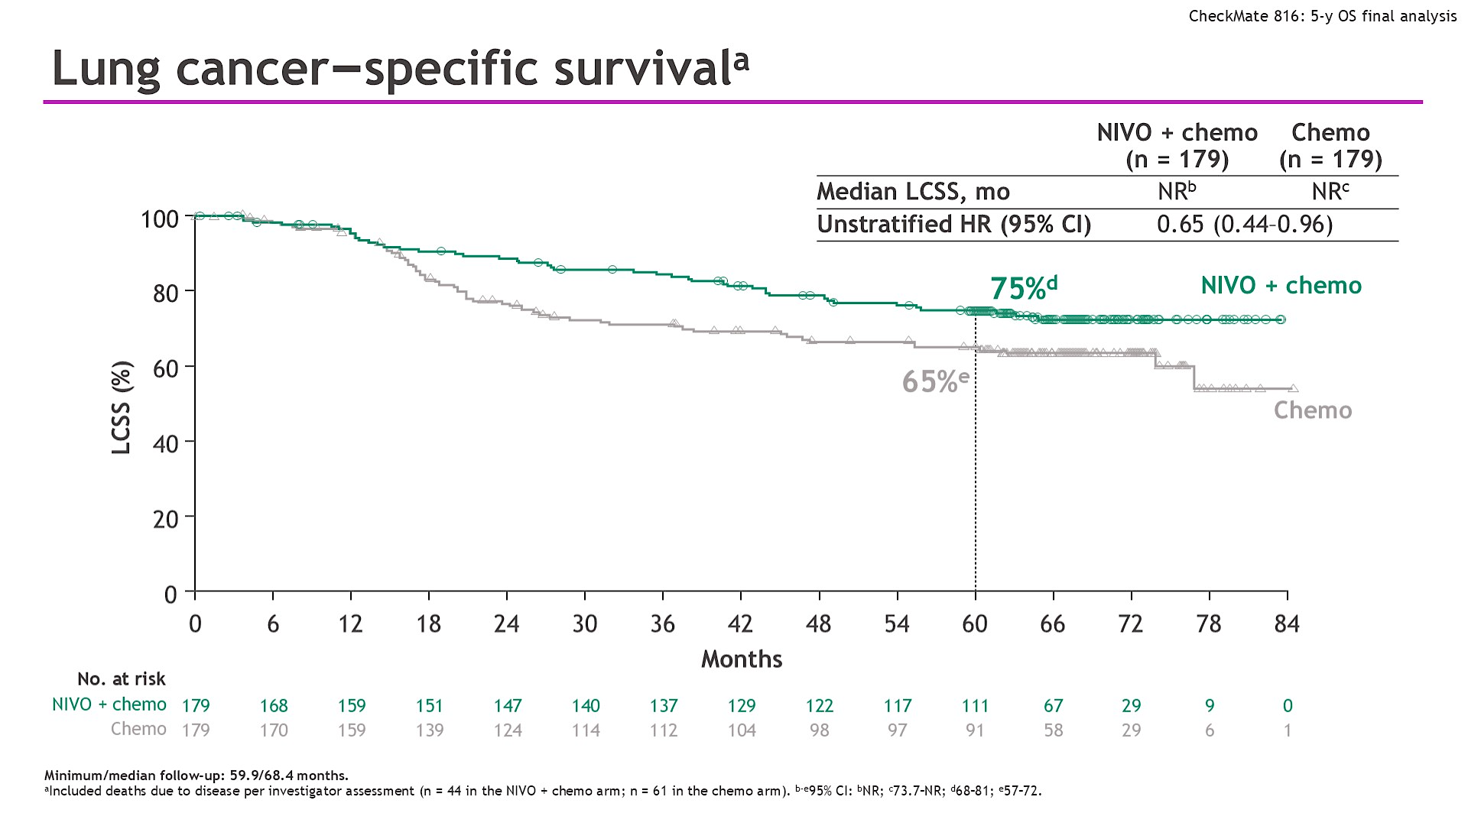
Lung cancer–specific survivala
Frode ASCO 2025;Abstract LBA8000

Slide 19
AEGEAN: A phase 3, global, randomized, double-blind, placebo-controlled study
Study population
Treatment-naïve
ECOG PS 0 or 1
Resectable NSCLC* (stage IIA–IIIB[N2]; AJCC 8th ed)
Lobectomy, sleeve resection, or bilobectomy as planned surgery*
Confirmed PD-L1 status†
No documented EGFR/ALK aberrations*
Durvalumab 1500 mg IV + platinum-based CT‡
Q3W for 4 cycles
Durvalumab 1500 mg IV Q4W for 12 cycles
Surgery §
Randomization stratified by:
Disease stage (II vs III)
PD-L1 expression (≥1% vs <1%)
R
1:1
Placebo IV + platinum-based CT‡
Q3W for 4 cycles
Placebo IV
Q4W for 12 cycles
Surgery §
N=802 randomized
Endpoints: All efficacy analyses performed on a modified population that excludes patients with documented EGFR/ALK aberrations¶
Primary: pCR by central lab (per IASLC 2020¹) EFS using BICR (per RECIST v1.1) | Key secondary: MPR by central lab (per IASLC 2020¹) DFS using BICR (per RECIST v1.1) OS
*The protocol was amended while enrollment was ongoing to exclude (1) patients with tumors classified as T4 for any reason other than size; (2) patients with planned pneumonectomies; and (3) patients with documented EGFR/ALK aberrations. †Ventana SP263 immunohistochemistry assay. ‡Choice of CT regimen determined by histology and at the investigator’s discretion. For non-squamous: cisplatin + pemetrexed or carboplatin + pemetrexed. For squamous: carboplatin + paclitaxel or cisplatin + gemcitabine (or carboplatin + gemcitabine for patients who have comorbidities or who are unable to tolerate cisplatin per the investigator’s judgment). §Post-operative radiotherapy (PORT) was permitted where indicated per local guidance. ¶All efficacy analyses reported in this presentation were performed on the mITT population, which includes all randomized patients who did not have documented EGFR/ALK aberrations. AJCC, American Joint Committee on Cancer; BICR, blinded independent central review; DFS, disease-free survival; EFS, event-free survival; mITT, modified intent-to-treat; MPR, major pathologic response; pCR, pathologic complete response.
¹Travis WD, et al. J Thorac Oncol 2020;15:709-40.

Slide 20
AEGEAN: Pathologic response per IASLC 2020 methodology* (mITT) Final analysis
pCR (central lab)
MPR (central lab)
Difference = 21.0%
(95% CI: 15.1–26.9)†
Difference = 13.0%
(95% CI: 8.7–17.6)†
P-value = 0.000002 based on interim analysis (n=402)‡
pCR rate (%)
MPR rate (%)
P-value = 0.000036 based on interim analysis (n=402)‡
D arm (N=366)
PBO arm (N=374)
D arm (N=366)
PBO arm (N=374)
Heymach AACR 2023; Abstract CT005
*Using IASLC recommendations for pathologic assessment of response to therapy, including gross assessment and processing of tumor bed (Travis WD, et al. J Thorac Oncol 2020;15:709-40). pCR = a lack of any viable tumor cells after complete evaluation of the resected lung cancer specimen and all sampled regional lymph nodes. MPR = less than or equal to 10% viable tumor cells in lung primary tumor after complete evaluation of the resected lung cancer specimen. To be eligible for pathologic assessment, patients needed to have received three cycles of neoadjuvant study Tx per protocol. Patients who were not evaluable were classified as non-responders. †CIs calculated by stratified Miettinen and Nurminen method. ‡No formal statistical testing was performed at the pCR final analysis (DCO: Nov 10, 2022; n=740 [data shown]). Statistical significance was achieved at the interim pCR analysis (DCO: Jan 14, 2022; n=402; P-value for pCR/MPR calculated using a stratified Cochran-Mantel-Haenszel test with a significance boundary = 0.000082 calculated using a Lan-DeMets alpha spending function with O'Brien Fleming boundary).

Slide 21
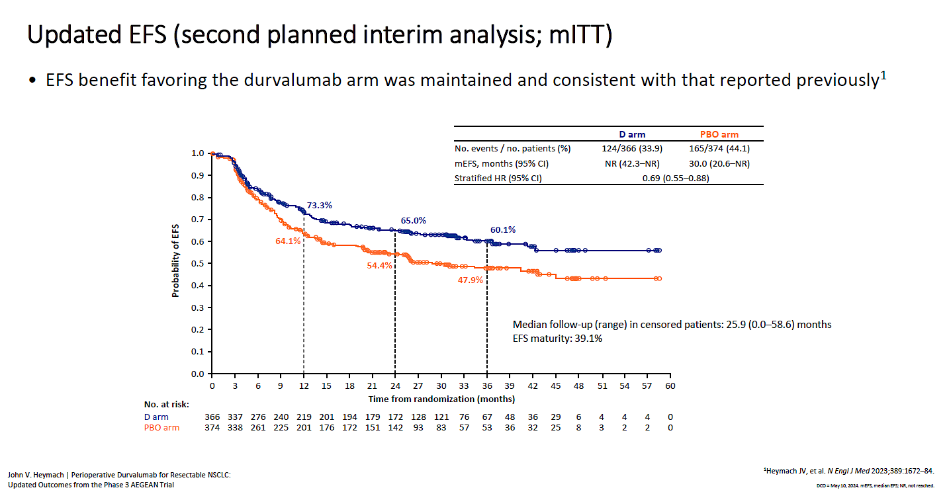
AEGEAN: Updated Event Free Survival

Slide 22
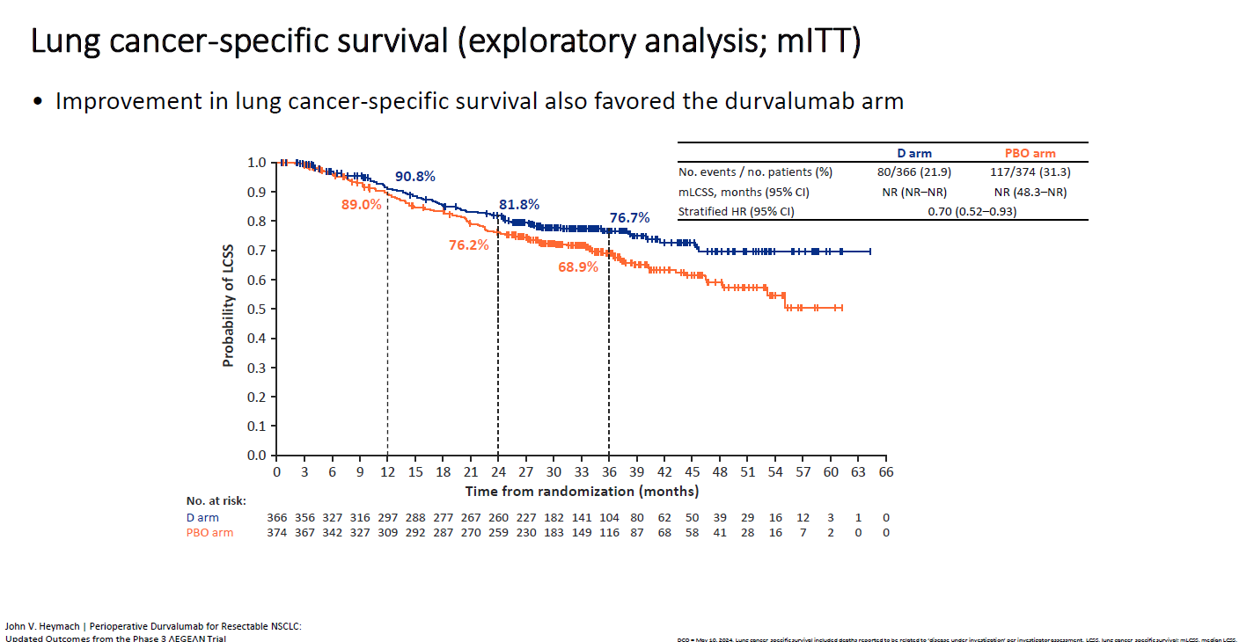
AEGEAN: Updated Overall Survival

Slide 23
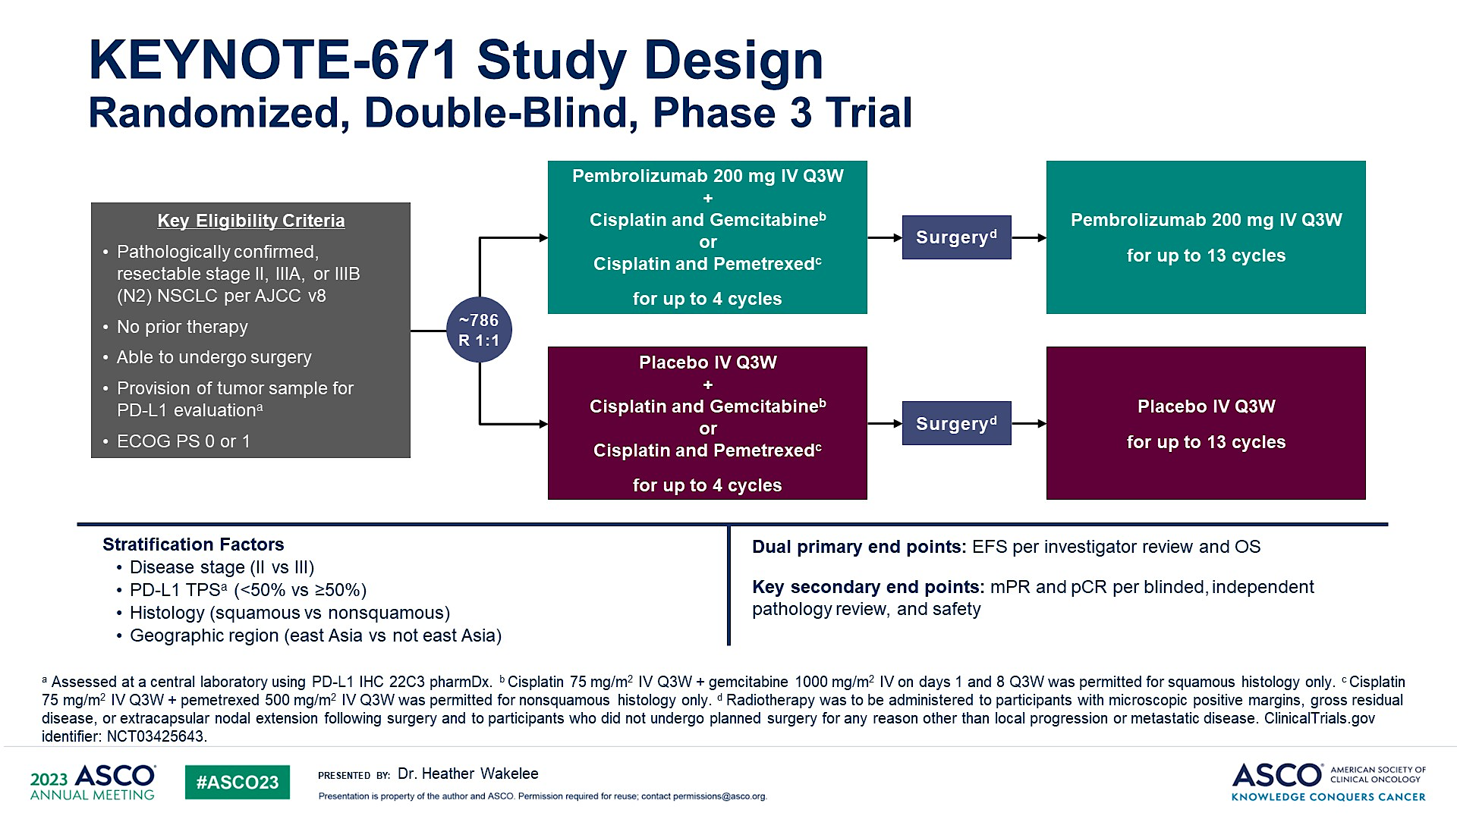
KEYNOTE-671 Study Design<br />Randomized, Double-Blind, Phase 3 Trial
Wakelee ASCO 2023; Abstract LBA1000

Slide 24
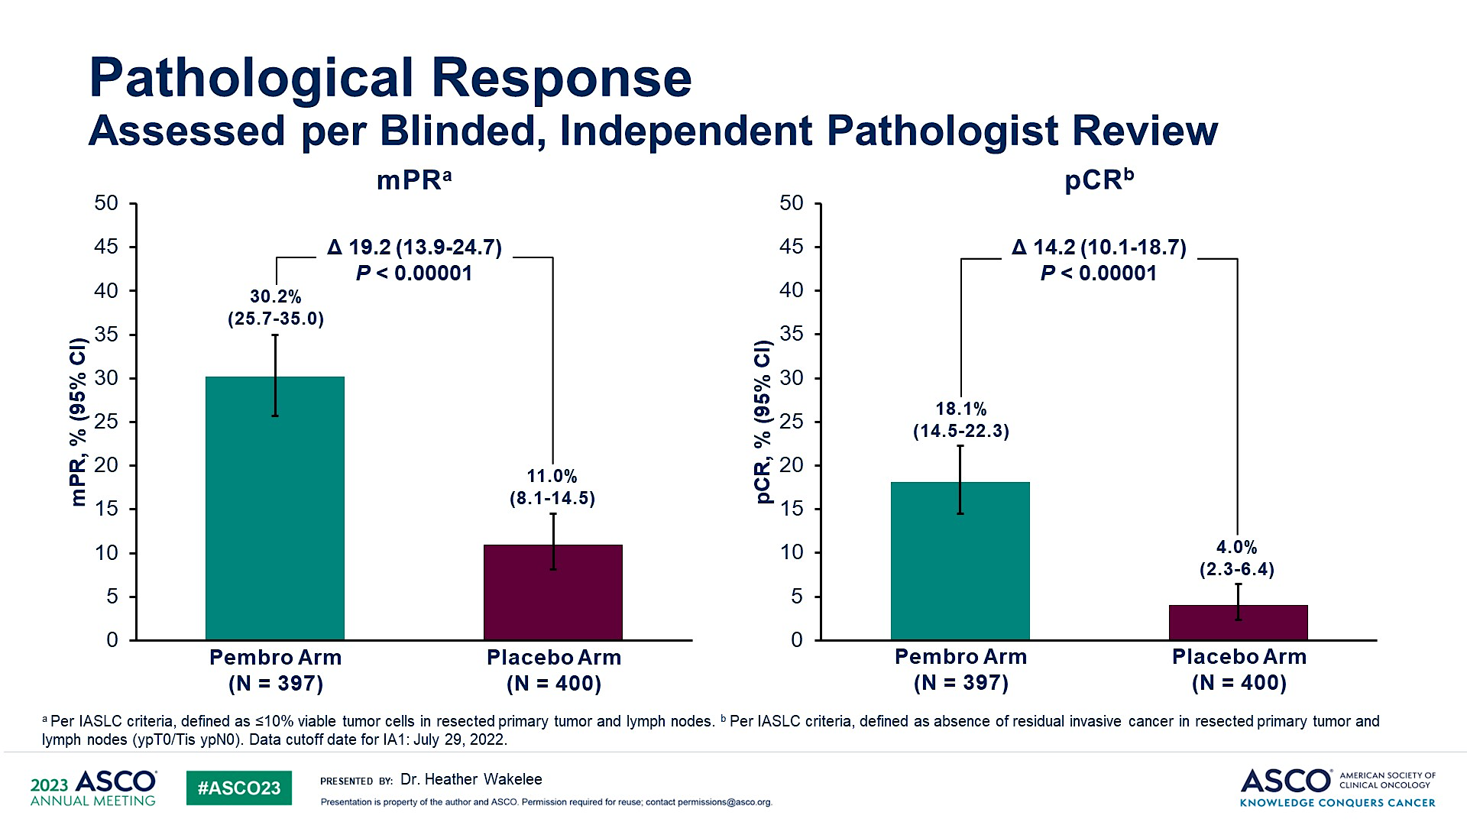
Pathological Response<br />Assessed per Blinded, Independent Pathologist Review
KEYNOTE-671
Wakelee ASCO 2023; Abstract LBA1000

Slide 25
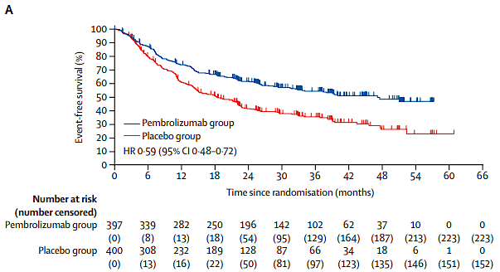
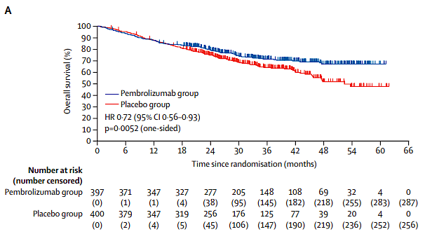
KEYNOTE-671: Updated Overall Survival
Event Free Survival
Overall Survival

Slide 26
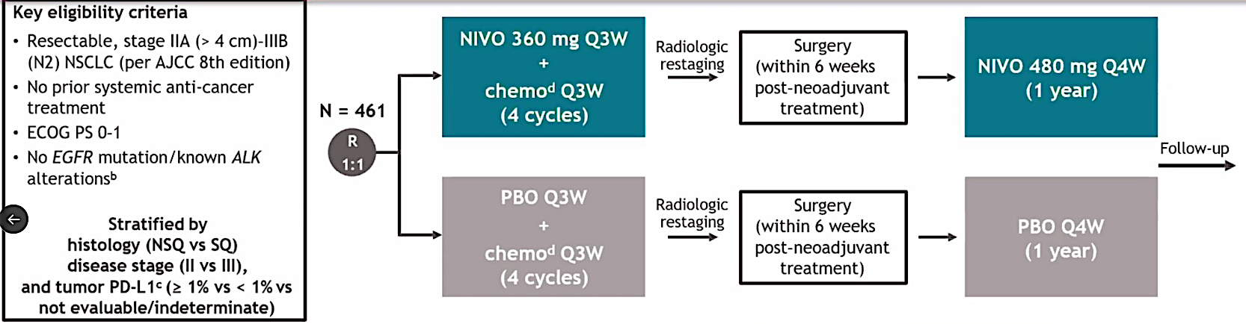
CHECKMATE-77T
Cascone ESMO 2023; Abstract LBA1

Slide 27
OS and lung cancer–specific survival
OS
Lung cancer–specific survival^{d}
 | NIVO (n = 229) | PBO (n = 232)
Median OS, mo (95% CI) | NR (NR–NR) | NR (NR–NR)
HR (97.63% CI)ª | 0.85 (0.58–1.25) | 0.97 (0.83–1.15)
 | NIVO (n = 229) | PBO (n = 232)
Median lung cancer–specific survival, mo (95% CI) | NR (NR–NR) | NR (NR–NR)
HR (95% CI) | 0.60 (0.40–0.89) | 0.97 (0.83–1.15)
100
100
89%
87%^{e}
80%
78%^{b}
NIVO
80
NIVO
80
80%
77%
72%^{c}
75%^{f}
60
60
PBO
OS (%)
PBO
Lung cancer–specific survival (%)
40
40
20
20
0
0
0
6
12
18
24
30
36
42
48
54
60
0
6
12
18
24
30
36
42
48
54
60
Months from randomization
Months from randomization
No. at risk
NIVO
229
206
187
176
166
161
114
66
23
6
0
229
206
187
176
166
161
114
66
23
6
0
PBO
232
216
197
178
161
152
103
52
20
7
0
232
216
197
178
161
152
103
52
20
7
0
Median follow-up (range): 41.0 months (31.3–59.8).
67 (29%) patients in the NIVO arm and 101 (44%) patients in the PBO arm received subsequent therapy of any type; 50 (22%) and 87 (38%) patients, respectively, received subsequent systemic therapy. ªHR (95% CI), 0.85 (0.61–1.18). Significance boundary for OS was not met at this interim analysis. ^{b,c}95% CI: ^{b}72–83; ^{c}66–78. ^{d}Exploratory analysis; events were deaths with noted reason of “disease” per investigator assessment. ^{e,f}95% CI: ^{e}82–91; ^{f}69–81.
Provencio ASCO 2025;Abstract LBA8010

Slide 28
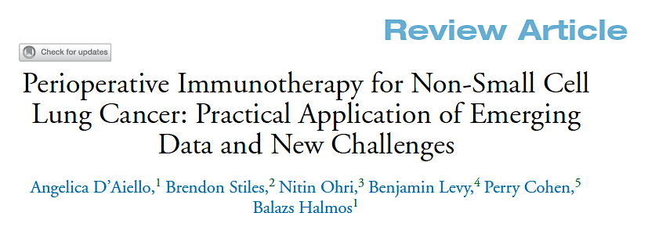

Clin Lung Cancer 2024;25(3):197-214.

Slide 29
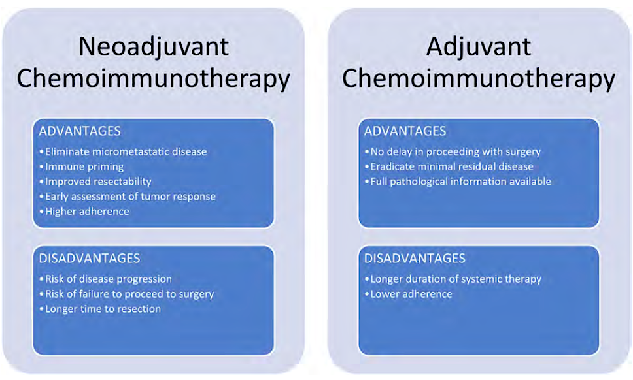
Neoadjuvant and Adjuvant Advantages and Disadvantages
D’Aiello A et al. Clin Lung Cancer 2024;25(3):197-214.

Slide 30
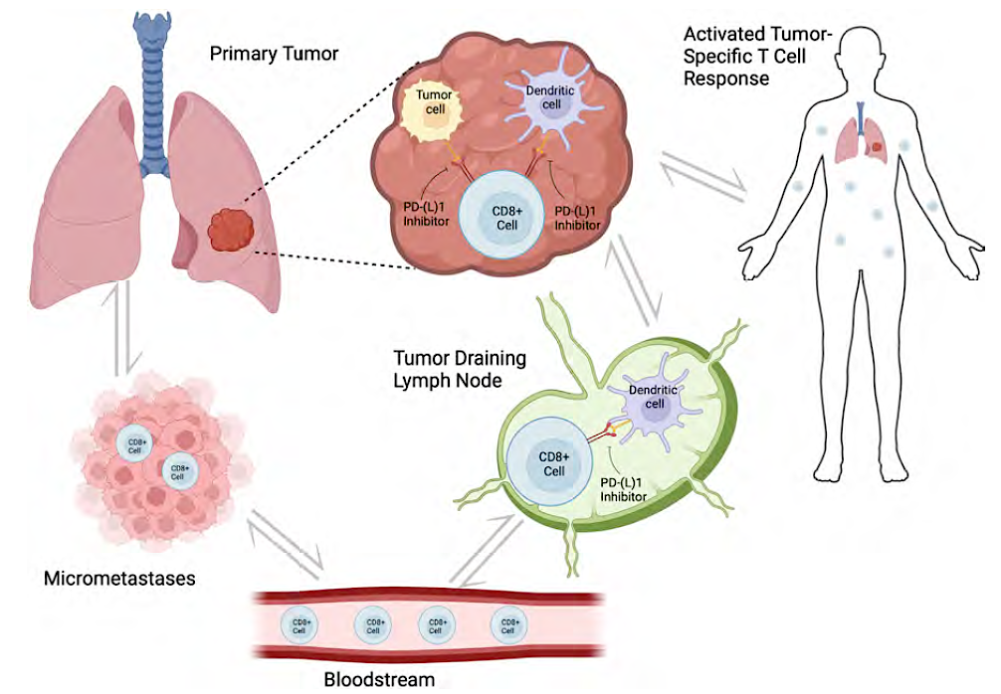
Neoadjuvant Biology
D’Aiello A et al. Clin Lung Cancer 2024;25(3):197-214.

Slide 31
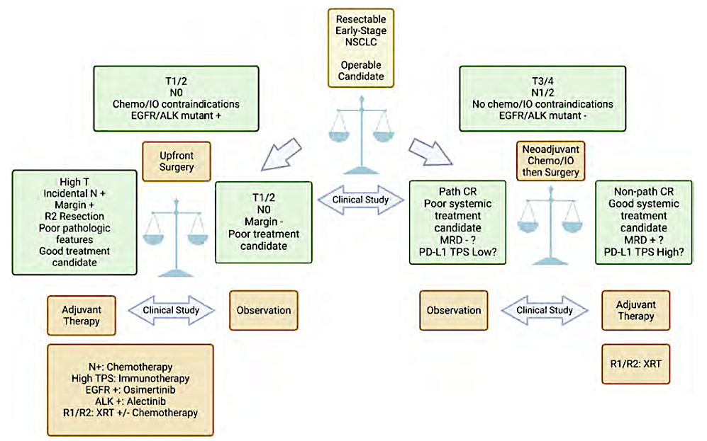
Practical Implementation and Patient Navigation for Perioperative Immunotherapy in NSCLC
D’Aiello A et al. Clin Lung Cancer 2024;25(3):197-214.

Slide 32
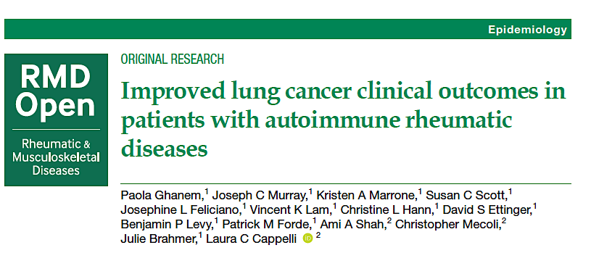
2023;9(4):e003471.

Slide 33
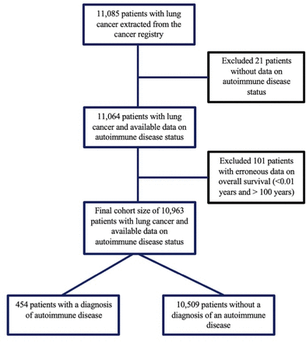
Flow Diagram of Cohort Selection
Ghanem P et al. RMD Open 2023;9(4):e003471.

Slide 34
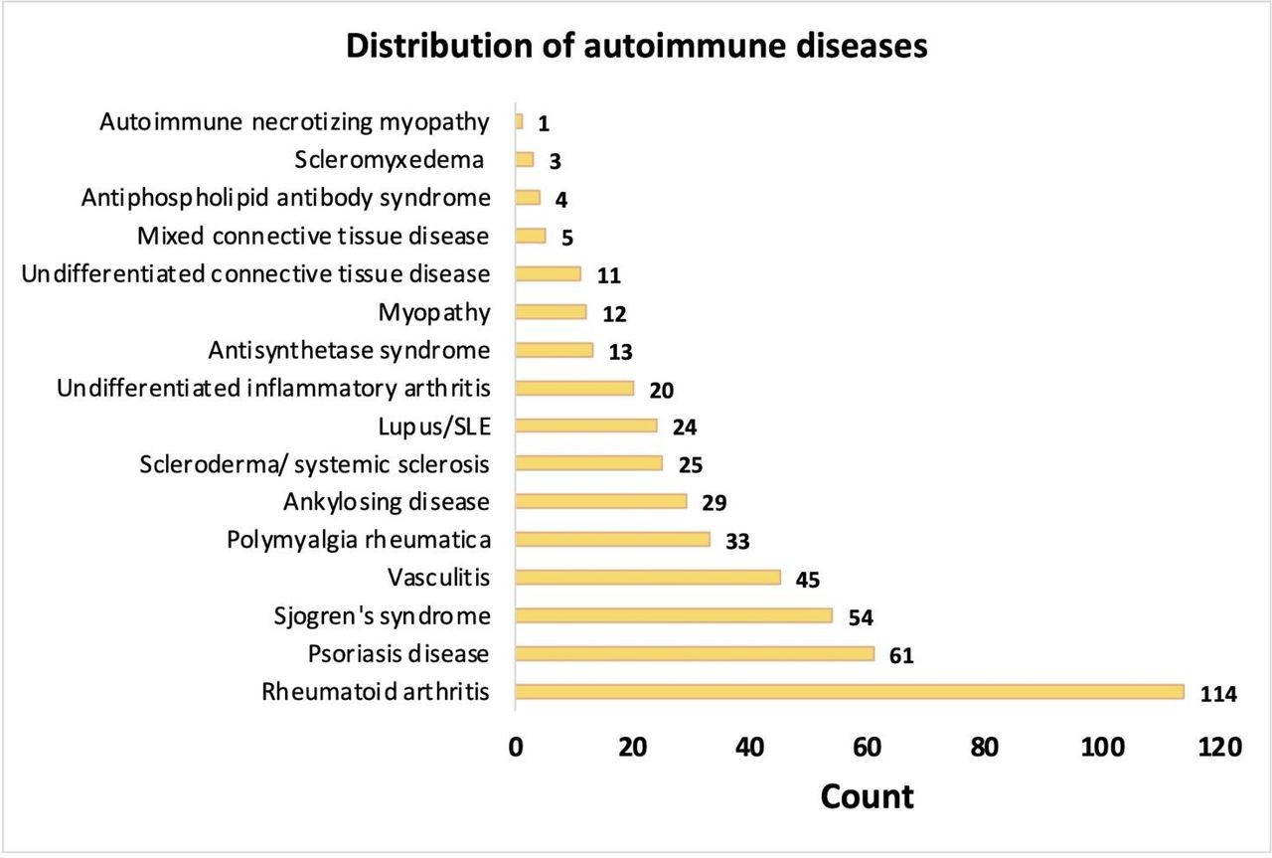
Distribution of Autoimmune Diseases
Ghanem P et al. RMD Open 2023;9(4):e003471.

Slide 35
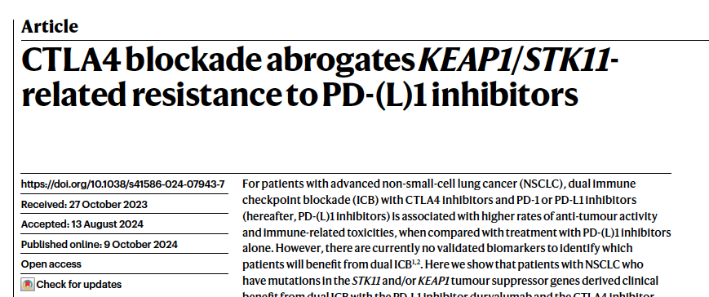
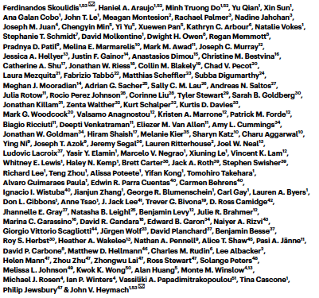
Nature 2024;635(8038):462-71.

Slide 36
PACIFIC: 5 YEAR OUTCOMES
Spigel et al. JCO 2022

Slide 37

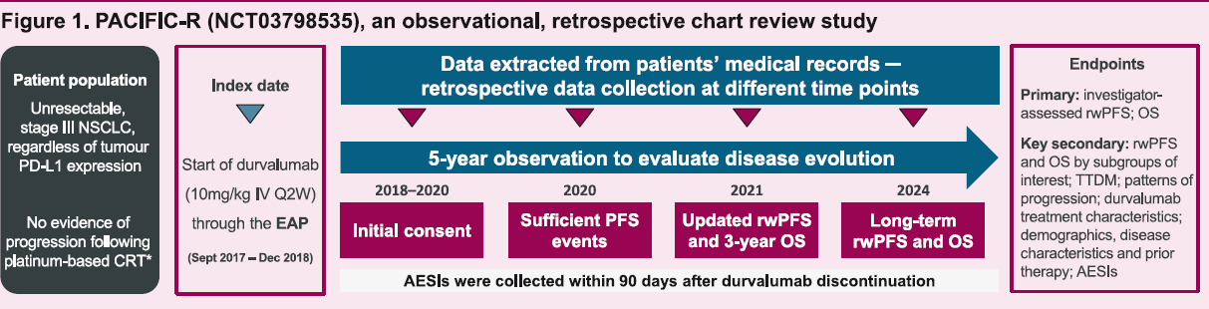
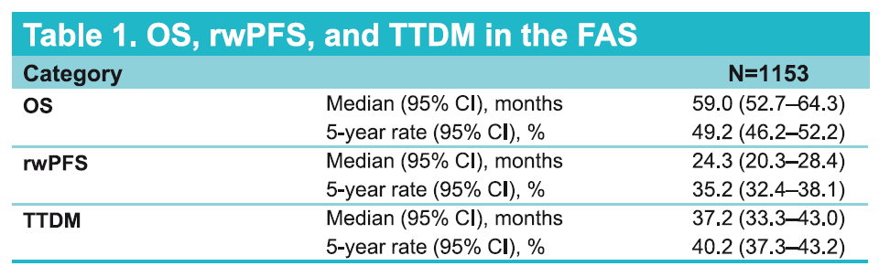
No evidence of progression following platinum-based CRT*
Filippi ELCC 2025;Abstract 190P

Slide 38
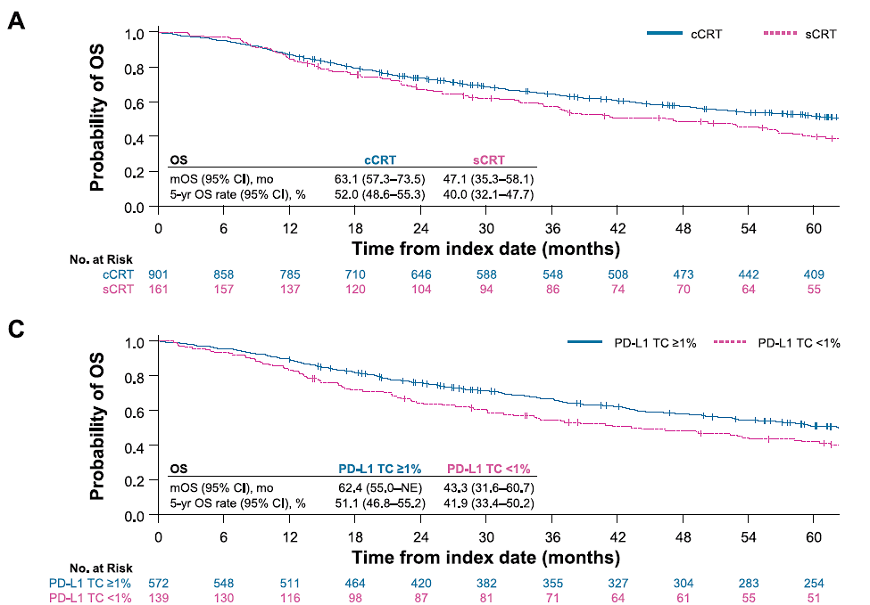
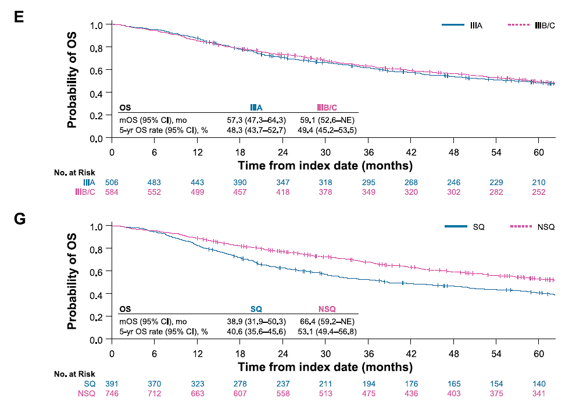
PACIFIC-RW OUTCOMES
Filippi ELCC 2025;Abstract 190P

Slide 39
QUESTIONS?

Slide 40
Year in Review: Nontargeted Approaches for Lung Cancer
INTRODUCTION: The Boards
MODULE 1: Immune Checkpoint Inhibition for Localized Non-Small Cell Lung Cancer (NSCLC)
MODULE 2: Immunotherapy for Metastatic NSCLC
MODULE 3: Antibody-Drug Conjugates
MODULE 4: Novel Bispecific Antibodies
MODULE 5: Journal Club with Dr Levy

Slide 41
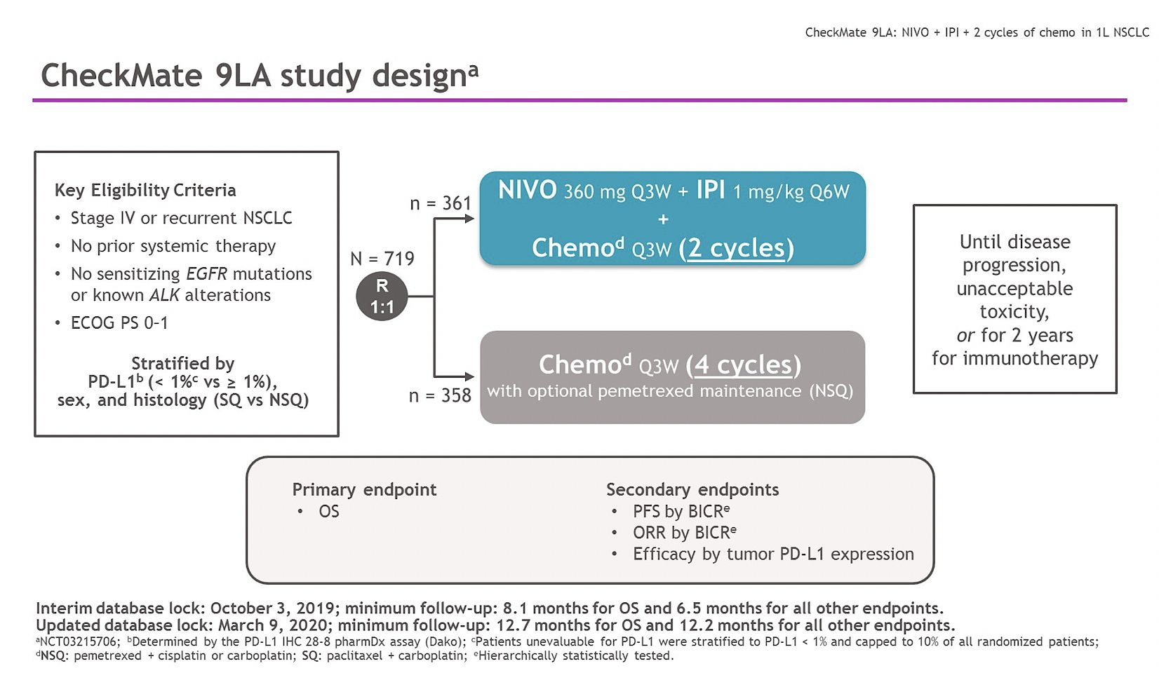
Reck ASCO 2024;Abstract 8560

Slide 42
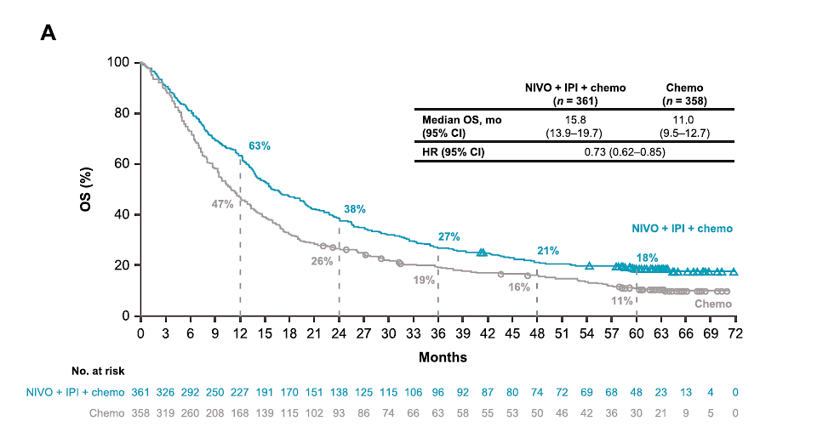
CheckMate 9LA: IIT UPDATED OS
Reck Eur J Cancer 2024

Slide 43
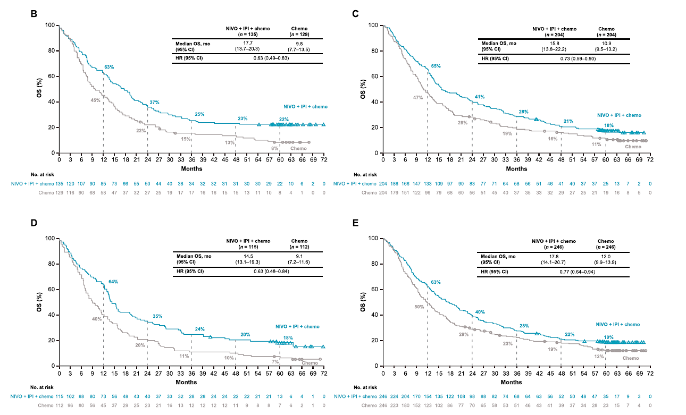
CheckMate 9LA: UPDATED OS
PD-L1 < 1%
PD-L1 > 1%
Squamous
Non-Squamous
Reck Eur J Cancer 2024

Slide 44
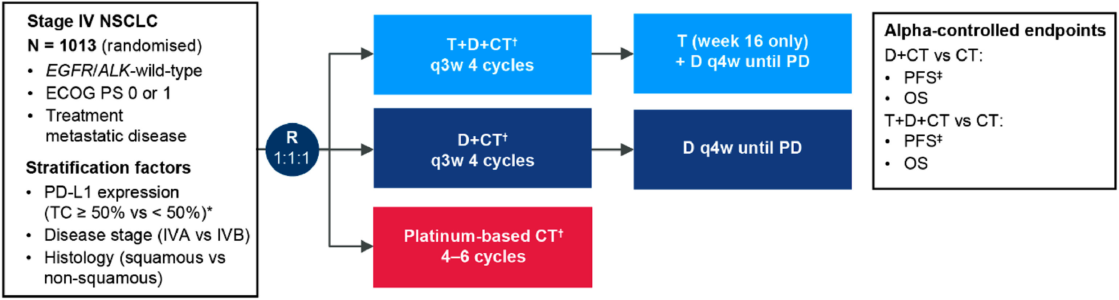
POSEIDON STUDY DESIGN
Garon Clin Lung Cancer 2024

Slide 45
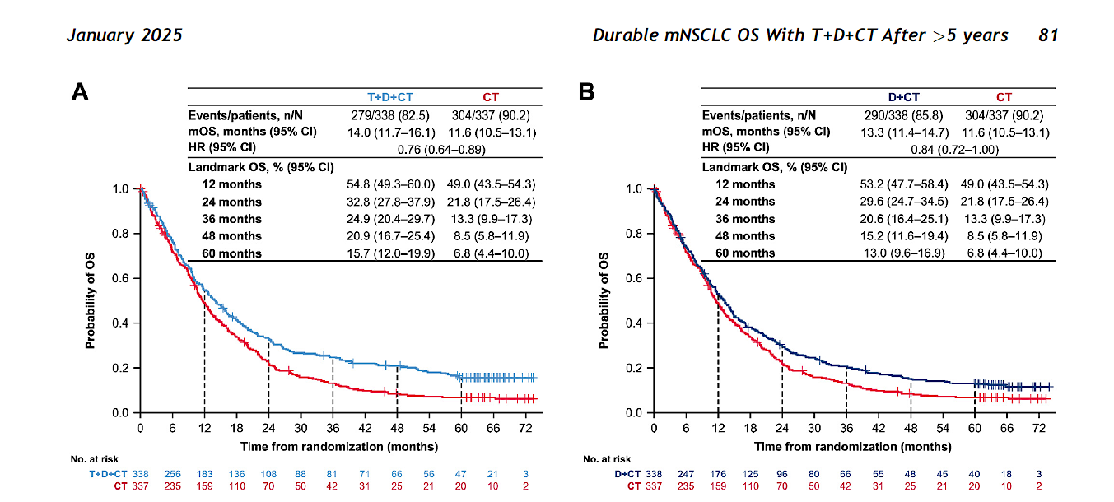
POSEIDON: UPDATED OS
Peters J Thorac Oncol 2025

Slide 46
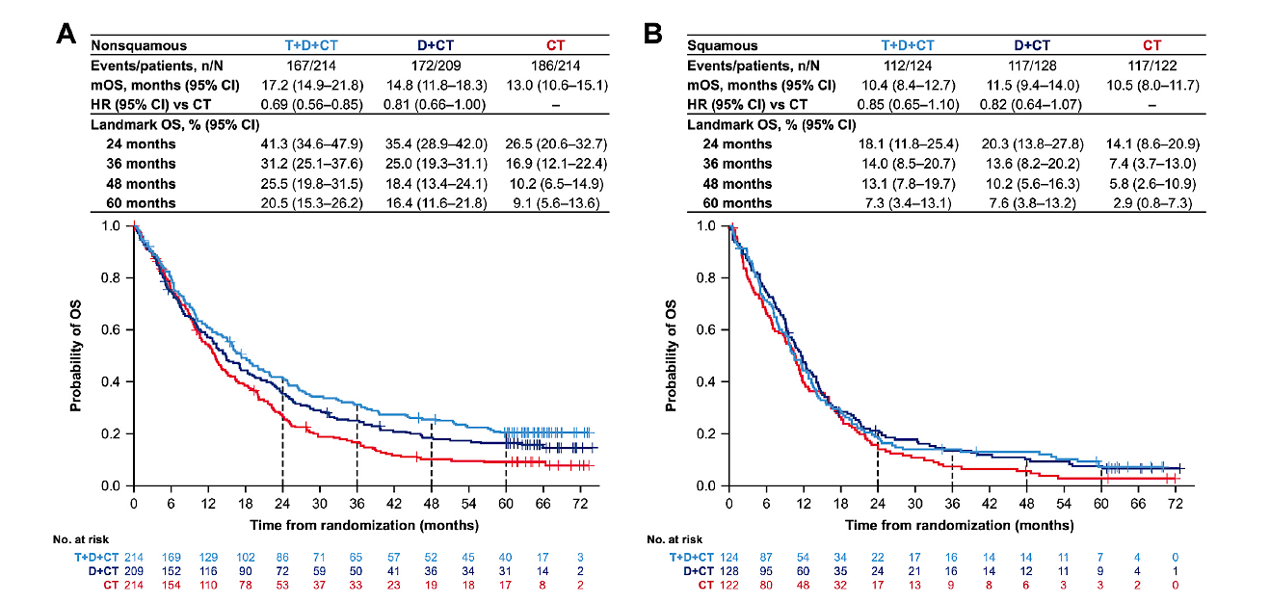
POSEIDON: UPDATED OS
Peters J Thorac Oncol 2025

Slide 47
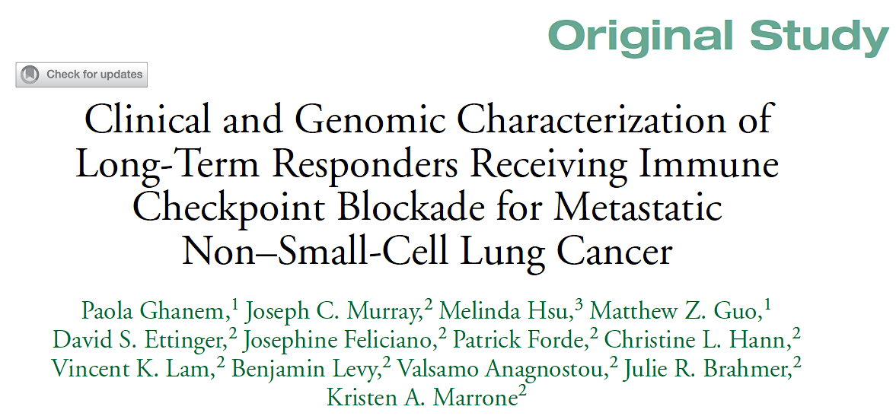
Clin Lung Cancer 2024;25(2):109-18.

Slide 48
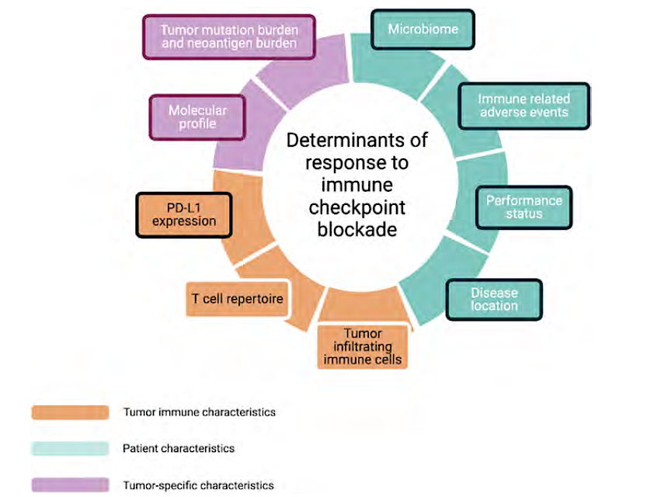
Determinants of Clinical Benefit with Immune Checkpoint Blockade
Ghanem P et al. Clin Lung Cancer 2024;25(2):109-18.

Slide 49
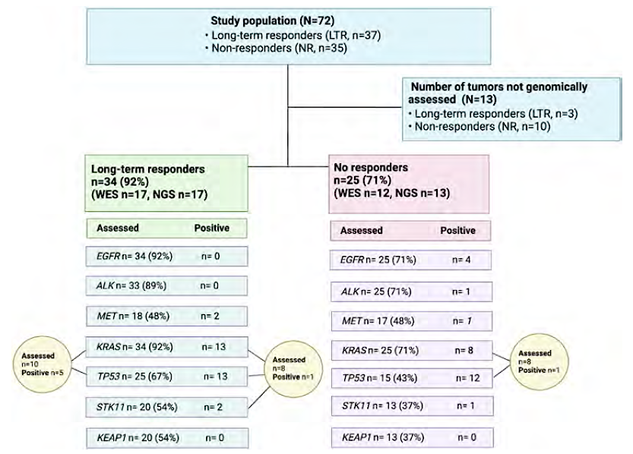
Genomic Features by Cohort
Ghanem P et al. Clin Lung Cancer 2024;25(2):109-18.

Slide 50
QUESTIONS?

Slide 51
Year in Review: Nontargeted Approaches for Lung Cancer
INTRODUCTION: The Boards
MODULE 1: Immune Checkpoint Inhibition for Localized Non-Small Cell Lung Cancer (NSCLC)
MODULE 2: Immunotherapy for Metastatic NSCLC
MODULE 3: Antibody-Drug Conjugates
MODULE 4: Novel Bispecific Antibodies
MODULE 5: Journal Club with Dr Levy

Slide 52
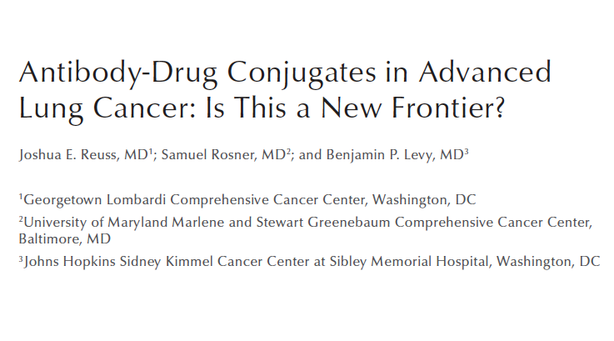
Clin Adv Hematol Oncol 2024;22(5):217-26.

Slide 53
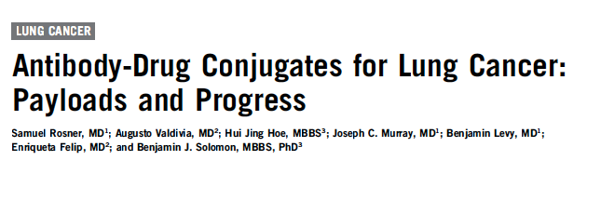
Am Soc Clin Oncol Educ Book 2023;43:e389968.

Slide 54
Datopotamab Deruxtecan vs Docetaxel in NSCLC TROPION-Lung01: Study Design
Key Eligibility Criteria
NSCLC (stage IIIB, IIIC, or IV)
ECOG PS of 0 or 1
No prior docetaxel
Without actionable genomic alterations
1 or 2 prior lines, including platinum CT and anti–PD-(L)1 mAb therapy
With actionable genomic alterations
Positive for EGFR, ALK, NTRK, BRAF, ROS1, MET exon 14 skipping, or RET
1 or 2 prior approved targeted therapies + platinum-based CT, and ≤ 1 anti–PD-(L)1 mAb
Dato-DXd
6 mg/kg IV Q3W
(n = 299)
Primary Endpoints
PFS assessed by BICR, per RECIST v1.1 OS
Key Secondary Endpoints
ORR by BICR DOR by BICR Safety
N = 590
R 1:1
Docetaxel
75 mg/m² Q3W
(n = 305)
Stratification by
Histology (actionable genomic alteration)
Anti-PD-(L)1 mAb included in most recent prior therapy, geography

Slide 55
Datopotamab Deruxtecan vs Docetaxel in NSCLC TROPION-Lung01: Primary Endpoints
Dual primary endpoints: PFS endpoint met, but OS endpoint not met
 | Dato-DXd (n = 299) | Docetaxel (n = 305)
No. of events/No. of patients | 213/299 | 218/305
Median PFS, months (95% CI) | 4.4 (4.2-5.6) | 3.7 (2.9-4.2)
HR (95% CI) P value | 0.75 (0.62-0.91) 0.004
100
80
 | Datopotamab deruxtecan | Docetaxel
ORR | 26.4% | 12.8%
mDOR | 7.1 mos | 5.6 mos
mPFS | 4.4 mos | 3.7 mos
mOS | 12.9 mos | 11.8 mos
60
PFS (%)
40
Dato-DXd
20
Docetaxel
0
0
2
4
6
8
10
12
14
16
18
Months
 | Dato-DXd (n = 299) | Docetaxel (n = 305)
No. of events/No. of patients | 215/299 | 218/305
Median OS, months (95% CI) | 12.9 (11.0-13.9) | 11.8 (10.0-12.8)
HR (95% CI) P value | 0.94 (0.78-1.14) 0.530
100
80
60
OS (%)
40
Dato-DXd
20
Docetaxel
0
0
2
4
6
8
10
12
14
16
18
20
22
24
26
28
30
32
34
Months
Ahn MJ J Clin Oncol. 2025

Slide 56
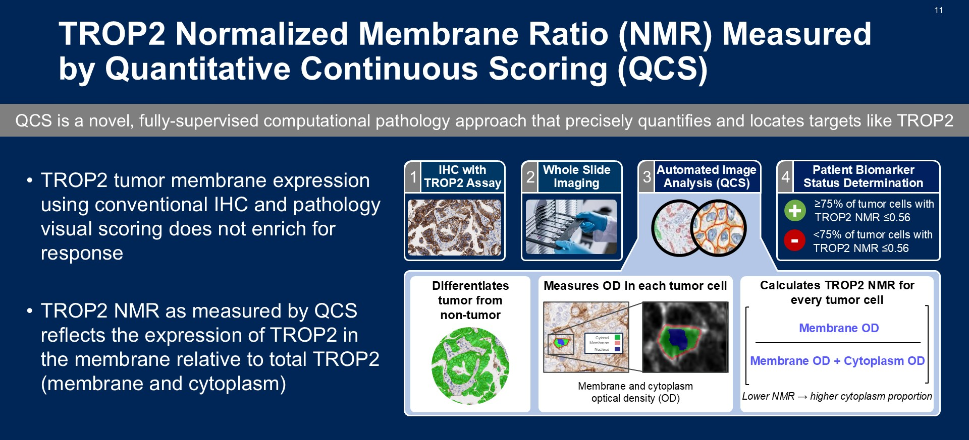
Slide 11
Levy ASCO 2025; Abstract 8501

Slide 57
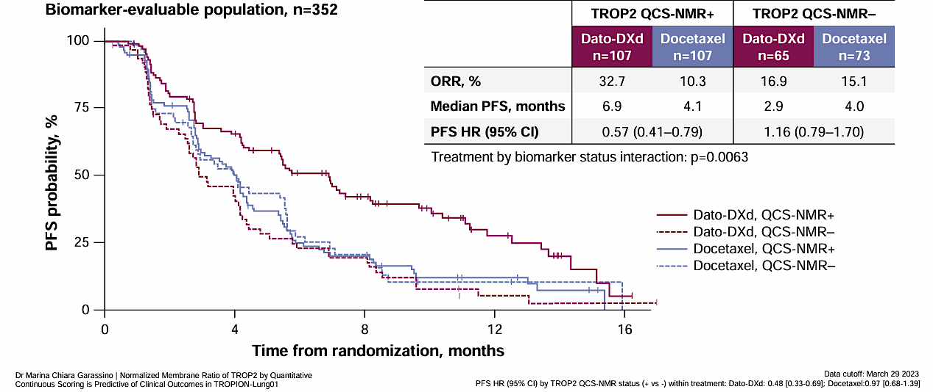
Overall BEP: Efficacy by TROP2 QCS-NMR Status
TROP2 QCS-NMR positivity is predictive for longer PFS with Dato-DXd in the biomarker-evaluable population
Garassino et al WCLC 2024

Slide 58
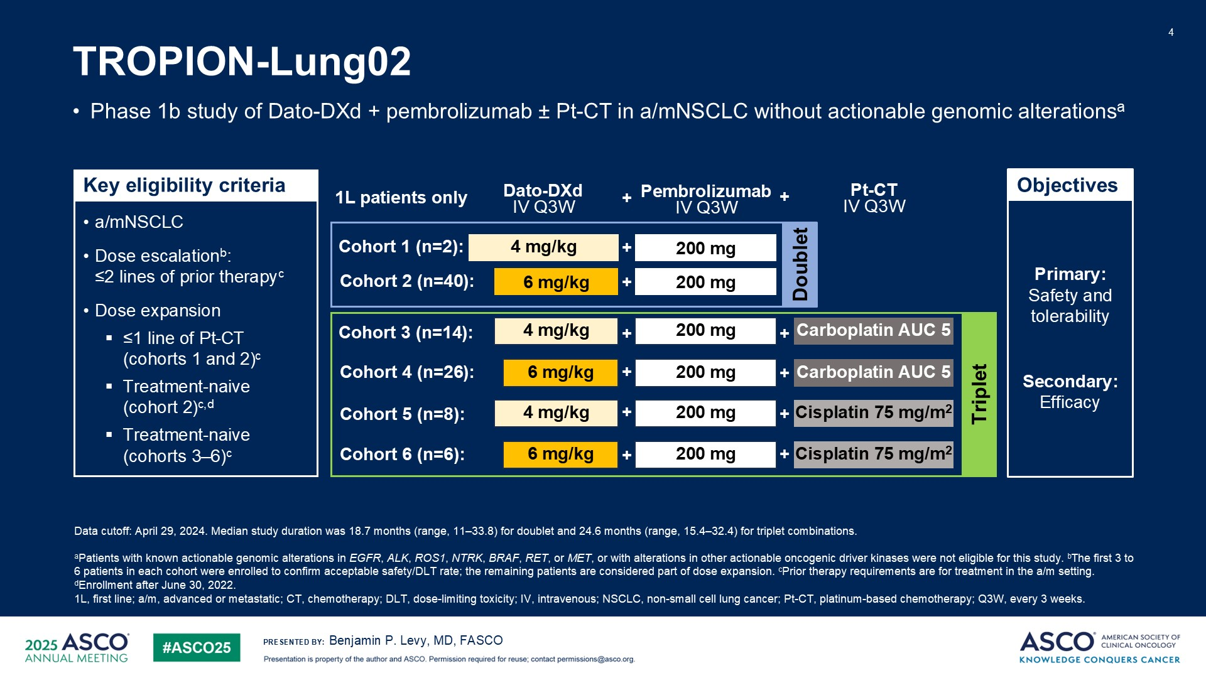
TROPION-Lung02

Slide 59
TROPION-Lung02: Efficacy, 1L Doublet
 | Doublet (n=42)
Confirmed ORR*, n (%) | 23 (54.8)
95% CI | 38.7–70.2
Median DOR, months | 20.1
95% CI | 9.7–NE
DCR, n (%) | 37 (88.1)
95% CI | 74.4–96.0
Median TTR, months | 1.4
Range | 1.2–7.0
Median PFS, months | 11.2
95% CI | 8.2–21.3
Median OS, months | NE
95% CI | 19.2–NE
Progression-Free Survival
100
Median PFS (95% CI)
Doublet: 11.2 months (8.2–21.3)
80
60
Progression-free survival (%)
40
20
Censored
0
0
2
4
6
8
10
12
14
16
18
20
22
24
26
28
30
32
Time since start of treatment (months)
No. at risk:
Doublet 42 36 32 28 25 22 12 10 8 6 5 4 4 4 2 0
Data cutoff: April 29, 2024. *1 CR, 22 PR. Pooled data including patients who received Dato-DXd 4mg/kg (5%) and Dato-DXd 6 mg/kg (doublet: 95%)
1L, first line; BOR, best overall response; CI, confidence interval; CR, complete response; DCR, disease control rate; DOR, duration of response; NE, not evaluable; ORR, objective response rate; PR, partial response;
TTR, time to response.
Benjamin P. Levy, MD, FASCO

Slide 60
TROPION-Lung02: Efficacy, 1L Triplet
Progression-Free Survival
 | Triplet (n=54)
Confirmed ORR*, n (%) | 30 (55.6)
95% CI | 41.4–69.1
Median DOR, months | 13.7
95% CI | 5.7–NE
DCR, n (%) | 48 (88.9)
95% CI | 77.4–95.8
Median TTR, months | 1.4
Range | 1.2–9.6
Median PFS, months | 6.8
95% CI | 5.5–11.1
Median OS, months | 17.4
95% CI | 9.1–NE
100
Median PFS (95% CI)
Triplet: 6.8 months (5.5–11.1)
80
60
Progression-free survival (%)
40
20
Censored
0
0
2
4
6
8
10
12
14
16
18
20
22
24
26
28
30
32
Time since start of treatment (months)
No. at risk:
Triplet 54 48 38 28 23 20 18 17 14 9 7 6 5 4 2 1 0
Data cutoff: April 29, 2024. *2 CR, 28 PR. Pooled data including patients who received Dato-DXd 4mg/kg (41%) and Dato-DXd 6 mg/kg (59%)
1L, first line; BOR, best overall response; CI, confidence interval; CR, complete response; DCR, disease control rate; DOR, duration of response; NE, not evaluable; ORR, objective response rate; PR, partial response;
TTR, time to response.
Benjamin P. Levy, MD, FASCO

Slide 61
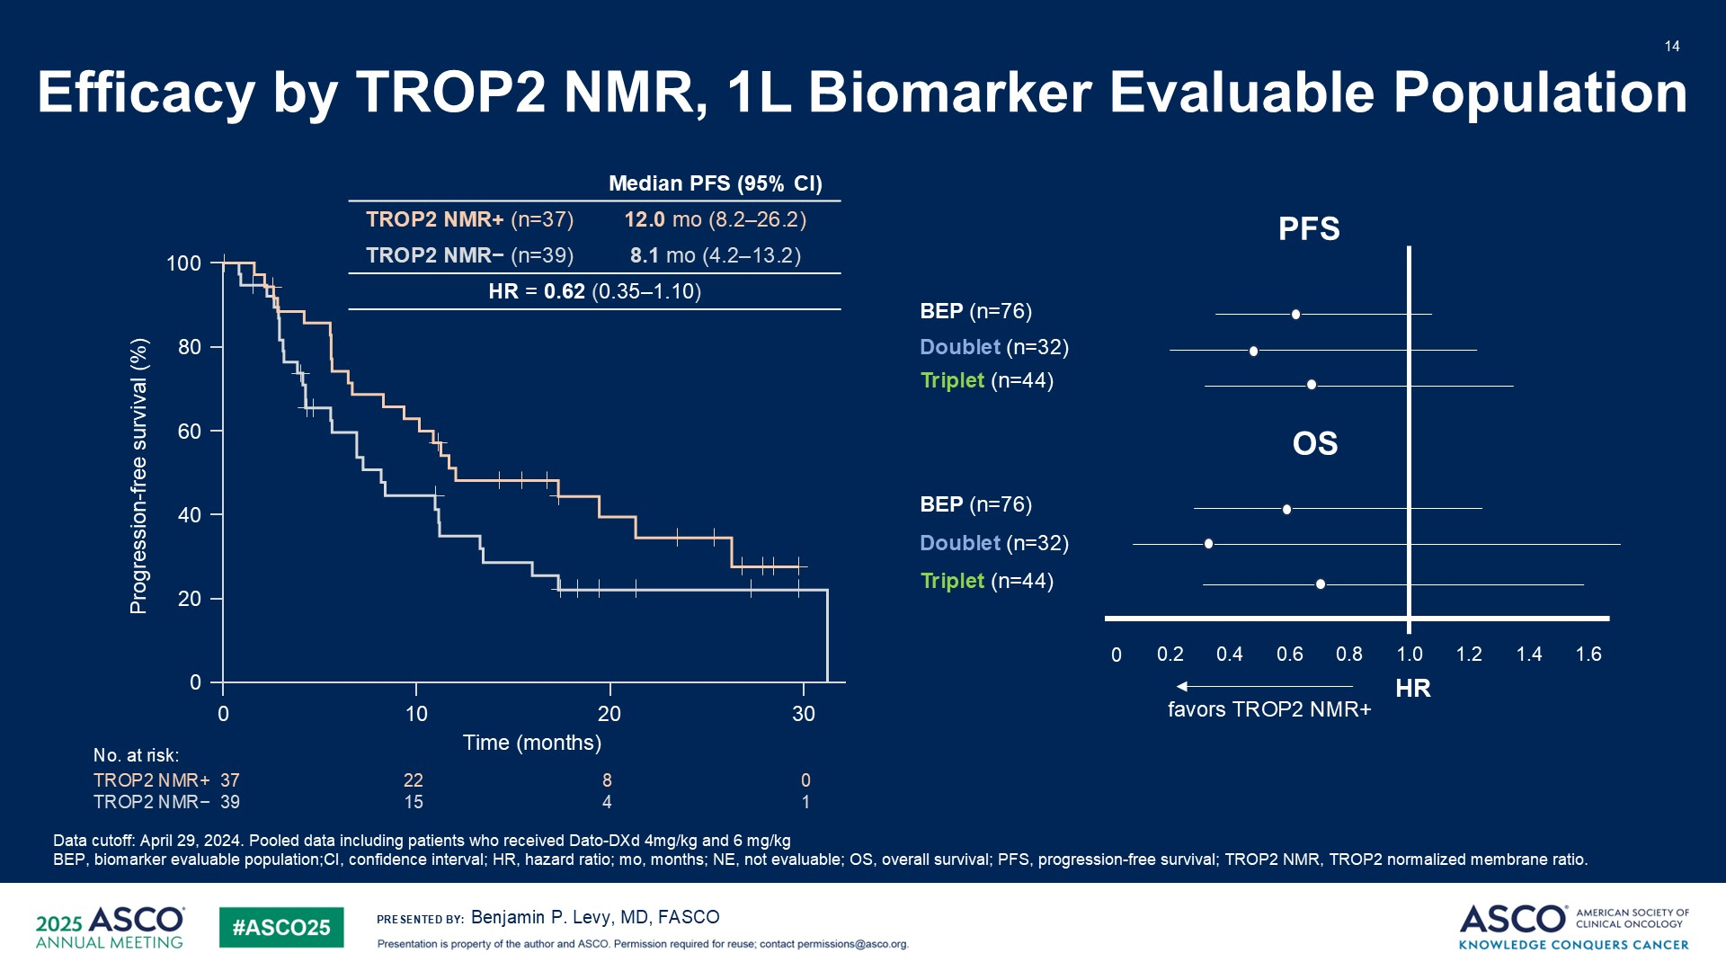
Efficacy by TROP2 NMR, 1L Biomarker Evaluable Population
TROPION-Lung02

Slide 62
QUESTIONS?

Slide 63
Year in Review: Nontargeted Approaches for Lung Cancer
INTRODUCTION: The Boards
MODULE 1: Immune Checkpoint Inhibition for Localized Non-Small Cell Lung Cancer (NSCLC)
MODULE 2: Immunotherapy for Metastatic NSCLC
MODULE 3: Antibody-Drug Conjugates
MODULE 4: Novel Bispecific Antibodies
MODULE 5: Journal Club with Dr Levy

Slide 64
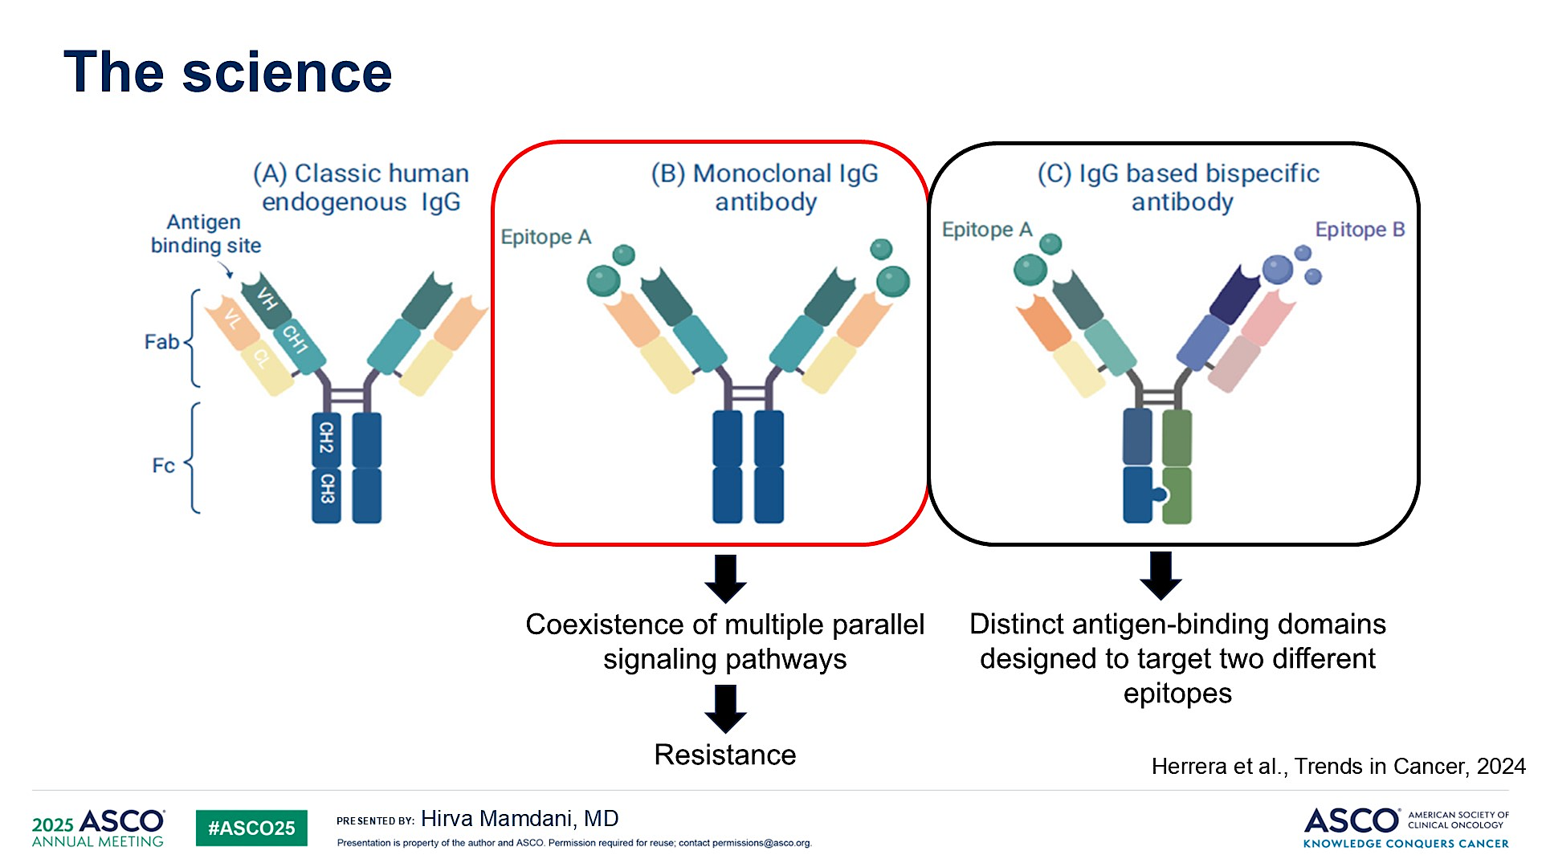
The science
Mamdani ASCO 2025; Clinical Science Symposium

Slide 65
HARMONi-2 STUDY
Ivonescimab vs Pembrolizumab for PD-L1 positive NSCLC
(NCT05499390)
Xiong Lancet 2025

Slide 66
Xiong Lancet 2025

Slide 67
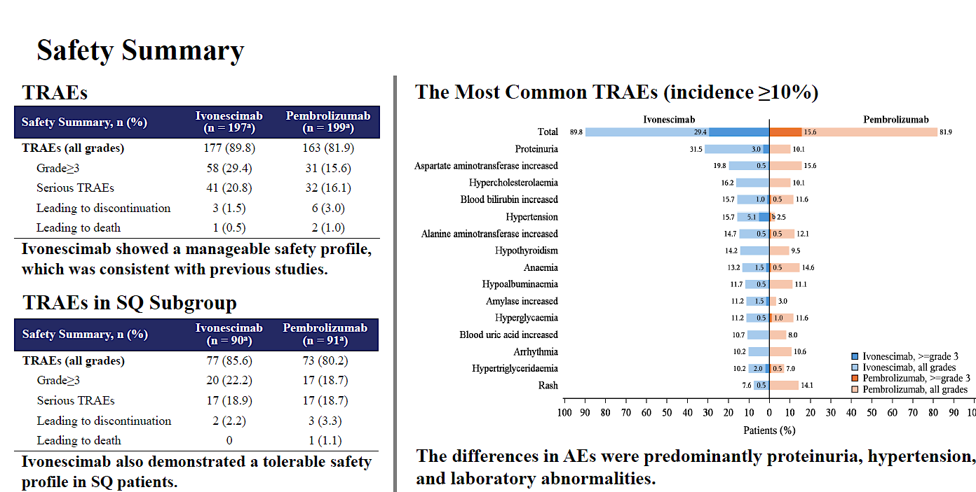
HARMONi-2
Zhou WCLC 2024; Abstract PL02.04

Slide 68
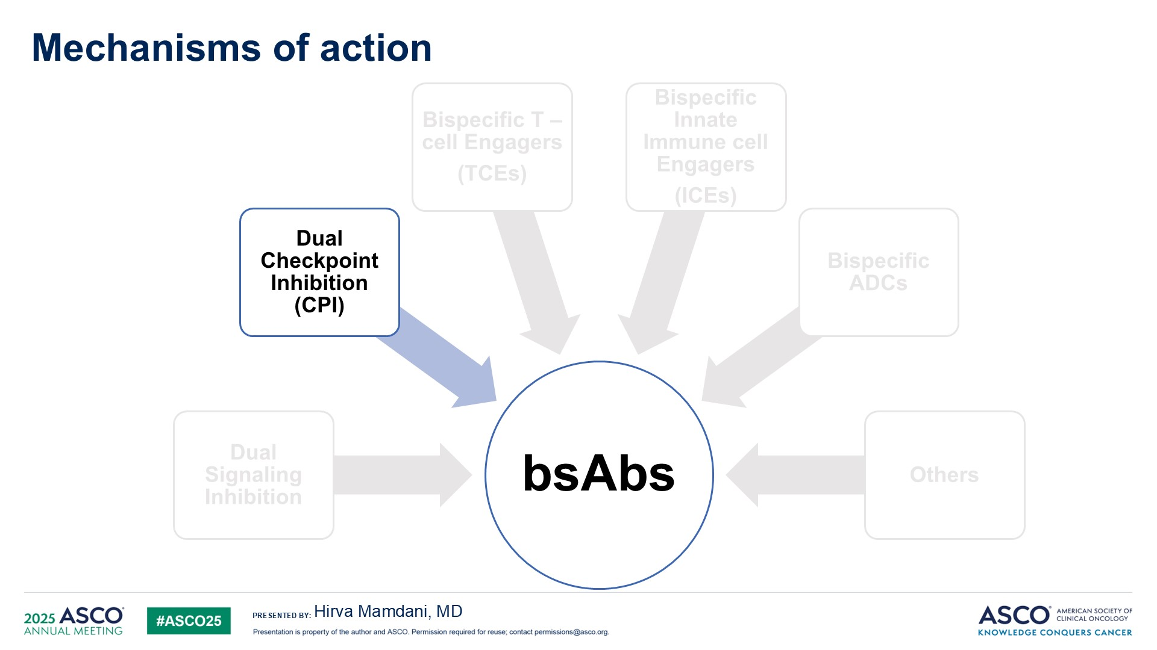
Mechanisms of action
Mamdani ASCO 2025; Clinical Science Symposium

Slide 69
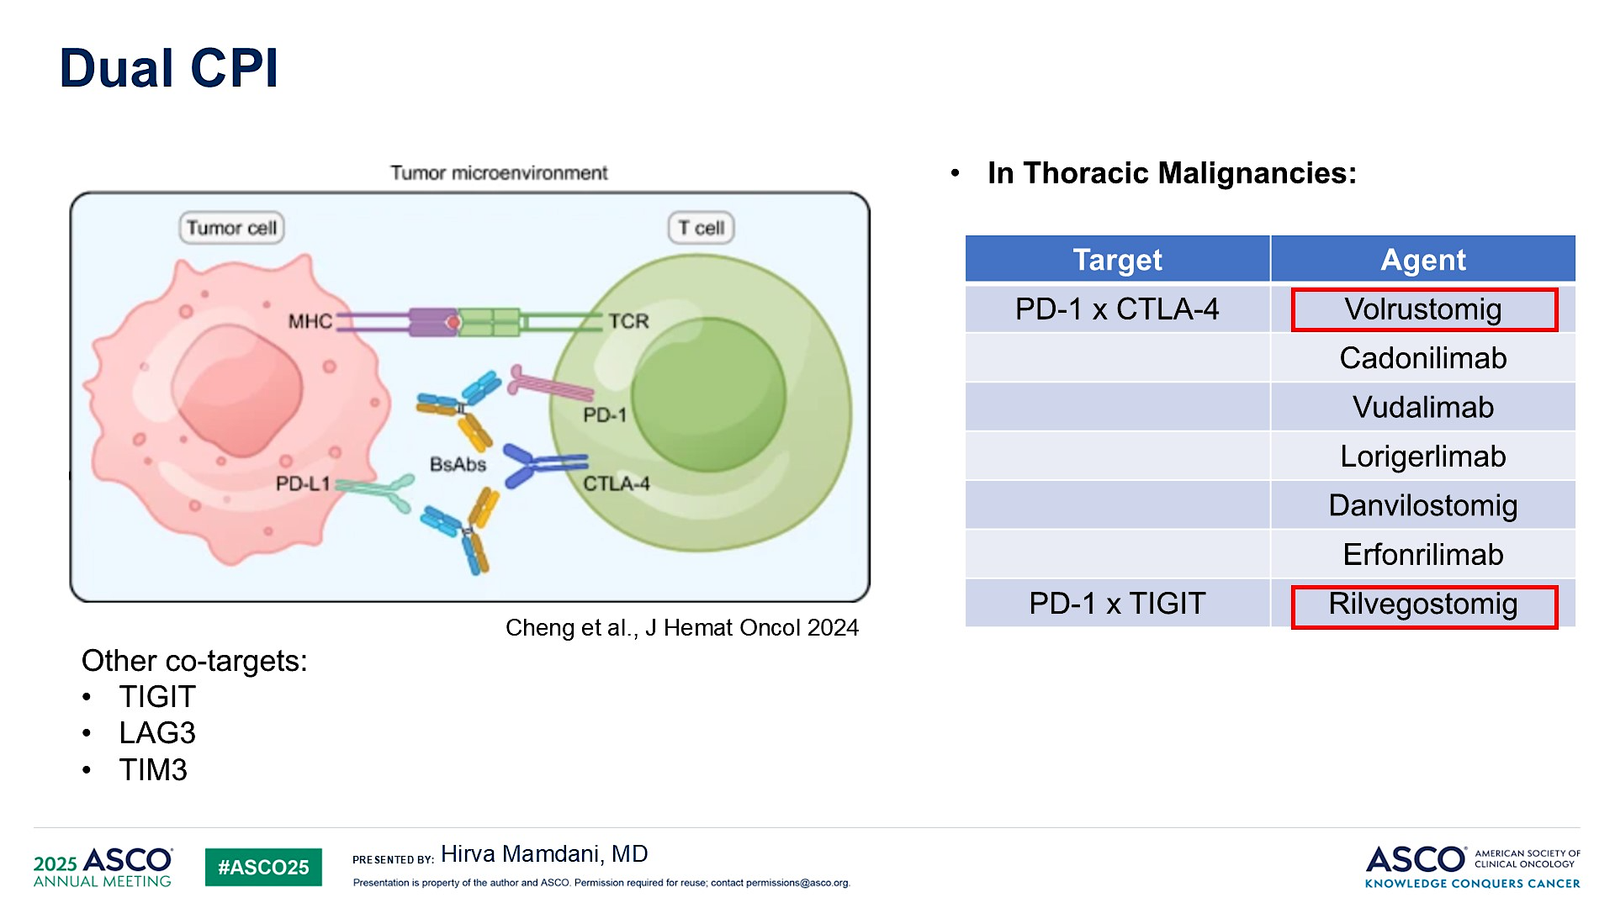
Dual CPI
Mamdani ASCO 2025; Clinical Science Symposium

Slide 70
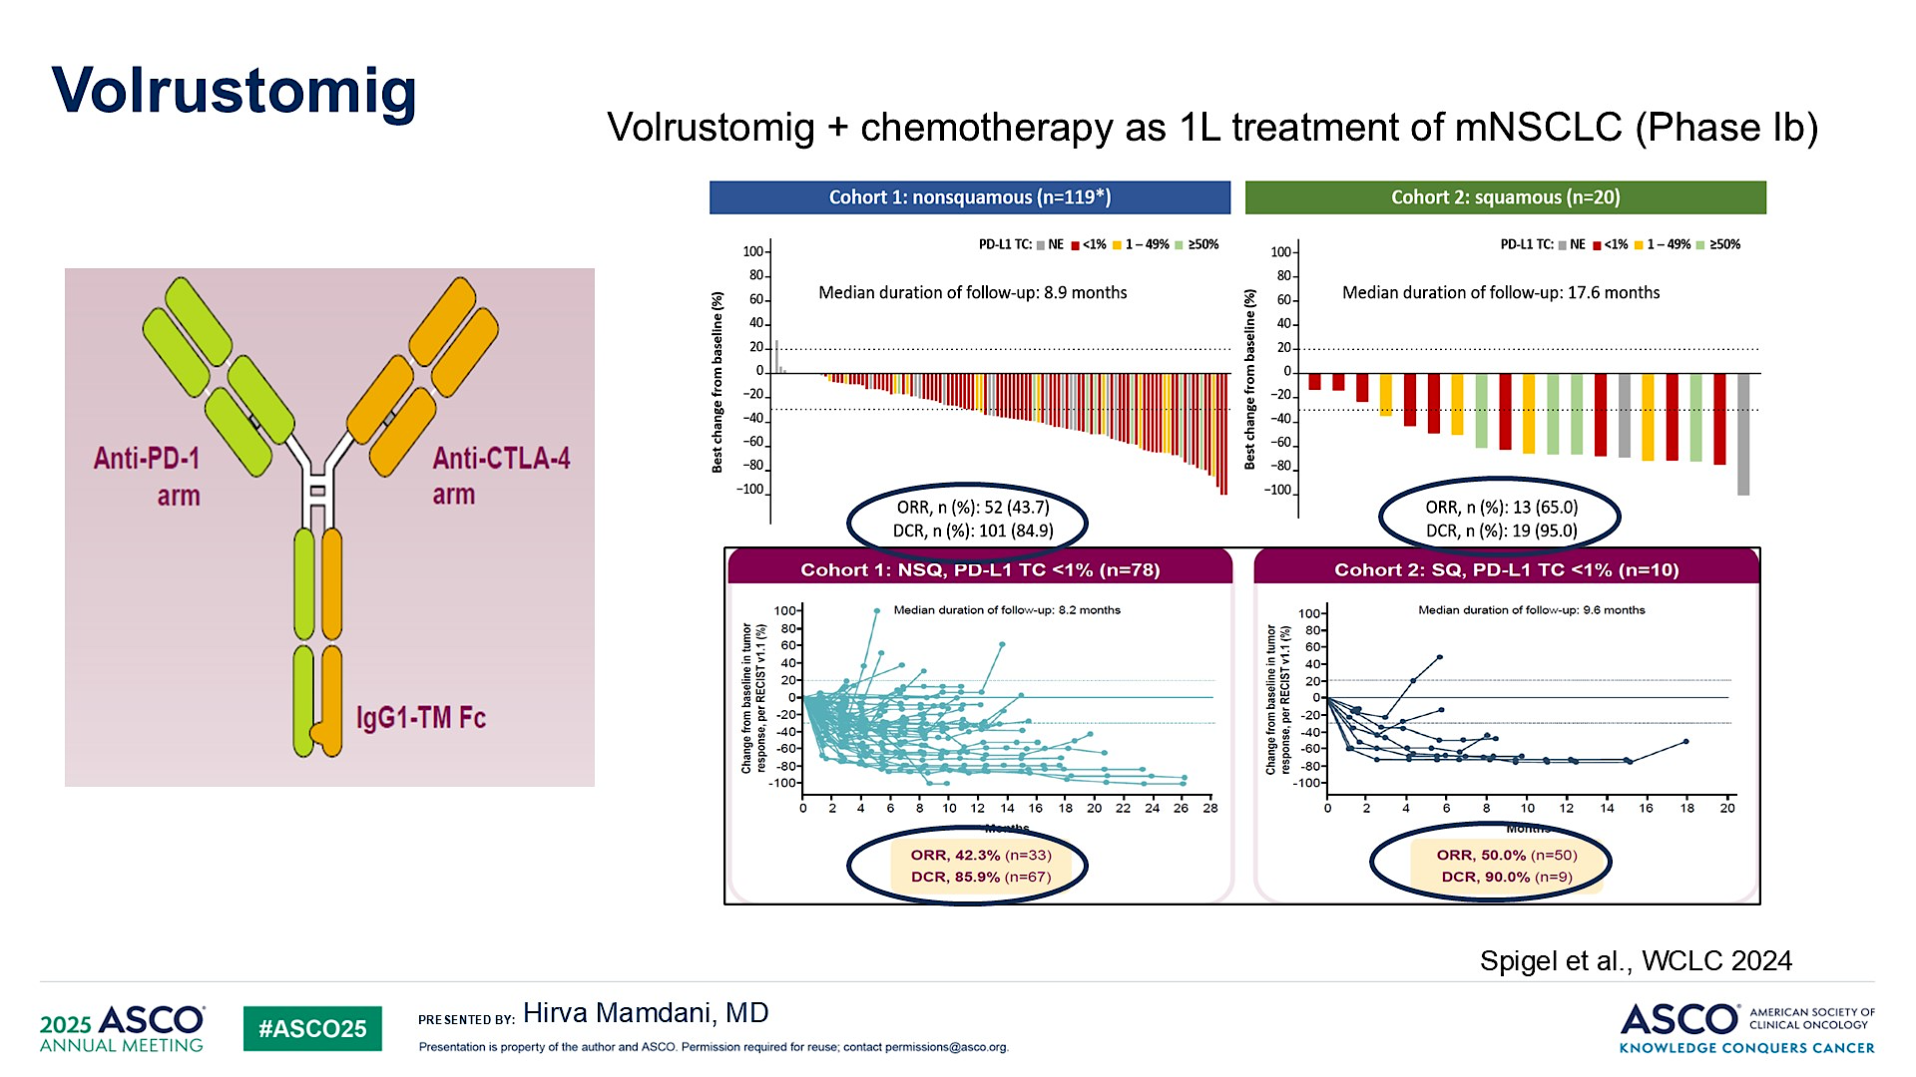
Volrustomig
Mamdani ASCO 2025; Clinical Science Symposium

Slide 71
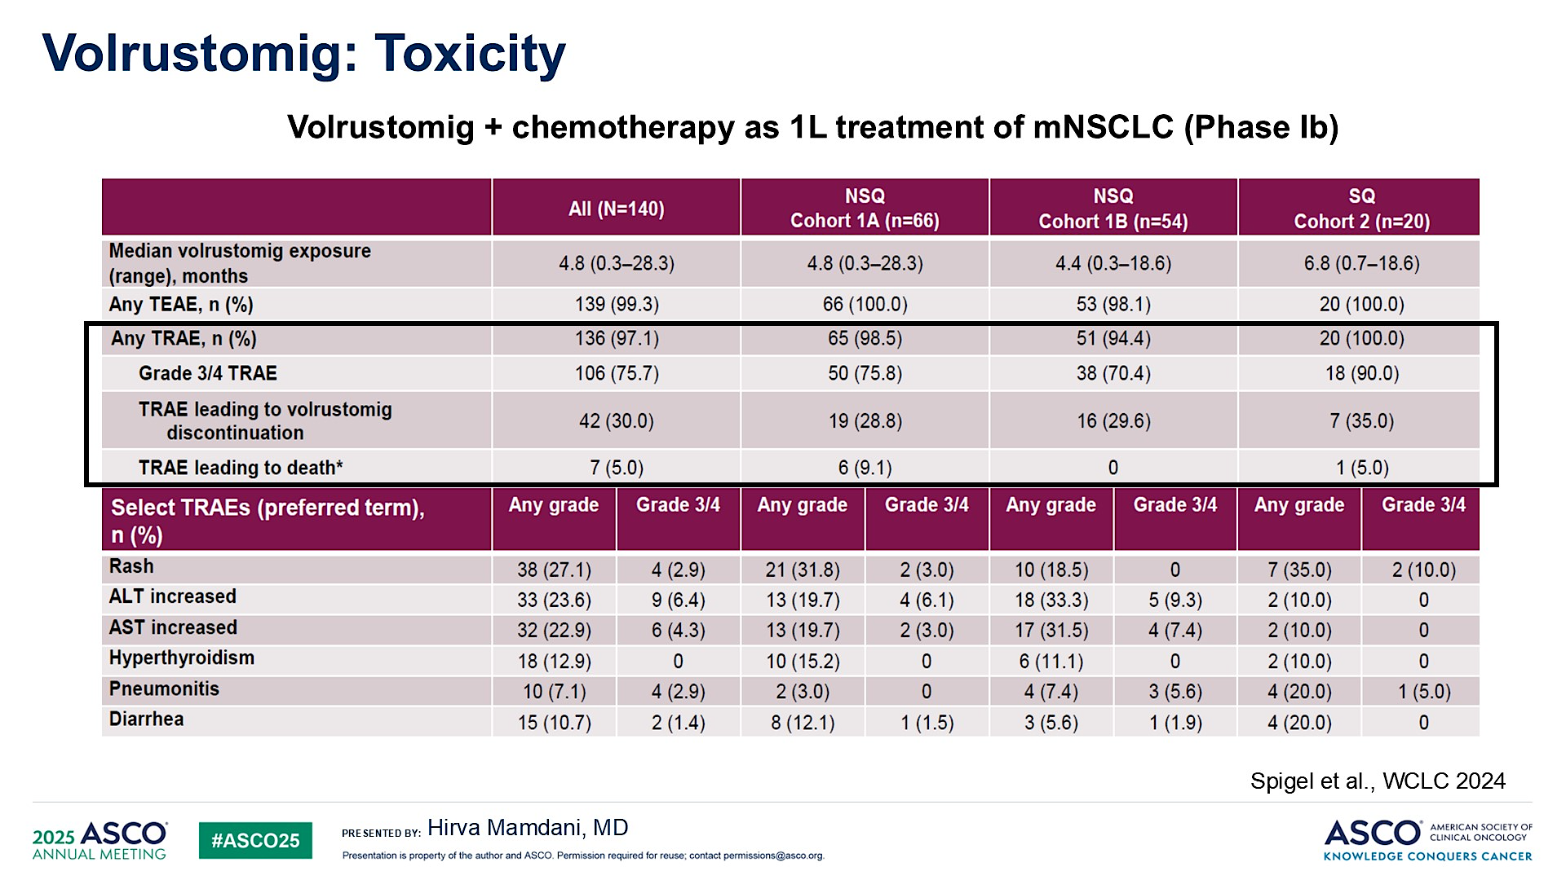
Volrustomig: Toxicity
Mamdani ASCO 2025; Clinical Science Symposium

Slide 72
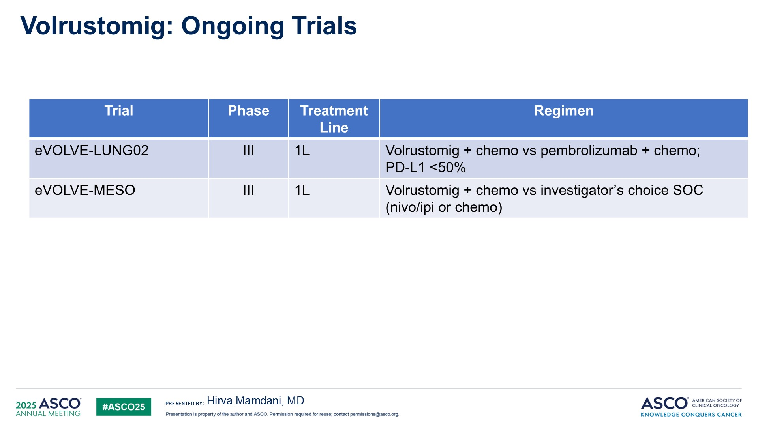
Volrustomig: Ongoing Trials
Mamdani ASCO 2025; Clinical Science Symposium

Slide 73
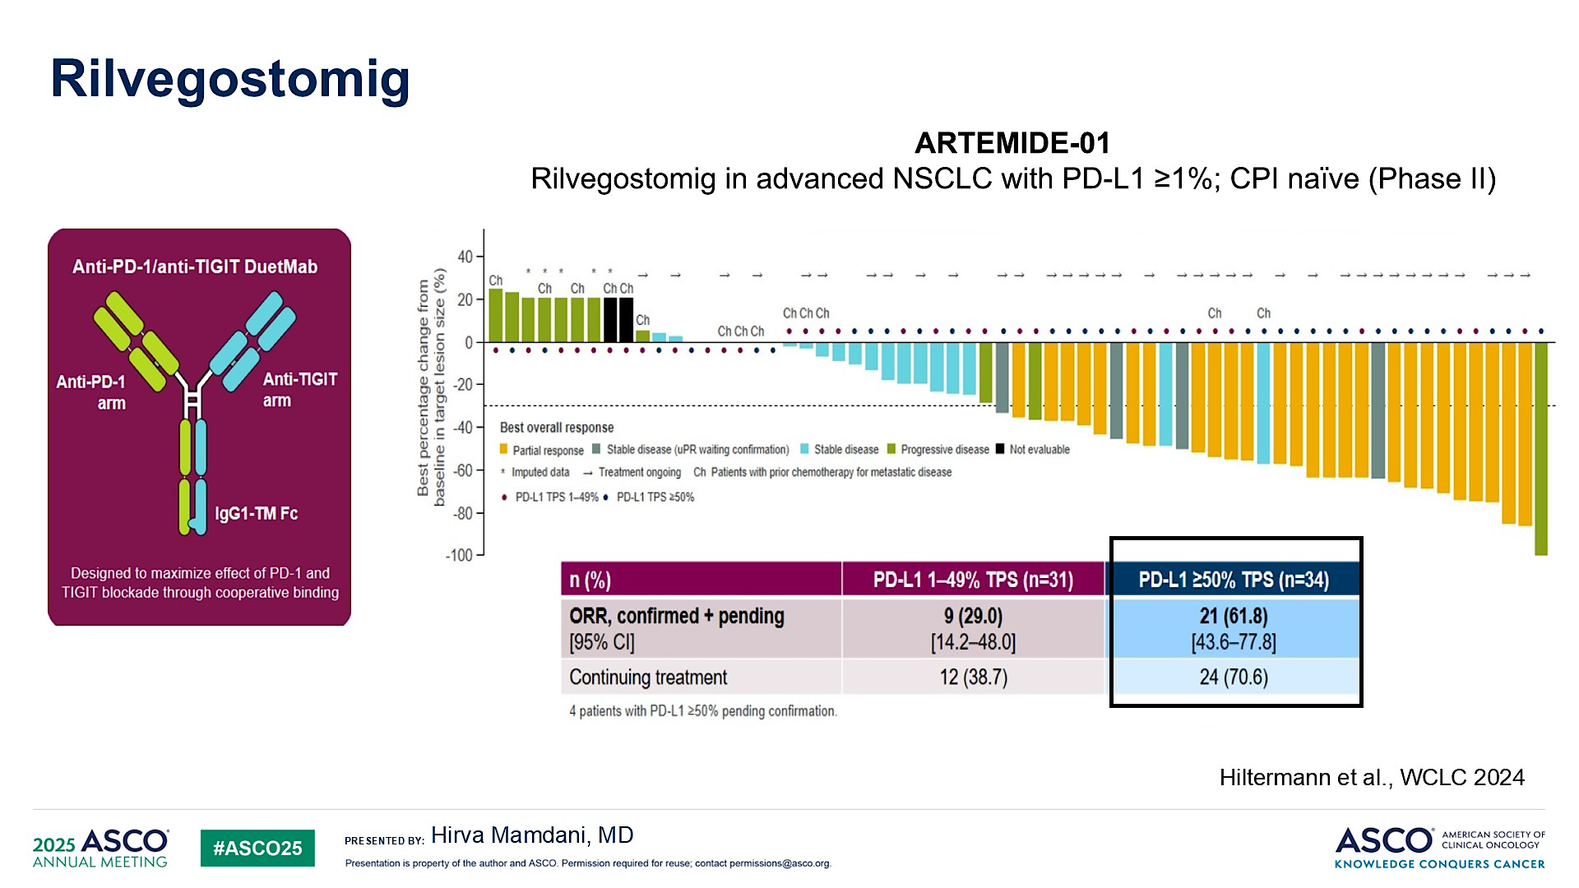
Rilvegostomig
Mamdani ASCO 2025; Clinical Science Symposium

Slide 74
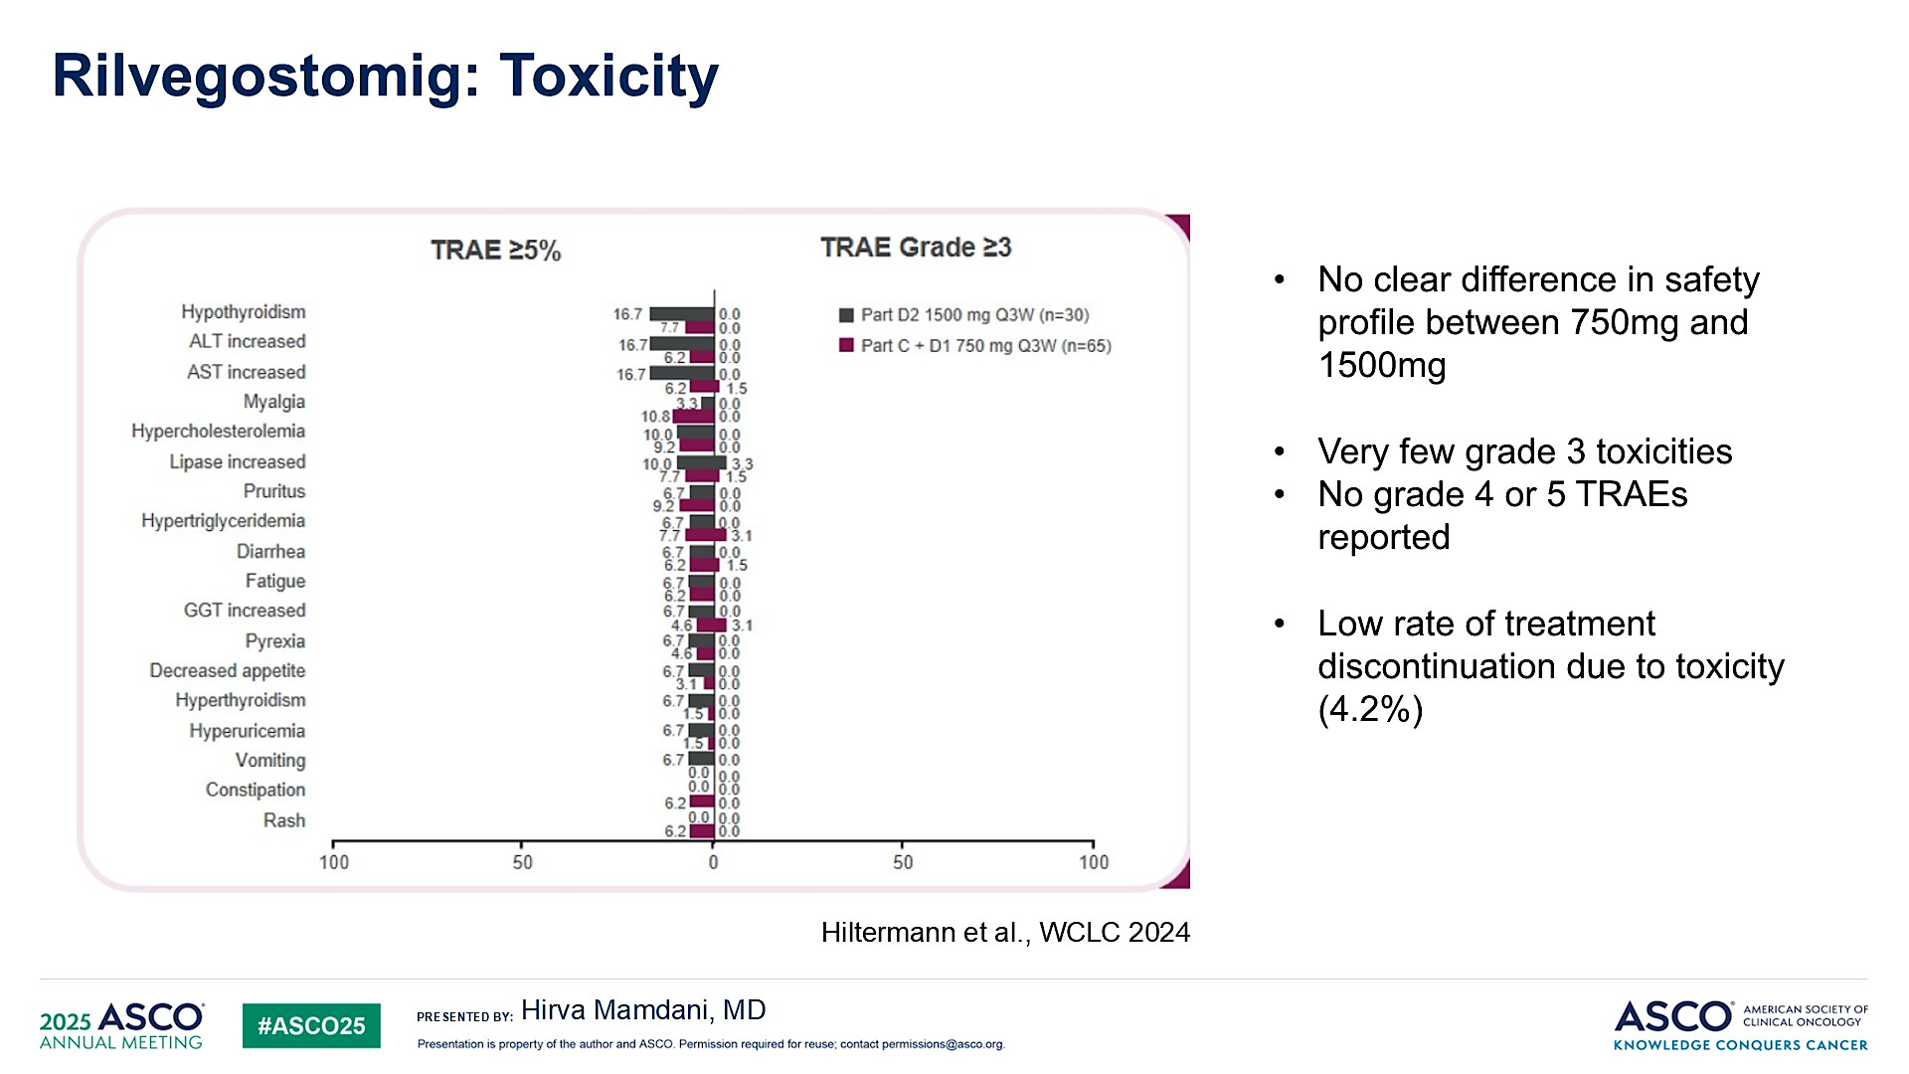
Rilvegostomig: Toxicity
Mamdani ASCO 2025; Clinical Science Symposium

Slide 75
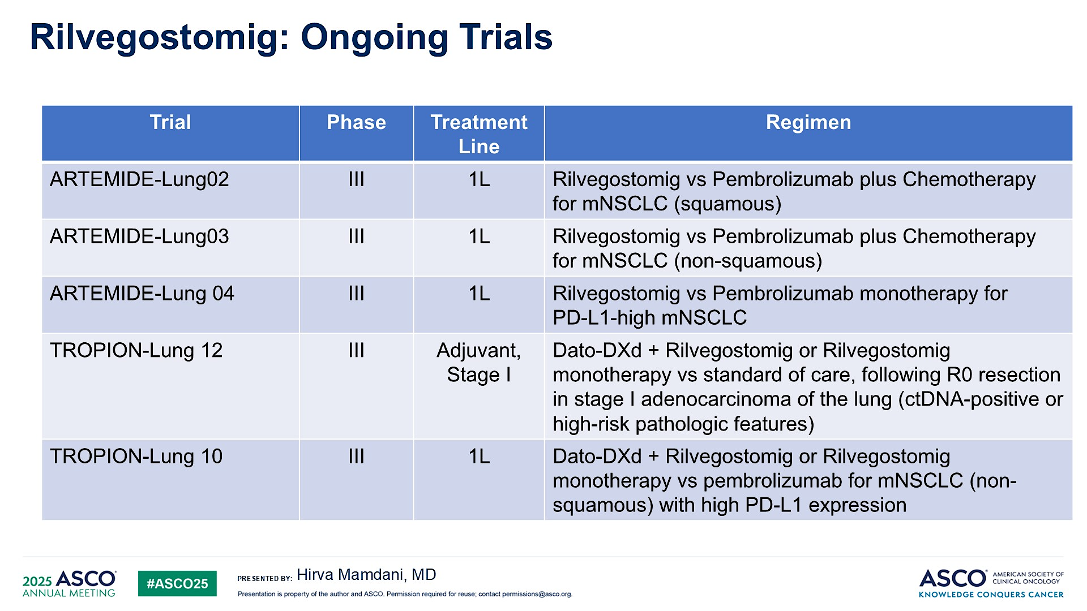
Rilvegostomig: Ongoing Trials
Mamdani ASCO 2025; Clinical Science Symposium

Slide 76
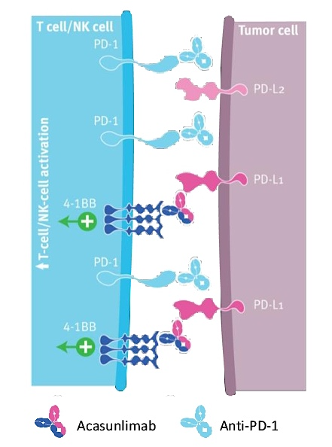

Phase II Study of Acasunlimab with or without Pembrolizumab for Previously Treated Metastatic NSCLC
Aerts J et al. ASCO 2024;Abstract 2533.

Slide 77


Acasunlimab with or without Pembrolizumab: Efficacy by PD-L1 Status
ORR = objective response rate; DCR = disease control rate; DOR = duration of response; PFS = progression-free survival; OS = overall survival; TPS = tumor proportion score
Aerts J et al. ASCO 2024;Abstract 2533.

Slide 78

Acasunlimab with or without Pembrolizumab: Safety
Blood alkaline phosphatase increased
TRAEs = treatment-related adverse events
Aerts J et al. ASCO 2024;Abstract 2533.

Slide 79



Ongoing Phase III ABBIL1TY NSCLC-06 Trial Schema
Paz-Ares L et al. ELCC 2025;Abstract 128TiP.

Slide 80
QUESTIONS?

Slide 81
Year in Review: Nontargeted Approaches for Lung Cancer
INTRODUCTION: The Boards
MODULE 1: Immune Checkpoint Inhibition for Localized Non-Small Cell Lung Cancer (NSCLC)
MODULE 2: Immunotherapy for Metastatic NSCLC
MODULE 3: Antibody-Drug Conjugates
MODULE 4: Novel Bispecific Antibodies
MODULE 5: Journal Club with Dr Levy

Slide 82

2023;29(10):2559-69.

Slide 83

BR36 Trial Schema
Target enrollment of 50 patients reached
First stage
Anagnostou V et al. Nat Med 2023;29(10):2559-69.

Slide 84

BR36 Consort Flow Diagram
Anagnostou V et al. Nat Med 2023;29(10):2559-69.

Slide 85

Overview of Plasma Variants Detected by Next-Generation Sequencing
ctDNA = circulating tumor DNA
Anagnostou V et al. Nat Med 2023;29(10):2559-69.

Slide 86

Representative ctDNA Kinetics Patterns
Anagnostou V et al. Nat Med 2023;29(10):2559-69.

Slide 87

Radiographic Response Assessment, Molecular Response and OS
Anagnostou V et al. Nat Med 2023;29(10):2559-69.

Slide 88

PFS and OS for Patients with ctDNA Molecular Responses
Anagnostou V et al. Nat Med 2023;29(10):2559-69.

Slide 89

Depth of ctDNA Response in Association with RECIST Radiographic Response
maxMAF = maximal mutant allele fraction; CR = complete response; PR = partial response; SD = stable disease; PD = progressive disease
Anagnostou V et al. Nat Med 2023;29(10):2559-69.

Slide 90

2024;30(2):389-403.

Slide 91

Overview of Study Methodology
NGS = next-generation sequencing
Murray JC et al. Clin Cancer Res 2024;30(2):389-403.

Slide 92

Course of Disease for Each Patient
Murray JC et al. Clin Cancer Res 2024;30(2):389-403.

Slide 93

Landscape of Variants Detected in Plasma
Murray JC et al. Clin Cancer Res 2024;30(2):389-403.

Slide 94

Longitudinal Cell-Free Tumor Load Dynamics and Molecular Response Classifications
BOR = best overall radiographic response
Murray JC et al. Clin Cancer Res 2024;30(2):389-403.

Slide 95

Association Between ctDNA Maximum Mutant Allele Fraction (max MAF) Dynamics and Molecular Response
Murray JC et al. Clin Cancer Res 2024;30(2):389-403.

Slide 96

Association Between ctDNA Molecular Responses and Radiographic Response Assessments
DCB = durable clinical benefit; NDB = nondurable clinical benefit; mPD = molecular progressive disease; mR = molecular response; mR f/b REC/EM = mR followed by recrudescence/emergence
Murray JC et al. Clin Cancer Res 2024;30(2):389-403.

Slide 97

Association Between Cell-Free Tumor Load (cfTL) Clearance and PFS and OS
Murray JC et al. Clin Cancer Res 2024;30(2):389-403.

Slide 98

Survival Outcomes in the Cohort of Patients with Radiographically Stable Disease
Murray JC et al. Clin Cancer Res 2024;30(2):389-403.

Slide 99

cfTL Clearance and Tumor Responses
SLD = sum of tumor longest diameter; TT = time to
Murray JC et al. Clin Cancer Res 2024;30(2):389-403.

Slide 100


T-Cell Receptor Clonal Dynamics and Clinical Benefit and Development of Immune-Related Adverse Events (irAEs)
Murray JC et al. Clin Cancer Res 2024;30(2):389-403.

Slide 101

T-Cell Receptor (TCR) Clonal Dynamics and Immunotherapy-Related Pneumonitis
Murray JC et al. Clin Cancer Res 2024;30(2):389-403.

Slide 102

Examples of TCR Cluster Dynamics in Patients with Immune-Related Adverse Events
Murray JC et al. Clin Cancer Res 2024;30(2):389-403.

