Slide 1
Other Available and Emerging Novel Therapies for NHL
Stephen M. Ansell, MD, PhD
Dorotha W. and Grant L. Sundquist Professor in Hematologic Malignancies Research
Chair, Division of Hematology
Mayo Clinic

Slide 2
Diffuse large B-cell Lymphoma

Slide 3
Five-Year Analysis of the POLARIX study
Pola-R-CHP
Polatuzumab vedotin (1.8mg/kg)*
R-CHP + vincristine placebo
Patients
Previously untreated DLBCL
Age 18–80 years
IPI 2–5
ECOG PS 0–2
Randomize
1:1
Cycles 1–6
(1 cycle=21 days)
Rituximab
375mg/m²
R-CHOP
Cycles 7 & 8
Stratification factors
IPI score (2 vs 3–5)
Bulky disease (<7.5 vs ≥7.5cm)
Geographic region (Western Europe, US, Canada, & Australia vs Asia vs rest of world)
R-CHOP† +
polatuzumab vedotin placebo
Primary endpoint: PFS by INV
Key secondary endpoints:
EFS_{eff} by INV, PET CR at EOT by BICR, OS
 |  | Pola-R-CHP | R-CHOP | Total | Median PFS follow-up | Median OS follow-up
Global population | ITT‡ | 440 | 439 | 879 | 54.9 months | 64.1 months
 | Safety evaluable§ | 435¶ | 438# | 873
*IV on Day 1; †R-CHOP: IV rituximab 375mg/m², cyclophosphamide 750mg/m², doxorubicin 50mg/m², and vincristine 1.4mg/m² (max. 2mg) on Day 1,
plus oral prednisone 100mg once daily on Days 1–5; ‡As randomized population; §As treated population; ¶One patient was randomized to Pola-R-CHP but did not receive polatuzumab vedotin; #One patient was randomized to R-CHOP but did not receive vincristine.
BICR, blinded independent central review; CR, complete response; DLBCL, diffuse large B-cell lymphoma; ECOG PS, Eastern Cooperative Oncology Group performance status; EFS_{eff}, event-free survival (efficacy); EOT, end of treatment; INV, investigator; IPI, International Prognostic Index; OS, overall survival;
PET, positron emission tomography; PFS, progression-free survival; R, randomized; R-CHOP, rituximab, cyclophosphamide, doxorubicin, vincristine and prednisone.
Salles et al. ASH 2024;Abstract 469.

Slide 4
Initial PFS benefit of Pola-R-CHP over R-CHOP is maintained at 5 years
PFS in the global ITT population
100
80
60
PFS (%)
40
Event-free rate, % (95% CI) | Primary analysis at 2 years* | 3-year update† | 5-year update‡
Pola-R-CHP | 76.7 (72.7–80.8) | 71.8 (67.1–76.5) | 64.9 (59.8–70.0)
R-CHOP | 70.2 (65.8–74.6) | 64.1 (59.1–69.1) | 59.1 (54.0–64.3)
HR (95% CI) | 0.73 (0.57–0.95) | 0.76 (0.60–0.97) | 0.77 (0.62–0.97)
20
0
0
6
12
18
24
30
36
42
48
54
60
66
72
Time (months)
At the 5-year follow up, Pola-R-CHP had a sustained and significant PFS benefit,
confirming results from the primary analysis of PFS at 2 years of follow up (HR 0.73).¹
*Data cut-off: June 28, 2021; †Data cut-off: June 15, 2022; ‡Data cut-off: July 5, 2024.
CI, confidence interval; HR, hazard ratio; NE, not evaluable.
Notes:
Delta 5.8%

Slide 5
5-year PFS and OS show consistent treatment effect of Pola-R-CHP across subgroups in the global population
Baseline risk factors |  | PFS |  |  |  |  |  |  |  | OS
 |  | Pola-R-CHP (n=440) |  | R-CHOP (n=439) |  | HR | 95% Wald CI | Pola-R-CHP better | R-CHOP better | Pola-R-CHP (n=440) |  | R-CHOP (n=439) |  | HR | 95% Wald CI | Pola-R-CHP better | R-CHOP better
 |  | n | 60-month (%) | n | 60-month (%) |  |  |  |  | n | 60-month (%) | n | 60-month (%)
All patients |  | 440 | 64.9 | 439 | 59.1 | 0.78 | 0.62–0.97 |  |  | 440 | 82.3 | 439 | 79.5 | 0.85 | 0.63–1.16
Age group | ≤65 | 225 | 69.6 | 219 | 64.3 | 0.80 | 0.57–1.11 |  |  | 225 | 89.1 | 219 | 84.7 | 0.73 | 0.44–1.21
 | >65 | 215 | 60.0 | 220 | 54.5 | 0.78 | 0.58–1.06 |  |  | 215 | 75.3 | 220 | 74.5 | 0.95 | 0.65–1.38
Stratification – IPI score | 2 | 167 | 67.2 | 167 | 68.3 | 0.91 | 0.61–1.36 |  |  | 167 | 87.6 | 167 | 87.4 | 0.96 | 0.53–1.75
 | 3–5 | 273 | 63.2 | 272 | 53.5 | 0.72 | 0.55–0.94 |  |  | 273 | 79.2 | 272 | 74.7 | 0.81 | 0.57–1.15
Stratification – bulky disease (≥ 7cm) | Absent | 247 | 69.9 | 247 | 60.0 | 0.61 | 0.44–0.83 |  |  | 247 | 83.9 | 247 | 80.9 | 0.79 | 0.52–1.20
 | Present | 193 | 58.5 | 192 | 57.9 | 1.02 | 0.73–1.41 |  |  | 193 | 80.3 | 192 | 77.9 | 0.92 | 0.60–1.43
Baseline LDH | ≤1xULN | 146 | 65.3 | 154 | 64.8 | 0.83 | 0.55–1.23 |  |  | 146 | 88.7 | 154 | 87.9 | 0.85 | 0.45–1.61
 | >1xULN | 291 | 64.3 | 284 | 55.7 | 0.77 | 0.59–1.01 |  |  | 291 | 79.0 | 284 | 74.9 | 0.85 | 0.60–1.19
No. of extranodal sites | 0–1 | 227 | 68.1 | 226 | 64.2 | 0.78 | 0.56–1.09 |  |  | 227 | 83.7 | 226 | 81.9 | 0.86 | 0.56–1.34
 | ≥2 | 213 | 61.2 | 213 | 53.8 | 0.78 | 0.58–1.06 |  |  | 213 | 80.9 | 213 | 77.1 | 0.85 | 0.56–1.28
NHL subtype | DLBCL, NOS, ABC, GCB | 373 | 65.7 | 367 | 58.8 | 0.75 | 0.59–0.95 |  |  | 373 | 81.9 | 367 | 79.8 | 0.89 | 0.64–1.23
 | HGBL, NOS, DHL/THL | 43 | 66.0 | 50 | 57.6 | 0.67 | 0.33–1.37 |  |  | 43 | 85.4 | 50 | 72.4 | 0.46 | 0.18–1.22
 | Other LBCL | 24 | 49.7 | 22 | 70.3 | 1.86 | 0.69–5.04 |  |  | 24 | 83.3 | 22 | 90.9 | 1.93 | 0.35–10.52
NanoString COO | NanoString GCB | 187 | 65.9 | 170 | 65.8 | 1.07 | 0.74–1.56 |  |  | 187 | 82.9 | 170 | 82.3 | 0.99 | 0.60–1.61
 | NanoString ABC | 106 | 72.5 | 129 | 45.8 | 0.38 | 0.24–0.59 |  |  | 106 | 84.6 | 129 | 69.9 | 0.49 | 0.28–0.88
 | NanoString UNC | 44 | 55.2 | 53 | 70.8 | 1.60 | 0.79–3.25 |  |  | 44 | 76.9 | 53 | 94.2 | 4.46 | 1.23–16.21
 | Unknown | 103 | 60.2 | 87 | 59.7 | 0.83 | 0.51–1.33 |  |  | 103 | 81.3 | 87 | 79.0 | 0.80 | 0.42–1.51
Double expressor by IHC | DEL | 139 | 63.1 | 151 | 50.0 | 0.65 | 0.45–0.94 |  |  | 139 | 76.4 | 151 | 73.0 | 0.84 | 0.53–1.33
 | Non DEL | 223 | 66.6 | 215 | 64.7 | 0.89 | 0.64–1.24 |  |  | 223 | 86.3 | 215 | 82.8 | 0.81 | 0.51–1.30
 | Unknown | 78 | 63.7 | 73 | 63.5 | 0.84 | 0.48–1.47 |  |  | 78 | 81.6 | 73 | 84.1 | 1.18 | 0.53–2.59
PFS and OS by subgroups, including high-risk subgroups, generally favor
Pola-R-CHP; however, subgroup analyses are exploratory and generally underpowered (especially for OS).
Patient characteristics are multidimensional; therefore, translating univariate subgroup results into patient care should be applied
with caution.
0.25
1
5
0.25
1
5
DEL, double-expressor lymphoma; IHC, immunohistochemistry; LBCL, large B-cell lymphoma; LDH, lactate dehydrogenase; ULN, upper limit of normal; UNC, unclassified.
Salles et al. ASH 2024;Abstract 469.
Notes:
Numerical difference for ABC

Slide 6
Efficacy outcomes in the expanded population are similar to the global population
OS in the expanded ITT population
HR (95% CI): 0.83 (0.62–1.10)
Data cut-off: July 5, 2024.

Slide 7
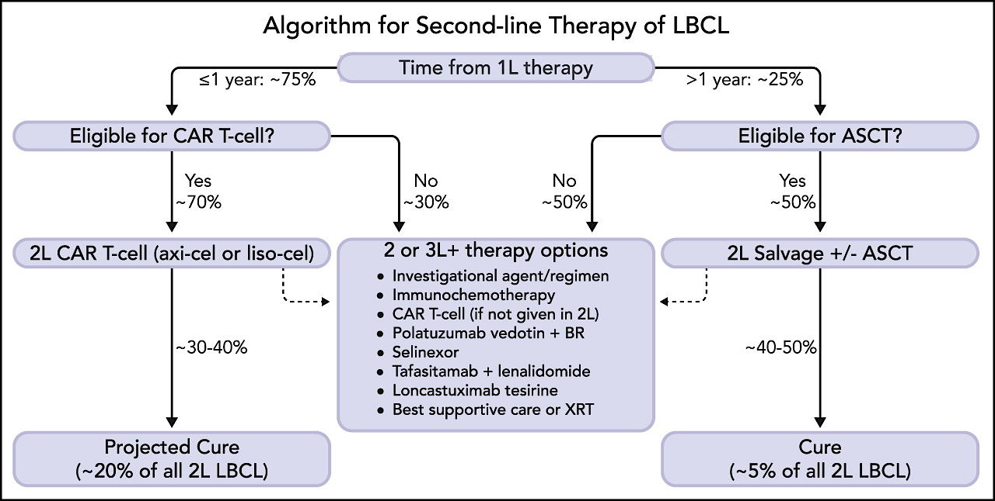
Westin J, Sehn LH. Blood. 2022 May 5;139(18):2737-2746.
Notes:
Figure Legend:

Slide 8
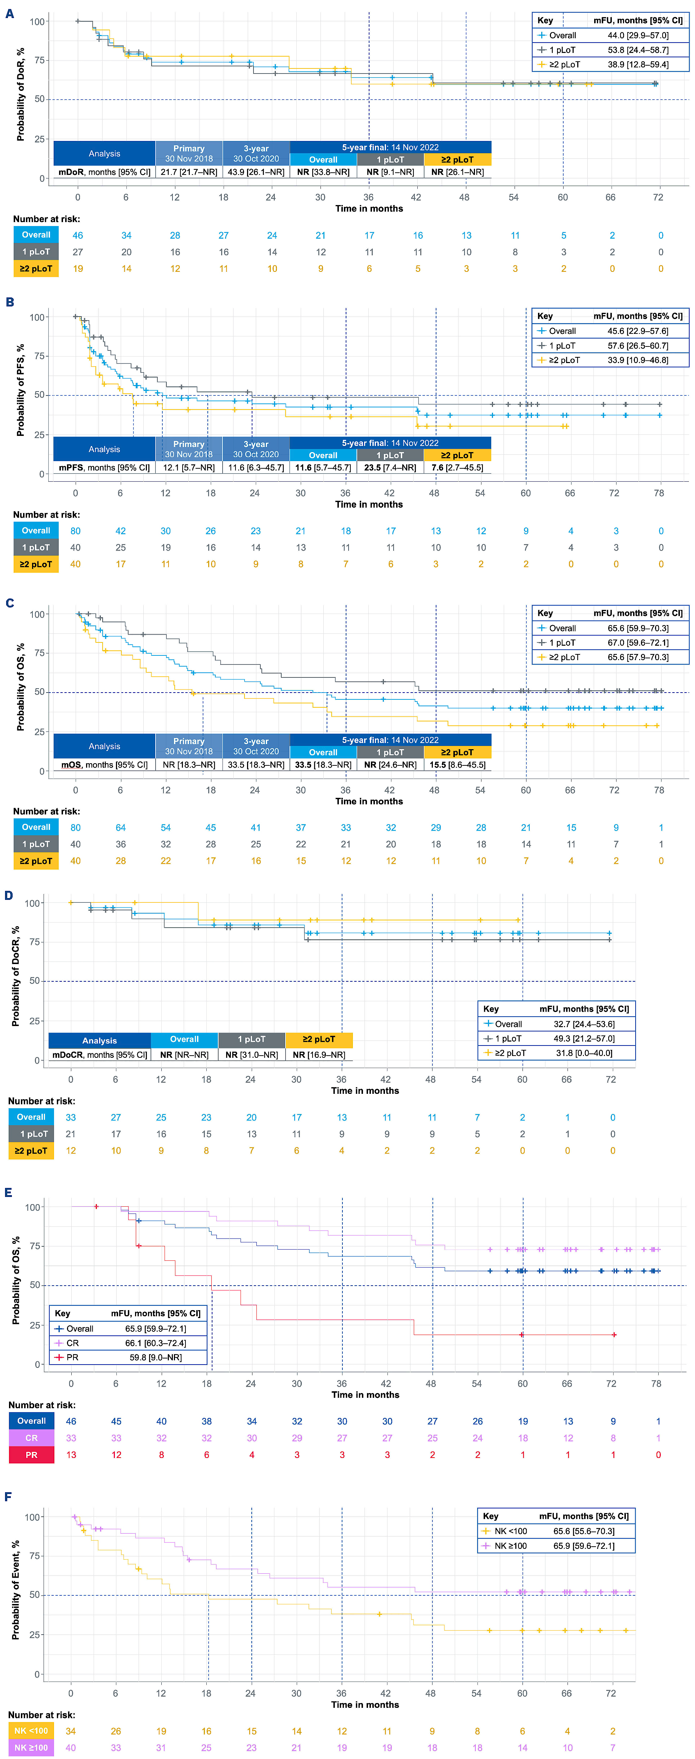
Tafasitamab for relapsed or refractory diffuse large B-cell lymphoma: final 5-year efficacy
80 R/R DLBCL patients
Received up to 12 cycles of co-administered tafasitamab and lenalidomide, followed by tafasitamab monotherapy until progression
ORR 57.5%, CR rate 41.3% (n=33).
Median PFS 11.6 months.
Median OS 33.5 months.
Duell et al. Haematologica. 2024 Feb 1;109(2):553-566.

Slide 9
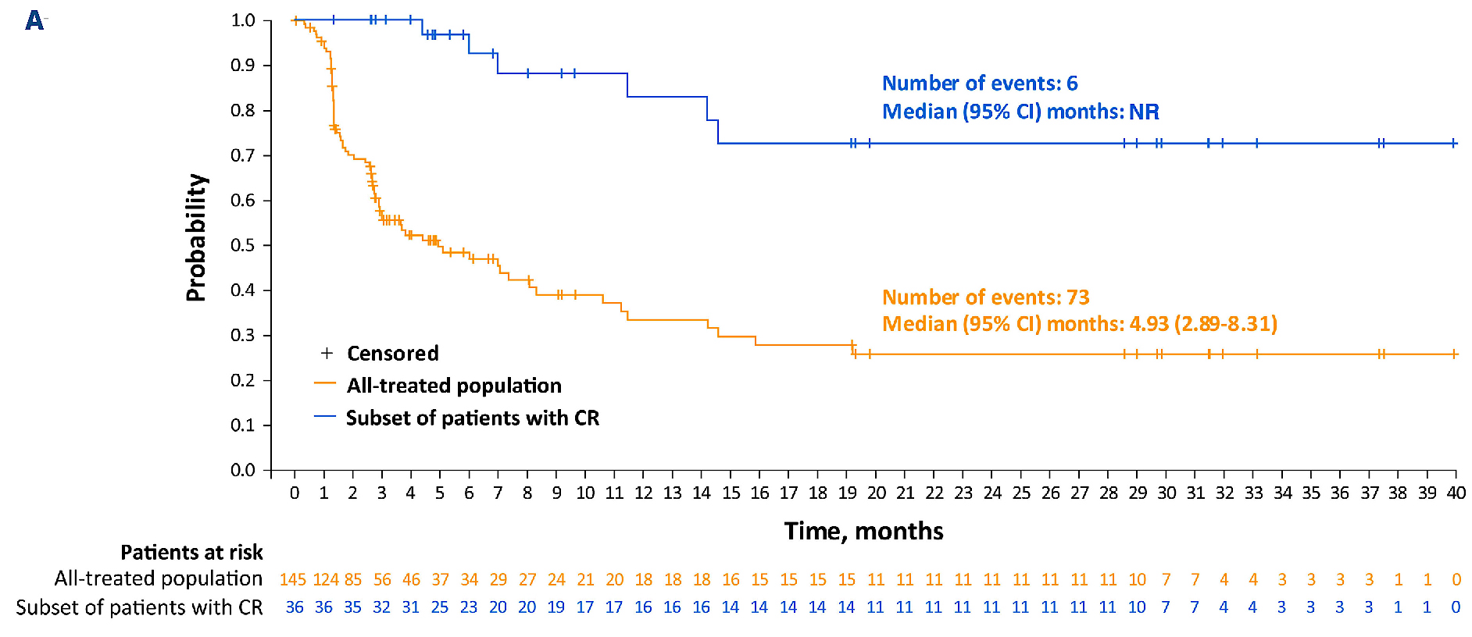
Loncastuximab tesirine in relapsed/refractory diffuse large B-cell lymphoma: long-term efficacy
145 patients enrolled.
ORR 48.3%.
Thirty-six (24.8%) achieved CR, of which 16 (44%) and 11 (31%) were event-free for ≥1 year and ≥2 years, respectively.
Median OS 9.5 months
Median PFS 4.9 months.
Caimi PF, et al. Haematologica. 2024 Apr 1;109(4):1184-1193.

Slide 10
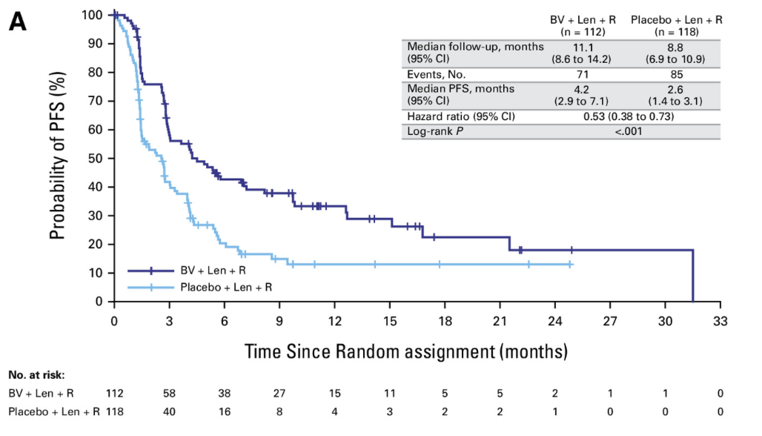
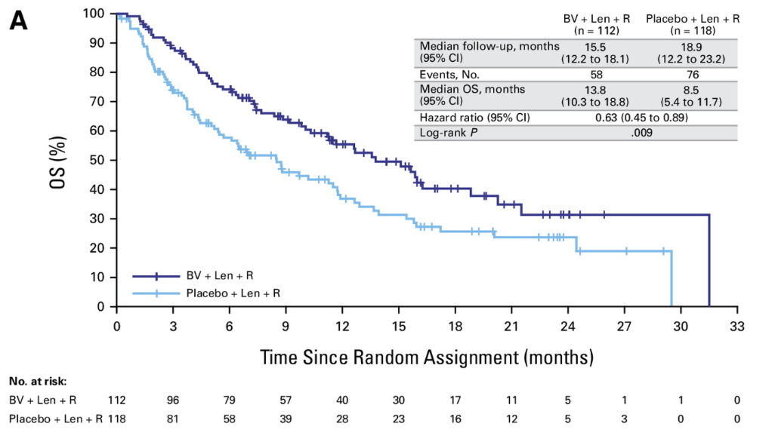
Brentuximab Vedotin in Combination with R² for Relapsed Diffuse Large B-Cell Lymphoma (ECHELON-3)
230 patients - BV + Len + R (n = 112) or placebo + Len + R (n = 118).
Median OS was 13.8 months with BV + Len + R versus 8.5 months with placebo + Len + R (P = .009).
Median PFS was 4.2 months with BV + Len + R versus 2.6 months with placebo + Len + R (P < .001).
ORR was 64% with BV + Len + R and 42% with placebo + Len + R
CR rates were 40% and 19%, respectively.
Bartlett et al. J Clin Oncol. 2025 Jan 7:JCO2402242.

Slide 11
Follicular Lymphoma

Slide 12
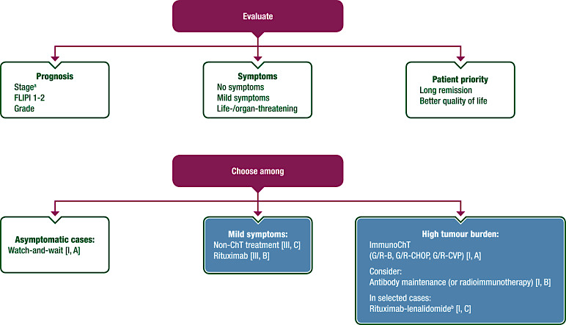
Newly diagnosed and relapsed follicular lymphoma: ESMO Clinical Practice Guidelines
Dreyling et al. Ann Oncol. 2021 Mar;32(3):298-308.

Slide 13
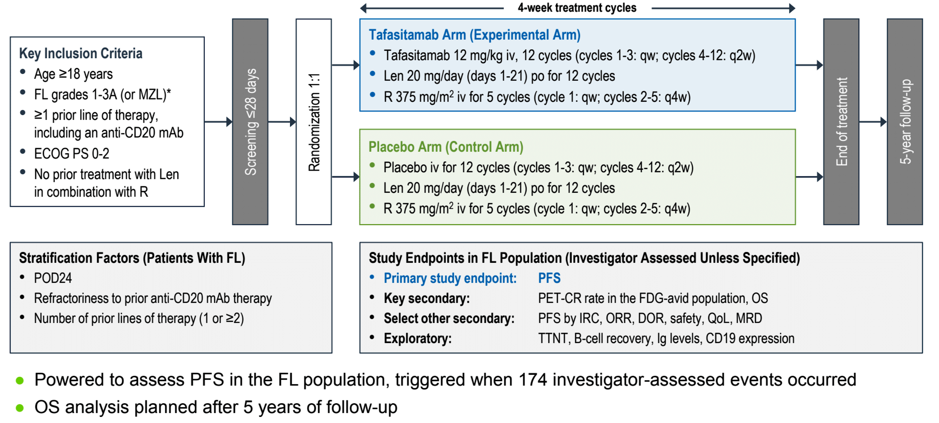
Tafasitamab Plus Lenalidomide and Rituximab for Relapsed or Refractory Follicular Lymphoma: Phase 3 Study (inMIND).
Sehn et al. ASH 2024;Abstract LBA-1.

Slide 14
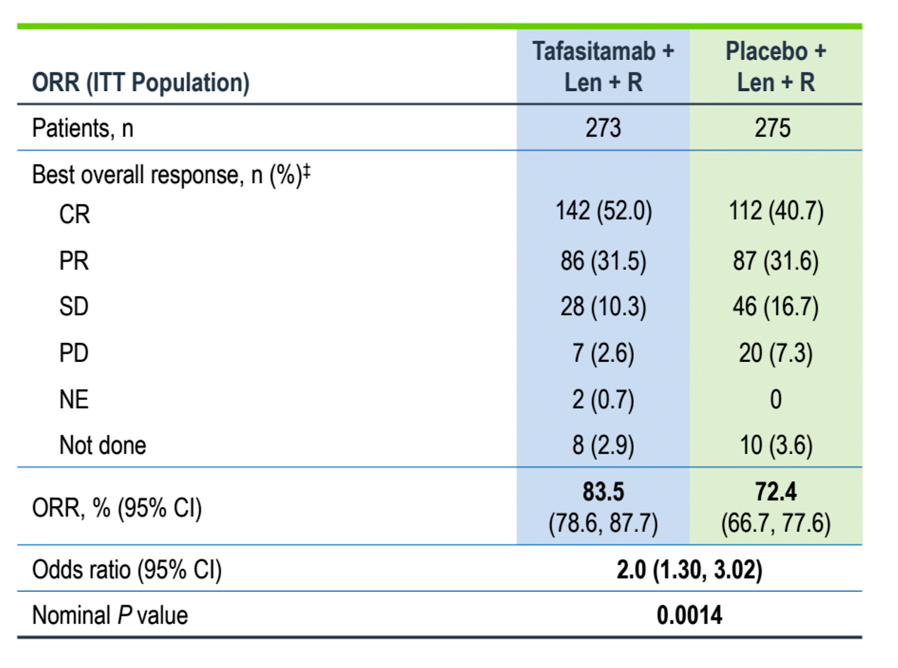
Tafasitamab Plus Lenalidomide and Rituximab for Relapsed or Refractory Follicular Lymphoma: Phase 3 Study (inMIND).
Sehn et al. ASH 2024;Abstract LBA-1.

Slide 15
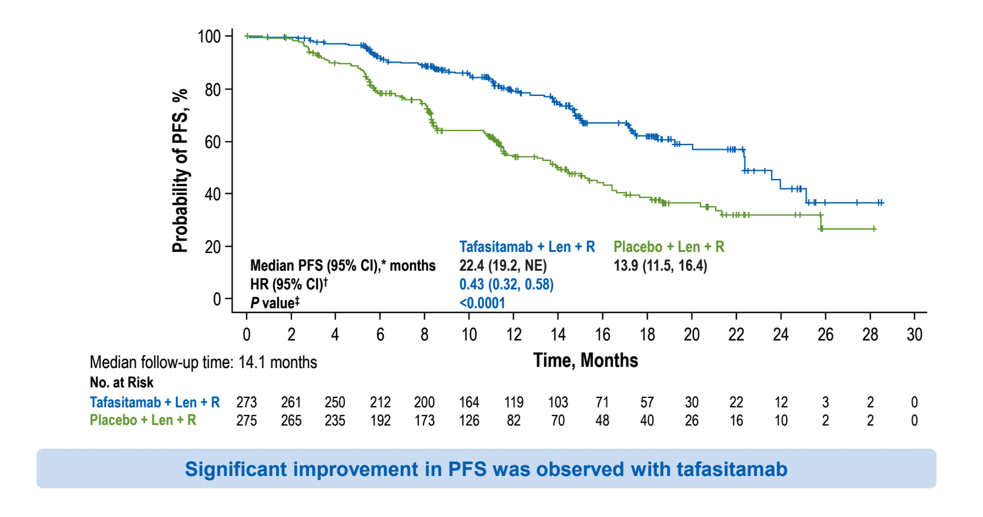
Tafasitamab Plus Lenalidomide and Rituximab for Relapsed or Refractory Follicular Lymphoma: Phase 3 Study (inMIND).
Sehn et al. ASH 2024;Abstract LBA-1.

Slide 16
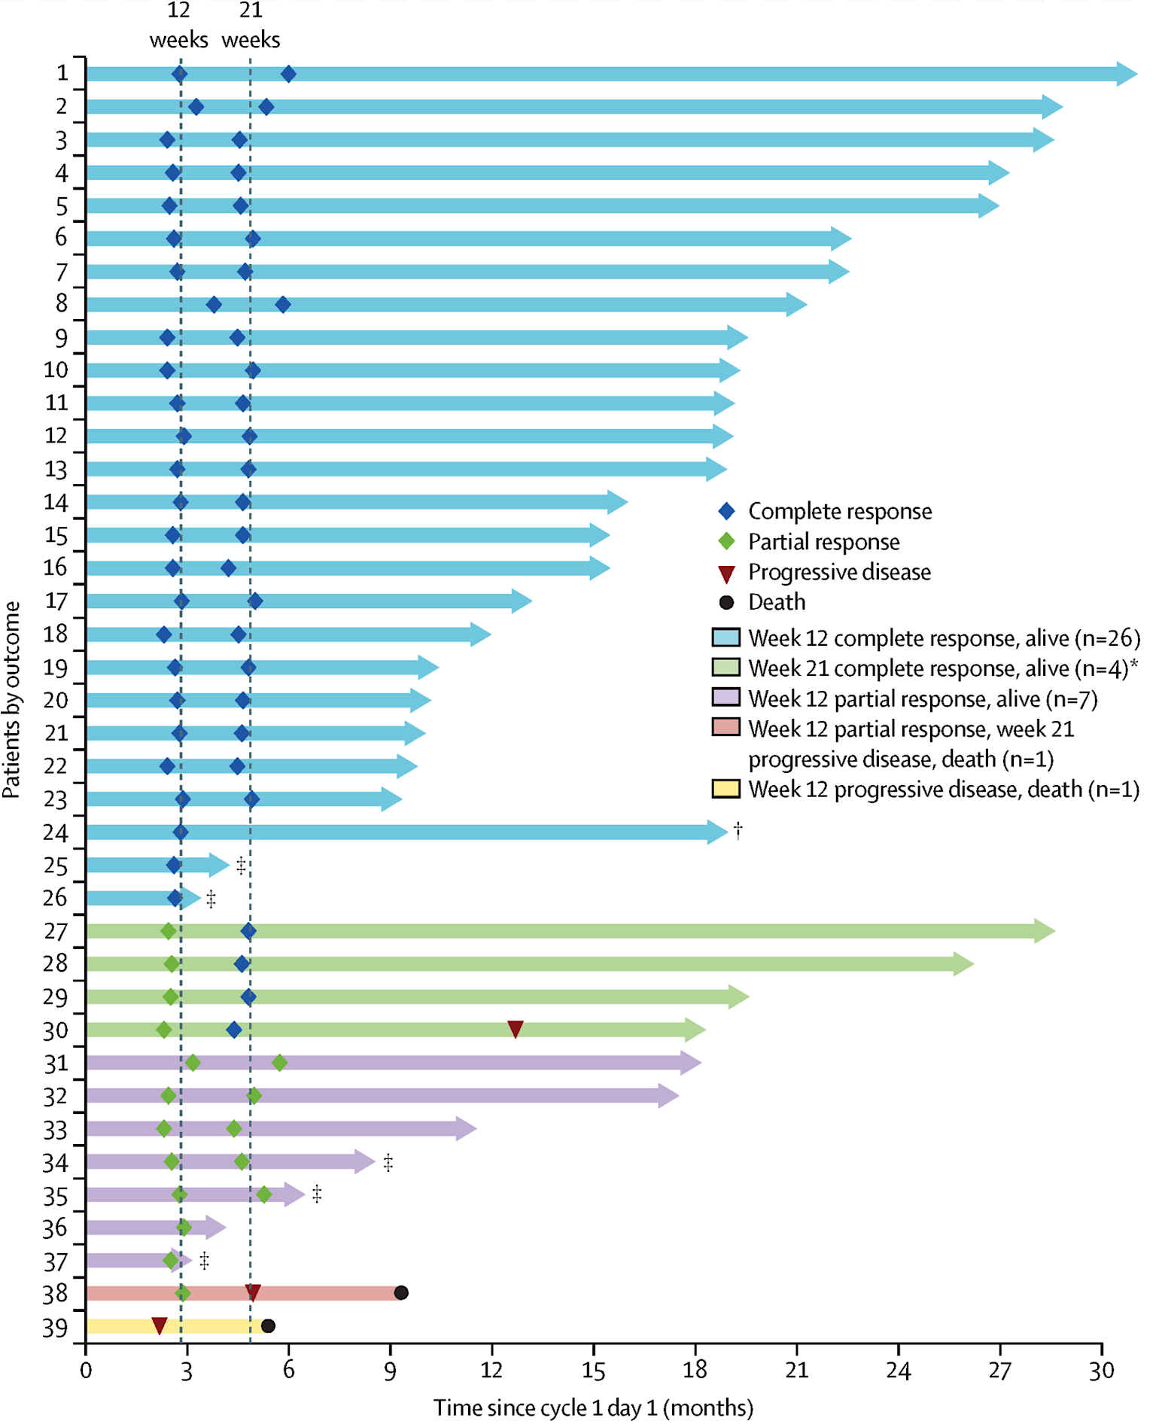
Loncastuximab tesirine with rituximab in patients with relapsed or refractory follicular lymphoma
39 patients
Primary endpoint of week 12 CR rate was 67% (n=26 of 39).
Secondary endpoint of week 12 ORR was 97% (n=38 of 39).
23 of 26 patients with a week 12 CR maintained a CR at the week 21
Alderuccio et al. Lancet Haematol 2025;12(1):e23-e34.

Slide 17
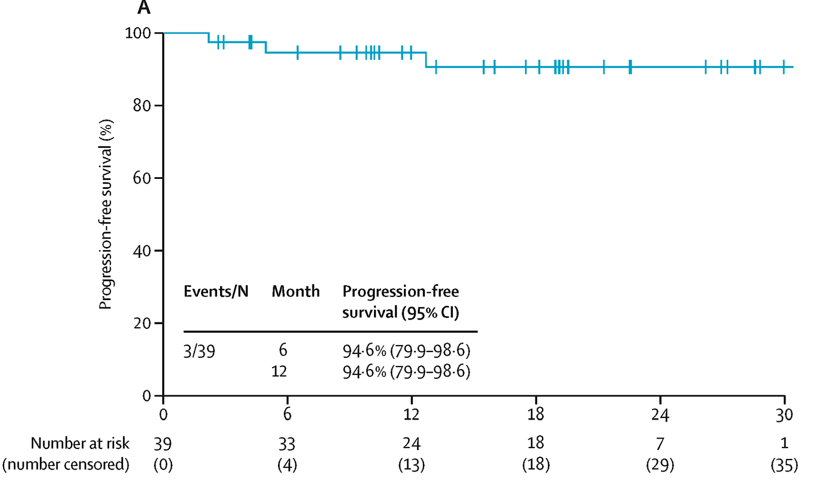
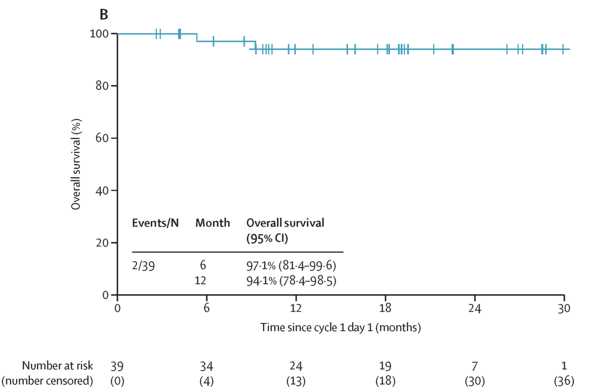
Loncastuximab tesirine with rituximab in patients with relapsed or refractory follicular lymphoma
Alderuccio et al. Lancet Haematol 2025;12(1):e23-e34.

Slide 18
Mantle cell Lymphoma

Slide 19
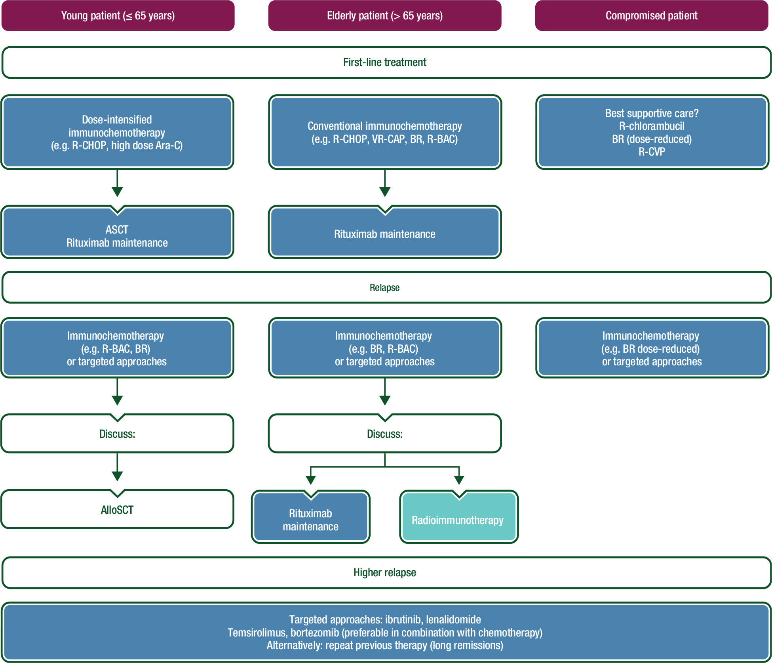
Newly diagnosed and relapsed mantle cell lymphoma:
ESMO Clinical Practice Guidelines
Dreyling Ann Oncol. 2017 Jul 1;28(suppl_4):iv62-iv71.

Slide 20
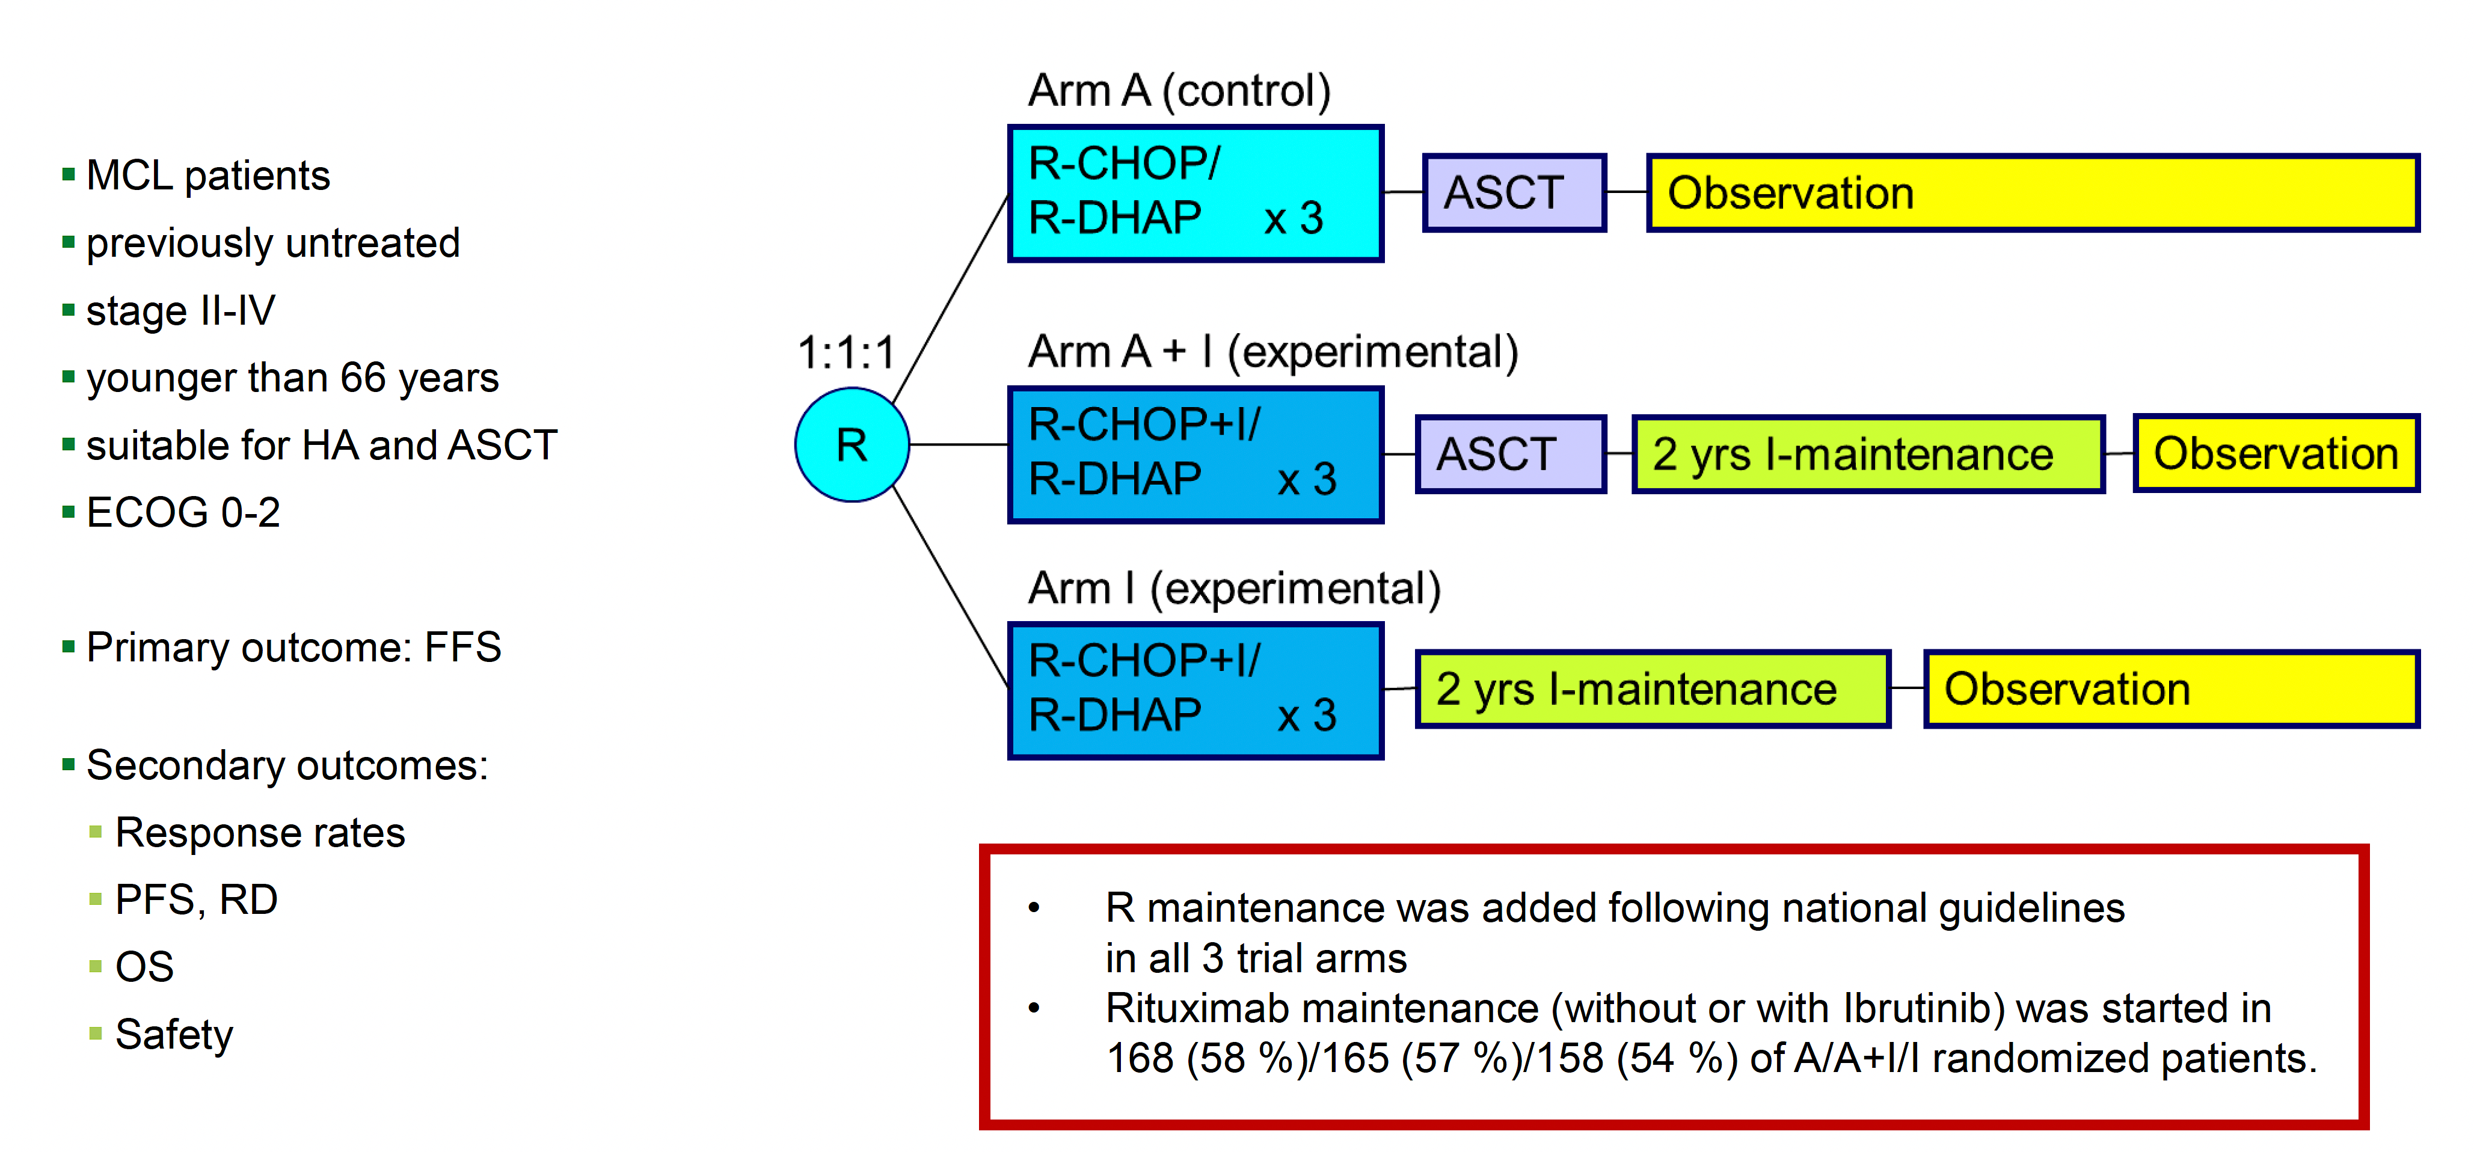
Ibrutinib +/- immunochemotherapy with or without autologous stem-cell transplantation in previously untreated patients with mantle cell lymphoma (TRIANGLE)
Dreyling et al. Lancet. 2024 May 25;403(10441):2293-2306.

Slide 21
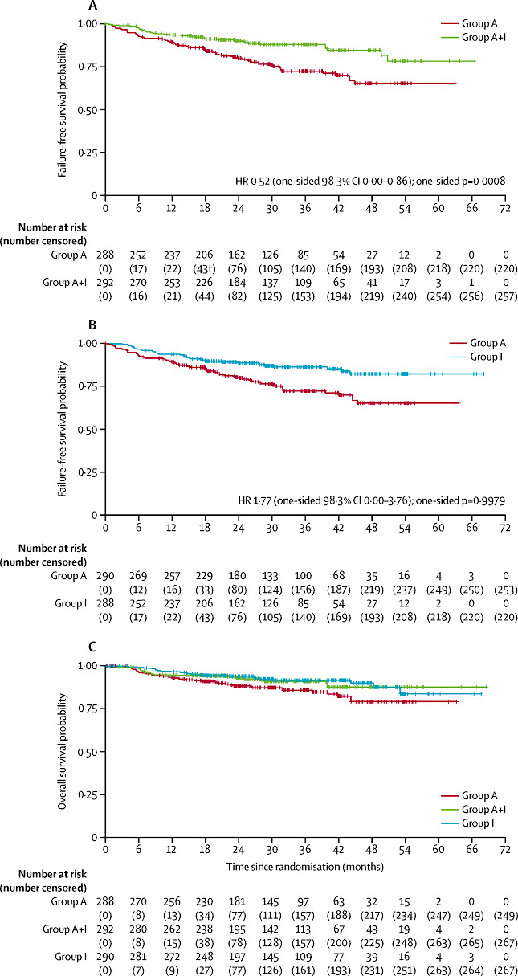
Ibrutinib +/- immunochemotherapy with or without autologous stem-cell transplantation in previously untreated patients with mantle cell lymphoma (TRIANGLE)
Dreyling et al. Lancet. 2024 May 25;403(10441):2293-2306.

Slide 22
Acalabrutinib plus bendamustine and rituximab in untreated elderly patients with mantle cell lymphoma (ECHO)
International, randomized, double-blind phase III trial
Stratified by sMIPI score (low vs intermediate vs high), region (N America vs W Europe vs other)
6 x 28-day cycles
Acalabrutinib 100 mg PO BID +
Bendamustine 90 mg/m² IV on Days 1, 2 +
Rituximab 375 mg/m² IV on Day 1
(n = 299)
Acalabrutinib until PD or toxicity; if ≥PR, maintenance rituximab every 2 cycles x 2 yr
Patients aged ≥65 yr with previously untreated MCL; ECOG PS ≤2
(N = 598)
Crossover permitted after PD
Placebo PO BID +
Bendamustine 90 mg/m² IV on Days 1, 2 +
Rituximab 375 mg/m² IV on Day 1
(n = 299)
Placebo until PD or toxicity;
if ≥PR, maintenance rituximab every 2 cycles x 2 yr
Primary endpoint:
PFS per IRC
Key secondary endpoints:
ORR per IRC, OS, safety
Wang et al. EHA 2024. Abstr LB3439.
Notes:
BR, bendamustine/rituximab; ECOG, Eastern Cooperative Oncology Group; IRC, independent review committee; MCL, mantle cell lymphoma; ORR, overall response rate; OS, overall survival; PD, progressive disease; PR, partial response; PS, performance status; sMIPI, simplified Mantle Cell Lymphoma International Prognostic Index

Slide 23
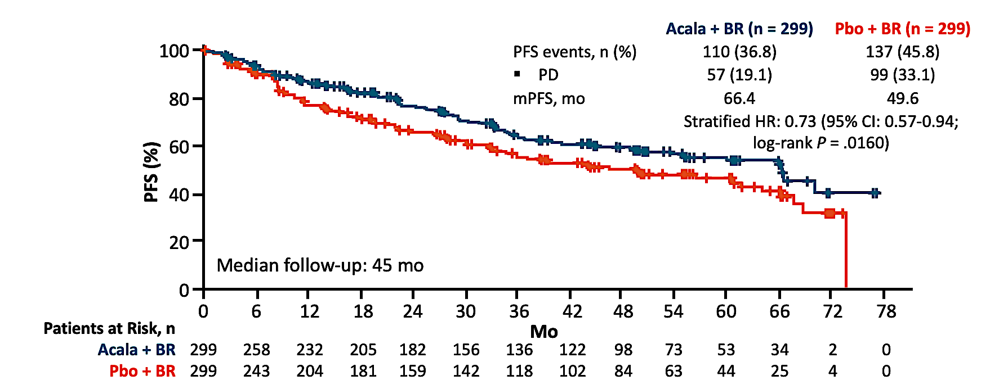
Acalabrutinib plus bendamustine and rituximab in untreated elderly patients with mantle cell lymphoma (ECHO)
ORR 91% vs 88%; CR rate 67% vs 54%
Of the 99 patients with PD on Pbo + BR, 69% subsequently received a BTK inhibitor
Wang et al. EHA 2024. Abstr LB3439.

Slide 24
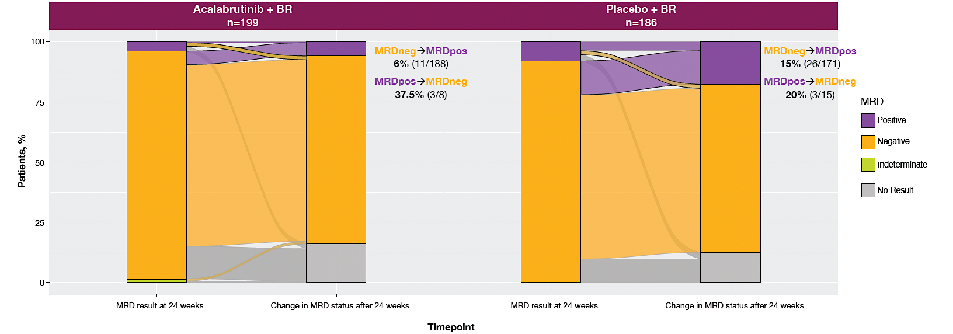
High-risk Subgroups and MRD:
An Updated Analysis of the Phase 3 ECHO Trial
PFS benefit was consistent across subgroups with high-risk disease characteristics (TP53 mutation, high Ki-67 index, and blastoid/ pleomorphic histology)
Among patients who were MRD-negative after induction, fewer acalabrutinib-treated patients converted to MRD-positive during maintenance
Dreyling et al. ASH 2024;Abstract 1626

Slide 25
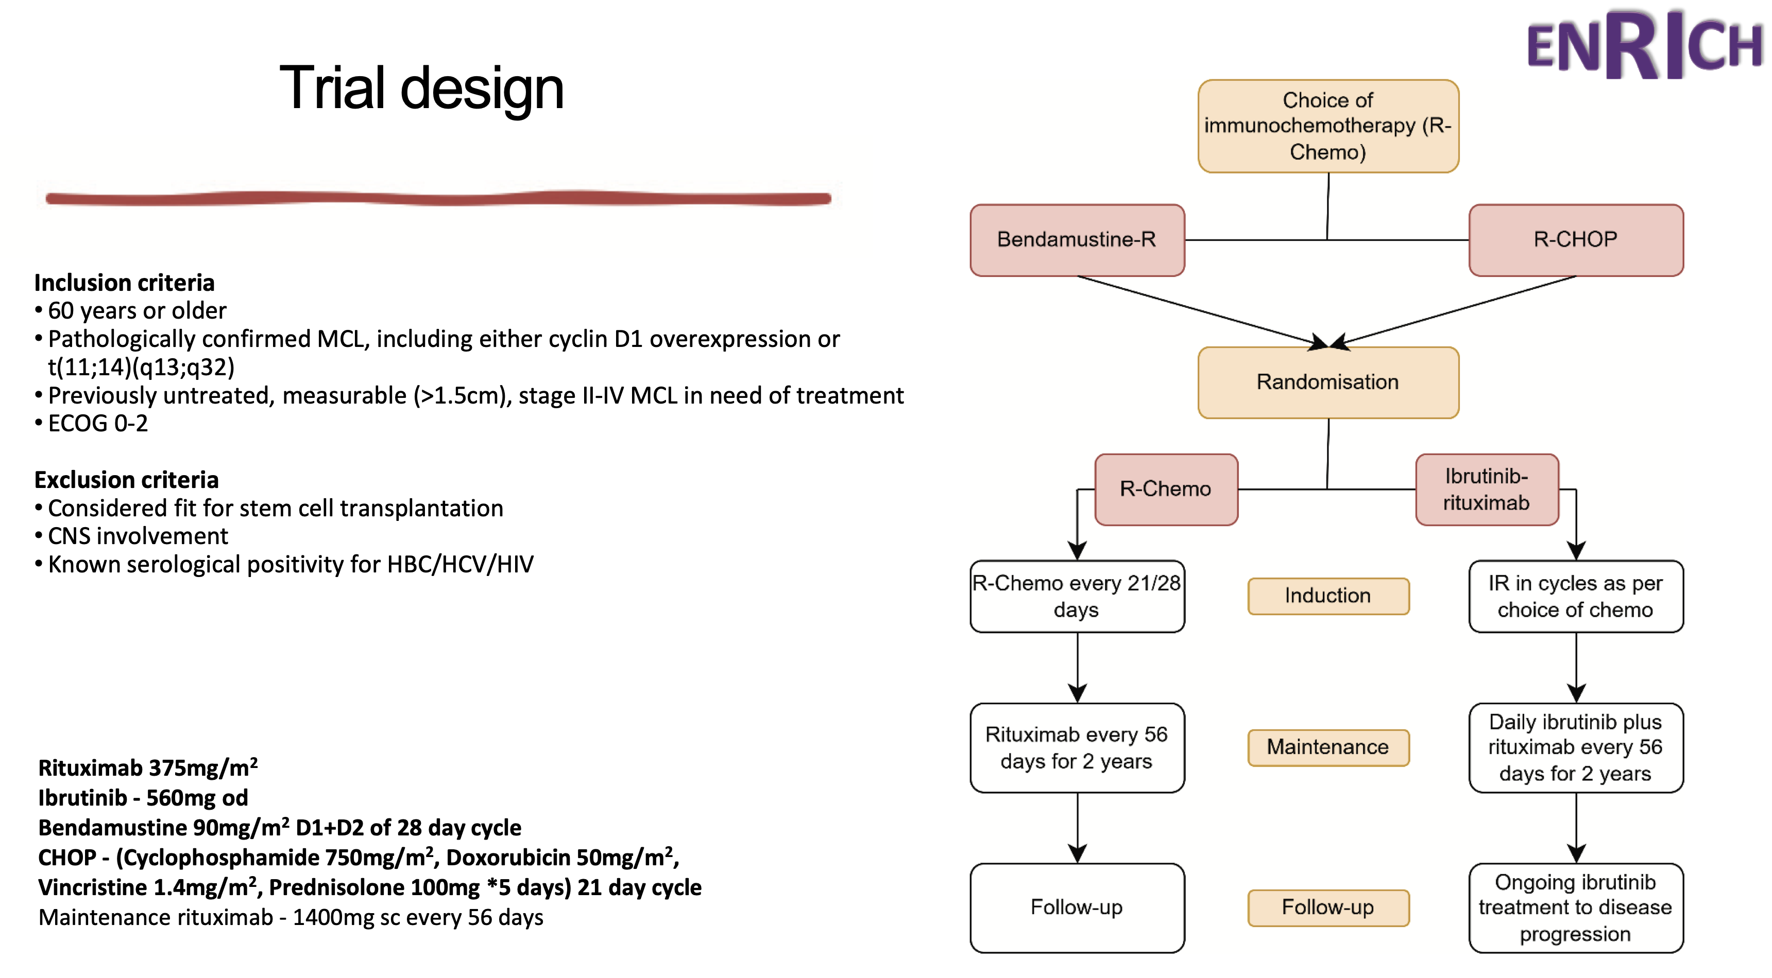
Ibrutinib-Rituximab Is Superior to Rituximab-Chemotherapy in Previously Untreated Older Mantle Cell Lymphoma Patients
Lewis et al. ASH 2024;Abstract 235.

Slide 26
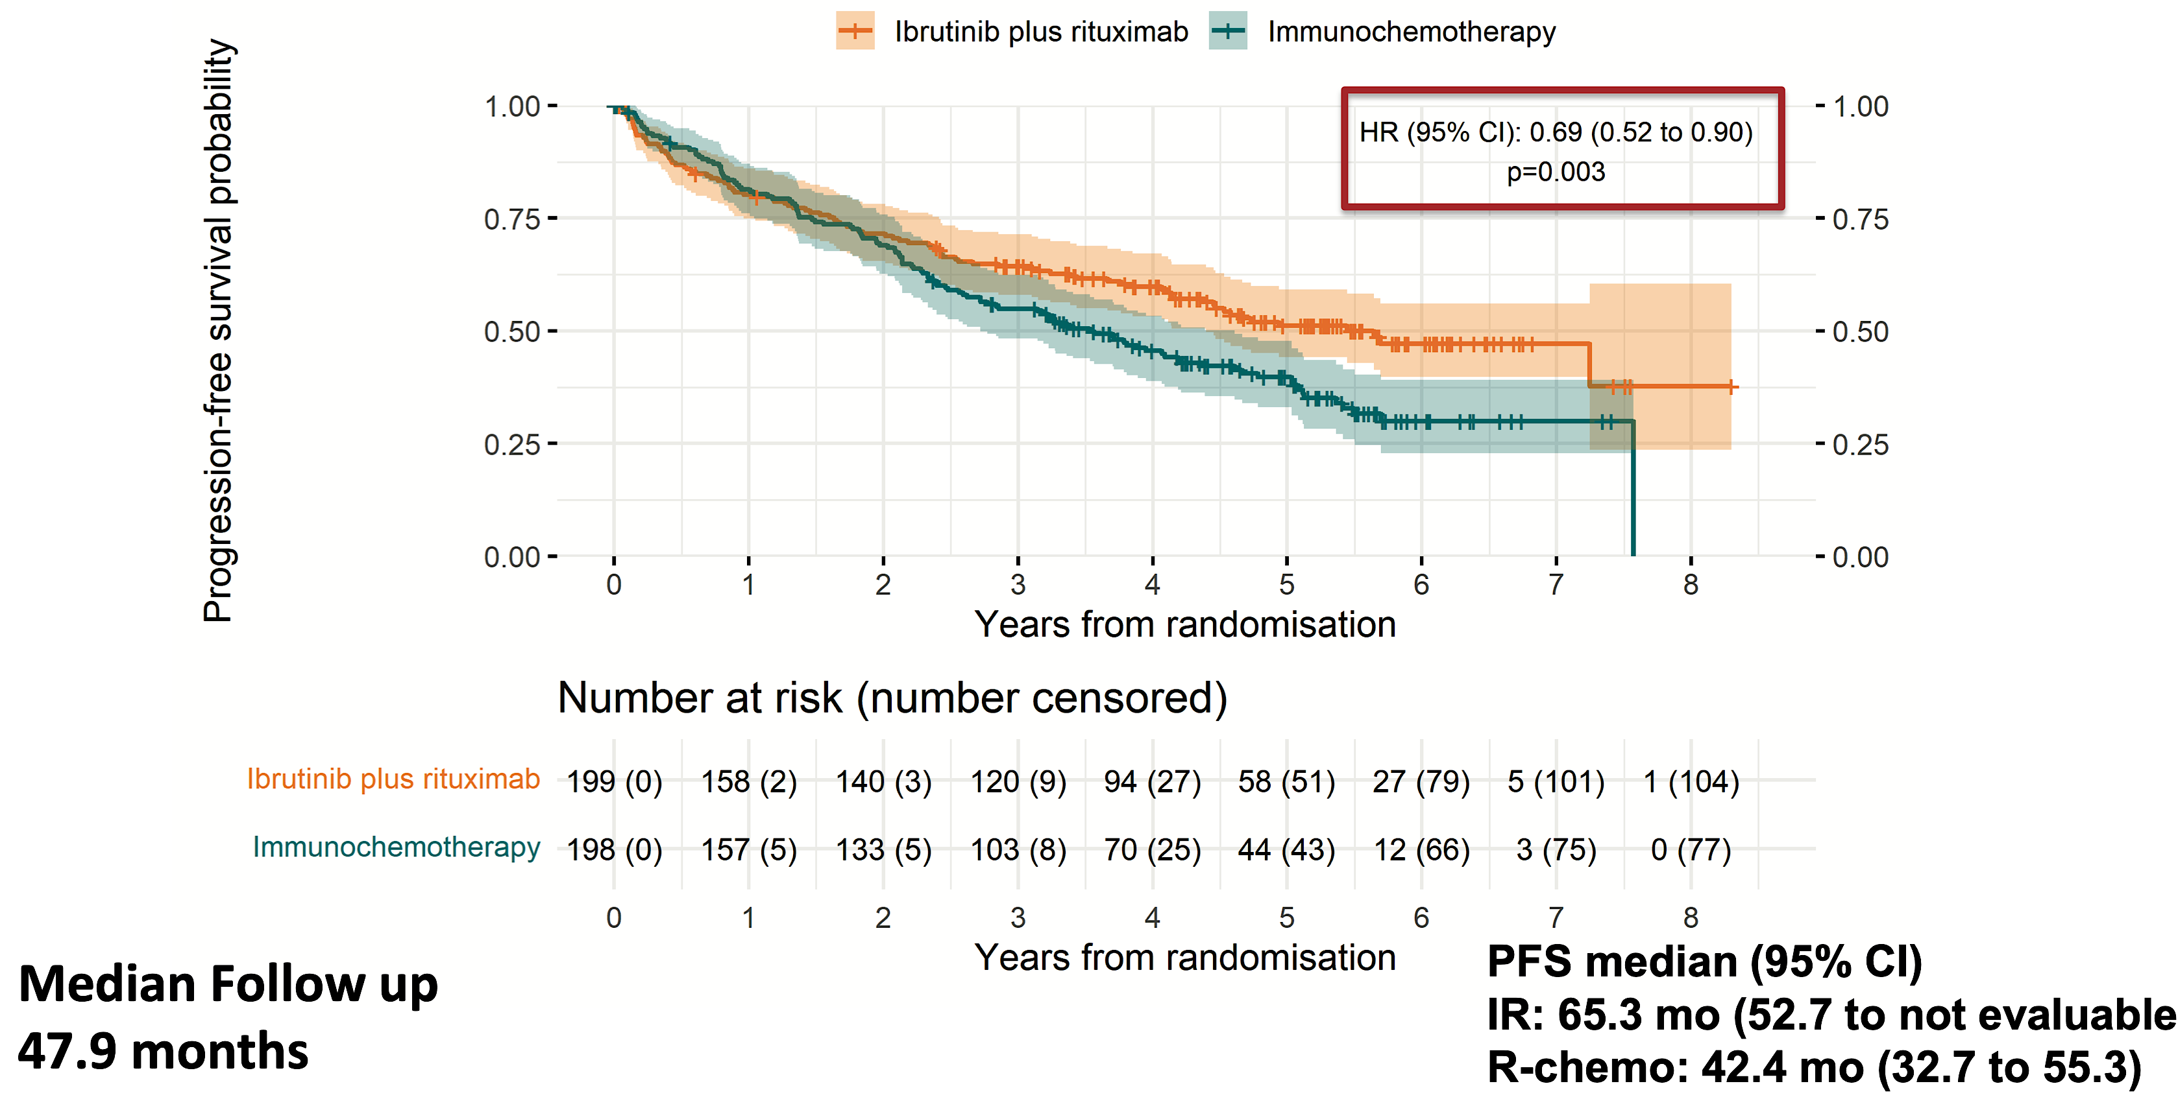
Ibrutinib-Rituximab Is Superior to Rituximab-Chemotherapy in Previously Untreated Older Mantle Cell Lymphoma Patients
Lewis et al. ASH 2024;Abstract 235.

Slide 27
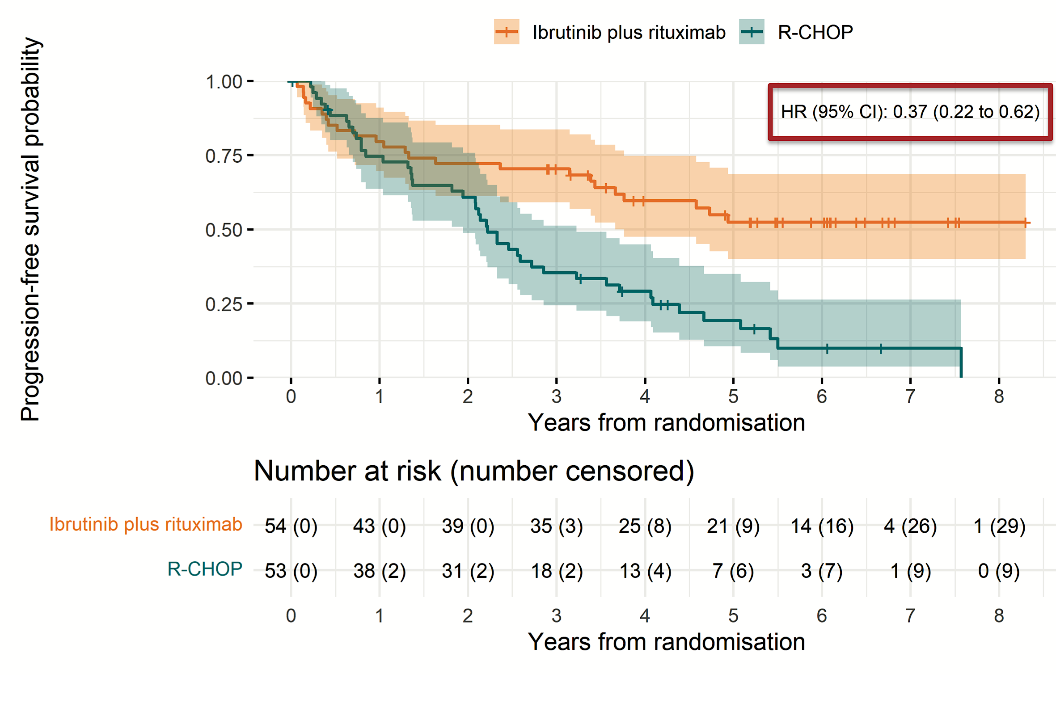
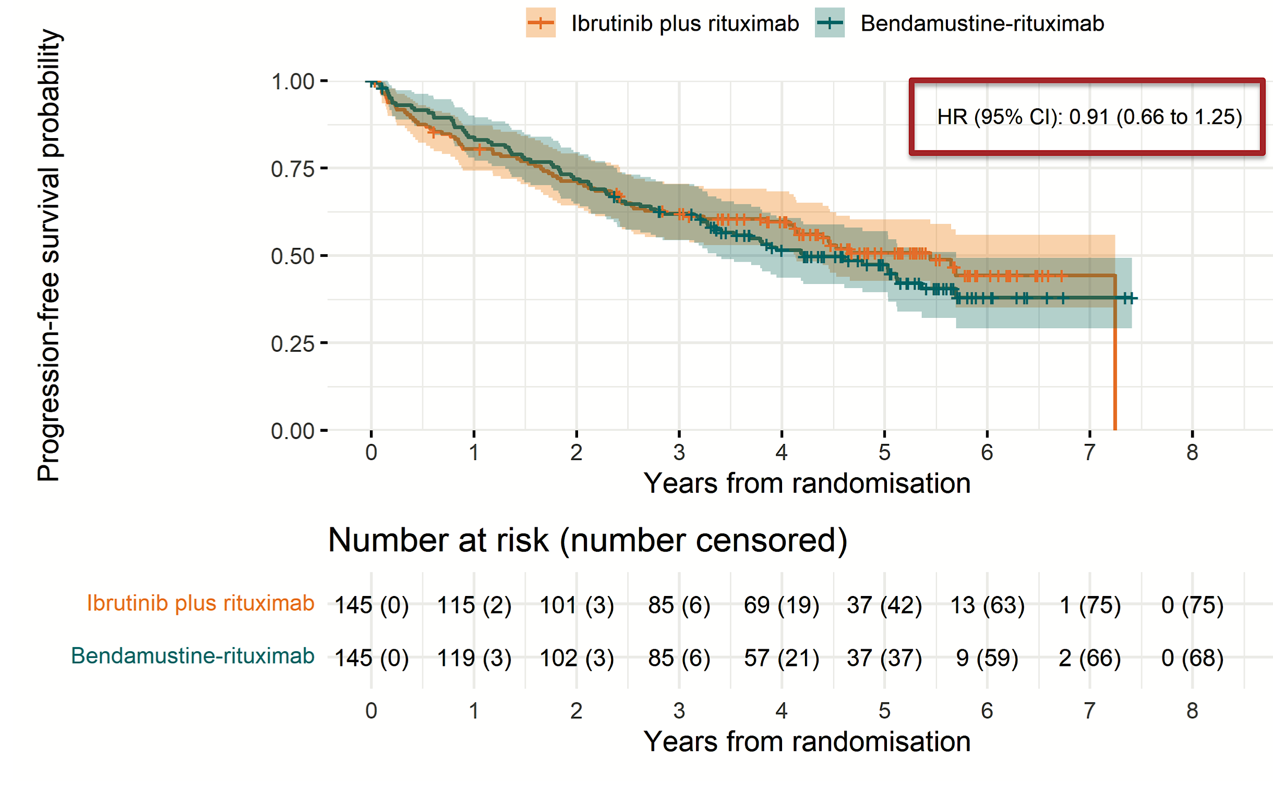
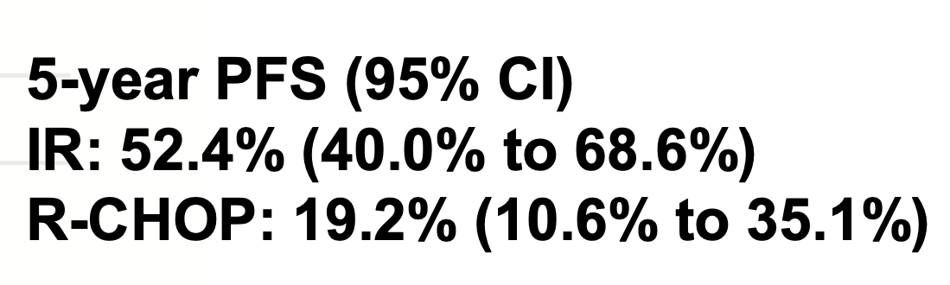

Ibrutinib-Rituximab Is Superior to Rituximab-Chemotherapy in Previously Untreated Older Mantle Cell Lymphoma Patients
Lewis et al. ASH 2024;Abstract 235.

Slide 28
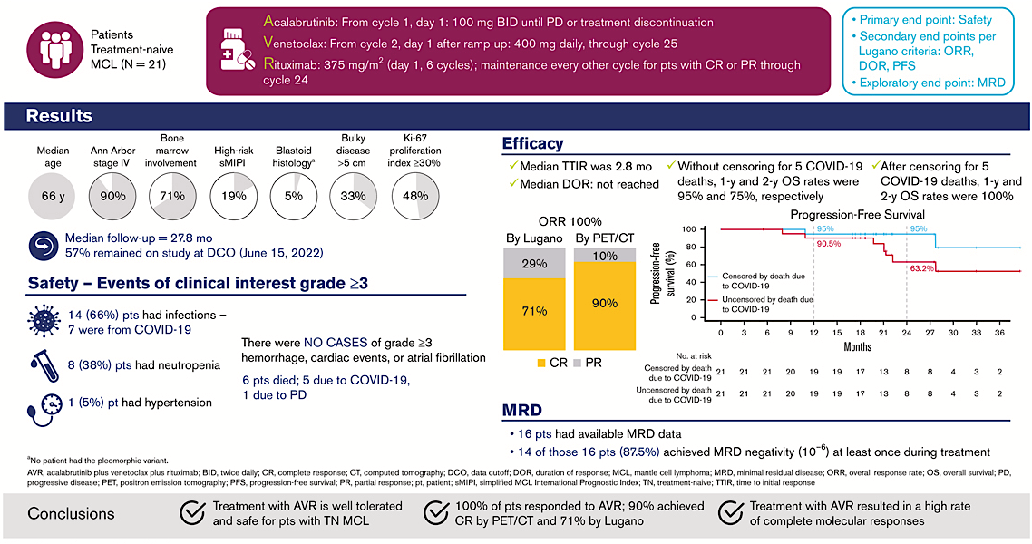
Acalabrutinib plus venetoclax and rituximab
in treatment-naive mantle cell lymphoma
Wang et al. Blood Adv, 2024 Sep 10;8(17):4539-4548.
Notes:
Figure Legend:

Slide 29
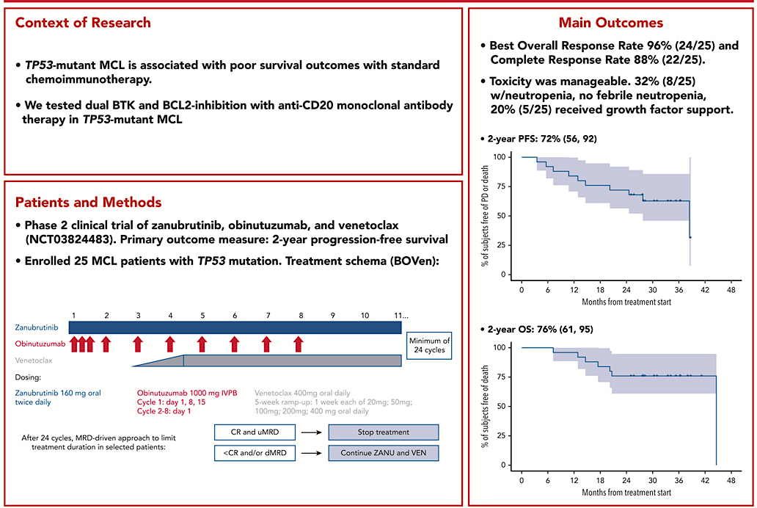
Zanubrutinib, obinutuzumab, and venetoclax for first-line treatment of MCL with TP53 mutations (BOVen)
Kumar et al. Blood. 2025 Jan 30;145(5):497-507.
Notes:
Figure Legend:

Slide 30
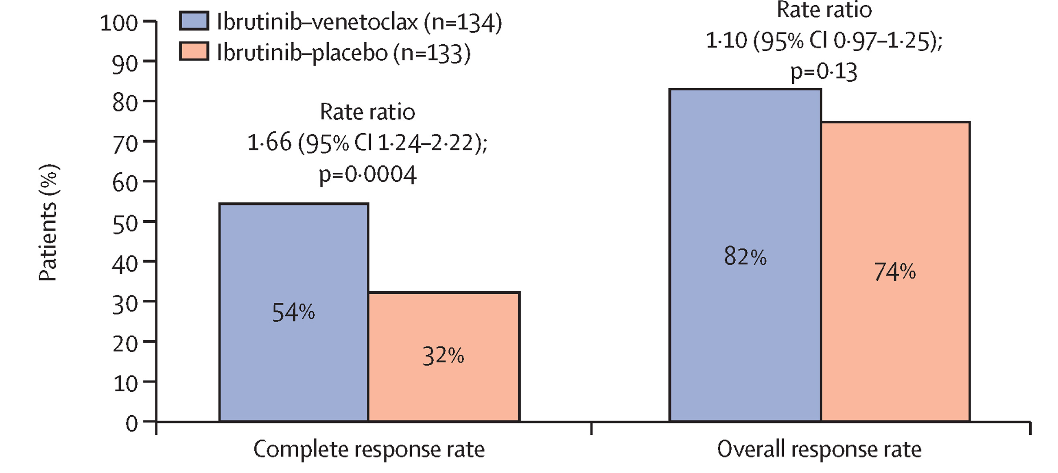
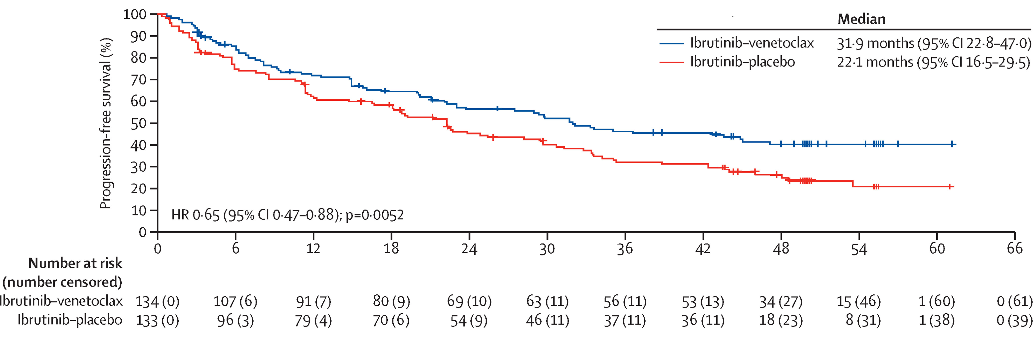
Ibrutinib plus venetoclax in relapsed or refractory mantle cell lymphoma (SYMPATICO)
267 patients were enrolled - 134 to ibrutinib-venetoclax and 133 to ibrutinib-placebo
Wang et al. Lancet Oncol. 2025 Feb;26(2):200-213.

Slide 31
Take away messages
Addition of polatuzumab vedotin to R-CHP chemotherapy as frontline therapy for DLBCL improves PFS, particularly in the ABC subtype.
Tafasitamab/lenalidomide and loncastuximab tesirine are effective in relapsed DLBCL and follicular lymphoma.
Brentuximab vedotin/lenalidomide/rituximab is effective in relapsed DLBCL.
The addition of a BTK inhibitor to chemotherapy or immunotherapy in newly diagnosed mantle cell lymphoma improves outcomes – and makes intensive chemotherapy and an autologous stem cell transplant unnecessary.
Venetoclax added to a BTK inhibitor and an anti-CD20 antibody is effective as initial therapy for mantle cell lymphoma – particularly in p53 mutated disease.
Venetoclax added to ibrutinib is superior to ibrutinib alone in relapsed mantle cell lymphoma patients.

