Slide 1
Year in Review: Management of Multiple Myeloma
A CME/MOC-Accredited Live Webinar
Thursday, May 8, 2025​ 5:00 PM – 6:00 PM ET
Faculty
Meletios-Athanasios (Thanos) C Dimopoulos, MD
Robert Z Orlowski, MD, PhD
Moderator
Neil Love, MD

Slide 2

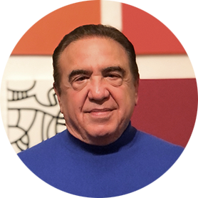
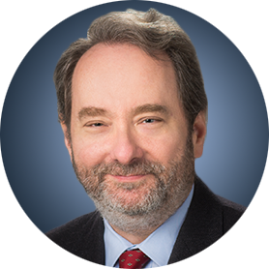
Faculty
Meletios-Athanasios (Thanos) C Dimopoulos, MD
Professor and Chairman
Plasma Cell Dyscrasias Unit
Section of Hematology and Medical Oncology
Department of Clinical Therapeutics
School of Medicine
National and Kapodistrian University of Athens
Alexandra Hospital
Athens, Greece
MODERATOR
Neil Love, MD Research To Practice
Miami, Florida
Robert Z Orlowski, MD, PhD
Florence Maude Thomas Cancer Research Professor
Department of Lymphoma and Myeloma
Professor, Department of Experimental Therapeutics
Vice Chair, Myeloma Translational Research
Division of Cancer Medicine
The University of Texas MD Anderson Cancer Center
Houston, Texas

Slide 3
Commercial Support
This activity is supported by educational grants from GSK and Sanofi.
Research To Practice CME Planning Committee Members, Staff and Reviewers
Planners, scientific staff and independent reviewers for Research To Practice have no relevant conflicts of interest to disclose.

Slide 4
Prof Dimopoulos — Disclosures
Advisory Committees, Consulting Agreements and Speakers Bureaus | Amgen Inc, AstraZeneca Pharmaceuticals LP, BeiGene Ltd, Bristol Myers Squibb, GSK, Janssen Biotech Inc, Menarini Group, Regeneron Pharmaceuticals Inc, Sanofi, Swixx Biopharma SA, Takeda Pharmaceutical Company Limited

Slide 5
Dr Orlowski — Disclosures
Advisory Committees and Consulting Agreements | AbbVie Inc, Adaptive Biotechnologies Corporation, Asylia Therapeutics Inc, Biotheryx, Bristol Myers Squibb, CellCentric, DEM BioPharma, IASO Bio, Karyopharm Therapeutics, Lytica Therapeutics, Meridian Therapeutics, Monte Rosa Therapeutics, MYELOMA360, Neoleukin Therapeutics Inc, Oncopeptides, Pfizer Inc, Regeneron Pharmaceuticals Inc, Sanofi, Takeda Pharmaceuticals USA Inc
Stock Options — Private Companies | Asylia Therapeutics Inc

Slide 6
This educational activity contains discussion of non-FDA-approved uses of agents and regimens. Please refer to official prescribing information for each product for approved indications.

Slide 7
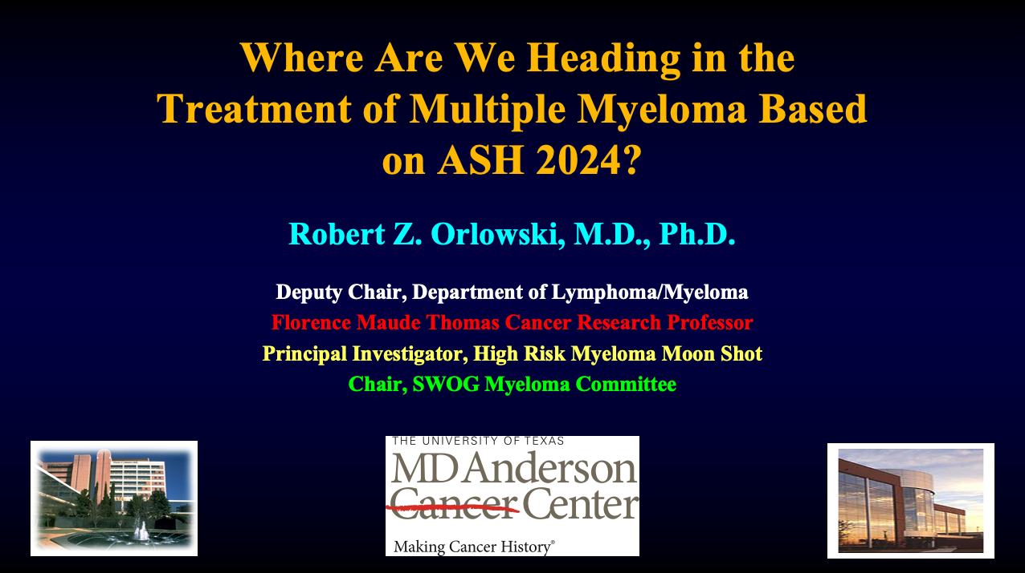
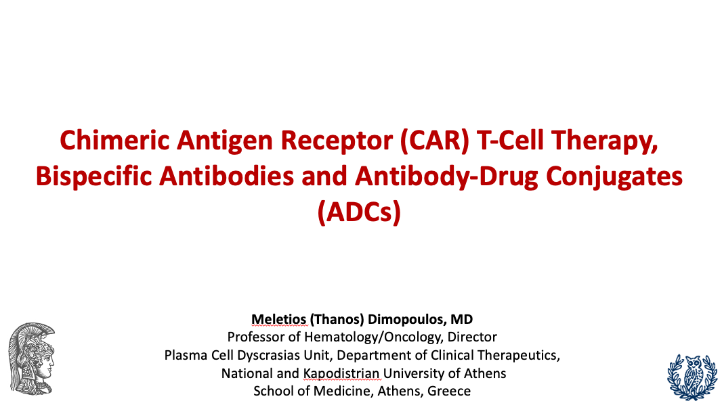

Slide 8
Key Datasets
Robert Z Orlowski, MD, PhD
Dimopoulos MA et al. Daratumumab or active monitoring for high-risk smoldering multiple myeloma. N Engl J Med 2024;[Online ahead of print].
Bertamini L et al. Circulating tumor cells as a biomarker to identify high-risk transplant eligible myeloma patients treated with bortezomib, lenalidomide and dexamethasone with or without daratumumab during induction/consolidation, and lenalidomide with or without daratumumab during maintenance: Results from the Perseus study. ASH 2024;Abstract 487.
Mai EK et al. Isatuximab, lenalidomide, bortezomib, and dexamethasone induction therapy for transplant-eligible newly diagnosed multiple myeloma: Final part 1 analysis of the GMMG-HD7 trial. J Clin Oncol 2025;43(11):1279-88.
Usmani SZ et al. Daratumumab plus bortezomib, lenalidomide and dexamethasone for transplant-ineligible or transplant-deferred newly diagnosed multiple myeloma: The randomized phase 3 CEPHEUS trial. Nat Med 2025;[Online ahead of print].
Facon T et al. Isatuximab, bortezomib, lenalidomide, and dexamethasone for multiple myeloma. N Engl J Med 2024;391(17):1597-609.
Leleu X et al. Isatuximab, lenalidomide, dexamethasone and bortezomib in transplant-ineligible multiple myeloma: The randomized phase 3 BENEFIT trial. Nat Med 2024;30(8):2235-41.

Slide 9
Key Datasets
Robert Z Orlowski, MD, PhD (continued)
Badros A et al. Daratumumab with lenalidomide as maintenance after transplant in newly diagnosed multiple myeloma: The AURIGA study. Blood 2025;145(3):300-10.
Pasquini MC et al. Minimal residual disease status in multiple myeloma 1 year after autologous hematopoietic cell transplantation and lenalidomide maintenance are associated with long-term overall survival. J Clin Oncol 2024;42(23):2757-68.
Yong K et al. Isatuximab plus carfilzomib-dexamethasone versus carfilzomib-dexamethasone in patients with relapsed multiple myeloma (IKEMA): Overall survival analysis of a phase 3, randomised, controlled trial. Lancet Haematol 2024;11(10).
Richardson PG et al. Isatuximab-pomalidomide-dexamethasone versus pomalidomide-dexamethasone in patients with relapsed and refractory multiple myeloma: Final overall survival analysis. Haematologica 2024;109(7):2239-49.
New isatuximab subcutaneous formulation met co-primary endpoints in the IRAKLIA phase 3 study in multiple myeloma [press release]. January 9, 2025.
Sandhu I et al. Mezigdomide (MEZI) plus dexamethasone (DEX) and bortezomib (BORT) or carfilzomib (CFZ) in patients (pts) with relapsed/refractory multiple myeloma (RRMM): Updated results from the CC-92480-MM-002 trial. ASH 2024;Abstract 1025.

Slide 10
Key Datasets
Meletios-Athanasios (Thanos) C Dimopoulos, MD
Mateos MV et al. Overall survival (OS) with ciltacabtagene autoleucel (cilta-cel) versus standard of care (SoC) in lenalidomide (len)-refractory multiple myeloma (MM): Phase 3 CARTITUDE-4 study update. IMS 2024;Abstract OA-65.
Ailawadhi S et al. Ide-cel vs standard regimens in triple-class-exposed relapsed and refractory multiple myeloma: Updated KarMMa-3 analyses. Blood 2024;144(23):2389-401.
Freeman CL et al. Phase 2 registrational study of anitocabtagene autoleucel for the treatment of patients with relapsed and/or refractory multiple myeloma: Preliminary results from the IMMagine-1 trial. ASH 2024;Abstract 1031.
Jurgens EM et al. Phase I trial of MCARH109, a G protein-coupled receptor class C group 5 member D (GPRC5D)-targeted chimeric antigen receptor T-cell therapy for multiple myeloma: An updated analysis. J Clin Oncol 2025;43(5):498-504.
Garfall A et al. Long-term follow-up from the phase 1/2 MajesTEC-1 trial of teclistamab in patients with relapsed/refractory multiple myeloma. ASCO 2024;Abstract 7540.
Prince HM et al. MagnetisMM-3: Long-term update and efficacy and safety of less frequent dosing of elranatamab in patients with relapsed or refractory multiple myeloma. ASH 2024;Abstract 4738.

Slide 11
Key Datasets
Meletios-Athanasios (Thanos) C Dimopoulos, MD (continued)
Rasche L et al. Long-term efficacy and safety results from the Phase 1/2 MonumenTAL-1 study of talquetamab, a GPRC5D×CD3 bispecific antibody, in patients with relapsed/refractory multiple myeloma. EHA 2024;Abstract P915.
Cohen YC et al. Talquetamab plus teclistamab in relapsed or refractory multiple myeloma. N Engl J Med 2025;392(2):138-49.
Shah MR et al. Linvoseltamab in patients with relapsed/refractory multiple myeloma: Longer follow-up and selected high-risk subgroup analyses of the Linker-MM1 study. ASH 2024;Abstract 3369.
Dimopoulos MA et al. Belantamab mafodotin, pomalidomide, and dexamethasone in multiple myeloma. N Engl J Med 2024;391(5):408-21.
Hungria V et al. Belantamab mafodotin, bortezomib, and dexamethasone vs daratumumab, bortezomib, and dexamethasone in relapsed/refractory multiple myeloma: Overall survival analysis and updated efficacy outcomes of the phase 3 Dreamm-7 trial. ASH 2024;Abstract 772.
Usmani S et al. Phase I study of belantamab mafodotin in combination with standard of care in transplant-ineligible newly diagnosed multiple myeloma: Dreamm-9 updated interim analysis. ASH 2024;Abstract 497.

Slide 12
AGENDA Year in Review: Management of Multiple Myeloma
INTRODUCTION: ASCO 2025 Preview
MODULE 1: Anti-CD38 Antibodies
MODULE 2: Belantamab Mafodotin
MODULE 3: CAR T-Cell Therapy
MODULE 4: Bispecific Antibodies
MODULE 5: Other Novel Agents

Slide 13
AGENDA Year in Review: Management of Multiple Myeloma
INTRODUCTION: ASCO 2025 Preview
MODULE 1: Anti-CD38 Antibodies
MODULE 2: Belantamab Mafodotin
MODULE 3: CAR T-Cell Therapy
MODULE 4: Bispecific Antibodies
MODULE 5: Other Novel Agents

Slide 14
ASCO 2025 Oral Session
June 3, 2025
9:45 AM CDT Abstract 7500
MRD-driven strategy following IsaKRD induction in transplant-eligible NDMM: Primary endpoints of the phase 3 MIDAS trial.
Aurore Perrot, MD, PhD
9:57 AM CDT Abstract 7501
Subcutaneous daratumumab (Dara) + bortezomib/lenalidomide/dexamethasone (VRd) with Dara + lenalidomide (DR) maintenance in transplant-eligible (TE) patients with newly diagnosed multiple myeloma (NDMM): Analysis of sustained minimal residual disease negativity in the phase 3 PERSEUS trial.
Philippe Moreau, MD
10:09 AM CDT Abstract 7502
Sustained MRD negativity in patients with newly diagnosed multiple myeloma treated with carfilzomib-lenalidomide-dexamethasone with or without isatuximab (phase III IsKia trial).
Francesca Gay, MD, PhD

Slide 15
ASCO 2025 Oral Session
June 3, 2025
10:21 AM CDT Abstract 7503
Randomized, multi-center study of carfilzomib, lenalidomide, and dexamethasone (KRd) with or without daratumumab (D) in patients with newly diagnosed multiple myeloma (NDMM): The ADVANCE clinical trial.
Carl Ola Landgren, MD, PhD
10:57 AM CDT Abstract 7504
Elranatamab in combination with daratumumab and lenalidomide (EDR) in patients with newly diagnosed multiple myeloma (NDMM) not eligible for transplant: Initial results from MagnetisMM-6 part 1.
Hang Quach, MD, FRACP, FRCPA
11:09 AM CDT Abstract 7505
First-in-human study of JNJ-79635322 (JNJ-5322), a novel, next-generation trispecific antibody (TsAb), in patients (pts) with relapsed/refractory multiple myeloma (RRMM): Initial phase 1 results.
Niels WCJ van de Donk, MD, PhD

Slide 16
ASCO 2025 Oral Session
June 3, 2025
11:21 AM CDT Abstract 7506
Isatuximab (Isa) subcutaneous (SC) via an on-body delivery system (OBDS) vs Isa intravenous (IV), plus pomalidomide and dexamethasone (Pd) in relapsed/refractory multiple myeloma (RRMM): Results of the randomized, non-inferiority, phase 3 IRAKLIA study.
Xavier P Leleu, MD, PhD
11:57 AM CDT Abstract 7507
Long-term (≥5 year) remission and survival after treatment with ciltacabtagene autoleucel (cilta-cel) in CARTITUDE-1 patients (pts) with relapsed/refractory multiple myeloma (RRMM).
Peter M Voorhees, MD
12:09 PM CDT Abstract 7508
Safety and efficacy data from NEXICART-2, the first US trial of CAR-T in R/R light chain (AL) amyloidosis, NXC-201.
Heather Jolie Landau, MD

Slide 17
ASCO 2025 Rapid Oral Session
June 2, 2025
8:00 AM CDT Abstract 7509
Isatuximab, carfilzomib, lenalidomide, and dexamethasone (Isa-KRd) for high-risk (HR) newly diagnosed multiple myeloma (NDMM): First-time report of the full cohort of transplant-eligible (TE) patients in the GMMG-CONCEPT trial.
Lisa B Leypoldt, MD
8:06 AM CDT Abstract 7510
Linvoseltamab (LINVO) + bortezomib (BTZ) in patients (pts) with relapsed/refractory multiple myeloma (RRMM): First results from the LINKER-MM2 trial.
Xavier P Leleu, MD, PhD
8:12 AM CDT Abstract 7511
Heterogeneity in the expression of GPRC5D between patients with multiple myeloma.
Harsh Parmar, MD

Slide 18
ASCO 2025 Rapid Oral Session
June 2, 2025
8:30 AM CDT Abstract 7512
Belantamab mafodotin plus lenalidomide/dexamethasone in newly diagnosed intermediate-fit & frail multiple myeloma patients: Long-term efficacy and safety from the phase 1/2 BELARD clinical trial.
Evangelos Terpos, MD, PhD
8:36 AM CDT Abstract 7513
Linvoseltamab (LINVO) + carfilzomib (CFZ) in patients (pts) with relapsed/refractory multiple myeloma (RRMM): Initial results from the LINKER-MM2 trial.
Salomon Manier, MD, PhD
8:42 AM CDT Abstract 7514
Phase 1, first-in-human study of ISB 2001: A BCMAxCD38xCD3-targeting trispecific antibody for patients with relapsed/refractory multiple myeloma (RRMM) — Dose escalation (DE) results.
Hang Quach, MD, FRACP, FRCPA

Slide 19
ASCO 2025 Rapid Oral Session
June 2, 2025
9:00 AM CDT Abstract 7515
Minimal residual disease (MRD) negativity (neg) in patients (pts) with relapsed or refractory multiple myeloma (RRMM) treated with belantamab mafodotin plus pomalidomide and dexamethasone (BPd) vs pomalidomide, bortezomib, and dexamethasone (PVd): Analysis from the DREAMM-8 trial.
Suzanne Trudel, MD
9:06 AM CDT Abstract 7516
Daratumumab plus bortezomib, lenalidomide, and dexamethasone (DVRd) in patients with newly diagnosed multiple myeloma (NDMM): Subgroup analysis of transplant-ineligible (TIE) patients in the phase 3 CEPHEUS study.
Saad Z Usmani, MD, MBA, FRCP, FASCO
9:12 AM CDT Abstract 7517
Isatuximab, bortezomib, lenalidomide, and dexamethasone (Isa-VRd) in newly diagnosed multiple myeloma (NDMM): Outcomes in patients with 1q21+ status in the phase 3 IMROZ study.
Robert Orlowski, MD, PhD

Slide 20
AGENDA Year in Review: Management of Multiple Myeloma
INTRODUCTION: ASCO 2025 Preview
MODULE 1: Anti-CD38 Antibodies
MODULE 2: Belantamab Mafodotin
MODULE 3: CAR T-Cell Therapy
MODULE 4: Bispecific Antibodies
MODULE 5: Other Novel Agents

Slide 21
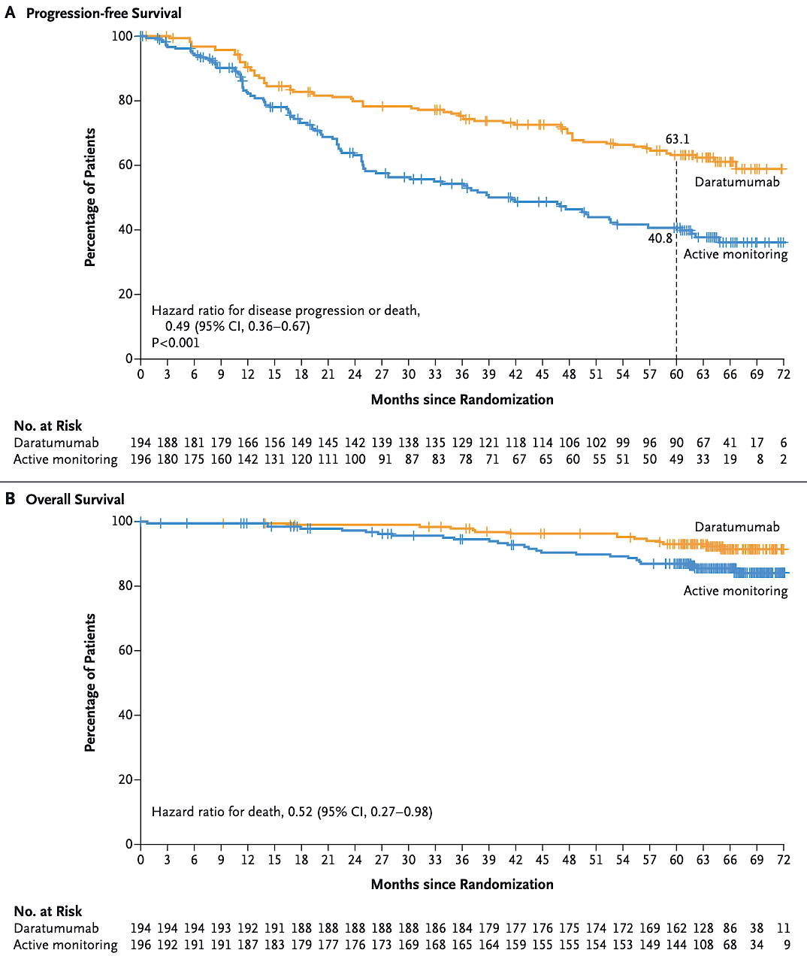
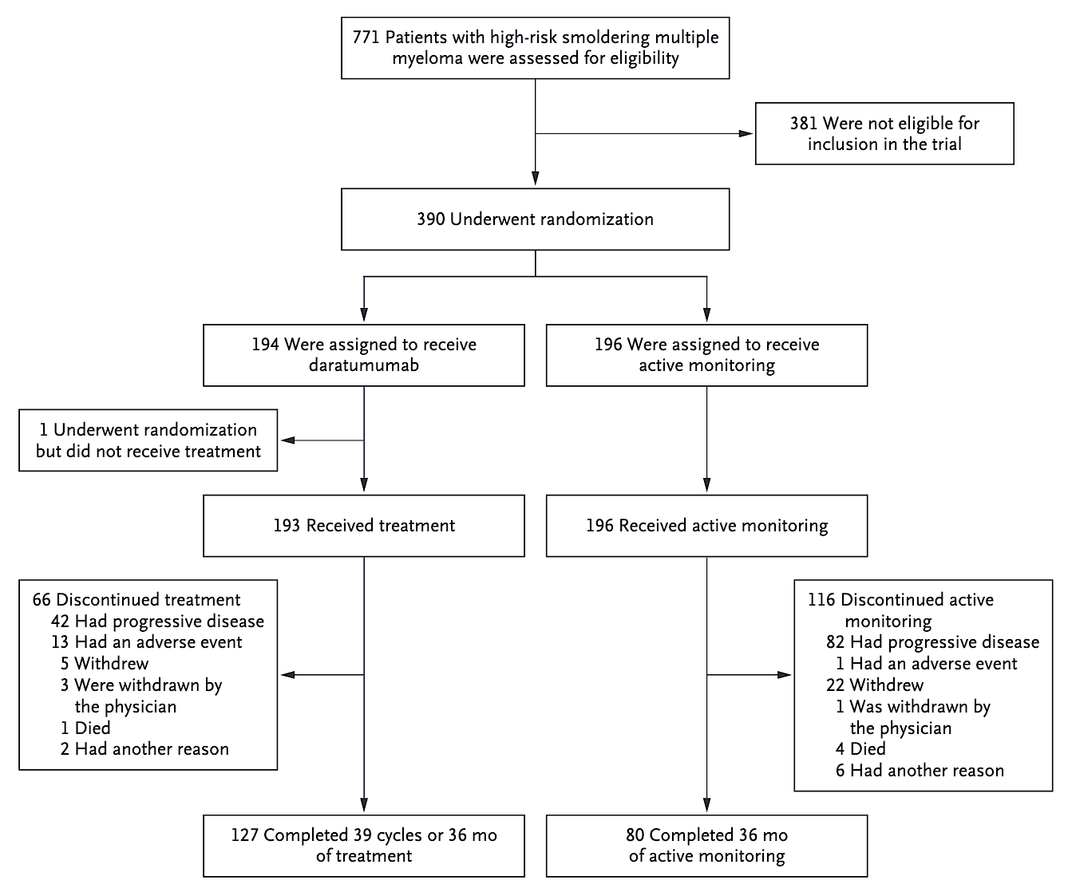
Dara in Smoldering: Design & Outcomes
Courtesy of Robert Z Orlowski, MD, PhD
Dimopoulos MA et al. N Engl J Med. 2024 Dec 9.

Slide 22
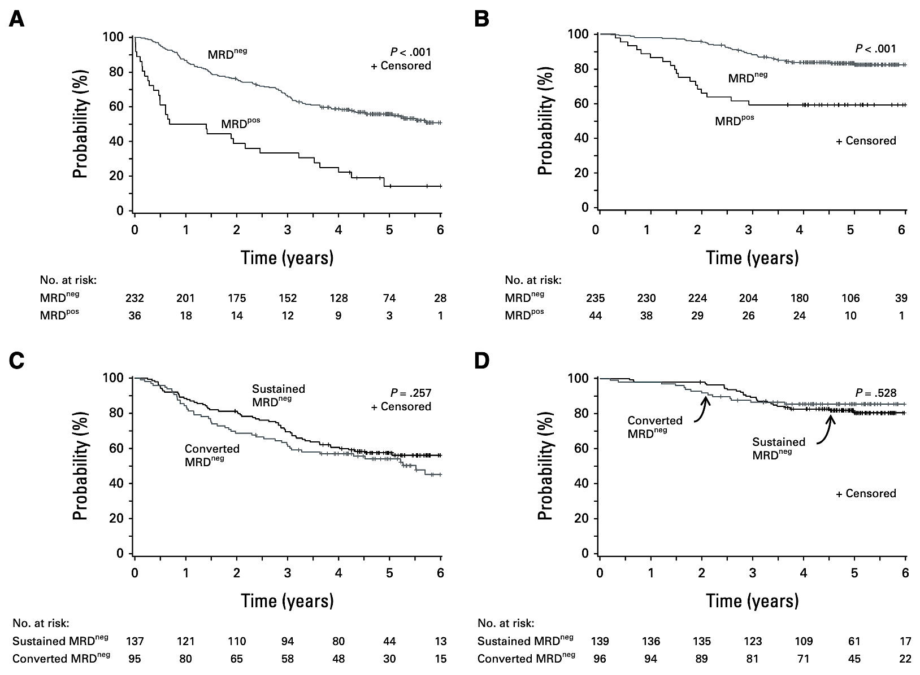
Value of MRD 1 Year Post-ASCT
PFS OS
PFS OS
Courtesy of Robert Z Orlowski, MD, PhD
Pasquini MC et al. J Clin Oncol. 2024 Aug 10;42(23):2757-2768.

Slide 23
Anti-CD38 Antibody First-Line Indications
IV Daratumumab | Isatuximab
In combination with lenalidomide and dexamethasone for newly diagnosed patients who are ineligible for autologous stem cell transplant | In combination with bortezomib, lenalidomide and dexamethasone for adult patients with newly diagnosed multiple myeloma who are not eligible for autologous stem cell transplant
In combination with bortezomib, melphalan and prednisone for newly diagnosed patients who are ineligible for autologous stem cell transplant
In combination with bortezomib, thalidomide, and dexamethasone for newly diagnosed patients who are eligible for autologous stem cell transplant
Daratumumab package insert, May 2025. Isatuximab package insert, May 2025.

Slide 24
New Isatuximab Subcutaneous Formulation Met Coprimary Endpoints in the IRAKLIA Phase III Study in Multiple Myeloma Press Release: January 9, 2025
“Results from the investigational, randomized, open-label IRAKLIA phase 3 study demonstrated that isatuximab administered at a fixed dose subcutaneously (SC) via an on-body delivery system (OBDS) in combination with pomalidomide and dexamethasone (Pd) met its co-primary endpoints of non-inferior objective response rate (ORR) and observed concentration before dosing (C trough) at steady state compared to intravenous (IV) isatuximab administered at a weight-based dose in combination with Pd in patients with relapsed or refractory multiple myeloma (R/R MM). Key secondary endpoints, including very good partial response (VGPR), incidence rate of infusion reactions and C trough at cycle 2 were also achieved. The study is ongoing, and the full results will be presented at a forthcoming medical meeting.
Additional studies evaluating isatuximab SC formulations across different combinations and lines of therapy are ongoing. The safety and efficacy of isatuximab SC [has] not been evaluated by any regulatory authority outside of [the] approved indications. Regulatory submissions in the US and in the EU are planned during the first half of 2025.”
https://www.sanofi.com/en/media-room/press-releases/2025/2025-01-09-06-00-00-3006798

Slide 25
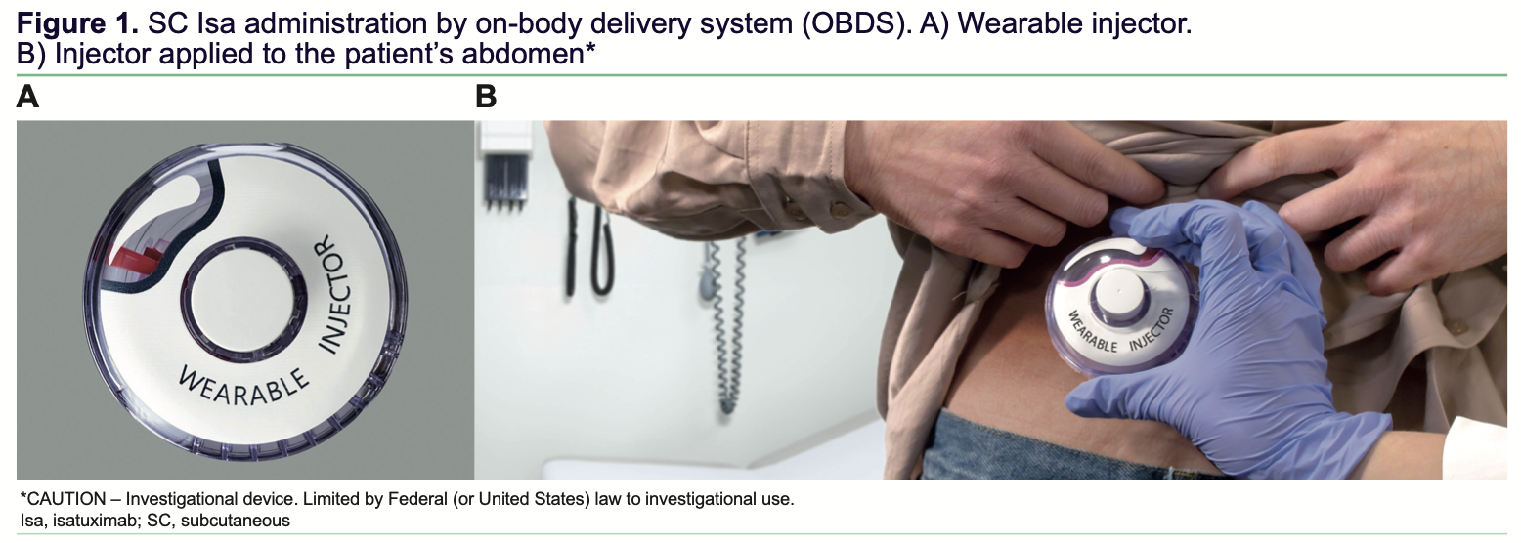
Subcutaneous Isatuximab Administration
Quach H et al. IMS 2022;Abstract P-306.

Slide 26
Neil’s Top 20 Questions

Slide 27
Is daratumumab a reasonable treatment option for patients with high-risk smoldering multiple myeloma?

Slide 28
Should patients generally receive an anti-CD38 monoclonal antibody (mAb) as part of induction treatment (transplant eligible and ineligible)?

Slide 29
What role, if any, do anti-CD38 mAbs play in maintenance treatment, and do MRD assays play a clinical role?

Slide 30
Currently how do you decide which anti-CD38 mAb to use in induction? Do you believe there are differences in efficacy and safety between them?

Slide 31
Is there a role for post-transplant MRD assessment?

Slide 32
How would you compare the patient experience with subcutaneous isatuximab versus subcutaneous daratumumab?

Slide 33
AGENDA Year in Review: Management of Multiple Myeloma
INTRODUCTION: ASCO 2025 Preview
MODULE 1: Anti-CD38 Antibodies
MODULE 2: Belantamab Mafodotin
MODULE 3: CAR T-Cell Therapy
MODULE 4: Bispecific Antibodies
MODULE 5: Other Novel Agents

Slide 34
DREAMM-8 Study: BelaPd vs PVd – Study Design
Recruitment period October 2020 to December 2022
Treatment period
Until PD, death, unacceptable toxicity, end of study, or withdrawal of consent
Eligibility criteria
BPd (Q4W)
Belantamab mafodotin
2.5 mg/kg IV (cycle 1) then 1.9 mg/kg IV Q4W from cycle 2 onward
+
Pomalidomide 4 mg orally on days 1-21 (28-day cycles)
+
Dexamethasone 40 mgª on days 1, 8, 15, and 22
N=302
Primary endpoint: PFS (IRC assessed per IMWG)
Key secondary endpoints: OS, MRD negativity, DOR
Additional secondary endpoints include: ORR, CRR, ≥VGPR,TTBR, TTR, TTP, PFS2, AEs, ocular findings, HRQOL, and PROs
Adults with MM
≥1 prior line of MM therapy including LEN
Documented PD during or after their most recent therapy
No prior treatment with anti-BCMA or pomalidomide; not refractory/intolerant to bortezomib
1:1 randomization
End-of-treatment visit
PVd (Q3W)
Bortezomib
1.3 mg/m² SC on days 1, 4, 8, and 11 of cycles 1-8 then days 1 and 8 (21-day cycles)
+
Pomalidomide 4 mg orally on days 1-14 (21-day cycles)
+
Dexamethasone 20 mgª on the day of and day after bortezomib
Stratification^{b}:
Prior lines of treatment (1 vs 2 or 3 vs ≥4)
Prior bortezomib (yes vs no)
Prior anti-CD38 therapy (yes vs no)
Courtesy of Thanos C Dimopoulos, MD
Dimopoulos MA, et al. N Engl J Med. 2024 Aug 1;391(5):408-421

Slide 35
DREAMM-8: Baseline Characteristics Were Balanced
Baseline characteristics | ITT population
 | BPd (N=155) | PVd (N=147)
Age, median (range), years <65, n (%) 65 to <75, n (%) ≥75, n (%) | 67 (40-82) 64 (41) 72 (46) 19 (12) | 68 (34-86) 53 (36) 59 (40) 35 (24)
Male/female, n (%) | 99 (64)/56 (36) | 82 (56)/65 (44)
White/Black/Asian/Mixed race, n (%)ª | 133 (86)/0/20 (13)/1 (<1) | 127 (87)/0/17 (12)/0
ECOG PS ≤1, n (%)^{b} | 146 (97) | 140 (97)
ISS stage at screening, n (%) I II III Unknown | 93 (60) 39 (25) 22 (14) 1 (<1) | 85 (58) 40 (27) 22 (15) 0
Years since diagnosis, median (range) | 4.04 (0.4-16.7) | 3.43 (0.4-17.7)
Cytogenetic abnormalities, n (%) Standard risk^{c} High risk^{d} Missing or nonevaluable | 72 (46) 52 (34) 31 (20) | 75 (51) 47 (32) 25 (17)
Time to relapse after initiation of 1L treatment ≤12 months >12 months | 22 (14) 133 (86) | 20 (14) 127 (86)
Extramedullary disease, n (%) | 20 (13) | 11 (7)
Prior treatments, n (%) | ITT population
 | BPd (N=155) |  | PVd (N=147)
Prior LOT
1 2 or 3 ≥4 | 82 (53) 54 (35) 19 (12) |  | 77 (52) 48 (33) 22 (15)
Prior ASCT | 99 (64) |  | 82 (56)
Prior treatment | Exposed | Refractory | Exposed | Refractory
Prior proteasome inhibitor Bortezomib Carfilzomib Ixazomib | 140 (90) 134 (86) 34 (22) 11 (7) | 40 (26) 16 (10) 18 (12) 8 (5) | 136 (93) 130 (88) 37 (25) 15 (10) | 35 (24) 8 (5) 23 (16) 11 (7)
Prior immunomodulatory drugª Lenalidomide Thalidomide | 155 (100) 155 (100) 49 (32) | 127 (82) 125 (81) 9 (6) | 147 (100) 147 (100) 48 (33) | 111 (76) 111 (76) 6 (4)
Prior anti-CD38 monoclonal antibody^{b} Daratumumab Isatuximab | 38 (25) 36 (23) 2 (1) | 35 (23) 33 (21) 2 (1) | 42 (29) 39 (27) 3 (2) | 36 (24) 34 (23) 2 (1)
Courtesy of Thanos C Dimopoulos, MD
Dimopoulos MA, et al. N Engl J Med. 2024 Aug 1;391(5):408-421

Slide 36
DREAMM-8: Significant PFS Benefit with BPd vs PVd
PFS | BPd (N=155) | PVd (N=147)
Events, n (%) | 62 (40) | 80 (54)
Median PFS (95% CI), months | NR (20.6-NR) | 12.7 (9.1-18.5)
HR (95% CI); P value | 0.52 (0.37-0.73); <.001
1.0
12 months
71%
Median
Not reached
0.8
0.6
51%
Proportion alive and progression free
0.4
Median
12.7 months
0.2
BPd
PVd
0.0
0
1
2
3
4
5
6
7
8
9
10
11
12
13
14
15
16
17
18
19
20
21
22
23
24
25
26
27
28
29
30
31
32
33
34
35
36
37
38
39
No. at risk
(no. of events)
Time since randomization, months
BPd
155
143
135
130
125
122
117
113
111
109
107
102
97
93
82
80
77
75
72
67
64
59
50
45
38
36
28
23
21
16
13
8
4
2
1
0
0
0
0
0
(0)
(5)
(10)
(15)
(19)
(21)
(26)
(28)
(30)
(32)
(34)
(37)
(41)
(42)
(47)
(47)
(49)
(50)
(52)
(53)
(54)
(56)
(58)
(59)
(61)
(61)
(62)
(62)
(62)
(62)
(62)
(62)
(62)
(62)
(62)
(62)
(62)
(62)
(62)
(62)
PVd
147
138
123
111
102
96
92
83
75
68
59
56
54
51
47
43
40
39
37
30
25
22
22
19
18
18
17
13
11
7
5
4
3
2
2
1
1
1
1
0
(0)
(4)
(14)
(23)
(27)
(33)
(37)
(45)
(49)
(52)
(59)
(62)
(62)
(64)
(66)
(68)
(68)
(68)
(70)
(73)
(76)
(77)
(77)
(77)
(77)
(77)
(78)
(78)
(79)
(80)
(80)
(80)
(80)
(80)
(80)
(80)
(80)
(80)
(80)
(80)
BPd led to a statistically significant and clinically meaningful reduction in risk of disease progression or death vs PVd (HR, 0.52; 95% CI, 0.37-0.73; P<.001)
Median follow-up, 21.8 months (range, 0.03-39.23 months). The treatment effect (HR and corresponding 95% CIs) was estimated using the stratified Cox proportional hazards model, and the P value was produced based on the 1-sided stratified log-rank test. Stratified analyses were adjusted for number of prior lines of therapy and prior bortezomib use. BPd, belamaf, pomalidomide, and dexamethasone; HR, hazard ratio; NR, not reported; PFS, progression-free survival; PVd, pomalidomide, bortezomib, and dexamethasone.
Courtesy of Thanos C Dimopoulos, MD
Dimopoulos MA, et al. N Engl J Med. 2024 Aug 1;391(5):408-421

Slide 37



DREAMM-7: Bela-Vd vs Dara-Vd – Study Design
CYCLE 1–8
CYCLE 9+
STRATIFICATION:
# of prior lines of therapy (1 vs 2/3 vs ≥4)
Prior bortezomib (Yes vs No)
R-ISS Staging ( I vs II/III)
Endpoints
Primary:
PFS
Secondary:
BVd Belamaf (IV 2.5 mg/kg D1 Q3W)
Belamaf monotherapy (IV 2.5 mg/kg Q3W)
DoR | TTP
MRD negativity rate | PFS2
OS | Safety, tolerability
CRR | Ocular findings
ORR | PK
CBR | ADAs
TTR | HRQoL, PROs
1:1
494 patients with ≥1 prior lines of therapy
DVd
Daratumumab (IV 16 mg/kg D1 C1–3 QW; C4–8 Q3W)
Daratumumab monotherapy (IV 16 mg/kg; C9 + Q4W)
Treatment period: Until PD, death, unacceptable toxicity, withdrawal of consent, or end of study
Screening and enrollment
Randomization
Day 1 of 21-day administration cycles
Bor (1.3 mg/m² on D1, 4, 8, 11; C1–8) Dex (20 mg on the day of, and day after, bortezomib; C1–8)
Courtesy of Thanos C Dimopoulos, MD
Hungria V, et al. N Engl J Med. 2024 Aug 1;391(5):393-407.

Slide 38
DREAMM-7 study – Patients Characteristics
Demographics and baseline characteristics | BVd (N=243) | DVd (N=251)
Median age, years (range) | 65 (34–86) | 64 (32–89)
Standard/high risk cytogenetic abnormalities, n (%) | 175 (72)/67 (28) | 175 (70)/69 (27)
EMD present, n (%) | 13 (5) | 25 (10)
R-ISS Stage I/II/III, n (%) | 102 (42)/130 (53)/9 (4) | 103 (41)/132 (53)/14 (6)
Prior ASCT, n (%) | 164 (67) | 173 (69)
Prior LoT, 1/2 or 3/≥4, n (%) | 125 (51)/88 (36)/30 (12) | 125 (50)/99 (39)/27 (11)
Prior lenalidomide, n (%) | 127 (52) | 130 (52)
Refractory to lenalidomide, n (%) | 79 (33) | 87 (35)
Prior daratumumab, n (%) | 3 (1) | 4 (2)
Courtesy of Thanos C Dimopoulos, MD
Hungria V, et al. N Engl J Med. 2024 Aug 1;391(5):393-407.

Slide 39
DREAMM-7 study – PFS
 | BVd (N=243) | DVd (N=251)
Median PFS (95% CI), mo | 36.6 (28.4, -) | 13.4 (11.1, 17.5)
Hazard ratio (95% CI): 0.41 (0.31, 0.53); P<0.00001
Median follow-up: 28.2 months (0.10–40.02)
1.0
18 months
0.8
69%
0.6
Proportion alive and progression free
0.4
Median PFS
36.6 months
Median PFS 13.4 months
43%
0.2
BVd
DVd
0.0
0
1
2
3
4
5
6
7
8
9
10
11
12
13
14
15
16
17
18
19
20
21
22
23
24
25
26
27
28
29
30
31
32
33
34
35
36
37
38
39
40
41
No. at risk
(No. of events)
Time since randomization (months)
BVd
243
(0)
230
(6)
220
(13)
211
(17)
205
(21)
200
(25)
192
(28)
183
(32)
175
(36)
171
(39)
163
(45)
158
(46)
155
(48)
150
(51)
147
(53)
140
(59)
137
(60)
131
(63)
128
(66)
127
(67)
125
(67)
122
(69)
120
(70)
118
(71)
115
(74)
110
(78)
105
(79)
94
(81)
79
(82)
72
(86)
56
(86)
41
(88)
31
(89)
25
(89)
15
(90)
11
(90)
8
(90)
6
(91)
3
(91)
2
(91)
1
(91)
0
(91)
DVd
251
(0)
230
(9)
214
(22)
205
(29)
194
(37)
183
(47)
176
(53)
155
(71)
148
(75)
141
(81)
132
(90)
124
(97)
115
(106)
107
(113)
103
(116)
99
(119)
94
(121)
91
(124)
87
(128)
80
(133)
78
(135)
73
(138)
68
(143)
67
(144)
65
(145)
61
(148)
59
(149)
52
(151)
39
(153)
33
(154)
22
(154)
19
(154)
12
(156)
11
(156)
5
(157)
2
(158)
1
(158)
1
(158)
1
(158)
1
(158)
0
(158)
0
(158)
Courtesy of Thanos C Dimopoulos, MD
Hungria V, et al. ASH 2024. Abstracts 772 ;Mateos ASCO 2024; Abstract 7503

Slide 40
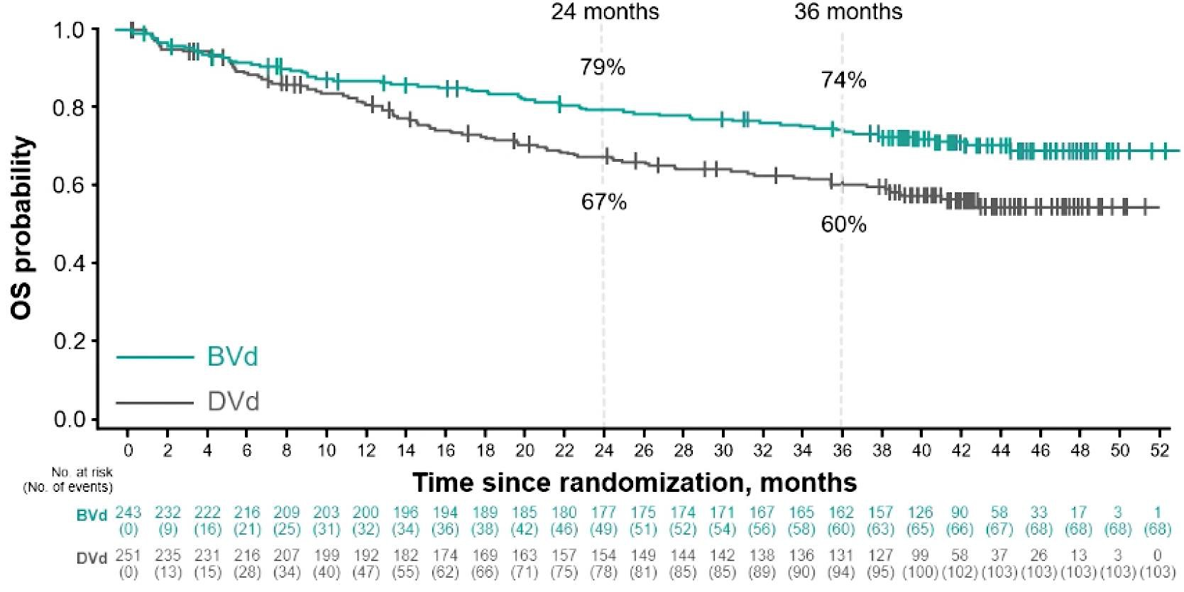
Updated and Additional Analyses From the Phase 3 DREAMM-7 Trial of BVd vs DVd in RRMM: OS
Median follow-up: 39.4 months (range, 0.1-52.3)
OS | BVd (n=243) | DVd (n=251)
Events, n (%) | 68 (28) | 103 (41)
Median OS (95% CI), months | NR (NR-NR) | NR (41.0-NR)
HR (95% CI); P value | 0.58 (0.43-0.79); P=0.00023
24-month OS, % (95% CI) | 79 (73-84) | 67 (61-73)
36-month OS, % (95% CI) | 74 (68-79) | 60 (54-66)
Median OS was not reached.
Predicted median OS based on modeling is
84 months with BVd and 51 months with DVd
Courtesy of Thanos C Dimopoulos, MD
Hungria V, et al. ASH 2024. Abstracts 772 and 3359.

Slide 41



DREAMM-9: Study design
Inclusion criteria
Belamaf dosing cohorts*
Primary endpoint:
MM diagnosis per IMWG criteria
ECOG performance status of 0–2
Not a candidate for HDT with ASCT due to frailty and/or significant comorbid condition(s)
Measurable disease per IMWG criteria
Prior systemic therapy for MM or SMM
Current corneal epithelial disease
1.9 mg/kg Q3/4W, every SOC cycle (n=12)
Safety (DLTs and AEs)
Efficacy (ORR, ≥CR, ≥VGPR per IMWG criteria)
RDI of lenalidomide and bortezomib after 4 cycles
Cumulative administered belamaf dose after 4 cycles with VRd
Incidence and titers of ADAs
PK
MRD negativity (assessed in bone marrow aspirate samples using next-generation sequencing [10^{–5}]).
Cohorts with lower doses and longer schedules were opened to assess the potential to improve tolerability while maintaining efficacy
All cohorts received belamaf with VRd for Cycles 1‒8 (21-day cycle), followed by belamaf with Rd for Cycles 9+ (28-day cycle)
Ocular events were managed by dose modifications or extending the dosing interval
1.9 mg/kg Q6/8W, every other SOC cycle (n=12)
Secondary endpoints
1.4 mg/kg Q3/4W, every SOC cycle (n=13)
1.4 mg/kg Q6/8W, every other SOC cycle (n=12)
Exclusion criteria
Screening phase
1.9 (9W) to 1.4 mg/kg Q9/12W, every third SOC cycle (n=19)
Safety follow-up
1.0 mg/kg Q3/4W, every SOC cycle (n=15)
1.4 (9W) to 1.0 mg/kg Q9/12W, every third SOC cycle (n=15)
Exploratory endpoint
1.0 mg/kg Q12W, every third/fourth SOC cycle (n=10)
21 days
Randomized assignment
+ SOC (VRd [Cycles 1–8], Rd [Cycles 9+]) ¹
70-day safety follow-up visit
*Cohorts of the same color opened at the same time. Cohorts with longer rectangles opened earlier. ADA, anti-drug antibodies; AE, adverse event; ASCT, autologous stem cell transplant; belamaf, belantamab mafodotin; CR, complete response; DLT, dose-limiting toxicities; ECOG, Eastern Cooperative Oncology Group; HDT, high-dose chemotherapy; IMWG, International Myeloma Working Group; MM, multiple myeloma; MRD, minimal residual disease; ORR, overall response rate; PK, pharmacokinetics; PR, partial response; QxW, every x weeks; RDI, relative dose intensity; SMM, smouldering MM; SOC, standard of care; VGPR, very good partial response
Courtesy of Thanos C Dimopoulos, MD
Usmani S, et al. ASH 2024;Abstract 497.

Slide 42

DREAMM-9: Efficacy | ORR
VGPR+ was 100% in 3 cohorts including those with lower doses and less frequent schedules
ORRs ranged from 71% to 100%
Time to achieve VGPR+ was consistent across the cohorts (median 2.1–3.2 months) and response deepened over time
In the first 4 cohorts, CR+ was 62–92%
ORRs ranged from 71% to 100%
Time to achieve VGPR+ was consistent across the cohorts (median 2.1–3.2 months) and response deepened over time
In the first 4 cohorts, CR+ was 62–92%
ORR*, % | 100 | 100 | 92 | 100 | 71 | 86 | 87 | 100
VGPR+ / CR+, % | 92 / 75 | 100 / 92 | 92 / 62 | 100 / 91 | 59 / 41 | 79 / 71 | 73 / 53 | 100 / 30
PR
VGPR
CR
sCR
 | n=12 | n=12 | n=13 | n=11 | n=17 | n=14 | n=15 | n=10
Median follow-up, months (range) | 37.6 (7–50) | 32.3 (6–38) | 20.2 (1–37) | 32.4 (5–37) | 17.1 (1–23) | 31.0 (0–38) | 18.2 (2–22) | 7.8 (5–10)
Median time to VGPR+, months (range) | 2.8 (0.7–4.2) | 2.9 (0.8–14.7) | 2.2 (0.8–16.8) | 2.1 (0.8–5.0) | 2.2 (0.7–8.1) | 3.0 (1.4–6.8) | 3.1 (0.8–4.9) | 3.2 (1.3–4.9)
Median time to CR+, months (range) | 8.3 (2.1–19.4) | 12.0 (4.4–22.9) | 6.2 (1.4–15.7) | 8.8 (1.4–18.4) | 9.5 (3.7–11.1) | 8.2 (2.1–19.8) | 6.1 (1.4–13.8) | 6.5 (2.1–9.1)
Median follow-up varied as cohorts opened at different times; some patients had not been treated for long enough to achieve response
CI, confidence interval; CR+, complete response or better; ORR, overall response rate; PR, partial response; QxW, every x weeks; sCR, stringent complete response; VGPR+, very good partial response or better.
Courtesy of Thanos C Dimopoulos, MD
Usmani S, et al. ASH 2024;Abstract 497.

Slide 43

DREAMM-9: Efficacy | MRD-negativity rate*
Higher belamaf starting doses were associated with deeper and faster MRD[−] rates
 | 1.9 mg/kg Q3/4W | 1.9 mg/kg Q6/8W | 1.4 mg/kg Q3/4W | 1.4 mg/kg Q6/8W | 1.9 (9W) to 1.4 mg/kg Q9/12W | 1.0 mg/kg Q3/4W | 1.4 (9W) to 1.0 mg/kg Q9/12W | 1.0 mg/kg Q12W
MRD[−], n (% of patients with CR+) | 9 (100) | 8 (73) | 7 (88) | 5 (50) | 5 (71) | 6 (60) | 4 (50) | 0
Median time to MRD[−], months (range) | 8.3 (2.1–17.5) | 7.9 (4.2–14.7) | 12.2 (2.3–24.9) | 14.6 (2.1–23.1) | 4.4 (2.2–10.2) | 3.8 (2.5–12.3) | 5.1 (2.1–9.2) | 0
Median follow-up, months | 37.6 | 32.3 | 20.2 | 32.4 | 17 | 31.0 | 18.2 | 7.8
*MRD[-] was measured by next-generation sequencing [10⁻⁵] in patients achieving CR+​, and is shown as proportion of the ITT population. belamaf, belantamab mafodotin; CR,+ complete response or better; ITT, intention-to-treat; MRD[−], minimal residual disease negativity; QxW, every x weeks.​
Courtesy of Thanos C Dimopoulos, MD
Usmani S, et al. ASH 2024;Abstract 497.

Slide 44
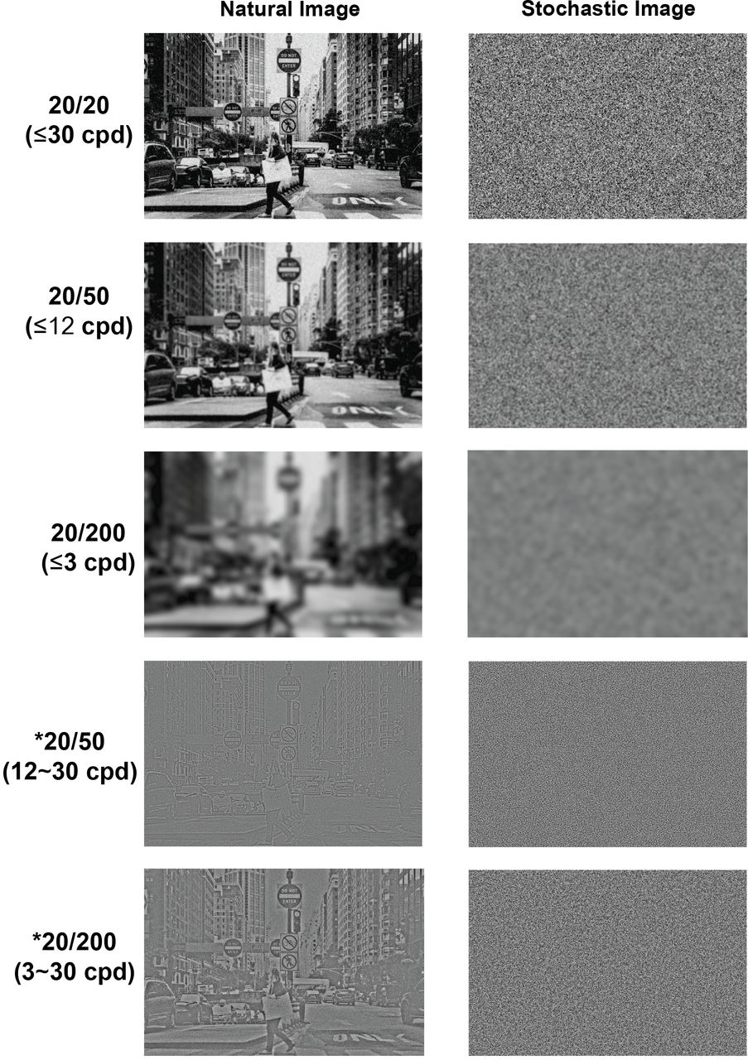

DREAMM-9: Best corrected visual acuity
Dose and schedule affected the time to, and resolution of, BCVA decreases
Extending the dosing interval between the 1.9 mg/kg or 1.4 mg/kg doses from Q3/4W to Q6/8W was associated with longer time to BCVA decrease to 20/50 or worse*
Resolution of BCVA decreases was generally faster in cohorts with lower initial doses of belamaf
20/20
20/50†
First occurrence of decrease in BCVA score from baseline (20/25 or better) to 20/50 or worse
Belamaf schedule | Number of patients, n (%) | Time to onset |  | Median (range), days
1.9 mg/kg Q3/4W | 6 (50) |  |  | 76 (42–439)
1.9 mg/kg Q6/8W | 6 (50) |  |  | 246 (106–472)
1.4 mg/kg Q3/4W | 3 (23) |  |  | 128 (113–409)
1.4 mg/kg Q6/8W | 6 (50) |  |  | 264 (92–546)
 |  | Time to resolution
1.9 mg/kg Q3/4W |  |  |  | 163 (36–230)
1.9 mg/kg Q6/8W |  |  |  | 135 (29–246)
1.4 mg/kg Q3/4W |  |  |  | 36 (22–85)
1.4 mg/kg Q6/8W |  |  |  | 70 (43–421)
Days
*In the 4 cohorts shown, 2 patients had a BCVA change from 20/25 or better to 20/200 or worse. These patients both had bilateral cataracts. †Image adapted from Shi C, et al. bioRxiv. 2018;doi:doi.org/10.1101/328443. Copyright © 2018 the Author. belamaf, belantamab mafodotin; BCVA, best corrected visual acuity; QxW, every x weeks.
Courtesy of Thanos C Dimopoulos, MD
Usmani S, et al. ASH 2024;Abstract 497.

Slide 45
In general, how would you compare the efficacy of belantamab mafodotin versus daratumumab as a component of combination therapy for patients with relapsed MM?

Slide 46
How do you manage the dose and schedule of belantamab mafodotin to maximize efficacy and minimize ophthalmic toxicity?

Slide 47
How do you approach prevention, screening and management of ophthalmic toxicity with belantamab mafodotin?

Slide 48
Do you have any predictions for what results of the DREAMM-10 trial will demonstrate?

Slide 49
DREAMM-10 Trial: Phase III Study of Belantamab Mafodotin with Lenalidomide and Dexamethasone (BRd) versus Daratumumab with Lenalidomide and Dexamethasone (DRd) in Transplant-Ineligible Newly Diagnosed MM
Trial identifier: NCT06679101
Estimated enrollment: 520
Key inclusion criteria:
Newly diagnosed, transplant-ineligible MM
ECOG PS 0-2
BRd
(belantamab mafodotin, lenalidomide, dexamethasone)
R
1:1
DRd
(daratumumab, lenalidomide, dexamethasone)
Lonial S et al. ASCO 2025;Abstract TPS7567; www.clinicaltrials.gov. NCT06679101. Accessed May 2025.

Slide 50
Would you recommend belantamab mafodotin for a patient with relapsed/refractory MM who has previously received both BCMA-directed CAR T-cell therapy and a BCMA-directed bispecific antibody (BS)?

Slide 51
AGENDA Year in Review: Management of Multiple Myeloma
INTRODUCTION: ASCO 2025 Preview
MODULE 1: Anti-CD38 Antibodies
MODULE 2: Belantamab Mafodotin
MODULE 3: CAR T-Cell Therapy
MODULE 4: Bispecific Antibodies
MODULE 5: Other Novel Agents

Slide 52
Phase 2 iMMagine-1: Anito-cel - Preliminary efficacy data for an anti-BCMA CAR T-cell therapy in RRMM
Patient characteristics | Safety evaluable (N=98) | Efficacy evaluable (N=86)
Median age (yrs) | 65 | 65
Previous lines of therapy
Lines of prior therapy, median (min-max) | 4 (3-8) | 4 (3-8)
3 prior lines of therapy | 45 (46%) | 37 (43%)
Triple refractory | 85 (87%) | 74 (86%)
Penta refractory | 41 (42%) | 37 (43%)
Prior ASCT | 73 (75%) | 64 (74%)
Bridging therapy | 65 (66%) | 61 (71%)
Outpatient administration | 8 (8%) | 5 (6%)
Median time since diagnosis (yrs) | 7.2 | 7.5
≥VGPR
81%
ORR: 97% and sCR/CR: 62% at 9.5 mos (median f/u)
MRD –ve rate at 10⁻⁵ or lower: 93.1% (54/58)
PFS rate at 6 mos: 93.3% and at 12 mos: 78.5%
OS rate at 6 mos: 96.5% and at 12 mos: 96.5%
Anito-cel is an investigational product, currently not approved by any regulatory agency.
-ve, negative; Anito-cel, anitocabtagene autoleucel; ASCT, autologous stem cell transplant; CAR T, chimeric antigen receptor T cell; CR, complete response; f/u, follow up; mo, month; MRDng, minimal residual disease negativity rate; ORR, overall response rate; OS, overall survival; PFS, progression-free survival; PR, partial response; RRMM, relapse/refractory multiple myeloma; sCR, stringent CR; TEAE, treatment-emergent adverse event; VGPR, very good PR; yr, year.
Freeman CL et al. Oral presentation at ASH 2024. Abstract 1031.
Courtesy of Thanos C Dimopoulos, MD

Slide 53
Phase 2 iMMagine-1: Anito-cel - Preliminary Safety Data in RRMM
Event | Safety evaluable (N=98)
CRS, any grade (%) | 83
Median onset (days) | 4
ICANS, any grade (%) | 9
Median onset (days) | 7
TEAEs (non-CRS/non-ICANS), Gr 3/4 after cell infusion (%)
Neutropenia | 54
Anemia | 22
Thrombocytopenia | 20
86% of patients with ≤Gr1 CRS
91% of patients with no ICANS
No delayed or non-ICANS neurotoxicities to date
Most common ≥Gr3 TEAEs: cytopenias
3 deaths due to TEAEs
Freeman CL et al. Oral presentation at ASH 2024. Abstract 1031.
Courtesy of Thanos C Dimopoulos, MD

Slide 54
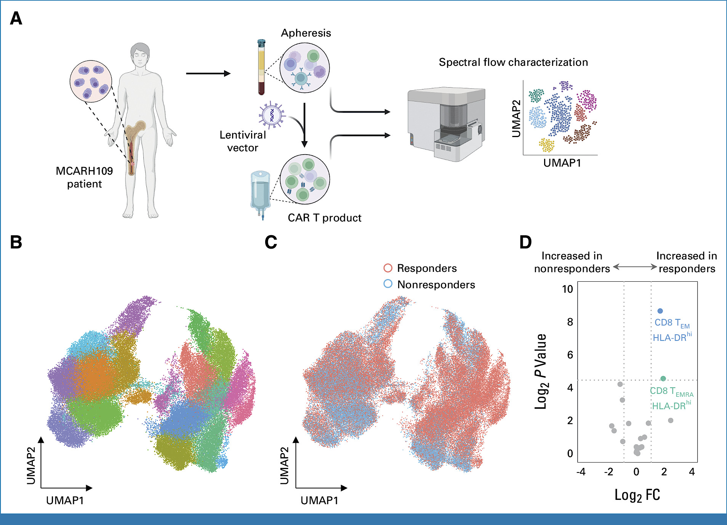
Phase I Trial of MCARH109, a GPRC5D-Targeted Chimeric Antigen Receptor T-Cell Therapy for RR Multiple Myeloma
Jurgens EM, et al. J Clin Oncol 2025;43:498-504.
Courtesy of Thanos C Dimopoulos, MD

Slide 55
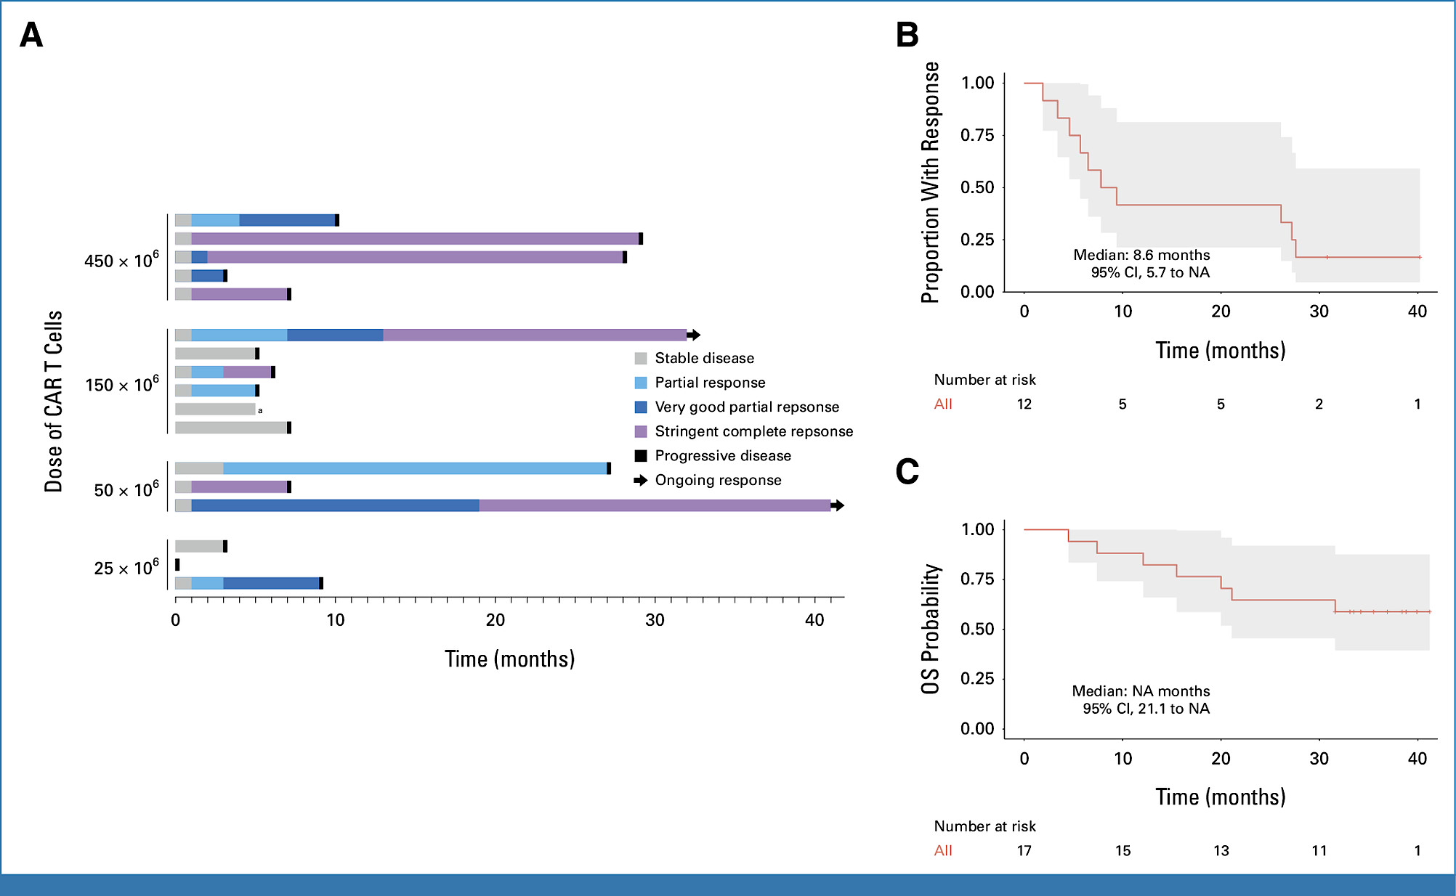
Phase I Trial of MCARH109 in RRMM: Efficacy Data
Characteristic | No Previous BCMA Therapy (n = 7) | Previous BCMA Therapy (n = 10) | Overall (N = 17)
Age, years Median (range) | 57.9 (37.6-76.4) | 63.8 (39.6-73.5) | 59.6 (37.6-76.4)
High-risk cytogenetics, No. (%)
Yes | 5 (71.4) | 8 (80.0) | 13 (76.5)
No | 2 (28.6) | 2 (20.0) | 4 (23.5)
Extramedullary plasmacytoma, No. (%)
Yes | 4 (57.1) | 4 (40.0) | 8 (47.1)
No | 3 (42.9) | 6 (60.0) | 9 (52.9)
Previous lines of therapy
Median (range) | 5.0 (4.0-8.0) | 6.50 (5.00-14.0) | 6.00 (4.00-14.0)
Penta-exposed, No. (%)
Yes | 7 (100) | 10 (100) | 17 (100)
Triple-refractory disease, No. (%)
Yes | 7 (100) | 9 (90.0) | 16 (94.1)
No | 0 (0) | 1 (10.0) | 1 (5.9)
Previous bispecific antibody
Yes | 0 (0) | 2(20) | 2 (11.8)
No | 7 (100) | 8(80) | 15 (88.2)
Bridging therapy, No. (%)
Yes | 7 (100) | 9 (90.0) | 16 (94.1)
No | 0 (0) | 1 (10.0) | 1 (5.9)
Responsive to bridging therapy
Yes | 0/7 (0) | 1/9 (11.1) | 1/16 (6.3)
No | 7/7 (100) | 8/9 (88.9) | 15/16 (93.7)
Jurgens EM, et al. J Clin Oncol 2025;43:498-504.
Courtesy of Thanos C Dimopoulos, MD

Slide 56
Is there a role for a second dose of CAR T-cell therapy, either as a consolidation of the first dose or in the form of maintenance given several months apart?

Slide 57
How would you compare the efficacy of anitocabtagene autoleucel (anito-cel) CAR T-cell therapy to ciltacabtagene autoleucel (cilta-cel) and idecabtagene vicleucel (ide-cel)?

Slide 58
How would you compare the toxicity of anito-cel CAR T-cell therapy to cilta-cel and ide-cel?

Slide 59
AGENDA Year in Review: Management of Multiple Myeloma
INTRODUCTION: ASCO 2025 Preview
MODULE 1: Anti-CD38 Antibodies
MODULE 2: Belantamab Mafodotin
MODULE 3: CAR T-Cell Therapy
MODULE 4: Bispecific Antibodies
MODULE 5: Other Novel Agents

Slide 60
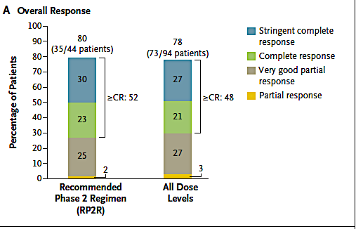
Phase Ib/II RedirecTT-1 Study: Teclistamab Plus Talquetamab in R/R Multiple Myeloma
A Phase 1b/2 Dose Escalation and Expansion Study of the Combination of the Bispecific T Cell Redirection Antibodies Talquetamab and Teclistamab in Participants With Relapsed or Refractory Multiple Myeloma
Previous exposure to a PI, IMiD, and anti-CD38 mAb and refractory to last line of therapy
Median prior LOT: 4 (1-11); extramedullary plasmacytomas: 37.6%
Primary endpoint: dose-limiting toxic effects;
Secondary endpoints: overall response (partial response or better), dor, time to response, pharmacokinetics, pharmacodynamics, and immunogenicity.
Courtesy of Thanos C Dimopoulos, MD
Cohen YC, et al. N Engl J Med 2025;392:138-49.

Slide 61
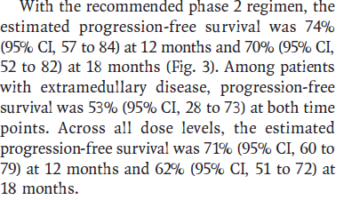
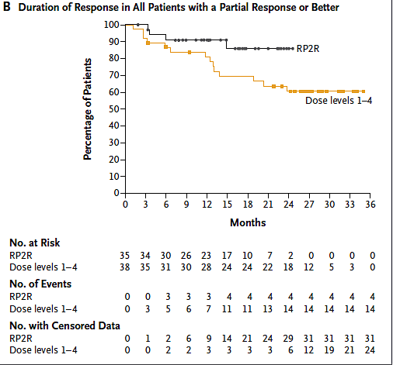
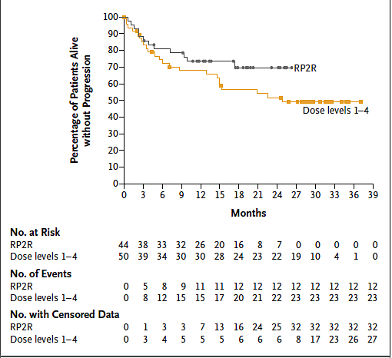
Phase Ib/II RedirectTT-1 Study: Teclistamab Plus Talquetamab in R/R Multiple Myeloma – DoR and PFS
Courtesy of Thanos C Dimopoulos, MD
Cohen YC, et al. N Engl J Med 2025;392:138-49.

Slide 62
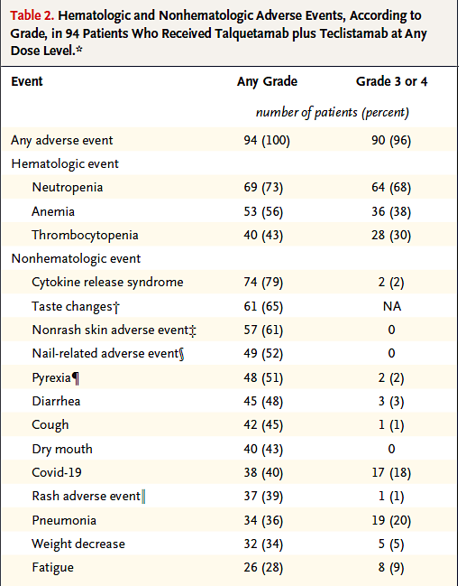
Phase Ib/II RedirectTT-1 Study: Teclistamab Plus Talquetamab in R/R Multiple Myeloma – Safety
Courtesy of Thanos C Dimopoulos, MD
Cohen YC, et al. N Engl J Med 2025;392:138-49.

Slide 63
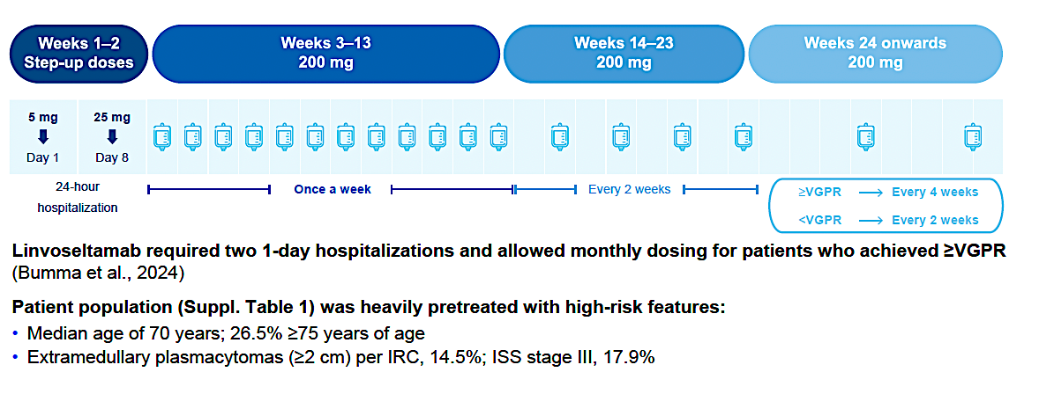
LINKER-MM1 Update: Linvoseltamab in RRMM - Study Design
Courtesy of Thanos C Dimopoulos, MD
Shah MR, et al. ASH 2024;Abstract 3369.

Slide 64
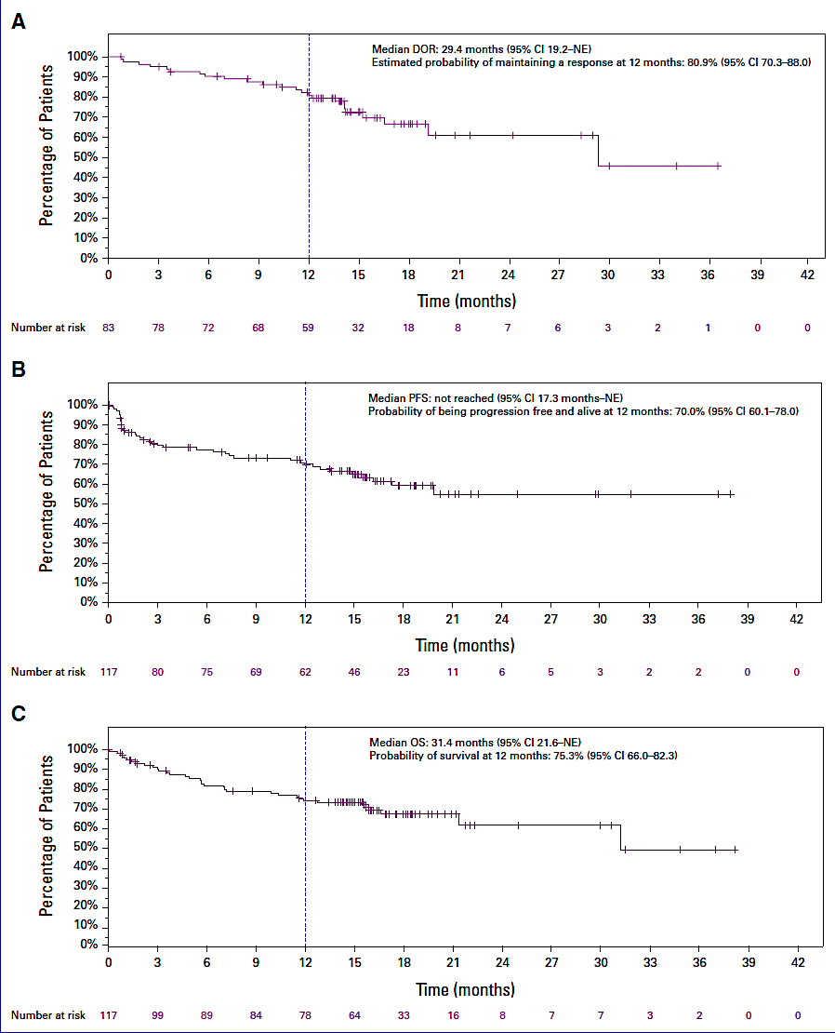
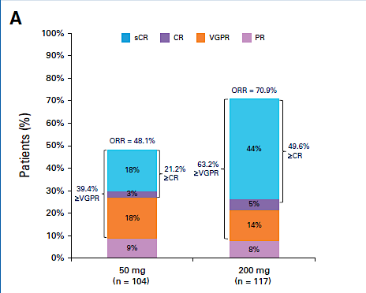
LINKER-MM1 Update: Efficacy
Courtesy of Thanos C Dimopoulos, MD
Shah MR, et al. ASH 2024;Abstract 3369; Bumma J Clin Oncol 2024

Slide 65
How does the PFS with bispecific antibodies (indirectly) compare to that with CAR T-cell therapy for patients with relapsed/refractory MM?

Slide 66
How do you typically sequence BS and CAR T-cell therapy in MM?

Slide 67
Other than tolerability issues with talquetamab, how would you compare schedule, method of administration and duration of treatment of the other approved BS and linvoseltamab?

Slide 68
What is the likely future role of BS and CAR-T as upfront therapy?

Slide 69
How much of a problem are infections in patients on BS, and how does the use of immunoglobulins impact infection risks? Should BS be given for a fixed duration?

Slide 70
AGENDA Year in Review: Management of Multiple Myeloma
INTRODUCTION: ASCO 2025 Preview
MODULE 1: Anti-CD38 Antibodies
MODULE 2: Belantamab Mafodotin
MODULE 3: CAR T-Cell Therapy
MODULE 4: Bispecific Antibodies
MODULE 5: Other Novel Agents

Slide 71
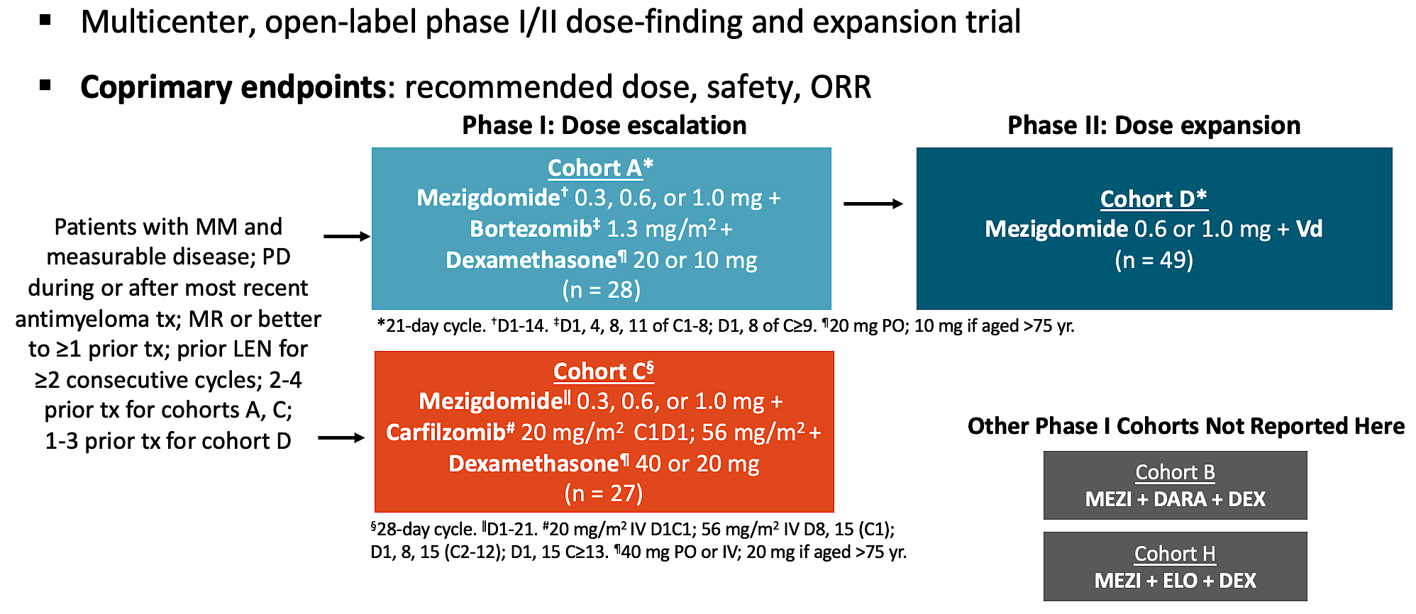
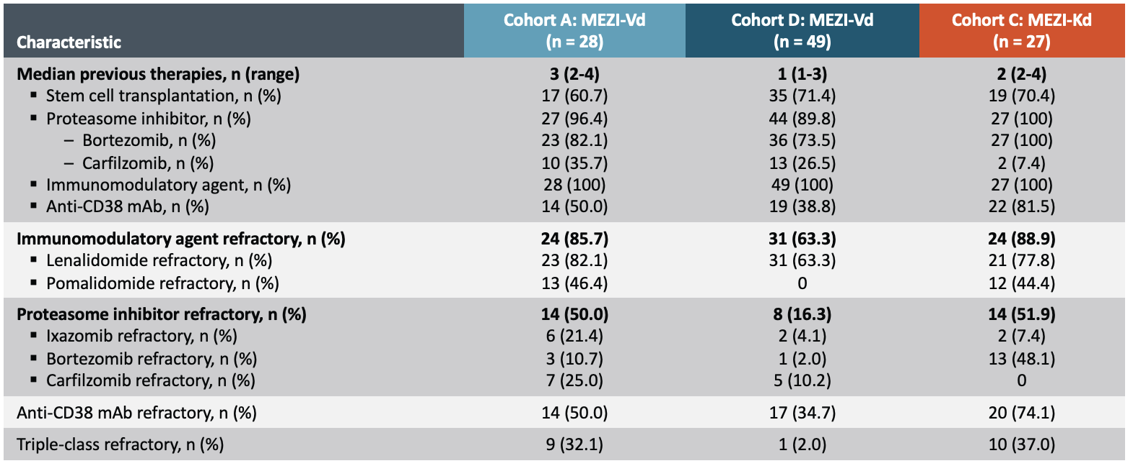
CC-92480-MM-02: MeziKd or MeziVd
Sandhu I et al. ASH 2024;Abstract 1025.
Courtesy of Robert Z Orlowski, MD, PhD

Slide 72
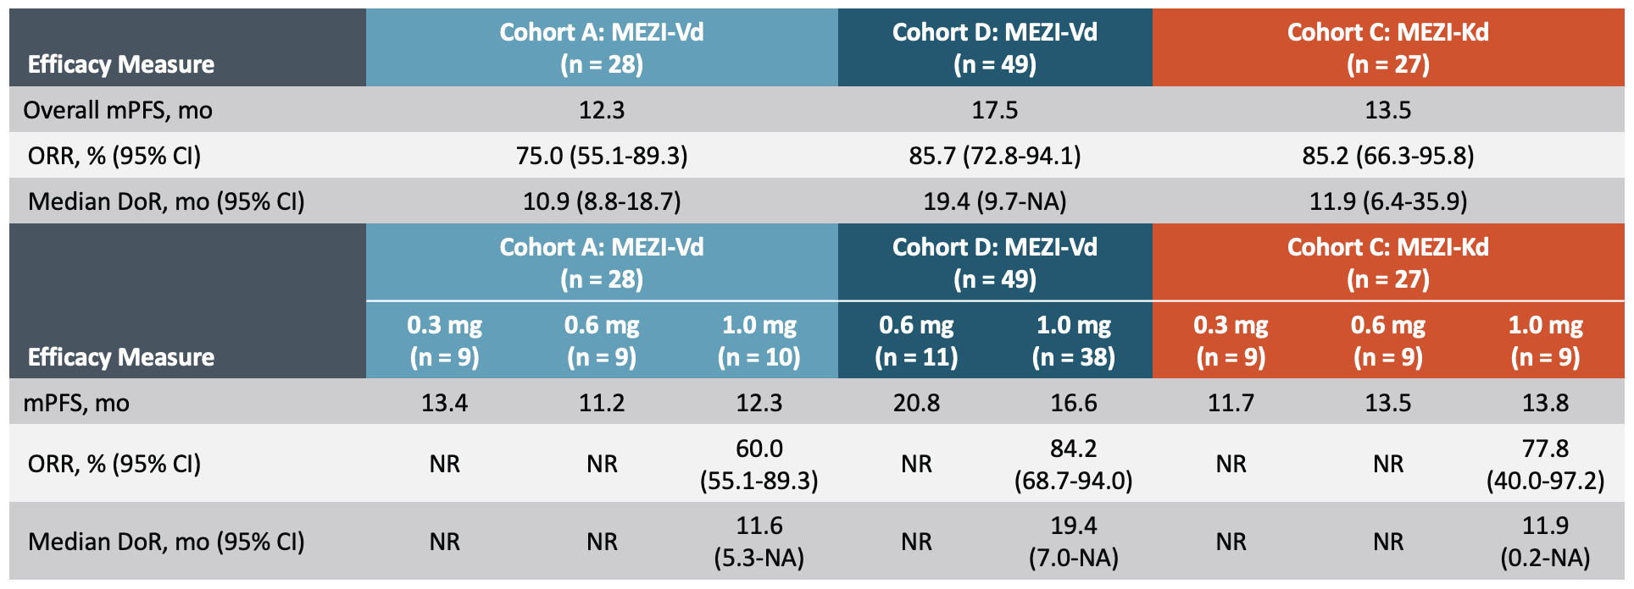
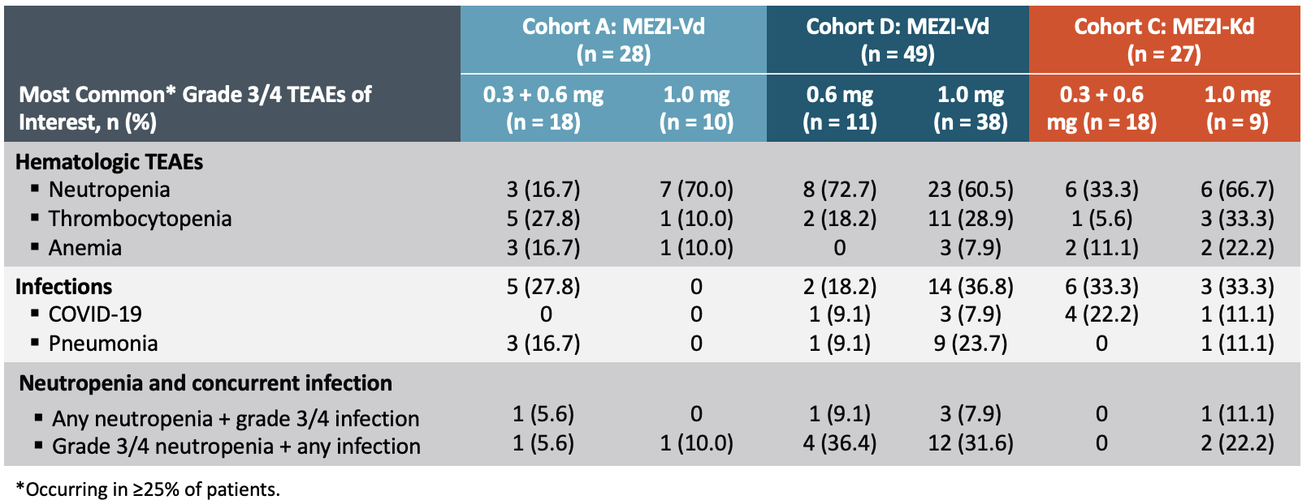
MeziKd or MeziVd: Efficacy & Safety
Sandhu I et al. ASH 2024;Abstract 1025.
Courtesy of Robert Z Orlowski, MD, PhD

Slide 73
How would you compare the efficacy and tolerability of mezigdomide, iberdomide and lenalidomide?

