Slide 1


Where Are We Heading in the Treatment of Multiple Myeloma Based on ASH 2024?
Robert Z. Orlowski, M.D., Ph.D.
Deputy Chair, Department of Lymphoma/Myeloma
Florence Maude Thomas Cancer Research Professor
Principal Investigator, High Risk Myeloma Moon Shot
Chair, SWOG Myeloma Committee

Slide 2
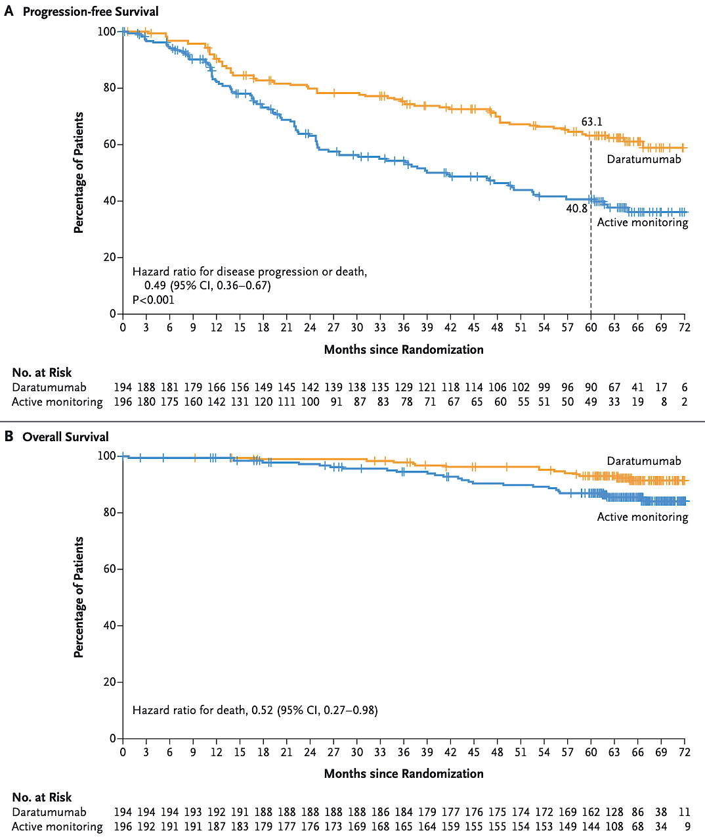
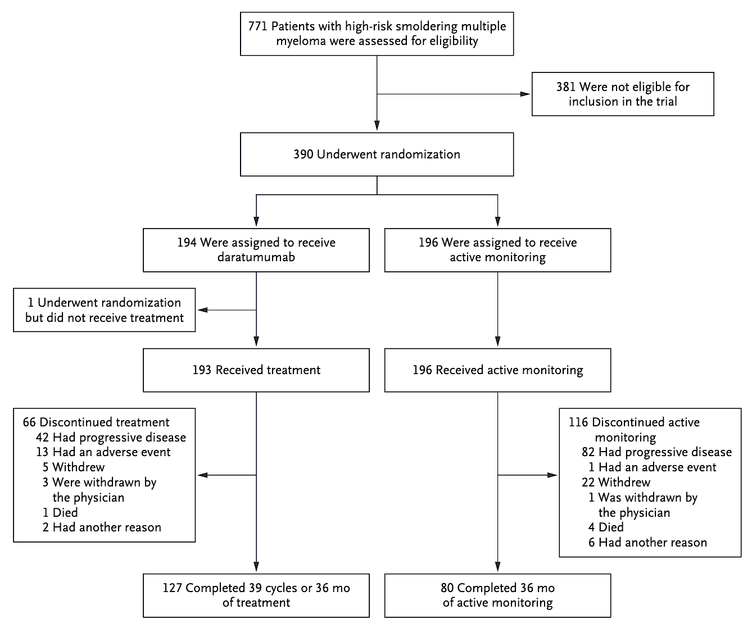
Dara in Smoldering: Design & Outcomes
Dimopoulos MA et al. N Engl J Med. 2024 Dec 9.

Slide 3
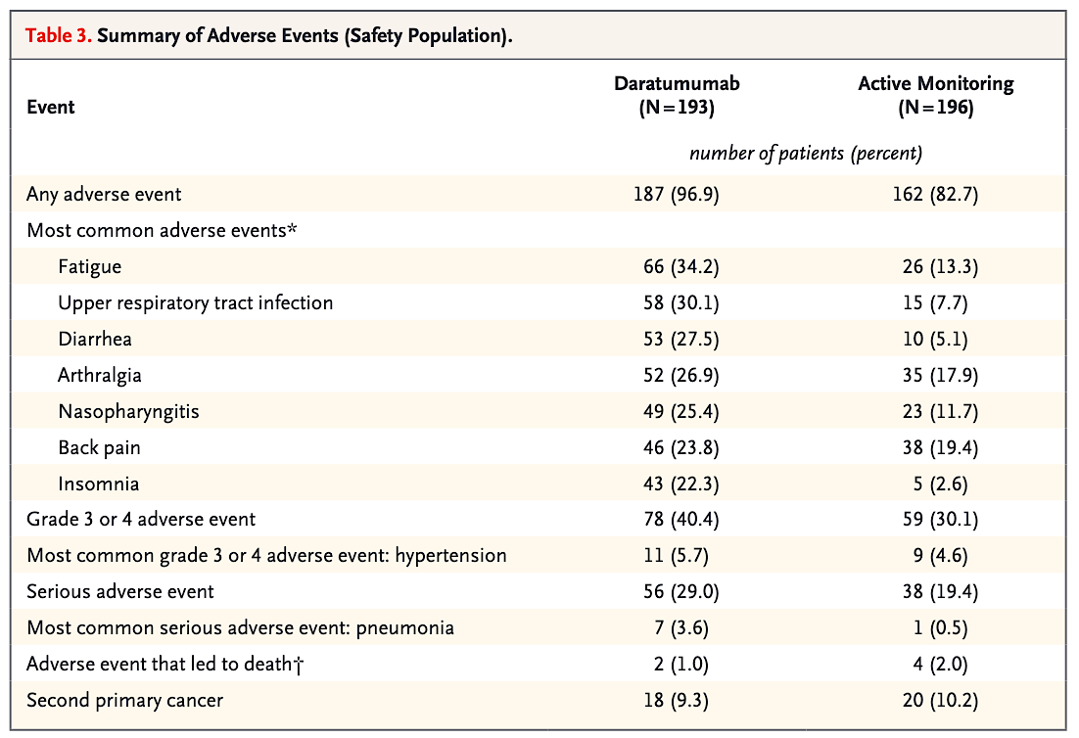
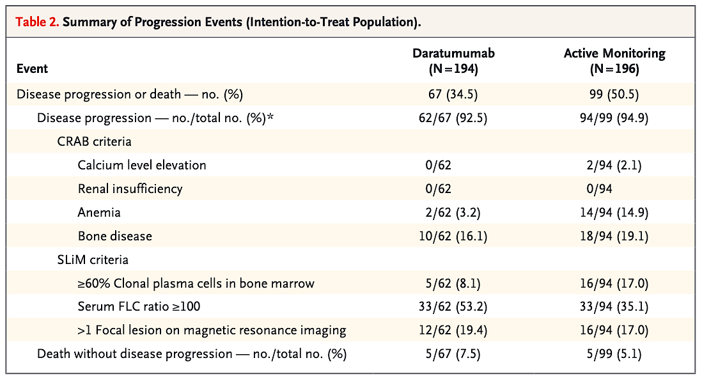
Dara in Smoldering: Progression & AEs
Dimopoulos MA et al. N Engl J Med. 2024 Dec 9.

Slide 4
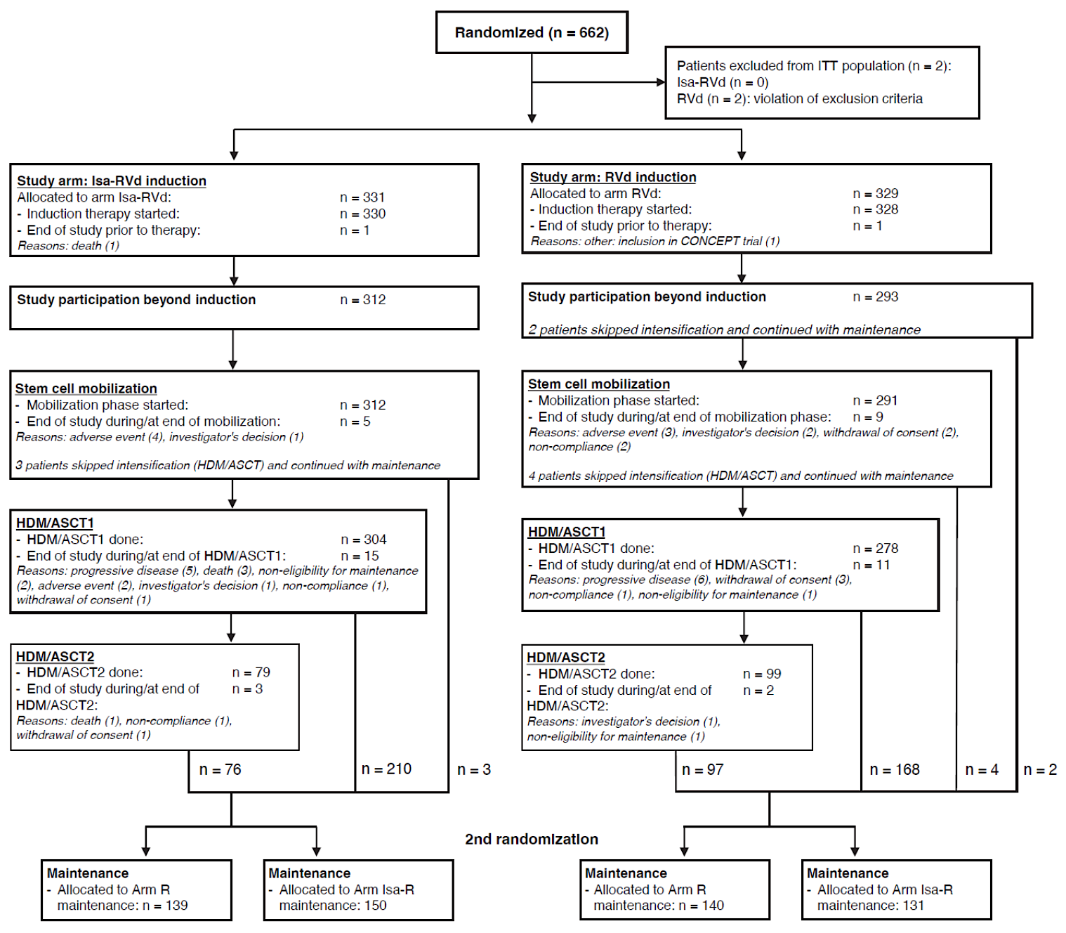
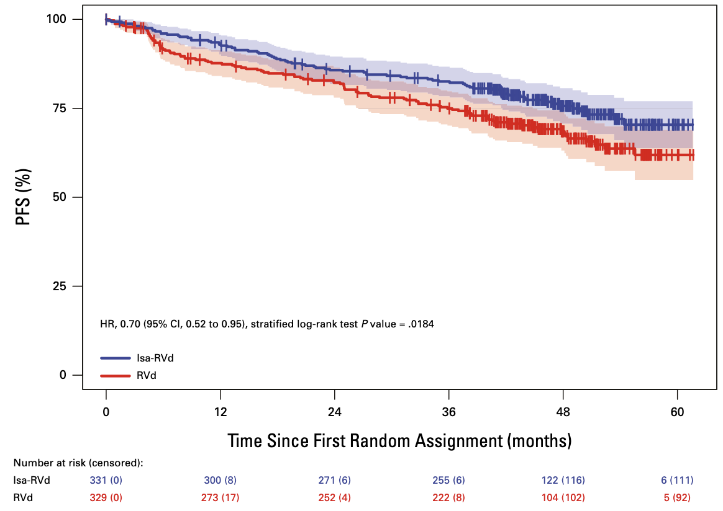
GMMG-HD7: IsaRVd in TE Myeloma
Mai EK et al. J Clin Oncol. 2025 Apr 10;43(11):1279-1288.

Slide 5
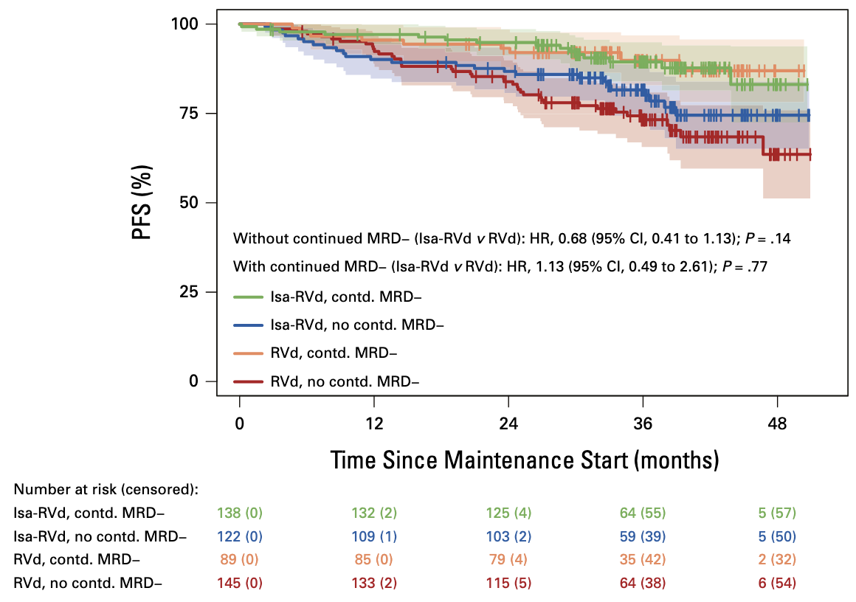
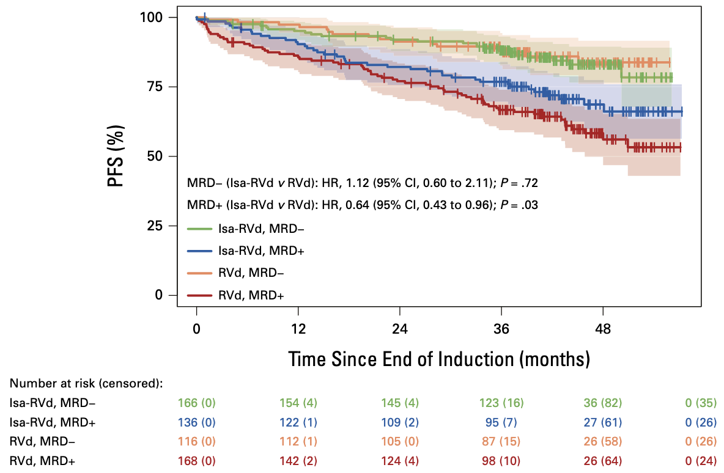
GMMG-HD7: MRD & Outcomes
Mai EK et al. J Clin Oncol. 2025 Apr 10;43(11):1279-1288.

Slide 6
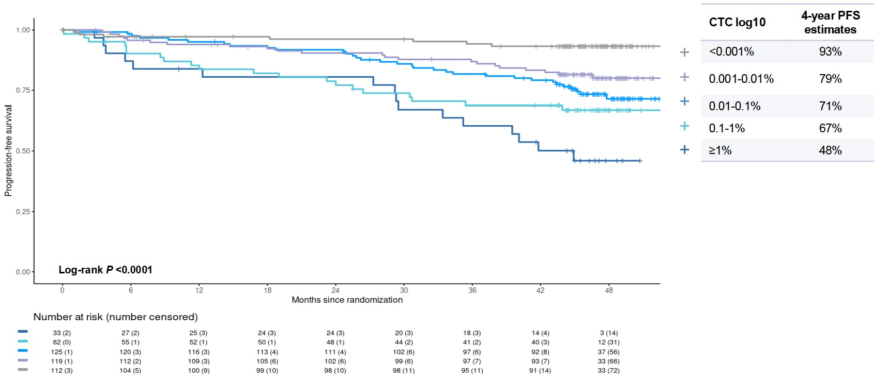
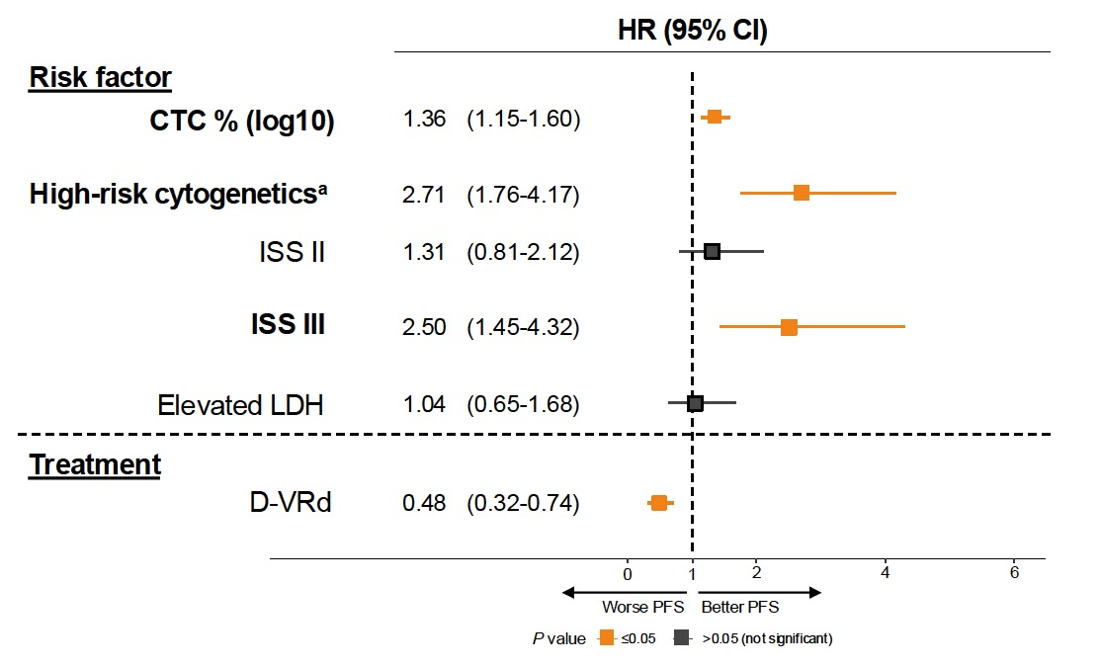
PERSEUS: Value of CTCs
Bertamini L et al. ASH 2024;Abstract 487.

Slide 7
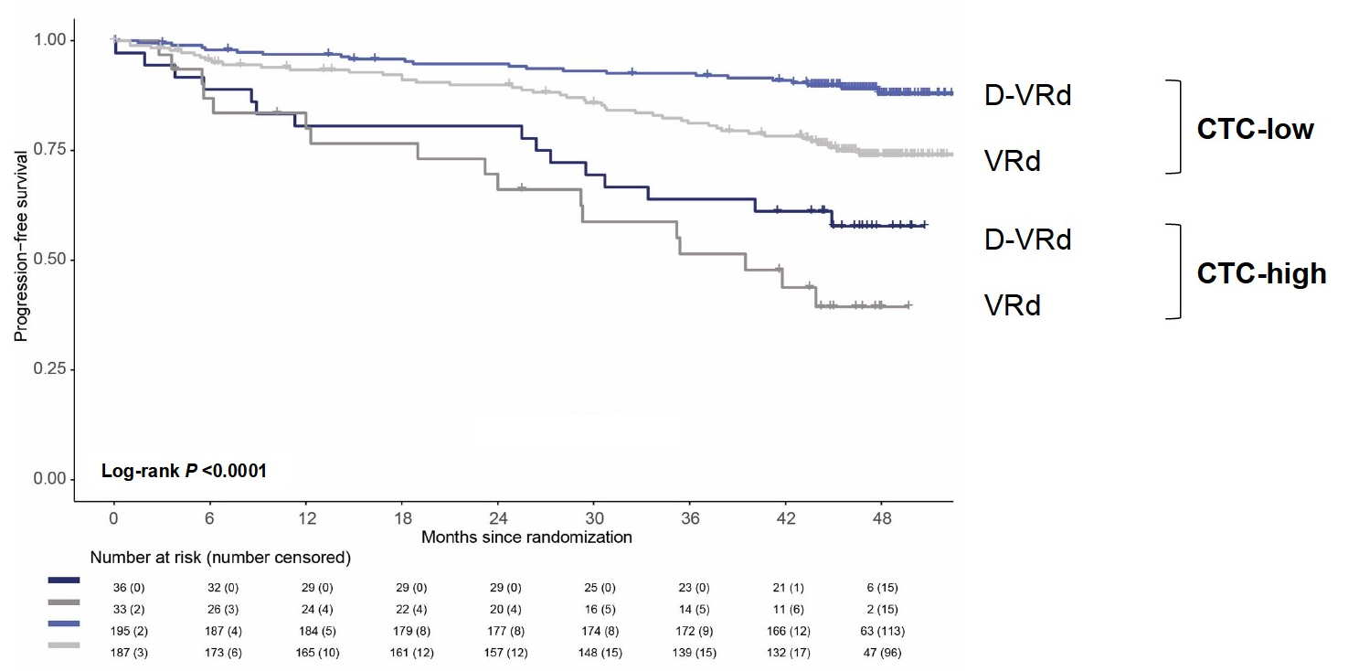
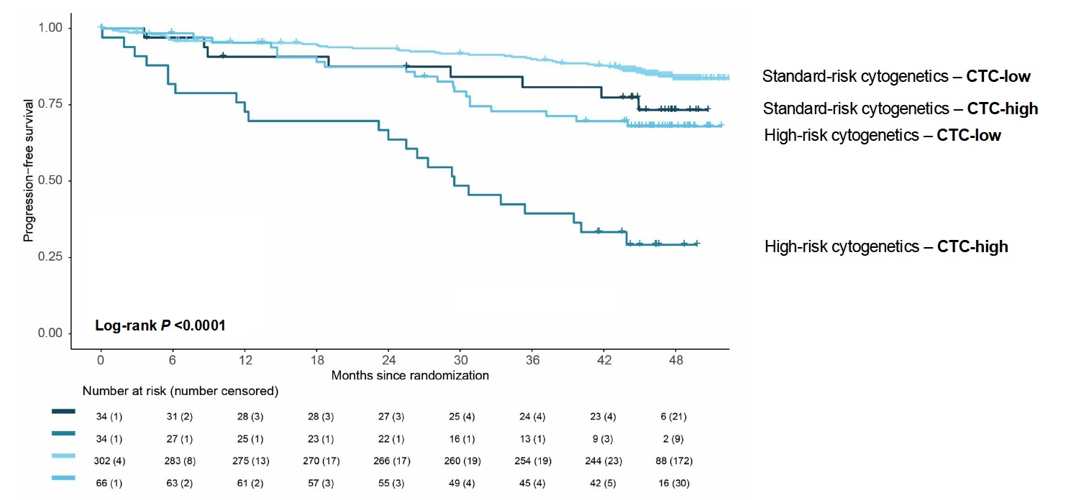
CTCs & Risk Groups
Bertamini L et al. ASH 2024;Abstract 487.

Slide 8
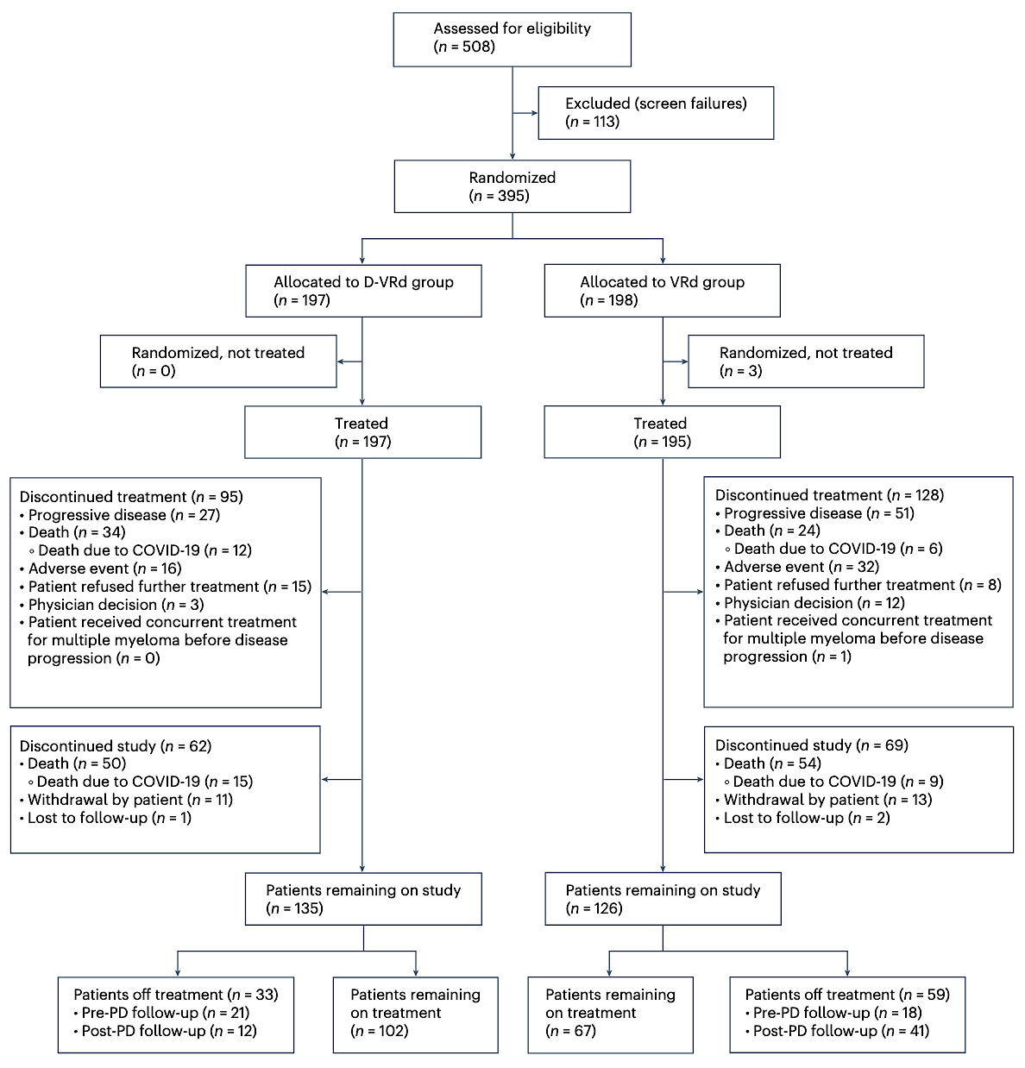
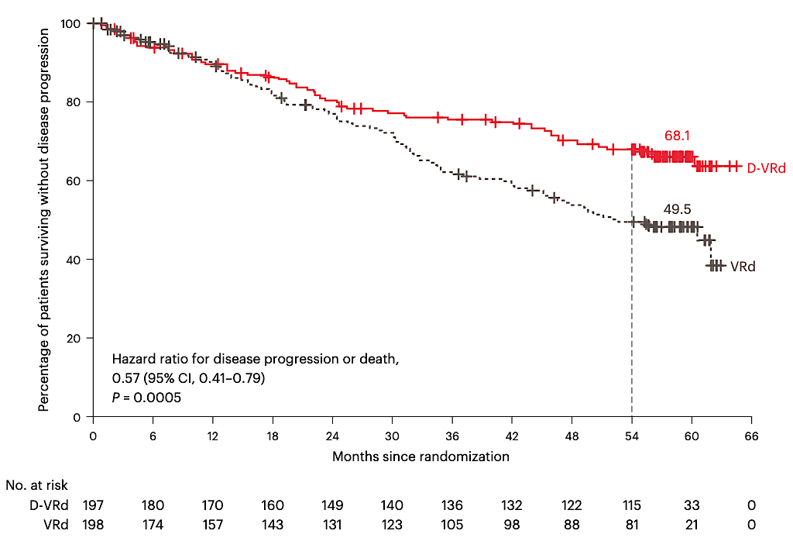
CEPHEUS: DVRd vs. VRd in TIE Non-frail
Usmani SZ et al. Nat Med. 2025 Apr;31(4):1195-1202.

Slide 9
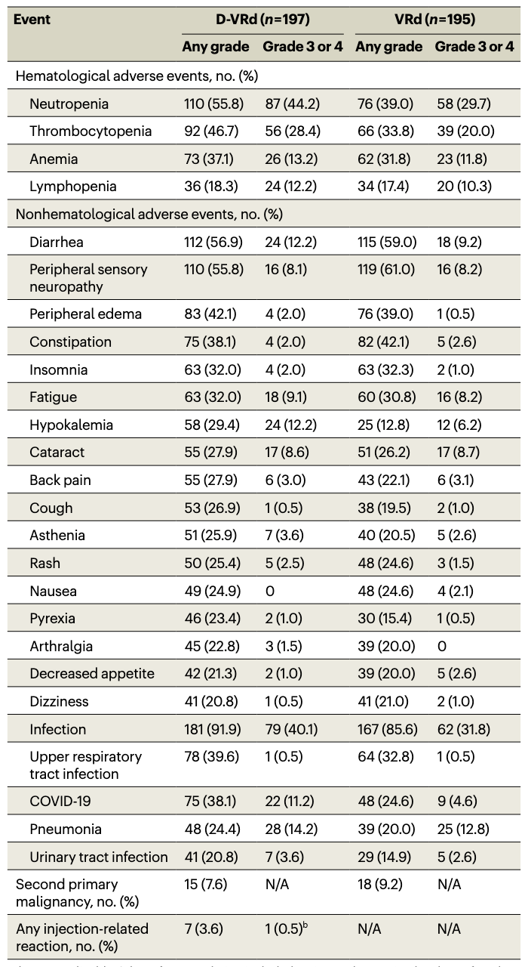
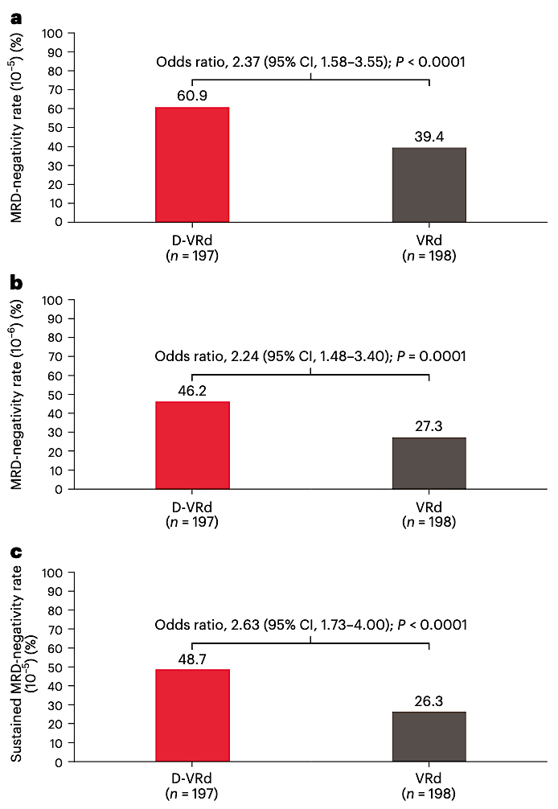
CEPHEUS: MRD Negativity & AEs
Usmani SZ et al. Nat Med. 2025 Apr;31(4):1195-1202.

Slide 10
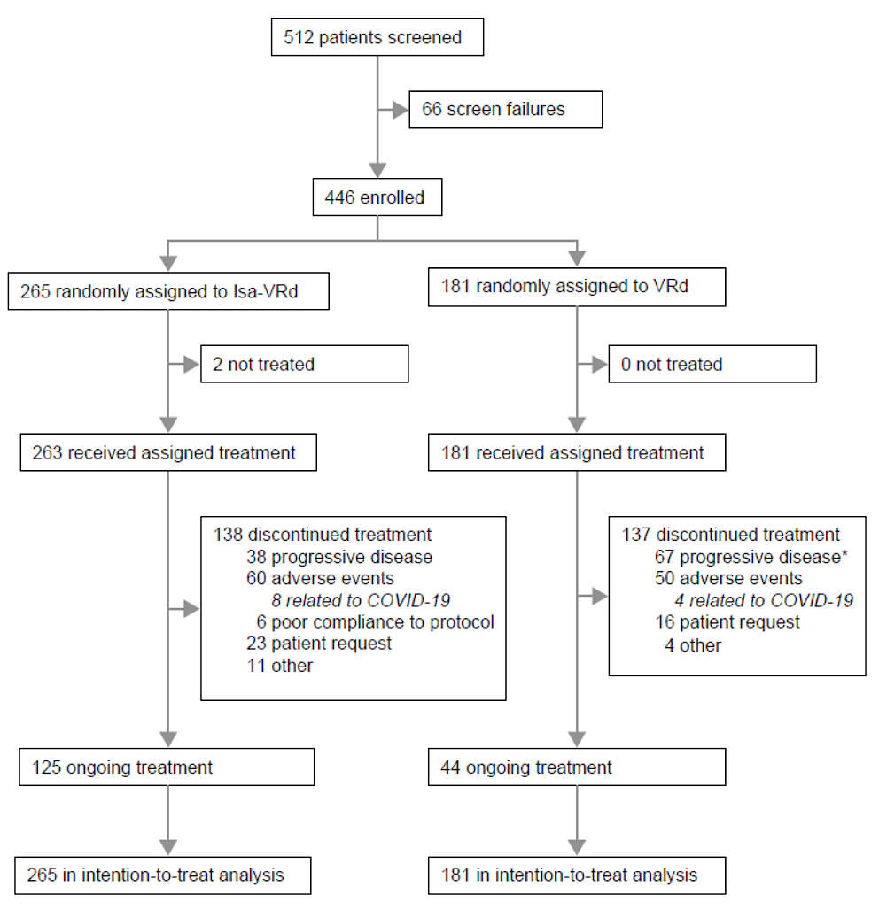
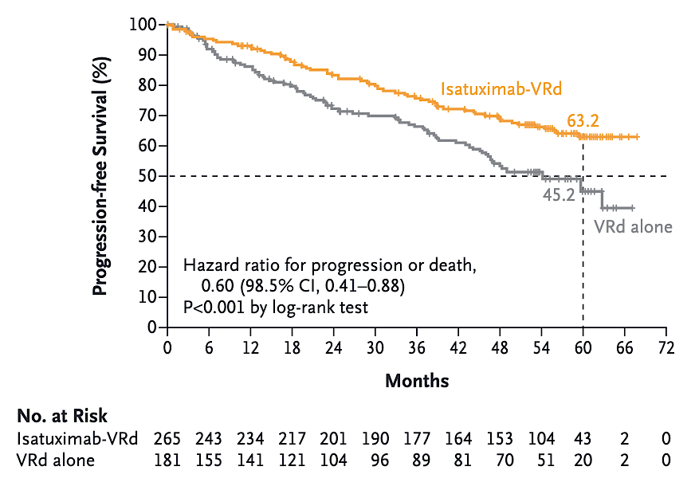
IMROZ : IsaVRd vs. VRd in TIE MM
Facon T et al. N Engl J Med. 2024 Oct 31;391(17):1597-1609.

Slide 11
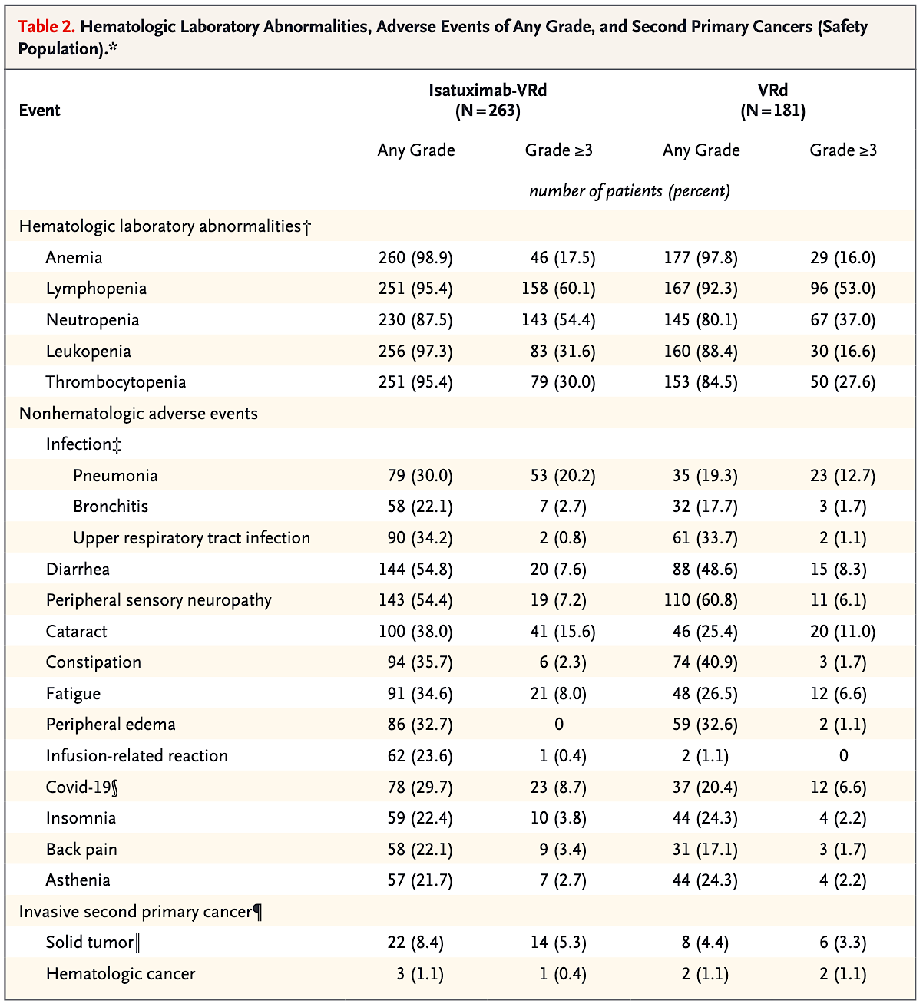
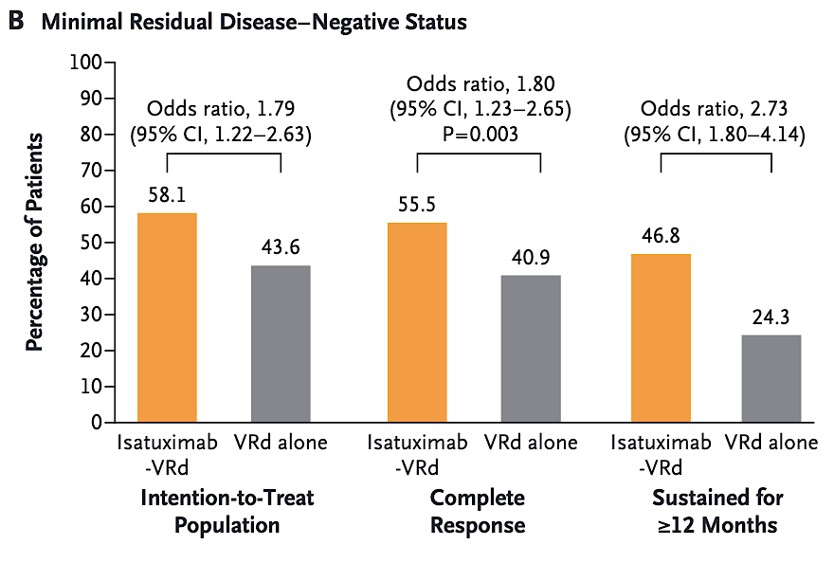
IsaVRd in TIE MM: MRD & AEs
Facon T et al. N Engl J Med. 2024 Oct 31;391(17):1597-1609.

Slide 12
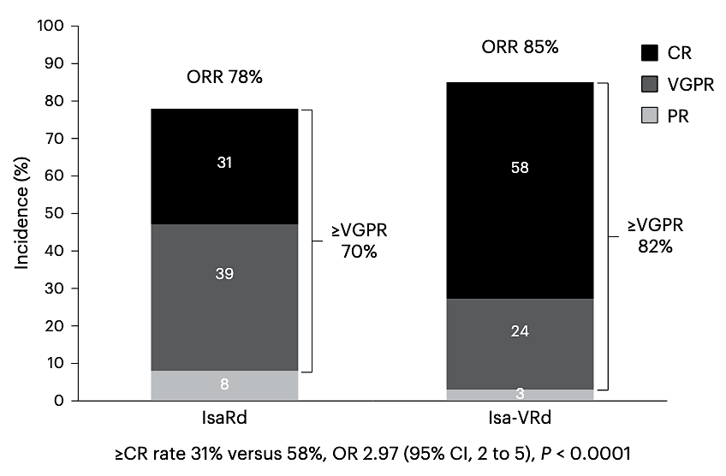
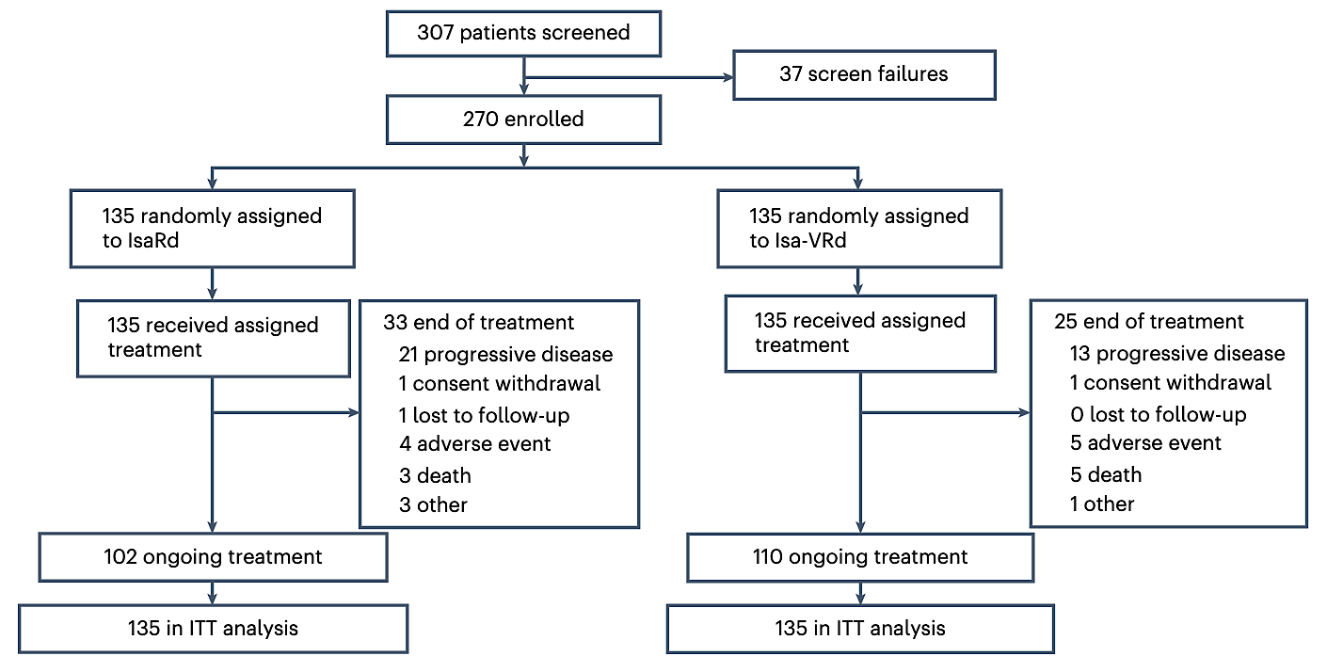
BENEFIT: IsaVRd vs. IsaRd in TIE
Leleu X et al. Nat Med. 2024 Aug;30(8):2235-2241.

Slide 13
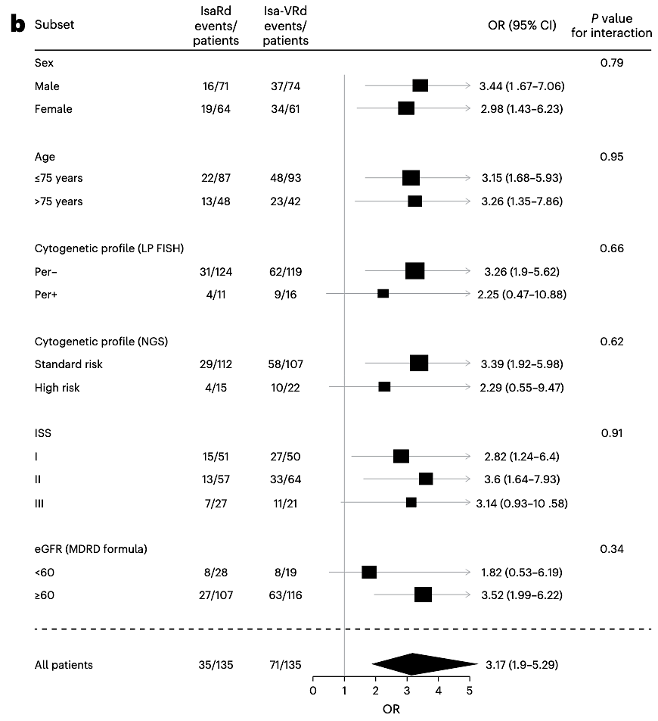
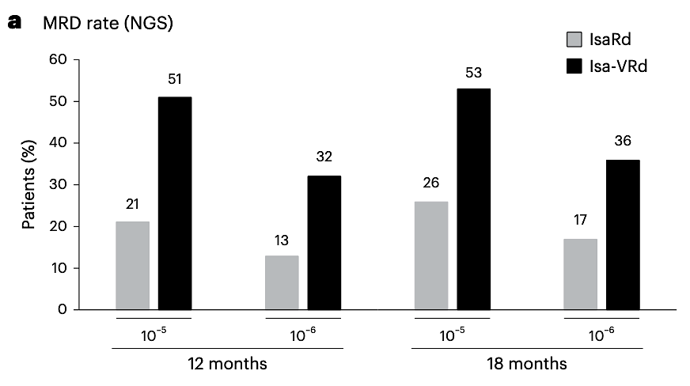
BENEFIT: MRD & Subgroups
Leleu X et al. Nat Med. 2024 Aug;30(8):2235-2241.

Slide 14
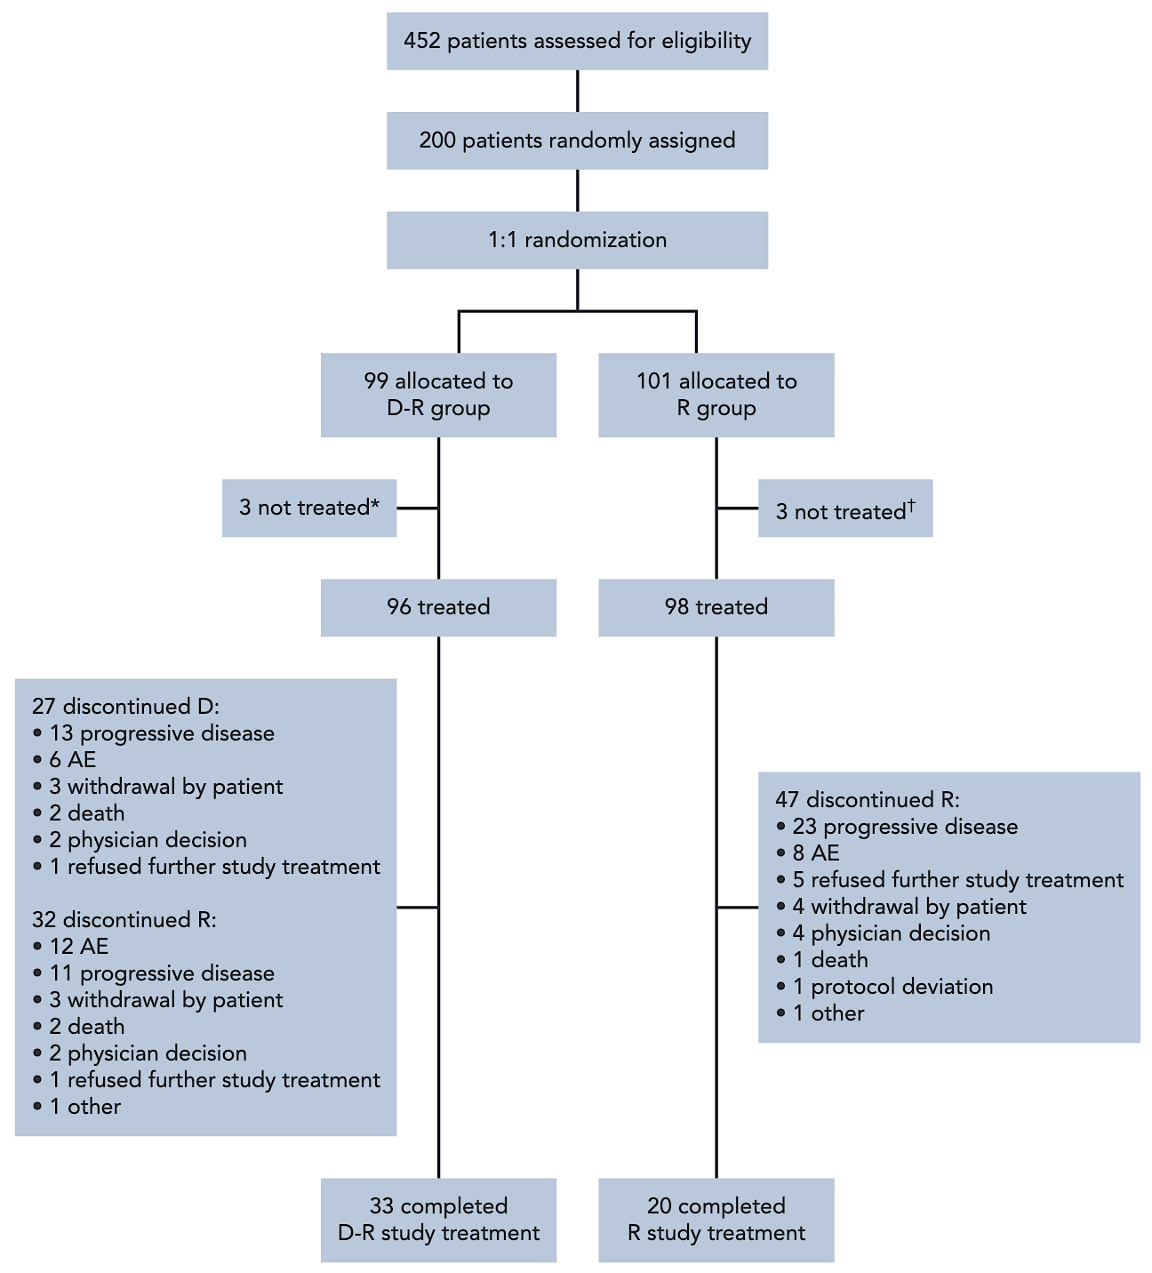
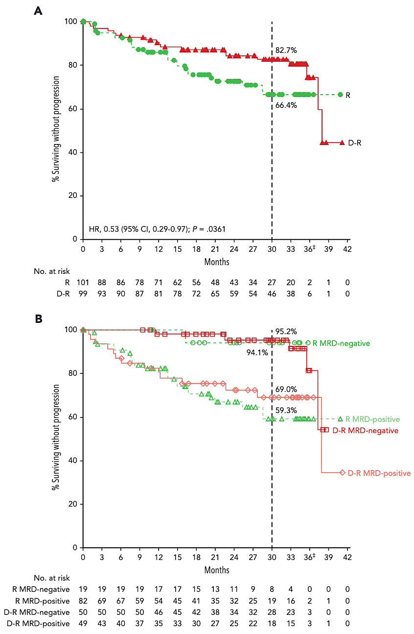
AURIGA: DR vs. R Post-ASCT w/ MRD⁺
Badros A et al. Blood. 2025 Jan 16;145(3):300-310.

Slide 15
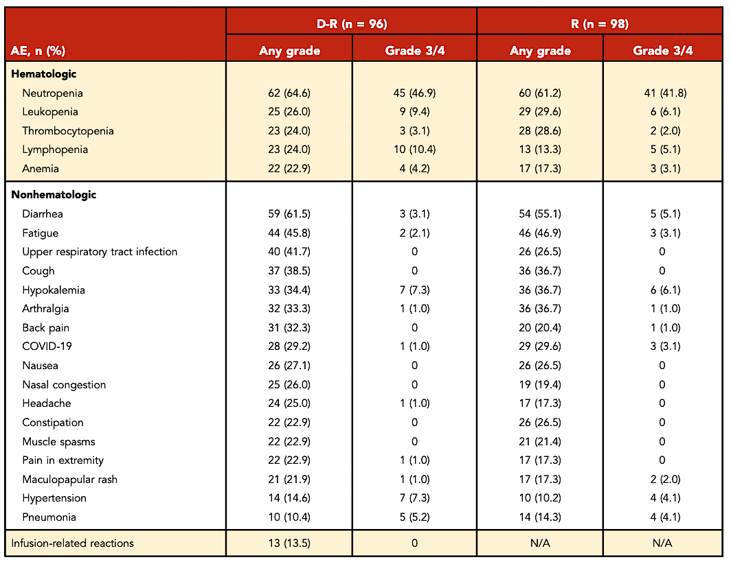
AURIGA: MRD and AEs
Badros A et al. Blood. 2025 Jan 16;145(3):300-310.

Slide 16
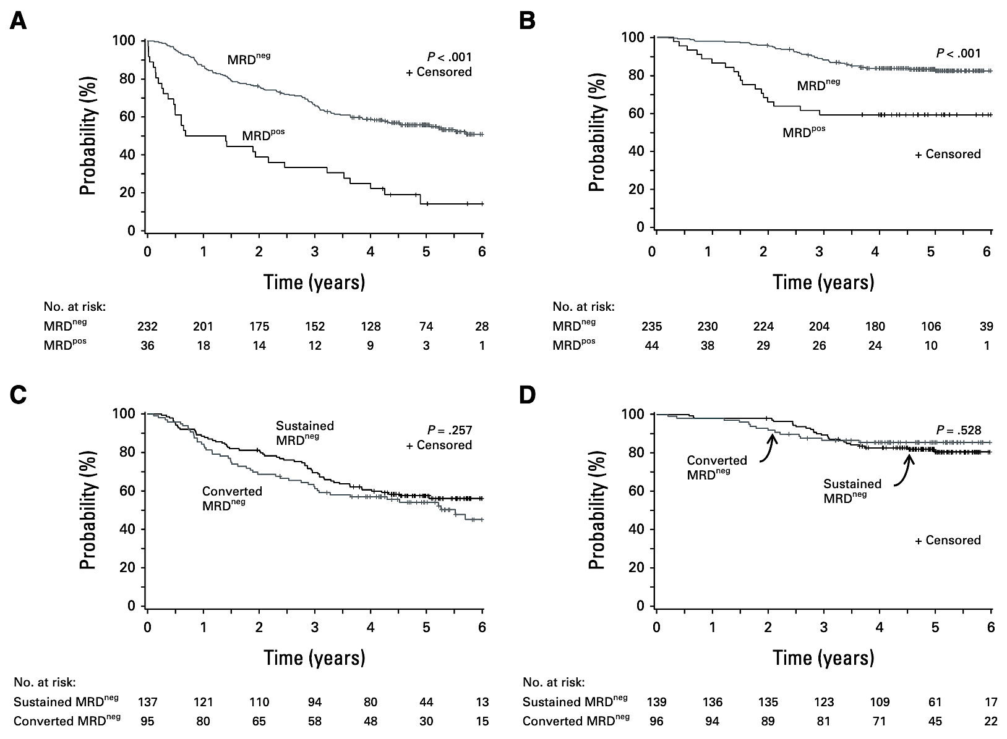
Value of MRD 1 Year Post-ASCT
PFS OS
PFS OS
Pasquini MC et al. J Clin Oncol. 2024 Aug 10;42(23):2757-2768.

Slide 17
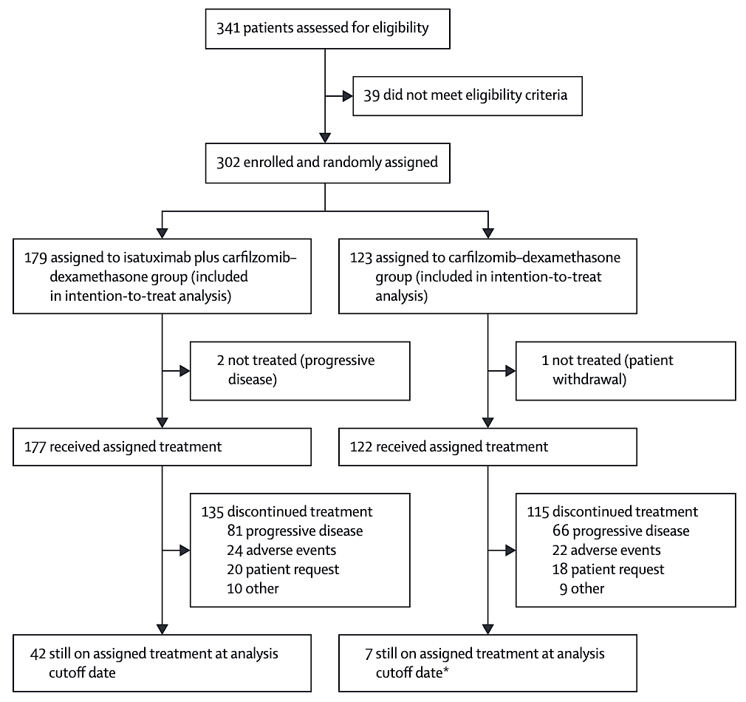
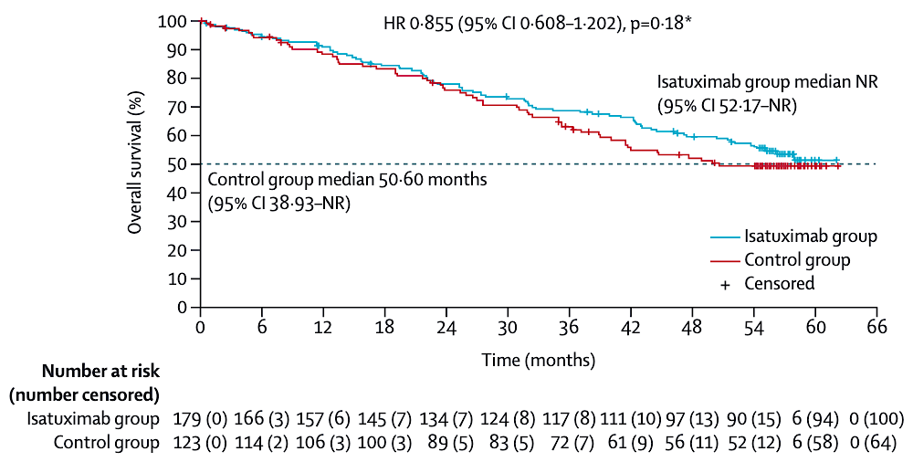
IKEMA: IKd vs. Kd OS Analysis
PFS OS
PFS OS
Yong K et al. Lancet Haematol. 2024 Oct;11(10):e741-e750.

Slide 18
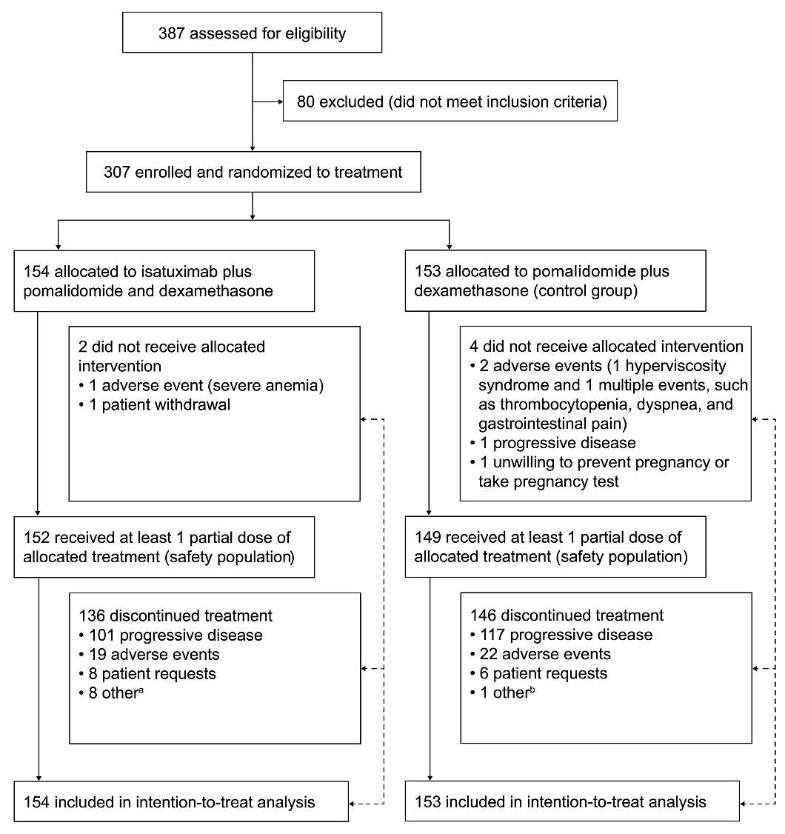
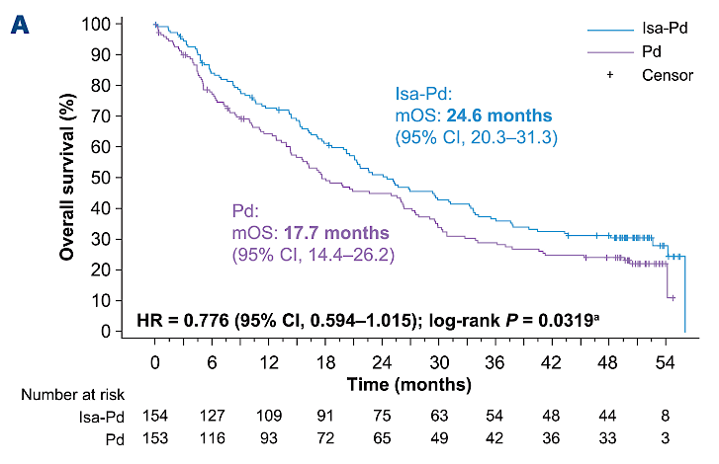
ICARIA: IPd vs. Pd OS Final Analysis
PFS OS
PFS OS
Richardson PG et al. Haematologica. 2024 Jul 1;109(7):2239-2249.

Slide 19
New Isatuximab Subcutaneous Formulation Met Coprimary Endpoints in the IRAKLIA Phase III Study in Multiple Myeloma Press Release: January 9, 2025
“Results from the investigational, randomized, open-label IRAKLIA phase 3 study demonstrated that isatuximab administered at a fixed dose subcutaneously (SC) via an on-body delivery system (OBDS) in combination with pomalidomide and dexamethasone (Pd) met its co-primary endpoints of non-inferior objective response rate (ORR) and observed concentration before dosing (C trough) at steady state compared to intravenous (IV) isatuximab administered at a weight-based dose in combination with Pd in patients with relapsed or refractory multiple myeloma (R/R MM). Key secondary endpoints, including very good partial response (VGPR), incidence rate of infusion reactions and C trough at cycle 2 were also achieved. The study is ongoing, and the full results will be presented at a forthcoming medical meeting.
Additional studies evaluating isatuximab SC formulations across different combinations and lines of therapy are ongoing. The safety and efficacy of isatuximab SC [has] not been evaluated by any regulatory authority outside of [the] approved indications. Regulatory submissions in the US and in the EU are planned during the first half of 2025.”
https://www.sanofi.com/en/media-room/press-releases/2025/2025-01-09-06-00-00-3006798

Slide 20
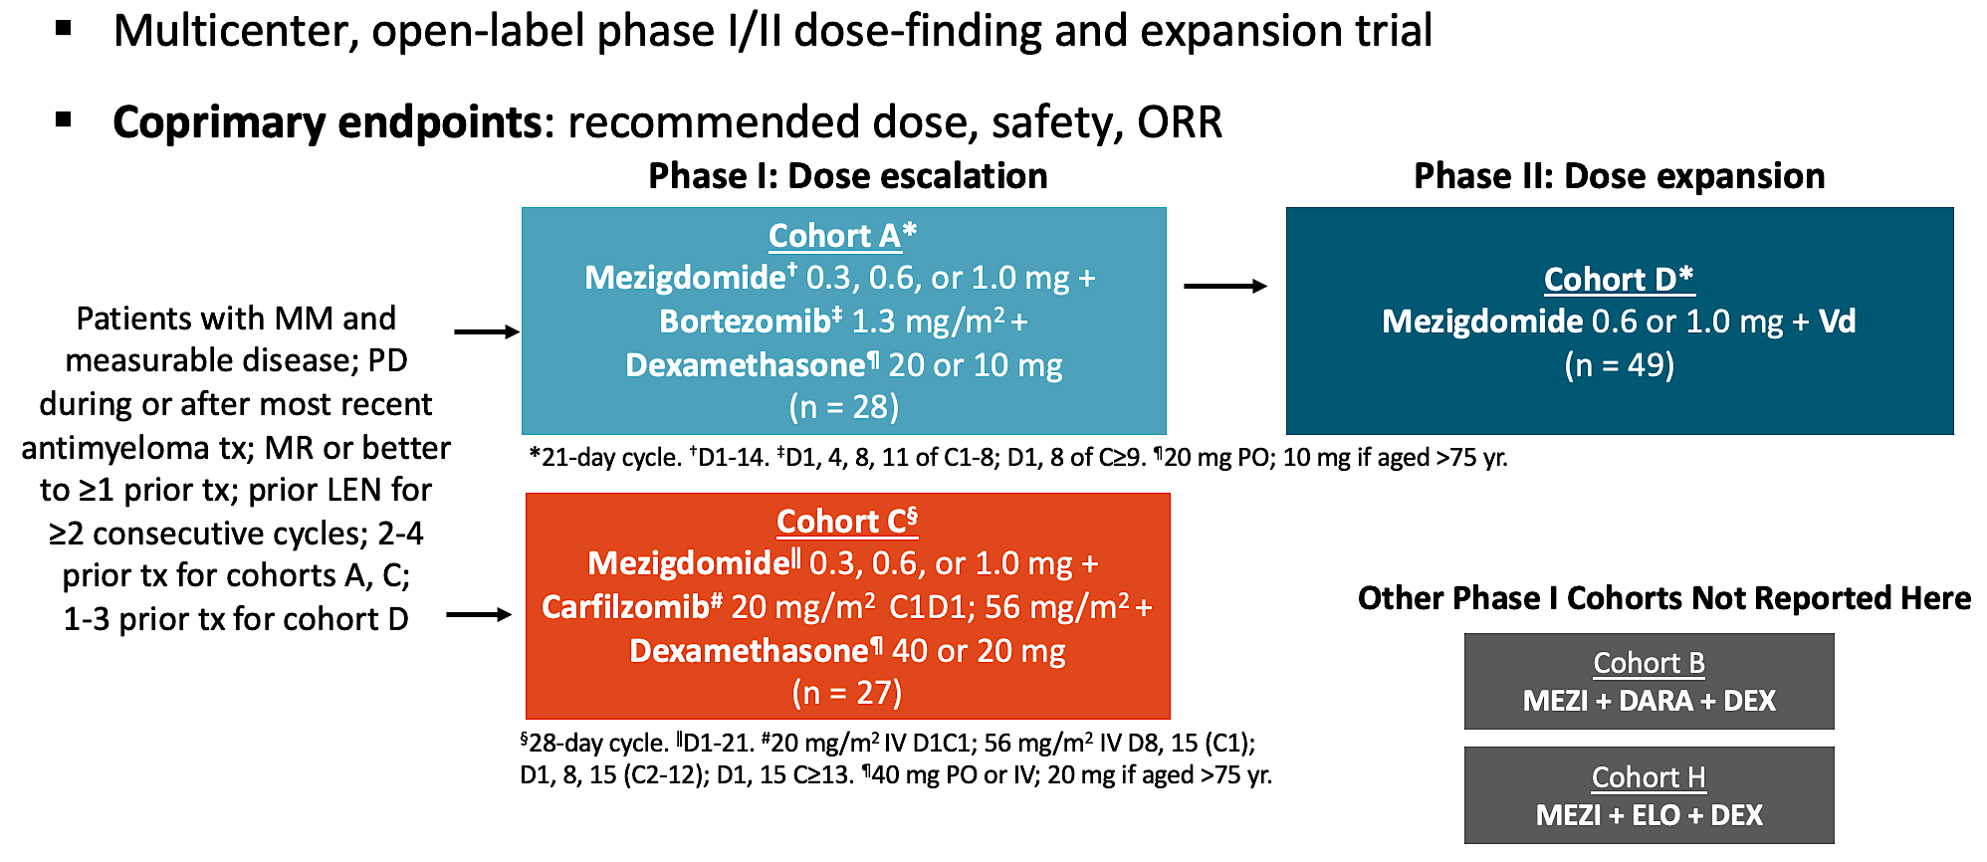
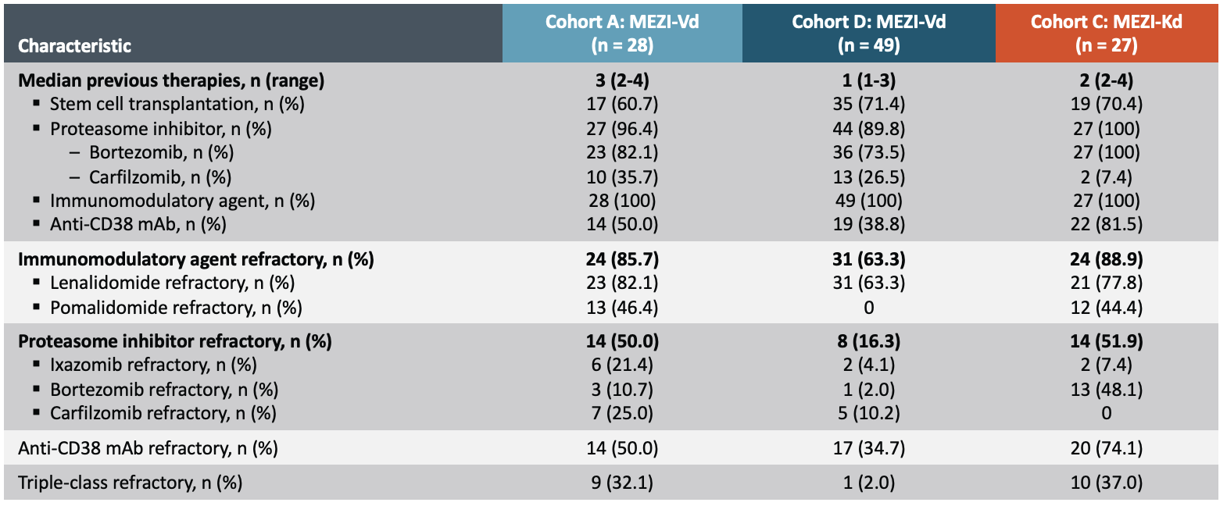
CC-92480-MM-02: MeziKd or MeziVd
Sandhu I et al. ASH 2024;Abstract 1025.

Slide 21
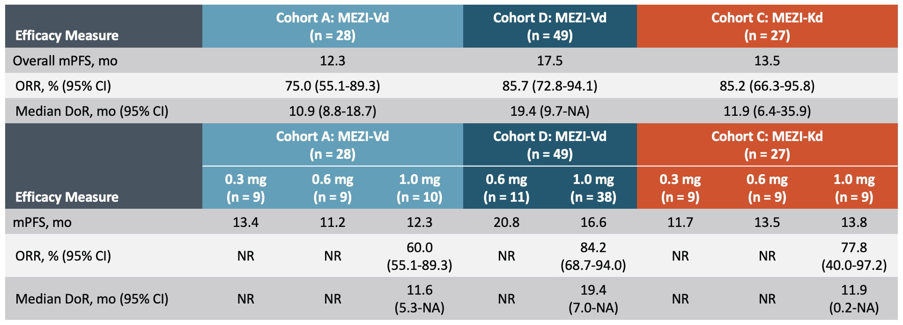
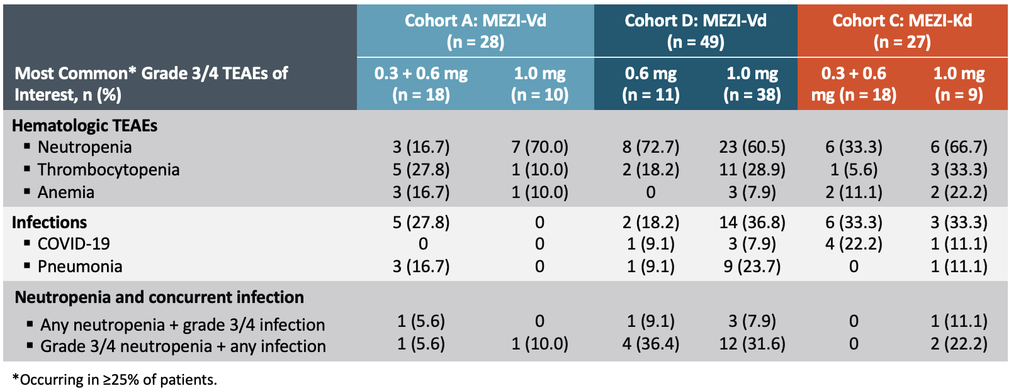
MeziKd or MeziVd: Efficacy & Safety
Sandhu I et al. ASH 2024;Abstract 1025.

