Slide 1


Chimeric Antigen Receptor (CAR) T-Cell Therapy, Bispecific Antibodies and Antibody-Drug Conjugates (ADCs)
Meletios (Thanos) Dimopoulos, MD
Professor of Hematology/Oncology, Director
Plasma Cell Dyscrasias Unit, Department of Clinical Therapeutics,
National and Kapodistrian University of Athens
School of Medicine, Athens, Greece

Slide 2
CARTITUDE-4: Cilta-cel vs SoC in early RRMM - Study Design
SOC PVdª or DPd^{b-e}
Study design
Screening
Key inclusion criteria^{1,2}
Age ≥18 years with diagnosed MM
1–3 prior LOT (must include PI + immunomodulator)
Lenalidomide refractory
ECOG PS ≤1
Key exclusion criteria^{1,2}
Prior CAR-T or BCMA-targeting therapy
1:1 Randomization (N=419)
Patients stratified by choice of PVd/DPd, ISS stage, and number of prior LOT
Follow-up
For survival, subsequent therapies, and safety
Cilta-cel arm
Bridging therapy
PVd or DPdª ≥1 cycle
Lympho-depletion Days -7 to -5
Cy/Flu
Cilta-cel infusion Day 1
(Target,
0.75 × 10⁶ CAR+ T cells/kg)
Follow-up Days 1–112
Collect safety, efficacy, and PK/PD data every 28 days
Apheresis
Start of efficacy endpoint analyses
Start of study treatment
T-cell transduction and expansion to manufacture cilta-cel CAR-T cells
San Miguel, J et al. N Engl J Med. 2023;389:335-347; Mateos MV, et al. IMS 2024 (Abstract No. OA65 – presentation
Notes:
HCP Webinar 5 – DO NOT FE
1. Moreau 2022/p499/c1/¶1/L2-4; ¶2/L1-3; p500/Figure 1
2. Martin 2022/p1268/c1/Table 1/Rows 2-3
1. Moreau 2022/p498/Table 1; Rows 1, 2, 13, 22, 26, 35
1. Moreau 2022/p500/Figure 1A; p501/Figure 2A-C
[calculation:
58.8*165/100=97]
1. Moreau 2022/p499/c1/¶1/L2-7; p500/Figure 1A
Calculation VGPR:
97/165=0.5878=58.8%
3. Nooka 2022/c2/Results//Enrollment/L3-6
1. Moreau 2022/ p499/c2/¶1/L5-11; p502/Table 2/Rows 5-7, 24
1. Moreau 2022/p496/c1/¶2/L6-11, 14-18; c2/¶2/L1-4; p497/c1/¶4/L10,11
1. *Moreau 2022/p497/c2/¶2/L8,9
1. †Moreau 2022/p497/c2/¶3/L9-11
EDT: skip

Slide 3
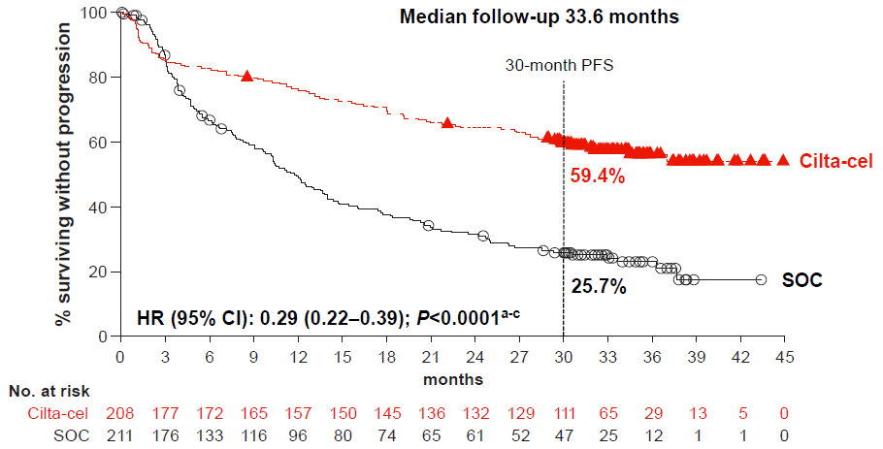
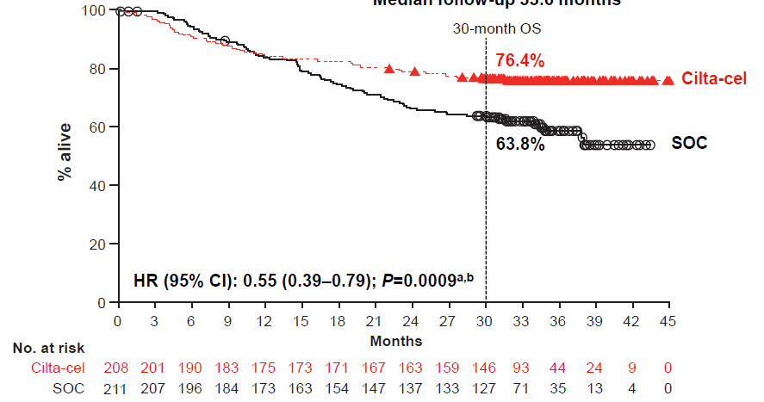
CARTITUDE-4 1-3 prior LOT; lenalidomide-refractory
After a median follow-up of 33.6 months:
PFS
OS
d,e

Slide 4
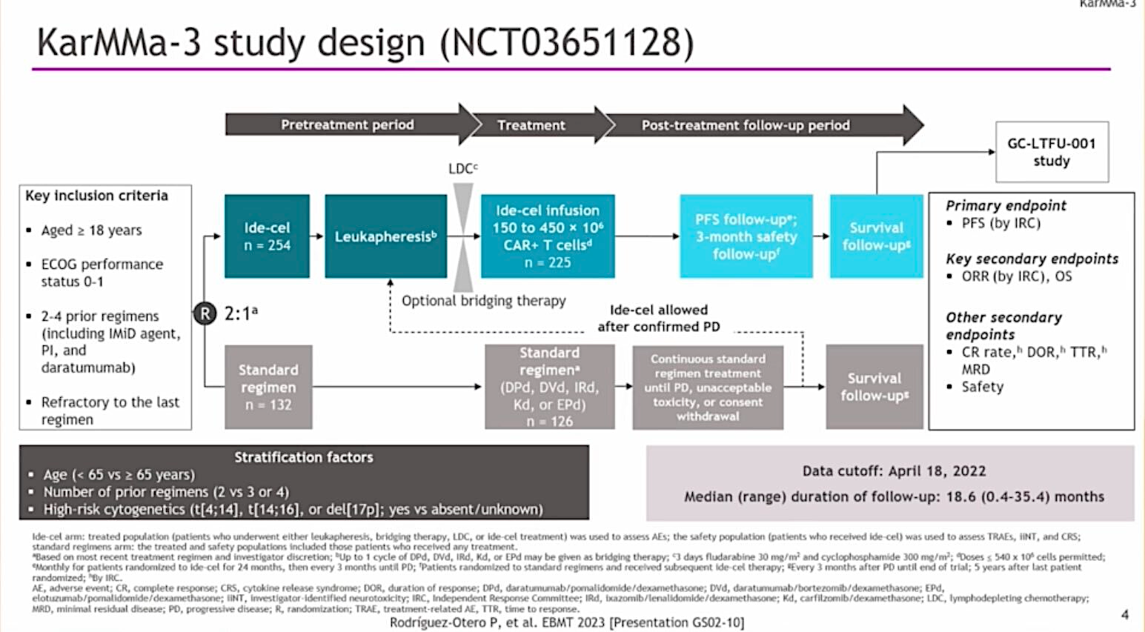

Slide 5
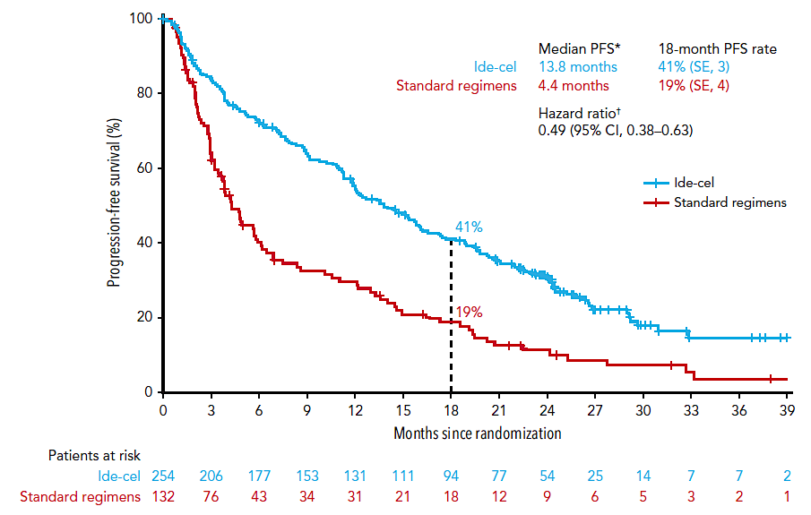
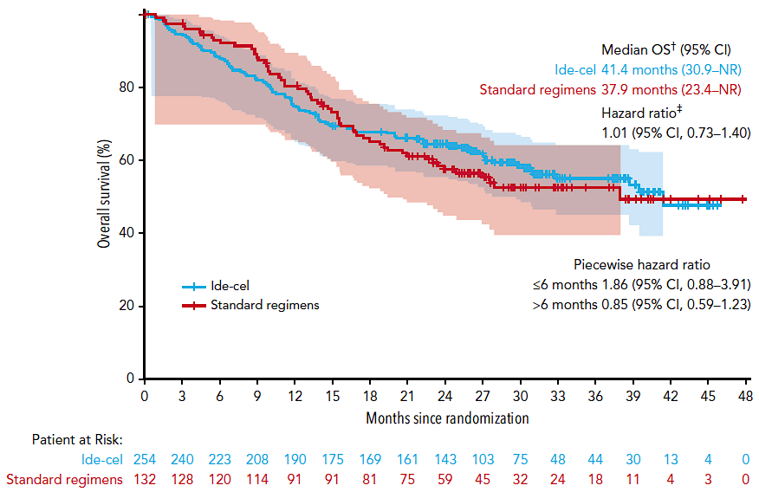
KarMMa-3 2-4 prior LOT; triple-class-exposed
After a median follow-up of 30.9 months:
PFS
OS
Crossover: at data cutoff, 56% (74/132) of patients in the SR arm had received ide-cel as subsequent therapy after PD

Slide 6
Phase 2 iMMagine-1: Anito-cel - Preliminary efficacy data for an anti-BCMA CAR T-cell therapy in RRMM
Patient characteristics | Safety evaluable (N=98) | Efficacy evaluable (N=86)
Median age (yrs) | 65 | 65
Previous lines of therapy
Lines of prior therapy, median (min-max) | 4 (3-8) | 4 (3-8)
3 prior lines of therapy | 45 (46%) | 37 (43%)
Triple refractory | 85 (87%) | 74 (86%)
Penta refractory | 41 (42%) | 37 (43%)
Prior ASCT | 73 (75%) | 64 (74%)
Bridging therapy | 65 (66%) | 61 (71%)
Outpatient administration | 8 (8%) | 5 (6%)
Median time since diagnosis (yrs) | 7.2 | 7.5
≥VGPR
81%
ORR: 97% and sCR/CR: 62% at 9.5 mos (median f/u)
MRD –ve rate at 10⁻⁵ or lower: 93.1% (54/58)
PFS rate at 6 mos: 93.3% and at 12 mos: 78.5%
OS rate at 6 mos: 96.5% and at 12 mos: 96.5%
Anito-cel is an investigational product, currently not approved by any regulatory agency.
-ve, negative; Anito-cel, anitocabtagene autoleucel; ASCT, autologous stem cell transplant; CAR T, chimeric antigen receptor T cell; CR, complete response; f/u, follow up; mo, month; MRDng, minimal residual disease negativity rate; ORR, overall response rate; OS, overall survival; PFS, progression-free survival; PR, partial response; RRMM, relapse/refractory multiple myeloma; sCR, stringent CR; TEAE, treatment-emergent adverse event; VGPR, very good PR; yr, year.
Freeman CL et al. Oral presentation at ASH 2024. Abstract 1031.

Slide 7
Phase 2 iMMagine-1: Anito-cel - Preliminary Safety Data in RRMM
Event | Safety evaluable (N=98)
CRS, any grade (%) | 83
Median onset (days) | 4
ICANS, any grade (%) | 9
Median onset (days) | 7
TEAEs (non-CRS/non-ICANS), Gr 3/4 after cell infusion (%)
Neutropenia | 54
Anemia | 22
Thrombocytopenia | 20
86% of patients with ≤Gr1 CRS
91% of patients with no ICANS
No delayed or non-ICANS neurotoxicities to date
Most common ≥Gr3 TEAEs: cytopenias
3 deaths due to TEAEs
Freeman CL et al. Oral presentation at ASH 2024. Abstract 1031.

Slide 8
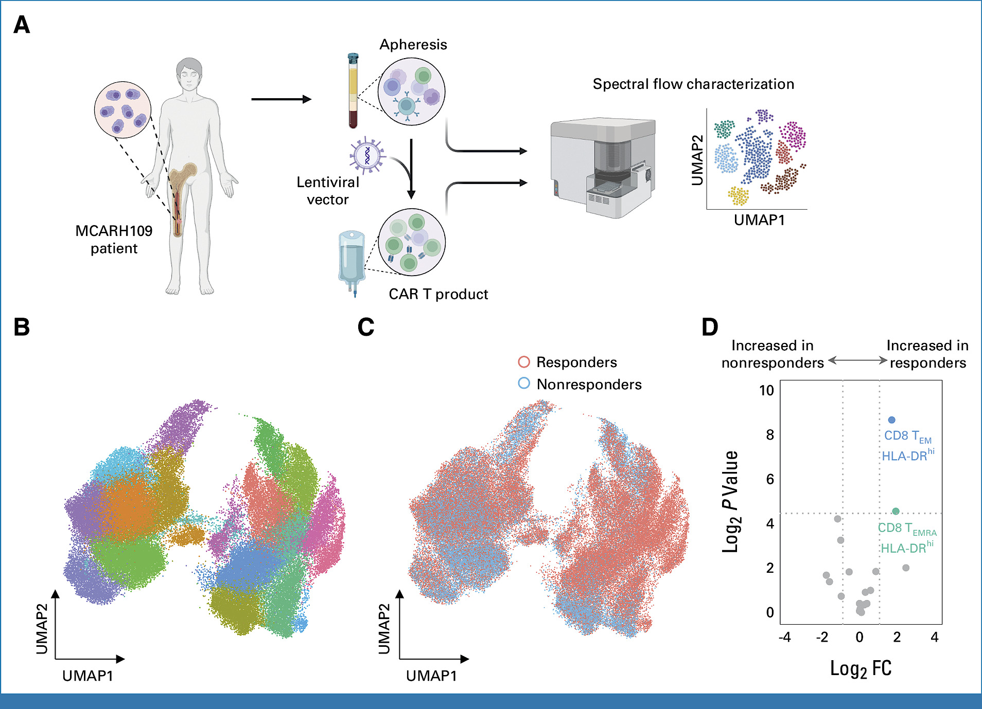
Phase I Trial of MCARH109, a GPRC5D-Targeted Chimeric Antigen Receptor T-Cell Therapy for RR Multiple Myeloma
Jurgens EM, et al. J Clin Oncol 2025;43:498-504.

Slide 9
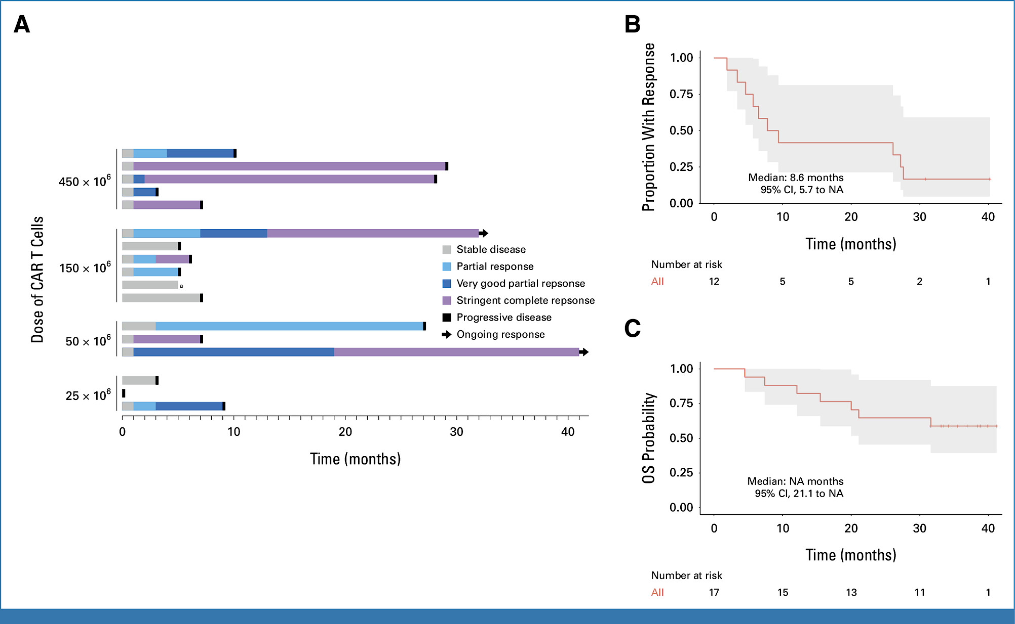
Phase I Trial of MCARH109 in RRMM: Efficacy Data
Characteristic | No Previous BCMA Therapy (n = 7) | Previous BCMA Therapy (n = 10) | Overall (N = 17)
Age, years Median (range) | 57.9 (37.6-76.4) | 63.8 (39.6-73.5) | 59.6 (37.6-76.4)
High-risk cytogenetics, No. (%)
Yes | 5 (71.4) | 8 (80.0) | 13 (76.5)
No | 2 (28.6) | 2 (20.0) | 4 (23.5)
Extramedullary plasmacytoma, No. (%)
Yes | 4 (57.1) | 4 (40.0) | 8 (47.1)
No | 3 (42.9) | 6 (60.0) | 9 (52.9)
Previous lines of therapy
Median (range) | 5.0 (4.0-8.0) | 6.50 (5.00-14.0) | 6.00 (4.00-14.0)
Penta-exposed, No. (%)
Yes | 7 (100) | 10 (100) | 17 (100)
Triple-refractory disease, No. (%)
Yes | 7 (100) | 9 (90.0) | 16 (94.1)
No | 0 (0) | 1 (10.0) | 1 (5.9)
Previous bispecific antibody
Yes | 0 (0) | 2(20) | 2 (11.8)
No | 7 (100) | 8(80) | 15 (88.2)
Bridging therapy, No. (%)
Yes | 7 (100) | 9 (90.0) | 16 (94.1)
No | 0 (0) | 1 (10.0) | 1 (5.9)
Responsive to bridging therapy
Yes | 0/7 (0) | 1/9 (11.1) | 1/16 (6.3)
No | 7/7 (100) | 8/9 (88.9) | 15/16 (93.7)
Jurgens EM, et al. J Clin Oncol 2025;43:498-504.

Slide 10
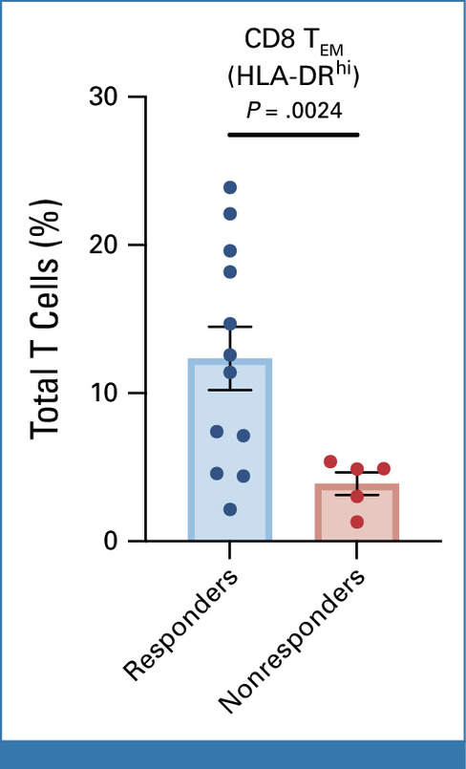
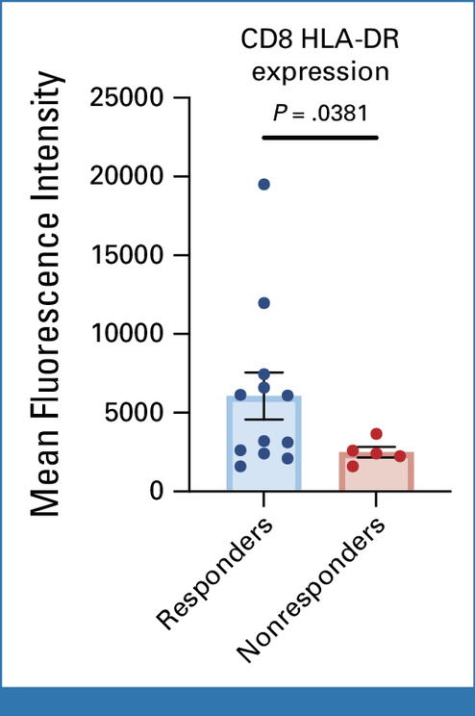
Phase I Trial of MCARH109 in RRMM: Efficacy Data
Jurgens EM, et al. J Clin Oncol 2025;43:498-504.

Slide 11
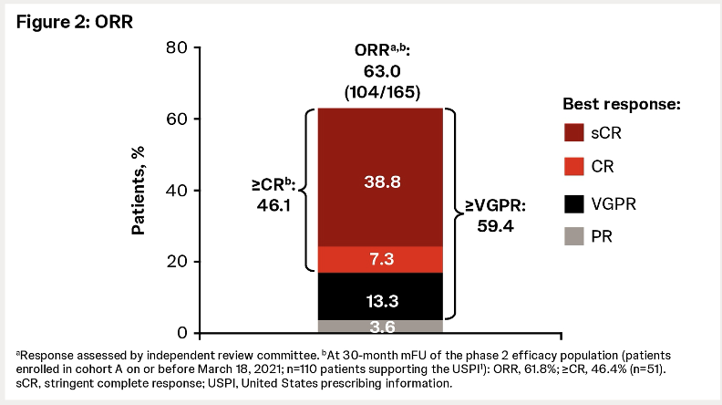
Phase I/II MajesTEC-1: Teclistamab in R/R MM
R/R MM after ≥3 lines of therapy, including an IMiD, PI, and anti-CD38 mAb
High-risk cytogenetics=26%
Median prior lines of therapy = 5 (range: 2-14)
Triple-class refractory=78%
Penta refractory= 30%
Refractory to last therapy line= 90%
Teclistamab: 1.5 mg/kg SC weekly, after step-up
Outcomes, mo (95% CI) | All Patients (N = 165)
Median DoR | 24.0 (17.0-NE)
Median PFS | 11.4 (8.8-16.4)
Median OS | 21.9 (16-NE)
Garfall A, et al. ASCO 2024. Abstr 7540. ​

Slide 12
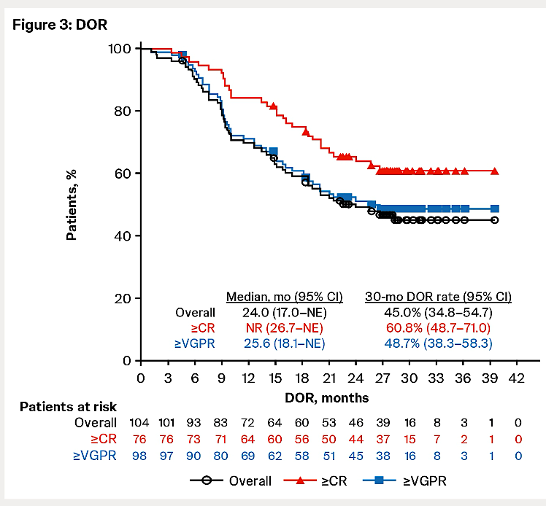
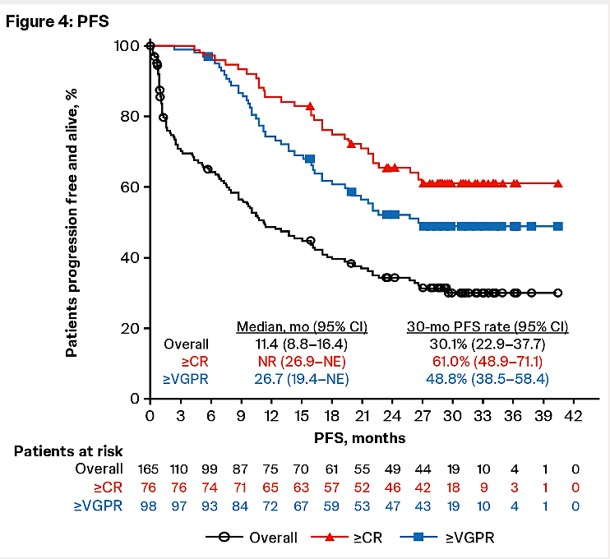
MajesTEC-1: Updated Efficacy of Teclistamab in R/R MM
Outcomes, mo (95% CI) | All Patients (N = 165)
Median DoR | 24.0 (17.0-NE)
Median PFS | 11.4 (8.8-16.4)
Median OS | 21.9 (16-NE)
Garfall A, et al. ASCO 2024. Abstr 7540. ​

Slide 13
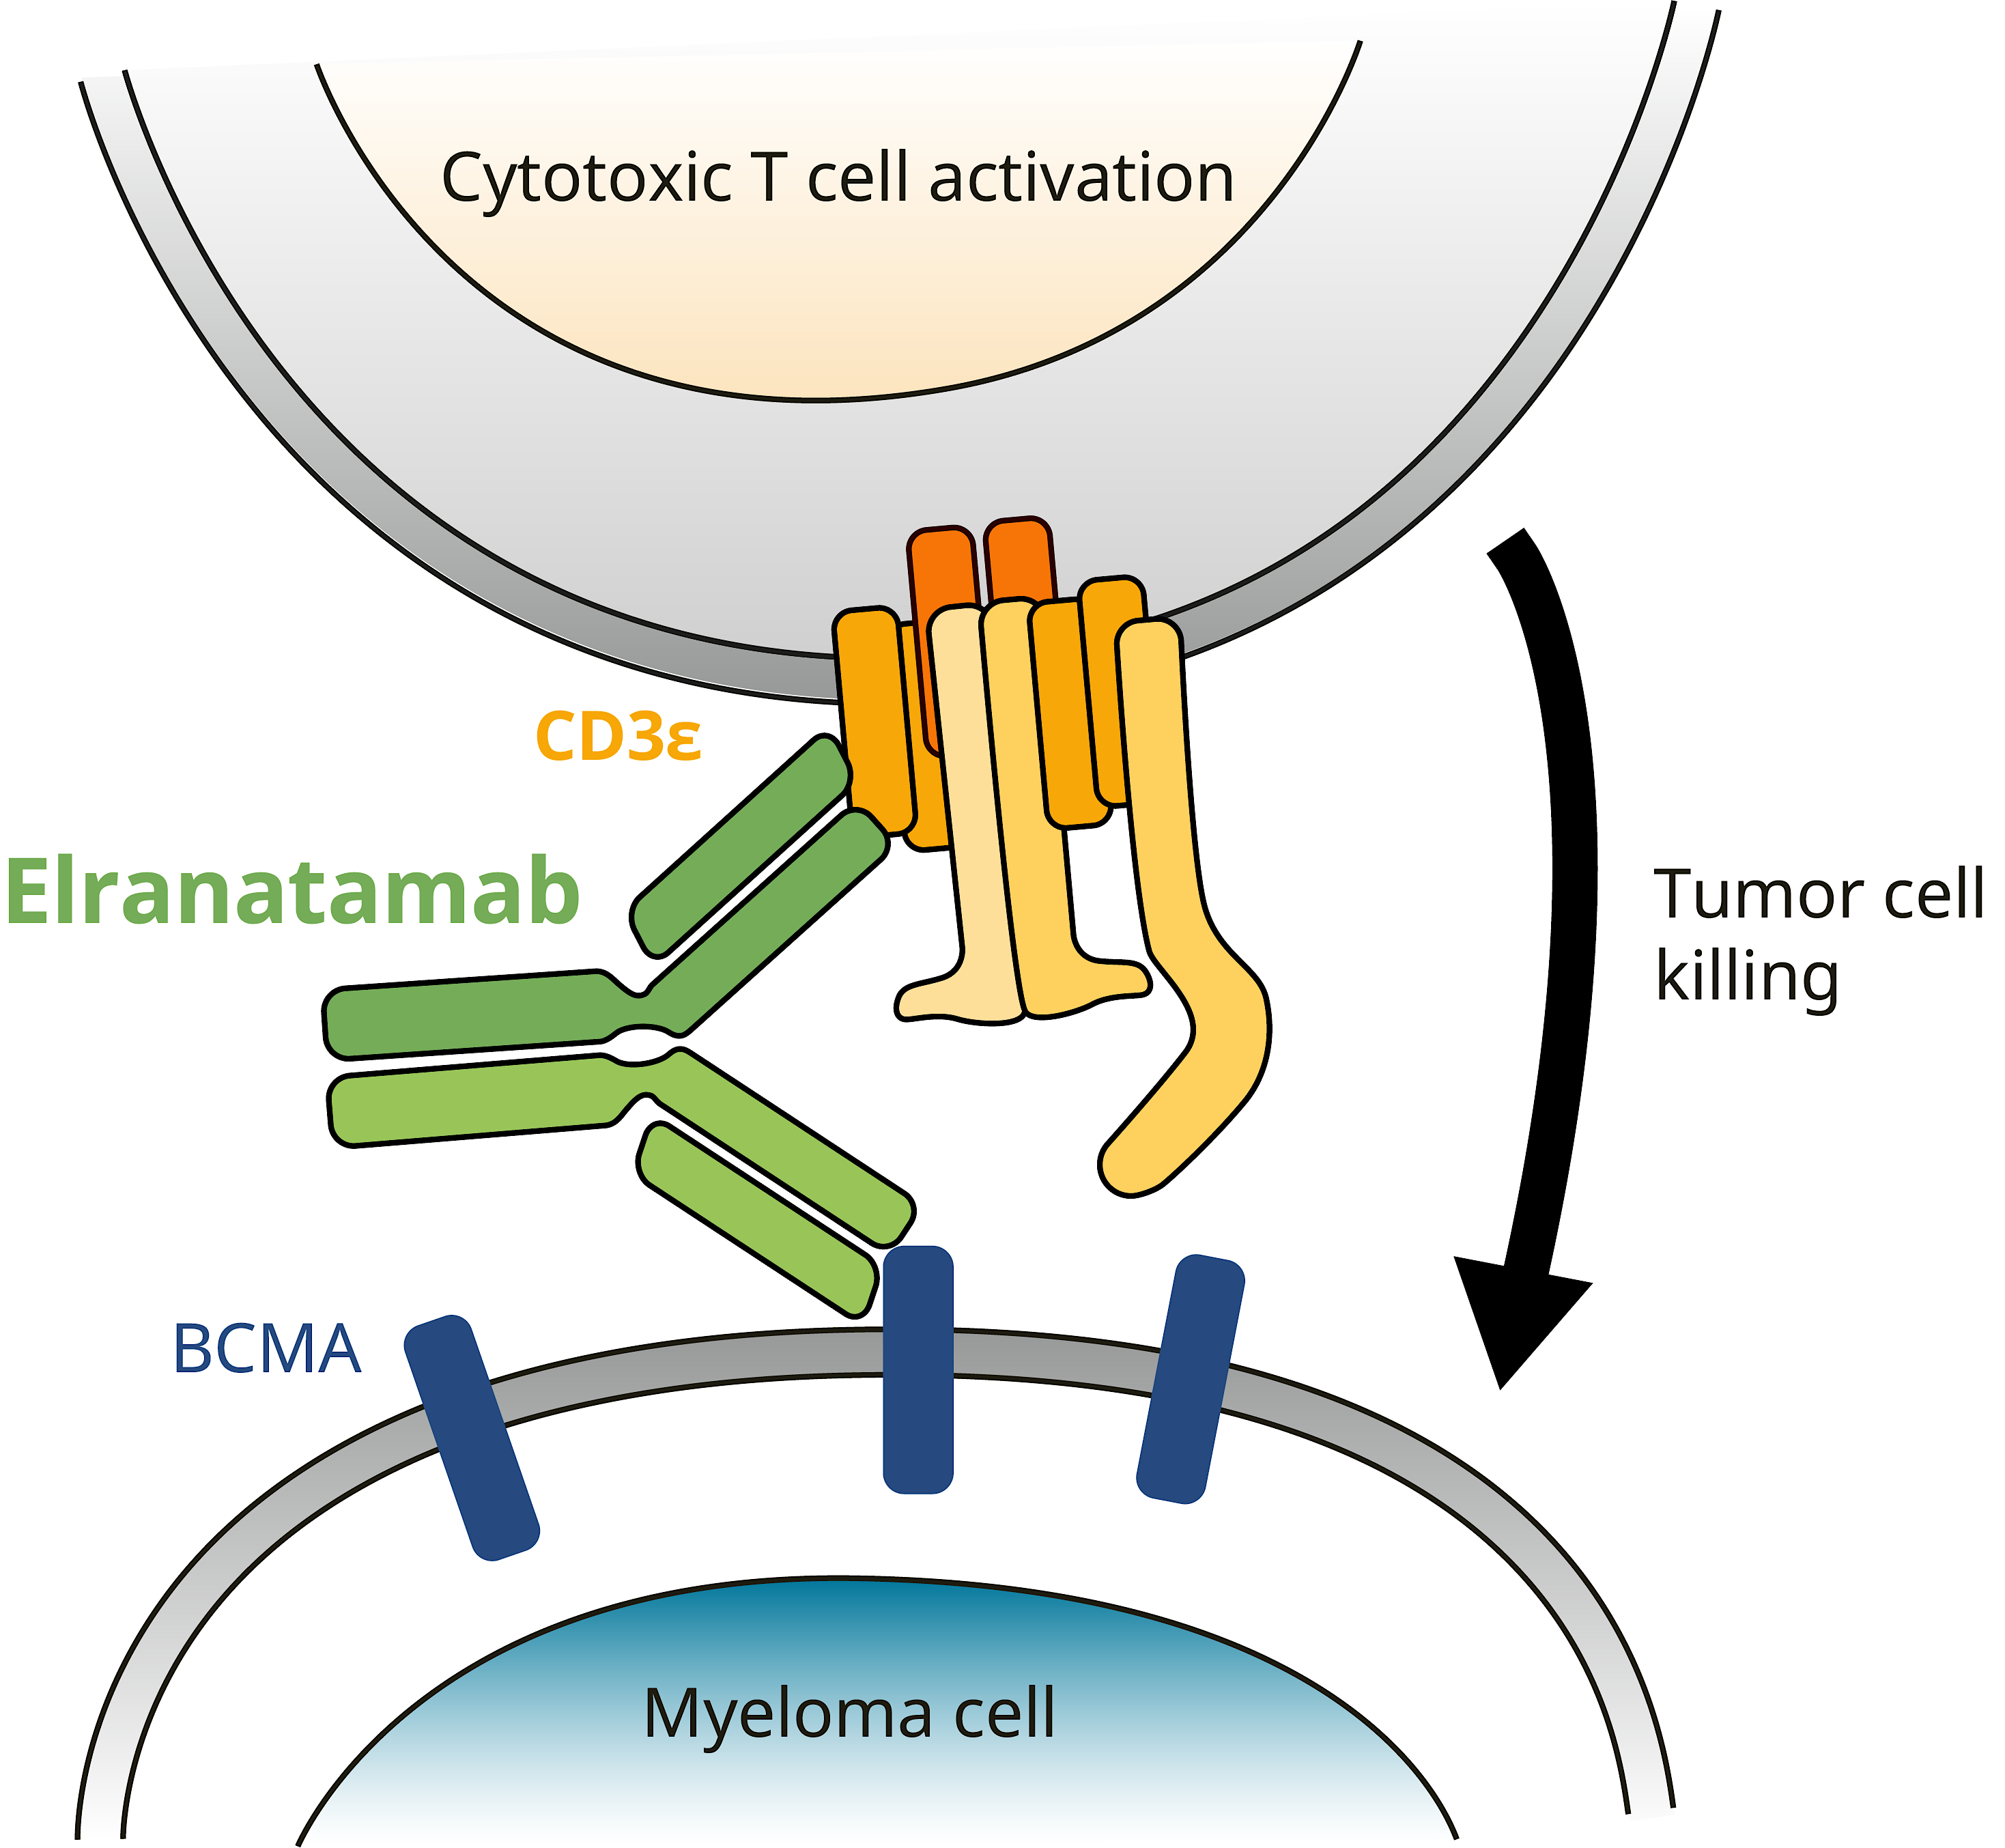
MagnetisMM-3: Elranatamab in TCE RRMM
Elranatamab dosing schedule
QW cycles 1–6; Q2W cycles 7+ for patients with ≥PR
Baseline characteristics, Cohort A (N=123)
Extramedullary disease by BICR,† n (%) | 39 (31.7)
Bone marrow plasma cells, n (%)
<50% | 89 (72.4)
≥50% | 26 (21.1)
Missing | 8 (6.5)
Prior lines of therapy, median (range) | 5 (2–22)
Prior stem cell transplant, n (%) | 87 (70.7)
Exposure status, n (%)
Triple-class | 123 (100.0)
Penta-drug | 87 (70.7)
Refractory status, n (%)
Triple-class | 119 (96.7)
Penta-drug | 51 (41.5)
Refractory to last line of therapy, n (%) | 118 (95.9)

Slide 14
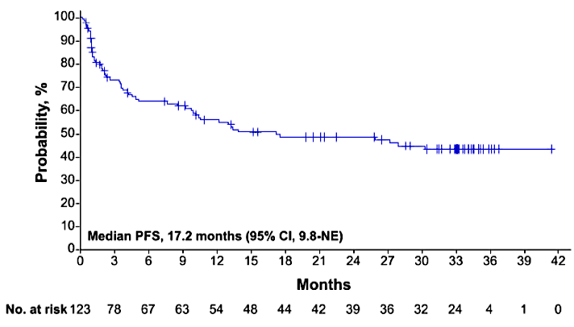
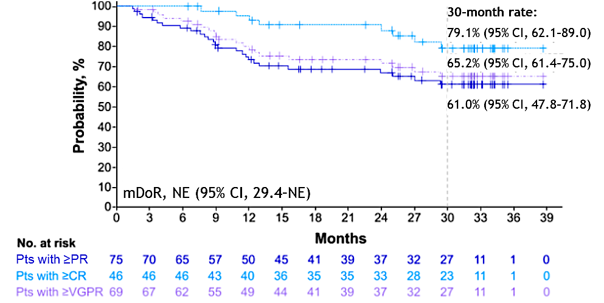
MagnetisMM-3: Elranatamab in TCE RRMM
ORR per BICR: 61.0%
≥CR: 37.4%
N = 123
Median prior regimens: 5
mFU: 33.9 months (95% CI, 33.4–34.6)
PFS
DoR
mPFS, 17.2 months (95% CI, 9.8–NE)

Slide 15
Phase II MonumenTAL-1: Talquetamab in R/R MM
Patients with R/R MM after ≥3 lines of therapy, including an IMiD, PI, anti-CD38 mAb
Median 5-6 prior lines of therapy across all cohorts
Triple-class refractory: 69%-84%
high-risk cytogenetics: 27.1%
Extramedullary Disease: 24.3%
Talquetamab: 0.4 mg/kg SC QW or 0.8 mg/kg SC Q2W with 2-3 step-up doses and/or premedication to reduce CRS
Primary endpoint: DLTs; Key secondary endpoint: ORR
Overall Response Rate with Talquetamab
100
PR
VGPR
CR
sCR
74.1 (106/143)
69.5 (107/154)
80
66.7 (52/78)
60
23.1
Patients (%)
≥ VGPR: 59.4
31.2
32.1
9.8
≥ VGPR: 59.1
≥ VGPR: 55.1
40
9.1
10.3
26.6
20
18.8
12.8
14.7
10.4
11.5
0
0.4 mg/kg SC QW
0.8 mg/kg SC Q2W
Prior TCR
Rasche L, et al. EHA 2024. Abstr P915.

Slide 16
MonumenTAL-1: Updated DoR and Survival Outcomes
DoR in 0.8 mg/kg Q2W Cohort
100
Best response: PR
Best response: VGPR
Best response: ≥ CR
Outcome | 0.4 mg/kg QW (n = 143) | 0.8 mg/kg Q2W (n = 154) | Prior T-Cell Redirection Tx (n = 78)
Median f/u | 29.8 | 23.4 | 20.5
Median DoR, mo (95% CI) | 9.5 (6.7-13.4) | 17.5 (12.5-NE) | N/A
Median PFS, mo (95% CI) | 7.5 (5.7-9.4) | 11.2 (8.4-14.6) | 7.7 (4.1-14.5)
24-Mo OS, % | 60.6 | 67.1 | 57.3
80
60
Patients in Response (%)
40
20
0
0
3
6
9
12
15
18
21
24
27
30
33
Pts at Risk
Best response: PR
Best response: VGPR
Best response: ≥ CR
Mo
16
29
62
7
24
61
3
21
59
2
14
56
1
7
50
1
6
46
0
5
39
0
4
24
0
0
9
0
0
4
0
0
3
0
0
1
Rasche L, et al. EHA 2024. Abstr P915.

Slide 17
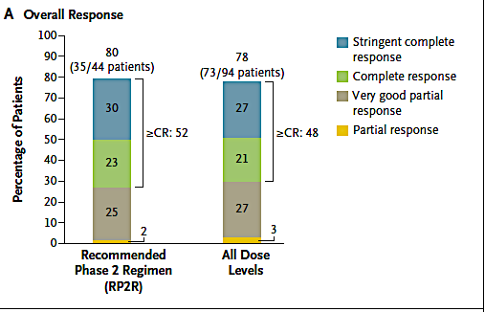
Phase Ib/II RedirecTT-1 Study: Teclistamab Plus Talquetamab in R/R Multiple Myeloma
A Phase 1b/2 Dose Escalation and Expansion Study of the Combination of the Bispecific T Cell Redirection Antibodies Talquetamab and Teclistamab in Participants With Relapsed or Refractory Multiple Myeloma
Previous exposure to a PI, IMiD, and anti-CD38 mAb and refractory to last line of therapy
Median prior LOT: 4 (1-11); extramedullary plasmacytomas: 37.6%
Primary endpoint: dose-limiting toxic effects;
Secondary endpoints: overall response (partial response or better), dor, time to response, pharmacokinetics, pharmacodynamics, and immunogenicity.
Cohen YC, et al. N Engl J Med 2025;392:138-49.

Slide 18
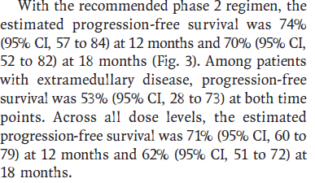
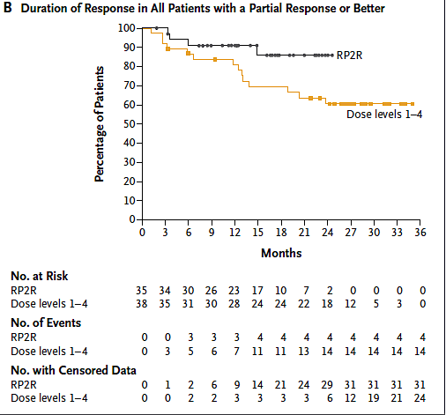
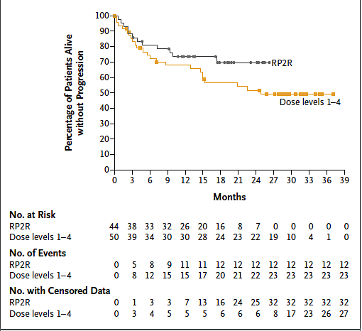
Phase Ib/II RedirectTT-1 Study: Teclistamab Plus Talquetamab in R/R Multiple Myeloma – DoR and PFS
Cohen YC, et al. N Engl J Med 2025;392:138-49.

Slide 19
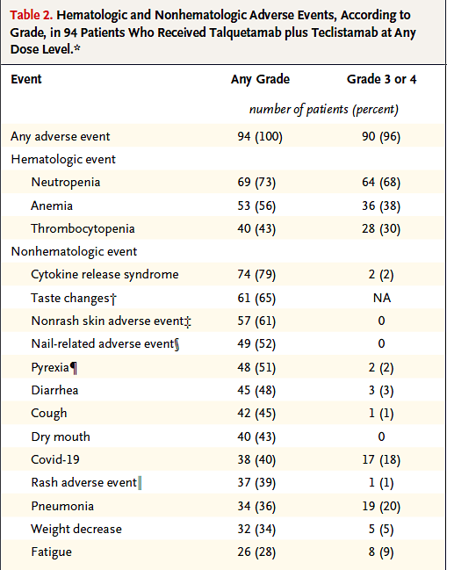
Phase Ib/II RedirectTT-1 Study: Teclistamab Plus Talquetamab in R/R Multiple Myeloma – Safety
Cohen YC, et al. N Engl J Med 2025;392:138-49.

Slide 20
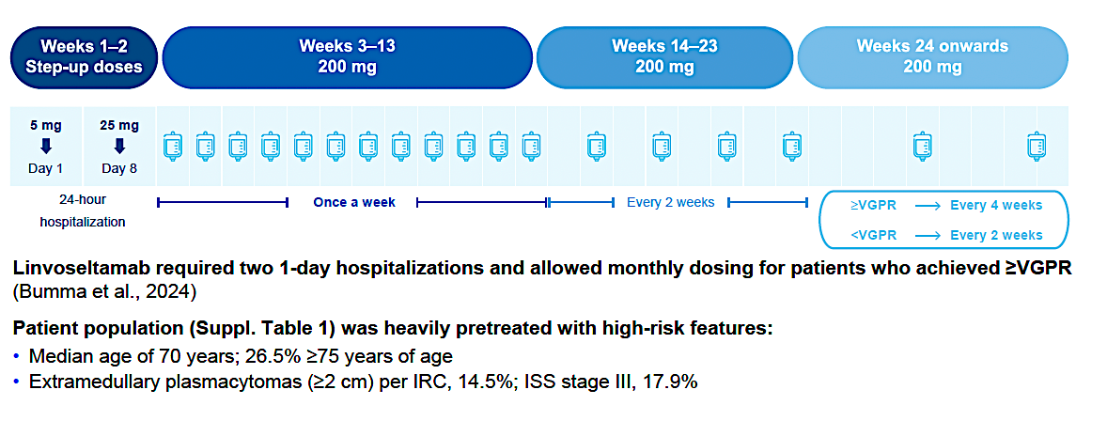
LINKER-MM1 Update: Linvoseltamab in RRMM - Study Design
Shah MR, et al. ASH 2024;Abstract 3369.

Slide 21
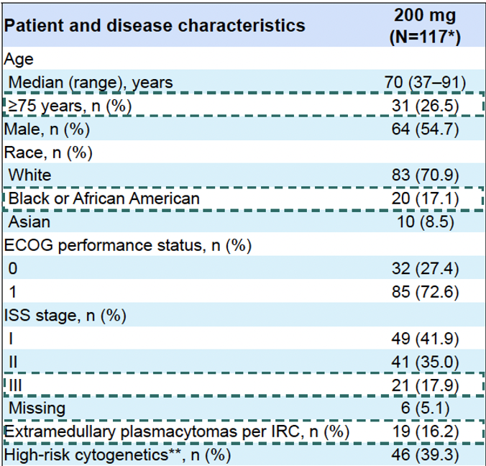
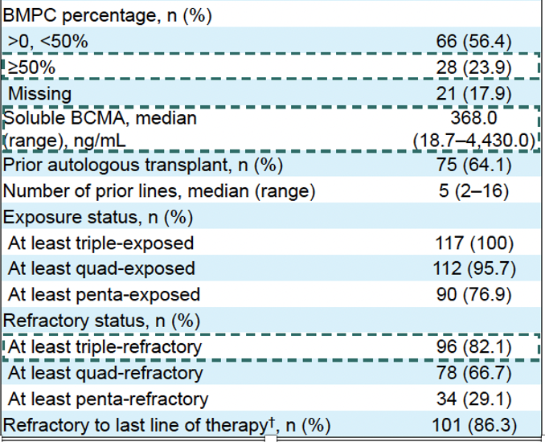
LINKER-MM1 Update: Baseline Characteristics
Shah MR, et al. ASH 2024;Abstract 3369.

Slide 22
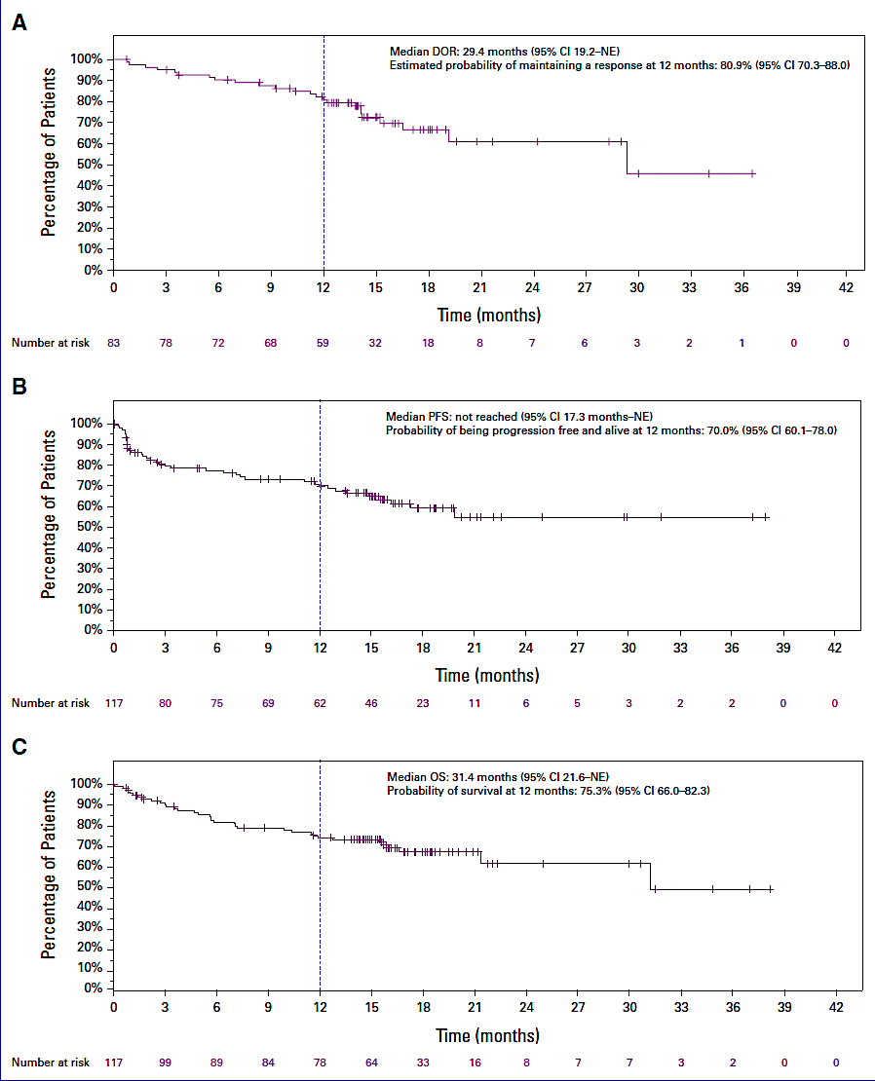
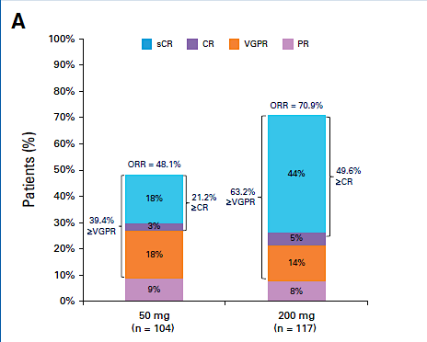
LINKER-MM1 Update: Efficacy
Shah MR, et al. ASH 2024;Abstract 3369; Bumma J Clin Oncol 2024

Slide 23
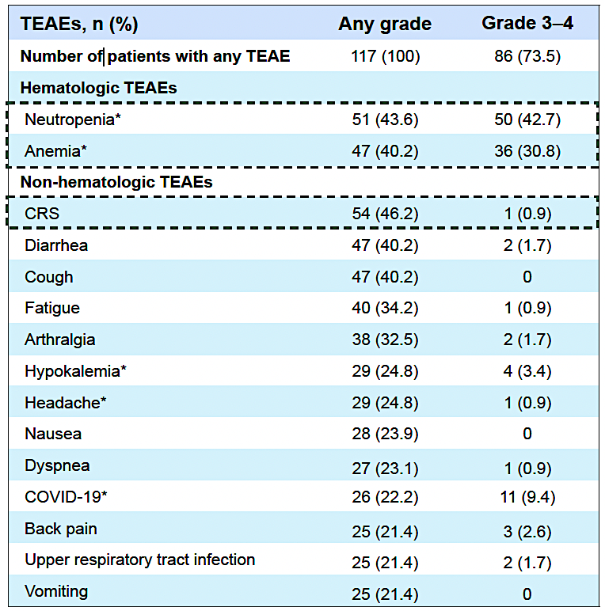
LINKER-MM1 Update: Safety
Shah MR, et al. ASH 2024;Abstract 3369.

Slide 24
DREAMM-8 Study: BelaPd vs PVd – Study Design
Recruitment period October 2020 to December 2022
Treatment period
Until PD, death, unacceptable toxicity, end of study, or withdrawal of consent
Eligibility criteria
BPd (Q4W)
Belantamab mafodotin
2.5 mg/kg IV (cycle 1) then 1.9 mg/kg IV Q4W from cycle 2 onward
+
Pomalidomide 4 mg orally on days 1-21 (28-day cycles)
+
Dexamethasone 40 mgª on days 1, 8, 15, and 22
N=302
Primary endpoint: PFS (IRC assessed per IMWG)
Key secondary endpoints: OS, MRD negativity, DOR
Additional secondary endpoints include: ORR, CRR, ≥VGPR,TTBR, TTR, TTP, PFS2, AEs, ocular findings, HRQOL, and PROs
Adults with MM
≥1 prior line of MM therapy including LEN
Documented PD during or after their most recent therapy
No prior treatment with anti-BCMA or pomalidomide; not refractory/intolerant to bortezomib
1:1 randomization
End-of-treatment visit
PVd (Q3W)
Bortezomib
1.3 mg/m² SC on days 1, 4, 8, and 11 of cycles 1-8 then days 1 and 8 (21-day cycles)
+
Pomalidomide 4 mg orally on days 1-14 (21-day cycles)
+
Dexamethasone 20 mgª on the day of and day after bortezomib
Stratification^{b}:
Prior lines of treatment (1 vs 2 or 3 vs ≥4)
Prior bortezomib (yes vs no)
Prior anti-CD38 therapy (yes vs no)
Dimopoulos MA, et al. N Engl J Med. 2024 Aug 1;391(5):408-421

Slide 25
DREAMM-8: Baseline Characteristics Were Balanced
Baseline characteristics | ITT population
 | BPd (N=155) | PVd (N=147)
Age, median (range), years <65, n (%) 65 to <75, n (%) ≥75, n (%) | 67 (40-82) 64 (41) 72 (46) 19 (12) | 68 (34-86) 53 (36) 59 (40) 35 (24)
Male/female, n (%) | 99 (64)/56 (36) | 82 (56)/65 (44)
White/Black/Asian/Mixed race, n (%)ª | 133 (86)/0/20 (13)/1 (<1) | 127 (87)/0/17 (12)/0
ECOG PS ≤1, n (%)^{b} | 146 (97) | 140 (97)
ISS stage at screening, n (%) I II III Unknown | 93 (60) 39 (25) 22 (14) 1 (<1) | 85 (58) 40 (27) 22 (15) 0
Years since diagnosis, median (range) | 4.04 (0.4-16.7) | 3.43 (0.4-17.7)
Cytogenetic abnormalities, n (%) Standard risk^{c} High risk^{d} Missing or nonevaluable | 72 (46) 52 (34) 31 (20) | 75 (51) 47 (32) 25 (17)
Time to relapse after initiation of 1L treatment ≤12 months >12 months | 22 (14) 133 (86) | 20 (14) 127 (86)
Extramedullary disease, n (%) | 20 (13) | 11 (7)
Prior treatments, n (%) | ITT population
 | BPd (N=155) |  | PVd (N=147)
Prior LOT
1 2 or 3 ≥4 | 82 (53) 54 (35) 19 (12) |  | 77 (52) 48 (33) 22 (15)
Prior ASCT | 99 (64) |  | 82 (56)
Prior treatment | Exposed | Refractory | Exposed | Refractory
Prior proteasome inhibitor Bortezomib Carfilzomib Ixazomib | 140 (90) 134 (86) 34 (22) 11 (7) | 40 (26) 16 (10) 18 (12) 8 (5) | 136 (93) 130 (88) 37 (25) 15 (10) | 35 (24) 8 (5) 23 (16) 11 (7)
Prior immunomodulatory drugª Lenalidomide Thalidomide | 155 (100) 155 (100) 49 (32) | 127 (82) 125 (81) 9 (6) | 147 (100) 147 (100) 48 (33) | 111 (76) 111 (76) 6 (4)
Prior anti-CD38 monoclonal antibody^{b} Daratumumab Isatuximab | 38 (25) 36 (23) 2 (1) | 35 (23) 33 (21) 2 (1) | 42 (29) 39 (27) 3 (2) | 36 (24) 34 (23) 2 (1)
Dimopoulos MA, et al. N Engl J Med. 2024 Aug 1;391(5):408-421

Slide 26
DREAMM-8: Significant PFS Benefit with BPd vs PVd
PFS | BPd (N=155) | PVd (N=147)
Events, n (%) | 62 (40) | 80 (54)
Median PFS (95% CI), months | NR (20.6-NR) | 12.7 (9.1-18.5)
HR (95% CI); P value | 0.52 (0.37-0.73); <.001
1.0
12 months
71%
Median
Not reached
0.8
0.6
51%
Proportion alive and progression free
0.4
Median
12.7 months
0.2
BPd
PVd
0.0
0
1
2
3
4
5
6
7
8
9
10
11
12
13
14
15
16
17
18
19
20
21
22
23
24
25
26
27
28
29
30
31
32
33
34
35
36
37
38
39
No. at risk
(no. of events)
Time since randomization, months
BPd
155
143
135
130
125
122
117
113
111
109
107
102
97
93
82
80
77
75
72
67
64
59
50
45
38
36
28
23
21
16
13
8
4
2
1
0
0
0
0
0
(0)
(5)
(10)
(15)
(19)
(21)
(26)
(28)
(30)
(32)
(34)
(37)
(41)
(42)
(47)
(47)
(49)
(50)
(52)
(53)
(54)
(56)
(58)
(59)
(61)
(61)
(62)
(62)
(62)
(62)
(62)
(62)
(62)
(62)
(62)
(62)
(62)
(62)
(62)
(62)
PVd
147
138
123
111
102
96
92
83
75
68
59
56
54
51
47
43
40
39
37
30
25
22
22
19
18
18
17
13
11
7
5
4
3
2
2
1
1
1
1
0
(0)
(4)
(14)
(23)
(27)
(33)
(37)
(45)
(49)
(52)
(59)
(62)
(62)
(64)
(66)
(68)
(68)
(68)
(70)
(73)
(76)
(77)
(77)
(77)
(77)
(77)
(78)
(78)
(79)
(80)
(80)
(80)
(80)
(80)
(80)
(80)
(80)
(80)
(80)
(80)
BPd led to a statistically significant and clinically meaningful reduction in risk of disease progression or death vs PVd (HR, 0.52; 95% CI, 0.37-0.73; P<.001)
Median follow-up, 21.8 months (range, 0.03-39.23 months). The treatment effect (HR and corresponding 95% CIs) was estimated using the stratified Cox proportional hazards model, and the P value was produced based on the 1-sided stratified log-rank test. Stratified analyses were adjusted for number of prior lines of therapy and prior bortezomib use. BPd, belamaf, pomalidomide, and dexamethasone; HR, hazard ratio; NR, not reported; PFS, progression-free survival; PVd, pomalidomide, bortezomib, and dexamethasone.
Dimopoulos MA, et al. N Engl J Med. 2024 Aug 1;391(5):408-421

Slide 27
DREAMM-8: AEs of Clinical Interest
Grouped term, n (%)ª | Safety population
 | BPd (N=150) |  |  | PVd (N=145)
 | n (%) | Patients/100-person years | Patients/100-person years | n (%) | Patients/100-person years | Patients/100-person years
Thrombocytopenia^{b} Any event Grade 3 or 4 | 82 (55) 57 (38) | 40 28 | 40 28 | 60 (41) 42 (29) | 44 31 | 44 31
Neutropenia^{c} Any event Grade 3 or 4 | 95 (63) 86 (57) | 46 42 | 46 42 | 66 (46) 57 (39) | 49 42 | 49 42
Infections^{d} Any event Grade ≥3 | 123 (82) 73 (49) | 59 35 | 59 35 | 99 (68) 38 (26) | 73 28 | 73 28
Ocular AESIs (by CTCAE) preferred terms, n (%) ≥30% of patients in either treatment group
 | Any grade |  | Grade ≥3 | Any grade |  | Grade ≥3
Any event | 133 (89) |  | 65 (43) | 44 (30) |  | 3 (2)
Vision blurred | 119 (79) |  | 26 (17) | 22 (15) |  | 0
Dry eye | 91 (61) |  | 12 (8) | 14 (10) |  | 0
Foreign body sensation in eye | 91 (61) |  | 9 (6) | 9 (6) |  | 0
Eye irritation | 75 (50) |  | 6 (4) | 13 (9) |  | 0
Photophobia | 66 (44) |  | 5 (3) | 6 (4) |  | 0
Eye pain | 49 (33) |  | 3 (2) | 7 (5) |  | 0
Safety profile of BPd was broadly consistent with the known profile of the individual components of the regimen
AE, adverse event; AESI, adverse event of special interest; BPd, belamaf, pomalidomide, and dexamethasone; CTCAE, Common Terminology Criteria for Adverse Events; PVd, pomalidomide, bortezomib, and dexamethasone. ª posthoc analysis. ^{b} Thrombocytopenia includes events identified by site or preferred terms thrombocytopenia or platelet count decreased. ^{c} Neutropenia includes preferred terms febrile neutropenia, neutropenia, and neutrophil count decreased. ^{d} Infections are based on all preferred terms included in the system organ class of infections and infestations.
Dimopoulos MA, et al. N Engl J Med. 2024 Aug 1;391(5):408-421

Slide 28



DREAMM-7: Bela-Vd vs Dara-Vd – Study Design
CYCLE 1–8
CYCLE 9+
STRATIFICATION:
# of prior lines of therapy (1 vs 2/3 vs ≥4)
Prior bortezomib (Yes vs No)
R-ISS Staging ( I vs II/III)
Endpoints
Primary:
PFS
Secondary:
BVd Belamaf (IV 2.5 mg/kg D1 Q3W)
Belamaf monotherapy (IV 2.5 mg/kg Q3W)
DoR | TTP
MRD negativity rate | PFS2
OS | Safety, tolerability
CRR | Ocular findings
ORR | PK
CBR | ADAs
TTR | HRQoL, PROs
1:1
494 patients with ≥1 prior lines of therapy
DVd
Daratumumab (IV 16 mg/kg D1 C1–3 QW; C4–8 Q3W)
Daratumumab monotherapy (IV 16 mg/kg; C9 + Q4W)
Treatment period: Until PD, death, unacceptable toxicity, withdrawal of consent, or end of study
Screening and enrollment
Randomization
Day 1 of 21-day administration cycles
Bor (1.3 mg/m² on D1, 4, 8, 11; C1–8) Dex (20 mg on the day of, and day after, bortezomib; C1–8)
Hungria V, et al. N Engl J Med. 2024 Aug 1;391(5):393-407.

Slide 29
DREAMM-7 study – Patients Characteristics
Demographics and baseline characteristics | BVd (N=243) | DVd (N=251)
Median age, years (range) | 65 (34–86) | 64 (32–89)
Standard/high risk cytogenetic abnormalities, n (%) | 175 (72)/67 (28) | 175 (70)/69 (27)
EMD present, n (%) | 13 (5) | 25 (10)
R-ISS Stage I/II/III, n (%) | 102 (42)/130 (53)/9 (4) | 103 (41)/132 (53)/14 (6)
Prior ASCT, n (%) | 164 (67) | 173 (69)
Prior LoT, 1/2 or 3/≥4, n (%) | 125 (51)/88 (36)/30 (12) | 125 (50)/99 (39)/27 (11)
Prior lenalidomide, n (%) | 127 (52) | 130 (52)
Refractory to lenalidomide, n (%) | 79 (33) | 87 (35)
Prior daratumumab, n (%) | 3 (1) | 4 (2)
Hungria V, et al. N Engl J Med. 2024 Aug 1;391(5):393-407.

Slide 30
DREAMM-7 study – PFS
 | BVd (N=243) | DVd (N=251)
Median PFS (95% CI), mo | 36.6 (28.4, -) | 13.4 (11.1, 17.5)
Hazard ratio (95% CI): 0.41 (0.31, 0.53); P<0.00001
Median follow-up: 28.2 months (0.10–40.02)
1.0
18 months
0.8
69%
0.6
Proportion alive and progression free
0.4
Median PFS
36.6 months
Median PFS 13.4 months
43%
0.2
BVd
DVd
0.0
0
1
2
3
4
5
6
7
8
9
10
11
12
13
14
15
16
17
18
19
20
21
22
23
24
25
26
27
28
29
30
31
32
33
34
35
36
37
38
39
40
41
No. at risk
(No. of events)
Time since randomization (months)
BVd
243
(0)
230
(6)
220
(13)
211
(17)
205
(21)
200
(25)
192
(28)
183
(32)
175
(36)
171
(39)
163
(45)
158
(46)
155
(48)
150
(51)
147
(53)
140
(59)
137
(60)
131
(63)
128
(66)
127
(67)
125
(67)
122
(69)
120
(70)
118
(71)
115
(74)
110
(78)
105
(79)
94
(81)
79
(82)
72
(86)
56
(86)
41
(88)
31
(89)
25
(89)
15
(90)
11
(90)
8
(90)
6
(91)
3
(91)
2
(91)
1
(91)
0
(91)
DVd
251
(0)
230
(9)
214
(22)
205
(29)
194
(37)
183
(47)
176
(53)
155
(71)
148
(75)
141
(81)
132
(90)
124
(97)
115
(106)
107
(113)
103
(116)
99
(119)
94
(121)
91
(124)
87
(128)
80
(133)
78
(135)
73
(138)
68
(143)
67
(144)
65
(145)
61
(148)
59
(149)
52
(151)
39
(153)
33
(154)
22
(154)
19
(154)
12
(156)
11
(156)
5
(157)
2
(158)
1
(158)
1
(158)
1
(158)
1
(158)
0
(158)
0
(158)
Hungria V, et al. ASH 2024. Abstracts 772 ;Mateos ASCO 2024; Abstract 7503

Slide 31
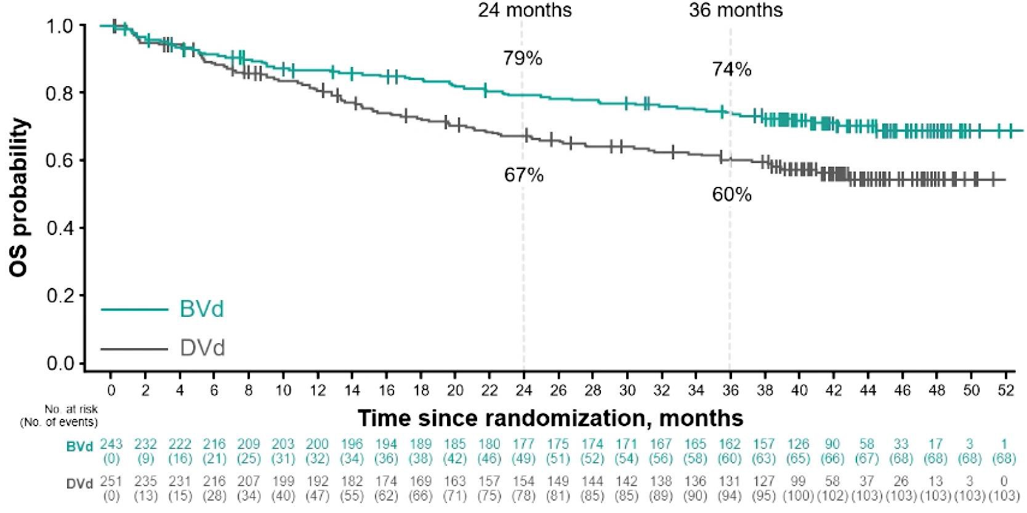
Updated and Additional Analyses From the Phase 3 DREAMM-7 Trial of BVd vs DVd in RRMM: OS
Median follow-up: 39.4 months (range, 0.1-52.3)
OS | BVd (n=243) | DVd (n=251)
Events, n (%) | 68 (28) | 103 (41)
Median OS (95% CI), months | NR (NR-NR) | NR (41.0-NR)
HR (95% CI); P value | 0.58 (0.43-0.79); P=0.00023
24-month OS, % (95% CI) | 79 (73-84) | 67 (61-73)
36-month OS, % (95% CI) | 74 (68-79) | 60 (54-66)
Median OS was not reached.
Predicted median OS based on modeling is
84 months with BVd and 51 months with DVd
Hungria V, et al. ASH 2024. Abstracts 772 and 3359.

Slide 32



DREAMM-9: Study design
Inclusion criteria
Belamaf dosing cohorts*
Primary endpoint:
MM diagnosis per IMWG criteria
ECOG performance status of 0–2
Not a candidate for HDT with ASCT due to frailty and/or significant comorbid condition(s)
Measurable disease per IMWG criteria
Prior systemic therapy for MM or SMM
Current corneal epithelial disease
1.9 mg/kg Q3/4W, every SOC cycle (n=12)
Safety (DLTs and AEs)
Efficacy (ORR, ≥CR, ≥VGPR per IMWG criteria)
RDI of lenalidomide and bortezomib after 4 cycles
Cumulative administered belamaf dose after 4 cycles with VRd
Incidence and titers of ADAs
PK
MRD negativity (assessed in bone marrow aspirate samples using next-generation sequencing [10^{–5}]).
Cohorts with lower doses and longer schedules were opened to assess the potential to improve tolerability while maintaining efficacy
All cohorts received belamaf with VRd for Cycles 1‒8 (21-day cycle), followed by belamaf with Rd for Cycles 9+ (28-day cycle)
Ocular events were managed by dose modifications or extending the dosing interval
1.9 mg/kg Q6/8W, every other SOC cycle (n=12)
Secondary endpoints
1.4 mg/kg Q3/4W, every SOC cycle (n=13)
1.4 mg/kg Q6/8W, every other SOC cycle (n=12)
Exclusion criteria
Screening phase
1.9 (9W) to 1.4 mg/kg Q9/12W, every third SOC cycle (n=19)
Safety follow-up
1.0 mg/kg Q3/4W, every SOC cycle (n=15)
1.4 (9W) to 1.0 mg/kg Q9/12W, every third SOC cycle (n=15)
Exploratory endpoint
1.0 mg/kg Q12W, every third/fourth SOC cycle (n=10)
21 days
Randomized assignment
+ SOC (VRd [Cycles 1–8], Rd [Cycles 9+]) ¹
70-day safety follow-up visit
*Cohorts of the same color opened at the same time. Cohorts with longer rectangles opened earlier. ADA, anti-drug antibodies; AE, adverse event; ASCT, autologous stem cell transplant; belamaf, belantamab mafodotin; CR, complete response; DLT, dose-limiting toxicities; ECOG, Eastern Cooperative Oncology Group; HDT, high-dose chemotherapy; IMWG, International Myeloma Working Group; MM, multiple myeloma; MRD, minimal residual disease; ORR, overall response rate; PK, pharmacokinetics; PR, partial response; QxW, every x weeks; RDI, relative dose intensity; SMM, smouldering MM; SOC, standard of care; VGPR, very good partial response
Usmani S, et al. ASH 2024;Abstract 497.

Slide 33

DREAMM-9: Efficacy | ORR
VGPR+ was 100% in 3 cohorts including those with lower doses and less frequent schedules
ORRs ranged from 71% to 100%
Time to achieve VGPR+ was consistent across the cohorts (median 2.1–3.2 months) and response deepened over time
In the first 4 cohorts, CR+ was 62–92%
ORRs ranged from 71% to 100%
Time to achieve VGPR+ was consistent across the cohorts (median 2.1–3.2 months) and response deepened over time
In the first 4 cohorts, CR+ was 62–92%
ORR*, % | 100 | 100 | 92 | 100 | 71 | 86 | 87 | 100
VGPR+ / CR+, % | 92 / 75 | 100 / 92 | 92 / 62 | 100 / 91 | 59 / 41 | 79 / 71 | 73 / 53 | 100 / 30
PR
VGPR
CR
sCR
 | n=12 | n=12 | n=13 | n=11 | n=17 | n=14 | n=15 | n=10
Median follow-up, months (range) | 37.6 (7–50) | 32.3 (6–38) | 20.2 (1–37) | 32.4 (5–37) | 17.1 (1–23) | 31.0 (0–38) | 18.2 (2–22) | 7.8 (5–10)
Median time to VGPR+, months (range) | 2.8 (0.7–4.2) | 2.9 (0.8–14.7) | 2.2 (0.8–16.8) | 2.1 (0.8–5.0) | 2.2 (0.7–8.1) | 3.0 (1.4–6.8) | 3.1 (0.8–4.9) | 3.2 (1.3–4.9)
Median time to CR+, months (range) | 8.3 (2.1–19.4) | 12.0 (4.4–22.9) | 6.2 (1.4–15.7) | 8.8 (1.4–18.4) | 9.5 (3.7–11.1) | 8.2 (2.1–19.8) | 6.1 (1.4–13.8) | 6.5 (2.1–9.1)
Median follow-up varied as cohorts opened at different times; some patients had not been treated for long enough to achieve response
CI, confidence interval; CR+, complete response or better; ORR, overall response rate; PR, partial response; QxW, every x weeks; sCR, stringent complete response; VGPR+, very good partial response or better.
Usmani S, et al. ASH 2024;Abstract 497.

Slide 34

DREAMM-9: Efficacy | MRD-negativity rate*
Higher belamaf starting doses were associated with deeper and faster MRD[−] rates
 | 1.9 mg/kg Q3/4W | 1.9 mg/kg Q6/8W | 1.4 mg/kg Q3/4W | 1.4 mg/kg Q6/8W | 1.9 (9W) to 1.4 mg/kg Q9/12W | 1.0 mg/kg Q3/4W | 1.4 (9W) to 1.0 mg/kg Q9/12W | 1.0 mg/kg Q12W
MRD[−], n (% of patients with CR+) | 9 (100) | 8 (73) | 7 (88) | 5 (50) | 5 (71) | 6 (60) | 4 (50) | 0
Median time to MRD[−], months (range) | 8.3 (2.1–17.5) | 7.9 (4.2–14.7) | 12.2 (2.3–24.9) | 14.6 (2.1–23.1) | 4.4 (2.2–10.2) | 3.8 (2.5–12.3) | 5.1 (2.1–9.2) | 0
Median follow-up, months | 37.6 | 32.3 | 20.2 | 32.4 | 17 | 31.0 | 18.2 | 7.8
*MRD[-] was measured by next-generation sequencing [10⁻⁵] in patients achieving CR+​, and is shown as proportion of the ITT population. belamaf, belantamab mafodotin; CR,+ complete response or better; ITT, intention-to-treat; MRD[−], minimal residual disease negativity; QxW, every x weeks.​
Usmani S, et al. ASH 2024;Abstract 497.

Slide 35
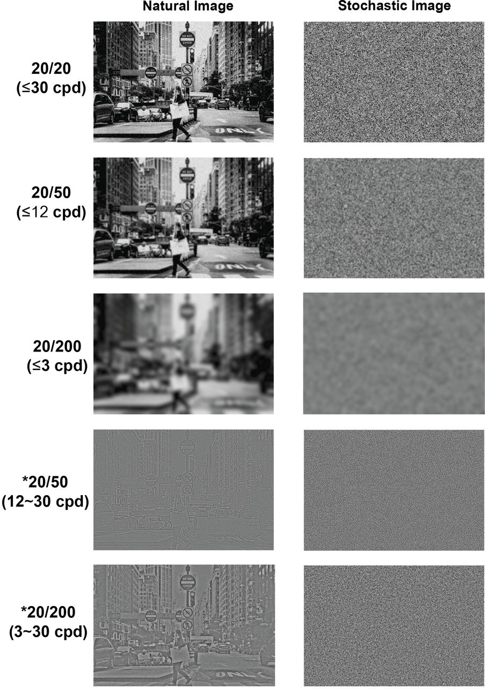

DREAMM-9: Best corrected visual acuity
Dose and schedule affected the time to, and resolution of, BCVA decreases
Extending the dosing interval between the 1.9 mg/kg or 1.4 mg/kg doses from Q3/4W to Q6/8W was associated with longer time to BCVA decrease to 20/50 or worse*
Resolution of BCVA decreases was generally faster in cohorts with lower initial doses of belamaf
20/20
20/50†
First occurrence of decrease in BCVA score from baseline (20/25 or better) to 20/50 or worse
Belamaf schedule | Number of patients, n (%) | Time to onset |  | Median (range), days
1.9 mg/kg Q3/4W | 6 (50) |  |  | 76 (42–439)
1.9 mg/kg Q6/8W | 6 (50) |  |  | 246 (106–472)
1.4 mg/kg Q3/4W | 3 (23) |  |  | 128 (113–409)
1.4 mg/kg Q6/8W | 6 (50) |  |  | 264 (92–546)
 |  | Time to resolution
1.9 mg/kg Q3/4W |  |  |  | 163 (36–230)
1.9 mg/kg Q6/8W |  |  |  | 135 (29–246)
1.4 mg/kg Q3/4W |  |  |  | 36 (22–85)
1.4 mg/kg Q6/8W |  |  |  | 70 (43–421)
Days
*In the 4 cohorts shown, 2 patients had a BCVA change from 20/25 or better to 20/200 or worse. These patients both had bilateral cataracts. †Image adapted from Shi C, et al. bioRxiv. 2018;doi:doi.org/10.1101/328443. Copyright © 2018 the Author. belamaf, belantamab mafodotin; BCVA, best corrected visual acuity; QxW, every x weeks.
Usmani S, et al. ASH 2024;Abstract 497.

Slide 36
Summary/Conclusions
CAR-T cell therapies are effective therapies for both early and late RRMM but there are many unsolved questions
How “sustainable” are the responses?
Is there a plateau in the PFS curve ?
Which targets, which constructs, what dose ?
Are different CARs similar?
Is a second dose effective?
Is there cross-resistance / target loss ?
Are there options after CAR-T failure? Other immunotherapies ?
Toxicity – Logistics - Costs
Immunotherapy approaches with T-cell engagers offer very good results in late RRMM and may go to earlier lines. Side-effects remain a problem. Infections for BCMA-targeted bispecific Abs – gastrointestinal AEs for talquetamab? Continuous Use or fixed duration?
Belantamab mafodotin in combination with either Vd or Pd are new standards of care in patients with early RRMM

