Slide 1
Year in Review: Management of Myelofibrosis
A CME/MOC-Accredited Live Webinar
Wednesday, April 30, 2025 5:00 PM – 6:00 PM ET
Faculty
Professor Claire Harrison
John Mascarenhas, MD
Moderator
Neil Love, MD

Slide 2

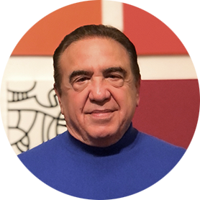

Faculty
Professor Claire Harrison
Professor of Myeloproliferative Neoplasms
Guy’s and St Thomas’ NHS Foundation Trust
London, United Kingdom
MODERATOR
Neil Love, MD Research To Practice
Miami, Florida
John Mascarenhas, MD
Director, Adult Leukemia Program
Professor of Medicine
The Tisch Cancer Institute
Icahn School of Medicine at Mount Sinai
New York, New York

Slide 3
Commercial Support
This activity is supported by educational grants from Geron Corporation and Incyte Corporation.
Research To Practice CME Planning Committee Members, Staff and Reviewers
Planners, scientific staff and independent reviewers for Research To Practice have no relevant conflicts of interest to disclose.

Slide 4
Prof Harrison — Disclosures
Advisory Committees | Galecto Inc, Geron Corporation, GSK, Incyte Corporation, Karyopharm Therapeutics, Keros Therapeutics, Novartis, Silence Therapeutics, Sobi
Consulting Agreements | Galecto Inc, Geron Corporation, GSK, Incyte Corporation, Karyopharm Therapeutics, Keros Therapeutics, Novartis, Silence Therapeutics, Sobi, Takeda Pharmaceutical Company Limited
Contracted Research | Galecto Inc, Geron Corporation, GSK, Incyte Corporation, Karyopharm Therapeutics, Novartis, Silence Therapeutics, Sobi
Data and Safety Monitoring Boards/Committees | Galecto Inc, Incyte Corporation, Novartis, Silence Therapeutics
Speakers Bureaus | AOP Health, GSK, Incyte Corporation, Novartis

Slide 5
Dr Mascarenhas — Disclosures
Consulting Agreements | Bristol Myers Squibb, Disc Medicine, Geron Corporation, GSK, Incyte Corporation, Italfarmaco SpA, Kartos Therapeutics, Karyopharm Therapeutics, Keros Therapeutics, Merck, MorphoSys, Novartis, PharmaEssentia, Roche Laboratories Inc, Sobi, Sumitomo Dainippon Pharma Oncology Inc
Contracted Research | AbbVie Inc, Bristol Myers Squibb, Disc Medicine, Incyte Corporation, Italfarmaco SpA, Kartos Therapeutics, Karyopharm Therapeutics, Novartis, PharmaEssentia, Sobi
Data and Safety Monitoring Boards/Committees | Incyte Corporation

Slide 6
This educational activity contains discussion of non-FDA-approved uses of agents and regimens. Please refer to official prescribing information for each product for approved indications.

Slide 7
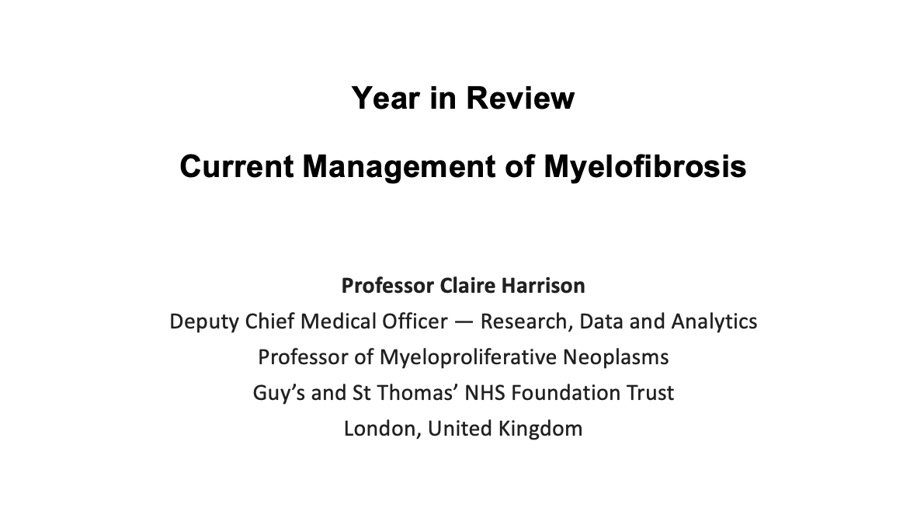
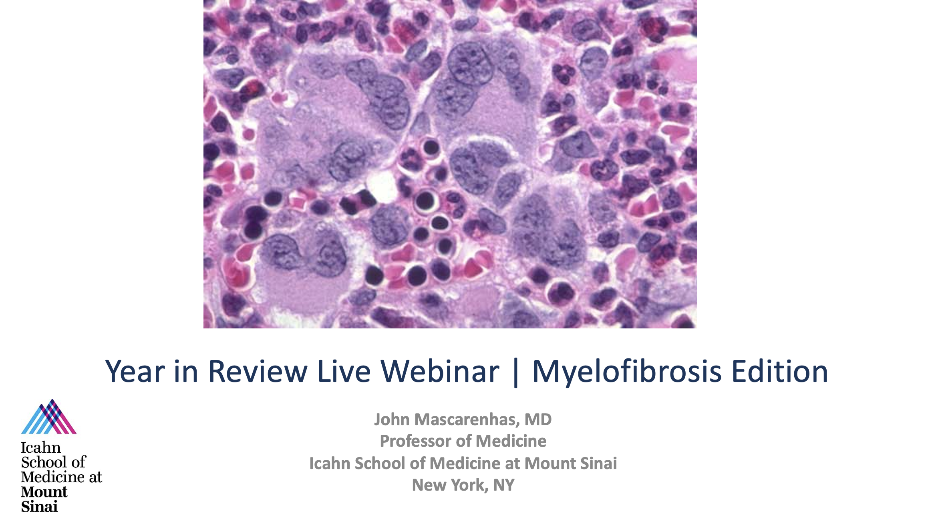

Slide 8
Key Datasets
Professor Claire Harrison
Palandri F et al. Clinical outcomes of ruxolitinib treatment in 595 intermediate-1 risk patients with myelofibrosis: The RUX-MF Real-World Study. Cancer 2024;130(24):4257-66.
Breccia M et al. Dosing and clinical outcomes of ruxolitinib in patients with myelofibrosis in a real-world setting: Interim results of the Italian observational study (ROMEI). Cancer 2025;131(7):e35801.
Vachhani P et al. Clinical outcomes in patients with myelofibrosis treated with ruxolitinib and anemia-supporting medications. ASH 2024;Abstract 4546.
Gupta V et al. Safety and efficacy of fedratinib in patients with myelofibrosis previously treated with ruxolitinib: Primary analysis of FREEDOM trial. Leuk Lymphoma 2024;65(9):1314-24.
Harrison CN et al. Efficacy and safety of fedratinib in patients with myelofibrosis previously treated with ruxolitinib (FREEDOM2): Results from a multicentre, open-label, randomised, controlled, phase 3 trial. Lancet Haematol 2024;11(10).
Koschmieder S et al. Myelofibrosis management in routine clinical practice with a focus on patients with cytopenias: Recommendations from a global consensus group. Leukemia 2024;38(8):1831-8.

Slide 9
Key Datasets
Professor Claire Harrison (continued)
Gagelmann N et al. Consistency of spleen and symptom reduction regardless of cytopenia in patients with myelofibrosis treated with pacritinib. Clin Lymphoma Myeloma Leuk 2024;24(11):796-803.
Gupta V et al. Long-term survival adjusted for treatment crossover in patients (pts) with myelofibrosis (MF) treated with momelotinib (MMB) vs danazol (DAN) in the MOMENTUM trial. ASCO 2024;Abstract 6571.
Gupta V et al. Momelotinib vs ruxolitinib in myelofibrosis patient subgroups by baseline hemoglobin levels in the SIMPLIFY-1 trial. Leuk Lymphoma 2024;65(7):965-77.
Harrison CN et al. Momelotinib versus continued ruxolitinib or best available therapy in JAK inhibitor-experienced patients with myelofibrosis and anemia: Subgroup analysis of SIMPLIFY-2. Adv Ther 2024;41(9):3722-35.
Harrison CN et al. Longitudinal assessment of transfusion intensity in patients with JAK inhibitor-naive or -experienced myelofibrosis treated with momelotinib. Clin Lymphoma Myeloma Leuk 2025;25(3):199-211.

Slide 10
Key Datasets
John Mascarenhas, MD
Mascarenhas J et al. Updated results from the phase 3 Manifest-2 study of pelabresib in combination with ruxolitinib for Janus kinase inhibitor–naïve patients with myelofibrosis. ASH 2024;Abstract 3178.
Watts JM et al. Safety and efficacy of bromodomain and extra-terminal inhibitor INCB057643 in patients with relapsed or refractory myelofibrosis and other advanced myeloid neoplasms: A phase 1 study. ASH 2024;Abstract 658.
Duan M et al. The efficacy and safety of selinexor in combination with ruxolitinib in ruxolitinib-treated myelofibrosis patients: The interim analysis of a prospective, open-label, multicenter, parallel-cohort, phase 2 study. ASH 2024;Abstract 1002.
Mascarenhas J et al. Selinexor plus ruxolitinib in JAK inhibitor treatment-naive myelofibrosis: SENTRY phase 3 study design. Future Oncol 2025;21(7):807-13.
Mascarenhas J et al. Trial update from IMproveMF, an ongoing, open-label, dose-escalation and -expansion, phase 1/1B trial to evaluate the safety, pharmacokinetics, and clinical activity of the novel combination of imetelstat with ruxolitinib in patients with intermediate-1, intermediate-2, or high-risk myelofibrosis (MF). ASH 2024;Abstract 998.

Slide 11
Key Datasets
John Mascarenhas, MD (continued)
Mascarenhas J et al. Imetelstat versus best available therapy in patients with intermediate-2 or high-risk myelofibrosis relapsed or refractory to Janus kinase inhibitor in IMpactMF, a randomized, open-label, phase 3 trial. ASH 2024;Abstract 1808.1.
Mascarenhas J et al. Results from the randomized, multicenter, global phase 3 BOREAS study: Navtemadlin versus best available therapy in JAK inhibitor relapsed/refractory myelofibrosis. ASH 2024;Abstract 1000.
Mascarenhas J et al. Disease-modifying activity of navtemadlin correlates with clinical responses in a randomized, multicenter, global phase 3 study (BOREAS) in JAK-inhibitor relapsed/refractory myelofibrosis. ASH 2024;Abstract 483.
Vachhani P et al. POIESIS: A randomized, double-blind, placebo-controlled, multicenter, global phase 3 study of navtemadlin as add-on to ruxolitinib in JAK inhibitor-naïve patients with myelofibrosis who have a suboptimal response to ruxolitinib. ASH 2024;Abstract 1808.2.
Harrison C et al. Hematological improvement and other clinical benefits of elritercept as monotherapy and in combination with ruxolitinib in participants with myelofibrosis from the ongoing phase 2 Restore trial. ASH 2024;Abstract 997.
Masarova L et al. A phase Ib, open-label study of add on therapy with CK0804 in participants with myelofibrosis and suboptimal response to ruxolitinib. ASH 2024;Abstract 999.

Slide 12
AGENDA Year in Review: Management of Myelofibrosis
INTRODUCTION:
The New Trastuzumab?
Off-the-Shelf Allo T-Reg Cell Infusions?
MODULE 1: Myelofibrosis 2025 — JAK Inhibitors (Ruxolitinib)
MODULE 2: BET Inhibitors — Pelabresib
MODULE 3: Navtemadlin
MODULE 4: Selinexor and Elritercept

Slide 13
AGENDA Year in Review: Management of Myelofibrosis
INTRODUCTION:
The New Trastuzumab?
Off-the-Shelf Allo T-Reg Cell Infusions?
MODULE 1: Myelofibrosis 2025 — JAK Inhibitors (Ruxolitinib)
MODULE 2: BET Inhibitors — Pelabresib
MODULE 3: Navtemadlin
MODULE 4: Selinexor and Elritercept

Slide 14
New Biology of Myelofibrosis

Slide 15
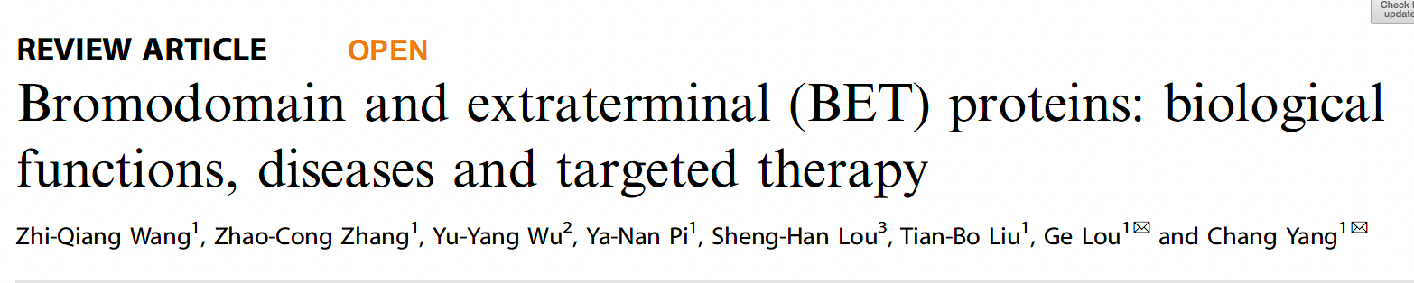
Signal Transduct Target Ther 2023;8(1):420.

Slide 16
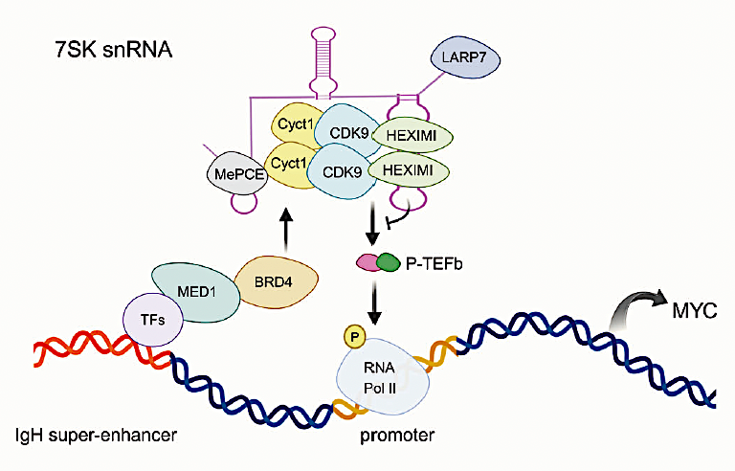
Mechanism by Which BRD4 Promotes Transcriptional Elongation
Wang Z-Q et al. Signal Transduct Target Ther 2023;8(1):420.

Slide 17
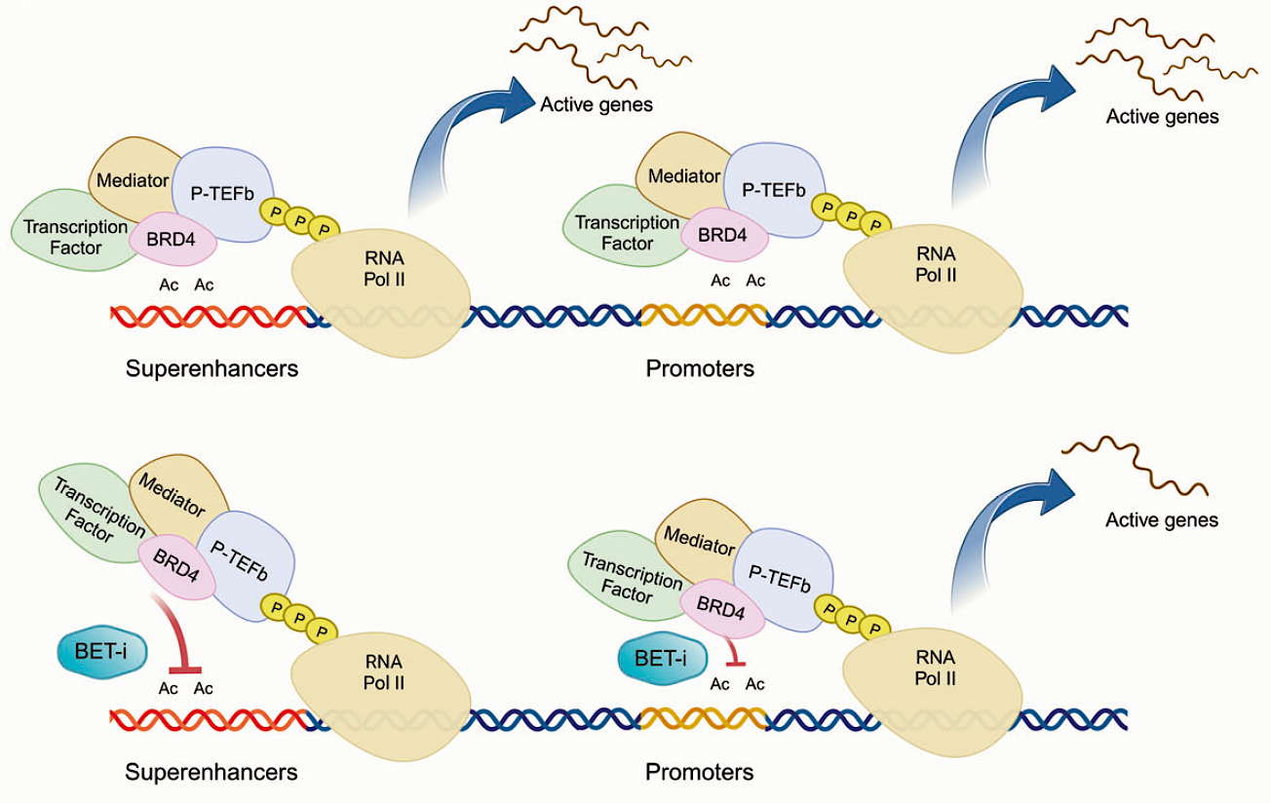
Mechanism of Action of BET Inhibitors
Wang Z-Q et al. Signal Transduct Target Ther 2023;8(1):420.

Slide 18
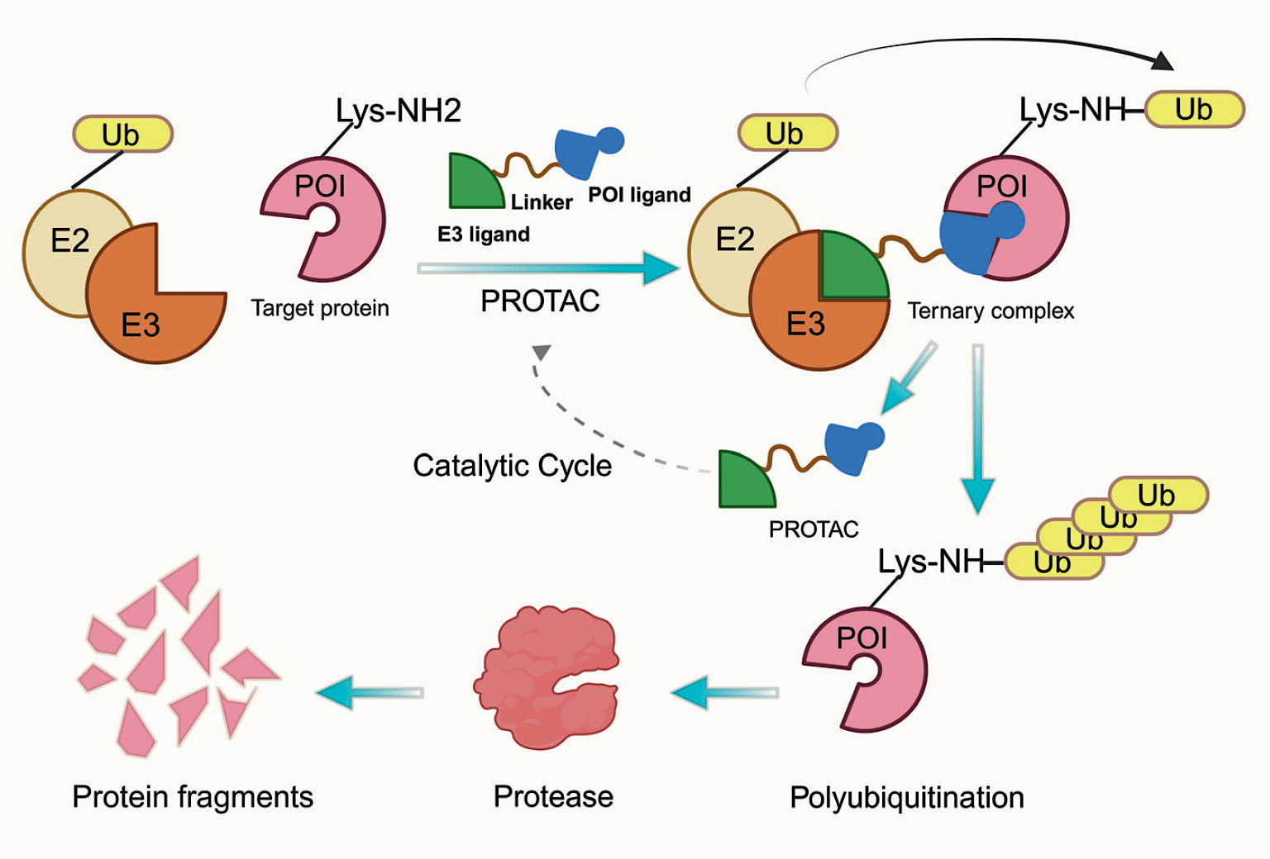
Mechanism of Proteolysis Targeting Chimera (PROTAC)
Wang Z-Q et al. Signal Transduct Target Ther 2023;8(1):420.

Slide 19
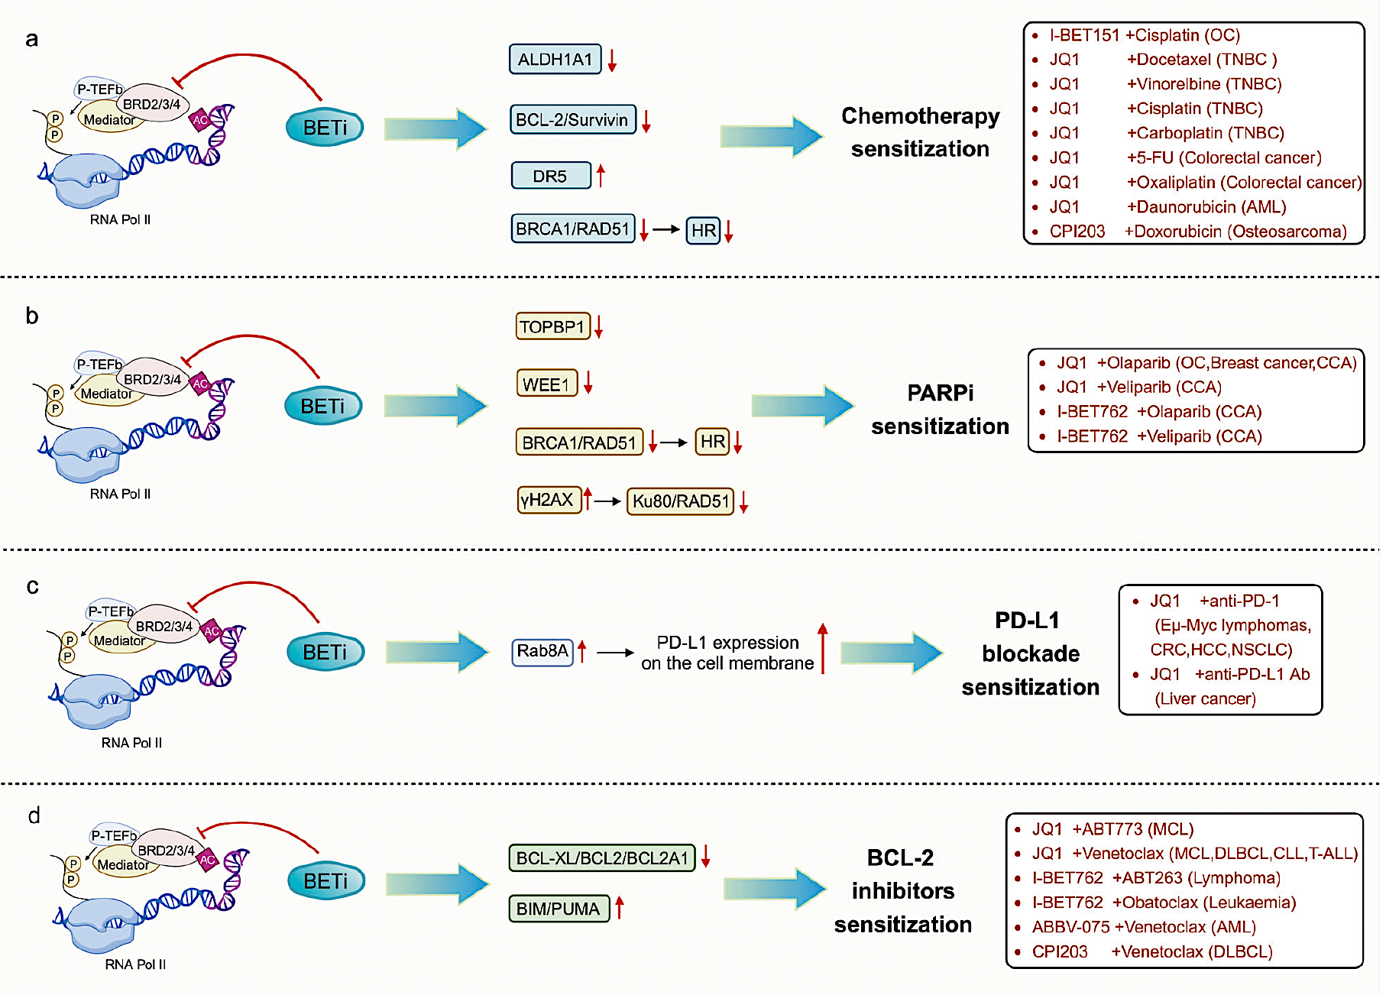
BET Inhibitors May Synergize with a Variety of Antitumor Agents
Wang Z-Q et al. Signal Transduct Target Ther 2023;8(1):420.

Slide 20
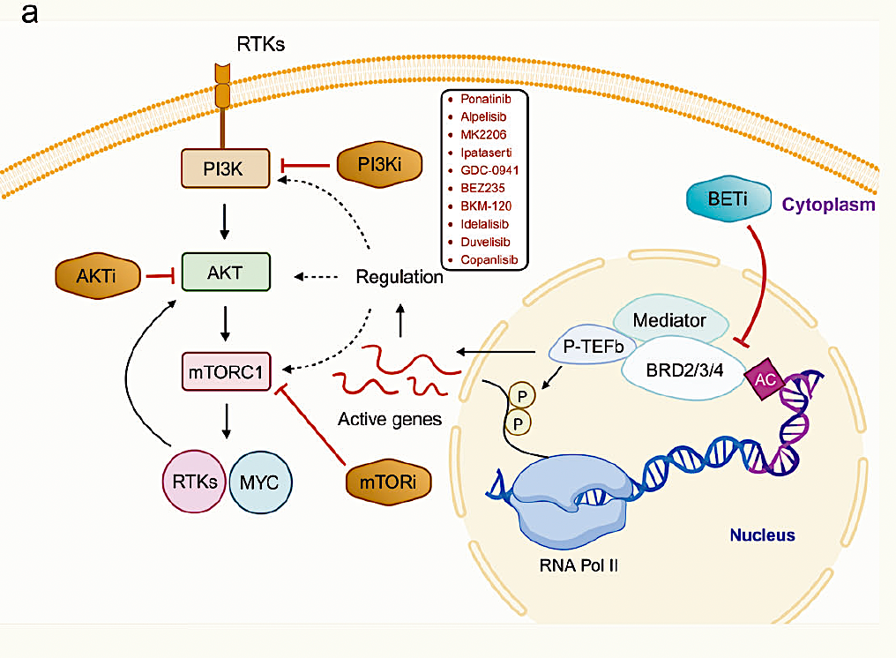
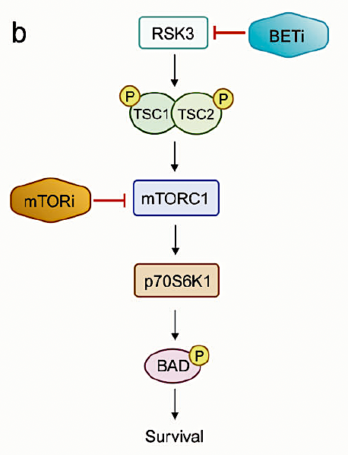
BET Inhibitors’ Synergism with PI3K and mTOR Inhibitors
Wang Z-Q et al. Signal Transduct Target Ther 2023;8(1):420.

Slide 21
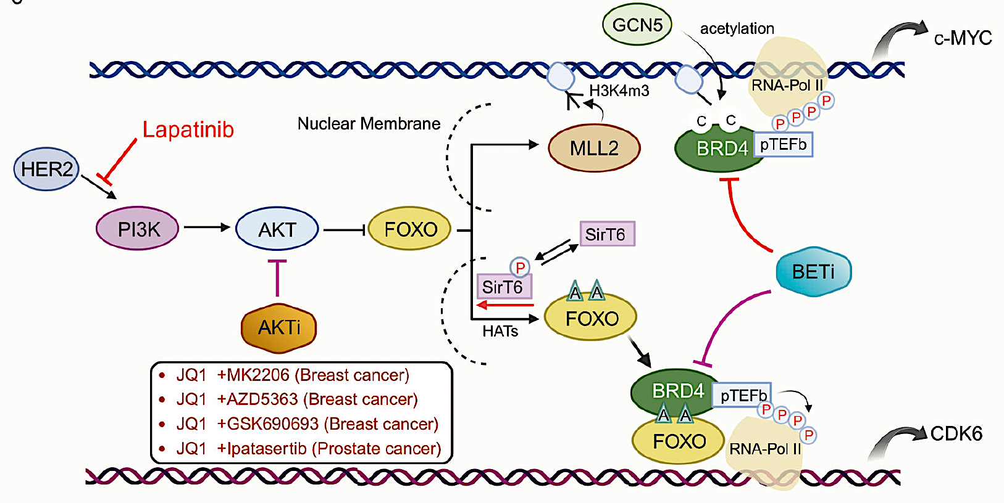
BET Inhibitors’ Synergism with Lapatinib and AKT Inhibitors
Wang Z-Q et al. Signal Transduct Target Ther 2023;8(1):420.

Slide 22
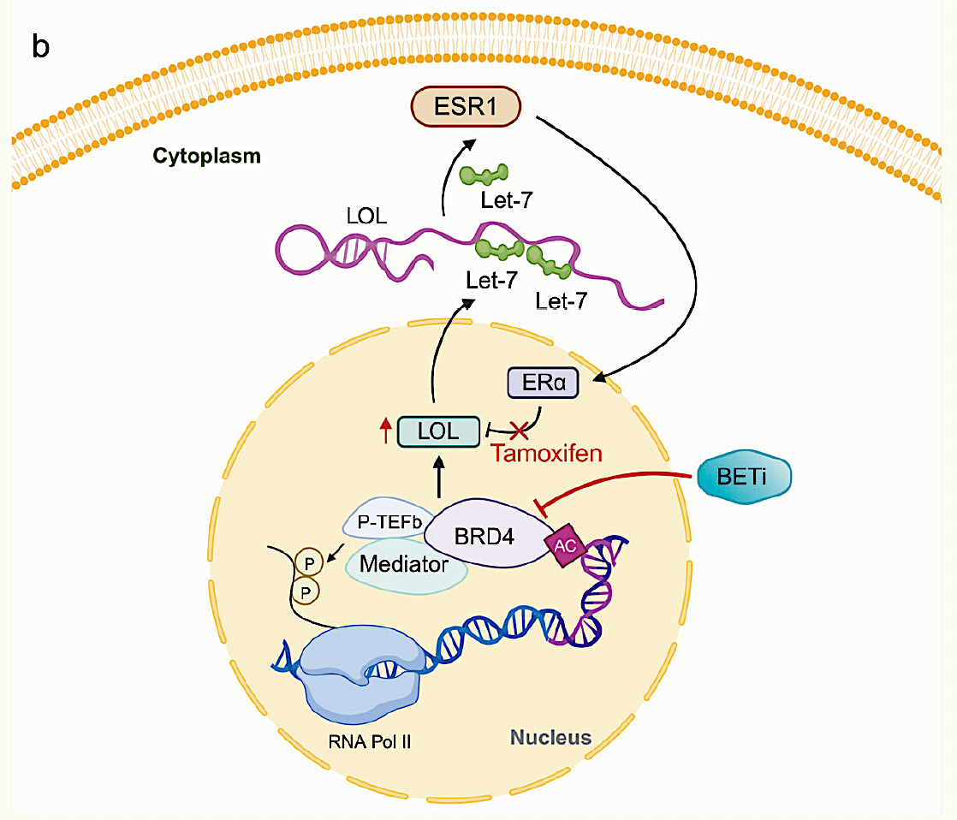
BET Inhibition Resensitizes ER-Positive Breast Cancer Cells to Tamoxifen
Wang Z-Q et al. Signal Transduct Target Ther 2023;8(1):420.

Slide 23
Novel Antibody Targeting Calreticulin

Slide 24
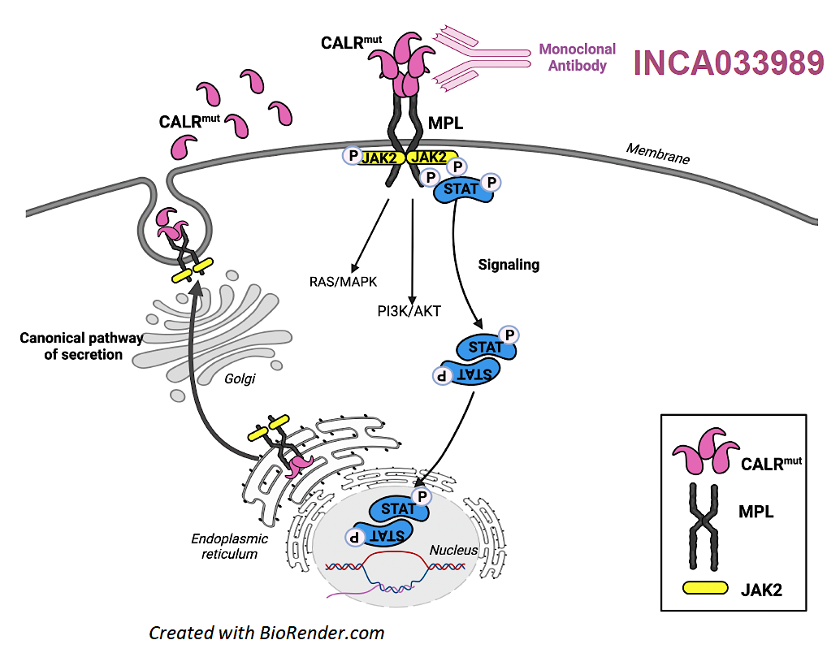
INCA033989: Mechanism of Action
Marty C et al. EHA 2024;Abstract P1002.

Slide 25
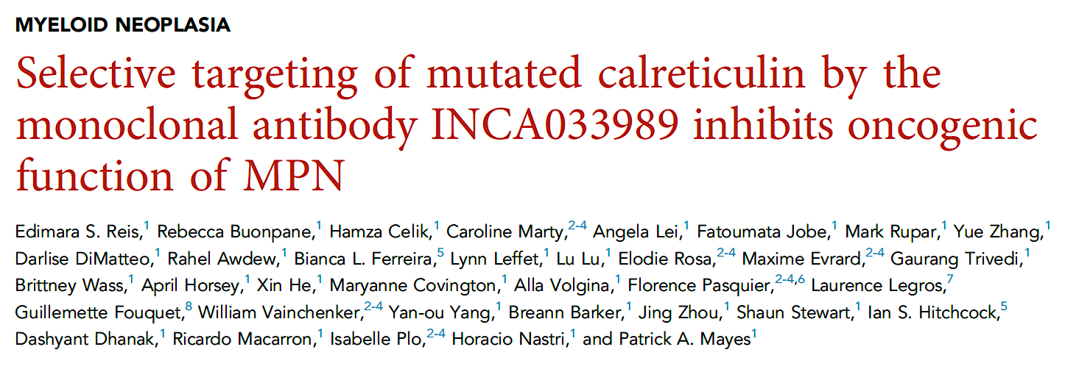
Blood 2024;144(22):2336-48.

Slide 26
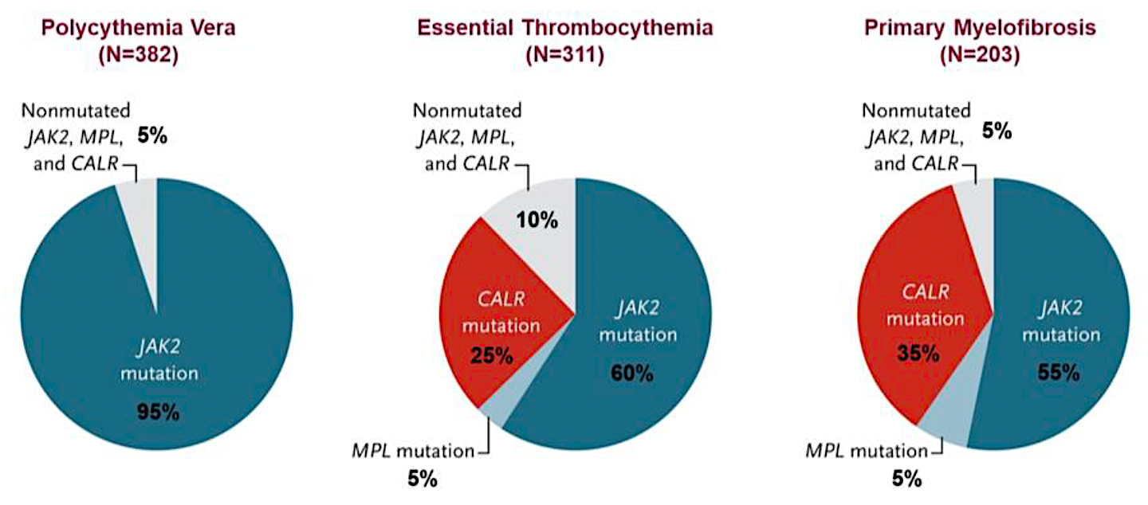
Driver Mutations in Myeloproliferative Neoplasms
Stubbs MC et al. ASH 2023;Abstract 860.

Slide 27
Novel Regulatory T-Cell Infusion Therapy

Slide 28

A Phase Ib, Open-label Study of Add-On Therapy with CK0804 in Participants with Myelofibrosis and Suboptimal Response to Ruxolitinib
Abstract # 999
Lucia Masarova, MD, Meixian Huang, Swati Goel, MD, Sharon Bledsoe, Naveen Pemmaraju, MD, Tapan M. Kadia, MD, Prithviraj Bose, MD, Jo Ishizawa, MD, Phd, Guillermo Montalban-bravo, MD, Mi-ae Lyu, Tara Sadeghi, Simrit Parmar, MBBS, Christopher R. Flowers, MD, MS and Hagop M. Kantarjian, MD
Courtesy of John Mascarenhas, MD

Slide 29
Tregs with ruxolitinib in MF
Phase 1b Study of CK0804: CXCR4 Enriched, Non-HLA matched, Cryopreserved, Multi-Dose, Treg Therapy in MF Patients with Suboptimal Response to Ruxolitinib
Eligible patients
Age > 18 years with PMF/ PPV-MF or PET-MF by IWG MRT criteria.
On ruxolitinib for at least 3 months and stable dose for 8 weeks and presence of:
disease-related symptoms, as determined by a MPN SAF TSS score of ≥10 points
OR
splenomegaly of ≥5 cm below the costal margin by physical examination or by ultrasound or MRI.
OR
new grade ≥2 anemia or thrombocytopenia or neutropenia
Primary Objective: Safety of the add-on CK0804 to ruxolitinib
Secondary Objective: Efficacy of the add-on CK0804 to ruxolitinib
Exploratory Objective: PB and BM immune reconstitution; longitudinal serum biomarker and plasma inflammatory cytokines analysis
Safety Run-In
Expansion Cohort 1
Every 28 days x 6 infusions of 100 million Tregs per dose;
N=9
Every 7 days x 4 infusions; then
Every 28 days x 5 infusions
N=6
Courtesy of John Mascarenhas, MD
Masarova et al. ASH 2024;Abstract 999

Slide 30
Tregs with ruxolitinib in MF
Spleen Volume Change (Best); n=6
MPN SAF TSS: Early Satiety; n=6
782 cm³
2680 cm³
1699 cm³
2562 cm³
1264 cm³
1799 cm³
Maximum SVR = EOC6 in all pt
The Early Satiety subset score
 | Mean | 95% CI Lower | 95% CI Upper
Baseline | 4.0 | 2.0 | 5.5
C4D1 | 1.8 | 0 | 4.0
EOC6 | 2.1 | 0.5 | 5.0
Masarova et al. ASH 2024;Abstract 999
Courtesy of John Mascarenhas, MD

Slide 31
Reduction of TGF-𝛃 Levels Correlates with Clinical Response [n=5]
Tregs with ruxolitinib in MF
Patients # 1-5
C1D8 | C2D1 | C3D1 | C4D1 | C5D1 | C6D1 | EOT
TGF𝛃 Baseline Levels [9] | Median (range) | Ref.
TGF𝛃1 (ng/ml) | 11629 (5935-25630) | <2
TGF𝛃2 (ng/ml) | 574 (336-1035) | <0.2
TGF𝛃3 (ng/ml) | 382 (9.3-2503) | <0.1
8364
863
9.2
TGF-β1
TGF-β2
TGF-β3
TSS50 & Improved TD
14538
602
TGF-β1
TGF-β2
TSS30 & Improved TD
16192
720
22
TGF-β1
TGF-β2
TGF-β3
TSS50 & SVR35
TGF- β Levels Prior to CK0804
16496
991
40
TGF-β1
TGF-β2
TGF-β3
Increase > 50%
TSS50 & SVR25
Increase 25- 50%
Increase 0 - 25%
12654
1067
2413
TGF-β1
TGF-β2
TGF-β3
Decrease 0 - 25%
TSS50 & SVR10
Decrease 25- 50%
Courtesy of John Mascarenhas, MD
Decrease > 50%
Masarova et al. ASH 2024;Abstract 999

Slide 32
Selective JAK Inhibitors

Slide 33
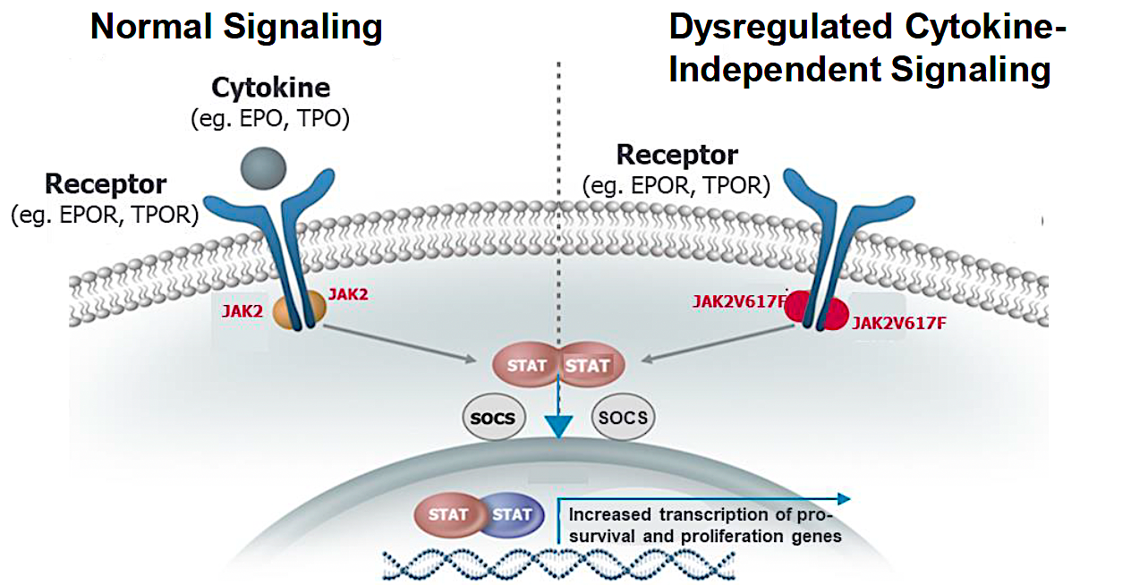
Potential Therapeutic Option: Selective Targeting of JAK2V617F
Stubbs MC et al. ASH 2023;Abstract 860.

Slide 34
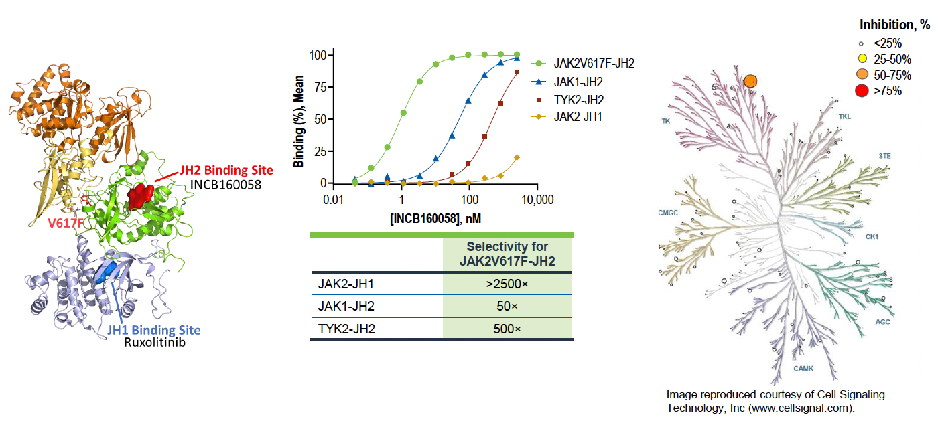
INCB160058 Is a Selective Pseudokinase (JH2)-Binding Inhibitor of JAK2V617F
Stubbs MC et al. ASH 2023;Abstract 860.

Slide 35
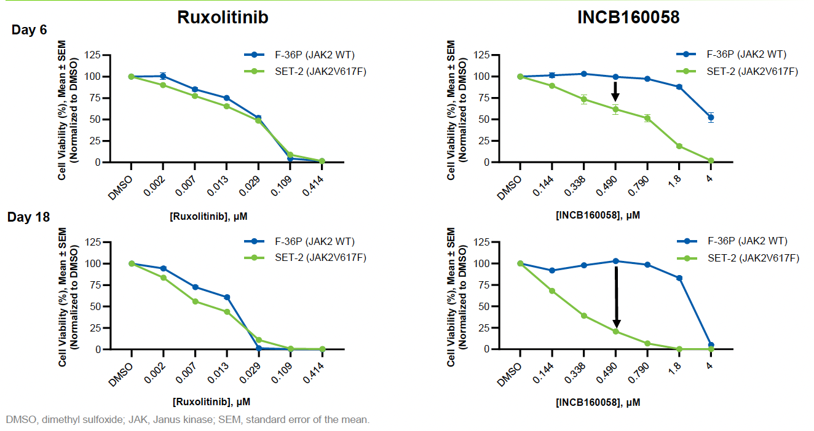
INCB160058 Selectively Inhibits Growth of JAK2V617F-Expressing Cells
Stubbs MC et al. ASH 2023;Abstract 860.

Slide 36
Summary of Preclinical Findings with INCB160058
INCB160058 is a potent and selective JAK2 pseudokinase domain binder
Pseudokinase binding offers a new mechanism of action for selective inhibition of JAK2V617F, with potential to eradicate mutant clones
INCB160058 inhibits cytokine-independent activity of JAK2V617F while sparing wild-type JAK2
In vitro, INCB160058 selectively targets JAK2V617F-harboring cell lines as well as myeloproliferative neoplasm patient-derived CD34-positive cells, repressing phosphorylated STAT5 levels and slowing cell growth
In vivo, INCB160058 maintains its selective nature, reducing human JAK2V617F-derived cell engraftment; erythropoietic cells and proinflammatory cytokines were selectively reduced
Stubbs MC et al. ASH 2023;Abstract 860.

Slide 37
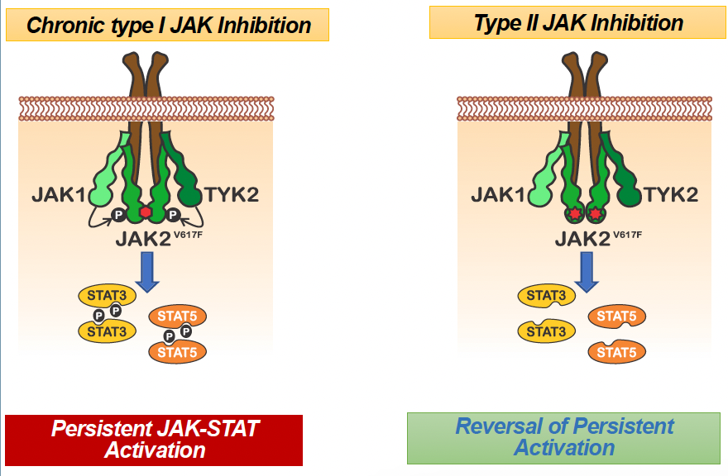
Potential of Type II JAK Inhibitors
Mascarenhas J et al. ASH 2024;Abstract 3147.1.

Slide 38
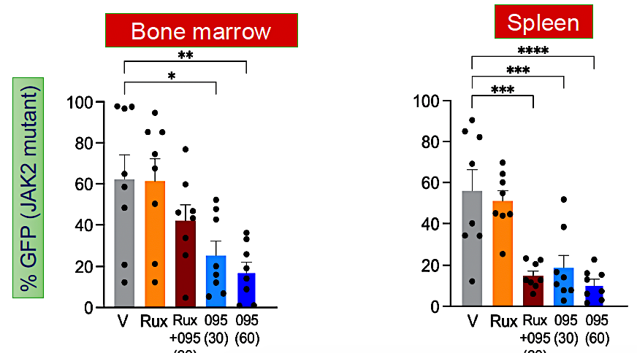
AJ1-11095 Preclinical Data
• AJ1-11095 was designed through computational and structure-based methods to specifically bind the Type II (inactive) conformation of JAK2
• AJ1-11095 is highly selective for JAK2 compared with other JAK family members (JAK1, JAK3, TYK2)
• Cell line experiments and murine models of MPN show potent activity of AJ1-11095 both as initial therapy and post ruxolitinib treatment (ruxolitinib persistence model)
• AJ1-11095 (“095”) also induces reduction in the mutant clone in preclinical MPN models
Mascarenhas J et al. ASH 2024;Abstract 3147.1.

Slide 39
AGENDA Year in Review: Management of Myelofibrosis
INTRODUCTION:
The New Trastuzumab?
Off-the-Shelf Allo T-Reg Cell Infusions?
MODULE 1: Myelofibrosis 2025 — JAK Inhibitors (Ruxolitinib)
MODULE 2: BET Inhibitors — Pelabresib
MODULE 3: Navtemadlin
MODULE 4: Selinexor and Elritercept

Slide 40
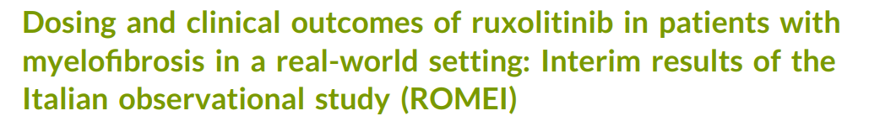
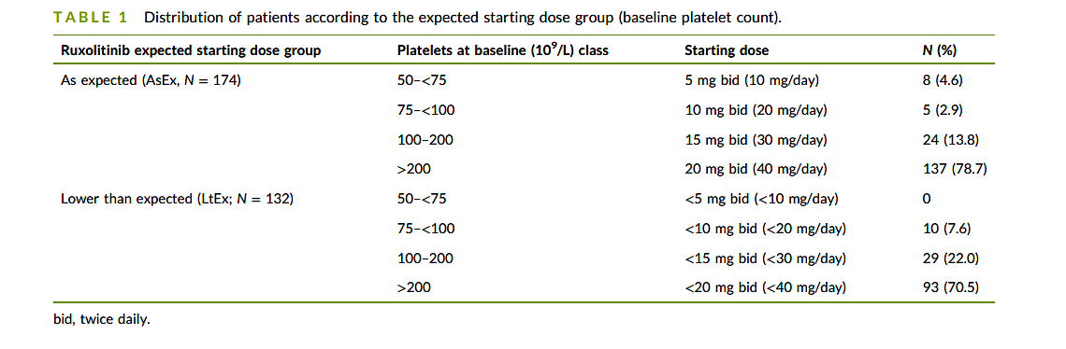
Breccia et al
Prospective multicentre study in Italy enrolling MF patients treated with ruxolitinib - 508 patients enrolled
Prior work from this study confirmed in its 24‐week findings, the beneficial effect of ruxolitinib in improving symptoms and QOL (primary endpoints) and reducing spleen size. A favorable safety profile was observed, consistent with results from clinical studies. The interim results in the ROMEI study indicated high adherence (60%–75%) to oral ruxolitinib at 24 weeks.
However, one third (25%–40%) of the patients receiving ruxolitinib may be undertreated owing to suboptimal adherence, potentially undermining disease control and survival outcomes.
This paper presents an interim analysis at 12 months based upon outcomes of patients according to starting dose of ruxolitinib.
AsEx – as expected for platelet count n = 174
LtEx – less than expected n= 132
Courtesy of Professor Claire Harrison

Slide 41
Discussion Question
What is the optimal dosing strategy for
initial treatment with ruxolitinib?

Slide 42
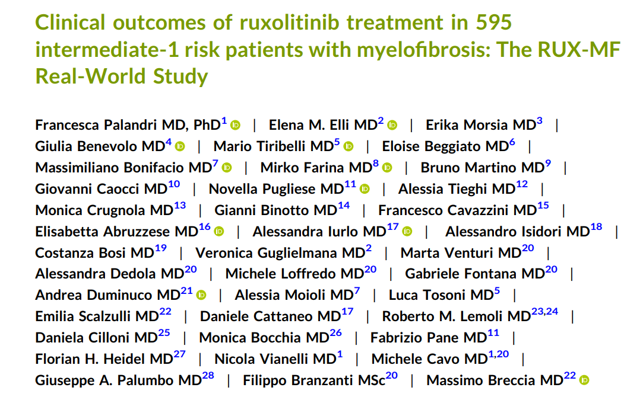
Courtesy of Professor Claire Harrison

Slide 43
Discussion Question
How do you decide when
to start ruxolitinib treatment?

Slide 44
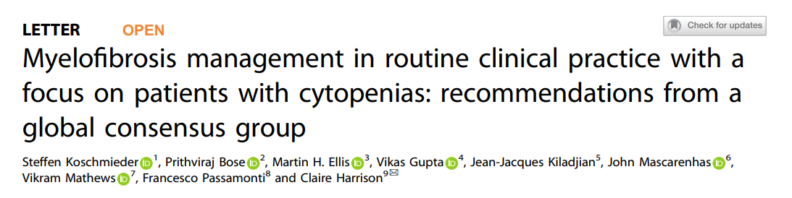
Aims to assess:
Defining the thresholds for anemia, and when to initiate/ modify treatment
Defining the threshold for thrombocytopenia and when to initiate/modify treatment
Defining JAKi failure and what would warrant switching treatment
How and when to determine prognosis in patients with MF
Unmet needs in MF clinical trials
Courtesy of Professor Claire Harrison

Slide 45
Question 8: What Criteria Should be Used to Define a Patient who is Relapsed, Refractory, or Intolerant to JAK Inhibitor Treatment?
Theme 3: Defining JAK Inhibitor Failure and What Would Warrant Switching Treatment
Clinical Recommendation 8
There are existing criteria for ruxolitinib that are used in clinical trials to determine if a patient is relapsed, refractory, or intolerant to treatment (Table 2)
However, in clinical practice, it may be difficult to distinguish exactly between ruxolitinib intolerance and relapse, as often these can coexist
Criteria for other JAK inhibitors are likely to be similar
Table 2: Criteria for Ruxolitinib Failure Used in the Re-analysis of the JAKARTA-2, PAC203, and FREEDOM Trials (Adapted From Bose P, Verstovsek S. Hemasphere. 2020;4:e424)
Relapsed | Ruxolitinib for ≥3 months with spleen regrowth (defined as <10% SVR or <30% decrease in spleen size by palpation from baseline) following an initial response*
Refractory | Ruxolitinib for ≥3 months with <10% SVR or <30% decrease in spleen size by palpation from baseline
Intolerant | Ruxolitinib for ≥28 days complicated by development of RBC transfusion requirement (≥2 units/month for two consecutive months); or Grade ≥3 thrombocytopenia, anemia, hematoma/hemorrhage or other, non-hematologic adverse events while on ruxolitinib
8
94%
MEDIAN SCORE
CONSENSUS
*Response to ruxolitinib is defined as ≥35% reduction in spleen volume from baseline or ≥50% reduction in spleen size for baseline spleen sizes >10cm below LCM, a non-palpable spleen for baseline spleen sizes between 5–10cm below LCM, or not eligible for spleen response for baseline spleen <5cm below LCM (Harrison CN, et al. Am J Hematol. 2020;95:594–603).
JAK, Janus kinase; LCM, left costal margin; RBC, red blood cell; SVR, spleen volume reduction.
Courtesy of Professor Claire Harrison
Koschmieder Leukemia 2024

Slide 46
Discussion Questions
How do you determine if a patient has relapsed/refractory disease?
What is the optimal way to identify intolerance
to JAK inhibitor therapy?

Slide 47

Question 3: Which Current and Emerging Treatments to Improve Anemia Should be Considered for: • MF-Related Anemia? • Treatment-Related Anemia?
Theme 1: Defining the Thresholds for Anemia, and When to Initiate/Modify Treatment
Clinical Recommendation 3
Once other causes such as disease progression have been excluded: for MF-related anemia, JAK inhibition with momelotinib or pacritinib, danazol, luspatercept, ESAs, IMiD®, or conventional combination therapies, such as JAK inhibition plus ESAs, danazol, luspatercept, or IMiD®, may overcome the necessity of dose adjustments/interruptions, which may be associated with ruxolitinib or fedratinib*
In the future, novel combination therapies may deliver these benefits
Splenectomy can be considered as a last resort in select cases of refractory disease-related anemia. For treatment-related anemia, consider dose reduction of current therapy for 4–6 weeks.
*Only ruxolitinib, fedratinib, pacritinib, and momelotinib are approved treatments for MF.
8
All current and emerging treatment options for MF- and treatment-related anemia should be considered
100%
MEDIAN SCORE
CONSENSUS
ESA, erythropoietin-stimulating agent; Hb, hemoglobin; IMiD, immunomodulatory drugs; JAK, Janus kinase; MF, myelofibrosis.
Courtesy of Professor Claire Harrison
Koschmieder Leukemia 2024

Slide 48




Question 4: Aside From Access and Reimbursement, What Factors Guide Selection of JAK Inhibitor Therapy in Patients With MF and Anemia?
Theme 1: Defining the Thresholds for Anemia, and When to Initiate/Modify Treatment
Clinical Recommendation 4
Factors guiding selection of JAK inhibitor monotherapy would include:
For some agents, consideration of drug-specific adverse events (immunosuppression, skin cancer, infection risk, nutritional status, tolerance of GI toxicity, neurotoxicity, cardiovascular adverse events) is also a factor
Baseline Hb
Likely tolerance of anemia
Baseline thrombocytopenia
MF-related symptoms
8.5
92%
MEDIAN SCORE
CONSENSUS
GI, gastrointestinal; Hb, hemoglobin; JAK, Janus kinase; MF, myelofibrosis.
Courtesy of Professor Claire Harrison
Koschmieder Leukemia 2024

Slide 49
Clinical Outcomes in Patients with Myelofibrosis Treated with Ruxolitinib and Anemia-Supporting Medications Vachhani ASH 2024; Abstract 4546
The large (N=2233), single-arm, phase 3b, expanded-access JUMP trial evaluated safety and efficacy of ruxolitinib treatment for patients with MF in a setting similar to routine clinical practice.
This post hoc analysis included patients with BL anemia (hemoglobin [Hb] <12.0 g/dL or Hb <10.0 g/dL) who were not receiving supportive care for anemia at enrollment but initiated an ESA or danazol within 3 months of enrollment and remained on that therapy for ≥3 months. Clinical outcomes evaluated were spleen length response.
101 (7.3%) initiated an ESA (n=98) or danazol (n=3) within 3 months of enrollment (52 [6.9%] with Hb<10.0g/dL) and were included in this analysis.
For the Hb<12.0 g/dL cohort, time from enrollment to first dose of an ESA or danazol was 43.0 (2–91) days.
For the Hb<10.0 g/dL subgroup, time to first dose of ESA or danazol was 34 (2–90) days.
Courtesy of Professor Claire Harrison

Slide 50
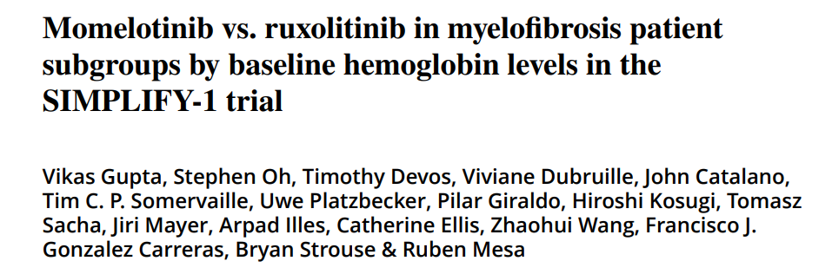
Anemia is a key hallmark of MF and often results in poor quality of life and under dosing of ruxolitinib. This is a post hoc analysis of the SIMPLIFY-1 study.
This study was the only trial to perform a head to head analysis of JAK inhibitors.
Courtesy of Professor Claire Harrison

Slide 51
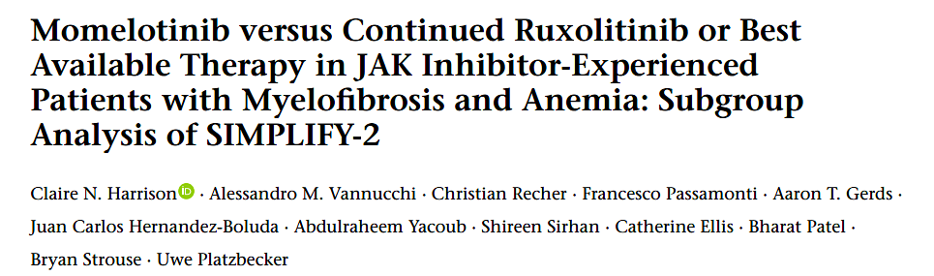
Post hoc analysis of SIMPLIFY 2
The patient subgroups for the present analysis were defined by either:
Hb of < 100 g/L
or transfusion status, ie all patients who were non-TI.
Transfusion independence is absence of RBC transfusions and no Hb of < 80 g/L in the 12 weeks before randomization.
As few patients received anemia supportive therapies other than RBC transfusions (e.g., ESAs), results in the small subgroup of the overall intent-to-treat (ITT) population who did were also summarized.
Courtesy of Professor Claire Harrison

Slide 52
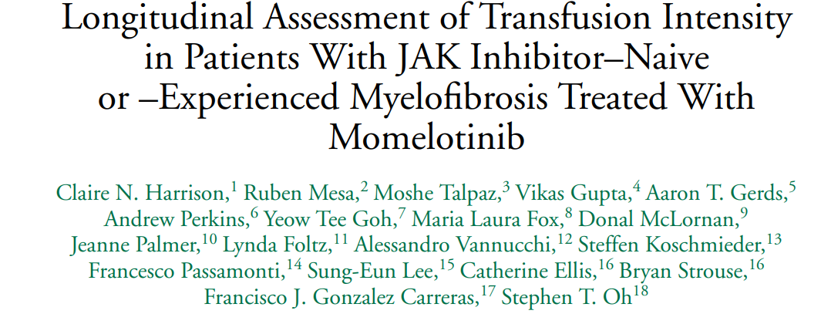
In this descriptive analysis, the impact of momelotinib on RBC transfusion burden over time was further characterized across JAK inhibitor–naive and –experienced patients.
To further visualize changes to RBC transfusion burden during treatment, patients were arrayed in ordinal bins jointly based on their baseline- and treatment-period intensities of RBC units per 28 days: exactly zero units, >0 to 1 unit, >1 to 2 units, >2 to 3 units, >3 to 4 units, and >4 units.
Courtesy of Professor Claire Harrison

Slide 53
Discussion Question
How do you choose between JAK inhibitors as initial therapy for patients with anemia?

Slide 54
Discussion Question
How do you determine when to switch from ruxolitinib to momelotinib for patients with anemia?

Slide 55
Discussion Question
If a patient is receiving ruxolitinib and is going to switch to momelotinib, does the ruxolitinib need to be tapered down?

Slide 56
AGENDA Year in Review: Management of Myelofibrosis
INTRODUCTION:
The New Trastuzumab?
Off-the-Shelf Allo T-Reg Cell Infusions?
MODULE 1: Myelofibrosis 2025 — JAK Inhibitors (Ruxolitinib)
MODULE 2: BET Inhibitors — Pelabresib
MODULE 3: Navtemadlin
MODULE 4: Selinexor and Elritercept

Slide 57
Updated Results From the Phase 3 MANIFEST-2 Study of Pelabresib in Combination With Ruxolitinib for Janus Kinase Inhibitor–Naïve Patients With Myelofibrosis
Abstract number: 3178
John Mascarenhas john.mascarenhas@mssm.edu
Courtesy of John Mascarenhas, MD
John Mascarenhas,¹ Sebastian Grosicki,² Dominik Chraniuk,³ Elisabetta Abruzzese,⁴ Prithviraj Bose,⁵ Aaron Gerds,⁶ Alessandro M. Vannucchi,⁷ Francesca Palandri,⁸ Sung-Eun Lee,⁹ Vikas Gupta,¹⁰ Alessandro Lucchesi,¹¹ Stephen T. Oh,¹² Andrew T. Kuykendall,¹³ Andrea Patriarca,¹⁴ Alberto Álvarez-Larrán,¹⁵ Ruben Mesa,¹⁶ Jean-Jacques Kiladjian,¹⁷ Moshe Talpaz,¹⁸ Morgan Harris,¹⁹ Sarah-Katharina Kays,²⁰ Tabea Kräft,²⁰ Qing Li,²¹ Anna-Maria Jegg,²⁰ Claire Harrison,²² Raajit K. Rampal²³
¹Tisch Cancer Institute, Icahn School of Medicine at Mount Sinai, New York, NY, USA; ²Department of Cancer Prevention, Medical University of Silesia, Katowice, Poland; ³Hematology Ward, Wojewódzki Szpital Zespolony im. L. Rydygiera, Torun, Poland; ⁴Department of Hematology, S. Eugenio Hospital, Tor Vergata University, ASL Roma 2, Rome, Italy; ⁵Leukemia Department, University of Texas MD Anderson Cancer Center, Houston, TX, USA; ⁶Cleveland Clinic Taussig Cancer Institute, Cleveland, OH, USA; ⁷Department of Clinical and Experimental Medicine, University of Florence, Florence, Italy; ⁸IRCCS Azienda Ospedaliero-Universitaria di Bologna, Istituto di Ematologia “Seràgnoli”, Bologna, Italy; ⁹Department of Hematology, Seoul St. Mary's Hospital, College of Medicine, The Catholic University of Korea, Seoul, Republic of Korea; ¹⁰Medical Oncology and Hematology, Princess Margaret Cancer Centre, Toronto, ON, Canada; ¹¹Hematology Unit, IRCCS Istituto Romagnolo per lo Studio e la Cura dei Tumori (IRST) “Dino Amadori”, Meldola (FC), Italy; ¹²Washington University School of Medicine in St. Louis, St. Louis, MO, USA; ¹³Moffitt Cancer Center, Tampa, FL, USA; ¹⁴Hematology Unit, AOU Maggiore della Carità and University of Eastern Piedmont, Novara, Italy; ¹⁵Hematology Department, Hospital Clínic, Institut d'Investigacions Biomèdiques August Pi i Sunyer (IDIBAPS), Barcelona, Spain; ¹⁶Atrium Health Wake Forest Baptist Comprehensive Cancer Center, Wake Forest University School of Medicine, Winston-Salem, NC, USA; ¹⁷Clinical Investigation Center, Hôpital Saint-Louis, Université de Paris, Paris, France; ¹⁸University of Michigan Comprehensive Cancer Center, Ann Arbor, MI, USA; ¹⁹Constellation Pharmaceuticals, a MorphoSys Company, Boston, MA, USA; ²⁰MorphoSys AG, Planegg, Germany; ²¹MorphoSys US Inc, Boston, MA, USA; ²²Department of Haematology, Guy’s and St Thomas’ NHS Foundation Trust, London, UK; ²³Leukemia Service, Memorial Sloan Kettering Cancer Center, New York, NY, USA

Slide 58
Safety and Efficacy of Bromodomain and Extra-Terminal Inhibitor INCB057643 in Patients With Relapsed or Refractory Myelofibrosis and Other Advanced Myeloid Neoplasms: A Phase 1 Study
Presentation #658
Justin Watts, MD,¹ Anthony M. Hunter, MD,² Alessandro M. Vannucchi, MD,³ Vikas Gupta, MD, FRCP,⁴ Srinivas K. Tantravahi, MD,⁵ Alessandra Iurlo, MD, PhD,⁶ Brandon McMahon, MD,⁷ Francesca Palandri, MD, PhD,⁸ María T. Gómez-Casares, MD,⁹ Junichiro Yuda, MD, PhD,¹⁰ Emma Searle, MD, PhD,^{11,12} Anna B. Halpern, MD,^{13,14} Rosa Ayala Diaz, MD,¹⁵ Akihiro Tomita, MD, PhD,¹⁶ Blanca Xicoy, MD,¹⁷ Prithviraj Bose, MD,¹⁸ Brandi Reeves, MD,¹⁹ Xuejun Chen, PhD,²⁰ Lea Burke, MS,²⁰ Feng Zhou, PhD,²⁰ Fred Zheng, MD,²⁰ Pankit Vachhani, MD²¹
¹Sylvester Comprehensive Cancer Center, University of Miami, Miami, FL, USA; ²Emory University School of Medicine, Atlanta, GA, USA; ³AOU Careggi, University of Florence, Florence, Italy; ⁴Princess Margaret Cancer Centre, Toronto, ON, Canada; ⁵University of Utah Huntsman Cancer Institute, Salt Lake City, UT, USA; ⁶Foundation IRCCS Ca’ Granda Ospedale Maggiore Policlinico, Milan, Italy; ⁷University of Colorado Anschutz Medical Campus, Aurora, CO, USA; ⁸IRCCS Azienda Ospedaliero-Universitaria di Bologna, Istituto di Ematologia “Seràgnoli,” Bologna, Italy; ⁹Hospital Universitario de Gran Canaria Doctor Negrín, Las Palmas de Gran Canaria, Spain; ¹⁰National Cancer Center Hospital East, Chiba, Japan; ¹¹The Christie Hospital NHS Foundation Trust, Manchester, UK; ¹²University of Manchester, Manchester, UK; ¹³University of Washington, Seattle, WA, USA; ¹⁴Fred Hutchinson Cancer Center, Seattle, WA, USA; ¹⁵Hospital Universitario 12 de Octubre, Madrid, Spain; ¹⁶Fujita Health University School of Medicine, Toyoake, Japan; ¹⁷Hospital Germans Trias I Pujol, Institut Català Oncologia, Josep Carreras Leukemia Research Institute, Universitat Autònoma de Barcelona, Badalona, Spain; ¹⁸The University of Texas MD Anderson Cancer Center, Houston, TX, USA; ¹⁹University of North Carolina School of Medicine, Chapel Hill, NC, USA; ²⁰Incyte Corporation, Wilmington, DE, USA; ²¹O’Neal Comprehensive Cancer Center at UAB, Birmingham, AL, USA
Courtesy of John Mascarenhas, MD

Slide 59
Efficacy – Monotherapy
Courtesy of John Mascarenhas, MD
Spleen Volume Response in Individual Patients With MF (n=25)
Week 24 SVR35 achieved by 3/7 patients receiving INCB057643 ≥10 mg and 3/20 all evaluable patients
Of 23 evaluable patients, BOR SVR35 achieved by 3 patients; SVR25 achieved by 9 patients
4 mg
6 mg
8 mg
10 mg
12 mg
Spleen Volume Change at Week 24*†
Best Spleen Volume Response During Treatment*‡
Change From Baseline, %
Change From Baseline, %
−35
−35
Visit, wk
24
12
12
12
12
12
12
12
12
12
24
12
12
36
12
12
24
36
48
36
Watts ASH 2024;Abstract 658

Slide 60
Efficacy – Monotherapy
Courtesy of John Mascarenhas, MD
Symptom Response in Individual Patients With MF (n=25)
Week 24 TSS50 achieved by 5/8 evaluable patients receiving INCB057643 ≥10 mg; 7/19 all evaluable patients
BOR TSS50 achieved by 11/20 evaluable patients
4 mg
6 mg
8 mg
10 mg
12 mg
MPN-SAF TSS Change at Week 24*†
Best Symptom Improvement During Treatment*‡
Change From Baseline, %
Change From Baseline, %
Visit, wk
4
12
4
4
8
12
29
12
12
24
16
32
16
24
40
8
44
16
28
44
Watts ASH 2024;Abstract 658

Slide 61
Trial Update from IMproveMF, an Ongoing, Open-label, Dose-Escalation and -Expansion Phase 1/1b Trial to Evaluate the Safety, Pharmacokinetics, and Clinical Activity of the Novel Combination of Imetelstat with Ruxolitinib in Patients with Intermediate-1, Intermediate-2, or High-Risk Myelofibrosis
John O. Mascarenhas, MD,¹ Salman Otoukesh, MD,² Terrence Bradley, MD,³ Bart L. Scott, MD,⁴ Habte A. Yimer, MD,⁵ Souria Dougherty, MBA,⁶ Lixian Peng, PhD,⁶ Fei Huang, PhD,⁶ Ying Wan, MD, PhD,⁶ Faye M. Feller, MD,⁶ Vivian Rodolf, MD,⁶ Judy Ho, BS,⁶ Tymara Berry, MD,⁶ Andrew T. Kuykendall, MD⁷
¹Tisch Cancer Institute, Icahn School of Medicine at Mount Sinai, New York, NY, USA; ²City of Hope Comprehensive Cancer Center, Duarte, CA, USA; ³University of Miami Sylvester Comprehensive Cancer Center, Miami, FL, USA; ⁴Fred Hutchinson Cancer Center, Seattle, WA, USA; ⁵Texas Oncology/US Oncology Research, Tyler, TX, USA; ⁶Geron Corporation, Foster City, CA, USA; ⁷Moffitt Cancer Center, Tampa, FL, USA
Courtesy of John Mascarenhas, MD
Presentation 998 | Presented at the 66th American Society of Hematology (ASH) Annual Meeting and Exposition; December 7-10, 2024; San Diego, CA, USA

Slide 62
Imetelstat Combined With Ruxolitinib Was Well Tolerated
No DLTsª were reported at any imetelstat dose level within the first 28 days of cycle 1
Any-grade TEAEs in ≥15% of patients
Grade 3 TEAEs
Preferred term, n (%) | Total (N=17)
Patients with ≥1 TEAE | 15 (88)
Pain in extremity | 7 (41)
Nausea | 6 (35)
ALT increased | 5 (29)
Anemia | 5 (29)
Thrombocytopenia^{b} | 4 (24)
Fatigue | 4 (24)
AST increased | 3 (18)
Neutropenia^{c} | 3 (18)
Preferred term, n (%) | Total (N=17)
Patients with ≥1 grade 3 TEAE | 8 (47)
Anemia^{d} | 4 (24)
Neutropenia^{c} | 3 (18)
Leukopenia^{e} | 2 (12)
Abdominal pain | 1 (6)
Fatigue | 1 (6)
Pneumonia^{f} | 1 (6)
Epistaxis^{f} | 1 (6)
No grade 4 or 5 events were reported
ALT, alanine aminotransferase; AST, aspartate aminotransferase; DLT, dose-limiting toxicity; SAE, serious adverse event; TEAE, treatment-emergent adverse event.
ªToxicities determined by the investigator to be possibly, probably, or definitely related to imetelstat treatment, and not attributable to the underlying disease, or toxicities with ruxolitinib increasing in grade and/or clinically significant from before imetelstat initiation. ^{b}Combined term includes decreased platelet count. ^{c}Combined term includes decreased neutrophil count. ^{d}One was a SAE considered related to study treatments and resulted in dose reduction to 6.0 mg/kg. ^{e}Combined term includes decreased white blood cell count. ^{f}SAE considered to be related to underlying disease and resolved without dose modification.
Courtesy of John Mascarenhas, MD
Mascarenhas et al. ASH 2024;Abstract 998

Slide 63
Imetelstat Versus Best Available Therapy in Patients with Intermediate-2 or High-Risk Myelofibrosis Relapsed or Refractory to Janus Kinase Inhibitor in IMpactMF, a Randomized, Open-label, Phase 3 Trial
John O. Mascarenhas, MD,¹ Claire Harrison, MD,² Prithviraj Bose, MD,³ Jean-Jacques Kiladjian, MD, PhD,⁴ Alessandro Lucchesi, MD, PhD,⁵ Alessandro M. Vannucchi, MD,⁶ Tymara Berry, MD,⁷ Jennifer Riggs, MPH,⁷ Lixian Peng, PhD,⁷ Fei Huang, PhD,⁷ Ying Wan, MD, PhD,⁷ Vivian Rodolf, MD,⁷ Judy Ho, BS,⁷ Shyamala Navada, MD,⁷ Rami S. Komrokji, MD⁸
¹Tisch Cancer Institute, Icahn School of Medicine at Mount Sinai, New York, NY, USA; ²Guy’s and St Thomas’ National Health Service Foundation Trust, London, UK; ³The University of Texas MD Anderson Cancer Center, Houston, TX, USA; ⁴Hôpital Saint-Louis, Assistance Publique-Hôpitaux de Paris, Université Paris Cité, Paris, France; ⁵Hematology Unit, IRCCS Istituto Romagnolo per lo Studio dei Tumori (IRST) “Dino Amadori,” Meldola, Italy; ⁶University of Florence, Florence, Italy; ⁷Geron Corporation, Foster City, CA, USA; ⁸H. Lee Moffitt Cancer Center, Tampa, FL, USA
Courtesy of John Mascarenhas, MD
Poster 1808.1 | Presented at the 66th American Society of Hematology (ASH) Annual Meeting and Exposition; December 7-10, 2024; San Diego, CA, USA

Slide 64
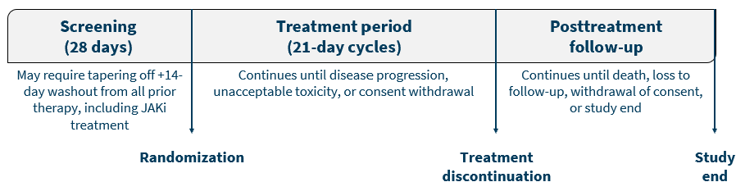
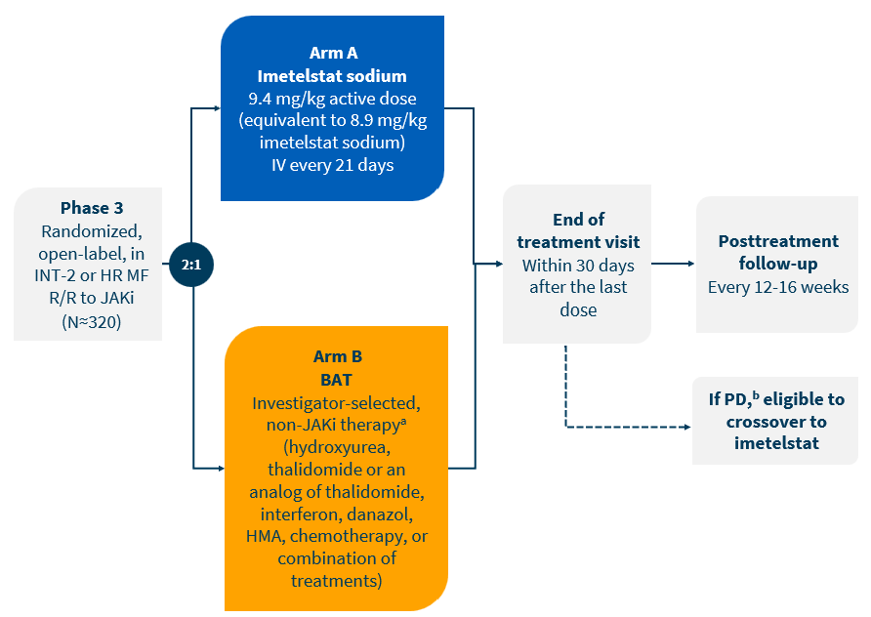
IMpactMF Phase 3 Study Design
An interim analysis is planned when ~35% of the planned enrolled patients have died (early 2026)
The final analysis is planned when >50% of the planned enrolled patients have died (early 2027)
(n≈214)
BAT, best available therapy; HMA, hypomethylating agent; HR, high risk; INT, intermediate; IV, intravenous; JAKi, Janus kinase inhibitor; MF, myelofibrosis; PD, progressive disease; R/R, relapsed or refractory.
ªHematopoietic stem cell transplantation or splenectomy are not to be permitted as BAT. ^{b}Must demonstrate ≥25% increase in spleen volume from baseline during the study or a palpable increase in splenomegaly after 6 months of BAT.
Courtesy of John Mascarenhas, MD
Mascarenhas ASH 2024;Abstract 1808.1

Slide 65
Study End Points
PRIMARY END POINT
Overall survival
EXPLORATORY END POINTS
Association between baseline cytogenetic and mutational status and clinical responses; change in mutant allele burden (molecular response)
Correlation between baseline TA, TL, or hTERT and OS, symptom response, or spleen response
SECONDARY END POINTS
Symptom response rate at week 24 (≥50% reduction in TSS measured by MFSAF v4.0)
PFS
Spleen response rate at week 24 (≥35% spleen volume reduction by MRI or CT)
Complete remission, partial remission, clinical improvement, spleen response, symptom response, and anemia response per modified 2013 IWG-MRT criteria
Time to and duration of responses
Reduction in the degree of bone marrow fibrosis
Safety
PK and immunogenicity of imetelstat
PROs as measured by the EORTC QLQ-C30 and EuroQol-EQ-5D (EQ-5D-5L) questionnaires
BAT, best available therapy; CT, computed tomography; EORTC QLQ-C30, European Organisation for Research and Treatment of Cancer Quality of Life Questionnaire-Core 30 items; hTERT, human telomerase reverse transcriptase; IWG-MRT, International Working Group-Myeloproliferative Neoplasms Research and Treatment; MFSAF, Myelofibrosis Symptom Assessment Form; MRI, magnetic resonance imaging; OS, overall survival; PFS, progression-free survival; PK, pharmacokinetics; PRO, patient-reported outcome; TA, telomerase activity; TL, telomere length; TSS, Total Symptom Score.
Courtesy of John Mascarenhas, MD
Mascarenhas ASH 2024;Abstract 1808.1

Slide 66
AGENDA Year in Review: Management of Myelofibrosis
INTRODUCTION:
The New Trastuzumab?
Off-the-Shelf Allo T-Reg Cell Infusions?
MODULE 1: Myelofibrosis 2025 — JAK Inhibitors (Ruxolitinib)
MODULE 2: BET Inhibitors — Pelabresib
MODULE 3: Navtemadlin
MODULE 4: Selinexor and Elritercept

Slide 67
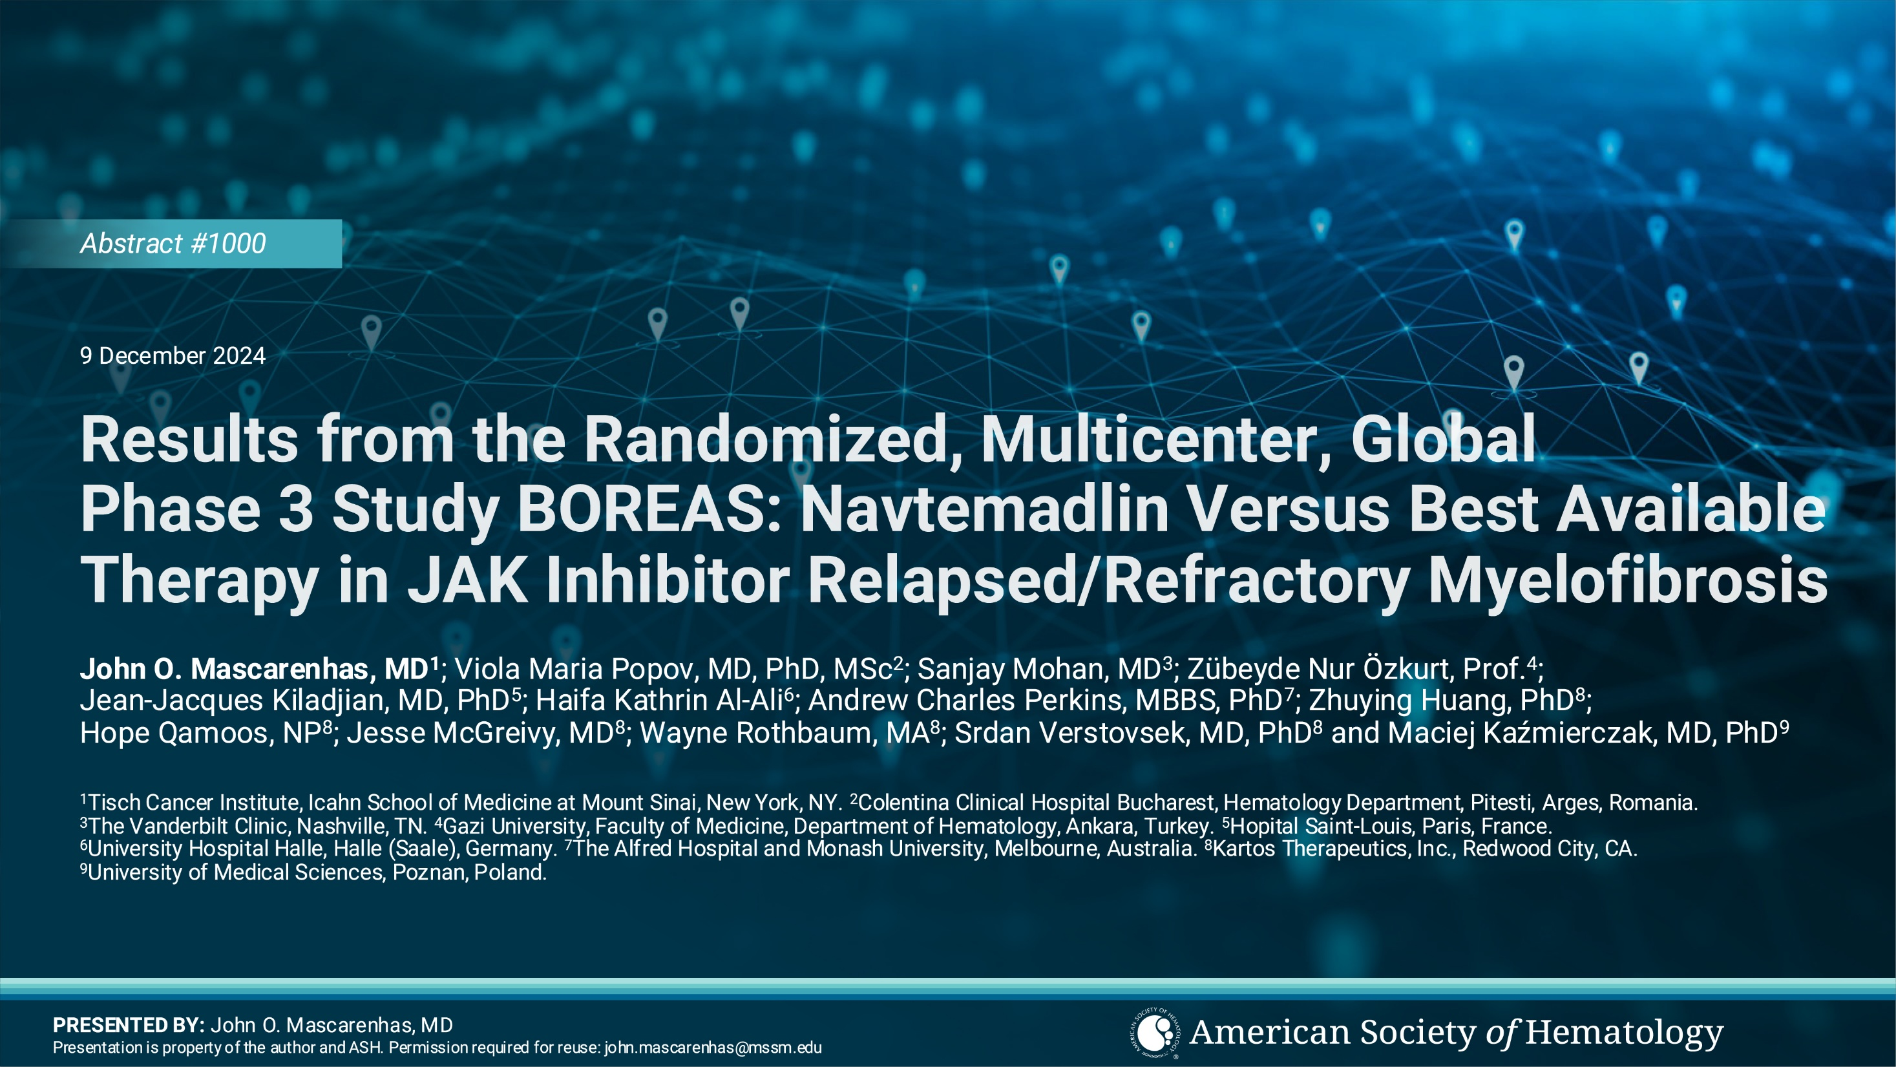
Courtesy of John Mascarenhas, MD

Slide 68
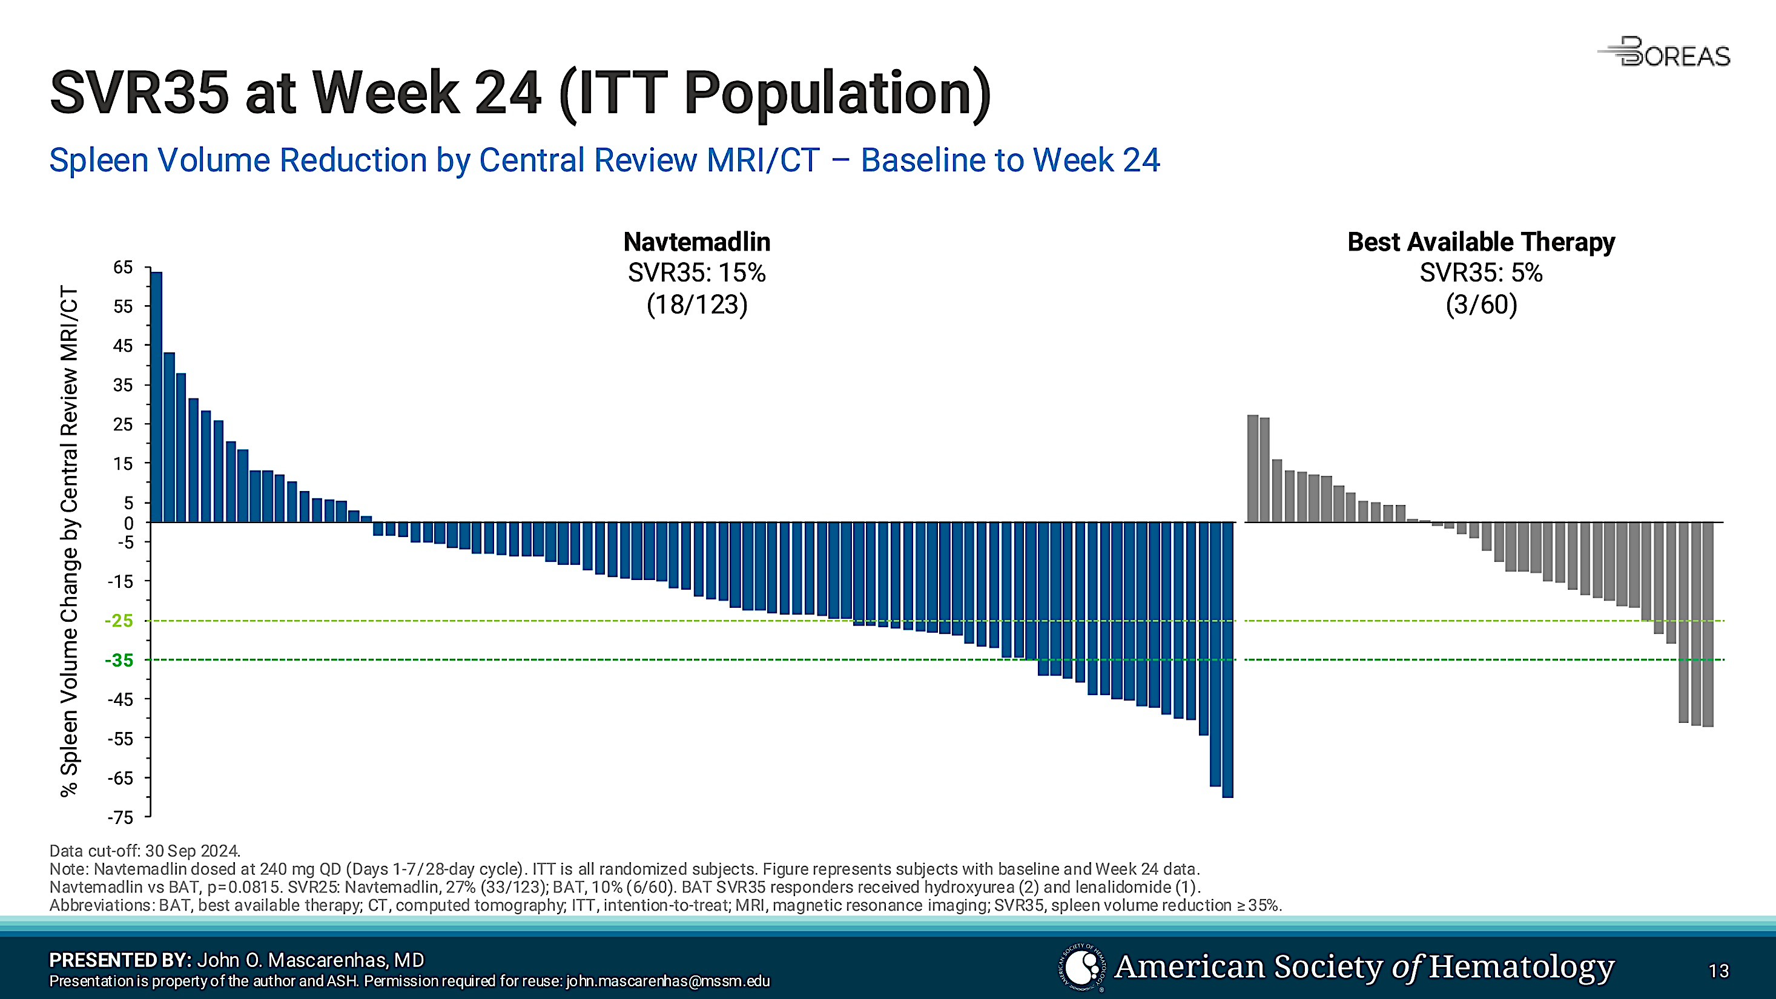
Mascarenhas et al. ASH 2024;Abstract 1000
Courtesy of John Mascarenhas, MD

Slide 69
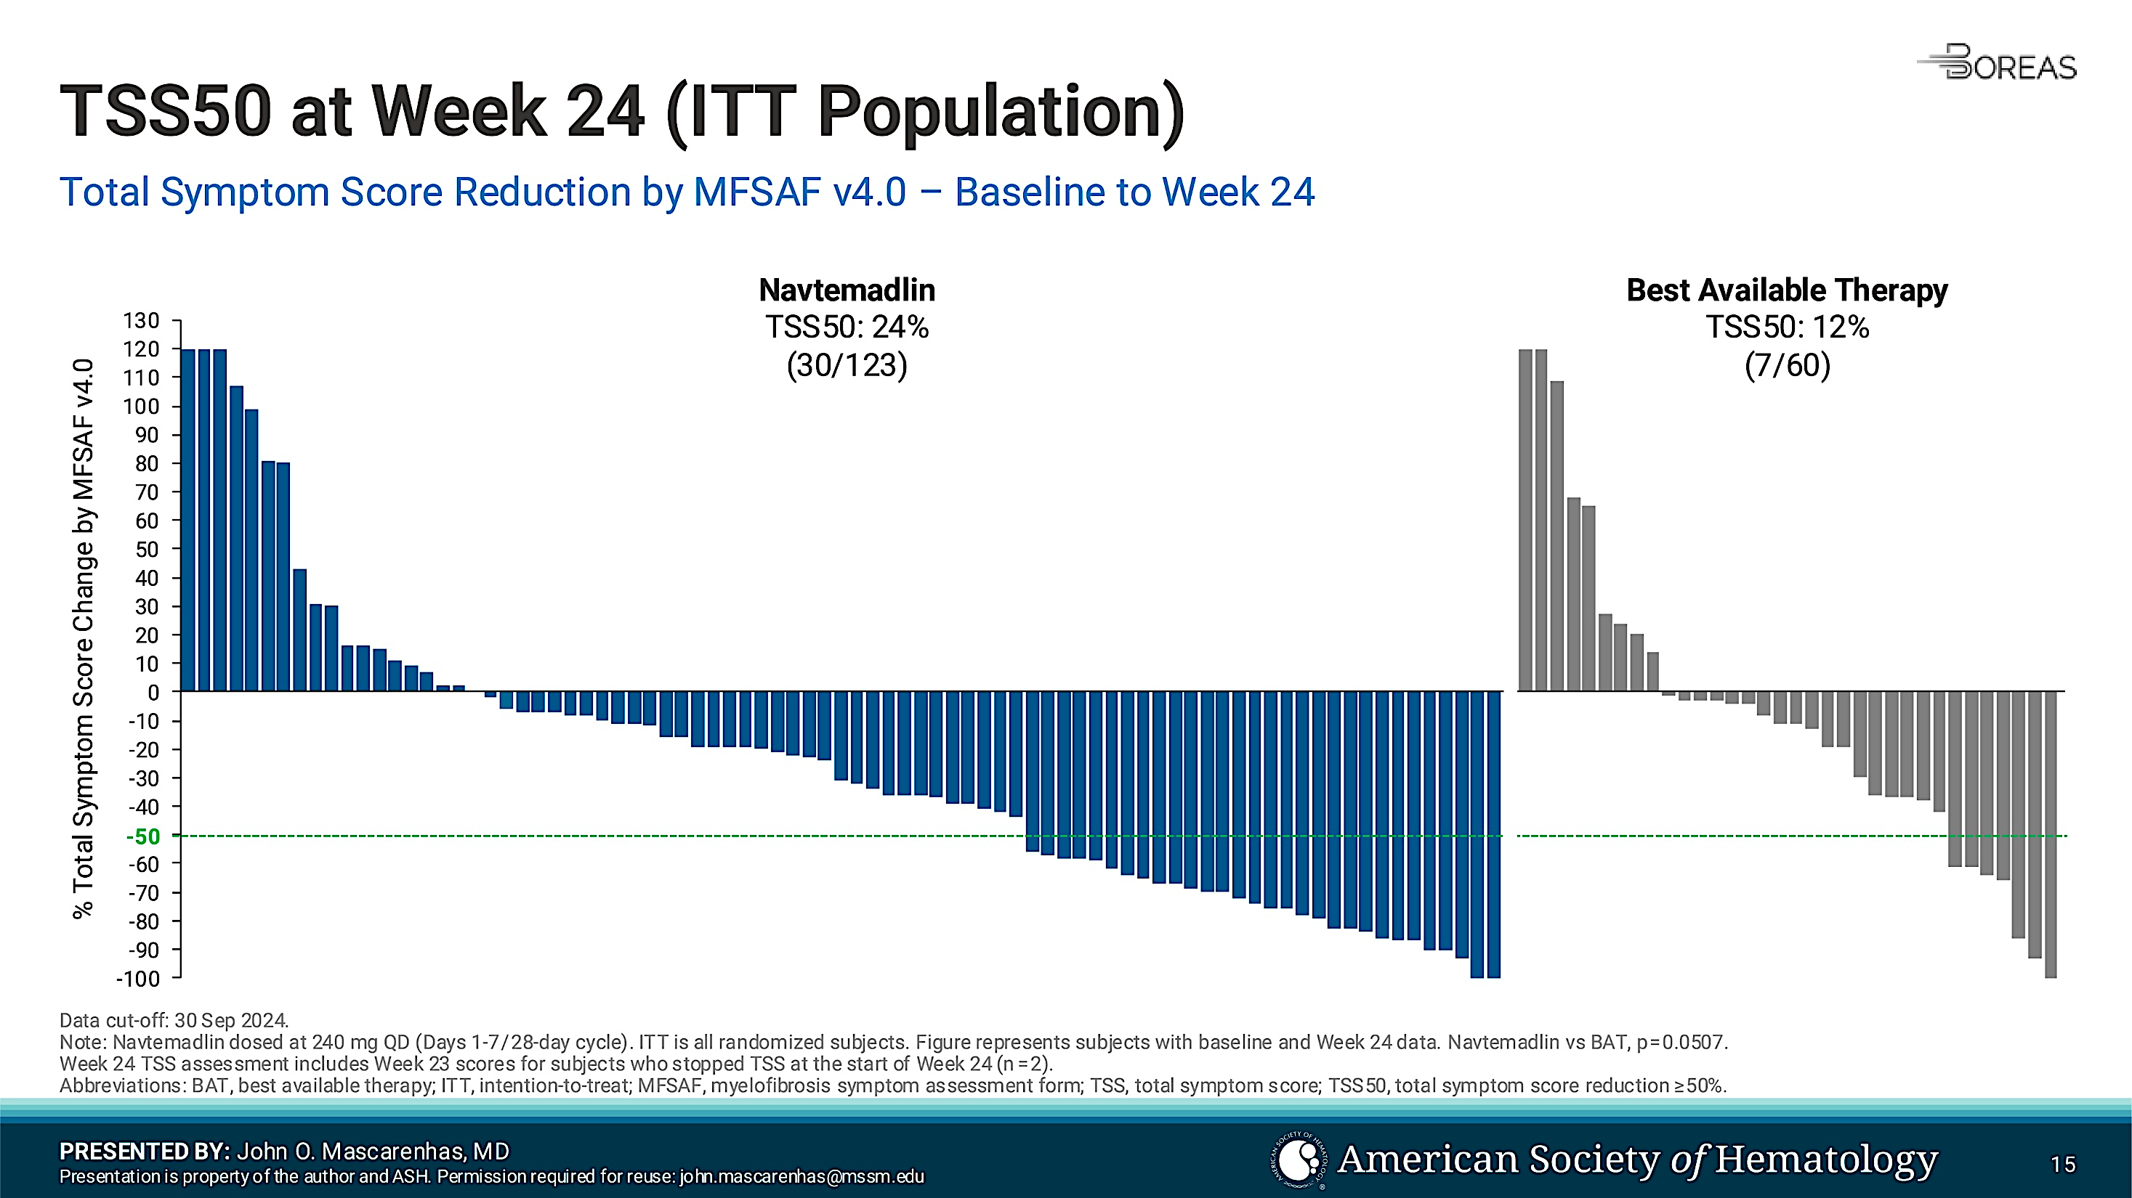
Mascarenhas et al. ASH 2024;Abstract 1000
Courtesy of John Mascarenhas, MD

Slide 70
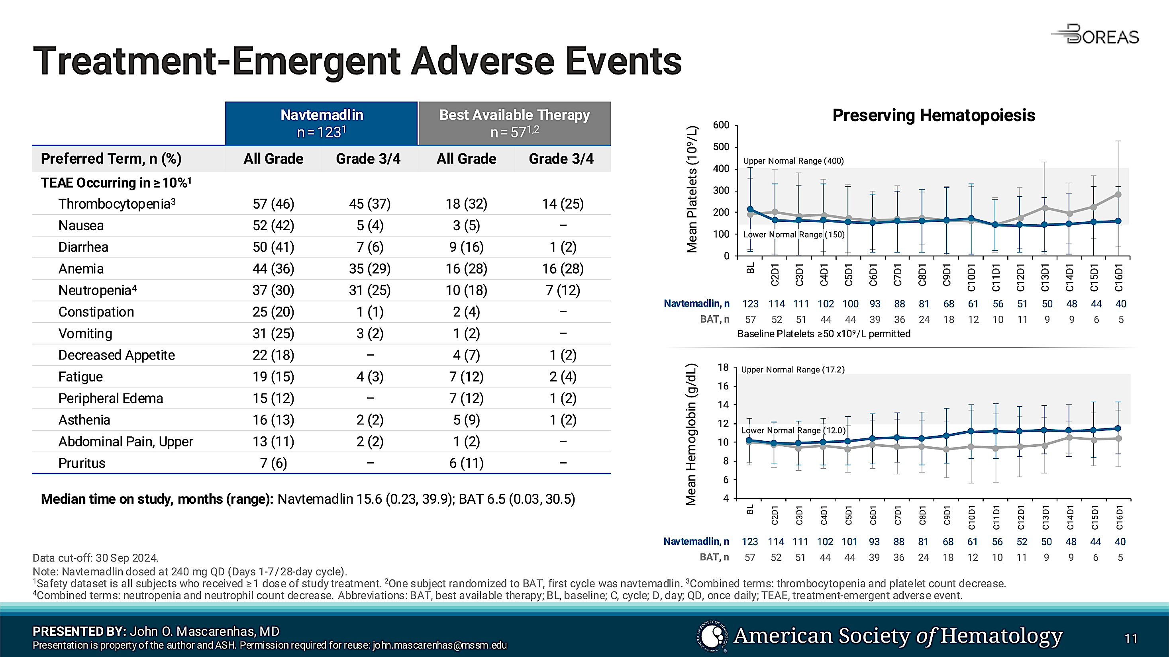
Mascarenhas et al. ASH 2024;Abstract 1000
Courtesy of John Mascarenhas, MD

Slide 71
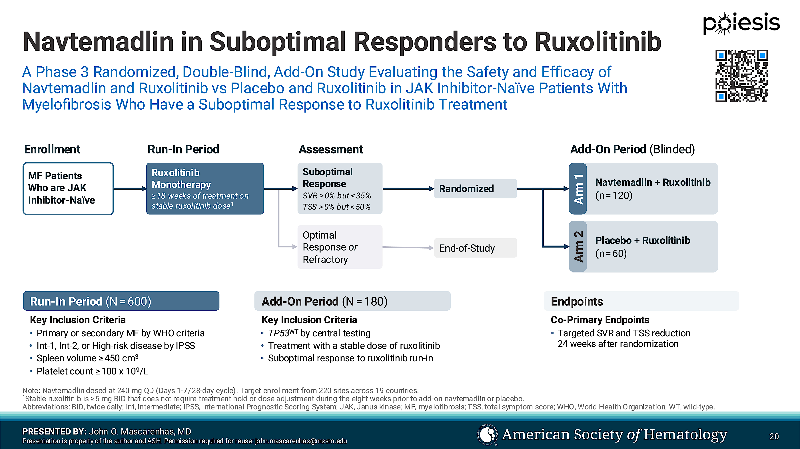
Mascarenhas et al. ASH 2024;Abstract 1000
Courtesy of John Mascarenhas, MD

Slide 72
AGENDA Year in Review: Management of Myelofibrosis
INTRODUCTION:
The New Trastuzumab?
Off-the-Shelf Allo T-Reg Cell Infusions?
MODULE 1: Myelofibrosis 2025 — JAK Inhibitors (Ruxolitinib)
MODULE 2: BET Inhibitors — Pelabresib
MODULE 3: Navtemadlin
MODULE 4: Selinexor and Elritercept

Slide 73
The Efficacy and Safety of Selinexor in Combination with Ruxolitinib in Ruxolitinib-Treated Myelofibrosis Patients: the Interim Analysis of a Prospective, Open-Label, Multicenter, Parallel-Cohort, Phase 2 Study
Minghui Duan, Lan Ma , Qiuling Wu, Hong Liang, Wei Wang, Shaoling Wu, Lijun Mu, Hai Lin, Hebing Zhou, Hong-Xia Shi, MD, Jinghua Wang, Hongmei Jing
Courtesy of John Mascarenhas, MD

Slide 74
Hematological Improvement and Other Clinical Benefits of Elritercept as Monotherapy and in Combination with Ruxolitinib in Participants with Myelofibrosis from the Ongoing Phase 2 RESTORE Trial
Claire Harrison, MD, FRCP, FRCPath
Professor of Myeloproliferative Neoplasms and Deputy Chief Medical Officer (Research, Data, and Analytics) of the Guy’s and St. Thomas’ NHS Foundation Trust, UK
Courtesy of John Mascarenhas, MD

