Slide 1
Year in Review — Clinical Investigator Perspectives on the
Most Relevant New Datasets and Advances in Oncology
Current Role of Covalent Bruton Tyrosine Kinase Inhibitors and Bcl-2 Inhibitors in the Treatment of Chronic Lymphocytic Leukemia
Paolo Ghia, MD, PhD

Slide 2
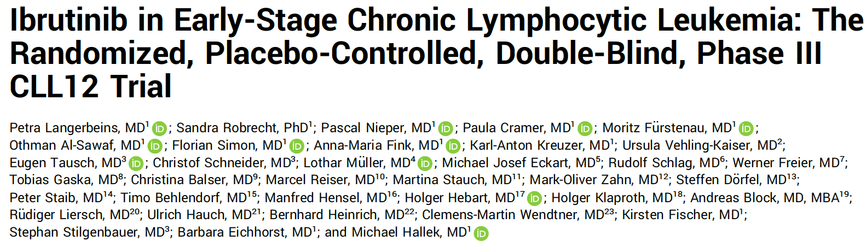
J Clin Oncol 2025 February;43(4):392-402.

Slide 3
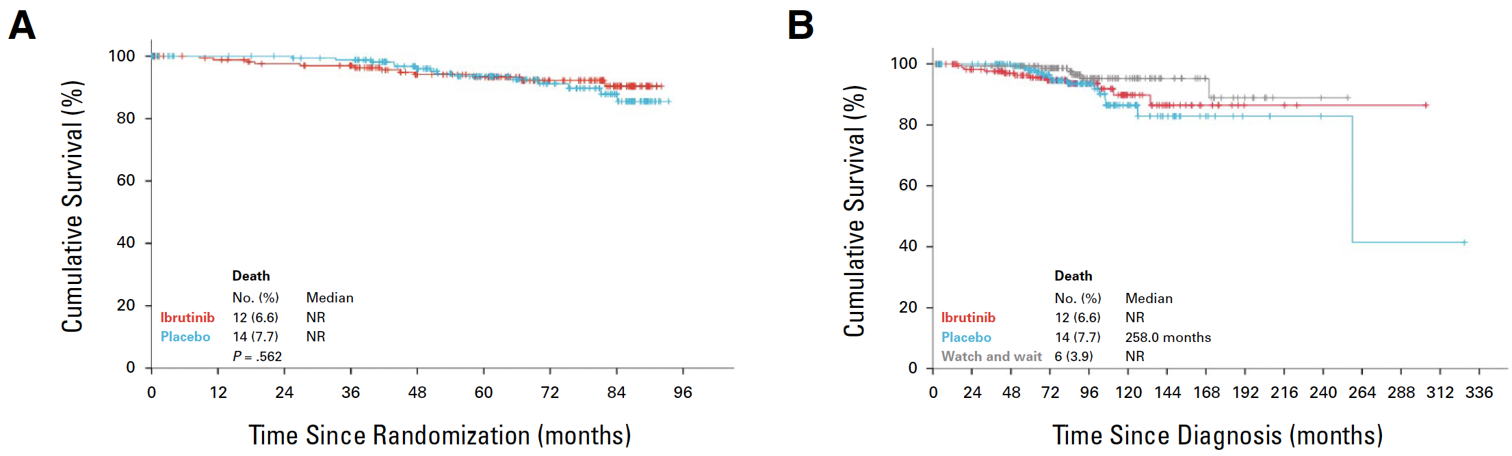
Phase III CLL12 Study: Ibrutinib versus Placebo for Early-Stage Chronic Lymphocytic Leukemia (CLL)
10-year OS
(from CLL diagnosis)
5-year OS
5-year survival
Ibrutinib 93.3% (89.3 – 97.3)
Placebo 93.6% (89.5 – 97.7)
Watch and wait 97.9% (95.6 – 100)
P = 0.562
10-year survival
Ibrutinib 89.8% (83.3 – 96.3)
Placebo 86.5% (78.7 – 94.3)
Watch and wait 95.3% (91.1 – 99.4)
OS = overall survival
Langerbeins P et al. J Clin Oncol 2025 February;43(4):392-402.

Slide 4
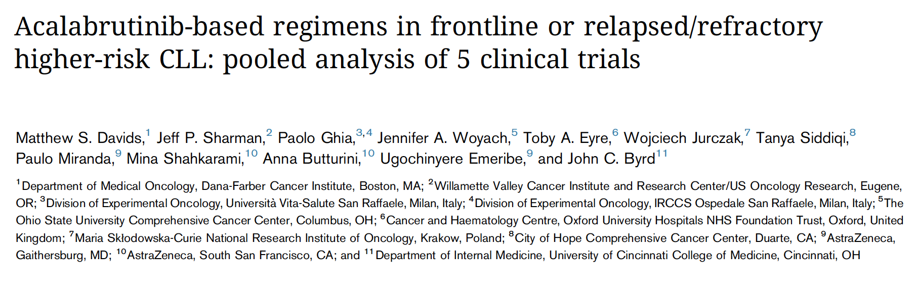
Blood Adv 2024 July 9;8(13):3345-59.

Slide 5
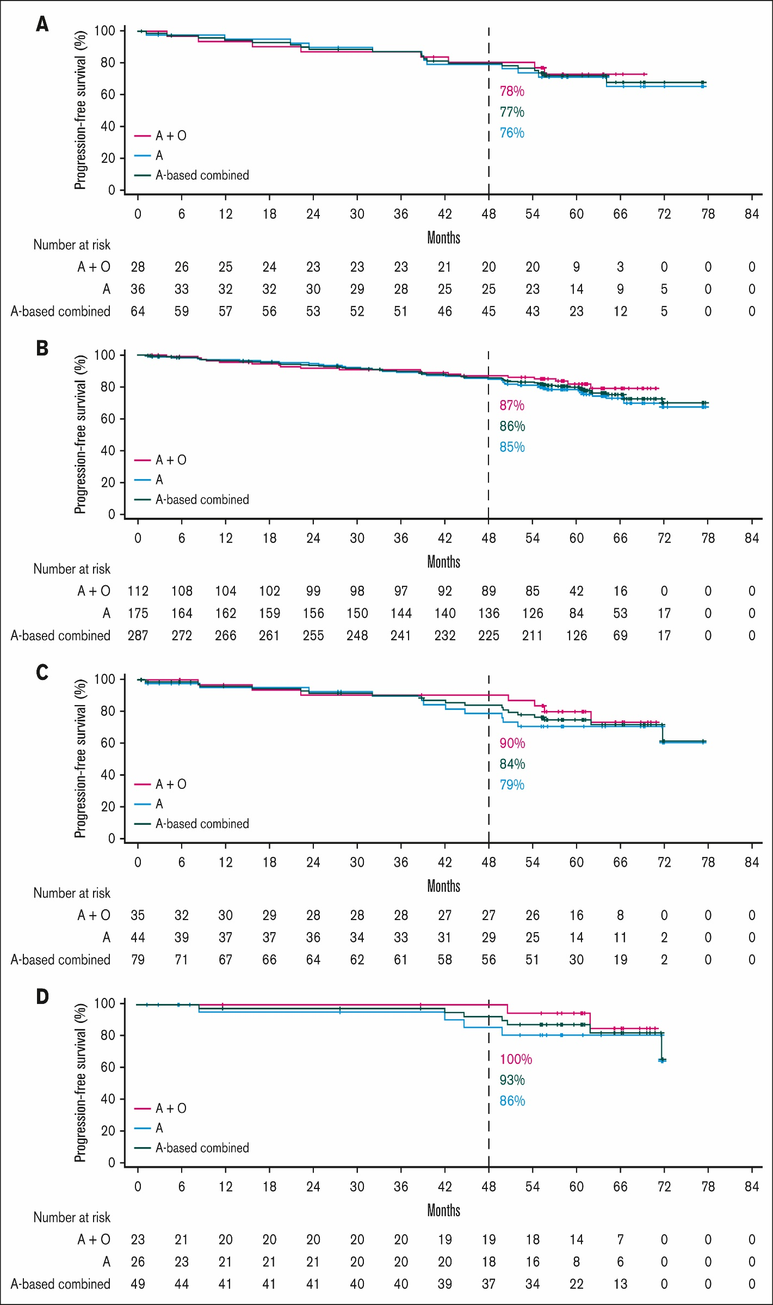
Pooled Analysis of 5 Clinical Trials of Acalabrutinib: Survival by Genetic Features in Patients with Treatment-Naïve Disease
del(17p)/TP53m
CK overall
CK without del(17p)/TP53m
uIGHV
Davids MS et al. Blood Adv 2024 July 9;8(13):3345-59.

Slide 6
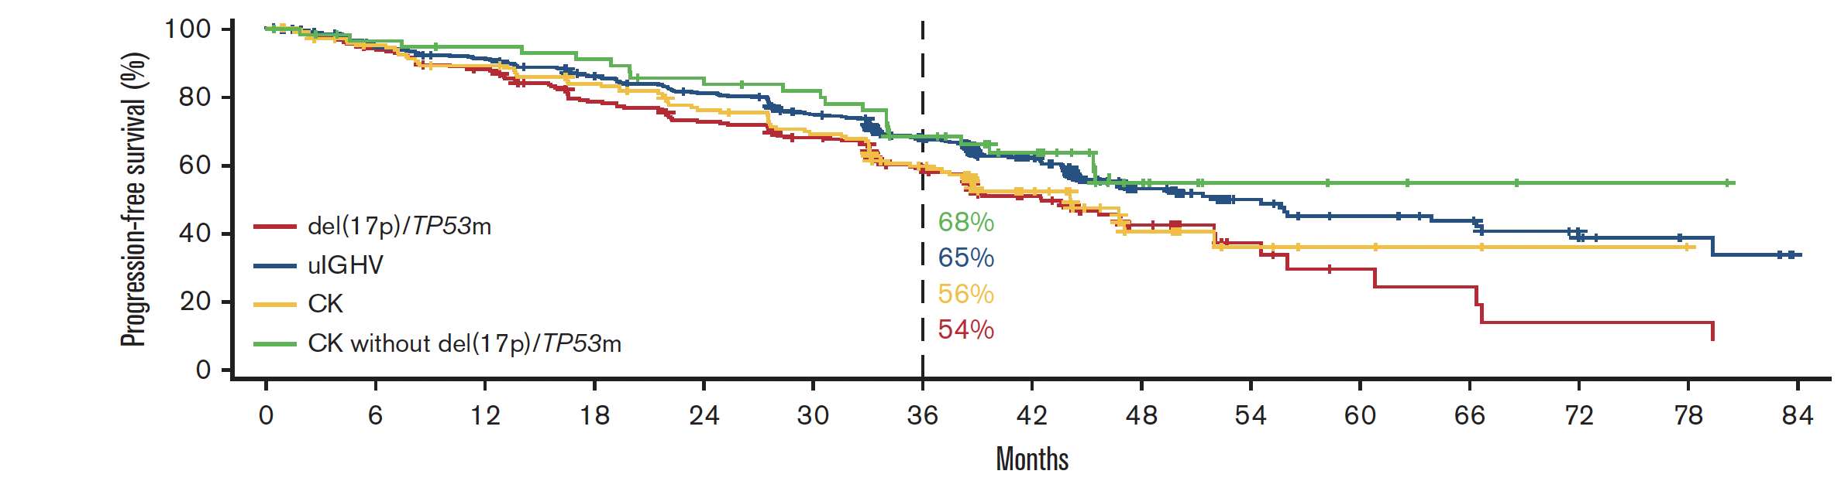
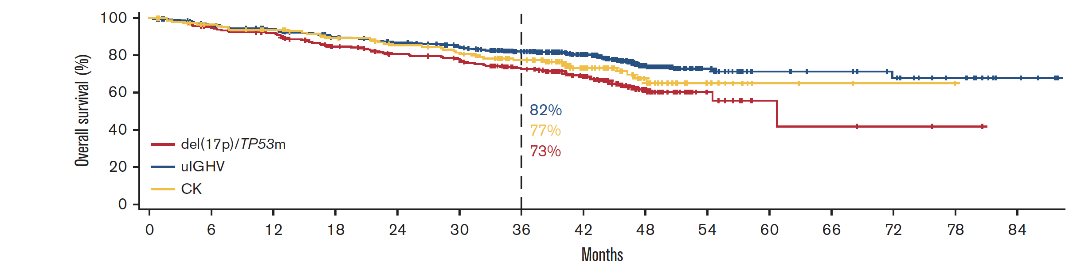
Pooled Analysis of 5 Clinical Trials of Acalabrutinib: Survival by Genetic Features in Patients with Relapsed/Refractory Disease
Davids MS et al. Blood Adv 2024 July 9;8(13):3345-59.

Slide 7
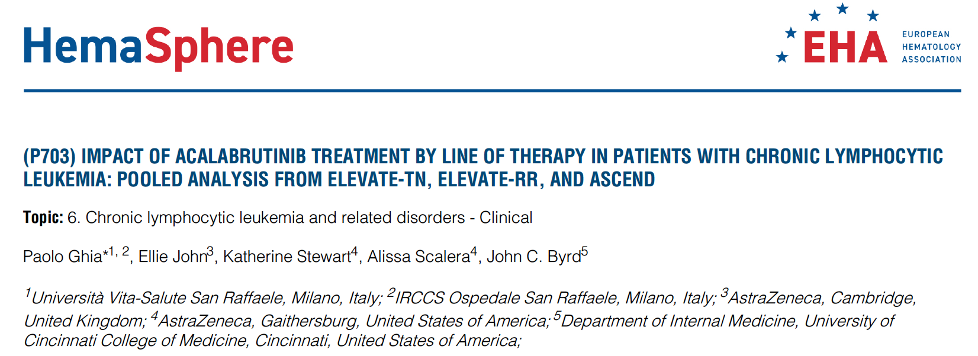

Slide 8
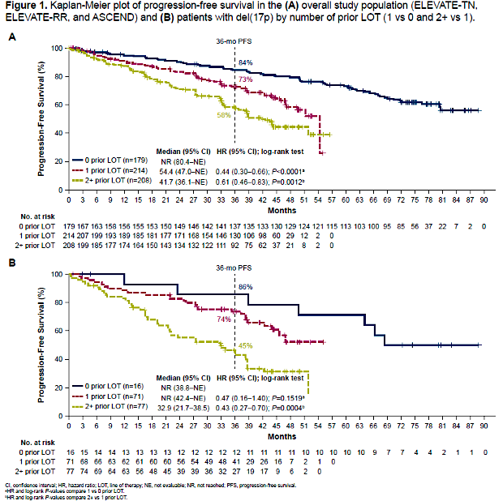
Impact of Acalabrutinib by Line of Therapy (LOT): Pooled Analysis from the ELEVATE-TN, ELEVATE-RR and ASCEND Trials – Overall Population
Overall study population
(ELEVATE-TN, ELEVATE-RR, ASCEND)
Ghia P et al. EHA 2024;Abstract P703.

Slide 9
Impact of Acalabrutinib by Line of Therapy (LOT): Pooled Analysis from ELEVATE-TN, ELEVATE-RR and ASCEND – Del(17p) Population
Patients with del(17p)
(by number of prior LOT)
Ghia P et al. EHA 2024;Abstract P703.

Slide 10
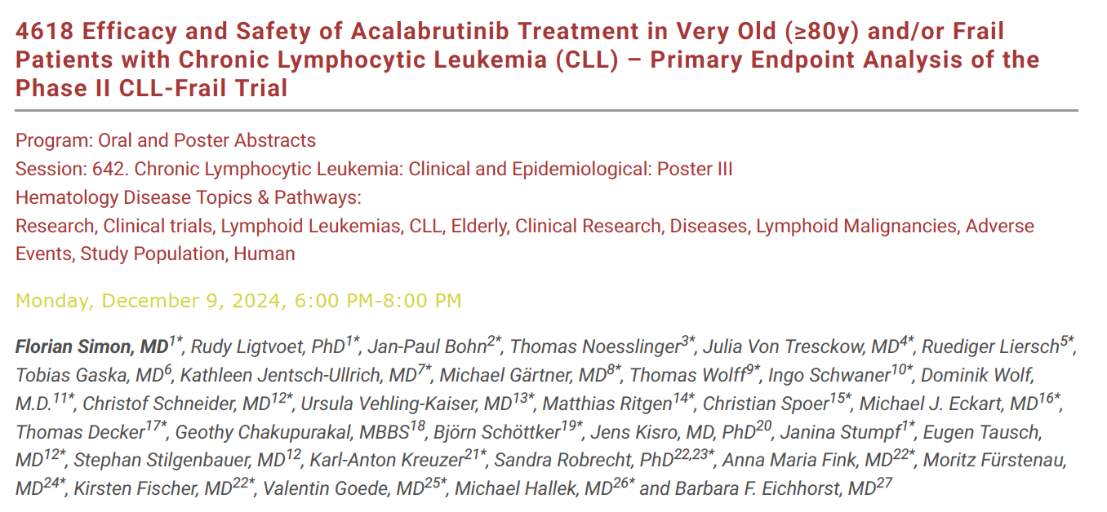
ASH 2024

Slide 11
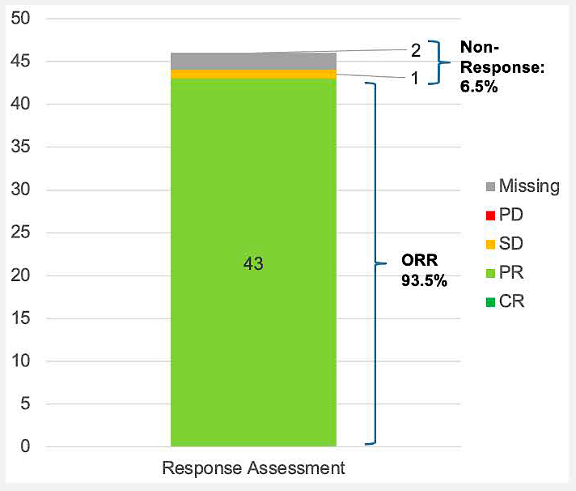
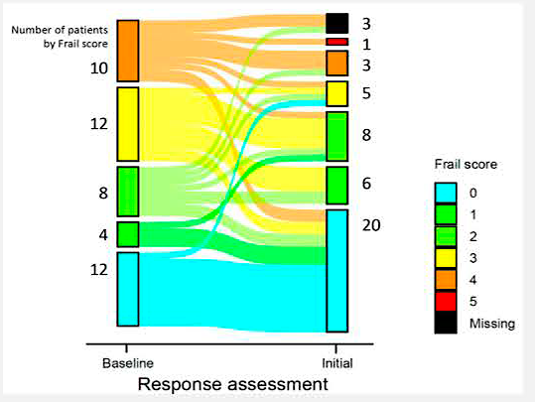
Phase II CLL-Frail Study of Acalabrutinib for Very Old (≥80 Years) and/or Frail Patients: ORR and Frailty Assessment
Simon F et al. ASH 2024;Abstract 4618.

Slide 12
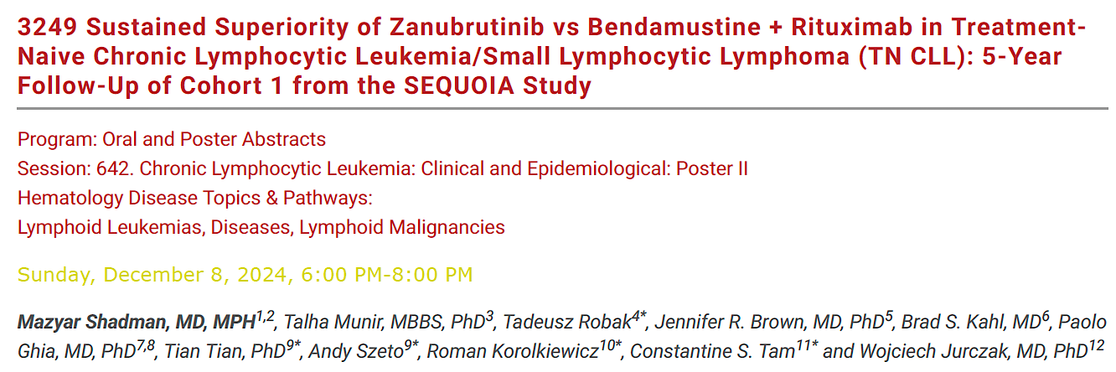
ASH 2024

Slide 13
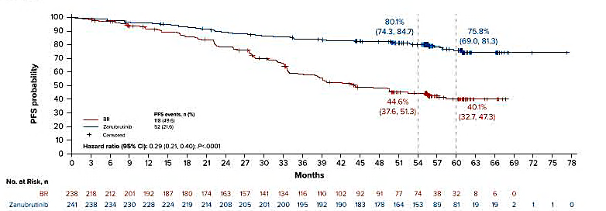
Five-Year Follow-Up of Cohort 1 of the Phase III SEQUOIA
Study of Zanubrutinib versus Bendamustine/Rituximab (BR): Overall Progression-Free Survival (PFS)
Hazard ratio (95% CI): 0.29 (0.21, 0.40); P<.0001
Shadman M et al. ASH 2024;Abstract 3249.

Slide 14
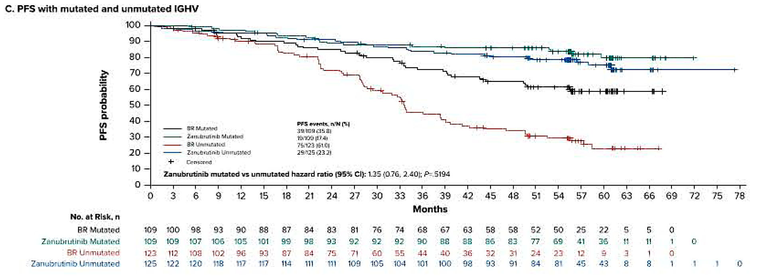
Five-Year Follow-Up of Cohort 1 of the Phase III SEQUOIA
Study of Zanubrutinib versus BR: PFS by IGHV Status
Zanubrutinib mutated vs unmutated hazard ratio (95% CI): 1.35 (0.76, 2.40); P=.5194
Shadman M et al. ASH 2024;Abstract 3249.

Slide 15
Phase III SEQUOIA: Summary
Zanubrutinib offers a sustained PFS benefit compared to BR for treatment-naïve patients with CLL/small lymphocytic lymphoma, with a 71% reduction in risk of disease progression or death (with a median study follow-up of 61.2 months).
  PFS benefit was consistent regardless of IGHV status.
Zanubrutinib was well tolerated, with low rates of atrial fibrillation, infections and adverse events that impact daily living (such as gastrointestinal toxicities).
These data support the use of zanubrutinib as a standard first-line treatment option for patients, regardless of disease risk status.
Shadman M et al. ASH 2024;Abstract 3249.

Slide 16
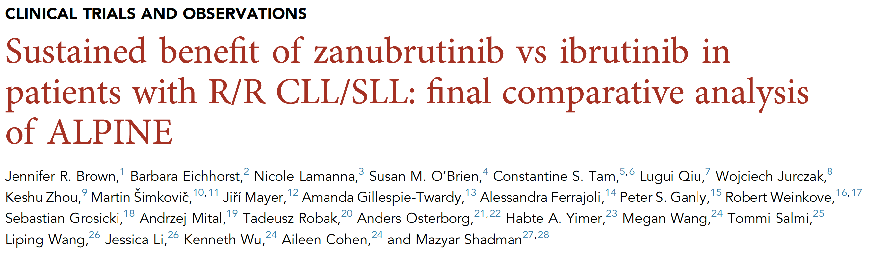
Blood 2024 December 26;144(26):2706-17.

Slide 17
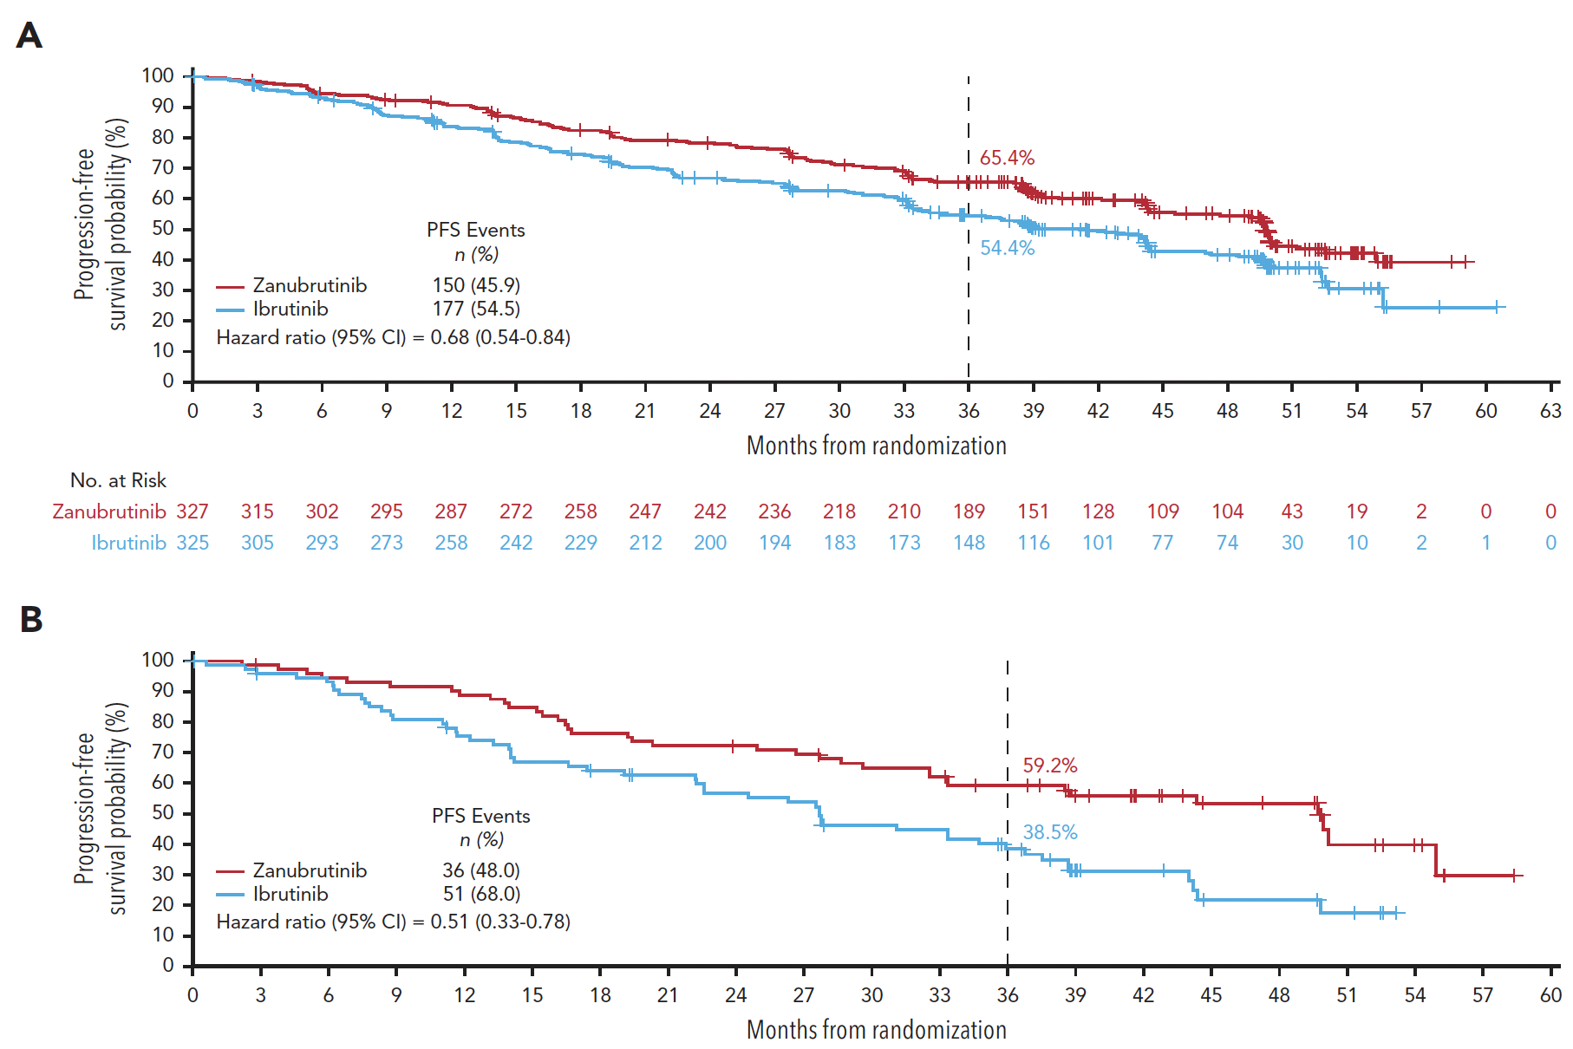
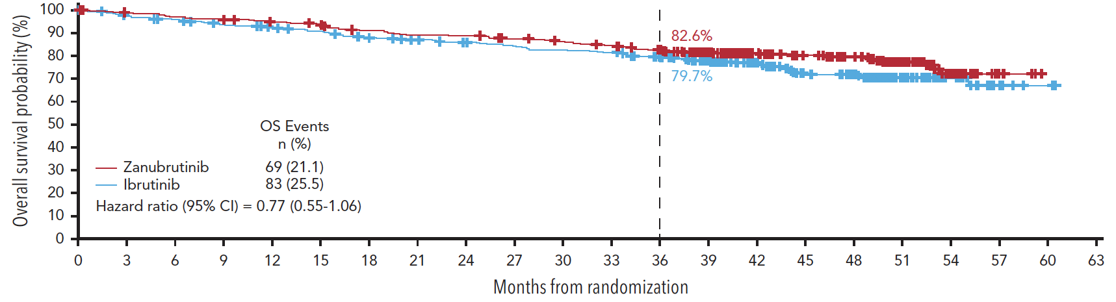
Final Comparative Analysis of the ALPINE Trial (Zanubrutinib versus Ibrutinib)
PFS – Overall population
PFS – Patients with del(17p)/TP53mut
Overall survival
Brown JR et al. Blood 2024 December 26;144(26):2706-17.

Slide 18
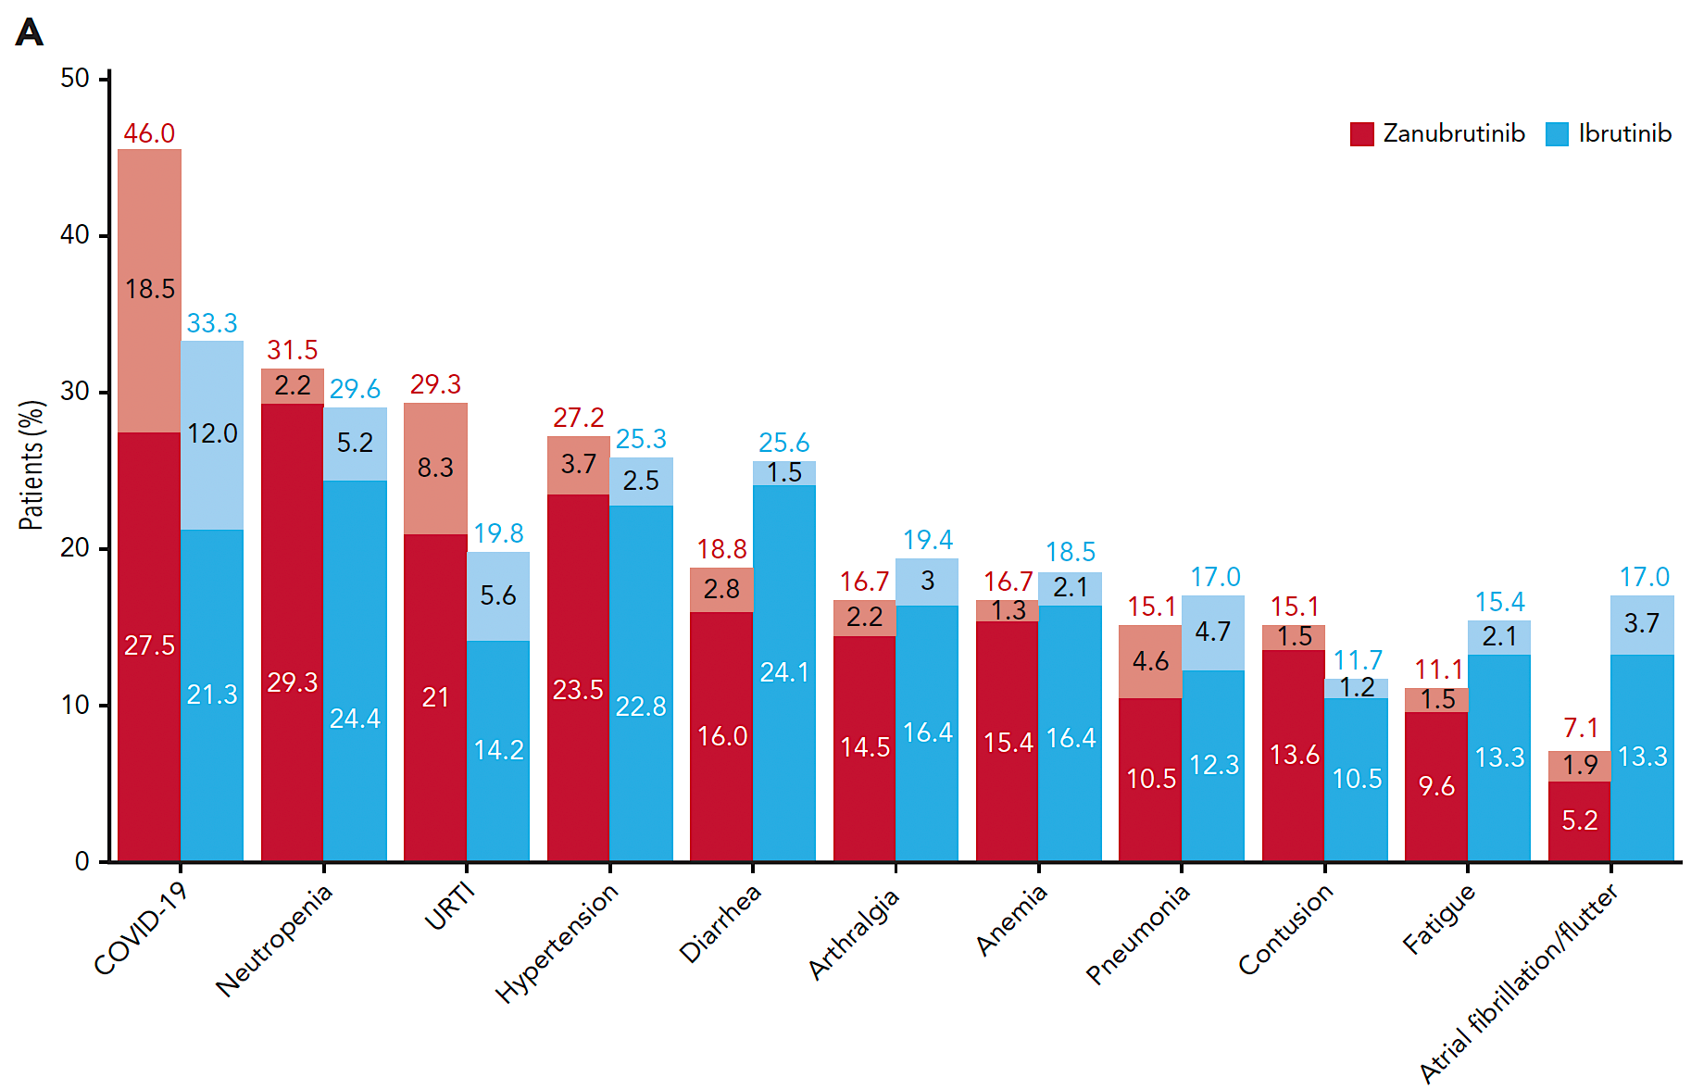
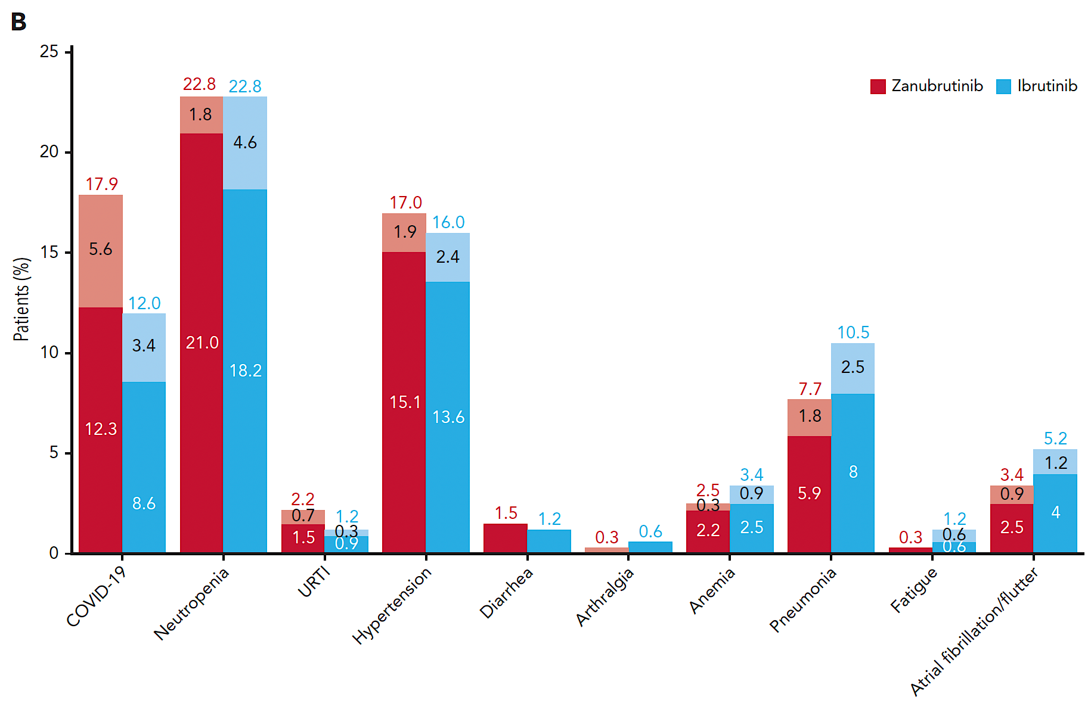
Phase III ALPINE: Safety Profile
All Grade TEAEs in ≥15% of Population
Grade ≥3 TEAEs
TEAEs = treatment-emergent adverse events
Brown JR et al. Blood 2024 December 26;144(26):2706-17.

Slide 19
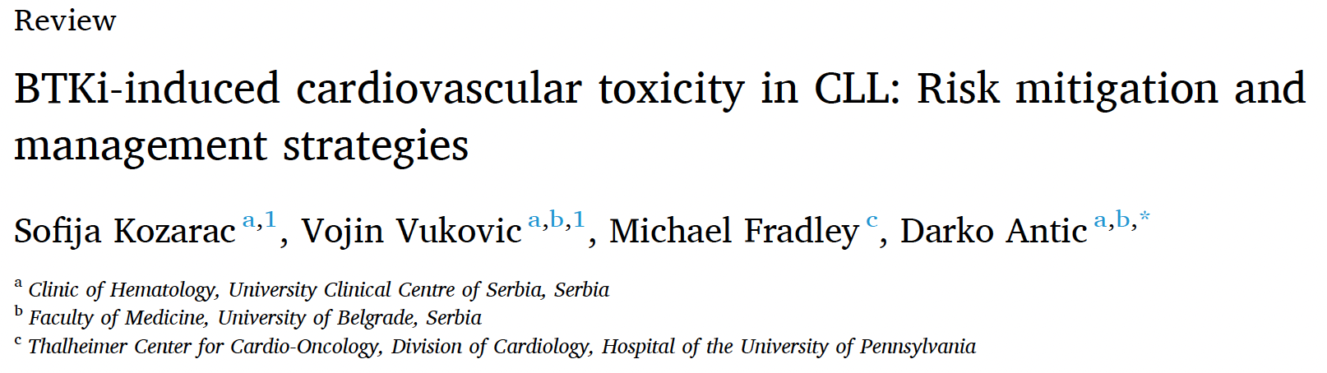
Blood Rev 2025 March;70:101268.

Slide 20
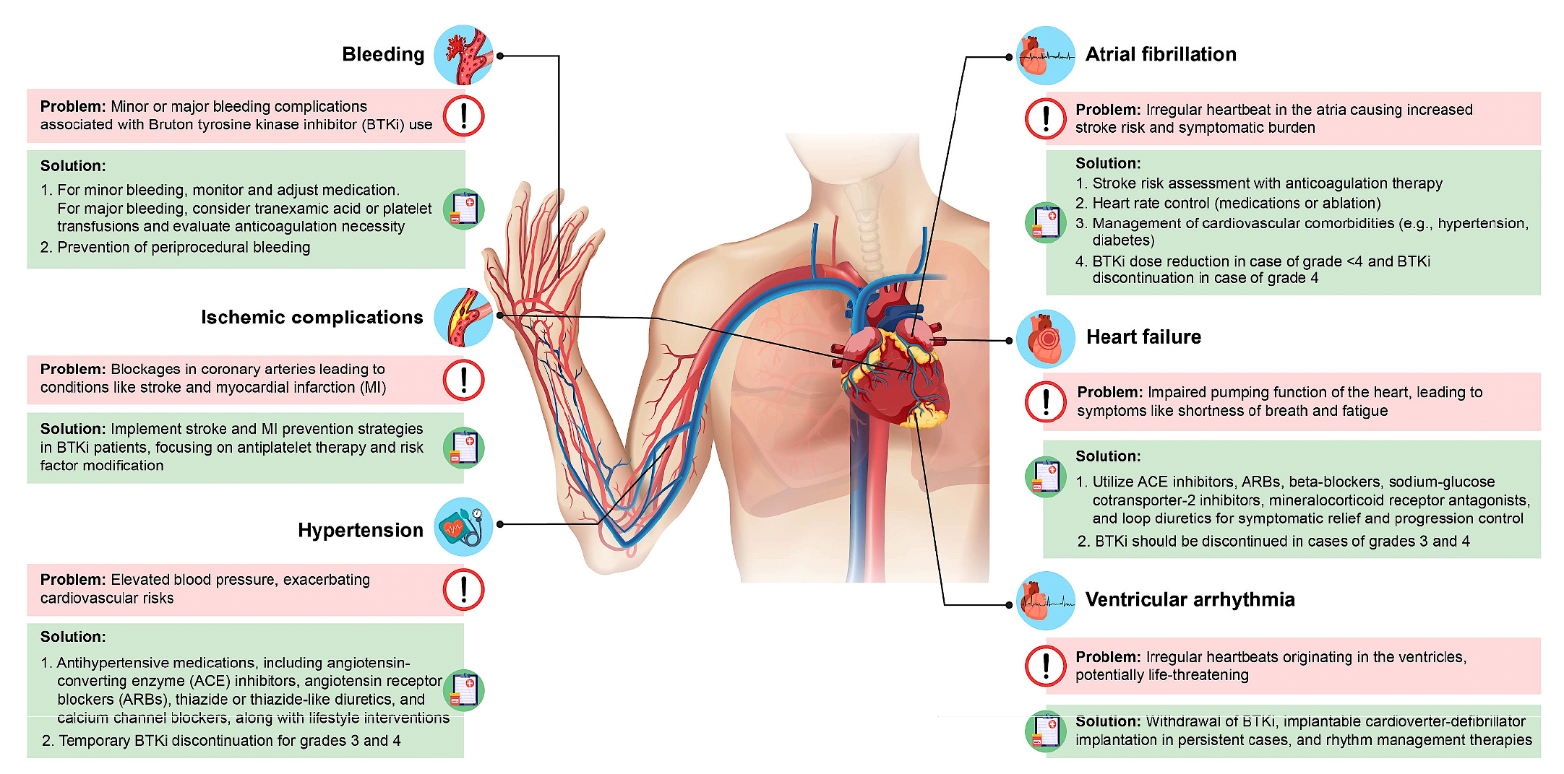
Cardiovascular Adverse Events Associated with BTK Inhibitors for CLL
Kozarac S et al. Blood Rev 2025 March;70:101268.

Slide 21
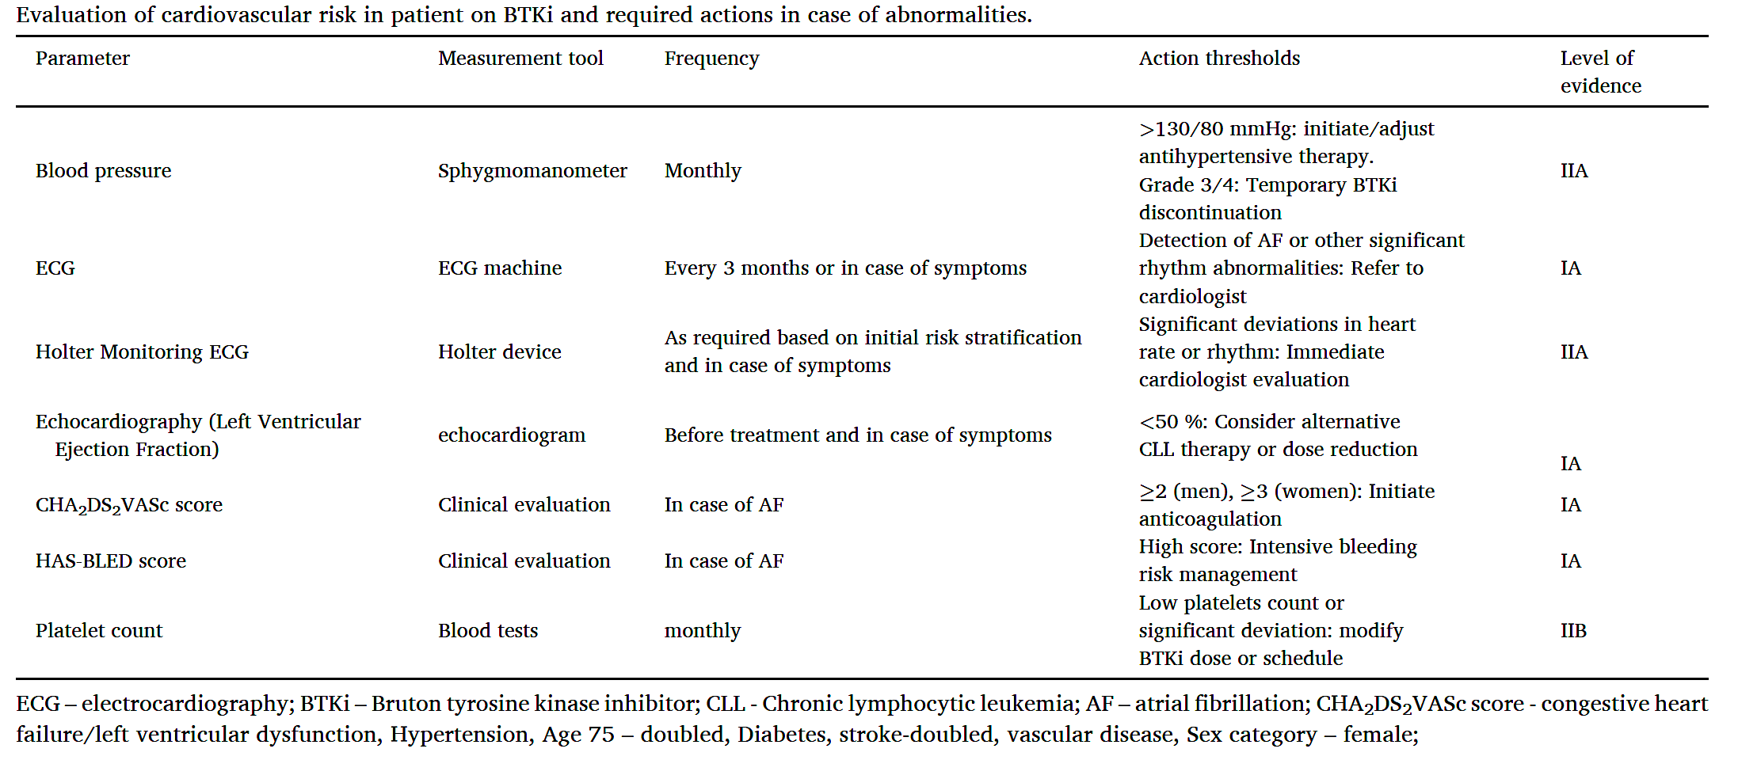
Evaluation of Cardiovascular Risk and Action Thresholds with
BTK Inhibitors
Kozarac S et al. Blood Rev 2025 March;70:101268.

Slide 22
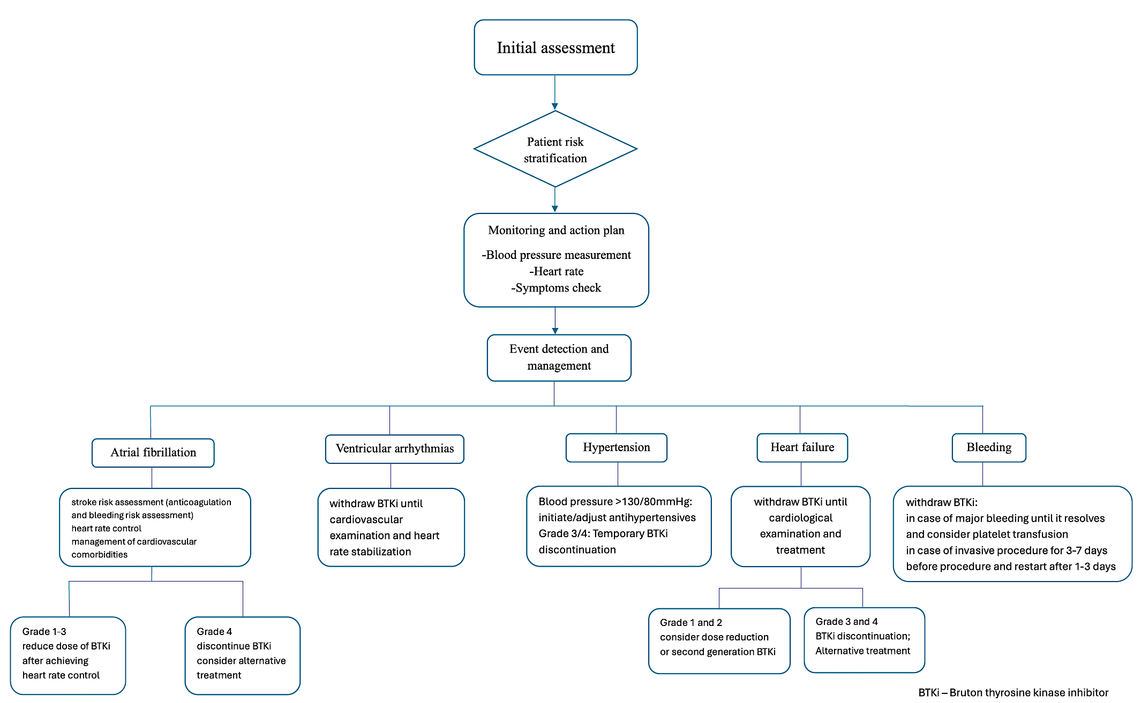
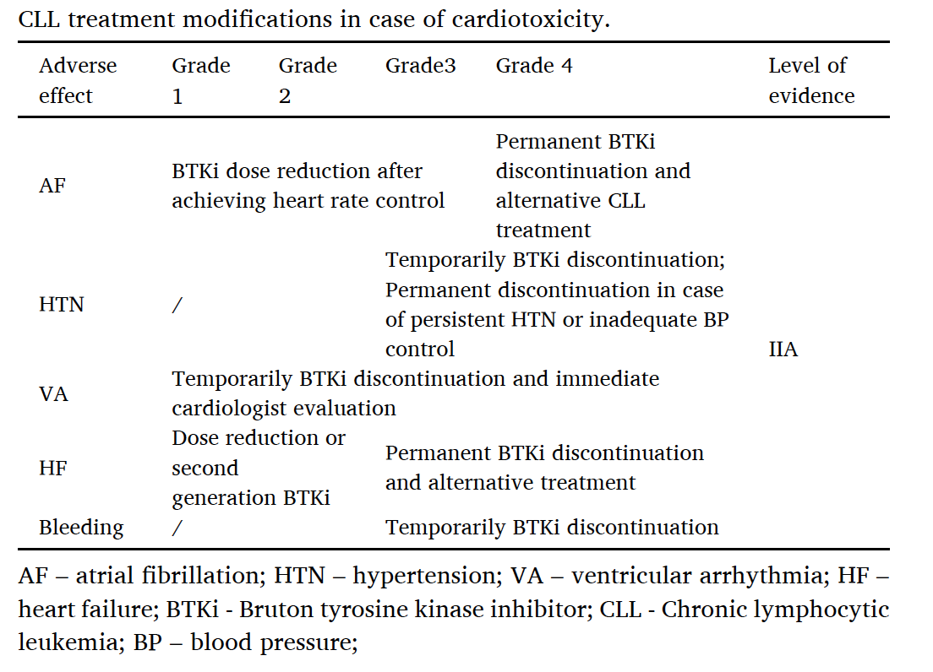
Algorithm for Managing Cardiovascular Toxicity During CLL Treatment
BTKi – Bruton tyrosine kinase inhibitor
Kozarac S et al. Blood Rev 2025 March;70:101268.

Slide 23
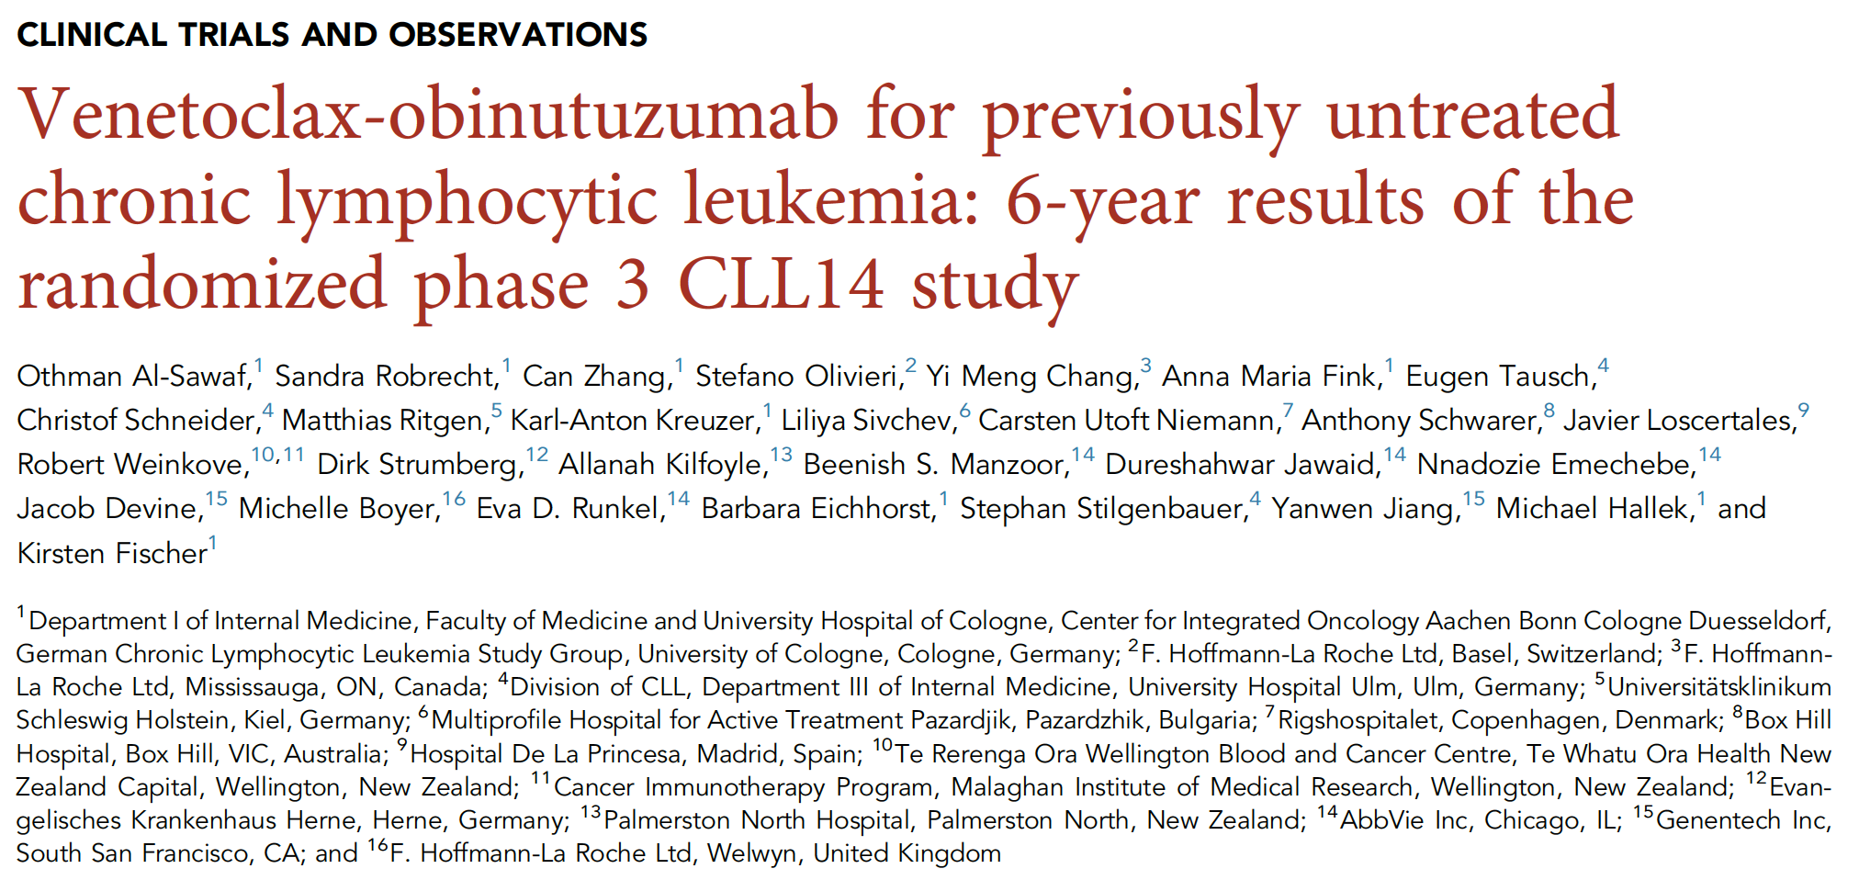
Blood 2024 October 31;144(18):1924-35.

Slide 24
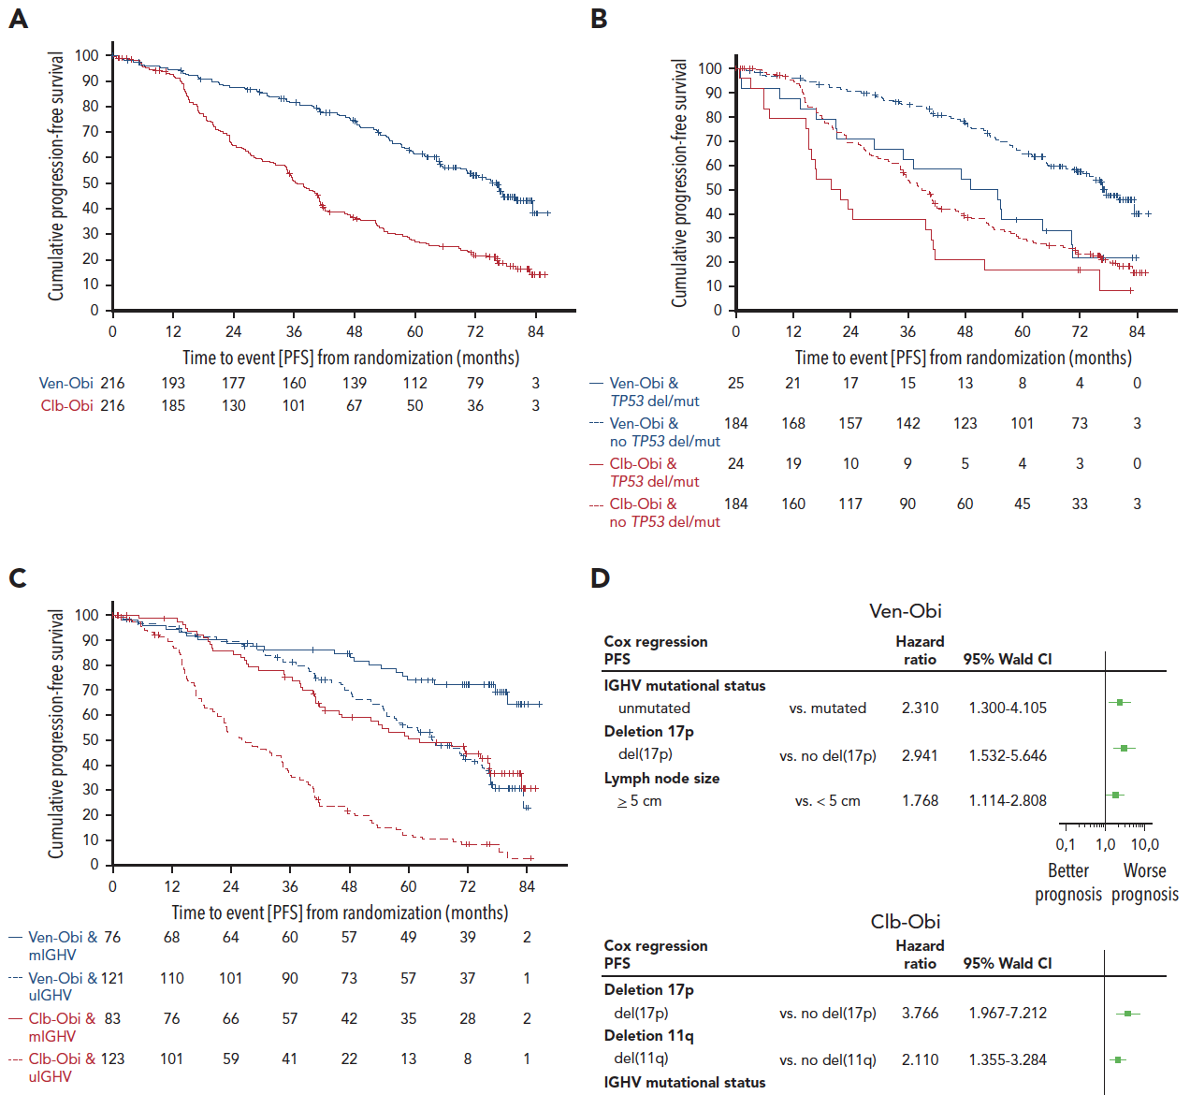
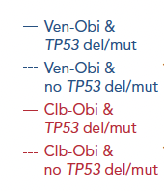
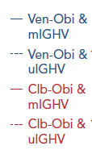

Venetoclax/Obinutuzumab for Previously Untreated CLL:
6-Year Results of the Phase III CLL14 Study – PFS
All patients
TP53 del/mut
IGHV status
 | Median PFS | 6-year PFS rate
Ven-Obi | 76.2 months | 53.1%
Clb-Obi | 36.4 months | 21.7%
 | HR 0.40, 95% CI [0.31-0.52] P<0.0001 | 34 (8.8%)
mPFS, mo | Venetoclax + obinutuzumab | Chlorambucil + obinutuzumab
No TP53 del/mut TP53 del/mut | 76.6 51.9 | 38.9 20.8
IGHV mutated IGHV no mutation | NR 64.8 | 62.2 26.9
Al-Sawaf O et al. Blood 2024 October 31;144(18):1924-35.

Slide 25
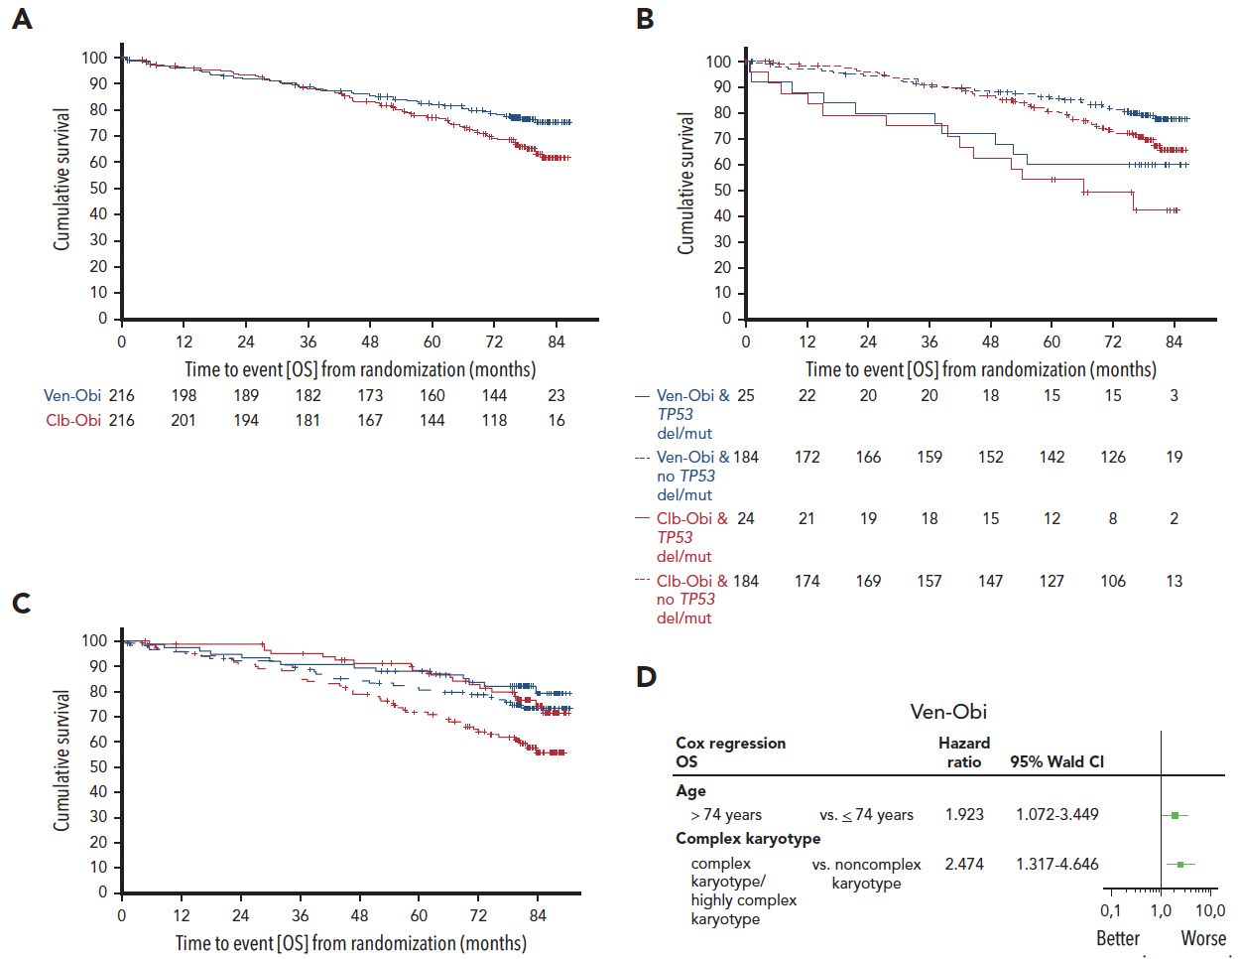
Venetoclax/Obinutuzumab for Previously Untreated CLL:
6-Year Results of the Phase III CLL14 Study – OS
All patients
TP53 del/mut
IGHV status
Al-Sawaf O et al. Blood 2024 October 31;144(18):1924-35.

Slide 26
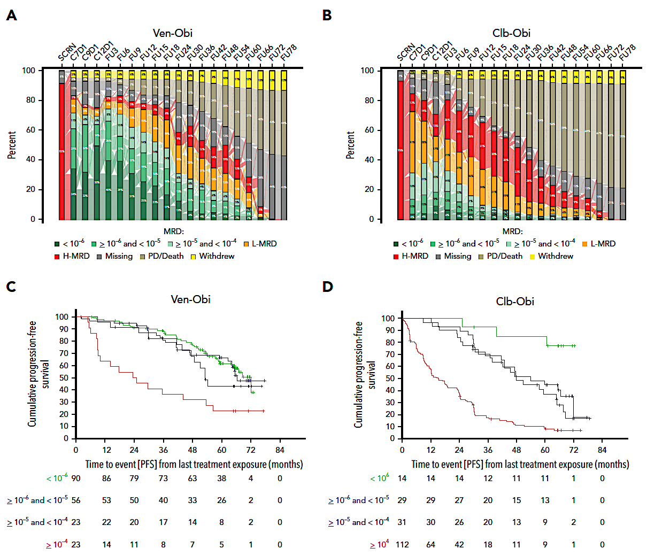
Venetoclax/Obinutuzumab for Previously Untreated CLL: 6-Year Results of the Phase III CLL14 Study – Minimal Residual Disease (MRD)
Al-Sawaf O et al. Blood 2024 October 31;144(18):1924-35.

Slide 27
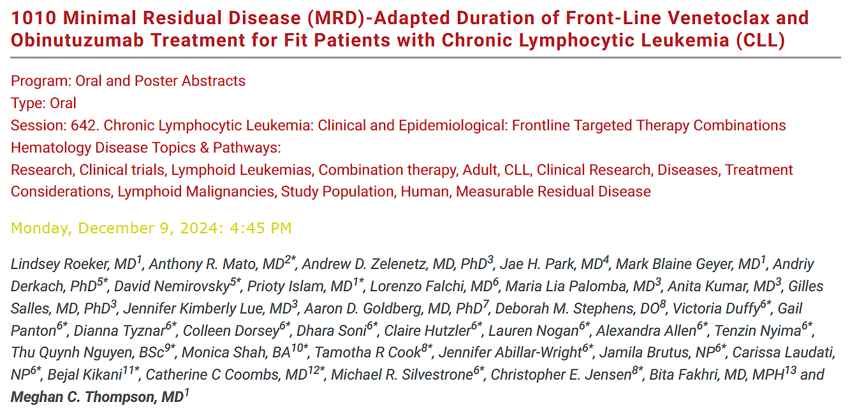
ASH 2024

Slide 28
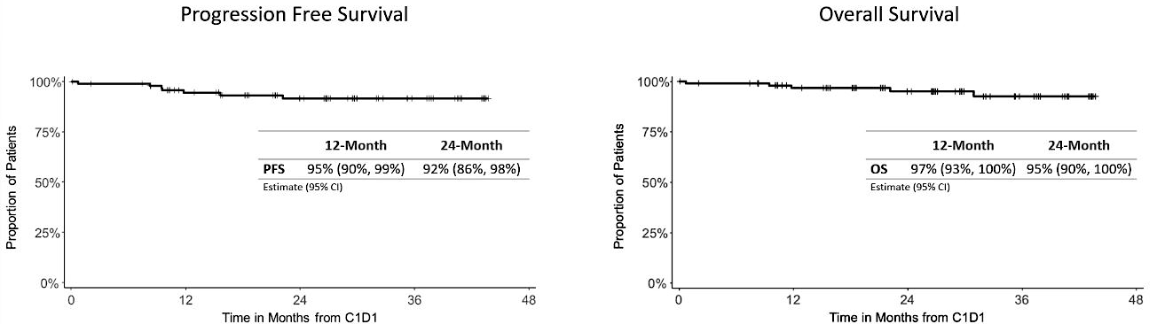
Phase II Study of MRD-Adapted Duration of Front-Line Venetoclax and Obinutuzumab for Fit Patients with CLL: Efficacy
Patients with undetectable (<10⁻⁶) MRD (uMRD6) in peripheral blood (PB) at C9 completed 9C of tx and entered treatment-free observation (TFO).
Patients with detectable MRD (dMRD) at C7 were tested again at C12. Those with uMRD5 (defined as <10⁻⁵) in PB at C12 completed 12C of tx and entered TFO.
Patients who had dMRD at C12 completed 24C of tx and entered TFO regardless of MRD status
Median follow-up: 27 months*
*Data cutoff: 10/18/2024
Thompson M et al. ASH 2024;Abstract 1010.

Slide 29
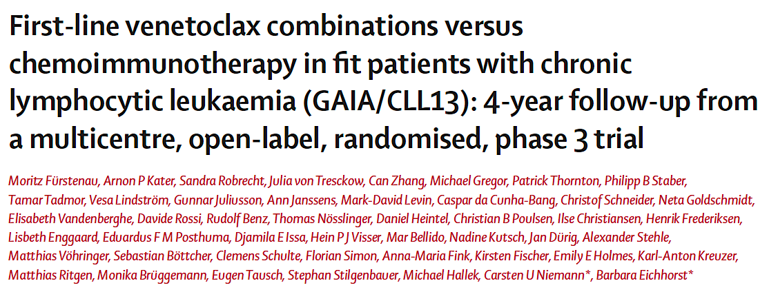
Lancet Oncol 2024 June;25(6):744-59.

Slide 30
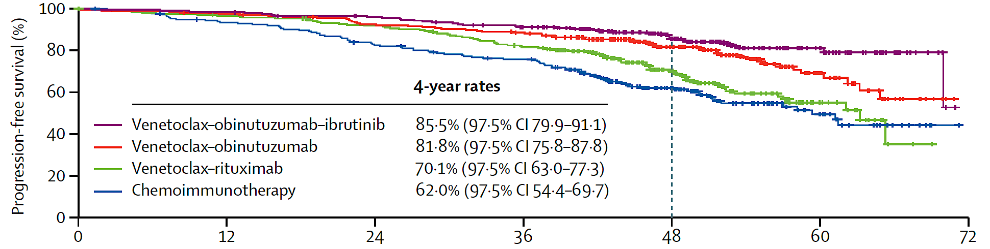

First-Line Venetoclax Combinations versus Chemo-IO for Fit Patients with CLL:
4-Year Follow-Up of the Phase III GAIA/CLL13 Study – Efficacy in ITT Population
Chemo-IO = chemoimmunotherapy; ITT = intention to treat
Fürstenau M et al. Lancet Oncol 2024 June;25(6):744-59.

Slide 31
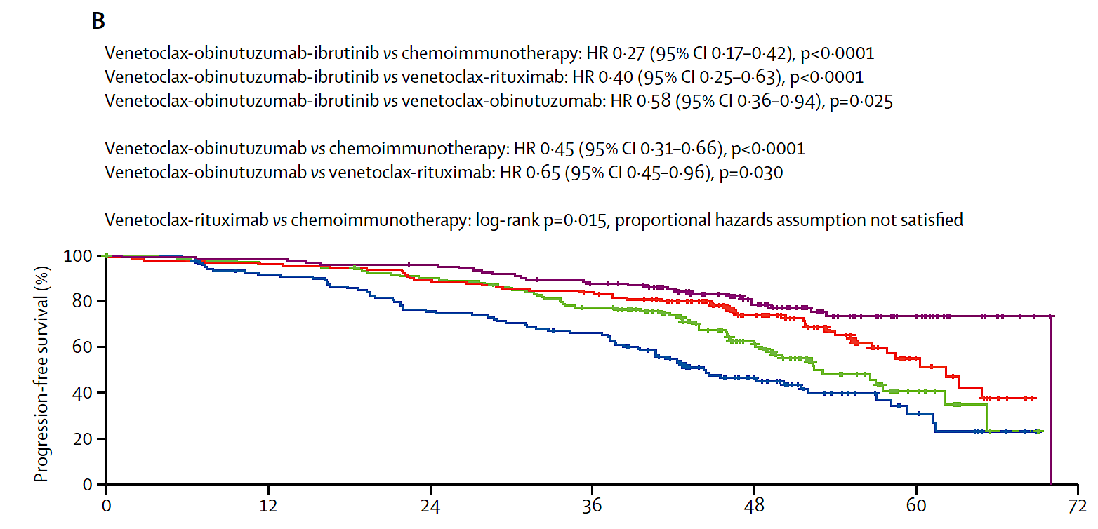
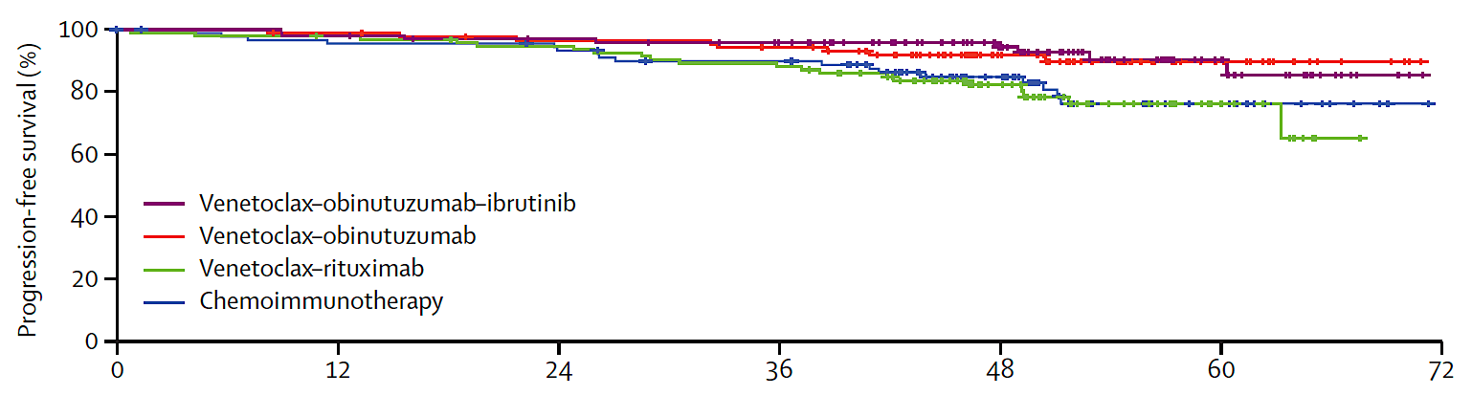

First-Line Venetoclax Combinations versus Chemo-IO for Fit Patients with CLL:
4-Year Follow-Up of the Phase III GAIA/CLL13 Study – Efficacy by IGHV Status
Unmutated IGHV
Mutated IGHV
Fürstenau M et al. Lancet Oncol 2024 June;25(6):744-59.

Slide 32
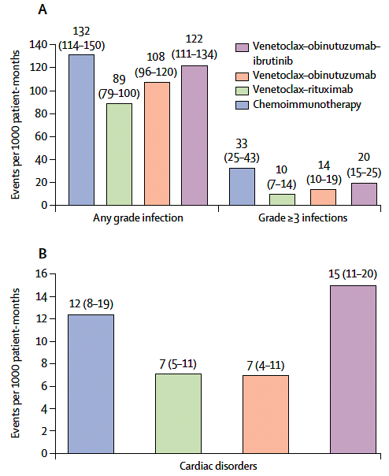
First-Line Venetoclax Combinations versus Chemo-IO for Fit Patients with CLL:
4-Year Follow-Up of the Phase III GAIA/CLL13 Study – Adverse Events of Special Interest
Fürstenau M et al. Lancet Oncol 2024 June;25(6):744-59.

Slide 33
Phase III GAIA/CLL13: Summary
This follow-up analysis supports the use of venetoclax/obinutuzumab for fit patients with previously untreated CLL and encourages a further evaluation of the MRD-guided combination of venetoclax/obinutuzumab/ibrutinib, especially for patients with unmutated IGHV.
Ongoing trials (FLAIR, ALLIANCE A041702, ECOG-ACRIN EA9161, MAJIC, CLL17 and CLL16) will generate evidence by comparing time-limited treatments to continuous treatments or venetoclax/obinutuzumab to venetoclax/BTK inhibitor-based double or triple combinations.
Given the higher rates of infections and cardiac events with venetoclax/
obinutuzumab/ibrutinib, further investigations of this triple combination should also focus on its safety profile.
Fürstenau M et al. Lancet Oncol 2024 June;25(6):744-59.

Slide 34
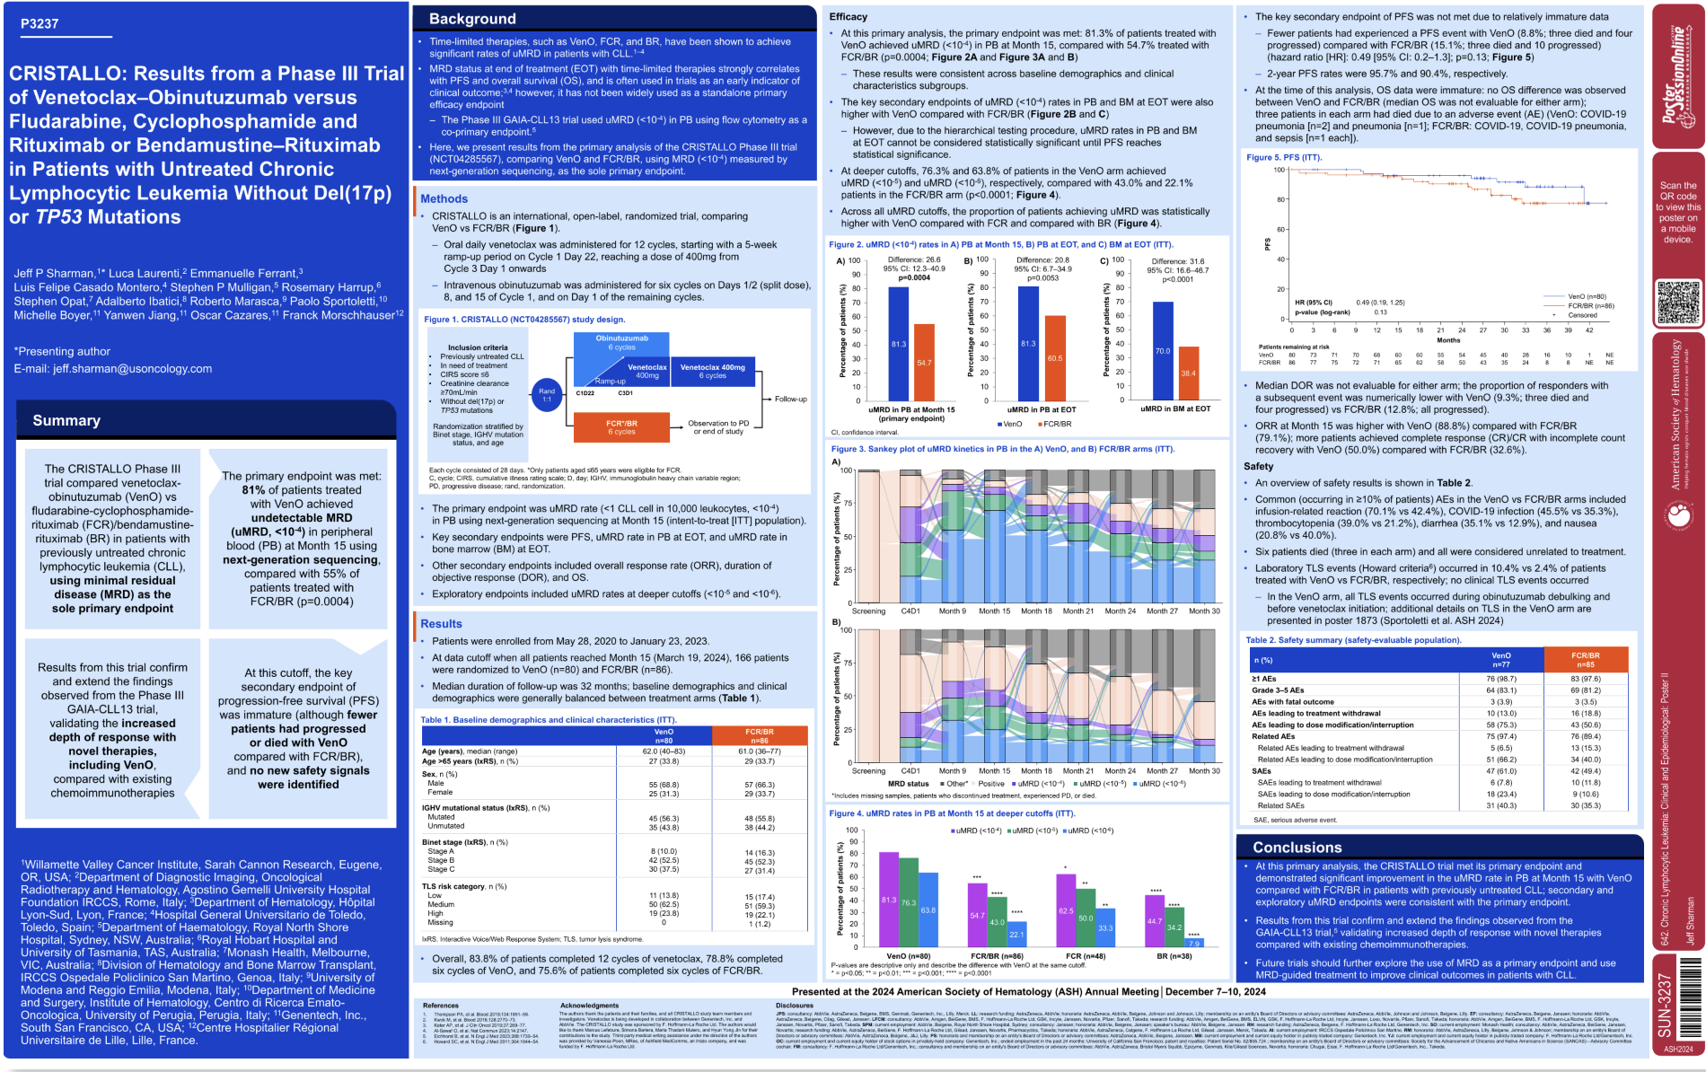
ASH 2024

Slide 35
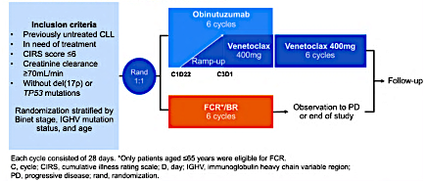
CRISTALLO: A Phase III Trial of Venetoclax/Obinutuzumab versus Fludarabine/Cyclophosphamide/Rituximab (FCR) or BR for Untreated CLL without del(17p) or TP53 Mutations
Sharman J et al. ASH 2024;Abstract 3237.

Slide 36
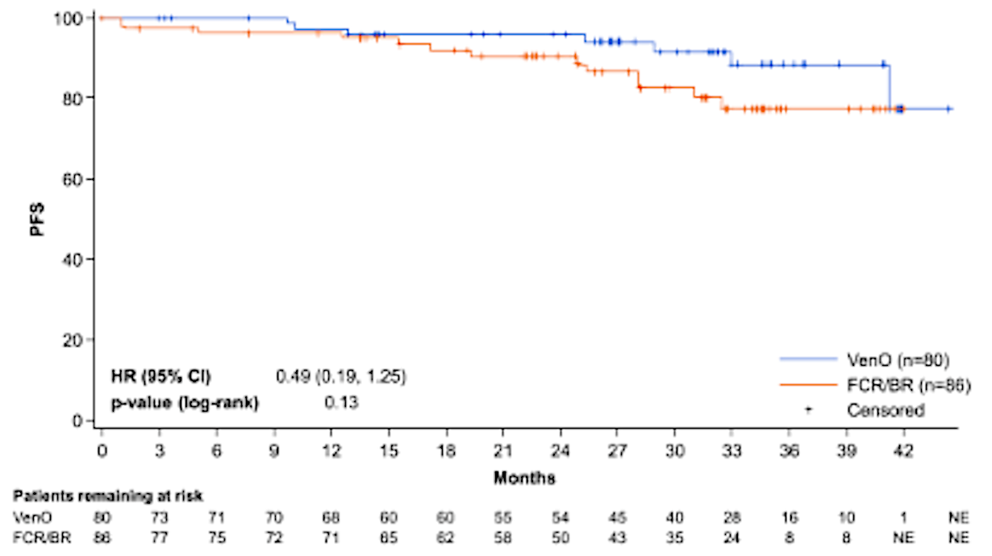
Phase III CRISTALLO: Undetectable MRD (uMRD) and PFS
MRD assessment by NGS (uMRD4)
Secondary endpoint
PB = peripheral blood; EOT = end of therapy; BM = bone marrow; VenO = venetoclax/obinutuzumab
Sharman J et al. ASH 2024;Abstract 3237.

Slide 37
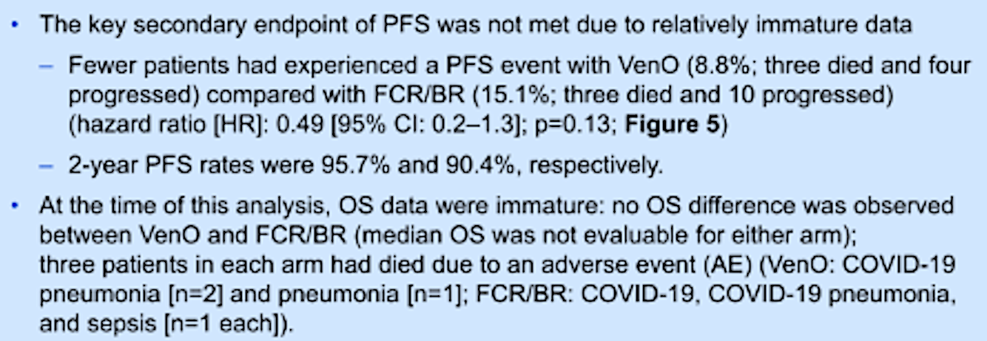
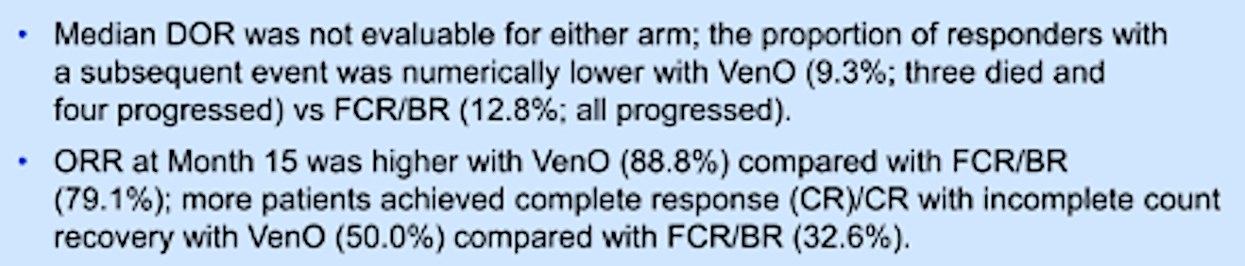
Phase III CRISTALLO: Efficacy Summary
Sharman J et al. ASH 2024;Abstract 3237.

Slide 38
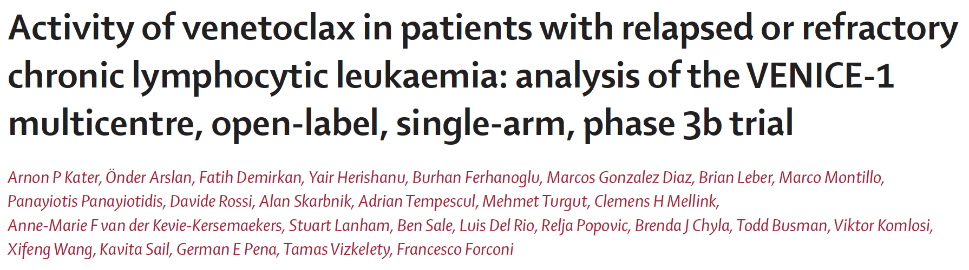
Lancet Oncol 2024 April;25(4):463-73.

Slide 39
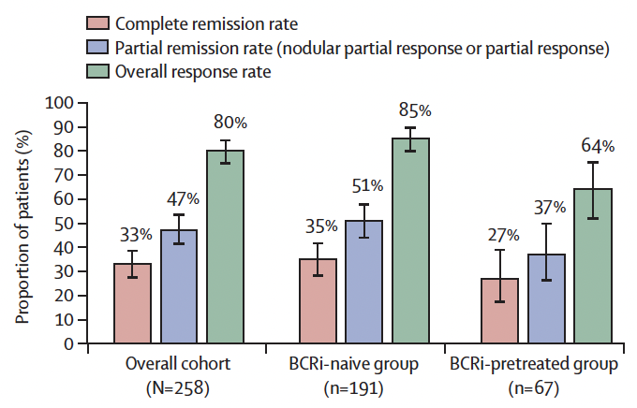
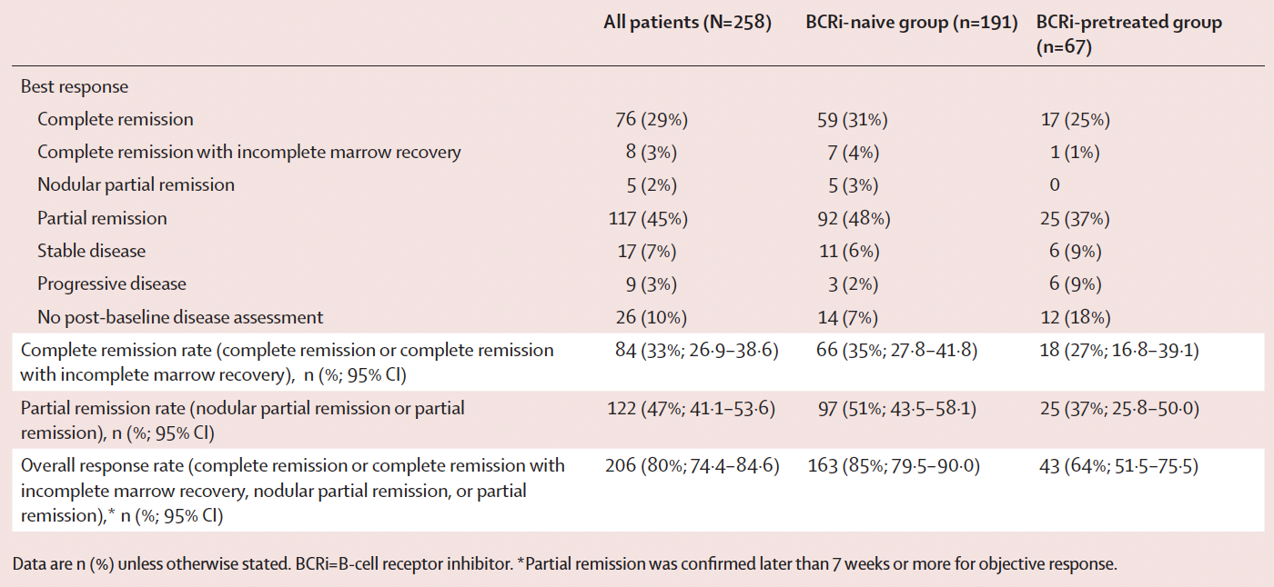
Venetoclax Monotherapy for Relapsed or Refractory CLL:
The Single-Arm Phase IIIb VENICE-1 Trial – Response
Median follow-up in the overall cohort was 49·5 months (IQR 47·2-54·1)
Kater AP et al. Lancet Oncol 2024 April;25(4):463-73.

Slide 40
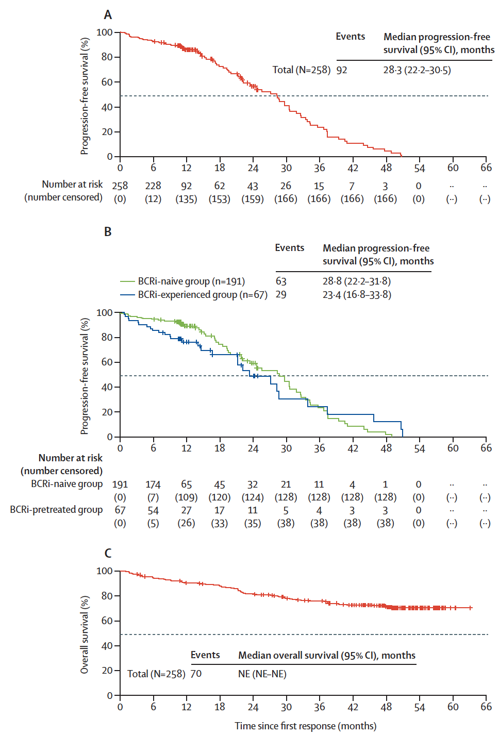
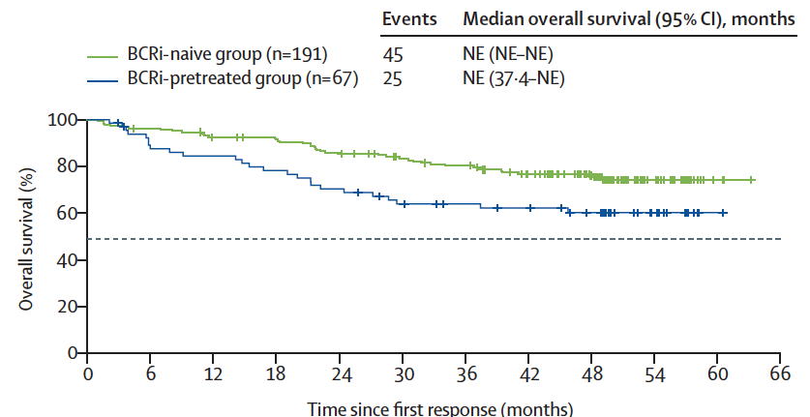
Phase IIIb VENICE-1: Survival by B-Cell Receptor-Associated Kinase Inhibitor (BCRi) Exposure
PFS
OS
Kater AP et al. Lancet Oncol 2024 April;25(4):463-73.

Slide 41
Phase IIIb VENICE-1: Summary
Venetoclax monotherapy demonstrated deep and durable responses and prolonged overall survival, irrespective of previous BCRi treatment.
  With dose modifications, the safety profile of venetoclax was manageable even given this extended period of follow-up, and many patients transitioned to an extension study to continue receiving venetoclax therapy.
The safety profile reported here was consistent with previously published venetoclax data with relapsed or refractory CLL.
  Although common, neutropenia was managed with brief interruptions or reductions in venetoclax dosing.
Kater AP et al. Lancet Oncol 2024 April;25(4):463-73.

