Slide 1
Novel Agents and Combination Strategies
Jennifer R Brown, MD, PhD
Director, CLL Center and Institute Physician
Dana-Farber Cancer Institute
Worthington and Margaret Collette Professor of Medicine
in the Field of Hematologic Oncology
Harvard Medical School
Boston, Massachusetts

Slide 2
AMPLIFY: AV and AVO vs FCR/BR
Progression-Free Survival
PFS Significantly Improved With
AV and AVO vs FCR/BR
100
83.1%
80
76.5%
AVO
60
PFS (%)
66.5%
AV
FCR/BR
40
20
HR (95% CI)
P value
AV vs FCR/BR
AVO vs FCR/BR
0.65 (0.49 to 0.87)
0.42 (0.30 to 0.59)
P=0.0038
P<0.0001
0
0
6
12
18
24
30
36
42
48
54
60
Months from Randomization
Median PFS was NR for AV and AVO, and was 47.6 mo for FCR/BR
uMRD rates (<10⁻⁴) in peripheral blood at EOT (evaluable patients):
45.0% (AV), 95.0% (AVO), 72.9% (FCR/BR)
Brown JR et al. ASH 2024; Abstract 1009
Brown JR NEJM 2025
Notes:
LEFT
PFS was assessed by IRC; median follow-up from randomization: 40.8 months (range, 0–59 months).
Hazard ratio (95% CI) computed using a Cox proportional-hazards model stratified by the randomization strata. P-value based on stratified log-rank test.
AV, acalabrutinib-venetoclax; AVO, acalabrutinib-venetoclax-obinutuzumab; BR, bendamustine-rituximab; CI, confidence interval; EOT, end of therapy; FCR, fludarabine-cyclophosphamide-rituximab; HR, hazard ratio; NR, not reached; IRC, independent review committee; PFS, progression-free survival; uMRD, undetectable measurable residual disease.
RIGHT
IRC-assessed PFS was evaluated by IGHV mutational status in a prespecified analysis.
In the subgroup of patients with unmutated IGHV, shown here, PFS was longer with AV and AVO compared with FCR/BR with associated hazard ratios of 0.69 and 0.35, respectively.
The 36-month PFS rate was highest with AVO at 83% compared with 69% for AV and 57% for FCR/BR.
PFS assessed by IRC; PFS by IGHV status was a prespecified analysis (ITT population).
Hazard ratio (95% CI) computed using an unstratified Cox proportional-hazards model.
AV, acalabrutinib-venetoclax; AVO, acalabrutinib-venetoclax-obinutuzumab; BR, bendamustine-rituximab; CI, confidence interval; FCR, fludarabine-cyclophosphamide-rituximab; HR, hazard ratio; IRC, independent review committee; ITT, intent-to-treat; NR, not reached; PFS, progression-free survival; uIGHV, unmutated immunoglobulin heavy-chain variable region gene.

Slide 3
What about AMPLIFY results?
First potential registration trial for a BTKi-BCL2i combination
AV is very safe and very easy: potentially applicable to most any CLL patient
AVO is very effective, equalizing outcome in UM and M IGHV patients at 3 yrs: good for young fit higher risk patients
Notes:
NCCN GLs HMS 082021: 2nd sub-bullet:
Added BCL2i before Venetoclax
Venetoclax – anti-CD20 antibody: Revised as Venetoclax + anti-CD20 antibody

Slide 4
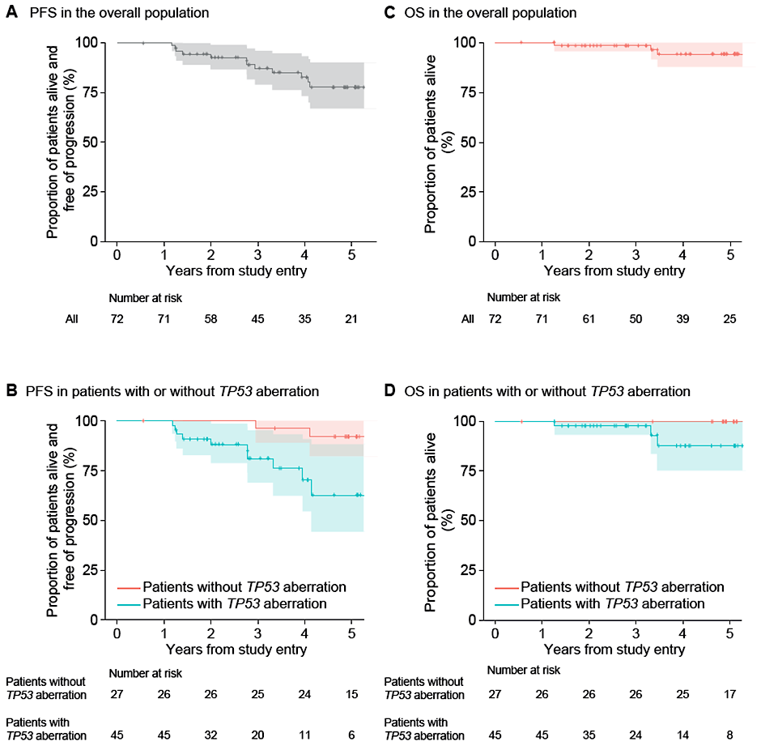
AVO for 16-25 Months for High Risk Del17p Disease: Survival & Recurrence
35 pts (51%) had MRD recurrence
  Median time to MRD recurrence was 32.2 months
70% 4-year PFS in pts with TP53 aberration; 96% in pts without TP53 aberration
88% 4-year OS in pts with TP53 aberration; 100% in pts without TP53 aberration
10 pts have had clinical progression, 4 of these 10 progressions were transformation events, including Richter’s DLBCL (n=2) and Hodgkin lymphoma (n=2)
3 pts have died in total, one each due to gr 5 COVID-19 infection during treatment, complications from polysubstance abuse, and progression of Richter’s
Davids M et al. ASH 2024; Abstract 1865

Slide 5
AVO for 16-25 Months for High Risk Del17p Disease
Longer, MRD guided AVO regimen for patients with del17p disease
Highly effective in inducing uMRD remission
Durability is somewhat reduced compared to the 17p wild type population – but nonetheless looks better compared to ven obin
Ongoing head to head trial comparing AVO to VO in high risk del17p disease (GCLLSG)
Author’s slide
Notes:
NCCN GLs HMS 082021: 2nd sub-bullet:
Added BCL2i before Venetoclax
Venetoclax – anti-CD20 antibody: Revised as Venetoclax + anti-CD20 antibody

Slide 6
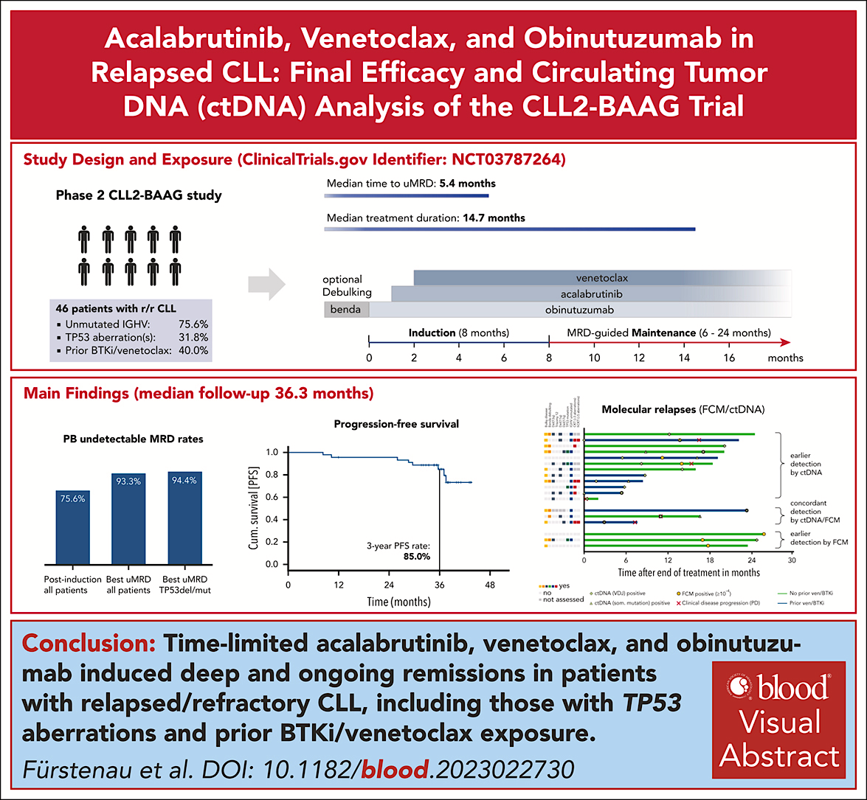
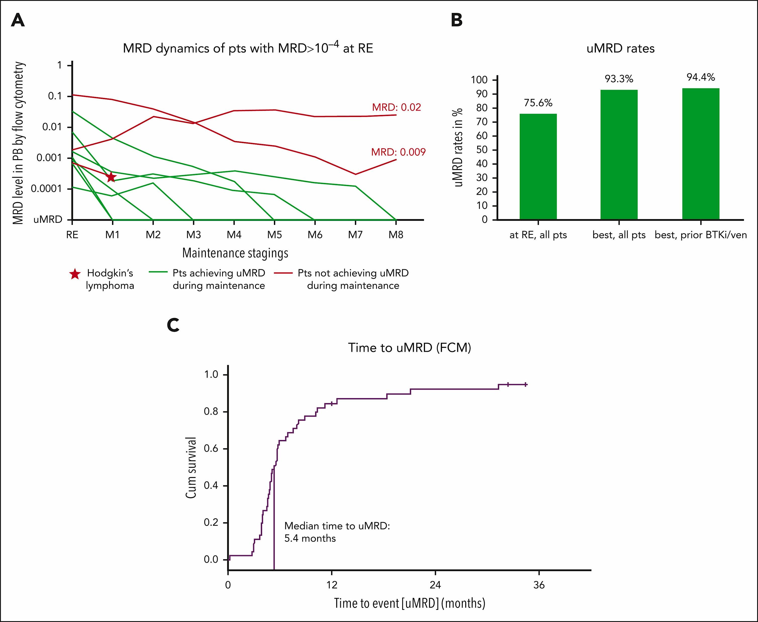
Fürstenau M et al. Blood 2024

Slide 7
What about AVO in Relapsed Disease?
Heterogeneous group of heavily pretreated patients
Surprisingly effective – 3 yr PFS 85%
Some patients may not get to uMRD: should they just continue?
Underscores the importance of avoiding development of resistance – but maybe combination will still work….
Author’s slide
Notes:
NCCN GLs HMS 082021: 2nd sub-bullet:
Added BCL2i before Venetoclax
Venetoclax – anti-CD20 antibody: Revised as Venetoclax + anti-CD20 antibody

Slide 8
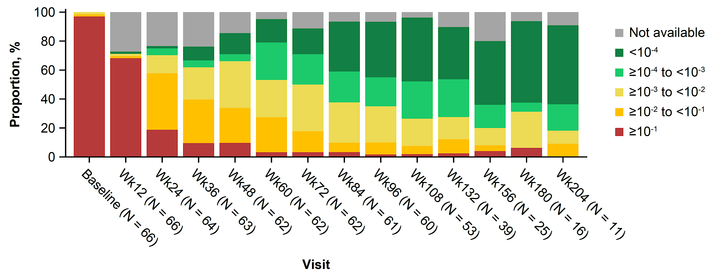




SEQUOIA Arm D Treatment Regimen and MRD
Zanubrutinib lead-in (3 cycles) followed by zanubrutinib + venetoclax (12-24 cycles dependent on uMRD early dose-stopping rules), then zanubrutinib monotherapy until disease progression, unacceptable toxicity, or meeting uMRD early dose-stopping rules
Beyond C28, continue zanubrutinib alone until confirmed uMRD
C1
C4
C7
C10
C13
C16
C19
C22
C25
C28+
Zanubrutinib 160 mg twice daily for ≥27 cycles
Venetoclax ramp-up cycle, then 400 mg once daily for 12-24 cycles
Lead-in
Fürstenau
Treatments
Starting at C16, may discontinue venetoclax for confirmed uMRD (PB & BM)
TLS risk assessments
Hematology/physical examination/imaging
MRD: PB
Assessments
BM biopsy & aspirate
for CRª
MRD: BM aspirate^{b}
ª BM biopsy and aspirate are required to confirm a suspected CR/CRi (BM collection timepoint not defined per protocol), starting after cycle 9 and then annually if needed.
^{b} Patients with confirmed CR/CRi and 2 consecutive PB uMRD ≥12 weeks apart.
Shuo MA et al. EHA 2024;Abstract S160
Notes:
Patients with confirmed CR/CRi and 2 consecutive PB uMRD ≥12 weeks apart.

Slide 9
SEQUOIA Arm D: Zanu Ven in Del17p
Relatively slow achievement of uMRD:? Due to 17p
Very strict stopping criteria: Most patients continue on therapy
  --?Is this really a time limited regimen
  BUT: maybe a longer treatment duration is preferred in this patient subgroup –
  Longer follow-up is required
Author’s slide
Notes:
NCCN GLs HMS 082021: 2nd sub-bullet:
Added BCL2i before Venetoclax
Venetoclax – anti-CD20 antibody: Revised as Venetoclax + anti-CD20 antibody

Slide 10
Sonrotoclax + Zanubrutinib Demonstrates Substantial Antitumor Activity in TN CLL
Best Responseª
Best Blood MRD^{b}
By Week 24
By Week 48
By Week 24^{c}
By Week 48^{c}
100
1%
100
9%
4%
9%
SD
18%
13%
N/A
80
PR
80
14%
MRD4+
60%
58%
CR/CRi
24%
uMRD4
67%
60
73%
60
Patients, %
Patients, %
91%
40
40
82%
78%
59%
20
40%
42%
20
26%
33%
0
0
Sonro
160 mg
(n=51)
Sonro
320 mg
(n=58)
Sonro
160 mg
(n=45)
Sonro
320 mg
(n=53)
Sonro
160 mg
(n=51)
Sonro
320 mg
(n=58)
Sonro
160 mg
(n=45)
Sonro
320 mg
(n=53)
ª Percentages based on the number of patients who reached assessment at 24 or 48 weeks after completion of ramp-up, following zanu monotherapy and sonro ramp-up to target dose
^{b} As measured by ERIC flow cytometry panel; uMRD4 is defined as less than 1 CLL cell per 10,000 leukocytes (<10-4). c Number of weeks at target dose, following zanu monotherapy and sonro ramp-up to target dose.
Soumerai JD et al. ASH 2024;Abstract 1012

Slide 11
Sonrotoclax + Zanubrutinib Demonstrates Substantial Antitumor Activity in TN CLL
Sonrotoclax more potent in vitro and so far very limited TLS, although ramp-up schedule has been as complicated as venetoclax
Highest uMRD rates of any BTKi-BCL2i combination (without an antibody)
Selected phase 1 population, needs longer follow-up and broadly multicenter trials
Notes:
NCCN GLs HMS 082021: 2nd sub-bullet:
Added BCL2i before Venetoclax
Venetoclax – anti-CD20 antibody: Revised as Venetoclax + anti-CD20 antibody

Slide 12
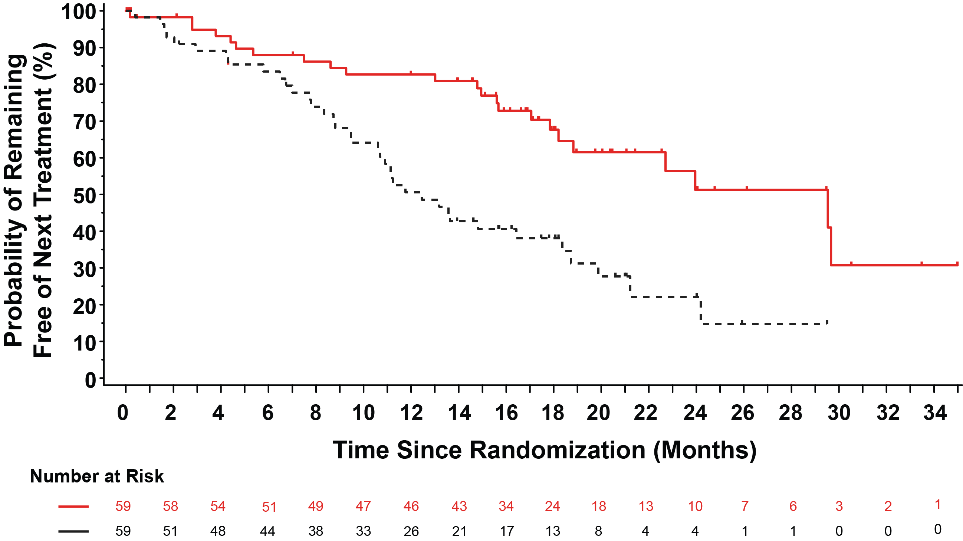
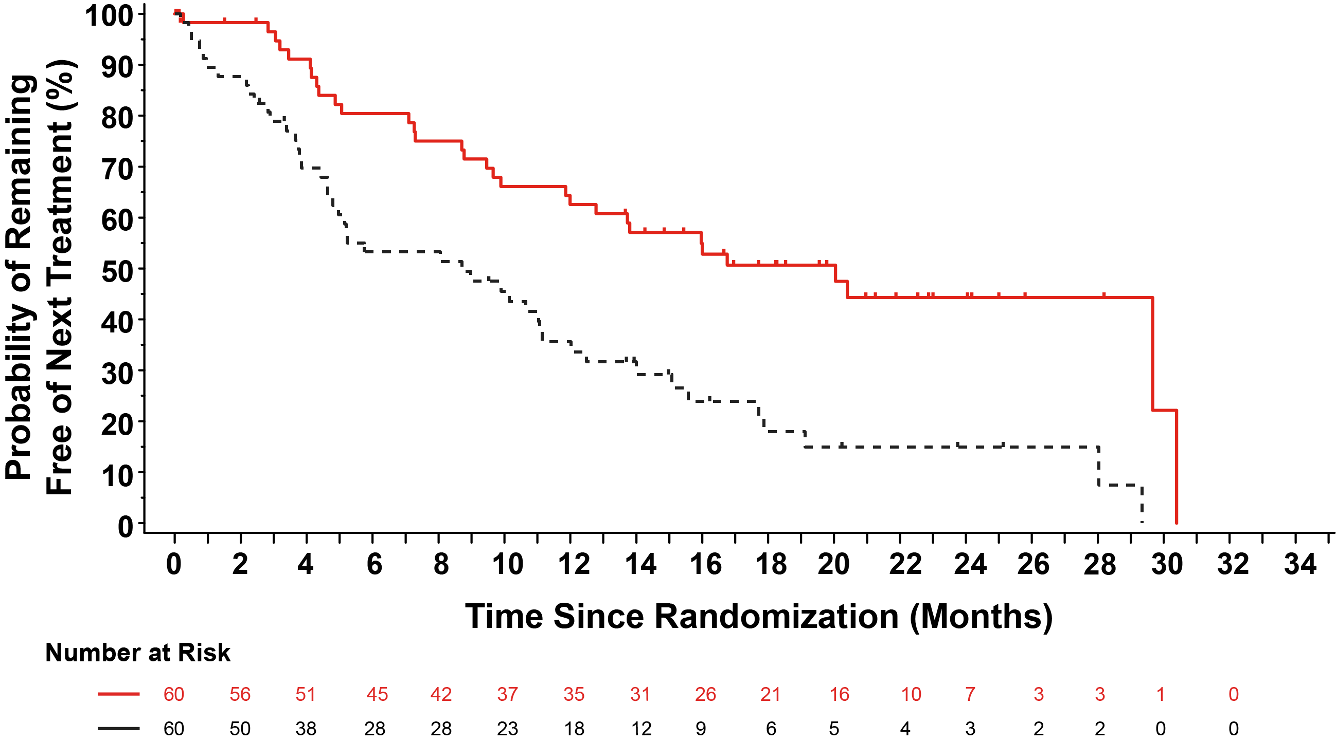
BRUIN 321: Time to Next Treatment or Death in Venetoclax Naïve and Treated Patients​
Venetoclax Naïve
n=59/arm
Venetoclax Treated
n=60/arm
Pirtobrutinib
Pirtobrutinib
IdelaR/BR
IdelaR/BR
Pirtobrutinib
n=119
IdelaR/BR
n=119
Pirtobrutinib
n=119
IdelaR/BR
n=119
Median TTNT, mo (95% CI)​ | 29.5​ | 12.5​
Hazard ratio (95% CI)​ | 0.36 (0.21- 0.61)​
Stratified log-rank 2-sided p-value​ | 0.0001​*
Median TTNT, mo (95% CI)​ | 20.0​ | 8.7​
Hazard ratio (95% CI)​ | 0.37 (0.23- 0.60)​
Stratified log-rank 2-sided p-value​ | <0.0001​​*
Sharman J et al ASH 2024;Abstract 866
Notes:
We evaluated the TTNTD according to prior venetoclax exposure. The effect size is robust in both subsets, and pirtobrutinib was able to delay subsequent treatment or death for over 2 1/2 years in venetoclax naive patients
*nominal p-value. Abbreviations: BR, bendamustine + rituximab; CI, confidence interval; HR, hazard ratio; IdelaR, idelalisib + rituximab; IRC, independent review committee; mo, months; TTNT, time to next treatment.

Slide 13
BRUIN 321
First phase 3 registration trial in patients with prior cBTKi treatment
Pirtobrutinib improved PFS compared to IdelaR/BR
Outcomes are poor overall, underscoring the high risk nature of this group
Idela-R has activity, with about one year of clinical benefit
Notes:
NCCN GLs HMS 082021: 2nd sub-bullet:
Added BCL2i before Venetoclax
Venetoclax – anti-CD20 antibody: Revised as Venetoclax + anti-CD20 antibody

Slide 14
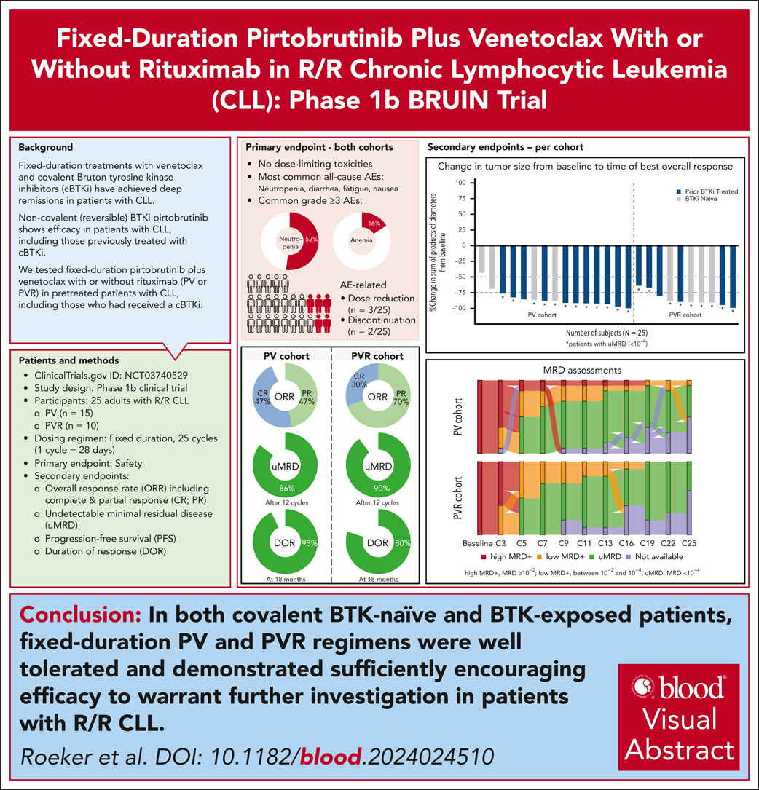
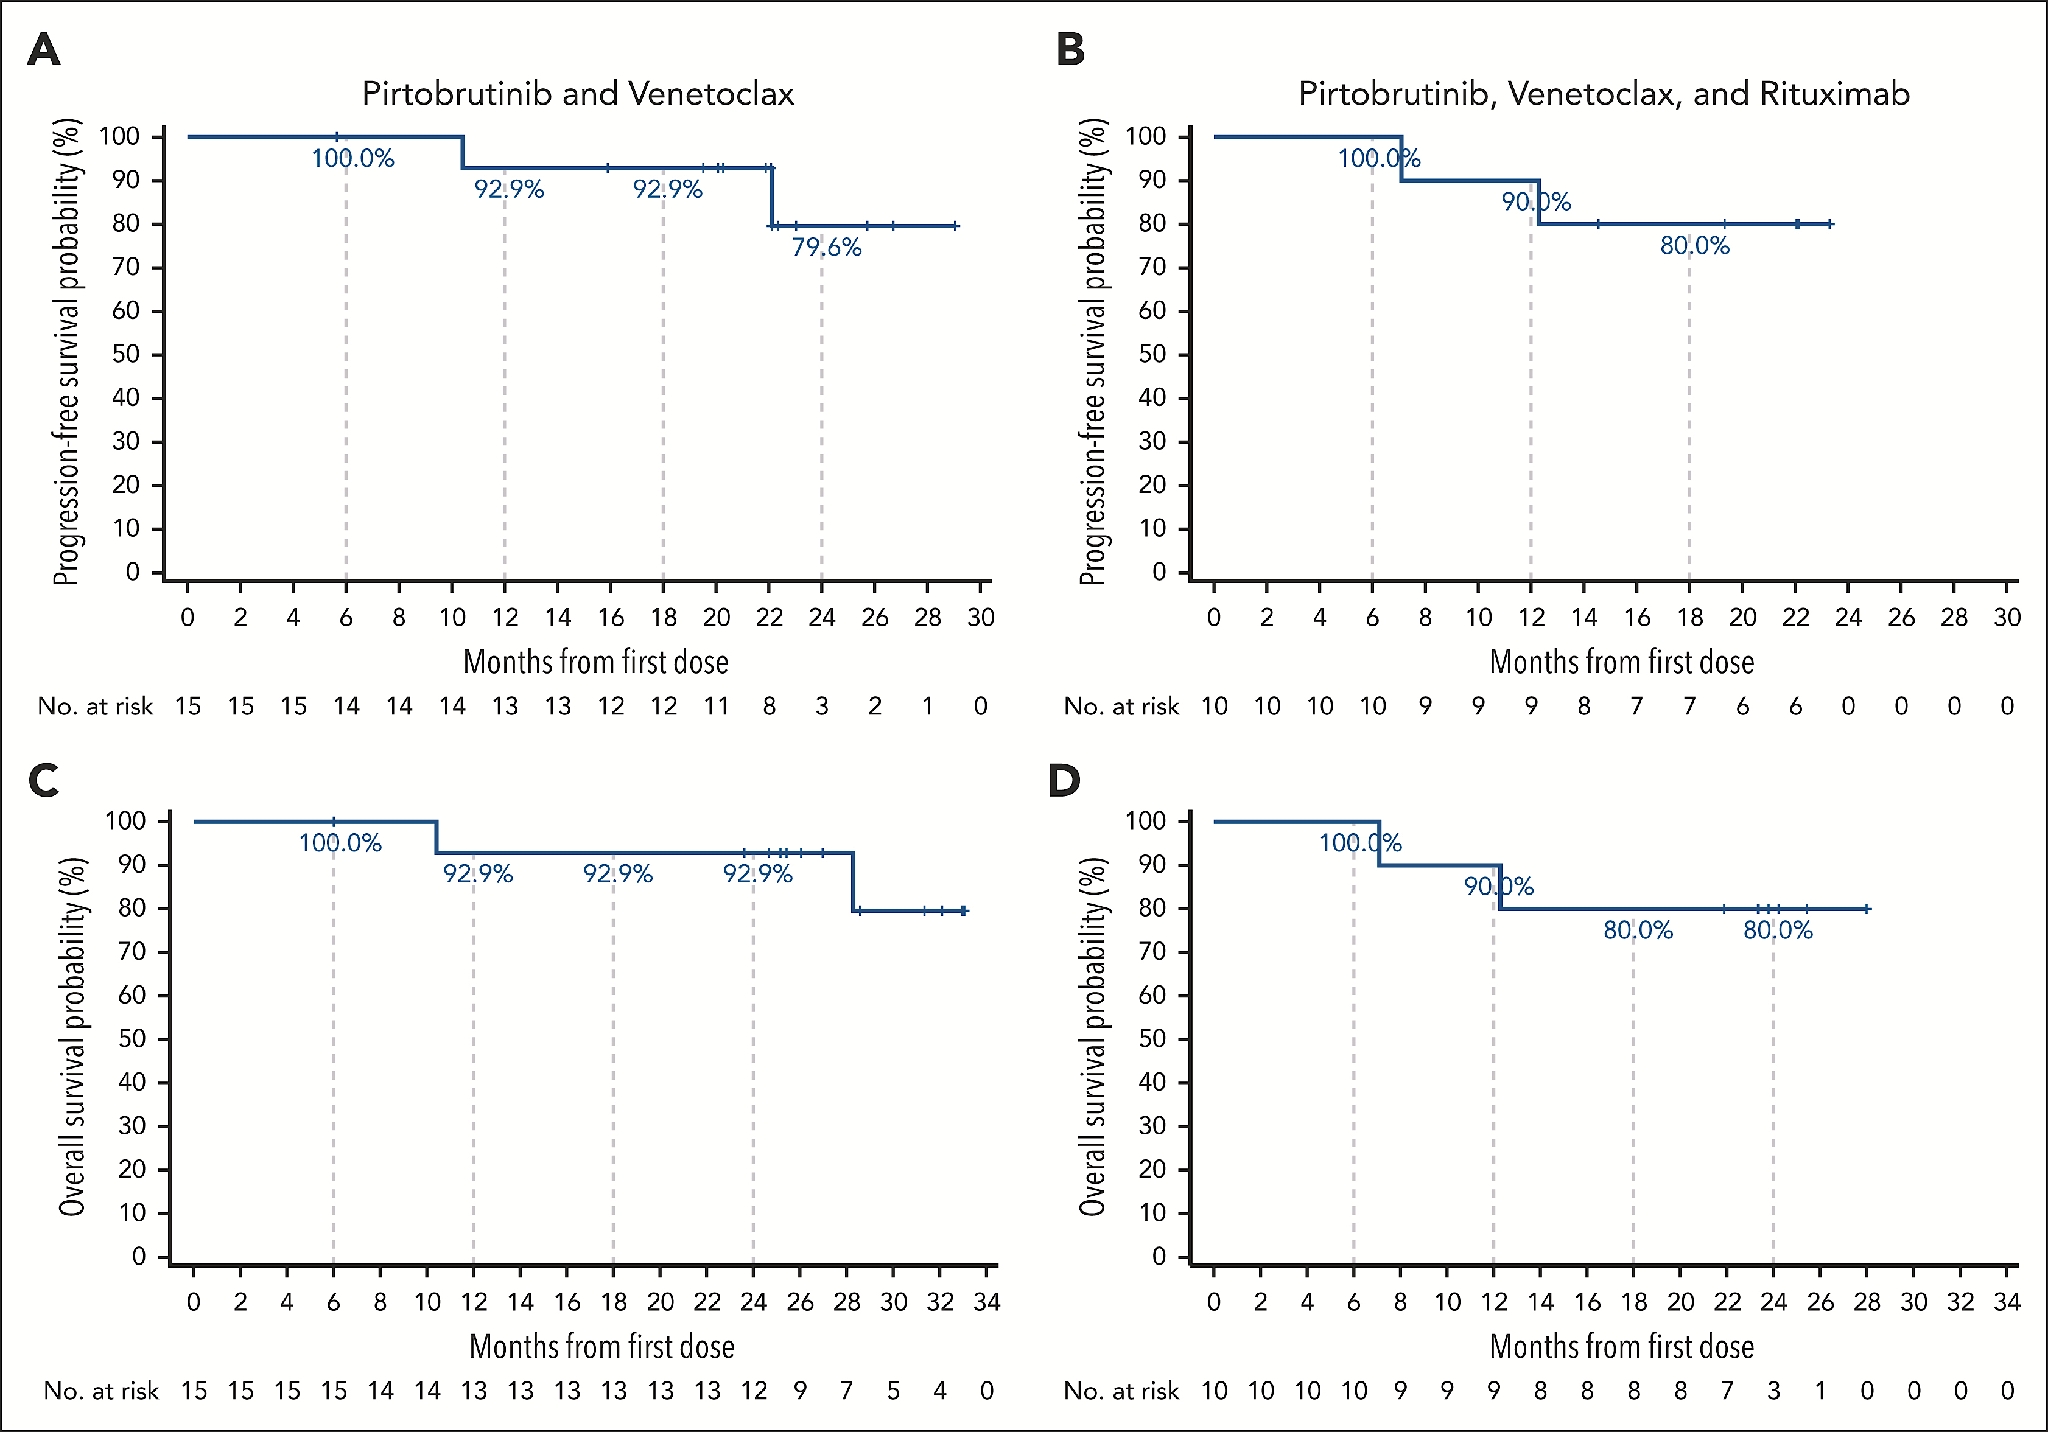
Pirtobrutinib + Venetoclax +/- Rituximab
Roeker LE et al Blood 2024

Slide 15
Pirtobrutinib Ven +/- R in R/R CLL
Phase 1 study – well tolerated
High ORR and uMRD
About 20% progression during the two years of therapy
Need longer follow-up after discontinuation of therapy at 2 yrs
Basis of fully accrued phase 3 registration trial
Notes:
NCCN GLs HMS 082021: 2nd sub-bullet:
Added BCL2i before Venetoclax
Venetoclax – anti-CD20 antibody: Revised as Venetoclax + anti-CD20 antibody

Slide 16
Pirtobrutinib, Venetoclax, Obinutuzumab Frontline
MRD at Serial Time-Points in Blood and Bone Marrow
100%
U-MRD4
98%
U-MRD4
93%
U-MRD4
91% U-MRD4
TOXICITY
G3-4 ANC 60% and plts 14%
58% pts required G-CSF
4 pts neutropenic fever
Pirto dose-reduced in 21%
Ven dose-reduced in 31%
3 pts off study for non progression are not included in this figure
Jain, PVO in CLL, ASH 2024, Abs 1011

Slide 17
Pirto Ven Obin
MDACC trial
Very high rates of uMRD
BUT: very high rates of heme tox and dose reductions
Needs confirmation in multicenter setting
Risk of using pirto before cBTKi
Author’s slide
Notes:
NCCN GLs HMS 082021: 2nd sub-bullet:
Added BCL2i before Venetoclax
Venetoclax – anti-CD20 antibody: Revised as Venetoclax + anti-CD20 antibody

Slide 18
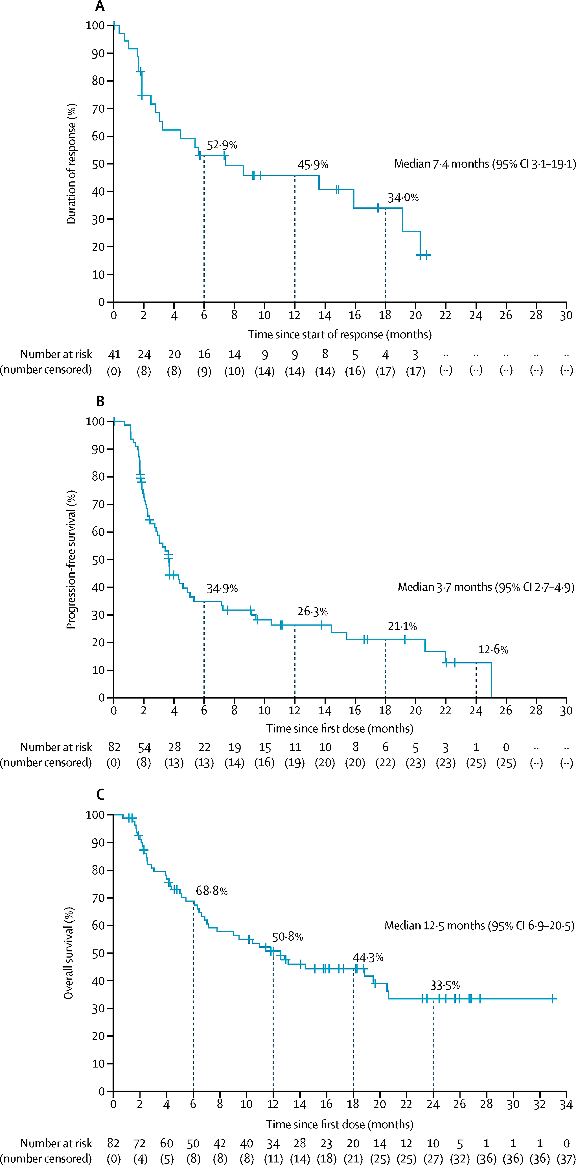
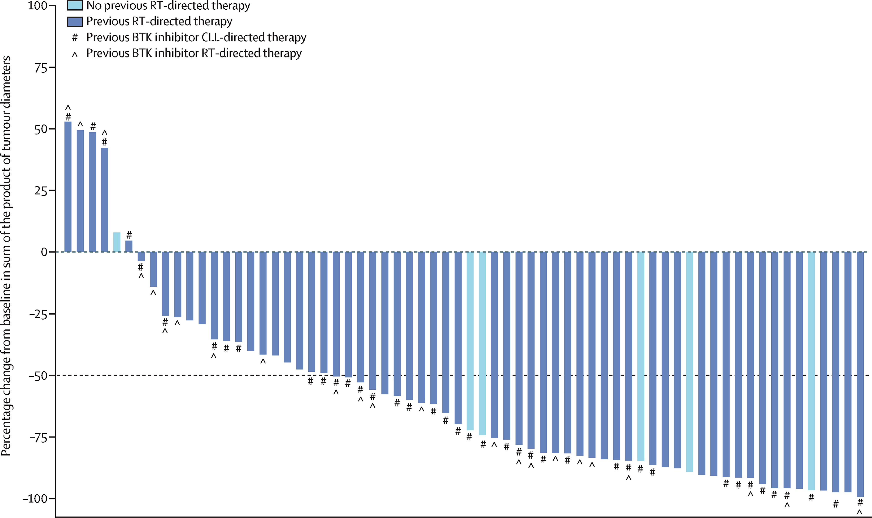
Pirtobrutinib in RT
Wierda WG et al Lancet Haematol 2024

Slide 19
What about Pirtobrutinib in RT?
Largest prospective trial (82 patients)
ORR 50%, CR 13%
DOR 7.4 mos, PFS 3.7 mos
High response but short durability
Basis for combination therapies?
Notes:
NCCN GLs HMS 082021: 2nd sub-bullet:
Added BCL2i before Venetoclax
Venetoclax – anti-CD20 antibody: Revised as Venetoclax + anti-CD20 antibody

Slide 20
TRANSCEND CLL 004: lisocabtagene maraleucel (liso-cel)
Full Population at Dose-Level 2 (DL2)
Progression-Free Survival (PFS)
PEAS (BTKi progression/ venetoclax failure subset) at DL2
Progression-Free Survival (PFS)
100
100
CR/CRi
90
NR
CR/CRi
90
NR
PFS, %
80
PFS, %
80
70
70
60
26.9 (17.9—NR)
60
26.2 (10.3—NR)
50
50
40
18.0 (9.4—30.1)
Total
40
30
PR/nPR
30
11.9 (5.7—26.2)
Total
20
3.7 (2.4—6.3)
20
10
10
3.7 (2.1—6.1)
PR/nPR
Nonresponder
0
0
0
6
12
18
24
30
36
42
48
54
0
6
12
18
24
30
36
42
48
Time From liso-cel Infusion, Months
Time From liso-cel Infusion, Months
Full Population at Dose-Level 2 (DL2)
PFS by uMRD4 Response in Blood
PEAS (BTKi progression/ venetoclax failure subset) at DL2
PFS by uMRD4 Response in Blood
100
100
90
90
PFS, %
80
PFS, %
80
70
70
60
31.2 (18.0—NR)
60
26.2 (11.9—NR)
50
50
11.9 (5.7—26.2)
40
0.8 (0.4—13.4)
uMRD4
40
0.8 (0.1—13.4)
30
18.0 (9.4—30.1)
Total
30
uMRD4
20
Unknown
20
Total
10
10
Unknown
0
2.9 (1.9—6.1) MRD positive
0
2.8 (0.8—3.2)
MRD positive
0
6
12
18
24
30
36
42
48
54
0
6
12
18
24
30
36
42
48
Time From liso-cel Infusion, Months
Time From liso-cel Infusion, Months
Median (95% CI) follow-up: 31.4 mo (24.3—36.2)
Siddiqi et al Blood (2024) 144 (Supplement 1): 4633.
Notes:
Data on KM curves are expressed as median (95% CI, if available). KM method was used to obtain 2-sided 95% CIs.

Slide 21
Update on Liso-cel in CLL
CR is more predictive than uMRD (unlike every other situation)
CR rate only 20%
Double refractory population has worse outcome than full population (similar to pirtobrutinib)
<=3 prior regimens and absence of bulky disease associated with response (PR or CR)
Notes:
NCCN GLs HMS 082021: 2nd sub-bullet:
Added BCL2i before Venetoclax
Venetoclax – anti-CD20 antibody: Revised as Venetoclax + anti-CD20 antibody

Slide 22
Liso-cel + Ibrutinib Outcomes
Efficacy Outcomes:
Response by Investigator and uMRD4
Progression-Free Survival by Best Overall Response at DL2
ORR
86%
95% CI, 74—94
96%
95% CI, 78—100
96%
95% CI, 78—100
Response by INV
uMRD4 rate
100
86%
95% CI, 74—94
84%
95% CI, 71—93
90
NR (29.6—NR)
CR/CRi rate 45%
95% CI, 31—60
80
CR/CRi
70
n = 44
60
31.4 (20.1—NR)
n = 22
n = 22
3.2 (0.8—NR)
All DL2 patients
Progression-Free Survival %
n = 44
n = 43
50
Patients with uMRD4, %
40
n = 23
24.2 (11.9—42.3)
30
20
PR/nPR
10
0
Nonresponders
DL2 + ibrutinib set
(n = 51)
0
6
12
18
24
30
36
42
48
54
uMRD4 Rate in Blood
uMRD4 Rate in Marrowª
Time from liso-cel infusion, months
  Median (IQR) on-study follow-up (including LTFU): 24.8 months (14.2—34.6)
  Median (range) time to first response: 1 month (0.9—6.0)
  Median (range) time to first CR/CRi: 3 months (0.9—12.1)
Median (95% CI) follow-up for PFS: 24.3 months (23.7—35.5)
Wierda W, et al. ASH 2024 TRANSCEND CLL 004: Liso-cel + Ibrutinib Cohort [Abstract #887]
Notes:
Ibrutinib was given for one month before and 3 mos after infusion, approximately
Data on KM curves are expressed as median (95% CI). No formal landmarking analyses were conducted.

Slide 23
What about Liso-cel + Ibrutinib?
Also heavily pretreated
CR rate higher at 45% - but hard to compare patient populations across studies
Ibrutinib side effects (brain hemorrhage, cardiac arrests on prior studies) plus still 59% needed steroids or toci for CRS
Consider studies with second generation BTKis
Notes:
NCCN GLs HMS 082021: 2nd sub-bullet:
Added BCL2i before Venetoclax
Venetoclax – anti-CD20 antibody: Revised as Venetoclax + anti-CD20 antibody

Slide 24
EPCORE
C1 OPT Mitigated Adverse Events of Interest
Including ICANS and Clinical TLS
Study Design: EPCORE® CLL-1 Expansion and C1 Optimization
CRS Events by Dosing Period
EXP
Expansion
(EXP; N=23)
Cycle 1 Optimization
(C1 OPT; N=17)
CRS prophylaxis
Prednisone
CRS prophylaxis
Dexamethasone
Adequate hydration
First full dose
(C1D15): 48 mg
First full dose (C1D22): 48 mg
Incidence (%)
Key inclusion criteria
CD20⁺ R/R CLL
≥2 prior lines of systemic therapy
ECOG PS 0–2
Measurable disease with ≥5×10⁹/L B lymphocytes (expansion only)
No prior allogeneic HSCT
Step-up dose 3
(C1D15): 3 mg
Step-up dose 2
(C1D8): 0.8 mg
Cycle 1
Step-up dose 2
(C1D8): 0.8 mg
C1 OPT
Step-up dose 1
(C1D1): 0.16 mg
Step-up dose 1 (C1D1): 0.16 mg
Incidence (%)
Data cutoff: May 28, 2024
Median follow-up: 22.8 months
Data cutoff: May 28, 2024
Median follow-up: 2.9 months
Cycle 1
ClinicalTrials.gov: NCT04623541; EudraCT: 2023-504828-25.
Danilov A et al ASH 2024; Abstract 883

Slide 25
Epcoritamab in R/R CLL
Optimization cohort to reduce CRS risk
  CRS still most common at the first full dose but now no grade 3 and mostly grade 1
Heavily pretreated patients, ORR 61% and CR 39% are encouraging
  uMRD 75% in responders
Median PFS about one year at present
Ongoing enrollment: plan combinations, or consolidation
Notes:
NCCN GLs HMS 082021: 2nd sub-bullet:
Added BCL2i before Venetoclax
Venetoclax – anti-CD20 antibody: Revised as Venetoclax + anti-CD20 antibody

Slide 26
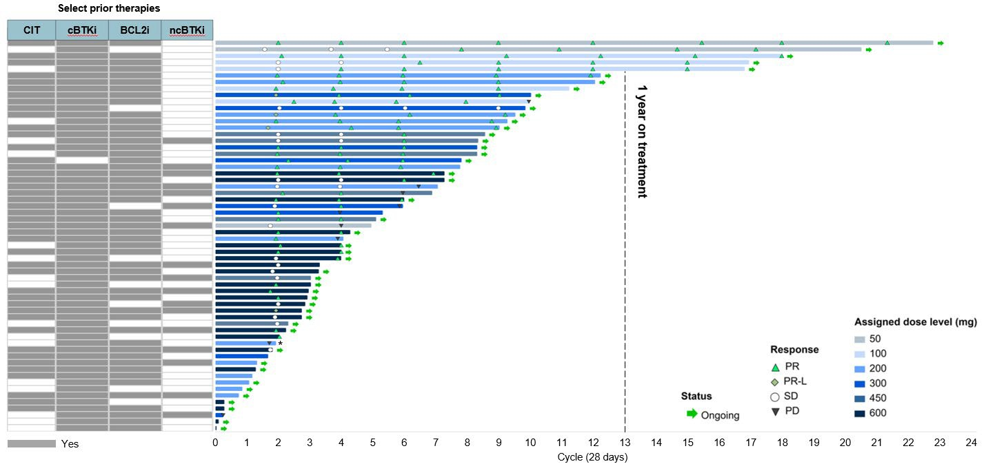
NX-5948 Duration of Treatment
Durable Responses Regardless of Prior Therapy
*Patient with Richter’s transformation to Hodgkin's on biopsy
ORR 76% at
all dose levels
Median duration of treatment, months (range) | 3.9 (0.1–21.0)
Patients dose escalated during treatment, n | 19
Median duration of response, months (95% CI) | Not reached (6.9 – not reached)
Patients with duration of response >6 months | 13 (26.5%)
Data Cutoff: 10 Oct 2024
Shah et. al. ASH 2024 - Blood 2024;144(Supplement 1):884.
Notes:
BCL2i, BCL2 inhibitor; BTKi, BTK inhibitor; cBTKi, covalent BTKi; CIT, chemo/chemo-immunotherapies; ncBTKi, non-covalent BTKi; PD, progressive disease; PR, partial response; PR-L, PR with rebound lymphocytosis; SD, stable disease; CI, confidence interval

Slide 27
BGB-16673 Treatment Duration & Response
Prior Treatment
cBTKi
ncBTKi
BCL2i
BTKmut
 |  |  | N
 |  |  | Y
 |  |  | N
 |  |  | N
 |  |  | Y
 |  |  | N
 |  |  | Y
 |  |  | N
 |  |  | Y
 |  |  | N
 |  |  | N
 |  |  | Y
 |  |  | N
 |  |  | N
 |  |  | N
 |  |  | N
 |  |  | N
 |  |  | N
 |  |  | Y
 |  |  | N
 |  |  | U
 |  |  | N
 |  |  | N
 |  |  | Y
 |  |  | N
 |  |  | Y
 |  |  | N
 |  |  | N
 |  |  | N
 |  |  | N
 |  |  | Y
 |  |  | Y
 |  |  | N
 |  |  | Y
 |  |  | N
 |  |  | Y
 |  |  | Y
 |  |  | N
 |  |  | Y
 |  |  | N
 |  |  | N
 |  |  | U
 |  |  | N
 |  |  | Y
 |  |  | N
 |  |  | N
 |  |  | N
 |  |  | N
 |  |  | Y
ORR 78% across
all dose levels
Median follow-up in
efficacy-evaluable patients:
11.0 months (range, 0.3-26.4+)
Dose level (mg)
50
100
200
350
500
Responses
CR
CRi
PR
PR-L
SD
PD
NE
Ongoing treatment
Death
Data Cutoff: September 2, 2024.
0
10
20
30
40
50
60
70
80
90
100
110
120
Efficacy-evaluable patients. First response assessment after 12 weeks.
Treatment Duration, weeks
Thompson MC et al ASH 2024; Abstract 885

Slide 28
BTK Degraders
Two phase 1 studies of distinct molecules, in heavily pretreated patients most with prior BTKi and BCL-2i exposure, both with very nice ORR approximately 76%
Follow-up short but very encouraging
Mechanisms of resistance still to emerge but important
Notes:
NCCN GLs HMS 082021: 2nd sub-bullet:
Added BCL2i before Venetoclax
Venetoclax – anti-CD20 antibody: Revised as Venetoclax + anti-CD20 antibody

