Slide 1
Year in Review:
Management of Chronic Lymphocytic Leukemia
A CME/MOC-Accredited Live Webinar
Tuesday, March 25, 2025
5:00 PM – 6:00 PM ET
Faculty
Jennifer R Brown, MD, PhD
Paolo Ghia, MD, PhD
Moderator
Neil Love, MD

Slide 2

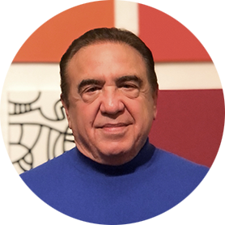

Faculty
Jennifer R Brown, MD, PhD
Director, CLL Center and Institute Physician
Dana-Farber Cancer Institute
Worthington and Margaret Collette Professor of Medicine in the Field of Hematologic Oncology
Harvard Medical School
Boston, Massachusetts
MODERATOR
Neil Love, MD
Research To Practice
Miami, Florida
Paolo Ghia, MD, PhD
Professor of Medical Oncology
Università Vita-Salute San Raffaele
Director, CLL Strategic Program
IRCCS Ospedale San Raffaele
Milano, Italy

Slide 3
Commercial Support
This activity is supported by educational grants from AstraZeneca Pharmaceuticals LP and Lilly.
Research To Practice CME Planning Committee Members,
Staff and Reviewers
Planners, scientific staff and independent reviewers for Research To Practice have no relevant conflicts of interest to disclose.

Slide 4
Dr Brown — Disclosures
Consulting Agreements | AbbVie Inc, Acerta Pharma — A member of the AstraZeneca Group, Alloplex Biotherapeutics, BeiGene Ltd, Bristol-Myers Squibb, EcoR1 Capital LLC, Galapagos NV, Genentech, a member of the Roche Group, Grifols Worldwide Operations Ltd, InnoCare Pharma, Loxo Oncology Inc, a wholly owned subsidiary of Eli Lilly & Company, Magnet Biomedicine, Merck, Pharmacyclics LLC, an AbbVie Company
Contracted Research | BeiGene Ltd, Gilead Sciences Inc, iOnctura SA, Loxo Oncology Inc, a wholly owned subsidiary of Eli Lilly & Company, MEI Pharma Inc, Nagoon Therapeutics, TG Therapeutics Inc
Data and Safety Monitoring Boards/Committees | Grifols
Nonrelevant Financial Relationships | UpToDate

Slide 5
Prof Ghia — Disclosures
Advisory Committees | AstraZeneca Pharmaceuticals LP, BeiGene Ltd, Johnson & Johnson Pharmaceuticals, Lilly
Consulting Agreements | AbbVie Inc, AstraZeneca Pharmaceuticals LP, BeiGene Ltd, Bristol Myers Squibb, Galapagos NV, Johnson & Johnson Pharmaceuticals, Lilly, MSD, Roche Laboratories Inc
Contracted Research | AbbVie Inc, AstraZeneca Pharmaceuticals LP, BeiGene Ltd, Bristol Myers Squibb, Johnson & Johnson Pharmaceuticals, Lilly, MSD

Slide 6
This educational activity contains discussion of
non-FDA-approved uses of agents and regimens. Please refer to official prescribing information for each product for approved indications.

Slide 7
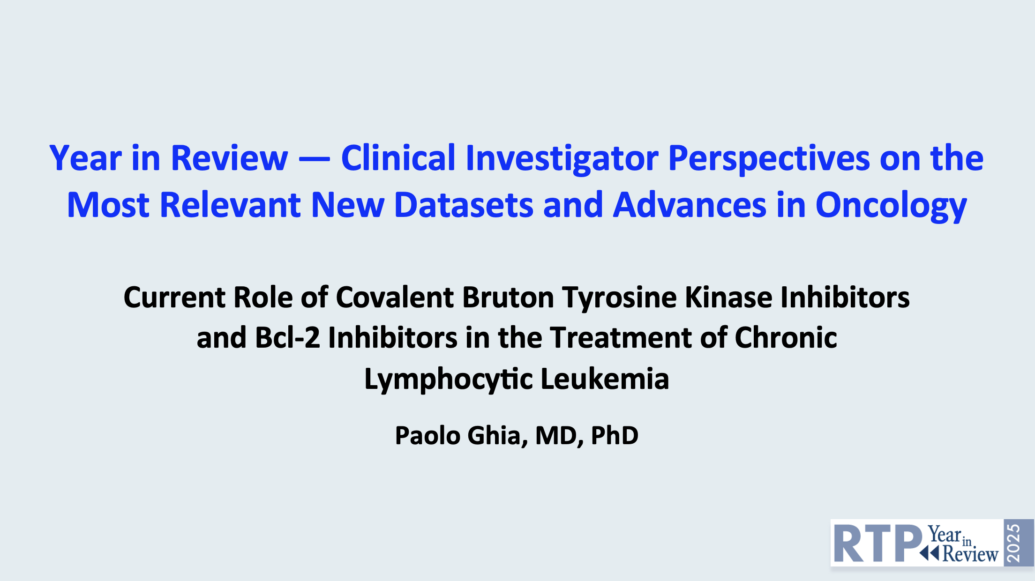
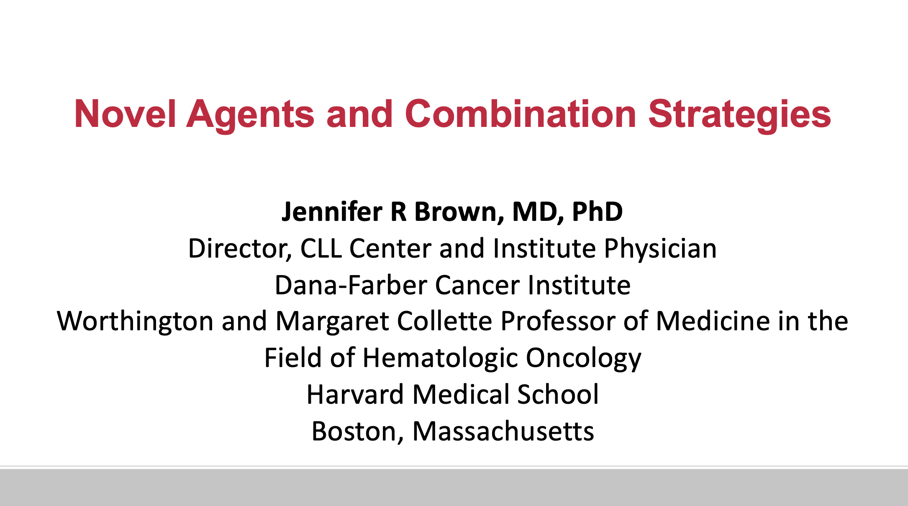

Slide 8
Key Datasets
Paolo Ghia, MD, PhD
Langerbeins P et al. Ibrutinib in early-stage chronic lymphocytic leukemia: The randomized, placebo-controlled, double-blind, phase III CLL12 trial. J Clin Oncol 2025 February;43(4):392-402.
Davids MS et al. Acalabrutinib-based regimens in frontline or relapsed/refractory higher-risk CLL: pooled analysis of 5 clinical trials. Blood Adv 2024 July 9;8(13):3345-59.
Ghia P et al. Impact of acalabrutinib treatment by line of therapy in patients with chronic lymphocytic leukemia: Pooled analysis from ELEVATE-TN, ELEVATE-RR, and ASCEND. EHA 2024;Abstract P703.
Simon F et al. Efficacy and safety of acalabrutinib treatment in very old (≥80y) and/or frail patients with chronic lymphocytic leukemia (CLL) – Primary endpoint analysis of the phase II CLL-Frail trial. ASH 2024;Abstract 4618.
Shadman M et al. Sustained superiority of zanubrutinib vs bendamustine + rituximab in treatment-naive chronic lymphocytic leukemia/small lymphocytic lymphoma (TN CLL): 5-year follow-up of cohort 1 from the SEQUOIA study. ASH 2024;Abstract 3249.
Brown JR et al. Sustained benefit of zanubrutinib vs ibrutinib in patients with R/R CLL/SLL: Final comparative analysis of ALPINE. Blood 2024 December 26;144(26):2706-17.

Slide 9
Key Datasets
Paolo Ghia, MD, PhD (continued)
Kozarac S et al. BTKi-induced cardiovascular toxicity in CLL: Risk mitigation and management strategies. Blood Rev 2025 March;70:101268.
Al-Sawaf O et al. Venetoclax-obinutuzumab for previously untreated chronic lymphocytic leukemia: 6-year results of the randomized phase 3 CLL14 study. Blood 2024 October 31;144(18):1924-35.
Fürstenau M et al. First-line venetoclax combinations versus chemoimmunotherapy in fit patients with chronic lymphocytic leukaemia (GAIA/CLL13): 4-year follow-up from a multicentre, open-label, randomised, phase 3 trial. Lancet Oncol 2024 June;25(6):744-59.
Roeker L et al. Minimal residual disease (MRD)-adapted duration of front-line venetoclax
and obinutuzumab treatment for fit patients with chronic lymphocytic leukemia (CLL). ASH 2024;Abstract 1010.
Sharman JP et al. CRISTALLO: Results from a Phase III trial of venetoclax-obinutuzumab versus fludarabine, cyclophosphamide and rituximab or bendamustine-rituximab in patients with untreated chronic lymphocytic leukemia without del(17p) or TP53 mutations. ASH 2024;Abstract 3237.
Kater AP et al. Activity of venetoclax in patients with relapsed or refractory chronic lymphocytic leukaemia: Analysis of the VENICE-1 multicentre, open-label, single-arm, phase 3b
trial. Lancet Oncol 2024 April;25(4):463-73.

Slide 10
Key Datasets
Jennifer R Brown, MD, PhD
Brown JR et al. Fixed-duration acalabrutinib combinations in untreated chronic lymphocytic leukemia. N Engl J Med 2025 February 20;392(8):748-62.
Davids MS et al. Primary endpoint evaluation of a multicenter, phase 2 study of acalabrutinib, venetoclax, obinutuzumab (AVO) in a population of previously untreated patients with CLL enriched for high-risk disease. ASH 2024;Abstract 1865.
Fürstenau M et al. Acalabrutinib, venetoclax, and obinutuzumab in relapsed/refractory CLL: Final efficacy and ctDNA analysis of the CLL2-BAAG trial. Blood 2024 July 18;144(3):272-82.
Ma S et al. Combination of zanubrutinib + venetoclax for treatment-naïve (TN) CLL/SLL with del(17p) and/or TP53: Preliminary results from SEQUOIA arm D. EHA 2024;Abstract S160.
Soumerai JD et al. Sonrotoclax and zanubrutinib as frontline treatment for CLL demonstrates high MRD clearance rates with good tolerability: Data from an ongoing phase 1/1b study BGB-11417-101. ASH 2024;Abstract 1012.
Sharman JP et al. BRUIN CLL-321: Randomized phase III trial of pirtobrutinib versus idelalisib plus rituximab (IdelaR) or bendamustine plus rituximab (BR) in BTK inhibitor pretreated chronic lymphocytic leukemia/small lymphocytic lymphoma. ASH 2024;Abstract 886.

Slide 11
Key Datasets
Jennifer R Brown, MD, PhD (continued)
Roeker LE et al. Fixed-duration pirtobrutinib plus venetoclax with or without rituximab in relapsed/refractory CLL: The phase 1b BRUIN trial. Blood 2024 September 26;144(13):1374-86.
Wierda WG et al. Pirtobrutinib, a highly selective, non-covalent (reversible) BTK inhibitor in patients with B-cell malignancies: Analysis of the Richter transformation subgroup from the multicentre, open-label, phase 1/2 BRUIN study. Lancet Haematol 2024 September;11(9):e682-92.
Jain N et al. Combined pirtobrutinib, venetoclax, and obinutuzumab as first-line treatment of patients with chronic lymphocytic leukemia (CLL). ASH 2024;Abstract 1011.
Siddiqi T et al. Lisocabtagene maraleucel (liso-cel) in patients (pts) with relapsed or refractory (R/R) chronic lymphocytic leukemia (CLL)/small lymphocytic lymphoma (SLL): Updated follow-up of TRANSCEND CLL 004. ASH 2024;Abstract 4633.
Wierda WG et al. Lisocabtagene maraleucel (liso-cel) combined with ibrutinib (ibr) for patients (pts) with relapsed or refractory (R/R) chronic lymphocytic leukemia (CLL)/small lymphocytic lymphoma (SLL): Primary results from the open-label, phase 1/2 TRANSCEND CLL 004 study. ASH 2024;Abstract 887.
Danilov A et al. Epcoritamab monotherapy in patients (pts) with relapsed or refractory (R/R) chronic lymphocytic leukemia (CLL): Results from CLL expansion and optimization cohorts of
EPCORE CLL-1. ASH 2024;Abstract 883.

Slide 12
AGENDA
Year in Review: Management of
Chronic Lymphocytic Leukemia (CLL)
INTRODUCTION: The CLL Experience — 2000 to 2025
MODULE 1: Current Therapy Options with Covalent Bruton Tyrosine Kinase (BTK) Inhibitors
MODULE 2: Role of Venetoclax in the Treatment of CLL
MODULE 3: AMPLIFY Trial and Other Novel BTK Inhibitor and Bcl-2 Inhibitor Combination Strategies
MODULE 4: Noncovalent BTK Inhibitor Pirtobrutinib
MODULE 5: CAR T-Cell Therapy; Novel Agents

Slide 13
AGENDA
Year in Review: Management of
Chronic Lymphocytic Leukemia (CLL)
INTRODUCTION: The CLL Experience — 2000 to 2025
MODULE 1: Current Therapy Options with Covalent Bruton Tyrosine Kinase (BTK) Inhibitors
MODULE 2: Role of Venetoclax in the Treatment of CLL
MODULE 3: AMPLIFY Trial and Other Novel BTK Inhibitor and Bcl-2 Inhibitor Combination Strategies
MODULE 4: Noncovalent BTK Inhibitor Pirtobrutinib
MODULE 5: CAR T-Cell Therapy; Novel Agents

Slide 14
The CLL Experience: 2000 to 2025
2000-2013: Rituximab/BR/FCR
2013: Ibrutinib
2017: Acalabrutinib
2020: COVID-19 pandemic
2023: Zanubrutinib, pirtobrutinib
2024: Lisocabtagene maraleucel, AMPLIFY

Slide 15
AGENDA
Year in Review: Management of
Chronic Lymphocytic Leukemia (CLL)
INTRODUCTION: The CLL Experience — 2000 to 2025
MODULE 1: Current Therapy Options with Covalent Bruton Tyrosine Kinase (BTK) Inhibitors
MODULE 2: Role of Venetoclax in the Treatment of CLL
MODULE 3: AMPLIFY Trial and Other Novel BTK Inhibitor and Bcl-2 Inhibitor Combination Strategies
MODULE 4: Noncovalent BTK Inhibitor Pirtobrutinib
MODULE 5: CAR T-Cell Therapy; Novel Agents

Slide 16
Current Therapy Options with Covalent BTK Inhibitors
Langerbeins P et al. Ibrutinib in early-stage chronic lymphocytic leukemia: The randomized, placebo-controlled, double-blind, phase III CLL12 trial. J Clin Oncol 2025 February;43(4):392-402.
Davids MS et al. Acalabrutinib-based regimens in frontline or relapsed/refractory higher-risk CLL: pooled analysis of 5 clinical trials. Blood Adv 2024 July 9;8(13):3345-59.
Ghia P et al. Impact of acalabrutinib treatment by line of therapy in patients with chronic lymphocytic leukemia: Pooled analysis from ELEVATE-TN, ELEVATE-RR, and ASCEND. EHA 2024;Abstract P703.
Simon F et al. Efficacy and safety of acalabrutinib treatment in very old (≥80y) and/or frail patients with chronic lymphocytic leukemia (CLL) – Primary endpoint analysis of the phase II CLL-Frail trial. ASH 2024;Abstract 4618.
Shadman M et al. Sustained superiority of zanubrutinib vs bendamustine + rituximab in treatment-naive chronic lymphocytic leukemia/small lymphocytic lymphoma (TN CLL): 5-year follow-up of cohort 1 from the SEQUOIA study. ASH 2024;Abstract 3249.
Brown JR et al. Sustained benefit of zanubrutinib vs ibrutinib in patients with R/R CLL/SLL: Final comparative analysis of ALPINE. Blood 2024 December 26;144(26):2706-17.
Kozarac S et al. BTKi-induced cardiovascular toxicity in CLL: Risk mitigation and management strategies. Blood Rev 2025 March;70:101268.

Slide 17
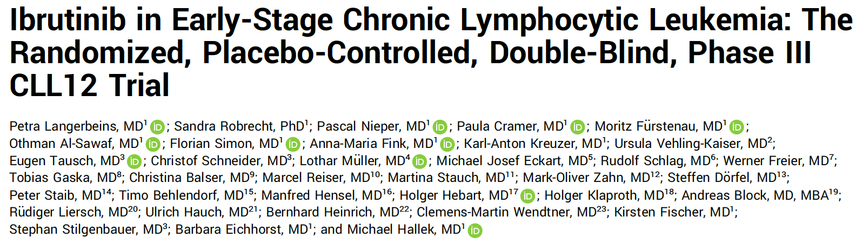
J Clin Oncol 2025 February;43(4):392-402.

Slide 18
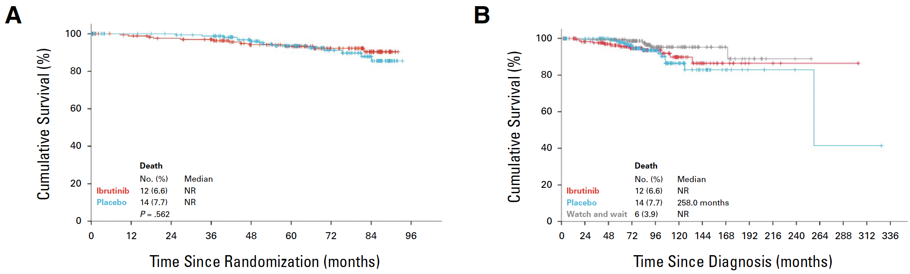
Phase III CLL12 Study: Ibrutinib versus Placebo for Early-Stage Chronic Lymphocytic Leukemia (CLL)
10-year OS
(from CLL diagnosis)
5-year OS
5-year survival
Ibrutinib 93.3% (89.3 – 97.3)
Placebo 93.6% (89.5 – 97.7)
Watch and wait 97.9% (95.6 – 100)
P = 0.562
10-year survival
Ibrutinib 89.8% (83.3 – 96.3)
Placebo 86.5% (78.7 – 94.3)
Watch and wait 95.3% (91.1 – 99.4)
OS = overall survival
Langerbeins P et al. J Clin Oncol 2025 February;43(4):392-402.

Slide 19
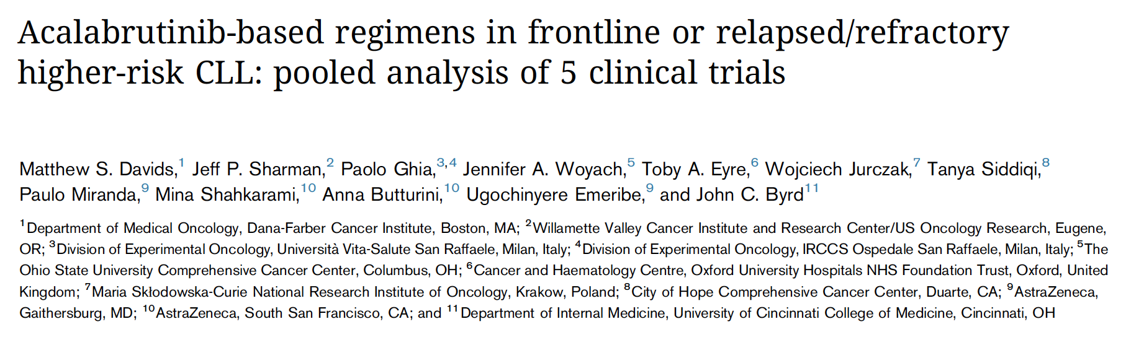
Blood Adv 2024 July 9;8(13):3345-59.

Slide 20
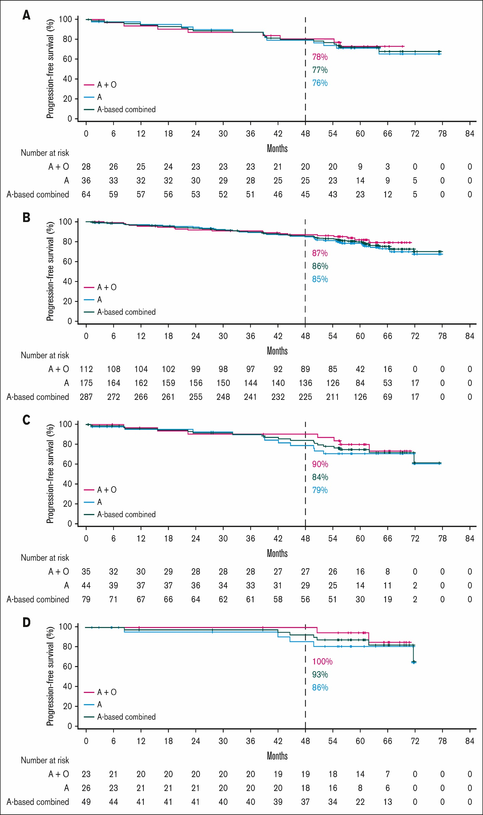
Pooled Analysis of 5 Clinical Trials of Acalabrutinib: Survival by Genetic Features in Patients with Treatment-Naïve Disease
del(17p)/TP53m
CK overall
CK without del(17p)/TP53m
uIGHV
Davids MS et al. Blood Adv 2024 July 9;8(13):3345-59.
Courtesy of Paolo Ghia, MD, PhD

Slide 21
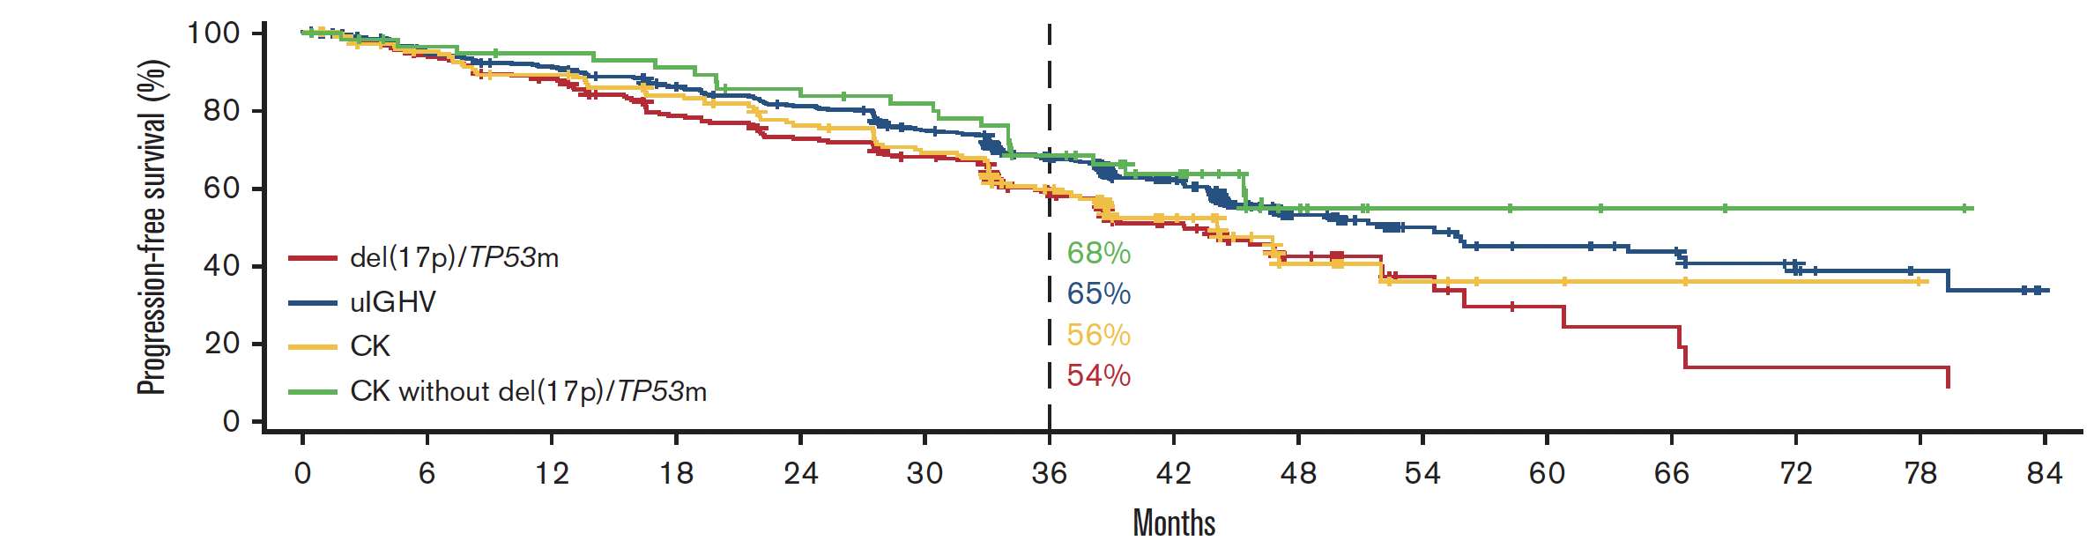
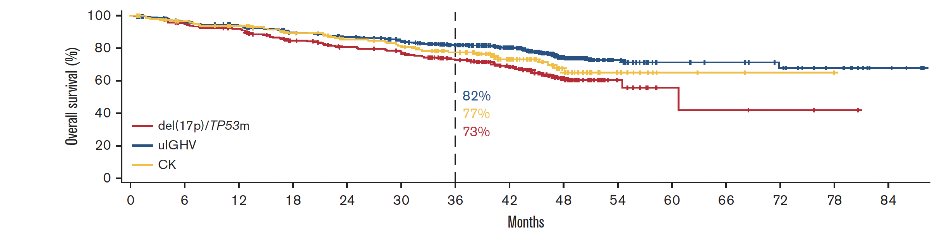
Pooled Analysis of 5 Clinical Trials of Acalabrutinib: Survival by Genetic Features in Patients with Relapsed/Refractory Disease
Davids MS et al. Blood Adv 2024 July 9;8(13):3345-59.

Slide 22
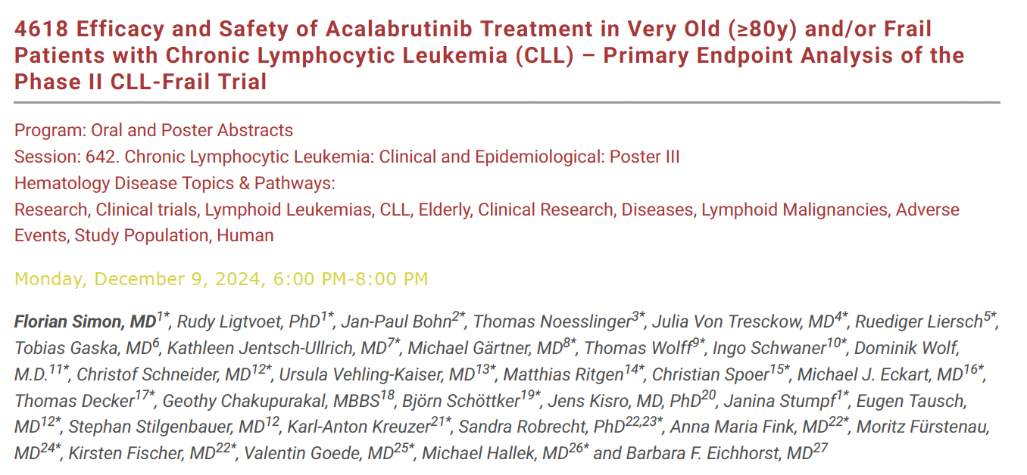
ASH 2024

Slide 23
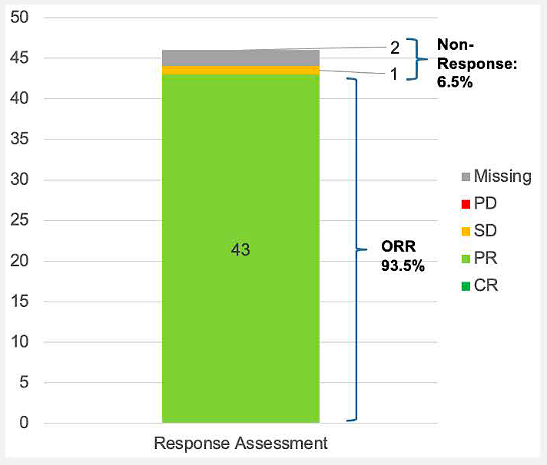
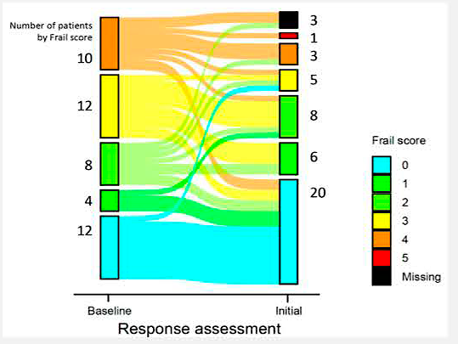
Phase II CLL-Frail Study of Acalabrutinib for Very Old (≥80 Years) and/or Frail Patients: ORR and Frailty Assessment
Simon F et al. ASH 2024;Abstract 4618.

Slide 24
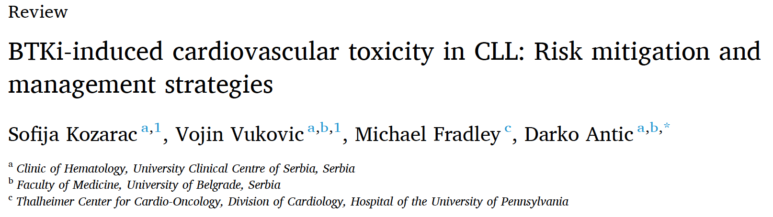
Blood Rev 2025 March;70:101268.

Slide 25
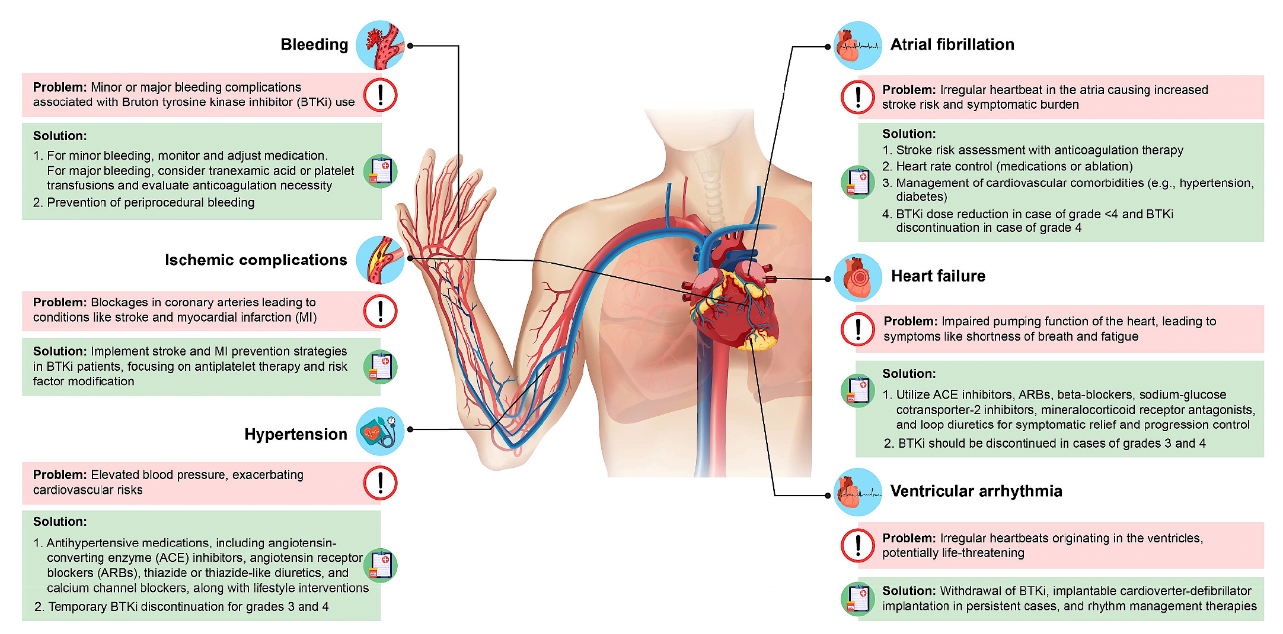
Cardiovascular Adverse Events Associated with BTK Inhibitors for CLL
Kozarac S et al. Blood Rev 2025 March;70:101268.

Slide 26
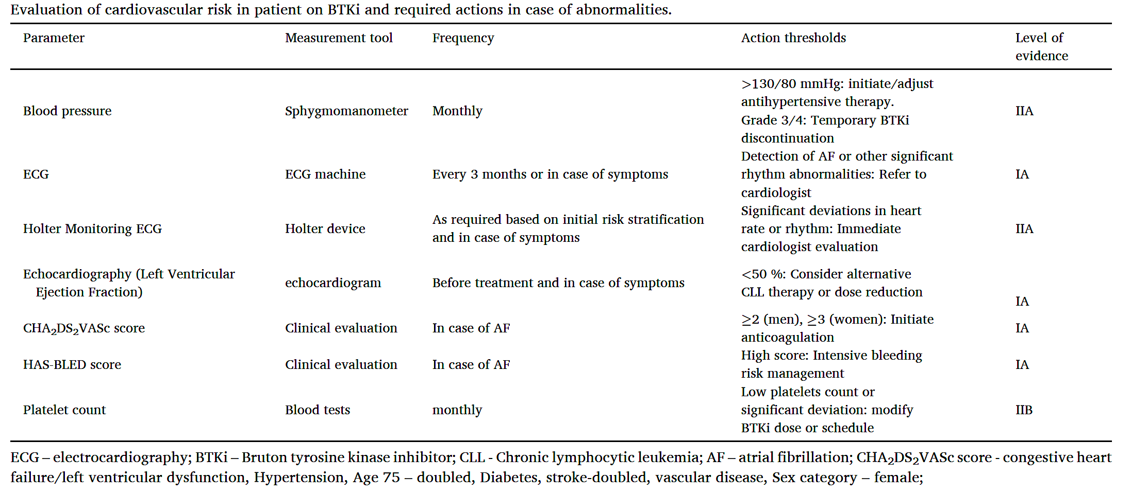
Evaluation of Cardiovascular Risk and Action Thresholds with
BTK Inhibitors
Kozarac S et al. Blood Rev 2025 March;70:101268.

Slide 27
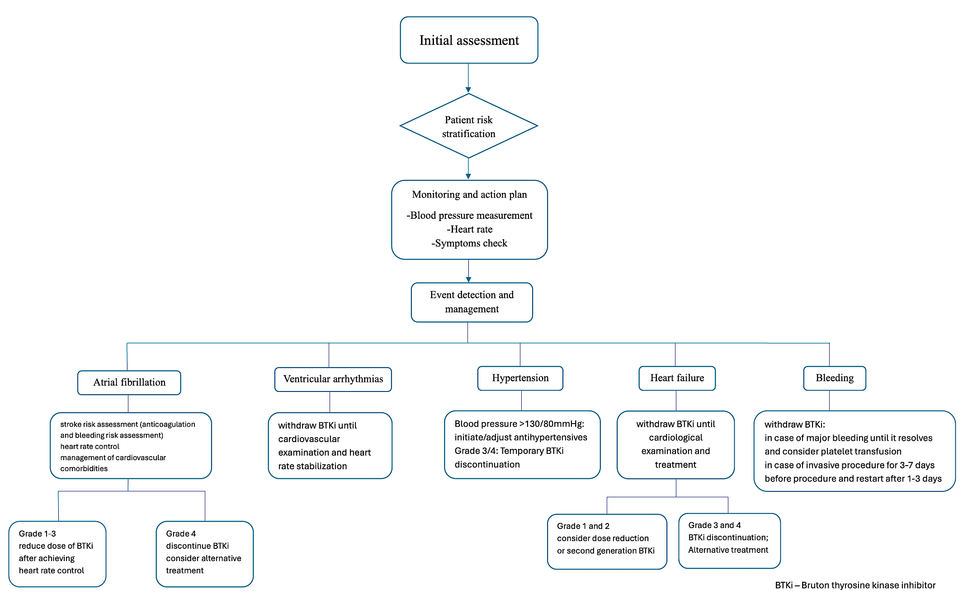
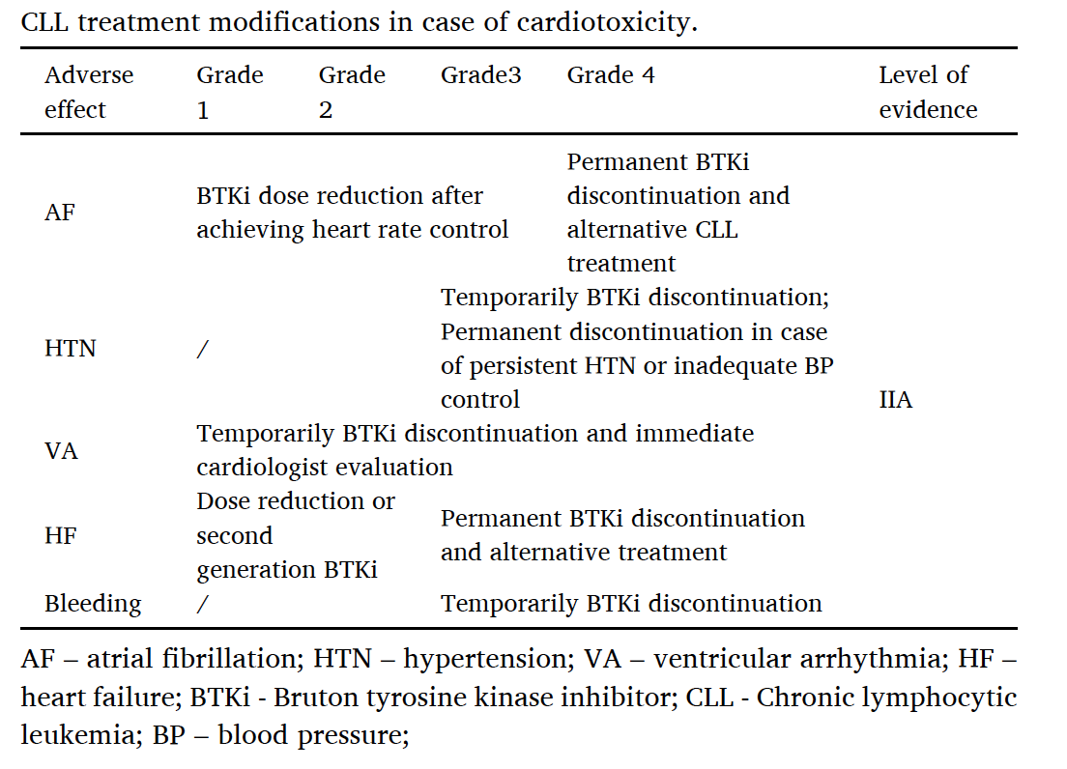
Algorithm for Managing Cardiovascular Toxicity During CLL Treatment
BTKi – Bruton tyrosine kinase inhibitor
Kozarac S et al. Blood Rev 2025 March;70:101268.

Slide 28
AGENDA
Year in Review: Management of
Chronic Lymphocytic Leukemia (CLL)
INTRODUCTION: The CLL Experience — 2000 to 2025
MODULE 1: Current Therapy Options with Covalent Bruton Tyrosine Kinase (BTK) Inhibitors
MODULE 2: Role of Venetoclax in the Treatment of CLL
MODULE 3: AMPLIFY Trial and Other Novel BTK Inhibitor and Bcl-2 Inhibitor Combination Strategies
MODULE 4: Noncovalent BTK Inhibitor Pirtobrutinib
MODULE 5: CAR T-Cell Therapy; Novel Agents

Slide 29
Role of Venetoclax in the Treatment of CLL
Al-Sawaf O et al. Venetoclax-obinutuzumab for previously untreated chronic lymphocytic leukemia: 6-year results of the randomized phase 3 CLL14 study. Blood 2024 October 31;144(18):1924-35.
Fürstenau M et al. First-line venetoclax combinations versus chemoimmunotherapy in fit patients with chronic lymphocytic leukaemia (GAIA/CLL13): 4-year follow-up from a multicentre, open-label, randomised, phase 3 trial. Lancet Oncol 2024 June;25(6):744-59.
Roeker L et al. Minimal residual disease (MRD)-adapted duration of front-line venetoclax
and obinutuzumab treatment for fit patients with chronic lymphocytic leukemia (CLL). ASH 2024;Abstract 1010.
Sharman JP et al. CRISTALLO: Results from a Phase III trial of venetoclax-obinutuzumab versus fludarabine, cyclophosphamide and rituximab or bendamustine-rituximab in patients with untreated chronic lymphocytic leukemia without del(17p) or TP53 mutations. ASH 2024;Abstract 3237.
Kater AP et al. Activity of venetoclax in patients with relapsed or refractory chronic lymphocytic leukaemia: Analysis of the VENICE-1 multicentre, open-label, single-arm, phase 3b
trial. Lancet Oncol 2024 April;25(4):463-73.

Slide 30
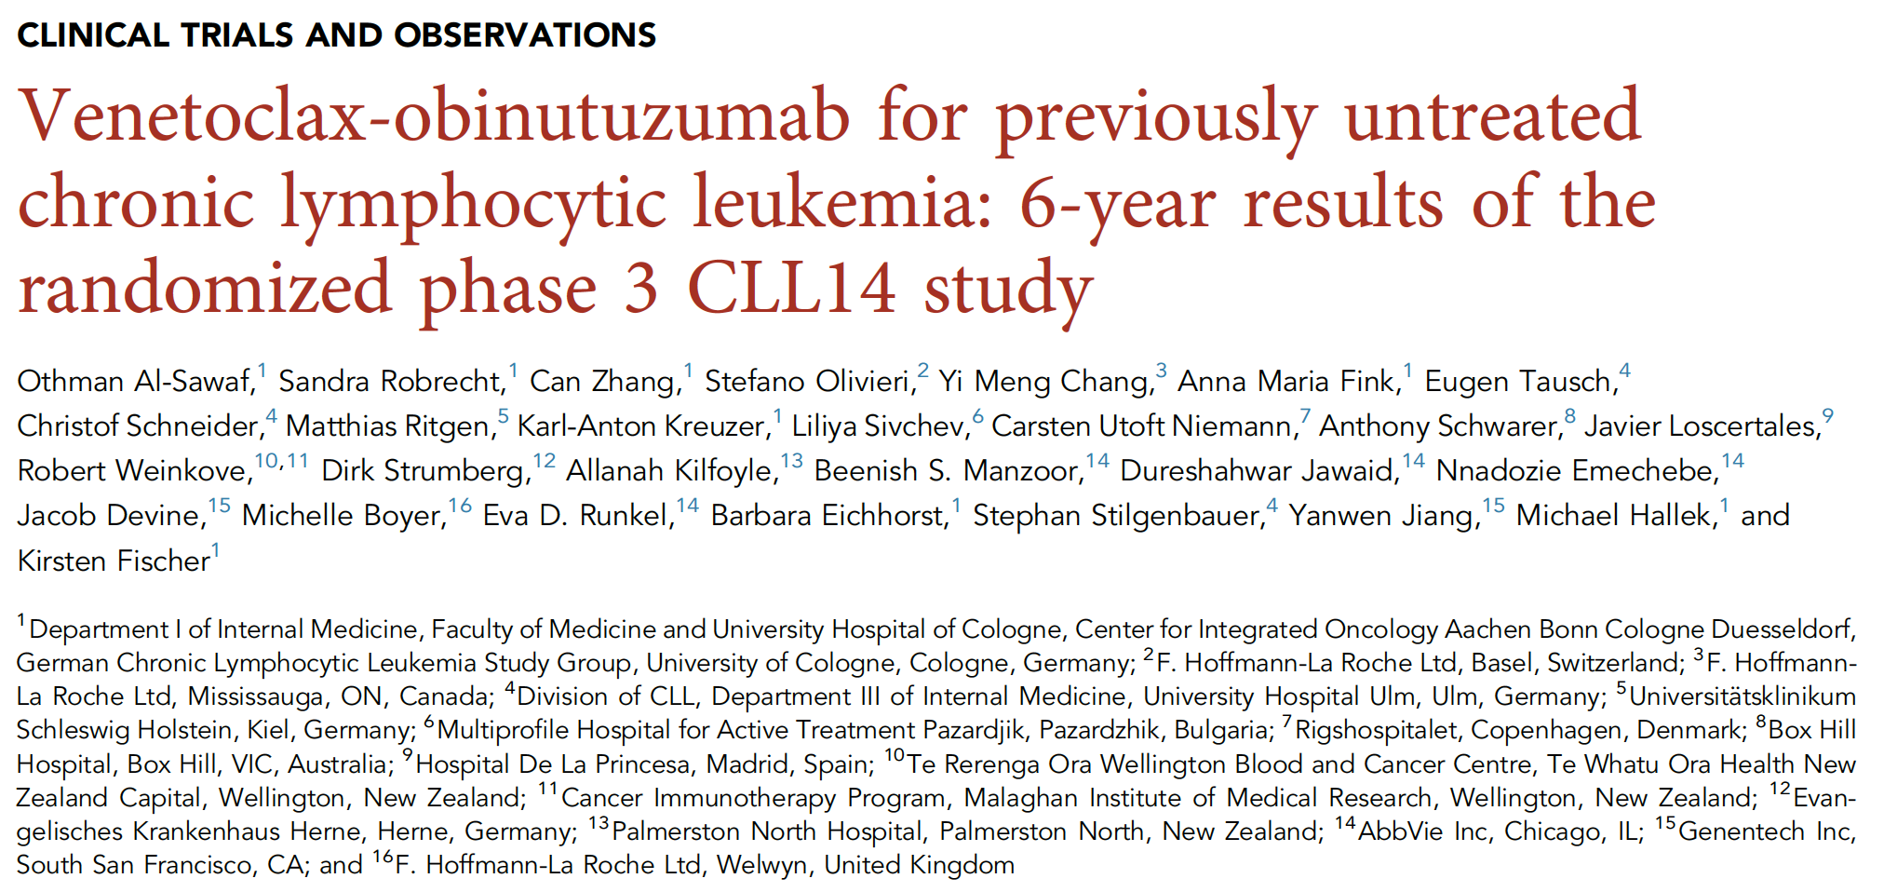
Blood 2024 October 31;144(18):1924-35.

Slide 31
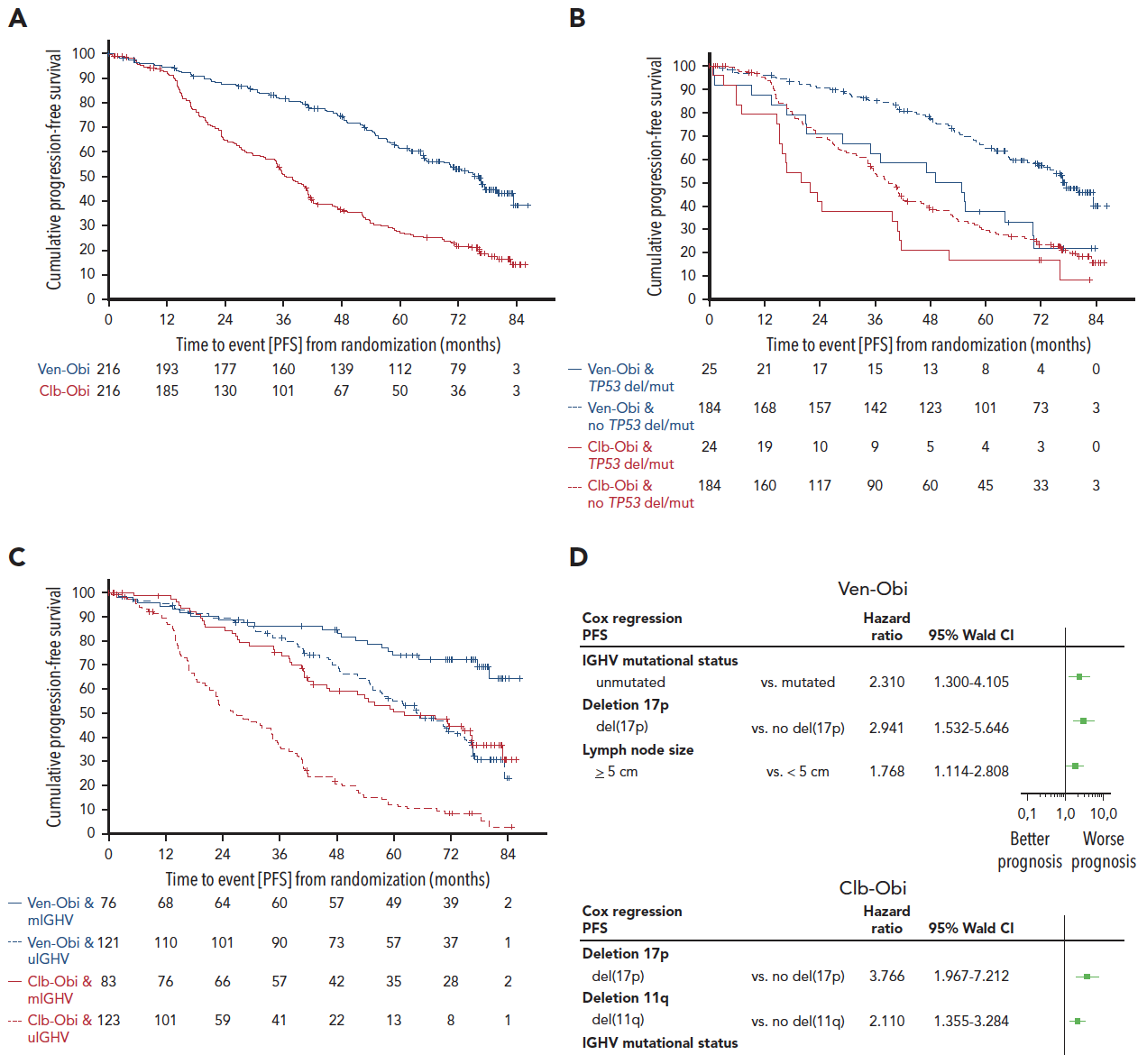
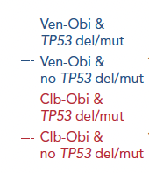
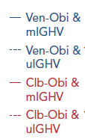

Venetoclax/Obinutuzumab for Previously Untreated CLL:
6-Year Results of the Phase III CLL14 Study – PFS
All patients
TP53 del/mut
IGHV status
 | Median PFS | 6-year PFS rate
Ven-Obi | 76.2 months | 53.1%
Clb-Obi | 36.4 months | 21.7%
 | HR 0.40, 95% CI [0.31-0.52] P<0.0001 | 34 (8.8%)
mPFS, mo | Venetoclax + obinutuzumab | Chlorambucil + obinutuzumab
No TP53 del/mut TP53 del/mut | 76.6 51.9 | 38.9 20.8
IGHV mutated IGHV no mutation | NR 64.8 | 62.2 26.9
Al-Sawaf O et al. Blood 2024 October 31;144(18):1924-35.
Courtesy of Paolo Ghia, MD, PhD

Slide 32
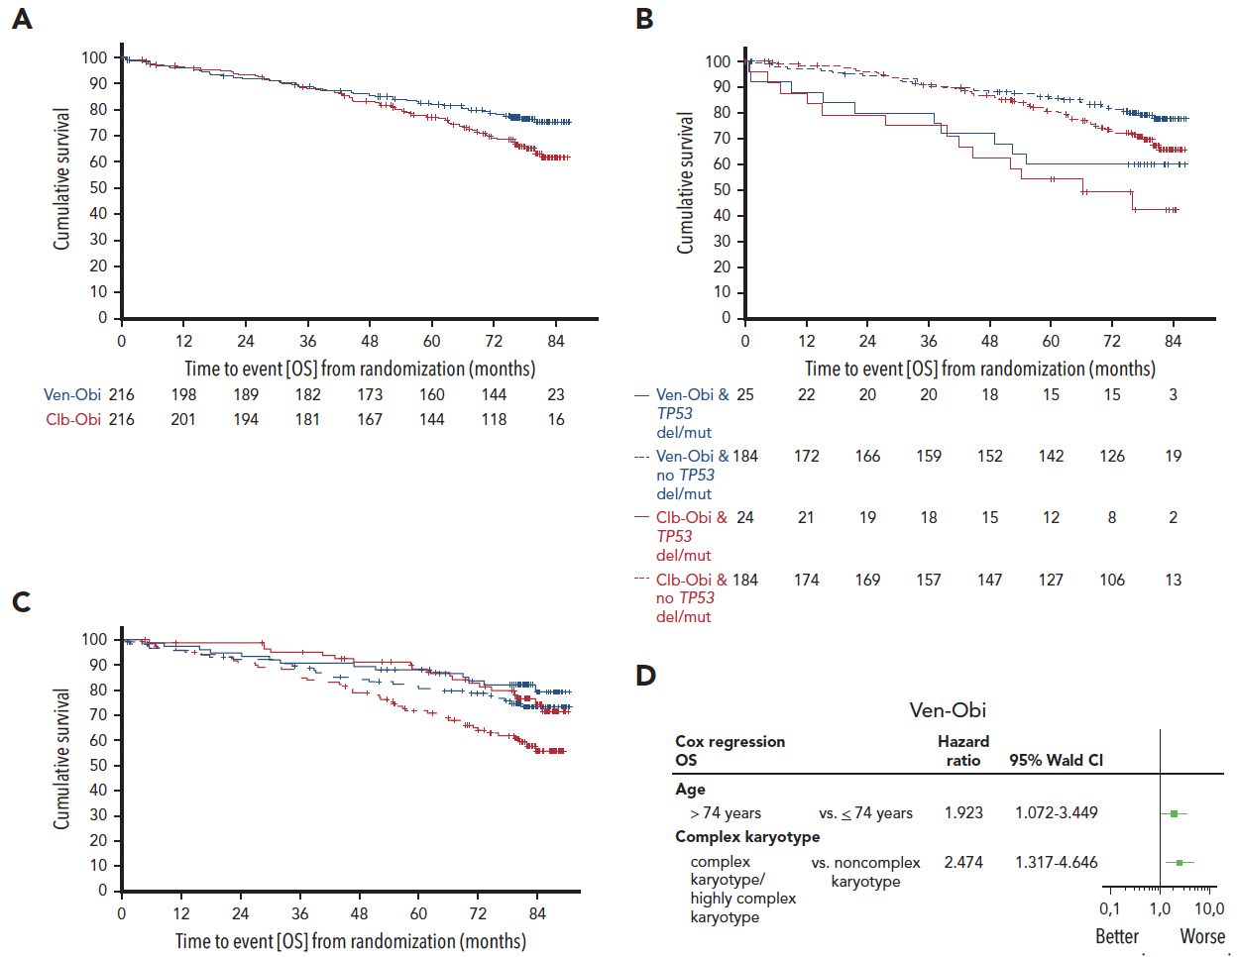
Venetoclax/Obinutuzumab for Previously Untreated CLL:
6-Year Results of the Phase III CLL14 Study – OS
All patients
TP53 del/mut
IGHV status
Al-Sawaf O et al. Blood 2024 October 31;144(18):1924-35.

Slide 33
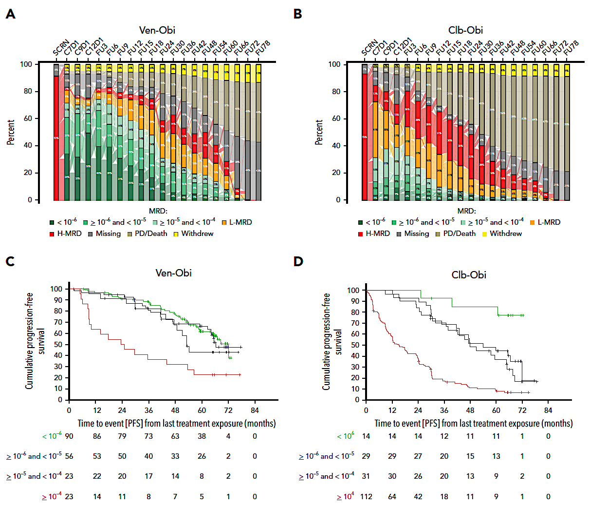
Venetoclax/Obinutuzumab for Previously Untreated CLL: 6-Year Results of the Phase III CLL14 Study – Minimal Residual Disease (MRD)
Al-Sawaf O et al. Blood 2024 October 31;144(18):1924-35.

Slide 34
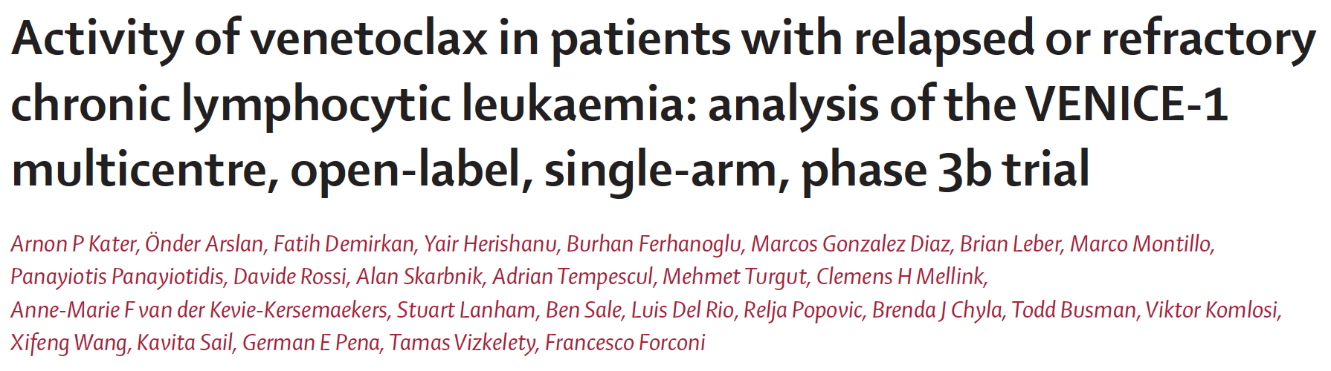
Lancet Oncol 2024 April;25(4):463-73.

Slide 35
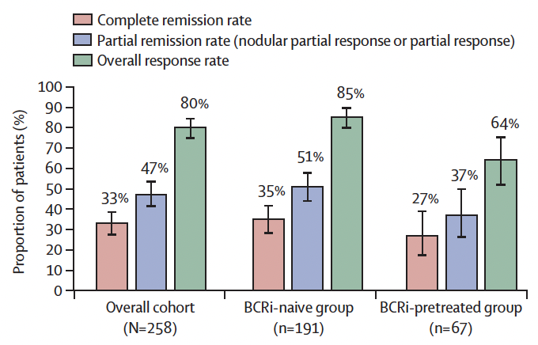
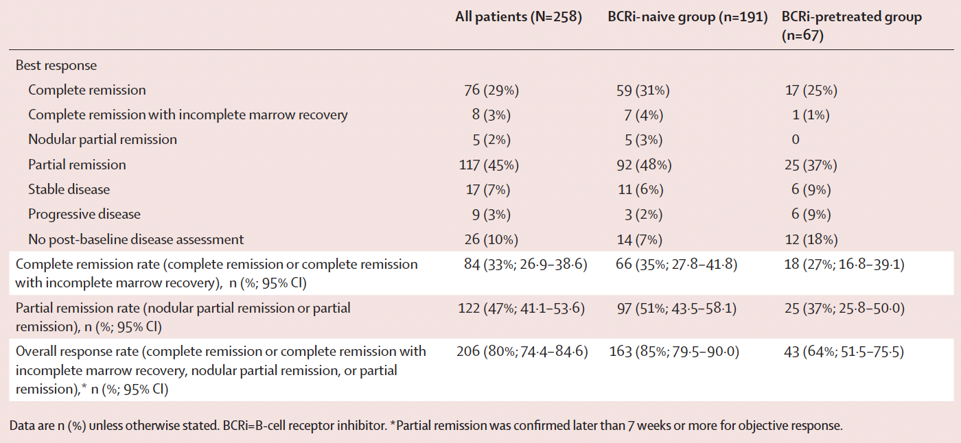
Venetoclax Monotherapy for Relapsed or Refractory CLL:
The Single-Arm Phase IIIb VENICE-1 Trial – Response
Median follow-up in the overall cohort was 49·5 months (IQR 47·2-54·1)
Kater AP et al. Lancet Oncol 2024 April;25(4):463-73.

Slide 36
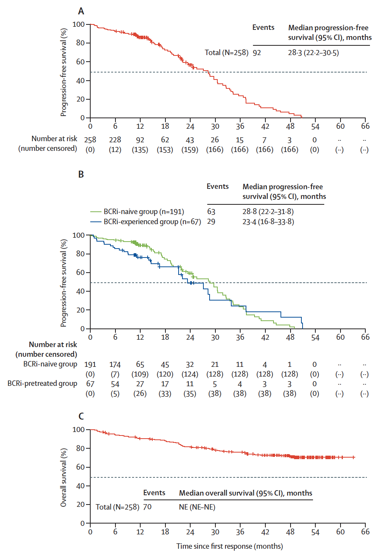
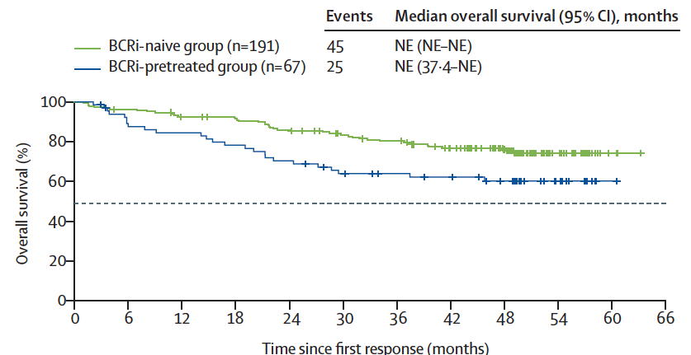
Phase IIIb VENICE-1: Survival by B-Cell Receptor-Associated Kinase Inhibitor (BCRi) Exposure
PFS
OS
Kater AP et al. Lancet Oncol 2024 April;25(4):463-73.

Slide 37
Phase IIIb VENICE-1: Summary
Venetoclax monotherapy demonstrated deep and durable responses and prolonged overall survival, irrespective of previous BCRi treatment.
  With dose modifications, the safety profile of venetoclax was manageable even given this extended period of follow-up, and many patients transitioned to an extension study to continue receiving venetoclax therapy.
The safety profile reported here was consistent with previously published venetoclax data with relapsed or refractory CLL.
  Although common, neutropenia was managed with brief interruptions or reductions in venetoclax dosing.
Kater AP et al. Lancet Oncol 2024 April;25(4):463-73.

Slide 38
AGENDA
Year in Review: Management of
Chronic Lymphocytic Leukemia (CLL)
INTRODUCTION: The CLL Experience — 2000 to 2025
MODULE 1: Current Therapy Options with Covalent Bruton Tyrosine Kinase (BTK) Inhibitors
MODULE 2: Role of Venetoclax in the Treatment of CLL
MODULE 3: AMPLIFY Trial and Other Novel BTK Inhibitor and Bcl-2 Inhibitor Combination Strategies
MODULE 4: Noncovalent BTK Inhibitor Pirtobrutinib
MODULE 5: CAR T-Cell Therapy; Novel Agents

Slide 39
AMPLIFY and Other Novel BTK Inhibitor and Bcl-2 Inhibitor Combination Strategies
Brown JR et al. Fixed-duration acalabrutinib combinations in untreated chronic lymphocytic leukemia. N Engl J Med 2025 February 20;392(8):748-62.
Davids MS et al. Primary endpoint evaluation of a multicenter, phase 2 study of acalabrutinib, venetoclax, obinutuzumab (AVO) in a population of previously untreated patients with CLL enriched for high-risk disease. ASH 2024;Abstract 1865.
Fürstenau M et al. Acalabrutinib, venetoclax, and obinutuzumab in relapsed/refractory CLL: Final efficacy and ctDNA analysis of the CLL2-BAAG trial. Blood 2024 July 18;144(3):272-82.
Ma S et al. Combination of zanubrutinib + venetoclax for treatment-naïve (TN) CLL/SLL with del(17p) and/or TP53: Preliminary results from SEQUOIA arm D. EHA 2024;Abstract S160.
Soumerai JD et al. Sonrotoclax and zanubrutinib as frontline treatment for CLL demonstrates high MRD clearance rates with good tolerability: Data from an ongoing phase 1/1b study BGB-11417-101. ASH 2024;Abstract 1012.

Slide 40
AMPLIFY: AV and AVO vs FCR/BR
Progression-Free Survival
PFS Significantly Improved With
AV and AVO vs FCR/BR
100
83.1%
80
76.5%
AVO
60
PFS (%)
66.5%
AV
FCR/BR
40
20
HR (95% CI)
P value
AV vs FCR/BR
AVO vs FCR/BR
0.65 (0.49 to 0.87)
0.42 (0.30 to 0.59)
P=0.0038
P<0.0001
0
0
6
12
18
24
30
36
42
48
54
60
Months from Randomization
Median PFS was NR for AV and AVO, and was 47.6 mo for FCR/BR
uMRD rates (<10⁻⁴) in peripheral blood at EOT (evaluable patients):
45.0% (AV), 95.0% (AVO), 72.9% (FCR/BR)
Brown JR et al. ASH 2024; Abstract 1009
Brown JR NEJM 2025

Slide 41
What about AMPLIFY results?
First potential registration trial for a BTKi-BCL2i combination
AV is very safe and very easy: potentially applicable to most any CLL patient
AVO is very effective, equalizing outcome in UM and M IGHV patients at 3 yrs: good for young fit higher risk patients
Courtesy of Jennifer R Brown, MD, PhD

Slide 42
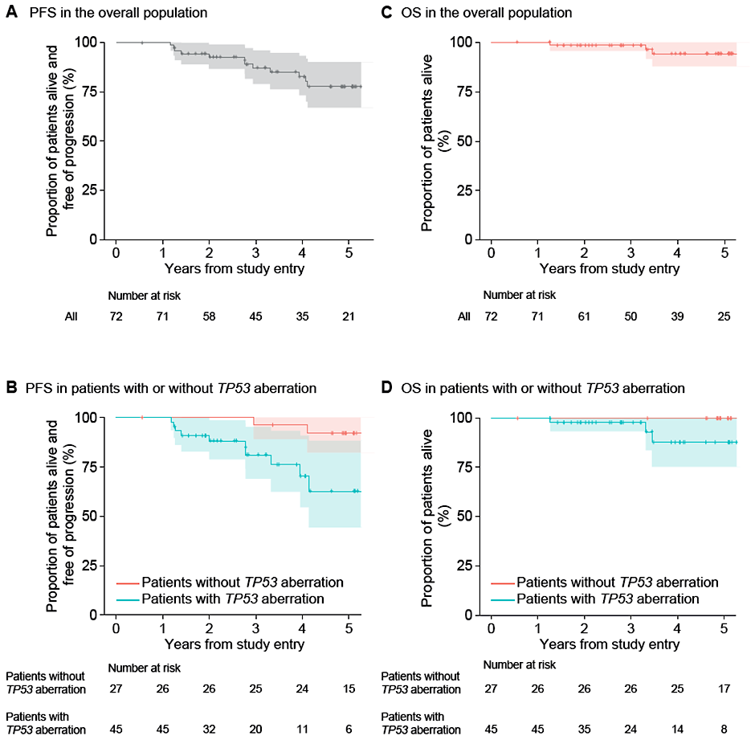
AVO for 16-25 Months for High Risk Del17p Disease: Survival & Recurrence
35 pts (51%) had MRD recurrence
  Median time to MRD recurrence was 32.2 months
70% 4-year PFS in pts with TP53 aberration; 96% in pts without TP53 aberration
88% 4-year OS in pts with TP53 aberration; 100% in pts without TP53 aberration
10 pts have had clinical progression, 4 of these 10 progressions were transformation events, including Richter’s DLBCL (n=2) and Hodgkin lymphoma (n=2)
3 pts have died in total, one each due to gr 5 COVID-19 infection during treatment, complications from polysubstance abuse, and progression of Richter’s
Courtesy of Jennifer R Brown, MD, PhD
Davids M et al. ASH 2024; Abstract 1865

Slide 43
AVO for 16-25 Months for High Risk Del17p Disease
Longer, MRD guided AVO regimen for patients with del17p disease
Highly effective in inducing uMRD remission
Durability is somewhat reduced compared to the 17p wild type population – but nonetheless looks better compared to ven obin
Ongoing head to head trial comparing AVO to VO in high risk del17p disease (GCLLSG)
Courtesy of Jennifer R Brown, MD, PhD
Author’s slide

Slide 44
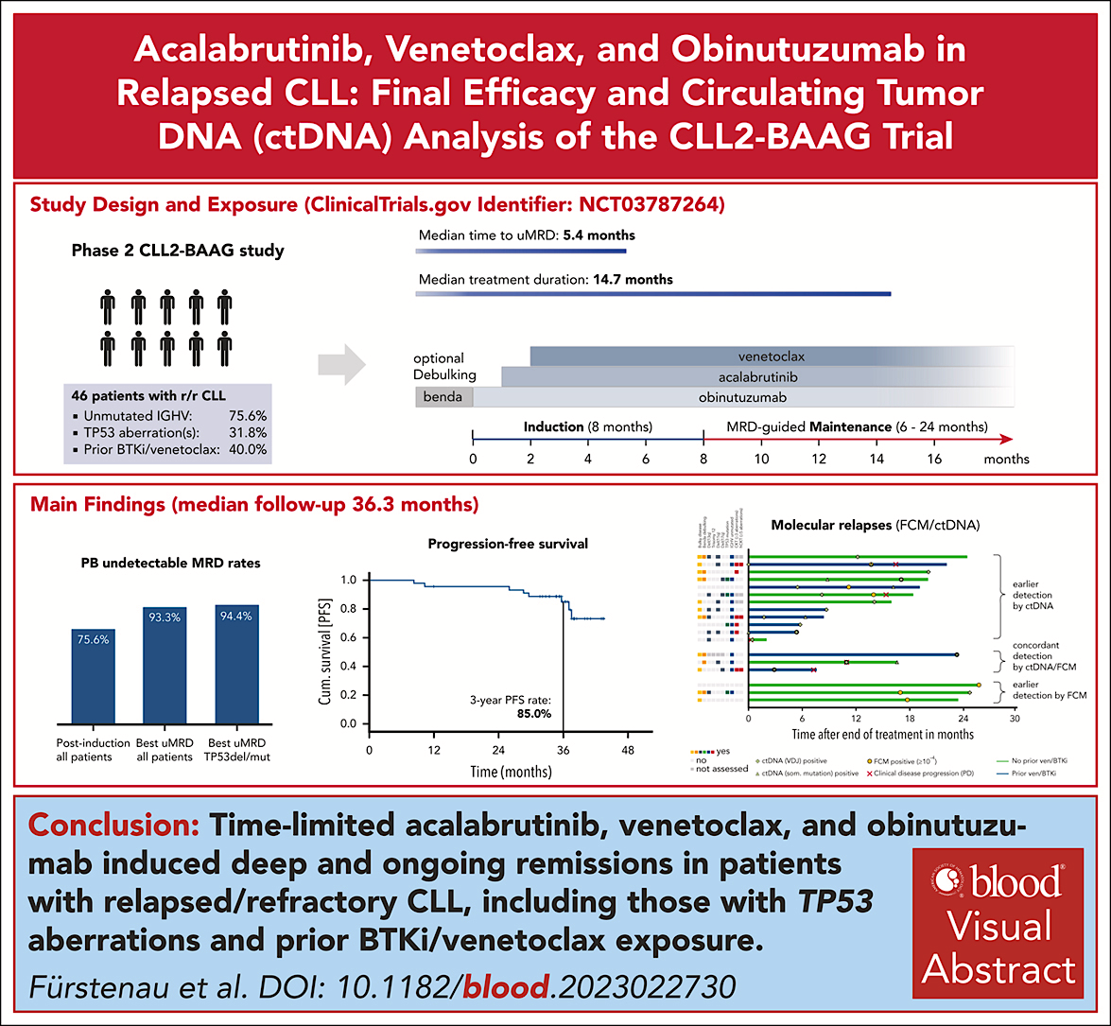
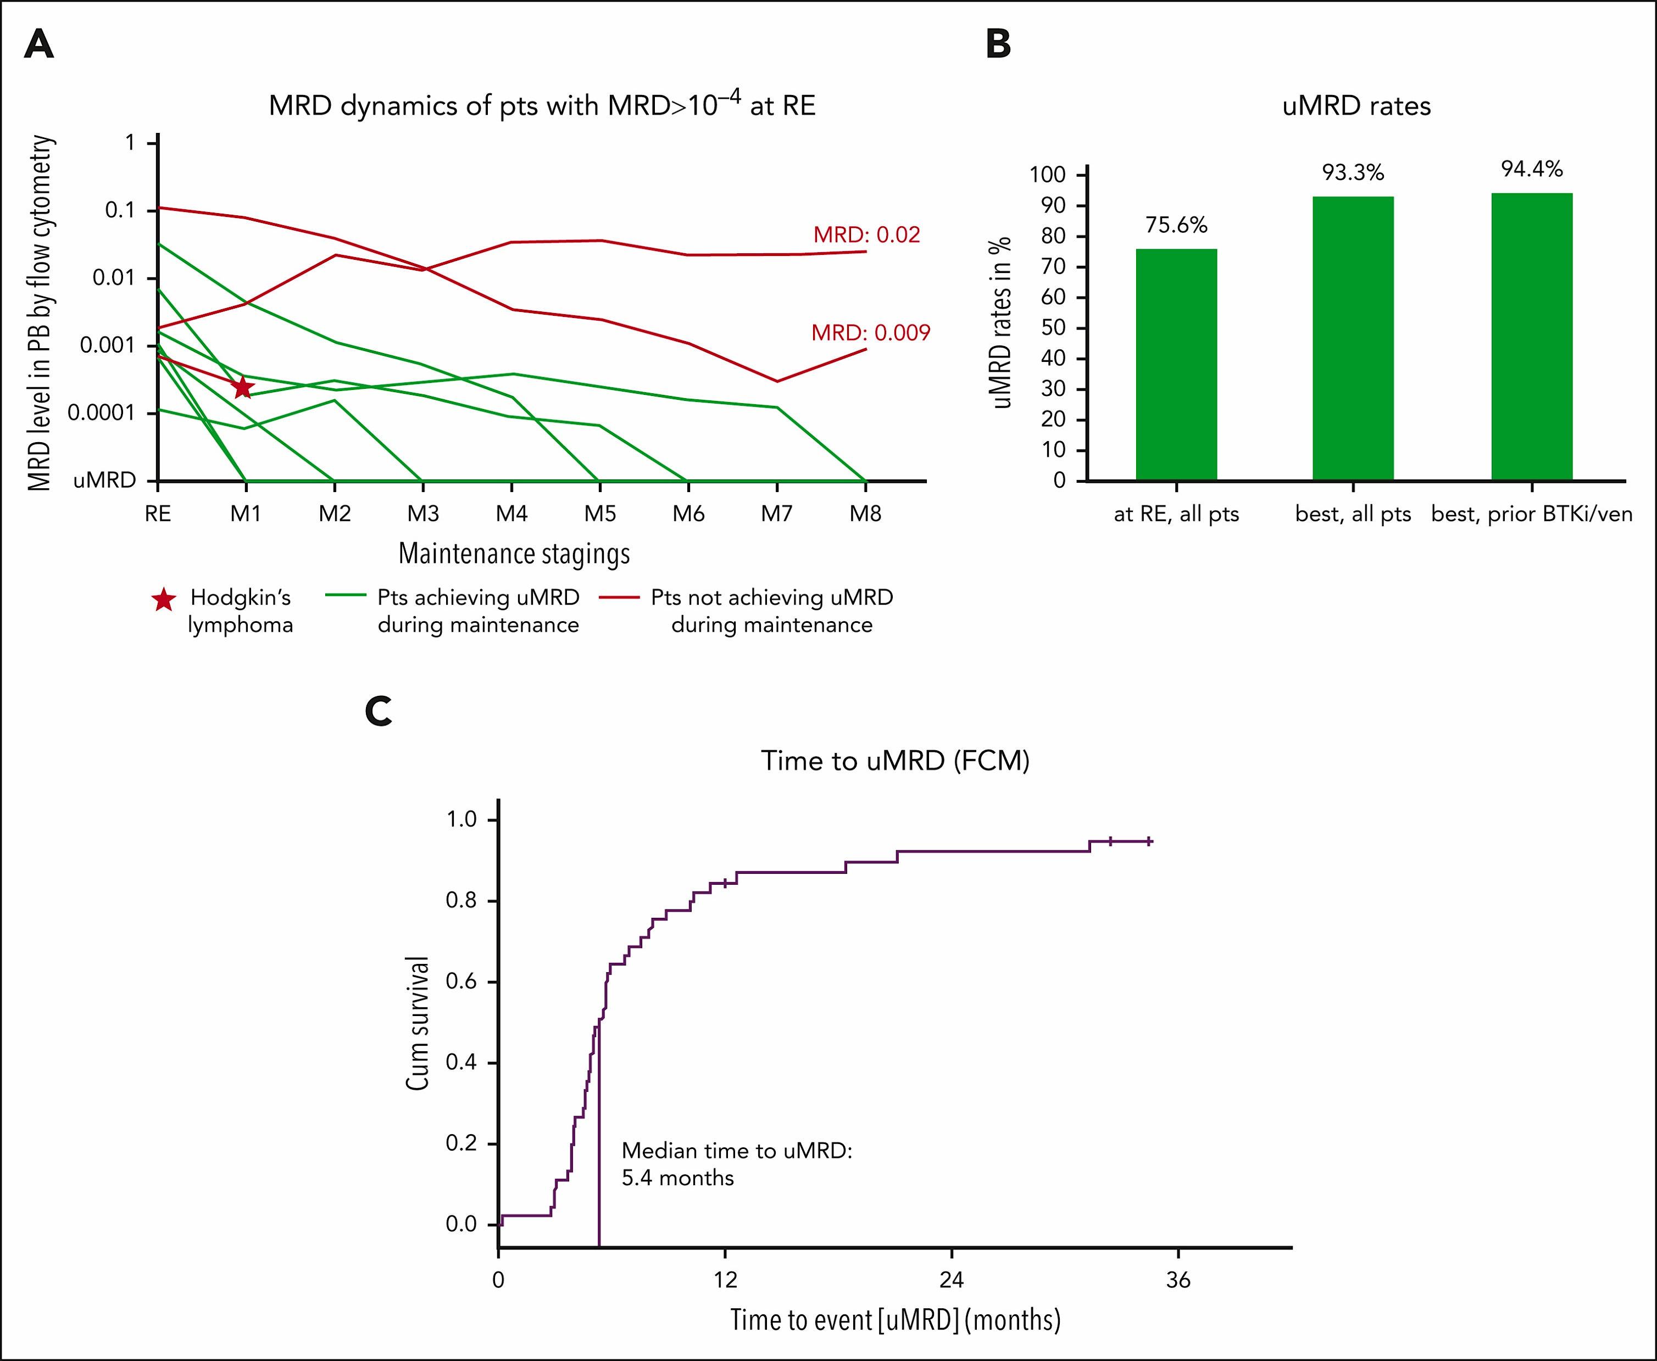
Fürstenau M et al. Blood 2024
Courtesy of Jennifer R Brown, MD, PhD

Slide 45
What about AVO in Relapsed Disease?
Heterogeneous group of heavily pretreated patients
Surprisingly effective – 3 yr PFS 85%
Some patients may not get to uMRD: should they just continue?
Underscores the importance of avoiding development of resistance – but maybe combination will still work….
Courtesy of Jennifer R Brown, MD, PhD
Author’s slide

Slide 46
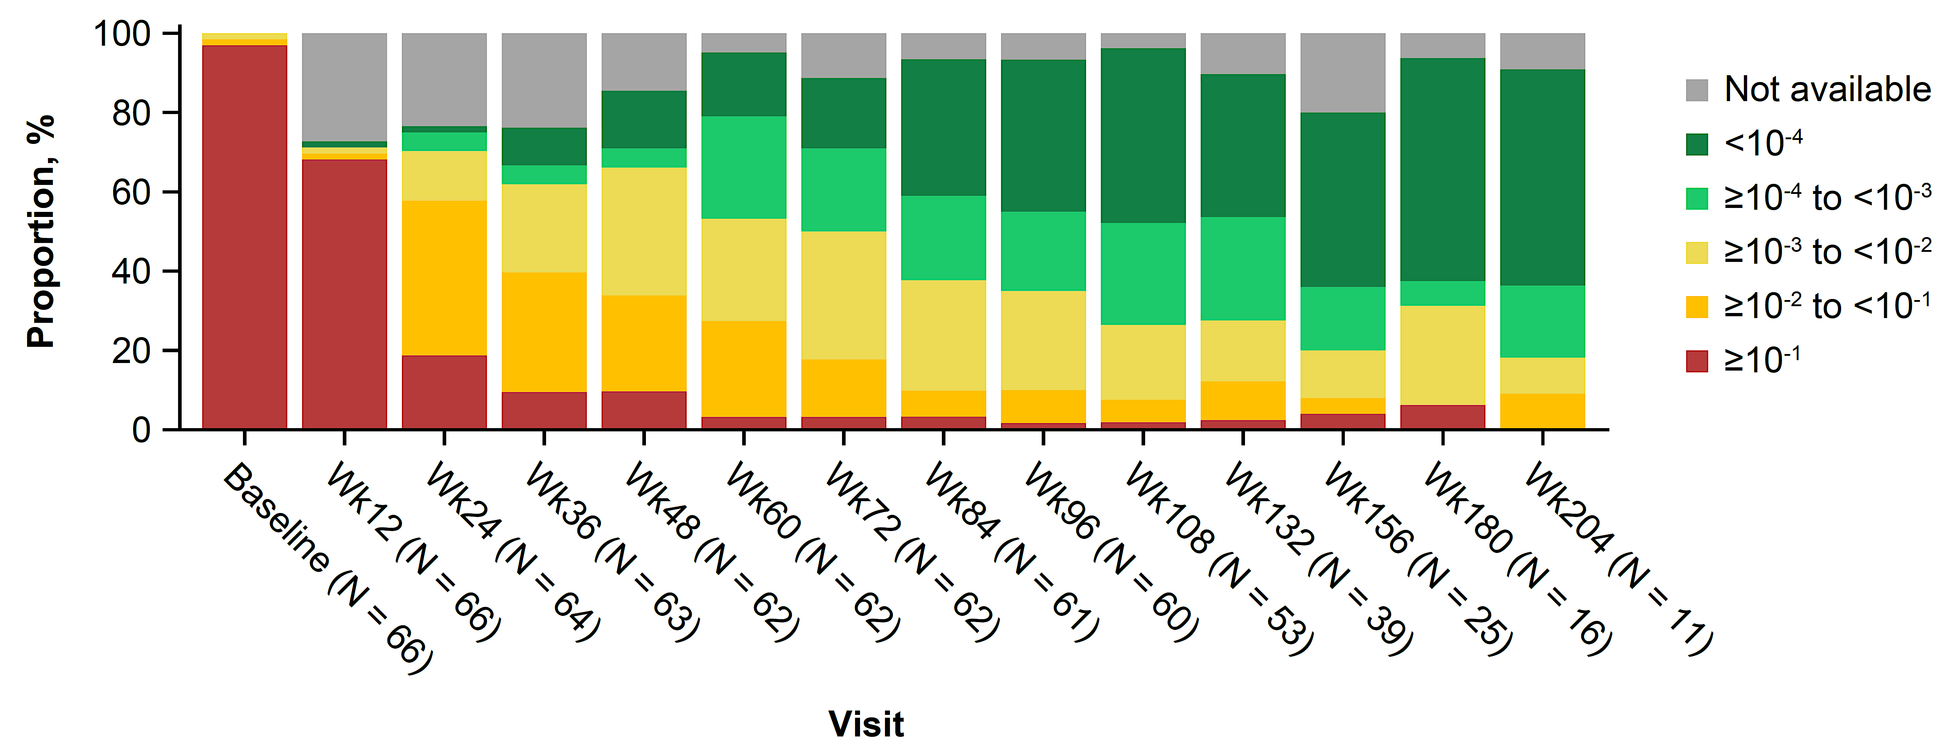




SEQUOIA Arm D Treatment Regimen and MRD
Zanubrutinib lead-in (3 cycles) followed by zanubrutinib + venetoclax (12-24 cycles dependent on uMRD early dose-stopping rules), then zanubrutinib monotherapy until disease progression, unacceptable toxicity, or meeting uMRD early dose-stopping rules
Beyond C28, continue zanubrutinib alone until confirmed uMRD
C1
C4
C7
C10
C13
C16
C19
C22
C25
C28+
Zanubrutinib 160 mg twice daily for ≥27 cycles
Venetoclax ramp-up cycle, then 400 mg once daily for 12-24 cycles
Lead-in
Fürstenau
Treatments
Starting at C16, may discontinue venetoclax for confirmed uMRD (PB & BM)
TLS risk assessments
Hematology/physical examination/imaging
MRD: PB
Assessments
BM biopsy & aspirate
for CRª
MRD: BM aspirate^{b}
ª BM biopsy and aspirate are required to confirm a suspected CR/CRi (BM collection timepoint not defined per protocol), starting after cycle 9 and then annually if needed.
^{b} Patients with confirmed CR/CRi and 2 consecutive PB uMRD ≥12 weeks apart.
Courtesy of Jennifer R Brown, MD, PhD
Shuo MA et al. EHA 2024;Abstract S160

Slide 47
SEQUOIA Arm D: Zanu Ven in Del17p
Relatively slow achievement of uMRD:? Due to 17p
Very strict stopping criteria: Most patients continue on therapy
  --?Is this really a time limited regimen
  BUT: maybe a longer treatment duration is preferred in this patient subgroup –
  Longer follow-up is required
Courtesy of Jennifer R Brown, MD, PhD
Author’s slide

Slide 48
Sonrotoclax + Zanubrutinib Demonstrates Substantial Antitumor Activity in TN CLL
Best Responseª
Best Blood MRD^{b}
By Week 24
By Week 48
By Week 24^{c}
By Week 48^{c}
100
1%
100
9%
4%
9%
SD
18%
13%
N/A
80
PR
80
14%
MRD4+
60%
58%
CR/CRi
24%
uMRD4
67%
60
73%
60
Patients, %
Patients, %
91%
40
40
82%
78%
59%
20
40%
42%
20
26%
33%
0
0
Sonro
160 mg
(n=51)
Sonro
320 mg
(n=58)
Sonro
160 mg
(n=45)
Sonro
320 mg
(n=53)
Sonro
160 mg
(n=51)
Sonro
320 mg
(n=58)
Sonro
160 mg
(n=45)
Sonro
320 mg
(n=53)
ª Percentages based on the number of patients who reached assessment at 24 or 48 weeks after completion of ramp-up, following zanu monotherapy and sonro ramp-up to target dose
^{b} As measured by ERIC flow cytometry panel; uMRD4 is defined as less than 1 CLL cell per 10,000 leukocytes (<10-4). c Number of weeks at target dose, following zanu monotherapy and sonro ramp-up to target dose.
Courtesy of Jennifer R Brown, MD, PhD
Soumerai JD et al. ASH 2024;Abstract 1012

Slide 49
Sonrotoclax + Zanubrutinib Demonstrates Substantial Antitumor Activity in TN CLL
Sonrotoclax more potent in vitro and so far very limited TLS, although ramp-up schedule has been as complicated as venetoclax
Highest uMRD rates of any BTKi-BCL2i combination (without an antibody)
Selected phase 1 population, needs longer follow-up and broadly multicenter trials
Courtesy of Jennifer R Brown, MD, PhD

Slide 50
AGENDA
Year in Review: Management of
Chronic Lymphocytic Leukemia (CLL)
INTRODUCTION: The CLL Experience — 2000 to 2025
MODULE 1: Current Therapy Options with Covalent Bruton Tyrosine Kinase (BTK) Inhibitors
MODULE 2: Role of Venetoclax in the Treatment of CLL
MODULE 3: AMPLIFY Trial and Other Novel BTK Inhibitor and Bcl-2 Inhibitor Combination Strategies
MODULE 4: Noncovalent BTK Inhibitor Pirtobrutinib
MODULE 5: CAR T-Cell Therapy; Novel Agents

Slide 51
Noncovalent BTK Inhibitor Pirtobrutinib
Sharman JP et al. BRUIN CLL-321: Randomized phase III trial of pirtobrutinib versus idelalisib plus rituximab (IdelaR) or bendamustine plus rituximab (BR) in BTK inhibitor pretreated chronic lymphocytic leukemia/small lymphocytic lymphoma. ASH 2024;Abstract 886.
Roeker LE et al. Fixed-duration pirtobrutinib plus venetoclax with or without rituximab in relapsed/refractory CLL: The phase 1b BRUIN trial. Blood 2024 September 26;144(13):1374-86.
Wierda WG et al. Pirtobrutinib, a highly selective, non-covalent (reversible) BTK inhibitor in patients with B-cell malignancies: Analysis of the Richter transformation subgroup from the multicentre, open-label, phase 1/2 BRUIN study. Lancet Haematol 2024 September;11(9):e682-92.
Jain N et al. Combined pirtobrutinib, venetoclax, and obinutuzumab as first-line treatment of patients with chronic lymphocytic leukemia (CLL). ASH 2024;Abstract 1011.

Slide 52
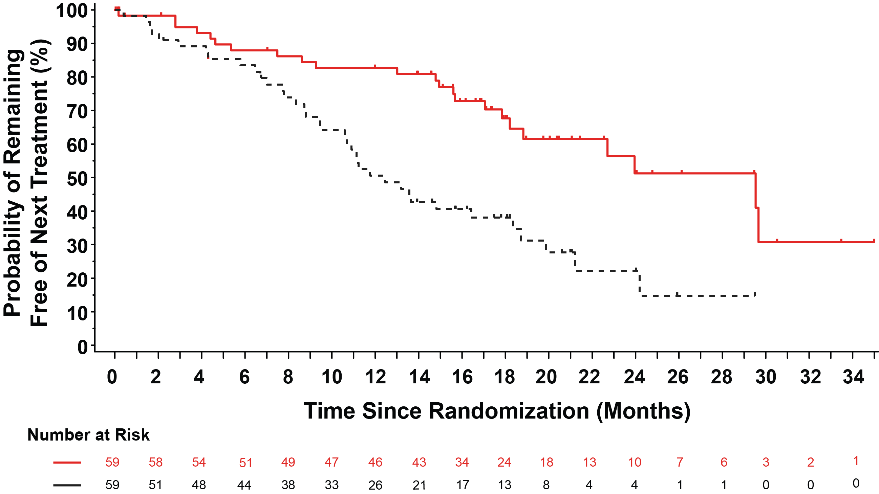
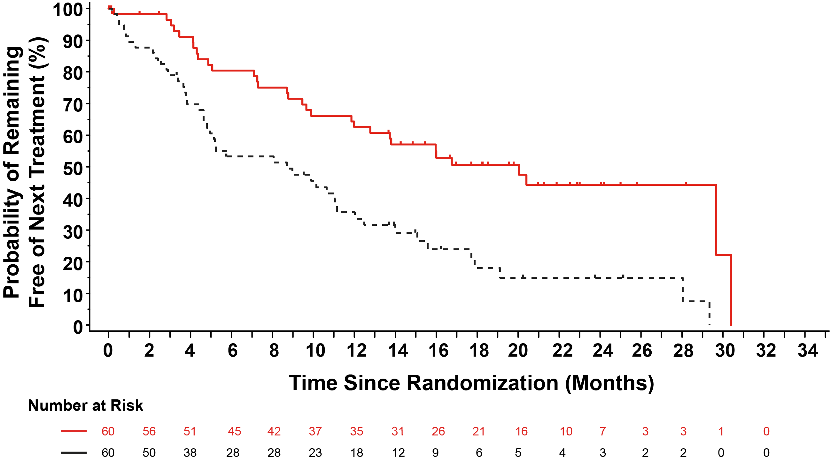
BRUIN 321: Time to Next Treatment or Death in Venetoclax Naïve and Treated Patients​
Venetoclax Naïve
n=59/arm
Venetoclax Treated
n=60/arm
Pirtobrutinib
Pirtobrutinib
IdelaR/BR
IdelaR/BR
Pirtobrutinib
n=119
IdelaR/BR
n=119
Pirtobrutinib
n=119
IdelaR/BR
n=119
Median TTNT, mo (95% CI)​ | 29.5​ | 12.5​
Hazard ratio (95% CI)​ | 0.36 (0.21- 0.61)​
Stratified log-rank 2-sided p-value​ | 0.0001​*
Median TTNT, mo (95% CI)​ | 20.0​ | 8.7​
Hazard ratio (95% CI)​ | 0.37 (0.23- 0.60)​
Stratified log-rank 2-sided p-value​ | <0.0001​​*
Courtesy of Jennifer R Brown, MD, PhD
Sharman J et al ASH 2024;Abstract 866

Slide 53
BRUIN 321
First phase 3 registration trial in patients with prior cBTKi treatment
Pirtobrutinib improved PFS compared to IdelaR/BR
Outcomes are poor overall, underscoring the high risk nature of this group
Idela-R has activity, with about one year of clinical benefit
Courtesy of Jennifer R Brown, MD, PhD

Slide 54
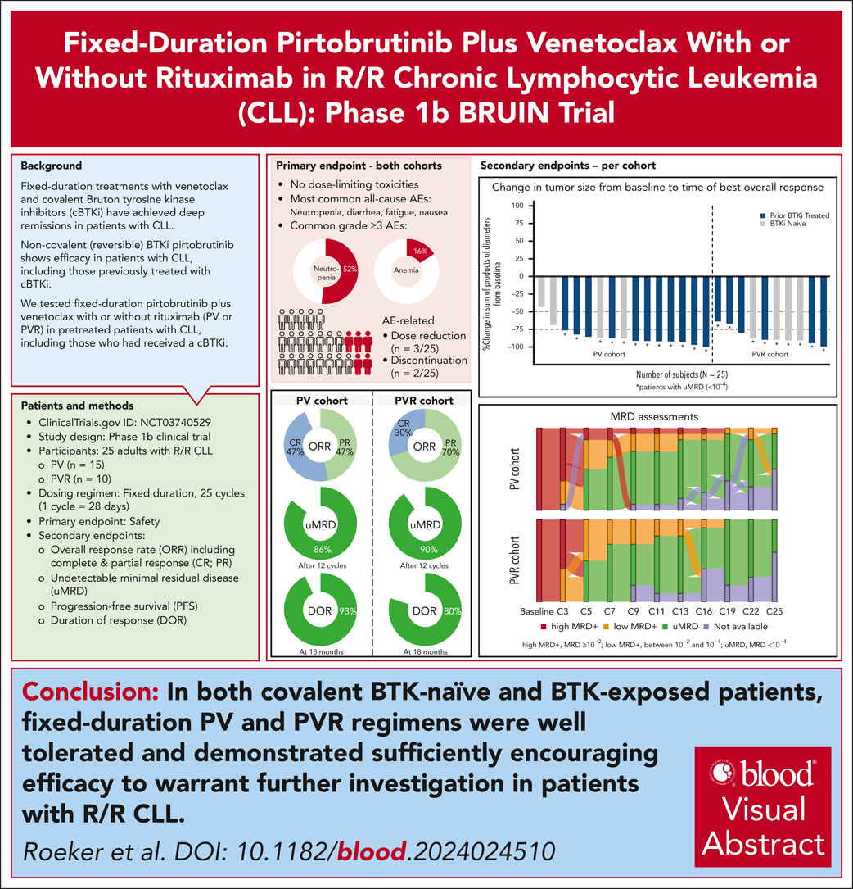
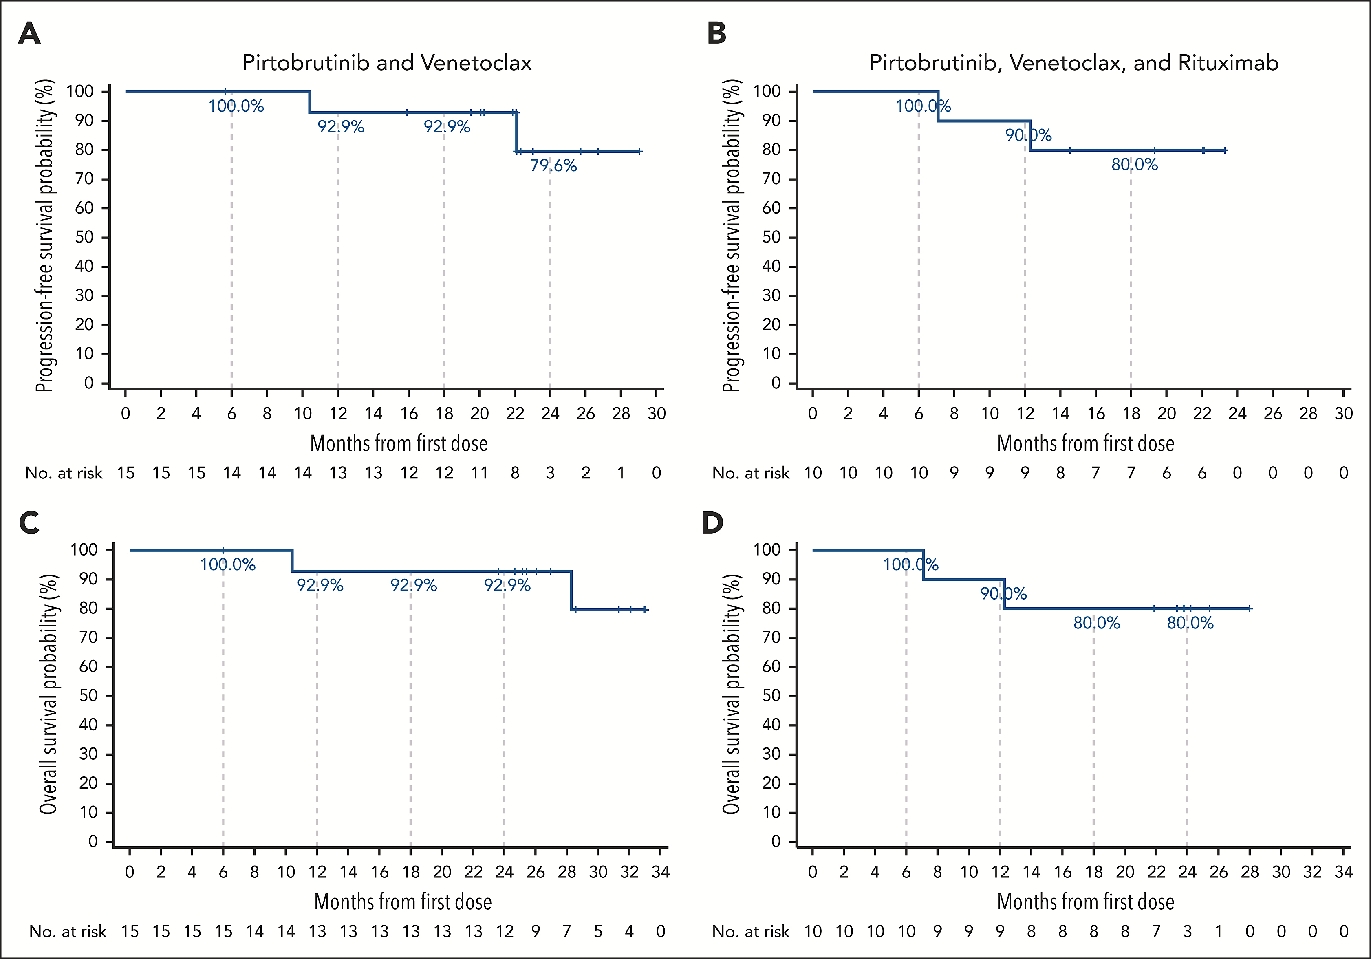
Pirtobrutinib + Venetoclax +/- Rituximab
Courtesy of Jennifer R Brown, MD, PhD
Roeker LE et al Blood 2024

Slide 55
Pirtobrutinib Ven +/- R in R/R CLL
Phase 1 study – well tolerated
High ORR and uMRD
About 20% progression during the two years of therapy
Need longer follow-up after discontinuation of therapy at 2 yrs
Basis of fully accrued phase 3 registration trial
Courtesy of Jennifer R Brown, MD, PhD

Slide 56
Pirtobrutinib, Venetoclax, Obinutuzumab Frontline
MRD at Serial Time-Points in Blood and Bone Marrow
100%
U-MRD4
98%
U-MRD4
93%
U-MRD4
91% U-MRD4
TOXICITY
G3-4 ANC 60% and plts 14%
58% pts required G-CSF
4 pts neutropenic fever
Pirto dose-reduced in 21%
Ven dose-reduced in 31%
Jain, PVO in CLL, ASH 2024, Abs 1011
3 pts off study for non progression are not included in this figure
Courtesy of Jennifer R Brown, MD, PhD

Slide 57
Pirto Ven Obin
MDACC trial
Very high rates of uMRD
BUT: very high rates of heme tox and dose reductions
Needs confirmation in multicenter setting
Risk of using pirto before cBTKi
Courtesy of Jennifer R Brown, MD, PhD
Author’s slide

Slide 58
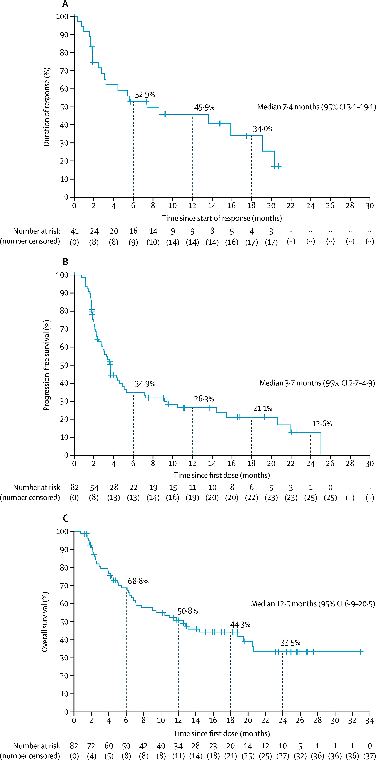
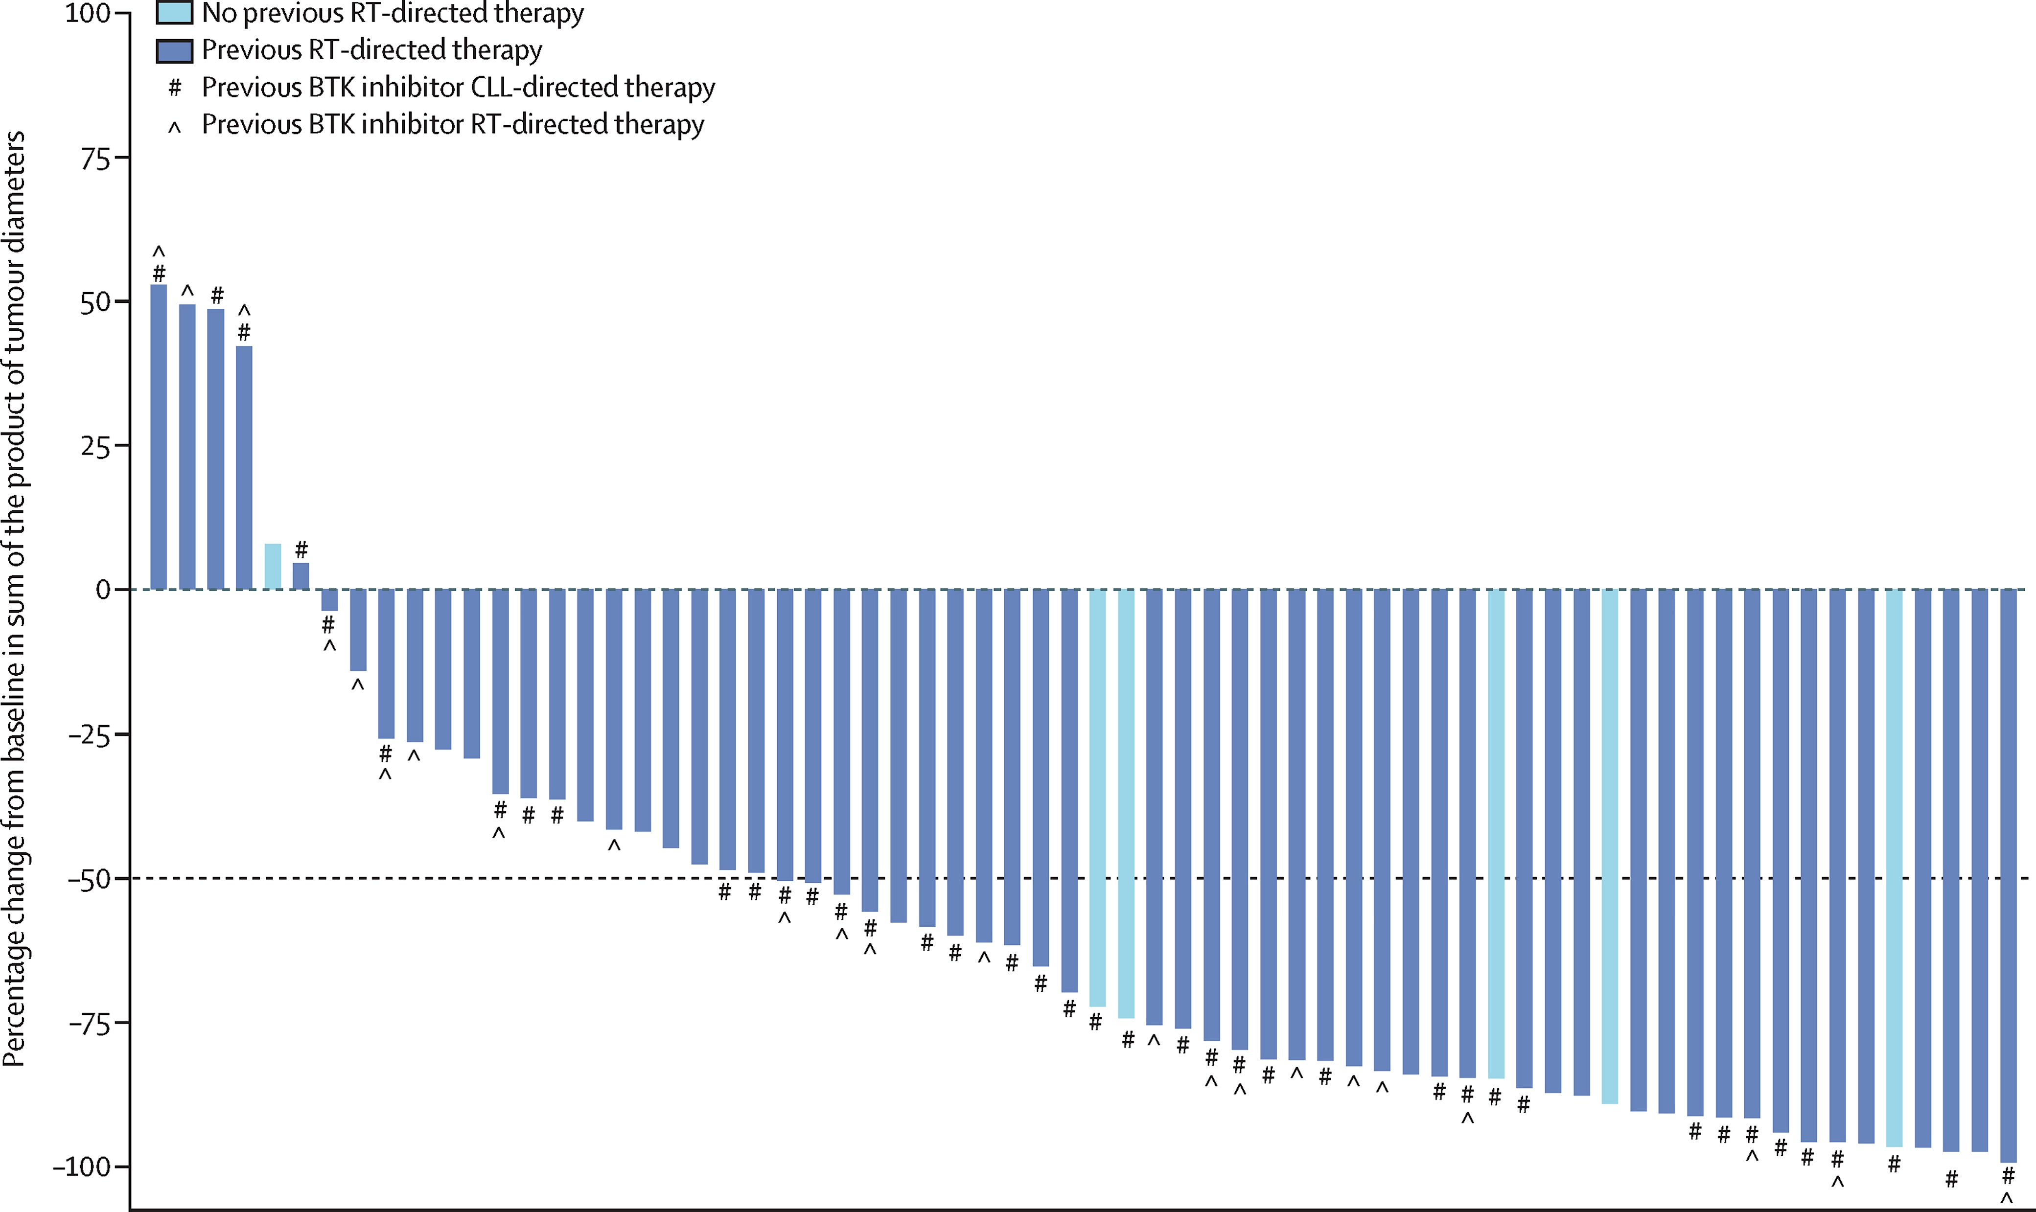
Pirtobrutinib in RT
Wierda WG et al Lancet Haematol 2024
Courtesy of Jennifer R Brown, MD, PhD

Slide 59
What about Pirtobrutinib in RT?
Largest prospective trial (82 patients)
ORR 50%, CR 13%
DOR 7.4 mos, PFS 3.7 mos
High response but short durability
Basis for combination therapies?
Courtesy of Jennifer R Brown, MD, PhD

Slide 60
AGENDA
Year in Review: Management of
Chronic Lymphocytic Leukemia (CLL)
INTRODUCTION: The CLL Experience — 2000 to 2025
MODULE 1: Current Therapy Options with Covalent Bruton Tyrosine Kinase (BTK) Inhibitors
MODULE 2: Role of Venetoclax in the Treatment of CLL
MODULE 3: AMPLIFY Trial and Other Novel BTK Inhibitor and Bcl-2 Inhibitor Combination Strategies
MODULE 4: Noncovalent BTK Inhibitor Pirtobrutinib
MODULE 5: CAR T-Cell Therapy; Novel Agents

Slide 61
CAR (Chimeric Antigen Receptor) T-Cell Therapy; Novel Agents
Siddiqi T et al. Lisocabtagene maraleucel (liso-cel) in patients (pts) with relapsed or refractory (R/R) chronic lymphocytic leukemia (CLL)/small lymphocytic lymphoma (SLL): Updated follow-up of TRANSCEND CLL 004. ASH 2024;Abstract 4633.
Wierda WG et al. Lisocabtagene maraleucel (liso-cel) combined with ibrutinib (ibr) for patients (pts) with relapsed or refractory (R/R) chronic lymphocytic leukemia (CLL)/small lymphocytic lymphoma (SLL): Primary results from the open-label, phase 1/2 transcend CLL 004 study. ASH 2024;Abstract 887.
Danilov A et al. Epcoritamab monotherapy in patients (pts) with relapsed or refractory (R/R) chronic lymphocytic leukemia (CLL): Results from CLL expansion and optimization cohorts of EPCORE CLL-1. ASH 2024;Abstract 883.

Slide 62
TRANSCEND CLL 004: lisocabtagene maraleucel (liso-cel)
Full Population at Dose-Level 2 (DL2)
Progression-Free Survival (PFS)
PEAS (BTKi progression/ venetoclax failure subset) at DL2
Progression-Free Survival (PFS)
100
100
CR/CRi
90
NR
CR/CRi
90
NR
PFS, %
80
PFS, %
80
70
70
60
26.9 (17.9—NR)
60
26.2 (10.3—NR)
50
50
40
18.0 (9.4—30.1)
Total
40
30
PR/nPR
30
11.9 (5.7—26.2)
Total
20
3.7 (2.4—6.3)
20
10
10
3.7 (2.1—6.1)
PR/nPR
Nonresponder
0
0
0
6
12
18
24
30
36
42
48
54
0
6
12
18
24
30
36
42
48
Time From liso-cel Infusion, Months
Time From liso-cel Infusion, Months
Full Population at Dose-Level 2 (DL2)
PFS by uMRD4 Response in Blood
PEAS (BTKi progression/ venetoclax failure subset) at DL2
PFS by uMRD4 Response in Blood
100
100
90
90
PFS, %
80
PFS, %
80
70
70
60
31.2 (18.0—NR)
60
26.2 (11.9—NR)
50
50
11.9 (5.7—26.2)
40
0.8 (0.4—13.4)
uMRD4
40
0.8 (0.1—13.4)
30
18.0 (9.4—30.1)
Total
30
uMRD4
20
Unknown
20
Total
10
10
Unknown
0
2.9 (1.9—6.1) MRD positive
0
2.8 (0.8—3.2)
MRD positive
0
6
12
18
24
30
36
42
48
54
0
6
12
18
24
30
36
42
48
Time From liso-cel Infusion, Months
Time From liso-cel Infusion, Months
Courtesy of Jennifer R Brown, MD, PhD
Median (95% CI) follow-up: 31.4 mo (24.3—36.2)
Siddiqi et al Blood (2024) 144 (Supplement 1): 4633.

Slide 63
Update on Liso-cel in CLL
CR is more predictive than uMRD (unlike every other situation)
CR rate only 20%
Double refractory population has worse outcome than full population (similar to pirtobrutinib)
<=3 prior regimens and absence of bulky disease associated with response (PR or CR)
Courtesy of Jennifer R Brown, MD, PhD

Slide 64
Liso-cel + Ibrutinib Outcomes
Efficacy Outcomes:
Response by Investigator and uMRD4
Progression-Free Survival by Best Overall Response at DL2
ORR
86%
95% CI, 74—94
96%
95% CI, 78—100
96%
95% CI, 78—100
Response by INV
uMRD4 rate
100
86%
95% CI, 74—94
84%
95% CI, 71—93
90
NR (29.6—NR)
CR/CRi rate 45%
95% CI, 31—60
80
CR/CRi
70
n = 44
60
31.4 (20.1—NR)
n = 22
n = 22
3.2 (0.8—NR)
All DL2 patients
Progression-Free Survival %
n = 44
n = 43
50
Patients with uMRD4, %
40
n = 23
24.2 (11.9—42.3)
30
20
PR/nPR
10
0
Nonresponders
DL2 + ibrutinib set
(n = 51)
0
6
12
18
24
30
36
42
48
54
uMRD4 Rate in Blood
uMRD4 Rate in Marrowª
Time from liso-cel infusion, months
  Median (IQR) on-study follow-up (including LTFU): 24.8 months (14.2—34.6)
  Median (range) time to first response: 1 month (0.9—6.0)
  Median (range) time to first CR/CRi: 3 months (0.9—12.1)
Median (95% CI) follow-up for PFS: 24.3 months (23.7—35.5)
Courtesy of Jennifer R Brown, MD, PhD
Wierda W, et al. ASH 2024 TRANSCEND CLL 004: Liso-cel + Ibrutinib Cohort [Abstract #887]

Slide 65
What about Liso-cel + Ibrutinib?
Also heavily pretreated
CR rate higher at 45% - but hard to compare patient populations across studies
Ibrutinib side effects (brain hemorrhage, cardiac arrests on prior studies) plus still 59% needed steroids or toci for CRS
Consider studies with second generation BTKis
Courtesy of Jennifer R Brown, MD, PhD

Slide 66
EPCORE
C1 OPT Mitigated Adverse Events of Interest
Including ICANS and Clinical TLS
Study Design: EPCORE® CLL-1 Expansion and C1 Optimization
CRS Events by Dosing Period
EXP
Expansion
(EXP; N=23)
Cycle 1 Optimization
(C1 OPT; N=17)
CRS prophylaxis
Prednisone
CRS prophylaxis
Dexamethasone
Adequate hydration
First full dose
(C1D15): 48 mg
First full dose (C1D22): 48 mg
Incidence (%)
Key inclusion criteria
CD20⁺ R/R CLL
≥2 prior lines of systemic therapy
ECOG PS 0–2
Measurable disease with ≥5×10⁹/L B lymphocytes (expansion only)
No prior allogeneic HSCT
Step-up dose 3
(C1D15): 3 mg
Step-up dose 2
(C1D8): 0.8 mg
Cycle 1
Step-up dose 2
(C1D8): 0.8 mg
C1 OPT
Step-up dose 1
(C1D1): 0.16 mg
Step-up dose 1 (C1D1): 0.16 mg
Incidence (%)
Data cutoff: May 28, 2024
Median follow-up: 22.8 months
Data cutoff: May 28, 2024
Median follow-up: 2.9 months
Cycle 1
ClinicalTrials.gov: NCT04623541; EudraCT: 2023-504828-25.
Courtesy of Jennifer R Brown, MD, PhD
Danilov A et al ASH 2024; Abstract 883

Slide 67
Epcoritamab in R/R CLL
Optimization cohort to reduce CRS risk
  CRS still most common at the first full dose but now no grade 3 and mostly grade 1
Heavily pretreated patients, ORR 61% and CR 39% are encouraging
  uMRD 75% in responders
Median PFS about one year at present
Ongoing enrollment: plan combinations, or consolidation
Courtesy of Jennifer R Brown, MD, PhD

Slide 68
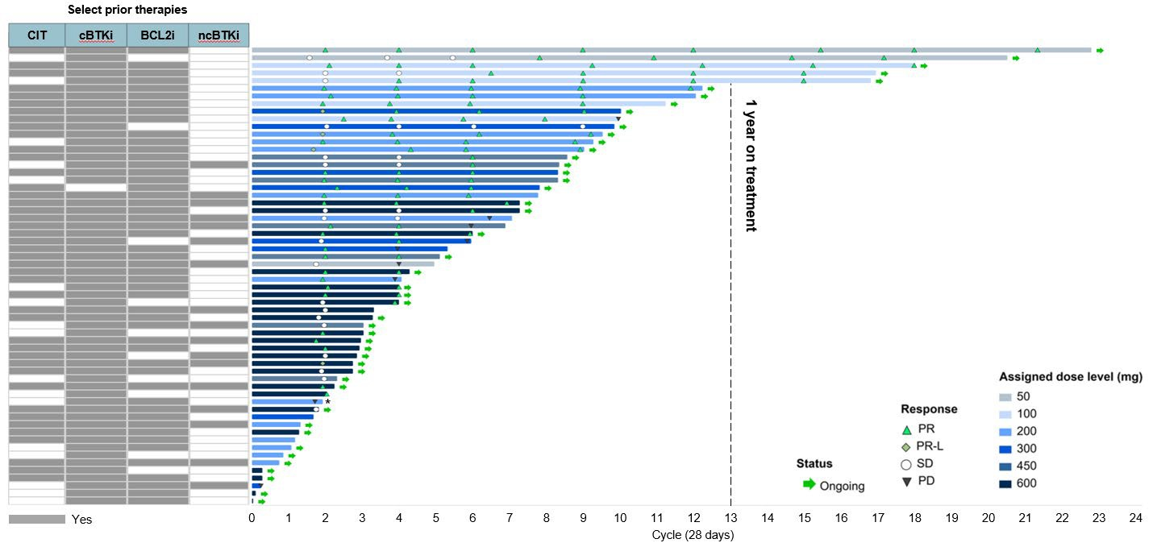
NX-5948 Duration of Treatment
Durable Responses Regardless of Prior Therapy
*Patient with Richter’s transformation to Hodgkin's on biopsy
ORR 76% at
all dose levels
Median duration of treatment, months (range) | 3.9 (0.1–21.0)
Patients dose escalated during treatment, n | 19
Median duration of response, months (95% CI) | Not reached (6.9 – not reached)
Patients with duration of response >6 months | 13 (26.5%)
Data Cutoff: 10 Oct 2024
Courtesy of Jennifer R Brown, MD, PhD
Shah et. al. ASH 2024 - Blood 2024;144(Supplement 1):884.

Slide 69
BGB-16673 Treatment Duration & Response
Prior Treatment
cBTKi
ncBTKi
BCL2i
BTKmut
 |  |  | N
 |  |  | Y
 |  |  | N
 |  |  | N
 |  |  | Y
 |  |  | N
 |  |  | Y
 |  |  | N
 |  |  | Y
 |  |  | N
 |  |  | N
 |  |  | Y
 |  |  | N
 |  |  | N
 |  |  | N
 |  |  | N
 |  |  | N
 |  |  | N
 |  |  | Y
 |  |  | N
 |  |  | U
 |  |  | N
 |  |  | N
 |  |  | Y
 |  |  | N
 |  |  | Y
 |  |  | N
 |  |  | N
 |  |  | N
 |  |  | N
 |  |  | Y
 |  |  | Y
 |  |  | N
 |  |  | Y
 |  |  | N
 |  |  | Y
 |  |  | Y
 |  |  | N
 |  |  | Y
 |  |  | N
 |  |  | N
 |  |  | U
 |  |  | N
 |  |  | Y
 |  |  | N
 |  |  | N
 |  |  | N
 |  |  | N
 |  |  | Y
ORR 78% across
all dose levels
Median follow-up in
efficacy-evaluable patients:
11.0 months (range, 0.3-26.4+)
Dose level (mg)
50
100
200
350
500
Responses
CR
CRi
PR
PR-L
SD
PD
NE
Ongoing treatment
Death
Data Cutoff: September 2, 2024.
0
10
20
30
40
50
60
70
80
90
100
110
120
Efficacy-evaluable patients. First response assessment after 12 weeks.
Treatment Duration, weeks
Courtesy of Jennifer R Brown, MD, PhD
Thompson MC et al ASH 2024; Abstract 885

Slide 70
BTK Degraders
Two phase 1 studies of distinct molecules, in heavily pretreated patients most with prior BTKi and BCL-2i exposure, both with very nice ORR approximately 76%
Follow-up short but very encouraging
Mechanisms of resistance still to emerge but important
Courtesy of Jennifer R Brown, MD, PhD

