Slide 1
Endometrial and Cervical Cancer
Year in Review 2025
Prof Susana Banerjee, London. UK

Slide 2
Endometrial Cancer (1)
Overall Survival First line IO in advanced/recurrent EC
Powell MA et al. Overall survival in patients with endometrial cancer treated with dostarlimab plus carboplatin-paclitaxel in the randomized ENGOT-EN6/GOG-3031/RUBY trial. Ann Oncol 2024;35(8):728-38.
Eskander RN et al. Pembrolizumab plus chemotherapy in advanced or recurrent endometrial cancer: Overall survival and exploratory analyses of the NRG GY018 phase 3 randomized trial. Nat Med 2025 May;31(5):1539-46.
Patient subgroups
Mirza MR et al. Progression-free survival (PFS) in primary advanced or recurrent endometrial cancer (pA/rEC) in the overall and mismatch repair proficient (MMR/MSS) populations and in histological and molecular subgroups: Results from part 2 of the RUBY trial. ESMO Gynaecological Cancers Congress 2024;Abstract 38MO.
Westin et al. Durvalumab plus carboplatin/paclitaxel followed by durvalumab with or without olaparib as first-line treatment for endometrial cancer: longitudinal changes in circulating tumor DNA. ASCO 2025 Abstract 5512.

Slide 3
Endometrial Cancer (2)
Non IO maintenance
Makker V et al. Long-term follow-up of efficacy and safety of selinexor maintenance treatment in patients with TP53wt advanced or recurrent endometrial cancer: A subgroup analysis of the ENGOT-EN5/GOG-3055/SIENDO study. Gynecol Oncol 2024;185:202-11.
Molecular Residual Disease Detection
Recio F et al. Post-surgical ctDNA-based molecular residual disease detection in patients with stage I uterine malignancies. Gynecol Oncol 2024:182:63-9.

Slide 4
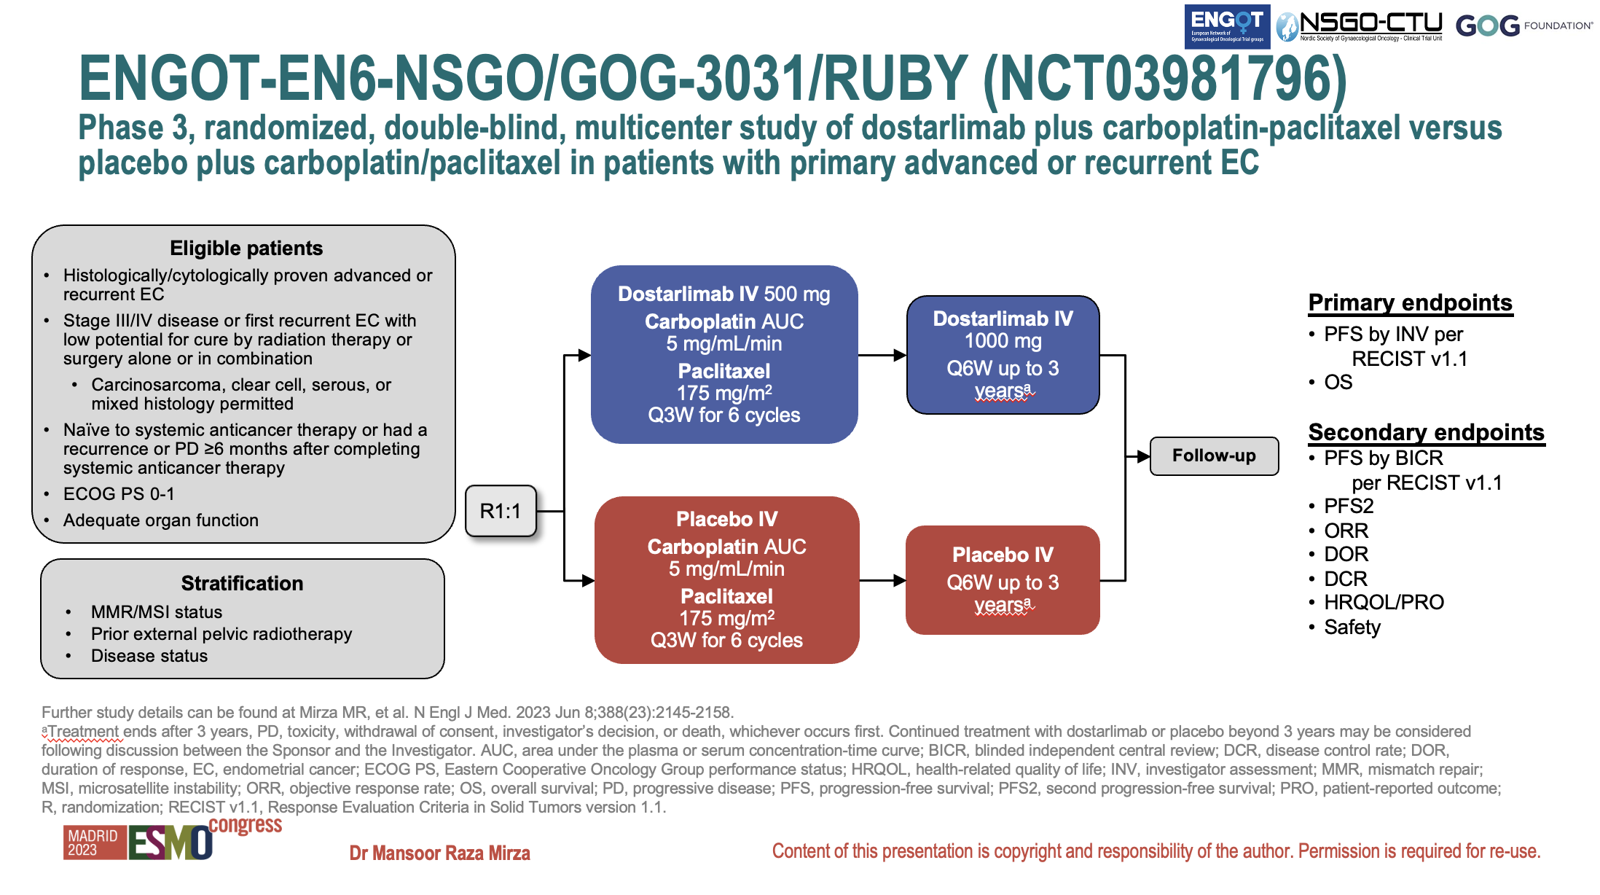

Slide 5
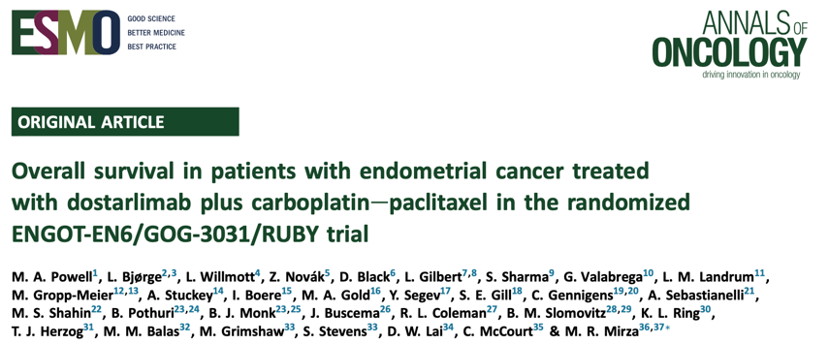
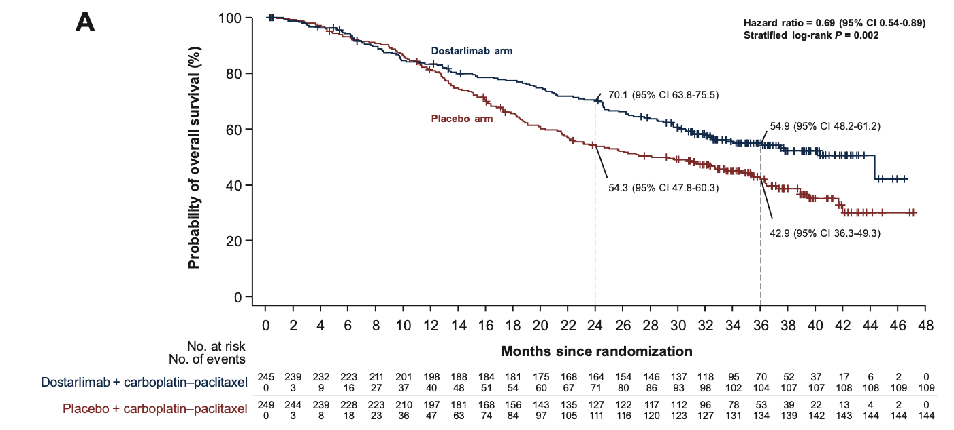
FDA approval (Aug 2024)
EMA approval (2025)
Dostarlimab with carboplatin and paclitaxel, followed by single-agent dostarlimab primary advanced or recurrent endometrial cancer
Regardless of MMR status
494 patients were randomized
(245 in the dostarlimab arm;
249 in the placebo arm)
second interim analysis 51% maturity
Overall population
statistically significant reduction in the risk of death HR 0.69, 95% (CI 0.54- 0.89, p= 0.0020) with addition of dostarlimab plus carboplatin/paclitaxel versus carboplatin/paclitaxel alone
median OS of 44.6 months versus 28.2 months
Powell MA et al. Ann Oncol 2024;35(8):728-38.

Slide 6

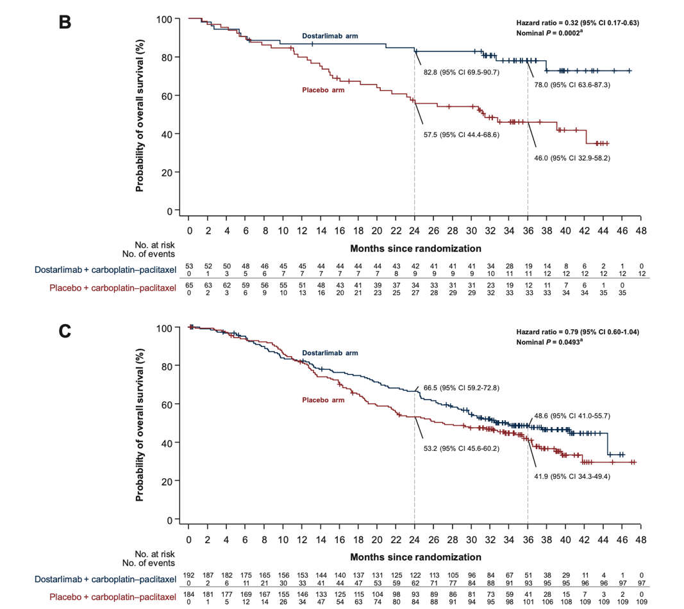
prespecified exploratory analysis.
Risk of death was lower in the dMMR/MSI-H population (HR 0.32, 95% CI 0.17-0.63, nominal P = 0.0002)
Median OS NR vs 31.4 months
trend in favor of dostarlimab was seen in the MMRp/MSS (HR 0.79, 95% CI 0.60-1.04, nominal P=0.0493) median OS 34 vs 27 months
Powell MA et al. Ann Oncol 2024;35(8):728-38.

Slide 7
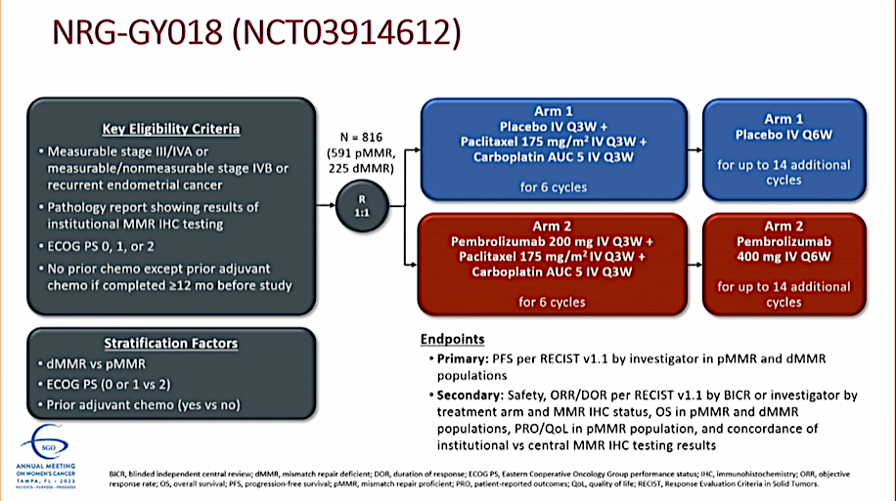
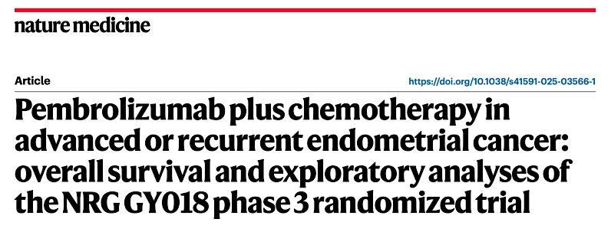
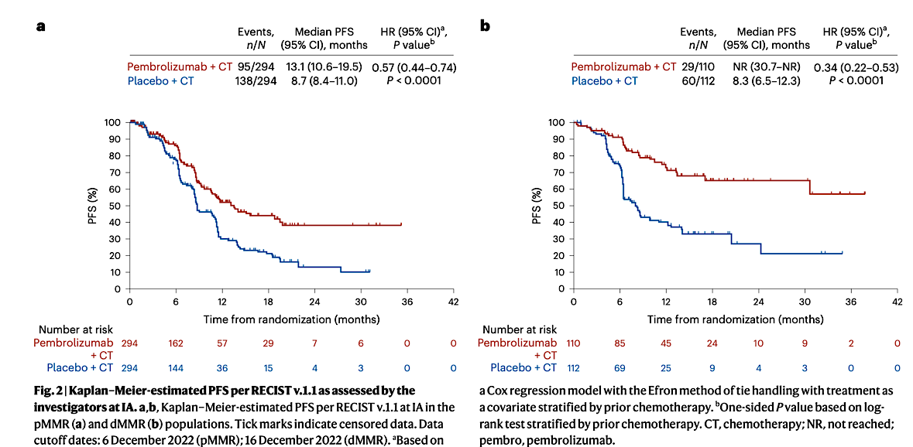
Eskander RN et al. Nat Med 2025 May;31(5):1539-46.
Primary endpoint PFS investigator assessed
ITT
pMMR
Median PFS 13.1 (95% CI, 10.6–19.5) vs 8.7 (95% CI, 8.4– 11.0) months
HR pembrolizumab plus chemotherapy (0.57 (95% CI, 0.44– 0.74); P < 0.0001
dMMR
Median PFS NR vs 8.3 (95% CI, 6.5–12.3) months, HR pembrolizumab plus chemotherapy (0.34 (95% CI, 0.22–0.53); P < 0.0001

Slide 8
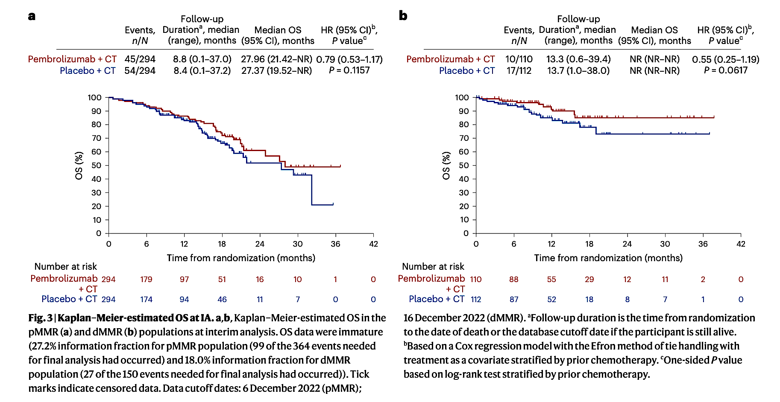
NRG GY018 OS secondary endpoint (immature)
Ad hoc analyses (DCO August 2023)
pMMR (46.8% information) HR 0.80 (95% CI, 0.59–1.08; 1-sided nominal P = 0.0683)
dMMR (29.3% information) HR 0.57 (95% CI, 0.31–1.04; 1-sided nominal P = 0.0323)
DCO of KM estimates Dec 2022
Eskander RN et al. Nat Med 2025 May;31(5):1539-46.

Slide 9

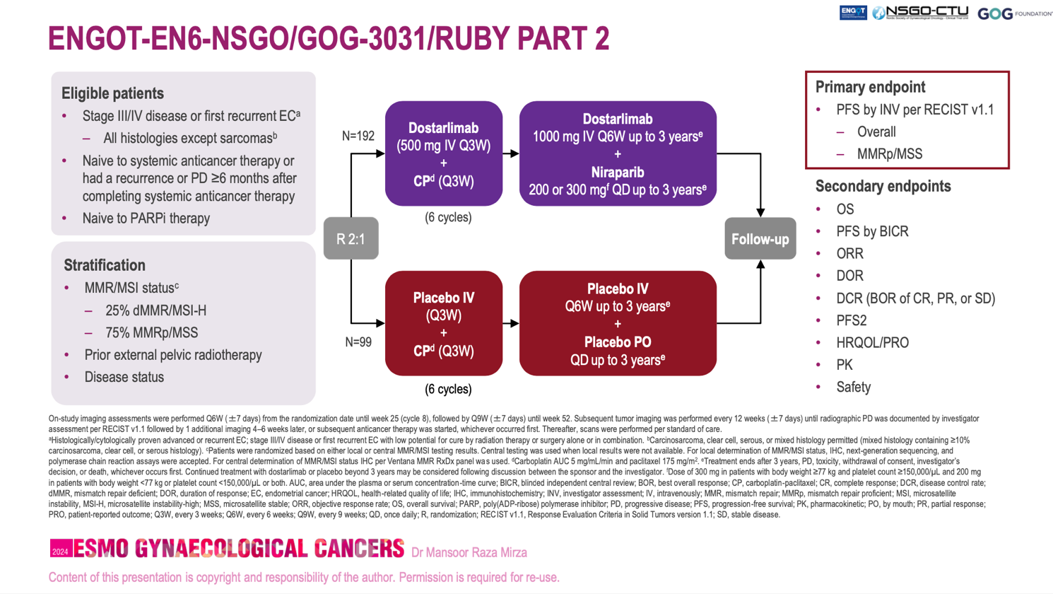
Mirza MR et al. ESMO Gynaecological Cancers Congress 2024;Abstract 38MO.

Slide 10
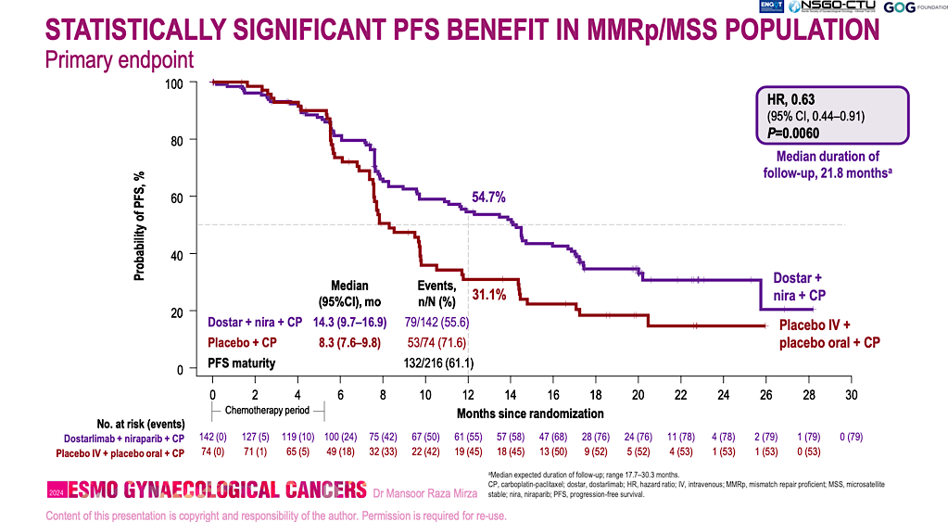
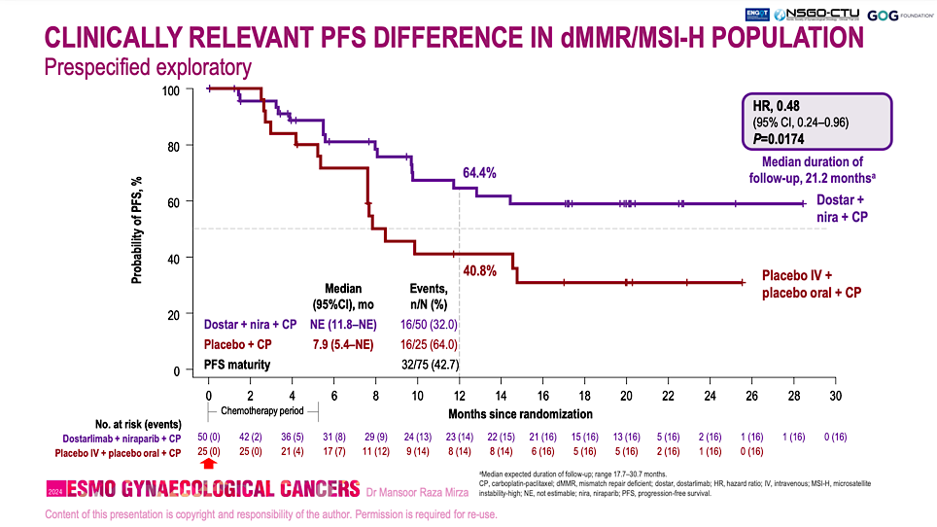
RUBY Trial Part 2: PFS Outcomes
Mirza MR et al. ESMO Gynaecological Cancers Congress 2024;Abstract 38MO.

Slide 11
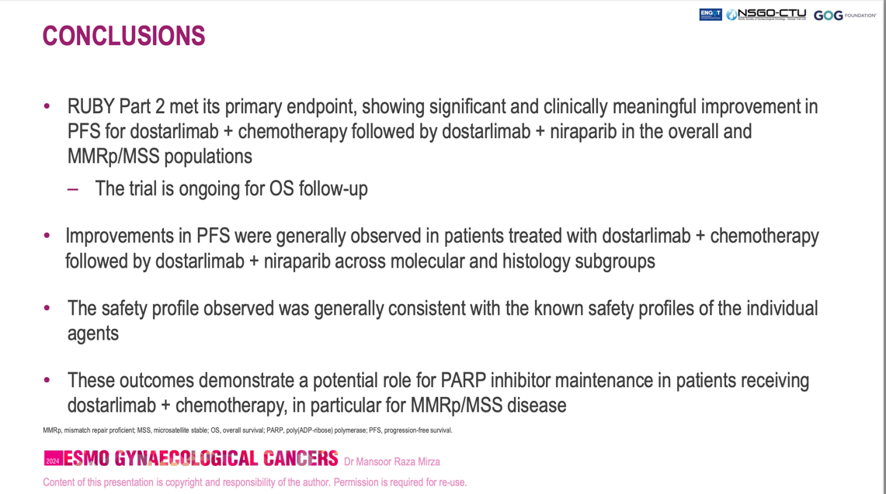
RUBY Part 2: Role for PARPi?
No Dostarlimab alone arm
What is the magnitude of benefit with
Addition of niraparib?
RUBY part 1 PFS HR (95% CI, 0.16–0.50)
(NEJM 2023)
dMMR/MSI-H 0.28
Overall 0.64 (95% CI, 0.51–0.80)
pMMR/MSS 0.76 (95% CI (0.59-0.98)
Mirza MR et al. ESMO Gynaecological Cancers Congress 2024;Abstract 38MO.

Slide 12
DUO-E met its dual primary endpoints
Randomized, placebo-controlled, double-blind study¹
ITT population: PFS – primary endpoints
6 months
Chemotherapy phase
(six cycles)
Maintenance phase
100
83.9%
83.8%
Patients
Newly diagnosed Stage III/IV or recurrent endometrial cancer
Known MMR status
Naïve to first-line systemic anticancer treatment
Naïve to PARP inhibitors and immune-mediated therapy
All histologies except sarcomas
90
82.5%
12 months
CP
CP
Placebo
80
61.5%
18 months
70
48.5%
60
41.1%
46.3%
37.8%
N=718
PFS (%)
21.7%
50
Durvalumab + olaparib arm
R
1:1:1
CP+D
CP
+
durvalumab
Durvalumab
40
Patients without disease progression
30
Stratified by:
MMR status
(proficient
vs deficient)
Disease status (recurrent vs
newly diagnosed)
Geographic region (Asia vs non-Asia)
20
Durvalumab arm
10
Control arm
CP+D+O
0
CP
+
durvalumab
Durvalumab
+
olaparib
0
3
6
9
12
15
18
21
24
27
30
33
No. at risk
Time since randomization (months)
Durvalumab + olaparib arm
239
214
198
169
139
95
51
30
16
7
3
0
Treatment until disease progression, unacceptable toxicity, or other
discontinuation criteria were met
Durvalumab arm
238
211
188
138
105
69
45
26
13
5
0
0
Control arm
241
213
184
125
86
45
26
10
3
1
1
0
 | Control arm (N=241) | Durvalumab arm (N=238) | Durvalumab + olaparib arm (N=239)
Events, n (%) | 173 (71.8) | 139 (58.4) | 126 (52.7)
Median PFS (95% CI), months | 9.6 (9.0–9.9) | 10.2 (9.7–14.7) | 15.1 (12.6–20.7)
HR (95% CI) vs control |  | 0.71 (0.57–0.89); p=0.003 | 0.55 (0.43–0.69); p<0.0001
Endpoints
Primary (ITT): PFS (RECIST per investigator) in CP+D versus CP and CP+D+O versus CP
Secondary (ITT): OS (key secondary) and safety
Prespecified exploratory analyses: subpopulation analyses of PFS by MMR status
CI, confidence interval; CP, carboplatin + paclitaxel; D, durvalumab; HR, hazard ratio; ITT, intent to treat;
MMR, mismatch repair; O, olaparib; OS, overall survival; PARP, poly(ADP-ribose) polymerase; PFS, progression-free survival; R, randomization; RECIST, Response Evaluation Criteria in Solid Tumors.
1. Westin SN, et al. J Clin Oncol 2024;42:283–99. Kaplan–Meier figure borrowed with permission from Westin SN, et al. Durvalumab plus carboplatin/paclitaxel followed by maintenance durvalumab with or without olaparib as first-line treatment for advanced endometrial cancer: the phase III DUO-E trial. J Clin Oncol 2024;42:283–99: https://ascopubs.org/doi/full/10.1200/JCO.23.02132. © American Society of Clinical Oncology.
Prof. Shannon N. Westin
Abstract 5512

Slide 13
DUO-E: PFS based on mismatch repair status
PFS in the dMMR subpopulation
PFS in the pMMR subpopulation
 | Control (N=49) | D arm (N=46) | D+O arm (N=48)
Events, n (%) | 25 (51.0) | 15 (32.6) | 18 (37.5)
Median PFS (95% CI), months | 7.0 (6.7–14.8) | NR (NR–NR) | 31.8 (12.4–NR)
HR (95% CI) vs control |  | 0.42 (0.22–0.80) | 0.41 (0.21–0.75)
 | Control (N=192) | D arm (N=192) | D+O arm (N=191)
Events, n (%) | 148 (77.1) | 124 (64.6) | 108 (56.5)
Median PFS (95% CI), months | 9.7 (9.2–10.1) | 9.9 (9.4–12.5) | 15.0 (12.4–18.0)
HR (95% CI) vs control |  | 0.77 (0.60–0.97) | 0.57 (0.44–0.73)
6 months
6 months
100
87.2%
100
83.1%
90.6%
12 months
18 months
82.4%
90
73.1%
90
84.4%
12 months
80
70.0%
62.7%
80
67.9%
67.9%
59.4%
18 months
70
43.3%
31.7%
70
44.4%
60
60
40.8%
42.0%
Durvalumab
+ olaparib arm
31.3%
PFS (%)
PFS (%)
20.0%
50
Durvalumab arm
50
40
40
Durvalumab + olaparib arm
30
Control arm
30
Durvalumab arm
20
20
10
10
Control arm
0
0
No. at risk
0
2
4
6
8
10
12
14
16
18
20
22
24
26
28
30
32
0
2
4
6
8
10
12
14
16
18
20
22
24
26
28
30
32
Durvalumab +
olaparib arm
Time since randomization (months)
No. at risk
Time since randomization (months)
48
Durvalumab +
olaparib arm
47
46
46
46
41
41
39
38
37
32
32
32
24
23
23
18
18
16
16
16
10
10
9
4
3
3
2
2
1
1
1
0
191
185
183
168
164
159
157
141
134
132
114
109
Durvalumab arm
46
107
77
75
72
46
46
35
32
31
20
19
19
12
11
10
5
5
4
2
2
0
42
40
37
37
36
36
34
32
31
27
26
26
19
19
19
17
17
14
11
11
9
9
7
5
5
5
2
2
1
0
0
0
Durvalumab arm
192
186
182
174
169
159
152
128
113
107
Control arm
49
83
81
79
53
53
50
36
36
31
27
27
17
15
15
8
7
7
3
2
2
0
0
0
45
43
41
39
29
28
19
17
17
16
15
13
10
9
8
7
7
5
4
4
2
2
2
2
2
2
0
0
0
0
0
0
Control arm
192
184
178
172
170
163
156
126
113
108
77
76
73
44
40
37
25
25
21
13
13
8
7
6
1
1
1
1
1
1
1
1
0
The greatest benefit with CP + durvalumab versus CP was in the dMMR subpopulation¹
In the pMMR subpopulation, the addition of olaparib
further enhanced the PFS benefit¹
Here, we present post hoc exploratory longitudinal circulating tumor (ct)DNA analyses
dMMR, mismatch repair deficient; NR, not reported; pMMR, mismatch repair proficient. 1. Westin SN, et al. J Clin Oncol 2024;42:283–99. Kaplan–Meier figure borrowed with permission from Westin SN, et al. Durvalumab plus carboplatin/paclitaxel followed by maintenance durvalumab with or without olaparib as first-line treatment for advanced endometrial cancer: the phase III DUO-E trial. J Clin Oncol 2024;42:283–99: https://ascopubs.org/doi/full/10.1200/JCO.23.02132. © American Society of Clinical Oncology.
Prof. Shannon N. Westin
Abstract 5512

Slide 14
DUO-E: PFS rate by treatment and baseline ctDNA status in the ITT population
Baseline ctDNA positivity was associated with higher risk of progression across treatment arms
CP arm
CP+D arm
CP+D+O arm
100
100
100
90
90
90
80
80
ctDNA–
80
70
70
70
ctDNA–
60
60
60
PFS (%)
ctDNA–
PFS (%)
PFS (%)
50
50
50
ctDNA+
40
40
ctDNA+
40
30
30
30
Unknown
20
20
Unknown
20
10
No. pts/events
ctDNA+
10
No. pts/events
10
No. pts/events
ctDNA+
94/74
Unknown
ctDNA+
96/51
ctDNA+
88/35
0
ctDNA–
24/9
0
ctDNA–
16/4
0
ctDNA–
29/6
Unknown
123/90
Unknown
126/84
Unknown
122/85
0
2
4
6
8
10
12
14
16
18
20
22
24
26
28
30
32
0
2
4
6
8
10
12
14
16
18
20
22
24
26
28
30
32
0
2
4
6
8
10
12
14
16
18
20
22
24
26
28
30
32
Time since randomization (months)
Time since randomization (months)
Time since randomization (months)
No. at risk
No. at risk
No. at risk
ctDNA+
94
94
94
94
63
42
41
26
17
14
10
5
2
2
1
1
0
ctDNA+
96
95
95
93
75
61
59
41
29
24
22
14
5
4
2
0
0
ctDNA+
88
87
86
85
77
70
67
49
32
23
23
12
7
5
3
1
0
ctDNA–
24
24
24
24
23
19
19
12
8
8
5
3
0
0
0
0
0
ctDNA–
16
16
16
16
15
14
13
11
8
7
5
3
3
3
0
0
0
ctDNA–
29
29
28
28
26
25
25
21
17
14
13
9
4
4
2
0
0
Unknown
123
103
91
66
44
32
26
11
7
4
2
1
1
1
0
0
0
Unknown
126
111
95
79
55
35
33
20
16
14
11
7
5
5
2
0
0
Unknown
122
113
96
85
69
51
47
28
15
14
11
8
5
4
2
2
0
Prof. Shannon N. Westin
Abstract 5512

Slide 15
DUO-E: durvalumab and olaparib mediated ctDNA changes during the maintenance phase (C7D1–C9D1) in pMMR patients
Addition of olaparib may be driving novel anti-tumor activity in pMMR tumors not seen with durvalumab alone
CP (n=102)
CP+D (n=89)
CP+D+O (n=93)
13% clearance
(5/38)
17% clearance
(4/23)
37%
ctDNA+
26%
ctDNA+
23%
ctDNA+
48% clearance
(10/21)
ctDNA–
ctDNA–
ctDNA–
ctDNA–
50%
ctDNA+
36%
ctDNA+
26%
ctDNA+
C7D1
ctDNA–
ctDNA–
C7D1
C7D1
20% rebound
(13/66)
28% rebound
(18/64)
C9D1
C9D1
18% rebound
(13/72)
C9D1
Durvalumab led to 4% more clearance of ctDNA and 8% less rebound, vs CP arm
Addition of olaparib to durvalumab led to 35% more clearance of ctDNA and 10% less rebound, vs CP arm
Prof. Shannon N. Westin
Abstract 5512

Slide 16
Key takeaway points
Baseline ctDNA positivity in DUO-E was associated with increased risk
of progression in all treatment arms
Addition of durvalumab was associated with rapid reductions in ctDNA detection during chemotherapy phase and less rebound of ctDNA during maintenance phase compared with chemotherapy alone
Addition of maintenance olaparib was associated with additional ctDNA clearance, resulting in a further reduction of detectable ctDNA in patients with pMMR tumors
Prof. Shannon N. Westin
Abstract 5512

Slide 17
Endometrial Cancer (2)
Non IO maintenance
Makker V et al. Long-term follow-up of efficacy and safety of selinexor maintenance treatment in patients with TP53wt advanced or recurrent endometrial cancer: A subgroup analysis of the ENGOT-EN5/GOG-3055/SIENDO study. Gynecol Oncol 2024;185:202-11.
Molecular Residual Disease Detection
Recio F et al. Post-surgical ctDNA-based molecular residual disease detection in patients with stage I uterine malignancies. Gynecol Oncol 2024:182:63-9.

Slide 18
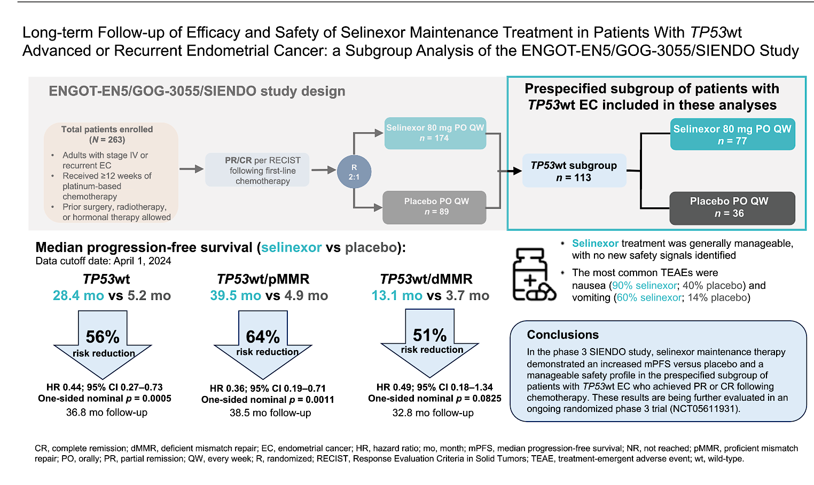
ENGOT-EN5/GOG-3055/SIENDO
Makker V et al. Gynecol Oncol 2024;185:202-11.

Slide 19
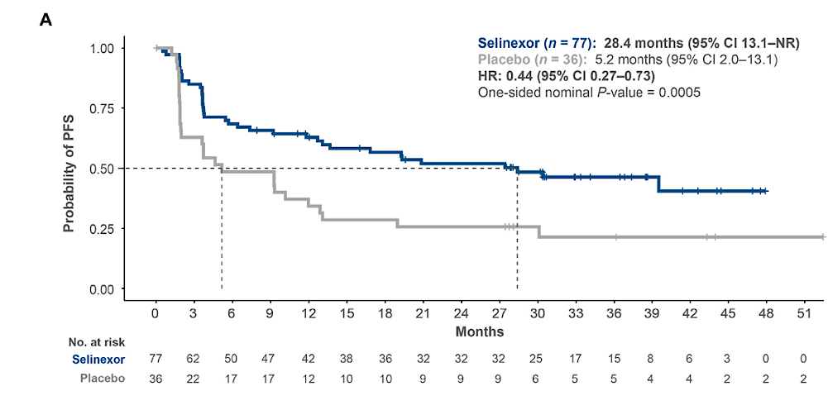
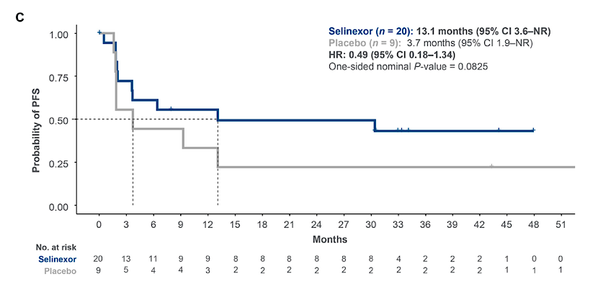
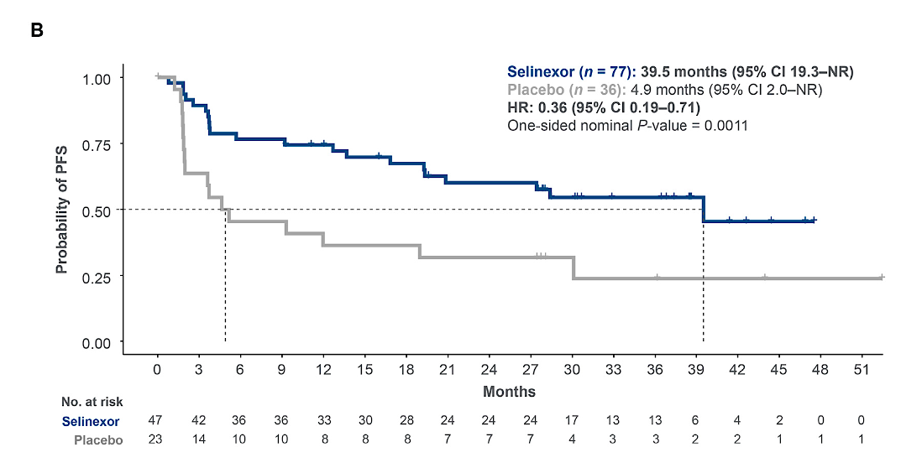
SIENDO: Progression Free Survival
TP53wt/dMMR subgroup
All TP53wt patients
Relatively low numbers but signal of interest
positive results of this subgroup analysis provide a strong rationale to further evaluate selinexor as maintenance therapy in patients with TP53wt advanced or recurrent EC, Ongoing phase 3 ENGOT-EN20/GOG- 3083/XPORT-EC-042 trial
How to integrate in era of IO?
TP53wt/pMMR subgroup
Makker V et al. Gynecol Oncol 2024;185:202-11.

Slide 20
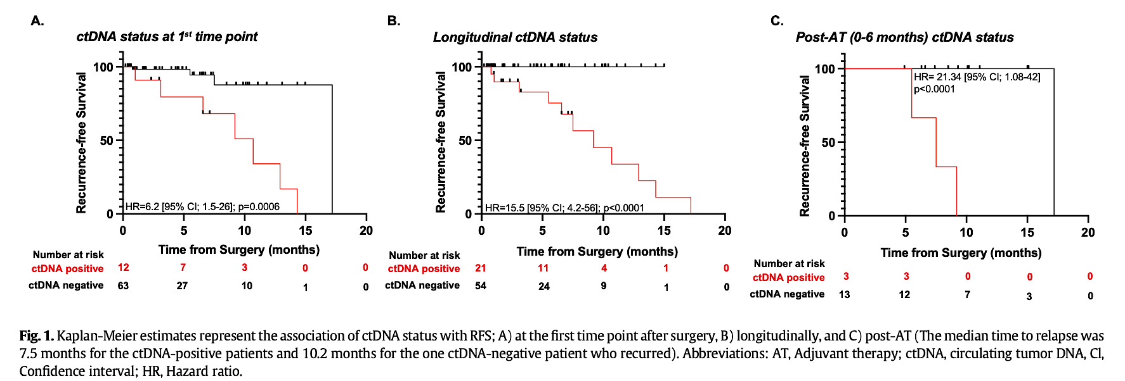
Post-surgical ctDNA detection rates in patients with stage I endometrial malignancies
Recio F et al. Gynecol Oncol 2024:182:63-9.

Slide 21
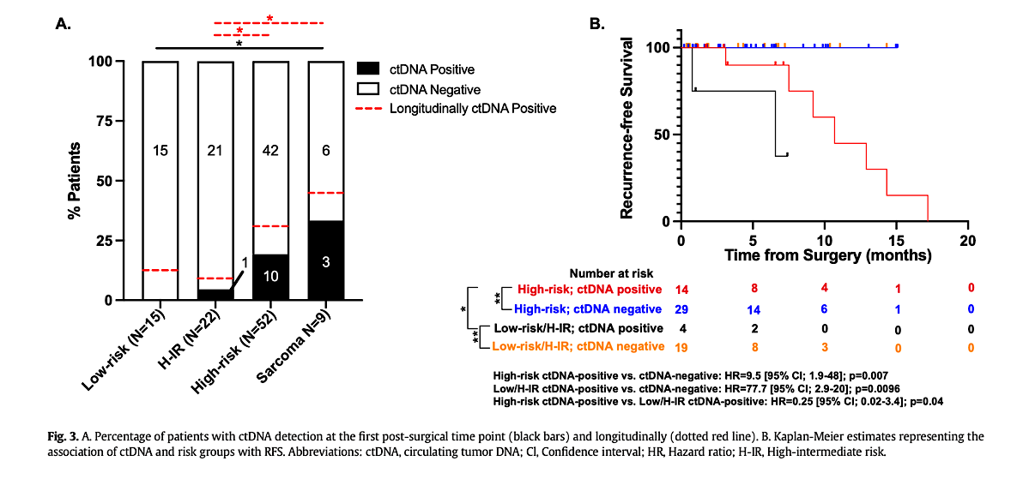
Post-surgical ctDNA detection rates in patients with stage I endometrial malignancies
Results suggest:
patients who were ctDNA-positive at the first time point or at any time point post-surgery had significantly worse RFS (p = 0.0006; p < 0.0001) compared to patients who were either ctDNA-negative at the first time point or remained serially negative.
Increase in ctDNA levels pre- and post-adjuvant therapy identified patients experiencing disease recurrence, while all patients with serially negative ctDNA status remained clinically NED.
Recio F et al. Gynecol Oncol 2024:182:63-9.

Slide 22
Post-surgical ctDNA detection rates in patients with stage I endometrial malignancies
Limitations- retrospective, real world, short follow up
Prospective trials required for incorporation of post-surgical ctDNA status, together with longitudinal ctDNA to direct adjuvant therapy, escalation/ de-escalation, and maintenance therapy in patients with or without detectable ctDNA

Slide 23
Cervical Cancer (1)
Recurrent, metastatic cervical cancer ADCs (post first line)
Vergote I et al. Tisotumab Vedotin as Second- or Third-Line Therapy for Recurrent Cervical Cancer. N Engl J Med 2024;391(1):44-55.
Oaknin A et al. Efficacy of Trastuzumab Deruxtecan in HER2-Expressing Solid Tumors by Enrollment HER2 IHC Status: Post Hoc Analysis of DESTINY-PanTumor02. Adv Ther 2024;41(11):4125-39.
Advanced/recurrent cervical cancer (1st line)
Lorusso D et al. Pembrolizumab plus chemotherapy for advanced and recurrent cervical cancer: Final analysis according to bevacizumab use in the randomized KEYNOTE-826 study. Ann Oncol 2025;36(1):65-75.

Slide 24
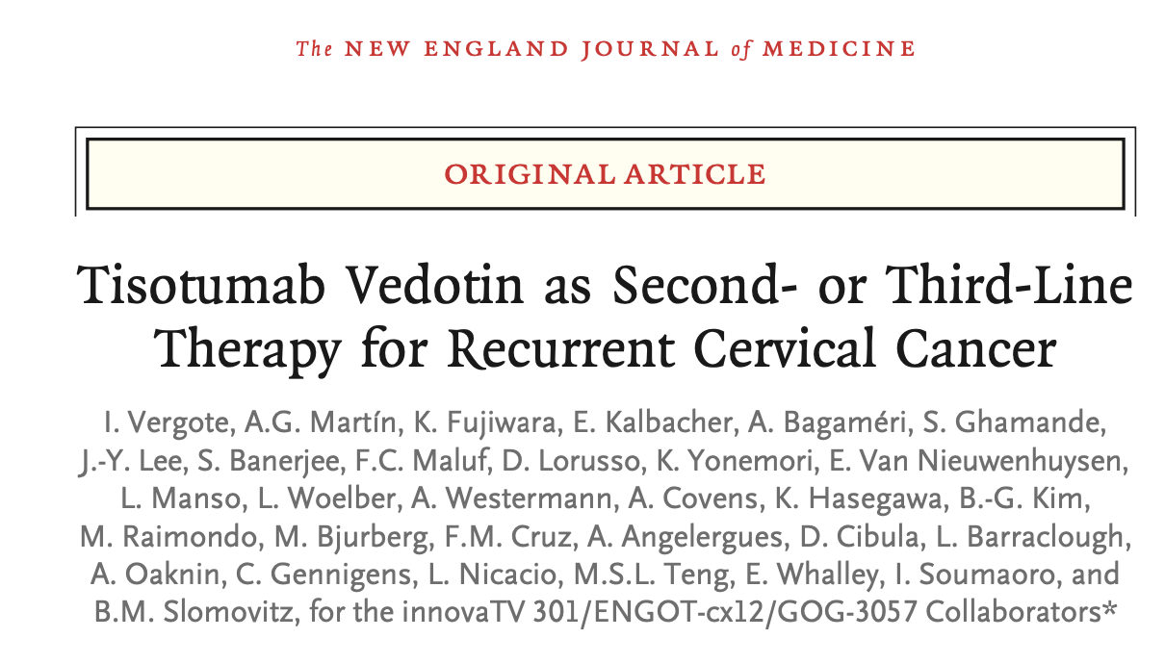
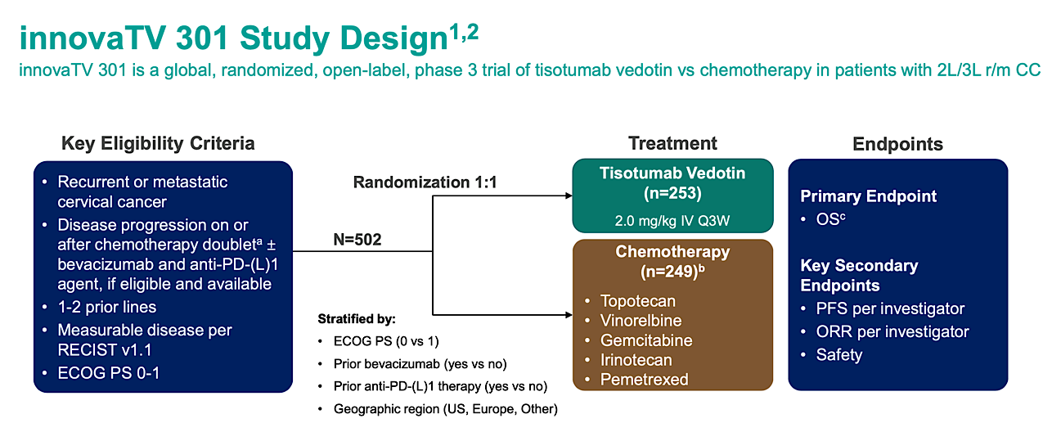
1st ADC FDA approved in gynae cancers
Vergote I et al. N Engl J Med 2024;391(1):44-55.

Slide 25
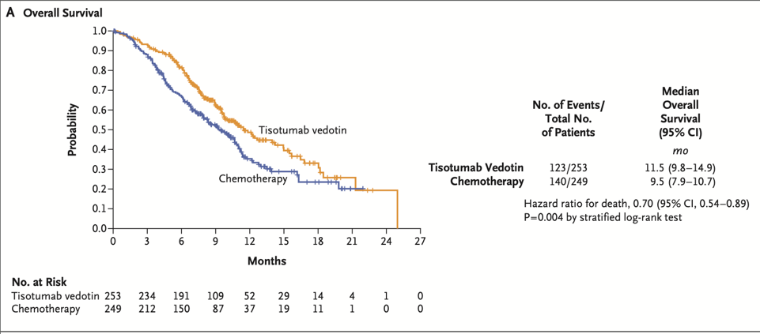
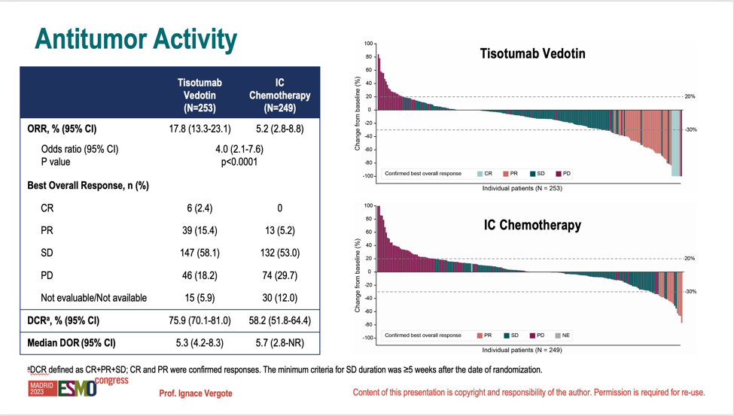
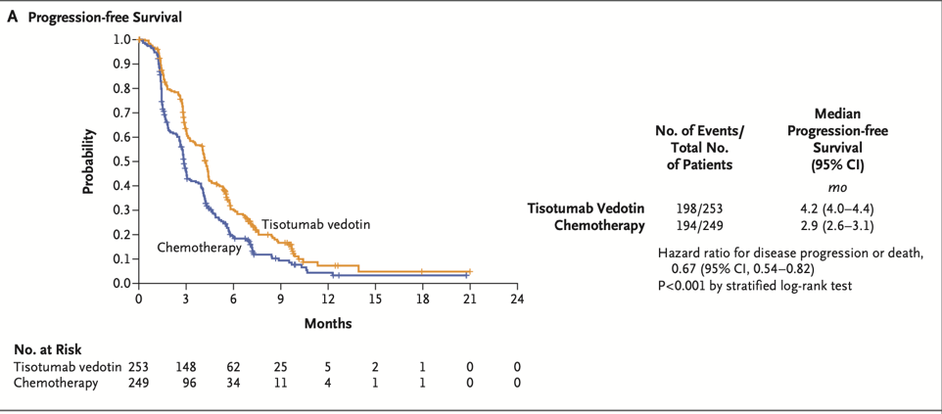
innovaTV 301: Tisotumab Vedotin in recurrent Cervical Cancer
Vergote I et al. N Engl J Med 2024;391(1):44-55.
Vergote I et al. ESMO 2023. Abstract LBA9.

Slide 26
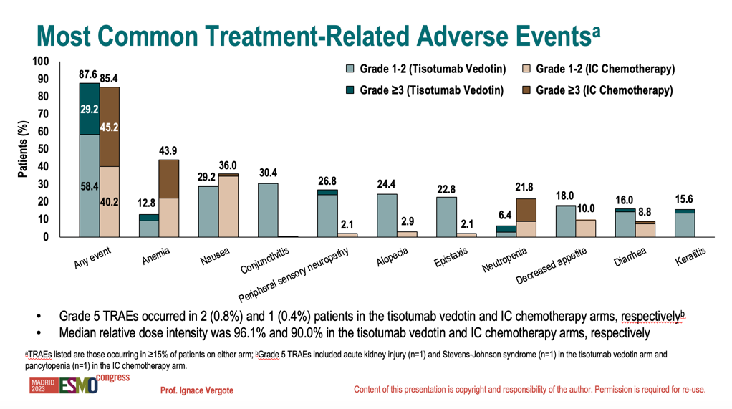
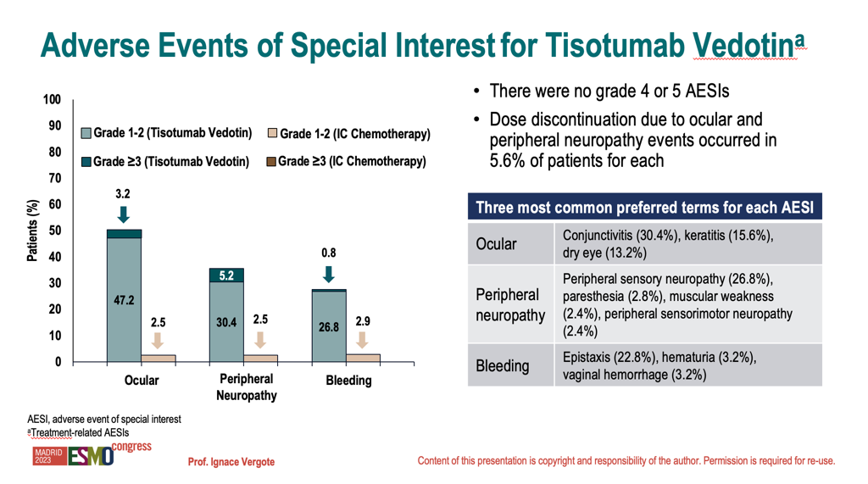
innovaTV 301: Tisotumab Vedotin Adverse Events
Vergote I et al. ESMO 2023. Abstract LBA9.

Slide 27
Tisotumab vedotin showed a statistically significant and clinically meaningful improvement in OS
The hazard ratio for OS was 0.70, demonstrating a 30% reduction in the risk of death
Adverse events – recognition of ocular toxicity
Step forward – prognosis remains poor: need to further improve outcomes in recurrent cervical cancer

Slide 28
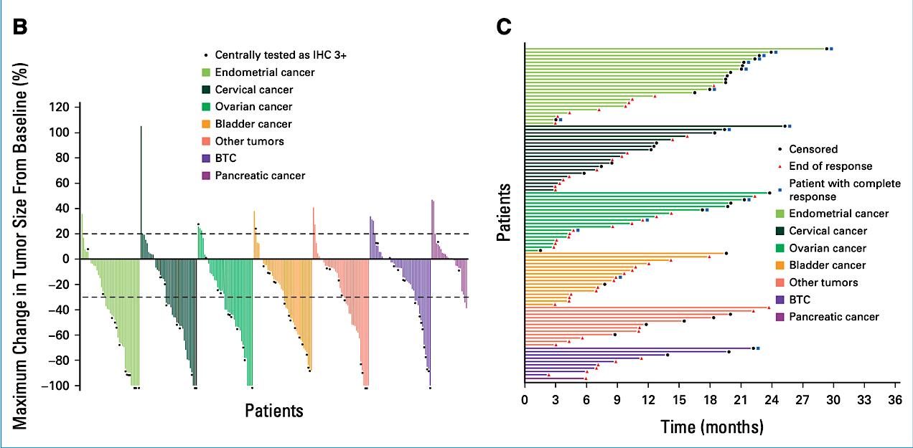
Efficacy of T-DXd: DESTINYPanTumour-02
FDA approval IHC3+ tumour agnostic
Primary endpoint (IHC3+/2+):
Investigator assessed ORR
37.1%
In patients central HER2 3+
RR 61% median DOR 22.1 months
*5 IHC1+ enrolled in cervical cancer
Meric-Bernstam F et al. J Clin Oncol 2024;
42(1):47-58.

Slide 29
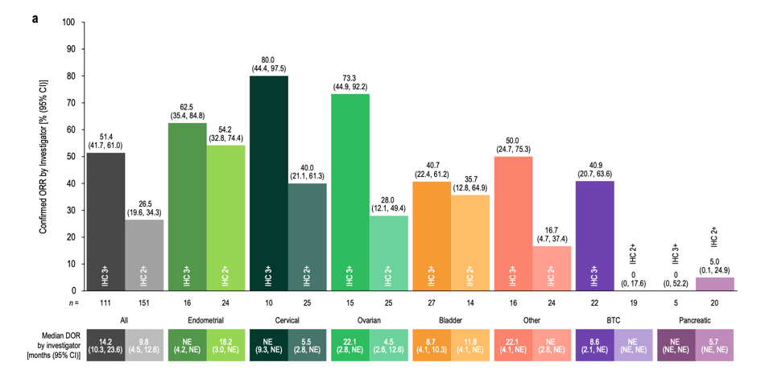
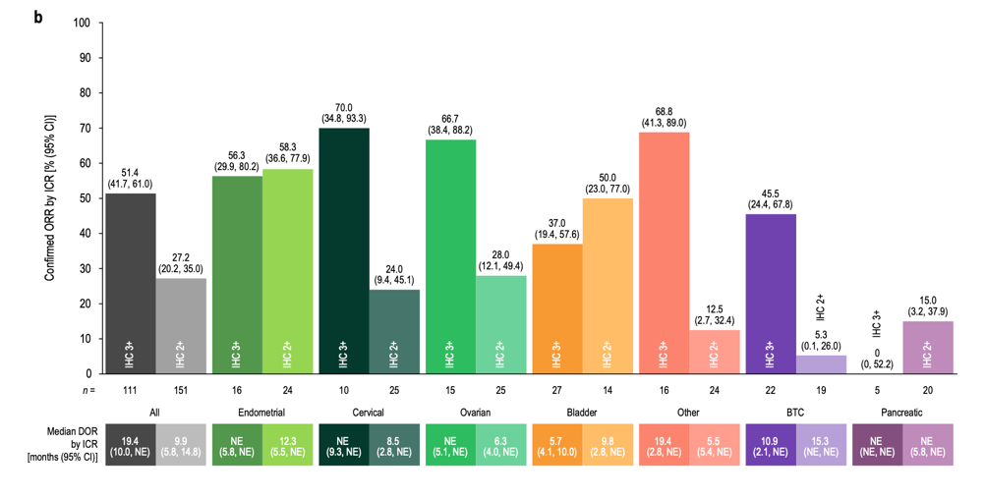
HER2 IHC Status: Efficacy T-DXd DESTINYPanTumour-02
Cervical
Local: IHC 3+ ORR 80%
IHC2+ ORR 40%
Central: IHC 3+ ORR 70%
IHC2+ ORR 24%
Single arm, relatively low numbers
Positive signals
Needs prospective trials/results
Oaknin A et al. Adv Ther 2024;41(11):4125-39.

Slide 30
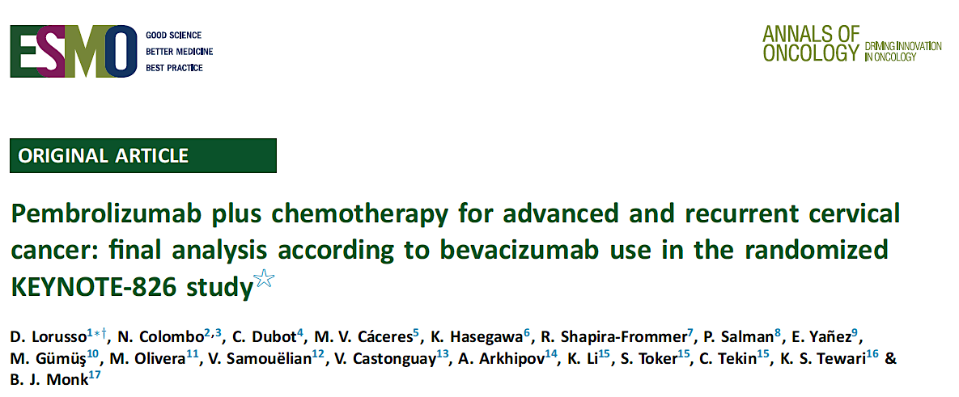
Ann Oncol 2025;36(1):65-75.

Slide 31
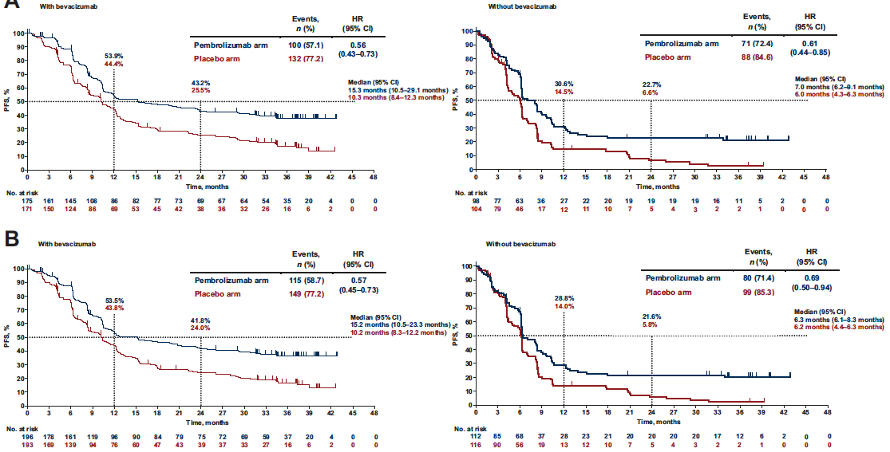
KEYNOTE-826: Progression-Free Survival by Bevacizumab Use
PD-L1
CPS ≥1
All-Comer
Population
Lorusso D et al. Ann Oncol 2025;36(1):65-75.

Slide 32
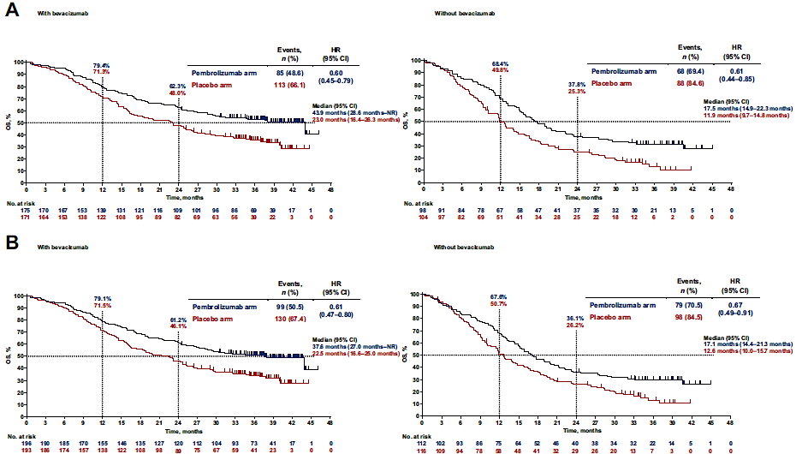
KEYNOTE-826: Overall Survival by Bevacizumab Use
PD-L1
CPS ≥1
All-Comer
Population
Lorusso D et al. Ann Oncol 2025;36(1):65-75.

Slide 33
Cervical Cancer (2)
Locally Advanced cervical cancer
Duska LR et al. Pembrolizumab with chemoradiotherapy in patients with high-risk locally advanced cervical cancer: Final analysis results of the phase 3, randomized, double-blind ENGOT-cx11/GOG-3047/KEYNOTE-A18 study. ASCO 2025;Abstract LBA5504.
Mayadev J et al. Ultrasensitive detection and tracking of circulating tumor DNA (ctDNA) and association with relapse and survival in locally advanced cervical cancer (LACC): Phase 3 CALLA trial analyses. ASCO 2025;Abstract 5502.

Slide 34
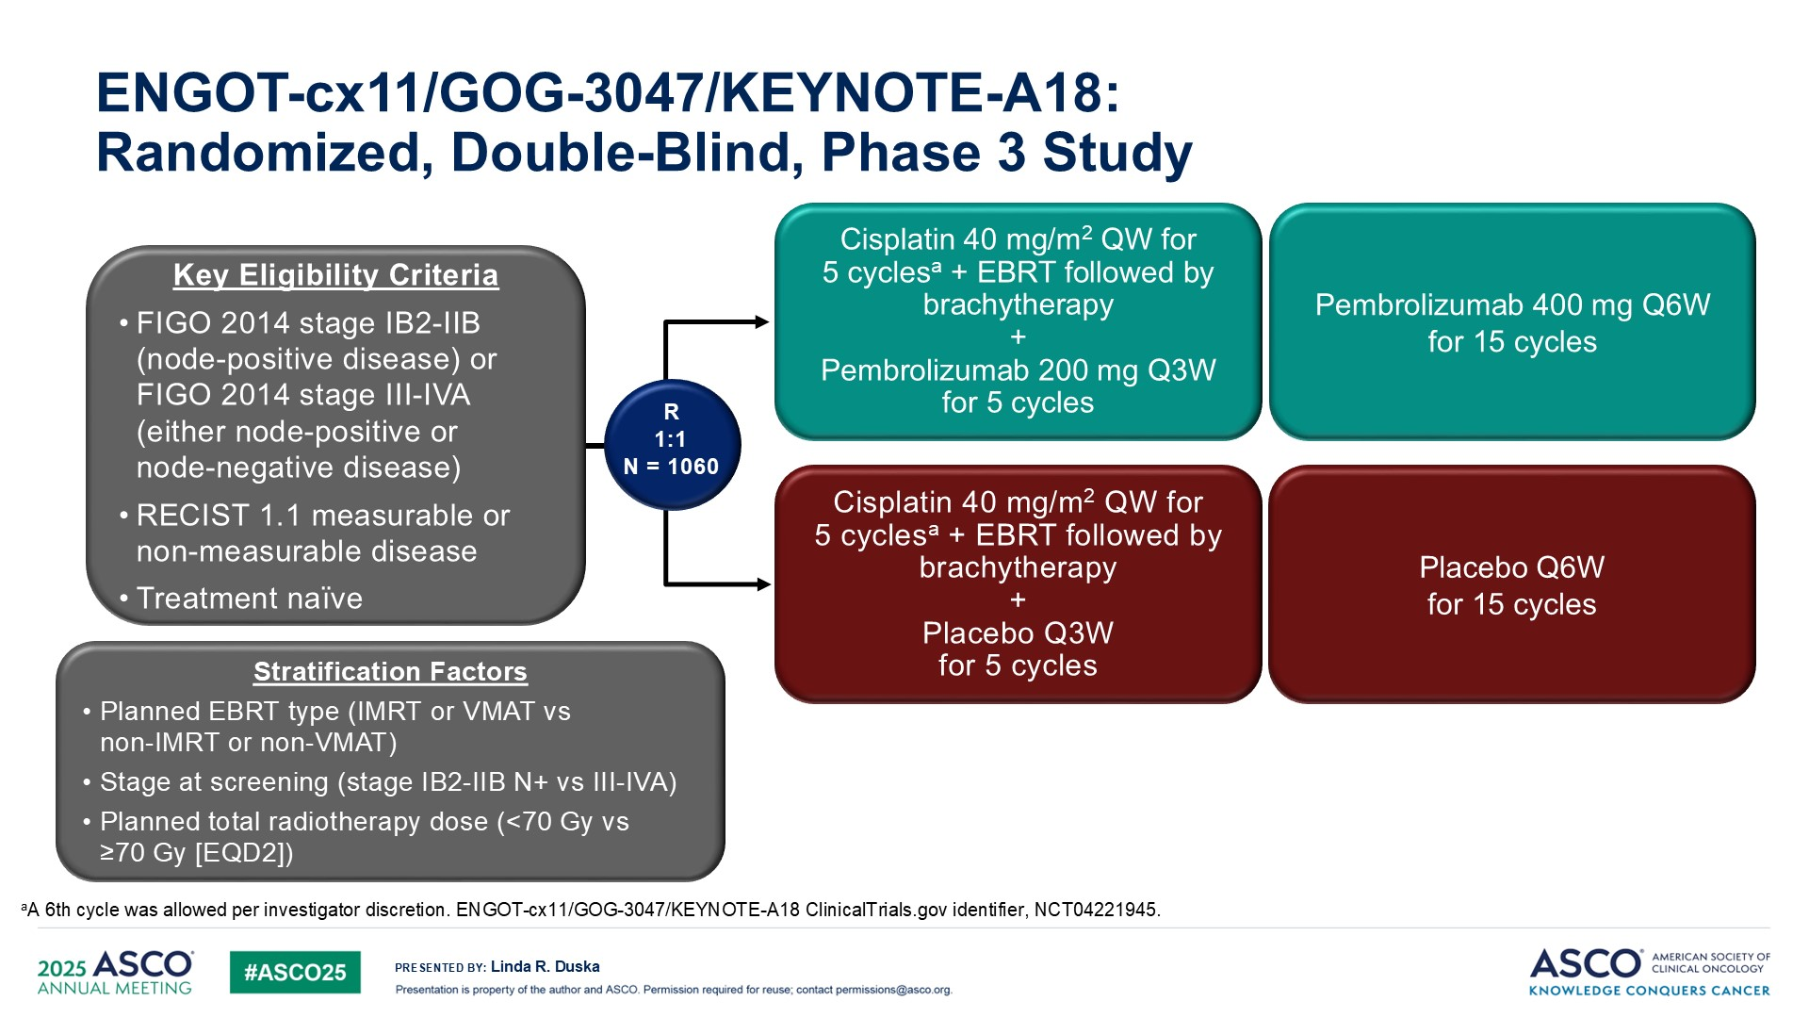
ENGOT-cx11/GOG-3047/KEYNOTE-A18:<br />Randomized, Double-Blind, Phase 3 Study
FDA and EMA approval
Duska LR et al. ASCO 2025;Abstract LBA5504.
Content of this presentation is the property of the author, licensed by ASCO. Permission required for reuse.

Slide 35
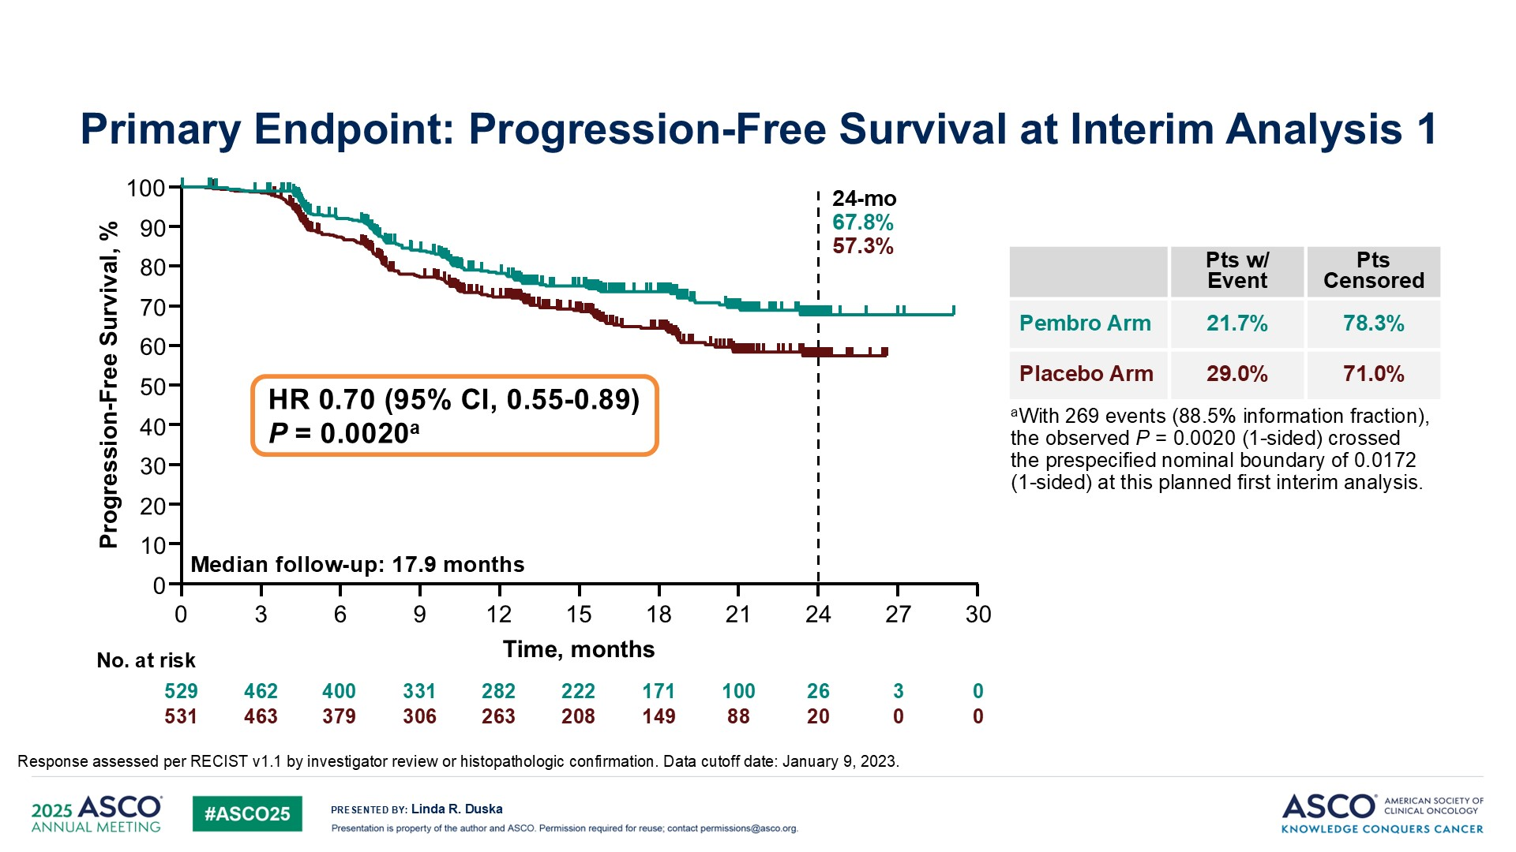
Primary Endpoint: Progression-Free Survival at Interim Analysis 1
KEYNOTE-A18
Duska LR et al. ASCO 2025;Abstract LBA5504.
Content of this presentation is the property of the author, licensed by ASCO. Permission required for reuse.

Slide 36
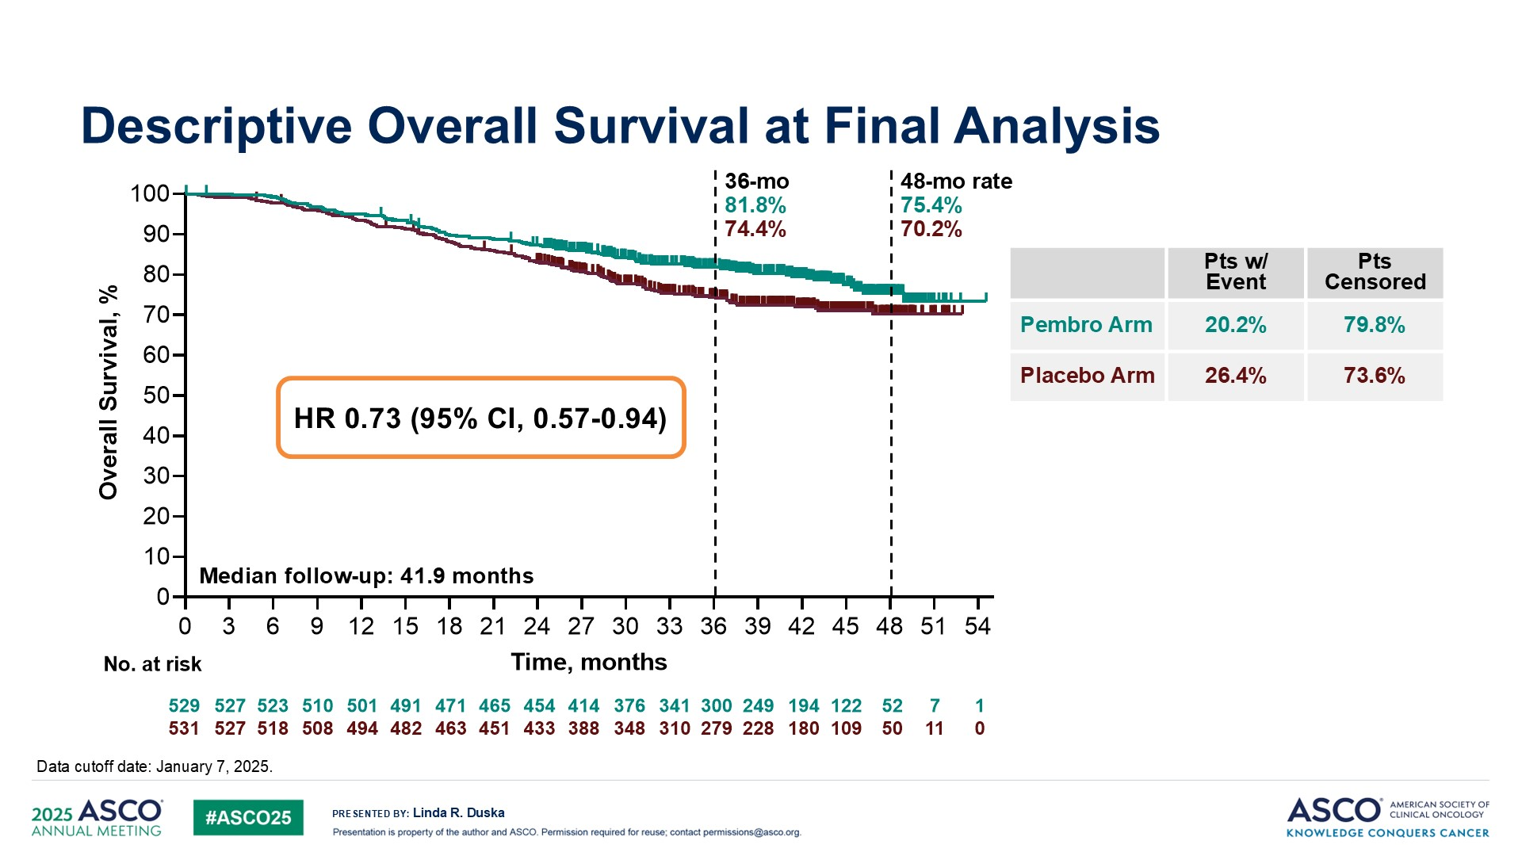
Descriptive Overall Survival at Final Analysis
KEYNOTE-A18
Duska LR et al. ASCO 2025;Abstract LBA5504.
Content of this presentation is the property of the author, licensed by ASCO. Permission required for reuse.

Slide 37
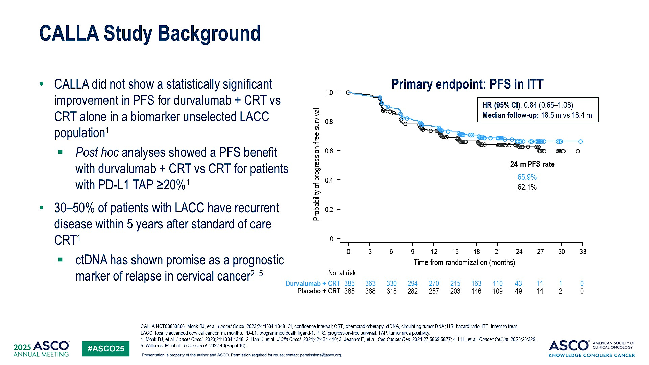
CALLA Study Background
Mayadev J et al. ASCO 2025;Abstract 5502.

Slide 38
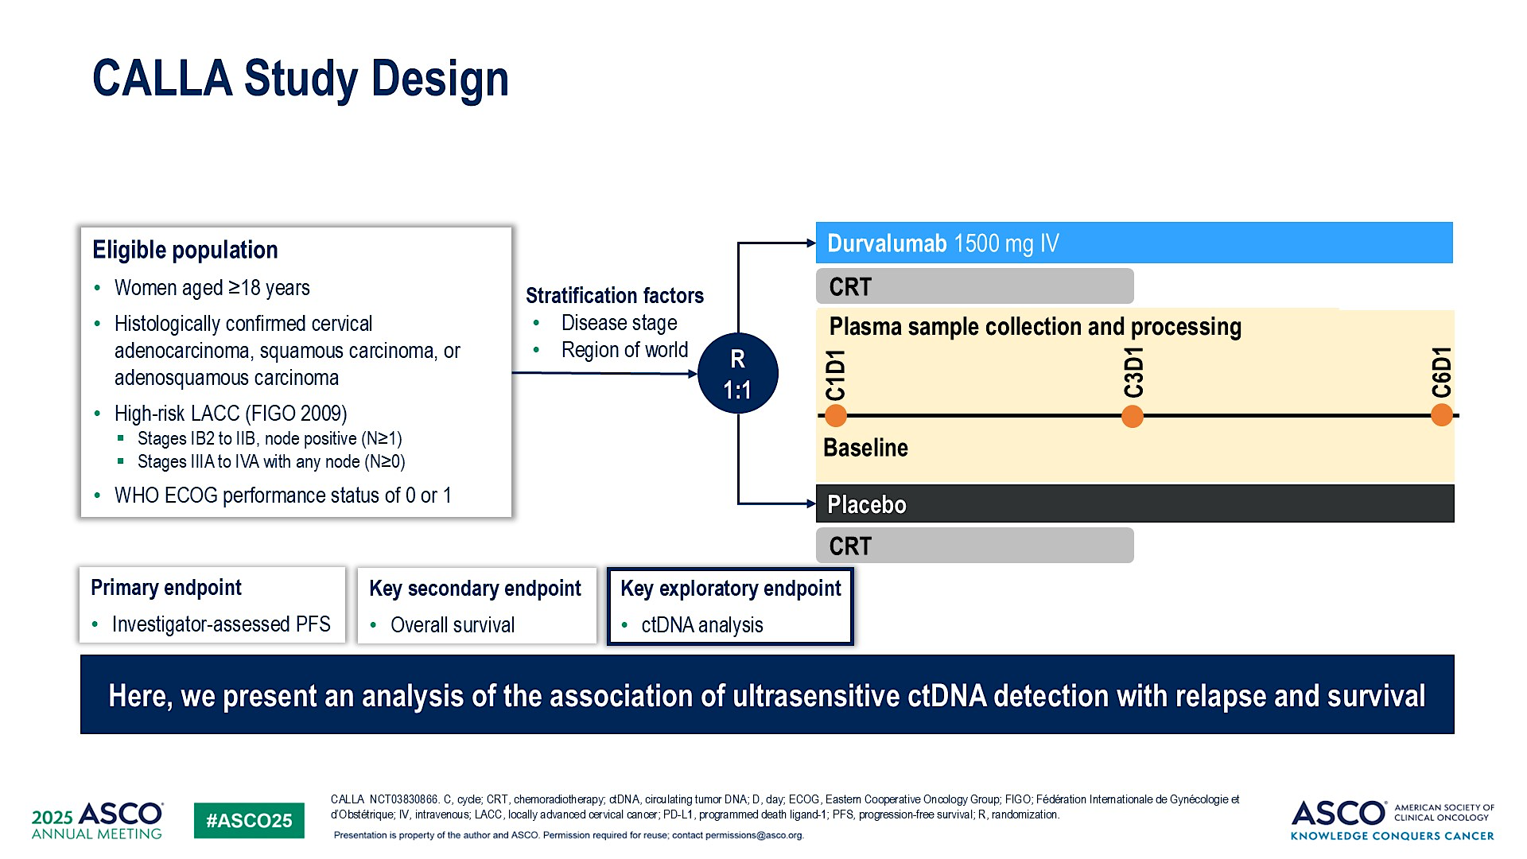
CALLA Study Design
Mayadev J et al. ASCO 2025;Abstract 5502.

Slide 39
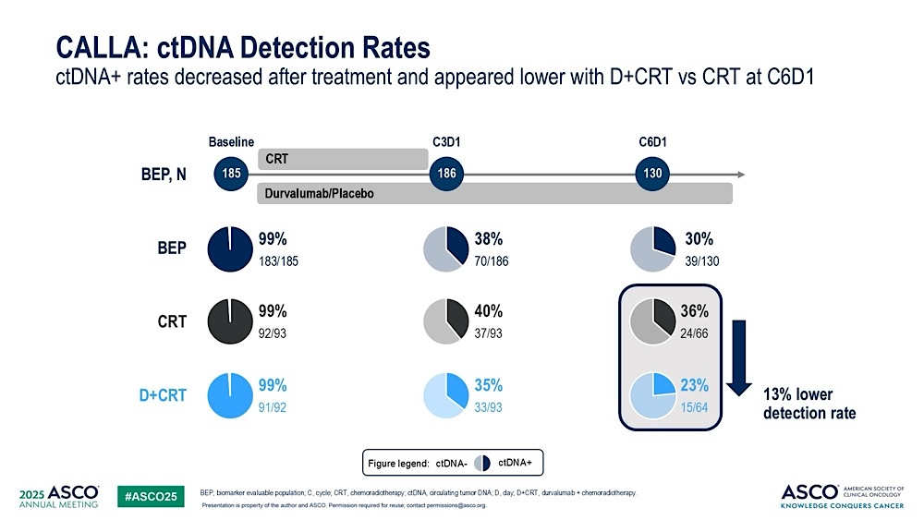
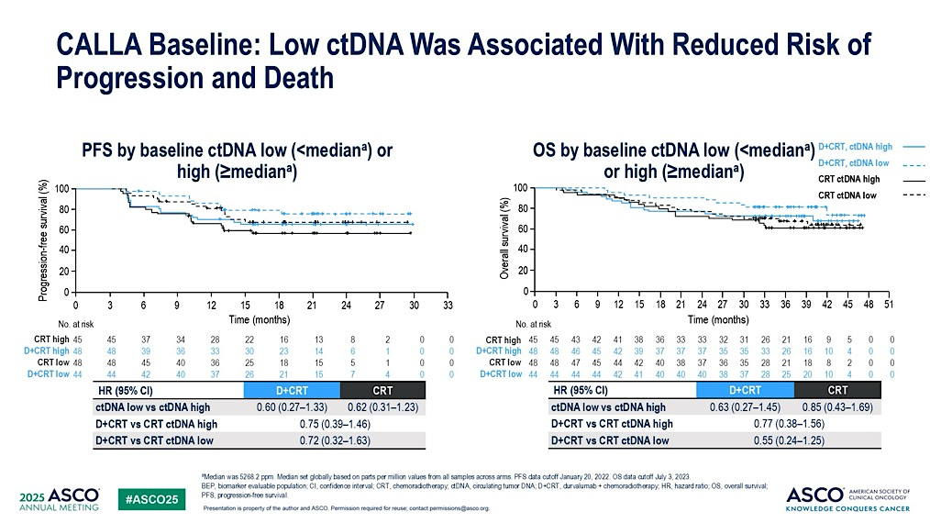
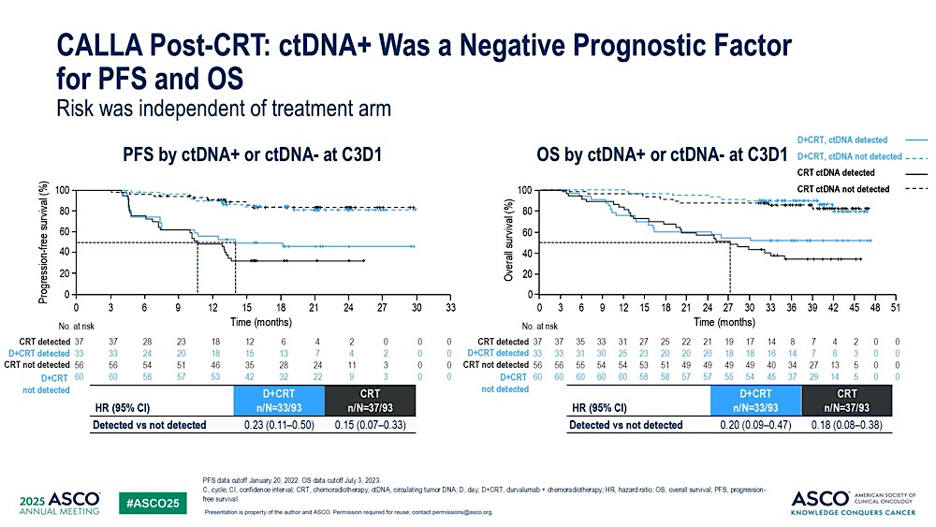
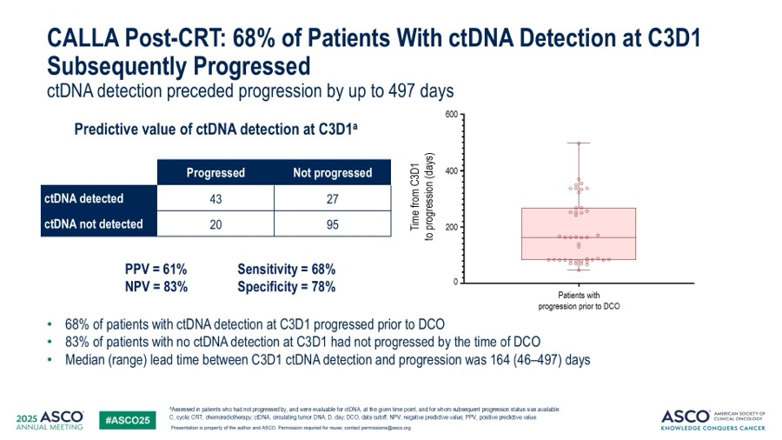
Mayadev J et al. ASCO 2025;Abstract 5502.

Slide 40
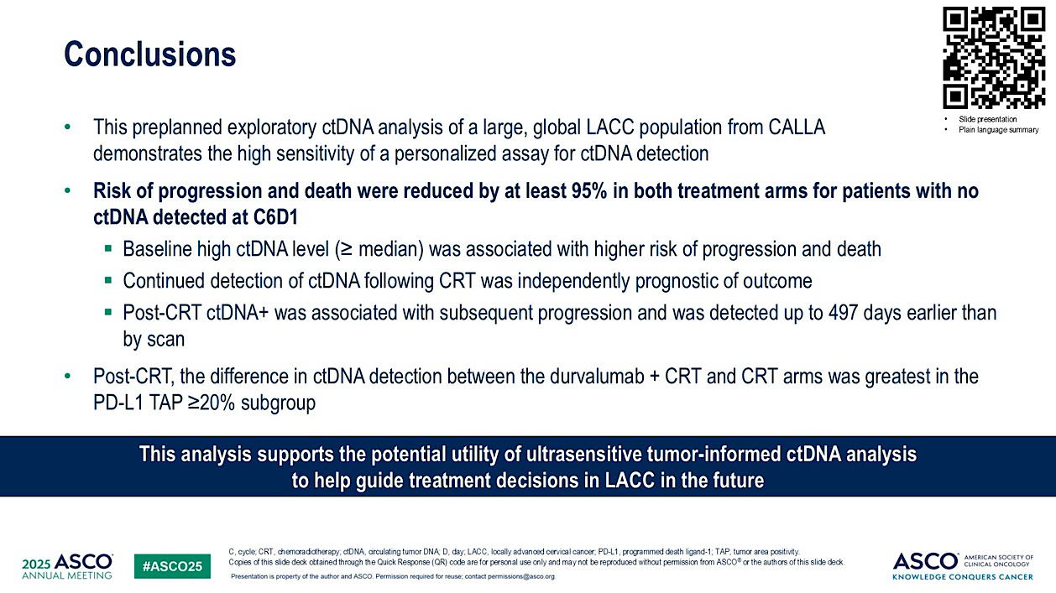
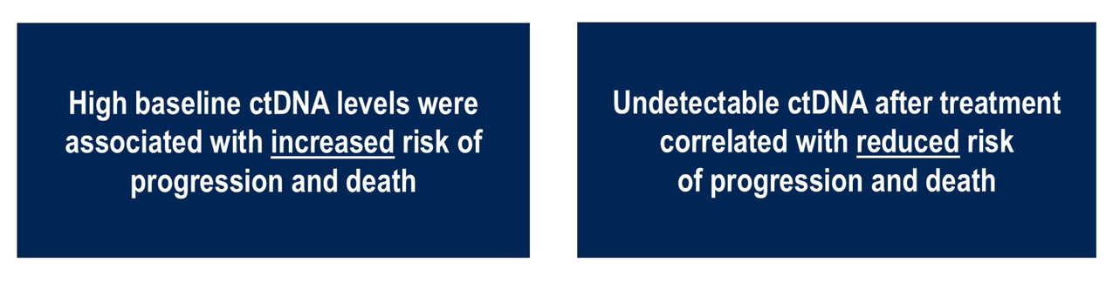
Conclusions
Next steps:
Integrating prospectively in to clinical
Trials?
Mayadev J et al. ASCO 2025;Abstract 5502.

Slide 41
Take Home
IO (Pembrolizumab, Dostarlimab, Durvalumab, Durvalumab+olaparib) changed SOC 1st line advanced/recurrent EC
Other maintenance strategies in trials eg Selinexor (p53wt)
ADCs changing SOC in cervical cancer
Tisotumab vedotin, T-DXd (IHC3+)
IO (pembrolizumab) in LACC changing SOC
ctDNA endometrial and cervical cancer promising

