Slide 1


Discussing recent data about Advanced prostate cancer
Karim Fizazi, MD, PhD
Institut Gustave Roussy
Villejuif, France

Slide 2
High-risk localized prostate cancer

Slide 3
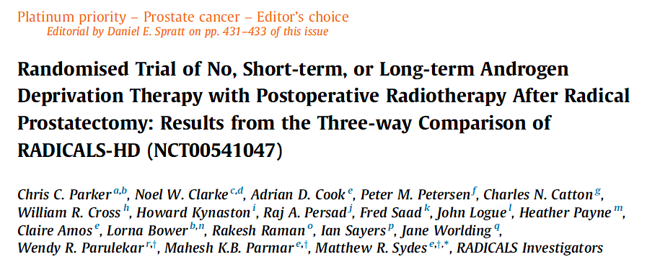
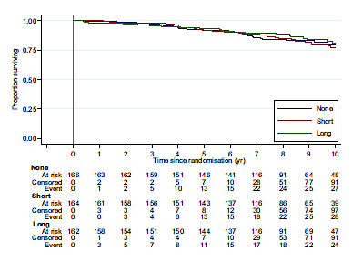
n=492 pts
Mix of adjuvant (40%) and salvage (60%) RT
MFS
RT alone
R
RT + ADT 6 m
RT + ADT 2y

Slide 4
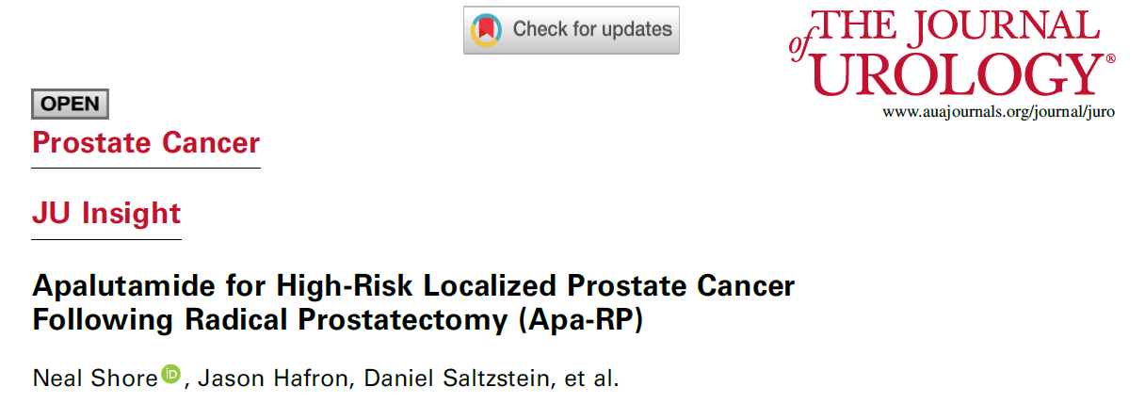
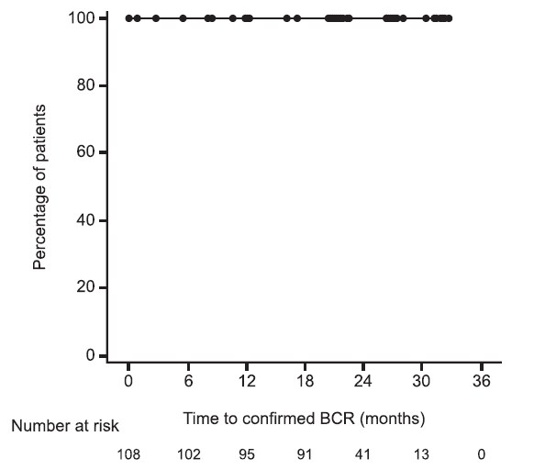
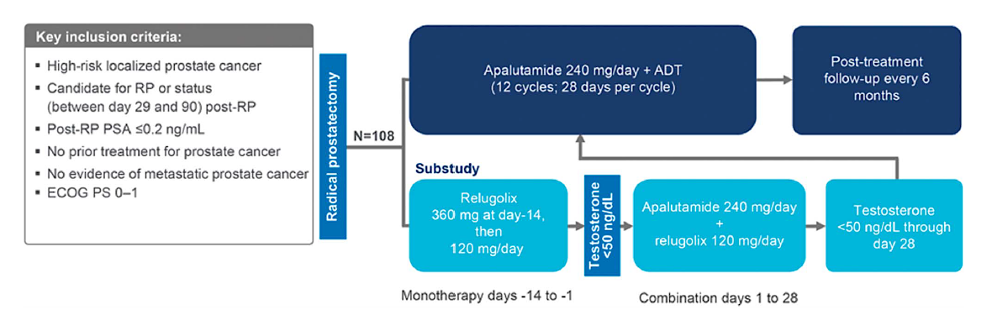
Time to BCR

Slide 5
Biochemical failure post-local treatment

Slide 6
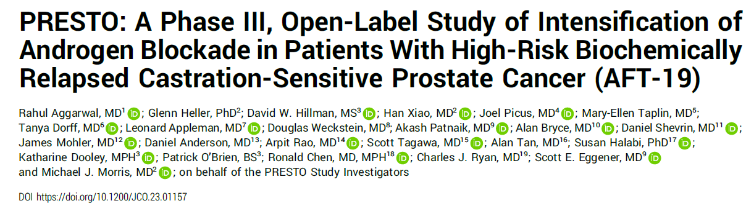
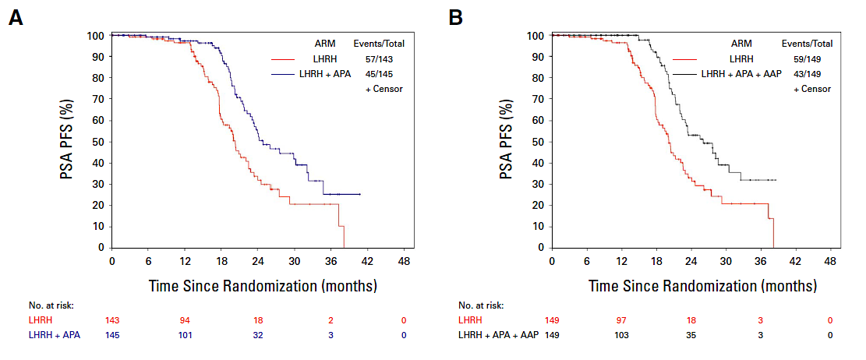
PSA-Progression free survival
BCR post RP
PSA DT<9m
n=503 pts
ADT 1y
R
ADT + Apa 1y
ADT + Apa+ AA 1y

Slide 7
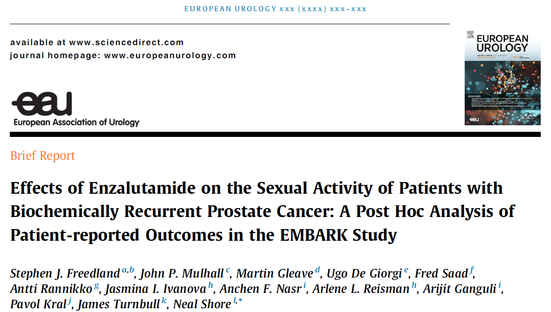
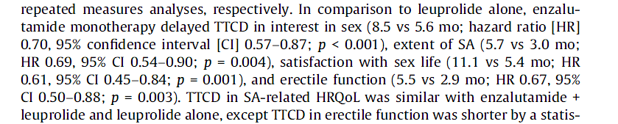
Biochemical failure: ADT+ Enzalutamide MFS (EMBARK)
3-yr rate
92.9%
83.5%
5-yr rate
87.3%
71.4%
100
 | Enzalutamide combination (n = 355) | Leuprolide acetate (n = 358)
Median follow-up, mo | 60.7 | 60.6
Events, n (%) | 45 (13) | 92 (26)
Per BICR, median MFS (95% CI), mo | NR (NR) | NR (85.1–NR)
80
Enzalutamide combination
Leuprolide acetate
60
Metastasis-free survival (%)
40
HR (95% CI):
0.42 (0.31–0.61); P<0.0001ª
20
0
0
6
12
18
24
30
36
42
48
54
60
66
72
78
84
90
96
Metastasis-free survival (mo)
355 | 331 | 324 | 318 | 304 | 292 | 281 | 265 | 251 | 234 | 180 | 116 | 60 | 24 | 6 | 0 | 0
358 | 335 | 321 | 303 | 280 | 259 | 238 | 221 | 203 | 183 | 138 | 88 | 32 | 15 | 6 | 1 | 0
Patients at risk
Enzalutamide combination
Leuprolide acetate
A consistent treatment effect was seen for investigator-assessed MFS: HR (95% CI): 0.47 (0.37–0.67); P<0.0001
Data cutoff: January 31, 2023. Symbols indicate censored data. ªHR was based on a Cox regression model with treatment as the only covariate stratified by screening PSA, PSADT, and prior hormonal therapy as reported in the IWRS; relative to leuprolide acetate <1 favoring enzalutamide combination; the two-sided P-value was based on a stratified log-rank. CI, confidence interval; HR, hazard ratio; IWRS, interactive web response system; NR, not reached.
Notes:
EMBARK TLR TLF/p137A
EMBARK AUA Additional ad hoc/p1A

Slide 8
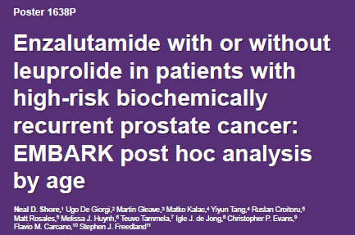
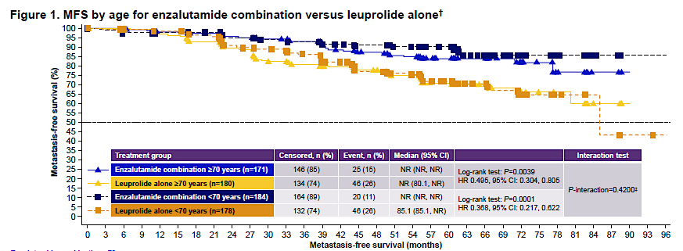
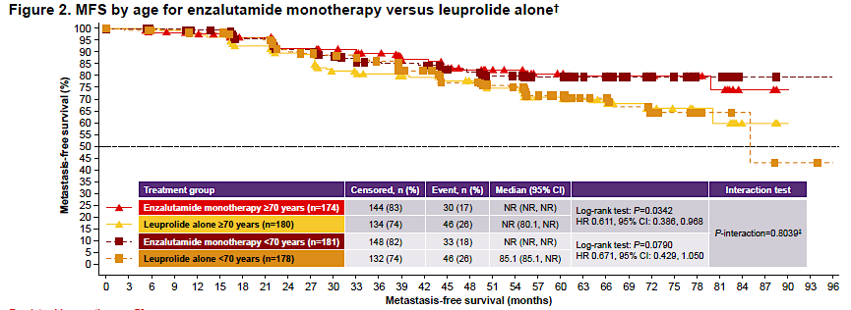

Slide 9

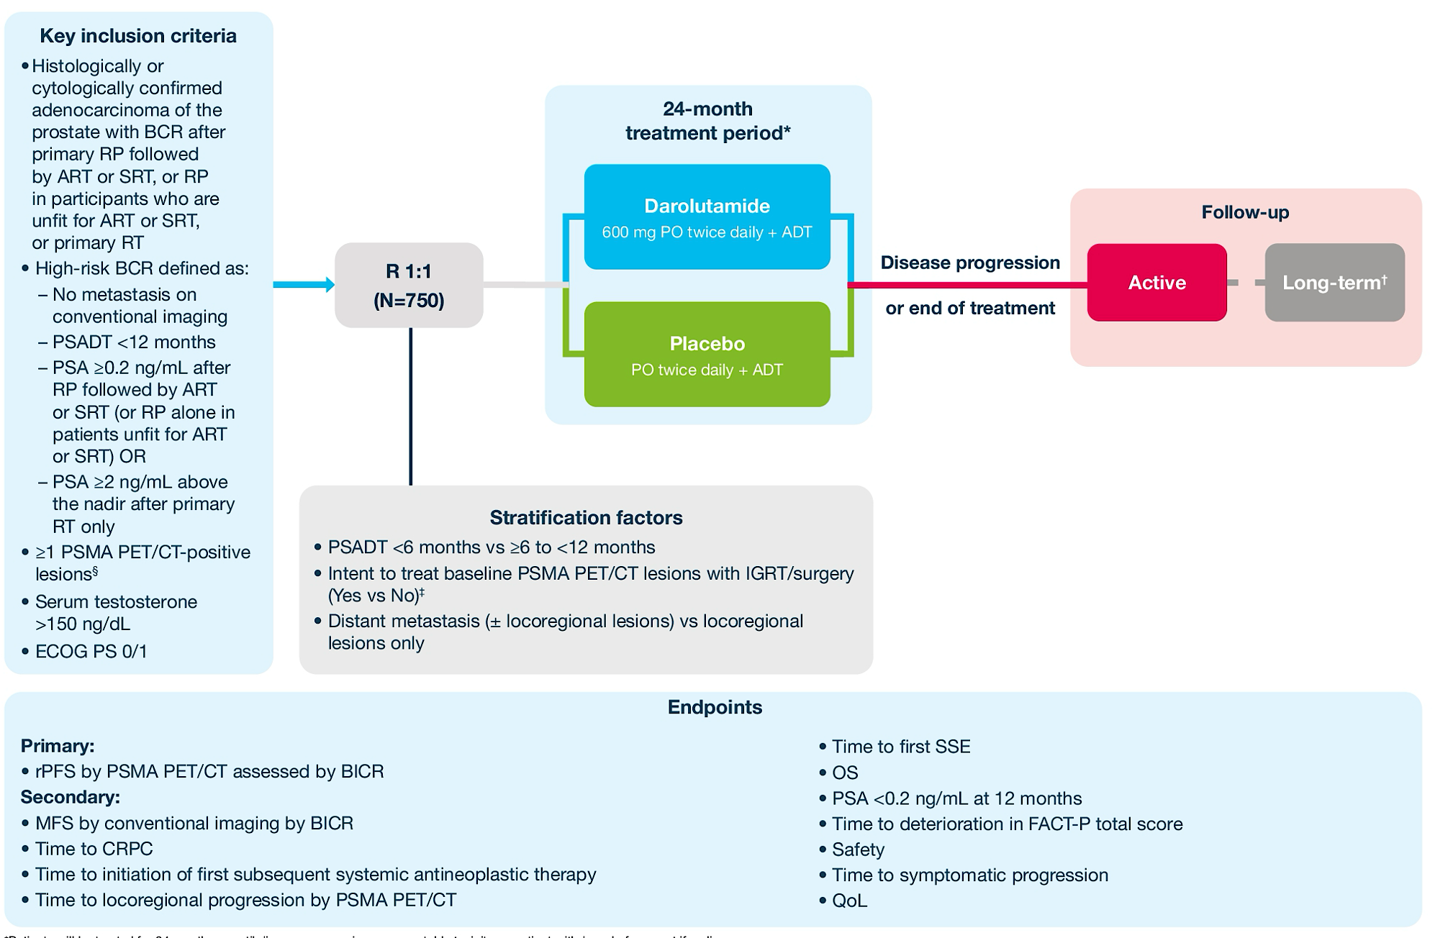

Slide 10
Metastatic prostate cancer

Slide 11
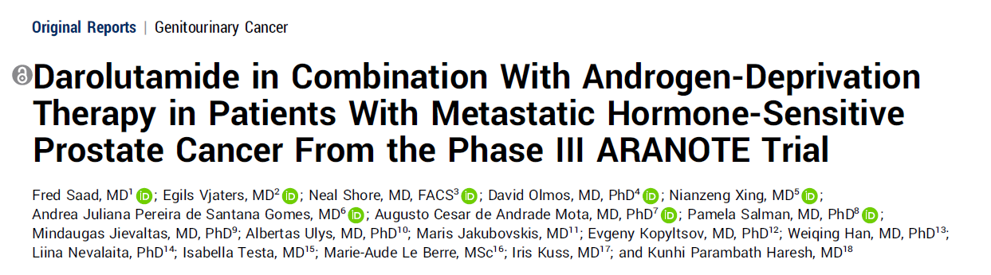
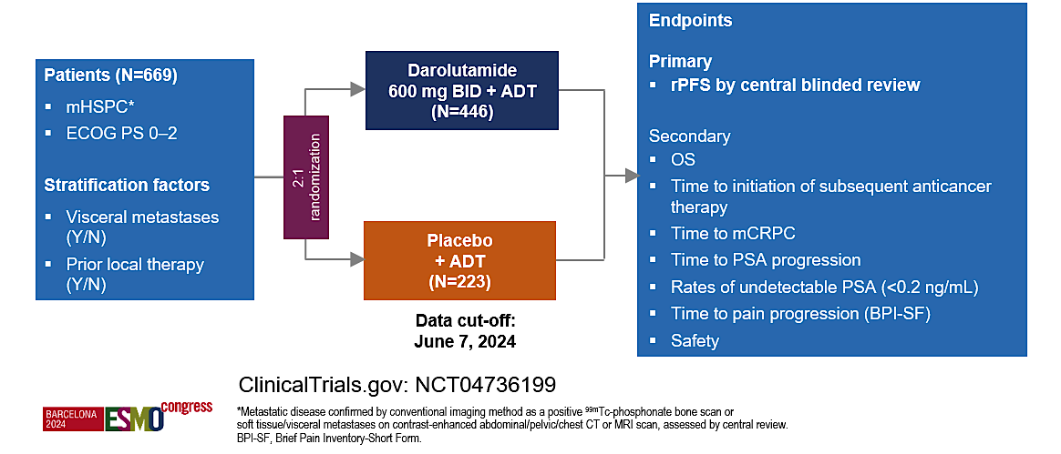
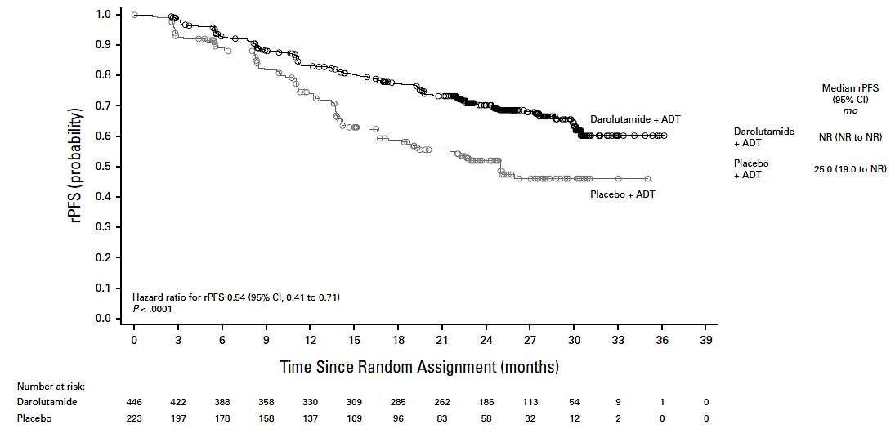

Slide 12
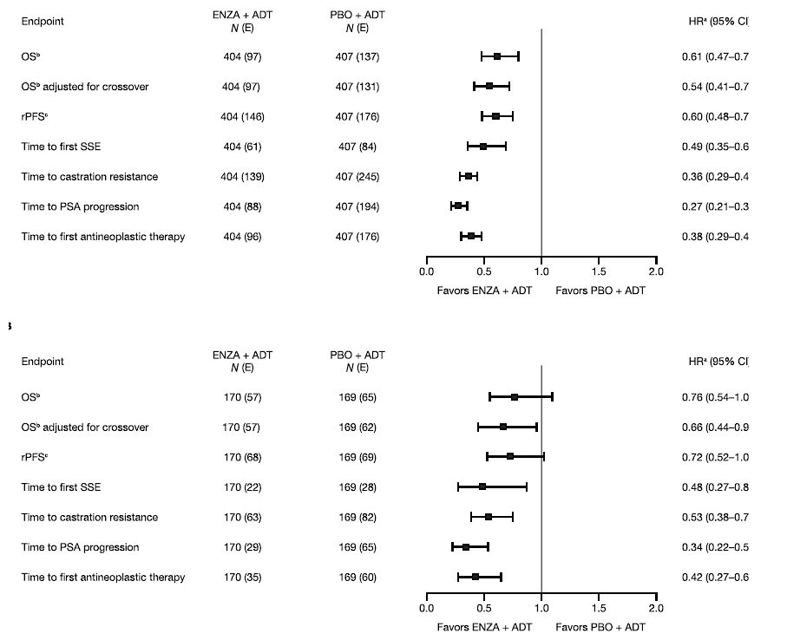
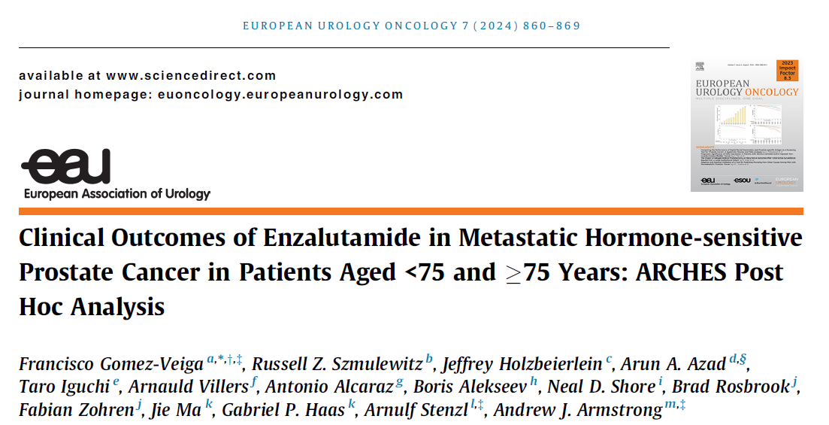
Metastatic Castration-Sensitive Prostate Cancer
Men <75y
Men >75y

Slide 13
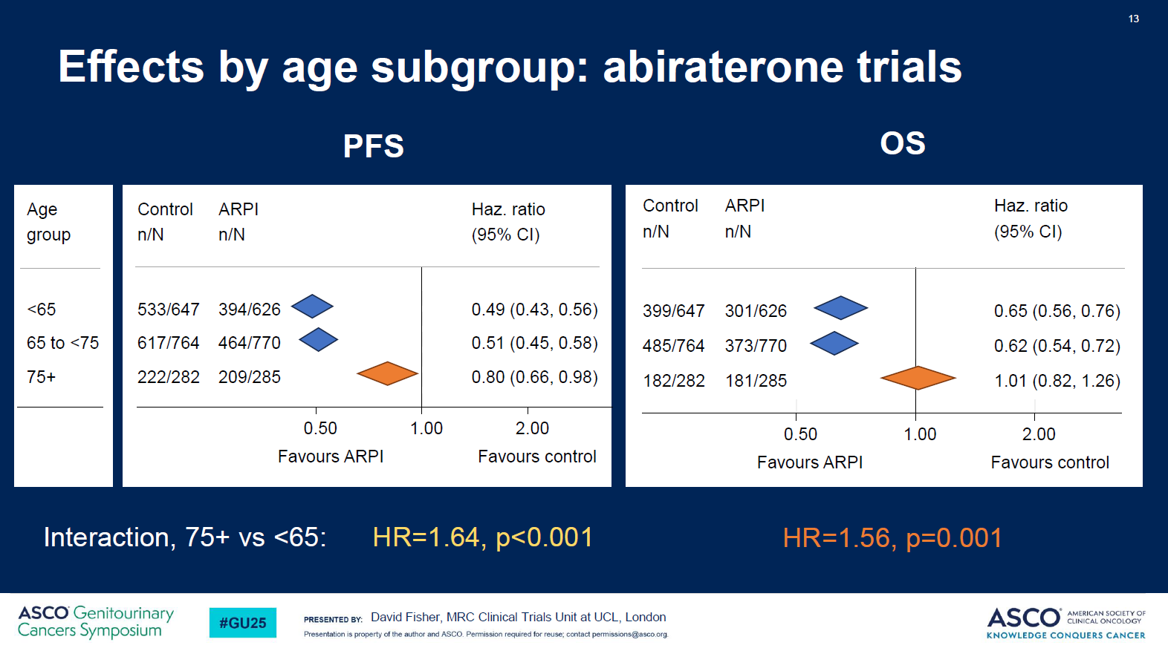
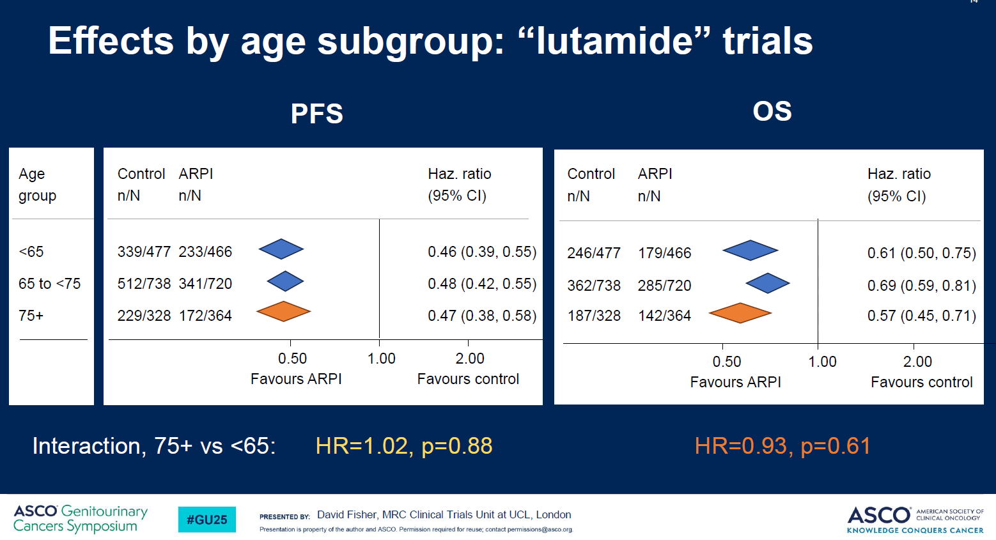
« Lutamides » to be preferred over Abiraterone in older patients?

Slide 14
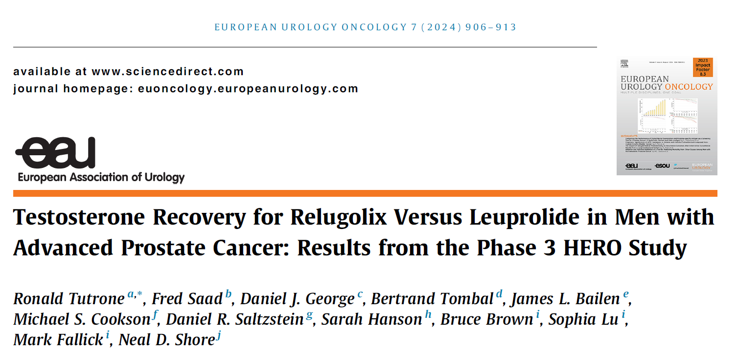
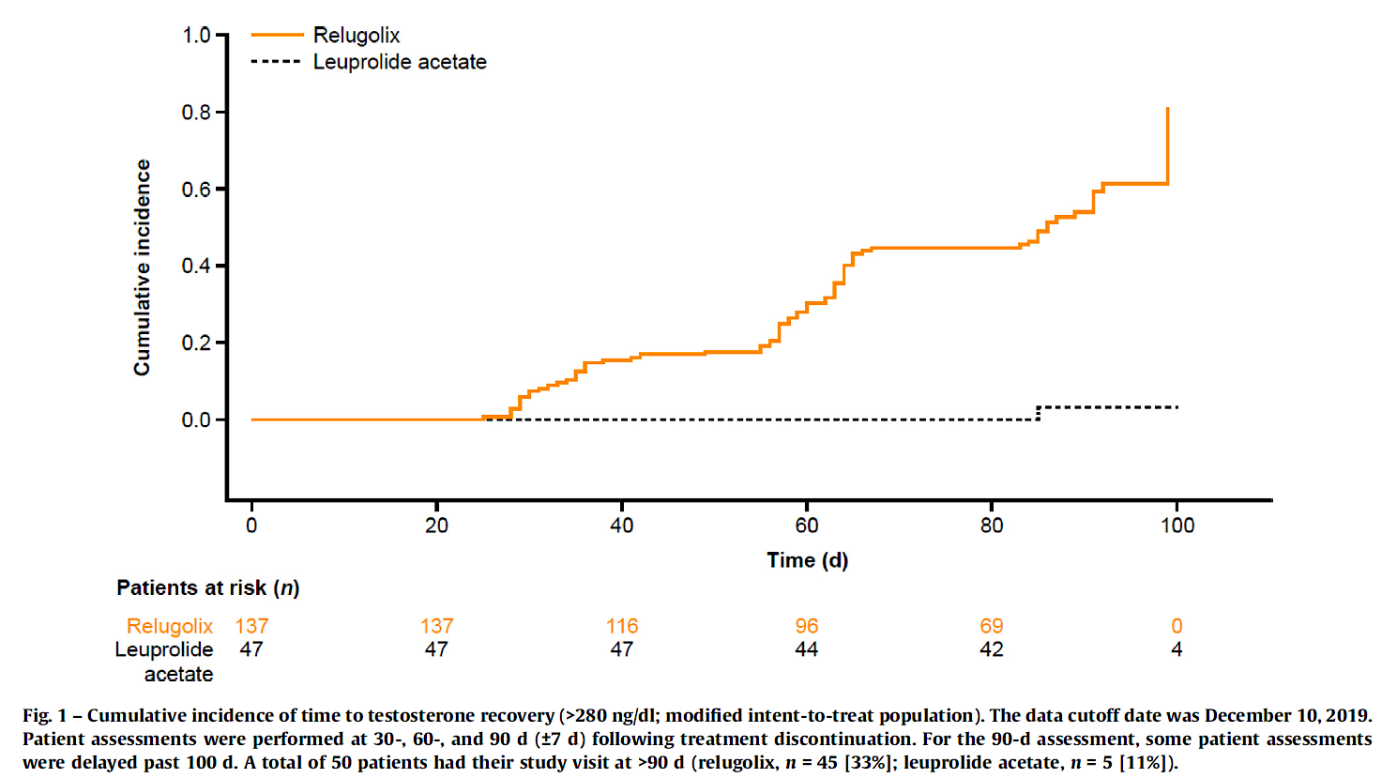

Slide 15
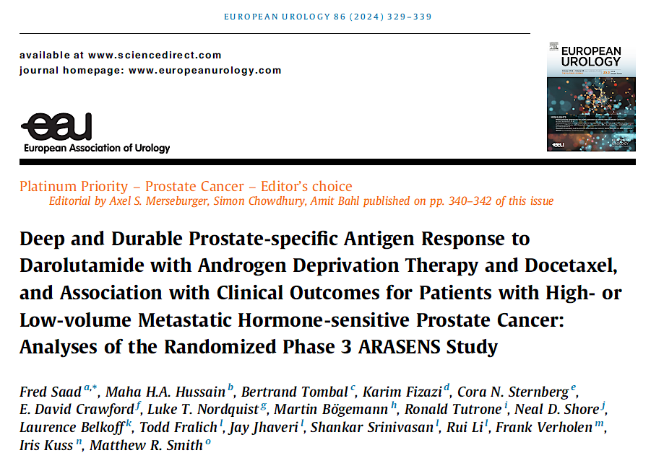
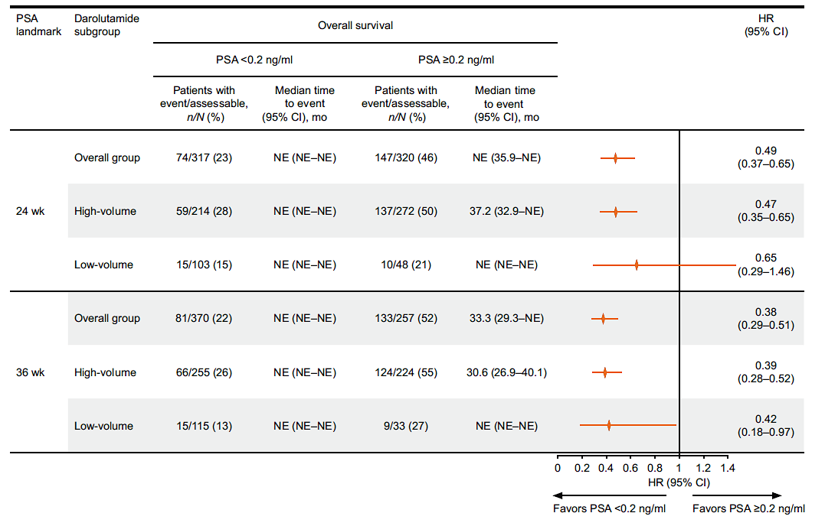

Slide 16
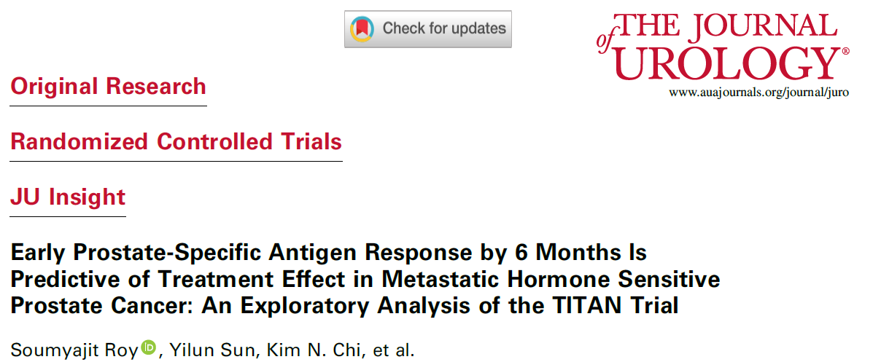
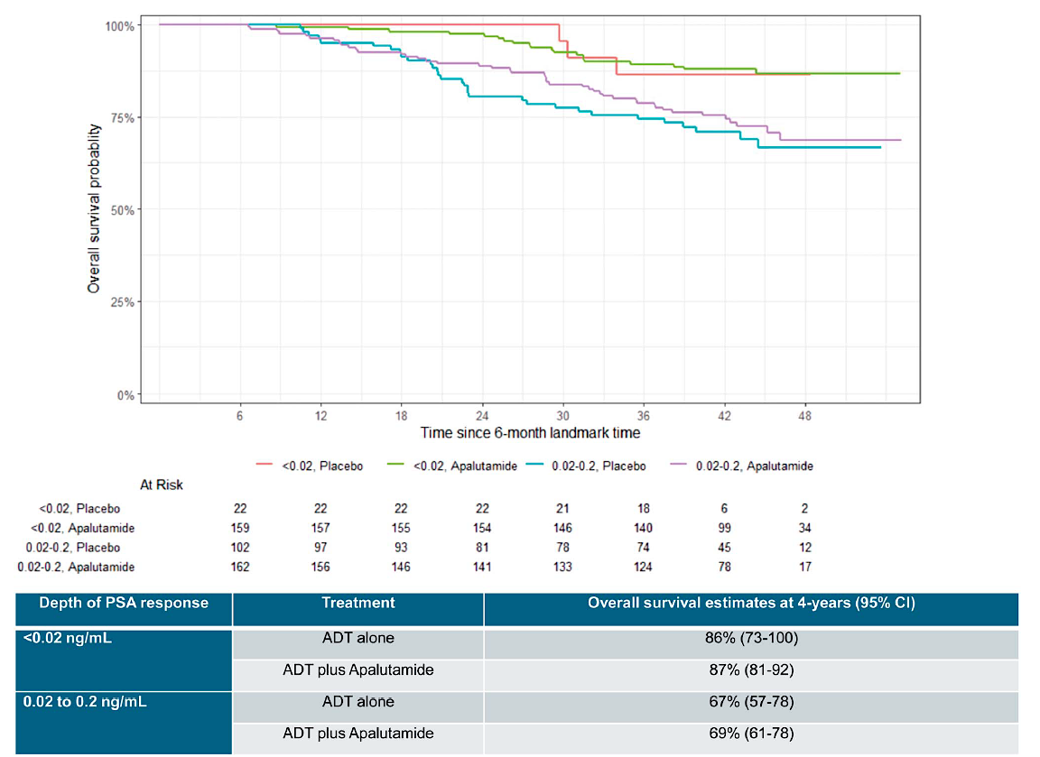
Overall survival probability

Slide 17
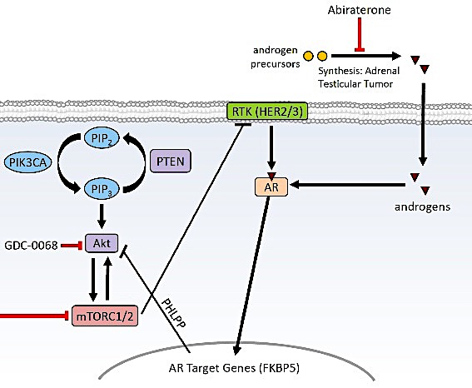
Targeting both the Akt and the AR pathways
Abiraterone
androgen
precursors
synthesis adrenal
testicular tumor
androgens
Ipatasertib
PHLPP/FKBP5
INPP4B
AR target genes
K Fizazi, personal slide

Slide 18


Abiraterone +/- Ipatasertib
(Akt inhibitor): PFS
PTEN loss
PTEN non-loss
HR,ª 0.39 (0.22-0.70)
HR,ª 0.84 (0.51-1.37)
400 mg Ipat + Abi
Median 11.5 mo
400 mg Ipat + Abi
Median 7.5 mo
400 mg Ipatasertib
Pbo + Abi
Median 4.6 mo
Pbo + Abi
Median 5.6 mo
HR,ª 0.46 (0.25-0.83)
HR,ª 1.13 (0.69-1.85)
200 mg Ipat + Abi
Median 11.1 mo
200 mg Ipat + Abi
Median 4.6 mo
200 mg Ipatasertib
Pbo + Abi
Median 4.6 mo
Pbo + Abi
Median 5.6 mo
de Bono et al, Ipatasertib, ESMO 2016

Slide 19
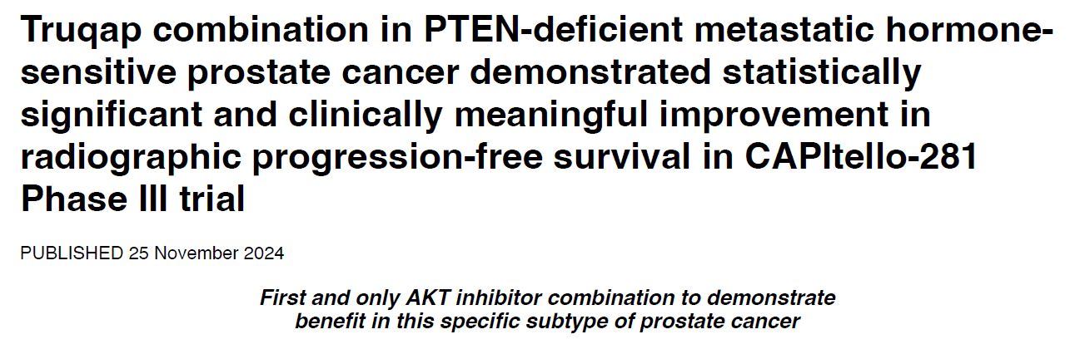
CAPItello-281: A Phase III study of capivasertib + abiraterone vs. placebo + abiraterone for patients with de novo mHSPC characterised by PTEN loss
Study population
De novo metastatic prostate cancer
PTEN deficiency determined by IHC (central testing)
Capivasertib combination in PTEN-deficient metastatic hormone-
Capivasertib
(400 mg PO BID,
4 days on, 3 days off) + abiraterone
(1000 mg PO QD)
+ ADT
Primary endpoint
Radiographic Progression Free Survival, defined as investigator assessment per
  RECIST 1.1 (soft tissue) progression via CT/MRI
  PCWG3 (bone) progression via bone scan
  Death due to any cause
Randomisation
N=1000
Placebo
(BID, 4 days on,
3 days off)
+ abiraterone
(1000 mg PO QD)
+ ADT

