Slide 1
Year in Review: Management of Prostate Cancer
A CME/MOC-Accredited Live Webinar
Thursday, April 17, 2025​ 5:00 PM – 6:00 PM ET
Faculty
Emmanuel S Antonarakis, MD
Professor Karim Fizazi, MD, PhD
Moderator
Neil Love, MD

Slide 2



Faculty
Emmanuel S Antonarakis, MD
Clark Endowed Professor of Medicine
Division of Hematology, Oncology and Transplantation
University of Minnesota
Minneapolis, Minnesota
MODERATOR
Neil Love, MD Research To Practice
Miami, Florida
Professor Karim Fizazi, MD, PhD
Head of Service and Full Professor
Institut Gustave Roussy
University of Paris Saclay
Villejuif, France

Slide 3
Commercial Support
This activity is supported by educational grants from Astellas and Pfizer Inc, AstraZeneca Pharmaceuticals LP, Bayer HealthCare Pharmaceuticals, Janssen Biotech Inc, administered by Janssen Scientific Affairs LLC, and Merck.
Research To Practice CME Planning Committee Members, Staff and Reviewers
Planners, scientific staff and independent reviewers for Research To Practice have no relevant conflicts of interest to disclose.

Slide 4
Dr Antonarakis — Disclosures
Advisory Committees | Abeona Therapeutics Inc, AstraZeneca Pharmaceuticals LP, Blue Earth Diagnostics, Boundless Bio, Curium, Forbion, Sanofi, Tango Therapeutics
Consulting Agreements | Acerand Therapeutics, Clarity Pharmaceuticals, Curium, EcoR1 Capital LLC, Health Monitor, Lilly, LinKinVax, Vir Biotechnology Inc, Z-Alpha
Contracted Research | Bayer HealthCare Pharmaceuticals, Bristol Myers Squibb, MacroGenics Inc, Novartis, Orion Corporation, pharmaand GmbH, Seagen Inc

Slide 5
Prof Fizazi — Disclosures
Institutional Honoraria | Advanced Accelerator Applications, Amgen Inc, Astellas, AstraZeneca Pharmaceuticals LP, Bayer HealthCare Pharmaceuticals, Daiichi Sankyo Inc, Janssen Biotech Inc, Merck, MSD, Novartis, Pfizer Inc

Slide 6
This educational activity contains discussion of non-FDA-approved uses of agents and regimens. Please refer to official prescribing information for each product for approved indications.

Slide 7
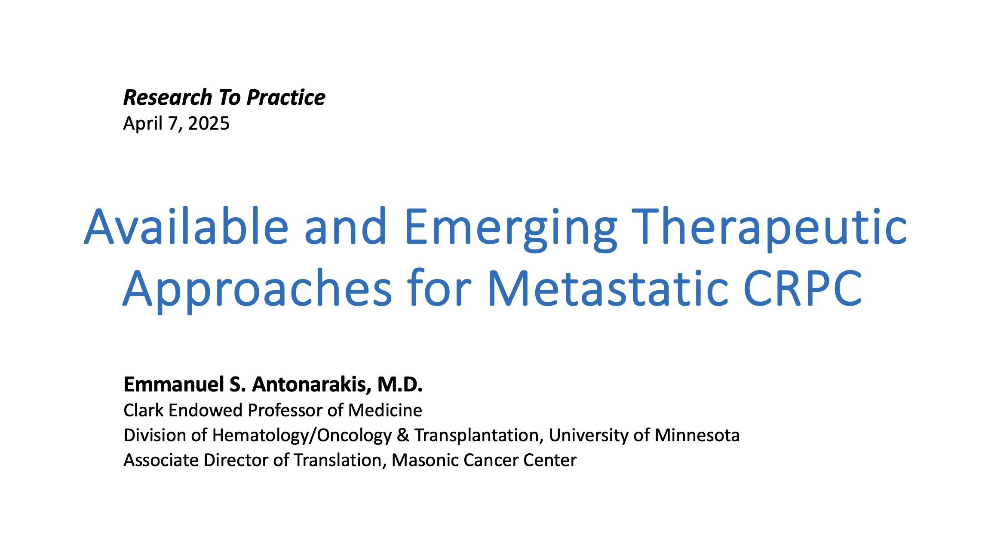
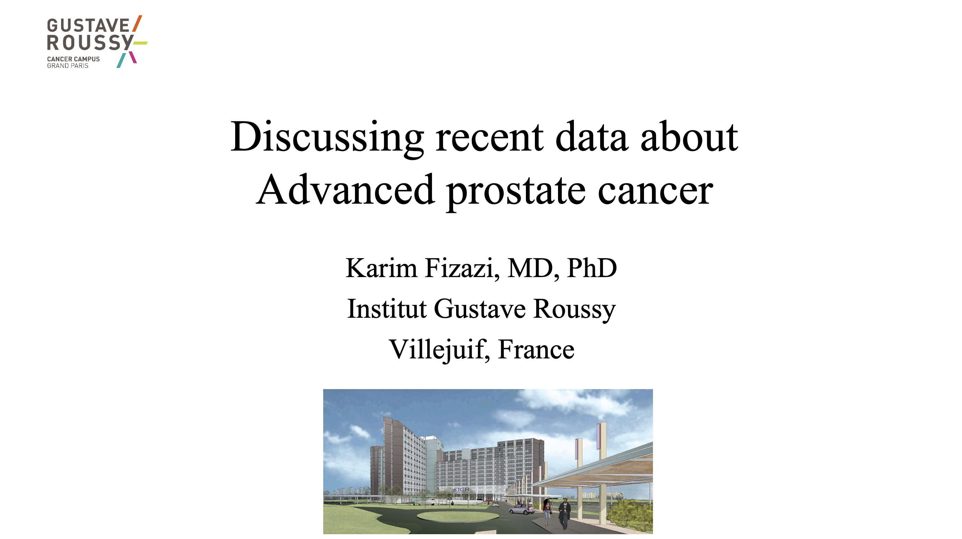

Slide 8
Key Datasets
Professor Karim Fizazi, MD, PhD
Parker CC et al. Randomised trial of no, short-term, or long-term androgen deprivation therapy with postoperative radiotherapy after radical prostatectomy: Results from the three-way comparison of RADICALS-HD (NCT00541047). Eur Urol 2024;86(5):422-30.
Tutrone R et al. Testosterone recovery for relugolix versus leuprolide in men with advanced prostate cancer: Results from the Phase 3 HERO study. Eur Urol Oncol 2024;7(4):906-13.
Shore N et al. Apalutamide for high-risk localized prostate cancer following radical prostatectomy (Apa-RP). J Urol 2024;212(5):682-91.
Shore ND et al. Enzalutamide (enza) with or without leuprolide in patients (pts) with high-risk biochemically recurrent (hrBCR) prostate cancer (PC): EMBARK post hoc analysis by age. ESMO 2024;Abstract 1638P.
Freedland SJ et al. Effects of enzalutamide on the sexual activity of patients with biochemically recurrent prostate cancer: A post hoc analysis of patient-reported outcomes in the EMBARK study. Eur Urol 2025;[Online ahead of print].
Aggarwal R et al. PRESTO: A phase III, open-label study of intensification of androgen blockade in patients with high-risk biochemically relapsed castration-sensitive prostate cancer (AFT-19). J Clin Oncol 2024;42(10):1114-23.

Slide 9
Key Datasets
Professor Karim Fizazi, MD, PhD (continued)
Morgans AK et al. Darolutamide plus androgen-deprivation therapy (ADT) in patients with high-risk biochemical recurrence (BCR) of prostate cancer: A phase 3, randomized, double-blind, placebo-controlled study (ARASTEP). Genitourinary Cancers Symposium 2025;Abstract TPS432.
Roy S et al. Early prostate-specific antigen response by 6 months is predictive of treatment effect in metastatic hormone sensitive prostate cancer: An exploratory analysis of the TITAN trial. J Urol 2024;212(5):672-81.
Gomez-Veiga F et al. Clinical outcomes of enzalutamide in metastatic hormone-sensitive prostate cancer in patients aged <75 and 75 years: ARCHES post hoc analysis. Eur Urol Oncol 2024;7(4):860-9.
Saad F et al. Darolutamide in combination with androgen-deprivation therapy in patients with metastatic hormone-sensitive prostate cancer from the phase III ARANOTE trial. J Clin Oncol 2024;42(36):4271-81.
Saad F et al. Deep and durable prostate-specific antigen response to darolutamide with androgen deprivation therapy and docetaxel, and association with clinical outcomes for patients with high- or low-volume metastatic hormone-sensitive prostate cancer: Analyses of the randomized phase 3 ARASENS study. Eur Urol 2024;86(4):329-39.

Slide 10
Key Datasets
Emmanuel S Antonarakis, MD
Saad F et al. Efficacy of olaparib (ola) plus abiraterone (abi) versus placebo (pbo) plus abi in patients (pts) with metastatic castration-resistant prostate cancer (mCRPC) with a germline or somatic BRCA mutation in the PROpel trial. Genitourinary Cancers Symposium 2025;Abstract 219.
Roubaud G et al. Adjustment for imbalances in baseline characteristics in the MAGNITUDE phase 3 study confirms the clinical benefit of niraparib in combination with abiraterone acetate plus prednisone in patients with metastatic prostate cancer. Eur J Cancer 2024;209:114183.
Agarwal N et al. Final overall survival (OS) with talazoparib (TALA) + enzalutamide (ENZA) as first-line treatment in unselected patients with metastatic castration-resistant prostate cancer (mCRPC) in the phase 3 TALAPRO-2 trial. Genitourinary Cancers Symposium 2025;Abstract LBA18.
Hussain MH et al. Abiraterone, olaparib, or abiraterone + olaparib in first-line metastatic castration-resistant prostate cancer with DNA repair defects (BRCAAway). Clin Cancer Res 2024;30(19):4318-28.
Azad A et al. Phase III, double-blind, placebo-controlled, 2-cohort, randomized study of saruparib (AZD5305) in combination with androgen receptor pathway inhibitors in patients with metastatic hormone-sensitive prostate cancer with and without homologous recombination repair mutation (EvoPAR-Prostate01). Genitourinary Cancers Symposium 2025;Abstract TPS279.
Gillessen S et al. A randomized multicenter open label phase III trial comparing enzalutamide vs a combination of radium-223 (Ra223) and enzalutamide in asymptomatic or mildly symptomatic patients with bone metastatic castration-resistant prostate cancer (mCRPC): First results of EORTC-GUCG 1333/PEACE-3. ESMO 2024;Abstract LBA1.

Slide 11
Key Datasets
Emmanuel S Antonarakis, MD (continued)
Morris MJ et al. 177Lu-PSMA-617 versus a change of androgen receptor pathway inhibitor therapy for taxane-naive patients with progressive metastatic castration-resistant prostate cancer (PSMAfore): A phase 3, randomised, controlled trial. Lancet 2024;404(10459):1227-39.
Emmett L et al. Overall survival and quality of life with [(177)Lu]Lu-PSMA-617 plus enzalutamide versus enzalutamide alone in metastatic castration-resistant prostate cancer (ENZA-p): Secondary outcomes from a multicentre, open-label, randomised, phase 2 trial. Lancet Oncol 2025;26(3):291-9.
Sartor O et al. Efficacy of 177Lu-PNT2002 in PSMA-positive mCRPC following progression on an androgen-receptor pathway inhibitor (ARPI) (SPLASH). ESMO 2024;Abstract LBA65.
Agarwal N et al. Cabozantinib (C) plus atezolizumab (A) versus 2nd novel hormonal therapy (NHT) in patients (Pts) with metastatic castration-resistant prostate cancer (mCRPC): Final overall survival (OS) results of the phase III, randomized, CONTACT-02 study. ESMO 2024;Abstract LBA67.
Schweizer MT et al. Mevrometostat (PF-06821497), an enhancer of zeste homolog 2 (EZH2) inhibitor, in combination with enzalutamide in patients with metastatic castration-resistant prostate cancer (mCRPC): A randomized dose-expansion study. Genitourinary Cancers Symposium 2025;Abstract LBA138.
Gratzke CJ et al. Phase 3 OMAHA-004 study of CYP11A1 inhibitor opevesostat versus next-generation hormonal agent (NHA) switch in patients with metastatic castration-resistant prostate cancer (mCRPC) after 1 prior NHA. Genitourinary Cancers Symposium 2025;Abstract TPS301.
Yu EY et al. OMAHA-003: A phase 3 study of CYP11A1 inhibitor opevesostat versus next-generation hormonal agent (NHA) switch in metastatic castration-resistant prostate cancer (mCRPC) after NHA and taxane-based chemotherapy. Genitourinary Cancers Symposium 2025;Abstract TPS286.

Slide 12
Year in Review: Management of Prostate Cancer
INTRODUCTION: Quality of Life
MODULE 1: PARP Inhibition (PARPi)
Mutations that predict PARPi sensitivity
Endocrine therapy and PARPi synergy
Ongoing PARPi trials in metastatic hormone-sensitive prostate cancer
MODULE 2: M0 Disease
PRESTO; EMBARK
MODULE 3: Metastatic Hormone-Sensitive Prostate Cancer
De novo versus recurrent
PTEN deficiency – CAPItello-281
MODULE 4: Radiopharmaceuticals
Radium-223
¹⁷⁷Lu-PSMA-617; ¹⁷⁷Lu-PNT2002 – SPLASH
MODULE 5: Other Novel Investigational Approaches for Metastatic Castration-Resistant Prostate Cancer
CYP11A1 inhibition – Opevesostat
EZH2 inhibition – Mevrometostat

Slide 13
Year in Review: Management of Prostate Cancer
INTRODUCTION: Quality of Life
MODULE 1: PARP Inhibition (PARPi)
Mutations that predict PARPi sensitivity
Endocrine therapy and PARPi synergy
Ongoing PARPi trials in metastatic hormone-sensitive prostate cancer
MODULE 2: M0 Disease
PRESTO; EMBARK
MODULE 3: Metastatic Hormone-Sensitive Prostate Cancer
De novo versus recurrent
PTEN deficiency – CAPItello-281
MODULE 4: Radiopharmaceuticals
Radium-223
¹⁷⁷Lu-PSMA-617; ¹⁷⁷Lu-PNT2002 – SPLASH
MODULE 5: Other Novel Investigational Approaches for Metastatic Castration-Resistant Prostate Cancer
CYP11A1 inhibition – Opevesostat
EZH2 inhibition – Mevrometostat

Slide 14
Year in Review: Management of Prostate Cancer
INTRODUCTION: Quality of Life
MODULE 1: PARP Inhibition (PARPi)
Mutations that predict PARPi sensitivity
Endocrine therapy and PARPi synergy
Ongoing PARPi trials in metastatic hormone-sensitive prostate cancer
MODULE 2: M0 Disease
PRESTO; EMBARK
MODULE 3: Metastatic Hormone-Sensitive Prostate Cancer
De novo versus recurrent
PTEN deficiency – CAPItello-281
MODULE 4: Radiopharmaceuticals
Radium-223
¹⁷⁷Lu-PSMA-617; ¹⁷⁷Lu-PNT2002 – SPLASH
MODULE 5: Other Novel Investigational Approaches for Metastatic Castration-Resistant Prostate Cancer
CYP11A1 inhibition – Opevesostat
EZH2 inhibition – Mevrometostat

Slide 15
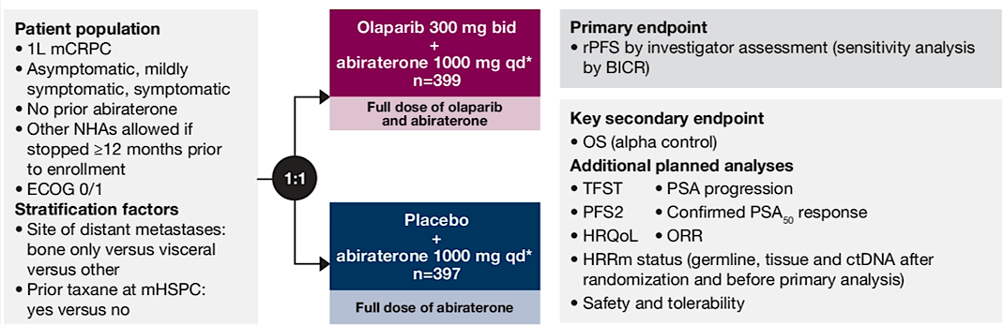
Olap + Abi: Phase 3 PROpel trial design
Saad F, et al. ASCO GU Symposium 2025; Abstract 219.
Courtesy of Emmanuel S Antonarakis, MD

Slide 16
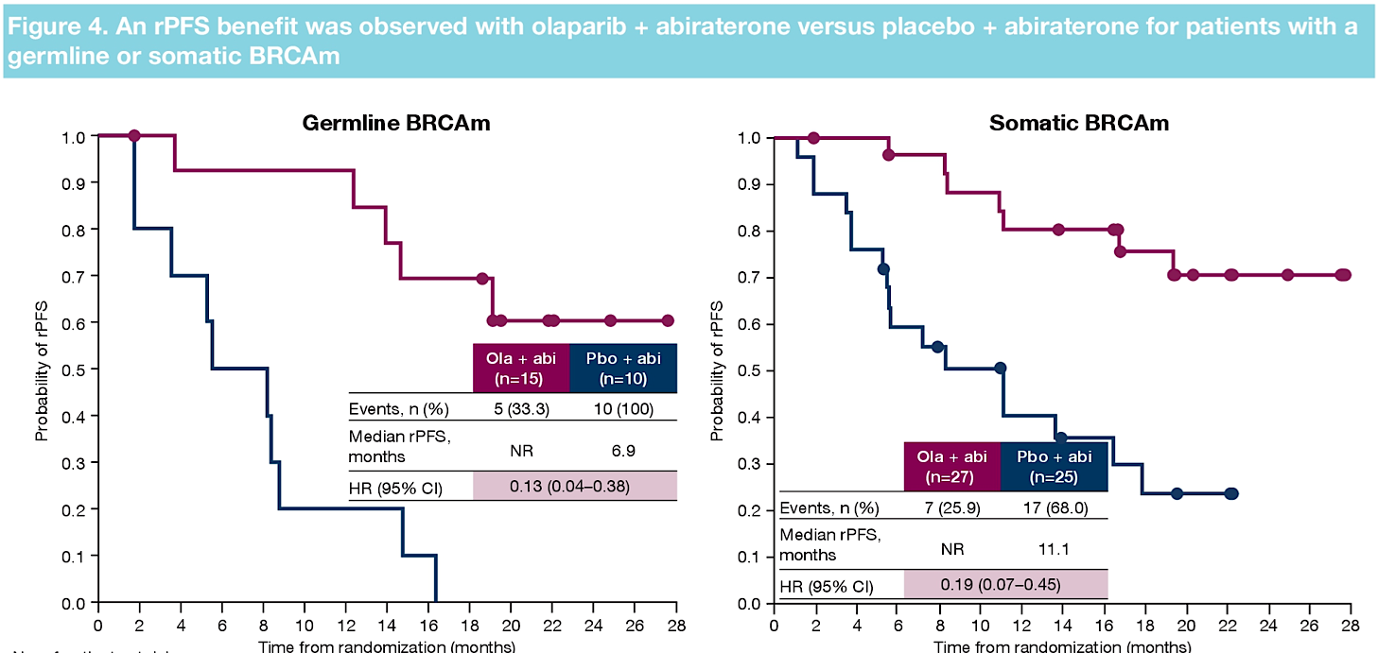
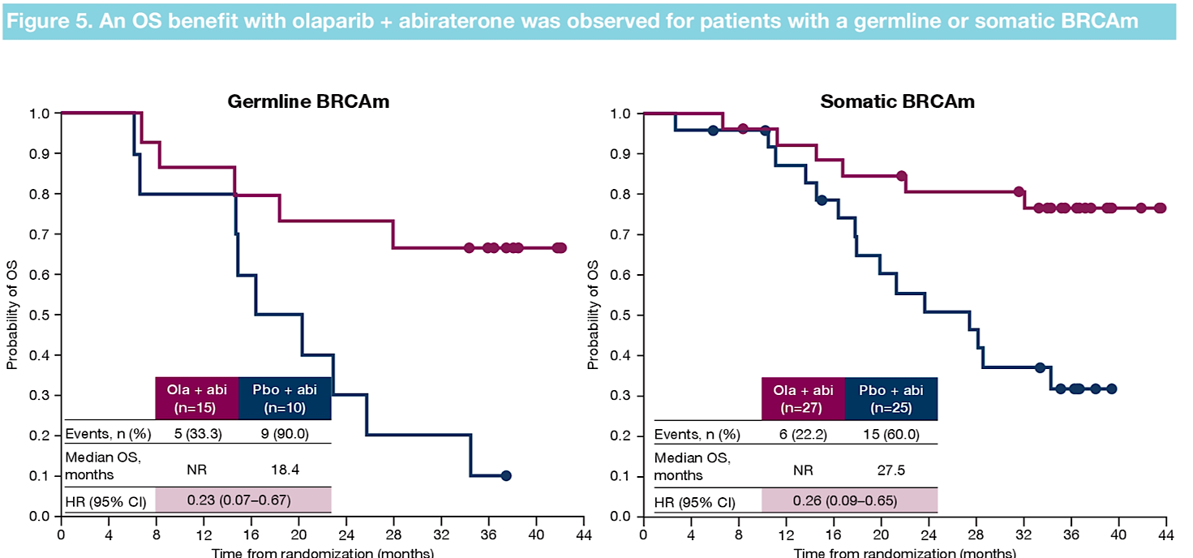
PFS/OS results by germline or somatic BRCAm
Saad F, et al. ASCO GU Symposium 2025; Abstract 219.
Courtesy of Emmanuel S Antonarakis, MD

Slide 17

PFS/OS results by germline or somatic BRCAm
Saad F, et al. ASCO GU Symposium 2025; Abstract 219.
Courtesy of Emmanuel S Antonarakis, MD

Slide 18
Conclusions
In first-line mCRPC patients with BRCAm, both germline and somatic muts derive similar benefit to olaparib + abiraterone
The natural history of germline BRCAm may be worse than somatic BRCAm in terms of PFS and OS
Since about 50% of BRCA mutations are of somatic-only origin, relying on germline testing alone will miss half of BRCAm cases
Germline and somatic testing are needed for all mCRPC patients
Somatic testing: tissue biopsy (primary, mets) or ctDNA assay
Courtesy of Emmanuel S Antonarakis, MD

Slide 19
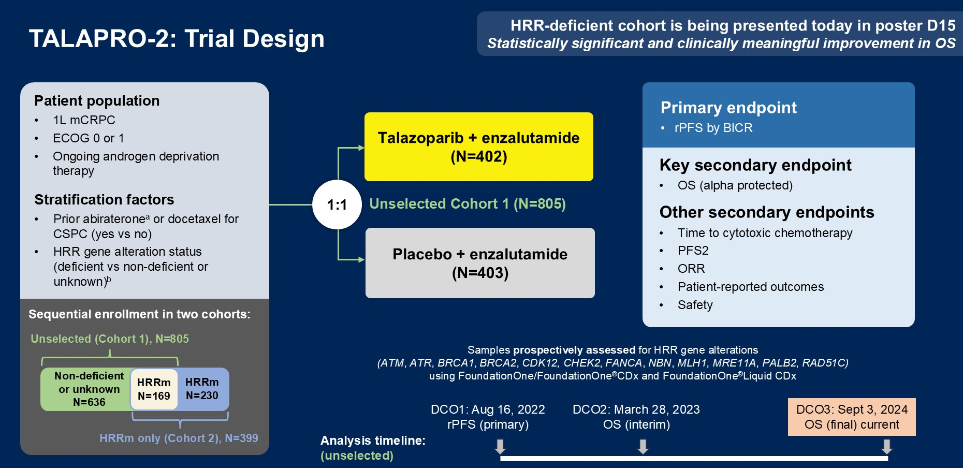
Talazop + Enza: Phase 3 TALAPRO-2 trial
Agarwal N, et al. ASCO GU Symposium 2025; Abstract LBA18.
Courtesy of Emmanuel S Antonarakis, MD

Slide 20
Conclusions
TALAPRO-2 was a randomized phase 3 trial of enza +/- talazop in both unselected and HRRm first-line mCRPC patients
The primary PFS endpoint in unselected pts was met (HR 0.63, P<0.001) and was previously reported
Here, we see that OS is also significantly improved with enza/ talazoparib in unselected first-line mCRPC pts
Although this combo regimen is currently only FDA approved for HRR-altered mCRPC, expanded FDA approval will likely be sought
Courtesy of Emmanuel S Antonarakis, MD

Slide 21
BRCAaway trial: Abi vs. Olap vs. Abi/Olap
Hussain M, et al. Clin Cancer Res 2024; 30: 4318-28. www.clinicaltrials.gov: (NCT03012321)
Courtesy of Emmanuel S Antonarakis, MD

Slide 22
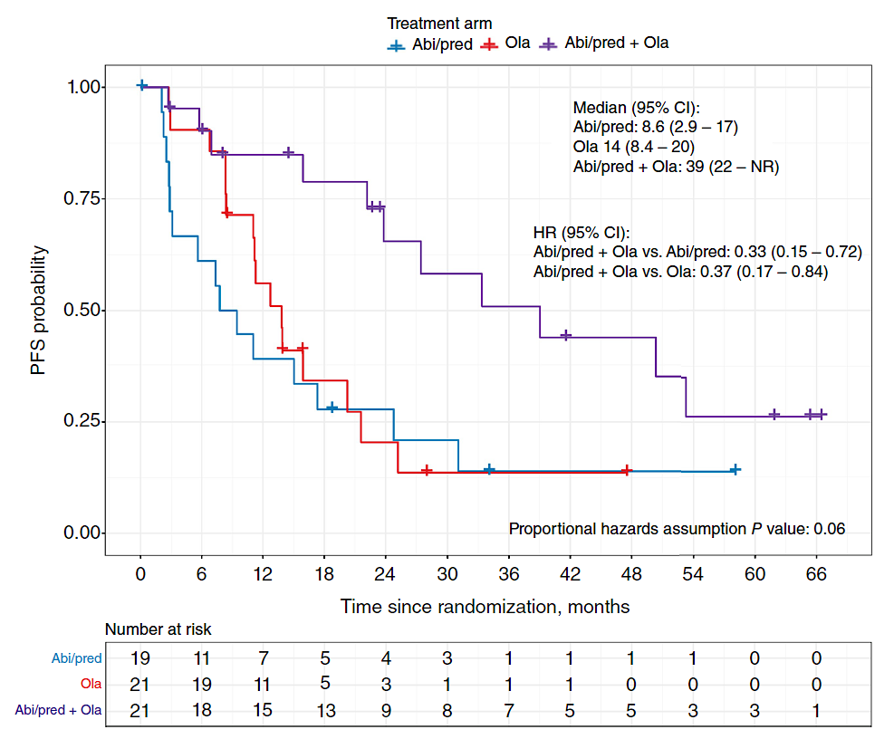
BRCAaway trial: Abi vs. Olap vs. Abi/Olap
Hussain M, et al. Clin Cancer Res 2024; 30: 4318-28.
Courtesy of Emmanuel S Antonarakis, MD

Slide 23
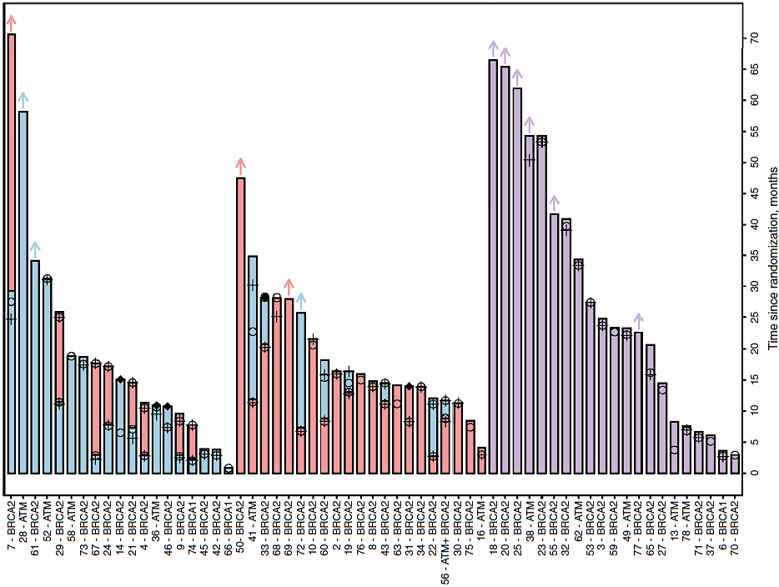
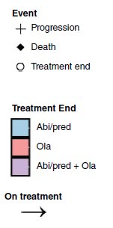
BRCAaway trial: Abi vs. Olap vs. Abi/Olap
Abi --> Olap
Olap --> Abi
Abi + Olap
Hussain M, et al. Clin Cancer Res 2024; 30: 4318-28.
Courtesy of Emmanuel S Antonarakis, MD

Slide 24
Conclusions
BRCAaway is the only PARPi/ARPI randomized trial with two control arms: Olaparib alone and Abiraterone alone
The trial had a built-in crossover design for Arm A (abiraterone
--> olaparib) and Arm B (olaparib --> abiraterone)
Even accounting for crossover, the combo of olap/abi produced better PFS than sequential abi --> olap or olap --> abi
Albeit a small trial, this is the best evidence that combination PARPi/ARPI therapy may be superior to sequential treatment
Courtesy of Emmanuel S Antonarakis, MD

Slide 25
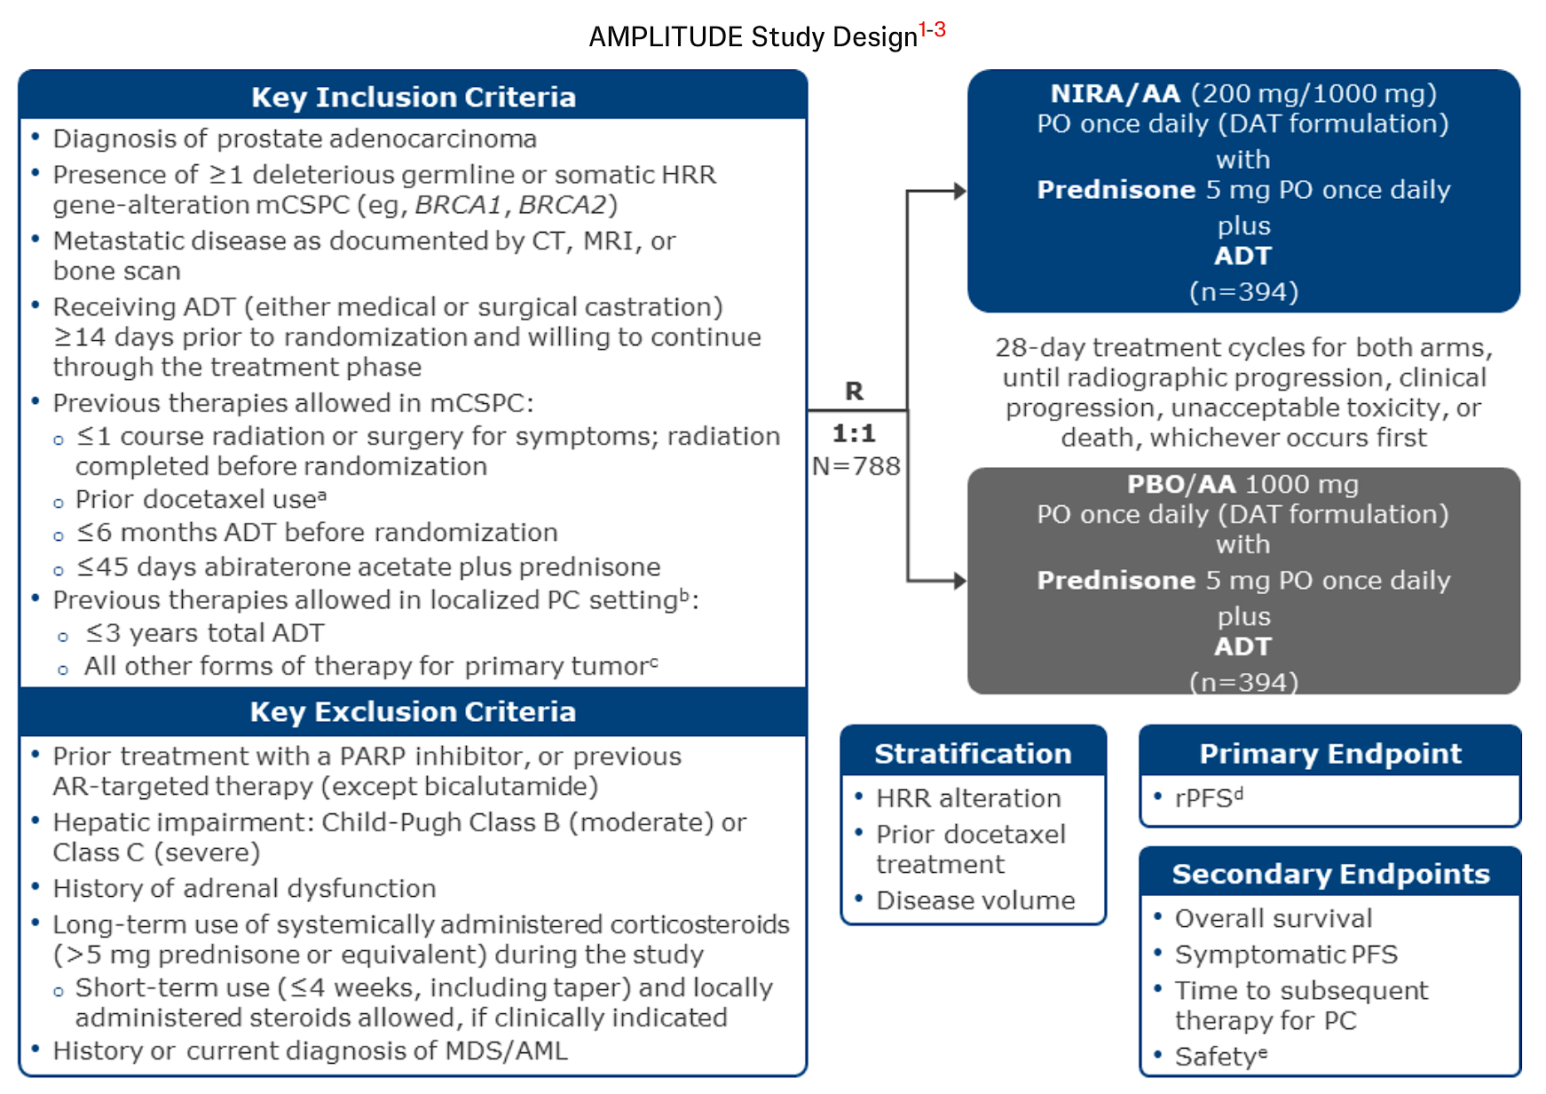
AMPLITUDE: A Phase III Study of Niraparib/Abiraterone/ADT for mHSPC
mCSPC = metastatic castration-sensitive prostate cancer; rPFS = radiographic progression-free survival
Rathkopf DE et al. Genitourinary Cancers Symposium 2021;Abstract TPS176.

Slide 26
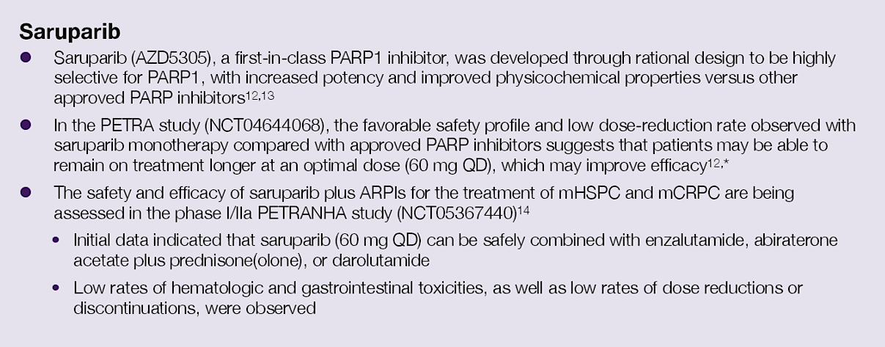
Saruparib: PARP1-selective inhibitor
Azad A, et al. ASCO GU Symposium 2025; Abstract TPS279.
Courtesy of Emmanuel S Antonarakis, MD

Slide 27
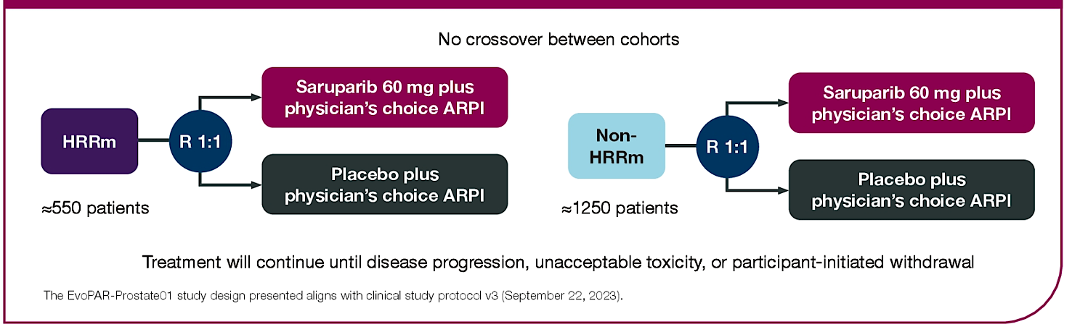
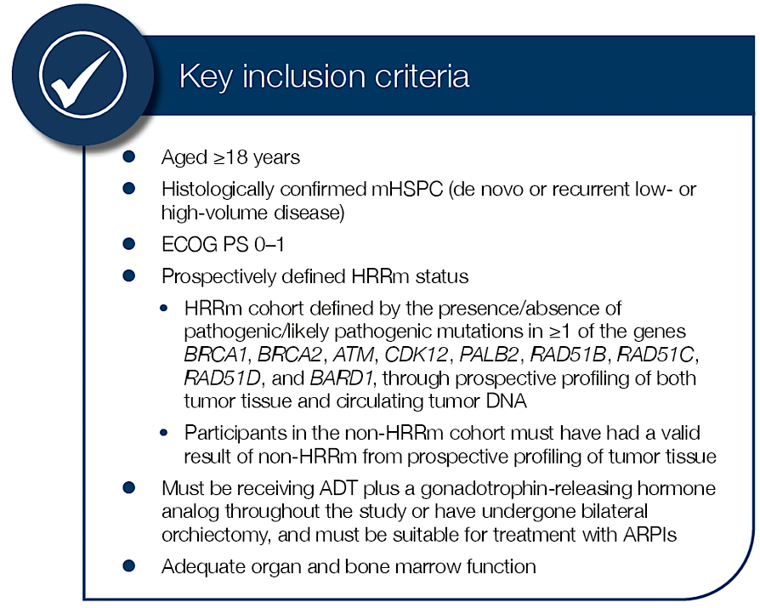
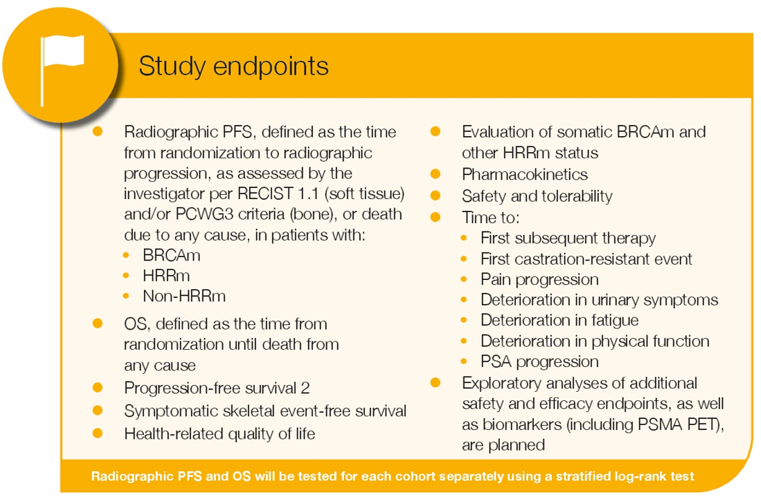
EvoPAR-01 trial: ARPI +/- Saruparib in mHSPC
Azad A, et al. ASCO GU Symposium 2025; Abstract TPS279.
Courtesy of Emmanuel S Antonarakis, MD

Slide 28
Conclusions
Saruparib is the first PARP1-selective inhibitor
EvoPAR-01 is a Phase 3 randomized trial of ADT/ARPI +/- saruparib in mHSPC patients both with/without HRR muts
Other PARPi trials in mHSPC: TALAPRO-3 (ADT/ARPI +/- Talazop), and AMPLITUDE (ADT/ARPI +/- Nirap)
No indication currently for PARPi in mHSPC space, even for BRCA1/2-altered patients
Courtesy of Emmanuel S Antonarakis, MD

Slide 29
Year in Review: Management of Prostate Cancer
INTRODUCTION: Quality of Life
MODULE 1: PARP Inhibition (PARPi)
Mutations that predict PARPi sensitivity
Endocrine therapy and PARPi synergy
Ongoing PARPi trials in metastatic hormone-sensitive prostate cancer
MODULE 2: M0 Disease
PRESTO; EMBARK
MODULE 3: Metastatic Hormone-Sensitive Prostate Cancer
De novo versus recurrent
PTEN deficiency – CAPItello-281
MODULE 4: Radiopharmaceuticals
Radium-223
¹⁷⁷Lu-PSMA-617; ¹⁷⁷Lu-PNT2002 – SPLASH
MODULE 5: Other Novel Investigational Approaches for Metastatic Castration-Resistant Prostate Cancer
CYP11A1 inhibition – Opevesostat
EZH2 inhibition – Mevrometostat

Slide 30
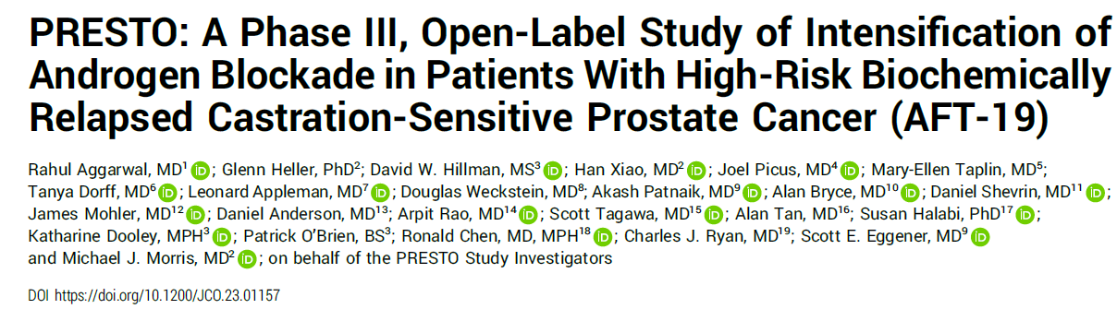
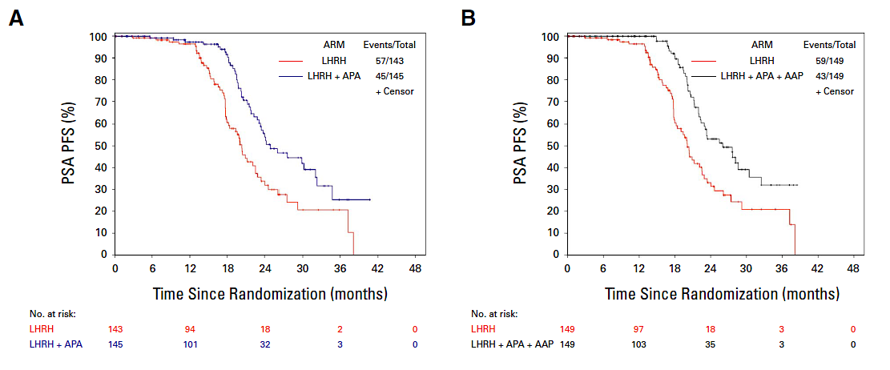
PSA-Progression free survival
BCR post RP
PSA DT<9m
n=503 pts
ADT 1y
R
ADT + Apa 1y
ADT + Apa+ AA 1y
Courtesy of Professor Karim Fizazi, MD, PhD

Slide 31
Biochemical failure: ADT+ Enzalutamide MFS (EMBARK)
3-yr rate
92.9%
83.5%
5-yr rate
87.3%
71.4%
100
 | Enzalutamide combination (n = 355) | Leuprolide acetate (n = 358)
Median follow-up, mo | 60.7 | 60.6
Events, n (%) | 45 (13) | 92 (26)
Per BICR, median MFS (95% CI), mo | NR (NR) | NR (85.1–NR)
80
Enzalutamide combination
Leuprolide acetate
60
Metastasis-free survival (%)
40
HR (95% CI):
0.42 (0.31–0.61); P<0.0001ª
20
0
0
6
12
18
24
30
36
42
48
54
60
66
72
78
84
90
96
Metastasis-free survival (mo)
355 | 331 | 324 | 318 | 304 | 292 | 281 | 265 | 251 | 234 | 180 | 116 | 60 | 24 | 6 | 0 | 0
358 | 335 | 321 | 303 | 280 | 259 | 238 | 221 | 203 | 183 | 138 | 88 | 32 | 15 | 6 | 1 | 0
Patients at risk
Enzalutamide combination
Leuprolide acetate
A consistent treatment effect was seen for investigator-assessed MFS: HR (95% CI): 0.47 (0.37–0.67); P<0.0001
Data cutoff: January 31, 2023. Symbols indicate censored data. ªHR was based on a Cox regression model with treatment as the only covariate stratified by screening PSA, PSADT, and prior hormonal therapy as reported in the IWRS; relative to leuprolide acetate <1 favoring enzalutamide combination; the two-sided P-value was based on a stratified log-rank. CI, confidence interval; HR, hazard ratio; IWRS, interactive web response system; NR, not reached.
Notes:
EMBARK TLR TLF/p137A
EMBARK AUA Additional ad hoc/p1A

Slide 32
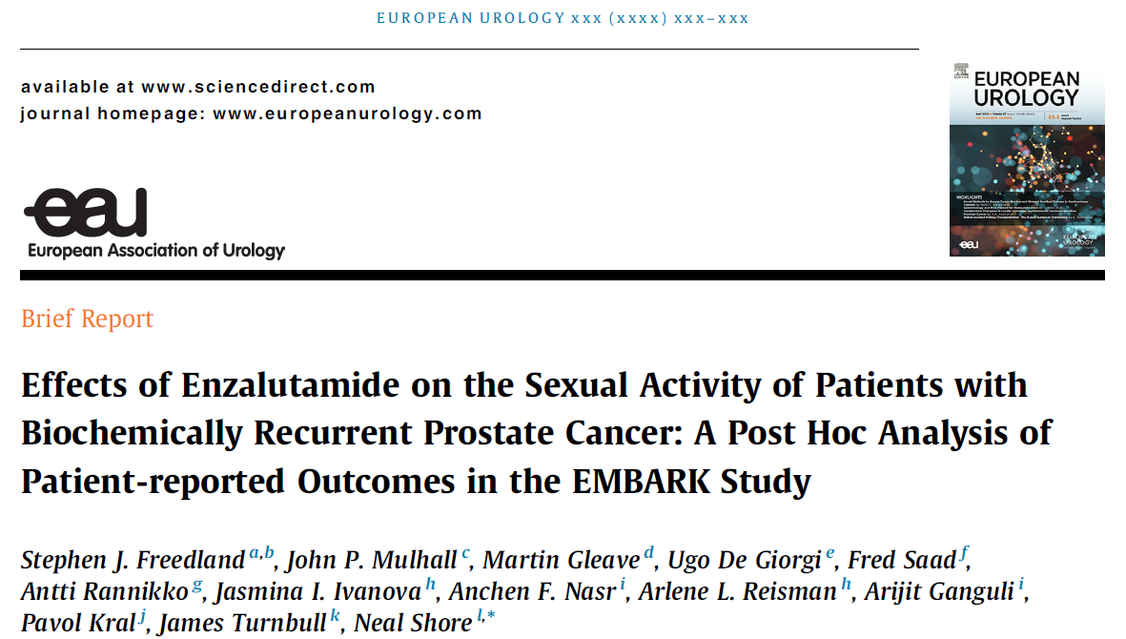
Biochemical failure: ADT+ Enzalutamide MFS (EMBARK)
Courtesy of Professor Karim Fizazi, MD, PhD
3-yr rate
92.9%
83.5%
5-yr rate
87.3%
71.4%
100
 | Enzalutamide combination (n = 355) | Leuprolide acetate (n = 358)
Median follow-up, mo | 60.7 | 60.6
Events, n (%) | 45 (13) | 92 (26)
Per BICR, median MFS (95% CI), mo | NR (NR) | NR (85.1–NR)
80
Enzalutamide combination
Leuprolide acetate
60
Metastasis-free survival (%)
40
HR (95% CI):
0.42 (0.31–0.61); P<0.0001ª
20
0
0
6
12
18
24
30
36
42
48
54
60
66
72
78
84
90
96
Metastasis-free survival (mo)
355 | 331 | 324 | 318 | 304 | 292 | 281 | 265 | 251 | 234 | 180 | 116 | 60 | 24 | 6 | 0 | 0
358 | 335 | 321 | 303 | 280 | 259 | 238 | 221 | 203 | 183 | 138 | 88 | 32 | 15 | 6 | 1 | 0
Patients at risk
Enzalutamide combination
Leuprolide acetate
A consistent treatment effect was seen for investigator-assessed MFS: HR (95% CI): 0.47 (0.37–0.67); P<0.0001
Data cutoff: January 31, 2023. Symbols indicate censored data. ªHR was based on a Cox regression model with treatment as the only covariate stratified by screening PSA, PSADT, and prior hormonal therapy as reported in the IWRS; relative to leuprolide acetate <1 favoring enzalutamide combination; the two-sided P-value was based on a stratified log-rank. CI, confidence interval; HR, hazard ratio; IWRS, interactive web response system; NR, not reached.
Notes:
EMBARK TLR TLF/p137A
EMBARK AUA Additional ad hoc/p1A

Slide 33
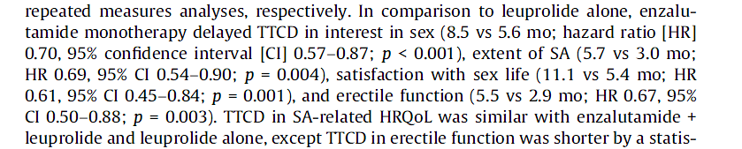
Biochemical failure: ADT+ Enzalutamide MFS (EMBARK)
Courtesy of Professor Karim Fizazi, MD, PhD
3-yr rate
92.9%
83.5%
5-yr rate
87.3%
71.4%
100
 | Enzalutamide combination (n = 355) | Leuprolide acetate (n = 358)
Median follow-up, mo | 60.7 | 60.6
Events, n (%) | 45 (13) | 92 (26)
Per BICR, median MFS (95% CI), mo | NR (NR) | NR (85.1–NR)
80
Enzalutamide combination
Leuprolide acetate
60
Metastasis-free survival (%)
40
HR (95% CI):
0.42 (0.31–0.61); P<0.0001ª
20
0
0
6
12
18
24
30
36
42
48
54
60
66
72
78
84
90
96
Metastasis-free survival (mo)
355 | 331 | 324 | 318 | 304 | 292 | 281 | 265 | 251 | 234 | 180 | 116 | 60 | 24 | 6 | 0 | 0
358 | 335 | 321 | 303 | 280 | 259 | 238 | 221 | 203 | 183 | 138 | 88 | 32 | 15 | 6 | 1 | 0
Patients at risk
Enzalutamide combination
Leuprolide acetate
A consistent treatment effect was seen for investigator-assessed MFS: HR (95% CI): 0.47 (0.37–0.67); P<0.0001
Data cutoff: January 31, 2023. Symbols indicate censored data. ªHR was based on a Cox regression model with treatment as the only covariate stratified by screening PSA, PSADT, and prior hormonal therapy as reported in the IWRS; relative to leuprolide acetate <1 favoring enzalutamide combination; the two-sided P-value was based on a stratified log-rank. CI, confidence interval; HR, hazard ratio; IWRS, interactive web response system; NR, not reached.
Notes:
EMBARK TLR TLF/p137A
EMBARK AUA Additional ad hoc/p1A

Slide 34
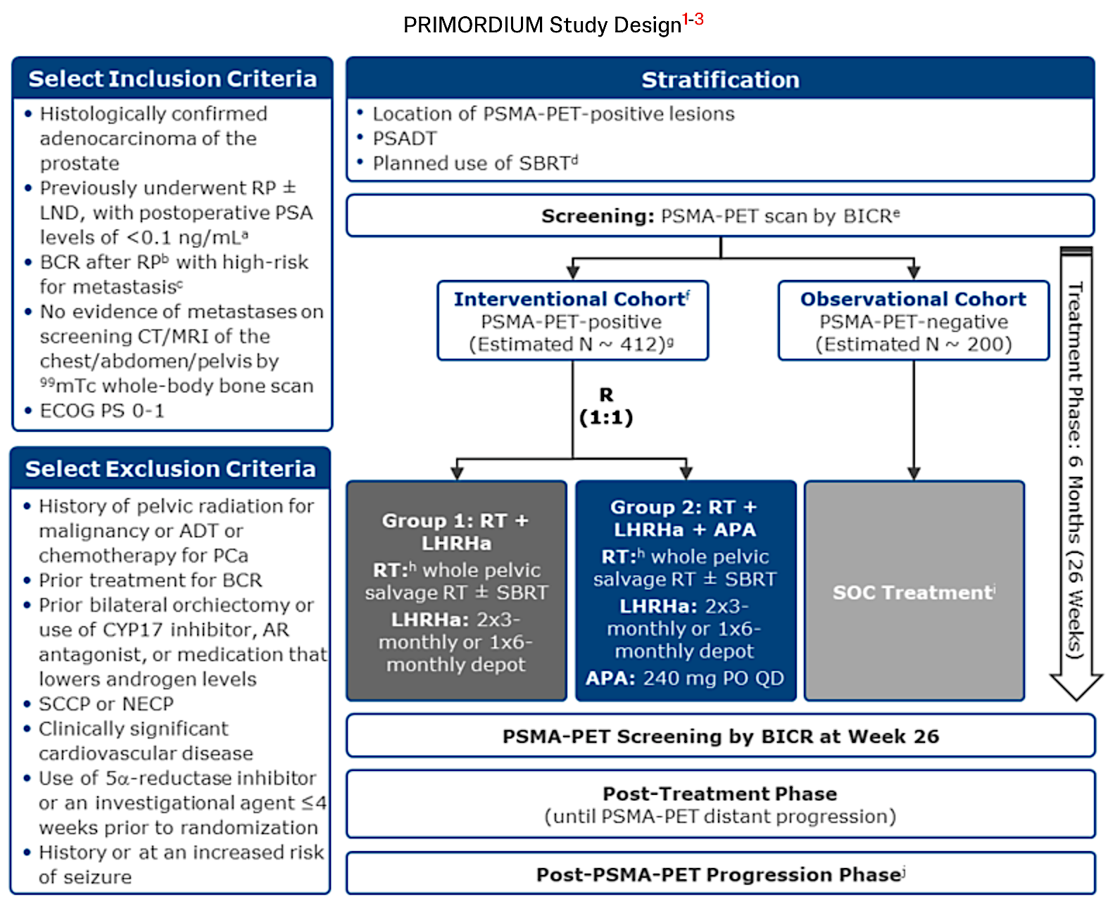
PRIMORDIUM Trial: Addition of Apalutamide to RT and an LHRH Agonist for Patients at High Risk with PSMA-PET-Positive Prostate Cancer
RT = radiation therapy; BCR = biochemical recurrence
Hadaschik B et al. ESMO 2021;Abstract 649TiP.

Slide 35

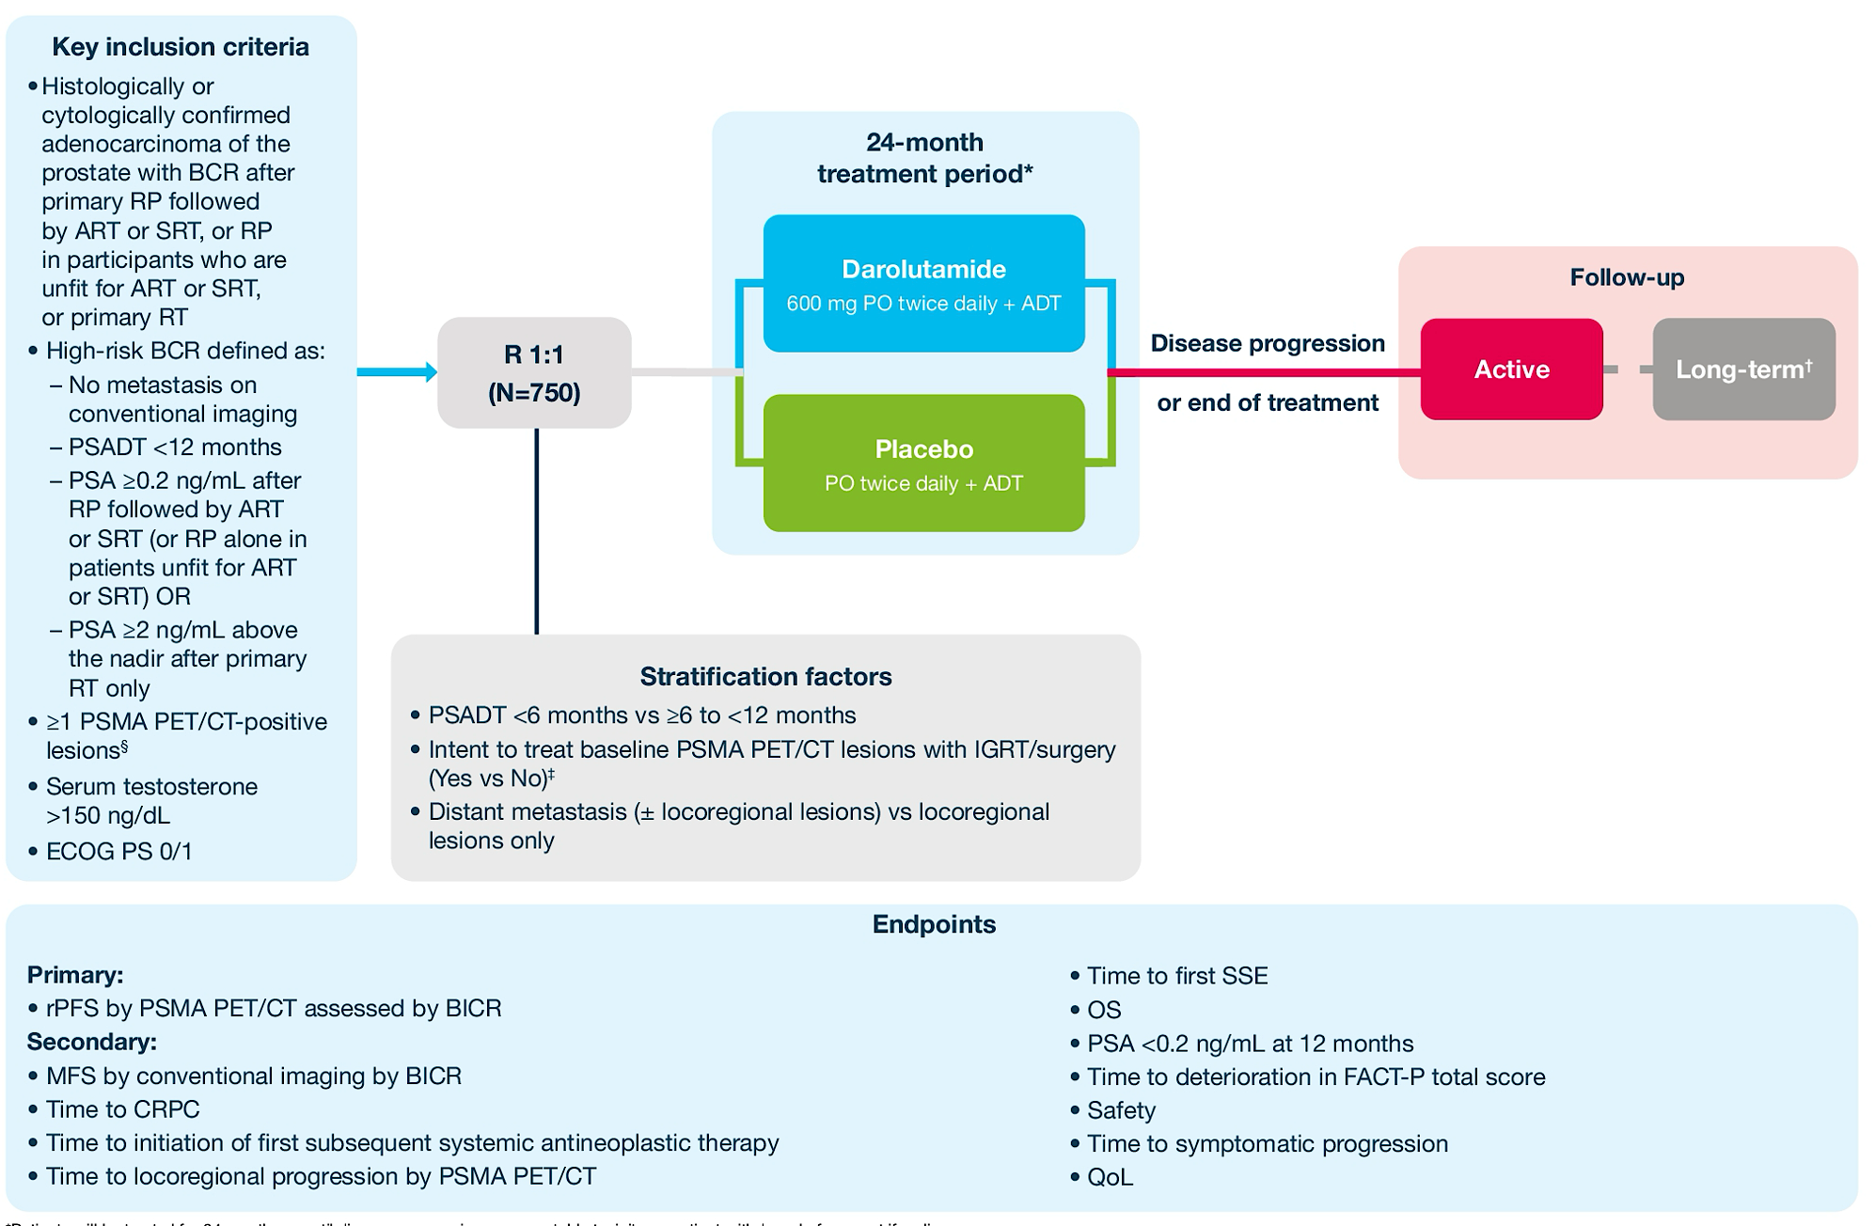
Courtesy of Professor Karim Fizazi, MD, PhD

Slide 36
Year in Review: Management of Prostate Cancer
INTRODUCTION: Quality of Life
MODULE 1: PARP Inhibition (PARPi)
Mutations that predict PARPi sensitivity
Endocrine therapy and PARPi synergy
Ongoing PARPi trials in metastatic hormone-sensitive prostate cancer
MODULE 2: M0 Disease
PRESTO; EMBARK
MODULE 3: Metastatic Hormone-Sensitive Prostate Cancer
De novo versus recurrent
PTEN deficiency – CAPItello-281
MODULE 4: Radiopharmaceuticals
Radium-223
¹⁷⁷Lu-PSMA-617; ¹⁷⁷Lu-PNT2002 – SPLASH
MODULE 5: Other Novel Investigational Approaches for Metastatic Castration-Resistant Prostate Cancer
CYP11A1 inhibition – Opevesostat
EZH2 inhibition – Mevrometostat

Slide 37
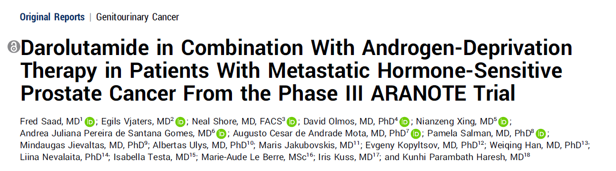
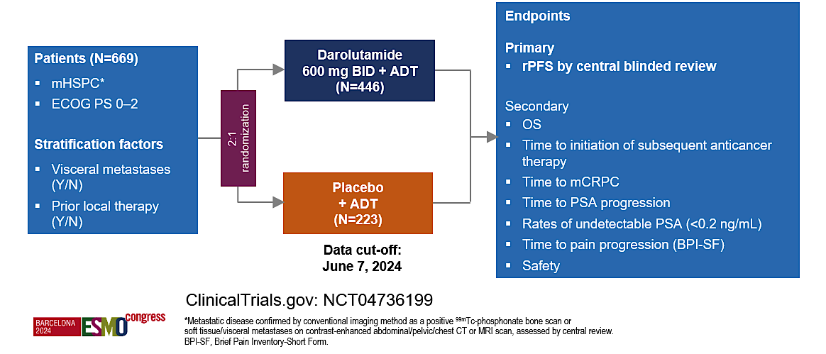
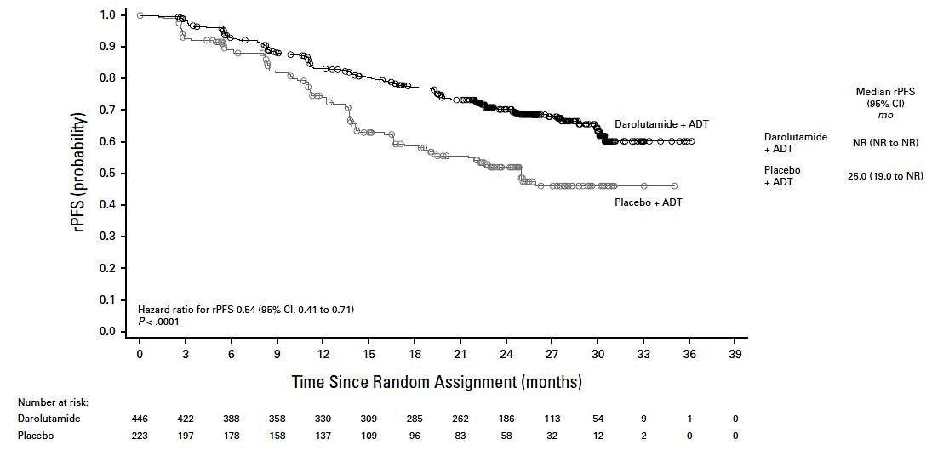
Courtesy of Professor Karim Fizazi, MD, PhD

Slide 38
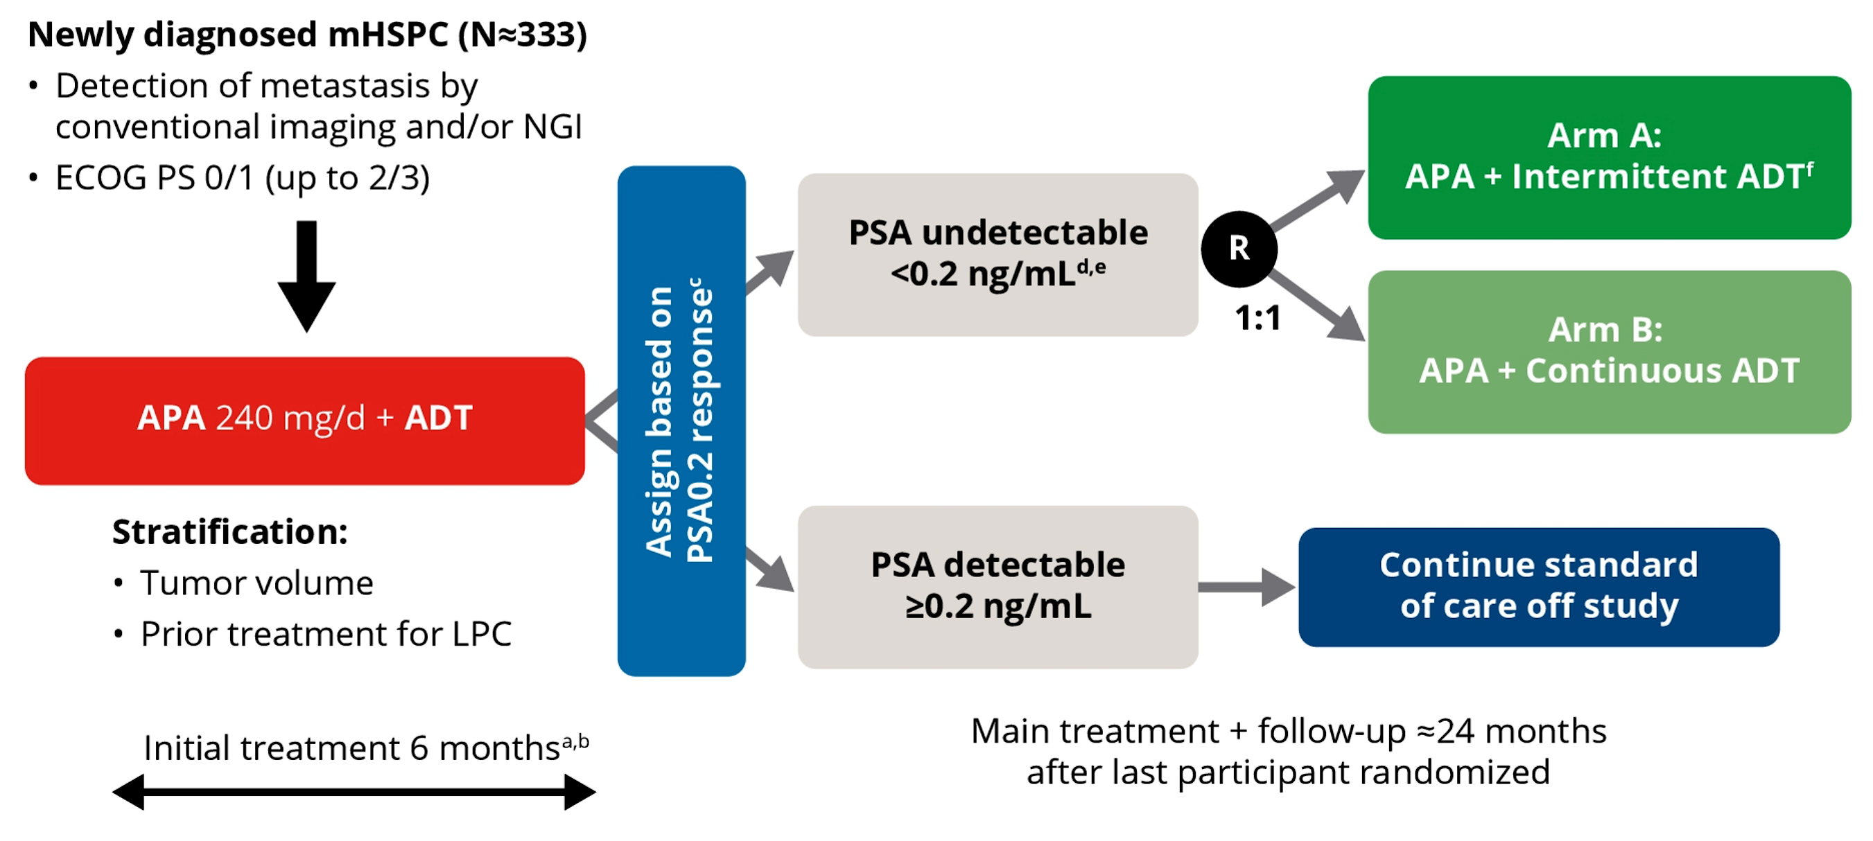
LIBERTAS: A Phase III Study of Apalutamide with
Intermittent versus Continuous ADT for mHSPC
Azad A et al. Genitourinary Cancers Symposium 2024;Abstract TPS236.

Slide 39
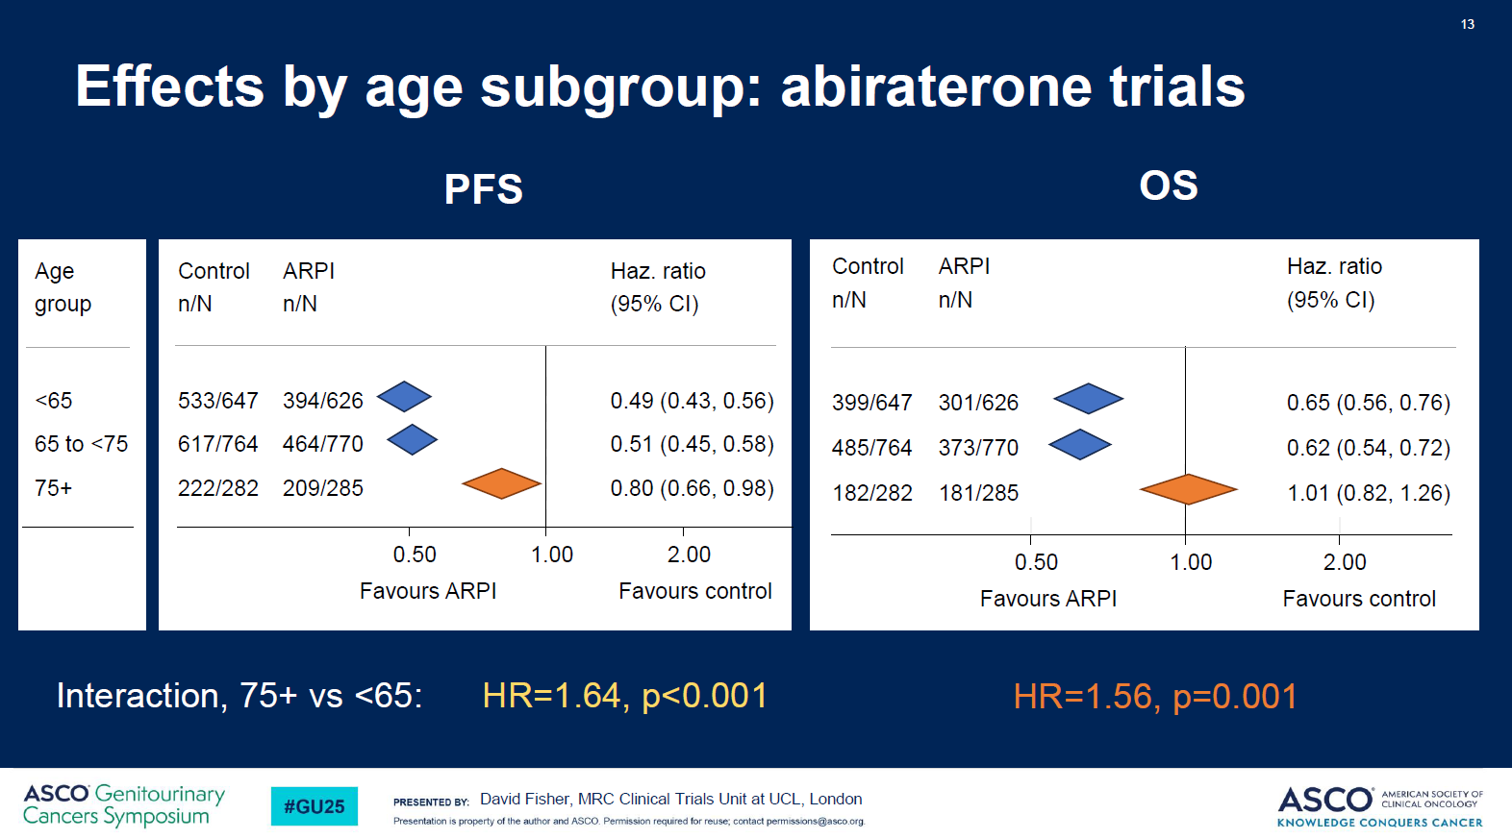
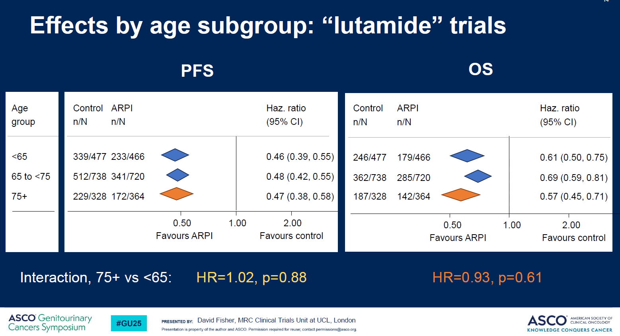
« Lutamides » to be preferred over Abiraterone in older patients?
Courtesy of Professor Karim Fizazi, MD, PhD

Slide 40
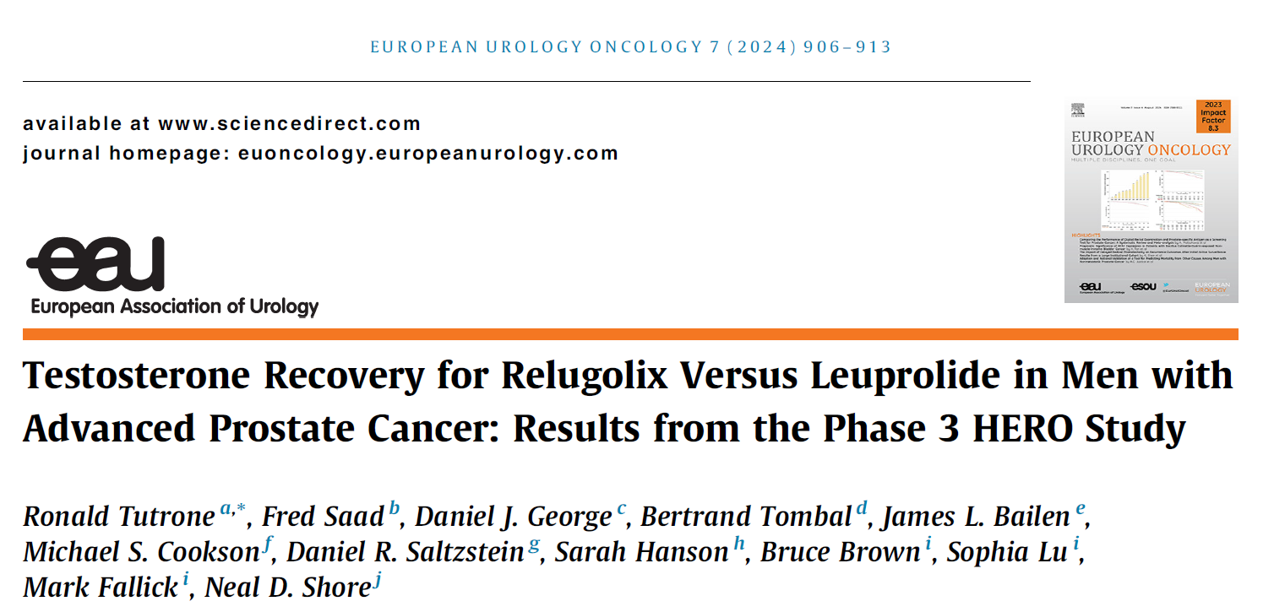
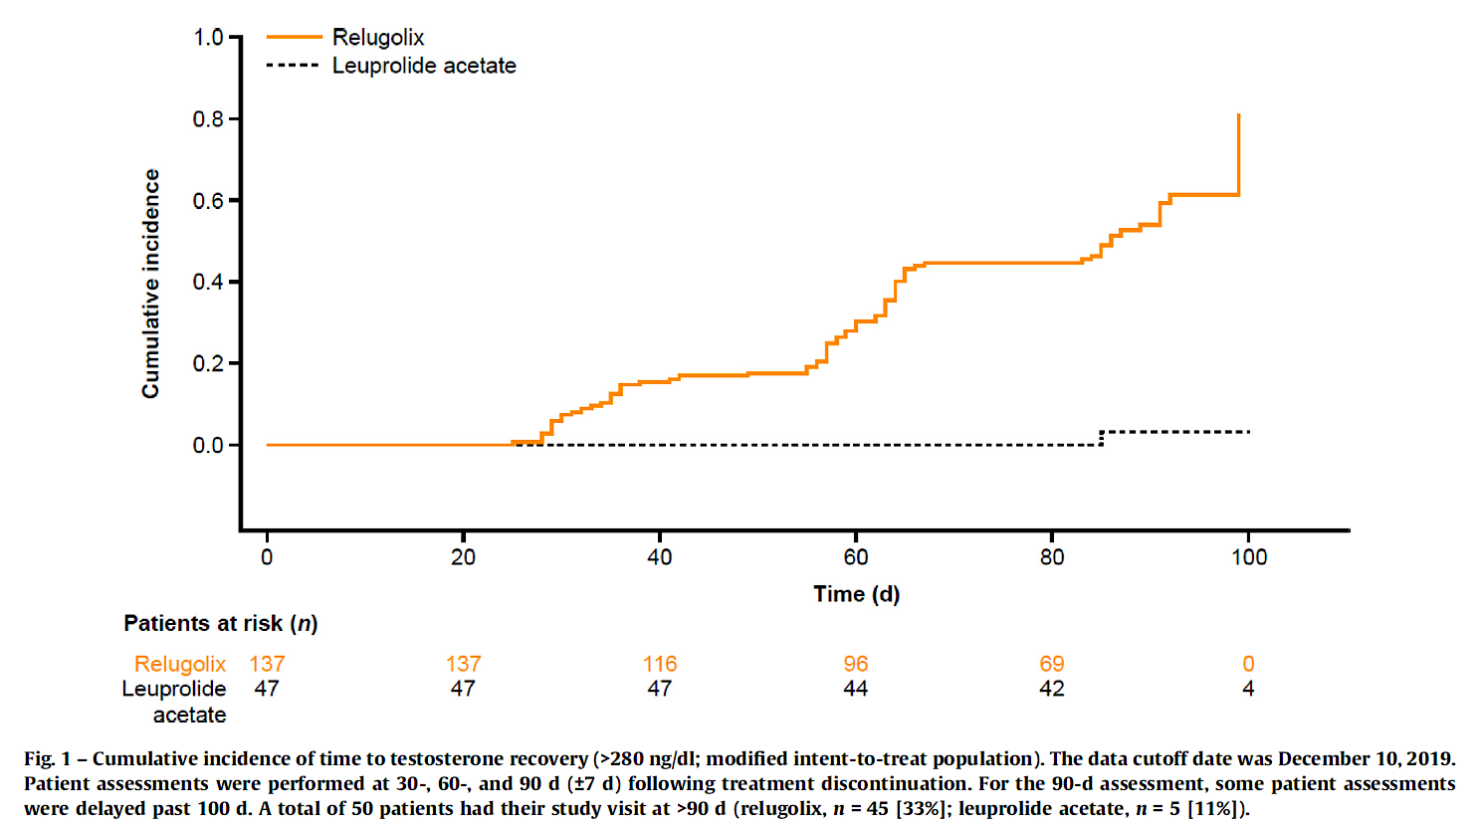
Courtesy of Professor Karim Fizazi, MD, PhD

Slide 41
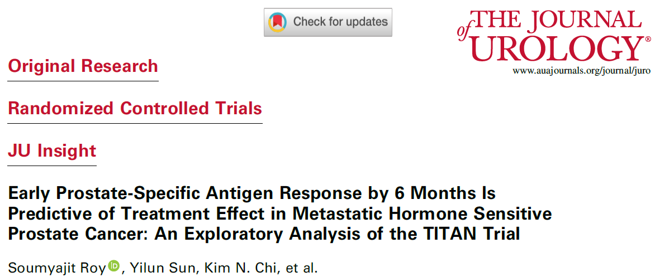
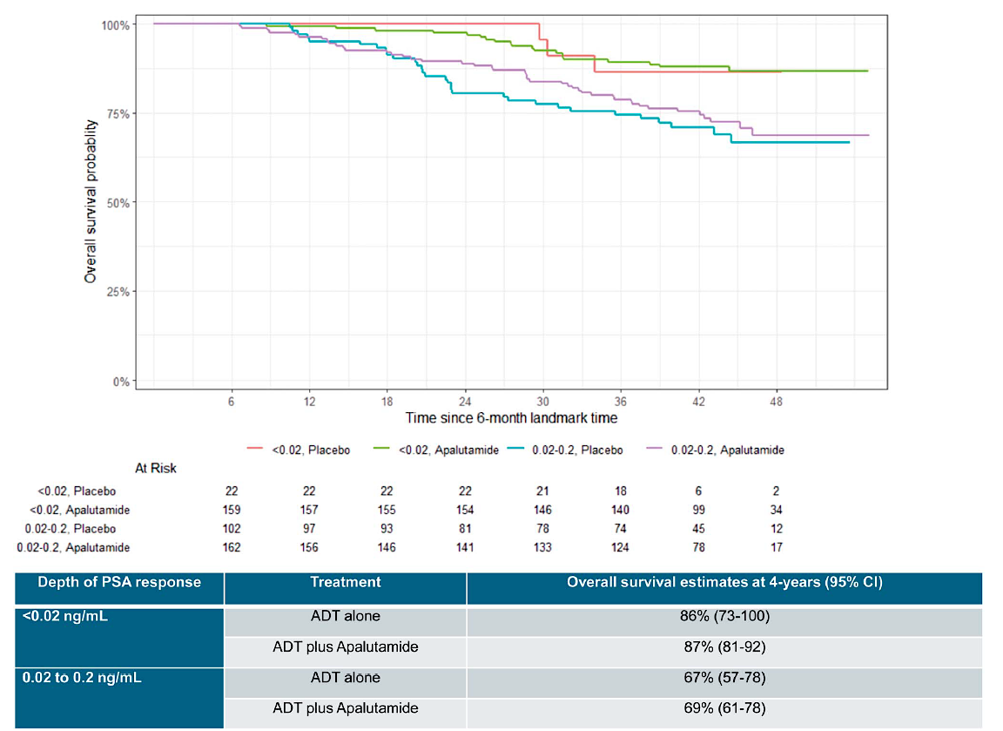
Overall survival probability
Courtesy of Professor Karim Fizazi, MD, PhD

Slide 42
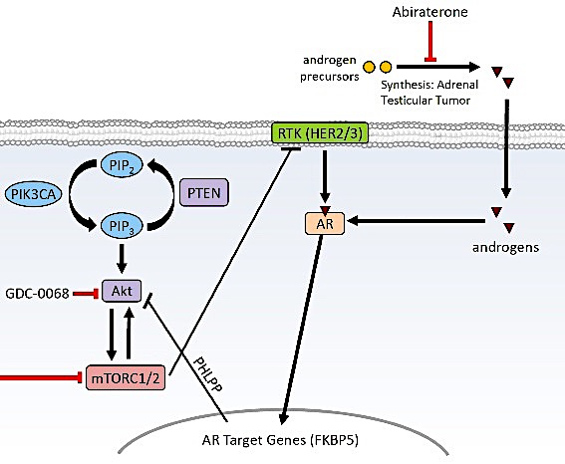
Targeting both the Akt and the AR pathways
Abiraterone
androgen
precursors
synthesis adrenal
testicular tumor
androgens
Ipatasertib
PHLPP/FKBP5
INPP4B
AR target genes
Courtesy of Professor Karim Fizazi, MD, PhD

Slide 43


Abiraterone +/- Ipatasertib (Akt inhibitor): PFS
PTEN loss
PTEN non-loss
HR,ª 0.39 (0.22-0.70)
HR,ª 0.84 (0.51-1.37)
400 mg Ipat + Abi
Median 11.5 mo
400 mg Ipat + Abi
Median 7.5 mo
400 mg Ipatasertib
Pbo + Abi
Median 4.6 mo
Pbo + Abi
Median 5.6 mo
HR,ª 0.46 (0.25-0.83)
HR,ª 1.13 (0.69-1.85)
200 mg Ipat + Abi
Median 11.1 mo
200 mg Ipat + Abi
Median 4.6 mo
200 mg Ipatasertib
Pbo + Abi
Median 4.6 mo
Pbo + Abi
Median 5.6 mo
Courtesy of Professor Karim Fizazi, MD, PhD
de Bono et al, Ipatasertib, ESMO 2016

Slide 44
CAPItello-281: A Phase III study of capivasertib + abiraterone vs. placebo + abiraterone for patients with de novo mHSPC characterised by PTEN loss
Study population
De novo metastatic prostate cancer
PTEN deficiency determined by IHC (central testing)
Capivasertib (400 mg PO BID, 4 days on, 3 days off) + abiraterone (1000 mg PO QD) + ADT
Primary endpoint
Radiographic Progression Free Survival, defined as investigator assessment per
RECIST 1.1 (soft tissue) progression via CT/MRI
PCWG3 (bone) progression via bone scan
Death due to any cause
Randomisation
N=1000
Placebo (BID, 4 days on, 3 days off) + abiraterone (1000 mg PO QD) + ADT
Courtesy of Professor Karim Fizazi, MD, PhD

Slide 45
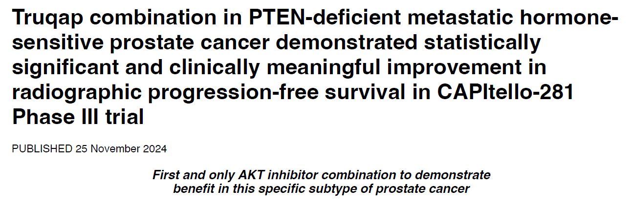
CAPItello-281: A Phase III study of capivasertib + abiraterone vs. placebo + abiraterone for patients with de novo mHSPC characterised by PTEN loss
Study population
De novo metastatic prostate cancer
PTEN deficiency determined by IHC (central testing)
Capivasertib combination in PTEN-deficient metastatic hormone-
Capivasertib (400 mg PO BID, 4 days on, 3 days off) + abiraterone (1000 mg PO QD) + ADT
Primary endpoint
Radiographic Progression Free Survival, defined as investigator assessment per
RECIST 1.1 (soft tissue) progression via CT/MRI
PCWG3 (bone) progression via bone scan
Death due to any cause
Randomisation
N=1000
Placebo (BID, 4 days on, 3 days off) + abiraterone (1000 mg PO QD) + ADT
Courtesy of Professor Karim Fizazi, MD, PhD

Slide 46
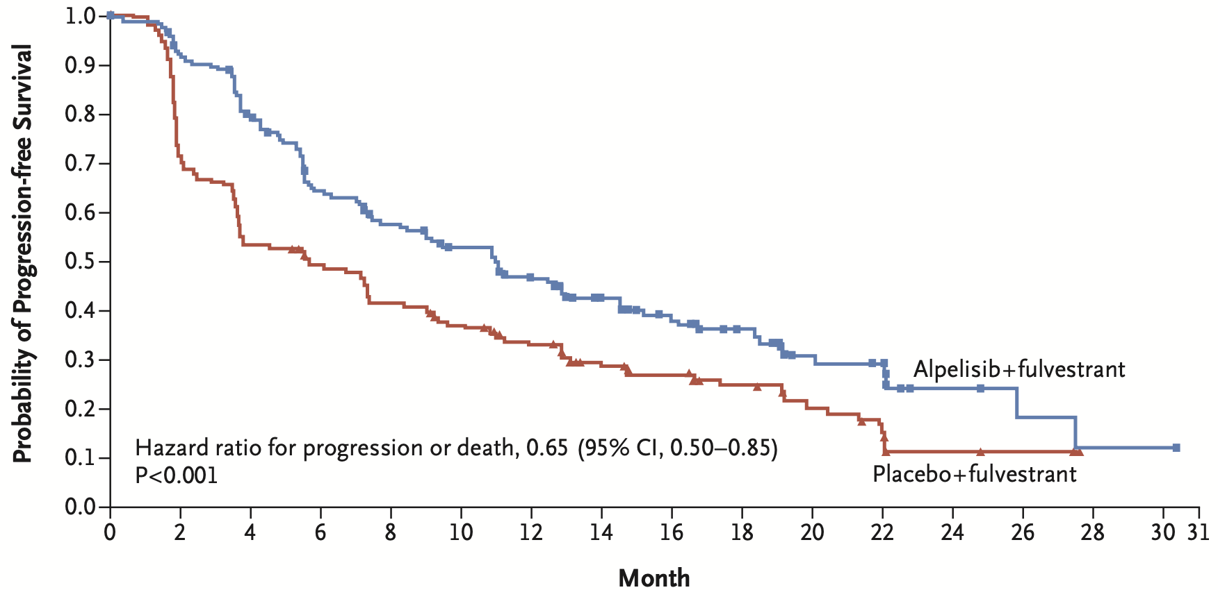
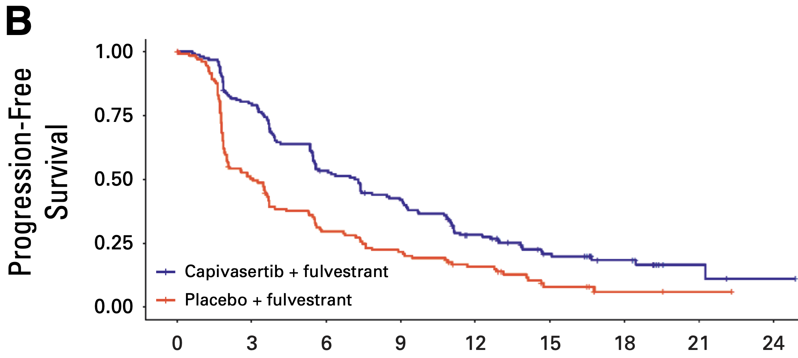
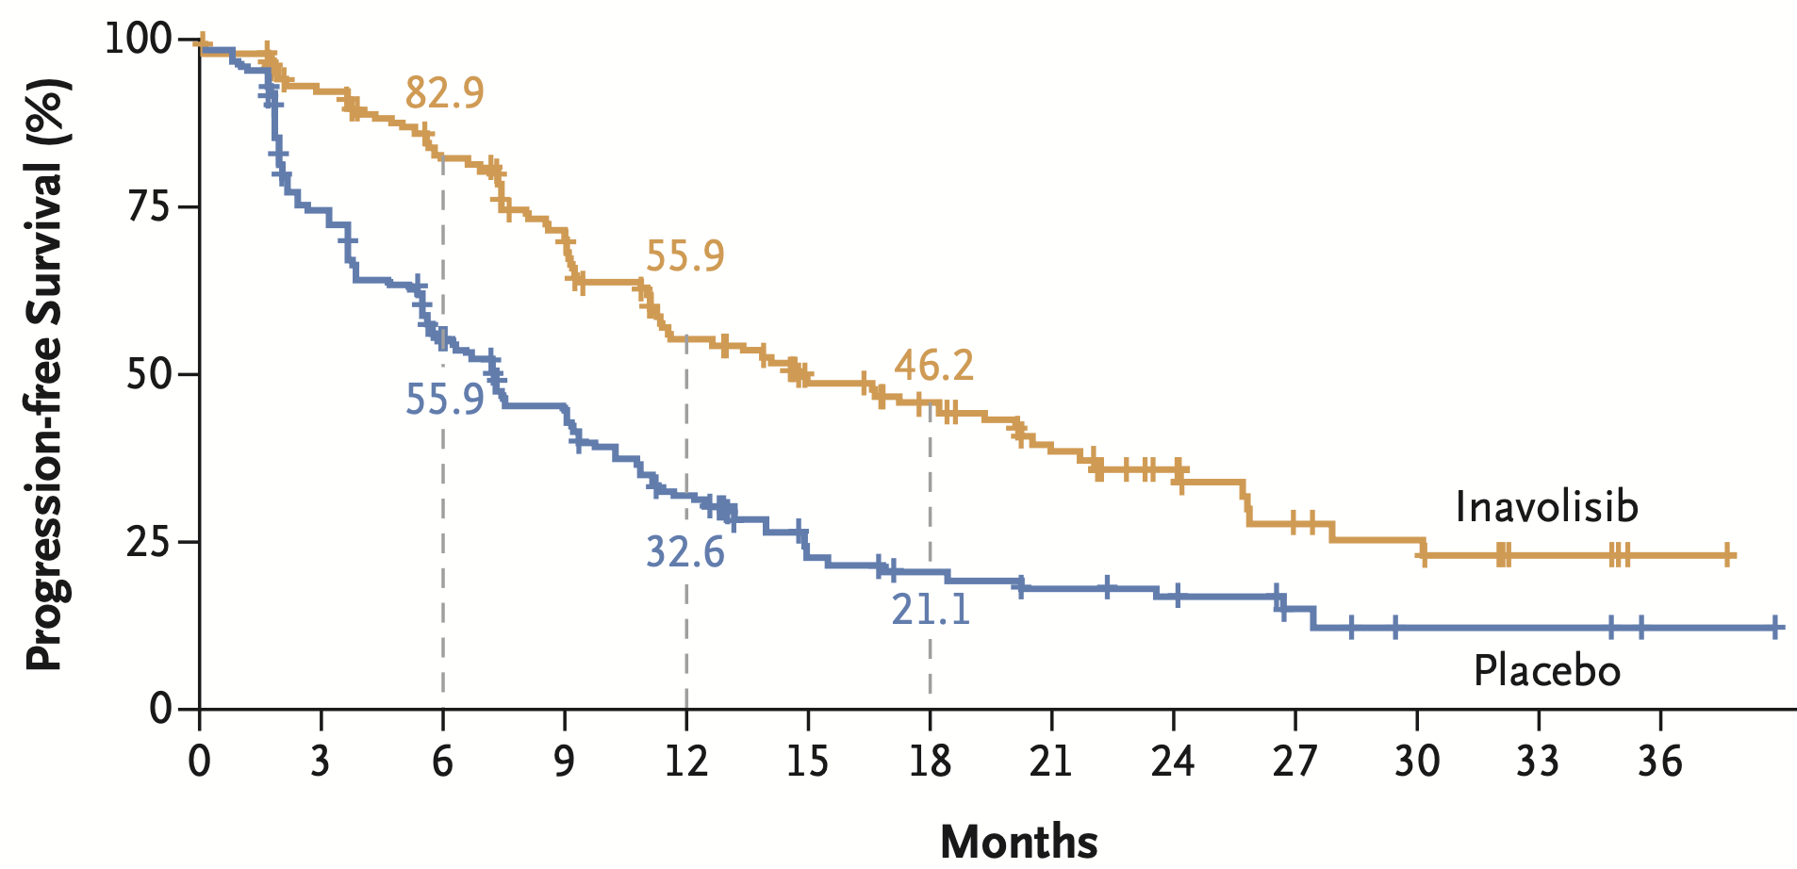
PIK3CA/PTEN/AKT Trials in Breast Cancer
Alpelisib
PI3Kα-specific
Capivasertib AKT1, AKT2, and AKT3
HR, 0.5 [95% CI, 0.37-0.68]
Inavolisib PIK3CAi
0.43 (95% CI, 0.32–0.59)
P<0.001
Toxicities:
Neutropenia, hyperglycemia, stomatitis, diarrhea, rash
F Andre et al. NEJM 2019; M Oliveira et al. Lancet Oncology 2024; N Turner et al. NEJM 2024
Courtesy of Rebecca A Dent, MD, MSc
Notes:
André NEJM 2019 SOLAR-1
Dilawari J Clin Oncol 2024 FDA capivasertib PIK3CA AKT PTEN MBC.pdf & Turner NEJM CAPItello-291
Turner NEJM 2024 INAVO120

Slide 47
Year in Review: Management of Prostate Cancer
INTRODUCTION: Quality of Life
MODULE 1: PARP Inhibition (PARPi)
Mutations that predict PARPi sensitivity
Endocrine therapy and PARPi synergy
Ongoing PARPi trials in metastatic hormone-sensitive prostate cancer
MODULE 2: M0 Disease
PRESTO; EMBARK
MODULE 3: Metastatic Hormone-Sensitive Prostate Cancer
De novo versus recurrent
PTEN deficiency – CAPItello-281
MODULE 4: Radiopharmaceuticals
Radium-223
¹⁷⁷Lu-PSMA-617; ¹⁷⁷Lu-PNT2002 – SPLASH
MODULE 5: Other Novel Investigational Approaches for Metastatic Castration-Resistant Prostate Cancer
CYP11A1 inhibition – Opevesostat
EZH2 inhibition – Mevrometostat

Slide 48
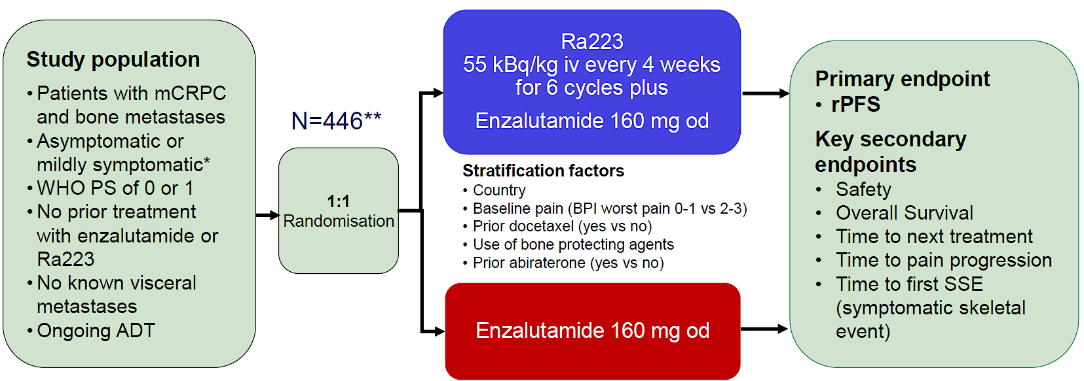

PEACE-3 trial: Enza +/- Radium²²³ in mCRPC
Gillessen S, et al. ESMO 2024; Abstract LBA1.
Courtesy of Emmanuel S Antonarakis, MD

Slide 49
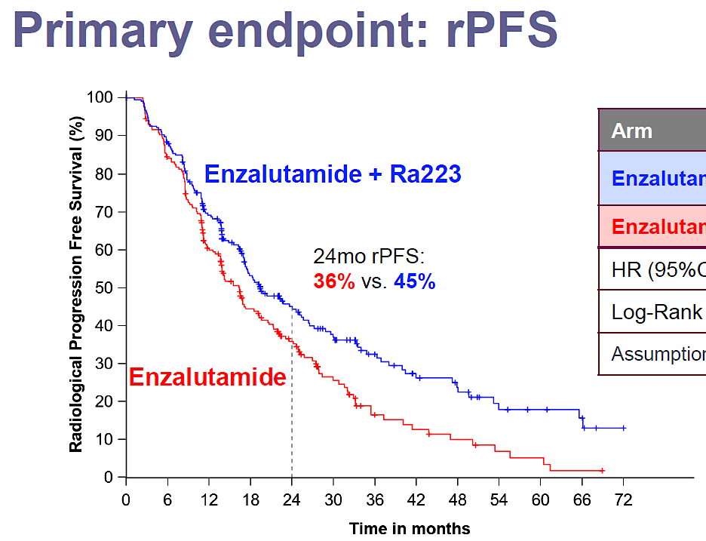
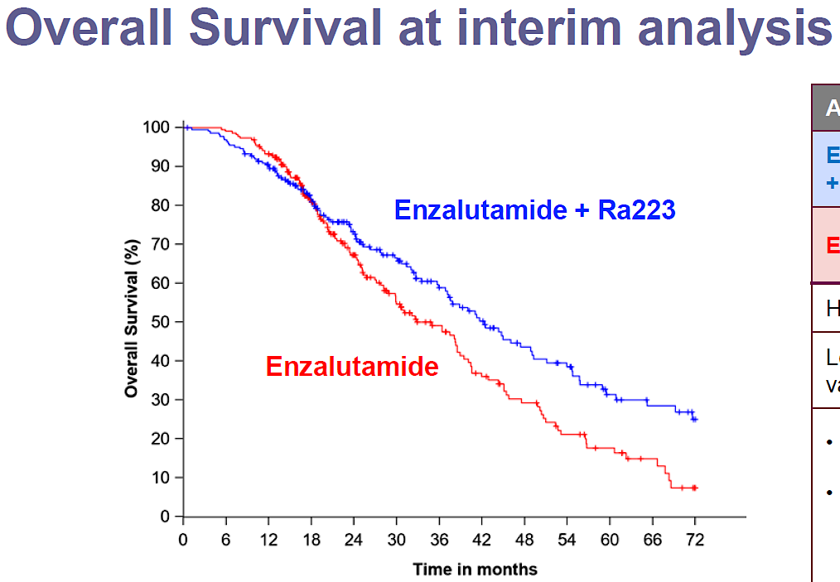
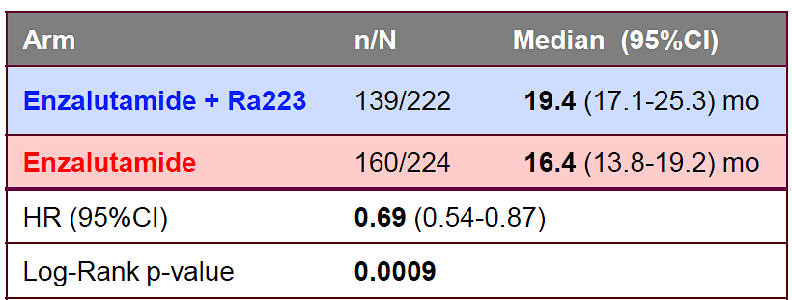
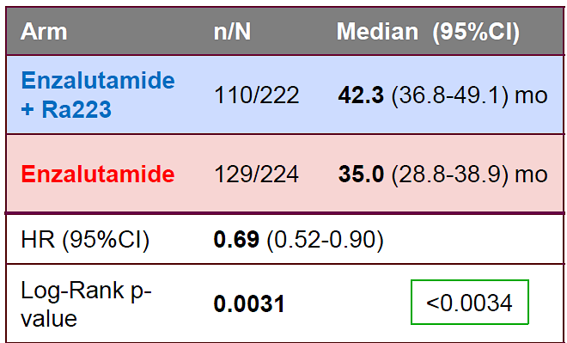
PEACE-3 trial: Enza +/- Radium²²³ in mCRPC
Gillessen S, et al. ESMO 2024; Abstract LBA1.
Courtesy of Emmanuel S Antonarakis, MD

Slide 50
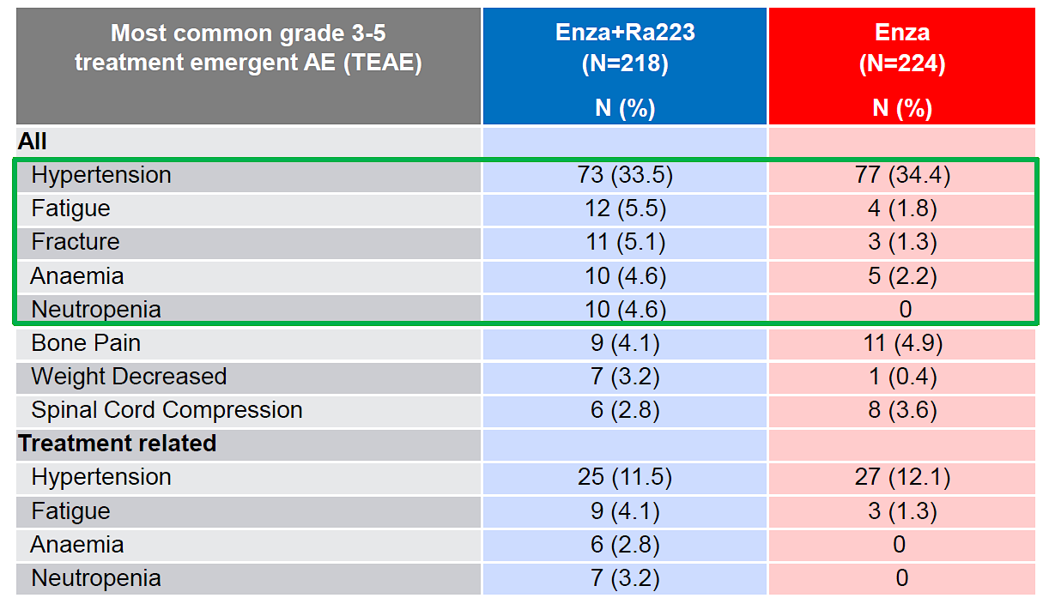
PEACE-3 trial: Adverse Events
Gillessen S, et al. ESMO 2024; Abstract LBA1.
Courtesy of Emmanuel S Antonarakis, MD

Slide 51
Conclusions
PEACE-3 showed a statistically significant and clinically meaningful OS advantage with Enza/Rad²²³ vs. Enza alone
Conversely, there is no demonstrable OS benefit with use of ¹⁷⁷Lu-PSMA therapies in the pre-docetaxel mCRPC space
Safety of Enza/Rad²²³ seemed reasonable, with increased grade-3 fatigue, anemia, neutropenia, and weight loss
Enza + Rad²²³ (+ bone protection) may be a new standard for first-line bone-dominant mCRPC without prior ARPI treatment
Courtesy of Emmanuel S Antonarakis, MD

Slide 52
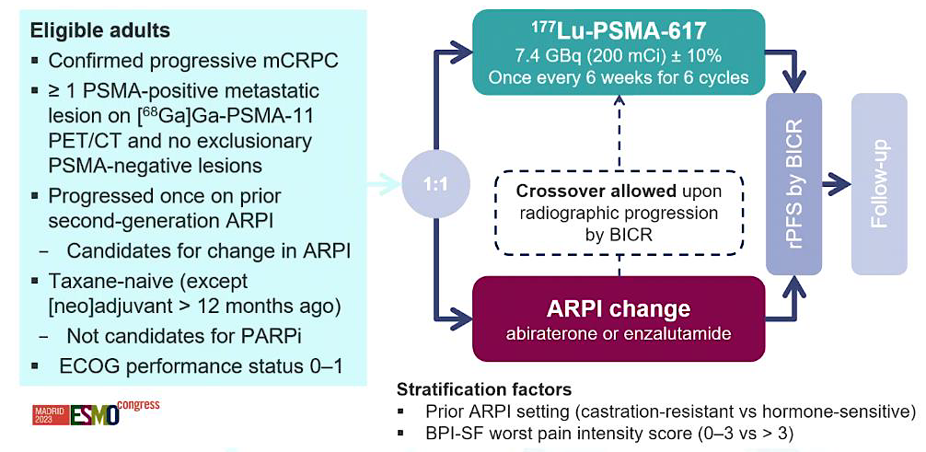
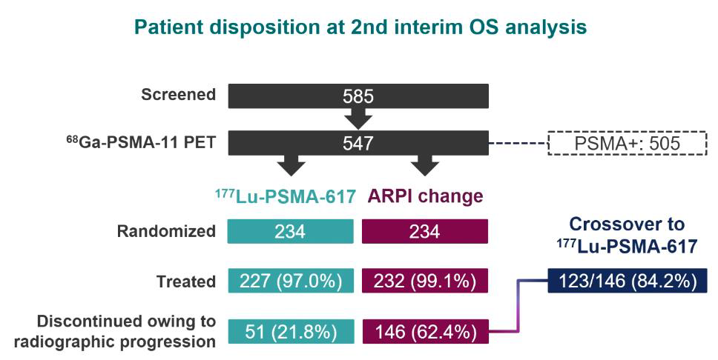
PSMAfore: ¹⁷⁷Lu-PSMA-617 in pre-taxane mCRPC
Morris MJ, et al. Lancet 2024; 404: 1227-39.
Courtesy of Emmanuel S Antonarakis, MD

Slide 53
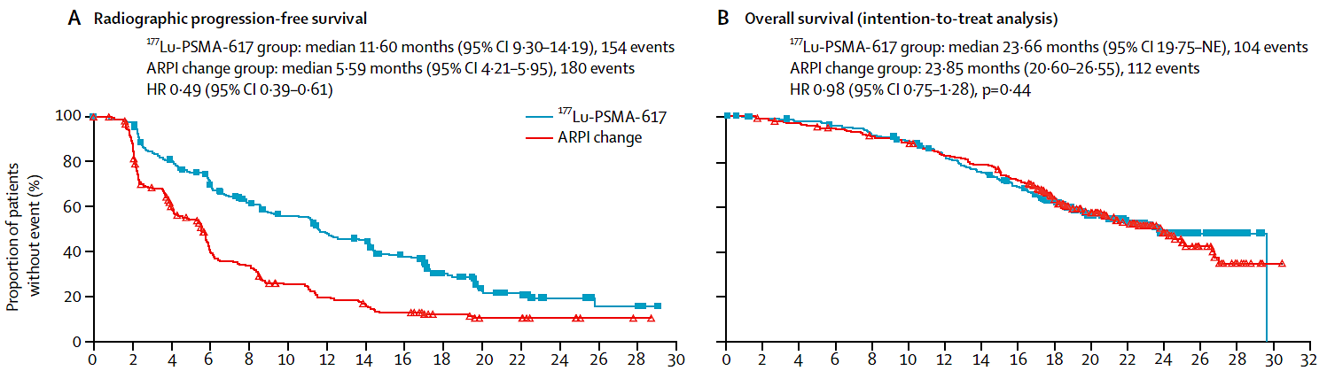
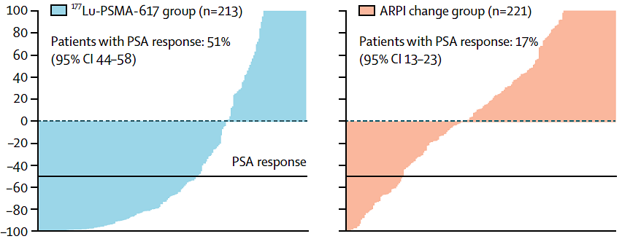

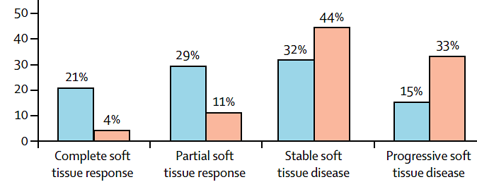
PSMAfore: ¹⁷⁷Lu-PSMA-617 vs. ARPI switch
Morris MJ, et al. Lancet 2024; 404: 1227-39.
Courtesy of Emmanuel S Antonarakis, MD

Slide 54
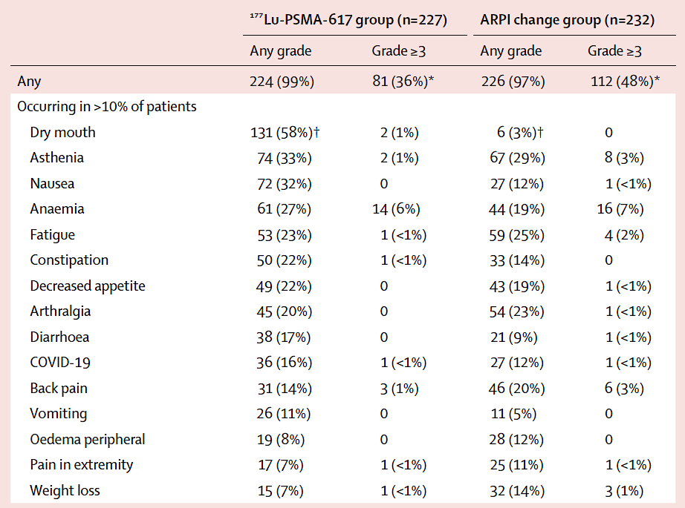
PSMAfore: Adverse Events
Morris MJ, et al. Lancet 2024; 404: 1227-39.
Courtesy of Emmanuel S Antonarakis, MD

Slide 55
Conclusions
PSMAfore is the first randomized Phase 3 trial to assess ¹⁷⁷Lu-PSMA-617 in the pre-taxane mCRPC space
In this setting, ¹⁷⁷Lu-PSMA-617 improved rPFS (but not OS) when compared to ARPI switch in patients with one prior ARPI
The toxicity profile of ¹⁷⁷Lu-PSMA-617 is favorable, but includes dry mouth, nausea, diarrhea and anemia
On 3/28/2025, based on this trial, the FDA expanded the indication for ¹⁷⁷Lu-PSMA-617 into the pre-taxane mCRPC setting
Courtesy of Emmanuel S Antonarakis, MD

Slide 56
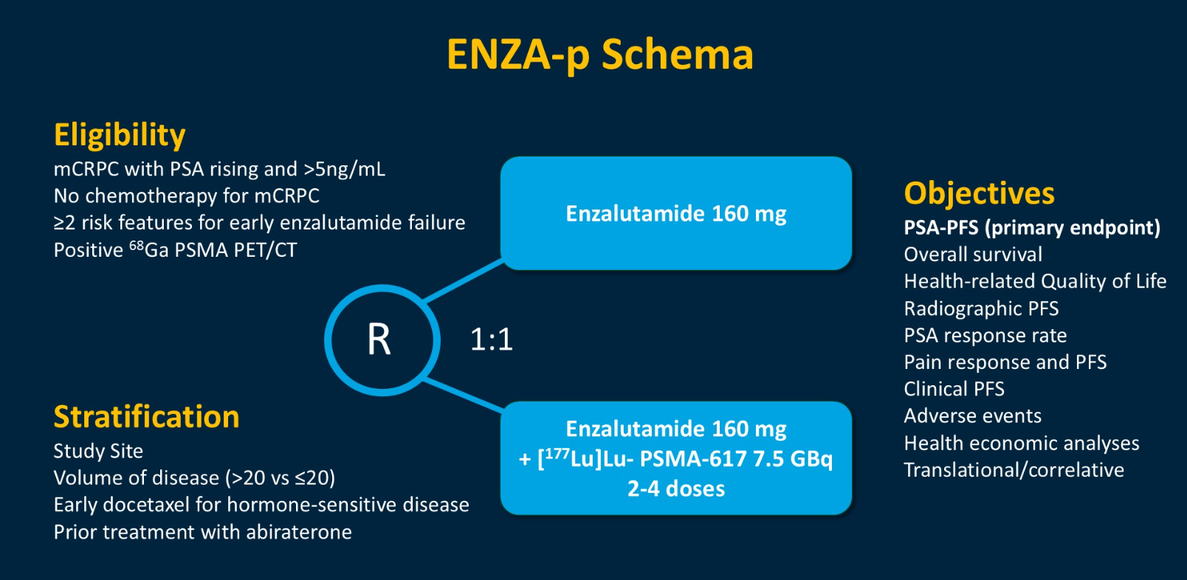
Enza-P trial: Enza +/- ¹⁷⁷Lu-PSMA-617 in mCRPC
Emmett L, et al. Lancet Oncol 2025; 26: 291-9.
Courtesy of Emmanuel S Antonarakis, MD

Slide 57
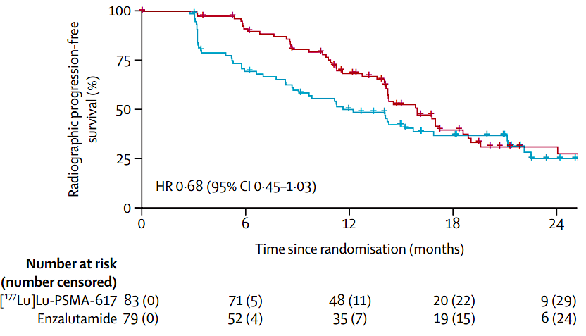
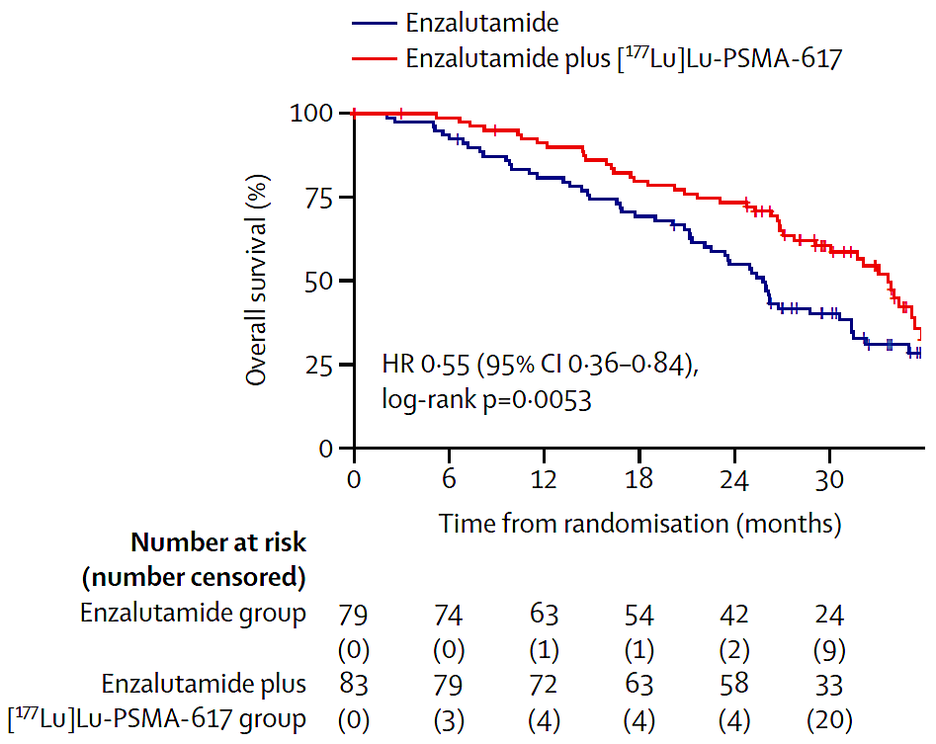
Enza-P trial: Enza +/- ¹⁷⁷Lu-PSMA-617 in mCRPC
rPFS
Survival
Emmett L, et al. Lancet Oncol 2025; 26: 291-9.
Courtesy of Emmanuel S Antonarakis, MD

Slide 58
Conclusions
Enza-P is the first study to show an OS advantage using ¹⁷⁷Lu-PSMA-617 (w/ Enza) in the pre-taxane mCRPC setting
Relative to Enza alone, ¹⁷⁷Lu-PSMA + Enza led to improved rPFS, improved deterioration-free survival, and improved pain/fatigue
Adverse events were dry mouth/eyes, nausea, cytopenias
The combination of Enza + ¹⁷⁷Lu-PSMA-617 is not currently FDA approved in the pre-taxane mCRPC setting
Phase 3 trials of this combination are needed
Courtesy of Emmanuel S Antonarakis, MD

Slide 59




SPLASH: ¹⁷⁷Lu-PNT2002 vs. ARPI switch
Sartor O, et al. ESMO 2024; Abstract LBA65.
Courtesy of Emmanuel S Antonarakis, MD

Slide 60





SPLASH: ¹⁷⁷Lu-PSMA-PNT2002 vs. ARPI switch
Sartor O, et al. ESMO 2024; Abstract LBA65.
Courtesy of Emmanuel S Antonarakis, MD

Slide 61
Head-to-head comparison: SPLASH vs. PSMAfore
0.98
Sartor O, et al. ESMO 2024; Abstract LBA65. Morris MJ, et al. Lancet 2024; 404: 1227-39.
Courtesy of Emmanuel S Antonarakis, MD

Slide 62
Conclusions
SPLASH (¹⁷⁷Lu-PNT2002) showed a more modest rPFS benefit vs. ARPI switch compared to PSMAfore (¹⁷⁷Lu-PSMA-617)
In SPLASH: ¹⁷⁷Lu-PSMA was given at 6.8 GBq (184 mCi) x 4
In PSMAfore: ¹⁷⁷Lu-PSMA was given at 7.4 GBq (184 mCi) x 6
Dose intensity was higher in PSMAfore, leading to better PFS?
Unclear if ¹⁷⁷Lu-PNT2002 will seek approval in 1st-L mCRPC
¹⁷⁷Lu-PNT2002 not currently FDA approved in any indication
Courtesy of Emmanuel S Antonarakis, MD

Slide 63
Year in Review: Management of Prostate Cancer
INTRODUCTION: Quality of Life
MODULE 1: PARP Inhibition (PARPi)
Mutations that predict PARPi sensitivity
Endocrine therapy and PARPi synergy
Ongoing PARPi trials in metastatic hormone-sensitive prostate cancer
MODULE 2: M0 Disease
PRESTO; EMBARK
MODULE 3: Metastatic Hormone-Sensitive Prostate Cancer
De novo versus recurrent
PTEN deficiency – CAPItello-281
MODULE 4: Radiopharmaceuticals
Radium-223
¹⁷⁷Lu-PSMA-617; ¹⁷⁷Lu-PNT2002 – SPLASH
MODULE 5: Other Novel Investigational Approaches for Metastatic Castration-Resistant Prostate Cancer
CYP11A1 inhibition – Opevesostat
EZH2 inhibition – Mevrometostat

Slide 64

ODM-208 → MK-5684 → Opevesostat
Courtesy of Emmanuel S Antonarakis, MD

Slide 65


Opevesostat: Phase 2 CYPIDES trial
Fizazi K, et al. NEJM Evid. 2024;3:EVIDoa2300171; Fizazi K, et al. ASCO GU 2024; abstract 159.
Courtesy of Emmanuel S Antonarakis, MD

Slide 66


OMAHA-004 (Pre-chemo mCRPC) OMAHA-003 (Post-chemo mCRPC)
Gratzke CJ, et al. ASCO GU 2025; Abstract TPS301; Yu EY, et al. ASCO GU 2025; Abstract TPS286.
Courtesy of Emmanuel S Antonarakis, MD

Slide 67
Conclusions
Opevesostat (MK-5684, formerly ODM-208) is an oral CYP11 inhibitor that suppresses production of all adrenal steroids
Has shown clinical activity in mCRPC post-ARPI in phase 2
Might show greater efficacy against AR-LBD+ mutations
OMAHA-004 and OMAHA-003 are phase 3 randomized trials of opevesostat vs. ARPI switch in pre- and post-chemo mCRPC
Opevesostat requires co-administration of glucocorticoid (dex) and mineralocorticoid (fludro) supplementation
Courtesy of Emmanuel S Antonarakis, MD

Slide 68


EZH2 Inhibitor: Mevrometostat
Schweizer MT , et al. ASCO GU Symposium 2025; Abstract LBA138.
Courtesy of Emmanuel S Antonarakis, MD

Slide 69





Post-Abiraterone mCRPC: Enza +/- Mevro
Schweizer MT , et al. ASCO GU Symposium 2025; Abstract LBA138.
Courtesy of Emmanuel S Antonarakis, MD

Slide 70


Adverse Events: Enza +/- Mevrometostat
Schweizer MT , et al. ASCO GU Symposium 2025; Abstract LBA138.
Courtesy of Emmanuel S Antonarakis, MD

Slide 71
Conclusions
Mevrometostat is an oral EZH2 inhibitor that enhances efficacy of enzalutamide in post-abiraterone mCRPC pts (rPFS, HR 0.51)
Mevro 875 mg (with food) is the recommended Phase 3 dose
Adverse events: diarrhea, nausea, dysgeusia, anemia, alopecia
Phase 3 trials are in progress for mCRPC pts in the post-Abi space (MEVPRO-1) and the ARPI-naïve space (MEVPRO-2)
Courtesy of Emmanuel S Antonarakis, MD

