Slide 1
Year in Review: Treatment of Localized Colorectal Cancer
Jeffrey Meyerhardt, MD, MPH
Douglas Gray Woodruff Chair in Colorectal Cancer Research
Chief Clinical Research Officer
Dana-Farber Cancer Institute
Boston, Massachusetts

Slide 2
Abstract 15
2025
Sub-cohort

Slide 3
to inform ACT treatment decisions in patients with
pathologic stage II/III CRC.¹
ctDNA = circulating tumor DNA; ACT = adjuvant chemotherapy
Shah PK et al. Gastrointestinal Cancers Symposium 2025;Abstract 15.

Slide 4
Shah PK et al. Gastrointestinal Cancers Symposium 2025;Abstract 15.

Slide 5
assay timepoint positivity predicts
inferior DFS
by assay Status
Shah PK et al. Gastrointestinal Cancers Symposium 2025;Abstract 15.

Slide 6
Stage II/III BESPOKE CRC Study
ctDNA positivity is highly predictive of outcome – both immediately after surgery (MRD) and during surveillance
ctDNA MRD influences 16.3% of decisions on adjuvant therapy – 60% de-escalated and 36% escalated
ctDNA clearance is associated with improved outcomes (HR 0.43)
ctDNA MRD (+) had superior DFS (HR 0.48) with adjuvant therapy compared to observation; ctDNA MRD (-) did not have significant benefit (HR 0.93) for adjuvant therapy compared to observation
This is an observational study – not randomized and decision for therapy not controlled and likely confounded

Slide 7
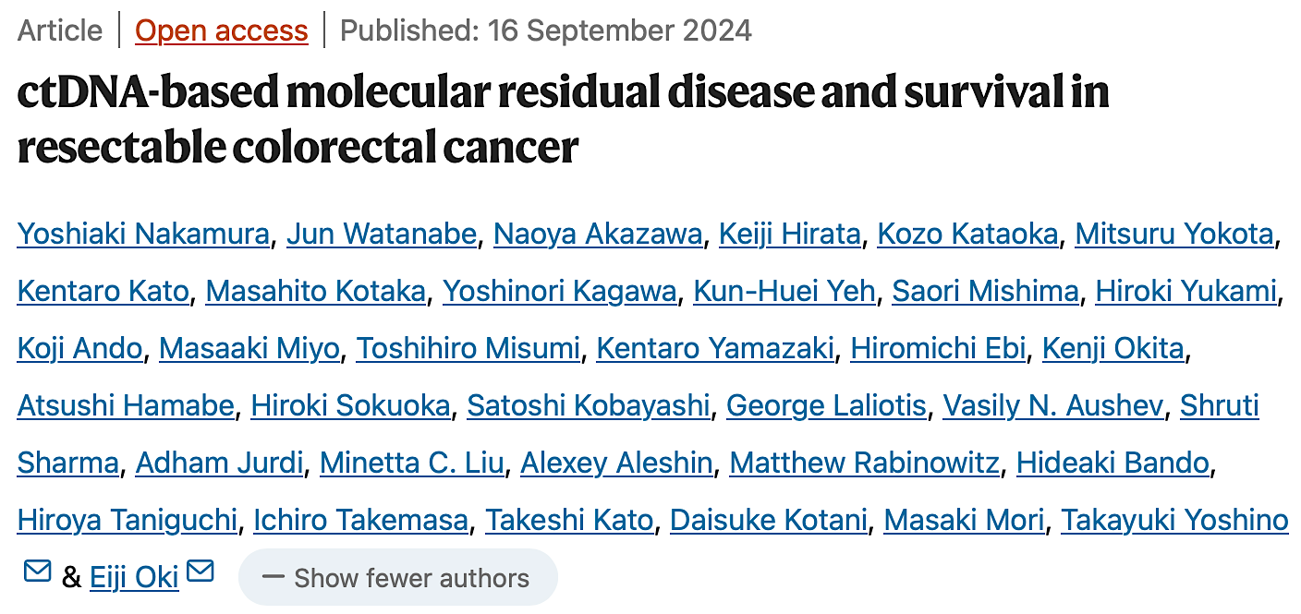
Nat Med 2024 November;30(11):3272-83.

Slide 8
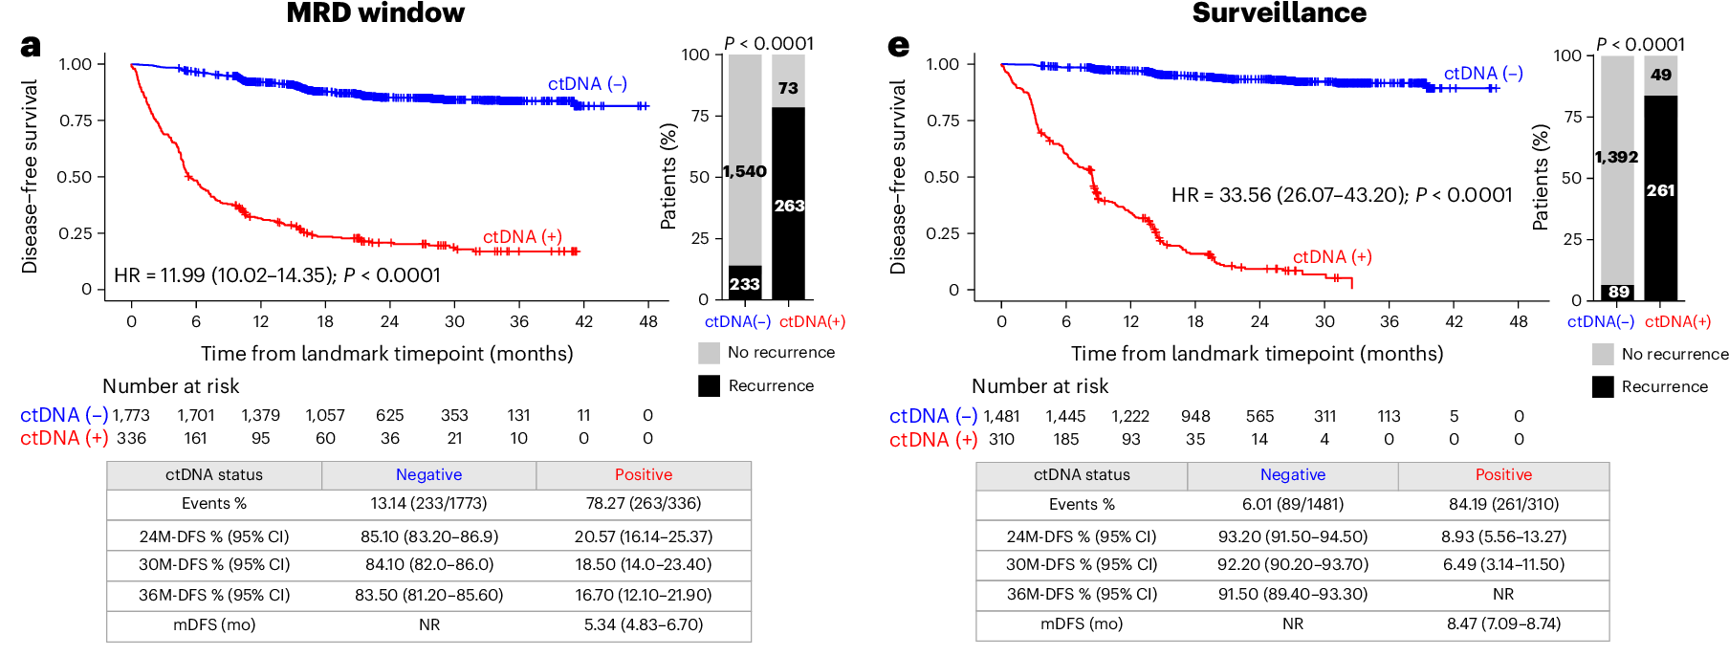
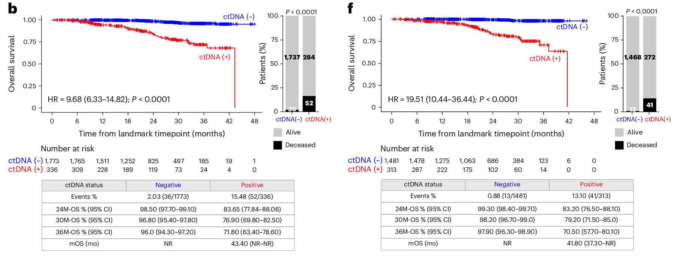
ctDNA Status Predicts Survival Outcomes After Surgery
Nakamura Y et al. Nat Med 2024 November;30(11):3272-83.

Slide 9
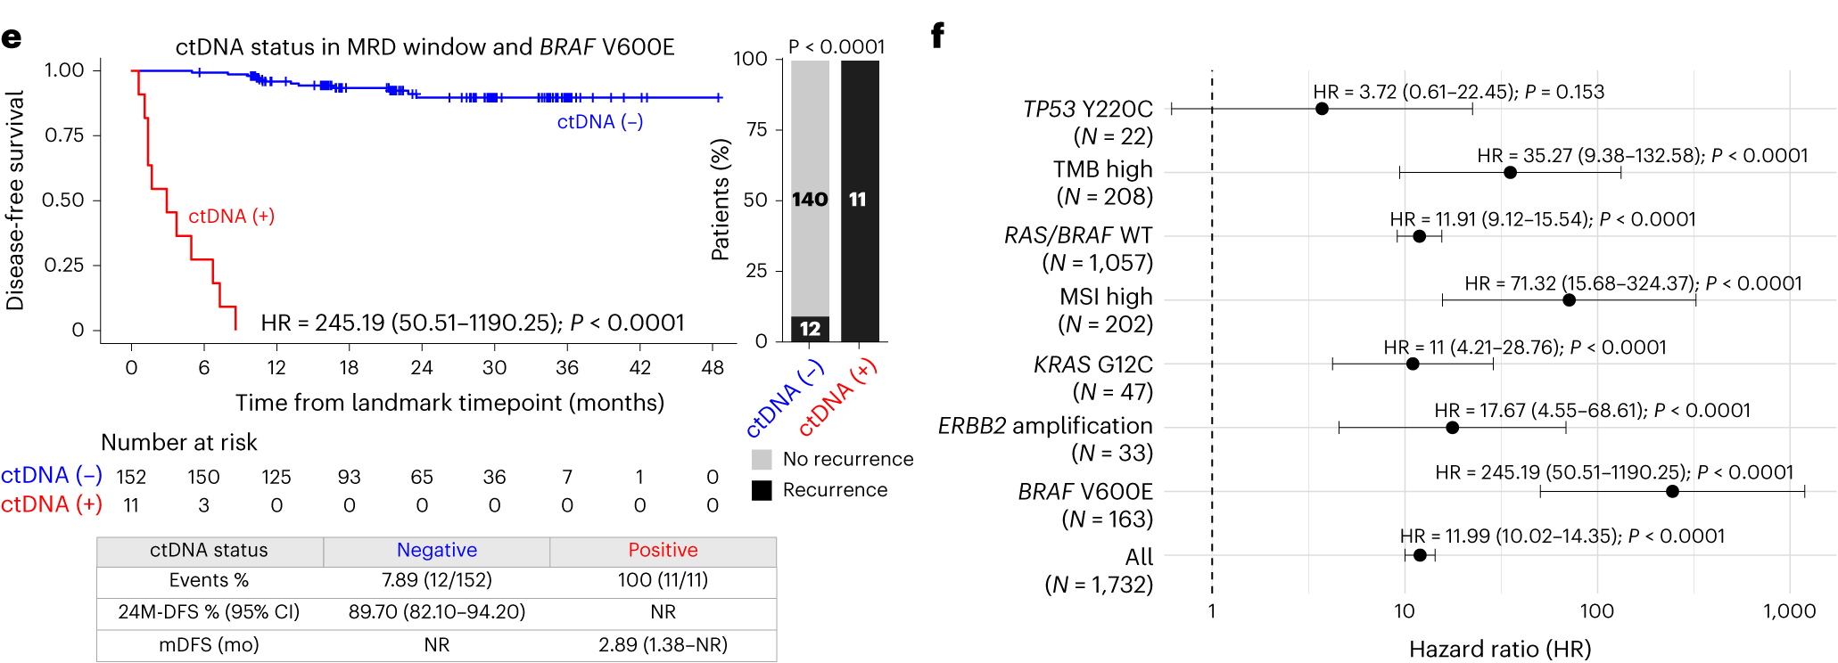
MRD Positivity Associated with Inferior DFS
Nakamura Y et al. Nat Med 2024 November;30(11):3272-83.

Slide 10
ctDNA Clearance Associated with Superior DFS
Nakamura Y et al. Nat Med 2024 November;30(11):3272-83.

Slide 11
CIRCULATE-Japan GALAXY CRC Study
In this expanded cohort of 2,240 patients with Stage I to IV colorectal cancer, a majority of the cohort did not receive chemotherapy
ctDNA MRD highly prognostic of outcome
Clearance also prognostic – 181 ctDNA(+) received adjuvant therapy – 38% sustained clearance, 31% transient clearance, 31% no clearance
Observational study – decision on who received chemotherapy and who did not likely confounded by other factors

Slide 12
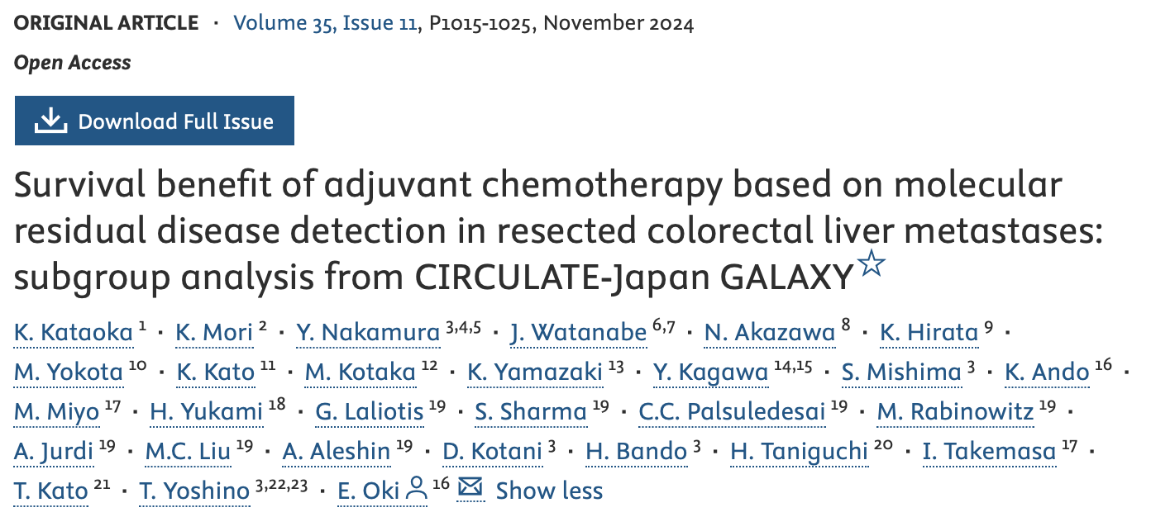
Ann Oncol

Slide 13
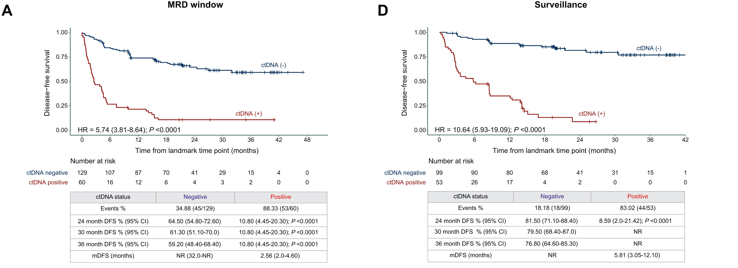
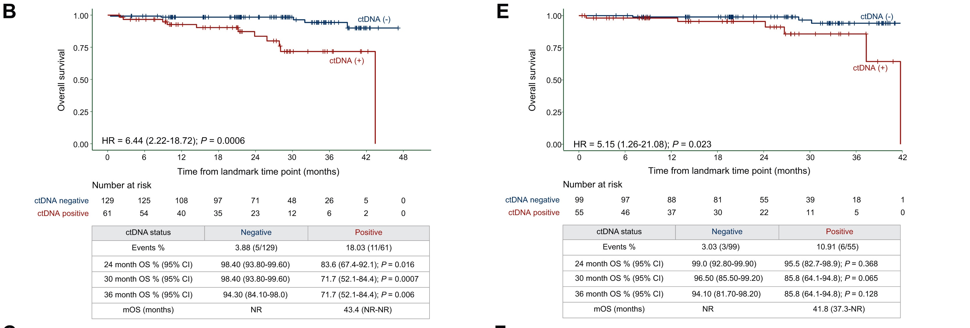
ctDNA Status in MRD and Surveillance Windows Predicts Survival Outcomes
Kataoka K et al. Ann Oncol 2024 November;35(11):1015-25.

Slide 14
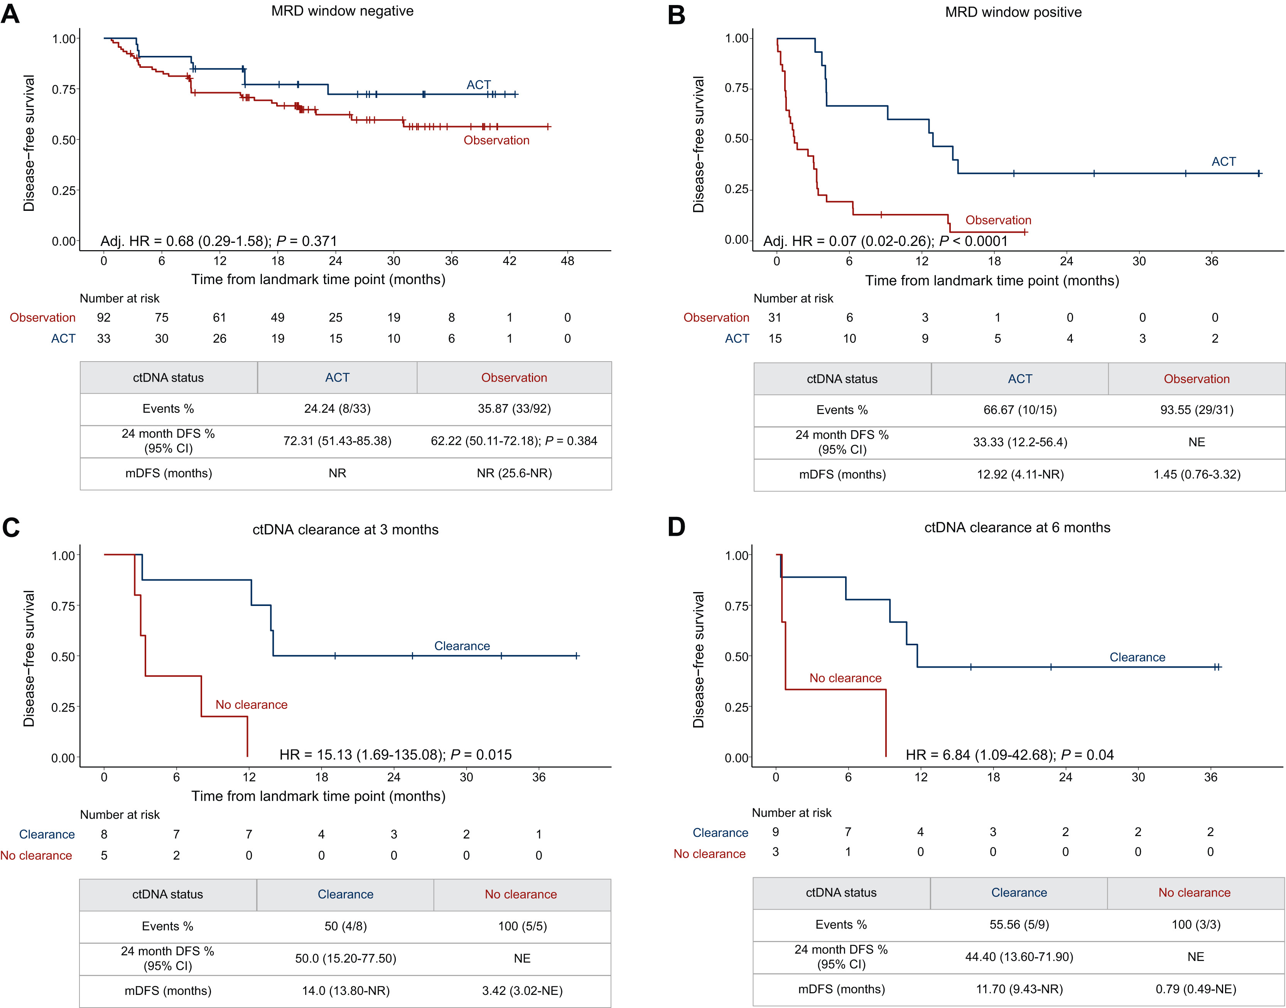
ctDNA Status Predicts ACT Benefit for Patients with Resected Colorectal Liver Metastases
Kataoka K et al. Ann Oncol 2024 November;35(11):1015-25.

Slide 15
CIRCULATE-Japan GALAXY Resected Liver Met Subset
190 patients with surgically resected colorectal liver metastases without any preoperative chemotherapy were included
32% MRD-positive; only 25% received adjuvant chemotherapy
MRD-negative not statistically different between chemotherapy and observation but absolute 10% difference at 2 years
Observational and small numbers

Slide 16
2025
Abstract LBA14

Slide 17
Nowak JA et al. Gastrointestinal Cancers Symposium 2025;Abstract LBA14.

Slide 18
Nowak JA et al. Gastrointestinal Cancers Symposium 2025;Abstract LBA14.

Slide 19
Nowak JA et al. Gastrointestinal Cancers Symposium 2025;Abstract LBA14.

Slide 20
Nowak JA et al. Gastrointestinal Cancers Symposium 2025;Abstract LBA14.

Slide 21
CALGB/SWOG 80702: Celecoxib and ctDNA
ctDNA is highly prognostic
Celecoxib seemed to benefit patients with ctDNA-positive status, but the interaction p-value was not significant
Benefit was observed for patients with PIK3CA wild-type and mutated tumors
Data are suggestive but not definitive for using celecoxib when ctDNA-positive

Slide 22
Abstract 108

Slide 23
Tie J et al. ASCO 2024;Abstract 108.

Slide 24
Tie J et al. ASCO 2024;Abstract 108.

Slide 25
Tie J et al. ASCO 2024;Abstract 108.

Slide 26
Tie J et al. ASCO 2024;Abstract 108.

Slide 27
DYNAMIC: Stage II Colon Cancer
Noninferiority of standard (non-ctDNA approach) to ctDNA-guided management can be interpreted either as checking MRD does not change outcome or as checking MRD reduces the use of chemotherapy among patients with Stage II disease
Fewer patients on ctDNA-guided management received chemotherapy (15% vs 28%), but more received oxaliplatin (9.5% vs 2.7%)
Median time from surgery to start of therapy increased by 30 days with ctDNA-guided management (53 vs 83 days)

Slide 28
Gastrointestinal Cancers Symposium 2024;Abstract TPS243.

Slide 29
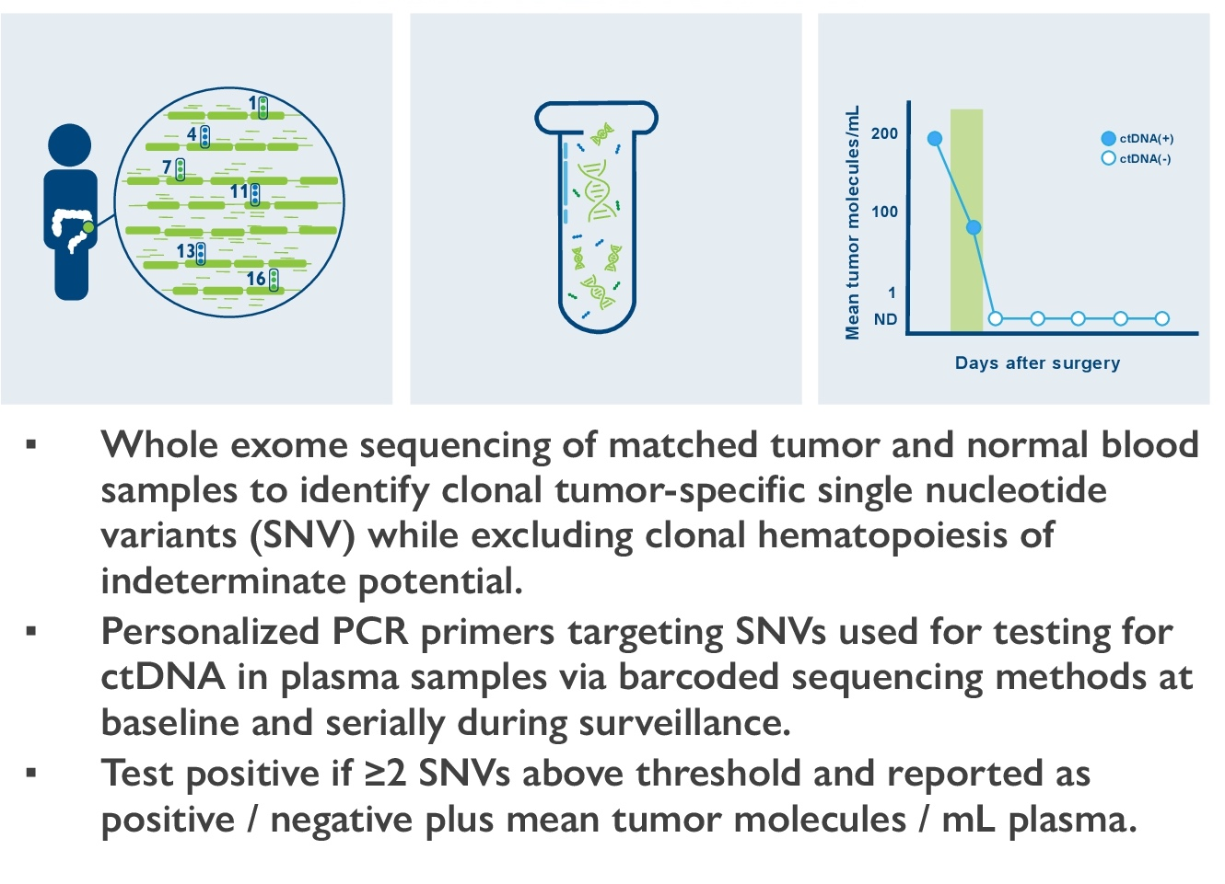
Phase II/III NRG-GI008 Study Design and ctDNA Testing
Primary endpoints (cohort A, ctDNA-):
Time to ctDNA-positive status (Phase II)
Disease-free survival (Phase III)
Primary endpoint (cohort B, ctDNA+):
Disease-free survival (Phase II/III)
Lieu CH et al. Gastrointestinal Cancers Symposium 2024;Abstract TPS243.

Slide 30
Phase II/III NRG-GI008 — CIRCULATE-North America
As of February 2025, ∼1/3 accrued
Stage IIB, IIC and III, microsatellite stable, colon only
Several questions are addressed in this trial:
To compare disease-free survival (DFS) in the ctDNA(-) cohort after resection of colon cancer treated with immediate versus delayed chemotherapy (based on serial ctDNA surveillance)
To compare DFS in the ctDNA(+) cohort after resection of colon cancer treated with FOLFOX versus FOLFIRINOX

Slide 31
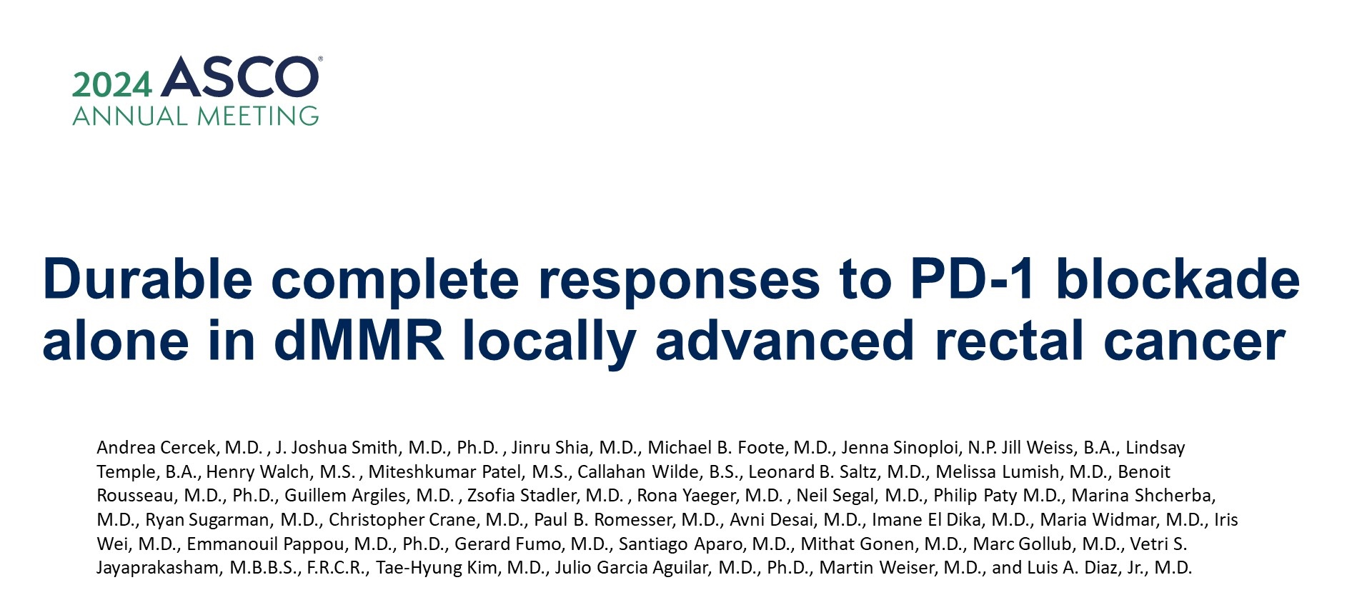
Abstract LBA3512

Slide 32
Neoadjuvant PD-1 blockade in dMMR locally advanced rectal cancer
PD-1 alone or in
Cercek A et al. ASCO 2024;Abstract LBA3512.

Slide 33
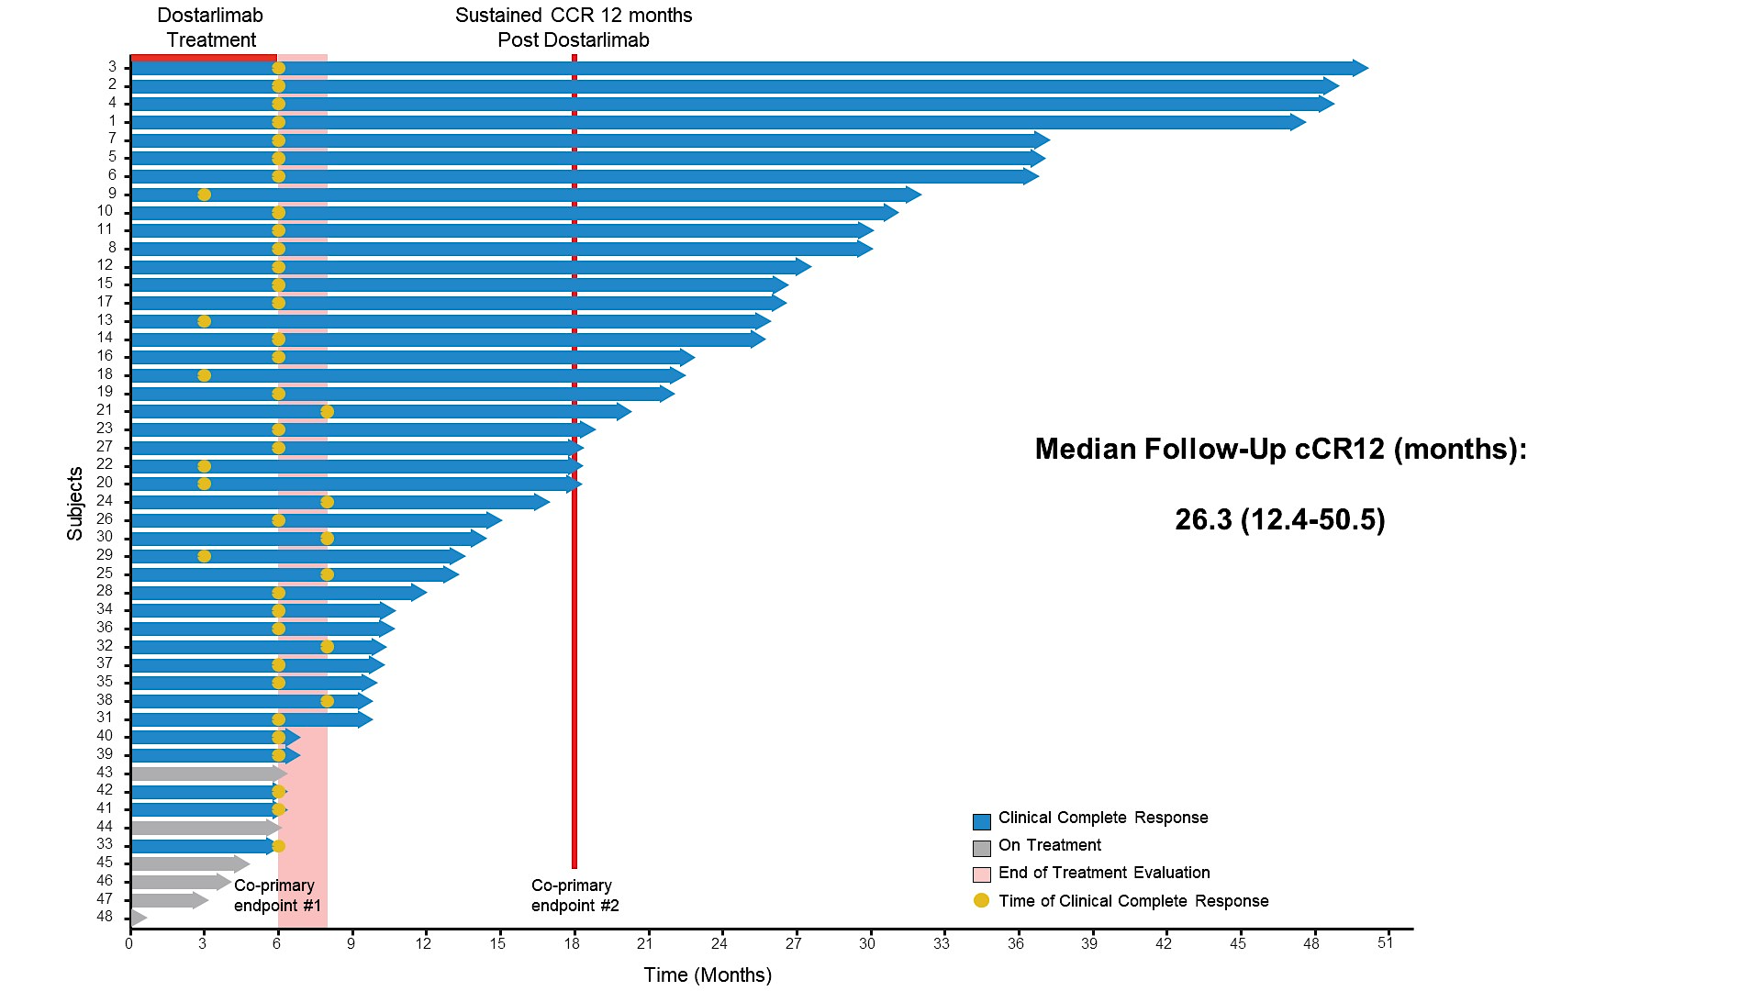
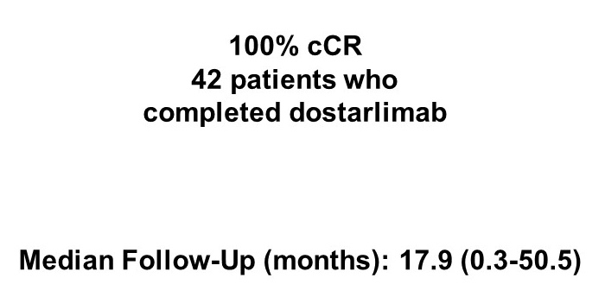
Dostarlimab: Clinical Complete Response (cCR) Rates After PD-1 Blockade
Sustained cCR 12 months Post Dostarlimab
Cercek A et al. ASCO 2024;Abstract LBA3512.

Slide 34
Neoadjuvant Therapy for MSI-H Rectal Cancer
5% to 10% of rectal cancers are microsatellite instability high (MSI-H)
To date, no patient has received standard chemotherapy, radiation or surgery
Sample size is still modest, but it is continuing to hold up
Is this applicable to all checkpoint inhibitors? How many doses are needed? Will there be late recurrences?

Slide 35
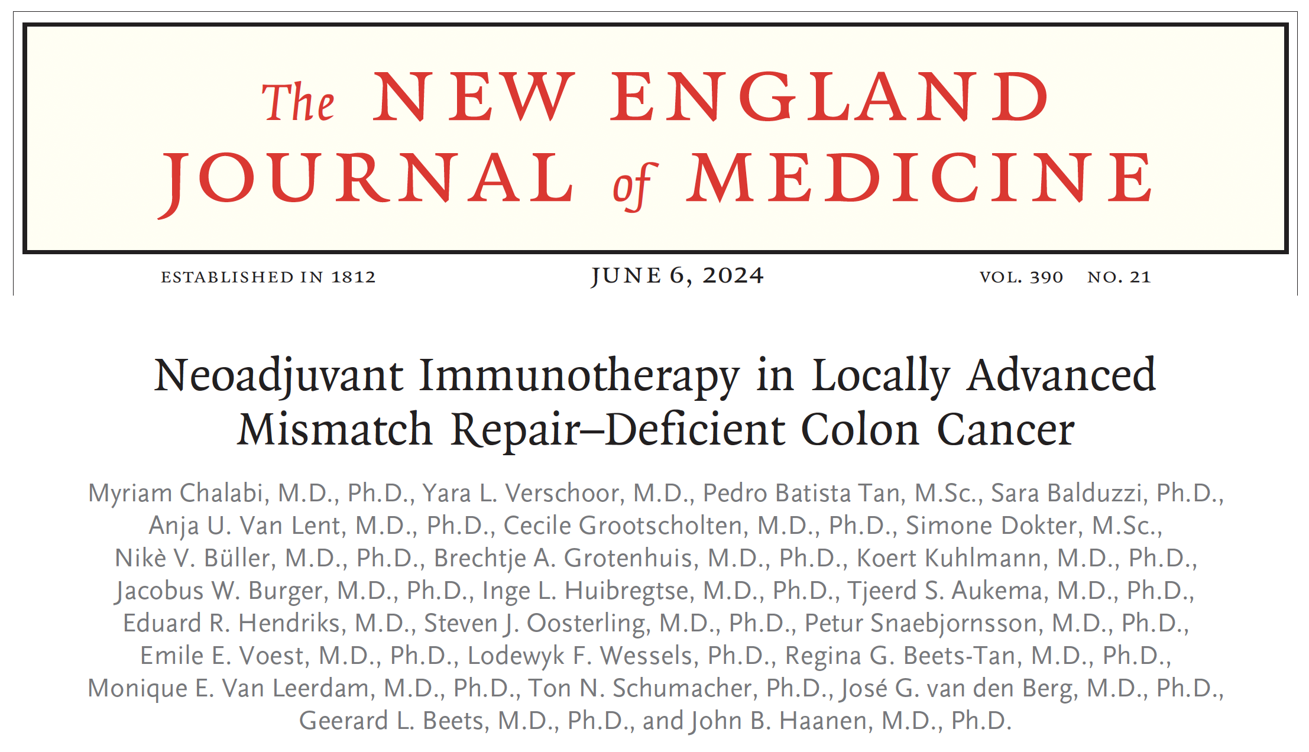
Abstract LBA24

Slide 36
NICHE-2 Trial: Pathologic Response
Chalabi M et al. N Engl J Med 2024 June 6;390(21):1949-58; ESMO 2024;Abstract LBA24.

Slide 37
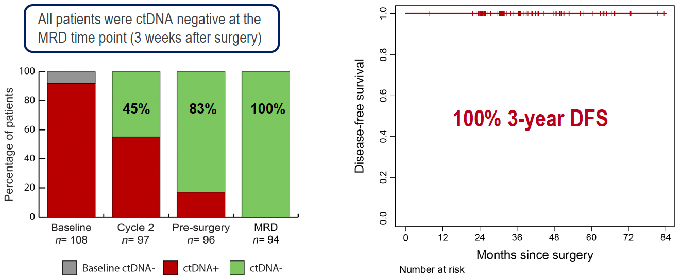
NICHE-2: Minimal Residual Disease (MRD)
Chalabi M et al. ESMO 2024;Abstract LBA24.

Slide 38
NICHE-2: Author Conclusions and Future Perspectives
dMMR = mismatch repair deficient; pCR = pathologic complete response
Chalabi M et al. ESMO 2024;Abstract LBA24.

Slide 39
NICHE-1 and NICHE-2 Studies in Colon Cancer
Patients received 2 doses of nivolumab and 1 dose of ipilimumab
Only 2.7% received chemotherapy after surgery (3/14 with positive nodes – 1 had 60% residual tumor in specimen)
Very few patients had delay of surgery beyond 6 weeks from study enrollment
Radiographic response only seen in 2 of 75 with pCR
Identifying the patients (both stages – NICHE-2 was limited to clinical Stage II and III) and MMR status is the challenge to implementation
Difference in response and duration of response for localized disease compared to metastatic disease (71% PFS at 2 years with combination in mCRC)

Slide 40
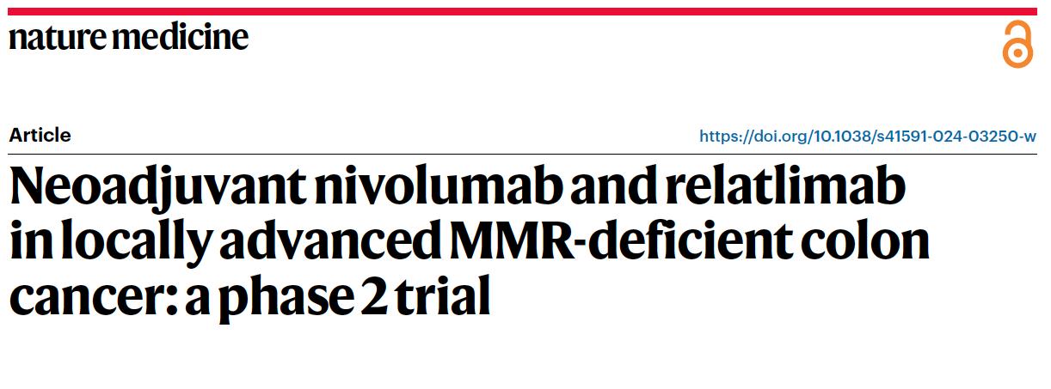
de Gooyer PG et al. 2024;30(11):3284-90.
Author Conclusions: Our results show that neoadjuvant nivolumab/relatlimab induces high rates of pathologic responses and that further investigation of this treatment in larger studies is warranted. These data add to the body of evidence in support of neoadjuvant immunotherapy regimens in dMMR colon cancer.

Slide 41
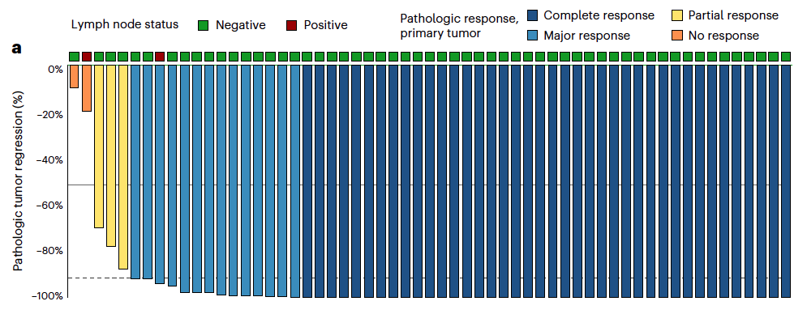
Pathologic Response and Outcome After Neoadjuvant Nivolumab and Relatlimab for Locally Advanced dMMR CRC
de Gooyer PG et al. Nat Med 2024;30(11):3284-90.

Slide 42
NICHE-3 Colon Cancer Trial
First PD-1 and LAG-3 inhibitor combination for MSI-H, T≥3 or N+ colon cancer
2 treatments – 28 days apart – both drugs
Very similar results to NICHE-1 and 2.
Unclear if combination therapy necessary
Higher rate of thyroid dysfunction, adrenal insufficiency and colitis compared to nivo/ipi (caution with cross-study comparison)

Slide 43
Select Ongoing Trials Evaluating Anti-PD-1/PD-L1 Antibodies for Patients with Localized CRC
Study | N | Phase | Eligibility | Randomization | Estimated primary completion
SMALLER (NCT06520683) | 180 | III | Stage II dMMR and/or MSI-H CRC s/p surgical resection | Tislelizumab + chemotherapy Chemotherapy | November 2027
TORCH-iTNT (NCT06281405) | 198 | II | Stage T3-4 and/or N+ MSS rectal adenocarcinoma | Toripalimab + capecitabine Toripalimab + capecitabine + RT | June 2026
STELLAR II (NCT05484024) | 588 | II-III | Locally advanced rectal adenocarcinoma | Sintilimab + CRT CRT | July 2028
BASKETIII (NCT06791512) | 122 | III | Locally advanced MMR-proficient/MSS CRC | Sintilimab + bevacizumab + mFOLFOX6 mFOLFOX6 | December 2030
MSS = microsatellite stable; RT = radiation therapy; CRT = chemoradiation therapy
www.clinicaltrials.gov. Accessed February 2025.

Slide 44
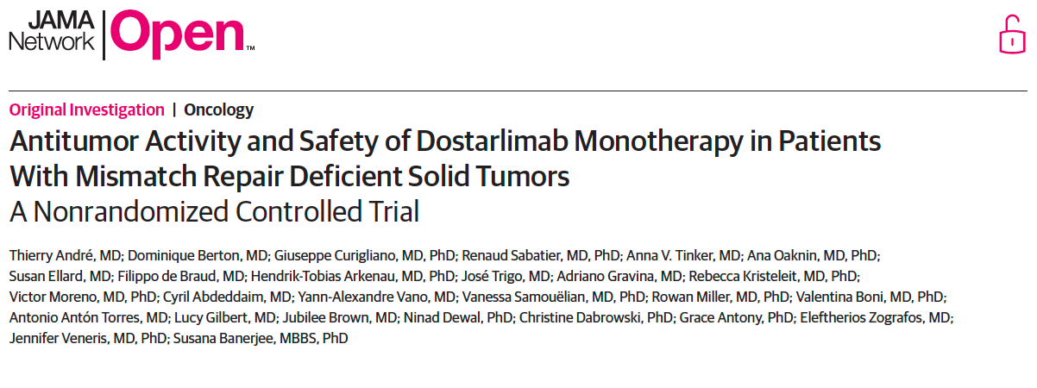
2023 November 1;6(11):e2341165.

Slide 45
GARNET Trial: Efficacy Results by Tumor Type for Patients with dMMR and MSI-H or POLE-Altered Tumors in the Efficacy Population
CR = complete response; PR = partial response; ORR = objective response rate; mDOR = median duration of response; mPFS = median progression-free survival; mOS = median overall survival; NR = not reached; EC = endometrial cancer
André T et al. JAMA Netw Open 2023 November 1;6(11):e2341165.

Slide 46
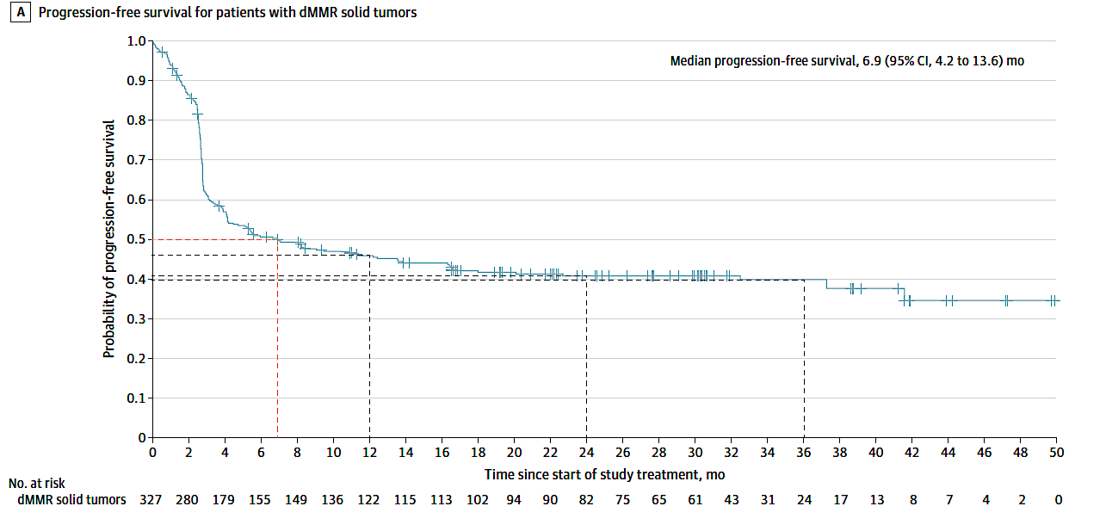
GARNET: Efficacy
Berton D et al. ASCO 2021;Abstract 2564.

Slide 47
GARNET
Confirms data learned from other PD-1 inhibitors
MSI-H or POLE (leading to high tumor mutational burden) tumors respond to checkpoint inhibitors, despite prior therapies (58% of patients had 2 or more prior therapies)
The curve has a long tail – understanding who is a long responder is needed

Slide 48
Abstract LBA125
2025

Slide 49
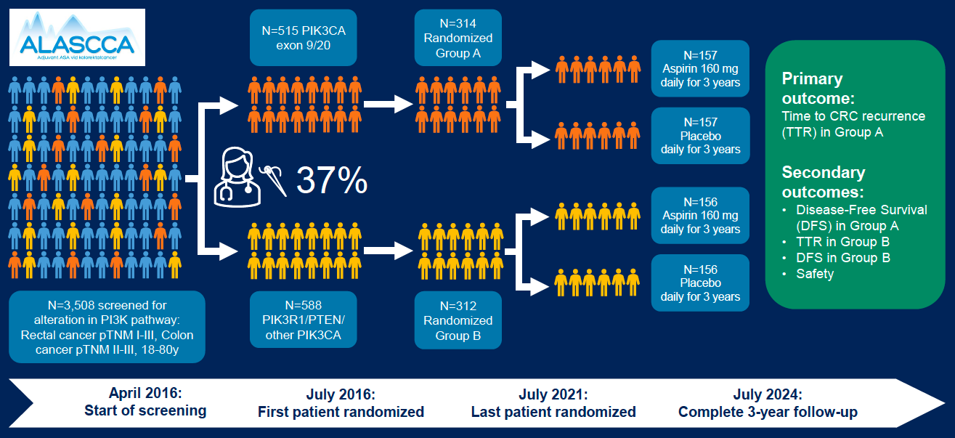
ALASCCA Phase III Biomarker-Driven Trial Schema
Martling A et al. Gastrointestinal Cancers Symposium 2025;Abstract LBA125.

Slide 50
ALASCCA: CRC Recurrence (Primary Outcome)
Martling A et al. Gastrointestinal Cancers Symposium 2025;Abstract LBA125.

Slide 51
ALASCCA: Author Conclusions and Key Takeway Points
Martling A et al. Gastrointestinal Cancers Symposium 2025;Abstract LBA125.

Slide 52
ALASCCA: PIK3CA and Aspirin
First randomized trial to demonstrate benefit of aspirin in a subset of colorectal cancer patients
The reported hazard ratio is similar to multiple other observational data and data from a randomized trial of celecoxib for patients with PIK3CA mutations

