Slide 1
Year in Review: Clinical Investigator Perspectives on the Most Relevant New Datasets and Advances in Oncology
Antibody-Drug Conjugates for Breast Cancer
A CME/MOC-Accredited Live Webinar
Wednesday, February 18, 2026 5:00 PM – 6:00 PM ET
Faculty
Hope S Rugo, MD
Sara M Tolaney, MD, MPH
Moderator
Neil Love, MD

Slide 2



Faculty
Hope S Rugo, MD
Director, Women’s Cancers Program
Division Chief, Breast Medical Oncology
Professor, Department of Medical Oncology
and Therapeutics Research
City of Hope Comprehensive Cancer Center
Duarte, California
Professor Emeritus, UCSF
MODERATOR
Neil Love, MD Research To Practice
Miami, Florida
Sara M Tolaney, MD, MPH
Chief, Division of Breast Oncology
Dana-Farber Cancer Institute
Associate Professor of Medicine
Harvard Medical School
Boston, Massachusetts

Slide 3
Commercial Support
This activity is supported by educational grants from AstraZeneca Pharmaceuticals LP, Daiichi Sankyo Inc, and Gilead Sciences Inc.
Research To Practice CME Planning Committee Members, Staff and Reviewers
Planners, scientific staff and independent reviewers for Research To Practice have no relevant conflicts of interest to disclose.

Slide 4
Dr Rugo — Disclosures
Advisory Committees and Consulting Agreements | BioNTech SE, Bristol Myers Squibb, Helsinn Therapeutics (US) Inc, Napo Pharmaceuticals
Contracted Research (Funding to City of Hope) | Bicycle Therapeutics, Genentech, a member of the Roche Group, Stemline Therapeutics Inc
Contracted Research (Funding to Prior Institution, UCSF) | Ambrx Inc, AstraZeneca Pharmaceuticals LP, Daiichi Sankyo Inc, Genentech, a member of the Roche Group, Gilead Sciences Inc, Lilly, Merck, Novartis, Pfizer Inc, Stemline Therapeutics Inc

Slide 5
Dr Tolaney — Disclosures
Consulting Agreements | Aadi Bioscience, Aktis Oncology, Ambrx, Artios Pharma Limited, Arvinas, AstraZeneca Pharmaceuticals LP, Avenzo Therapeutics, Bayer HealthCare Pharmaceuticals, BeOne, Bicycle Therapeutics, BioNTech SE, Blueprint Medicines, Boehringer Ingelheim Pharmaceuticals Inc, Bristol Myers Squibb, Celcuity, Circle Pharma, Cullinan Therapeutics, Daiichi Sankyo Inc, eFFECTOR Therapeutics Inc, Eisai Inc, Genentech, a member of the Roche Group, Gilead Sciences Inc, Hengrui Therapeutics Inc, Jazz Pharmaceuticals Inc, Johnson & Johnson, Launch Therapeutics, Lilly, Menarini Group, Merck, Mersana Therapeutics Inc, Natera Inc, Olema Oncology, Pfizer Inc, Reveal Genomics, Samsung Bioepis, Seagen Inc, Stemline Therapeutics Inc, Sumitovant Biopharma, Summit Therapeutics, SystImmune Inc, Tango Therapeutics, Tempus, Zuellig Pharma
Contracted Research | AstraZeneca Pharmaceuticals LP, Bristol Myers Squibb, Daiichi Sankyo Inc, Exelixis Inc, Genentech, a member of the Roche Group, Gilead Sciences Inc, Jazz Pharmaceuticals Inc, Lilly, Menarini Group, Merck, NanoString Technologies, Novartis, OncoPep, Pfizer Inc, Seagen Inc, Stemline Therapeutics Inc
Travel Support | Arvinas, AstraZeneca Pharmaceuticals LP, Gilead Sciences Inc, Jazz Pharmaceuticals Inc, Lilly, Pfizer Inc, Roche Laboratories Inc

Slide 6
Dr Love — Disclosures
Dr Love is president and CEO of Research To Practice. Research To Practice receives funds in the form of educational grants to develop CME activities from the following companies: Aadi Bioscience, AbbVie Inc, ADC Therapeutics, Agendia Inc, Alexion Pharmaceuticals, Amgen Inc, Array BioPharma Inc, a subsidiary of Pfizer Inc, Arvinas, Astellas, AstraZeneca Pharmaceuticals LP, Aveo Pharmaceuticals, Bayer HealthCare Pharmaceuticals, BeOne, Biotheranostics, A Hologic Company, Black Diamond Therapeutics Inc, Blueprint Medicines, Boehringer Ingelheim Pharmaceuticals Inc, Bristol Myers Squibb, Celcuity, Clovis Oncology, Coherus BioSciences, Corcept Therapeutics Inc, CTI BioPharma, a Sobi Company, Daiichi Sankyo Inc, Eisai Inc, Elevation Oncology Inc, Exact Sciences Corporation, Exelixis Inc, Genentech, a member of the Roche Group, Genmab US Inc, Geron Corporation, Gilead Sciences Inc, GSK, Helsinn Therapeutics (US) Inc, ImmunoGen Inc, Incyte Corporation, Ipsen Biopharmaceuticals Inc, Jazz Pharmaceuticals Inc, Johnson & Johnson, Karyopharm Therapeutics, Kite, A Gilead Company, Kura Oncology, Legend Biotech, Lilly, MEI Pharma Inc, Merck, Mersana Therapeutics Inc, Mirati Therapeutics Inc, Mural Oncology Inc, Natera Inc, Novartis, Novartis Pharmaceuticals Corporation on behalf of Advanced Accelerator Applications, Novocure Inc, Nuvalent, Nuvation Bio Inc, Pfizer Inc, Pharmacyclics LLC, an AbbVie Company, Puma Biotechnology Inc, Regeneron Pharmaceuticals Inc, Revolution Medicines Inc, Rigel Pharmaceuticals Inc, R-Pharm US, Sanofi, Seagen Inc, Servier Pharmaceuticals LLC, SpringWorks Therapeutics Inc, Stemline Therapeutics Inc, Sumitomo Pharma America, Syndax Pharmaceuticals, Taiho Oncology Inc, Takeda Pharmaceuticals USA Inc, TerSera Therapeutics LLC, and Tesaro, A GSK Company.

Slide 7
This educational activity contains discussion of non-FDA-approved uses of agents and regimens. Please refer to official prescribing information for each product for approved indications.

Slide 8
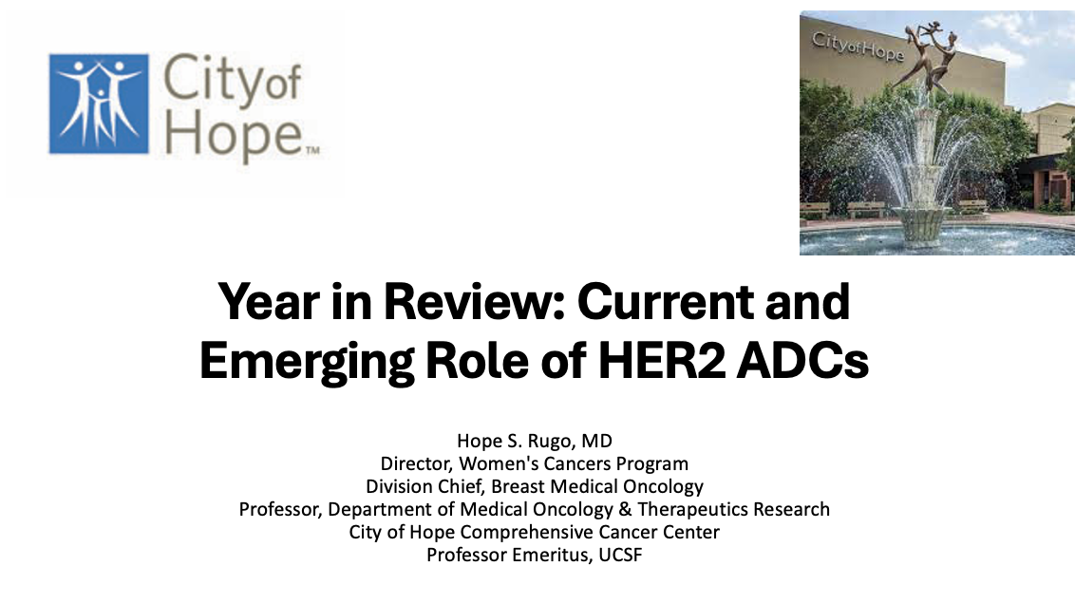
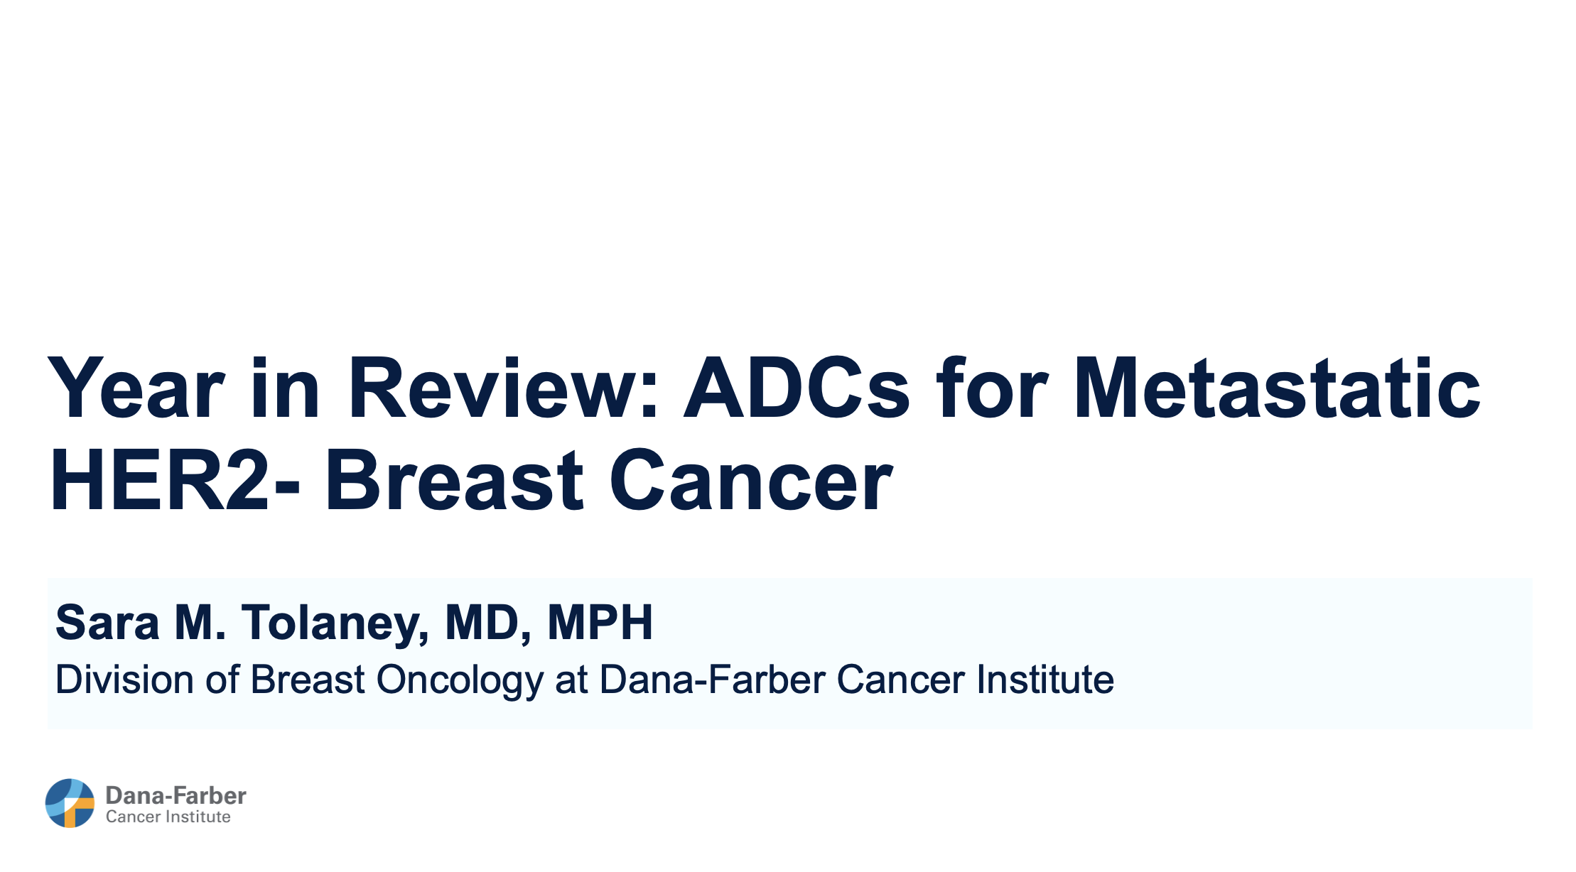

Slide 9
Key Datasets
Hope S Rugo, MD
Harbeck N et al. Neoadjuvant trastuzumab deruxtecan alone or followed by paclitaxel, trastuzumab, and pertuzumab for high-risk HER2-positive early breast cancer (DESTINY-Breast11): A randomised, open-label, multicentre, phase III trial. Ann Oncol 2026;37(2):166-79.
Loibl S et al. Trastuzumab deruxtecan in residual HER2-positive early breast cancer. N Engl J Med 2025;[Online ahead of print].
Tolaney SM et al. Trastuzumab deruxtecan plus pertuzumab for HER2-positive metastatic breast cancer. N Engl J Med 2025;[Online ahead of print].
Wildiers H et al. Outcomes by hormone receptor (HR) status in patients (pts) with HER2+ advanced/metastatic breast cancer (mBC) with brain metastases (BM) treated with trastuzumab deruxtecan (T-DXd): A post-hoc subgroup analysis of DESTINY-Breast12. San Antonio Breast Cancer Symposium 2025;Abstract PS5-01-27.
Hu X et al. Patient-reported outcomes with trastuzumab deruxtecan in hormone receptor-positive, HER2-low or HER2-ultralow metastatic breast cancer: Results from the randomized DESTINY-Breast06 trial. ESMO Open 2025;10(5):105082.

Slide 10
Key Datasets
Hope S Rugo, MD (continued)
Modi S et al. Trastuzumab deruxtecan in HER2-low metastatic breast cancer: Long-term survival analysis of the randomized, phase 3 DESTINY-Breast04 trial. Nat Med 2025;31(12):4205-13.
Sakai H et al. A randomized, double-blind, placebo-controlled phase II study of olanzapine-based prophylactic antiemetic therapy for delayed and persistent nausea and vomiting in patients with HER2-positive or HER2-low breast cancer treated with trastuzumab deruxtecan: ERICA study (WJOG14320B). Ann Oncol 2025;36(1):31-42.
Natsuhara KH et al. Treatment rechallenge after trastuzumab-deruxtecan–related interstitial lung disease: A multi-institution cohort study. ASCO 2025;Abstract 1015.
Hu X et al. Trastuzumab botidotin vs trastuzumab emtansine (T-DM1) in HER2-positive unresectable or metastatic breast cancer: Results from a randomized phase III study. ESMO 2025;Abstract LBA24.
Song E et al. SHR-A1811 versus pyrotinib plus capecitabine in human epidermal growth factor receptor 2-positive (HER2+) advanced/metastatic breast cancer (BC): A multicenter, open-label, randomized, phase III study (HORIZON-Breast01). ESMO 2025;Abstract LBA19.

Slide 11
Key Datasets
Sara M Tolaney, MD, MPH
Tolaney SM et al. Sacituzumab govitecan (SG) + pembrolizumab (pembro) vs chemotherapy (chemo) + pembro in previously untreated PD-L1–positive advanced triple-negative breast cancer (TNBC): Primary results from the randomized phase 3 ASCENT-04/KEYNOTE-D19 study. ASCO 2025;Abstract LBA109.
Cortés J et al. Sacituzumab govitecan in untreated, advanced triple-negative breast cancer. N Engl J Med 2025;393(19):1912-25.
Dent RA et al. First-line (1L) datopotamab deruxtecan (Dato-DXd) vs chemotherapy in patients with locally recurrent inoperable or metastatic triple-negative breast cancer (mTNBC) for whom immunotherapy was not an option: Primary results from the randomised, phase III TROPION-Breast02 trial. ESMO 2025;Abstract LBA21.
Yin Y et al. Sacituzumab tirumotecan (sac-TMT) as first-line treatment for unresectable locally advanced/metastatic triple-negative breast cancer (a/mTNBC): Initial results from the phase II OptiTROP-Breast05 study. ASCO 2025;Abstract 1019.
Rugo HS et al. Q-TWiST analysis of sacituzumab govitecan vs chemotherapy in previously treated patients with HR+/HER2- metastatic breast cancer. Curr Oncol 2025;32(3):169.

Slide 12
Key Datasets
Sara M Tolaney, MD, MPH (continued)
Bardia A et al. Datopotamab deruxtecan versus chemotherapy in previously treated inoperable/metastatic hormone receptor-positive human epidermal growth factor receptor 2-negative breast cancer: Primary results from TROPION-Breast01. J Clin Oncol 2025;43(3):285-96.
Pistilli B et al. Datopotamab deruxtecan (Dato-DXd) vs chemotherapy (CT) in previously-treated inoperable or metastatic hormone receptor-positive, HER2-negative (HR+/HER2–) breast cancer (BC): Final overall survival (OS) from the phase III TROPION-Breast01 trial. ESMO Virtual Plenary 2025;Abstract VP1-2025.
Jhaveri K et al. Sacituzumab govitecan vs chemotherapy as first therapy after endocrine therapy in HR+/HER2− (IHC 0, 1+, 2+/ISH−) metastatic breast cancer: Primary results from ASCENT-07. San Antonio Breast Cancer Symposium 2025;Abstract GS1-09.
Fan Y et al. Sacituzumab tirumotecan (sac-TMT) vs investigator’s choice of chemotherapy (ICC) in previously treated locally advanced or metastatic hormone receptor-positive, HER2-negative (HR+/HER2-) breast cancer (BC): Results from the randomized, multi-center phase III OptiTROP-Breast02 study. ESMO 2025;Abstract LBA23.
Yin Y et al. Sacituzumab tirumotecan in previously treated metastatic triple-negative breast cancer: A randomized phase 3 trial. Nat Med 2025;31(6):1969-75.

Slide 13
Year in Review: Antibody-Drug Conjugates (ADCs) for Breast Cancer
INTRODUCTION: Long-Term Outcomes with ADCs
MODULE 1: HER2-Positive Breast Cancer
First-line treatment for metastatic disease (current role of endocrine therapy?)
Brain metastases
Neoadjuvant and adjuvant therapy
Olanzapine prophylaxis with T-DXd; rechallenge after ILD
MODULE 2: HER2-Negative Breast Cancer
TROP2-targeted ADCs for triple-negative metastatic breast cancer (mBC)
TROP2-targeted ADCs for HR-positive, HER2-negative mBC

Slide 14
Year in Review: Antibody-Drug Conjugates (ADCs) for Breast Cancer
INTRODUCTION: Long-Term Outcomes with ADCs
MODULE 1: HER2-Positive Breast Cancer
First-line treatment for metastatic disease (current role of endocrine therapy?)
Brain metastases
Neoadjuvant and adjuvant therapy
Olanzapine prophylaxis with T-DXd; rechallenge after ILD
MODULE 2: HER2-Negative Breast Cancer
TROP2-targeted ADCs for triple-negative metastatic breast cancer (mBC)
TROP2-targeted ADCs for HR-positive, HER2-negative mBC

Slide 15
Year in Review: Antibody-Drug Conjugates (ADCs) for Breast Cancer
INTRODUCTION: Long-Term Outcomes with ADCs
MODULE 1: HER2-Positive Breast Cancer
First-line treatment for metastatic disease (current role of endocrine therapy?)
Brain metastases
Neoadjuvant and adjuvant therapy
Olanzapine prophylaxis with T-DXd; rechallenge after ILD
MODULE 2: HER2-Negative Breast Cancer
TROP2-targeted ADCs for triple-negative metastatic breast cancer (mBC)
TROP2-targeted ADCs for HR-positive, HER2-negative mBC

Slide 16
Optimal Therapy for HER2+ MBC in 2026?
Accessibility is clearly a key issue around the world; THP remains the standard of care
T-DXd has regulatory approval in the US as first-line therapy based on DB09
When to use T-DXd in the first-line setting - Early relapse, patients presenting with brain metastases?
T-DXd + P is associated with more nausea, less neuropathy than THP
Higher mortality by 1%; 0.5% grade 5 ILD
Maintenance therapy is a critical question given ongoing nausea with T-DXd/risk of ILD
Optimal treatment?
T-DXd or THP induction, and in those with responding or stable disease followed by:
ER+: ET+ trastuzumab/pertuzumab + palbociclib
ER-: trastuzumab/pertuzumab + tucatinib
Sequencing therapy is a critical issue in interpreting trials and a key factor in improving outcome
1st Line Study | PFS, months
TH vs THP | 18.7 | 12.4
T-DXd/P vs THP | 40.7 | 26.9
Palbociclib plus ET/HP vs ET/HP in responding pts | 44.3 | 29.1
Tucatinib plus HP in responding pts | 24.9 | 16.3
Courtesy of Hope S Rugo, MD

Slide 17
Ongoing Maintenance Studies
Courtesy of Hope S Rugo, MD

Slide 18
Questions?

Slide 19
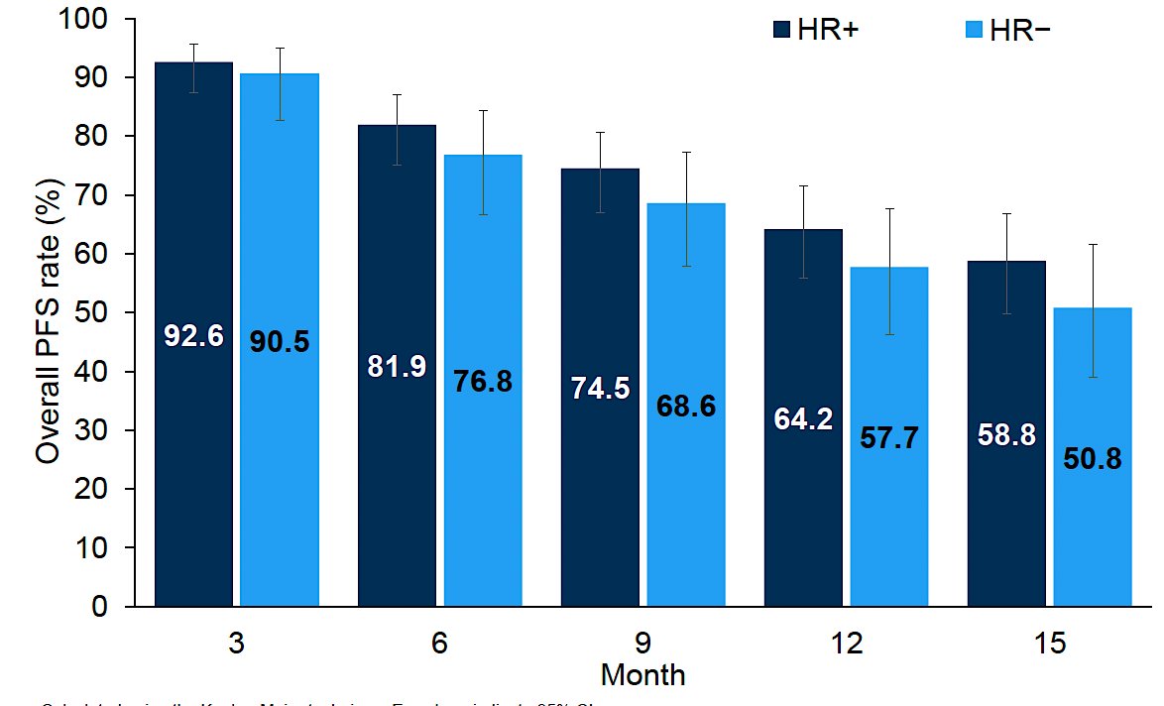
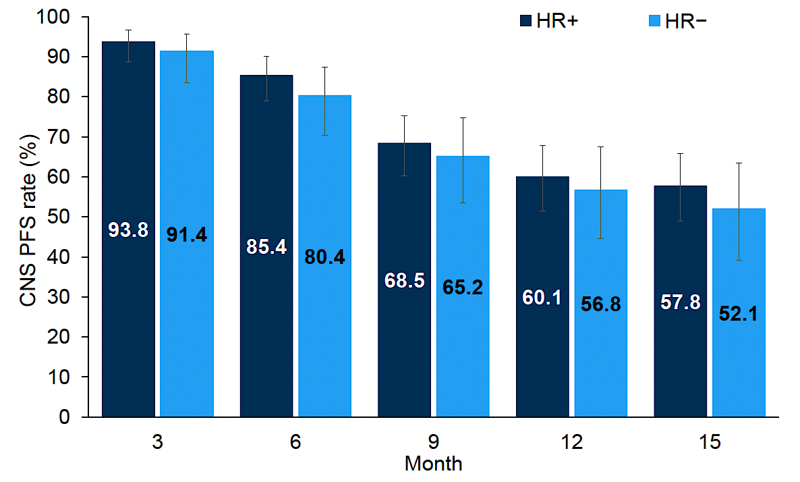
Destiny Breast12: Post Hoc Analysis of Efficacy by Hormone Receptor Status
DB12 treated 263 patients with HER2+ stable or active brain metastases with T-DXd with a primary endpoint of PFS
Almost all had 1-2 lines of prior therapy
Overall PFS 17.3 mo, 12 mo CNS PFS 58.9%
ORR 51.7%, 64.1% for measurable dse
Est PFS rates
Est CNS PFS rates
Response rates in patients with BMs
Overall and CNS PFS similar for HR+ and HR-
Safety similar; 3 ILD in each subgroup
ILD rate high at 15.8 /16.5% (HR+/-) likely due to steroid use and lack of PJP prophylaxis
Conclusions
Efficacy of T-DXd in HER2+ MBC in brain maintained regardless of HR status
Careful management with prophylaxis to avoid opportunistic infections is critical
Response, n (%, 95% CI) | HR+ (n-165) | HR- (n=97)
ORR | 81(49.1) [41.5, 56.7] | 54(55.7) [45.8, 65.6]
CNS ORR | 56 (66.7) [56.6, 76.7]) | 42(79.2) [68.3, 90.2)
ORR in measurable dse | 76(60.8) [52.2, 69.4] | 50(69.4) [58.8, 80.1]
Harbeck N, et al. Nat Med. 2024;30:3717–3727; Wildiers et al, SABCS 2025
Courtesy of Hope S Rugo, MD

Slide 20
Questions?

Slide 21
DESTINY-Breast11 Phase 3 Trial of Neoadjuvant T-DXd Alone or Followed by THP vs SOC for High-Risk HER2+ EBC: Study Design and Patients
Key Eligibility Criteria
Previously untreated HR+ or HR– HER2+ EBC
High risk defined as:
≥cT3 and N0-3 or cT0-4 and N1-3
Inflammatory breast cancer
Patient Characteristics, n (%) |  | T-DXd-THP (n=321) | ddAC-THP (n=320) | T-DXd (n=286)
Median (range) age, years |  | 50 (25-82) | 50 (23-79) | 50 (23-79)
Geographic region | Asia | 152 (47.4) | 152 (47.5) | 124 (43.4)
 | Western Europe | 69 (21.5) | 77 (24.1) | 66 (23.1)
 | North America | 43 (13.4) | 41 (12.8) | 52 (18.2)
 | Rest of world | 57 (17.8) | 50 (15.6) | 44 (15.4)
HR+ |  | 236 (73.5) | 235 (73.4) | 205 (71.7)
Clinical tumor stage | cT0-2 | 176 (54.8) | 188 (58.8) | 157 (54.9)
 | cT3-4 | 145 (45.2) | 132 (41.3) | 129 (45.1)
Nodal status | N0 | 26 (8.1) | 35 (10.9) | 20 (7.0)
Liver mets at baseline, n (%) | N+ | 287 (89.4) | 281 (87.8) | 254 (88.8)
1:1:1
T-DXdª → THP^{b} (n=321)
4 + 4 cycles
RANDOMIZED
Recommended post-neoadjuvant treatment per study protocol
pCR: RT + HP for up to 1 year
No pCR: RT + T-DM1 for up to 14 cycles
HR+: ET
ddAC^{c} → THP^{d} (n=320)
4 + 4 cycles
SURGERY^{e}
T-DXdª (n=286)
8 cycles
The T-DXd alone arm was closed early following Independent Data Monitoring Committee recommendation
N=927
Primary endpoint: pCR (ypT0/is ypN0) by BCR
Secondary endpoints: pCR (ypT0 ypN0) by BCR, EFS, safety, PK and immunogenicity, IDFS, OS, HRQoL
ª 5.4 mg/kg q3w. ^{b} Paclitaxel (80 mg/m² qw) + trastuzumab (6 mg/kg q3w) + pertuzumab (840 mg loading dose followed by 420 mg q3w). ^{c} Doxorubicin (60 mg/m² q2w) + cyclophosphamide (600 mg/m² q2w). ^{d} Paclitaxel (80 mg/m² qw) + trastuzumab (8 mg/kg loading dose followed by 6 mg/kg q3w) + pertuzumab (840 mg loading dose followed by 420 mg q3w). ^{e} Recommended window for surgery was 3-6 weeks following administration of the last dose of neoadjuvant study treatment.
Harbeck N, et al. ESMO 2025. Abstract 219O; Ann Oncol 2025.
Courtesy of Hope S Rugo, MD

Slide 22
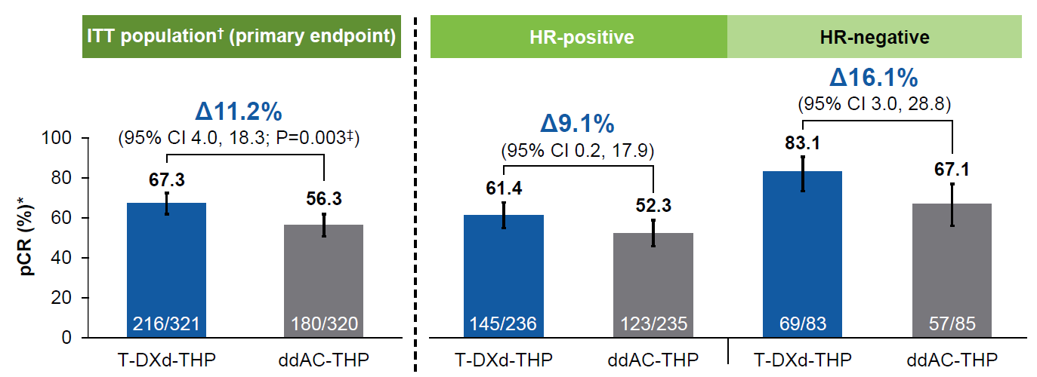
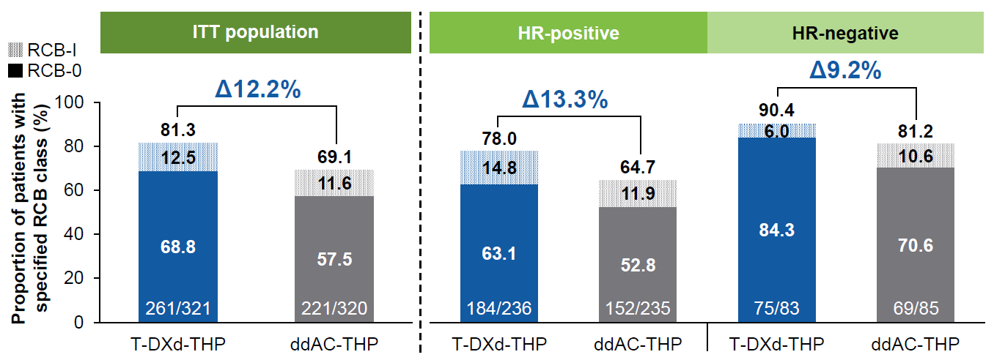
DESTINY-Breast11: pCR and RCB with T-DXd-THP vs ddAC-THP
Harbeck N, et al. ESMO 2025. Abstract 219O, Ann Oncol 2025
Courtesy of Hope S Rugo, MD

Slide 23
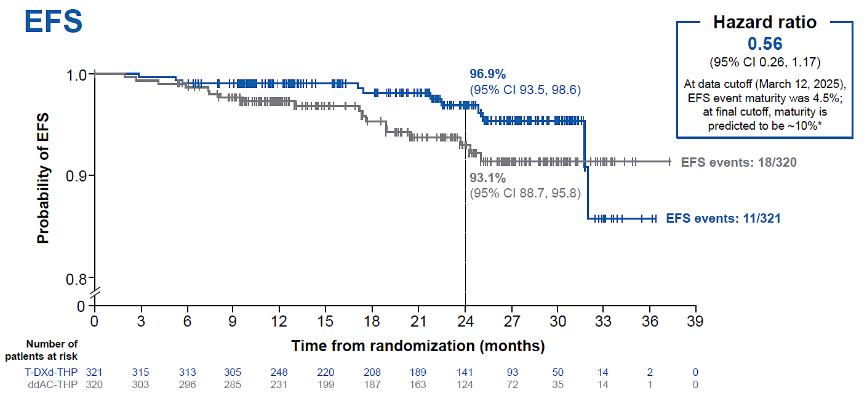
DESTINY-Breast11: EFS Immature Trial was not powered for EFS or OS
EFS in T-DXd-THP vs ddAC-THP
Post-neoadjuvant treatments were generally well balanced between T-DXd-THP and ddAC-THP arms
In both arms, more than half of patients without pCR received post-neoadjuvant T-DM1
Harbeck N, et al. ESMO 2025. Abstract 219O, Ann Oncol 2025.
Courtesy of Hope S Rugo, MD

Slide 24
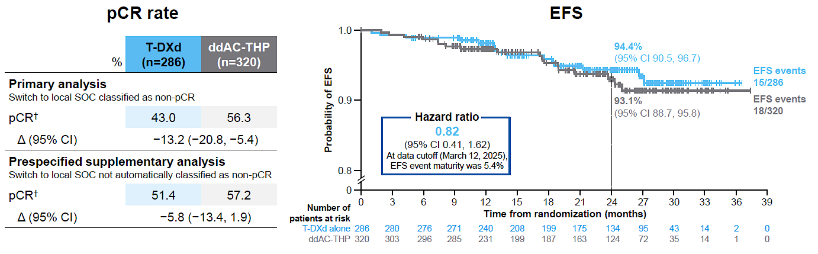
DESTINY-Breast11 Phase 3 Trial of Neoadjuvant T-DXd Alone or Followed by THP vs SOC for High-Risk HER2+ EBC: pCR and EFS in T-DXd vs ddAC-THP
On March 13, 2024, the T-DXd alone arm closed following Independent Data Monitoring Committee recommendation.ª Patients who were still receiving T-DXd alone could remain on therapy or immediately switch to local SOC.
pCR Rate
EFS
The overall safety profile of T-DXd alone was favorable vs ddAC-THP, with reduced rates of grade ≥3 AEs, SAEs, treatment reductions/interruptions, and left ventricular dysfunction; ILD incidence was low and similar in both arms
ª The reasons were multifactorial, including a lower pCR rate, low likelihood that T-DXd alone would be superior to ddAC-THP, and the timing of surgery.
Harbeck N, et al. ESMO 2025. Abstract 219O; Ann Oncol 2025.
Courtesy of Hope S Rugo, MD

Slide 25
What did we Learn?
T-DXd-THP showed the highest reported pCR rate in HER2+ EBC for a registrational study in the neoadjuvant setting, despite high prevalence of HR+ disease and a high-risk population
Definitive data – and the 4th trial – to show that anthracyclines do not improve pCR in HER2+ breast cancer and are less safe than non-anthracycline based chemotherapy/ADCs
Sequential non-cross resistant chemotherapy remains the best treatment approach for high-risk early stage HER2+ breast cancer
T-DXd alone was inferior in this high-risk patient population
T-DXd-THP associated with lower rates of hematologic AEs, left ventricular dysfunction, and fatigue, with similar rates of ILD
Control arm imperfect as TCHP is the SOC in many countries although that is due to equivalency in randomized phase III trials
Safety comparison impacted the most
Courtesy of Hope S Rugo, MD

Slide 26
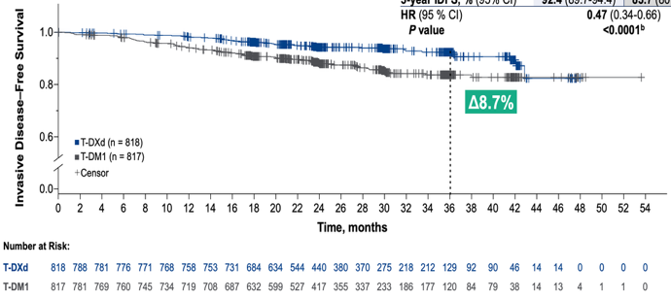
Interim Analysis of DESTINY-Breast05: IDFS with T-DXd vs T-DM1 in High-Risk HER2+ EBC
IDFS
Categories of First IDFS Events
77
Non-
CNS
52
42
Non-
CNS
25
Outcome Measure | T-DXd (n=818) | T-DM1 (n=817)
Patients with events, n (%) | 51 (6.2) | 102 (12.5)
3-year IDFS, % (95% CI) | 92.4 (89.7-94.4) | 83.7 (80.2-86.7)
HR (95% CI) | 0.47 (0.34-0.66)
P value | <0.0001
CNSª
25
CNSª
17
b
ª CNS as sole site for distant recurrence or one of multiple distant recurrent sites. ^{b} Causes of death in the T-DXd arm were 2 drug-related ILD, unrelated respiratory tract infection, acute respiratory failure (outside AE reporting period), acute respiratory distress syndrome (outside AE reporting period), and 2 disease progression, and in the T-DM1 arm were drug-related sepsis, unrelated ovarian cancer, unrelated aneurysm, unrelated pneumothorax, unrelated leiomyosarcoma, self-inflicted gun wound, and 2 disease progression.
Geyer CE, et al. ESMO 2025. Abstract LBA1.
Courtesy of Hope S Rugo, MD

Slide 27
What did we Learn? How to Incorporate T-DXd into treatment for early stage HER2+ BC?
T-DXd for patients with high risk HER2+ disease and residual disease in breast and/or node following at least 6 cycles of neoadjuvant chemotherapy containing HER2 targeted therapy significantly improved IDFS and DFS compared to T-DM1 – with short follow-up
Effect seen across all prespecified subgroups
At interim analysis there are less CNS metastases in the T-DXd group
T-DXd was associated with more ILD compared to DB11, presumably due to longer exposure and perhaps prior treatment, as well as more nausea than T-DM1
Less cytopenias and liver enzyme elevations
Similar deaths attributed to treatment (2 v 1)
Neoadjuvant or adjuvant?
More T-DXd (8 cycles vs 4 followed by THP) was definitely not better
T-DXd x 4 followed by THP is associated with less toxicity and increases pCR, thereby sparing a subset of patients 14 cycles of T-DXd
But in patients with no pCR, next steps are unclear!
THP is sufficient for a subset of patients, as is T-DXd x 4: individualizing therapy to risk is critical
Ex: I-SPY 2.2
T-DXd in patients with residual disease (and high-risk) will become the SOC
Courtesy of Hope S Rugo, MD

Slide 28
Questions?

Slide 29
ERICA Trial: Randomized Trial of Olanzapine Prophylaxis for T-DXd Delayed/Persistent Nausea and Vomiting
162 evaluable patients were enrolled at 43 sites in Japan
Study design: placebo controlled, dbl blind
Olanzapine/pla 5 mg/d day 1-6
Day 1: 5-HT3 RA, dexamethasone (6.6mg IV, 8 mg PO)
Primary endpoint CR in 21d observation period
No emetic events, no rescue meds in delayed phase (24-120hr post T-DXd)
Secondary endpoints
No nausea in delayed/persistent phases (120-504 hrs, 21d)
Adverse events
Results
Delayed phase CR (olanzapine vs pla)
70 vs 56.1%. P 0.047
Persistent phase
63.9 vs 44.4%
No nausea
57.5 vs 37.8%
Less appetite loss, low-grade somnolence and hyperglycemia with olanzapine
Hyperglycemia: 7.5% vs 0
Somnolence: 25 vs 10.8%
Sakai et al, Ann Oncol 2025
Courtesy of Hope S Rugo, MD

Slide 30
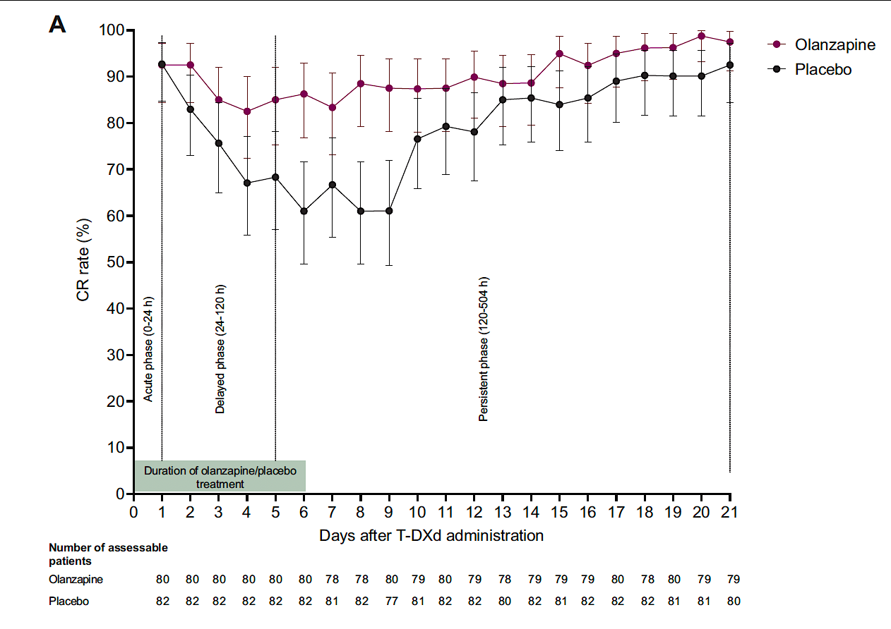
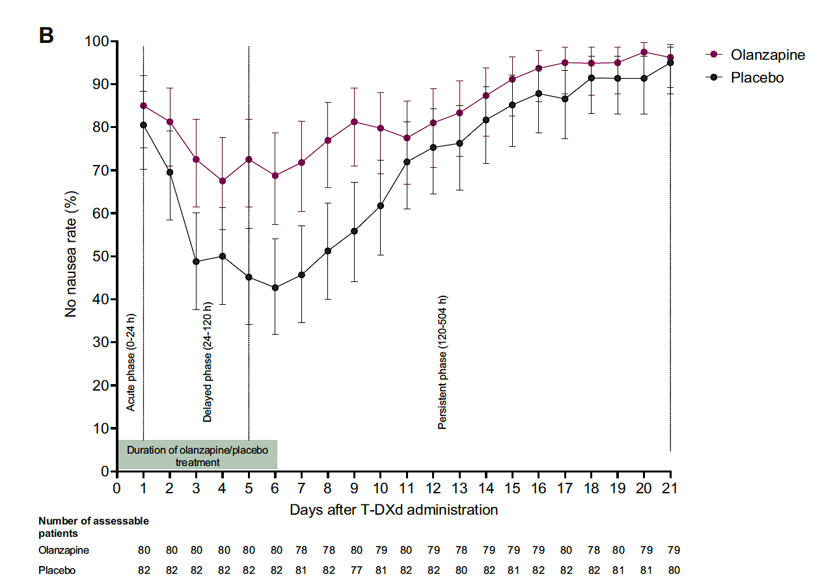
Results and Conclusions
Nausea is the most common toxicity from T-DXd impacting QOL and adherence
Affects >70% with standard antiemetics
Recommendations for prophylaxis include a 3-drug regimen with 5-HT3 RA, NK1 RA and dexamethasone
Delayed and long-delayed nausea remain an issue
Olanzapine at bedtime d1-4+ is remarkably effective at reducing nausea, also effective when extended for delayed nausea
Start at 2.5 mg* and increase as needed (1.25mg for some!)
Indian study: Mainly AC showed 2.5 mg as effective as 10 mg d1-4 with much less somnolence
Daily CR rates
Daily no nausea rates
Courtesy of Hope S Rugo, MD
*Bajpai et al, Lancet Oncology 2024

Slide 31
Outcomes after Rechallenge with T-DXd
3 patients with recurrent grade 1 ILD were rechallenged with T-DXd a 2nd time
1 patient rechallenged with a dose reduction, 2 without
2 remained on T-DXd until disease progression for 63 and 211 days and 1 remains on therapy as of 5/8/25
19 patients with grade 2 ILD were re-challenged with T-DXd, outside of the guidelines
Median time to rechallenge was 49 days (IQR 42-126 days)
Patients remained on T-DXd after rechallenge for a median of 91 days (IQR 27-162)
3 patients (16%) developed recurrent ILD (1-G2, 1-G3, 1-G4)
* No grade 5 cases of recurrent ILD were seen after rechallenge
Abbreviations: IQR = interquartile range, G = grade
Courtesy of Hope S Rugo, MD

Slide 32
Conclusion
Rechallenge with T-DXd after grade 1 ILD was safe; patients in a diverse real-world population had ongoing clinical benefit from T-DXd.
High rates of rechallenge after grade 1 ILD were safe with long duration of clinical benefit
Treatment with steroids resulted in faster radiographic improvement of ILD
Among patients rechallenged after grade 1 ILD, rates of recurrent ILD were low, with mostly grade 1 events and no grade 5 events
A small number of patients with grade 2 ILD were rechallenged with a similar rate of recurrent ILD, but this data must be interpreted with caution
Courtesy of Hope S Rugo, MD

Slide 33
Questions?

Slide 34
Year in Review: Antibody-Drug Conjugates (ADCs) for Breast Cancer
INTRODUCTION: Long-Term Outcomes with ADCs
MODULE 1: HER2-Positive Breast Cancer
First-line treatment for metastatic disease (current role of endocrine therapy?)
Brain metastases
Neoadjuvant and adjuvant therapy
Olanzapine prophylaxis with T-DXd; rechallenge after ILD
MODULE 2: HER2-Negative Breast Cancer
TROP2-targeted ADCs for triple-negative metastatic breast cancer (mBC)
TROP2-targeted ADCs for HR-positive, HER2-negative mBC

Slide 35
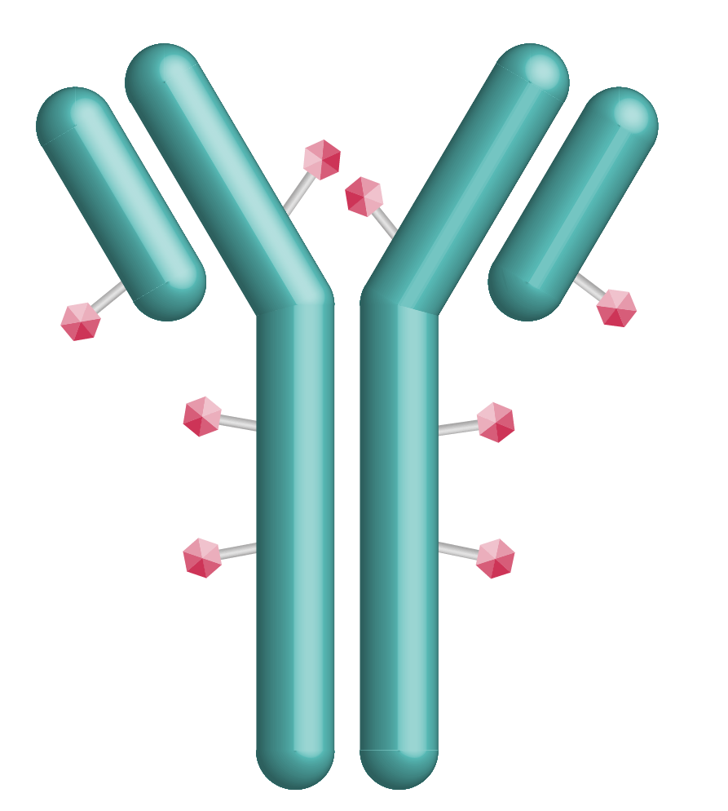

How To Approach Therapy for 1L mTNBC? TROP2 ADCs Moving Into The First Line Space
 | Sacituzumab govitecan (SG) | Datopotamab deruxtecan (Dato-DXd)
Antibody | hRS7 Humanized IgG1 mAb | MAAP-9001a Humanized IgG1 mAb
Payload | SN38 (DNA Topoisomerase I inhibitor) | DXd (DNA Topoisomerase I inhibitor)
Linker cleavage | Enzymatic and pH-dependent | Enzymatic
Bystander effect | Yes | Yes
DAR | 7.6 | 4
Half-life | 11-14h | ∼5 days
Dosing | D1, D8 of Q3W schedule | Q3W
Sands J et al, ASCO 2018; Okajima D et al. Mol Cancer Ther 2021
Courtesy of Sara M Tolaney, MD, MPH

Slide 36
TROP2 ADC IN 1L mTNBC NOT CANDIDATE FOR PD-(L)1i
ASCENT-03
TROPION-Breast02
Previously untreated, locally advanced inoperable or metastatic TNBC
Not candidate for PD-(L)1 inhibitor:
PD-L1- (CPS <10) OR
PD-L1+ AND:
Received PD-(L)1 inhibitor in curative setting OR
Ineligible for PD-(L)1 inhibitor due to comorbidity
≥6 months since treatment in curative setting
Previously treated, stable CNS metastases allowed
Sacituzumab govitecan (10 mg/kg IV on
Days 1, 8 of 21-day cycles)
Previously untreated, locally recurrent inoperable or metastatic TNBC
Not candidate for PD-(L)1 inhibitor:
PD-L1- (CPS <10) OR
PD-L1+ AND
Relapsed after PD-(L)1 inhibitor for eBC OR
Ineligible for PD-(L)1 inhibitor due to comorbidity OR
No regulatory access to PD-(L)1 inhibitor
Any interval since treatment in curative setting (DFI ≤12 mo: ≤20%)
Stable brain metastasesª allowed
Datopotamab deruxtecan (6 mg/kg IV on
Day 1 of 21-day cycles)
1:1
1:1
*Crossover to SG allowed after BICR-verified PD
ICC (n=321)
paclitaxel or nab-paclitaxel
(if no prior taxane or neo-/adjuvant taxane + DFI >12 mo) OR capecitabine, carboplatin or eribulin
(if prior taxane + DFI ≤12 mo)
TPC Chemotherapy*
gemcitabine/carboplatin, paclitaxel or nab-paclitaxel
Stratification Factors:
US/Canada/Western Europe vs. other geographic regions
De novo vs. recurrent 6-12 mo. vs. recurrent >12 mo. after treatment in curative setting
Stratification Factors:
PD-L1 (positive vs. negative)
US/Canada/Europe vs. other geographic regions
De novo vs. DFI 0-12 mo. vs. DFI >12 mo. after treatment in curative setting
Cortés J et al. ESMO 2025.
Dent R et al. ESMO 2025.
Courtesy of Sara M Tolaney, MD, MPH

Slide 37
How to Select 1L TROP2 ADC for a Patient with PD-L1-Negative mTNBC?
Sacituzumab govitecan
Datopotamab deruxtecan
PFS benefit
OS data immature (impact of crossover?)
↑ Neutropenia (growth factor needed in most)
↑ Nausea
↑ Diarrhea
Two infusions per 21-day cycle
↑ Longer total infusion time
PFS benefit
OS benefit
↑ Response rate
↑ Ocular surface toxicity (Eye drops, avoid contact lenses, baseline eye exam)
↑ Oral mucositis/stomatitis: Mouthwash
ILD monitoring
One infusion per 21-day cycle
↓ Shorter total infusion time
Slide courtesy of Ana Garrido-Castro.
Courtesy of Sara M Tolaney, MD, MPH

Slide 38

How to Select 1L TROP2 ADC for a Patient with PD-L1-Negative mTNBC?
 | Sacituzumab Govitecan Preferred | Dato-DXd Preferred
Early relapse (0-6 mo)
Prior or current pneumonitis
Baseline cytopenias
Diarrhea at baseline/Bowel disorders
Transportation challenges
Corneal disorders/contact lenses/difficulty getting eye exam
Significant mucositis at baseline
Limitation: Unknown efficacy post KN522 given ~5% of pts in these trials had recv’d prior IO
Courtesy of Sara M Tolaney, MD, MPH

Slide 39
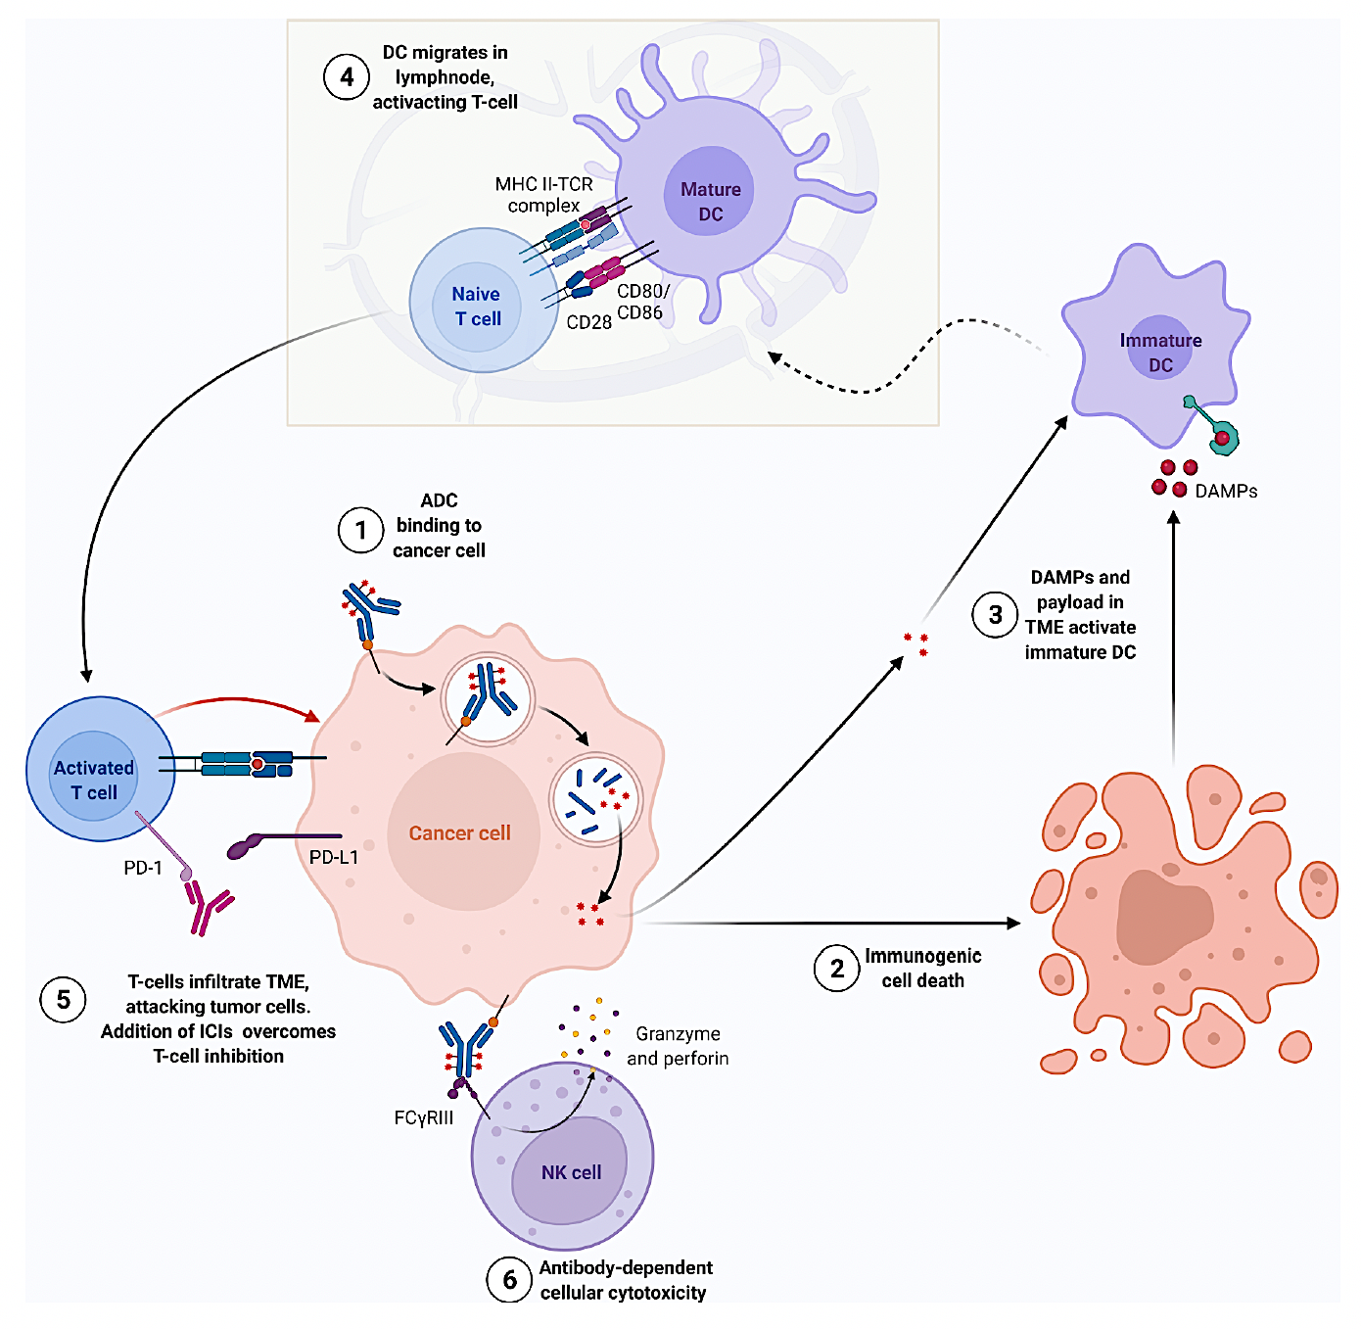
Rationale for Combining Immunotherapy and ADCs
Immunogenic cell death
↑ ADCC
↑ T-cell infiltration
Courtesy of Sara M Tolaney, MD, MPH
Nicolo E et al, Cancer Treatment Reviews 2022

Slide 40
1L Treatment of PD-L1+ mTNBC
ASCENT-04
TROPION-Breast05
Patient Population
PD-L1+ (CPS ≥10) untreated, inoperable/locally advanced or metastatic TNBC
≥6 months since therapy in curative setting (prior PD-L1 use allowed in this setting)
Patient Population
PD-L1+ (CPS ≥10) untreated, inoperable/locally advanced or metastatic TNBC
DFI ≥6 months since therapy in curative setting (DFI 6–12 months capped at 20%)
Prior PD-(L)1 use allowed in this setting
History of ILD/pneumonitis and clinically significant corneal disease excluded
R
1:1
SG + pembrolizumab
Dato-DXd + durvalumab
R
1:1
Study Design
Study Design
Dato-DXd monotherapy
N=440
TPC chemo + pembrolizumab
(gem + carbo; pac; nab-pac)
N~625
TPC chemo + pembrolizumab
(gem + carbo; pac; nab-pac)
Stratification Factors
De novo vs recurrent disease
Geographic region
Prior exposure to immunotherapy
Stratification Factors
Geographic region
Prior PD-(L)1
De novo vs prior DFI 6–12 months vs prior DFI >12 months
Crossover to SG is allowed after BICR-verified disease progression
Key Endpointsª
Key Endpoints
Primary: PFS by BICR in ITT population
Secondary: OS, ORR, PROs
Primary: PFS by BICR
Secondary: OS, PFS (per investigator), ORR, safety, PROs
STILL ENROLLING
Courtesy of Sara M Tolaney, MD, MPH

Slide 41
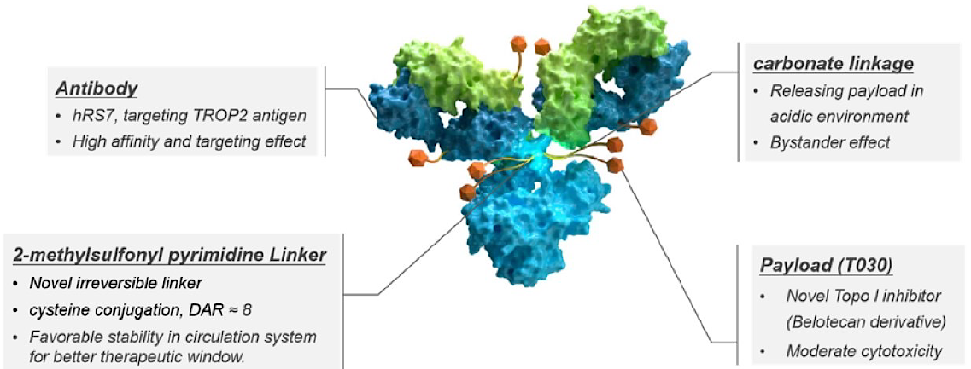
Novel ADCs: TROP2 ADC with Topo1 Payload: Sacituzumab Tirumotecan
Sacituzumab Tirumotecan (Sac-TMT)
anti-Trop2 ADC
 | OptiTROP-Breast 01
 | Sac-TMT vs TPC (2L+) in mTNBC
PFS | 6.7 vs 2.5 mo (HR 0.32)
OS | NR vs 9.4 mo (HR 0.53)
Approved in China for TNBC
OptiTROP-Breast05, 1L mTNBC (n=41), mPFS=13.1 mo
Xu B, et al. J Clin Oncol. 2024;42(Suppl_16): Abstract 104.
Yin Y et al, J Clin Oncol 2025; 43 (Suppl_16): Abstract 1019
Courtesy of Sara M Tolaney, MD, MPH

Slide 42
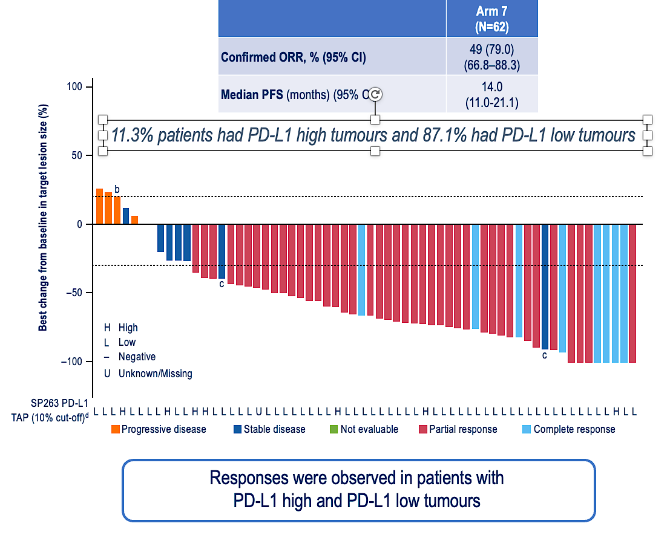
Could an ADC Allow Checkpoint Inhibition to Have Benefit in Metastatic TNBC that is PD-L1-negative?
BEGONIA: Dato-DXd+ durvalumab
DIAMOND (Ph 2):
Dato-DXd +/- durvalumab in PD-L1- mTNBC
Previously untreated, locally advanced inoperable or metastatic TNBC
PD-L1- (CPS <10)
No prior neoadj/adj IO within 6 mo
Dato-DXd
1:1
N=140
Dato-DXd + durvalumab
Stratification Factors:
De novo OR DFI≤12 mo OR DFI>12 mo
Schmid P et al, ESMO 2025
NCT06954480
PI:Peter Schmid
Courtesy of Sara M Tolaney, MD, MPH

Slide 43
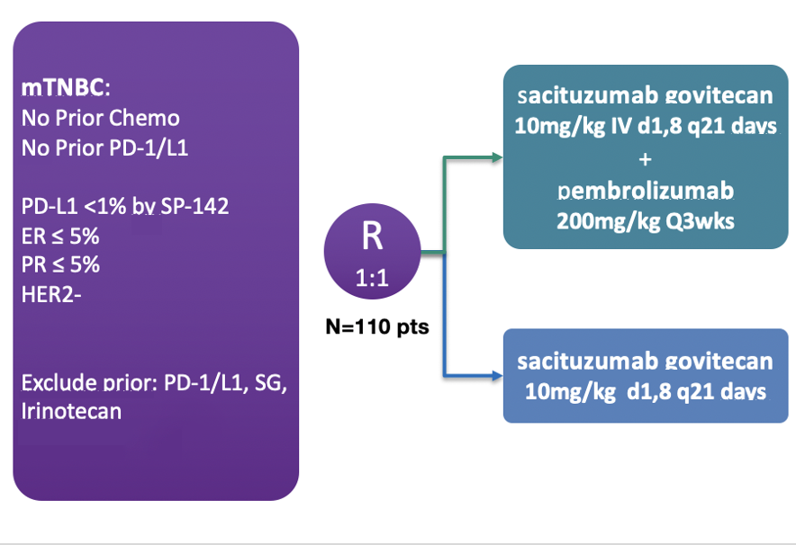
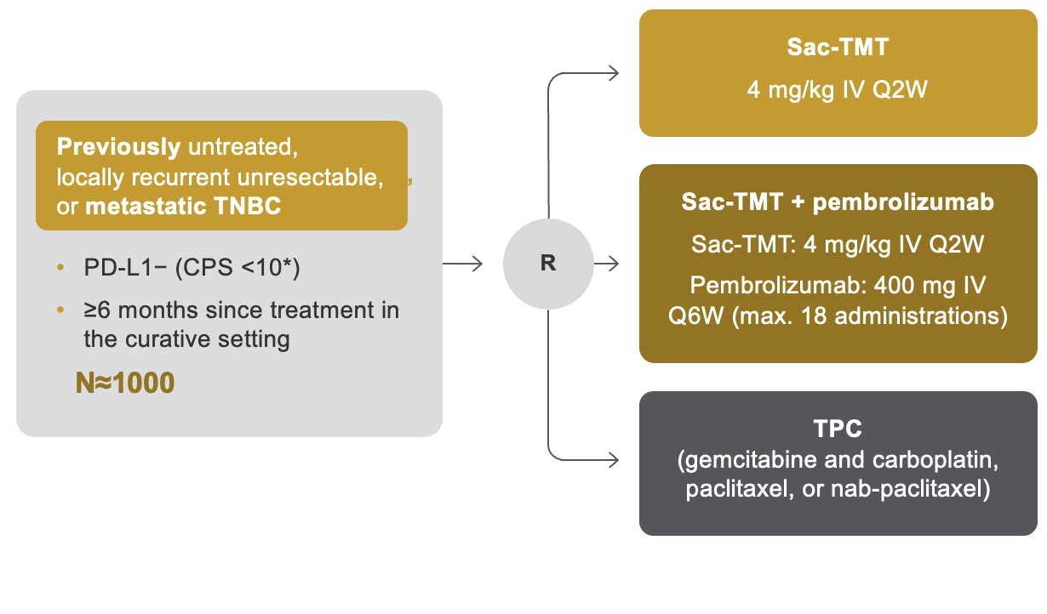
Could an ADC Allow Checkpoint Inhibition to Have Benefit in Metastatic TNBC that is PD-L1-negative?
SACI IO TNBC (Ph 2):
SG +/- pembro in PD-L1- 1L mTNBC
TroFuse-011 (Ph 3):
Sac-TMT+/- pembro vs TPC in PD-L1- 1L mTNBC
NCT04468061 PI: Ana Garrido-Castro
NCT06841354
Courtesy of Sara M Tolaney, MD, MPH

Slide 44
New Potential Treatment Algorithm for mTNBC
PD-L1-positive
PD-L1-negative
1L
Sacituzumab govitecan + Pembrolizumab
Datopotamab deruxtecan
Sacituzumab govitecan
Olaparib or talazoparib (if BRCAm)
Olaparib or talazoparib
(if BRCAm)
Sacituzumab
govitecan
T-DXd
(if HER2-low)
Chemotherapy
(e.g., taxane, platinum)
2L
Sacituzumab govitecan
T-DXd
(if HER2-low)
Olaparib or talazoparib
(if BRCAm)
Chemotherapy
(e.g., eribulin, capecitabine, gemcitabine, vinorelbine)
Biomarker positive*
(TMB-H, MSI-H/dMMR, NTRK fusion, RET fusion)
3L+
*TMB-H: Pembrolizumab; MSI-H: Pembrolizumab, Dostarlimab; NTRK fusion: Larotrectinib, Entrectinib, Repotrectinib; RET fusion: Selpercatinib. Slide courtesy of Ana Garrido-Castro
Courtesy of Sara M Tolaney, MD, MPH

Slide 45
Questions?

Slide 46
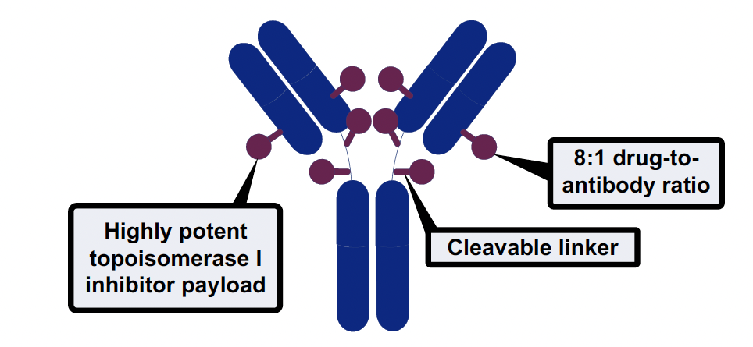
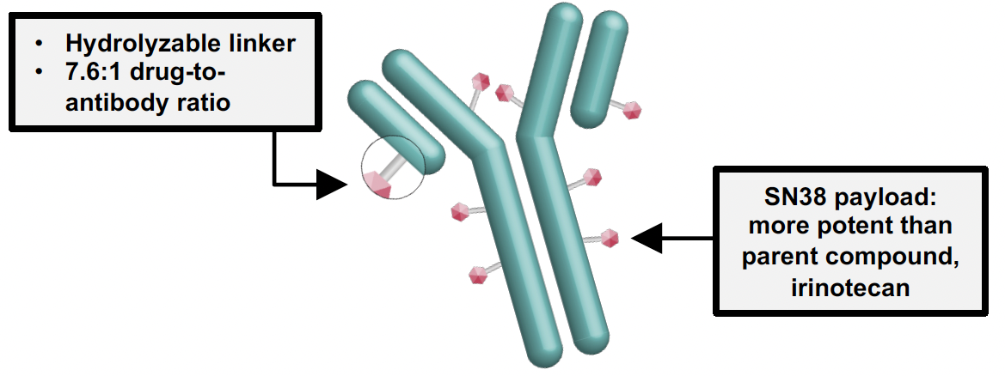


Available ADCs for HR+/HER2- MBC in 2026
Trastuzumab deruxtecan (T-DXd)
anti-HER2 ADC
Sacituzumab Govitecan (SG)
anti-Trop2 ADC
Datopotamab Deruxtecan (Dato-DXd)
anti-Trop2 ADC
~90% (HER2-low, -ultralow)
~100% (no biomarker)
~100% (no biomarker)
Courtesy of Sara M Tolaney, MD, MPH

Slide 47
TROPICS-02
SG demonstrated a statistically significant and clinically meaningful improvement in both PFS and OS vs chemotherapy in 3L and later HR+/HER2-negative mBC^{1,2}
NCT03901339^{1,3}
Treatment was continued until progression or unacceptable toxicity
PFS¹*,†
BICR analysis | SG (n=272) | Chemotherapy (n=271)
No. of events | 170 | 159
6-mo PFS rate | 46% | 30%
12-mo PFS rate | 21% | 7%
Median PFS, mo (95% CI) | 5.5 (4.2−7.0) | 4.0 (3.1−4.4)
Stratified HR (95% CI) | 0.66 (0.53−0.83)
Stratified log rank P value | 0.0003
Metastatic or locally recurrent inoperable HR+/HER2-negative breast cancer that progressed after*
At least 1 endocrine therapy, taxane, and CDK4/6 inhibitor in any setting
At least 2, but no more than 4, lines of chemotherapy for metastatic disease
Measurable disease by RECIST 1.1
Sacituzumab govitecan
10 mg/kg IV days 1 and 8, every 21 days n=272
100
Primary endpoint:
PFS by BICR
Secondary endpoints:
OS
ORR, DOR, CBR by LIR and BICR
PRO
Safety profile
90
80
70
60
50
Continue treatment until progression or unacceptable toxicity
40
30
20
10
R
1:1
0
0
3
6
9
12
15
18
21
24
No. at risk
Time, months
SG
272
148
82
44
22
12
6
3
0
TPC† (capecitabine, vinorelbine, gemcitabine, or eribulin) n=271
Chemotherapy
271
105
41
17
4
1
1
0
OS²*,†
 | SG (n=272) | TPC (n=271)
Median OS, mo (95% CI) | 14.4 (13.0−15.7) | 11.2 (10.1−12.7)
Stratified HR (95% CI) | 0.79 (0.65−0.96)
Stratified log rank P value | 0.020
100
90
80
70
OS rate, % (95% CI)
 | SG (n=272) | TPC (n=271)
12-mo | 61 (55−66) | 47 (41−53)
60
50
40
Stratification factors
Visceral metastases (yes/no)
Endocrine therapy in metastatic setting ≥6 months (yes/no)
Prior lines of chemotherapies (2 vs 3/4)
30
20
10
0
0
3
6
9
12
15
18
21
24
27
30
33
36
No. of patients still at risk (events)
Time, months
SG
272 (0)
252 (16)
221 (44)
197 (67)
160 (104)
120 (137)
80 (158)
53 (173)
31 (183)
20 (188)
4 (190)
2 (190)
0 (191)
Chemotherapy
271 (0)
246 (16)
196 (64)
164 (95)
122 (137)
92 (163)
70 (174)
49 (183)
23 (193)
13 (196)
5 (198)
1 (199)
0 (199)
Courtesy of Sara M Tolaney, MD, MPH
*Disease histology based on the ASCO/CAP criteria; †Single-agent standard-of-care treatment of physician’s choice was specified prior to randomisation by the investigator. ASCO/CAP, American Society of Clinical Oncology/College of American Pathologists; BICR, blinded independent central review; CBR, clinical benefit rate; CDK, cyclin-dependent kinase; CI, confidence interval; DOR, duration of response; HER2-negative, human epidermal growth factor receptor 2-negative; HR, hazard ratio; HR+, hormonal receptor-positive; ITT, intent-to-treat; IV, intravenously; LIR, local investigator review; mo, months; ORR, objective response rate; OS, overall survival; PFS, progression-free survival; PRO, patient-reported outcome; R, randomised; RECIST, Response Evaluation Criteria in Solid Tumours; SG, sacituzumab govitecan; TPC, treatment of physician’s choice. 1. Adapted from Rugo HS, et al. J Clin Oncol. 2022;40:3365−3376 (inc. Suppl); 2. Adapted from Rugo HS, et al. Lancet 2023; 402: 1423–1433. 3. ClinicalTrials.gov, NCT03901339: https://www.clinicaltrials.gov/study/NCT03901339. Accessed: July 2025.

Slide 48
TROPiCS-02
SG significantly improved ORR,^{1,2} and significantly extended TTD of Global Health Status and fatigue vs TPC²*
ORR (%)^{1,2}
Sacituzumab govitecan (n=272)
21%
(CR: 1.0%; PR: 20.0%)
Single-agent chemotherapy (n=271)
14%
(CR: 0; PR: 14.0%)
TTD^{2–4,*} | Patients SG/TPC, n/n | SG median TTD, mo (95% CI) | TPC median TTD, mo (95% CI) | Stratified HR (95% CI) | Stratified Log Rank P value
Global health status QoL | 234/207 | 4.3 (3.1–5.7) | 3.0 (2.2–3.9) | 0.75 (0.61–0.92) | 0.006
Fatigue | 234/205 | 2.2 (1.6–2.8) | 1.4 (1.1–1.9) | 0.73 (0.60–0.89) | 0.002
Pain | 236/210 | 3.8 (N/A) | 3.5 (N/A) | 0.92 (0.75–1.13) | 0.42
*HRQoL was formally tested as part of the testing hierarchy in TROPiCS-02.⁴ CI, confidence interval; CR, complete response; HR, hazard ratio; mo, months; N/A, not available; OR, overall response; ORR, objective response rate; PD, progressive disease; PR, partial response; QoL, quality of life; SD, stable disease; SG, sacituzumab govitecan; TPC, treatment of physician’s choice; TTD, time to deterioration.
1. Adapted from Rugo HS, et al. J Clin Oncol. 2022; 40(29):3365‒3376; 2. Rugo HS, et al. Lancet 2023; 402: 1423–1433; 3. Rugo HS, et al. Lancet 2023; 402: 1423–1433 (Suppl); 4. Rugo HS, et al. Oncologist. 2024; 29: 768–779.
Courtesy of Sara M Tolaney, MD, MPH

Slide 49
TROPiCS-02
SG had a manageable safety profile that was consistent with previous studies¹
Selected TRAEs*^{2,3} |  | SG (n=268) |  | TPC (n=249)
 |  | All Grade, % | Grade ≥3, % | All Grade, % | Grade ≥3, %
Hematologic | Neutropenia† | 71 | 52 | 55 | 39
 | Anaemia‡ | 37 | 7 | 28 | 3
 | Thrombocytopenia§ | 6 | <1 | 16 | 4
Gastrointestinal | Diarrhea | 62 | 10 | 23 | 1
 | Nausea | 59 | 1 | 35 | 3
 | Vomiting | 24 | 1 | 16 | 2
Other | Alopecia | 48 | 0 | 18 | 0
 | Fatigue | 39 | 6 | 33 | 4
TEAEs associated with/leading to:^{1,3}
n(%) | Sacituzumab govitecan (n=268) | TPC (n=249)
Treatment discontinuation | 17 (6) | 11 (4)
Dose reductions | 90 (34) | 82 (33)
Treatment-related leading to death** | 1 (<1) | 0
SG: no events TPC: 1%
ILD events⁴
Neutropenia and diarrhoea were the most common treatment-related AEs
Assessed in the safety population of patients who received ≥1 dose of study treatment.¹ *Patients may report more than one event per preferred term. AEs were coded using Medical Dictionary for Regulatory Activities v25.0, and AE severity was graded per National Cancer Institute Common Terminology Criteria for Adverse Events v 5.0. †Combined preferred terms of neutropenia and neutrophil count decreased. ‡Combined preferred terms of anaemia, hemoglobin decreased, and red blood cell count decreased. §Combined preferred terms of “thrombocytopenia” and “platelet count decreased”;² **Of 6 TEAEs leading to death, only 1 was considered by the investigator as treatment-related (septic shock due to neutropenic colitis). The other 5 were: COVID-19 pneumonia, pulmonary embolism, pneumonia, nervous system disorder, and arrhythmia. Upon detailed review of the TEAEs leading to death, there were no patterns identified.³ AE, adverse event; ILD, interstitial lung disease; LVD, left ventricular dysfunction; TPC, treatment of physician’s choice; TRAE, treatment-related adverse event; TEAE, treatment-emergent adverse event.
1. Adapted from Rugo HS, et al. Lancet 2023; 402: 1423–1433. 2. Rugo HS, et al. Lancet 2023; 402: 1423–1433 (Suppl); 3. Tolaney S, et al. ASCO 2023. Abstract #1003. 4. Rugo HS, et al. J Clin Oncol. 2022;40:3365−3376.
Courtesy of Sara M Tolaney, MD, MPH

Slide 50
Dato-DXd vs T-DXd
Targets Trop2 like SG
Same payload-linker as T-DXd
Same schedule as T-DXd (Q3W)
Lower DAR as other ADCs DAR 4, vs 8 for SG and T-DXd
Same half-life as T-DXd
5 days, vs 1 day for SG
Courtesy of Sara M Tolaney, MD, MPH

Slide 51
TROPION-Breast01
Dato-DXd demonstrated significant PFS benefit, but did not show a significant difference in OS vs ICC^{1,2}
NCT02574455²
PFS¹ (%)
Dato-DXd (n=365)
 | Dato-DXd | ICC
Median PFS, months (95% CI) | 6.9 (5.7–7.4) | 4.9 (4.2–5.5)
Hazard ratio (95% CI) | 0.63 (0.52–0.76)
P value | <.0001
Key inclusion criteria:
Patients with HR+/HER2-negative breast cancer* (HER2-negative defined as IHC 0/1+/2+; ISH negative)
Previously treated with 1–2 lines of chemotherapy (inoperable/ metastatic setting)
Experienced progression on ET and for whom ET was unsuitable
ECOG PS 0 or 1
Dato-DXd
6 mg/kg IV Day 1 Q3W
(n=365)
Dual primary endpoints:
PFS by BICR per RECIST v1.1, and OS
Key secondary endpoints:
ORR, PFS (investigator assessed), TFST,² Safety,² PROs²
Exploratory PRO endpoints²
1.0
ICC (n=367)
0.9
0.8
0.7
53.3%
0.6
Probability of PFS
0.5
37.5%
0.4
38.5%
25.5%
0.3
0.2
18.7%
R
1:1
0.1
14.6%
Number at risk
0
3
6
9
12
15
Time from randomisation (months)
Investigator’s choice of chemotherapy (ICC)
as per protocol directions†
(eribulin mesylate D1,8 Q3W; vinorelbine D1,8 Q3W; gemcitabine D1,8 Q3W; capecitabine D1–14 Q3W)
(n=367)
Dato-DXd
365
249
158
66
15
4
ICC
367
205
93
26
8
1
OS² (%)
 | Dato-DXd | ICC
Median OS, months (95% CI) | 18.6 (17.3–20.1) | 18.3 (17.3–20.5)
Hazard ratio (95% CI) | 1.01 (0.83–1.22)
1.0
0.9
0.8
0.7
0.6
Probability of OS
0.5
Dual primary OS did not reach statistical significance
0.4
0.3
0.2
0.1
Number at risk
0
3
6
9
12
15
18
21
24
27
30
33
36
Stratification factors
Lines of chemotherapy (1 vs 2)
Geographic location (USA/Canada/Europe vs other geographic regions)
Previous CDK4/6 inhibitor (yes vs no)
Time from randomisation (months)
Dato-DXd
365
349
331
299
259
227
180
118
49
12
1
ICC
367
335
309
283
249
213
175
123
51
9
1
*Per American Society of Clinical Oncology/College of American Pathologists (ASCO/CAP) guidelines;² †ICC was administered as follows: eribulin mesylate, 1.4 mg/m² IV on Days 1 and 8, Q3W; capecitabine, 1000 or 1250 mg/m² orally twice daily on Days 1 to 14, Q3W (dose per standard institutional practice); vinorelbine, 25 mg/m² IV on Days 1 and 8, Q3W; or gemcitabine, 1000 mg/m² IV on Days 1 and 8, Q3W.²
BICR, blinded independent central review; CDK4/6, cyclin-dependent kinase 4/6; CI, confidence interval; D, day; Dato-DXd, datopotamab deruxtecan; ECOG PS, Eastern Cooperative Oncology Group performance status; ET, endocrine therapy; HER2, human epidermal growth factor receptor 2; HR, hormone receptor; ICC, investigator’s choice of chemotherapy; IHC, immunohistochemistry; ISH, in situ hybridisation; IV, intravenous; ORR, objective response rate; OS, overall survival; PD, progressive disease; PFS, progression-free survival; PRO, patient-reported outcome; Q3W, every 3 weeks; RECIST, Response Evaluation Criteria in Solid Tumours; TFST, time to first subsequent therapy.
1. Bardia A, et al. J Clin Oncol. 2025;43:285–296; 2. Pistilli B, et al. Oral presentation. ESMO On Air Webinar series. 12 February 2025.
Courtesy of Sara M Tolaney, MD, MPH

Slide 52
ASCENT-07: Phase 3, Randomized, Open-Label Study
Locally advanced unresectable or metastatic HR+/HER2− BC:
No prior chemotherapy for locally advanced or metastatic HR+/HER2− BC
Measurable disease per RECIST v1.1
Must have at least 1 of the following:
Progression on ≥ 2 previous lines of ET ± targeted therapy for mBCª
Progression < 6 mo of starting 1L ET ± CDK4/6i for mBC
Recurrence < 24 mo of starting adjuvant ET + CDK4/6i and no longer a candidate for additional ET for mBC
End points
Primary
PFS by BICR
Key Secondary
OS
ORR by BICR
QOL
Other Secondary
PFS by INV
ORR by INV
DOR by BICR and INV
Safety
Sacituzumab govitecan 10 mg/kg IV
Days 1 and 8, every 21 days
n = 456
N = 690
R 2:1
Treatment of physician’s choice (capecitabine, paclitaxel, nab-paclitaxel)^{b}
n = 234
Treatment continued until disease progression^{c} or unacceptable toxicity
Stratification factors:
Duration of prior CDK4/6i^{d} for mBC (none vs ≤ 12 mo vs > 12 mo)
HER2 IHC (HER2 IHC 0 vs HER2 IHC-low [IHC 1+ or IHC 2+/ISH–])
Geographic region (US/Canada/UK/EU vs ROW)
Courtesy of Sara M Tolaney, MD, MPH
ClinicalTrials.gov identifier: NCT05840211.
ªDisease recurrence while on the first 24 months of starting adjuvant ET will be considered a line of therapy; these participants will only require 1 line of ET in the metastatic setting. ^{b}Paclitaxel 80 mg/m² or nab-paclitaxel 100 mg/m² IV on days 1, 8, and 15 of 28-day cycles, or capecitabine oral 1000 or 1250 mg/m² twice daily for first 2 weeks of 21-day cycles. ^{c}Per RECIST v1.1. ^{d}Enrollment of CDK4/6i-naïve participants was capped at 10%.
1L, first-line; BICR, blinded independent central review; CDK4/6i, cyclin-dependent kinase 4/6 inhibitor; DOR, duration of response; ET, endocrine therapy; EU, European Union; HER2−, human epidermal growth factor receptor 2 negative; HR+, hormone receptor positive; IHC, immunohistochemistry; INV, investigator assessment; ISH, in situ hybridization; IV, intravenously; mBC, metastatic breast cancer; mo, months; ORR, objective response rate; OS, overall survival; PFS, progression-free survival; QOL, quality of life; R, randomized; RECIST v1.1, Response Evaluation Criteria in Solid Tumors, version 1.1; ROW, rest of the world.

Slide 53
Primary End Point: Progression-Free Survival by BICR
 | SG (n = 456) | TPC (n = 234)
Median PFS, mo (95% CI) | 8.3 (8.1-10.3) | 8.3 (6.9-10.0)
Stratified HR (95% CI) | 0.85 (0.69-1.05)
P-valueª | 0.130
6-month PFS rate, % (95% CI) | 71 (66-75) | 64 (57-71)
12-month PFS rate, % (95% CI) | 40 (35-45) | 37 (29-44)
100
90
80
70
60
Probability of progression-free survival (%)
50
40
30
20
10
0
0
2
4
6
8
10
12
14
16
18
20
22
24
Time (months)
No. at risk (events)
SG | 456 (0) | 415 (25) | 335 (86) | 285 (126) | 219 (179) | 168 (216) | 136 (242) | 92 (260) | 49 (272) | 17 (278) | 4 (282) | 0 (282)
TPC | 234 (0) | 204 (16) | 159 (49) | 119 (74) | 90 (90) | 63 (108) | 52 (118) | 30 (131) | 14 (135) | 5 (137) | 2 (137) | 0 (137)
With a hazard ratio of 0.85, PFS by BICR did not meet statistical significance
ªTwo-sided P-value from stratified log-rank test.
BICR, blinded independent central review; HR, hazard ratio; mo, months; PFS, progression-free survival; SG, sacituzumab govitecan; TPC, treatment of physician’s choice.
Courtesy of Sara M Tolaney, MD, MPH

Slide 54
Secondary End Point: Progression-Free Survival by Investigator Assessment
 | SG (n = 456) | TPC (n = 234)
Median PFS, mo (95% CI) | 8.4 (8.2-9.7) | 6.4 (6.0-8.1)
Stratified HR (95% CI) | 0.78 (0.64-0.93)
Nominal P-valueª | 0.008
6-month PFS rate, % (95% CI) | 69 (64-73) | 58 (51-64)
12-month PFS rate, % (95% CI) | 36 (32-41) | 30 (24-36)
100
90
80
70
60
Probability of progression-free survival (%)
50
40
30
20
10
0
0
2
4
6
8
10
12
14
16
18
20
22
24
Time (months)
No. at risk (events)
SG | 456 (0) | 417 (30) | 345 (96) | 298 (138) | 242 (190) | 188 (242) | 150 (277) | 98 (306) | 58 (321) | 24 (326) | 5 (330) | 0 (330)
TPC | 234 (0) | 203 (23) | 160 (62) | 124 (94) | 92 (118) | 71 (139) | 60 (150) | 34 (163) | 15 (170) | 8 (172) | 2 (173) | 0 (174)
There was a numerical improvement in investigator-assessed PFS with SG versus TPC
ªTwo-sided P-value from stratified log-rank test
HR, hazard ratio; mo, months; PFS, progression-free survival; SG, sacituzumab govitecan; TPC, treatment of physician’s choice.
Courtesy of Sara M Tolaney, MD, MPH

Slide 55
Overall Survival at Primary Analysis (27% maturity)
100
90
80
70
60
 | SG (n = 456) | TPC (n = 234)
Median OS, mo (95% CI) | NR (NR-NR) | NR (19.7-NR)
HR (95% CI) | 0.72 (0.54-0.97)
Nominal P-valueª | 0.029
Probability of overall survival (%)
50
40
61% of participants in the TPC group received an ADC following treatment discontinuation^{b}
30
20
10
0
0
2
4
6
8
10
12
14
16
18
20
22
24
26
28
30
Time (months)
No. at risk (events)
SG | 456 (0) | 442 (12) | 436 (17) | 423 (30) | 402 (48) | 385 (64) | 368 (79) | 315 (95) | 206 (101) | 112 (109) | 43 (111) | 10 (112) | 4 (112) | 2 (112) | 0 (112)
TPC | 234 (0) | 229 (4) | 225 (7) | 217 (15) | 205 (26) | 192 (39) | 181 (50) | 145 (61) | 95 (65) | 51 (71) | 19 (74) | 4 (75) | 0 (75)
While the OS data were not mature, an early trend was observed favoring SG over TPC
Median follow-up was 15.4 months. ªThe nominal P-value was reported as a descriptive measure of the observed treatment effect and does not support statistical significance. ^{b}97/160 participants in the TPC group received at least one ADC as subsequent therapy after treatment discontinuation.
ADC, antibody drug conjugate; HR, hazard ratio; mo, months; NR, not reached; OS, overall survival; SG, sacituzumab govitecan; TPC, treatment of physician’s choice.
Courtesy of Sara M Tolaney, MD, MPH

Slide 56
OptiTROP-Breast02 Study Design
Randomized, multi-center, open-label trial (NCT06081959)
Key Eligibility
Previously treated with 1-4 lines of chemotherapy
Received at least one endocrine, CDK 4/6 inhibitor, and taxane in any setting
ECOG PS 0 or 1
Sac-TMT
5 mg/kg IV, Q2W
Primary endpoints
PFS by BICR per RECIST v1.1
Secondary endpoints
PFS (investigator assessed)
OS
ORR, DCR
DOR
R
1:1
N=399
ICC
(eribulin, capecitabine,
gemcitabine or vinorelbine)
Stratification Factors:
1. Lines of chemotherapy (1 vs >1)
2. HER2 status (zero vs low) ª
3. Endocrine therapy ≥ 6 months (yes vs no)^{b}
Statistical considerations:
Pre-specified interim analysis for PFS: all randomized subjects who had the opportunity to complete 1 post-baseline tumor assessment and at least 188 PFS events occurred.
Pre-specified interim analysis for OS: approximately 165 OS events occurred.
O`Brien-Fleming α-spending as implemented by the Lan-DeMets method.
ª HER2-zero: No staining, or barely perceptible staining with a proportion > 0% but ≤ 10%; HER2-low defined as IHC1+, or IHC2+ and ISH-negative. ^{b} If no prior endocrine therapy in advanced setting, assess if (neo)adjuvant endocrine therapy duration ≥ 2 years.
BICR, blinded independent central review; CDK 4/6, cyclin dependent kinase 4/6; DCR, disease control rate; DOR, duration of response; ECOG, Eastern Cooperative Oncology Group; ICC, investigator's choice of chemotherapy; IHC, immunohistochemistry; OS, overall survival; Q2W, every 2 weeks; RECIST, Response Evaluation Criteria in Solid Tumors.
PRESENTED BY : Ying Fan, MD
Courtesy of Sara M Tolaney, MD, MPH

Slide 57
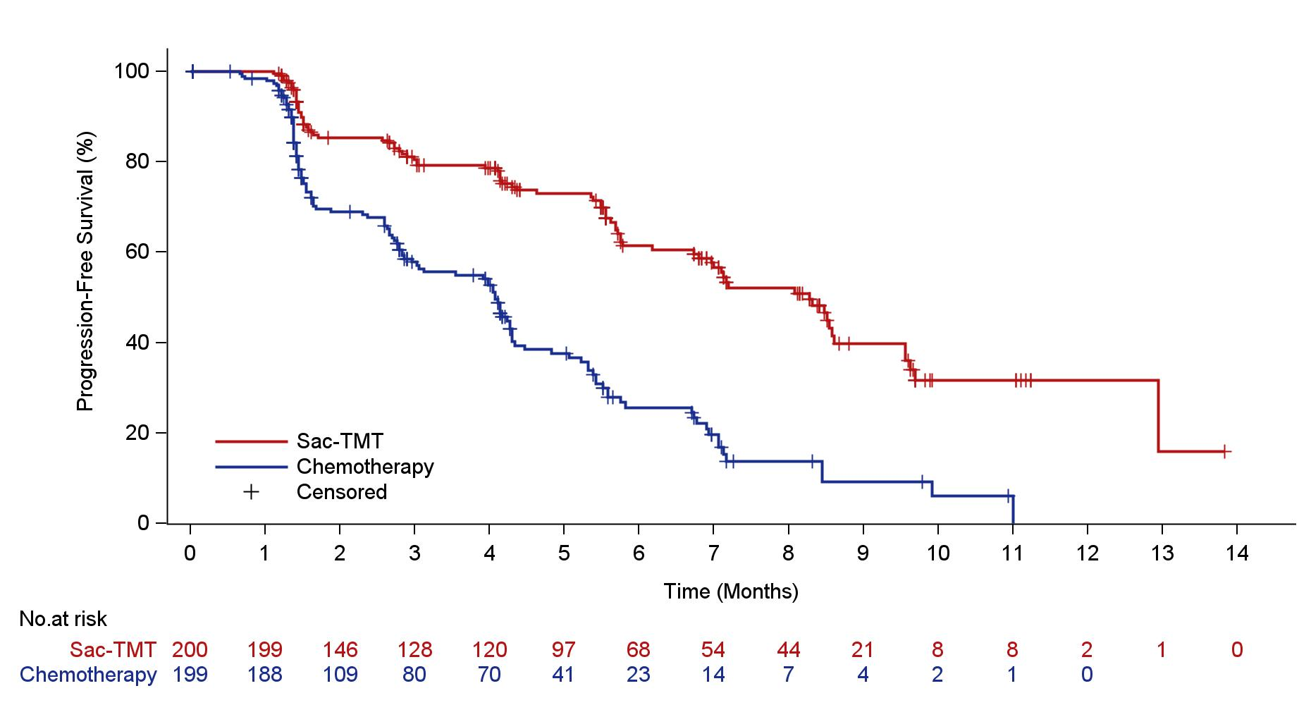
Progression-Free Survival by BICR
Sac-TMT significantly improved PFS over chemotherapy with 65% lower risk of disease progression or death.
100
 | Sac-TMT (n = 200) | Chemotherapy (n = 199)
PFS events，n (%) | 82 (41.0) | 121 (60.8)
Median PFS-mo (95% CI) | 8.3 (7.0, 8.6) | 4.1 (3.0, 4.3)
6-mo PFS rate, % (95% CI) | 61.4 (52.9, 68.8) | 25.7 (18.2, 33.8)
80
60
Progression-Free Survival (%)
HR 0.35 (95% CI: 0.26, 0.48) p＜0.0001*
40
mPFS: 4.1 mo
mPFS: 8.3 mo
20
Sac-TMT
Chemotherapy Censored
0
0
1
2
3
4
5
6
7
8
9
10
11
12
13
14
NO.at risk
Time (Months)
Sac-TMT
200 199 146 128 120 97 68 54 44 21 8 8 2 1 0
Chemotherapy
199 198 109 80 70 41 23 14 7 4 2 1 0
The investigator-assessed PFS was consistent with BICR: HR 0.39 (95% CI: 0.30, 0.52)
* Pre-specified efficacy boundary (one side alpha level of 0.010 determined by the O‘Brien-Fleming alpha spending function).
PRESENTED BY : Ying Fan, MD
Courtesy of Sara M Tolaney, MD, MPH

Slide 58
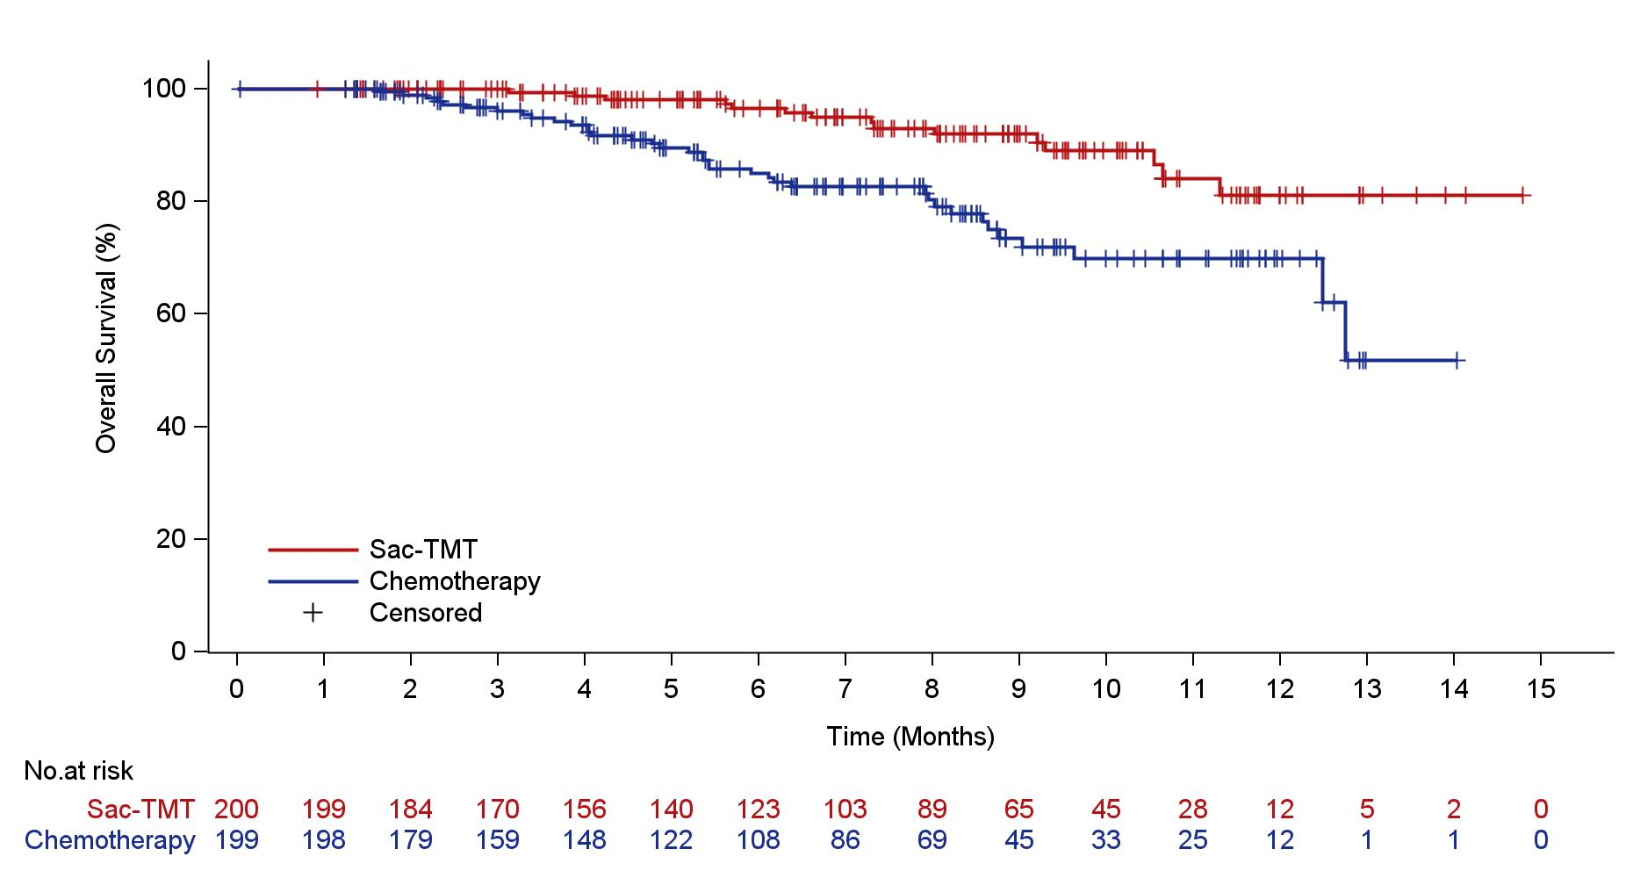
Overall Survival
Survival benefit trend with sac-TMT has been observed at time of PFS interim analysis. The study is continuing to the pre-specified interim analysis for OS.
100
80
60
overall survival (%)
40
 | Sac-TMT (n = 200) | Chemotherapy (n = 199)
OS events, n (%) | 15 (7.5) | 37 (18.6)
HR (95% CI) | 0.33 (0.18, 0.61)
20
Sac-TMT
Chemotherapy
Censored
0
0 1 2 3 4 5 6 7 8 9 10 11 12 13 14 15
Time (Months)
No.at risk
Sac-TMT
200 199 184 170 156 140 123 103 89 65 45 28 12 5 2 0
Chemotherapy
199 198 179 159 148 122 108 86 69 45 33 25 12 1 1 0
CI, confidence interval; HR, hazard ratio; OS, overall survival.
PRESENTED BY : Ying Fan, MD
Courtesy of Sara M Tolaney, MD, MPH

Slide 59
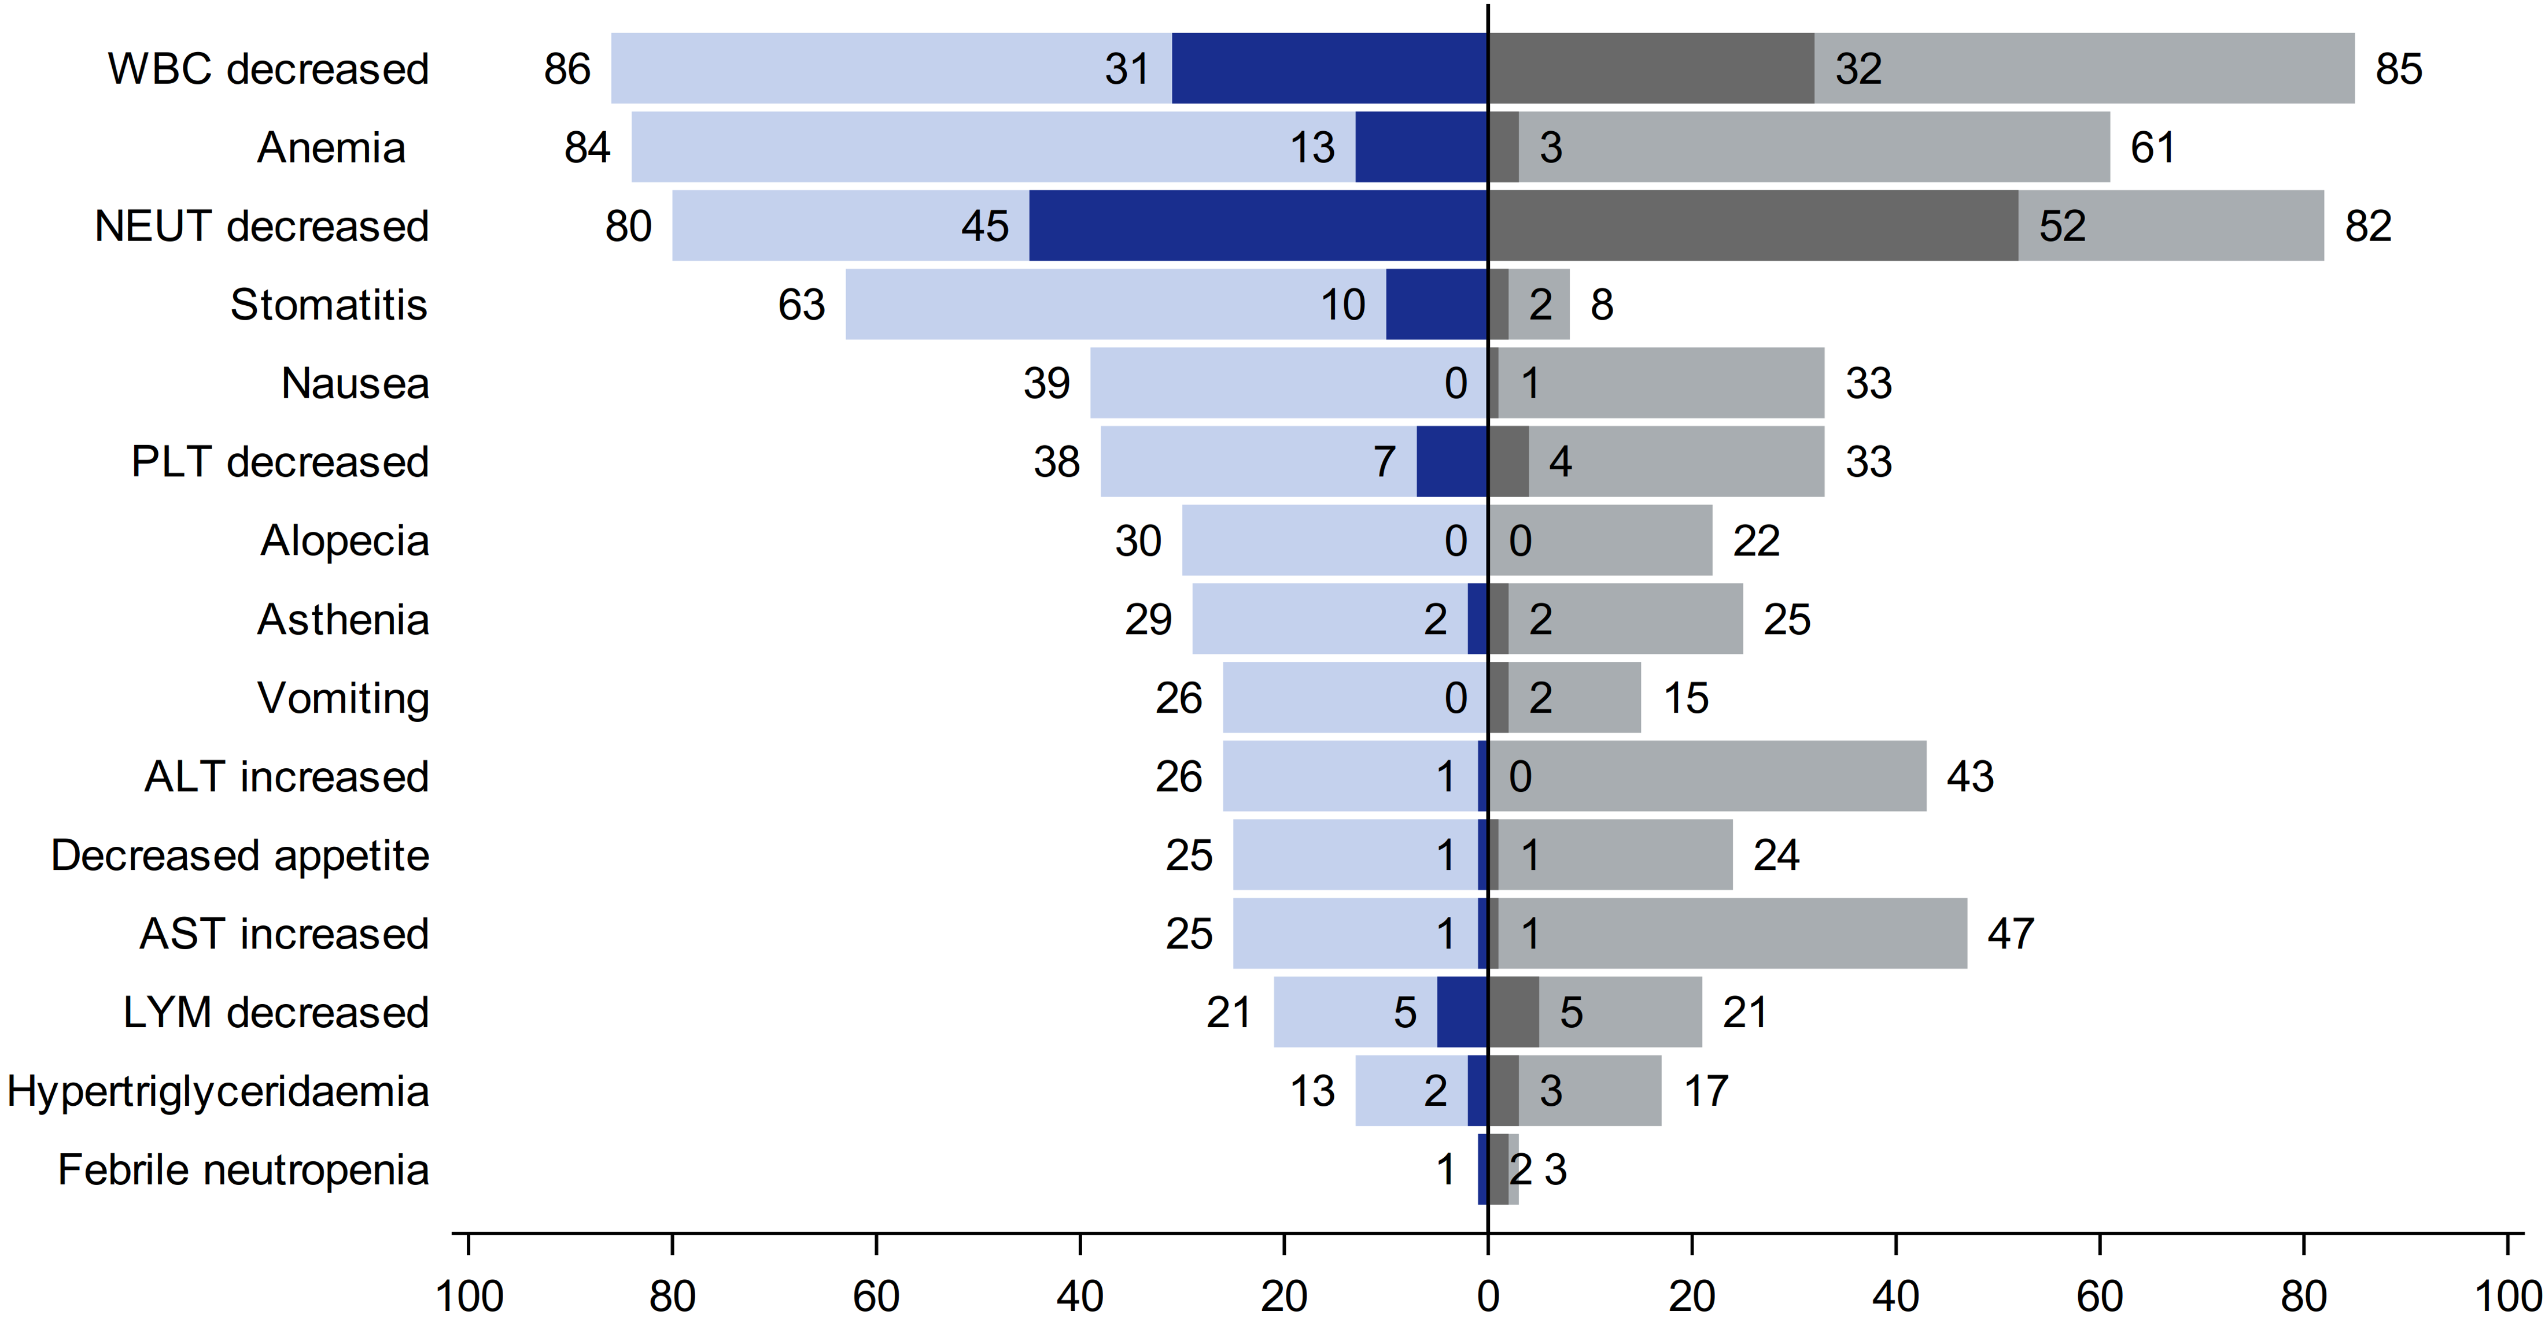
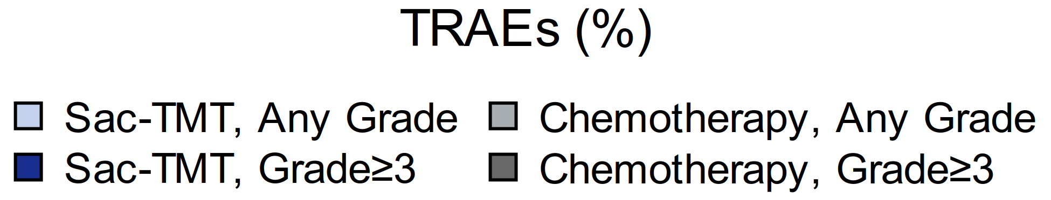
Common TRAEs*
The most common TRAEs for both sac-TMT and chemotherapy were hematologic toxicities.
Stomatitis was the common TRAE seen with sac-TMT and predominantly grade 1 or 2 with no case leading to discontinuation.
Grade ≥ 3 diarrhea occurred in 1.0% of patients in sac-TMT.
Pneumonitis occurred in 1.5% and 1.0% of patients (all grade 1-2) in sac-TMT and chemotherapy, respectively.
* Summary of TRAEs that occurred in either treatment group at an incidence of ≥ 20% for any grade or ≥ 2% for grade ≥ 3.
ALT, alanine aminotransferase; AST, aspartate aminotransferase; LYM, lymphocyte count; NEUT, neutrophil count; PLT, platelet count; WBC, white blood cell.
PRESENTED BY : Ying Fan, MD
Courtesy of Sara M Tolaney, MD, MPH

Slide 60
TROP2 ADCs in chemo-pretreated HR+/HER2- MBC: Phase 3 studies
ADC vs Chemo
 | OptiTROP-Breast 02 | ASCENT-07 | TROPION-Breast01 | TROPiCS-02
ADC Payload (MoA) | Sacituzumab tirumotecan Topo I Inhibitor | Sacituzumab govitecan Topo I inhibitor | Datopotamab deruxtecan Topo I Inhibitor | Sacituzumab govitecan Topo I Inhibitor
ADC-Target | TROP-2 | TROP2 | TROP-2 | TROP-2
N (ADC arm) | 200 | 690 | 365 | 272
Prior Chemo | 1-4 lines | 0 | 1-2 | 2-4
Prior CT lines in MBC | 2 (1-≥3) | 0 | 1 (1-2) | 3 (0-8)
Prior CDK 4/6inh | 100% | 91% | 82% | 98%
Primary Objective | PFS by BICR* | PFS by BICR | PFS by BICR & OS | PFS by BICR
ORR | 41.5% | 37% | 36.4% | 21%
PFS (HR & 95% CI) Median PFS (mo) | 0.35 (0.26-0.48) 8.3 mo | 0.85 (0.69-1.05) 8.3 mo | 0.63 (0.52-0.76) 6.9 mo | 0.66 (0.63-0.83) 5.5 mo
OS (HR & 95% CI) Median OS (mo) | 0.33 (0.18-0.61) NR | 0.72 (0.54-0.97) NR | 1.01 (0.83-1.22) 18.6 mo | 0.79 (0.65-0.96) 14.4 mo
Courtesy of Sara M Tolaney, MD, MPH
1. Fan Y, et al. ESMO 2025; 2. Modi S, et al. N Engl J Med 2022; 3. Pristilli B. et al. ESMO Virtual Plenary 2025; 4. Rugo H, et al. Lancet 2023 5. Jhaveri K et al, SABCS 2025

Slide 61
Current treatment algorithm for HR+/HER2- metastatic breast cancer
1L
Aromatase inhibitor + CDK4/6 inhibitor
Fulvestrant + Palbociclib + Inavolisib
(if PIK3CA mut + early relapse)
PI3K and ESR1 wild-type
ESR1 mut
PI3K pathway altered
2L
Fulvestrant + everolimus
Fulvestrant + abemaciclib
Elacestrant or Imlunestrant
Fulvestrant + capivasertib
Fulvestrant + alpelisib
(if PIK3CA mut)
AI or fulvestrant or tamoxifen
± targeted therapy
(if not previously received)
Elacestrant or Imlunestrant
(if ESR1 mut)
Olaparib or talazoparib
(if BRCA mut)
T-DXd
(if HER2-low/
ultralow)
Chemotherapy
(e.g., capecitabine, paclitaxel)
3L
Chemotherapy (e.g., capecitabine, paclitaxel, eribulin)
Olaparib or talazoparib
(if BRCA mut)
T-DXd
(if HER2-low/
ultralow)
Dato-DXd
Sacituzumab govitecan
Biomarker positive*
(TMB-H, MSI-H/dMMR, NTRK fusion, RET fusion)
4L+
*TMB-H: Pembrolizumab; MSI-H: Pembrolizumab, Dostarlimab; NTRK fusion: Larotrectinib, Entrectinib, Repotrectinib; RET fusion: Selpercatinib.
Abbreviations: HR, hormone receptor; HER2, human epidermal growth factor receptor 2; AI, aromatase inhibitor; T-DXd, trastuzumab deruxtecan; Dato-DXd, datopotamab deruxtecan; PI3K, phosphatidylinositol 3-kinase; mut, mutant; CT, chemotherapy; TMB-H, tumor mutational burden-high; MSI-H, microsatellite instability-high; dMMR, mismatch repair-deficient
Courtesy of Sara M Tolaney, MD, MPH

Slide 62
Questions?

