Slide 1

Year in Review: ADCs for Metastatic HER2- Breast Cancer
Sara M. Tolaney, MD, MPH
Division of Breast Oncology at Dana-Farber Cancer Institute

Slide 2
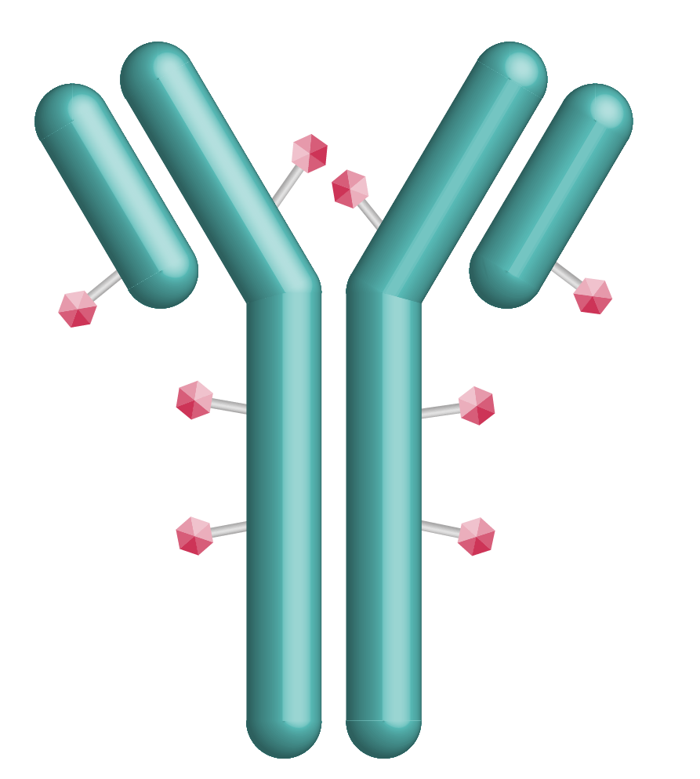

How To Approach Therapy for 1L mTNBC? TROP2 ADCs Moving Into The First Line Space
 | Sacituzumab govitecan (SG) | Datopotamab deruxtecan (Dato-DXd)
Antibody | hRS7 Humanized IgG1 mAb | MAAP-9001a Humanized IgG1 mAb
Payload | SN38 (DNA Topoisomerase I inhibitor) | DXd (DNA Topoisomerase I inhibitor)
Linker cleavage | Enzymatic and pH-dependent | Enzymatic
Bystander effect | Yes | Yes
DAR | 7.6 | 4
Half-life | 11-14h | ∼5 days
Dosing | D1, D8 of Q3W schedule | Q3W
Sands J et al, ASCO 2018; Okajima D et al. Mol Cancer Ther 2021

Slide 3
TROP2 ADC IN 1L mTNBC NOT CANDIDATE FOR PD-(L)1i
ASCENT-03
TROPION-Breast02
Previously untreated, locally advanced inoperable or metastatic TNBC
Not candidate for PD-(L)1 inhibitor:
PD-L1- (CPS <10) OR
PD-L1+ AND:
Received PD-(L)1 inhibitor in curative setting OR
Ineligible for PD-(L)1 inhibitor due to comorbidity
≥6 months since treatment in curative setting
Previously treated, stable CNS metastases allowed
Sacituzumab govitecan (10 mg/kg IV on
Days 1, 8 of 21-day cycles)
Previously untreated, locally recurrent inoperable or metastatic TNBC
Not candidate for PD-(L)1 inhibitor:
PD-L1- (CPS <10) OR
PD-L1+ AND
Relapsed after PD-(L)1 inhibitor for eBC OR
Ineligible for PD-(L)1 inhibitor due to comorbidity OR
No regulatory access to PD-(L)1 inhibitor
Any interval since treatment in curative setting (DFI ≤12 mo: ≤20%)
Stable brain metastasesª allowed
Datopotamab deruxtecan (6 mg/kg IV on
Day 1 of 21-day cycles)
1:1
1:1
*Crossover to SG allowed after BICR-verified PD
ICC (n=321)
paclitaxel or nab-paclitaxel
(if no prior taxane or neo-/adjuvant taxane + DFI >12 mo) OR capecitabine, carboplatin or eribulin
(if prior taxane + DFI ≤12 mo)
TPC Chemotherapy*
gemcitabine/carboplatin, paclitaxel or nab-paclitaxel
Stratification Factors:
US/Canada/Western Europe vs. other geographic regions
De novo vs. recurrent 6-12 mo. vs. recurrent >12 mo. after treatment in curative setting
Stratification Factors:
PD-L1 (positive vs. negative)
US/Canada/Europe vs. other geographic regions
De novo vs. DFI 0-12 mo. vs. DFI >12 mo. after treatment in curative setting
Cortés J et al. ESMO 2025.
Dent R et al. ESMO 2025.

Slide 4
Eligibility Criteria in 1L mTNBC Studies
ASCENT-03
TROPION-Breast02
Differences in Patient Populations
Early relapsers, 0-6 mo (↑TB02: 15% vs 0%)
Brain mets (↑TB02: 10% vs 5%)
PDL1+ (↑TB02: 10% vs 0.4%)
Control arm, Taxane use (↑TB02: 82% vs 55%)
Control arm, Carbo/gem use (↑A03: 45% vs 0%)
Subsequent ADC after PD in control (↑A03)
Difference in f/u time (↑TB02: 27.5 mo vs 13.2 mo)
SG vs
pac; nab-pac
Dato-DXd vs pac or nab-pac
(if no prior taxane or DFI >12 months), or
gem + carbo;
cape or carbo or eribulin (if prior taxane and DFI ≤12 months)
Not a candidate for PD-(L)1 inhibitor therapy, defined as:
PD-L1− at screening, or
PD-L1+ at screening and
Received an anti−PD-(L)1 agent in the (neo)adjuvant setting, or
Cannot be treated with an anti−PD-(L)1 agent due to a comorbidity
Not a candidate for PD-(L)1 inhibitor therapy, defined as:
PD-L1− at screening, or
PD-L1+ at screening and
Relapsed after anti−PD-(L)1 therapy for eBC, or
Cannot be treated with an anti−PD-(L)1 agent due to a comorbidity, or
No pembro access
≥6 months since therapy in curative setting
Any length of time since therapy in curative setting is allowed, but DFI ≤12 months is capped at 20% of patients

Slide 5
Efficacy of TROP2 ADC in 1L mTNBC for IO Ineligible Patients
 | ASCENT-03 (Cortés J, NEJM 2025) | TROPION-Breast02 (Dent R, ESMO 2025)
 | SG vs TPC | Dato-DXd vs ICC
PFS | 9.7 vs 6.9 mo (HR 0.62) | 10.8 vs 5.6 mo (HR 0.57)
ORR | 48% vs 46% | 63% vs 29%
OS | 21.5 vs 20.2 (HR 0.98)* | 23.7 vs 18.7 mo (HR 0.79)
*OS immature (37% events)

Slide 6
How to Select 1L TROP2 ADC for a Patient with PD-L1-Negative mTNBC?
Sacituzumab govitecan
Datopotamab deruxtecan
PFS benefit
OS data immature (impact of crossover?)
↑ Neutropenia (growth factor needed in most)
↑ Nausea
↑ Diarrhea
Two infusions per 21-day cycle
↑ Longer total infusion time
PFS benefit
OS benefit
↑ Response rate
↑ Ocular surface toxicity (Eye drops, avoid contact lenses, baseline eye exam)
↑ Oral mucositis/stomatitis: Mouthwash
ILD monitoring
One infusion per 21-day cycle
↓ Shorter total infusion time
Slide courtesy of Ana Garrido-Castro.

Slide 7

How to Select 1L TROP2 ADC for a Patient with PD-L1-Negative mTNBC?
 | Sacituzumab Govitecan Preferred | Dato-DXd Preferred
Early relapse (0-6 mo)
Prior or current pneumonitis
Baseline cytopenias
Diarrhea at baseline/Bowel disorders
Transportation challenges
Corneal disorders/contact lenses/difficulty getting eye exam
Significant mucositis at baseline
Limitation: Unknown efficacy post KN522 given ~5% of pts in these trials had recv’d prior IO

Slide 8
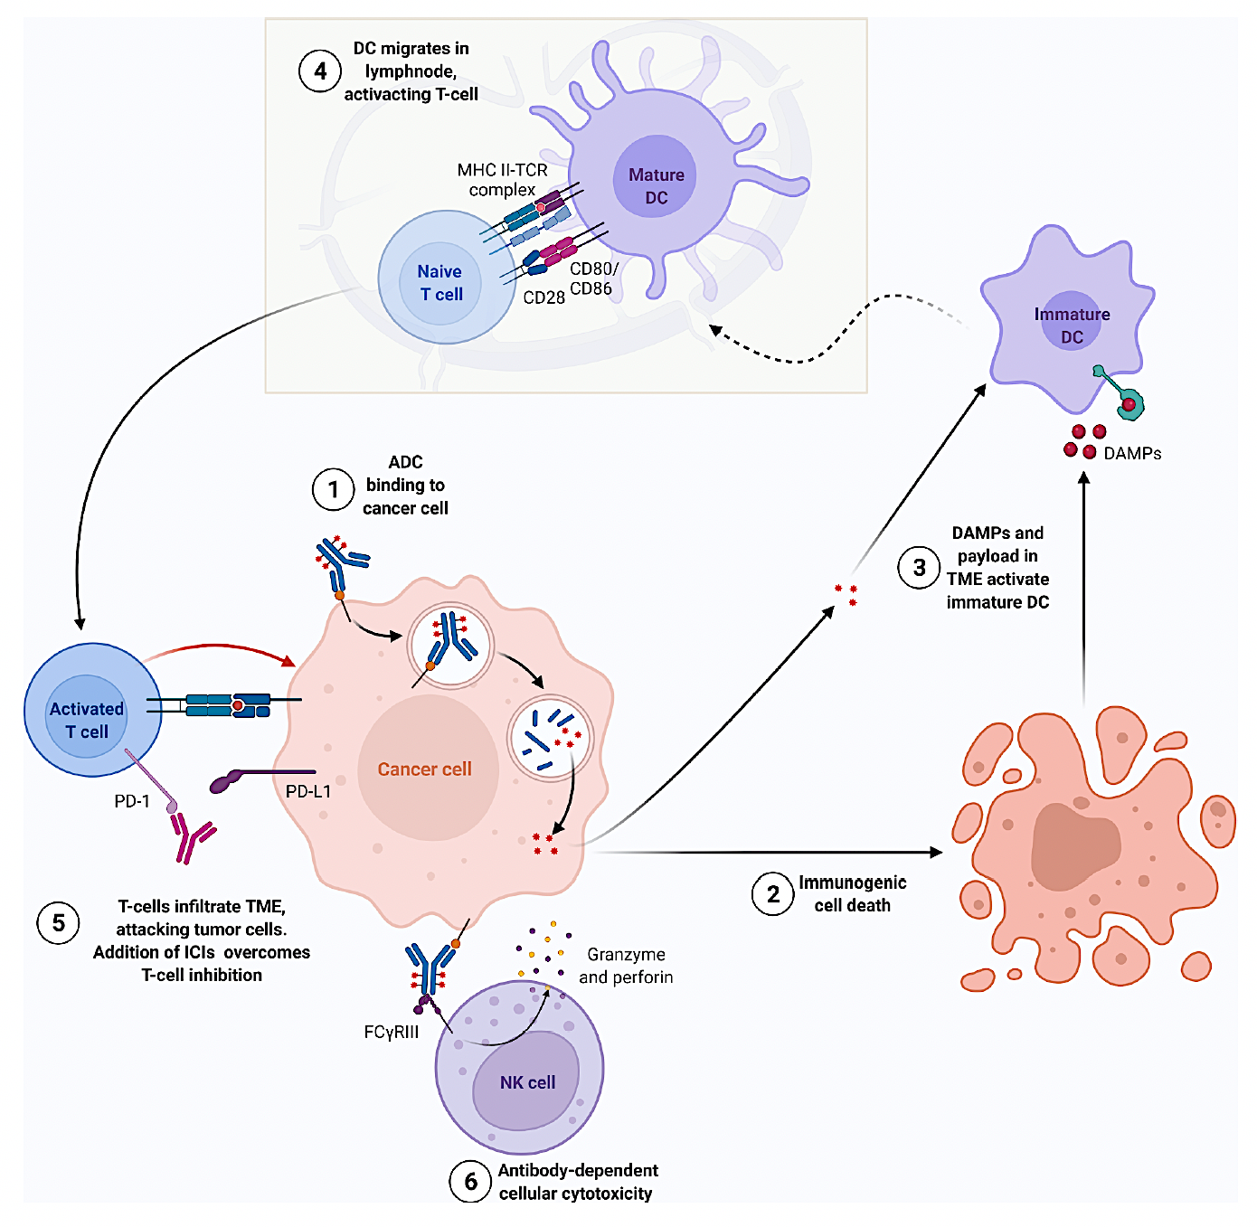
Rationale for Combining Immunotherapy and ADCs
Immunogenic cell death
↑ ADCC
↑ T-cell infiltration
Nicolo E et al, Cancer Treatment Reviews 2022

Slide 9
1L Treatment of PD-L1+ mTNBC
ASCENT-04
TROPION-Breast05
Patient Population
PD-L1+ (CPS ≥10) untreated, inoperable/locally advanced or metastatic TNBC
≥6 months since therapy in curative setting (prior PD-L1 use allowed in this setting)
Patient Population
PD-L1+ (CPS ≥10) untreated, inoperable/locally advanced or metastatic TNBC
DFI ≥6 months since therapy in curative setting (DFI 6–12 months capped at 20%)
Prior PD-(L)1 use allowed in this setting
History of ILD/pneumonitis and clinically significant corneal disease excluded
R
1:1
SG + pembrolizumab
Dato-DXd + durvalumab
R
1:1
Study Design
Study Design
Dato-DXd monotherapy
N=440
TPC chemo + pembrolizumab
(gem + carbo; pac; nab-pac)
N~625
TPC chemo + pembrolizumab
(gem + carbo; pac; nab-pac)
Stratification Factors
De novo vs recurrent disease
Geographic region
Prior exposure to immunotherapy
Stratification Factors
Geographic region
Prior PD-(L)1
De novo vs prior DFI 6–12 months vs prior DFI >12 months
Crossover to SG is allowed after BICR-verified disease progression
Key Endpointsª
Key Endpoints
Primary: PFS by BICR in ITT population
Secondary: OS, ORR, PROs
Primary: PFS by BICR
Secondary: OS, PFS (per investigator), ORR, safety, PROs
STILL ENROLLING

Slide 10

ASCENT-04: Baseline Characteristics and PFS
ASCENT-04
ASCENT-04: PFS
ITT Population | SG + Pembro (n=221) | Chemo + Pembro (n=222)
Median age (range), years | 54 (23–88) | 55 (27–82)
<65 years, n (%) | 163 (74) | 165 (74)
≥65 years, n (%) | 58 (26) | 57 (26)
Menopausal status, n (%)
Pre-menopausal | 81 (37) | 77 (35)
Post-menopausal | 140 (63) | 145 (65)
Treatment-free interval, n (%)
De novo | 75 (34) | 75 (34)
Recurrent within 6–12 months | 40 (18) | 40 (18)
Recurrent >12 months | 106 (48) | 107 (48)
Metastatic sites, n (%)
Lymph node | 159 (72) | 154 (69)
Lung | 111 (50) | 95 (43)
Bone | 61 (28) | 45 (20)
Liver | 55 (25) | 57 (26)
Brain | 8 (4) | 6 (3)
Other | 81 (37) | 71 (32)
BRCA1/2 mutation status
Mutant | 19 (9) | 13 (6)
Wild-type | 41 (19) | 57 (26)
Unknown | 161 (73) | 152 (68)
 | SG + Pembro (n=221) | Chemo + Pembro (n=222)
Number of PFS events | 109 | 140
Median PFS, months (95% CI) | 11.2 (9.3–16.7) | 7.8 (7.3–9.3)
Stratified HR (95% CI) | 0.65 (0.51–0.84)
P-valueª | <0.001
100
90
6 mo
80
70
60
12 mo
50
Progression-Free Survival Probability (%)
40
30
20
10
0
0
2
4
6
8
10
12
14
16
18
20
22
24
26
Time (months)
No. at risk
SG + pembro
Chemo + pembro
221 | 202 | 174 | 142 | 105 | 78 | 58 | 42 | 34 | 22 | 11 | 6 | 2 | 0
222 | 191 | 159 | 123 | 88 | 59 | 40 | 29 | 21 | 13 | 7 | 4 | 1 | 0
OS Immature

Slide 11
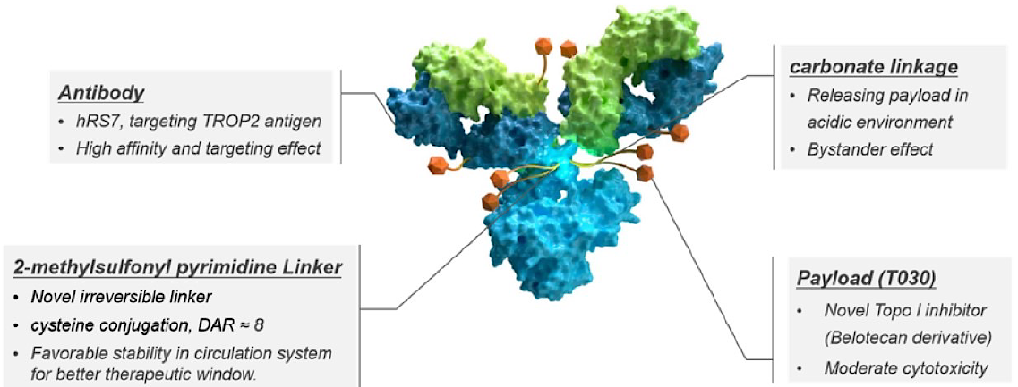
Novel ADCs: TROP2 ADC with Topo1 Payload: Sacituzumab Tirumotecan
Sacituzumab Tirumotecan (Sac-TMT)
anti-Trop2 ADC
 | OptiTROP-Breast 01
 | Sac-TMT vs TPC (2L+) in mTNBC
PFS | 6.7 vs 2.5 mo (HR 0.32)
OS | NR vs 9.4 mo (HR 0.53)
Approved in China for TNBC
OptiTROP-Breast05, 1L mTNBC (n=41), mPFS=13.1 mo
Xu B, et al. J Clin Oncol. 2024;42(Suppl_16): Abstract 104.
Yin Y et al, J Clin Oncol 2025; 43 (Suppl_16): Abstract 1019

Slide 12
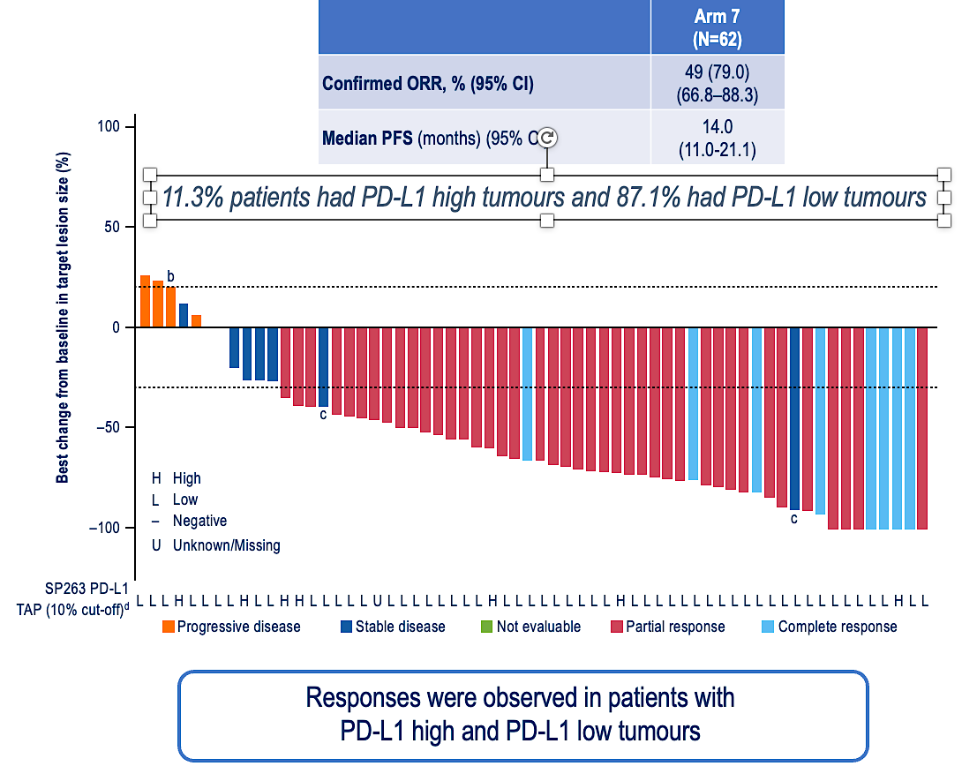
Could an ADC Allow Checkpoint Inhibition to Have Benefit in Metastatic TNBC that is PD-L1-negative?
BEGONIA: Dato-DXd+ durvalumab
DIAMOND (Ph 2):
Dato-DXd +/- durvalumab in PD-L1- mTNBC
Previously untreated, locally advanced inoperable or metastatic TNBC
PD-L1- (CPS <10)
No prior neoadj/adj IO within 6 mo
Dato-DXd
1:1
N=140
Dato-DXd + durvalumab
Stratification Factors:
De novo OR DFI≤12 mo OR DFI>12 mo
Schmid P et al, ESMO 2025
NCT06954480
PI:Peter Schmid

Slide 13
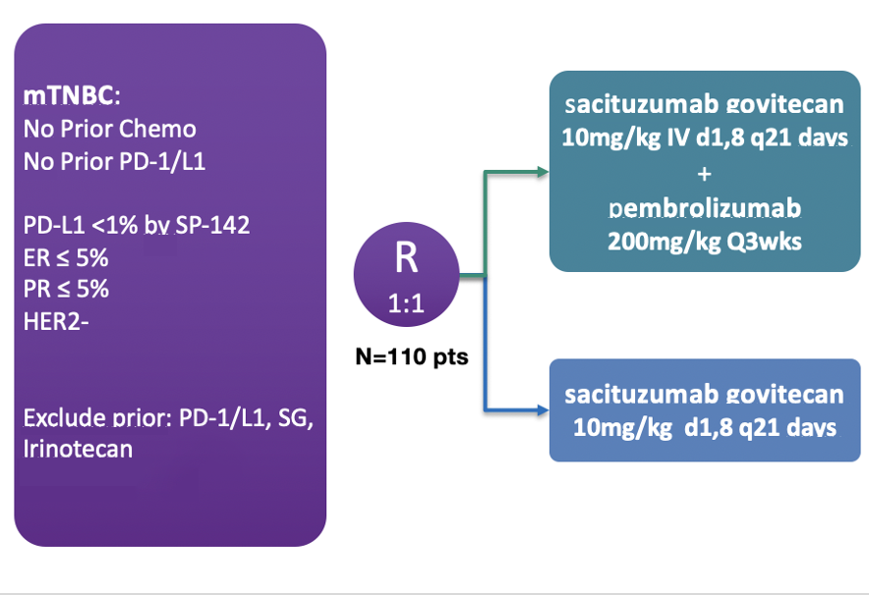
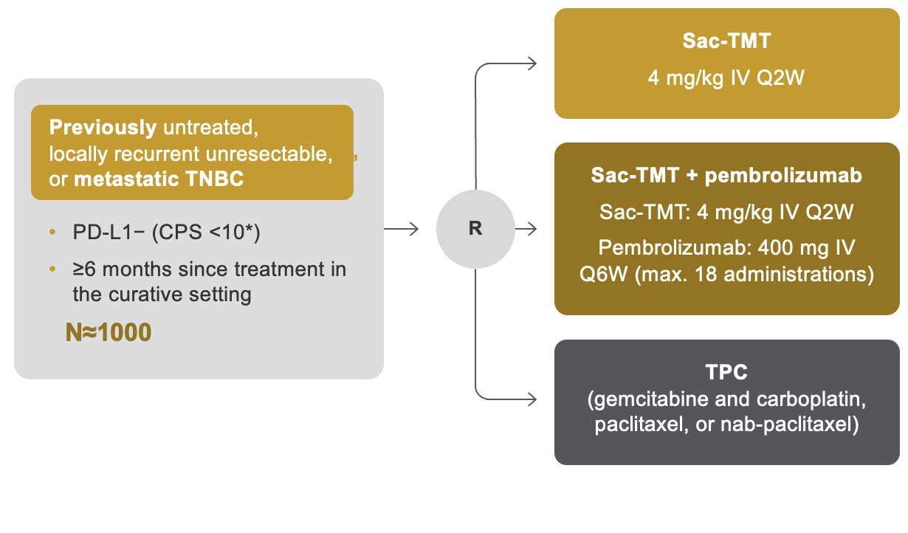
Could an ADC Allow Checkpoint Inhibition to Have Benefit in Metastatic TNBC that is PD-L1-negative?
SACI IO TNBC (Ph 2):
SG +/- pembro in PD-L1- 1L mTNBC
TroFuse-011 (Ph 3):
Sac-TMT+/- pembro vs TPC in PD-L1- 1L mTNBC
NCT04468061 PI: Ana Garrido-Castro
NCT06841354

Slide 14
New Potential Treatment Algorithm for mTNBC
PD-L1-positive
PD-L1-negative
1L
Sacituzumab govitecan + Pembrolizumab
Datopotamab deruxtecan
Sacituzumab govitecan
Olaparib or talazoparib (if BRCAm)
Olaparib or talazoparib
(if BRCAm)
Sacituzumab
govitecan
T-DXd
(if HER2-low)
Chemotherapy
(e.g., taxane, platinum)
2L
Sacituzumab govitecan
T-DXd
(if HER2-low)
Olaparib or talazoparib
(if BRCAm)
Chemotherapy
(e.g., eribulin, capecitabine, gemcitabine, vinorelbine)
Biomarker positive*
(TMB-H, MSI-H/dMMR, NTRK fusion, RET fusion)
3L+
*TMB-H: Pembrolizumab; MSI-H: Pembrolizumab, Dostarlimab; NTRK fusion: Larotrectinib, Entrectinib, Repotrectinib; RET fusion: Selpercatinib. Slide courtesy of Ana Garrido-Castro

Slide 15
Metastatic HR+/HER2- mBC

Slide 16
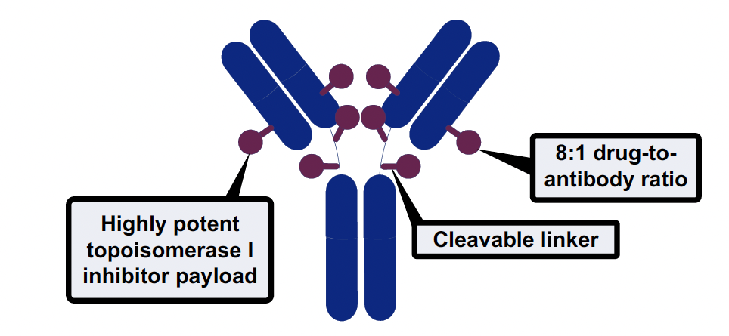
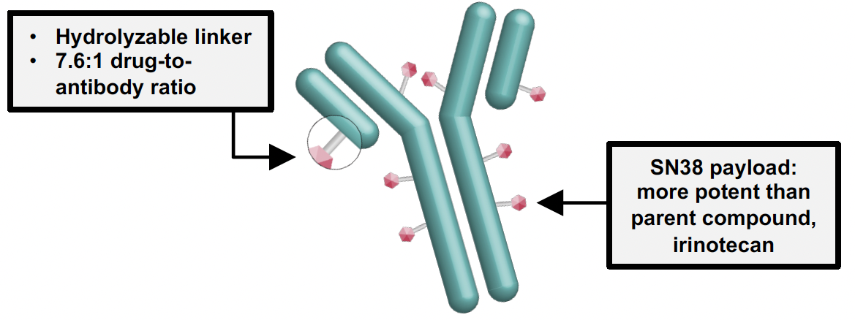


Available ADCs for HR+/HER2- MBC in 2026
Trastuzumab deruxtecan (T-DXd)
anti-HER2 ADC
Sacituzumab Govitecan (SG)
anti-Trop2 ADC
Datopotamab Deruxtecan (Dato-DXd)
anti-Trop2 ADC
~90% (HER2-low, -ultralow)
~100% (no biomarker)
~100% (no biomarker)

Slide 17
TROPICS-02
SG demonstrated a statistically significant and clinically meaningful improvement in both PFS and OS vs chemotherapy in 3L and later HR+/HER2-negative mBC^{1,2}
NCT03901339^{1,3}
Treatment was continued until progression or unacceptable toxicity
PFS¹*,†
BICR analysis | SG (n=272) | Chemotherapy (n=271)
No. of events | 170 | 159
6-mo PFS rate | 46% | 30%
12-mo PFS rate | 21% | 7%
Median PFS, mo (95% CI) | 5.5 (4.2−7.0) | 4.0 (3.1−4.4)
Stratified HR (95% CI) | 0.66 (0.53−0.83)
Stratified log rank P value | 0.0003
Metastatic or locally recurrent inoperable HR+/HER2-negative breast cancer that progressed after*
At least 1 endocrine therapy, taxane, and CDK4/6 inhibitor in any setting
At least 2, but no more than 4, lines of chemotherapy for metastatic disease
Measurable disease by RECIST 1.1
Sacituzumab govitecan
10 mg/kg IV days 1 and 8, every 21 days n=272
100
Primary endpoint:
PFS by BICR
Secondary endpoints:
OS
ORR, DOR, CBR by LIR and BICR
PRO
Safety profile
90
80
70
60
50
Continue treatment until progression or unacceptable toxicity
40
30
20
10
R
1:1
0
0
3
6
9
12
15
18
21
24
No. at risk
Time, months
SG
272
148
82
44
22
12
6
3
0
TPC† (capecitabine, vinorelbine, gemcitabine, or eribulin) n=271
Chemotherapy
271
105
41
17
4
1
1
0
OS²*,†
 | SG (n=272) | TPC (n=271)
Median OS, mo (95% CI) | 14.4 (13.0−15.7) | 11.2 (10.1−12.7)
Stratified HR (95% CI) | 0.79 (0.65−0.96)
Stratified log rank P value | 0.020
100
90
80
70
OS rate, % (95% CI)
 | SG (n=272) | TPC (n=271)
12-mo | 61 (55−66) | 47 (41−53)
60
50
40
Stratification factors
Visceral metastases (yes/no)
Endocrine therapy in metastatic setting ≥6 months (yes/no)
Prior lines of chemotherapies (2 vs 3/4)
30
20
10
0
0
3
6
9
12
15
18
21
24
27
30
33
36
No. of patients still at risk (events)
Time, months
SG
272 (0)
252 (16)
221 (44)
197 (67)
160 (104)
120 (137)
80 (158)
53 (173)
31 (183)
20 (188)
4 (190)
2 (190)
0 (191)
Chemotherapy
271 (0)
246 (16)
196 (64)
164 (95)
122 (137)
92 (163)
70 (174)
49 (183)
23 (193)
13 (196)
5 (198)
1 (199)
0 (199)
*Disease histology based on the ASCO/CAP criteria; †Single-agent standard-of-care treatment of physician’s choice was specified prior to randomisation by the investigator. ASCO/CAP, American Society of Clinical Oncology/College of American Pathologists; BICR, blinded independent central review; CBR, clinical benefit rate; CDK, cyclin-dependent kinase; CI, confidence interval; DOR, duration of response; HER2-negative, human epidermal growth factor receptor 2-negative; HR, hazard ratio; HR+, hormonal receptor-positive; ITT, intent-to-treat; IV, intravenously; LIR, local investigator review; mo, months; ORR, objective response rate; OS, overall survival; PFS, progression-free survival; PRO, patient-reported outcome; R, randomised; RECIST, Response Evaluation Criteria in Solid Tumours; SG, sacituzumab govitecan; TPC, treatment of physician’s choice. 1. Adapted from Rugo HS, et al. J Clin Oncol. 2022;40:3365−3376 (inc. Suppl); 2. Adapted from Rugo HS, et al. Lancet 2023; 402: 1423–1433. 3. ClinicalTrials.gov, NCT03901339: https://www.clinicaltrials.gov/study/NCT03901339. Accessed: July 2025.

Slide 18
TROPiCS-02
SG significantly improved ORR,^{1,2} and significantly extended TTD of Global Health Status and fatigue vs TPC²*
ORR (%)^{1,2}
Sacituzumab govitecan (n=272)
21%
(CR: 1.0%; PR: 20.0%)
Single-agent chemotherapy (n=271)
14%
(CR: 0; PR: 14.0%)
TTD^{2–4,*} | Patients SG/TPC, n/n | SG median TTD, mo (95% CI) | TPC median TTD, mo (95% CI) | Stratified HR (95% CI) | Stratified Log Rank P value
Global health status QoL | 234/207 | 4.3 (3.1–5.7) | 3.0 (2.2–3.9) | 0.75 (0.61–0.92) | 0.006
Fatigue | 234/205 | 2.2 (1.6–2.8) | 1.4 (1.1–1.9) | 0.73 (0.60–0.89) | 0.002
Pain | 236/210 | 3.8 (N/A) | 3.5 (N/A) | 0.92 (0.75–1.13) | 0.42
*HRQoL was formally tested as part of the testing hierarchy in TROPiCS-02.⁴ CI, confidence interval; CR, complete response; HR, hazard ratio; mo, months; N/A, not available; OR, overall response; ORR, objective response rate; PD, progressive disease; PR, partial response; QoL, quality of life; SD, stable disease; SG, sacituzumab govitecan; TPC, treatment of physician’s choice; TTD, time to deterioration.
1. Adapted from Rugo HS, et al. J Clin Oncol. 2022; 40(29):3365‒3376; 2. Rugo HS, et al. Lancet 2023; 402: 1423–1433; 3. Rugo HS, et al. Lancet 2023; 402: 1423–1433 (Suppl); 4. Rugo HS, et al. Oncologist. 2024; 29: 768–779.

Slide 19
TROPiCS-02
SG had a manageable safety profile that was consistent with previous studies¹
Selected TRAEs*^{2,3} |  | SG (n=268) |  | TPC (n=249)
 |  | All Grade, % | Grade ≥3, % | All Grade, % | Grade ≥3, %
Hematologic | Neutropenia† | 71 | 52 | 55 | 39
 | Anaemia‡ | 37 | 7 | 28 | 3
 | Thrombocytopenia§ | 6 | <1 | 16 | 4
Gastrointestinal | Diarrhea | 62 | 10 | 23 | 1
 | Nausea | 59 | 1 | 35 | 3
 | Vomiting | 24 | 1 | 16 | 2
Other | Alopecia | 48 | 0 | 18 | 0
 | Fatigue | 39 | 6 | 33 | 4
TEAEs associated with/leading to:^{1,3}
n(%) | Sacituzumab govitecan (n=268) | TPC (n=249)
Treatment discontinuation | 17 (6) | 11 (4)
Dose reductions | 90 (34) | 82 (33)
Treatment-related leading to death** | 1 (<1) | 0
SG: no events TPC: 1%
ILD events⁴
Neutropenia and diarrhoea were the most common treatment-related AEs
Assessed in the safety population of patients who received ≥1 dose of study treatment.¹ *Patients may report more than one event per preferred term. AEs were coded using Medical Dictionary for Regulatory Activities v25.0, and AE severity was graded per National Cancer Institute Common Terminology Criteria for Adverse Events v 5.0. †Combined preferred terms of neutropenia and neutrophil count decreased. ‡Combined preferred terms of anaemia, hemoglobin decreased, and red blood cell count decreased. §Combined preferred terms of “thrombocytopenia” and “platelet count decreased”;² **Of 6 TEAEs leading to death, only 1 was considered by the investigator as treatment-related (septic shock due to neutropenic colitis). The other 5 were: COVID-19 pneumonia, pulmonary embolism, pneumonia, nervous system disorder, and arrhythmia. Upon detailed review of the TEAEs leading to death, there were no patterns identified.³ AE, adverse event; ILD, interstitial lung disease; LVD, left ventricular dysfunction; TPC, treatment of physician’s choice; TRAE, treatment-related adverse event; TEAE, treatment-emergent adverse event.
1. Adapted from Rugo HS, et al. Lancet 2023; 402: 1423–1433. 2. Rugo HS, et al. Lancet 2023; 402: 1423–1433 (Suppl); 3. Tolaney S, et al. ASCO 2023. Abstract #1003. 4. Rugo HS, et al. J Clin Oncol. 2022;40:3365−3376.

Slide 20
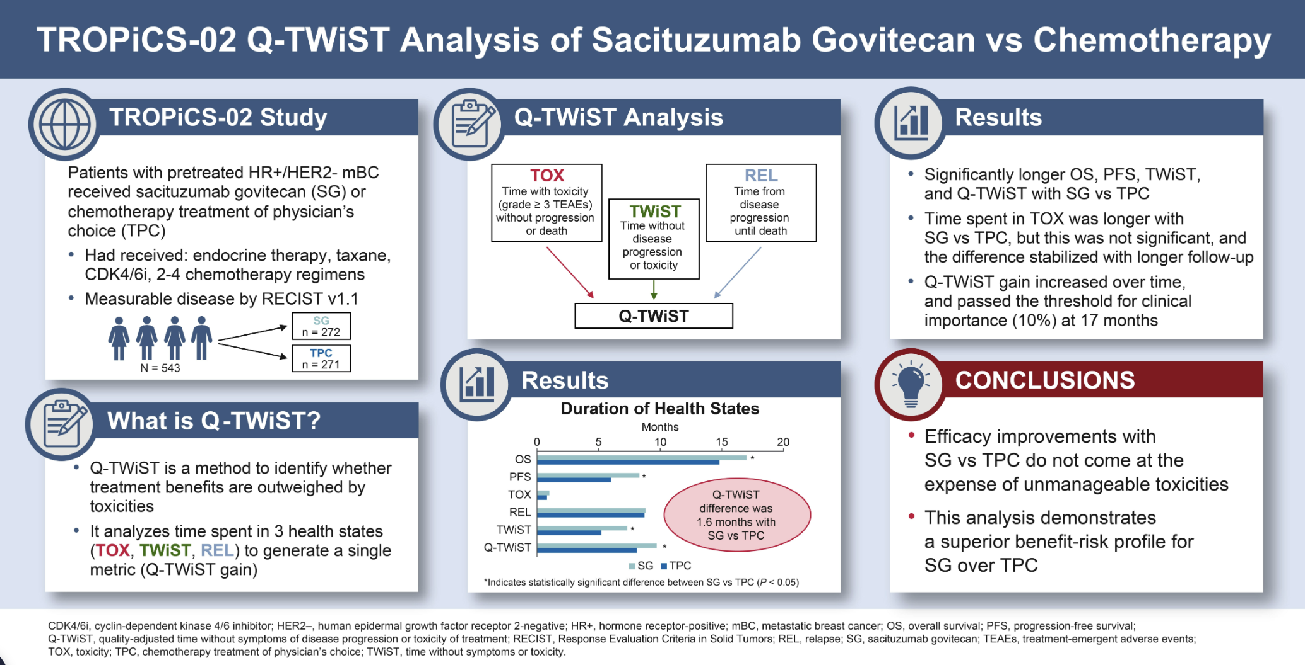
Quality-adjusted Time Without Symptoms of disease progression or Toxicity of treatment (Q-TWiST) analysis

Slide 21
Dato-DXd vs T-DXd
Targets Trop2 like SG
Same payload-linker as T-DXd
Same schedule as T-DXd (Q3W)
Lower DAR than other ADCs DAR 4, vs 8 for SG and T-DXd
Same half-life as T-DXd
5 days, vs 1 day for SG

Slide 22
TROPION-Breast01
Dato-DXd demonstrated significant PFS benefit, but did not show a significant difference in OS vs ICC^{1,2}
NCT02574455²
PFS¹ (%)
Dato-DXd (n=365)
 | Dato-DXd | ICC
Median PFS, months (95% CI) | 6.9 (5.7–7.4) | 4.9 (4.2–5.5)
Hazard ratio (95% CI) | 0.63 (0.52–0.76)
P value | <.0001
Key inclusion criteria:
Patients with HR+/HER2-negative breast cancer* (HER2-negative defined as IHC 0/1+/2+; ISH negative)
Previously treated with 1–2 lines of chemotherapy (inoperable/ metastatic setting)
Experienced progression on ET and for whom ET was unsuitable
ECOG PS 0 or 1
Dato-DXd
6 mg/kg IV Day 1 Q3W
(n=365)
Dual primary endpoints:
PFS by BICR per RECIST v1.1, and OS
Key secondary endpoints:
ORR, PFS (investigator assessed), TFST,² Safety,² PROs²
Exploratory PRO endpoints²
1.0
ICC (n=367)
0.9
0.8
0.7
53.3%
0.6
Probability of PFS
0.5
37.5%
0.4
38.5%
25.5%
0.3
0.2
18.7%
R
1:1
0.1
14.6%
Number at risk
0
3
6
9
12
15
Time from randomisation (months)
Investigator’s choice of chemotherapy (ICC)
as per protocol directions†
(eribulin mesylate D1,8 Q3W; vinorelbine D1,8 Q3W; gemcitabine D1,8 Q3W; capecitabine D1–14 Q3W)
(n=367)
Dato-DXd
365
249
158
66
15
4
ICC
367
205
93
26
8
1
OS² (%)
 | Dato-DXd | ICC
Median OS, months (95% CI) | 18.6 (17.3–20.1) | 18.3 (17.3–20.5)
Hazard ratio (95% CI) | 1.01 (0.83–1.22)
1.0
0.9
0.8
0.7
0.6
Probability of OS
0.5
Dual primary OS did not reach statistical significance
0.4
0.3
0.2
0.1
Number at risk
0
3
6
9
12
15
18
21
24
27
30
33
36
Stratification factors
Lines of chemotherapy (1 vs 2)
Geographic location (USA/Canada/Europe vs other geographic regions)
Previous CDK4/6 inhibitor (yes vs no)
Time from randomisation (months)
Dato-DXd
365
349
331
299
259
227
180
118
49
12
1
ICC
367
335
309
283
249
213
175
123
51
9
1
*Per American Society of Clinical Oncology/College of American Pathologists (ASCO/CAP) guidelines;² †ICC was administered as follows: eribulin mesylate, 1.4 mg/m² IV on Days 1 and 8, Q3W; capecitabine, 1000 or 1250 mg/m² orally twice daily on Days 1 to 14, Q3W (dose per standard institutional practice); vinorelbine, 25 mg/m² IV on Days 1 and 8, Q3W; or gemcitabine, 1000 mg/m² IV on Days 1 and 8, Q3W.²
BICR, blinded independent central review; CDK4/6, cyclin-dependent kinase 4/6; CI, confidence interval; D, day; Dato-DXd, datopotamab deruxtecan; ECOG PS, Eastern Cooperative Oncology Group performance status; ET, endocrine therapy; HER2, human epidermal growth factor receptor 2; HR, hormone receptor; ICC, investigator’s choice of chemotherapy; IHC, immunohistochemistry; ISH, in situ hybridisation; IV, intravenous; ORR, objective response rate; OS, overall survival; PD, progressive disease; PFS, progression-free survival; PRO, patient-reported outcome; Q3W, every 3 weeks; RECIST, Response Evaluation Criteria in Solid Tumours; TFST, time to first subsequent therapy.
1. Bardia A, et al. J Clin Oncol. 2025;43:285–296; 2. Pistilli B, et al. Oral presentation. ESMO On Air Webinar series. 12 February 2025.

Slide 23
Subsequent Anticancer Therapy
Use of ADCs as subsequent therapy after discontinuation of study treatment was imbalanced
Subsequent therapy (in any treatment line) | Dato-DXd (n=365) | ICC (n=367)
Any, n (%) | 269 (74) | 289 (79)
ADC | 45 (12) | 88 (24)
Trastuzumab deruxtecan | 34 (9) | 80 (22)
Sacituzumab govitecan | 15 (4) | 26 (7)
Both trastuzumab deruxtecan and sacituzumab govitecan | 4 (1) | 18 (5)
Data cutoff: 24 July 2024.

Slide 24
Overall Survival Adjusted for Subsequent ADC Therapy Post-hoc Sensitivity Analysis Using IPCW Method^{1–3}
1.0
 | Dato-DXd | ICC
OS events, n (%) | 195 (53) | 177 (48)
Median OS, months | 19.1 | 17.5
HR (95% CI) | 0.86 (0.70–1.06)
0.9
0.8
0.7
0.6
Probability of OS
0.5
0.4
0.3
0.2
Dato-DXd (n=365)
0.1
ICC (n=367)
0
0
3
6
9
12
15
18
21
24
27
30
33
Number at risk
Time from randomisation (months)
Dato-DXd
365
348
327
290
245
212
163
105
43
12
2
ICC
367
329
285
243
196
158
120
79
29
8
2
Data cutoff: 24 July 2024.
IPCW, Inverse Probability Censoring Weighting
1. Robins JM. Proceedings of the Biopharmaceutical Section (American Statistical Association) 1993:24–33;
2. Robins JM, Finkelstein DM. Biometrics 2000;56:779–88;
3. Sherry AD, et al. BMJ Oncology 2024;3:e000322.

Slide 25
TROPION-Breast01
Dato-DXd demonstrated a higher ORR, and had longer time to deterioration in GHS/QoL vs ICC^{1,2}
ORR¹
TTD²
Complete response (0.5%)
Partial response
 | Median TTD, mo (first instance*) |  | Hazard ratio (95% CI) | Median TTD, mo (confirmed†) |  | Hazard ratio (95% CI)
 | Dato-DXd (n=365) | ICC (n=367) |  | Dato-DXd (n=365) | ICC (n=367)
Global health status/QoL | 3.4 | 2.1 | 0.85 (0.68–1.06) | 9.0 | 4.8 | 0.76 (0.58–0.98)
Pain | 3.5 | 2.8 | 0.85 (0.68–1.07) | 9.0 | 5.5 | 0.72 (0.55–0.94)
Physical functioning | 5.6 | 3.5 | 0.77 (0.61–0.99) | 12.5 | 6.2 | 0.77 (0.59–1.01)
45
ORR 36.4%
40
35
ORR 22.9%
30
25
Patients with response, %
20
15
10
5
0
Dato-DXd (n=365)
ICC (n=367)
*Time to first deterioration (primary analysis) was defined as the time from date of randomisation to date of first deterioration; †Time to confirmed deterioration (sensitivity analysis) required deterioration to be confirmed at a subsequent timepoint.
Dato-DXd, datopotamab deruxtecan; CI, confidence interval; HER2, human epidermal growth factor receptor 2; HR, hormone receptor; (HR)QoL, (health-related) quality of life; ICC, investigator’s choice of chemotherapy; mBC, metastatic breast cancer; ORR, objective response rate; TTD, time to deterioration.
1. Bardia A, et al. J Clin Oncol. 2025;43:285–296; 2. Pernas S, et al. Oral presentation. ASCO 2024. (Abstract 1006).

Slide 26
TROPION-Breast01
Dato-DXd demonstrated a manageable safety profile that was consistent with previous reports¹
TEAEs in ≥10% of patients with Grade ≥3 in ≥1% of patients in the Dato-DXd arm
TEAEs associated with/leading to:
Any grade TEAE, % (Grade ≥3) | Dato-DXd (n=360) | ICC (n=351)
Any TRAE | 93.6 (20.8) | 86.3 (44.7)
Nausea | 51.1 (1.4) | 23.6 (0.6)
Stomatitis | 50 (6.4) | 13.1 (2.6)
Fatigue | 23.6 (1.7) | 18.2 (2)
Vomiting | 19.7 (1.1) | 7.7 (0.6)
Anaemia | 11.1 (1.1) | 19.7 (2)
Neutropenia* | 10.8 (1.1) | 42.5 (30.8)
 | Dato-DXd (n=360) | ICC (n=351)
Treatment discontinuation | 2.5% | 2.6%
Dose reduction | 20.8% | 30.2%
Dose interruption | 11.9% | 24.5%
Total on-treatment deaths | 0 | 0.3%†
Treatment-related AESIs
| | Grade 1 |  | Grade 2 |  | Grade 3 |  | Grade 4 |  | Grade 5 |  | Any grade
 | Dato-DXd (n=360) | ICC (n=351) | Dato-DXd (n=360) | ICC (n=351) | Dato-DXd (n=360) | ICC (n=351) | Dato-DXd (n=360) | ICC (n=351) | Dato-DXd (n=360) | ICC (n=351) | Dato-DXd (n=360) | ICC (n=351)
Oral mucositis/stomatitis | 25.3% | 8.8% | 23.3% | 3.4% | 6.9% | 2.6% | 0 | 0 | 0 | 0 | 55.6% | 14.8%
Ocular surface events | 31.9% | 9.7% | 7.2% | 2.0% | 0.8% | 0 | 0 | 0 | 0 | 0 | 40.0% | 11.7%
Adjudicated drug-related ILD^{II} | 1.4% | 0 | 1.1% | 0 | 0.6% | 0 | 0 | 0 | 0.3%¶ | 0 | 3.3% | 0
1. Bardia A, et al. J Clin Oncol. 2025;43:285–296

Slide 27
ASCENT-07: Phase 3, Randomized, Open-Label Study
Locally advanced unresectable or metastatic HR+/HER2− BC:
No prior chemotherapy for locally advanced or metastatic HR+/HER2− BC
Measurable disease per RECIST v1.1
Must have at least 1 of the following:
Progression on ≥ 2 previous lines of ET ± targeted therapy for mBCª
Progression < 6 mo of starting 1L ET ± CDK4/6i for mBC
Recurrence < 24 mo of starting adjuvant ET + CDK4/6i and no longer a candidate for additional ET for mBC
End points
Primary
PFS by BICR
Key Secondary
OS
ORR by BICR
QOL
Other Secondary
PFS by INV
ORR by INV
DOR by BICR and INV
Safety
Sacituzumab govitecan 10 mg/kg IV
Days 1 and 8, every 21 days
n = 456
N = 690
R 2:1
Treatment of physician’s choice (capecitabine, paclitaxel, nab-paclitaxel)^{b}
n = 234
Treatment continued until disease progression^{c} or unacceptable toxicity
Stratification factors:
Duration of prior CDK4/6i^{d} for mBC (none vs ≤ 12 mo vs > 12 mo)
HER2 IHC (HER2 IHC 0 vs HER2 IHC-low [IHC 1+ or IHC 2+/ISH–])
Geographic region (US/Canada/UK/EU vs ROW)
ClinicalTrials.gov identifier: NCT05840211.
ªDisease recurrence while on the first 24 months of starting adjuvant ET will be considered a line of therapy; these participants will only require 1 line of ET in the metastatic setting. ^{b}Paclitaxel 80 mg/m² or nab-paclitaxel 100 mg/m² IV on days 1, 8, and 15 of 28-day cycles, or capecitabine oral 1000 or 1250 mg/m² twice daily for first 2 weeks of 21-day cycles. ^{c}Per RECIST v1.1. ^{d}Enrollment of CDK4/6i-naïve participants was capped at 10%.
1L, first-line; BICR, blinded independent central review; CDK4/6i, cyclin-dependent kinase 4/6 inhibitor; DOR, duration of response; ET, endocrine therapy; EU, European Union; HER2−, human epidermal growth factor receptor 2 negative; HR+, hormone receptor positive; IHC, immunohistochemistry; INV, investigator assessment; ISH, in situ hybridization; IV, intravenously; mBC, metastatic breast cancer; mo, months; ORR, objective response rate; OS, overall survival; PFS, progression-free survival; QOL, quality of life; R, randomized; RECIST v1.1, Response Evaluation Criteria in Solid Tumors, version 1.1; ROW, rest of the world.

Slide 28
Primary End Point: Progression-Free Survival by BICR
 | SG (n = 456) | TPC (n = 234)
Median PFS, mo (95% CI) | 8.3 (8.1-10.3) | 8.3 (6.9-10.0)
Stratified HR (95% CI) | 0.85 (0.69-1.05)
P-valueª | 0.130
6-month PFS rate, % (95% CI) | 71 (66-75) | 64 (57-71)
12-month PFS rate, % (95% CI) | 40 (35-45) | 37 (29-44)
100
90
80
70
60
Probability of progression-free survival (%)
50
40
30
20
10
0
0
2
4
6
8
10
12
14
16
18
20
22
24
Time (months)
No. at risk (events)
SG | 456 (0) | 415 (25) | 335 (86) | 285 (126) | 219 (179) | 168 (216) | 136 (242) | 92 (260) | 49 (272) | 17 (278) | 4 (282) | 0 (282)
TPC | 234 (0) | 204 (16) | 159 (49) | 119 (74) | 90 (90) | 63 (108) | 52 (118) | 30 (131) | 14 (135) | 5 (137) | 2 (137) | 0 (137)
With a hazard ratio of 0.85, PFS by BICR did not meet statistical significance
ªTwo-sided P-value from stratified log-rank test.
BICR, blinded independent central review; HR, hazard ratio; mo, months; PFS, progression-free survival; SG, sacituzumab govitecan; TPC, treatment of physician’s choice.

Slide 29
Secondary End Point: Progression-Free Survival by Investigator Assessment
 | SG (n = 456) | TPC (n = 234)
Median PFS, mo (95% CI) | 8.4 (8.2-9.7) | 6.4 (6.0-8.1)
Stratified HR (95% CI) | 0.78 (0.64-0.93)
Nominal P-valueª | 0.008
6-month PFS rate, % (95% CI) | 69 (64-73) | 58 (51-64)
12-month PFS rate, % (95% CI) | 36 (32-41) | 30 (24-36)
100
90
80
70
60
Probability of progression-free survival (%)
50
40
30
20
10
0
0
2
4
6
8
10
12
14
16
18
20
22
24
Time (months)
No. at risk (events)
SG | 456 (0) | 417 (30) | 345 (96) | 298 (138) | 242 (190) | 188 (242) | 150 (277) | 98 (306) | 58 (321) | 24 (326) | 5 (330) | 0 (330)
TPC | 234 (0) | 203 (23) | 160 (62) | 124 (94) | 92 (118) | 71 (139) | 60 (150) | 34 (163) | 15 (170) | 8 (172) | 2 (173) | 0 (174)
There was a numerical improvement in investigator-assessed PFS with SG versus TPC
ªTwo-sided P-value from stratified log-rank test
HR, hazard ratio; mo, months; PFS, progression-free survival; SG, sacituzumab govitecan; TPC, treatment of physician’s choice.

Slide 30
Overall Survival at Primary Analysis (27% maturity)
100
90
80
70
60
 | SG (n = 456) | TPC (n = 234)
Median OS, mo (95% CI) | NR (NR-NR) | NR (19.7-NR)
HR (95% CI) | 0.72 (0.54-0.97)
Nominal P-valueª | 0.029
Probability of overall survival (%)
50
40
61% of participants in the TPC group received an ADC following treatment discontinuation^{b}
30
20
10
0
0
2
4
6
8
10
12
14
16
18
20
22
24
26
28
30
Time (months)
No. at risk (events)
SG | 456 (0) | 442 (12) | 436 (17) | 423 (30) | 402 (48) | 385 (64) | 368 (79) | 315 (95) | 206 (101) | 112 (109) | 43 (111) | 10 (112) | 4 (112) | 2 (112) | 0 (112)
TPC | 234 (0) | 229 (4) | 225 (7) | 217 (15) | 205 (26) | 192 (39) | 181 (50) | 145 (61) | 95 (65) | 51 (71) | 19 (74) | 4 (75) | 0 (75)
While the OS data were not mature, an early trend was observed favoring SG over TPC
Median follow-up was 15.4 months. ªThe nominal P-value was reported as a descriptive measure of the observed treatment effect and does not support statistical significance. ^{b}97/160 participants in the TPC group received at least one ADC as subsequent therapy after treatment discontinuation.
ADC, antibody drug conjugate; HR, hazard ratio; mo, months; NR, not reached; OS, overall survival; SG, sacituzumab govitecan; TPC, treatment of physician’s choice.

Slide 31
Subsequent Anticancer Therapy
n (%) | SG (n = 348) | TPC (n = 203)
Participants without subsequent anticancer therapyª | 66 (19) | 43 (21)
Participants with any subsequent anticancer therapy^{b} | 282 (81) | 160 (79)
ADC | 91 (32) | 97 (61)
T-DXd | 83 (29) | 66 (41)
SG | 1 (0.4) | 29 (18)
Dato-DXd | 0 | 3 (2)
Other ADC | 8 (3) | 7 (4)
Chemotherapy | 238 (84) | 106 (66)
Targeted therapy^{c} | 65 (23) | 24 (15)
Endocrine therapy | 42 (15) | 24 (15)
Immunotherapy | 10 (4) | 3 (2)
All other | 5 (2) | 3 (2)
Among participants who discontinued treatment, almost twice as many in the TPC group compared to the SG group received at least one subsequent ADC
ªDue to death or due to no subsequent treatment data available. ^{b}Participants could have received more than 1 treatment type across subsequent lines of treatment. ^{c}Targeted therapies received included PARPi, bevacizumab, mTORi, AKTi, PI3Ki, CDK4/6i, other.
ADC, antibody drug conjugate; AKTi, protein kinase B inhibitor; CDK4/6i, cyclin-dependent kinase 4/6 inhibitor; Dato-DXd, datopotamab deruxtecan; mo, months; mTORi, mammalian target of rapamycin inhibitor; PARPi, poly-adenosine diphosphate-ribose polymerase inhibitor; PI3Ki, phosphatidylinositol 3-kinase inhibitor; SG, sacituzumab govitecan; TDXd, trastuzumab deruxtecan; TPC, treatment of physician’s choice.

Slide 32
OptiTROP-Breast02 Study Design
Randomized, multi-center, open-label trial (NCT06081959)
Key Eligibility
Previously treated with 1-4 lines of chemotherapy
Received at least one endocrine, CDK 4/6 inhibitor, and taxane in any setting
ECOG PS 0 or 1
Sac-TMT
5 mg/kg IV, Q2W
Primary endpoints
PFS by BICR per RECIST v1.1
Secondary endpoints
PFS (investigator assessed)
OS
ORR, DCR
DOR
R
1:1
N=399
ICC
(eribulin, capecitabine,
gemcitabine or vinorelbine)
Stratification Factors:
1. Lines of chemotherapy (1 vs >1)
2. HER2 status (zero vs low) ª
3. Endocrine therapy ≥ 6 months (yes vs no)^{b}
Statistical considerations:
Pre-specified interim analysis for PFS: all randomized subjects who had the opportunity to complete 1 post-baseline tumor assessment and at least 188 PFS events occurred.
Pre-specified interim analysis for OS: approximately 165 OS events occurred.
O`Brien-Fleming α-spending as implemented by the Lan-DeMets method.
ª HER2-zero: No staining, or barely perceptible staining with a proportion > 0% but ≤ 10%; HER2-low defined as IHC1+, or IHC2+ and ISH-negative. ^{b} If no prior endocrine therapy in advanced setting, assess if (neo)adjuvant endocrine therapy duration ≥ 2 years.
BICR, blinded independent central review; CDK 4/6, cyclin dependent kinase 4/6; DCR, disease control rate; DOR, duration of response; ECOG, Eastern Cooperative Oncology Group; ICC, investigator's choice of chemotherapy; IHC, immunohistochemistry; OS, overall survival; Q2W, every 2 weeks; RECIST, Response Evaluation Criteria in Solid Tumors.
PRESENTED BY : Ying Fan, MD

Slide 33
Demographics and Baseline Characteristics
Characteristic | Sac-TMT (n = 200) | Chemotherapy (n = 199)
Median age, y (range) | 53.5 (31, 74) | 54.0 (33, 70)
≥ 65 y，n(%) | 25 (12.5) | 25 (12.6)
Female, n (%) | 199 (99.5) | 198 (99.5)
ECOG PS 1, n (%) | 122 (61.0) | 128 (64.3)
HER2 status (IHC) at baseline, n (%)
Zero | 108 (54.0) | 103 (51.8)
Low | 92 (46.0) | 96 (48.2)
Median time from initial metastatic diagnosis to consent, mo (range) | 84.9 （8.6, 384.3） | 73.0 （12.6, 438.7）
Number of metastatic site ≥ 3, n(%) | 114 (57.0) | 111 (55.8)
Visceral metastases, n (%) | 193 (96.5) | 189 (95.0)
Liver metastases, n (%) | 157 (78.5) | 146 (73.4)
Characteristic | Sac-TMT (n = 200) | Chemotherapy (n = 199)
Prior chemotherapy in (neo)adjuvant setting, n (%) | 146 (73.0) | 147 (73.9)
Prior taxane, n (%) | 200 (100) | 199 (100)
Prior endocrine therapy, n (%) | 200 (100) | 199 (100)
Prior CDK 4/6 inhibitor, n (%) | 200 (100) | 199 (100)
≤ 12 months | 140 (70.0) | 130 (65.3)
> 12 months | 60 (30.0) | 69 (34.7)
Lines of prior chemotherapy in the advanced/metastatic setting, n (%)
1 | 87 (43.5) | 86 (43.2)
2 | 79 (39.5) | 83 (41.7)
≥ 3 | 34 (17.0) | 30 (15.1)
Primary endocrine resistanceª, n (%)
YES | 53 (26.5) | 54 (27.1)
NO | 147 (73.5) | 145 (72.9)
ª Primary endocrine resistance defined as disease progression during the first endocrine therapy within 6 months in advanced/metastatic setting, or within 2 years in the (neo)adjuvant setting if no endocrine therapy was administered in advanced/metastatic setting for mBC.
PRESENTED BY : Ying Fan, MD

Slide 34
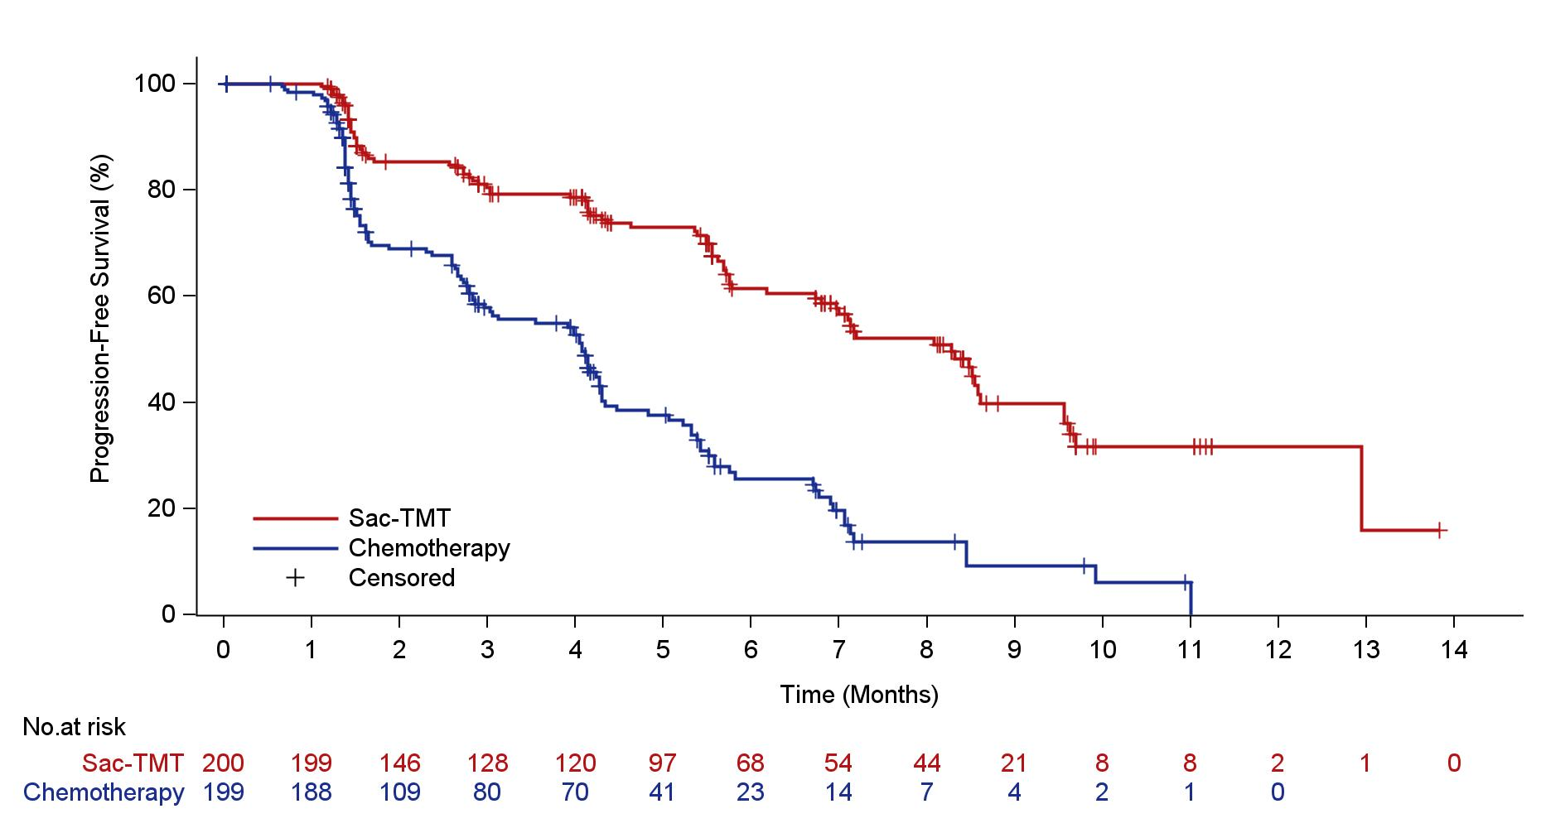
Progression-Free Survival by BICR
Sac-TMT significantly improved PFS over chemotherapy with 65% lower risk of disease progression or death.
100
 | Sac-TMT (n = 200) | Chemotherapy (n = 199)
PFS events，n (%) | 82 (41.0) | 121 (60.8)
Median PFS-mo (95% CI) | 8.3 (7.0, 8.6) | 4.1 (3.0, 4.3)
6-mo PFS rate, % (95% CI) | 61.4 (52.9, 68.8) | 25.7 (18.2, 33.8)
80
60
Progression-Free Survival (%)
HR 0.35 (95% CI: 0.26, 0.48) p＜0.0001*
40
mPFS: 4.1 mo
mPFS: 8.3 mo
20
Sac-TMT
Chemotherapy Censored
0
0
1
2
3
4
5
6
7
8
9
10
11
12
13
14
NO.at risk
Time (Months)
Sac-TMT
200 199 146 128 120 97 68 54 44 21 8 8 2 1 0
Chemotherapy
199 198 109 80 70 41 23 14 7 4 2 1 0
The investigator-assessed PFS was consistent with BICR: HR 0.39 (95% CI: 0.30, 0.52)
* Pre-specified efficacy boundary (one side alpha level of 0.010 determined by the O‘Brien-Fleming alpha spending function).
PRESENTED BY : Ying Fan, MD

Slide 35
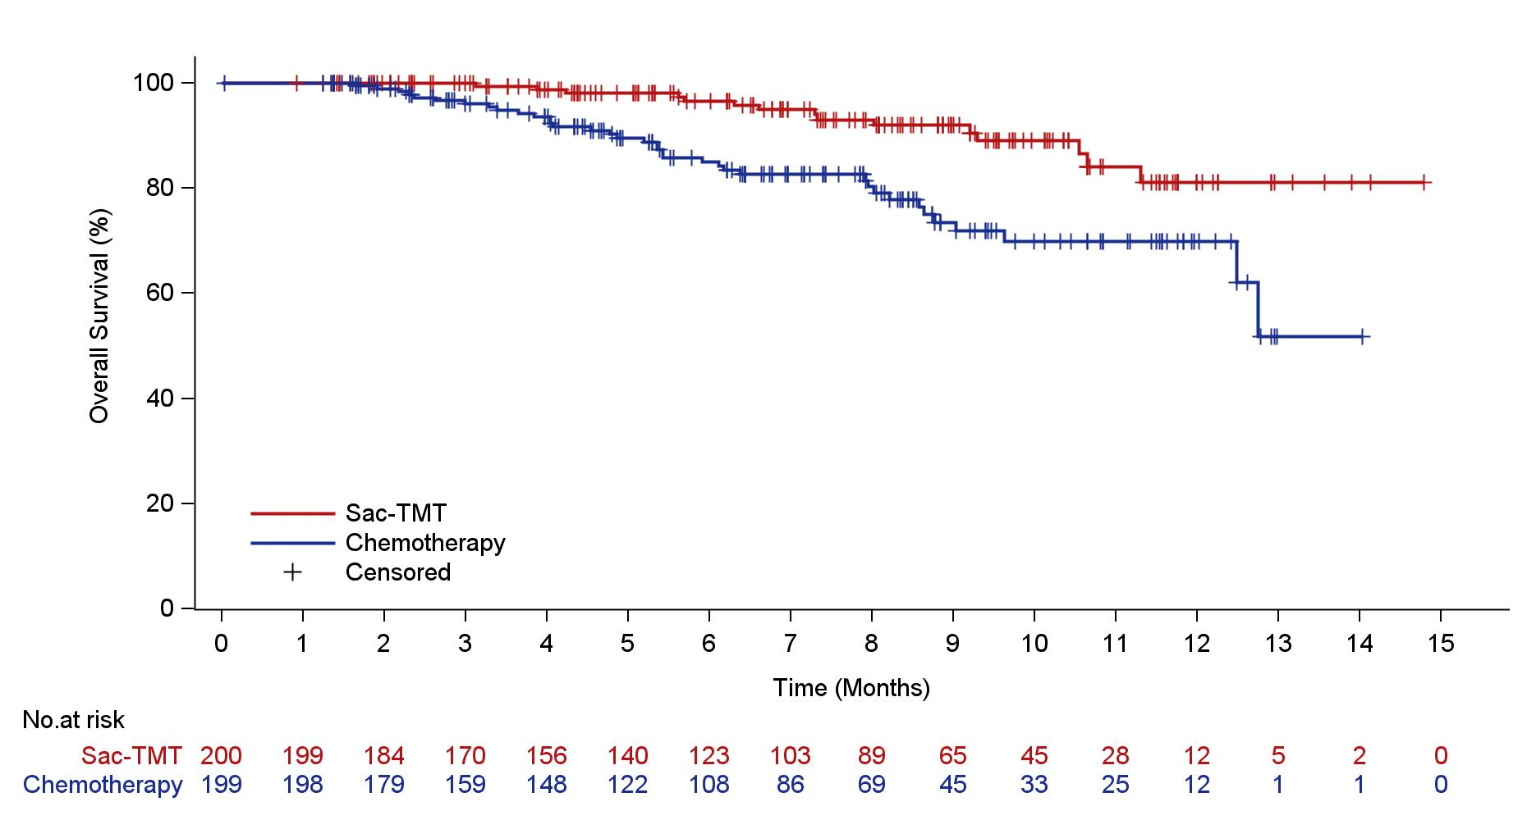
Overall Survival
Survival benefit trend with sac-TMT has been observed at time of PFS interim analysis. The study is continuing to the pre-specified interim analysis for OS.
100
80
60
overall survival (%)
40
 | Sac-TMT (n = 200) | Chemotherapy (n = 199)
OS events, n (%) | 15 (7.5) | 37 (18.6)
HR (95% CI) | 0.33 (0.18, 0.61)
20
Sac-TMT
Chemotherapy
Censored
0
0 1 2 3 4 5 6 7 8 9 10 11 12 13 14 15
Time (Months)
No.at risk
Sac-TMT
200 199 184 170 156 140 123 103 89 65 45 28 12 5 2 0
Chemotherapy
199 198 179 159 148 122 108 86 69 45 33 25 12 1 1 0
CI, confidence interval; HR, hazard ratio; OS, overall survival.
PRESENTED BY : Ying Fan, MD

Slide 36
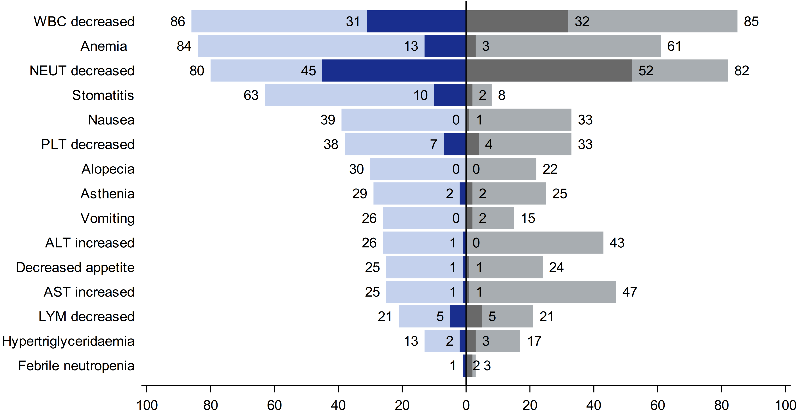
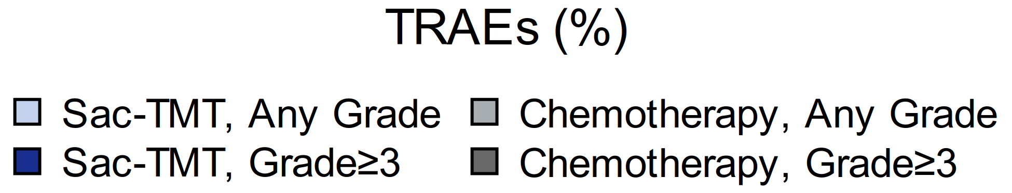
Common TRAEs*
The most common TRAEs for both sac-TMT and chemotherapy were hematologic toxicities.
Stomatitis was the common TRAE seen with sac-TMT and predominantly grade 1 or 2 with no case leading to discontinuation.
Grade ≥ 3 diarrhea occurred in 1.0% of patients in sac-TMT.
Pneumonitis occurred in 1.5% and 1.0% of patients (all grade 1-2) in sac-TMT and chemotherapy, respectively.
* Summary of TRAEs that occurred in either treatment group at an incidence of ≥ 20% for any grade or ≥ 2% for grade ≥ 3.
ALT, alanine aminotransferase; AST, aspartate aminotransferase; LYM, lymphocyte count; NEUT, neutrophil count; PLT, platelet count; WBC, white blood cell.
PRESENTED BY : Ying Fan, MD

Slide 37
TROP2 ADCs in chemo-pretreated HR+/HER2- MBC: Phase 3 studies
ADC vs Chemo
 | OptiTROP-Breast 02 | ASCENT-07 | TROPION-Breast01 | TROPiCS-02
ADC Payload (MoA) | Sacituzumab tirumotecan Topo I Inhibitor | Sacituzumab govitecan Topo I inhibitor | Datopotamab deruxtecan Topo I Inhibitor | Sacituzumab govitecan Topo I Inhibitor
ADC-Target | TROP-2 | TROP2 | TROP-2 | TROP-2
N (ADC arm) | 200 | 690 | 365 | 272
Prior Chemo | 1-4 lines | 0 | 1-2 | 2-4
Prior CT lines in MBC | 2 (1-≥3) | 0 | 1 (1-2) | 3 (0-8)
Prior CDK 4/6inh | 100% | 91% | 82% | 98%
Primary Objective | PFS by BICR* | PFS by BICR | PFS by BICR & OS | PFS by BICR
ORR | 41.5% | 37% | 36.4% | 21%
PFS (HR & 95% CI) Median PFS (mo) | 0.35 (0.26-0.48) 8.3 mo | 0.85 (0.69-1.05) 8.3 mo | 0.63 (0.52-0.76) 6.9 mo | 0.66 (0.63-0.83) 5.5 mo
OS (HR & 95% CI) Median OS (mo) | 0.33 (0.18-0.61) NR | 0.72 (0.54-0.97) NR | 1.01 (0.83-1.22) 18.6 mo | 0.79 (0.65-0.96) 14.4 mo
1. Fan Y, et al. ESMO 2025; 2. Modi S, et al. N Engl J Med 2022; 3. Pristilli B. et al. ESMO Virtual Plenary 2025; 4. Rugo H, et al. Lancet 2023 5. Jhaveri K et al, SABCS 2025

Slide 38
Current treatment algorithm for HR+/HER2- metastatic breast cancer
1L
Aromatase inhibitor + CDK4/6 inhibitor
Fulvestrant + Palbociclib + Inavolisib
(if PIK3CA mut + early relapse)
PI3K and ESR1 wild-type
ESR1 mut
PI3K pathway altered
2L
Fulvestrant + everolimus
Fulvestrant + abemaciclib
Elacestrant or Imlunestrant
Fulvestrant + capivasertib
Fulvestrant + alpelisib
(if PIK3CA mut)
AI or fulvestrant or tamoxifen
± targeted therapy
(if not previously received)
Elacestrant or Imlunestrant
(if ESR1 mut)
Olaparib or talazoparib
(if BRCA mut)
T-DXd
(if HER2-low/
ultralow)
Chemotherapy
(e.g., capecitabine, paclitaxel)
3L
Chemotherapy (e.g., capecitabine, paclitaxel, eribulin)
Olaparib or talazoparib
(if BRCA mut)
T-DXd
(if HER2-low/
ultralow)
Dato-DXd
Sacituzumab govitecan
Biomarker positive*
(TMB-H, MSI-H/dMMR, NTRK fusion, RET fusion)
4L+
*TMB-H: Pembrolizumab; MSI-H: Pembrolizumab, Dostarlimab; NTRK fusion: Larotrectinib, Entrectinib, Repotrectinib; RET fusion: Selpercatinib.
Abbreviations: HR, hormone receptor; HER2, human epidermal growth factor receptor 2; AI, aromatase inhibitor; T-DXd, trastuzumab deruxtecan; Dato-DXd, datopotamab deruxtecan; PI3K, phosphatidylinositol 3-kinase; mut, mutant; CT, chemotherapy; TMB-H, tumor mutational burden-high; MSI-H, microsatellite instability-high; dMMR, mismatch repair-deficient

