Slide 1


Year in Review: Current and
Emerging Role of HER2 ADCs
Hope S. Rugo, MD
Director, Women's Cancers Program
Division Chief, Breast Medical Oncology
Professor, Department of Medical Oncology & Therapeutics Research
City of Hope Comprehensive Cancer Center
Professor Emeritus, UCSF

Slide 2
Topics
Metastatic HER2+ disease
  Tolaney SM et al. Trastuzumab Deruxtecan plus Pertuzumab for HER2-Positive Metastatic Breast Cancer. N Engl J Med 2025;[Online ahead of print].
  Hamilton, E et al. Her2climb-05: a randomized, double-blind, phase 3 study of tucatinib versus placebo in combination with trastuzumab and pertuzumab as maintenance therapy for HER2+ metastatic breast cancer. San Antonio Breast Cancer Symposium 2025 Abstract GS1-01
  Wildiers H et al. Outcomes by hormone receptor (HR) status in patients (pts) with HER2+ advanced/metastatic breast cancer (mBC) with brain metastases (BM) treated with trastuzumab deruxtecan (T-DXd): A post-hoc subgroup analysis of DESTINY-Breast12. San Antonio Breast Cancer Symposium 2025; Abstract PS5-01-27.
  Hu X et al. Trastuzumab botidotin vs trastuzumab emtansine (T-DM1) in HER2-positive unresectable or metastatic breast cancer: Results from a randomized phase III study. ESMO 2025;Abstract LBA24.
  Song E et al. SHR-A1811 versus pyrotinib plus capecitabine in human epidermal growth factor receptor 2-positive (HER2+) advanced/metastatic breast cancer (BC): A multicenter, open-label, randomized, phase III study (HORIZON-Breast01). ESMO 2025;Abstract LBA19.
Early stage HER2+ disease
  Harbeck N et al. Neoadjuvant trastuzumab deruxtecan alone or followed by paclitaxel, trastuzumab, and pertuzumab for high-risk HER2-positive early breast cancer (DESTINY-Breast11): A randomised, open-label, multicentre, phase III trial. Ann Oncol 2025.
  Loibl S et al. Trastuzumab Deruxtecan in Residual HER2-Positive Early Breast Cancer. N Engl J Med 2025 ;[Online ahead of print].

Slide 3
Topics (2)
Metastatic HER2 low disease
  Modi S et al. Trastuzumab deruxtecan in HER2-low metastatic breast cancer: Long-term survival analysis of the randomized, phase 3 DESTINY-Breast04 trial. Nat Med 2025;31(12):4205-13.
  Hu X et al. Patient-reported outcomes with trastuzumab deruxtecan in hormone receptor-positive, HER2-low or HER2-ultralow metastatic breast cancer: Results from the randomized DESTINY-Breast06 trial. ESMO Open 2025;10(5):105082.
Symptom management
  Sakai H et al. A randomized, double-blind, placebo-controlled phase II study of olanzapine-based prophylactic antiemetic therapy for delayed and persistent nausea and vomiting in patients with HER2-positive or HER2-low breast cancer treated with trastuzumab deruxtecan: ERICA study (WJOG14320B). Ann Oncol 2025;36(1):31-42.
  Natsuhara KH et al. Treatment rechallenge after trastuzumab-deruxtecan–related interstitial lung disease: A multi-institution cohort study. ASCO 2025;Abstract 1015.

Slide 4
Metastatic HER2 Positive Disease

Slide 5
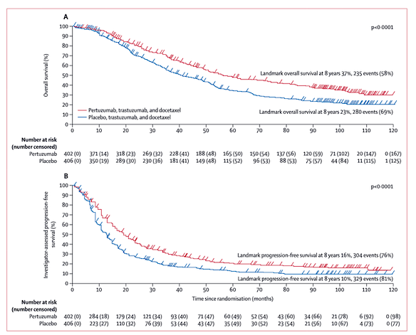
CLEOPATRA End-of-Study Results:
Taxane + Trastuzumab +/- Pertuzumab in 1st line HER2+ MBC
Pertuzumab approved June 2012 based on CLEOPATRA
90% of patients had no prior trastuzumab
Endocrine therapy was not allowed during the maintenance setting in CLEOPATRA, however this has become the standard of care
mOS: 57.1 vs 40.8 mos (Δ16.3 mos)
Landmark OS at 8 yrs : 37% vs 23%
mPFS: 18.7 vs 12.4 mos
Landmark PFS at 8 yrs: 16% vs 10%
Swain S, et al. Lancet Oncol. 2020;21:519-530.

Slide 6
Destiny-Breast09: Moving T-DXd to the 1st Line Setting
Eligibility criteria
HER2+ a/mBC
Asymptomatic/inactive brain mets allowed
DFI >6 mo from last chemotherapy or HER2-targeted therapy in neoadjuvant/ adjuvant setting
One prior line of ET for mBC permitted
No other prior systemic treatment
for mBC†
T-DXd‡ + placebo
Endpoints
Primary
PFS (BICR)
Key secondary
OS
Secondary
PFS (INV)
ORR (BICR/INV)
DOR (BICR/INV)
PFS2 (INV)
Safety and tolerability
n=387
Blinded until final PFS analysis
T-DXd‡ + pertuzumab§
R
1:1:1
n=383
N=1157
THP
Taxane (paclitaxel or docetaxel)¶ + trastuzumab║ + pertuzumab§
n=387
Stratification factors
De-novo vs recurrent mBC
HR+ or HR−
PIK3CAm (detected vs non-detected)
At DCO: 45.8% (n=174) T-DXd + P vs 33.4% (n=128) THP remained on any therapy
At the 1st planned interim analysis (DCO Feb 26, 2025), results were reported for the T-DXd + P and THP arms
ET allowed after TDXd x 6 or off taxane
Demographics
  49% were treated in Asia
  82% HER2 3+; 54% HR+; 30% PIK3CA mutations
  52% had de novo metastatic disease, 71% visceral mets, 6% brain mets
Prior therapy
  Only 7% had prior pertuzumab, 1% prior T-DM1 and 28.5% prior trastuzumab
  40% prior chemotherapy, 20% prior ET
Tolaney et al, ASCO 2025

Slide 7
Consistent PFS benefit with T-DXd + P observed across stratification factors
  Recurrent disease / prior treatment
  (~50% of patients in this setting)
  HR-negative status (~50% of patients)
  PIK3CA mutation (~30% of patients)
Updates ESMO 2025 (Loibl et al)
  PFS and ORR benefit seen across
  Denovo and recurrent disease: HR 0.49 v 0.63
  Across HR status: HR+ 0.61, HR- 0.52
  Across mPIK3CA status: mut 0.52, wt 0.57

Slide 8
Drug exposure
  T-DXd + P
    8.7% (n=33/380) switched to trastuzumab (+ P) after stopping T-DXd for reasons other than PD
  Concurrent ET use (per protocol)
    13.5% (T-DXd + P) vs 38.3% (THP) in pts with HR+ disease
Median total treatment duration:
T-DXd + P: 21.7 mo (range 0.3–44.5)
    T-DXd: 20.0 mo§
    THP: 16.9 mo (range 0.7–41.7)
Post Trial Treatments
PFS2: Loibl et al, ESMO 2025
    Median treatment duration for taxanes:
    Docetaxel: 5.5 mo (range 0.7–37.4)
    Paclitaxel: 4.4 mo (range 0.2–30.7)
    Median number of cycles for taxanes:
    Docetaxel: 8 (range 1–51)
    Paclitaxel: 6 (range 1–42)

Slide 9
Overall safety
TEAEs associated with :
  Dose reduction: 46 v 20%
  Interruption: 69 v 49%
  Outcome of death possibly related: 1.3 vs 0.3%
On December 15, 2025, the US FDA approved fam-trastuzumab deruxtecan-nxki in combination with pertuzumab for the first-line treatment of adults with advanced HER2+ (IHC 3+ or ISH+) breast cancer as determined by an FDA-approved test.
FDA also approved the PATHWAY anti-HER-2/neu (4B5) Rabbit Monoclonal Primary Antibody and HER2 Dual ISH DNA Probe Cocktail as companion diagnostic devices for selecting HER2-positive (HER2 IHC3+ or ISH+) breast cancer patients for treatment with fam-trastuzumab deruxtecan-nxki in combination with pertuzumab.
More N/V, GI issues, transaminitis, fatigue, thrombocytopenia, similar diarrhea, less PN
Adjudicated drug-related ILD/pneumonitis*
n (%) | Grade 1 | Grade 2 | Grade 3 | Grade 4 | Grade 5 | Any grade
T-DXd + P (n=381) | 17 (4.5) | 27 (7.1) | 0 | 0 | 2 (0.5) | 46 (12.1)
THP (n=382) | 2 (0.5) | 2 (0.5) | 0 | 0 | 0 | 4 (1.0)
Left ventricular dysfunction†
n (%) | Grade 1 | Grade 2 | Grade 3 | Grade 4 | Grade 5 | Any grade
T-DXd + P (n=381) | 4 (1.0) | 30 (7.9) | 7 (1.8) | 1 (0.3) | 0 | 42 (11.0)
THP (n=382) | 1 (0.3) | 19 (5.0) | 7 (1.8) | 0 | 0 | 27 (7.1)

Slide 10
HER2CLIMB-05: Tucatinib as Maintenance Therapy for HER2+ MBC
Demographics
  HR+: 52%
  Brain mets: 12%
  De novo MBC:71%
  Prior trastuzumab: 69%
  Prior pertuzumab 17%
  Median 6 cycles of induction therapy
Hamilton et al, SABCS 2025

Slide 11
Primary endpoint: Investigator assessed PFS

Slide 12
CNS-PFS
24 v 28 events
77 v 80 events
HR 0.846 (0.616-1.162)
Safety
Tucatinib vs Placebo
Dose reduction: 29 v 11%
Dose hold: 49 vs 25%
Discontinuation for TUC/PBO: 13.5 vs 2.2%

Slide 13
Primary Results From AFT-38 PATINA Phase 3 Trial of Palbociclib + Anti-HER2 Therapy + ET in HR+/HER2+ MBC: Study Design and Patients
PFS (Investigator Assessed
Key Eligibility Criteria
HR+/HER2+ MBC
!st line induction therapy
    6-8 cycles Rx: tras ± pertuz and taxane/vinorelbine
No evidence of disease progression
Primary endpoint: INV-assessed PFS
Key secondary endpoint: OS
Δ: 15.2 months!
Additional data
Improved ORR
OS early
Safety: Well tolerated with low discontinuation rates
ª Trastuzumab and pertuzumab were administered per SOC. ET options include an AI or fulvestrant.
Metzger O, et al. SABCS 2024. Abstract GS2-12; NEJM 2026
A new SOC!

Slide 14
Ongoing Maintenance Studies

Slide 15
Optimal Therapy for HER2+ MBC in 2026?
Accessibility is clearly a key issue around the world; THP remains the standard of care
  T-DXd has regulatory approval in the US as first-line therapy based on DB09
  When to use T-DXd in the first-line setting - Early relapse, patients presenting with brain metastases?
  T-DXd + P is associated with more nausea, less neuropathy than THP
    Higher mortality by 1%; 0.5% grade 5 ILD
  Maintenance therapy is a critical question given ongoing nausea with T-DXd/risk of ILD
Optimal treatment?
  T-DXd or THP induction, and in those with responding or stable disease followed by:
    ER+: ET+ trastuzumab/pertuzumab + palbociclib
    ER-: trastuzumab/pertuzumab + tucatinib
    Sequencing therapy is a critical issue in interpreting trials and a key factor in improving outcome
1st Line Study | PFS, months
TH vs THP | 18.7 | 12.4
T-DXd/P vs THP | 40.7 | 26.9
Palbociclib plus ET/HP vs ET/HP in responding pts | 44.3 | 29.1
Tucatinib plus HP in responding pts | 24.9 | 16.3

Slide 16
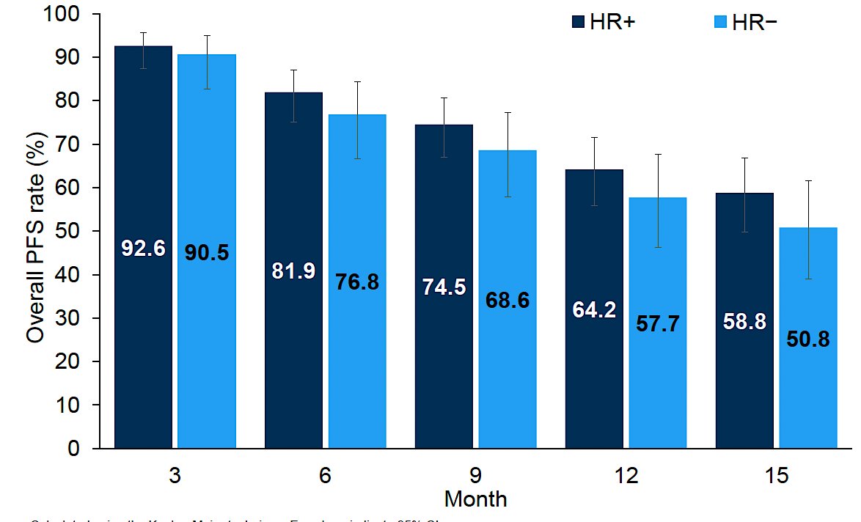
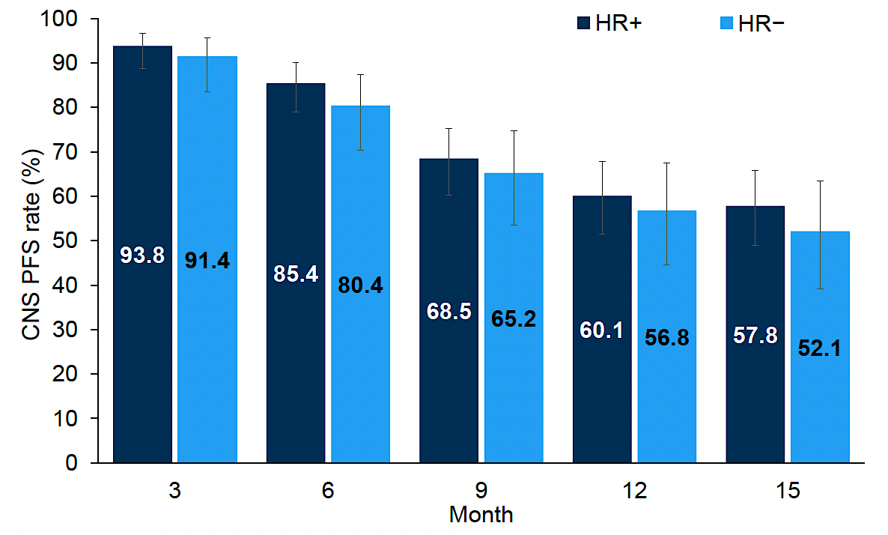
Destiny Breast12: Post Hoc Analysis of
Efficacy by Hormone Receptor Status
DB12 treated 263 patients with HER2+ stable or active brain metastases with T-DXd with a primary endpoint of PFS
  Almost all had 1-2 lines of prior therapy
  Overall PFS 17.3 mo, 12 mo CNS PFS 58.9%
  ORR 51.7%, 64.1% for measurable dse
Est PFS rates
Est CNS PFS rates
Response rates in patients with BMs
Overall and CNS PFS similar for HR+ and HR-
Safety similar; 3 ILD in each subgroup
ILD rate high at 15.8 /16.5% (HR+/-) likely due to steroid use and lack of PJP prophylaxis
Conclusions
Efficacy of T-DXd in HER2+ MBC in brain maintained regardless of HR status
Careful management with prophylaxis to avoid opportunistic infections is critical
Response, n (%, 95% CI) | HR+ (n-165) | HR- (n=97)
ORR | 81(49.1) [41.5, 56.7] | 54(55.7) [45.8, 65.6]
CNS ORR | 56 (66.7) [56.6, 76.7]) | 42(79.2) [68.3, 90.2)
ORR in measurable dse | 76(60.8) [52.2, 69.4] | 50(69.4) [58.8, 80.1]
Harbeck N, et al. Nat Med. 2024;30:3717–3727; Wildiers et al, SABCS 2025

Slide 17
Trastuzumab botidotin vs T-DM1 in HER2+ MBC
N=365
Median FU 14.9 mo
Demographics
Visceral mets
73%
Prior lines of Rx
1: 46%
>2: 54%
Prior pertuzumab
46%
Prior TKI
59%
Xichun Hu et al, ESMO 2025
Sichuan Kelun-Biotech Biopharmaceutical Co., Ltd.

Slide 18
OS: immature but positive trend
ORR was improved (23.9% higher) in the experimental arm
Safety
  2 discontinued TB due to AEs
  Most common toxicity was ocular
    62% all grade, 30% >grade 3
  Minimal nausea
  1.1% grade 2 ILD
Summary
Highly effective MMAF ADC with different toxicity profile compared to T-DXd
Ocular toxicities are a key issue
  Ongoing studies evaluating prophylaxis and treatment

Slide 19
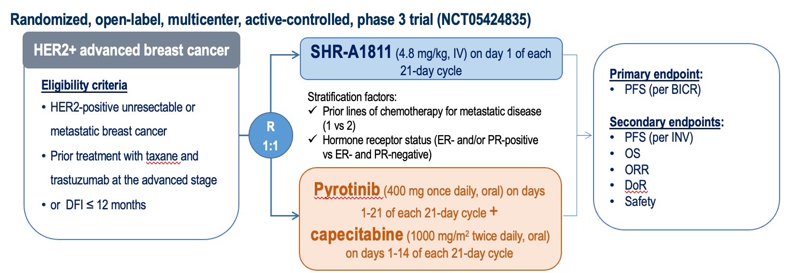
Phase III Horizon Breast-01: SHR-A1811 vs Pyrotinib + Capecitabine in HER2+ MBC
Pyrotinib
  Pan ErbB2 TKI
  Approved in China in 2nd line with capecitabine
SHR-A1811(Trastuzumab rezetecan)
  HER2 ADC with Topo1 payload
Demographics
  83.8 v 76.6% one line prior Rx
  100% prior tras, 72% prior pert
  5-7% prior T-DM1
  28-30% prior ET (48% HR+)
12 mo OS
  Encouraging
ORR
  82 v 56%
N=287
Median FU: 15.3-15.9mo
PFS benefit seen across all subgroups
Song et al, SABCS 2025
Jiangsu Hengrui Pharmaceuticals

Slide 20
Post-Treatment, Safety, Conclusions
Post progression therapy (SHR vs Pyr/cape)
  21 vs 58% received at least 1 anti-tumor Rx
  3.5 vs 50.3% received anti-HER2 ADC
    1.4 vs 22.8% T-DXd
    2.1 vs 20.7% T-DM1
Conclusions
  PFS benefit, trend towards OS benefit and ORR improved with SHR ADC vs Pyr/cape
  Prior and post study Rx very different from US population, impacting assessment of OS
  Markedly different toxicity
    More bone marrow suppression, alopecia with SHR
    Low rate of ILD
    More GI toxicity/diarrhea, PPE with Pyr/cape
  Great about low ILD, but need to balance with other toxicities
Safety
  Dose reductions almost 3x higher with Pyr/cape
  Discontinuations higher with SHR (4.9 vs 1.4%)
  No difference in related deaths
  Primary toxicities: SHR vs Pyr/cape
    Neutropenia
      All grade: 89 vs 45%; grade 3: 54 vs 9%
    Thrombocytopenia
      All grade: 35 vs 10%; grade 3: 10.6 vs 1.4%
    Alopecia: 36 vs 0%
    Vomiting: 32 vs 61%
    Diarrhea
      All grade: 26 vs 91%; grade 3: 0.7 vs 24%
    Other
      PPE, increased creatinine with Pyr
      ILD 2.8%/0.7% grade 3 with SHR

Slide 21
Early Stage HER2 Positive Disease

Slide 22
DESTINY-Breast11 Phase 3 Trial of Neoadjuvant T-DXd Alone or Followed by THP vs SOC for High-Risk HER2+ EBC: Study Design and Patients
Key Eligibility Criteria
Previously untreated HR+ or HR– HER2+ EBC
High risk defined as:
  ≥cT3 and N0-3 or cT0-4 and N1-3
  Inflammatory breast cancer
Patient Characteristics, n (%) |  | T-DXd-THP (n=321) | ddAC-THP (n=320) | T-DXd (n=286)
Median (range) age, years |  | 50 (25-82) | 50 (23-79) | 50 (23-79)
Geographic region | Asia | 152 (47.4) | 152 (47.5) | 124 (43.4)
 | Western Europe | 69 (21.5) | 77 (24.1) | 66 (23.1)
 | North America | 43 (13.4) | 41 (12.8) | 52 (18.2)
 | Rest of world | 57 (17.8) | 50 (15.6) | 44 (15.4)
HR+ |  | 236 (73.5) | 235 (73.4) | 205 (71.7)
Clinical tumor stage | cT0-2 | 176 (54.8) | 188 (58.8) | 157 (54.9)
 | cT3-4 | 145 (45.2) | 132 (41.3) | 129 (45.1)
Nodal status | N0 | 26 (8.1) | 35 (10.9) | 20 (7.0)
Liver mets at baseline, n (%) | N+ | 287 (89.4) | 281 (87.8) | 254 (88.8)
1:1:1
T-DXdª → THP^{b} (n=321)
4 + 4 cycles
RANDOMIZED
Recommended post-neoadjuvant treatment per study protocol
pCR: RT + HP for up to 1 year
No pCR: RT +
T-DM1 for up to 14 cycles
HR+: ET
ddAC^{c} → THP^{d} (n=320)
4 + 4 cycles
SURGERY^{e}
T-DXdª (n=286)
8 cycles
The T-DXd alone arm was closed early following Independent Data Monitoring Committee recommendation
N=927
Primary endpoint: pCR (ypT0/is ypN0) by BCR
Secondary endpoints: pCR (ypT0 ypN0) by BCR, EFS, safety, PK and immunogenicity, IDFS, OS, HRQoL
ª 5.4 mg/kg q3w. ^{b} Paclitaxel (80 mg/m² qw) + trastuzumab (6 mg/kg q3w) + pertuzumab (840 mg loading dose followed by 420 mg q3w).
^{c} Doxorubicin (60 mg/m² q2w) + cyclophosphamide (600 mg/m² q2w). ^{d} Paclitaxel (80 mg/m² qw) + trastuzumab (8 mg/kg loading dose followed by 6 mg/kg q3w) + pertuzumab (840 mg loading dose followed by 420 mg q3w). ^{e} Recommended window for surgery was 3-6 weeks following administration of the last dose of neoadjuvant study treatment.
Harbeck N, et al. ESMO 2025. Abstract 219O; Ann Oncol 2025.

Slide 23
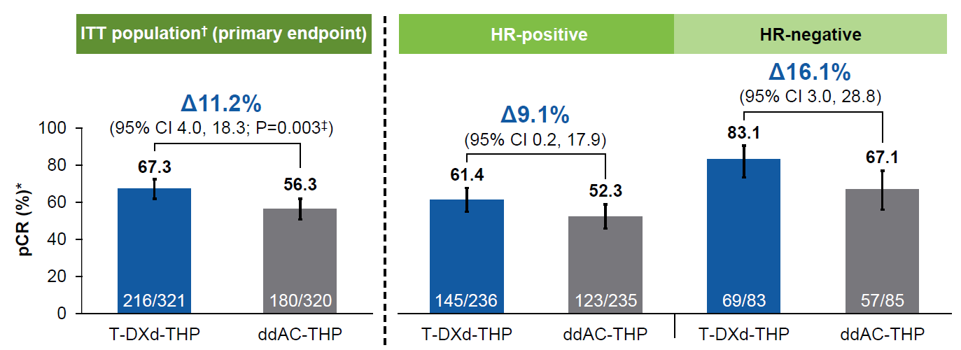
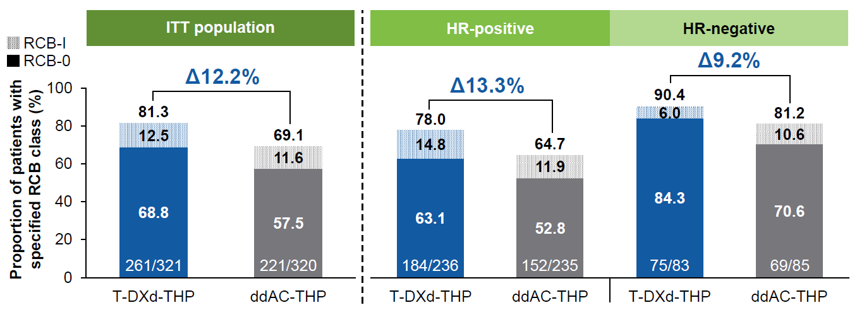
DESTINY-Breast11: pCR and RCB with T-DXd-THP vs ddAC-THP
Harbeck N, et al. ESMO 2025. Abstract 219O, Ann Oncol 2025

Slide 24
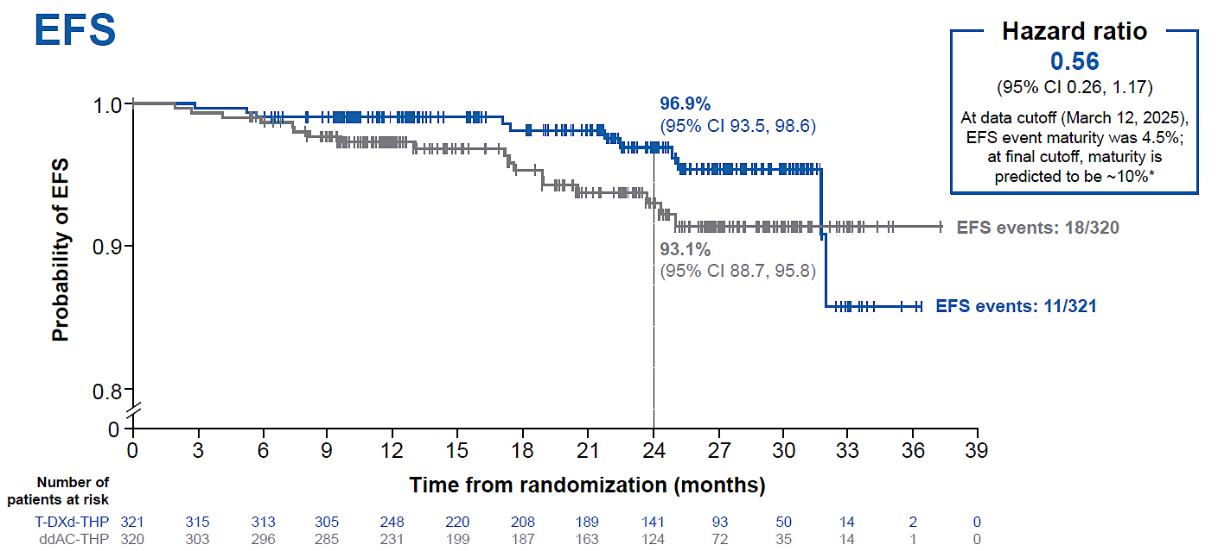
DESTINY-Breast11: EFS Immature
Trial was not powered for EFS or OS
EFS in T-DXd-THP vs ddAC-THP
Post-neoadjuvant treatments were generally well balanced between T-DXd-THP and ddAC-THP arms
In both arms, more than half of patients without pCR received post-neoadjuvant T-DM1
Harbeck N, et al. ESMO 2025. Abstract 219O, Ann Oncol 2025.

Slide 25
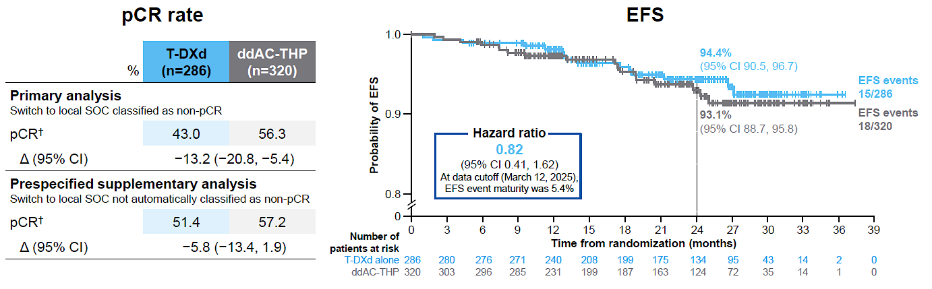
DESTINY-Breast11 Phase 3 Trial of Neoadjuvant T-DXd Alone or Followed by THP vs SOC for High-Risk HER2+ EBC: pCR and EFS in T-DXd vs ddAC-THP
On March 13, 2024, the T-DXd alone arm closed following Independent Data Monitoring Committee recommendation.ª Patients who were still receiving T-DXd alone could remain on therapy or immediately switch to local SOC.
pCR Rate
EFS
The overall safety profile of T-DXd alone was favorable vs ddAC-THP, with reduced rates of grade ≥3 AEs, SAEs, treatment reductions/interruptions, and left ventricular dysfunction; ILD incidence was low and similar in both arms
ª The reasons were multifactorial, including a lower pCR rate, low likelihood that T-DXd alone would be superior to ddAC-THP, and the timing of surgery.
Harbeck N, et al. ESMO 2025. Abstract 219O; Ann Oncol 2025.

Slide 26
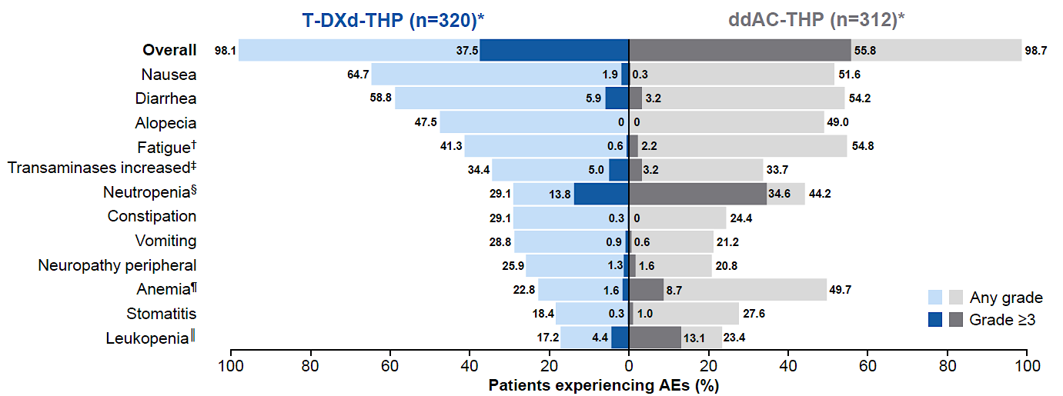
DESTINY-Breast11 Phase 3 Trial of Neoadjuvant T-DXd Alone or Followed by THP vs SOC for High-Risk HER2+ EBC: Safety
Monitoring:
High-resolution CT chest scans: Q6W during treatment; if ILD/pneumonitis was suspected on T-DXd, treatment was interrupted and a full investigation completed
Echocardiograms or multigated acquisition scans: during screening (<28 days prior to randomization), during treatment (<3 days before Cycle 5), and at end of treatment to assess LVEF
Harbeck N, et al. ESMO 2025. Abstract 219O; Ann Oncol 2025.

Slide 27
What did we Learn?
T-DXd-THP showed the highest reported pCR rate in HER2+ EBC for a registrational study in the neoadjuvant setting, despite high prevalence of HR+ disease and a high-risk population
Definitive data – and the 4th trial – to show that anthracyclines do not improve pCR in HER2+ breast cancer and are less safe than non-anthracycline based chemotherapy/ADCs
Sequential non-cross resistant chemotherapy remains the best treatment approach for high-risk early stage HER2+ breast cancer
  T-DXd alone was inferior in this high-risk patient population
T-DXd-THP associated with lower rates of hematologic AEs, left ventricular dysfunction, and fatigue, with similar rates of ILD
  Control arm imperfect as TCHP is the SOC in many countries although that is due to equivalency in randomized phase III trials
  Safety comparison impacted the most

Slide 28
KATHERINE IDFS Final Analysis; Median Follow-up 8.4 Years (101 months)
Absolute IDFS benefit of 13.7 % at 7 years
100
3 years
5 years
88.4%
84.4%
7 years
80.8%
80
77.1%
72.2%
60
67.1%
IDFS rate (%)
40
 | Trastuzumab (n = 743) | T-DM1 (n = 743)
IDFS events, no. (%) | 239 (32.2) | 146 (19.7)
Unstratified hazard ratio 0.54 (95% CI = 0.44, 0.66); p < 0.0001*
T-DM1
Trastuzumab
20
0
0
6
12
18
24
30
36
42
48
54
60
66
72
78
84
90
96
102
108
114
120
No. at risk
Time (months)
Trastuzumab
743
677
636
595
556
540
511
495
485
475
460
444
431
421
397
368
238
187
74
42
2
T-DM1
743
708
682
658
637
620
605
591
574
561
548
537
521
516
481
443
281
236
89
50
3
* p-value for IDFS is now exploratory given the statistical significance was established at the primary analysis.
CI, confidence interval; IDFS, invasive disease-free survival; T-DM1, ado-trastuzumab emtansine.
First efficacy data at median FU of 3.4 years
Loibl et al, SABCS 2023; Geyer et al, NEJM 2025

Slide 29
Interim Analysis of DESTINY-Breast05 Phase 3 Trial of T-DXd vs T-DM1 in
High-Risk HER2+ EBC: Study Design and Patients
Key Eligibility Criteria
Centrally confirmed HER2+ (IHC 3+ or ISH+) EBC with residual invasive disease in breast and/or axillary lymph nodes after NAT with HER2-directed therapyª
High-risk defined as presentation prior to NAT with:
    Inoperable EBC (cT4, N0-3, M0 or cT1-3, N2-3, M0) OR
    Operable EBC (cT1-3, N0-1,MO) with axillary node-positive disease (ypN1-3) after NAT
Patient Characteristics, n (%) |  | T-DXd (n=818) | T-DM1 (n=817)
Median age (range), years |  | 50.3 (24-78) | 50.6 (21-83)
HER2 expression | IHC 3+ | 676 (82.6) | 670 (82.0)
 | IHC 2+ and ISH+ | 129 (15.8) | 133 (16.3)
 | IHC 2+ and ISH– | 2 (0.2) | 0
 | IHC 1+ and ISH+ | 11 (1.3) | 14 (1.7)
HR+ |  | 581 (71.0) | 583 (71.4)
Inoperable disease at presentation |  | 431 (52.7) | 424 (51.9)
Positive nodal status after NAT |  | 660 (80.7) | 658 (80.5)
Neoadjuvant HER2-targeted therapy | H | 176 (21.5) | 171 (20.9)
 | HP | 637 (77.9) | 641 (78.5)
 | Other | 5 (0.6) | 5 (0.6)
Radiotherapy treatment | Concurrent | 438 (53.5) | 480 (58.8)
 | Sequential | 326 (39.9) | 279 (34.1)
 | No radiotherapy | 54 (6.6) | 58 (7.1)
RANDOMI
ZED
T-DXd 5.4 mg/kg IV q3w for 14 cycles
(n=818)
Concomitant adjuvant ET was allowed per local practices
If administered, RT could be initiated concurrent with study therapy or completed prior to initiation of study therapy (sequential)
1:1
T-DM1 3.6 mg/kg IV q3w for 14 cycles
(n=817)
ILD monitoring program for patients treated with RT
All patients had baseline non-contrast, low dose (LD) chest CT during screening
All RT patients (concurrent and sequential) had LD chest CT 6 weeks after start of study therapy, then Q12W while on therapy, and at 40-day follow-up
Sequential RT patients had additional LD chest CT after completion of RT prior to therapy
N=1635
Primary endpoint: IDFS
Key secondary endpoint: DFS
Secondary endpoints: OS, BMFI, DRFI, safety
Median FU 30 months
ª NAT is defined as ≥16 weeks’ NAT with ≥9 weeks trastuzumab ± pertuzumab and ≥9 weeks taxane-based Chemo. b
Geyer CE, et al. ESMO 2025. Abstract LBA1.

Slide 30
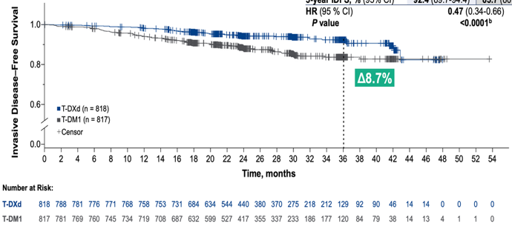
Interim Analysis of DESTINY-Breast05: IDFS with T-DXd vs T-DM1 in
High-Risk HER2+ EBC
IDFS
Categories of First IDFS Events
77
Non-
CNS
52
42
Non-
CNS
25
Outcome Measure | T-DXd (n=818) | T-DM1 (n=817)
Patients with events, n (%) | 51 (6.2) | 102 (12.5)
3-year IDFS, % (95% CI) | 92.4 (89.7-94.4) | 83.7 (80.2-86.7)
HR (95% CI) | 0.47 (0.34-0.66)
P value | <0.0001
CNSª
25
CNSª
17
b
ª CNS as sole site for distant recurrence or one of multiple distant recurrent sites. ^{b} Causes of death in the T-DXd arm were 2 drug-related ILD, unrelated respiratory tract infection, acute respiratory failure (outside AE reporting period), acute respiratory distress syndrome (outside AE reporting period), and 2 disease progression, and in the T-DM1 arm were drug-related sepsis, unrelated ovarian cancer, unrelated aneurysm, unrelated pneumothorax, unrelated leiomyosarcoma, self-inflicted gun wound, and 2 disease progression.
Geyer CE, et al. ESMO 2025. Abstract LBA1.

Slide 31
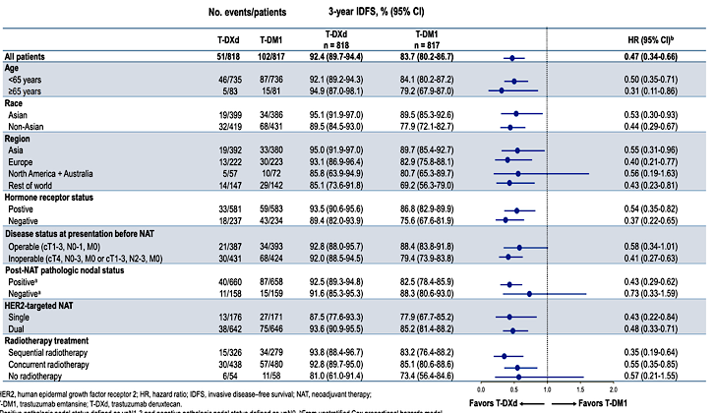
Interim Analysis of DESTINY-Breast05: Additional Efficacy Analyses
IDFS Subgroup Analysis
Absolute improvement in DFS: 8.8%
ª Positive pathologic nodal status defined as ypN1-3, and negative pathologic nodal status defined as ypN0. ^{b} From unstratified Cox proportional hazards model.
Geyer CE, et al. ESMO 2025. Abstract LBA1.

Slide 32
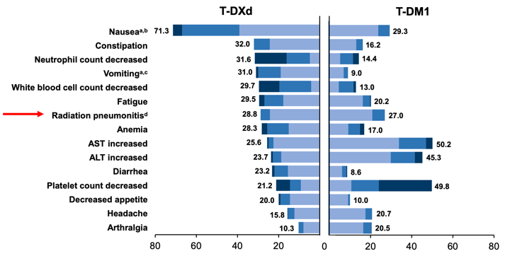
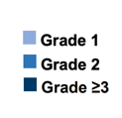
Interim Analysis of DESTINY-Breast05 : Safety
TEAEs in ≥20% of Patients
ª Prophylactic antiemetics were recommended but not mandatory. ^{b} In the T-DXd and T-DM1 arms: 39.1% and 23.7% grade 1, 27.8% and 5.5% grade 2, and 4.5% and 0.1% grade 3 events, respectively. ^{c} In the T-DXd and T-DM1 arms: 19.0% and 6.9% grade 1, 10.9% and 2.0% grade 2, and 1.1% and 0.1% grade 3 events, respectively. ^{d} In the T-DXd and T-DM1 arms: 24.2% and 20.8% grade 1 and 4.6% and 6.1% grade 2 events, Geyer CE, et al. ESMO 2025. Abstract LBA1.

Slide 33
What did we Learn?
How to Incorporate T-DXd into treatment for early stage HER2+ BC?
T-DXd for patients with high risk HER2+ disease and residual disease in breast and/or node following at least 6 cycles of neoadjuvant chemotherapy containing HER2 targeted therapy significantly improved IDFS and DFS compared to T-DM1 – with short follow-up
  Effect seen across all prespecified subgroups
  At interim analysis there are less CNS metastases in the T-DXd group
  T-DXd was associated with more ILD compared to DB11, presumably due to longer exposure and perhaps prior treatment, as well as more nausea than T-DM1
    Less cytopenias and liver enzyme elevations
    Similar deaths attributed to treatment (2 v 1)
Neoadjuvant or adjuvant?
  More T-DXd (8 cycles vs 4 followed by THP) was definitely not better
  T-DXd x 4 followed by THP is associated with less toxicity and increases pCR, thereby sparing a subset of patients 14 cycles of T-DXd
  But in patients with no pCR, next steps are unclear!
  THP is sufficient for a subset of patients, as is T-DXd x 4: individualizing therapy to risk is critical
    Ex: I-SPY 2.2
  T-DXd in patients with residual disease (and high-risk) will become the SOC

Slide 34
Metastatic HER2 Low Disease

Slide 35
DESTINY-Breast04
Updated data cutoff (March 1, 2023), median FU 32 mos
N=557
Primary endpoint
PFS by BICR (HR+)
Key secondary endpoints^{d}
PFS by BICR (all patients)
OS (HR+ and all patients)
Secondary endpoints^{d}
PFS by investigator
ORR by BICR and investigator
DOR by BICR
Safety
Patient-reported outcomes (HR+)^{e}
T-DXd
5.4 mg/kg Q3W
(n = 373)
Patientsª
HER2-low (IHC 1+ or IHC 2+/ISH−), unresectable, and/or mBC treated with 1-2 prior lines of chemotherapy in the metastatic setting
HR+ disease considered endocrine refractory
Chemotherapy, n (%)
Eribulin | 94 (51.1)
Capecitabine | 37 (20.1)
Nab-paclitaxel | 19 (10.3)
Gemcitabine | 19 (10.3)
Paclitaxel | 15 (8.2)
R
2:1
TPC
Capecitabine, eribulin, gemcitabine, paclitaxel, nab-paclitaxel^{c}
(n = 184)
Stratification factors
Centrally assessed HER2 status^{b} (IHC 1+ vs IHC 2+/ISH−)
1 vs 2 prior lines of chemotherapy
HR+ (with vs without prior treatment with CDK4/6i) vs HR−
Modi et al, NEJM 2022; ESMO 2023; Nat Med 2025

Slide 36
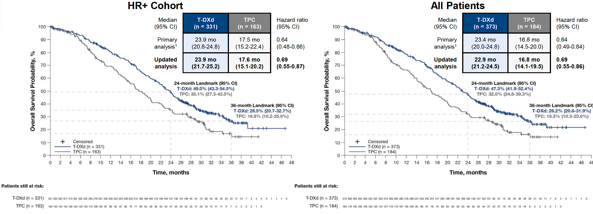
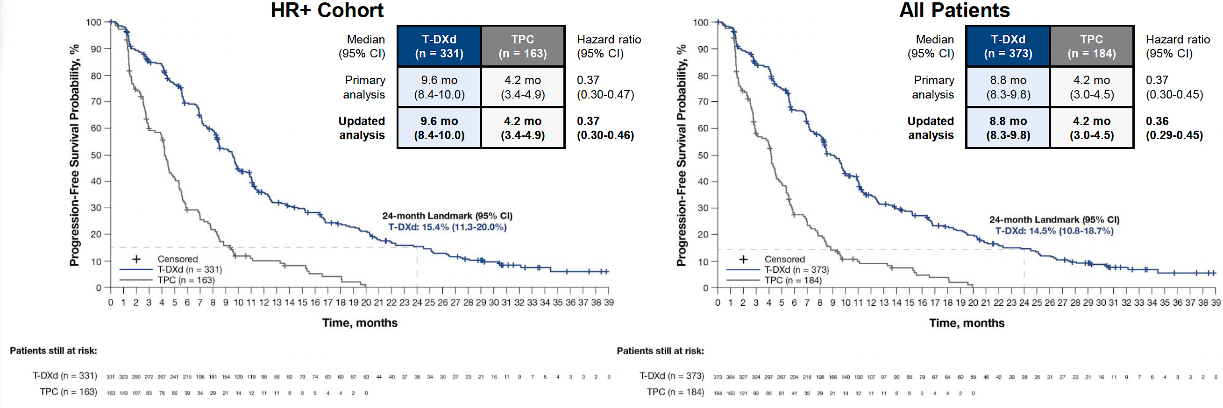
DESTINY-Breast04: T-DXd significantly improved PFS and OS vs TPC in HER2 low MBC after a Median of one Line of Prior Chemotherapy
PFS in HR+ Cohort
OS in HR+ Cohort
FDA approval of T-DXd in HER2 low MBC after one prior chemotherapy for advanced disease (or recurrence within 6mo of adjuvant chemotherapy)
Modi et al, NEJM 2022; ESMO 2023; Nat Med 2025

Slide 37
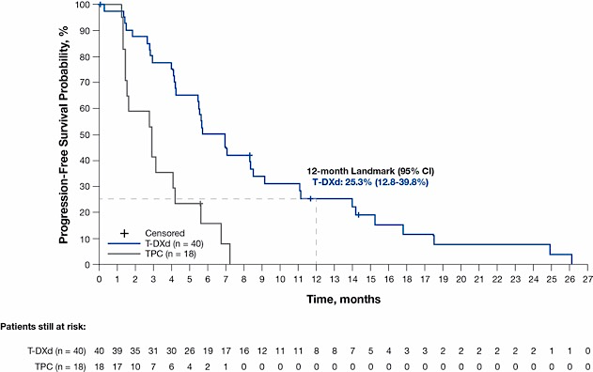
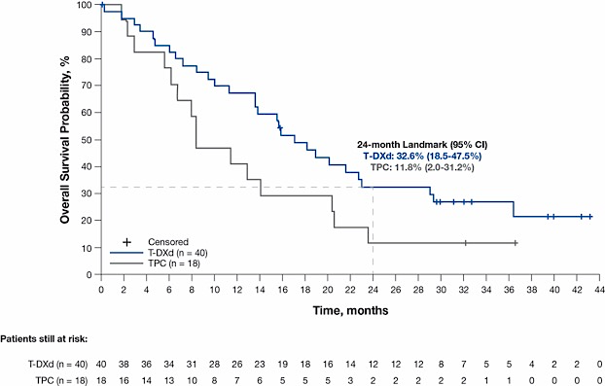
DESTINY-Breast04: Efficacy in the HR− Cohort
(Exploratory Analyses)
Progression-Free Survival (by Investigator)
Overall Survival
Median (95% CI) | T-DXd (n = 40) | TPC (n = 18) | Hazard ratio (95% CI)
Primary analysis (by BICRª)¹ | 8.5 mo (4.3-11.7) | 2.9 mo (1.4-5.1) | 0.46 (0.24-0.89)
Updated analysis (by investigator) | 6.3 mo (4.2-8.5) | 2.9 mo (1.4-4.2) | 0.29 (0.15-0.57)
Median (95% CI) | T-DXd (n = 40) | TPC (n = 18) | Hazard ratio (95% CI)
Primary analysis¹ | 18.2 mo (13.6-NE) | 8.3 mo (5.6-20.6) | 0.48 (0.24-0.95)
Updated analysis | 17.1 mo (13.6-23.0) | 8.3 mo (5.6-20.4) | 0.58 (0.31-1.08)
ªPFS by investigator was not analyzed for the HR− cohort at the time of the primary analysis.
Median FU now 32 months vs 18.4 at primary analysis
There was a 42% reduction in risk of death and 71% reduction in risk of disease progression or death for HR− patients receiving T-DXd compared with TPC
BICR, blinded independent central review; HR, hormone receptor; mo, month; NE, not evaluable; OS, overall survival; T-DXd, trastuzumab deruxtecan; TPC, treatment of physician’s choice.
Modi et al, NEJM 2022; ESMO 2023, Nat Med 2025

Slide 38
Additional Results and Conclusions
Sequencing was not an issue
  T-DXd was only approved for HER2 low MBC based on this study
No new safety events
  Nausea is the most common toxicity
  16.7 vs 8.1% discontinued due to Aes
  4 vs 2.9% AEs associated with death
    1.9% (n=7) vs 0 drug related
  ILD 12.1% (n=45)
    Median time to onset 129d (26-710d)
    1.1% (n=4) grade 5
Based on this data, T-DXd became a standard of care as 2nd line therapy for HR+/HER2 low MBC
  Remains an option for HER2 low TNBC but TROP2 ADCs have level 1 evidence
DB06 added further data moving T-DXd to the 1st line chemotherapy setting for those with higher disease burden, visceral dominant disease for both HER2 low and HER2 ultra low HR+ MBC
Careful monitoring and management of ILD is critical to maintain benefit

Slide 39
DESTINY-Breast06: Patient Reported Outcomes
PROs
  EORTC QLQ-C30 and QLQ-BR35 given every 3 weeks
  Overall, GHS/QOL was maintained over 36 weeks between the 2 arms
  Time to deterioration in QLQ-C30 GHS/QOL was similar with T-DXd and TPC
  T-DXd reduced the risk of clinically meaningful deterioration in pain by 49% vs TPC
  Worse TTD for GI symptoms with T-DXd
  Deterioration of skin and mucosal symptoms with TPC
These data further support the early use of T-DXd for patients with endocrine resistant, HR+, HER2 low/ultralow MBC
Nausea management is critical
Hu et al, ESMO Open 2025

Slide 40
Symptom Management and Toxicity

Slide 41
ERICA Trial: Randomized Trial of Olanzapine Prophylaxis for T-DXd Delayed/Persistent Nausea and Vomiting
162 evaluable patients were enrolled at 43 sites in Japan
Study design: placebo controlled, dbl blind
  Olanzapine/pla 5 mg/d day 1-6
  Day 1: 5-HT3 RA, dexamethasone (6.6mg IV, 8 mg PO)
  Primary endpoint CR in 21d observation period
    No emetic events, no rescue meds in delayed phase (24-120hr post T-DXd)
  Secondary endpoints
    No nausea in delayed/persistent phases (120-504 hrs, 21d)
    Adverse events
Results
  Delayed phase CR (olanzapine vs pla)
    70 vs 56.1%. P 0.047
  Persistent phase
    63.9 vs 44.4%
  No nausea
    57.5 vs 37.8%
  Less appetite loss, low-grade somnolence and hyperglycemia with olanzapine
    Hyperglycemia: 7.5% vs 0
    Somnolence: 25 vs 10.8%
Sakai et al, Ann Oncol 2025

Slide 42
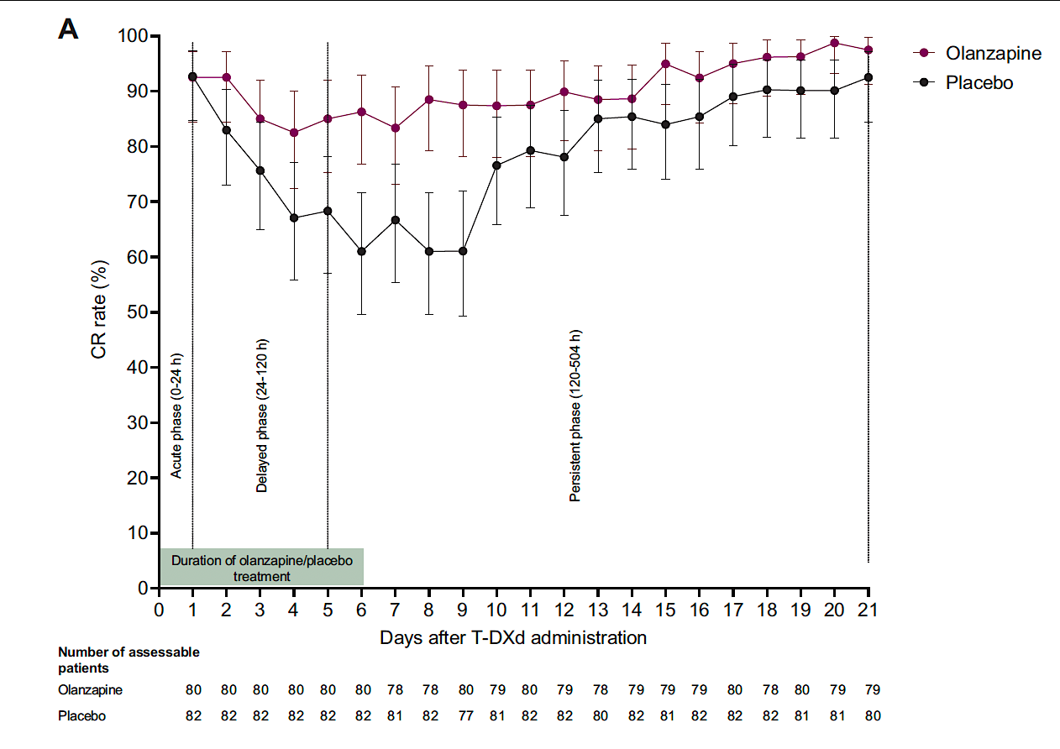
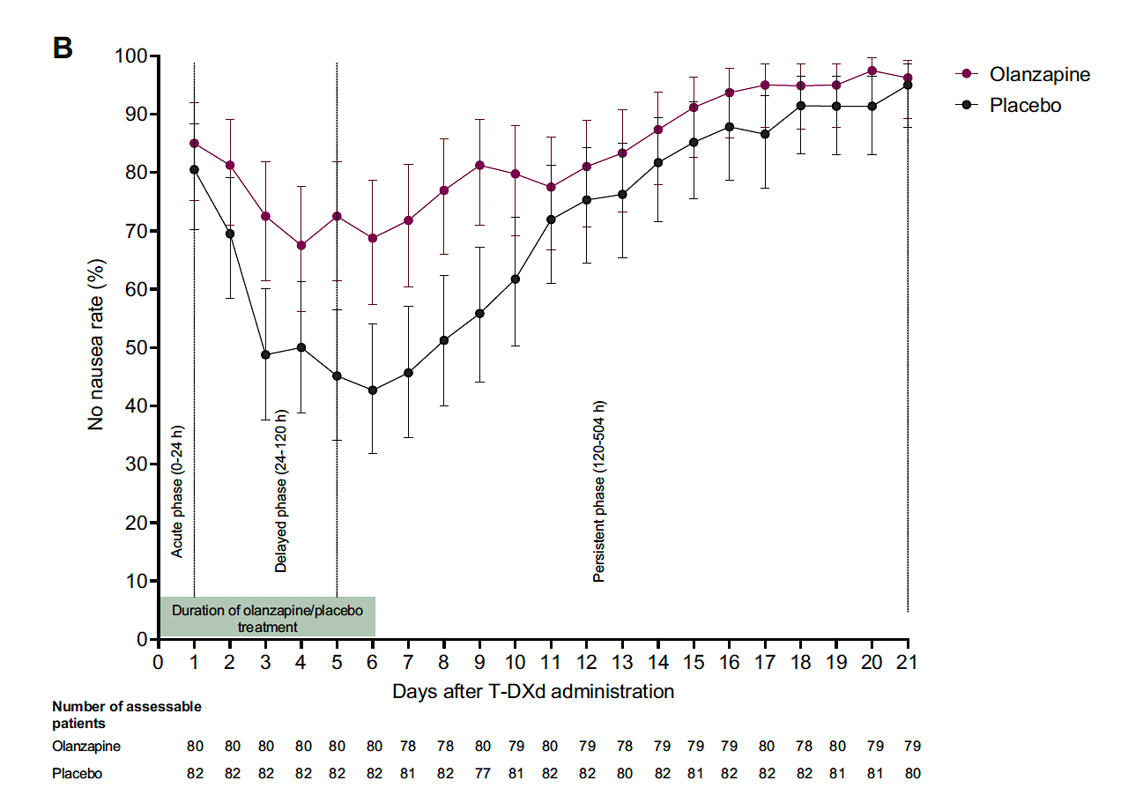
Results and Conclusions
Nausea is the most common toxicity from T-DXd impacting QOL and adherence
  Affects >70% with standard antiemetics
Recommendations for prophylaxis include a 3-drug regimen with 5-HT3 RA, NK1 RA and dexamethasone
  Delayed and long-delayed nausea remain an issue
Olanzapine at bedtime d1-4+ is remarkably effective at reducing nausea, also effective when extended for delayed nausea
  Start at 2.5 mg* and increase as needed (1.25mg for some!)
  Indian study: Mainly AC showed 2.5 mg as effective as 10 mg d1-4 with much less somnolence
Daily CR rates
Daily no nausea rates
*Bajpai et al, Lancet Oncology 2024

Slide 43
Pooled Analysis of Grade 1 ILD Rechallenge
 | T-DXd retreatment (N = 45)
Dose level of T-DXd retreatment
Same dose, n (%) | 31 (68.9)
Reduced dose, n (%) | 14 (31.1)
Median time to retreatment after ILD1 onset (range), days | 28 (8-48)
Median retreatment cycles (range) | 5.0 (1-37)
Patients with ILD2 (n = 15) | 5.0 (2-23)
Patients without ILD2 (n = 30) | 4.5 (1-37)
Median retreatment duration (range), days | 85.0 (1-848)
Patients with ILD2 (n = 15) | 85.0 (22-648)
Patients without ILD2 (n = 30) | 82.5 (1-848)
Reason for retreatment discontinuation
0-3
>3-6
>6-9
>9-12
>12
68.9% (31/45) of patients were retreated without any dose reductions
24.4% (11/45) of patients were still receiving T-DXd retreatment at the DCOs of each respective study
Progressive disease was the main reason for T-DXd retreatment discontinuation (33.3% [15/45] of patients)
  20.0% (9/45) of patients discontinued retreatment due to recurrent ILD (ILD2)
33.3% (15/45) of patients were retreated for >6 months and 17.8% (8/45) of patients were retreated for >12 months
AE, adverse event; DCO, data cutoff; ILD, interstitial lung disease/pneumonitis; ILD1; first Gr 1 ILD event; ILD2, any-grade recurrent ILD event; PD, progressive disease; T-DXd, trastuzumab deruxtecan.
Rugo et al, Ann Oncol 2025

Slide 44



T-DXd Rechallenge After ILD:
A Real World Study at 5 US Academic Centers:
Outcomes after T-DXd Rechallenge for patients with G1 ILD (n=44)
Median time to rechallenge was 42 days (IQR 34-64) from last dose before ILD
  3 patients (7%) received intervening therapy prior to rechallenge
  27 patients (61%) were rechallenged with a dose-reduction
  17 patients (38%) were rechallenged while completing steroid taper
After rechallenge, patients remained on T-DXd for a median of 215 days (IQR 74-319)*
12 patients (27%) developed recurrent ILD (9-G1, 2-G2, 1-G3)
  Median time to recurrent ILD was 211 days (IQR 72-295)
  No statistically significant differences were seen in demographic or clinical characteristics between patients who developed recurrent ILD vs not
.
Natsuhara and Rugo, ASCO 2025
Abbreviations: IQR = interquartile range, G = grade
*8 patients remain on T-DXd at data lock

Slide 45
Outcomes after Rechallenge with T-DXd
3 patients with recurrent grade 1 ILD were rechallenged with T-DXd a 2nd time
  1 patient rechallenged with a dose reduction, 2 without
  2 remained on T-DXd until disease progression for 63 and 211 days and 1 remains on therapy as of 5/8/25
19 patients with grade 2 ILD were re-challenged with T-DXd, outside of the guidelines
  Median time to rechallenge was 49 days (IQR 42-126 days)
  Patients remained on T-DXd after rechallenge for a median of 91 days (IQR 27-162)
  3 patients (16%) developed recurrent ILD (1-G2, 1-G3, 1-G4)
  * No grade 5 cases of recurrent ILD were seen after rechallenge
Abbreviations: IQR = interquartile range, G = grade

Slide 46
Conclusion
Rechallenge with T-DXd after grade 1 ILD was safe; patients in a diverse real-world population had ongoing clinical benefit from T-DXd.
High rates of rechallenge after grade 1 ILD were safe with long duration of clinical benefit
Treatment with steroids resulted in faster radiographic improvement of ILD
Among patients rechallenged after grade 1 ILD, rates of recurrent ILD were low, with mostly grade 1 events and no grade 5 events
A small number of patients with grade 2 ILD were rechallenged with a similar rate of recurrent ILD, but this data must be interpreted with caution

Slide 47

Thank you!

