Slide 1
HER2-Positive BC and
Triple-Negative BC (TNBC)
Nancy U Lin, MD
Associate Chief, Division of Breast Oncology
Dana-Farber Cancer Institute
Professor of Medicine
Harvard Medical School
Boston, Massachusetts

Slide 2
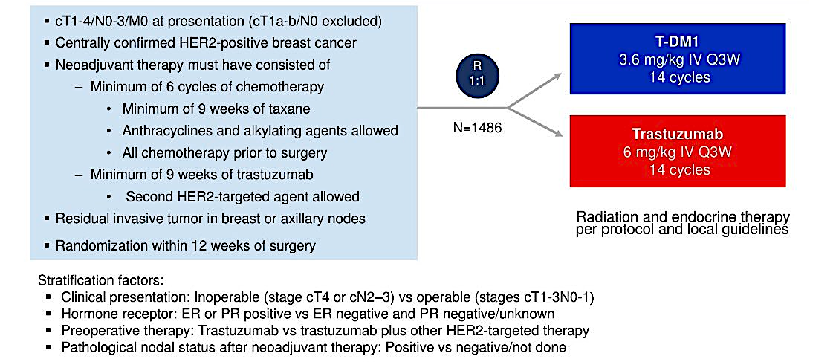
KATHERINE: T-DM1 vs Trastuzumab for HER2-Positive Residual Disease
Geyer CE Jr et al. N Engl J Med 2025;392(3):249-57

Slide 3
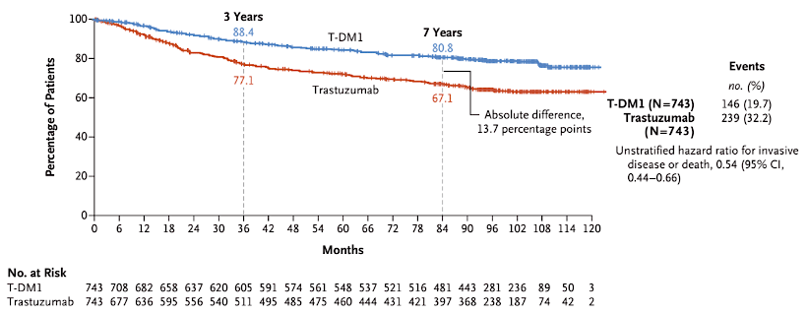
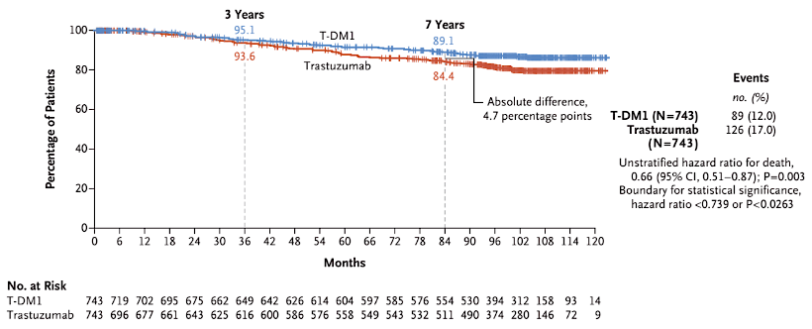
KATHERINE: iDFS and OS at the final analysis
Invasive Disease-Free Survival
Overall Survival
At a median follow up of ~100 months:
Estimated 7 year iDFS: 80.8% vs 67.1% (13.7% absolute Δ)
Estimated 7 year OS: 89.1% vs 84.4% (4.7% absolute Δ)
Geyer CE Jr et al. N Engl J Med 2025;392(3):249-57

Slide 4
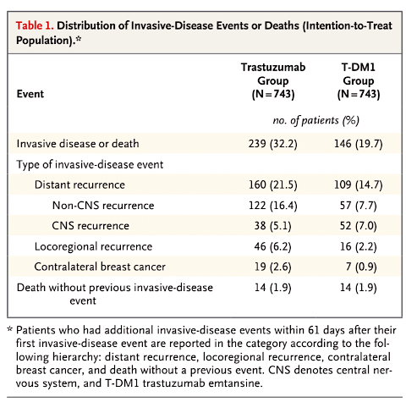
KATHERINE: Exploratory Analyses
7-yr iDFS by HER2 2+ or 3+
3+: 82.8% vs 66.5% (HR 0.47)
2+: 72.4% vs 68.8% (HR 0.84)
Interaction term (HR 0.55, 95% CI, 0.35-0.88)
Residual disease < 1 cm and ypN0 (n=328)
7 yr iDFS 85.7% vs 76.7% (HR 0.62, 95% CI 0.37-1.03)
Similar benefit in ypT1a and ypT1b groups
Centrally confirmed HER2+ on pre-tx bx and HER2-negative after NAT (n=70)
2 iDFS events or deaths (7%) in the T-DM1 group and 14 (33%) in the trastuzumab group
CNS recurrences as a component of first iDFS event: 7.0% vs 5.1%
Geyer CE Jr et al. N Engl J Med 2025;392(3):249-57

Slide 5
KATHERINE: Conclusions and Thoughts
Substantial improvement in iDFS and now demonstration of improvement in OS with adjuvant T-DM1 in this setting
Confirms the value of T-DM1 and inclusion in standard of care
More benefit in 3+ compared to 2+ IHC
Substantial benefit even in ypN0 patients with ypT1a or ypT1b disease
Benefit in patients with HER2-negative residual disease
No reduction of CNS relapse
7-year iDFS of 80.8% still leaves much room for improvement
  CompassHER2 RD: addition of tucatinib to T-DM1
  DESTINY-Breast05: value of T-DXd vs T-DM1
  ASTEFANIA: addition of atezolizumab to T-DM1

Slide 6
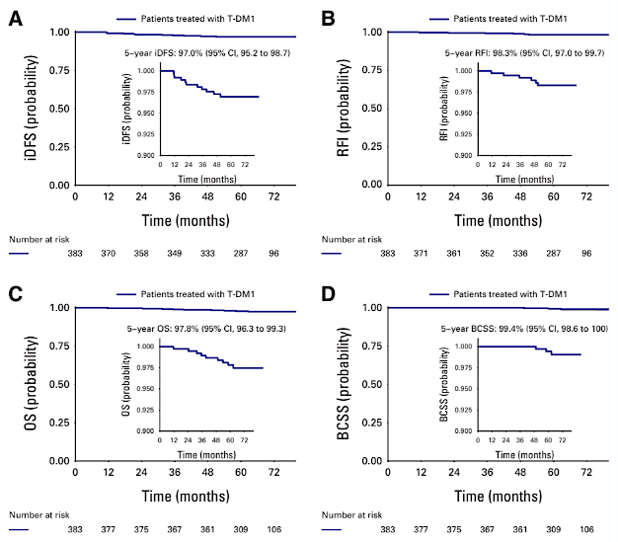
ATEMPT: T-DM1 vs TH for Stage I HER2+ BC
Median f/u 5.8 years
N=383 T-DM1
N=114 TH
~1/2 of patients with T1c tumors; 75% HR+, 4% N1mic
11 iDFS events in the T-DM1 arm (only 3 distant mets)
5 yr iDFS 97% (95% CI 95.2 to 98.7)
5 yr RFI 98.3%
5 yr OS 97.8%
5 yr BCSS 99.4%
9 iDFS events in the TH arm
5 yr iDFS 91.1% (95% CI 85.7 to 96.8)
5 yr RFI 93.2%
5 yr OS 97.9%
5 yr BCSS 99.0%
Tarantino P et al. J Clin Oncol 2024;42(31):3652-65.

Slide 7
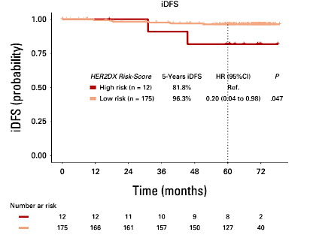
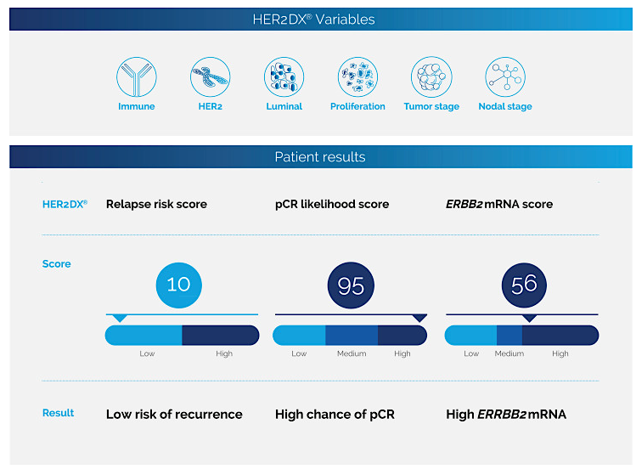
ATEMPT: HER2DX Risk Score Predicts Outcomes
N=187 (147 T-DM1, 40 TH) had HER2DX performed
6.4% had high risk disease by HER2DX assay
HER2DX: 27-gene expression and clinical feature-based
classifier – integrates clinical information (T/N stage) and
Immune response, luminal differentiation, proliferation,
ERBB2 mRNA score
Tarantino P et al. J Clin Oncol 2024;42(31):3652-65.

Slide 8
ATEMPT: Conclusions and Thoughts
Excellent 5- year outcomes with adjuvant T-DM1 in Stage I HER2+ BC
Not designed to formally compare T-DM1 and TH
Toxicity tradeoffs:
  CRT (clinically relevant toxicities, G3+ non heme, G2+ neurotox, G4 heme tox, F&N, SAE, AE require dose delay or tx discont) higher with T-DM1
  PROs favored T-DM1 (alopecia and work productivity)
  Less neuropathy with T-DM1 (23% with TH vs 11% with T-DM1)
  Less amenorrhea (at 18 mo) with T-DM1 (50% with TH vs 24% with T-DM1)
Adds to body of literature that HER2DX risk score predicts risk of recurrence
An option for patients particularly if there is a desire to avoid TH
Remember the value of scalp cooling for patients who receive TH!
Ongoing trials:
  ATEMPT 2.0: 6 cycles of TDM1 then H to complete 1 year
  ADEPT: Phesgo + ET for stage I ER+/HER2+ BC
Tarantino P et al. J Clin Oncol 2024;42(31):3652-65.
Ruddy et al, Breast Ca Res Treat 2021;189(1):103-110.
Tolaney et al. J Clin Oncol 2021;39(21): 2375-85.

Slide 9
DESTINY-Breast01: T-DXd for HER2+ MBC
Phase 2 Trial
N=184 patients treated at 5.4 mg/kg
Key characteristics
  24% age 65+
  53% HR+
  84% HER2 3+
  Median 6 prior lines, 100% prior trastuzumab and 100% prior T-DM1
  13% (n=24) with brain mets (5 with no reported prior CNS tx)
Confirmed ORR 62.0%
ILD in 15.8% (2.7% grade 5)
Median OS was not reached in the primary analysis -
Saura C et al. Ann Oncol 2024;35(3):302-7.

Slide 10
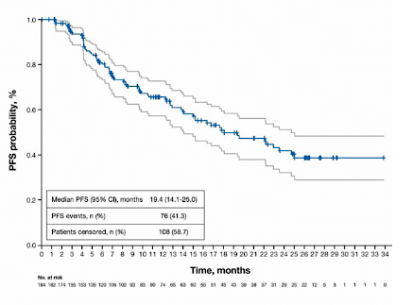
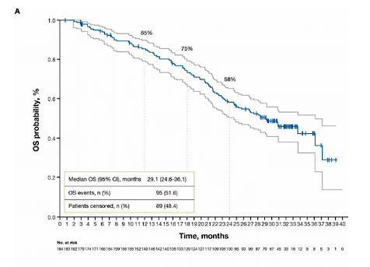
DESTINY-Breast01: T-DXd for HER2+ MBC
At a median follow up of 26.5 months (28 pts on tx at data cutoff)
Median PFS 19.4 months
Median OS 29.1 months
Saura C et al. Ann Oncol 2024;35(3):302-7.

Slide 11
DESTINY-Breast01: Conclusions and Thoughts
Further solidifies the value of T-DXd in HER2+ MBC
  Median OS 29.1 mo; ORR 62%
  Activity in heavily refractory patients including after T-DM1
Consistent with data from DESTINY-Breast02
  Median OS 39.2 mo vs 26.5 mo
Compares favorably to other 3L+ trials
  SOPHIA 21.6 mo with margetuximab
  HER2CLIMB 24.7 mo with tucatinib (but 1/2 of pts with brain mets including active BM)
Does not change current sequencing (T-DXd as 2L standard of care)
For those who missed out on T-DXd in earlier lines of therapy – T-DXd is very effective in later lines
Awaiting results of DESTINY-Breast09: T-DXd, T-DXd + P, vs THP
Andre et al, Lancet 2023
Rugo et al, JAMA 2021
Murthy et al, N Engl J Med 2020

Slide 12
DESTINY-Breast02:
T-DXd vs TPC for HER2+ MBC - PRO Analysis
Primary study summary:
  T-DXd versus treatment of provider’s choice (TPC; trastuzumab + capecitabine or lapatinib + capecitabine)
  Key eligibility: HER+ MBC, progressed on or after T-DM1
  Median of 2 prior MBC lines
  Improvement in PFS (17.8 mo vs 6.9 mo; HR 0.36, p<0.001)
  Improvement in OS (39.2 mo vs 26.5 mo; HR 0.66, p=0.002)
Fehm T et al. Lancet Oncol 2024;25(5):614-25.

Slide 13
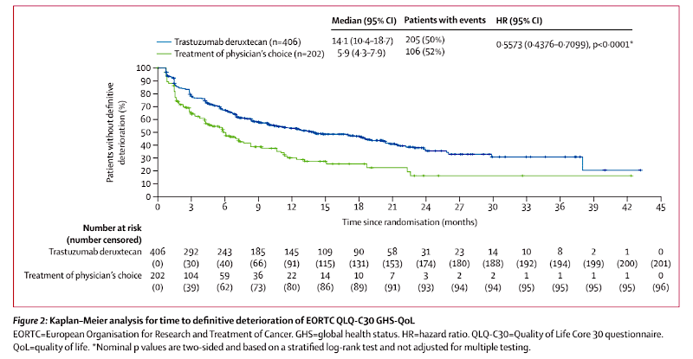
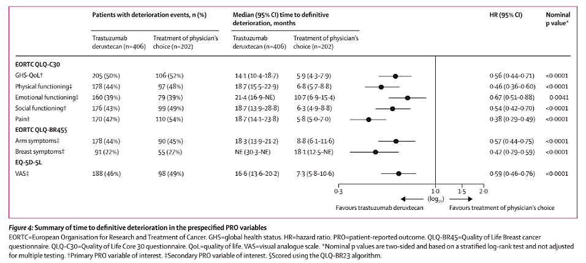
DESTINY-Breast02:
T-DXd vs TPC for HER2+ MBC - PRO Analysis
Overall, T-DXd associated with longer time to deterioration of global QoL compared to TPC
More treatment emergent nausea and vomiting with T-DXd in early treatment cycles, improving after cycle 3.
Initially, prophylactic anti-emetics were not built into the protocol…
More diarrhea in the TPC group that persisted over time
Fehm T et al. Lancet Oncol 2024;25(5):614-25.

Slide 14
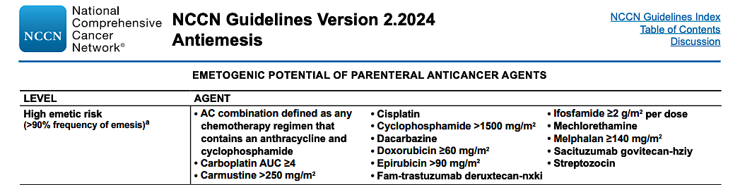
DESTINY-Breast02: Conclusions and Thoughts
T-DXd extends time to deterioration of QoL compared to tras-cape or lapatinib-cape
Careful attention to anti-emetic regimen
  NCCN:
    Olanzapine + NK1 receptor antagonist + 5HT3 receptor antagonist + dexamethasone, or
    Olanzapine + palanosetron + dexamethasone, or
    NK1 RA + 5-HT3 RA + dexamethasone
Fehm T et al. Lancet Oncol 2024;25(5):614-25.

Slide 15
DESTINY-Breast03:
T-DXd vs T-DM1 for HER2+ MBC
Patient and Treatment Characteristics
  ~15% of patients with CNS mets (inactive or asymptomatic) at baseline
  ~15% with prior HER2 TKI exposure
  Median of 2 prior lines in MBC setting - ~40% with 1 prior line
Confirmed ORR 78.9% vs 36.9%
Updated analysis at median follow up of 43 months for T-DXd and 35.4 months for T-DM1
Cortés J et al. Nat Med 2024;30(8):2208-15.

Slide 16
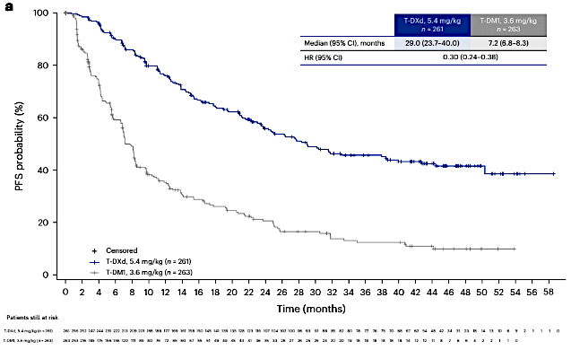
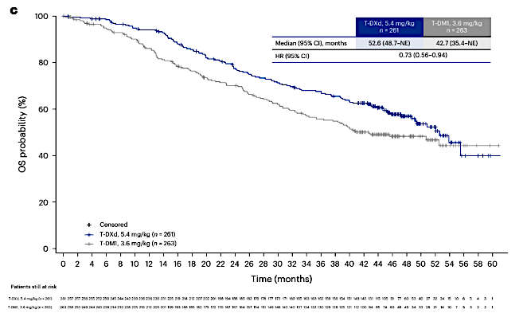
DESTINY-Breast03:
T-DXd vs T-DM1 for HER2+ MBC
Median PFS 29.0 months vs 7.2 months, HR 0.30
3-yr PFS 45.7% vs 12.4%
Median OS 52.6 months vs 42.7 months, HR 0.73
Cortés J et al. Nat Med 2024;30(8):2208-15.

Slide 17
DESTINY-Breast03: Conclusions and Thoughts
Careful attention to ILD counseling, surveillance, and management is critical
  Any grade ILD with T-DXd: 16.7% (G1 4.3%, G2 11.7%, G3 0.8%, no G4-5) vs 3.4%
  with T-DM1
  No grade 4 or 5 events
Crossover may have diluted OS differences
  64 patients (32.3%) in the T-DM1 arm subsequently received T-DXd – adjusting for this in sensitivity analysis widened the OS difference between arms
Relatively few patients with brain mets
  Leaves the CNS question open
Substantial benefits in both PFS and OS make T-DXd the preferred 2L regimen for the vast majority of patients despite the toxicity tradeoff vs T-DM1

Slide 18
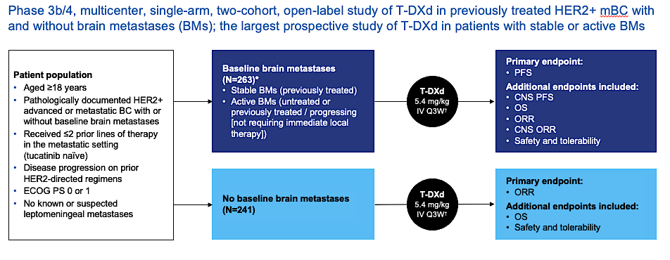
DESTINY-Breast12: T-DXd for HER2+ Brain Mets
Harbeck N et al. Nat Med 2024;30(12):3717-27.

Slide 19
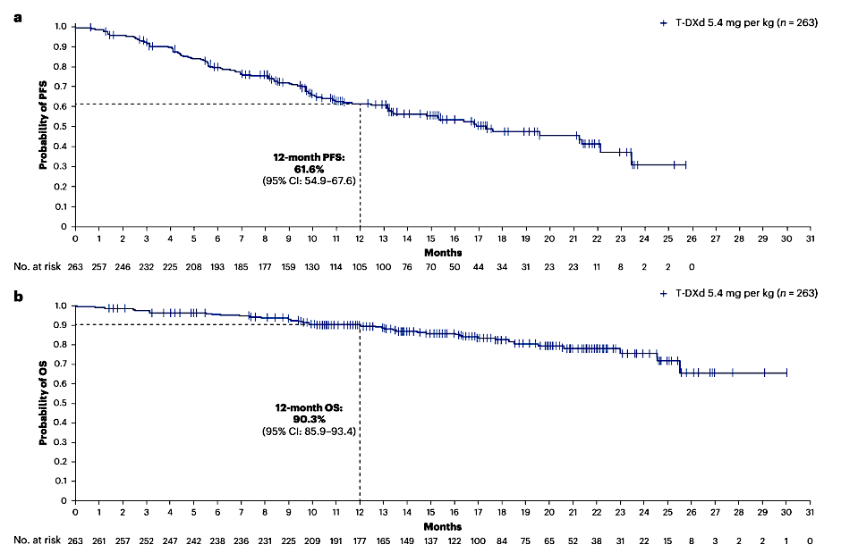
DESTINY-Breast12: T-DXd for HER2+ Brain Mets
Brain Metastases Cohort (n=263)
Median PFS 17.3 months
12 month PFS 61.6%
12 month CNS PFS 58.9%
12 month OS 90.3%
Overall ORR 51.7% (64.1% in those
with measurable dx at BL)
CNS ORR 71.7%
Prior lines: 0 prior (7.6%), 1 prior (50.2%), 2 prior (41.4%)
Harbeck N et al. Nat Med 2024;30(12):3717-27.

Slide 20
100
Patients with measurable CNS disease at baseline (post-hoc analysis)
n=138
80
60
40
20
Best percentage change in target CNS lesion size from baseline
0
−20
−40
−60
−80
−100
 |  |  |  | Active BM subgroups
Measurable CNS disease at baseline | All patients (n=138) | Stable BMs (n=77) | Active BMs (n=61) | Untreated (n=23) Post-hoc analysis | Previously treated / progressing (n=38) Post-hoc analysis
Confirmed CNS ORR, % (95% CI) | 71.7 (64.2, 79.3) | 79.2 (70.2, 88.3) | 62.3 (50.1, 74.5) | 82.6 (67.1, 98.1) | 50.0 (34.1, 65.9)
T-DXd showed substantial CNS responses in the overall BMs population, including patients with stable and active BMs
Dashed line indicates a 30% decrease in target tumor size (PR)
*Imputed values: a value of +20% was imputed if best percentage change could not be calculated because of missing data if: a patient had a new lesion or progression of non-target lesions or target lesions, or had withdrawn because of PD and had no evaluable target lesion data before or at PD
BM, brain metastasis; CI, confidence interval; CNS, central nervous system; ORR, objective response rate; PD, progressive disease; PR, partial response; T-DXd, trastuzumab deruxtecan
Lin et al, ESMO 2024
Harbeck N et al. Nat Med 2024;30(12):3717-27.

Slide 21
DESTINY-Breast12: Conclusions and Thoughts
Robust and durable intracranial activity of T-DXd in HER2+ MBC
  Favorable results seen in patients with both stable and active brain mets
Increases confidence in the use of T-DXd in the 2L setting even in patients with active brain metastases
Another systemic option for patients with active BM – to be weighed against local therapy
ILD remains an issue
  9 grade 5 events: 4/9 co-occurring with opportunistic infection (none received PJP prophylaxis)
  Investigator-reported ILD rates may overestimate compared to centrally adjudicated rates
  Several cases of confirmed opportunistic lung infections – careful attention to PJP prophylaxis in the BM population on chronic steroids is important
Harbeck N et al. Nat Med 2024;30(12):3717-27.

Slide 22
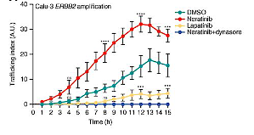
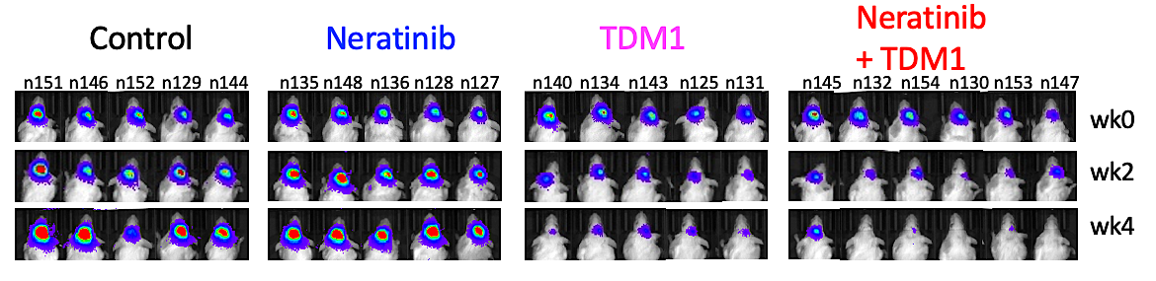
TBCRC 022: T-DM1 + Neratinib for HER+ Brain Mets
Rationale for the Combination
Neratinib
+ T-DM1
T-DM1
PDX model of HER2+ breast cancer brain mets
Deeper and more durable responses with the combination
Neratinib increases HER2 trafficking
and may overcome T-DM1 resistance
Freedman RA et al. Ann Oncol 2024;35(11):993-1002.
Li et al, Cancer Discov 2020

Slide 23
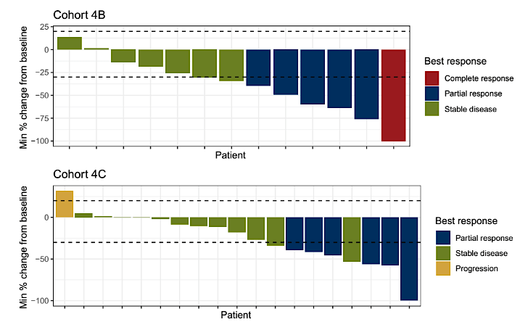
TBCRC 022: T-DM1 + neratinib for HER+ Brain Mets
Progressing after prior local tx
No prior T-DM1
CNS ORR 35.3%
Median PFS 4.1 mo
Median OS 23.3 mo
12 mo OS 87%
Progressing after prior local tx
Prior T-DM1 exposure
CNS ORR 28.6%
Median PFS 4.1 mo
Median OS 20.9 mo
12 mo OS 80%
Freedman RA et al. Ann Oncol 2024;35(11):993-1002.

Slide 24
TBCRC 022: Conclusions and Thoughts
Even with the advent of T-DXd and tucatinib, there is a substantial need for multiple lines of systemic therapy for patients with active brain metastases
CNS ORR to T-DM1 + neratinib exceeds that of neratinib monotherapy (CNS ORR 8%)
CNS responses are seen in about 1/3 of patients with prior T-DM1 exposure
Limitations: no patients had received prior tucatinib, and only a few had prior T-DXd
Await more granular CNS data from HER2CLIMB-02
Provides another systemic option for patients with HER2+ BM

Slide 25
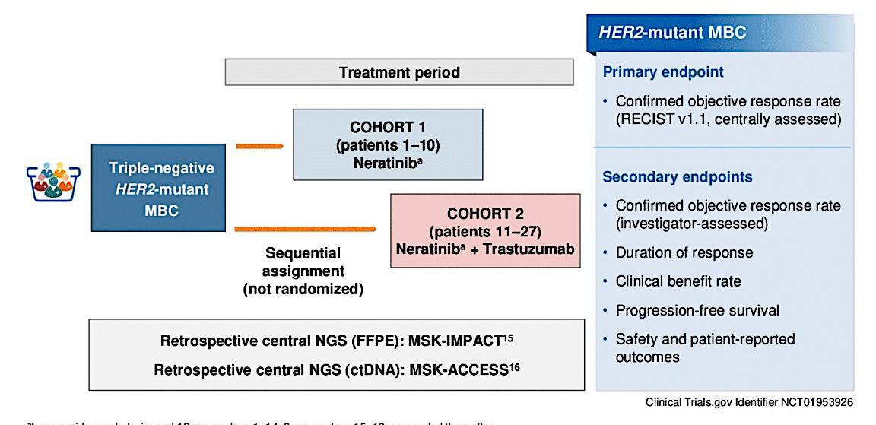
SUMMIT Trial: HER2-mutant TNBC treated with Neratinib or Neratinib + Trastuzumab
Cohort 1
Neratinib
N=10
Median 2.5 prior lines
Cohort 2
Neratinib + trastuzumab
N=17
Median 2 prior lines
Jhaveri K et al. ASCO 2024;Abstract 1094.

Slide 26
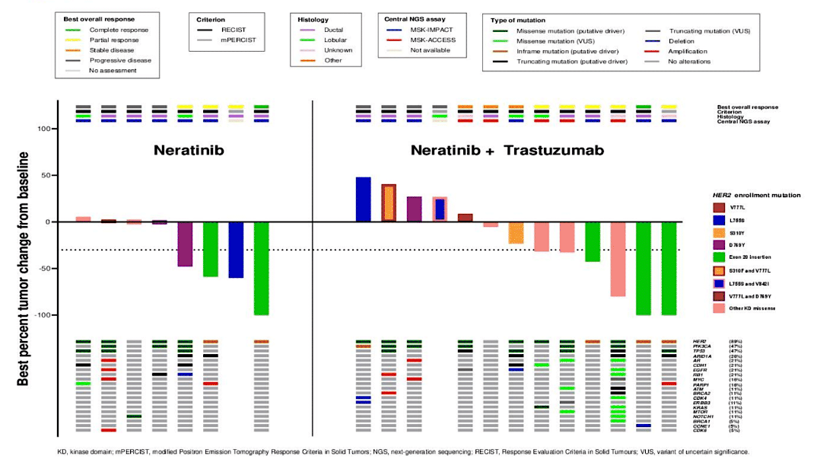
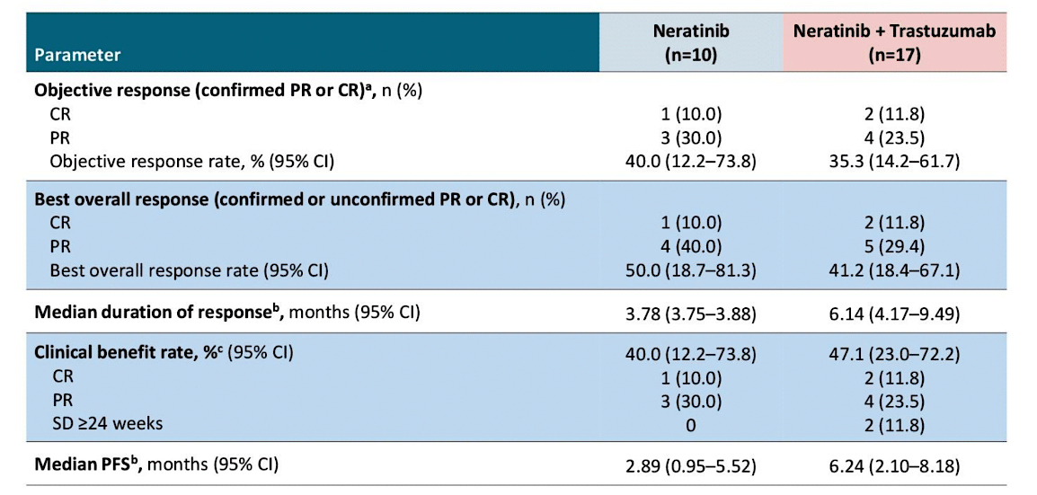
SUMMIT Trial: HER2-mutant TNBC treated with Neratinib or Neratinib + Trastuzumab
Confirmed ORR 40% (N), 35.3% (N+T)
Median PFS 2.89 mo (N), 6.24 mo (N+T)
Deepest responses in those with Exon 20 insertions
Jhaveri K et al. ASCO 2024;Abstract 1094.

Slide 27
SUMMIT Trial TNBC basket:
Conclusions and Thoughts
Impressive response rates (40%) in pre-treated HER2-mut TNBC
Longer DoR and PFS with the doublet of N+T
Small numbers but compares favorably to “nth-line” chemo in TNBC
Previously published data in HR+/HER2-mut MBC
  ORR 38.6%, median PFS 8.3 months with neratinib + fulvestrant + trastuzumab
New data for tucatinib + trastuzumab in HER2-mut MBC
  Confirmed ORR 41.9%; median PFS 9.5 months
  Pts with HR+ disease also received fulvestrant
  Only 4 pts with TNBC included
Jhaveri K et al. ASCO 2024;Abstract 1094.
Jhaveri et al, Ann Oncol 2023
Okines et al, Nat Med 2025

Slide 28
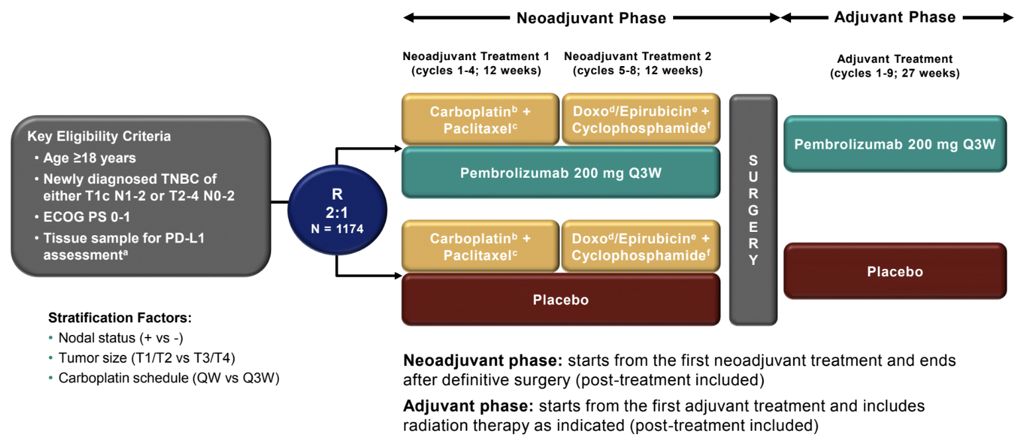
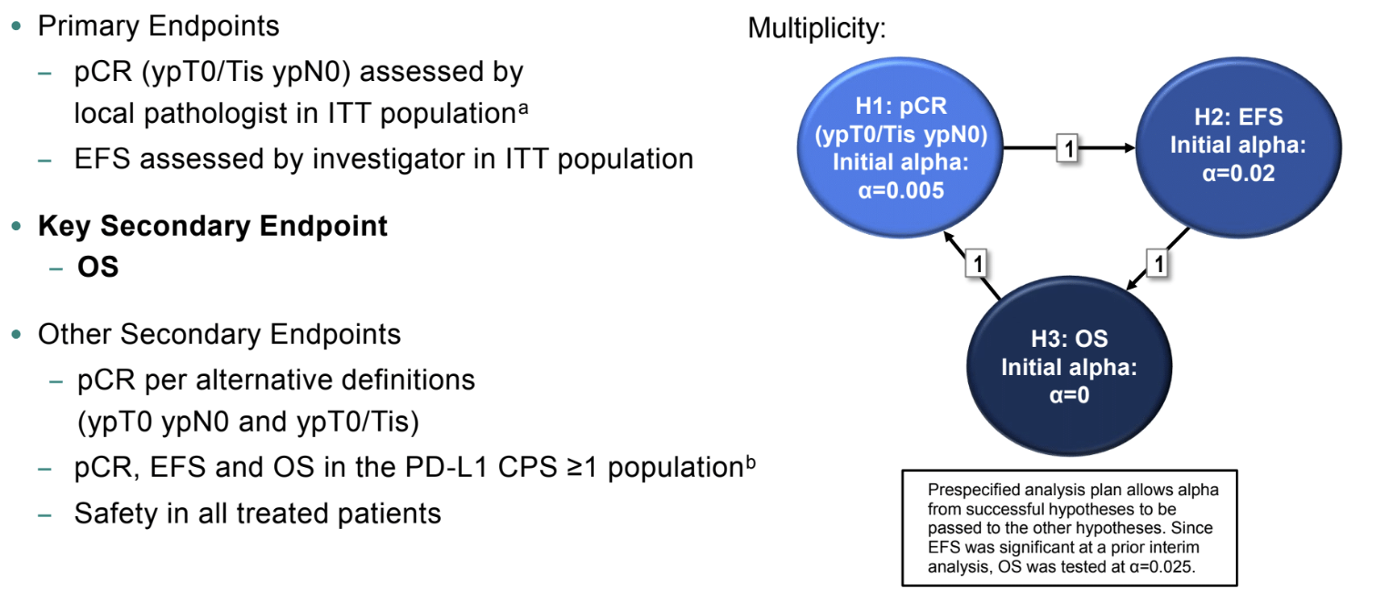
KEYNOTE-522: Neoadjuvant pembro for TNBC
Notes:
~1/2 node positive
Median age 48-49
Only 132 pts (84 pembro)
age 65+
Schmid P et al. ESMO 2024;Abstract LBA4.

Slide 29
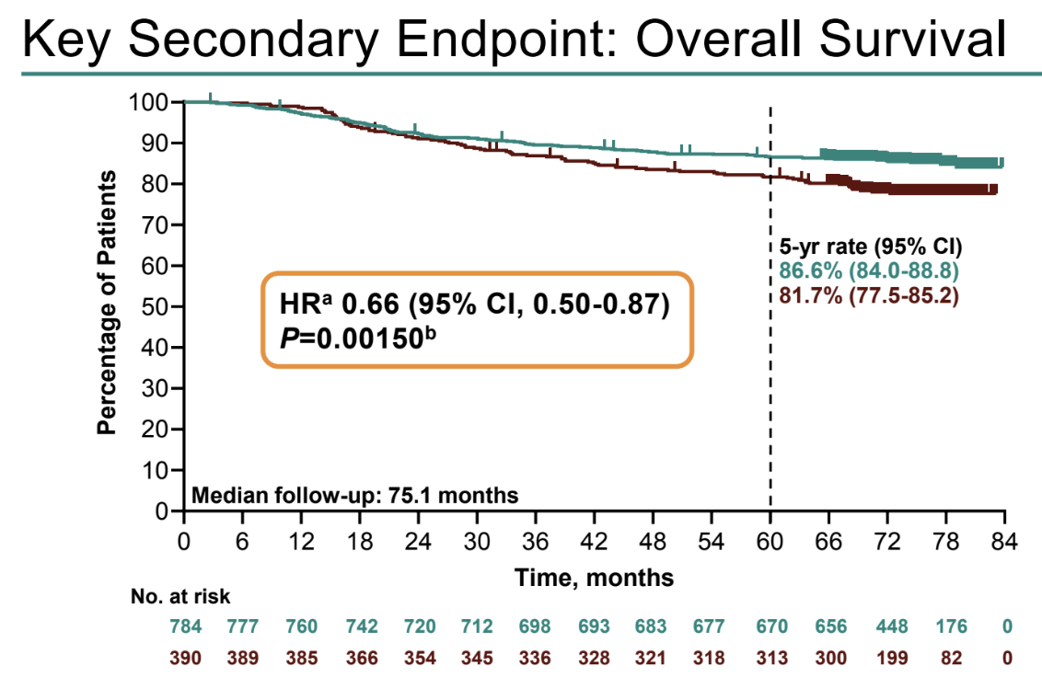
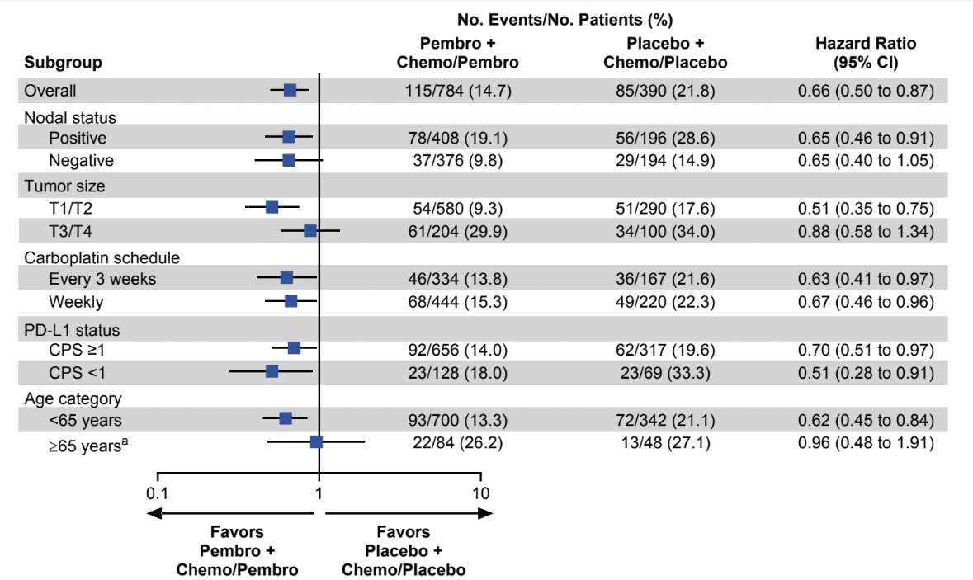
KEYNOTE-522: Improvement in OS with Pembro
Schmid P et al. ESMO 2024;Abstract LBA4.
Schmid P et al, N Engl J Med 2024

Slide 30
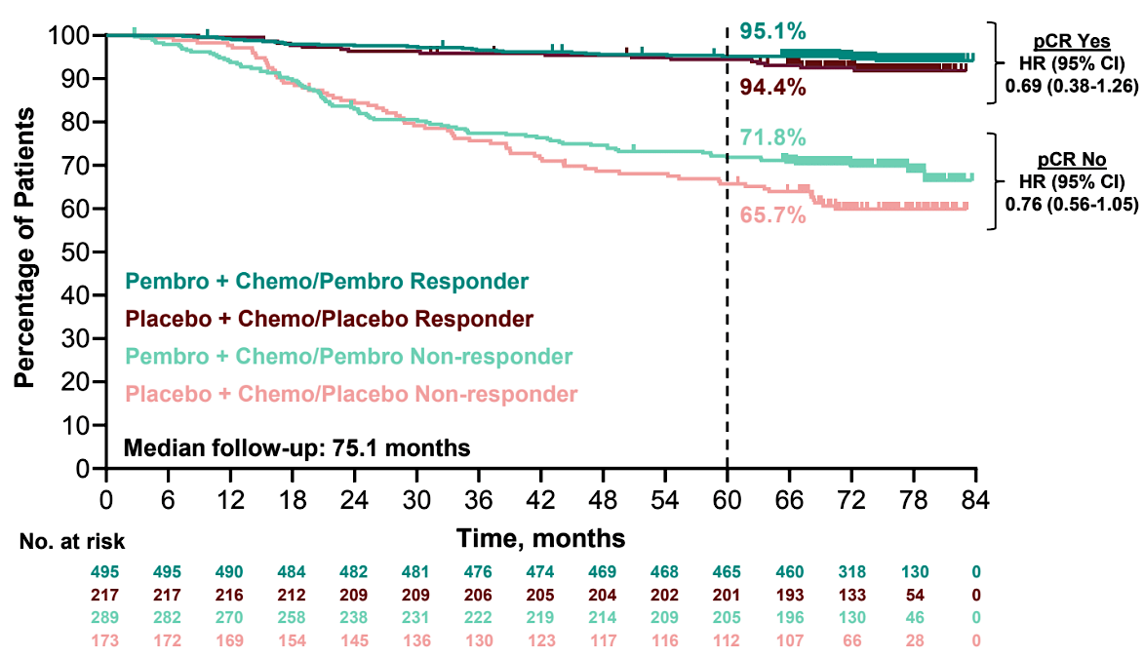
KEYNOTE-522: OS by Pathologic Response
Schmid P et al. ESMO 2024;Abstract LBA4.
Schmid P et al, N Engl J Med 2024

Slide 31
KEYNOTE-522: Conclusions and Thoughts
At a median f/u of 75.1 mo, a 5% gain in 5 year OS (81.7% vs 86.6%) with pembrolizumab
Similar hazard ratio for benefit in N+ and N-
Benefits seen regardless of PD-L1 status
Supports the use of KN522 as standard of care for pts with T2N0 or node positive TNBC
Questions:
  Is adjuvant pembro required in those with pCR (to be tested in OptimICE-pCR)?
  In whom can we de-escalate the anthracycline a la NeoPACT – carbo/docetaxel/pembro x 6 cycles – (few pts age 65+ treated on KN522)?
  Who can do well with chemotherapy alone (without IO)?
  How can we improve outcomes in patients with residual disease, where 5 yr OS is still only 71.8%?

Slide 32
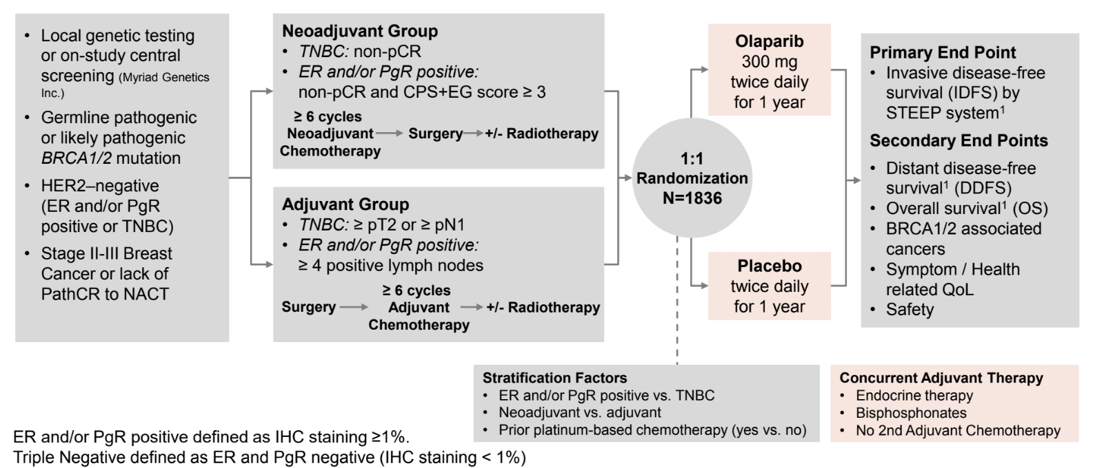
OlympiA: Adjuvant Olaparib in gBRCA1/2 carriers
>70% enrolled pts were gBRCA1
>80% had TNBC
~50% adjuvant
~50% post neoadjuvant
Third pre-specified analysis at 10 years from first patient in
Median follow up of 6.1 years (additional 2.6 y f/u since previous)
Garber J et al. SABCS 2024;Abstract GS1-09.

Slide 33
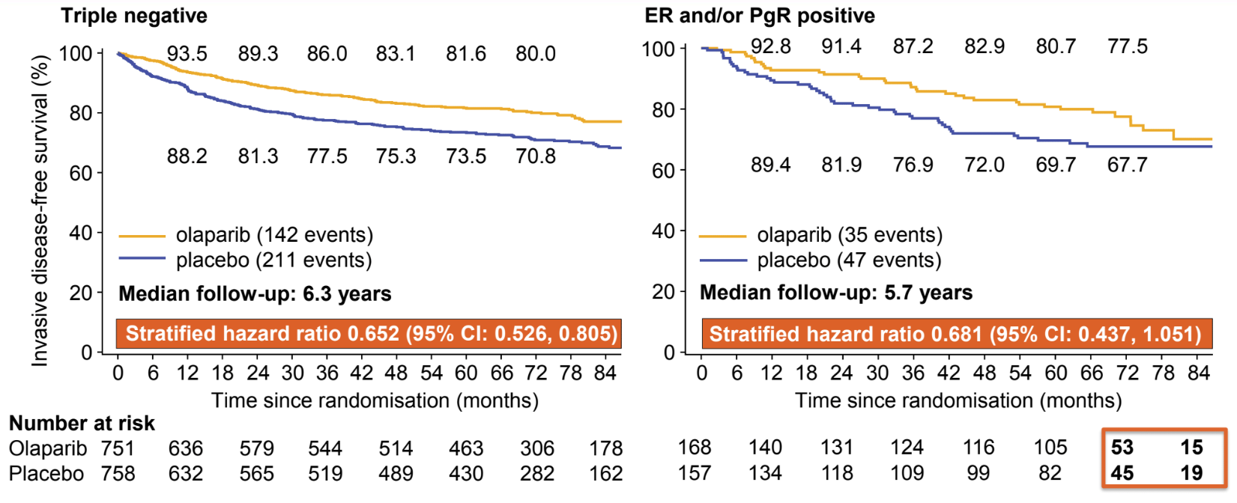
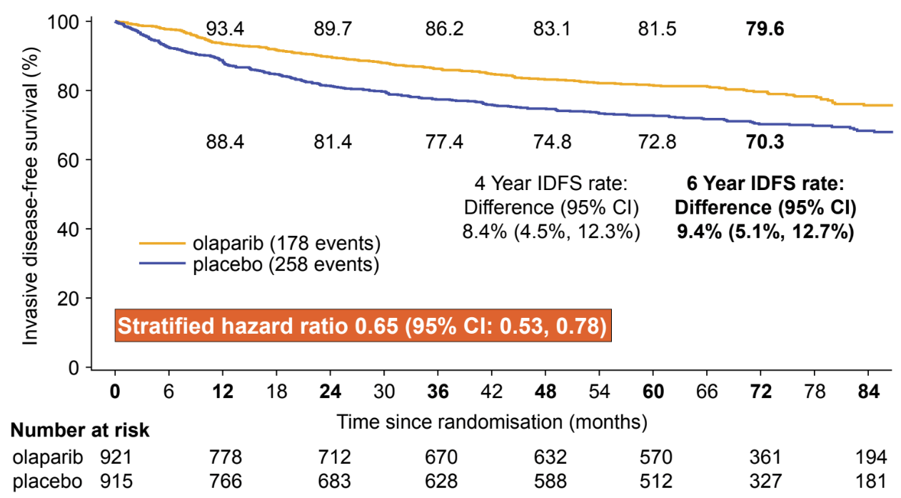
OlympiA: iDFS
ITT Population
Similar magnitude of benefit for DDFS
Similar rates of MDS/AML (4 events (0.4%) for Olaparib; 6 events (0.7%) in placebo arm)
Numerically fewer CNS events as 1st iDFS event (2.8% vs 4.4%)
Fewer new primary cancers with olaparib (contralateral breast cancer, new primary ovarian/fallopian tube cancer)
Garber J et al. SABCS 2024;Abstract GS1-09.

Slide 34
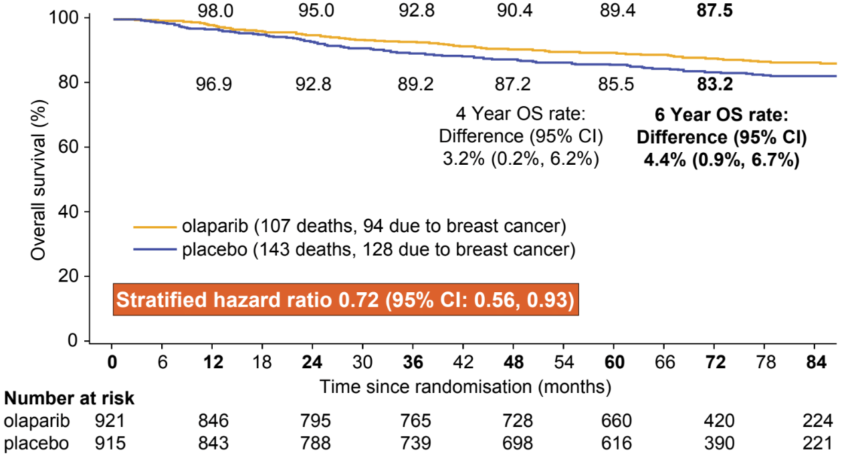
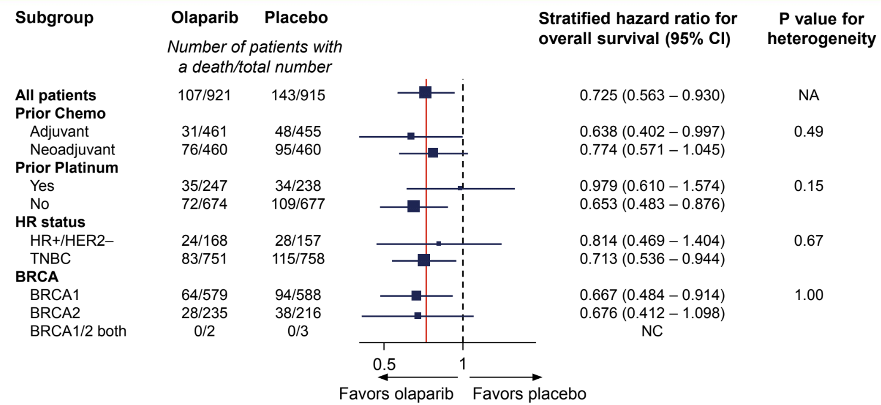
OlympiA: OS
ITT Population
Garber J et al. SABCS 2024;Abstract GS1-09.

Slide 35
OlympiA: Conclusions and Thoughts
Significant benefit in iDFS (HR 0.65), DDFS, and OS (HR 0.72) with adjuvant Olaparib
Effect seen in both HR+ and TN patients and in BRCA1 or BRCA2 carriers
No signal of increase in MDS/AML at 6.1 y median f/u
All patients who meet anatomic eligibility criteria for Olaparib (with drug access) should be offered germline genetic testing
TNBC: Cape vs Olaparib post NAC?
  No direct comparison
  CREATE-X OS HR 0.52, 8% absolute gain
  GEICAM (adjuvant cape) suggested more benefit of capecitabine in non-basal subtypes
  OlympiAD – Olaparib outperformed chemo of provider choice (~1/2 capecitabine) in MBC setting
ER+: Abema or Ribo vs Olaparib?
  No direct comparison
  MONARCHE @ 54 mo median f/u, HR 0.68 for iDFS (7.6% absolute gain); no statistically significant OS benefit
  NATALEE @ 34 mo median f/u, HR 0.75 for iDFS (3% gain at 3y); no difference yet in OS
  For 4+ positive nodes, generally prefer Olaparib (or a sequence of ola -> CDK4/6i in very high-risk patients)
  For 1-3 positive nodes (OlympiA did not include if adjuvant only), could consider CDK4/6i but lean towards olaparib: shorter duration of therapy and OS benefit already demonstrated
  For node negative disease, olaparib has not been studied, and would consider ribo in carefully selected patients who would have met eligibility for NATALEE
Notes:
NATALEE T2N0 grade 3 or grade 2 with high genomic risk or Ki67>/=20%

Slide 36
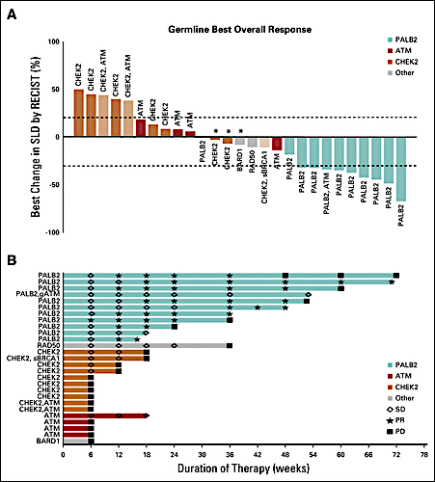
TBCRC 048: Olaparib Expanded Initial Cohort
Gene | ORR (90% CI)
gPALB2 (n=11) | 82% (48-98%)
sBRCA (n=16) | 50% (25-75%)
ATM, CHEK2 (n=18) | 0%
Tung NM et al. J Clin Oncol 2020

Slide 37
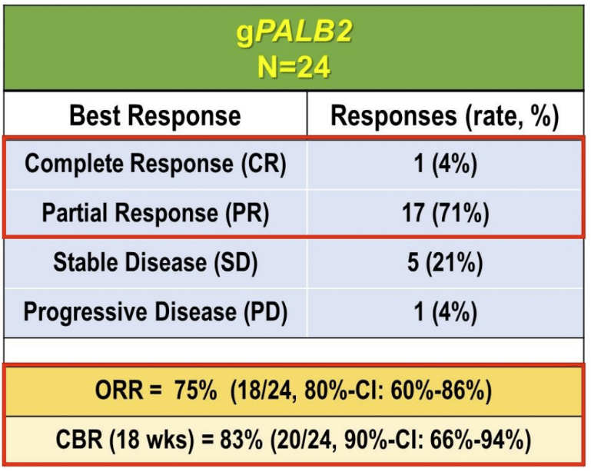
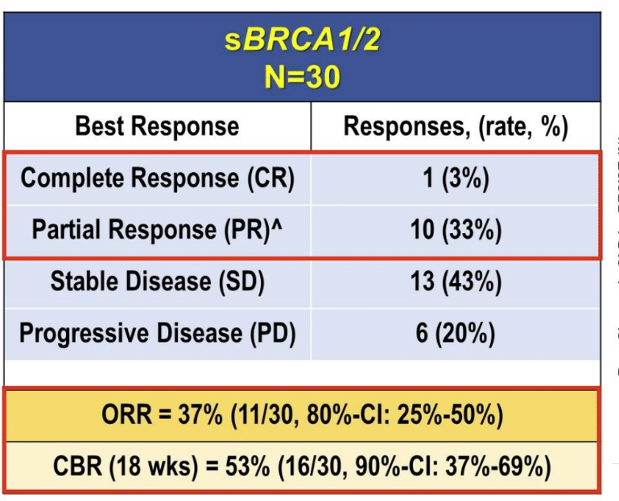
TBCRC 048: Olaparib Expanded Expansion Cohorts
Median PFS 9.6 months
Median PFS 7.2 months
Key Eligibility: 0-2 prior chemo for MBC
Key exclusion: prior PARP, progression on platinum
Tung NM et al. ASCO 2024;Abstract 1021.
Notes:
Higher ORR if no prior platinum, bi-allelic BRCA loss (2/2, very small numbers)

Slide 38
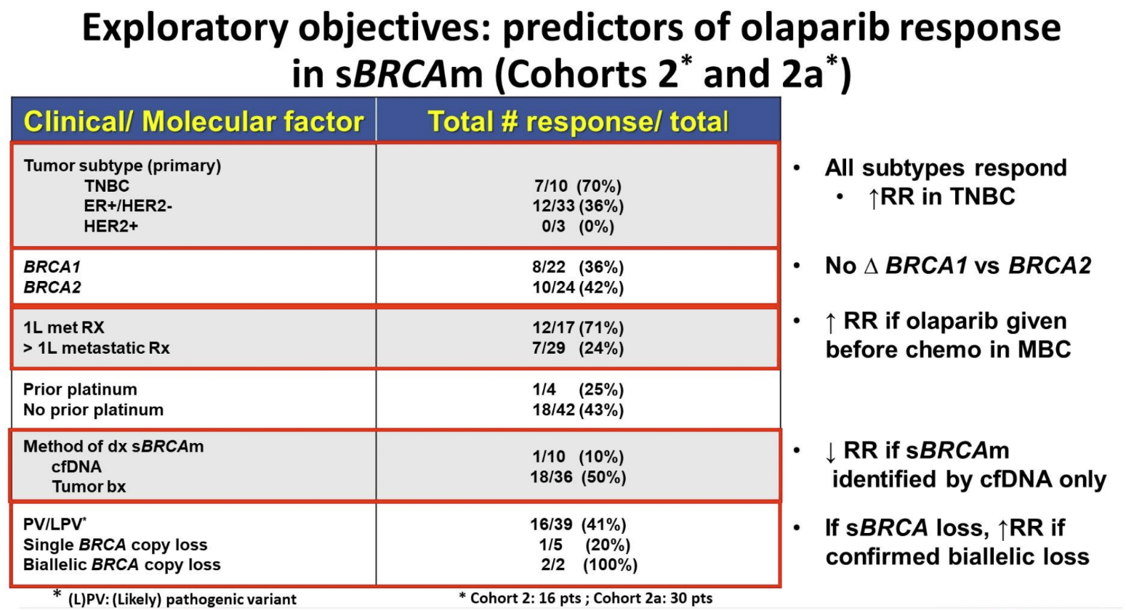
TBCRC 048: Olaparib Expanded Expansion Cohorts
Tung NM et al. ASCO 2024;Abstract 1021.
Notes:
Higher ORR if no prior platinum, bi-allelic BRCA loss (2/2, very small numbers)

Slide 39
TBCRC 048: Conclusions and Thoughts
Confirms very high response rates and durability of benefit in gPALB2 carriers
Activity in sBRCA numerically less than in initial cohort but still respectable (37%, median PFS 7.2 mo)
Estimates of frequency of sBRCA in primary tumors ~3-4%
Frequency in MBC esp in later lines is not well-described
Sufficient activity to consider on a routine basis and to justify:
  Routine germline testing in MBC patients
  NGS testing to identify somatic alterations

Slide 40
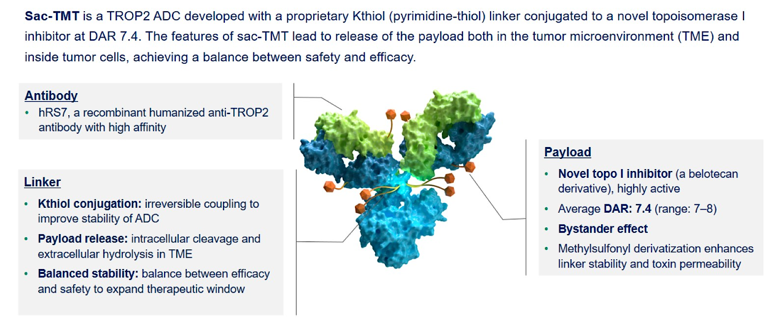
Phase III OptiTROP-Breast01: Sacituzumab tirumotecan (SKB264/MK-2870) for mTNBC
Xu B et al. ASCO 2024;Abstract 104.

Slide 41
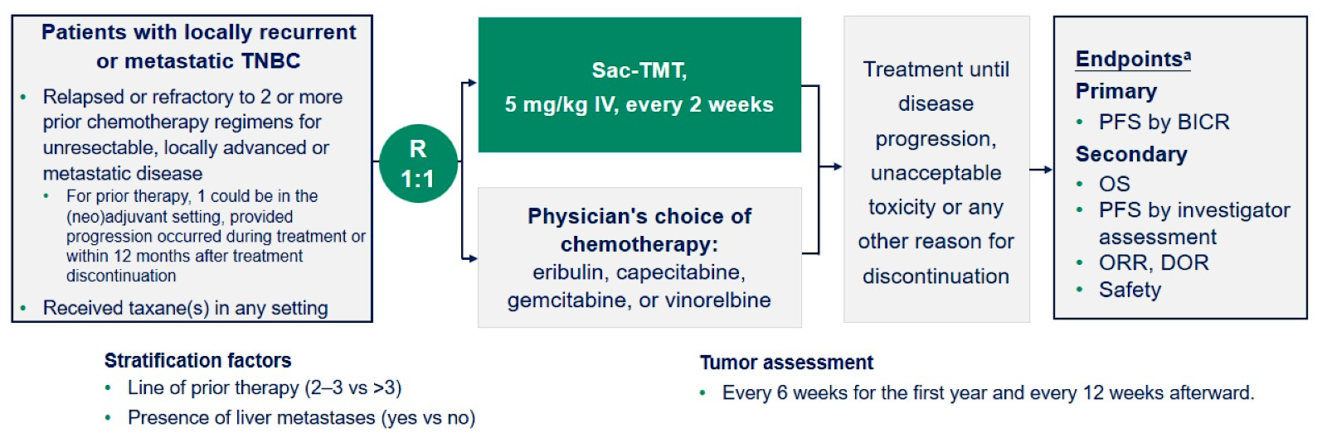
Phase III OptiTROP-Breast01: Sacituzumab tirumotecan (SKB264/MK-2870) for mTNBC
Xu B et al. ASCO 2024;Abstract 104.

Slide 42
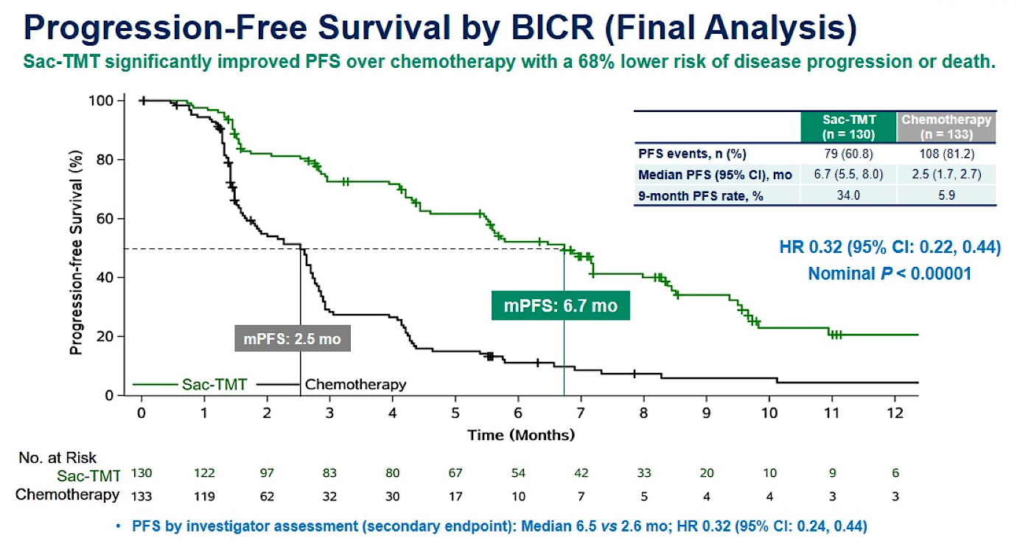
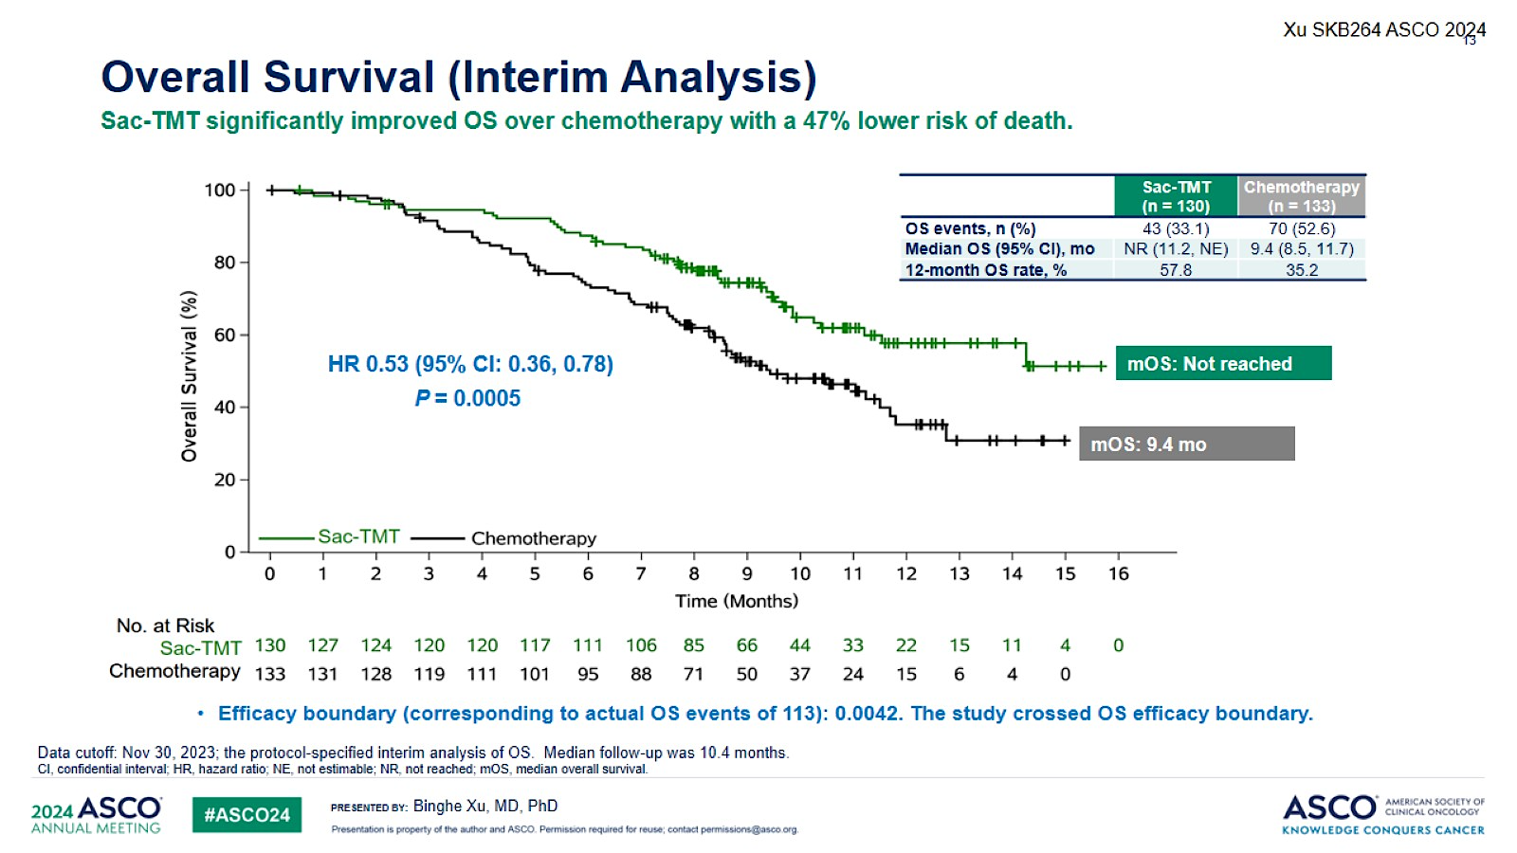
Phase III OptiTROP-Breast01: PFS and OS Benefit
PFS benefit maintained in all subgroups:
Age, PS, line of tx, liver mets, prior IO, visceral mets
Benefit regardless of Trop 2 high or low status
Median OS not reached vs. 9.4 mo
ORR 45.4% vs 12.0%
TRAEs: anemia, neutropenia, stomatitis, thrombocytopenia
Only 1.5% neuropathy; 0.8% ILD
Xu B et al. ASCO 2024;Abstract 104.

Slide 43
Phase III OptiTROP-Breast01: Conclusions and Thoughts
Exciting new agent
Significant improvement in PFS and OS vs TPC
Tox profile mostly heme and stomatitis
Minimal neuropathy or ILD risks
Ongoing Phase 3 trials
  TroFuse-010: Sac-TMT+/- Pembro vs TPC in HR+/HER2- MBC
  TroFuse-011: Sac-TMT +/- Pembro vs TPC for 1L PDL1-negative mTNBC
  TroFuse-012: Sac-TMT/pembro vs TPC (pembro +/- cape) for TNBC RD post NAC
Questions:
  ADC selection – how will this compare to T-DXd, SG, Dato-DXd?
  Another topo I payload – can we sequence?
Notes:
TROFUSE-012: Sac-TMT/pembro vs TPC (pembro +/- cape) for TNBC RD post-NAC: https://clinicaltrials.gov/study/NCT06393374?intr=Sacituzumab%20tirumotecan&cond=Breast%20Cancer&rank=1
TROFUSE-010: Sac-TMT +/- Pembro vs TPC (cape, paclitaxel, nab-P, or Doxil) for HR+/HER2- MBC after endocrine therapy (no prior chemotherapy): https://clinicaltrials.gov/study/NCT06312176?intr=Sacituzumab%20tirumotecan&cond=Breast%20Cancer&rank=2
TROFUSE-011: Sac-TMT +/- Pembro vs TPC (paclitaxel, nab-P, or carbo/gem) for 1L PD-L1-negative mTNBC: https://clinicaltrials.gov/study/NCT06841354?intr=Sacituzumab%20tirumotecan&cond=Breast%20Cancer&rank=3

Slide 44
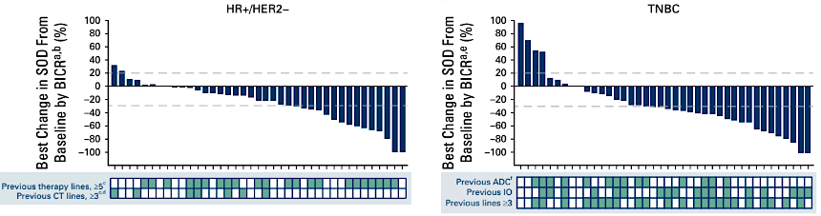
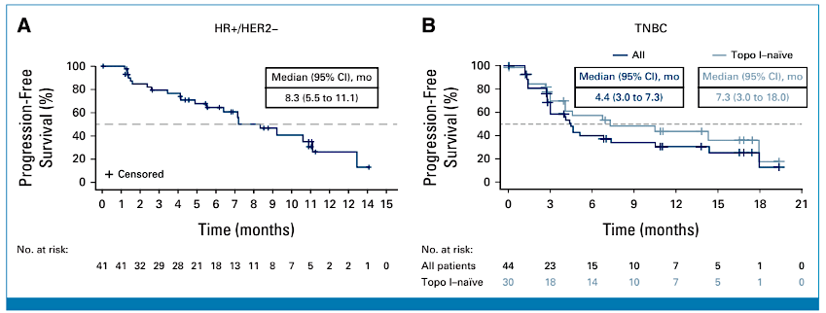
TROPION-PanTumor01: Phase 1 Dato-DXd for HR+ or TN MBC
Bardia A et al. J Clin Oncol 2024;42(19):2281-94.

Slide 45
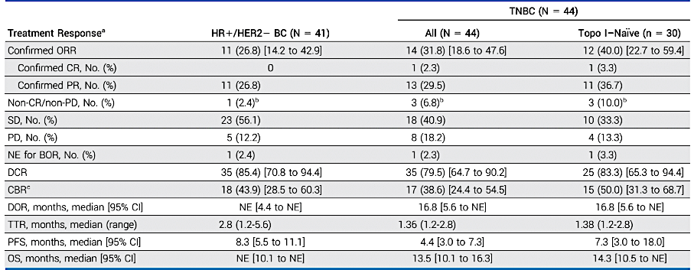
TROPION-PanTumor01: Phase 1 Dato-DXd for HR+ or TN MBC
Bardia A et al. J Clin Oncol 2024;42(19):2281-94.
Notes:
Stomatitis, ocular toxicity

Slide 46
TROPION-PanTumor01: Where does Dato-DXd fit in?
 | HR+/HER2- MBC
 | DESTINY-Breast06 | DESTINY-Breast04 | TROPION-PanTumor01 | TROPION-Breast01 | TROPiCS-02
Treatment arms | T-DXd vs TPC | T-DXd vs TPC | Dato-DXd | Dato-DXd vs TPC | SG vs TPC
HER2 status | Low or ultralow | Low (1+, 2+/ISH-) | Any HER2-neg | Any HER2-neg | Any HER2-neg
Prior chemo for MBC | 0 | 1-2 | No upper limit* | 1-2 | 2-4
Median PFS HR (95% CI) | 13.2 vs 8.1 mo HR 0.63 (0.53-0.75) | 9.6 vs 4.2 mo HR 0.37 (0.30-0.56) | 8.3 mo | 6.9 vs 4.9 mo HR 0.63 (0.52-0.76) | 5.5 vs 4.9 mo HR 0.65 (0.53-0.81)
Median OS HR (95% CI) | N/A HR 0.81 (0.65-1.00) | 23.9 vs 17.6 mo HR 0.69 (0.55-0.87) | NE | N/A HR 0.84 (0.62-1.14) | 14.5 vs 11.2 mo HR 0.79 (0.65-0.95)
ORR | 57.3% vs 31.2% | 52.6% vs 16.3% | 26.8% | 36.4% vs 22.9% | 21% vs 14%
*median of 5 prior lines for MBC
Slide adapted from Ana Garrido-Castro MD
Notes:
Median of 5 prior lines for MBC in HR+ cohort

Slide 47
TROPION-PanTumor01: Where does Dato-DXd fit in?
 | Triple-Negative MBC
 | DESTINY-Breast04 | TROPION-PanTumor01 | TROPION-Breast02 | ASCENT | OptiTROP-Breast01
Treatment arms | T-DXd vs TPC | Dato-DXd | Dato-DXd vs TPC | SG vs TPC | Sac-TMT vs TPC
HER2 status | Low (1+, 2+/ISH-) | Any HER2-neg | Any HER2-neg; Not a candidate for PD1/PDL1 inhibitor | Any HER2-neg | Any HER2-neg
Prior chemo for MBC | 1-2 | No upper limit* | 0 | >1 | >2
Median PFS HR (95% CI) | 6.3 vs 2.9 mo HR 0.29 (0.15-0.57) | 4.4 mo (all) 7.3 mo (topo1-naïve) | ?? | 5.6 vs 1.7 mo HR 0.41 (0.32-0.52) | 6.7 vs 2.5 mo HR 0.32 (0.22-0.44)
Median OS HR (95% CI) | 17.1 vs 8.3 mo HR 0.58 (0.31-1.08) | 13.5 mo (all) 14.3 mo (topo1-naïve) | ?? | 12.1 vs 6.7 mo HR 0.48 (0.38-0.59) | NR vs 9.4 mo HR 0.53 (0.36-0.78)
ORR | 50.0% vs 16.7% | 31.8% (all) 40.0% (topo1-naïve) | ?? | 35% vs 5% | 45.4% vs 12.0%
*median of 3 prior lines for MBC
Notes:
Median of 5 prior lines for MBC in HR+ cohort

