Slide 1
Breast Cancer - Year in Review
Professor Rebecca Dent, MD FRCP (Canada)
Senior Consultant, Medical Oncology
National Cancer Centre Singapore, Duke-NUS Medical School

Slide 2
monarchE: Adjuvant Abemaciclib + ET in High-Risk, Node-Positive HR+/HER2- EBC
International, randomized, open-label phase III trial
Stratified by prior CT,
menopausal status, region
ITT Population (Cohorts 1 + 2)
Patients with high-risk, node-positive, HR+/HER2- EBC; prior (neo)adjuvant CT permitted;
pre- or postmenopausal;
no distant metastasis;
≤16 mo from surgery to randomization; ≤12 wk of ET
after last non-ET
(N = 5637)
Cohort 1 (91% of patients)
≥4 positive ALNs or 1-3 positive ALNs plus histologic grade 3 and/or tumor ≥5 cm
Abemaciclib 150 mg BID up to 2 yr +
ET per standard of care of physician’s choice for 5-10 yr as clinically indicated
(n = 2808)
Cohort 2 (9% of patients)
1-3 positive ALNs, Ki-67 ≥20% per central testing, grade 1/2, tumor size <5 cm
ET per standard of care of physician’s choice for 5-10 yr as clinically indicated
(n = 2829)
Primary endpoint: iDFS
Key secondary endpoints: iDFS in Ki-67 high (≥20%) population, DRFS, OS, safety, PROs
Rastogi. J Clin Oncol. 2024;42:987. Johnston. JCO. 2020;38:3987.
Notes:
ALN, axillary lymph node; CT, chemotherapy; DRFS, distant relapse–free survival; EBC, early breast cancer; ET, endocrine therapy; HR, hormone receptor; iDFS, invasive disease–free survival; ITT, intention-to-treat; OS, overall survival; PRO, patient-reported outcome.

Slide 3
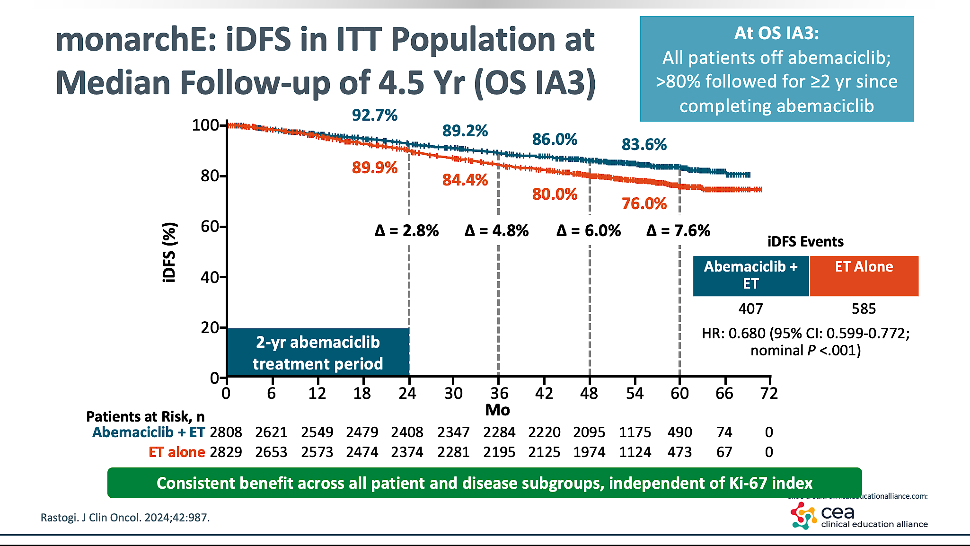
monarchE; iDFS

Slide 4
monarchE: Subgroup Analysis of Benefit by Age
Outcome | iDFS |  |  | DRFS
Parameter, % | ITT | Age <65 Yr | Age ≥65 Yr | ITT | Age <65 Yr | Age ≥65 Yr
Events, n/N Abemaciclib + ET ET alone | 336/2808 499/2829 | 270/2371 414/2416 | 66/437 85/413 | 281/2808 421/2829 | 230/2371 353/2416 | 51/437 68/413
HR (95% CI) | 0.664 (0.578-0.762) | 0.646 (0.554-0.753)* | 0.767 (0.556-1.059)* | 0.659 (0.567-0.767) | 0.647 (0.548-0.764)† | 0.748 (0.520-1.077)†
4-yr rate, % Abemaciclib + ET ET alone | 85.8 79.4 | 86.5 79.8 | 82.0 76.8 | 88.4 82.5 | 88.8 82.6 | 86.1 81.5
Absolute benefit in 4-yr rate, % | 6.4 | 6.7 | 5.2 | 5.9 | 6.2 | 4.6
iDFS and DRFS benefits with abemaciclib are similar for older vs younger patients
Patients aged ≥75 yr more frequently had grade 3 diarrhea, grade 2/3 fatigue, and more discontinuations due to AEs
Hamilton. ASCO 2023. Abstr 501.
Notes:
DRFS, distant relapse–free survival; ET, endocrine therapy; iDFS, invasive disease–free survival; ITT, intention-to-treat.

Slide 5
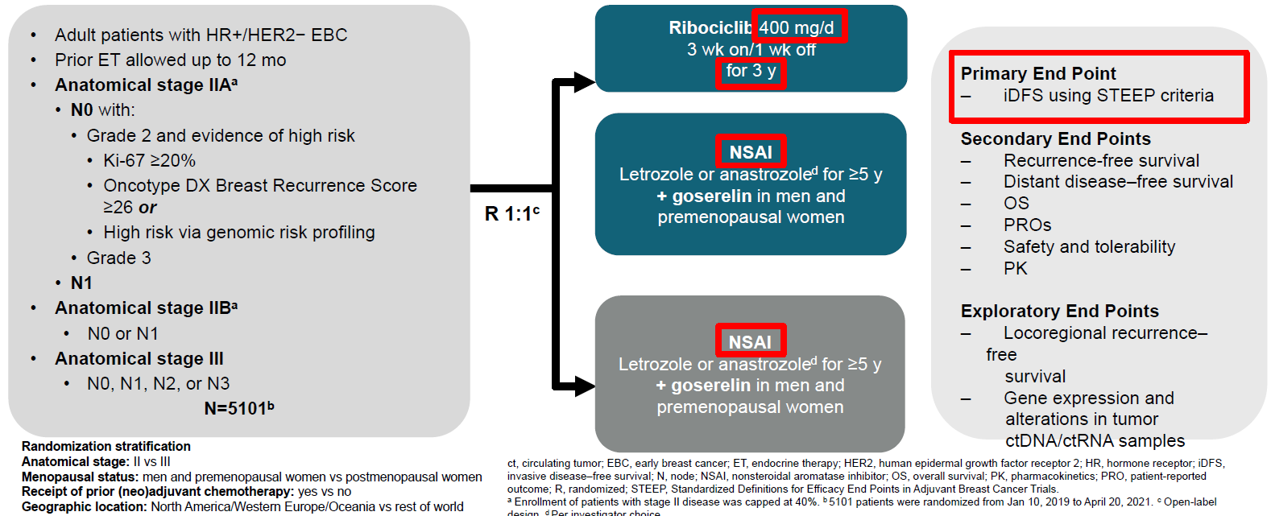
NATALEE: Adjuvant ribociclib+NSAI for HR+/HER2- EBC
Hortobagyi G, et al. Annals of Oncology 2025

Slide 6
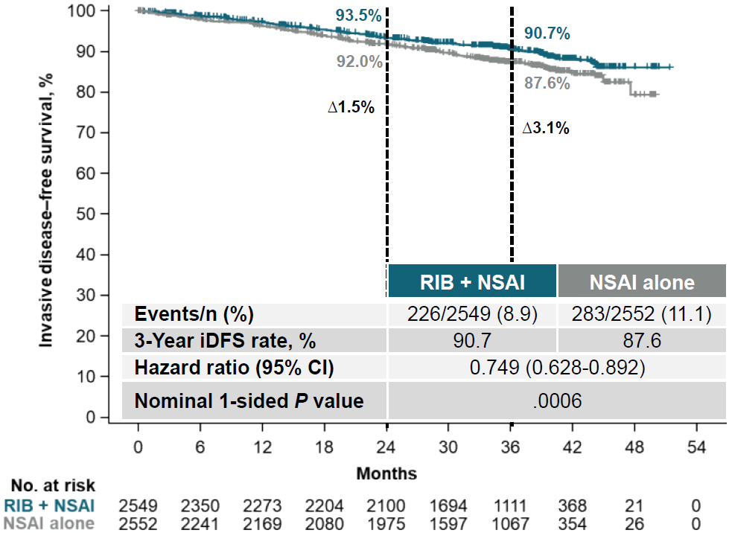
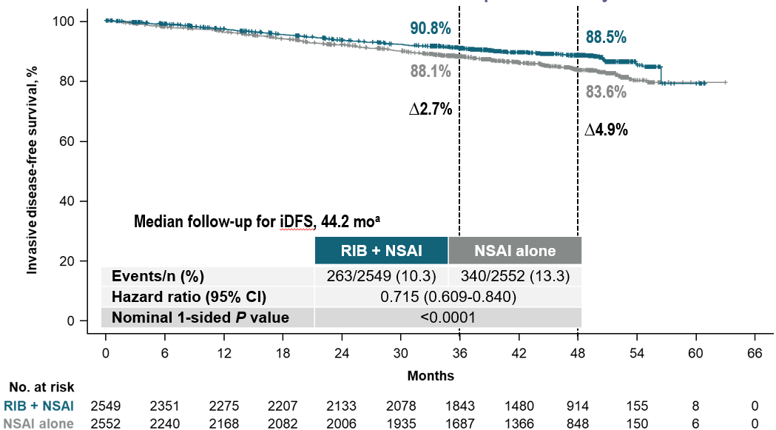
NATALEE: iDFS – primary endpoint
Median follow-up 33.3 months
78.3% of pts off ribociclib treatment
Median follow-up 44.2 months
100% of pts off ribociclib treatment
Δ1.5%
Δ3.1%
Δ 2.7%
Δ 4.9%
Risk of invasive disease was reduced by 28.5% with ribociclib plus NSAI vs NSAI alone
Hortobagyi G, et al. Annals of Oncology 2025
Notes:
Clinical threshold of 5% where clinicians feel that we should discuss with patients

Slide 7
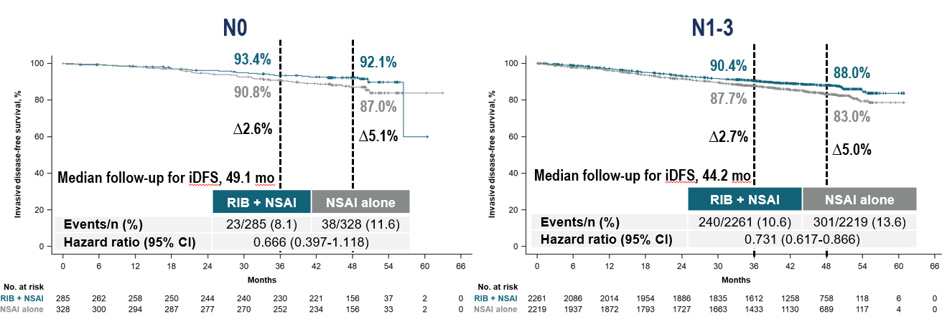
NATALEE: iDFS by nodal status
Median follow-up 44.2 months
100% of pts off ribociclib treatment
Ribociclib + NSAI showed an increasing magnitude of iDFS benefit over time for patients with N0 or N1-3 disease
Hortobagyi G, et al. Annals of Oncology 2025

Slide 8
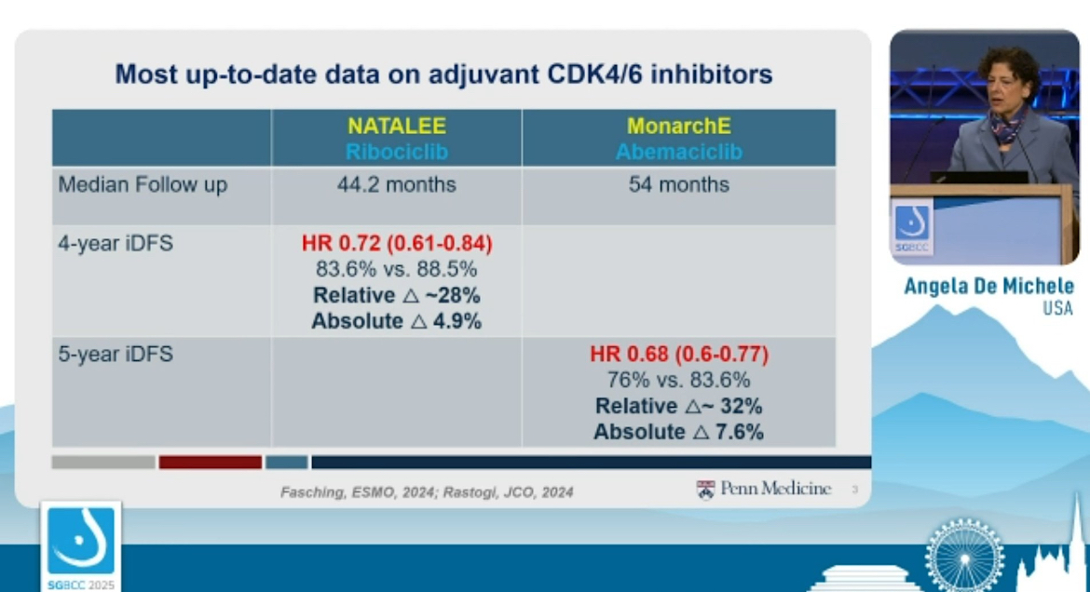
monarchE
Abemaciclib
No overall survival benefit for either agent
at this time
Notes:
In high risk node neg, node +
IDFS and no OS benefit, may be hard to show OS give long term survival and heterogeneity of disease and treatment

Slide 9
The treatment landscape for HR-positive mBC is rapidly evolving
Patients with ER+/HER2– mBC
If imminent organ failure
ET-CDK4/6i [I, A]*†
PD or intolerable toxicities
ChT
Somatic mutation testing (tissue or liquid)
Germline BRCA1/2 testing + PALB2
PD
If HER2‑low: T‑DXd
[I, A; MCBS 4]**
No imminent risk of organ failure and long PFS on prior ET
Imminent organ failure or short PFS on endocrine-based therapy
Everolimus-exemestane [I, B]*
PIK3CA/AKT1/PTEN-altered:
Capivasertib-fulvestrant⁴
ESR1m+:
Elacestrant
[I, A]
gBRCA/PALB2m+:
PARPi
[I, A; MCBS 4; ESCAT
I-A]§¶
Everolimus-fulvestrant [I, B]*‡
If HER2‑0
If HER2‑low
Switch ET ± CDK4/6i
PIK3CAm+:
fulvestrant-alpelisib
[I, B; MCBS 2;
ESCAT I-A]§¶
SG
[I, A; MCBS 3]
T‑DXd
[I, B; MCBS 4]
Fulvestrant monotherapy
Fulvestrant monotherapy
ChT or SG if not used before
[I, A; MCBS 3]
PD after several lines of ET ± targeted therapies
Gennari A, et al. Ann Oncol 2021;32(12): 1475-1495. ESMO Metastatic Breast Cancer Living Guidelines. V1.1 May 2023;

Slide 10
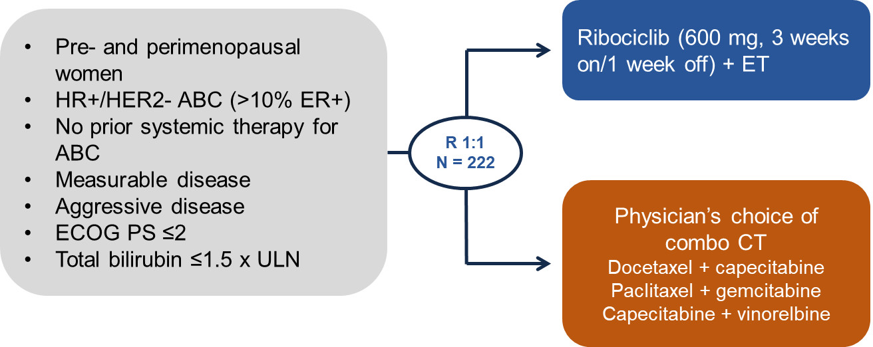
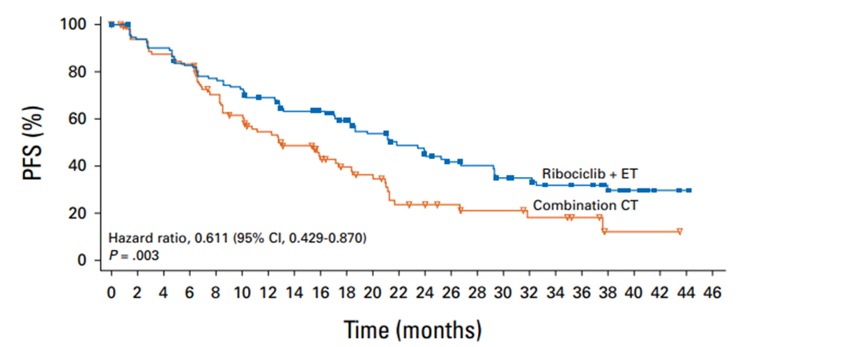
RIGHT Choice: 1L ribociclib + ET vs CT for high-risk HR+/HER2- MBC
Patient population
ER-positivity ≥50%: 86.0%
de novo metastatic: 64.4%
Rapid progression: 18.5%
Visceral crisis: 47.7%
Doublet chemotherapy
Primary Endpoint: PFS in Arm A vs Arm B
OS data is immature
Patients on the ribociclib + ET arm had lower symptomatic AE rates, and fewer discontinuations
Δ9.0 months
Ribociclib + ET resulted in a significant improvement in mPFS in premenopausal women with clinically aggressive HR+/HER2- MBC compared to combination CT
Saghir et al., ASCO 2023 Abstract 1063; Lu YS et al. J Clin Oncol 2024;42:2812.

Slide 11
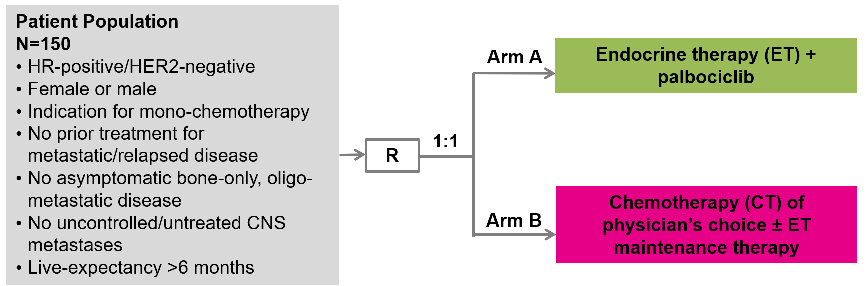
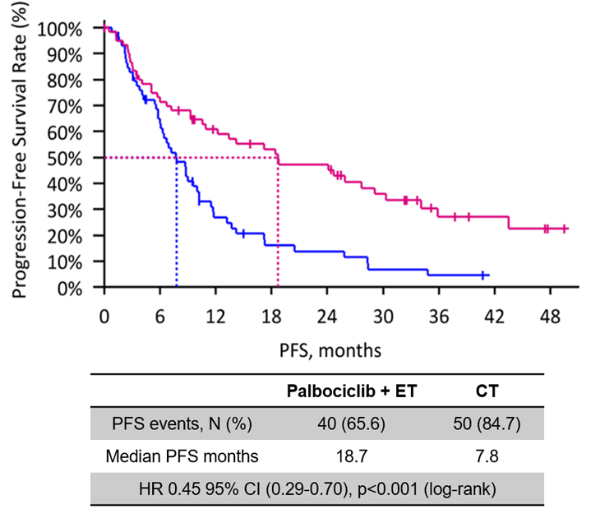
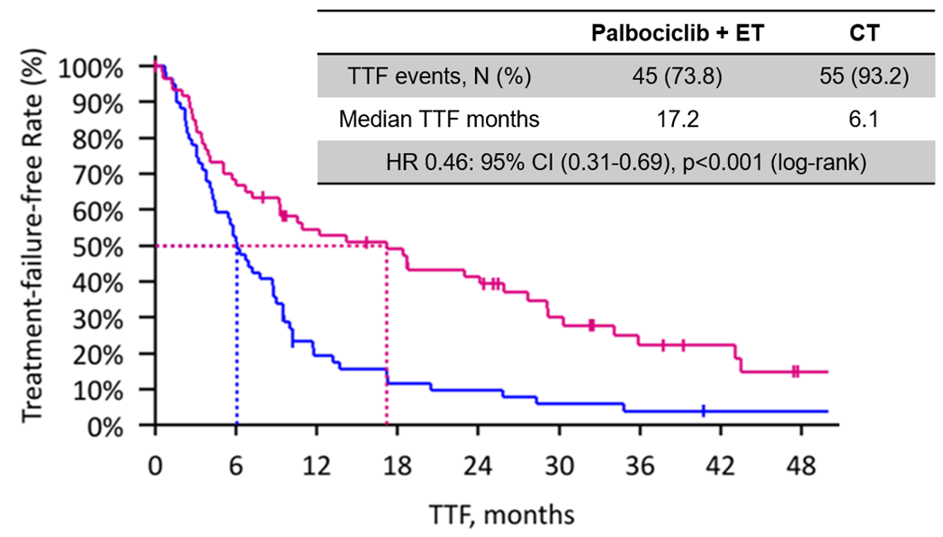
PADMA: 1L palbociclib + ET vs CT for high-risk HR+/HER2- MBC
Patient population
Endocrine resistant: ~32%
de novo metastatic: ~37%
HER2-low: ~66%
PIK3CA mutations: 22.5%
BRCA mutations: 5.8%
ESR1 mutations: 1.7%
Primary Endpoint: Time to treatment failure in Arm A vs Arm B
Secondary Endpoint: PFS in Arm A vs Arm B
Median follow-up was 36.8 months (range 0-74.4)
Significant improvement in TTF and PFS for palbociclib + ET vs mono-CT as 1L therapy for HR+/HER2- MBC
Loibl S et al., SABCS 2024 LB1-03
Notes:
Unless visceral disease endo and CDKi

Slide 12
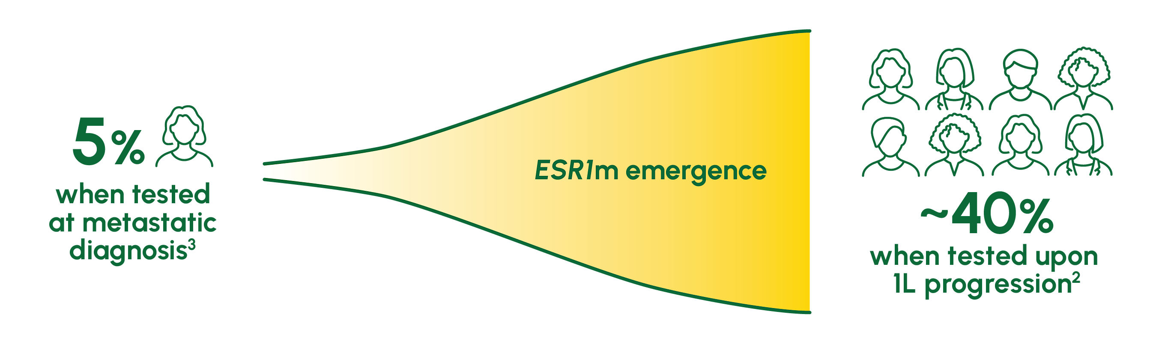
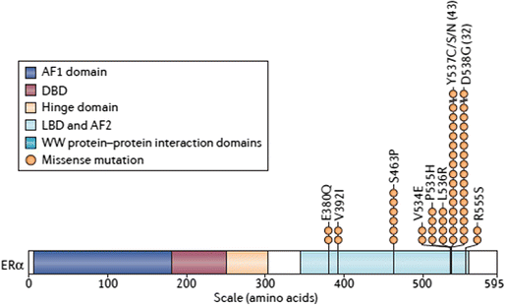
ESR1 SNV; Fulvestrant = SOC
Most aberrations lie in
Ligand (Estrogen) Binding Domain
Notes:
The ER LBD mutations confer constitutive ligand-independent activity and are relatively resistant to tamoxifen and fulvestrant treatment
These mutations in the gene encoding the ER, ESR1, are detected mainly in metastatic tumours, implicating the clonal selection of these mutations as the mechanism of resistance to therapy
Structural studies have shown that the ER LBD mutations lead to ligand-independent stabilization of the LBD in the agonistic conformation
Jeselsohn, NRCO 2015

Slide 13
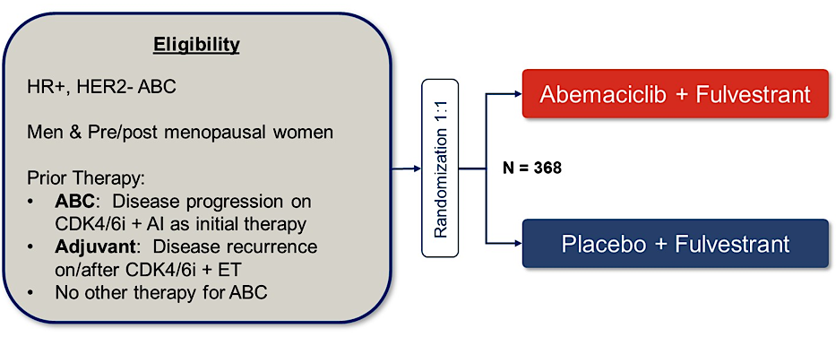
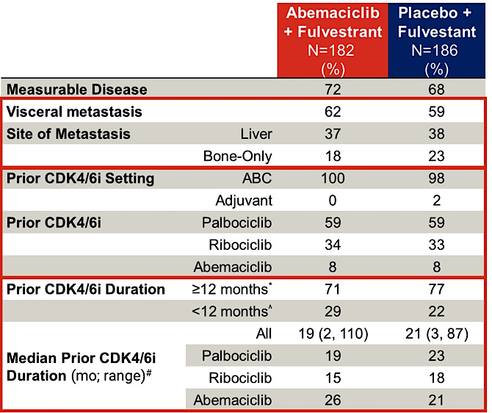
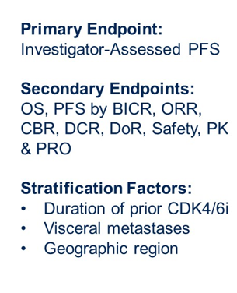
postMONARCH: CDK 4/6i after PD on CDK 4/6i+ET
Is continued CDK4/6 blockade after progression on CDK4/6i with an ET switch effective?
Study Schema
Patient population
Kalinsky K et al. ASCO 2024 LBA1001; Kalinsky K et al. JCO 2024.

Slide 14
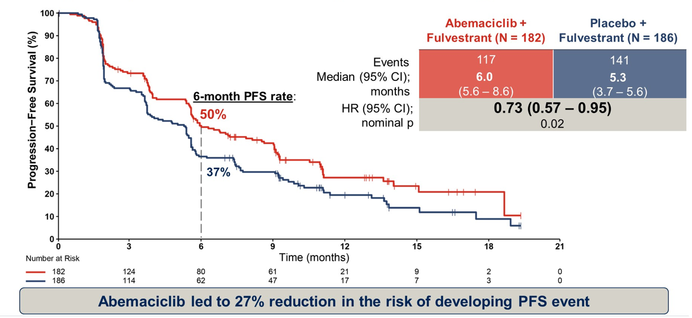
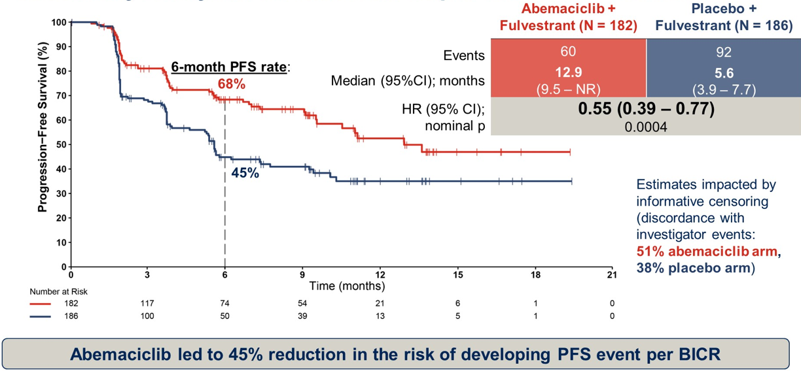
postMONARCH: Efficacy endpoints
Primary EP: Investigator assessed PFS
Secondary EP: BICR - assessed PFS
Kalinsky K et al. ASCO 2024 LBA1001; Kalinsky K et al. JCO 2024.

Slide 15






postMONARCH (Phase 3): Subgroup analysis of investigator- assessed PFS by prior CDK4/6i duration and visceral metastasis
PFS by prior CDK4/6i duration: <12 months
PFS among patients without visceral metastases
100
 | Abemaciclib + fulvestrant (n=53) | Placebo + fulvestrant (n=40)
Events | 38 | 31
Median (95% CI); months | 5.5 (2.4, 9.1) | 3.0 (1.9, 4.2)
HR (95% Cl) | 0.80 (0.50, 1.29)
100
 | Abemaciclib + fulvestrant (n=70) | Placebo + fulvestrant (n=77)
Events | 32 | 53
Median (95% CI); months | 11.1 (6.3, NR) | 5.6 (5.3, 9.2)
HR (95% Cl) | 0.53 (0.34, 0.83)
90
90
80
80
70
70
60
60
50
50
PFS (%)
PFS (%)
40
40
30
30
20
20
10
10
0
0
0
3
6
9
12
15
18
21
0
3
6
9
12
15
18
21
Time (months)
Time (months)
PFS by prior CDK4/6i duration: ≥12 months
PFS among patients with visceral metastases
 | Abemaciclib + fulvestrant (n=129) | Placebo + fulvestrant (n=144)
Events | 79 | 109
Median (95% CI); months | 7.0 (5.6, 9.0) | 5.4 (4.0, 5.7)
HR (95% Cl) | 0.70 (0.52, 0.94)
100
 | Abemaciclib + fulvestrant (n=112) | Placebo + fulvestrant (n=109)
Events | 85 | 88
Median (95% CI); months | 5.4 (3.7, 5.9) | 3.7 (2.0, 5.4)
HR (95% Cl) | 0.87 (0.64, 1.17)
100
90
90
80
80
70
70
60
60
50
50
PFS (%)
PFS (%)
40
40
30
30
20
20
10
10
0
0
0
3
6
9
12
15
18
21
0
3
6
9
12
15
18
21
Time (months)
Time (months)
Kalinsky K et al. ASCO 2024 LBA1001; Kalinsky K et al. JCO 2024.
Notes:
First randomized phase 3 trial in ER+/HER2- MBC to confirm efficacy of continuing CDK 4/6i after progression on CDK 4/6i and switching ET
Abemaciclib + fulvestrant improved PFS in patients who had previously been treated with prior palbociclib or ribociclib
27% reduction in risk of progression or death
Benefit seen in all pre-specified subgroups regardless of biomarker
The safety profile was as expected for abemaciclib and treatment discontinuation rate was low
Abemaciclib + fulvestrant is a reasonable 2L option for patients who have done well on 1L CDK 4/6i and may be most appropriate for those without PIK3CA or ESR1 mutations.

Slide 16
SERENA-2: Camizestrant vs Fulvestrant (oral vs IM SERD) Postmenopausal Patients With ER+/HER2- Advanced BC
Multicenter, open-label, parallel-group, randomized phase II study
Prior CDK4/6i, lung/liver metastases
Camizestrant 300 mg PO QD
(n = 20) (stopped early*)
Postmenopausal women with ER+/HER2- advanced BC; evidence of progression on/after last systemic therapy; at least 1 lesion measuring ≥10 mm in longest diameter; ECOG/WHO PS 0-1; ≤1 line of ET or chemotherapy in advanced setting; without prior fulvestrant or oral SERD
(N = 240)
Camizestrant 75 mg PO QD
(n = 74)
Camizestrant 150 mg PO QD
(n = 73)
Fulvestrant 500 mg IM Q28†
(n = 73)
*CSP v5 amendment: 16Dec20. †In cycle 1, fulvestrant given on D1, 15, 29, then Q28 for additional cycles.
Primary endpoint: investigator-assessed PFS
Key secondary endpoints: CBR24, ORR, OS, safety
M Oliveira et al. Lancet Oncology 2024
Notes:
CBR24, clinical benefit rate at Week 24; CDK4/6i, CKD4/6 inhibitor; CSP, clinical study protocol; CTC, circulating tumor cell; ctDNA, circulating tumor DNA; ER, estrogen receptor; ET, endocrine therapy; ORR, objective response rate; OS, overall survival; PFS, progression-free survival; SERD, selective estrogen receptor degrader; BC, breast cancer; ECOG/WHO PS, Eastern Cooperative Oncology Group/World Health Organization performance status.

Slide 17
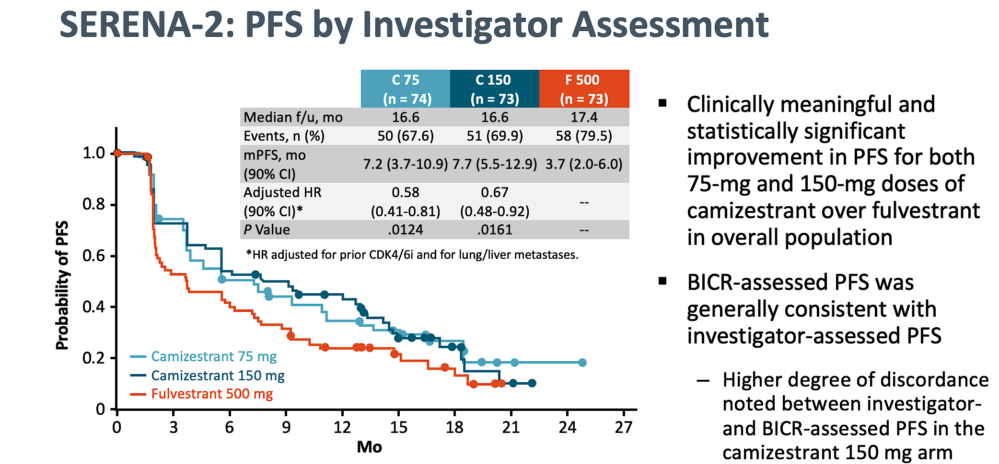
M Oliveira et al. Lancet Oncology 2024

Slide 18
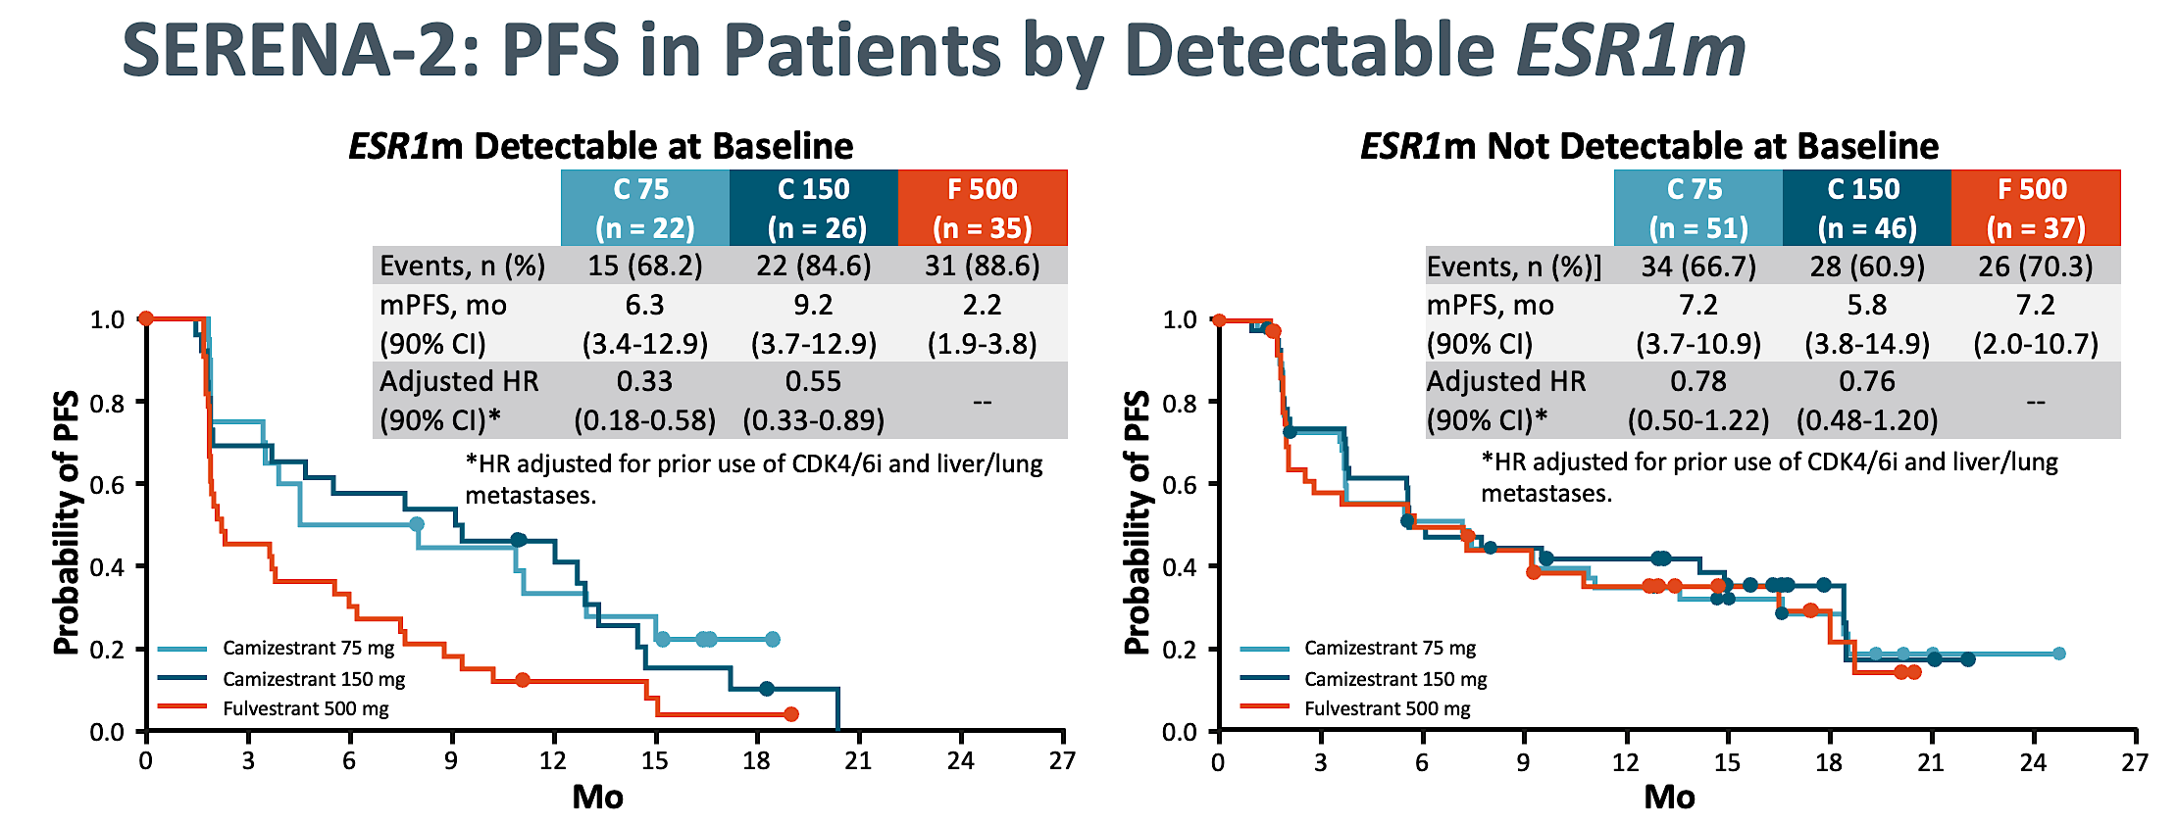
Camizestrant results in a clinically meaningful improvement in PFS vs fulvestrant in patients with ESR1m
M Oliveira et al. Lancet Oncology 2024

Slide 19
    For 1L mBC patients who develop an ESR1m during AI + CDK4/6i treatment, SERENA-6 aims to get ahead of clinical progression to extend the benefit of 1L ET
PIK3CA/AKT1/PTEN alterations
BRCAm/PALB2m
ESR1m
SERENA-6 (Phase III)
1L switch to camizestrant + CDK4/6i on emergence of ESR1m
Step 1: ESR1m detection
HR-positive,
HER2-negative
locally advanced (inoperable) or mBC^{1,2}
Currently receiving AI (anastrozole or letrozole) + CDK4/6i (palbociclib, abemaciclib or ribociclib) ± LHRH as 1L treatment for ≥6 months with no evidence of PD^{1,2*}
Continue 1L treatment with AI (anastrozole or letrozole)
+ CDK4/6i (palbociclib, abemaciclib or ribociclib) ± LHRH
Primary endpoint²
PFS*
Key secondary endpoints²
PFS2, ORR, CBR₂₄, OS, PROs (TTD), time to ChT
ESR1m screening in plasma ctDNA (every 2–3 treatment cycles) and tumour imaging as per SoC
ESR1m positive ctDNA detected and no evidence
of PD†
ESR1m negative tumour
and no evidence of PD
Step 2: Randomised treatment (N=300)²
Switch to camizestrant (75 mg QD)
+ maintain same CDK4/6i + placebo for AI
R
Continue on AI + maintain same CDK4/6i
+ placebo for camizestrant
1:1
This is an investigational regimen, not licenced or reimbursed by any regulatory health or payer body globally.
*By investigator assessment; †Inclusion criteria for Step 2 include evaluable disease as per RECIST v1.1.²
1L=first-line; AI=aromatase inhibitor; CBR₂₄=clinical benefit rate at 24 weeks; CDK4/6i=cyclin-dependent kinase 4/6 inhibitor; ChT=chemotherapy; CI=confidence interval; ctDNA=circulating tumour DNA; ESR1m=oestrogen receptor alpha mutation; ET=endocrine therapy; HER2=human epidermal growth factor receptor 2; HR=hormone receptor; LHRH=luteinising hormone-releasing hormone; mBC=metastatic breast cancer; ngSERD=next-generation selective oestrogen receptor degrader; ORR=objective response rate; OS=overall survival; PD=disease progression; PFS=progression-free survival; PRO=patient reported outcome; QD=once daily; R=randomisation; RECIST=response evaluation criteria in solid tumors; SoC=standard of care; TTD=time to deterioration.
1. NIH. SERENA-6. Available at: https://www.clinicaltrials.gov/study/NCT04964934 (Accessed November 2024); 2. Bidard F-C, et al. Presented at SABCS Annual Meeting 2021, December 7–10. San Antonio, Tx. Abstract #OT2-11-05.

Slide 20
SERENA-6: First-Line Camizestrant Demonstrated Improvement in Progression-Free Survival for Advanced HR-Positive Breast Cancer with an Emergent ESR1 Tumor Mutation
Press Release: February 26, 2025
“Positive high-level results from a planned interim analysis of the SERENA-6 Phase III trial showed that camizestrant in combination with a cyclin-dependent kinase (CDK) 4/6 inhibitor (palbociclib, ribociclib or abemaciclib) demonstrated a highly statistically significant and clinically meaningful improvement in the primary endpoint of progression-free survival (PFS). The trial evaluated switching to the camizestrant combination versus continuing standard-of-care treatment with an aromatase inhibitor (AI) (anastrozole or letrozole) in combination with a CDK4/6 inhibitor in the 1st-line treatment of patients with hormone receptor (HR)-positive, HER2-negative advanced breast cancer whose tumors have an emergent ESR1 mutation.
The key secondary endpoints of time to second disease progression (PFS2) and overall survival (OS) were immature at the time of this interim analysis. However, the camizestrant combination demonstrated a trend toward improvement in PFS2. The trial will continue as planned to further assess key secondary endpoints.”
https://www.astrazeneca.com/media-centre/press-releases/2025/camizestrant-improved-pfs-in-1l-hr-breast-cancer.html

Slide 21
EMBER-3 (Phase 3): Imlunestrant ± abemaciclib for ER+, HER2− advanced breast cancer pretreated with ET
Key eligibility
ER+, HER2– advanced breast cancer
Men and pre-ª/postmenopausal women
Prior therapy:
Adjuvant: Recurrence on or within 12 months of completion of AI ± CDK4/6i
Advanced breast cancer: Progression on first-line AI ± CDK4/6i
No other therapy for advanced disease
A: Imlunestrant 400 mg QD (n=331)
Primary endpoints
  Investigator-assessed PFS for^{c}:
    A vs B in patients with ESR1m^{d}
    A vs B in all patients
    C vs A in all^{e} patients
Key secondary endpoints
  OS, PFS by BICR, and ORR
  Safety
  Exploratory endpoints
  PFS and OS for C vs B in all^{e} patients
R
1:1:1
B: SOC ET
Fulvestrant or exemestane
(n=330)
N=874
C:^{b} Imlunestrant 400 mg QD + abemaciclib
(n=213)
Stratification factors
The primary reason for study treatment discontinuation was progressive disease in all arms
Prior CDK4/6i therapy (yes vs no)
Visceral metastases (yes vs no)
Region (East Asia, US/EU vs others)
Jhaveri K, et al. SABCS 2024. Abstract GS1-01.

Slide 22
EMBER-3 (Phase 3): Investigator-assessed PFS by subgroup, imlunestrant + abemaciclib vs imlunestrant
PFS: Patients with ESR1 mutation
PFS: Patients without ESR1 mutation
 | Imlunestrant + abemaciclib | Imlunestrant
Events, n/N | 36/67 | 71/92
Median PFS, months (95% CI) | 11.1 (7.4, 13.7) | 5.5 (3.8, 7.2)
HR (95% CI) | 0.53 (0.35, 0.80)
 | Imlunestrant + abemaciclib | Imlunestrant
Events, n/N | 78/146 | 78/121
Median PFS, months (95% CI) | 9.1 (7.4, 14.4) | 5.5 (3.6, 5.8)
HR (95% CI) | 0.59 (0.43, 0.81)
100
100
75
75
PFS (%)
Treatment response (95% CI):
Patients with ESR1 mutation
  Imlunestrant + abemaciclib, n=54: 35% (22, 48)
  Imlunestrant [n=74]: 15% (7, 23)
  SOC ET, n=58: 3% (0, 8)
Patients without ESR1 mutation
  Imlunestrant + abemaciclib, n=113: 23% (15, 31)
  Imlunestrant, n=95: 10% (4, 15)
  SOC ET, n=104: 6% (1, 10)
50
50
PFS (%)
25
25
0
0
0
2
4
6
8
10
12
14
16
18
20
22
24
26
28
30
0
2
4
6
8
10
12
14
16
18
20
22
24
26
28
30
Time (months)
No. at risk
Time (months)
No. at risk
67
54
47
39
33
22
14
7
6
3
1
1
0
0
0
0
146
111
94
83
63
50
34
22
19
10
5
4
3
0
0
0
92
62
50
35
28
20
12
9
7
3
0
0
0
0
0
0
121
78
56
42
39
28
17
11
11
7
3
2
0
0
0
0
PFS: Patients with prior CDK4/6i treatment
PFS: Patients with PI3K pathway mutation
 | Imlunestrant + abemaciclib | Imlunestrant
Events, n/N | 79/139 | 109/140
Median PFS, months (95% CI) | 9.1 (7.2, 11.2) | 3.7 (2.1, 5.5)
HR (95% CI) | 0.51 (0.38, 0.68)
 | Imlunestrant + abemaciclib | Imlunestrant
Events, n/N | 55/88 | 70/84
Median PFS, months (95% CI) | 7.6 (5.6, 11.0) | 3.8 (3.1, 5.5)
HR (95% CI) | 0.61 (0.42, 0.87)
100
100
75
75
50
50
PFS (%)
PFS (%)
25
25
0
0
0
2
4
6
8
10
12
14
16
18
20
22
24
26
28
30
0
2
4
6
8
10
12
14
16
18
20
22
24
26
28
Time (months)
Time (months)
No. at risk
139
105
87
76
58
43
29
19
17
8
3
2
1
0
0
0
No. at risk
88
62
51
41
32
19
11
8
5
2
1
1
0
0
0
140
79
56
39
32
21
13
11
10
6
1
0
0
0
0
0
84
53
35
23
20
15
7
5
4
2
0
0
0
0
0
Jhaveri K, et al. SABCS 2024. Abstract GS1-01

Slide 23
EMBER-3 (Phase 3): Interim OS, imlunestrant vs SOC ET
Patients with ESR1 mutation
(31% maturity)
All patients
(23% maturity)
100
100
75
75
OS (%)
OS (%)
50
50
25
 | Imlunestrant | SOC ET
Events n/N | 32/138 | 48/118
HR (95% CI) | 0.55 (0.35, 0.86); P=0.008ª
25
 | Imlunestrant | SOC ET
Events n /N | 62/331 | 90/330
HR (95% CI) | 0.69 (0.50, 0.96)^{b}
0
0
0
2
4
6
8
10
12
14
16
18
20
22
24
26
28
30
32
34
0
2
4
6
8
10
12
14
16
18
20
22
24
26
28
30
32
34
In patients without ESR1 mutation: maturity 18% (HR=0.87; 95% CI: 0.54, 1.40)^{c}
In all patients within the combination therapy comparison: maturity 15% (HR=1.34; 95% CI: 0.81, 2.21)^{c}
This important trial showed that imlunestrant improved PFS compared with SOC ET in patients with ESR1 mutations
The addition of abemaciclib further improved PFS compared with imlunestrant alone in all patients, but it was not compared with SOC ET plus abemaciclib which makes assessment of components more difficult in the ESR1 wildtype population. However, these data demonstrate efficacy of abemaciclib plus ET after progression on prior CDK4/6i therapy with either palbociclib or ribociclib
Imlunestrant was well tolerated alone and in combination with abemaciclib
Jhaveri K, et al. SABCS 2024. Abstract GS1-01.

Slide 24
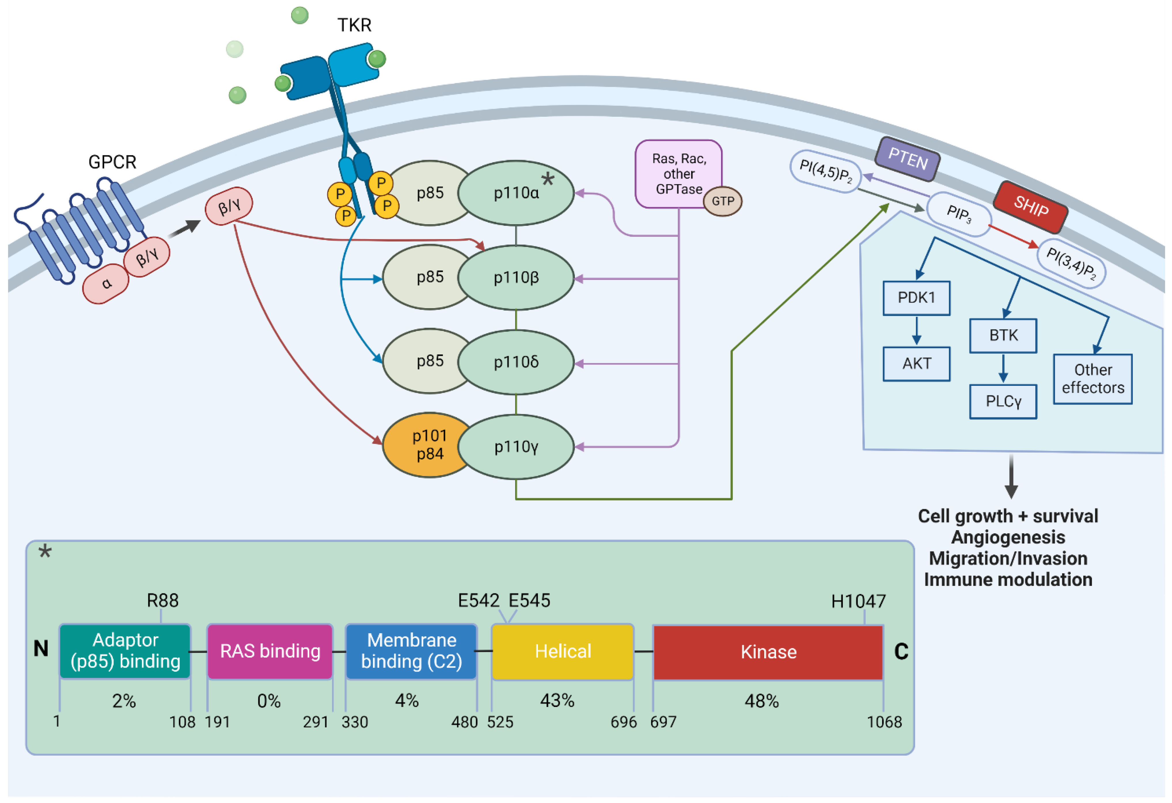
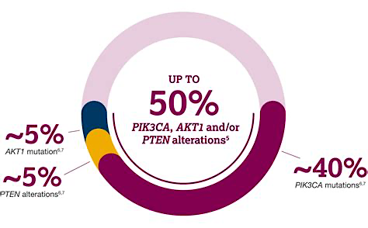
PIK3CA/PTEN/AKT
Biology
Notes:
PIK3CA is an almost ubiquitous signal transduction pathway in breast cancer
And like ESR1 is constitutively activated in ER-pos MBC

Slide 25
CAPItello-291 showed a PFS benefit with the addition of capivasertib to fulvestrant vs. fulvestrant in both ITT and PI3K/AKT pathway-altered populations
CAPItello-291 (Phase III)
2L+ capivasertib + fulvestrant vs. fulvestrant
Post-CDK4/6i: 70%
AEs occurring in >15% of patients in either treatment arm in the ITT population, %¹ | Capivasertib + fulvestrant (n=355) |  | Placebo + fulvestrant (n=350)
 | All Grade | Grade ≥3 | All Grade | Grade ≥3
Diarrhoea | 72.4 | 9.3 | 20.0 | 0.3
Rash† | 38.0 | 12.1 | 7.1 | 0.3
Nausea | 34.6 | 0.8 | 15.4 | 0.6
Fatigue | 20.8 | 0.6 | 12.9 | 0.6
Vomiting | 20.6 | 1.7 | 4.9 | 0.6
Headache | 16.9 | 0.3 | 12.3 | 0.6
Decreased appetite | 16.6 | 0.3 | 6.3 | 0.6
Hyperglycaemia | 16.3 | 2.0 | 3.7 | 0.3
Dual primary endpoint:
PFS in PI3K/AKT pathway-altered cohort^{1*}
 | Capivasertib + fulvestrant (n=155) | Placebo + fulvestrant (n=134)
PFS events | 121 | 115
Median PFS (95% CI); months | 7.3 (5.5–9.0) | 3.1 (2.0–3.7)
Adjusted hazard ratio (95% CI) | 0.50 (0.38–0.65); two-sided p-value <0.001
100
80
60
PFS (%)
40
20
Diarrhoea, rash, and hyperglycaemia occurred shortly after starting capivasertib + fulvestrant [median days to onset (IQR) of any grade: 8 (2–22), 12 (10–15), and 15 (1–51), respectively]²
0
0
1
2
3
4
5
6
7
8
9
10
11
12
13
14
15
16
17
18
19
20
21
22
23
24
25
26
Time from randomisation (months)
N Turner et al., ESMO Breast 2023 Abstract 187O

Slide 26
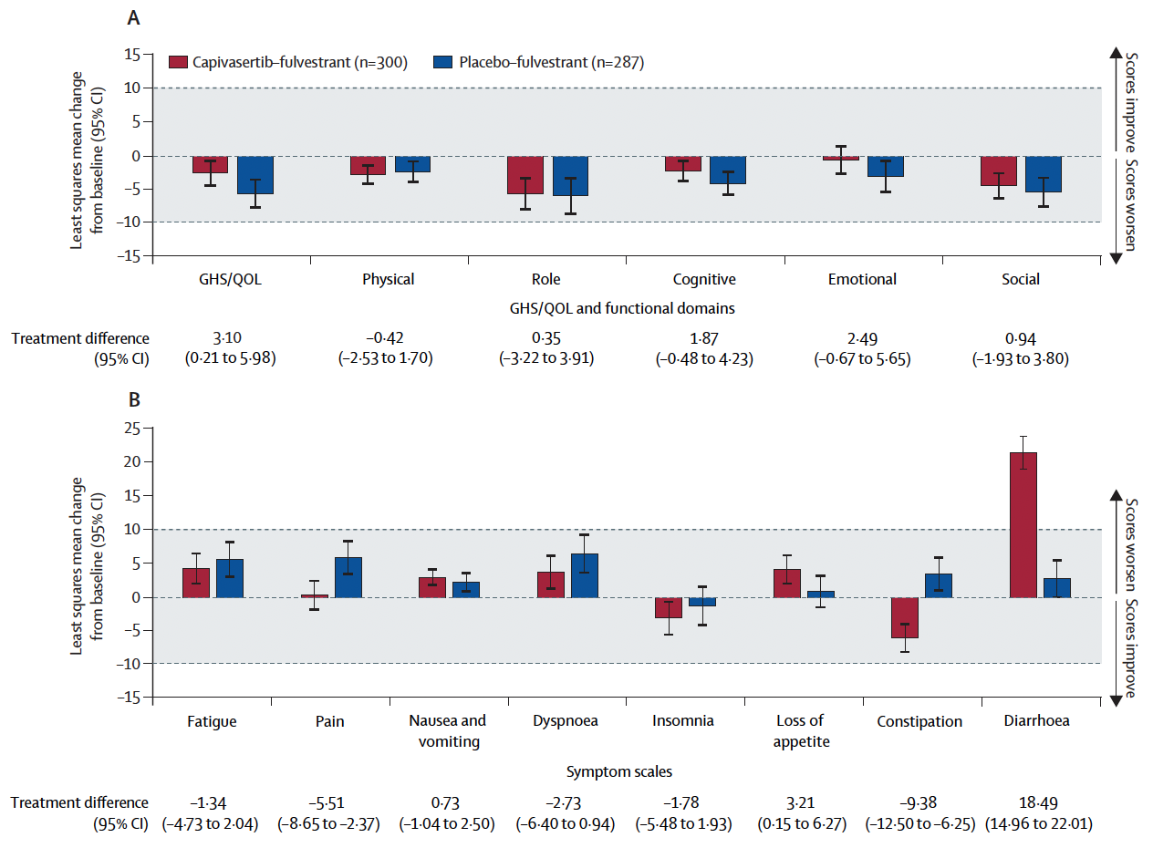
CAPItello-291: Mean Change from Baseline with Capivasertib and Fulvestrant in EORTC QLQ-C30 Global Health Status/Quality of LIfe, Functional Domains and Symptom Scales
Oliveira M et al. Lancet Oncol 2024;25(9):1231.

Slide 27
INAVO120 (Phase 3): Inavolisib + palbociclib + fulvestrant in patients with PIK3CA-mutated, HR+, HER2− locally advanced/metastatic breast cancer
Inavolisib is a selective inhibitor of the catalytic alpha isoform subunit
(p110α encoded by PIK3CA) of the P13K complex
Key eligibility
Enrichment of patients with poor prognosis:
PIK3CA-mutated, HR+, HER2– LA/mBC
by central ctDNA or local tissue/ctDNA test
Measurable disease
Progression during/ within 12 months of adjuvant ET completion
Inavolisib 9 mg QD PO + palbociclib 125 mg QD PO D1–D21 + fulvestrant 500 mg C1D1/15 and Q4W
Efficacy endpoints
PFS by investigator
OS
ORR, BOR, CBR, DOR
Time from randomization to end or discontinuation of next-line treatment, or death from any cause (proxy for PFS2)
Time from randomization to first
subsequent chemotherapy after
treatment discontinuation
R
1:1
N=325
Placebo PO QD +
palbociclib 125 mg PO QD
D1–D21 + fulvestrant 500 mg C1D1/15 and Q4W
Safety endpoints
Key selected AEs (hyperglycemia, diarrhea, rash, and
stomatitis/mucosal inflammation)
Jhaveri K et al. SABCS 2023; Turner N, et al. NEJM 2024; Juric D, et al. ASCO 2024
Notes:
% prior CDK?

Slide 28
INAVO120 (Phase 3): Efficacy
Primary endpoint: PFS (previously reported)
  Median PFS: 15 months vs 7.3 months; HR: 0.43 (95% CI: 0.32, 0.59); P<0.0001
Additional analyses (data cutoff: Sep 29, 2023), median follow-up: 21.3 months (prespecified boundary of significance for OS was not met, analyses are descriptive)
Time to discontinuation of next-line treatment, or death (proxy for PFS2)
Time to first subsequent chemo after treatment discontinuation
 | Inavo+Palbo+Fulv (n=161) | Pbo+Palbo+Fulv (n=164)
No. of events, n (%) | 59 (36.6) | 80 (48.4)
Median (95% CI), months | 24.0 (18.6, NE) | 15.1 (13.5, 22.3)
Stratified HR (95% CI) | 0.54 (0.38, 0.77)
 | Inavo+Palbo+Fulv (n=161) | Pbo+Palbo+Fulv (n=164)
No. of events, n (%) | 48 (29.28) | 68 (41.5)
Median (95% CI), months | NE (24.8, NE) | 15.0 (10.6, 24.8)
Unstratified HR (95% CI) | 0.54 (0.37, 0.78)
100
100
75
75
Event-free (%)
Event-free (%)
50
50
25
Δ 8.9 months
25
Inavo+Palbo+Fulv
Inavo+Palbo+Fulv
Pbo+Palbo+Fulv
Pbo+Palbo+Fulv
0
Censored
0
Censored
0
3
6
9
12
15
18
21
24
27
30
33
36
39
0
3
6
9
12
15
18
21
24
27
30
33
36
39
Time (months)
Time (months)
Jhaveri K et al. SABCS 2023; Turner N, et al. NEJM 2024; Juric D, et al. ASCO 2024

Slide 29
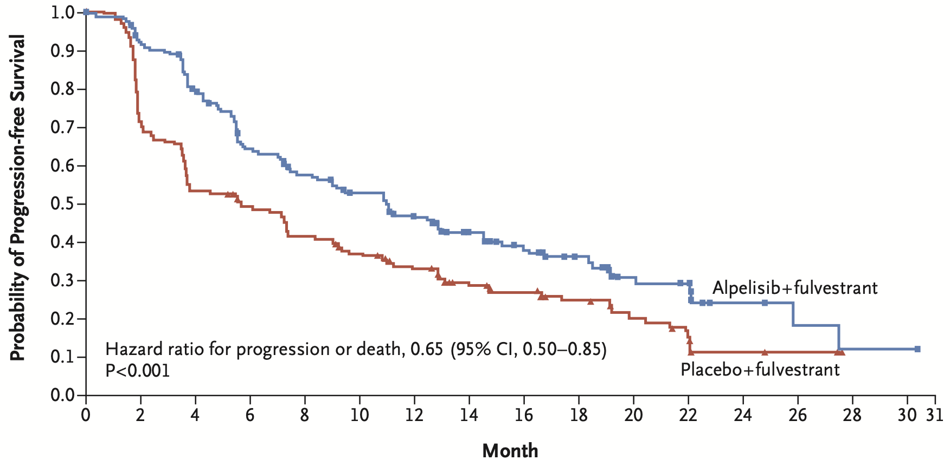
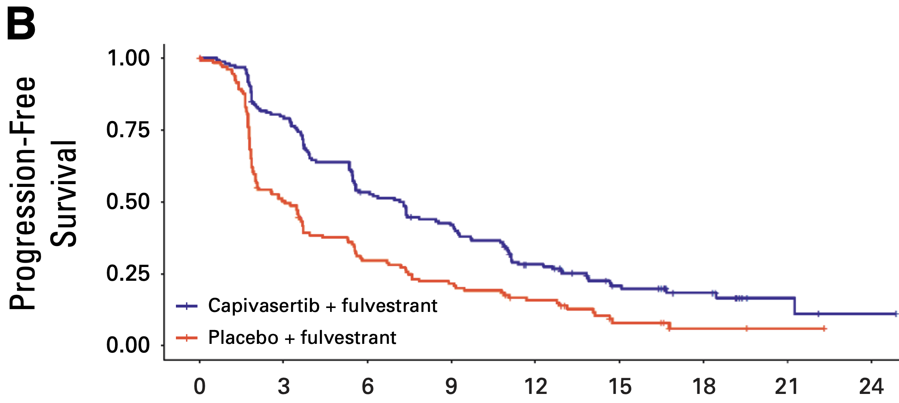
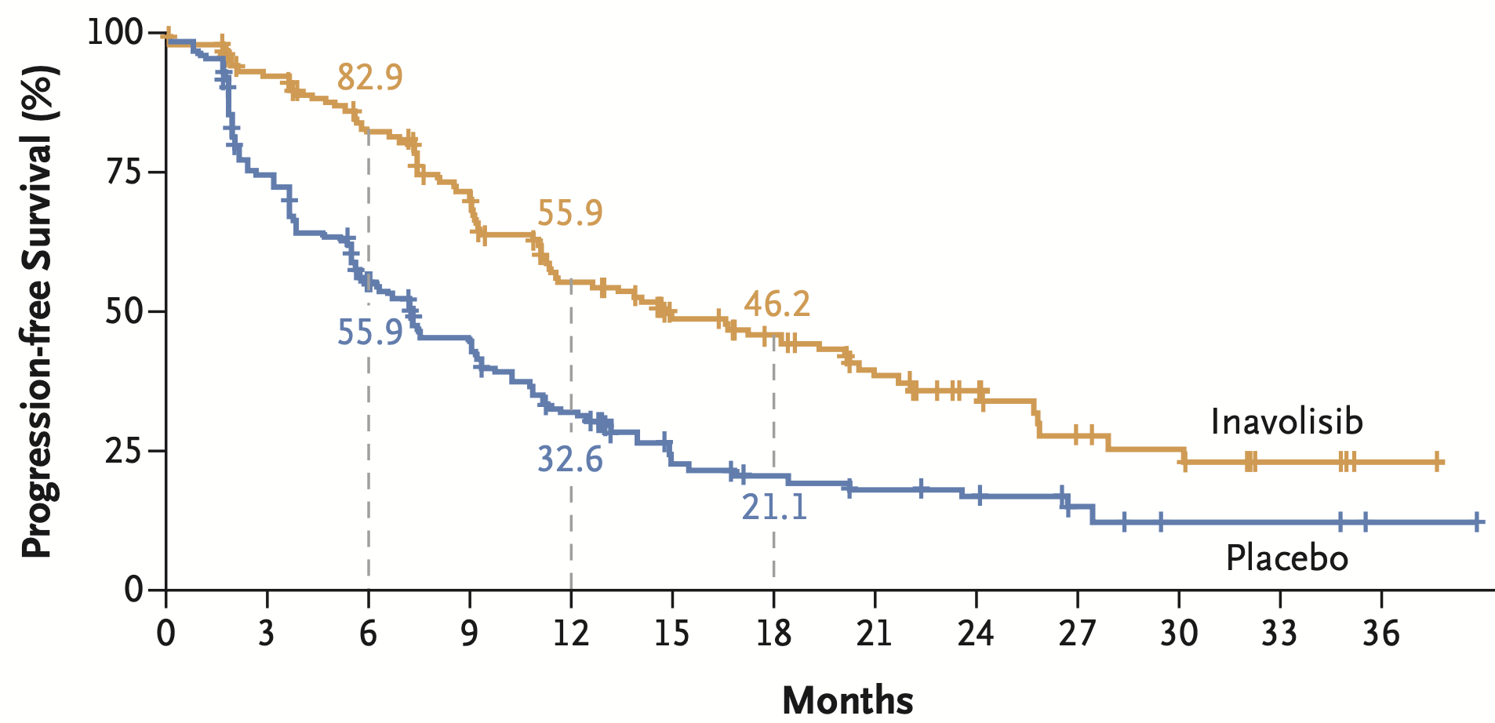
PIK3CA/PTEN/AKT Trials
Alpelisib
PI3Kα-specific
Capivasertib
AKT1, AKT2, and AKT3
HR, 0.5 [95% CI, 0.37-0.68]
Inavolisib PIK3CAi
0.43 (95% CI, 0.32–0.59)
P<0.001
Toxicities
neutropenia, hyperglycemia, stomatitis, diarrhea, rash
F Andre et al. NEJM 2019; M Oliveira et al. Lancet Oncology 2024; N Turner et al. NEJM 2024
Notes:
André NEJM 2019 SOLAR-1
Dilawari J Clin Oncol 2024 FDA capivasertib PIK3CA AKT PTEN MBC.pdf & Turner NEJM CAPItello-291
Turner NEJM 2024 INAVO120

Slide 30
DESTINY-Breast06 (Phase 3): Trastuzumab deruxtecan vs chemotherapy for HR+, HER2-low or HER2-ultralow metastatic breast cancer with prior ET
Open-label, randomized, multicenter study
Key eligibility
HR+ metastatic breast cancer
HER2-low (IHC 1+ or IHC 2+/ISH−) or HER2-ultralow (IHC 0 with membrane staining)
Chemotherapy naïve in the mBC setting
Prior lines of therapy
≥2 lines of ET ± targeted therapy for mBC OR 1 line for mBC AND
Progression ≤6 months of starting first-line ET + CDK4/6i OR Recurrence ≤24 months of starting adjuvant ET
Endpoints
Primary
PFS (BICR) in HER2-low
Key secondary
PFS (BICR) in ITT (HER2-low + ultralow)
OS in HER2-low
OS in ITT (HER2-low + ultralow)
T-DXd
5.4 mg/kg Q3W
(n=436)
R
1:1
HER2-low = 713
HER2-ultralow = 153
N=866
TPC
(n=430)
Other secondary
PFS (INV) in HER2-low
ORR (BICR/INV) and DOR (BICR/INV) in HER2-low and ITT (HER2-low + ultralow)
Safety and tolerability
Patient-reported outcomes
Stratification factors
Options:
capecitabine,
nab-paclitaxel,
paclitaxel
Prior CDK4/6i use (yes vs no)
HER2 expression (IHC 1+ vs IHC 2+/ISH− vs IHC 0 with membrane staining)
Prior taxane in the non-metastatic setting (yes vs no)
Curigliano G, et al. ASCO 2024. Abstract LBA1000.

Slide 31
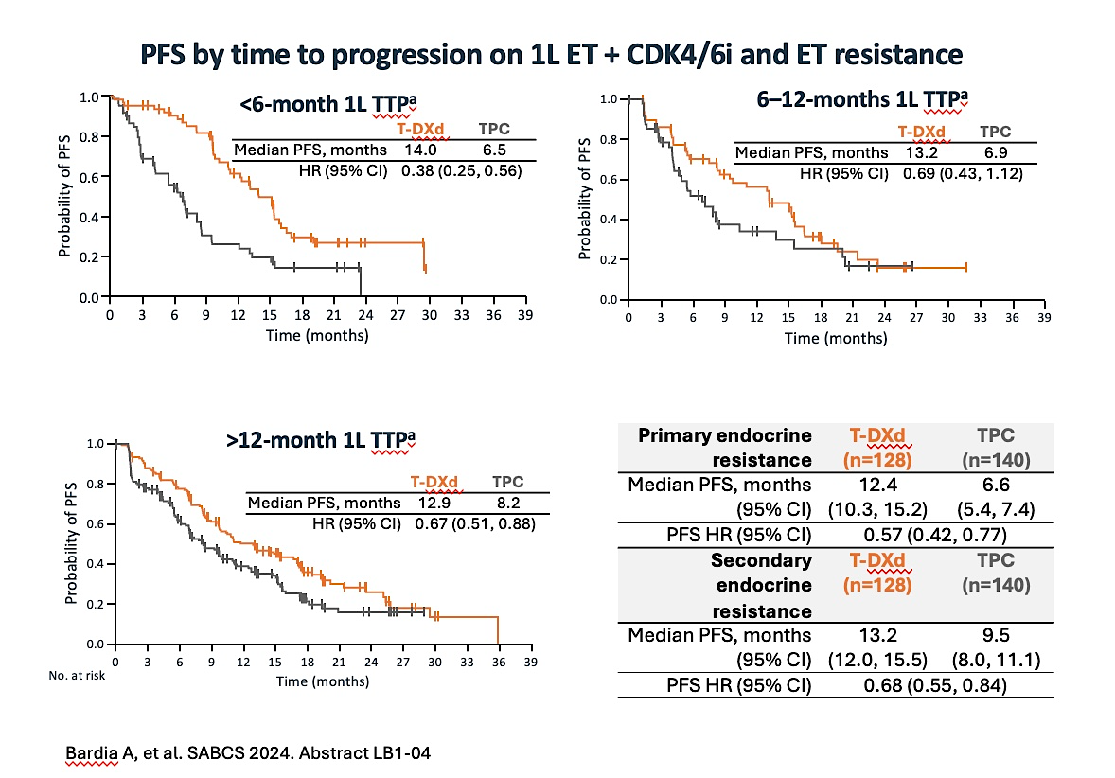
DESTINY-Breast06 (Phase 3): T-DXd efficacy by time to progression on 1L ET + CDK4/6i and ET resistance
6–12-month 1L TTPª

Slide 32
DESTINY-Breast06 (Phase 3): PFS2 in the overall ITT population and TTP subgroups
PFS2 (ITT population)ª
1.0
 | T-DXd | TPC
Median PFS2, months | 20.3 | 14.7
HR (95% CI) | 0.62 (0.52, 0.74); P<0.0001
0.8
0.6
Probability of EFS
0.4
Δ 5.6 months
0.2
0.0
0
3
6
9
12
15
18
21
24
27
30
33
35
39
42
No. at risk
Time (months)
T-DXd
TPC
436
430
431
399
396
365
365
311
322
244
268
183
176
109
115
69
78
48
43
26
23
12
11
6
4
2
1
0
0
0
 | <6-month 1L TTP |  | 6–12-month 1L TTP |  | >12-month 1L TTP
 | T-DXd (n=65) | TPC (n=59) | T-DXd (n=60) | TPC (n=52) | T-DXd (n=168) | TPC (n=166)
Median PFS2, months (95% CI) | 18.9 (14.4, 24.0) | 15.2 (10.9, 17.5) | 17.1 (13.9, 31.8) | 13.7 (10.3, 17.1) | 20.0 (18.6, 25.3) | 14.3 (12.6, 15.9)
PFS2 HR (95% CI) | 0.73 (0.46, 1.14) |  | 0.59 (0.37, 0.94) |  | 0.57 (0.43, 0.75)
This subset analysis of DESTINY-Breast06 provides important information about which patients are most likely to benefit from 1L
T-DXd compared with standard chemotherapy, which for the majority of patients was capecitabine
In particular, patients with a short TTP on first line ET, or those with primary endocrine resistance had markedly improved PFS with T-DXd
Bardia A, et al. SABCS 2024. Abstract LB1-04

Slide 33
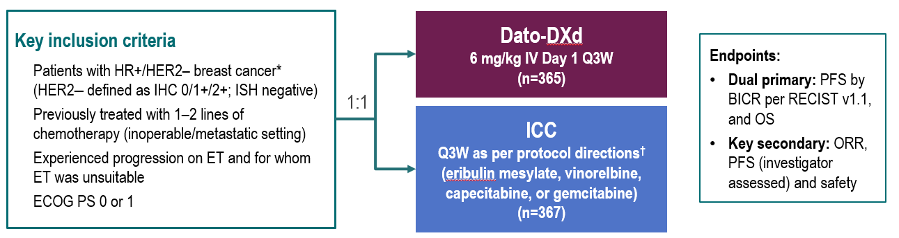
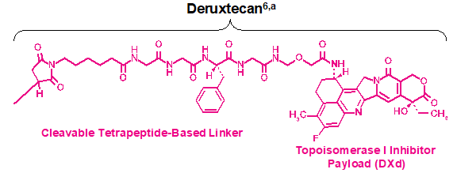
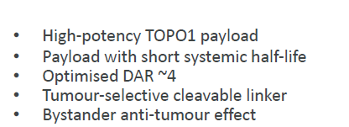
TROPION-Breast01: Ph 3 trial of Dato-DXd in HR+/HER2- MBC
Dato-DXd: Humanised anti-TROP2
monoclonal antibody
TROPION-Breast01 Schema
Bardia A et al. ESMO 2023, LBA11

Slide 34
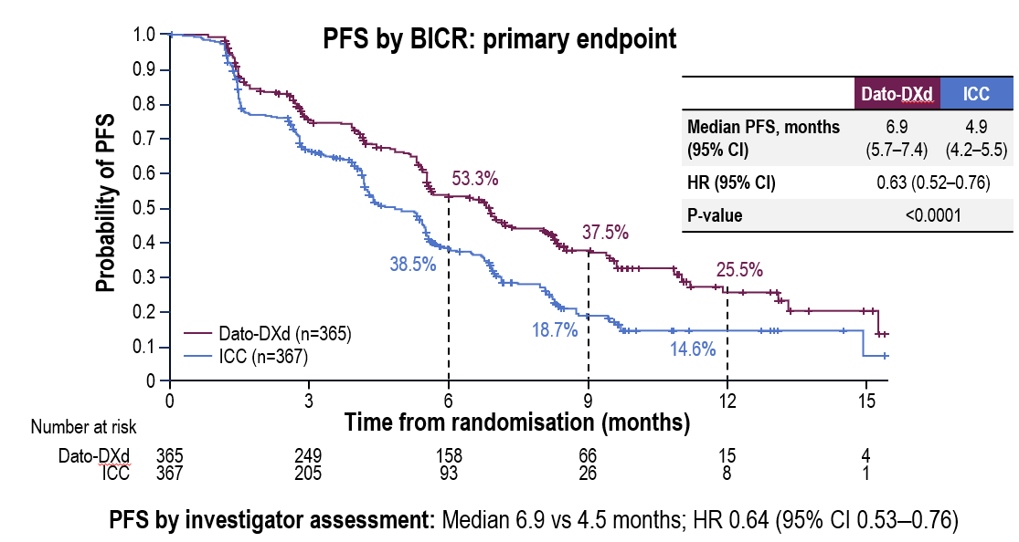
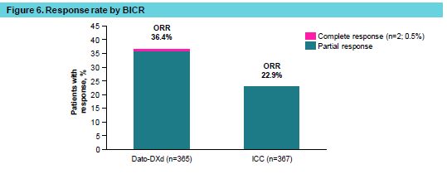
TROPION-Breast01: Efficacy outcomes
Primary EP: PFS by BICR
Response rate by BICR
Overall survival (dual primary endpoint)
OS data were not mature (information fraction 39%): median follow-up 9.7 months.
A trend favoring Dato-DXd was observed: HR 0.84 (95% CI 0.62–1.14).
Bardia A et al. ESMO 2023, LBA11; Rugo HS et al. MBCC 2024

Slide 35
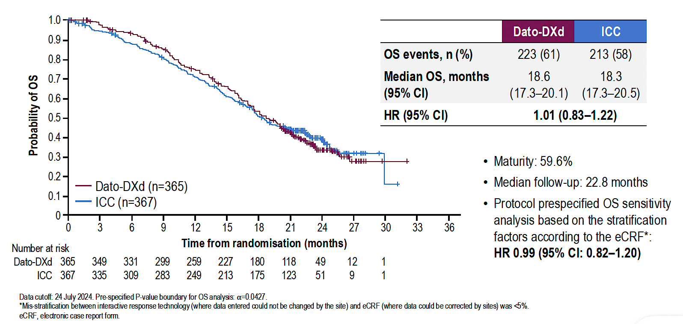
TROPION-Breast01: Final Overall Survival Analysis with Datopotamab Deruxtecan (Dato-DXd) for Previously Treated HR-Positive mBC
Pistilli B et al. ESMO 2024;Abstract VP1-2025.

Slide 36
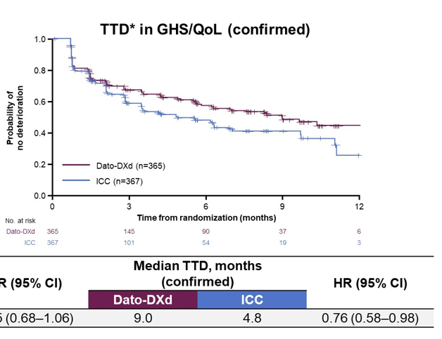
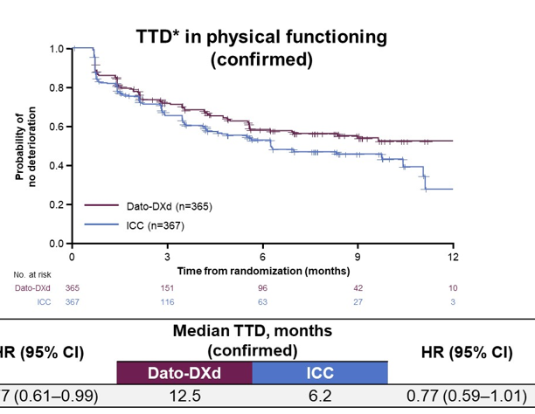
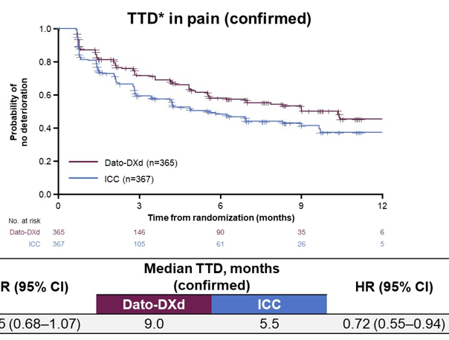
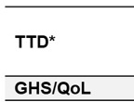
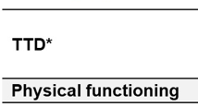
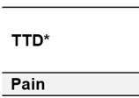
TROPION-Breast01: PRO endpoints
Time to deterioration (TTD) win GHS/QoL, physical functioning and pain was delayed in Dato-DXd arm compared to the ICC arm
Patient reported symptomatic AEs were generally consistent with clinician reported safety data
On Jan 17, 2024, FDA approved Dato-DXd for patients with HR+/HER2- MBC who received
prior ET based therapy and prior chemo in the metastatic setting
Pernas S et al. ASCO 2024

Slide 37
In ICARUS-BREAST01, HER3-DXd demonstrated efficacy in heavily pre-treated patients
There is no ongoing Phase III study for HER3-DXd, but additional Phase II studies are underway
Percentage of tumour reduction from baseline in patients with BC
N=99
 | n | % (95% CI)*
Confirmed ORR† | 53 | 53.5 (43.2–63.6)
CR | 2 | 2.0 (0.2–7.1)
PR | 51 | 51.5 (41.3–61.7)
SD | 37 | 37.4 (27.8–47.7)
PD | 7 | 7.1 (2.9–14.0)
NE‡ | 2 | 2.0 (0.2–7.1)
CBR§ | 62 | 62.6 (52.3–72.1)
*
100%
Confirmed global response
(RECIST v1.1)
80%
*
Complete response
Partial response
Stable disease
Progressive disease
60%
40%
20%
*
Percentage of tumour reduction baseline
0%
*
−20%
−40%
No significant association between HER2 expression and ORR was observed (p-value 0.8)¶
−60%
−80%
98% of patients had any grade TEAEs or TRAEs
−100%
tumour shrinkage: 90/99 patients
The most common TRAEs of any grade observed with HER3-DXd were fatigue (82.8%), nausea (74.7%), and diarrhoea (52.5%)
B Pistilli ESMO 2024

Slide 38
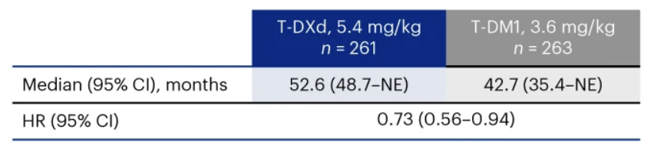
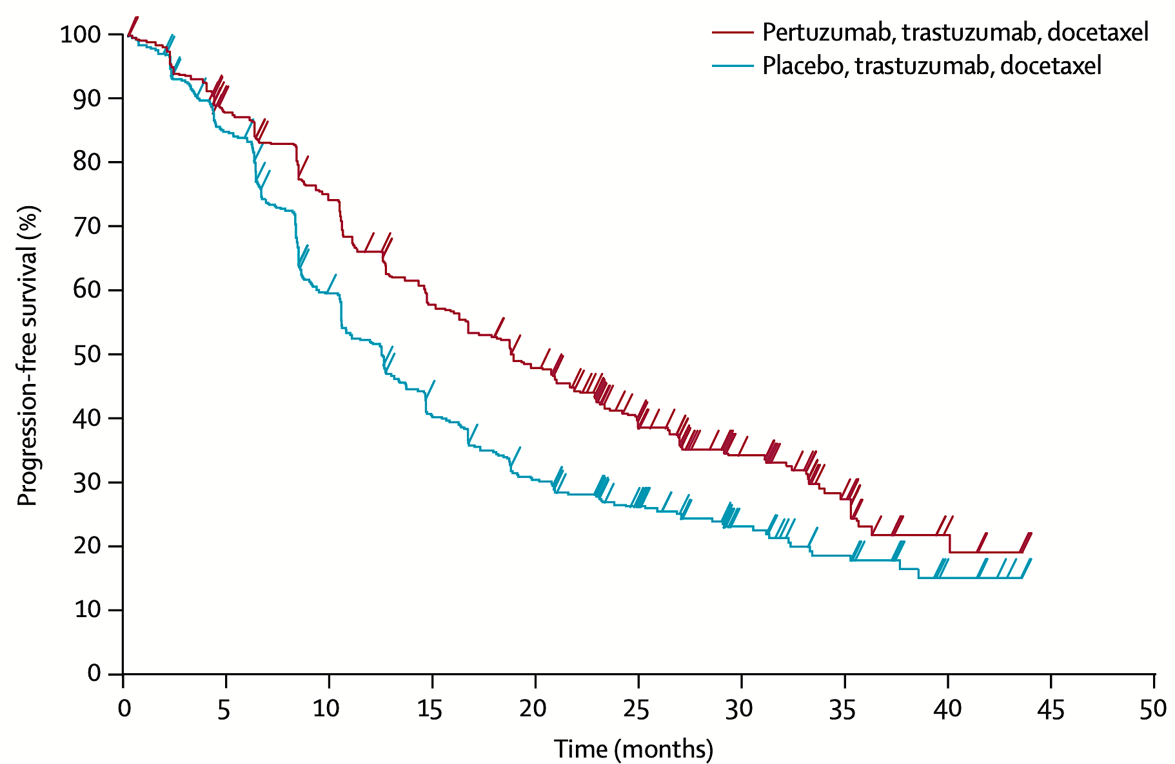
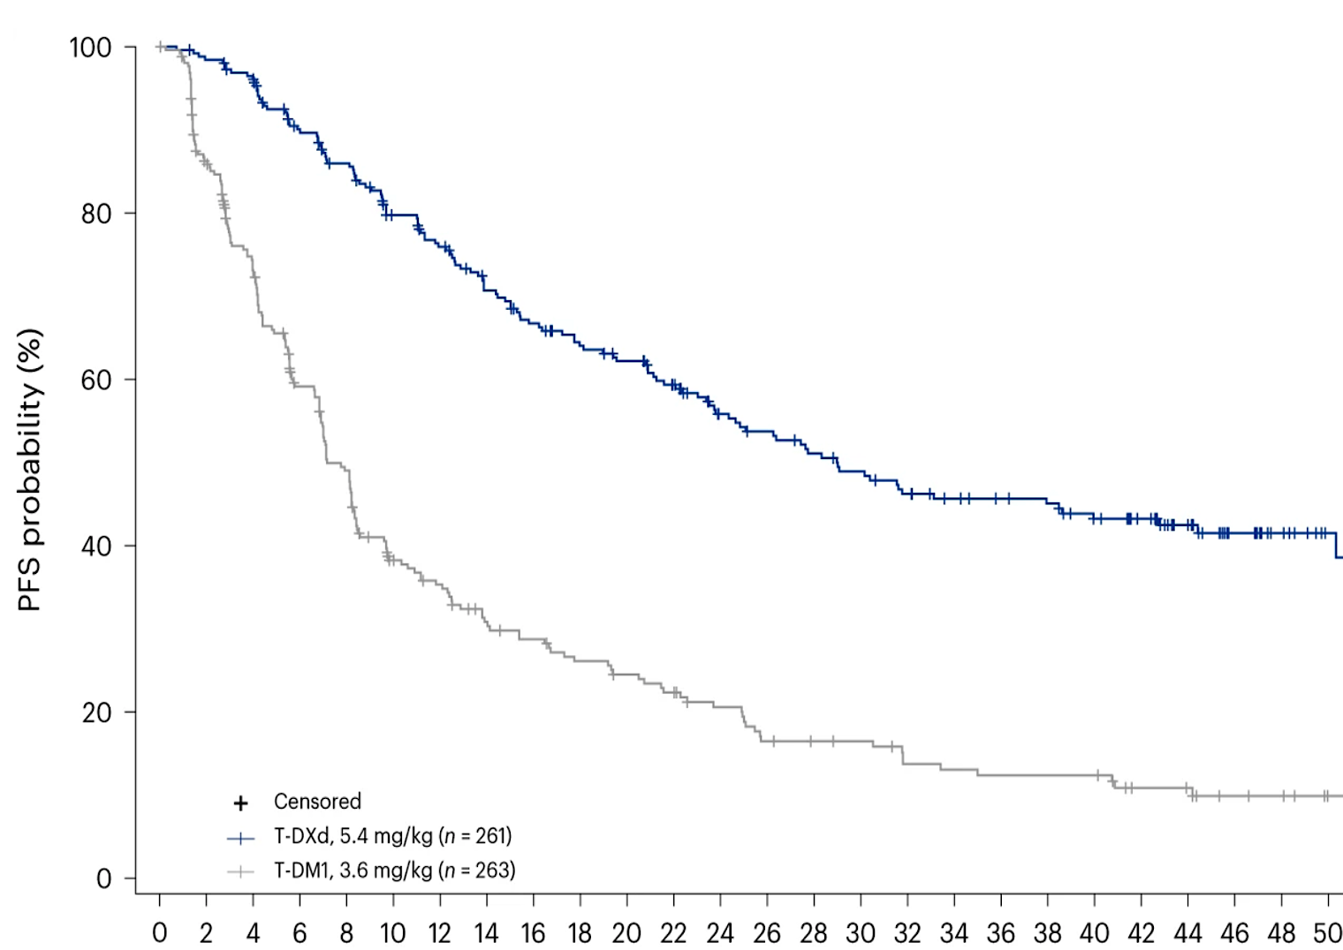
HER2-Positive MBC (HR all comers)
CLEOPATRA; 1st line
DESTINY-Breast; 2nd line
18.7 vs 12.4 mo
58
Notes:
Swain NEJM 2015
Cortes Nat Med 2024

Slide 39
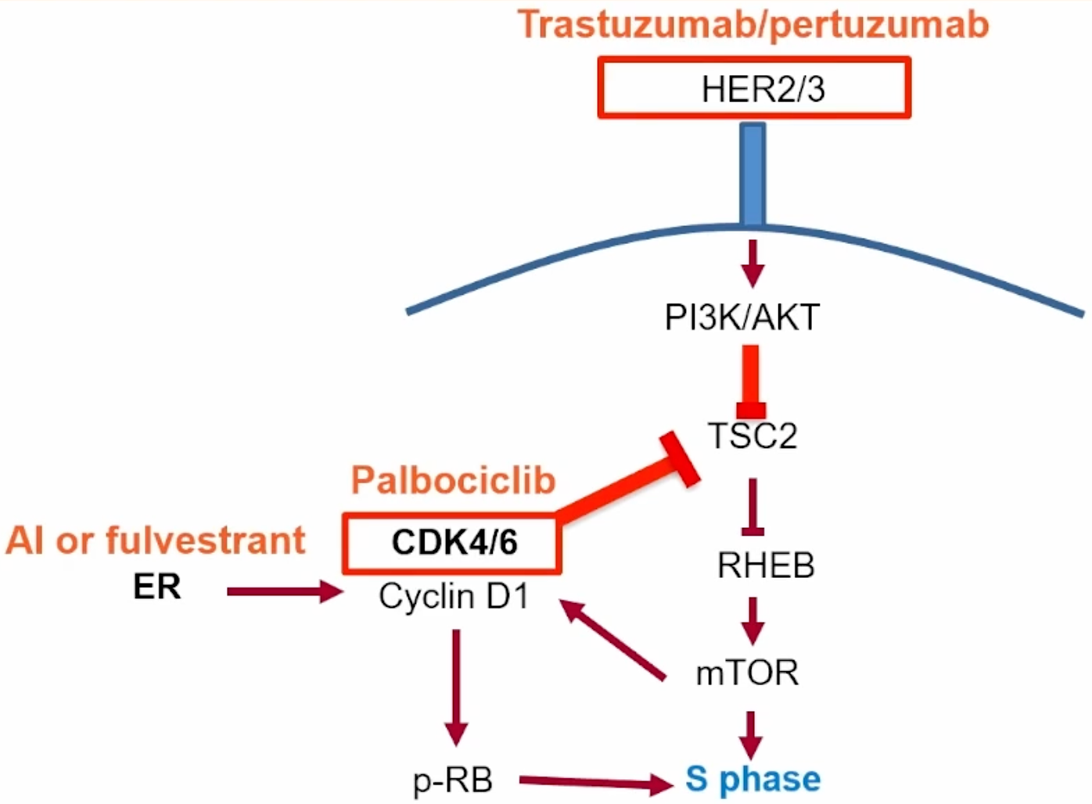
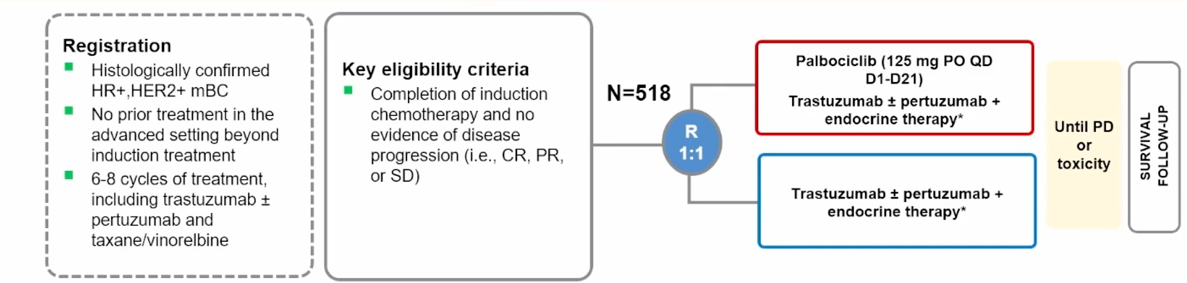
Triple-positive; PATINA
Metzger O, et al. SABCS 2024. Abstract GS02-12

Slide 40
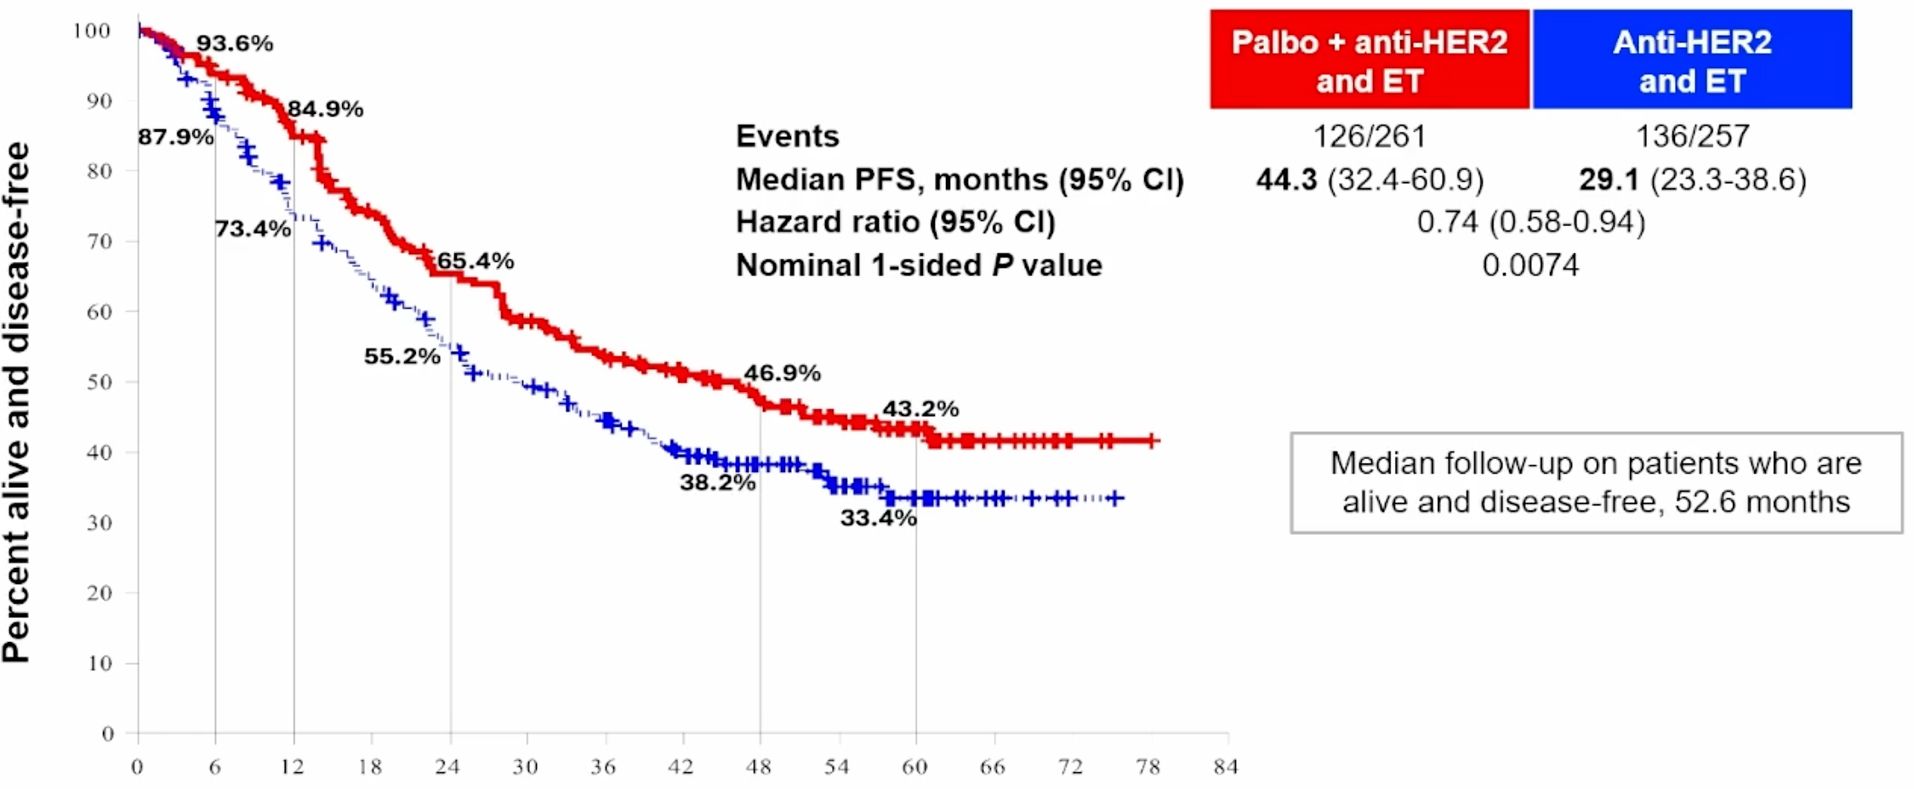
Triple-positive; PATINA
~ 4 years!
Oral + sc anti-Her2 = OPD
Metzger O, et al. SABCS 2024. Abstract GS02-12

Slide 41
PATINA (Phase 3): Efficacy of palbociclib + anti-HER2 therapy + ET, treatment response and OS
Confirmed ORRª
Secondary endpoint: OS (interim analysis)
P=0.046
ORR (%)
100
90
80
n=257
n=261
70
Anti-HER2 + ET
Palbociclib + anti-HER2 + ET
60
 | Palbo + anti-HER2 + ET | Anti-HER2 + ET
Events, n/N | 58/261 | 61/257
Median OS, months (95% CI) | NE (71.6, NE) | 77 (72, NE)
3-year OS, % (95% CI) | 87.0 (82.8, 91.2) | 84.7 (80, 89.3)
5-year OS, % (95% CI) | 74.3 (67.7, 80.9) | 69.8 (62.4, 77.2)
HR (95% CI) | 0.86 (0.6, 1.24)
OS (%)
50
Clinical benefit rate^{b}
P=0.01
40
30
20
CBR (%)
10
0
0
6
12
18
24
30
36
42
48
54
60
66
72
78
84
n=257
n=261
Time (months)
Anti-HER2 + ET
Palbociclib + anti-HER2 + ET
Metzger O, et al. SABCS 2024. Abstract GS02-12

Slide 42



More to come in Breast Cancer in 2025 ...

