Slide 1
Year in Review:
Management of Breast Cancer
A CME/MOC-Accredited Live Webinar
Tuesday, May 6, 2025​​
5:00 PM – 6:00 PM ET
Faculty
Ian E Krop, MD, PhD
Sara M Tolaney, MD, MPH
Moderator
Neil Love, MD

Slide 2



Faculty
Ian E Krop, MD, PhD
Professor of Internal Medicine
Associate Cancer Center Director for Clinical Research
Yale Cancer Center
New Haven, Connecticut
MODERATOR
Neil Love, MD
Research To Practice
Miami, Florida
Sara M Tolaney, MD, MPH
Chief, Division of Breast Oncology
Dana-Farber Cancer Institute
Associate Professor of Medicine
Harvard Medical School
Boston, Massachusetts

Slide 3
Commercial Support
This activity is supported by educational grants from AstraZeneca Pharmaceuticals LP, Daiichi Sankyo Inc, Genentech, a member of the Roche Group, Lilly, Novartis, and Puma Biotechnology Inc.
Research To Practice CME Planning Committee Members,
Staff and Reviewers
Planners, scientific staff and independent reviewers for Research To Practice have no relevant conflicts of interest to disclose.

Slide 4
Dr Krop — Disclosures
Advisory Committees | AstraZeneca Pharmaceuticals LP, Bristol Myers Squibb, Daiichi Sankyo Inc, EMD Serono Inc, Genentech, a member of the Roche Group, Lilly, Seagen Inc
Consulting Agreements | ALX Oncology, AstraZeneca Pharmaceuticals LP, Genentech, a member of the Roche Group, Halda Therapeutics, Novartis
Contracted Research | Pfizer Inc
Data and Safety Monitoring Boards/Committees | Novartis, Seagen Inc

Slide 5
Dr Tolaney — Disclosures
Consulting Agreements | Aadi Bioscience, Ambrx, Artios Pharma Limited, Arvinas, AstraZeneca Pharmaceuticals LP, Bayer HealthCare Pharmaceuticals, BeiGene Ltd, Bicycle Therapeutics, BioNTech SE, Blueprint Medicines, Bristol Myers Squibb, Circle Pharma, Cullinan Therapeutics, Daiichi Sankyo Inc, eFFECTOR Therapeutics Inc, Eisai Inc, Genentech, a member of the Roche Group, Gilead Sciences Inc, Hengrui Therapeutics Inc, Jazz Pharmaceuticals Inc, Johnson & Johnson Pharmaceuticals, Launch Therapeutics, Lilly, Menarini Group, Merck, Mersana Therapeutics Inc, Natera Inc, Novartis, Pfizer Inc, Reveal Genomics, Seagen Inc, Stemline Therapeutics Inc, Sumitovant Biopharma, Summit Therapeutics, SystImmune Inc, Tango Therapeutics, Zuellig Pharma
Contracted Research (All to Institution) | AstraZeneca Pharmaceuticals LP, Bristol Myers Squibb, Daiichi Sankyo Inc, Exelixis Inc, Genentech, a member of the Roche Group, Gilead Sciences Inc, Jazz Pharmaceuticals Inc, Lilly, Menarini Group, Merck, NanoString Technologies, Novartis, OncoPep, Pfizer Inc, Seagen Inc, Stemline Therapeutics Inc
Travel Support | Arvinas, Gilead Sciences Inc, Jazz Pharmaceuticals Inc, Lilly, Pfizer Inc

Slide 6
This educational activity contains discussion of
non-FDA-approved uses of agents and regimens. Please refer to official prescribing information for each product for approved indications.

Slide 7
AGENDA
Year in Review: Management of Breast Cancer
INTRODUCTION: Adjuvant CDK4/6 Inhibition
MODULE 1: HER2-Positive Disease
MODULE 2: PARP Inhibition
MODULE 3: Antibody-Drug Conjugates
MODULE 4: Up-Front Treatment of HR-Positive Metastatic Disease

Slide 8
AGENDA
Year in Review: Management of Breast Cancer
INTRODUCTION: Adjuvant CDK4/6 Inhibition
MODULE 1: HER2-Positive Disease
MODULE 2: PARP Inhibition
MODULE 3: Antibody-Drug Conjugates
MODULE 4: Up-Front Treatment of HR-Positive Metastatic Disease

Slide 9

J Clin Oncol 2025 April 14;[Online ahead of print].

Slide 10
AGENDA
Year in Review: Management of Breast Cancer
INTRODUCTION: Adjuvant CDK4/6 Inhibition
MODULE 1: HER2-Positive Disease
MODULE 2: PARP Inhibition
MODULE 3: Antibody-Drug Conjugates
MODULE 4: Up-Front Treatment of HR-Positive Metastatic Disease

Slide 11
Meet The Professor
Optimizing the Selection and Sequencing of Therapy for Patients with
HER2-Positive Breast Cancer
Sara M Tolaney, MD, MPH
Associate Director, Susan F Smith Center for Women’s Cancers
Director of Clinical Trials, Breast Oncology
Director of Breast Immunotherapy Clinical Research
Senior Physician
Breast Oncology Program
Dana-Farber Cancer Institute
Associate Professor of Medicine
Harvard Medical School
Boston, Massachusetts

Slide 12
Trastuzumab Deruxtecan Significantly Improved Progression-Free Survival in Comparison to T-DM1 for HER2-Positive Metastatic Breast Cancer
Press Release – August 9, 2021
“Trastuzumab deruxtecan demonstrated superior progression-free survival (PFS) outcomes over trastuzumab emtansine (T-DM1) in patients with HER2-positive metastatic breast cancer, based on the phase 3 DESTINY-Breast03 trial (NCT03529110). The study’s planned interim analysis identified a statistically significant and clinically meaningful improvement in the primary end point of PFS as assessed by an Independent Data Monitoring Committee (IDMC) for patients with HER2-positive, unresectable and/or metastatic breast cancer who received prior treatment with trastuzumab and a taxane.
Approximately 500 patients were enrolled in the DESTINY-Breast03 trial, who were randomized to either the experimental trastuzumab deruxtecan arm or the comparator T-DM1 arm. The primary end point was PFS assessed by IDMC, with secondary end points including overall survival (OS), objective response rate (ORR), duration of response, and PFS based on investigator assessment.
While patients treated with trastuzumab deruxtecan trended toward OS improvement, the data were immature. Furthermore, the safety profile was consistent with previously reported data regarding trastuzumab deruxtecan, with no new safety signals or grade 4/5 treatment-related interstitial lung disease events observed.”
https://www.cancernetwork.com/view/trastuzumab-deruxtecan-significantly-improved-pfs-over-tdm-1-for-her2-metastatic-breast-cancer

Slide 13


Slide 14
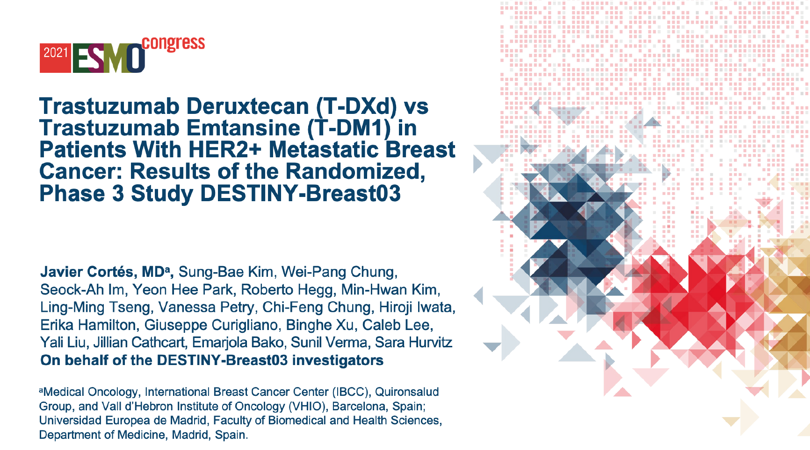
Abstract LBA1

Slide 15
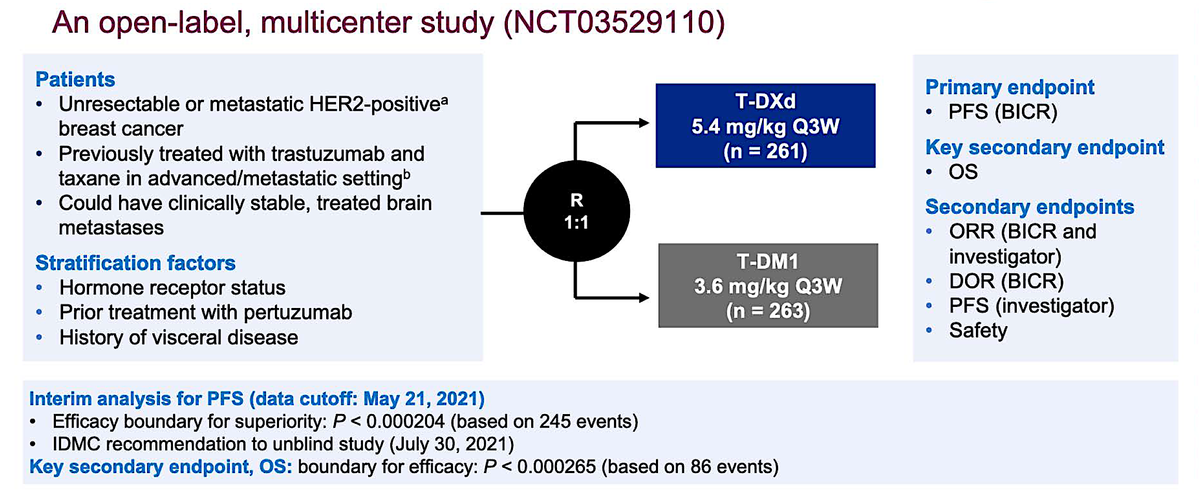
DESTINY-Breast03 Phase III Trial Schema
Cortés J et al. ESMO 2021;Abstract LBA1.

Slide 16
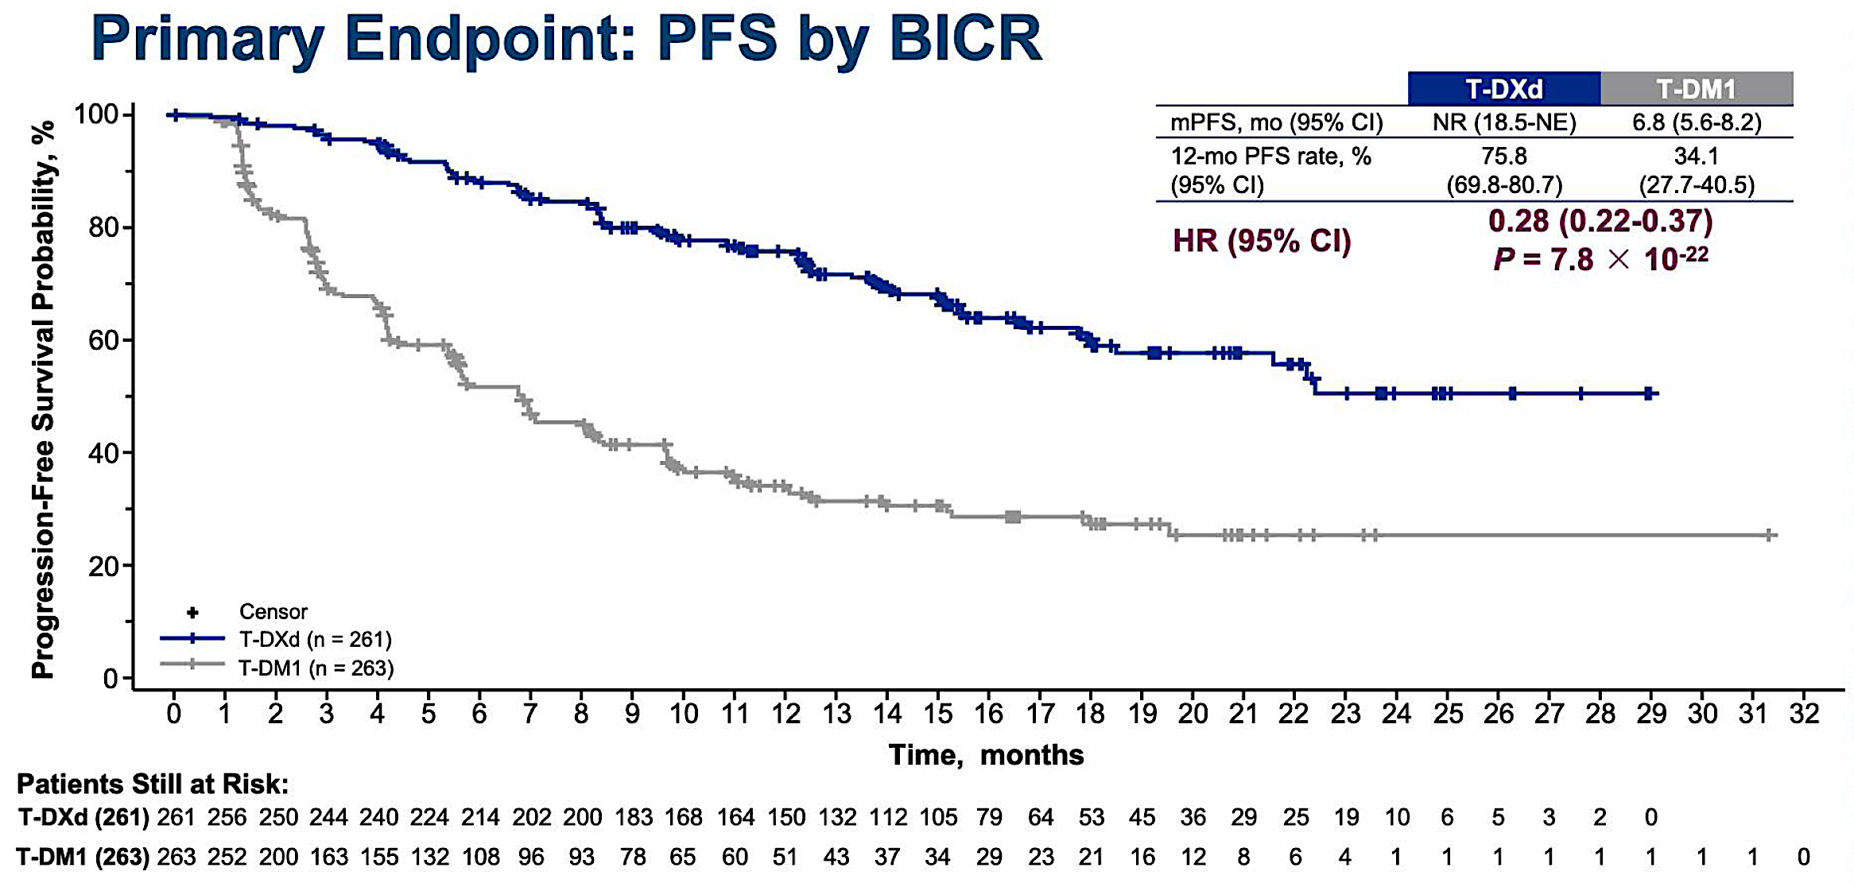
DESTINY-Breast03: PFS by Blinded Independent Central Review (BICR)
Cortés J et al. ESMO 2021;Abstract LBA1.

Slide 17
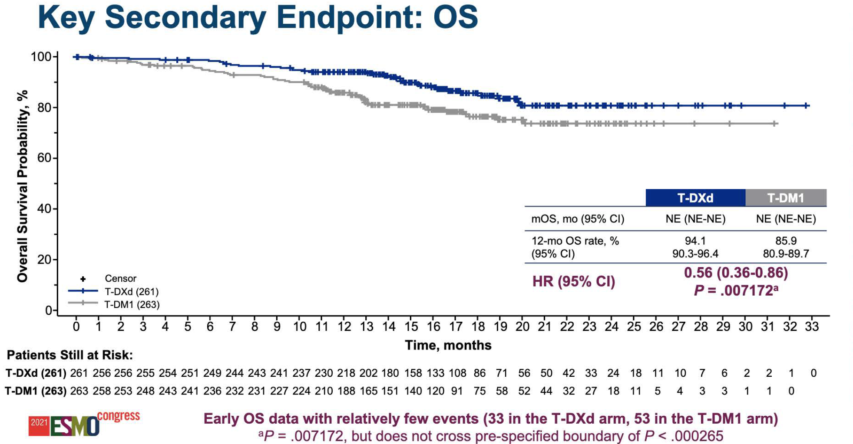
DESTINY-Breast03: Overall Survival (OS) by BICR
Cortés J et al. ESMO 2021;Abstract LBA1.

Slide 18
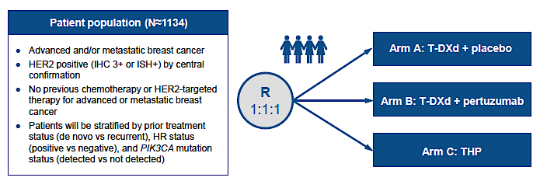
DESTINY-Breast09 Phase III Trial Design
Tolaney SM et al. San Antonio Breast Cancer Symposium 2021;Abstract OT1-14-02.

Slide 19
Trastuzumab Deruxtecan with Pertuzumab Demonstrated Highly Statistically Significant and Clinically Meaningful Improvement in PFS in Comparison to THP as First-Line Therapy for Patients with HER2-Positive Metastatic Breast Cancer
Press Release: April 21, 2025
“Positive high-level results from a planned interim analysis of the DESTINY-Breast09 Phase III trial showed trastuzumab deruxtecan in combination with pertuzumab demonstrated a highly statistically significant and clinically meaningful improvement in progression-free survival (PFS) compared to a taxane, trastuzumab and pertuzumab (THP) as a 1st-line treatment for patients with HER2-positive metastatic breast cancer.
The PFS improvement was seen across all pre-specified patient subgroups with trastuzumab deruxtecan in combination with pertuzumab. The key secondary endpoint of overall survival (OS) was not mature at the time of this planned interim analysis; however, interim OS data showed an early trend favoring the trastuzumab deruxtecan combination compared with THP. The second arm assessing trastuzumab deruxtecan monotherapy versus THP remains blinded to patients and investigators and will continue to the final PFS analysis.”
https://www.astrazeneca.com/media-centre/press-releases/2025/enhertu-combination-improved-pfs-in-1l-her-positive-mbc.html

Slide 20
Trastuzumab Deruxtecan (T-DXd) + Pertuzumab (P) vs Taxane + Trastuzumab + Pertuzumab (THP) for First-Line (1L) Treatment of Patients (pts) with Human Epidermal Growth Factor Receptor 2-Positive (HER2+) Advanced/Metastatic Breast Cancer (a/mBC): Interim Results from DESTINY-Breast09
Tolaney S et al.
ASCO 2025;Abstract LBA1008.
MONDAY, JUNE 2| 7:30 AM CDT

Slide 21
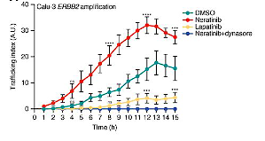
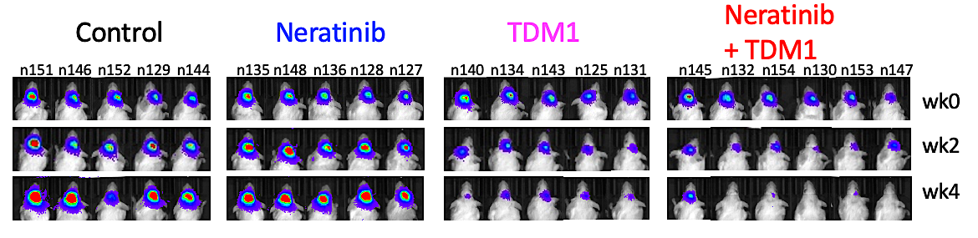
TBCRC 022: T-DM1 + Neratinib for HER+ Brain Mets
Rationale for the Combination
Neratinib
+ T-DM1
T-DM1
PDX model of HER2+ breast cancer brain mets
Deeper and more durable responses with the combination
Neratinib increases HER2 trafficking
and may overcome T-DM1 resistance
Freedman RA et al. Ann Oncol 2024;35(11):993-1002.
Li et al, Cancer Discov 2020
Courtesy of Nancy U Lin, MD

Slide 22
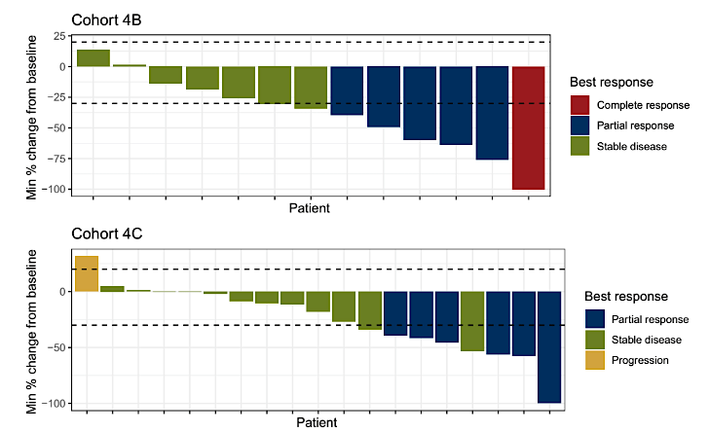
TBCRC 022: T-DM1 + neratinib for HER+ Brain Mets
Progressing after prior local tx
No prior T-DM1
CNS ORR 35.3%
Median PFS 4.1 mo
Median OS 23.3 mo
12 mo OS 87%
Progressing after prior local tx
Prior T-DM1 exposure
CNS ORR 28.6%
Median PFS 4.1 mo
Median OS 20.9 mo
12 mo OS 80%
Freedman RA et al. Ann Oncol 2024;35(11):993-1002.
Courtesy of Nancy U Lin, MD

Slide 23
TBCRC 022: Conclusions and Thoughts
Even with the advent of T-DXd and tucatinib, there is a substantial need for multiple lines of systemic therapy for patients with active brain metastases
CNS ORR to T-DM1 + neratinib exceeds that of neratinib monotherapy (CNS ORR 8%)
CNS responses are seen in about 1/3 of patients with prior T-DM1 exposure
Limitations: no patients had received prior tucatinib, and only a few had prior T-DXd
Await more granular CNS data from HER2CLIMB-02
Provides another systemic option for patients with HER2+ BM
Courtesy of Nancy U Lin, MD

Slide 24
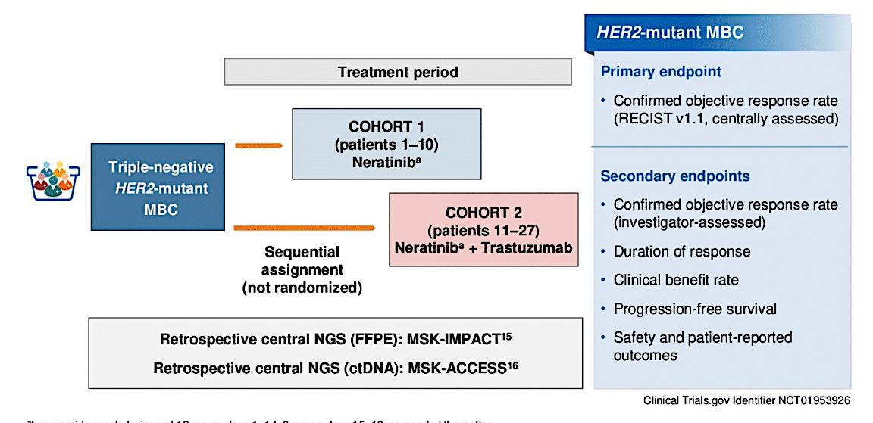
SUMMIT Trial: HER2-mutant TNBC treated with Neratinib or Neratinib + Trastuzumab
Cohort 1
Neratinib
N=10
Median 2.5 prior lines
Cohort 2
Neratinib + trastuzumab
N=17
Median 2 prior lines
Courtesy of Nancy U Lin, MD
Jhaveri K et al. ASCO 2024;Abstract 1094.

Slide 25
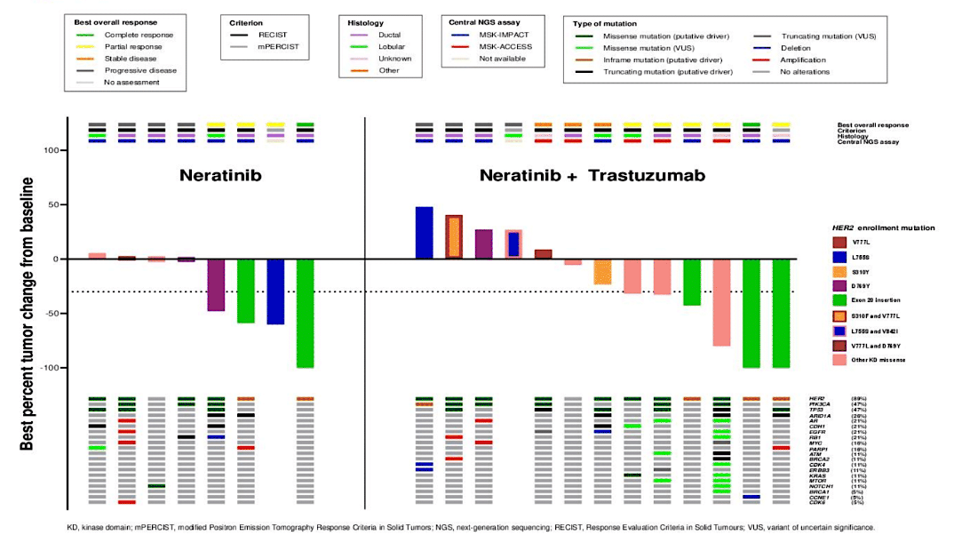
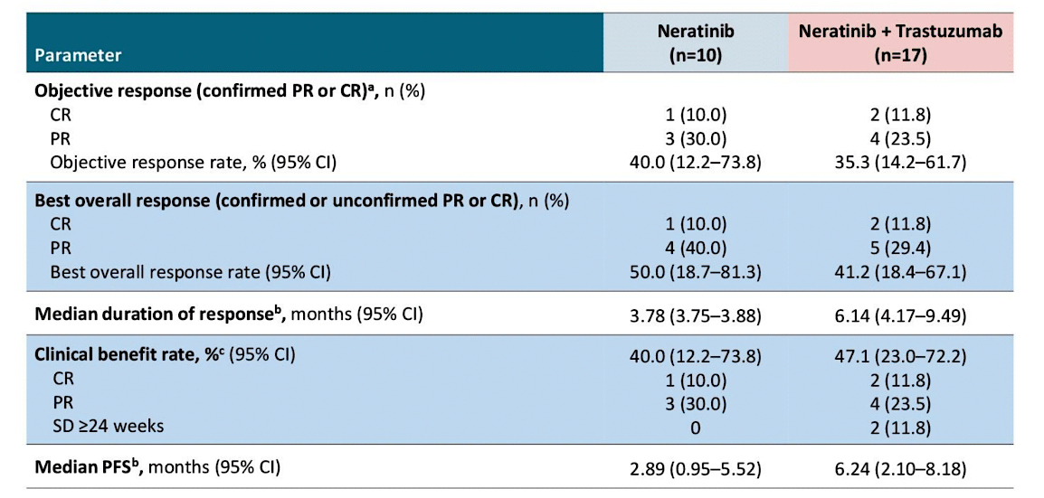
SUMMIT Trial: HER2-mutant TNBC treated with Neratinib or Neratinib + Trastuzumab
Confirmed ORR 40% (N), 35.3% (N+T)
Median PFS 2.89 mo (N), 6.24 mo (N+T)
Deepest responses in those with Exon 20 insertions
Jhaveri K et al. ASCO 2024;Abstract 1094.
Courtesy of Nancy U Lin, MD

Slide 26
SUMMIT Trial TNBC basket:
Conclusions and Thoughts
Impressive response rates (40%) in pre-treated HER2-mut TNBC
Longer DoR and PFS with the doublet of N+T
Small numbers but compares favorably to “nth-line” chemo in TNBC
Previously published data in HR+/HER2-mut MBC
  ORR 38.6%, median PFS 8.3 months with neratinib + fulvestrant + trastuzumab
New data for tucatinib + trastuzumab in HER2-mut MBC
  Confirmed ORR 41.9%; median PFS 9.5 months
  Pts with HR+ disease also received fulvestrant
  Only 4 pts with TNBC included
Jhaveri K et al. ASCO 2024;Abstract 1094.
Jhaveri et al, Ann Oncol 2023
Okines et al, Nat Med 2025
Courtesy of Nancy U Lin, MD

Slide 27
2018 and 2024 Surveys of Clinical Investigator (CI) Use of Postoperative Systemic Therapy After
Prior Neoadjuvant Treatment of HER2-Positive Breast Cancer (HER2+ BC)
Wallace T et al.
SABCS 2024;Abstract P3-11-20.

Slide 28
Survey Participants
Virginia F Borges, MD, MMSc
Adam M Brufsky, MD, PhD
Harold J Burstein, MD, PhD
Karen A Gelmon, MD
Matthew P Goetz, MD
Virginia Kaklamani, MD, DSc
Kevin Kalinsky, MD, MS
Ian E Krop, MD, PhD
Erica Mayer, MD, MPH, FASCO
Jane Lowe Meisel, MD
Kathy D Miller, MD
Ruth O’Regan, MD
Joyce O’Shaughnessy, MD
Lajos Pusztai, MD, DPhil, FASCO
Mark E Robson, MD
Hope S Rugo, MD
Priyanka Sharma, MD
Laura Spring, MD
Sara M Tolaney, MD, MPH
Seth Wander, MD, PhD

Slide 29






HER2-positive, ER-positive
Neoadjuvant TCHP
Minimal residual disease at surgery
What adjuvant anti-HER2 treatment would you most likely recommend in the following scenario?
2018
Trastuzumab
8
Trastuzumab/pertuzumab
15
Trastuzumab/pertuzumab followed by neratinib
5
Survey of 28 US-based clinical investigators November 2018
2024
T-DM1
11
T-DM1 followed by neratinib
8
T-DM1 + endocrine therapy
1
Wallace T et al. SABCS 2024;Abstract P3-11-20.
Survey of 20 US-based clinical investigators April-May 2024

Slide 30

HER2-positive, ER-positive
Neoadjuvant TCHP
Macroscopic residual disease at surgery
What adjuvant anti-HER2 treatment would you most likely recommend in the following scenario?
2018
Trastuzumab/pertuzumab
8
16
Trastuzumab/pertuzumab followed by neratinib
Trastuzumab followed
by neratinib
4
Survey of 28 US-based clinical investigators November 2018
2024
T-DM1
4
T-DM1 followed by neratinib
15
T-DM1 + endocrine therapy
1
Wallace T et al. SABCS 2024;Abstract P3-11-20.
Survey of 20 US-based clinical investigators April-May 2024

Slide 31
ASCO 2025:
HER2-Positive Breast Cancer

Slide 32
Phase IB and II Study of Ribociclib with Trastuzumab plus Endocrine Therapy in HR+/HER2+ Advanced Breast Cancer Patients: Korean Cancer Study Group BR 18-2 MINI Trial
Sohn J et al.
ASCO 2025;Abstract 1016.
FRIDAY, MAY 30| 3:15 PM CDT

Slide 33
Treatment Rechallenge After Trastuzumab-Deruxtecan-Related Interstitial Lung Disease: A Multi-Institution Cohort Study
Rugo H et al.
ASCO 2025;Abstract 1015.
FRIDAY, MAY 30| 2:57 PM CDT

Slide 34
AGENDA
Year in Review: Management of Breast Cancer
INTRODUCTION: Adjuvant CDK4/6 Inhibition
MODULE 1: HER2-Positive Disease
MODULE 2: PARP Inhibition
MODULE 3: Antibody-Drug Conjugates
MODULE 4: Up-Front Treatment of HR-Positive Metastatic Disease

Slide 35
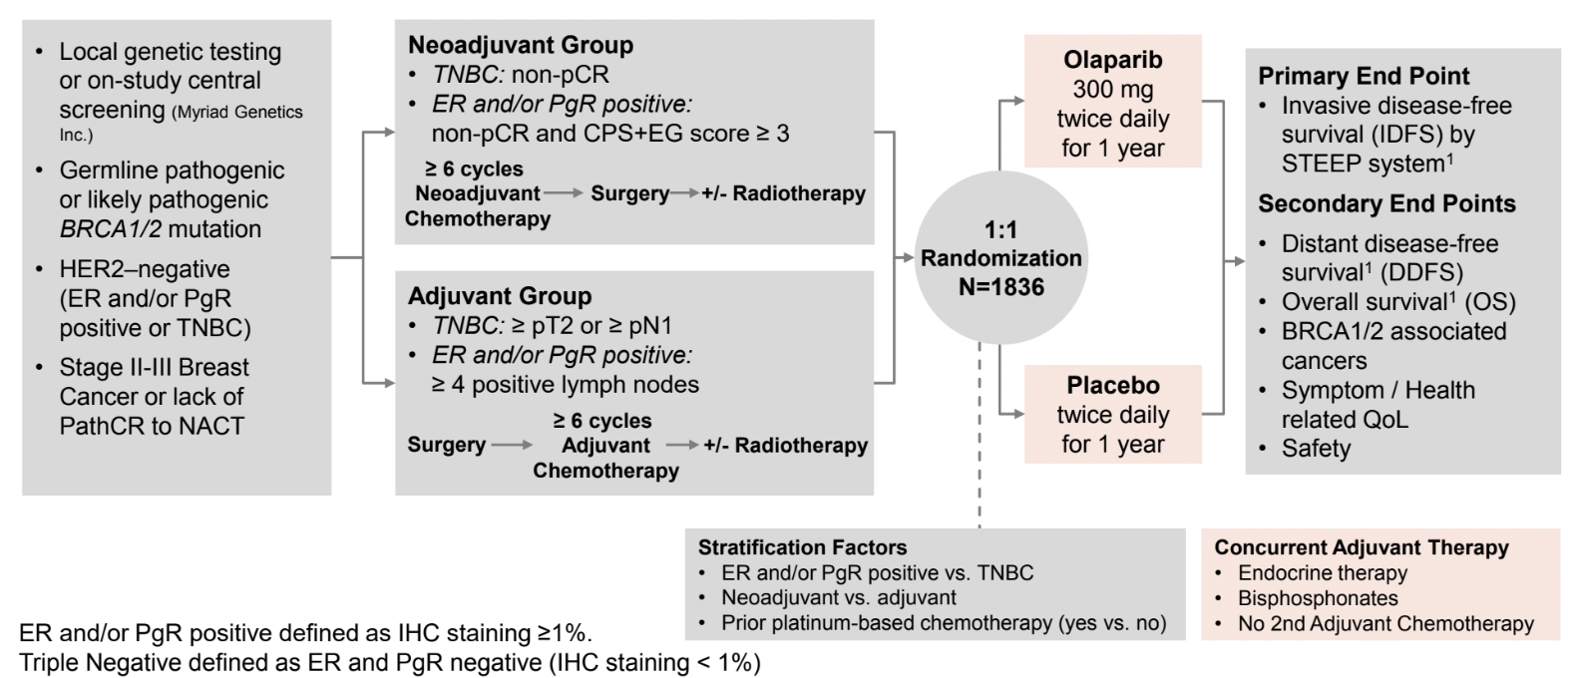
OlympiA: Adjuvant Olaparib in gBRCA1/2 carriers
>70% enrolled pts were gBRCA1
>80% had TNBC
~50% adjuvant
~50% post neoadjuvant
Third pre-specified analysis at 10 years from first patient in
Median follow up of 6.1 years (additional 2.6 y f/u since previous)
Garber J et al. SABCS 2024;Abstract GS1-09.
Courtesy of Nancy U Lin, MD

Slide 36
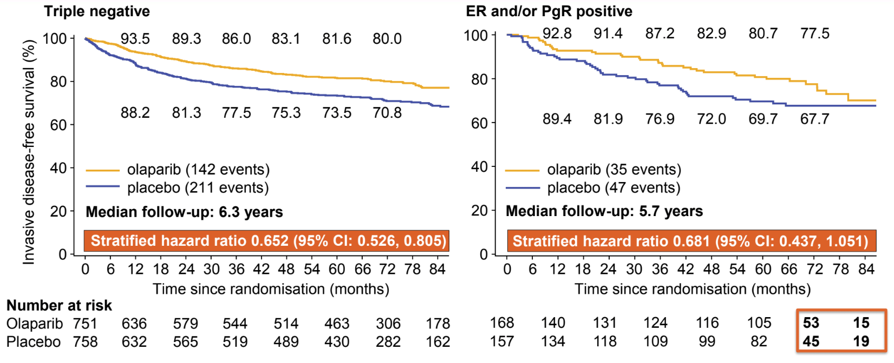
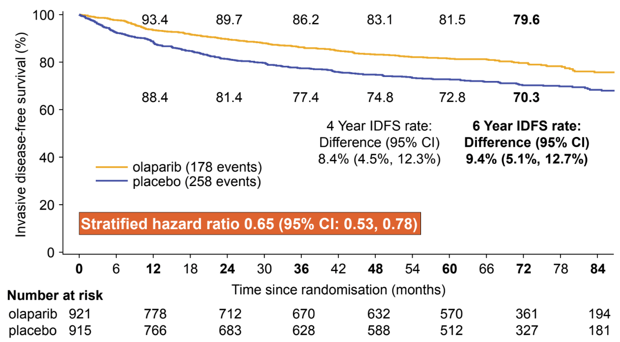
OlympiA: iDFS
ITT Population
Similar magnitude of benefit for DDFS
Similar rates of MDS/AML (4 events (0.4%) for Olaparib; 6 events (0.7%) in placebo arm)
Numerically fewer CNS events as 1st iDFS event (2.8% vs 4.4%)
Fewer new primary cancers with olaparib (contralateral breast cancer, new primary ovarian/fallopian tube cancer)
Garber J et al. SABCS 2024;Abstract GS1-09.
Courtesy of Nancy U Lin, MD

Slide 37
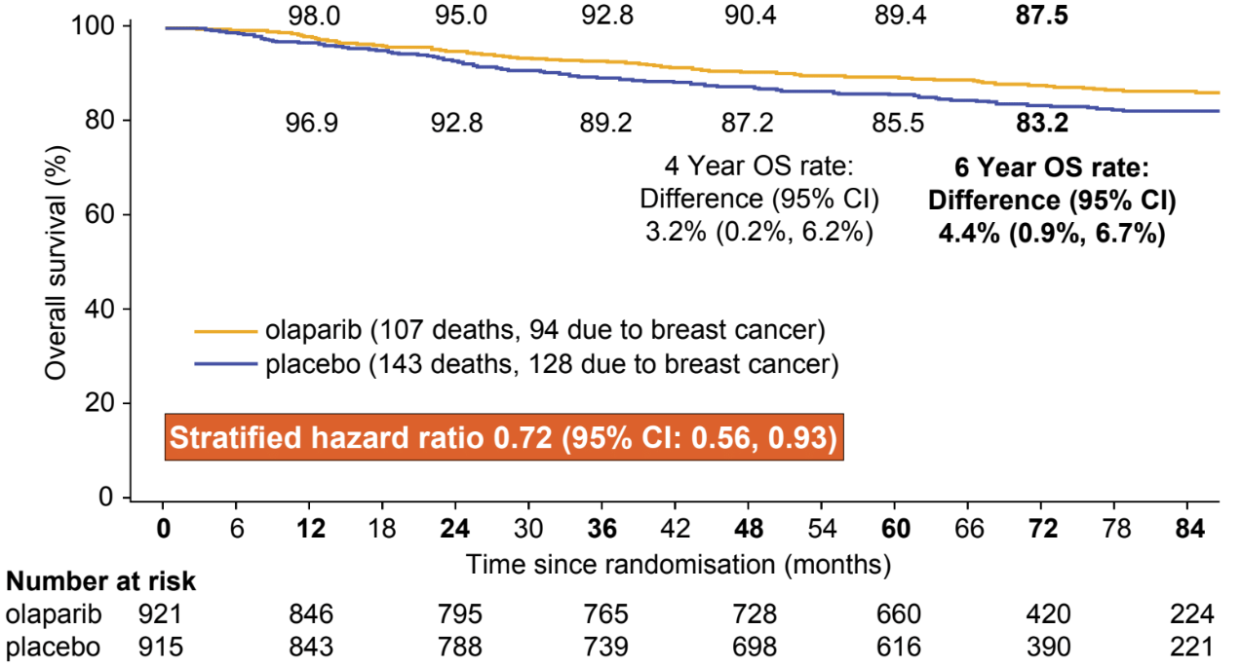
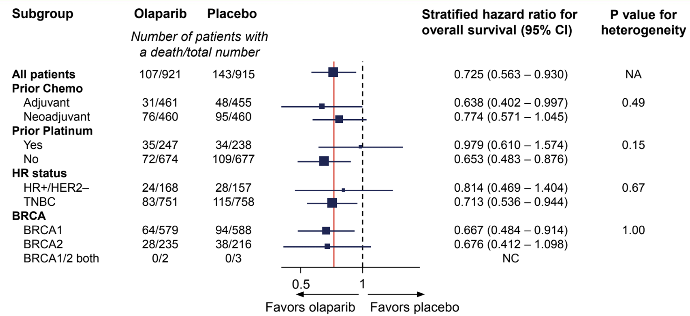
OlympiA: OS
ITT Population
Garber J et al. SABCS 2024;Abstract GS1-09.
Courtesy of Nancy U Lin, MD

Slide 38
OlympiA: Conclusions and Thoughts
Significant benefit in iDFS (HR 0.65), DDFS, and OS (HR 0.72) with adjuvant Olaparib
Effect seen in both HR+ and TN patients and in BRCA1 or BRCA2 carriers
No signal of increase in MDS/AML at 6.1 y median f/u
All patients who meet anatomic eligibility criteria for Olaparib (with drug access) should be offered germline genetic testing
TNBC: Cape vs Olaparib post NAC?
  No direct comparison
  CREATE-X OS HR 0.52, 8% absolute gain
  GEICAM (adjuvant cape) suggested more benefit of capecitabine in non-basal subtypes
  OlympiAD – Olaparib outperformed chemo of provider choice (~1/2 capecitabine) in MBC setting
ER+: Abema or Ribo vs Olaparib?
  No direct comparison
  MONARCHE @ 54 mo median f/u, HR 0.68 for iDFS (7.6% absolute gain); no statistically significant OS benefit
  NATALEE @ 34 mo median f/u, HR 0.75 for iDFS (3% gain at 3y); no difference yet in OS
  For 4+ positive nodes, generally prefer Olaparib (or a sequence of ola -> CDK4/6i in very high-risk patients)
  For 1-3 positive nodes (OlympiA did not include if adjuvant only), could consider CDK4/6i but lean towards olaparib: shorter duration of therapy and OS benefit already demonstrated
  For node negative disease, olaparib has not been studied, and would consider ribo in carefully selected patients who would have met eligibility for NATALEE
Courtesy of Nancy U Lin, MD

Slide 39
“Beyond the Guidelines” Questions
What would be your most likely adjuvant treatment approach for a patient with an ER-positive, HER2-negative 1.8-cm IDC,
3 positive nodes and a germline BRCA mutation?
How, if at all, would you integrate a PARP inhibitor into current or future treatment?

Slide 40
“Beyond the Guidelines” Questions
What would be your most likely adjuvant treatment approach for a patient with a 1.8-cm ER/PR-negative, HER2-negative, node-negative IDC and a germline BRCA mutation?
How, if at all, would you integrate a PARP inhibitor into current or future treatment?

Slide 41
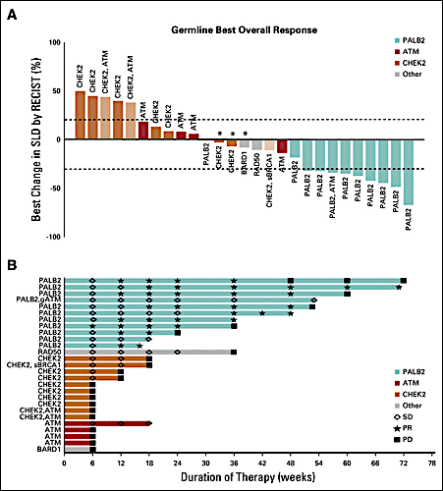
TBCRC 048: Olaparib Expanded Initial Cohort
Gene | ORR (90% CI)
gPALB2 (n=11) | 82% (48-98%)
sBRCA (n=16) | 50% (25-75%)
ATM, CHEK2 (n=18) | 0%
Tung NM et al. J Clin Oncol 2020
Courtesy of Nancy U Lin, MD

Slide 42
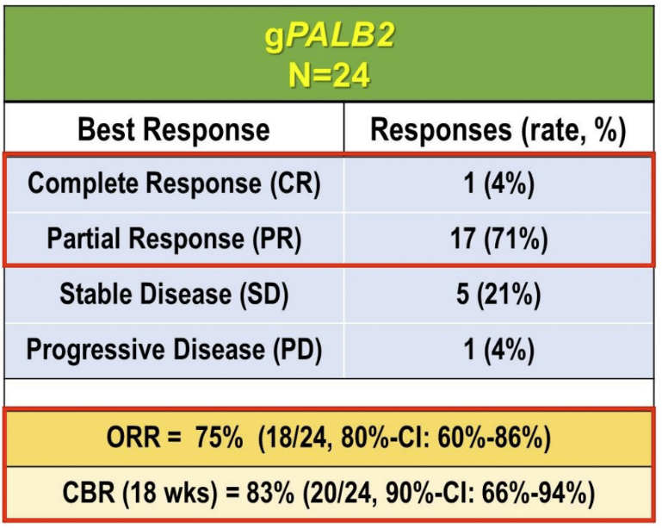
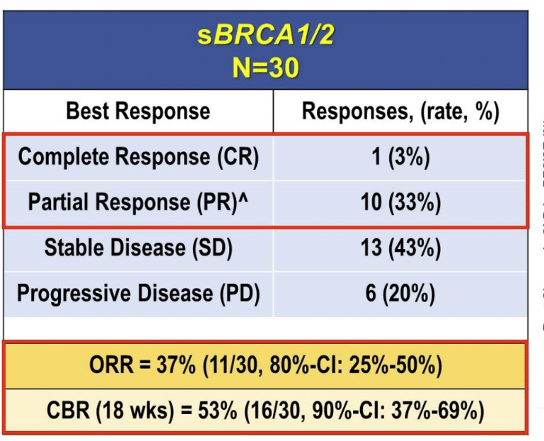
TBCRC 048: Olaparib Expanded Expansion Cohorts
Median PFS 9.6 months
Median PFS 7.2 months
Key Eligibility: 0-2 prior chemo for MBC
Key exclusion: prior PARP, progression on platinum
Tung NM et al. ASCO 2024;Abstract 1021.
Courtesy of Nancy U Lin, MD

Slide 43
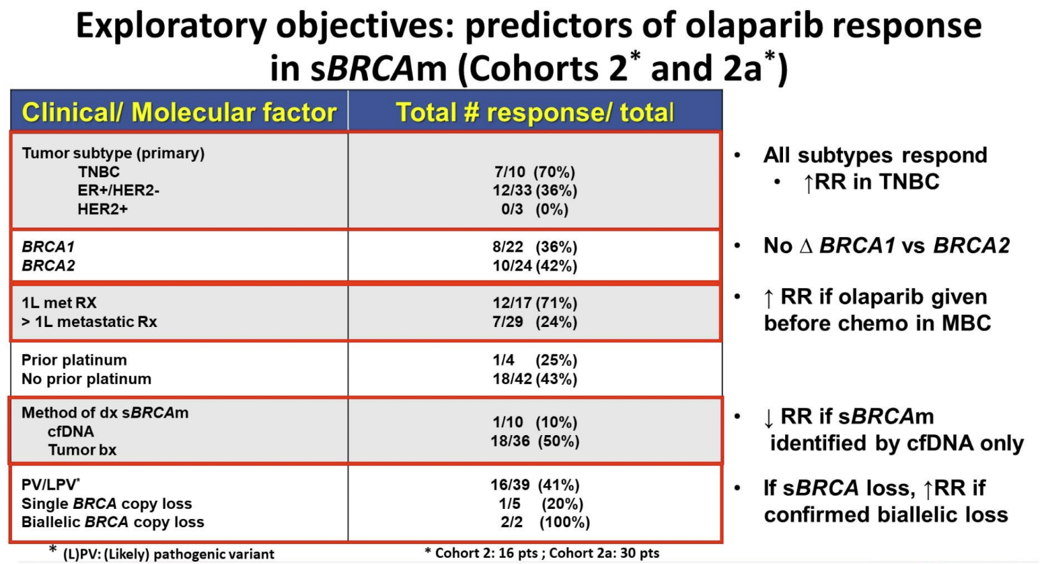
TBCRC 048: Olaparib Expanded Expansion Cohorts
Tung NM et al. ASCO 2024;Abstract 1021.
Courtesy of Nancy U Lin, MD

Slide 44
TBCRC 048: Conclusions and Thoughts
Confirms very high response rates and durability of benefit in gPALB2 carriers
Activity in sBRCA numerically less than in initial cohort but still respectable (37%, median PFS 7.2 mo)
Estimates of frequency of sBRCA in primary tumors ~3-4%
Frequency in MBC esp in later lines is not well-described
Sufficient activity to consider on a routine basis and to justify:
  Routine germline testing in MBC patients
  NGS testing to identify somatic alterations
Courtesy of Nancy U Lin, MD

Slide 45
“Beyond the Guidelines” Questions
A 65-year-old woman presents with de novo HR-positive, HER2-negative (IHC 0) metastatic breast cancer (mBC) with a germline BRCA1 mutation. Biomarker evaluation is negative for ESR1 mutations and PIK3CA/AKT1/PTEN alterations. Regulatory and reimbursement issues aside, what would be your most likely treatment?
How, if at all, would you integrate a PARP inhibitor into current or future treatment?

Slide 46
“Beyond the Guidelines” Questions
A 65-year-old woman presents with de novo HR-positive, HER2-low (IHC 1+) mBC with a germline BRCA1 mutation. Biomarker evaluation is negative for ESR1 mutations and PIK3CA/AKT1/PTEN alterations. Regulatory and reimbursement issues aside, what would be your most likely treatment?
How, if at all, would you integrate a PARP inhibitor into current or future treatment?

Slide 47
“Beyond the Guidelines” Questions
A 65-year-old woman presents with de novo HR-negative, HER2-negative (IHC 0) PD-L1-positive mBC with a germline BRCA1 mutation. Regulatory and reimbursement issues aside, what would be your most likely treatment?
How, if at all, would you integrate a PARP inhibitor into current or future treatment?

Slide 48
“Beyond the Guidelines” Questions
A 65-year-old woman presents with de novo HR-negative, HER2-negative (IHC 0) PD-L1-negative mBC with a germline BRCA1 mutation. Regulatory and reimbursement issues aside, what would be your most likely treatment?
How, if at all, would you integrate a PARP inhibitor into current or future treatment?

Slide 49
ASCO 2025:
PARP Inhibitors; BRCA-Positive Disease

Slide 50
Prospective Randomized Phase II Trial to Assess the Efficacy and Safety of Neo-Adjuvant Olaparib/Carboplatin (OC) in Comparison to Docetaxel/Epirubicin/Cyclophosphamide (TAC) in Patients with Early Triple-Negative Breast Cancer (TNBC) with Homologous Recombination Deficiency (HRD): Primary Results from the ABCSG 45 Trial
Singer C et al.
ASCO 2025;Abstract 510.
SUNDAY, JUNE 1| 8:06 AM CDT

Slide 51
Menopausal Hormone Therapy After a Diagnosis of Breast Cancer in Women with a BRCA Pathogenic Variant and Risk of Death
Kotsopoulos J et al.
ASCO 2025;Abstract 10506.
SUNDAY, JUNE 1| 1:30 PM CDT

Slide 52
Video-Based Genetic Counseling to Reduce Physician Workload and Enhance Consulter Understanding: A Prospective Randomized Clinical Trial
Pfeiler G et al.
ASCO 2025;Abstract 1502.
MONDAY, JUNE 2| 3:24 PM CDT

Slide 53
AGENDA
Year in Review: Management of Breast Cancer
INTRODUCTION: Adjuvant CDK4/6 Inhibition
MODULE 1: HER2-Positive Disease
MODULE 2: PARP Inhibition
MODULE 3: Antibody-Drug Conjugates
MODULE 4: Up-Front Treatment of HR-Positive Metastatic Disease

Slide 54
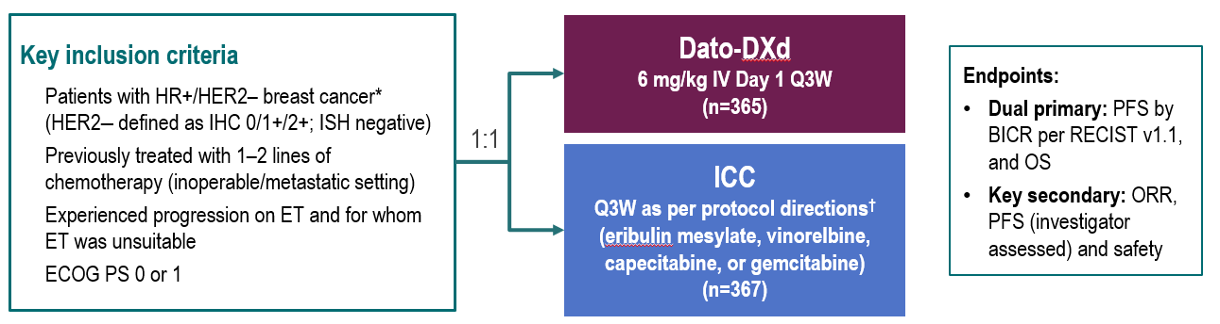
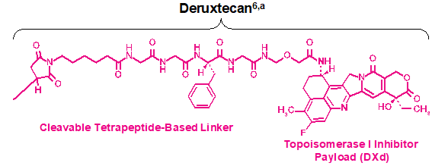
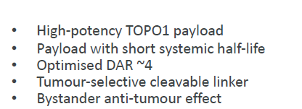
TROPION-Breast01: Ph 3 trial of Dato-DXd in HR+/HER2- MBC
Dato-DXd: Humanised anti-TROP2
monoclonal antibody
TROPION-Breast01 Schema
Courtesy of Rebecca A Dent, MD, MSc
Bardia A et al. ESMO 2023, LBA11

Slide 55
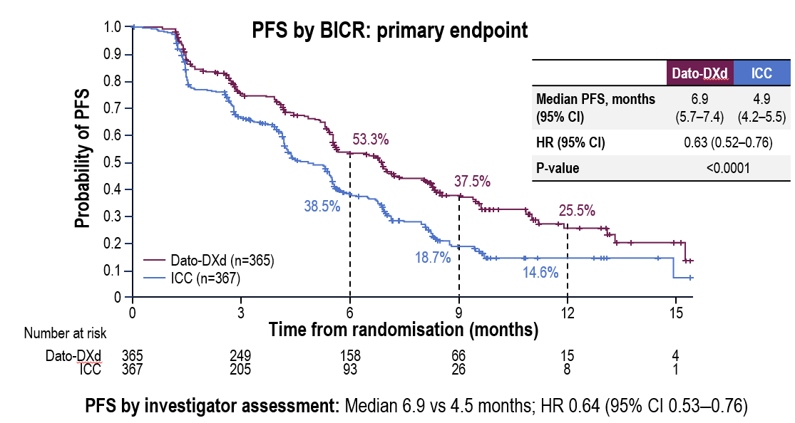
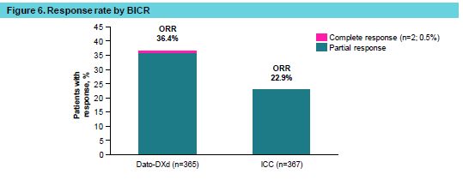
TROPION-Breast01: Efficacy outcomes
Primary EP: PFS by BICR
Response rate by BICR
Overall survival (dual primary endpoint)
OS data were not mature (information fraction 39%): median follow-up 9.7 months.
A trend favoring Dato-DXd was observed: HR 0.84 (95% CI 0.62–1.14).
Courtesy of Rebecca A Dent, MD, MSc
Bardia A et al. ESMO 2023, LBA11; Rugo HS et al. MBCC 2024

Slide 56
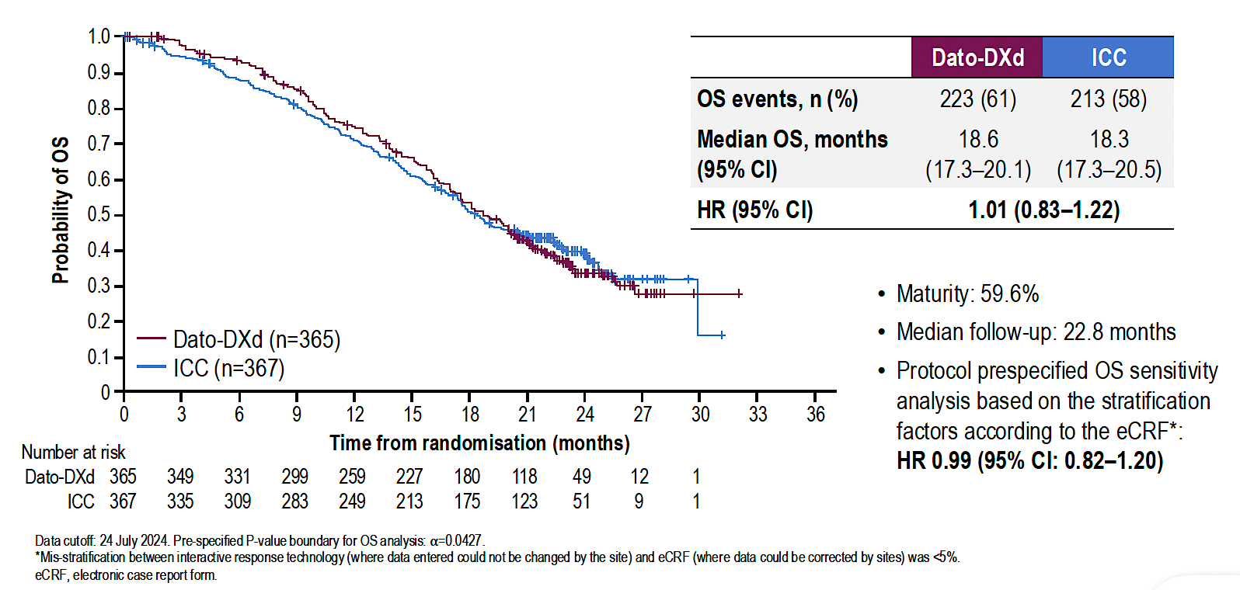
TROPION-Breast01: Final Overall Survival Analysis with Datopotamab Deruxtecan (Dato-DXd) for Previously Treated HR-Positive mBC
Pistilli B et al. ESMO 2024;Abstract VP1-2025.

Slide 57
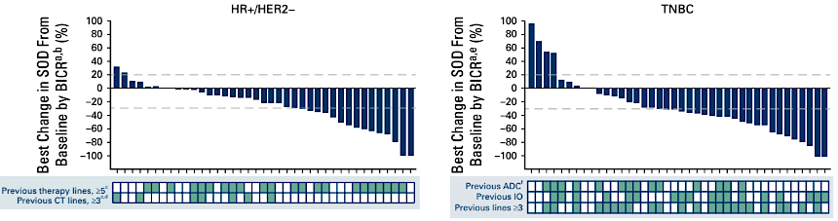
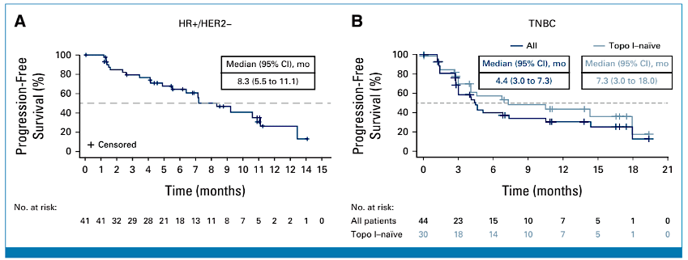
TROPION-PanTumor01: Phase 1 Dato-DXd for HR+ or TN MBC
Courtesy of Nancy U Lin, MD
Bardia A et al. J Clin Oncol 2024;42(19):2281-94.

Slide 58
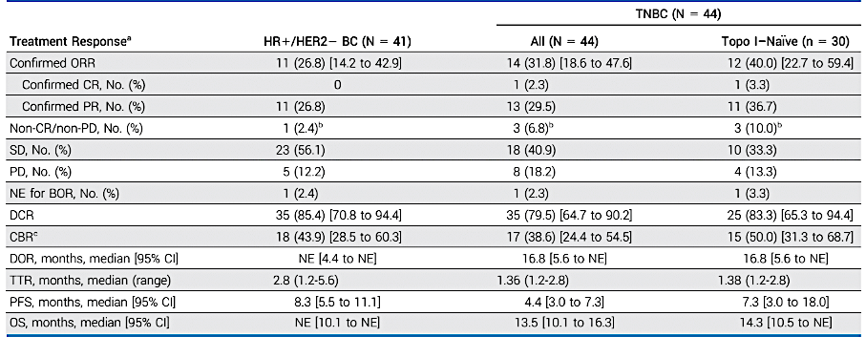
TROPION-PanTumor01: Phase 1 Dato-DXd for HR+ or TN MBC
Bardia A et al. J Clin Oncol 2024;42(19):2281-94.
Courtesy of Nancy U Lin, MD

Slide 59
TROPION-PanTumor01: Where does Dato-DXd fit in?
 | HR+/HER2- MBC
 | DESTINY-Breast06 | DESTINY-Breast04 | TROPION-PanTumor01 | TROPION-Breast01 | TROPiCS-02
Treatment arms | T-DXd vs TPC | T-DXd vs TPC | Dato-DXd | Dato-DXd vs TPC | SG vs TPC
HER2 status | Low or ultralow | Low (1+, 2+/ISH-) | Any HER2-neg | Any HER2-neg | Any HER2-neg
Prior chemo for MBC | 0 | 1-2 | No upper limit* | 1-2 | 2-4
Median PFS HR (95% CI) | 13.2 vs 8.1 mo HR 0.63 (0.53-0.75) | 9.6 vs 4.2 mo HR 0.37 (0.30-0.56) | 8.3 mo | 6.9 vs 4.9 mo HR 0.63 (0.52-0.76) | 5.5 vs 4.9 mo HR 0.65 (0.53-0.81)
Median OS HR (95% CI) | N/A HR 0.81 (0.65-1.00) | 23.9 vs 17.6 mo HR 0.69 (0.55-0.87) | NE | N/A HR 0.84 (0.62-1.14) | 14.5 vs 11.2 mo HR 0.79 (0.65-0.95)
ORR | 57.3% vs 31.2% | 52.6% vs 16.3% | 26.8% | 36.4% vs 22.9% | 21% vs 14%
*median of 5 prior lines for MBC
Slide adapted from Ana Garrido-Castro MD
Courtesy of Nancy U Lin, MD

Slide 60
TROPION-PanTumor01: Where does Dato-DXd fit in?
 | Triple-Negative MBC
 | DESTINY-Breast04 | TROPION-PanTumor01 | TROPION-Breast02 | ASCENT | OptiTROP-Breast01
Treatment arms | T-DXd vs TPC | Dato-DXd | Dato-DXd vs TPC | SG vs TPC | Sac-TMT vs TPC
HER2 status | Low (1+, 2+/ISH-) | Any HER2-neg | Any HER2-neg; Not a candidate for PD1/PDL1 inhibitor | Any HER2-neg | Any HER2-neg
Prior chemo for MBC | 1-2 | No upper limit* | 0 | >1 | >2
Median PFS HR (95% CI) | 6.3 vs 2.9 mo HR 0.29 (0.15-0.57) | 4.4 mo (all) 7.3 mo (topo1-naïve) | ?? | 5.6 vs 1.7 mo HR 0.41 (0.32-0.52) | 6.7 vs 2.5 mo HR 0.32 (0.22-0.44)
Median OS HR (95% CI) | 17.1 vs 8.3 mo HR 0.58 (0.31-1.08) | 13.5 mo (all) 14.3 mo (topo1-naïve) | ?? | 12.1 vs 6.7 mo HR 0.48 (0.38-0.59) | NR vs 9.4 mo HR 0.53 (0.36-0.78)
ORR | 50.0% vs 16.7% | 31.8% (all) 40.0% (topo1-naïve) | ?? | 35% vs 5% | 45.4% vs 12.0%
*median of 3 prior lines for MBC
Courtesy of Nancy U Lin, MD

Slide 61
“Beyond the Guidelines” Questions
A 65-year-old woman presents with de novo HR-positive, HER2-negative (IHC 0), BRCA wild-type (WT) mBC. She receives first-line ribociclib with anastrozole followed by second-line elacestrant on disease progression. Recent imaging shows evidence of asymptomatic bone and soft tissue metastases which are biopsy confirmed to be consistent with the primary. Biomarker evaluation is negative for PIK3CA/AKT1/PTEN alterations. Regulatory and reimbursement issues aside, what would be your most likely treatment?

Slide 62
“Beyond the Guidelines” Questions
A 65-year-old woman presents with de novo HR-positive, HER2-low (IHC 1+, FISH negative), BRCA WT mBC. She receives first-line ribociclib with anastrozole followed by second-line elacestrant then trastuzumab deruxtecan on disease progression. Recent imaging shows evidence of asymptomatic bone and soft tissue metastases which are biopsy confirmed to be consistent with the primary. Biomarker evaluation is negative for PIK3CA/AKT1/PTEN alterations. Regulatory and reimbursement issues aside, what would be your most likely treatment?

Slide 63
“Beyond the Guidelines” Questions
In general, what is your approach to the prevention and management of mucositis associated with datopotamab deruxtecan?

Slide 64
ASCO 2025:
Antibody-Drug Conjugates

Slide 65
Sacituzumab Govitecan with Pembrolizumab Demonstrated a Statistically Significant and Clinically Meaningful Improvement in PFS for Patients with Previously Untreated PD-L1-Positive Metastatic Triple-Negative Breast Cancer
Press Release: April 21, 2025
“[The manufacturer] today announced positive topline results from the Phase 3 ASCENT-04/KEYNOTE
D19 study, demonstrating that sacituzumab govitecan-hziy plus pembrolizumab significantly improved
progression-free survival (PFS) compared to pembrolizumab and chemotherapy in patients with inoperable (unresectable) locally advanced or metastatic triple-negative breast cancer (mTNBC) whose tumors express PD-L1 (CPS ≥ 10). The study met its primary endpoint, showing a statistically significant and clinically meaningful improvement in PFS.
The safety profile of sacituzumab govitecan plus pembrolizumab in the ASCENT-04 study was consistent with the known safety profile of each agent. No new safety signals were identified with the combination.”
https://www.gilead.com/news/news-details/2025/trodelvy-plus-keytruda-demonstrates-a-statistically-significant-and-clinically-meaningful-improvement-in-progression-free-survival-in-patients-with-previously-untreated-pd-l1-metastatic-trip

Slide 66
Sacituzumab Govitecan (SG) + Pembrolizumab (Pembro) vs Chemotherapy (Chemo) + Pembro in Previously Untreated PD-L1 Positive Advanced Triple-Negative Breast Cancer (TNBC): Primary Results from the Randomized Phase 3 ASCENT-04/KEYNOTE-D19 Study
Tolaney S et al.
ASCO 2025;Abstract LBA109.
SATURDAY, MAY 31| 3:35 PM CDT

Slide 67
A Phase 2 Study of Response-Guided Neoadjuvant Sacituzumab Govitecan and Pembrolizumab (SG/P) in Patients with Early-Stage Triple-Negative Breast Cancer: Results from the NeoSTAR Trial
Abelman R et al.
ASCO 2025;Abstract 511.
SUNDAY, JUNE 1| 8:12 AM CDT

Slide 68
Exploratory Biomarker Analysis of Trastuzumab Deruxtecan (T-DXd) vs Physician’s Choice of Chemotherapy (TPC) in HER2-Low/Ultralow, Hormone Receptor-Positive (HR+) Metastatic Breast Cancer (mBC) in DESTINY-Breast06 (DB-06)
Dent R et al.
ASCO 2025;Abstract 1013.
SATURDAY, MAY 31| 3:23 PM CDT

Slide 69
Use of Artificial Intelligence-Assistance Software for HER2-Low and HER2-Ultralow IHC Interpretation Training to Improve Diagnostic Accuracy of Pathologists and Expand Patients’ Eligibility for HER2-Targeted Treatment
De Brot M et al.
ASCO 2025;Abstract 1014.
FRIDAY, MAY 30| 2:51 PM CDT

Slide 70
Patritumab Deruxtecan (HER3-DXd) in Active Brain Metastases (BM) from Metastatic Breast (mBC) and Non-Small Cell Lung Cancers (aNSCLC), and Leptomeningeal Disease (LMD) from Advanced Solid Tumors: Results from the TUXEDO-3 Phase II Trial
Preusser M et al.
ASCO 2025;Abstract 2005.
FRIDAY, MAY 30| 4:09 PM CDT

Slide 71
Sacituzumab Tirumotecan (Sac-TMT) as
First-Line Treatment for Unresectable Locally Advanced/Metastatic Triple-Negative Breast Cancer (a/mTNBC): Initial Results from the Phase II OptiTROP-Breast05 Study
Yin Y et al.
ASCO 2025;Abstract 1019.
FRIDAY, MAY 30| 3:45 PM CDT

Slide 72
AGENDA
Year in Review: Management of Breast Cancer
INTRODUCTION: Adjuvant CDK4/6 Inhibition
MODULE 1: HER2-Positive Disease
MODULE 2: PARP Inhibition
MODULE 3: Antibody-Drug Conjugates
MODULE 4: Up-Front Treatment of HR-Positive Metastatic Disease

Slide 73
Optimizing Therapy for Patients with Hormone Receptor-Positive Metastatic Breast Cancer
Harboring PI3K/AKT/PTEN Pathway Abnormalities
Beyond the Guidelines Survey

Slide 74
Breast Cancer Survey Respondents
Aditya Bardia, MD, MPH
Virginia F Borges, MD, MMSc
Adam M Brufsky, MD, PhD
Harold J Burstein, MD, PhD
Karen A Gelmon, MD
Stephanie L Graff, MD, FACP
Sara A Hurvitz, MD, FACP
Komal Jhaveri, MD, FACP
Virginia Kaklamani, MD, DSc
Kevin M Kalinsky, MD, MS
Ian E Krop, Md, PhD
Erica Mayer, MD, MPH, FASCO
Kathy D Miller, MD
Ruth O’Regan, MD
Joyce A O’Shaughnessy, MD
Lajos Pusztai, MD, DPhil, FASCO
Hope S Rugo, MD
Priyanka Sharma, MD
Paolo Tarantino, MD
Sara M Tolaney, MD, MPH
Seth Wander, MD, PhD

Slide 75

A 65-year-old woman with ER-positive, HER2-negative (HER2 IHC 0), node-negative breast cancer has developed multiple metastases 2 years after starting adjuvant anastrozole.
ESR1 mutation-negative
PIK3CA mutation-negative
AKT1 and PTEN mutation-negative
18
Ribociclib + fulvestrant
Palbociclib + fulvestrant
1
Abemaciclib + fulvestrant
1
Any CDK4/6 inhibitor + fulvestrant
1

Slide 76
A 65-year-old woman with ER-positive, HER2-negative (HER2 IHC 0), node-negative breast cancer has developed multiple metastases 2 years after starting adjuvant anastrozole.
ESR1 mutation-negative
PIK3CA mutation-positive
AKT and PTEN mutation-negative
16
Inavolisib + palbociclib + fulvestrant
Ribociclib + fulvestrant
4
Any CDK4/6 inhibitor + fulvestrant
1

Slide 77


A 65-year-old woman with ER-positive, HER2-negative (HER2 IHC 0), node-negative breast cancer has developed multiple metastases
2 years after starting adjuvant anastrozole.
ESR1 mutation-negative
PIK3CA mutation-negative
AKT1 or PTEN mutation-positive
Ribociclib + fulvestrant
15
Capivasertib + fulvestrant
2
Palbociclib + fulvestrant
1
Abemaciclib + AI
1
Capivasertib + palbociclib
+ fulvestrant
1
Any CDK4/6 inhibitor + fulvestrant
1

Slide 78
A 65-year-old woman with ER-positive, HER2-negative (HER2 IHC 0), node-negative breast cancer has developed multiple metastases
2 years after starting adjuvant anastrozole.
ESR1 mutation-positive
PIK3CA mutation-positive
AKT1 and PTEN mutation-negative
Inavolisib + palbociclib + fulvestrant
15
Ribociclib + fulvestrant
4
Capivasertib + fulvestrant
1
Any CDK4/6 inhibitor + fulvestrant
1

Slide 79
A 65-year-old woman with ER-positive, HER2-negative (HER2 IHC 0), node-negative mBC receives a CDK4/6 inhibitor with an AI and initially responds but then experiences disease progression 18 months later.
ESR1 mutation-negative
PIK3CA mutation-positive
AKT1 and PTEN mutation-negative
20
Capivasertib + fulvestrant
Alpelisib + fulvestrant
1
AI = aromatase inhibitor

Slide 80
A 65-year-old woman with ER-positive, HER2-negative (HER2 IHC 0), node-negative mBC receives a CDK4/6 inhibitor with an AI and initially responds but then experiences disease progression 18 months later.
ESR1 mutation-negative
PIK3CA mutation-negative
AKT1 or PTEN mutation-positive
21
Capivasertib + fulvestrant

Slide 81
A 65-year-old woman with ER-positive, HER2-negative (HER2 IHC 0), node-negative mBC receives a CDK4/6 inhibitor with an AI and initially responds but then experiences disease progression 18 months later.
ESR1 mutation-positive
PIK3CA mutation-positive
AKT1 and PTEN mutation-negative
Capivasertib + fulvestrant
12
Elacestrant
6
Other*
3
* Depends on extent of progression: Elacestrant if progression is less aggressive/asymptomatic, capivasertib + fulvestrant or combined with ET if progression is more aggressive/asymptomatic

Slide 82
Would you administer alpelisib and capivasertib in sequence to the same patient?
Yes
6
No
15

Slide 83
For patients about to receive capivasertib, do you take any prophylactic measures to prevent hyperglycemia?
Yes*
4
17
No
* Check HbA1C, finger stick blood glucose, dietary education, metformin

Slide 84
For patients about to receive capivasertib, do you take any prophylactic measures to prevent cutaneous reactions?
Yes*
11
No
10
* Antihistamines

Slide 85
For patients about to receive capivasertib, do you take any prophylactic measures to prevent gastrointestinal toxicity?
Yes*
6
No
15
* Loperamide/antidiarrheal agents

Slide 86
ASCO 2025:
HR-Positive Breast Cancer

Slide 87
First-Line Camizestrant Demonstrated Highly Statistically Significant and Clinically Meaningful Improvement in PFS for Advanced HR-Positive Breast Cancer with an Emergent ESR1 Tumor Mutation in the SERENA-6 Phase III Trial
Press Release: February 26, 2025
“Positive high-level results from a planned interim analysis of the SERENA-6 Phase III trial showed that camizestrant in combination with a cyclin-dependent kinase (CDK) 4/6 inhibitor (palbociclib, ribociclib or abemaciclib) demonstrated a highly statistically significant and clinically meaningful improvement in the primary endpoint of progression-free survival (PFS). The trial evaluated switching to the camizestrant combination versus continuing standard-of-care treatment with an aromatase inhibitor (AI) (anastrozole or letrozole) in combination with a CDK4/6 inhibitor in the 1st-line treatment of patients with hormone receptor (HR)-positive, HER2-negative advanced breast cancer whose tumors have an emergent ESR1 mutation.
The key secondary endpoints of time to second disease progression (PFS2) and overall survival (OS) were immature at the time of this interim analysis. However, the camizestrant combination demonstrated a trend toward improvement in PFS2. The trial will continue as planned to further assess key secondary endpoints.”
https://www.astrazeneca.com/media-centre/press-releases/2025/camizestrant-improved-pfs-in-1l-hr-breast-cancer.html

Slide 88
Camizestrant + CDK4/6 Inhibitor (CDK4/6i) for the Treatment of Emergent ESR1 Mutations During First-Line (1L) Endocrine-Based Therapy (ET) and Ahead of Disease Progression in Patients (pts) with HR+/HER2- Advanced Breast Cancer (ABC): Phase 3, Double-Blind ctDNA-Guided SERENA-6 Trial
Turner N et al.
ASCO 2025;Abstract LBA4.
Plenary| SUNDAY, JUNE 1| 2:41 PM CDT

Slide 89
Patient-Reported Outcomes (PROs) in Patients with ER+, HER2- Advanced Breast Cancer (ABC) Treated with Imlunestrant, Investigator’s Choice Standard Endocrine Therapy, or Imlunestrant + Abemaciclib: Results from the Phase III EMBER-3 Trial
Curigliano G et al.
ASCO 2025;Abstract 1001.
SATURDAY, MAY 31| 1:27 PM CDT

Slide 90
Vepdegestrant, A PROTAC Estrogen Receptor (ER) Degrader, vs Fulvestrant in ER-Positive/Human Epidermal Growth Factor Receptor 2 (HER2)-Negative Advanced Breast Cancer: Results of the Global, Randomized, Phase 3 VERITAC-2 Study
Hamilton E et al.
ASCO 2025;Abstract LBA1000.
SATURDAY, MAY 31| 1:15 PM CDT

Slide 91
INAVO120: Phase III Trial Final Overall Survival (OS) Analysis of First-Line Inavolisib (INAVO)/Placebo (PBO) + Palbociclib (PALBO) + Fulvestrant (FULV) in Patients (pts) with PIK3CA-Mutated, Hormone Receptor-Positive (HR+), HER2-Negative (HER2-), Endocrine-Resistant Advanced Breast Cancer (aBC)
Turner N et al.
ASCO 2025;Abstract 1003.
SATURDAY, MAY 31| 2:07 PM CDT

Slide 92
Phase I/Ib Study of Inavolisib (INAVO) Alone and in Combination with Endocrine Therapy ± Palbociclib (PALBO) in Patients (pts) with PIK3CA-Mutated, Hormone Receptor-Positive, HER2-Negative Locally Advanced/Metastatic Breast Cancer (HR+, HER2- LA/mBC): Analysis of Hyperglycemia (HG) in Prediabetic/Obese Patients
Oliveira M et al.
ASCO 2025;Abstract 1004.
SATURDAY, MAY 31| 2:19 PM CDT

Slide 93
A Double-Blind Placebo Controlled Randomized Phase III Trial of Fulvestrant and Ipatasertib as Treatment for Advanced HER-2 Negative and Estrogen Receptor Positive (ER+) Breast Cancer Following Progression on First Line CDK 4/6 Inhibitor and Aromatase Inhibitor:
The CCTG/BCT MA.40/FINER Study (NCT04650581)
Chia S et al.
ASCO 2025;Abstract LBA1005.
SATURDAY, MAY 31| 2:31 PM CDT

Slide 94
15-Year Outcomes for Women with Premenopausal Hormone Receptor-Positive Early Breast Cancer (BC) in the SOFT and TEXT Trials Assessing Benefits from Adjuvant Exemestane (E) + Ovarian Function Suppression (OFS) or Tamoxifen (T)+OFS
Francis P et al.
ASCO 2025;Abstract 505.
MONDAY, JUNE 2| 4:48 PM CDT

Slide 95
ASCO 2025:
Other Topics

Slide 96
A Randomized Controlled Trial of Cognitive Behavioral Therapy and Bright Light Therapy for Insomnia and Fatigue During Breast Cancer Treatment: SleepCaRe Trial
Wiley J et al.
ASCO 2025;Abstract 12009.
SUNDAY, JUNE 1| 9:45 AM CDT

