Slide 1
Management of Non-small Cell Lung Cancer (NSCLC) with EGFR Mutation
Karen Reckamp, MD, MS
Professor of Medicine
Division Director, Medical Oncology
Cedars-Sinai
Los Angeles, CA

Slide 2
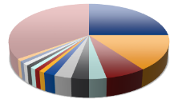
Evolution of Therapy in Lung Cancer
Not 1 disease, but many
Histologic Breakdown
(eg, SQ, NSQ, large cell, adenocarcinoma)
Molecular Pathology
(eg, EGFR, ALK, ROS1)
SCLC
PD-L1 Expression Level
<1%
Lung Cancer
≥1%-49%
NSCLC
≥50%
Traditional View
Present View
Cooper. Pathology. 2011;43:103. Langer. JCO. 2010;28:5311. Galon. Immunity. 2013;39:11. Pao. Lancet Oncol. 2011;12:175. Krigsfeld. AACR 2017. Abstr CT143.

Slide 3
Oncogenic drivers in NSCLC

Slide 4
FLAURA: Progression-free and Overall Survival
 | Median PFS, Mo (95% CI)
Osimertinib (n = 279) | 18.9 (15.2-21.4)
Erlotinib/gefitinib (n = 277) | 10.2 (9.6-11.1)
 | Median OS, Mo (95% CI)
Osimertinib (n = 279) | 38.6 (34.5-41.8)
Erlotinib/gefitinib (n = 277) | 31.8 (26.6-36.0)
PFS
Updated OS
1.0
1.0
0.8
0.8
0.6
0.6
Probability of PFS
Probability of OS
0.4
0.4
0.2
HR: 0.46
(95% CI: 0.37-0.57; P <.001)
0.2
HR: 0.80
(95.05% CI: 0.64-1.00; P = 0.046)
0
0
0
3
6
9
12
15
18
21
24
27
0
3
6
9
12
15
18
21
24
27
30
33
36
39
42
45
48
51
54
Mo
Mo
PFS, Mo (95% CI) | Osimertinib | Erlotinib/Gefitinib | HR
EGFR ex19del | 21.4 (16.5-24.3) | 11.0 (9.7-12.6) | 0.43
EGFR L858R | 14.4 (11.1-18.9) | 9.5 (8.1-11.0) | 0.51
Soria. NEJM. 2018;378:113. Ramalingam. NEJM. 2020;282:41.
Notes:
OS, overall survival; PFS, progression-free survival.

Slide 5
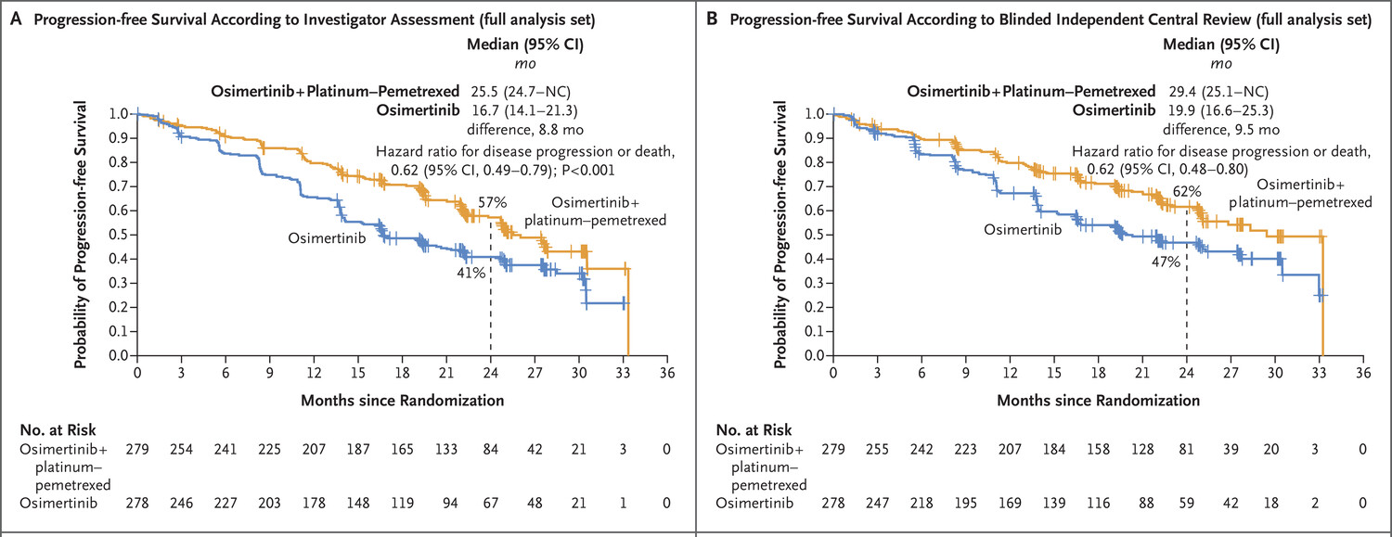
FLAURA2 Phase III—osimertinib +/- chemotherapy
Pts with untreated locally advanced / metastatic EGFRm NSCLC
Osimertinib 80 mg (QD) + pemetrexed 500 mg/m² + carboplatin AUC5 or cisplatin 75 mg/m² (Q3W for 4 cycles), followed by maintenance osimertinib 80 mg (QD) + pemetrexed (Q3W)*
n=279
Key inclusion criteria:
Aged ≥18 years (Japan: ≥20 years)
Pathologically confirmed non-squamous NSCLC
Ex19del / L858R (local / central test)
WHO PS 0 / 1
No prior systemic therapy for advanced NSCLC
Primary endpoint:
PFS by investigator assessment per RECIST 1.1†‡
Key secondary endpoints:
OS, ORR, DoR, DCR, HRQoL, safety (AEs by CTCAE v5), PFS2†
Randomisation 1:1 (N=557)
Osimertinib 80 mg (QD)
n=278

Slide 6
FLAURA2—PFS with CNS metastases
Jänne PA et al. WCLC 2023. Planchard D et al. N Engl J Med 2023;389(21):1935-48.

Slide 7
FLAURA2—Common adverse events (≥15% of patients)*
Osimertinib + platinum-pemetrexed (n=276) | Osimertinib monotherapy (n=275)
Anemia†
Diarrhea
Nausea
Neutropenia†
Thrombocytopenia†
Decreased appetite
Constipation
Rash
Fatigue
Vomiting
Stomatitis
Paronychia
COVID-19‡
ALT increase
Dry skin
AST increase
Blood creatinine increase
WBC count decrease
Edema peripheral
4
19
ILD (grouped term) was reported in 9 patients (3%) in the osimertinib plus platinum-pemetrexed arm and 10 patients (4%) in the osimertinib monotherapy arm (all grades)†
1
Grade 1 / 2
Grade 3
Grade 4
3
Grade 1 / 2
Grade 3
Patients with adverse events, %
Of most common AEs (occurring in ≥15% of patients in either arm), all Grade 4 AEs in the osimertinib plus platinum-pemetrexed arm were hematological toxicities, known to be associated with chemotherapy; there were no common Grade 4 AEs in the monotherapy arm
Data cut-off: 03 April 2023 *In commonly reported AEs, defined as occurring in >15% of patients in either treatment arm, by MedDRA preferred terms (unless stated as a grouped term of the same medical concepts); †Grouped term: anemia / hemoglobin decreased, thrombocytopenia / platelet count decreased, neutropenia / neutrophil count decreased, and interstitial lung disease / pneumonitis / organizing pneumonitis (by preferred terms); ‡Of common AEs (≥15% of patients), one Grade 5 AE of COVID-19 was reported in the osimertinib plus platinum-pemetrexed arm. AE, adverse event; ALT, alanine aminotransferase; AST, aspartate aminotransferase; COVID, coronavirus disease; ILD, interstitial lung disease; MedDRA, Medical Dictionary for Regulatory Activities; WBC, white blood cell
Jänne PA et al. WCLC 2023. Planchard D et al. N Engl J Med 2023;389(21):1935-48.

Slide 8
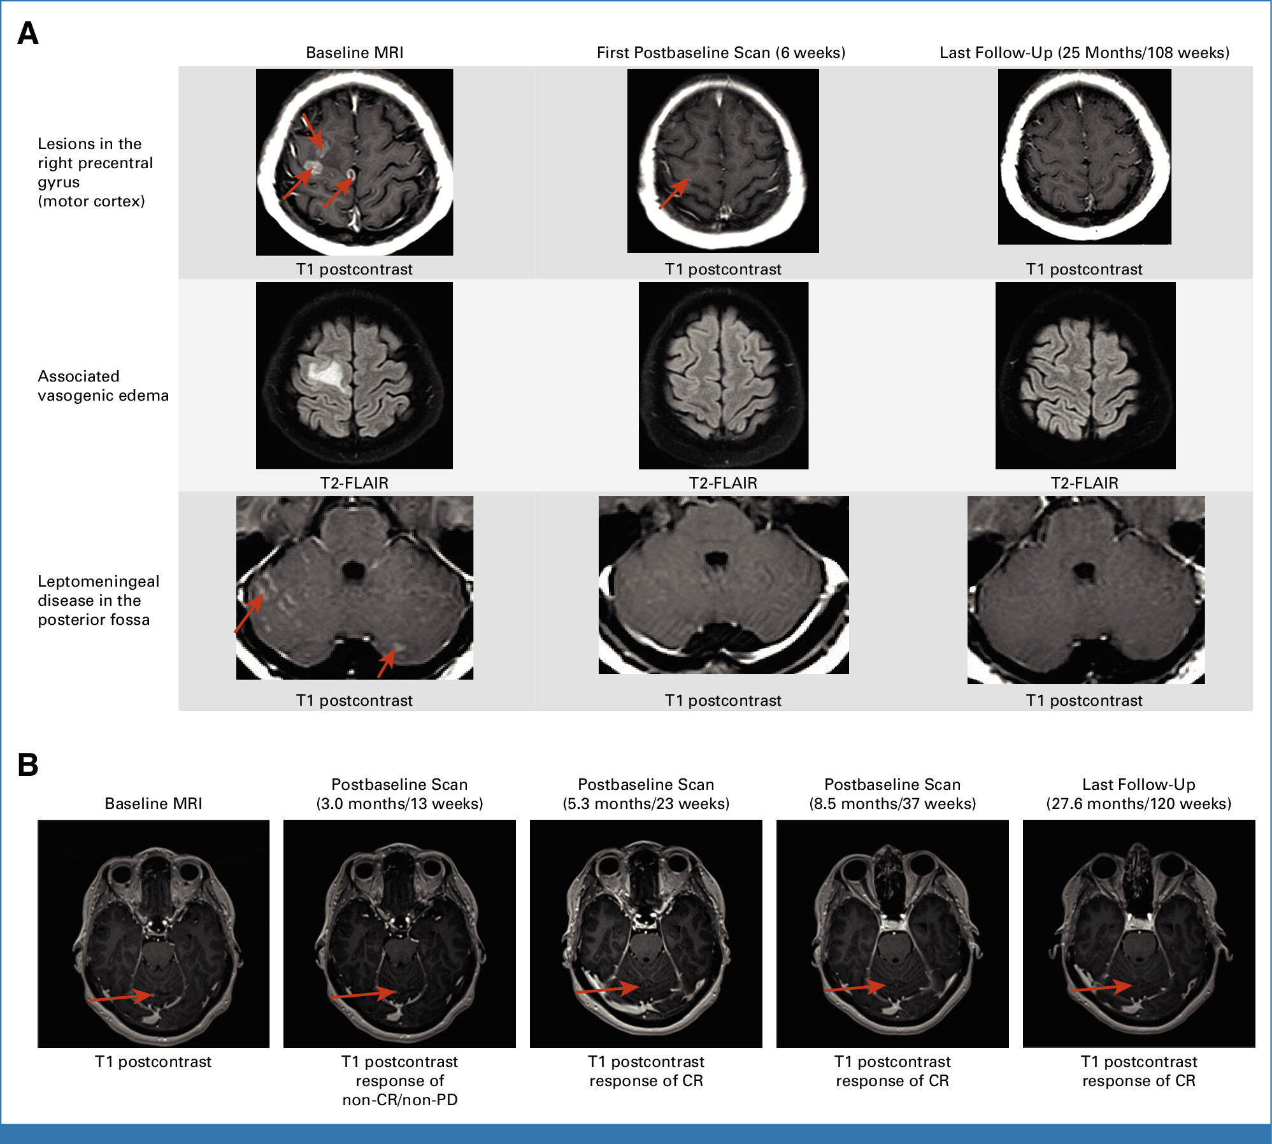
FLAURA2—Lower Risk of CNS Progression
The estimated probability of observing CNS progression at 24 months was 9% (95% CI 4, 16) with osimertinib and the addition of CTx vs 23% (95% CI 14, 33) with osimertinib monotherapy
Planchard D et al. ESMO 2023; Jänne PA et al. J Clin Oncol 2024;42(7):808-20.

Slide 9
MARIPOSA—Phase 3 Study Design
Key Eligibility Criteria
Locally advanced or metastatic NSCLC
Treatment-naïve for advanced disease
Documented EGFR
Ex19del or L858R
ECOG PS 0 or 1
Serial brain MRIs were required for all patientsª
Primary endpoint of progression-free survival (PFS)^{b} by BICR per RECIST v1.1:
Amivantamab + lazertinib vs osimertinib
2:2:1 Randomization (N=1074)
Amivantamab + Lazertinib
(n=429; open-label)
Secondary endpoints of
amivantamab + lazertinib vs osimertinib:
Osimertinib
(n=429; blinded)
Overall survival (OS)^{b}
Objective response rate (ORR)
Duration of response (DoR)
PFS after first subsequent therapy (PFS2)
Symptomatic PFS^{c}
Intracranial PFS^{c}
Safety
Stratification Factors
EGFR mutation type (Ex19del or L858R)
Lazertinib
(n=216; blinded)
Asian race (yes or no)
History of brain metastasesª (yes or no)
Dosing (in 28-day cycles)
Amivantamab: 1050 mg (1400 mg if ≥80 kg) weekly for the first 4 weeks, then every 2 weeks
Lazertinib: 240 mg daily
Osimertinib: 80 mg daily
Lazertinib monotherapy arm was included to assess the contribution of components
Cho BC et al ESMO 2023

Slide 10
MARIPOSA—Progression-free survival
Amivantamab + lazertinib reduced the risk of progression or death by 30% and improved median PFS by 7.1 months
100
Patients who are progression-free (%)
Median PFS (95% CI)
Median follow-up: 22.0 months
80
73%
Amivantamab + Lazertinib
Osimertinib
23.7 mo (19.1–27.7)
16.6 mo (14.8–18.5)
HR, 0.70 (95% CI, 0.58–0.85); P<0.001
60
65%
48%
40
Amivantamab + Lazertinib
34%
Osimertinib
20
0
0
3
6
9
12
15
18
21
24
27
30
33
 |  |  |  |  | Months
No. at risk Amivantamab + Lazertinib 429 | 391 | 357 | 332 | 291 | 244 194 | 106 | 60 | 33 | 8 | 0
Osimertinib 429 | 404 | 358 | 325 | 266 | 205 160 | 90 | 48 | 28 | 10 | 0
ªAt time of the prespecified final PFS analysis, there were a total of 444 PFS events in the amivantamab + lazertinib and osimertinib arms combined.
BICR, blinded independent central review; CI, confidence interval; HR, hazard ratio; mo, months; PFS, progression-free survival.
Cho BC et al ESMO 2023

Slide 11
MARIPOSA—PFS Benefit With or Without Brain Metastases
With History of Brain Metastases | Median PFS (95% CI)
Amivantamab + Lazertinib | 18.3 mo (16.6–23.7)
Osimertinib | 13.0 mo (12.2–16.4)
HR, 0.69 (95% CI, 0.53–0.92)
Without History of Brain Metastases | Median PFS (95% CI)
Amivantamab + Lazertinib | 27.5 mo (22.1–NE)
Osimertinib | 19.9 mo (16.6–22.9)
HR, 0.69 (95% CI, 0.53–0.89)
Patients who are progression-free (%)
100
Patients who are progression-free (%)
100
80
80
Amivantamab
+ Lazertinib
60
Amivantamab
+ Lazertinib
60
40
40
Osimertinib
20
Osimertinib
20
0
9 12 15 18 21 24 27 30 33
Months
0
9 12 15 18 21 24 27 30 33
Months
0
3
6
0
3
6
No. at risk
Amivantamab + Lazertinib 178
Osimertinib 172
No. at risk
Amivantamab + Lazertinib 251
Osimertinib 257
162 146 134 115
164 146 126 95
92
64
71
47
34
21
24
11
12
6
3
1
0
0
229 211 198 176 152 123
240 212 199 171 141 113
72
69
36
37
21
22
5
9
0
0
BICR, blinded independent central review; CI, confidence interval; HR, hazard ratio; mo, months; NE, not estimable; PFS, progression-free survival.
Cho BC et al ESMO 2023

Slide 12
MARIPOSA—Safety Profile
Most common TEAEs (≥20%) by preferred term, n (%)
Related to EGFR inhibition
Paronychia
Rash Diarrhea
Dermatitis acneiform
Stomatitis Pruritus
Safety profile of amivantamab +
11%
57%
28% 0.5%
lazertinib was consistent with prior reports, mostly grades 1-2
15%
46%
30% 1%
2% 27%
44% 1%
8%
21%
13%
EGFR- and MET-related AEs were
1% 28%
21% 0.2%
higher for amivantamab + lazertinib
0.5% 23%
17% 0.2%
except diarrhea, which was higher
Related to MET inhibition
Hypoalbuminemia
Peripheral edema
5%
43%
6%
for osimertinib
Incidence of grade 4-5 AEs was
2% 34%
6%
Other
IRR
ALT increased Constipation
6%
57%
low and comparable between arms
Rates of ILD/pneumonitis remained low, at ~3% for both arms
5%
31%
11% 2%
29%
13%
AST increased | 3% | 25% | 12% | 1%
COVID-19 | 2% | 24% |  | 22% | 2%
Decreased appetite | 1% | 24% | 16% |  | 1%
Anemia | 4% | 19% | 20% |  | 2%
Nausea
Hypocalcemia
1% 20%
13% 0.2%
Amivantamab + Lazertinib: grade 1-2
Amivantamab + Lazertinib: grade ≥3
2% 19%
8%
Osimertinib: grade 1-2
Cough |  | 15% | 21% |  | Osimertinib: grade ≥3
100% | 50% | 0% |  | 50% | 100%
AE, adverse event; ALT, alanine aminotransferase; AST, aspartate aminotransferase; EGFR, epidermal growth factor receptor; ILD, interstitial lung disease (includes pneumonitis);
IRR, infusion-related reaction; TEAE, treatment-emergent AE.
Cho BC et al ESMO 2023

Slide 13
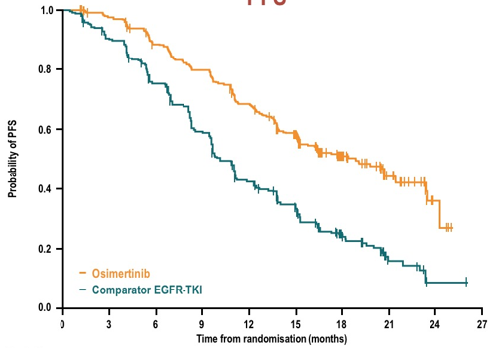
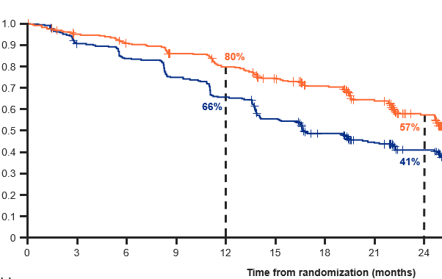
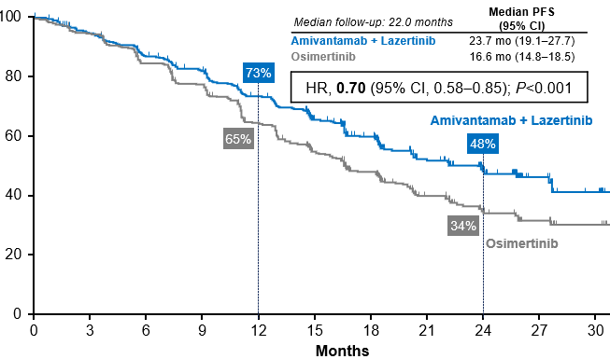
Considering options for frontline treatment of advanced EGFR+ NSCLC
FLAURA
FLAURA2
MARIPOSA
osimertinib monotherapy
osimertinib + chemotherapy
amivantamab + lazertinib
Progression-free survival
Osimertinib 18.9 mo
1st gen TKI 10.2 mo
Progression-free survival
Osi+chemo 25.5 mo
Osimertinib 16.7 mo
Progression-free survival
Ami+Laz 23.7 mo
Osimertinib 16.6 mo
Multiple options for front line, improvement in PFS without detriment in OS
Increased cost and toxicity compared to osimertinib alone
Selection of patients will be important (brain mets, disease burden, ctDNA…)

Slide 14
MARIPOSA-2—Phase 3 Study Design
Serial brain MRIs were required for all patientsª
Dual primary endpoint of PFS^{c} by BICR per RECIST v1.1:
Amivantamab-Lazertinib-Chemotherapy vs Chemotherapy
Amivantamab-Chemotherapy vs Chemotherapy
Secondary endpoints:
Objective response rate (ORR)^{c}
Duration of response (DoR)
Overall survival (OS)^{c}
Intracranial PFS
Time to subsequent therapy^{d}
PFS after first subsequent therapy (PFS2)^{d}
Symptomatic PFS^{d}
Safety
Key Eligibility Criteria
Locally advanced or metastatic NSCLC
Documented EGFR Ex19del or L858R
Progressed on or after osimertinib monotherapy (as most recent line)
ECOG PS 0 or 1
Stable brain metastases were allowed; radiation/definitive therapy was not required (untreated)
Stratification Factors
Osimertinib line of therapy (1st vs 2nd)
Asian race (yes or no)
History of brain metastases (yes or no)
2:2:1 Randomization (N=657)
Amivantamab-Lazertinib-Chemotherapy
(n=263)
Chemotherapy
(n=263)
Amivantamab-Chemotherapy
(n=131)
Dosing (in 21-day cycles)
Amivantamab: 1400 mg (1750 mg if ≥80 kg) for the first 4 weeks, then 1750 mg (2100 mg if ≥80 kg) every 3 weeks starting at Cycle 3 (week 7)
Lazertinib: 240 mg daily starting after completion of carboplatin^{b}
Chemotherapy administered at the beginning of every cycle:
Carboplatin: AUC5 for the first 4 cycles
Pemetrexed: 500 mg/m² until disease progression
Passaro A et al. ESMO 2023. Passaro A et al. Ann Oncol 2024;35(1):77-90.

Slide 15
MARIPOSA-2—Progression-free Survival
At a median follow-up of 8.7 months, amivantamab-chemotherapy and amivantamab-lazertinib-chemotherapy reduced the risk of progression or death by 52% and 56%, respectively
Amivantamab-Chemotherapy vs Chemotherapy Median PFS: 6.3 vs 4.2 months |  | Amivantamab-Lazertinib-Chemotherapyª vs Chemotherapy Median PFS: 8.3 vs 4.2 months
HR, 0.48 (95% CI, 0.36–0.64) P<0.001 |  | HR, 0.44 (95% CI, 0.35–0.56) P<0.001
59%
51%
37%
Amivantamab-Lazertinib-Chemotherapy
30%
22%
Amivantamab-Chemotherapy
13%
Chemotherapy
No. at risk
Amivantamab-Chemotherapy
Amivantamab-Lazertinib-Chemotherapy
Chemotherapy
131
263
263
99
194
135
49
104
49
27
52
17
7
21
6
0
4
0
0
0
0
Consistent PFS benefit by investigator: HR, 0.41 (8.2 vs 4.2 mo; P<0.001^{b}) & HR, 0.38 (8.3 vs 4.2 mo; P<0.001^{b})
ªAmivantamab-lazertinib-chemotherapy arm includes all patients regardless of the dosing regimen received. ^{b}Nominal P-value; endpoint not part of hierarchical hypothesis testing.
BICR, blinded independent central review; CI, confidence interval; HR, hazard ratio; PFS, progression-free survival.
Passaro A et al. ESMO 2023. Passaro A et al. Ann Oncol 2024;35(1):77-90.

Slide 16
MARIPOSA-2—Intracranial PFS
Amivantamab-chemotherapy and amivantamab-lazertinib-chemotherapy reduced the risk of intracranial progression or death by 45% and 42%, respectively
Amivantamab-Chemotherapy vs Chemotherapy Median icPFS: 12.5 vs 8.3 months |  | Amivantamab-Lazertinib- Chemotherapyª vs Chemotherapy Median icPFS: 12.8 vs 8.3 months
HR, 0.55 (95% CI, 0.38–0.79) P=0.001^{b} |  | HR, 0.58 (95% CI, 0.44–0.78) P<0.001^{b}
79%
78%
66%
54%
Amivantamab-Chemotherapy
50%
Chemotherapy
Amivantamab-Lazertinib-Chemotherapy
34%
No. at risk
Amivantamab-Chemotherapy
Amivantamab-Lazertinib-Chemotherapy
Chemotherapy
131
263
263
103
211
167
72
135
89
40
74
37
11
32
13
0
6
1
0
0
0
ªAmivantamab-lazertinib-chemotherapy arm includes all patients regardless of the dosing regimen received. ^{b}Nominal P-value; endpoint not part of hierarchical hypothesis testing.
BICR, blinded independent central review; CI, confidence interval; HR, hazard ratio; icPFS, intracranial progression-free survival.
Passaro A et al. ESMO 2023. Passaro A et al. Ann Oncol 2024;35(1):77-90.

Slide 17
MARIPOSA-2—Safety Profile
Amivantamab-containing arms had higher rates of EGFR- and MET-related AEs
Neutropenia and thrombocytopenia:
Mostly occurred during cycle 1
Low rates of febrile neutropenia (2%, 2%, and 8%)
Low rates of grade 3-4 bleeding^{d} (0%, 1%, and 3%)
VTE highest in amivantamab-lazertinib-chemotherapy arm
No grade 5 events
Rates of discontinuation due to VTE were low (0%, 1%, and 0.4%)
Incidence of ILD was low in all arms (<3%)
Most common TEAEs (≥25%) by preferred term, n (%) | Chemotherapy (n=243) |  | Amivantamab-Chemotherapy (n=130) |  | Amivantamab-Lazertinib-Chemotherapyª (n=263)
 | All grades | Grade ≥3 | All grades | Grade ≥3 | All grades | Grade ≥3
Associated with EGFR inhibition
Paronychia | 1 (0.4) | 0 | 48 (37) | 3 (2) | 133 (51) | 11 (4)
Rash | 12 (5) | 0 | 56 (43) | 8 (6) | 126 (48) | 17 (6)
Stomatitis | 21 (9) | 0 | 41 (32) | 1 (1) | 120 (46) | 24 (9)
Diarrhea | 16 (7) | 1 (0.4) | 18 (14) | 1 (1) | 68 (26) | 10 (4)
Associated with MET inhibition
Hypoalbuminemia | 21 (9) | 1 (0.4) | 29 (22) | 3 (2) | 104 (40) | 12 (5)
Peripheral edema | 15 (6) | 0 | 42 (32) | 2 (2) | 85 (32) | 1 (0.4)
Associated with Chemotherapy
Neutropenia | 101 (42) | 52 (21) | 74 (57) | 59 (45) | 181 (69) | 144 (55)
Thrombocytopenia | 72 (30) | 22 (9) | 57 (44) | 19 (15) | 158 (60) | 96 (37)
Anemia | 97 (40) | 23 (9) | 51 (39) | 15 (12) | 141 (54) | 48 (18)
Leukopenia | 68 (28) | 23 (9) | 37 (28) | 26 (20) | 106 (40) | 71 (27)
Other
Infusion-related reaction | 1 (0.4) | 0 | 76 (58) | 7 (5) | 148 (56) | 9 (3)
Nausea | 90 (37) | 2 (1) | 58 (45) | 1 (1) | 131 (50) | 16 (6)
Constipation | 72 (30) | 0 | 50 (38) | 1 (1) | 96 (37) | 3 (1)
Decreased appetite | 51 (21) | 3 (1) | 40 (31) | 0 | 85 (32) | 7 (3)
Vomiting | 42 (17) | 1 (0.4) | 32 (25) | 1 (1) | 76 (29) | 10 (4)
Fatigue | 47 (19) | 4 (2) | 36 (28) | 4 (3) | 69 (26) | 15 (6)
Asthenia | 40 (16) | 5 (2) | 34 (26) | 1 (1) | 67 (25) | 14 (5)
Alanine aminotransferase increased | 67 (28) | 10 (4) | 26 (20) | 7 (5) | 55 (21) | 14 (5)
AESIs by grouped term, n (%)
Rash^{b} | 30 (12) | 0 | 92 (71) | 13 (10) | 197 (75) | 40 (15)
VTE^{c} | 11 (5) | 7 (3) | 13 (10) | 3 (2) | 58 (22) | 17 (6)
ILD | 0 | 0 | 2 (2) | 1 (1) | 7 (3) | 5 (2)
ªAmivantamab-lazertinib-chemotherapy arm includes all patients regardless of the dosing regimen received. ^{b}Grouping includes the following preferred terms: rash, dermatitis acneiform, rash maculo-papular, erythema, acne, rash pruritic, rash erythematous, rash macular, drug eruption, folliculitis, dermatitis, skin lesion, rash pustular, papule, rash follicular, exfoliative rash, pustule, rash papular, skin exfoliation. ^{c}Grouping includes the following preferred terms: pulmonary embolism, deep vein thrombosis, embolism, renal vein thrombosis, venous thrombosis limb, venous thrombosis, embolism venous, jugular vein thrombosis, superficial vein thrombosis, thrombophlebitis, thrombosis. ^{d}Identified by the standardized MedDRA query for “Haemorrhage Terms (Excl Laboratory Terms)”.
AE, adverse event; AESI, AE of special interest; EGFR, epidermal growth factor receptor; ILD, interstitial lung disease (includes pneumonitis); TEAE, treatment-emergent AE; VTE, venous thromboembolism.
Passaro A et al. ESMO 2023. Passaro A et al. Ann Oncol 2024;35(1):77-90.

Slide 18
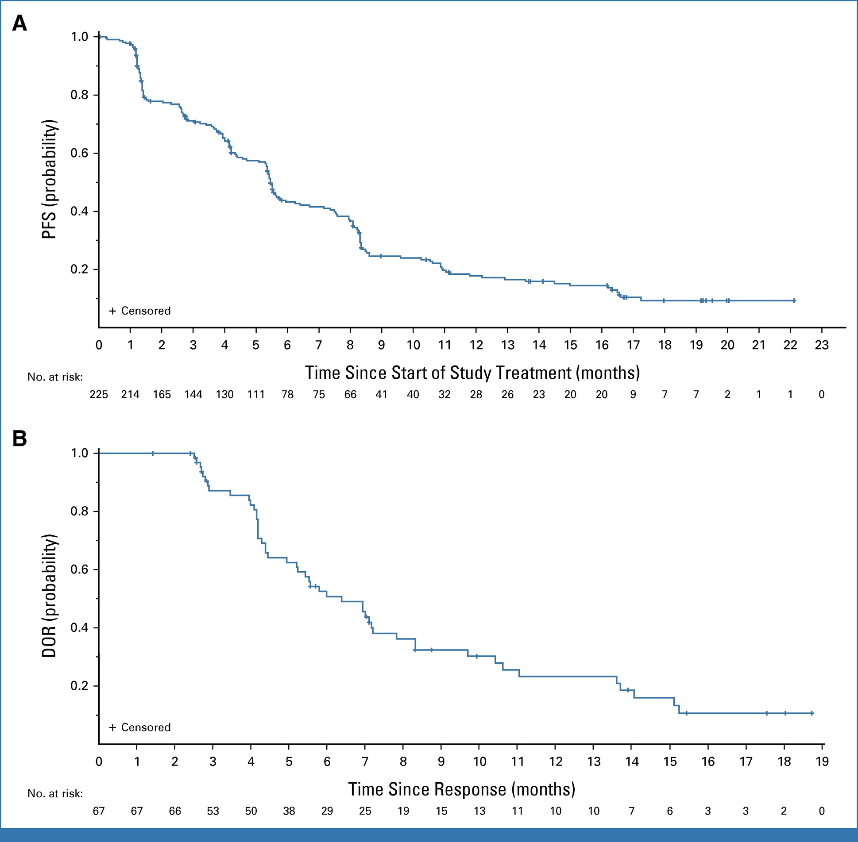
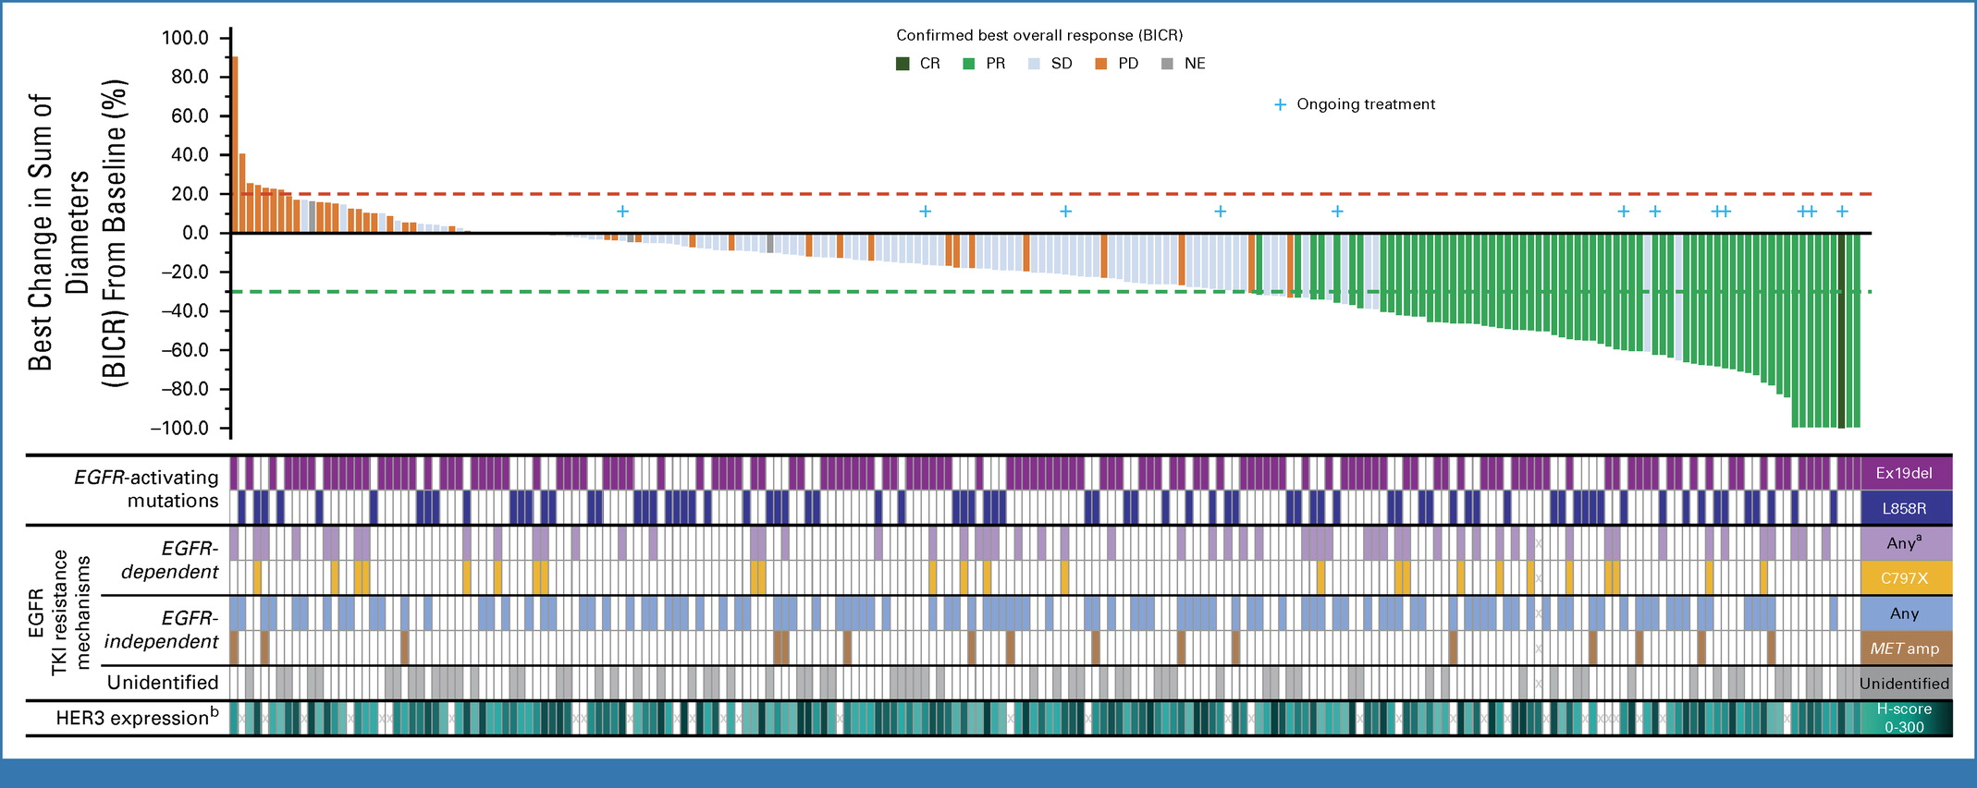
HERTHENA-Lung01—Patritumab deruxtecan in EGFR mutant NSCLC
Median PFS: 5.5 mo (5.1-5.9)
ORR: 29.8% (23.9-36.2)
Median DOR: 6.4 mo (4.9-7.8)
Yu HA et al. J Clin Oncol 2023 415363-5375.

Slide 19
HERTHENA-Lung01—Cumulative Incidence of CNS progression
With History of Brain Metastasis (n=115) With No History of Brain Metastasis (n=110)
CIR landmarks (95% CI), %
CNS progression
6 months | 20.4 ( 13.2, 28.8)
12 months | 23.8 ( 15.9, 32.7)
Non-CNS progression
6 months | 34.4 ( 25.2, 43.8)
12 months | 51.5 ( 40.8, 61.3)
CIR landmarks (95% CI), %
CNS progression
6 months | 2.0 ( 0.4, 6.3)
12 months | 3.1 ( 0.8, 8.0)
Non-CNS progression
6 months | 38.3 ( 28.8, 47.7)
12 months | 58.4 ( 47.7, 67.7)
1.0
1.0
0.9
0.9
0.8
0.8
Cumulative Incidence
0.7
Cumulative Incidence
0.7
0.6
0.6
0.5
0.5
0.4
CNS
Non-CNS
Death
0.4
CNS
Non-CNS
Death
0.3
0.3
0.2
0.2
0.1
0.1
0.0
0.0
0
3
6
9
12
15
18
21
0
3
6
9
12
Months
19
15
18
21
24
No. of patients
at risk 115 69 31 16
Months
No. of patients
at risk 110
9
5
1
0
75
47
25
15
6
1
0
CIR, cumulative incidence rate; CNS, central nervous system.
Yu HA et al. J Clin Oncol 2023 415363-5375. Johnson ML et al. ESMO 2023;Abstract 1319MO.

Slide 20
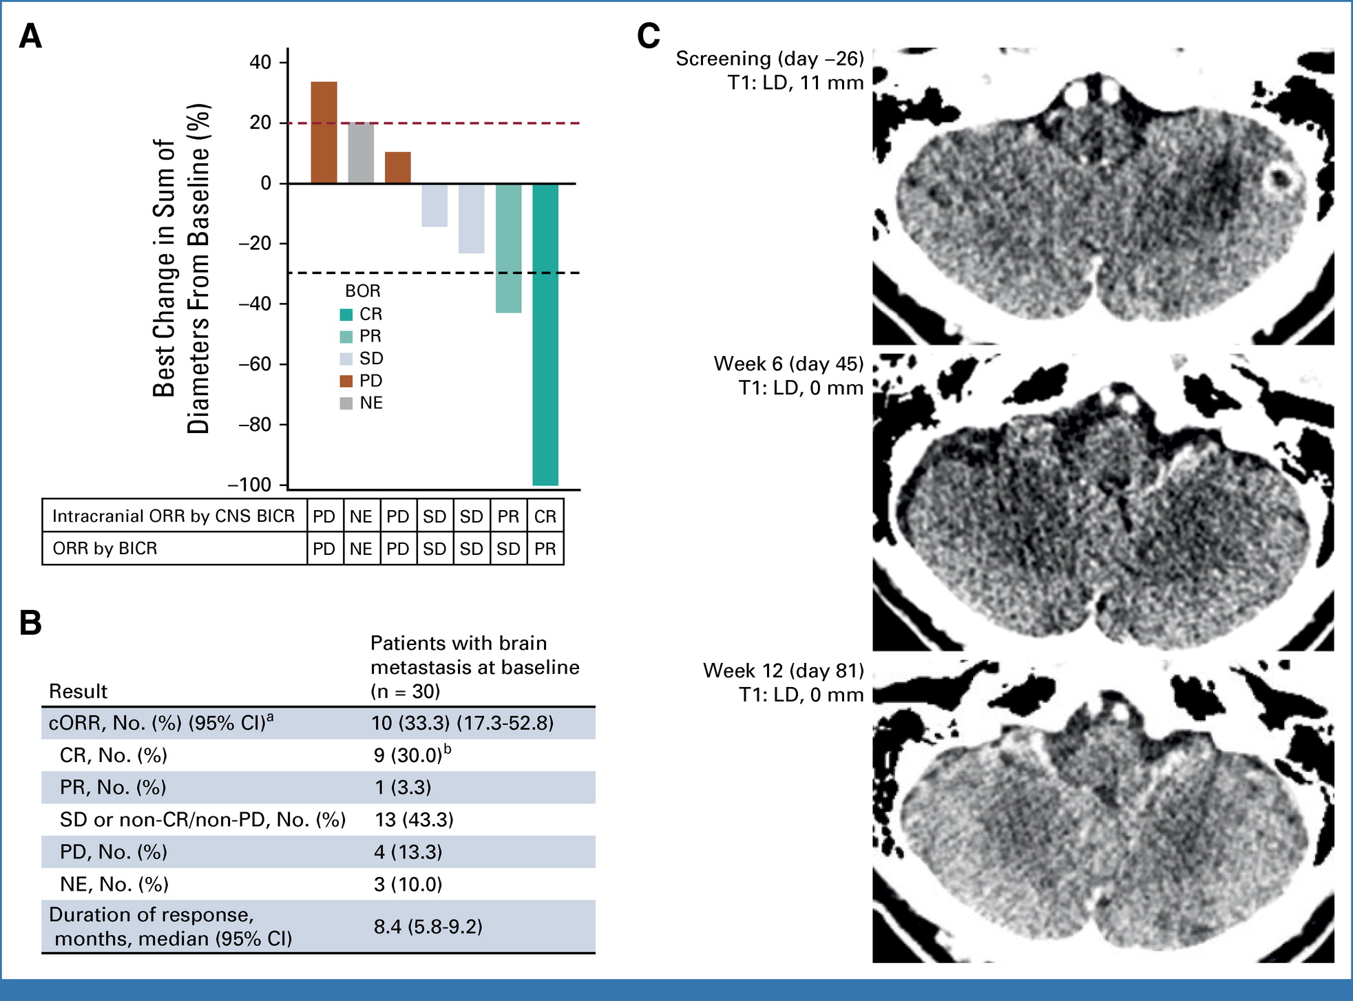
HERTHENA-Lung01—CNS outcomes
Yu HA et al. J Clin Oncol 2023 415363-5375. Johnson ML et al. ESMO 2023;Abstract 1319MO.

Slide 21
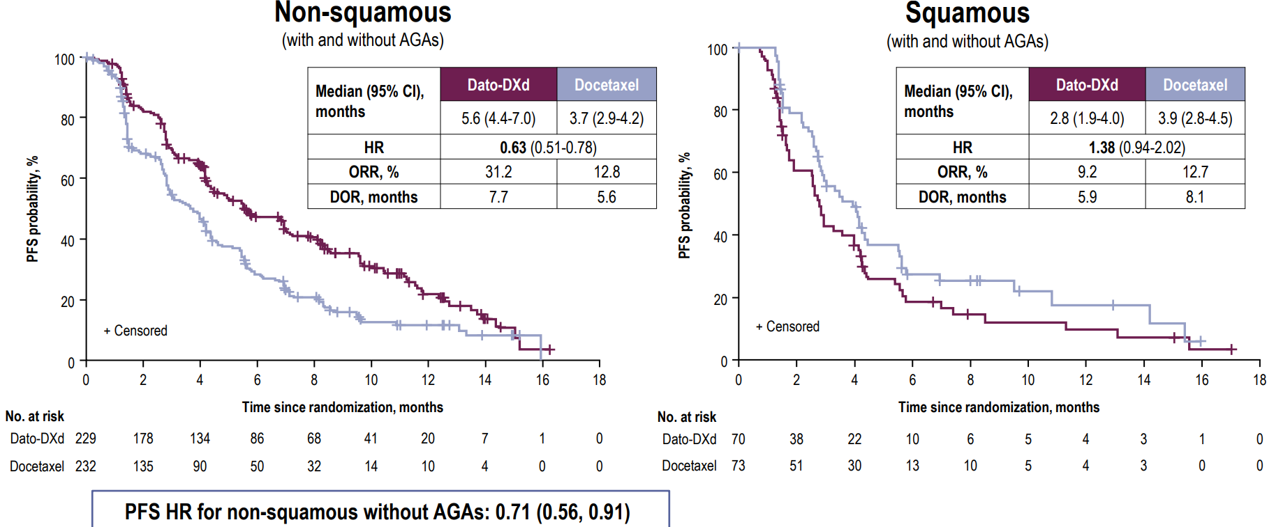
TROPION-Lung01—PFS by Histology

Slide 22
TROPION-Lung05—Datopotamab deruxtecan (Dato-DXd) in NSCLC with actionable genomic alterations
Screening
Key inclusion criteria
Stage IIIB, IIIC, or IV NSCLC
Presence of ≥1 actionable genomic alteration (EGFR, ALK, ROS1, NTRK, BRAF, MET exon 14 skipping, or RET)
ECOG PS of 0 or 1
≥1 line of targeted therapy
1 or 2 prior cytotoxic agent–containing therapies including platinum- based therapy in the metastatic setting
Radiographic disease progression after targeted therapy
Endpointsª
Treatment
Primary: ORR by BICR
Secondary:
By BICR and investigator: DOR, DCR, CBR, PFS, TTR
By investigator: ORR
OS, safety, PK, immunogenicity
Dato-DXd 6 mg/kg Q3W
Relative Frequency of Genomic Alterations^{b-d}
ALK
rearrangement 25%
EGFR
mutation^{e}
57%
ROS1 rearrangement 7%
RET rearrangement 6%
MET exon 14 skipping
BRAF mutation 3%
4%
Paz-Ares L et al. ESMO 2023;Abstract 1314MO.

Slide 23
TROPION-Lung05—Efficacy Summary
Response per BICR | All treated patients (N=137) | Patients with EGFR mutations (N=78) | Patients with ALK rearrangement (N=34)
ORR confirmed, n (%) [95% CI]ª | 49 (35.8) [27.8-44.4] | 34 (43.6) [32.4-55.3] | 8 (23.5) [10.7-41.2]
Median DOR (95% CI), months | 7.0 (4.2-9.8) | 7.0 (4.2-10.2) | 7.0 (2.8-8.4)
DCR confirmed, n (%) [95% CI]ª | 108 (78.8) [71.0-85.3] | 64 (82.1) [71.7-89.8] | 25 (73.5) [55.6-87.1]
Median PFS, (95% CI), months^{b} | 5.4 (4.7-7.0) | 5.8 (5.4-8.3) | 4.3 (2.6-6.9)
Best Percent Change From Baseline in Sum of Diameters of Target Lesions
100
80
60
40
20
0
-20
-40
-60
-80
-100
No. of prior systemic lines for advanced or metastatic disease
1/2 ≥3
Best percent change
+
+
+
++ +
+
⁺ + + ₊
+
⁺ ⁺+ +
+: Ongoing participant
Patient
++ +
Percent Change From Baseline in Sum of Diameters of Target Lesions in
Patients With Confirmed CR/PR^{c}
₀ Confirmed BOR
CR PR
-25
BOR: In the overall population (N=137), 4 patients (3%) achieved a CR and 45 (33%) achieved a PR
EGFR subset: Among patients with sensitizing or T790M mutations (N=68), the ORR was 49.1% in those previously treated with osimertinib
Percent change
-50
-75
-100
-125
0 1 2 3 4 5 6 7 8 9 10 11 12 13 14 15 16 17 18 19 20
Months
BICR, blinded independent central review; BOR, best overall response; CR, complete response; DCR, disease control rate; DOR, duration of response; ORR, objective response rate; PFS, progression-free survival; PR, partial response.
ªThe 2-sided 95% CIs are based on the Clopper-Pearson exact binomial method. ^{b}Median PFS and PFS probabilities are based on the Kaplan-Meier method. ^{c}Per BICR.
Paz-Ares L et al. ESMO 2023;Abstract 1314MO.

Slide 24
TROPION-Lung05—Safety Summary
TEAEs Occurring in ≥15% of Patients; All Grades (N=137)ª
137 patients (100%) experienced TEAEs (grade ≥3, 47%)
129 (94%) experienced treatment-related TEAEs (grade ≥3, 29%)
34 (25%) experienced serious AEs (grade ≥3, 5%)
30 (22%), 13 (10%), and 2 (2%) patients experienced TEAEs associated with dose reduction, dose withdrawal, and death,^{c} respectively
AESI Incidence by Grade^{d}
Nausea Stomatitis Alopecia Constipation
35 23
29 20
36 16^{b}
2
10
23
9
Decreased appetite | 12 |  | 12 |  |  | 4
Fatigue | 12 |  | 10 |  |  | 4
Vomiting | 14 |  | 8 |  |  | 1
Anemia | 4 5 | 6
Asthenia | 7 | 7 | 2
COVID-19 | 10 | 5 |  | 1
Rash | 12 | 4
Cough | 10 | 4
n (%) | Total | Grade 1 | Grade 2 | Grade ≥3
Oral mucositis/stomatitis | 90 (66) | 45 (33) | 30 (22) | 15 (11)
Ocular surface toxicity^{e} | 36 (26) | 26 (19) | 7 (5) | 3 (2)^{f}
IRR | 22 (16) | 15 (11) | 7 (5) | 0
Adjudicated drug-related ILD | 5 (4) | 1 (1) | 3 (2) | 1 (1)^{g}
Grade 1
Grade 2 Grade ≥3
0 20 40 60
Patients, %
AE, adverse event; AESI, adverse event of special interest; CTCAE, Common Terminology Criteria for Adverse Events; ILD, interstitial lung disease; IRR, infusion-related reaction; TEAE, treatment-emergent adverse event.
ªDue to rounding, summed rates may not reflect total percentage of TEAEs. ^{b}Includes an event reported as grade 3 incorrectly per CTCAE grades. ^{c}Two deaths were associated with disease progression, unrelated to study drug by investigator. ^{d}AESIs
listed in this slide include all preferred terms defined by the medical concept. ^{e}Dry eye was the most commonly reported ocular surface toxicity (n=15 [11%]). ^{f}Patients with grade 3 ocular surface toxicity had corneal disorder, cornea verticillata, and punctate keratitis. ^{g}One case of ILD was reported as a grade 3 event by investigator, and the patient died due to disease progression per investigator. The same event was adjudicated as a grade 5 event.
Paz-Ares L et al. ESMO 2023;Abstract 1314MO.

Slide 25
Options for subsequent treatment of advanced EGFR+ NSCLC
Emerging options to treat osimertinib resistance
Chemotherapy with amivantamab improves PFS over chemotherapy with less toxicity than chemotherapy with amivantamab and lazertinib with CNS benefit
Patritumab deruxtecan demonstrates responses with ~5.5 mo PFS in heavily pretreated patients with 30% CR in the brain
Datopotamab deruxtecan shows early efficacy in patients with actionable genomic alterations with ORR in EGFR mutant NSCLC ~43%
Toxicities differ across therapies and should be considered
Consideration for potential sequencing of therapies with differing MOA

Slide 26
PAPILLON—Phase 3 Study Design
Key Eligibility Criteria
1:1 Randomization (N=308)
Amivantamab-Chemotherapy
(n=153)
Primary endpoint: Progression-free survival (PFS) by BICR according to RECIST v1.1^{c}
Treatment-naïve,ª locally advanced or metastatic NSCLC
Documented EGFR Exon 20 insertion mutations
ECOG PS 0 or 1
Secondary endpoints:
Objective response rate (ORR)^{c}
Duration of response (DoR)
Overall survival (OS)^{c}
PFS after first subsequent therapy (PFS2)
Symptomatic PFS^{d}
Time to subsequent therapy^{d}
Safety
Chemotherapy
(n=155)
Stratification Factors
ECOG PS
History of brain metastases^{b}
Prior EGFR TKI useª
Dosing (in 21-day cycles)
Amivantamab: 1400 mg (1750 mg if ≥80 kg) for the first 4 weeks, then 1750 mg (2100 mg if ≥80 kg) every 3 weeks starting at week 7 (first day of cycle 3)
Chemotherapy on the first day of each cycle:
Carboplatin: AUC5 for the first 4 cycles
Pemetrexed: 500 mg/m² until disease progression
Optional crossover to 2nd-line amivantamab monotherapy^{e}
PAPILLON (ClinicalTrials.gov Identifier: NCT04538664) enrollment period: December 2020 to November 2022; data cut-off: 3-May-2023.
ªRemoved as stratification factor since only 4 patients had prior EGFR TKI use (brief monotherapy with common EGFR TKIs was allowed if lack of response was documented).
^{b}Patients with brain metastases were eligible if they received definitive treatment and were asymptomatic, clinically stable, and off corticosteroid treatment for ≥2 weeks prior to randomization.
^{c}Key statistical assumption: 300 patients with 200 events needed for 90% power to detect an HR of 0.625 (estimated PFS of 8 vs 5 months). PFS, ORR, and then OS were included in hierarchical testing.
^{d}These secondary endpoints (time to subsequent therapy and symptomatic progression-free survival) will be presented at a future congress.
^{e}Crossover was only allowed after BICR confirmation of disease progression; amivantamab monotherapy on Q3W dosing per main study.
AUC, area under the curve; BICR, blinded independent central review; ECOG PS, Eastern Cooperative Oncology Group performance status; EGFR, epidermal growth factor receptor; HR, hazard ratio;
Girard N et al ESMO 2023; Zhou C et al. N Engl J Med 2023;389(22):2039-51.
NSCLC, non-small cell lung cancer; Q3W, every 3 weeks; RECIST, Response Evaluation Criteria in Solid Tumors; TKI, tyrosine kinase inhibitor.

Slide 27
PAPILLON—Progression-free Survival
Amivantamab-chemotherapy reduced risk of progression or death by 60%
100
80
60
atients who are progression-free (%)
Median follow-up: 14.9 months | Median PFS (95% CI)
Amivantamab-Chemotherapy | 11.4 mo (9.8–13.7)
Chemotherapy | 6.7 mo (5.6–7.3)
HR, 0.395 (95% CI, 0.30–0.53); P<0.0001
48%
40
31%
Amivantamab-Chemotherapy
20
13%
3%
motherapy
P | 0 | 0 | 3 | 6 | 9 | 12 | 15 | 18 | 21 | Che 24
No. at risk |  |  |  |  |  | Months
Amivantamab- Chemotherapy |  | 153 | 135 | 105 | 74 | 50 | 33 | 15 | 3 | 0
Chemotherapy |  | 155 | 131 | 74 | 41 | 14 | 4 | 2 | 1 | 0
Consistent PFS benefit by investigator: 12.9 vs 6.9 mo (HR, 0.38; 95% CI, 0.29–0.51; P<0.0001ª)
Girard N et al ESMO 2023; Zhou C et al. N Engl J Med 2023;389(22):2039-51.

Slide 28
Amivantamab-chemotherapy shows trend in reducing risk of death by over 30%
PAPILLON—Interim Overall Survival
100
Patients who survived (%)
80
74%
72%
Amivantamab-Chemotherapy
60
68%
54%
40
Median follow-up: 14.9 months | Median OS (95% CI)
Amivantamab-Chemotherapy | NE (NE–NE)
Chemotherapy | 24.4 mo (22.1–NE)
HR, 0.675 (95% CI, 0.42–1.09); P=0.106
20
Chemotherapy
0
71 of 107 (66%)
patients whose disease progressed crossed over to amivantamab^{b}
0
3
6
9
12
15
18
21
24
27
No. at risk
Amivantamab-
Months
Chemotherapy | 153 | 144 | 133 | 115 | 88 | 60 | 38 | 15 | 5 | 0
Chemotherapy | 155 | 153 | 144 | 110 | 85 | 57 | 37 | 24 | 6 | 0
ªThere were 70 deaths in the study at the time of the prespecified interim OS analysis, which represents 23% of all randomized patients and 33% of the ~210 projected deaths for the final OS analysis. ^{b}A total of 71 patients (65 patients as part of the crossover arm plus an additional 6 patients off-protocol) received second-line amivantamab monotherapy out of 107 chemotherapy-randomized patients with disease progression.
CI, confidence interval; HR, hazard ratio; mo, months; NE, not estimable; OS, overall survival.
Girard N et al ESMO 2023; Zhou C et al. N Engl J Med 2023;389(22):2039-51.

Slide 29
PAPILLON—Safety Profile
Most common AEs of any cause by preferred term (≥20%), n (%) | Amivantamab-Chemotherapy (n=151) |  | Chemotherapy (n=155)
 | All grades | Grade ≥3 | All grades | Grade ≥3
Associated with EGFR inhibition
Paronychia | 85 (56) | 10 (7) | 0 | 0
Rash | 81 (54) | 17 (11) | 12 (8) | 0
Dermatitis acneiform | 47 (31) | 6 (4) | 5 (3) | 0
Stomatitis | 38 (25) | 2 (1) | 9 (6) | 0
Diarrhea | 31 (21) | 5 (3) | 20 (13) | 2 (1)
Associated with MET inhibition
Hypoalbuminemia | 62 (41) | 6 (4) | 15 (10) | 0
Peripheral edema | 45 (30) | 2 (1) | 16 (10) | 0
Other
Neutropenia | 89 (59) | 50 (33) | 70 (45) | 35 (23)
Anemia | 76 (50) | 16 (11) | 85 (55) | 19 (12)
Infusion-related reaction | 63 (42) | 2 (1) | 2 (1) | 0
Constipation | 60 (40) | 0 | 47 (30) | 1 (1)
Leukopenia | 57 (38) | 17 (11) | 50 (32) | 5 (3)
Nausea | 55 (36) | 1 (1) | 65 (42) | 0
Thrombocytopenia | 55 (36) | 15 (10) | 46 (30) | 16 (10)
Decreased appetite | 54 (36) | 4 (3) | 43 (28) | 2 (1)
Alanine aminotransferase increased | 50 (33) | 6 (4) | 56 (36) | 2 (1)
Aspartate aminotransferase increased | 47 (31) | 1 (1) | 51 (33) | 1 (1)
COVID-19 | 36 (24) | 3 (2) | 21 (14) | 1 (1)
Hypokalemia | 32 (21) | 13 (9) | 13 (8) | 2 (1)
Vomiting | 32 (21) | 5 (3) | 29 (19) | 1 (1)
EGFR- and MET-related AEs were increased with amivantamab-chemotherapy, primarily grade 1-2
Chemotherapy-associated hematologic and GI toxicities were comparable except for neutropenia
Neutropenia was transient; majority of events were not serious, with low rates of discontinuations
Pneumonitis was reported in 4 (3%) patients in the
amivantamab-chemotherapy arm
AE, adverse event; EGFR, epidermal growth factor receptor; GI, gastrointestinal.
Girard N et al ESMO 2023; Zhou C et al. N Engl J Med 2023;389(22):2039-51.

Slide 30
EGFR Exon 20 NSCLC
Amivantamab remains the targeted therapy option
Frontline amivantamab with chemotherapy improves PFS over chemotherapy alone with trend toward improved OS
Novel drugs with an improved therapeutic window are needed
Drugs with improved CNS activity are necessary

Slide 31
Moving Targeted Therapy Earlier in the Disease Course
December 18, 2020—Approval of adjuvant osimertinib
April 18, 2024—Approval of adjuvant alectinib
February 19, 2024—Press release, consolidation osimertinib improves PFS
Stage I
Stage II
Stage III
Stage IV
Tumors
Nonmetastatic lymph nodes
Regional/local metastatic lymph nodes/distant metastases

Slide 32
ADAURA Phase III study design
Herbst RS et al. ASCO 2023; Tsuboi M et al. N Engl J Med 2023;389(2):137-47.

Slide 33
ADAURA—Osimertinib improves Overall Survival in resected EGFR mutation positive NSCLC
Herbst RS et al. ASCO 2023; Tsuboi M et al. N Engl J Med 2023;389(2):137-47.

Slide 34
ADAURA—Benefit seen across stages
Herbst RS et al. ASCO 2023; Tsuboi M et al. N Engl J Med 2023;389(2):137-47.

Slide 35
ADAURA—Safety summary
Herbst RS et al. ASCO 2023; Tsuboi M et al. N Engl J Med 2023;389(2):137-47.

Slide 36
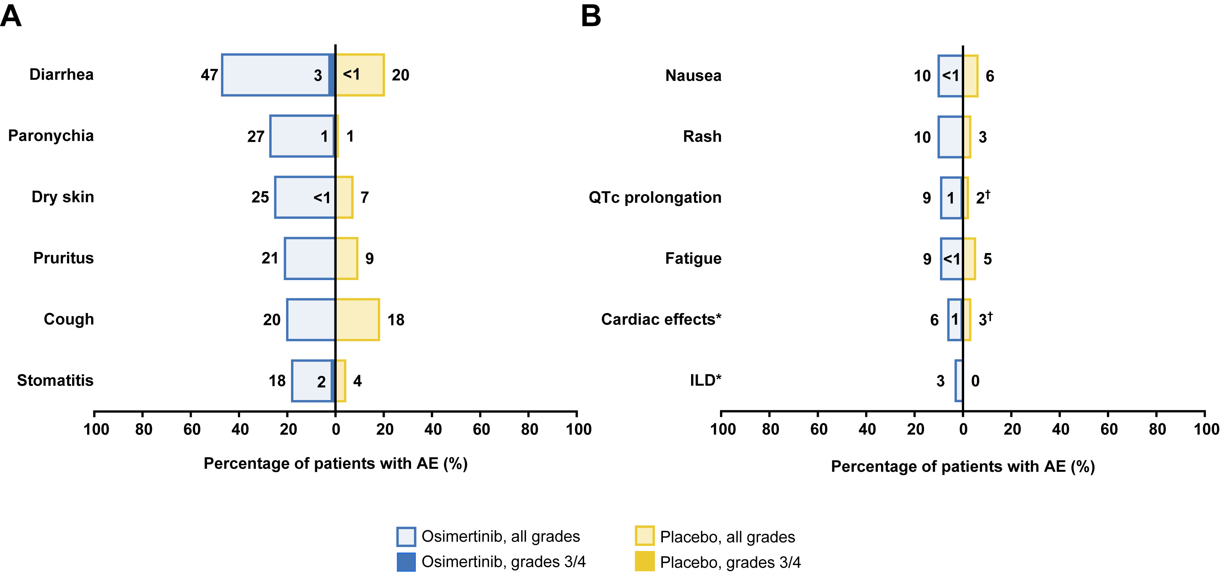
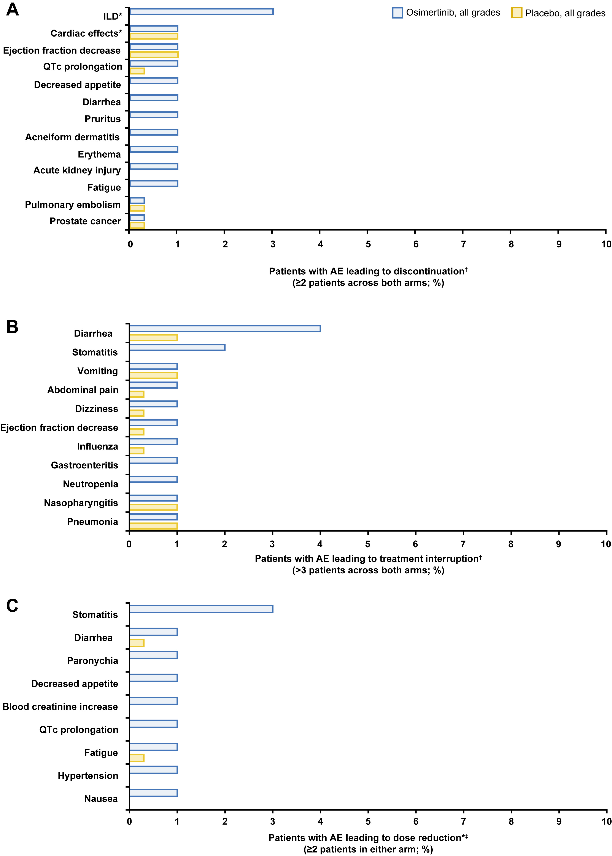
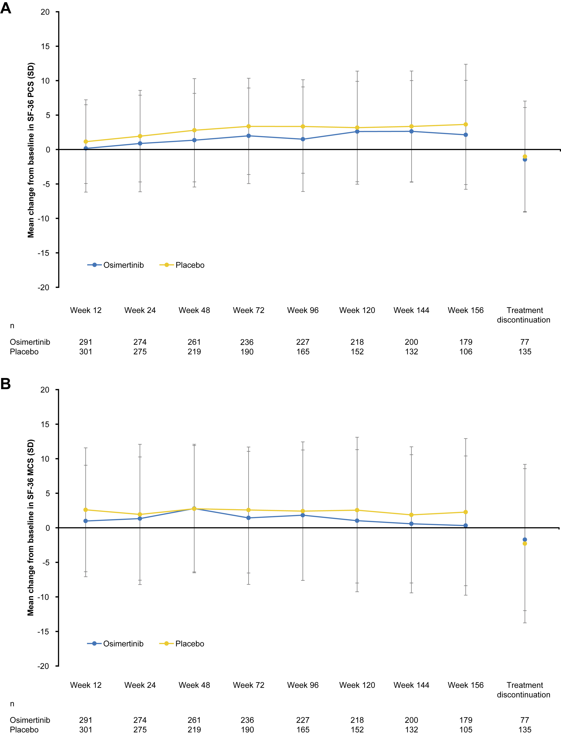
ADAURA—3-year Safety, Tolerability and HRQOL
Adverse events
Dose Discontinuation
Dose Interruption
HRQOL
Dose Reduction
John T et al. J Thorac Oncol 2023;18(9):1209-21.
Notes:
Incidence of (A) most common AEs and (B) selected AEs of clinical interest. ∗Grouped terms. ILD (grouped): ILD and pneumonitis; cardiac effects (grouped), including ejection fraction decrease, cardiac failure, pulmonary edema, and cardiomyopathy. †QTc prolongation placebo grades 3 or 4, less than 1%; cardiac effects placebo grades 3 or 4, less than 1%. AEs, adverse events; ILD, interstitial lung disease; QTc, corrected QT interval.

Slide 37
Questions remain after ADAURA
How can perioperative targeted therapy be optimized?
What is the optimal duration?
Is chemotherapy necessary?
What is the optimal timing for TKI therapy?
Neoadjuvant/adjuvant/both
Which patients benefit?
Stage IA or locally advanced
All EGFR mutations or only Exon 19del/L858R
Can detection of MRD identify patients to intensify or de-intensify therapy?
What are the mechanisms of resistance?
What are the best therapies after relapse?

Slide 38
LAURA—Consolidation osimertinib in unresectable stage III NSCLC, NCT03521154

Slide 39
LAURA—Consolidation osimertinib in unresectable stage III NSCLC, NCT03521154
Osimertinib demonstrated overwhelming efficacy benefit for patients with unresectable, Stage III EGFR-mutated lung cancer in LAURA Phase III trial

Slide 40
Evolving Treatment Landscape for EGFR mutant NSCLC
Increased options for frontline therapy that improve efficacy with osimertinib and chemotherapy and amivantamab and lazertinib
Paradigm for subsequent therapy is shifting with amivantamab and chemotherapy, patritumab deruxtecan and possibly datopotamab deruxtecan with differing mechanisms of action
Adjuvant osimertinib improves OS for resected EGFR mutated NSCLC and should be used for most patients in this setting
Consolidation osimertinib improves PFS for patients following CRT, await full results
Biomarker testing should be done in the perioperative setting for the greatest benefit for all patients
Biomarkers for patient selection will be essential

