Slide 1
Year in Review: Immunotherapy and Other Nontargeted Approaches for Lung Cancer
A CME/MOC-Accredited Live Webinar
Tuesday, June 18, 2024
5:00 PM – 6:00 PM ET
Faculty
Matthew Gubens, MD, MS
Moderator
Neil Love, MD

Slide 2


Faculty
Matthew Gubens, MD, MS
Professor of Medicine
Medical Director, Thoracic Medical Oncology
University of California, San Francisco
San Francisco, California
MODERATOR
Neil Love, MD
Research To Practice
Miami, Florida

Slide 3
Commercial Support
This activity is supported by educational grants from AstraZeneca Pharmaceuticals LP and Daiichi Sankyo Inc.
Research To Practice CME Planning Committee Members,
Staff and Reviewers
Planners, scientific staff and independent reviewers for Research To Practice have no relevant conflicts of interest to disclose.

Slide 4
Dr Gubens — Disclosures
Advisory Committees | AnHeart Therapeutics, AstraZeneca Pharmaceuticals LP, Atreca, Bristol Myers Squibb, Cardinal Health, Genzyme Corporation, Invitae, Johnson & Johnson Pharmaceuticals, Merus, OncoHost, Sanofi, Summit Therapeutics
Contracted Research | Amgen Inc, Johnson & Johnson Pharmaceuticals, Merck, Trizell
Data and Safety Monitoring Board/Committee | Samsung Bioepis

Slide 5
This educational activity contains discussion of
non-FDA-approved uses of agents and regimens. Please refer to official prescribing information for each product for approved indications.

Slide 6
Key Data Sets
Spicer J et al. Neoadjuvant nivolumab (NIVO) + chemotherapy (chemo) vs chemo in patients (pts) with resectable NSCLC: 4-year update from CheckMate 816. ASCO 2024;Abstract LBA8010.
Cascone T et al. Perioperative nivolumab in resectable lung cancer. N Engl J Med 2024 May 16;390(19):1756-69.
Cascone T et al. Clinical outcomes with perioperative nivolumab (NIVO) by nodal status among patients (pts) with stage III resectable NSCLC: Results from the phase 3 CheckMate 77T study. ASCO 2024;Abstract LBA8007.
Wakelee H et al. Perioperative pembrolizumab for early-stage NSCLC. N Engl J Med 2023;389(6):491-503.
Garassino MC et al. Health-related quality of life (HRQoL) outcomes from the randomized, double-blind phase 3 KEYNOTE-671 study of perioperative pembrolizumab for early-stage non-small-cell lung cancer (NSCLC). ASCO 2024;Abstract 8012.
Heymach J et al. Outcomes with perioperative durvalumab (D) in pts with resectable NSCLC and baseline N2 lymph node involvement (N2 R-NSCLC): An exploratory subgroup analysis of AEGEAN. ASCO 2024;Abstract 8011.

Slide 7
Key Data Sets (Continued)
Felip E et al. Overall survival with adjuvant atezolizumab after chemotherapy in resected stage II-IIIA NSCLC (IMpower010): A randomised, multicentre, open-label, phase III trial. Ann Oncol 2023;34(10):907-19.
Oselin K et al. Pembrolizumab vs placebo for early-stage NSCLC after resection and adjuvant therapy: Subgroup analysis of patients who received adjuvant chemotherapy in the phase III PEARLS/KEYNOTE-091 study. ASCO 2023;Abstract 8520.
Khan S et al. ctDNA-Lung-DETECT: ctDNA outcomes for resected early-stage non-small cell lung cancers at 12 months. ASCO 2024;Abstract 8018.
Rodrigues G et al. American Radium Society appropriate use criteria for unresectable locally advanced non-small cell lung cancer. JAMA Oncol 2024 April 11;[Online ahead of print].
Ramalingam SS et al.
Filippi AR et al. Real-world outcomes with durvalumab after chemoradiotherapy in patients with unresectable stage III NSCLC: Interim analysis of overall survival from PACIFIC-R. ESMO Open 2024 June 3;9(6):103464.

Slide 8
Key Data Sets (Continued)
Filippi ARR et al. Durvalumab after radiotherapy in patients with unresectable stage III NSCLC ineligible for chemotherapy: Primary results from the DUART study. ESMO 2023;Abstract LBA62.
de Castro G Jr et al. Five-year outcomes with pembrolizumab versus chemotherapy as first-line therapy in patients with NSCLC and PD-L1 tumor proportion score ≥1% in the KEYNOTE-042 study.
J Clin Oncol 2023;41(11):1986-91.
Garassino MC et al. Pembrolizumab plus pemetrexed and platinum in nonsquamous NSCLC: 5-year outcomes from the phase III KEYNOTE-189 study. J Clin Oncol 2023;41(11):1992-8.
Novello S et al. Pembrolizumab plus chemotherapy in squamous NSCLC: 5-year update of the phase III KEYNOTE-407 study. J Clin Oncol 2023;41(11):1999-2006.
Ramalingam SS et al. Six-year survival and HRQoL outcomes with 1L nivolumab + ipilimumab in patients with metastatic NSCLC (mNSCLC) from CheckMate227. WCLC 2023;Abstract OA14.03.
Reck M et al. Five-year outcomes with first-line (1L) nivolumab + ipilimumab + chemotherapy
(N + I + C) vs C in patients (pts) with metastatic NSCLC (mNSCLC) in CheckMate 9LA. ASCO 2024;Abstract 8560.

Slide 9
Key Data Sets (Continued)
Johnson ML et al. Durvalumab with or without tremelimumab in combination with chemotherapy as first-line therapy for mNSCLC: The phase III POSEIDON study. J Clin Oncol 2023;41(6):1213-27.
Peters S et al. Durvalumab ± tremelimumab + chemotherapy in first-line metastatic NSCLC: 5-year overall survival update from the POSEIDON study. ESMO Immuno-Oncology 2023;Abstract LBA3.
Ahn M-J et al. Datopotamab deruxtecan (Dato-DXd) vs docetaxel in previously treated advanced/metastatic (adv/met) non-small cell lung cancer (NSCLC): Results of the randomized phase 3 study TROPION-Lung01. ESMO Asia 2023;Abstract 509MO.
Goto Y et al. TROPION-Lung02: Dato-DXd plus pembrolizumab with or without platinum chemotherapy in advanced NSCLC. ASCO 2023;Abstract 9004.
Levy B et al. Datopotamab deruxtecan (Dato-DXd) plus pembrolizumab (pembro) with or without platinum chemotherapy (Pt-CT) as first-line (1L) therapy for advanced non-small cell lung cancer (aNSCLC): Subgroup analysis from TROPION-Lung02. ASCO 2024;Abstract 8617.

Slide 10
Key Data Sets (Continued)
Planchard D et al. ICARUS-LUNG01: A phase 2 study of datopotomab deruxtecan (Dato-DXd) in patients with previously treated advanced non-small cell lung cancer (NSCLC), with sequential tissue biopsies and biomarkers analysis to predict treatment outcome. ASCO 2024;Abstract 8501.
Paz-Ares L et al. TROPION-Lung05: Datopotamab deruxtecan (Dato-DXd) in previously treated non-small cell lung cancer (NSCLC) with actionable genomic alterations (AGAs). ESMO 2023;Abstract 1314MO.
Lisberg A et al. Intracranial efficacy of datopotamab deruxtecan (Dato-DXd) in patients (pts) with previously treated advanced/metastatic non-small cell lung cancer (a/m NSCLC)
with actionable genomic alterations (AGA): Results from TROPION-Lung05. ASCO 2024;Abstract 8593.
Benjamin DJ et al. The role of chemotherapy plus immune checkpoint inhibitors in oncogenic-driven NSCLC: A University of California Lung Cancer Consortium retrospective study. JTO Clin Res Rep 2022 October 29;3(12):100427.
Middleton G et al. A phase II trial of ceralasertib and durvalumab in advanced NSCLC with and without RAS mutations: Results of NLMT arm J. WCLC 2023;Abstract MA06.06.

Slide 11
Key Data Sets (Continued)
Besse B et al. Biomarker-directed targeted therapy plus durvalumab in advanced non-small-cell lung cancer: A phase 2 umbrella trial. Nat Med 2024;30(3):716-29.
Spigel DR et al. ADRIATIC: Durvalumab (D) as consolidation treatment (tx) for patients (pts) with limited-stage small-cell lung cancer (LS-SCLC). ASCO 2024;Abstract LBA5.
Lee S-H et al. A phase II, open-label, combination therapy of durvalumab and ceralasertib in relapsed and refractory small cell lung cancer (SUKSES-N4). ASCO 2024;Abstract 8104.
Johnson M et al. Ifinatamab deruxtecan (I-DXd; DS-7300) in patients with refractory SCLC: A subgroup analysis of a phase 1/2 study. WCLC 2023;Abstract OA05.05.
Dowlati A et al. Sacituzumab govitecan as second-line treatment for extensive SCLC: Preliminary results from the phase II TROPiCS-03 basket trial. ESMO 2023;Abstract 1990MO.
Paz-Ares L et al. Tarlatamab, a first-in-class DLL3-targeted bispecific T-cell engager, in recurrent SCLC: An open-label, phase I study. J Clin Oncol 2023;41(16):2893-903.
Paz-Ares L et al. Tarlatamab for patients with previously treated SCLC: Primary analysis of the phase II DeLLphi-301 study. ESMO 2023;Abstract LBA92.

Slide 12
Agenda
INTRODUCTION: Risk of Autoimmune Toxicity with Checkpoint Inhibitors
MODULE 1: Immunotherapy in the Neoadjuvant/Adjuvant Setting
MODULE 2: Immunotherapy for Locally Advanced NSCLC
MODULE 3: First-Line Immunotherapy for Metastatic NSCLC
MODULE 4: Novel Agents and Strategies
MODULE 5: Immunotherapy for NSCLC with a Targetable Mutation
MODULE 6: Small Cell Lung Cancer

Slide 13
Agenda
INTRODUCTION: Risk of Autoimmune Toxicity with Checkpoint Inhibitors
MODULE 1: Immunotherapy in the Neoadjuvant/Adjuvant Setting
MODULE 2: Immunotherapy for Locally Advanced NSCLC
MODULE 3: First-Line Immunotherapy for Metastatic NSCLC
MODULE 4: Novel Agents and Strategies
MODULE 5: Immunotherapy for NSCLC with a Targetable Mutation
MODULE 6: Small Cell Lung Cancer

Slide 14
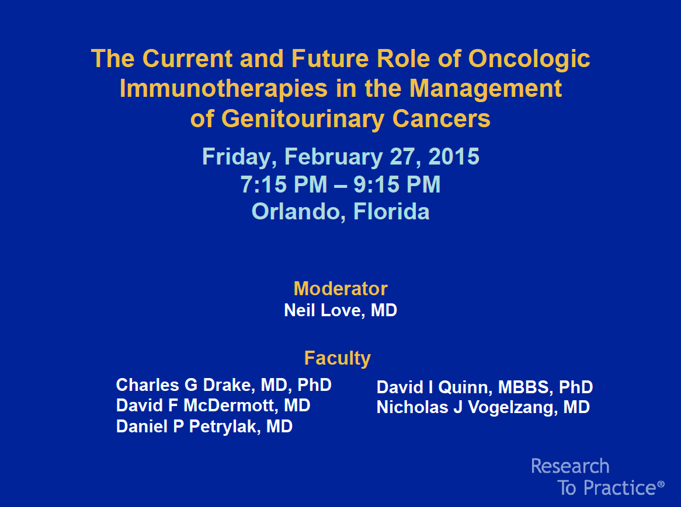

Slide 15
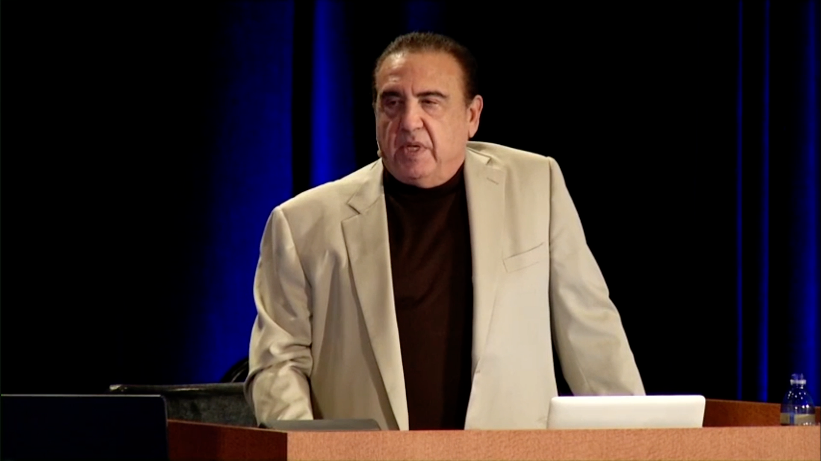
ASCO Genitourinary Cancers Symposium, February 27, 2015.

Slide 16
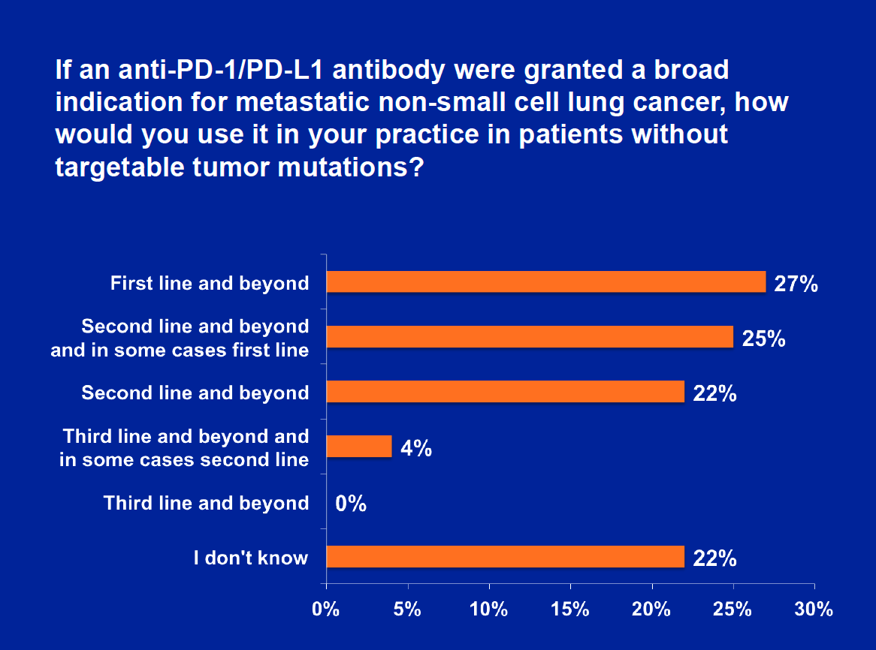
ASCO Genitourinary Cancers Symposium, February 27, 2015.

Slide 17
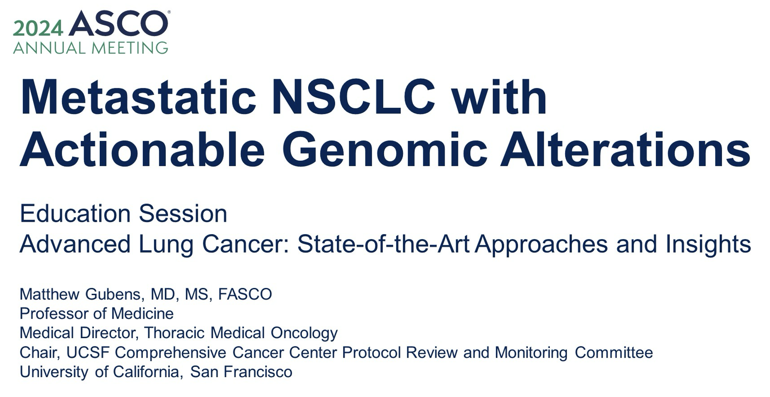

Slide 18
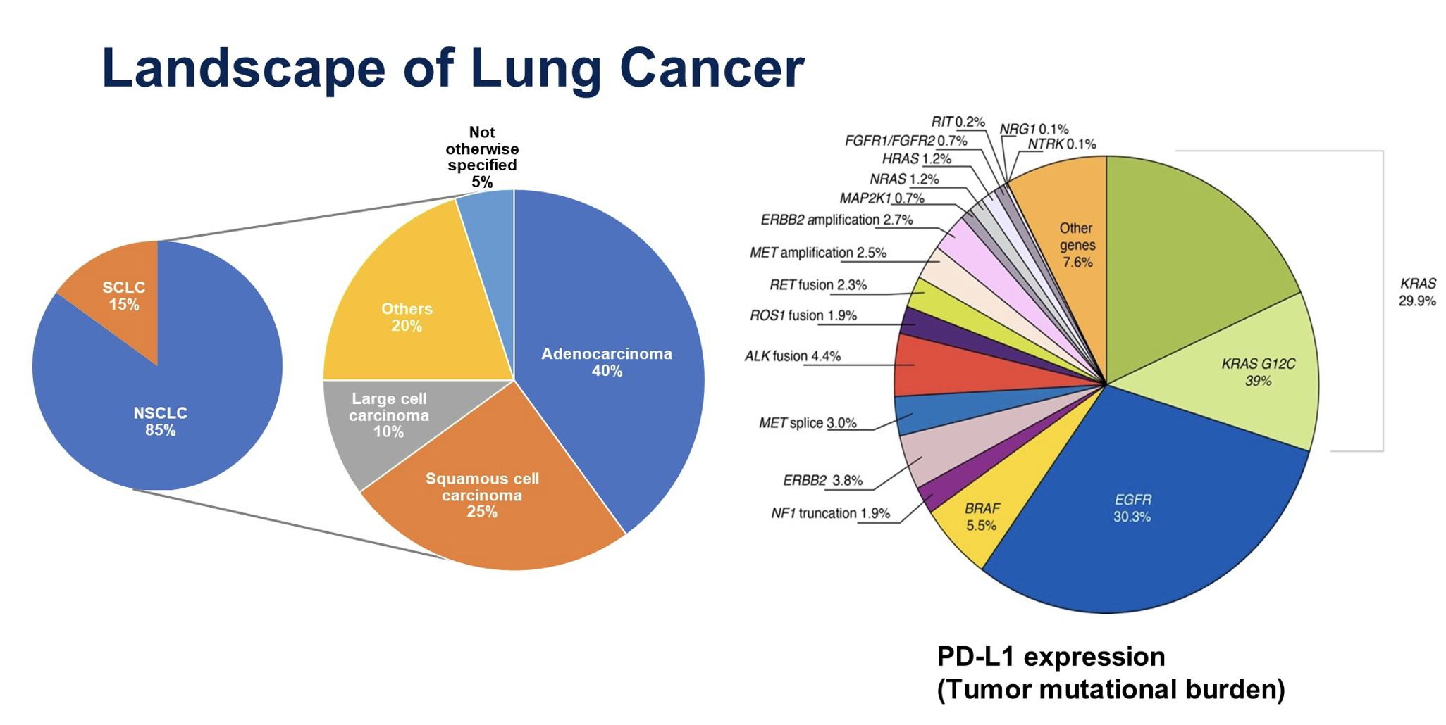
Gubens M. ASCO 2024 Education Session.

Slide 19
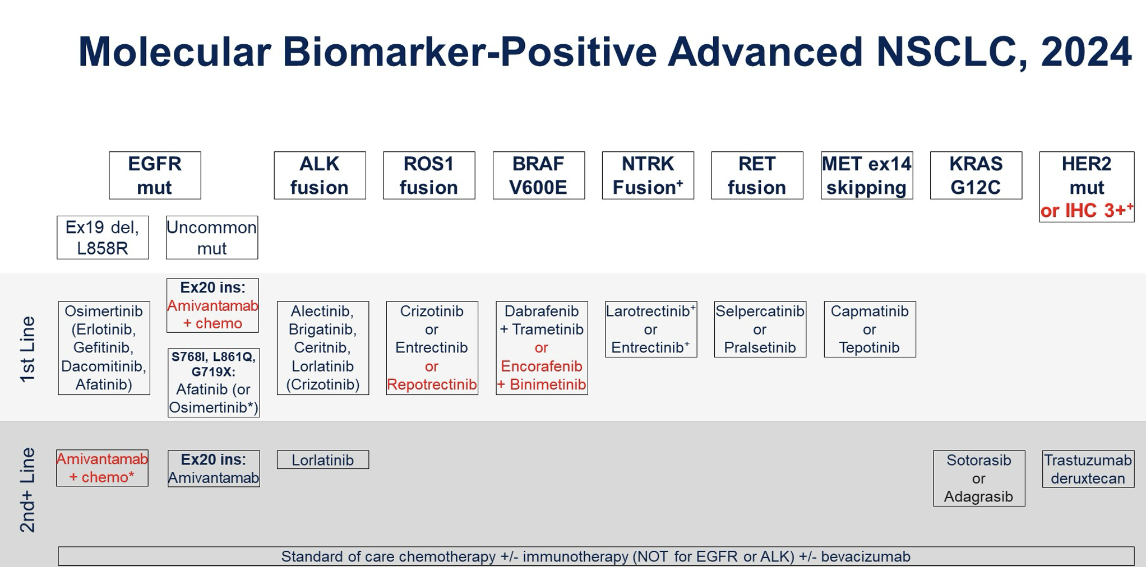
Gubens M. ASCO 2024 Education Session.

Slide 20
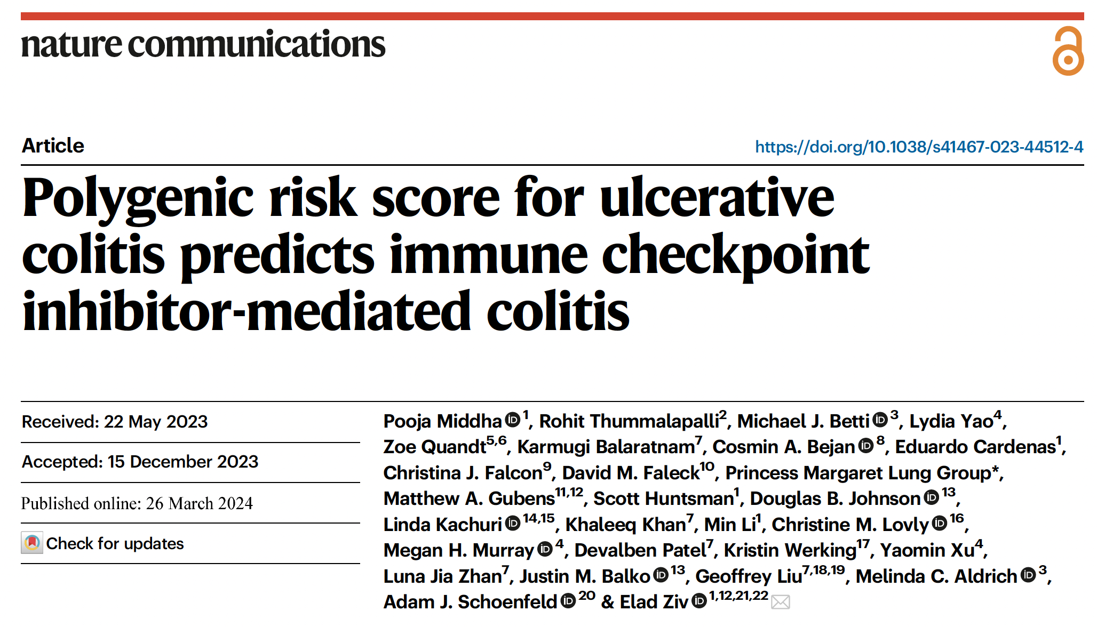

Slide 21
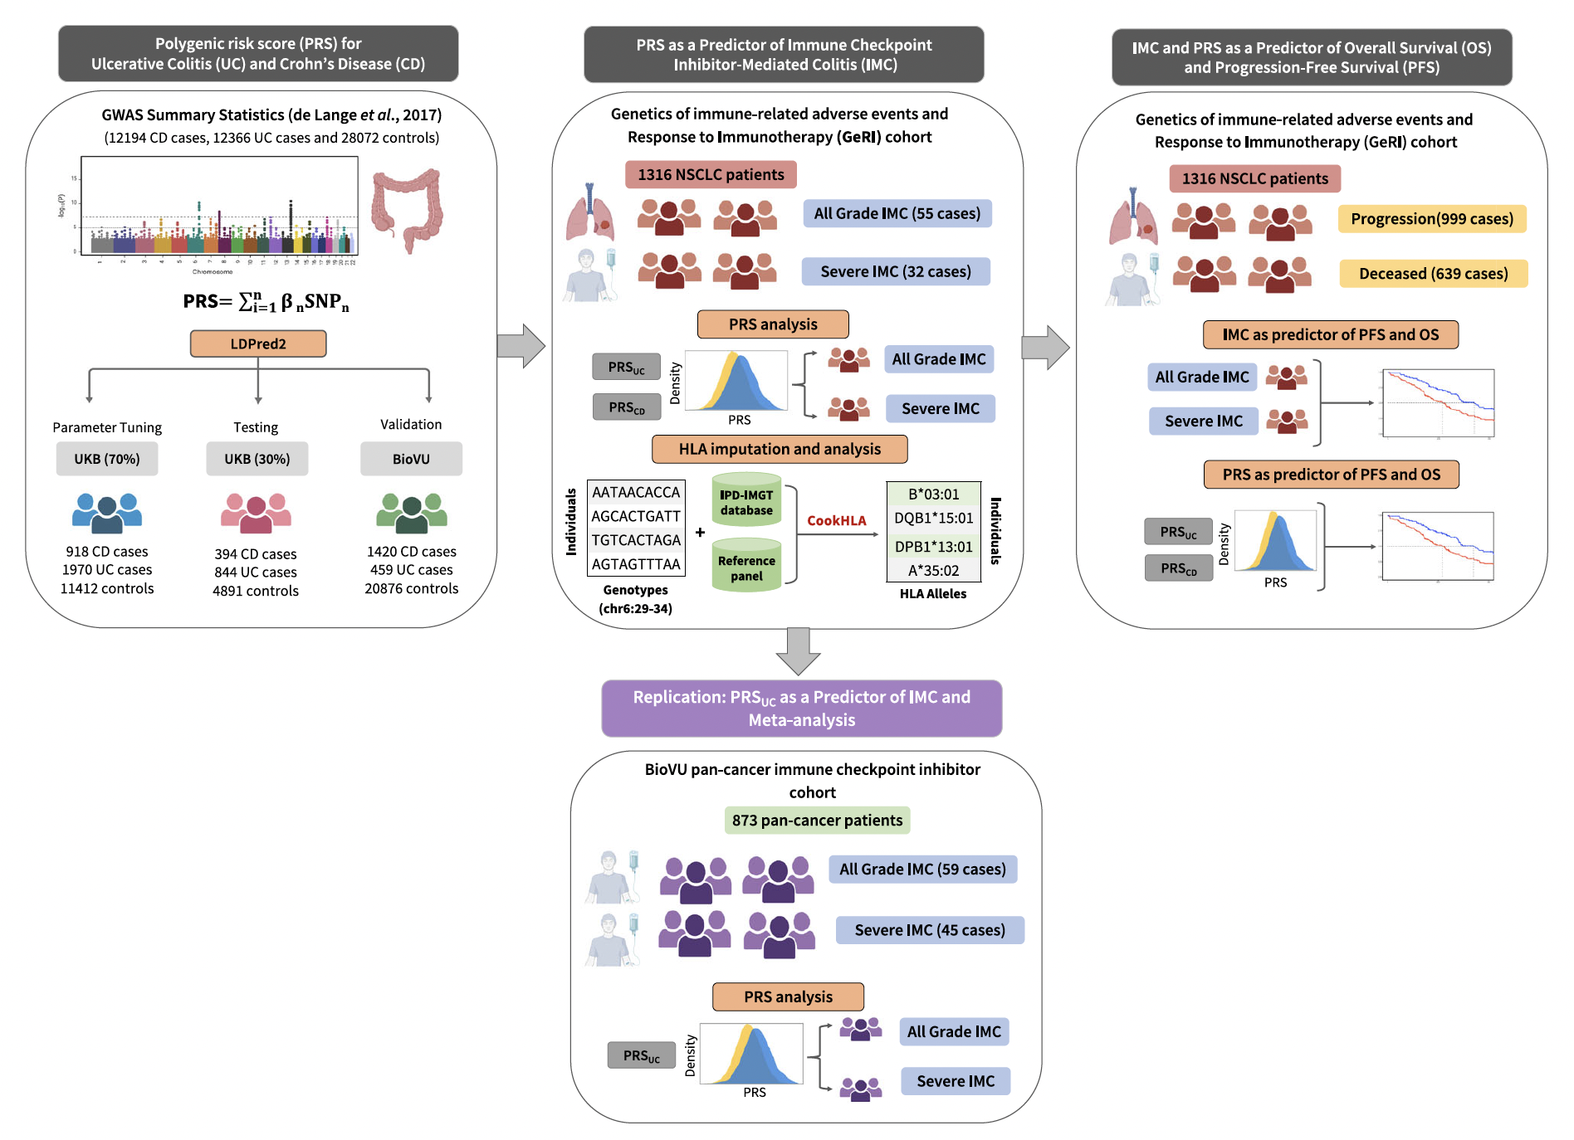
Polygenic Risk Score for Ulcerative Colitis Predicts Immune Checkpoint Inhibitor-Mediated Colitis
Middha P et al. Nat Commun 2024 March 26;[Online ahead of print].

Slide 22
Polygenic Risk Score for Ulcerative Colitis Predicts Immune Checkpoint Inhibitor-Mediated Colitis (Continued)
Middha P et al. Nat Commun 2024 March 26;[Online ahead of print].

Slide 23
Polygenic Risk Score for Ulcerative Colitis Predicts Immune Checkpoint Inhibitor-Mediated Colitis (Continued)
Middha P et al. Nat Commun 2024 March 26;[Online ahead of print].

Slide 24
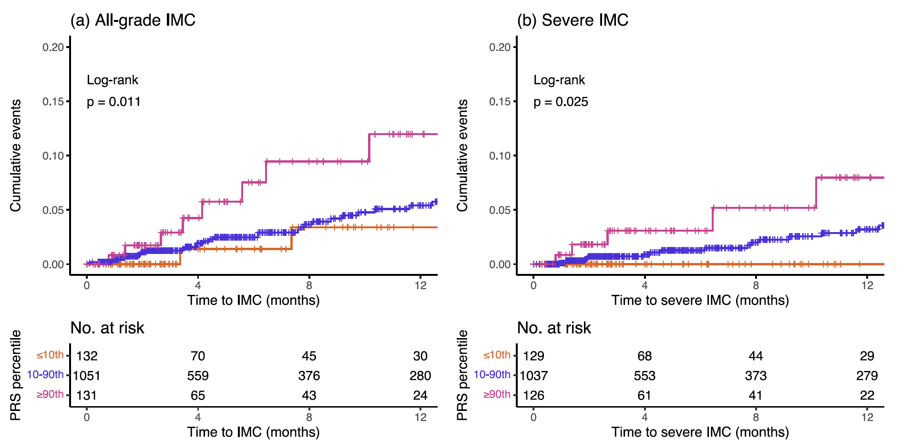
All-Grade and Severe Immune Checkpoint Inhibitor-Mediated Colitis by Polygenic Risk Score for Ulcerative Colitis in the GeRI Cohort
GeRI = genetics of immune-related adverse events and response to immunotherapy
Middha P et al. Nat Commun 2024 March 26;[Online ahead of print].

Slide 25
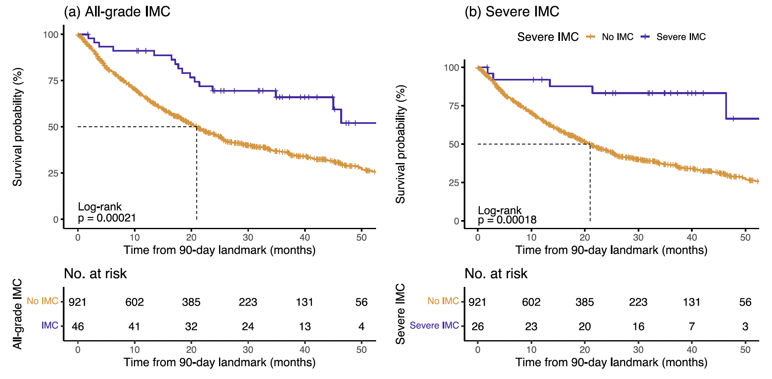
Immune Checkpoint Inhibitor-Mediated Colitis as a Predictor of
Overall Survival in the Entire GeRI Cohort
Middha P et al. Nat Commun 2024 March 26;[Online ahead of print].

Slide 26
Agenda
INTRODUCTION: Risk of Autoimmune Toxicity with Checkpoint Inhibitors
MODULE 1: Immunotherapy in the Neoadjuvant/Adjuvant Setting
MODULE 2: Immunotherapy for Locally Advanced NSCLC
MODULE 3: First-Line Immunotherapy for Metastatic NSCLC
MODULE 4: Novel Agents and Strategies
MODULE 5: Immunotherapy for NSCLC with a Targetable Mutation
MODULE 6: Small Cell Lung Cancer

Slide 27
Neoadjuvant and Perioperative Immunotherapy for NSCLC
Spicer J et al. Neoadjuvant nivolumab (NIVO) + chemotherapy (chemo) vs chemo in patients (pts) with resectable NSCLC: 4-year update from CheckMate 816. ASCO 2024;Abstract LBA8010.
Cascone T et al. Perioperative nivolumab in resectable lung cancer. N Engl J Med 2024 May 16;390(19):1756-69.
Cascone T et al. Clinical outcomes with perioperative nivolumab (NIVO) by nodal status among patients (pts) with stage III resectable NSCLC: Results from the phase 3 CheckMate 77T study. ASCO 2024;Abstract LBA8007.
Wakelee H et al. Perioperative pembrolizumab for early-stage NSCLC. N Engl J Med 2023;389(6):491-503.
Garassino MC et al. Health-related quality of life (HRQoL) outcomes from the randomized, double-blind phase 3 KEYNOTE-671 study of perioperative pembrolizumab for early-stage non-small-cell lung cancer (NSCLC). ASCO 2024;Abstract 8012.
Heymach J et al. Outcomes with perioperative durvalumab (D) in pts with resectable NSCLC and baseline N2 lymph node involvement (N2 R-NSCLC): An exploratory subgroup analysis of AEGEAN. ASCO 2024;Abstract 8011.

Slide 28
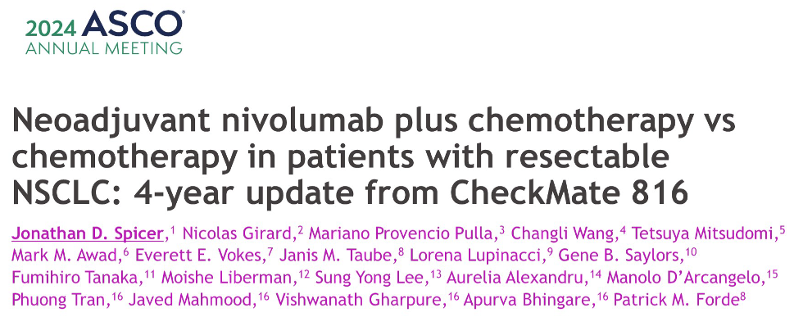
Abstract LBA8010

Slide 29
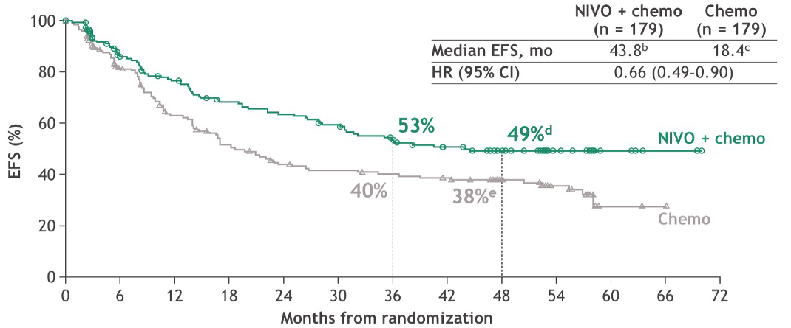
CheckMate 816 4-Year Update: Event-Free Survival (EFS)
Spicer J et al. ASCO 2024;Abstract LBA8010.

Slide 30
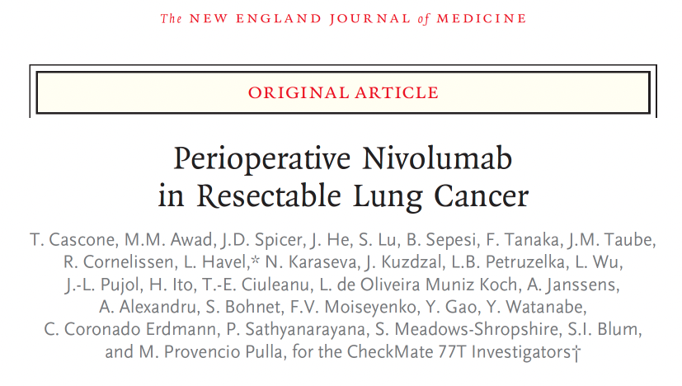
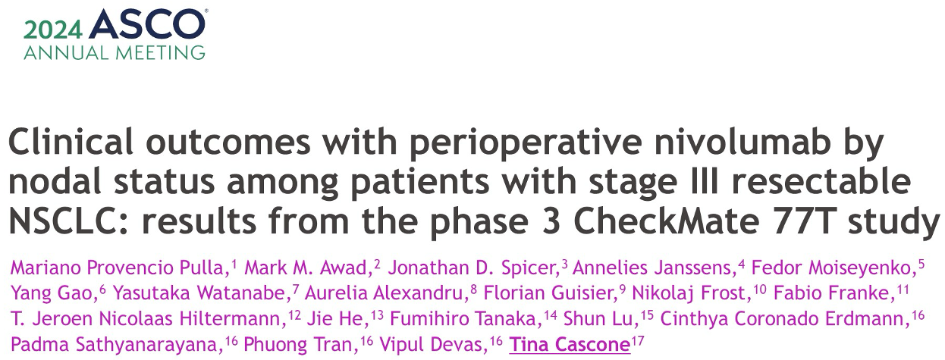
2024 May 16;390(19):1756-69
Abstract LBA8007

Slide 31

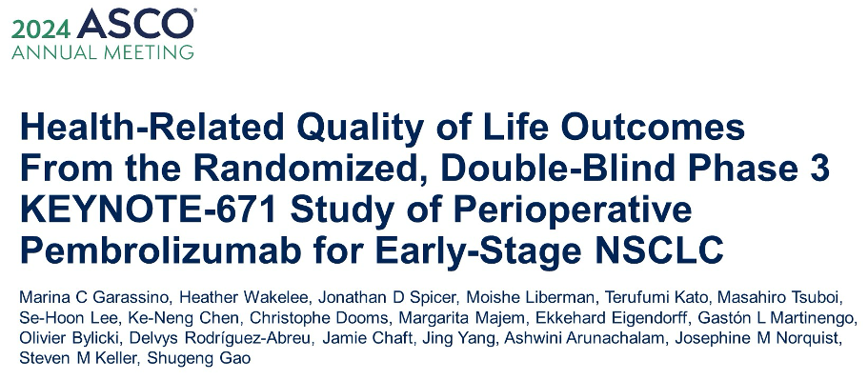
2023;389(6):491-503
Abstract 8012

Slide 32
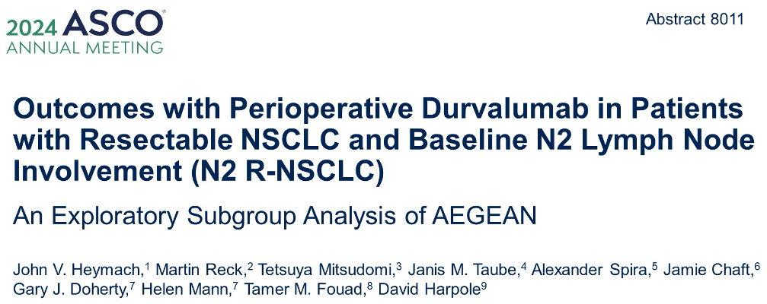

Slide 33
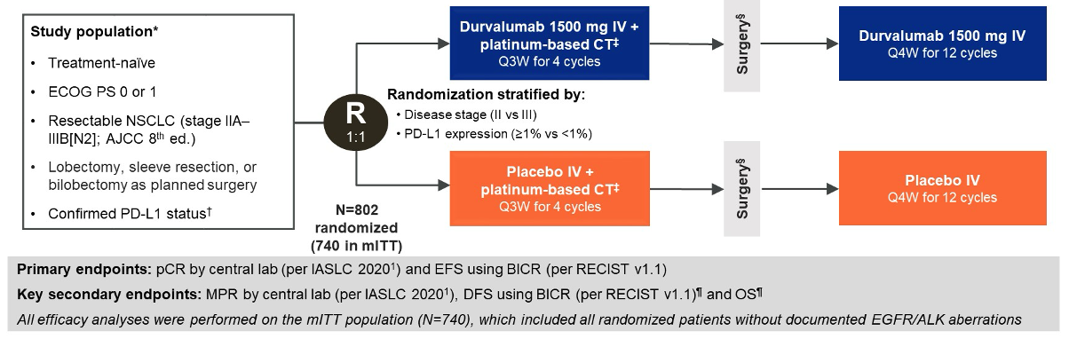
AEGEAN: Phase III Study Design
Heymach J et al. ASCO 2024;Abstract 8011.

Slide 34
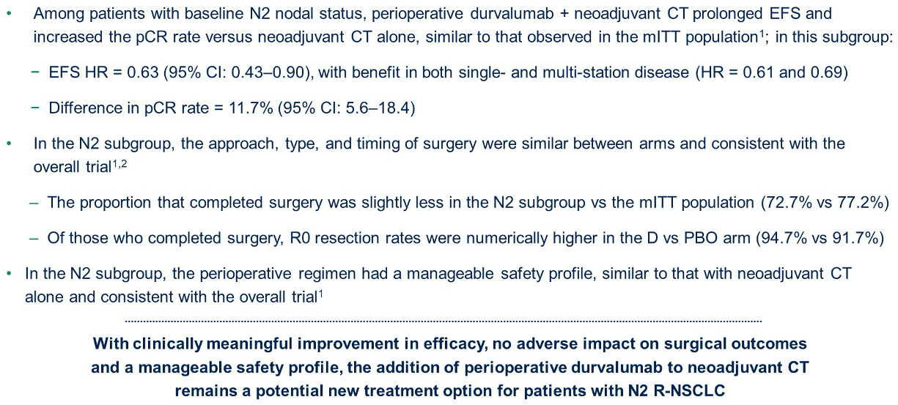
AEGEAN Subgroup Analysis: Author Conclusions
Heymach J et al. ASCO 2024;Abstract 8011.

Slide 35
Adjuvant Immunotherapy for NSCLC
Felip E et al. Overall survival with adjuvant atezolizumab after chemotherapy in resected stage II-IIIA NSCLC (IMpower010): A randomised, multicentre, open-label, phase III trial. Ann Oncol 2023;34(10):907-19.
Oselin K et al. Pembrolizumab vs placebo for early-stage NSCLC after resection and adjuvant therapy: Subgroup analysis of patients who received adjuvant chemotherapy in the phase III PEARLS/KEYNOTE-091 study. ASCO 2023;Abstract 8520.
Khan S et al. ctDNA-Lung-DETECT: ctDNA outcomes for resected early-stage non-small cell lung cancers at 12 months. ASCO 2024;Abstract 8018.

Slide 36
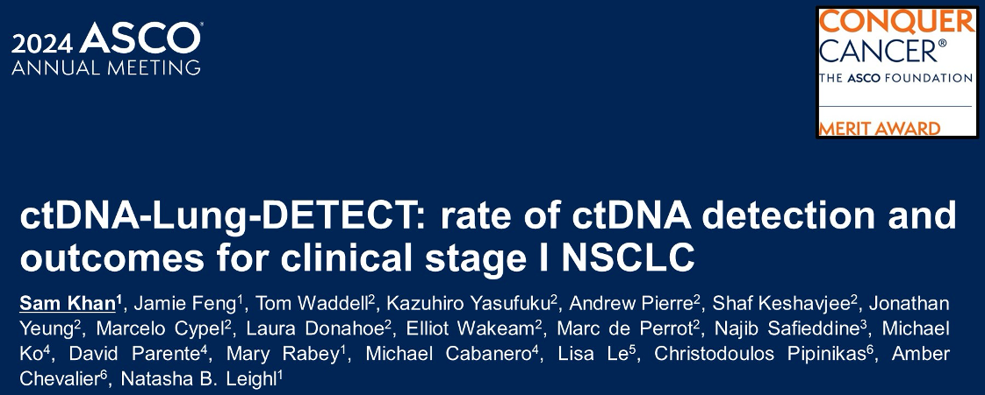
Abstract 8018

Slide 37
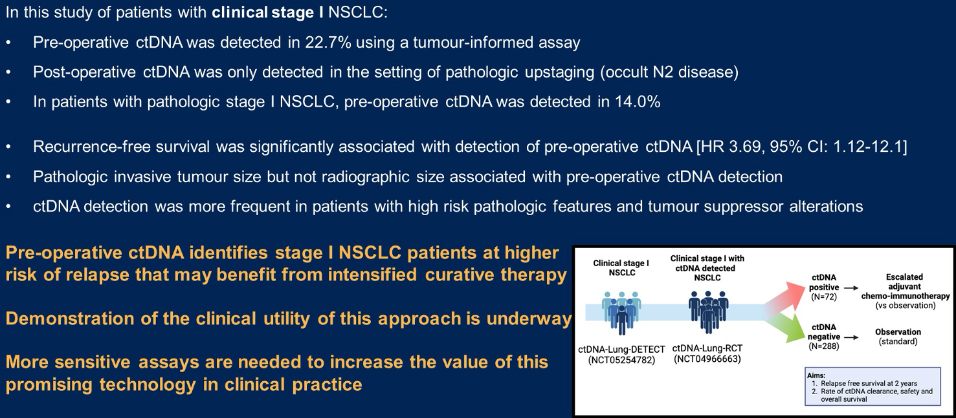
ctDNA-Lung-DETECT: Author Conclusions
Khan S et al. ASCO 2024;Abstract 8018.

Slide 38
Agenda
INTRODUCTION: Risk of Autoimmune Toxicity with Checkpoint Inhibitors
MODULE 1: Immunotherapy in the Neoadjuvant/Adjuvant Setting
MODULE 2: Immunotherapy for Locally Advanced NSCLC
MODULE 3: First-Line Immunotherapy for Metastatic NSCLC
MODULE 4: Novel Agents and Strategies
MODULE 5: Immunotherapy for NSCLC with a Targetable Mutation
MODULE 6: Small Cell Lung Cancer

Slide 39
Consolidation for Locally Advanced NSCLC
Rodrigues G et al. American Radium Society appropriate use criteria for unresectable locally advanced non-small cell lung cancer. JAMA Oncol 2024 April 11;[Online ahead of print].
Lu S et al. Osimertinib after Chemoradiotherapy in Stage III EGFR-Mutated NSCLC. N Engl J Med 2024; Jun 2 [online ahead of print]
Filippi AR et al. Real-world outcomes with durvalumab after chemoradiotherapy in patients with unresectable stage III NSCLC: Interim analysis of overall survival from PACIFIC-R. ESMO Open 2024 June 3;9(6):103464.
Filippi ARR et al. Durvalumab after radiotherapy in patients with unresectable stage III NSCLC ineligible for chemotherapy: Primary results from the DUART study. ESMO 2023;Abstract LBA62.

Slide 40
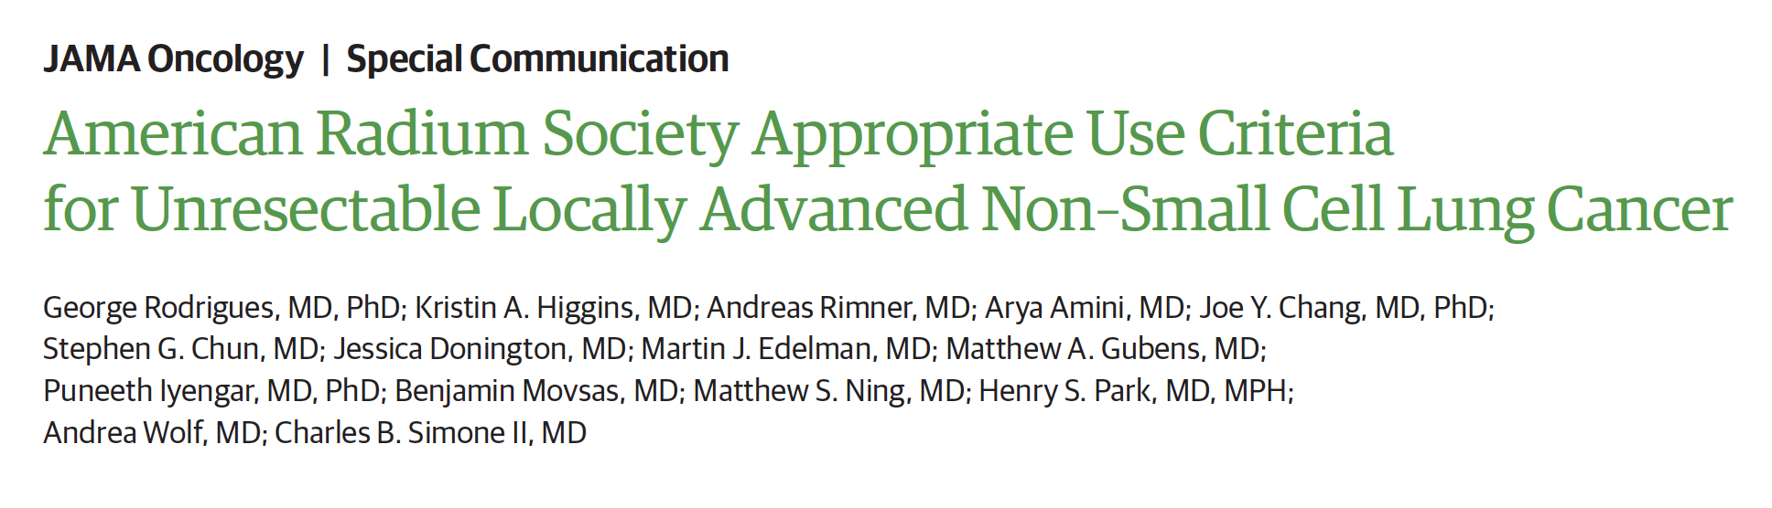
JAMA Oncol 2024; April 11;[Online ahead of print].

Slide 41
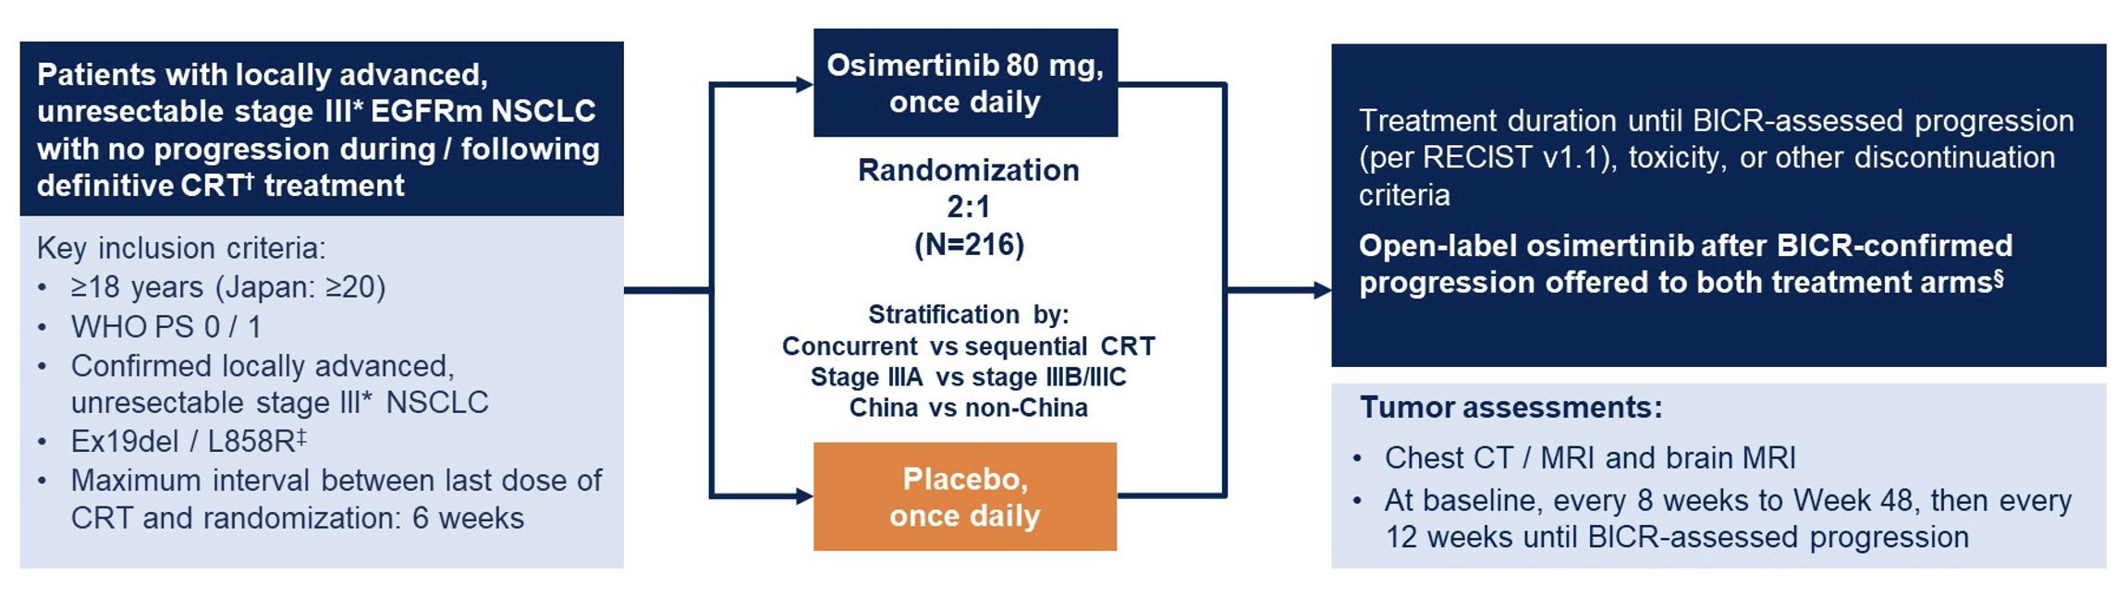
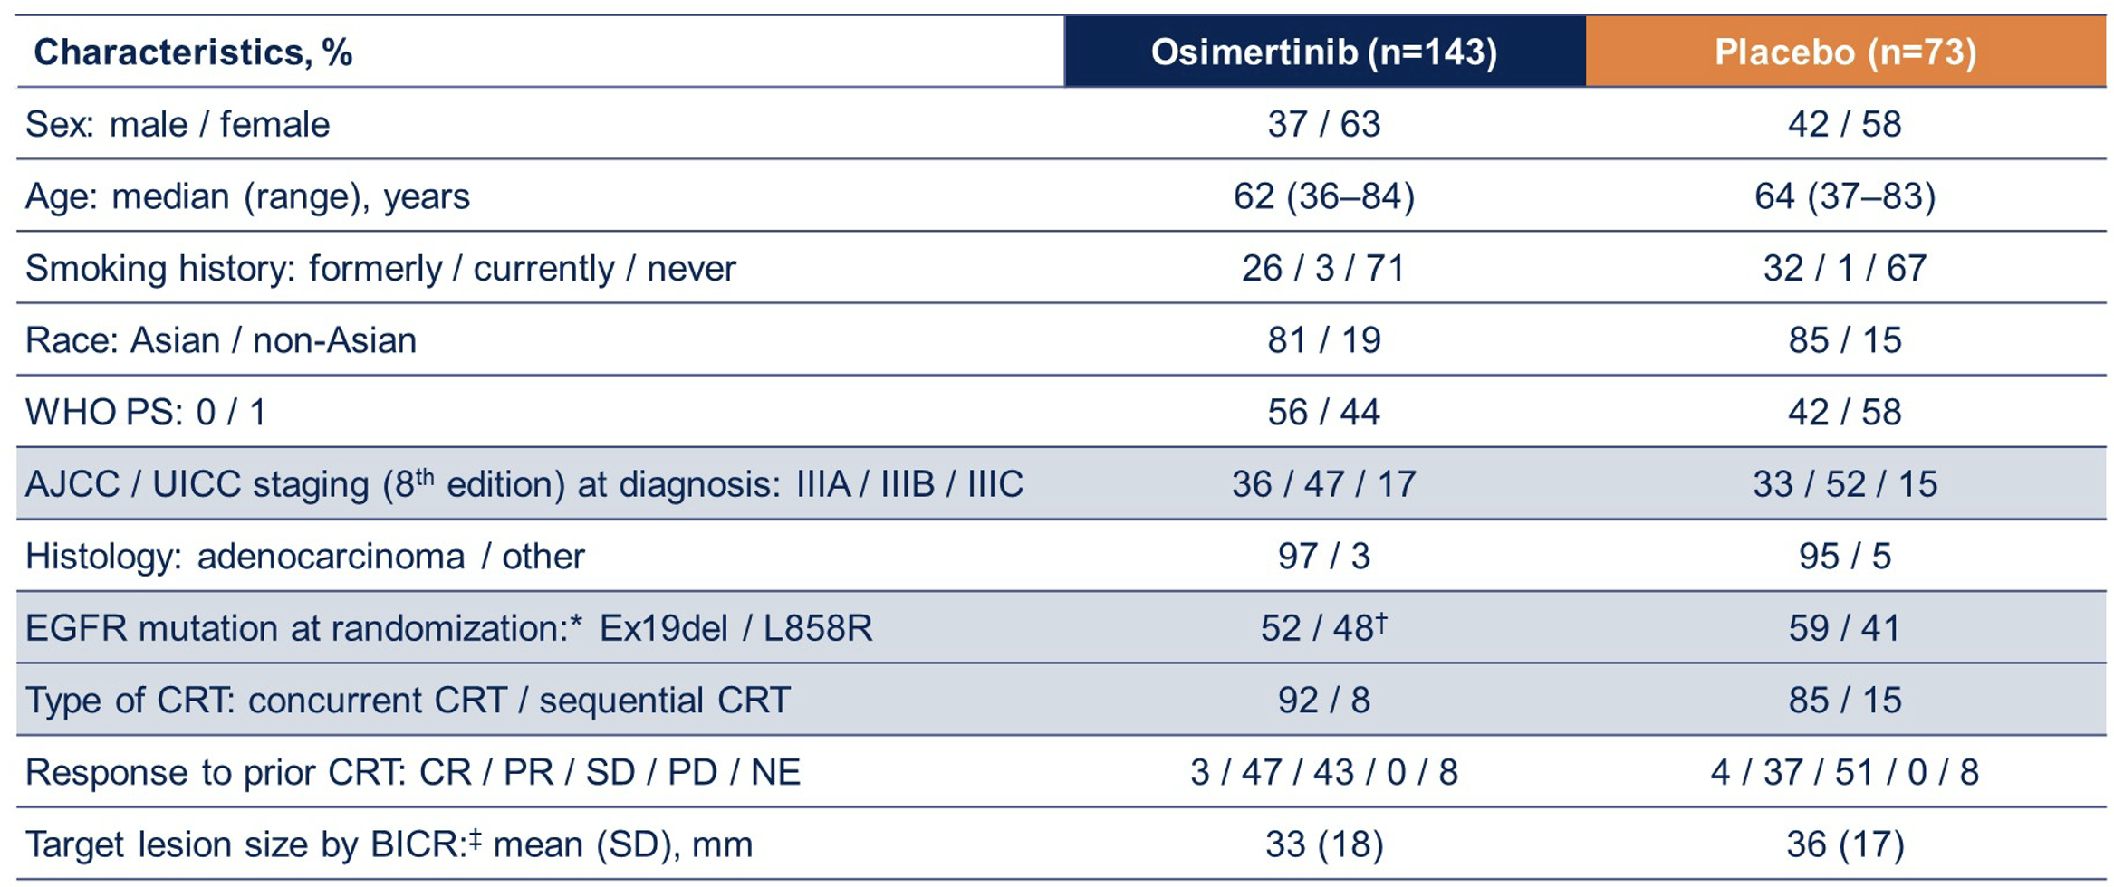
LAURA Phase III Study
Ramalingam SS et al. ASCO 2024;Abstract LBA4. Lu S et al. N Engl J Med 2024 June 2;[Online ahead of print].

Slide 42
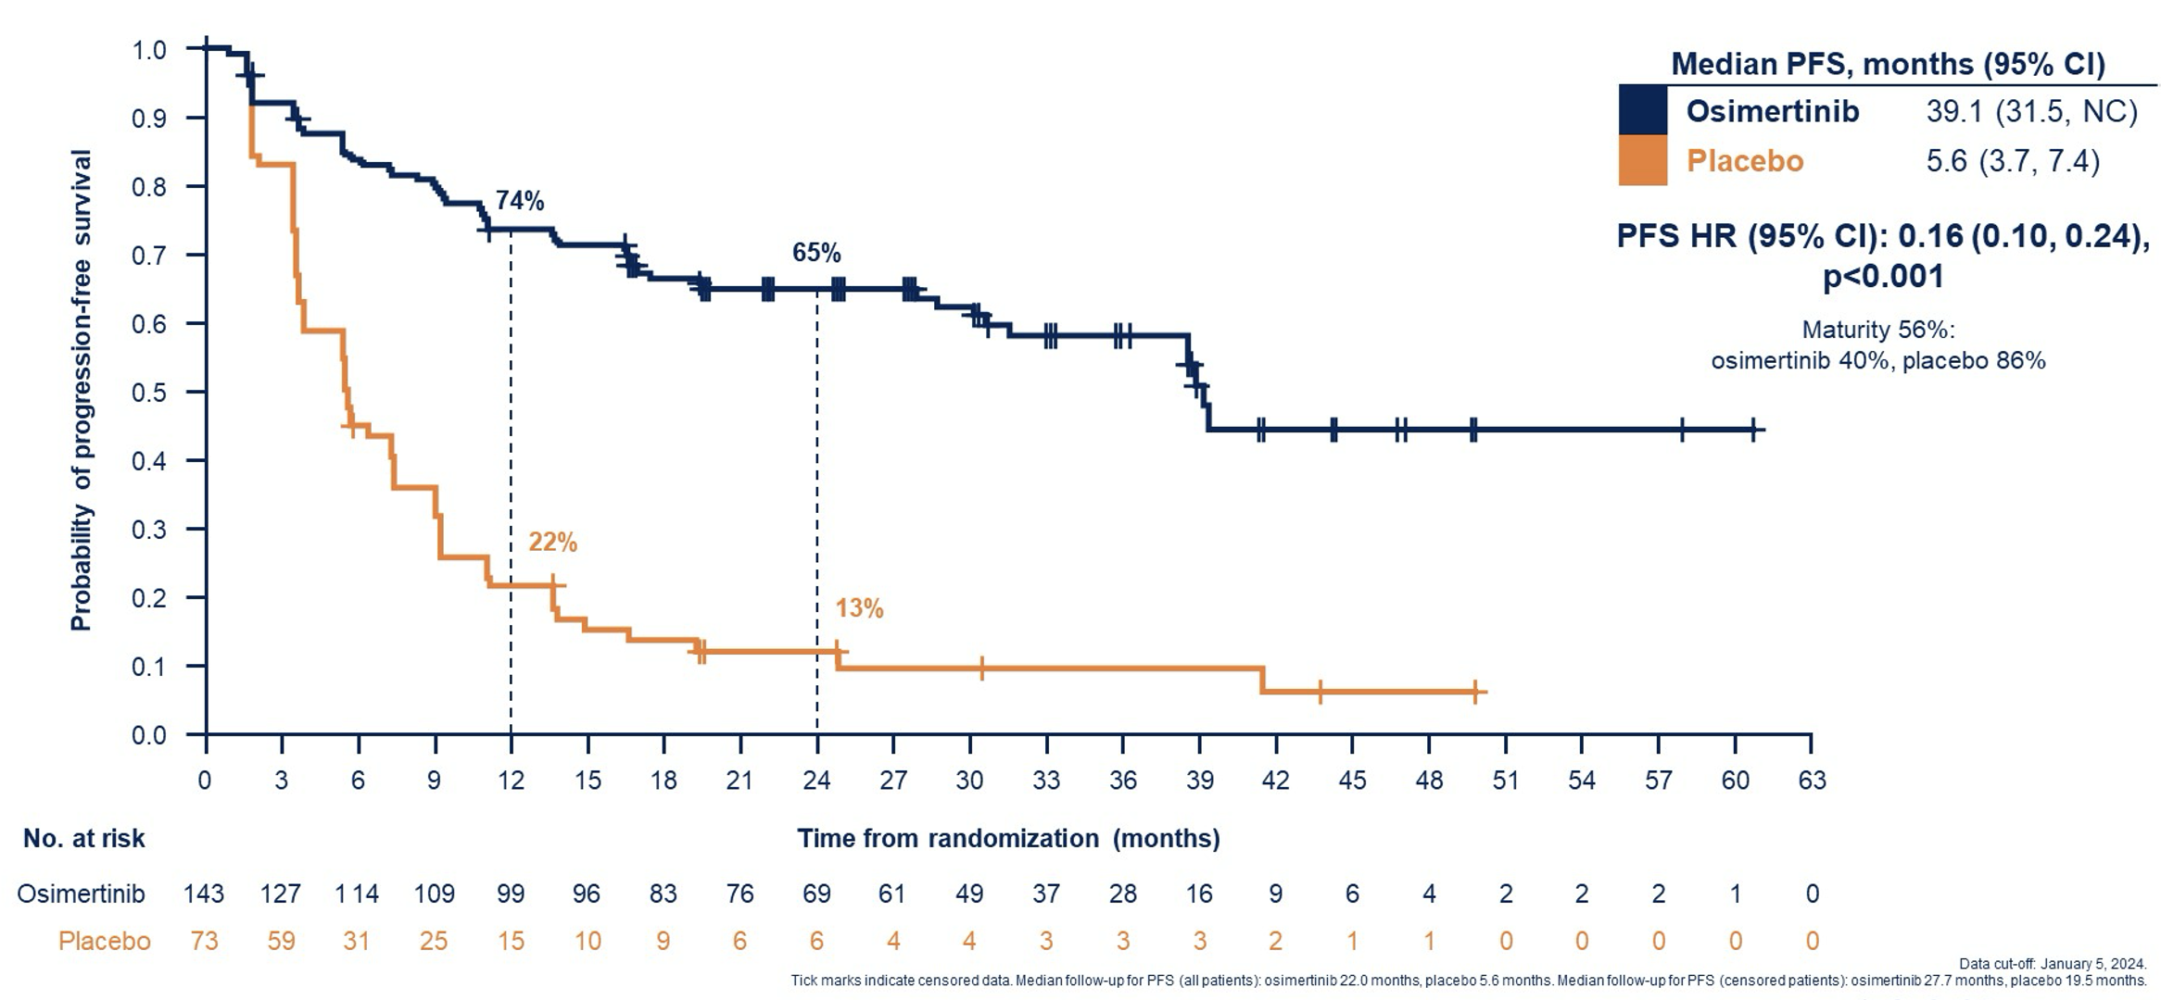
LAURA: PFS Outcomes by BICR
Ramalingam SS et al. ASCO 2024;Abstract LBA4. Lu S et al. N Engl J Med 2024 June 2;[Online ahead of print]

Slide 43
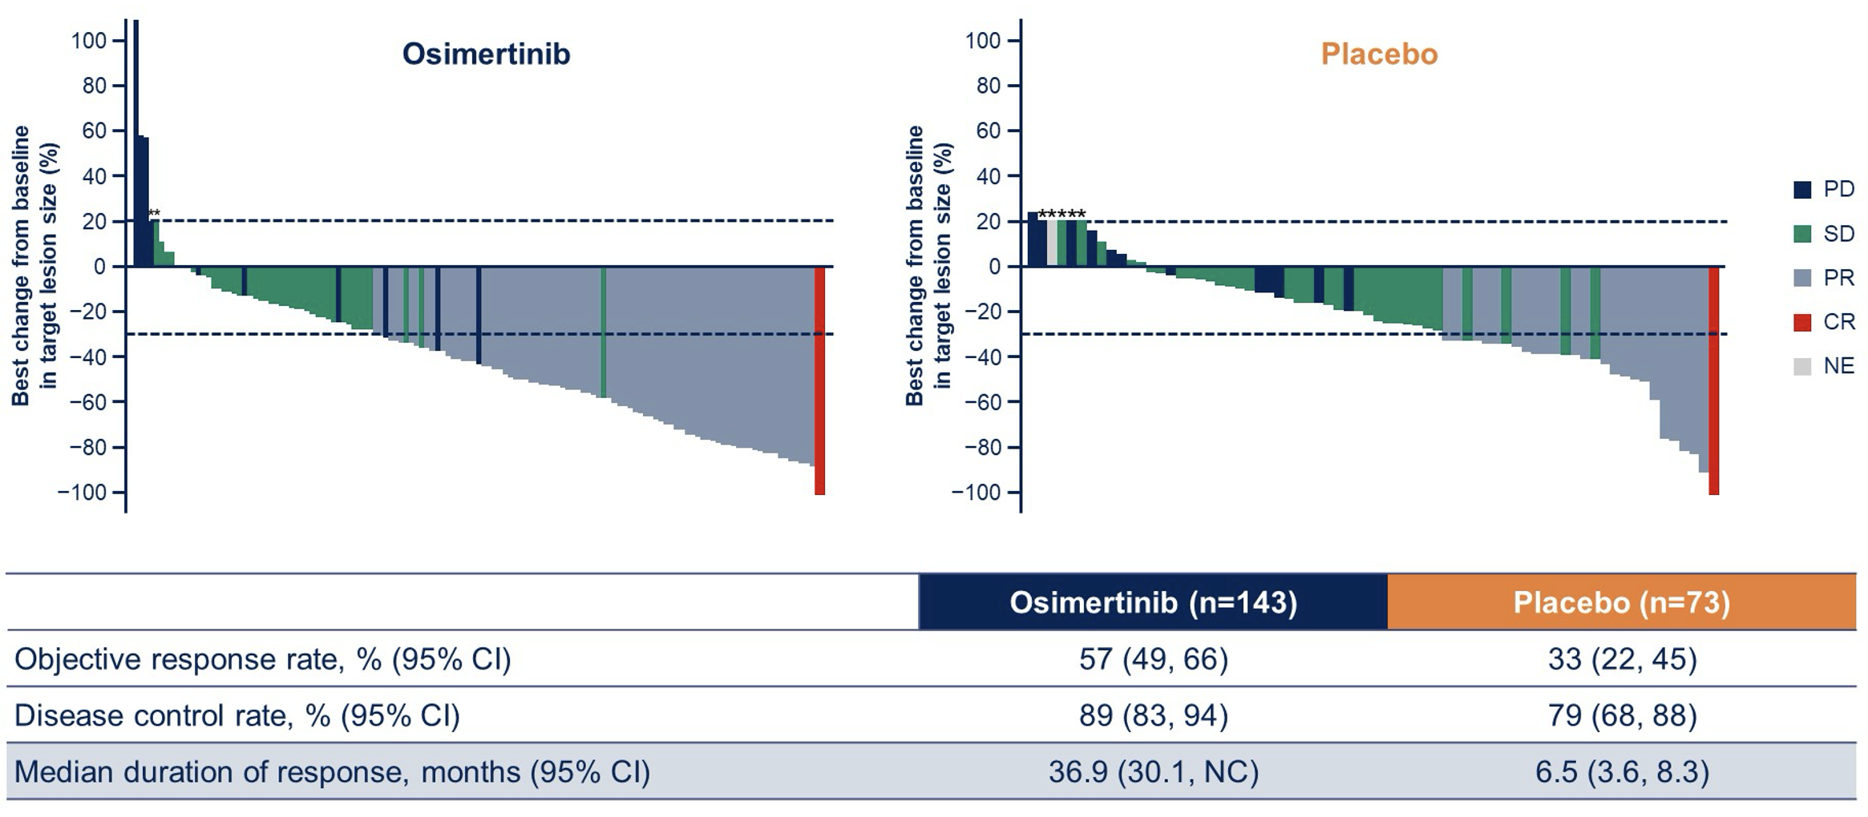
LAURA: Tumor Response by BICR
Ramalingam SS et al. ASCO 2024;Abstract LBA4.

Slide 44
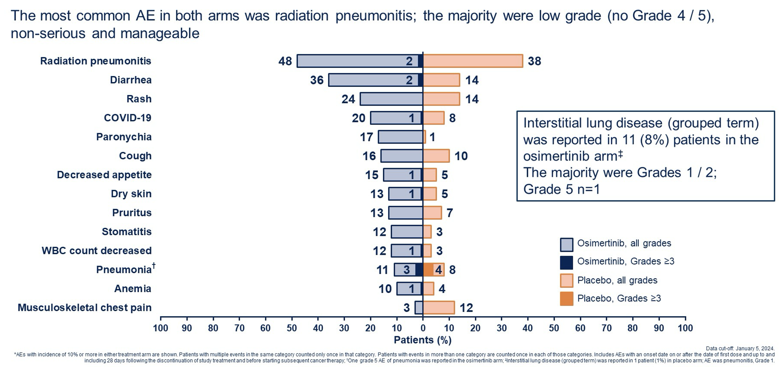
LAURA: Safety Profile
Ramalingam SS et al. ASCO 2024;Abstract LBA4.

Slide 45

ESMO Open 2024 June 3;9(6):103464

Slide 46
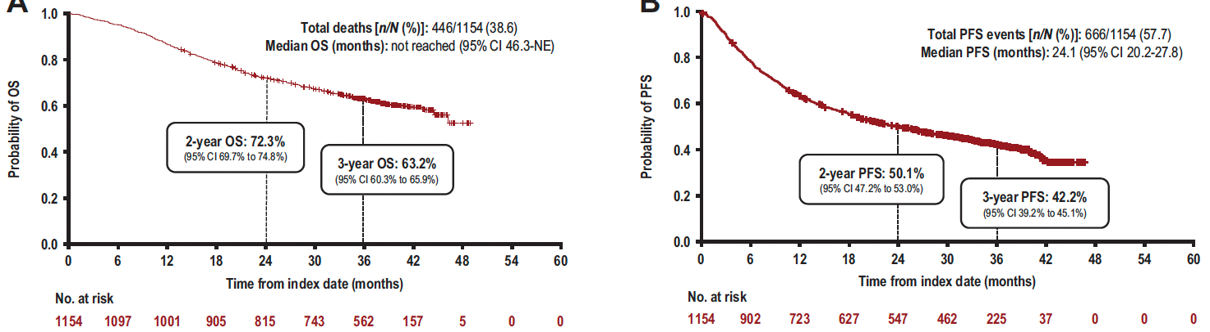
PACIFIC-R Study: Overall Survival (OS) and Investigator-Assessed Progression-Free Survival (PFS) in the Full Analysis Set
Filippi AR et al. ESMO Open 2024 June 3;9(6):103464.

Slide 47
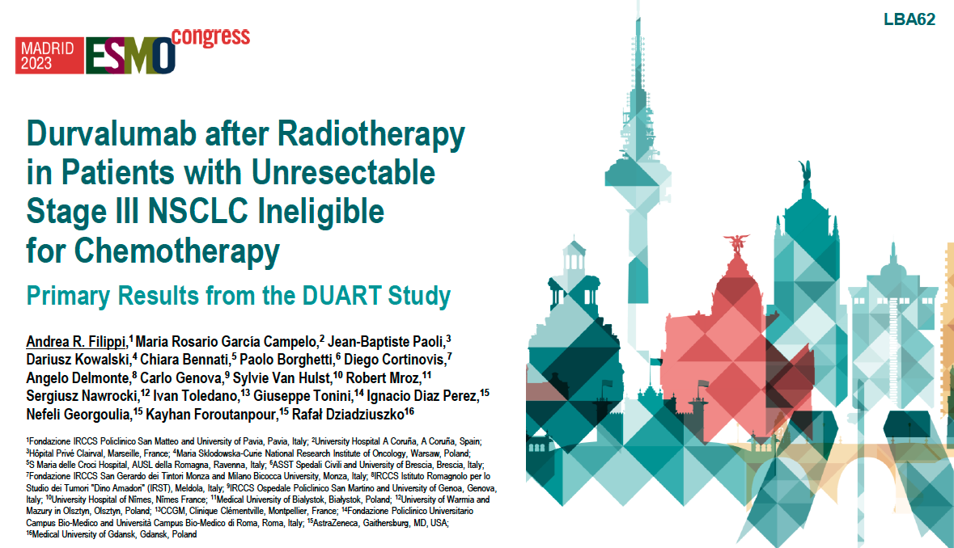

Slide 48
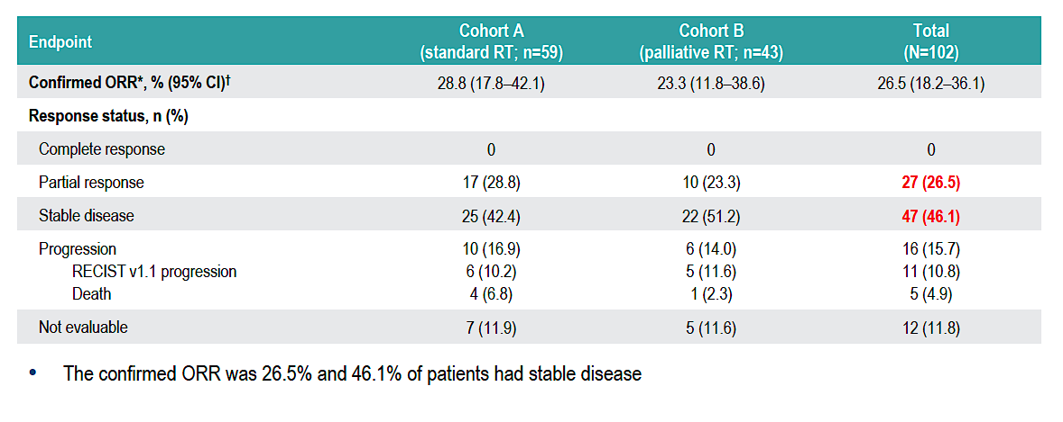
DUART: Objective Response Rate (ORR)
Filippi AR et al. ESMO 2023;Abstract LBA62.

Slide 49
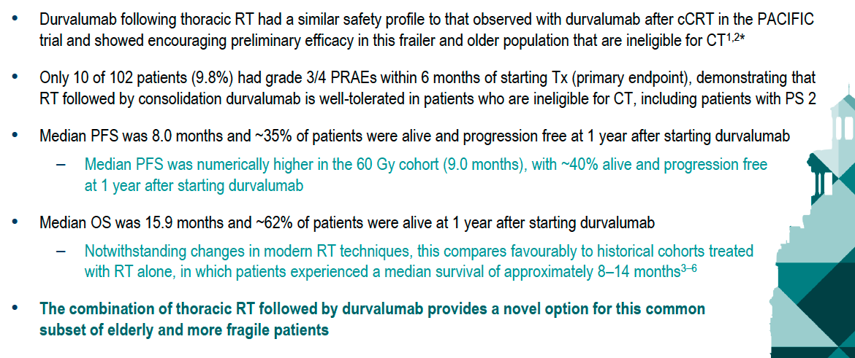
DUART: Conclusions
Filippi AR et al. ESMO 2023;Abstract LBA62.

Slide 50
Agenda
INTRODUCTION: Risk of Autoimmune Toxicity with Checkpoint Inhibitors
MODULE 1: Immunotherapy in the Neoadjuvant/Adjuvant Setting
MODULE 2: Immunotherapy for Locally Advanced NSCLC
MODULE 3: First-Line Immunotherapy for Metastatic NSCLC
MODULE 4: Novel Agents and Strategies
MODULE 5: Immunotherapy for NSCLC with a Targetable Mutation
MODULE 6: Small Cell Lung Cancer

Slide 51
First-Line Immunotherapy for Metastatic NSCLC
de Castro G Jr et al. Five-year outcomes with pembrolizumab versus chemotherapy as first-line therapy in patients with NSCLC and PD-L1 tumor proportion score ≥1% in the KEYNOTE-042 study.
J Clin Oncol 2023;41(11):1986-91.
Garassino MC et al. Pembrolizumab plus pemetrexed and platinum in nonsquamous NSCLC: 5-year outcomes from the phase III KEYNOTE-189 study. J Clin Oncol 2023;41(11):1992-8.
Novello S et al. Pembrolizumab plus chemotherapy in squamous NSCLC: 5-year update of the phase III KEYNOTE-407 study. J Clin Oncol 2023;41(11):1999-2006.
Ramalingam SS et al. Six-year survival and HRQoL outcomes with 1L nivolumab + ipilimumab in patients with metastatic NSCLC (mNSCLC) from CheckMate227. WCLC 2023;Abstract OA14.03.
Reck M et al. Five-year outcomes with first-line (1L) nivolumab + ipilimumab + chemotherapy (N + I + C) vs C in patients (pts) with metastatic NSCLC (mNSCLC) in CheckMate 9LA. ASCO 2024;Abstract 8560.
Johnson ML et al. Durvalumab with or without tremelimumab in combination with chemotherapy as first-line therapy for mNSCLC: The phase III POSEIDON study. J Clin Oncol 2023;41(6):1213-27.
Peters S et al. Durvalumab ± tremelimumab + chemotherapy in first-line metastatic NSCLC: 5-year overall survival update from the POSEIDON study. ESMO Immuno-Oncology 2023;Abstract LBA3.

Slide 52
First-Line Pembrolizumab as Monotherapy or Combined with Chemotherapy: 5-Year Updates
Monotherapy | Histologic type | Study arms | Median 5-year OS HR
KEYNOTE-042¹ | PD-L1 TPS ≥1% nonsquamous squamous | Pembrolizumab vs chemotherapy | PD-L1 TPS ≥1%: 0.79 PD-L1 TPS ≥20%: 0.75 PD-L1 TPS ≥50%: 0.68
Combination regimen
KEYNOTE-189² | Nonsquamous | Pembrolizumab + platinum/pemetrexed vs placebo + platinum/pemetrexed | ITT: 0.60 PD-L1 TPS <1%: 0.55 PD-L1 TPS 1%-49%: 0.65 PD-L1 TPS ≥50%: 0.68
KEYNOTE-407³ | Squamous | Pembrolizumab + carboplatin, paclitaxel or nab paclitaxel vs placebo + carboplatin, paclitaxel or nab paclitaxel | ITT: 0.71 PD-L1 TPS <1%: 0.83 PD-L1 TPS 1%-49%: 0.61 PD-L1 TPS ≥50%: 0.68
OS = overall survival; HR = hazard ratio; TPS = tumor proportion score; ITT = intention to treat
¹ de Castro G Jr et al. J Clin Oncol 2023;41(11):1986-91. ² Garassino MC et al. J Clin Oncol 2023;41(11):1992-8.
³ Novello S et al. J Clin Oncol 2023;41(11):1999-2006.

Slide 53
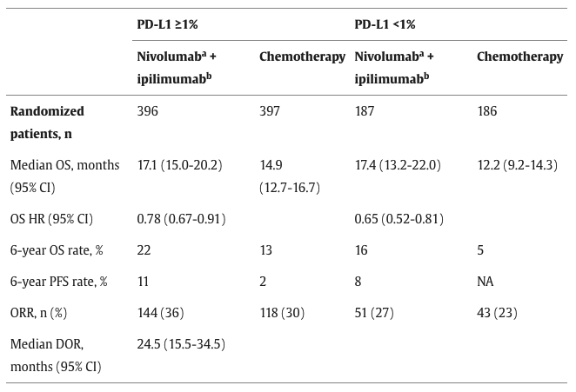
CheckMate 227 Study: 6-Year Outcomes with First-Line Nivolumab and Ipilimumab for Metastatic NSCLC
Ramalingam SS et al. WCLC 2023;Abstract OA14.03.

Slide 54
CheckMate 9LA Study: 5-Year Outcomes with First-Line Nivolumab and Ipilimumab for Metastatic NSCLC
Endpoint | All randomized |  | PD-L1 < 1% |  | PD-L1 ≥1% |  | Squamous |  | Nonsquamous
 | Nivo + ipi (n = 368) | Chemo (n = 358) | Nivo + ipi (n = 135) | Chemo (n = 129) | Nivo + ipi (n = 204) | Chemo (n = 204) | Nivo + ipi (n = 115) | Chemo (n = 112) | Nivo + ipi (n = 246) | Chemo (n = 246)
Median OS | 15.8 mo | 11.0 mo | 17.7 mo | 9.8 mo | 15.8 mo | 10.9 mo | 14.5 mo | 9.1 mo | 17.8 mo | 12.0 mo
OS HR | 0.73 |  | 0.63 |  | 0.73 |  | 0.63 |  | 0.77
5-year OS rate | 18% | 11% | 22% | 8% | 18% | 11% | 18% | 7% | 19% | 12%
Median PFS | 6.7 mo | 5.3 mo | 5.8 mo | 5.0 mo | 6.9 mo | 4.7 mo | 5.6 mo | 4.3 mo | 6.9 mo | 5.6 mo
PFS HR | 0.70 |  | 0.71 |  | 0.70 |  | 0.65 |  | 0.75
5-year PFS rate | 10% | 4% | 9% | 3% | 10% | 5% | 8% | 4% | 10% | 4%
nivo = nivolumab; ipi = ipilimumab; PFS = progression-free survival
Reck M et al. ASCO 2024;Abstract 8560.

Slide 55
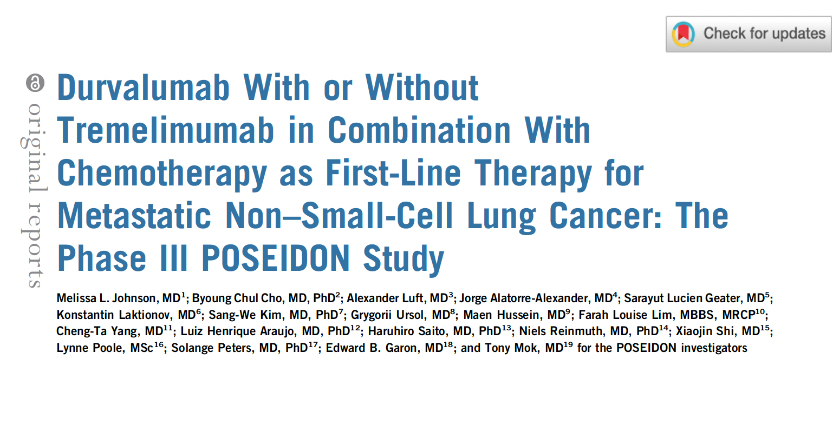
J Clin Oncol 2023;41:1213-27

Slide 56
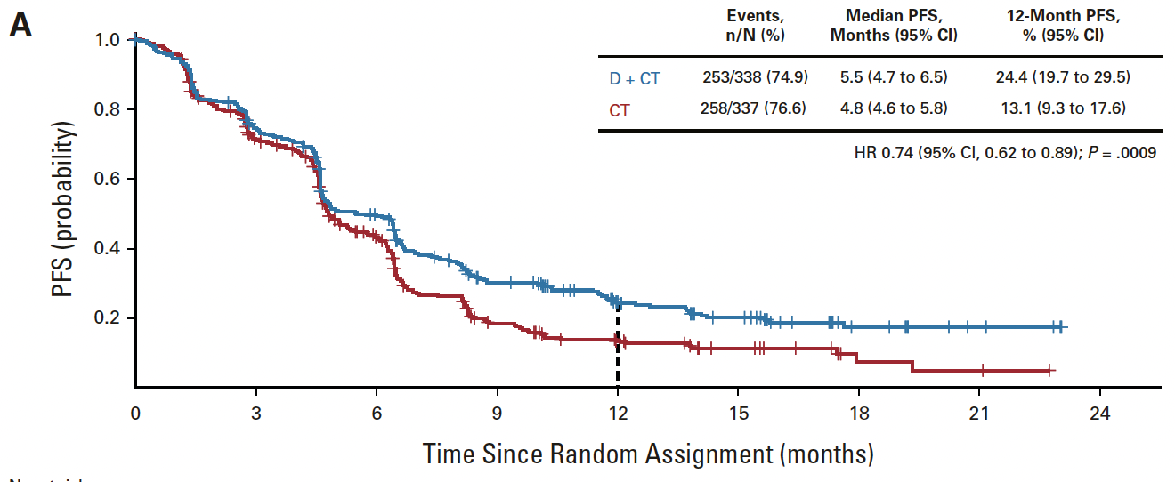
POSEIDON: Progression-Free Survival with Durvalumab and Chemotherapy versus Chemotherapy
D = durvalumab; CT = chemotherapy
Johnson ML et al. J Clin Oncol 2023;41:1213-27.

Slide 57
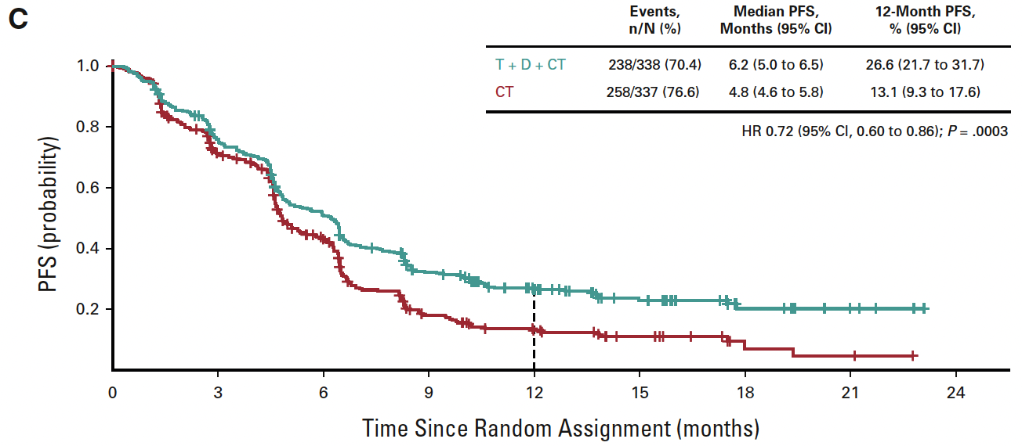
POSEIDON: Progression-Free Survival with Durvalumab, Tremelimumab and Chemotherapy versus Chemotherapy
T = tremelimumab
Johnson ML et al. J Clin Oncol 2023;41:1213-27.

Slide 58
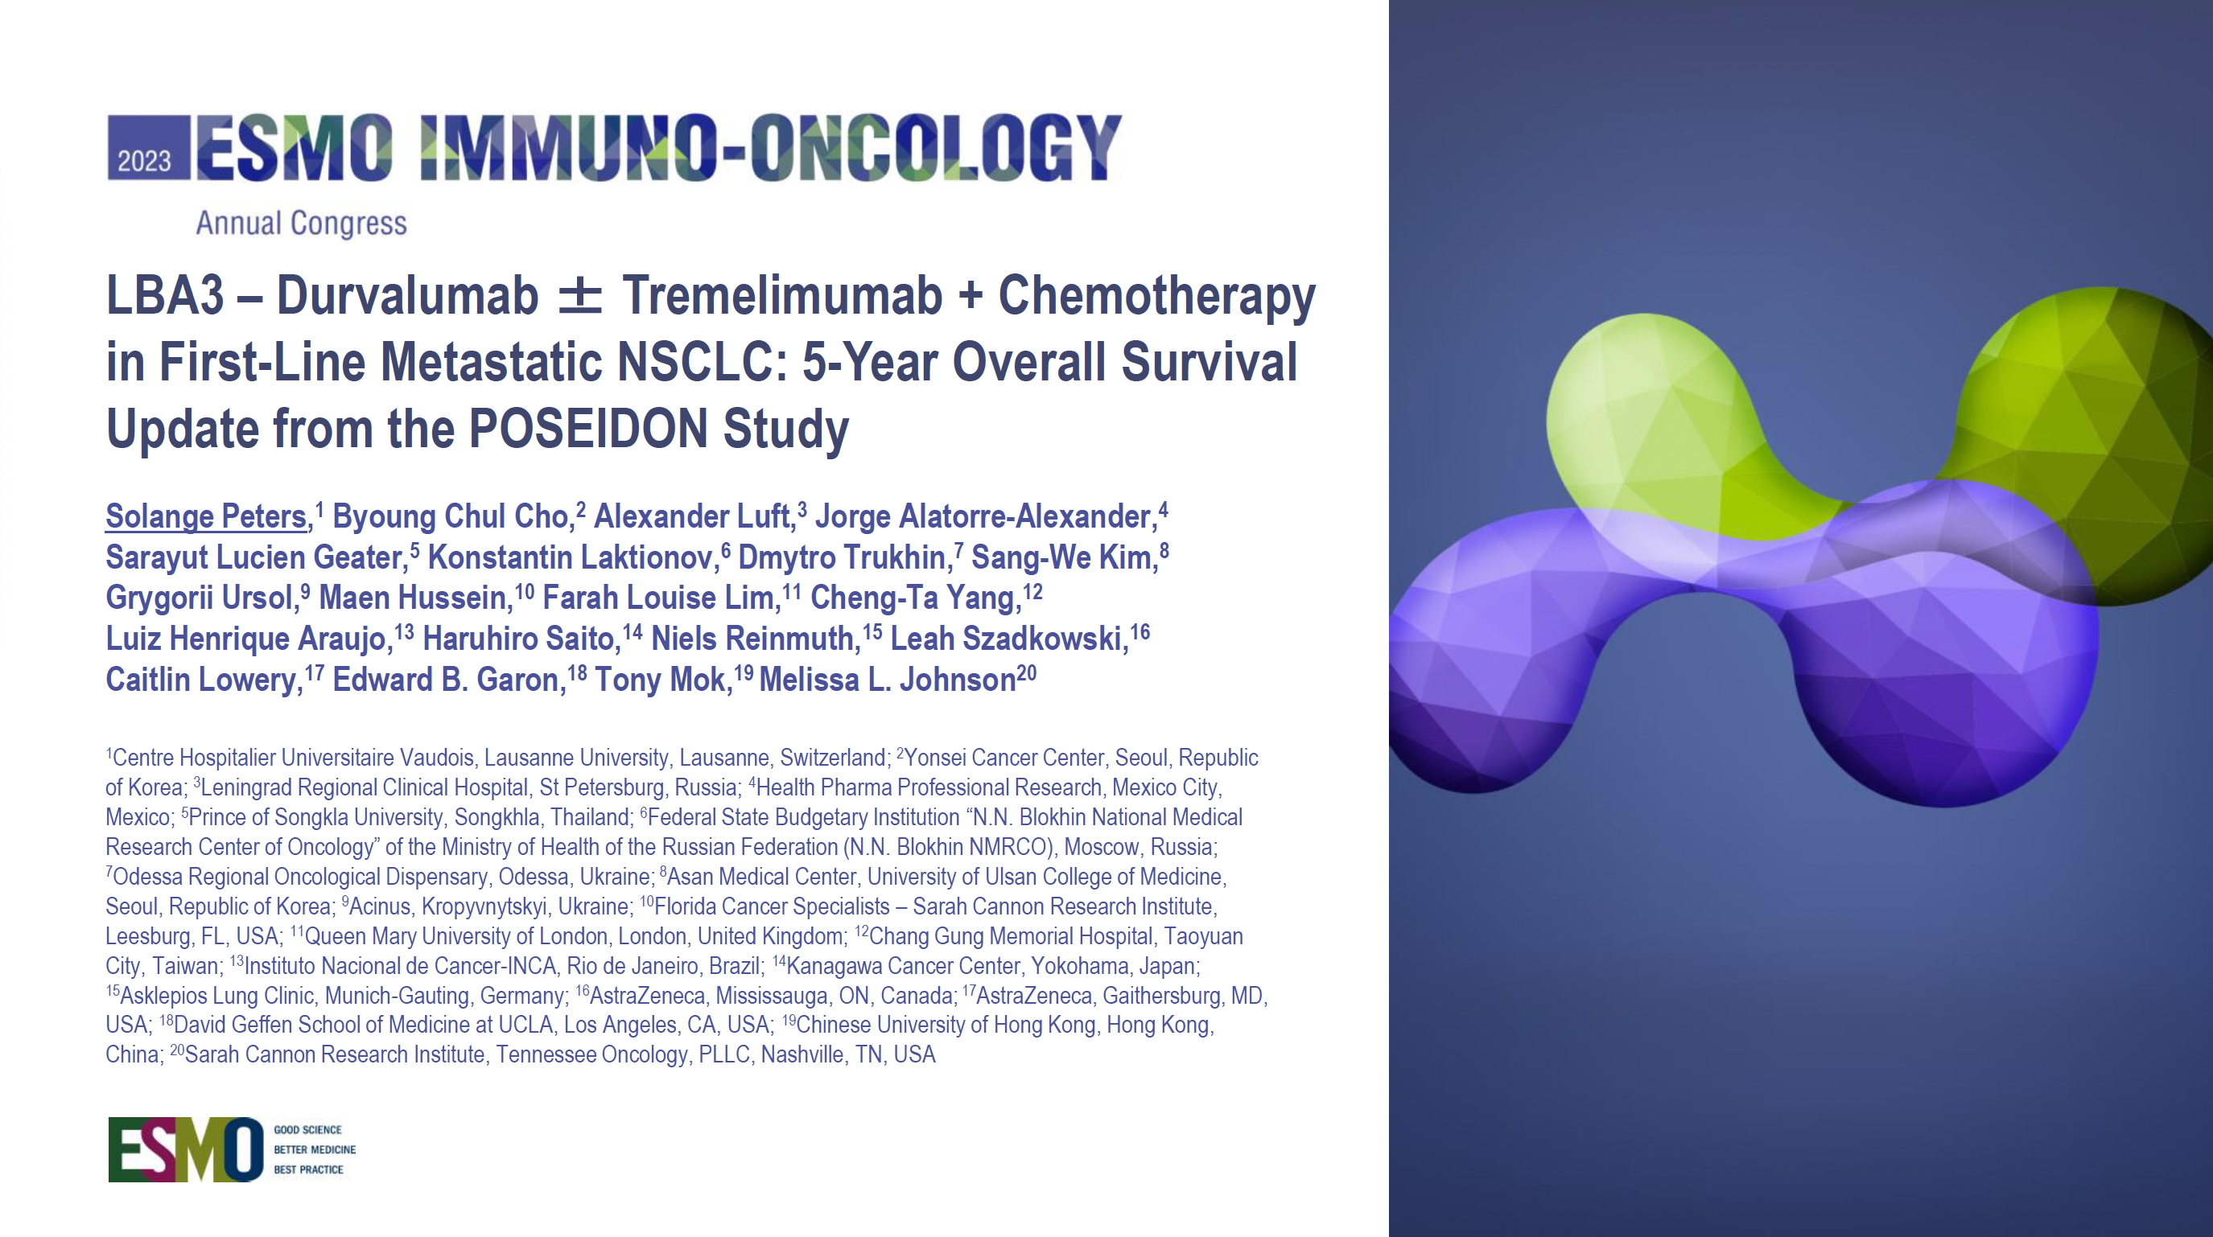

Slide 59
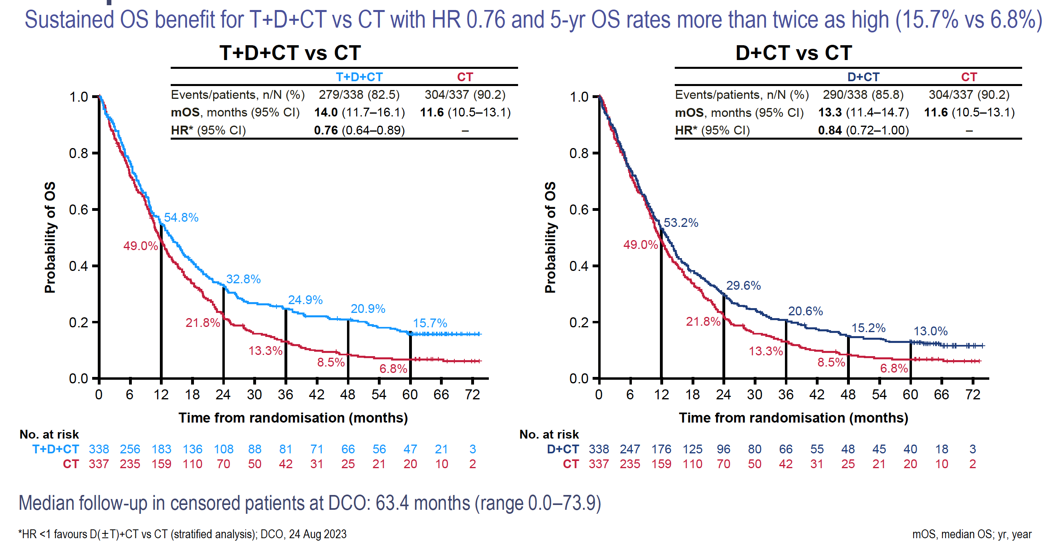
POSEIDON: 5-Year Overall Survival Update
Peters S et al. ESMO Immuno-Oncology 2023;Abstract LBA3.

Slide 60
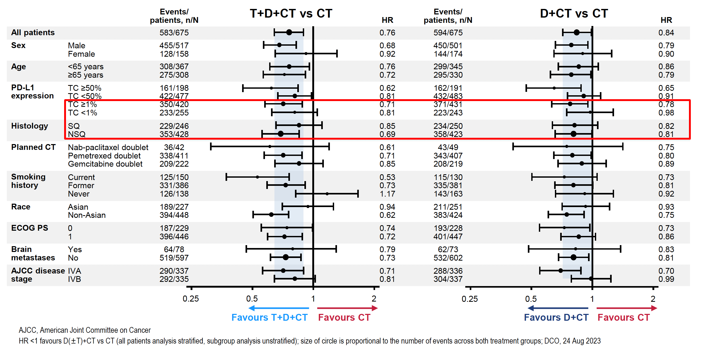
POSEIDON: 5-Year Overall Survival Update Subgroup Analysis
Peters S et al. ESMO Immuno-Oncology 2023;Abstract LBA3.

Slide 61
Agenda
INTRODUCTION: Risk of Autoimmune Toxicity with Checkpoint Inhibitors
MODULE 1: Immunotherapy in the Neoadjuvant/Adjuvant Setting
MODULE 2: Immunotherapy for Locally Advanced NSCLC
MODULE 3: First-Line Immunotherapy for Metastatic NSCLC
MODULE 4: Novel Agents and Strategies
MODULE 5: Immunotherapy for NSCLC with a Targetable Mutation
MODULE 6: Small Cell Lung Cancer

Slide 62
Novel Agents and Strategies for mNSCLC
Ahn M-J et al. Datopotamab deruxtecan (Dato-DXd) vs docetaxel in previously treated advanced/metastatic (adv/met) non-small cell lung cancer (NSCLC): Results of the randomized phase 3 study TROPION-Lung01. ESMO Asia 2023;Abstract 509MO.
Goto Y et al. TROPION-Lung02: Dato-DXd plus pembrolizumab with or without platinum chemotherapy in advanced NSCLC. ASCO 2023;Abstract 9004.
Levy B et al. Datopotamab deruxtecan (Dato-DXd) plus pembrolizumab (pembro) with or without platinum chemotherapy (Pt-CT) as first-line (1L) therapy for advanced non-small cell lung cancer (aNSCLC): Subgroup analysis from TROPION-Lung02. ASCO 2024;Abstract 8617.
Planchard D et al. ICARUS-LUNG01: A phase 2 study of datopotomab deruxtecan (Dato-DXd) in patients with previously treated advanced non-small cell lung cancer (NSCLC), with sequential tissue biopsies and biomarkers analysis to predict treatment outcome. ASCO 2024;Abstract 8501.

Slide 63
Novel Agents and Strategies for mNSCLC (Continued)
Paz-Ares L et al. TROPION-Lung05: Datopotamab deruxtecan (Dato-DXd) in previously treated non-small cell lung cancer (NSCLC) with actionable genomic alterations (AGAs). ESMO 2023;Abstract 1314MO.
Lisberg A et al. Intracranial efficacy of datopotamab deruxtecan (Dato-DXd) in patients (pts) with previously treated advanced/metastatic non-small cell lung cancer (a/m NSCLC)
with actionable genomic alterations (AGA): Results from TROPION-Lung05. ASCO 2024;Abstract 8593.

Slide 64
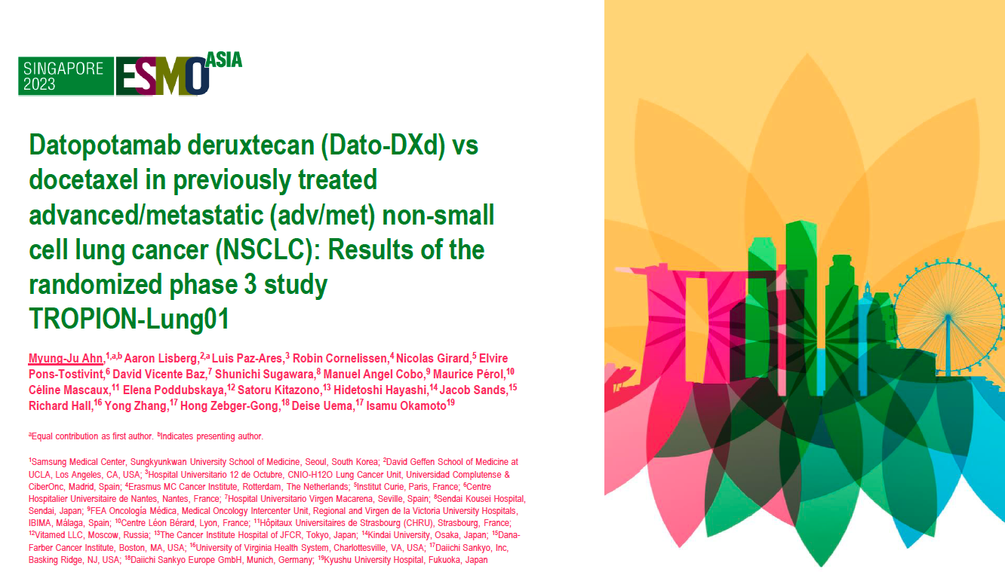
Abstract 509MO

Slide 65
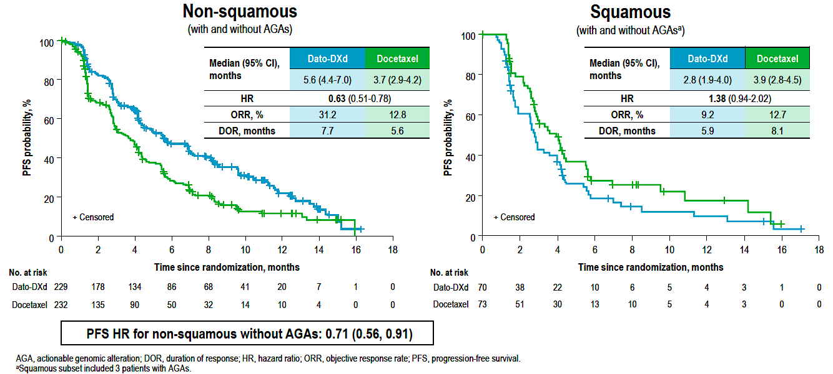
TROPION-Lung01: PFS by Histology
Ahn M-J et al. ESMO Asia 2023;Abstract 509MO.

Slide 66
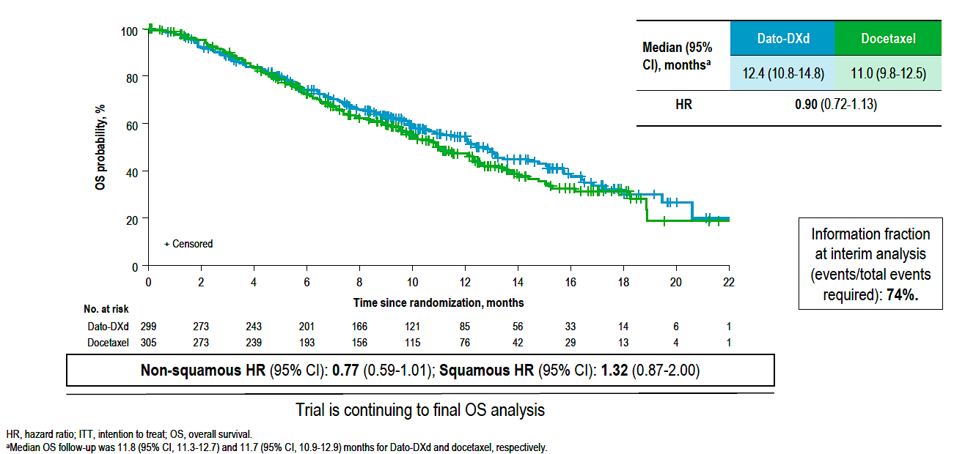
TROPION-Lung01: Interim OS Analysis
Ahn M-J et al. ESMO Asia 2023;Abstract 509MO.

Slide 67
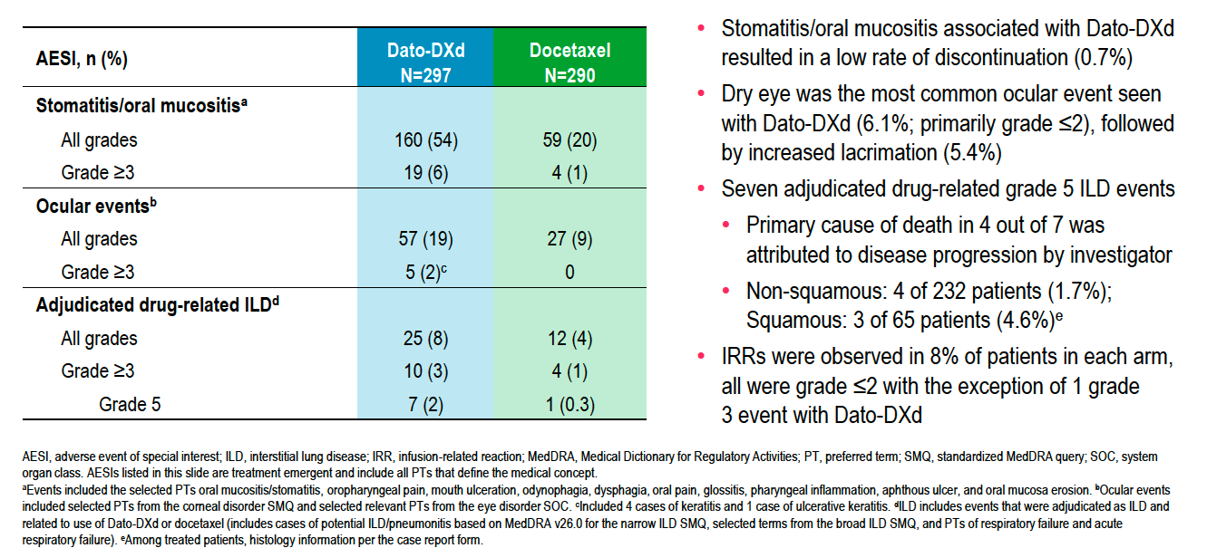
TROPION-Lung01: Adverse Events of Special Interest
Ahn M-J et al. ESMO Asia 2023;Abstract 509MO.

Slide 68
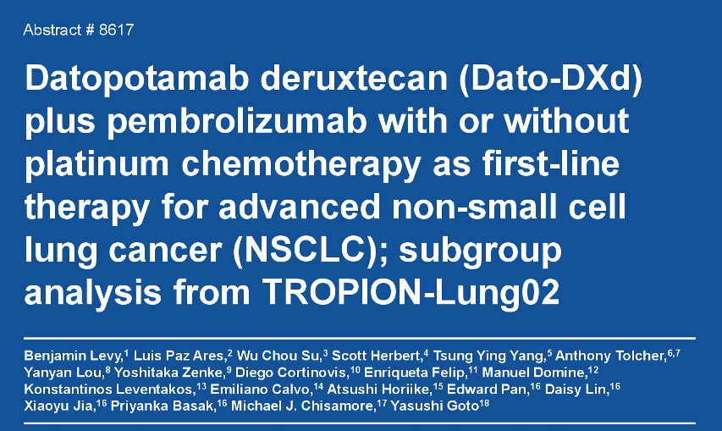
ASCO 2024

Slide 69
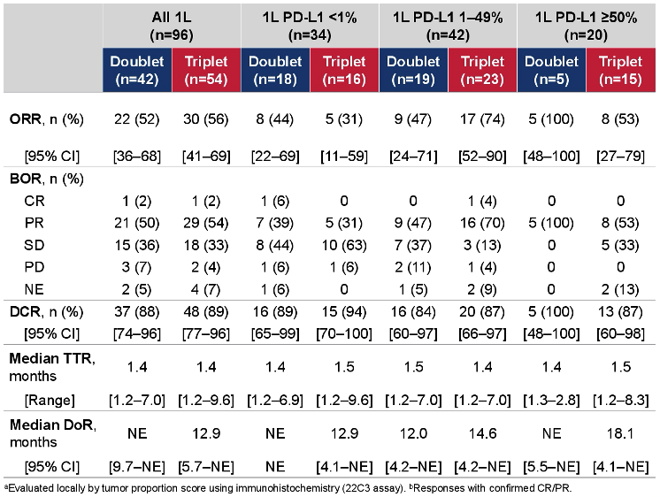
TROPION-Lung02 Subgroup Analysis: First-Line Efficacy Outcomes
ORR = objective response rate; BOR = best overall response; CR = complete response; PR = partial response; SD = stable disease; PD = progressive disease; NE = not evaluable; DCR = disease control rate; TTR = time to response; DoR = duration of response
Levy B et al. ASCO 2024;Abstract 8617.

Slide 70
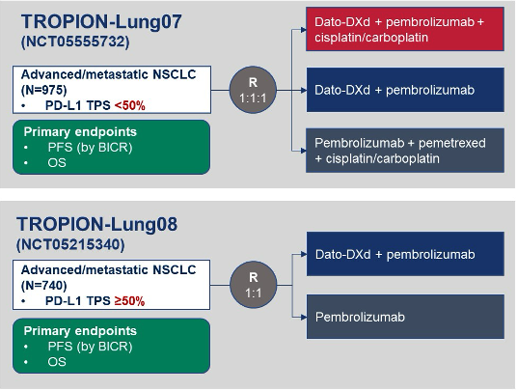
Ongoing Phase III Trials of Dato-DXd with Pembrolizumab for Advanced/Metastatic NSCLC
BICR = blinded independent central review
Goto Y et al. ASCO 2023;Abstract 9004.

Slide 71
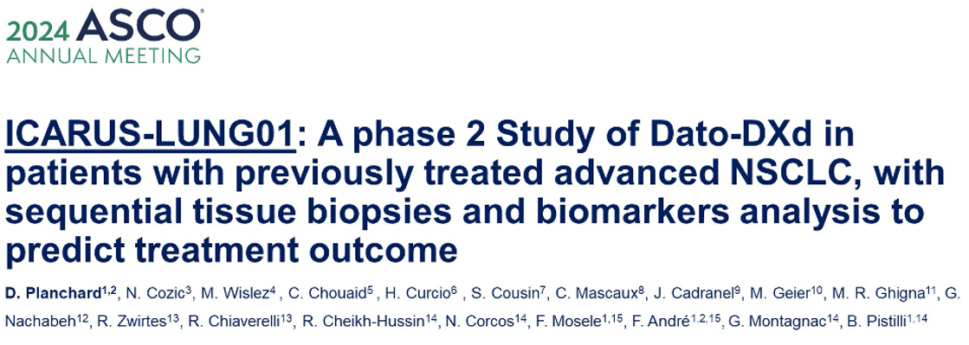
Abstract 8501

Slide 72
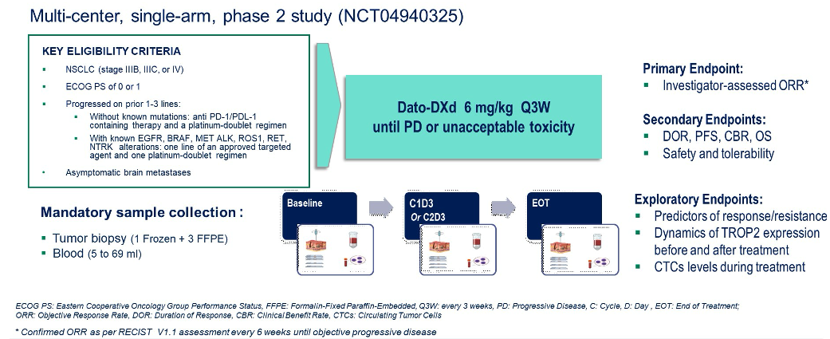
ICARUS-LUNG01 Study Design
Planchard D et al. ASCO 2024;Abstract 8501.

Slide 73
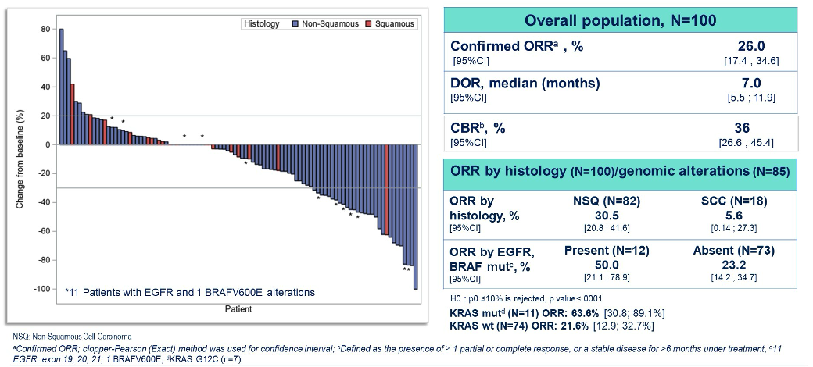
ICARUS-LUNG01: Objective Response Rates with Dato-DXd for Previously Treated Advanced NSCLC
CBR = clinical benefit rate; NSQ = nonsquamous; SCC = squamous cell carcinoma
Planchard D et al. ASCO 2024;Abstract 8501.

Slide 74
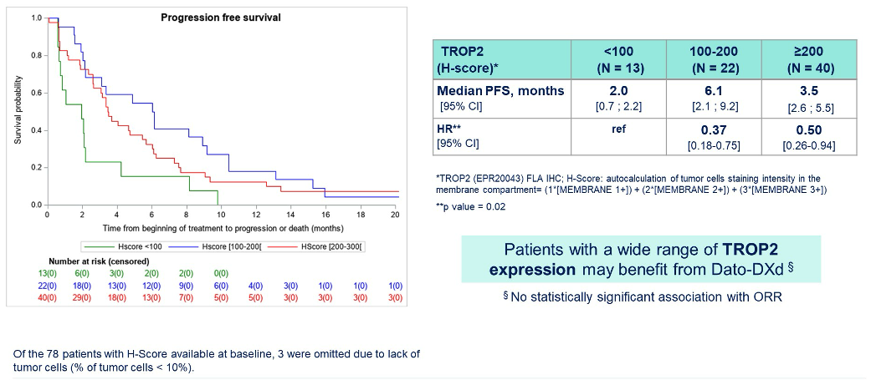
ICARUS-LUNG01: TROP2 Expression and PFS with Dato-DXd for Previously Treated Advanced NSCLC
Planchard D et al. ASCO 2024;Abstract 8501.

Slide 75
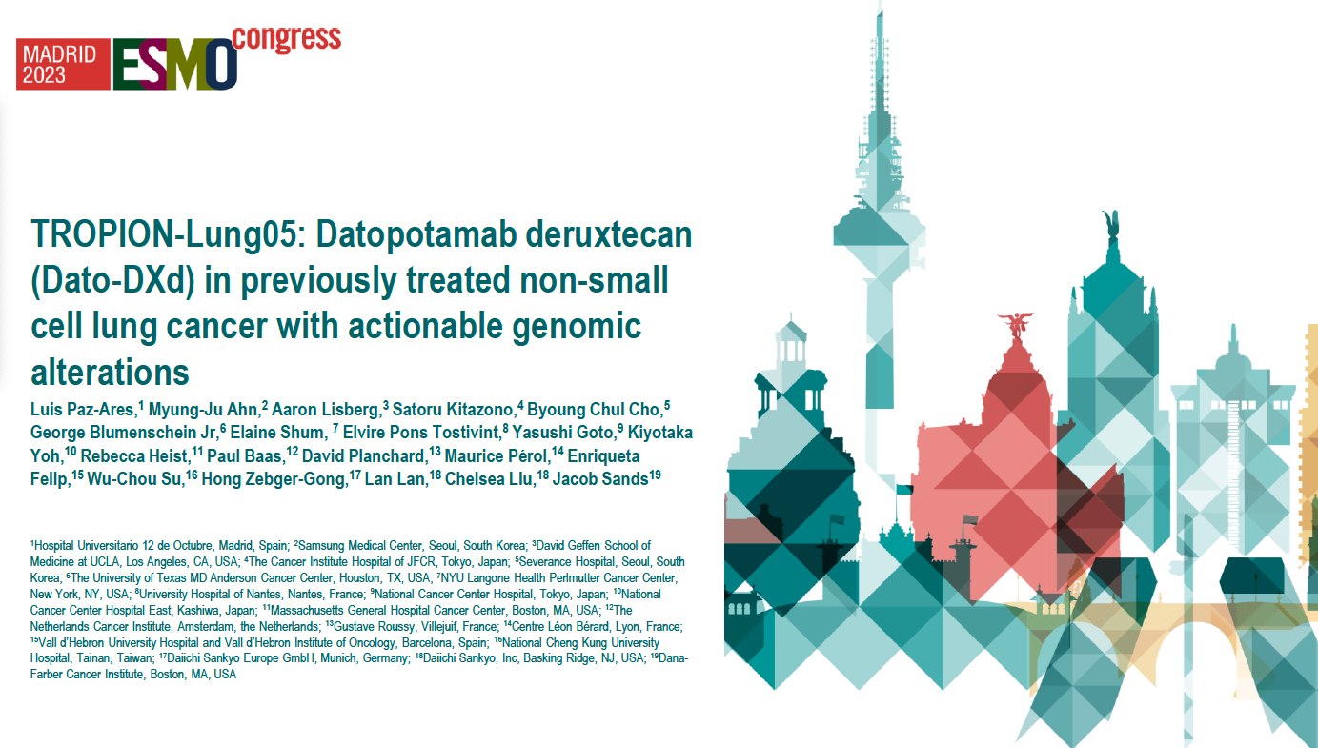
Abstract 1314MO

Slide 76
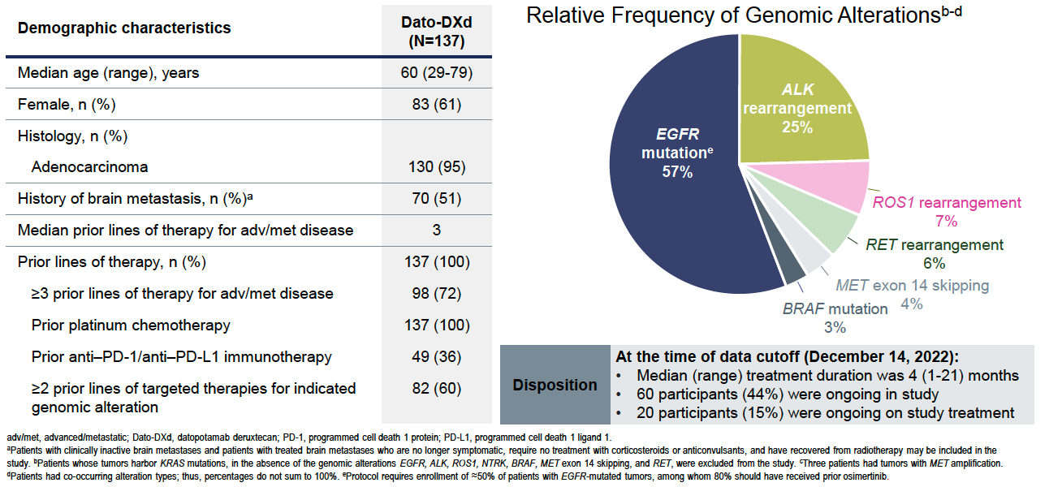
TROPION-Lung05: Patient Characteristics and Disposition
Paz-Ares L et al. ESMO 2023;Abstract 1314MO.

Slide 77

TROPION-Lung05: Efficacy Summary
Paz-Ares L et al. ESMO 2023;Abstract 1314MO.

Slide 78

ASCO 2024

Slide 79

TROPION-Lung05: Intracranial PFS in Patients With and Without Baseline Brain Metastases
Lisberg A et al. ASCO 2024;Abstract 8593.

Slide 80
Agenda
INTRODUCTION: Risk of Autoimmune Toxicity with Checkpoint Inhibitors
MODULE 1: Immunotherapy in the Neoadjuvant/Adjuvant Setting
MODULE 2: Immunotherapy for Locally Advanced NSCLC
MODULE 3: First-Line Immunotherapy for Metastatic NSCLC
MODULE 4: Novel Agents and Strategies
MODULE 5: Immunotherapy for NSCLC with a Targetable Mutation
MODULE 6: Small Cell Lung Cancer

Slide 81
Immunotherapy for NSCLC with a Targetable Mutation
Benjamin DJ et al. The role of chemotherapy plus immune checkpoint inhibitors in oncogenic-driven NSCLC: A University of California Lung Cancer Consortium retrospective study. JTO Clin Res Rep 2022 October 29;3(12):100427.
Middleton G et al. A phase II trial of ceralasertib and durvalumab in advanced NSCLC with and without RAS mutations: Results of NLMT arm J. WCLC 2023;Abstract MA06.06.
Besse B et al. Biomarker-directed targeted therapy plus durvalumab in advanced non-small-cell lung cancer: A phase 2 umbrella trial. Nat Med 2024;30(3):716-29.

Slide 82

JTO Clin Res Rep 2022;3(12):100427.

Slide 83

PFS and OS in Study Cohort (n = 246)
Benjamin DJ et al. JTO Clin Res Rep 2022;3(12):100427.

Slide 84

Possible Detriment of Immune Checkpoint Inhibition After EGFR Tyrosine Kinase Inhibitor for NSCLC with EGFR Mutation
Benjamin DJ et al. JTO Clin Res Rep 2022;3(12):100427.

Slide 85


Slide 86



National Lung Matrix Trial Arm J: Response and Survival Among Patients Who Received Prior Immune Checkpoint Blockade (ICB)
DCB = durable clinical benefit; OR = objective response
Middleton G et al. WCLC 2023;Abstract MA06.06.

Slide 87


Nat Med 2024;30:716-29

Slide 88

HUDSON Study: Treatment Efficacy with Durvalumab/Ceralasertib and with Other Regimens in Previously Treated Advanced NSCLC
Besse B et al. Nat Med 2024;30:716-29.

Slide 89
Agenda
INTRODUCTION: Risk of Autoimmune Toxicity with Checkpoint Inhibitors
MODULE 1: Immunotherapy in the Neoadjuvant/Adjuvant Setting
MODULE 2: Immunotherapy for Locally Advanced NSCLC
MODULE 3: First-Line Immunotherapy for Metastatic NSCLC
MODULE 4: Novel Agents and Strategies
MODULE 5: Immunotherapy for NSCLC with a Targetable Mutation
MODULE 6: Small Cell Lung Cancer

Slide 90
Durvalumab Consolidation for Limited-Stage SCLC
Spigel DR et al. ADRIATIC: Durvalumab (D) as consolidation treatment (tx) for patients (pts) with limited-stage small-cell lung cancer (LS-SCLC). ASCO 2024;Abstract LBA5.

Slide 91

Abstract LBA5

Slide 92

ADRIATIC: Phase III Study Design
cCRT = concurrent chemoradiation therapy; PCI = prophylactic cranial irradiation; RT = radiation therapy
Spigel DR et al. ASCO 2024;Abstract LBA5.

Slide 93

ADRIATIC: Overall Survival (Dual Primary Endpoint)
mOS = median overall survival
Spigel DR et al. ASCO 2024;Abstract LBA5.

Slide 94

ADRIATIC: Progression-Free Survival (Dual Primary Endpoint)
mPFS = median progression-free survival
Spigel DR et al. ASCO 2024;Abstract LBA5.

Slide 95

ADRIATIC: Author Conclusions
Spigel DR et al. ASCO 2024;Abstract LBA5.

Slide 96
Anti-PD-1/PD-L1-Based Therapies for Extensive-Stage SCLC
Paz-Ares L et al. Durvalumab ± tremelimumab + platinum-etoposide in extensive-stage SCLC (CASPIAN): Outcomes by PD-L1 expression and tissue tumor mutational burden. Clin Cancer Res 2024 February 16;30(4):824-35.
Liu SV et al. Five-year survival in patients with ES-SCLC treated with atezolizumab in IMpower133: IMbrella A extension study results. WCLC 2023;Abstract OA01.04.

Slide 97

Clin Cancer Res 2024 February 16;30(4):824-35

Slide 98


CASPIAN: OS Analysis by Subgroup
PD-L1 TC or IC ≥1%
PD-L1 TC and IC <1%
Author Conclusions: These results support treatment benefit with first-line durvalumab plus EP in patients with ES-SCLC irrespective of biomarker status; there was no evidence that either PD-L1 expression or tTMB can be used to select patients or predict outcomes with durvalumab plus EP in this disease setting. However, our observations in the durvalumab plus tremelimumab plus EP arm suggest that PD-L1 expression may yet prove to be a useful biomarker for combined treatment with PD-(L)1 and CTLA-4 inhibition, although this requires confirmation with a prospective and independent dataset.
TC = tumor cell; IC = immune cell; ES-SCLC = extensive-stage small cell lung cancer
Paz-Ares L et al. Clin Cancer Res 2024 February 16;30(4):824-35.

Slide 99
Novel Agents and Strategies for Patients with SCLC
Lee S-H et al. A phase II, open-label, combination therapy of durvalumab and ceralasertib in relapsed and refractory small cell lung cancer (SUKSES-N4). ASCO 2024;Abstract 8104.
Johnson M et al. Ifinatamab deruxtecan (I-DXd; DS-7300) in patients with refractory SCLC: A subgroup analysis of a phase 1/2 study. WCLC 2023;Abstract OA05.05.
Rudin C et al. A phase II study of ifinatamab deruxtecan (I-DXd; DS-7300) in patients with previously treated ES-SCLC. WCLC 2023;Abstract P2.16-06.
Dowlati A et al. Sacituzumab govitecan as second-line treatment for extensive SCLC: Preliminary results from the phase II TROPiCS-03 basket trial. ESMO 2023;Abstract 1990MO.
Paz-Ares L et al. Tarlatamab, a first-in-class DLL3-targeted bispecific T-cell engager, in recurrent SCLC: An open-label, phase I study. J Clin Oncol 2023;41(16):2893-903.
Paz-Ares L et al. Tarlatamab for patients with previously treated SCLC: Primary analysis of the phase II DeLLphi-301 study. ESMO 2023;Abstract LBA92.

Slide 100
A Phase II, Open-Label, Combination Therapy of Durvalumab and Ceralasertib in Relapsed and Refractory Small Cell Lung Cancer (SUKSES-N4)
Lee S-H et al.
ASCO 2024;Abstract 8104.

Slide 101


SUKSES-N4: A Phase II Study of Durvalumab with Ceralasertib for Relapsed/Refractory SCLC
Overall Changes of Measurable Lesions
Lee S-H et al. ASCO 2024;Abstract 8104.

Slide 102

SUKSES-N4: Safety Profile of Durvalumab and Ceralasertib for Relapsed/Refractory SCLC
Lee S-H et al. ASCO 2024;Abstract 8104.

Slide 103
FDA Grants Accelerated Approval to Tarlatamab for Extensive-Stage Small Cell Lung Cancer
Press Release: May 16, 2024
“On May 16, 2024, the Food and Drug Administration granted accelerated approval to tarlatamab-dlle for extensive stage small cell lung cancer (ES-SCLC) with disease progression on or after platinum-based chemotherapy. The major efficacy outcome measures were overall response rate (ORR) per RECIST 1.1 and duration of response (DOR), as assessed by blinded independent central review. ORR was 40% and median DOR was 9.7 months.
The prescribing information for tarlatamab includes a Boxed Warning for serious or life-threatening cytokine release syndrome (CRS) and neurologic toxicity, including immune effector cell-associated neurotoxicity syndrome (ICANS). The most common adverse reactions (>20%) were CRS, fatigue, pyrexia, dysgeusia, decreased appetite, musculoskeletal pain, and constipation, anemia and nausea. The most common Grade 3 or 4 laboratory abnormalities (≥5%) were decreased lymphocytes, decreased sodium, increased uric acid, decreased total neutrophils, decreased hemoglobin, increased activated partial thromboplastin time, and decreased potassium.
The recommended tarlatamab dose is an initial dose of 1 mg administered as an intravenous infusion over 1 hour on Cycle 1 Day 1, followed by 10 mg on Cycle 1 Day 8 and Day 15 then every 2 weeks thereafter until disease progression or unacceptable toxicity.”
https://www.fda.gov/drugs/resources-information-approved-drugs/fda-grants-accelerated-approval-tarlatamab-dlle-extensive-stage-small-cell-lung-cancer

Slide 104

DeLLphi-301 Trial: Onset and Duration of Response
Paz-Ares L et al. N Engl J Med 2023 November 30;389(22):2063-75.

Slide 105

DeLLphi-301: Efficacy Analysis Set per ITT Analysis
ITT = intent to treat; ORR = objective response rate
Paz-Ares L et al. ESMO 2023;Abstract LBA92.

Slide 106
APPENDIX

Slide 107

TROPION-Lung01: PFS in ITT Population
Ahn M-J et al. ESMO Asia 2023;Abstract 509MO.

Slide 108

Abstract 9004

Slide 109

TROPION-Lung02: Tumor Response with Dato-DXd and Pembrolizumab with or without Platinum Chemotherapy
ORR (confirmed and pending)
Doublet: 38%
Triplet: 49%
ORR (confirmed and pending)
Doublet: 50%
Triplet: 57%
ORR = objective response rate
Goto Y et al. ASCO 2023;Abstract 9004.

Slide 110

TROPION-Lung02: Treatment-Emergent Adverse Events (TEAEs) with Dato-DXd and Pembrolizumab with or without Platinum Chemotherapy
Goto Y et al. ASCO 2023;Abstract 9004.

Slide 111

Ifinatamab Detuxtecan: Mechanism of Action
Johnson et al. WCLC 2023;Abstract OA05.05.

Slide 112

DS7300-A-J101 Study Design
Johnson M et al. WCLC 2023;Abstract OA05.05.

Slide 113


DS7300-A-J101: Ifinatamab Deruxtecan Antitumor Activity
Nearly all patients with postbaseline scans had a reduction in target lesions
Median time to response was 1.2 months (95% CI, 1.2-1.4)
Median duration of response was 5.9 months (95% CI, 2.8-7.5); 2 patients remain on treatment
Median follow-up was 11.7 months (95% CI, 4.63-12.88)
Data cutoff: January 31, 2023.
Johnson M et al. WCLC 2023;Abstract OA05.05.

Slide 114

DS7300-A-J101: Ifinatamab Deruxtecan Most Common (≥10%) All-Grade TEAEs Regardless of Causality
A total of 3 patients (13.6%) experienced an interstitial lung disease (ILD) or pneumonitis event (2 Grade 1, 1 Grade 2).
  All events were adjudicated by the ILD adjudication committee, of which 1 was adjudicated as drug-related ILD (Grade 2,
  8.0 mg/kg), and treatment was discontinued per protocol.
Prophylactic premedication for nausea, vomiting and infusion-related reaction were not permitted for primary prophylaxis during cycle 1 of dose escalation.
Johnson M et al. WCLC 2023;Abstract OA05.05.

Slide 115
IDeate-Lung02: A Phase III Study of Ifinatamab Deruxtecan versus Treatment of Physician’s Choice for Relapsed SCLC
I-DXd at 12 mg/kg Day 1 of each 21-day cycle
Key inclusion criteria
  Histologically confirmed SCLC
  ≥1 prior therapy, including
  ≥2 cycles of platinum-based therapy
  ECOG PS 0-1
N = 468
Topotecan, lurbinectedin or amrubicin
Key exclusion criteria
  Prior orlotamab, enoblituzumab or other B7-H3-targeted agents (including I-DXd)
  Prior ADC that consists of an exatecan derivative (eg, T-DXd)
  Received the study comparators or any topoisomerase I inhibitor
  Any history of ILD/pneumonitis
Outcomes
  Primary endpoints: ORR and OS (up to 4.5 years)
  Key secondary endpoints: PFS, DOR, safety (up to 4.5 years)
I-DXd = ifinatamab deruxtecan; ADC = antibody-drug conjugate; ILD = interstitial lung disease; ORR = overall response rate
www.clinicaltrials.gov. NCT06203210. Accessed June 2024.

Slide 116


Slide 117

TROPiCS-03: Safety Summary with Sacituzumab Govitecan for ES-SCLC
Dowlati A et al. ESMO 2023;Abstract 1990MO.

Slide 118

TROPiCS-03: Tumor Response with Sacituzumab Govitecan for ES-SCLC
Objective response rate: 37%
Dowlati A et al. ESMO 2023;Abstract 1990MO.

