Slide 1
Current and Emerging Therapeutic Approaches
Thomas Martin, MD
Helen Diller Family Comprehensive Cancer Center
UCSF Medical Center
San Francisco, California

Slide 2
Included - NDMM
PERSEUS
GMMG-HD7
IsKia
GMMG-CONCEPT Trial
IMROZ
BENEFIT Trial
MAIA Update
DETERMINATION Diversity

Slide 3
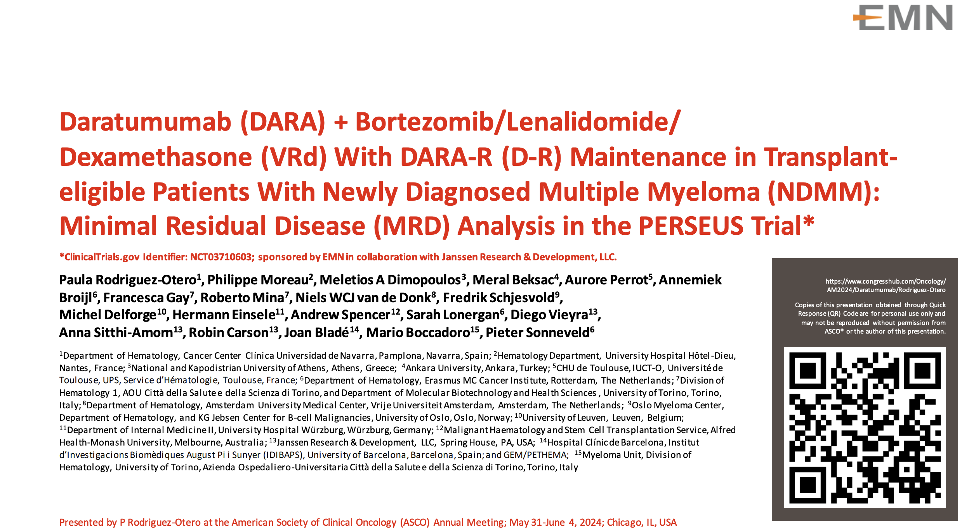

Slide 4
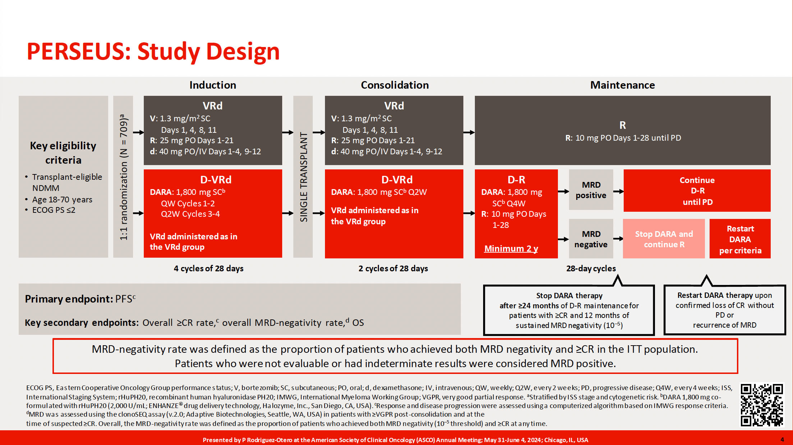

Slide 5
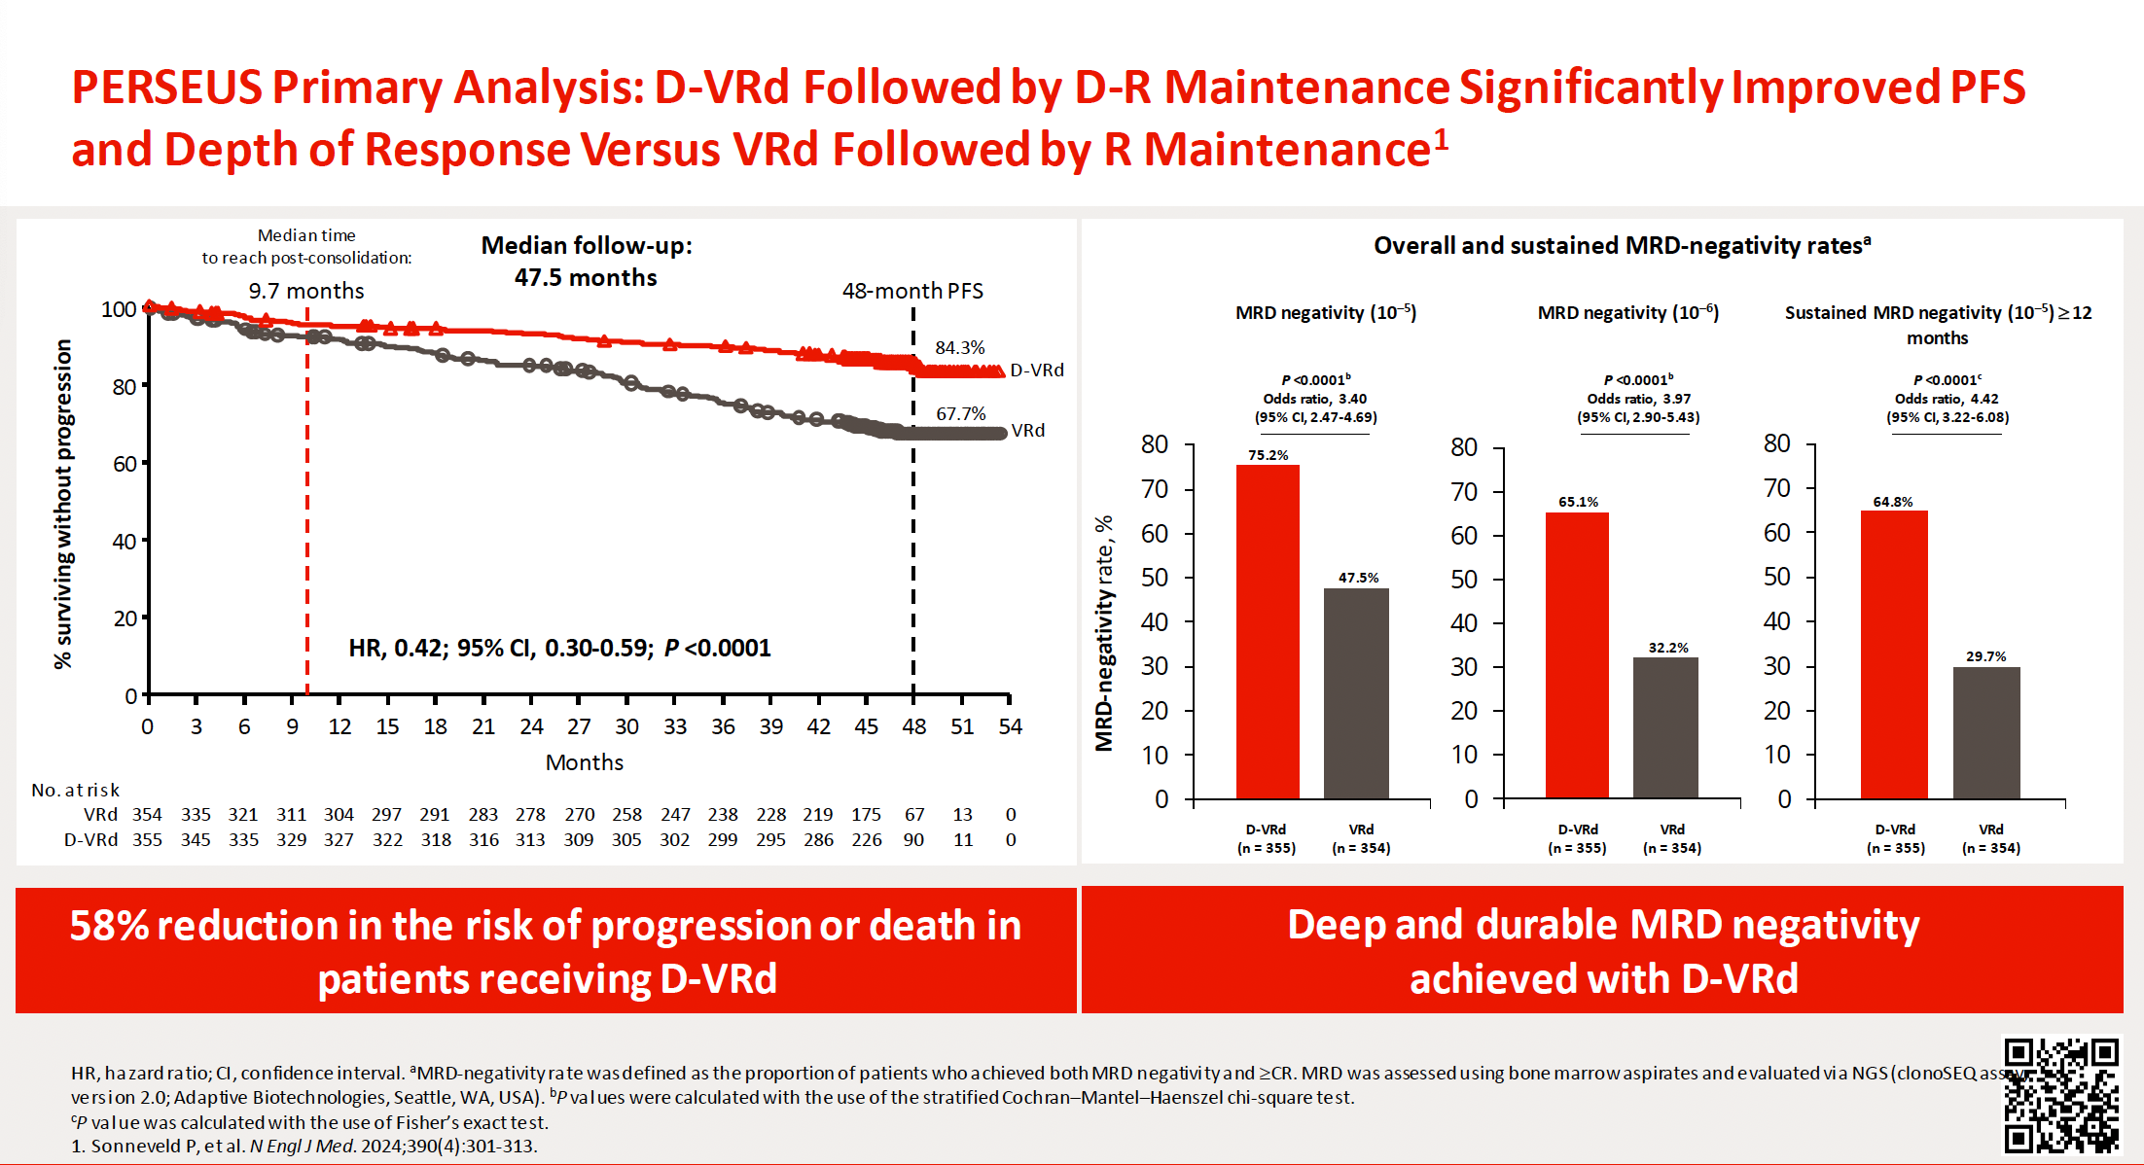

Slide 6

GMMG-HD7 interim analysis:
MRD negativity after HDT + ASCT (intensification)
Induction phase (3 x 6-week cycles)
Maintenance phase (4-week cycles)
3 years or PD
NDMM
N=662
Isa + RVd
HDT + ASCT
Isa + R
Randomization 1:1
Randomization
RVd
R
After
Cycle 3
After
HDT
After
12 months
After
24 months
Screening
End of study
MRD (bone marrow aspirate)
↑
↑
↑
↑
↑
Primary endpoint
MRD negativity at the end of induction treatment (NGF, sensitivity 10⁻⁵) stratified according to R-ISS
Secondary endpoints
CR rate
MRD negativity after intensification
Data cutoff
Oct 2023
Exploratory endpoints
ORR
MRD negativity/VGPR and MRD negativity/CR rates after intensification
ASCT, autologous stem cell transplant; CR, complete response; d, dexamethasone; HDT, high-dose therapy; Isa, isatuximab; MRD, minimal residual disease; NDMM, newly diagnosed multiple myeloma; NGF, next-generation flow; ORR, objective response rate; PD, progressive disease;
R, lenalidomide; R-ISS, Revised International Staging System; V, bortezomib; VGPR, very good partial response.
1. ClinicalTrials.gov identifier: NCT03617731. Updated May 12, 2023. Accessed June 5, 2024. https://clinicaltrials.gov/study/NCT03617731?term=NCT03617731&rank=1
6

Slide 7
GMMG-HD7 interim analysis:
MRD negativity by NGF (10⁻⁵) after intensification (ITT; by response)
Patients with MRD negativity and indicated response status
P<0.001*
63.4%
P<0.001*
43.8%
38.1%
Patients (%)
Patients (%)
25.8%
≥VGPR
≥CR
Isa-RVd led to significantly higher MRD negativity/VGPR and
MRD negativity/CR rates (per IMWG) compared with RVd after intensification
*P value derived from stratified conditional logistic regression analysis.
CR, complete response; d, dexamethasone; Isa, isatuximab; ITT, intent to treat; MRD, minimal residual disease; NGF, next-generation flow; R, lenalidomide;
V, bortezomib; VGPR, very good partial response.
7

Slide 8
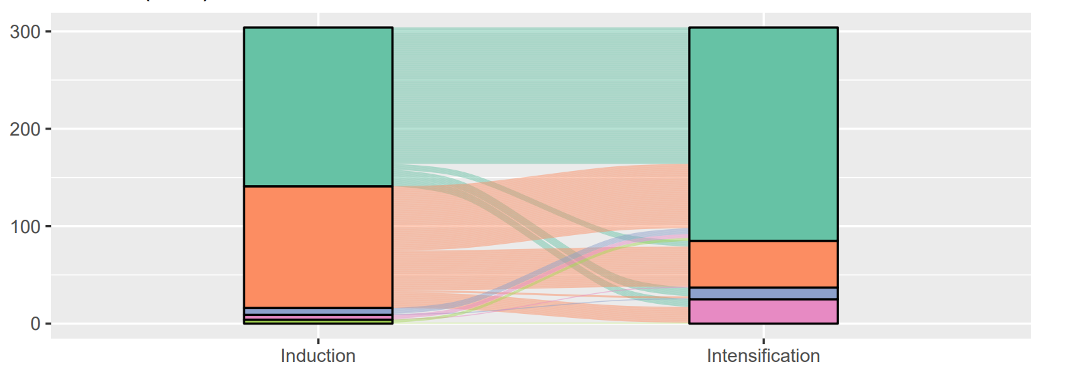
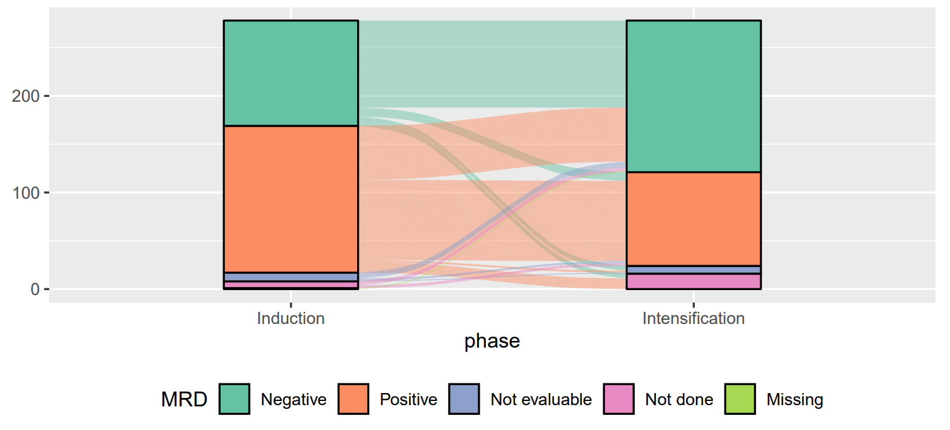
GMMG-HD7 interim analysis: MRD negativity dynamics
MRD negativity status after induction with Isa-RVd vs. RVd was confirmed in
85.9% vs. 82.6%
after intensification
Only 6/9 patients, respectively, lost their MRD negative status
66 vs 56 patients (52.8%/36.8%) converted from MRD positive after induction to MRD negative after intensification
Patients
Isa-RVd
Patients
RVd
ASCT, autologous stem cell transplant; d, dexamethasone; HDT, high-dose therapy; Isa, isatuximab; MRD, minimal residual disease; R, lenalidomide; V, bortezomib.
8
Notes:
while out of 125/152 pts being MRD positive after induction with Isa-RVd/RVd, 66/56 pts (52.8%/36.8%) converted to MRDneg after intensification. MRD assessment at end of intensification was not evaluable for 9/5 pts and not done for 8/5 pts. 17/10

Slide 9
IsKia EMN24 Study Design
42 active sites; enrollment: Oct 7, 2020 ‒ Nov 15, 2021
Post-ASCT consolidation
Induction
Light consolidation
Four 28-day cycles
Four 28-day cycles
Twelve 28-day cycles
4× KRd
K: 20 mg/m² IV dd 1 cc 1 only; followed by 56 mg/m² IV dd 8,15 cc 1 and dd 1,8,15 cc 2-4
R: 25 mg PO daily dd 1-21
d: 40 mg PO dd 1,8,15,22
MOBILIZATION
Cy: 2-3 g/m²
followed by
G-CSF
for stem-cell collection
and
MEL200-ASCT
MEL: 200 mg/m²
followed by
ASCT
4× KRd
K: 56 mg/m² IV dd 1,8,15 cc 5-8
R: 25 mg PO daily dd 1-21
d: 40 mg PO dd 1,8,15,22
12× KRd
K: 56 mg/m² IV dd 1,15
R: 10 mg PO dd 1-21
d: 20 mg PO dd 1,15
Key eligibility criteria:
TE NDMM patients
aged <70 years
Stratification:
- Centralized FISH (standard risk/missing vs. high risk defined as del(17p) and/or t(4;14) and/or t(14;16);
- ISS (I vs. II and III)
R
4× Isa-KRd
Isa: 10 mg/kg IV dd 1,8,15,22 cc 1, followed by 10 mg/kg IV dd 1 and 15 cc 2 to 4.
K: 20 mg/m² IV dd 1 cc 1 only; followed by 56 mg/m² IV dd 8,15 cc 1 and dd 1,8,15 cc 2-4
R: 25 mg PO daily dd 1-21
d: 40 mg PO dd 1,8,15,22
4× Isa-KRd
Isa: 10 mg/kg IV dd 1,15 cc 5-8
K: 56 mg/m² IV dd 1,8,15 cc 5-8
R: 25 mg PO daily dd 1-21
d: 40 mg PO dd 1,8,15,22
12× Isa-KRd
Isa: 10 mg/kg IV d 1
K: 56 mg/m² IV dd 1,15
R: 10 mg PO dd 1-21
d: 20 mg PO dd 1,15
Gay F, et al ASH 2023
MRD by NGS
MRD by NGS
MRD by NGS*
MRD by NGS
TE, transplant-eligible; NDMM, newly diagnosed multiple myeloma; FISH, fluorescence in situ hybridization; del, deletion; t, translocation; ISS, International Staging System stage; R, randomization; Isa, isatuximab; K, carfilzomib; R, lenalidomide; d, dexamethasone; IV, intravenous; dd, days; cc, cycles; PO, orally; Cy, cyclophosphamide; G-CSF, granulocyte colony-stimulating factor; MEL, melphalan; ASCT, autologous stem-cell transplantation; MRD, minimal residual disease; NGS, next-generation sequencing; PFS, progression-free survival.
*Primary Endpoint: MRD negativity by NGS after post-ASCT consolidation

Slide 10
IsKia - Primary Endpoint:
Post-consolidation MRD negativity (ITT analysis)
NGS, 10⁻⁵
NGS, 10⁻⁶
OR 1.67, p=0.049
OR 2.29, p<0.001
Patients (%)
Patients (%)
≥VGPR after consolidation was 94% in both arms; ≥CR 74% vs 72% and sCR 64% vs 67% in the IsaKRd vs KRd arms.
High MRD compliance and sample quality (97-100% of sample evaluable at 10⁻⁵ and 10⁻⁶ cut off.
Consistent MRD results were detected by next-generation flow
In the logistic regression analysis, ORs, 95% CIs, and p-values were adjusted for stratification factor.
Gay F, et al ASH 2023
MRD, minimal residual disease; ITT, intention to treat; NGS, next-generation sequencing; OR, odds ratio; p, p-value; Isa, isatuximab; K, carfilzomib; R, lenalidomide; d, dexamethasone; CI, confidence interval.

Slide 11
IsKia - Post-consolidation MRD negativity by NGS
Subgroup analysis by cytogenetic risk
Very high risk
Very high risk
NGS, 10⁻⁵
NGS, 10⁻⁶
Patients (%)
2+ HRCA
2+ HRCA
1 HRCA was defined as the presence of one of the following high-risk cytogenetic abnormalities: del(17p13.1), t(4;14) (p16.3;q32.3), t(14;16) (q32.3;q23), gain(1q21), or amp(1q21); 2+ HRCA was defined as the presence of at least two high-risk cytogenetic abnormalities.
MRD, minimal residual disease; NGS, next-generation sequencing; HRCA, high-risk cytogenetic abnormalities; Isa, isatuximab; K, carfilzomib; R, lenalidomide; d, dexamethasone; del, deletion; t, translocation; amp, amplification.

Slide 12
GMMG-CONCEPT Trial: Study Design
Arm A
TE and
≤70 years
ITT-IA
n=99
Induction
Consolidation
Maintenance
ND HRMM
ITT N=125
Isa-KRd
6 cycles
HDT + ASCT
Isa-KRd
4 cycles
Isa-KR
26 cycles
Stem cell mobilization after cycle 3
28-day cycles
28-day cycles
28-day cycles
Arm B
TNE or
>70 years
n=26
Isa-KRd
8 cycles
Isa-KRd
4 cycles
Isa-KR
26 cycles
Isa: 10 mg/kg D1,8,15,22 in C1; D1,15 in C2+; K: 20 mg/m² D1,2 of C1; 36 mg/m² D8,9,15,16 of C1 and D1,2,8,9,15,16 in C2+; R: 25 mg D1-21 all Cycles; d: 40 mg D1,8,15,22 all Cycles (20 mg age >75).
Arm A: app. 15-18 months after inclusion
Arm B: app. 12 months after inclusion
HRMM criteria: ISS stage II or III PLUS ≥1 of: del(17p), t(4;14), t(14;16) and/or >3 copies 1q21 (amp1q21)
Primary objective: MRD negativity after consolidation (NGF, 10⁻⁵)
Secondary objective: PFS; Key tertiary objectives: ORR, OS, safety

Slide 13
CONCEPT Trial: MRD Negativity and IMWG Response
MRD negativity (10⁻⁵ NGF)
at end of consolidation
p = 0.0004 ‡
≥CR: 48%
[95% CI,
38% to 57%]
≥CR: 38%
[95% CI,
22% to 57%]
≥CR: 38%
[95% CI,
22% to 57%]
p=0.012 ‡
≥CR: 65%
[95% CI,
55% to 73%]
≥CR: 73%
[95% CI,
63% to 81%]
≥CR: 58%
[95% CI,
39% to 74%]
IMWG response
sCR
CR
VGPR
PR
SD/PD/NE
MRD status, n (%) | TE patients (Arm A) (n=93*) | TNE patients (Arm B) (n=24†)
Negative | 63 (67.7) | 13 (54.2)
Positive | 3 (3.2) | 0 (0)
Not done/missing | 2 (2.2) | 0 (0)
Time point not reached | 25 (27.0) | 11 (45.8)
The trial met its primary endpoint with MRD negativity rates of 67.7% (TE) and 54.2% (TNE) at the end of consolidation
Responses deepened over time with ≥CR-rates of 72.7% (TE) and 57.7% (TNE) as best response
6 TE and 2 TNE patients were not assessable
Leypoldt LB, et al, IMS 2023

Slide 14
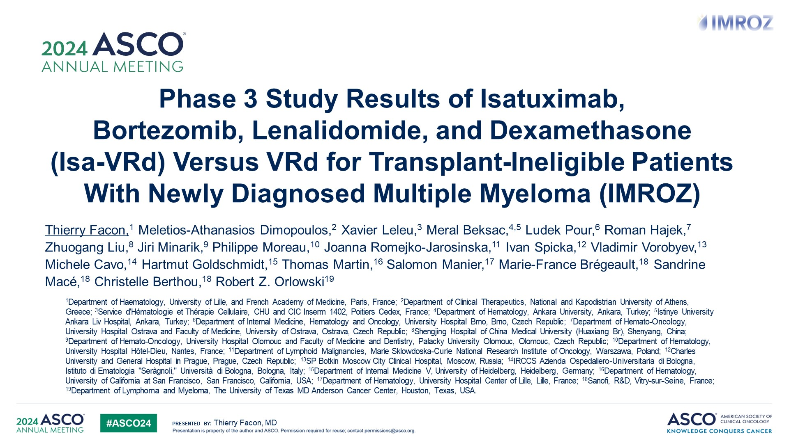
Phase 3 Study Results of Isatuximab,<br />Bortezomib, Lenalidomide, and Dexamethasone <br />(Isa-VRd) Versus VRd for Transplant-Ineligible Patients With Newly Diagnosed Multiple Myeloma (IMROZ)
Content of this presentation is the property of the author, licensed by ASCO. Permission required for reuse.

Slide 15
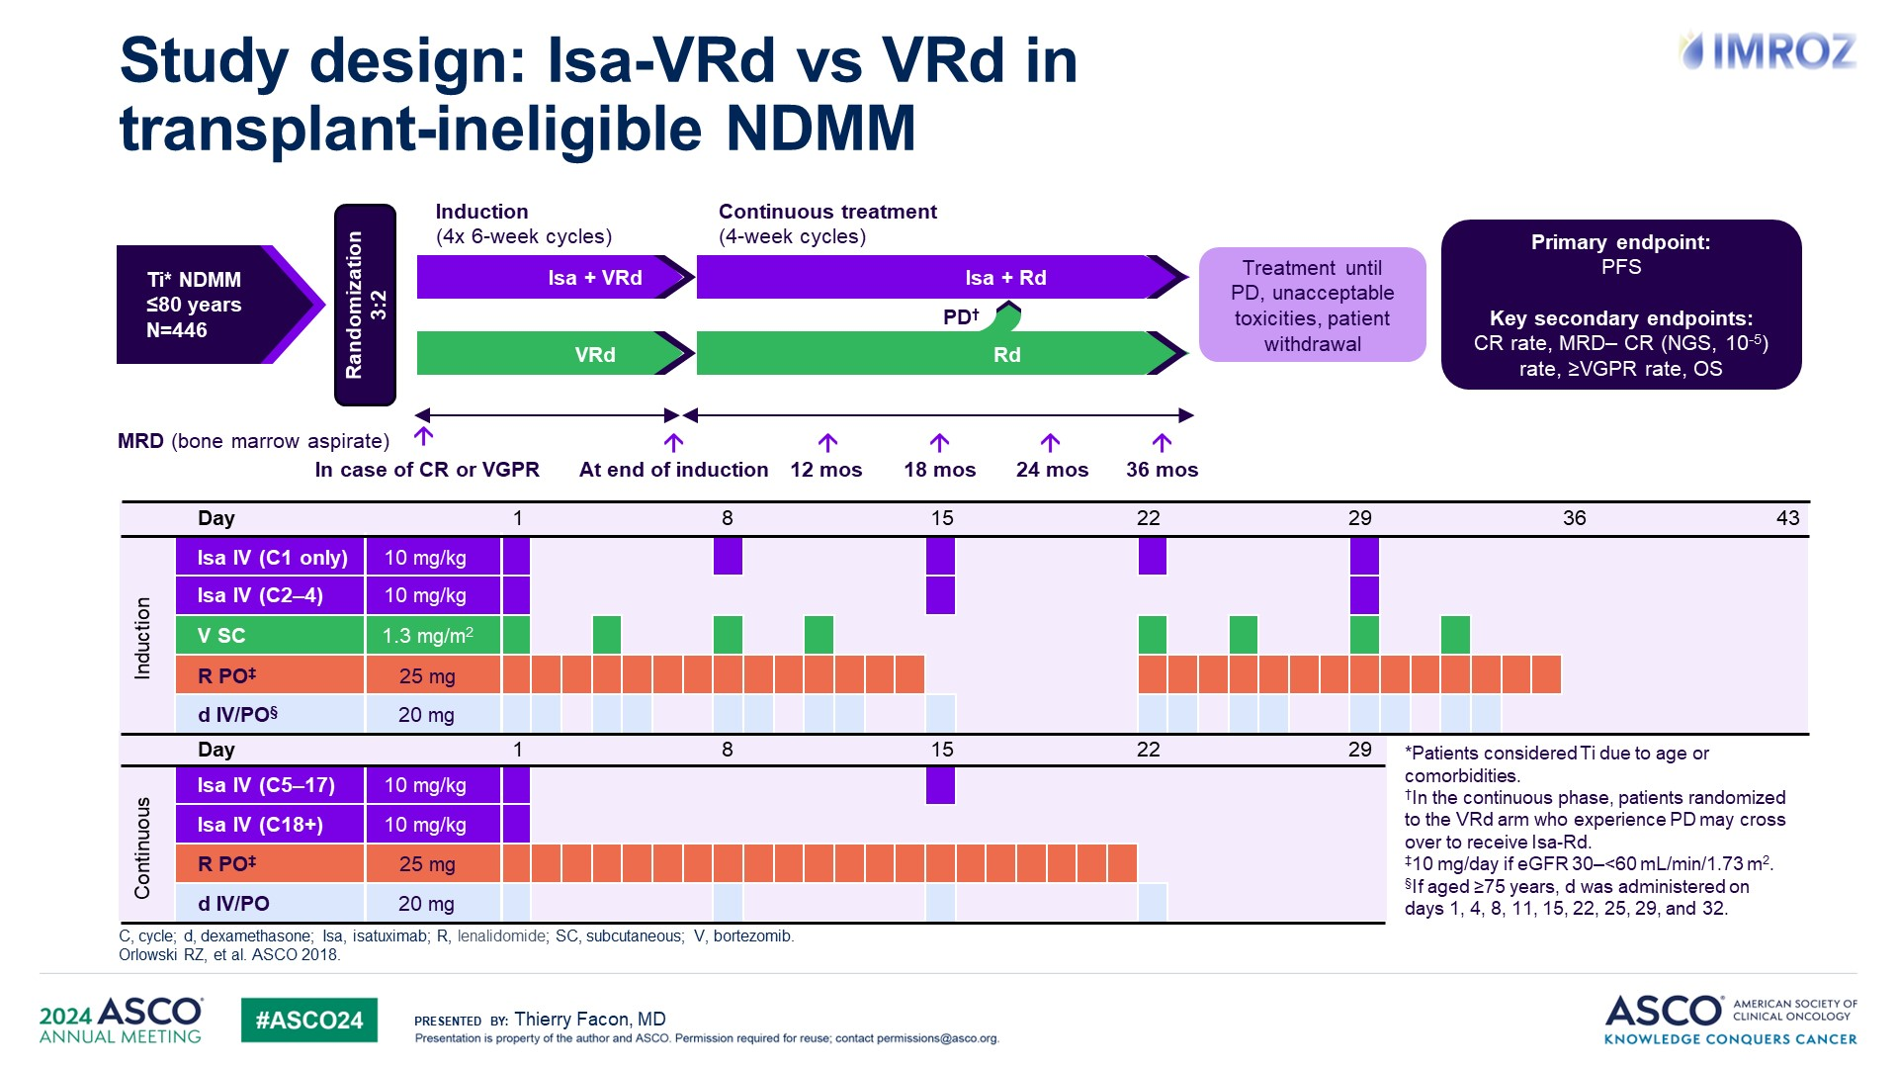
Study design: Isa-VRd vs VRd in <br />transplant-ineligible NDMM
Content of this presentation is the property of the author, licensed by ASCO. Permission required for reuse.

Slide 16
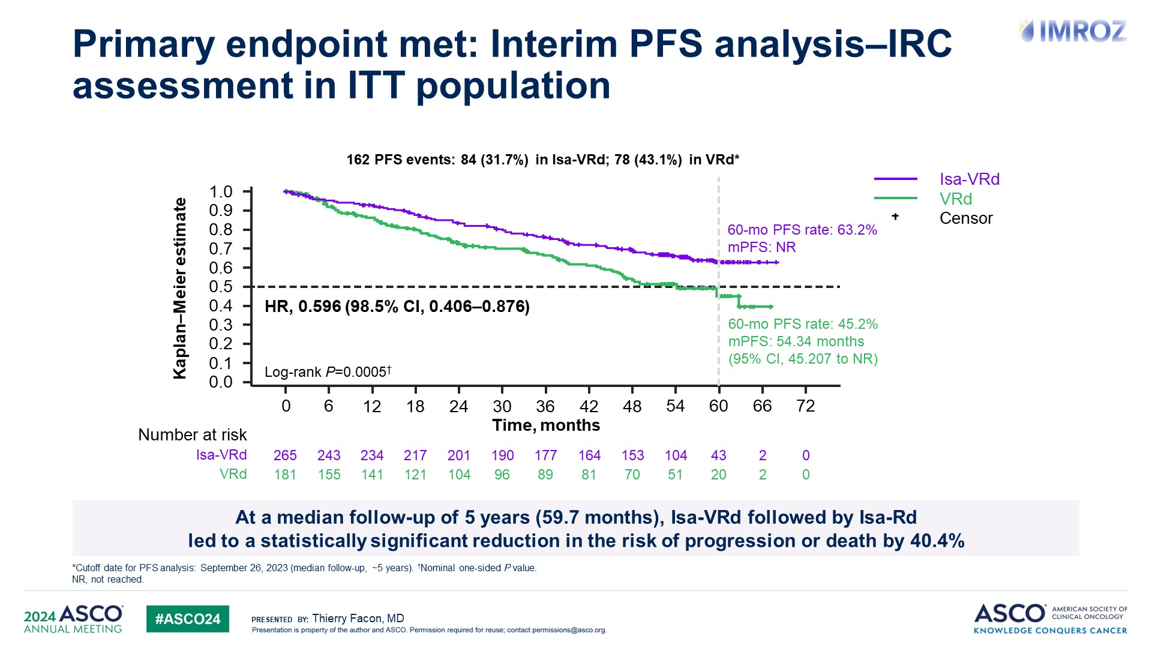
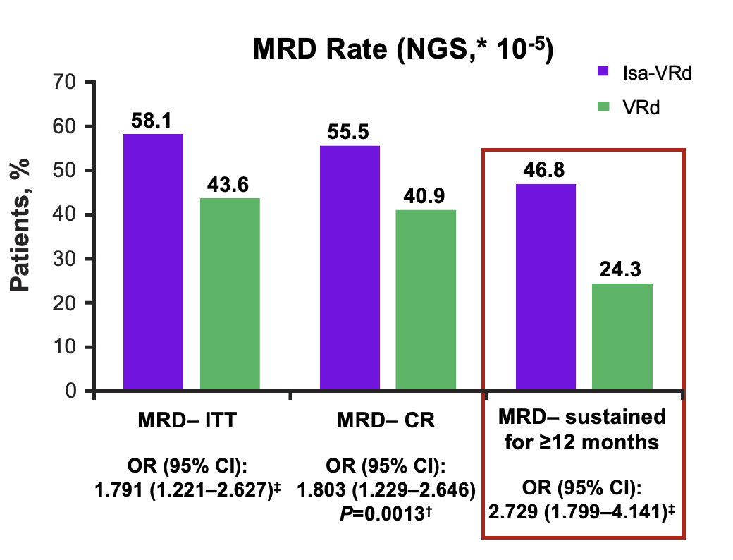
Primary endpoint met: Interim PFS analysis–IRC assessment in ITT population
Content of this presentation is the property of the author, licensed by ASCO. Permission required for reuse.

Slide 17
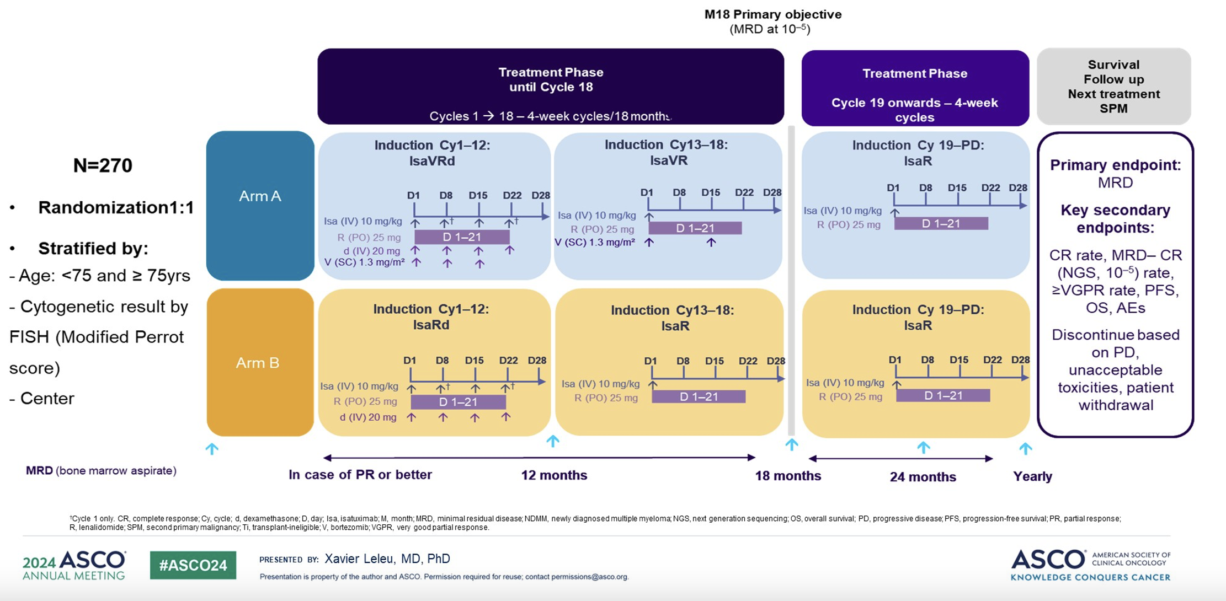
BENEFIT Trial: Isa-VRd vs. Isa-RD in TI NDMM
Study Schema

Slide 18
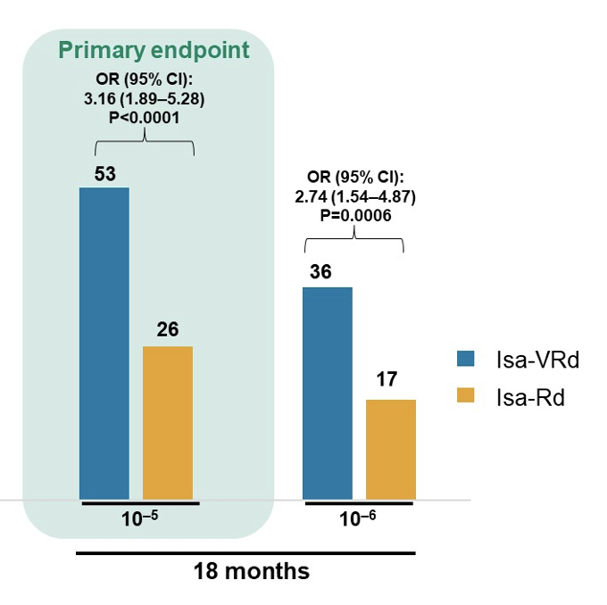
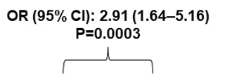
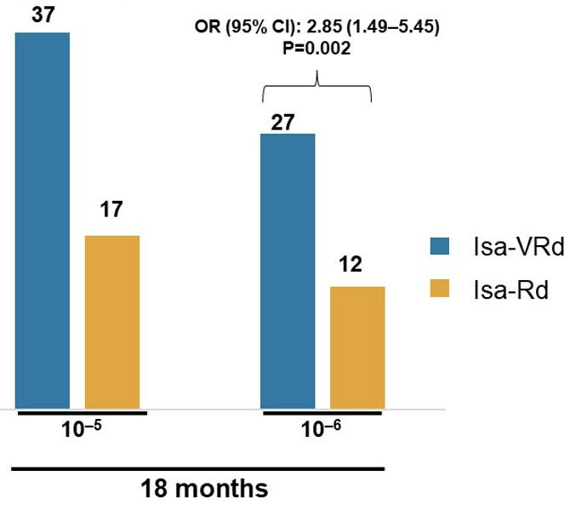
BENEFIT Trial: Isa-VRd vs. Isa-RD in TI NDMM
Results: Primary Endpoint MRD(-) Secondary Endpoint MRD(-) CR rates
Isa-VRd resulted in significant improvements in MRD- and MRD- CR rates at 18 months and at the 10⁻⁵ and 10⁻⁶ levels

Slide 19
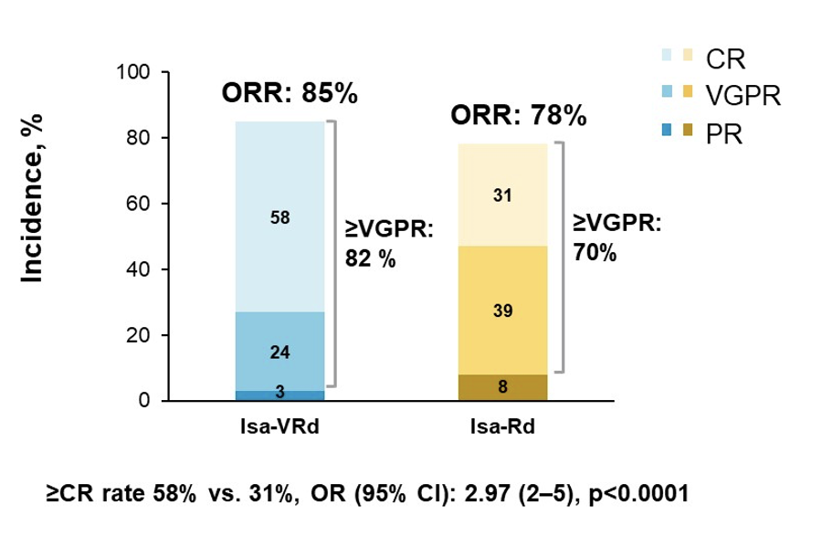
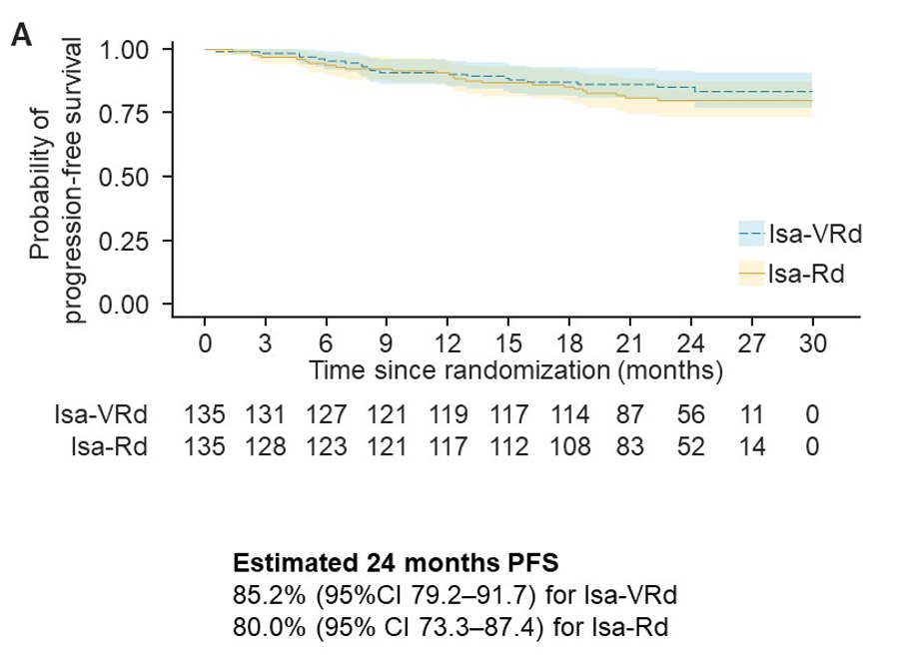
BENEFIT Trial: Isa-VRd vs. Isa-RD in TI NDMM
Results: Depth of Response (at 18 mos) Preliminary PFS (Median F/U 23.5 mos)
Isa-VRd resulted in deep response rates, particularly CR at 18 months and PFS is still immature

Slide 20
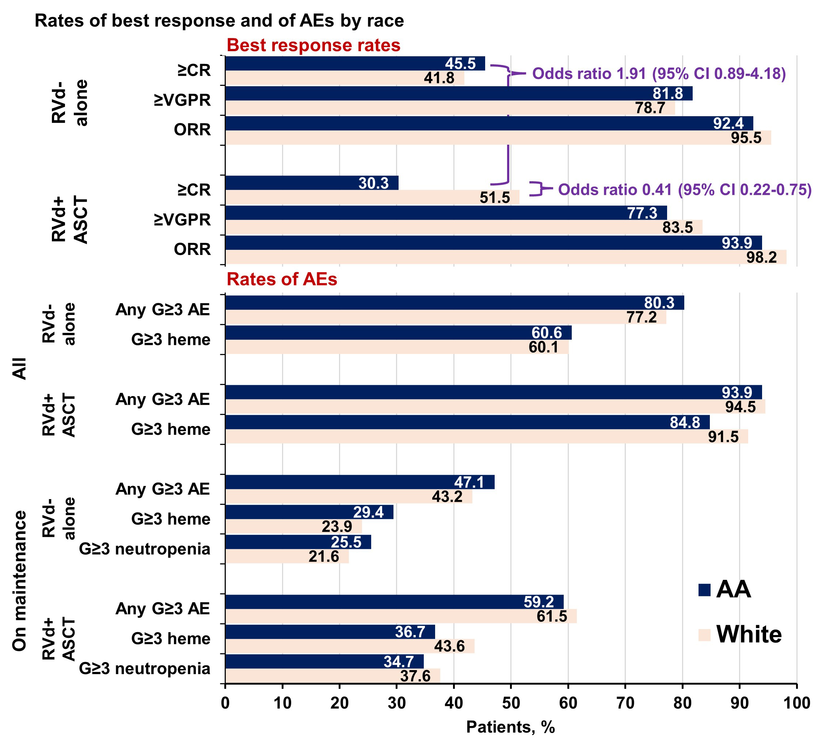
DETERMINATION Trial: Diversity
Results
AA 132/772 (18.3%)
AA: RVd-alone vs RVd+ASCT, median EFS was 47.7 vs 48.2 mos (HR 0.99)
Odds of achieving ≥CR were greater with RVd-alone vs RVd+ASCT in AA pts
Zonder JA, et al; ASH Abstract 4762

Slide 21
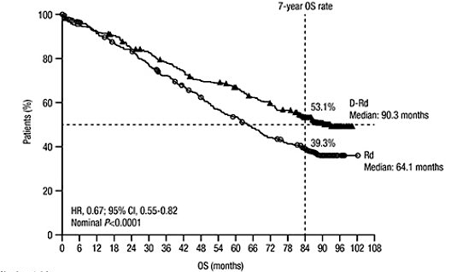
Phase III MAIA Trial: Final OS with D-Rd and Rd
With a median follow-up of 7.5 years, D-Rd continued to demonstrate a clinically significant survival benefit
versus Rd for patients with NDMM. Median OS with D-Rd was 7.5 years. Furthermore, subsequent antimyeloma therapy was daratumumab-based in 28.8% of patients who received Rd versus 6.3% who received D-Rd.
OS = overall survival; D-Rd = daratumumab in combination with lenalidomide/dexamethasone; Rd = lenalidomide/dexamethasone; NDMM = newly diagnosed multiple myeloma
Facon T et al. EHA 2024;Abstract P968.

Slide 22
Conclusions for NDMM
CD38 + VRd (QUAD therapy) – appears to be new SOC for TE and TI NDMM
Results appear durable both in TE and TI – projected PFS >80-90 months
In TI, (BENEFIT) – QWk bortezomib appears well-tolerated and effective
  Unclear in TE
High-risk NDMM appears to benefit from QUAD therapy
  Dara-VRd subgroup looks good
  Isa-KRd shows improved MRD- rates, especially in double hit subgroup
Future results from GMMG-HD7 and PERSEUS will assess the value of doublet maintenance and whether using MRD to guide maintenance duration makes sense
MRD(–) CR will be the new “early” response metric for future trials
More treatment adapted trials based on MRD, will be needed to help guide treatment choice and duration in the future
NDMM trials should further assess differences based on diversity

Slide 23
Relapsed/Refractory Multiple Myeloma
IKEMA
ICARIA
BOSTON Trial
Mezigdomide +Dex
Mezigdomide + Dara + Dex
Belantamab – DREAMM-7 + 8

Slide 24
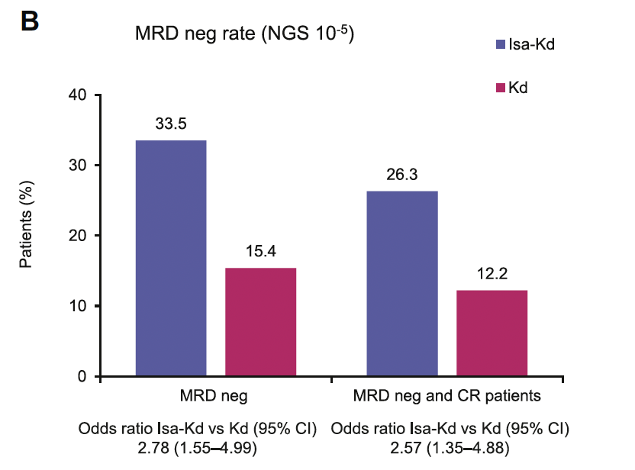
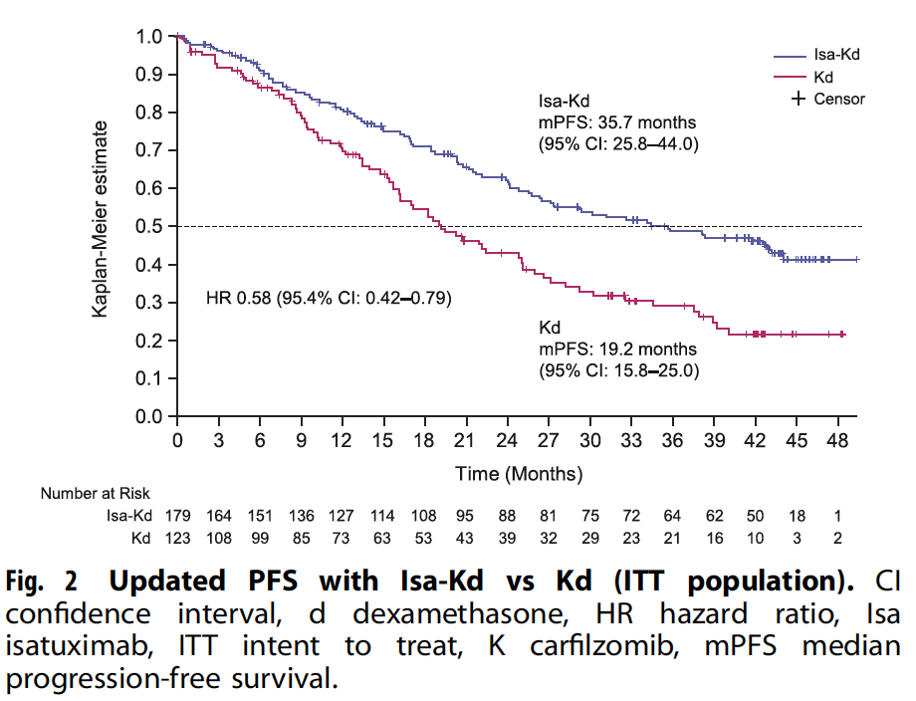
Updated Results from IKEMA (Isa-Kd vs. Kd)
Progression free survival Rates of achieving MRD negativity
Martin T, et al; Blood Cancer Journal (2023) 13:72

Slide 25
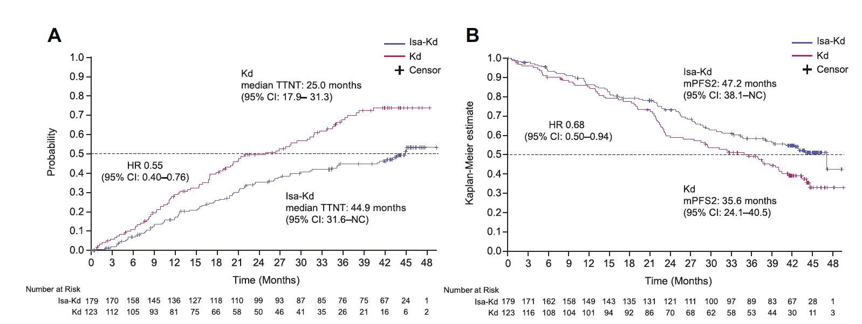
Updated Results from IKEMA (Isa-Kd vs. Kd)
A. Time to next therapy (TTNT) B. Progression free survival-2
Martin T, et al; Blood Cancer Journal (2023) 13:72

Slide 26
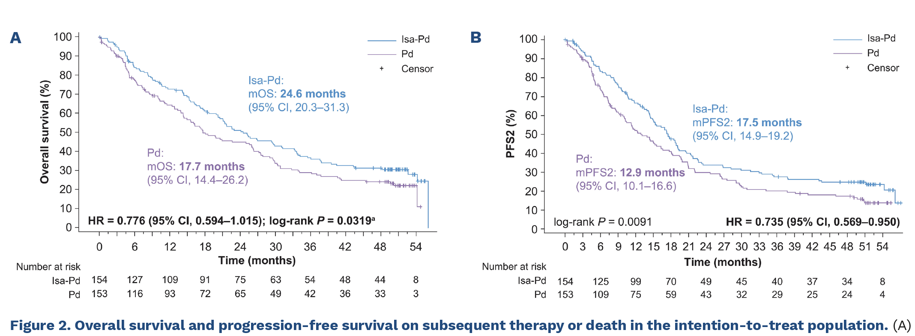
ICARIA (Isa-Pd vs. Pd): FINAL Results
Richardson P, et al; Haematologica 2024

Slide 27
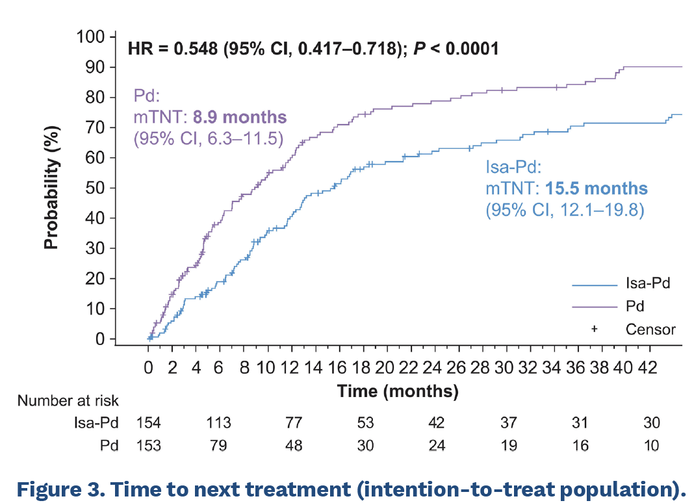
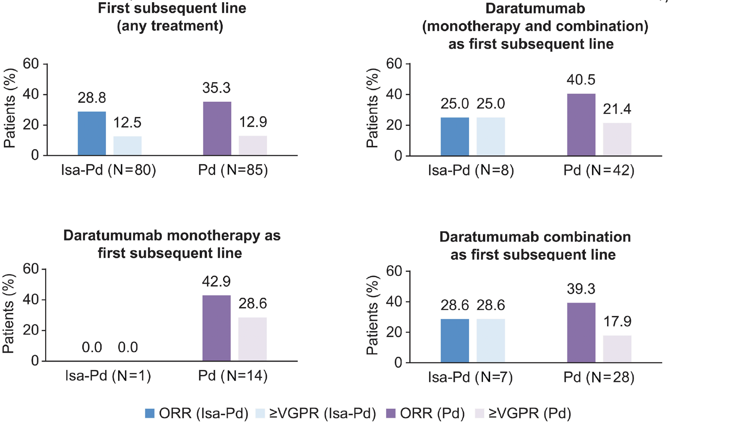
ICARIA – FINAL Results
Richardson P, et al; Haematologica 2024

Slide 28
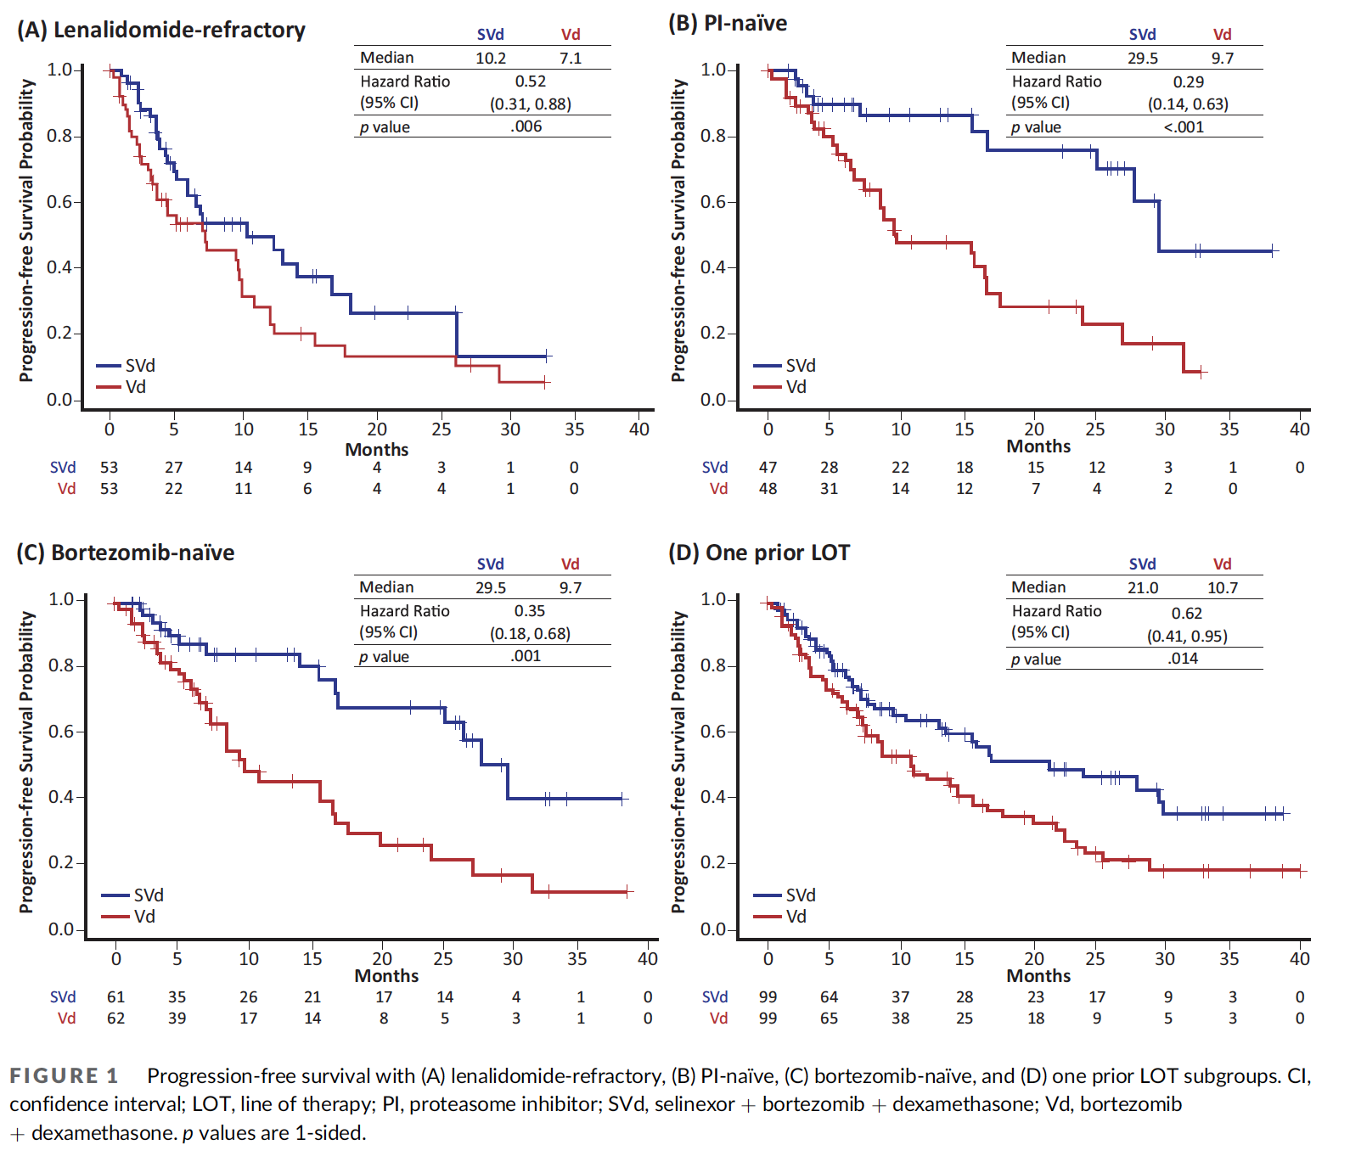
BOSTON Trial:
Results
Median F/U >28 mos
PFS
  Len-Refr: 10.2 vs 7.1 mos
  PI-naïve: 29.5 vs 9.7 mos
  1 PLOT: 21.0 vs 10.7 mos
In all subgroups
  ORR and ≥VGPR favored SVd
Mateos MV, et al; Eur J Haematol. 2024;1–11

Slide 29
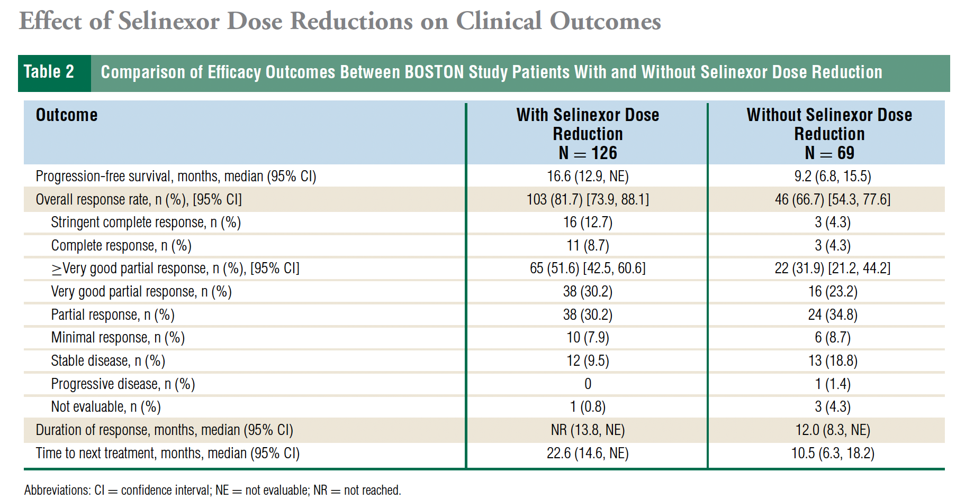
BOSTON Trial: Importance of Dose Adjustments
195 Patients
  Seli-Qwk + Vd
  126 (65%) – required dose Adj
  Median Seli dose 71.4 mg/wk
PFS –
  Pts with dose adj ➔ 16.6 mos
  Pts w/o dose adj ➔ 9.2 mos
ORR
  W= 81.7% vs. w/o= 66.7%
Jaganath S, et al; Clinical Lymphoma, Myeloma and Leukemia 2023. Vol. 23, No. 12, 917–923

Slide 30
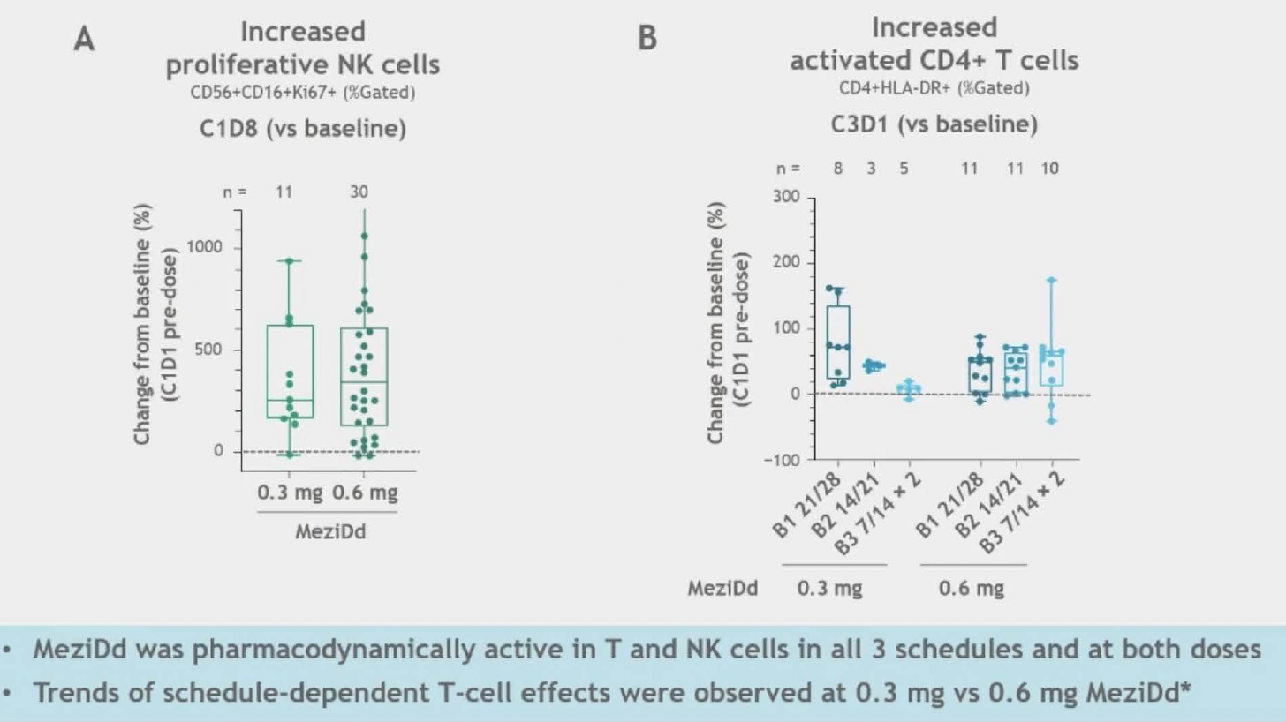
Mezigdomide Combinations: Mezi-Dara+Dex
PK/PD with Mezi-Dd:
EHA Abstract 2024
> 4-fold increase in proliferating T and NK cells,
> 2-fold increase in activated/ effector memory T cells
> 75% decrease in median absolute B cells
MRD(-) response in 23/51
Richardson P, et al; ASH 2023. Amantangelo M, et al. EHA 2024

Slide 31
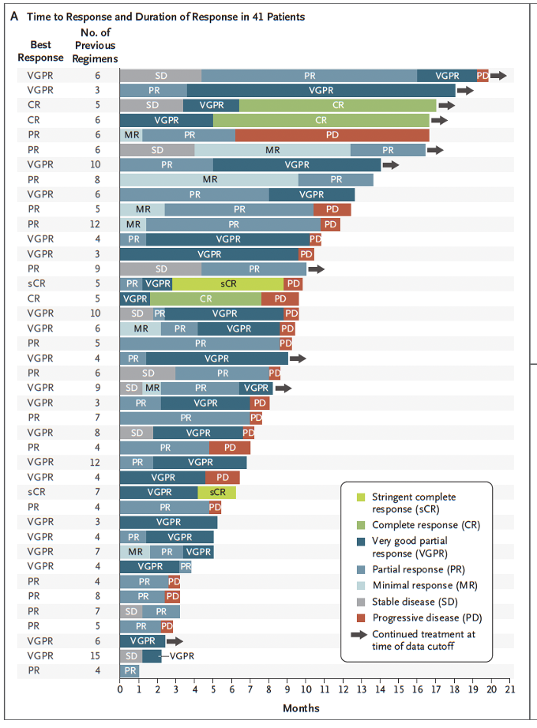
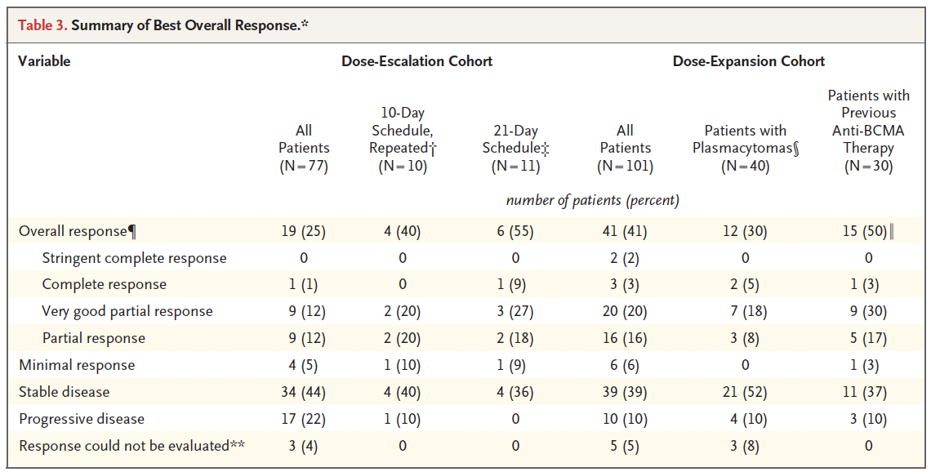
Phase 1/2 - Mezigdomide + Dex
Phase 1: 77 pts – dose escalation
Phase 2: 101 pts – dose expansion
- RP2D: Mezi=1 mg Day 1-21 + Dex Qwk
- Med 6 PLT, 100% IMiD refr, 1000% TCR
PFS 4.4 mos
Richardson P, et al; NEJM 2023.

Slide 32
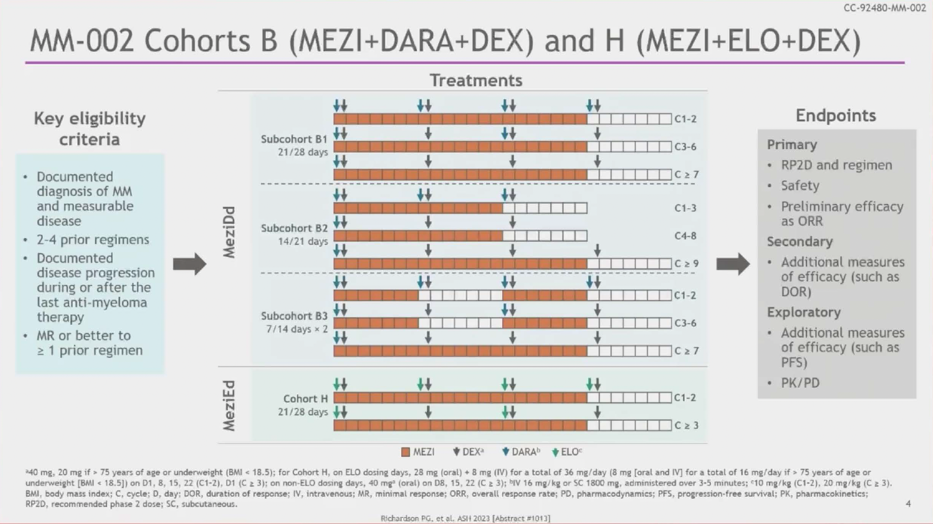

Slide 33
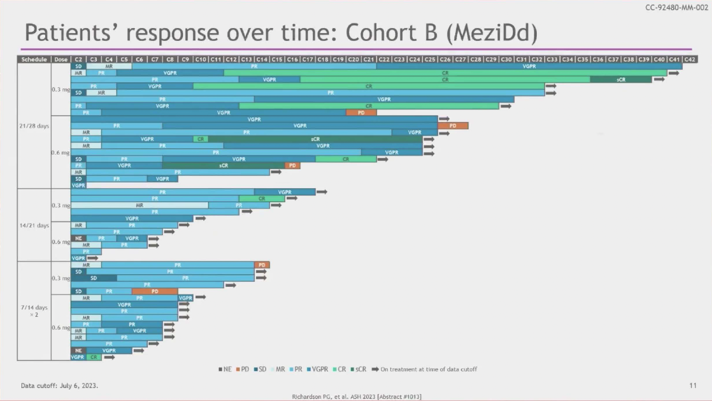
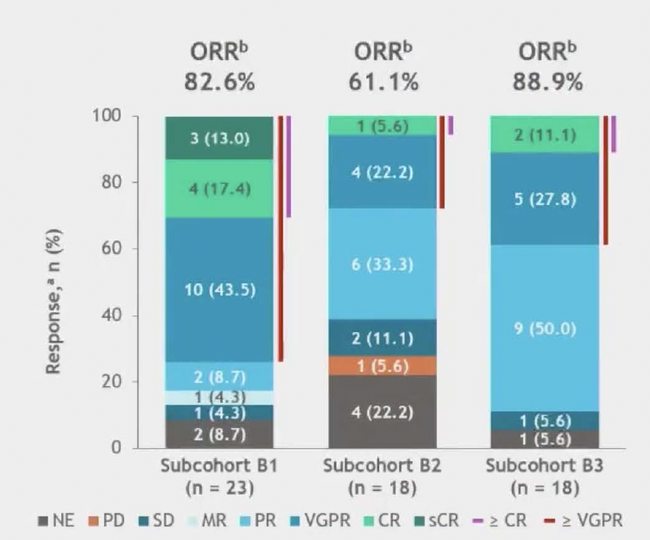
Patients' responses over time: Cohort B (MeziDd)
Combined ORR 78%

Slide 34
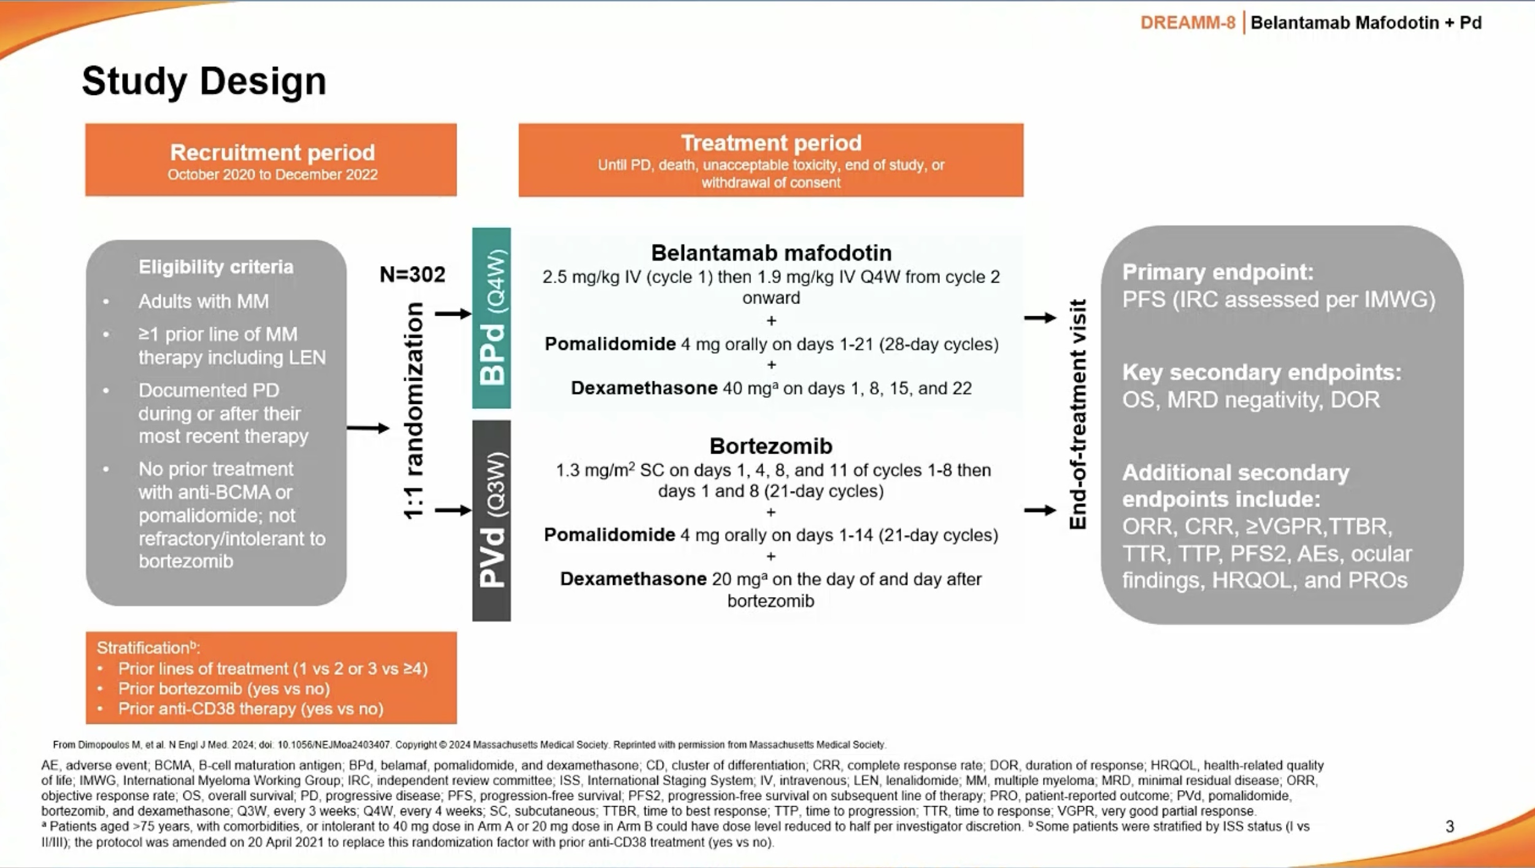

Slide 35
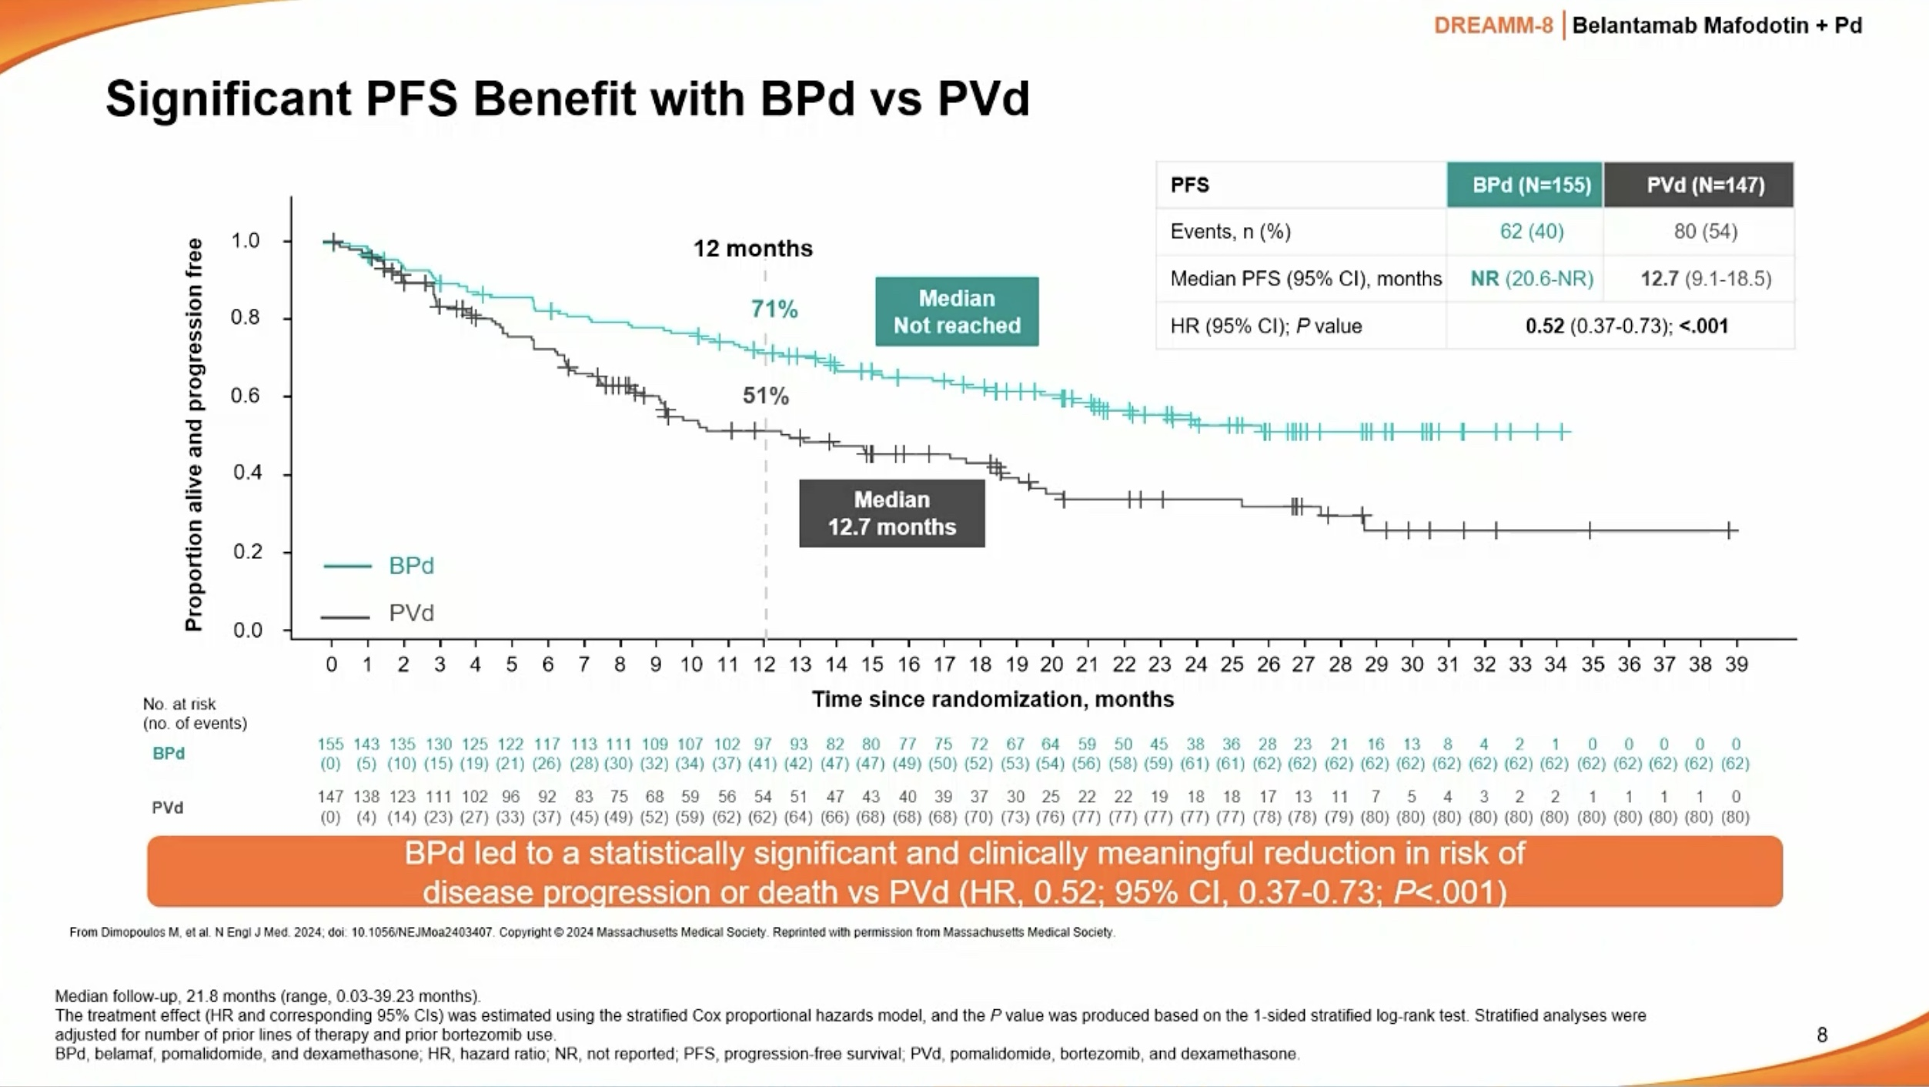
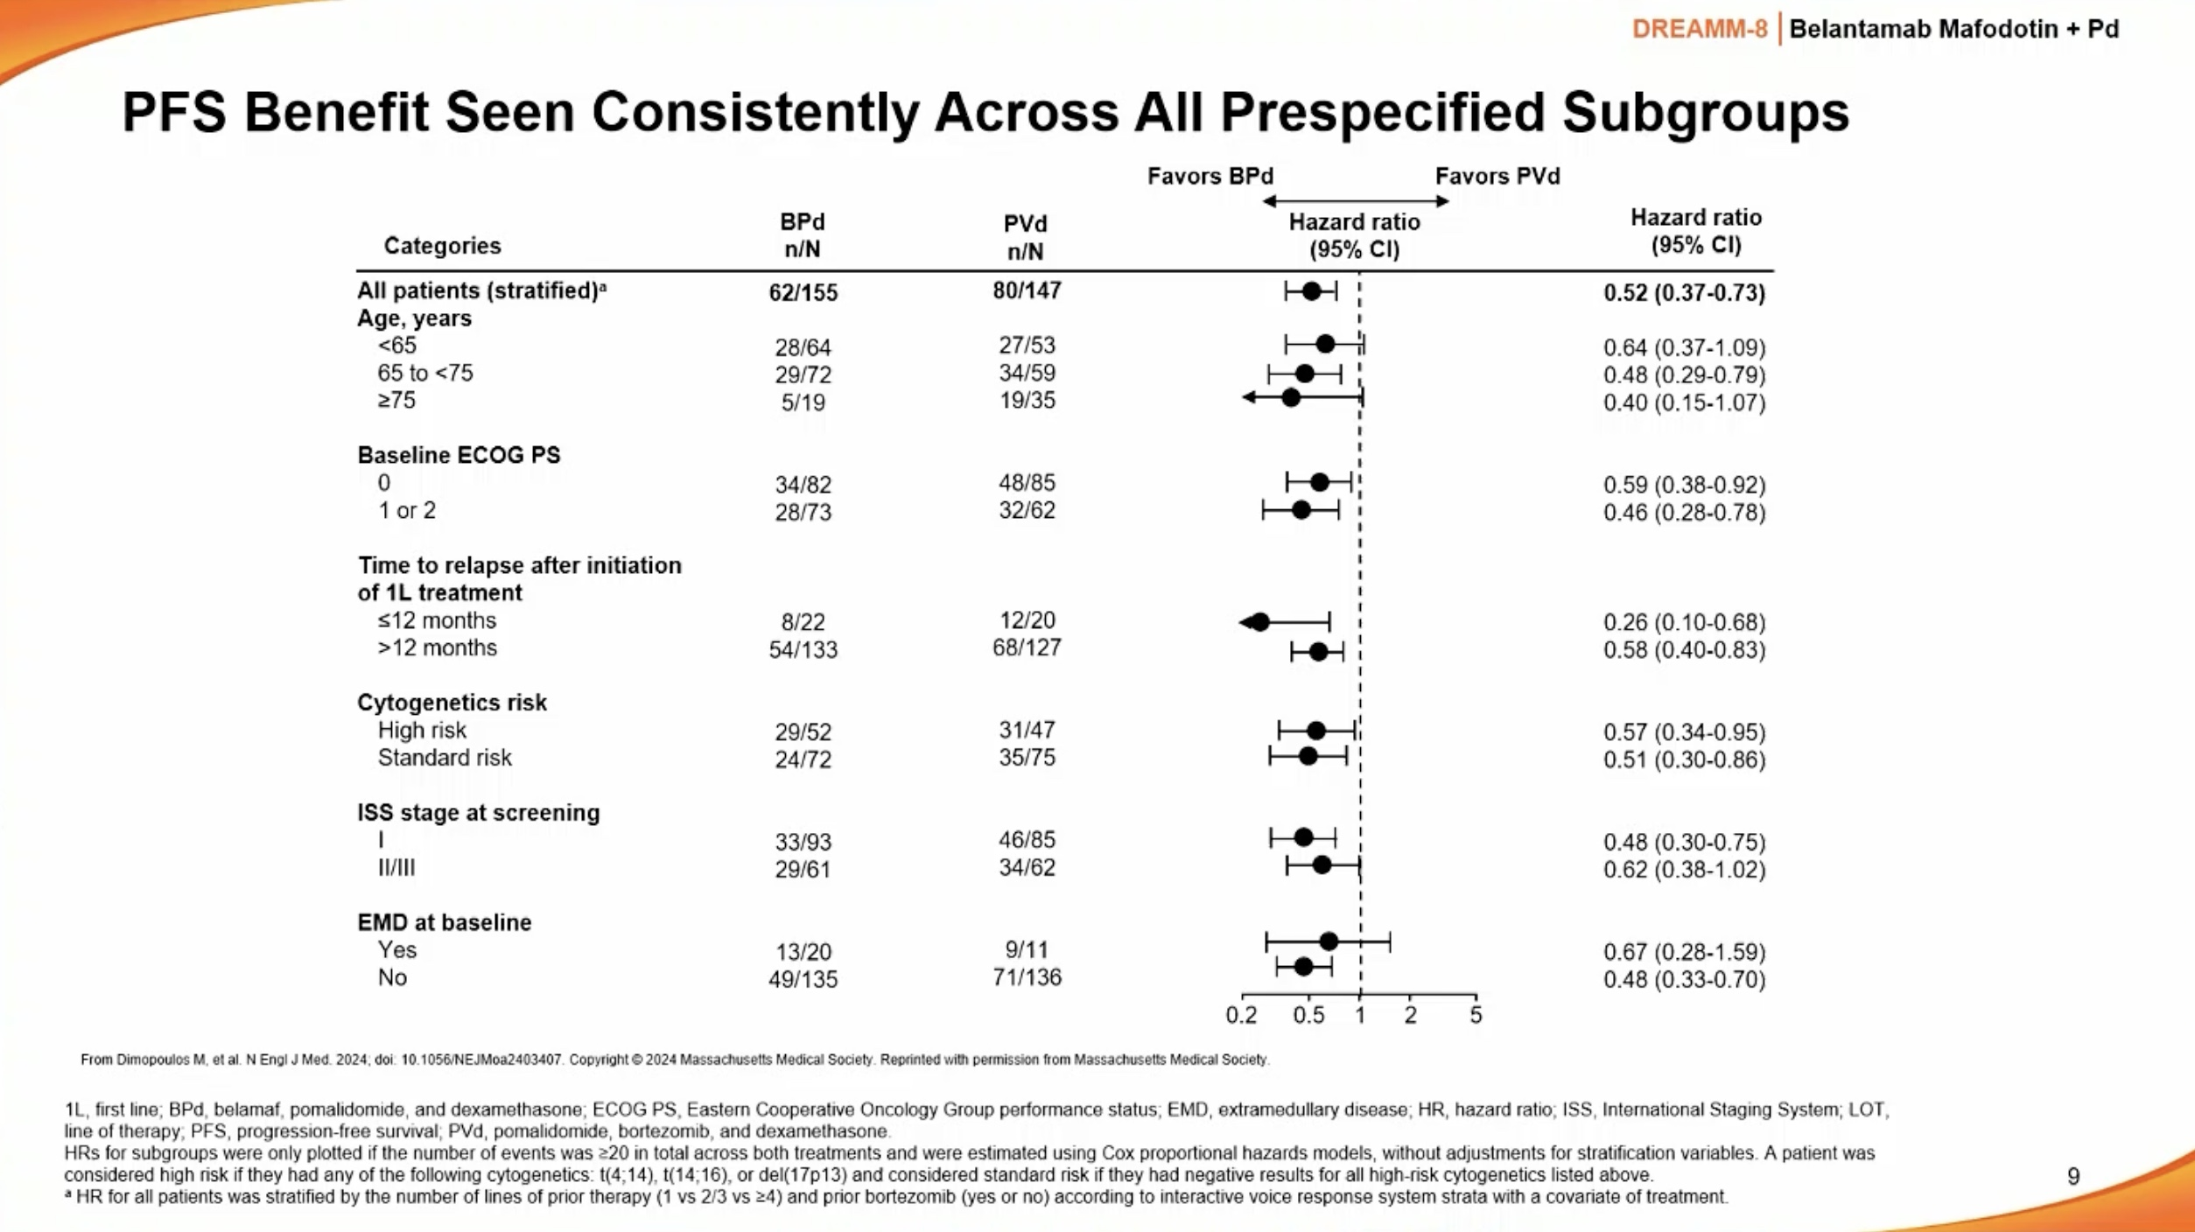

Slide 36
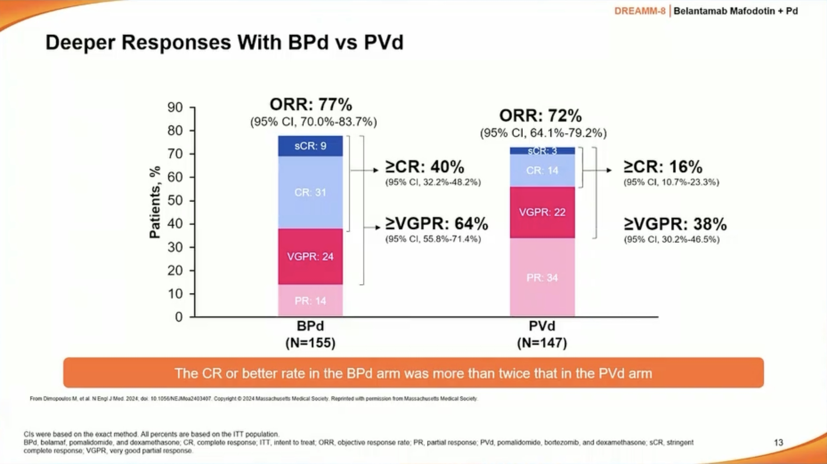

Slide 37
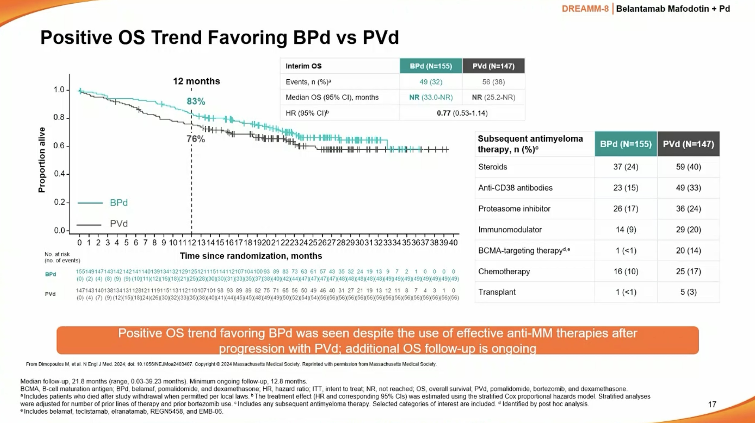

Slide 38
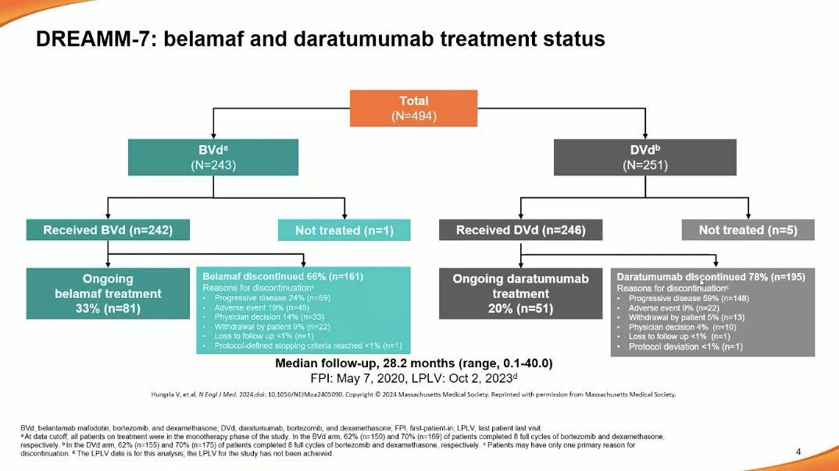

Slide 39
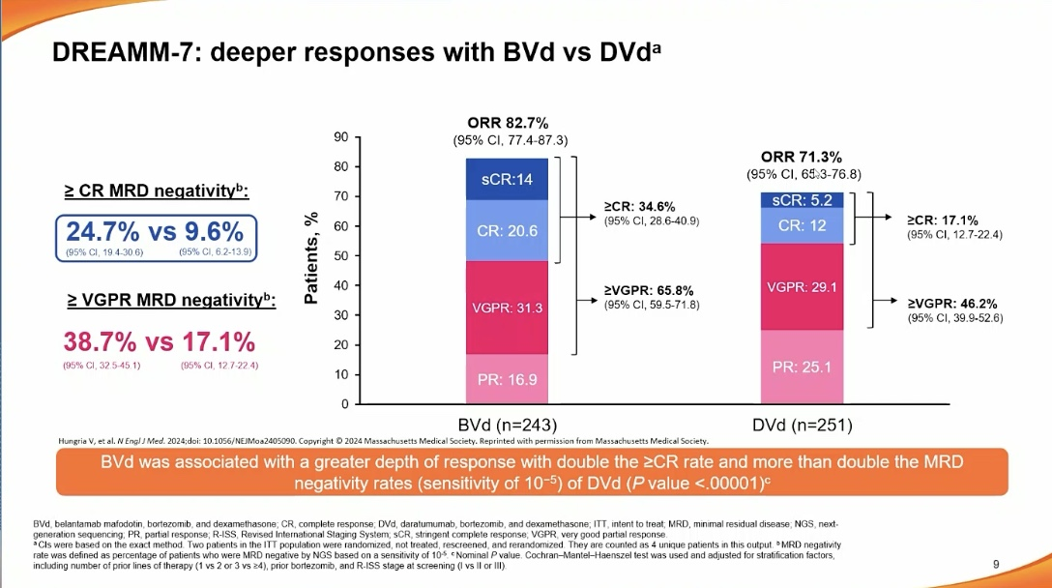

Slide 40
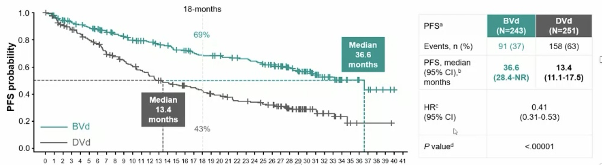
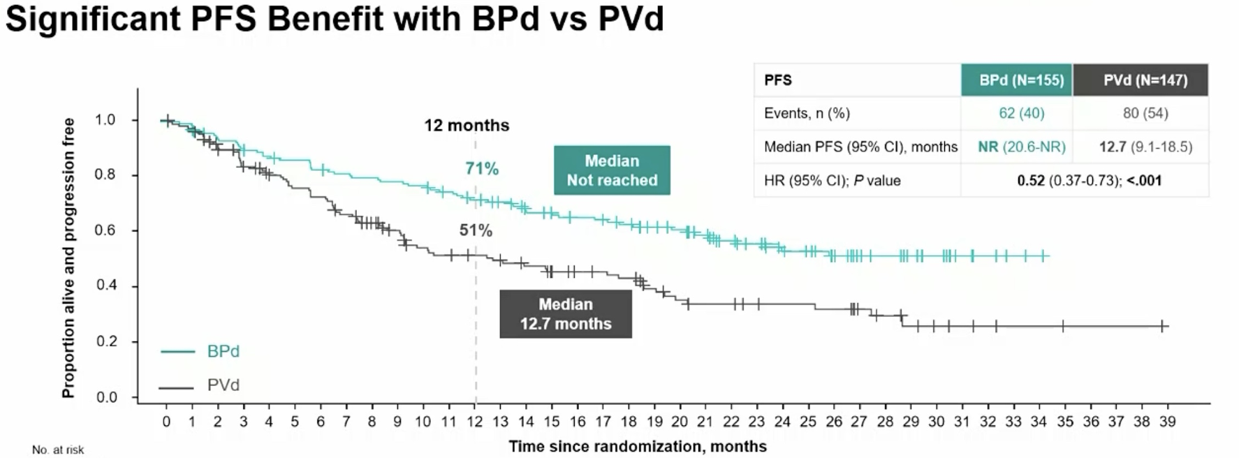
Both DREAMM-7 and -8 Show Significant PFS Benefit – No Blurriness Here
DREAMM
7
8
Mateous et al.
EHA2024
Dimopoulos et al.
EHA2024

Slide 41
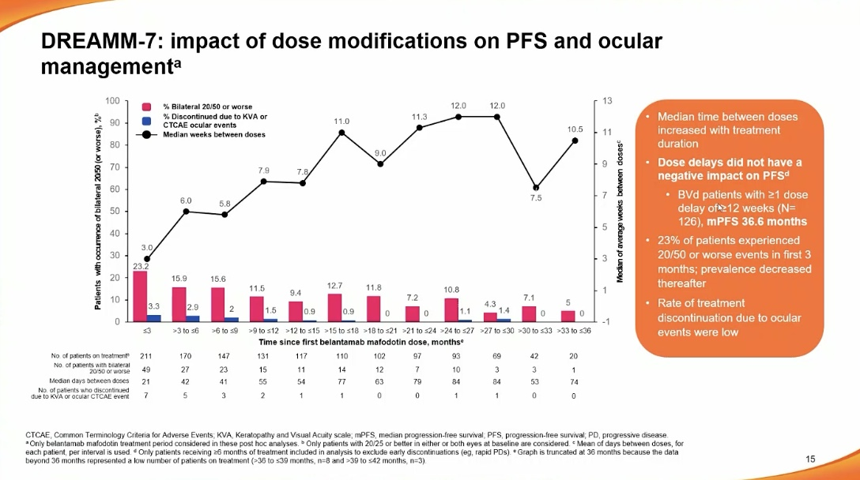

Slide 42
Conclusions for RRMM
CD38 + PI (Carfilzomib) – is very active in RRMM with all subgroups showing benefit
CD38 + pomalidomide – also quite active and more convenient
Selinexor + Vd in PI naïve has shown impressive results with PFS ~3 years
Mezigdomide combinations are also showing promise with Mezi-Dara-Dex leading the charge and other combinations under development
The DREAMM-7 + 8 studies have shown impressive results with Belantamab in combination with bortezomib and dex and pomalidomide and dex
How to incorporate all these combinations as well as early use of CAR T cell therapy will be important questions to answer in the coming years

