Slide 1
Year in Review: Myelofibrosis A CME/MOC-Accredited Live Webinar
Tuesday, May 14, 2024 5:00 PM – 6:00 PM ET
Faculty
Aaron T Gerds, MD, MS
Moderator
Neil Love, MD

Slide 2
Faculty
Aaron T Gerds, MD, MS
Associate Professor of Medicine
Hematology and Medical Oncology
Deputy Director for Clinical Research
Cleveland Clinic Taussig Cancer Institute
Medical Director
Case Comprehensive Cancer Center Clinical Research Office
Cleveland Clinic
Cleveland, Ohio
MODERATOR
Neil Love, MD Research To Practice
Miami, Florida

Slide 3
Commercial Support
This activity is supported by an educational grant from GSK.
Research To Practice CME Planning Committee Members, Staff and Reviewers
Planners, scientific staff and independent reviewers for Research To Practice have no relevant conflicts of interest to disclose.

Slide 4
Dr Gerds — Disclosures
Consulting Agreements | AbbVie Inc, Agios Pharmaceuticals Inc, Disc Medicine, GSK, PharmaEssentia, Rain Oncology

Slide 5
This educational activity contains discussion of non-FDA-approved uses of agents and regimens. Please refer to official prescribing information for each product for approved indications.

Slide 6
Key Data Sets
Chase ML et al. Consensus recommendations on peripheral blood smear review: Defining curricular standards and fellow competency. Blood Adv 2023;7(13):3244-52.
Chase ML et al. Development of consensus guidelines for hematology fellow competency in peripheral blood smear review utilizing nominal group technique 3204. Blood 2022; 140(Supplement 1):10781-3.
Mendez LF et al. Mediterranean diet intervention in patients with myeloproliferative neoplasm. Blood 2022;140(Suppl 1):3972-3.
Verstovsek S et al. MOMENTUM Study Investigators. Momelotinib versus danazol in symptomatic patients with anaemia and MF (MOMENTUM): Results from an international, double-blind, randomised, controlled, phase III study. Lancet 2023;401(10373):269-80.
Gerds AT et al. Momelotinib versus danazol in symptomatic patients with anaemia and myelofibrosis previously treated with a JAK inhibitor (MOMENTUM): An updated analysis of an international, double-blind, randomised phase 3 study. Lancet Haematol 2023;10(9):e735-46.
Verstovsek S et al. Momelotinib long-term safety and survival in MF: Integrated analysis of phase III randomized controlled trials. Blood Adv 2023;7(14):3582-91.

Slide 7
Key Data Sets
Gangat N et al. Predictors of anemia response to momelotinib therapy in myelofibrosis and impact on survival. Am J Hematol 2023;98:282-89.
Pemmaraju N et al. TRANSFORM-1: A randomized, double-blind, placebo-controlled, multicenter, international phase 3 study of navitoclax in combination with ruxolitinib versus ruxolitinib plus placebo in patients with untreated myelofibrosis. ASH 2023;Abstract 620.
Rampal R et al. Pelabresib in combination with ruxolitinib for Janus kinase inhibitor treatment-naïve patients with myelofibrosis: Results of the MANIFEST-2 randomized, double-blind, phase 3 study. ASH 2023;Abstract 628.
Tantravahi S et al. Selinexor plus ruxolitinib in JAK inhibitor (JAKi)-naïve patients with myelofibrosis: Long-term follow-up from XPORT-MF-034 suggestive of disease modification. ASH 2023;Abstract 622.
Mesa R et al. Clinical outcomes of patients with myelofibrosis after immediate transition to momelotinib from ruxolitinib. Haematologica 2024;109(2):676-81.
Harrison CN et al. Clinical effectiveness and safety of momelotinib compared with continued ruxolitinib or best available therapy in patients with myelofibrosis who required RBC transfusions: Subgroup analysis of the phase 3 Simplify-2 study. ASH 2023;Abstract 2189.

Slide 8
Key Data Sets
Gupta V et al. Long-term survival adjusted for treatment crossover in patients (pts) with myelofibrosis (MF) treated with momelotinib (MMB) vs danazol (DAN) in the MOMENTUM trial. ASCO 2024;Abstract 6571.
Kuzmanovic T et al. Identification and management of clonal hematopoiesis of indeterminate potential (CHIP) in cancer survivors: The Cleveland Clinic experience. ASCO 2023;Abstract 7010.
Scandura JM et al. A phase 2 study to evaluate the efficacy and safety of selinexor monotherapy in patients with JAK inhibitor-naïve myelofibrosis and moderate thrombocytopenia (XPORT-MF-044). ASH 2023;Abstract 3211.
Scandura JM et al. Phase 2 study evaluating selinexor monotherapy in patients with JAKi-naïve myelofibrosis and moderate thrombocytopenia. ASCO 2024;Abstract TPS6593.
Gerds AT et al. Ruxolitinib for myelofibrosis in elderly non-transplant patients: Healthcare resource utilization and costs. J Med Econ 2023;26(1):843-9.
Mishra R et al. Risk of myelodysplastic syndromes (MDS) in adolescents and young adults with cancers treated with chemotherapy with or without radiotherapy. ASH 2023;Abstract 2351.
Pemmaraju N et al. Ten years after ruxolitinib approval for myelofibrosis: A review of clinical efficacy. Leuk Lymphoma 2023;64(6):1063-81.

Slide 9
Agenda
INTRODUCTION: Myelofibrosis (MF) for Oncology “Newbies”
MODULE 1: Biology of MF
MODULE 2: Management of Anemia in MF
MODULE 3: Novel Strategies for MF
MODULE 4: Journal Club

Slide 10
Agenda
INTRODUCTION: Myelofibrosis (MF) for Oncology “Newbies”
MODULE 1: Biology of MF
MODULE 2: Management of Anemia in MF
MODULE 3: Novel Strategies for MF
MODULE 4: Journal Club

Slide 11
2023;7(13):3244-52

Slide 12
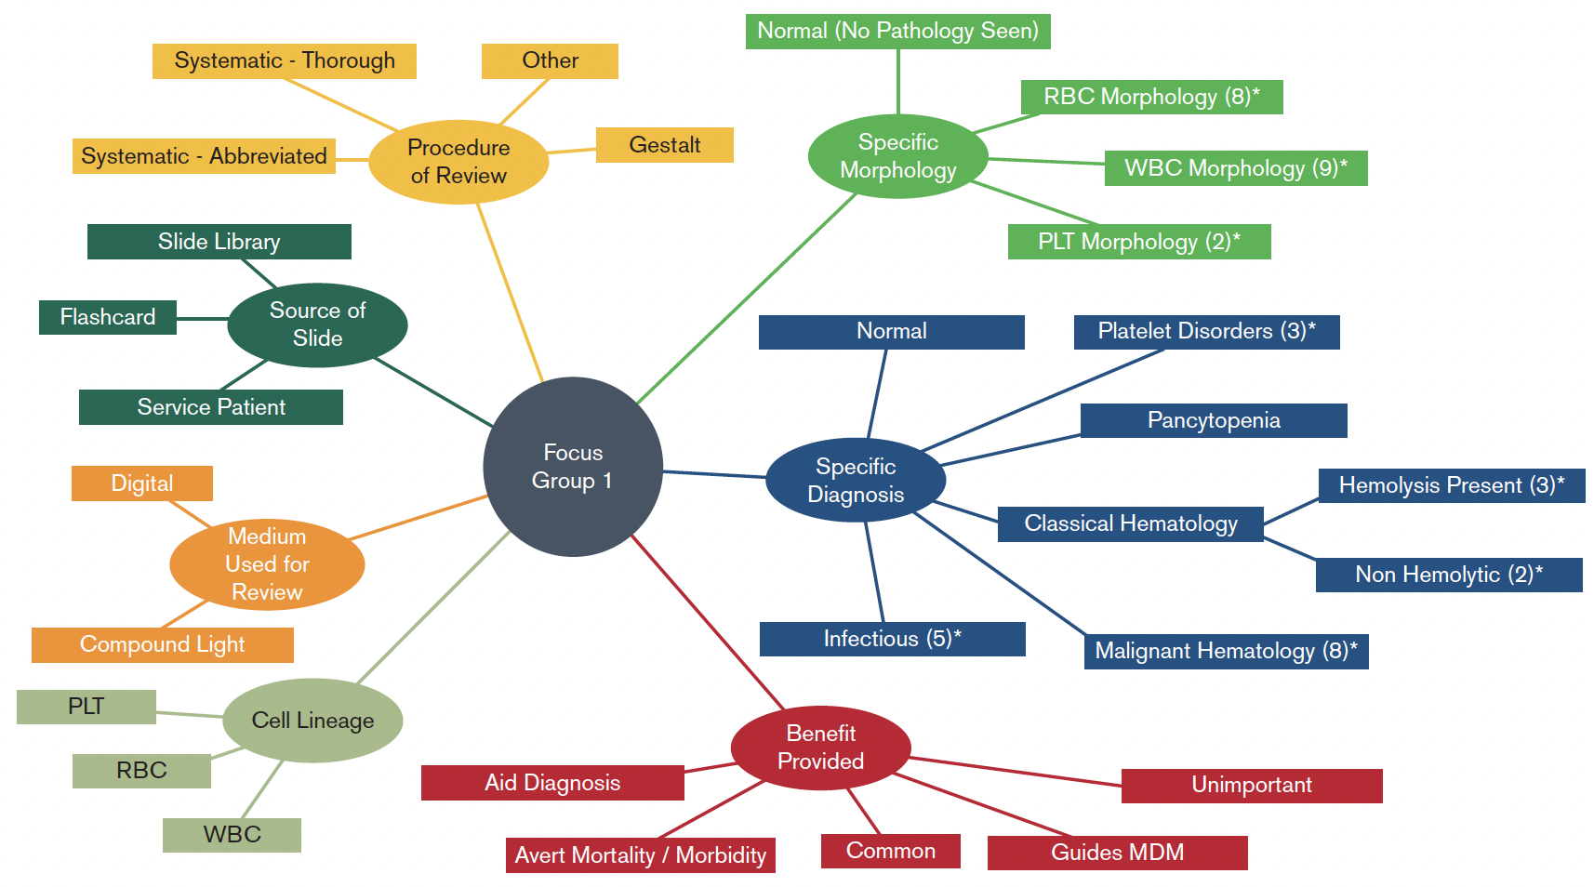
Participant Statement Coding
Chase ML et al. Blood Adv 2023;7(13):3244-52.

Slide 14
Agenda
INTRODUCTION: Myelofibrosis (MF) for Oncology “Newbies”
MODULE 1: Biology of MF
MODULE 2: Management of Anemia in MF
MODULE 3: Novel Strategies for MF
MODULE 4: Journal Club

Slide 15
Overview of Myelofibrosis (MF)
Ph positive
BCR-ABL
Myeloproliferative Neoplasms¹
Ph negative
CML
PV
ET
Primary MF
Post-PV MF
Post-ET MF
Myelofibrosis
MF prevalence
Approximately 16,000 to 18,500 patients in the United States²
MF is characterized by
Bone marrow fibrosis, cytopenias, and constitutional symptoms³
Splenomegaly⁴
MF natural history
Time course of disease progression is highly variable but frequently characterized by a period of stable disease followed by a late stage with rapid clinical progression^{5,6}
MF, myelofibrosis
PV, polycythemia vera
ET, essential thrombocythemia
CML, chronic myeloid leukemia
¹Tefferi A, Vardiman JW. Leukemia. 2008;22:14-22; ²Data on file, Incyte Corporation; ³Verstovsek S. Clin Can Res. 2010;16:1988-1996; ⁴Mesa RA. Blood. 2009;113(22):5394-5400; ⁵Cervantes F, et al. Blood. 2009;113:2895-2901; ⁶Tam CS, et al. J Clin Oncol. 2009;27:5587-5593.
Courtesy of Rami Komrokji, MD
Notes:
Myelofibrosis (MF) is a Philadelphia chromosome-negative, or Ph(-), myeloproliferative neoplasm (MPN) distinct from Ph(+) MPNs such as chronic myelogenous leukemia (CML)
MF is either a primary event or evolves secondarily from polycythemia vera (post-PV MF) or essential thrombocythemia (post-ET MF)
MF is characterized by bone marrow fibrosis, cytopenias, splenomegaly, and other symptoms. The natural history is highly variable but is frequently characterized by a period of stable disease followed by a late stage with rapid clinical progression
There are about 16,000 to 18,500 patients with MF in the United States

Slide 16
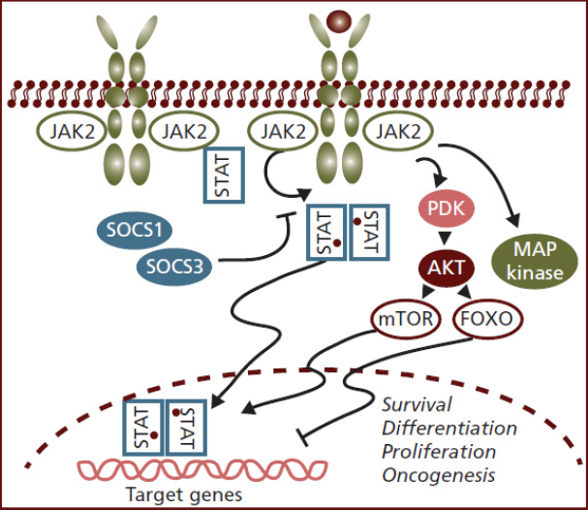
JAK-STAT Pathway Constitutively Activated in Myelofibrosis
JAK-STAT pathway implicated in normal hematopoiesis¹
An activating mutation in the pseudokinase domain of Janus kinase 2 (JAK2) was identified in approximately 50% of MF patients
Dysregulation of JAK-STAT, regardless of JAK mutation status, is a key pathologic feature of MF and other MPNs^{1,2}
1. Vannucchi AM et al. CA Cancer J Clin. 2009;59:171-191. 2. Anand S et al. Blood. 2011;118:1610-1621.
Courtesy of Rami Komrokji, MD

Slide 17
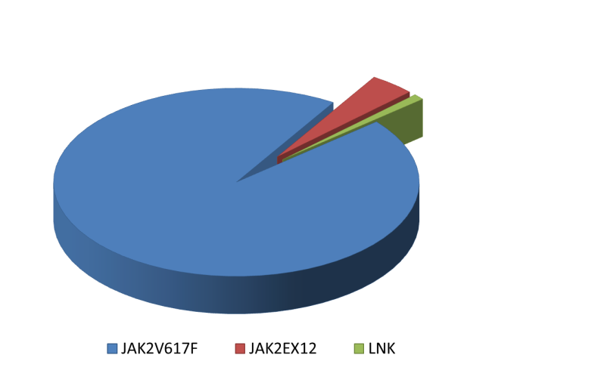
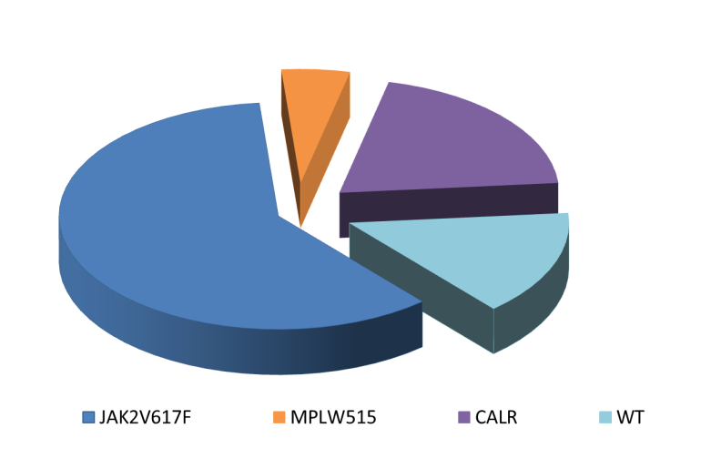
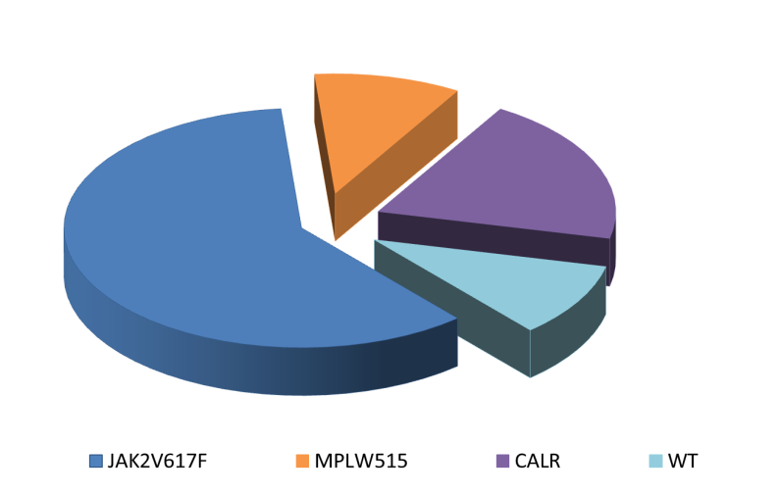
Phenotypic Driver Mutations (activate JAK-STAT pathway) in MPNs
PV
ET
MF
3%
3-5%
5-8%
20-25%
20-25%
1%
96%
60%
60%
10-15%
10-15%
JAK2 V617F
MPL (W515x)
Type1/Type1-like
JAK2 Exon12
CALR mut
Type2/Type2-like
Others (SH2B3)
Unknown (Triple Negative)
Klampfl T, et al. NEJM 2013;369(25):2379-90; Nangalia J, et al. NEJM 2013;369(25):2391-405.
Courtesy of Rami Komrokji, MD

Slide 18
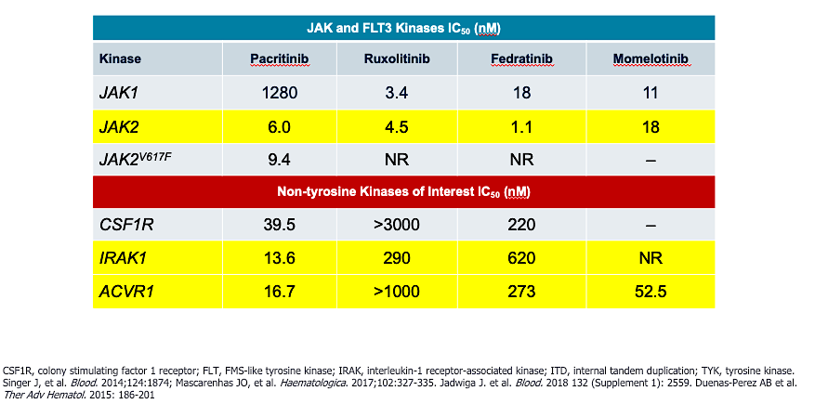
JAK Inhibitor Specificities
Courtesy of John O Mascarenhas, MD.

Slide 19
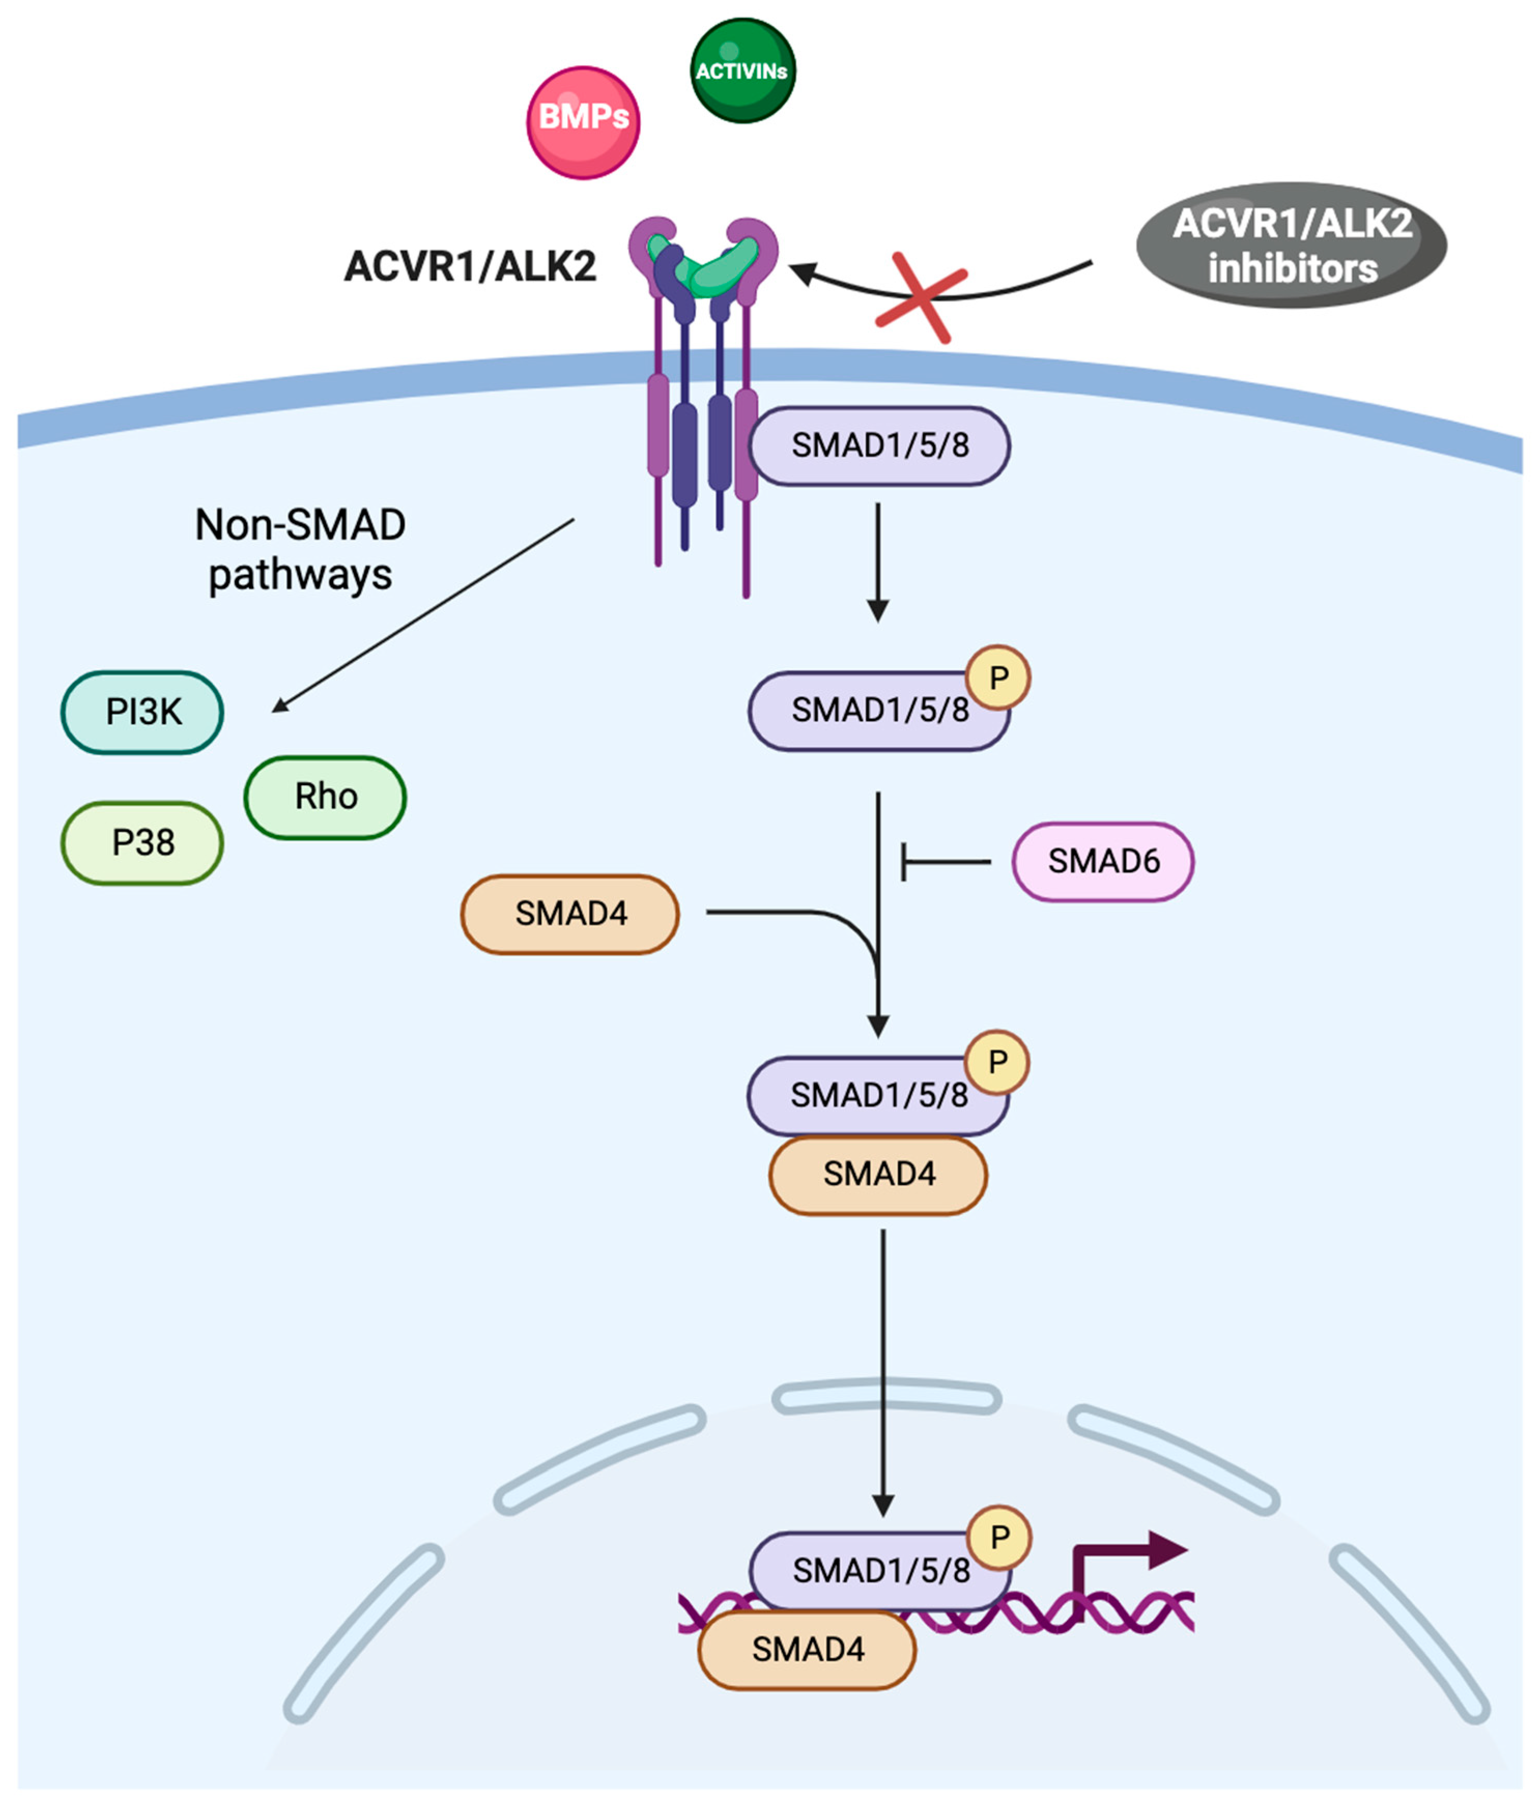
ACVR1 Is an Emerging Biomarker in MF and Anemia
Oh ST et al. Blood Adv 2023;7(19):5835-42; Duminuco A et al. Cancers 2024;16(1):154.

Slide 20
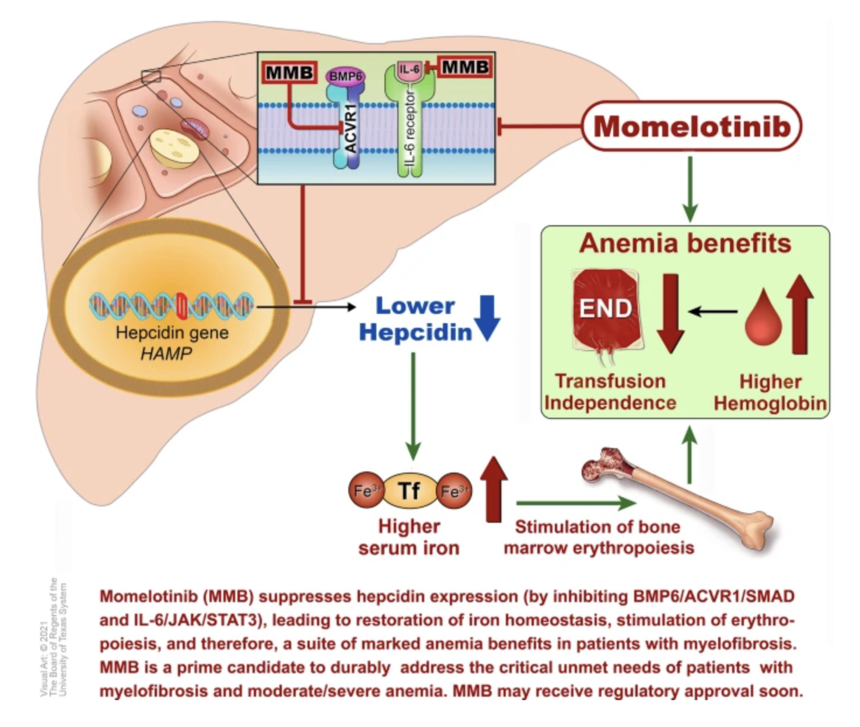
Proposed Mechanism of Momelotinib for MF with Anemia
Chifotides HT et al. J Hematol Oncol 2022;15(1):7.

Slide 21
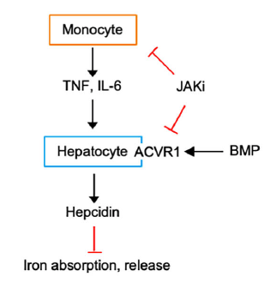
Hepcidin Regulation
Kong T et al. Am J Hematol 2023;98(7):1029-42.

Slide 22
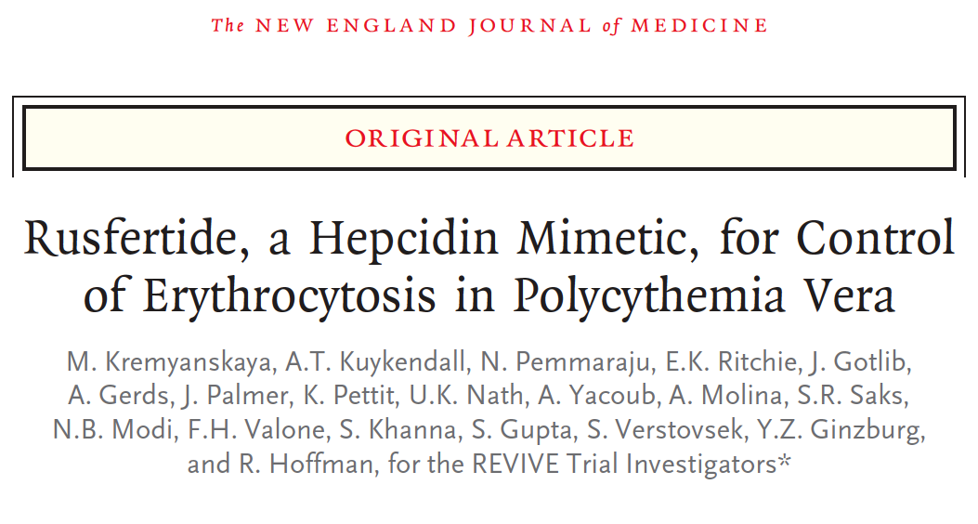
2024 February 22;390(8):723-35

Slide 23
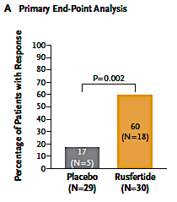
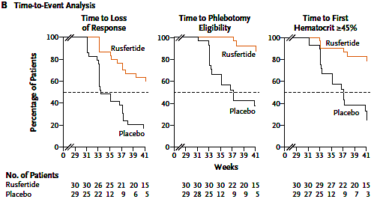
REVIVE Trial: Clinical Efficacy of Rusfertide in Patients with Polycythemia Vera
Response defined by hematocrit control, absence of phlebotomy and completion of the trial regimen during part 2.
Analysis of times until the loss of response, phlebotomy eligibility and a first hematocrit of at least 45% during part 2. The dashed
lines indicate the median time to the event.
Kremyanskaya M et al. N Engl J Med 2024;390(8):723-35 .

Slide 24
Phase 3 Study VERIFY (NCT05210790): Rusfertide vs Placebo in Patients With PV^{1,2} ≈250 Patients with PV Are Being Randomized Globally¹
32 weeks
(Weeks 0-32)
104 weeks (Weeks 52-156)^{c}
Goal: Assess long-term safety
20 weeks
(Weeks 32-52)
Goal: Assess durability of responses through Week 52
Key Eligibility:¹⁻³
Part 1A: Double-Blind^{1,2}
Part 1B: Open-Label^{1,2}
Part 2: Open-Label^{1,2}
Age ≥18 years
Meet revised 2016 WHO criteria for diagnosis of PV
≥3 phlebotomies due to inadequate HCT control in 28 weeksª before randomization OR ≥5 phlebotomies due to inadequate HCT control within 1 year prior to randomization
Placebo + ongoing therapy
Rusfertide + PV therapy
R
1:1
Rusfertide + ongoing therapy
Dose of CRT may be changed or new CRT may be initiated
Rusfertide + ongoing therapy
Starting dose: 20 mg SC Q1W
CRT may be decreased or stopped but not increased
CRT may be decreased or stopped but not increased
ªDefined as 28 weeks in protocol amendment 3.1, but previously published as 6 months.^{2,3} ^{b}Phlebotomy eligibility defined as confirmed HCT >45% that is >3% higher than baseline, or HCT >48%.¹ CRT, cytoreductive therapy; HCT, hematocrit; PV, polycythemia vera; Q1W, once a week; R, randomized; SC, subcutaneous; WHO, World Health Organization. 1. ClinicalTrials.gov. NCT05210790. https://clinicaltrials.gov/ct2/show/NCT05210790 2. Verstovsek S, et al. 64th American Society of Hematology (ASH) Annual Meeting; December 2022. TiP poster presentation. 3. Protagonist Therapeutics. Protocol Number: PTG-300-11, Protocol Amendment 3.1. July 25, 2023. 4. Protagonist Therapeutics. Press release. Published March 22, 2021. https://feeds.issuerdirect.com/news-release.html?newsid=6535012005620858 5. EU Clinical Trials Register. 2021-004732-29. https://www.clinicaltrialsregister.eu/ctr-search/trial/2021-004732-29/HU.
N=250
Key Endpoints:^{1,4,5}
Proportion of patients achieving response, defined as absence of phlebotomy eligibility^{b} (Weeks 20-32)
Mean number of phlebotomies (Weeks 0-32)
Data cutoff: 17 October 2023

Slide 25
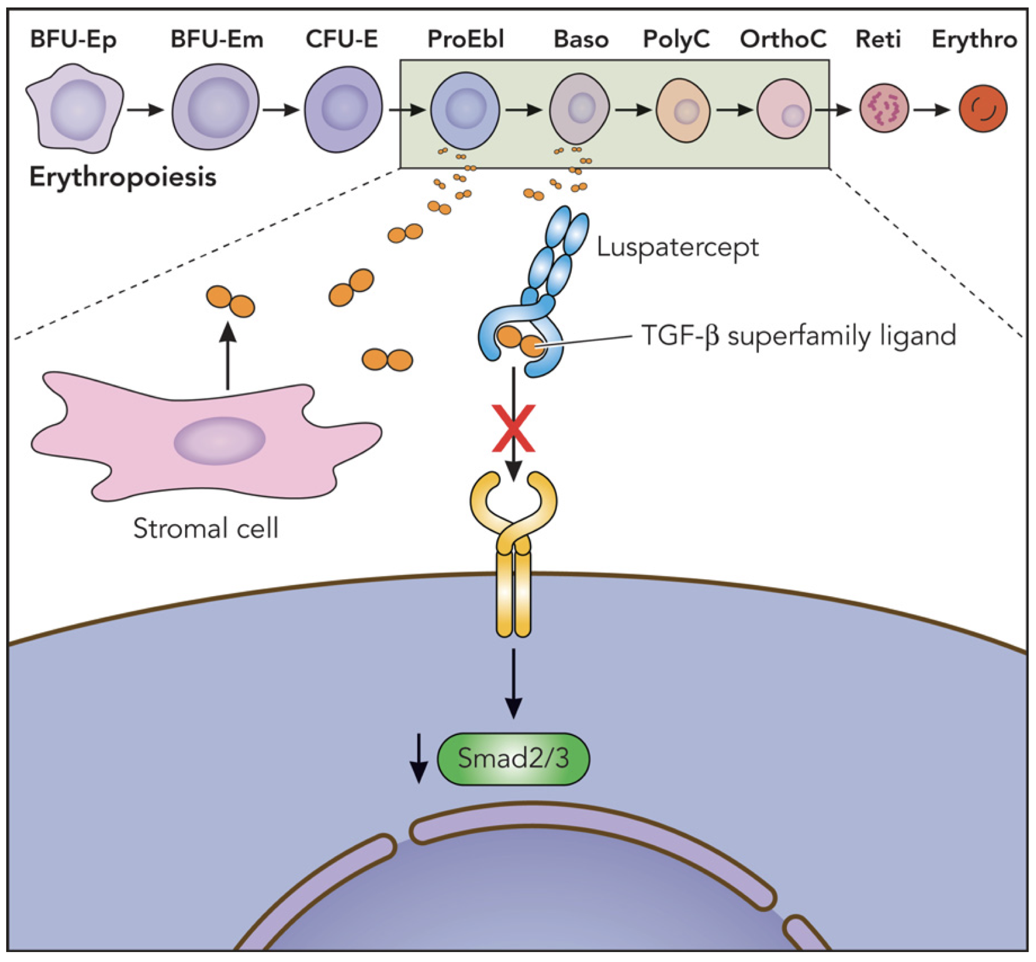
Luspatercept Mechanism of Action in Anemia
Kubasch AS et al. Blood Adv 2021;5(5):1565-75.

Slide 26
Selinexor Mechanism of Action in Myelofibrosis
Tantravahi S et al. ASH 2023;Abstract 622.

Slide 27
Agenda
INTRODUCTION: Myelofibrosis (MF) for Oncology “Newbies”
MODULE 1: Biology of MF
MODULE 2: Management of Anemia in MF
MODULE 3: Novel Strategies for MF
MODULE 4: Journal Club

Slide 28
A 78-year-old man with symptomatic MF receives ruxolitinib 10 mg BID but develops severe anemia and cardiac symptoms. Ruxolitinib dose is decreased to 5 mg BID with no change in symptoms. Platelet count = 77,000/μL, Hgb = 6.16 g/dL, WBC = 32,500/μL with 2% blasts, spleen is 12 cm below left costal margin. Regulatory and reimbursement issues aside, which treatment would you most likely recommend (assuming the patient is not a transplant candidate)?
Switch to momelotinib
Switch to momelotinib
Switch to momelotinib
Switch to momelotinib
Switch to momelotinib
Switch to momelotinib

Slide 29
Momelotinib Granted Approval for Myelofibrosis with Anemia Press Release: September 15, 2023
“On September 15, 2023, the FDA approved momelotinib for the treatment of intermediate- or high-risk myelofibrosis, including primary myelofibrosis or secondary myelofibrosis (post-polycythemia vera and post-essential thrombocythemia), in adults with anemia.
The FDA approval of momelotinib is supported by data from the pivotal MOMENTUM study (NCT04173494) and a subpopulation of adults with anemia from the SIMPLIFY-1 phase III trial (NCT01969838).
MOMENTUM was designed to evaluate the safety and efficacy of momelotinib vs danazol for the treatment and reduction of key manifestations of myelofibrosis in an anemic, symptomatic, JAK inhibitor-experienced patient population. The MOMENTUM trial met all its primary and key secondary endpoints, demonstrating statistically significant response with respect to constitutional symptoms, splenic response, and transfusion independence in patients treated with momelotinib vs danazol.”
https://ascopost.com/news/september-2023/fda-approves-momelotinib-for-patients-with-myelofibrosis-and-anemia/

Slide 30
Mesa R et al. Haematologica 2024 February 1;109(2):676-81

Slide 31
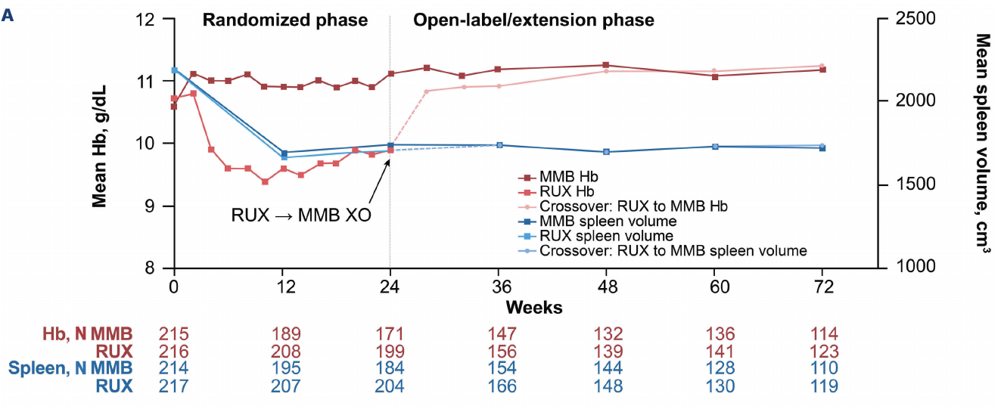
SIMPLIFY-1 Trial: Clinical Efficacy of Momelotinib After Immediate Crossover from Ruxolitinib
Hemoglobin and Spleen Volume Dynamics
MMB = momelotinib; RUX = ruxolitinib; XO = crossover
Mesa R et al. Haematologica 2024 February 1;109(2):676-81.

Slide 32
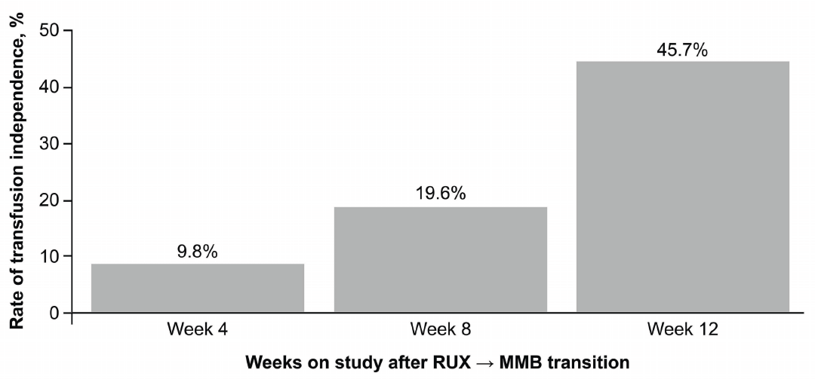
SIMPLIFY-1: Clinical Efficacy of Momelotinib After Immediate Crossover from Ruxolitinib
Transfusion Independence Rate After Transition to Open-Label Momelotinib
MMB = momelotinib; RUX = ruxolitinib; XO = crossover
Mesa R et al. Haematologica 2024 February 1;109(2):676-81.

Slide 33
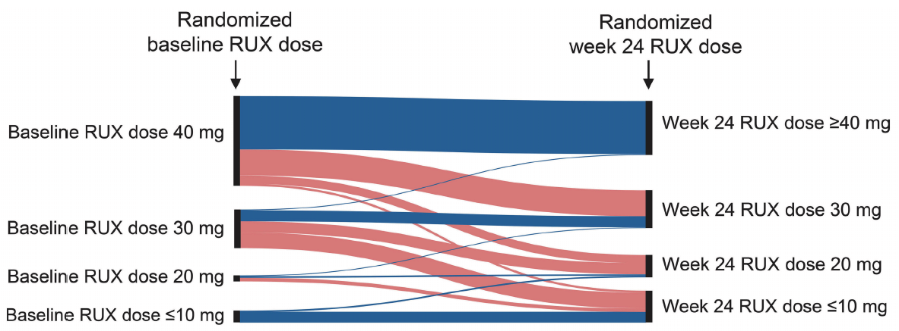
SIMPLIFY-1: Dosing for Patients Randomly Assigned to Ruxolitinib
Dosing from Baseline to Week 24 of Ruxolitinib Treatment
Mesa R et al. Haematologica 2024 February 1;109(2):676-81.

Slide 34
SIMPLIFY-1: Dosing for Patients Randomly Assigned to Ruxolitinib
Dosing at Crossover from Ruxolitinib → Momelotinib
Mesa R et al. Haematologica 2024 February 1;109(2):676-81.

Slide 35
SIMPLIFY-1: Dosing for Patients Randomly Assigned to Ruxolitinib
Dosing from Baseline Momelotinib at Crossover to Week 12 of Open-Label Momelotinib Treatment
Mesa R et al. Haematologica 2024 February 1;109(2):676-81.

Slide 36
ASH 2023;Abstract 2189

Slide 37
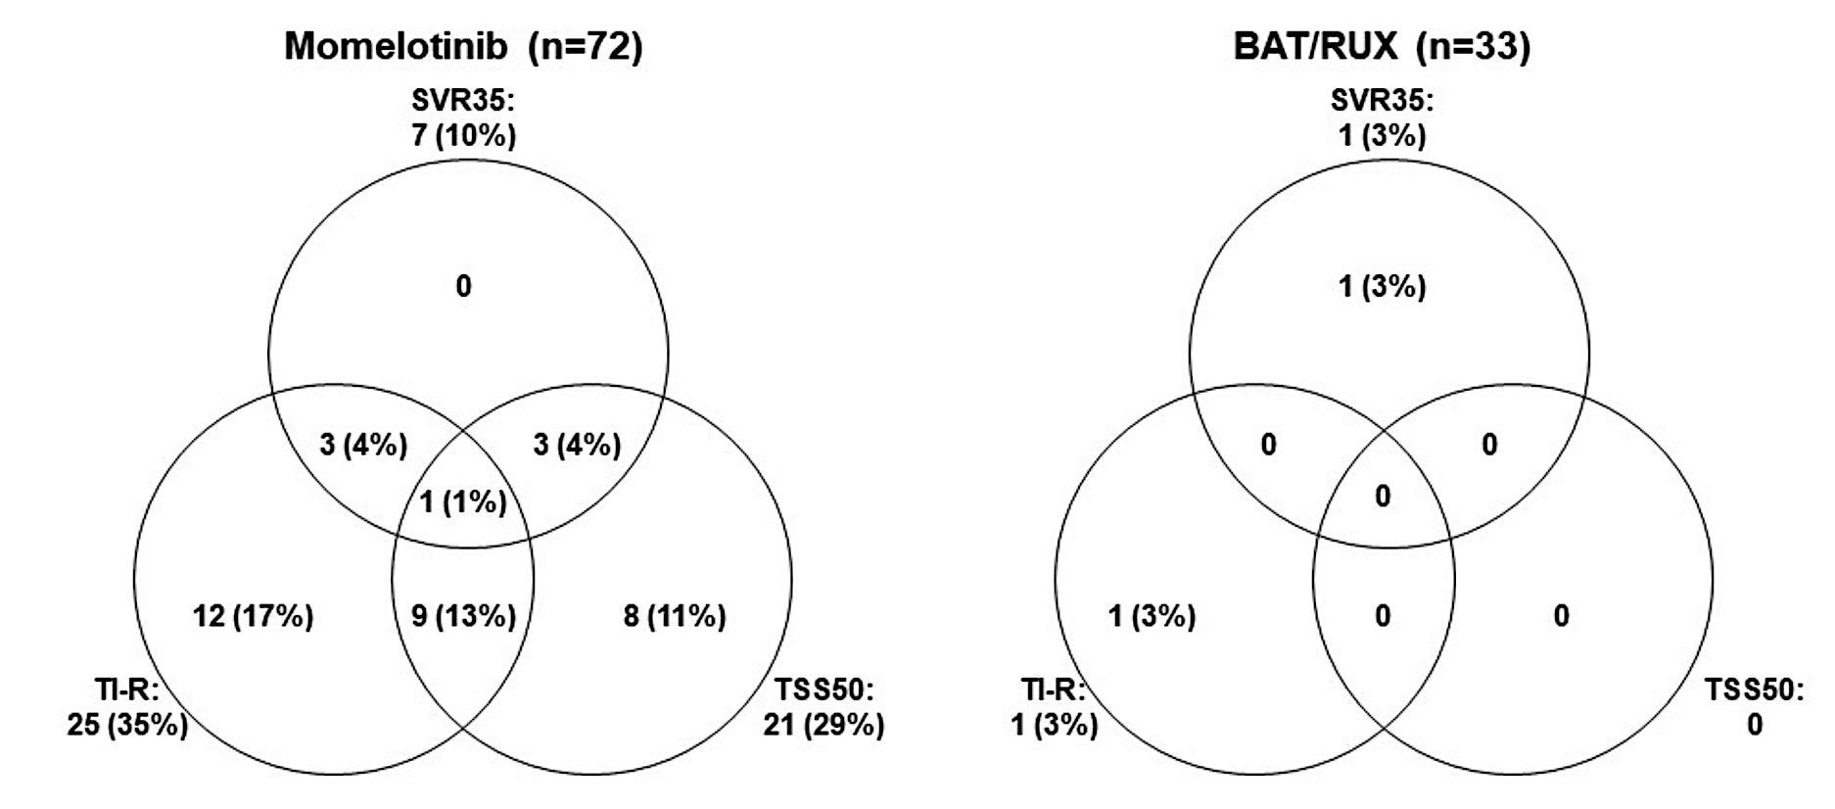
SIMPLIFY-2: Responses at Week 24 for Transfusion-Dependent Patients at Baseline
Harrison CN et al. ASH 2023;Abstract 2189.

Slide 38
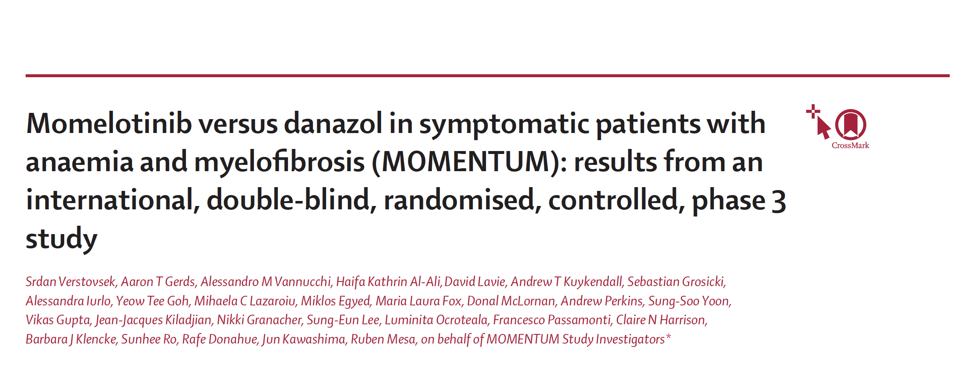
Lancet 2023;401;269-80

Slide 39
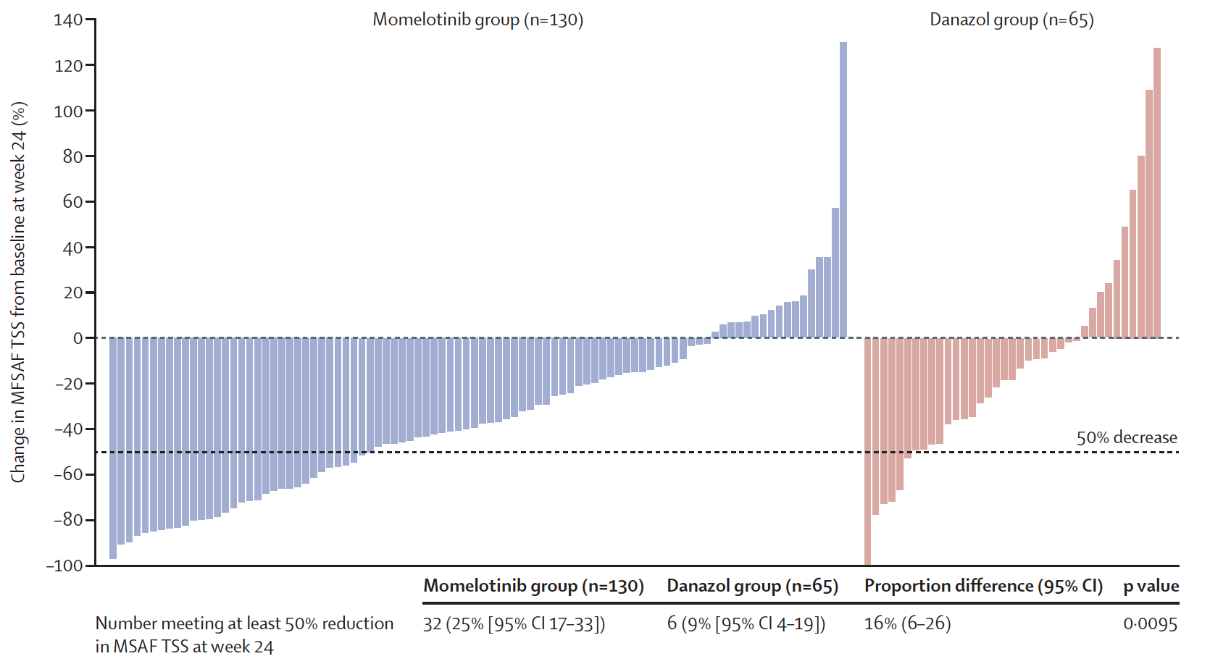
MOMENTUM: Percent Change of TSS from Baseline to Week 24 for Each Patient
MFSAF=Myelofibrosis Symptom Assessment Form
TSS=total symptom score
Verstovsek S et al. Lancet 2023;401:269-80.

Slide 40
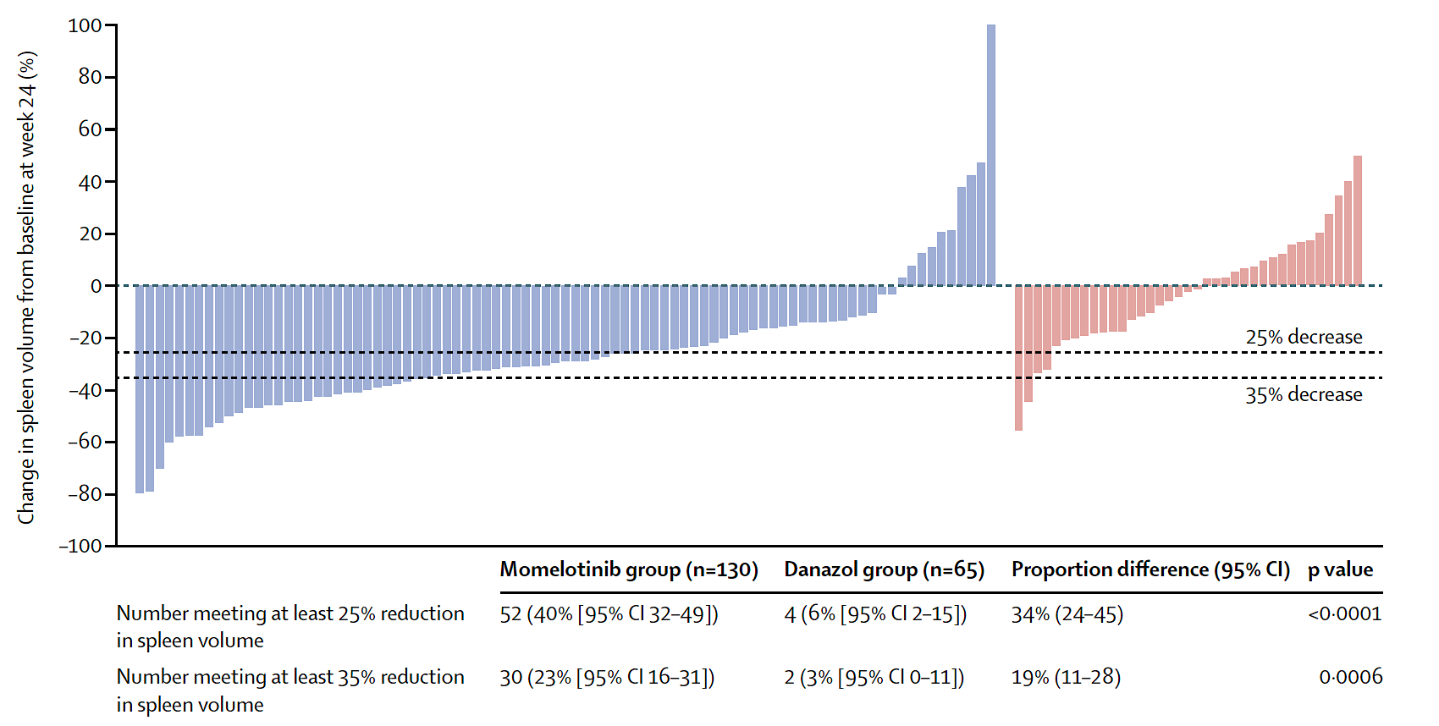
MOMENTUM: Percent Change of Spleen Volume from Baseline to Week 24 for Each Patient
Verstovsek S et al. Lancet 2023;401:269-80.

Slide 41
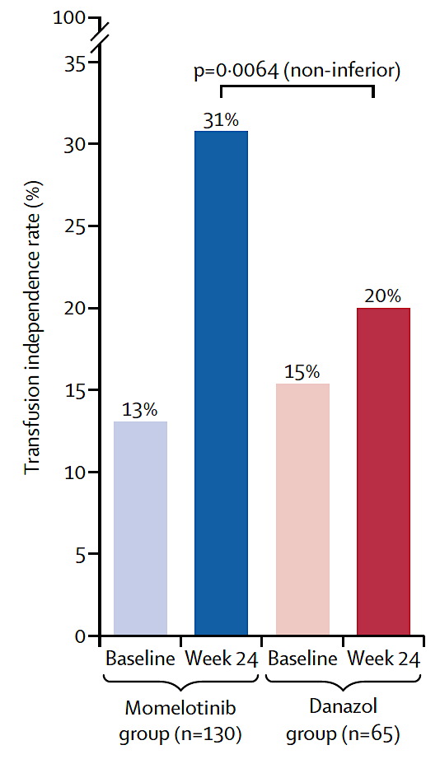
MOMENTUM: Change in Transfusion Independence Rate from Baseline to Week 24
Verstovsek S et al. Lancet 2023;401:269-80.

Slide 42
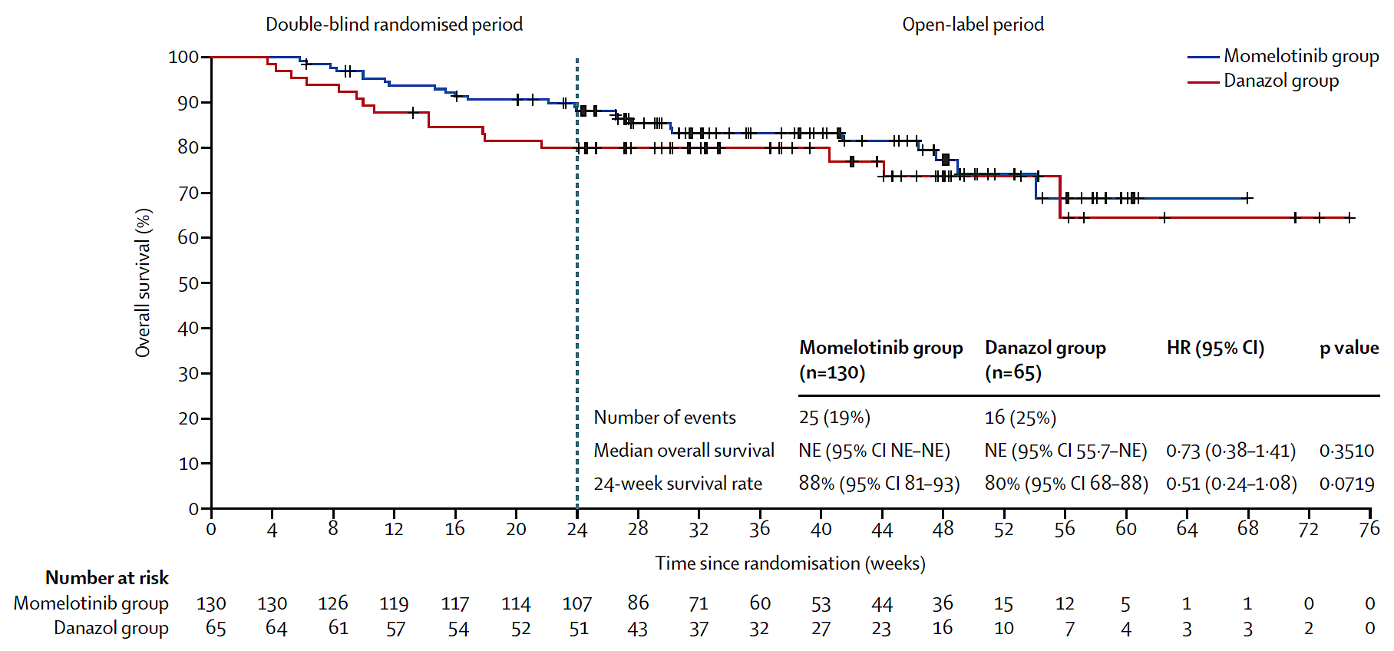
MOMENTUM: Overall Survival (ITT Population)
Verstovsek S et al. Lancet 2023;401:269-80.

Slide 43
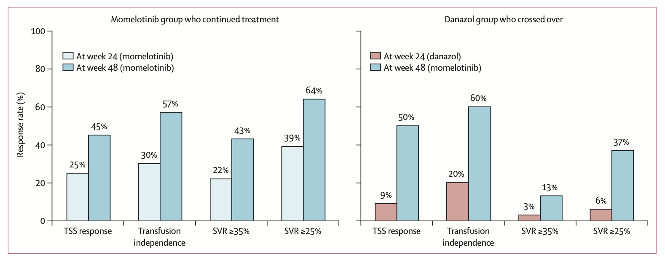
MOMENTUM Updated Analysis: Summary of Response Rates at Weeks 24 and 48
Gerds AT et al. Lancet Haematol 2023;10(9):e735-46.

Slide 44
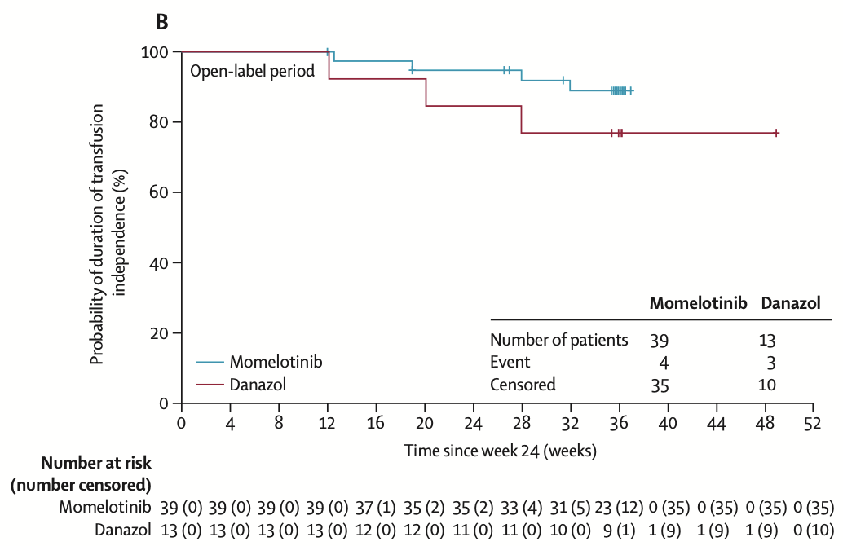
MOMENTUM Updated Analysis: : Duration of Transfusion Independence Response
Gerds AT et al. Lancet Haematol 2023;10(9):e735-46.

Slide 45
Long-Term Survival Adjusted for Treatment Crossover in Patients (pts) with Myelofibrosis (MF) Treated with Momelotinib (MMB) vs Danazol (DAN) in the MOMENTUM Trial
Gupta V et al.
ASCO 2024;Abstract 6571.

Slide 46
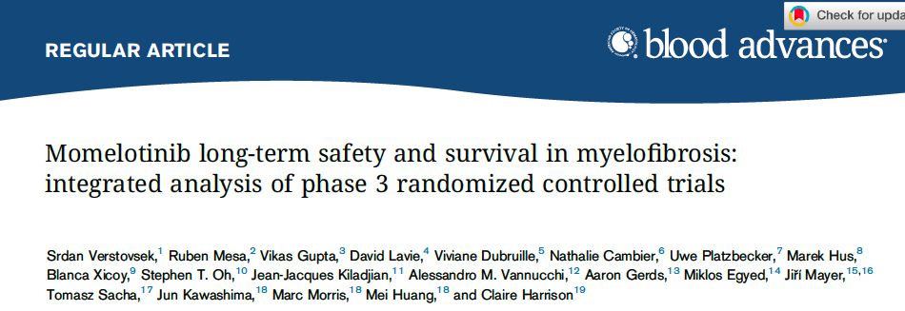
2023;7(14):3582-91

Slide 47
Overall Survival (OS) and Safety of Momelotinib from Pooled Analysis of SIMPLIFY-1, SIMPLIFY-2 and MOMENTUM Studies
Pooled analysis of overall survival
2-year OS rate | 76.5%
4-year OS rate | 59.6%
6-year OS rate | 51.1%
Median OS | Not reached
The most common nonhematologic treatment-emergent adverse event occurring in ≥20% of patients was diarrhea (any grade, 27% and Grade ≥3, 3%).
The most common reason for momelotinib discontinuation was thrombocytopenia (4% discontinuation rate).
AE = adverse event; MACE = major adverse cardiovascular event
Verstovsek S et al. Blood Adv 2023;7(14):3582-91.

Slide 48
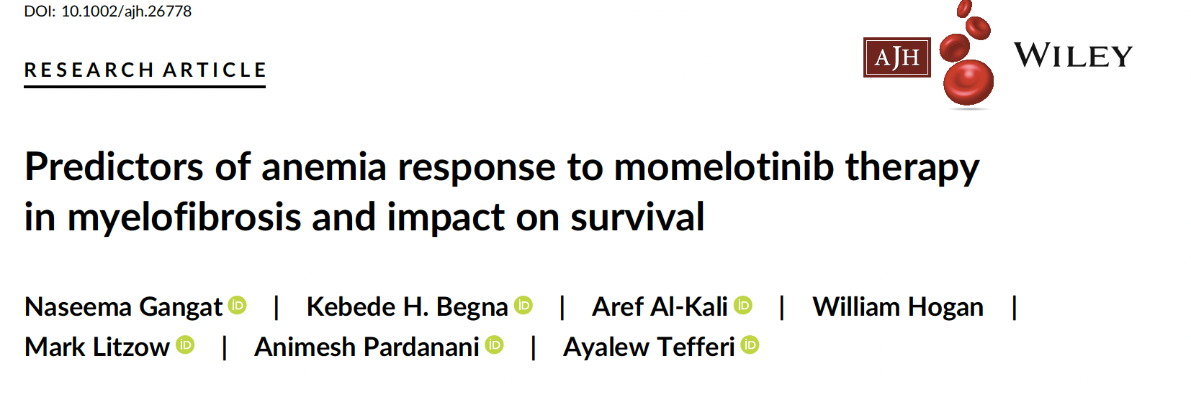
Am J Hematol 2023;98:282-89

Slide 49
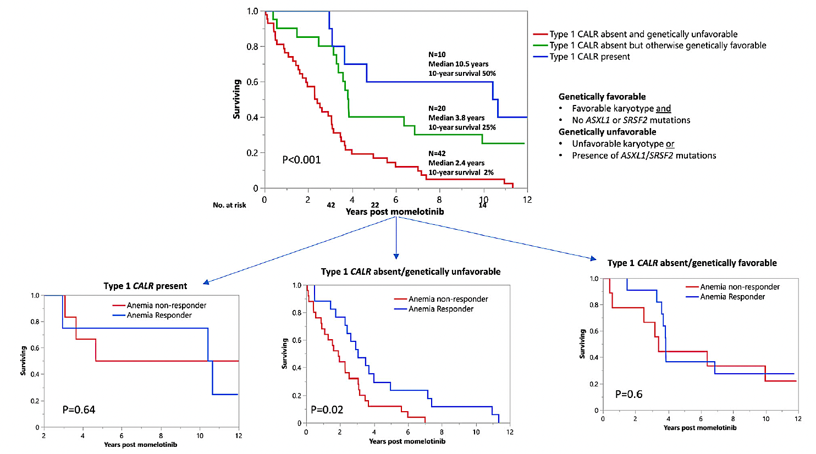
Predictors of Anemia Response to Momelotinib and Impact on Survival
Survival
Anemia response to momelotinib favorably impacted by:
Post-ET MF variant
Lower serum ferritin level
Shorter time from diagnosis to initiation of momelotinib
Serum ferritin level <55 mcg/L
Time from diagnosis to initiation of momelotinib of <23 months
In addition to achieving an anemia response, overall survival with momelotinib was favorably affected by the presence of type 1/CALR mutations and the absence of ASXL1/SRSF2 mutations
Gangat N et al. Am J Hematol 2023;98:282-89.

Slide 50
Agenda
INTRODUCTION: Myelofibrosis (MF) for Oncology “Newbies”
MODULE 1: Biology of MF
MODULE 2: Management of Anemia in MF
MODULE 3: Novel Strategies for MF
MODULE 4: Journal Club

Slide 51
ASCO 2024 Highlights
Rampal R et al. Updated safety and efficacy data from the phase 3 MANIFEST-2 study of pelabresib in combination with ruxolitinib for JAK inhibitor treatment-naïve patients with myelofibrosis. Abstract 6502.
Braish B et al. Impact of JAK2 allele burden on MF outcome in the era of ruxolitinib. Abstract 6514.
Mascarenhas J et al. Phase 3 randomized double-blind study evaluating selinexor, an XPO1 inhibitor, plus ruxolitinib in JAKi-naïve myelofibrosis. Abstract TPS6594 .
Scandura JM et al. Phase 2 study evaluating selinexor monotherapy in patients with JAKi-naïve myelofibrosis and moderate thrombocytopenia. Abstract TPS6593 .

Slide 52
ASH 2023;Abstract 620

Slide 53
TRANSFORM-1: Efficacy Outcomes with Navitoclax and Ruxolitinib for Treatment-Naïve Myelofibrosis
Pemmaraju N et al. ASH 2023;Abstract 620.

Slide 54
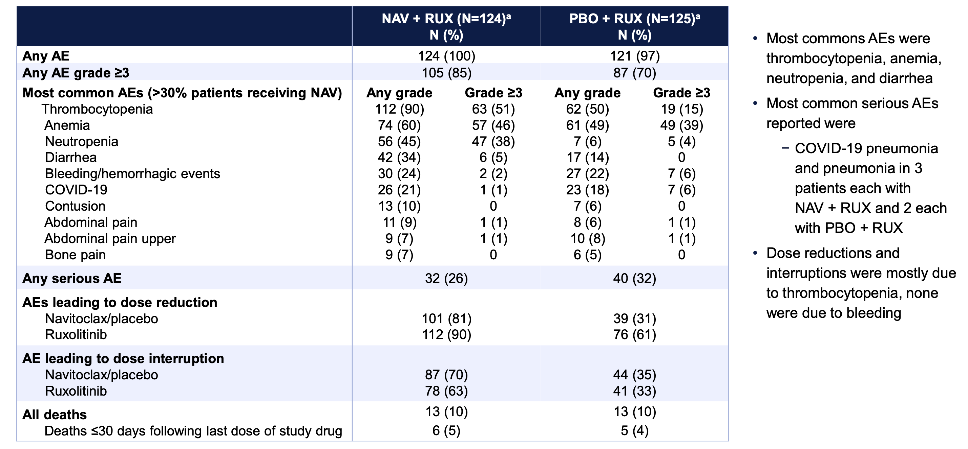
TRANSFORM-1: Safety Outcomes with Navitoclax and Ruxolitinib for Treatment-Naïve Myelofibrosis
Pemmaraju N et al. ASH 2023;Abstract 620.

Slide 55
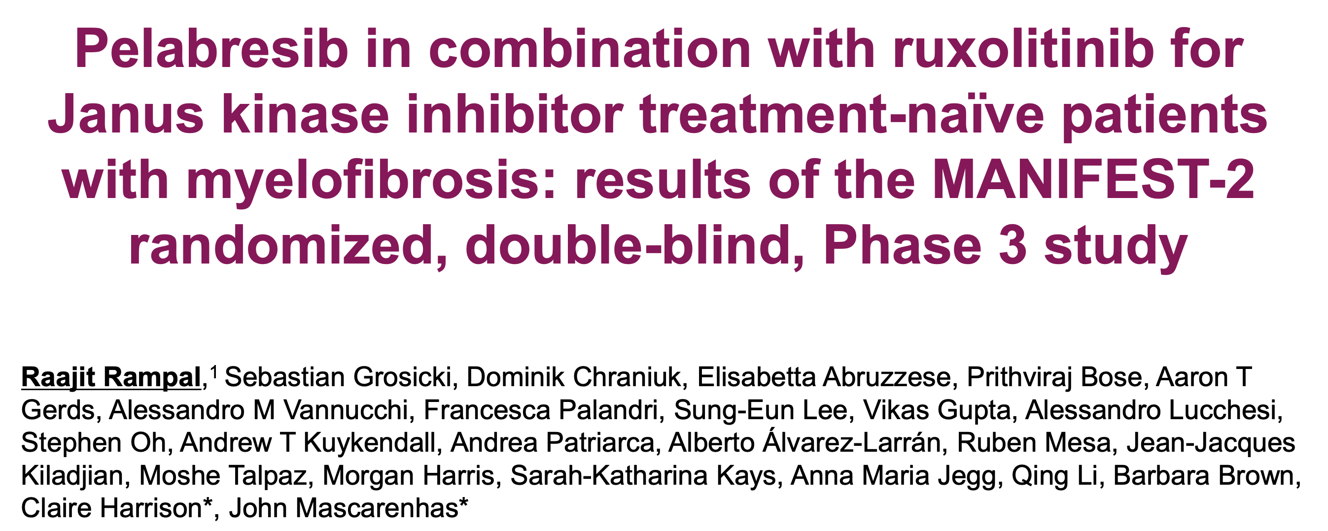
ASH 2023;Abstract 628

Slide 56
MANIFEST-2: Spleen Volume Reduction with Pelabresib and Ruxolitinib for Treatment-Naïve Myelofibrosis
Rampal R et al. ASH 2023;Abstract 628.

Slide 57
MANIFEST-2: Safety Outcomes with Pelabresib and Ruxolitinib for Treatment-Naïve Myelofibrosis
Rampal R et al. ASH 2023;Abstract 628.

Slide 58
Updated Safety and Efficacy Data from the Phase 3 MANIFEST-2 Study of Pelabresib in Combination with Ruxolitinib for JAK Inhibitor Treatment-Naïve Patients with Myelofibrosis
Rampal R et al.
ASCO 2024;Abstract 6502 (Oral).
May 31, 2024
3:09 PM – 3:21 PM CDT

Slide 59
ASH 2023;Abstract 622

Slide 60
XPORT-MF-034: Phase I Long-Term Follow-Up of SVR and TSS with Selinexor and Ruxolitinib
Tantravahi S et al. ASH 2023;Abstract 622.

Slide 61
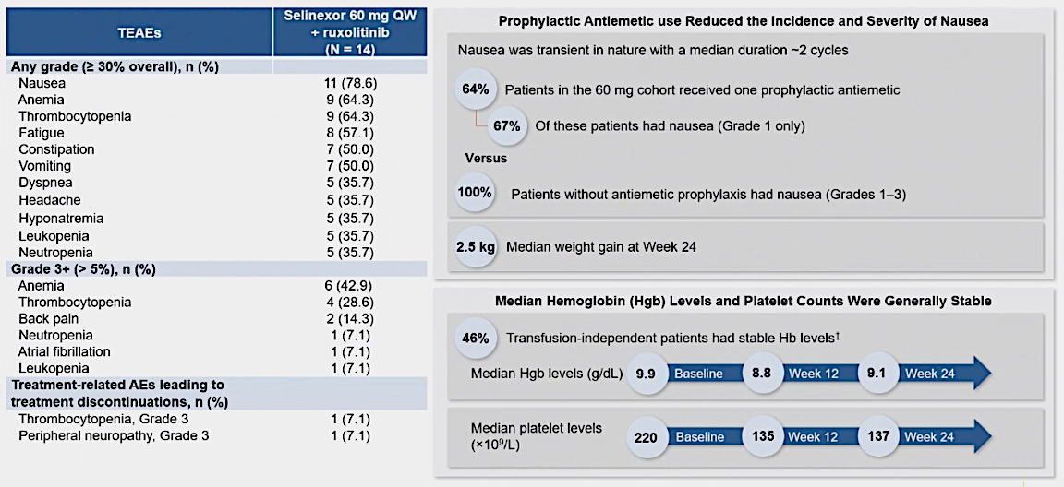
XPORT-MF-034: Phase I Treatment-Emergent Adverse Events with Selinexor 60 mg per Week
Tantravahi S et al. ASH 2023;Abstract 622.

Slide 62
A Phase 2 Study to Evaluate the Efficacy and Safety of Selinexor Monotherapy in Patients with JAK Inhibitor-Naïve Myelofibrosis and Moderate Thrombocytopenia (XPORT-MF-044)
Sandura JM et al.
ASH 2023;Abstract 3211.
Phase 2 Study Evaluating Selinexor Monotherapy in Patients with JAKi-Naïve Myelofibrosis and Moderate Thrombocytopenia
Sandura JM et al.
ASCO 2024;Abstract TPS6593.

Slide 63
Mendez LF et al. Blood 2022;140(Suppl 1):3972-3.

Slide 64
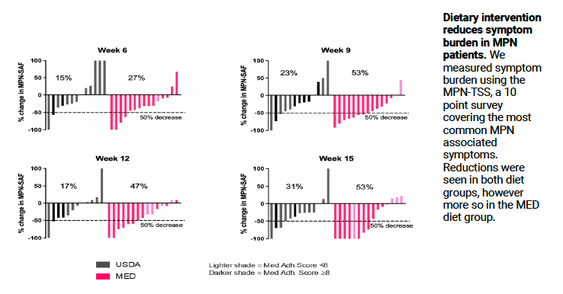
Diet Intervention and Symptom Burden
Mendez LF et al. Blood 2022;140(Suppl 1):3972-3.

Slide 65
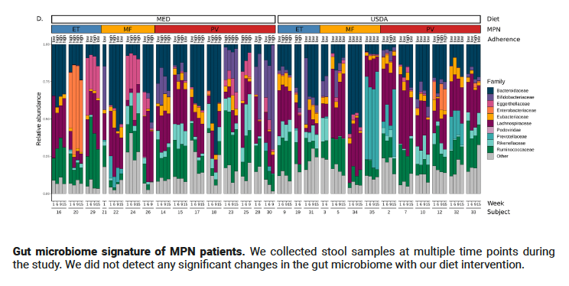
Gut Microbiome Signature
Mendez LF et al. Blood 2022;140(Suppl 1):3972-3.

Slide 66
Abstract 7010: Identification and management of clonal hematopoiesis of indeterminate potential (CHIP) in cancer survivors: The Cleveland Clinic experience
ASCO 2023

Slide 67
Background and Design
Kuzmanovic T et al. ASCO 2023;Abstract 7010.

Slide 68
Results: NGS and CBC
Kuzmanovic T et al. ASCO 2023;Abstract 7010.

Slide 69
Results: Serial NGS
Kuzmanovic T et al. ASCO 2023;Abstract 7010.

Slide 70
CHIP and Preventive Cardiology
Kuzmanovic T et al. ASCO 2023;Abstract 7010.

Slide 71
Summary
Kuzmanovic T et al. ASCO 2023;Abstract 7010.

Slide 72
Agenda
INTRODUCTION: Myelofibrosis (MF) for Oncology “Newbies”
MODULE 1: Biology of MF
MODULE 2: Management of Anemia in MF
MODULE 3: Novel Strategies for MF
MODULE 4: Journal Club

Slide 73
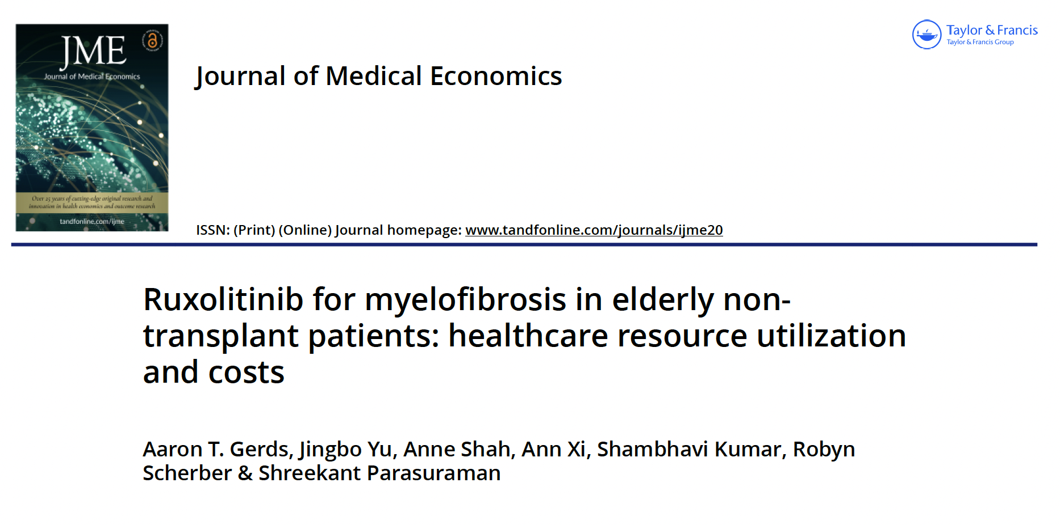
2023;26(1):843-9.

Slide 74
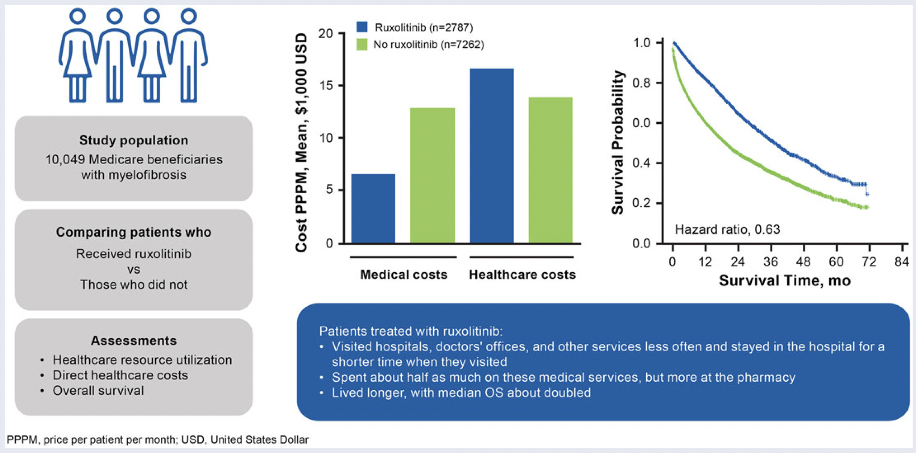
Cost of Medical Care and Survival with Ruxolitinib
Gerds AT et al. J Med Econ 2023;26(1):843-9.

Slide 75
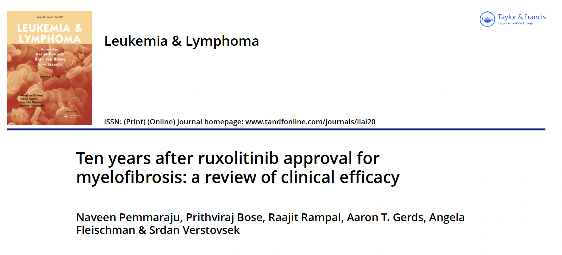
2023;64(6):1063-81

Slide 76
Risk of Myelodysplastic Syndromes (MDS) in Adolescents and Young Adults with Cancers Treated with Chemotherapy with or without Radiotherapy
Mishra E et al.
ASH 2023;Abstract 2351.

