Slide 1
Year in Review:
Follicular lymphoma and Mantle cell lymphoma
Sonali Smith, MD FASCO
Elwood V. Jensen Professor of Medicine
Chief, Section of Hematology/Oncology
Co-Leader, Cancer Service Line
Notes:
30 min
Includes 2 MOC questions

Slide 2
Follicular lymphoma: key principles

Slide 3
Advanced Stage Treatment-Naïve FL
Morschhauser F et al. N Engl J Med. 2018;379:934-947.
1. Federico M et al. J Clin Oncol. 2013;31:1506-1513. 2. Luminari S et al. J Clin Oncol. 2018;36:689-696. 3. Rummel MJ et al. Lancet. 2013;381:1203-1210. 4. Rummel MJ et al. ASCO 2017. Abstract 7501. 5. Flinn IW et al. Blood. 2014;123:2944-2952. 6. Flinn IW et al. J Clin Oncol. 2019;37:984-991.

Slide 4
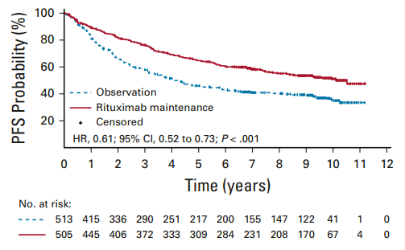
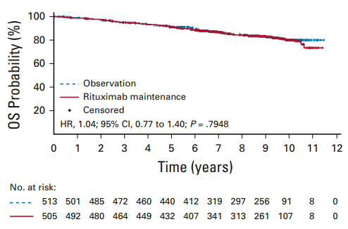
Maintenance After 1st Line Rituximab-Chemotherapy: PRIMA PFS study update
10yr PFS estimates
80%
Median 10.5yrs
80%
51%
Median 4.1 yrs
10yr OS estimates
35%
Comments:
In PRIMA, no BR as induction
No PET to assess EOI response
Value in BR/OB-treated patients unclear
Salles G et al. Lancet. 2011;377:42-51. Bachy E et al. J Clin Oncol. 2019;37:2815-2824.

Slide 5
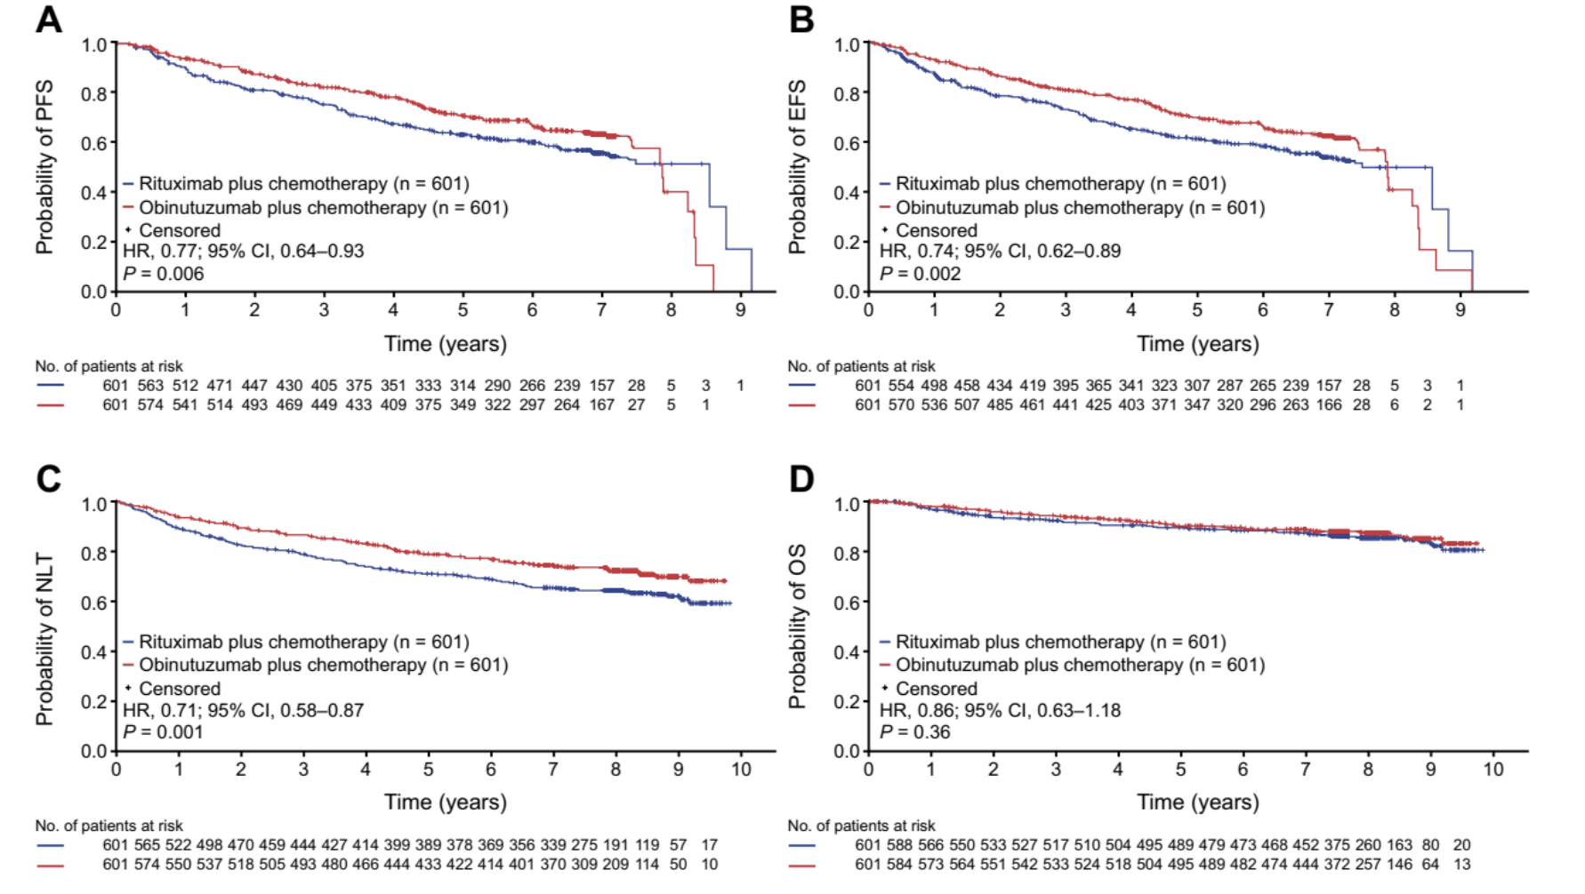
GALLIUM: R-chemo vs. O-chemo final results
Townsend W et al. Hemasphere 2023;7(7):e919.

Slide 6
RELAPSED/REFRACTORY FOLLICULAR LYMPHOMA

Slide 7
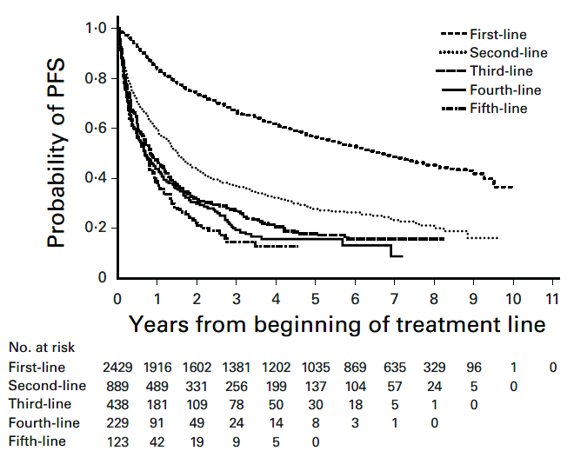
Survival decreases by line of therapy in the chemoimmunotherapy era
Link et al. BJH, 2018; 184: 660-63
Rivas-Delgado et al. BJH 2018; 184: 753-59

Slide 8
Early POD and PET Positivity at End of CIT Predicts Poor Prognosis in Patients With FL
PFS by PET Assessment† at End of CIT
From GALLIUM (n = 595)
Casulo. JCO. 2015;33:2516. Trotman. Lancet Oncol. 2018;19:1530. Nielsen. ASCO 2020. Abstr 8025.
Notes:
CHOP, cyclophosphamide/doxorubicin/vincristine/prednisone; CIT, chemoimmunotherapy; CVP, cyclophosphamide/vincristine/prednisone; FL, follicular lymphoma; NLCS, National LymphoCare Study; POD, progression of disease; R, rituximab.

Slide 9
Outcomes in pts early POD 24 after BR: 2 y PFS 38%
76% had transformed disease
Freeman et al Blood 2019 Aug 29;134(9):761-764

Slide 10
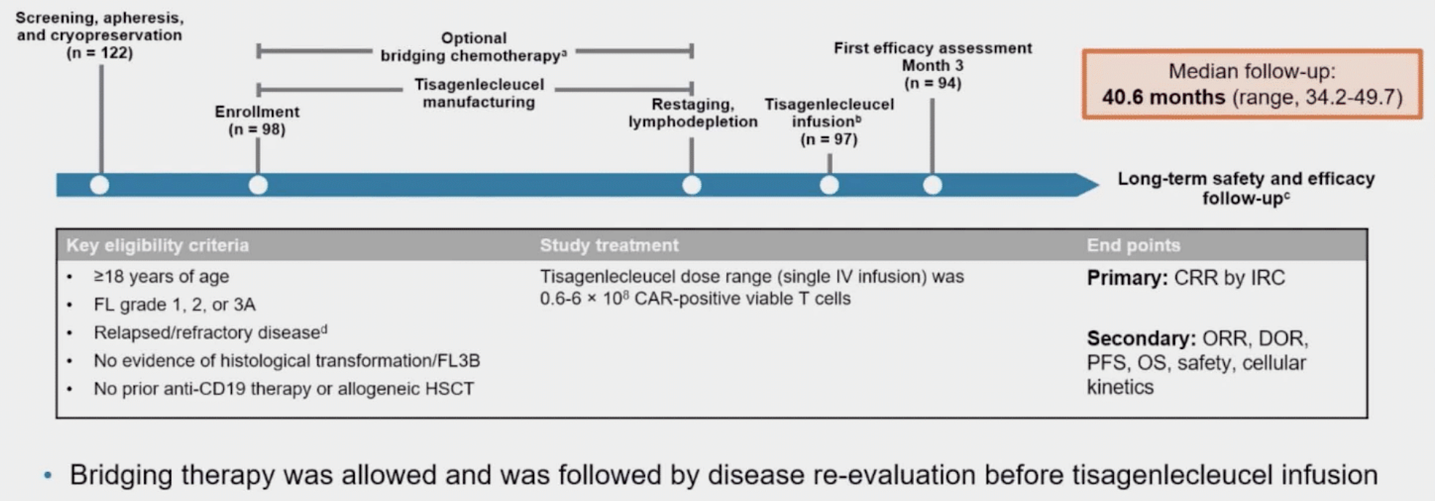
Where does CAR-T fit into FL management?
Two FDA-approved products: axi-cel and tisa-cel
ZUMA-5: axi-cel
ELARA: tisa-cel
Neelapu ASH 2023;Abstract 4868; Schuster ASH 2023;Abstract 601
Notes:
AE, adverse event; axi-cel, axicabtagene ciloleucel; CR, complete response; CT, chemotherapy; DoR, duration of response; FL, follicular lymphoma; IRRC, Independent Radiology Review Committee; mAb, monoclonal antibody; MZL, marginal zone lymphoma; ORR, overall response rate; OS, overall survival; PFS, progression-free survival; R/R, relapsed/refractory; SD, stable disease.

Slide 11
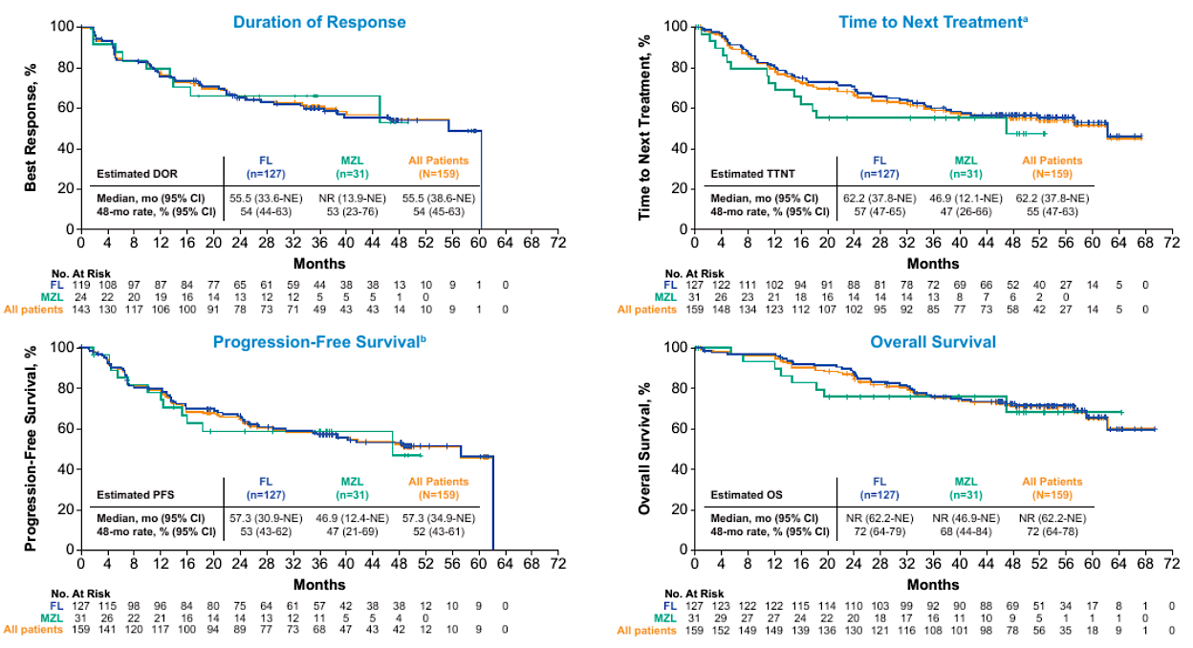
ZUMA-5: med follow up 52.5m (n=159)
ORR 90%
CR 75%
DR for CR 60.4m; DR for PR 4.9m
Med PFS 57.3m
Med OS not reached
Neelapu ASH 2023;Abstract 4868

Slide 12
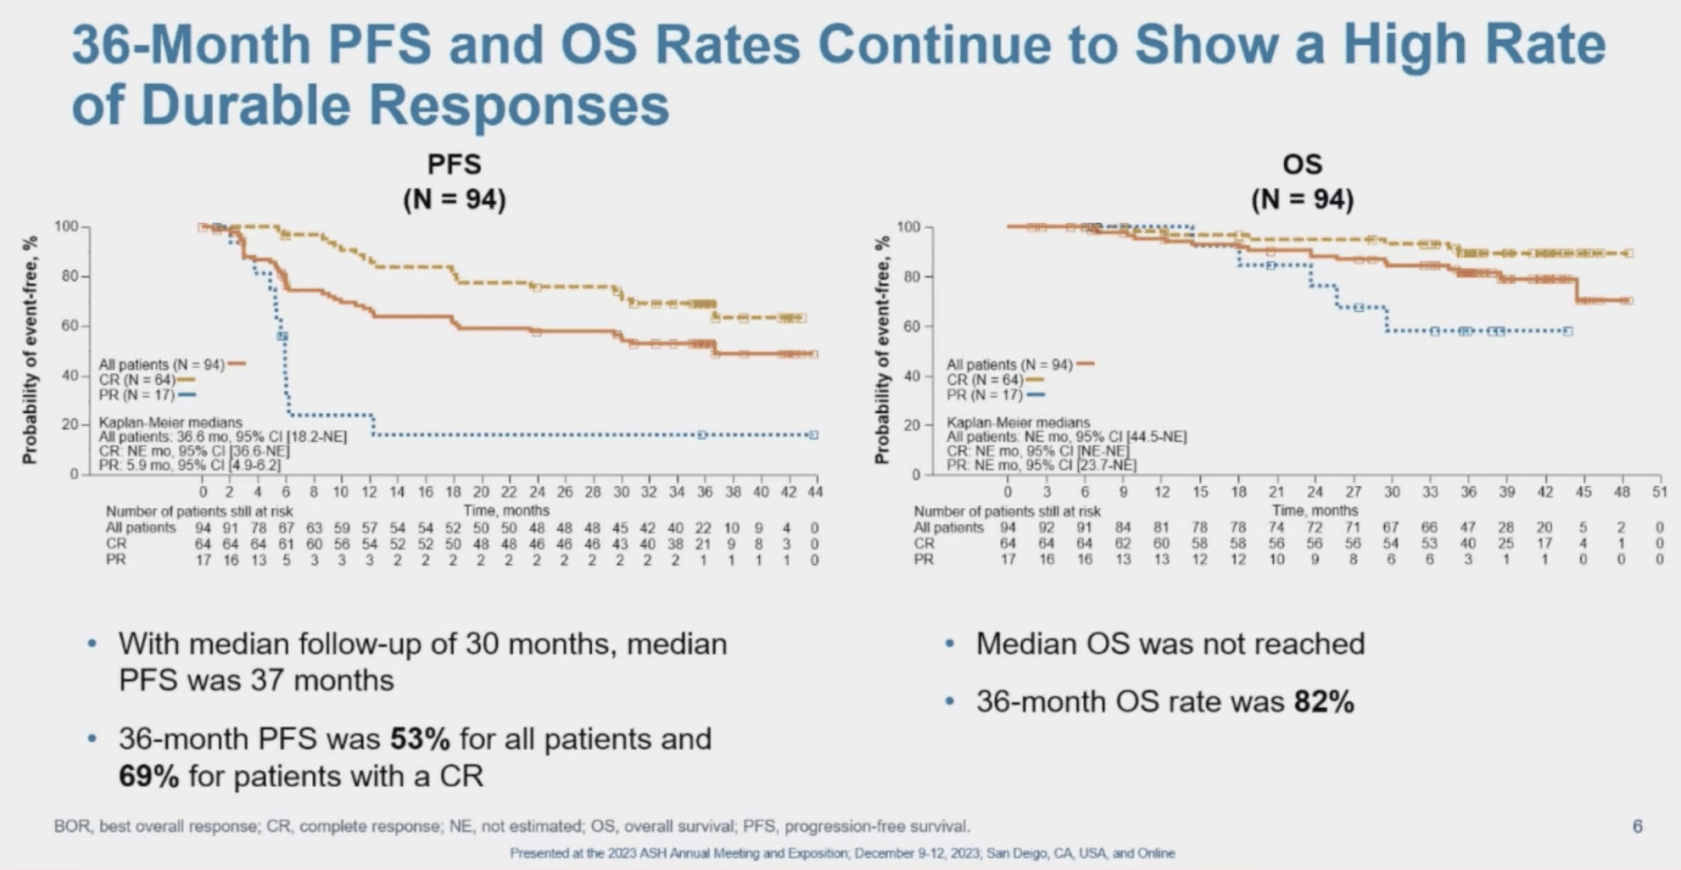
ELARA: longer follow up
Probability of survival, %
No new toxicities
Achieving CR is key
Schuster ASH 2023;Abstract 601.

Slide 13
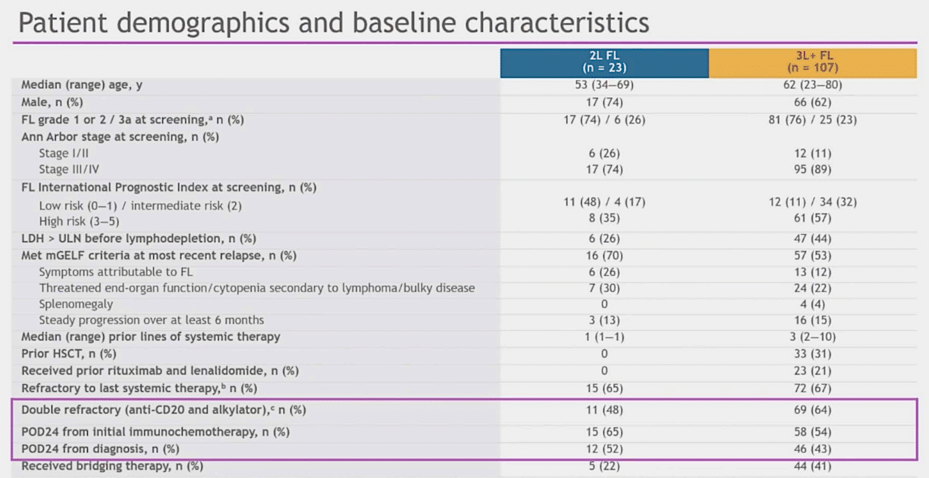
What about liso-cel? TRANSCEND trials in 2L high-risk FL and 3L+
Morschhauser ICML 2023;Abstract LBA4; Morschhauser ASH 2023;Abstract 602.

Slide 14
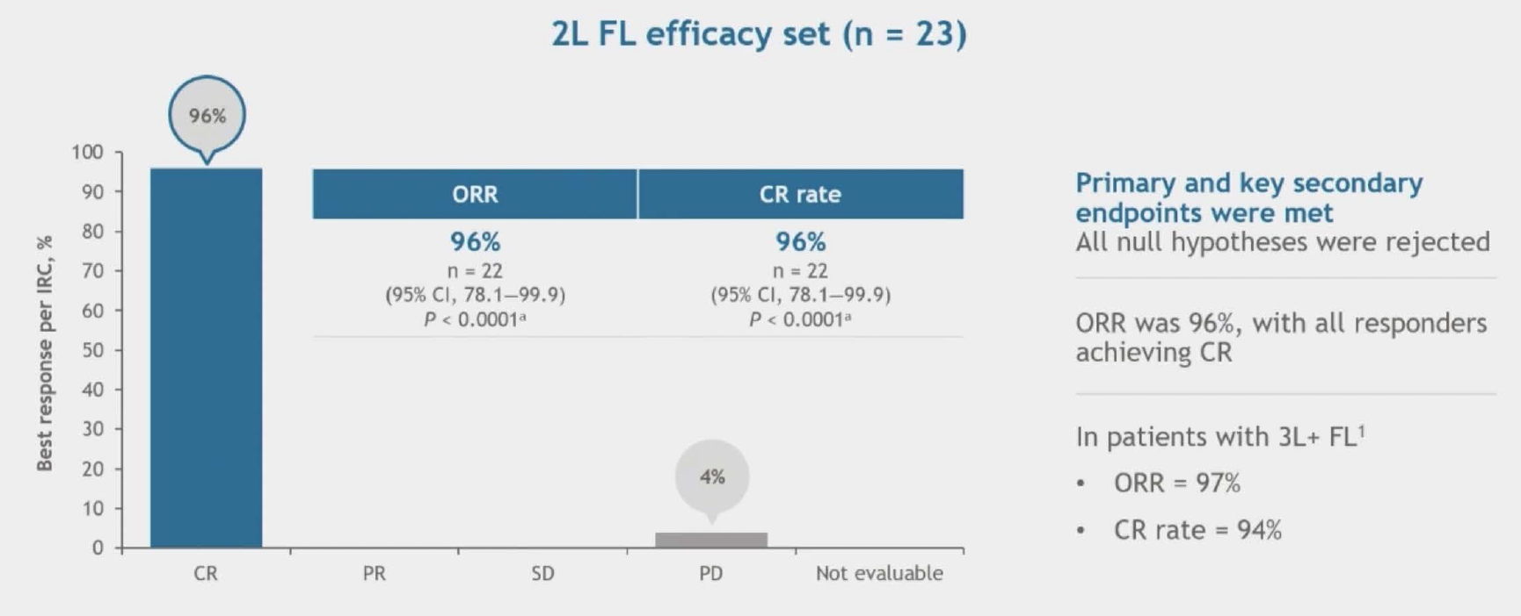
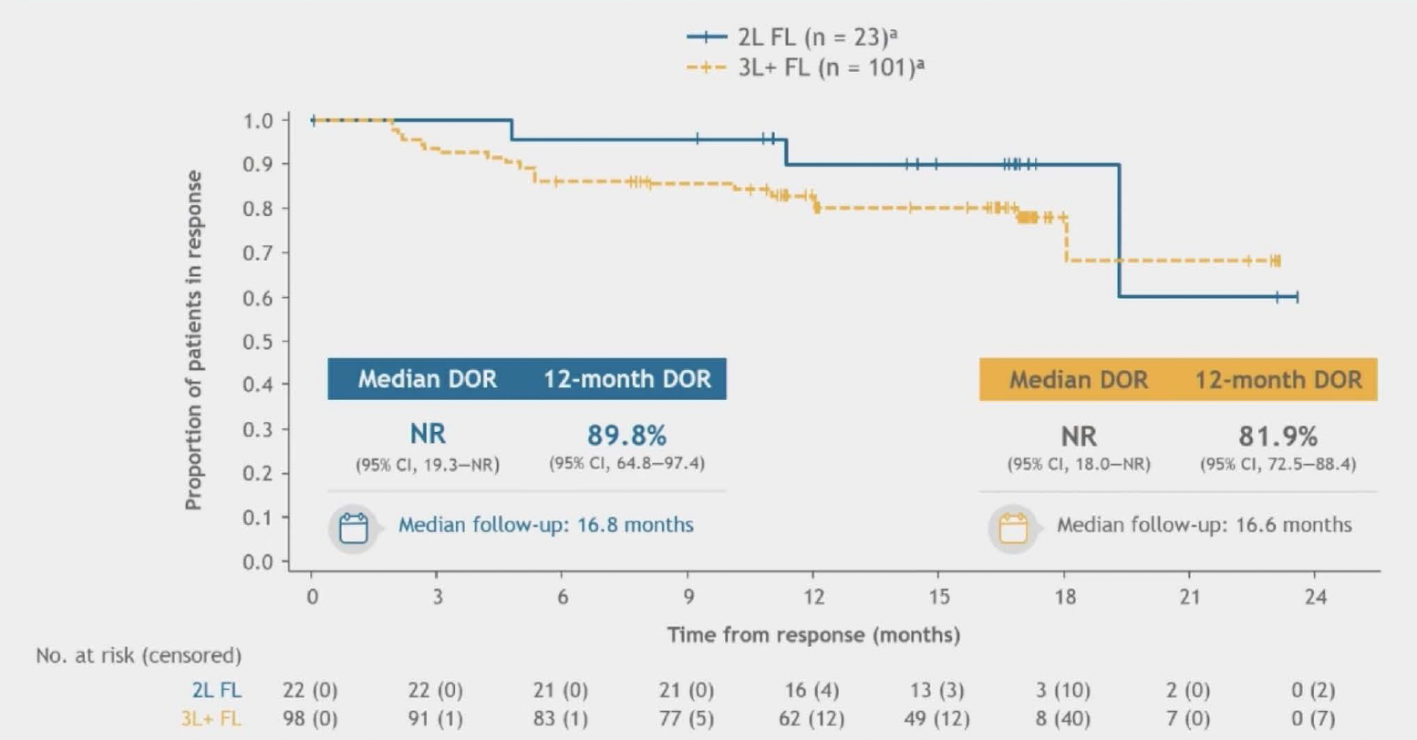
Liso-cel in 2L high-risk FL: high overall and complete response rates
96% CR rate
Short follow up (~17m)
Well-tolerated
Morschhauser ICML 2023;Abstract LBA4; Morschhauser ASH 2023;Abstract 602.

Slide 15


CD20xCD3 bispecific antibodies in FL
Clinicaloptions.com*
Bispecifics
CAR-T
Off the shelf
Lower CRS
Need for longer treatment
Requires manufacturing
Higher CRS, ICANS
“one and done”
Castaneda-Puglianni. Drugs Context. 2021;10:2021. Bannerji. ASH 2020. Abstr 42. Budde. ASH 2018. Abstr 399. Hutchings. Lancet. 2021;398:1157. Engelberts. eBioMedicine. 2020;52:102625. Hutchings. JCO. 2021;39:1959.

Slide 16
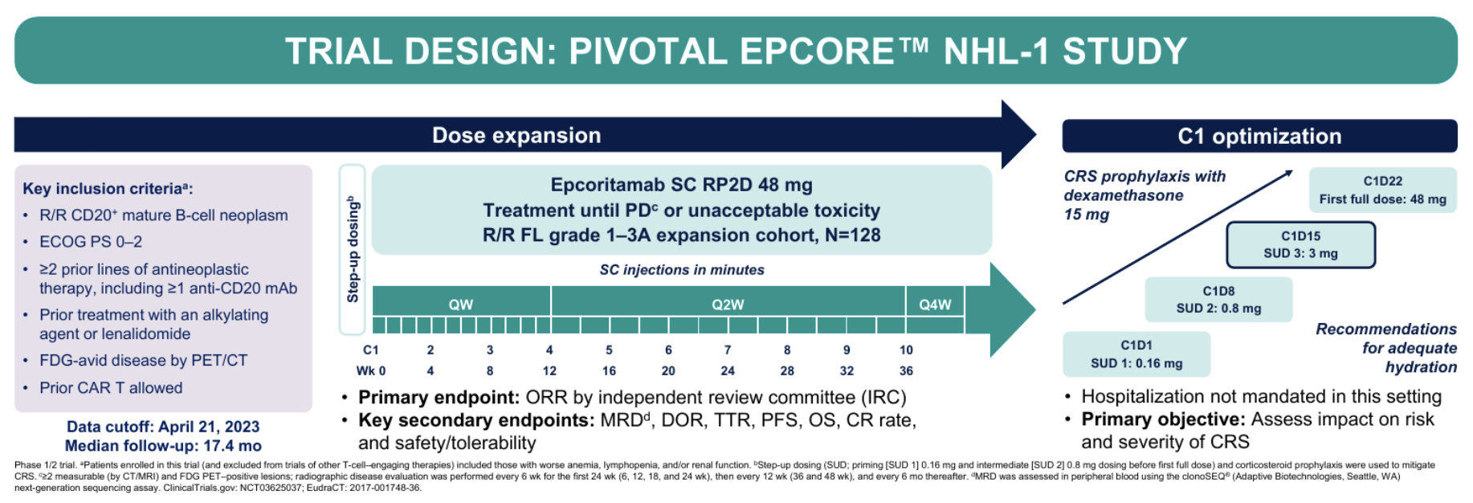
EPCORE NHL-1: epco in r/r FL
Linton ASH 2023;Abstract 1655.

Slide 17
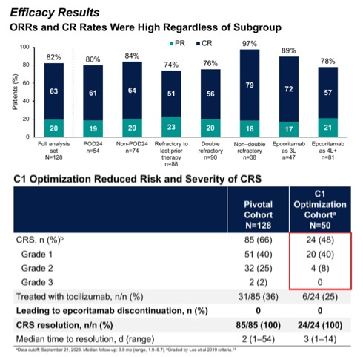
EPCORE NHL-1: epco in r/r FL results
Linton ASH 2023;Abstract 1655.

Slide 18
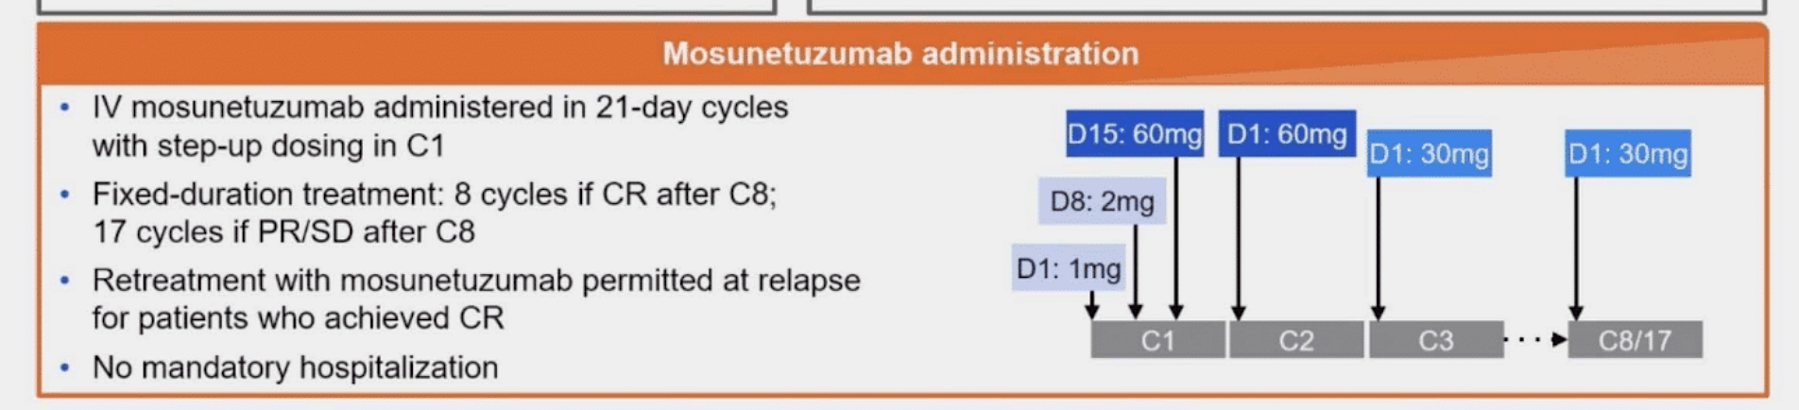
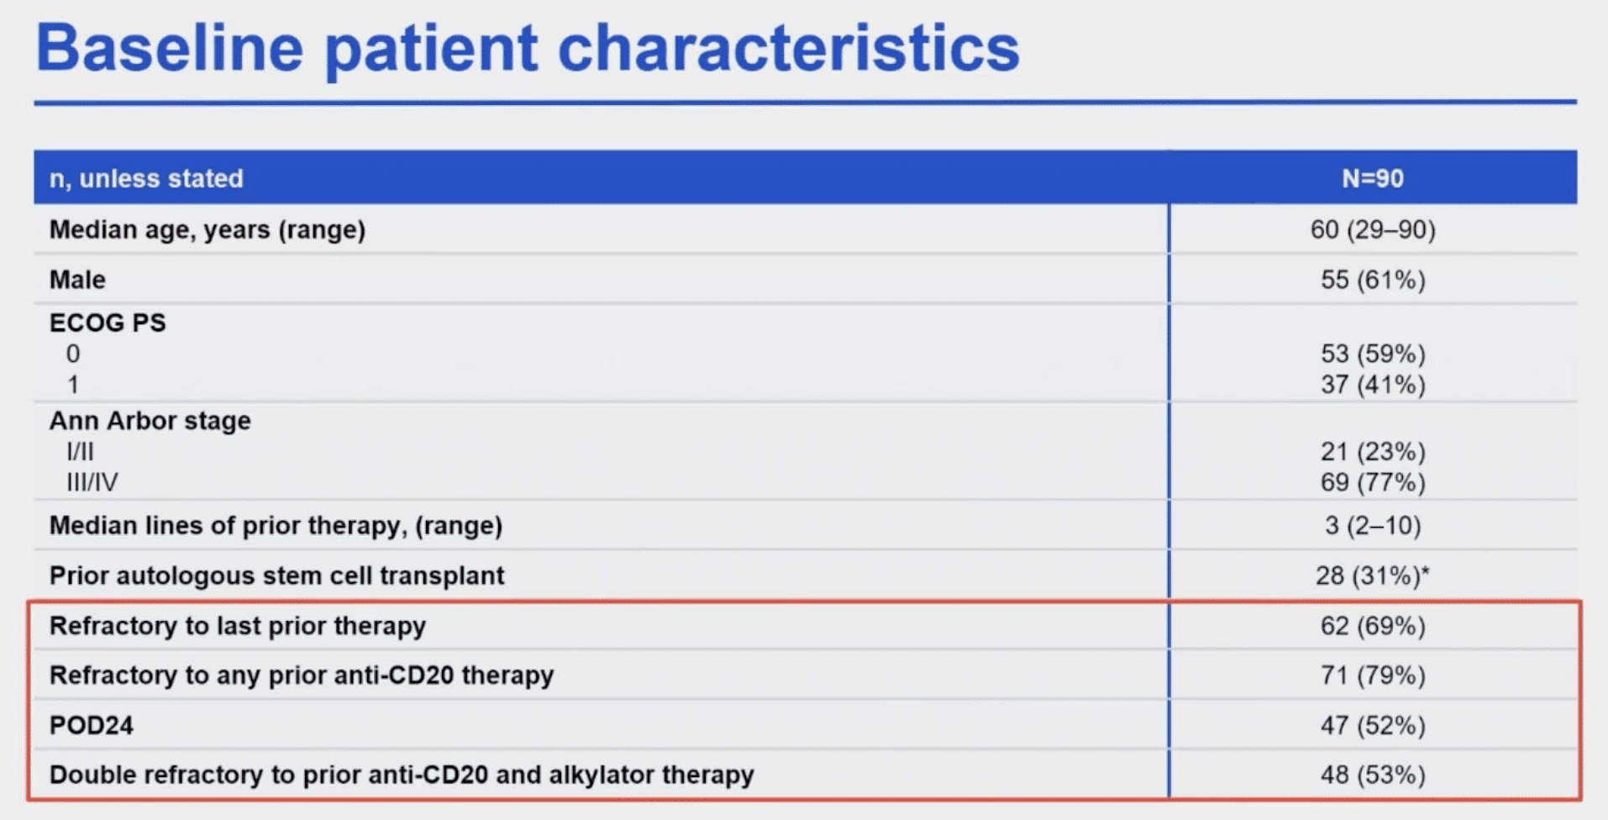
Mosun in FL
Schuster ASH 2023;Abstract 603.

Slide 19
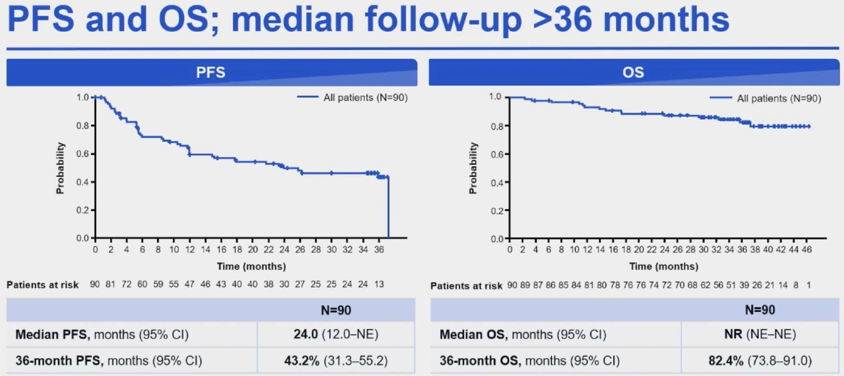
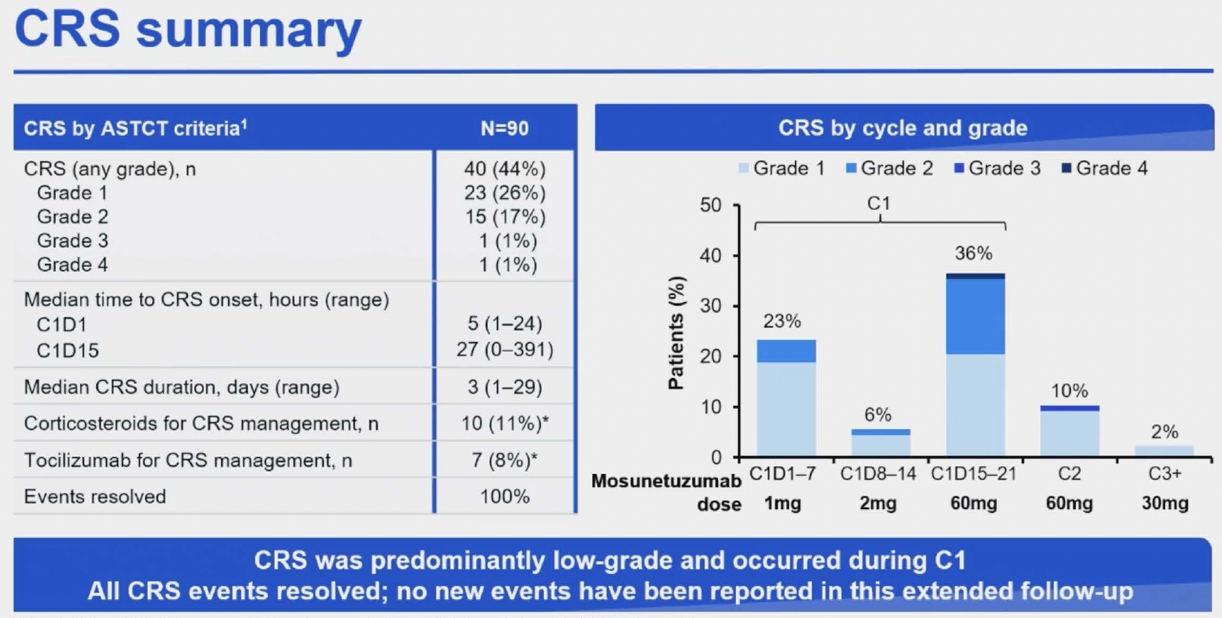
Mosun in r/r FL: 3-year follow up
Schuster ASH 2023;Abstract 603.

Slide 20
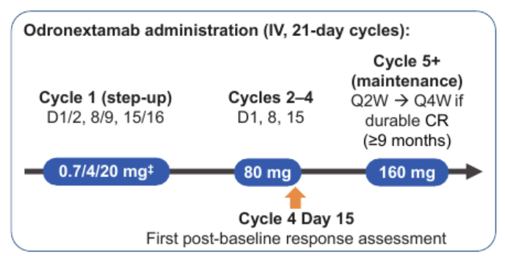
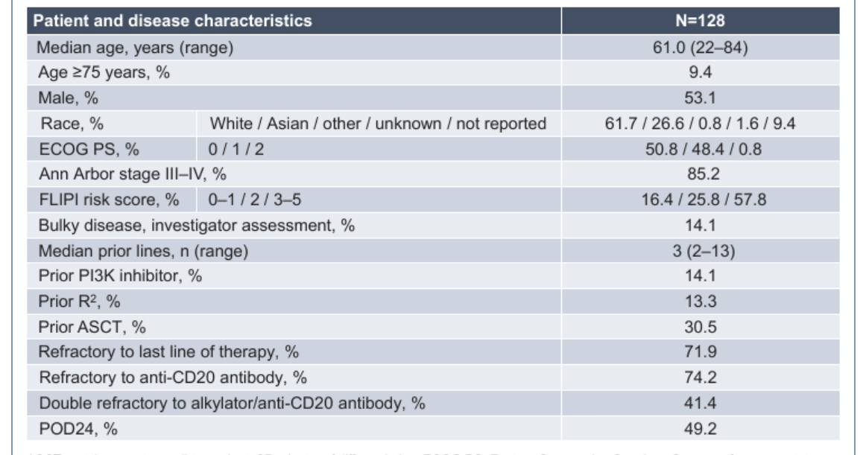
Odronextamab (ELM-2 trial)
Primary endpt: ORR
Villasboas ASH 2023;Abstract 3041.

Slide 21
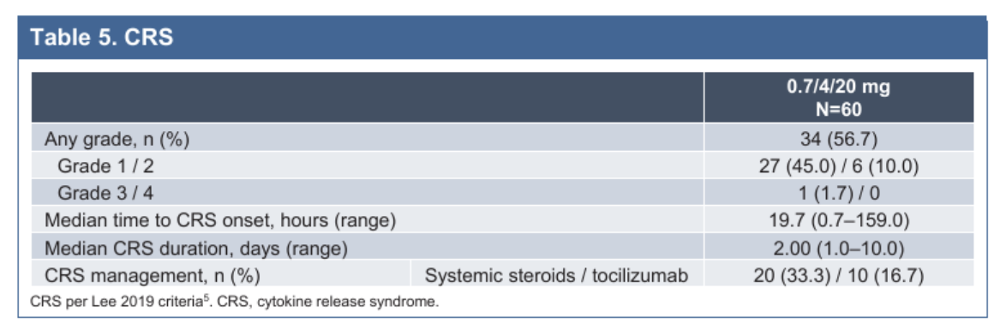
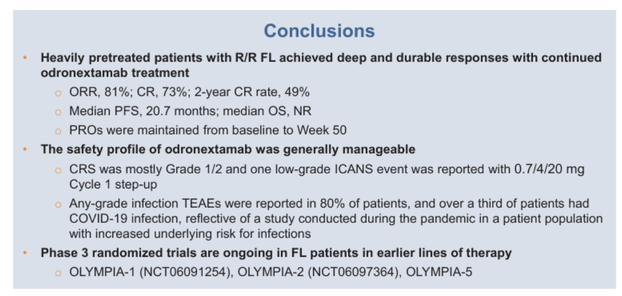
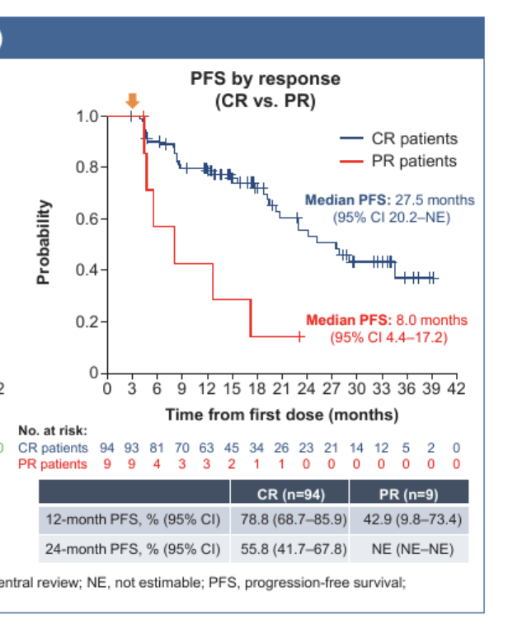
Odronextamab in r/r FL: outcomes
Villasboas ASH 2023;Abstract 3041.

Slide 22
Mantle cell lymphoma

Slide 23
General approach to TN MCL
BR-VEN for pts > 60y (Portell ASH abstr 733)
Ibr-R-ven→risk stratified RHCVAD (Wang ICML 2023 abstr 101)
Acala-R→chemo/HCT (Hawkes ASH abstr 735)
BOVen for TP53-mut MCL (Kumar ASH abstr 738)

Slide 24
Young/fit TN MCL: IRV → risk adapted HCVAD
IRV maint x 2y
Results:
Med f/u 41m
ORR and CR 100% to IRV induction
3 year PFS 85% and OS 86%
PFS and OS not significantly different in pts with high and low Ki‐67% or with/without TP53 aberrations or among pts with low, medium or high‐risk categories.
Wang ICML 2023;Abstract 101.

Slide 25
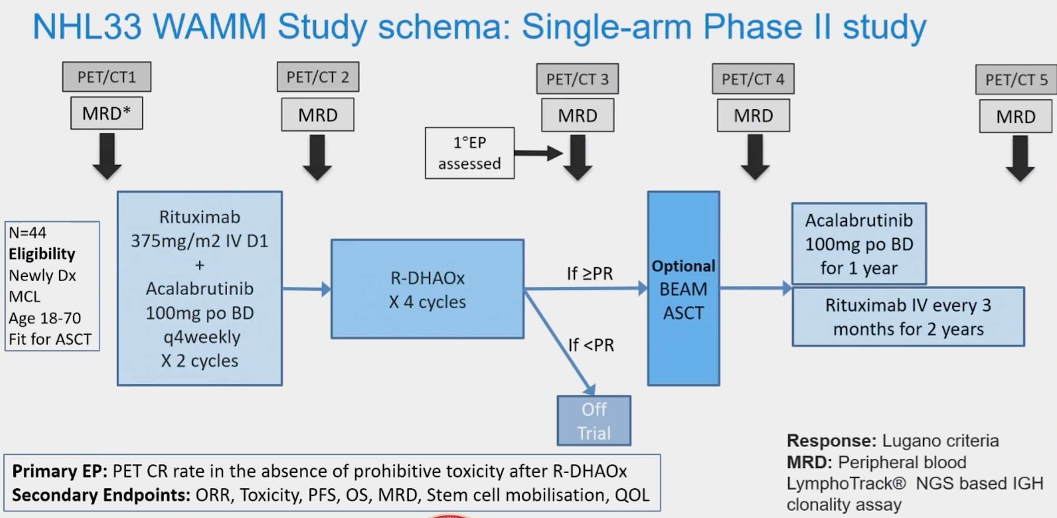
Young/fit MCL: Acala-R→chemo/ASCT
Hawkes ASH 2023;Abstract 735.

Slide 26
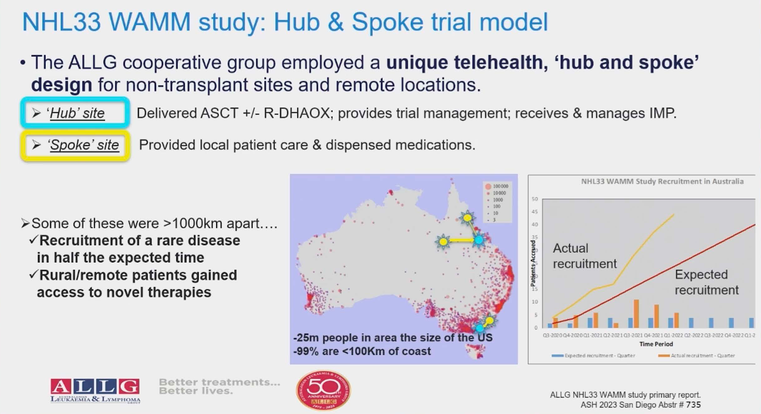
Rapid accrual in rural and remote areas
Hawkes ASH 2023;Abstract 735.

Slide 27
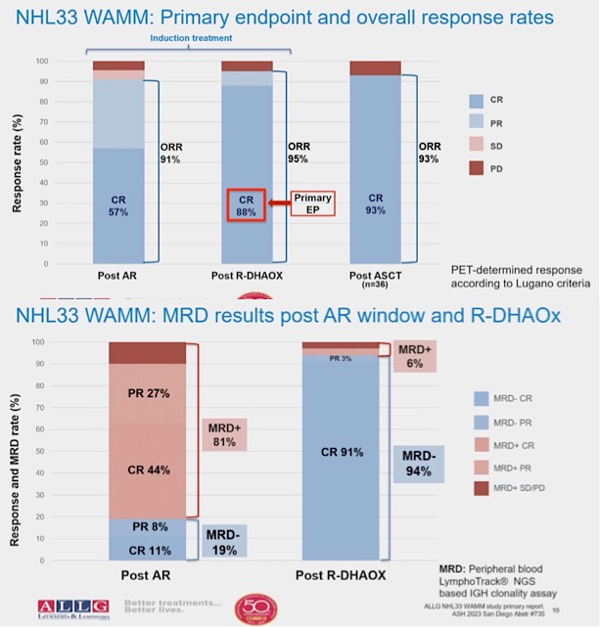
Young/fit TN MCL: Acala-R→chemo/ASCT
Results:
Med f/u 25m
CR after AR: 57%
CR after chemo 88%
Higher MRD neg after chemo
2-yr PFS: 73%
2-yr OS: 79%
Hawkes ASH 2023;Abstract 735.

Slide 28
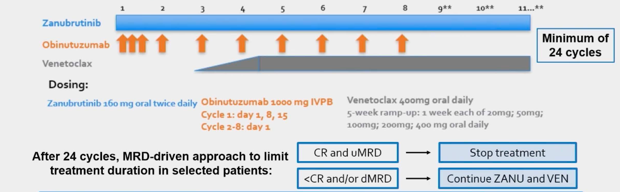
Treatment-naïve TP53 mut MCL: zanu-obin-ven
Patient Characteristics:
N=25
Blastoid/pleomorphic 20%
Ki67 >30% 62% (incl 33% over 50%)
High MIPI 68%
TP53 overexpression by IHC 86%
17p del via FISH 44%
Toxicity:
Well-tolerated
Grade 3 neutropenia
Grade 1 diarrhea (60%)
COVID infections—2 fatal
Kumar ASH 2023;Abstract 738.

Slide 29
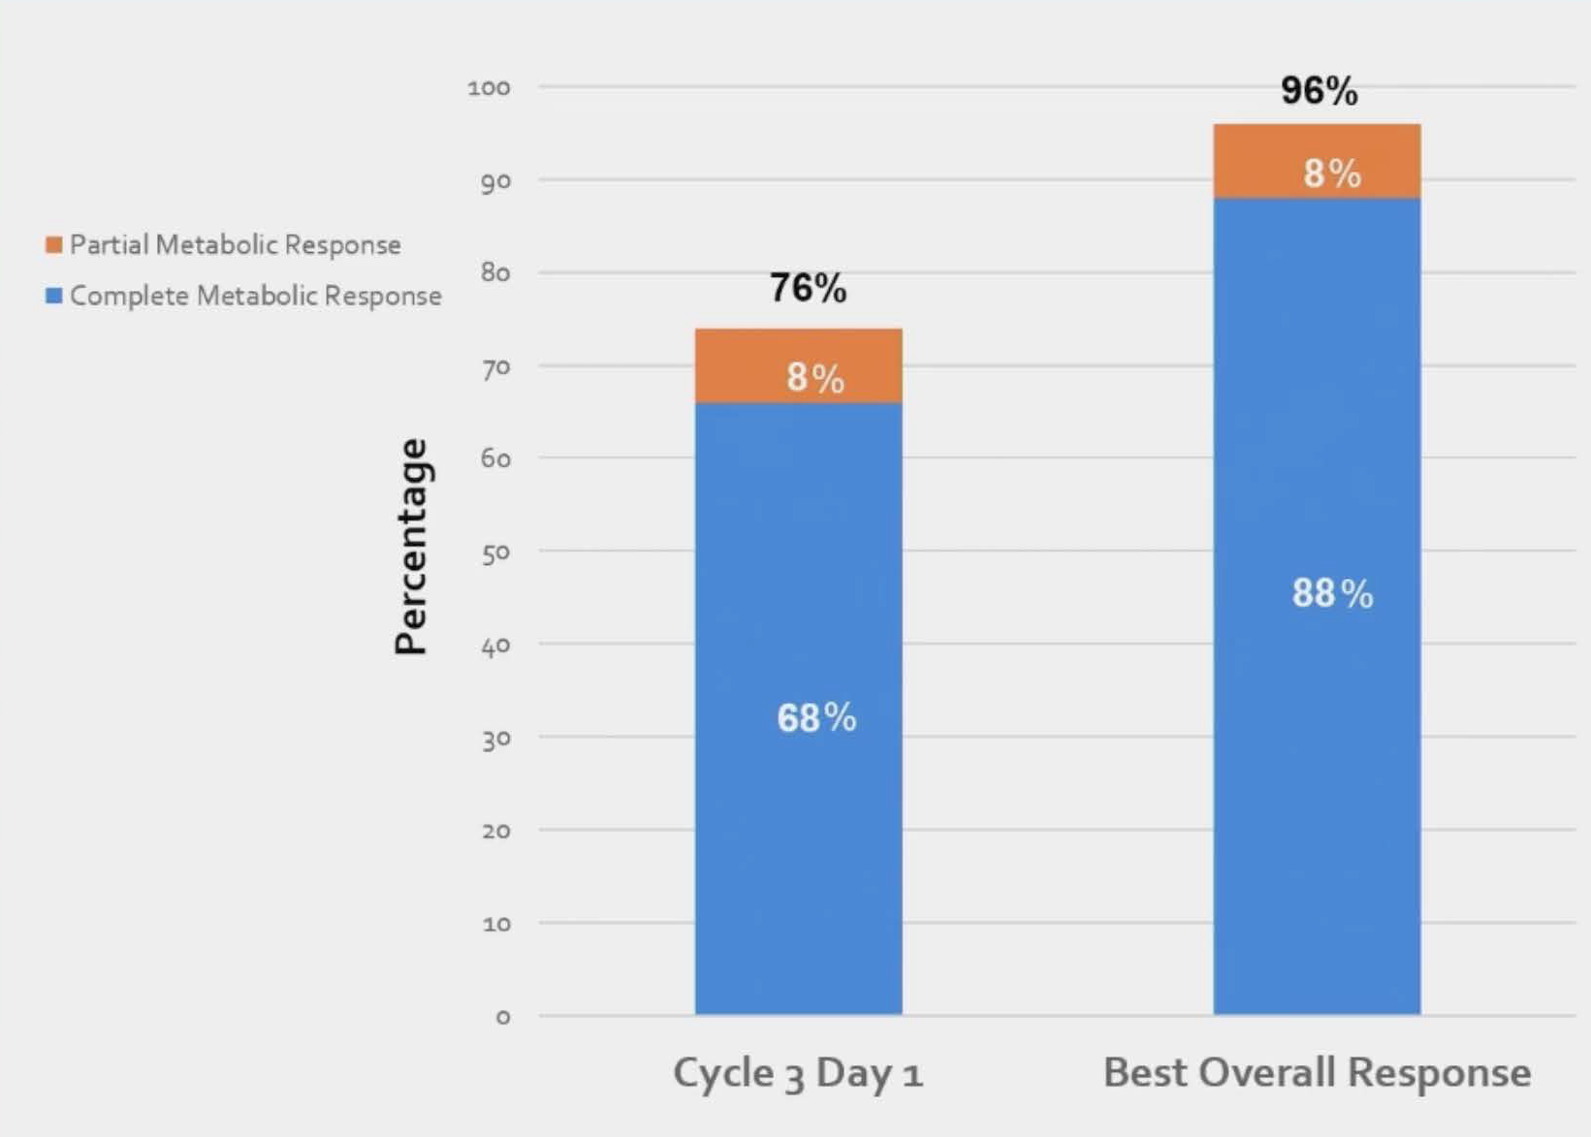
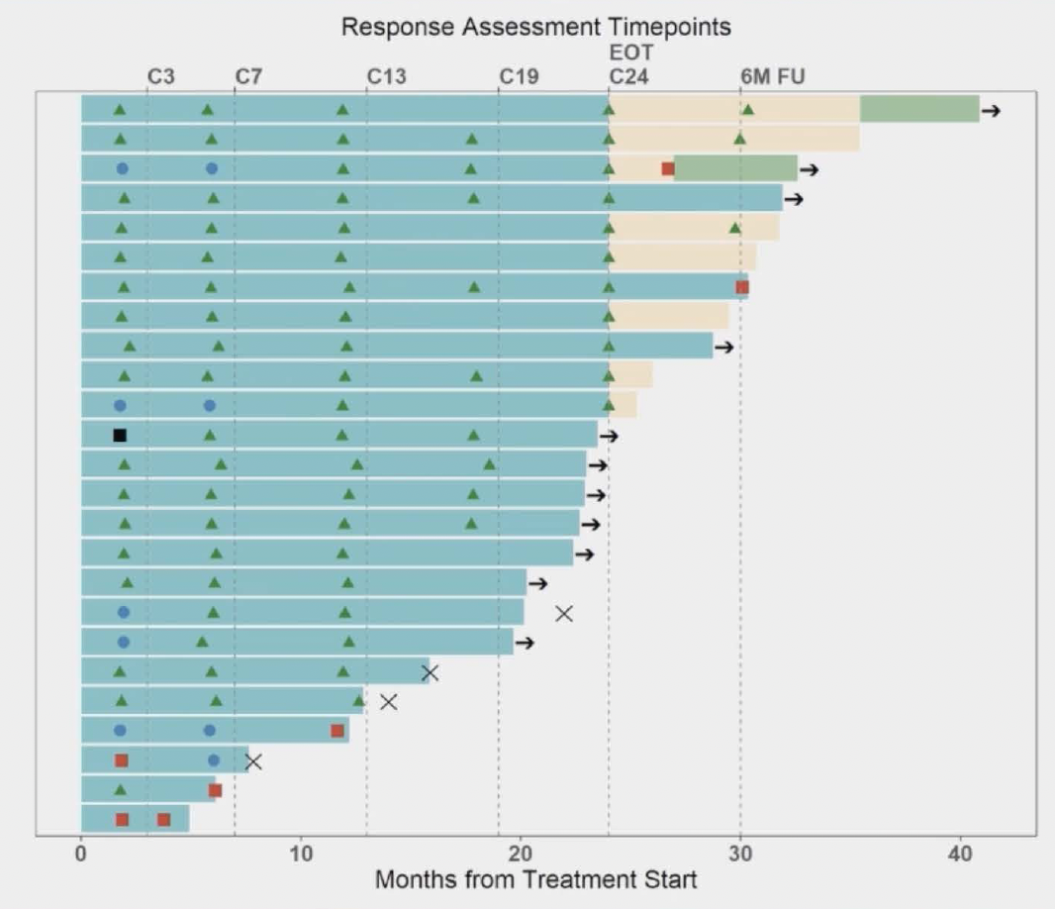
Treatment-naïve TP53 mut MCL: zanu-obin-ven
Median f/u 23m
9 events:
5 PD
4 deaths (all infectious)
Kumar ASH 2023;Abstract 738.

Slide 30
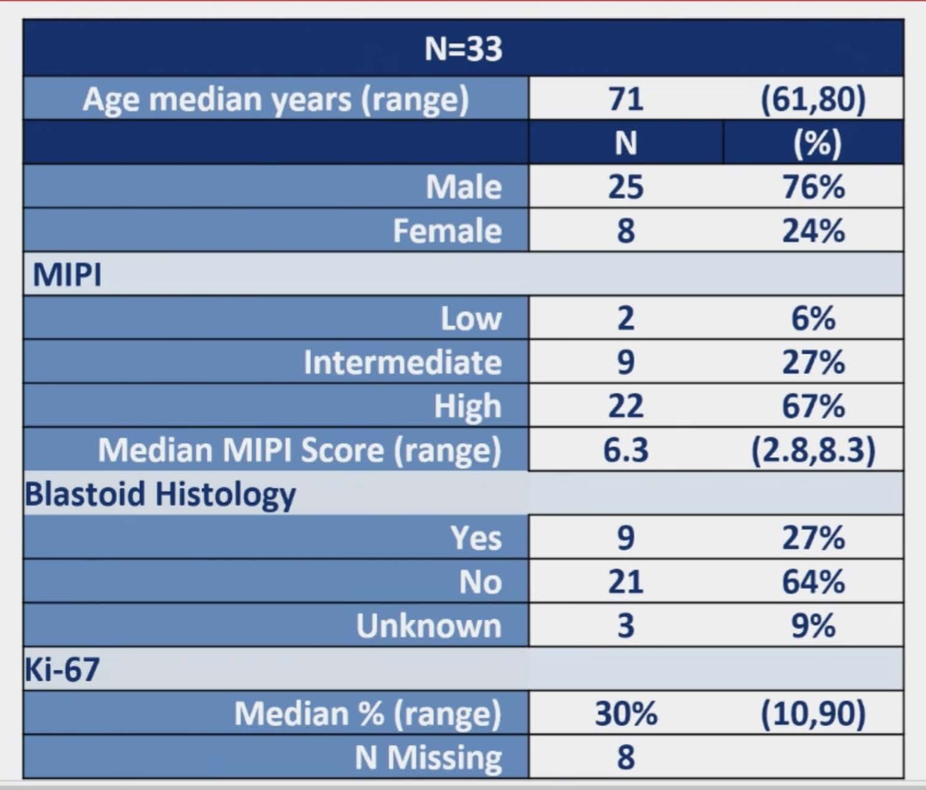
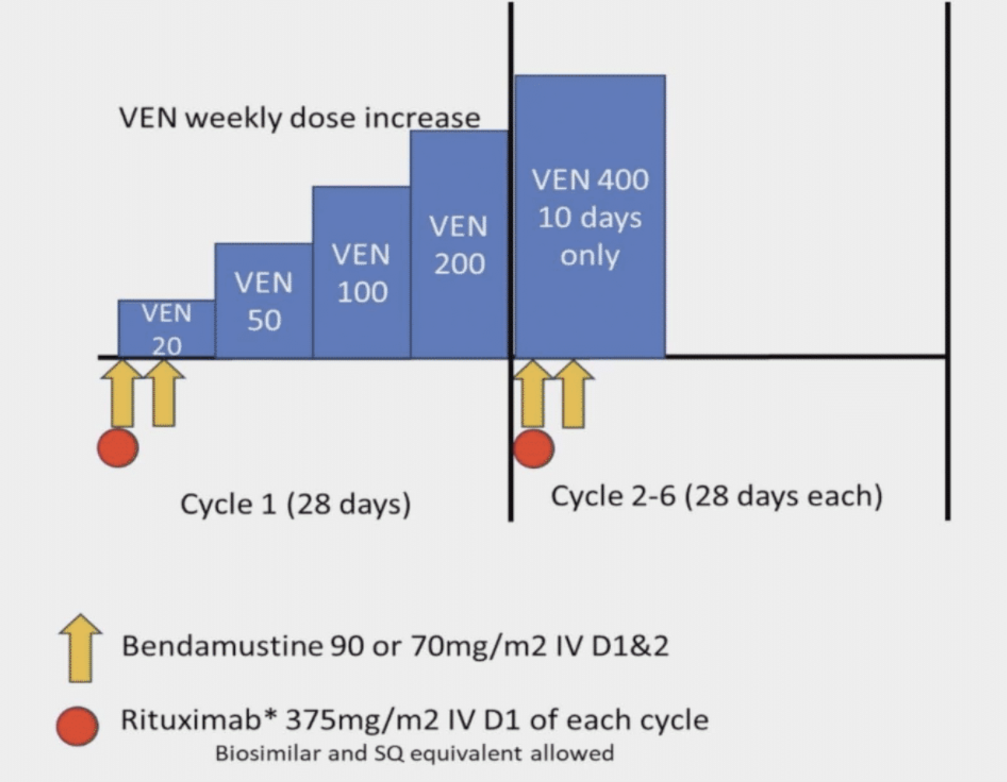
Older pts with MCL: BR-ven
Primary endpt: CR
Portell ASH 2023;Abstract 733.

Slide 31
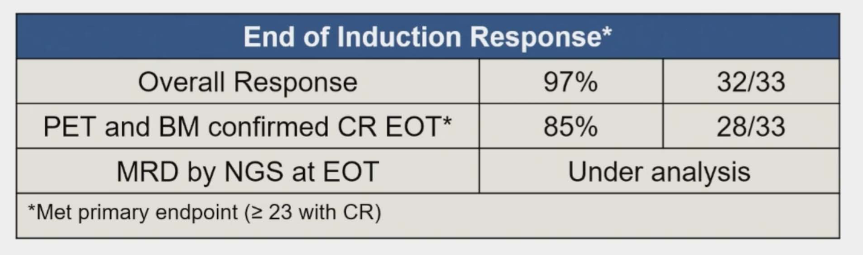
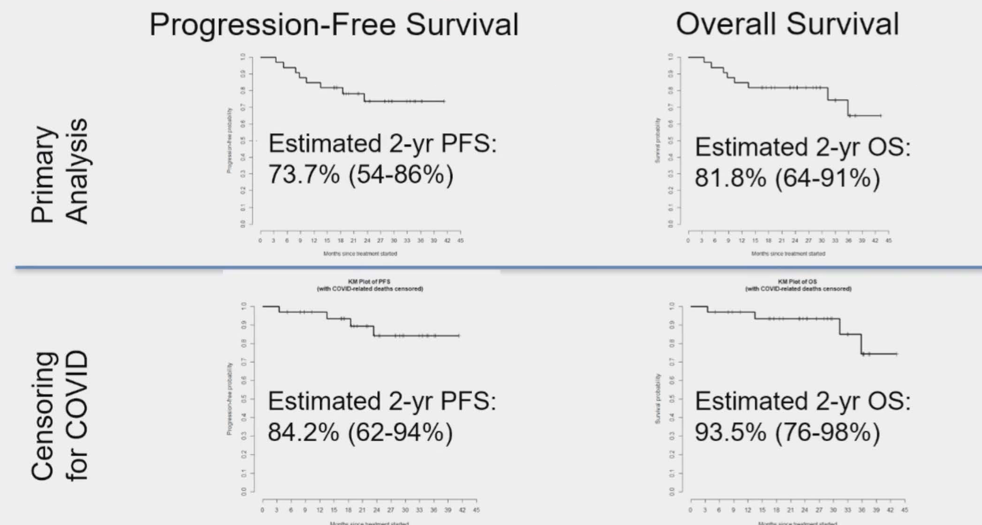
BR-ven in older adults with MCL
AE’s: cytopenias
8 deaths on study (4 from COVID, 1 influenza)
Portell ASH 2023;Abstract 733.

Slide 32
Rel/Ref Mantle cell lymphoma

Slide 33
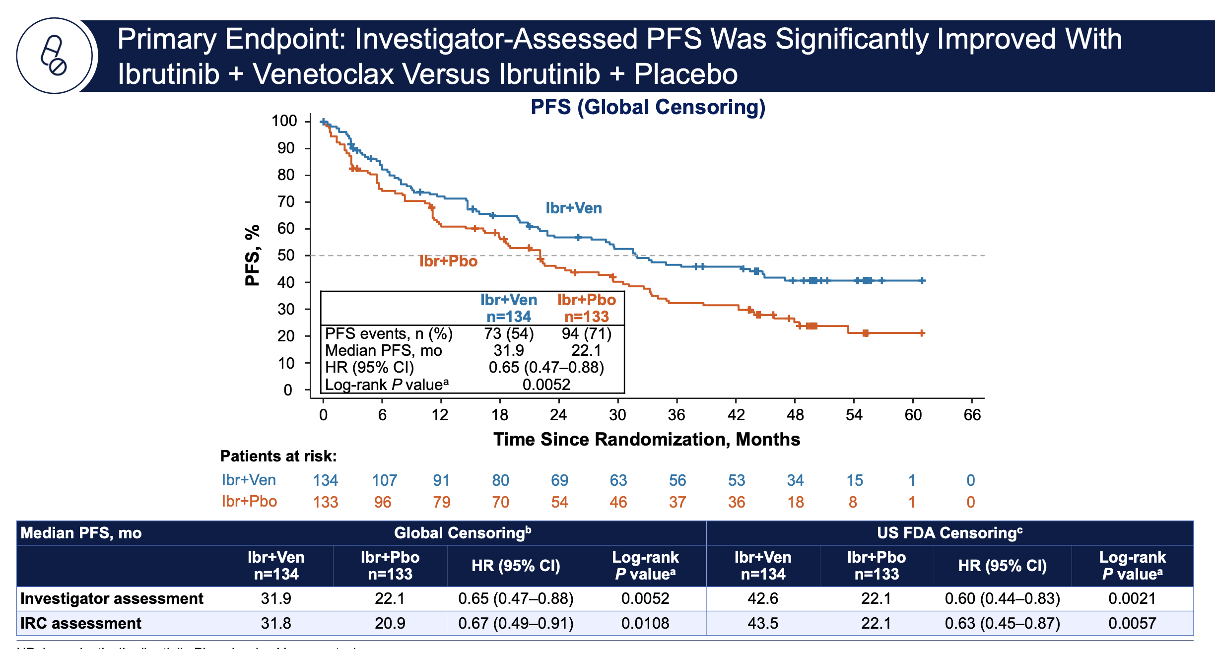
SYMPATICO: RP3 ibr-ven vs. ibr-pbo x 24m→ibr maintenance
No unexpected toxicity
No sig diff in OS (?trend)
Wang ASH 2023;Abstract LBA-2

Slide 34
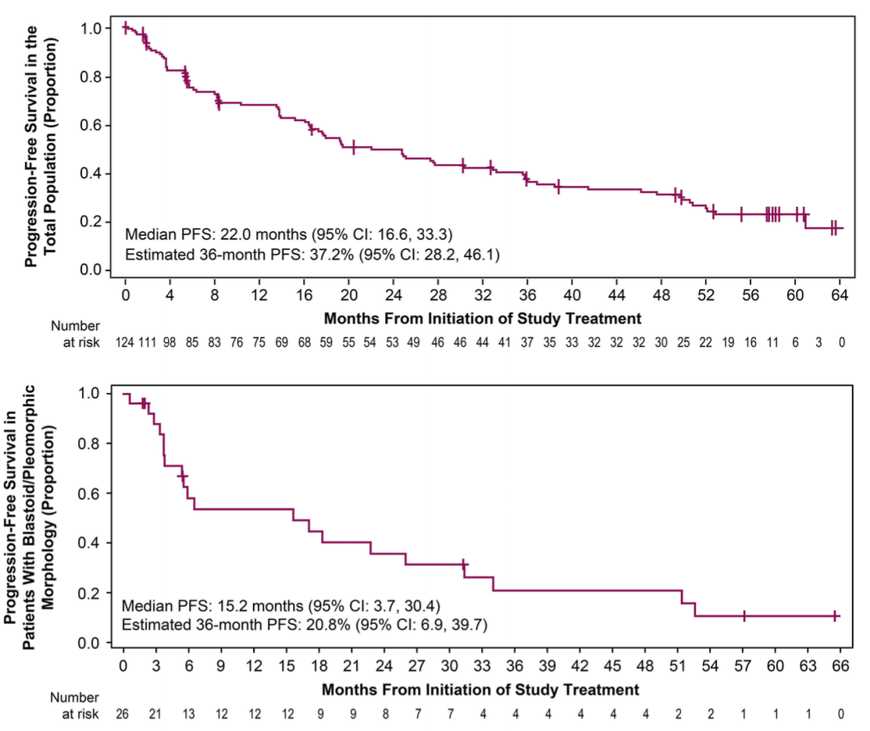
Acalabrutinib monotherapy in rel/ref MCL (n=124)
Pt Characteristics:
Med age 68y
37.1% bulky
21% blastoid morphology
Ki67 > 50% in 25% of pts
Results:
ORR 81%
CR 47.6%
DoR 28m
Low risk and CR pts had the best outcomes
Le Gouill Haematologica 2024;109(1):343-50.

Slide 35
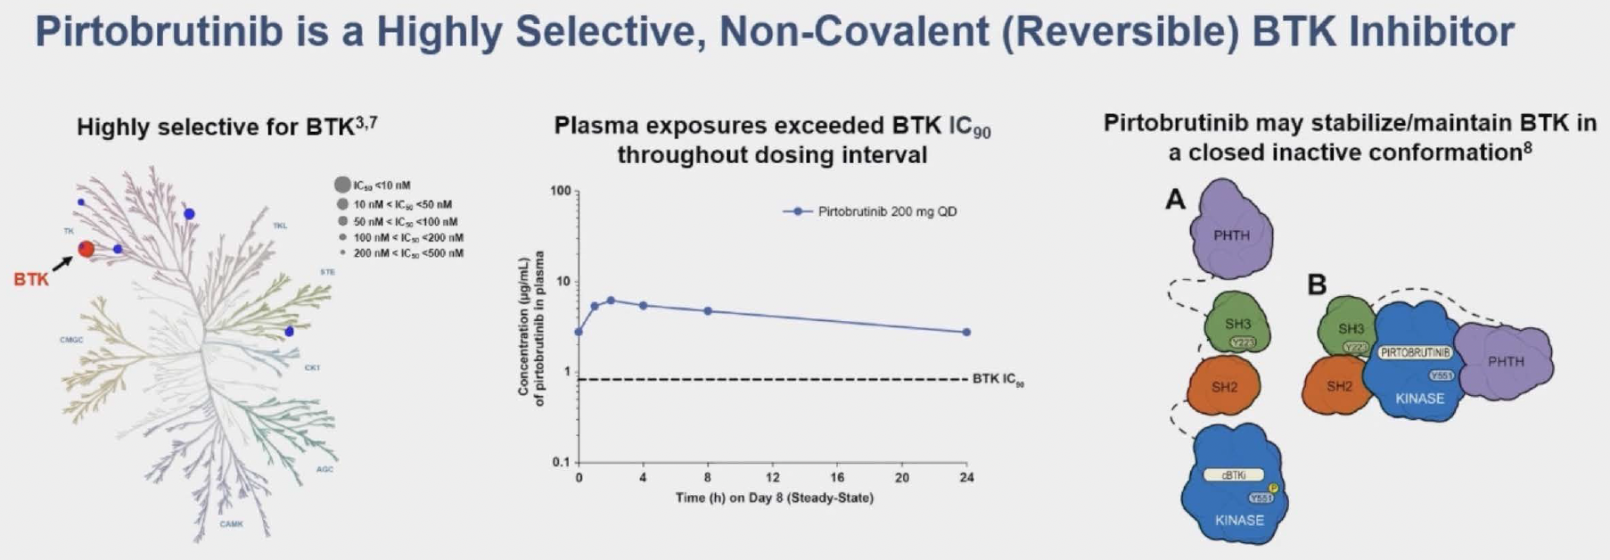
BRUIN Phase I/II trial of pirtobrutinib monotherapy (MCL cohort=166, with 14 naïve to prior BTKi)
Cohen ASH 2023;Abstract 981.

Slide 36
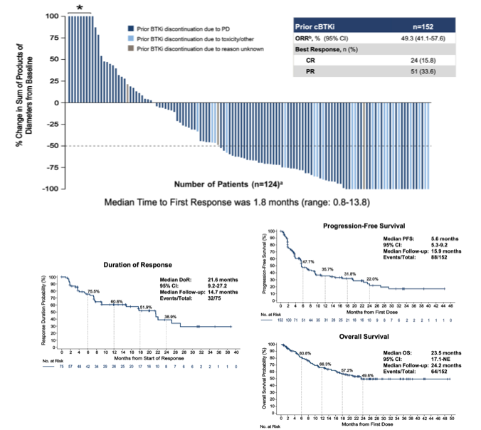
Pirtobrutinib in rel/ref MCL
ORR 49%
Med DoR 21m
Cohen ASH 2023;Abstract 981.

Slide 37
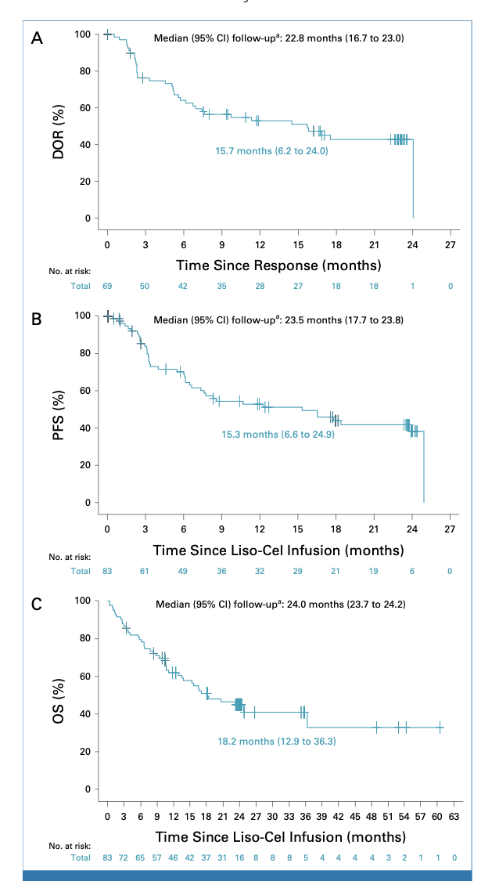
CAR-T for MCL: Liso-cel (104 pts→88 received product)
DR 15.7m
Patient Characteristics:
Med age 68.5y
20% over age 75y
75% with Ki67 over 30%
31% blastoid morphology
23% with TP53 mutation
Med prior Rx 3 (range, 1-11)
69% refractory disease
PFS 15.3m
ORR and CR: 86.5% and 74.3%
OS 18.2m
Wang J Clin Oncol 2023

Slide 38
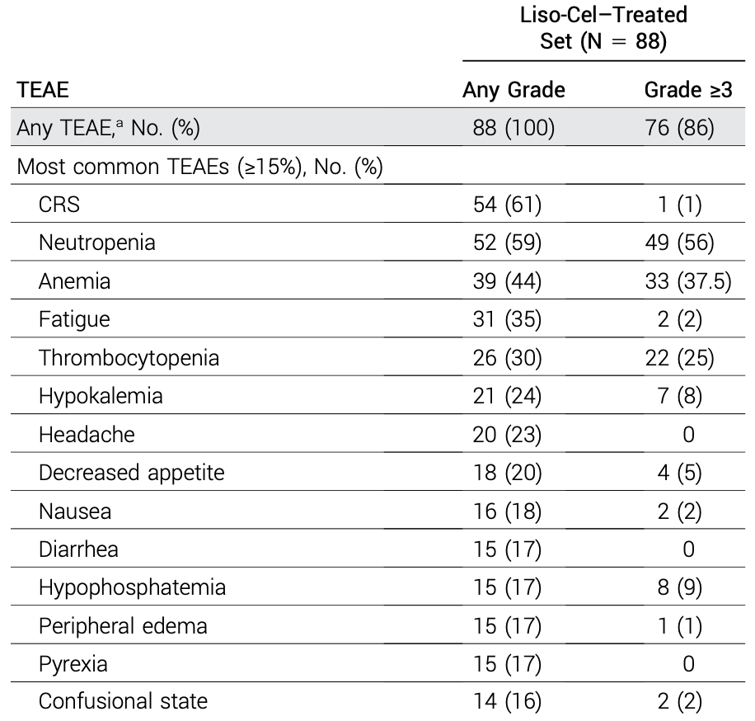
Liso-cel in rel/ref MCL: Results
Wang J Clin Oncol 2023

Slide 39
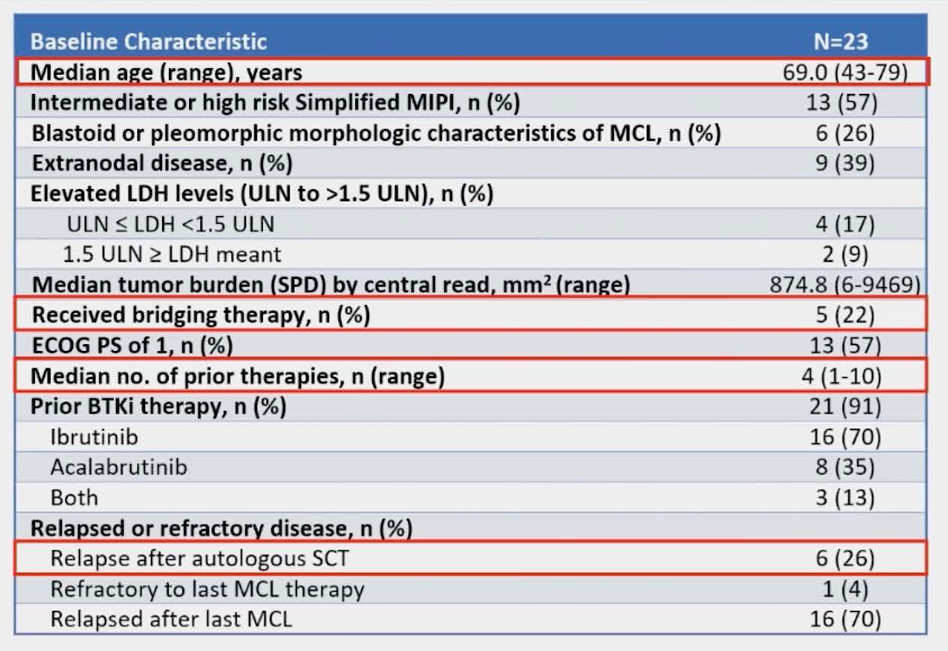
Brexu-cel in rel/ref MCL: 4y f/u ZUMA-2 and primary analysis of ZUMA-18 expanded access study
Goy ASH 2023;Abstract 106.

Slide 40
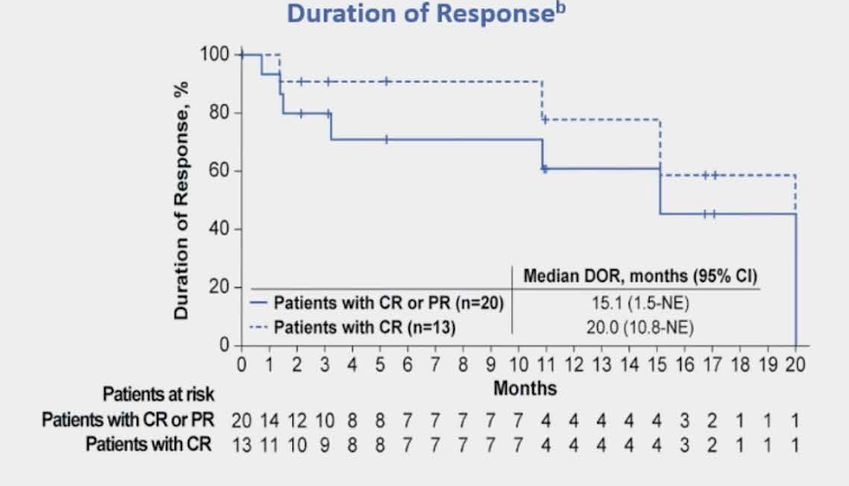
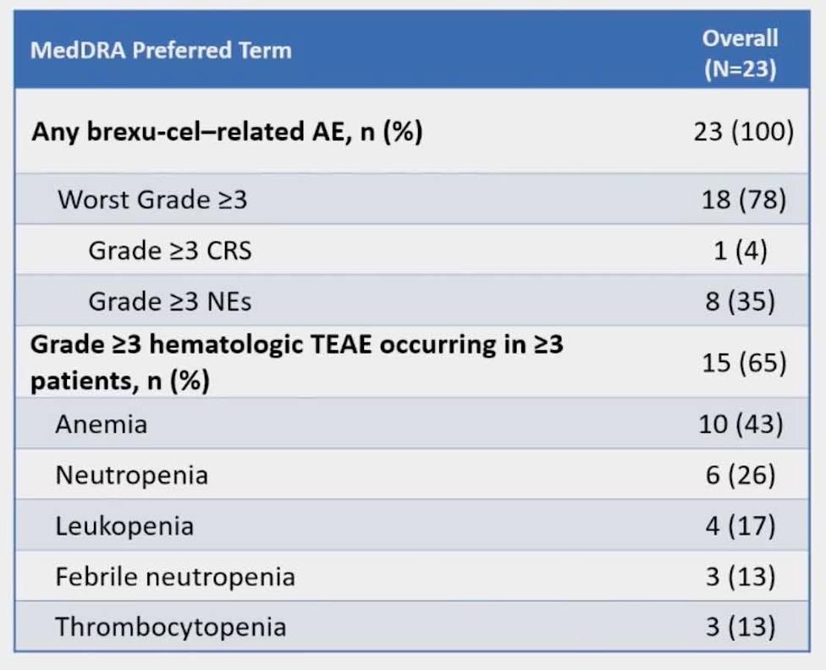
ZUMA-18 Results
ORR 87%
CR 57%
Goy ASH 2023;Abstract 106.

Slide 41
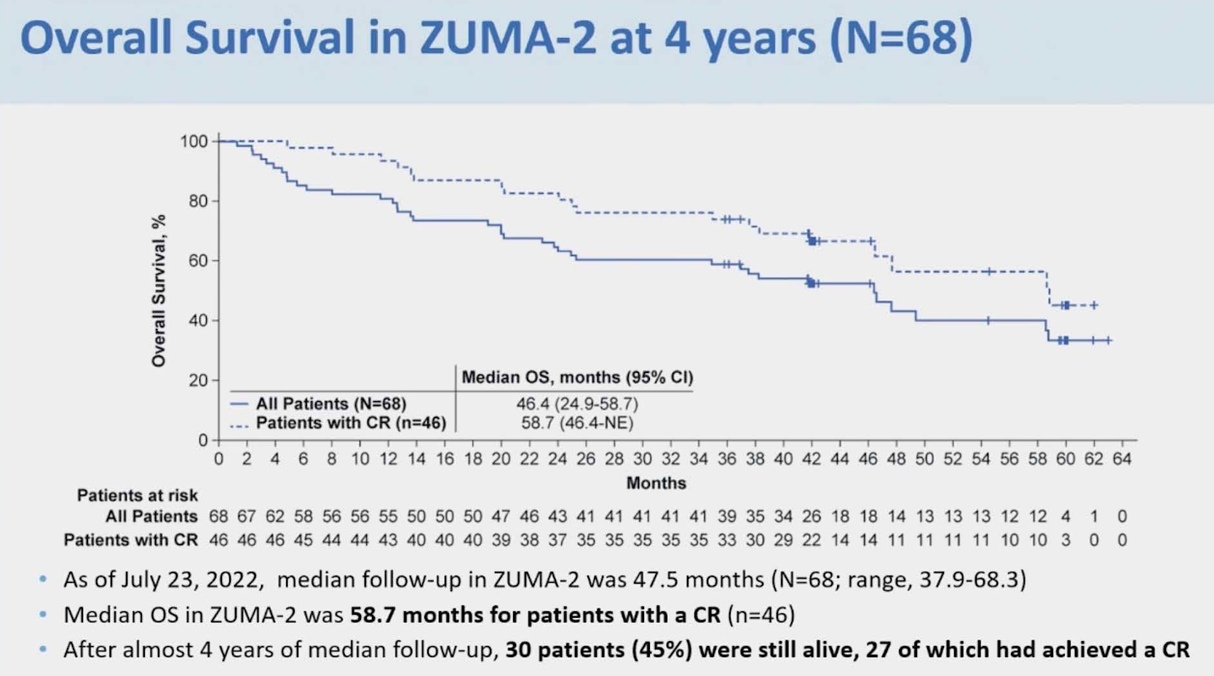
ZUMA-2 4y results
Goy ASH 2023;Abstract 106.

