Slide 1
2023 Year-in-Review: Updates in the Management of Diffuse Large B-Cell Lymphoma and Hodgkin Lymphoma
Andrew M Evens, DO, MBA, MSc
Deputy Director for Clinical Services, Rutgers Cancer Institute of New Jersey
Associate Vice Chancellor, Clinical Innovation and Data Analytics, Rutgers Health
System Director of Medical Oncology, and Oncology Lead for RWJBarnabas-Rutgers Medical Group, RWJBarnabas Health
Professor of Medicine, Rutgers Robert Wood Johnson Medical School
New Brunswick, New Jersey

Slide 2
Diffuse Large B-Cell Lymphoma (DLBCL)

Slide 3
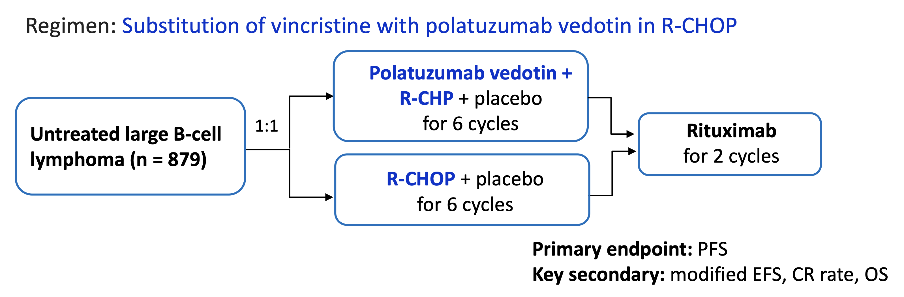
POLARIX: Study Schema
Kasamon Y. FDA Oncologic Drugs Advisory Committee Meeting. March 9, 2023.
https://www.fda.gov/media/166090/download

Slide 4
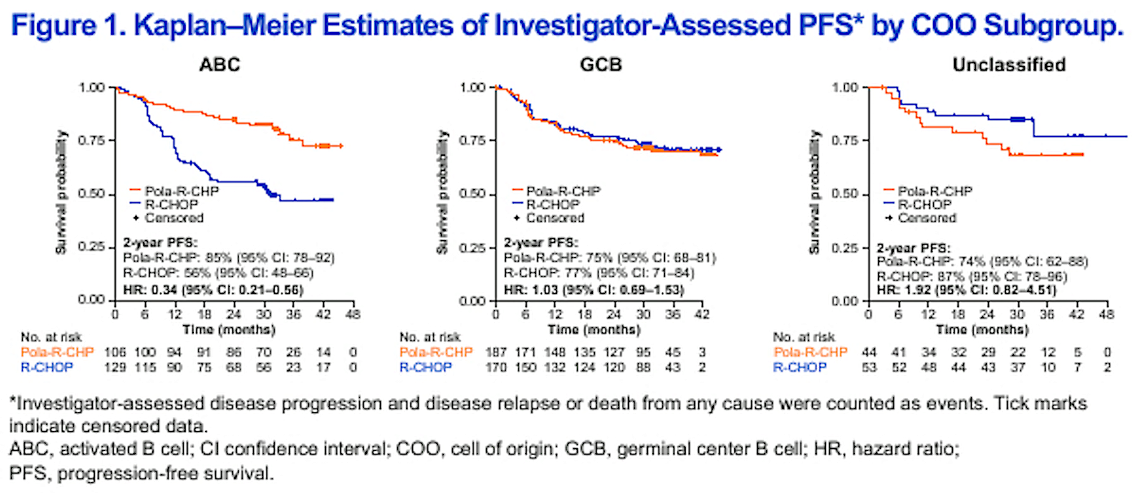
POLARIX: PFS by Cell of Origin
2-year PFS:
Pola-R-CHP: 85% (95% CI: 78-92)
R-CHOP: 56% (95% CI: 48-66)
HR: 0.34 (95% CI 0.22-0.56)
2-year PFS:
Pola-R-CHP: 75% (95% CI: 68-81)
R-CHOP: 77% (95% CI: 71-84)
HR: 1.03 (95% CI 0.69-1.53)
2-year PFS:
Pola-R-CHP: 74% (95% CI: 62-88)
R-CHOP: 87% (95% CI: 78-96)
HR: 1.92 (95% CI 0.82-4.51)
Morschhauser F et al. ASH 2023;Abstract 3000.

Slide 5
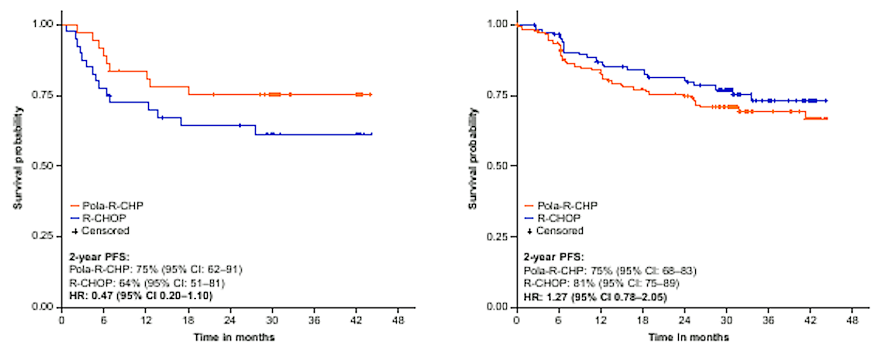
POLARIX: PFS by Dark Zone Signature (DZSig)
DZsig^{Pos}
GCB-DZsigNeg/Und
2-year PFS:
Pola-R-CHP: 75% (95% CI: 62-91)
R-CHOP: 64% (95% CI: 51-81)
HR: 0.47 (95% CI 0.20-1.10)
2-year PFS:
Pola-R-CHP: 75% (95% CI: 68-83)
R-CHOP: 81% (95% CI: 75-89)
HR: 1.27 (95% CI 0.78-2.05)
GCB-DLBCL was composed predominantly of EZH2 mutations and Bcl-2 translocations (EZB), the undetermined subgroup and BC6 fusions and NOTCH2 mutated (BN2) subtypes. In ABC-DLBCL, the MYD88 and CD79B-mutated (MCD) subtype and the undetermined subgroup were the major genetic subtypes. ﻿﻿
In patients with the EZB and MCD subtypes, Pola-R-CHP appeared to improve 2-year PFS compared to
R-CHOP. Patients with GCB-DLBCL who were DZsig positive significantly benefited from Pola-R-CHP vs R-CHOP.
Morschhauser F et al. ASH 2023;Abstract 3000.

Slide 6
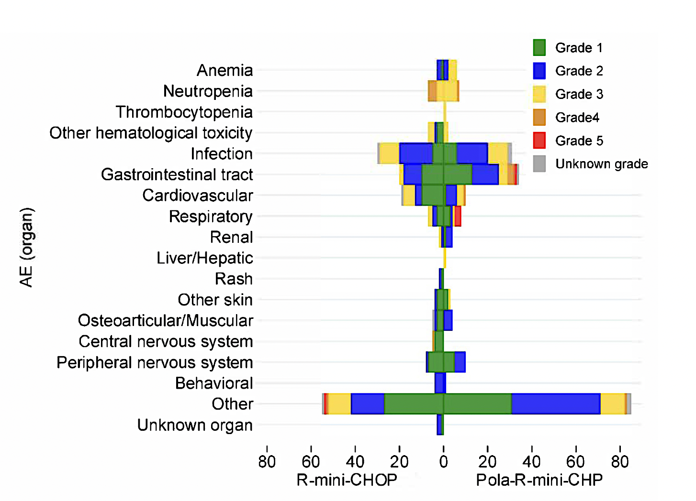
POLAR BEAR: Initial Safety Data with R-pola-mini-CHP versus
R-mini-CHOP for Older or Frail Patients with DLBCL
Grade 4
Jerkeman M et al. EHA 2023;Abstract S227.

Slide 7
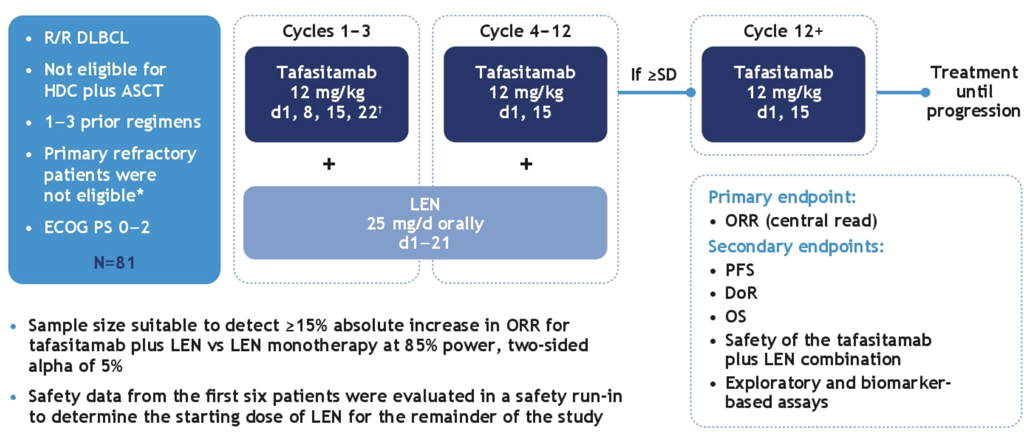
L-MIND: Tafasitamab + Lenalidomide — Study Design
Düll J et al. ASCO 2021;Abstract 7513.

Slide 8
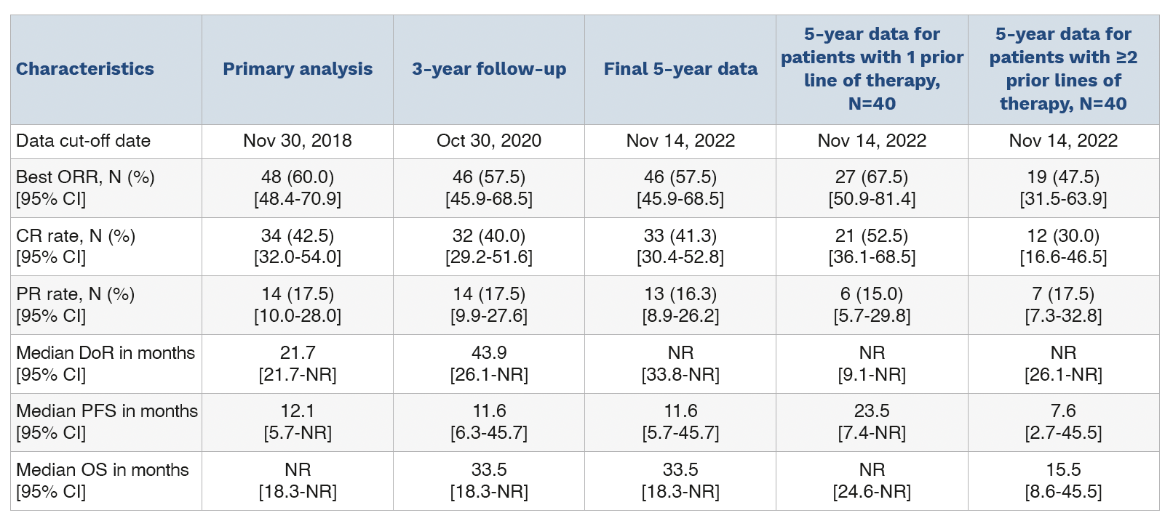
L-MIND: Tafasitamab + Lenalidomide — Response Data
Duell J et al. Haematologica 2023 August 31;[Online ahead of print].

Slide 9
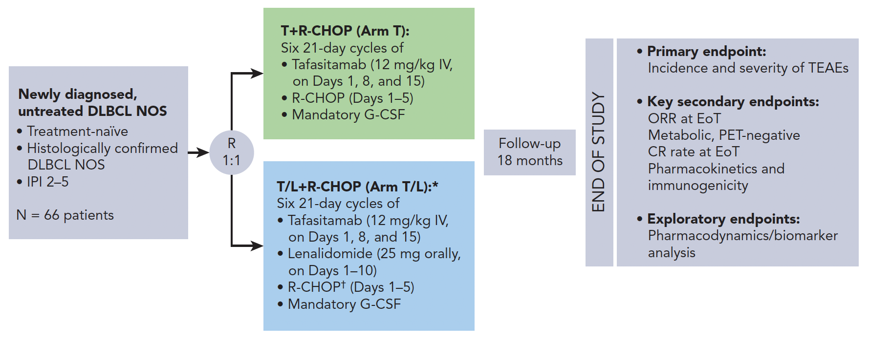
First-MIND: R-CHOP + Tafasitamab ± Lenalidomide
Belada D et al. Blood 2023;142(16):1348-58.

Slide 10
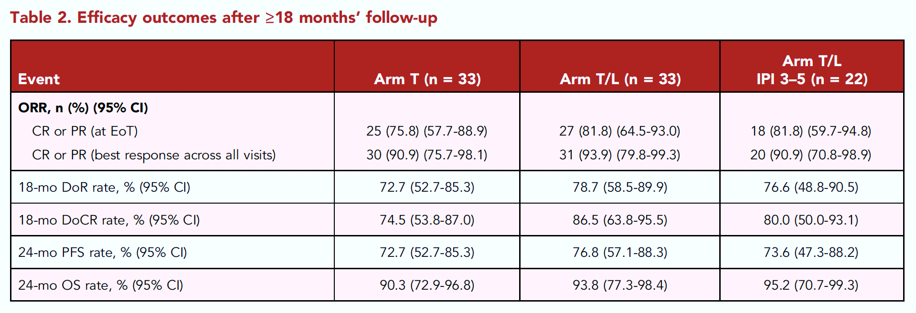
First-MIND: R-CHOP + Tafasitamab ± Lenalidomide (continued)
Belada D et al. Blood 2023;142(16):1348-58.

Slide 11
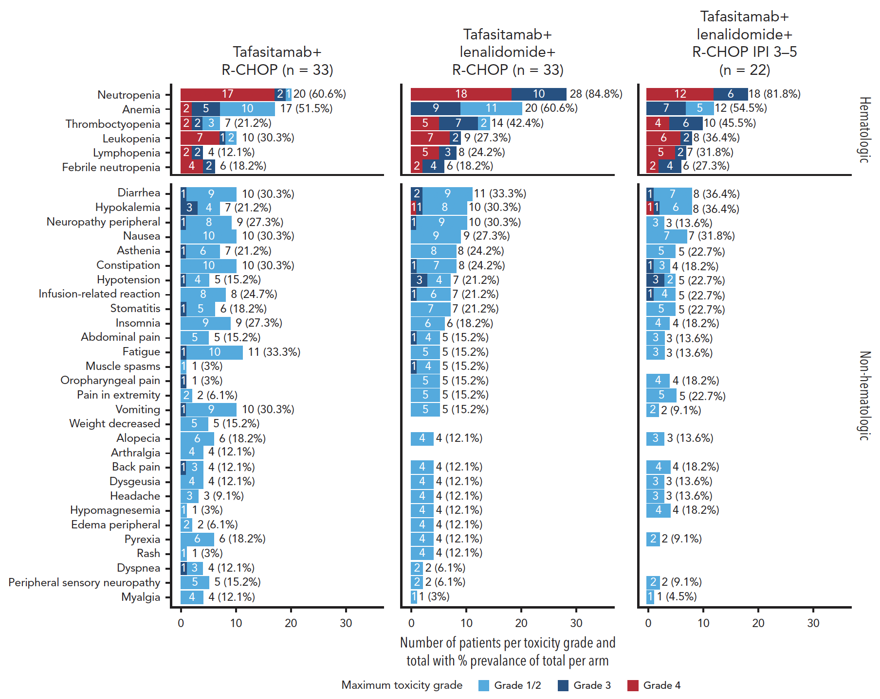
First-MIND: R-CHOP + Tafasitamab ± Lenalidomide (continued)
Belada D et al. Blood 2023;142(16):1348-58.

Slide 12
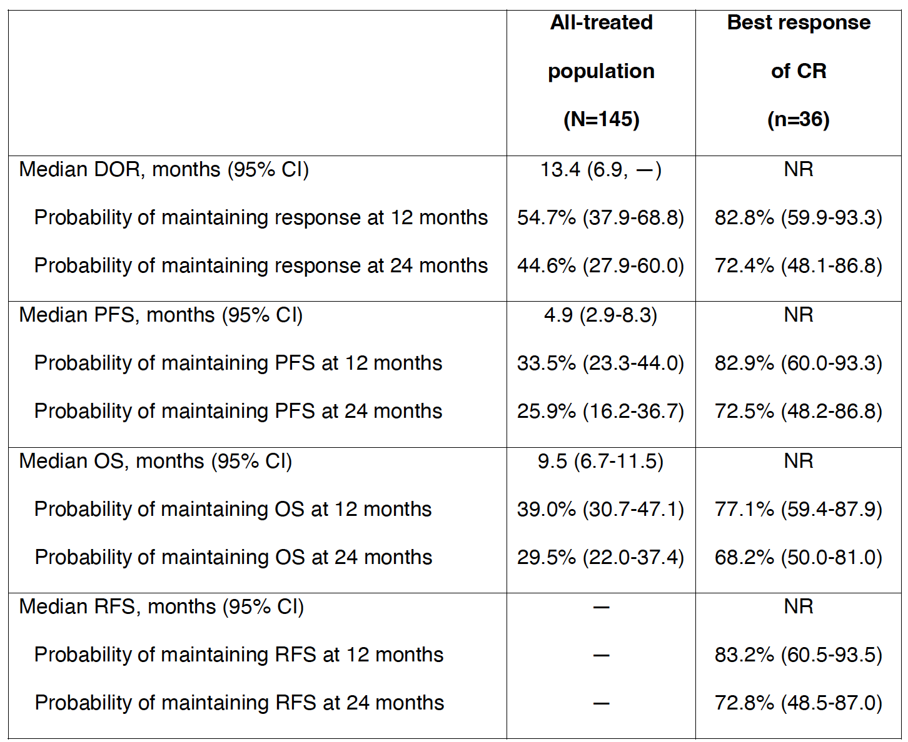
LOTIS-2: Loncastuximab Tesirine (N = 145)
- R/R DLBCL (≥2 prior therapies)
- ECOG PS 0-2
Loncastuximab tesirine Q3W
- 150 μg/kg for the first two cycles
- 75 μg/kg for subsequent cycles
Continue until 1 year, disease relapse/progression, or unacceptable toxicity
Caimi PF et al. Haematologica 2023 August 31;[Online ahead of print].

Slide 13
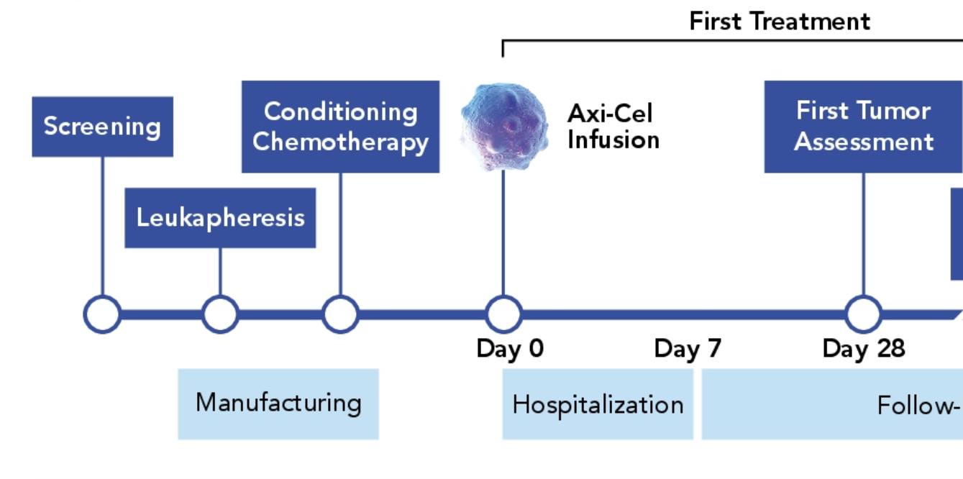
ZUMA-1: Axicabtagene Ciloleucel (Axi-cel) for Relapsed/Refractory LBCL — Study Design
Follow-up Period
Locke FL et al. ASCO 2020;Abstract 8012.

Slide 14
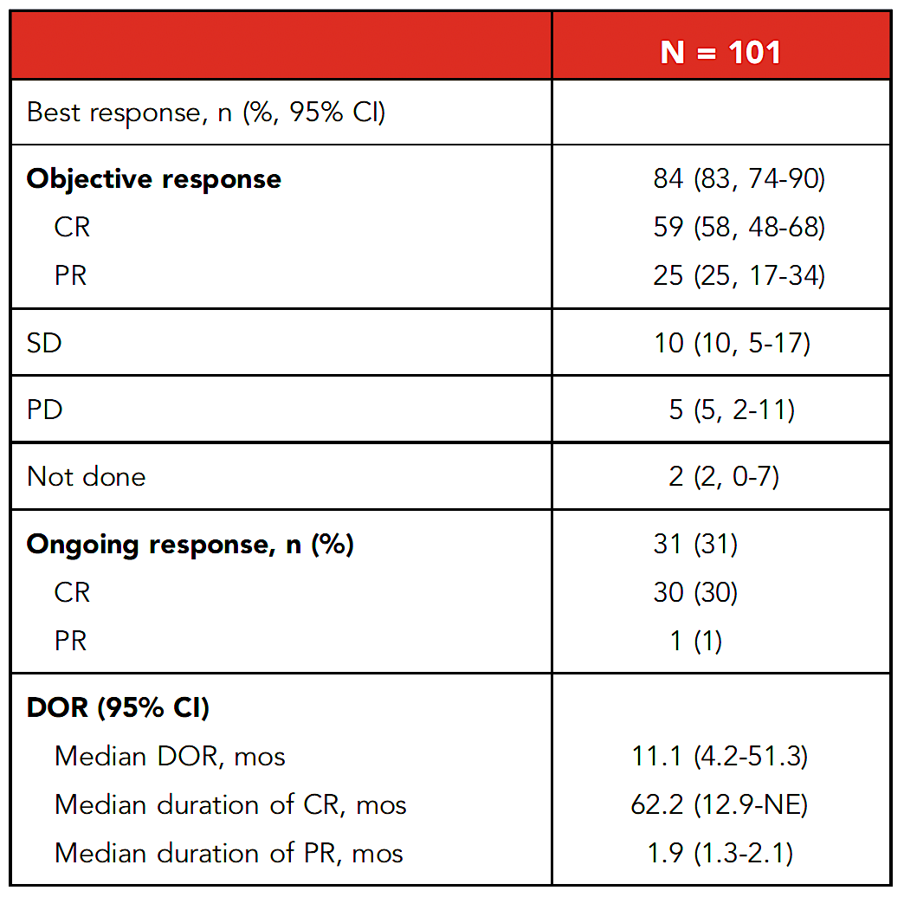
ZUMA-1: 5-Year Efficacy Outcomes
 | Median | 95% CI
EFS | 5.7 months | (3.1 to 13.9)
PFS | 5.9 months | (3.3 to 15.0)
OS | 25.8 months | (12.8 to NE)
CRS (cytokine release syndrome) occurred in 94 patients (93%) with Grade ≥3 cases in 11 patients (11%). Neurologic events occurred in 65 patients (64%) with Grade ≥3 events in 30 patients (30%).
No new safety signals were reported in patients who received axi-cel (n = 101), and no new serious adverse events related to axi-cel were reported after the 2-year analysis. No secondary cancer related to axi-cel has been reported thus far.
Neelapu SS et al. Blood 2023;141(19):2307-15.

Slide 15
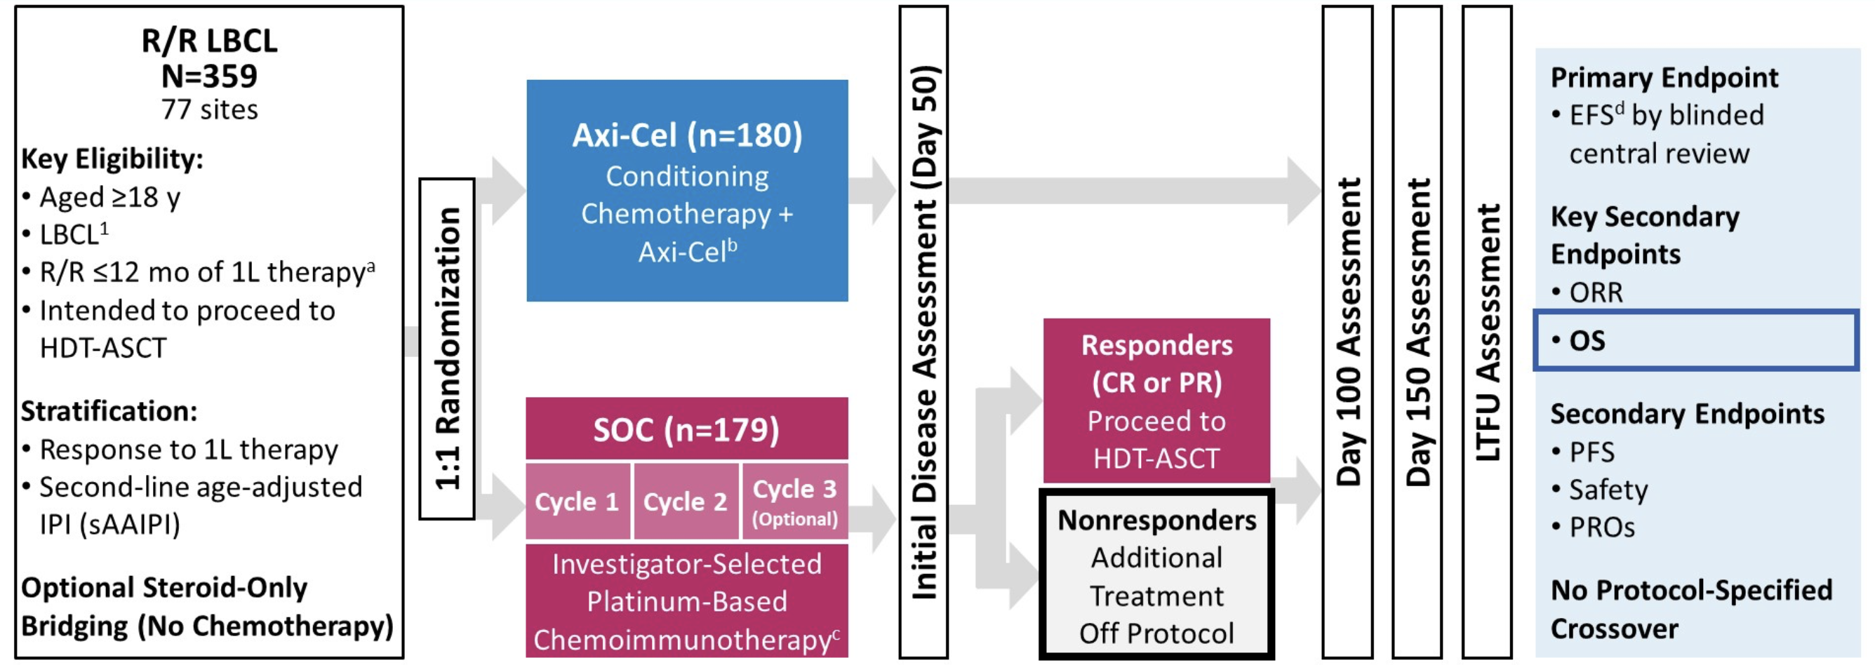
ZUMA-7: Study Design
Westin JR et al. ASCO 2023;Abstract LBA107.

Slide 16
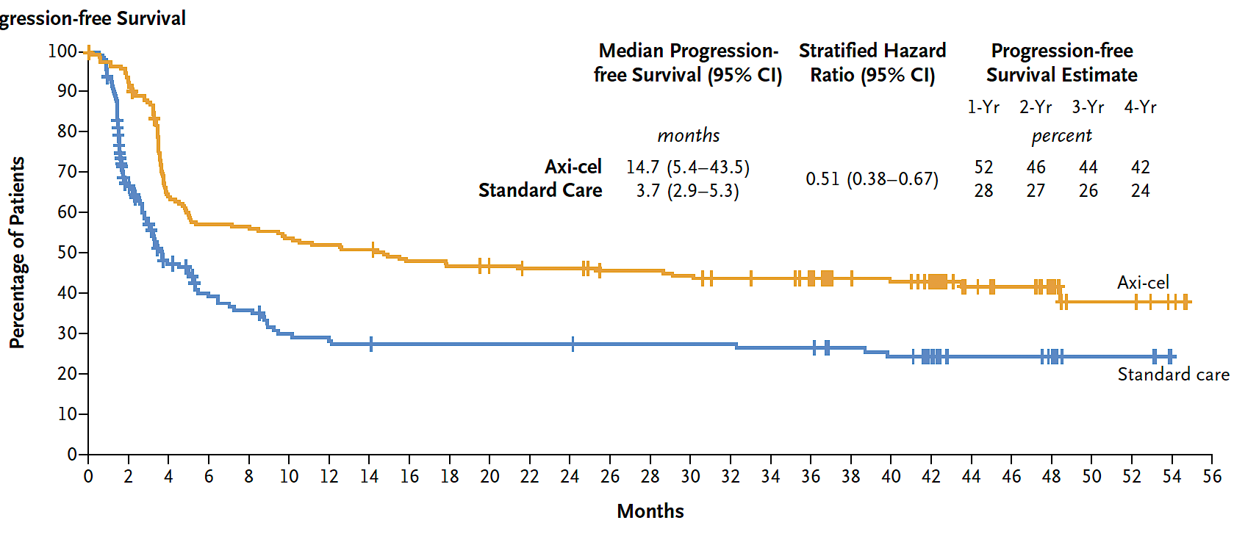
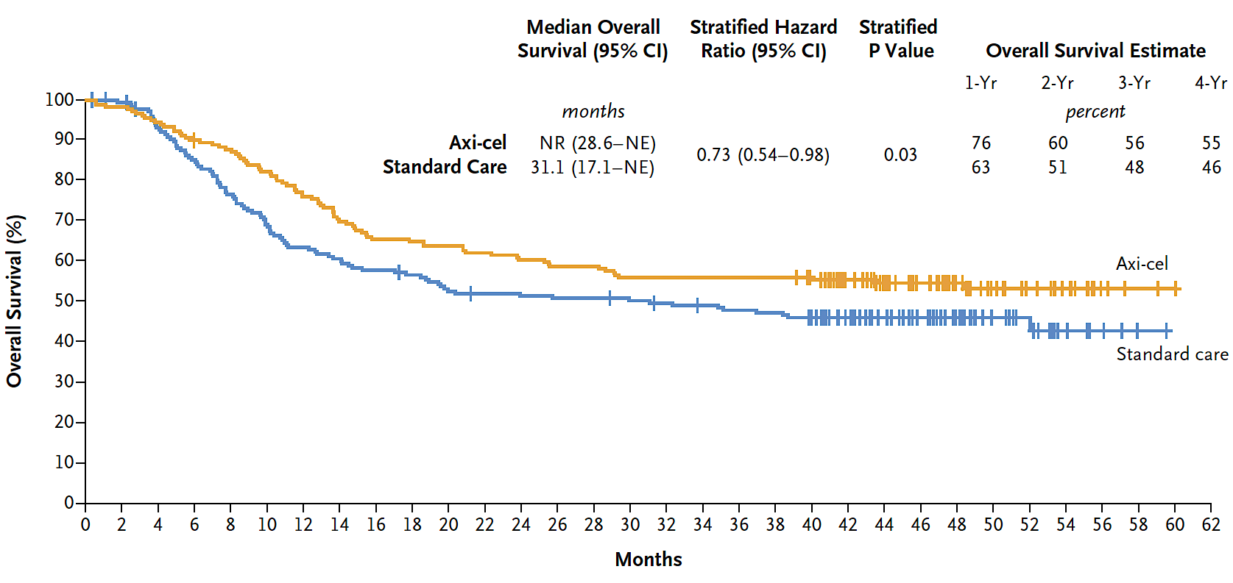
ZUMA-7: Progression-Free and Overall Survival
Westin JR et al. N Engl J Med 2023;389(2):148-57.

Slide 17
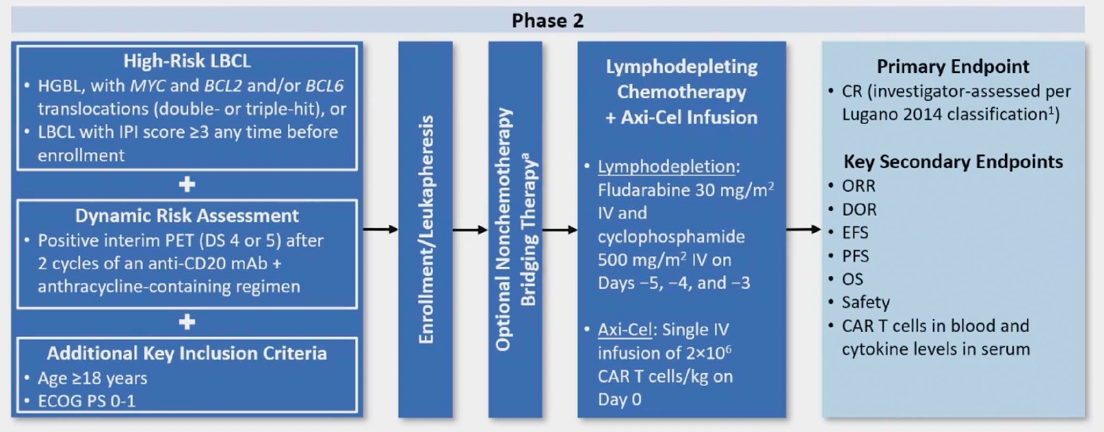
ZUMA-12: Study Design
Chavez JC et al. ASH 2023;Abstract 894.

Slide 18
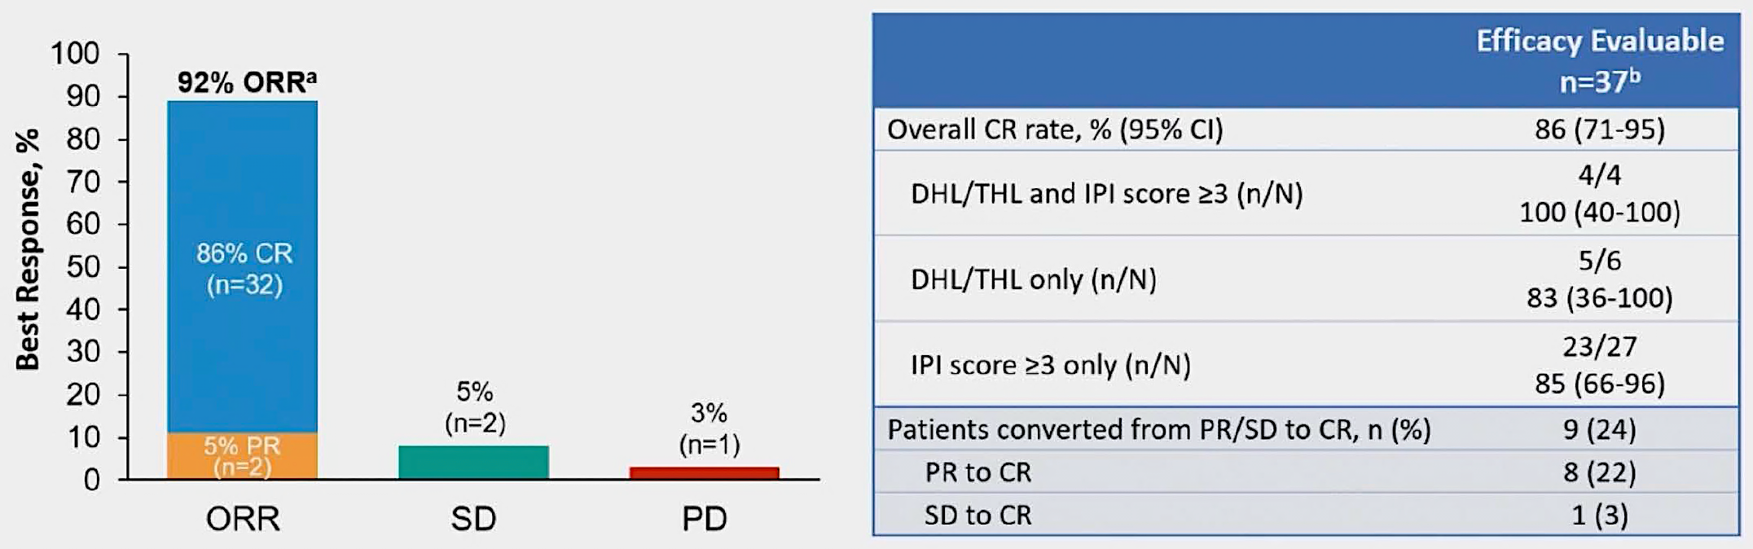
ZUMA-12: 3-Year Response Data
Secondary endpoints (median EFS/PFS/OS) have not been reached.
Chavez JC et al. ASH 2023;Abstract 894.

Slide 19
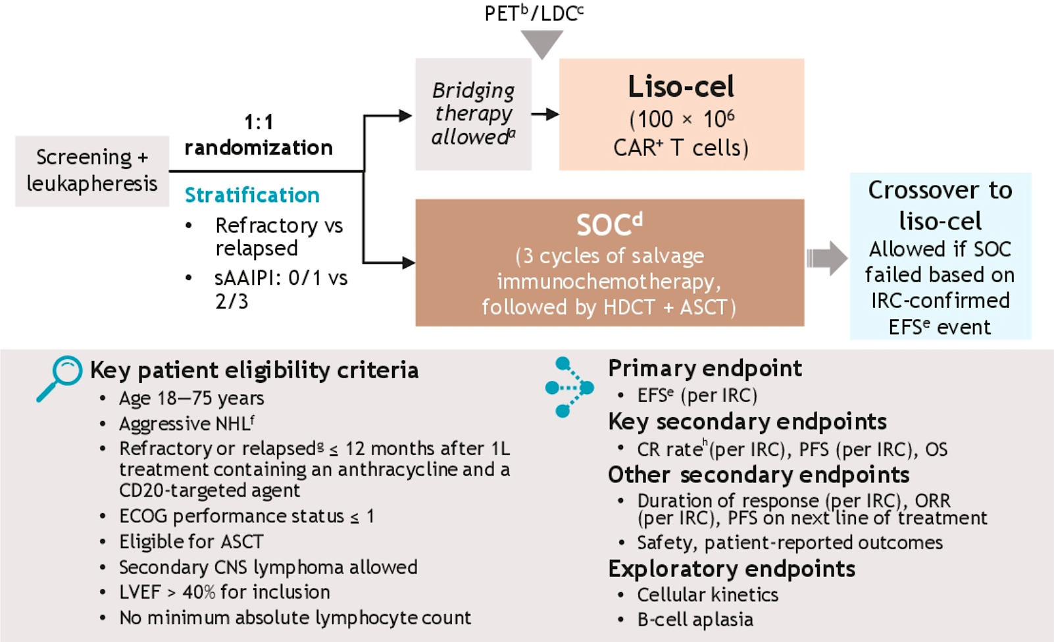
TRANSFORM: Lisocabtagene Maraleucel (Liso-cel) as Second-Line Treatment for R/R LBCL – Study Design
Nastoupil LJ et al. ASCO 2023;Abstract 7526.

Slide 20
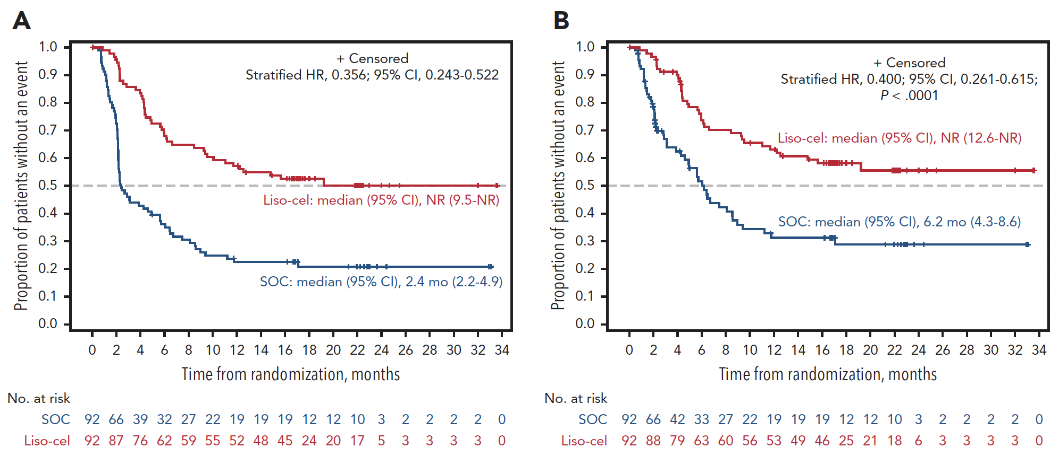
TRANSFORM: Efficacy Outcomes
The most common TEAEs of any grade were neutropenia, anemia, thrombocytopenia and nausea. The most common Grade ≥3 AEs in both arms were neutropenia, thrombocytopenia and anemia.
The rates of any-grade CRS and NEs were 49% and 11%, respectively, with Grade 3 CRS and NEs in only 1% and 4%, respectively; there were no Grade 4 or 5 events.
EFS
PFS
No significant improvement in OS (HR, 0.724; 95% CI, 0.443-1.183; P = 0.0987)
EFS = event-free survival; PFS = progression-free survival; TEAEs = treatment-emergent adverse events; AEs = adverse events; CRS = cytokine release syndrome; NEs = neurologic events
Nastoupil LJ et al. ASCO 2023;Abstract 7526.

Slide 21
FDA Investigating Serious Risk of T-Cell Cancer After BCMA-Directed or CD19-Directed Autologous Chimeric Antigen Receptor (CAR) T-Cell Immunotherapies
Press Release: November 28, 2023
“The Food and Drug Administration (FDA) has received reports of T-cell malignancies, including chimeric antigen receptor CAR-positive lymphoma, in patients who received treatment with BCMA- or CD19-directed autologous CAR T cell immunotherapies. Reports were received from clinical trials and/or postmarketing adverse event (AE) data sources.
FDA has determined that the risk of T-cell malignancies is applicable to all currently approved BCMA-directed and CD19-directed genetically modified autologous CAR T cell immunotherapies. T-cell malignancies have occurred in patients treated with several products in the class.
Although the overall benefits of these products continue to outweigh their potential risks for their approved uses, FDA is investigating the identified risk of T cell malignancy with serious outcomes, including hospitalization and death, and is evaluating the need for regulatory action.”
https://www.fda.gov/vaccines-blood-biologics/safety-availability-biologics/fda-investigating-serious-risk-t-cell-malignancy-following-bcma-directed-or-cd19-directed-autologous

Slide 22
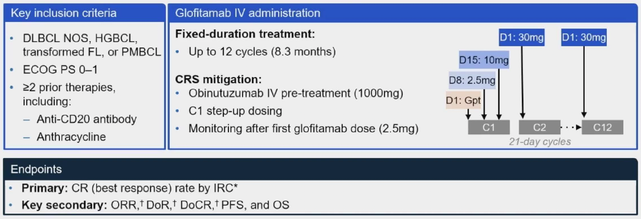
Phase II Study of Glofitamab Monotherapy
Hutchings M et al. ASH 2023;Abstract 433.

Slide 23
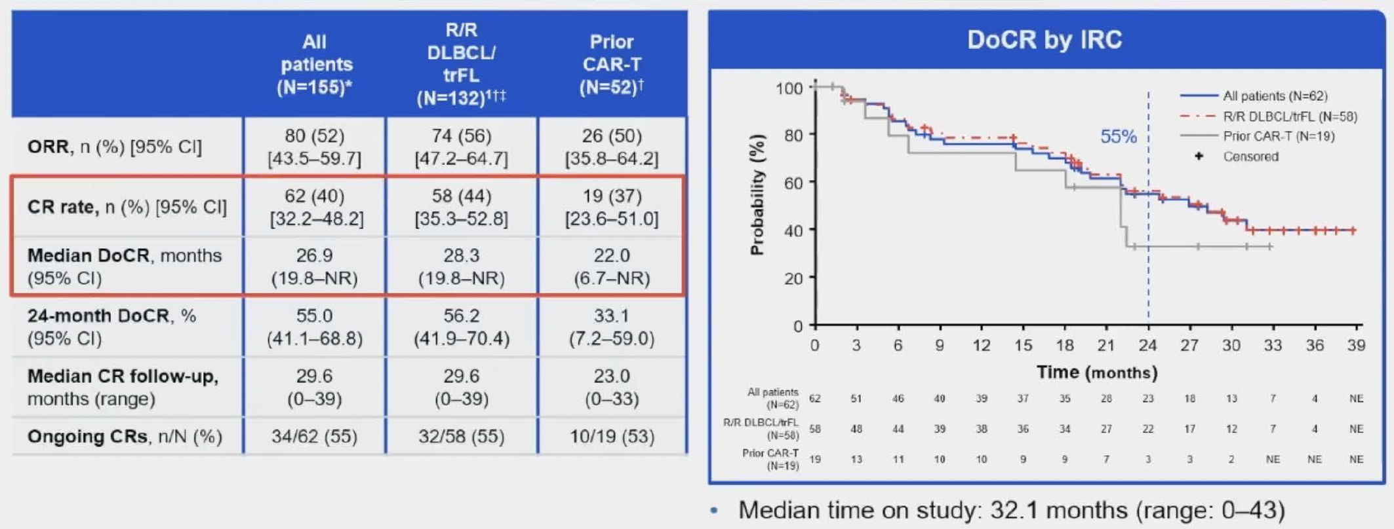
Phase II Study of Glofitamab Monotherapy
The most common AE was CRS in 64% of patients, mostly Grade 1-2.
Hutchings M et al. ASH 2023;Abstract 433.

Slide 24
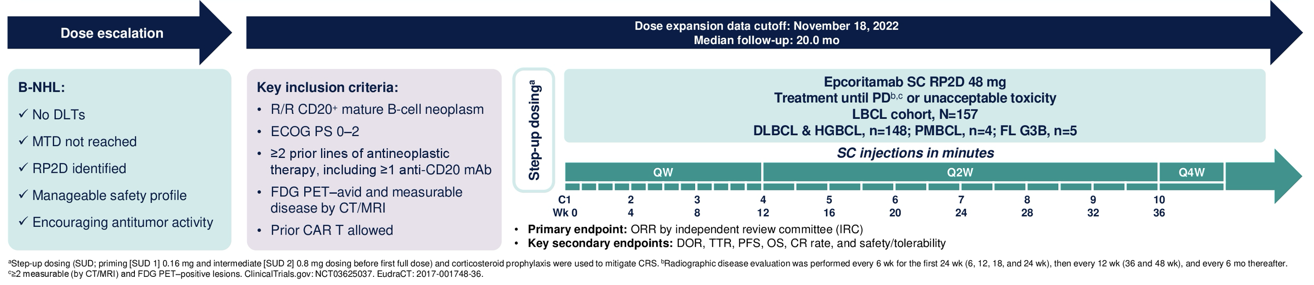
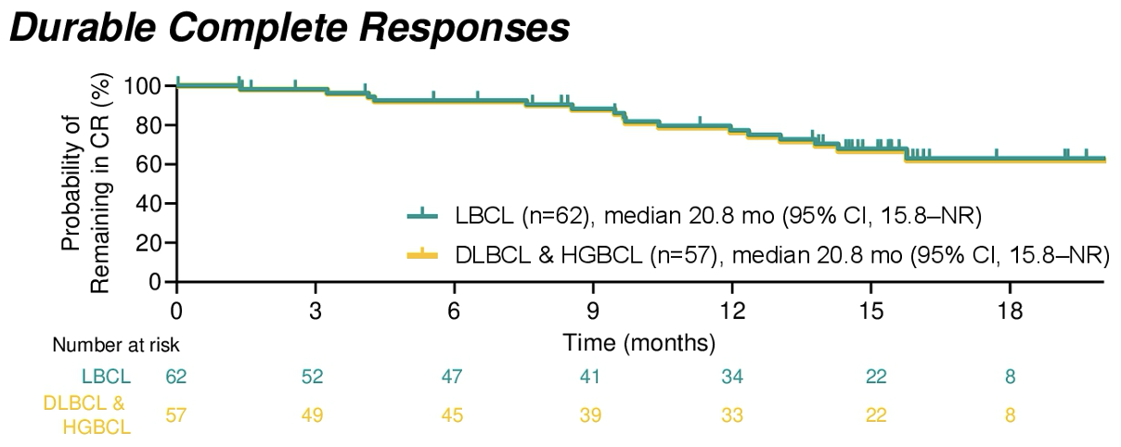
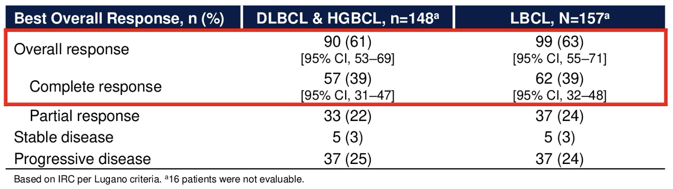
EPCORE NHL-1: Subcutaneous Epcoritamab
The most common AE was CRS in 51% of patients (mostly Grade 1-2), followed by neutropenia in 25% of patients.
Karimi Y et al. ASCO 2023;Abstract 7525.

Slide 25
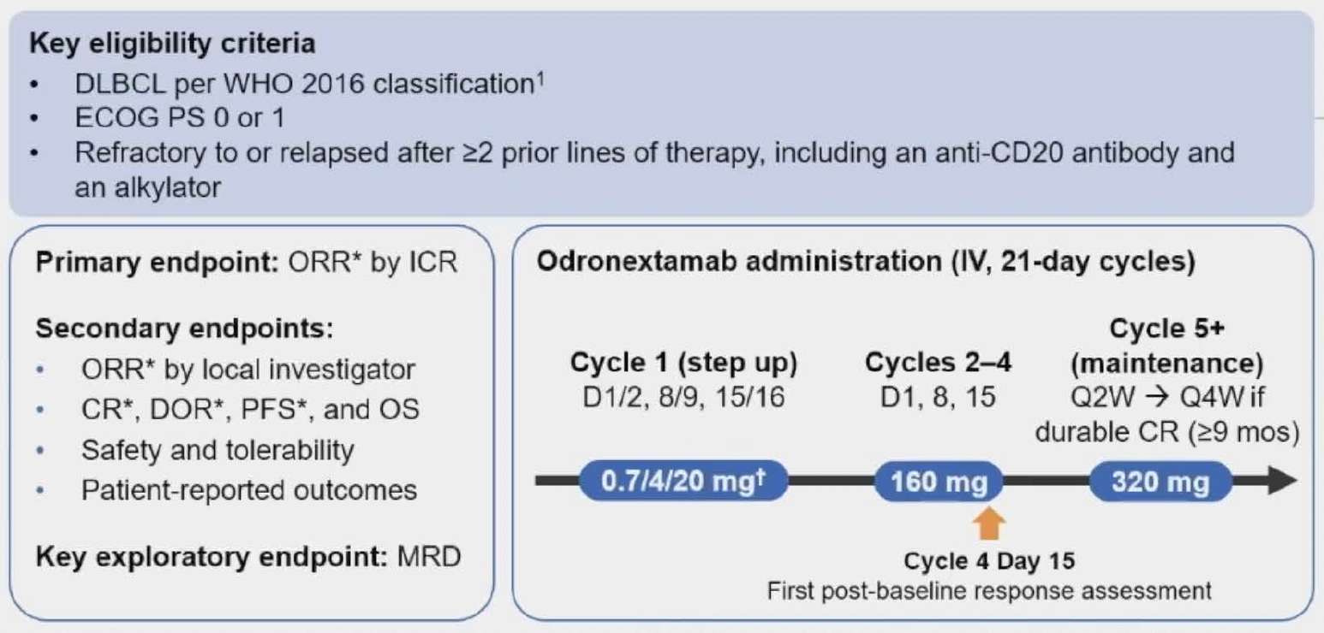
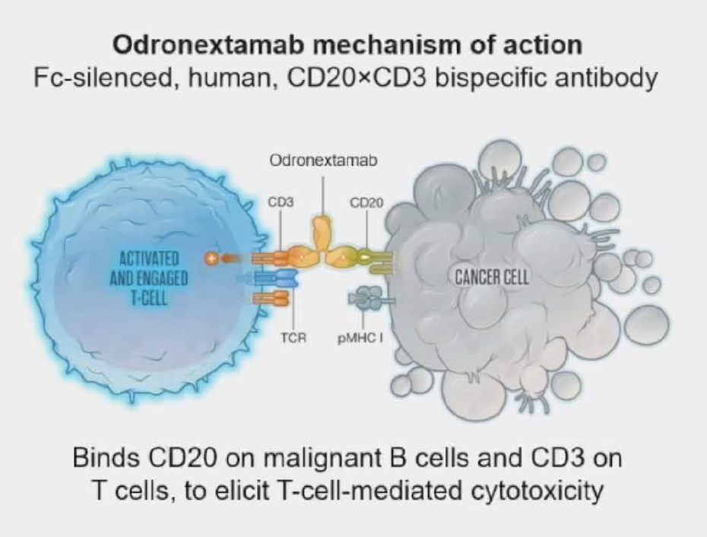
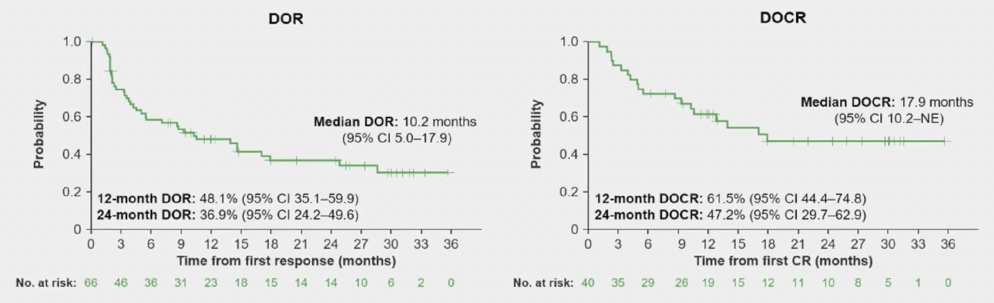
ELM-2: Odronextamab
for R/R DLBCL
ORR = 52.0%; CR = 31.5%
The most common AE was CRS in 55.1% of patients, mostly Grade 1-2.
Ayyappan S et al. ASH 2023;Abstract 436.

Slide 26
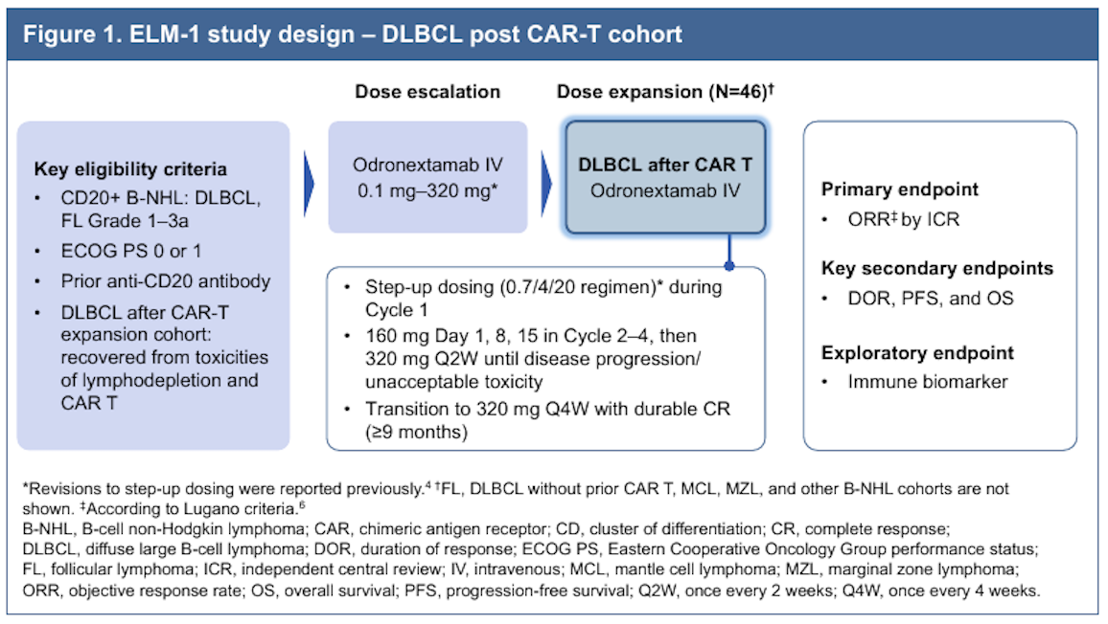
ELM-1 Study: Odronextamab
Crombie J et al. ASH 2023;Abstract 4461.

Slide 27
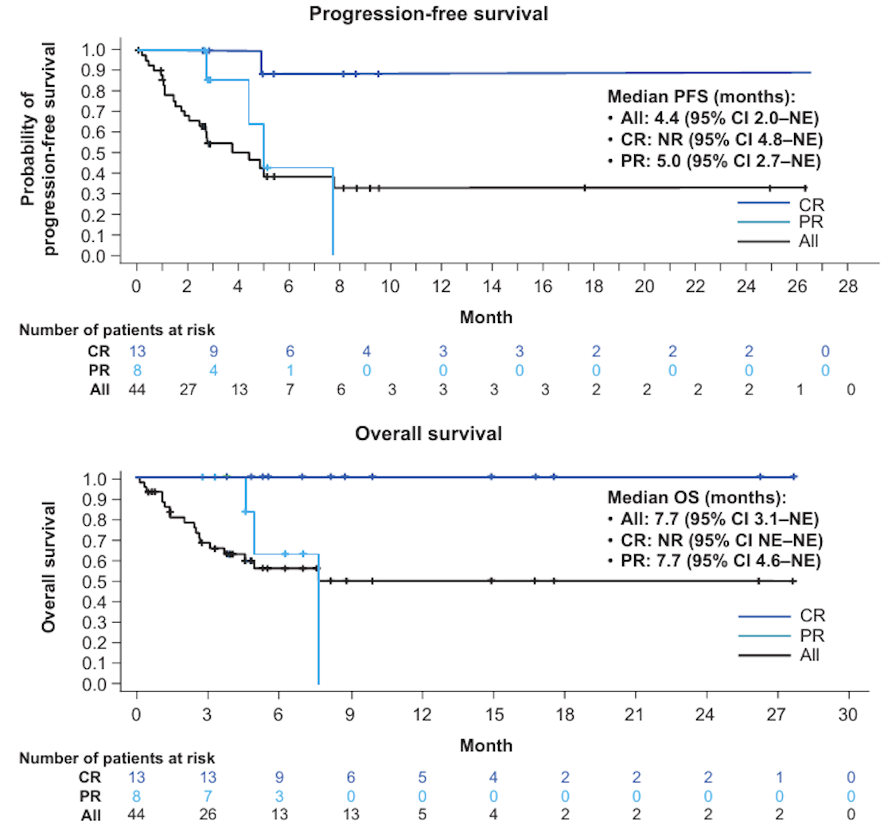
ELM-1: Odronextamab After CAR T-Cell Therapy
Response data
ORR | 47.7%
CR | 29.5%
The most common AE was CRS occurring in 52.3% of patients. All events were Grade 1-2 and resolved with a median time to resolution of 2 days.
Crombie J et al. ASH 2023;Abstract 4461.

Slide 28
Hodgkin Lymphoma (HL)

Slide 29
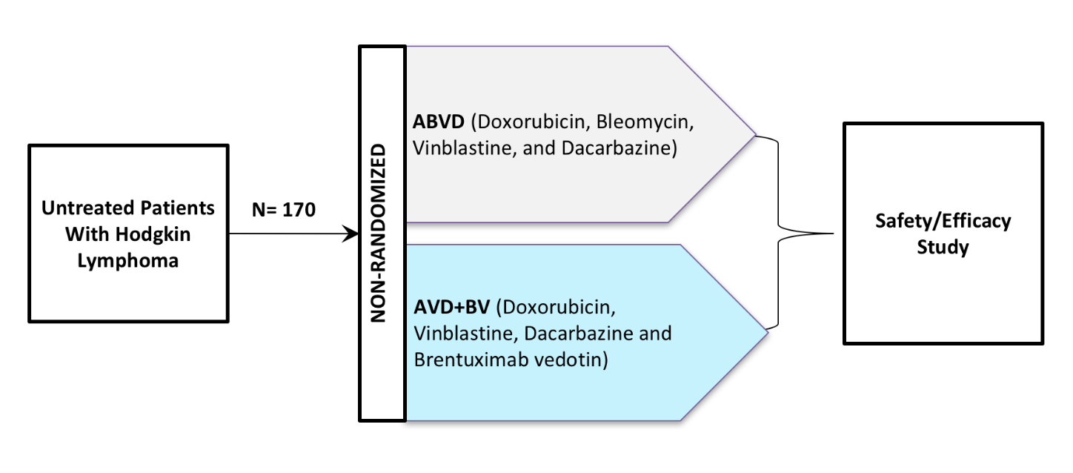
BREACH: BV-AVD vs ABVD — Study Schema
https://www.adcreview.com/adcs-101/clinical-trials/nct02292979-breach-trial-eortc-20113/

Slide 30
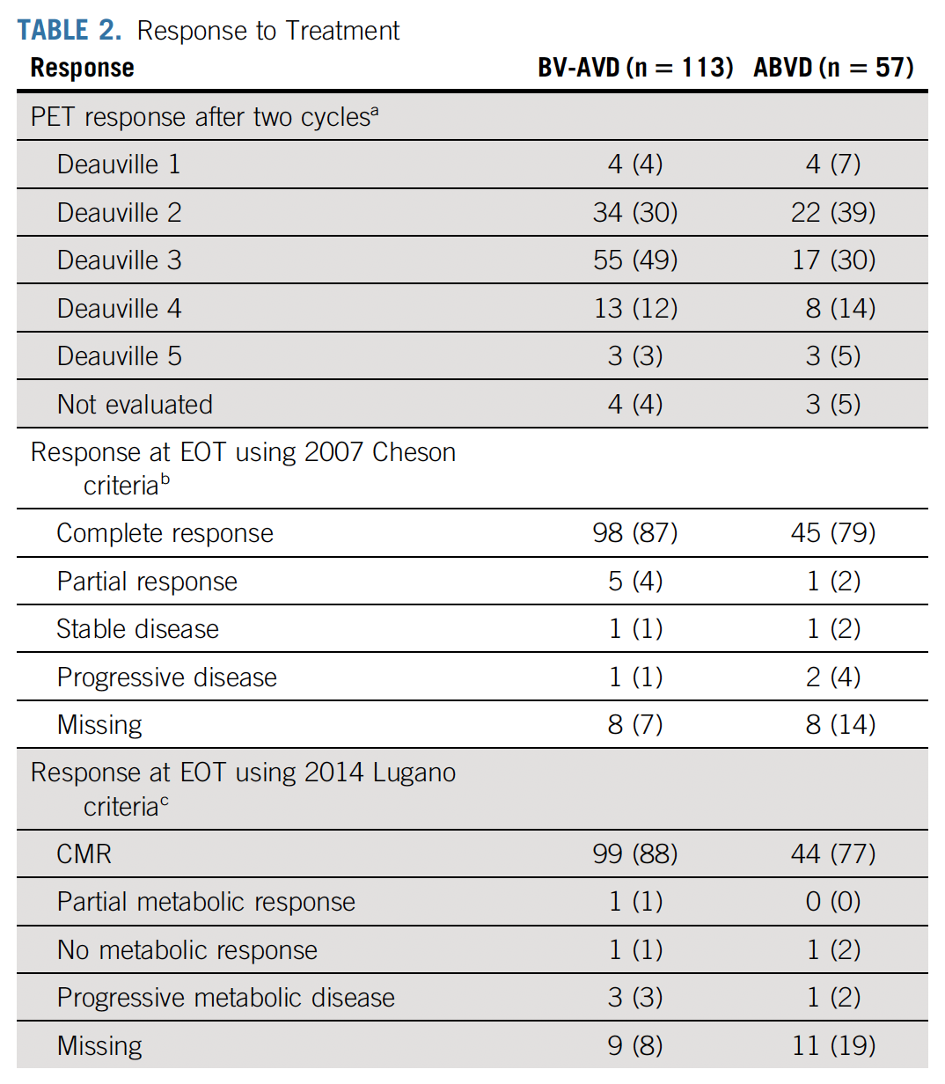
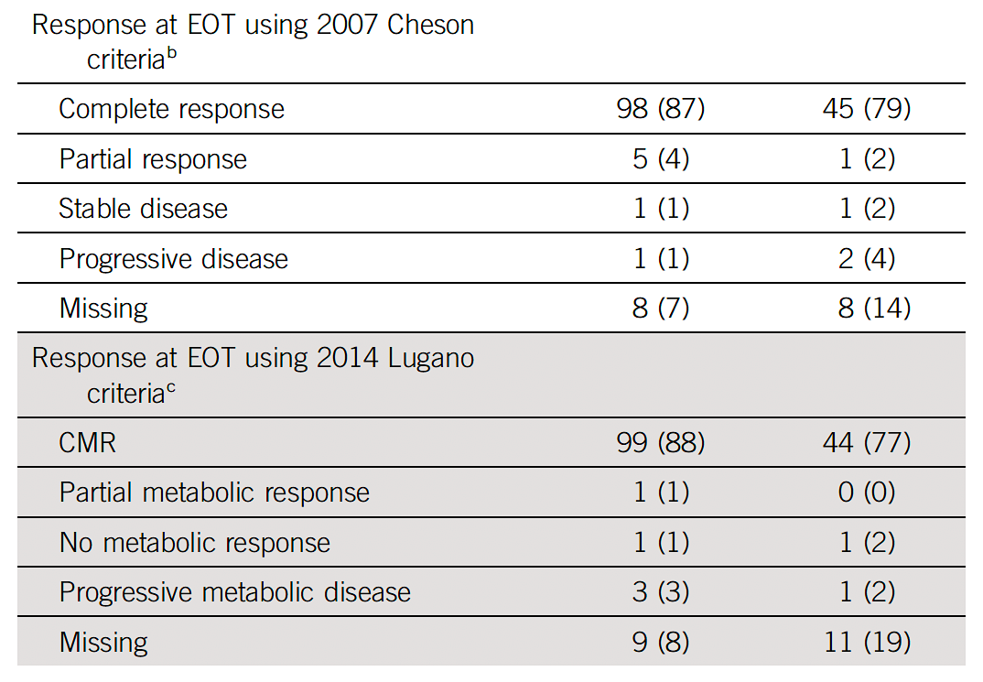
BREACH: BV-AVD vs ABVD — Response Data
Fornecker L et al. J Clin Oncol 2023;41(2):327-35.

Slide 31
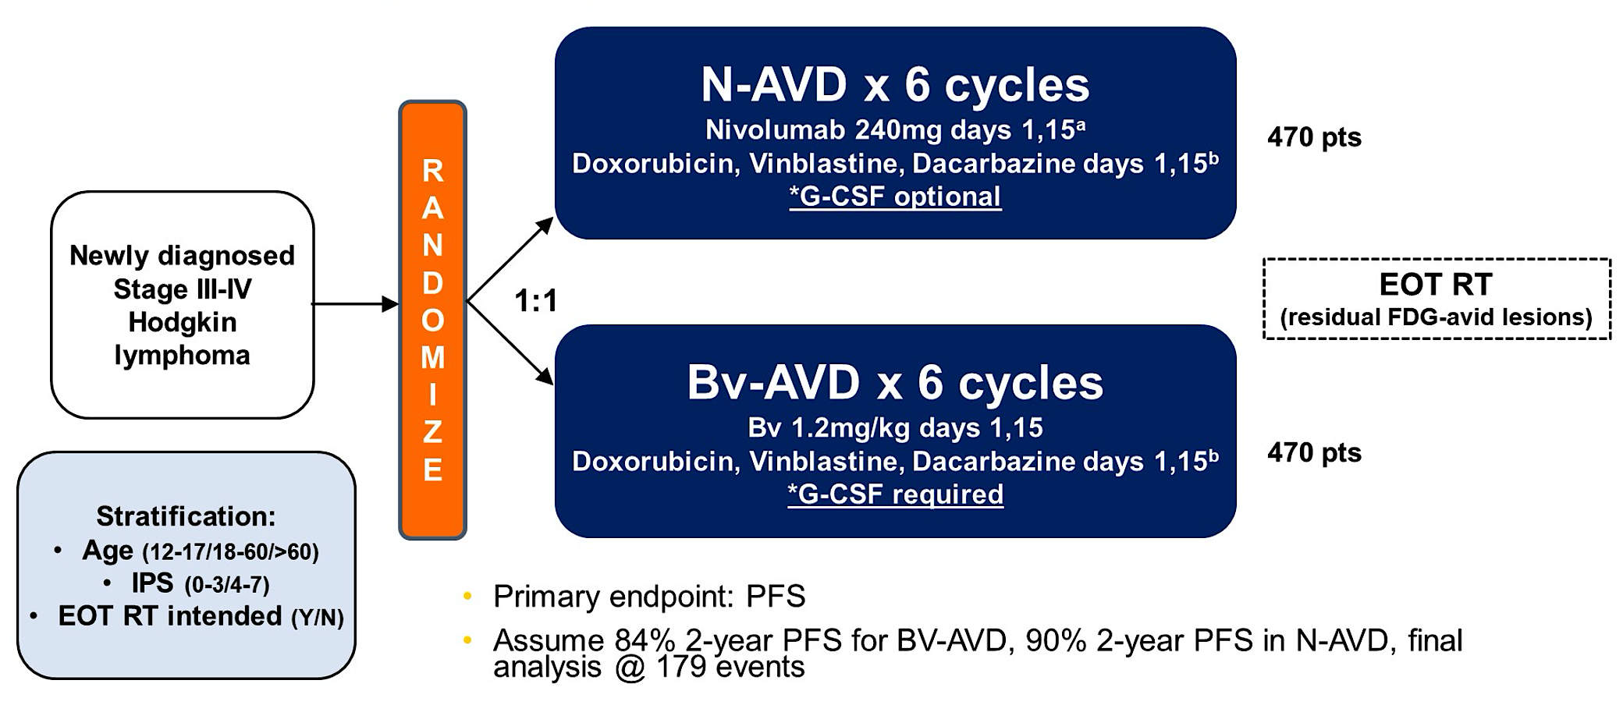
SWOG-S1826: Nivolumab/AVD vs BV-AVD — Study Design
Herrera AF et al. ASCO 2023;Abstract LBA4.

Slide 32
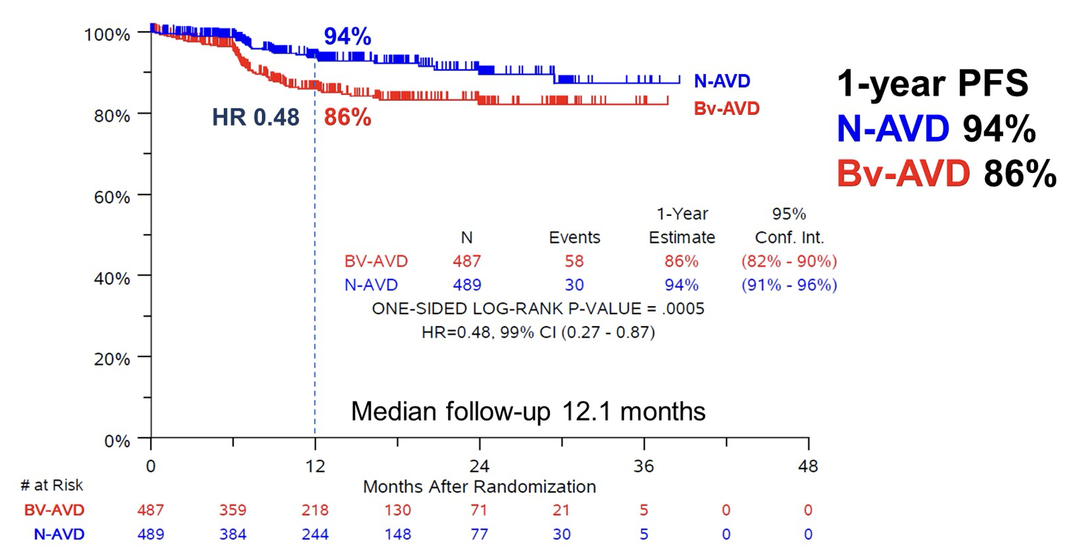
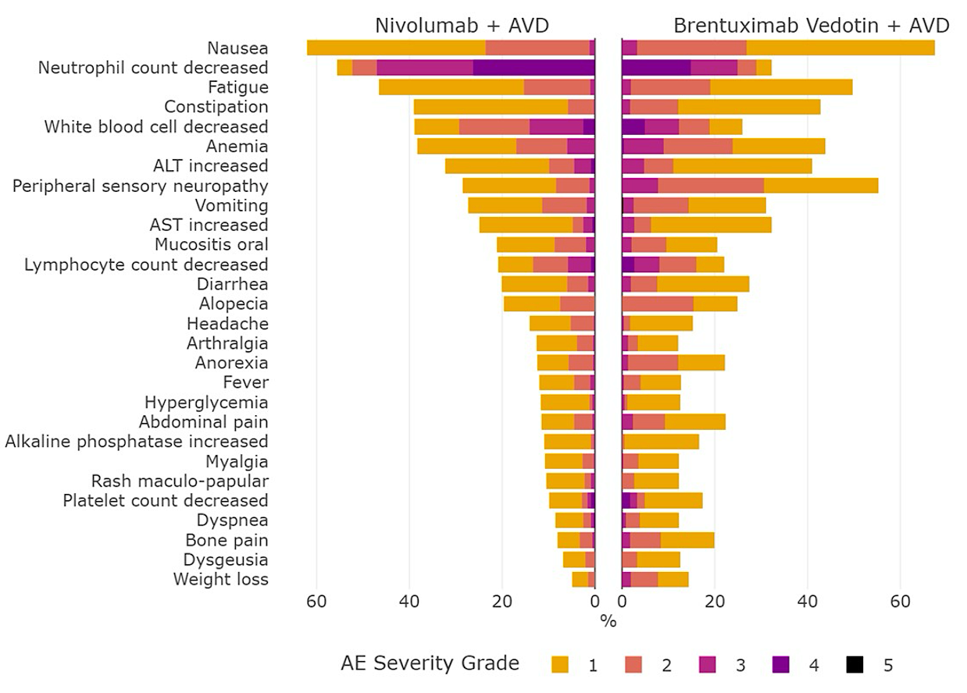
SWOG-S1826: Nivolumab/AVD vs BV-AVD — Efficacy and Safety
However, no improvement in OS.
1-year OS estimates
BV-AVD | 98%
Nivo-AVD | 99%
Herrera AF et al. ASCO 2023;Abstract LBA4.

Slide 33
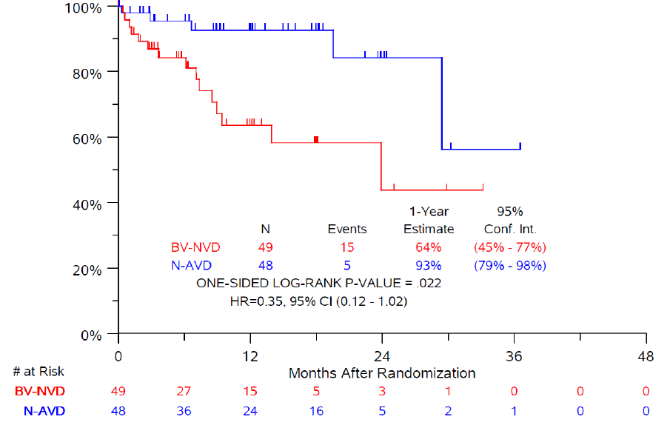
N-AVD markedly improves PFS over Bv-AVD in older patients with cHL
1-year PFS
N-AVD 93%
Bv-AVD 64%
N-AVD
Bv-AVD
Median follow-up
12.1 months
p-value = 0.022
HR = 0.35,
95% CI (0.12-1.02)
Rutherford SC et al. ASH 2023;Abstract 181.

Slide 34
S1826 in Older Pts with cHL: Conclusions
N-AVD is better tolerated than Bv-AVD
  More GI AEs, sepsis/infections, and peripheral neuropathy with Bv-AVD
  Low immune event rates with N-AVD, similar to whole study population
  More pts discontinued Bv than Nivolumab
N-AVD substantially improves PFS compared to Bv-AVD in older pts
  EFS is also improved, and fewer deaths occurred on N-AVD
Follow-up ongoing to confirm PFS durability, assess long-term safety, OS, and patient-reported outcomes
Rutherford SC et al. ASH 2023;Abstract 181.

Slide 35
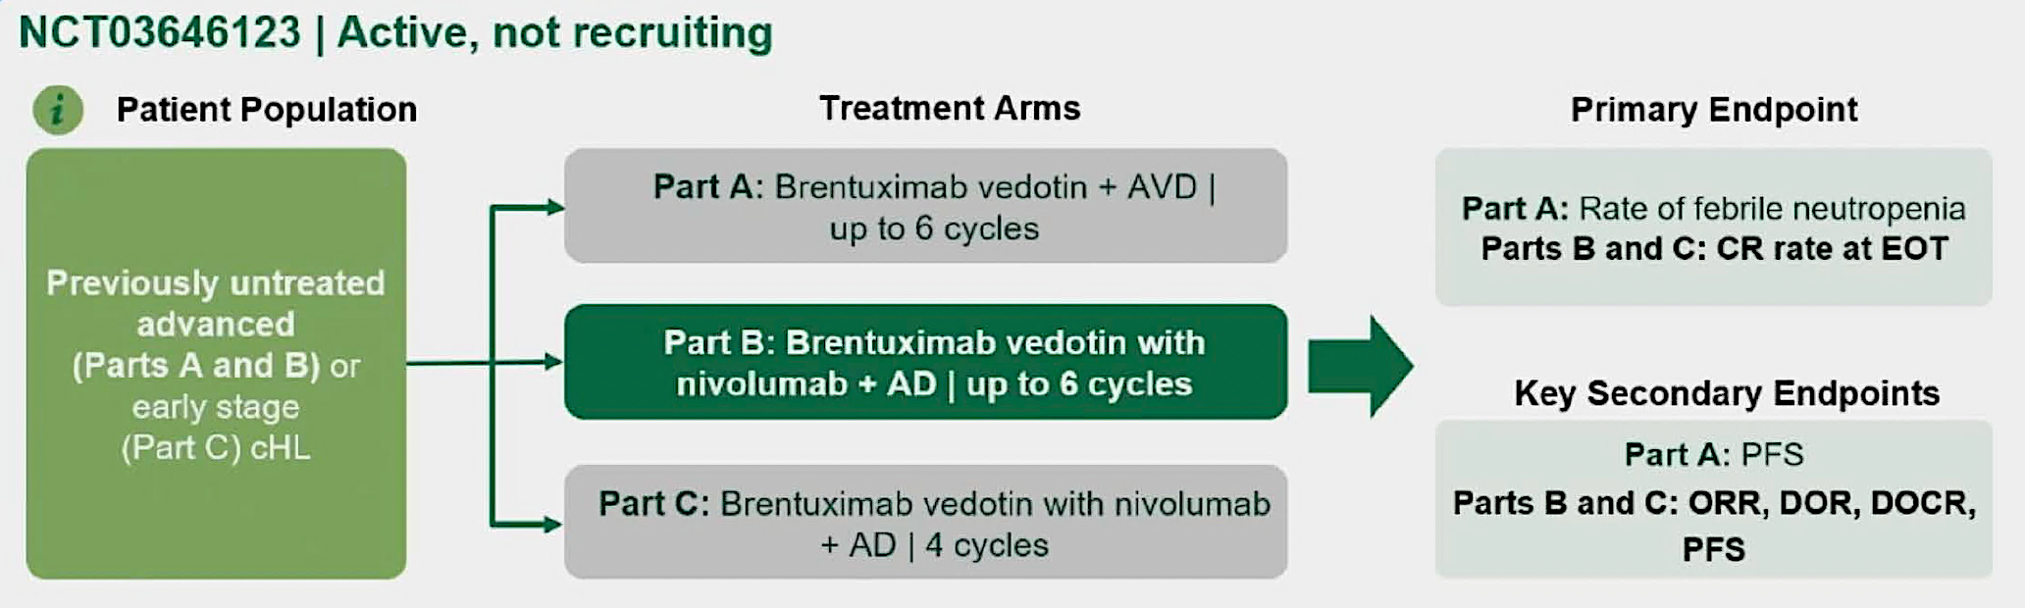
SGN35-027 Study Part B: BV + Nivolumab + AD
Lee HJ et al. ASH 2023;Abstract 608.

Slide 36
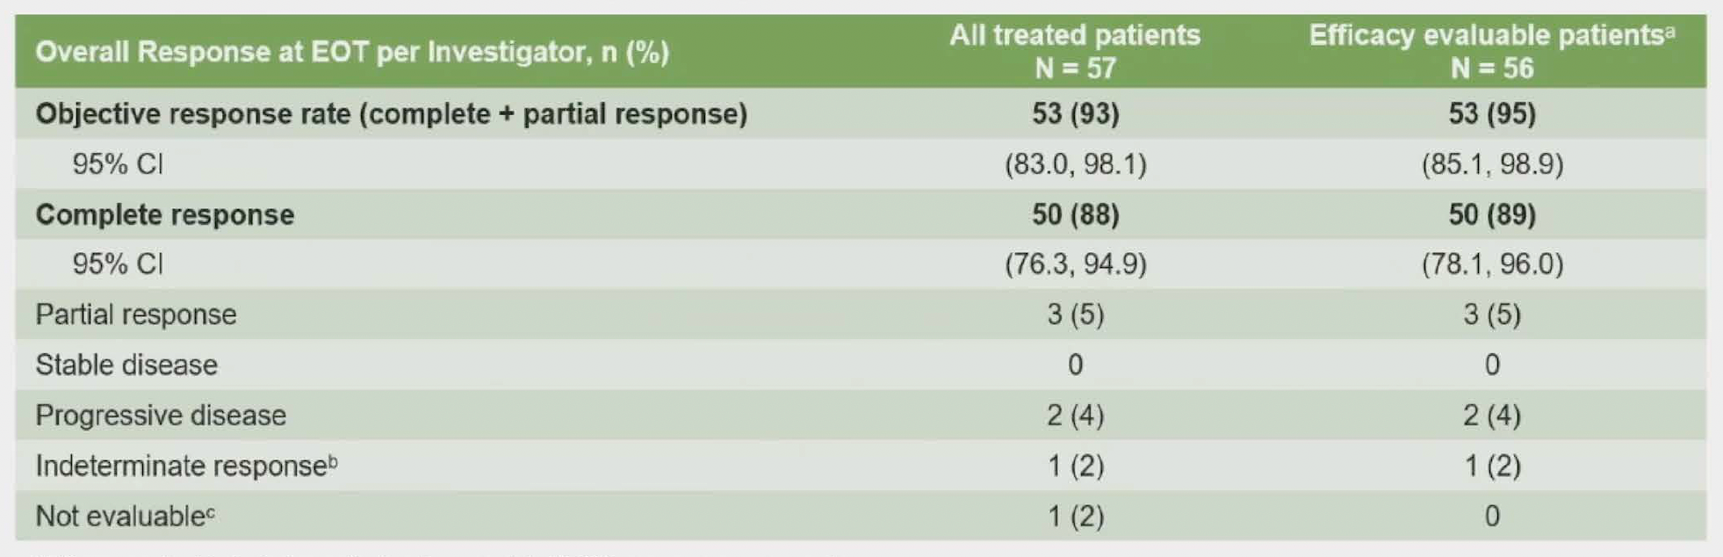
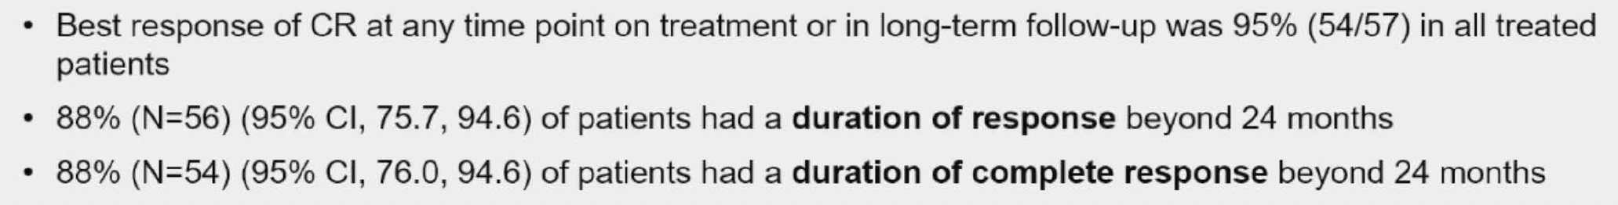
SGN35-027 Part B: BV + Nivolumab + AD
Lee HJ et al. ASH 2023;Abstract 608.

Slide 37
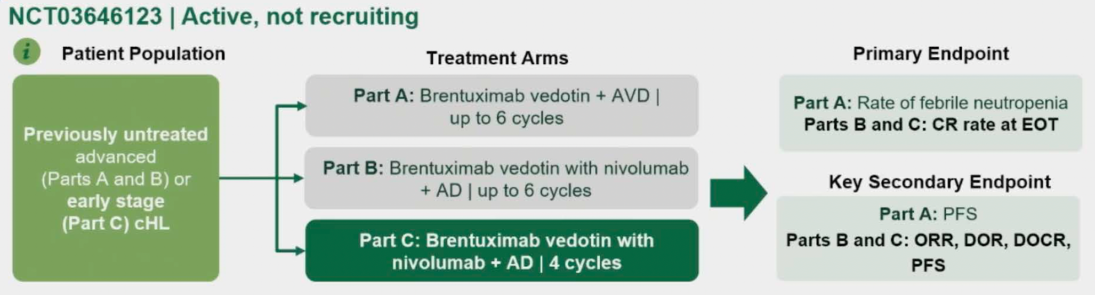
SGN35-027 Part C: BV + Nivolumab + AD
Abramson JS et al. ASH 2023;Abstract 611.

Slide 38
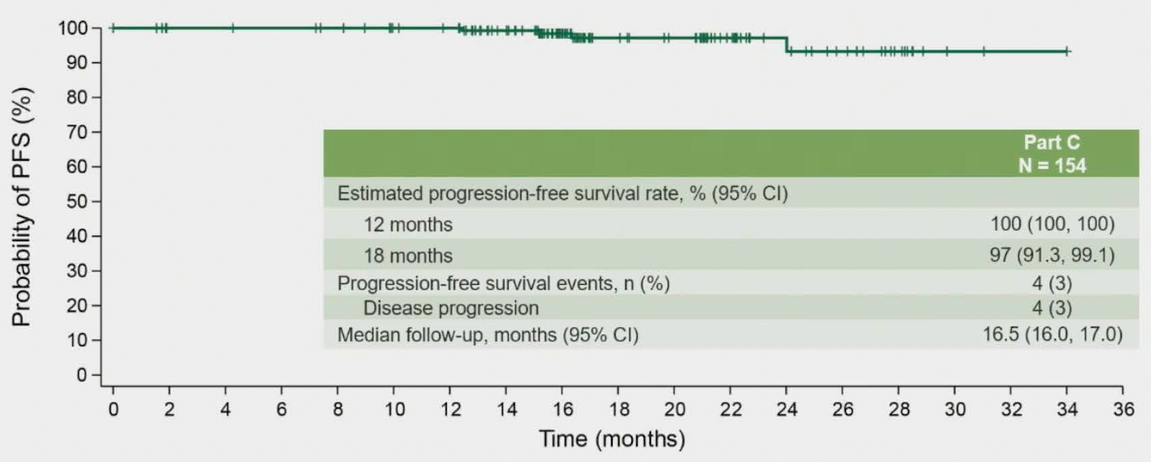
SGN35-027 Part C: BV + Nivolumab + AD — PFS Outcomes
Abramson JS et al. ASH 2023;Abstract 611.

Slide 39




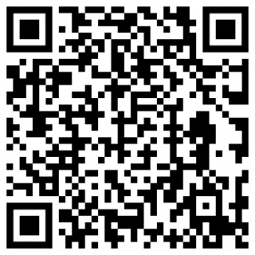
Standard therapy vs. immuno-oncology for children and adults with newly diagnosed stage I and II classic HL: AHOD 2131
Planned enrollment 1875 patients (ages 5-60 years)
Favorable Risk
Unfavorable Risk
ABVD x 2 cycles
ABVD x 2 cycles
NCT05675410
PET-2
PET-2
RER
SER
RER
SER
Randomize
Randomize
Randomize
Randomize
Arm A
ABVD x 2 cycles
Arm B
Bv-Nivo x 4 cycles
Arm C
eBEACOPP x 2 cycles
Arm D
Bv-Nivo x 4 cycles
Arm E
AVD x 4 cycles
Arm F
Bv-Nivo x 4 cycles
Arm G
eBEACOPP x 2 cycles
Arm H
Bv-Nivo x 4 cycles
ISRT
ISRT
ISRT
ISRT
Notes:
39

Slide 40
Standard therapy vs. immuno-oncology for children and adults with newly diagnosed stage I and II classic HL: AHOD 2131
Large study (N=1875) in which the majority of ES patients will avoid radiation (N=1514 anticipated PET-).
  Primary Endpoint: 3-year PFS superiority
  Secondary Endpoint: 12-year OS non-inferiority
Minority of patients will receive escBEACOPP (N=134, 5-7% overall)
Harmonization of pediatric and adult cHL treatments
Incorporation of reduced chemotherapy strategy in frontline
Dedicated end point of long follow up (12-year OS) allows assessment of late-term effects of treatment
Multitude of correlative studies planned (metabolic PET, ctDNA, quality of life, cost of care, post-acute and late effects, etc)
Notes:
40

