Slide 1
Year in Review
Chronic Lymphocytic Leukemia
Jeff Sharman MD
Medical Director of Hematology Research
US Oncology / Sarah Cannon
Willamette Valley Cancer Institute

Slide 2
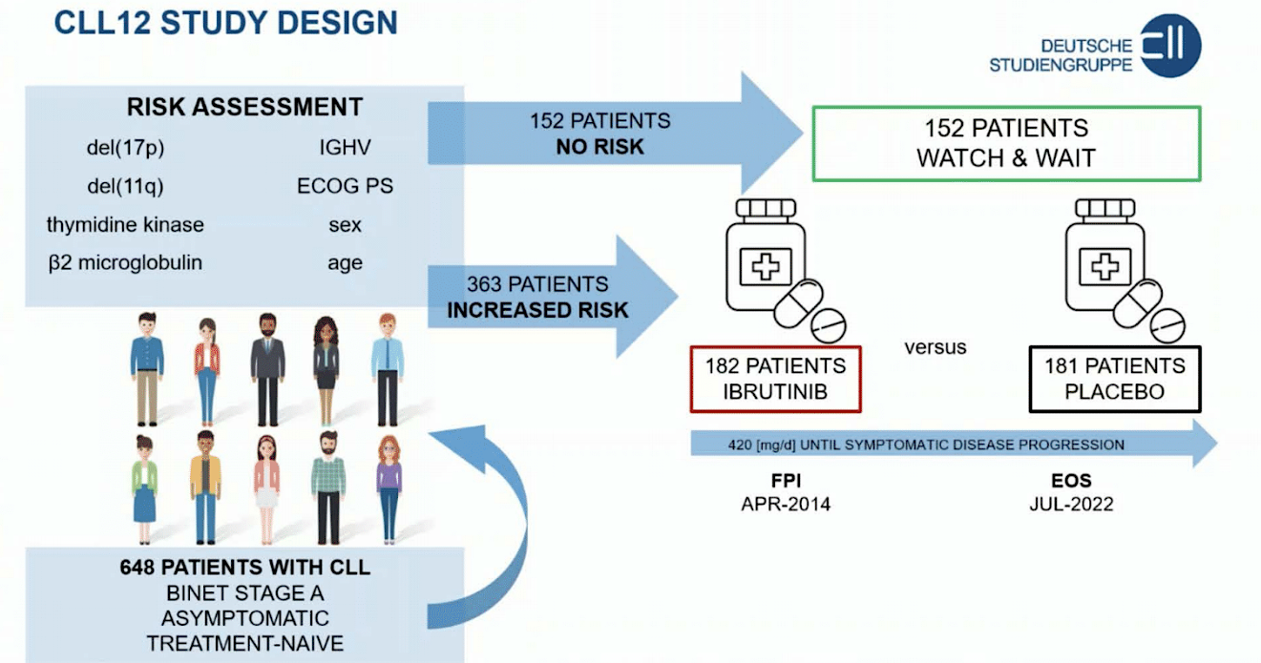
CLL12 Ibrutinib vs Watch and Wait
Langerbeins P et al. EHA 2023;Abstract S200.

Slide 3
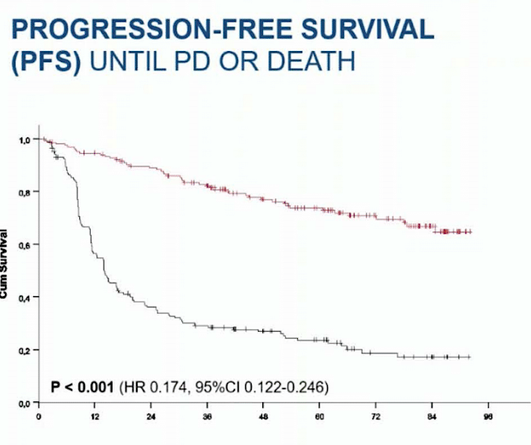
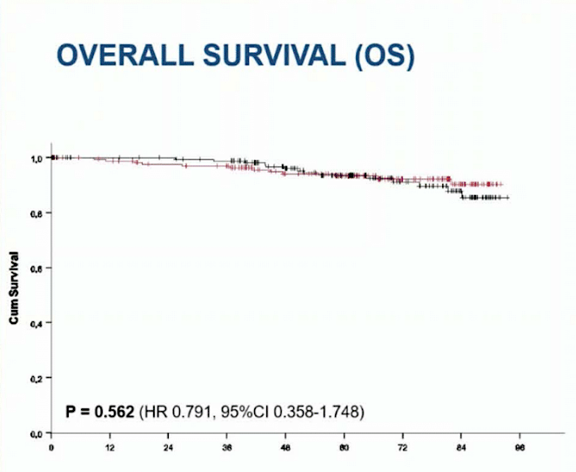
Treatment improves PFS but no OS impact of early therapy
Langerbeins P et al. EHA 2023;Abstract S200.

Slide 4
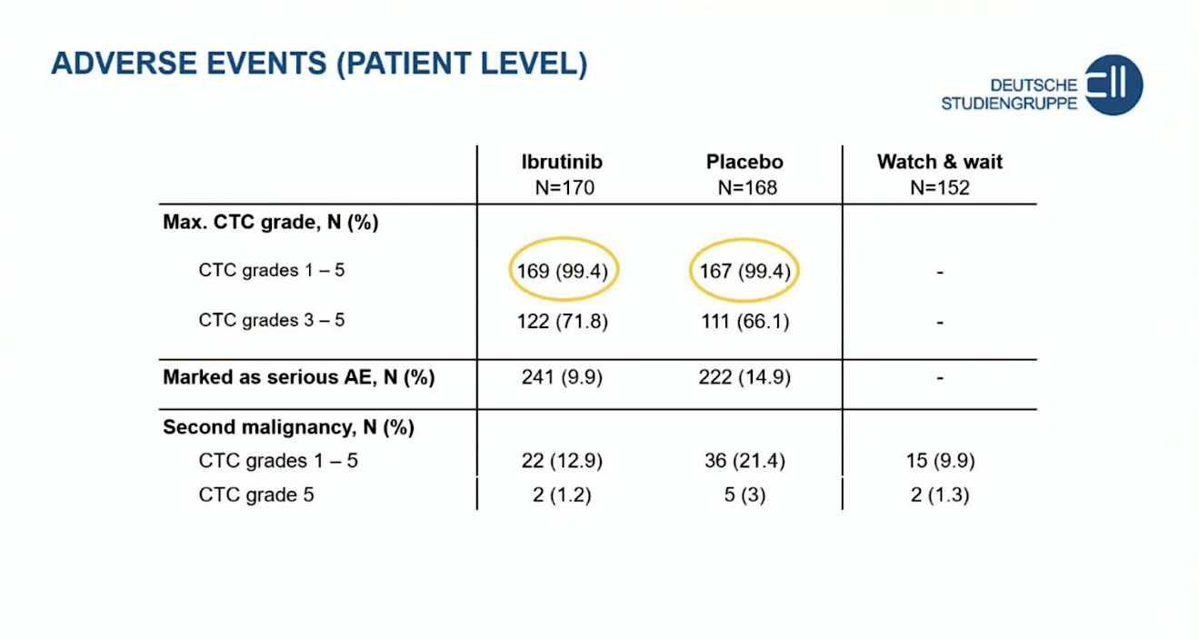
Langerbeins P et al. EHA 2023;Abstract S200.

Slide 5
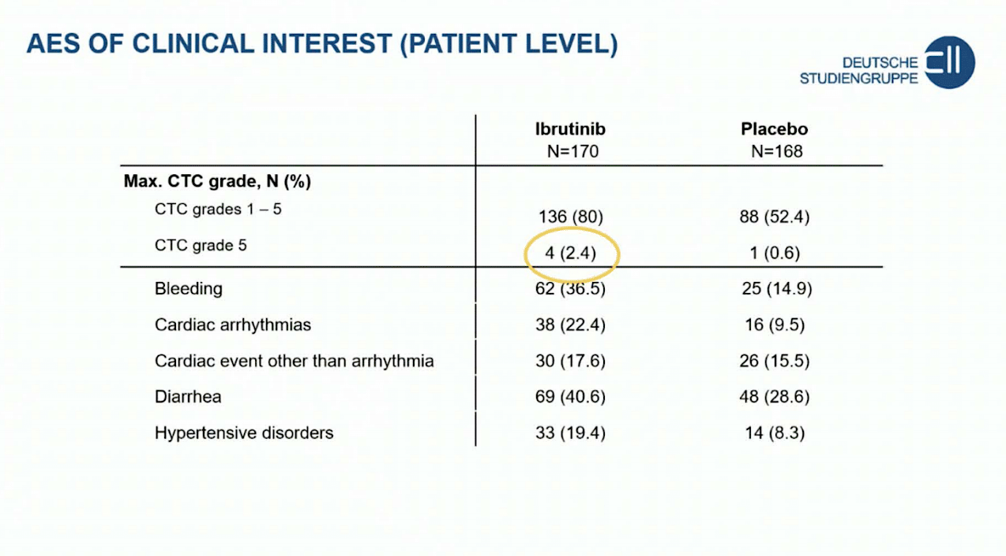
Langerbeins P et al. EHA 2023;Abstract S200.

Slide 6
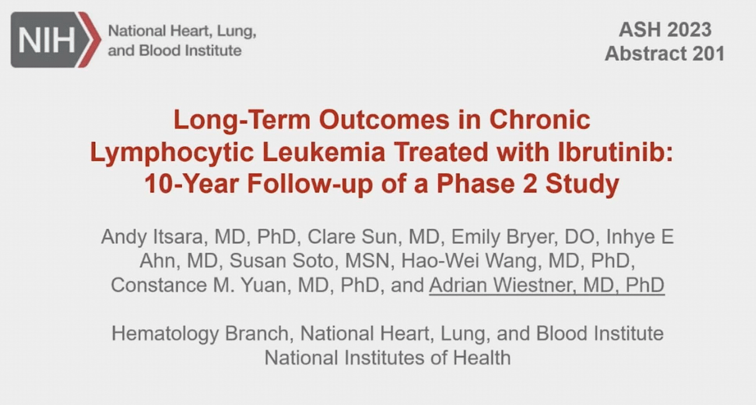

Slide 7
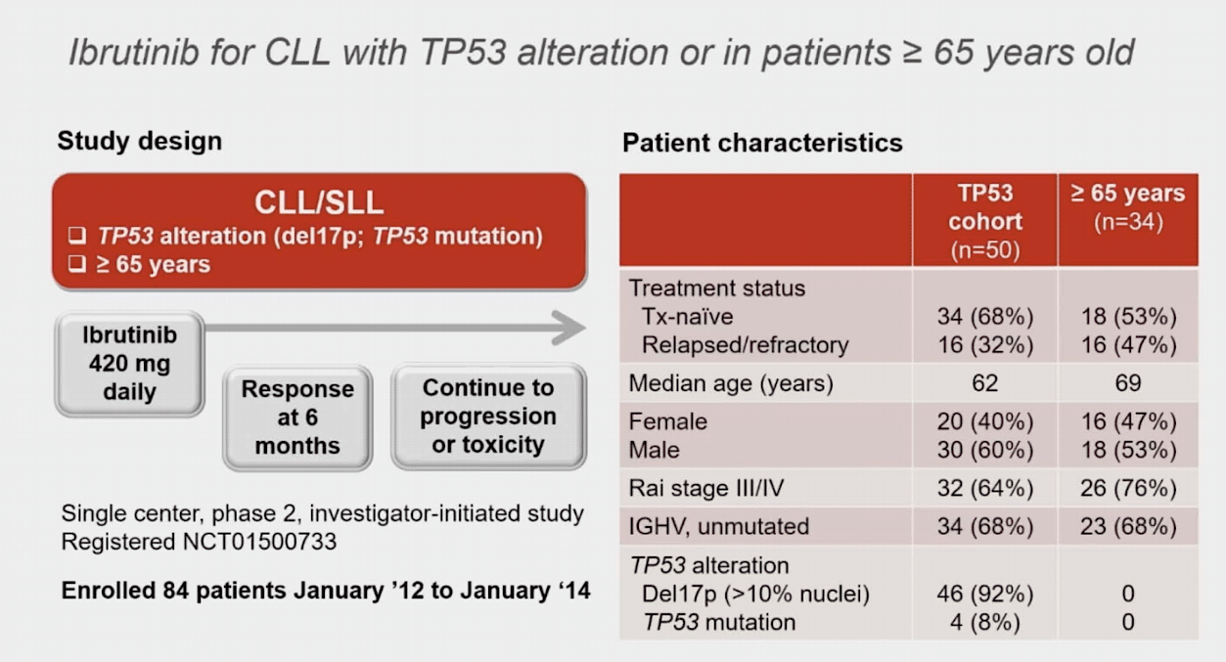
Wiestner A et al. ASH 2023;Abstract 201.

Slide 8
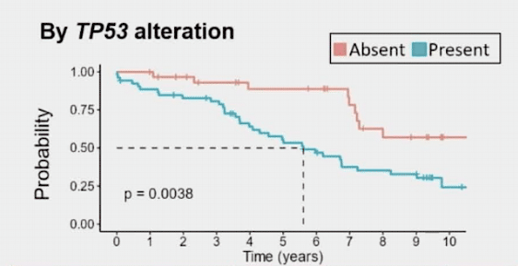
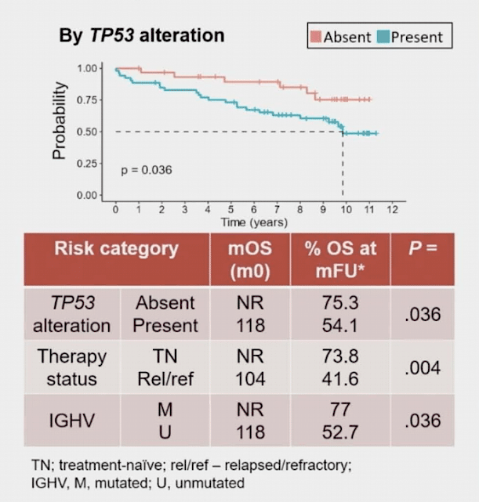
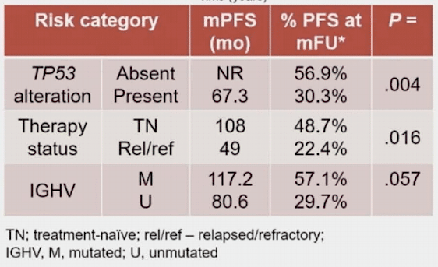
PFS and OS among TP53 subjects
Wiestner A et al. ASH 2023;Abstract 201.

Slide 9
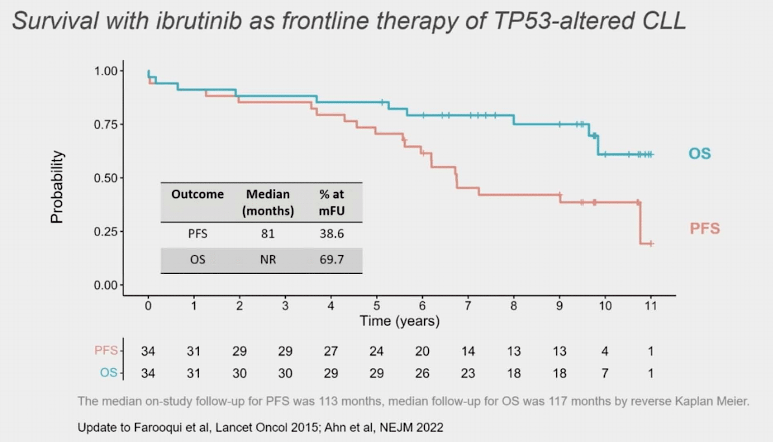
Wiestner A et al. ASH 2023;Abstract 201.

Slide 10
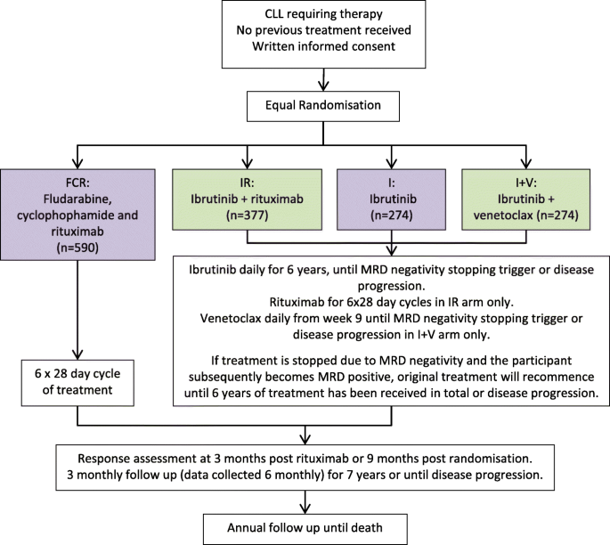
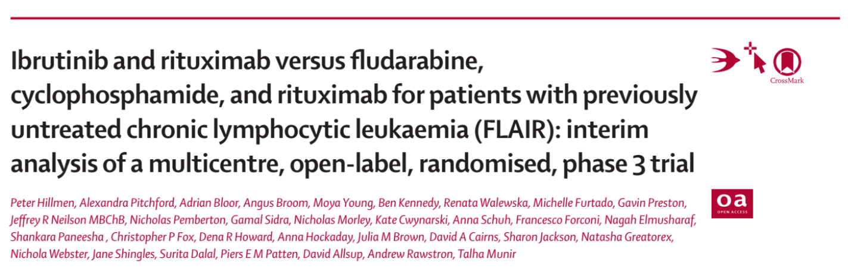

Slide 11
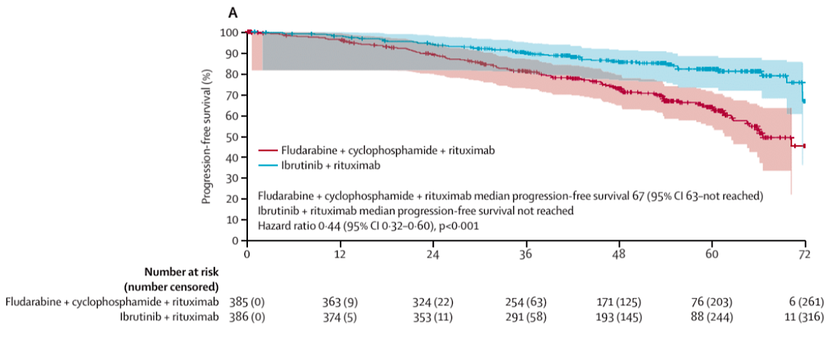
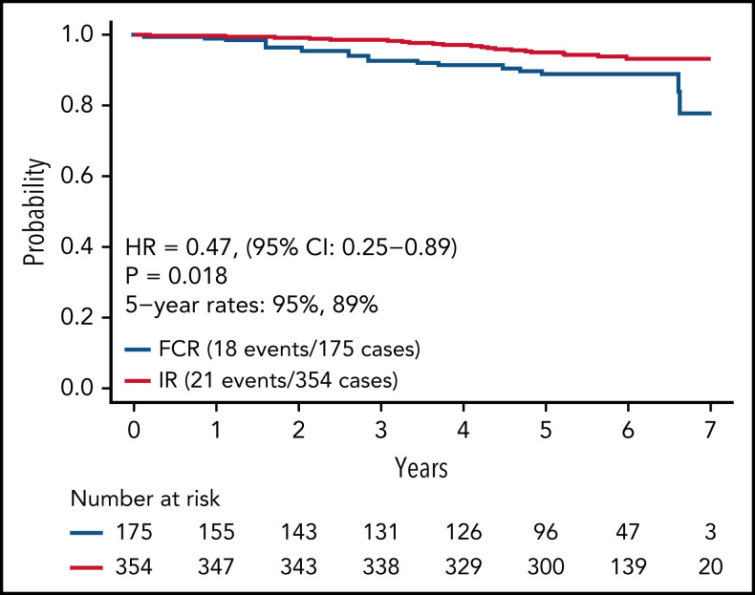
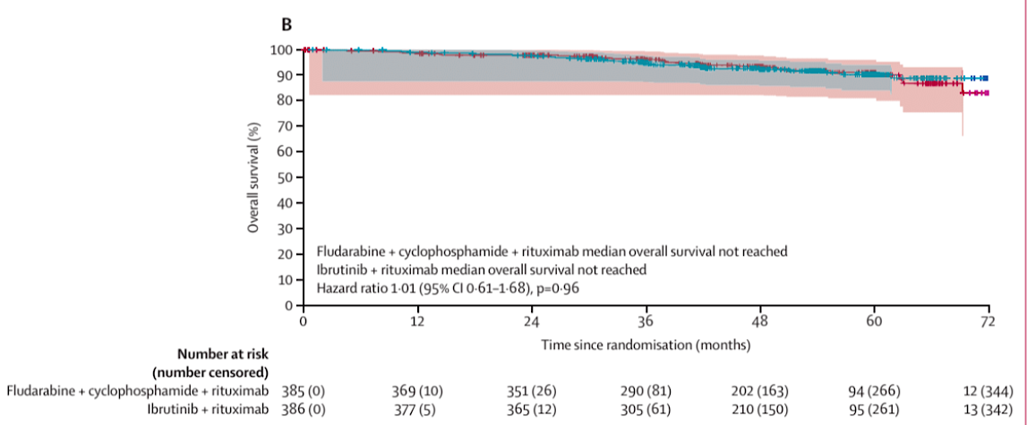
FLAIR vs ECOG 1912
Hillmen and Shanafelt

Slide 12
Frontline Ibrutinib Conclusions
Early treatment of high risk CLL has not replaced watch and wait
Placebo side effects considerable relative to ibrutinib
TP53 mut/del reduces efficacy of ibrutinib however earlier use remains highly effective
Ibrutinib superior to FCR in fit patients with variable impact on OS

Slide 13
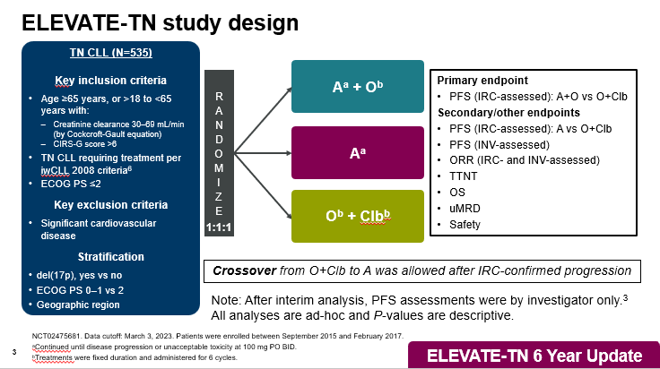
BTK/CD20
Sharman 2023

Slide 14
Median PFS was significantly higher for A-containing arms vs O+Clb
100
78%
80
Median PFS=NR
A+O vs O+Clb
HRª (95% CI): 0.14 (0.10, 0.20); P<0.0001^{b}
A vs O+Clb
HRª (95% CI): 0.24 (0.17, 0.32); P<0.0001^{b}
A+O vs A
HRª (95% CI): 0.58 (0.39, 0.86); P=0.0229^{b}
60
62%
Progression-Free Survival, %
Median PFS=NR
40
17%
Median PFS=27.8 mo
20
A+O
A
0
O+Clb
0
3
6
9
12
15
18
21
24
27
30
33
36
39
42
45
48
51
54
57
60
63
66
69
72
75
78
81
84
87
90
Months
No. at risk
A+O
A
O+Clb
179 | 175 | 170 | 168 | 164 | 163 | 160 | 157 | 156 | 156 | 153 | 152 | 151 | 146 | 144 | 141 | 140 | 138 | 136 | 133 | 127 | 124 | 119 | 116 | 99 | 54 | 39 | 25 | 10 | 2 | 0
179 | 167 | 163 | 158 | 156 | 155 | 153 | 150 | 149 | 146 | 142 | 141 | 137 | 135 | 133 | 130 | 129 | 124 | 121 | 115 | 113 | 103 | 100 | 95 | 85 | 56 | 37 | 22 | 7 | 2 | 0
177 | 163 | 156 | 153 | 139 | 125 | 110 | 100 | 86 | 82 | 67 | 66 | 56 | 49 | 44 | 41 | 38 | 30 | 29 | 28 | 24 | 21 | 21 | 18 | 14 | 8 | 6 | 3 | 1 | 0 | 0
Median PFS was significantly higher for A+O vs A
ªHazard ratio based on stratified Cox proportional-hazards model.
^{b}P-value based on stratified log-rank test.
Sharman J et al. ASH 2023;Abstract 636.
Notes:
The PFS is shown here with 78%, 62%, and 17% free from progression at 6 years. Comparing the two acalabrutinib arms in a post hoc analysis, the difference of 16% resulted in a hazard ratio of 0.58 with a p value of 0.02

Slide 15
ORR improves over time in acalabrutinib-containing arms
ORR Difference %, 95% CI
6.1% (0.9, 11.4)
P=0.022
CR Difference %, 95% CI
17.9% (8.8, 27.0)
P=0.022
ORR and CR/CRi rates were significantly higher with A+O and A vs O+Clb (P≤0.0499 for both arms of the analyses)
ORR and CR/CRi rates were significantly higher with A+O vs A (P=0.022 for both comparisons)
ªORR is defined as achieving CR, CRi, nPR, or PR per the investigator per iwCLL 2008 criteria⁶ at or before initiation of subsequent anticancer therapy. ORR does not include PRL.
Sharman J et al. ASH 2023;Abstract 636.
Notes:
We evaluated the change in overall and complete response as a function of time among patients treated with acalabrutinib. The addition of Obinutuzumab resulted in a higher overall response rate at early time points that narrowed with subsequent follow up and a higher rate of complete. These differences were in overall response rate and complete response rate were statistically significant with an absolute difference of 6.1% for ORR and 17.9% for CR respectively.

Slide 16
Acalabrutinib-treated patients who achieved CR/CRi had longer PFS
100
80
60
Progression-Free Survival, %
40
A-treated patients who achieved CR/CRi vs
A-treated patients who did not
HR (95% CI): 0.23
(0.12, 0.42); P<0.0001
20
A-treated patients who achieved CR/CRi
A-treated patients without CR/CRi
0
0
3
6
9
12
15
18
21
24
27
30
33
36
39
42
45
48
51
54
57
60
63
66
69
72
75
78
81
84
87
90
Months
No. at risk
A-treated patients who achieved CR/CRi
A-treated patients without CR/CRi
100 | 100 | 100 | 100 | 100 | 100 | 100 | 100 | 100 | 100 | 97 | 97 | 97 | 96 | 94 | 93 | 93 | 92 | 91 | 89 | 86 | 84 | 81 | 80 | 70 | 36 | 26 | 14 | 4 | 2 | 0
258 | 242 | 233 | 226 | 220 | 218 | 213 | 207 | 205 | 202 | 198 | 196 | 191 | 185 | 183 | 178 | 176 | 170 | 166 | 159 | 154 | 143 | 138 | 131 | 114 | 74 | 50 | 33 | 13 | 2 | 0
Sharman J et al. ASH 2023;Abstract 636.
Notes:
In early studies of BTK inhibitors, particularly monotherapy studies, few patients obtained CR and its value in discriminating outcome was limited.
We evaluated the impact of depth of response on PFS. We initially evaluated impact of MRD however since the prospective collection of MRD negative status was limited to those patients with CR, it proved to be inadequate for analysis.
Looking at CR rates, those patients treated on either acalabrutinib arm who achieved a CR had significant improvement in PFS with a hazard ratio of 0.23 and highly statistically significant P value.

Slide 17
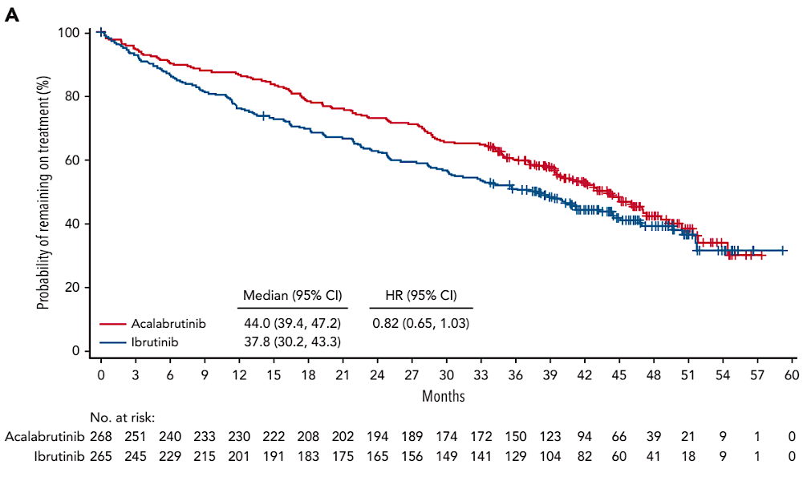
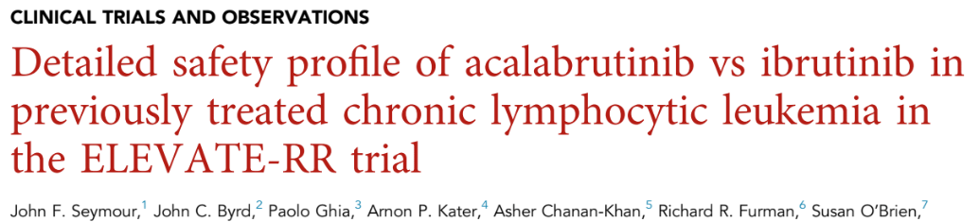
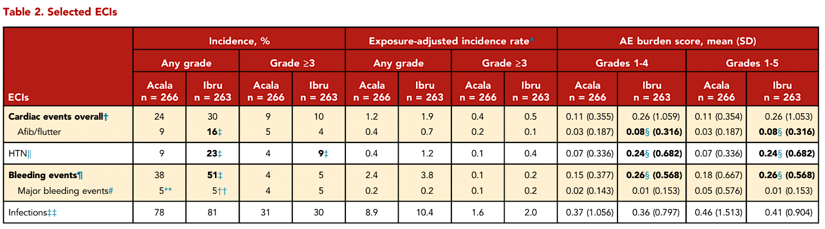
Seymour JF et al. Blood 2023;142(8):687-99.

Slide 18
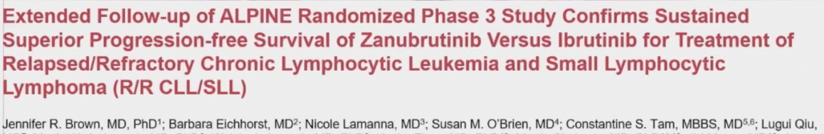
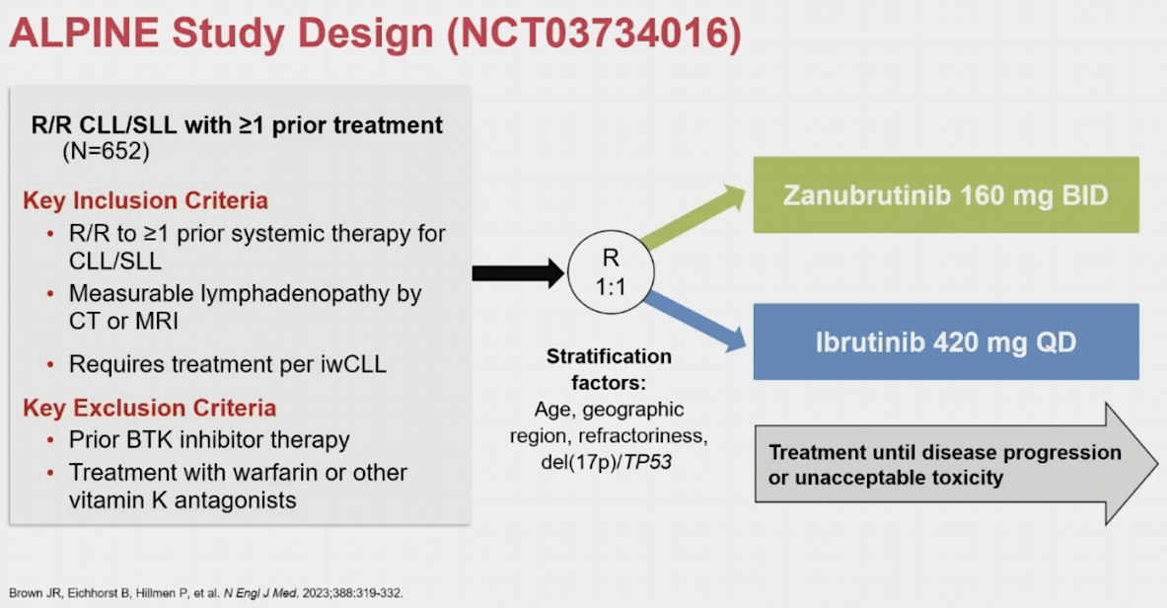
Brown J et al. ASH 2023;Abstract 202.

Slide 19
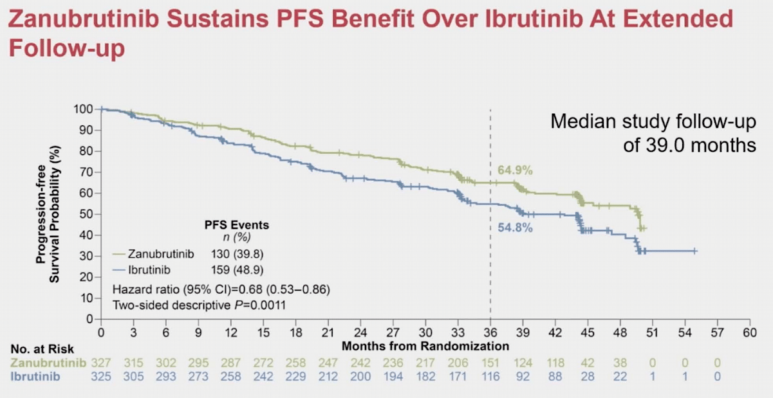
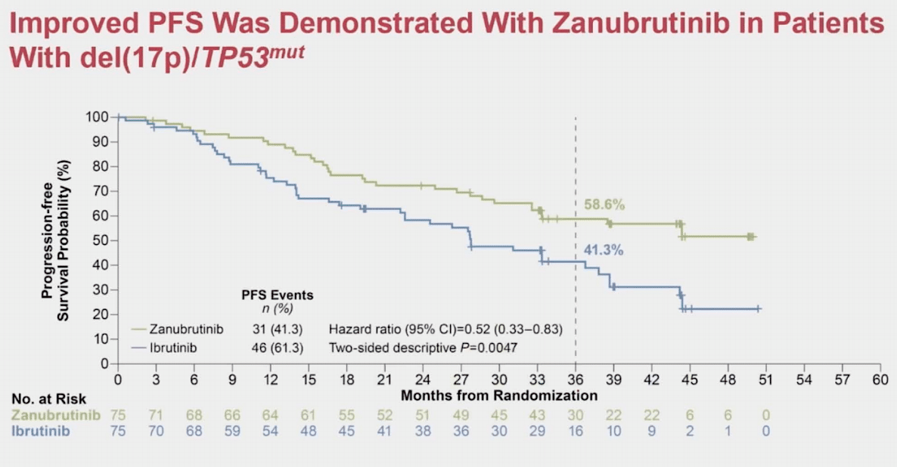
ALPINE: Zanu vs Ibrutinib
Brown J et al. ASH 2023;Abstract 202.

Slide 20
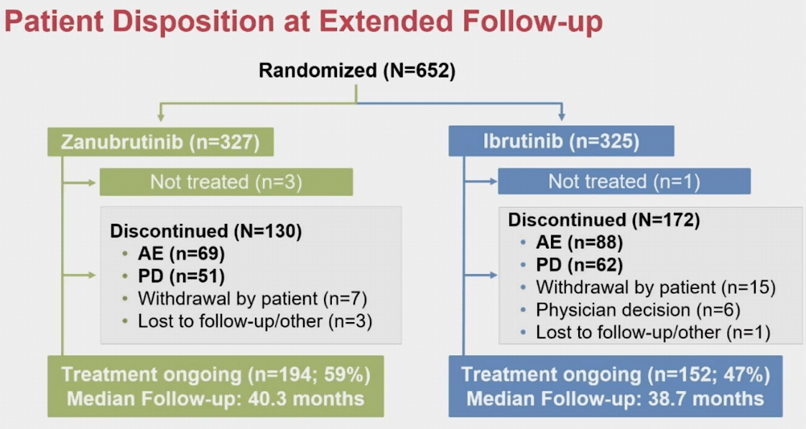
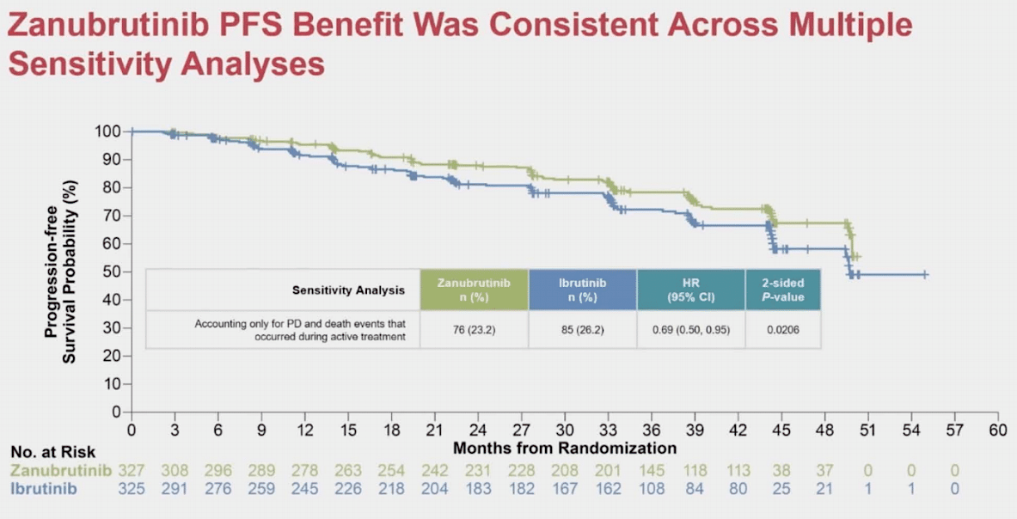
ALPINE: Zanu vs Ibrutinib
Brown J et al. ASH 2023;Abstract 202.

Slide 21
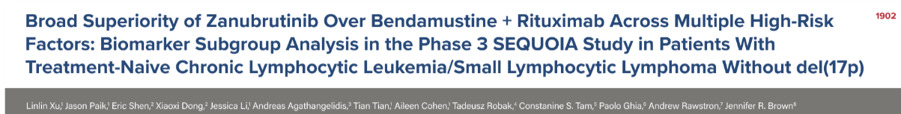
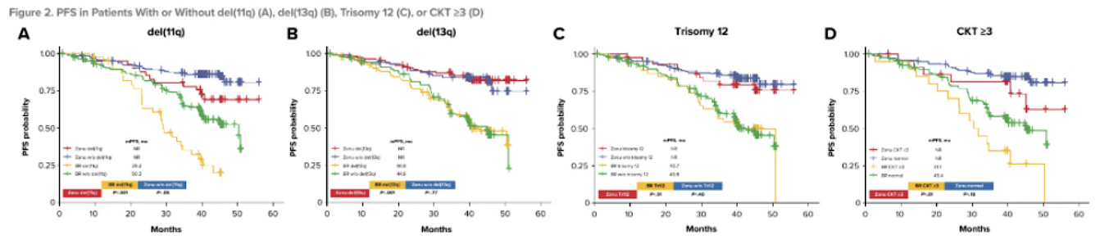
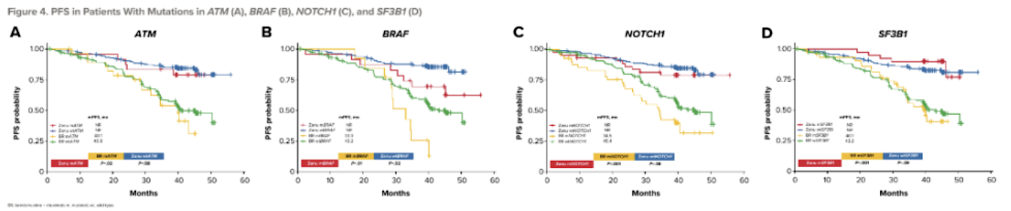
PFS in Patients with or without del(11q) (A), del(13q) (B), Trisomy 12 (C), or CKT ≥3 (D)
PFS in Patients with Mutations in ATM (A), BRAF (B), NOTCH1 (C), and SF3B1 (D)
Xu L et al. ASH 2023;Abstract 1902.

Slide 22
Second Generation BTK Conclusions
Adding Obinutuzumab to acalabrutinib results in deeper responses and longer disease control
Patients discontinue ibrutinib earlier than second generation BTK inhibitors and side effect profiles favor second generation agents
Zanubrutinib beats BR in untreated CLL, study serves regulatory purpose if not clinical purpose

Slide 23
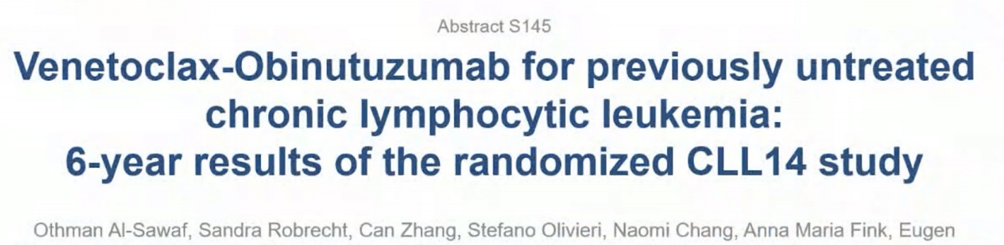
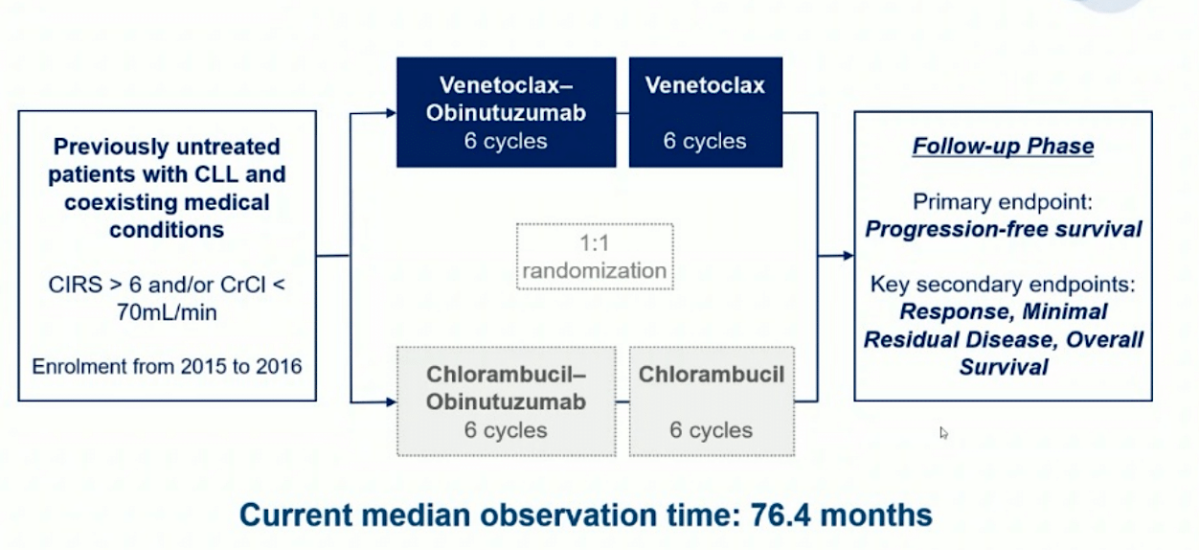
Al-Sawaf O et al. EHA 2023;Abstract S145.

Slide 24
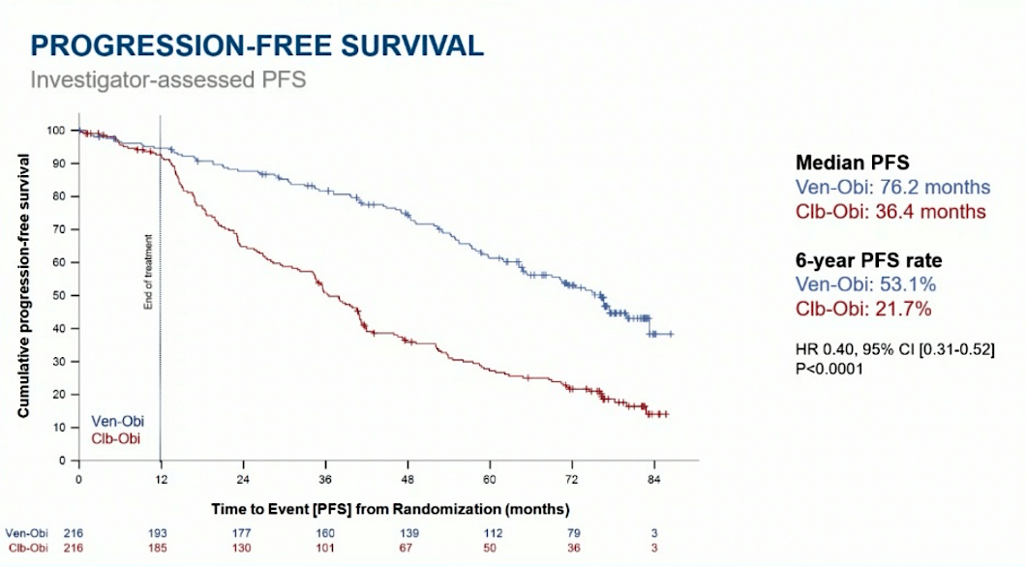
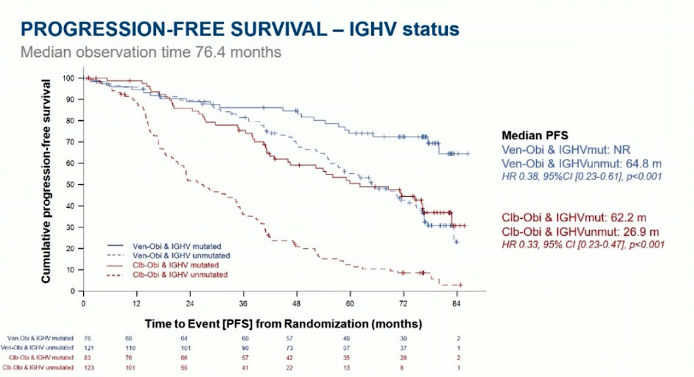
CLL14: Obi+Clb vs Obi+Ven
Al-Sawaf O et al. EHA 2023;Abstract S145.

Slide 25
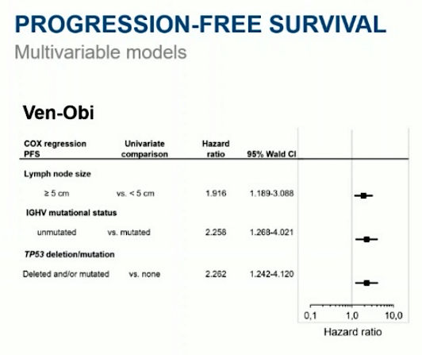
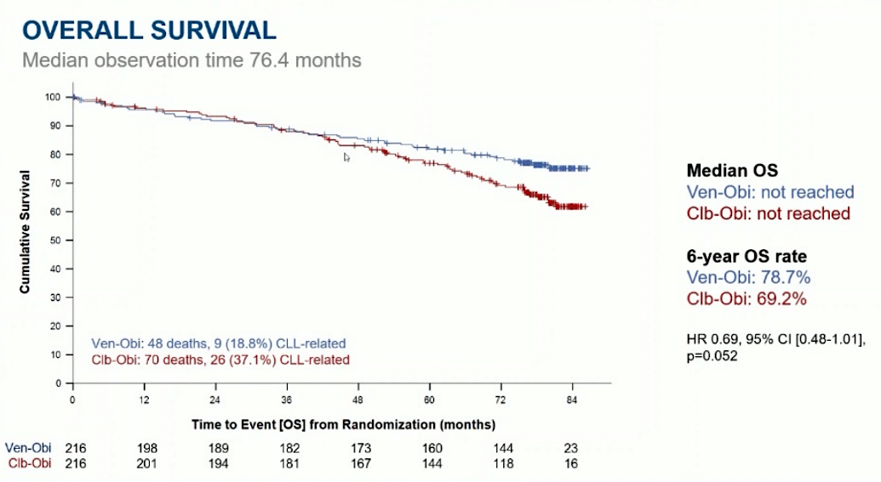
Obi-Ven; Multivariate Analysis and OS Curve
Al-Sawaf O et al. EHA 2023;Abstract S145.

Slide 26
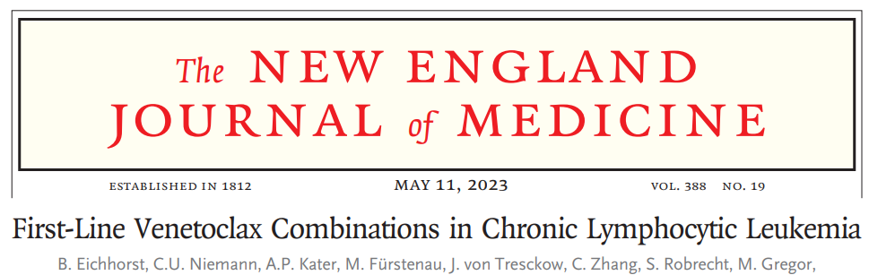
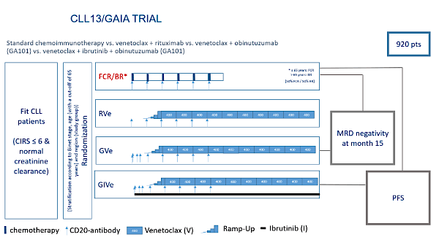

Slide 27
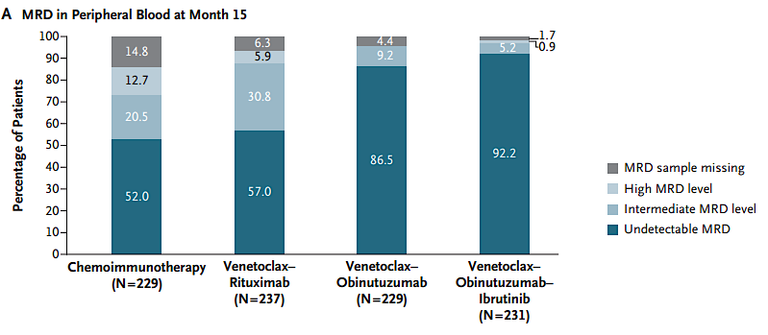
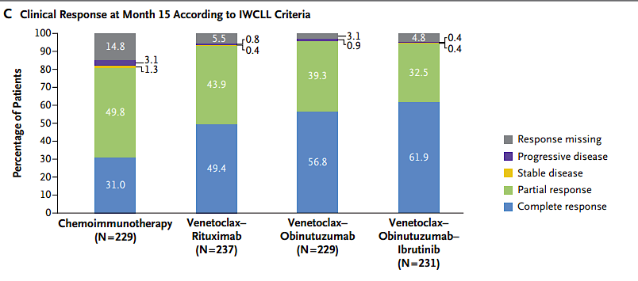
ORR/MRD favors Obinutuzumab
Eichhorst B et al. N Engl J Med 2023;388(19):1739-54.

Slide 28
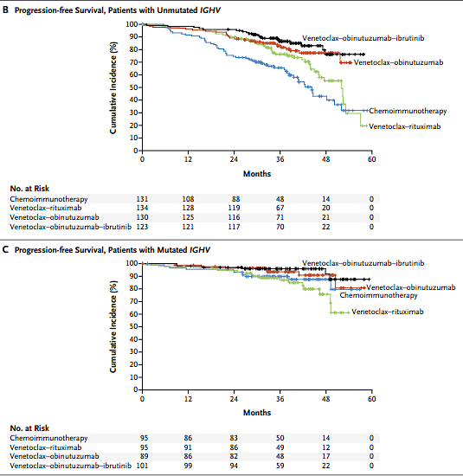
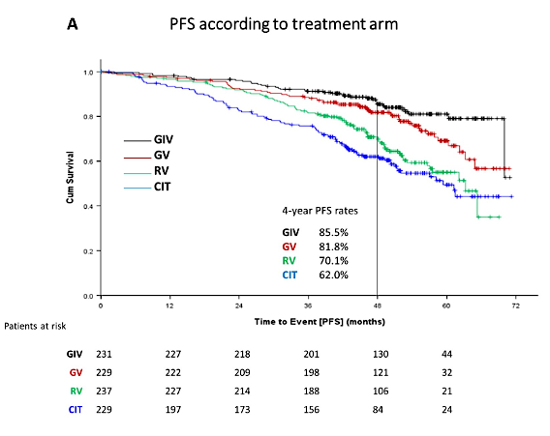
PFS favors Obi/Ven +/- BTK
Fürstenau M et al. ASH 2023;Abstract 635.
Eichhorst B et al. N Engl J Med 2023;388(19):1739-54.

Slide 29
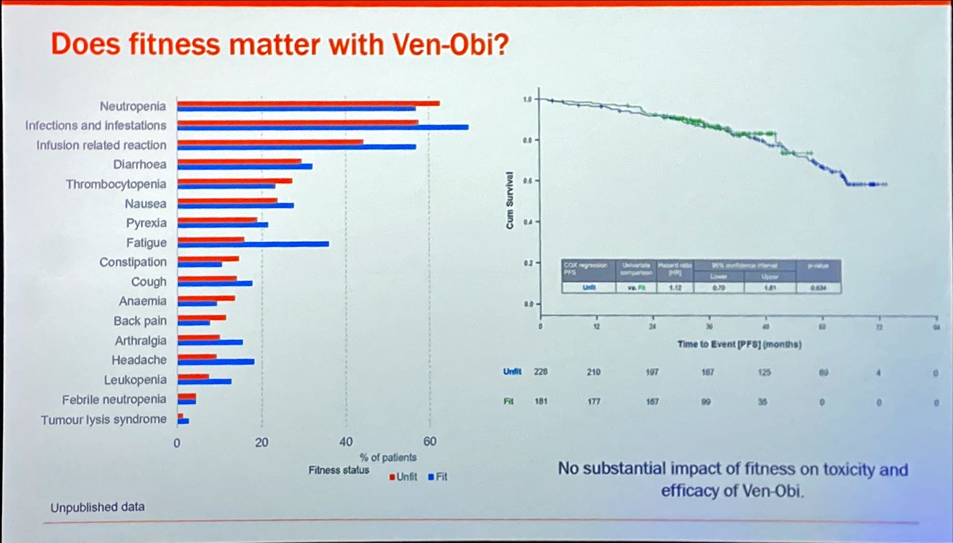
CLL13 vs CLL14: Impact of Patient Fitness
Al Sawaf 2023

Slide 30
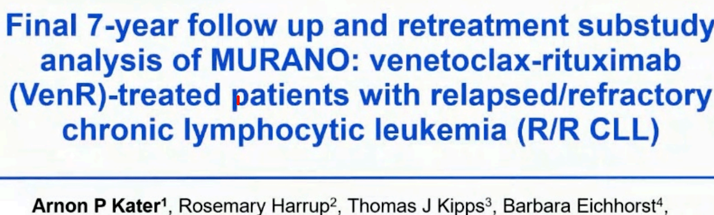
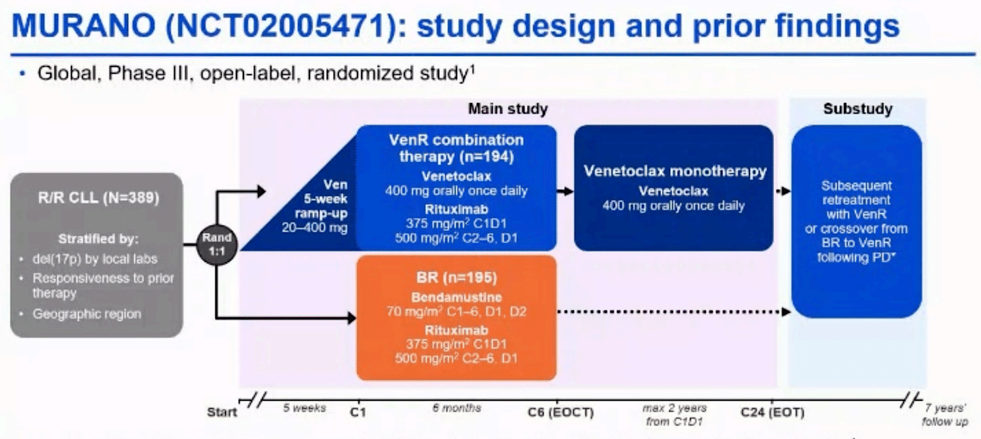

Slide 31
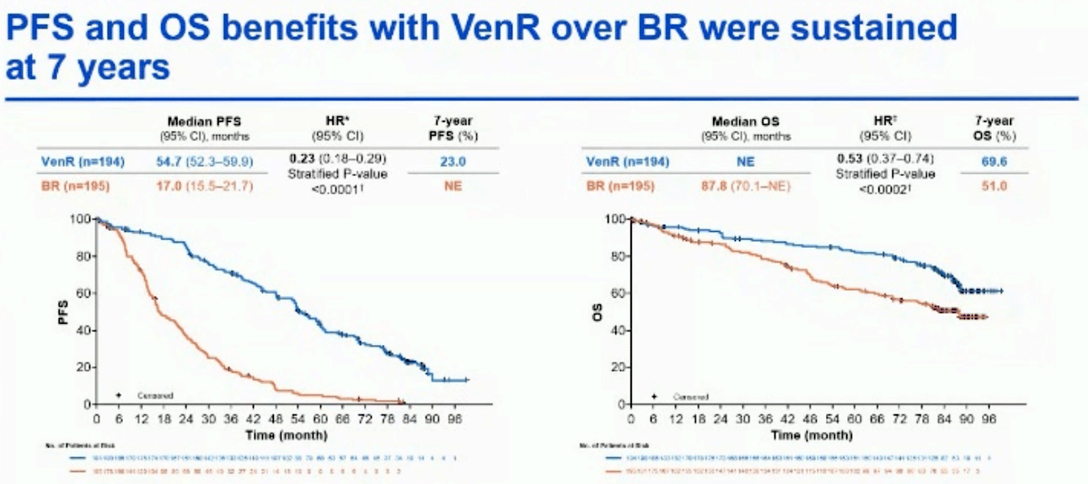
Final PFS Analysis of MURANO
Kater A et al. EHA 2023;Abstract S201.

Slide 32
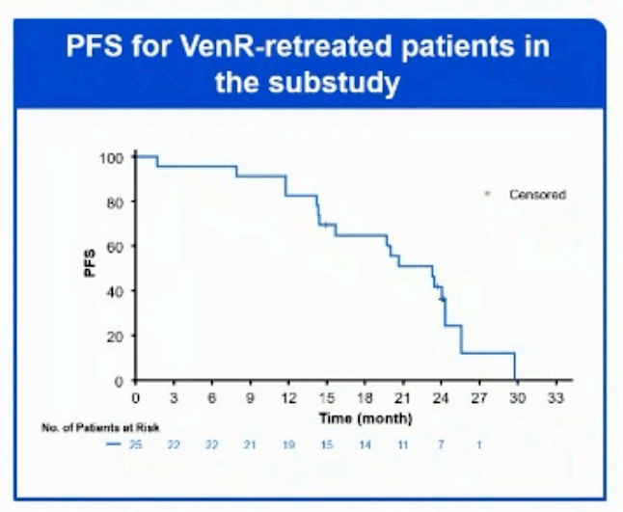
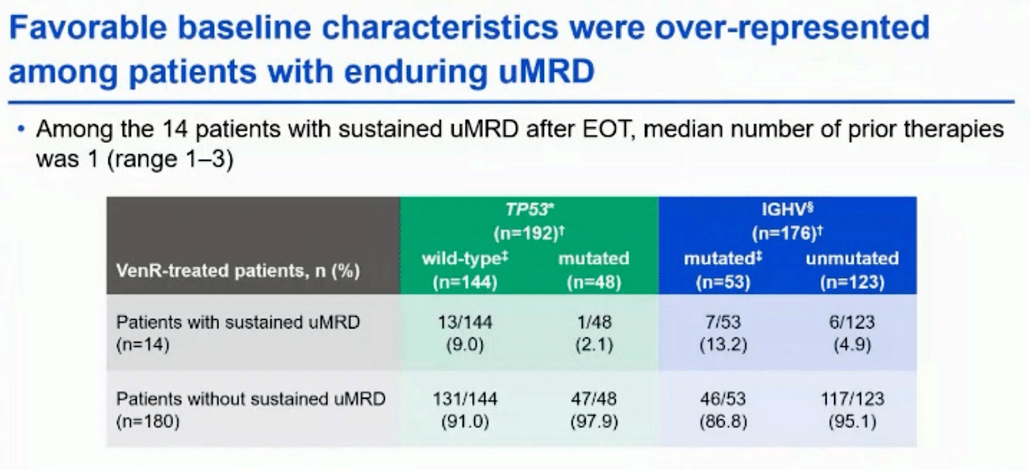
MURANO: Enduring MRD and Retreatment
Kater A et al. EHA 2023;Abstract S201.

Slide 33
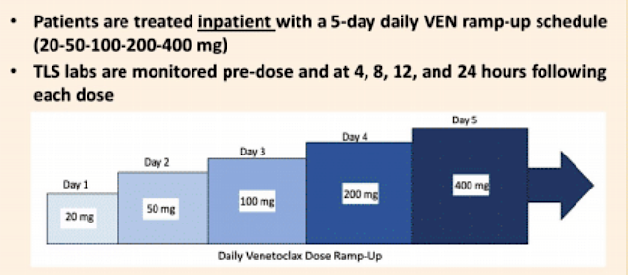
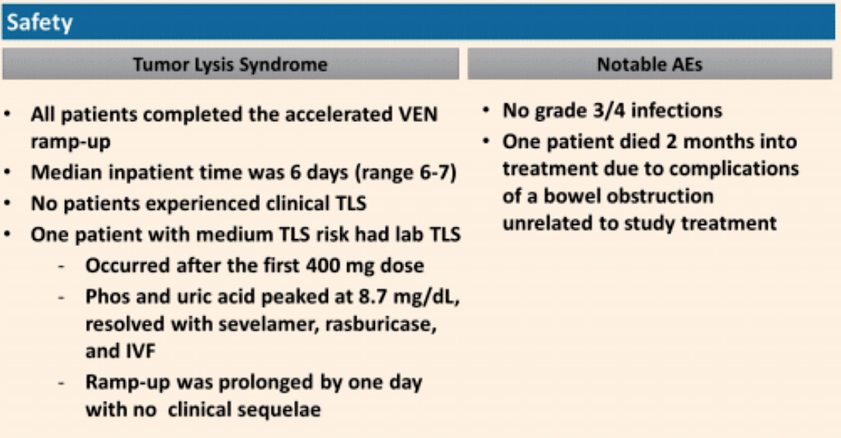
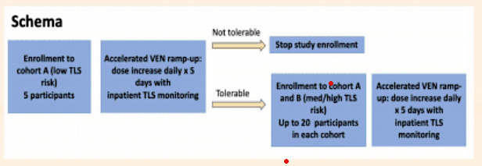
Crombie JL et al. ASCO 2023;Abstract 7512.

Slide 34
Venetoclax Conclusions
Obinutuzumab with venetoclax offers fixed duration therapy yielding impressive duration of disease control
Bulky disease has lower PFS along with IgHV and TP53
Obinutuzumab better than rituximab when combined with venetoclax
Any advantage of triplet therapy emerges late
Obi-ven can be given in both young/fit, and older/comorbid patients with similar efficacy
Retreatment feasible
Accelerating ramp up schedules remain a consideration

Slide 35



Woyach JA et al. ASH 2023;Abstract 325.

Slide 36

ORR Similar Between BCL-2 Exposed/Naive
Woyach JA et al. ASH 2023;Abstract 325.

Slide 37

PFS Varied based upon prior BCL2 exposure
Woyach JA et al. ASH 2023;Abstract 325.

Slide 38



Brown J et al. ASH 2023;Abstract 326.

Slide 39



Mutation Profile Evolves on Pirtobrutinib
Brown J et al. ASH 2023;Abstract 326.

Slide 40
Pirtobrutinib conclusions
Pirtobrutinib offers high response rates but modest PFS and significantly impacted by prior BCL2 use
BTK resistance is an evolving story and clonal dynamics evolve quickly

