Slide 1
Future Directions in the Care of Patients with CLL
Lindsey Roeker, MD
Assistant Attending
Memorial Sloan Kettering Cancer Center
New York, NY

Slide 2
Doublets and Triplets

Slide 3
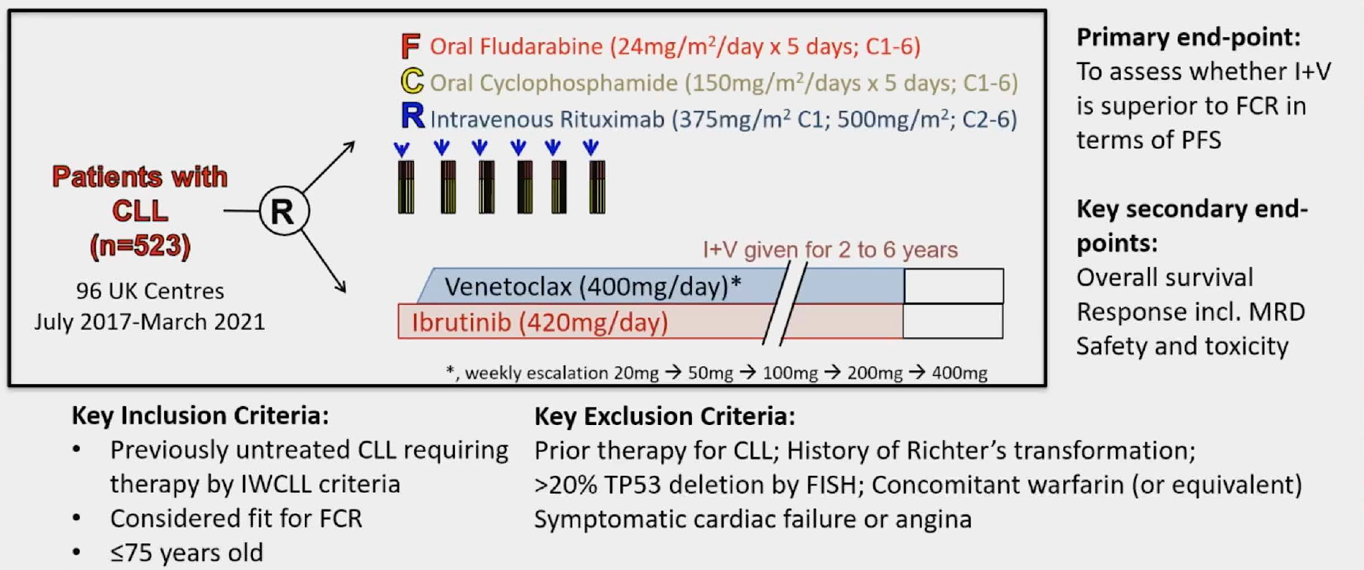
Ibrutinib plus venetoclax with MRD-directed duration of treatment is superior to FCR and is a new standard of care for previously untreated CLL: Report of the Phase III UK NCRI FLAIR study
Hillmen, et al. ASH 2023; Abstract 631.
Notes:
FLAIR has an adaptive design with multiple parallel arms – FCR, I/R, I mono, I+V; this is an analysis of I+V vs. FCR
I+V: 2 month I lead in followed by V dose ramp, duration was MRD guided, 2-6 years

Slide 4
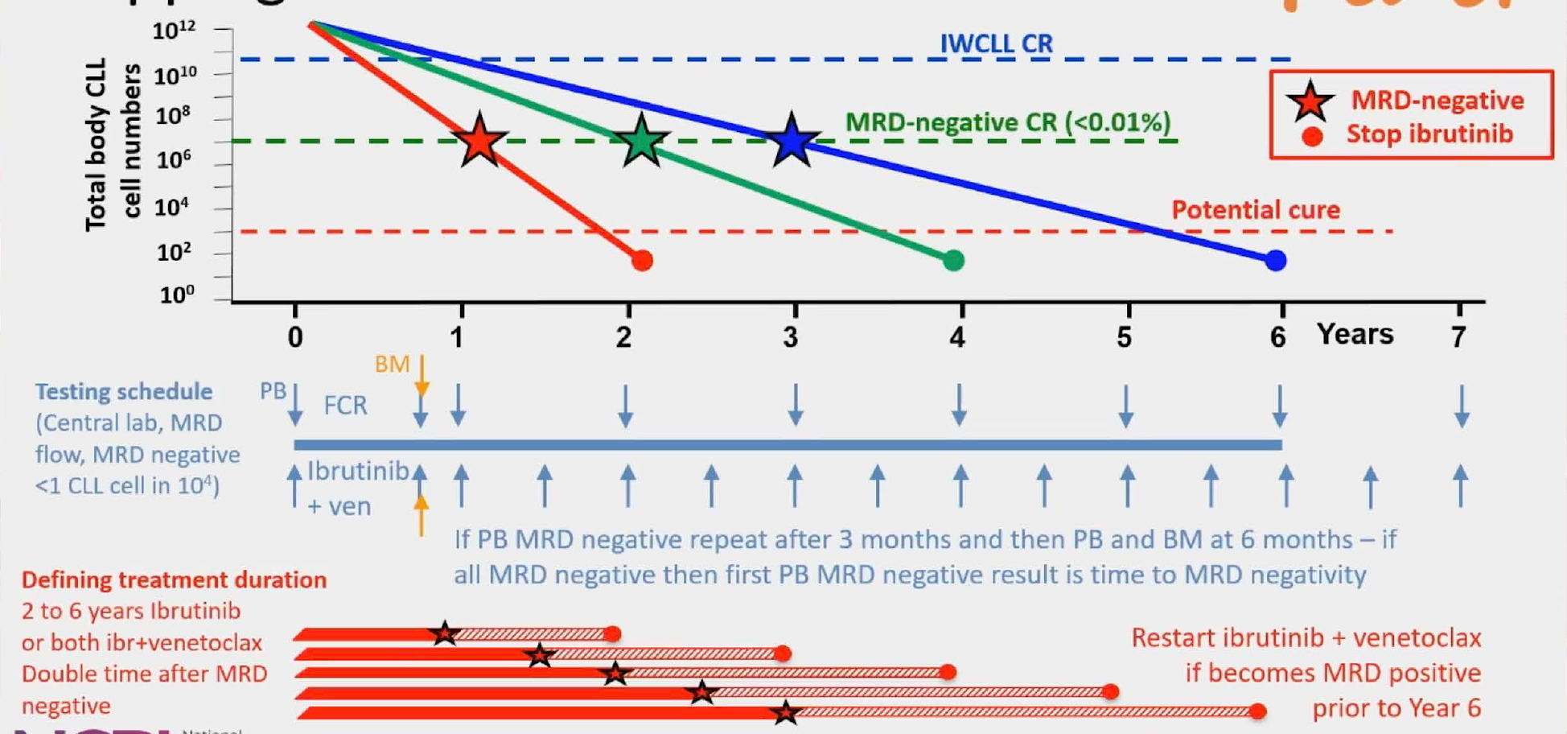
Ibrutinib plus venetoclax with MRD-directed duration of treatment is superior to FCR and is a new standard of care for previously untreated CLL: Report of the Phase III UK NCRI FLAIR study
Hillmen, et al. ASH 2023; Abstract 631.
Notes:
FLAIR has an adaptive design with multiple parallel arms – FCR, I/R, I mono, I+V; this is an analysis of I+V vs. FCR
I+V: 2 month I lead in followed by V dose ramp, duration was MRD guided, 2-6 years

Slide 5
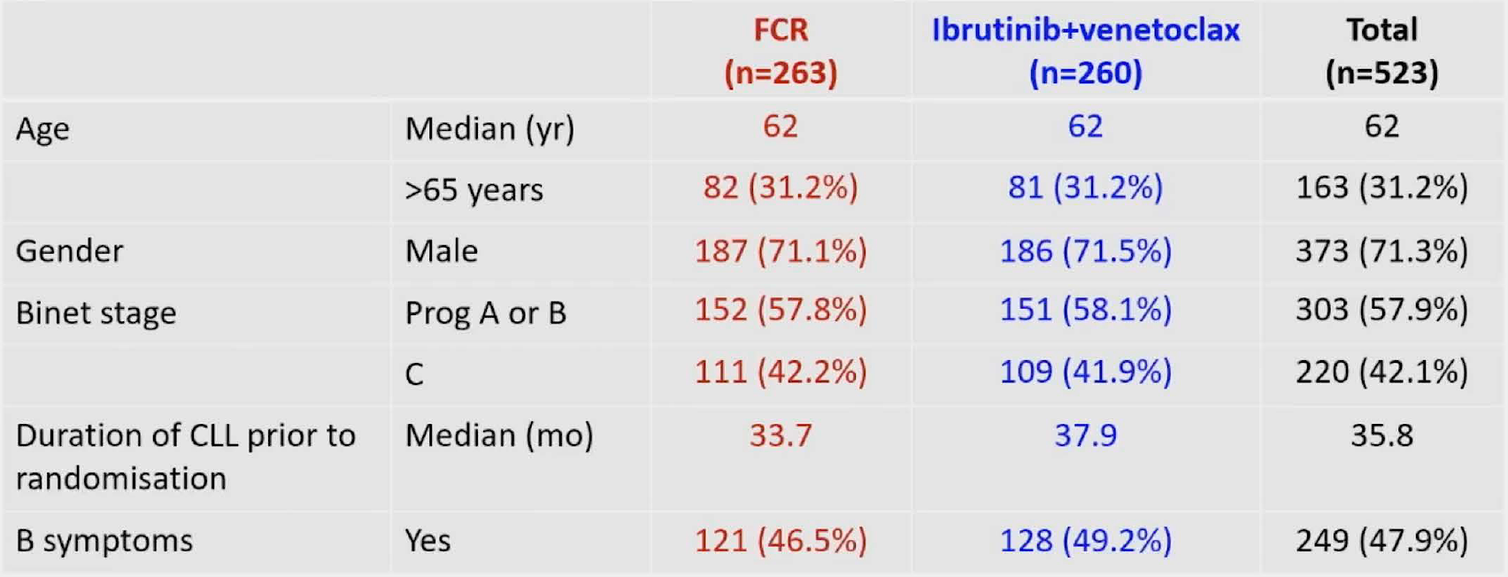
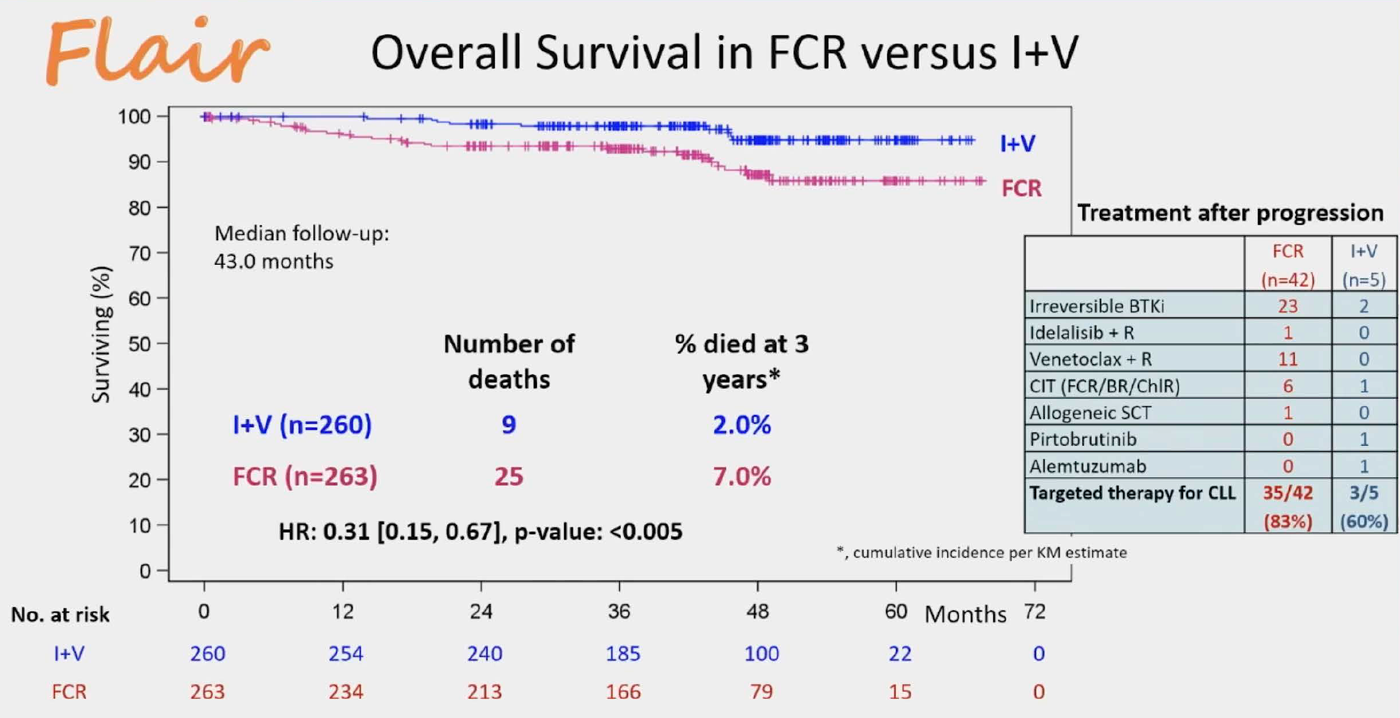
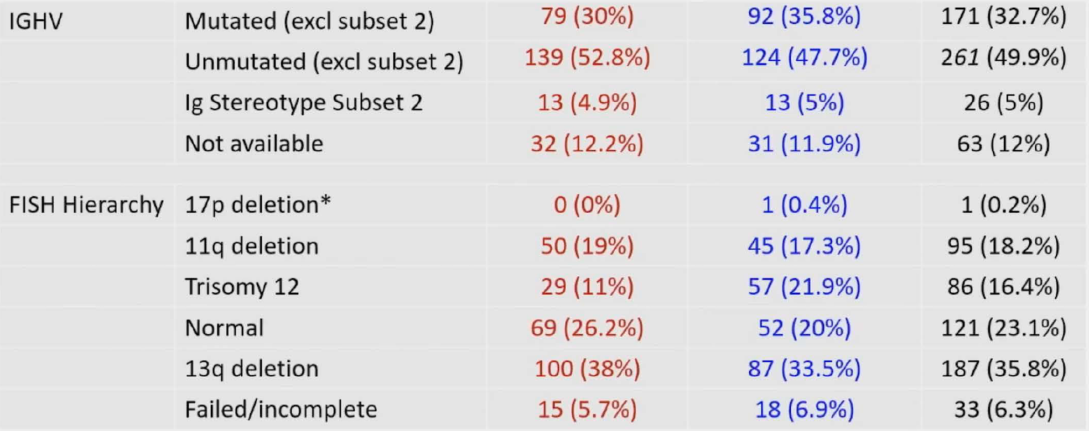
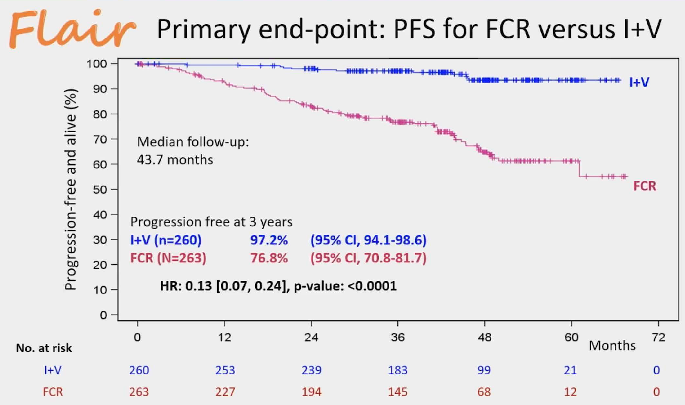
Significantly improved PFS (HR 0.07, p<0.001) and OS (HR 0.23, p=0022) for IGHV unmutated
No significant improvement in PFS (HR 0.54, p=0.199) or OS (HR 0.61, p=0.374) for IGHV mutated
Significantly improved PFS for del11q, tri12, and del13q
Hillmen, et al. ASH 2023; Abstract 631.
Notes:
FLAIR has an adaptive design with multiple arms – FCR, I/R, I mono, I+V; this is an analysis of I+V vs. FCR
Safety: Heme tox more common in FCR, cadiac tox more common in I+V
Second malignanices observed more commonly in FCR (incidence per 100 person-years was 5.4 vs. 2.6)
31 deaths: 23 in FCR and 8 in I+V

Slide 6
Ibrutinib plus venetoclax with MRD-directed duration of treatment is superior to FCR and is a new standard of care for previously untreated CLL: Report of the Phase III UK NCRI FLAIR study
I+V improves progression free and overall survival compared to FCR (a real control arm!), especially in uIGHV and regardless of cytogenetics
Hillmen, et al. ASH 2023; Abstract 631.
Notes:
FLAIR has an adaptive design with multiple parallel arms – FCR, I/R, I mono, I+V; this is an analysis of I+V vs. FCR
I+V: 2 month I lead in followed by V dose ramp, duration was MRD guided, 2-6 years

Slide 7
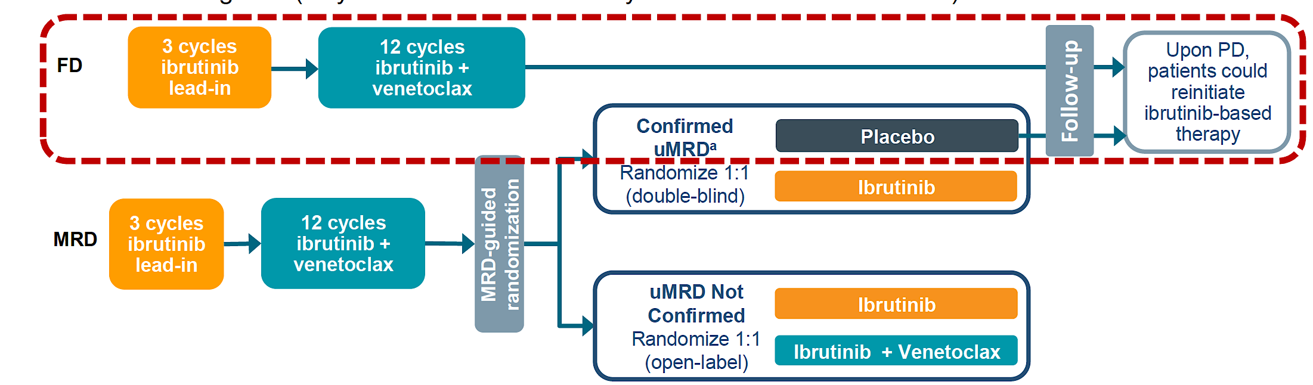
Relapse after first-line fixed duration ibrutinib + venetoclax: High response rates to ibrutinib retreatment and absence of BTK mutations in patients with chronic lymphocytic leukemia (CLL)/small lymphocytic lymphoma (SLL) with up to 5 years of follow-up in the Phase 2 CAPTIVATE study
Of the 202 patients who received fixed duration ibrutinib / venetoclax,
53 have had PD (49 with CLL PD, 4 with Richter’s transformation)
Ghia, et al. ASH 2023; Abstract 633.
Notes:
1L CLL

Slide 8
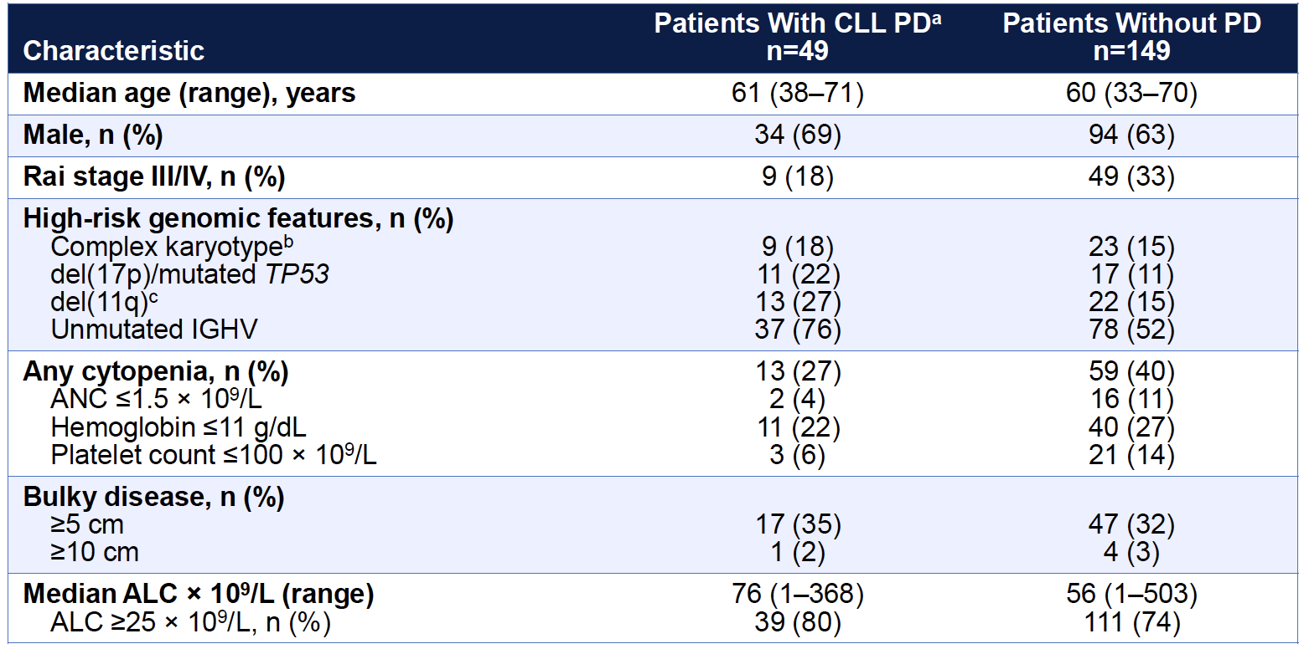
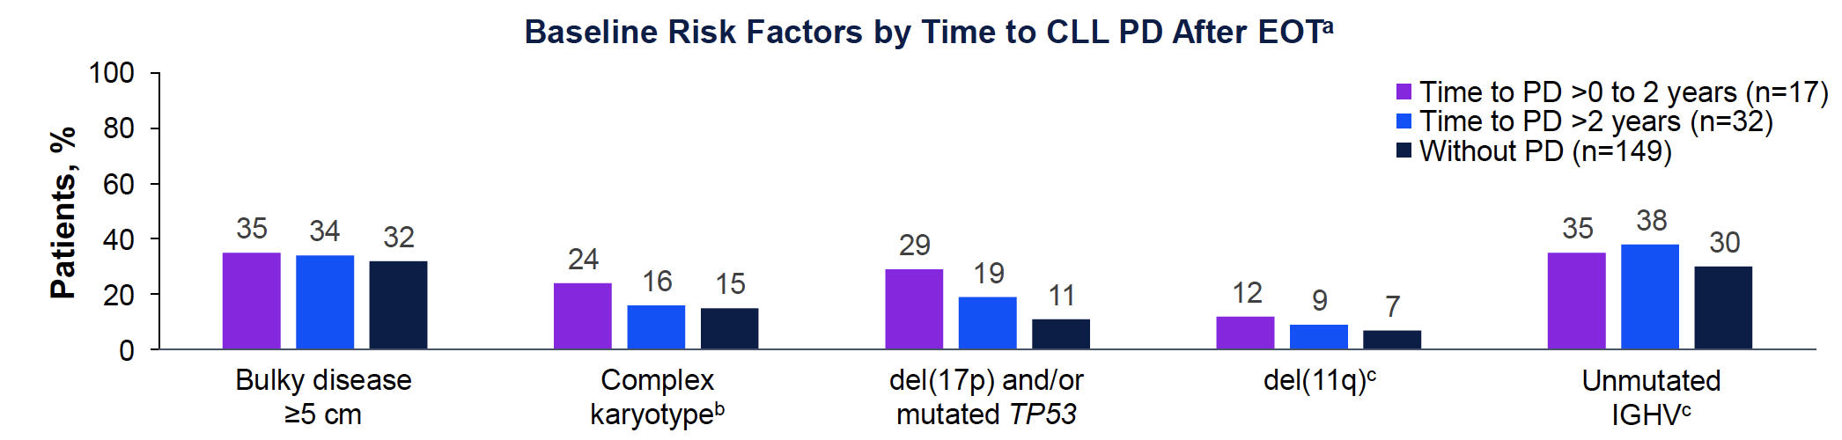
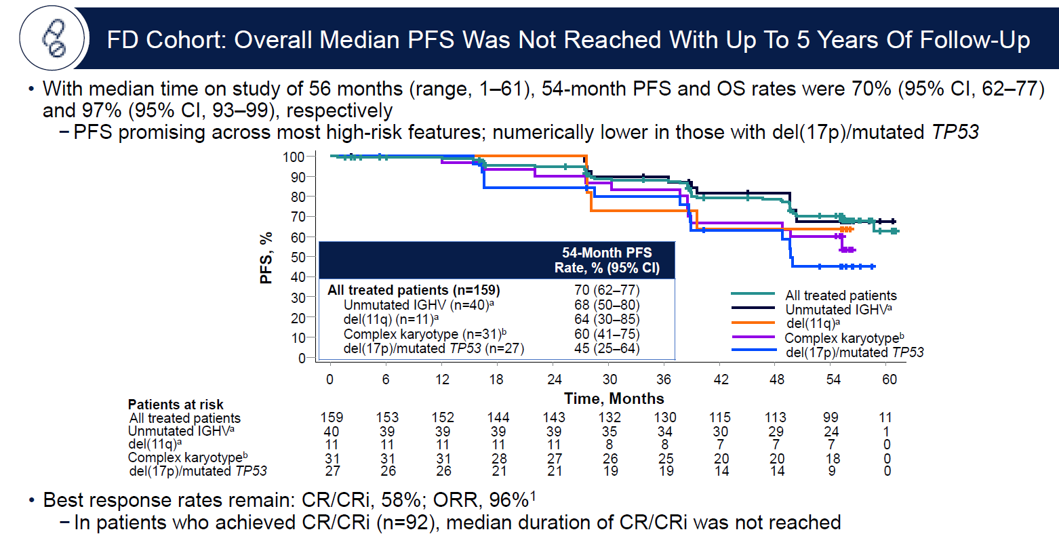
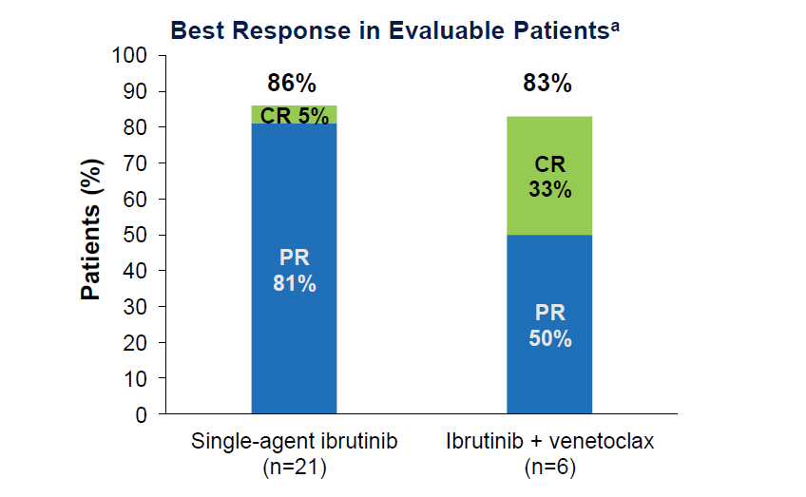
40 patient samples were collected at time of PD, no BTK or PCLG2 mutations; 1 BCL-2 A113G subclonal mutation
Ghia, et al. ASH 2023; Abstract 633.
Notes:
First-line fixed-duration treatment with ibrutinib + venetoclax may mitigate development
of resistance mechanisms associated with continuous single-agent targeted therapies; to date, only one
mutation of uncertain clinical significance has been detected in BCL-2, and none in BTK or PLCG2

Slide 9
Relapse after first-line fixed duration ibrutinib + venetoclax: High response rates to ibrutinib retreatment and absence of BTK mutations in patients with chronic lymphocytic leukemia (CLL)/small lymphocytic lymphoma (SLL) with up to 5 years of follow-up in the Phase 2 CAPTIVATE study
Fixed duration I+V may mitigate risk of developing resistance mutations
Patients can successfully be retreated with ibrutinib-based therapy
Ghia, et al. ASH 2023; Abstract 633.
Notes:
1L CLL

Slide 10
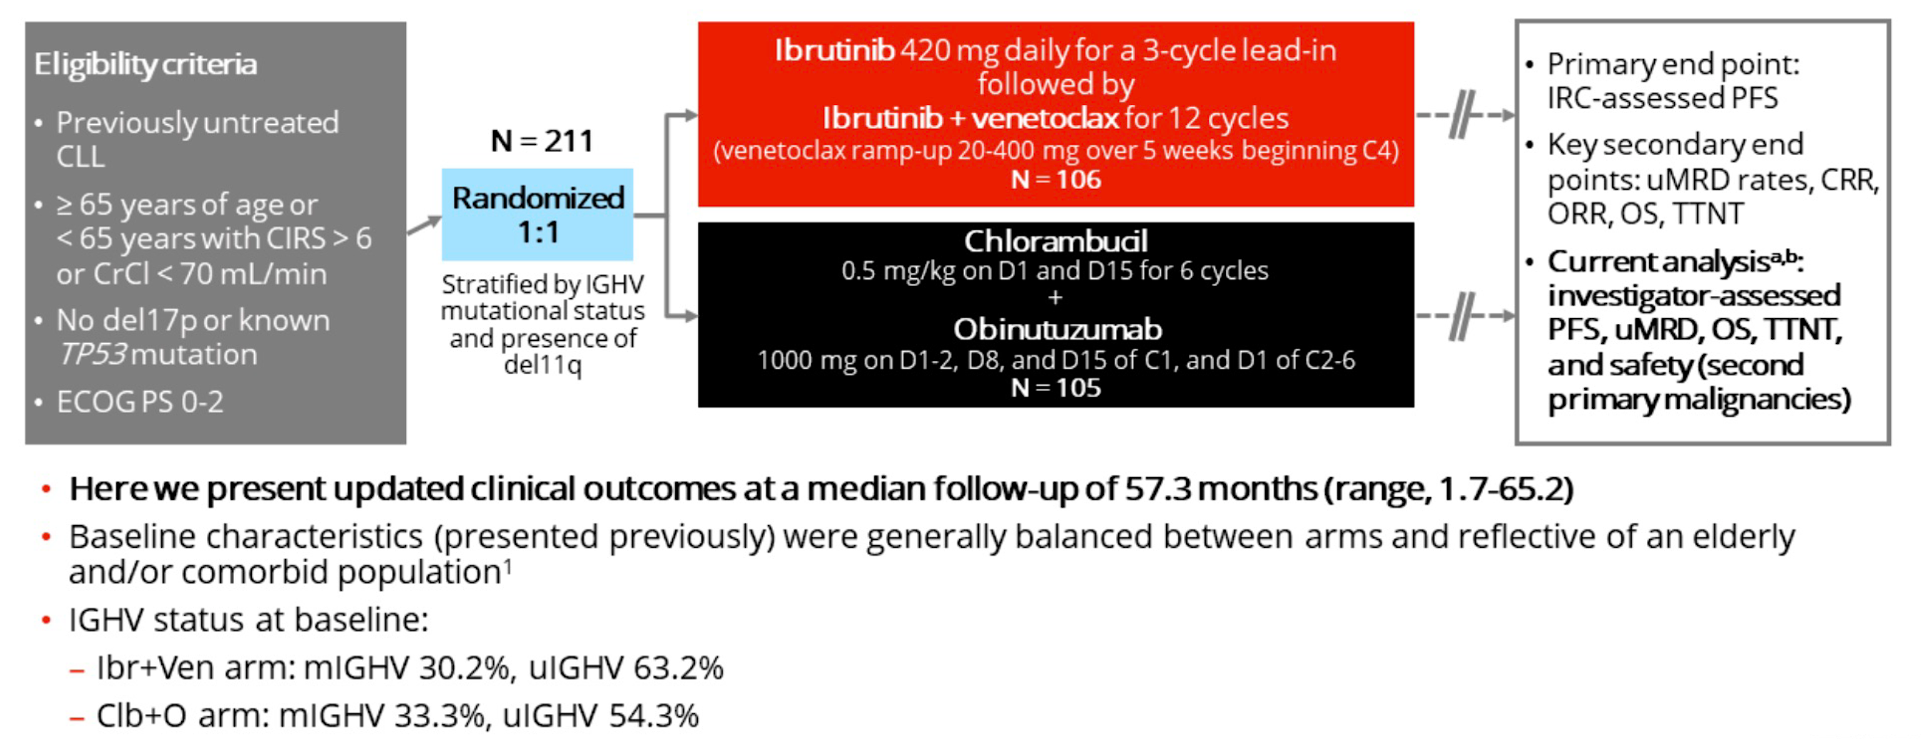
First-line fixed-duration ibrutinib plus venetoclax (Ibr+Ven) versus chlorambucil plus obinutuzumab (Clb+O): 55-month follow-up from the GLOW study
Follows, et al. ASH 2023; Abstract 634.
Notes:
Update on data with longer follow up, now 55 months
And subgroup analyses by IGHV and MRD status

Slide 11
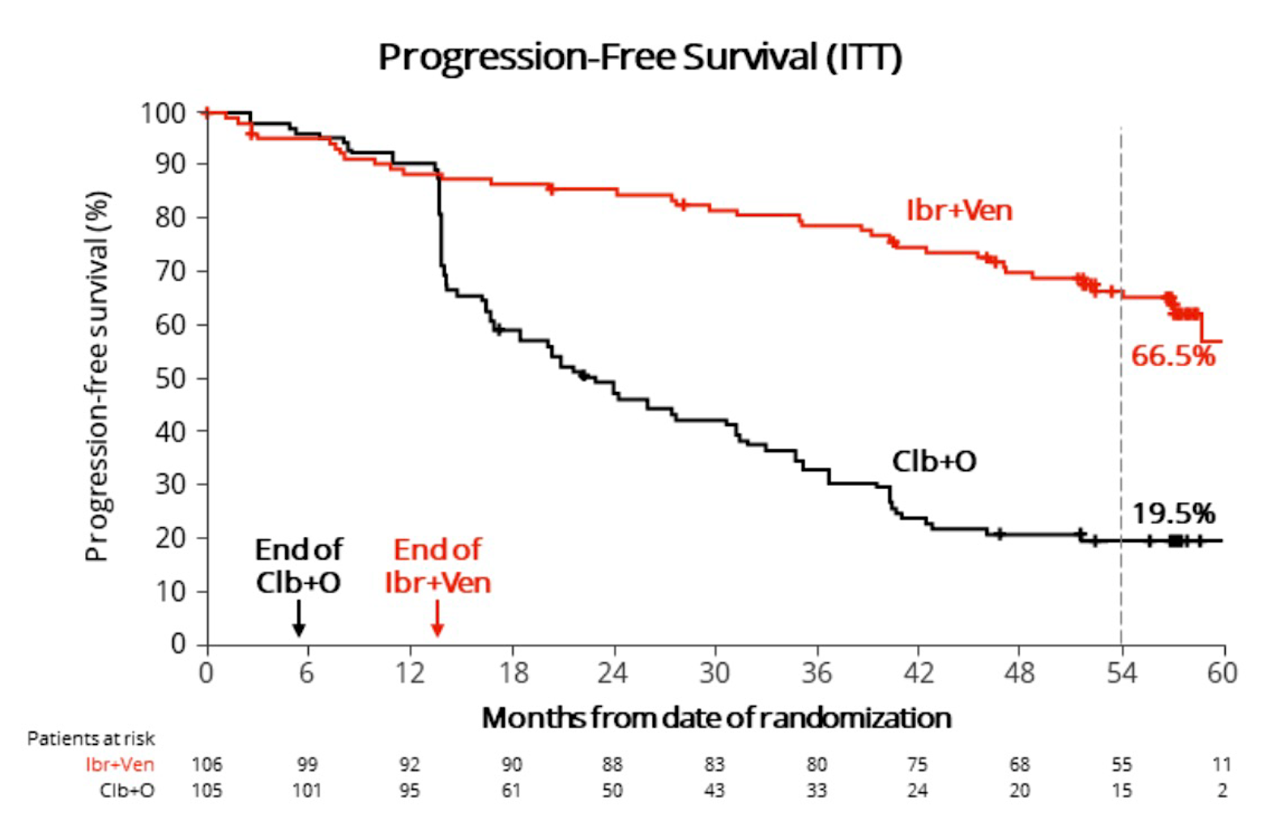
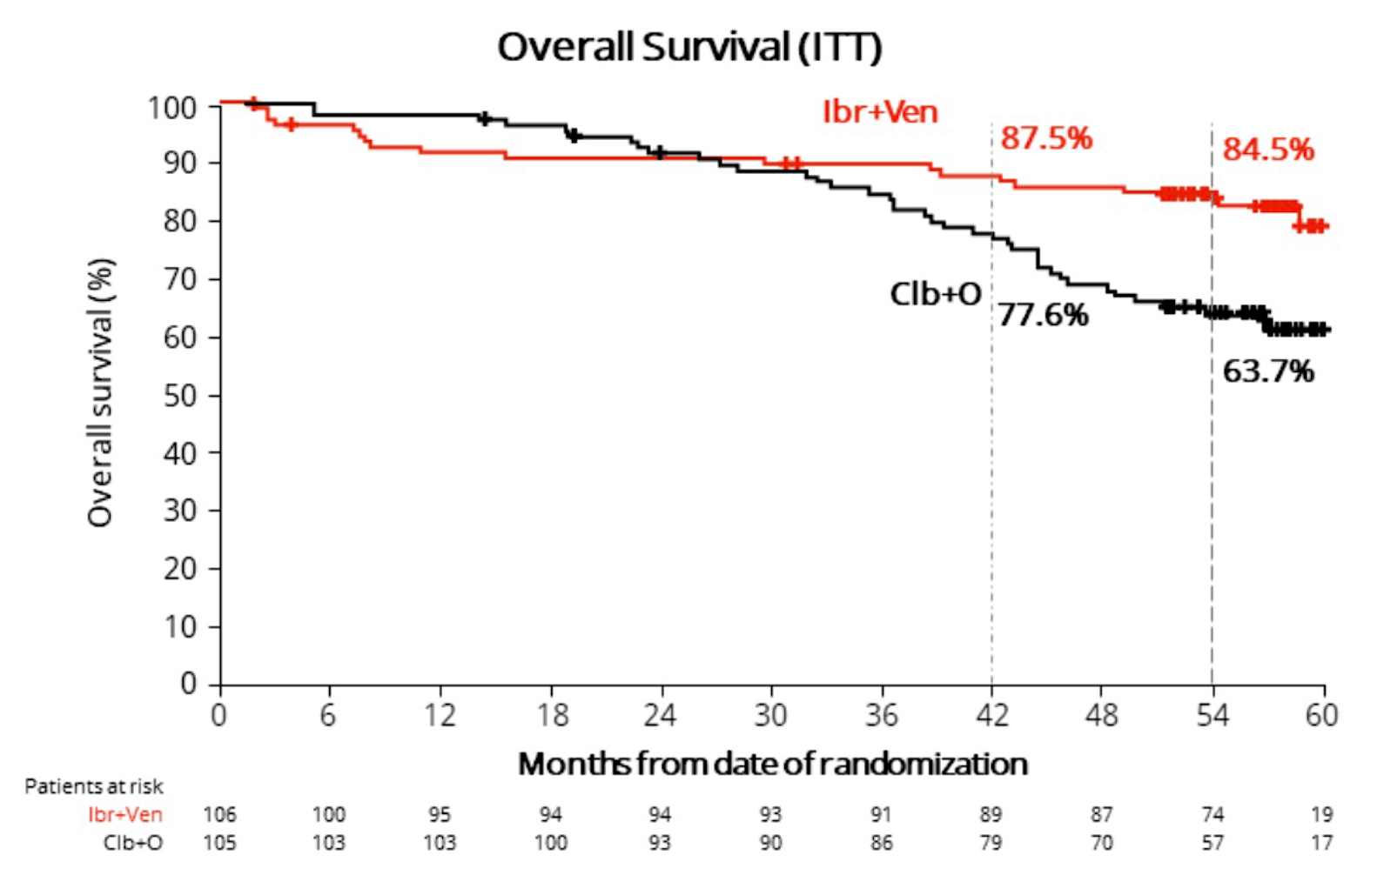
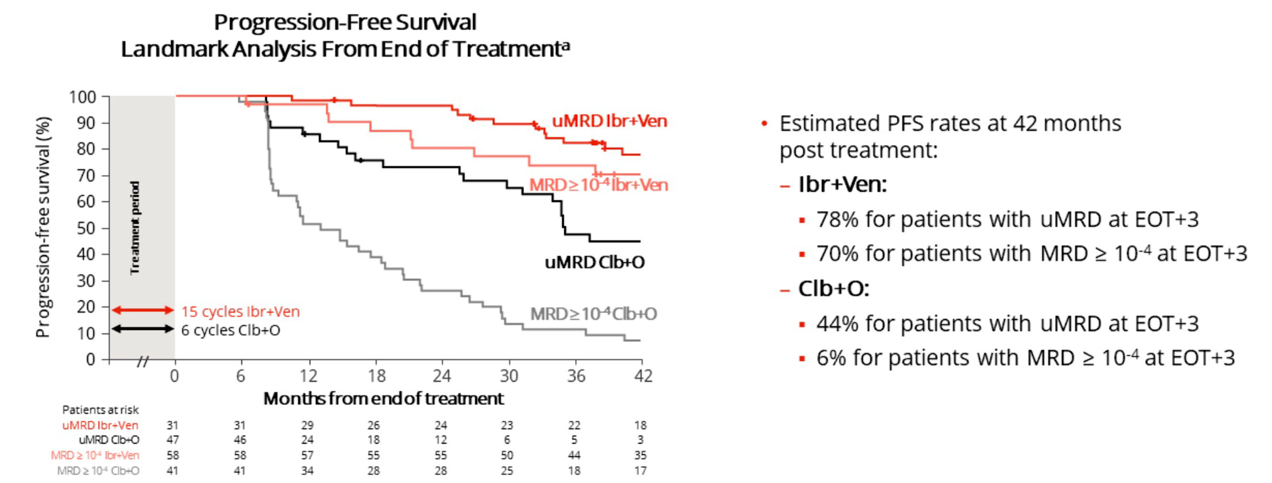
Follows, et al. ASH 2023; Abstract 634.
Notes:
54 month updates of PFS and OS
Landmark analyses looking at effect of MRD status at end of tx on MRD – IV improved PFS regardless of MRD status

Slide 12
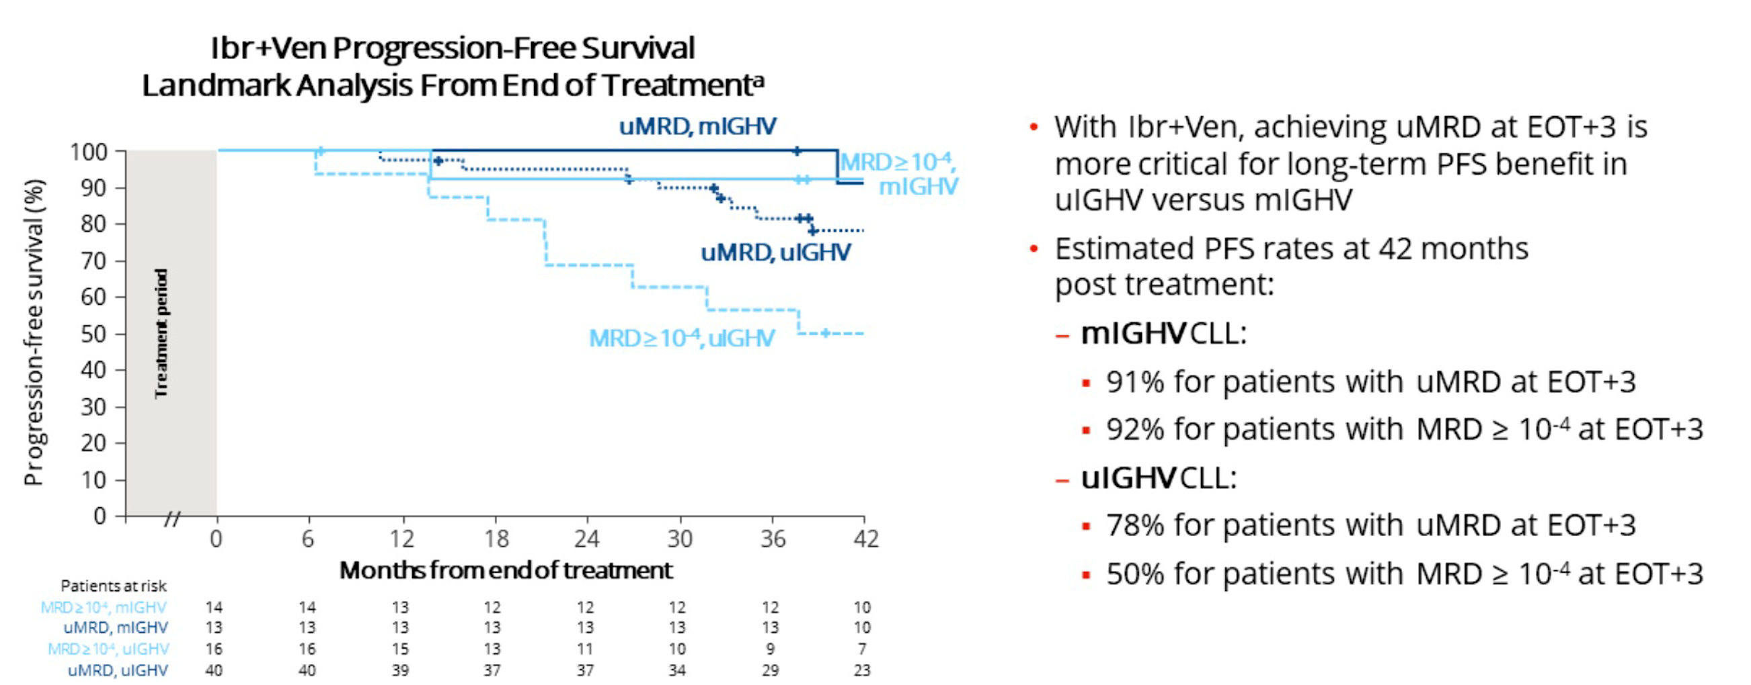
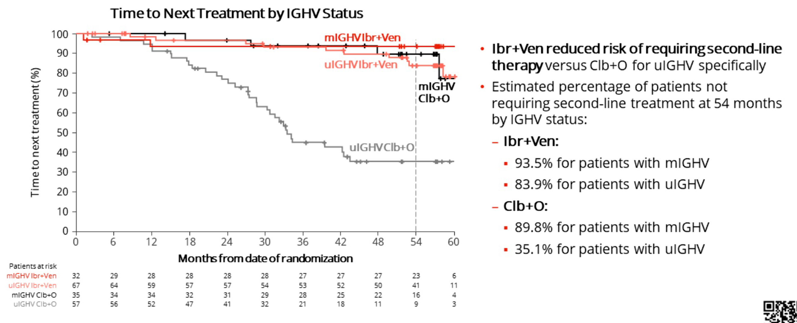
Follows, et al. ASH 2023; Abstract 634.
Notes:
54 month updates of PFS and OS
Landmark analyses looking at effect of MRD status at end of tx on MRD

Slide 13
First-line fixed-duration ibrutinib plus venetoclax (Ibr+Ven) versus chlorambucil plus obinutuzumab (Clb+O): 55-month follow-up from the GLOW study
MRD status at end of treatment predicts PFS,
especially for uIGHV (less significant for mIGHV)
I+V improves TTNT for uIGHV vs. Chlorambucil/Obin
Follows, et al. ASH 2023; Abstract 634.
Notes:
Update on data with longer follow up, now 55 months
And subgroup analyses by IGHV and MRD status

Slide 14
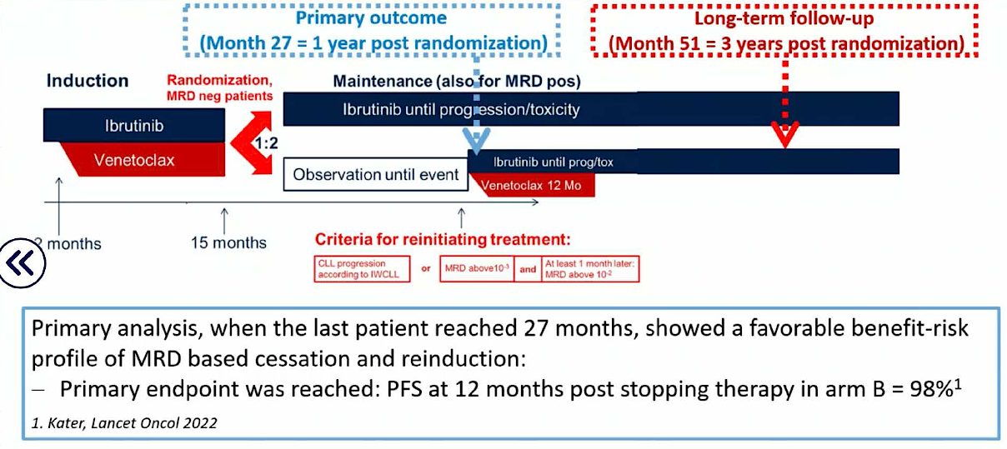
Time-limited venetoclax and ibrutinib for patients with relapsed/refractory CLL who have undetectable MRD – 4-year follow up from the randomized Phase II VISION/HO141 trial
2 months
Kater, et al. EHA 2023; Abstract S148.
Notes:
R/R study – update with 4 years of f/u
Patients received I for 2 (28-day) cycles followed by V+I combination. Patients reaching at least partial remission
(PR) and flow-based undetectable (u)MRD (<10-4) in blood (PB) and bone marrow (BM), at cycle 15 (C15) were
randomized 1:2 between I maintenance (arm A) or treatment cessation (arm B). Patients in arm B becoming MRD
positive (>10-2) reinitiated V+I. MRD positive patients at C15 remained on I.

Slide 15
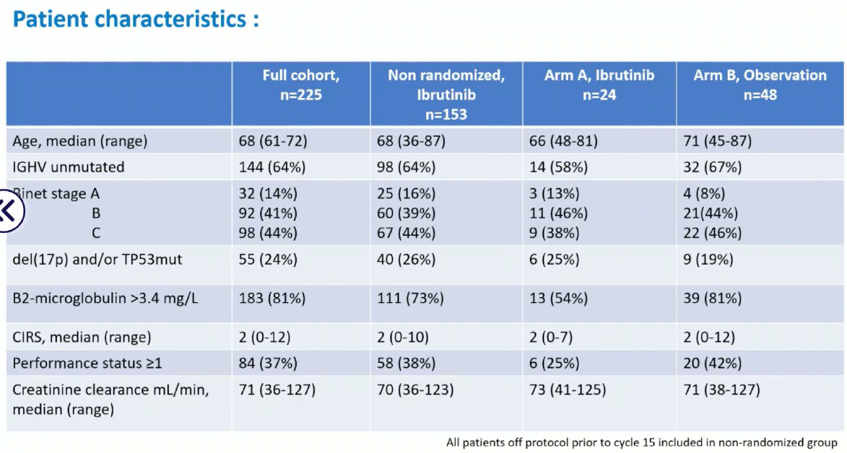
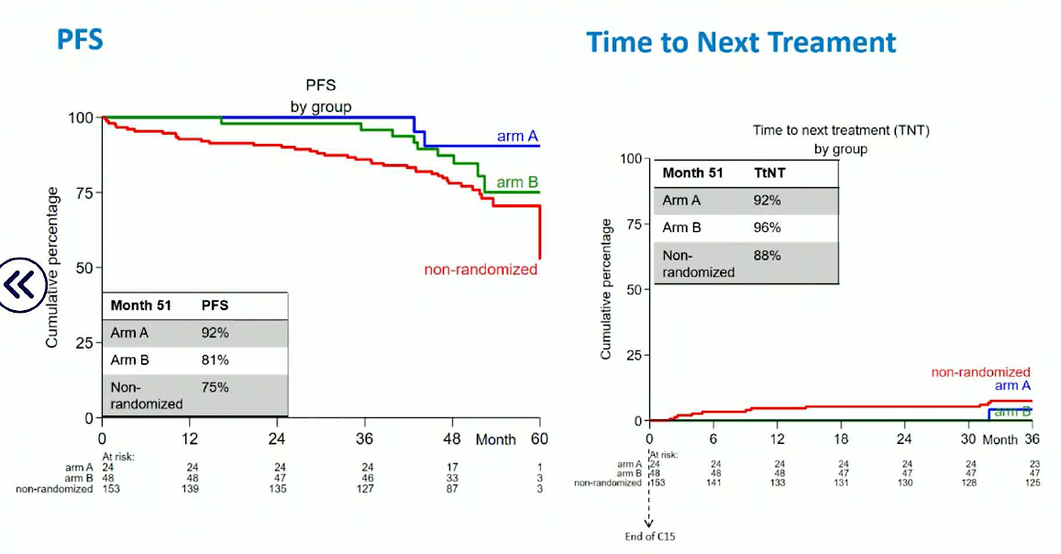
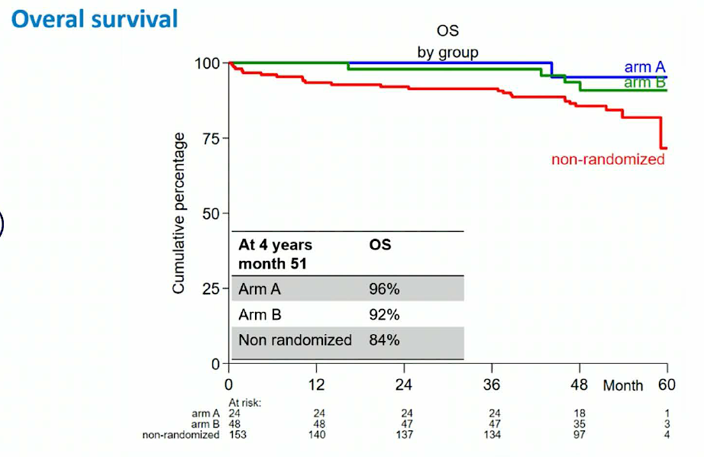
Safety at 3 years post-C15 | Discontinuation Rate
Non-randomized (continued I) | 31% (36/116) discontinued toxicity n=19 progression n=2 death n=3 other reasons n=12
Arm A (continued I) | 54% (13/24) discontinued toxicity n=6 progression n=1 death n=1 other reason n=5
Binet stage A
Kater, et al. EHA 2023; Abstract S148.
Notes:
225 patients enrolled
72 achieved U-MRD – randomized to I (arm A - blue) vs. observation (arm B – green), 116 continued I maintenance because MRD+, 37 patients went off protocol before randomization – total of 153
Seventy-two (32%) of the 225 patients achieved uMRD and were randomized to I maintenance (arm A; n=24), or
treatment cessation arm B (n=48). Patients who did not achieve uMRD (n=116) continued I maintenance without
randomization while 37 patients went off protocol prior to randomization.
For all patients enrolled (n=225),
overall survival (OS) 88%
PFS 79%
TTNT 83%
Curves show break down by arm.

Slide 16
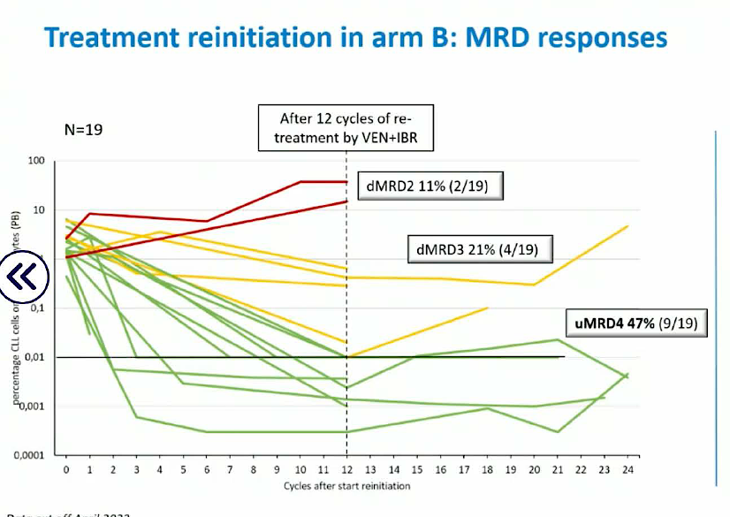
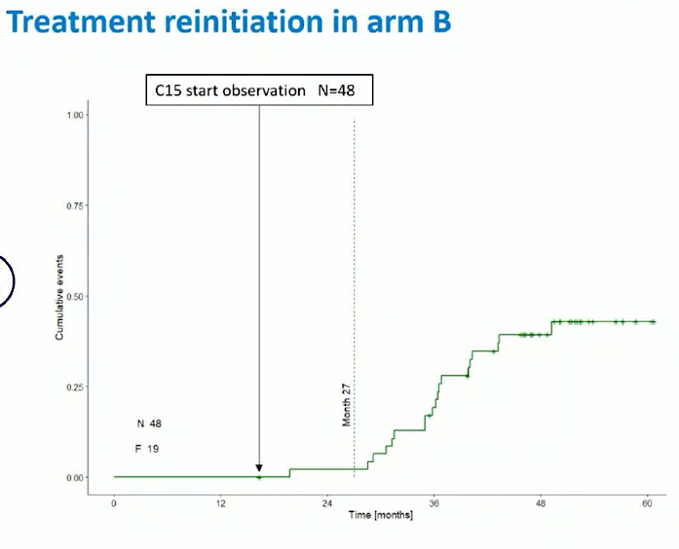
1
percentage CLL cells or lymphocytes (PB)
0,1
0,01
0,001
After ibrutinib cessation:
MRD relapse in 40% (19/48)
4 of 19 off protocol: toxicity (n=4), progression (n=2), other reason (n=1)
Median time to MRD relapse = 24 months of observation
MRD relapsed patients enriched for TP53 aberrations and CK
Second uMRD response upon retreatment in 47%
Kater, et al. EHA 2023; Abstract S148.
Notes:
In arm B treatment was reinitiated per-protocol due to MRD conversion in 19 patients (40%) of whom 4 went off
protocol due to toxicity (n=1), progression (n=2 including 1 death) and other reason (n=1). Following 12 cycles of
re-treatment with V+I, a second uMRD response was achieved in 8 (42%) whereas 3 (16%) and 2 (11%) had low
and high MRD positive responses, respectively. Retreatment resulted in a clinical remission in 10 (53%) while 2
(11%) progressed and 1 patient went off protocol (toxicity). Six patients are still under evaluation for responses
and MRD.

Slide 17
Time-limited venetoclax and ibrutinib for patients with relapsed/refractory CLL who have undetectable MRD – 4-year follow up from the randomized Phase II VISION/HO141 trial
Patients who achieve uMRD and stop therapy
can be successfully retreated upon MRD progression
Kater, et al. EHA 2023; Abstract S148.
Notes:
R/R study – update with 4 years of f/u
Patients received I for 2 (28-day) cycles followed by V+I combination. Patients reaching at least partial remission
(PR) and flow-based undetectable (u)MRD (<10-4) in blood (PB) and bone marrow (BM), at cycle 15 (C15) were
randomized 1:2 between I maintenance (arm A) or treatment cessation (arm B). Patients in arm B becoming MRD
positive (>10-2) reinitiated V+I. MRD positive patients at C15 remained on I.

Slide 18
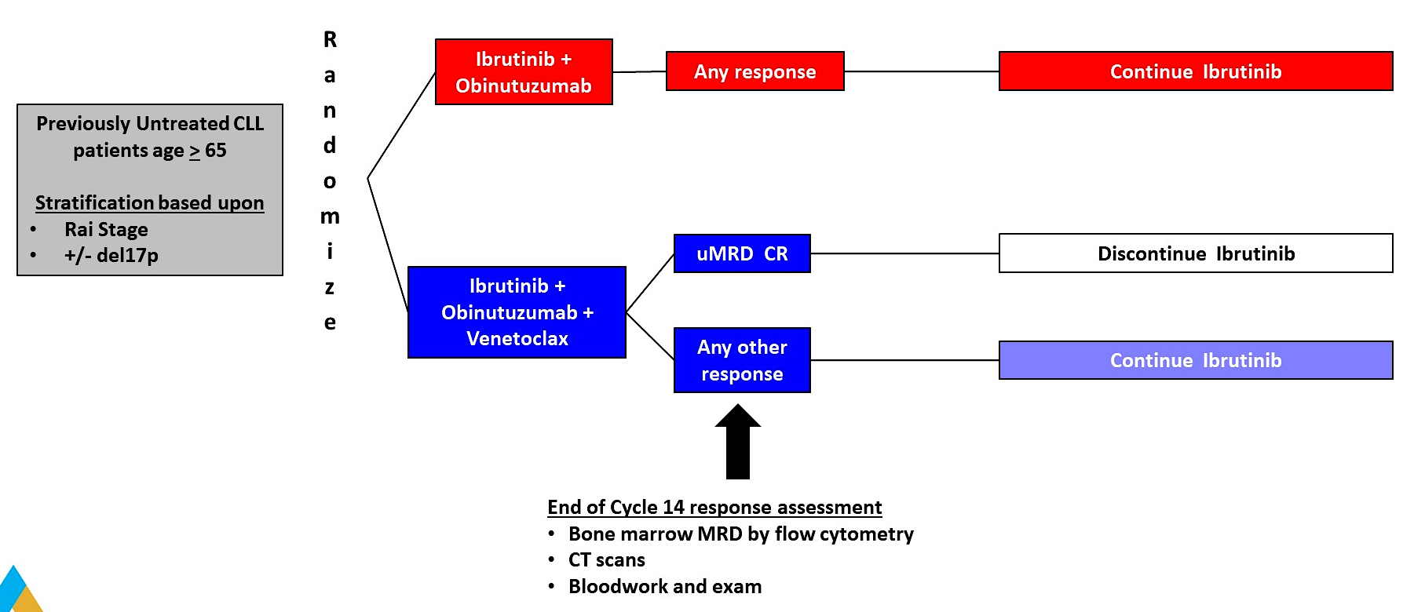
Results of a phase 3 study of IVO vs IO for previously untreated older patients (pts) with chronic lymphocytic leukemia (CLL) and impact of COVID-19 (Alliance)
Primary Endpoint: PFS
Woyach, et al. ASCO 2023; Abstract 7500.
Notes:
Older adults
1L therapy
IO (indefinite) vs. IVO (MRD guided discontinuation, discontinue if uMRD CR- flow in BM)
Designed to detect if IVO improves PFS compared to IO
Data released after the study met predefined futility threshold (HR of ½ in favor of IO) at the second planned event-driven interim analysis.

Slide 19
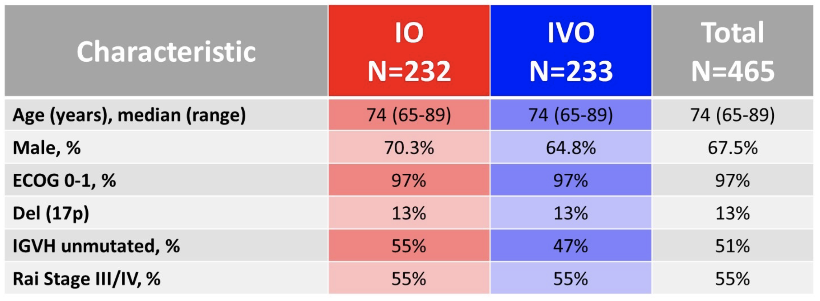
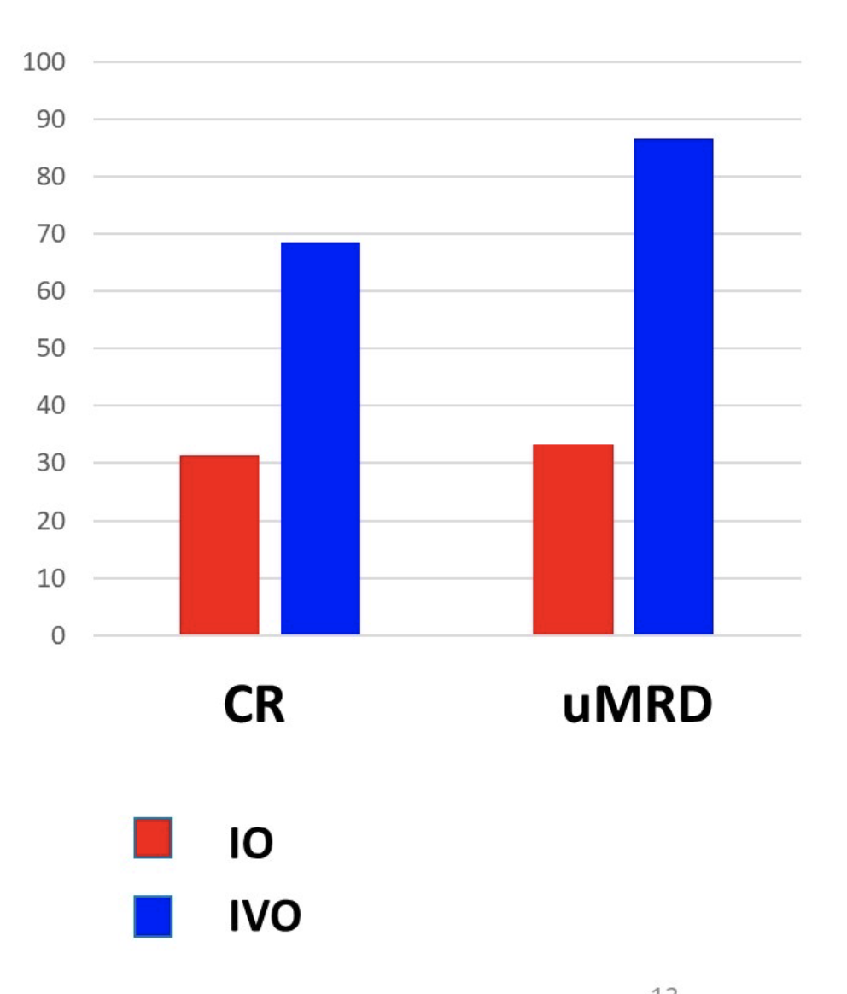
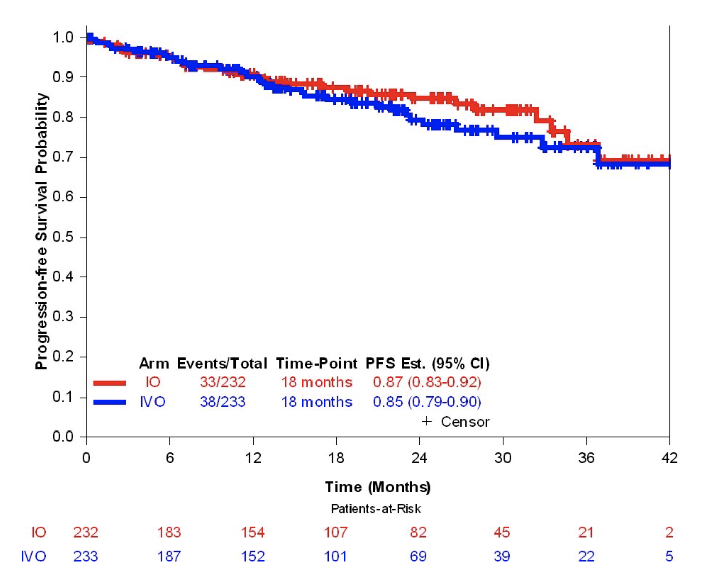
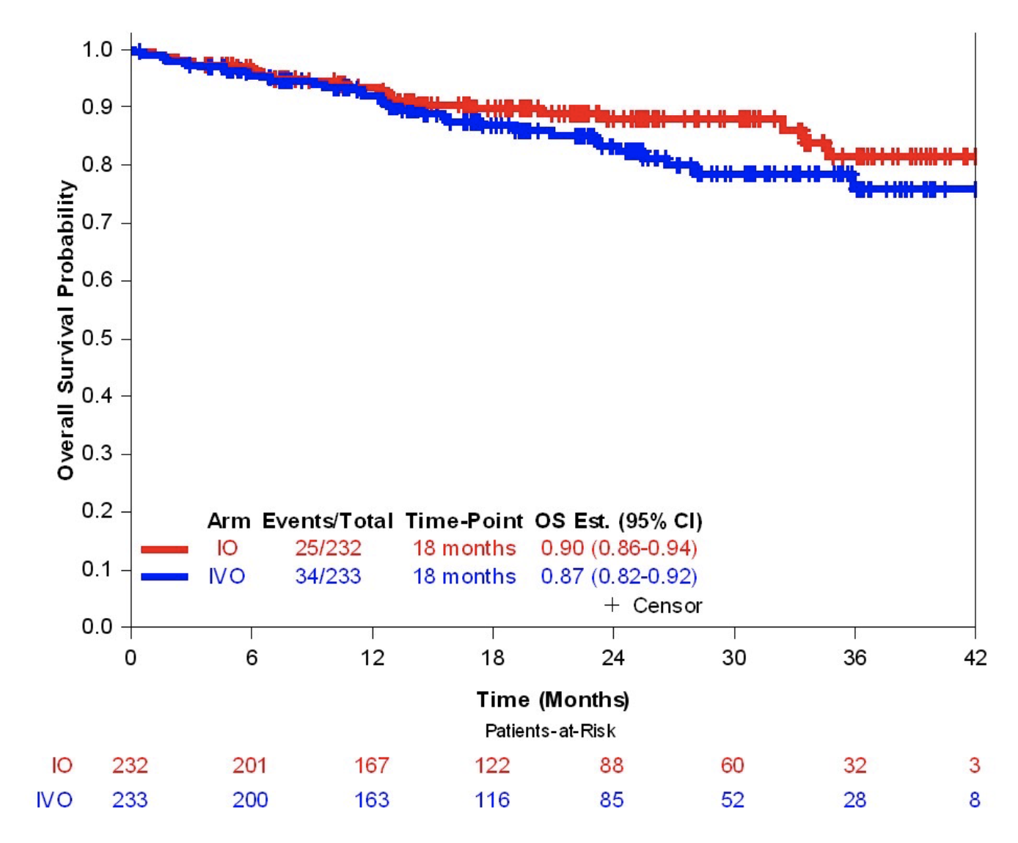
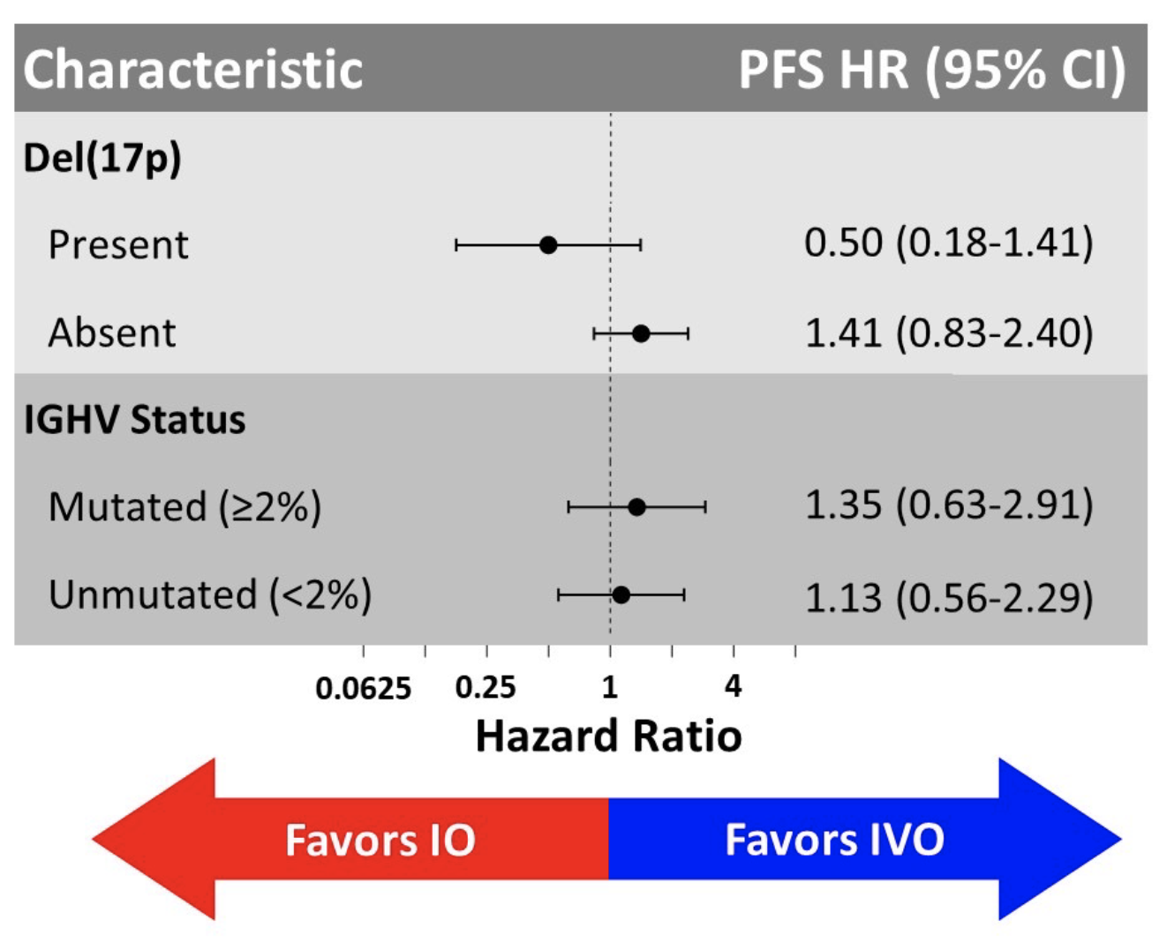
MRD and Response Rate
Progression Free Survival
Overall Survival
Woyach, et al. ASCO 2023; Abstract 7500.
Notes:
IVO is not superior to IO for initial treatment of older adults with CLL
COVID-19 was the leading cause of death in both arms, (11 COVID-19 deaths on IO, 19 on IVO), with 13 and 11 additional deaths from other causes, respectively.
PFS or OS curves are overlapping when covid deaths are censored – more covid deaths observed in patients who received triplet vs. doublet
PFS for patients treated with IVO is not impacted by MRD or response status

Slide 20
Results of a phase 3 study of IVO vs IO for previously untreated older patients (pts) with chronic lymphocytic leukemia (CLL) and impact of COVID-19 (Alliance)
IVO is not superior to IO in older adults
Excess COVID-related deaths for those who received IVO
Woyach, et al. ASCO 2023; Abstract 7500.
Notes:
Older adults
1L therapy
IO (indefinite) vs. IVO (MRD guided discontinuation, discontinue if uMRD CR- flow in BM)
Designed to detect if IVO improves PFS compared to IO
Data released after the study met predefined futility threshold (HR of ½ in favor of IO) at the second planned event-driven interim analysis.

Slide 21
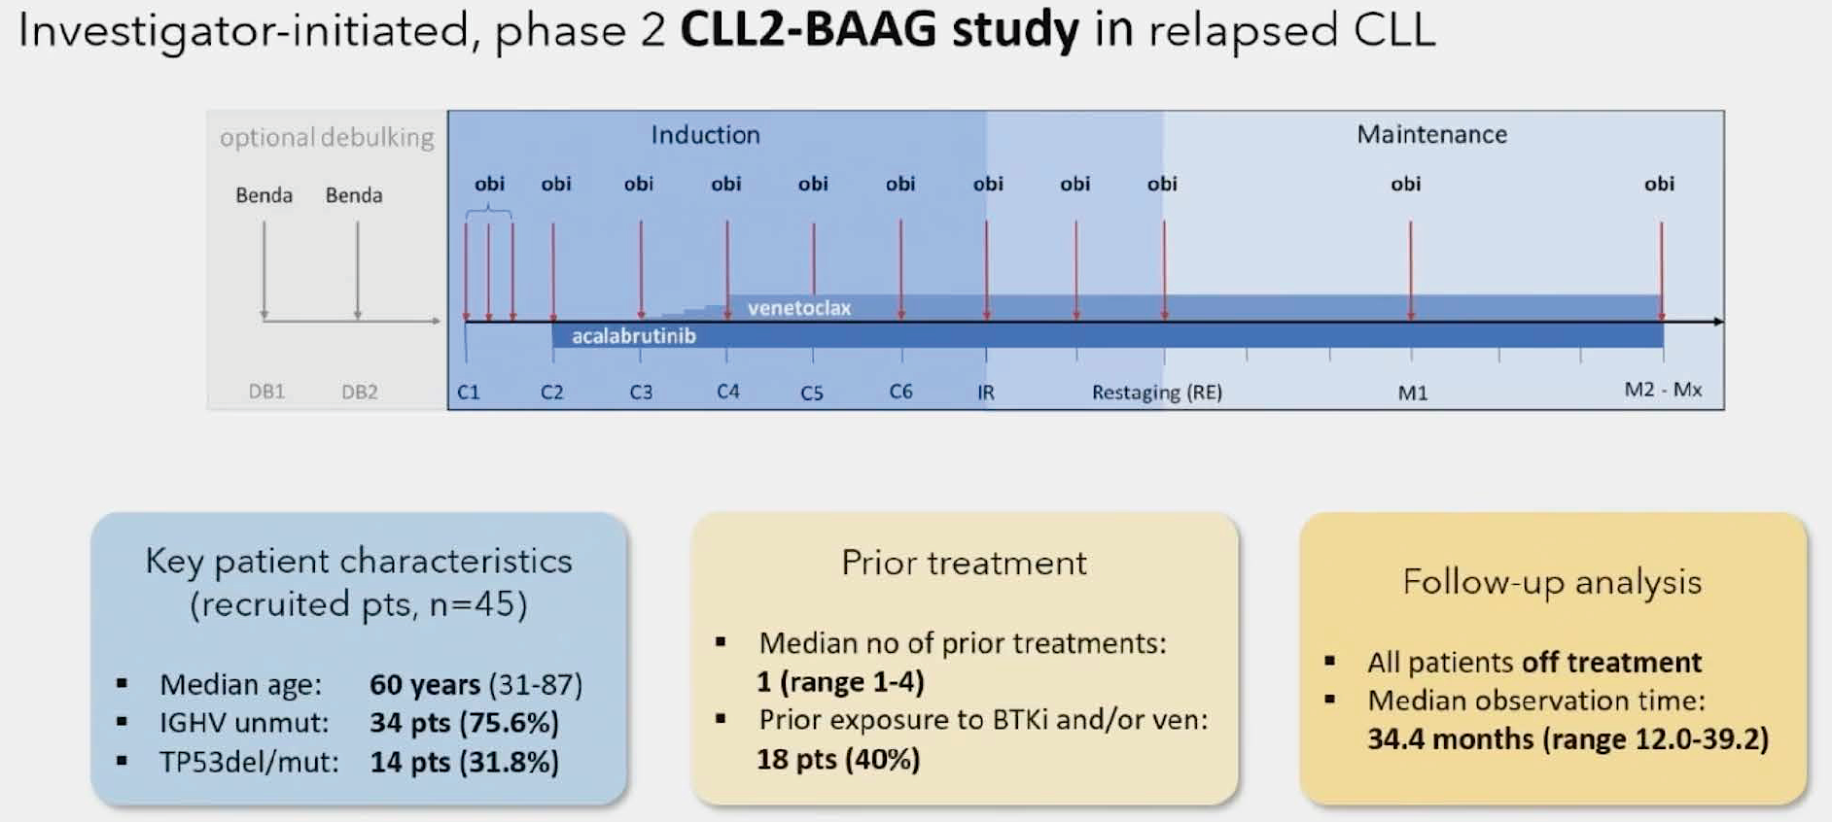
Long-term remissions with MRD-guided acalabrutinib, venetoclax and obinutuzumab in relapsed/refractory CLL: Follow-up efficacy and circulating tumor DNA analysis of the CLL2-BAAG trial
Furstenau, et al. ASH 2023; Abstract 203.
Notes:
Optional benda debulking, C1 Obin, C2 acala, C3 ven, MRD tested at C9, Q3 month maintenance
Treated until uMRD (10^-4 sens, pb), max of 24 months of maintenance
Primary endpoint = uMRD, 76% had achieved uMRD after 6months of triplet therapy, here presented efficacy data

Slide 22
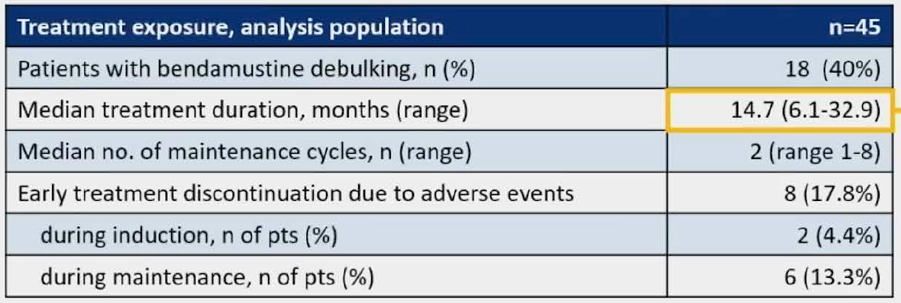
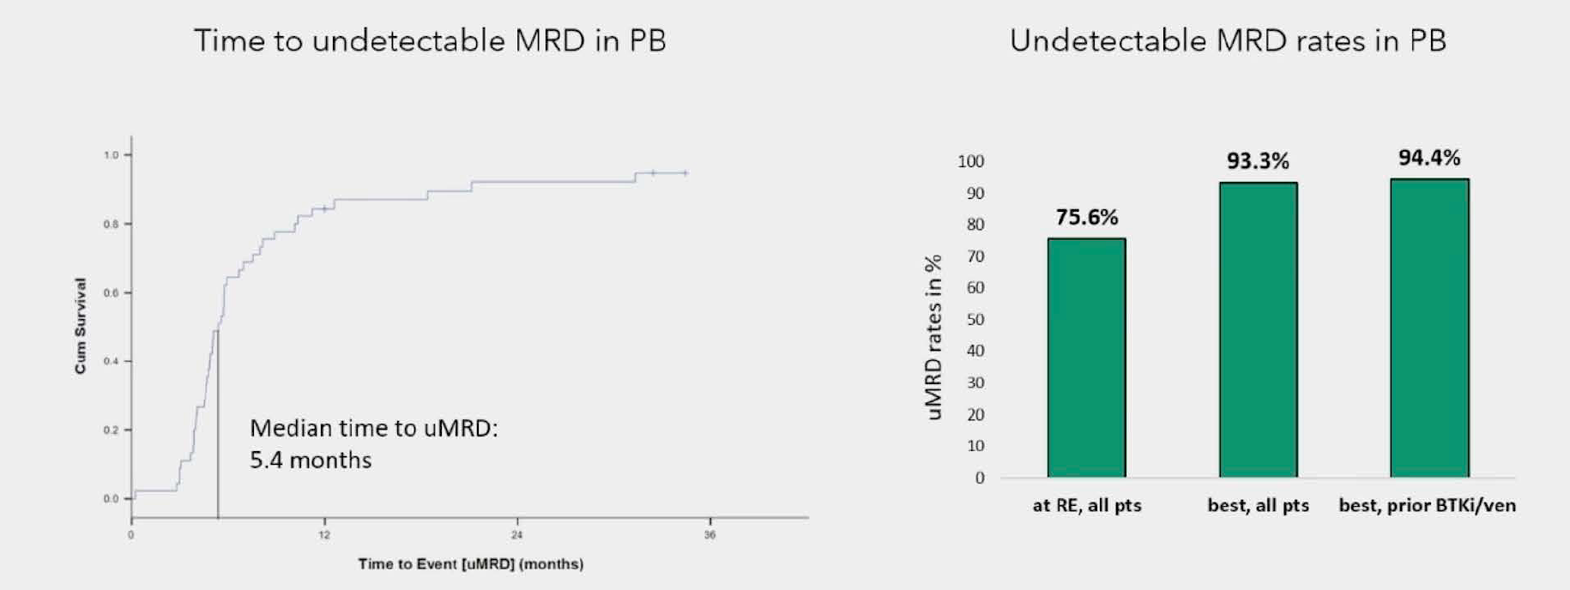
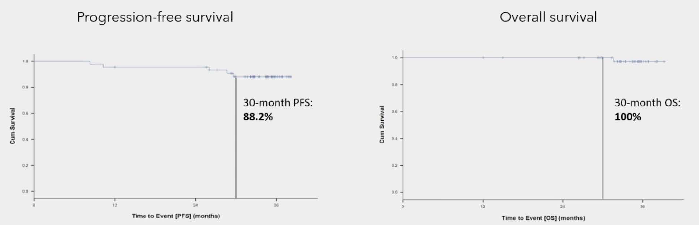
7 of 10 patients with +MRD after induction achieved uMRD during maintenance
Furstenau, et al. ASH 2023; Abstract 203.
Notes:
Authors also looked at ctDNA analyses, found that addition of ctDNA to standard flow based MRD detection improved ability to detect early relapse, esp for patients with higher risk disease

Slide 23
Long-term remissions with MRD-guided acalabrutinib, venetoclax and obinutuzumab in relapsed/refractory CLL: Follow-up efficacy and circulating tumor DNA analysis of the CLL2-BAAG trial
Treatment with AVO in a R/R population achieves high levels of uMRD
ctDNA enhances ability to detect early molecular relapse
Furstenau, et al. ASH 2023; Abstract 203.
Notes:
Optional benda debulking, C1 Obin, C2 acala, C3 ven, MRD tested at C9, Q3 month maintenance
Treated until uMRD (10^-4 sens, pb), max of 24 months of maintenance
Primary endpoint = uMRD, 76% had achieved uMRD after 6months of triplet therapy, here presented efficacy data

Slide 24
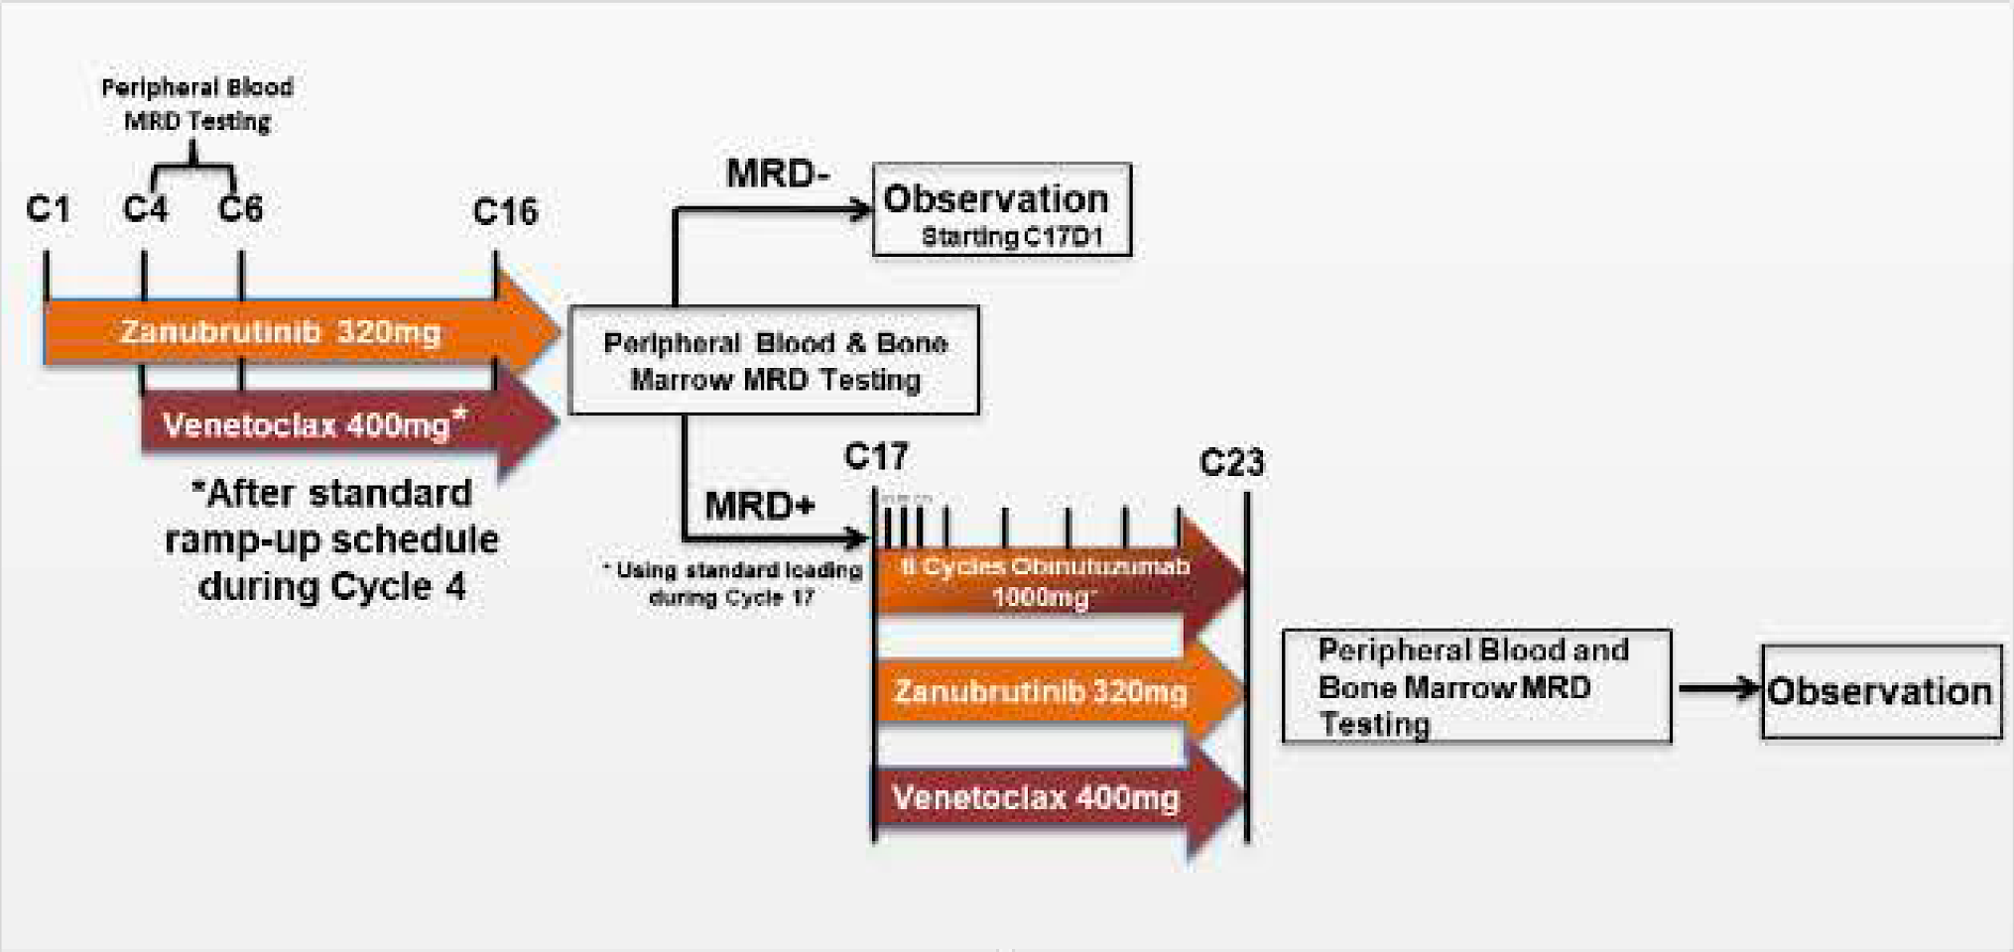
Trial in Progress: Zanubrutinib and venetoclax as initial therapy for CLL/SLL with obinutuzumab triplet consolidation in patients with minimal residual disease positivity (BruVenG)
Allan, et al. ASH 2023; Abstract 3285.
Notes:
TIP – address need for triplet therapy
Recent reports of triplet regimens demonstrate modest improvement in minimal residual disease (MRD) negativity with similar response rates when compared to oral doublets
Therefore, anti-CD20 therapy may not be required for all patients and could be optimized within
a response-adapted strategy. This trial has been developed to assess e_cacy and safety of a response adapted consolidative
treatment approach utilizing obinutuzumab triplet consolidation in CLL/SLL patients who remain MRD positive after an oral
doublet Yxed duration treatment with zanubrutinib and venetoclax.
This approach looks to maximize MRD negative
remissions, spare toxicity by limiting anti-CD20 exposure, and provide a Ynite therapy.

Slide 25
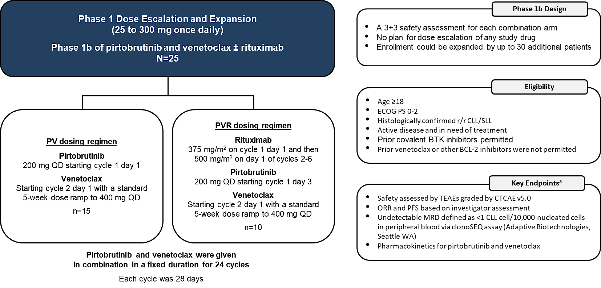
Fixed-duration pirtobrutinib combined with venetoclax ± rituximab in relapsed/refractory chronic lymphocytic leukemia: Updated results, including MRD data, from the BRUIN Phase 1b study
Roeker, et al. ASH 2023; Abstract 3269.

Slide 26
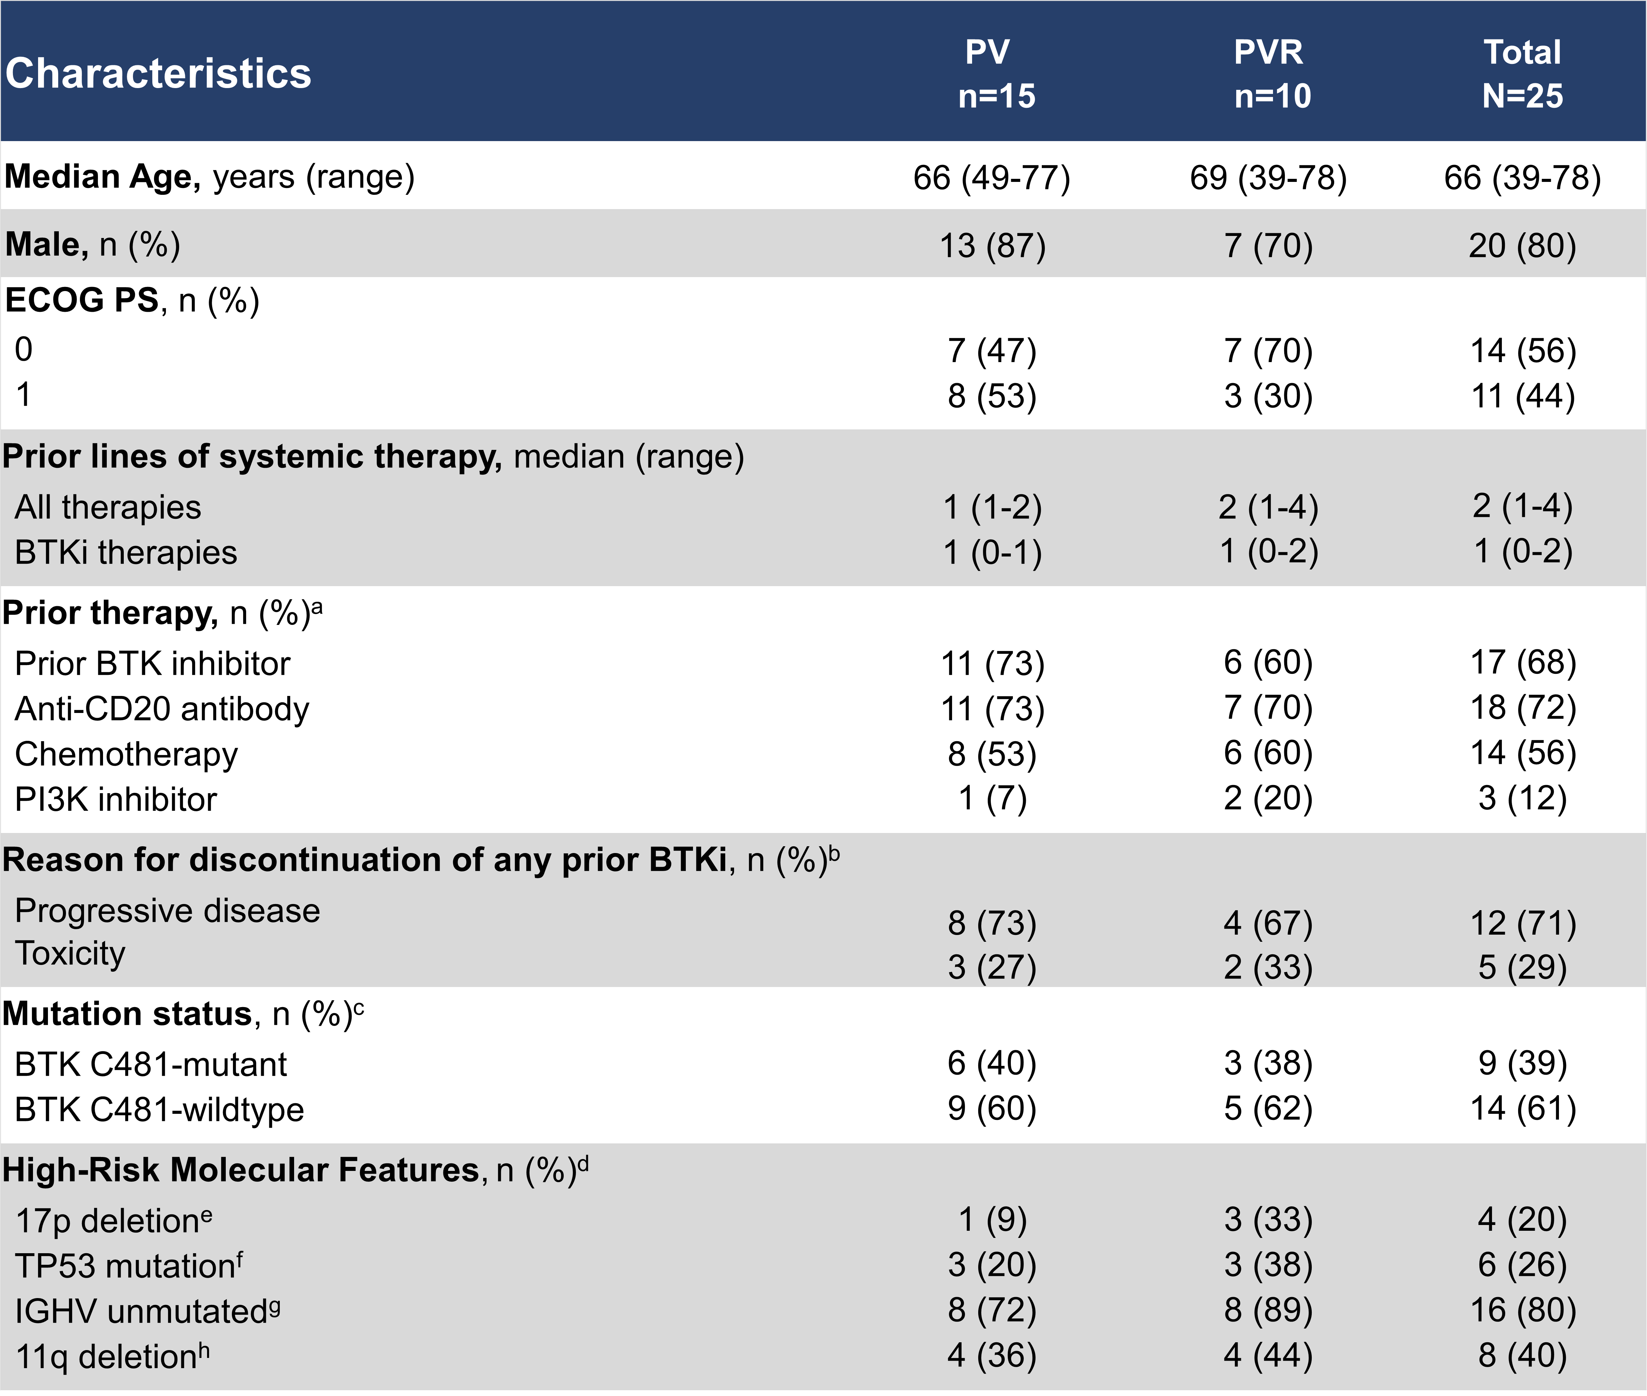
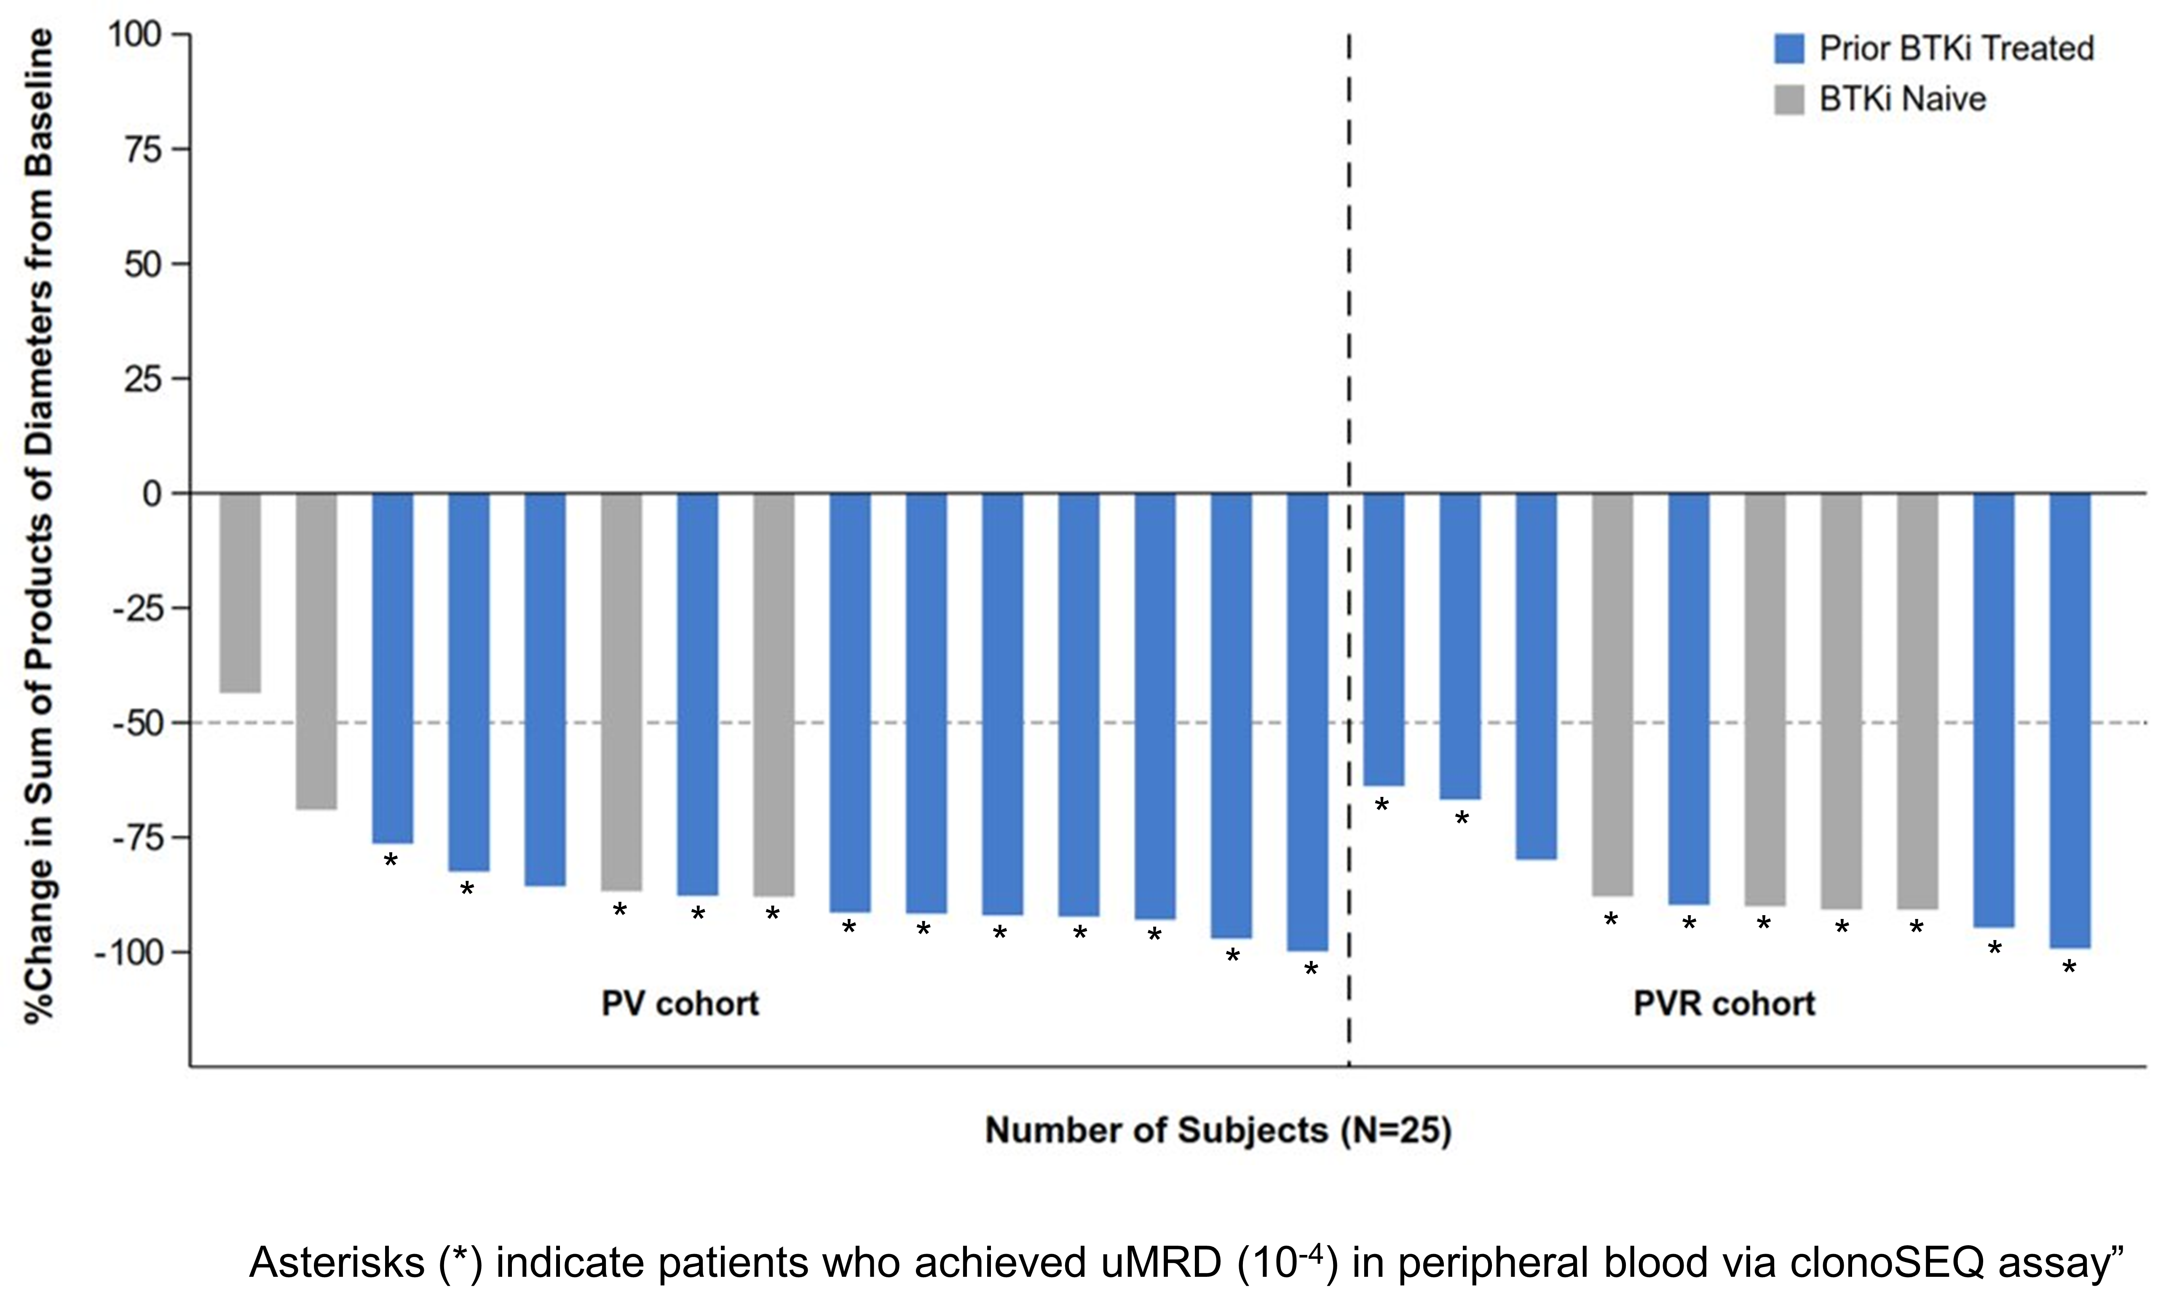
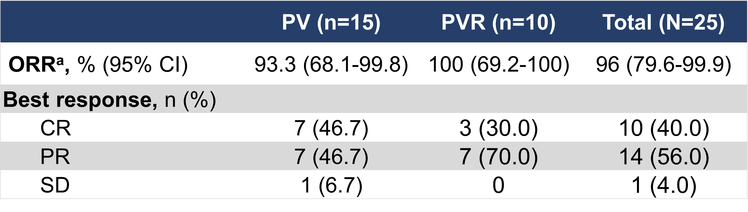
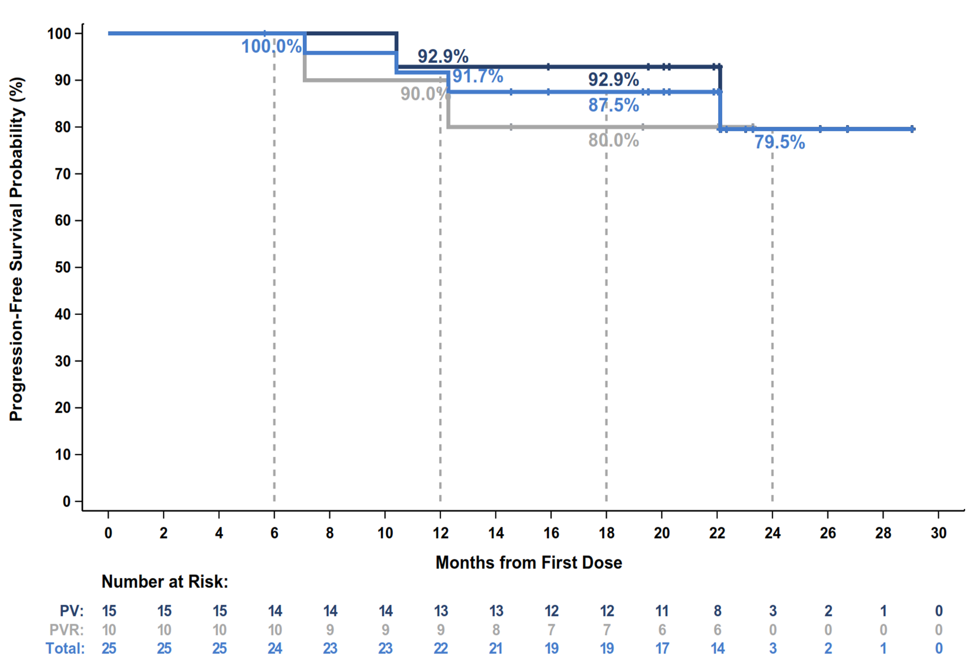
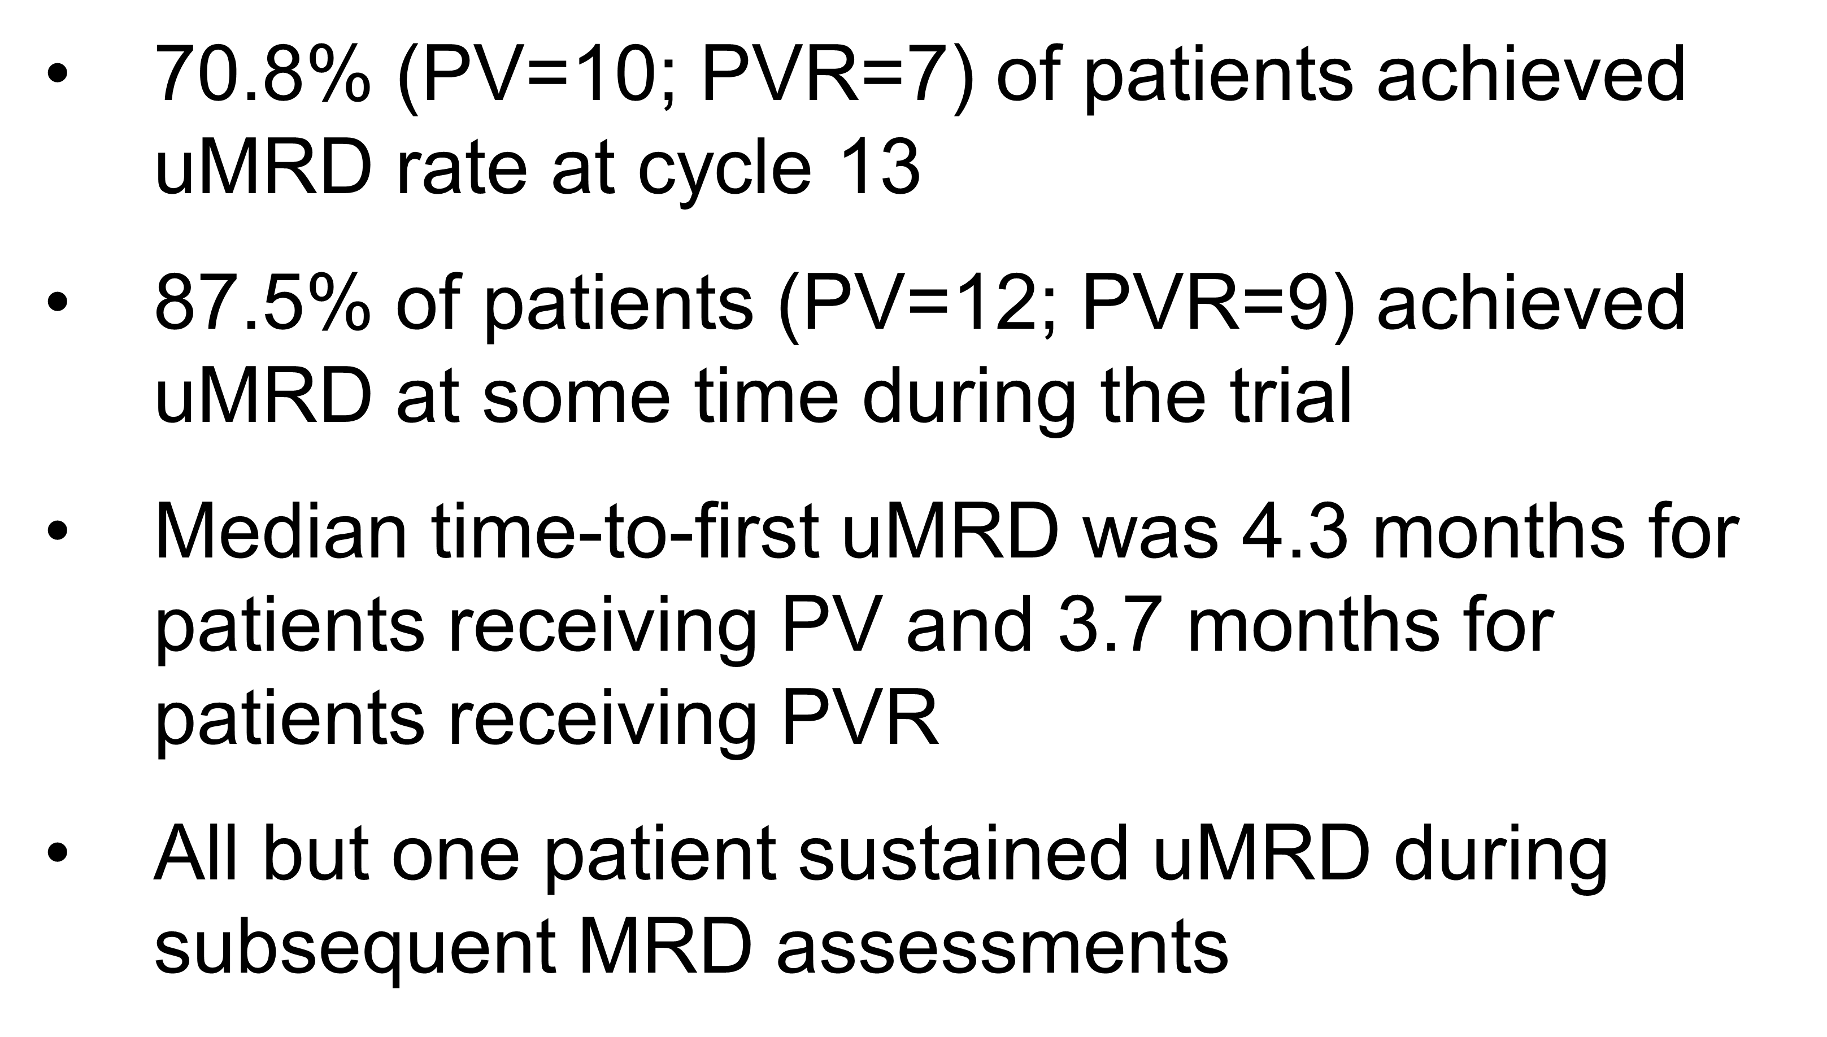
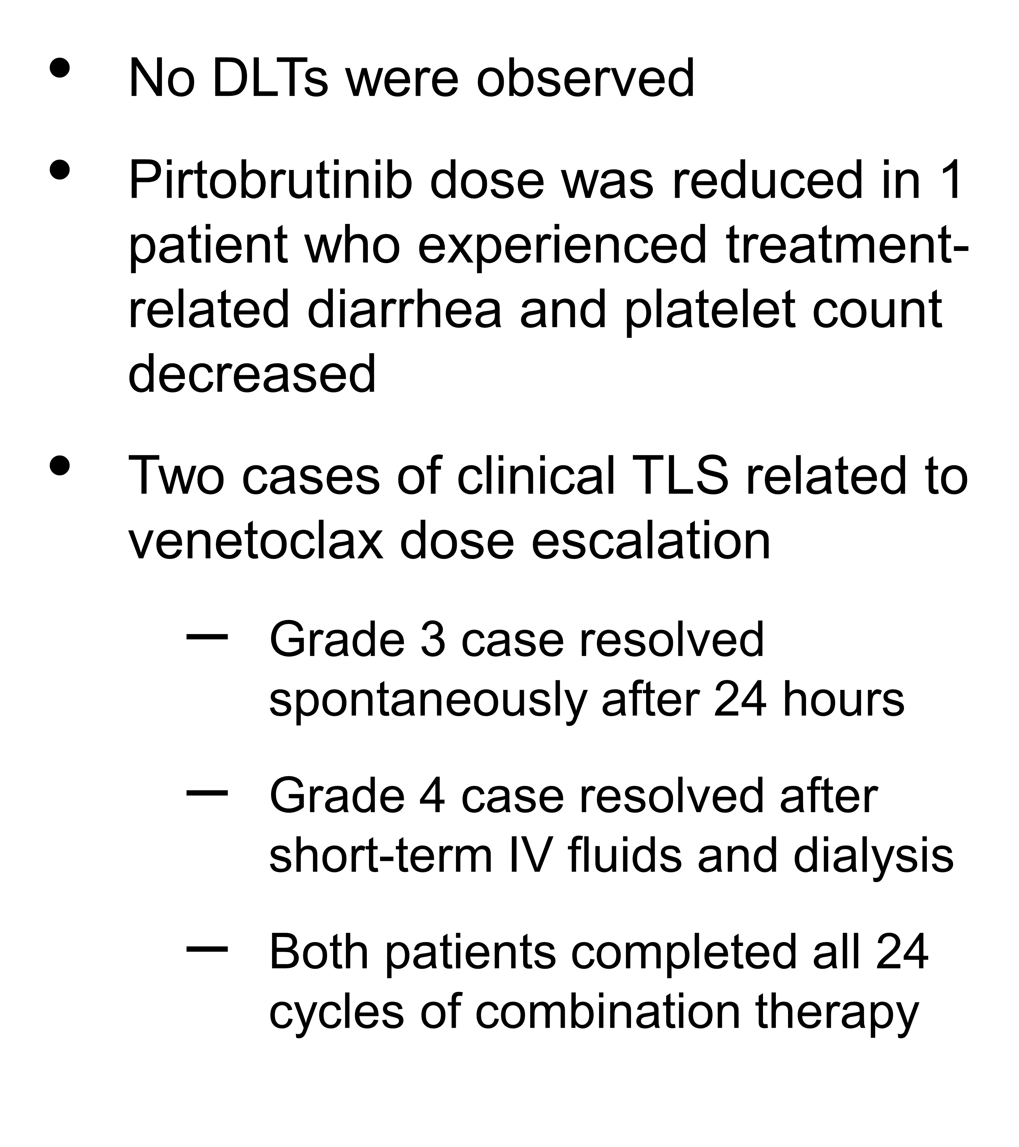
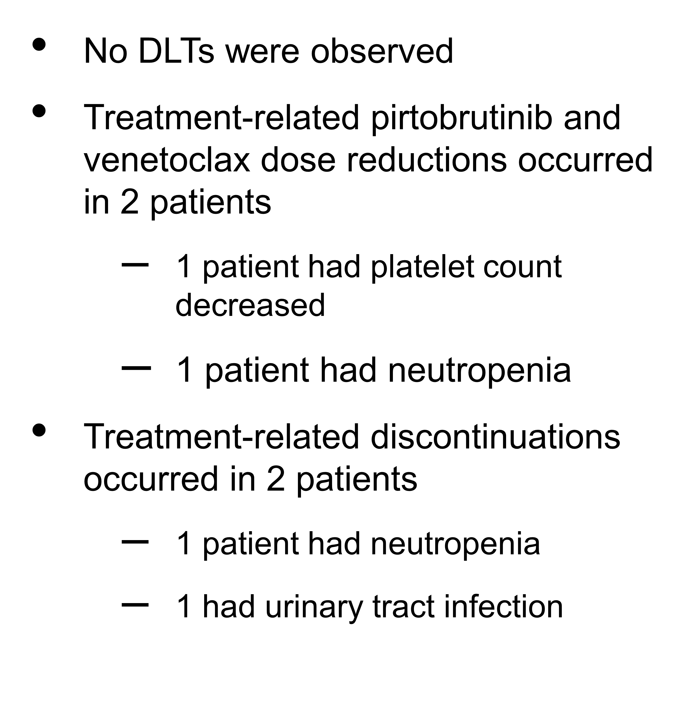
PV Safety
PVR Safety
Roeker, et al. ASH 2023; Abstract 3269.

Slide 27
Fixed-duration pirtobrutinib combined with venetoclax ± rituximab in relapsed/refractory chronic lymphocytic leukemia: Updated results, including MRD data, from the BRUIN Phase 1b study
Pirtobrutinib / Venetoclax ± Rituximab is effective
(achieves high ORR) in R/R population
No DLTs observed, combination being explored in Ph3 study
Roeker, et al. ASH 2023; Abstract 3269.

Slide 28
New Agents

Slide 29
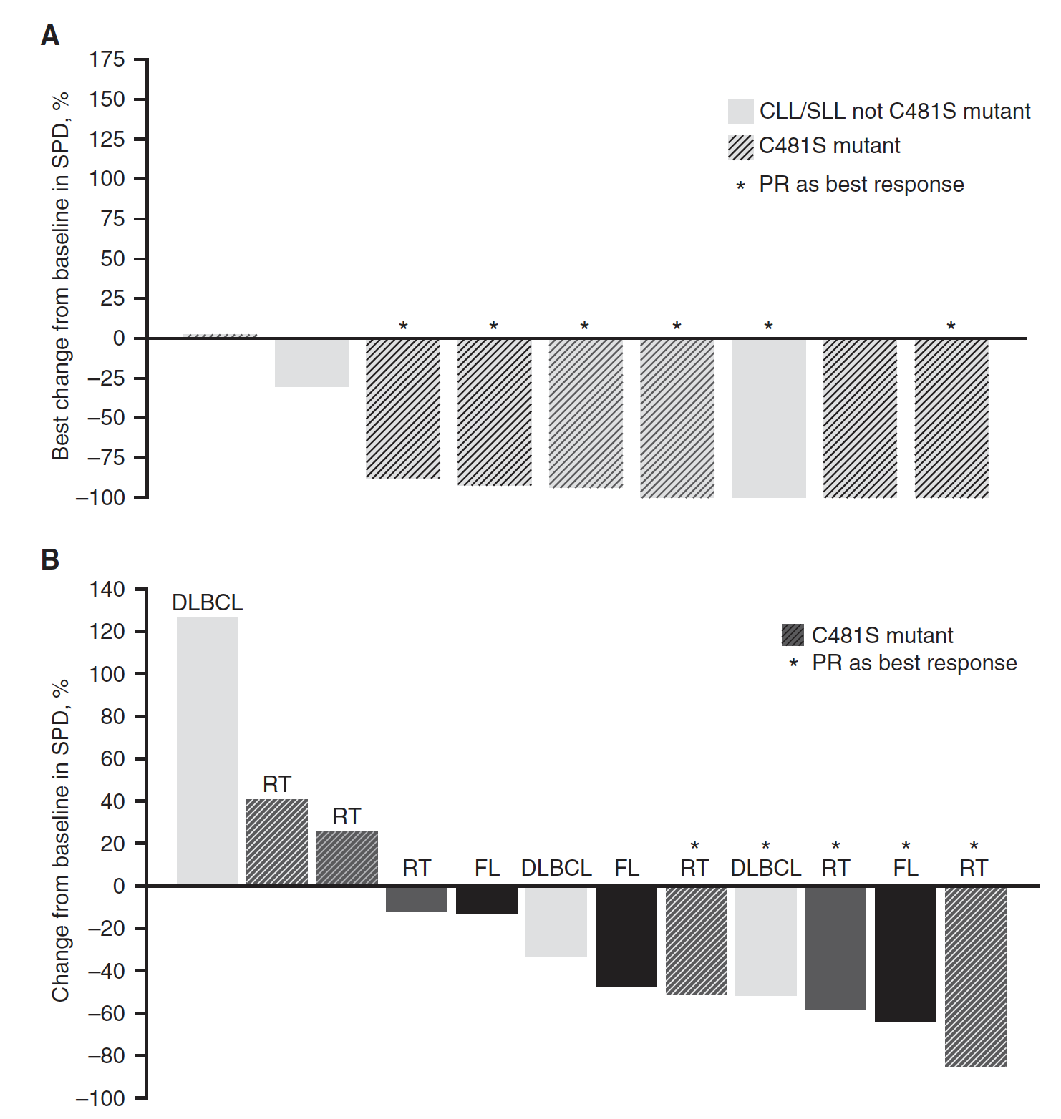
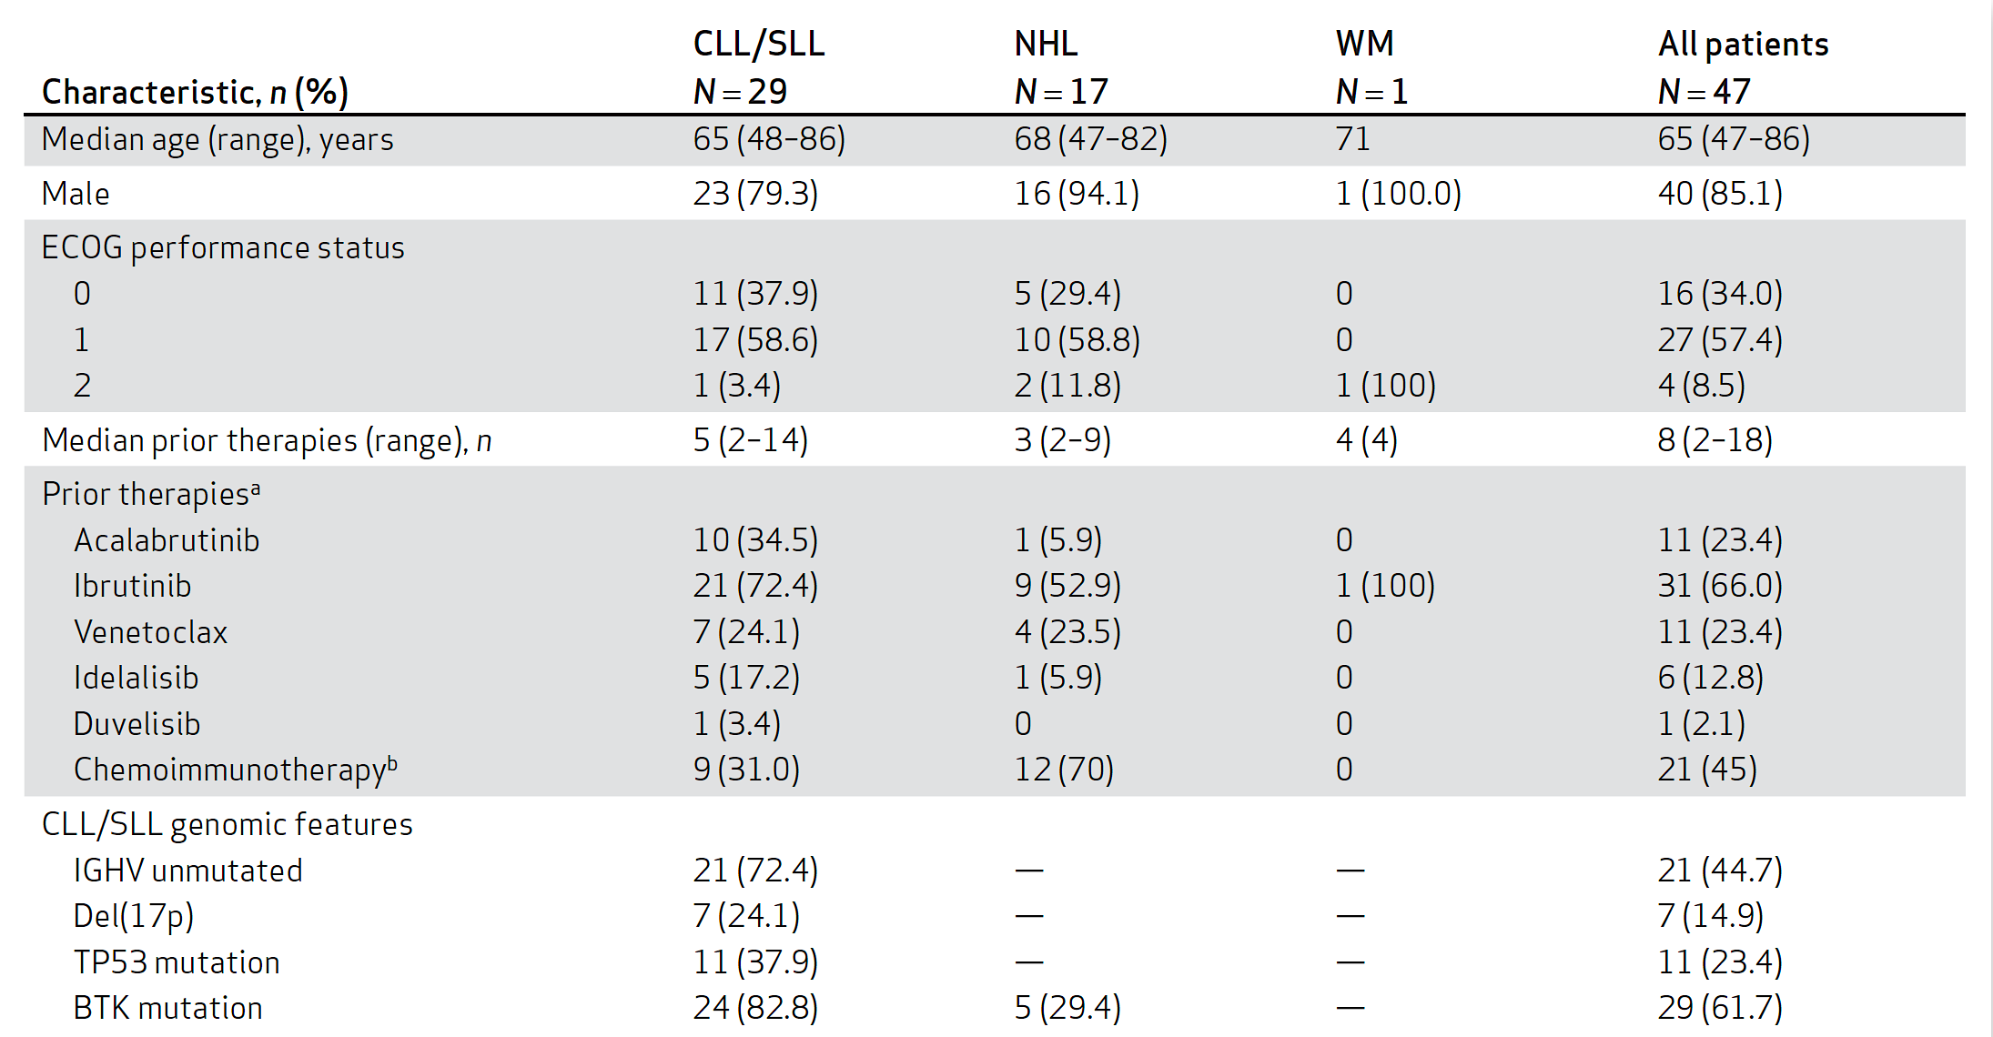
First-in-human study of the reversible BTK inhibitor nemtabrutinib in patients with relapsed/refractory chronic lymphocytic leukemia and B-cell non-Hodgkin lymphoma
CLL ORR = 36%, 75% in those who received 65mg+
median PFS = 16.7 months
Heme AEs: anemia 13% (G3 11%), neutropenia 26% (G3 13%, G4 11%) thrombocytopenia 15% (G3 4%, G4 9%).
Most common non-heme AEs: weight gain (21%), cough (36%), fatigue (34%), back pain (32%)
Response in 3 of 6 RT patients
Woyach, et al. Cancer Discov 2024;14(1):66-75.

Slide 30
First-in-human study of the reversible BTK inhibitor nemtabrutinib in patients with relapsed/refractory chronic lymphocytic leukemia and B-cell non-Hodgkin lymphoma
Nemtabrutinib is a noncovalent BTKi with activity in CLL
(regardless of C481 status) and NHL
Woyach, et al. Cancer Discov 2024;14(1):66-75.

Slide 31
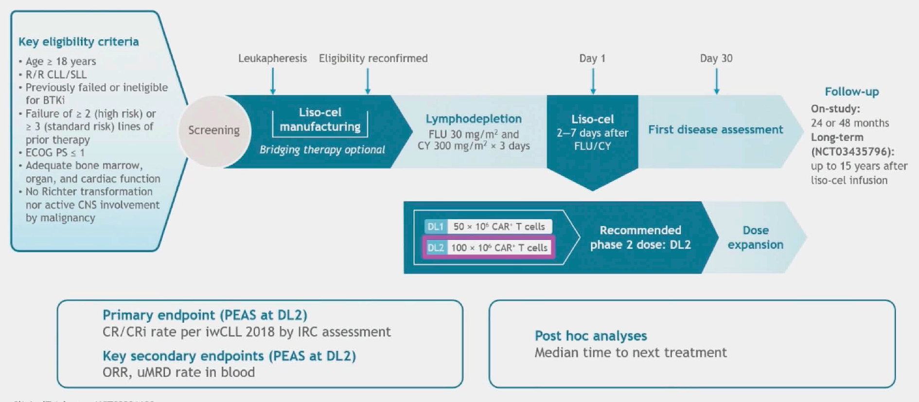
Lisocabtagene maraleucel (liso-cel) in R/R CLL/SLL: 24-month median follow-up of TRANSCEND CLL 004
Siddiqi, et al. ASH 2023; Abstract 330.

Slide 32
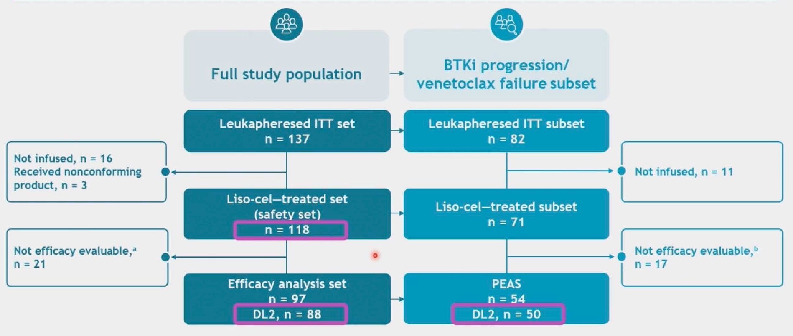
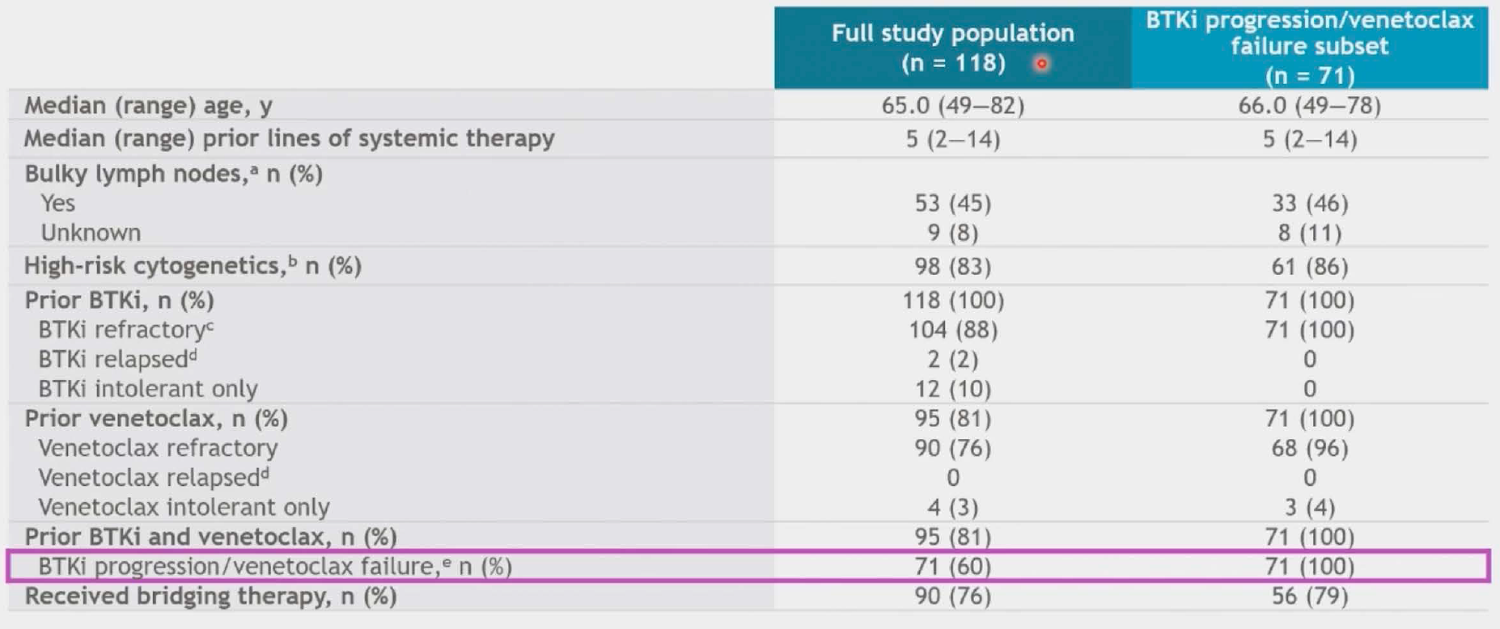
Primary endpoint = CR/CRi in double refractory population
Siddiqi, et al. ASH 2023; Abstract 330.

Slide 33
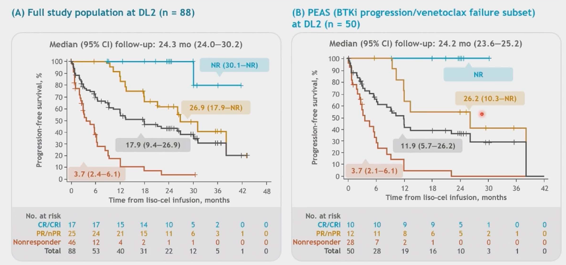
CR/CRi in full study population = 19% (17/88)
ORR in double refractory population = 48% (42/88)
CR/CRi in double refractory population = 20% (10/50)
ORR in double refractory population = 44% (22/50)
Siddiqi, et al. ASH 2023; Abstract 330.
Notes:
Median (95% CI) OS was 30.3 months (15.0–NR).
The rate of any-grade cytokine release syndrome (CRS) was 85% (grade 3, 8%; no grade 4/5) and neurological events (NE) was 45% (grade 3, 18%; grade 4, 1%; no grade 5); 69% received tocilizumab and/or corticosteroids for CRS/NEs.

Slide 34
Lisocabtagene maraleucel (liso-cel) in R/R CLL/SLL: 24-month median follow-up of TRANSCEND CLL 004
For responders, Liso-cel achieves durable remissions,
even for those with double refractory disease
Siddiqi, et al. ASH 2023; Abstract 330.

Slide 35
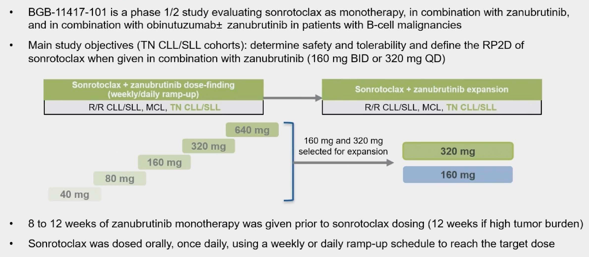
Combination treatment with sonrotoclax (BGB-11417), a second-generation BCL2 inhibitor, and zanubrutinib, a Bruton tyrosine kinase (BTK) inhibitor, is well tolerated and achieves deep responses in patients with treatment-naïve chronic lymphocytic leukemia/small lymphocytic lymphoma (TN-CLL/SLL): Data from an ongoing Phase 1/2 study
Tam, et al. ASH 2023; Abstract 327.
Notes:
Sonrotoclax – highly potent BCL2i
This is a look at the 1L patients who recived combo of sonrotocola + zanu
Therapy continued until progression, intolerance, or they elected to stop

Slide 36
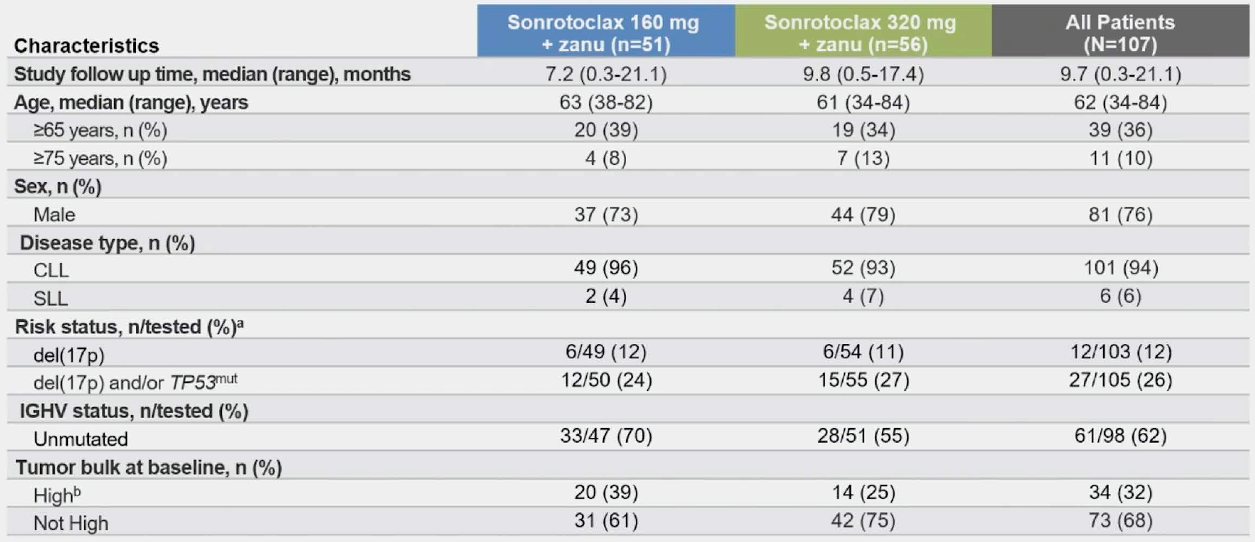





Tam, et al. ASH 2023; Abstract 327.
Notes:
Sonrotoclax – highly potent BCL2i
This is a look at the 1L patients who recived combo of sonrotocola + zanu
Therapy continued until progression, intolerance, or they elected to stop
Safe and well tolerated -106 of 107 patients remain on drug
No TLS or cardiac tox observed
Most common grade 3 AE was neutropenia
ORR 100%
320mg dose was selected for ph 3 study

Slide 37
Combination treatment with sonrotoclax (BGB-11417), a second-generation BCL2 inhibitor, and zanubrutinib, a Bruton tyrosine kinase (BTK) inhibitor, is well tolerated and achieves deep responses in patients with treatment-naïve chronic lymphocytic leukemia/small lymphocytic lymphoma (TN-CLL/SLL): Data from an ongoing Phase 1/2 study
Sonrotoclax and Zanubrutinib is a well tolerated and effective (ORR 100%, though follow up is currently limited) combination
Tam, et al. ASH 2023; Abstract 327.
Notes:
Sonrotoclax – highly potent BCL2i
This is a look at the 1L patients who recived combo of sonrotocola + zanu
Therapy continued until progression, intolerance, or they elected to stop

Slide 38
Richter’s Transformation

Slide 39



Results of MOLTO, a multicenter, open label, phase II clinical trial evaluating venetoclax, atezolizumab and obinutuzumab combination in Richter syndrome
Frustaci, et al. ASCO 2023; Abstract 7502.

Slide 40



ORR = 68% (29% CR, 39% PR by Lugano Criteria)
Ann Arbor stage
III-IV
Frustaci, et al. ASCO 2023; Abstract 7502.
Notes:
Median duration of response = 11.7 months
PFS = 16.2 months
OS = 31.6 months

Slide 41
Results of MOLTO, a multicenter, open label, phase II clinical trial evaluating venetoclax, atezolizumab and obinutuzumab combination in Richter syndrome
Obin / Atezo / Ven has activity in untreated Richter’s transformation with ORR of 68%, median PFS of 16 months (compares favorably to CIT)
Frustaci, et al. ASCO 2023; Abstract 7502.

Slide 42

Tislelizumab plus zanubrutinib in patients with Richter transformation: Primary endpoint analysis of the prospective, multi-center, Phase-II RT1 trial of the German CLL Study Group
Patients with ≤1 prior RT-directed LOT
Q3 week Tislelizumab + daily zanubrutinib
6 cycles induction + 6 cycles consolidation
CR/PR/SD → Continue until POD
3 Deaths
2 Deaths
2 discontinued study
2 Deaths
Al-Sawaf, et al. ASH 2023; Abstract 204.
Notes:
Tislelizumab = PD1 inhibitor
Most o

Slide 43




ORR = 58%
6-month DOR rate = 75%
1-year OS rate = 75%
Median PFS = 10 months
Median TTNT = 12 months
Al-Sawaf, et al. ASH 2023; Abstract 204.
Notes:
Tislelizumab = PD1 inhibitor
Median age was 67 years (range 45 - 82). 22 (45.8%) pts had ECOG 1 or higher. Median LDH at enrollment was 335 U/l.
Sixteen (34.8%) pts had del(17p)/TP53mut, 29 (70.7%) pts had unmutated IGHV. 25 (64.1%) pts had high or very high-risk CLL
according to CLL-IPI, 11 (28.2%) intermediate and 3 (7.7%) low risk. Complex karyotype (≥3 aberrations) was detected in 16
(42.1%) pts.
46 (95.8%) pts had DLBCL-RT and 2 (4.2%) pts had HL-RT. In 26 (54.2%) pts, the RT was reported as clonally related to the CLL
(22 [45.8%] unknown). Overall, 36 (75.0%) pts had received prior CLL-directed therapy, including CIT (25 pts) and targeted
agents (32 pts) as well as prior allogeneic stem cell transplant (SCT) in 3 pts. 12 (25.0%) pts had treatment-naive CLL.
Thirteen pts (27.1%) had received prior RT-directed therapy, including CHOP-like regimens and BTK inhibitors. 35 (72.8%) pts
had not received prior RT-directed therapy.
Twenty-eight of 48 pts responded to induction therapy resulting in an ORR of 58.3% (95% CI, 0.43-0.72), including 9 (18.8%)
CR and 19 (39.6%) PR, meeting the study’s primary endpoint (p=0.008) (Fig A). SD was reported in 6 (12.5%) pts, 11 (22.9%)
pts had progressive disease (PD), three had missing assessment due to PD. The median DOR was not reached, the 6-month
DOR rate was 70.6%. Median PFS was 10 months (95% CI 3.8 -16.3) with a 12-month rate of 46.9% (Fig B). Median OS was
not reached (12-month OS rate 74.7%). Median TTNT was not reached (12-month TTNT rate 56.2%).

Slide 44
Tislelizumab plus zanubrutinib in patients with Richter transformation: Primary endpoint analysis of the prospective, multi-center, Phase-II RT1 trial of the German CLL Study Group
Tislelizumab / Zanubrutinib has activity in Richter's transformation
(≤1 prior line) with ORR 58%, median PFS 10 months
Al-Sawaf, et al. ASH 2023; Abstract 204.
Notes:
Tislelizumab = PD1 inhibitor
Most o

Slide 45


Pirtobrutinib in Richter transformation: Updated efficacy and safety results with 18-month median survival follow-up from the Phase 1/2 BRUIN study
Median DOR = 7.4 months (9.7 mo f/u)
Median PFS = 3.7 months (13.8 mo f/u)
Wierda, et al. ASH 2023; Abstract 1737.

Slide 46
Pirtobrutinib in Richter transformation: Updated efficacy and safety results with 18-month median survival follow-up from the Phase 1/2 BRUIN study
Pirtobrutinib has single agent activity in R/R Richter’s with ORR of 50%
Wierda, et al. ASH 2023; Abstract 1737.

