Slide 1
RTP: Current and Emerging Role of Biomarker-Directed Therapeutic Approaches for Patients with AML
Courtney DiNardo

Slide 2
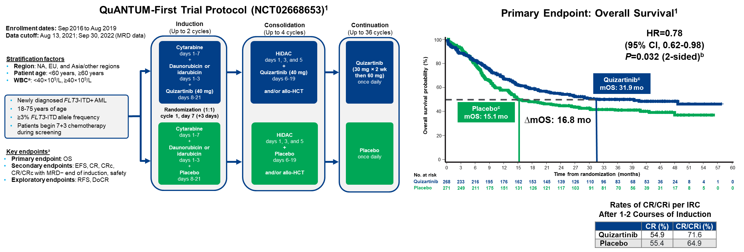
Newly Dx IC-eligible FLT3-ITD Mutated: QuANTUM-First Updates
Background: The addition of QUIZ to IC induction, Consolidation and Maintenance Improves OS
Erba H et al, Lancet 2023

Slide 3
Comparing RATIFY and QuANTUM-First?
HR: 0.78
60-day mortality: not reported
60-day mortality: quizartinib 7.5%, placebo 4.9% (mostly infections)
ANC recovery was 7 days longer in quiz arm; platelets 2 days longer in quiz arm
Stone RM, et al. N Engl J Med. 2017 Aug 3;377(5):454-464
Erba HP, et al. Lancet. 2023 May 13;401(10388):1571-1583

Slide 4
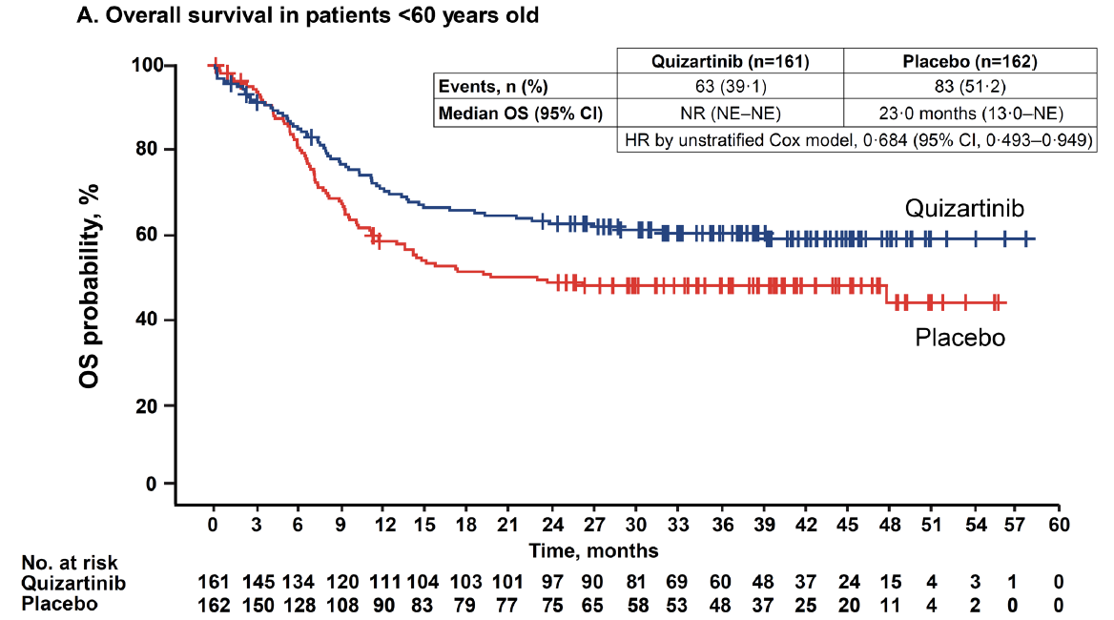
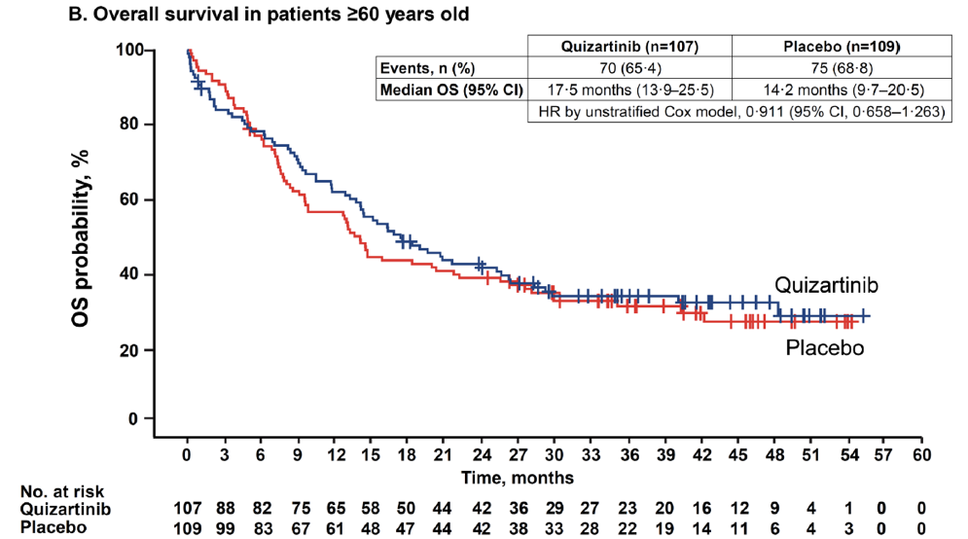
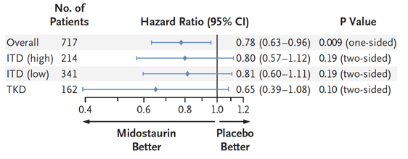
Younger patients particularly benefit from addition of quizartinib
RATIFY, all <60 years old and 25% FLT3-TKD: 4yr OS 51%
QuANTUM-First: <60yr old and FLT-ITD: 4yr OS 60%
HR: 0.78

Slide 5
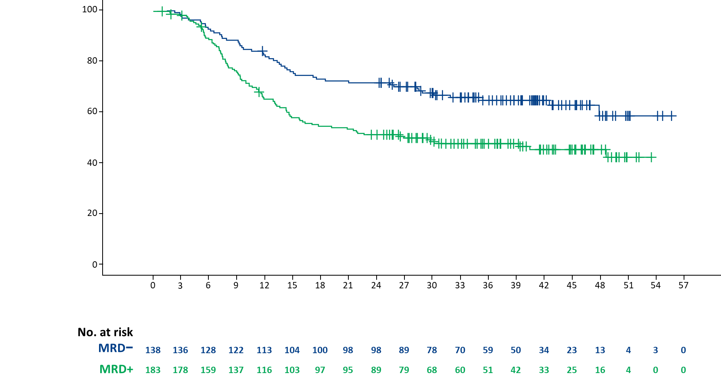
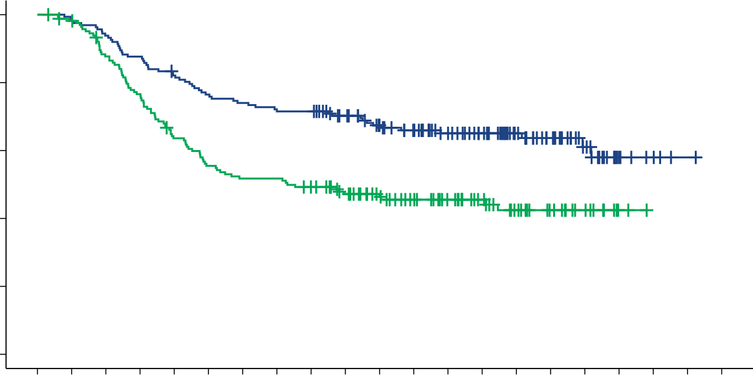
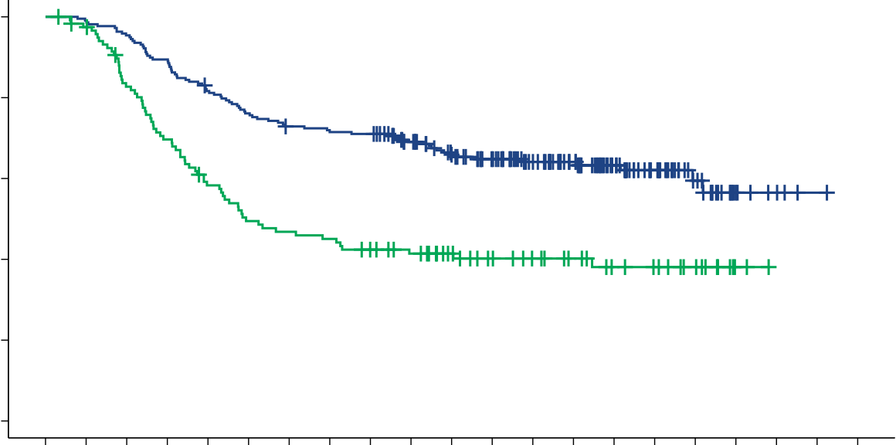
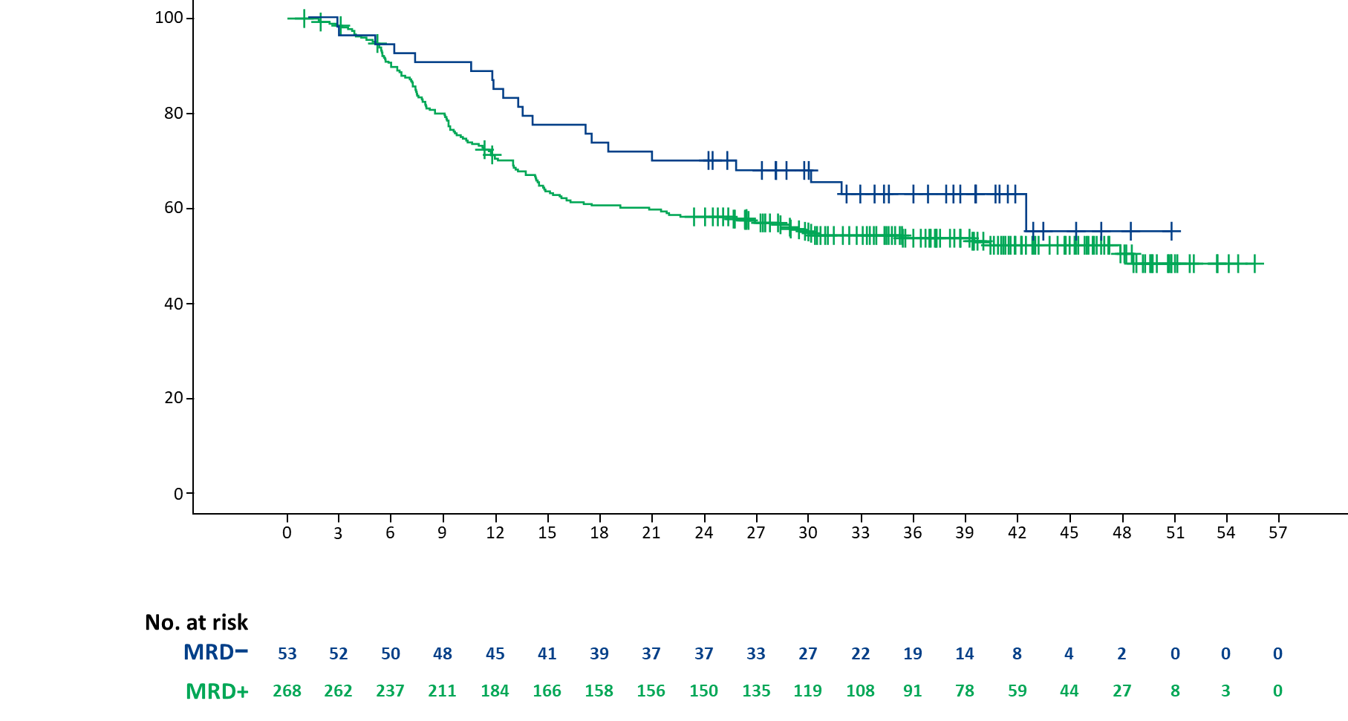
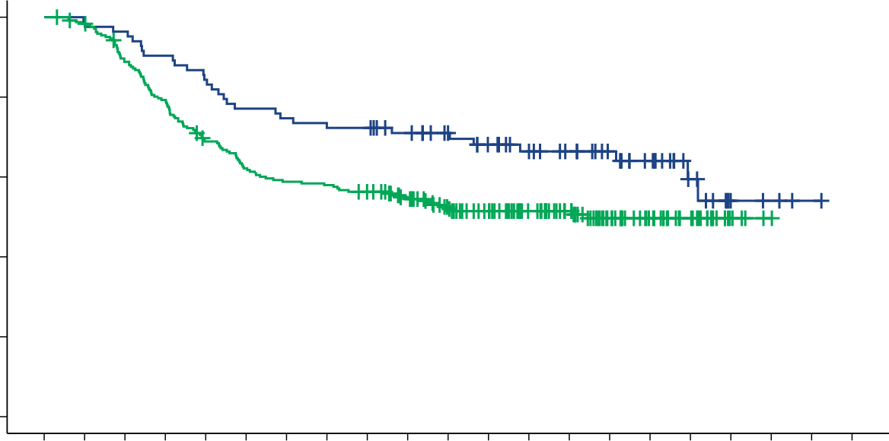
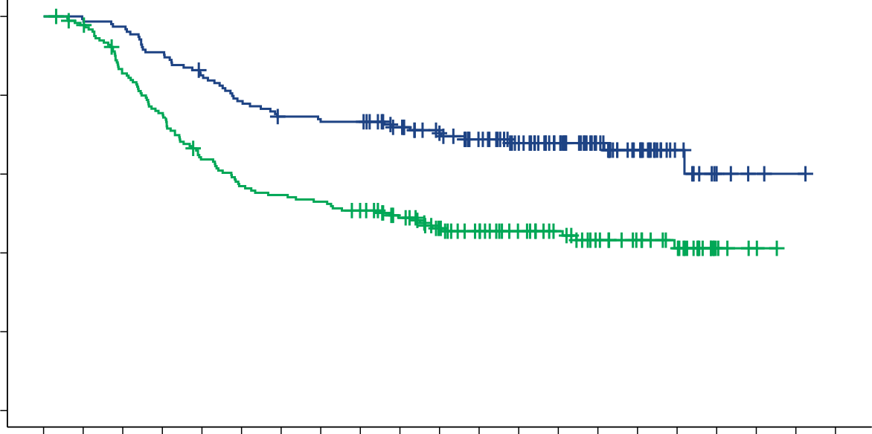
QuANTUM-First Updates: FLT3-ITD MRD Predicts OS (Perl, #832)
MRD cutoff 10-4 based on LLOQ (lower limit of quant), also zero/undetectable (as post-hoc)
CRc After Induction
(1 or 2 cycles)
After 2 Cycles of CTxª
(CRc after induction × 2 or
CRc after induction #1 + consol. #1)
After Last Consolidation Cycle^{b}
(up to 4 cycles)
+ CENSORED
100
80
60
40
20
0
100
80
60
40
20
0
+ CENSORED
MRD cutoff: 10⁻⁴
+ CENSORED
MRD− (n=138)
MRD− (n=162)
MRD− (n=218)
OS probability (%)
OS probability (%)
OS probability (%)
MRD+ (n=183)
MRD+ (n=166)
MRD+ (n=119)
HR=0.562
95% CI, 0.398-0.794
Median OS
MRD−: NR
MRD+: 29.4 months
HR=0.525
95% CI, 0.376-0.731
Median OS
MRD−: NR
MRD+: 21.9 months
HR=0.458
95% CI, 0.332-0.633
Median OS
MRD−: NR
MRD+: 14.8 months
Time from randomization (months)
MRD− (N=138; Q n=77, P n=61) MRD+ (N=183; Q n=85, P n=98)
0 | 3 | 6 | 9 | 12 | 15 | 18 | 21 | 24 | 27 | 30 | 33 | 36 | 39 | 42 | 45 | 48 | 51 | 54 | 57 | 60
0 | 3 | 6 | 9 | 12 | 15 | 18 | 21 | 24 | 27 | 30 | 33 | 36 | 39 | 42 | 45 | 48 | 51 | 54 | 57 | 60
Time from randomization (months)
MRD− (N=162; Q n=89, P n=73) MRD+ (N=166; Q n=78, P n=88)
Time from randomization (months)
MRD− (N=218; Q n=126, P n=92) MRD+ (N=119; Q n=46, P n=73)
No. at risk
MRD−
MRD+
162 | 160 | 152 | 142 | 132 | 123 | 119 | 115 | 115 | 105 | 93 | 85 | 73 | 64 | 48 | 36 | 22 | 7 | 4 | 1 | 0
166 | 161 | 142 | 124 | 102 | 89 | 83 | 83 | 77 | 67 | 57 | 49 | 41 | 32 | 23 | 16 | 10 | 2 | 0 | 0 | 0
No. at risk
MRD−
MRD+
218 | 216 | 208 | 195 | 177 | 165 | 157 | 154 | 153 | 137 | 121 | 109 | 92 | 76 | 56 | 39 | 22 | 7 | 4 | 1 | 0
119 | 114 | 95 | 80 | 66 | 56 | 53 | 51 | 46 | 42 | 35 | 29 | 25 | 21 | 16 | 14 | 10 | 2 | 0 | 0 | 0
MRD Cutoff: 0
MRD Cutoff: 0
MRD Cutoff: 0
100
80
60
40
20
0
100
80
60
40
20
0
+ CENSORED
+ CENSORED
+ CENSORED
MRD− (n=53)
MRD− (n=83)
MRD− (n=154)
OS probability (%)
OS probability (%)
OS probability (%)
MRD cutoff: 0
MRD+ (n=268)
MRD+ (n=245)
MRD+ (n=183)
Median OS
MRD−: NR
MRD+: 48.6 months
Median OS
MRD−: NR
MRD+: 40.4 months
Median OS
MRD−: NR
MRD+: 26.2 months
HR=0.722
95% CI, 0.450-1.159
HR=0.626
95% CI, 0.419-0.935
HR=0.470
95% CI, 0.334-0.661
0 | 3 | 6 | 9 | 12 | 15 | 18 | 21 | 24 | 27 | 30 | 33 | 36 | 39 | 42 | 45 | 48 | 51 | 54 | 57 | 60
0 | 3 | 6 | 9 | 12 | 15 | 18 | 21 | 24 | 27 | 30 | 33 | 36 | 39 | 42 | 45 | 48 | 51 | 54 | 57 | 60
Time from randomization (months)
MRD− (N=53; Q n=34, P n=19) MRD+ (N=268; Q n=128, P n=140)
Time from randomization (months)
MRD− (N=83; Q n=48, P n=35) MRD+ (N=245; Q n=119, P n=126)
Time from randomization (months)
MRD− (N=154; Q n=88, P n=66) MRD+ (N=183; Q n=84, P n=99)
No. at risk
MRD−
MRD+
82 | 82 | 80 | 75 | 70 | 64 | 62 | 60 | 60 | 55 | 49 | 44 | 39 | 34 | 28 | 22 | 12 | 4 | 3 | 1 | 0
245 | 239 | 214 | 191 | 164 | 148 | 140 | 138 | 132 | 117 | 101 | 90 | 75 | 62 | 43 | 30 | 20 | 5 | 1 | 0 | 0
No. at risk
MRD−
MRD+
154 | 153 | 150 | 140 | 130 | 120 | 113 | 111 | 111 | 101 | 91 | 81 | 69 | 56 | 40 | 27 | 12 | 4 | 2 | 1 | 0
183 | 177 | 153 | 135 | 113 | 101 | 97 | 94 | 88 | 78 | 65 | 57 | 48 | 41 | 32 | 26 | 20 | 5 | 2 | 0 | 0

Slide 6
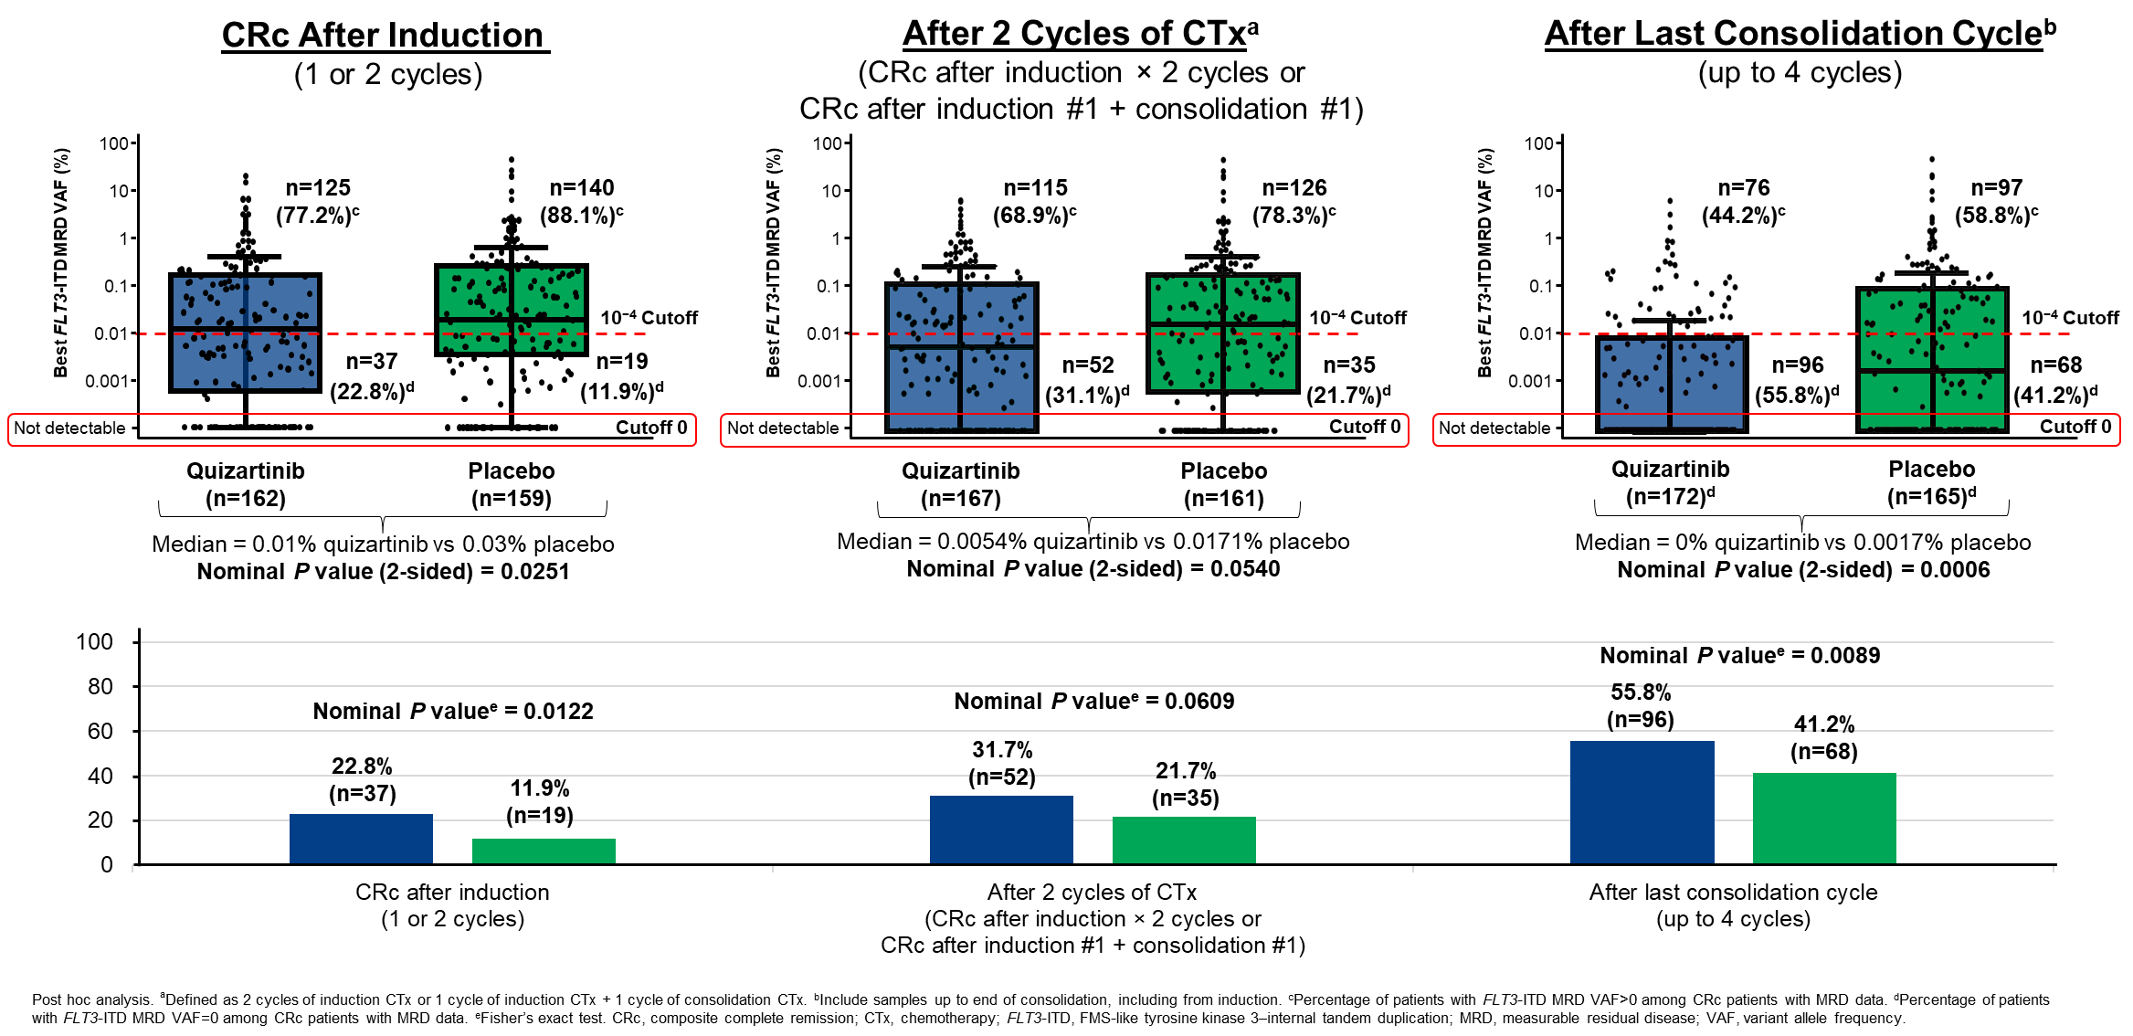
QuANTUM-First Outcomes: QUIZ Improves MRD- Rates

Slide 7
QuANTUM-First: Conclusions
There is a clear prognostic utility of FLT3-ITD specific MRD measurements in management of patients with FLT3-ITD AML
Elimination of detectable FLT3-ITD MRD is associated with longer OS (in patients both w/wo QUIZ)
QUIZ is associated with deeper responses and more frequent MRD clearance

Slide 8
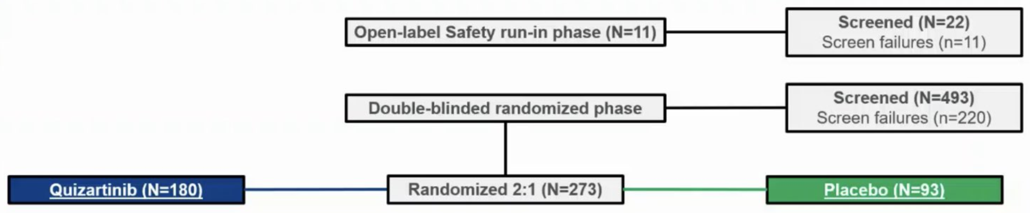
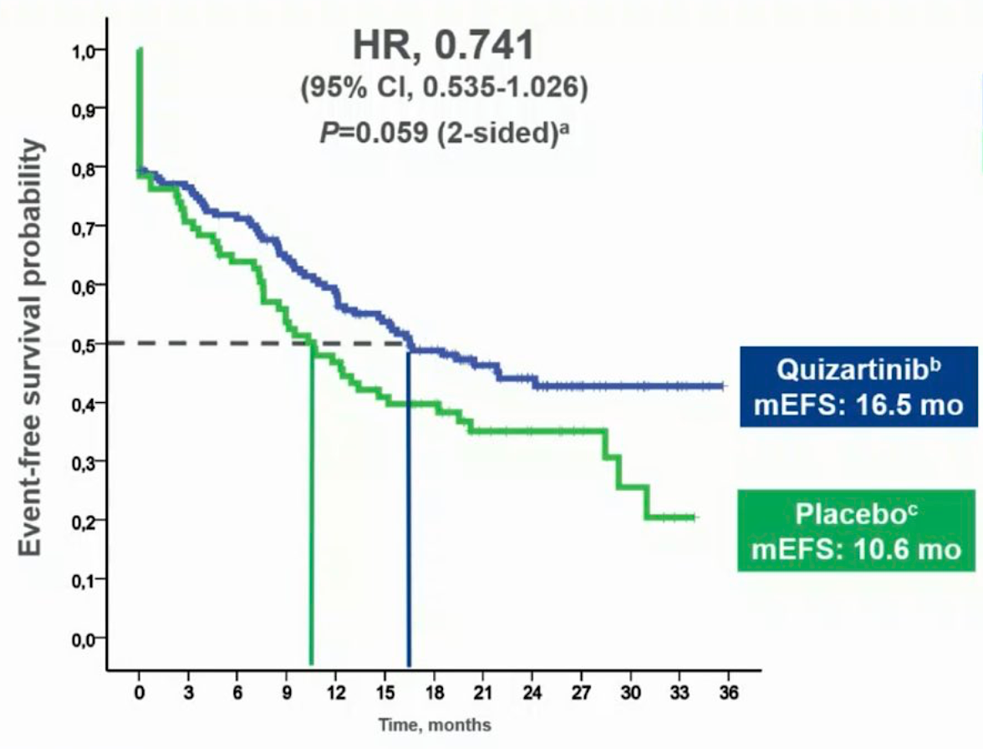
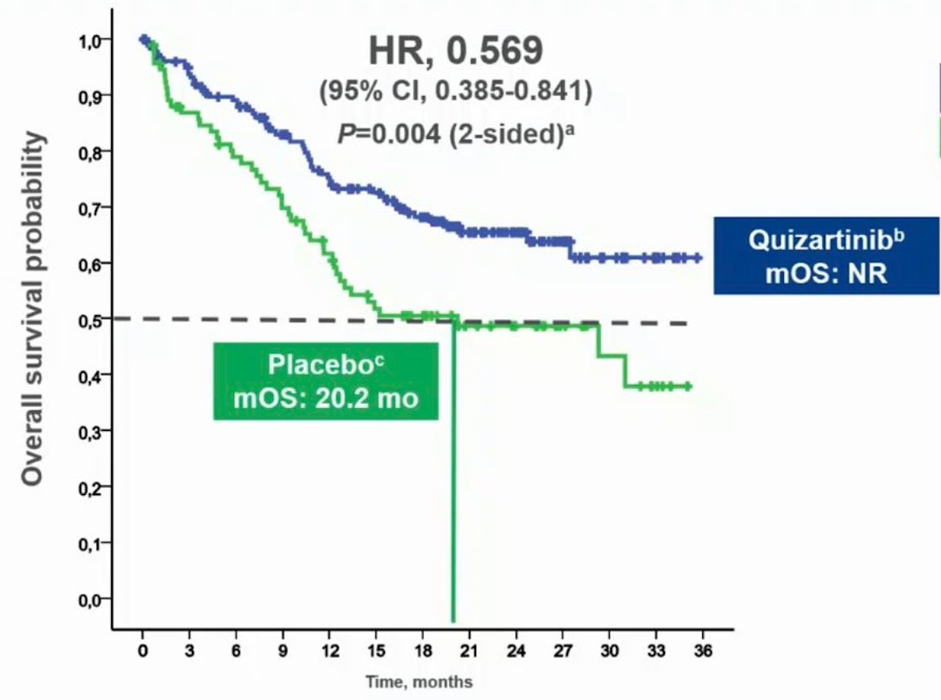
QUIWI: A Double-Blinded, Randomized Phase 2 Study Comparing Standard Chemotherapy
Plus Quizartinib Versus Placebo Newly Diagnosed FLT3-ITD Wildtype AML
OS
(interim analysis)
EFS
(interim analysis)
Montesinos P et al.
EHA 2023;Abstract S130.

Slide 9
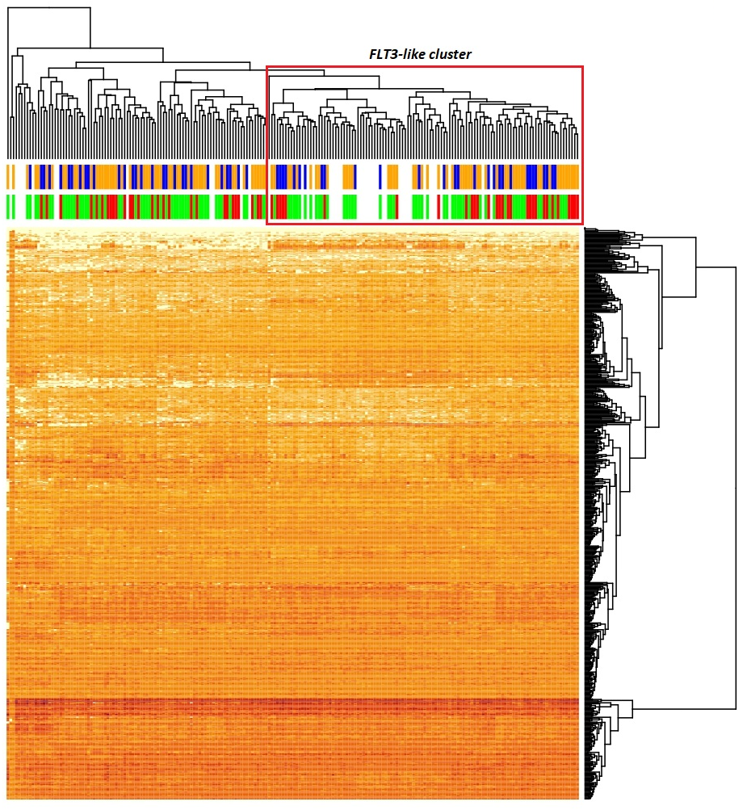
QUIZ for patients with FLT3-”like” gene expression signature
Mosquera Orgueira A, ASH #974
Background: A FLT3-like transcriptomic signature is present in 28-53% of FLT3-ITD neg patients¹
The QUIWI Trial compared QUIZ vs PBO + standard chemo in FLT3-ITD wild-type AML (n=284)
*2-yr OS was 63.5% (QUIZ) vs 47% (PBO)
*49.7% of QUIWI cases had “FLT3-LIKE” expression
The FLT3-like signature¹
Differential Expression: 649 distinct genes were significantly differentially expressed in FLT3 mutants vs. WT samples.
FLT3 Clustering: FLT3-ITD mutants consistently clustered together in multiple datasets. 28-53% of all FLT3-ITD negative patients were FLT3-like.
Mutation Landscape: NPM1 and DNMT3A mutations were highly enriched in FLT3-like AMLs.
Implications: Findings suggest that FLT3-like AMLs have unique gene expression profiles.
Overview of the Non-FLT3-Like Transcriptomic Cluster
FLT3-Like Patients: 50% of FLT3-ITD negative patients (N=81)
ELN-17 Classification:
Low Risk: 18.2%
Intermediate Risk: 39.5%
High Risk: 42.0%
¹Mosquera et al, Plos One 2021

Slide 10
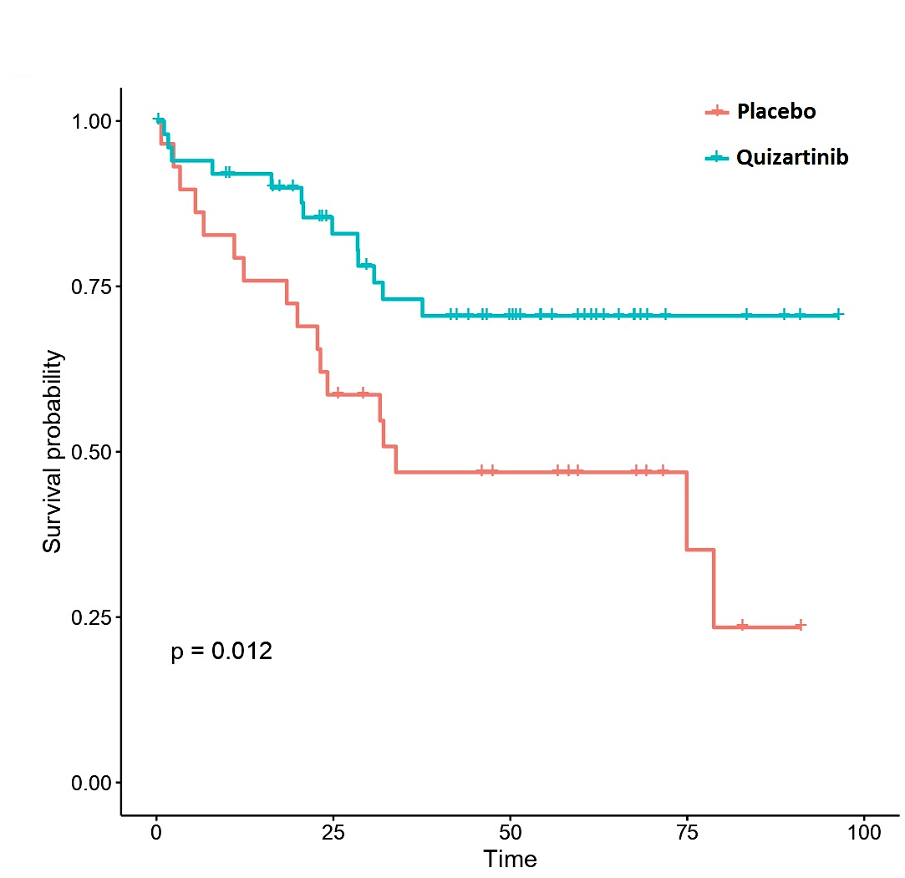
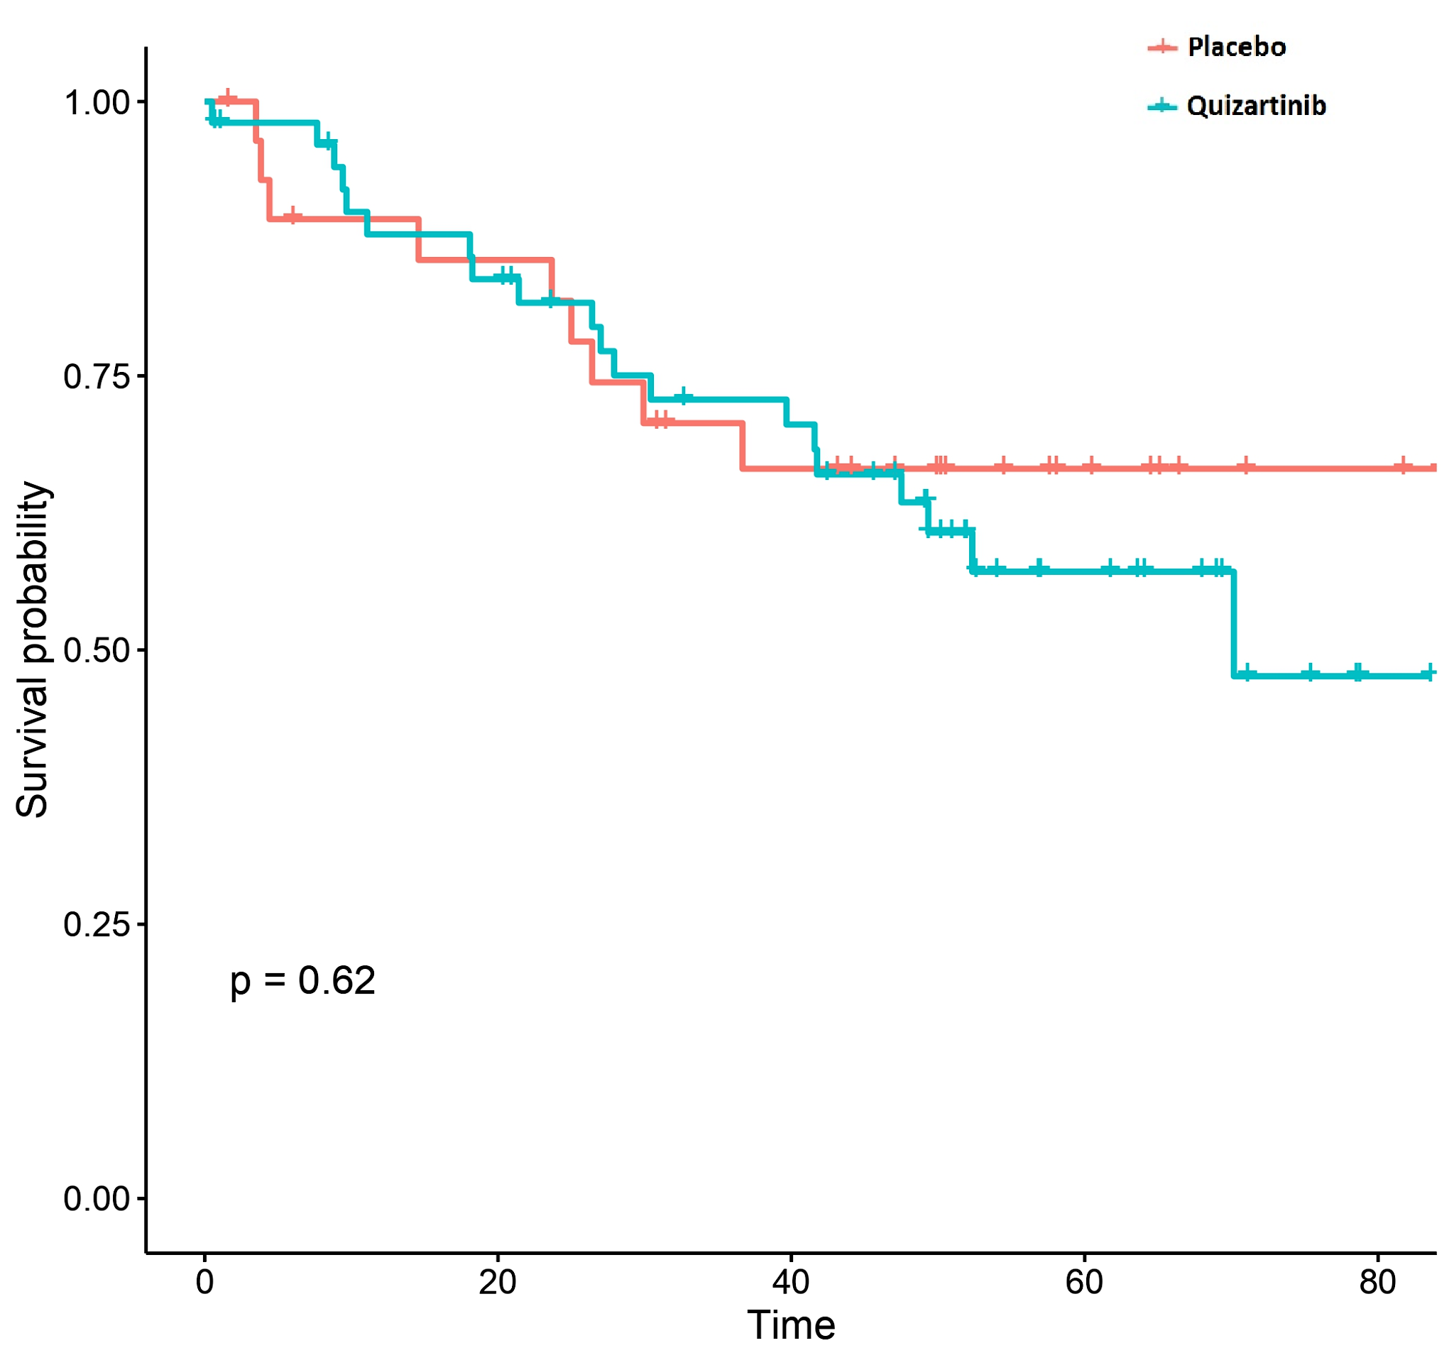
QUIZ for patients with FLT3-”like” gene expression signature
QUIWI trial of QUIZ in wild-type FLT3 patients (PETHEMA group)
NON-FLT3-LIKE AML (n=81)
FLT3-LIKE AML (n=80)
NMP1^{mut} & DNMT3A^{mut} enrichment
FLT3-like AMLs: 42.5% NMP1^{mut}, 38.7% DNMT3A^{mut}, 23.7% double mutants
Non-FLT3-like AMLs: 6.2% NMP1mut, 14.8% DNMT3A^{mut}, 2.5% double mutants
FLT3-Like with NPM1 or DNMT3A mut
26% were FLT3-TKD
Characteristics of Non-FLT3-Like Cluster
Characteristics of FLT3-Like Patients
50.33% of FLT3-ITD negative patients (N=81)
ELN-17 Classification:
Low Risk: 18.2%
Intermediate Risk: 39.5%
High Risk: 42.0%
49.67% of FLT3-ITD negative patients (N=80)
ELN-17 Classification:
Low Risk: 30.4%
Intermediate Risk: 40.5%
High Risk: 29.1%
Mosquera A, ASH #974

Slide 11
QUIWI results of QUIZ for FLT3-ITD wild-type AML
The QUIWI trial provides initial evidence of efficacy of quizartinib with standard chemotherapy for FLT3-WT patients with “FLT3-like” disease based on expression patterns
Expression patterns are hard to obtain in real time in the clinical setting, but this contributes to the growing body of evidence suggesting a more personalized and targeted approach for AML therapy is possible

Slide 12
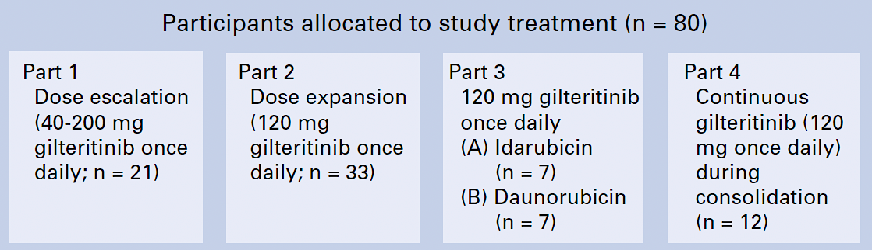
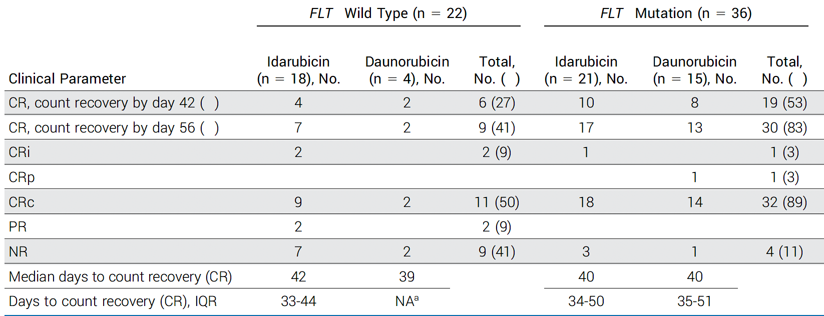
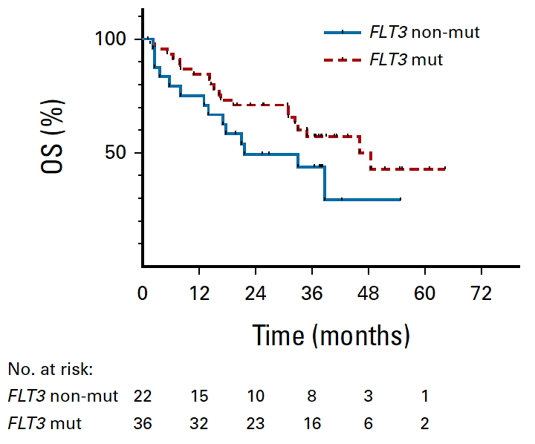
Gilteritinib in Combination With Induction and Consolidation Chemotherapy and as Maintenance Therapy: A Phase IB Study in Patients With Newly Diagnosed AML
In the 36 participants with FLT3 mutations, the median OS was 46.1 months, and anthracycline or gilteritinib start day during induction did not influence survival.
OS
Pratz KW et al. J Clin Oncol 2023;41(26):4236-46.

Slide 13
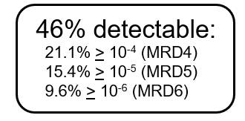
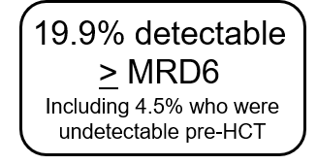
MORPHO Study Design: GILT post HSCT maintenance
AML with a FLT3-ITD mutation
Morphologic first remission with only 1 or 2 inductions
PCR-NGS MRD Assay (MRD6)
First 2cc aspirate sent for MRD
46% + 4.5% = 50.5% FLT3-ITD MRD+
Registration
Marrow aspirate sample for MRD analysis
Allogeneic transplant within 1 year of CR1
Any conditioning, donor, or GVHD prophylaxis allowed
Day +30 to +90 after transplant:
Engraftment (ANC >500, platelets >20K, transfusion independent)
Able to take oral medication
No active grades II-IV acute GVHD requiring > 0.5 mg/kg prednisone daily
Sample for MRD analysis
Gilteritinib
120 mg po daily
Randomization
Placebo
Stratification:
Conditioning regimen intensity (myeloablative vs. reduced intensity)
Time from transplant to randomization (30-60 days vs. 61-90 days)
Measurable residual disease > 10⁻⁴ (presence vs absence from registration sample)
24 months maintenance treatment
24 months maintenance treatment

Slide 14
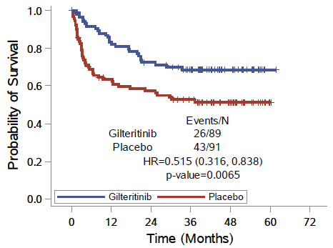
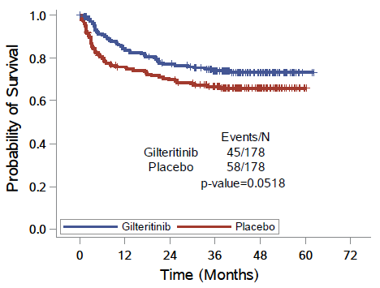
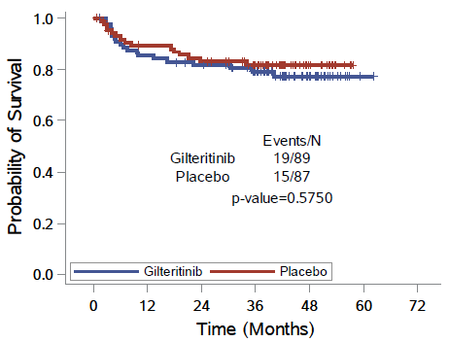
Post-Hoc MRD Analysis of MORPHO Study: FLT3i post SCT improves RFS in MRD+ patients
Primary objective:
Relapse-free survival (RFS)
HR = 0.679 (0.459-1.005)
P = 0.0518
RFS: MRD positive
(either pre or post SCT)
RFS:
MRD negative
Levis M ASH #973

Slide 15
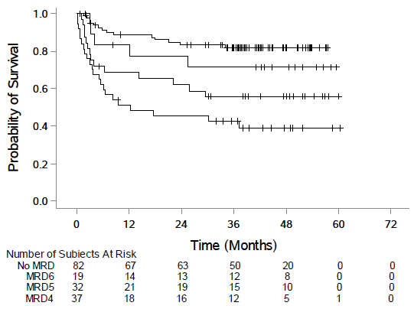
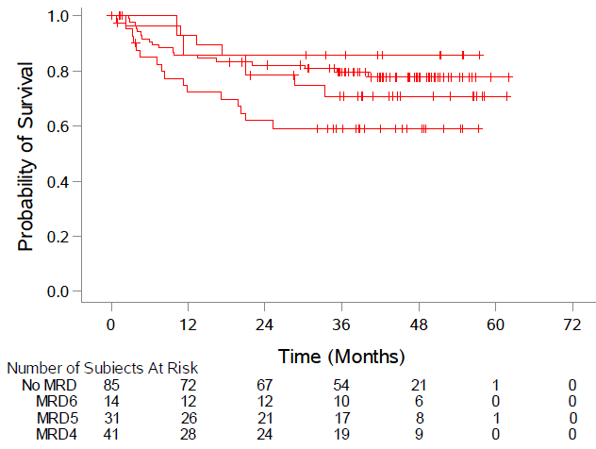
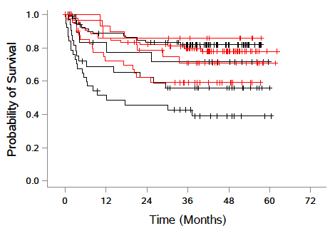
FLT3 MRD at any level impacts RFS, and is improved with GILT
MRD
Events/N
MRD
Events/N
No MRD 14/82
MRD6 2/14
MRD6 5/19
No MRD 18/85
MRD5 8/31
MRD5 14/32
MRD4 16/41
MRD4 22/37
Placebo
Gilteritinib
10⁻⁶ ≤ MRD6 < 10⁻⁵
10⁻⁵ ≤ MRD5 < 10⁻⁴
10⁻⁴ ≤ MRD4
Levis M ASH #973

Slide 16
FLT3-ITD MRD eradication post-SCT is improved with GILT
% MRD Eradication
Randomization
FLT3-ITD clones post-SCT are more often eradicated with GILT compared to placebo
  MRD was eradicated in 69% of pts on GILT vs 44% with placebo
Relapse or eradication predominantly occurs during the first 6 months post-SCT
Any level of FLT3-ITD MRD impacts RFS (the higher the MRD the worse the RFS)

Slide 17
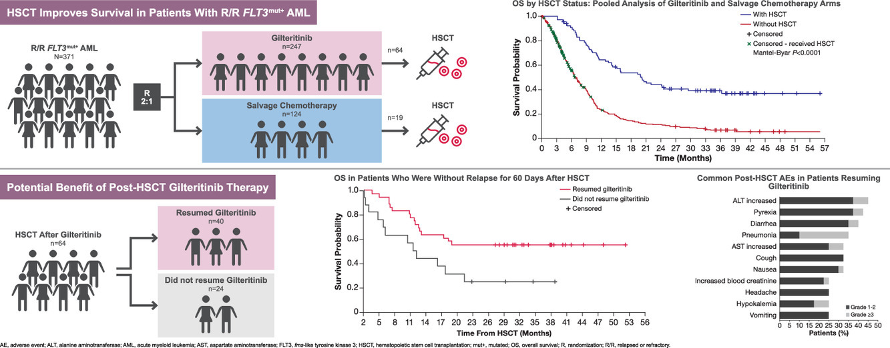
ADMIRAL study: Additional evidence of benefit of post-HSCT GILT
Perl AE et al, Transplant Cell Ther 2023

Slide 18
GILT as post-HSCT maintenance
Identification of FLT3 MTD at any level peri-transplant impacts RFS, and is improved with gilteritinib post-HSCT maintenance (the higher the MRD level, the worse the RFS)
FLT3-ITD MRD eradication post-SCT is improved with GILT
Relapse or eradication predominantly occurs during the first 6 months post-SCT

Slide 19
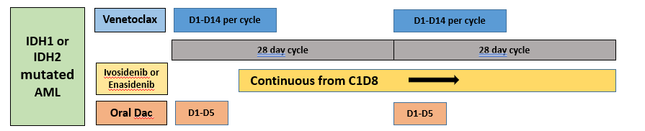
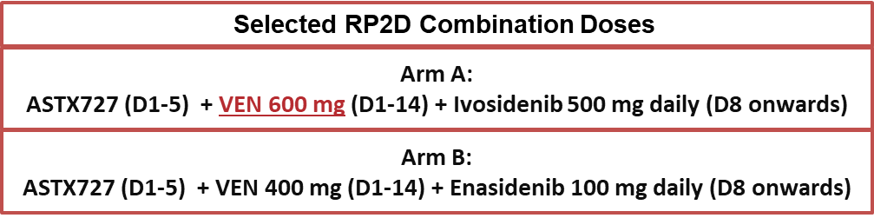
Update of HMA+VEN+IDHi for IDHm AML
Baseline Characteristics
Variable | All (n=57) | Newly Diagnosed (n=27) |  | Relapsed Refractory (n=30)
 |  | IDH1 (n=11) | IDH2 (n=16) | IDH1 (n=11) | IDH2 (n=19)
Age (years) | 72 (41-86) | 74 (70-80) | 71 (62-83) | 73 (41-86) | 70 (56-84)
Male | 35 (61) | 4 (36) | 12 (75) | 8 (72) | 11 (58)
ECOG | 1 (1-2) | 2 (1-2) | 2 (1-2) | 1 (1-2) | 1(1-2)
ELN Risk (2022)
ELN Favorable | 7 (12) | 3 (27) | 2 (13) | 1 (9) | 1 (5)
ELN Intermediate | 2 (4) | - | 1 (6) | - | 2 (10)
ELN Adverse | 47 (82) | 8 (72) | 13 (81) | 10 (91) | 16 (85)
Cytogenetic Risk
Intermediate Risk | 37 (65) | 8 (73) | 14 (88) | 4 (36) | 11 (58)
Adverse Risk | 20 (35) | 3 (27) | 2 (12) | 7 (64) | 8 (42)
Co-Occurring Mutations
NPM1 | 9 (16) | 3 (27) | 3 (19) | 2 (18) | 1 (5)
KRAS/NRAS | 6 (14) | 1 (9) | 3 (19) | 1 (9) | 1 (5)
FLT3 | 1 (2) | - | - | 1 (9) | -
TP53 | 12 (21) | - | 2 (12) | 6 (55) | 4 (21)
Prior Treatments (R/R Only)
 | IDH1 (n=11) | IDH2 (n=19)
Prior HMA + VEN | 6 (55) | 13 (68)
No Prior VEN | 3 (27) | 6 (32)
Prior IDHi | 4 (36) | 3 (16)
HMA/VEN/IDHi naïve | 1 (9) | 4 (21)
Atluri H ASH #968

Slide 20
HMA+VEN+IDHi for Newly Dx IDHm AML
Overall Survival
ND-AML | ND-AML
Outcome (months) | IDH1 (n=11) | IDH2 (n=16)
Median DOR | NR (6.9-NR) | NR (10.1-NR)
Median OS | NR | NR
(n=11)
(n=9)
(n=16)
(n=14)
Overall CRc 96.2% with 85% flow MRD negative
*No 30 or 60 day early mortality
Atluri H ASH #968
Notes:
Looking at the responses in the ND AML cohort, our overall composite remission was 96.2% with 85% of those patients MRD negative by flow cytometry. The swimmer’s plot on the left with IDH1 mutated AML on the top and IDH2 mutated on the bottom, we can see 3 patients from each cohort have gone on to stem cell transplant with 8 patients (30%) remaining on study. The Purple and Green bullets on the left are patients wo received prior IDHi or HMA for prior MDS.
- 4 patients (15%) with prior HMA
- 6 patients (22%) proceeded to SCT
- 4 deaths → Cardiac arrest (unrelated), patient withdrawal (hospice, de-conditioining, 2 cycles), Relapse, progressive deconditioning (likely relapse) → all 4 had s/t AML

Slide 21
HMA+VEN+IDHi for R/R IDHm AML
Overall Survival
R/R-AML | R/R-AML
Outcome (months) | IDH1 (n=11) | IDH2 (n=19)
Median DOR | 13.8 (13.2-NR) | 16.1 (NR-NR)
Median OS | 17.7 (4.47-NR) | 10.4 (8.78 – NR)
(n=11)
(n=6)
(n=19)
(n=6)
*Overall CRc 56.6% with 70.5% flow MRD neg
*CRc 47.6% in pts with prior VEN (n=21) and 77.7% in VEN naïve (n=9)
*78% flow MRD(-) CRc in R/R but VEN naïve pts
* CRc 71% in those with prior IDHi (n=7)
Outcomes by Prior therapy | R/R-AML
 | Prior VEN (n=21) | VEN Naïve (n=9) | Prior IDHi (n=7) | TP53 Mut (n=10)
Median DOR | 14.5 (14.5 –NA) | 13.2 (NR-NR) | 13.8 (13.2 – NR) | 13.2 (NR-NR)
Median OS | 10.4 (4.7 – NR) | 17.7 (5.9-NR) | 17.7 (10.4-NR) | 4.59 (2.9 -NR)
Atluri H ASH #968
Notes:
Looking at the responses in the ND AML cohort, our overall composite remission was 96.2% with 85% of those patients MRD negative by flow cytometry. The swimmer’s plot on the left with IDH1 mutated AML on the top and IDH2 mutated on the bottom, we can see 3 patients from each cohort have gone on to stem cell transplant with 8 patients (30%) remaining on study. The Purple and Green bullets on the left are patients wo received prior IDHi or HMA for prior MDS.
- 4 patients (15%) with prior HMA
- 6 patients (22%) proceeded to SCT
- 4 deaths → Cardiac arrest (unrelated), patient withdrawal (hospice, de-conditioining, 2 cycles), Relapse, progressive deconditioning (likely relapse) → all 4 had s/t AML

Slide 22
Conclusions
ASTX727 + Venetoclax + IDHi in Newly Diagnosed and Relapsed Refractory IDH mutated AML: Abstract 968
Safety profile and tolerability of triplet combination of ASTX727 + VEN + IDHi in both ND and R/R AML appears reassuring and may prove to be the optimal method of incorporating all effective therapies (HMA+VEN vs HMA+IVO vs HMA+VEN+IVO)
Triplet outcomes to date:
CRc rates of 96.2% (ND-AML) and 56.6% (RR-AML)
Median OS NR (ND-AML); mOS 17.7 and 10.4 months for IDH1 and IDH2 RR-AML
Notes:
Overall we confirmed a reasonable safety and tolerability for this triplet study with impressive CRc rates in both ND and RR AML especially considering extensive prior treatment in the RR cohort

Slide 23
Phase 1/2 Study of Novel IDH1 Inhibitor Olutasidenib
Multiple Cohorts of Monotherapy and Combination With Aza^{[1]}
Monotherapy
Olutasidenib 150 mg BID
Cohort 1: R/R AML (N = 153)
Cohort 2: MRD-positive AML in CR/CRi
Combination Therapy
Olutasidenib 150 mg BID + Aza
Cohort 4: R/R AML/MDS with no prior HMA or IDH1 inhibitor
Cohort 5: R/R AML/MDS with progression on HMA
Cohort 6: R/R AML most recently treated with IDH1 inhibitor monotherapy
Cohort 8: ND AML eligible for frontline Aza
Cohort 3: R/R AML/MDS treated with prior IDH1 inhibitors; standard treatments contraindicated
Cohort 7: ND AML; standard treatments contraindicated
Primary endpoint
CR + CRh
Key secondary endpoints
ORR
DoR
transfusion independence
OS
Safety
Results of Cohort 1 led to FDA approval of olutasidenib in December 2022 for IDH1-mutated R/R AML^{[2]}
1. ClinicalTrials.gov. Accessed August 31, 2023. https://www.clinicaltrials.gov/study/NCT02719574; 2. Olutasidenib [PI]. Approved 2022.
Notes:
New
Schema is based on ClinicalTrials.gov description; diagram was redrawn from August 2023 corporate presentation https://www.rigel.com/investors/news-events/events-presentations

Slide 24

OS by Response Category With Olutasidenib and Ivosidenib
*NOTE: This is a summary of data from independent trials, not a head-to-head comparison within a single study.
Olutasidenib¹
Ivosidenib²
Median OS = 11.6 mo
Median OS = 9 mo
CR/CRh responders
CR/CRh responders
  78%
  NR
  mOS
Other responders
Other responders
Nonresponders
Nonresponders
  4.0 months
  mOS
  13.7 months
  mOS
  3.9 months
  mOS
  9.3 months
  mOS
  18.8 months
  mOS
  NR
  mOS
  50%
Survival Probability
Survival Probability
Censored
Censored
Time (months)
Time (months)
51
51
51
47
46
40
31
23
18
14
13
7
1
0
38
38
38
37
32
25
19
13
8
5
4
3
1
1
1
1
0
mOS, median overall survival.
1. de Botton S, et al. Blood Adv. 2023;bloodadvances.2022009411. 2. DiNardo CD, et al. N Engl J Med. 2018;378:2386-2398.
20
19
16
14
11
7
6
5
2
1
0
0
0
0
14
13
11
11
8
5
2
2
1
0
0
0
0
0
0
0
0
76
45
26
18
10
5
2
0
0
0
0
0
0
0
73
51
32
24
19
8
7
4
2
1
0
0
0
0
0
0
0

Slide 25
Olutasidenib and Ivosidenib Data in R/R AML
*NOTE: This is a summary of data from independent trials, not a head-to-head comparison within a single study.
PARAMETERS | OLUTASIDENIB¹ | IvoSIDENIB^{2,3}
Composite complete remission (CR + CRh) | 35% | 33%
Median duration of CR/CRh (95% CI) | 25.9 months (13.5, NR) | 8.2 months (5.6, 12)
Complete remission rate (CR) | 32% | 25%
Median duration of CR | 28.1 months | 10.1 months
Overall response rate (CR + CRh + CRi + PR + MLFS) | 48% | 42%
Median duration of overall response | 11.7 months | 6.5 months
1. de Botton S, et al. Blood Adv. 2023;bloodadvances.2022009411. 2. Tibsovo®. Prescribing information. Servier Pharmaceuticals LLC. 3. DiNardo CD, et al. N Engl J Med. 2018;378:2386-2398.
Notes:
1. De botton/ p8/¶1/ln1 (CI)
2. Tibsovo PI/ p29/Table 16 /row12
(95% CR)

Slide 26
Olutasidenib and Ivosidenib Baseline Demographics and Disease Characteristics in Approval R/R AML Study Populations
 | OLUTASIDENIB N=147 | IVOSIDENIB N=174
Age, median (range) | 71 (32-87) | 67 (18-87)
Cytogenetic risk, n (%)
Favorable | 6 (4) | –
Intermediate | 107 (73) | 104 (60)
Poor | 25 (17) | 47 (27)
Missing/unknown | 9 (6) | 23 (13)
Comutations, n (%)*
NPM1 | 31 (21) | 44 (26)
FLT3 | 15 (10) | 11 (7)
TP53 | 9 (6) | 21 (13)
 | OLUTASIDENIB N=147 | IVOSIDENIB N=174
Prior AML therapy outcome, n (%)
Primary refractory | 46 (31) | 64 (37)
Untreated relapse | 81 (55) | 65 (37)
Refractory relapse | 20 (14) | 45 (26)
Prior regimens, median (range) | 2 (1-7) | 2 (1-6)
Venetoclax, n (%) | 12 (8) | 0
HSCT, n (%) | 17 (12) | 40 (23)
ECOG PS, n (%)
0 | 45 (31) | 36 (21)
1 | 76 (52) | 97 (56)
2 | 23 (16) | 39 (22)
3 | 0 (0) | 2 (1)
ECOG, Eastern Cooperative Oncology Group; PS, performance status.
*For ivosidenib, comutation analysis based on Choe et al. (2020), which had a baseline of 167 samples (ie, denominator=167).
1. de Botton S, et al. Blood Adv. 2023;bloodadvances.2022009411. 2. REZLIDHIATM. Prescribing information. Rigel Pharmaceuticals, Inc. 3. Tibsovo®. Prescribing information. Servier Pharmaceuticals LLC.
4. Choe S, et al. Blood Adv. 2020;4(9):1894-1905.

Slide 27
Oluta for R/R post-VEN AML
Overall response to olutasidenib in 7 (41%).
ORR was 40% with OLU monotherapy and 50% in the 2 patients receiving combination OLU + AZA.
Median duration of CR+CRh has not been reached and is ongoing at 18.5 months (range 4.8-NR [28.5+])
Post-venetoclax patients (N=17)
Study Treatment: Monotherapy* Combination therapy** | 15 (88) 2 (12)
Median age (range) | 73 years (65-83)
AML type, n (%) Primary / Secondary | 7 (41) / 10 (59)
Cytogenetics, n (%) Favorable Intermediate Poor Unknown | 1 (6) 9 (53) 6 (35) 1 (6)
Median # of prior txmt | 2.0 (range 1-6)
Prior HMA, n (%) | 13 (76)
Prior venetoclax (VEN) | 17 (100)
Induction | 15 (88%)
Maintenance or Salvage | 2 (12%)
30.4+
22.6+
18.5+
9.0+
4.8
*12 from Pivotal Cohort and 3 from other monotherapy cohorts
**Combination of Olutasidenib+Azacitidine
Notes:
Abbreviations: CR=complete remission; CRi=CR with incomplete recovery;
CRh=CR with partial hematologic recovery; HMA=hypomethylating agen

Slide 28
Menin Inhibitors for R/R AML
Menin inhibition
KMT2Ar acute leukemia
Revumenib
Menin
KMT2Ar
Menin
KMT2Ar
HOX
OFF
HOX
Menin
KMT2Ar
Leukemia
MEIS
OFF
Differentiation/
Apoptosis
MEIS
Gene transcription ON
Gene transcription OFF

Slide 29
Overview of Menin Inhibitors in Development for AML
Agent (Former Name) Route of Administration | NCT Identifier (Trial Name) | Study Phase (n) | Phase 1/ 2 Expansion Cohorts for R/R Disease | Current Status
Revumenib (SNDX-5613)^{[1]} PO BID | NCT04065399 (AUGMENT-101) | Phase 1 (n = 186) | ALL or MPAL with KMT2Ar AML with KMT2Ar AML with NPM1mut | In expansion (10 sites) FDA breakthrough
Ziftomenib (KO-539)^{[2]} PO QD | NCT04067336 (KOMET-001) | Phase 1/2 (n = 199) | AML with KMT2Ar AML with NPM1mut | Recruiting (25 sites)
BMF-219^{[3]} PO | NCT05153330 | Phase 1 (n = 177) | AML/ALL/MPAL, DLBCL, and MM/PCD | Recruiting (6 sites)
D1594b^{[4]} PO BID | NCT04752163 | Phase 1/2 (n = 20) | AML/ALL with KMT2Ar AML with NPM1mut | Active (1 site)
DSP-5336^{[5]} PO QD | NCT04988555 | Phase 1/2 (n = 70) | R/R AML, R/R ALL Phase 2: NPM1mut/KMT2Ar | Recruiting (6 sites)
JNJ-75276617^{[6]} PO QD | NCT04811560 | Phase 1 (n = 110) | AML/ALL with KMT2Ar AML with NPM1mut | Recruiting (27 sites)
.
1. Issa GC, et al. Blood. 2022;140: Abstract 63; 2. Erba HP, et al. Blood. 2022;140: Abstract 64; 3. Clinicaltrials.gov. Accessed August 31, 2023. https://clinicaltrials.gov/ct2/show/NCT05153330; 4. Clinicaltrials.gov. Accessed August 31, 2023. https://clinicaltrials.gov/ct2/show/ NCT04752163; 5. Daver N, et al. Blood. 2022;140: Poster 1460; 6. Kwon MC, et al. Blood. 2022;140: Poster 2637.
Notes:
From 330499
ALL, acute lymphocytic leukemia; DLBCL, diffuse large B-cell lymphoma; MM/PCD, multiple myeloma/plasma cell disorders; MPAL, mixed-phenotype acute leukemia.

Slide 30
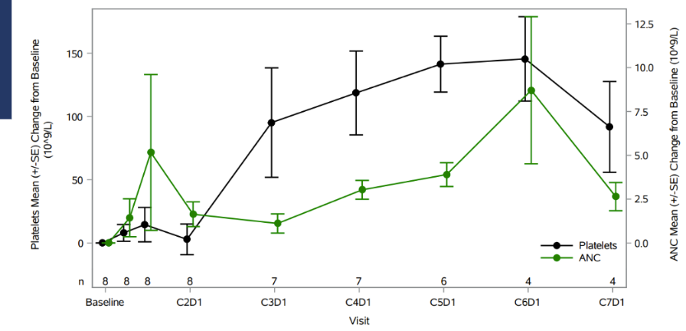
Phase 1/2 KOMET-001 Study
Ziftomenib (KO-539) in Adults With NPM1-Mutated AML
Mean Change in Platelets and ANC for CRc up to C7D1
Best Overall Response, n (%) | 600 mg (n = 20)
ORR (CR + CRh + CRi + MLFS)​ | 9 (45)
CRc (CR + CRh + CRi) ​ | 8 (40)
CR | 7 (35)
CRh | 0
CRi | 1 (5)
MLFS | 1 (5)
Median time to first response = 51 d
Median DoR censored at time of allo HSCT = 5.6 mo (95% CI: 1.0, NE)
Median DoR not censored at time of HSCT = 8.2 mo (95% CI: 1.0, NE)
Safety
Most frequent grade 3+ TEAEs were anemia (25%) and thrombocytopenia (20%)
Differentiation syndrome occurred in 20% of patients; most were grade 2
Fathi AT, et al. HemaSphere. 2023;7(S3): EHA Abstract LB2713.

Slide 31
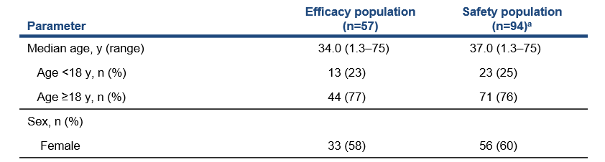
AUGMENT-101: Revumenib Monotherapy for R/R KMT2Ar
Patients aged
≥30 days with R/R acute leukemia
Revumenib RP2D
163 mg (95 mg/m² if body weight <40 kg) q12h oral
+ a strong CYP3A4i in 28-day cycles
Primary endpoint
  CR+CRh rate*
Key secondary efficacy endpoints
  CRc
  ORR
A planned interim analysis of patients with
KMT2Ar acute leukemia was conducted
KMT2Ar acute leukemia
NPM1m AML
Still enrolling, not included in this analysis
*CR+CRh rate >10% in adult evaluable population considered lower efficacy bound
Aldoss I ASH LBA#5
Data cut-off date: October 25, 2023
Notes:
As of July 24, 2023, 94 patients received ≥1 dose of revumenib at a recommended phase 2 dose of 163 mg (or 95 mg/m² if body weight <40 kg) and were included in the KMT2Ar safety population
At the time of the pre-specified interim analysis, 57 patients had the opportunity for sufficient follow-up to evaluate for efficacy

Slide 32
AUGMENT-101: Revumenib Monotherapy for R/R KMT2Ar
Parameter | Efficacy population (n=57) | Safety population (n=94)ª
Leukemia type, n (%)
AML | 49 (86) | 78 (83)
ALL | 7 (12) | 14 (15)
MPAL/Other | 1 (2) | 2 (2)
Co-mutations^{b}, n (%)
FLT3 | 5 (9) | 7 (7)
RAS | 9 (16) | 12 (13)
p53 | 4 (7) | 5 (5)
Primary refractory, n (%) | 14 (25) | 18 (19)
Number of prior lines of therapy, median (range) | 2 (1–11) | 2 (1–11)
1, n (%) | 17 (30) | 25 (27)
2, n (%) | 14 (25) | 28 (30)
≥3, n (%) | 26 (46) | 41 (44)
Prior venetoclax, n (%) | 41 (72) | 61 (65)
Prior HSCT, n (%) | 26 (46) | 47 (50)
Data cutoff: July 24, 2023. ªDefined as patients with KMT2Ar acute leukemia having received at least 1 dose of revumenib. ^{b}In patients that had co-mutation status reported.
Notes:
The majority of patients had AML.
RAS was the most common co-mutation.
A quarter of patients were primary refractory and had never achieved a remission, and over half of pts were refractory to their last salvage therapy
Patients were heavily pretreated
About half of patients had 3 or more prior lines of therapy, the majority had prior venetoclax, and about half of patients had prior transplant, with about 10% with two prior transplants

Slide 33
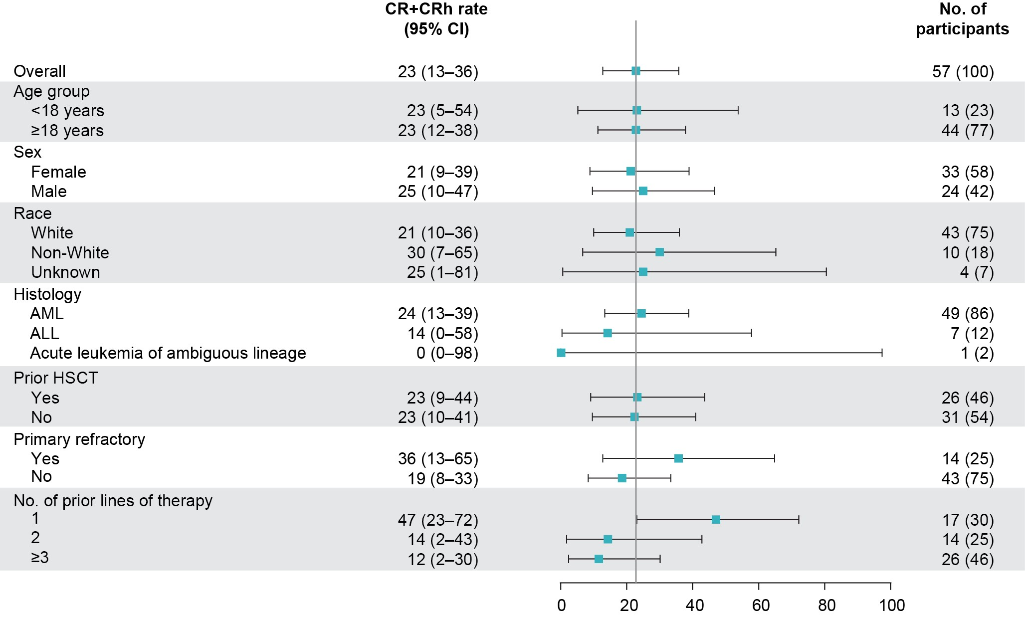
AUGMENT-101: Revumenib Monotherapy for R/R KMT2Ar
Parameter | Efficacy population (n=57)
ORR, n (%) | 36 (63)
CR+CRh rate, n (%) | 13 (23)
95% CI | 12.7–35.8
P value, 1-sided | 0.0036
Median duration of CR/CRh | 6.4 (3.4 – NR)
CRc | 25 (44)
Proceeded to HSCT | 14/36 (39)
Negative MRD statusª
CR+CRh | 7/10 (70)
CRc | 15/22 (68)
Median OS (95% CI) 8.0 months (4.1–10.9)
CR, complete remission; CRc, composite CR (CR+CRh+CRp+CRi); CRh, CR with partial hematologic recovery; CRi, CR with incomplete hematologic recovery; CRp, CR with incomplete platelet recovery; MLFS, morphological leukemia-free state; MRD, minimal residual disease; ORR, overall response rate (CRc+MLFS+PR); PD, progressive disease; PR, partial remission.
Notes:
With a median follow-up time of 6.1 months in the efficacy population, the ORR was 63.2% (95% CI, 49.3-75.6).
The primary endpoint of the pivotal phase 2 study was met with a CR+CRh rate of 22.8% (13/57; 95% CI, 12.7-35.8) ; 1-sided P=0.0036
The lower bound of the 95% CI was 12.7% and exceeded the null hypothesis of 10% for antileukemic activity.
CRc rate was 44%.
70% of patients in CR/CRh were MRD negative, with similar MRD negative rates in patients with CRc.
Overall, responses were observed across all major subgroups, including in patients with or without prior transplant, patients with relapsed/refractory disease, and with varying numbers of prior lines of treatment
CR+CRh rate was similar in adult (22.7%; 95% CI, 11.5-37.8) and pediatric patients (23.1%; 95% CI, 5.0-53.8)
In general, the number of patients per subgroup are small and the study was not powered to look at difference among subgroups.

Slide 34
AUGMENT-101: Revumenib Monotherapy for R/R KMT2Ar
Any grade TEAEs that occurred in ≥25% patients
Grade ≥3 TEAEs that occurred in ≥10% patients
All terms, n (%) | Safety population (n=94)ª
Nausea | 42 (45)
Febrile neutropenia | 36 (38)
Diarrhea | 33 (35)
Vomiting | 29 (31)
Differentiation syndrome | 26 (28)
Hypokalemia | 26 (28)
Epistaxis | 25 (27)
QTc prolongation | 24 (26)
All terms, n (%) | Safety population (n=94)ª
Febrile neutropenia | 35 (37)
Decreased neutrophil count | 15 (16)
Decreased white blood cell count | 15 (16)
Decreased platelet count | 14 (15)
Anemia | 17 (18)
Differentiation syndrome | 15 (16)
QTc prolongation | 13 (14)
Sepsis | 11 (12)
Hypokalemia | 10 (11)
Data cutoff: July 24, 2023. ªDefined as patients with KMT2Ar acute leukemia having received at least 1 dose of revumenib.
No patients discontinued due to differentiation syndrome, QTc prolongation, or cytopenias
AEs leading to Dose reduction: 9 (10%) or Discontinuation: 12 (14%)
Notes:
Febrile neutropenia was the most frequent ≥grade 3 adverse event; dose reductions because of cytopenias were infrequent (thrombocytopenia [3 patients, 3.2%] and neutropenia [2 patients; 2.1%])
≥grade 3 DS occurred in 16%
≥grade 3 QTC occurred in 14%
No patients discontinued due to differentiation syndrome, QTc prolongation, or cytopenias

Slide 35
AUGMENT-101: Revumenib Monotherapy for R/R KMT2Ar
Revumenib is effective and safe in pediatric and adult patients with R/R KMT2Ar acute leukemia
Durable MRD-negative remissions were observed in responders
High rates of transplants among responders
Discontinuations and dose reductions due to adverse events were low
Study was stopped early after meeting the primary efficacy endpoint at the predefined interim analysis. A New Drug Application for KMT2Ar leukemia has been initiated under the FDA Real-Time Oncology Review program based on these data
The independent NPM1m cohort continues to enroll at all sites
Notes:
Revumenib is effective and safe in pediatric and adult patients with R/R KMT2Ar acute leukemia
Durable MRD-negative remissions were observed in responders
This therapy allowed a high percentage of patients to proceed to potentially curative transplant and resumed revumenib post-transplant
Discontinuations and dose reductions due to adverse events were low
Study was stopped early after meeting the primary efficacy endpoint at the predefined interim analysis
A New Drug Application for KMT2Ar leukemia has been initiated under the FDA Real-Time Oncology Review program based on these data
The independent NPM1m cohort continues to enroll at all sites

Slide 36
JNJ-75276617 for R/R Acute Leukemia with KMT2Ar or NPM1m
 | All Treated (N=86)
Age, median (range), years | 59.5 (18-85)
Female, n (%) | 49 (57)
Male, n (%) | 37 (43)
Diagnosis, n (%)
AML | 78 (91)
ALL | 4 (4.5)
Other acute leukemia | 4 (4.5)
Prior therapy
Lines of prior therapy, median (range) | 3.0 (1-7)
Prior HSCT, n (%) | 20 (23)
Prior venetoclax therapy, n (%) | 52 (61)
KMT2A alteration, n (%) | 50 (58)
Translocation | 36 (72)
Amplification | 5 (10)
Partial tandem duplication | 5 (10)
Other/Unknown | 4 (8)
NPM1 alteration, n (%) | 36 (42)
Insertion/Frameshift | 27 (75)
Translocation | 6 (17)
Other/Unknown | 3 (8)
Part 1: Dose Escalation (NCT04811560)
Ongoing; RP2D yet to be determined
RP2D Candidate(s)
Step-up to 150 mg BID
Adult pts with R/R acute leukemia harboring KMT2A or NPM1 alterations
Step-up to 130 mg BID
Step-up to 100 mg BID
Step-up to 45 mg BID
BOIN statistical design
Pts receive JNJ-75276617 orally either daily or BID continuously
Step-up dosing started early in dose escalation
100 mg Daily
50 mg Daily
Jabbour E ASH #57
Notes:
Here are the response rates with the combination of enasidenib plus venetoclax. The overall response rate was 70%, composed mostly of complete remissions. Interestingly, the response rate was higher in patients with R172 mutations, with an overall response rate of 83% compared to 55% in patients with R140 mutations.
The only patient with MDS received less than 1 cycle of treatment and was not evaluable for response.

Slide 37
JNJ-75276617 for R/R Acute Leukemia with KMT2Ar or NPM1m
Efficacy subset | 45-130 mg BID Cohorts (N=33, acute leukemia)
ORR (≥PR), n (%) | 15 (46)
Ongoing responders | 8 (53)
Best response, n (%)
CR/CRh/CRi | 9 (27)
CR/CRh | 7 (21)
CR | 6 (18)
MLFS/PR | 6 (18)
Median time to first response, mos | 1.8 (0.9-3.3)
Median duration of response, mos | 6.5 (1.0-NE)
 | KMT2A (N=19) | NPM1 (N=14)
ORR, n (%) | 8 (42) | 7 (50)
    3/6 of CR were MRD negative
    1 responder discontinued for HSCT
    2 pts in > Cycle 12
    Similar response rates observed in KMT2A and NPM1
  SAFETY:
  DS occurred in 12% pts; effectively managed w/ BID dosing and supportive mgmt
  1 pt with QT prolongation
Data cut-off date: October 25, 2023

Slide 38
SAVE: SNDX + ASTX727 + VEnetoclax triplet
Revumenib (SNDX-5613)
DL-0: 113 mg
DL-1: 163 mg (RP2D of monotherapy)
PO Q12h D1-D28 + a strong CYP3A4i
Primary objectives:
Phase 1 (3+3 design)
Safety, MTD and RP2D
Phase 2
Efficacy
Secondary objectives:
Phase 2
  OS, RFS, CRD, MRD
Age ≥12 years
R/R AML or Myeloid MPAL
KMT2Ar or NPM1mt or NUP98r
ECOG ≤2
Adequate organ function
ASTX727
1 tablet (35 mg decitabine and 100 mg cedazuridine) PO daily for D1-D5​
Venetoclax
400 mg target dose* with ramp up
PO D1-D14
*adjusted with azoles
Maintenance revumenib post-HSCT for 1 year
*D14 bone marrow for early response
Issa G, ASH #58

Slide 39
SAVE: SNDX + ASTX727 + VEnetoclax triplet
Characteristic | N = 9
Median age, years [range] | 30 [12-63]
12-18 years, n (%) | 3 (33%)
Female, n (%) | 7 (78%)
BM Blasts, % [range] | 24 [4-45]
AML, n (%) | 8 (89%)
MPAL, n (%) | 1 (11%)
Medullary and extramedullary | 1 (11%)
Therapy-related AML | 2 (22%)
Genotype, n (%)
KMT2Ar | 5 (56%)
NUP98r | 3 (33%)
NPM1mt | 1 (11%)
Characteristic | N = 9
Co-occurring mutations, n (%)
WT1 | 4 (44%)
RAS | 3 (33%)
IDH2 | 2 (22%)
FLT3 | 1 (11%)
Previous therapies
Median no. [range] | 3 [1-5]
Venetoclax, n (%) | 5 (55%)
Menin inhibitor, n (%) | 1 (11%)
HSCT, n (%) | 6 (67%)
Data Cutoff 11/01/2023

Slide 40
SAVE: SNDX + ASTX727 + VEnetoclax triplet
Best Response n (%) | All patients (N = 9) | KMT2Ar (N=5) | NUP98r (N=3) | NPM1mt (N=1)
ORR | 9 (100%) | 5 (100%) | 3 (100%) | 1 (100%)
CR/CRh | 4 (44%) | 3 (60%) | 1 (33%) | 0
CR | 3 (33%) | 3 (60%) | 0 | 0
CRh | 1 (11%) | 0 | 1 (33%) | 0
CRp | 3 (33%) | 2 (40%) | 0 | 1 (100%)
PR | 1 (11%) | 0 | 1 (33%) | 0
MLFS | 1 (11%) | 0 | 1 (33%) | 0
MRD neg by MFC | 6/9 (67%) | 4/5 (80%) | 1/3 (33%) | 1/1 (100%)
Within CR/CRh | 4/4 (100%) | 3/3 (100%) | 1/1 (100%) | 1/1 (100%)
Complete cytogenetic remission by FISH | 5/8 (63%) | 4/5 (80%) | 1/3 (33%) | NA
Overall Response Rate (ORR) = CR + CRh + CRp + PR + MLFS. Complete cytogenetic remission in which fusions were not detectable by fluorescence in situ hybridization (FISH).
Median f/u 6.5 mo. Median RFS and OS not reached with 2 pts in ongoing remission beyond 11 months

Slide 41
SAVE: SNDX + ASTX727 + VEnetoclax triplet
Early results of all-oral SAVE [revumenib (SNDX-5613), oral decitabine (ASTX727) and VEnetoclax] → acceptable safety and high efficacy in children and adults with R/R AML susceptible to menin inhibition
High rates of response in heavily pretreated population
  ORR 100% (9/9), CR/CRh 44% (4/9), MRD-neg 67% (6/9)
  5/9 patients to alloHSCT, 2 resumed revumenib maintenance with ongoing remission > 11 months
No severe differentiation syndrome or ≥Grade 3 QT prolongation
Myelosuppression, confounded by expected risk with HMA + Ven in R/R AML
  Future mitigation measures to include intermittent revumenib dosing, without compromising efficacy given clearance of leukemia by day 14
This study continues to accrue patients

Slide 42
Generalized Conclusions
AML therapeutic options continue to improve with increasingly individualized treatments
Monitoring MRD is essential for ongoing risk assessment, and we now have studies showing that acting on MRD can improve patient outcome
Menin inhibitors are a new effective class of therapy in AML, with initial studies evaluating patients with R/R NPM1 and KMT2A-rearranged leukemias

