Slide 1
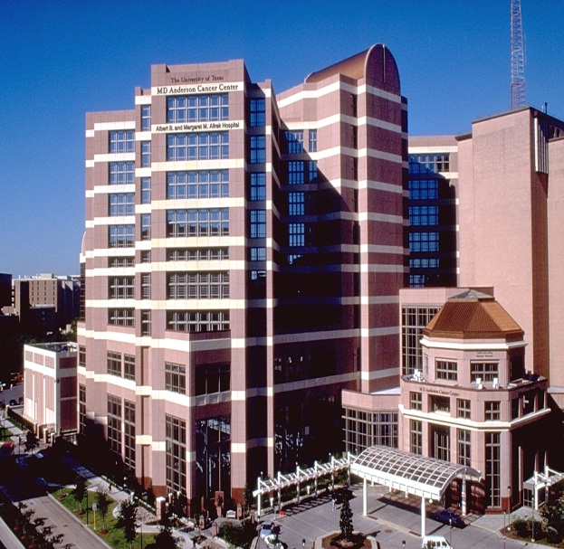
RTP: Year in Review
Available and Emerging Nontargeted Therapies for AML
Naval Daver, MD
Director, Leukemia Research Alliance Program,
Professor
Department of Leukemia
MD Anderson Cancer Center

Slide 2
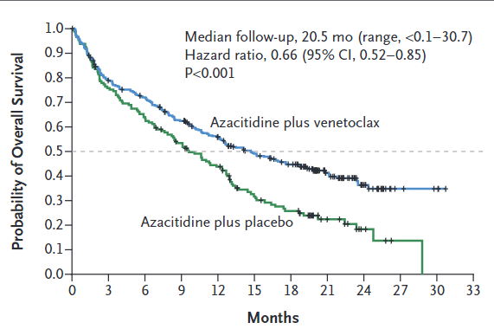
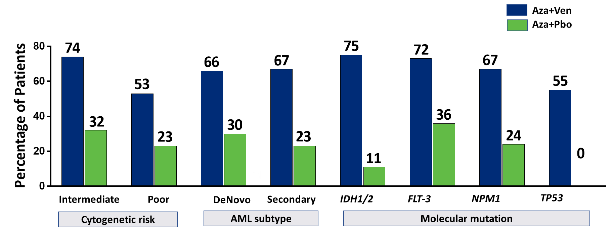
AZA+VEN induces high response rates
CR rate: 36.7% vs 17.9% (P < .001)
CR/CRi rate: 66.4% vs 28.3% (P < .001)
Median time to response: 1 vs 3 cycles (P < .001)
Significant OS improvement with venetoclax/azacitidine
 | Median OS, mo (95% CI)
VEN + AZA | 14.7 (11.9-18.7)
AZA + placebo | 9.6 (7.4-12.7)
Improved responses occurred independent of high risk genomics
DiNardo C, et al. N Engl J Med. 2020;383:617-629.
Notes:
So that brings us to what is arguably one of the more important advances in AML therapy, that of venetoclax combinations.
Shown here are the confirmatory Phase 3 results of the VIALE-A trial, demonstrating an improvement in response, composite response, and OS in patients randomized to the combination of azacitidine and venetoclax, and with responses which are improved with the combination regardless of genomics.
Updated subset analyses of two important genomic cohorts were presented at ASH this year,

Slide 3
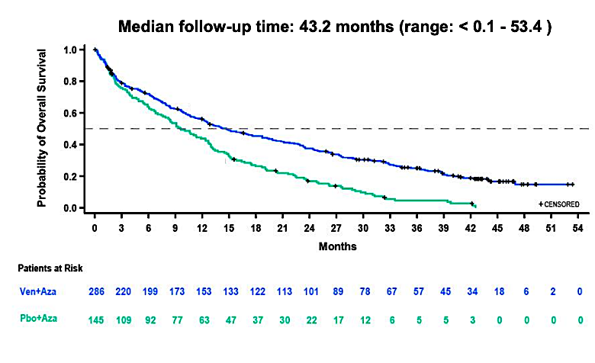
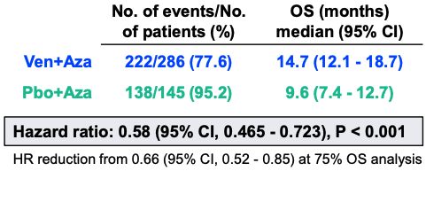
Long term OS with AZA+VEN needs further improvement (3 year follow-up)
 | Events/Patientsn (%) | OS median, mo (95% CI)
VEN + AZA | 222/286 (77.6) | 14.7 (12.1-18.7)
Placebo + AZA | 138/145 (95.2) | 9.6 (7.4-12.7)
Median follow-up time: 43.2 mo (range: <0.1-53.4)
Probability of Overall Survival
HR = 0.58 (95% CI, 0.465-0.723)
P < .001
HR reduction from 0.66 (95% CI, 0.52-0.85) at 75% OS analysis
VEN + AZA
Placebo + AZA
+ Censored
Time, mo
No. at Risk
VEN + AZA | 286 | 220 | 199 | 173 | 153 | 133 | 122 | 113 | 101 | 89 | 78 | 67 | 57 | 45 | 34 | 18 | 6 | 2 | 0
Placebo + AZA | 145 | 109 | 92 | 77 | 63 | 47 | 37 | 30 | 22 | 17 | 12 | 6 | 5 | 5 | 3 | 0 | 0 | 0 | 0

Slide 4
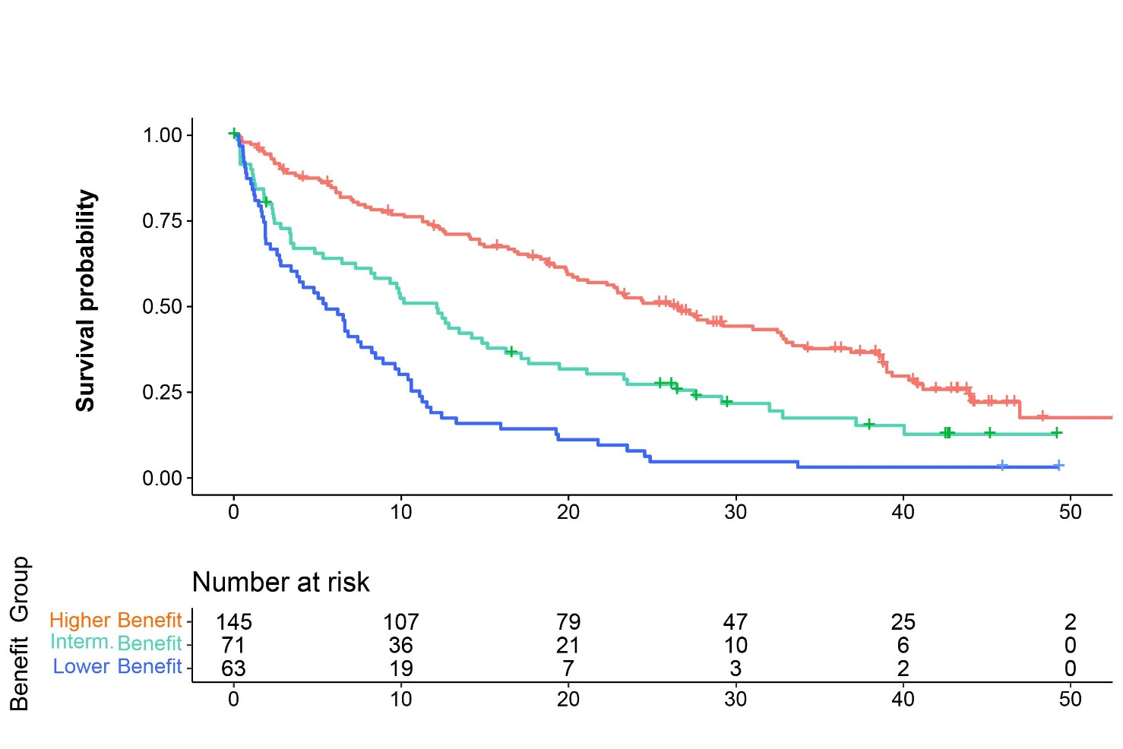
  What are the most urgent populations in need of improvement?
  Patients receiving Ven+Aza distinguishable into 3 subgroups by OS benefit
  First a higher benefit group was identified, with a median OS > 24 months
  Subsequently a lower benefit group was determined, with a median OS < 6 months
  Patients fitting neither criteria were categorized as the intermediate benefit group, with a median OS of 12 months
TP53^{WT}, No FLT3-ITD, K/NRAS^{WT}
Ven + Aza (N = 279) | n | Events | Median OS, months (95% CI)
Higher Benefit | 145 | 96 | 26.51 (20.24, 32.69)
Intermediate Benefit | 71 | 57 | 12.12 (7.26 – 15.15)
Lower Benefit | 63 | 61 | 5.52 (2.79 – 7.59)
TP53^{WT} and FLT3-ITD or K/NRAS mutated
TP53 mutated
Majority of patients in the Ven+Aza arm are in the higher benefit group: 52% (145/279)
The remainder of the patients are distributed equally between the intermediate and lower benefit groups:
25.4% (71/279) and 22.6% (63/279), respectively
Time (months)
Patients at Risk
Patients at risk
Dohner H et al, ASH 2022

Slide 5
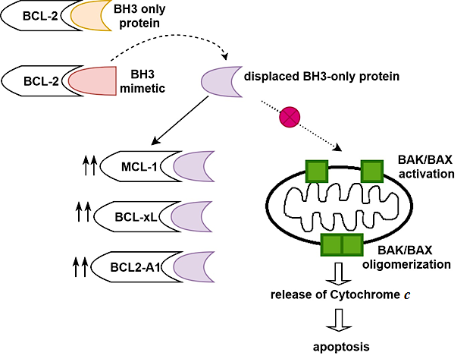

Venetoclax Resistance: Road to “Triplets”
1. Other anti-apoptotic BCL-2 family proteins
2. TP53 mutation
3. BAX mutation
4. Mitochondrial aberration
5. Mutations in activating kinases
6. Monocytic differentiation
2
TP53 mutant
6
↓↓
BAK/BAX
1
3
X
↓↓ mitophagy
5
X
FLT3-ITD
PTPN11
Tighter mitochondrial cristae lumen
KRAS
4
↑↑CLPB
↓ Opening of cristae junction
↓ Cytochrome c release
Modified from Ong et al. Cancer Drug Resistance 2022
↓ apoptosis

Slide 6
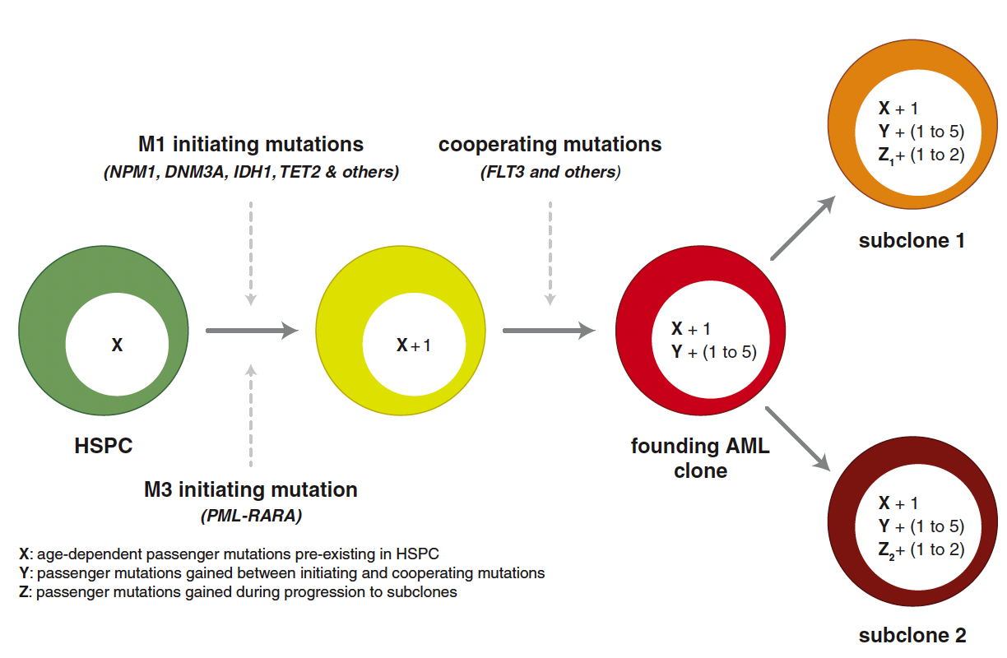
Combination approaches may help overcome heterogenous mechanisms of resistance:
Many FLT3 relapses are FLT3wt and FLT3 is almost always a late hit.
FLT3 mutations are late hits and frequently subclonal
can be gained or lost at relapse/progression
Short N….Daver N et al, Cancer Discov. 2020 Apr;10(4):506-525

Slide 7





Triplet Combination of Azacitidine, Venetoclax, and Gilteritinib Appear Effective in FLT3-Mutated AML
Induction
Azacitidine 75 mg/m² IV/SC on D1-7 Venetoclax R/U, then 400 mg D3-14 Gilteritinib 80 mg on D1-14
(ONLY if blasts >5% with >10% cellularity on C1D14 marrow, continue both GV and repeat marrow in 10-14 d)
Consolidation (Up to 24 Cycles)
Azacitidine 75 mg/m² IV/SC on D1-5 Venetoclax 400 mg on D1-7 Gilteritinib 80 mg on D1-28
100
FLT3-TKD
100
CR: 92%
FLT3-ITD
CRi: 4%
Overall survival (%)
ANC ≥0.5 37 d
Plt ≥50 25 d
Overall survival (%)
OS, %
OS, %
50
50
N Median OS 6-months OS 1-year OS
27 Not reached 96% 85%
N Median OS 6-month OS 1-year OS
FLT3 ITD 19 Not reached 95% 79%
FLT3 TKD 8 Not reached 100% 100%
n
Median OS 6-mo OS, % 1-y OS, %
NR 95 79
NR 100 100
N
Median OS 6-mo OS, % 1-y OS, %
NR 96 85
FLT3-ITD
19
27
FLT3-TKD
8
0
0
12
Time, mo
0
6
12
Time, mo
18
24
0
6
18
24
Time (months)
Time (months)
Short N, Daver N et al. JCO Feb 2023.

Slide 8
VICEROY: Phase 2 Multicenter Frontline Optimization Trial of Azacitidine, Venetoclax, and Gilteritinib (N = 80-100)
Phase 1 (Randomized Dose Ranging)
Participant meets study
discontinuation criteria
Triplet Treatment Period
Cycle 1 | Cycle 2 to 12ª
Azacitidine + Gilteritinib + Venetoclax^{b} | Azacitidine + Gilteritinib + Venetoclax^{b}
Long-Term Treatment Period
Cycle 1 to 24ª
Azacitidine + Gilteritinib
Adult FLT3 mutation
(ITD or TKD) positive newly diagnosed AML participants
CONSENT
SCREEN
End of treatment
visit
30-day follow-up visit
Survival follow-up
Every 3 months for up to 3 years
Phase 2 (Dose Expansion)
Participant meets study
discontinuation criteria
Triplet Treatment Period |  | Long-Term Treatment Period
Cycle 1 to 12ª |  | Cycle 1 to 24ª
Azacitidine + Gilteritinib + Venetoclax At optimized dose |  | Azacitidine + Gilteritinib
Adult FLT3 mutation (ITD
or TKD) positive newly diagnosed AML participants
CONSENT
SCREEN
End of treatment
visit
30-day follow-up visit
Survival follow-up
Every 3 months for up to 3 years
PIs : J Altman and N Daver
Notes:
AML: acute myeloid leukemia; DLT: dose-limiting toxicity; EOT: end of treatment; FLT3: FMS-like tyrosine kinase 3; ITD: internal tandem duplication; LTT: Long-term Treatment;
RP2D: recommended phase 2 dose; TKD: tyrosine kinase domain.

Slide 9
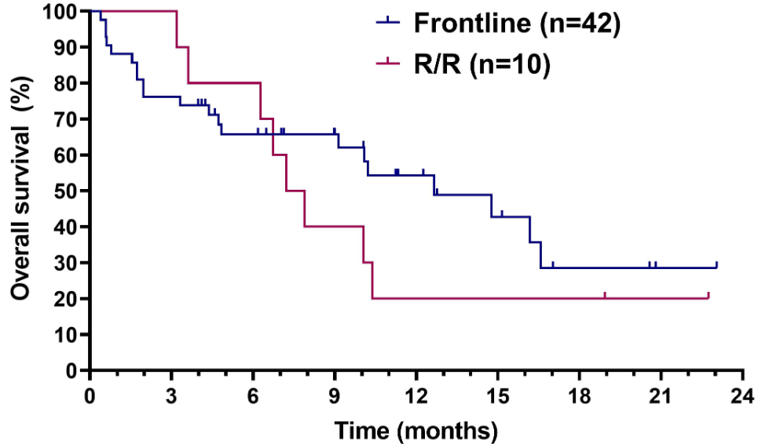
Oral DAC + Venetoclax in Older /Unfit AML
52 pts: 42 frontline (median age 79 yrs [50-92]); 10 R-R. 17/42 Rx secondary AML
Oral DAC 35mg/Dx5, VEN 40mg/Dx21-28
ORR 281/42=67%: CR 36%, CRi 26%. MLFS 5%. FCM-MRD 7/22=32%
Median OS 12.7 mos
R-R ORR 5/10=50%. Median OS 7.6 mos
Bazinet. Blood 142: abst 833; 2023

Slide 10
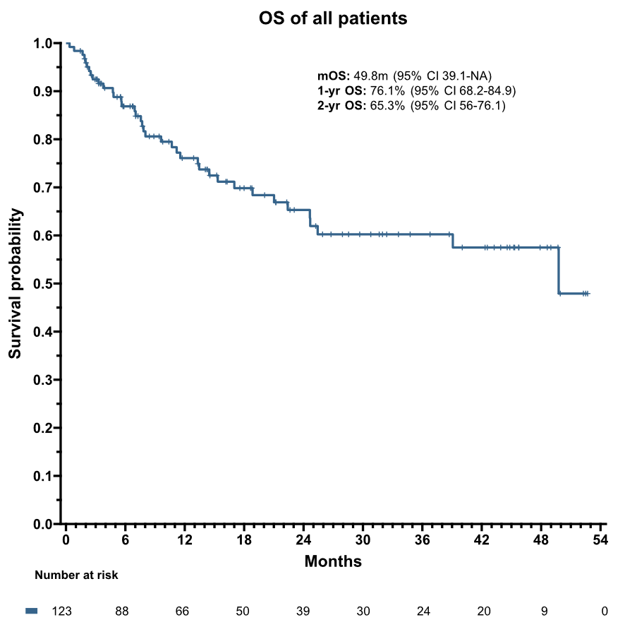
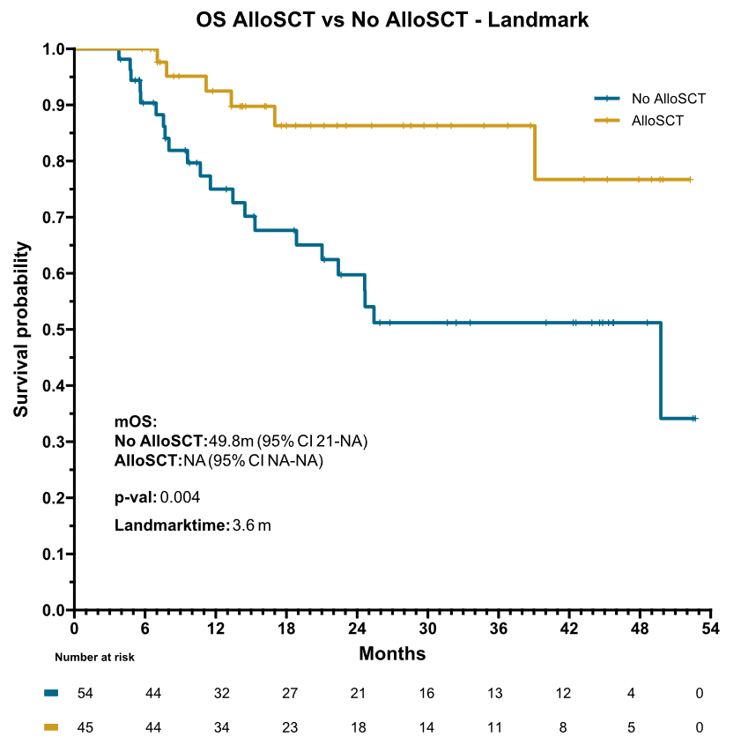
Triple-Nucleoside Regimen ( CDA- LDaraC-AZA) + Venetoclax in Newly Dx older AML
123 pts; median age 68 yrs (57-84)
CDA-LD araC VEN x 2 alternating with AZA VEN x2. Total 2 years
CR 92/123 = 75%. CR+CRi 105/123 = 92%. MRD-negative 81%. Early (4-wk) death 3/123 (2%)
2-yr OS 65%. Median OS 50 mos. Allo SCT = 51/123 (41%)
Kadia. JCO 21: June 16,2022. Bataller. Blood 142: abstr 4256; 2023

Slide 11
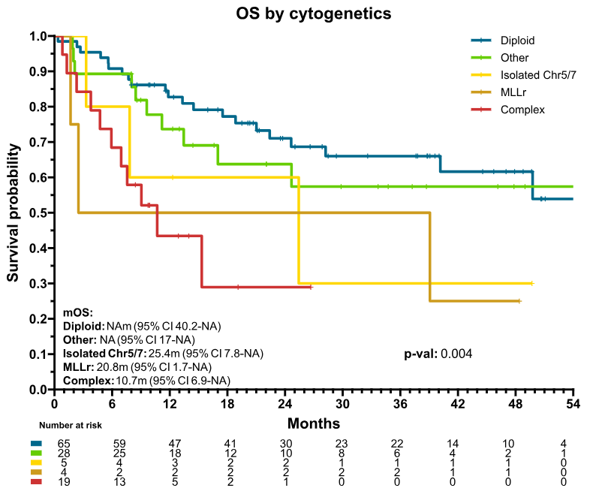
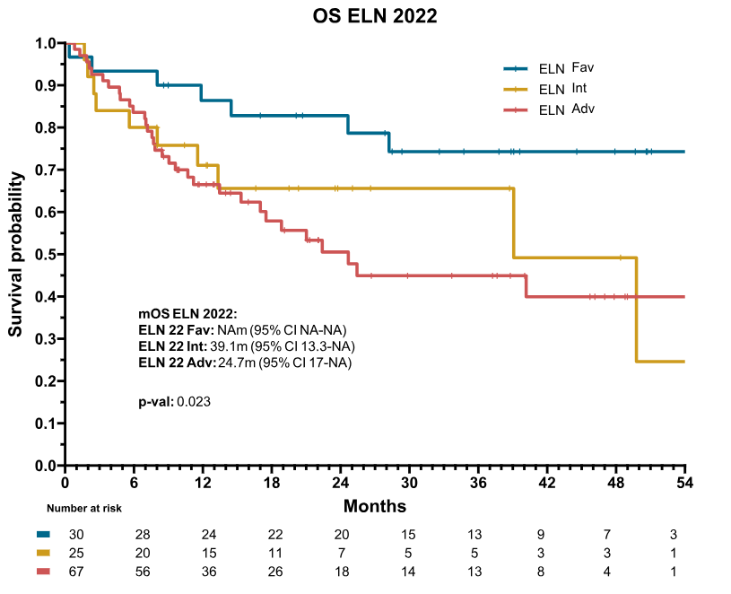
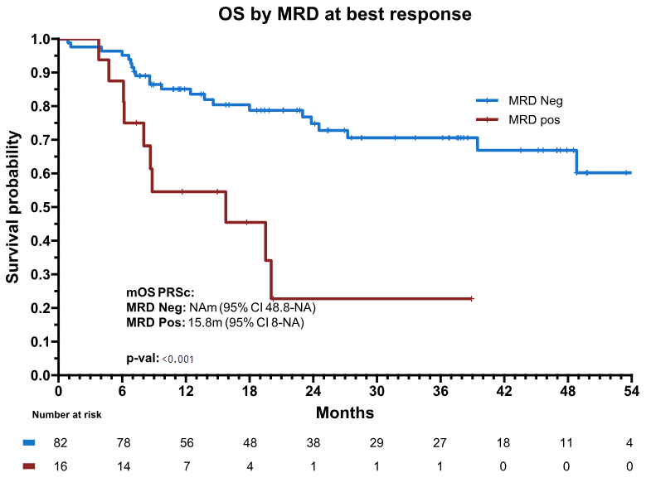
Triple-Nucleoside Regimen + Venetoclax in Older AML
Kadia. JCO 21: June 16,2022. Bataller. Blood 142: abstr 4256; 2023

Slide 12
STOP-VEN: Study Design
Retrospective study of patients treated at French FILO centers and US Moffit Cancer Center between 11/2018 and 7/2023
Patients aged ≥18 yr with ND or R/R AML
(N = 84)
VEN + AZA
≥1 cycle
achieving CR/CRi/MLFS
Discontinued
VEN* and/or AZA
≥3 mo prior
Follow-up for
TFR and OS
*For reasons other than progression, lack of response, or allogeneic SCT.
Primary Endpoints: OS, TFR (from last day of VEN)
Other Endpoints: Multivariate analysis of OS and TFR by Cox regression based on disease and mutation status
Garciaz. ASH 2023. Abstr 161.
Notes:
AML, acute myeloid leukemia; AZA, azacitidine; CR, complete response; CRi, complete response with incomplete hematologic recovery; FILO, French Innovative Leukemia Organization; MLFS, morphologic leukemia-free state; ND, newly diagnosed; OS, overall survival; R/R, relapsed/refractory; SCT stem cell transplant; TFR, treatment-free remission; VEN, venetoclax.

Slide 13
STOP-VEN: VEN + AZA Treatment and Response
Patient Disposition and Response With VEN + AZA | ND AML (n = 62) | R/R AML (n = 22)
Median number of cycles, n (range) | 4 (1-17) | 3.5 (1-17)
ORR, n (%) CR CRi | 57 (92) 44 (79) 13 (21) | 17 (82) 12 (55) 6 (27)
MLFS, n (%) | 5 (8) | 4 (18)
MRD-negative CR, n/N (%) | 21/25 (78)* | 10 (100)†
Reason for discontinuation, n (%) Hematologic toxicities Patient preference Nonhematologic toxicities Poor general status | 36 (58) 8 (13) 5 (8) 3 (5) | 16 (72.7) 3 (13.6) 3 (13.6) 2 (9.1)
*Molecular (NPM1), n = 11; flow cytometry, n = 10. †Molecular (NPM1), n = 4; flow cytometry, n = 6.
Garciaz. ASH 2023. Abstr 161.
Notes:
AML, acute myeloid leukemia; AZA, azacitidine; CR, complete response; Cri, complete response with incomplete hematologic recovery; MLFS, morphologic leukemia-free state; MRD, measurable residual disease; ND, newly diagnosed; ORR, objective response rate; R/R relapsed/refractory; VEN, venetoclax.

Slide 14
STOP-VEN: Efficacy
Efficacy Outcomes | ND AML (n = 62) | R/R AML (n = 22)
All Patients
Correction of cytopenias, n/N (%) | 23/39 (59) | 8/20 (40)
Median TFR, mo | 16 | 10
Median OS, mo | 44 | 19
MRD-negative Patients | (n = 25) | (n = 10)
Median OS, mo | NR | 31
2-yr OS, % | 80 | —
VEN + AZA Rechallenged Patients | (n = 11) | (n = 5)
CR/CRi, n (%) | 3 (27.3) | 2 (40)
Garciaz. ASH 2023. Abstr 161.
Notes:
AML, acute myeloid leukemia; AZA, azacitidine; MRD, measurable residual disease; ND, newly diagnosed; NR, not reached; OS, overall survival; R/R, relapsed/refractory; TFR, treatment-free remission; VEN, venetoclax.

Slide 15
STOP-VEN: Investigators’ Conclusions
In this retrospective analysis, discontinuation of VEN + AZA treatment in responding patients with ND or R/R AML was associated with sustained responses and survival
  Median TFR: 60 mo and 10 mo, respectively
  Median OS: 44 mo and 19 mo, respectively
MRD negativity was associated with sustained remission
  Median OS in ND AML: NR
  Median OS in R/R AML: 31 mo
Investigators conclude that it is feasible to discontinue VEN + AZA in patients with ND AML in remission and will explore this strategy in a prospective clinical trial
Garciaz. ASH 2023. Abstr 161.
Notes:
AML, acute myeloid leukemia; AZA, azacitidine; ND, newly diagnosed; OS, overall survival; R/R, relapsed/refractory; TFR, treatment-free remission; VEN, venetoclax.

Slide 16
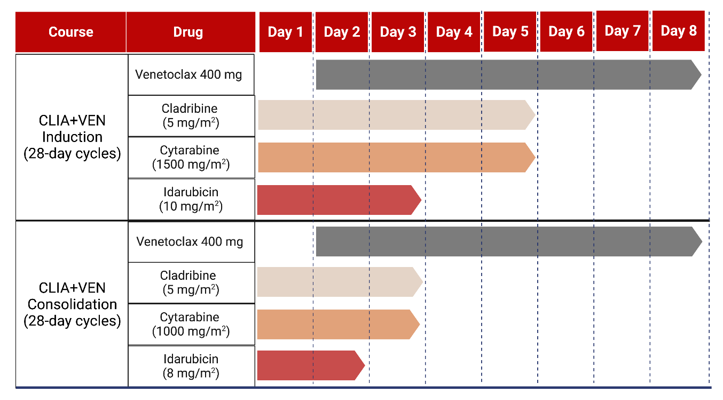
Improving Cytotoxic therapy, non-FLT3, non-CBF approaches with the Addition of Venetoclax to frontline IC
Induction:
  Cladribine 5 mg/m² IV daily for 5 days on D1-5
  Idarubicin 10 mg/m² IV daily for 3 days on D1-3
  Cytarabine 1500 mg/m² (1000 mg/m² for patients ≥ 60) IV daily for 5 days on D1-5
Consolidation:
  Cladribine 5 mg/m² IV daily for 3 days on D1-3
  Idarubicin 8 mg/m² IV daily for 2 days on D1-2
  Cytarabine 1000 mg/m² (750 mg/m² for patients ≥ 60) IV daily for 3 days on D1-3
Venetoclax dosing:
  400 mg daily (modifications made for CYP3A4i)
  Given on days 2-8 of each cycle
Cytoreduce to WBC < 20,000 prior to venetoclax
TLS monitoring per institutional standard
  Antimicrobial Prophylaxis in all patients: antibacterial, antiviral, antifungal

Slide 17
VEN + IC in AML: MRD-Negative Response Rates and SCT Rates
VEN + IC compared with IC resulted in
  Earlier responses
  Increased overall response rate
  Increase in MRD-negative CR rates
  Increase in MRD-negative CR rates in ELN adverse risk
VEN + IC compared with IC resulted in increased alloHSCT incidence and lower incidence of death
  AlloHSCT VEN + IC 79% vs IC 57%; P = .012
  Early death VEN + IC 5% vs IC 26%; P = .018
MRD-Negative Response Rates Between Cohorts
AlloHSCT Rates Between Cohorts
Lachowiez CA, et al. Lancet Haematol. 2022;9:e350-e360.

Slide 18
VEN + IC: EFS and OS in ELN Intermediate- and Adverse-Risk AML
EFS in Intermediate- or Adverse-Risk AML
OS in Intermediate- or Adverse-Risk AML
Event-Free Survival (N = 226) | IC (n = 162) | VEN + IC (n = 64)
Median OS, months | 12 | NR
HR 0.32 (95% CI: 0.16-0.66); P = .0020 | 18 (13-22) | 18 (30-46)
Overall Survival (N = 226) | IC (n = 162) | VEN + IC (n = 64)
Median OS, months | 21 | NR
HR: 0.43 (95% CI: 0.20-0.92); P = .030 | 18 (13-22) | 18 (30-46)
Lachowiez CA, et al. Lancet Haematol. 2022;9:e350-e360.

Slide 19
Venetoclax Plus High-Dose Cytarabine and Mitoxantrone (HAM-Ven) As Salvage
Treatment for Relapsed/Refractory AML:
Updated Results of the Phase-I/II SAL RELAX Trial
Leo Ruhnke, Christoph Schliemann, Jan-Henrik Mikesch, Matthias Stelljes, Lars Fransecky, Björn Steffen, Martin Kaufmann, Andreas Burchert, Andreas Rank, Maher Hanoun, Alexander Höllein, Sabrina Kraus, Mathias Hänel, Kerstin Schäfer-Eckart, Annett Haake, Frank Fiebig, Sven Zukunft, Jan Moritz Middeke, Désirée Kunadt, Johannes Schetelig, Malte von Bonin, Maximilian Alexander Röhnert, Uta Oelschlägel, Friedrich Stölzel, Claudia D Baldus, Hubert Serve, Martin Wermke, Martin Bornhäuser, and Christoph Röllig

Slide 20
HAM+Ven in R/R AML: Phase II design/dosing schedule
HAM + Ven | Drugs | d1 | d2 | d3 | d4 | d5 | d6 | d7 | d8-14
 | Cytarabine (1000 mg/m² BID)
 | Mitoxantrone (10 mg/m² QD)
 | Venetoclax (400 mg QD, initial ramp-up)
days 3-5
days 5-7
days 1-14
Early response assessment: bone marrow biopsy d18-21
Remission control: bone marrow biopsy d28-45
Optional Ven maintenance (400 mg QD) for one year

Slide 21
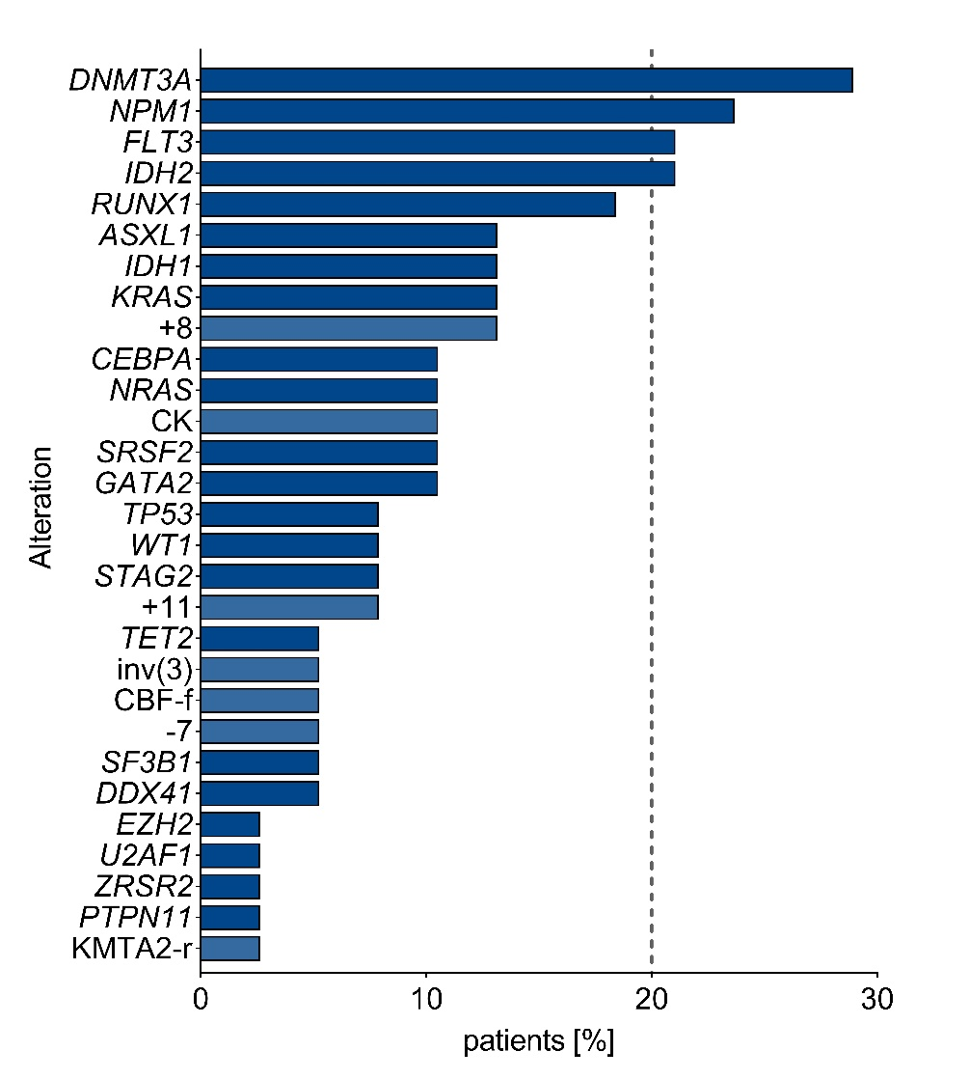
HAM+Ven in R/R AML: Baseline characteristics
Interim analysis: data on first 38 pts treated within RELAX trial (12 phase I, 26 phase II)
Baseline characteristics
Molecular profile (initial diagnosis)
Characteristics | All patients, n = 38 n/n (%)
Age | 54 y (26-74)
Sex, female | 17 (45%)
AML state
Relapsed AML | 28 (74%)
Primary refractory AML | 10 (26%)
Prior therapies
Induction therapy (DA, CPX-351) | 38 (100%)
Induction plus consolidation therapy | 18 (48%)
Induction plus allo-SCT | 10 (26%)
ELN 2022 risk group
Favorable | 8 (21%)
Intermediate | 12 (32%)
Adverse | 18 (47%)
28.9%
23.7%
21.1%
21.1%
18.4%

Slide 22
HAM+Ven in R/R AML: Adverse Events and Early Mortality
HAM+Ven is feasible and safe
Adverse Events | all grades, n/n (%) | ≥ grade 3, n/n (%)
Febrile neutropenia | 19/36 (53%) | 19/36 (53%)
Nausea | 9/36 (25%) | 2/36 (6%)
Pneumonia | 9/36 (25%) | 9/36 (25%)
Mucositis oral | 8/36 (22%) | 4/36 (11%)
Diarrhea | 6/36 (17%) | 3/36 (8%)
Sepsis | 4/36 (11%) | 4/36 (11%)
Vomiting | 4/36 (11%) | 0/36 (0%)
Skin/soft tissue infections | 4/36 (11%) | 2/36 (6%)
Typhilitis | 3/36 (8%) | 3/36 (8%)
Urinary tract infections | 3/36 (8%) | 1/36 (3%)
Abdominal pain | 3/36 (8%) | 1/36 (3%)
Bacteremia | 3/36 (8%) | 0/36 (0%)
Early Mortality | n/n (%)
30-day mortality | 1/38 (2.6%)
60-day mortality | 2/38 (5.2%)

Slide 23
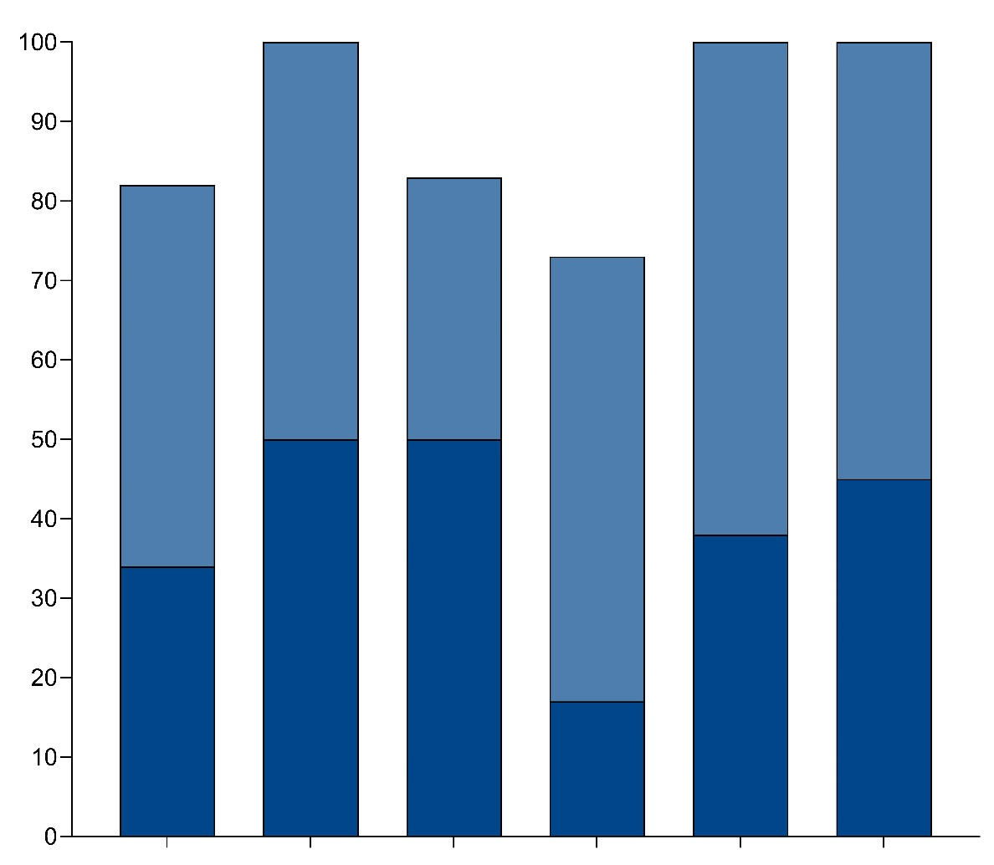
HAM+Ven in R/R AML: Outcomes (CR rate, MRD)
Response rates | n/n (%)
CRc | 31/38 (82%)
CR | 13/38 (34%)
CRi | 18/38 (48%)
CRc ELN₂₂ FAV | 8/8 (100%)
CRc ELN₂₂ INT | 10/12 (83%)
CRc ELN₂₂ ADV | 13/18 (73%)
CRc IDH1/IDH2^{mut} | 13/13 (100%)
CRc NPM1^{mut} | 9/9 (100%)
100%
100%
100%
82%
83%
74%
Remission rate [%]
CRi
CR
MRD (MFC) | n/n (%)
CR_{MRD-} (MFC LAIP) | 7/22 (32%)
CR_{MRD-} (MFC LAIP+DfN) | 7/31 (23%)
CR_{MRD+} pts with MRD load <0.1%* | 7/24 (29%)
all
patients
n=38
ELN22
FAV
n=8
ELN22
INT
n=12
ELN22
ADV
n=18
IDH1/2
n=13
NPM1
n=9
*MRD events (LAIP and/or DfN)/CD45+ events

Slide 24
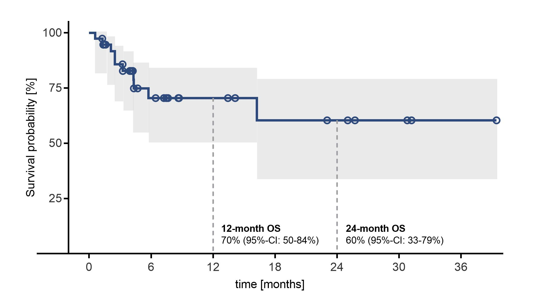
HAM+Ven in R/R AML: Overall survival
Demographic | All patients, (n=38)
Median follow-up, months | 9
Median OS, months | NR
12-month OS | 70,4%
24-month OS | 60,4%

Slide 25
Secondary Endpoint (Interim Analysis): Overall Survival
Newly Diagnosed FLT3-ITD-WT AML; Randomized Ph2 Quizartinib + Chemotherapy
HR, 0.569 (95% CI, 0.385-0.841)
P=0.004 (2-sided)ª
Number of Events
Quizartinib | 56/180
Placebo | 46/93
Quizartinib^{b}
mOS: NR
Overall survival probability
Placebo^{c}
mOS: 20.2 mo
Time, months

Slide 26
Sensitivity Analysis: Overall Survival According to ELN2017 Risk
Newly Diagnosed FLT3-ITD-WT AML; Randomized Ph2 Quizartinib + Chemotherapy
OS – ELN2017 Favorable
OS – ELN2017 Intermediate
OS – ELN2017 Adverse
Quizartinib
Quizartinib
Overall survival probability
Overall survival probability
Overall survival probability
Placebo
Placebo
Quizartinib
HR, 0.178 (95% CI, 0.038-0.841)
HR, 0.353 (95% CI, 0.162-0.770)
HR, 0.908 (95% CI, 0.554-1.487)
Placebo
Time, months
Time, months
Time, months

Slide 27
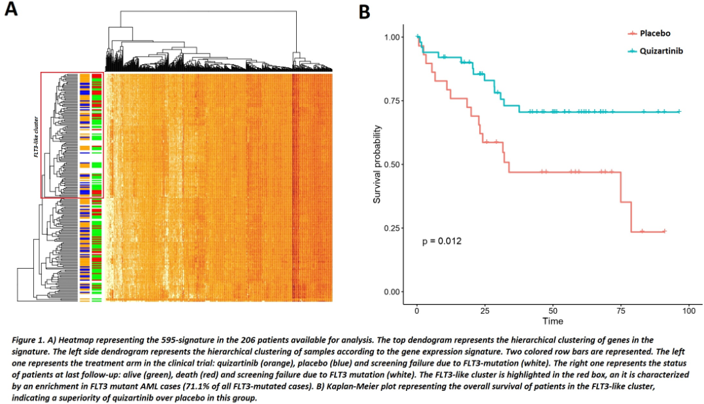
FLT3-like “Gene Expression” Predicts Outcome on Quizartinib (QIWI)
FLT3-like gene expression signature that clustered a proportion of FLT3 WT with FLT3 mutated
206 pts—112 (54%) cluster enriched in FLT3-mutant cases (71%).
80 cases (50%) of FLT3 WT were “FLT3-like”
FLT3-like pts benefited from addition of QUIZ
HR/p Value | Not FLT3-like QUIZ vs NO | FLT3-like QUIZ vs NO
EFS | 1.07/.8 | 0.45/.009
RFS | 0.88/.76 | 0.37/.01
OS | 1.22/.62 | 0.41/.01
Mosquera-Orgueira. Blood 142: abst 974; 2023

Slide 28
Pivekimab (IMGN632) With AZA+VEN in Newly Diagnosed AML
PVEK with AZA + VEN (14-21 days) in newly diagnosed CD123+ AML (NCT04086264)
Peripheral Edema All grades (44%), Grade 3/4 (4%)
IRRs: 16% (all Grade 1/2)
No capillary leak syndrome, CRS, or VOD events
Study discontinuation: 2/50 (1 generalized edema, 1 prolonged myelosuppression)
30-day mortality: 0; 60-day mortality 2/50 (4%) (1 PNA, 1 disease progression)
EOC1 r: ANC>500 34 days, PLT>50 22 days
Post-remission cycles : ANC>500 28 days, PLT>50 22 days
Among 29 responders with evaluable central MRD (</=0.02%): MRDneg 22/29 (76%)
Responses (N=50)
 | CR rate | CCR rate | CCR_{mrd-} rate
Overall Population (N=50) | 54% (27/50) | 68% (34/50) | 76% (22/29)
Strictly meet unfit FDA criteria (n=23) | 61% (14/23) | 78% (18/23) | 79% (11/14)
Molecular Stratification in Subsets |  | PVEK Triplet
Higher benefit (TP53^{wt}, no FLT3-ITD, K/NRAS^{wt}) | CCR CR MRD- | 94% (17/18) 89% (16/18) 73% (11/15)
Intermediate benefit (TP53^{wt} and FLT3-ITD or K/NRAS^{mut}) | CCR CR MRD- | 71% (5/7) 71% (5/7) 100% (5/5)
Lower benefit (TP53^{mut}) | CCR CR MRD- | 50% (7/14) 21% (3/14) 50% (3/6)
Daver N et al, ASH 2023
Notes:
Footnotes for antileukemia activity table :
Responses determined by ELN 2017 criteria (with addition of CRh)
CCR=CR+CRh+CRp+CRi
MRD rate (assessed centrally [Hematologics, Inc.] by flow cytometry; <0.1% defined as negative)
Unfit by FDA criteria includes patients ≥75 years old, or younger patients with defined organ dysfunction; the 27 patients who were not included in unfit population by FDA criteria were <75 years old without defined comorbidities

Slide 29
First-in-Human Study of the CD123 NK Cell Engager SAR443579 in Relapsed or Refractory Acute Myeloid Leukemia, B-Cell Acute Lymphoblastic Leukemia or High Risk-Myelodysplasia:
Updated Safety, Efficacy, Pharmacokinetics and Pharmacodynamics
Ashish Bajel,¹ Sylvain Garciaz,² Pinkal Desai,³ Gerwin A. Huls,⁴ Abhishek Maiti,⁵ Mojca Jongen-Lavrencic,⁶ Nicolas Boissel,⁷ Stephane De Botton,⁸ David C. deLeeuw,⁹ Shaun A. Fleming,¹⁰ C. Michel Zwaan,¹¹ Martha L. Arellano,¹² David Avigan,¹³ Jennifer N. Saultz,¹⁴ loannis Mantzaris,¹⁵ Kyle Jensen,¹⁶ Timothy Wagenaar,¹⁶ Gu Mi,¹⁶ Samira Ziti-Ljajic,¹⁷ Dobrin Draganov,¹⁶ Giovanni Abbadessa,¹⁶ Anthony Selwyn Stein,¹⁸
¹Peter MacCallum Cancer Centre and Royal Melbourne Hospital, Melbourne, Australia; ²Institut Paoli-Calmettes, Aix-Marseille University, Marseille, France; ³Weill Cornell Medicine, New York, NY; ⁴University Medical Center Groningen, Groningen, Netherlands; ⁵MD Anderson Cancer Center, Houston, TX; ⁶Erasmus University Medical Center, Rotterdam, Netherlands; ⁷Hôpital Saint-Louis, Paris, France; ⁸Institut Gustave Roussy, Paris, France; ⁹Amsterdam University Medical Center, Amsterdam, Netherlands; ¹⁰The Alfred Hospital, Melbourne, Australia; ¹¹Prinses Máxima Center for Pediatric Oncology Research, Utrecht, Netherlands; ¹²Emory University, Atlanta, GA; ¹³Beth Israel Deaconess Medical Center, Boston, MA; ¹⁴Oregon Health & Science University, Portland, OR; ¹⁵Montefiore Medical Center, Bronx, NY; ¹⁶Sanofi, Cambridge, MA;
¹⁷Sanofi, Chilly-Mazarin, France; ¹⁸City of Hope National Medical Center, Duarte, CA
Poster presented at the 65th Annual Meeting of the American Society of Hematology (ASH), San Diego, CA.
December 9–12, 2023 #3474

Slide 30
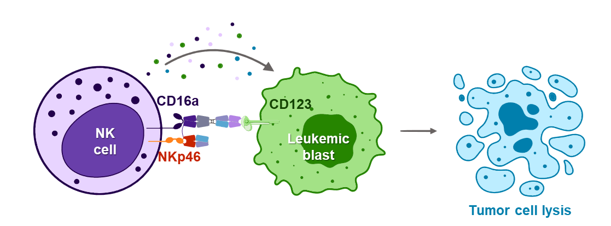
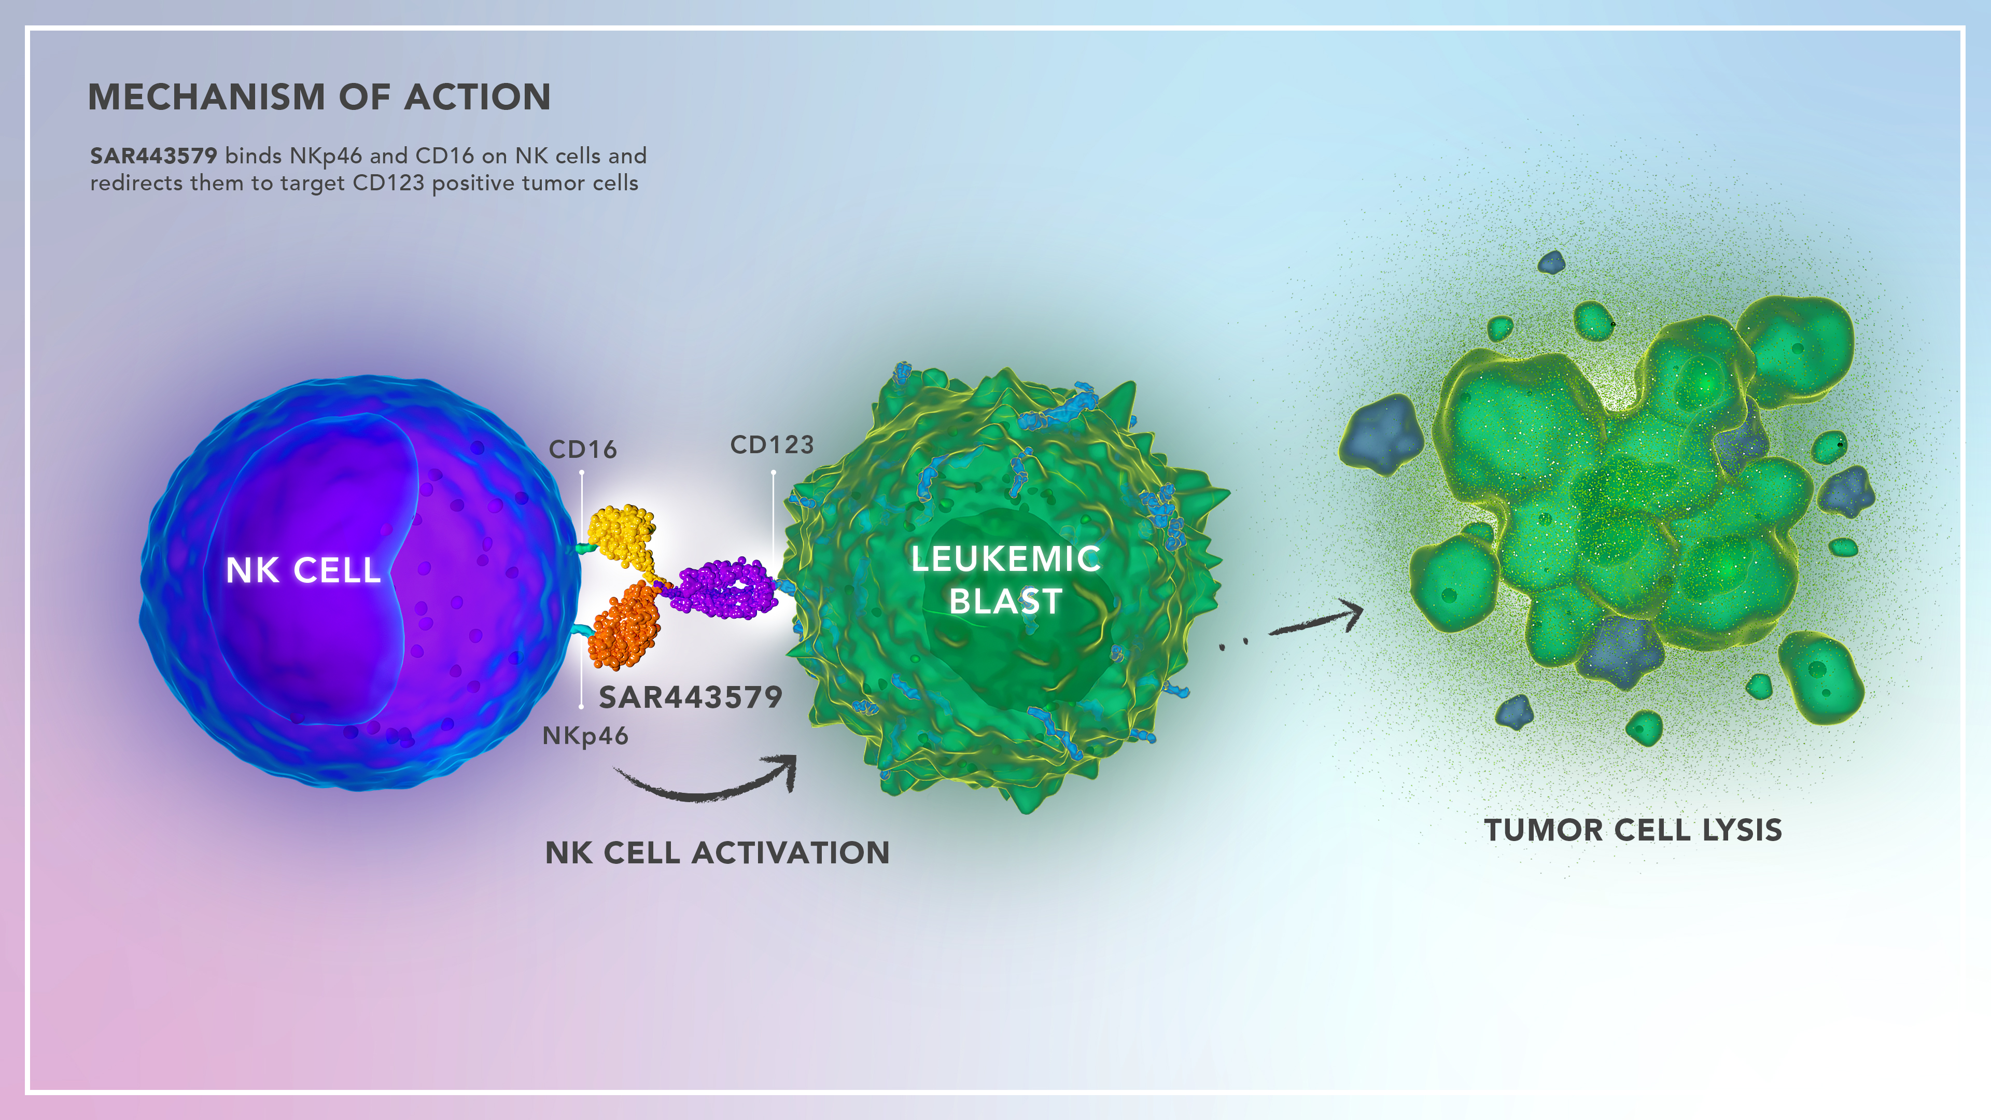

Background
Mechanism of Action
CD123 is widely expressed in
hematological malignancies¹⁻⁴
T cell engagers targeting CD123 have
displayed some preliminary clinical
efficacy; however, they have been
associated with safety concerns
including cytokine release syndrome
and neurotoxicity⁵
SAR443579 (SAR’579) is a trifunctional anti-CD123 NKp46xCD16 NKCE targeting the CD123 antigen and co-engaging NKp46 and CD16a on NK cells triggering tumor cell death
TCD17197 (NCT05086315) is an ongoing first-in-human phase 1/2 open-label, multicenter trial evaluating SAR’579 in patients with R/R AML, B-ALL, or HR-MDS
In early clinical results, SAR’579 was well tolerated up to 3000 µg/kg QW with no dose-limiting toxicities and clinical remissions were identified at a maximal target dose of 1000 µg/kg/infusion⁶
Here we present updated results from TCD17197 on SAR'579 doses ranging from 10 μg/kg through 6000 μg/kg at a data cutoff of October 23, 2023
B-ALL, B-cell acute lymphoblastic leukemia; CD, cluster of differentiation; HR-MDS, high risk-myelodysplasia; NK, natural killer; NKCE, NK cell engager; QW, once weekly; R/R AML, relapsed or refractory acute myeloid leukemia.
1. Lyapichev KA, et al. Clin Lymph Myel Leuk. 2021;21(4):e317-e320. 2. Patnaik MM, et al. Leuk Lymphoma. 2021;62(11):2568-86. 3. Uckun FM, et al. Front Aging. 2021;2:757276. 4. El Achi H, et al. Cancers (Basel). 2020;12(11):3087. 5. Uy GL, et al. Blood. 2021;137(6):751-62; 6. Stein AS, et al. J Clin Oncol. 2023;41(suppl 16):7005.

Slide 31
Responses per Investigator
Target Dose Levels (DL3/DL4/DL8)
CR
CR
CR
CRi
CR
Other Dose Levels
0
1
2
3
4
5
6
7
8
9
10
11
12
13
14
15
Duration on Treatment (Months)
DL1
DL2
DL3
DL4
DL5
DL6
DL7
DL8
Receiving treatment
 | DL1 (n=3) | DL2 (n=4) | DL3 (n=4) | DL4 (n=4) | DL5 (n=4) | DL6 (n=8) | DL7 (n=8) | DL8 (n=7) | All (N=42)
Maximum target dose (µg/kg) | 100 | 300 | 1000 | 1000 | 3000 | 3000 | 6000 | 1000 | —
CRc, n (%) | 0 | 0 | 2* (50.0) | 1 (25.0) | 0 | 0 | 0 | 2 (28.6) | 5 (11.9)
CR/CRi was reported in 5 of 16 (31.3%) patients treated at a maximal target dose of 1000 μg/kg/infusion; 3 patients with CR are still receiving treatment
The median duration of response was not estimable; maximum time on treatment was 65 weeks
4 responders had prior venetoclax and 2 responders had prior HSCT
Data cut-off: October 23, 2023. *1 CRi at DL3.
CR, complete remission; CRc, composite CR (CR+CRi); CRi, CR with incomplete hematological recovery; DL, dose level; HSCT, hematopoietic stem cell transplantation.

Slide 32
TRAEs Reported in ≥4% of All Patients
n (%) | DL1 (n=3) | DL2 (n=4) | DL3 (n=4) | DL4 (n=4) | DL5 (n=4) | DL6 (n=8) | DL7 (n=8) | DL8 (n=8) | All Grade (N=43) | Grade ≥3 (N=43)
Infusion-related reaction | 1 (33.3) | 3 (75.0) | 2 (50.0) | 4 (100.0) | 2 (50.0) | 4 (50.0) | 6 (75.0) | 7 (87.5) | 29 (67.4) | 0
Cytokine release syndrome | 0 | 0 | 0 | 1 (25.0)* | 1 (25.0)* | 0 | 0 | 0 | 2 (4.7)* | 0
Decreased appetite | 0 | 1 (25.0) | 0 | 0 | 1 (25.0) | 0 | 0 | 0 | 2 (4.7) | 0
Diarrhea | 1 (33.3) | 1 (25.0) | 0 | 0 | 0 | 0 | 0 | 0 | 2 (4.7) | 0
Nausea | 1 (33.3) | 0 | 0 | 0 | 1 (25.0) | 0 | 0 | 0 | 2 (4.7) | 0
The most common TRAE was infusion-related reaction, which generally occurred during cycle 1/day 1 and typically resolved within 1 hour utilizing temporary interruption of infusion and symptom management
Grade ≥3 TRAEs were reported in 2 patients and included grade 3 diverticulitis in 1 patient in DL3 and grade 4 neutropenia in 1 patient in DL3
There were no cases of immune effector cell-associated neurotoxicity syndrome
Data cut-off: October 23, 2023. *Grade 1. Events are per patient (i.e. an individual may have multiple concurrent AEs).
AE, adverse event; DL, dose level; TRAE, treatment-related AE.

Slide 33
The benefit of allogeneic transplant in 1st complete remission in NPM1 mutated AML with or without FLT3 ITD is restricted to those testing MRD positive after induction – an analysis of the UK NCRI AML17 and AML19 studies
J Othman*, N Potter*, A Ivey, J Jovanovic, SD Freeman, A Gilkes, I Thomas, S Johnson, J Canham, J Cavenagh, P Kottaridis, C Arnold, UM Overgaard, M Dennis, C Wilhelm-Benartzi, R Dillon*, NH Russell*
On behalf of the UK NCRI AML working group
*equal contribution

Slide 34
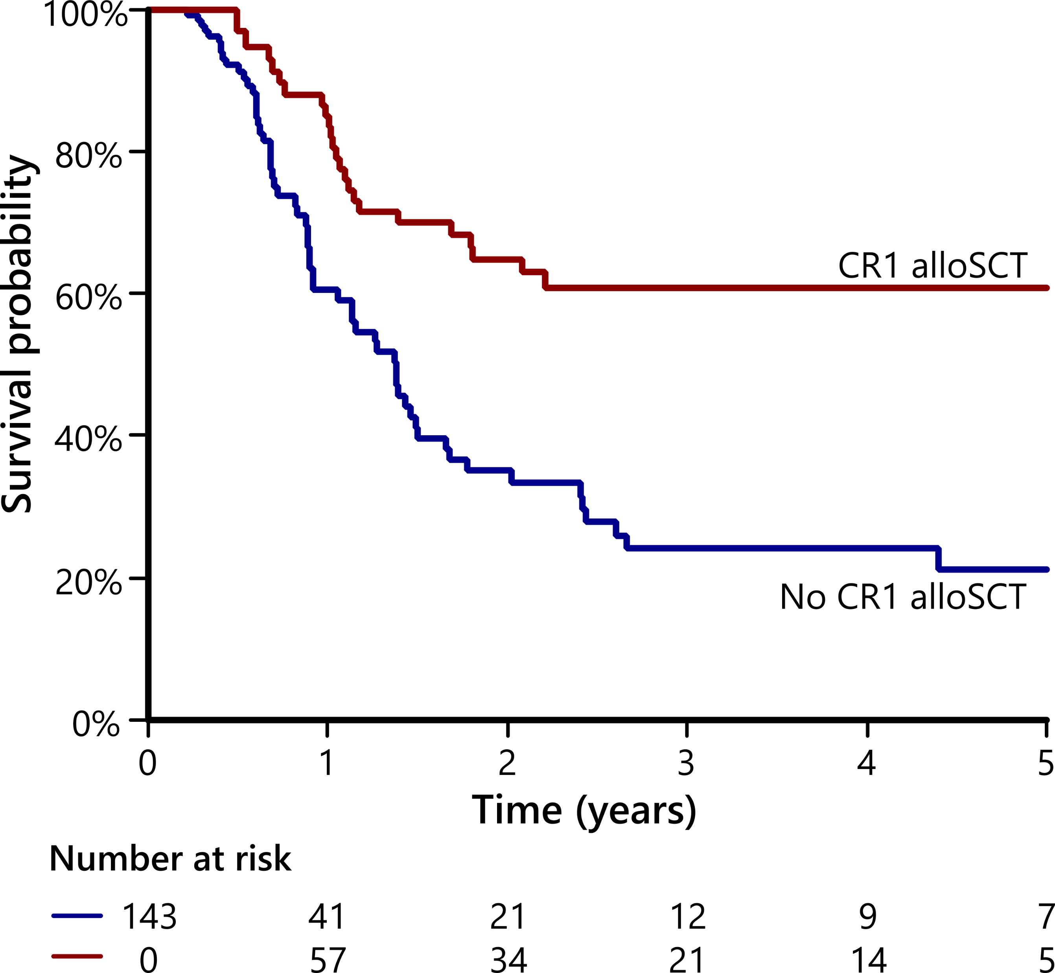
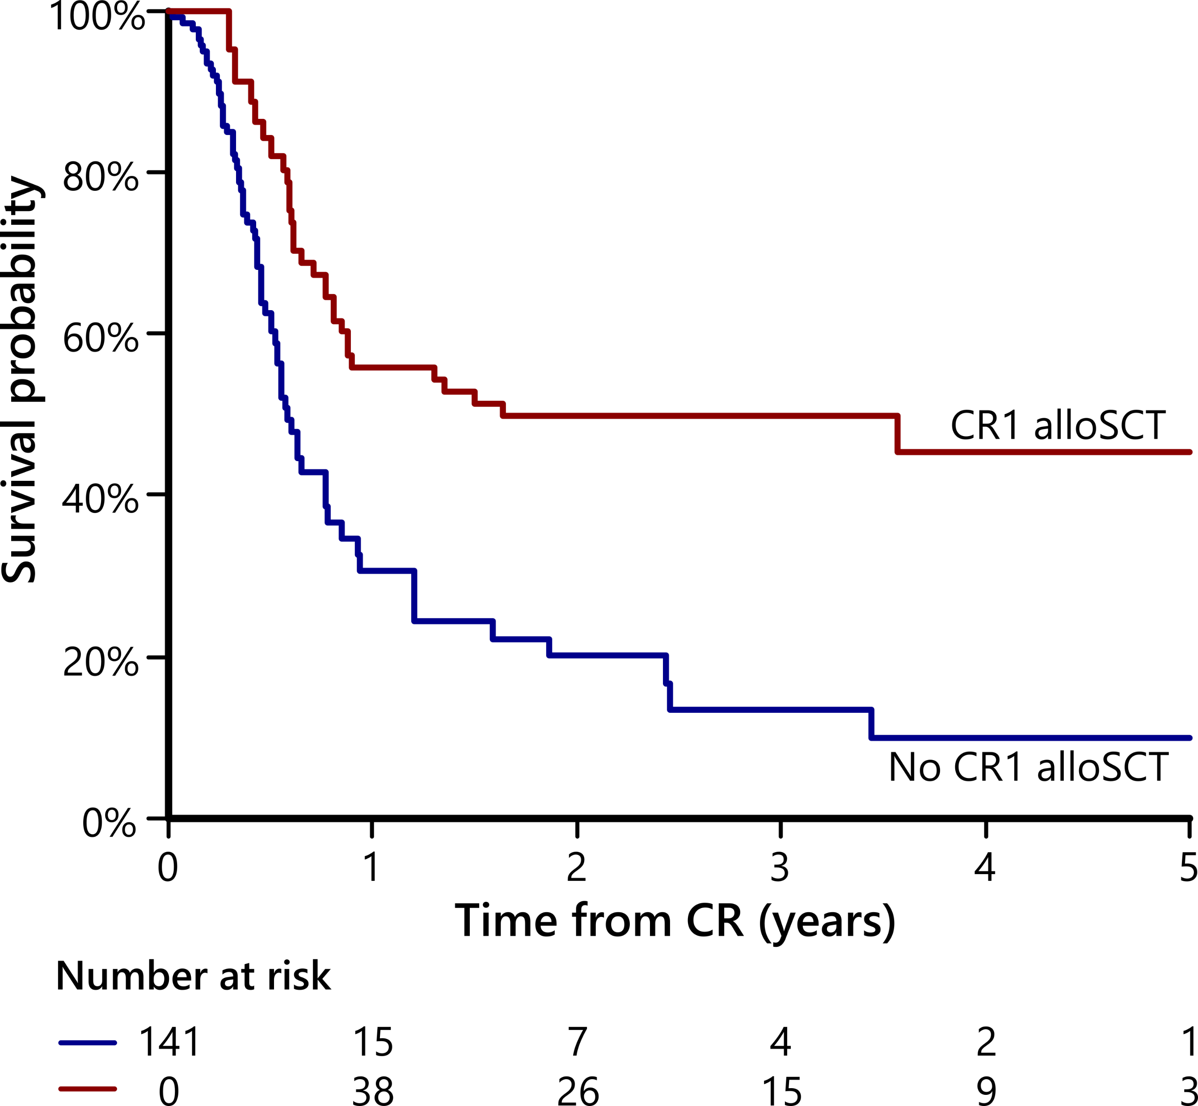
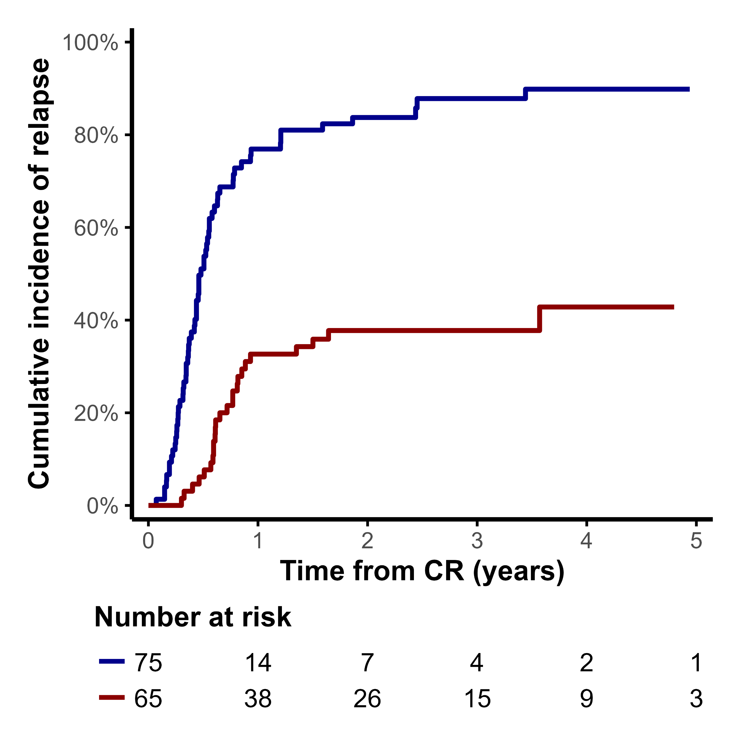
CR1-allo improves OS in NPM1^{mut} AML who were PB MRD positive after induction
Overall survival
Relapse-free survival
Relapse
No CR1 alloSCT
CR1 alloSCT
HR 0.39, 95%CI 0.24-0.64
HR 0.44, 95%CI 0.27-0.72
Gray’s test p<0.001
Notes:
3y OS 61% vs 24%

Slide 35
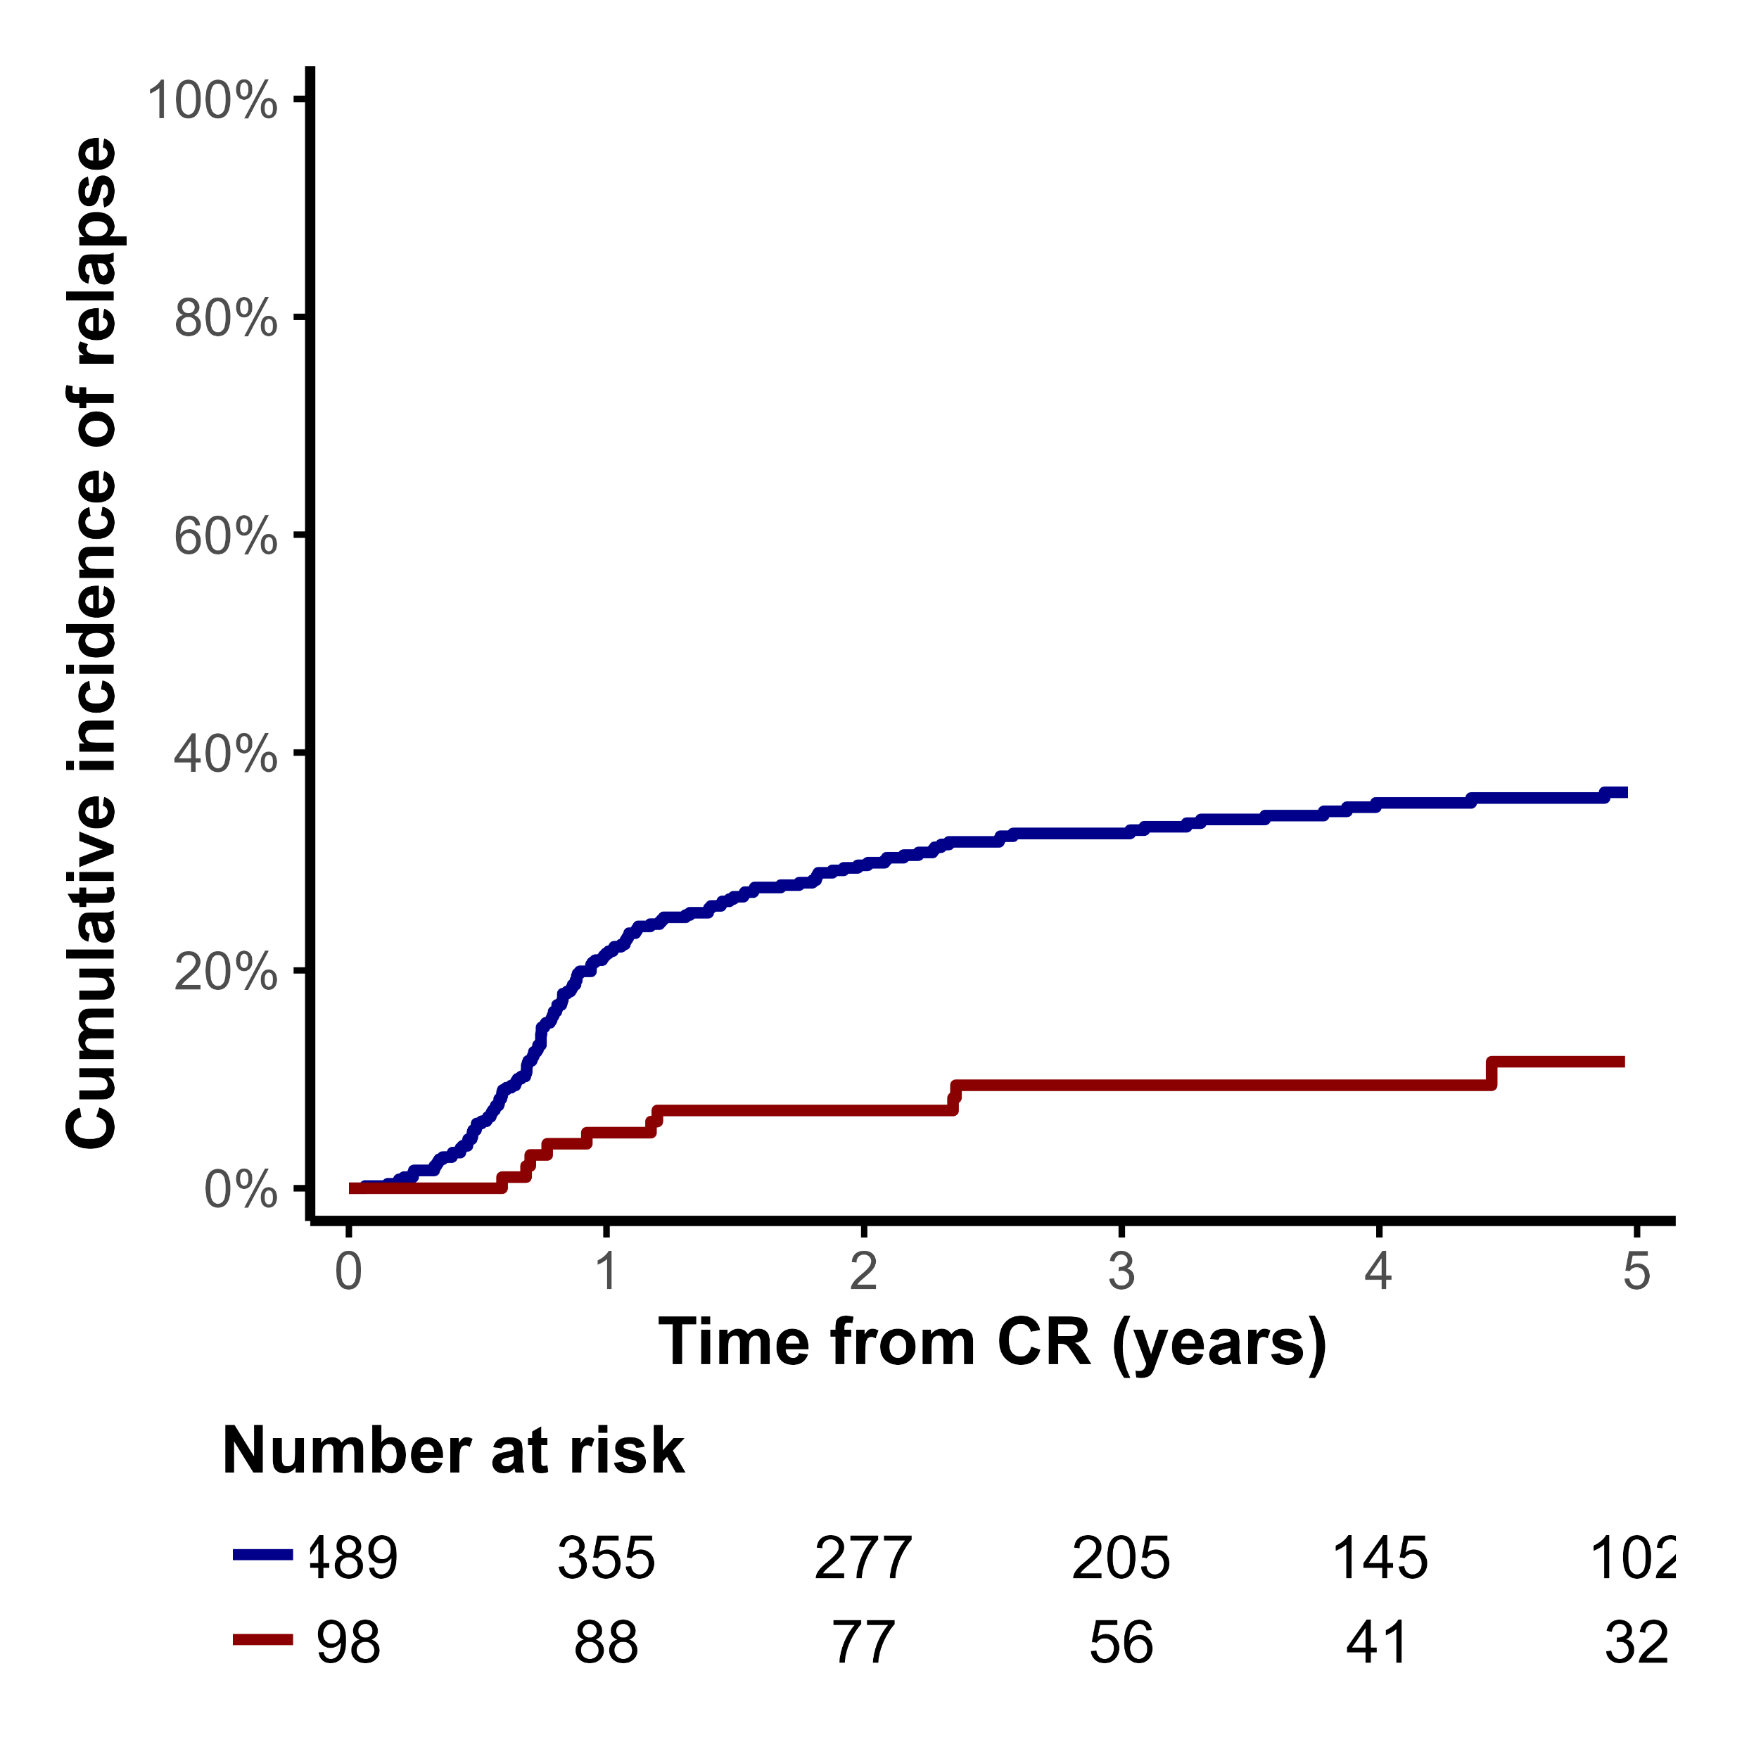
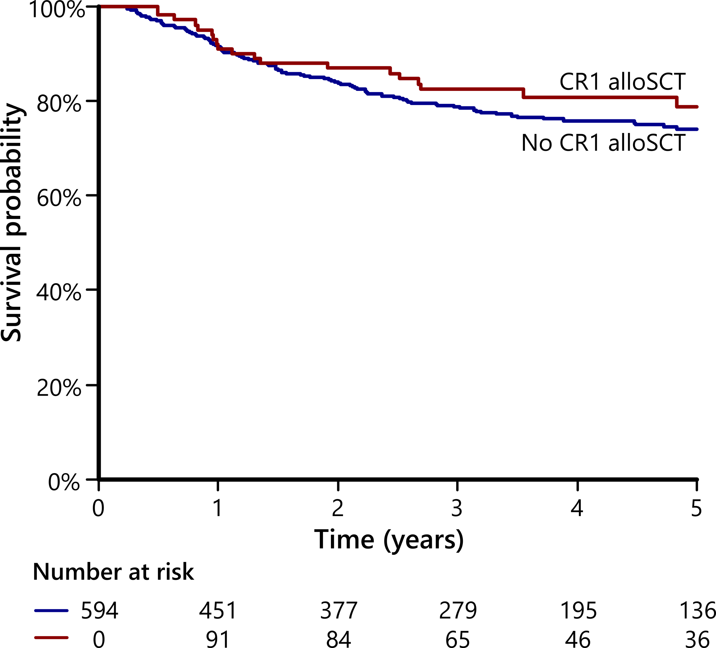
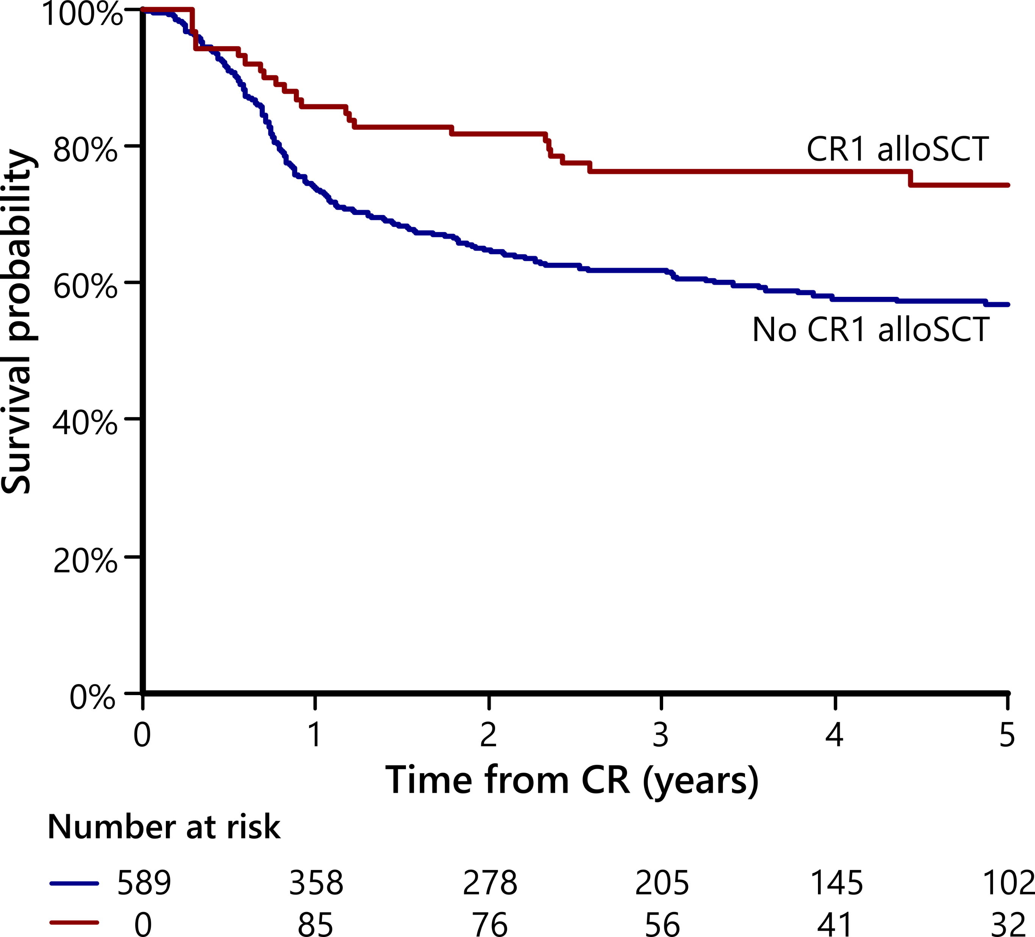
CR1-allo does not improve OS in NPM1^{mut} AML who were PB MRD negative after induction (despite reduced relapse)
Overall survival
Relapse-free survival
Relapse
Gray’s test p<0.001
No CR1 alloSCT
HR 0.82, 95%CI 0.50-1.33
HR 0.50, 95%CI 0.32-0.79
CR1 alloSCT
102
Notes:
NRM was not increased in transplanted patients
No CR1 allo group was able to be salvaged - high rate of transplant after relapse (103 of 169 relapsed patients) and 3y OS of 50% after relapse

Slide 36
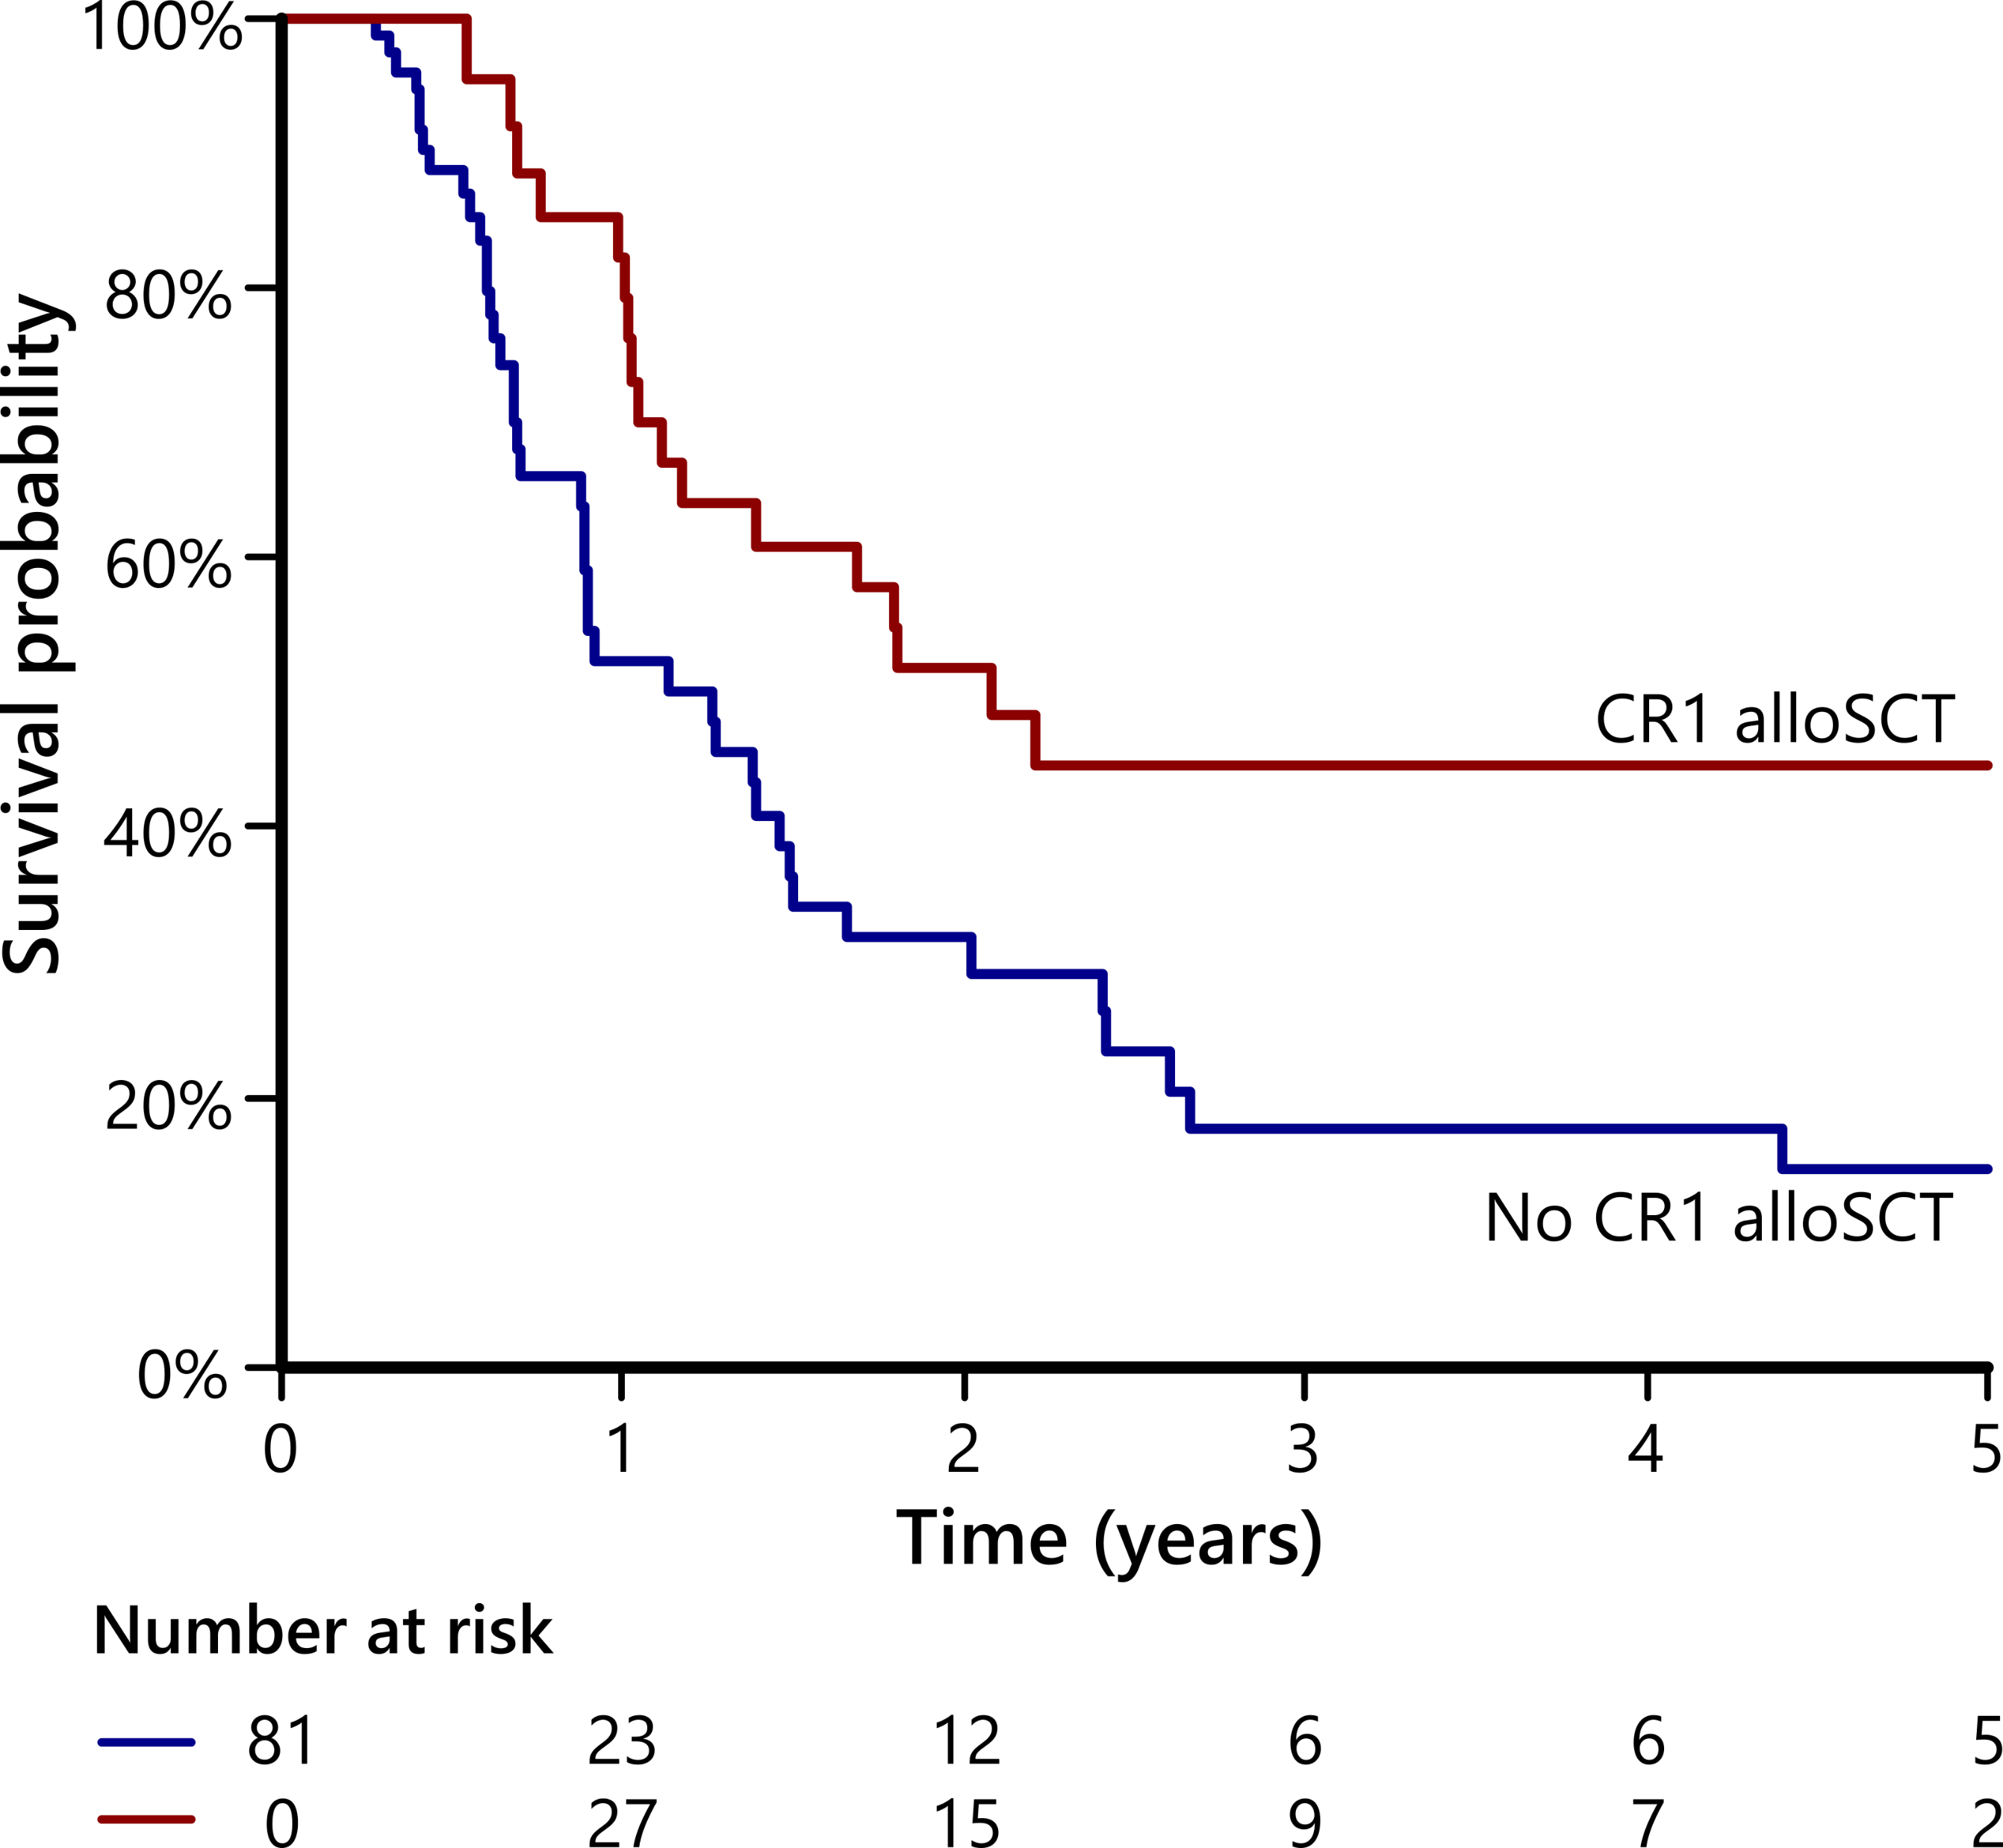
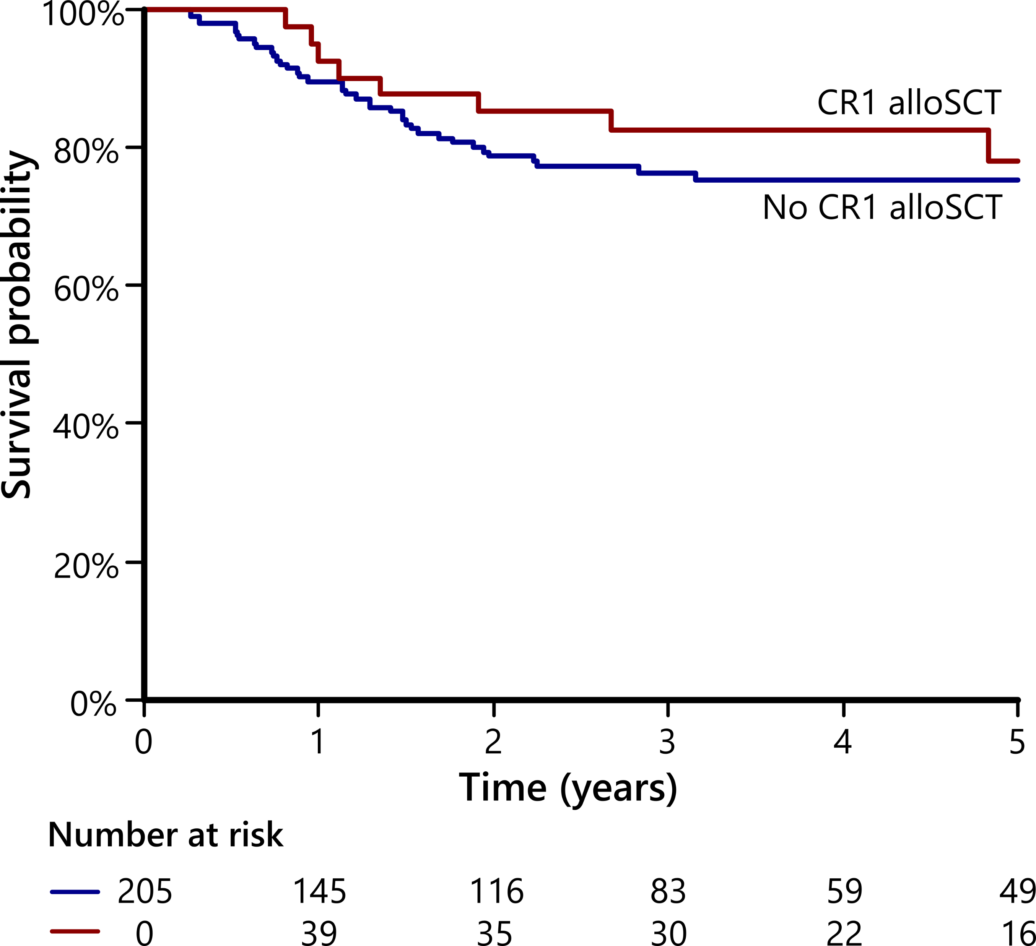
Results in NPM1^{mut} + FLT3 ITD patients were similar to the overall population
OS, MRD positive
OS, MRD negative
HR 0.52, 95%CI 0.29-0.93
HR 0.80, 95%CI 0.37-1.72
Notes:
3y OS 45% vs 18%
3yr OS 83% vs 76%

Slide 37
Limitations
No effective frontline FLT3 inhibitor
  Would expect this to deepen MRD responses
No FLT3 ITD MRD assays
  Combined NPM1 and FLT3 MRD may provide additional information in CR1-allo selection
May not be generalizable to older patients
  121 patients (16%) over age 60
Not applicable to flow cytometric MRD

Slide 38
Leukemia Questions?
Email: ndaver@mdanderson.org
Cell: 832-573-7080
Office: 713-794-4392

Slide 39
Appendix

Slide 40
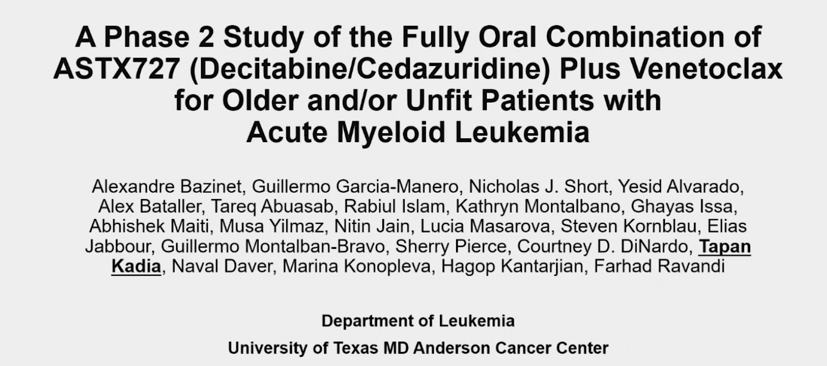
ASH 2023;Abstract 833.

Slide 41
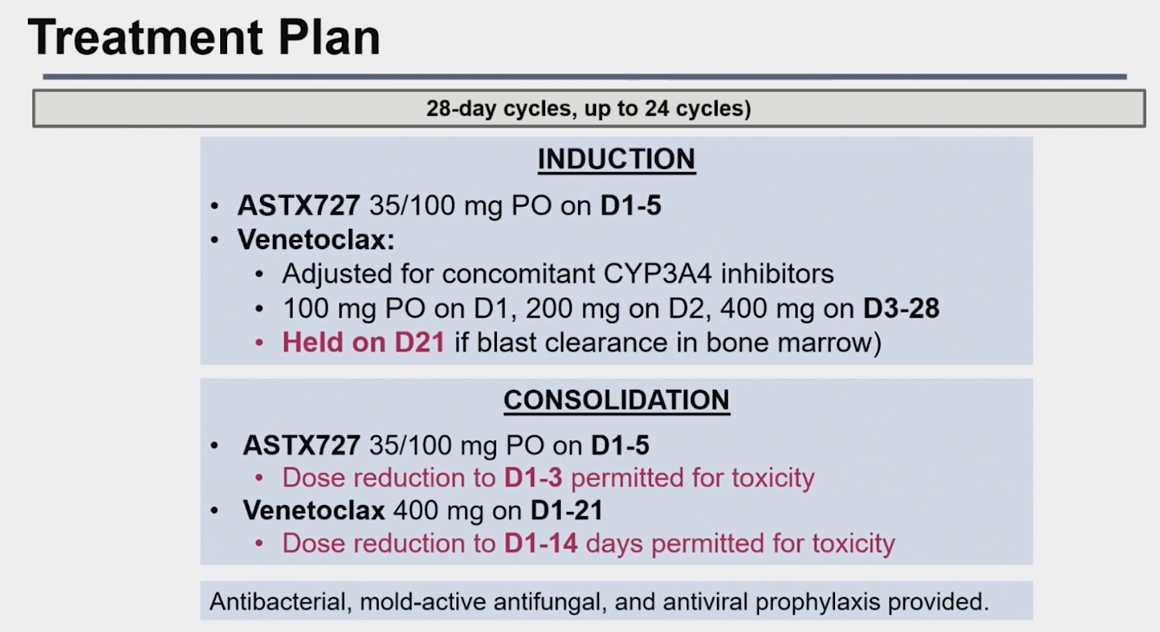
A Phase II Study of the Fully Oral Combination of ASTX727 (Decitabine/Cedazuridine) and Venetoclax for Older or Unfit Patients with AML
28-day cycles (up to 24 cycles)
Held on D21 (if blast clearance in bone marrow)
Kadia T et al. ASH 2023;Abstract 833.

Slide 42
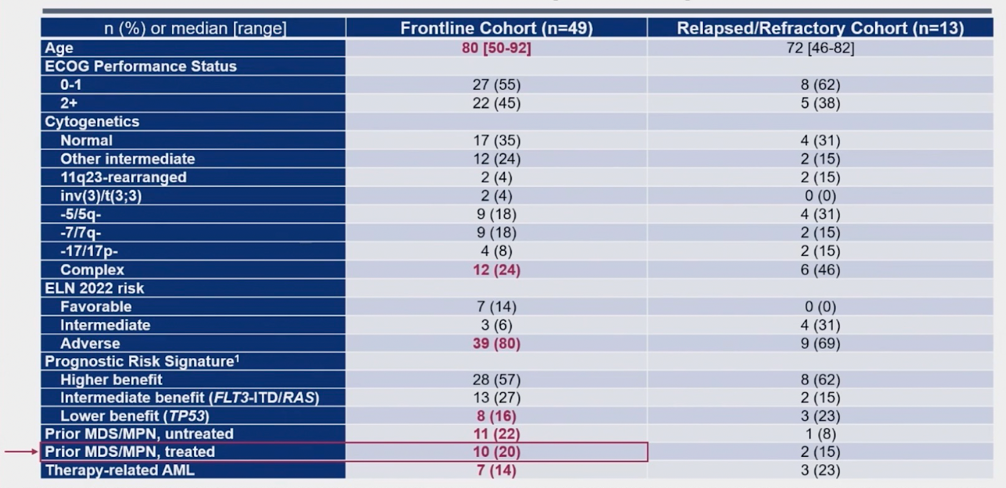
Study of ASTX727 (Decitabine/Cedazuridine) with Venetoclax:
Patient Baseline Characteristics (n = 62)
Kadia T et al. ASH 2023;Abstract 833.

Slide 43
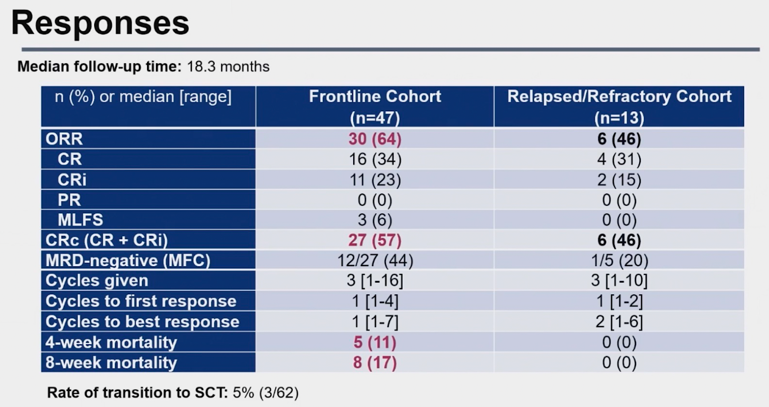
ASTX727 (Decitabine/Cedazuridine) with Venetoclax: Response
Kadia T et al. ASH 2023;Abstract 833.

Slide 44
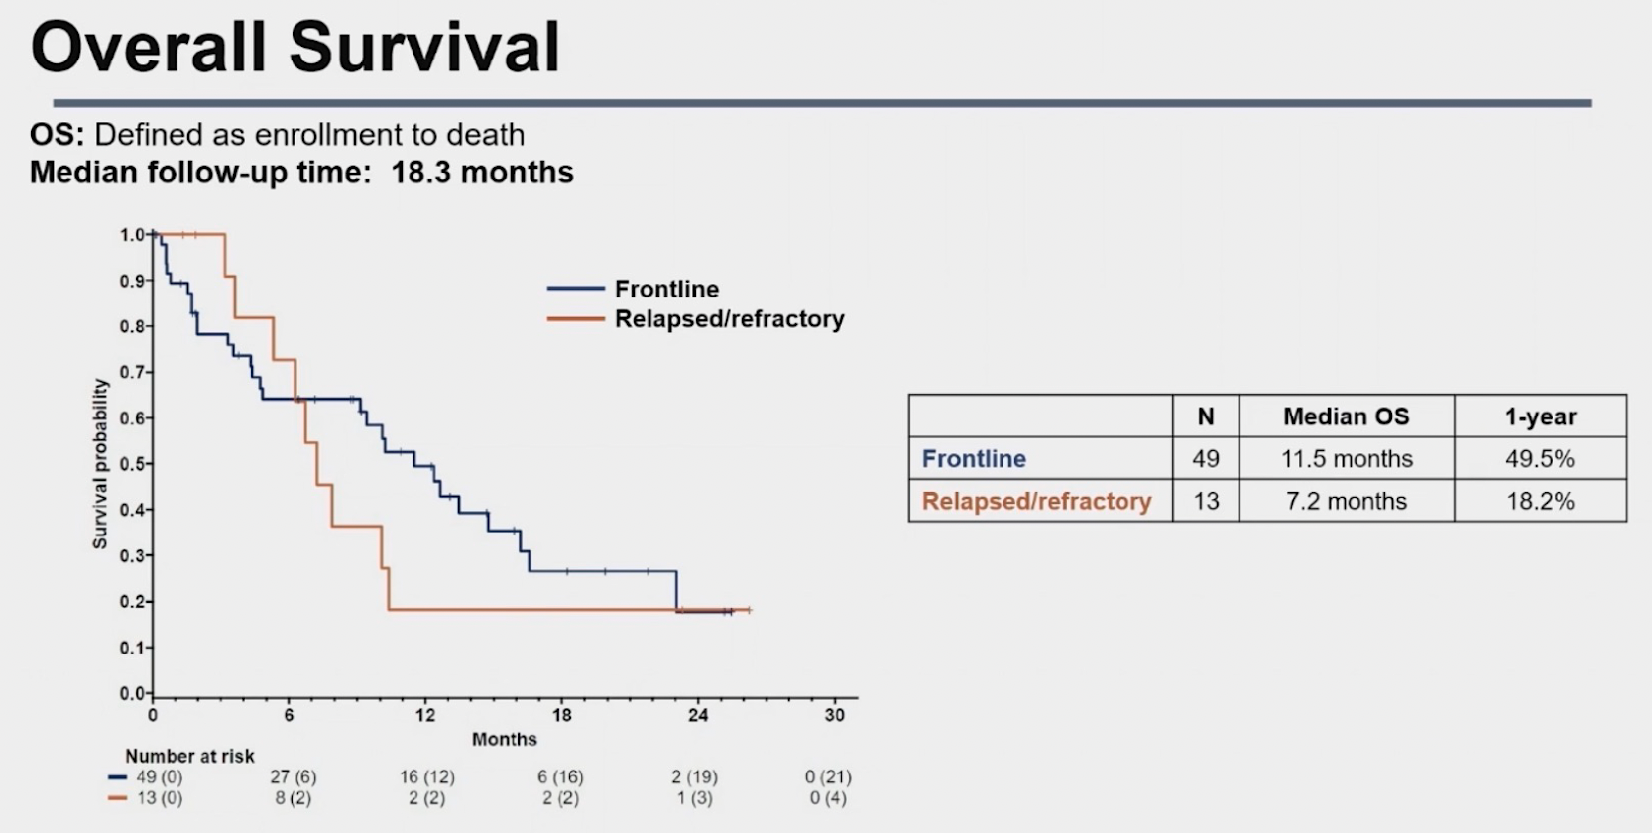
ASTX727 (Decitabine/Cedazuridine) with Venetoclax: OS
Kadia T et al. ASH 2023;Abstract 833.

Slide 45
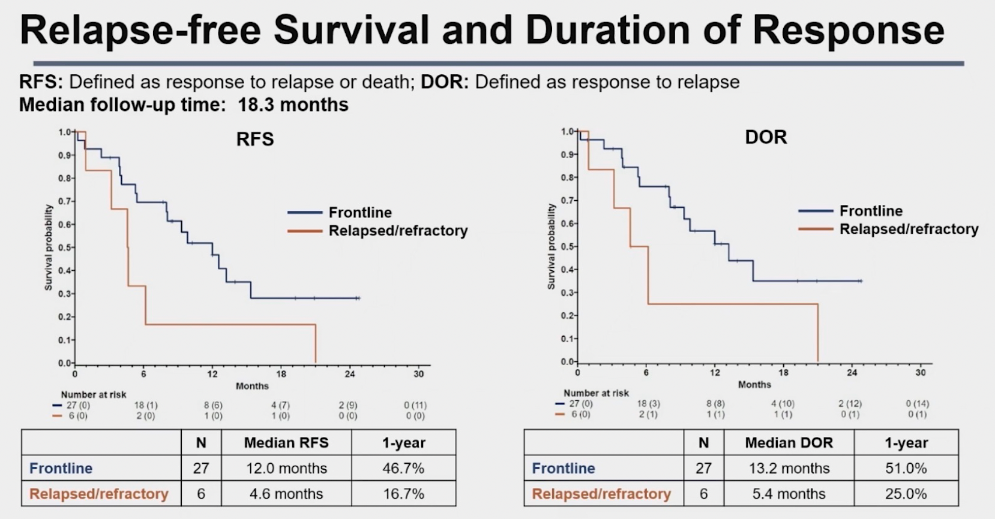
ASTX727 (Decitabine/Cedazuridine) with Venetoclax: RFS and DOR
Kadia T et al. ASH 2023;Abstract 833.

Slide 46
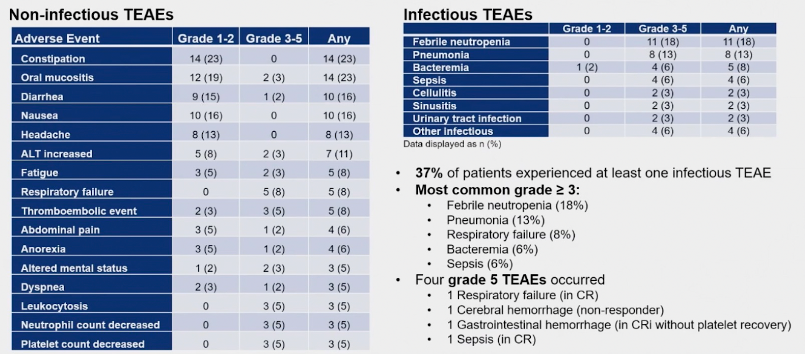
ASTX727 (Decitabine/Cedazuridine) with Venetoclax: Safety
Kadia T et al. ASH 2023;Abstract 833.

