Slide 1
Year in Review: Gynecologic Oncology
A CME/MOC-Accredited Live Webinar
Tuesday, June 25, 2024
5:00 PM – 6:00 PM ET
Faculty
Dana M Chase, MD
Moderator
Neil Love, MD

Slide 2


Faculty
Dana M Chase, MD
Associate Professor
Division of Gynecologic Oncology
David Geffen School of Medicine at UCLA
Los Angeles, California
MODERATOR
Neil Love, MD
Research To Practice
Miami, Florida

Slide 3
Commercial Support
This activity is supported by an educational grant from AstraZeneca Pharmaceuticals LP.
Research To Practice CME Planning Committee Members,
Staff and Reviewers
Planners, scientific staff and independent reviewers for Research To Practice have no relevant conflicts of interest to disclose.

Slide 4
Dr Chase — Disclosures
Advisory Committees and Contracted Research | GSK, Merck
Consulting Agreements | AstraZeneca Pharmaceuticals LP, Eisai Inc, GSK
Speakers Bureaus | AstraZeneca Pharmaceuticals LP, Eisai Inc, GSK, ImmunoGen Inc, Merck, Myriad Genetic Laboratories Inc
Nonrelevant Financial Relationship | NRG Oncology

Slide 5
This educational activity contains discussion of
non-FDA-approved uses of agents and regimens. Please refer to official prescribing information for each product for approved indications.

Slide 6
Key Data Sets
Pfisterer J et al. Optimal treatment duration of bevacizumab as front-line therapy for advanced OC: AGO-OVAR 17 BOOST/GINECO OV118/ENGOT Ov-15 open-label randomized Phase III Trial. J Clin Oncol 2023;41(4):893-902.
DiSilvestro P et al; SOLO1 Investigators. Overall survival with maintenance olaparib at a 7-year follow-up in patients with newly diagnosed advanced OC and a BRCA mutation: The SOLO1/GOG 3004 trial. J Clin Oncol 2023;41(3):609-17.
González-Martín A et al. Progression-free survival and safety at 3.5 years of follow-up: Results from the randomised Phase III PRIMA/ENGOT-OV26/GOG-3012 trial of niraparib maintenance treatment in patients with newly diagnosed OC. Eur J Cancer 2023;189:112908.
Ray-Coquard I et al. Olaparib plus bevacizumab first-line maintenance in ovarian cancer: Final overall survival results from the PAOLA-1/ENGOT-ov25 trial. Ann Oncol 2023;34(8):681-92.
Harter P et al. Durvalumab with paclitaxel/carboplatin (PC) and bevacizumab (bev), followed by maintenance durvalumab, bev, and olaparib in patients (pts) with newly diagnosed advanced ovarian cancer (AOC) without a tumor BRCA1/2 mutation (non-tBRCAm): Results from the randomized, placebo (pbo)-controlled phase III DUO-O trial. ASCO 2023;Abstract LBA5506.

Slide 7
Key Data Sets (Continued)
Pujade-Lauraine E et al. Maintenance olaparib rechallenge in patients with platinum-sensitive relapsed ovarian cancer previously treated with a PARP inhibitor (OReO/ENGOT-ov38): A phase IIIb trial. Ann Oncol 2023;34(12):1152-64.
Simpkins F et al. Combination ATR and PARP Inhibitor (CAPRI): A phase 2 study of ceralasertib plus olaparib
in patients with recurrent, platinum-sensitive epithelial ovarian cancer (cohort A). ASCO 2024;Abstract 5510.
Moore KN et al. Mirvetuximab soravtansine in FRα-positive, platinum-resistant ovarian cancer. N Engl J Med 2023;389(23):2162-74.
Meric-Bernstam F et al. Efficacy and safety of trastuzumab deruxtecan in patients with HER2-expressing solid tumors: Primary results from the DESTINY-PanTumor02 phase II trial. J Clin Oncol 2024;42(1):47-58.
Nishikawa T et al. Trastuzumab Deruxtecan for Human Epidermal Growth Factor Receptor 2-Expressing Advanced or Recurrent Uterine Carcinosarcoma (NCCH1615): The STATICE Trial. J Clin Oncol 2023; 41(15):2789-99.
Van Nieuwenhuysen E et al. Durvalumab + carboplatin/paclitaxel (CP) followed by durvalumab ± olaparib as first-line treatment for newly diagnosed advanced or recurrent endometrial cancer (EC) in DUO-E: Results by BRCA1/BRCA2 mutation (BRCAm) status. ASCO 2024;Abstract 5595.

Slide 8
Key Data Sets (Continued)
Pepin JT et al. Safety and tolerability of durvalumab + carboplatin/paclitaxel followed by durvalumab + olaparib in patients with newly diagnosed advanced or recurrent endometrial cancer (EC) in the
DUO-E/GOG-3041/ENGOT-EN10 trial. ASCO 2024;Abstract 5599.
Westin SN et al. Durvalumab plus carboplatin/paclitaxel followed by maintenance durvalumab with or without olaparib as first-line treatment for advanced endometrial cancer: The phase III DUO-E trial. J Clin Oncol 2023;42;283-99.
Eskander RN et al. Overall survival and progression-free survival by PD-L1 status among endometrial cancer patients treated with pembrolizumab plus carboplatin/paclitaxel as compared to carboplatin/paclitaxel plus placebo in the NRG GY018 trial. SGO 2024; Late-breaking abstract.
Makker V et al. Long-term follow-up of selinexor maintenance for patients with TP53wt advanced or recurrent endometrial cancer: A pre-specified subgroup analysis from the phase 3 ENGOT-EN5/GOG- 3055/SIENDO study. ASCO 2024;Rapid Update.
Makker V et al. Phase 3 dose selection for selinexor in TP53wt endometrial cancer based on exposure-response analysis. ASCO 2024;Abstract 5594.
Lorusso D et al. Pembrolizumab or placebo with chemoradiotherapy followed by pembrolizumab or placebo for newly diagnosed, high-risk, locally advanced cervical cancer (ENGOT-cx11/GOG-3047/KEYNOTE-A18): A randomised, double-blind, phase 3 clinical trial. Lancet 2024;403:1341-50.

Slide 9
Key Data Sets (Continued)
Oaknin A et al. Atezolizumab plus bevacizumab and chemotherapy for metastatic, persistent, or recurrent cervical cancer (BEATcc): A randomised, open-label, phase 3 trial. Lancet 2024;403:31-43.
Sánchez LM et al. Tisotumab vedotin in 2L/3L recurrent or metastatic cervical cancer: Subsequent therapy data from ENGOT-cx12/GOG-3057/innovaTV 301. ASCO 2024;Abstract 5531.
Vergote I et al. innovaTV 301/ENGOT-cx12/GOG-3057: A global, randomized, open-label, phase III study of tisotumab vedotin vs investigator’s choice of chemotherapy in 2L or 3L recurrent or metastatic cervical cancer. ESMO 2023;Abstract LBA9.
Vergote I et al. Tisotumab vedotin in combination with carboplatin, pembrolizumab, or bevacizumab in recurrent or metastatic cervical cancer: Results from the innovaTV 205/GOG-3024/ENGOT-cx8 study. J Clin Oncol 2023;41:5536-49.

Slide 10
Agenda
INTRODUCTION: ASCO 2024 Review
MODULE 1: Ovarian Cancer
MODULE 2: HER2 as a Therapeutic Target
MODULE 3: Endometrial Cancer
MODULE 4: Cervical Cancer

Slide 11
Agenda
INTRODUCTION: ASCO 2024 Review
MODULE 1: Ovarian Cancer
MODULE 2: HER2 as a Therapeutic Target
MODULE 3: Endometrial Cancer
MODULE 4: Cervical Cancer

Slide 12
ASCO 2024 Review
Lheureux S et al. Phase II randomized multi-centre study of neoadjuvant olaparib in patients with platinum sensitive relapsed high grade serous ovarian cancer: The NEO trial. ASCO 2024;Abstract 5506.
Francoeur AA et al. Endometrial cancer and obesity trends in the United States in the 21st century. ASCO 2024;Abstract 5507.
Rojas C et al. Vibostolimab coformulated with pembrolizumab (vibo/pembro) for previously treated advanced mismatch repair–deficient (dMMR) endometrial cancer: Results from cohort B1 of the phase 2 KEYVIBE-005 study. ASCO 2024;Abstract 5502.

Slide 13
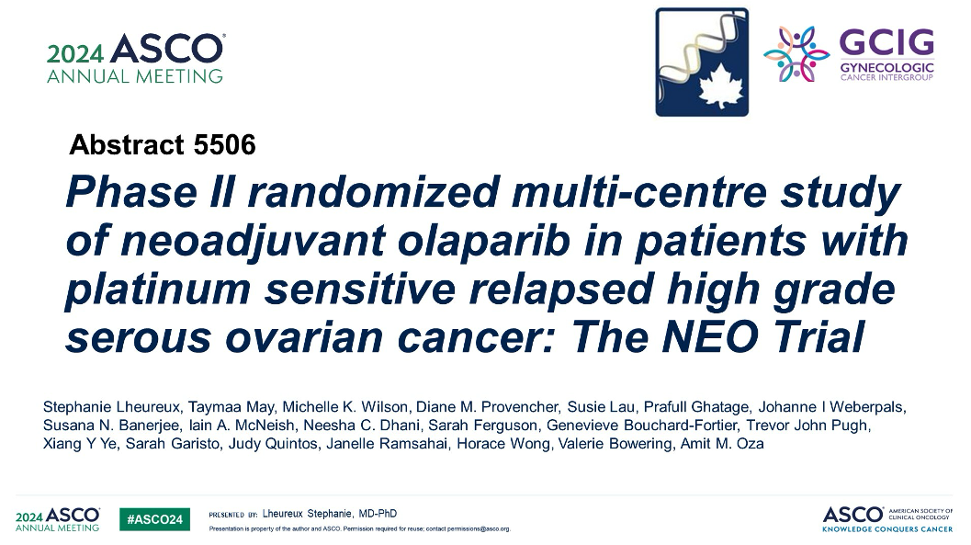

Slide 14
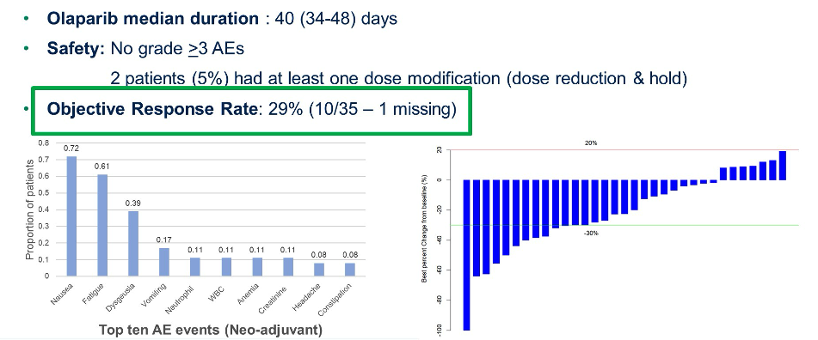
NEO Trial: Efficacy and Safety of Neoadjuvant Olaparib
Lheureux S et al. ASCO 2024;Abstract 5506.

Slide 15
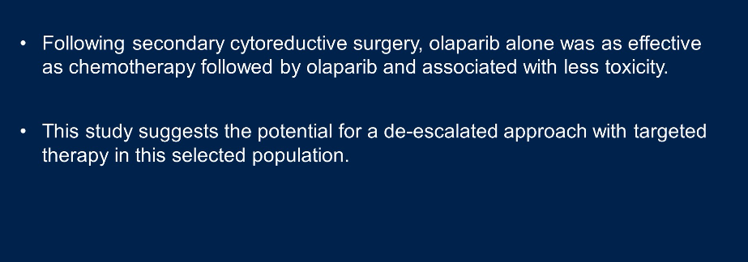
NEO Trial: Key Takeaways
Moroney JW. ASCO 2024 Highlights of the Day – Gynecologic Cancer, Discussant.

Slide 16

Abstract 5507

Slide 17
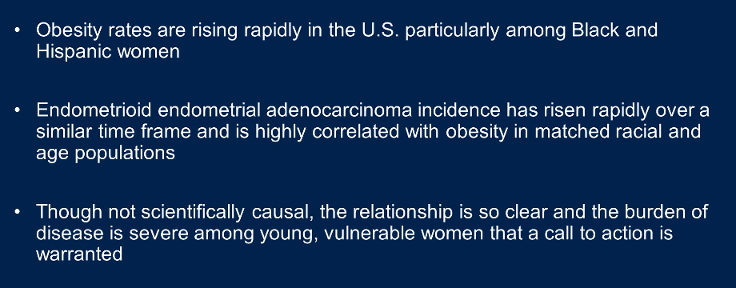
Endometrial Cancer and Obesity Trends: Key Takeaways
Moroney JW. ASCO 2024 Highlights of the Day – Gynecologic Cancer, Discussant.

Slide 18
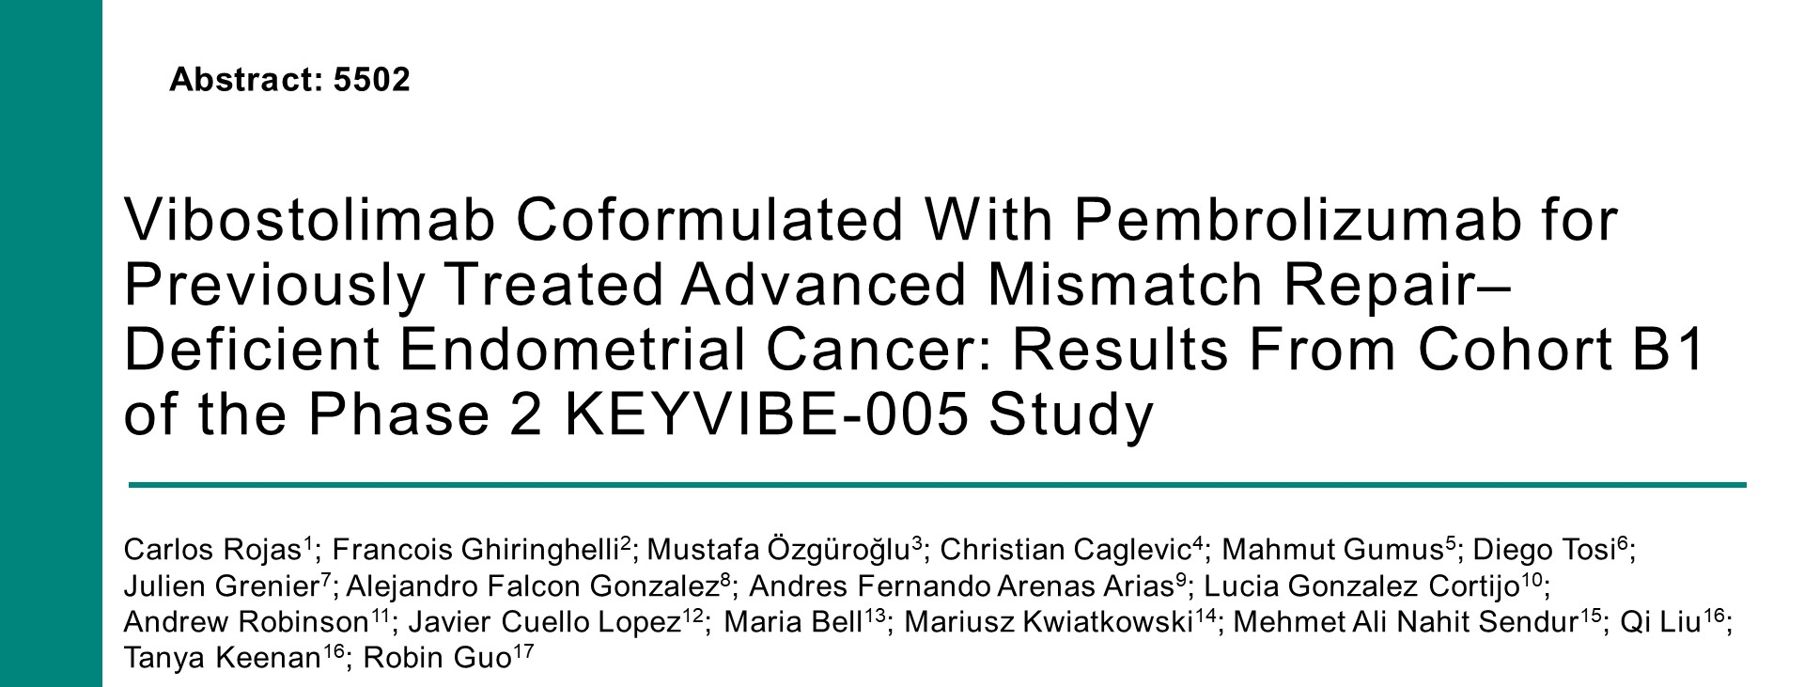
ASCO 2024

Slide 19
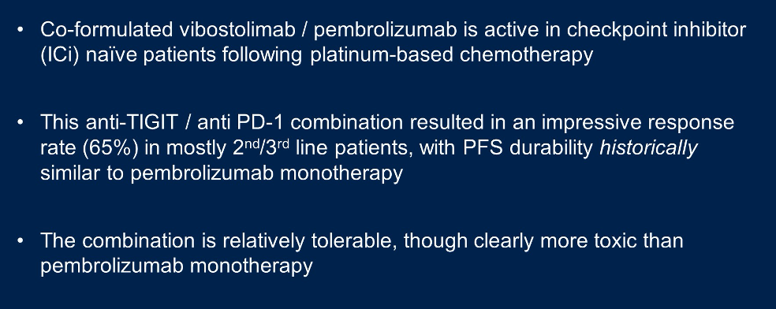
KEYVIBE-005: Key Takeaways
Moroney JW. ASCO 2024 Highlights of the Day – Gynecologic Cancer, Discussant.

Slide 20
Agenda
INTRODUCTION: ASCO 2024 Review
MODULE 1: Ovarian Cancer
MODULE 2: HER2 as a Therapeutic Target
MODULE 3: Endometrial Cancer
MODULE 4: Cervical Cancer

Slide 21
Bevacizumab as Front-Line Therapy for Advanced OC
Pfisterer J et al. Optimal treatment duration of bevacizumab as front-line therapy for advanced OC: AGO-OVAR 17 BOOST/GINECO OV118/ENGOT Ov-15 open-label randomized phase III trial. J Clin Oncol 2023;41(4):893-902.

Slide 22
DISCUSSION QUESTIONS
In what situations should bevacizumab be included as a component of front-line chemotherapy?
How, if at all, do you factor in the KELIM score when deciding on a treatment approach?

Slide 23
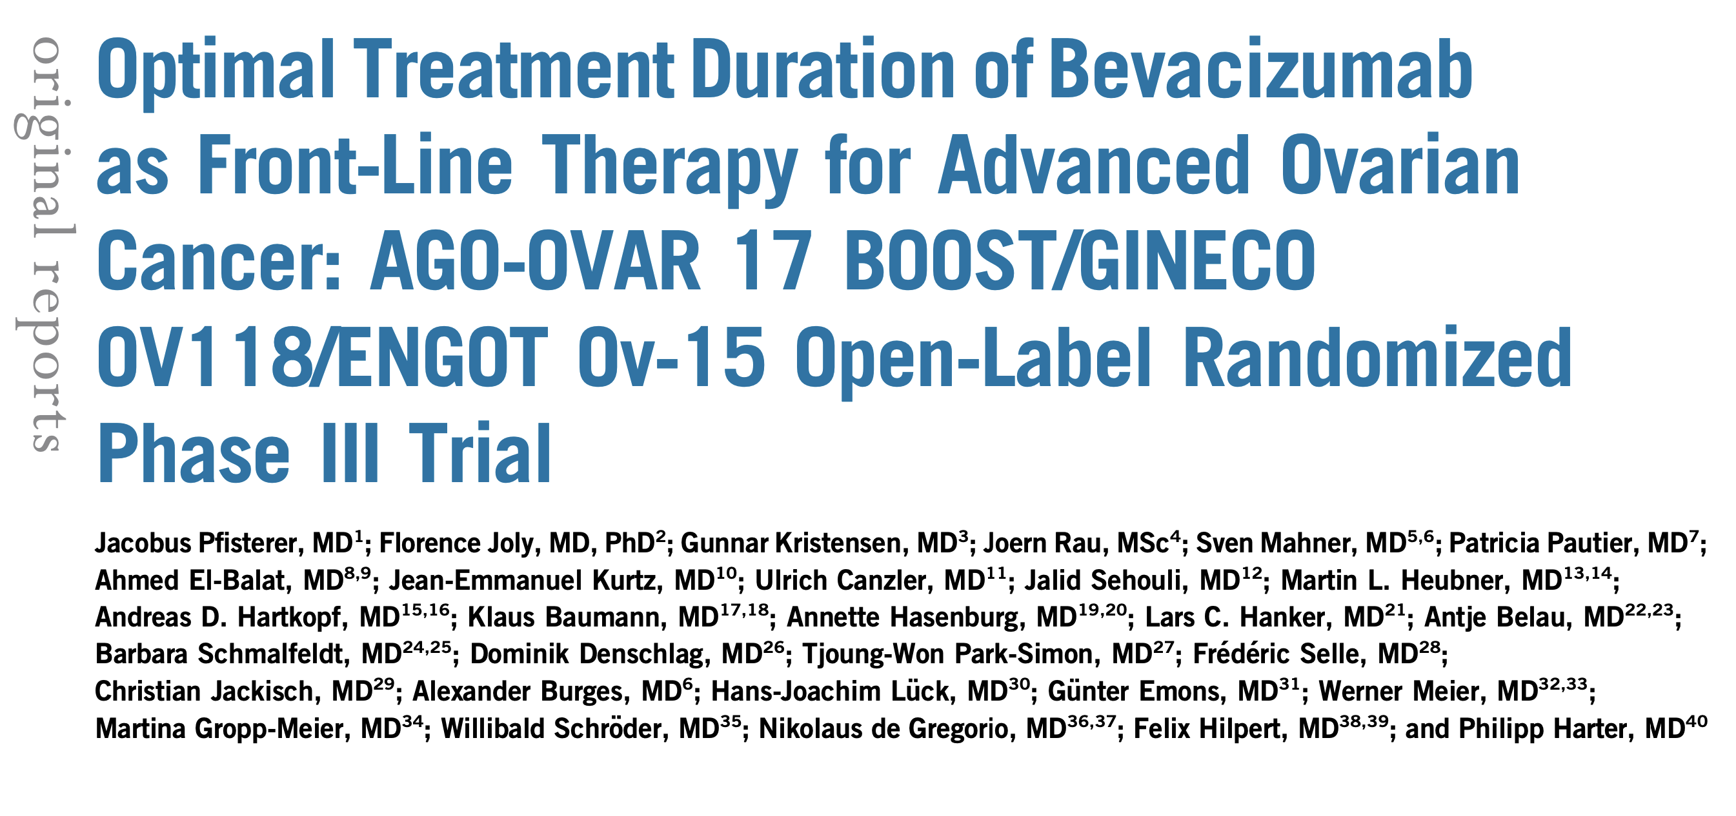
J Clin Oncol 2023;41(4):893-902.

Slide 24
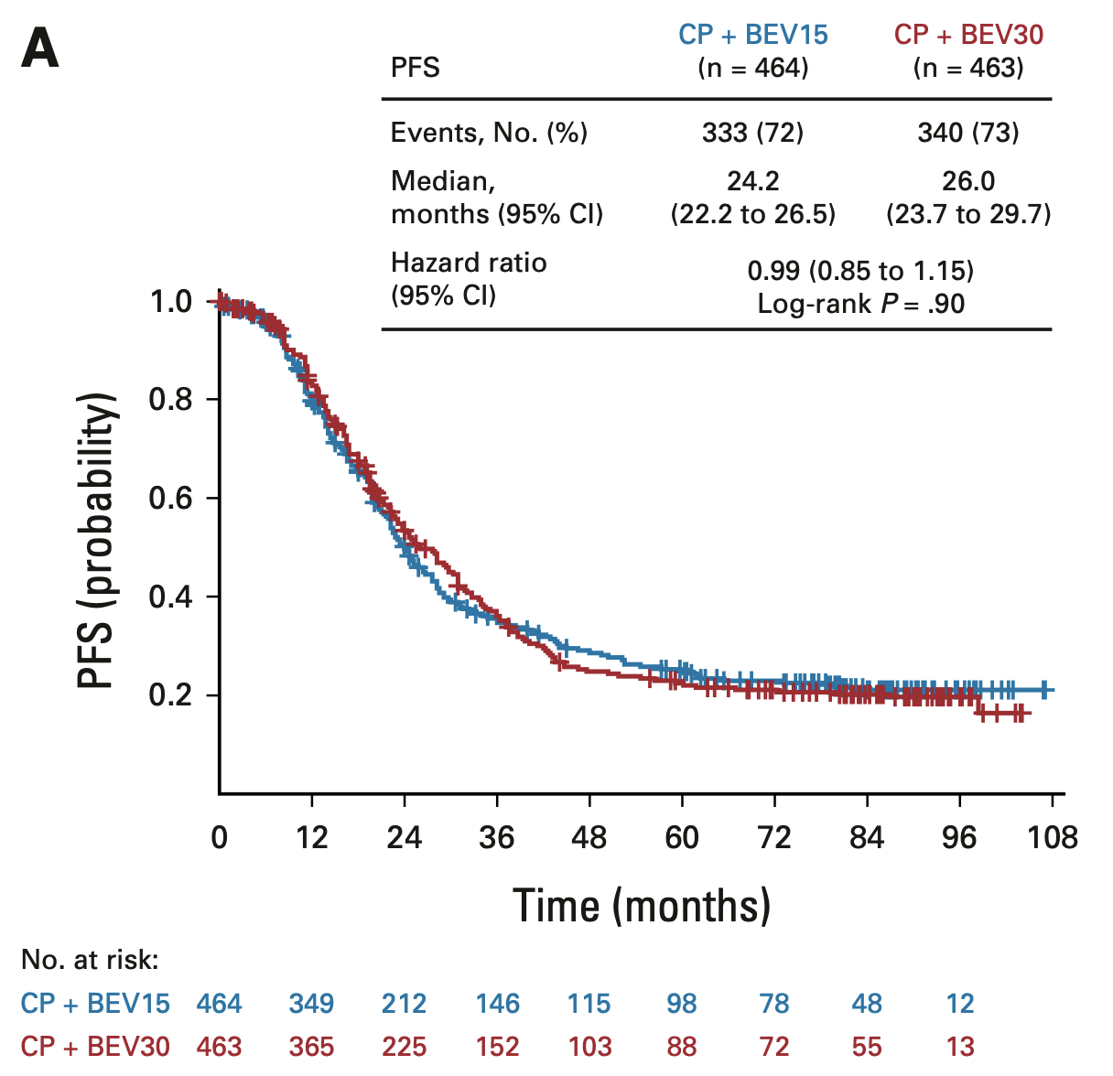
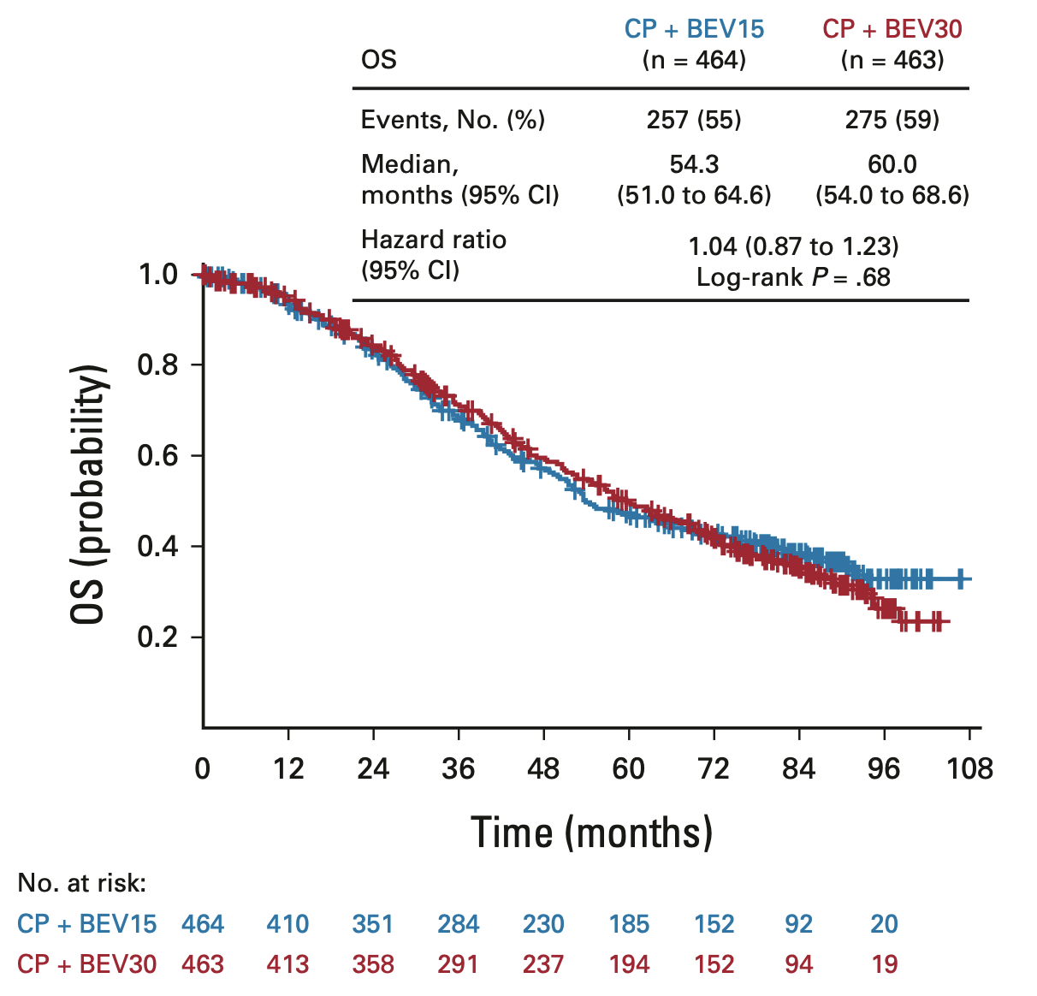
ENGOT-OV15: Progression-Free Survival (PFS) and Overall Survival (OS) Outcomes in the ITT Population
ITT = intention to treat; CP = carboplatin/paclitaxel; BEV = bevacizumab
Pfisterer J et al. J Clin Oncol 2023;41(4):893-902.

Slide 25
PARP Inhibitors as First-Line Maintenance for OC
DiSilvestro P et al; SOLO1 Investigators. Overall survival with maintenance olaparib at a 7-year follow-up in patients with newly diagnosed advanced OC and a BRCA mutation: The SOLO1/GOG 3004 trial. J Clin Oncol 2023;41(3):609-17.
González-Martín A et al. Progression-free survival and safety at 3.5 years of follow-up: Results from the randomised Phase III PRIMA/ENGOT-OV26/GOG-3012 trial of niraparib maintenance treatment in patients with newly diagnosed OC. Eur J Cancer 2023;189:112908.
Ray-Coquard I et al. Olaparib plus bevacizumab first-line maintenance in ovarian cancer: Final overall survival results from the PAOLA-1/ENGOT-ov25 trial. Ann Oncol 2023;34(8):681-92.
Harter P et al. Durvalumab with paclitaxel/carboplatin (PC) and bevacizumab (bev), followed by maintenance durvalumab, bev, and olaparib in patients (pts) with newly diagnosed advanced ovarian cancer (AOC) without a tumor BRCA1/2 mutation (non-tBRCAm): Results from the randomized, placebo (pbo)-controlled phase III DUO-O trial. ASCO 2023;Abstract LBA5506.

Slide 26
DISCUSSION QUESTIONS
In general, what is your approach to primary PARP-inhibitor maintenance for patients with a germline or somatic BRCA mutation?
What about patients without a BRCA mutation with
HRD-positive disease?
For patients who don’t receive bevacizumab with chemotherapy, when should it be added to PARP-inhibitor maintenance?

Slide 27
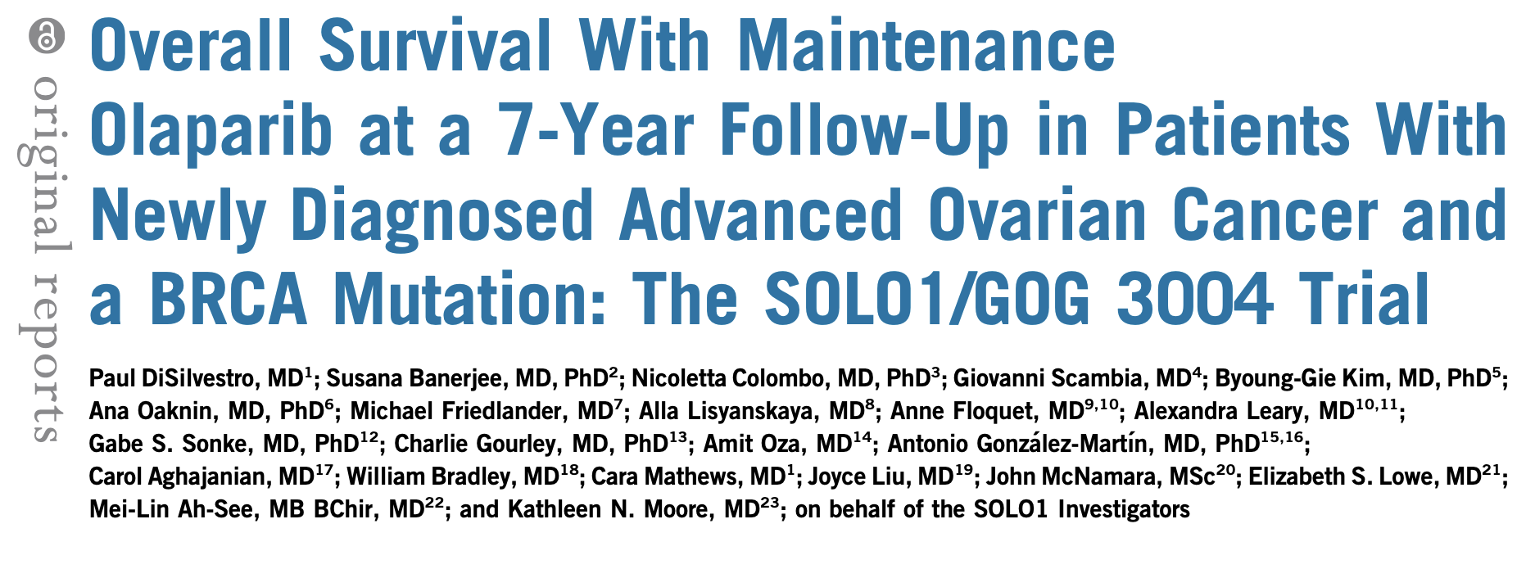
J Clin Oncol 2023;41(3):609-17.

Slide 28
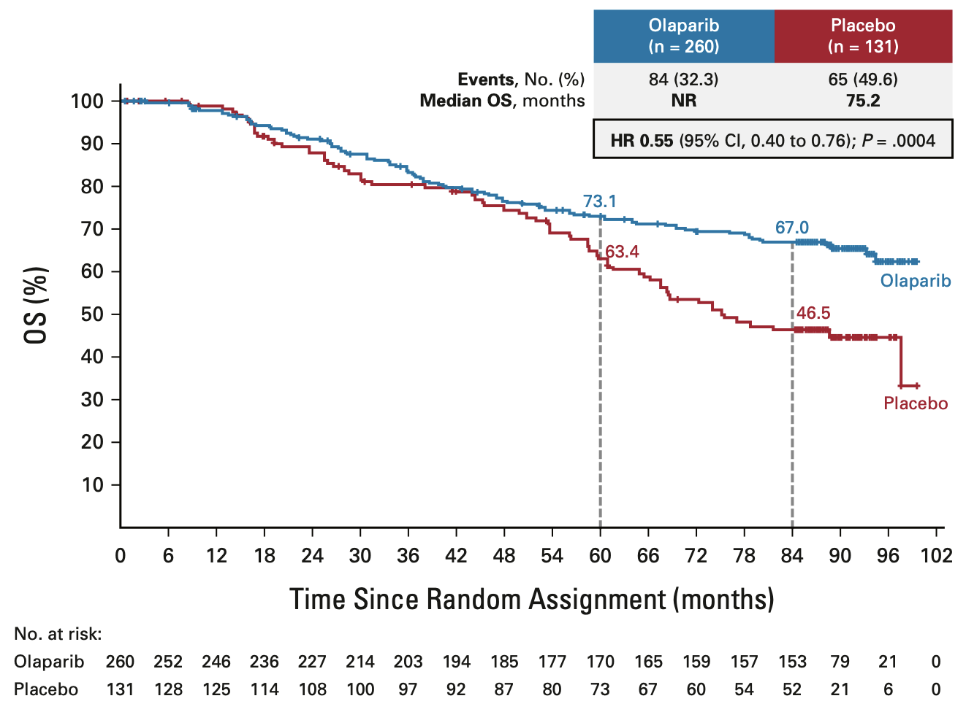
SOLO-1: Long-Term OS Outcomes
DiSilvestro P et al. J Clin Oncol 2023;41(3):609-17.

Slide 29
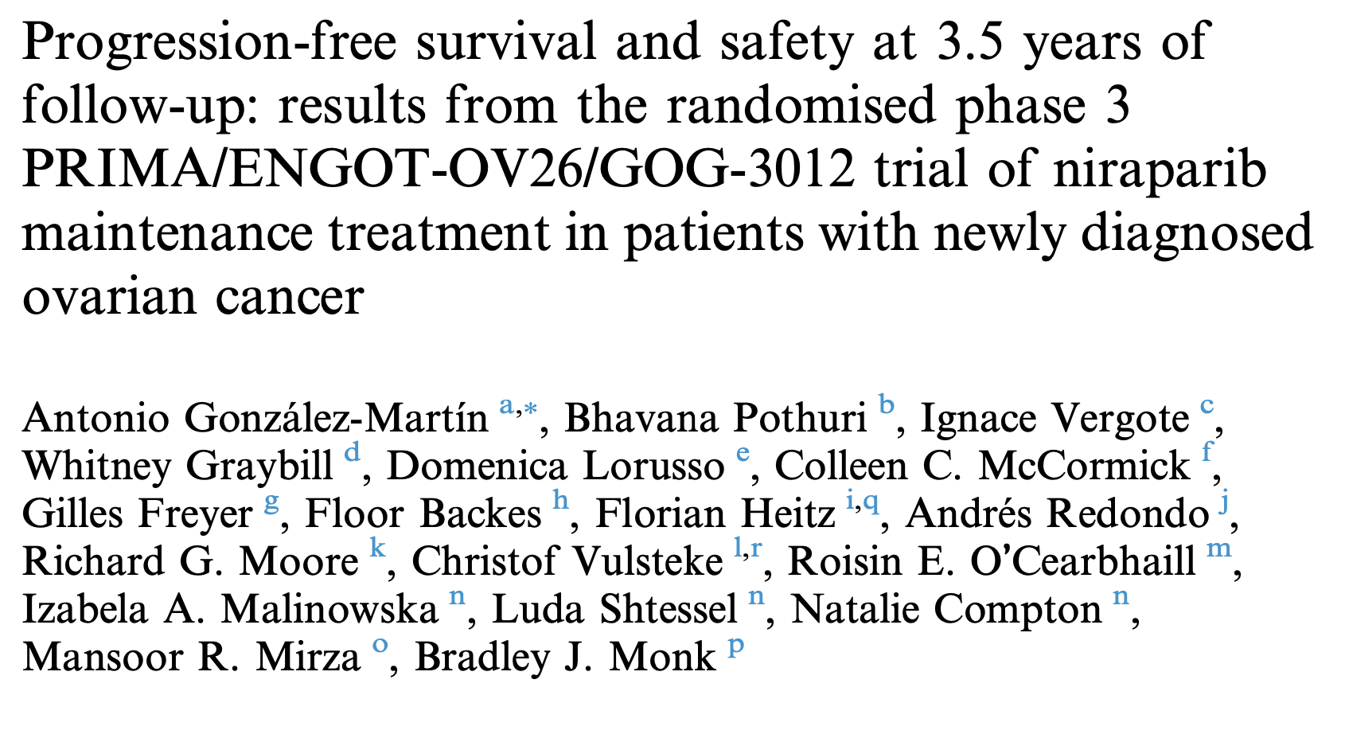
Eur J Cancer 2023;189:112908.

Slide 30
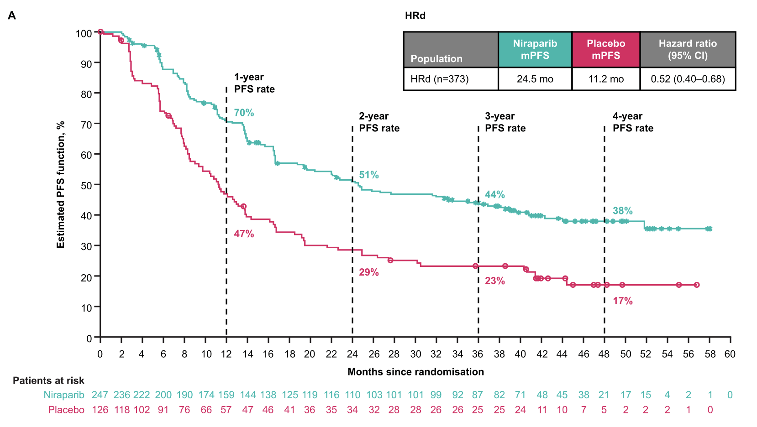
PRIMA/ENGOT-OV26: PFS in the Homologous
Recombination-Deficient (HRd) Population
mPFS = median progession-free survival
González-Martín A et al. Eur J Cancer 2023;189:112908.

Slide 31
DISCUSSION QUESTIONS
Do you believe there is therapeutic synergy between
PARP inhibitors and anti-PD-1/PD-L1 antibodies?
Based on available data from studies such as DUO-O,
is there any current role for this strategy?

Slide 32
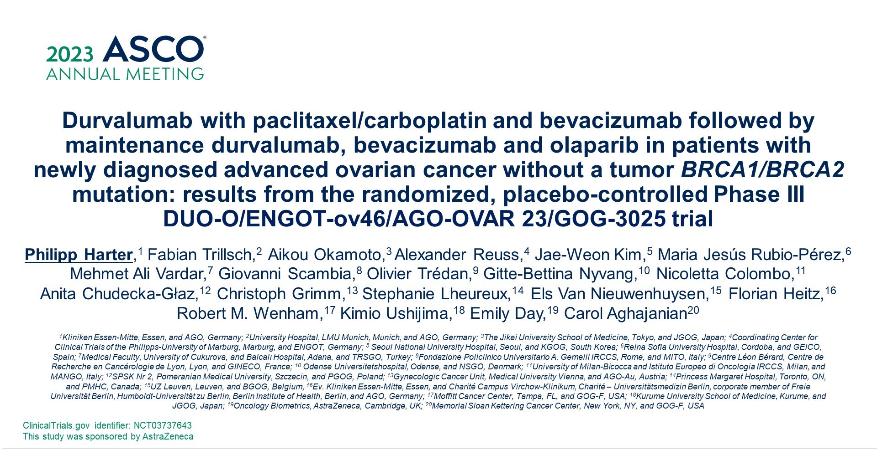
Abstract LBA5506

Slide 33
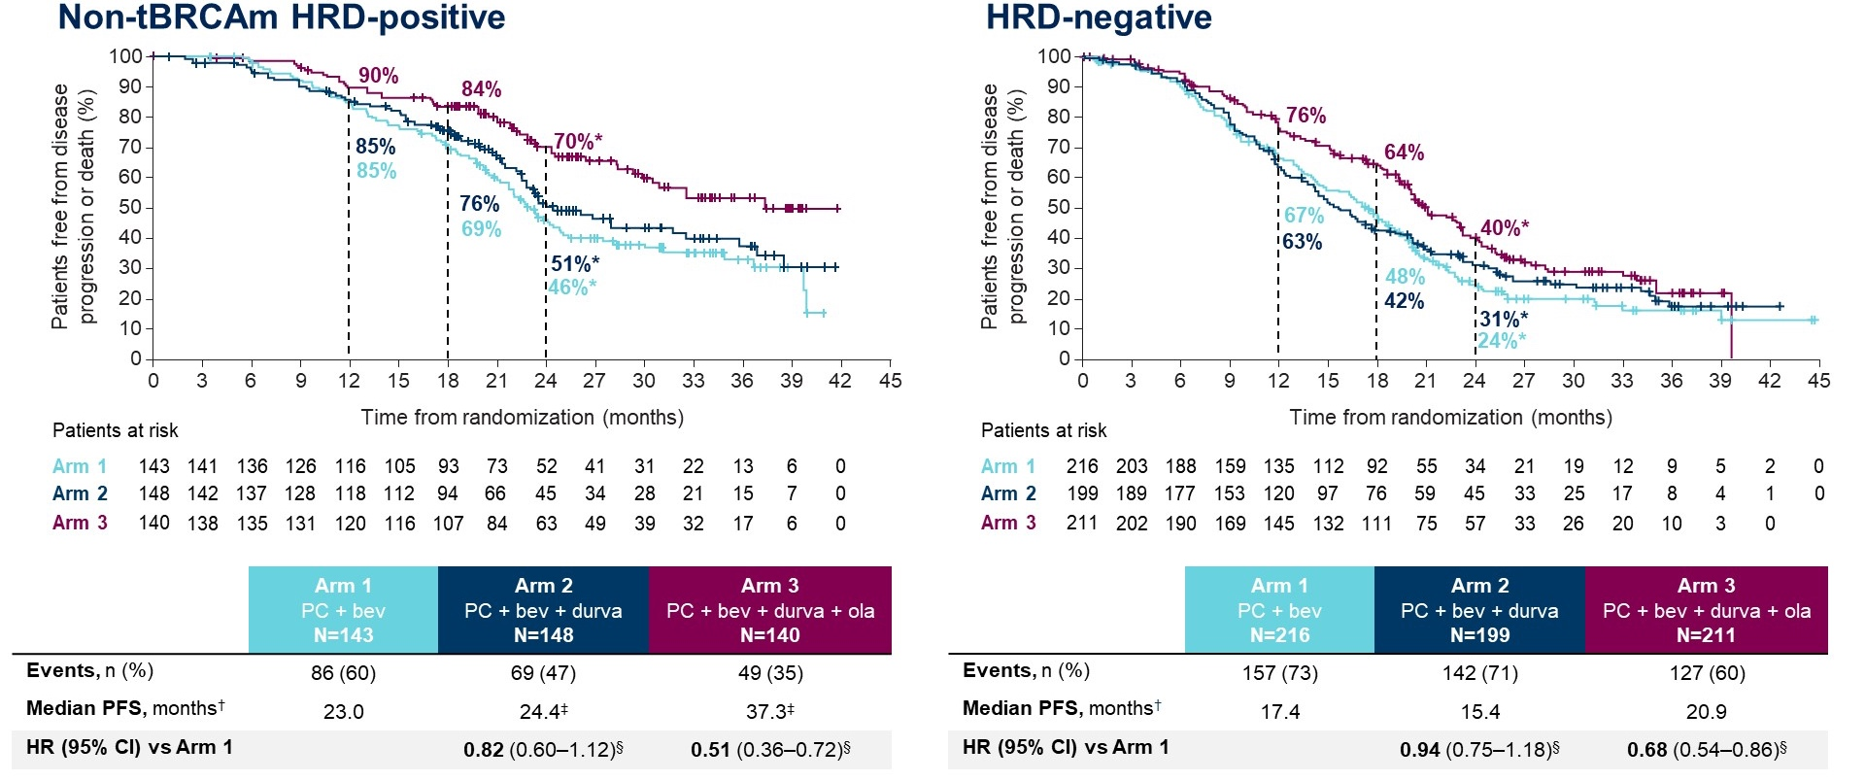
DUO-O: Subgroup Analysis of PFS by HRD status
Harter P et al. ASCO 2023;Abstract LBA5506.

Slide 34
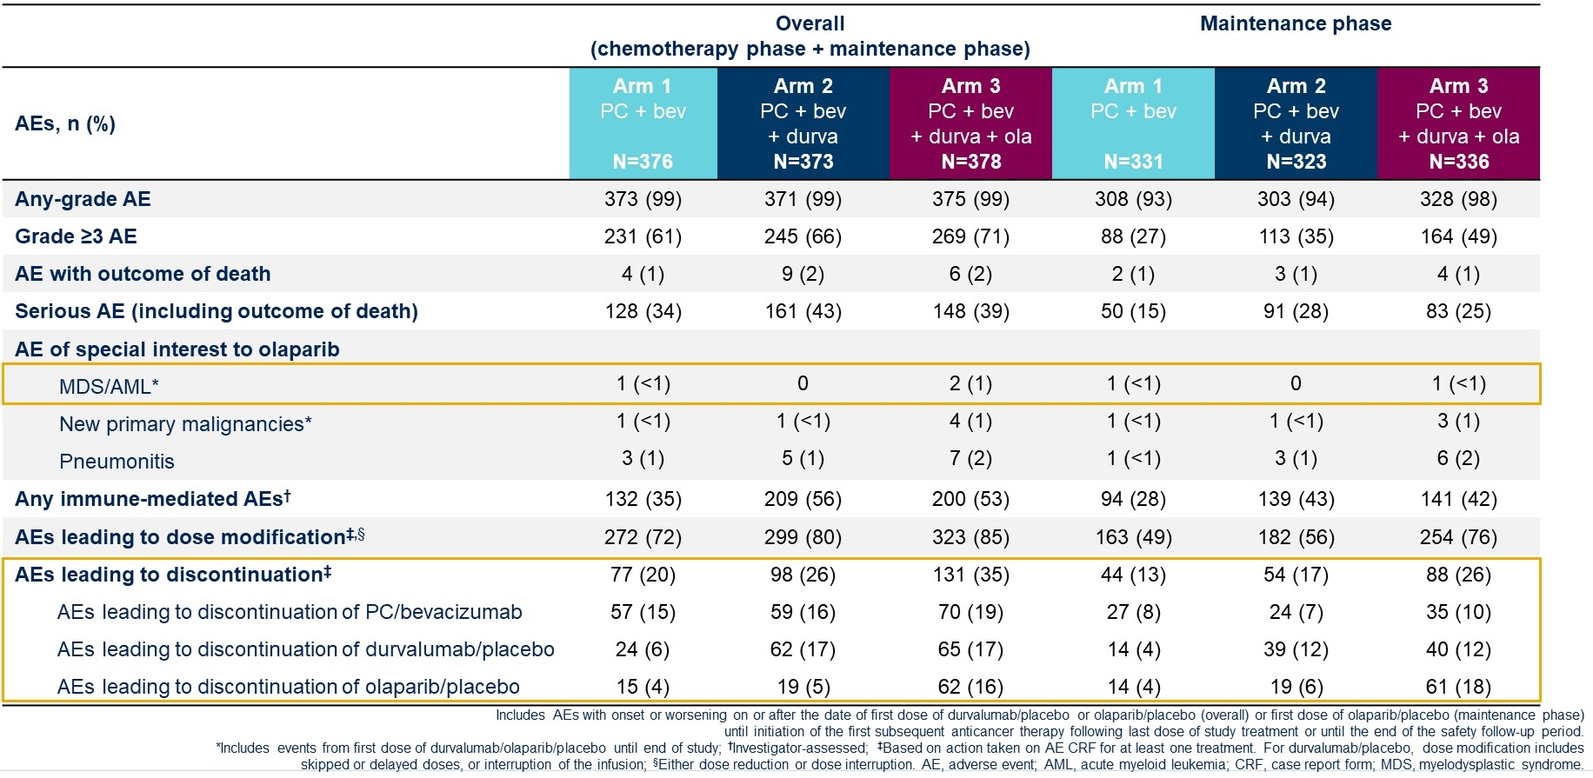
DUO-O: Safety Summary
Harter P et al. ASCO 2023;Abstract LBA5506.

Slide 35
PARP Inhibitors for Recurrent Ovarian Cancer
Pujade-Lauraine E et al. Maintenance olaparib rechallenge in patients with platinum-sensitive relapsed ovarian cancer previously treated with a PARP inhibitor (OReO/ENGOT-ov38): A phase IIIb trial. Ann Oncol 2023;34(12):1152-64.
Simpkins F et al. Combination ATR and PARP Inhibitor (CAPRI): A phase 2 study of ceralasertib plus olaparib in patients with recurrent, platinum-sensitive epithelial ovarian cancer (cohort A). ASCO 2024;Abstract 5510.

Slide 36
DISCUSSION QUESTION
Under what circumstances, if any, would you use a PARP inhibitor for a patient with recurrent ovarian cancer?

Slide 37
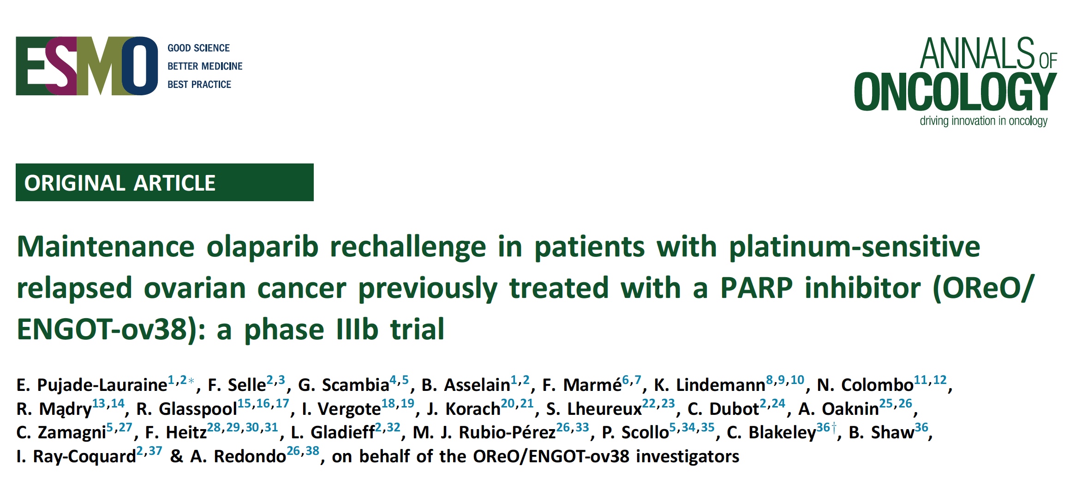
2023;34(12):1152-64
Abstract LBA33

Slide 38
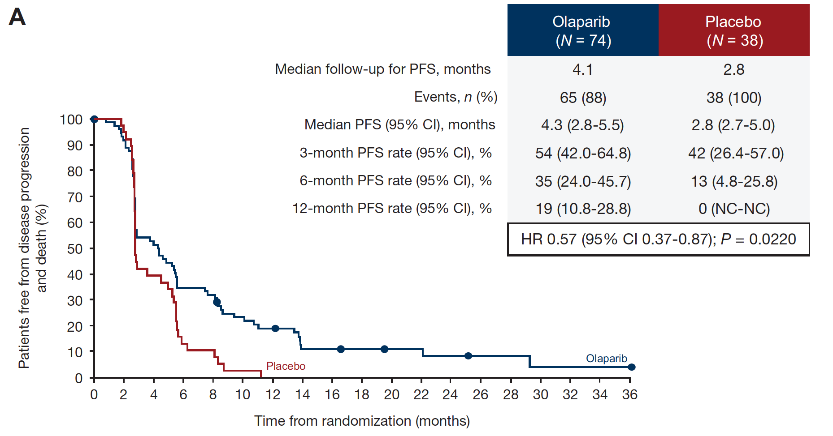
OReO: Investigator-Assessed PFS in the BRCA-Mutation Cohort
Pujade-Lauraine E et al. Ann Oncol 2023;34(12):1152-64.

Slide 39
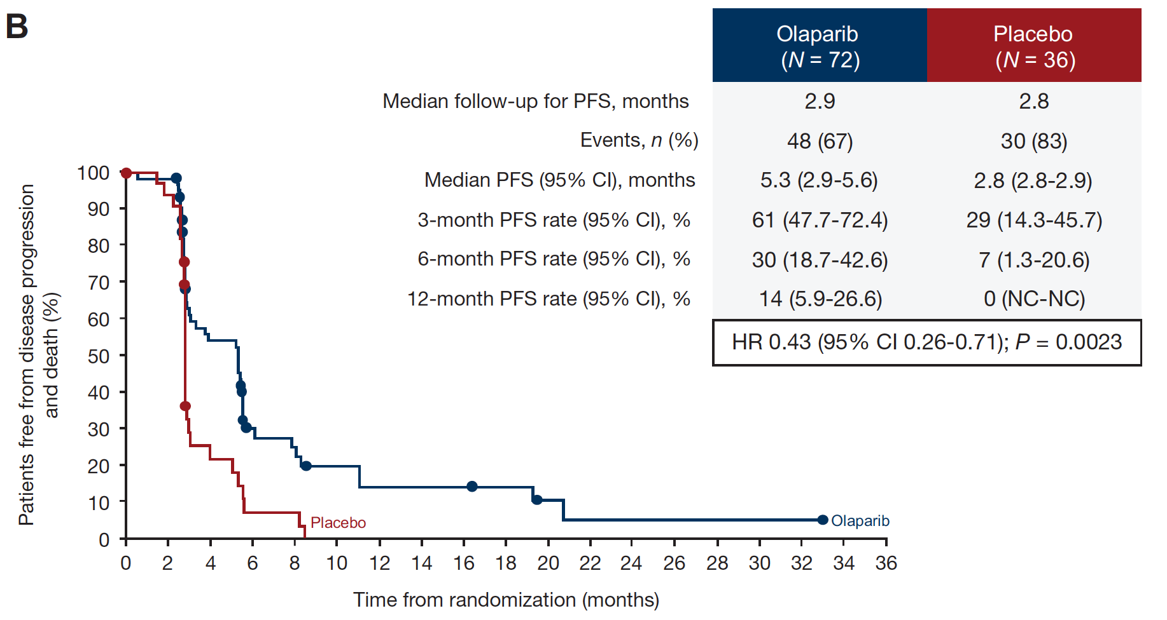
OReO: Investigator-Assessed PFS in the Non-BRCA-Mutation Cohort
Pujade-Lauraine E et al. Ann Oncol 2023;34(12):1152-64.

Slide 40
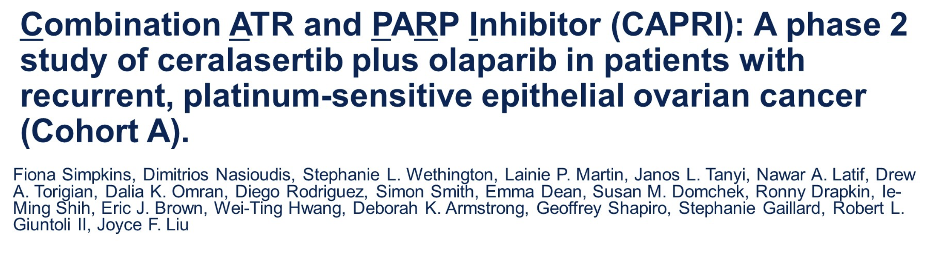
ASCO 2024;Abstract 5510.

Slide 41
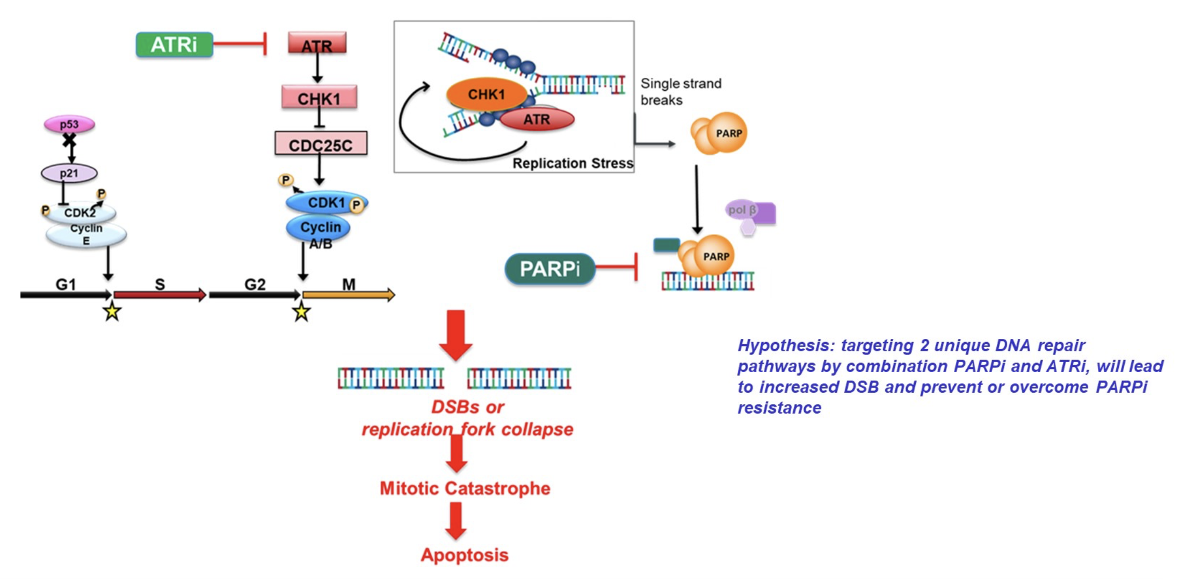
Scientific Rationale for Combining a PARP Inhibitor with an ATR Inhibitor
Simpkins F et al. ASCO 2024;Abstract 5510.

Slide 42
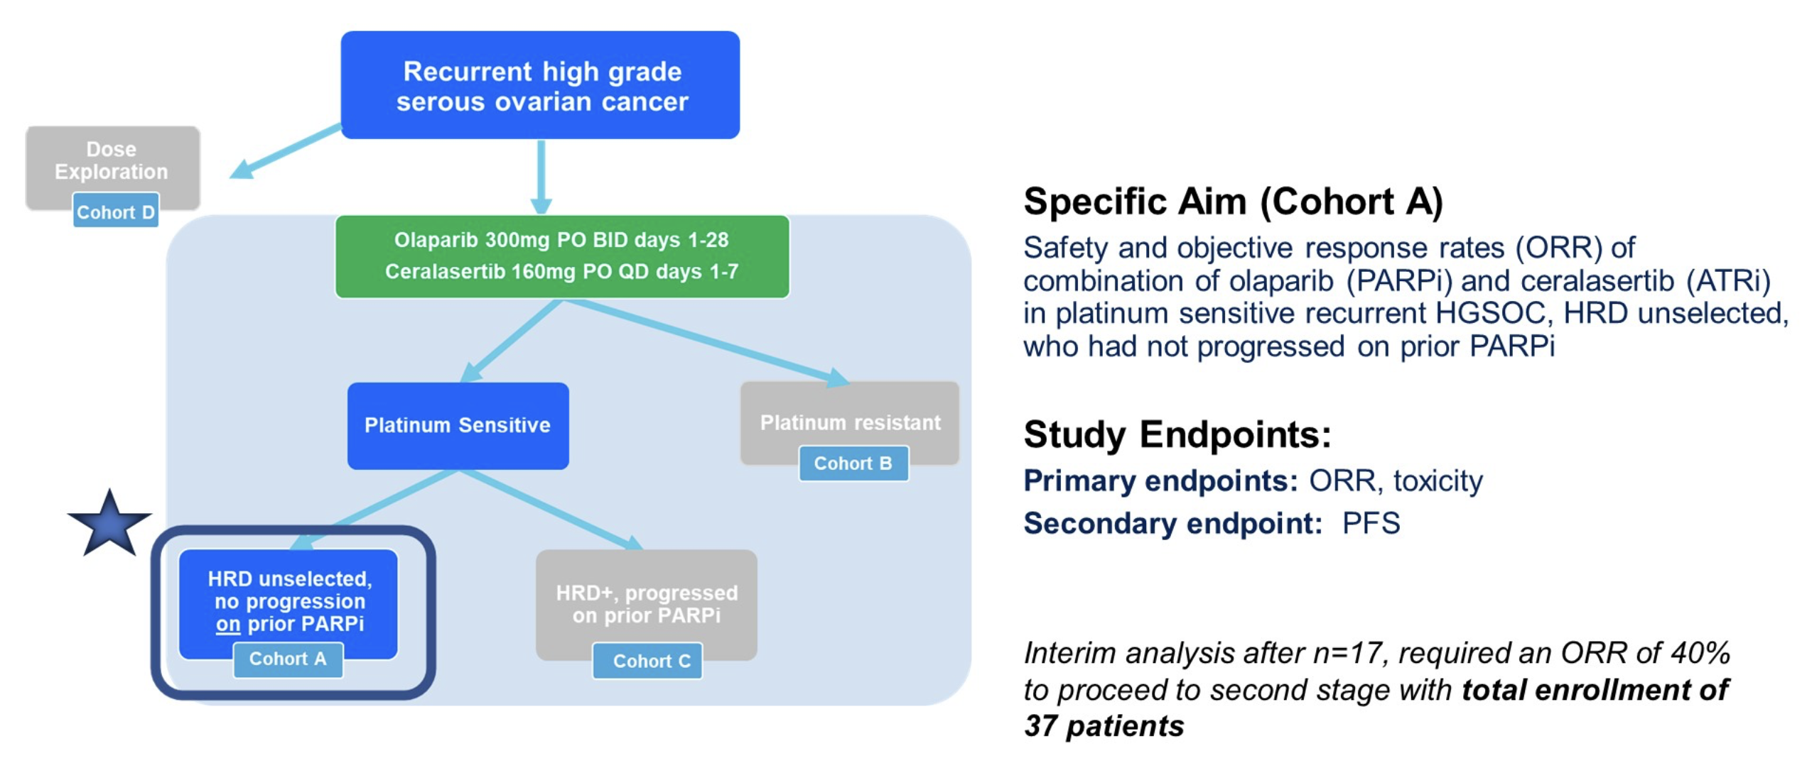
CAPRI: A Phase II Study of Ceralasertib with Olaparib for
Recurrent Platinum-Sensitive Ovarian Cancer (Cohort A)
Simpkins F et al. ASCO 2024;Abstract 5510.

Slide 43
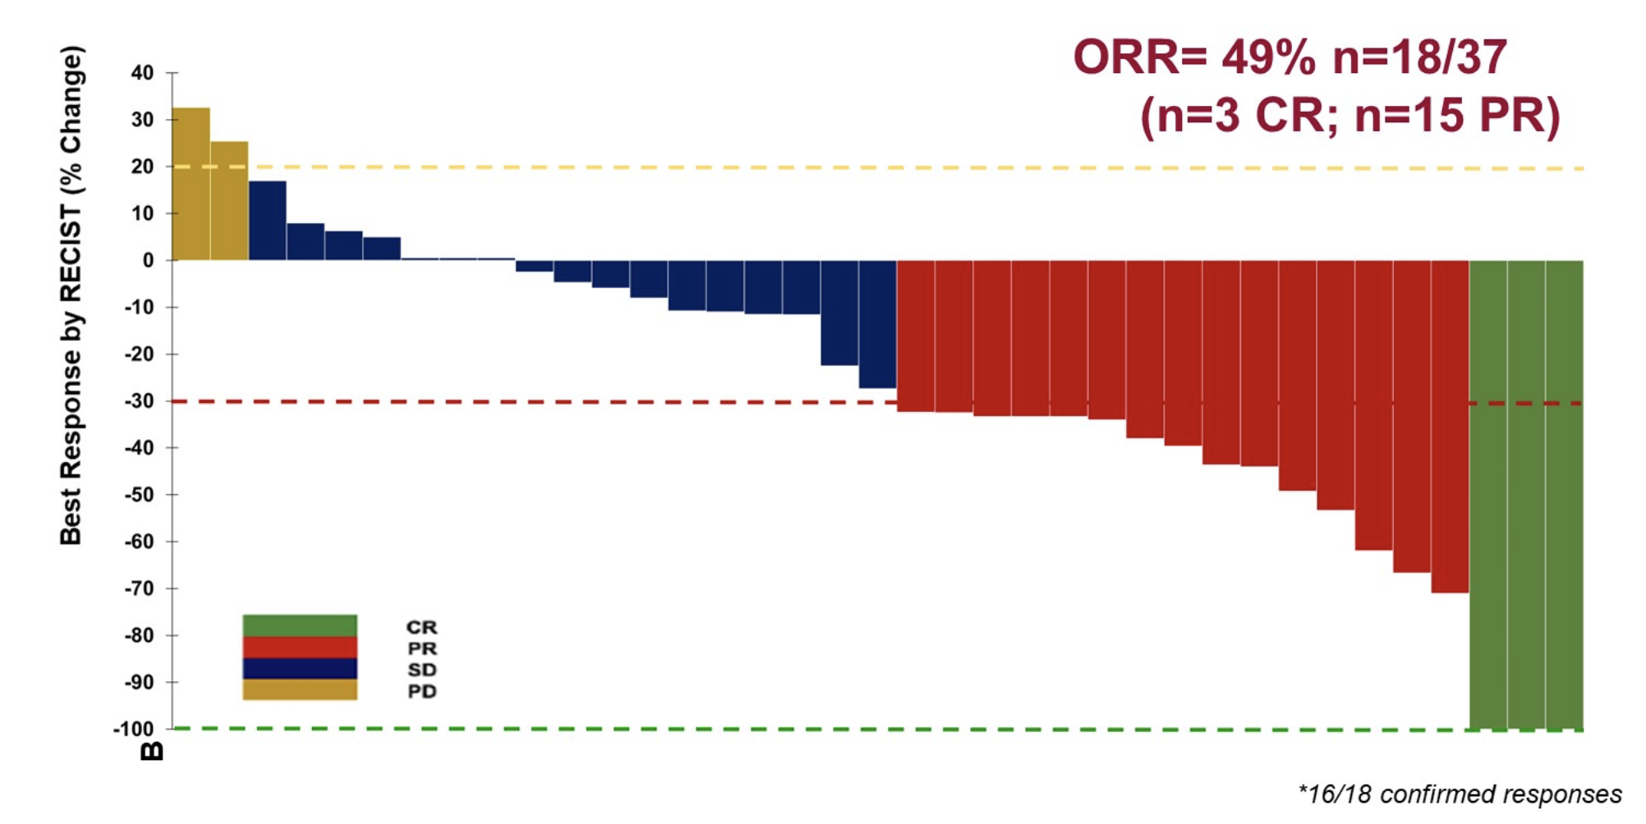
CAPRI: Ceralasertib and Olaparib – Response Data
ORR=49% n=18/37
Simpkins F et al. ASCO 2024;Abstract 5510.

Slide 44
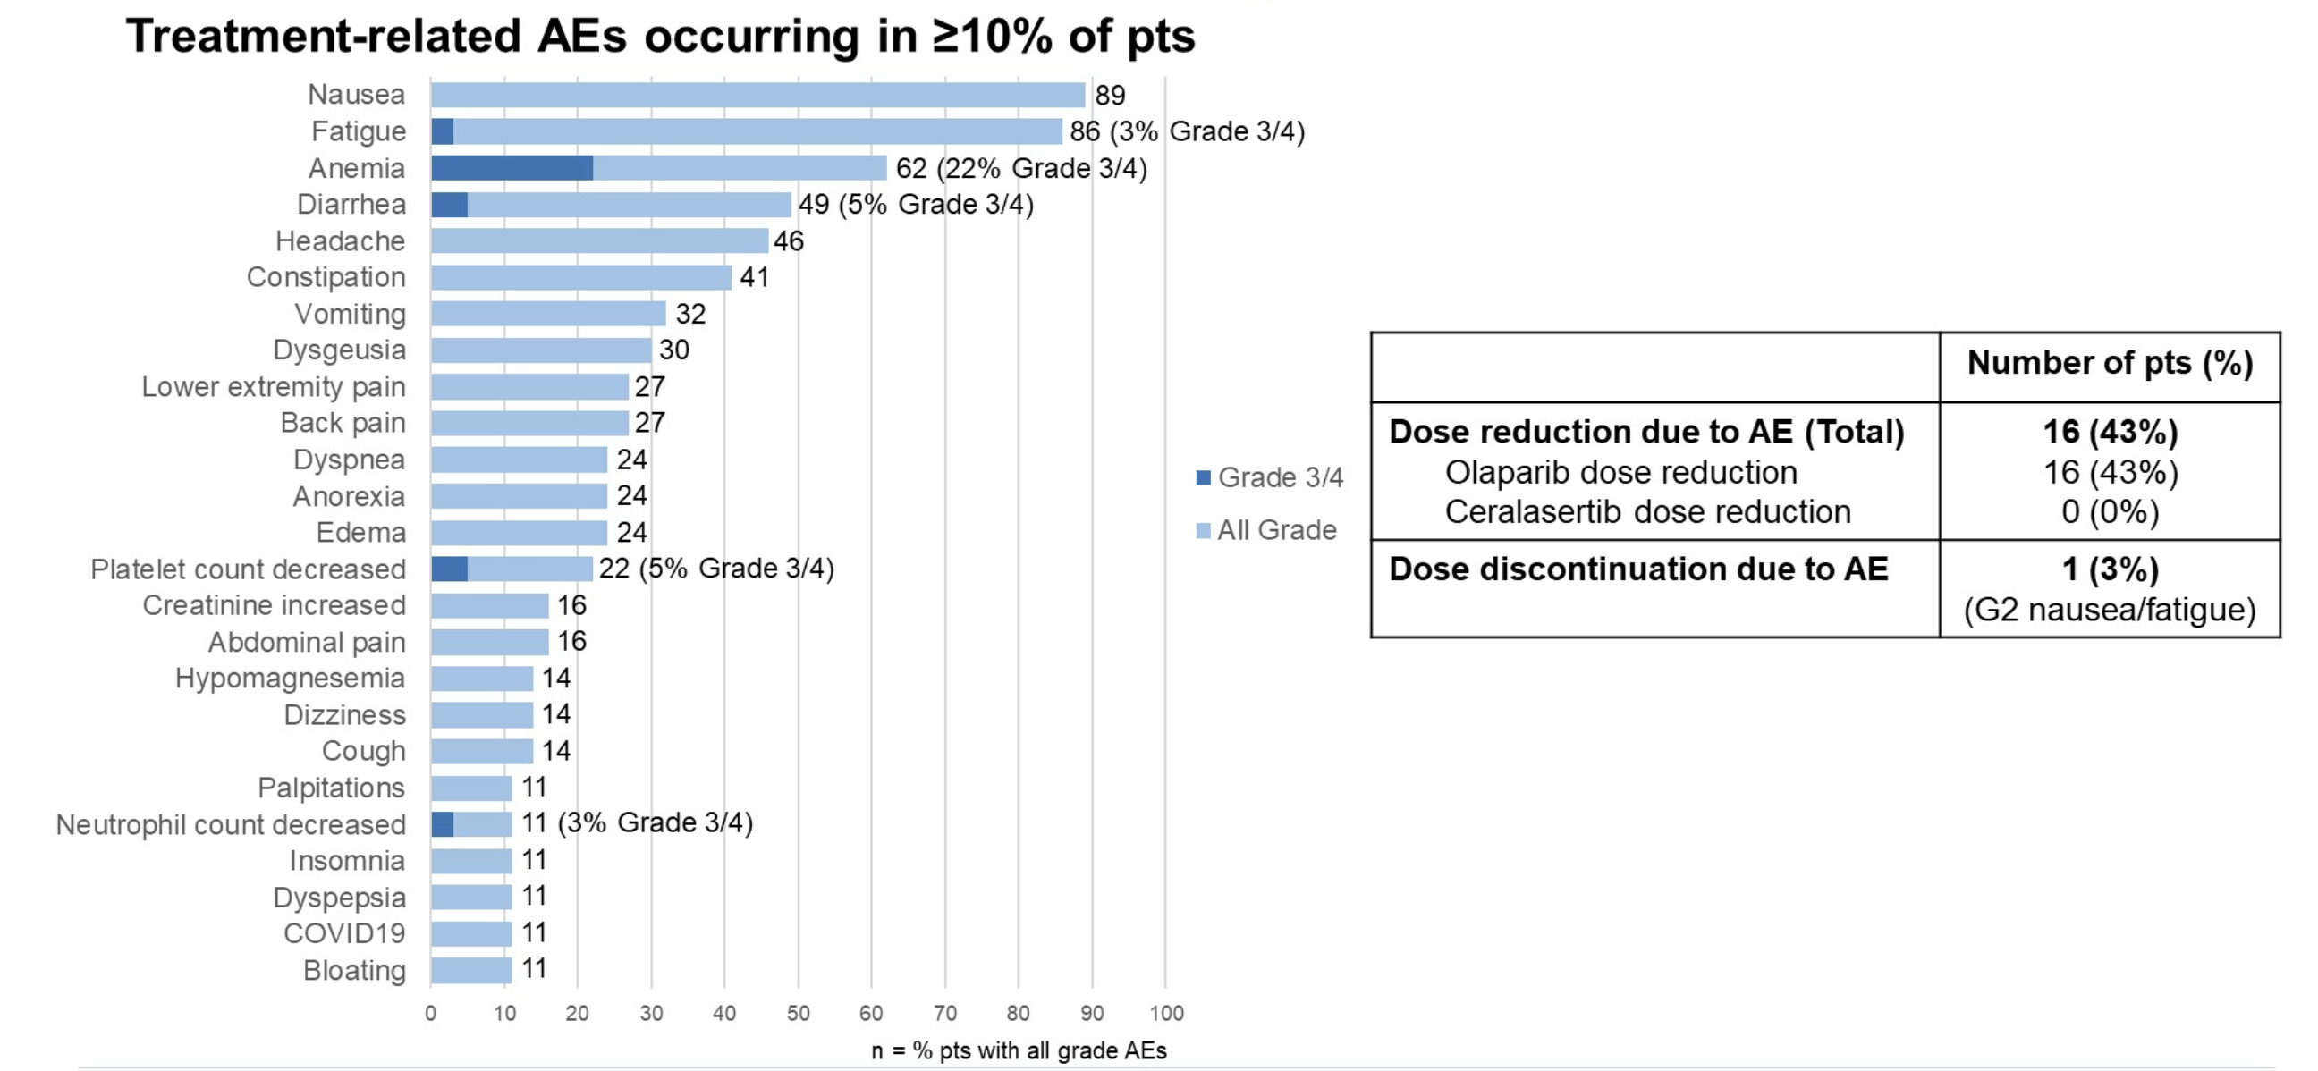
CAPRI: Ceralasertib and Olaparib – Safety Profile
AE = adverse event
Simpkins F et al. ASCO 2024;Abstract 5510.

Slide 45
Antibody-Drug Conjugates for Ovarian Cancer
Moore KN et al. Mirvetuximab soravtansine in FRα-positive, platinum-resistant ovarian cancer. N Engl J Med 2023;389(23):2162-74.

Slide 46
DISCUSSION QUESTION
What has been your clinical experience with efficacy and tolerability with mirvetuximab soravtansine?

Slide 47
FDA Approves Mirvetuximab Soravtansine-Gynx for FRα-Positive Platinum-Resistant Epithelial Ovarian, Fallopian Tube or Primary Peritoneal Cancer
Press Release: March 22, 2024
“On March 22, 2024, the Food and Drug Administration approved mirvetuximab soravtansine-gynx for adult patients with FRα positive, platinum-resistant epithelial ovarian, fallopian tube, or primary peritoneal cancer, who have received one to three prior systemic treatment regimens.
Efficacy was evaluated in Study 0416 (MIRASOL, NCT04209855), a multicenter, open-label, active-controlled, randomized, two-arm trial in 453 patients with platinum-resistant epithelial ovarian, fallopian tube, or primary peritoneal cancer. Patients were permitted to receive up to three prior lines of systemic therapy. The trial enrolled patients whose tumors were positive for FRα expression as determined by the FOLR1 (FOLR1-2.1) RxDx Assay.
The major efficacy outcome measures were overall survival (OS), investigator-assessed progression-free survival (PFS) and confirmed overall response rate (ORR) per investigator assessment. PFS and ORR were evaluated according to RECIST, version 1.1.”
https://www.fda.gov/drugs/resources-information-approved-drugs/fda-approves-mirvetuximab-soravtansine-gynx-fra-positive-platinum-resistant-epithelial-ovarian

Slide 48
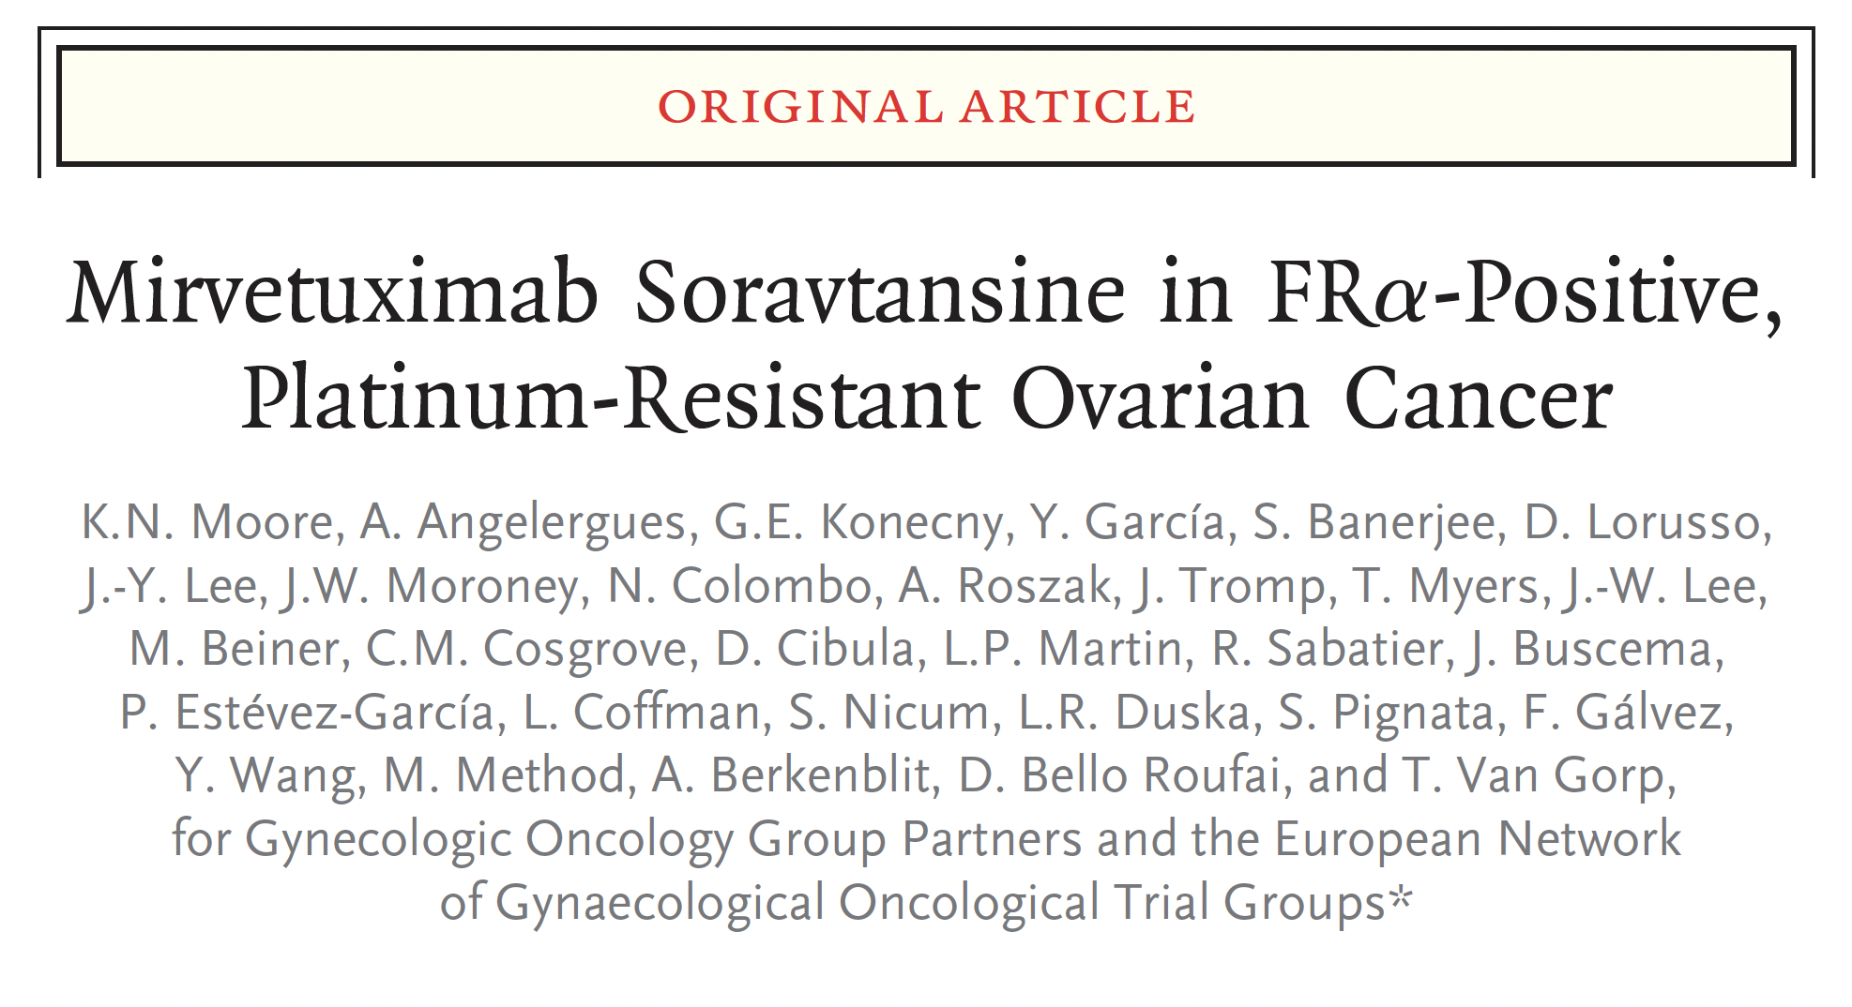
N Engl J Med 2023;389(23):2162-74.

Slide 49
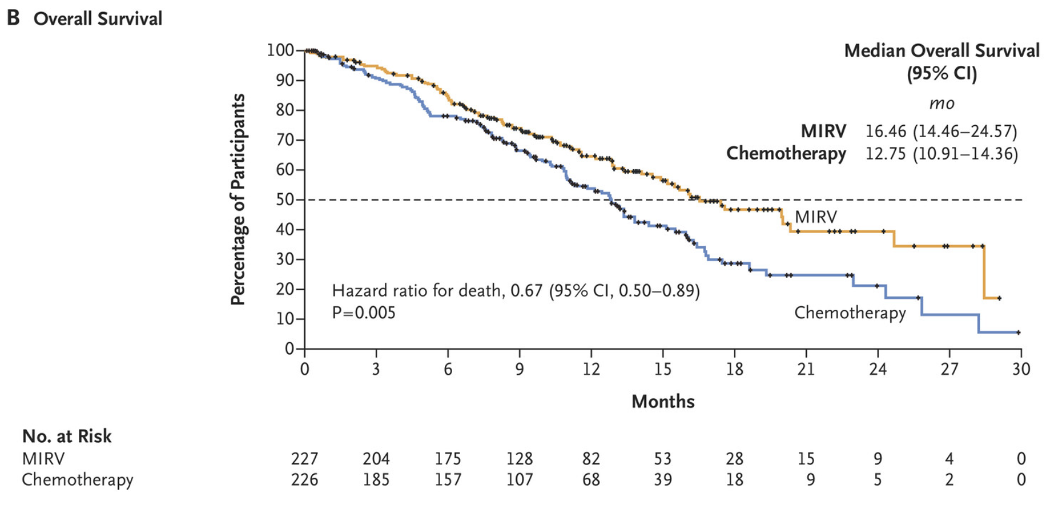
MIRASOL: OS Outcomes
Moore KN et al. N Engl J Med 2023;389(23):2162-74.

Slide 50
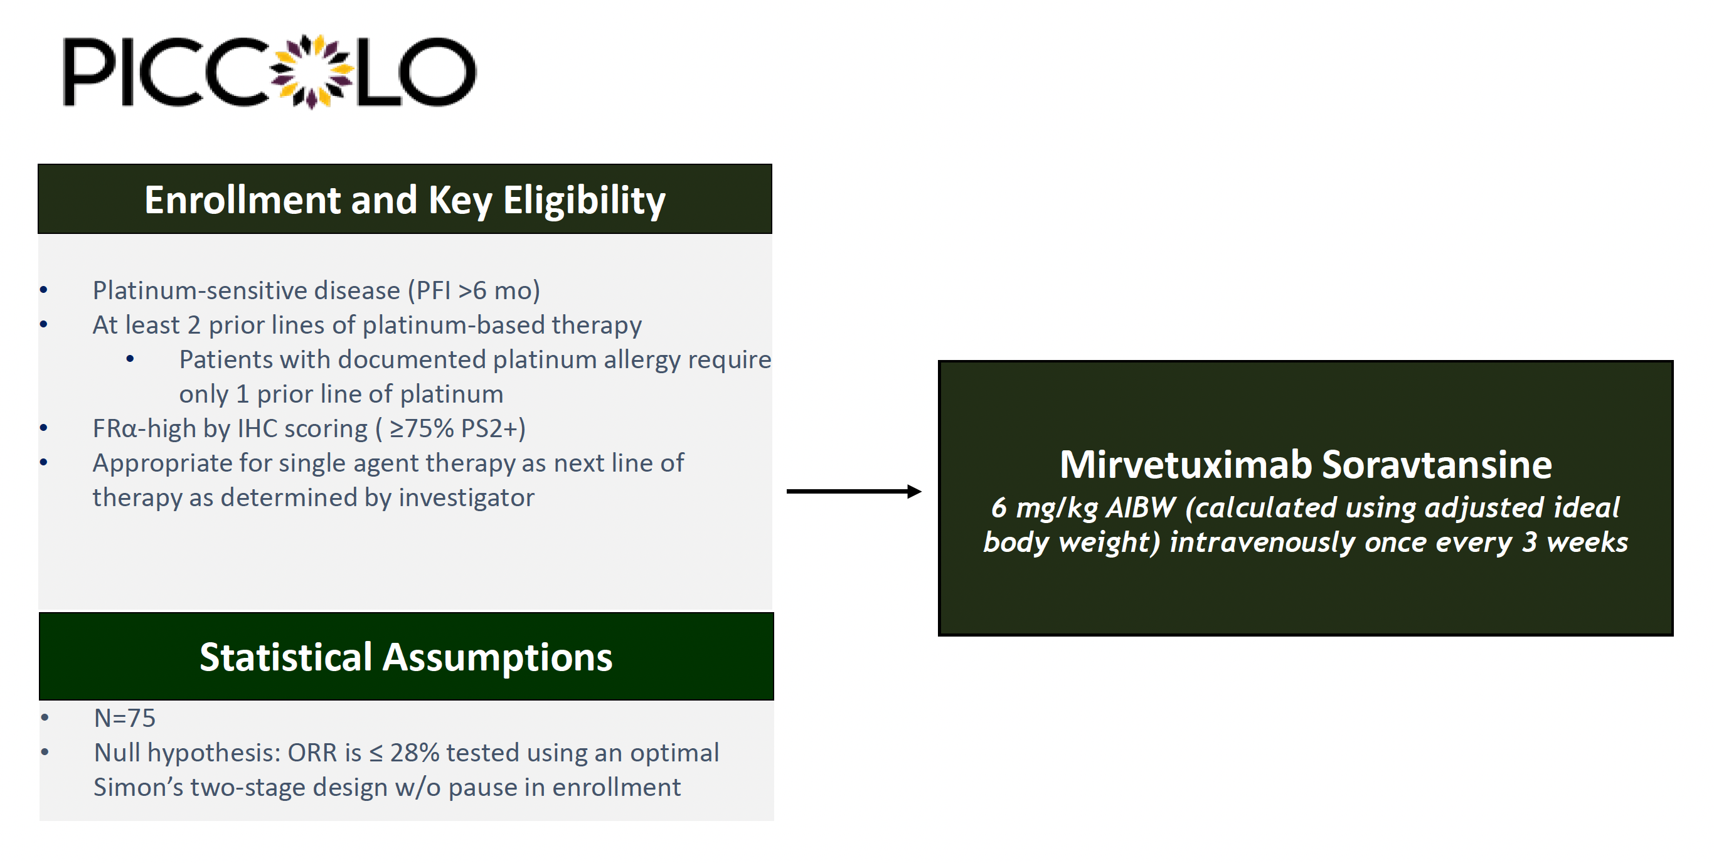
PICCOLO Phase II Trial Schema
Alvarez Secord A et al. SGO 2022;Abstract 300.

Slide 51
Positive Topline Results from the Phase II PICCOLO Trial Evaluating Mirvetuximab Soravtansine for High Folate Receptor-Alpha (FRα)- Expressing Platinum-Sensitive Ovarian Cancer
Press Release: June 6, 2024
“[The manufacturer] announced positive topline results from the Phase 2 PICCOLO trial evaluating investigational mirvetuximab soravtansine monotherapy in heavily pre-treated patients with folate receptor-alpha (FRα) positive, platinum-sensitive ovarian cancer (PSOC).
The study met its primary endpoint with an objective response rate (ORR) of 51.9% (95%CI 40.4 – 63.3%).
In addition, the median duration of response (DOR), a key secondary endpoint, was 8.25 months.
The safety profile of mirvetuximab soravtansine was consistent with findings from previous studies, and no new safety concerns were identified. Full data from the PICCOLO study will be presented at a future medical meeting.”
https://news.abbvie.com/2024-06-06-AbbVie-Announces-Positive-Topline-Results-from-Phase-2-PICCOLO-Trial-Evaluating-Mirvetuximab-Soravtansine-ELAHERE-R-for-High-Folate-Receptor-Alpha-FR-Expressing-Platinum-Sensitive-Ovarian-Cancer

Slide 52
GLORIOSA Phase III Trial Schema
An open-label, Phase III trial of MIRV + BEV maintenance for
FRα-high platinum-sensitive ovarian cancer
Treatment Regimen
Experimental
Actively
Enrolling
(N ≈ 418)
CR, PR
or SD
Treatment Regimen
Control
CR, PR or SD after treatment with
O’Malley DM et al. ASCO 2023;Abstract TPS5622. www.clinicaltrials.gov. NCT05445778. Accessed September 2023.

Slide 53
Agenda
INTRODUCTION: ASCO 2024 Review
MODULE 1: Ovarian Cancer
MODULE 2: HER2 as a Therapeutic Target
MODULE 3: Endometrial Cancer
MODULE 4: Cervical Cancer

Slide 54
HER2-Targeted Treatment Approaches
Meric-Bernstam F et al. Efficacy and safety of trastuzumab deruxtecan in patients with HER2-expressing solid tumors: Primary results from the DESTINY-PanTumor02 phase II trial. J Clin Oncol 2024;42(1):47-58.
Nishikawa T et al. Trastuzumab deruxtecan for human epidermal growth factor receptor 2-expressing advanced or recurrent uterine carcinosarcoma (NCCH1615): The STATICE trial. J Clin Oncol 2023; 41(15):2789-99.

Slide 55
DISCUSSION QUESTIONS
Where in the treatment course are you typically offering
trastuzumab deruxtecan (T-DXd) to your patients with ovarian, endometrial and cervical cancer?
Are you only offering T-DXd to patients with IHC 3+ disease per the indication, or would you consider it for a patient with no other options and lower levels of expression?

Slide 56
FDA Grants Accelerated Approval to Trastuzumab Deruxtecan for Unresectable or Metastatic HER2-Positive Solid Tumors
Press Release: April 5, 2024
“On April 5, 2024, the Food and Drug Administration granted accelerated approval to fam-trastuzumab deruxtecan-nxki for adult patients with unresectable or metastatic HER2-positive (IHC3+) solid tumors who have received prior systemic treatment and have no satisfactory alternative treatment options. Efficacy was evaluated in 192 adult patients with previously treated unresectable or metastatic HER2-positive (IHC 3+) solid tumors who were enrolled in one of three multicenter trials: DESTINY-PanTumor02 (NCT04482309), DESTINY-Lung01 (NCT03505710), and DESTINY-CRC02 (NCT04744831). All three trials excluded patients with a history of interstitial lung disease (ILD)/pneumonitis requiring treatment with steroids or ILD/pneumonitis at screening and clinically significant cardiac disease. Patients were also excluded for active brain metastases or ECOG performance status >1. Treatment was administered until disease progression, death, withdrawal of consent, or unacceptable toxicity.
The recommended fam-trastuzumab deruxtecan-nxki dosage for this indication is 5.4 mg/kg given as an intravenous infusion once every 3 weeks (21-day cycle) until disease progression or unacceptable toxicity. This tumor agnostic indication is approved under accelerated approval based on objective response rate and duration of response. Continued approval for this indication may be contingent upon verification and description of clinical benefit in a confirmatory trial(s).”
https://www.fda.gov/drugs/resources-information-approved-drugs/fda-grants-accelerated-approval-fam-trastuzumab-deruxtecan-nxki-unresectable-or-metastatic-her2

Slide 57
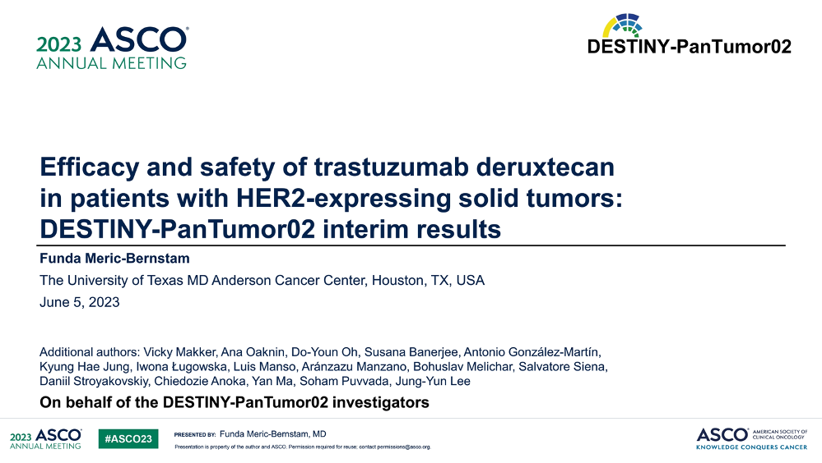
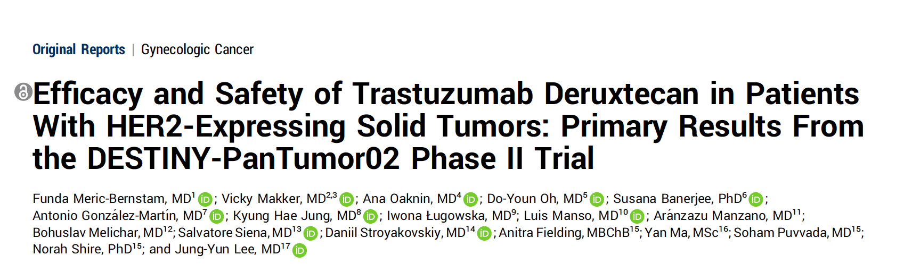
Abstract LBA3000
J Clin Oncol 2024;42(1):47-58

Slide 58
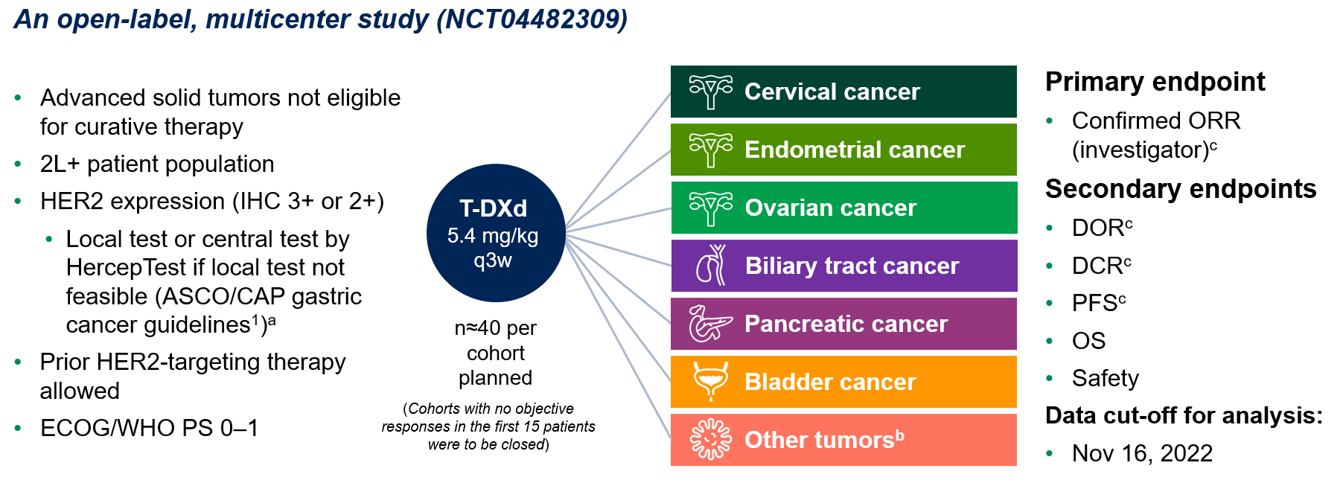
DESTINY-PanTumor02 Phase II Basket Trial Schema
2L+ = second or later line of treatment
Meric-Bernstam F et al. ASCO 2023;Abstract LBA3000; J Clin Oncol 2024;42(1):47-58.

Slide 59
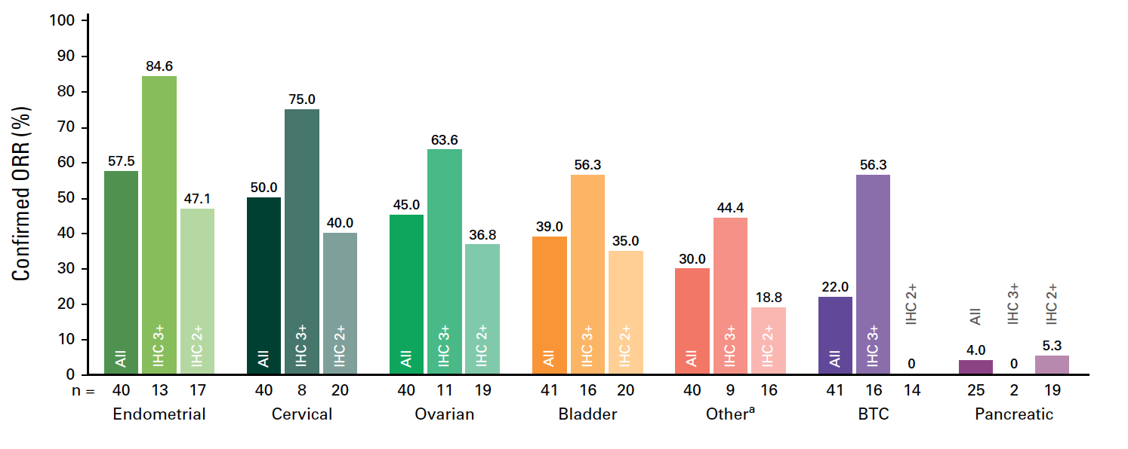
DESTINY-PanTumor02: Objective Response Rate by HER2 Status
Meric-Bernstam F et al. ASCO 2023;Abstract LBA3000; J Clin Oncol 2024;42(1):47-58.

Slide 60
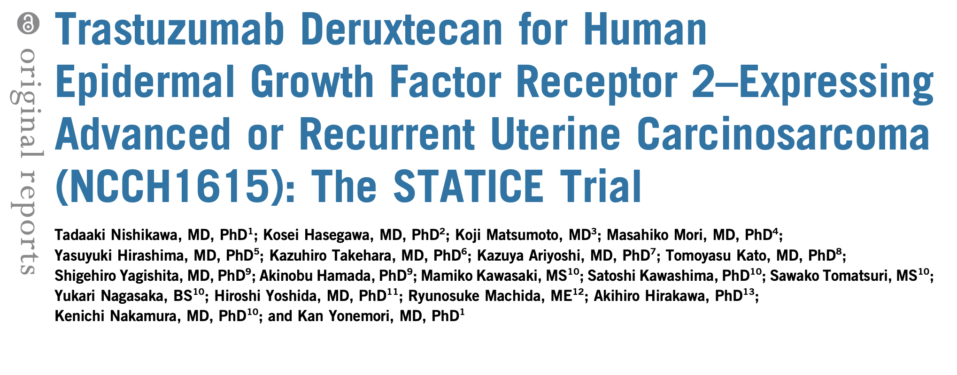
J Clin Oncol 2023;41(15):2789-99.

Slide 61
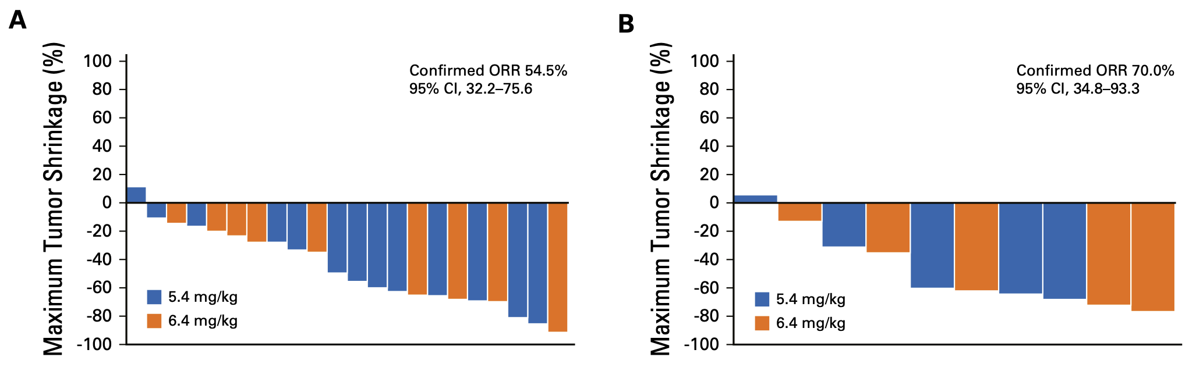
STATICE: Trastuzumab Deruxtecan for Uterine Carcinosarcoma — Response
HER2-High (n=22)
HER2-Low (n=10)
Nishikawa T et al. J Clin Oncol 2023;41(15):2789-99.

Slide 62
DISCUSSION QUESTIONS
How, specifically, are you monitoring for interstitial lung disease (ILD) in your patients receiving T-DXd?
At what level of ILD are you permanently discontinuing treatment even after resolution of symptoms?

Slide 63

Side Effects of Trastuzumab Deruxtecan (T-DXd)
T-DXd
Fatigue 48%
Determinants of ADC Toxicity
Target (tissue distribution)
Payload
Linker
Antibody effects (on target or immune)
Patient factors
Interstitial lung disease 12%
LVEF 4%
Thrombocytopenia 24%
Neutropenia 33%
LFTs 24%
Diarrhoea 22%
Nausea 73%
Adapted from Professor Peter Schmid, FRCP, MD, PhD
Modi et al, NEJM 2022. Hackshaw, BCRT 2022; Powell, ESMO Open 2022; Abuhelwa, Drugs 2022;

Slide 64
Diagnostic if ILD suspected
Courtesy of Professor Peter Schmid, FRCP, MD, PhD
Routine Monitoring
T-DXd: Management of ILD
Monitor for symptoms (cough, dyspnea, pyrexia)
Review every 4-6 weeks
Monitor SpO2 (examine if drop by 2-4% for 1-3d)
CT scans every 9-12 weeks
Lung function test
CT chest scan (ideally high-resolution CT)
Possibly Bronchoscopy
Bloods, blood and sputum cultures
 | Grade 1 | Grade 2 | Grade 3/4
Description | Asymptomatic (diagnostic observations only) | Symptomatic; limiting instrument. ADL | Severe symptoms; limiting self-care ADL; oxygen (G3); Life-threatening (G4)
T-DXd | Hold (restart if resolved within 49 days, otherwise discontinue) | Discontinue | Discontinue
Dose reduction | Same dose if ≤28d, lower dose if > 28d | N/A | N/A
Steroids | 0.5 mg/kg/day | ≥1 mg/kg/day | Methylprednisolone i.v. 500-1000 mg/d for 3d, followed by ≥1 mg/kg/d prednisolone for 14d
Escalation | If worsens despite initiation of steroids, follow Grade 2 guidelines | if not better within 5d: Increase dose or switch to IV | if not better within 5d: Infliximab, IVIG or MMF
Duration | Until improvement, followed by gradual taper over ≥4 weeks | For at least 14d or until complete resolution of clinical and chest CT findings then gradually taper (for at least 4wks)

Slide 65
Agenda
INTRODUCTION: ASCO 2024 Review
MODULE 1: Ovarian Cancer
MODULE 2: HER2 as a Therapeutic Target
MODULE 3: Endometrial Cancer
MODULE 4: Cervical Cancer

Slide 66
Immunotherapy for Endometrial Cancer
Van Nieuwenhuysen E et al. Durvalumab + carboplatin/paclitaxel (CP) followed by durvalumab ± olaparib as first-line treatment for newly diagnosed advanced or recurrent endometrial cancer (EC) in DUO-E: Results by BRCA1/BRCA2 mutation (BRCAm) status. ASCO 2024;Abstract 5595.
Pepin JT et al. Safety and tolerability of durvalumab + carboplatin/paclitaxel followed by durvalumab + olaparib in patients with newly diagnosed advanced or recurrent endometrial cancer (EC) in the
DUO-E/GOG-3041/ENGOT-EN10 trial. ASCO 2024;Abstract 5599.
Westin SN et al. Durvalumab plus carboplatin/paclitaxel followed by maintenance durvalumab with
or without olaparib as first-line treatment for advanced endometrial cancer: The phase III DUO-E trial. J Clin Oncol 2023;42;283-99.
Eskander RN et al. Overall survival and progression-free survival by PD-L1 status among endometrial cancer patients treated with pembrolizumab plus carboplatin/paclitaxel as compared to carboplatin/paclitaxel plus placebo in the NRG GY018 trial. SGO 2024; Late-breaking abstract.

Slide 67
DISCUSSION QUESTIONS
What is your preferred first-line therapy for metastatic microsatellite instability-high (MSI-H)/mismatch repair-deficient (dMMR) EC? Is your approach any different for a younger patient with no comorbidities? Does PD-L1 status matter?
Do you have a preferred anti-PD-1/PD-L1 antibody for patients with MSI-H/dMMR EC?

Slide 68
DISCUSSION QUESTIONS
Regulatory and reimbursement issues aside, what would be your recommended first-line therapy for a patient with microsatellite-stable/mismatch repair-proficient metastatic EC?
How frequently are BRCA and other HRD pathway abnormalities seen in patients with EC? Do you believe these are driving the benefit observed with PARP inhibitors?
Based on findings from DUO-E and RUBY Part 2, are there any situations in which you would like to include a PARP inhibitor for any of your patients with EC? If yes, for which specific patient populations?

Slide 69
FDA Approves Durvalumab with Chemotherapy for Mismatch
Repair-Deficient Primary Advanced or Recurrent Endometrial Cancer
Press Release: June 14, 2024
“On June 14, 2024, the Food and Drug Administration approved durvalumab with carboplatin plus paclitaxel followed by single-agent durvalumab for adult patients with primary advanced or recurrent endometrial cancer that is mismatch repair deficient (dMMR).
Efficacy was evaluated in DUO-E (NCT04269200), a randomized, multicenter, double-blind, placebo-controlled trial in patients with primary advanced or recurrent endometrial cancer. Tumor MMR status was a stratification factor and was assessed using an immunohistochemistry tumor tissue test. The major efficacy outcome measure was progression-free survival (PFS), determined by investigator assessment using RECIST v1.1.
The most common adverse reactions (>25%) with durvalumab in combination with carboplatin and paclitaxel were peripheral neuropathy, musculoskeletal pain, nausea, alopecia, fatigue, abdominal pain, constipation, rash, diarrhea, vomiting, and cough.
The recommended durvalumab dose for patients with a body weight ≥ 30 kg is 1,120 mg with carboplatin plus paclitaxel every 3 weeks for 6 cycles, followed by single-agent durvalumab 1,500 mg every 4 weeks. The recommended durvalumab dose for patients with a body weight of < 30 kg is 15 mg/kg with carboplatin and paclitaxel every 3 weeks for 6 cycles, followed by durvalumab 20 mg/kg every 4 weeks.”
https://www.fda.gov/drugs/resources-information-approved-drugs/fda-approves-durvalumab-chemotherapy-mismatch-repair-deficient-primary-advanced-or-recurrent

Slide 70
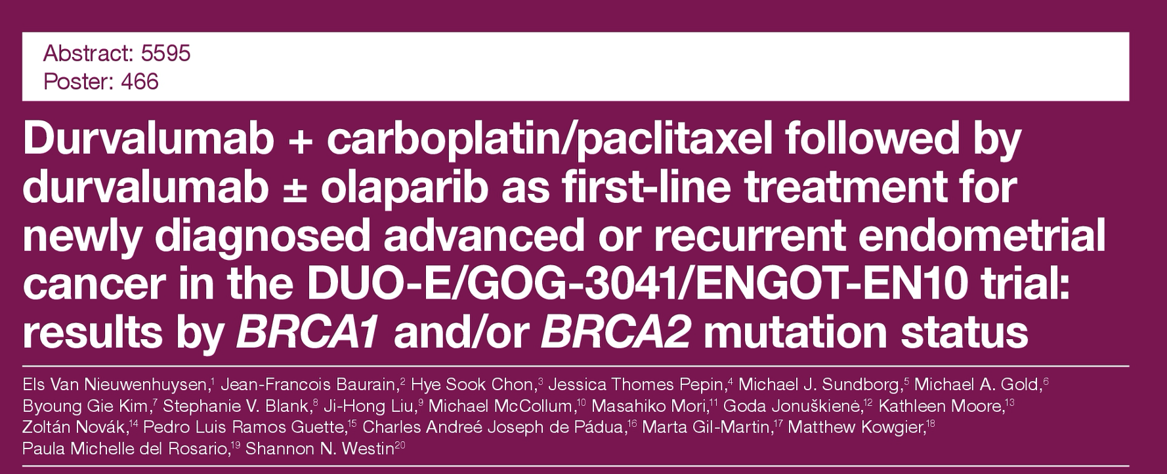
ASCO 2024

Slide 71
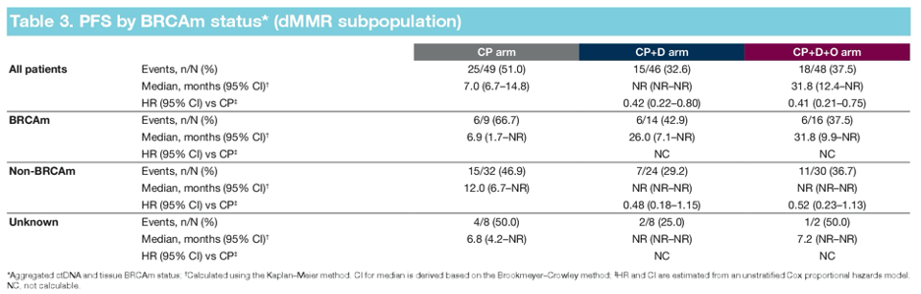
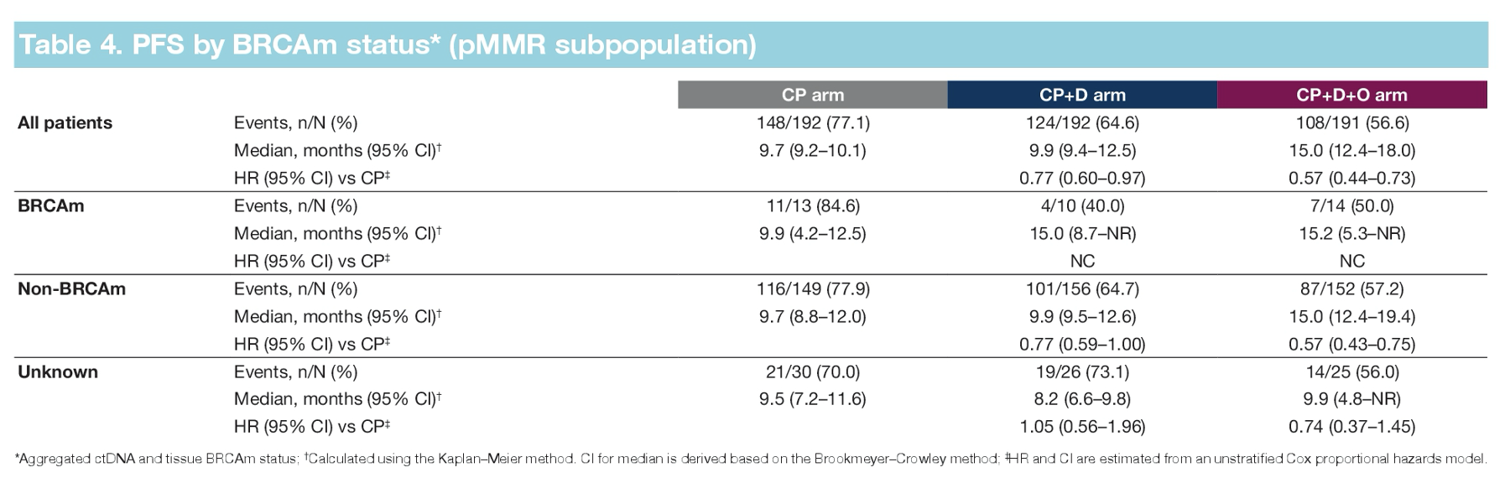
DUO-E: Progression-Free Survival by BRCA Mutation Status
Van Nieuwenhuysen E et al. ASCO 2024;Abstract 5595.

Slide 72
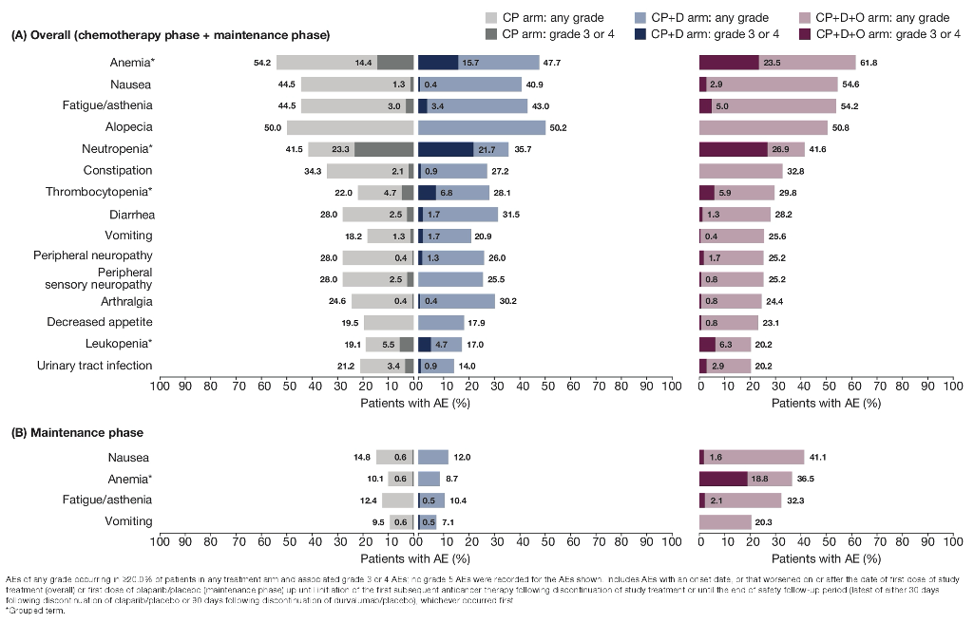
DUO-E: Most Common Adverse Events (≥20% of Patients in Either Study Arm)
Pepin JT et al. et al. ASCO 2024;Abstract 5599.

Slide 73
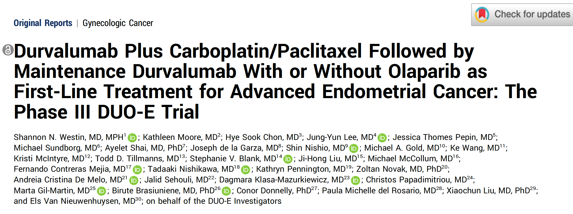
J Clin Oncol 2023;42;283-99.

Slide 74
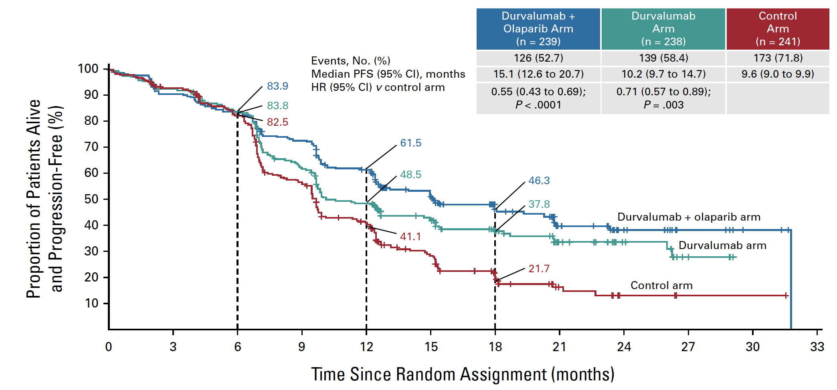
DUO-E Primary Endpoint: Progression-Free Survival
Westin SN et al. J Clin Oncol 2023;42:283-99.

Slide 75
DUO-E: Progression-Free Survival in Key Subgroups
Subgroup | Durvalumab + olaparib | Durvalumab | Control
MMR deficient (n = 48;46;49) | 31.8 mo | Not reached | 7.0 mo
PFS HR vs control | 0.41 | 0.42 | Reference
MMR proficient (n = 191;192;192) | 15.0 mo | 9.9 mo | 9.7 mo
PFS HR vs control | 0.57 | 0.77 | Reference
PD-L1-positive (n = 150;170;163) | 20.8 mo | 11.3 mo | 9.5 mo
PFS HR vs control | 0.42 | 0.63 | Reference
PD-L1-negative (n = 82;61;75) | 10.1 mo | 9.7 mo | 9.9 mo
PFS HR vs control | 0.80 | 0.89 | Reference
Westin SN et al. J Clin Oncol 2023;42:283-99.

Slide 76
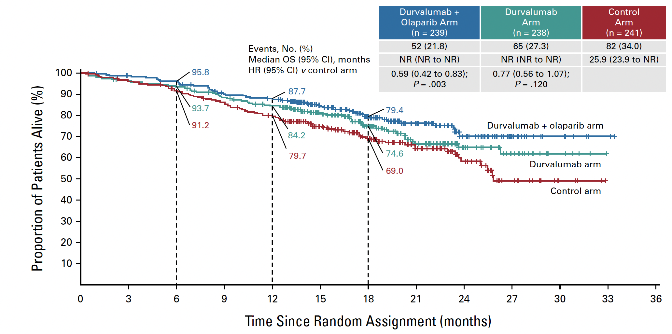
DUO-E: Overall Survival
Westin SN et al. J Clin Oncol 2023;42:283-99.

Slide 77
DISCUSSION QUESTIONS
What is your preferred approach to the management
of EC with a POLE mutation in the adjuvant and
metastatic settings?
Do you expect ongoing clinical trials evaluating
anti-PD-1/PD-L1 antibody-based strategies in the
adjuvant and neoadjuvant settings to be positive?
In what situations, if any, are you currently employing adjuvant immunotherapy outside of a clinical trial setting?

Slide 78
FDA Approves Pembrolizumab with Chemotherapy for Primary Advanced or Recurrent Endometrial Carcinoma
Press Release: June 17, 2024
“On June 17, 2024, the Food and Drug Administration approved pembrolizumab with carboplatin and paclitaxel, followed by single-agent pembrolizumab, for adult patients with primary advanced or recurrent endometrial carcinoma.
Efficacy was evaluated in KEYNOTE-868/NRG-GY018 (NCT03914612), a multicenter, randomized, double-blind, placebo-controlled trial enrolling 810 patients with advanced or recurrent endometrial carcinoma. The trial included two separate cohorts based on mismatch repair (MMR) status: 222 patients in the mismatch repair deficient (dMMR) cohort, and 588 patients in the mismatch repair (pMMR) proficient cohort.
The major efficacy outcome measure was progression-free survival (PFS), assessed by the investigator according to RECIST 1.1. In the dMMR cohort, median PFS was not reached (NR) (95% CI: 30.7, NR) in the pembrolizumab and chemotherapy arm and 6.5 months (95% CI: 6.4, 8.7) in the placebo and chemotherapy arm (Hazard ratio [HR] 0.30 [95% CI: 0.19, 0.48]; p-value <0.0001). In the pMMR cohort, median PFS was 11.1 months (95% CI: 8.7, 13.5) in the pembrolizumab and chemotherapy arm and 8.5 months (95% CI: 7.2, 8.8) for those receiving placebo and chemotherapy (HR 0.60 [95% CI: 0.46, 0.78; p-value <0.0001).”
https://www.fda.gov/drugs/resources-information-approved-drugs/fda-approves-pembrolizumab-chemotherapy-primary-advanced-or-recurrent-endometrial-carcinoma

Slide 79
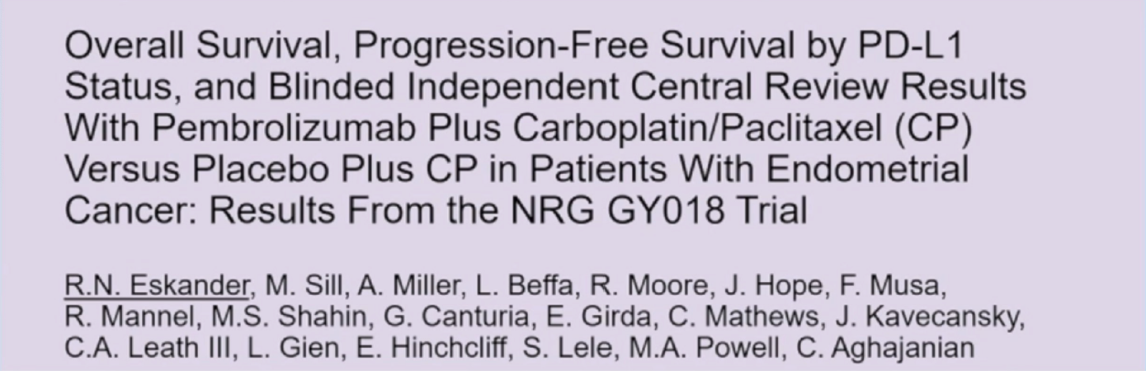
SGO 2024;Plenary.

Slide 80
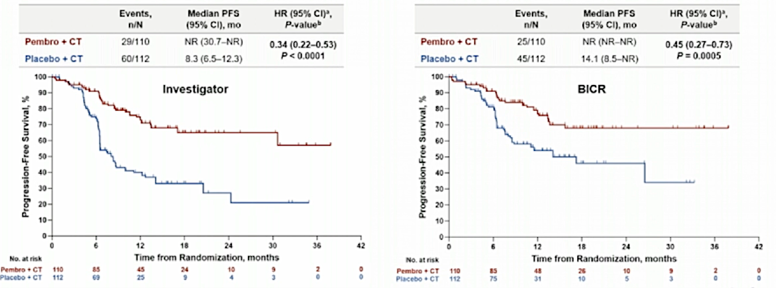
NRG-GY018: PFS in the dMMR Population
Eskander RN et al. SGO 2024;Plenary.

Slide 81
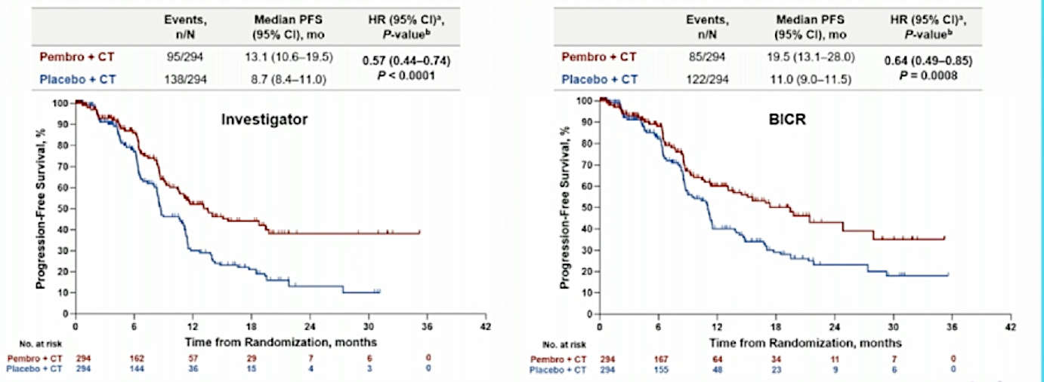
NRG-GY018: PFS in pMMR Population
pMMR = mismatch repair proficient
Eskander RN et al. SGO 2024;Plenary.

Slide 82
Selinexor for Endometrial Cancer
Makker V et al. Long-term follow-up of selinexor maintenance for patients with TP53wt advanced or recurrent endometrial cancer: A prespecified subgroup analysis from the phase 3 ENGOT-EN5/ GOG-3055/SIENDO study. ASCO 2024;Rapid Update.
Makker V et al. Phase 3 dose selection for selinexor in TP53wt endometrial cancer based on exposure-response analysis. ASCO 2024;Abstract 5594.

Slide 83
DISCUSSION QUESTIONS
Do you believe the signal reported with the use of selinexor
for patients with p53 wild-type disease is real?
Would you currently consider using selinexor for EC outside of a trial under any circumstances?
Are there any investigational agents — like antibody-drug conjugates — for patients with progressive EC that may be more attractive than currently available therapeutic options?

Slide 84
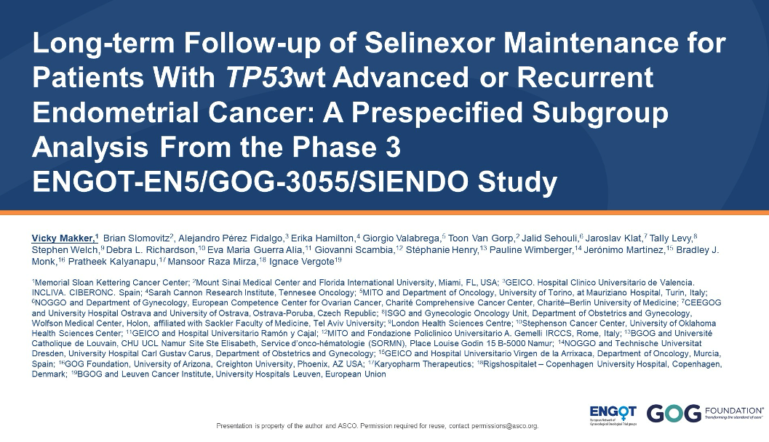
ASCO 2024; Rapid Update

Slide 85
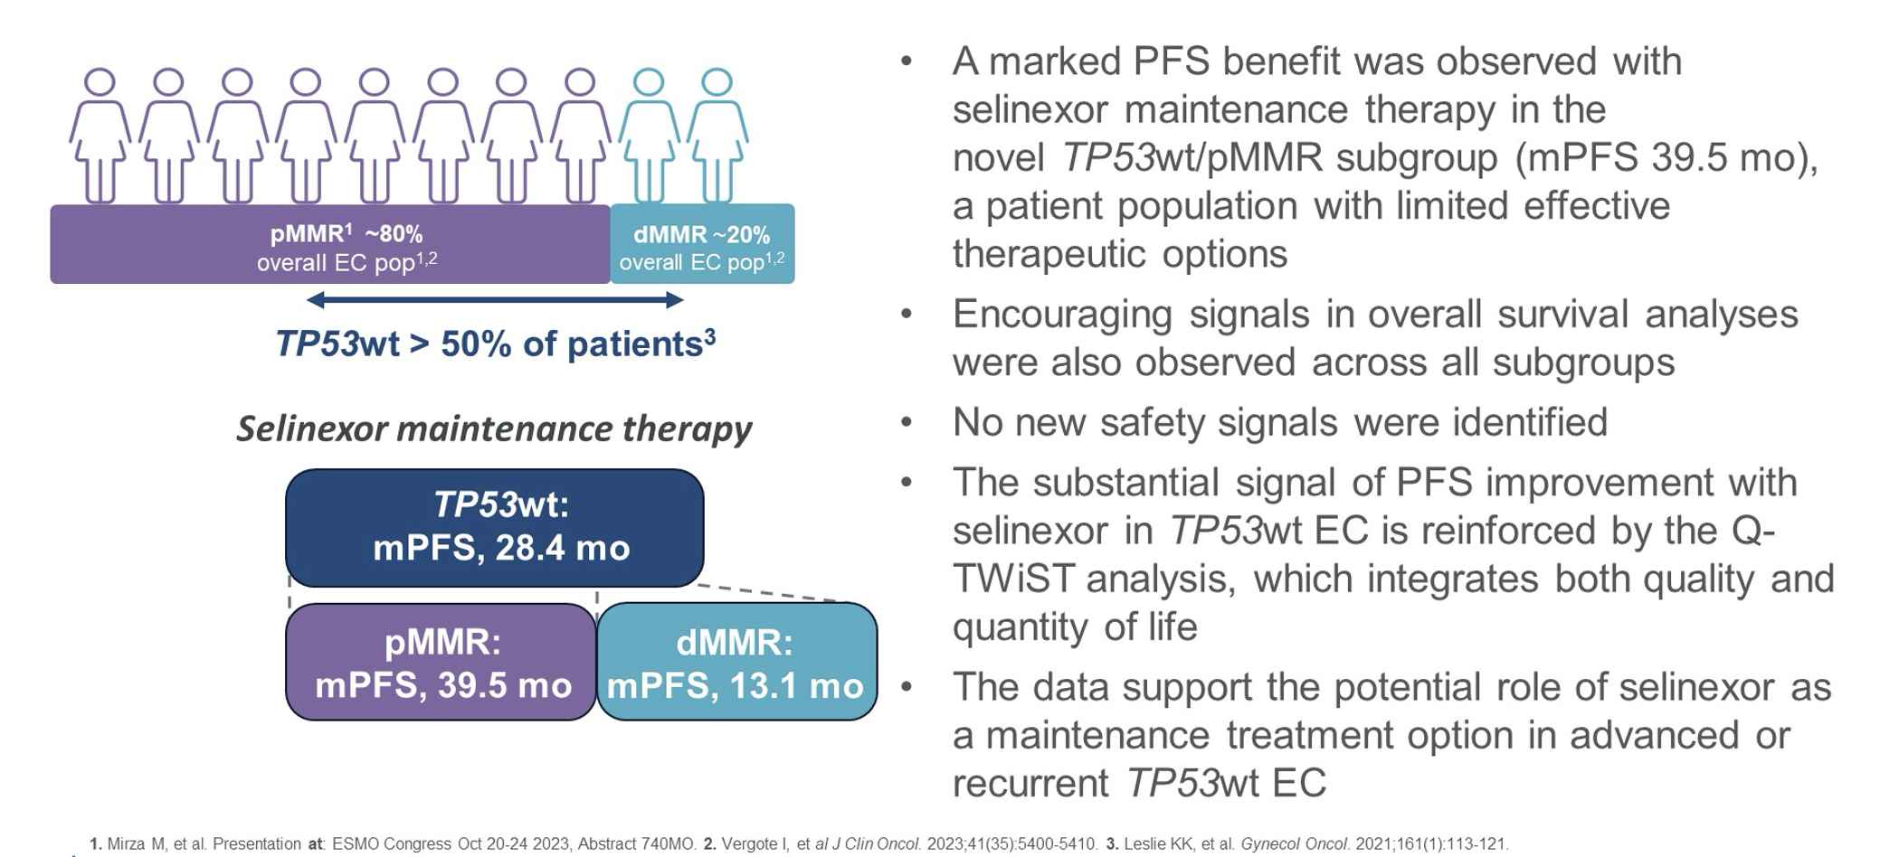
SIENDO: Long-Term Follow-Up Summary
Makker V et al. ASCO 2024;Rapid Abstract Update.

Slide 86
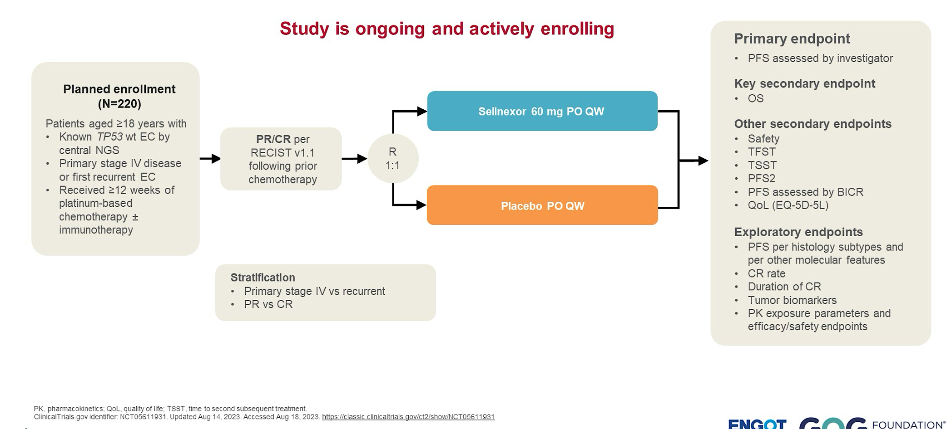
ENGOT-EN20/GOG-3083/XPORT-EC-042 Phase III Trial Design
Makker V et al. ASCO 2024;Rapid Abstract Update.

Slide 87
Agenda
INTRODUCTION: ASCO 2024 Review
MODULE 1: Ovarian Cancer
MODULE 2: HER2 as a Therapeutic Target
MODULE 3: Endometrial Cancer
MODULE 4: Cervical Cancer

Slide 88
Immune Checkpoint Inhibitors for Cervical Cancer
Lorusso D et al. Pembrolizumab or placebo with chemoradiotherapy followed by pembrolizumab or placebo for newly diagnosed, high-risk, locally advanced cervical cancer (ENGOT-cx11/GOG-3047/KEYNOTE-A18): A randomised, double-blind, phase 3 clinical trial. Lancet 2024;403:1341-50.
Oaknin A et al. Atezolizumab plus bevacizumab and chemotherapy for metastatic, persistent, or recurrent cervical cancer (BEATcc): A randomised, open-label, phase 3 trial. Lancet 2024;403:31-43.

Slide 89
DISCUSSION QUESTION
What is your current clinical approach for a patient with Stage III to IVA cervical cancer?

Slide 90
FDA Approves Pembrolizumab with Chemoradiation Therapy for FIGO 2014 Stage III to Stage IVA Cervical Cancer
Press Release: January 12, 2024
“On January 12, 2024, the Food and Drug Administration approved pembrolizumab with chemoradiotherapy (CRT) for patients with FIGO 2014 Stage III-IVA cervical cancer.
Efficacy was evaluated in KEYNOTE-A18 (NCT04221945), a multicenter, randomized, double-blind, placebo-controlled trial enrolling 1060 patients with cervical cancer who had not previously received definitive surgery, radiation, or systemic therapy. The trial included 596 patients with FIGO 2014 Stage III-IVA disease and 462 patients with FIGO 2014 Stage IB2-IIB, node-positive disease.
The major efficacy outcome measures were progression- free survival (PFS) assessed by the investigator according to RECIST v1.1, or histopathologic confirmation, and overall survival (OS) ... The most common adverse reactions (≥10%) occurring in patients who received pembrolizumab with chemoradiotherapy were nausea, diarrhea, vomiting, urinary tract infection, fatigue, hypothyroidism, constipation, decreased appetite, weight loss, abdominal pain, pyrexia, hyperthyroidism, dysuria, rash, and pelvic pain.
The recommended dosing regimen for pembrolizumab is 200 mg IV every 3 weeks or 400 mg IV every 6 weeks until disease progression, unacceptable toxicity, or for up to 24 months. Pembrolizumab should be administered before chemoradiotherapy when given on the same day.”
The recommended tisotumab vedotin dose is 2 mg/kg (maximum of 200 mg for patients ≥100 kg) administered as an intravenous infusion over 30 minutes every 3 weeks until disease progression or unacceptable toxicity.
https://www.fda.gov/drugs/resources-information-approved-drugs/fda-approves-pembrolizumab-chemoradiotherapy-figo-2014-stage-iii-iva-cervical-cancer

Slide 91
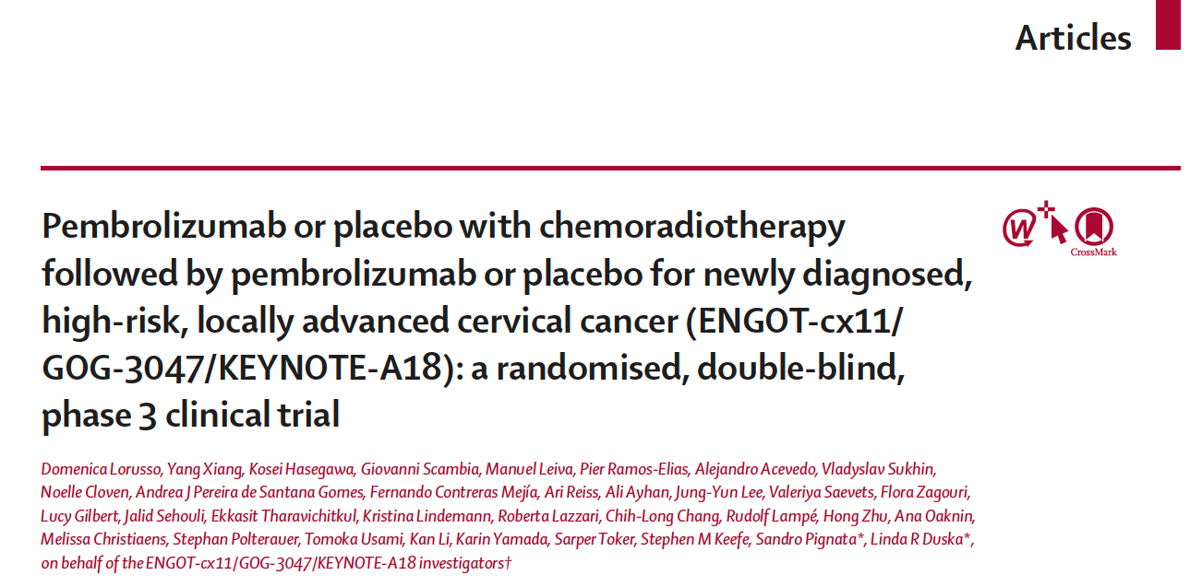
Lancet 2024;403:1341-50.

Slide 92
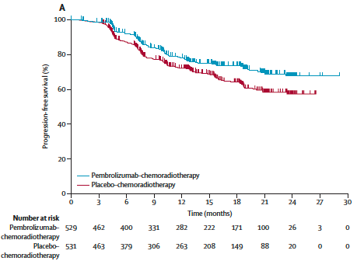
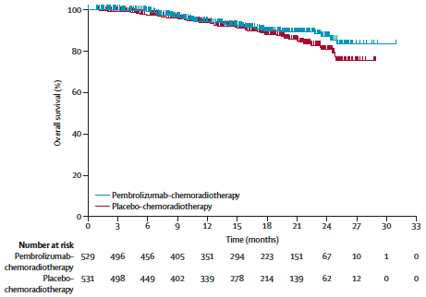
KEYNOTE-A18: Progression-Free and Overall Survival
Progression-free survival – Interim analysis
Overall survival – Interim analysis
Median: Not reached
HR 0.70, p = 0.0020
Median: Not reached
HR 0.73*
*p-value did not cross the pre-specified efficacy boundary
Lorusso D et al. Lancet 2024;403:1341-50.

Slide 93
Tisotumab Vedotin for Recurrent or Metastatic Cervical Cancer
Sánchez LM et al. Tisotumab vedotin in 2L/3L recurrent or metastatic cervical cancer: Subsequent therapy data from ENGOT-cx12/GOG-3057/innovaTV 301. ASCO 2024;Abstract 5531.
Vergote I et al. innovaTV 301/ENGOT-cx12/GOG-3057: A global, randomized, open-label, phase III study of tisotumab vedotin vs investigator’s choice of chemotherapy in 2L or 3L recurrent or metastatic cervical cancer. ESMO 2023;Abstract LBA9.
Vergote I et al. Tisotumab vedotin in combination with carboplatin, pembrolizumab, or bevacizumab in recurrent or metastatic cervical cancer: Results from the innovaTV 205/GOG-3024/ENGOT-cx8 study. J Clin Oncol 2023;41:5536-49.

Slide 94
DISCUSSION QUESTION
What has been your clinical experience with efficacy and tolerability with tisotumab vedotin?

Slide 95
FDA Approves Tisotumab Vedotin-tftv for Recurrent or Metastatic Cervical Cancer
Press Release: April 29, 2024
“On April 29, 2024, the Food and Drug Administration granted traditional approval to tisotumab vedotin-tftv for recurrent or metastatic cervical cancer with disease progression on or after chemotherapy. Tisotumab vedotin-tftv previously received accelerated approval for this indication.
Efficacy was evaluated in innovaTV 301 (NCT04697628), an open-label, active-controlled, multicenter, randomized trial that enrolled 502 patients with recurrent or metastatic cervical cancer who had received one or two prior systemic regimens, including chemotherapy with or without bevacizumab and/or an anti-PD-(L)-1 agent.
The major efficacy outcome measure was overall survival (OS) ... The most common adverse reactions (≥25%), including laboratory abnormalities, were decreased hemoglobin, peripheral neuropathy, conjunctival adverse reactions, increased aspartate aminotransferase, nausea, increased alanine aminotransferase, fatigue, decreased sodium, epistaxis, and constipation.
The recommended tisotumab vedotin dose is 2 mg/kg (maximum of 200 mg for patients ≥100 kg) administered as an intravenous infusion over 30 minutes every 3 weeks until disease progression or unacceptable toxicity.”
The recommended tisotumab vedotin dose is 2 mg/kg (maximum of 200 mg for patients ≥100 kg) administered as an intravenous infusion over 30 minutes every 3 weeks until disease progression or unacceptable toxicity.
https://www.fda.gov/drugs/resources-information-approved-drugs/fda-approves-tisotumab-vedotin-tftv-recurrent-or-metastatic-cervical-cancer

Slide 96
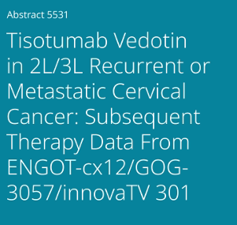

ASCO 2024

Slide 97

innovaTV 301: Prior and Subsequent Therapies
Summary of Efficacy in Dose Expansion Arms
Cytotoxic chemotherapy and immunotherapy were the most common subsequent systemic anticancer therapies received in both treatment arms.
Tisotumab vedotin did not prevent the initiation of subsequent therapies, including immunotherapy.
Sánchez LM et al. ASCO 2024;Abstract 5531.

