Slide 1
Other Available and Emerging Therapeutic Approaches in Prostate Cancer
Andrew J Armstrong MD ScM FACP
Professor of Medicine, Surgery, Pharmacology and Cancer Biology
Duke Cancer Institute Center for Prostate and Urologic Cancers

Slide 2
PROpel Trial: First-line Abiraterone/Prednisone ± Olaparib in mCRPC
International, randomized, double-blind phase III study
Stratified by metastatic disease sites (bone only vs visceral vs other); taxane for mHSPC (yes vs no)
Patients With mCRPC
No prior tx for mCRPC
Ongoing ADT
Docetaxel for mHSPC allowed
No prior abiraterone
ECOG PS 0/1
No screening for HRR mutations required, but optional biopsies and blood collected for NGS testing
(N = 796)
Olaparib 300 mg BID + Abiraterone 1000 mg QD +
Prednisone/Prednisolone 5 mg BID
(n = 399)
Until radiographic progression or unacceptable toxicity
Crossover from placebo to olaparib not permitted
Placebo + Abiraterone 1000 mg QD +
Prednisone/Prednisolone 5 mg BID
(n = 397)
Primary endpoint: rPFS by investigator
Key secondary endpoints: OS, time to subsequent therapy or death, PFS2, ORR, HRR mutation prevalence (retrospectively assessed), HRQoL, safety
Clarke. NEJM Evid. 2022;1. Saad. Lancet Oncol. 2023;24:1094.
Notes:
ADT, androgen deprivation therapy; ECOG, Eastern Cooperative Oncology Group; HRQoL, health-related quality of life; HRR, homologous recombination repair; mCRPC, metastatic castration-resistant prostate cancer; mHSPC, metastatic hormone-sensitive prostate cancer; NGS, next-generation sequencing; ORR, objective response rate; OS, overall survival; PFS2, time to second progression or death; PS, performance status; rPFS, radiographic progression-free survival.

Slide 3
PROpel: rPFS (Primary Endpoint)
Primary Endpoint: rPFS by Investigator Assessment
rPFS by BICR
1.0
1.0
0.8
0.8
Olaparib + Abi
Olaparib + Abi
0.6
0.6
Probability of rPFS
Probability of rPFS
0.4
0.4
0.2
Placebo + Abi
0.2
Placebo + Abi
0
0
0
1
2
3
4
5
6
7
8
9
10
11
12
13
14
15
16
17
18
19
20
21
22
23
24
25
26
27
28
29
30
31
0
1
2
3
4
5
6
7
8
Mo From Random Assignment
9
10
11
12
13
14
15
16
17
18
19
20
21
22
23
24
25
26
27
28
29
30
31
Mo From Random Assignment
Outcome | Olaparib + Abi (n = 399) | Placebo + Abi (n = 397)
Events, n (%) | 168 (42.1) | 226 (56.9)
Median rPFS, mo | 24.8 | 16.6
HR (95% CI) | 0.66 (0.54-0.81; P <.001)
Outcome | Olaparib + Abi (n = 399) | Placebo + Abi (n = 397)
Events, n (%) | 157 (39.3) | 218 (54.9)
Median rPFS, mo | 27.6 | 16.4
HR (95% CI) | 0.61 (0.49-0.74)
Clarke. NEJM Evid. 2022;1.
Notes:
Abi, abiraterone acetate + prednisone; BICR, blinded independent central review; rPFS, radiographic progression-free survival.

Slide 4
PROpel: rPFS Subgroup Analysis
Number of Patients, n
Median rPFS, Mo
HR (95% CI)
All patients Age at randomization, yr <65 ≥65 ECOG PS at baseline 0 1 Site of distant metastases Bone only Visceral Other Docetaxel treatment at mHSPC stage Yes No Baseline PSA Below median baseline PSA Above or equal to median baseline PSA HRRm status* HRRm Non-HRRm
796 227 569 558 236 434 105 257 189 607 396 397 226 552
24.8 NR 22.0 24.9 17.5 27.6 13.7 20.5 27.6 24.8 25.2 18.5 NR 24.1
16.6 16.4 16.7 16.8 14.6 22.2 10.9 13.7 13.8 16.8 22.0 13.8 13.9 19.0
0.66 (0.54-0.81) 0.51 (0.35-0.75) 0.78 (0.62-0.98) 0.67 (0.52-0.85) 0.75 (0.53-1.06) 0.73 (0.54-0.98) 0.62 (0.39-0.99) 0.62 (0.44-0.85) 0.61 (0.40-0.92) 0.71 (0.56-0.89) 0.75 (0.55-1.02) 0.63 (0.48-0.82) 0.50 (0.34-0.73) 0.76 (0.60-0.97)
Global interaction test not significant
0.1
1
10
Olaparib + Abiraterone Better
Placebo + Abiraterone Better
*HRR status determined retrospectively.
Saad. ASCO GU 2022. Abstr 11. Clarke. NEJM Evid. 2022;1.
Notes:
ECOG, Eastern Cooperative Oncology Group; mHSPC, metastatic hormone-sensitive prostate cancer; PS, performance status; PSA, prostate-specific antigen; rPFS, radiographic progression-free survival.

Slide 5
PROpel: OS in ITT Population
Outcome | Ola + Abi (n = 399) | Placebo + Abi (n = 397)
mOS, mo | 42.1 | 34.7
HR (95% CI) | 0.81 (0.67-1.00; P = .054)
2-yr OS rate, % | 70 | 67
3-yr OS rate, % | 57 | 50
Median f/u, mo | 36.6 | 36.5
1.0
0.9
0.8
0.7
0.6
0.5
Probability of OS
0.4
0.3
0.2
0.1
Δ 7.4 mo
0.0
0
2
4
6
8
10
12
14
16
18
20
22
24
26
28
30
32
34
36
38
40
42
44
46
48
Patients at Risk, n Ola + Abi Placebo + Abi
Time From Randomization (Mo)
399 397
399 395
391 388
385 383
374 376
364 370
349 355
334 337
318 316
312 305
298 301
283 282
273 254
258 241
253 225
246 213
226 201
192 157
135 119
96 84
63 53
29 25
10 7
2 0
0 0
Clarke. ASCO GU 2023. Abstr LBA16. Saad. Lancet Oncol. 2023;24:1094.
Notes:
Abi, abiraterone acetate + prednisone; f/u, follow-up; ITT, intention-to-treat; m, median; Ola, olaparib; OS, overall survival.

Slide 6
PROpel: OS by HRR Status
HRR Mutated (28.4% of ITT population)
Not HRR Mutated (69.3% of ITT population)
 | Ola + Abi (n = 111) | Placebo + Abi (n = 115)
Median OS, mo | NR | 28.5
 | HR: 0.66 (95% CI: 0.45-0.95)
 | Ola + Abi (n = 279) | Placebo + Abi (n = 273)
Median OS, mo | 42.1 | 38.9
HR: 0.89 (95% CI: 0.70-1.14) | HR: 0.89 (95% CI: 0.70-1.14)
1.0
1.0
0.8
0.8
0.6
0.6
Probability
Probability
0.4
0.4
0.2
0.2
0
0
0
4
8
12
16
20
24
28
32
36
40
44
48
0
4
8
12
16
20
24
28
32
36
40
44
48
Mo
Mo
Saad. Lancet Oncol. 2023;24:1094.
Notes:
Abi, abiraterone; HRR, homologous recombination repair; ITT, intention-to-treat; Ola, olaparib; OS, overall survival.

Slide 7
PROpel: OS in BRCAm
 | Ola + Abi (n = 47) | Placebo + Abi (n = 38)
Median OS, mo | NR | 23.0
HR: 0.29 (95% CI: 0.14-0.56) | HR: 0.89 (95% CI: 0.70-1.14)
100
80
60
OS (%)
40
20
0
0
2
4
6
8
10
12
14
16
18
20
22
24
26
28
30
32
34
36
38
40
42
44
46
48
Patients at Risk, n Ola + Abi Placebo + Abi
Time Since Randomization (Mo)
47 38
47 38
47 37
47 36
45 34
42 34
41 31
41 30
39 26
38 22
37 21
35 19
35 16
35 15
34 14
34 12
33 12
29 11
21 8
13 3
8 2
5 0
0 0
0 0
- -
Saad. Lancet Oncol. 2023:24:1094.
Notes:
Abi, abiraterone acetate + prednisone; NR, not reached; Ola, olaparib; OS, overall survival.

Slide 8
PROpel: AEs in >10% of Patients
AEs, % | Ola + Abi (n = 398) |  | Placebo + Abi (n = 396)
 | Any | Gr ≥3 | Any | Gr ≥3
Anemia | 50 | 16 | 18 | 3
Fatigue/asthenia | 39 | 3 | 30 | 2
Nausea | 31 | <1 | 14 | <1
Back pain | 22 | 1 | 20 | 2
Diarrhea | 21 | 1 | 11 | <1
Constipation | 19 | 0 | 15 | <1
Decreased appetite | 17 | 1 | 8 | 0
Vomiting | 16 | 2 | 9 | <1
AEs, % | Ola + Abi (n = 398) |  | Placebo + Abi (n = 396)
 | Any | Gr ≥3 | Any | Gr ≥3
Hypertension | 15 | 4 | 19 | 5
Arthralgia | 15 | 0 | 19 | 1
COVID-19 | 13 | 4 | 9 | 2
Peripheral edema | 12 | 0 | 13 | <1
Dizziness | 12 | 0 | 7 | 0
Urinary tract infection | 12 | 3 | 9 | 1
Cough | 12 | 0 | 7 | 0
Hot flush | 9 | 0 | 14 | 0
Pulmonary embolism: 7.3% vs 2.3%; cardiac failure events: 1.8% in both arms
Saad. Lancet Oncol. 2023;24:1094.
Notes:
Abi, abiraterone acetate + prednisone; AE, adverse event; Gr, grade; Ola, olaparib.

Slide 9
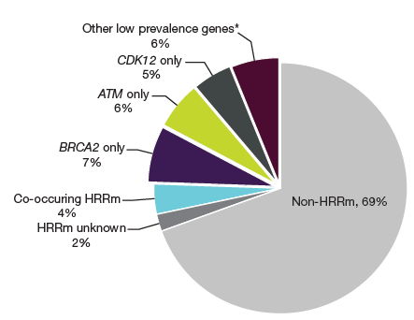
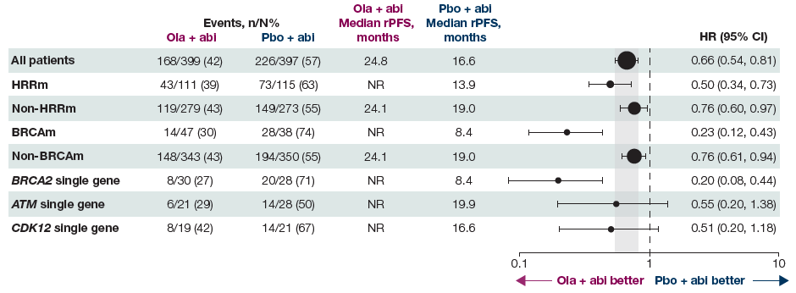
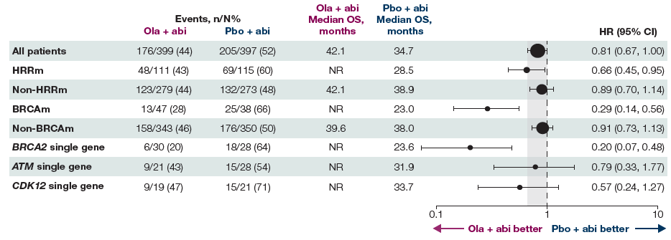
What about combination activity in non-BRCA2 HRRm mCRPC patients?
Shore, Armstrong et al GU 2024 abstract 165
rPFS
OS
• In the CHEK2 population, 5/7 (71%) patients in the olaparib plus abiraterone arm and 8/12 (67%) patients in the placebo plus abiraterone arm had an rPFS event; median rPFS was 5.7 months with olaparib plus abiraterone versus 13.8 months with placebo plus abiraterone
• In the BRCA1 population, 0/6 (0%) patients in the olaparib plus abiraterone arm and 3/3 (100%) patients in the placebo plus abiraterone arm had an rPFS event; median rPFS was not reached with olaparib plus abiraterone versus 5.5 months with placebo plus abiraterone
• In the PALB2 population, 1/3 (33%) patients in the olaparib plus abiraterone arm and 3/4 (75%) patients in the placebo plus abiraterone arm had an rPFS event; median rPFS was not reached with olaparib plus abiraterone versus 7.3 months with placebo plus abiraterone
PSA50 was 93% in BRCA2m with combo vs 31% with abi; for ATMm was 76 vs 75%; for CDK12 was 83 vs 62%

Slide 11
MAGNITUDE: PSA Progression and/or rPFS in HRRm- Cohort (Prespecified Early Futility Analysis)
Radiographic or PSA Progression: HRRm- Cohort
100
Futility definition (HR ≥1) met in HRRm- cohort at time of preplanned analysis
Composite HR: 1.09 (95% CI: 0.75-1.59)
PSA HR: 1.03 (95% CI: 0.67-1.59)
rPFS HR: 1.03 (95% CI: 0.63-1.67)
Grade 3/4 AEs higher in niraparib vs placebo arm
HRRm- enrollment stopped in August 2020
80
60
Placebo + AAP
Patients Without Events (%)
40
Nira + AAP
20
 | Nira + AAP (n = 117) | Placebo + AAP (n = 116)
Median progression, mo | 9.6 | NE
HR (95% CI) | 1.09 (0.75-1.57; P = .66)
0
0
3
6
9
12
15
Mo
Patients at Risk, n Nira + AAP Placebo + AAP
117 116
92 91
68 68
51 56
4 8
0 0
Chi. JCO. 2023;41:3339. Chi. ASCO GU 2022. Abstr 12.
Notes:
AAP, abiraterone acetate + prednisone; AE, adverse event; HRRm, homologous recombination repair mutation; Nira, niraparib; PSA, prostate-specific antigen; rPFS, radiographic progression-free survival.

Slide 12
MAGNITUDE: Radiologic PFS by Central Review (Primary Endpoint)
HRRm+ Cohort Median follow-up: 18.6 mo
BRCA1/2-Mutated Cohort Median follow-up: 16.7 mo
100
100
80
80
60
Nira + AAP: 16.5 mo
60
Nira + AAP: 16.6 mo
Patients Without Events (%)
Patients Without Events (%)
40
40
20
Placebo + AAP: 13.7 mo
20
Placebo + AAP: 10.9 mo
HR: 0.73 (95% CI: 0.56-0.96; P = .0217)
HR: 0.53 (95% CI: 0.36-0.79; P = .0014)
0
0
0
3
6
9
12
15
18
21
24
27
30
0
3
6
9
12
15
18
21
24
27
30
Patients at Risk, n
Mo From Randomization
Patients at Risk, n
Mo From Randomization
Nira + AAP
Placebo + AAP
212
211
192
182
167
149
129
102
96
78
64
53
45
35
21
15
10
9
2
2
0
0
Nira + AAP
Placebo + AAP
113
112
103
97
90
77
65
43
45
28
31
20
18
11
9
5
4
2
1
0
0
0
Chi. JCO. 2023;41:3339. Chi. ASCO GU 2022. Abstr 12.
Notes:
AAP, abiraterone acetate + prednisone; HRRm, homologous recombination repair mutation; Nira, niraparib; PFS, progression-free survival.

Slide 13
Not as much MAGNITUDE of benefit…
Chi et al ESMO 2023 LBA 85

Slide 14
TALAPRO-2: Enzalutamide ± Talazoparib as First-Line Therapy for mCRPC
Randomized, double-blind, placebo-controlled phase III trial
Primary endpoint: rPFS by BICR
Key secondary endpoint: OS
Other secondary endpoints: time to cytotoxic chemotherapy, PFS2 (by investigator), ORR, PROs, safety
Talazoparib† + Enzalutamide‡ (n = 402)
Cohort 1: All comers (N = 805) Recruited first Data cutoff: August 16, 2022
Patients with newly diagnosed mCRPC; ECOG PS 0-1; samples prospectively assessed for HRR* gene alterations
(N = 805)
Placebo + Enzalutamide‡ (n = 403)
Nondeficient or unknown (n = 636)
HRRm (n = 169)
HRRm (n = 230)
Talazoparib† + Enzalutamide‡ (n = 200)
Cohort 2: HRRm only (N = 399) Recruitment continued after cohort 1 closed Data cutoff: October 3, 2022
Placebo + Enzalutamide‡ (n = 199)
†0.5 mg QD; 0.35 mg if moderate renal impairment. ‡160 mg QD.
*HRR gene alterations: BRCA1, BRCA2, PALB2, ATM, ATR, CHECK2, FANCA, RAD51C, NBN, MLH1, MRE11A, CDK12.
Agarwal. ASCO GU 2023. Abstr LBA17. Agarwal. Lancet. 2023;204:291. Fizazi. ASCO 2023. Abstr 5004. Fizazi. Nat Med. 2023;[Epub].
Notes:
BICR, blinded independent central review; ECOG, Eastern Cooperative Oncology Group; HRR, homologous recombination repair; mCRPC, metastatic castration-resistant prostate cancer; ORR, overall response rate; OS, overall survival; PFS2, time to second progression or death; PRO, patient-reported outcome; PS, performance status; rPFS, radiographic progression-free survival.

Slide 15
TALAPRO-2: rPFS by BICR in Cohort 1 All Comers (Primary Endpoint)
rPFS
1.0
 | Tala + Enza (n = 402) | Placebo + Enza (n = 403)
Events, n | 151 | 191
Median rPFS, mo (95% CI) | NR (27.5-NR) | 21.9 (16.6-25.1)
Median f/u, mo | 24.9 | 24.6
0.8
0.6
Tala + Enza
Probability of rPFS
0.4
0.2
Placebo + Enza
HR: 0.63 (95% CI: 0.51-0.73; P <.001)
0.0
0
2
4
6
8
10
12
14
16
18
20
22
24
26
28
30
32
34
36
38
40
42
Mo
Patients at Risk, n
Tala + Enza | 402 | 379 | 353 | 326 | 318 | 285 | 256 | 234 | 226 | 209 | 193 | 175 | 136 | 97 | 67 | 61 | 29 | 13 | 2 | 2 | 1 | 0
Pbo + Enza | 403 | 346 | 311 | 279 | 272 | 237 | 200 | 185 | 179 | 154 | 140 | 124 | 96 | 68 | 43 | 42 | 14 | 3 | 1 | 1 | 1 | 0
Investigator-assessed rPFS HR: 0.64 (95% CI: 0.50-0.91; P <.001)
Agarwal. ASCO GU 2023. Abstr LBA17. Agarwal. Lancet. 2023;204:291.
Notes:
BICR, blinded independent central review; Enza, enzalutamide; f/u, follow-up; NR, not reached; Pbo, placebo; rPFS, radiographic progression-free survival; Tala, talazoparib.

Slide 16
TALAPRO-2: Subgroup Analysis of rPFS by BICR Cohort 1
Subgroup Overall Age, yr ≥70 <70 ECOG PS 0 1 Gleason score <8 ≥8 Stage of diagnosis M0 M1 Site of metastasis Bone only Soft tissue only Bone and soft tissue HRR status Deficient Nondeficient/unknown Prior abiraterone or docetaxel Yes No
Events/N
Tala + Enza 151/402 93/240 58/162 100/259 51/143 34/117 115/281 64/172 86/226 52/169 15/48 82/180 37/85 114/317 42/109 109/293
Placebo + Enza 191/403 109/240 82/163 130/271 61/132 49/113 137/283 92/185 98/215 63/154 29/57 98/188 49/84 142/319 58/110 133/293
HR (95% CI) 0.63 (0.51-0.78) 0.67 (0.51-0.89) 0.61 (0.44-0.86) 0.67 (0.51-0.86) 0.62 (0.43-0.90) 0.60 (0.39-0.93) 0.67 (0.52-0.86) 0.61 (0.44-0.84) 0.69 (0.51-0.92) 0.59 (0.41-0.86) 0.57 (0.30-1.07) 0.71 (0.53-0.95) 0.48 (0.31-0.74) 0.69 (0.54-0.89) 0.56 (0.38-0.83) 0.68 (0.53-0.88)
2-Sided P Value <.001 .005 .004 .002 .01 .02 .001 .002 .01 .005 .07 .02 <.001 .004 .004 .003
0.25
0.5
1
1.25
Favors Tala + Enza
Favors Placebo + Enza
Agarwal. ASCO GU 2023. Abstr LBA17. Agarwal. Lancet. 2023;204:291.
Notes:
BICR, blinded independent central review; ECOG, Eastern Cooperative Oncology Group; Enza, enzalutamide; HRR, homologous recombination repair; PS, performance status; rPFS, radiographic progression-free survival; Tala, talazoparib.

Slide 17
TALAPRO-2: Overall Survival in All-Comers Population
OS
1.0
 | Tala + Enza (n = 402) | Placebo + Enza (n = 403)
Events, n | 123 | 123
Median OS, mo (95% CI) | 36.4 (33.5-NR) | NR (33.7-NR)
0.8
Tala + Enza
0.6
Probability of OS
Placebo + Enza
0.4
HR: 0.89 (95% CI: 0.69-1.14; P = .35)
0.2
0.0
0
2
4
6
8
10
12
14
16
18
20
22
24
26
28
30
32
34
36
38
40
42
Mo
Patients at Risk, n
Tala + Enza | 402 | 398 | 388 | 377 | 368 | 360 | 344 | 331 | 313 | 298 | 288 | 277 | 223 | 167 | 136 | 104 | 59 | 26 | 10 | 2 | 1 | 0
Pbo + Enza | 403 | 399 | 387 | 376 | 360 | 344 | 326 | 315 | 301 | 290 | 280 | 260 | 200 | 146 | 117 | 86 | 42 | 16 | 6 | 3 | 1 | 0
OS data at 31% mature; additional follow-up needed
Agarwal. ASCO GU 2023. Abstr LBA17. Agarwal. Lancet. 2023;204:291.
Notes:
Enza, enzalutamide; NR, not reached; OS, overall survival; Pbo, placebo; Tala, talazoparib.

Slide 18
TALAPRO-2: rPFS by BICR in HRR-Deficient Cohort 2
 | Tala + Enza (n = 200) | Placebo + Enza (n = 199)
Events, n | 66 | 104
Median rPFS, mo (95% CI) | NR (21.9-NR) | 13.8 (11.0-16.7)
Median f/u, mo | 17.5 | 16.8
1.0
0.8
0.6
Tala + Enza
Probability of rPFS
0.4
HR: 0.45 (95% CI: 0.33-0.61; P <.0001)
0.2
Placebo + Enza
0.0
0
2
4
6
8
10
12
14
16
18
20
22
24
26
28
30
32
34
36
38
40
42
Mo
Patients at Risk, n
Tala + Enza | 200 | 191 | 180 | 168 | 163 | 131 | 107 | 86 | 82 | 60 | 49 | 45 | 34 | 26 | 21 | 19 | 9 | 4 | 2 | 1 | 0 | 0
Pbo + Enza | 199 | 171 | 149 | 131 | 126 | 96 | 67 | 51 | 47 | 38 | 29 | 25 | 21 | 11 | 7 | 7 | 4 | 0 | 0 | 0 | 0 | 0
Investigator-assessed rPFS HR: 0.48 (95% CI: 0.33-0.67; P <.0001)
Fizazi. ASCO 2023. Abstr 5004. Fizazi. Nat Med. 2023;[Epub].
Notes:
BICR, blinded independent central review; Enza, enzalutamide; f/u, follow-up; NR, not reached; Pbo, placebo; rPFS, radiographic progression-free survival; Tala, talazoparib.

Slide 19
TALAPRO-2: rPFS by BICR in Cohort 2 Selected Gene Subgroups
All HRR deficient Only BRCA1 Only BRCA2 Only PALB2 Only CDK12 Only ATM Only CHEK2
BRCA cluster PALB2 cluster CDK12 cluster ATM cluster Other gene cluster
65/198 2/8 11/55 3/6 12/28 12/35 8/24
15/71 3/7 13/35 16/43 18/42
104/197 5/9 40/60 4/5 18/30 7/22 8/24
54/84 6/8 23/36 9/29 12/40
Subgroup
Events/N
Median, Mo
NR/13.8 20.0/11.7 NR/11.0 NR/8.6 21.9/13.8 NR/27.7 22.1/NR
NR/11.0 NR/8.3 21.9/13.8 27.9/27.7 21.1/NR
HR (95% CI) 0.44 (0.32-0.60) 0.17 (0.02-1.51) 0.19 (0.10-0.38) 0.56 (0.12-2.51) 0.49 (0.23-1.02) 0.76 (0.30-1.94) 0.90 (0.34-2.39)
0.20 (0.11-0.36) 0.46 (0.12-1.87) 0.38 (0.19-0.76) 0.90 (0.39-2.04) 1.51 (0.73-3.15)
2-Sided P Value <.001 .074 <.0001 .44 .055 .58 .83
<.0001 .27 .0045 .80 .26
Tala + Enza
Placebo + Enza
Hierarchy
0.01
0.1
1.0
10.0
Favors Tala + Enza
Favors Placebo + Enza
Fizazi. ASCO 2023. Abstr 5004. Fizazi. Nat Med. 2023;[Epub].
Notes:
BICR, blinded independent central review; Enza, enzalutamide; NR, not reached; rPFS, radiographic progression-free survival; Tala, talazoparib.

Slide 20
TALAPRO-2: Adverse Events
AEs in ≥10% of Patients, n (%) | Tala + Enza (n = 398) |  | Placebo + Enza (n = 401)
Anemia | 262 (66) | 185 (46) | 70 (17) | 17 (4)
Neutropenia | 142 (36) | 73 (18) | 28 (7) | 6 (1)
Fatigue | 134 (34) | 16 (4) | 118 (29) | 8 (2)
Thrombocytopenia | 98 (25) | 29 (7) | 14 (3) | 4 (1)
Back pain | 88 (22) | 10 (3) | 72 (18) | 4 (1)
Leukopenia | 88 (22) | 25 (6) | 18 (4) | 0
Decreased appetite | 86 (22) | 5 (1) | 63 (16) | 4 (1)
Nausea | 82 (21) | 2 (<1) | 50 (12) | 3 (<1)
Constipation | 72 (18) | 1 (<1) | 68 (17) | 2 (<1)
Fall | 71 (18) | 9 (2) | 59 (15) | 8 (2)
AEs in ≥10% of Patients, n (%) | Tala + Enza (n = 398) |  | Placebo + Enza (n = 401)
Arthralgia | 58 (15) | 2 (<1) | 79 (20) | 2 (<1)
Asthenia | 57 (14) | 11 (3) | 38 (9) | 3 (<1)
Diarrhea | 57 (14) | 1 (<1) | 55 (14) | 0
Hypertension | 55 (14) | 21 (5) | 62 (15) | 30 (7)
Dizziness | 48 (12) | 4 (1) | 23 (6) | 2 (<1)
Hot flush | 47 (12) | 0 | 53 (13) | 0
Lymphopenia | 45 (11) | 20 (5) | 20 (5) | 4 (1)
Edema peripheral | 42 (11) | 0 | 23 (6) | 0
Dyspnea | 41 (10) | 2 (<1) | 25 (6) | 1 (<1)
Decreased weight | 40 (10) | 2 (<1) | 33 (8) | 3 (<1)
Agarwal. Lancet. 2023;204:291.
Notes:
AE, adverse event; Enza, enzalutamide; Tala, talazoparib.

Slide 21
TRITON3: Rucaparib vs Physician’s Choice in Progressing mCRPC With BRCA1/2 or ATM Alterations
Randomized, ongoing, multicenter, open-label phase III study
Stratification by ECOG PS (0 or 1), hepatic metastases (yes or no), and genetic alteration (BRCA1, BRCA2, or ATM)
Patients with mCRPC; deleterious somatic or germline alteration in BRCA1/2 or ATM; progression on ARPI in any setting; ECOG PS 0/1; no prior PARPi or CT for CRPC
(N = 405)
Rucaparib 600 mg BID x 28-day cycles
(n = 270)
Until radiographic progression or discontinuation for other reason
Crossover from CT to rucaparib optional following PD
2:1
Physician’s Choice*
(n = 135)
*Docetaxel 75 mg/m² in 21-day cycles (max 10 cycles) or abiraterone 1000 mg QD or enzalutamide 160 mg QD. Prednisone coadministered with docetaxel or abiraterone.
Primary endpoint: rPFS by IRR
Key secondary endpoints: OS, ORR by IRR
Subgroup analyses: OS and rPFS for rucaparib vs docetaxel or second-generation ARPI
Bryce. ASCO GU 2023. Abstr 18. Fizazi. NEJM. 2023;388:719.
Notes:
ARPI, androgen receptor pathway inhibitor; CRPC, castration-resistant prostate cancer; CT, chemotherapy; ECOG, Eastern Cooperative Oncology Group; IRR, independent radiology review; mCRPC, metastatic castration-resistant prostate cancer; ORR, overall response rate; OS, overall survival; PARPi, PARP inhibitor; PD, progressive disease; PS, performance status; rPFS, radiographic progression-free survival.

Slide 22
TRITON3: rPFS in BRCA-Altered Subgroup
 | Median rPFS, mo (95% CI)
Rucaparib (n = 201) | 11.2 (9.2-13.8)
Physician’s Choice (n = 101) | 6.4 (5.4-8.3)
100
80
60
rPFS (%)
HR: 0.50 (95% CI: 0.36-0.69); P <.0001
40
20
Rucaparib
Physician’s Choice
0
0
3
6
9
12
15
18
21
24
27
30
33
36
39
42
45
Patients at Risk, n
Rucaparib
Physician’s Choice
Mo
201
(0)
101
(0)
169
(18)
69
(21)
124
(44)
42
(42)
83
(70)
19
(55)
55
(89)
9
(64)
41
(95)
4
(66)
27
(103)
3
(66)
16
(109)
0
(67)
13
(110)
10
(112)
7
(113)
6
(113)
3
(115)
2
(115)
2
(115)
0
(115)
Median rPFS in ITT population: 10.2 mo (95% CI: 8.3-11.2) with rucaparib vs 6.4 mo (95% CI: 5.6-8.2) with physician’s choice (HR: 0.61; 95% CI: 0.47-0.80; P <.001)
Bryce. ASCO GU 2023. Abstr 18. Fizazi. NEJM. 2023;388:719.
Notes:
ITT, intention-to-treat; PFS, progression-free survival; rPFS, radiographic progression-free survival.

Slide 23
TRITON3: Interim OS in BRCA-Altered Subgroup
BRCA subgroup
 | Median OS, mo (95% CI)
Rucaparib (n = 201) | 24.3 (19.9-25.7)
Physician’s Choice (n = 101) | 20.8 (16.3-23.1)
100
80
60
OS (%)
HR: 0.81 (95% CI: 0.58-1.12); P = .21
40
20
Data maturity (rucaparib vs physician’s choice): 162/302 (53.6%)
Target maturity for final analysis: 70%
0
0
3
6
9
12
15
18
21
24
27
30
33
36
39
42
45
48
51
54
Patients at risk, n
Mo
Rucaparib
201 (0)
182 (10)
131 (39)
82 (61)
57 (75)
32 (92)
19 (99)
6 (104)
2 (105)
0 (105)
Physician’s Choice
101 (0)
86 (7)
61 (20)
40 (33)
22 (46)
10 (53)
5 (55)
1 (57)
1 (57)
0 (57)
Median OS in ITT population: 23.6 mo (95% CI: 19.7-25.0) with rucaparib vs 20.9 mo (95% CI: 17.5-24.4) with physician’s choice (HR: 0.94; 95% CI: 0.72-1.23; P = .67)
Bryce. ASCO GU 2023. Abstr 18. Fizazi. NEJM. 2023;388:719.
Notes:
ITT, intention-to-treat; OS, overall survival.

Slide 24
TRITON3: Do Patients With ATM Mutations Benefit From PARPi?
BRCA subgroup
ATM subgroup
100
100
80
Median, mo 11.2 6.4
95% CI 9.2-13.8 5.4-8.3
80
Median, mo 8.1 6.8
95% CI 5.5-8.3 4.0-10.4
Rucaparib PC Log-rank P < .0001 HR (95% CI): 0.50 (0.36-0.69)
Rucaparib PC Log-rank P = .84 HR (95% CI): 0.95 (0.59-1.52)
60
60
rPFS by IRR (%)
rPFS by IRR (%)
40
40
20
20
0
0
0
3
6
9
12
15
18
21
24
27
30
33
36
39
42
45
0
3
6
9
12
15
18
21
24
27
30
33
36
39
42
45
Patients at risk,n Rucaparib PC
Months
Months
201 101
169 69
124 42
83 19
55 9
41 4
27 3
16 0
13
10
7
6
3
2
2
0
Patients at risk, n Rucaparib PC
69 34
51 28
31 16
16 9
6 4
5 2
4 1
3 1
2 1
2 0
2
1
1
0
100
ITT population
80
Median, mo 10.2 6.4
95% CI 8.3-11.2 5.6-8.2
Rucaparib PC Log-rank P = .0003 HR (95% CI): 0.61 (0.47-0.80)
60
rPFS by IRR (%)
40
20
0
0
3
6
9
12
15
18
21
24
27
30
33
36
39
42
45
Months
Patients at risk, n Rucaparib PC
270 135
220 97
15858
99 28
61 13
46 13
31 4
19 1
15 1
12 0
9
7
4
2
2
0
Bryce. ASCO GU 2023. Abstr 18. Fizazi. NEJM. 2023;388:719.
Notes:
IRR, independent review; PARPi, PARP inhibitor; PC, physician’s choice of therapy; rPFS, radiographic progression-free survival.

Slide 25
PSMA-Lu177 vs Cabazitaxel: TheraP Trial
37%
66%
47%
91%
Hofman MS et al Lancet 2021
Burton JP et al Lancet Oncol 2022
PSMA SUVmean<10: PSA50 32 vs 52% still favored PSMA-Lu177

Slide 26
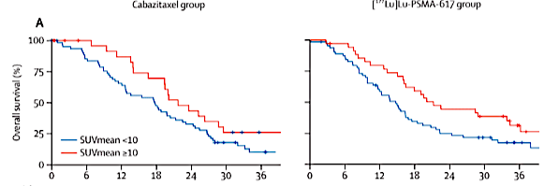
Lu177-PSMA-617 Updates: TheraP
HR 0.62
HR 0.56
Conclusion: SUVmean>10 is prognostic for survival with both cabazitaxel and Lu177-PSMA-617 therapy but not predictive (similar for FDG PET and adverse prognosis)
High SUV OS HR 0.96 vs 1.07 for low SUV mCRPC patients
P(interaction)=0.70 not significant
Hofman MS et al Lancet Oncol 2024

Slide 27
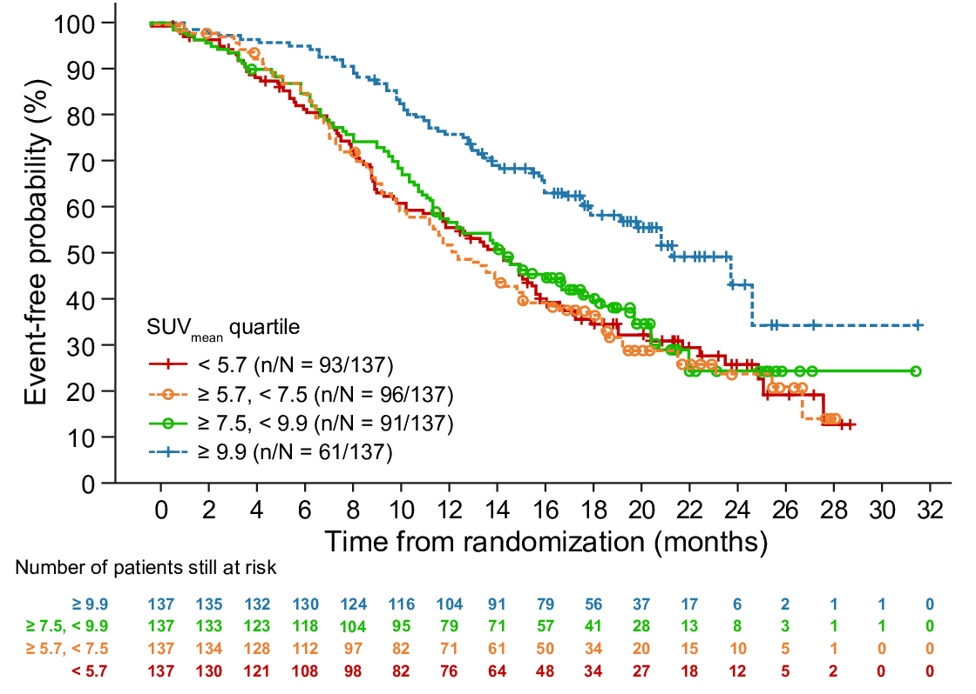
Overall Survival by whole-body SUV_{mean} quartiles
Higher whole-body SUV_{mean} was associated with improved OS
SUV_{mean} quartile | Median OS (months)
≥ 9.9 (highest) | 21.4
≥ 7.5, < 9.9 | 14.6
≥ 5.7, < 7.5 | 12.6
< 5.7 (lowest) | 14.5
All SUV subgroups had better rPFS and OS than a second/third ARSI thus prognostic but NOT predictive!
SUV_{mean} | OS
 | HR [95% CI], p value
Univariate analysis | 0.92 [0.89, 0.95], < 0.001
Multivariate analysis | 0.88 [0.84, 0.91], < 0.001
CI, confidence interval; HR, hazard ratio; FAS, full-analysis set; OS, overall survival; SUV, standardized uptake value
Abstract 5002
Dr Andrew J Armstrong

Slide 28
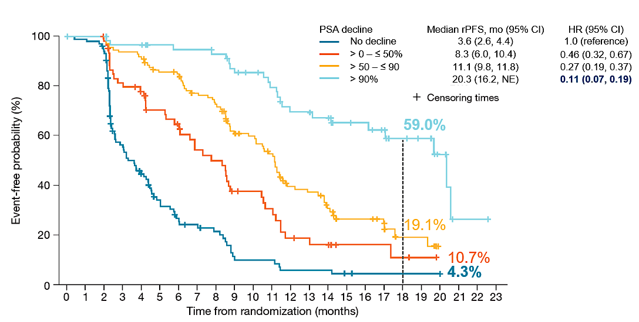
PSA decline is associated with improved overall and progression-free survival with PSMA-Lu177
Armstrong et al ESMO 2022 abstract 1372P

Slide 29
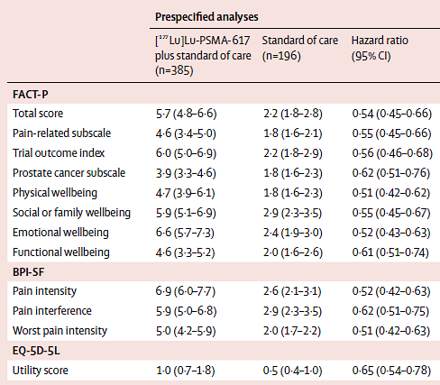
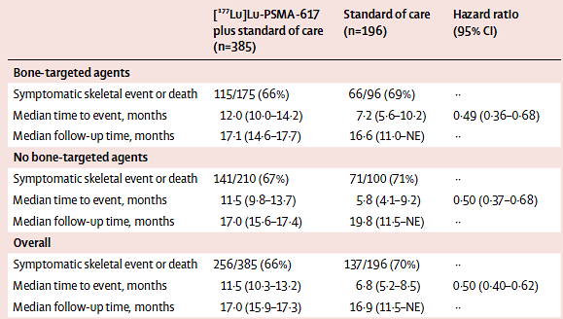
Lu177-PSMA-617 Updates: VISION and QOL
Fizazi K Lancet Oncol 2023

Slide 30
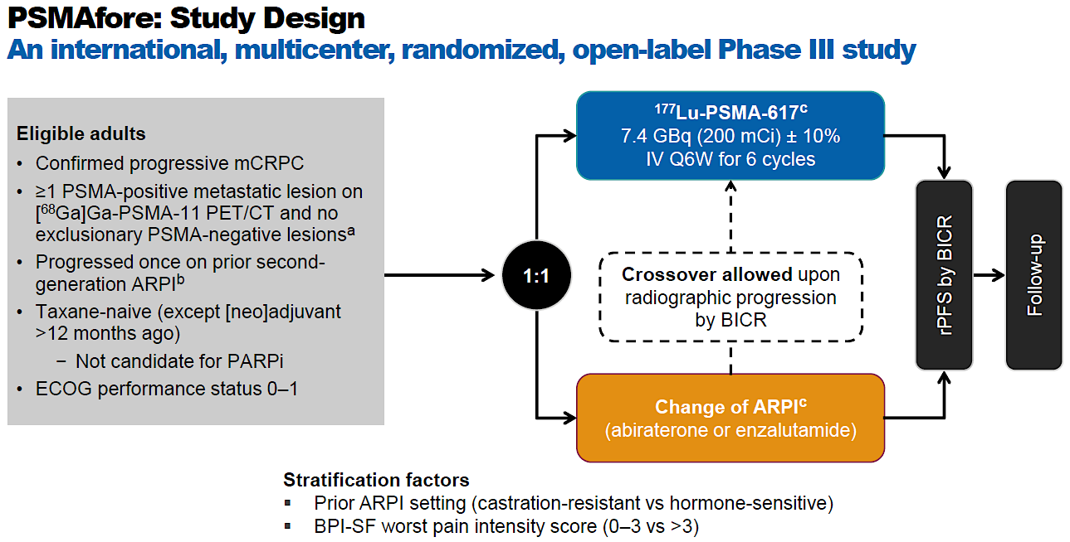
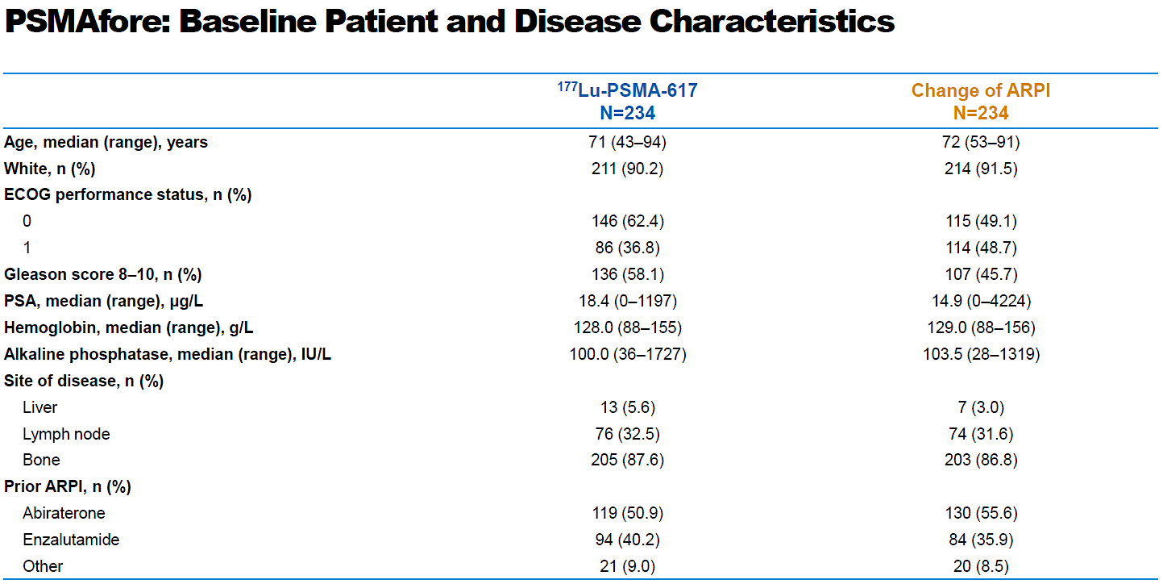
PSMAfore: Ph 3 evaluating ¹⁷⁷Lu-PSMA-617 vs change in NHA in chemo-naïve, NHA-exposed mCRPC
Baseline characteristics were as expected for a chemo-naïve mCRPC patient population
Note that 505/547 (92%) of patients meet ⁶⁸Ga-PSMA-11 screening criteria (see below)
⁶⁸Ga PSMA +ve based on whether soft tissue or bone only disease: centrally determined visually based on a lesion showing greater intensity compared to background liver;
soft tissue disease (with or without bone disease), all of the following 5 requirements must be met for eligibility [68Ga]Ga-PSMA-11 PET positivity in:
≥1 lesion (osseous or extraosseous) irrespective of size;
all lymph nodes that measure ≥25 mm in short axis;
all bone metastases with a soft tissue component ≥10 mm in the longest diameter (PSMA-negative bone metastases without a soft tissue component do not exclude pts);
all solid organ metastases ≥10 mm in the longest diameter;
all intraprostatic lesions regardless of size.
bone-only disease: ≥1 site of bone involvement must be [68Ga]Ga-PSMA-11 PET positive.
Sartor O, et al. Abstract presented at: ESMO Congress 2023; October 20-24, 2023; Madrid, Spain, Abstract LBA13
Notes:
ARPI, androgen receptor pathway inhibitor; BICR, blinded independent central review; BPI-SF, Brief Pain Inventory - Short Form; CT, computed tomography; ECOG, Eastern Cooperative Oncology Group; Ga, gallium; GBq, gigabecquerel;; IV, intravenous; Lu, lutetium; mCi, millicurie; mCRPC, metastatic castration-resistant prostate cancer; NHA, novel hormonal agent; PARPi, poly ADP-ribose polymerase inhibitor; PET, positron emission tomography; Q6W, every 6 weeks; rPFS, radiographic progression-free survival; PSA, prostate specific antigen; PSMA, prostate-specific membrane antigen.
Sartor O, et al. Abstract presented at: ESMO Congress 2023; October 20-24, 2023; Madrid, Spain, Abstract LBA13.

Slide 31
PSMAfore study met primary endpoint of rPFS
Primary endpoint was met:
At the time of primary analysis (DCO October 2, 2022): HR was 0.41 (95% CI: 0.29, 0.56); P < .0001
At the time of second interim OS analysis (DCO June 21, 2023): HR was 0.43 (95% CI: 0.33, 0.54)
rPFS (at the time of second interim OS analysis)
 | ¹⁷⁷Lu-PSMA-617 (N=234) | Change of ARPI (N=234)
Events, n (%) | 115 (49) | 168 (72%)
Median rPFS , months (95% CI) | 12.0 (9.30, 14.42) | 5.6 (4.2, 5.9)
HR (95% CI) P-value | 0.41 (0.29-0.56) < 0.0001
100
¹⁷⁷Lu-PSMA-617
Change of ARPI
Event-free probability, %
80
60
40
20
0
0
2
4
6
8
10 12 14
16 18
20
22
Patients at risk Time from randomization (months)
¹⁷⁷Lu-PSMA-617 | 234 | 216 | 174 | 150 | 125 | 82 | 64 | 45 | 20 | 10 | 2 | 0
Change of ARPI | 234 | 197 | 126 | 79 | 65 | 36 | 21 | 12 | 8 | 4 | 1 | 0
Sartor O, et al. Abstract presented at: ESMO Congress 2023; October 20-24, 2023; Madrid, Spain, Abstract LBA13
Notes:
ARPI, androgen receptor pathway inhibitor; DCO, data cutoff; HR, hazard ratio; Lu, lutetium; OS, overall survival; PSMA, prostate-specific membrane antigen; rPFS, radiographic progression-free survival.
Sartor O, et al. Abstract presented at: ESMO Congress 2023; October 20-24, 2023; Madrid, Spain, Abstract LBA13.

Slide 32
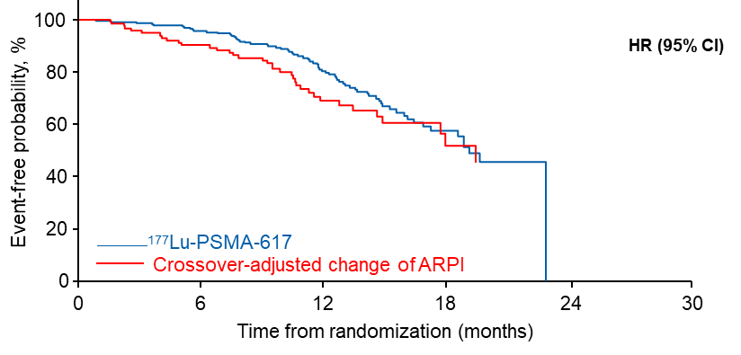
PSMAfore did not show an OS advantage at IA2
100
OS (intent-to-treat analysis)
ITT analysis
Event-free probability, %
 | ¹⁷⁷Lu-PSMA-617 (N=234) | Change of ARPI (N=234)
Events, n (%) | 69 (29)ª | 65 (28)
Median OS , months (95% CI) | 19.2 (16.9-NE) | 19.7 (17.8-NE)
HR (95% CI) P-value | 1.16 (0.83-1.64) --
80
60
40
20
¹⁷⁷Lu-PSMA-617
Change of ARPI
0
0
6
12 18
Time from randomization (months)
24
30
Crossover: 123/146 (84%)
patients with radiographic progression crossed over
OS (prespecified crossover-adjusted analysis)
 | ¹⁷⁷Lu-PSMA-617 (N=234) | Change of ARPI (N=234)
Median OS , months (95% CI) | 19.2 (16.9-NE) | 19.5 (14.9-NE)
HR (95% CI) | 0.80 (0.48-1.33)
ªThree patients died before receiving ¹⁷⁷Lu-PSMA-617.
Sartor O, et al. Abstract presented at: ESMO Congress 2023; October 20-24, 2023; Madrid, Spain, Abstract LBA13
Notes:
ARPI, androgen receptor pathway inhibitor; HR, hazard ratio; Lu, lutetium; NE, not estimable; OS, overall survival; PSMA, prostate-specific membrane antigen.
Sartor O, et al. Abstract presented at: ESMO Congress 2023; October 20-24, 2023; Madrid, Spain, Abstract LBA13

Slide 33
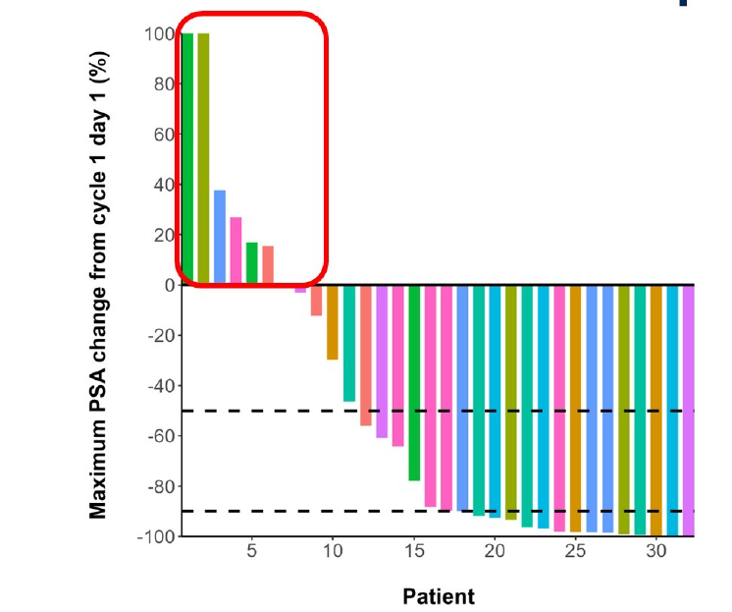
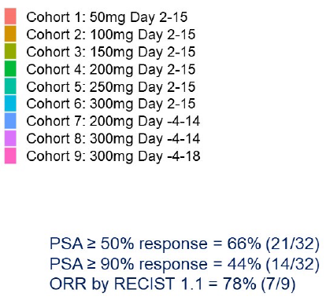
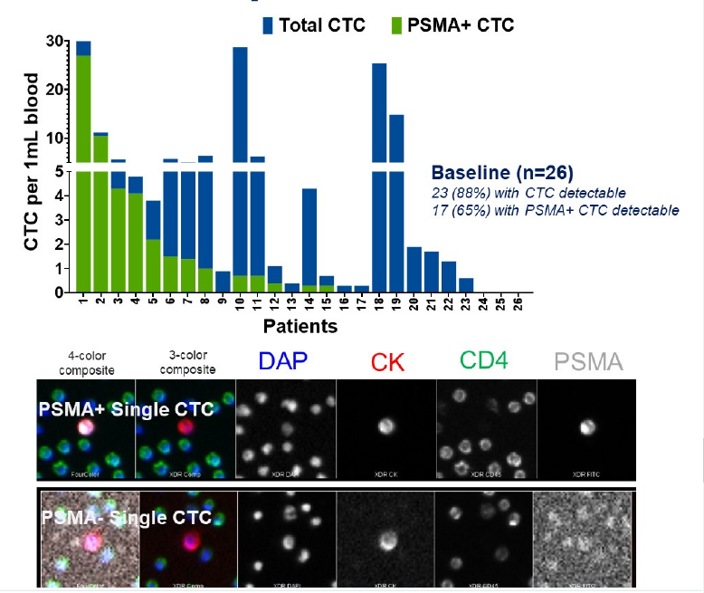
177Lu-PSMA-617 Combination Therapy: LuPARP
Sandhu GU 2023 abstract 5005
No DLTs, RP2D is olaparib 300 mg BID days -4 to +18 of each 6 weekly cycle
PSA50 66%
ORR 78%
47% cleared all CTCs; 87% cleared all PSMA+ CTCs

Slide 34
Enza-p: Synergy with ARSI Therapy?
Patient population:
11-14% prior abiraterone
52-58% de novo M1
53-56% prior docetaxel for mHSPC
2-4 doses given adaptively based on PSMA PET response, with further dosing only for those with PSMA-avid persistent disease
SUVmax>15 at one site, >10 at all sites PLUS 2 adverse prognostic factors
Emmett L et al ESMO 2023 LBA84

Slide 35
Enza-p Results
PSA50 93% (combo) vs 68% (enza alone)
Similar adverse event profile except slightly more dry mouth (40% vs 10%) and anemia (14% vs 3%)
Emmett L et al ESMO 2023 LBA84

Slide 36
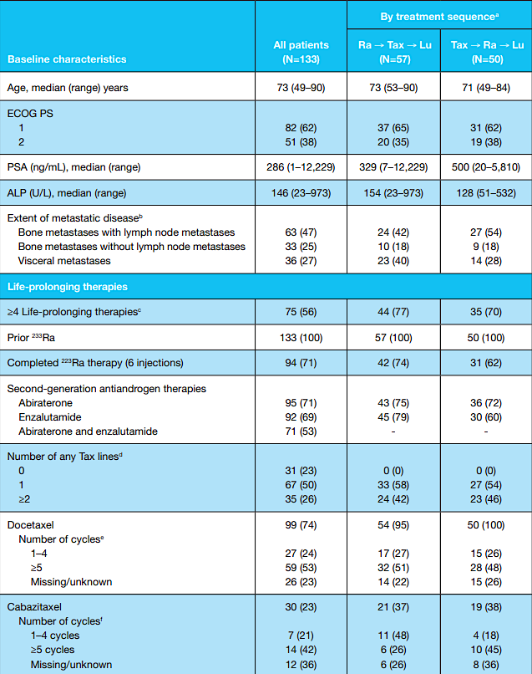
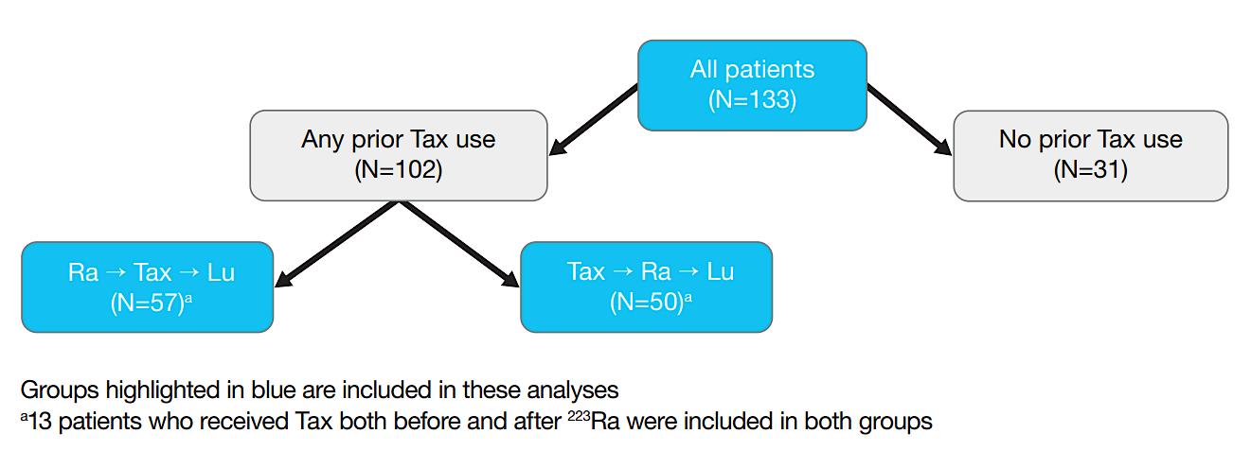
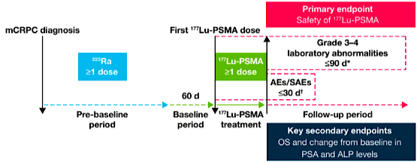
RALU Study Lutetium 177-PSMA in Patients With Prior Radium (cont)
Is Lu177-PSMA-617 Safe After Radium-223? RALU phase 2 Study
Rahbar K, et al. Ann Oncol. 2022;33(suppl 7):S1180 and J Nucl Med 2023; 64: 574-78.

Slide 37
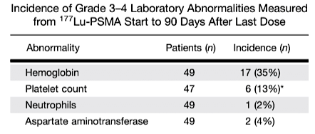
RALU Study: Grade 3 to 4 Lab Abnormalities
Lab Abnormalities | All Patients |  | By Treatment Sequence
 |  |  | Ra→Tax→Lu |  | Tax→Ra→Lu
 | n | Incidence, No. (%) | n | Incidence, No. (%) | n | Incidence, No. (%)
Hemoglobin | 133 | 40 (30) | 57 | 15 (26) | 50 | 19 (38)
Platelet count | 133 | 17 (13) | 57 | 7 (12) | 50 | 9 (18)
Neutrophils | 130 | 3 (2) | 54 | 0 (0) | 48 | 1 (2)
AST | 131 | 2 (2) | 55 | 1 (2) | 49 | 1 (2)
VISION (n=529)
12.9%
7.9%
2.5%
n/a
Rahbar K, et al. Ann Oncol. 2022;33(suppl 7):S1180 and J Nucl Med 2023; 64: 574-78.

Slide 38
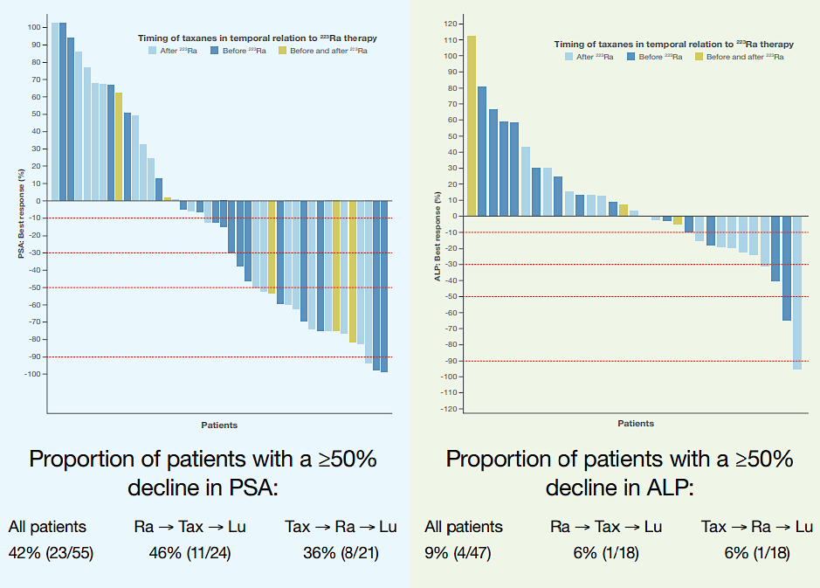
RALU Study: Lutetium 177-PSMA in Patients With Prior Radium 223 Safety and Effectiveness Outcomes
PSA Change From Baseline
ALP Change From Baseline
Rahbar K, et al. Ann Oncol. 2022;33(suppl 7):S1180.
Notes:
Timecode: 2:29

Slide 39
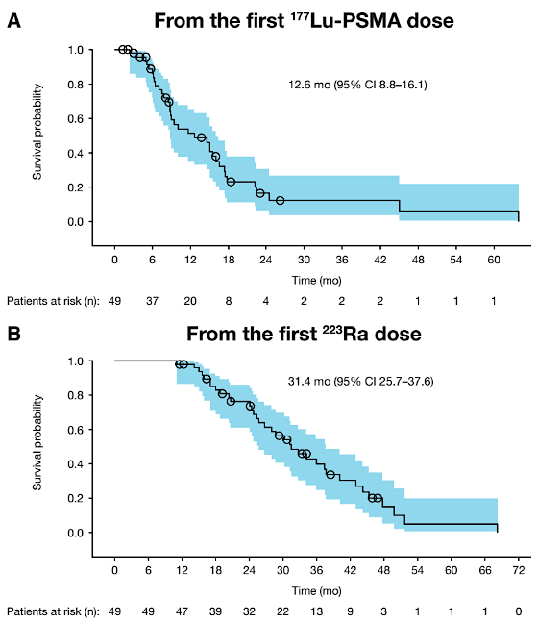
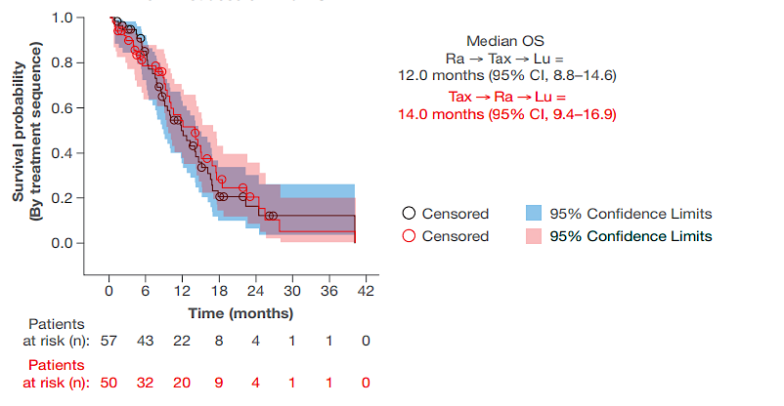
RALU Study: Lutetium 177-PSMA in Patients With Prior Radium 223 Safety and Effectiveness Outcomes (cont)
By Treatment Sequence
In patients for whom radium 223 had been used as part of routine disease management, subsequent lutetium 177-PSMA therapy was clinically feasible and well tolerated, with acceptable myelosuppression rates
Survival outcomes in patients who received the radium 223/lutetium 177-PSMA sequence were similar to those reported in previous real-world studies and the phase 3 VISION trial
Rahbar K, et al. Ann Oncol. 2022;33(suppl 7):S1180 and J Nucl Med 2023; 64: 574-78.
Notes:
Timecode:

Slide 40
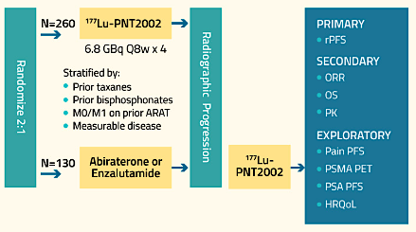
Phase 3 SPLASH study of 177Lu-PNT2002 demonstrated statistically significant improvement in radiographic progression-free survival (rPFS)
The SPLASH trial met its primary endpoint, improved rPFS per BICR of 9.5 mo for patients treated with ¹⁷⁷Lu-PNT2002, compared to 6.0 months for patients treated with ARPI in the control arm, a statistically significant 29% reduction in the risk of radiographic progression or death (hazard ratio [HR] 0.71; p=0.0088).
At the time of the analysis, interim overall survival (OS) results were immature (46% of protocol-specified target OS events reached), the HR was 1.11.
84.6% cross-over at progression on control (does not count commercial cross-over)

Slide 41
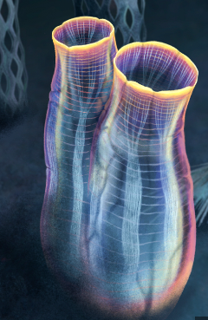
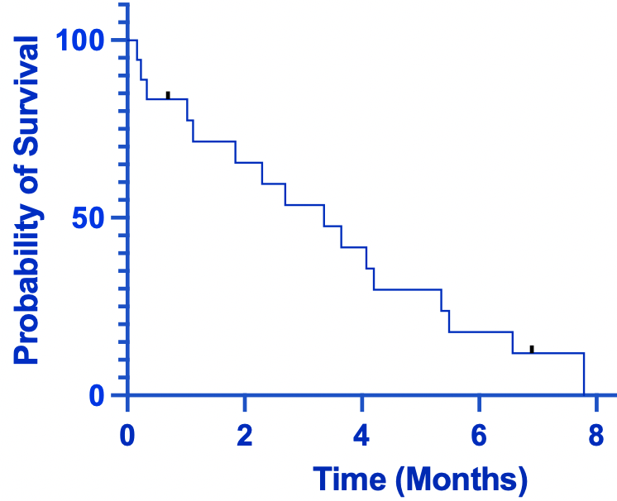
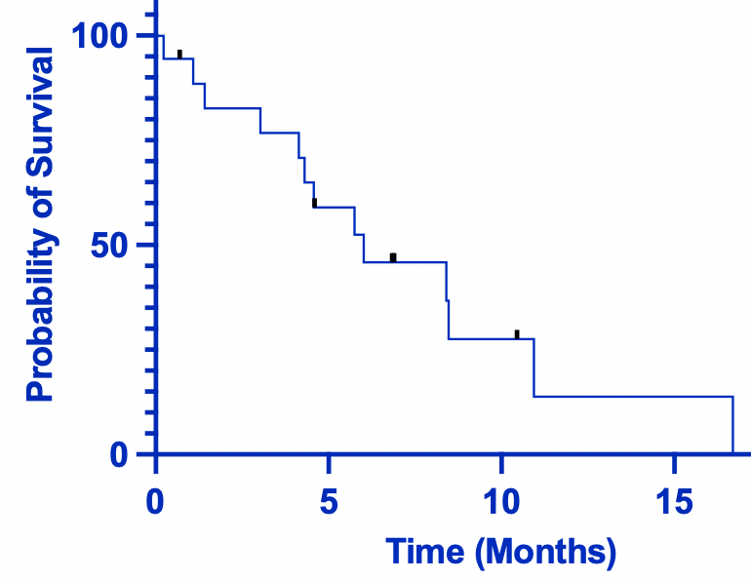
Lurbinectedin in Small Cell NEPC
Derived from the marine tunicate Ecteinascidia, inhibits oncogenic transcription and leads to dsDNA breaks
Approved in SCLC based on a single arm phase 2 study of 105 patients, ORR 35%, PFS 3.5 mo, OS 9.3 mo
Retrospective multicenter study presented at GU24 of 18 men with SCPC/NEPC treated with Lurbi: PR in 31%, SD in 25%, PD in 43%, PFS 3.35 mo, OS 6.01 mo
PFS 3.35 months (0.16 – 7.79)
OS 6.01 months (0.23 – 16.69)
Trigo J et al Lancet 2020
Meyer H et al abstract 164 GU 2024

Slide 42
HPN328 is a DLL3-targeting T Cell Engager with strong activity in DLL3+ cancer models

Slide 43
Anti-tumor Activity in 1 mg Priming Subjects Evaluable For Response<br />
*Shown are subjects treated in the 1mg priming dose optimization cohorts with at least 1 post-baseline scan, data cutoff = December 8, 2023
Using modified RECIST 1.1 to include extracranial response

Slide 44
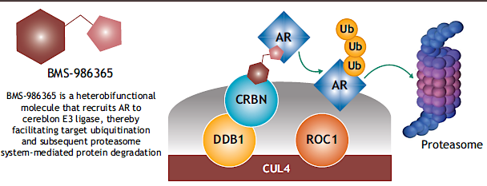
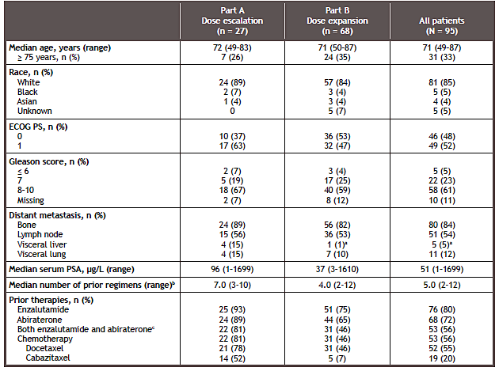
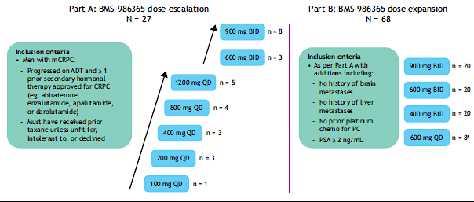
First-in-human phase 1 study of BMS-986365 (CC-94676), an androgen receptor ligand-directed degrader, in men with mCRPC
Rathkopf D…Armstrong AJ ASCO GU 2024 abstract 134

Slide 45
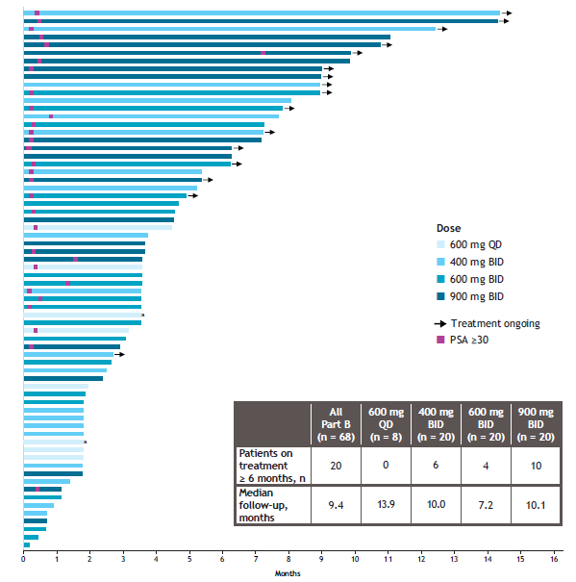
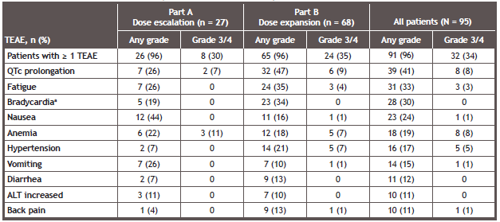
Results
Overall PSA30 was 46%
29% remain on tx for >6 mo
Rathkopf D…Armstrong AJ ASCO GU 2024 abstract 134

Slide 46
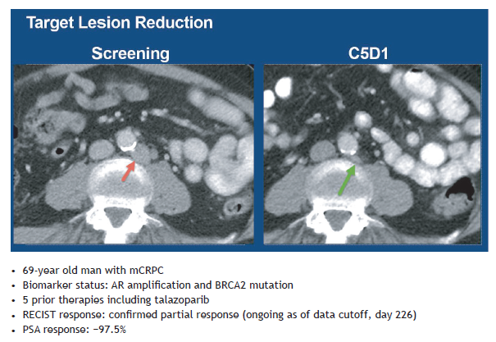
Outcomes by AR Alteration Status
Conclusions
BMS-986365 is well tolerated with a manageable safety profile. QTc prolongation was the most common TRAE, all cases were asymptomatic and resolved with dose modification
There were no treatment discontinuations due to TRAEs
BMS-986365 shows promising clinical activity in heavily pretreated patients with mCRPC, with best-in-class potential, across AR status. Responses were observed in patients with wildtype, amplified, and mutant AR status; rates of patients with PSA response increased dose-dependently from 400 to 900 mg BID
Durable clinical benefit was observed for a substantial proportion of patients, with notably 50% of patients in the 900 mg BID group still on treatment after 6 months
Selection of the recommended phase 2 dose is ongoing
Rathkopf D…Armstrong AJ ASCO GU 2024 abstract 134

Slide 47
CONTACT-02 Study Design

Slide 48
Baseline Characteristics (ITT Population)

Slide 49
PFS per BIRC* (PFS ITT Population†)

Slide 50
PFS per BIRC Subgroup Analyses (PFS ITT Population)

Slide 51
PFS per BIRC in Prespecified Subgroups*

Slide 52
Interim OS (ITT Population)

Slide 53
Interim OS in Prespecified Subgroups*

Slide 54
Summary of Treatment-emergent AEs (Safety Population)*

