Slide 1

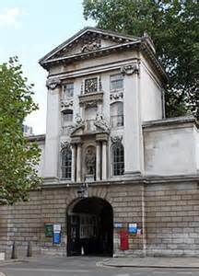
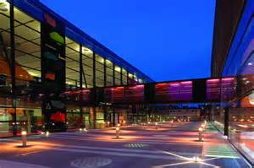

Improving outcomes in urothelial cancer
Thomas Powles
Director of Barts Cancer Center. Professor of Urology Cancer, Barts Cancer Institute.

Slide 2
JAVELIN Bladder 100 study design (NCT02603432)^{1,2}
All endpoints measured post randomisation (after chemotherapy)
Primary endpoint
OS
Primary analysis populations
All randomised patients
PD-L1+ population
Secondary endpoints
PFS and objective response per RECIST 1.1
Safety and tolerability
PROs
CR, PR, or SD with standard 1st-line chemotherapy (4-6 cycles)
Cisplatin + gemcitabine or
Carboplatin + gemcitabine
Unresectable locally advanced or metastatic UC
Avelumab 10 mg/kg IV Q2W + BSC* n=350
Treatment-free interval 4-10 weeks
R 1:1
Until PD, unacceptable toxicity, or withdrawal
N=700
BSC alone* n=350
Stratification
Best response to 1st-line chemo (CR or PR vs SD)
Metastatic site (visceral vs non-visceral)
PD-L1+ status was defined as PD-L1 expression in ≥25% of tumour cells or in ≥25% or 100% of tumour-associated immune cells if the percentage of immune cells was >1% or ≤1%, respectively, using the Ventana SP263 assay; 358 patients (51%) had a PD-L1–positive tumour
BSC, best supportive care; CR, complete response; IV, intravenous; PR, partial response; PRO, patient reported outcome; Q2W, every 2 weeks; R, randomization; RECIST 1.1, Response Evaluation Criteria in Solid Tumours version 1.1; SD, stable disease
*BSC (eg, antibiotics, nutritional support, hydration, or pain management) was administered per local practice based on patient needs and clinical judgment; other systemic antitumour therapy was not permitted, but palliative local radiotherapy for isolated lesions was acceptable.
1. Powles T, et al. N Engl J Med 2020;383:1218–30; 2. Powles T, et al. Oral presentation at ASCO 2020 (Abstract LBA1).
2

Slide 3
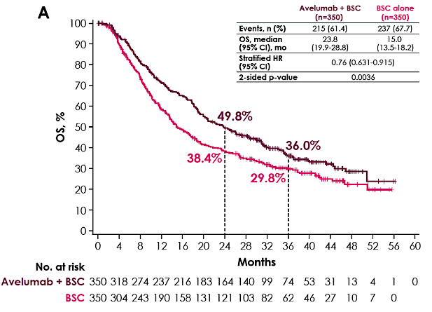
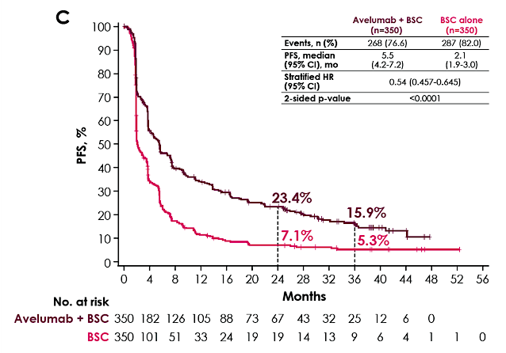
Long-term follow-up continues to show prolonged OS and PFS with avelumab + BSC vs BSC alone
Overall survival
Investigator-assessed progression-free survival
HR, hazard ratio.
Thomas Powles, MD

Slide 4
Subgroup analysis of OS in the overall population
Events/patients, n
Subgroup
Avelumab + BSC
BSC alone
Hazard ratio (95% CI)
All patients
145/350
179/350
0.69 (0.56, 0.86)*
Age
<65 years
≥65 years
61/129
84/221
53/107
126/243
0.79 (0.55, 1.15)
0.63 (0.47, 0.83)
ECOG PS score
0
≥1
77/213
68/137
101/211
78/139
0.64 (0.48, 0.86)
0.74 (0.54, 1.03)
1st-line chemotherapy regimen
Gemcitabine + cisplatin
Gemcitabine + carboplatin
Gemcitabine + cisplatin/carboplatin
71/183
68/147
6/20
98/206
73/122
7/20
0.69 (0.51, 0.94)
0.66 (0.47, 0.91)
0.75 (0.25, 2.25)
Best response to 1st-line chemotherapy
CR or PR
SD
104/253
41/97
127/252
52/98
0.69 (0.53, 0.89)
0.70 (0.46, 1.05)
Site of baseline metastasis
Visceral
Nonvisceral
93/191
52/159
101/191
78/159
0.82 (0.62, 1.09)
0.54 (0.38, 0.76)
Creatinine clearance
≥60 mL/min
<60 mL/min
74/181
71/168
97/196
81/148
0.68 (0.50, 0.92)
0.68 (0.50, 0.94)
PD-L1 status
Positive
Negative
Unknown
61/189
76/139
8/22
82/169
72/132
25/49
0.56 (0.40, 0.78)
0.86 (0.62, 1.18)
0.69 (0.31, 1.53)
0.25
0.5
1
2
4
Error bars show 95% CI
*Stratified (all other analyses are unstratified)
Hazard ratio for OS with 95% CI
Favors avelumab + BSC Favors BSC alone
Thomas Powles, MD

Slide 5
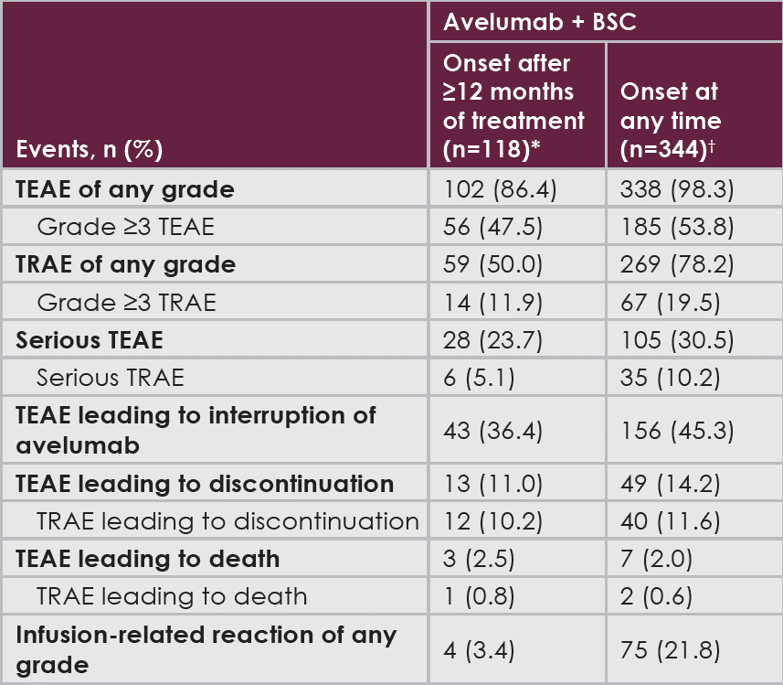
The long-term safety profile of avelumab was consistent with previous monotherapy studies¹
Long-term safety was analyzed in patients treated with avelumab + BSC for ≥12 months
The most common TEAEs with onset after ≥12 months of treatment were urinary tract infection and diarrhea (n=15, 12.7% each)
1 patient (0.8%) had a TRAE after ≥12 months of treatment that led to death (immune-mediated nephritis)
No new safety signals were identified
AE, adverse event; TEAE, treatment-emergent adverse event; TRAE, treatment-related adverse event. *Patients with ≥12 months of treatment. †All treated patients. 1. Kelly K, et al. Cancer. 2018;124:2010-17.
Thomas Powles, MD

Slide 6
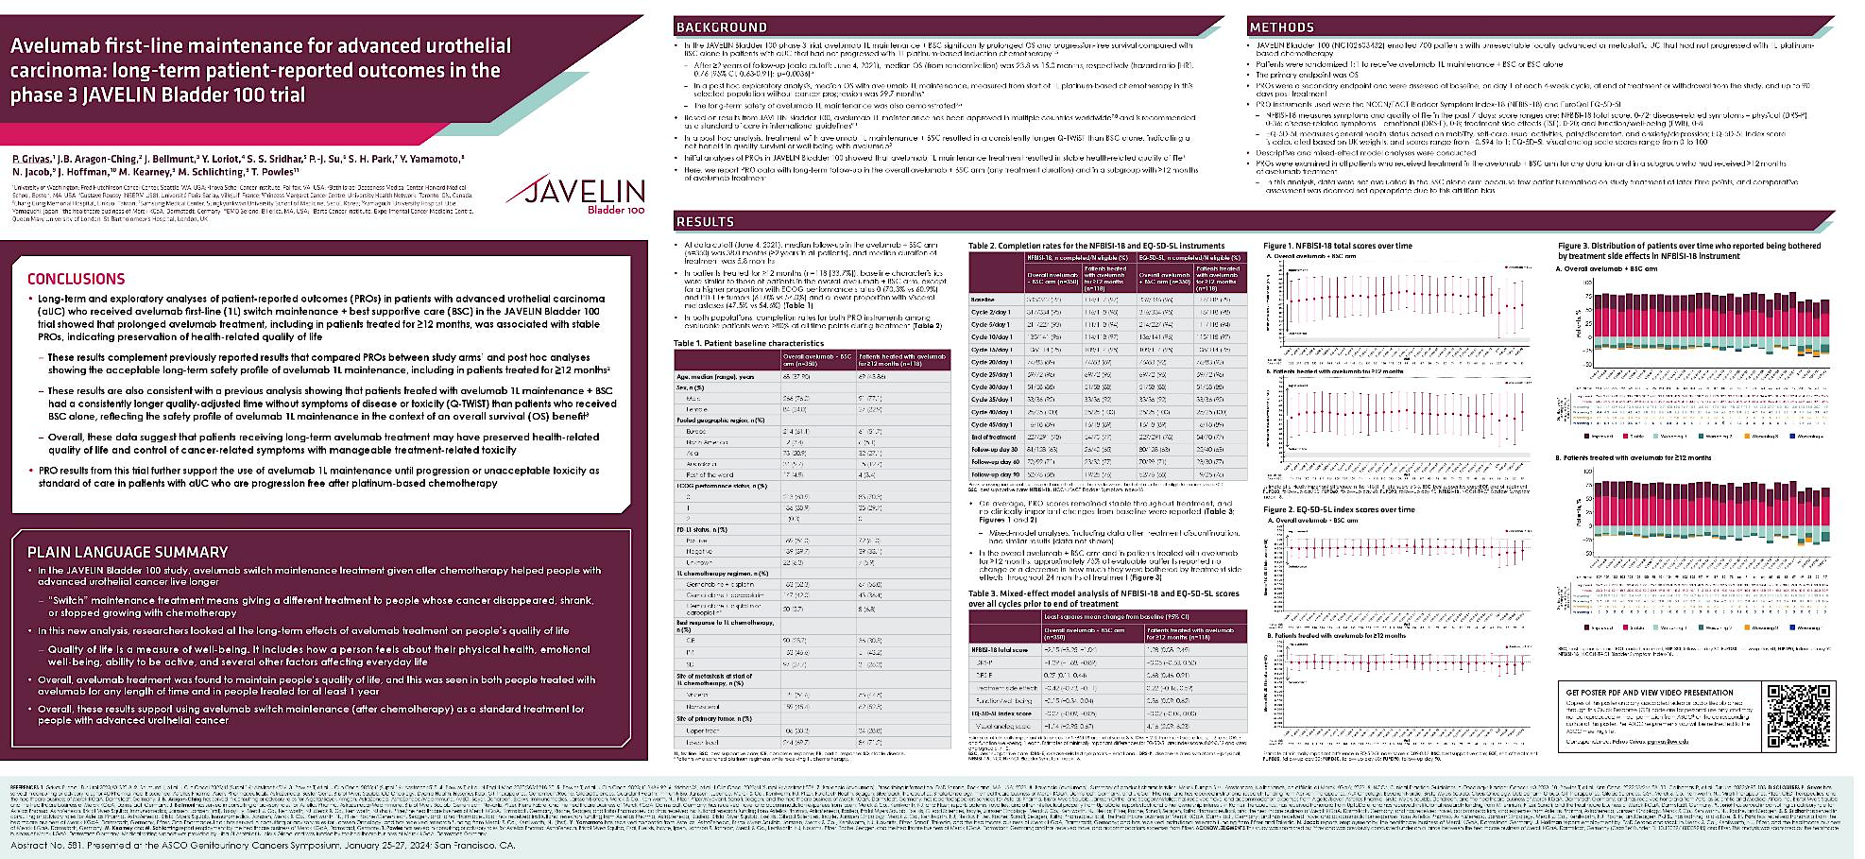
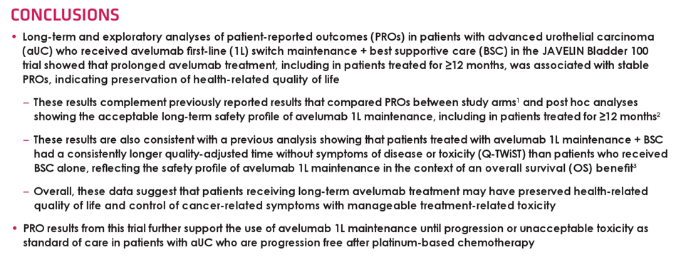

Slide 7

Nivolumab plus gemcitabine-cisplatin versus gemcitabine-cisplatin alone for previously untreated unresectable or metastatic urothelial carcinoma: results from the phase 3 CheckMate 901 trial
Michiel S. van der Heijden,¹ Guru Sonpavde,^{2a} Thomas Powles,³ Andrea Necchi,^{4b} Mauricio Burotto,⁵ Michael Schenker,⁶ Juan Pablo Sade,⁷ Aristotelis Bamias,⁸ Philippe Beuzeboc,⁹ Jens Bedke,^{10c} Jan Oldenburg,¹¹ Yüksel Ürün,¹² Dingwei Ye,¹³ Zhisong He,¹⁴ Begoña P. Valderrama,¹⁵ Yoshihiko Tomita,¹⁶ Jeiry Filian,¹⁷ Daniela Purcea,¹⁸ Federico Nasroulah,¹⁷ Matthew D. Galsky¹⁹
¹Netherlands Cancer Institute, Amsterdam, the Netherlands; ²Dana-Farber Cancer Institute, Harvard Medical School, Boston, MA, USA; ³Barts Cancer Institute, Queen Mary University of London, London, UK; ⁴Fondazione IRCCS Istituto Nazionale dei Tumori, Milan, Italy; ⁵Bradford Hill Clinical Research Center, Santiago, Chile; ⁶University of Medicine and Pharmacy, Craiova, Romania; ⁷Alexander Fleming Institute, Buenos Aires, Argentina; ⁸National and Kapodistrian University of Athens, ATTIKON University Hospital, Athens, Greece; ⁹Hopital Foch, Suresnes, France; ¹⁰Eberhard Karls University Tübingen, Tübingen, Germany; ¹¹Akershus University Hospital (Ahus), Lørenskog, Norway; ¹²Ankara University, Ankara, Turkey; ¹³Fudan University Shanghai Cancer Center, Shanghai, China; ¹⁴Peking University First Hospital, Beijing, China; ¹⁵Hospital Universitario Virgen del Rocío, Sevilla, Spain; ¹⁶Niigata University Graduate School of Medical and Dental Sciences, Niigata, Japan; ¹⁷Bristol Myers Squibb, Princeton, NJ, USA; ¹⁸Bristol Myers Squibb, Boudry, Neuchâtel, Switzerland; ¹⁹Tisch Cancer Institute, Icahn School of Medicine at Mount Sinai, New York, NY, USA
ªCurrent affiliation is AdventHealth Cancer Institute and University of Central Florida, Orlando, FL, USA. ^{b}Current affiliation is IRCCS San Raffaele Hospital, Vita-Salute San Raffaele University, Milan, Italy. ^{c}Current affiliation is Klinikum Stuttgart, Katharinenhospital, Stuttgart, Germany.
Presentation number LBA7

Slide 8
Study design (NIVO+GC vs GC in cisplatin-eligible patients)ª
Stratification factors:
Tumor PD-L1 expression (≥ 1% vs < 1%)
Liver metastases (yes vs no)
Combination phase
Monotherapy phase
Key inclusion criteria
Age ≥ 18 years
Previously untreated unresectable or mUC involving the renal pelvis, ureter, bladder, or urethra
Cisplatin eligible^{b}
ECOG PS of 0-1
NIVO 360 mg + GC^{c} Q3W (up to 6 cycles)
N = 304
NIVO 480 mg Q4W (until progression, unacceptable toxicity, withdrawal, or up to 24 months^{e})
3 weeks^{d}
R
1:1
GC^{c} Q3W (up to 6 cycles)
N = 304
Median (range) study follow-up, 33.6 (7.4–62.4) months
Primary endpoints: OS, PFS per BICR
Key secondary endpoints: OS and PFS by PD-L1 ≥ 1%, HRQoL
Key exploratory endpoints: ORR per BICR, safety
ªFurther CheckMate 901 study design details are available at https://clinicaltrials.gov/ct2/show/NCT03036098. ^{b}Cisplatin eligibility was determined in the study population by a GFR ≥ 60 mL/min (assessed by direct measurement, ie, creatinine clearance, or, if not available, using the Cockcroft-Gault formula), and absence of CTCAE v.4 grade ≥ 2 hearing loss and grade ≥ 2 peripheral neuropathy. ^{c}Patients who discontinued cisplatin alone could be switched to gemcitabine-carboplatin for the remainder of the platinum doublet cycles (up to six cycles in total). ^{d}NIVO monotherapy should begin 3 weeks after the last dose of NIVO+GC combination. ^{e}Represents a maximum of 24 months from the first dose of NIVO administered as part of the NIVO+GC combination. BICR, blinded independent central review; CTCAE, Common Terminology Criteria for Adverse Events; ECOG PS, Eastern Cooperative Oncology Group performance status; GFR, glomerular filtration rate; HRQoL, health-related quality of life; ORR, objective response rate; PD-L1, programmed death ligand 1; PFS, progression-free survival; Q×W, every × weeks; R, randomization.

Slide 9
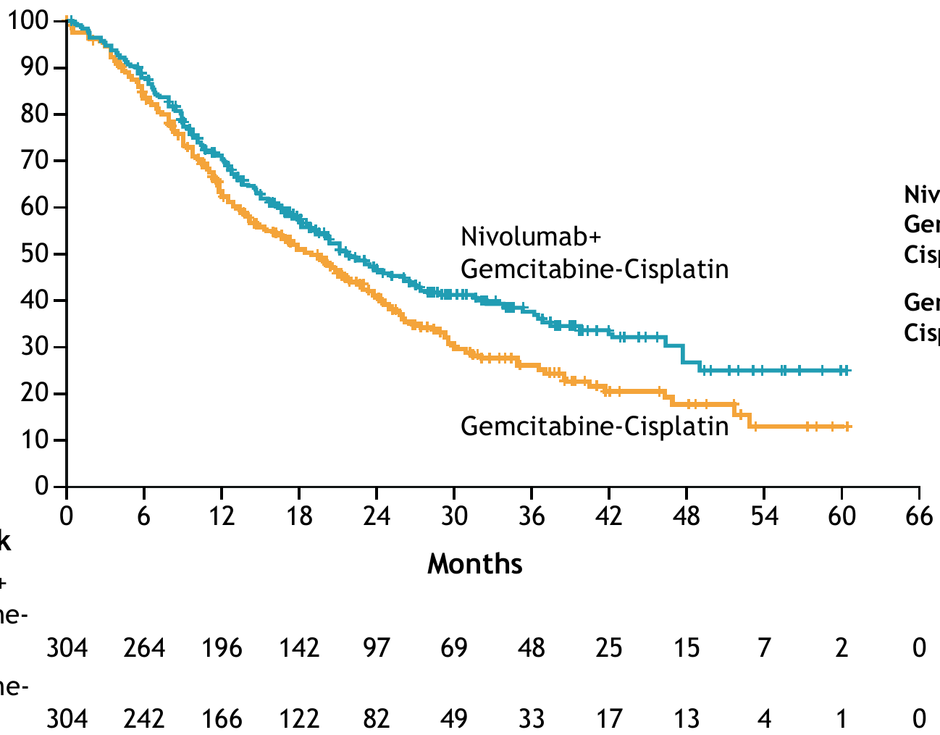
OS (primary endpoint)
OS final analysis statistical boundaries:
P value boundary, 0.0311
Critical HR, 0.7980
12-month rate:
70.2% 62.7%
Treatment | Events/patients | Median OS (95% CI), months
NIVO+GC | 172/304 | 21.7 (18.6-26.4)
GC | 193/304 | 18.9 (14.7–22.4)
HR (95% CI), 0.78 (0.63–0.96) P = 0.0171
24-month rate:
46.9%
40.7%
Probability (%)
No. at risk
NIVO+GC
GC
Median (range) study follow-up was 33.6 (7.4–62.4) months. OS was estimated in all randomized patients and defined as the time from date of randomization to date of death from any cause. For patients without documented death, OS was censored on the last date the patient was known to be alive. For randomized patients with no follow-up, OS was censored at the date of randomization.

Slide 10
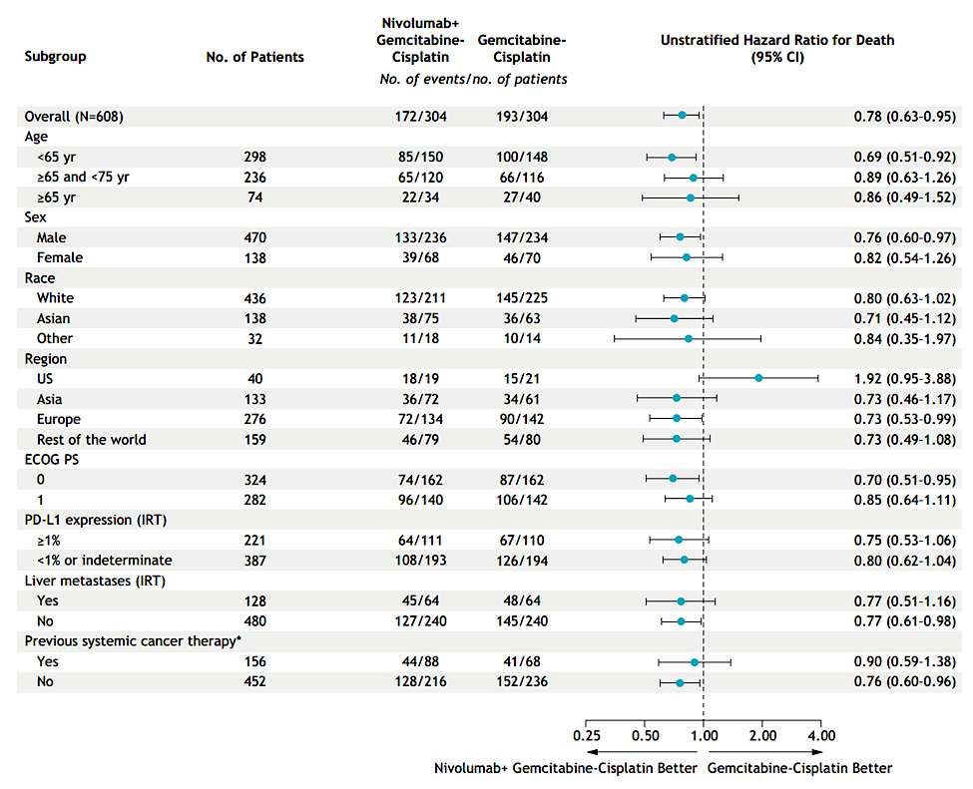
OS in subgroups
All randomized patients. HRs were not computed for subgroup categories (except for age, sex, race, and region) with < 10 patients per treatment group. Categories without a meaningful estimate of the HR are not shown. Tumor PD-L1 expression level and presence/absence of liver metastases are per interactive response technology. Previous systemic anticancer therapy refers to neoadjuvant/adjuvant treatments for patients undergoing radical resection or as part of a bladder-sparing approach in muscle-invasive bladder cancer.

Slide 11
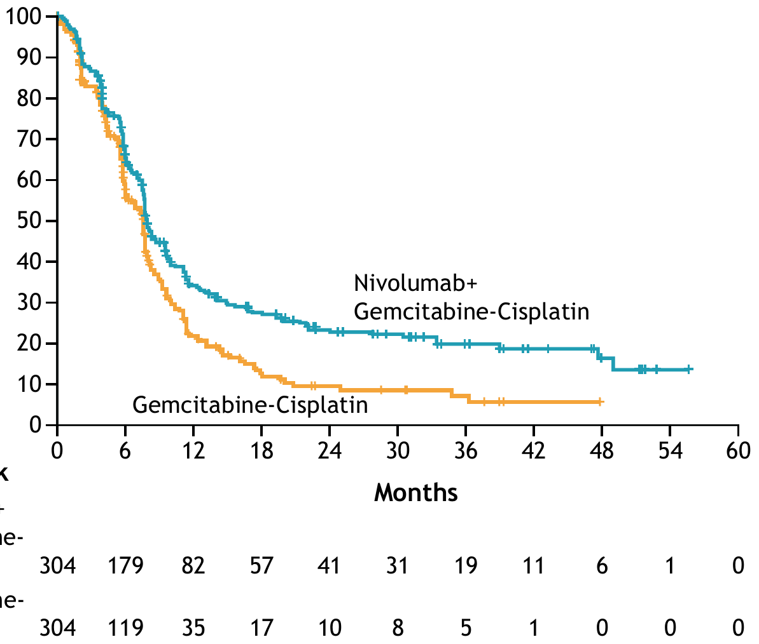
PFS per BICR (primary endpoint)
PFS final analysis statistical boundaries:
P value boundary, 0.01
Critical HR, 0.7734
Treatment | Events/patients | Median PFS (95% CI), months
NIVO+GC | 211/304 | 7.9 (7.6-9.5)
GC | 191/304 | 7.6 (6.1–7.8)
HR (95% CI), 0.72 (0.59–0.88) P = 0.0012
12-month rate:
34.2%
21.8%
Probability (%)
24-month rate:
23.5%
9.6%
No. at risk
NIVO+GC
GC
Median (range) study follow-up was 33.6 (7.4–62.4) months. PFS was estimated in all randomized patients and defined as the time from date of randomization to date of first documented disease progression (per BICR assessments using RECIST v1.1) or death due to any cause, whichever occurred first. Patients who died without reported progression were considered to have progressed on the date of death. Patients who did not progress or die were censored on the last evaluable tumor assessment date. Patients without on-study tumor assessments who did not die were censored on the date of randomization. Patients who started any subsequent anticancer therapy without prior reported progression were censored at the last evaluable tumor assessment before initiation of subsequent anticancer therapy. RECIST, Response Evaluation Criteria in Solid Tumors.

Slide 12
Objective response outcomes
Time to and duration of responses
57.6% (51.8-63.2)
CR
Any objective response^{c} | NIVO+GC (n = 175) | GC (n = 131)
Median TTR (Q1-Q3), months | 2.1 (2.0–2.3) | 2.1 (2.0–2.2)
Median DoR (95% CI), months | 9.5 (7.6–15.1) | 7.3 (5.7–8.9)
Complete response^{d} | NIVO+GC (n= 66) | GC (n = 36)
Median TTCR (Q1-Q3), months | 2.1 (1.9-2.2) | 2.1 (1.9-2.2)
Median DoCR (95% CI), months | 37.1 (18.1-NE) | 13.2 (7.3-18.4)
PR
43.1% (37.5-48.9)
Patients (%)
SD | 25.3% |  | 28.3%
PD | 9.5% |  | 12.8%
UE^{b} | 7.6% |  | 15.8%
ORR (95% CI) and BOR per BICRª
NIVO+GC
(N = 304)
GC
(N = 304)
ªIn all randomized patients. ^{b}The most common reasons for UE response included death before first tumor assessment, withdrawal of consent, treatment stopped due to toxicity, patient never treated, and receipt of subsequent anticancer therapy before first tumor assessment. ^{c}Based on patients with an objective response per BICR (PR or CR as BOR). ^{d}Based on patients with a CR per BICR. BOR, best overall response; CR, complete response; DoCR, duration of complete response; DoR, duration of objective response; NE, not estimable; PD, progressive disease; PR, partial response; Q, quartile; SD, stable disease; TTCR, time to complete response; TTR, time to objective response; UE, unevaluable.

Slide 13

Was cisplatin + nivolumab in CM901 a black swan event or should we have seen it coming?
Cisplatin + PD(L)1 | CR/PR | PFS HRs for the cisplatin population | OS HRs for the cisplatin population | Subsequent IO therapy For control arm
atezolizumab | 17/64 | 0.73 (0.55-0.97) | 0.76 (0.52-1.01) | 25%
Nivolumab | 22/58 | 0.72 (0.59-0.88) | 0.78 (0.63, 0.96) | 51% (20% maintenance)
Pembrolizumab | 18/49 | 0.67 (0.51-0.89) | 0.88 (0.67-1.15) | 48%
Median Progression Free survival
cisplatin
Median Overall survival
Cisplatin/IO
atezo
nivo
pembro
atezo
nivo
pembro
Galski et al Lancet 21
Powles et al Lancet onc 21
Van Der Heijden NEJM 23

Slide 14
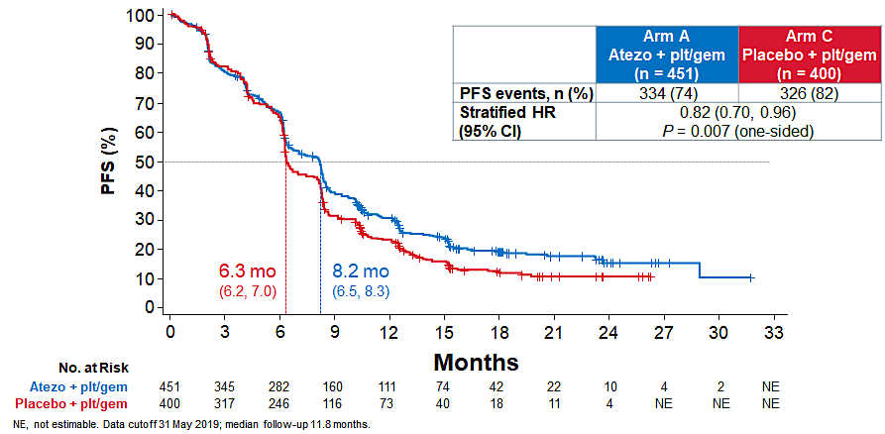
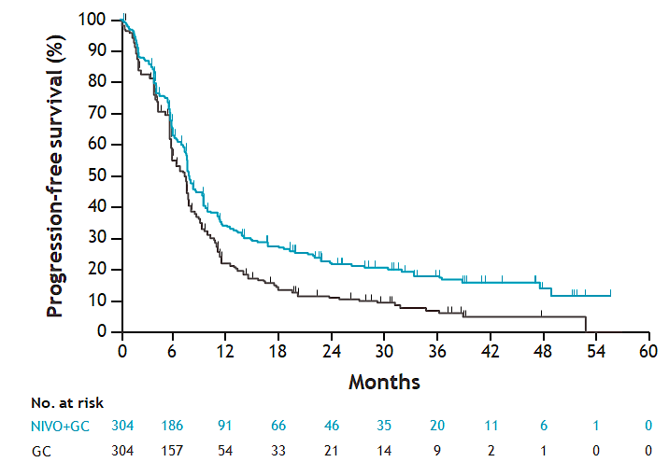
The PFS curves for chemo + IO suggest benefit is in the maintenance phase
Treatment | Events/patients | Median PFS (95% CI), months
NIVO+GC | 229/304 | 7.9 (7.6-9.5)
GC | 248/304 | 7.5 (6.1–7.8)
HR (95% CI), 0.74 (0.62–0.89)
 | Events, n (%) | PFS, median (95% CI), months | HR (95% CI)
Pembrolizumab + cisplatin–based chemotherapy | 109 (69.9) | 8.5 (8.2-10.3) | 0.67 (0.51-0.89)
Cisplatin-based chemotherapy | 98 (62.8) | 7.1 (6.3-8.0)
100
90
80
70
60
Progression-Free Survival, %
36.6%
16.4%
50
40
27.1%
10.6%
30
20
10
0
0
3
6
9
12
15
18
21
24
27
30
33
36
39
42
Months

Slide 15
Are the cisplatin/IO data better than the carboplatin/IO data?
Cisplatin + PD(L)1 | CR difference (CT+IO vs CT) | RR difference (CT+IO vs CT) | PFS HRs for the cisplatin population | OS HRs for the cisplatin population
atezolizumab | +8% | -1% | 0.73 (0.55-0.97) | 0.76 (0.52-1.01)
Nivolumab | +10% | +15% | 0.72 (0.59-0.88) | 0.78 (0.63, 0.96)
Pembrolizumab | +3% | +15% | 0.67 (0.51-0.89) | 0.88 (0.67-1.15)
Carboplatin + PD(L)1 | CR difference (CT+IO vs CT) | RR difference (CT+IO vs CT) | PFS HRs for the carboplatin population | OS HRs for the carboplatin population
atezolizumab | +6% | +6% | 0.84 (7.0-1.02) | 0.89 (0.79-1.08)
Pembrolizumab | +2% | +5% | 0.86 (0.68-1.09) | 0.84 (0.67-1.06)

Slide 16
EV-302/KEYNOTE-A39 (NCT04223856)
Patient population
Previously untreated la/mUC
Eligible for platinum, EV, and P
PD-(L)1 inhibitor naive
GFR ≥30 mL/minª
ECOG PS ≤2^{b}
EV + Pembrolizumab
No maximum treatment cycles for EV, maximum 35 cycles for P
Dual primary endpoints:
PFS by BICR
OS
Select secondary endpoints:
ORR per RECIST v1.1 by BICR and investigator assessment
Safety
N=886
R
1:1
Treatment until disease progression per BICR, clinical progression, unacceptable toxicity, or completion of maximum cycles
Chemotherapy^{c}
(Cisplatin or carboplatin + gemcitabine)
Maximum 6 cycles
Stratification factors: cisplatin eligibility (eligible/ineligible), PD-L1 expression (high/low), liver metastases (present/absent)
Cisplatin eligibility and assignment/dosing of cisplatin vs carboplatin were protocol-defined; patients received 3-week cycles of EV (1.25 mg/kg; IV) on Days 1 and 8 and P (200 mg; IV) on Day 1
Statistical plan for analysis: the first planned analysis was performed after approximately 526 PFS (final) and 356 OS events (interim); if OS was positive at interim, the OS interim analysis was considered final
BICR, blinded independent central review; ECOG PS, Eastern Cooperative Oncology Group performance status; GFR, glomerular filtration rate; ORR, overall response rate; PFS, progression-free survival; R, randomization; RECIST, Response Evaluation Criteria in Solid Tumors
ªMeasured by the Cockcroft-Gault formula, Modification of Diet in Renal Disease, or 24-hour urine
^{b}Patients with ECOG PS of 2 were required to also meet the additional criteria: hemoglobin ≥10 g/dL, GFR ≥50mL/min, may not have NYHA class III heart failure
^{c}Maintenance therapy could be used following completion and/or discontinuation of platinum-containing therapy
Data cutoff: 08 Aug 2023; FPI: 7 Apr 2020, LPI: 09 Nov 2022
Powles et al.

Slide 17
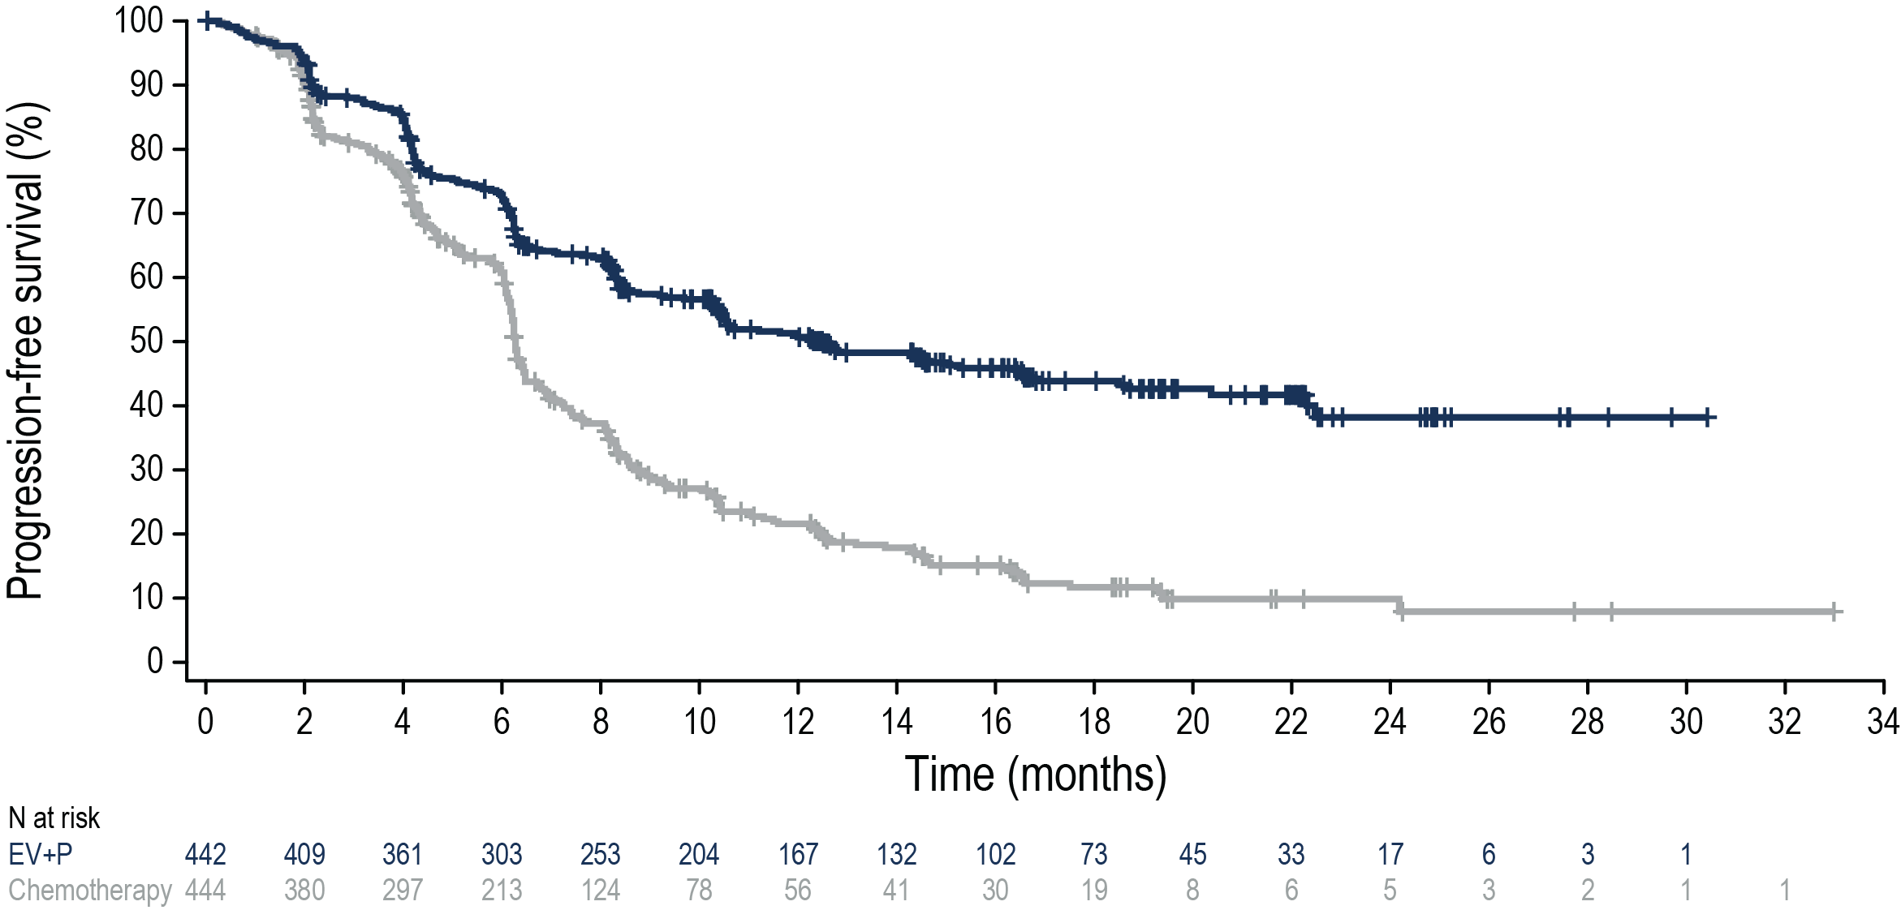
Progression-Free Survival per BICR
Risk of progression or death was reduced by 55% in patients who received EV+P
 | N | Events (%) | HRª (95% CI) | 2-sided P value | mPFS (95% CI), months
EV+P | 442 | 223 (50.5) | 0.45 (0.38-0.54) | <0.00001 | 12.5 (10.4-16.6)
Chemotherapy | 444 | 307 (69.1) |  |  | 6.3 (6.2-6.5)
50.7%
43.9%
21.6%
11.7%
Data cutoff: 08 Aug 2023
PFS at 12 and 18 months as estimated using Kaplan-Meier method
HR, hazard ratio; mPFS, median progression-free survival
ªCalculated using stratified Cox proportional hazards model; a hazard ratio <1 favors the EV+P arm
Powles et al.

Slide 18
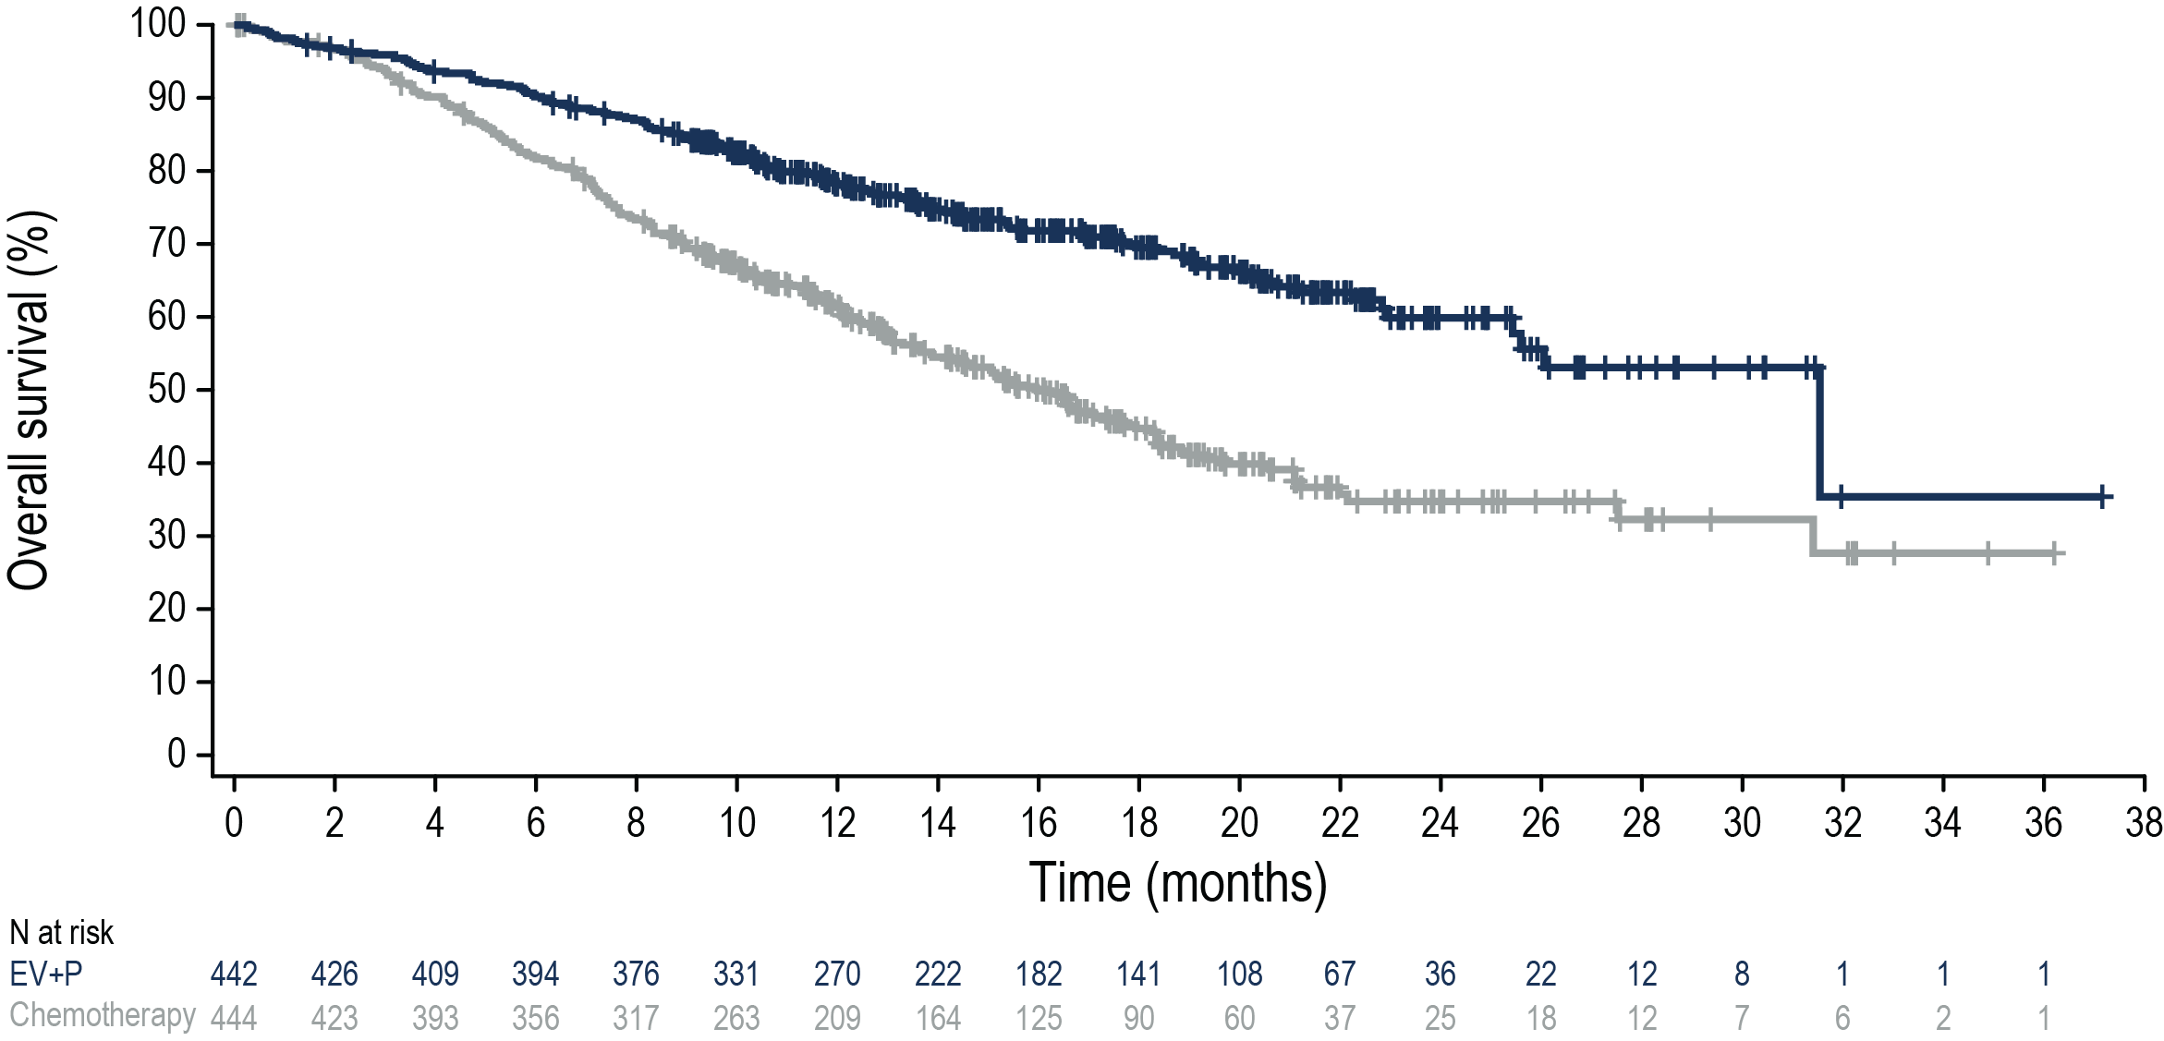
Overall Survival
Risk of death was reduced by 53% in patients who received EV+P
 | N | Events (%) | HRª (95% CI) | 2-sided P value | mOS (95% CI), months
EV+P | 442 | 133 (30.1) | 0.47 (0.38-0.58) | <0.00001 | 31.5 (25.4-NR)
Chemotherapy | 444 | 226 (50.9) |  |  | 16.1 (13.9-18.3)
78.2%
69.5%
Median survival follow-up: 17.2 months
61.4%
44.7%
Data cutoff: 08 Aug 2023
OS at 12 and 18 months was estimated using Kaplan-Meier method
mOS, median overall survival; NR, not reached
ªCalculated using stratified Cox proportional hazards model. A hazard ratio <1 favors the EV+P arm
Powles et al.

Slide 19
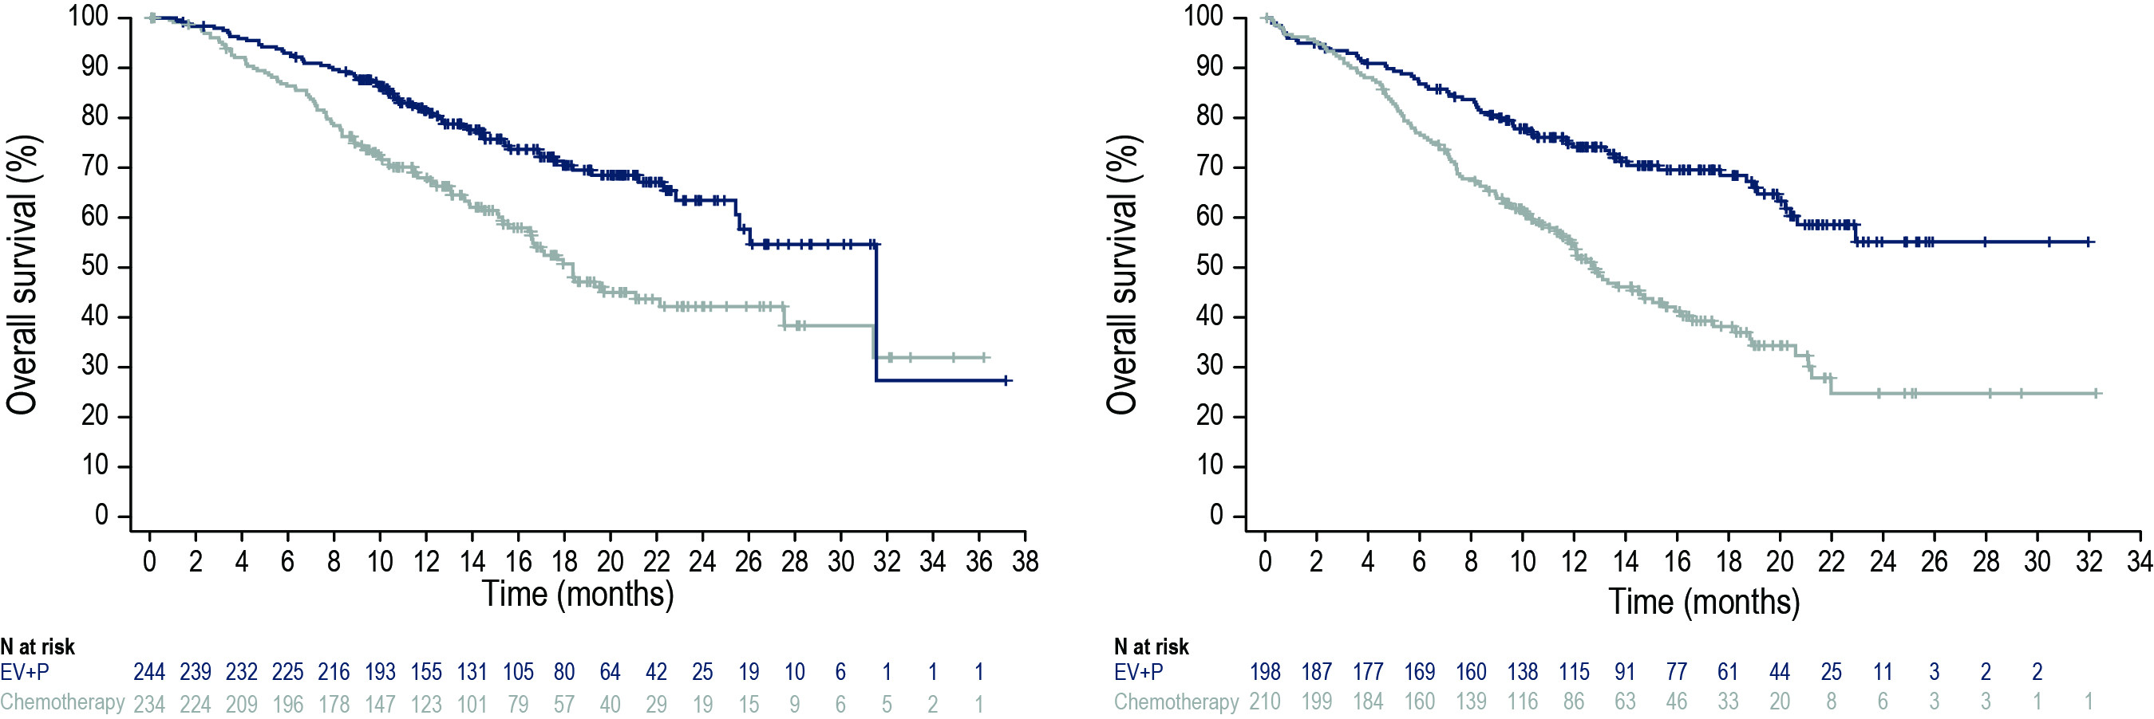
OS Subgroup Analysis: Cisplatin Eligibility
OS benefit was consistent with overall population regardless of cisplatin eligibility
Cisplatin-eligible
Cisplatin-ineligible
 | Events, n | HR (95% CI) | mOS (95% CI), months
EV+P | 69 | 0.53 (0.39-0.72) | 31.5 (25.4-NR)
Chemotherapy | 106
 |  |  | 18.4 (16.4-27.5)
 | Events, n | HR (95% CI) | mOS (95% CI), months
EV+P | 64 | 0.43 (0.31-0.59) | NR (20.7-NR)
Chemotherapy | 120
 |  |  | 12.7 (11.4-15.5)
Data cutoff: 08 Aug 2023
Powles et al.

Slide 20
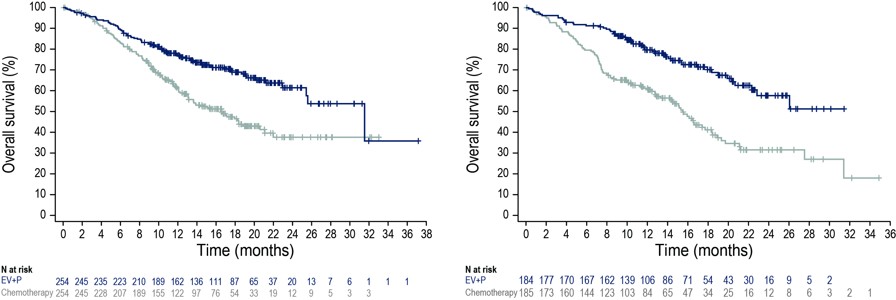
OS Subgroup Analysis: PD-L1 Expression
OS benefit was consistent with overall population regardless of PD-L1 expression status
PD-L1 high (CPS ≥10)
PD-L1 low (CPS <10)
 | Events, n | HR (95% CI) | mOS (95% CI), months
EV+P | 79 | 0.49 (0.37-0.66) | 31.5 (25.4-NR)
Chemotherapy | 125 |  | 16.6 (13.1-20.6)
 | Events, n | HR (95% CI) | mOS (95% CI), months
EV+P | 53 | 0.44 (0.31-0.61) | NR (22.3-NR)
Chemotherapy | 99 |  | 15.5 (12.9-17.7)
Data cutoff: 08 Aug 2023
Powles et al.

Slide 21
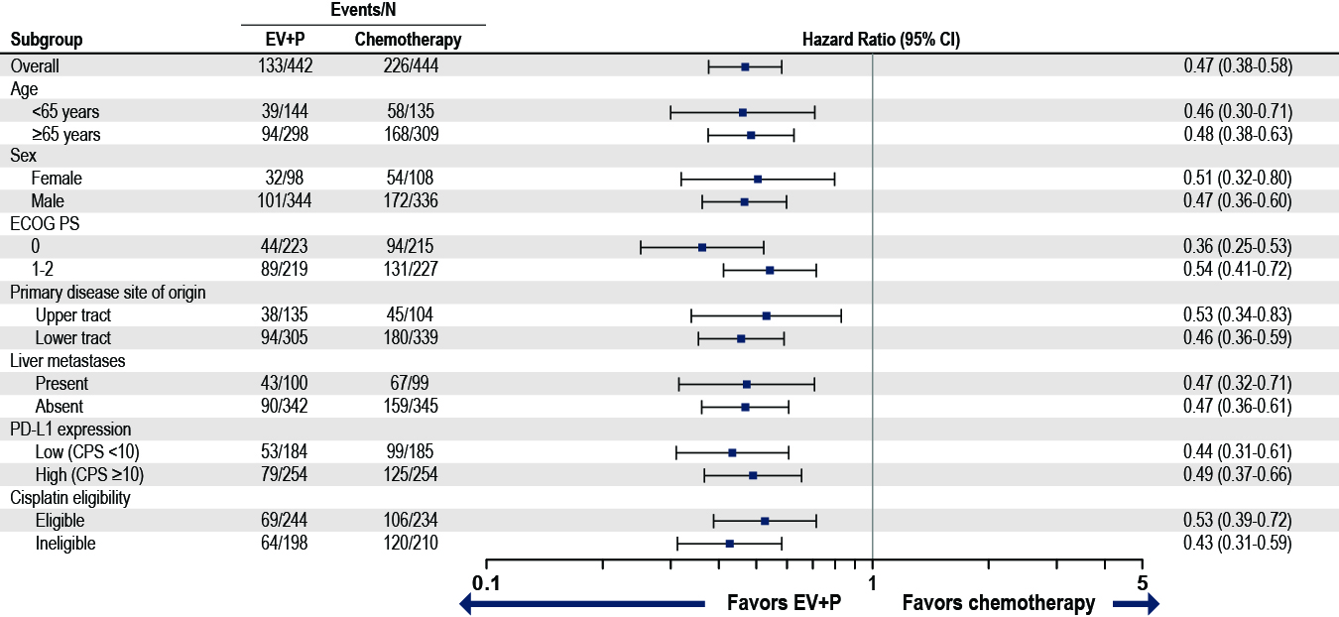
Subgroup Analysis of OS
OS benefit in select pre-specified subgroups was consistent with results in overall population
Data cutoff: 08 Aug 2023
Powles et al.

Slide 22
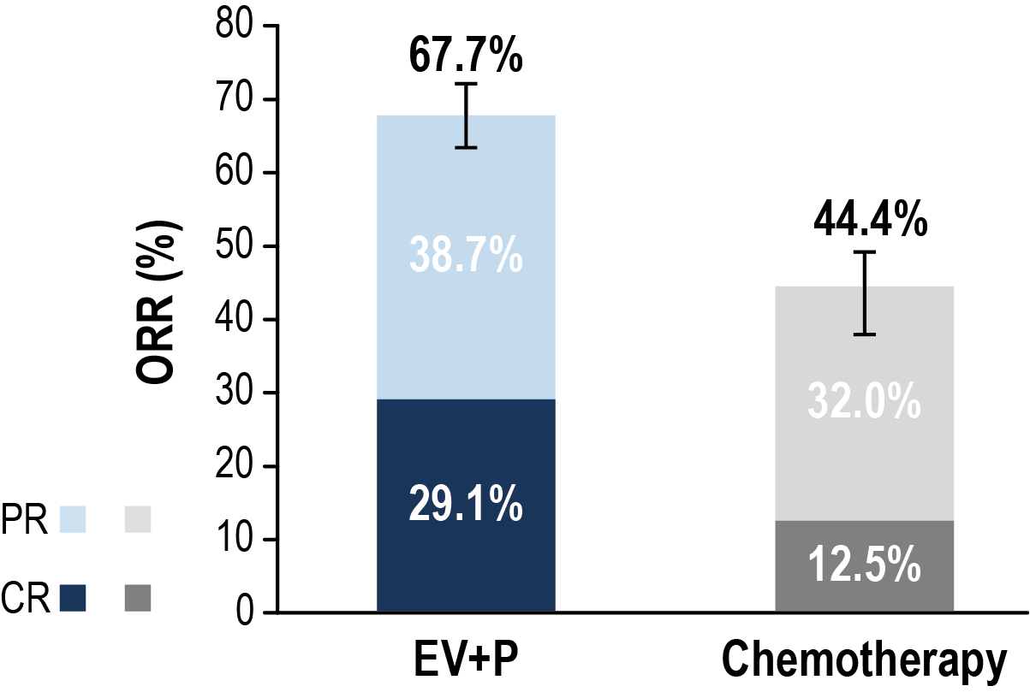
Confirmed Overall Response per BICR
Significant improvement in objective response rate was observed with EV+P
 | EV+P (N=437) | Chemotherapy (N=441)
Confirmed ORR, n (%) (95% CI) | 296 (67.7) (63.1-72.1) | 196 (44.4) (39.7-49.2)
2-sided P value | <0.00001
Best overall responseª, n (%)
Complete response | 127 (29.1) | 55 (12.5)
Partial response | 169 (38.7) | 141 (32.0)
Stable disease | 82 (18.8) | 149 (33.8)
Progressive disease | 38 (8.7) | 60 (13.6)
Not evaluable/No assessment^{b} | 21 (4.8) | 36 (8.2)
Median DOR (95% CI) | NR (20.2, NR) | 7.0 (6.2, 10.2)
CR, complete response; DOR, duration of response; PR, partial response
ªBest overall response according to RECIST v1.1 per BICR. CR or PR was confirmed with repeat scans ≥28 days after initial response
^{b}Patients had either post-baseline assessment and the best overall response was determined to be not evaluable per RECIST v1.1 or no response assessment post-baseline
Data cutoff: 08 Aug 2023
Powles et al.

Slide 23
Summary of Subsequent Systemic Therapy
59% of patients in chemotherapy arm received subsequent PD-1/L1 inhibitors
 | EV+P (N=442) n (%) | Chemotherapy (N=444) n (%)
First subsequent systemic therapyª | 128 (28.9) | 294 (66.2)
Platinum-based therapy | 110 (24.9) | 17 (3.8)
PD-1/L1 inhibitor-containing therapy | 7 (1.6) | 260 (58.6)
Maintenance therapy | 0 | 143 (32.2)
Avelumab maintenance | 0 | 135 (30.4)
PD-1/L1 inhibitor-containing therapy following progression | 7 (1.6) | 117 (26.4)
Other | 11 (2.5) | 17 (3.8)
ª144 (32.6%) patients in the EV+P arm remain on treatment at time of analysis.
Data cutoff: 08 Aug 2023
Powles et al.

Slide 24
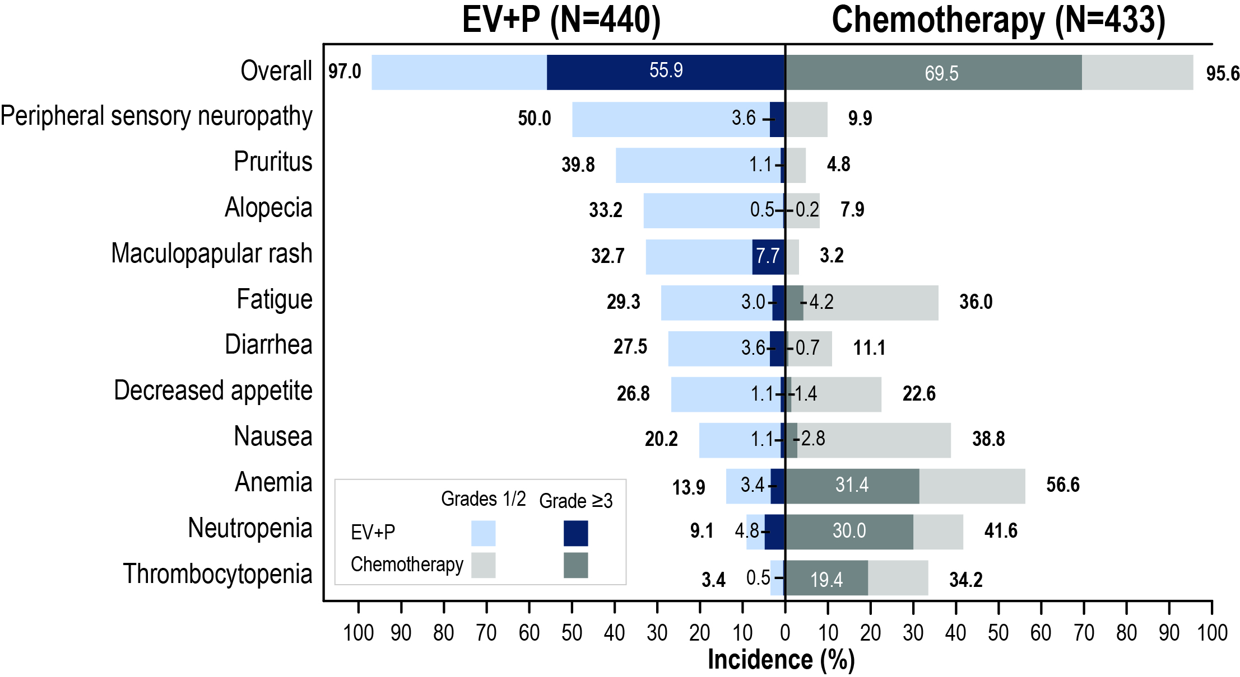
Treatment-Related Adverse Events
Grade ≥3 events were 56% in EV+P and 70% in chemotherapy
Serious TRAEs:
122 (27.7%) EV+P
85 (19.6%) chemotherapy
TRAEs leading to death (per investigator):
EV+P: 4 (0.9%)
Asthenia
Diarrhea
Immune-mediated lung disease
Multiple organ dysfunction syndrome
Chemotherapy: 4 (0.9%)
Febrile neutropenia
Myocardial infarction
Neutropenic sepsis
Sepsis
Median number of cycles (range): 12.0 (1,46) for EV+P; 6.0 (1,6) for chemotherapy
Data cutoff: 08 Aug 2023
TRAEs shown in figure are any grade by preferred term in ≥20% of patients for any grade in either arm
TRAEs, treatment-related adverse events
Powles et al.

Slide 25
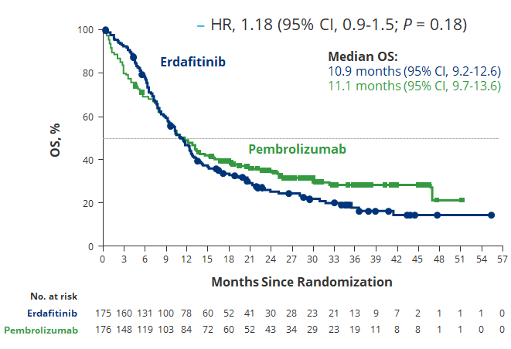
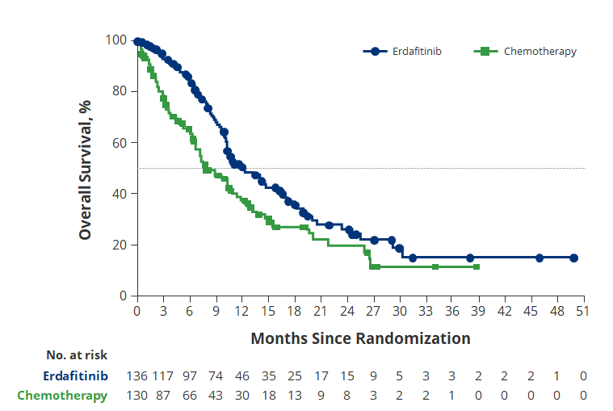
OS results in the THOR Trial of Erdafitinib in pretreated FGFR+ve UC raise many questions.
Arlene Siefker-Radtke Lotiott NEJM23 ASCO23
Advanced disease
Prior PD-(L)1 therapy
1-2 lines of prior therapy
FGFR alterations
Advanced disease
1 prior therapy
No prior PD-(L)1 therapy
FGFR alterations
erdafitinib
erdafitinib
R
R
Pembrolizumab
Paclitaxel/vinflunine
HR, 0.58 (95% CI, 0.44-0.78);
Notes:
Name a god in Norse mythology.

Slide 26
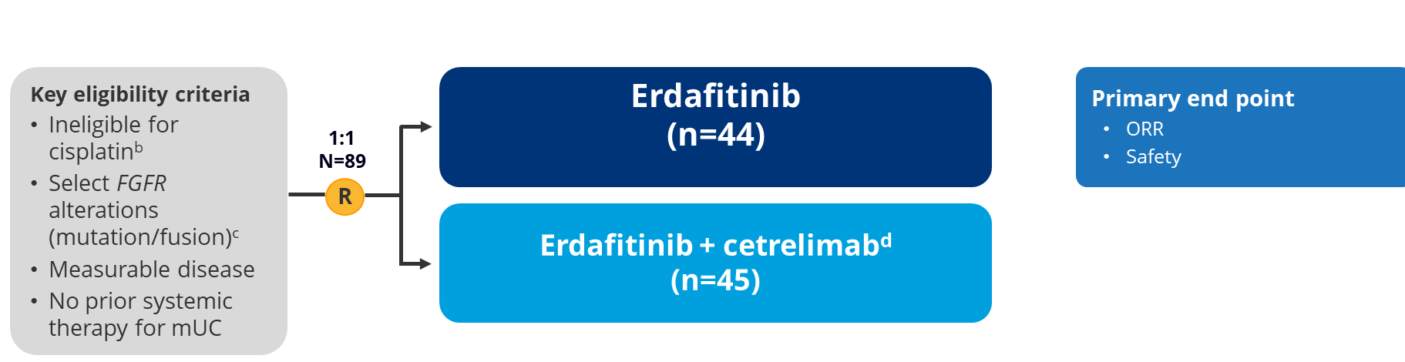
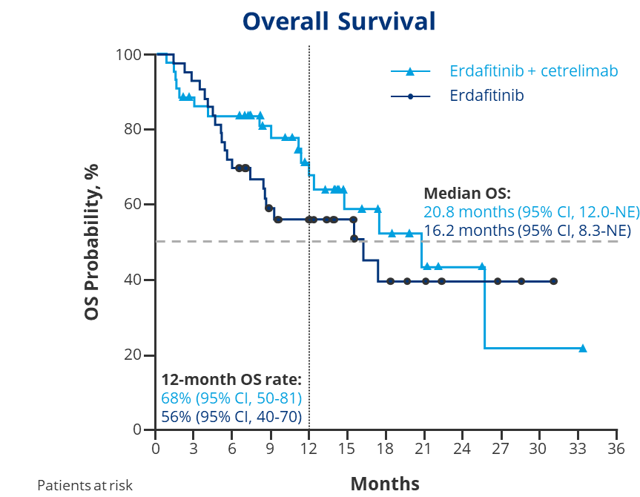
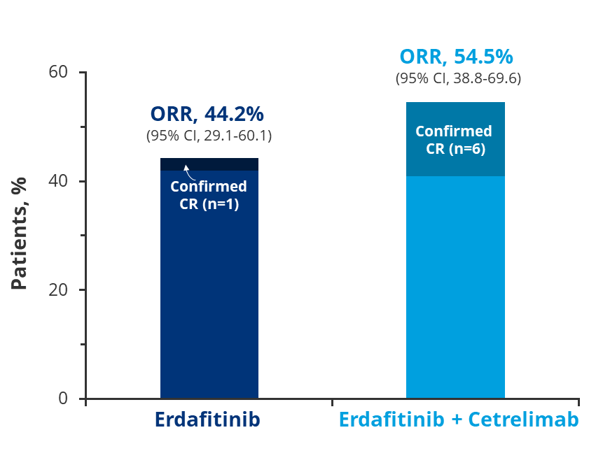
NORSE trial of erdafitinib + PD-1 in FGFR+ve 1st line advanced UC
Arlene Siefker-Radtke ASCO23

Slide 27
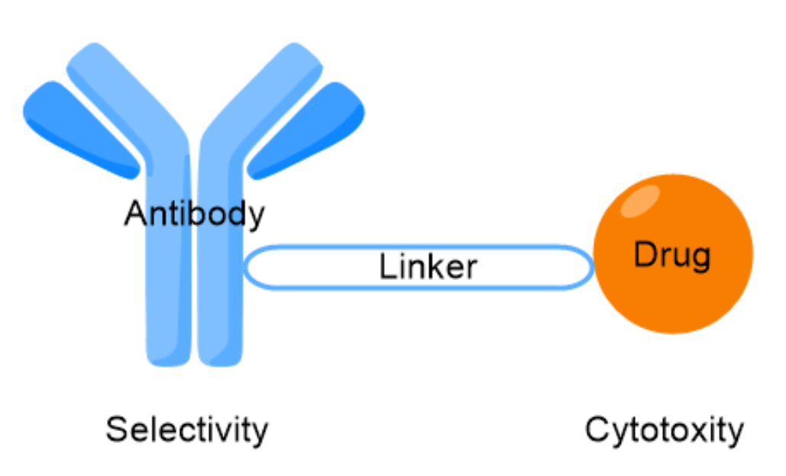
ADC strategies in advanced UC: Sacituzumab Govitecan
Platinum refractory UC monotherapy
Antibody drug conjugates
payload
Platinum refractory UC combination with PD1 inhibitor
 | Sacituzumab Govitecan
Target | TROP2
Payload | SN-38
Biomarker data | X
Grivas et al ASCO 2021

Slide 28
Enfortumab vedotin with Sacituzumab govitecan in pretreated advanced urothelial cancer
Response rate =70%
McGregor B ESMO 23

Slide 29
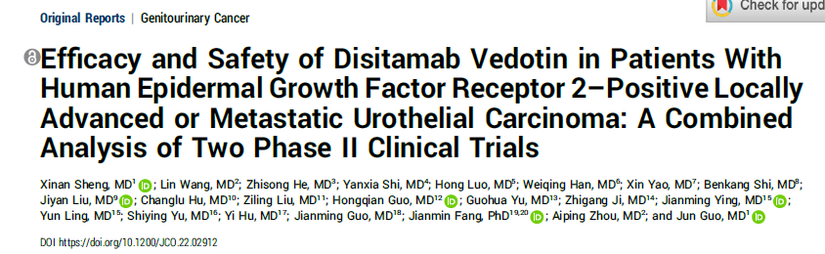
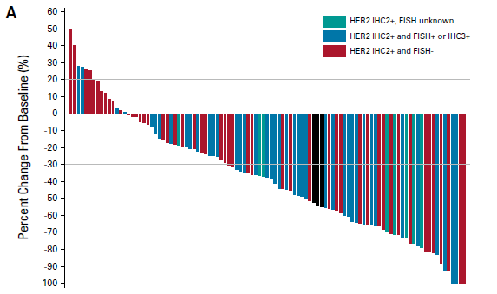
 | C005 (N=43) | C009 (N=64) | Pooled (N=107)
HER2-Positive IHC3+ or 2+/FISH+ | 60% | 64% | 62.2%
HER2 Low IHC2+/FISH- IHC2+/FISH Unknown | 40% 66% | 39.4% 50% | 39.6% 55.6%
Most frequent TRAEs All grades (≥30%)
Any event | 100%
Peripheral sensory neuropathy | 68%
Leukopenia | 51%
AST increase | 42%
Neutropenia | 42%
Alopecia | 40%
Asthenia | 39%
ALT increase | 36%
Decreased appetite | 32%
Sheng X et al. J Clin Oncol. Published online November 21, 2023. doi:10.1200/JCO.22.02912

Slide 30
Disitamab vedotin in HER2-low or in combination with PD-1 therapy
 | C011 DV monotherapy in HER2-low | C014 DV + toripalimab in all comers
Drug | DV monotherapy | DV + toripalimab (anti-PD-1)
n | 19 | 41
HER2 status | IHC 0 and 1+ | All-comers
Dose | 2.0 mg/kg Q2W | 2.0 mg/kg Q2W
Prior therapy | 2L+ Post platinum and/or anti-PD(L)1 68% had prior anti-PD(L)1 | 1L Treatment naive or previously treated, cis-ineligible or refused cis
Efficacy outcomes | ORR = 26.3% DCR = 94.7% (0 CR, 5 PR) mOS = 16.4 mos mPFS = 5.5 mos | ORR = 73.2% DCR = 90.2% (4 CR, 26 PR) 2-year OS = 63.2% mPFS = 9.2 mos
Status | Completed | Follow-up ongoing
Xu H, et al. American Society of Clinical Oncology; June 3-7, 2022; Chicago, IL. Abstract 4519
2. Sheng X, et al. American Society of Clinical Oncology; May 31, 2023; Chicago, IL. Abstract 45664566.

Slide 31
Appendix

Slide 32
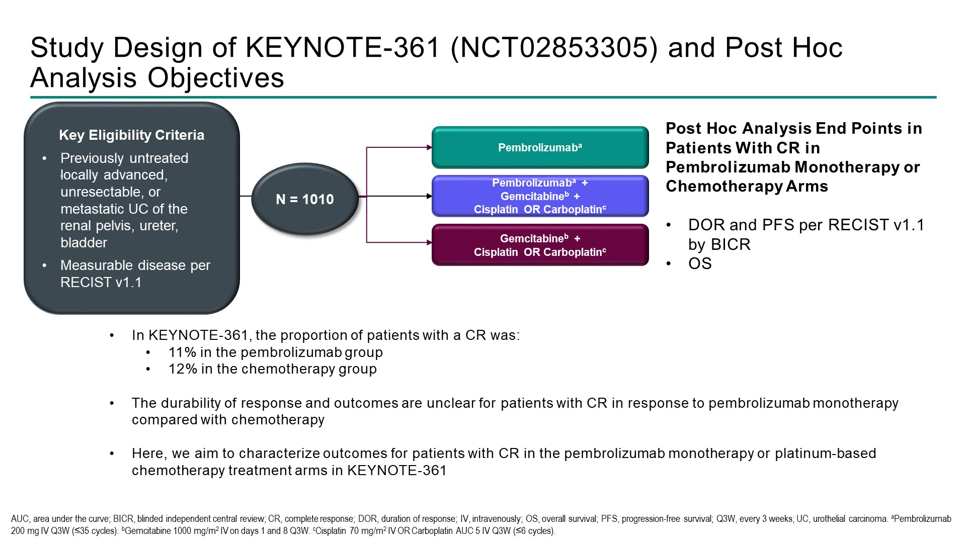
KEYNOTE-361 Study Design
Ozyilkan O et al. ASCO 2023;Abstract 4513.

Slide 33
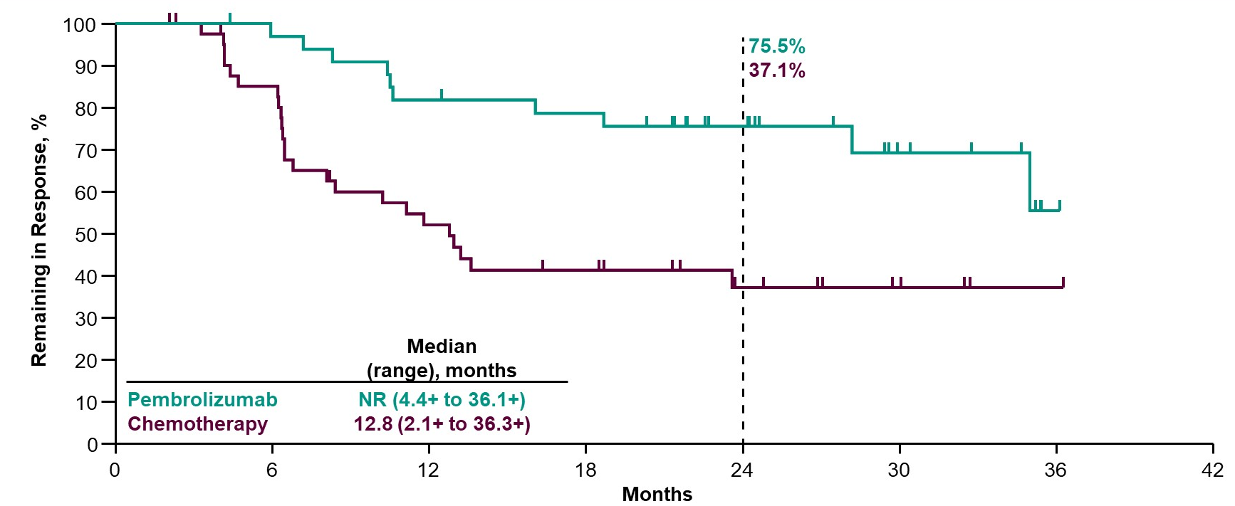
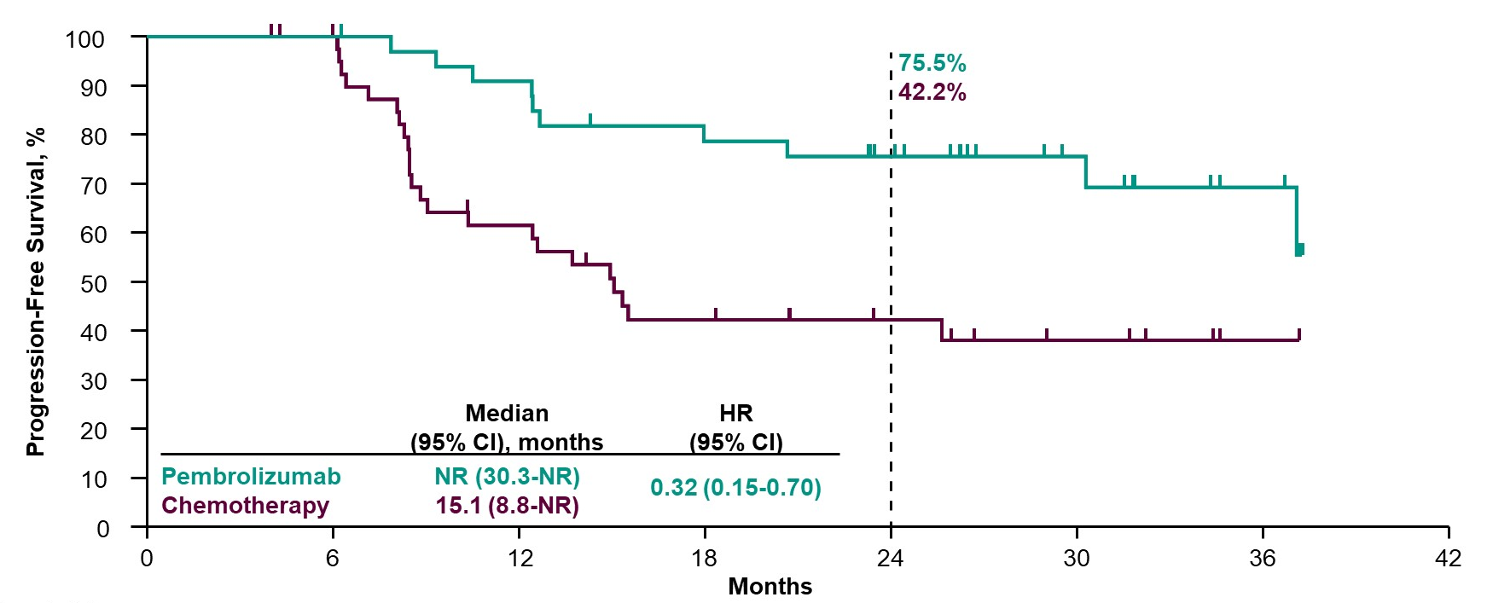
KEYNOTE-361: Efficacy
PFS
HR(95% CI): 0.32 (0.16-0.70)
OS
HR(95% CI): 0.20 (0.06-0.70)
Ozyilkan O et al. ASCO 2023;Abstract 4513.

Slide 34
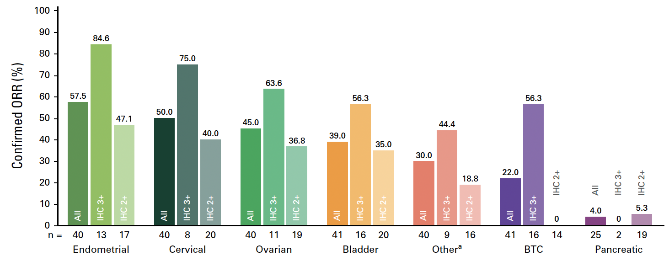
Phase II DESTINY-PanTumor02: Objective Response Rate (ORR)
Meric-Bernstam F et al. J Clin Oncol 2024;42(1):47-58.

