Slide 1
Year in Review — Clinical Investigator Perspectives on the Most Relevant New Datasets and Advances in Bladder Cancer Edition
Shilpa Gupta, M.D.
Clinical Professor
Cleveland Clinic Lerner College of Medicine at CWRU
Director, Genitourinary Oncology Program
Cleveland Clinic Taussig Cancer Institute

Slide 2
Addressing Unmet Needs in Non-Metastatic Urothelial Bladder Cancer (UBC)
Only a third of patients with NMIBC receive intravesical BCG; BCG shortages in the US affects access
Over 50% of patients with MIBC may not receive curative intent therapy globally
High risk of recurrence in MIBC despite neoadjuvant cisplatin-based chemotherapy (NAC) and surgery
50% of patients deemed ineligible for NAC, 30% refuse NAC
Radical Cystectomy (RC) has a significant mortality and morbidity and long term negative impact on QOL
Development of effective, safe, and durable treatment for NMIBC and MIBC as well as bladder sparing treatments is an unmet need
Tyson M et al. JCO 2019, Westergren DO et al. J Urol 2019; Roupret M et al. Eur Urol. 2021, Tan WS et al. Adv Urol 2015, Allareddy V et al. Cancer 2006, Zippe CD et al. Urology 2004

Slide 3
Non-muscle Invasive Bladder Cancer (NMIBC)

Slide 4
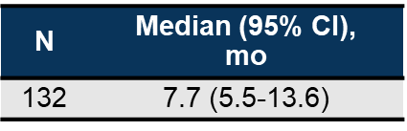
KEYNOTE-057 Cohort B: Pembrolizumab for Papillary High-Risk NMIBC
100
90
80
70
60
43.5%
DFS, %
34.9%
50
40
30
20
10
0
0
3
6
9
12
15
18
21
24
27
30
33
36
39
42
45
48
51
54
57
60
63
66
69
Time, mo
No. at risk
Median follow-up: 4 months

Slide 5
Durvalumab +/- BCG or with EBRT in patients with BCG-unresponsive NMIBC: HCRN GU16-243 ADAPT-BLADDER Study
Durva q 3w x 8 cycles +/- BCG induction and maintenance
EBRT patients received concurrent EBRT (6 Gy × 3 in cycle 1 only)
Primary endpoint: RP2D for each regimen
Secondary endpoints: Toxicity and CR rates
N=28
R2PD: Full-dose Durva, BCG and , full-dose BCG, 6 Gy EBRT
1 Grade 3 TRAE of autoimmune hepatitis
The 3-mo CR: 64% of all patients, 33%, 85%, and 50% of Durva, Durva + BCG, and Durva + EBRT cohorts
12-mo CR: 46% of all patients; 73% of Durva + BCG and 33% of Durva+ EBRT patients.
Durva (N = 3)
Durva + BCG (N = 13)
Durva + EBRT (N=12)
Hahn NM et al. Eur Urol 2023

Slide 6
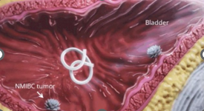
TAR-200 Intravesical Drug Delivery System
TAR-200
Intravesical drug delivery system that enables a sustained release of gemcitabine into the bladder, increasing the dwell time of the local drug concentration
Phase 2 SunRISe-1
Cohort 1: TAR-200 + cetrelimab (N = 100) Cohort closed
2:1:1
Key Eligibility Criteria
BCG-unresponsive high-risk NMIBC
ECOG PS 0-2
With or without papillary disease (T1, high-grade Ta)
Ineligible for or declined RC
Primary endpoint: Overall CR rate
Key secondary endpoints: DOR, OS, safety
Cohort 2: TAR-200ª (N = 80)
R
Cohort 3: Cetrelimab (N = 50)
Cohort closed
Key Eligibility Criteria
HR NMIBC papillary disease only (no CIS)
Cohort 4: TAR-200ª (N = 50)
Primary endpoint: DFS rate
TAR-200 dosing: Q3W (indwelling) for first 24 weeks; then Q12W through Week 96. Necchi A et al. ESMO 2023. LBA105

Slide 7
SunRISe-1:BCG-Unresponsive High-Risk NMIBC
CR Rate in Patients With High-Risk NMIBC CIS (Cohort 2)
Treatment Duration and Response to TAR-200 Monotherapy
(95% CI, 57.7-90.1)
(95% CI, 61.4-92.3)
Median DOR has not been reached
Median follow-up in responders was 48 wk (range, 12-21)
Overall CR Rate, %
CR
(n = 23)
CR
(n = 24)
Kaplan–Meier estimates for DOR rate
6 mo: 93% (95% CI, 61-99)
12 mo: 84% (95% CI, 49-96)
Patients (N = 54)
91% (21/ 23) responses are ongoing
11 patients had DOR ≥6 mo (10/11 ongoing)
6 patients had DOR ≥12 mo (all ongoing)
None of the patients with CR have undergone radical cystectomy
Response
CR
Non-CR
On treatment
Treatment ongoing
Completed treatment
Centrally Assessed
(n = 30)^{b,c}
Investigator Assessed
(n = 30)^{b,c}
TAR-200 was well tolerated—mainly low-grade 1 or 2 AEs, with manageable urinary symptoms
TAR-200–related SAEs, grade ≥3 AEs, and discontinuations were infrequent
Time, mo
Necchi A et al. ESMO 2023. LBA105

Slide 8
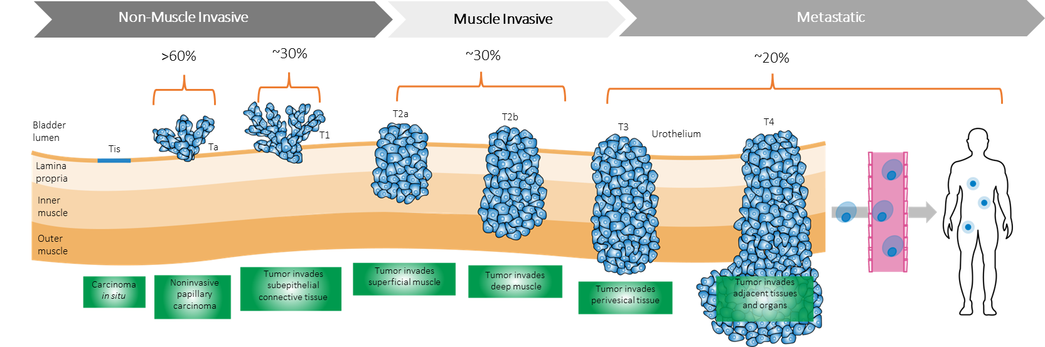
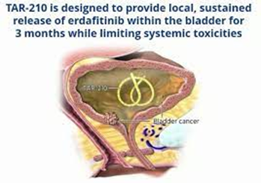
Targeting FGFR in NMIBC
FGFR alterations are commonly detected in NMIBC
~ 30% patients with high-risk papillary NMIBC have FGFR alterations
Targeting FGFR in NMIBC is a rational therapeutic approach
Systemic erdafitinib
Intravesical erdafitinib (TAR 210)

Slide 9
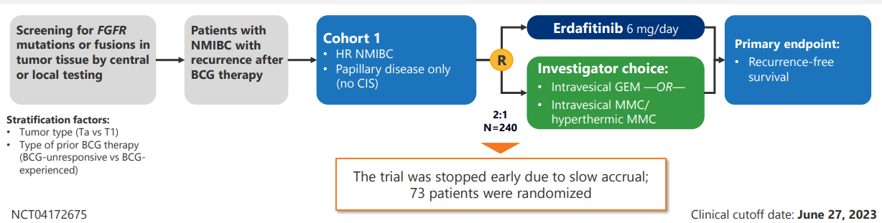
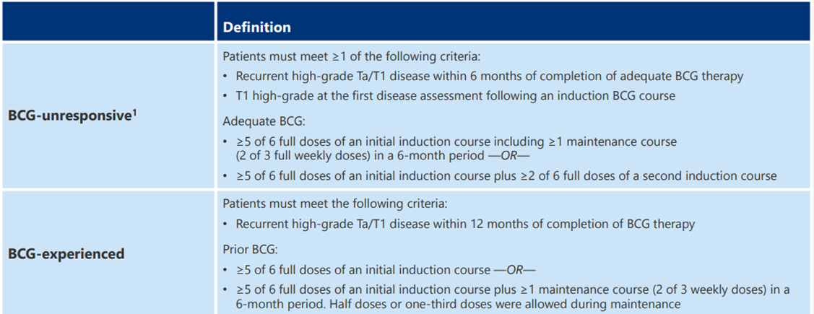
THOR-2 Cohort 1: Oral Erdafitinib Versus Intravesical Chemotherapy in BCG-Unresponsive High-Risk NMIBC
Catto JWF et al. ESMO 2023

Slide 10
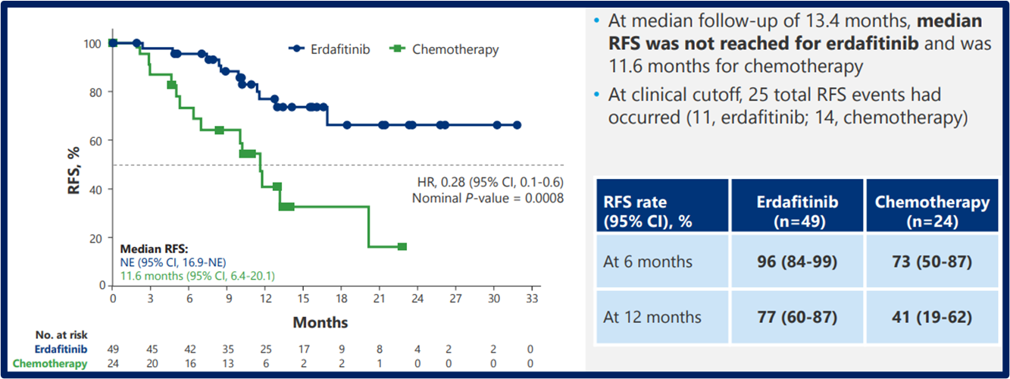
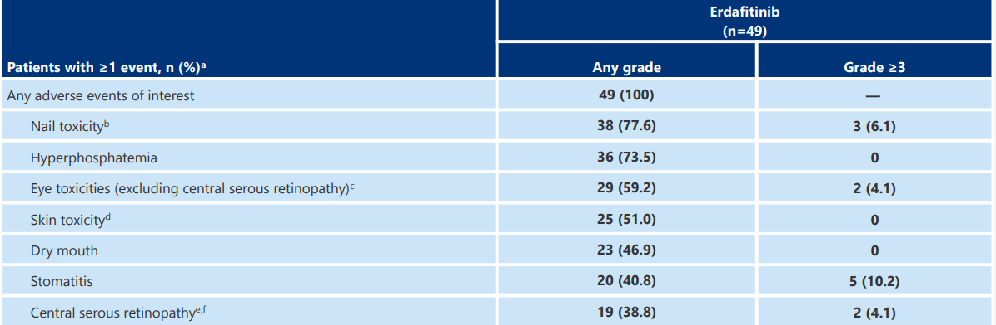
Efficacy
Safety
Catto JWF et al. ESMO 2023

Slide 11
TAR-210: Erdafitinib Intravesical Delivery
Cohort 1
High-risk NMIBC (high-grade Ta/T1, no CIS, papillary only), BCG-experienced/ unresponsive and not receiving RC
TURBT with complete resection of all visible disease prior to treatment
Treatment for up to 1 y if recurrence-free (cohort 1) or CR (cohort 3)
Molecular Eligibility
Local or central fresh/ archival tissue-based testing by NGS or PCR
OR
Urine cell-free DNA NGS testing
Part 1 Dose Escalation
Part 2 Dose Expansion
BOIN
TAR-210-D Dose level 2
Expansion Cohort 1
TAR-210-B Dose level 1
Expansion Cohort 3
Cohort 3
Intermediate-risk NMIBC, recurrent, history of low-grade only Ta/T1 disease
Visible target lesions prior to treatment (chemoablation design)
Non-RC patients: Cohort 1 and cohort 3 combined
Placement every 3 mo
Expansion of both dose levels
Primary endpoint: safety (AEs, AE severity, DLT)
.
Vilaseca A et al. ESMO 2023. LBA104

Slide 12
Steady-state mean plasma concentrations are >50x lower than oral erdafitinib 9 mg daily
No hyperphosphatemia
TAR-210 Provides Sustained Erdafitinib Release in Urine Over 90 Days With Very Low Plasma Concentrations
Urine Concentration
Plasma Concentration
Concentration of Erdafitinib,
Mean (SD), ng/mL
3,500
Concentration of Erdafitinib,
Mean (SD), ng/mL
80
3,000
2,500
60
TAR-210-D (n = 6)
TAR-210-D
(n = 8)
2,000
40
1,500
1,000
20
500
TAR-210-B (n = 10)
Plasma Concentration
TAR-210-B (n = 11)
0
0
29 43 57
Treatment Day (Cycle 1)
29 43 57
Treatment Day (Cycle 1)
1 8 15
90
1 8 15
90

Slide 13
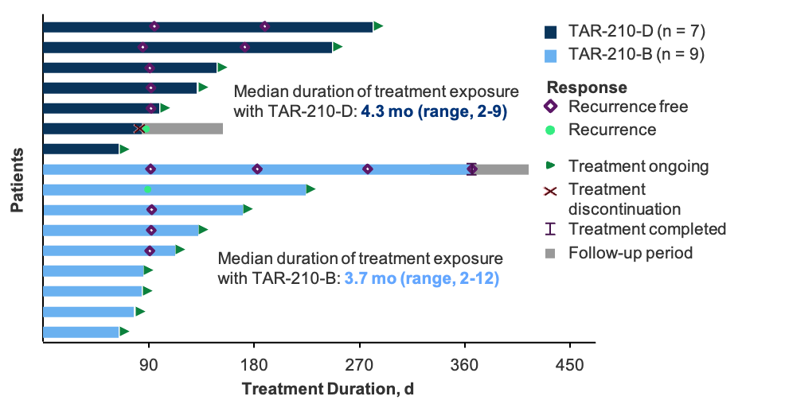
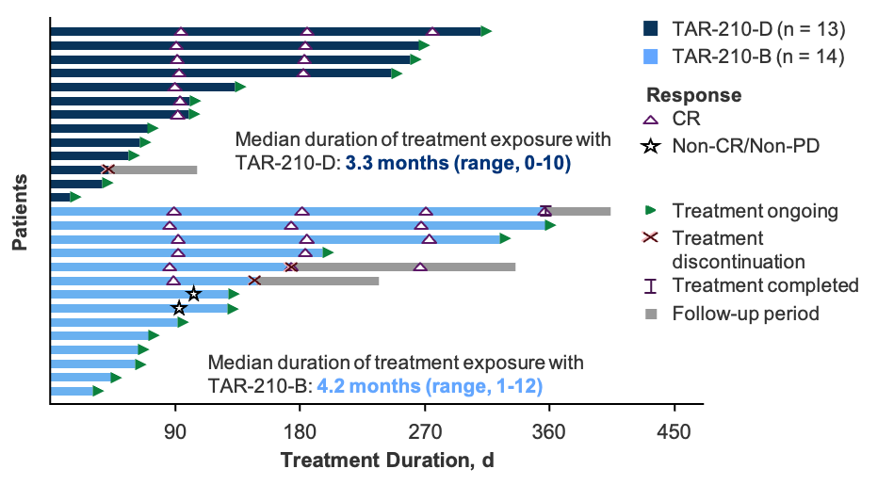
TAR-210 Efficacy
Cohort 1: FGFR-Altered High-Risk NMIBC (N = 16)
Cohort 3: FGFR-Altered Intermediate-Risk NMIBC (N = 27)
Primary endpoint: RFS
RFS-82%; median RFS not met
Primary endpoint: CR, DoR
CR- 87%
3.3 mo (range, 0-10)
4.2 mo (range, 1-12)

Slide 14
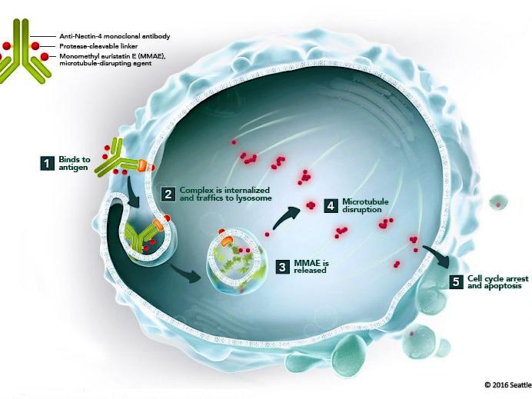
Exploiting ADC Enfortumab Vedotin in NMIBC

Slide 15
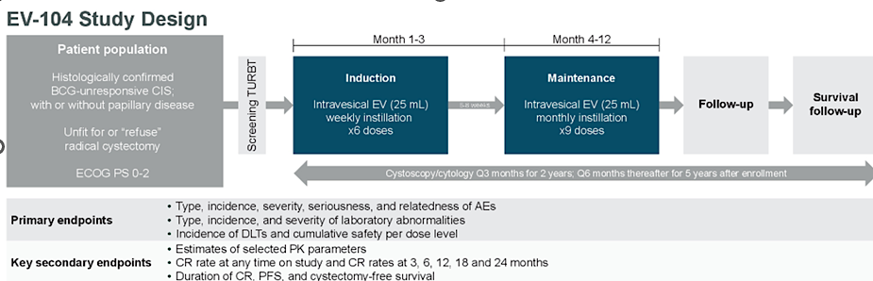
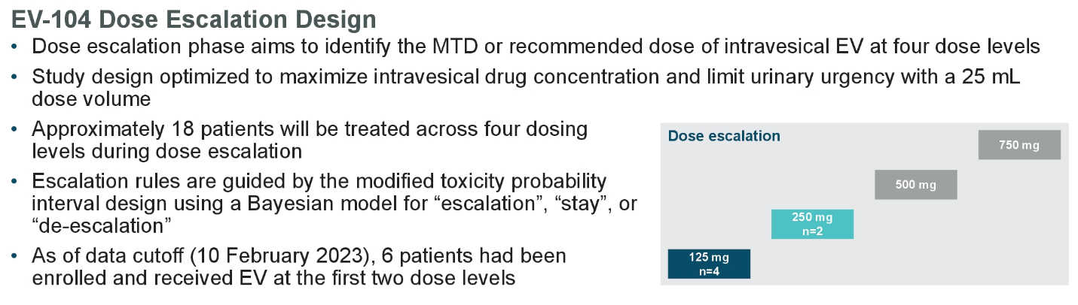
EV-104: Intravesical Enfortumab Vedotin in Patients with NMIBC
Roupret M et al. ASCO 2023

Slide 16
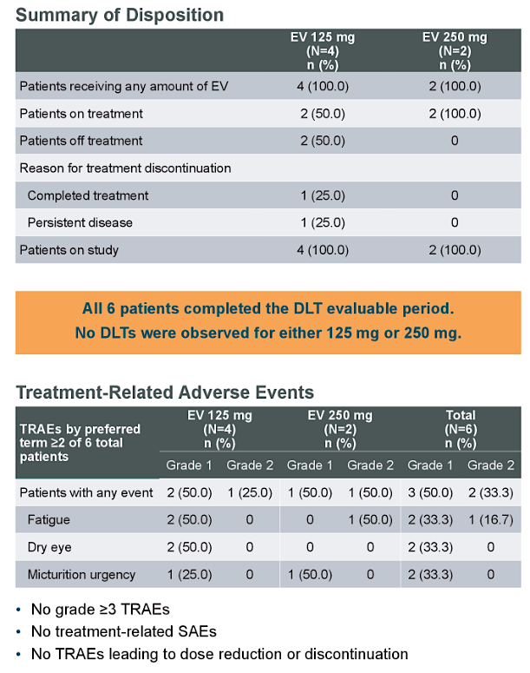
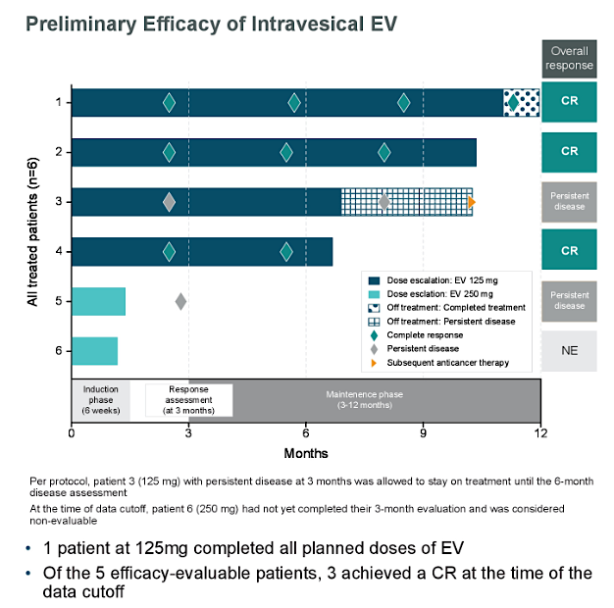
Dose escalation: EV 125 mg
Dose escalation: EV 250 mg

Slide 17
Muscle-Invasive Bladder Cancer

Slide 18
Adjuvant IO trials in high-risk MIUC
High risk MIUC: if received NAC- ypT2-T4a/ypN+ or pT3-T4a/pN+ if not eligible for or declined adjuvant cisplatin-based chemotherapy
IMvigor010
CheckMate 274
AMBASSADOR
Atezolizumab
Nivolumab
Pembrolizumab
R
R
R
Observation
Placebo
Observation
Primary endpoint: DFS
Primary endpoint: DFS
Coprimary endpoints: DFS and OS
Key secondary endpoints: OS, DSS, distant metastasis-free survival, NUTRFS
Key secondary endpoints: OS, NUTRFS, DSS
Key secondary endpoints: OS and DFS in PD-L1–positive and PD-L1–negative patients
No DFS or OS improvement
DFS Improvement
Waiting for OS
DFS Improvement
PI Andrea Apolo MD

Slide 19
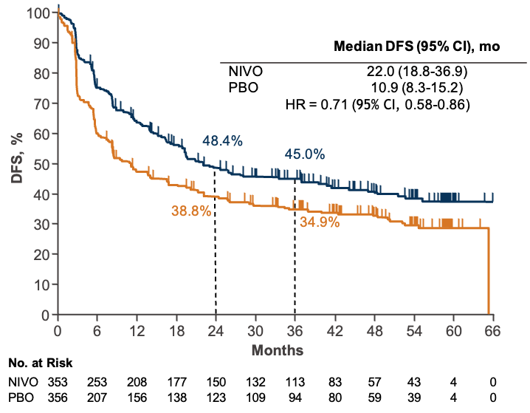



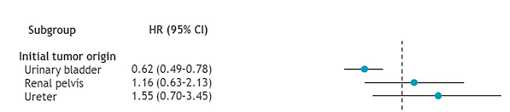
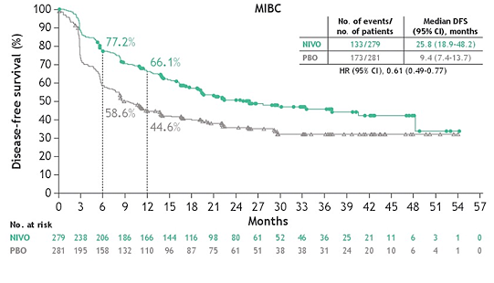
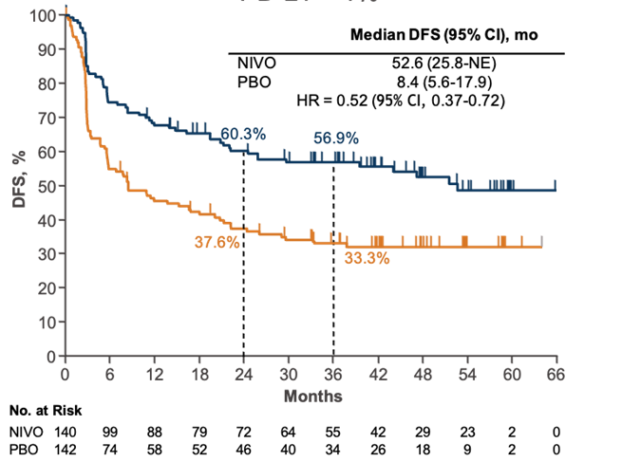
CheckMate 274 Extended Follow-up
ITT
MIBC only
PD-L1 ≥1%
Bajorin DF et al. NEJM 021, Galsky MD et al. ASCO 2023, Milowsky M et al. AUA 2023

Slide 20
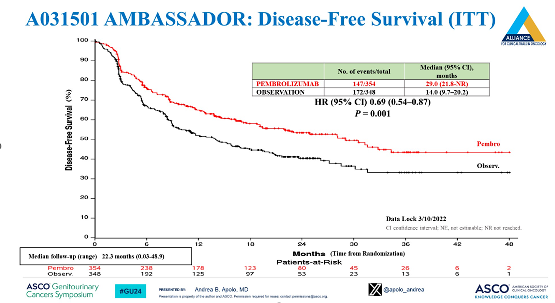

Slide 21
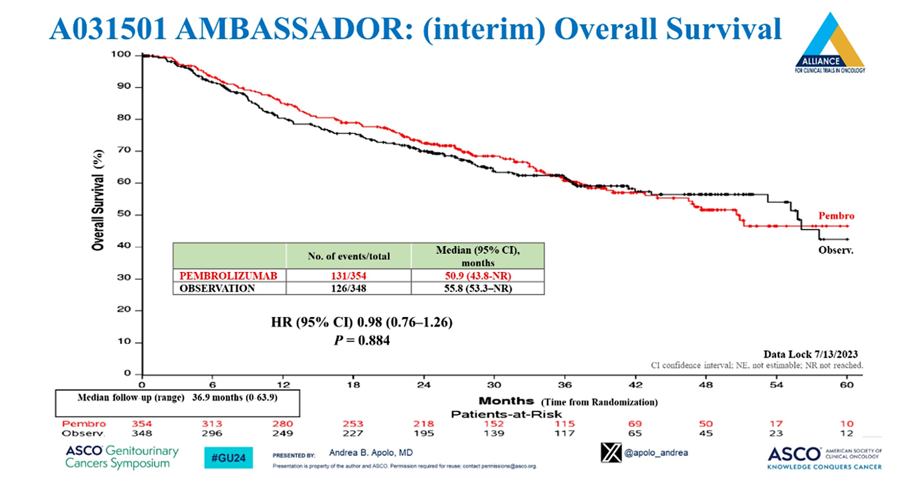

Slide 22
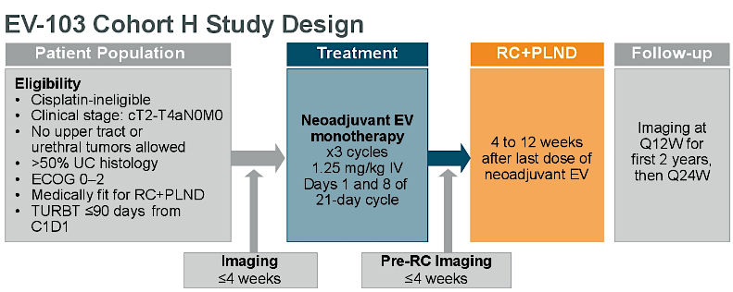
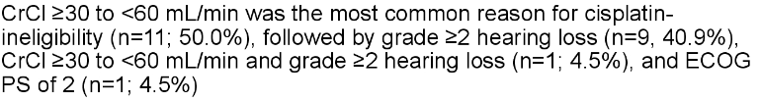
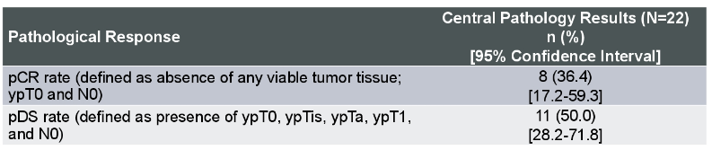
Neoadjuvant treatment with EV monotherapy in cisplatin-ineligible patients with MIBC: EV-103 Cohort H
19/22 pts completed all 3 cycles prior to RC
No delays to surgery
1 death from AKI
Flaig, T et al. ASCO 2023

Slide 23
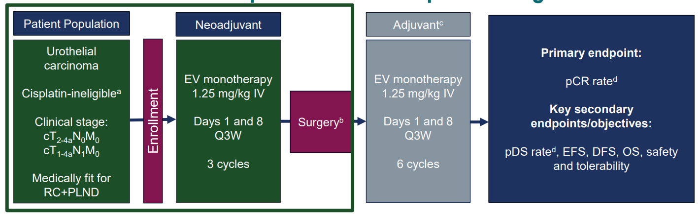
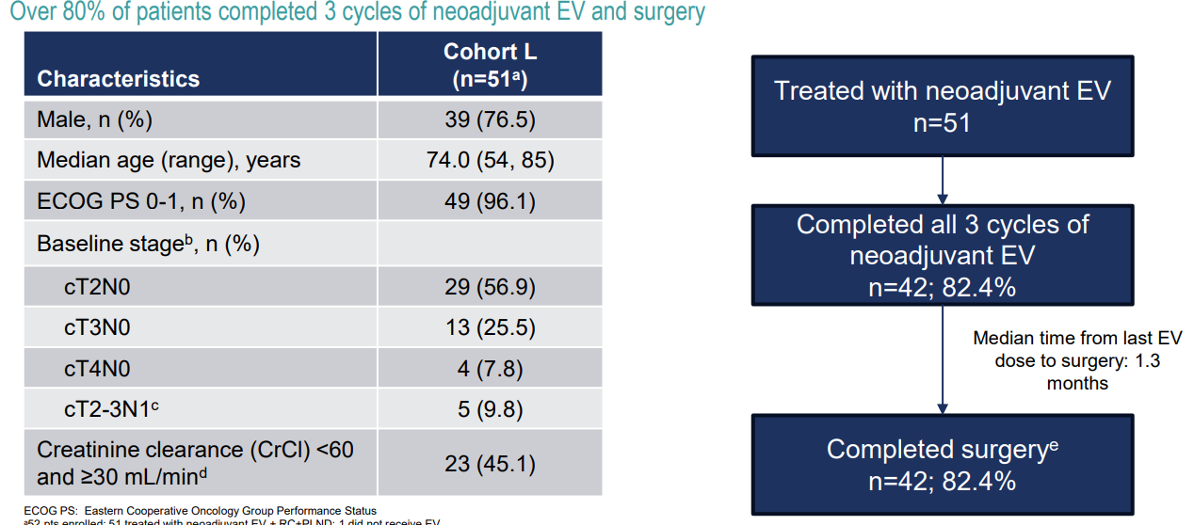
Perioperative treatment with EV monotherapy in cisplatin-ineligible patients with MIBC: EV-103 Cohort L
pCR: 17/51 (34%
pDS: 21/51 (42%)
Adverse Events:
29/51 (56.9%) of pts. had skin reactions; 1 death from Stevens-Johnson syndrome
17/ 51 (33.3%) of pts. had peripheral neuropathy
No delays to surgery
Sridhar S et al. ESMO 2023

Slide 24
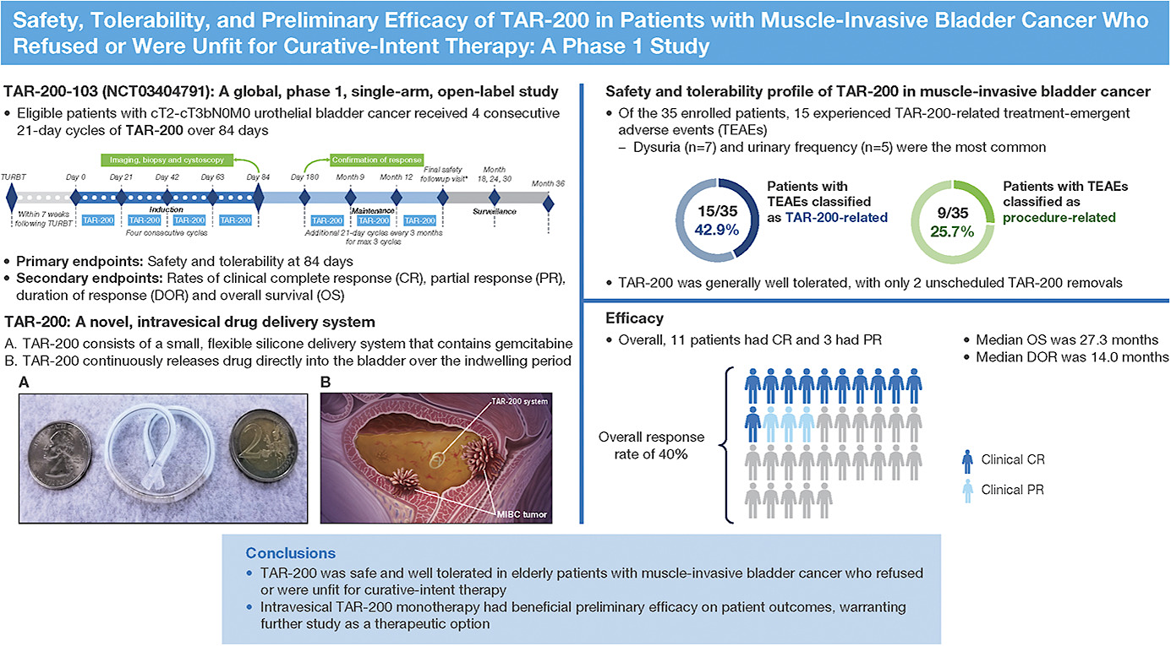
Tyson MD et al. J Urol 2023

Slide 25
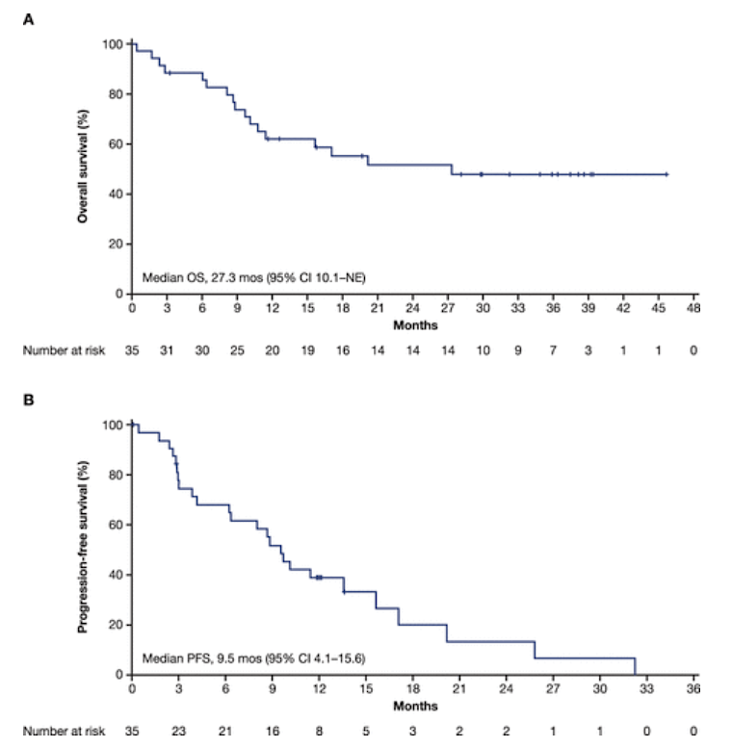
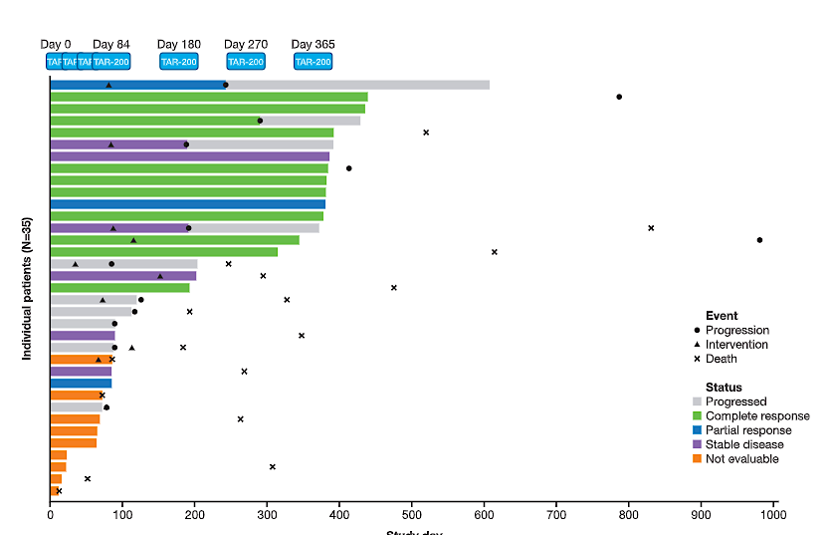
Tyson MD et al. J Urol 2023

Slide 26
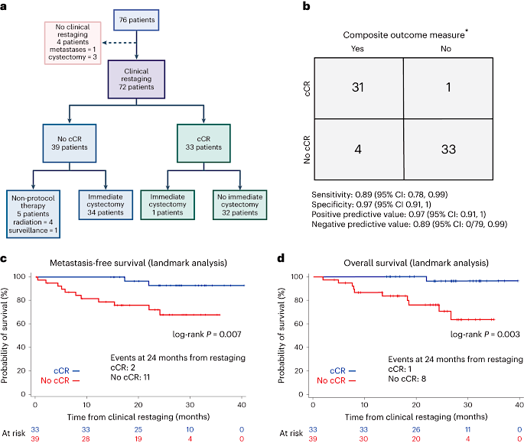
HCRN GU16-257: Gemcitabine and cisplatin plus nivolumab as organ-sparing treatment for muscle-invasive bladder cancer
Treatment:
4 cycles of neoadjuvant Gem-Cis and Nivolumab
Primary Objectives:
cCR rate and the positive predictive value (PPV) of cCR for a composite outcome:
2-year metastasis-free survival in patients forgoing immediate cystectomy or <ypT1N0 in patients electing immediate cystectomy.
Results:
76 pts enrolled
33 achieved a cCR (43%) and 32/33 opted to forgo immediate cystectomy.
The PPV of cCR was 0.97 (95% CI: 0.91, 1), meeting the co-primary objective.
Immediate cystectomy
1 patient
Galsky MD et al. Nature Medicine 2023

Slide 27
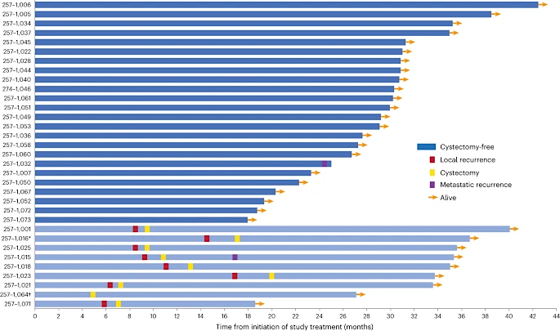
Clinical outcomes of patients enrolled on HCRN GU16-257 achieving a cCR
Galsky MD et al. Nature Medicine 2023

Slide 28
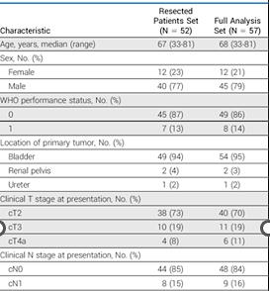
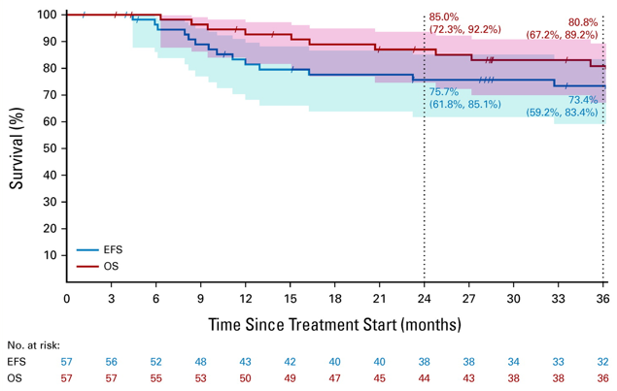
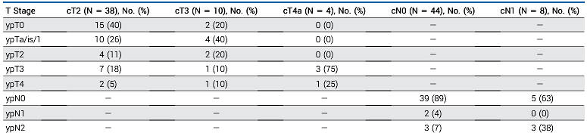
Perioperative Chemoimmunotherapy With Durvalumab for
MIBC: Primary Analysis of the Single-Arm Phase II Trial SAKK 06/17
Patient population:
N=61
cT2-T4a and≤N1 UC of the bladder, urethra, or UTUC
Treatment:
Neoadjuvant Gem-Cis-Durva x 4 cycles
Adjuvant Durva for up to 10 cycles
Primary Endpoint:
EFS at 2 years
2 yr EFS 75.7%
Pathologic Response
Canthomas R et al. JCO 2023

Slide 29
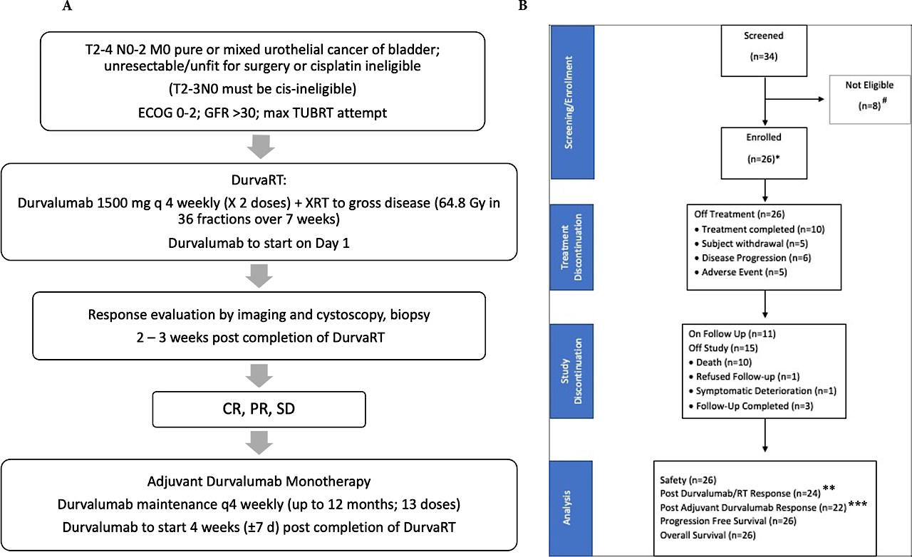
Concurrent durvalumab and radiation therapy (DUART) followed by adjuvant durvalumab in patients with localized bladder ca: BTCRC-GU15-023
Primary endpoints:
PFS at 1 year
Disease control rate (DCR) post adjuvant durva
Joshi M et al. JITC 2023

Slide 30
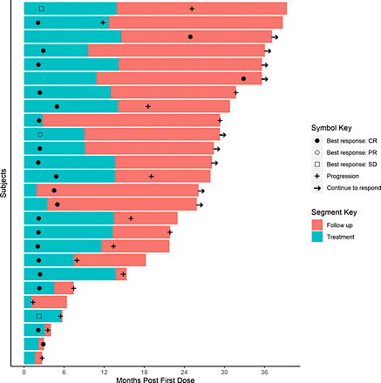
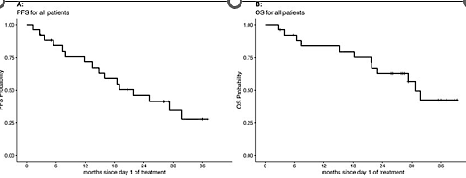
Median PFS was 21.8 months
1-year PFS probability was 71.5% and 2-year PFS probability was 45.9%
Median OS was 30.8 months
1-year OS probability was 83.8% and 2-year OS probability was 62.8%
Well tolerated, no new safety signals
DCR at 1 year of 72.7%
ORR in 15/22 patients (68.2%)
CR in 12/22 patients (54.5%)
PR in 3/22 patients (13.6%)
SD in 1/22 patient (4.5%)
Joshi M et al. JITC 2023

Slide 31









Thank You!
@shilpaonc
Guptas5@ccf.org

