Slide 1
2023 Year In Review: Gastro-Esophageal Cancers
Zev A. Wainberg
Professor of Medicine and Surgery
UCLA School of Medicine
Los Angeles, California

Slide 2
Agenda
Novel Targets:
  Claudin 18.2 (SPOTLIGHT, GLOW)
  Novel ADC’s
HER2+:
  KEYNOTE-811, DESTINY-Gastric02, HER2 Low, Zanidatamab
Refractory Disease
  VEGF, TAS 102

Slide 3
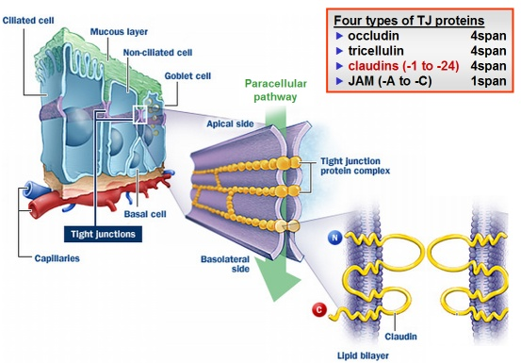
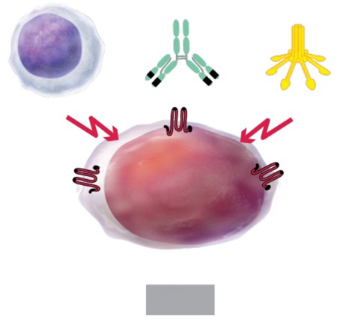
Claudin18.2 – A novel target
Claudin18.2
Mechanism of Action
of Zolbetuximab
zolbetuximab
FcγR+ Effector Cell
CLDN18.2
Complement
ADCC
CDC
CLDN18.2
Tumor Cell
CLDN18.2
Member of the claudin family
Major structural component of tight junctions
Seals intercellular space in epithelial sheets
Not expressed in any healthy tissues, except:
stomach mucosa
Cell Death
Sahin U et al. Ann Oncol. 2021 May;32(5):609-619

Slide 4
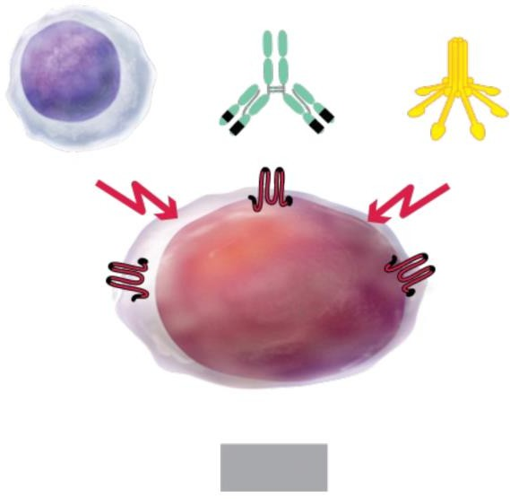
Zolbetuximab in Patients With mG/GEJ Adenocarcinoma
Mechanism of Action of Zolbetuximab
CLDN18.2, a tight junction protein, expressed in normal and malignant gastric mucosa cells, becomes exposed on the surface of G/GEJ adenocarcinoma cells during malignant transformation, making it a promising target^{8,12–18}
Zolbetuximab is a first-in-class chimeric IgG1 monoclonal antibody that targets CLDN18.2 and induces
ADCC/CDC^{8,15–18}
Zolbetuximab is a targeted treatment that continues to be evaluated in 2 ongoing global, phase 3 studies,
SPOTLIGHT and GLOW^{19,20}
– Primary analyses of both studies showed that treatment with zolbetuximab in combination with oxaliplatin-based chemotherapy regimens prolonged survival compared with the placebo group^{19,20}
Zolbetuximab
FcγR+ Effector Cell ADCC
CLDN18.2
Complement
CDC
CLDN18.2
Tumor Cell
CLDN18.2
Cell Death
Adapted from Singh P et al. J Hematol Oncol. 2017; 10(1):105.
1. Van Cutsem et al. Lancet. 2016; 388(10060):2654–2664; 2. Lordick F et al. Ann Oncol. 2022; 33(10):1005–1020; 3. Obermannová R et al. Ann Oncol. 2022; 33(10):992–1004; 4. JGCA. Gastric Cancer.
2021; 24(1):1–21; 5. Kelly RJ et al. N Engl J Med. 2021; 384(13):1191–1203; 6. NHCPRC. Chin J Cancer Res. 2022; 34(3):207–237; 7. Bang Y-J et al. Lancet. 2010; 376(9742):687–697; 8. Pellino et al. J
Pers Med. 2021;11(11):1095; 9. Shah MA et al. J Clin Oncol. 2023; 41(7):1470–1491; 10. Janjigian YY et al. Lancet. 2021; 398(10294):27–40; 11. Shitara K et al. Nature. 2022; 603(7903):942–948; 12. Niimi T et al. Mol Cell Biol. 2001;21(21):7380–7390; 13. Sahin U et al. Clin Cancer Res. 2008;14(23):7624–7634; 14. Moran D et al. Ann Oncol. 2018;29(suppl_8):viii14-viii57; 15. Sahin U et al. Eur J Cancer.
2018;100:17–26; 16. Rhode C et al. Jpn J Clin Oncol. 2019;49(9):870–876; 17. Türeci Ö et al. Ann Oncol. 2019;30(9):1487–1495; 18. Sahin U et al. Ann Oncol. 2021;32(5):609–619; 19. Shitara K et al. Lancet. 2023;401(10389):1655–1668; 20. Shah MA et al. Nat Med. 2023; 29(8):2133–2141.

Slide 5
Primary Endpoint: PFS by Independent Review Committeeª
Updated Analysis With 9.7 Months Additional Follow-Up
1.0
12-Month PFS rate 49% vs 38%
Zolbetuximab + mFOLFOX6
Placebo + mFOLFOX6
0.9
0.8
No. events/no. patients
157/283
184/282
Median PFS, months
(95% CI)
11.04
(9.69–12.52)
8.94
(8.21–10.41)
Probability of PFS
0.7
0.6
24-Month PFS rate 28% vs 14%
HR (95% CI)
P value
0.730 (0.587–0.907)
0.0022
0.⁵
0.4
0.3
Zolbetuximab + mFOLFOX6
0.2
0.1
Placebo +
0.0
mFOLFOX6
0 2 4 6 8 10 12 14 16 18 20 22 24 26 28 30 32 34
Months
283 263 254 232 227 193 190 160 155 123 117 101 93 78 75 70 58 55 46 39 39 32 29 29 24 24 23 19 18 18 15 14 11 11 11
36 | 38 | 40 | 42 | 44 | 46 | 48
9 9 | 9 7 | 7 5 | 4 4 | 2 2 | 2 1 1 | 1 0
4 4 | 4 3 | 3 3 | 1 1 | 0 0 | 0 0 0 | 0 0
No. at Risk
Zolbetuximab + mFOLFOX6
Placebo + mFOLFOX6
282 273 260 237 226 186 173 148 134 107 99 77 73 60 57 48 34 33 28 26 23 18 17 17 12 11 11 10 8 8 4 4 4 4 4
Data cutoff: June 29, 2023; Median follow-up = 17.87 months (zolbetuximab + mFOLFOX6) vs 15.18 months (placebo + mFOLFOX6).
ªPer RECIST version 1.1.

Slide 6
Key Secondary Endpoint: OS
Updated Analysis With 9.7 Months Additional Follow-Up
1.0
12-Month
Zolbetuximab + Placebo + mFOLFOX6 mFOLFOX6
189/283 211/282
0.9
OS rate
67% vs 61%
No. events/no. patients
0.8
0.7
Median OS, months
(95% CI)
18.23
(16.13–20.70)
15.57
(13.67–16.92)
Probability of OS
24-Month OS rate 38% vs 29%
0.6
HR (95% CI)
P value
0.778 (0.637–0.949)
0.0067
0.5
0.4
0.3
Zolbetuximab + mFOLFOX6
0.2
0.1
Placebo + mFOLFOX6
0 2 4 6 8 10 12 14 16 18 20 22 24 26 28 30 32 34 36 38 40 42 44 46 48 50 52
5 5 4 3 2 1 0
0.0
No. at Risk
Months
Zolbetuximab + 283 270 264 255 251 241 234 228 211 196 189 179 174 166 160 153 139 128 116 109 99 93 85 79 72 67 60 54 49 44 41 35 31 29 23 23 21 21 18 17 15 13 11 10 10 9
mFOLFOX6
Placebo + mFOLFOX6
282 277 271 266 253 243 228 219 209 198 184 174 162 156 142 134 117 107 91 86 73 67 63 57 56 51 45 36 32 30 25 22 20 18 17 17 13 13 12 11 10 6 4 3 2 0 0 0 0 0 0 0 0
Data cutoff: June 29, 2023; Median follow-up = 31.11 months (zolbetuximab + mFOLFOX6) vs 29.57 months (placebo + mFOLFOX6).

Slide 7
Key Secondary Endpoint: OS
Updated analysis with 8.7 months additional follow-up
1.0
Zolbetuximab + CAPOX
Placebo + CAPOX
0.9
12-Month OS rate 57% vs 50%
Events/patients, n/N
168/254
193/253
0.8
Median OS, months
(95% CI)
14.32
(12.09–16.49)
12.16
(10.28–13.67)
Probability of OS
0.7
HR (95% CI)
P value
0.771 (0.624–0.952)
0.0079
0.6
0.5
24-Month OS rate 28% vs 19%
0.4
0.3
Zolbetuximab +
0.2
CAPOX
0.1
Placebo + CAPOX
0.0
0 1 2 3 4 5 6 7 8 9 10 11 12 13 14 15 16 17 18 19 20 21 22 23 24 25 26 27 28 29 30 31 32 33 34 35 36 37 38 39 40 41 42 43 44
Months
254 243 233 226 211 203 193 187 176 160 154 143 129 122 113 108 98 88 78 67 54 51 46 42 41 38 36 26 21 17 15 12 10 9 7 4 3 3 2 2 1 1 1 1 0
No. at Risk
Zolbetuximab +
CAPOX
Placebo + CAPOX
253 243 235 220 210 197 181 168 153 143 133 125 116 106 97 89 80 74 62 52 46 43 38 33 28 25 23 17 14 11 9 8 4 4 2 2 2 2 1 1 1 1 1 0 0
Data cutoff: June 29, 2023. Median follow-up = 26.09 months (zolbetuximab + CAPOX) vs 26.18 months (placebo + CAPOX).

Slide 8
SPOTLIGHT and GLOW
 | SPOTLIGHT | GLOW
Control | FOLFOX | CapeOX
Countries | Global | Global (~50% from China)
CPS≥5 | 13% | 22%
mPFS | 10.6 vs 8.7 +1.9 HR 0.75 | 8.2 vs 6.8 +1.4 HR 0.69
mOS | 18.2 vs 15.5 +2.7 HR 0.75 | 14.4 vs 12.2 +2.2 HR 0.77
ORR | 61 vs 62% -1% | 54 vs 49% +5%
Nausea Vomiting | 81 vs 61% 65 vs 35% | 69 vs 50% 66 vs 31%
Discontinuation of zolbe/pbo by AE | 14 vs 2% | 7 vs 4%
Shitara K, et al. ASCO-GI 2023; Lancet 2023; Xu RH, et al. ASCO Plenary series 2023

Slide 9
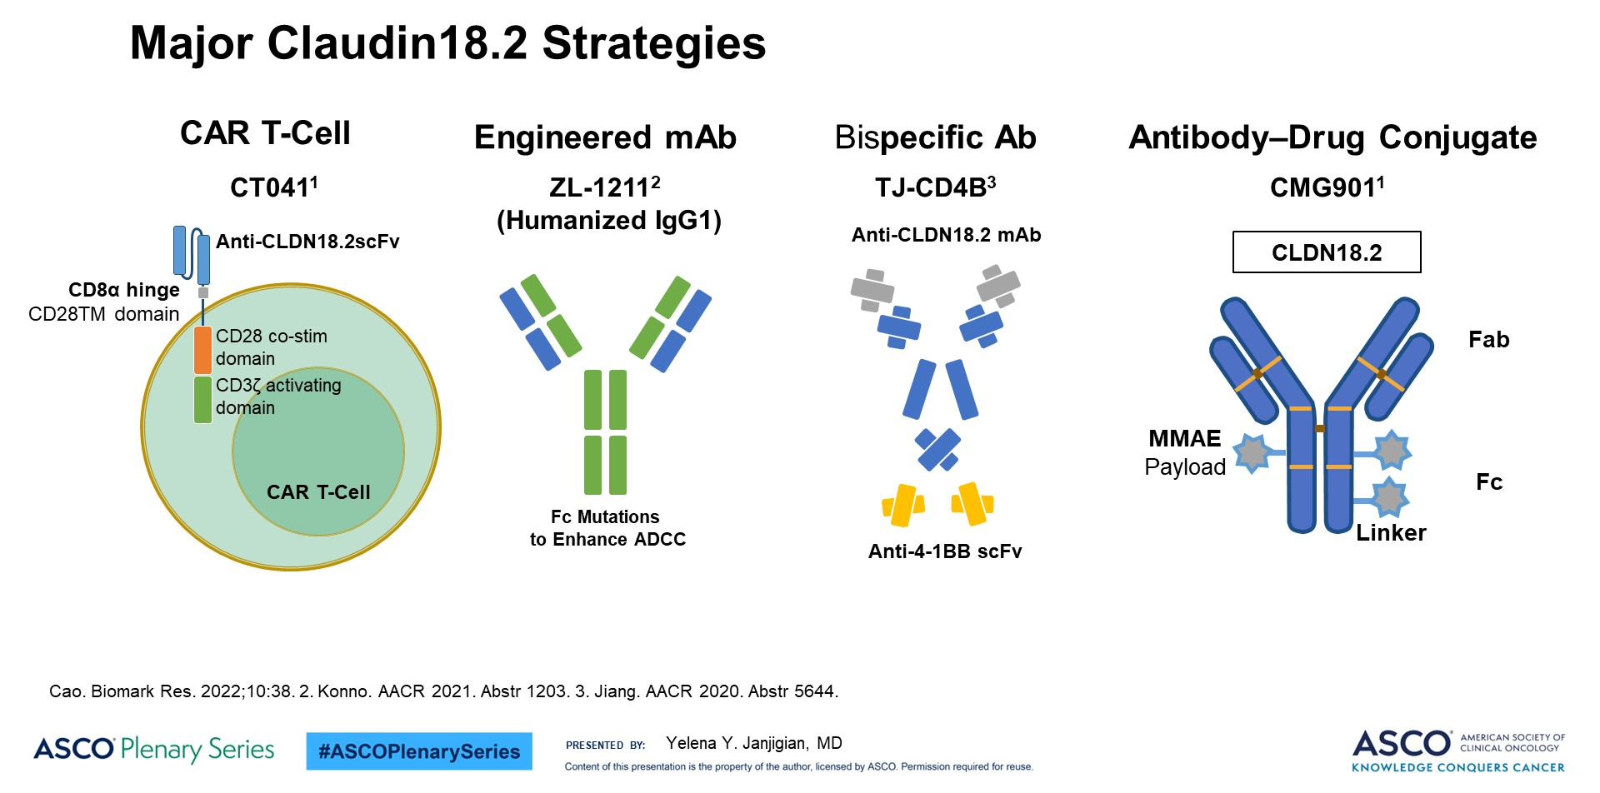
Major Claudin18.2 Strategies

Slide 10
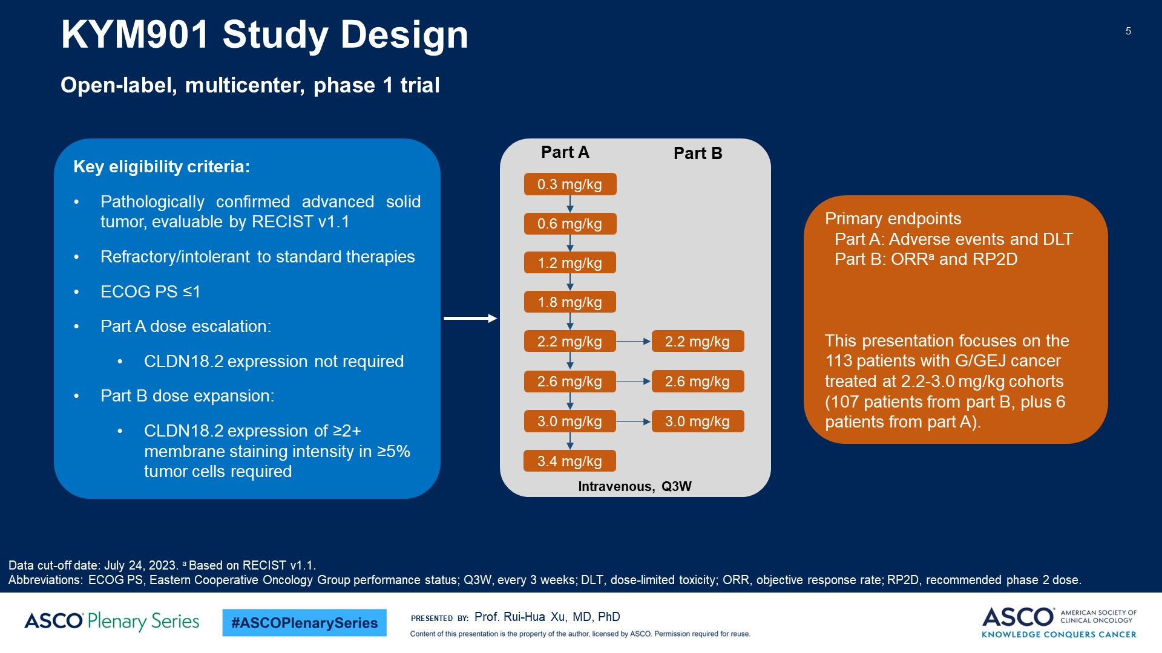
Slide 5

Slide 11
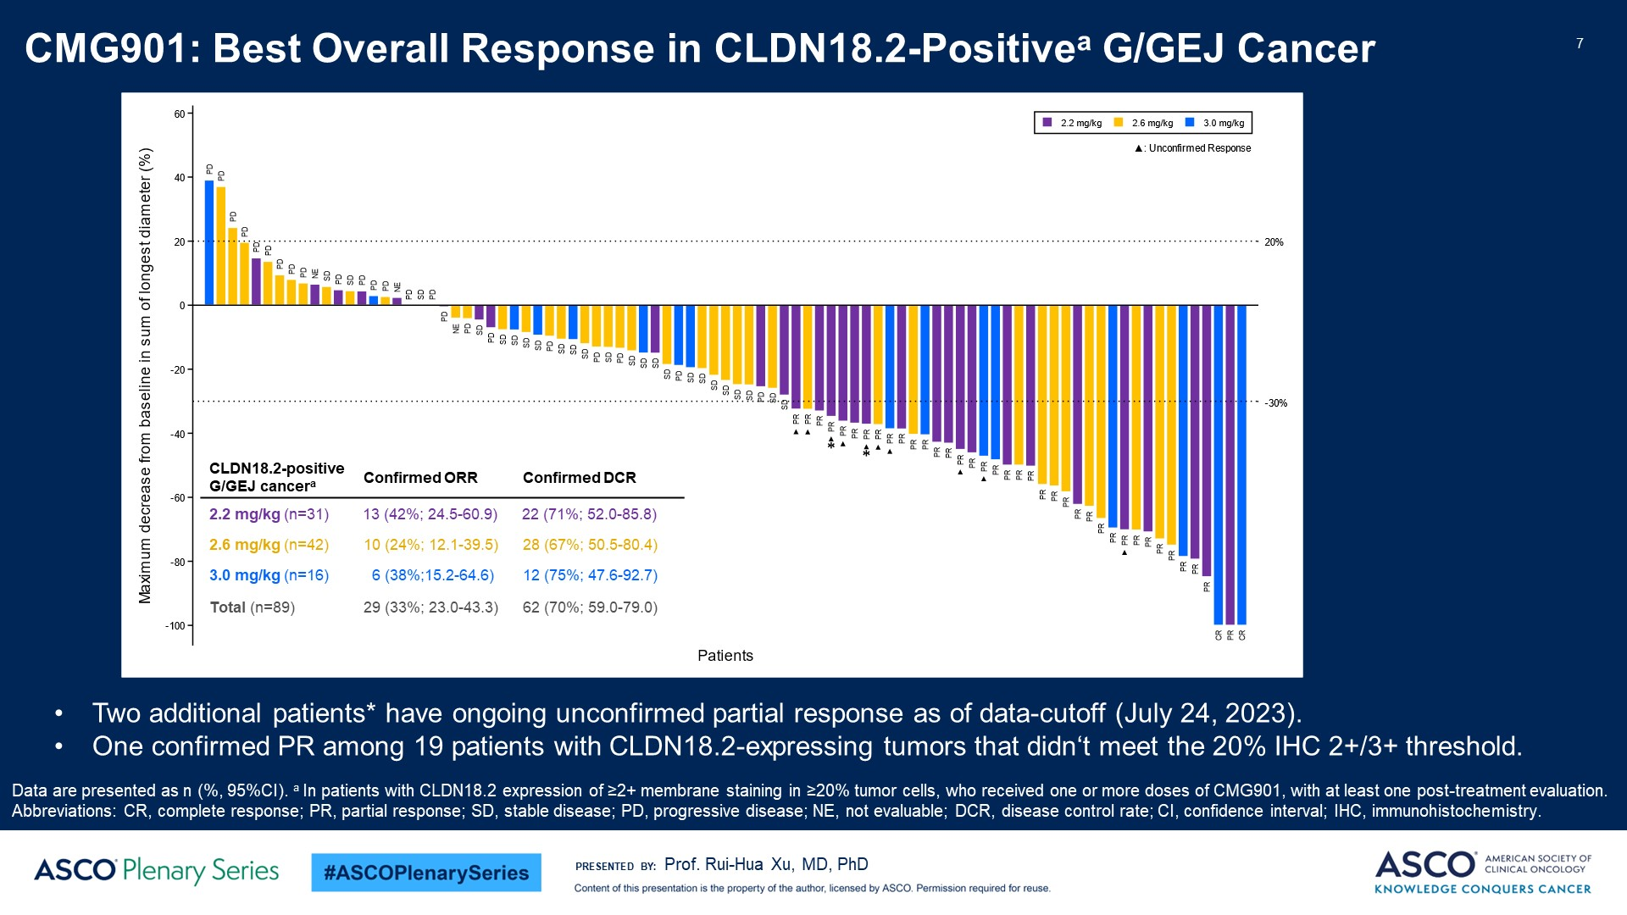
Slide 7

Slide 12
Biomarker Overlap, what do we know?
Can we combine with IO?
ILUSTRO Trial: Ongoing Now, seems to be safe, efficacy is pending
Feature/Biomarker | Kubota Y, et al. |  | Pellino A, et al. |  | Jia K, et al.
 | CLDN18.2+ (n= 98) | CLDN18.2- (n = 310) | CLDN18.2+ (n = 117) | CLDN18.2- (n = 233) | CLDN18.2+ (n = 42) | CLDN18.2- (n = 38)
HER2- | 83 (85%) | 267 (85%) | 100 (85%) | 198 (85%) | 33 (79%) | 25 (66%)
HER2+ | 15 (15%) | 43 (14%) | 17 (15%) | 35 (15%) | 9 (21%) | 13 (34%)
FGFR2b+ | N/A | N/A | N/A | N/A | N/A | N/A
FGFR2b- | N/A | N/A | N/A | N/A | N/A | N/A
pMMR/MSS | 93 (96%) | 291 (94%) | 102 (87%) | 194 (83%) | 36 (86%) | 33 (87%)
dMMR/MSI | 5 (5%) | 19 (6%) | 15 (13%) | 39 (17%) | 6 (14%) | 5 (13%)
EBV+ | 4 (4%) | 11 (4%) | 7 (6%) | 1 (0.4%) | 8 (19%) | 2 (5%)
EBV- | 94 (96%) | 299 (96%) | 110 (94%) | 232 (99.5%) | 34 (81%) | 36 (95%)
PD-L1- (CPS < 1) | 24 (26%) | 68 (23%) | 87 (74%) | 165 (71%) | 9 (21%) | 8 (21%)
PD-L1+ (CPS > 1) | 69 (74%) | 225 (77%) | 30 (26%) | 68 (29%) | 33 (79%) | 30 (79%)
PD-L1+ (CPS > 5) | 39 (42%) | 293 (52%) | 21 (18%) | 50 (21%) | N/A | N/A
PD-L1+ (CPS > 10) | N/A | N/A | N/A | N/A | 19 (45%) | 17 (45%)
Diffuse Type | 47 (48%) | 137 (44%) | 47 (40%) | 70 (30%) | 12 (29%) | 22 (58%)
Intestinal Type | 51 (52%) | 173 (56%) | 54 (46%) | 132 (57%) | 16 (38%) | 6 (16%)
Klempner SJ, Janjigian, Wainberg Z et al, ESMO Open 2023

Slide 13
Claudin 18.2: How to Handle Unique “On Target” Toxicity
Nausea and Vomiting reported with all Claudin 18.2 targeting agents
Most studies suggest tachyphylaxis
Not centrally induced nausea/vomiting
Things that help (Shitara et al Proc GI ASCO 2024):
  Slower infusion times
  ? Steroids
  ? H1/H2 blockers
  Lorazepam

Slide 14
KEYNOTE-811
Study Design
Phase 3, randomized, double-blind study
Key eligibility criteria:
Advanced G/GEJ adenocarcinoma
No prior therapy in advanced setting
HER2-positive
ECOG PS 0 or 1
Stratification:
Geographic region
PD-L1 CPS
Chemotherapy choice
Pembrolizumab 200 mg IV every 3 weeks + trastuzumab and FP or CAPOX for up to 35 cycles
Primary endpoints:
OS
PFS (RECIST v1.1 per BICR)
Secondary endpoints:
ORR (RECIST v1.1 per BICR)
DOR (RECIST v1.1 per BICR)
Safety
N = 698
R
1:1
Placebo IV every 3 weeks + trastuzumab and FP or CAPOX for up to 35 cycles
BICR, blinded independent central review; CAPOX, capecitabine plus oxaliplatin; DOR, duration of response.
Janjigian YY, et al. Nature. 2021;600:727-730. Janjigian YY, et al. Lancet, 2023; 402:2197-2208.
Notes:
Timecode:

Slide 15
KEYNOTE-811
PFS at IA3: 38.5 Months of Follow Up
All patients
PD-L1 CPS ≥1
 | Pembro | Placebo
Median PFS, mo 95% CI | 10.0 8.6-12.2 | 8.1 7.1-8.6
HR (95% CI) | 0.73 (0.61-0.87)
 | Pembro | Placebo
Median PFS, mo 95% CI | 10.9 8.5-12.5 | 7.3 6.8-8.5
HR (95% CI) | 0.71 (0.59-0.86)
100
100
90
90
80
80
70
70
60
60
PFS, %
50
50
PFS, %
40
40
30
24%
30
25%
20
17%
18%
20
10
15%
10
14%
11%
10%
0
0
0
3
6
9
12
15
18
21
24
27
30
33
36
39
42
45
48
51
0
3
6
9
12
15
18
21
24
27
30
33
36
39
42
45
48
51
No. at Risk
Time, months
No. at Risk
Time, months
Pembrolizumab gp
350
296
234
173
139
102
84
67
59
53
41
31
24
20
14
6
2
1
Pembrolizumab gp
298
250
200
151
123
91
74
63
56
51
39
30
23
20
14
6
2
1
Placebo gp
348
274
184
121
93
71
55
43
34
25
23
21
17
11
6
4
2
0
Placebo gp
296
231
152
100
78
58
45
34
28
20
18
16
14
10
6
4
2
0
Janjigian YY, et al. Lancet, 2023; 402:2197-2208.

Slide 16
KEYNOTE-811
OS at IA3
All patients
PD-L1 CPS ≥1
 | Pembro | Placebo
Median OS, mo 95% CI | 20.0 17.8-22.1 | 16.8 15.0-18.7
HR (95% CI) | 0.84 (0.70-1.01)
 | Pembro | Placebo
Median OS, mo 95% CI | 20.0 17.9-22.7 | 15.7 13.5-18.5
HR (95% CI) | 0.81 (0.67-0.98)
100
100
90
90
80
80
70
70
60
55%
60
56%
OS, %
50
OS, %
50
40
47%
40
31%
29%
46%
30
30
20
25%
20
25%
10
10
0
0
0
3
6
9
12
15
18
21
24
27
30
33
36
39
42
45
48
51
54
0
3
6
9
12
15
18
21
24
27
30
33
36
39
42
45
48
51
54
No. at Risk
Months
No. at Risk
Months
Pembrolizumab gp
350
339
311
281
243
220
192
156
126
105
84
69
61
48
37
23
7
2
0
Pembrolizumab gp
298
288
265
241
207
190
166
136
115
96
78
64
58
47
37
23
7
2
0
Placebo gp
348
327
292
259
220
193
165
138
116
96
83
58
51
37
25
15
8
1
0
Placebo gp
296
277
244
215
180
155
135
113
96
80
67
47
41
31
21
12
5
1
0
Janjigian YY, et al. Lancet, 2023; 402:2197-2208.

Slide 17
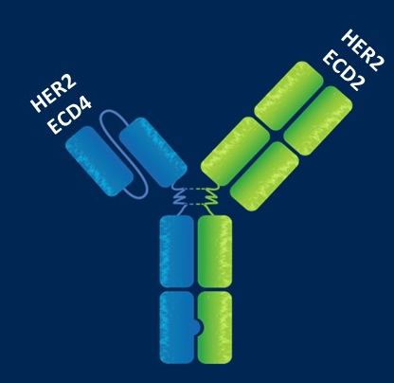
Zanidatamab: Bispecific HER2-Targeted Antibody
A biparatopic antibody that binds 2 distinct sites on HER2 at the same time: ECD4 and ECD2 (trastuzumab-targeted domain and pertuzumab-targeted domain, respectively)
Exclusive trans-binding leads to enhanced receptor clustering and internalization by zanidatamab
Meric-Bernstam F, et al. J Clin Oncol. 2021;39(suppl 3): Abs 164.

Slide 18
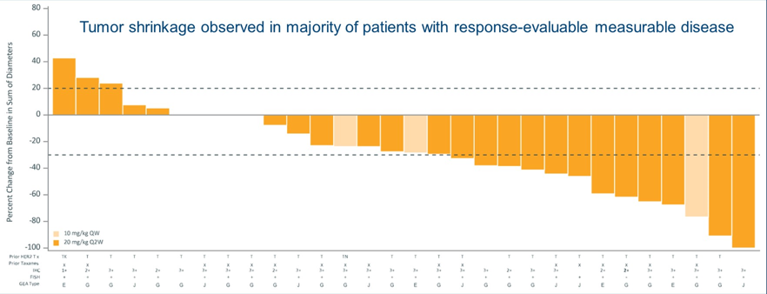
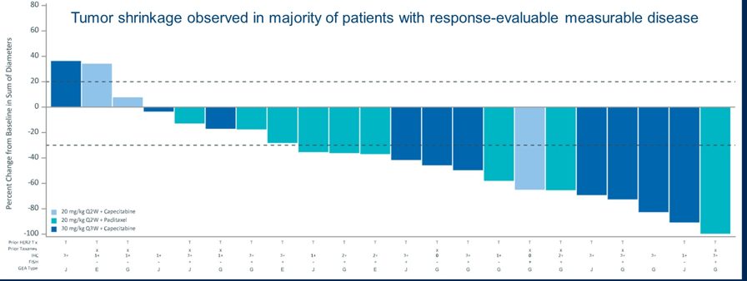
Zanidatamab: Phase 1, Dose Escalation and Expansion Study: Antitumor Activity
Zani monotherapy
Zani + chemotherapy
Meric-Bernstam F, et al. J Clin Oncol. 2021;39(suppl 3): Abs 164.

Slide 19
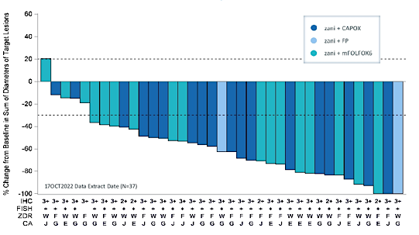
Zanidatamab + Chemotherapy as First Line Treatment for HER2-Expressing mGEA: Phase 2 Results
The majority of patients treated with zanidatamab (Zan) + chemo have reduced target lesion size and have durable objective responses
Change in target lesion size in response-evaluable patients with HER2-positive mGEA
 | Zan + CAPOX (n =18) | Zan + mFOLFOX6 (n = 18) | Zan + FP (n = 2) | Total N = 38
cORR, % | 89 | 67 | 100 | 79
Confirmed best overall response, %
CR | 2 | 1 | 0 | 3
PR | 14 | 11 | 2 | 27
SD | 2 | 3 | 0 | 5
PD | 0 | 3 | 0 | 3
DCR | 100 | 83 | 100 | 92
mDOR, months | 10.4 | NE | NE | 20.4
Elimova E, et al. J Clin Oncol 41, 2023 (suppl 4; abstr 347)
Notes:
Timecode:
Abbreviations
References

Slide 20
HERIZON-GEA-01
Global, randomized, open-label, active comparator, phase 3 trial (NCT05152147):
Evaluate and compare the efficacy and safety of zanidatamab plus chemotherapy with or without tislelizumab to the standard of care (trastuzumab plus chemotherapy)
As first-line treatment for patients with advanced/metastatic HER2-positive GEAs
Unresectable, locally advanced or metastatic GEA
HER2+
No prior therapy in the advanced/metastatic setting
No prior treatment with HER2 agents or checkpoint inhibitors
Any PD-L1 status
ECOG PS ≤ 1
Arm A:
Trastuzumab + chemo (CAPOX or FP)
Primary Endpoints
PFS, OS
Secondary Endpoints
ORR, frequency and severity of AEs, change in HRQOL from baseline
R 1:1:1
Arm B:
Zanidatamab + chemo (CAPOX or FP)
21-day treatment cycles
Arm C:
Zanidatamab + chemo (CAPOX or FP) + tislelizumab
CAPOX, Capecitabine + oxaliplatin; FP: 5-fluorouracil + cisplatin
Tabernero J, et al. Future Oncol. 2022;18:3255-3266.
Notes:
Abbreviations
References

Slide 21

DESTINY-Gastric02 Study Design
DESTINY-Gastric02
An open-label, multicenter phase 2 study in Western patients with HER2+ gastric or GEJ cancer (NCT04014075)
Key eligibility criteria
Pathologically documented, unresectable or metastatic gastric or GEJ cancer
Centrally confirmed HER2 positive disease (defined as IHC 3+ or IHC 2+/ISH+) on biopsy after progression on first-line trastuzumab-containing regimen
ECOG PS 0 or 1
Primary endpoint
Confirmed ORR by ICR
Secondary endpoints^{b}
PFS by ICR
OS
DOR by ICR
Safety and tolerability
T-DXd
6.4 mg/kg Q3W N = 79ª
DESTINY-Gastric02 is the first study focused only on second-line T-DXd monotherapy in Western patients with HER2+ gastric/GEJ cancer who have progressed on a trastuzumab-containing regimen
  It is the follow-on study to DESTINY-Gastric01, which evaluated T-DXd third-line or later in Asian patients¹
Patients were enrolled in Europe (Belgium, Great Britain, Italy, Spain) and the United States (data cutoff: April 9, 2021)
ªEnrollment of 80 patients was planned; actual enrollment was 79 patients.
^{b}Other secondary endpoints were ORR, PFS, and DOR by investigator assessment, pharmacokinetics, anti-drug antibodies, and patient-reported outcomes.
1. Shitara K et al. N Engl J Med. 2020;382:2419-30.
DOR, duration of response; ECOG PS, Eastern Cooperative Oncology Group performance status; GEJ, gastroesophageal junction; HER2, human epidermal growth factor receptor 2; ICR, independent central review; IHC, immunohistochemistry; ISH, in situ hybridization; ORR, objective response rate; OS, overall survival; PFS, progression- free survival; T-DXd, trastuzumab deruxtecan; Q3W, every 3 weeks.

Slide 22
DESTINY-Gastric02
Efficacy Endpoints
 | Patients (N = 79)
Confirmed ORRª, n (%) | 33 (42) (95% CI, 27.3-49.6)
Confirmed best overall response, n (%) CR PR SD PD Not evaluable | 4 (5) 29 (37) 31 (39) 13 (16) 2 (3)
Median DOR,^{b} months | 8.1 (95% CI, 5.9-NE)
Median PFS,^{d} months | 5.6 (95% CI, 4.2-7.3)
Median OS, months | 12.1 (95% CI, 9.4-15.4)
Median follow up, months | 10.2 (range, 5.6-12.9)
Van Cutsem et al Lancet Oncology 2023

Slide 23
HER2+ Disease
Clinical Trials:
  KEYNOTE-811: Chemo + Trastuzumab + Pembro now approved for HER2+ in PDL1+
  DS8201 approved for 2nd line (and beyond) HER2+ disease
    Await randomized Phase III data in 2nd line (DESTINY-Gastric04)
    Pneumonitis, which patients? Is 5.4 a better dose?
  Zanidatamab: Promising preliminary results, results expected 2025
Future Directions:
  ctDNA: Probably as sensitive for HER2 as tissue (Chakrabarti et al, ESMO GI 2023)
  Front line therapies beyond chemo + trastuzumab/pembro
  HER2 Low: RR of 26% in HER2 2+, 9% in HER2 1+ (Yamaguchi et al, JCO, 2023)

Slide 24
Refractory Disease
Clinical Implications:
  FOLFIRI/Ram: RAMIRIS Trial Ongoing(Consider in 2nd or 3rd line)
  JCOG: Maybe less benefit in post Paclitaxel/Ram
  TAGS: TAS 102
Future Directions:
  Novel ADC’s: TROP2, B7H4

