Slide 1
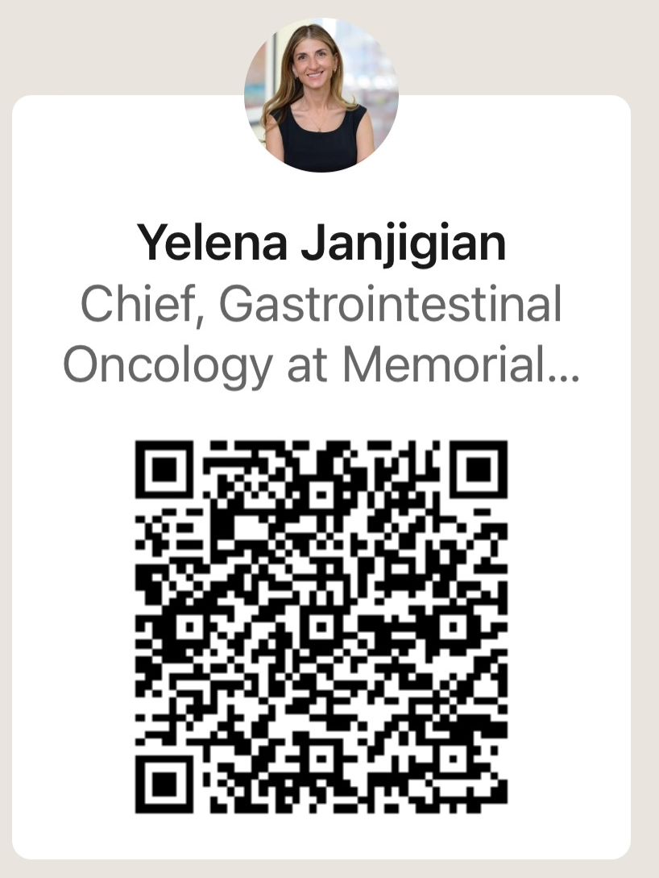
Immunotherapy in Gastroesophageal Cancers
Yelena Y. Janjigian, MD
Attending Physician
Chief, Gastrointestinal Oncology Service
Memorial Sloan Kettering Cancer Center
Email: janjigiy@mskcc.org
Monday, February 5th | 30 minutes
3:00 – 3:30 pm

Slide 2
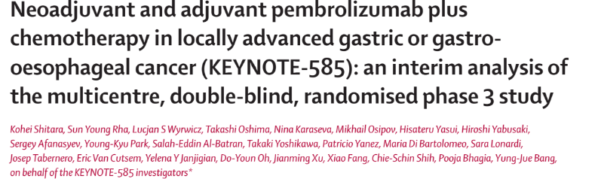

Slide 3
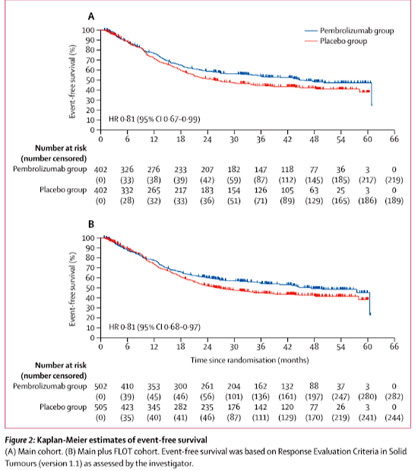
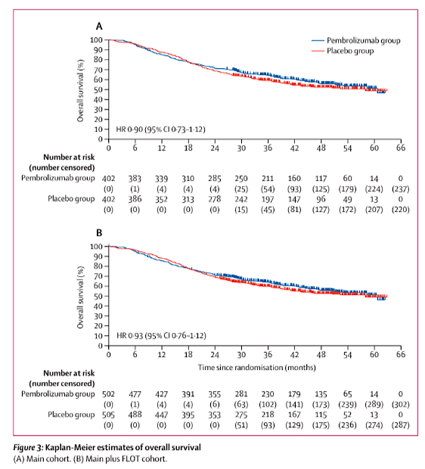

Slide 4
Pathological complete response to 5-fluorouracil, leucovorin, oxaliplatin and docetaxel (FLOT) with or without durvalumab in resectable gastric and gastroesophageal junction cancer: subgroup analysis by region from the Phase 3, randomized, double-blind MATTERHORN study
Yelena Y. Janjigian, MD
Yelena Y. Janjigian¹, Salah-Eddin Al-Batran², Zev A. Wainberg³, Eric Van Cutsem⁴, Daniela Molena⁵, Kei Muro⁶, Woo Jin Hyung⁷, Lucjan Wyrwicz⁸, Do-Youn Oh⁹, Takeshi Omori¹⁰, Markus Moehler¹¹,
Marcelo Garrido¹², Sulene C.S. Oliveira¹³, Moishe Liberman¹⁴, Victor Castro Oliden¹⁵, Mehmet Bilici¹⁶, John F. Kurland¹⁷, Ioannis Xynos¹⁸, Helen Mann¹⁸, Josep Tabernero¹⁹
¹Gastrointestinal Oncology Service, Memorial Sloan Kettering Cancer Center, New York, NY, USA; ²Institute of Clinical Cancer Research, Krankenhaus Nordwest, University Cancer Center, Frankfurt, Germany; ³Department of Gastrointestinal Medical Oncology,
David Geffen School of Medicine at UCLA, Los Angeles, CA, USA; ⁴Department of Gastroenterology/Digestive Oncology, University Hospitals Leuven and KU Leuven, Leuven, Belgium; ⁵Division of Thoracic Surgery, Memorial Sloan Kettering Cancer Center,
New York, NY, USA; ⁶Department of Clinical Oncology, Aichi Cancer Center Hospital, Nagoya, Japan; ⁷Department of Surgery, Yonsei University College of Medicine, Seoul, Republic of Korea; ⁸Department of Oncology and Radiotherapy, Maria Sklodowska-Curie
National Research Institute of Oncology, Warsaw, Poland; ⁹Division of Medical Oncology, Department of Internal Medicine, Seoul National University Hospital; Cancer Research Institute, Seoul National University College of Medicine, Seoul, Republic of Korea; ¹⁰Department of Gastroenterological Surgery, Osaka International Cancer Institute, Osaka, Japan; ¹¹Research Center for Immunotherapy (FZI), Johannes Gutenberg-University Clinic, Mainz, Germany; ¹²Hemato-Oncology Department, SAGA Clinical Trial Centre and Universidad Mayor, Santiago, Chile; ¹³Clinical Oncology, The Clinical Research Center, Northern Riograndense League Against Cancer, Natal, Rio Grande do Norte, Brazil; ¹⁴Division of Thoracic Surgery, Department of Surgery, Centre Hospitalier de l'Université de Montréal, Centre de Recherche du CHUM, Montréal, QC, Canada; ¹⁵National Institute of Neoplastic Diseases (INEN), Lima, Peru; ¹⁶Department of Medical Oncology, Atatürk University Faculty of Medicine, Erzurum, Turkey; ¹⁷Oncology R&D, Late-Stage Development, AstraZeneca, Gaithersburg, MD, USA; ¹⁸ Oncology R&D, Late-Stage Development, AstraZeneca, Cambridge, UK; ¹⁹Medical Oncology Department, Vall d’Hebron Hospital Campus & Institute of Oncology (VHIO), IOB-Quiron, UVic-UCC, Barcelona, Spain
Yelena Y. Janjigian, MD

Slide 5
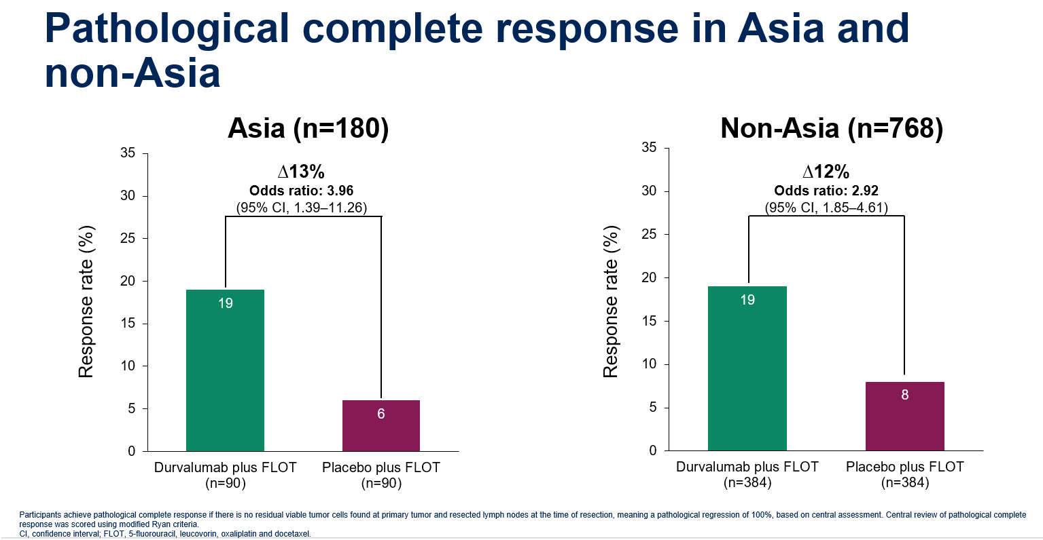
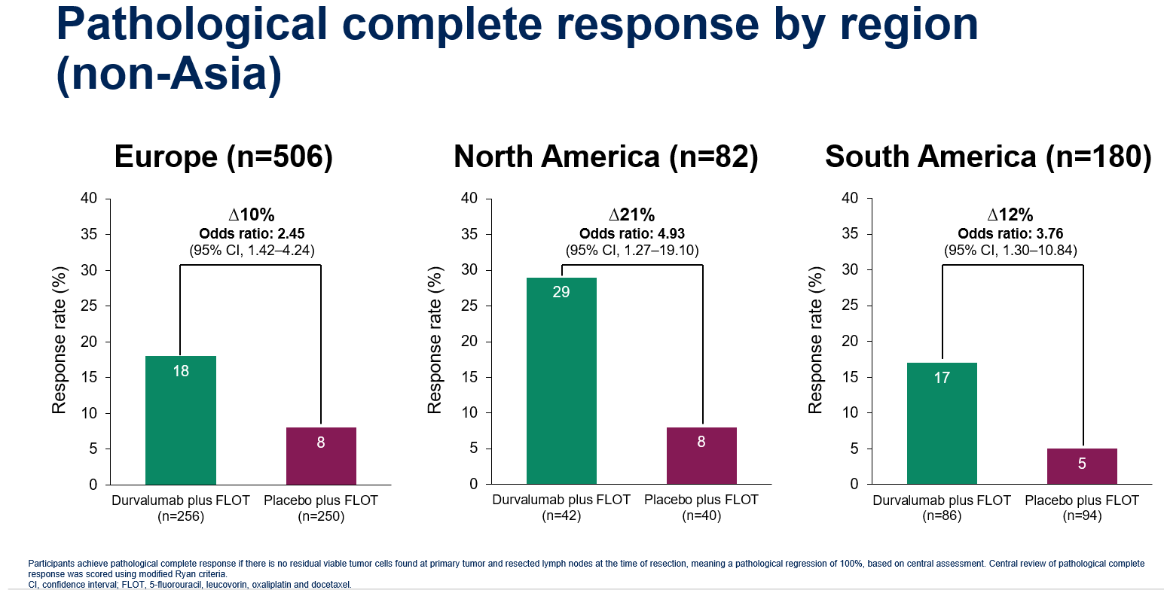
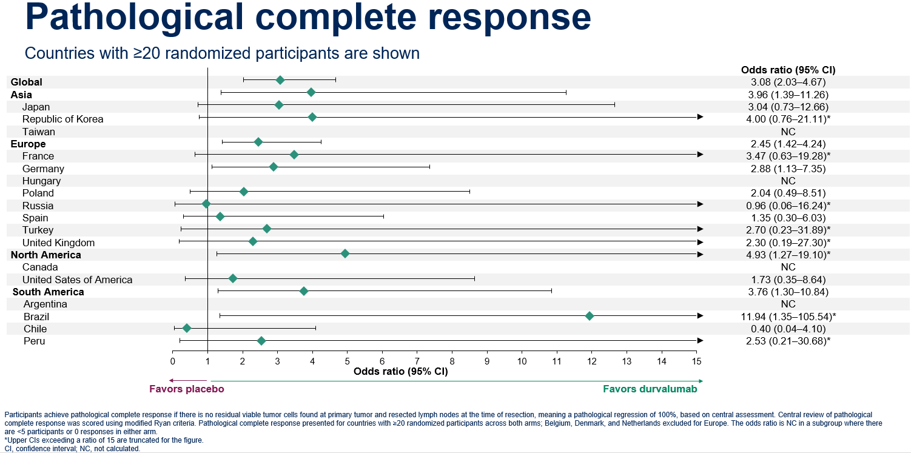

Slide 6
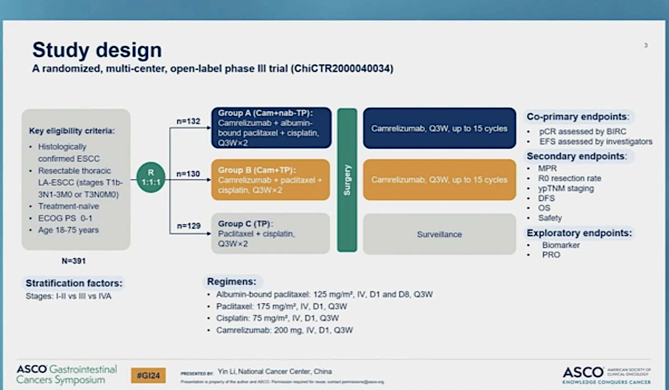
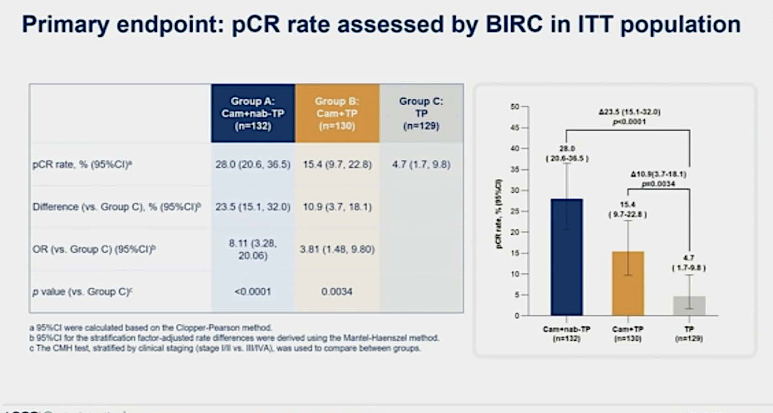
Chemotherapy plus camrelizumab versus chemotherapy alone as neoadjuvant treatment for resectable esophageal squamous cell carcinoma (ESCORT-NEO): A multicenter, randomized phase III trial.

Slide 7
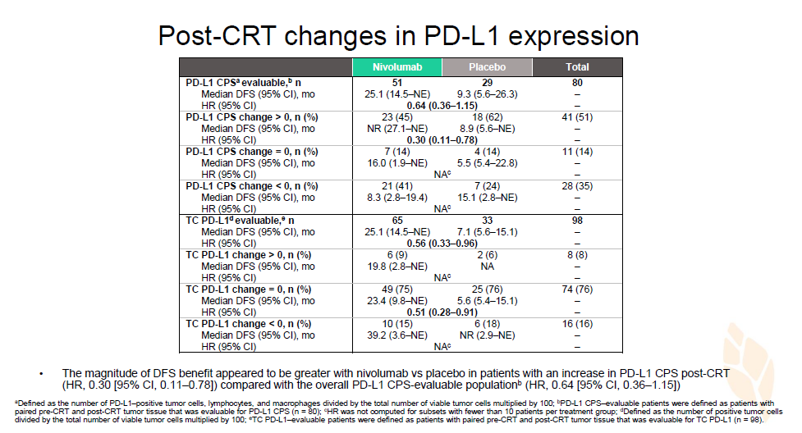
Adjuvant nivolumab vs placebo in resected esophageal or gastroesophageal junction cancer following neoadjuvant chemoradiotherapy: First report of comprehensive biomarker analyses from CheckMate 577

Slide 8
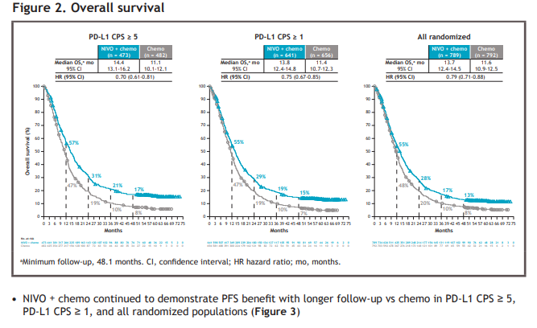
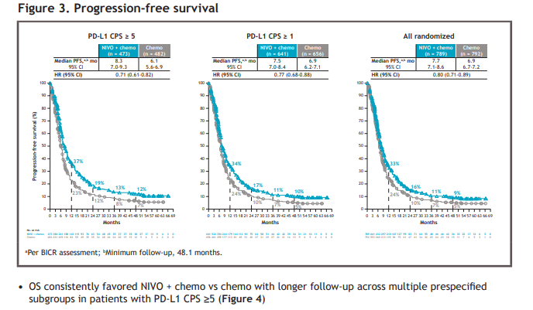
(Figure 2)

Slide 9
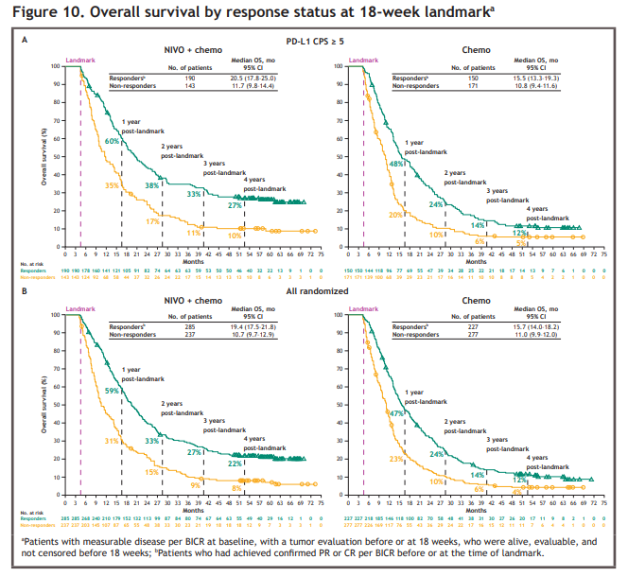
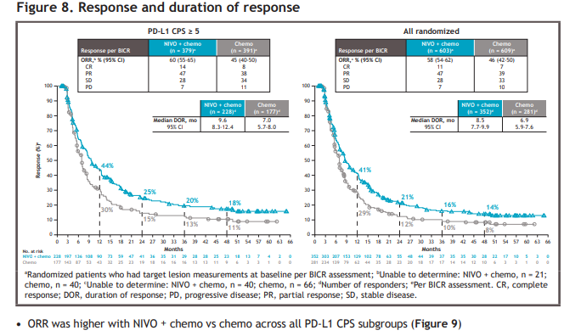

Slide 10
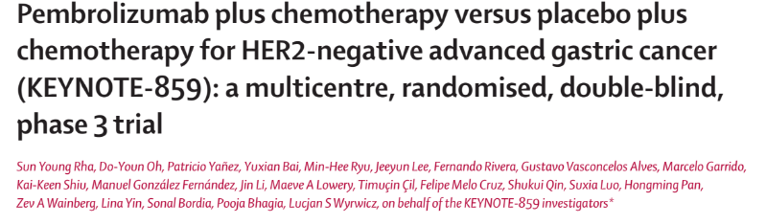

Slide 11
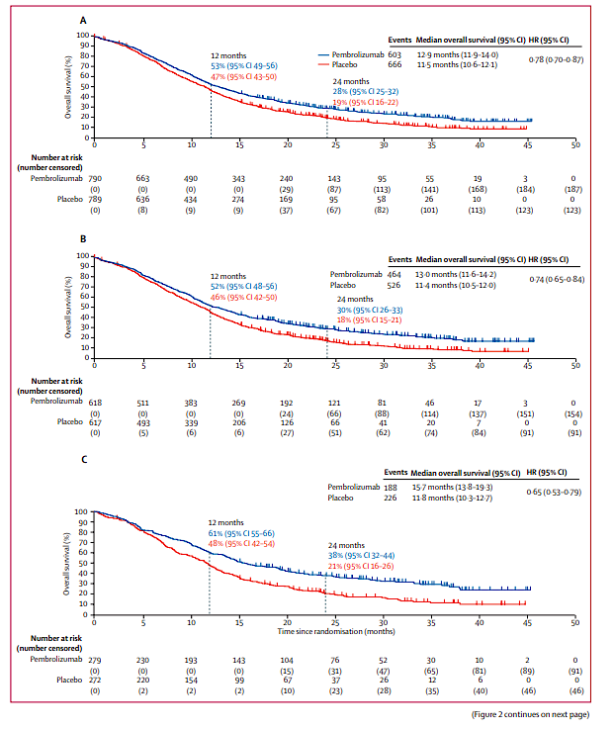
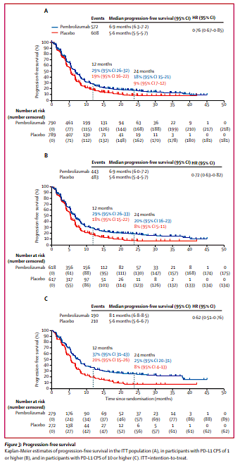

Slide 12
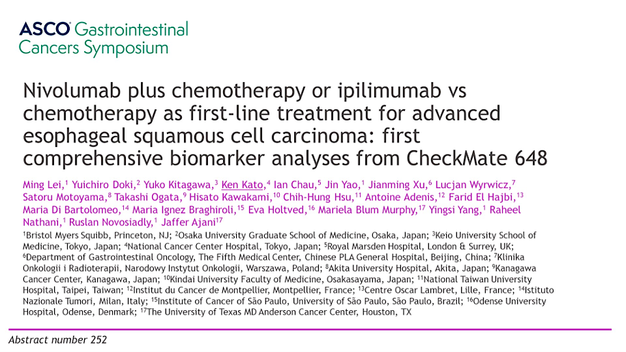

Slide 13
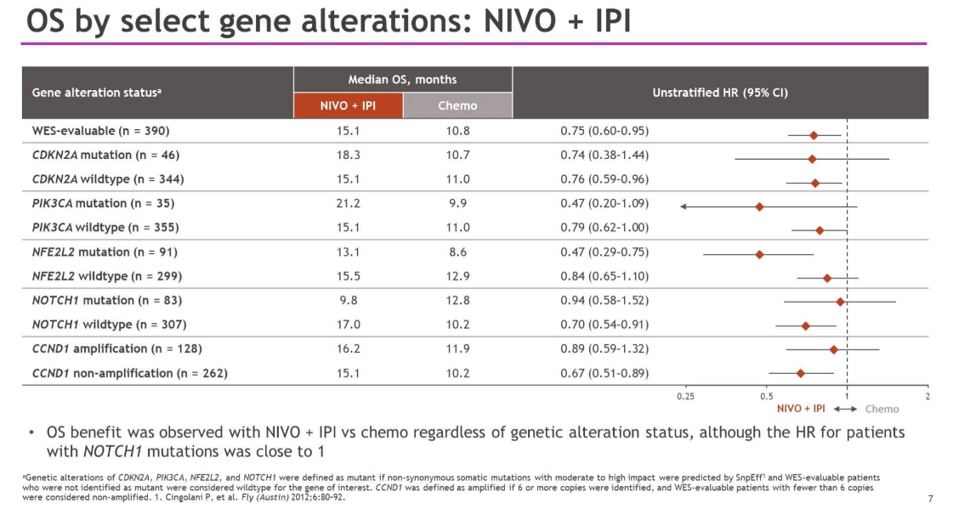
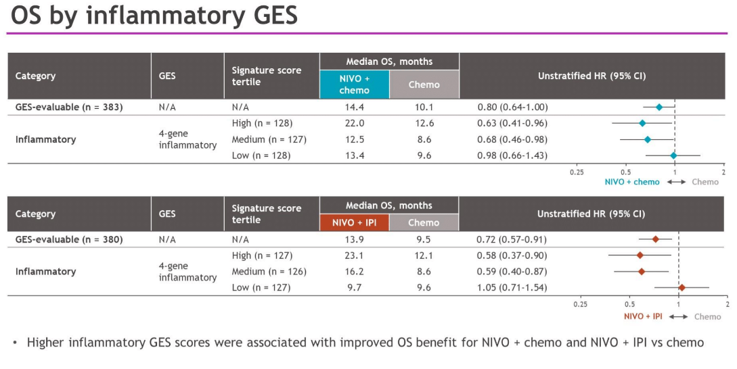
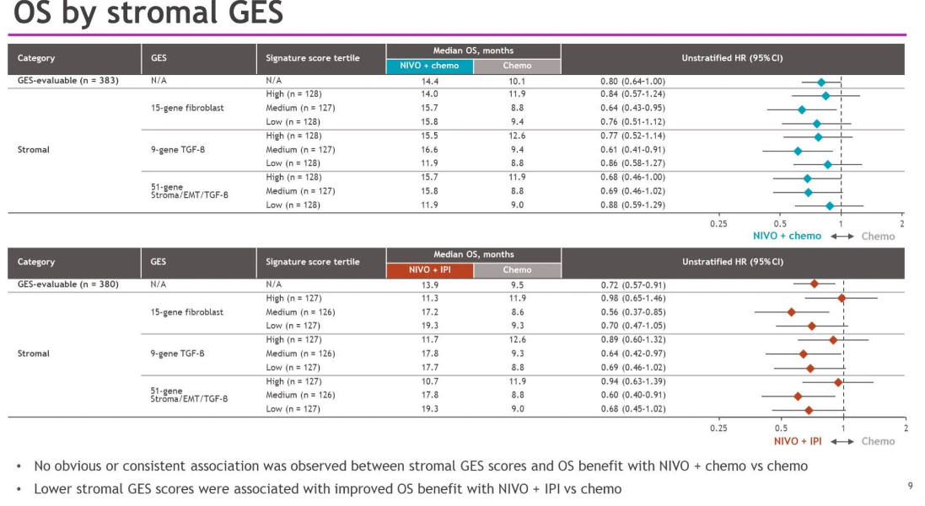
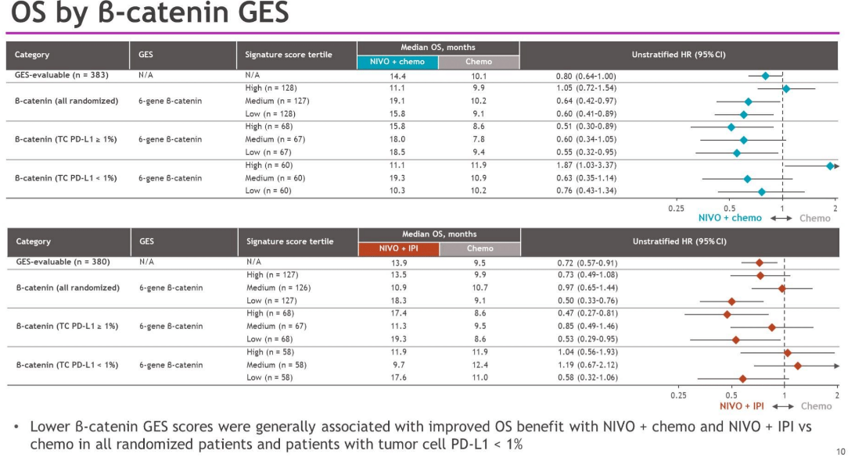

Slide 14
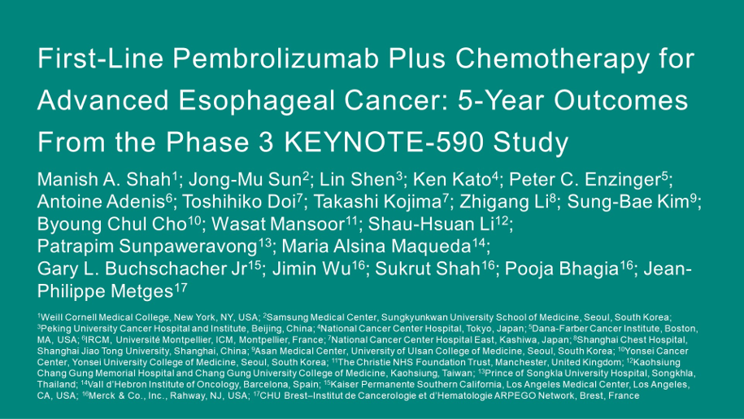
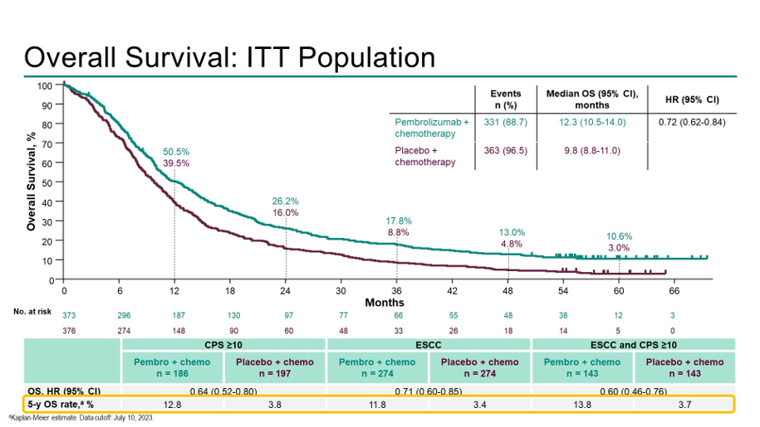
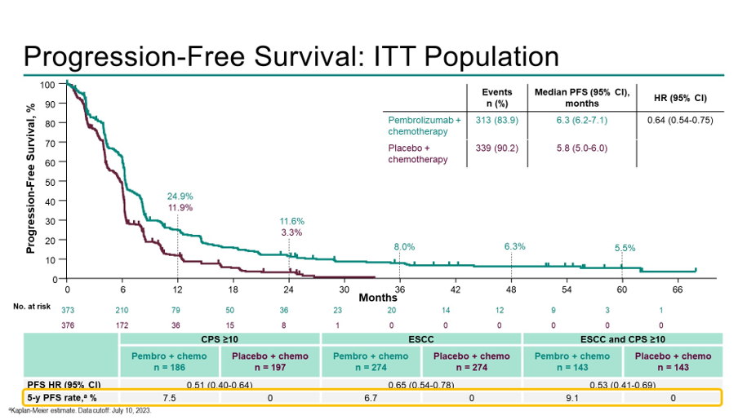

Slide 15
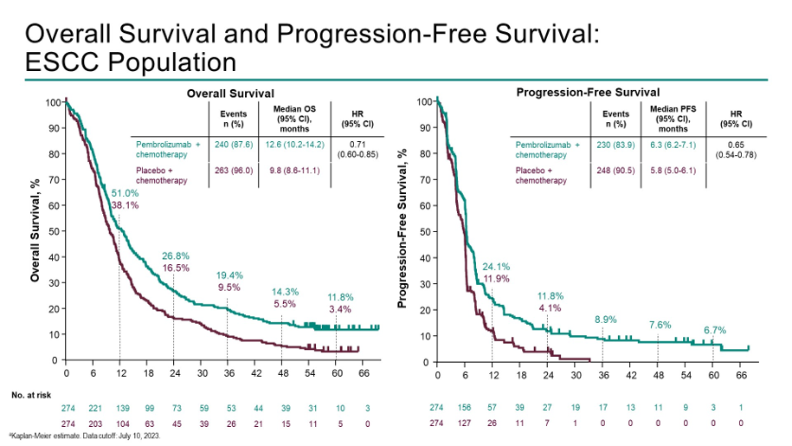
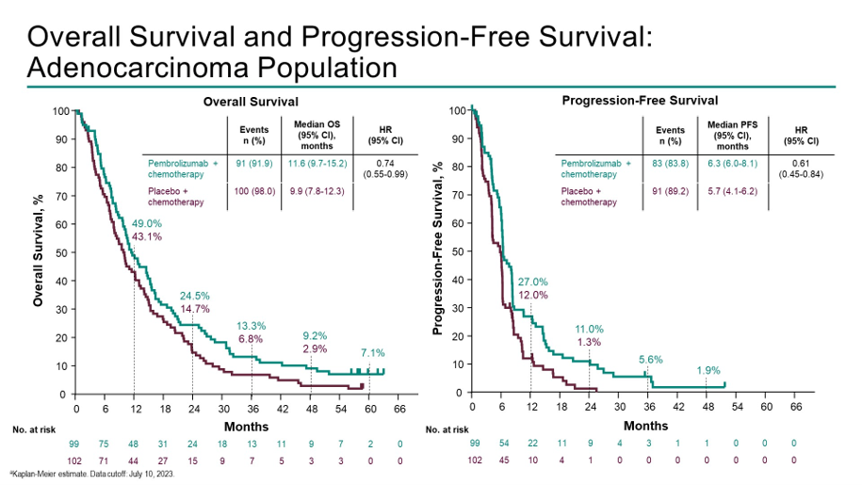

Slide 16
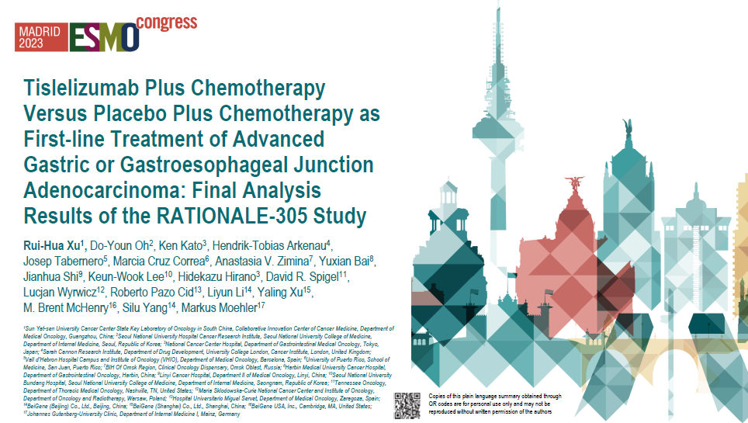

Slide 17
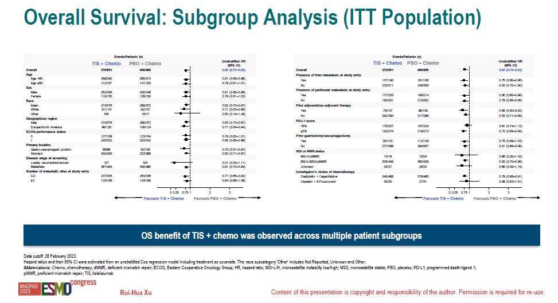
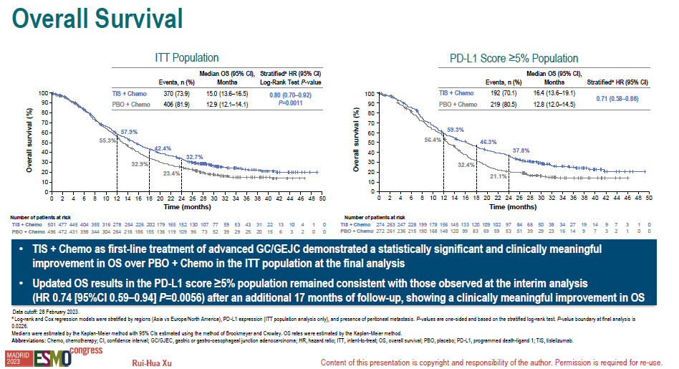
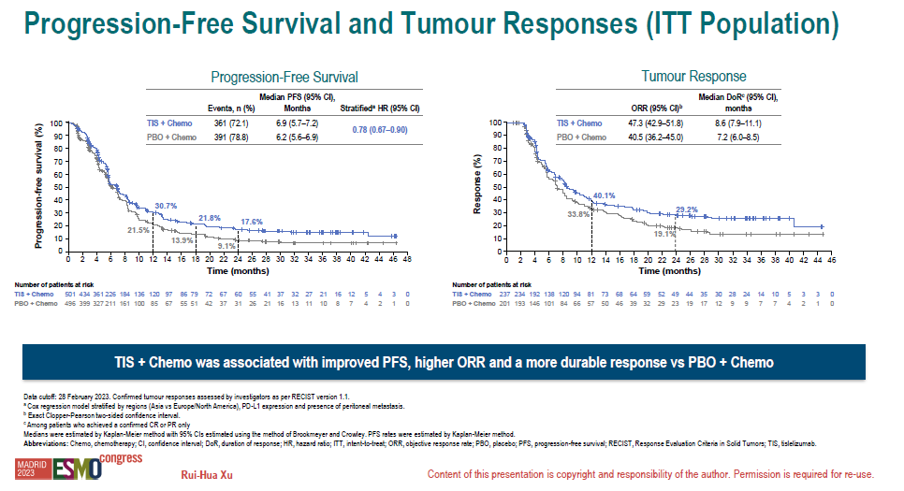

Slide 18
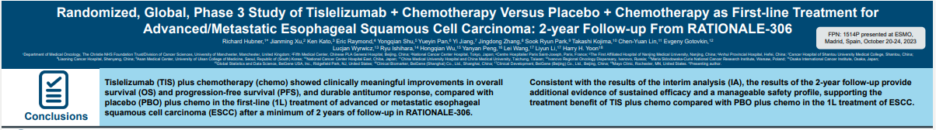
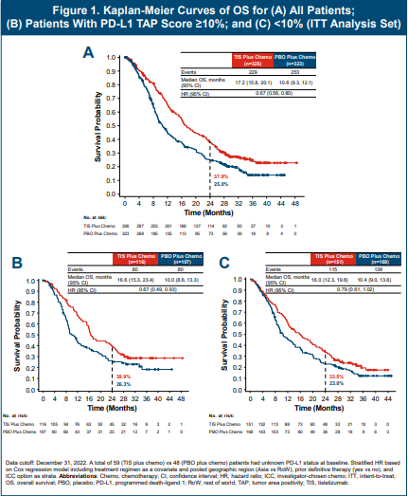
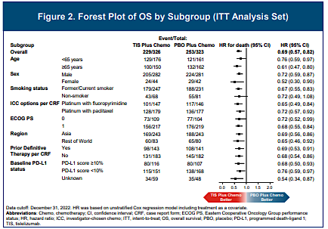

Slide 19
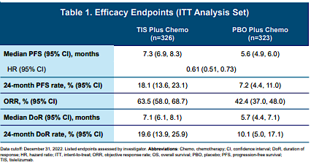
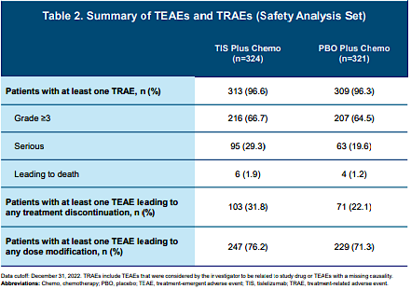

Slide 20
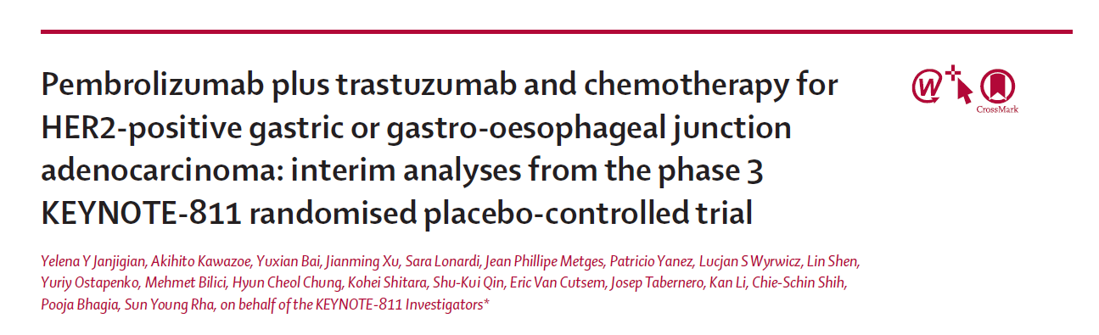
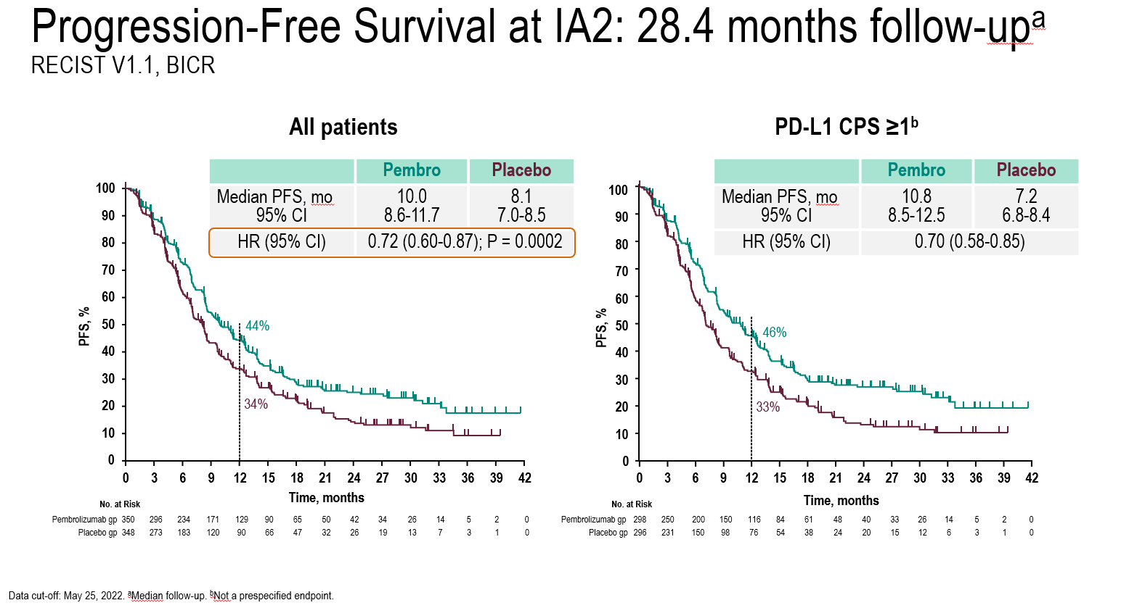
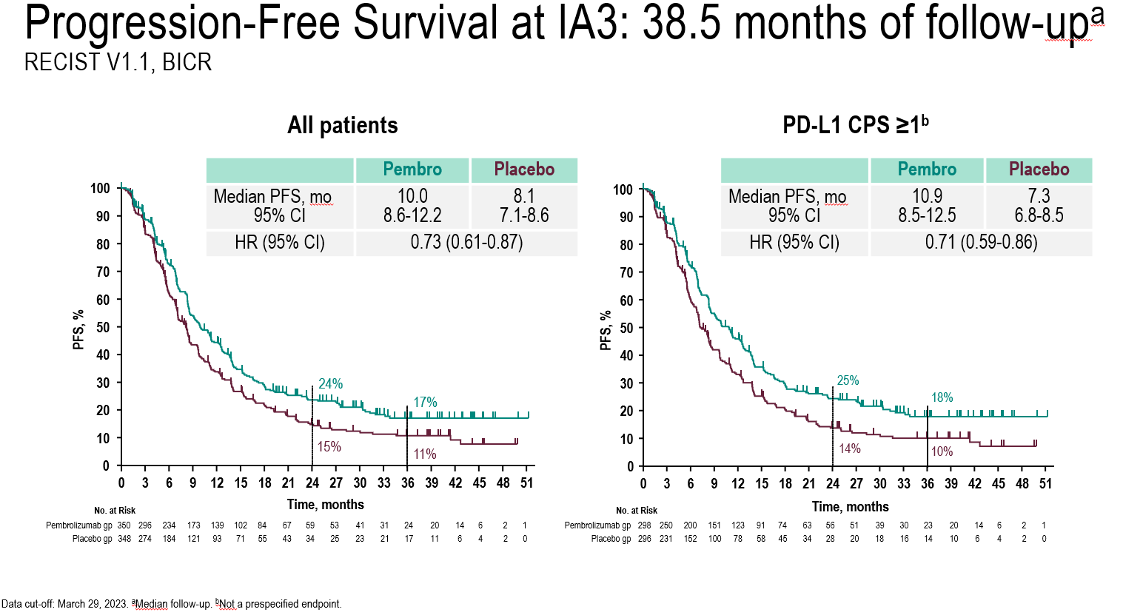

Slide 21
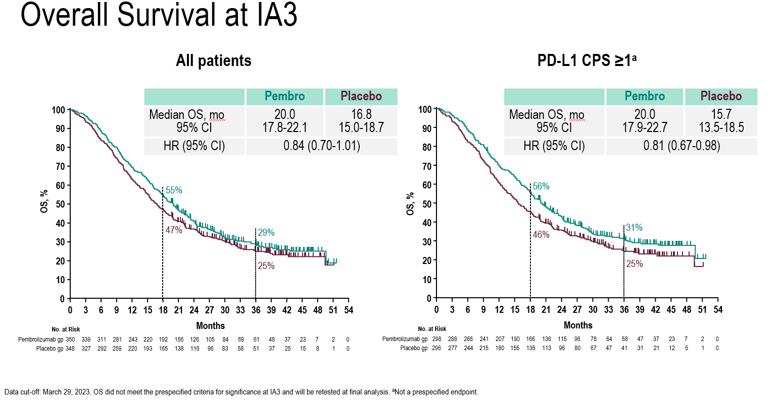
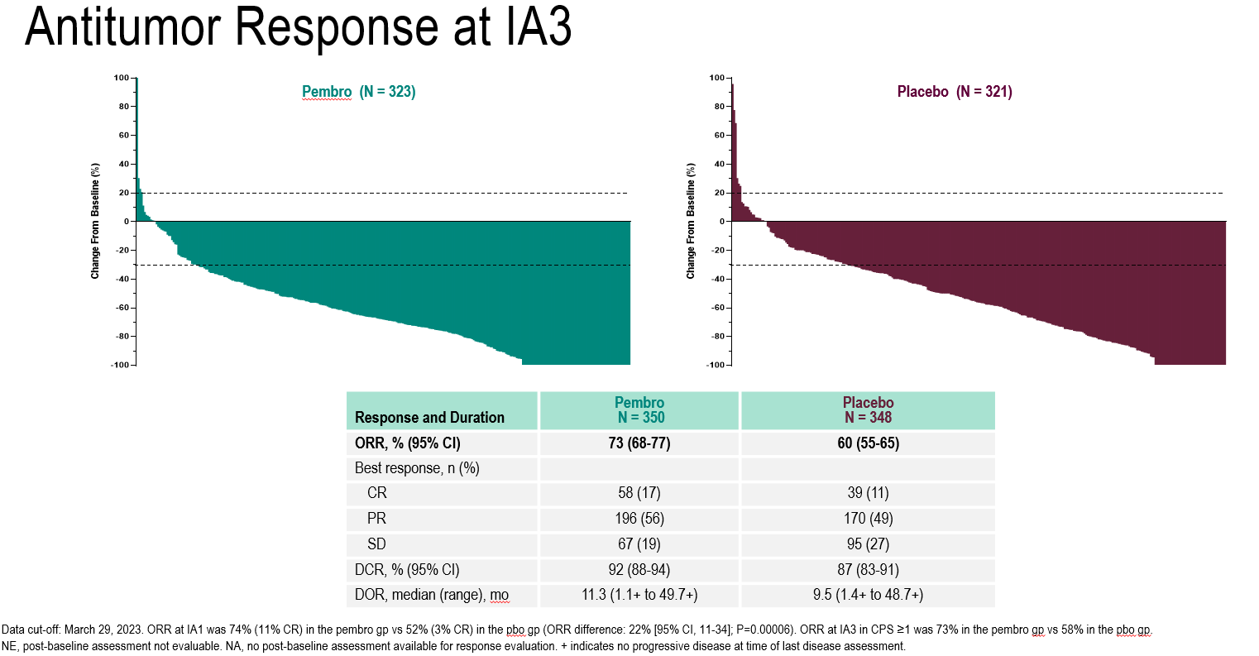

Slide 22
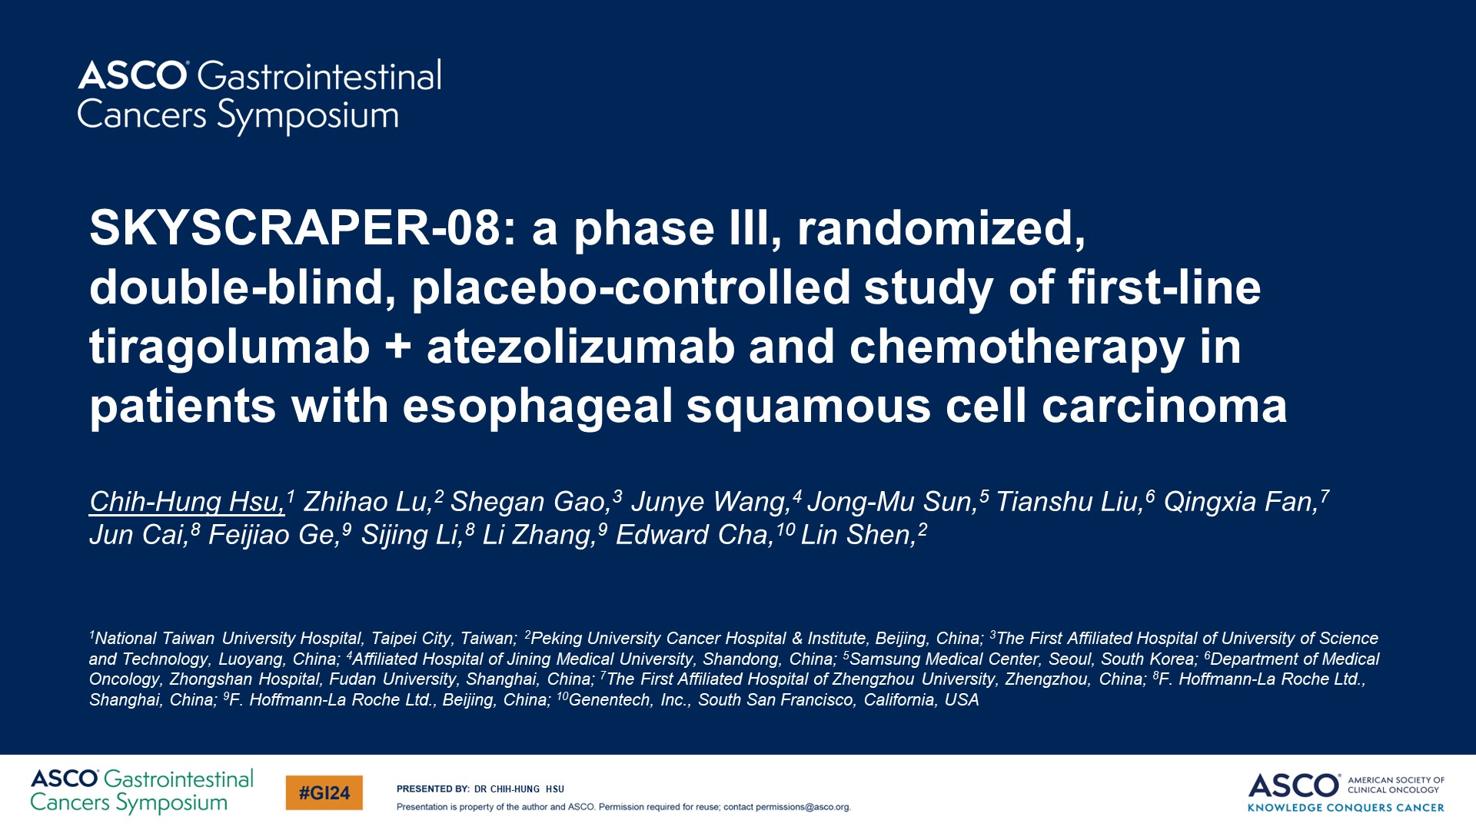

Slide 23
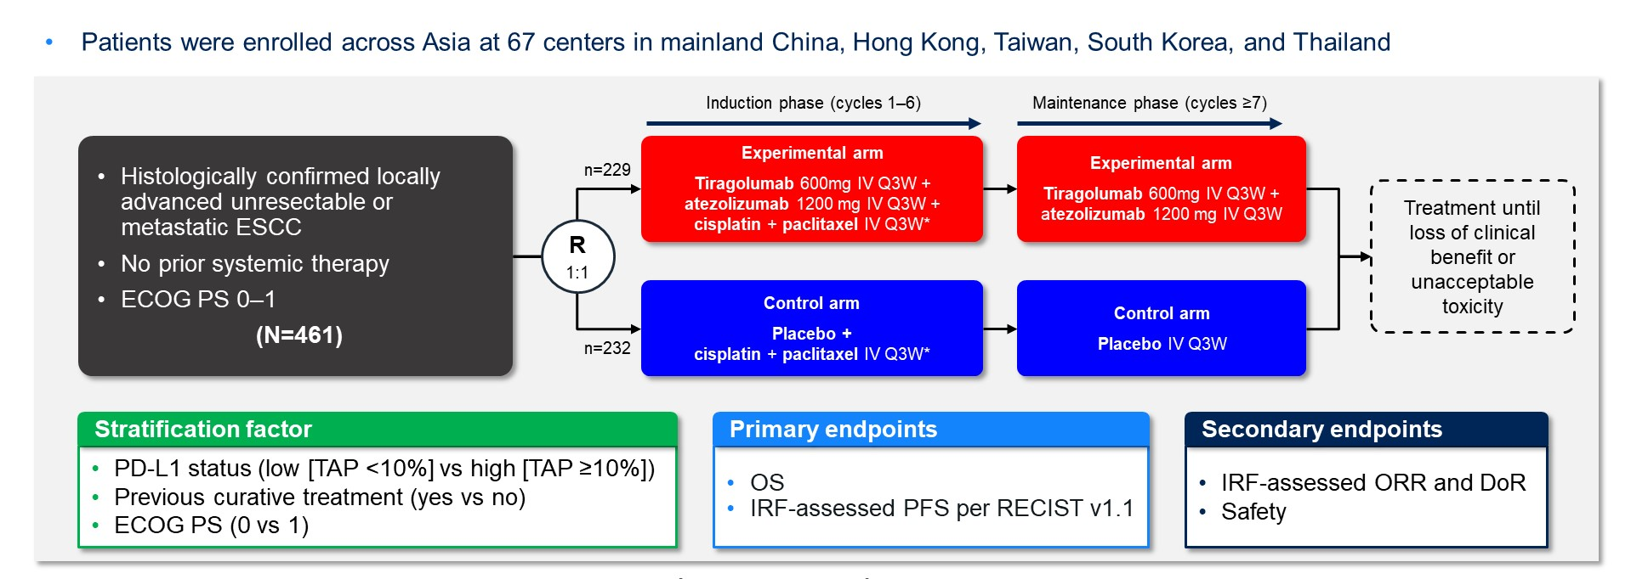
SKYSCRAPER-08: Study Design
Hsu C-H et al. Gastrointestinal Cancers Symposium 2024;Abstract 245.

Slide 24
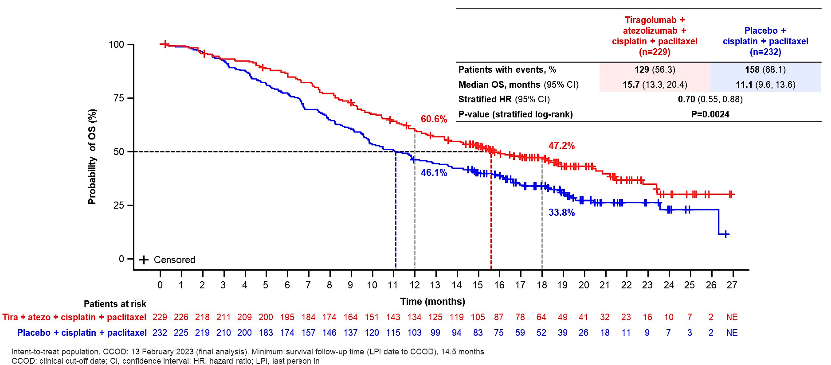
SKYSCRAPER-08: Final OS Analysis
Hsu C-H et al. Gastrointestinal Cancers Symposium 2024;Abstract 245.

Slide 25
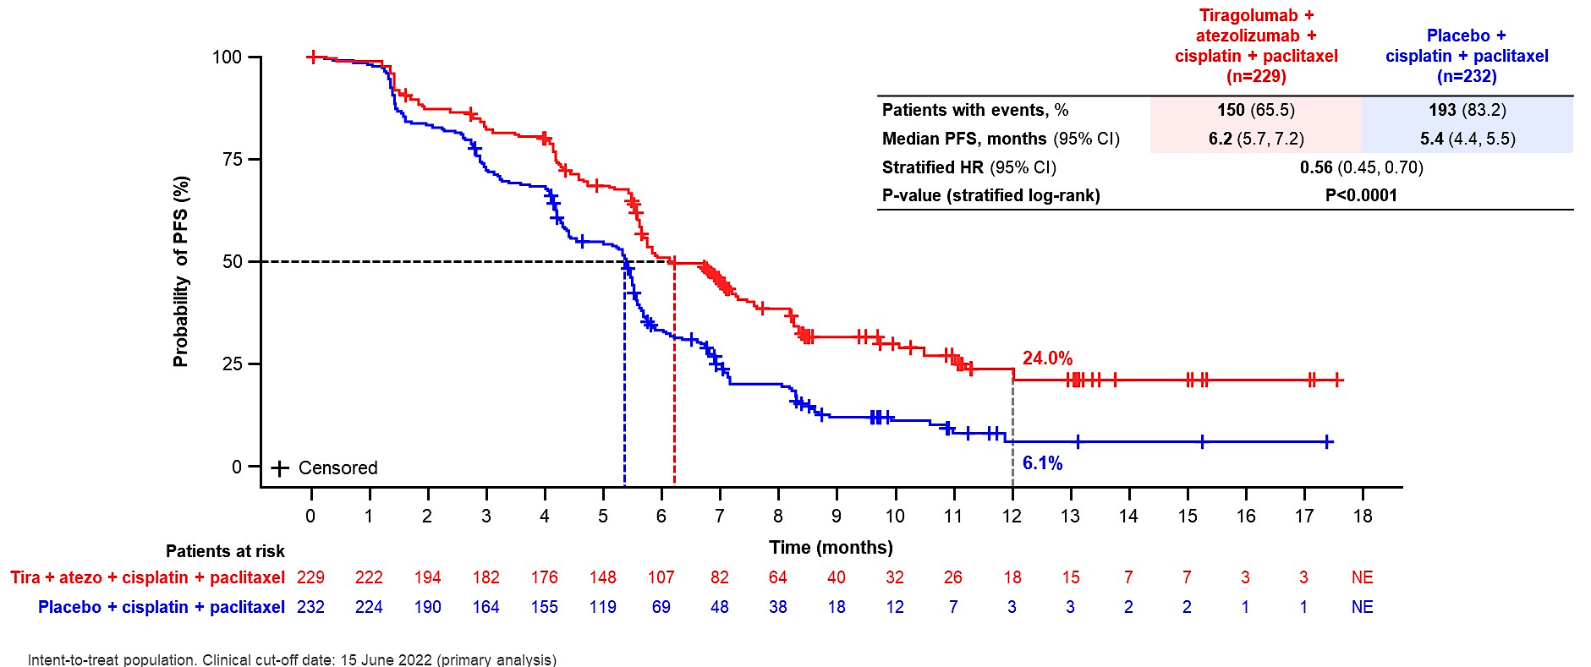
SKYSCRAPER-08: Independent Review Facility-Assessed PFS
Hsu C-H et al. Gastrointestinal Cancers Symposium 2024;Abstract 245.

