Slide 1
Year in Review: Melanoma and
Nonmelanoma Skin Cancers
A CME/MOC-Accredited Live Webinar
Wednesday, July 10, 2024
5:00 PM – 6:00 PM ET
Faculty
Evan J Lipson, MD
Moderator
Neil Love, MD

Slide 2


Faculty
Evan J Lipson, MD
Associate Professor, Medical Oncology
Bloomberg-Kimmel Institute
for Cancer Immunotherapy
Johns Hopkins School of Medicine
The Sidney Kimmel Comprehensive Cancer Center
Baltimore, Maryland
MODERATOR
Neil Love, MD
Research To Practice
Miami, Florida

Slide 3
Commercial Support
This activity is supported by an educational grant from Merck.
Research To Practice CME Planning Committee Members,
Staff and Reviewers
Planners, scientific staff and independent reviewers for Research To Practice have no relevant conflicts of interest to disclose.

Slide 4
Dr Lipson — Disclosures
Consulting Agreements | Agenus Inc, Bristol Myers Squibb, CareDx, Eisai Inc, Genentech, a member of the Roche Group, HUYA Bioscience International, Immunocore, Instil Bio, Lyvgen Biopharma, Merck, Merck KGaA, Natera Inc, Nektar Therapeutics, Novartis, OncoSec Medical, Pfizer Inc, Rain Oncology, Regeneron Pharmaceuticals Inc, Replimune, Sanofi, Sun Pharmaceutical Industries Limited, Syneos Health
Contracted Research | Bristol Myers Squibb, Haystack Oncology, Merck, Regeneron Pharmaceuticals Inc, Sanofi
Stock Options/Stock — Public Company | Iovance Biotherapeutics (less than $10K)

Slide 5
This educational activity contains discussion of
non-FDA-approved uses of agents and regimens. Please refer to official prescribing information for each product for approved indications.

Slide 6
Key Data Sets
Robert C et al. Seven-Year Follow-Up of the Phase III KEYNOTE-006 Study: Pembrolizumab Versus Ipilimumab in Advanced Melanoma. J Clin Oncol 2023;41(24):3998-4003.
Thomas S et al. Efficacy and safety of lifileucel, an autologous tumor-infiltrating lymphocyte cell therapy, and pembrolizumab in patients with immune checkpoint inhibitor-naive unresectable or metastatic melanoma: Updated results from IOV-COM-202 cohort 1A. ASCO 2024;Abstract 9505.
Hamid O et al. Significant durable response with fianlimab (anti-LAG-3) and cemiplimab (anti-PD-1) in advanced melanoma: Post adjuvant PD-1 analysis. ASCO 2023;Abstract 9501.
Baramidze et al. A phase 3 trial of fianlimab (anti–LAG-3) plus cemiplimab (anti-PD-1) versus pembrolizumab in patients with previously untreated unresectable locally advanced or metastatic melanoma. ASCO 2023;Abstract TPS9602.
Khushalani et al. A phase 3 trial of fixed dose combinations of fianlimab (anti-LAG-3) + Cemiplimab (anti–PD-1) versus relatlimab + nivolumab in patients with unresectable or metastatic melanoma. ASCO 2024;Abstract TPS9611.
Luke JJ et al. Pembrolizumab Versus Placebo as Adjuvant Therapy in Resected Stage IIB or IIC Melanoma: Final Analysis of Distant Metastasis-Free Survival in the Phase III KEYNOTE-716 Study. J Clin Oncol 2024;42(14):1619-1624.

Slide 7
Key Data Sets (Continued)
Patel SP et al. Neoadjuvant-adjuvant or adjuvant-only pembrolizumab in advanced melanoma. N Engl J Med 2023;388(9):813-23.
Couselo E et al. Pembrolizumab (pembro) for locally advanced (LA) or recurrent/metastatic (R/M) cutaneous squamous cell carcinoma (cSCC): Long-term results of the phase 2 KEYNOTE-629 study. ASCO 2024;Abstract 9554.
Maubec E et al. Final results of a Phase II study of pembrolizumab as first-line treatment in advanced cSCC. ESMO 2023;Abstract 1139P.
Rapisuwon S et al. Phase II multi-center study of adjuvant nivolumab in combination with ipilimumab in patients with high-risk uveal melanoma (HCRN MEL17-309). ASCO 2024;Abstract 9509.
Hassel JC et al. Three-year overall survival (OS) with tebentafusp in metastatic uveal melanoma. N Engl J Med 2023;389(24):2256-66.
Piperno-Neumann et al. Three year survival with tebentafusp in previously untreated metastatic uveal melanoma in a phase 3 trial. ESMO 2023;Abstract LBA50.

Slide 8
Key Data Sets (Continued)
Wermke M et al. Long-term efficacy and patterns of response of lifileucel tumor-infiltrating lymphocyte (TIL) cell therapy in patients with advanced melanoma: A 4-year analysis of the C-144-01 study. ESMO IO 2023;Abstract 1190.
Blank CU et al. Neoadjuvant nivolumab plus ipilimumab versus adjuvant nivolumab in macroscopic, resectable stage III melanoma: The phase 3 NADINA trial. ASCO 2024;Abstract LBA2.
Weber JS et al. Individualized neoantigen therapy mRNA-4157 (V940) plus pembrolizumab in resected melanoma: 3-year update from the mRNA-4157-P201 (KEYNOTE-942) trial. ASCO 2024;Abstract LBA9512.
Tawbi HA et al. Nivolumab (NIVO) plus relatlimab (RELA) vs NIVO in previously untreated metastatic or unresectable melanoma (RELATIVITY-047): Overall survival (OS) and melanoma-specific survival (MSS) outcomes at 3 years. ASCO 2024;Abstract 9524.
Ascierto PA et al. Efficacy and safety of triplet nivolumab, relatlimab, and ipilimumab (NIVO + RELA + IPI) in advanced melanoma: Results from RELATIVITY-048. ASCO 2024;Abstract 9504.
Gross ND et al. Neoadjuvant cemiplimab and surgery for stage II-IV cutaneous squamous-cell carcinoma: follow-up and survival outcomes of a single-arm, multicentre, phase 2 study. Lancet Oncol 2023;24(11):1196-205.

Slide 9
Key Data Sets (Continued)
Amaria RN et al. OBX-115, an interleukin 2 (IL2)-sparing engineered tumor-infiltrating lymphocyte (TIL) cell therapy, in patients (pts) with immune checkpoint inhibitor (ICI)-resistant unresectable or metastatic melanoma. ASCO 2024;Abstract 9515.
Hauschild AH et al. Long-term follow up for adjuvant dabrafenib plus trametinib in stage III BRAF-mutated melanoma: Final results of the COMBI-AD study. ASCO 2024;Abstract 9500.
Weber JS et al. Interleukin-6 receptor blockade with tocilizumab to reduce immune-related toxicity with ipilimumab and nivolumab in metastatic melanoma. ASCO 2024;Abstract 9538.
Amaral T et al. Clinical validation of a prognostic 7-marker IHC assay (7-IHC) in 382 patients (pts) with stage IB/IIA cutaneous melanoma (CM; MELARISK-001). ASCO 2024;Abstract 9572.
Wong MK et al. Efficacy and safety of RP1 combined with nivolumab in patients with anti–PD-1–failed melanoma from the IGNYTE clinical trial. ASCO 2024;Abstract 9517.
Ladwa R et al. A phase 2 study of de-escalation in resectable, locally advanced cutaneous squamous cell carcinoma (cSCC) with the use of neoadjuvant pembrolizumab: De-Squamate. ASCO 2024;Abstract 9514.

Slide 10
Agenda
INTRODUCTION: Johns Hopkins University
MODULE 1: Metastatic Melanoma
MODULE 2: Nonmetastatic Melanoma and Other Skin Cancers

Slide 11
Agenda
INTRODUCTION: Johns Hopkins University
MODULE 1: Metastatic Melanoma
MODULE 2: Nonmetastatic Melanoma and Other Skin Cancers

Slide 12

Miami Herald July 8, 2024

Slide 13
Agenda
INTRODUCTION: Johns Hopkins University
MODULE 1: Metastatic Melanoma
MODULE 2: Nonmetastatic Melanoma and Other Skin Cancers

Slide 14
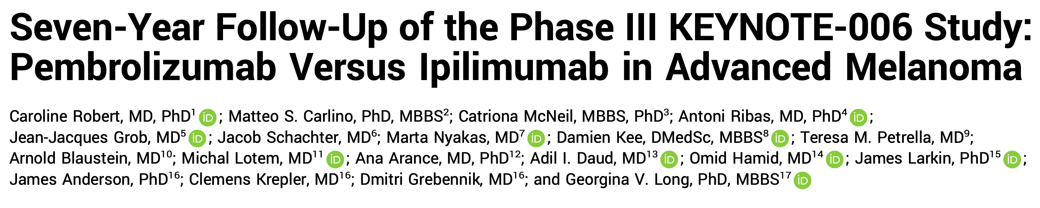
J Clin Oncol 2023;41(24):3998-4003.

Slide 15
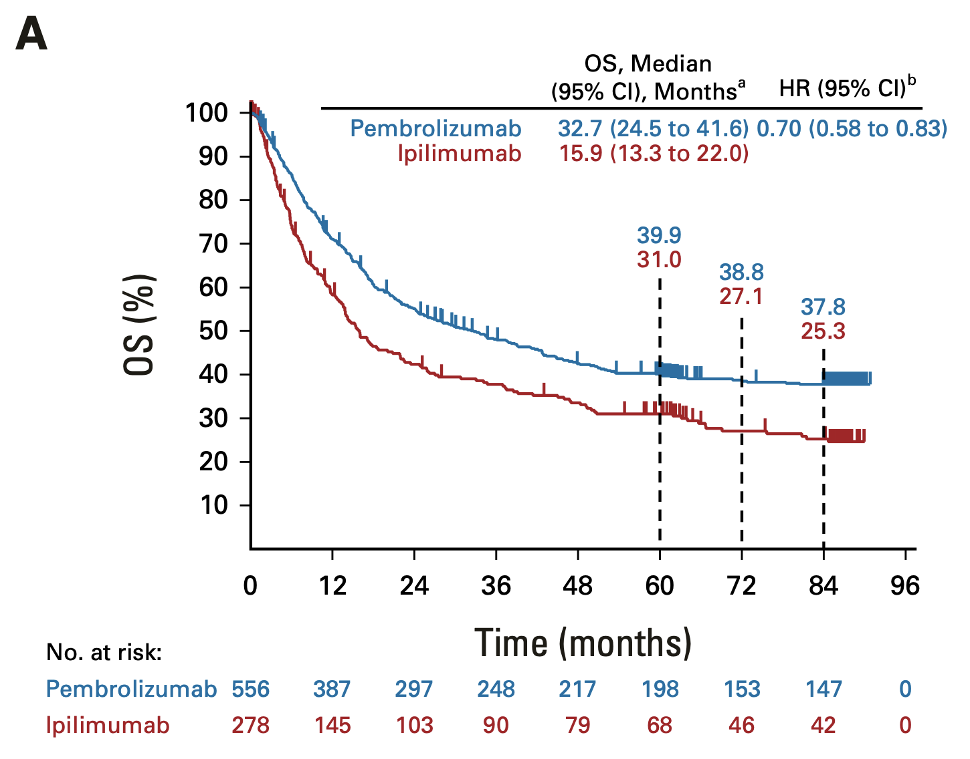
KEYNOTE-006: Pembrolizumab versus Ipilimumab – Long-Term Overall Survival (OS)
Robert C et al. J Clin Oncol 2023;41(24):3998-4003.

Slide 16
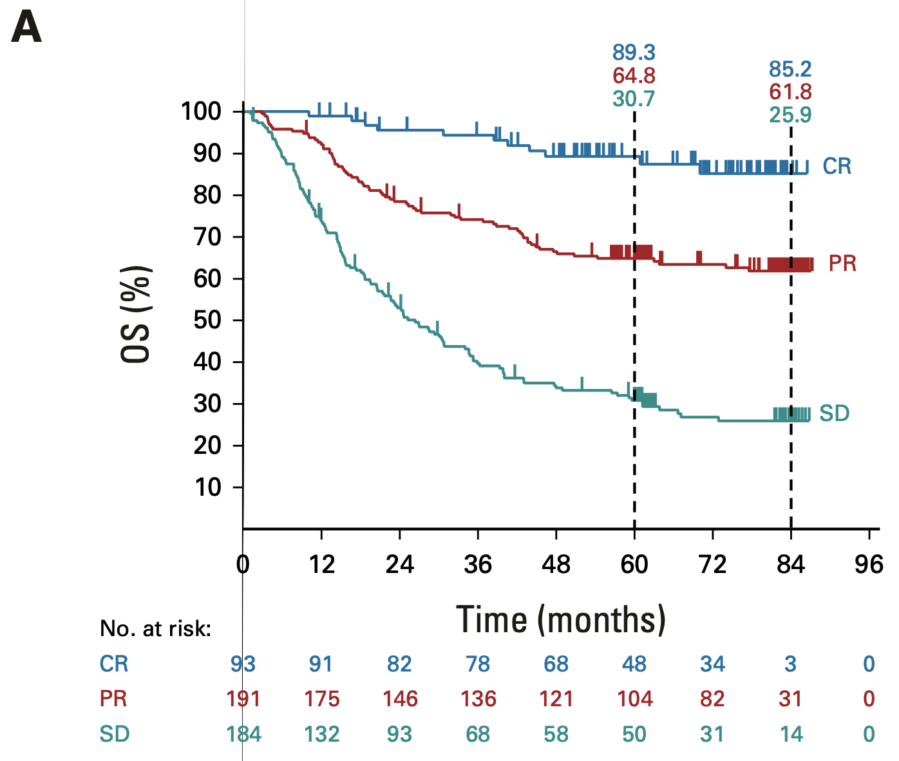
KEYNOTE-006: Pembrolizumab versus Ipilimumab – OS by Response
Robert C et al. J Clin Oncol 2023;41(24):3998-4003.
CR = complete response; PR = partial response; SD = stable disease

Slide 17

Nivolumab plus relatlimab vs nivolumab in previously untreated metastatic or unresectable melanoma (RELATIVITY-047): Overall survival and melanoma-specific survival outcomes at 3 years
Hussein A. Tawbi,¹ F. Stephen Hodi,² Evan J. Lipson,³ Dirk Schadendorf,⁴ Paolo Antonio Ascierto,⁵ Luis Matamala,⁶ Erika Castillo Gutiérrez,⁷ Piotr Rutkowski,⁸ Helen Gogas,⁹ Christopher D. Lao,¹⁰ Juliana Janoski De Menezes,¹¹ Stéphane Dalle,¹² Ana Maria Arance,¹³ Jean-Jacques Grob,¹⁴ Barbara Ratto,¹⁵ Saima Rodriguez,¹⁵ Antonella Mazzei,¹⁵ Sonia Dolfi,¹⁵ Georgina V. Long¹⁶
¹The University of Texas MD Anderson Cancer Center, Houston, TX; ²Dana-Farber Cancer Institute, Boston, MA; ³Bloomberg-Kimmel Institute for Cancer Immunotherapy, Johns Hopkins Medicine, The Sidney Kimmel Comprehensive Cancer Center, Baltimore, MD; ⁴University of Essen and the German Cancer Consortium, Essen, Germany; ⁵Istituto Nazionale dei Tumori IRCCS "Fondazione G. Pascale", Naples, Italy; ⁶Instituto Oncológico Fundación Arturo López Pérez and Department of Oncology, Instituto Nacional del Cáncer, Santiago, Chile; ⁷FAICIC Clinical Research, Veracruz, Mexico; ⁸Maria Skłodowska-Curie National Research Institute of Oncology, Warsaw, Poland; ⁹National and Kapodistrian University of Athens, Athens, Greece; ¹⁰Michigan Medicine, Rogel Cancer Center, University of Michigan (current affiliation is Bristol Myers Squibb), Ann Arbor, MI; ¹¹Hospital Nossa Senhora da Conceição, Porto Alegre, Brazil; ¹²Hospices Civils de Lyon, Cancer Research Center of Lyon, Pierre-Bénite, France; ¹³Hospital Clinic Barcelona and IDIBAPS, Barcelona, Spain; ¹⁴Aix-Marseille University, CHU Timone, Marseille, France; ¹⁵Bristol Myers Squibb, Princeton, NJ; ¹⁶Melanoma Institute Australia, The University of Sydney, Royal North Shore and Mater Hospitals, Sydney, NSW, Australia
Presentation number 9524
Courtesy of Evan J Lipson, MD

Slide 18
Figure 1. RELATIVITY-047 study design
Key eligibility criteria
Previously untreated, unresectable, or
metastatic melanoma
ECOG PS 0–1
Primary endpoint
PFS by BICRª
Secondary endpoints
OS^{b}
ORR by BICR^{c}
NIVO 480 mg + RELA 160 mg
FDC IV Q4W
R
1:1
NIVO 480 mg IV Q4W
Stratified by: LAG-3,^{d} PD-L1,^{e} BRAF, and AJCC v8 M stage
Endpoints were tested in hierarchy: PFS → OS → ORR
Database lock | March 9, 2021 | October 28, 2021 | October 27, 2022 | October 19, 2023
Min. follow-up^{f} | 1.3 months | 8.7 months | 21.0 months | 33.0 months
Median follow-up | 13.2 months | 19.3 months | 25.3 months | 33.8 months
Endpoint(s) | PFS per BICR | OS, ORR per BICR, and updated PFS per BICR | Updated PFS per BICR, OS, and ORR per BICR | Updated PFS per BICR, OS, and ORR per BICR (analyses are descriptive/exploratory)
RELATIVITY-047 (NCT03470922).
ªFirst tumor assessment (RECIST v1.1) was performed 12 weeks after randomization, every 8 weeks up to 52 weeks, and then every 12 weeks. ^{b}OS boundary for statistical significance was
P < 0.04302 (2-sided) analyzed at 69% power; target HR, 0.75. ^{c}ORR could not be formally tested and was descriptively analyzed. ^{d}LAG-3 expression on immune cells (1%) was determined by an analytically validated IHC assay (Labcorp, Burlington, NC, USA). ^{e}PD-L1 expression on tumor cells (1%) was determined by a validated Agilent Dako PD-L1 IHC 28-8 pharmDx test (Agilent, Santa Clara, CA, USA). ^{f}Minimum potential follow-up was defined as the time from last patient randomized to last patient, last visit.
Courtesy of Evan J Lipson, MD

Slide 19
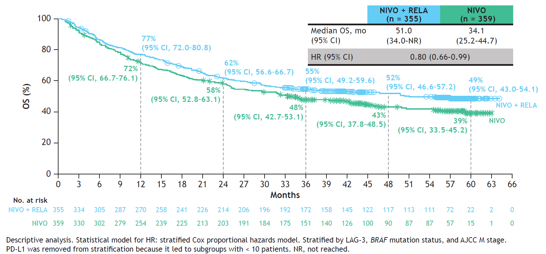
Courtesy of Evan J Lipson, MD

Slide 20
Conclusions
Critical finding(s): At 3 years of follow-up, PFS benefit persists for patients with previously untreated metastatic or unresectable melanoma who were treated with NIVO + RELA vs NIVO.
  Descriptive analyses suggest melanoma-specific survival benefit (MSS HR 0.75 (95% CI, 0.60–0.94))
  No new or unexpected safety signals
Clinical implication(s): RELA+NIVO has replaced single agent anti-PD-1 as standard-of-care for treating many patients with advanced melanoma
Research relevance: Biomarkers needed to better understand which patient needs which therapy.
Courtesy of Evan J Lipson, MD

Slide 21
Efficacy and safety of triplet nivolumab, relatlimab, and ipilimumab in advanced melanoma: results from RELATIVITY-048
Paolo Antonio Ascierto,¹ Reinhard Dummer,² Caroline Gaudy-Marqueste,³ Samantha Bowyer,⁴
Evan J. Lipson,⁵ Eleonora Ghisoni,⁶ Mark R. Middleton,⁷ Barbara Ratto,^{8a} William Joseph Jackson,⁸ Alicia M. Y. Cheong,⁹ Sourav Mukherjee,⁸ Jenny Wu,⁸ Georgina V. Long¹⁰
¹Istituto Nazionale Tumori IRCCS “Fondazione G. Pascale,” Naples, Italy; ²University of Zurich, Zurich, Switzerland; ³CEPCM, Aix-Marseille University, Assistance Publique-Hôpitaux de Marseille, Marseille, France; ⁴Linear Clinical Research, Nedlands, WA, Australia; ⁵The Sidney Kimmel Comprehensive Cancer Center at Johns Hopkins Medicine, Baltimore, MD; ⁶Lausanne University Hospital, and Ludwig Institute for Cancer Research, Lausanne, Switzerland; ⁷University of Oxford, Headington, Oxford, United Kingdom; ⁸Bristol Myers Squibb, Princeton, NJ; ⁹Bristol Myers Squibb, Uxbridge, UK; ¹⁰Melanoma Institute Australia, The University of Sydney, and Royal North Shore and Mater Hospitals, Sydney, NSW, Australia
ªAffiliation at the time the study was conducted.
Abstract number 9504
Courtesy of Evan J Lipson, MD

Slide 22
BOR per INV (primary endpoint) and BICR (exploratory endpoint)
BOR per INV
(N = 46)ª
BOR per BICR
(N = 46)^{b}
59%
(95% CI, 43–73)
52%
(95% CI, 37–61)
CR: 17%
(n = 8)
CR: 22%
(n = 10)
17%
(n = 8)
20%
(n = 9)
PR: 41%
(n = 19)
15%
(n = 7)
PR: 30%
(n = 14)
11%
(n = 5)
  Clinical benefit (CR + PR + SD) rate of 76% (95% CI, 61–87) per INV and 72% (95% CI, 56–84) per BICR
  Median duration of response per INV: NR (95% CI, NR–NR)
RELATIVITY-048 (NCT03459222). Median follow-up: 49.4 months. ORR determined using RECIST v1.1. ªUndetermined in 4 patients (9%; due to death prior to the first post-baseline tumor assessment). ^{b}Undetermined in 8 patients (17%; 4 due to death prior to first post-baseline assessment, 2 due to no measurable disease at baseline per BICR, and 2 due to receiving palliative surgery before first post-baseline tumor assessment).
Courtesy of Evan J Lipson, MD
Notes:
22

Slide 23
Best change from baseline in sum of target lesions per INV
180
ORR: 59% (27/46)
120
100
80
60
40
33/40 (82%) patientsª with any tumor reduction from baseline
Change from baseline in sum of target lesion diameters (%)
PD
20
0
−20
PR
−40
−60
−80
−100
CR
Subtype
Patients
Cutaneous non-acral
Other subtype
Mucosal
Baseline liver metastasis
Acral
Baseline brain metastasis
RELATIVITY-048 (NCT03459222). Median follow-up: 49.4 months. ªIncluded patients with both baseline and ≥ 1 post-baseline assessment of target lesions. Total of 6 patients not included (4 patients were nonevaluable due to death prior to first post-baseline tumor assessment and 2 patients receiving palliative subsequent surgery before the first post-baseline tumor assessment).
Courtesy of Evan J Lipson, MD

Slide 24
Safety summary
 | NIVO + RELA + IPI (N = 46)
 | Any grade, n (%) | Grade 3–4, n (%)
Any AE | 46 (100) | 27 (59)
Any SAE | 27 (59) | 17 (37)
TRAE | 44 (96) | 18 (39)
TRAE leading to discontinuation | 19 (41) | 10 (22)
Most common TRAEs (≥ 20%)ª
Pruritus | 16 (35) | 0
Fatigue | 14 (30) | 0
Hypothyroidism | 11 (24) | 0
Asthenia | 10 (22) | 0
Colitis | 10 (22) | 2 (4)
Diarrhea | 10 (22) | 2 (4)
Lipase increased | 10 (22) | 6 (13)
Vitiligo | 10 (22) | 0
Deaths due to TRAEs | 2 (4)
Treatment-related deaths occurring within 100 days of the last dose of study therapy were due to rectal hemorrhage and dyspnea (n = 1) and immune-mediated myositis (n = 1)
RELATIVITY-048 (NCT03459222). Median follow-up: 49.4 months. Includes AEs reported between first dose and 30 days after the last dose of study therapy.
ªTRAEs occurring in < 20% of patients are not shown.
Courtesy of Evan J Lipson, MD

Slide 25
Conclusions
Critical finding(s): NIVO + RELA + low-dose IPI demonstrated encouraging efficacy (ORR = 59%) in n= 46 patients with advanced treatment-naïve melanoma. Serious tox rate = 39%.
Clinical implication(s): Appropriate for patients in whom a single opportunity for therapy might exist?
Research relevance: Larger studies are needed to confirm the efficacy and safety of PD-1+LAG-3+CTLA-4 blockade in this patient population.
Courtesy of Evan J Lipson, MD

Slide 26
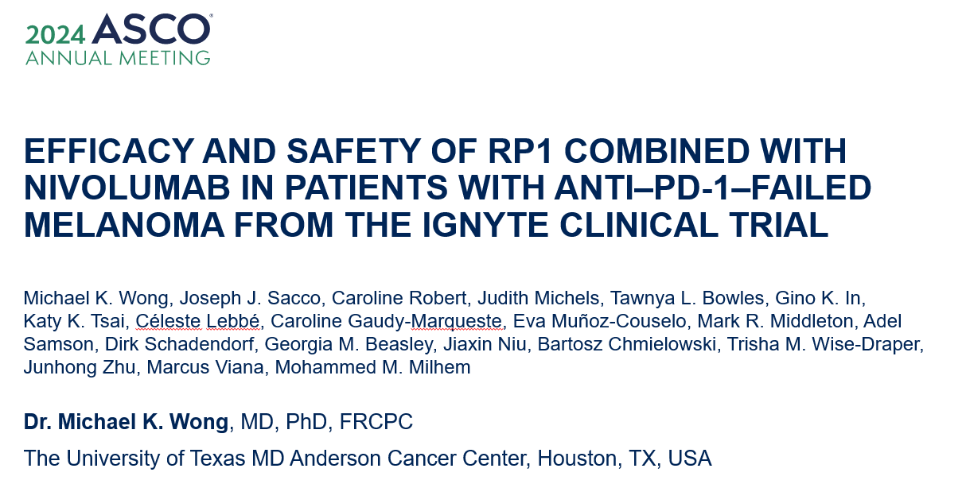
Courtesy of Evan J Lipson, MD

Slide 27
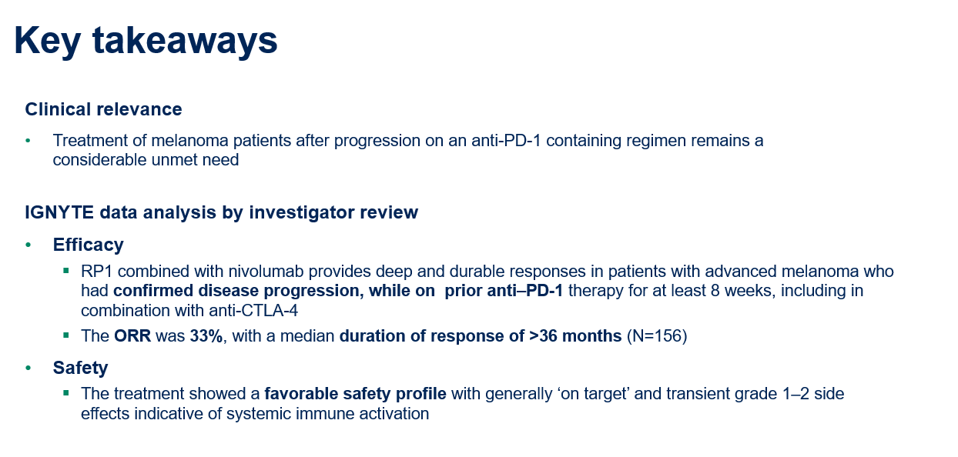
Courtesy of Evan J Lipson, MD

Slide 28
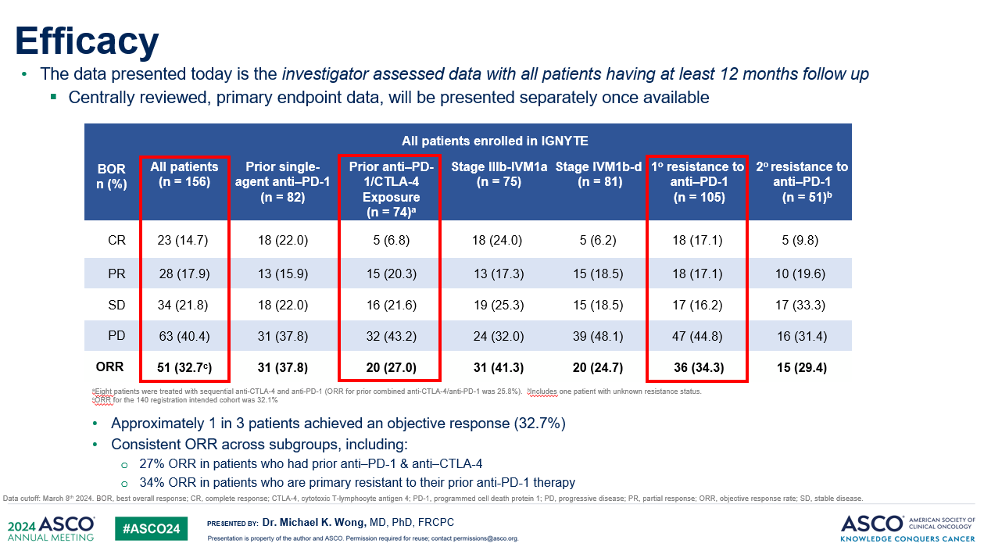
Courtesy of Evan J Lipson, MD

Slide 29
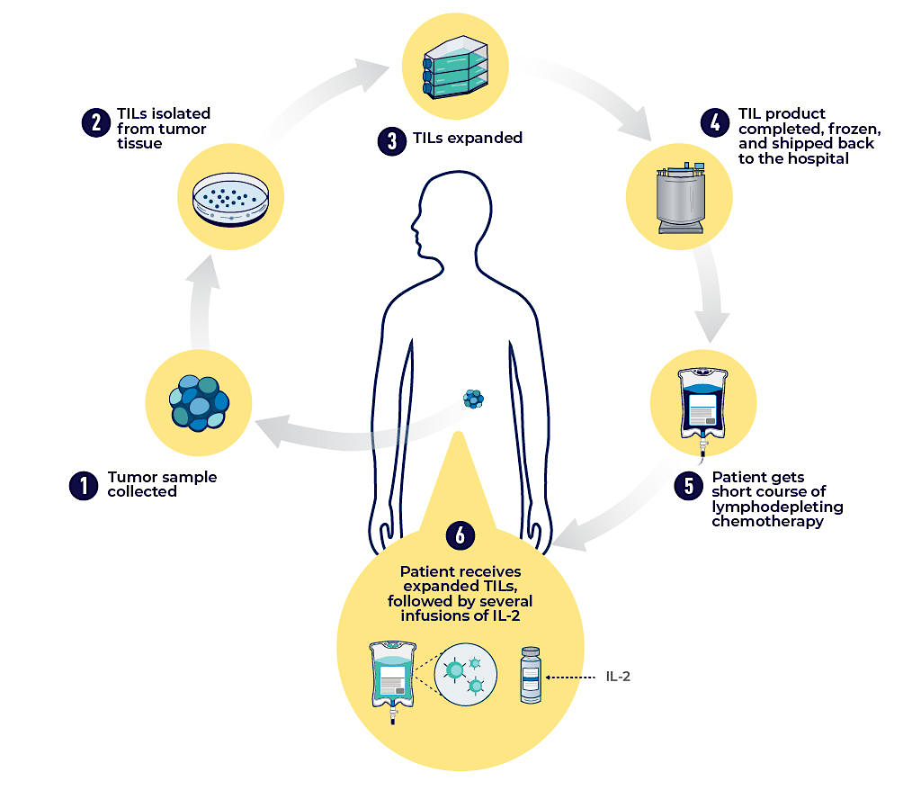
Tumor Infiltrating Lymphocyte (TIL) therapy
Credit: National Cancer Institute
Courtesy of Evan J Lipson, MD

Slide 30
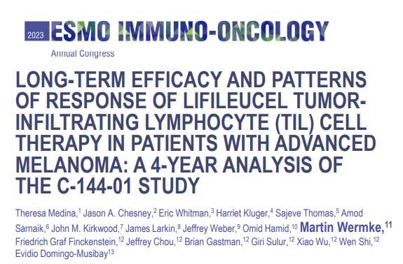
  Lifileucel FDA accelerated approved Feb 2024 for:
    Adult patients with unresectable or metastatic melanoma
    Prior anti-PD-1 (and BRAF-directed therapy if BRAF V600 positive)
Courtesy of Evan J Lipson, MD

Slide 31
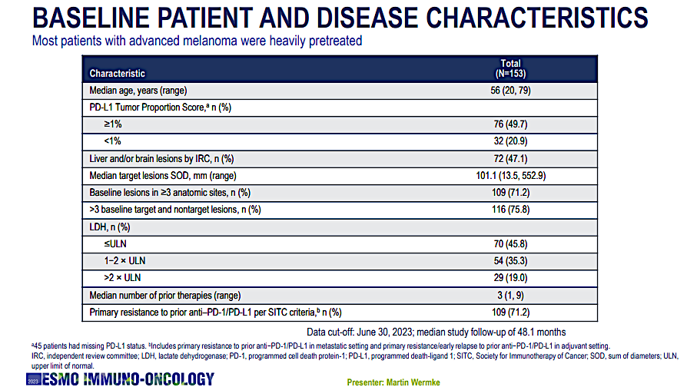
Courtesy of Evan J Lipson, MD

Slide 32
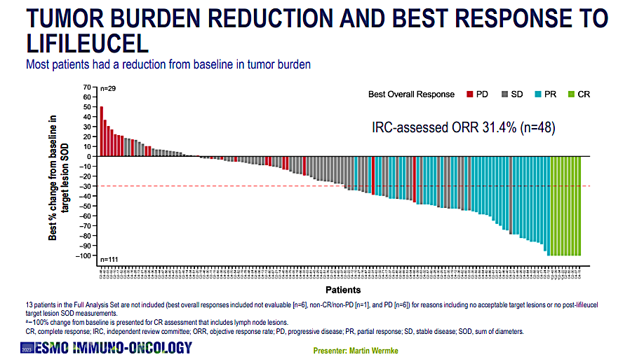
Courtesy of Evan J Lipson, MD

Slide 33
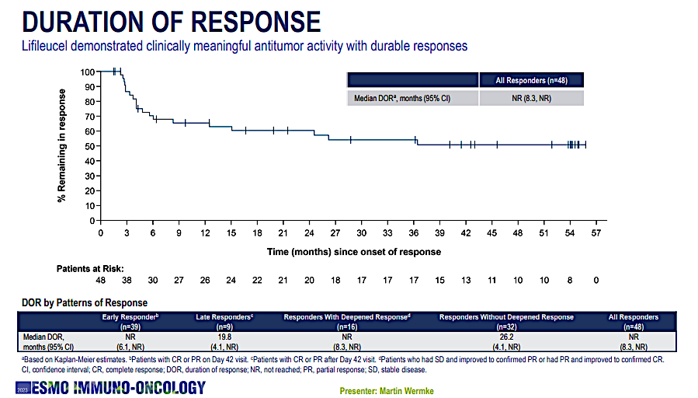
Courtesy of Evan J Lipson, MD

Slide 34
Safety
Boxed Warning:
  treatment-related mortality
  prolonged severe cytopenia
  severe infection
  cardiopulmonary, renal impairment
Most common AEs: chills, pyrexia, fatigue, tachycardia, diarrhea, febrile neutropenia, edema, rash hypotension, alopecia, infection, hypoxia, and dyspnea.
Courtesy of Evan J Lipson, MD

Slide 35
Conclusions
Critical finding(s): After decades of development, a TIL therapy is now FDA approved for patients with advanced melanoma.
Clinical implication(s): Additional treatment option after ICI (+/- BRAF) for appropriate patients
Research relevance: How best to maximize applicability / tolerability?
Courtesy of Evan J Lipson, MD

Slide 36
Efficacy and safety of lifileucel, an autologous tumor-infiltrating lymphocyte cell therapy, and pembrolizumab in patients with immune checkpoint inhibitor-naive unresectable or metastatic melanoma: updated results from IOV-COM-202 Cohort 1A
2024 ASCO Annual Meeting
May 31–June 4, 2024 | Chicago, IL, USA
Sajeve Thomas,¹ Helen Gogas,² Young Ki Hong,³ Gino K. In,⁴ Bernard Doger de Speville Uribe,⁵ Andrew J.S. Furness,⁶ Almudena Garcia Castano,⁷ Simon Häfliger,⁸
Kai He,⁹ Theresa Medina,¹⁰ Donald Lawrence,¹¹ Sylvia Lee,¹² Juan Martin-Liberal,¹³ Friedrich Graf Finckenstein,¹⁴ Brian Gastman,¹⁴ Jeffrey Chou,¹⁴ Rana Fiaz,¹⁴
Melissa Catlett,¹⁴ Guang Chen,¹⁴ Patrick Terheyden¹⁵
¹Orlando Health Cancer Institute, Orlando, FL, USA; ²Laiko General Hospital, School of Medicine, National and Kapodistrian University of Athens, Athens, Greece; ³Cooper University Hospital, Camden, NJ, USA; ⁴University of Southern California, Norris Comprehensive Cancer Center, Los Angeles, CA, USA; ⁵START Madrid Fundación Jiménez Díaz, Madrid, Spain; ⁶The Royal Marsden NHS Foundation Trust, London, UK; ⁷Hospital Universitario Marqués de Valdecilla, Santander, Spain; ⁸Inselspital, Bern University Hospital, Bern, Switzerland; ⁹James Cancer Center, The Ohio State University, Columbus, OH, USA; ¹⁰University of Colorado Cancer Center – Anschutz Medical Campus, Aurora, CO, USA; ¹¹Massachusetts General Hospital Cancer Center, Boston, MA, USA; ¹²Fred Hutchinson Cancer Center, Seattle, WA, USA; ¹³ICO L’Hospitalet – Hospital Duran i Reynals, Barcelona, Spain; ¹⁴Iovance Biotherapeutics, Inc., San Carlos, CA, USA; ¹⁵University of Lübeck, Lübeck, Germany
Courtesy of Evan J Lipson, MD

Slide 37
OBX-115, an interleukin 2 (IL2)-sparing engineered tumor-infiltrating lymphocyte (TIL) cell therapy, in patients with immune checkpoint inhibitor (ICI)-resistant unresectable or metastatic melanoma
ABSTRACT 9515
Rodabe N Amaria, MD¹; Jennifer L McQuade, MD¹; Michael A Davies, MD, PhD¹;
Isabella C Glitza Oliva, MD, PhD¹; Steffy Jose, RN¹; Erik Cressman, MD, PhD²;
Ashlynd L Clausell, MPH¹; Roland Bassett, MS³; Sapna Patel, MD¹; Adi Diab, MD¹;
Hussein A. Tawbi, MD, PhD¹; Michael K Wong MD, PhD¹; Alexandra P Ikeguchi, MD¹;
Cara Haymaker, PhD⁴; Seoung-Ae Lee, PhD⁴; Madan Jagasia, MD, MS⁵; Giridharan Ramsingh, MD⁵; Prakash Prabhakar, PhD⁵; Raina Duan, PhD⁵; Parameswaran Hari, MD⁵
1. Department of Melanoma Medical Oncology, MD Anderson Cancer Center, Houston, TX, USA; 2. Department of Interventional Radiology, MD Anderson Cancer Center, Houston, TX, USA; 3. Department of Biostatistics, MD Anderson Cancer Center, Houston, TX, USA; 4. Department of Translational Molecular Pathology, MD Anderson Cancer Center, Houston, TX, USA; 5. Obsidian Therapeutics, Cambridge, MA, USA
Courtesy of Evan J Lipson, MD

Slide 38
OBX-115: Promising Efficacy Profile Without IL2 Administration
 | Efficacy Cohort (n=9)
Objective response rate, n (%) | 4 (44.4)
Complete response | 2 (22.2)
Partial response | 2 (22.2)
Stable disease ≥12 weeks | 5 (55.6)
Progressive disease | 0
Disease control rate,* n (%) | 9 (100)
Progression-free survival at 24 weeks | 75%
Per-protocol efficacy analysis set (n=9)
  44.4% ORR, including 2 CRs
Per-protocol high-risk cohort (n=1, GNA11-mutated rare uveal-equivalent subtype)
  Best response of progressive disease
*Defined as stable disease (or better) for ≥12 weeks post-infusion.
CR, complete response; IL2, interleukin 2; ORR, objective response rate.
Courtesy of Evan J Lipson, MD

Slide 39

Conclusions
OBX-115 is a highly differentiated TIL cell therapy product with optimized characteristics for response and persistence, which can be manufactured using tumor tissue obtained via core needle biopsy
  ACZ-driven regulatable mbIL15 expression enables elimination of IL2 from the regimen
In this Phase 1 first-in-human study exploring optimal dosing of
OBX-115 + ACZ in this particularly high unmet need population, the
OBX-115 regimen resulted in:
  Positively differentiated safety from IL2-dependent non-engineered TIL cell therapy
  Promising efficacy profile without IL2 administration, including a 44% ORR across all dose-level cohorts (n=9)
      50% ORR in patients receiving OBX-115 dose >30 × 10⁹ cells
      100% disease control rate
      Tumor burden reduction in all patients
      75% PFS at 24 weeks
Planned regimen optimization is ongoing in a Phase 1/2 multicenter study, currently enrolling patients with advanced melanoma and metastatic non-small cell lung cancer (NCT06060613
[Agni-01]; Poster TPS9599)
Copies of these slides obtained through Quick Response (QR) Code are for personal use only and may not be reproduced without permission from ASCO® or the author of these slides.
ACZ, acetazolamide; IL2, interleukin 2; PFS, progression-free survival; ORR, objective response rate; OS, overall survival; TIL, tumor-infiltrating lymphocyte; TKI, tyrosine kinase inhibitor.
Courtesy of Evan J Lipson, MD

Slide 40
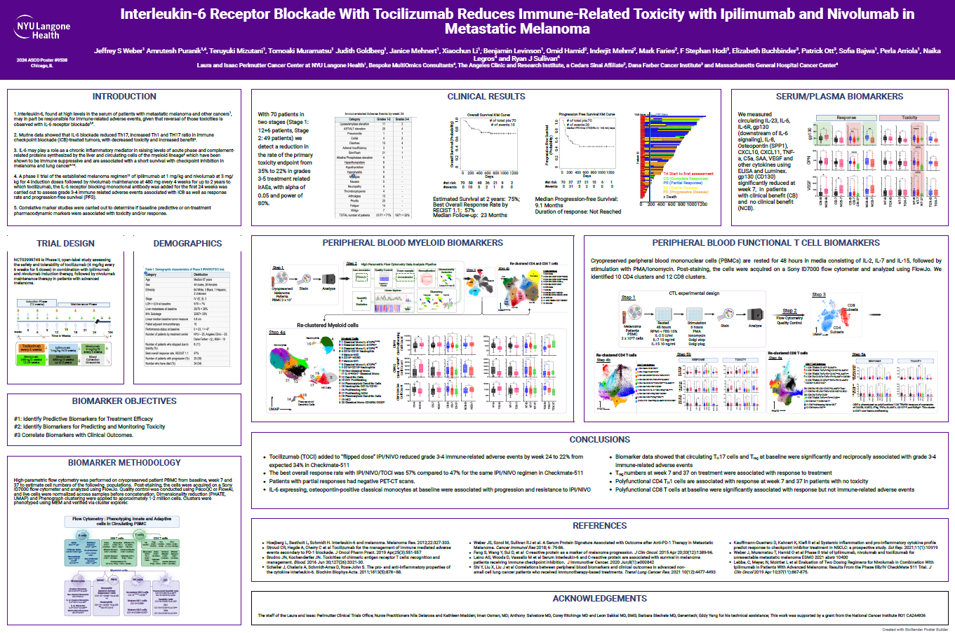

Slide 41
Agenda
INTRODUCTION: Johns Hopkins University
MODULE 1: Metastatic Melanoma
MODULE 2: Nonmetastatic Melanoma and Other Skin Cancers

Slide 42

Neoadjuvant Nivolumab Plus Ipilimumab Versus Adjuvant Nivolumab in Macroscopic, Resectable Stage III Melanoma: The Phase 3 NADINA Trial
Christian U. Blank, M.W. Lucas, R.A. Scolyer, B.A. van de Wiel, A.M. Menzies, M. Lopez-Yurda, A.C.J. van Akkooi, W.J. van Houdt, R.P.M. Saw, A. Torres-Acosta, S.N. Lo, G.A.P. Hospers, M.S. Carlino, J.W.B. de Groot, E. Kapiteijn, K.P.M. Suijkerbuijk, P. Rutkowski, S. Sandhu, A.A.M. van der Veldt, G.V. Long
lay abstract
Christian U. Blank, MD PhD
Courtesy of Evan J Lipson, MD

Slide 43
NADINA - Trial Design
A
Major pathologic response (MPR; pCR or near pCR; ≤ 10% vital tumor cells): no additional treatment, start FU, CT q12w
FU
▪︎ Stage III de novo or recurrent path proven resectable melanoma with at least 1 LN metastasis
▪︎ Additional in-transit (≤3) allowed
▪︎ Naïve for anti-PD-1, anti-CTLA-4, anti-LAG-3, BRAFi+MEKi
▪︎ Stratified for BRAF, continent, and in-transit metastases
2 courses
IPI 80mg + NIVO
240mg
q3w
TLND
no MPR (pPR or pNR; > 10% vital tumor cells):
start no later than week 12 with
11 courses NIVO 480mg q4w (BRAFwt) or
46 weeks DAB 150mg bid + TRAM 2mg qd (BRAFV600E/K)
+/- parallel adjuvant RT#
FU
TLND
start no later than week 12 with
12 courses NIVO 480mg q4w +/- adjuvant RT#
FU
B
# adjuvant radiotherapy according to patient’s and physician’s decision allowed
PET/CT,
CT, MR brain,
Tumor biopsy,
ePROs, QoL, lab
CT
QoL
lab
CT
QoL
lab
CT
QoL
lab
CT
QoL
lab
CT
QoL
lab
CT
QoL
lab
CT, lab q12w
QoL q26w
year 2 & 3
lab
lab
lab
-4
0
3
6
9
12
24
36
48
60
Christian U. Blank, MD PhD
Courtesy of Evan J Lipson, MD

Slide 44
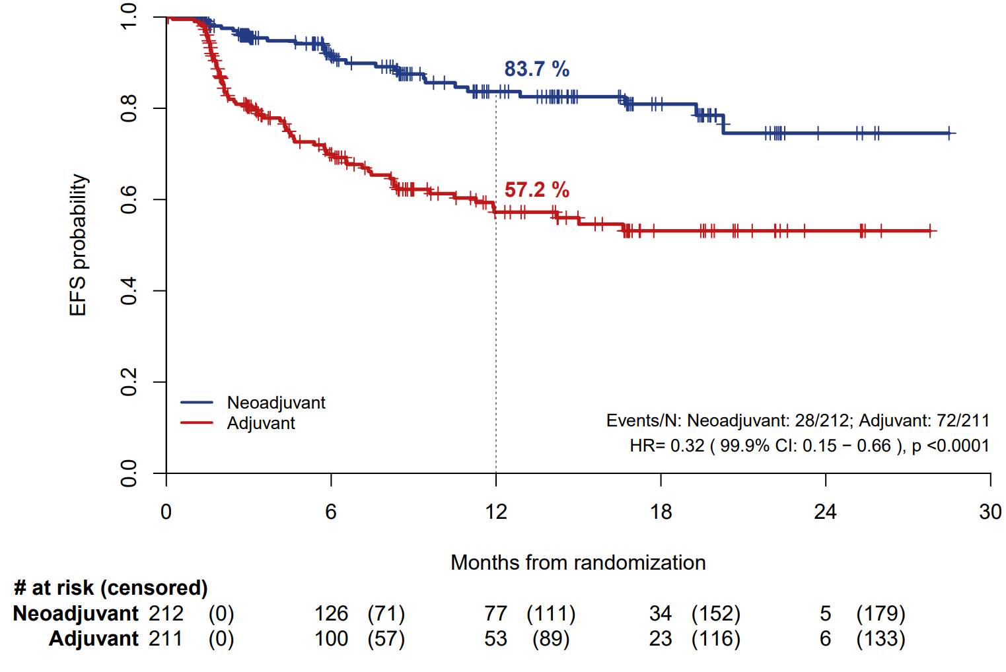


NADINA – Primary Endpoint: Event-Free Survival (EFS)
Christian U. Blank, MD PhD
Courtesy of Evan J Lipson, MD

Slide 45
Conclusions
Critical finding(s): NADINA shows a significant event-free survival (EFS) benefit for neoadjuvant ipilimumab + nivolumab compared to adjuvant nivolumab in patients with macroscopic stage III melanoma
Of the 59% of patients who experienced a major pathologic response, some were able to avoid adjuvant therapy altogether, limiting their total treatment time to 6 weeks.
Clinical implication(s): new standard of care for the treatment of patients with resectable macroscopic stage III melanoma.
Research relevance: What is the optimal approach for patients who do not experience an MPR following neoadjuvant therapy? What is the optimal neoadjuvant regimen?
Courtesy of Evan J Lipson, MD

Slide 46
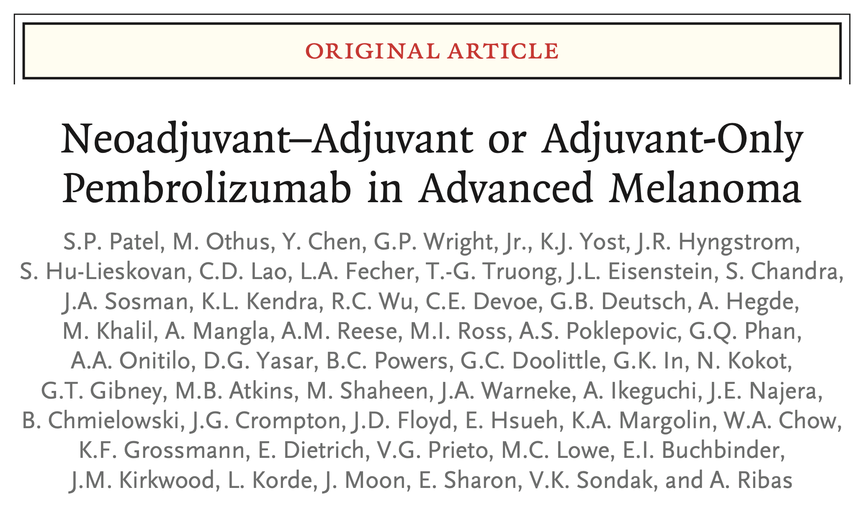
N Engl J Med 2023;388(9):813-23.

Slide 47
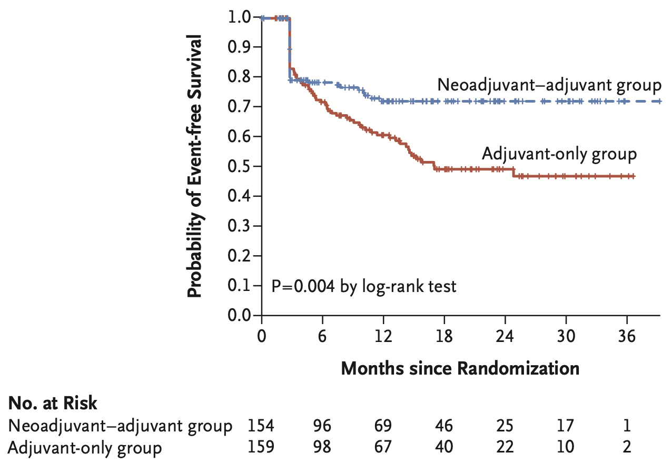
Neoadjuvant and Adjuvant or Adjuvant-Only Pembrolizumab: EFS
EFS at 2 years was 72% (95% CI, 64 to 80) in the neoadjuvant–adjuvant group.
EFS at 2 years was 49% (95% CI, 41 to 59) in the adjuvant-only group.
Patel SP et al. N Engl J Med 2023;388(9):813-23.

Slide 48
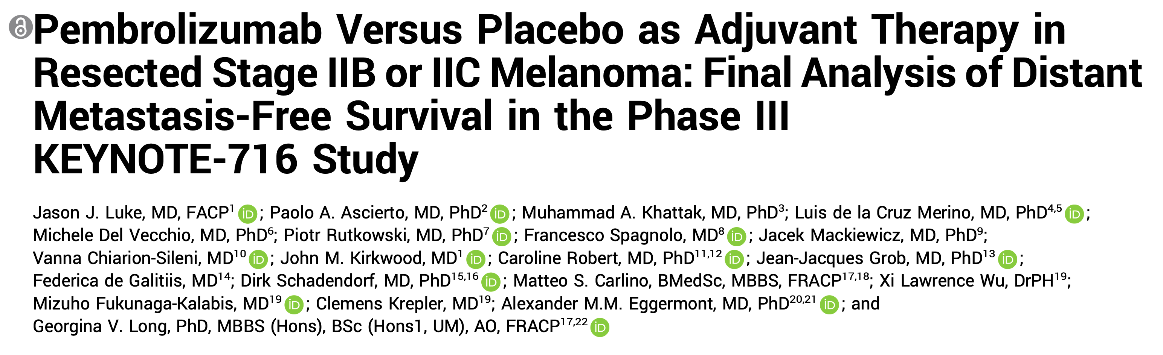
J Clin Oncol 2024;42(14):1619-24.

Slide 49
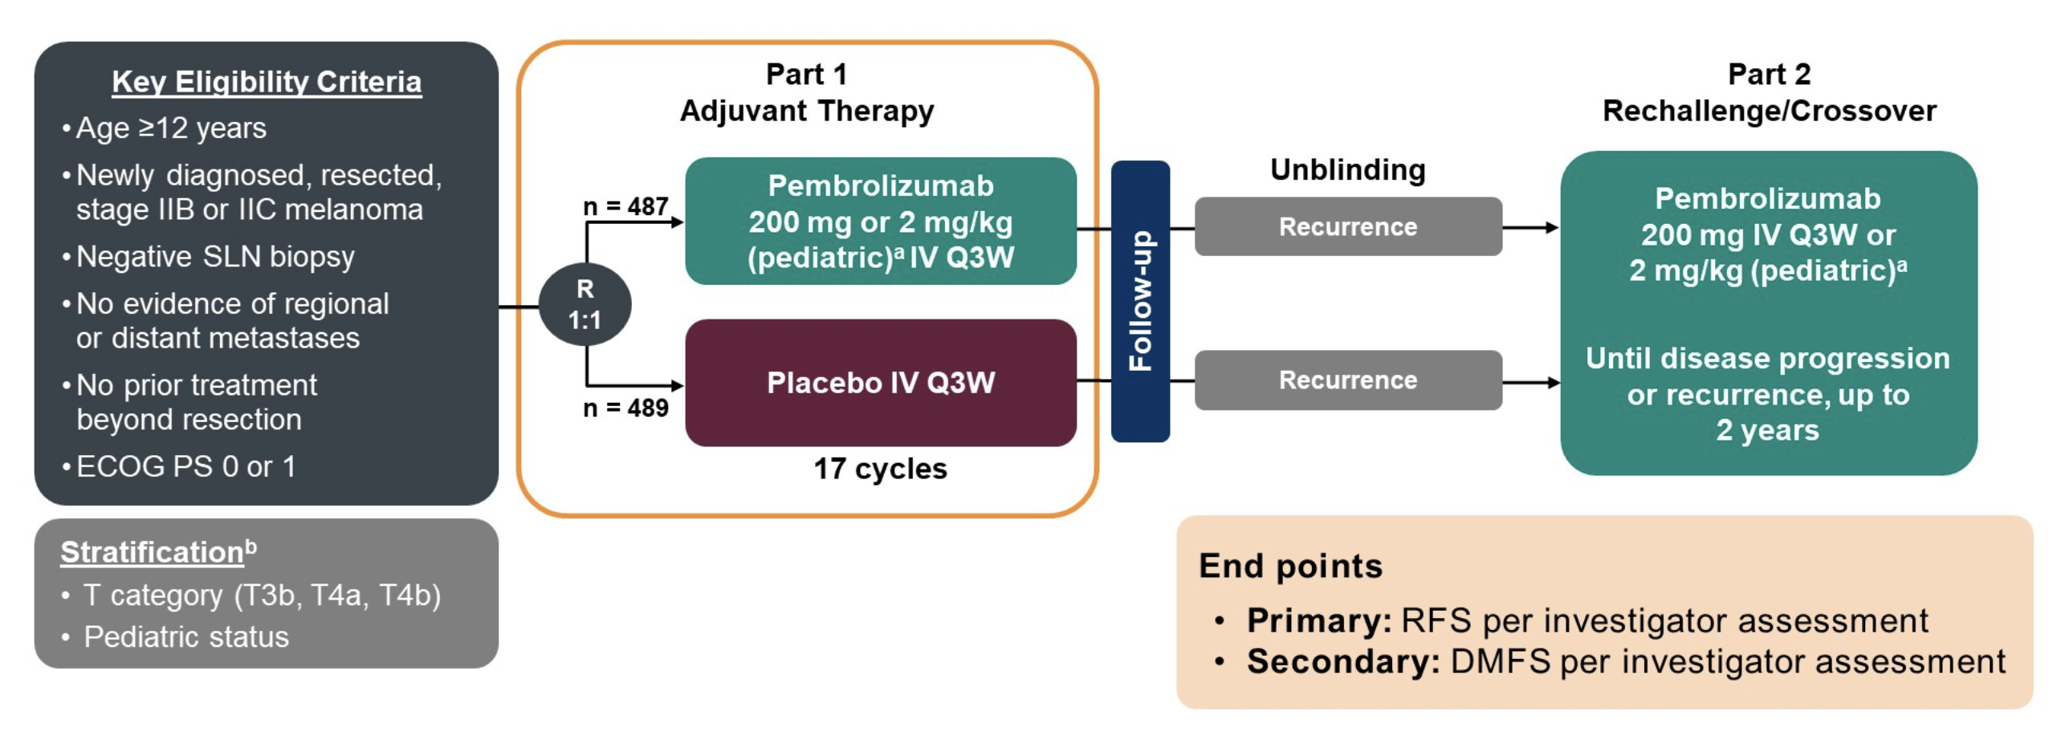
KEYNOTE-716 Study Design
Luke JJ et al. ASCO 2023;Abstract LBA9505.

Slide 50
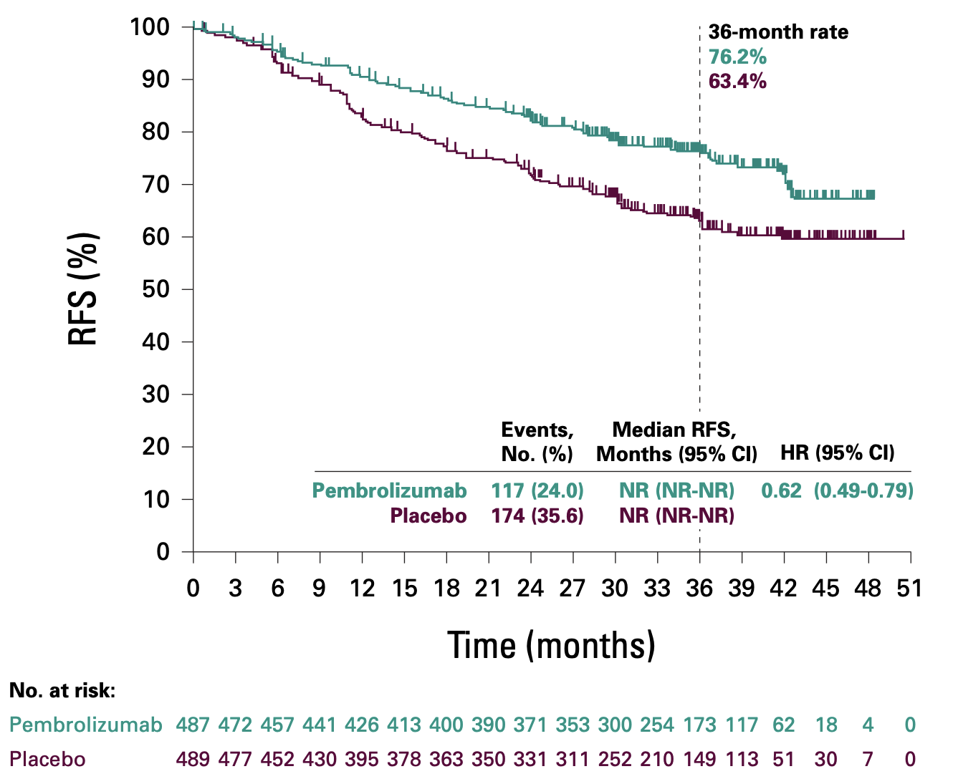
KEYNOTE-716: Recurrence-Free Survival (RFS) in the ITT Population
Luke JJ et al. J Clin Oncol 2024;42(14):1619-24.

Slide 51
Individualized neoantigen therapy mRNA-4157 (V940) plus pembrolizumab in resected melanoma: 3-year update from the mRNA-4157-P201 (KEYNOTE-942) trial
Jeffrey S. Weber,¹ Muhammad Adnan Khattak,² Matteo S. Carlino,³ Tarek Meniawy,⁴ Matthew H. Taylor,⁵ George Ansstas,⁶
Kevin B. Kim,⁷ Meredith McKean,⁸ Ryan J. Sullivan,⁹ Mark B. Faries,¹⁰ Thuy Tran,¹¹ C. Lance Cowey,¹² Theresa M. Medina,¹³ Jennifer M. Segar,¹⁴ Victoria Atkinson,¹⁵ Geoffrey T. Gibney,¹⁶ Jason J. Luke,¹⁷ Elizabeth I. Buchbinder,¹⁸ Georgina V. Long,¹⁹
INT Research and Development Author Group,^{20,21,a} Robert S. Meehan²⁰
ªManju Morrissey,²⁰ Igor Feldman,²⁰ Vasudha Sehgal,²⁰ Huzhang Mao,²⁰ Jia Guo,²⁰ Min Liu,²⁰ Anjali Rao,²⁰ Wei Zheng,²⁰ Praveen Aanur,²⁰ Lakshmi Srinivasan,²⁰ Mo Huang,²¹ Tal Zaks,²⁰ Michelle Brown,²⁰ Tracey Posadas²⁰
¹Laura and Isaac Perlmutter Cancer Center at NYU Langone Health, New York, NY, USA; ²Hollywood Private Hospital and Edith Cowan University, Perth, Australia; ³Melanoma Institute Australia and Westmead Hospital, Sydney, Australia; ⁴Saint John of God Subiaco Hospital, Subiaco, Australia; ⁵Earle A. Chiles Research Institute, Portland, OR, USA; ⁶Washington University School of Medicine, St Louis, MO, USA; ⁷California Pacific Medical Center Research Institute, San Francisco, CA, USA; ⁸Sarah Cannon Research Institute, Nashville, TN, USA; ⁹Massachusetts General Hospital, Boston, MA, USA; ¹⁰The Angeles Clinic and Research Institute, Los Angeles, CA, USA; ¹¹Yale-New Haven Hospital, New Haven, CT, USA; ¹²Baylor Charles A. Sammons Cancer Center, Dallas, TX, USA; ¹³University of Colorado, Aurora, CO, USA; ¹⁴University of Arizona Cancer Center, Tucson, AZ, USA; ¹⁵Princess Alexandra Hospital, Woolloongabba, Australia; ¹⁶Lombardi Comprehensive Cancer Center, Washington, DC, USA; ¹⁷UPMC Hillman Cancer Center, Pittsburgh, PA, USA; ¹⁸Dana-Farber Cancer Institute, Boston, MA, USA; ¹⁹Melanoma Institute Australia, Sydney, Australia; ²⁰Moderna, Inc., Cambridge, MA, USA; ²¹Merck & Co., Inc., Rahway, NJ, USA.
Sponsored by Moderna, Inc., in collaboration with Merck Sharp & Dohme LLC, a subsidiary of Merck & Co., Inc., Rahway, NJ, USA.
Courtesy of Evan J Lipson, MD

Slide 52
Sustained improvement of RFS primary efficacy endpoint
100
79.4%
76.6%
74.8%
Censored
80
Δ17.2
Δ16.6
Δ19.2
60
62.2%
60.0%
Recurrence-free survival, %
55.6%
40
20
0
0
6
12
18
24
30
36
42
48
54
Patients at risk
Time from first dose of pembrolizumab (months)
mRNA-4157 (V940) + pembrolizumab
107
87
83
77
52
29
12
6
1
0
Pembrolizumab
50
41
37
29
27
10
5
2
0
0
 | Median (95% CI), months | Events, % (n/N) | Hazard ratio (95% CI)ª
mRNA-4157 (V940) + pembrolizumab | NE | 23.4 (25/107) | 0.510 (0.288–0.906) P = 0.019^{b}
pembrolizumab | 42.51 (16.59–NE) | 44.0 (22/50)
ªThe hazard ratio and 95% CI for mRNA-4157 (V940) + pembrolizumab versus pembrolizumab were estimated using a Cox proportional hazards model with treatment group as a covariate, stratified by disease stage (stages IIIB or IIIC or IIID vs stage IV) used for randomization. The P value is based on a 2-sided log-rank test stratified by disease stage (stages IIIB or IIIC or IIID vs stage IV) used for randomization; ^{b}Formal hypothesis testing of RFS was performed using November 2022 data cut. P value reported above used the November 2023 data cut; it’s nominal and not for formal hypothesis testing. NE, not estimable.
Courtesy of Evan J Lipson, MD

Slide 53
Conclusions
Critical finding(s): mRNA-4157 (V940) + pembrolizumab demonstrated a durable clinically significant improvement in RFS & DMFS compared with standard of care pembrolizumab in high-risk resected melanoma, with a 49% reduction in the risk of recurrence or death and a 62% reduction of distant recurrence or death with 3 years of follow-up
3-year exploratory endpoint showed an encouraging trend in overall survival with the combination versus pembrolizumab monotherapy
Clinical implication(s): If platform is feasible and RFS benefit is sustained in Phase III study, with no new safety signals, this approach could replace single agent anti-PD-1 as standard-of-care.
Research relevance: The treatment landscape for patients with resectable Stage IIIB-IV melanoma is changing. How does this approach compare to neoadjuvant therapy?
Courtesy of Evan J Lipson, MD

Slide 54
Courtesy of Evan J Lipson, MD

Slide 55


Long-Term Follow-Up for Adjuvant Dabrafenib Plus Trametinib in Stage III BRAF-Mutated Melanoma: Final Results of the COMBI-AD Study
Axel Hauschild, Reinhard Dummer, Mario Santinami, Victoria Atkinson, Mario Mandala, Barbara Merelli, Vanna Chiarion-Sileni, Andrew Mark Haydon, Jacob Schachter, Dirk Schadendorf, Thierry Lesimple, Elizabeth Ruth Plummer, James Larkin, Monique Tan, Sachin Bajirao Adnaik, Paul Burgess, Tarveen Jandoo, Georgina V. Long
Dr Georgina V. Long
@profglong
@ProfGLongMIA
Courtesy of Evan J Lipson, MD

Slide 56
Overall Survival (ITT)
100%
90%
86%
79%
80%
71%
70%
77%
70%
60%
65%
50%
Proportion Alive
40%
30%
Arm n Events Median, months (95% CI)
D + T 438 125 NA (120.7, NA)
Placebo 432 136 NA (NA, NA)
20%
10%
HR: 0.80; P=0.063
95% CI (0.62, 1.01)
0%
0
4
8
12
16
20
24
28
32
36
40
44
48
52
56
60
64
68
72
76
80
84
88
92
96
100
104
108
112
116
120
124
128
Time From Randomization (Months)
Patients at Risk
D + T
438
416
407
395
381
370
362
351
347
336
325
318
312
305
299
294
279
268
261
255
254
251
246
245
240
222
173
124
75
27
8
2
0
Placebo
432
415
400
377
346
328
308
297
292
282
274
270
264
255
251
248
241
236
233
228
218
216
213
208
201
185
157
1
15
67
26
4
0
0
End of study 31 July 2023. Median follow-up: D+T 100.0 (0−125) months; Placebo 82.5 (1−122) months.
Dr Georgina V. Long
Courtesy of Evan J Lipson, MD

Slide 57
Conclusions
Longest follow-up (up to 10 years) in adjuvant treatment of stage III melanoma
Durable improvements in RFS and DMFS with dabrafenib plus trametinib over placebo
Overall survival and melanoma-specific survival were numerically improved (not statistically significant) with D+T vs placebo, despite post-relapse systemic therapy
  20% risk reduction for death with dabrafenib plus trametinib over placebo (P=0.063)
  22% reduction for risk of death due to melanoma with dabrafenib plus trametinib over placebo
BRAF V600E showed a benefit for OS with dabrafenib plus trametinib over placebo
  BRAF V600K population did not appear to have an OS benefit from adjuvant dabrafenib plus trametinib although caution warranted given this small subgroup
No new safety concerns
  No irreversible toxicities during the long-term follow-up
  Skin and other cancers incidence was similar in each arm
Dr Georgina V. Long
@profgLong
@ProfGLongMIA
Courtesy of Evan J Lipson, MD

Slide 58
Conclusions
Critical finding(s): Longest follow-up (≤10 years) in adjuvant treatment of patients with stage III melanoma demonstrated durable improvements in RFS and DMFS with dabrafenib plus trametinib vs placebo.
No statistically significant improvement in overall survival with D+T vs placebo
  20% risk reduction for death with dabrafenib plus trametinib over placebo (P=0.063)
  22% reduction for risk of death due to melanoma with dabrafenib plus trametinib over placebo
Clinical implication(s): data continue to support adjuvant administration of D+T in patients with resected stage III BRAF-mutant melanoma
Research relevance: The treatment landscape for patients with resectable Stage III melanoma is changing. How does this approach compare to neoadjuvant therapy?
Courtesy of Evan J Lipson, MD

Slide 59
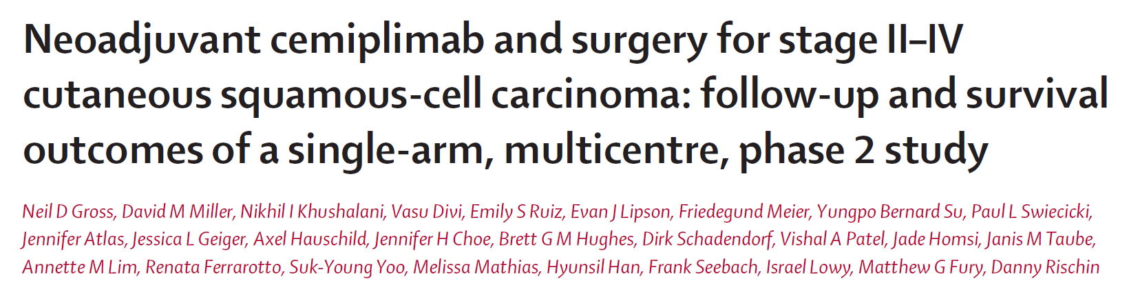
Lancet Oncology 2023
Courtesy of Evan J Lipson, MD

Slide 60
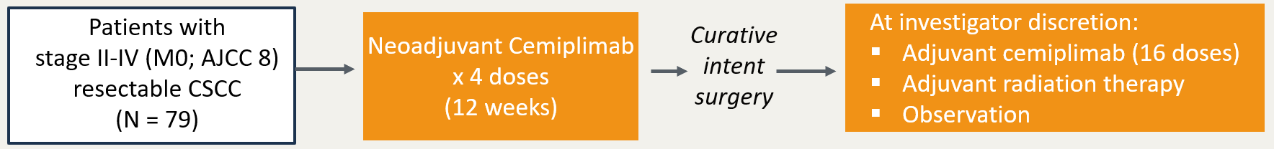
Neoadjuvant Cemiplimab in CSCC: Study Design
Multicenter phase II study
Patients with
stage II-IV (M0; AJCC 8) resectable CSCC
(N = 79)
Neoadjuvant Cemiplimab
x 4 doses
(12 weeks)
Curative intent
surgery
At investigator discretion:
Adjuvant cemiplimab (16 doses)
Adjuvant radiation therapy
Observation
Primary endpoint: pCR rate (0% residual viable tumor) by central review
Key secondary endpoints: Major Pathologic Response (MPR) rate (>0% and ≤10% residual viable tumor) by central review, EFS, DFS, OS
Gross et al. Lancet Oncol. 2023
Courtesy of Evan J Lipson, MD
Notes:
resectable stage II, III, or IV (M0) cutaneous squamous-cell carcinoma for which primary surgery would be recommended in routine clinical practice. Tumor– node–metastasis (TNM) staging of cutaneous squamous-cell carcinoma with involvement of the head and neck was based on the eighth edition of the American Joint Committee on Cancer Staging Manual

Slide 61
NEOADJUVANT CEMIPLIMAB IN CSCC
Patient Characteristics
Characteristic | Neoadjuvant cemiplimab (N=79)
Age, median (range), years | 73.0 (24–93)
Male, no. (%) | 67 (84.8)
Race, no. (%)
White | 69 (87.3)
Other | 2 (2.5)
Not reported | 8 (10.1)
Primary site of CSCC, no. (%)
Head and neck | 72 (91.1)
Trunk/extremities | 7 (8.9)
CSCC stage group, no. (%)
Stage II | 5 (6.3)
Stage III | 38 (48.1)
Stage IV (M0) | 36 (45.6)
ECOG performance status, no. (%)
0 | 60 (75.9)
1 | 19 (24.1)
Gross et al. Lancet Oncol. 2023
Courtesy of Evan J Lipson, MD

Slide 62
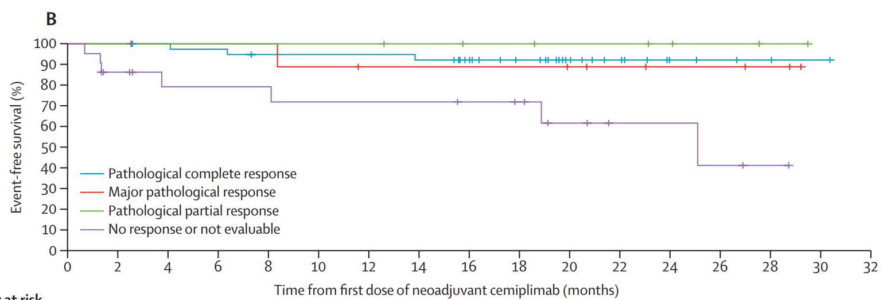
NEOADJUVANT CEMIPLIMAB IN CSCC
EFS Results by Depth of Response
No recurrence occurred in the 40 pCR patients
Only 3 EFS events occurred in pCR patients - deaths unrelated to study drug
EFS: time from first dose of neoadjuvant cemiplimab to progressive disease that precluded surgery, inability to undergo R0, R1 resection, disease recurrence by imaging criteria, or death due to any cause.
Gross et al. Lancet Oncol. 2023
Courtesy of Evan J Lipson, MD

Slide 63
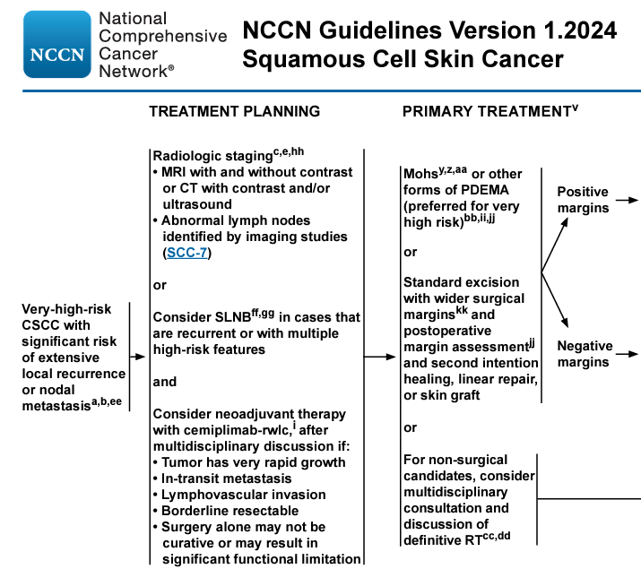
Courtesy of Evan J Lipson, MD

Slide 64
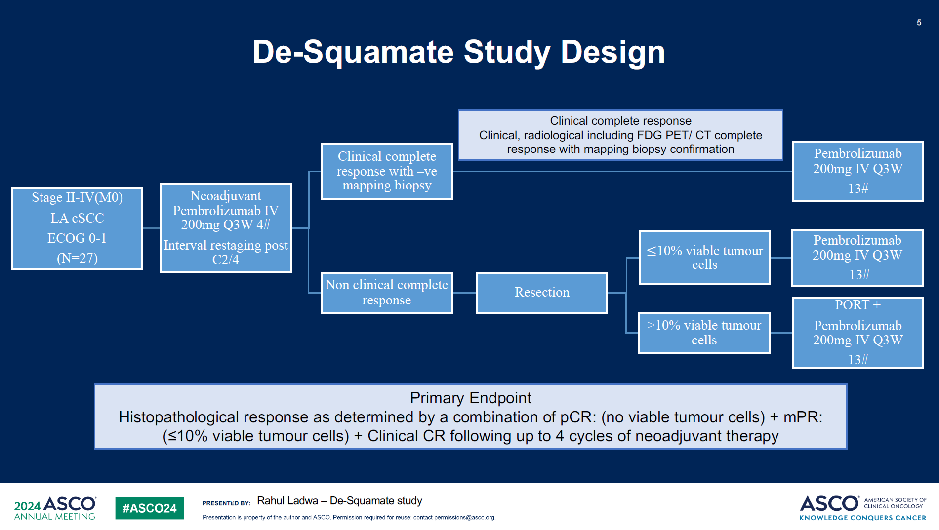
DESQUAMATE Study Design
Rahul Ladwa – DESQUAMATE study
Courtesy of Evan J Lipson, MD

Slide 65
ASCO 2024;Abstract 9554.

Slide 66
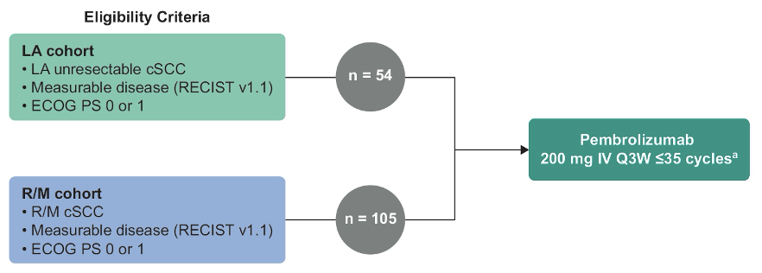
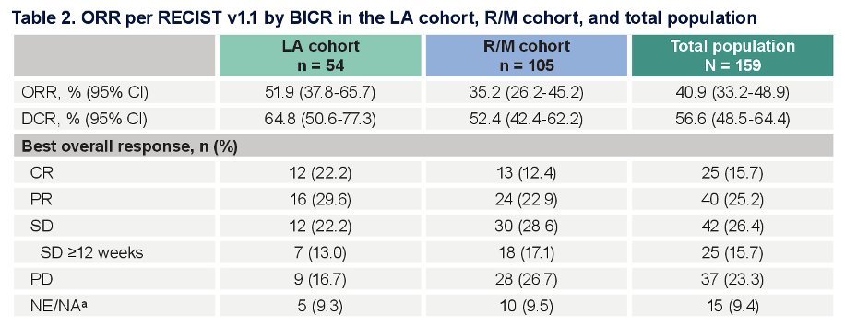
KEYNOTE-629: Pembrolizumab for Locally Advanced (LA) or
Recurrent or Metastatic (R/M) Cutaneous Squamous Cell Carcinoma (cSCC)
ORR = objective response rate
Couselo E et al. ASCO 2024;Abstract 9554.

Slide 67
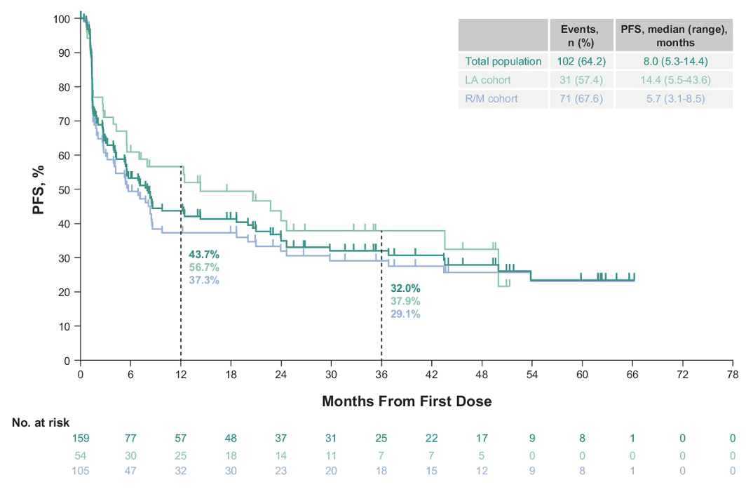
KEYNOTE-629: Progression-Free Survival (PFS) Outcomes by BICR
Couselo E et al. ASCO 2024;Abstract 9554.

Slide 68
ESMO 2023;Abstract 1139P.

Slide 69
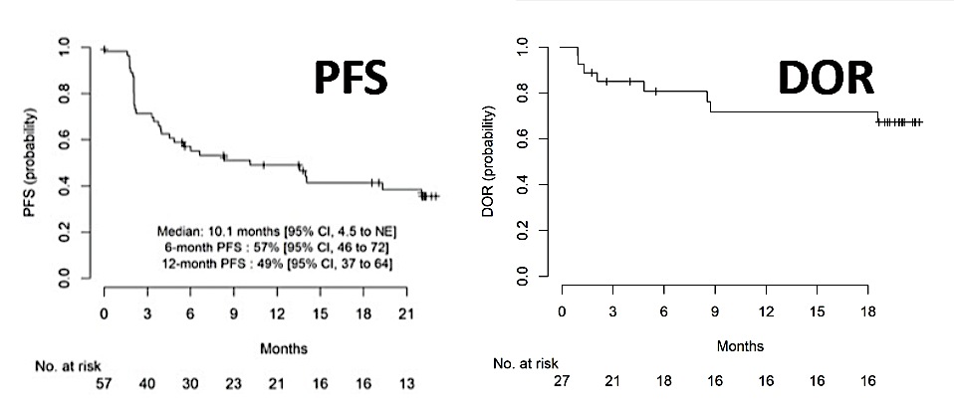
First-Line Pembrolizumab for Advanced Cutaneous Squamous Cell Carcinoma
Maubec E et al. ESMO 2023;Abstract 1139P.

Slide 70
APPENDIX

Slide 71
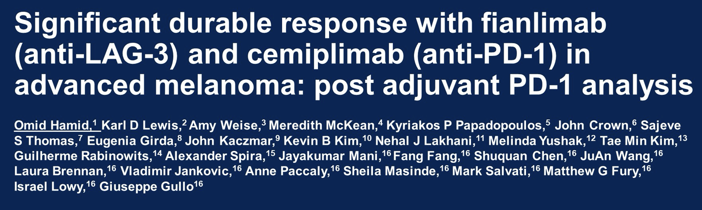
ASCO 2023;Abstract 9501.

Slide 72
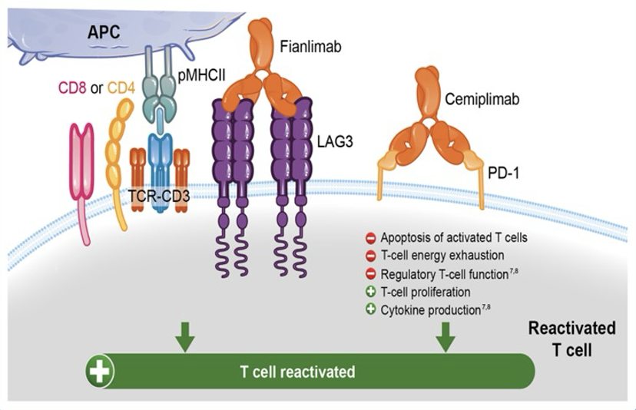
Fianlimab (Anti-LAG-3) and Cemiplimab for Advanced Melanoma
Hamid O et al. ASCO 2023;Abstract 9501.

Slide 73
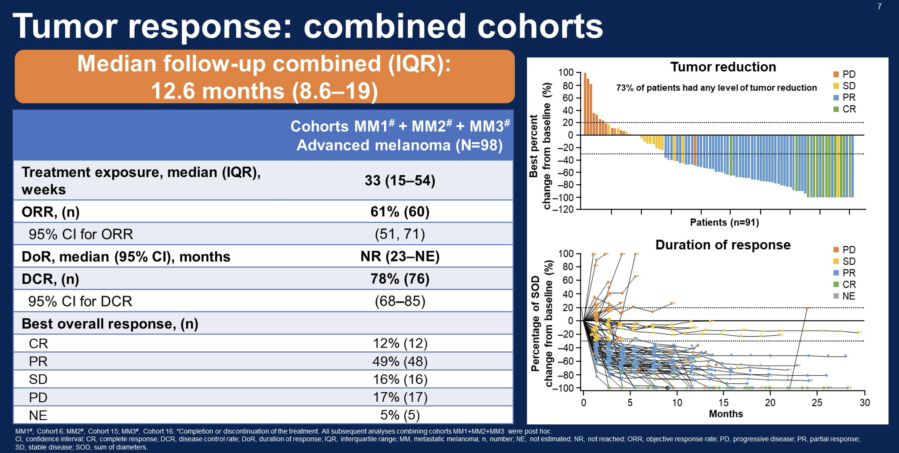
Fianlimab and Cemiplimab for Advanced Melanoma: Response
Hamid O et al. ASCO 2023;Abstract 9501.

Slide 74
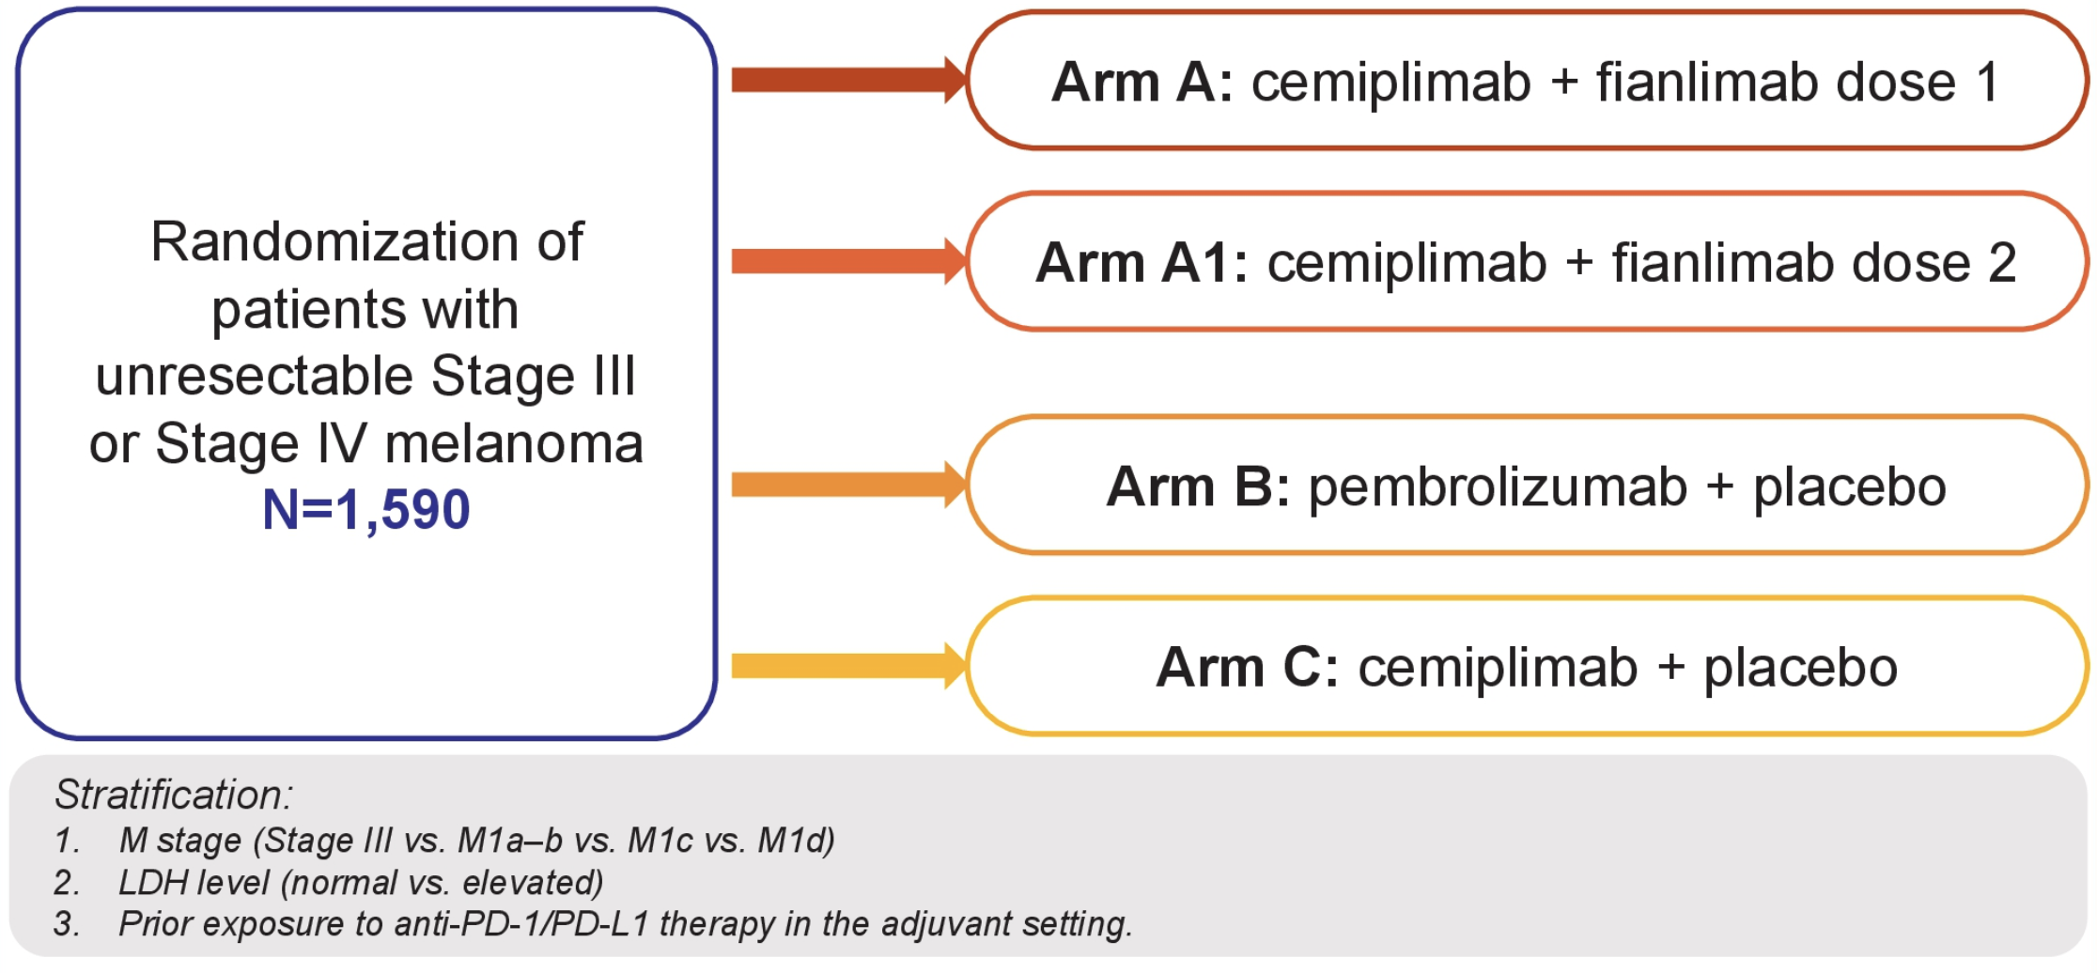
Ongoing Phase III Trial of Fianlimab/Cemiplimab versus
Pembrolizumab for Unresectable or Metastatic Melanoma
Baramidze A et al. ASCO 2023;Abstract TPS9602.

Slide 75
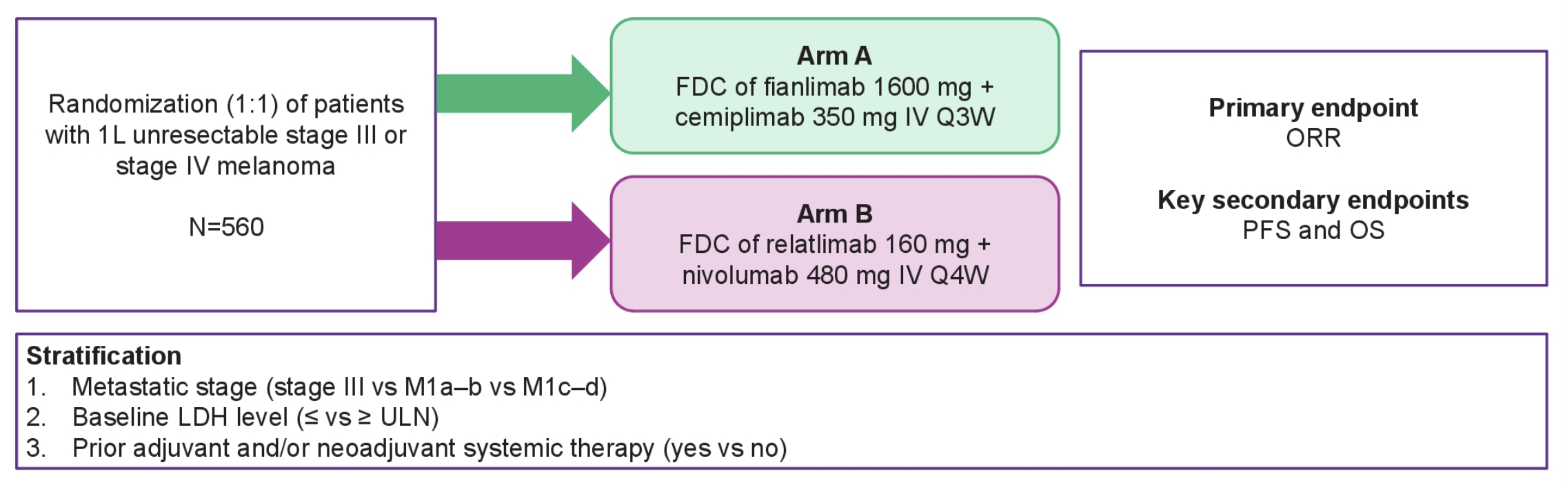
Ongoing Phase III Trial of Fianlimab/Cemiplimab versus
Relatlimab/Nivolumab for Unresectable or Metastatic Melanoma
Khushalani NI et al. ASCO 2024;Abstract TPS9611.

Slide 76
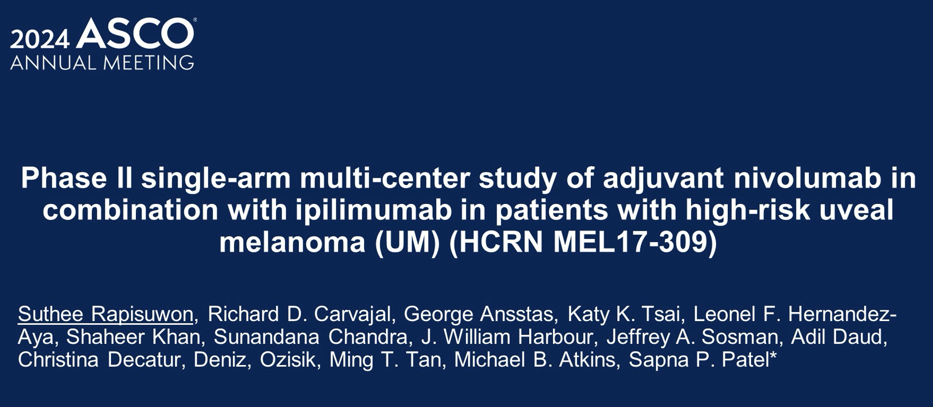
Deniz Ozisik,
Abstract 9509

Slide 77
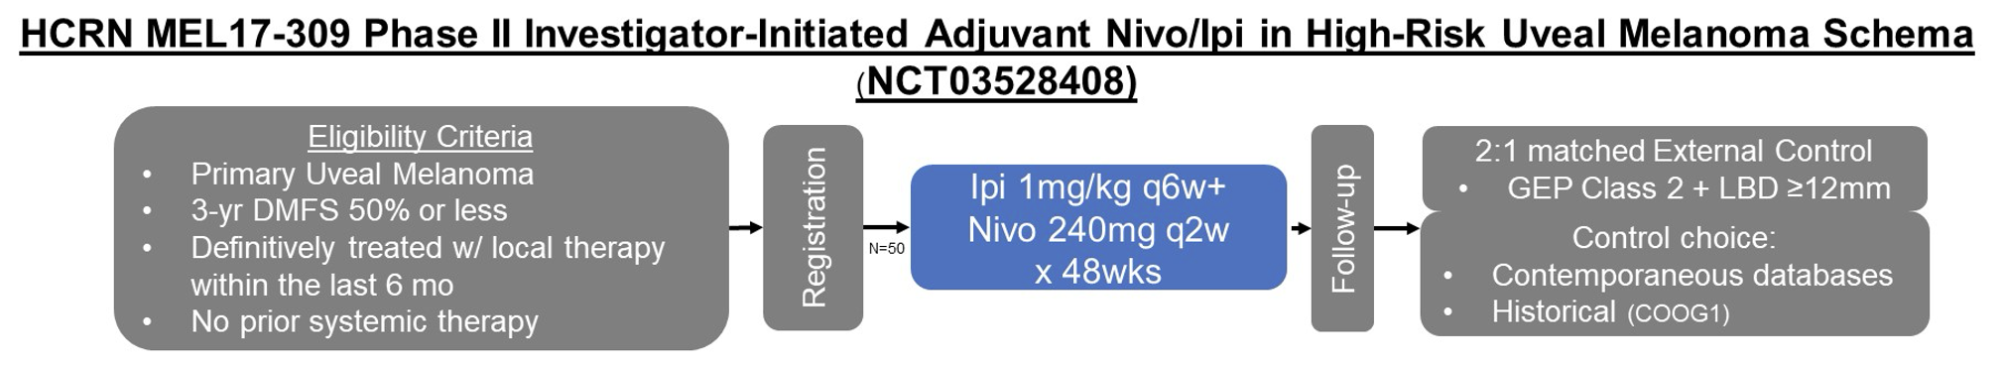
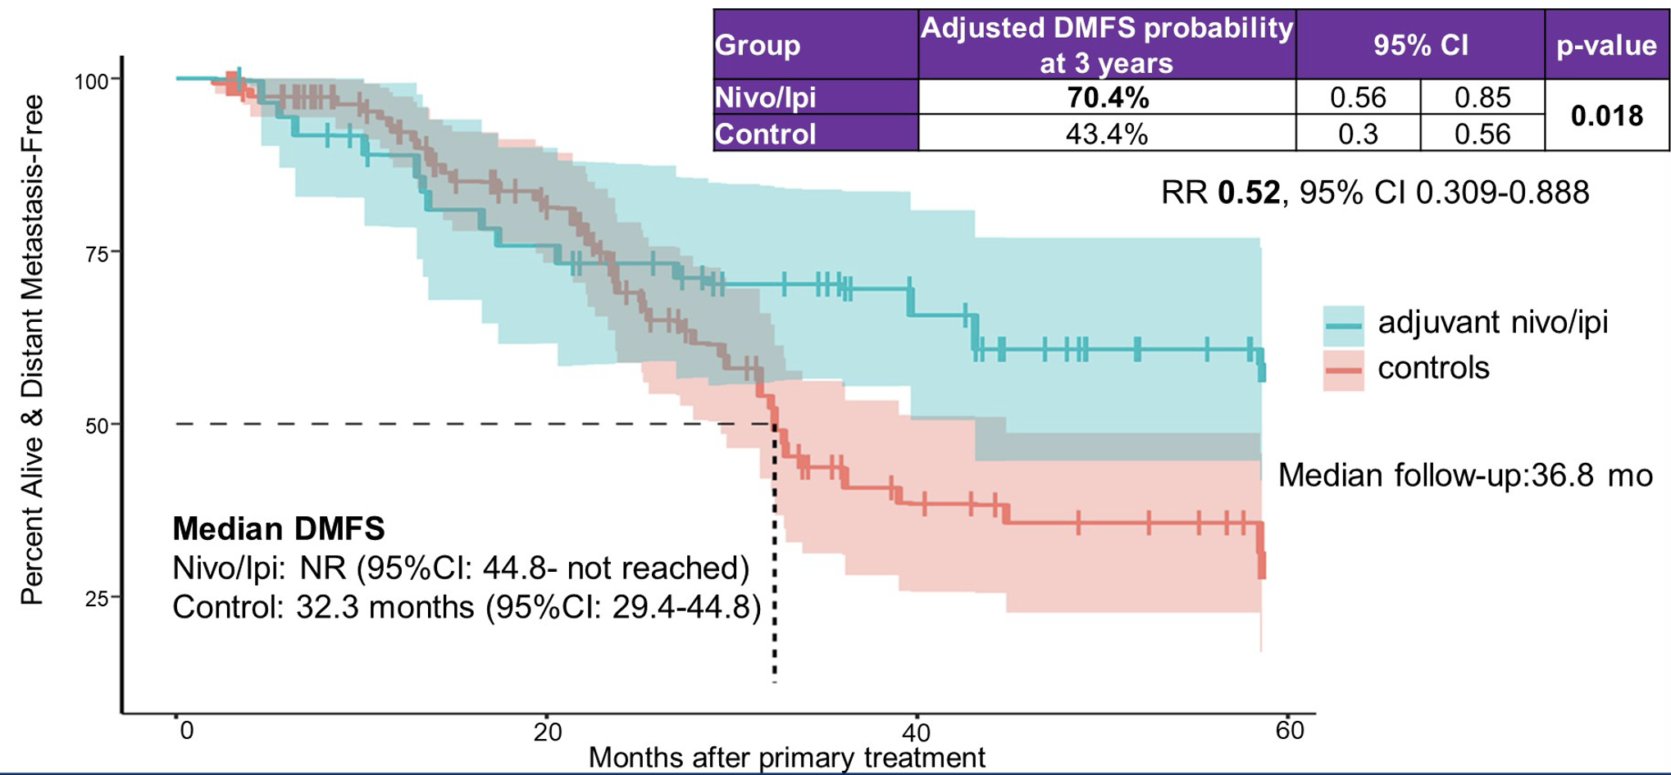
Phase II Study of Adjuvant Nivolumab/Ipilimumab for High-Risk Uveal Melanoma
Rapisuwon S et al. ASCO 2024;Abstract 9509.

Slide 78
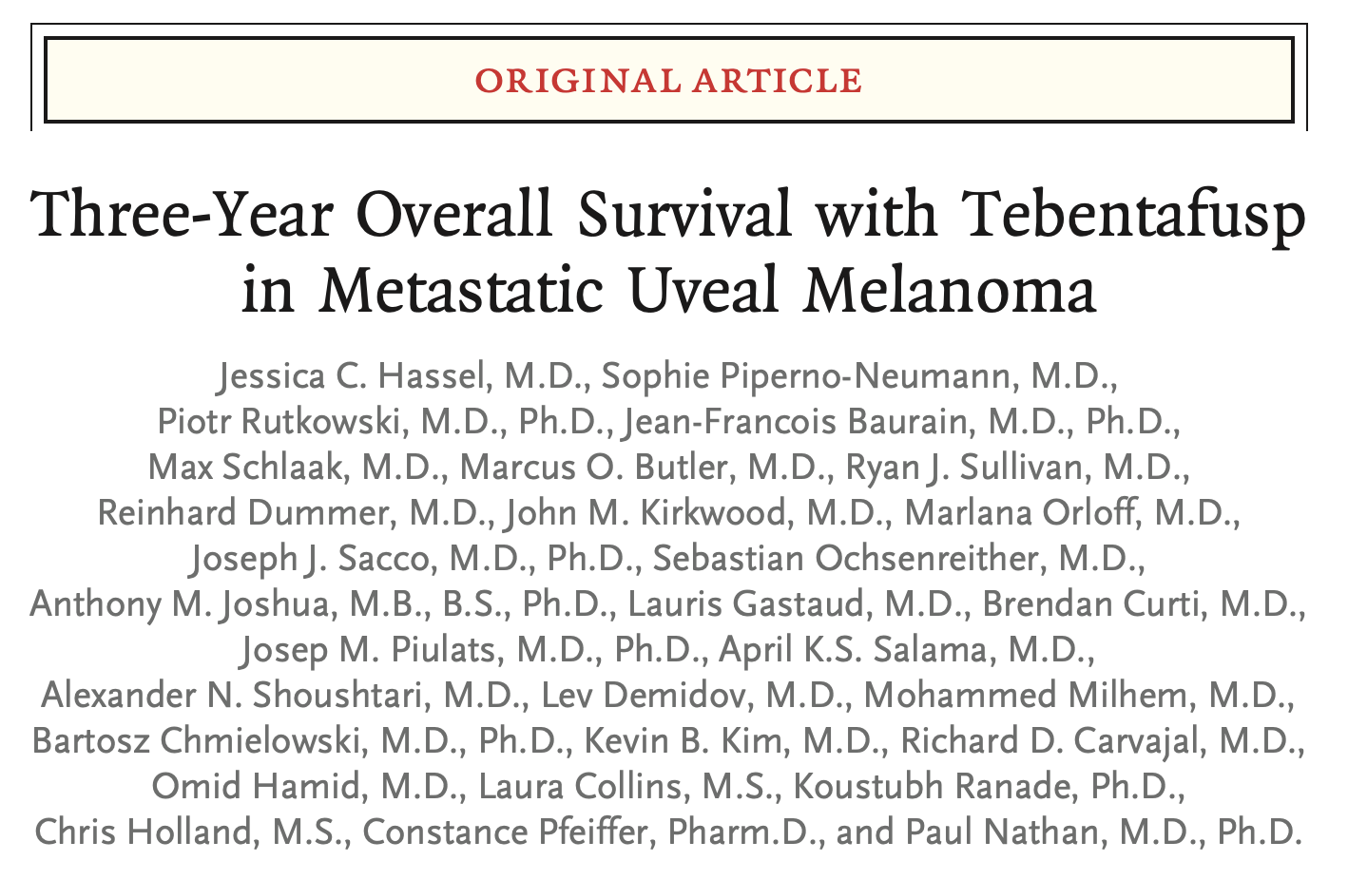
N Engl J Med 2023;389(24):2256-66.

Slide 79
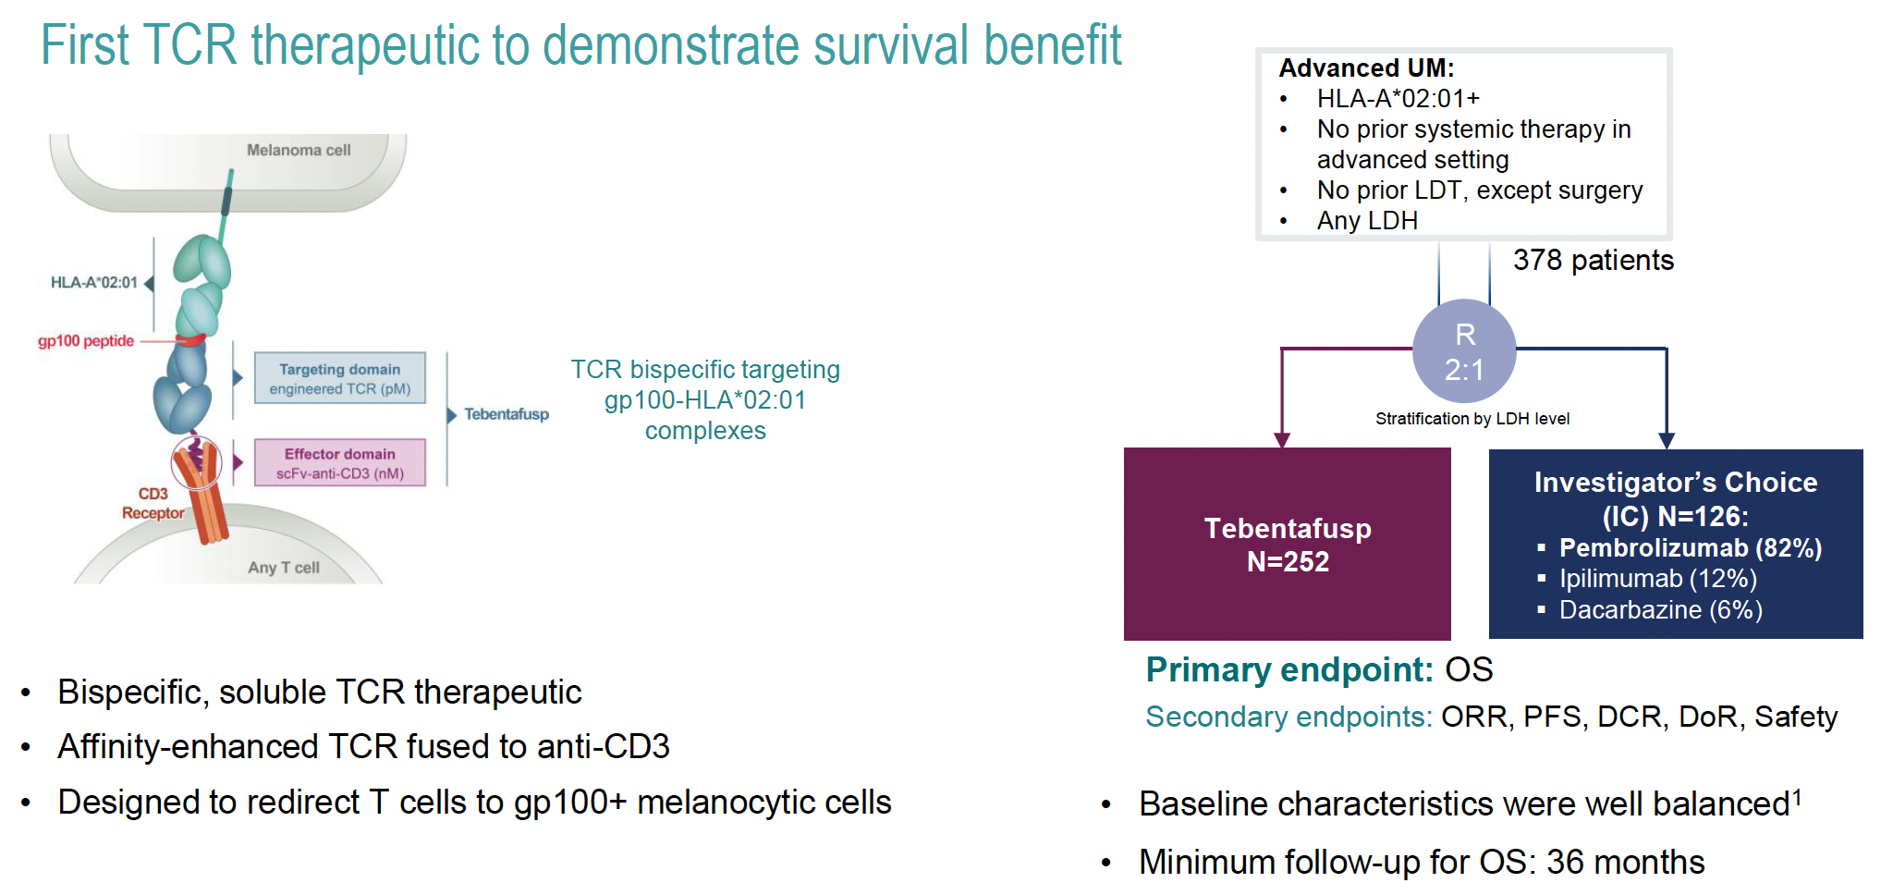
Tebentafusp for Metastatic Uveal Melanoma (UM)
LDT = liver-directed therapy; TCR = T-cell receptor
Piperno-Neumann et al. ESMO 2023;Abstract LBA50.

Slide 80
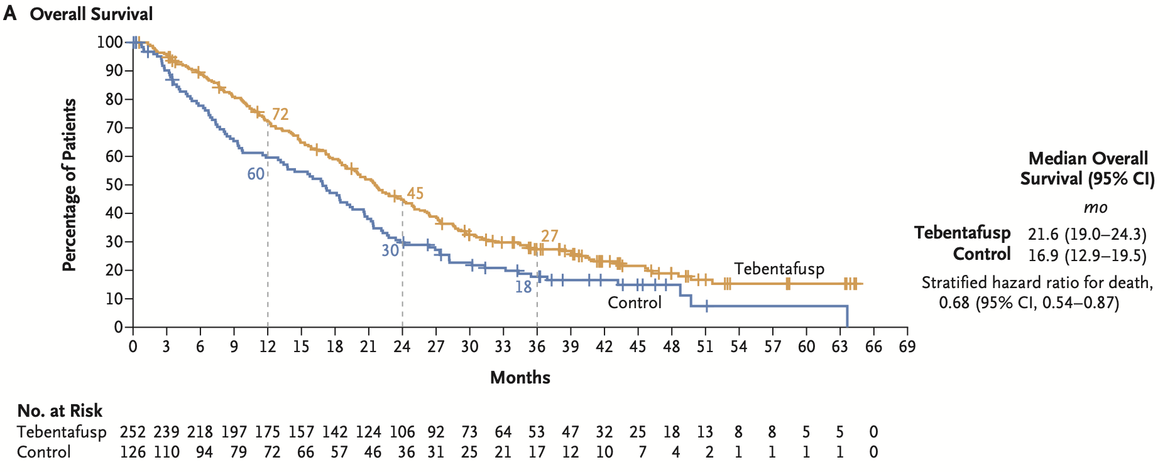
Tebentafusp for Metastatic Uveal Melanoma – Long-Term OS
Hassel JC et al. N Engl J Med 2023;389(24):2256-66.

Slide 81
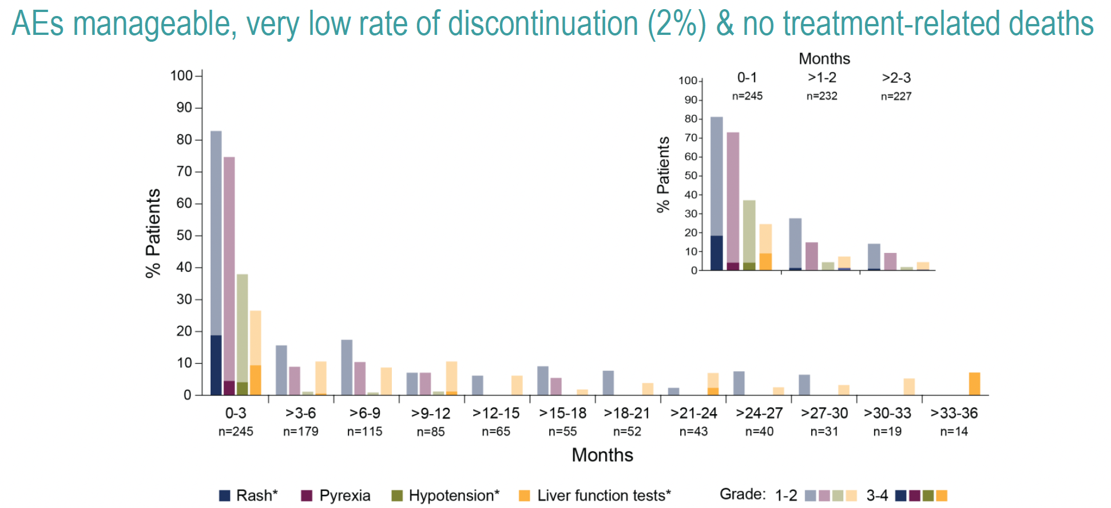
Tebentafusp for Metastatic Uveal Melanoma – Safety
Rash
Hypotension
Liver function tests
Piperno-Neumann et al. ESMO 2023;Abstract LBA50.

Slide 82
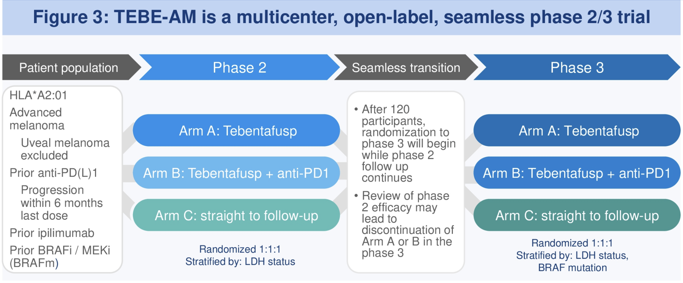
Ongoing Phase II/III Trial of Tebentafusp with or without Pembrolizumab
Daver D et al. ASCO 2023;Abstract TPS9594.

