Slide 1
Advances in the Care of Patients with HR+/HER2- Metastatic BC (MBC)
Erica L. Mayer MD MPH
Dana-Farber Cancer Institute
Boston, MA
Notes:
30 min

Slide 2
2023: What a year!
Mirroring the rest of oncology, breast cancer remains an incredibly fast paced field with multiple new agents and evolving data
New drug approvals and new results continue to modify treatment paradigms
Toxicity and tolerability are key and may be differentiators
New findings hopefully result in better and longer outcomes for our patients

Slide 3
MONARCH 3 Study Design
N = 493
Eligibility Criteria:
HR+, HER2- ABC
Postmenopausal
Metastatic or locoregionally recurrent disease with no prior systemic therapy in this setting
If (neo)adjuvant ET administered, a disease-free interval of >12 months since completion of ET
ECOG PS ≤1
abemaciclib 150 mg PO BID +
anastrozole 1 mg or
letrozole 2.5 mg PO QD until PD ª
Primary Endpoint⁵
Investigator-assessed PFS
Key Secondary Endpoints
Overall survival, response rates, safety
Exploratory Endpoint Chemotherapy-free survival
Stratification Factors
Metastatic site (visceral, bone only, or other)
Prior ET (AI, no ET, or other)
Randomization 2:1
placebo PO BID +
anastrozole 1 mg or
letrozole 2.5 mg QD until PDª
MONARCH 3 enrolled from November 2014 to November 2015 in 158 centers from 22 countries
ª per physician’s choice: 79.1 % received letrozole, 19.9 % received anastrozole
⁵Goetz MP, et al. J Clin Oncol. 2017;35(32):3638-3646

Slide 4
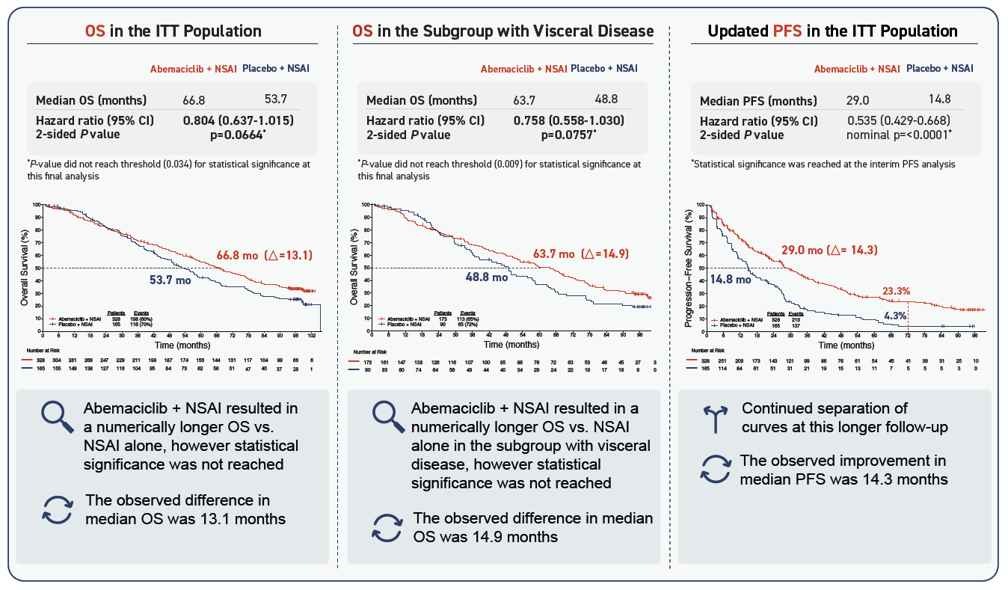
MONARCH 3 Final OS results of abemaciclib plus AI as first-line therapy for HR+, HER2- advanced breast cancer

Slide 5
Overall Survival in Patients Treated with CDK4/6i for Metastatic Disease
 | Treatment Arm: OS, Median, Mo | Placebo Arm: OS, Median, Mo | Hazard Ratio | Hazard Ratio (95% CI) | P Value | Significance reached vs placeboª
PALOMA-2¹ Palbociclib + letrozole | 53.9 | 51.2 |  | 0.956 (0.777-1.177) | 0.3378 | ✗
PALOMA-3² Palbociclib + fulvestrant | 34.9 | 28.0 |  | 0.81 (0.64-1.03) | .09 | ✗
MONARCH 2³ Abemaciclib + fulvestrant | 46.7 | 37.3 |  | 0.76 (0.61-0.95) | .01 | ✓
MONARCH 3 Abemaciclib + NSAI | 66.8 | 53.7 |  | 0.804 (0.637-1.015) | .0664 | ✗
MONALEESA-2^{4,5} Ribociclib + letrozole | 63.9 | 51.4 |  | 0.76 (0.63-0.93) | .004 | ✓
MONALEESA-7⁶ Ribociclib + goserelin + tamoxifen/NSAI | NR | 40.9 |  | 0.71 (0.54-0.95) | .00973 | ✓
MONALEESA-3⁷ Ribociclib + fulvestrant | NR | 40.0 |  | 0.72 (0.57-0.92) | .00455 | ✓
PAL
ABE
RIBO
PARSIFAL-LONG: mOS 65 months
0.4
0.6
0.8
1.0
1.2
Favors CDK4/6i
Favors PBO
ª The red × denotes trials that did not report significant median OS compared with placebo. ABC, advanced breast cancer; ABE, abemaciclib; NR, not reached; NSAI, non-steroidal aromatase inhibitor; OS, overall survival; RIBO, ribociclib; PAL, palbociclib. 1. Finn RS, et al. J Clin Oncol. 2022; 40 (suppl 17; abstr LBA1003). 2. Turner NC, et al. N Engl J Med. 2018;379:1926-1936. 3. Sledge GW, et al. JAMA Oncol. 2020;6:116-124. 4. Hortobagyi GN, et al. N Engl J Med. 2022;386:942-950. 5. Hortobagyi GN, et al. ESMO 2021. Oral LBA17_PR. 6. Im SA, et al. N Engl J Med. 2019;381:307-316. 7. Slamon DJ, et al. N Engl J Med. 2020;382:514-524.
5

Slide 6
MONARCH 3 OS
Smaller trial than other 1L CDK4/6i trials: 2:1 randomization and split alpha create statistical challenges versus the other larger trials
OS benefits are somewhat washed out with subsequent therapies
1 in 5 patients without progression at 8 years
PARSIFAL-LONG – 65 month median OS for palbociclib, may revive interest in the agent
For now, tend to select ribociclib, but abemaciclib is a reasonable alternative, especially if ribociclib not feasible

Slide 7
CAPItello-291: Study overview
Phase III, randomized, double-blind, placebo-controlled study (NCT04305496)
Capivasertib
Patients with HR+/HER2– ABC
400 mg twice daily,
4 days on, 3 days off
Dual primary endpoints
Fulvestrant
PFS by investigator assessment
Overall
AKT pathway–altered s (≥1 qualifying PIK3CA, AKT1, or PTEN alteration)
Men and pre-/post-menopausal women
Recurrence or progression while on or <12 months from end of adjuvant AI, or progression while on prior AI for ABC
≤2 lines of prior endocrine therapy for ABC
≤1 line of chemotherapy for ABC
Prior CDK4/6 inhibitors allowed (at least 51% required)
No prior SERD, mTOR inhibitor, PI3K inhibitor, or AKT inhibitor
HbA1c <8.0% (63.9 mmol/mol) and diabetes not requiring insulin allowed
FFPE sample from the primary/recurrent cancer available for retrospective central molecular testing
500 mg: cycle 1, days 1 & 15; then every 4 weeks
R1:1
(N=708)
Stratification factors:
Liver metastases (yes/no)
Prior CDK4/6 inhibitor (yes/no)
Region*
Placebo
Key secondary endpoints
Overall survival
Overall
AKT pathway–altered s
Objective response rate
Overall
AKT pathway–altered s
Twice daily,
4 days on, 3 days off
Fulvestrant
500 mg: cycle 1, days 1 & 15; then every 4 weeks
.
HER2– was defined as IHC 0 or 1+, or IHC 2+/ISH–. *Region 1: United States, Canada, Western Europe, Australia, and Israel, Region 2: Latin America, Eastern Europe and Russia vs Region 3: Asia.
ABC, advanced (locally advanced [inoperable] or metastatic) breast cancer.
Pre- or peri-menopausal women also received a luteinizing hormone-releasing hormone agonist for the duration of the study treatment
Turner NC, et al. SABCS 2022. Abstract GS3-04.
Notes:
SOLAR-1 only allowed HgA1c < 6.5. Here more lenient.

Slide 8
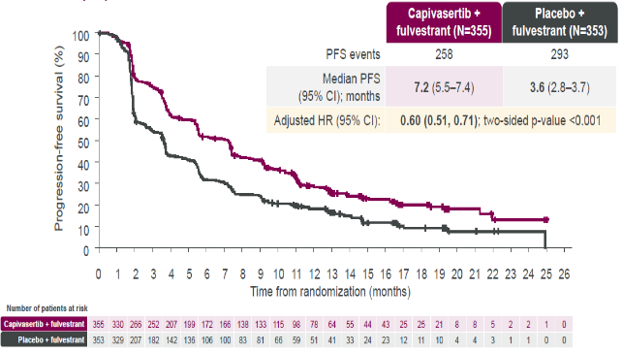
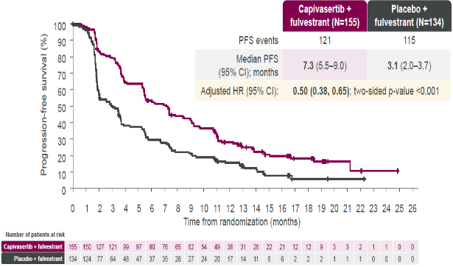
CAPItello-291 Dual Primary Endpoints: PFS in Overall and AKT Pathway-altered Populations¹
Capivasertib plus fulvestrant provides a statistically significant and clinically meaningful improvement in PFS in the overall and the AKT pathway-altered populations
PFS in Overall: 7.2 vs 3.6 HR: 0.60
PFS in AKT Altered: 7.3 vs 3.1 HR: 0.50
+ indicates a censored observation. HR was estimated using the Cox proportional hazard model stratified by the presence of liver metastases, prior use of CDK4/6 inhibitor, and geographic region.
Turner NC, et al. SABCS 2022. Abstract GS3-04.
8

Slide 9
CAPItello-291 Adverse Event Profile
AEs (>10% of patients) – overall population
Capivasertib + fulvestrant (N=355)
Placebo + fulvestrant (N=350)
Total (%)/Grade 3 (%)
Grade 1
Grade 2
Grade 3*
Grade 3*
Grade 2
Grade 1
Total (%)/Grade 3 (%)
Diarrhea
Rash†
Nausea
Fatigue
Vomiting
Headache
Decreased appetite Hyperglycemia
Stomatitis
Asthenia
Pruritus
Anemia
Urinary tract infection
72.4/
9.3
20.0
/0.3
38.0/
12.1
7.1/
0.3
Capivasertib/ placebo action | Capivasertib + fulvestrant (N=355) | Placebo + fulvestrant (N=350)
Dose hold | 124 (34.9) | 36 (10.3)
Dose reduction | 70 (19.7) | 6 (1.7)
Discontinuation for AE | 46 (13.0) | 8 (2.3)
34.6/
0.8
15.4
/0.6
20.8/
0.6
12.9
/0.6
20.6/
1.7
4.9/
0.6
16.9/
0.3
12.3
/0.6
16.6/0.3
6.3/
0.6
16.3/2.0
3.7/
0.3
14.6/2.0
4.9
/0.0
13.2/1.1
10.3
/0.6
12.4/0.6
6.6
/0.0
10.4/
2.0
4.9/1.1
10.1/
1.4
6.6/0.0
= Key AEs
100 80 60 40 20 0 0 20 40 60 80 100
Percentage of patients (%)
*All events shown were Grade 3 except 1 case of Grade 4 hyperglycemia in the capivasertib + fulvestrant arm.
†The collective term rash includes the preferred terms of rash, rash macular, maculopapular rash, rash papular, and rash pruritic.
Turner NC, et al. N Engl J Med. 2023;388(22):2058-2070.

Slide 10
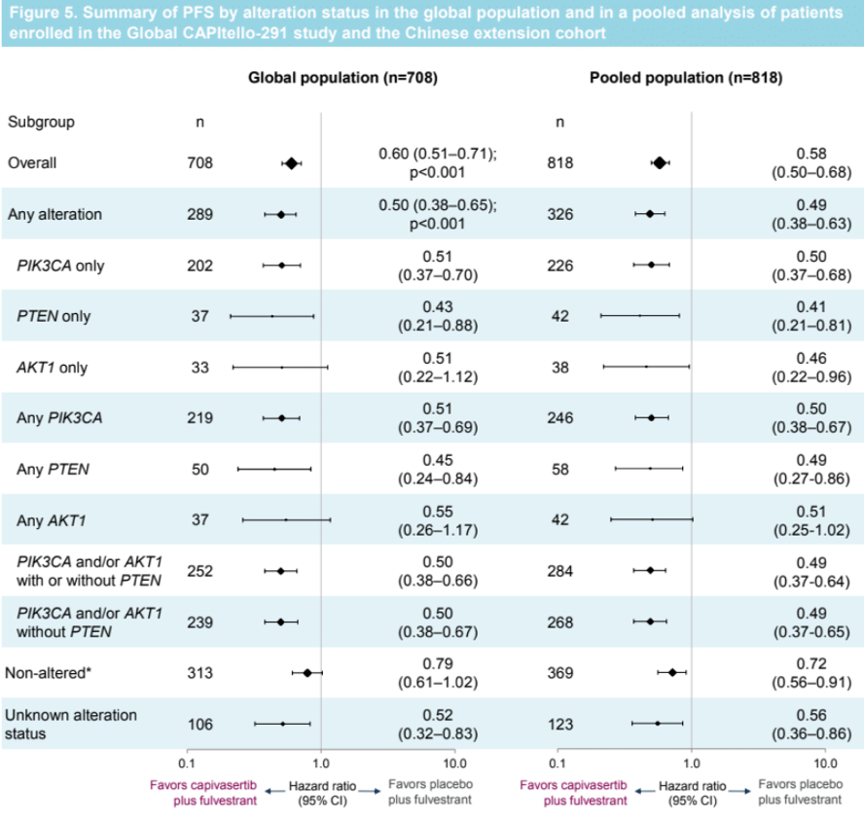
Capivasertib and fulvestrant for patients with AI-resistant HR positive/HER2-negative MBC: Exploratory analysis of PFS by AKT pathway gene from the CAPItello-291 trial
In patients with PIK3CA/AKT1/PTEN–altered tumors, the addition of capivasertib to fulvestrant provided a PFS benefit compared to fulvestrant alone, with benefit regardless of gene alteration detected, including:
  PIK3CA altered tumors
  AKT1 altered tumors
  PTEN altered tumors
Howell et al, SABCS 2023

Slide 11
CAPItello-291 - capivasertib
The combination of capivasertib and fulvestrant is now an approved therapy for pretreated HR+/HER2- MBC with a PIK3CA/AKT1/PTEN-alteration.
Supports need for tumor genomic profiling; ctDNA may be preferred
Toxicity profile may be a differentiator:
  Notable for diarrhea and rash; nausea and fatigue also observed.
  Less hyperglycemia than seen with alpelisib in a population including diabetics, although glucose monitoring is necessary.
  Consider prophylactic antihistamine for rash; educate patients about antidiarrheal use.
  May be a preferred choice compared to alpelisib, especially if concerned about hyperglycemia.

Slide 12
INAVO120: Phase III study of inavolisib (GDC-0077) or placebo in combination with palbociclib and fulvestrant in PIK3CA-mutant, HR+/HER2- MBC: Study Design
San Antonio Breast Cancer Symposium®, December 5–9, 2023
Key eligibility criteria
Enrichment of patients with poor prognosis:
PIK3CA-mutated, HR+, HER2- ABC by central ctDNA* or local tissue/ctDNA test
Measurable disease
Progression during/within 12 months of
adjuvant ET completion
No prior therapy for ABC
Fasting glucose <126 mg/dL and HbA_{1C} <6.0%
Enrolment period: December 2019-September 2023
N=325
Inavolisib (9 mg QD PO)
+ palbociclib (125 mg PO QD D1-D21)
+ fulvestrant (500 mg C1D1/15 and Q4W)**
Until PD
or toxicity
R
1:1
SURVIVAL
FOLLOW-UP
Placebo (PO QD)
+ palbociclib (125 mg PO QD D1-D21)
+ fulvestrant (500 mg C1D1/15 and Q4W)**
Stratification factors:
Visceral Disease (Yes vs. No)
        Endocrine Resistance (Primary vs. Secondary)†
Region (North America/Western Europe; Asia; Other)
Endpoints
Primary: PFS by Investigator
Secondary: OS‡, ORR, BOR, CBR, DOR, PROs
* Central testing for PIK3CA mutations was done on ctDNA using FoundationOne®Liquid (Foundation Medicine). In China, the central ctDNA test was the PredicineCARE NGS assay (Huidu). † Defined per 4th European School of Oncology (ESO)–European Society for Medical Oncology (ESMO) International Consensus Guidelines for Advanced Breast Cancer.¹ Primary: relapse while on the first 2 years of adjuvant ET; Secondary: relapse while on adjuvant ET after at least 2 years or relapse within 12 months of completing adjuvant ET. ‡ OS testing only if PFS is positive; interim OS analysis at primary PFS analysis; **Pre-menopausal women received ovarian suppression. ctDNA, circulating tumor DNA; R, randomized. 1. Cardoso F, et al. Ann Oncol 2018;29:1634–1657.

Slide 13
Primary endpoint: PFS (investigator assessed)
San Antonio Breast Cancer Symposium®, December 5–9, 2023
6-month
12-month
18-month
 | Inavo+Palbo+Fulv (n=161) | Pbo+Palbo+Fulv (n=164)
No. of events, n (%) | 82 (50.9) | 113 (68.9)
Median (95% CI), mo | 15.0 (11.3, 20.5) | 7.3 (5.6, 9.3)
Stratified hazard ratio (95% CI) | 0.43 (0.32, 0.59) p<0.0001
100
82.9%
75
55.9%
55.9%
PFS (%)
46.2%
50
32.6%
Inavo+Palbo+Fulv
21.1%
25
Pbo+Palbo+Fulv
Censored
0
0
3
6
9
12
15
18
21
24
27
30
33
36
Time (mo)
Patients at risk:
Inavo+Palbo+Fulv | 161 | 134 | 111 | 92 | 66 | 48 | 41 | 31 | 22 | 13 | 11 | 5 | 1
Pbo+Palbo+Fulv | 164 | 113 | 77 | 59 | 40 | 23 | 19 | 16 | 12 | 6 | 3 | 3 | 1
Median follow-up: 21.3 months
CCOD: 29th September 2023
CI, confidence interval; Fulv, fulvestrant; Inavo, inavolisib; mo, months; Palbo, palbociclib; Pbo, placebo; PFS, progression-free survival.

Slide 14
Adverse events with any grade AEs ≥20% incidence in either treatment group
San Antonio Breast Cancer Symposium®, December 5–9, 2023
Adverse Events | Inavo+Palbo+Fulv (N=162) |  | Pbo+Palbo+Fulv (N=162)
 | All Grades | Grade 3-4 | All Grades | Grade 3-4
Neutropenia | 144 (88.9%) | 130 (80.2%) | 147 (90.7%) | 127 (78.4%)
Thrombocytopenia | 78 (48.1%) | 23 (14.2%) | 73 (45.1%) | 7 (4.3%)
Stomatitis/Mucosal inflammation | 83 (51.2%) | 9 (5.6%) | 43 (26.5%) | 0
Anemia | 60 (37.0%) | 10 (6.2%) | 59 (36.4%) | 3 (1.9%)
Hyperglycemia | 95 (58.6%) | 9 (5.6%) | 14 (8.6%) | 0
Diarrhea | 78 (48.1%) | 6 (3.7%) | 26 (16.0%) | 0
Nausea | 45 (27.8%) | 1 (0.6%) | 27 (16.7%) | 0
Rash | 41 (25.3%) | 0 | 28 (17.3%) | 0
Decreased Appetite | 38 (23.5%) | <2% | 14 (8.6%) | <2%
Fatigue | 38 (23.5%) | <2% | 21 (13.0%) | <2%
COVID-19 | 37 (22.8%) | <2% | 17 (10.5%) | <2%
Headache | 34 (21.0%) | <2% | 22 (13.6%) | <2%
Leukopenia | 28 (17.3%) | 11 (6.8%) | 40 (24.7%) | 17 (10.5%)
Ocular Toxicities | 36 (22.2%) | 0 | 21 (13.0%) | 0
Key AEs are shown in bold. AES were assessed per CTCAE V5. Neutropenia, thrombocytopenia, stomatitis/mucosal inflammation, anemia, hyperglycemia, diarrhea, nausea and rash were assessed as medical concepts using grouped terms
AE, adverse event; ALT, alanine aminotransferase; AST, aspartate aminotransferase; Fulv, fulvestrant; Inavo, inavolisib; Palbo, palbociclib; Pbo, placebo.
No toxicity prophylaxis used in this trial

Slide 15
INAVO120: Inavolisib
Reassuring to see improved outcomes in a very high risk cohort of patients with HR+ MBC.
Supports need to know PIK3CA mutation status from time of diagnosis of MBC, in 1L setting.
Palbociclib remains a CDK4/6i option for MBC; may be best tolerated of the agents and easiest to combine in a triplet.
Population had low BMI and was not diverse; toxicity profile including hyperglycemia and mucositis, may be different in a more “real world” group of patients.
Next generation mutant specific PIK3CA inhibitors may offer efficacy with minimal hyperglycemia

Slide 16
EMERALD Phase 3 Trial of Elacestrant vs SOC in ER+/HER2–MBC: Study Design and Patients^{1,2}
Key Eligibility Criteria
ER+/HER2– MBC
1-2 prior lines of ET, one of which in combination with CDK4/6i
≤1 line of chemotherapy for advanced disease
ECOG PS 0-1
Patient Characteristics, n (%) |  | Elacestrant | C 150 mg (n=73) | SOC | Total (N=240)
 |  | All (n=239) | ESR1mut (n=115) | All (n=239) | ESR1mut (n=115)
Median age (range), years |  | 63 (24-89) | 64 (28-89) | 63 (32-83) | 63 (32-83)
ECOG PS | 0 | 143 (59.8) | 67 (58.3) | 135 (56.5) | 61 (54.9)
 | 1 | 96 (40.2) | 48 (41.7) | 103 (43.1) | 51 (45.1)
Visceral metastasis, % |  | 163 (68.2) | 81 (70.4) | 170 (71.1) | 84 (74.3)
Prior CDK4/6i |  | 239 (100) | 115 (100) | 239 (100) | 113 (100)
Prior lines of ET | 1 | 129 (54.0) | 73 (63.5) | 142 (59.4) | 69 (61.1)
 | 2 | 110 (46.0) | 42 (36.5) | 97 (40.6) | 44 (38.9)
Type of prior ET | Fulvestrant | 70 (29.3) | 27 (23.5) | 75 (31.4) | 28 (24.8)
 | AI | 193 (80.8) | 101 (87.8) | 194 (81.2) | 96 (85.0)
 | Tamoxifen | 19 (7.9) | 9 (7.8) | 15 (6.3) | 9 (8.0)
Prior lines of Chemo | 0 | 191 (79.9) | 89 (77.4) | 180 (75.3) | 81 (71.7)
 | 1 | 48 (20.1) | 26 (22.6) | 59 (24.7) | 32 (28.3)
R
A
N
D
O
M
I
Z
E
D
Elacestrant
400 mgª
PD or withdrawal criterion^{b}
1:1
Investigator’s choice (SOC)
Fulvestrant
Anastrozole
Letrozole
Exemestane
Primary endpoints^{c}: PFS in all, PFS in ESR1mut patients
Secondary endpoints: OS, safety
ª Protocol-defined dose reductions permitted. ^{b} Restaging CT scans every 8 weeks. ^{c} By BICR.
1. Bidard F, et al. J Clin Oncol. 2022;40(28):3246-3256. 2. Bardia A, et al. SABCS 2022. Abstract GS3-01.

Slide 17
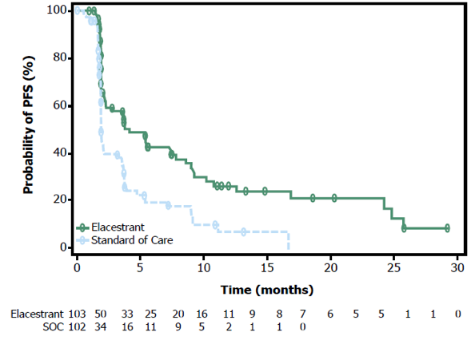
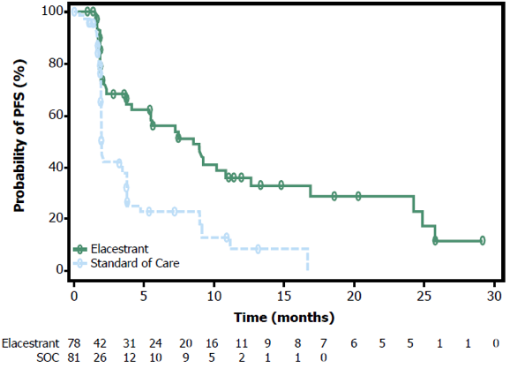
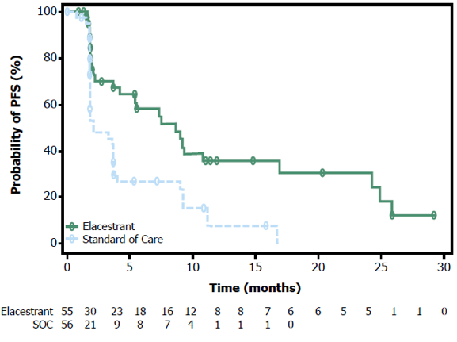
EMERALD: PFS in ESR1mut Population by Duration of
Prior CDK4/6i
PFS by Duration of CDK4/6i in Patients With ESR1mut Tumors
≥6 mo CDK4/6i
≥12 mo CDK4/6i
≥18 mo CDK4/6i
PFS by Duration of CDK4/6i | ≥6 Months |  | ≥12 Months |  | ≥18 Months
 | Elacestrant (n=103) | SOC (n=102) | Elacestrant (n=78) | SOC (n=81) | Elacestrant (n=55) | SOC (n=56)
mPFS, mo (95% CI) | 4.14 (2.20-7.79) | 1.87 (1.87-3.29) | 8.61 (4.14-10.84) | 1.91 (1.87-3.68) | 8.61 (5.45-16.89) | 2.10 (1.87-3.75)
12-mo PFS rate, % (95% CI) | 26.02 (15.12-36.92) | 6.45 (0.00-13.65) | 35.81 (21.84-49.78) | 8.39 (0.00-17.66) | 35.79 (19.54-52.05) | 7.73 (0.00-20.20)
HR (95% CI) | 0.517 (0.361-0.738) |  | 0.410 (0.262-0.634) |  | 0.466 (0.270-0.791)
Bardia A, et al. SABCS 2022. Abstract GS3-01

Slide 18
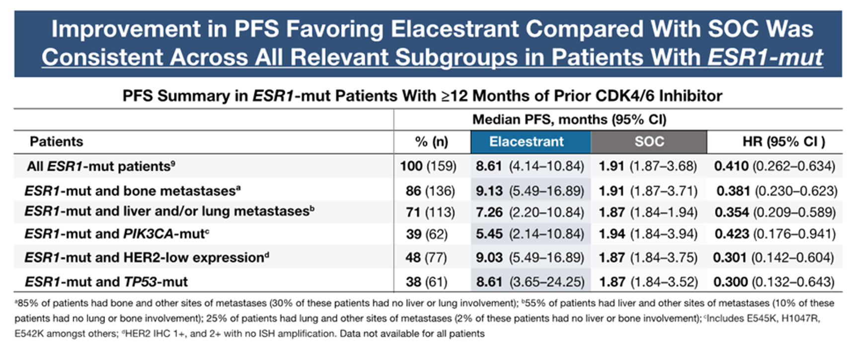
Phase 3 EMERALD Biomarker & Subgroup Analysis
Subgroup analysis (by sites of metastases, common coexisting mutations [PIK3CA, TP53], and HER2-low status) of patients with endocrine sensitive (CDK4/6i for ≥12 mos) HR+ MBC with ESR1 mutations, revealed clinically meaningful improvement in PFS favoring elacestrant vs SOC was consistent across all relevant subgroups
Lu et al. SABCS 2023. Abstract PS-17-02.

Slide 19
EMERALD Subgroup Analysis
Elacestrant monotherapy is an option in MBC with ESR1 mutation and retained endocrine sensitivity (eg, prior CDK4/6 inhibitor duration ≥12 months)
In that situation, the ER pathway could be the main driver of disease, regardless of the metastatic site or coexistence of PIK3CA-mut, TP53-mut, or HER2-low expression.
If there are both ESR1 and PIK3CA mutations or HER2-low, could prioritize elacestrant as a well tolerated option before moving to capivasertib, alpelisib, or T-DXd.
Await results of studies of elacestrant combinations.
ESR1 is a kinetic mutation that develops over time; supports need to check ESR1 status at time of PD.

Slide 20
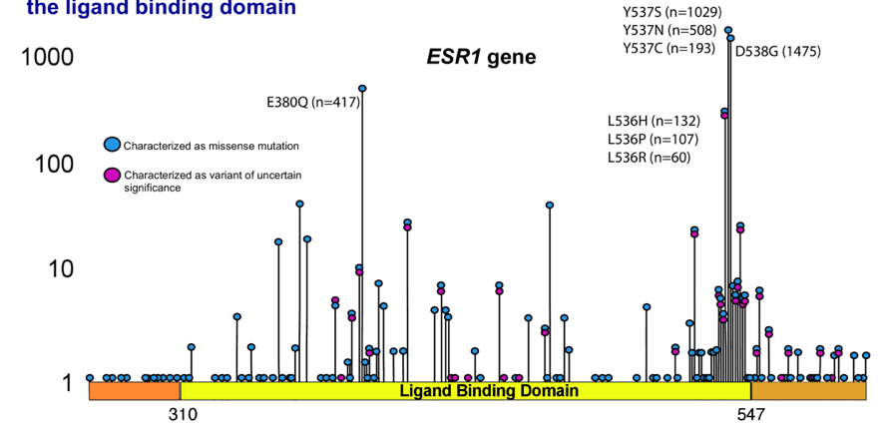
ESR1 Mutations in Advanced Breast Cancer
Major acquired mutation of metastatic ER+ BC
Acquired through prior AI therapy
Ligand independence
Rare in primary tumors (<1%), but highly enriched in MBC
Trial | Study Population | ER+ MBC Patient Population | ESR1 Mut, %
MONALEESA-2 | Letrozole ± ribociclib | 1st line | 4.0
BOLERO-2 | Exemestane ± everolimus | After PD on ET | 28.8
FERGI | Fulvestrant ± pictilisib | After PD on ET | ~40.0
PALOMA-3 | Fulvestrant ± palbociclib | After PD on ET | 25.3
SoFEA | Fulvestrant ± anastrozole | After PD on ET | 39.1
Toy W et al. Nat Genet. 2013;45(12)1439-1445. Robinson DR et al. Nat Genet. 2013;45(12):1446-1451. Ma CX et al. Nat Rev Cancer. 2015;15(5):261-275. Medford AJ et al. ASCO 2023. Abstract 1074. Hortobagyi GN et al. Ann Oncol. 2018;29(7):1541-1547. Chandarlapaty S et al. JAMA Oncol. 2016;2(10):1310-1315. Spoerke JM et al. Nat Commun. 2016;7:11579. Cristofanilli M et al. Lancet Oncol. 2016:17(4):425-439. Fribbens C et al. J Clin Oncol. 2016;34(25):29618.

Slide 21
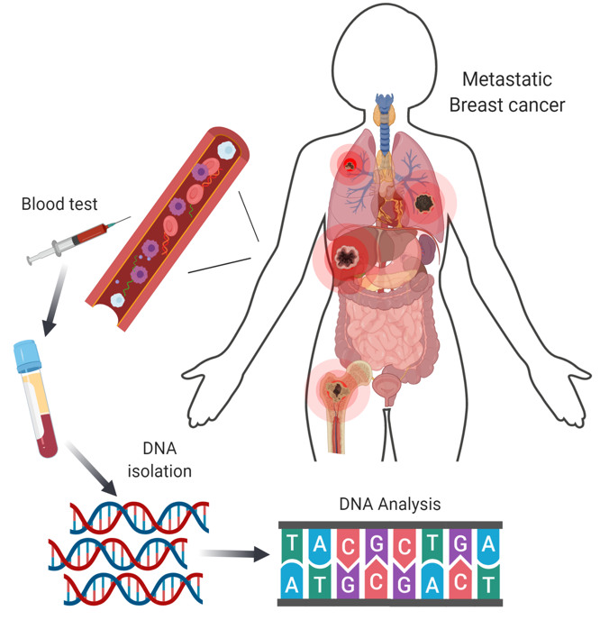
ESR1 Mutations Often Subclinical:
Liquid Biopsy Testing Is the Standard
ctDNA testing identified more ESR1 mutations than contemporaneous biopsy
Different metastases may develop different resistance mutations
Turner NC et al. Lancet Oncol. 2020;21(10):1296-1308.

Slide 22
Testing for ESR1 mutations to guide therapy for HR+/HER2- MBC: ASCO guideline rapid recommendation update
The Expert Panel recommends routine testing for ESR1 mutations at recurrence or progression on ET (with or without CDK4/6 inhibitor) in patients with ER-positive, HER2-negative MBC. Testing should be performed on blood or tissue obtained at the time of progression, as ESR1 mutations develop in response to selection pressure during treatment and are typically undetectable in the primary tumor; blood-based ctDNA is preferred owing to greater sensitivity. If not performed earlier, testing for PIK3CA mutations should also be performed to guide further therapy. Patients whose tumor or ctDNA tests remain ESR1 wildtype may warrant retesting at subsequent progression(s) to determine if an ESR1 mutation has arisen.
Burstein HJ et al. J Clin Oncol 2023;41(18):3423-5.

Slide 23
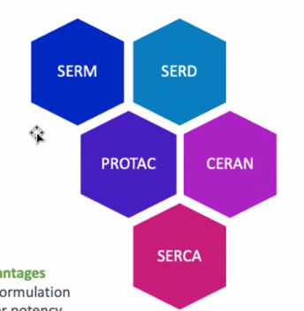
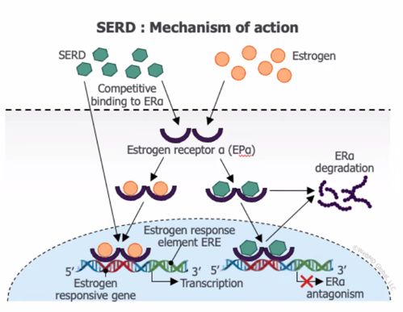
Novel Endocrine Therapies May Address Endocrine Resistance in MBC
Key Advantages
Oral formulation
Higher potency
Activity in ESR1mut MBC
Activity in post-ET and CDK4/6i treated pts
Can be well tolerated
Hernando et al. Int J Mol Sci. 2021; slide adapted from Erika Hamilton.

Slide 24
SERENA-2: Phase 2 Trial of Camizestrant vs Fulvestrant in ER+/HER2– MBC: Study Design and Patients
Key Eligibility Criteria
Recurrence or progression on ≥1 line of ET
No prior fulvestrant or oral SERD in ABC
≤1 line of ET in ABC setting
≤1 line chemotherapy in ABC setting
Measurable and nonmeasurable disease
Patient Characteristics, % |  | C75 (n=74) | C150 (n=73) | F (n=73)
Median age (range), years |  | 61 (37-79) | 60 (42-84) | 60 (35-84)
ER+ |  | 100 | 100 | 100
ECOG PS 0 |  | 62.2 | 57.5 | 58.9
Lung/liver metastasis |  | 58.1 | 58.9 | 58.9
Liver metastasis |  | 31.1 | 41.1 | 47.9
ESR1mut detectable^{c} |  | 29.7 | 35.6 | 47.9
Chemotherapy in ABC |  | 21.6 | 12.3 | 26.0
ET adjuvant | AI | 40.5 | 35.6 | 31.5
 | SERM | 32.4 | 45.2 | 43.8
ET in ABC | 0 lines | 37.8 | 28.8 | 26.0
 | 1 line | 62.2 | 71.2 | 74.0
 | AI | 55.4 | 67.1 | 67.1
 | SERM | 6.8 | 2.7 | 6.8
Prior CDK4/6i^{d} |  | 51.4 | 50.7 | 50.7
Palbociclib |  | 21.6 | 31.5 | 30.1
Ribociclib |  | 23.0 | 19.2 | 16.4
Abemaciclib |  | 5.4 | 1.4 | 4.1
R
A
N
D
O
M
I
Z
E
D
Camizestrant 300 mgª (n=20)
Postmenopausal ER+/HER2– ABC
C75: Camizestrant 75 mg (n=74)
C150: Camizestrant 150 mg (n=73)
F: Fulvestrant (n=73)
1:1:1:1
N=240
Primary endpoint: PFS by investigator^{b}
Secondary endpoints: CBR24, ORR, OS, safety
Translational endpoints: Serial CTC and ctDNA (ESR1mut) analyses
ª CSP v5 amendment: December 16, 2020. ^{b} Disease progression defined using RECIST v1.1. ^{c} ESR1mut assessed in plasma samples at screening and C1D1; ESR1mut defined as E380Q, V422del, S463P, L536H/P/R, Y537C/D/N/S, D538G, individual mutations present in >2% total cases reported. ^{d} Missing or not specified in 3 patients.
Oliveira M et al. SABCS 2022. Abstract GS3-02.

Slide 25
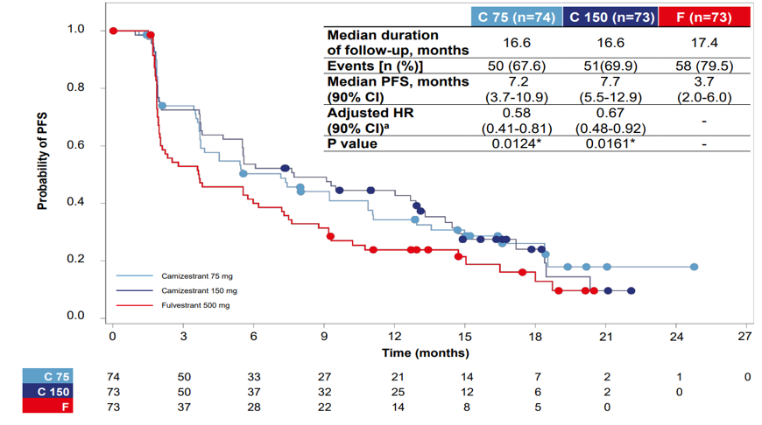
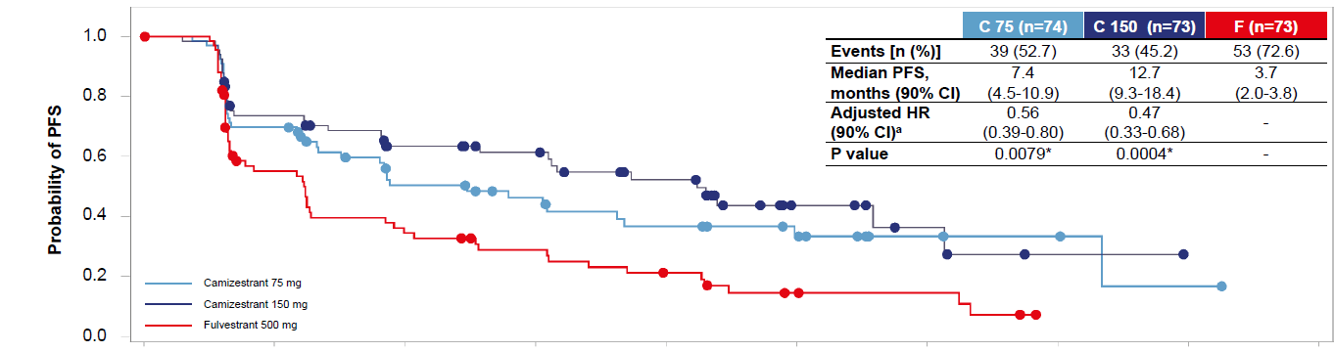
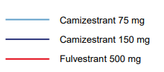
SERENA-2: PFS in ITT
Primary Endpoint: PFS by Investigator Assessment
PFS by BICR
 | C75 (n=74) | C150 (n=73) | F (n=73)
Median follow-up, mo | 16.6 | 16.6 | 17.4
Events, n (%) | 50 (67.6) | 51 (69.9) | 58 (79.5)
mPFS, mo (90% CI) | 7.2 (3.7-10.9) | 7.7 (5.5-12.9) | 3.7 (2.0-6.0)
Adjusted HRª (90% CI) | 0.58 (0.41-0.81) | 0.67 (0.48-0.92) | -
P value | 0.0124^{b} | 0.0161^{b} | -
 | C75 (n=74) | C150 (n=73) | F (n=73)
Events, n (%) | 39 (52.7) | 33 (45.2) | 53 (72.6)
mPFS, mo (90% CI) | 7.4 (4.5-10.9) | 12.7 (9.3-18.4) | 3.7 (2.0-3.8)
Adjusted HRª (90% CI) | 0.56 (0.39-0.80) | 0.47 (0.33-0.68) | -
P value | 0.0079^{b} | 0.0004^{b} | -
ª HR adjusted for prior use of CDK4/6i and liver/lung metastases. ^{b} Statistically significant.
Oliveira M et al. SABCS 2022. Abstract GS3-02.

Slide 26
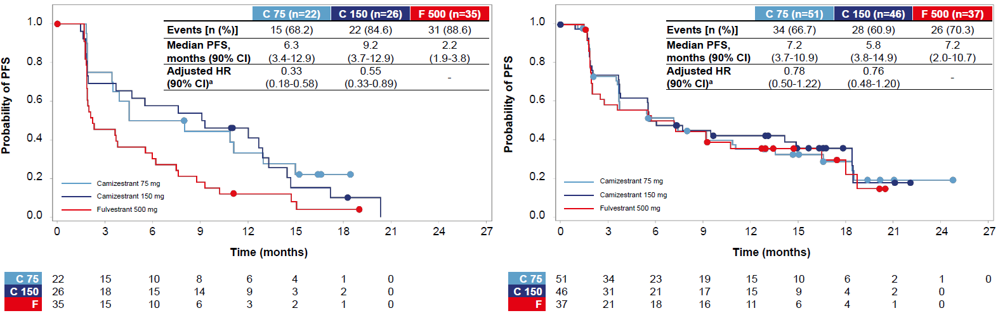
SERENA-2: PFS in Patients by Detectable ESR1mut
PFS in Patients With ESR1mut Detectable at Baseline
PFS in Patients With ESR1mut Not Detectable at Baseline
 | C75 (n=22) | C150 (n=26) | F (n=35)
mPFS, mo (90% CI) | 6.3 (3.4-12.9) | 9.2 (3.7-12.9) | 2.2 (1.9-3.8)
Adjusted HRª (90% CI) | 0.33 (0.18-0.58) | 0.55 (0.33-0.89) | -
 | C75 (n=51) | C150 (n=46) | F (n=37)
mPFS, mo (90% CI) | 7.2 (3.7-10.9) | 5.8 (3.8-14.9) | 7.2 (2.0-10.7)
Adjusted HRª (90% CI) | 0.78 (0.50-1.22) | 0.76 (0.48-1.20) | -
Camizestrant was associated with improvements in PFS over fulvestrant at both doses studied in the subgroups of patients with detectable ESR1mut, patients previously treated with CDK4/6i + ET, patients with lung and/or liver metastases, and patients with evidence of ER-driven disease
ª HR adjusted for prior use of CDK4/6i and liver/lung metastases.
Oliveira M et al. SABCS 2022. Abstract GS3-02.

Slide 27
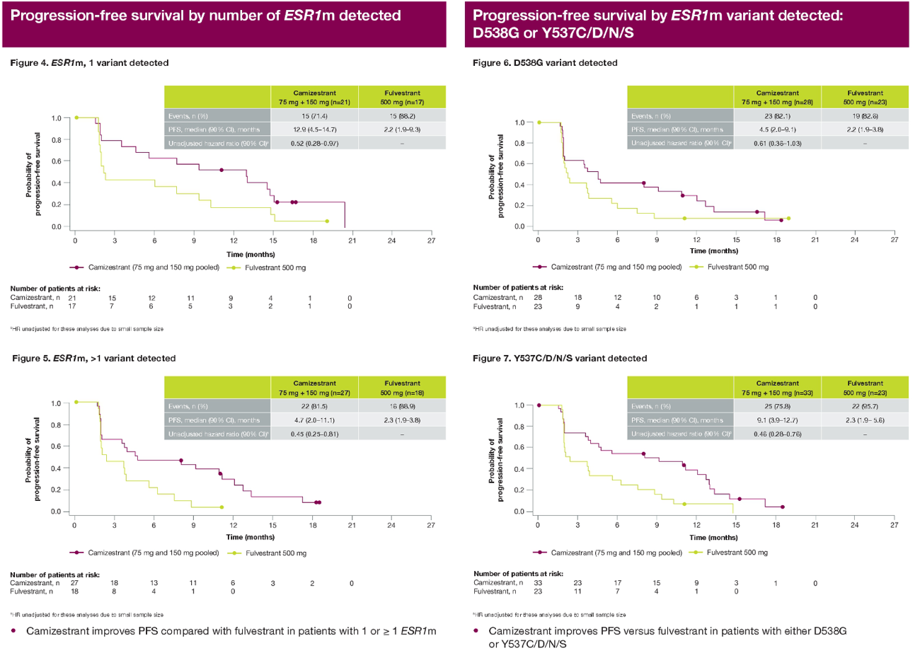
Clinical activity of camizestrant, a next-generation SERD, versus fulvestrant in patients with a detectable ESR1 mutation: Exploratory analysis of SERENA-2.
Benefit of oral SERD over fulvestrant was observed in patients with:
1 ESR1 mutation
>1 ESR1 mutation
Specific ESR1 mutations
Oliveira M et al. ASCO 2023;Abstract 1066.

Slide 28
SERENA-2: Exploratory Analysis
Camizestrant monotherapy has shown promising data over fulvestrant in patients with HR+/HER2- MBC and an ESR1 mutation
The agent retains activity regardless of number or type of ESR1 mutations
Ongoing studies are looking at:
  Camizestrant combinations
  Other oral SERDs in combinations: giredestrant, imlunestrant
  ARV-471 (vepdegestrant, PROTAC), OP-1250 (CERAN)
Likely will be a rapidly expanding space in the next 1-2 years

Slide 29
Novel Oral Endocrine Therapies: SERD, CERAN, PROTAC
Agent | Disease setting | Select ongoing trials
ORAL SERDs
Elacestrant (RAD1901) | Advanced/Metastatic | EMERALD, ELEVATE
Giredestrant (GDC-9545) | Advanced/Metastatic | persevERA, acelERA, evERA. pionERA
 | Neoadjuvant | coopERA
 | Adjuvant | lidERA
Camizestrant (AZD9833) | Advanced/Metastatic | SERENA-1,-2,-4, -6
 | Neoadjuvant | SERENA-3
 | Adjuvant | CAMBRIA, CAMBRIA-2
Imlunestrant (LY3484356) | Advanced/Metastatic | EMBER
 | Neoadjuvant | EMBER-2
 | Adjuvant | EMBER-4
Other novel agents
ARV-471 | Advanced/Metastatic | NCT04072952
OP-1250 | Advanced/Metastatic | NCT04505826

Slide 30
EMBER: Phase 1a/b Study of Imlunestrant With Abemaciclib ± AI in ER+ ABC: Study Design
Key Eligibility Criteria
ER+/HER2– ABC
≤1 line of prior therapy of ABC
No prior CDK4/6i
Demonstrated prior sensitivity to ET or have untreated de novo ABC
Imlunestrant + abemaciclib
Primary Endpoint
Determine RP2D
Secondary Endpoints
Safety
PK
Antitumor activity
(ORR, CBR, TTR, PFS)
R
1:1
Imlunestrant +
abemaciclib +
AIª
N=85
Imlunestrant PO qd with abemaciclib (150 mg bid) ± AI in
28-day cycles
Men and premenopausal women received concomitant GnRH agonist
Cutoff date Oct 6, 2022
RP2D imlunestrant combination
with abemaciclib:
imlunestrant 400 mg qd
(same as monotherapy)
Stratification Factors
Menopausal status
Visceral metastases
ª AI was physician’s choice of anastrozole, letrozole, or exemestane at standard doses.
Jhaveri KL, et al SABCS 2023. Abstract PS15-09.

Slide 31
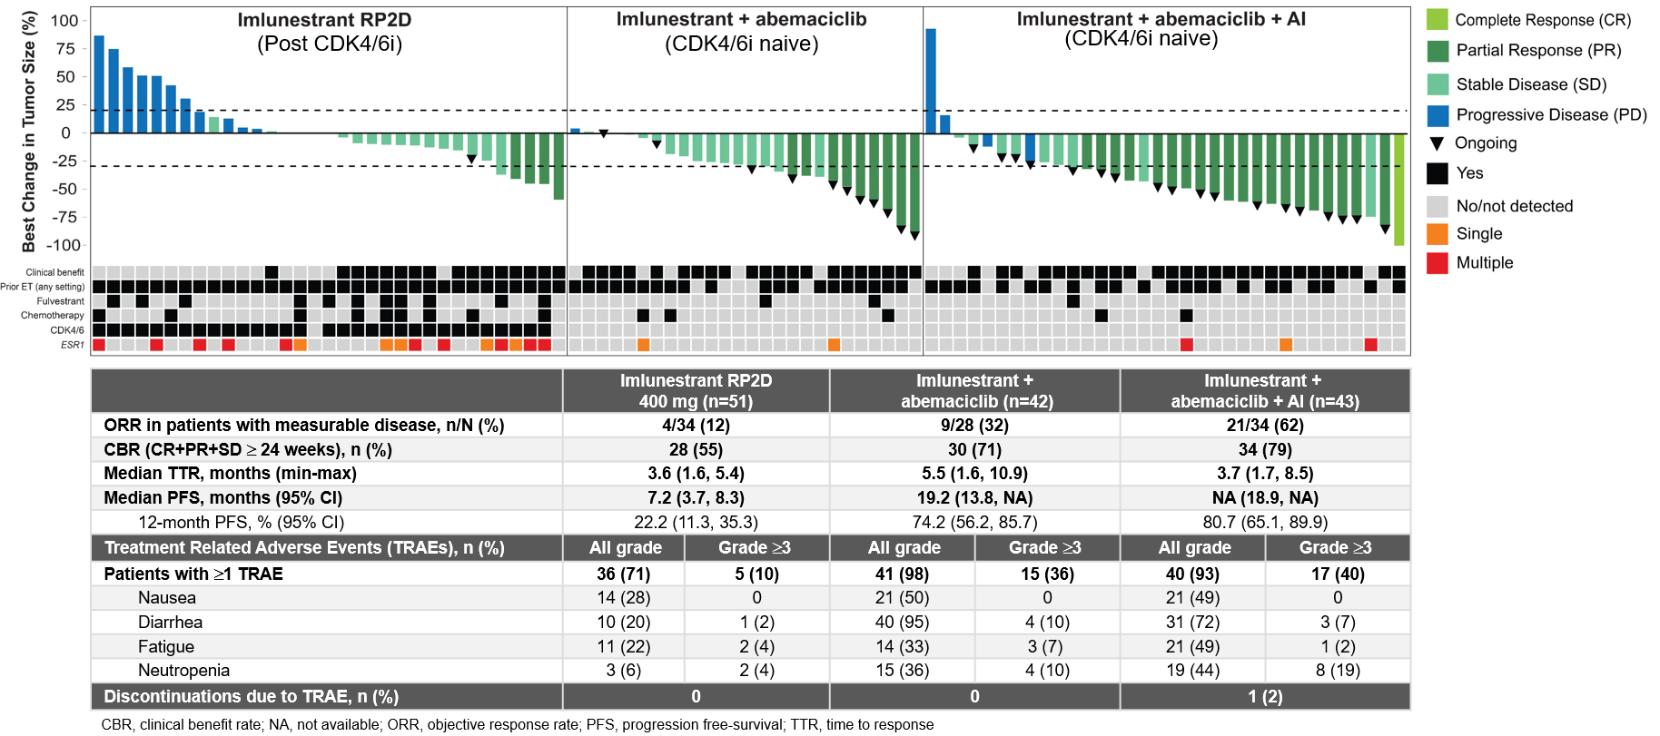
EMBER: Imlunestrant With Abemaciclib ± AI: Efficacy & Safety Summary
Jhaveri KL, et al SABCS 2023. Abstract PS15-09

Slide 32
EMBER: Imlunestrant With Abemaciclib ± AI: Summary
Imlunestrant monotherapy was well tolerated; no new safety signals observed
  RP2D was determined as 400mg QD
Combination with abemaciclib ± AI revealed no new safety signals and no drug-drug interactions
Clinical activity is encouraging with imlunestrant monotherapy, especially at the RP2D and particularly in the 2L post-CDK4/6i setting. Robust efficacy is observed with imlunestrant in combination with abemaciclib ± AI
Pivotal Phase 3, randomized, open-label registration trials of imlunestrant are ongoing:
  EMBER-3 (NCT04975308): Imlunestrant, investigator’s choice ET (fulvestrant or AI), and imlunestrant + abemaciclib in ER+/HER2- ABC previously treated with ET
  EMBER-4 (NCT05514054): Adjuvant imlunestrant vs. adjuvant ET in patients who have previously received 2 to 5 years of adjuvant ET for ER+/HER2- early BC with an increased risk of recurrence
Jhaveri KL, et al SABCS 2023. Abstract PS15-09

Slide 33
Approach to Therapy for HR+/HER2- MBC:
Move to Personalization
1L¹⁻⁴
2L¹
3L
4L/5L¹
4L+¹
AI + CDK4/6i
ET + CDK4/6i
Taxane or capecitabine
Eribulin
Liposomal doxorubicin
Vinorelbine
Gemcitabine
Carboplatin
Fulvestrant + CDK4/6i
BRCA mutated: olaparib or talazoparib^{5,6}
ET alone
ET + everolimus⁷
PIK3CA alteration:
ET + alpelisib⁸
Sacituzumab govitecan¹³
ESR1 mutated: elacestrant^{9,10}
HER2 low: trastuzumab deruxtecan¹⁴
PIK3CA/AKT/PTEN alteration:
Fulvestrant + capivasertib^{11,12}
Pembrolizumab for high TMB or MSI-H¹⁵

Slide 34
Antibody-drug conjugates in breast cancer
Datopotamab

Slide 35
TROPiCS-02: A Phase 3 Study of SG in Patients with HR+/HER2– mBC¹
Metastatic or locally recurrent inoperable HR+/HER2– (IHC0, IHC1+, or IHC2+/ISH–) breast cancer that progressed after^{a,b}:
  At least 1 endocrine therapy, taxane, and CDK4/6 inhibitor in any setting
  At least 2, but no more than 4, lines of chemotherapy for metastatic disease
  Measurable disease by
  RECIST 1.1
  N = 543
Treatment was continued until progression
or unacceptable toxicity
End points
Primary
PFS by BICR
Secondary
OS
ORR, DoR, CBR
by LIR, and BICR
PRO
Safety
Exploratory
OS by HER2 IHC status^{d}
Sacituzumab govitecan
10 mg/kg IV
days 1 and 8, every 21 days
n = 272
R
1:1
Treatment of physician’s choice^{c}
(capecitabine, vinorelbine,
gemcitabine, or eribulin)
n = 271
Stratification:
Visceral metastases (yes/no)
Endocrine therapy in metastatic setting ≥ 6 months (yes/no)
Prior lines of chemotherapies (2 vs 3/4)
ASCO/CAP, American Society of Clinical Oncology/College of American Pathologists; BICR, blinded independent central review; CBR, clinical benefit rate; CDK, cyclin-dependent kinase; DoR, duration of response; HER2–, human epidermal growth factor receptor 2-negative; HR+, hormonal receptor-positive; IHC, immunohistochemistry; ISH, in situ hybridization; IV, intravenously; LIR, local investigator review; ORR, objective response rate; OS, overall survival; PFS, progression-free survival, PRO, patient-reported outcomes; R, randomized; RECIST, Response Evaluation Criteria in Solid Tumors.
ªClinicalTrials.gov. NCT03901339. ^{b}Disease histology based on the ASCO/CAP criteria. ^{c}Single-agent standard-of-care treatment of physician’s choice was specified prior to randomization by the investigator. ^{d}HER2-low was defined as IHC score of 1+, or score of 2+ with negative ISH result; HER2 IHC0 was defined as IHC score of 0.
1. Rugo HS, et al. J Clin Oncol. 2022;40:3365-3376.
Sara M. Tolaney, MD, MPH

Slide 36
Progression-Free Survival
BICR analysis | SG (n = 272) | TPC (n = 271)
Median PFS, (95% CI) mo | 5.5 (4.2-6.9) | 4.0 (3.0-4.4)
Stratified HR (95% CI) | 0.65 (0.53-0.81)
Nominal P-valueª | .0001
6-month PFS rate, % (95% CI) | 45.6 (38.9-52.0) | 29.4 (22.9-36.2)
12-month PFS rate, % (95% CI) | 21.7 (15.8-28.3) | 8.4 (4.2-14.5)
18-month PFS rate, % (95% CI) | 14.4 (9.1-20.8) | 4.7 (1.3-11.6)
100
6 months
12 months
18 months
90
80
70
60
Progression-Free Survival Probability (%)
50
40
30
20
10
SG
TPC
0
0
3
6
9
12
15
18
21
24
27
30
33
36
Time (months)
No. of Patients Still at Risk (Events)
SG | 272 (0) | 148 (86) | 82 (127) | 48 (149) | 27 (164) | 17 (170) | 13 (172) | 6 (176) | 3 (179) | 2 (180) | 2 (180) | 1 (180) | 0 (180)
TPC | 271 (0) | 109 (96) | 42 (144) | 18 (160) | 7 (168) | 3 (169) | 1 (170) | 1 (170) | 1 (170) | 1 (170) | 1 (170) | 0 (170)
SG continued to demonstrate improvement in PFS vs TPC at longer follow-up, with 35% reduction in risk
of disease progression or death, and a higher proportion of patients remained alive and progression-free at each landmark
BICR, blinded independent central review; CI, confidence interval; HR, hazard ratio; PFS, progression-free survival; SG, sacituzumab govitecan; TPC, treatment of physician’s choice.
ªStratified log rank P-value.
Sara M. Tolaney, MD, MPH

Slide 37
Overall Survival
 | SG (n = 272) | TPC (n = 271)
Median OS, mo (95% CI) | 14.5 (13.0-16.0) | 11.2 (10.2-12.6)
Stratified HR (95% CI) | 0.79 (0.65-0.95)
Nominal P-valueª | 0.0133
12-month OS rate, % (95% CI) | 60.9 (54.8-66.4) | 47.1 (41.0-53.0)
18-month OS rate, % (95% CI) | 39.2 (33.4-45.0) | 31.7 (26.2-37.4)
24-month OS rate, % (95% CI) | 25.7 (20.5-31.2) | 21.1 (16.3-26.3)
100
12 months
18 months
24 months
90
80
70
60
Overall Survival Probability (%)
50
40
30
20
10
SG
TPC
0
0
3
6
9
12
15
18
21
24
27
30
33
36
39
Time (months)
No. of Patients Still at Risk (Events)
SG | 272 (0) | 253 (17) | 223 (45) | 200 (68) | 163 (105) | 130 (138) | 105 (163) | 71 (184) | 52 (196) | 33 (204) | 19 (209) | 13 (211) | 1 (213) | 0 (214)
TPC | 271 (0) | 251 (16) | 199 (66) | 167 (97) | 124 (140) | 96 (166) | 82 (180) | 66 (193) | 46 (206) | 27 (214) | 15 (220) | 7 (224) | 1 (224) | 0 (224)
SG continued to demonstrate improvement in OS vs TPC at longer follow-up, with 21% reduction in risk of death and a higher proportion of patients remaining alive at each landmark
CI, confidence interval; HR, hazard ratio; OS, overall survival; SG, sacituzumab govitecan; TPC, treatment of physician’s choice.
ªStratified log rank P-value.
Sara M. Tolaney, MD, MPH

Slide 38
TROPiCS-02: Update
Extended follow-up of TROPiCS-02 trial demonstrated durable improvements in PFS and OS among patients with pretreated endocrine-resistant HR+/HER2– mBC treated with SG
  1.5 months improvement in PFS with a 35% reduction in risk of progression or death
  3.3 months improvement in OS with a 21% reduction in risk of death
  SG improved efficacy outcomes vs TPC in subgroups including: Trop-2 expression level, HER2-Low, HER2 IHC0 HR+/HER2– mBC, consistent with the ITT population
ORR and CBR were improved with SG vs TPC, and DoR was extended
No new safety signals were identified with extended follow-up
Benefit with SG vs TPC in the TROPiCS-02 trial with additional follow-up reinforces SG as an important therapy for pretreated, endocrine-resistant HR+/HER2– mBC
DoR, duration of response; HER2, human epidermal growth factor receptor 2; HER2–, human epidermal growth factor receptor 2–negative; HR+, hormone receptor–positive; IHC, immunohistochemistry; mBC, metastatic breast cancer; OS, overall survival; PFS, progression-free survival; SG, sacituzumab govitecan; TPC, treatment of physician’s choice.
Sara M. Tolaney, MD, MPH

Slide 39
DESTINY-Breast04 Study Design:
An open-label, multicenter study (NCT03734029)¹⁻³
Primary endpoint
PFS by BICR (HR+)
Key secondary endpoints^{d}
PFS by BICR (all patients)
OS (HR+ and all patients)
Secondary endpoints^{d}
PFS by investigator
ORR by BICR and investigator
DOR by BICR
Safety
Patient-reported outcomes (HR+)^{e}
T-DXd
5.4 mg/kg Q3W
(n = 373)
Patientsª
HER2-low (IHC 1+ or IHC 2+/ISH−), unresectable, and/or mBC treated with 1-2 prior lines of chemotherapy in the metastatic setting
HR+ disease considered endocrine refractory
R
2:1
TPC
Capecitabine, eribulin, gemcitabine, paclitaxel, nab-paclitaxel^{c}
(n = 184)
Stratification factors
Centrally assessed HER2 status^{b} (IHC 1+ vs IHC 2+/ISH−)
1 vs 2 prior lines of chemotherapy
HR+ (with vs without prior treatment with CDK4/6i) vs HR−
At the updated data cutoff (March 1, 2023), median follow-up was 32.0 months (95% CI, 31.0-32.8 months)
ASCO, American Society of Clinical Oncology; BICR, blinded independent central review; CAP, College of American Pathologists; CDKi, cyclin-dependent kinase 4/6 inhibitors; DOR, duration of response; HER2, human epidermal growth factor receptor 2; HR, hormone receptor; IHC, immunohistochemistry; ISH, in situ hybridization; mBC, metastatic breast cancer; ORR, objective response rate; OS, overall survival; PFS, progression-free survival; R, randomization; T-DXd, trastuzumab deruxtecan; TPC, treatment of physician’s choice.
ªIf patients had HR+ mBC, prior endocrine therapy was required. ^{b}Performed on adequate archived or recent tumor biopsy per ASCO/CAP guidelines using the VENTANA HER2/neu (4B5) investigational-use-only [IUO] assay system, at the time of study. ^{c}TPC was administered according to the label. ^{d}Efficacy in the HR− cohort was an exploratory endpoint. ^{e}The patient-reported outcomes analysis was conducted in the HR+ cohort (per the statistical analysis plan) since the primary efficacy endpoint was evaluated in the HR+ cohort.
1. Modi S et al. N Engl J Med. 2022;387:9-20. 2. Harbeck N et al. Presented at: San Antonio Breast Cancer Symposium 2022; December 5-9, 2022; San Antonio, TX. Poster P1-11-0. 3. Prat A et al. Presented at: San Antonio Breast Cancer Symposium 2022; December 5-9, 2022; San Antonio, TX. Poster HER2-18.
Shanu Modi, MD
Notes:
Note that endpoints colored in teal were analyzed for this updated analysis and are reported in this presentation

Slide 40
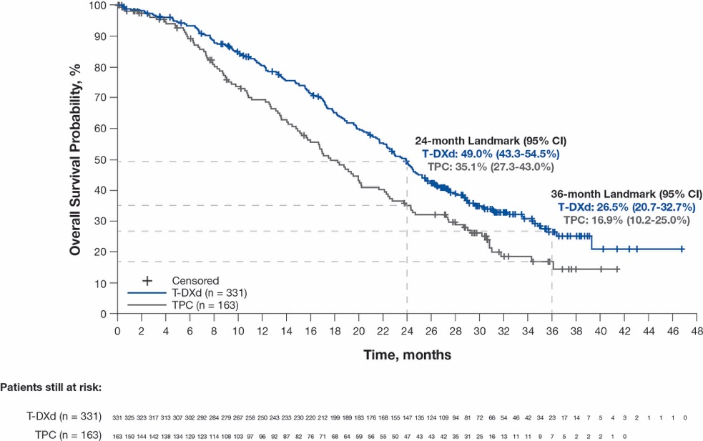

Overall Survival
HR+ Cohort
All Patients
Median (95% CI) | T-DXd (n = 331) | TPC (n = 163) | Hazard ratio (95% CI)
Primary analysis¹ | 23.9 mo (20.8-24.8) | 17.5 mo (15.2-22.4) | 0.64 (0.48-0.86)
Updated analysis | 23.9 mo (21.7-25.2) | 17.6 mo (15.1-20.2) | 0.69 (0.55-0.87)
Median (95% CI) | T-DXd (n = 373) | TPC (n = 184) | Hazard ratio (95% CI)
Primary analysis¹ | 23.4 mo (20.0-24.8) | 16.8 mo (14.5-20.0) | 0.64 (0.49-0.84)
Updated analysis | 22.9 mo (21.2-24.5) | 16.8 mo (14.1-19.5) | 0.69 (0.55-0.86)
In the HR+ cohort and all patients, median OS was consistent with results from the primary analysis,¹ showing a 31% reduction in risk of death for patients receiving T-DXd compared with those receiving TPC
HR, hormone receptor; mo, month; OS, overall survival; T-DXd, trastuzumab deruxtecan; TPC, treatment of physician’s choice.
1. Modi S et al. N Engl J Med. 2022;387:9-20.
Shanu Modi, MD

Slide 41
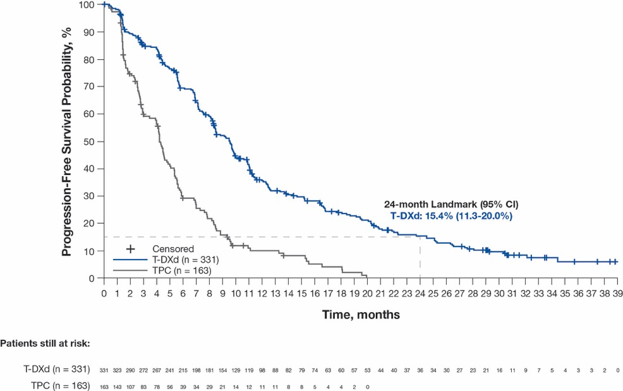

Progression-Free Survival (by Investigatorª)
HR+ Cohort
All Patients
Median (95% CI) | T-DXd (n = 331) | TPC (n = 163) | Hazard ratio (95% CI)
Primary analysis | 9.6 mo (8.4-10.0) | 4.2 mo (3.4-4.9) | 0.37 (0.30-0.47)
Updated analysis | 9.6 mo (8.4-10.0) | 4.2 mo (3.4-4.9) | 0.37 (0.30-0.46)
Median (95% CI) | T-DXd (n = 373) | TPC (n = 184) | Hazard ratio (95% CI)
Primary analysis | 8.8 mo (8.3-9.8) | 4.2 mo (3.0-4.5) | 0.37 (0.30-0.45)
Updated analysis | 8.8 mo (8.3-9.8) | 4.2 mo (3.0-4.5) | 0.36 (0.29-0.45)
Median PFS was consistent with results from the primary analysis,¹ showing a reduction in risk of disease progression or death of 63% and 64% in the HR+ cohort and all patients, respectively, for the T-DXd arm compared with the TPC arm
BICR, blinded independent central review; HR, hormone receptor; mo, month; PFS, progression-free survival; T-DXd, trastuzumab deruxtecan; TPC, treatment of physician’s choice.
ªPFS by BICR was stopped after the primary analysis as final PFS by BICR was achieved. At primary analysis, PFS by BICR for HR+ cohort was 10.1 mo and 5.4 mo for T-DXd and TPC, respectively (hazard ratio, 0.51). For all patients, the PFS by BICR was 9.9 mo and 5.1 mo for T-DXd and TPC, respectively (hazard ratio, 0.50). The updated analysis is based on PFS by investigator.
1. Modi S et al. N Engl J Med. 2022;387:9-20.
Shanu Modi, MD

Slide 42
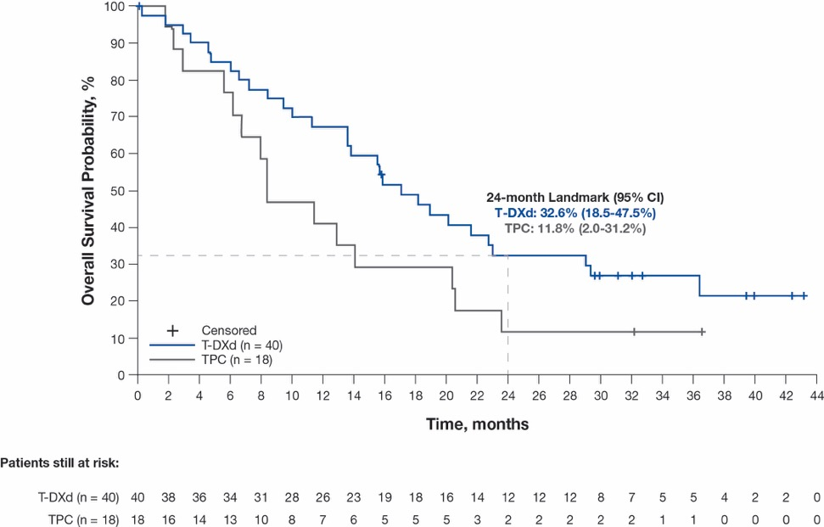
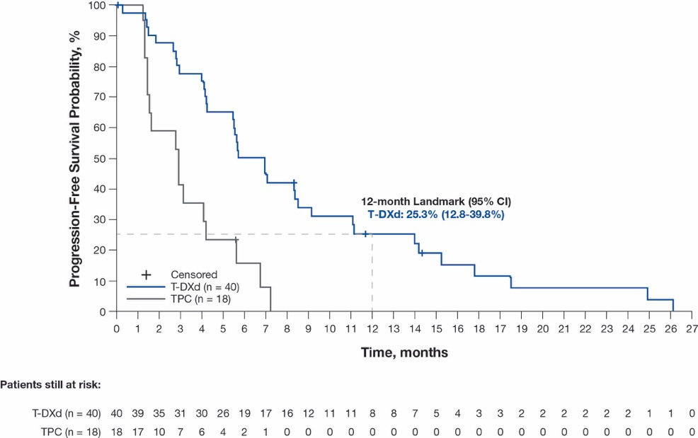
Efficacy in the HR− Cohort (Exploratory Analyses)
Overall Survival
Progression-Free Survival (by Investigator)
Median (95% CI) | T-DXd (n = 40) | TPC (n = 18) | Hazard ratio (95% CI)
Primary analysis¹ | 18.2 mo (13.6-NE) | 8.3 mo (5.6-20.6) | 0.48 (0.24-0.95)
Updated analysis | 17.1 mo (13.6-23.0) | 8.3 mo (5.6-20.4) | 0.58 (0.31-1.08)
Median (95% CI) | T-DXd (n = 40) | TPC (n = 18) | Hazard ratio (95% CI)
Primary analysis (by BICRª)¹ | 8.5 mo (4.3-11.7) | 2.9 mo (1.4-5.1) | 0.46 (0.24-0.89)
Updated analysis (by investigator) | 6.3 mo (4.2-8.5) | 2.9 mo (1.4-4.2) | 0.29 (0.15-0.57)
ªPFS by investigator was not analyzed for the HR− cohort at the time of the primary analysis.
There was a 42% reduction in risk of death and 71% reduction in risk of disease progression or death for HR− patients receiving T-DXd compared with TPC
BICR, blinded independent central review; HR, hormone receptor; mo, month; NE, not evaluable; OS, overall survival; T-DXd, trastuzumab deruxtecan; TPC, treatment of physician’s choice.
1. Modi S et al. N Engl J Med. 2022;387:9-20.
Shanu Modi, MD

Slide 43
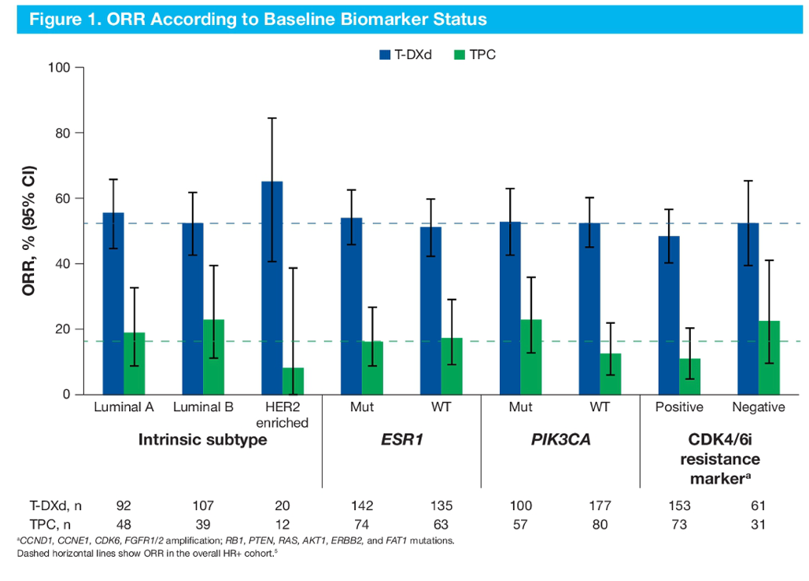
T-DXd versus TPC in HER2-low MBC: Updated survival results of the Phase III DESTINY-Breast04 study.
Preserved clinical benefit for T-DXd over TPC therapy was observed regardless of biomarker status including intrinsic subtype, ESR1 mutation, PIK3CA mutation, or CDK4/6i resistance marker status
PFS according to baseline biomarker status
Biomarker | Status | Median PFS (95% CI) |  | HR (95% CI)
Biomarker | Status | T-DXd | TPC | HR (95% CI)
PIK3CA | WT | 10.0 (8.5–12.2) n=177 | 4.8 (2.9–8.3) n=80 | 0.50 (0.35–0.70)
 | Mut | 9.7 (7.5–12.3) n=100 | 6.2 (5.3–7.8) n=57 | 0.60 (0.40–0.91)
ESR1 | WT | 10.0 (8.3–12.6) n=135 | 5.3 (4.0–7.8) n=63 | 0.43 (0.29–0.62)
 | Mut | 9.8 (8.2–12.0) n=142 | 6.9 (4.3–10.7) n=74 | 0.67 (0.47–0.97)
Intrinsic subtype | HER2 | 11.0 (6.6–NA) n=20 | 2.7 (1.4–5.9) n=12 | 0.15 (0.05–0.40)
 | Luminal A | 13.0 (10.1–16.4) n=92 | 7.8 (5.4–12.4) n=48 | 0.57 (0.36–0.89)
 | Luminal B | 8.7 (6.9–11.1) n=107 | 4.8 (2.7–8.3) n=39 | 0.60 (0.40–0.92)
Modi S et al. ESMO 2023;Abstract 376O

Slide 44
Conclusions
Results from the 32-month median follow-up for DESTINY-Breast04 confirm the sustained improvement for T-DXd vs TPC previously demonstrated in HER2-low (IHC 1+, IHC 2+/ISH−) mBC,¹ regardless of HR status
With longer treatment duration, the overall safety profile of T-DXd was acceptable and generally manageable, and was consistent with the primary analysis¹
Benefit was observed in biomarker subgroups including PIK3CA and ESR1 mutated
Outcomes from the longer follow-up of DESTINY-Breast04 continue to support the use of T-DXd as the new standard of care after 1L+ chemotherapy in patients with HER2-low mBC
1L, first-line; HER2, human epidermal growth factor receptor 2; HR, hormone receptor; IHC, immunohistochemistry; ILD, interstitial lung disease; ISH, in situ hybridization; mBC, metastatic breast cancer;
T-DXd, trastuzumab deruxtecan; TPC, treatment of physicians’ choice.
1. Modi S et al. N Engl J Med. 2022;387:9-20.
Shanu Modi, MD

Slide 45
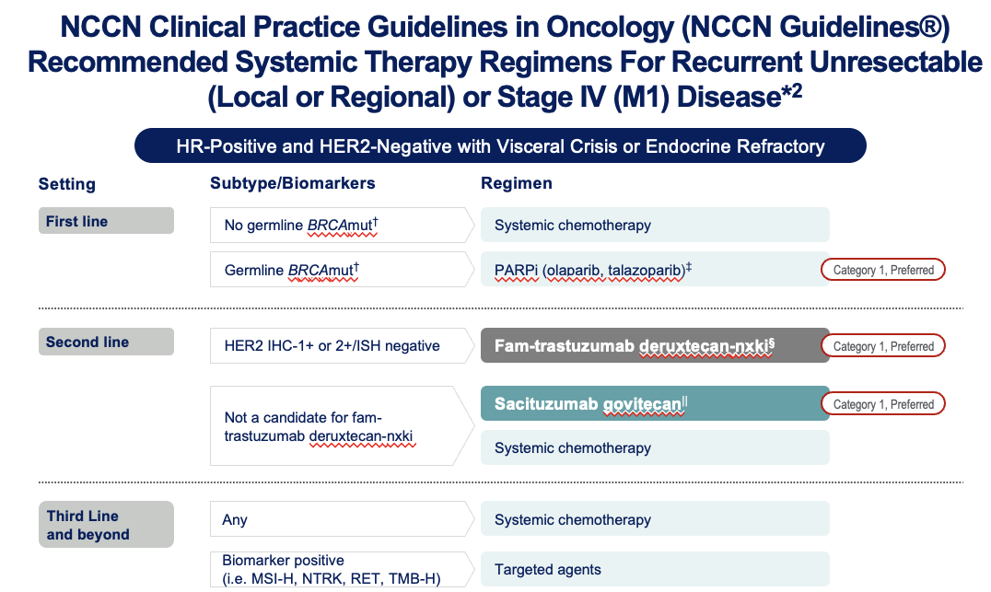
Adapted from the NCCN Clinical Practice Guidelines in Oncology (NCCN Guidelines®) for Breast Cancer V.4.2023. © 2023

Slide 46
TROPION-Breast01 Study Design¹
Randomized, phase 3, open-label, global study (NCT05104866)
Key inclusion criteria:
Patients with HR+/HER2– breast cancer* (HER2‒ defined as IHC 0/1+/2+; ISH negative)
Previously treated with 1–2 lines of chemotherapy (inoperable/metastatic setting)
Experienced progression on ET and for whom ET was unsuitable
ECOG PS 0 or 1
Dato-DXd
6 mg/kg IV Day 1 Q3W
(n=365)
Endpoints:
Dual primary: PFS by BICR per RECIST v1.1, and OS
Secondary endpoints included: ORR,
PFS (investigator assessed), TFST,
safety, PROs
1:1
Investigator’s choice of chemotherapy (ICC)
as per protocol directions†
(eribulin mesylate D1,8 Q3W; vinorelbine D1,8 Q3W;
gemcitabine D1,8 Q3W; capecitabine D1–14 Q3W)
(n=367)
Randomization stratified by:
Lines of chemotherapy in unresectable/metastatic setting (1 vs 2)
Geographic location (US/Canada/Europe vs ROW)
Previous CDK4/6 inhibitor (yes vs no)
Treatment continued until PD, unacceptable tolerability, or other discontinuation criteria
Detailed description of the statistical methods published previously.¹ *Per American Society of Clinical Oncology/College of American Pathologists (ASCO/CAP) guidelines. †ICC was administered as follows: eribulin mesylate, 1.4 mg/m² IV on Days 1 and 8, Q3W; vinorelbine, 25 mg/m² IV on Days 1 and 8, Q3W; or gemcitabine, 1000 mg/m² IV on Days 1 and 8, Q3W; capecitabine, 1000 or 1250 mg/m² orally twice daily on Days 1 to 14, Q3W (dose per standard institutional practice). CDK4/6, cyclin-dependent kinase 4/6; D, day; ECOG PS, Eastern Cooperative Oncology Group performance status; ET, endocrine therapy; IHC, immunohistochemistry; ISH, in-situ hybridization; IV, intravenous; PD, progressive disease; PROs, patient-reported outcomes; Q3W, every 3 weeks; RECIST, Response Evaluation Criteria in Solid Tumors; ROW, rest of world; TFST, time to first subsequent therapy.
1. Bardia A, et al.
Future Oncol 2023;
doi: 10.2217/fon-2023-0188.
San Antonio Breast Cancer Symposium® | @SABCSSanAntonio

Slide 47
Progression-Free Survival
PFS by investigator assessment
1.0
0.8
 | Dato-DXd | ICC
Median PFS, months (95% CI) | 6.9 (5.9–7.1) | 4.5 (4.2–5.5)
HR (95% CI) | 0.64 (0.53–0.76)
0.6
55.2%
Probability of PFS
0.4
34.7%
Dato-DXd (n=365)
36.9%
ICC (n=367)
21.7%
0.2
20.9%
9.9%
0.0
0
3
6
9
12
15
18
Number at risk
Time from randomization (months)
Dato-DXd
365
272
185
74
19
4
0
ICC
367
216
110
43
11
2
0
    PFS by BICR (primary endpoint)¹: Median 6.9 vs 4.9 months; HR 0.63 (95% CI 0.52‒0.76); P<0.0001
1. Bardia A, et al. Oral Presentation at ESMO 2023; Abstract LBA11.
Data cut-off: 17 July 2023.
San Antonio Breast Cancer Symposium® | @SABCSSanAntonio
Notes:
BICR: Figure 14.2.1.2, Table 14.2.1.1
Investigator: Figure 14.2.6.2, Table 14.2.6.1

Slide 48
Adverse Events of Clinical Interest
Neutropenia* | Dato-DXd (n=360) | ICC (n=351)
Treatment-related neutropenia*, n (%)
Any grade | 39 (11) | 149 (42)
Grade ≥3 | 4 (1) | 108 (31)
Leading to dose interruption | 0 | 60 (17)
Leading to dose reduction | 1 (0.3) | 45 (13)
Leading to dose discontinuation | 0 | 1 (0.3)
G-CSF usage, n (%)
On treatment | 10 (3) | 81 (22)
Post-treatment† | 1 (0.3) | 30 (8)
Stomatitis‡ | Dato-DXd (n=360) | ICC (n=351)
Treatment-related stomatitis‡, n (%)
Any grade | 180 (50) | 46 (13)
Grade 3 | 23 (6) | 9 (3)
Leading to dose interruption | 5 (1) | 3 (1)
Leading to dose reduction | 44 (12) | 5 (1)
Leading to dose discontinuation | 1 (0.3) | 0
*Neutropenia includes the preferred terms neutropenia and neutrophil count decreased. Treatment-related febrile neutropenia occurred in 0 patients in the Dato-DXd arm and 8 patients (2.3%; all grade ≥3) in the ICC arm.
†Administered after discontinuation of study treatment.
‡As part of the Oral Care Protocol specified in the study protocol, daily use of prophylaxis with a steroid-containing mouthwash (e.g., dexamethasone oral solution or a similar mouthwash regimen using an alternative steroid advocated by institutional/local guidelines) was highly recommended.
G-CSF, granulocyte colony stimulating factor.
San Antonio Breast Cancer Symposium® | @SABCSSanAntonio
Notes:
Neutropenia (grouped - PTs of neutropenia and neutrophil count decreased): ae202_pt_group_rel.pdf and ae205_pt_group_rel.pdf; iemt_0089_1.rtf, iemt_0089_2.rtf, iemt_0089_3.rtf
G-CSF: cm201.pdf and cm203.pdf
Diarrhea: ae204_teae_rel.pdf, iemt_0077_1.rtf, iemt_0077_2.rtf, iemt_0077_3.rtf

Slide 49
TROPION-Breast01
Dato-DXd improves PFS compared to TPC for HR+/HER2- (both HER2 low and HER2 0) MBC in 2L-3L setting
Awaiting OS data
Less neutropenia than chemotherapy, but more stomatitis, dry eye
Could become 4th ADC for breast cancer
Hard to know how to sequence with sacituzumab, as both target TROP-2

Slide 50
Emerging HR+/HER2- (Including HER2-Low) mBC Treatment Landscape
1L
2L
3L
4L+
HER2-low
(IHC 1+, 2+/ISH-)
ET regimen
ET regimen
ET regimen
ET regimen
Chemotherapy
Chemotherapy
HER2-ultralow
(IHC >0<1+)
Chemotherapy
Chemotherapy
T-DXd (DB-06)
T-DXd(DB-04)
SG (TROPiCS-02_
Dato-DXd (TB-01)
ET regimen
ET regimen
ET regimen
ET regimen
IHC 0
Chemotherapy
Chemotherapy
Chemotherapy
Chemotherapy
T-DXd (DB-06)→
if ultralow is +
SG (TROPiCS-02)
Dato-DXd (TB-01)
ET, endocrine therapy; HER2, human epidermal growth factor receptor 2; HR, hormone receptor; IHC, immunohistochemistry; ISH, in situ hybridization; mBC, metastatic breast cancer.
Notes:
Discussion questions:
For the following questions, assume DESTINY-Breast06 and Dato-DXd are approved based on the data presented on slide 28 (an immature OS with a positive trend for both):
In the context of positive DESTINY-Breast06 data, would you consider ENHERTU in an earlier line prior to chemotherapy for patients with HER2-low (IHC 1+, 2+/ISH-)? Alternatively, which patients would still receive capecitabine?
If DESTINY-Breast06 demonstrates a significant benefit of ENHERTU in the HER2-ultralow (IHC >0<1+) population, how would you use ENHERTU in this population?
For patients with IHC 0, would you reassess patients’ HER2 status prior to making a treatment decision? Or would you consider ENHERTU for patients with IHC 0?
Based on the observed data of TROPION-Breast01, would you consider Dato-DXd after ENHERTU in HER2-low (IHC 1+, 2+/ISH-) and HER2-ultralow (IHC >0<1+)?
Would you consider a chemotherapy between the two ADCs?
The OS data of TROPION-Breast01 may not be available at the time of launch for Dato-DXd. Would this impact your approach to implementing Dato-DXd in practice?
Would you consider Dato-DXd before or after TRODELVY in IHC 0? Will this be the same regardless of HER2 status?
What are your initial thoughts on payload versus target resistance? What factors will you consider when selecting an ADC?
What factors will be the main drivers for using Dato-DXd first over other TROP2 ADCs in this described emerging landscape?
What additional information would you need to drive confidence with ADC sequencing in this emerging landscape?
What additional emerging therapies do you anticipate having an impact on the HR+/HER2- (including HER2-low) mBC treatment landscape?
Do you anticipate new agents, such as oral SERDs and protein kinase B inhibitors, will add additional lines of endocrine therapy in your decision making? Or will they replace previous, less efficacious therapies?
What are your initial thoughts on emerging TROP2 ADCs, such as SKB264?

Slide 51
Phase 2 trial of HER3-DXd in patients with metastatic breast cancer
Key inclusion criteria
ECOG 0/1
Locally advanced/mBC with ≥1 measurable lesion
HER2− per ASCO-CAP guidelines by IHC (includes 0 and low expression)
HR+ or HR−
  HR+: Unlimited lines of ET; prior CDK4/6 inhibitor required; ≤2 prior CT lines in metastatic setting
  HR– TNBC: 1–3 prior CT lines in metastatic setting
No prior treatment with any HER3-targeting agent or any ADC that contains an exatecan derivative
Part A (presented here, N=60)
Part B (currently expanding, N=20–40)
Expansion in ≤3 populations based on:
HER3 expression 25–74% and/or ≥75%
ER expression: TNBC,
low (1–10%), high (>10%)
HER2– mBC
Patritumab deruxtecan 5.6 mg/kg IV Q3W
Patritumab deruxtecan 5.6 mg/kg IV Q3W
Part A efficacy analysis
Activity and
HER3 expression
Part B efficacy analysis
Response rate and
6-mo PFS
Primary objectives:
ORR and 6-month PFS
Secondary objectives:
Safety and tolerability
DoR
PFS
CBR
Part Z (currently enrolling, N=21)
HER2+ mBC
Post T-DXd
Patritumab deruxtecan
5.6 mg/kg IV Q3W
HER3 is expressed in 30%-75% of breast cancers; overexpression is associated with poor prognosis
Patritumab deruxtecan: novel ADC targeting HER3 with topoisomerase I inhibitor payload capable of bystander antitumor effects
Part Z efficacy analysis
Response rate and
6-mo PFS
CBR, clinical benefit rate
Hamilton EP, et al. ASCO 2023. Abstract 1004

Slide 52
Phase 2 trial of HER3-DXd: Efficacy
Duration on study treatment by HER3 membrane expression
Best percentage change in sum of diameters from baseline in target lesions
Response legend
CR
PR
PD
Death
Treatment Ongoing
>75% HER3 expression
25–74% HER3 expression
<25% HER3 expression
TNBC
60
HER3 unknown
ER+
≥75%
40
20
0
Best change in sum of diameters from baseline (%)
-20
Level of HER3 expression
25-74%
-40
-60
<25%
-80
Unknown
-100
Tumor type legend
ER+
TNBC
0
1
2
3
4
5
6
7
8
9
10
11
12
13
14
15
Treatment duration (months)
Hamilton EP, et al. ASCO 2023. Abstract 1004

Slide 53
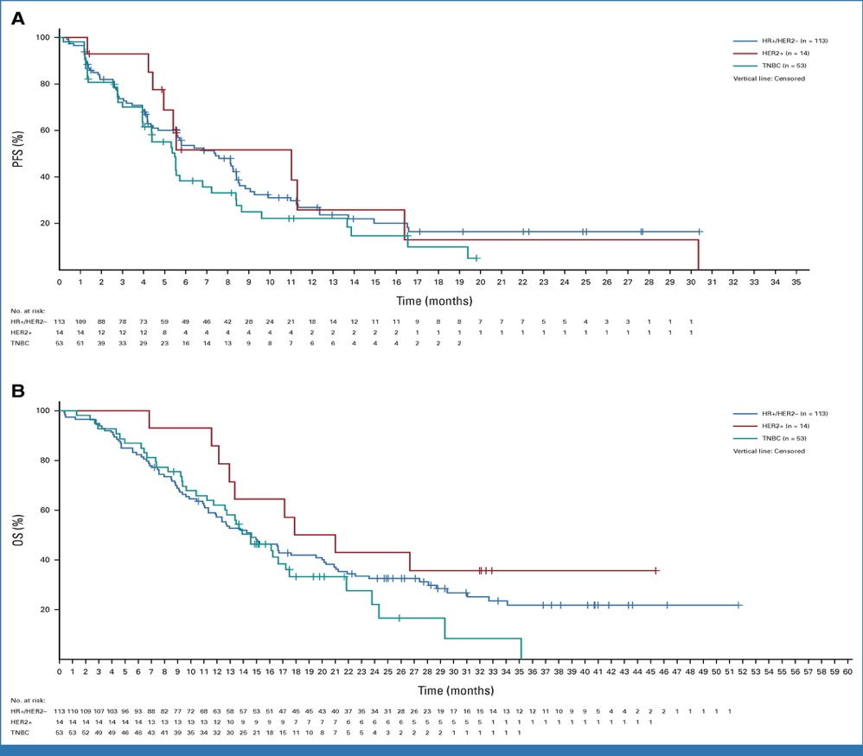
Patritumab Phase 2 trial: FIG 1. Kaplan-Meier plots for (A) PFS and (B) OS by breast cancer clinical subtype.
Krop at al, JCO 2023

Slide 54
Phase 2 trial of HER3-DXd: Safety and Conclusions
Safety summary
TRAEs occurring in ≥10% of patients by highest reported gradeª | Any grade (N=60) | Grade 3/4 (N=60)
Any AE | 56 (93.3) | 19 (31.7)
Nausea | 30 (50.0) | 2 (3.3)
Fatigue | 27 (45.0) | 4 (6.7)
Diarrhea | 22 (36.7) | 3 (5.0)
Vomiting | 19 (31.7) | 1 (1.7)
Anemia | 18 (30.0) | 0
Alopecia | 17 (28.3) | N/A
Hypokalemia | 9 (15.0) | 1 (1.7)
Decreased appetite | 8 (13.3) | 0
Neutrophil count decreased | 7 (11.7) | 3 (5.0)
WBC count decreased | 7 (11.7) | 1 (1.7)
Treatment-related SAEs | N=60
Interstitial lung disease | 1 (1.7)
Nausea/vomiting | 1 (1.7)
Pneumonitis | 1 (1.7)
Thrombocytopenia | 1 (1.7)
Unrelated SAEs
Dyspnea | 1 (1.7)
Pneumocystis jirovecii pneumonia | 1 (1.7)
Pneumothorax | 1 (1.7)
Patritumab is active, regardless of level of HER3 expression in HER2-non-amplified MBC, more so in HR+ than in TNBC pts
Responses are durable in most patients. Safety is also reasonable with nausea, diarrhea, and fatigue the main toxicities and very little ILD to date
Unclear how patients will respond to patritumab following treatment and progression on T-DXd with shared payload
Should patritumab be developed to follow T-DXd, or in patients with HER2 ultralow or 0 IHC pts, instead of T-DXd?
ªNo Grade 5 AEs recorded prior to data cutoff
Hamilton EP, et al. ASCO 2023. Abstract 1004

