Slide 1
Current and Emerging Strategies for Early-Stage HR-Positive Breast Cancer
Stephanie L. Graff, MD FACP
Legoretta Cancer Center at Brown University
Lifespan Cancer Institute
Providence, Rhode Island

Slide 2
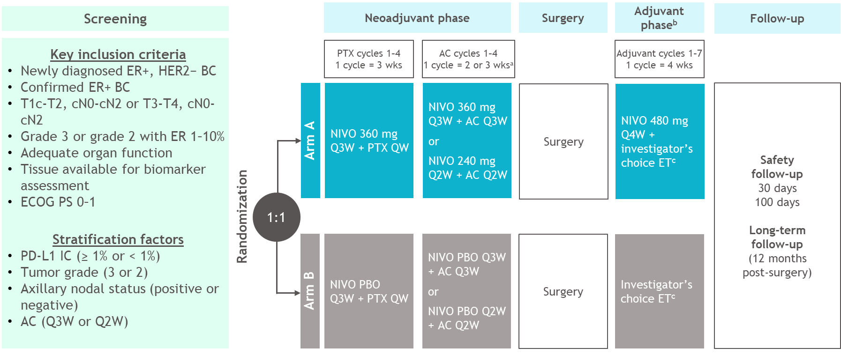
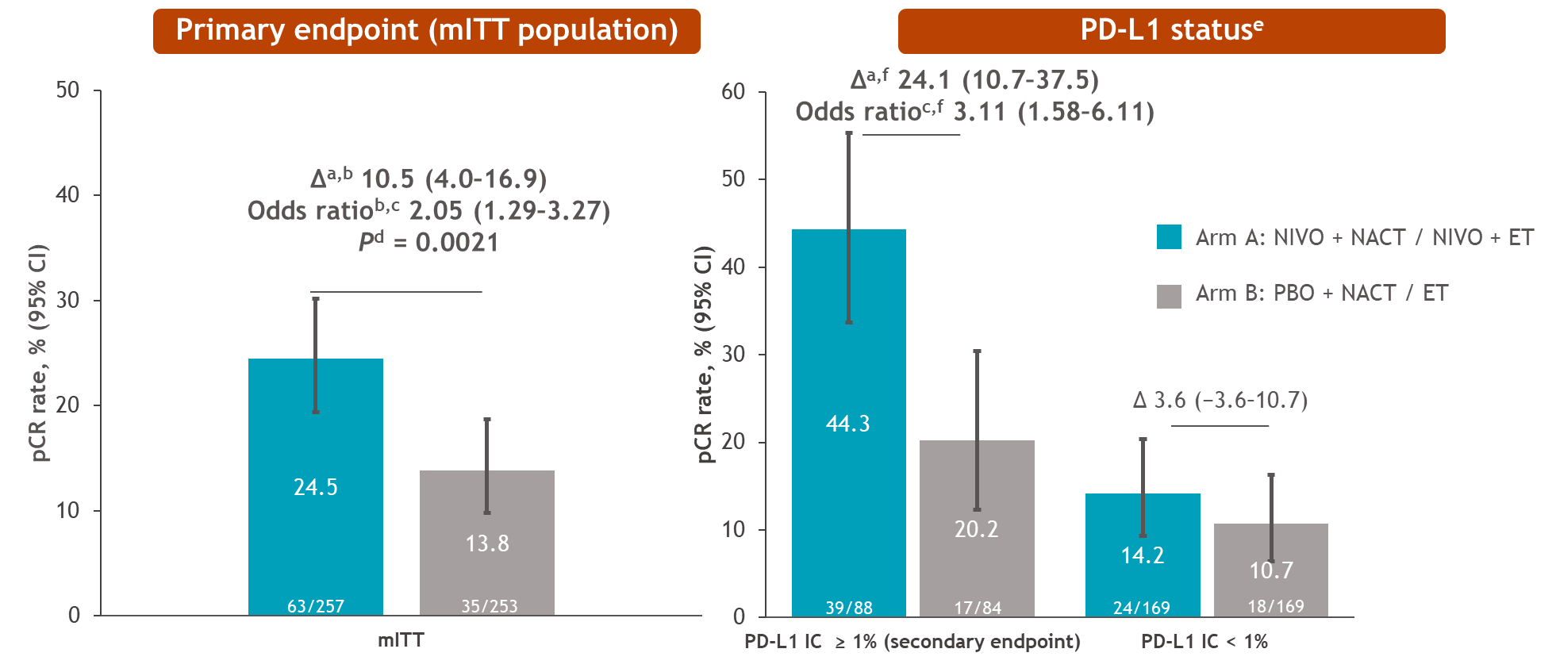
CheckMate 7FL: A randomized, double-blind trial of nivolumab vs placebo with neoadjuvant chemotherapy followed by adjuvant endocrine therapy ± NIVO in patients with high-risk, ER+ HER2− primary breast cancer
Study population: median age 50, 98% G3, ~45% Stage III, AC dosing 50/50 Q3 vs DD
The addition of NIVO to NACT/ET increased pCR by 10.5% (24.5% in arm A and 13.8% in arm B)
The benefit from NIVO was more pronounced in patients with PD-L1 IC ≥ 1% (SP142)
    ∆ pCR of 24.1% (44.3% in arm A and 20.2% in arm B)
    ∆ RCB 0-1 of 28.5% (54.5% in arm A and 26.2% in arm B)
Loi S et al. A randomized, double-blind trial of nivolumab (NIVO) vs placebo (PBO) with neoadjuvant chemotherapy (NACT) followed by adjuvant endocrine therapy (ET) ± NIVO in patients (pts) with high-risk, ER+ HER2− primary breast cancer (BC). ESMO 2023;Abstract LBA20.
Notes:
Historical Context:
Pathological complete response (pCR) rates range from 0 to 18%¹
In I-SPY 2, pembrolizumab + NAC vs NAC alone improved estimated pCR rates from 13.6% to 34.2% in patients with ER+/HER2– tumors²
Torrisi R et al. Crit Rev Oncol/Hematol 2021;160:103280. 2. Nanda R et al. J Clin Oncol 2017;35(suppl):506.
Permission received from Sherene Loi for reuse

Slide 3
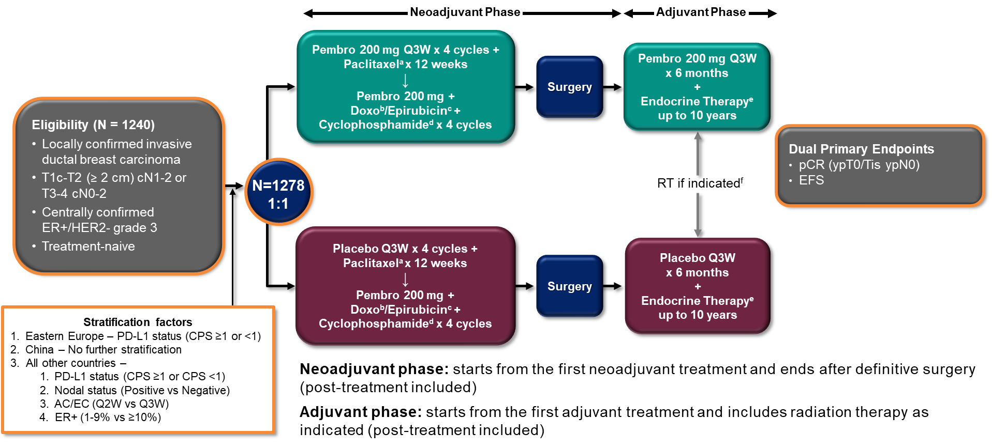
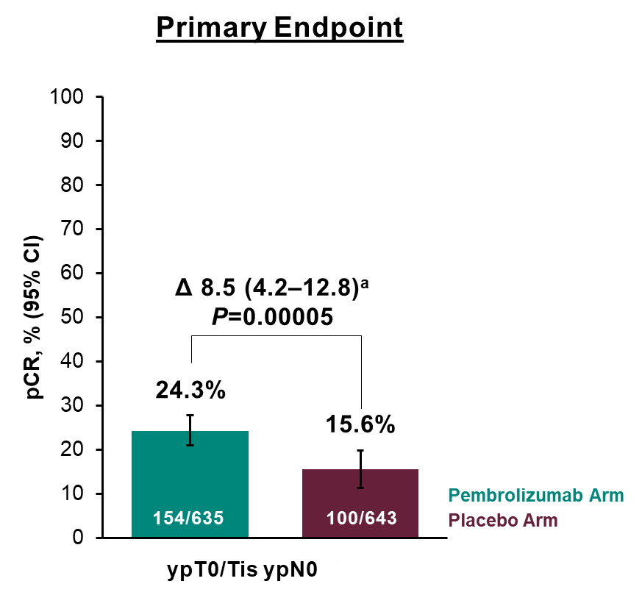
KEYNOTE-756: Phase 3 Study of Neoadjuvant Pembrolizumab or Placebo + Chemotherapy Followed by Adjuvant Pembrolizumab or Placebo
+ Endocrine Therapy for Early-Stage High-Risk ER+/HER2– Breast Cancer
Study population: median age 49, 100% G3, 90% node positive, 35% T3/T4, AC dosing ~65 Q3 weeks
The addition of PEMBRO to NACT/ET increased pCR by 8.5%
Presenter's conclusion: Pembro benefit was “regardless of PD-L1 status”; but magnitude of benefit smaller in PD-L1 negative population (∆ 4.5% vs 9.8%)
Rate of Grade 3-5 TRAE ∆ 6.1%, and serious TRAE ∆ 8.2% in pembro arm
Will await Event Free Survival before KEYNOTE-756 informs practice
Cardoso F et al. KEYNOTE-756: Phase III study of neoadjuvant pembrolizumab (pembro) or placebo (pbo) + chemotherapy (chemo), followed by adjuvant pembro or pbo + endocrine therapy (ET) for early-stage high-risk ER+/HER2– breast cancer. ESMO 2023;Abstract LBA21.
Notes:
PD-L1 IHC 22C3
*Permission requestion from Fatima

Slide 4
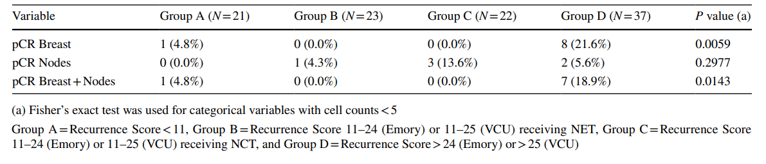
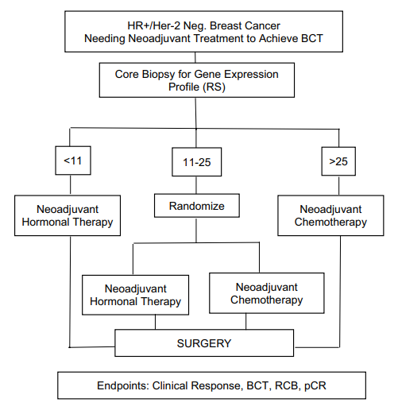
Using Oncotype DX breast recurrence score® assay to defne the role of neoadjuvant endocrine therapy in early‑stage hormone receptor‑positive breast cancer
Further supports TAILORx and RxPONDER
Two cohorts received significantly different lengths of neoadjuvant endocrine therapy (median 10 months versus 5.5), with no significant differences in pCR across RS result groups between the two institutions
Taylor C et al. Using Oncotype DX breast recurrence score® assay to define the role of neoadjuvant endocrine therapy in early-stage hormone receptor-positive breast cancer. Breast Cancer Res Treat 2023;199(1):91-8.

Slide 5
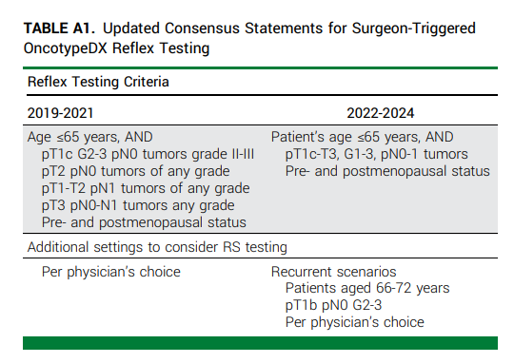
Identifying Patterns & Barriers in OncotypeDX Recurrence Score Testing in Older Patients With Early-Stage, Estrogen Receptor–Positive Breast Cancer: Implications for Guidance, Reimbursement, Trapani JCO-OP
 | Cohort A (Reflex) n=1087 (64.4%) | Cohort B (Case-by-Case) n=600 (35.6%) | Cohort B + Age>65 n=279 (46.5% of Cohort B)
RS Range | 0-74 (median 16) | 0-62 (median 17) | NR
Low | 205 (18.9%) | 130 (21.7%) | 70 (25.1%)
Intermediate | 711 (67.5%) | 357 (59.7%) | 156 (55.9%)
High | 167 (15.4%) | 111 (18.6%) | 52 (18.6%)
Received Chemotherapy | 20.5% | 21.8% | 15.4%
Authors created cohort of patients >65 years who did not have RS testing for comparison
  Were older (median age 73 v 69 years)
  More likely G1 tumors (43.9% v 15.1%)
  More likely to have not undergone SLNB/ALND (48% v 9.3%)
Trapani D et al. Identifying patterns and barriers in OncotypeDX Recurrence Score testing in older patients with early-stage, estrogen receptor-positive breast cancer: Implications for guidance and reimbursement. JCO Oncol Pract 2023;19(8):560-70.
Notes:
only 6.8% (n=19) were >75

Slide 6
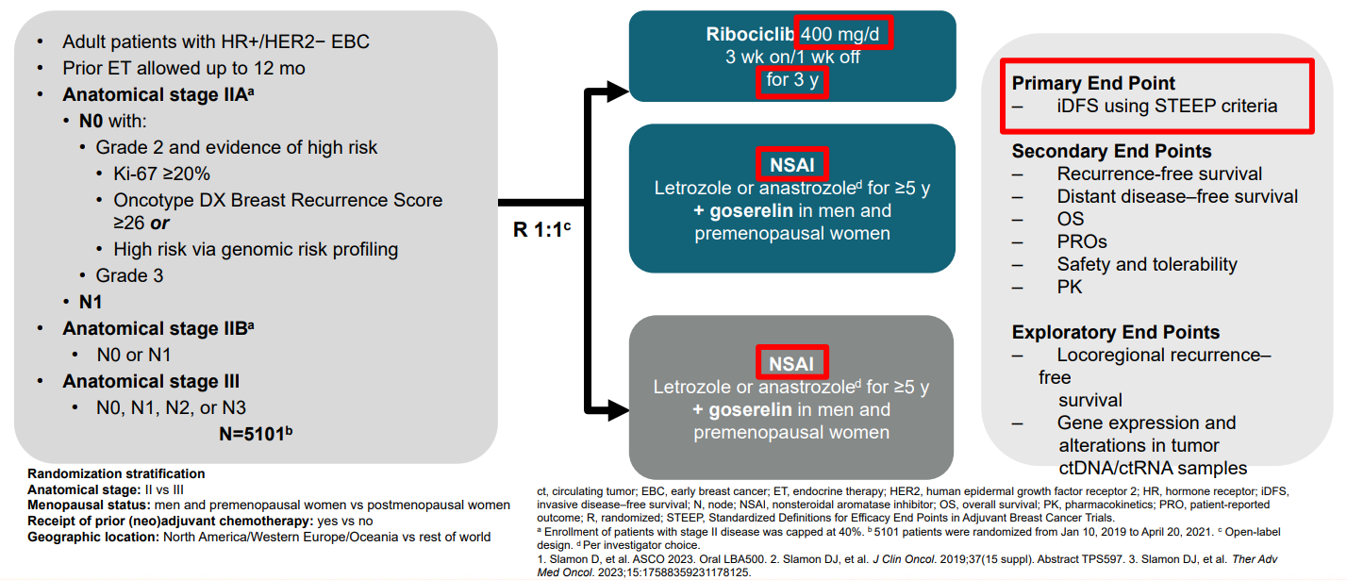
Ribociclib + Nonsteroidal Aromatase Inhibitor as Adjuvant Treatment in Patients With HR+/HER2− Early Breast Cancer: Final Invasive Disease–Free Survival Analysis From the NATALEE Trial
Second IE Analysis 1/11/23 = 426 iDFS events, 54% stopped Ribo including 20% completing 3 years and 33% stopping early vs Final IDFS Analysis 7/21/23 = 509 iDFS events, 78.3% stopped Ribo including 42.8% completing 3 years and 35.5% stopping early
Median follow-up for IDFS was 33.3 mos (max 51 mos)—5.6 mos more than second IE analysis
Hortobagyi G et al. Ribociclib (RIB) + nonsteroidal aromatase inhibitor (NSAI) as adjuvant treatment in patients with HR+/HER2− early breast cancer: Final invasive disease–free survival (iDFS) analysis from the NATALEE trial. San Antonio Breast Cancer Symposium 2023;Abstract GS03-03.
Notes:
Context:
EBC carries considerable risk of disease recurrence (27% to 37% for stage II and 46% to 57% for stage III HR+EBC)
1. Iqbal J, et al. JAMA. 2015;313:165-173.
2. Pistilli B, et al. Am Soc Clin Oncol Educ Book. 2022;42:1-13.
3. Pan H, et al. N Engl J Med. 2017;377:1836-1846.
*Permission received from GH for use of slides
8% have Grade 1 disease (vs. MonarchE 7%) and 12% N0

Slide 7
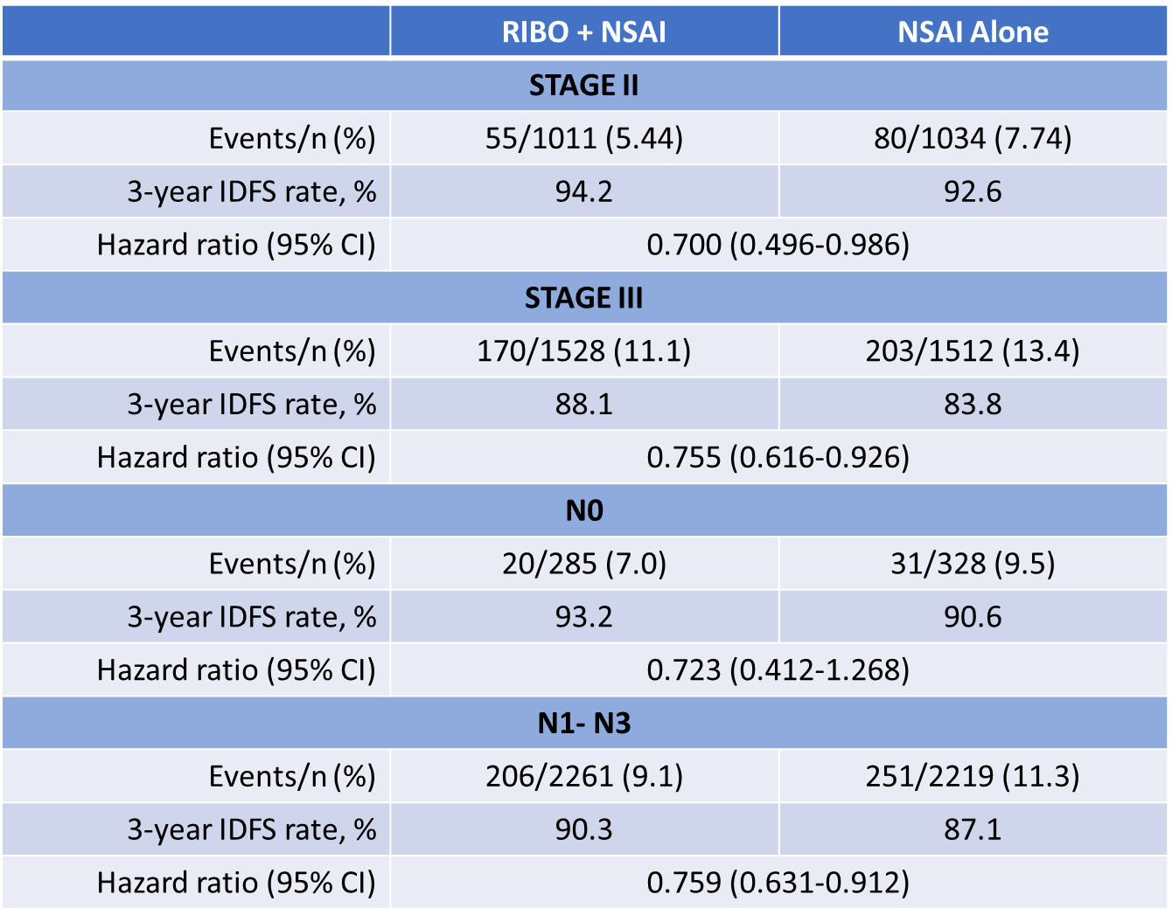
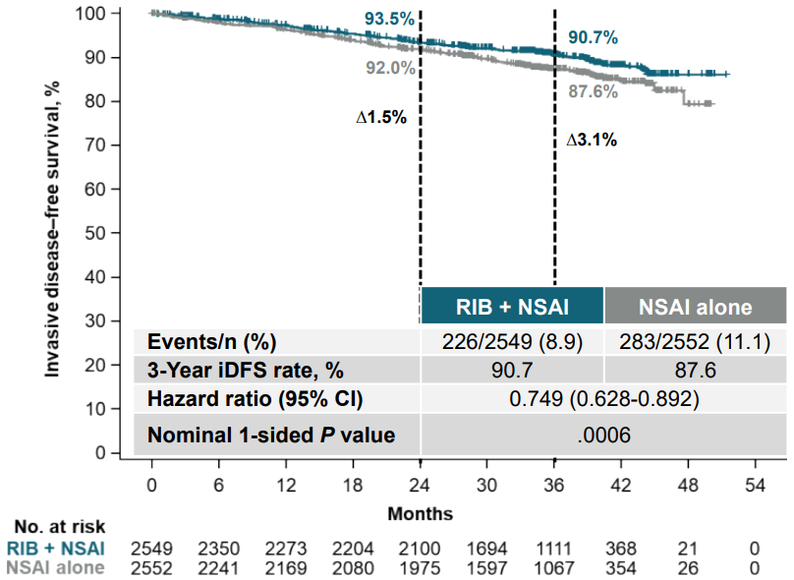
Ribociclib + Nonsteroidal Aromatase Inhibitor as Adjuvant Treatment in Patients With HR+/HER2− Early Breast Cancer: Final Invasive Disease–Free Survival Analysis From the NATALEE Trial
Invasive Disease-Free Survival
Absolute iDFS benefit with Ribo plus NSAI was 3.1% at 3 years, a 25.1% relative risk reduction
iDFS benefit consistent across prespecified subgroups, including patients with stage II, III, node-negative, and node-positive disease
Hortobagyi G et al. Ribociclib (RIB) + nonsteroidal aromatase inhibitor (NSAI) as adjuvant treatment in patients with HR+/HER2− early breast cancer: Final invasive disease–free survival (iDFS) analysis from the NATALEE trial. San Antonio Breast Cancer Symposium 2023;Abstract GS03-03.
Notes:
The risk of invasive disease was reduced by 30.0% for stage II and by 24.5% for stage III disease with ribociclib plus NSAI vs NSAI alone
The risk of invasive disease was reduced by 27.7% for node-negative and by 24.1% for nodepositive disease with ribociclib plus NSAI vs NSAI alone
The absolute DDFS benefit with ribociclib plus NSAI was 2.7% at 3 years
The risk of distant disease was reduced by 25.1% with ribociclib plus NSAI vs NSAI alone at the final analysis
MonarchE time point comparison: 4·8% difference at 3 years (89·2% [87·9–90·3] vs 84·4% [83·0–85·8]) ***4.3% difference in NATALEE for Stage III or

Slide 8
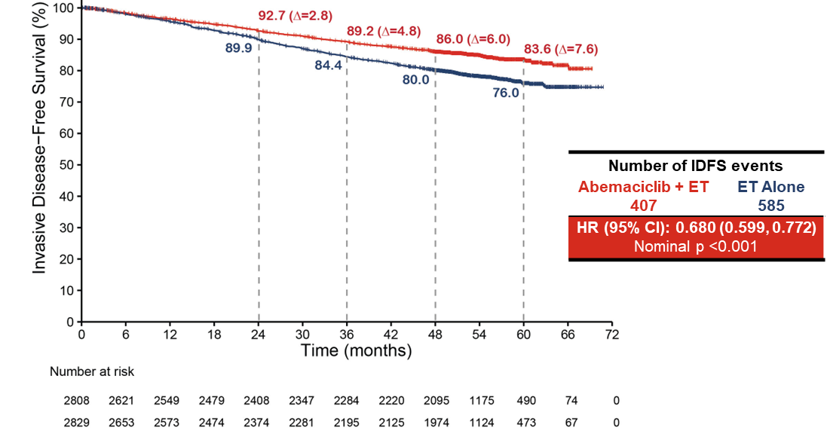
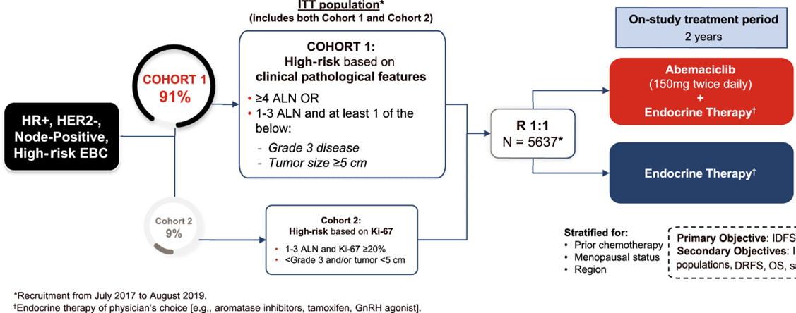
Adjuvant abemaciclib plus endocrine therapy for HR+, HER2-, high-risk early breast cancer: results from a preplanned monarchE overall survival interim analysis, including 5-year efficacy outcomes
Overall Survival Interim Analysis 3 (OS IA3) 7/3/2023= Median follow up 4.5 years (54 mos); all patients completed abemaciclib, with 80% followed 2 years since completion
32% risk reduction in IDFS, absolute difference of 7.6% at 5 years
  48 mos (Lancet, Jan 2023): 4-year IDFS rate abema + ET 85.8% (95% CI 84.2–87.3) vs. ET alone 79.4% (77.5–81.1), absolute ∆ 6.4%
32.5% risk reduction in DRFS, absolute difference of 6.7% at 5 years (not shown)
Johnston SRD et al. Abemaciclib plus endocrine therapy for hormone receptor-positive, HER2-negative, node-positive, high-risk early breast cancer (monarchE): Results from a preplanned interim analysis of a randomised, open-label, phase 3 trial. Lancet Oncol 2023;24(1):77-90.
Harbeck N et al. Adjuvant abemaciclib plus endocrine therapy for HR+, HER2-, high-risk early breast cancer: Results from a preplanned monarchE overall survival interim analysis, including 5-year efficacy outcomes. ESMO 2023;Abstract LBA17.
Notes:
Compared with a 2·8% difference at 2 years (92·7% [91·6–93·6] vs 89·9% [88·7–91·0]) and a 4·8% difference at 3 years (89·2% [87·9–90·3] vs 84·4% [83·0–85·8])
30.7-32.1% received tamoxifen alone [with OFS 6.9-8.3%]
In the AI arms OFS was given 14.7-13.8%
*Permission received to use from Nadia Harbeck

Slide 9
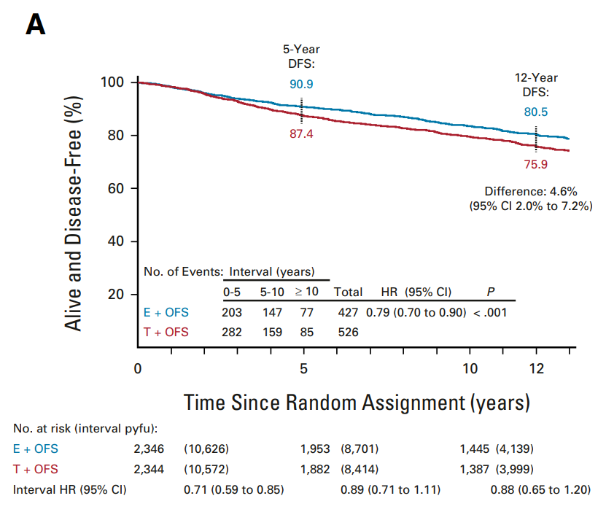
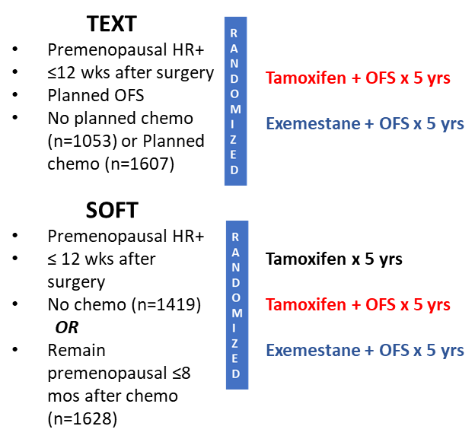
Adjuvant Exemestane With Ovarian Suppression in Premenopausal Breast Cancer: Long-Term Follow-Up of the Combined TEXT and SOFT Trials (Pagani, JCO)
Pagani O et al. Adjuvant exemestane with ovarian suppression in premenopausal breast cancer: Long-term follow-up of the combined TEXT and SOFT trials. J Clin Oncol 2023;41(7):1376-82
Notes:
DFS continued to be significantly improved with exemestane + OFS vs tam + OFS (80.5% v 75.9%, ∆ 4.6% absolute improvement, HR 0.79)
42% LN positive—overall cohort
No chemotherapy population—SOFT 9%; TEXT 21% LN positive

Slide 10
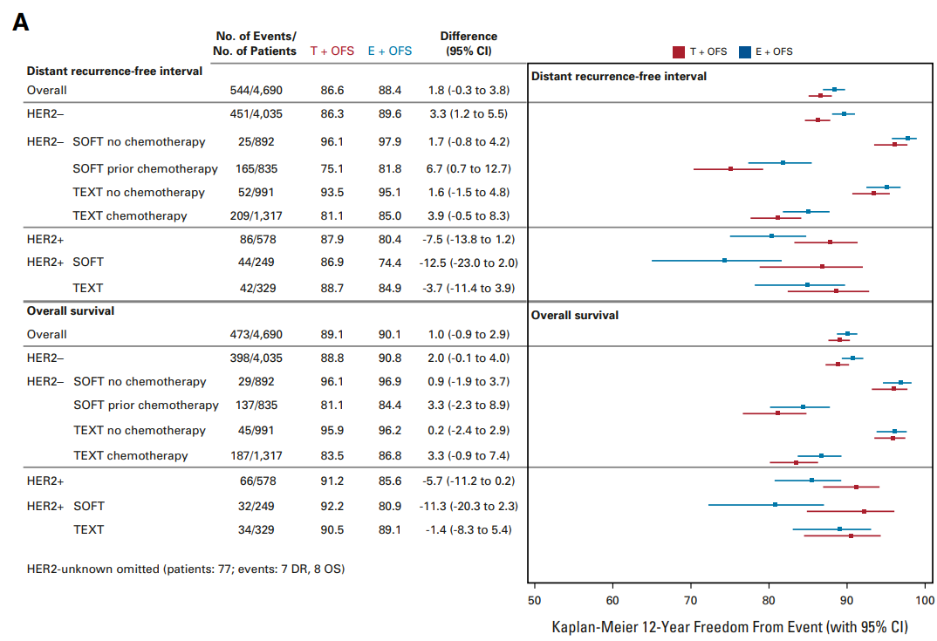
Adjuvant Exemestane With Ovarian Suppression in Premenopausal Breast Cancer: Long-Term Follow-Up of the Combined TEXT and SOFT Trials (Pagani, JCO)
Women with HER2-negative BC with high-risk clinicopathologic characteristics experienced the greatest absolute improvements in 12-year OS when treated with exemestane + OFS vs Tam + OFS, ranging 4.0% to 5.5%
In patients with HER2-positive disease, outcomes continued to favor tamoxifen 1 OFS versus exemestane 1 OFS
Pagani O et al. Adjuvant exemestane with ovarian suppression in premenopausal breast cancer: Long-term follow-up of the combined TEXT and SOFT trials. J Clin Oncol 2023;41(7):1376-82

Slide 11
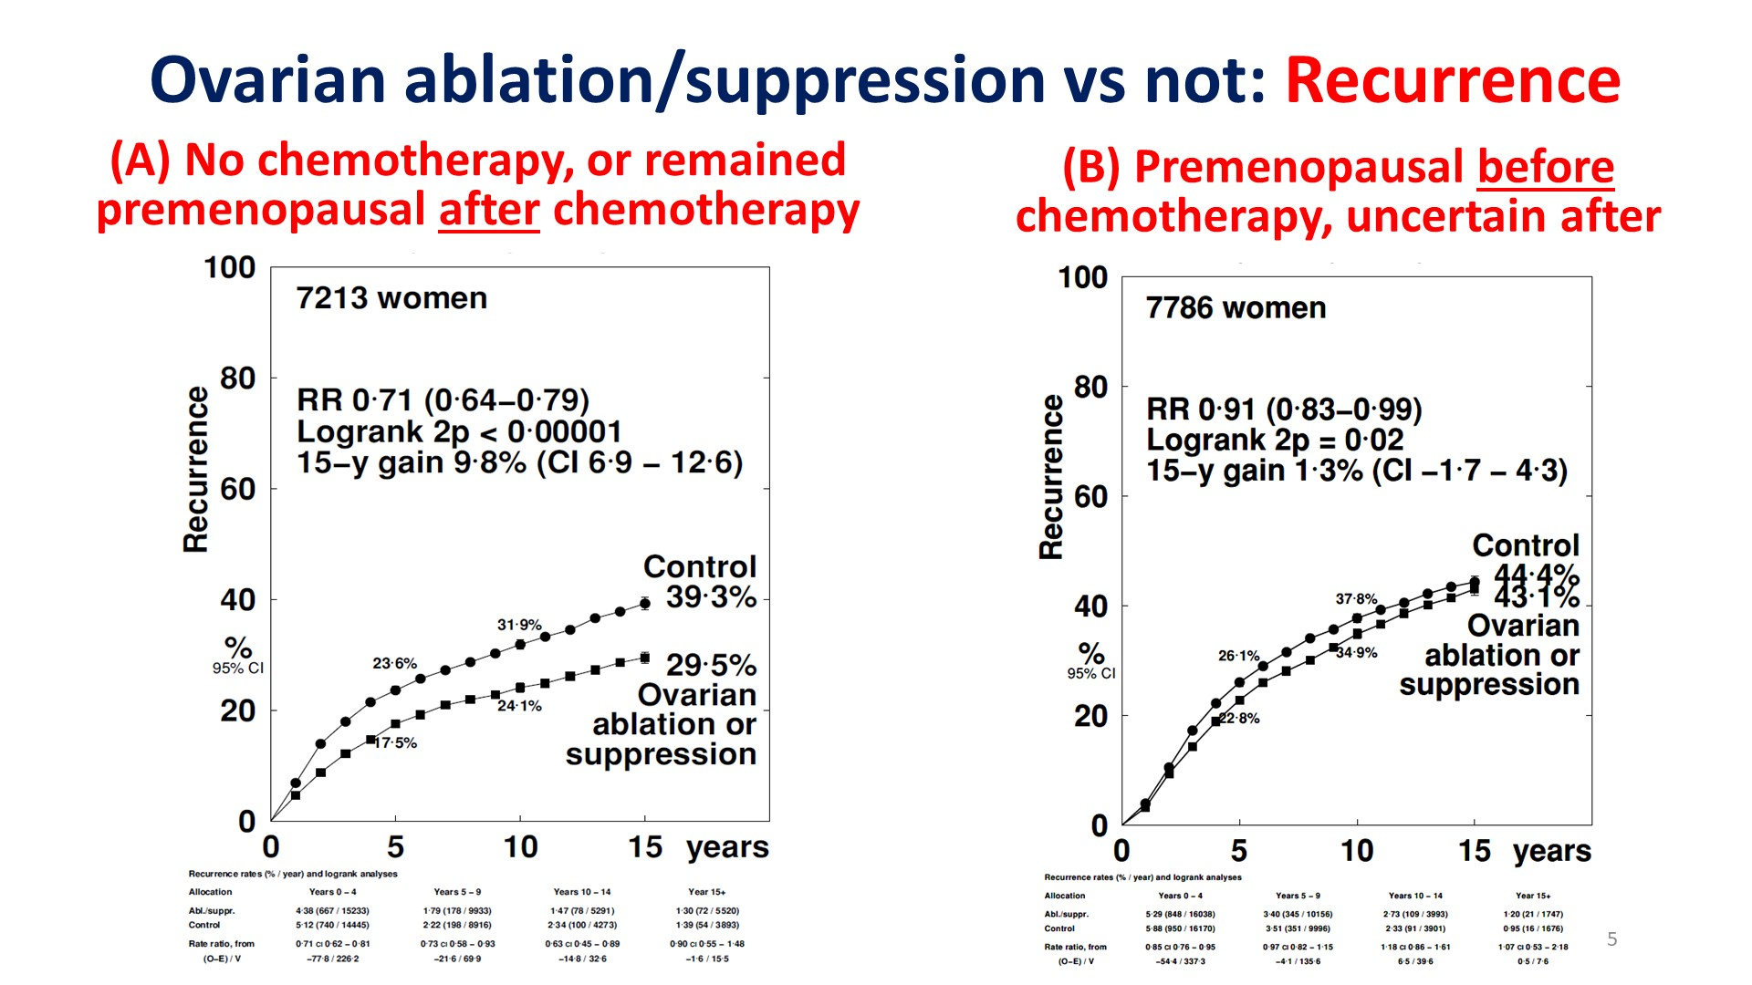
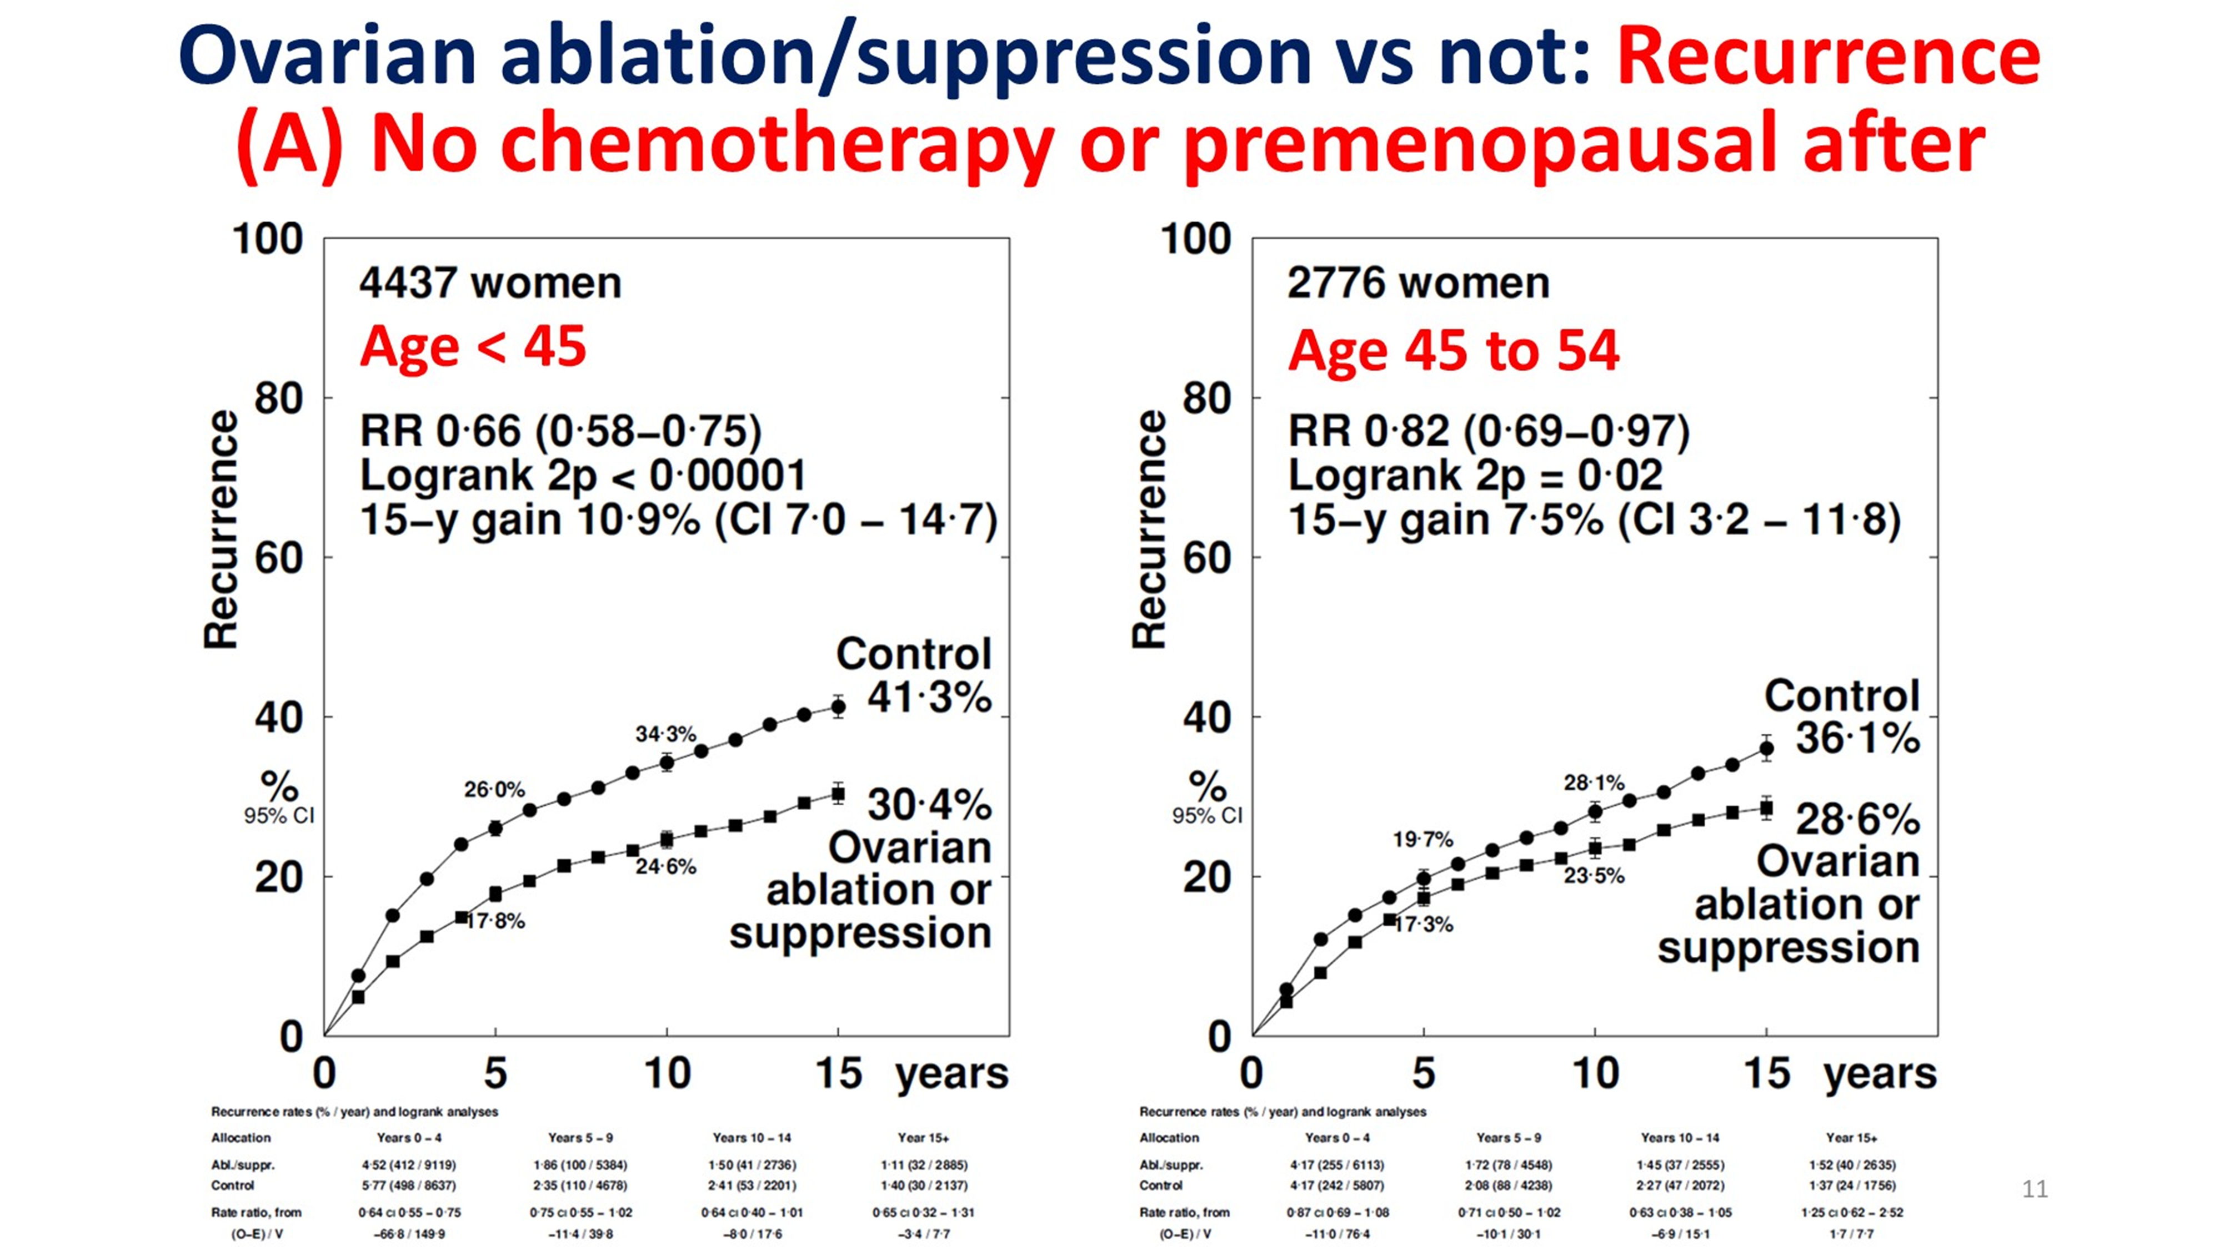
Effects of ovarian ablation or suppression on breast cancer recurrence and survival: Patient-level meta-analysis of 14,999 pre-menopausal women in 25 randomized trials. EBCTCG Meta Analysis
OFS reduced risk of recurrence by 29%, or absolute gain of 9.8%
Subgroup analysis by age suggests benefit of OFS correlates w/age:
  RR 0.79 <35 years
  RR 0.89 40-44 years
  RR 0.99 45-49 years
The magnitude of benefit for OFS was greatest for those age <45 (34% RR, 10.9% 15 yr gain), but women age 45-54 also benefitted (18% RR, 7.5% 15 yr gain)
Gray RG et al. Effects of ovarian ablation or suppression on breast cancer recurrence and survival: Patient-level meta-analysis of 14,993 pre-menopausal women in 25 randomized trials. ASCO 2023;Abstract 503.
Notes:
23 Trials, all patient premen at randomization—12 trials no chemo, 2 trials chemo prior to randomization, 14 trials received post-randomization chemotherapy (5 trials went to both “no chemo and post-randomization chemo” groups)=23
This data includes ONLY 3934 women who DID NOT GET CHEMOTHERAPY (26.2%)
3279 women had chemotherapy prior to randomization and remained premenopausal
7,786 were received chemotherapy after randomization
*Was unable to get permission to use slides (Richard gray unavailable; automatic response directs to email that constantly rejects all communication….)

Slide 12
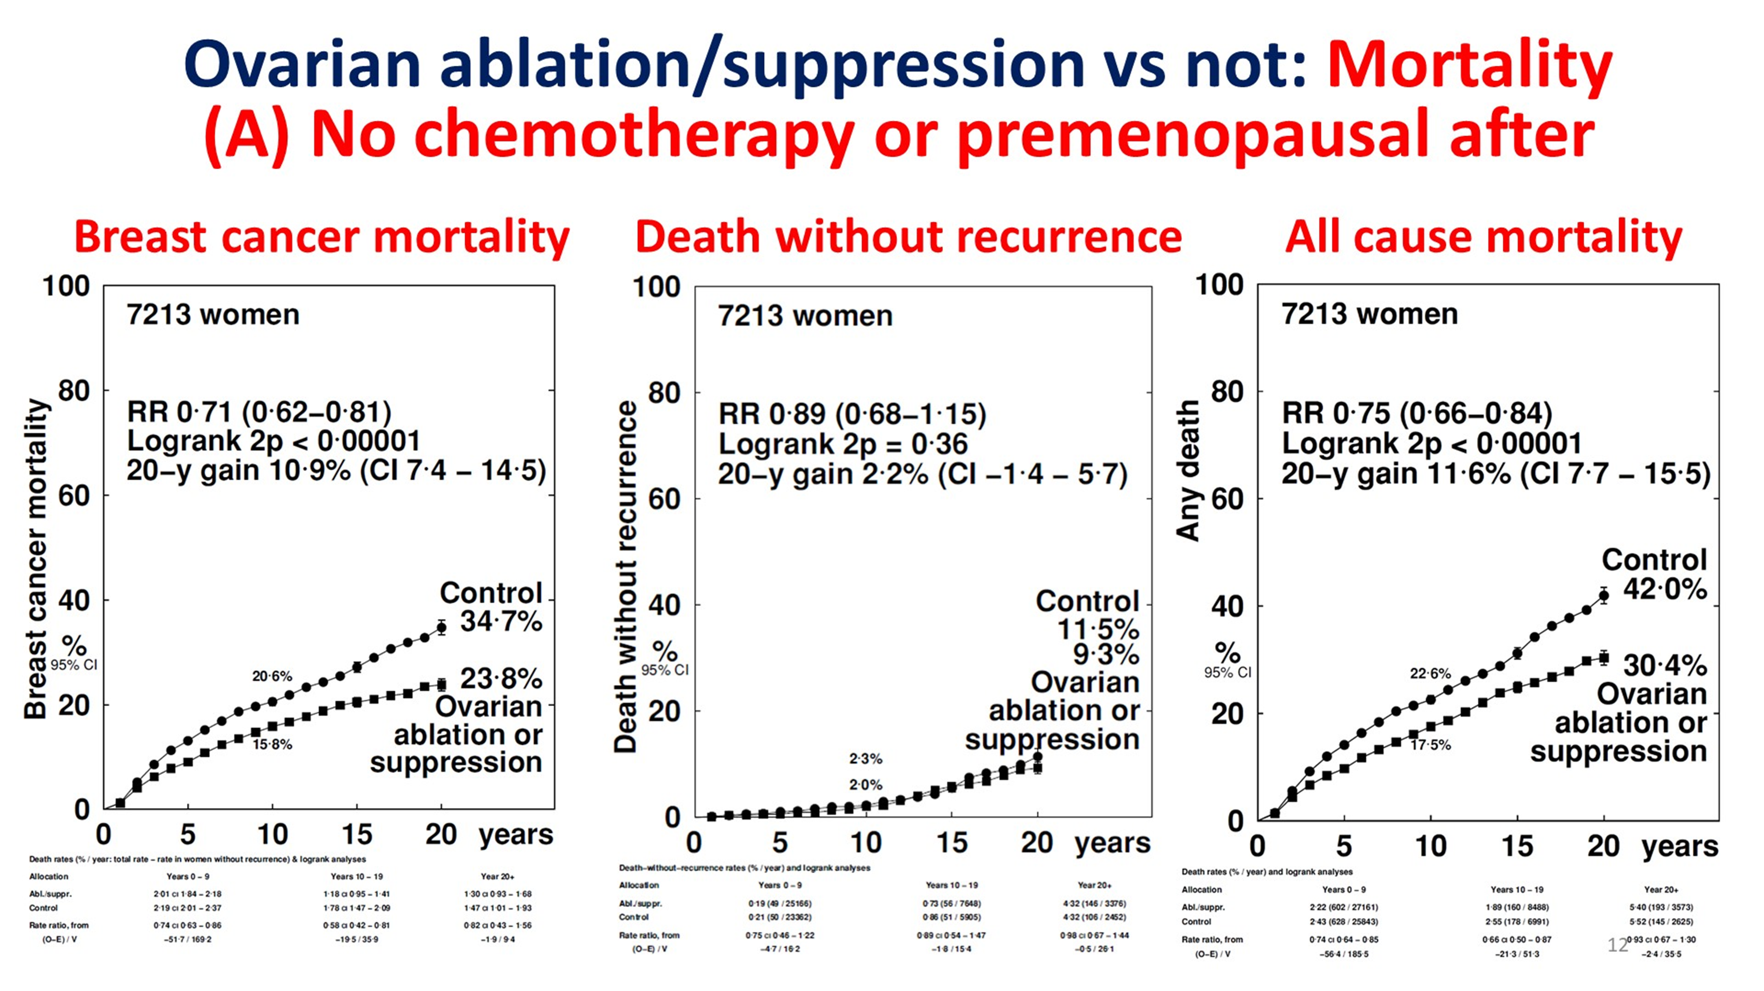
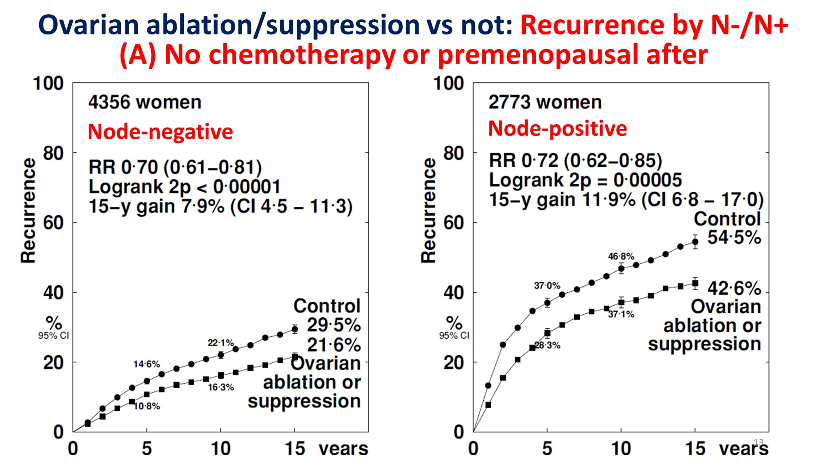
Effects of ovarian ablation or suppression on breast cancer recurrence and survival: Patient-level meta-analysis of 14,999 pre-menopausal women in 25 randomized trials. EBCTCG Meta Analysis
OFS results in a reduction in breast cancer mortality, without an increase in death without recurrence or excess in all cause mortality, reducing concerns about secondary health risks of OFS
RR reduction in patients w/node negative and node positive disease was similar (30% and 28%, respectively) with smaller 15-year gains in N0 (7.9%) vs N+ (11.9%) proportional to risk of disease recurrence
Gray RG et al. Effects of ovarian ablation or suppression on breast cancer recurrence and survival: Patient-level meta-analysis of 14,993 pre-menopausal women in 25 randomized trials. ASCO 2023;Abstract 503.
Notes:
23 Trials, all patient premen at randomization—12 trials no chemo, 2 trials chemo prior to randomization, 14 trials received post-randomization chemotherapy (5 trials went to both “no chemo and post-randomization chemo” groups)=23
RE: Premen before, uncertain after—age significant factor. RR varies by age. <35 0.79; 35-39 0.81; 40-44 0.89; 45-49 0.99, 50-54 +0.91 (favors no OFS)

Slide 13
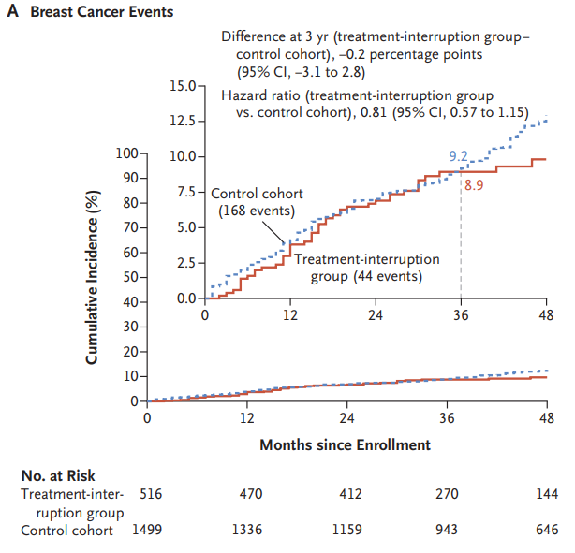
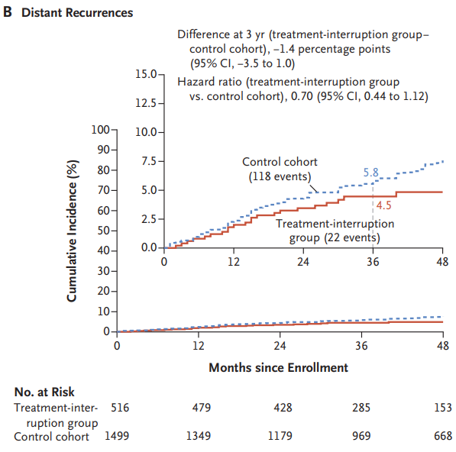
Pregnancy Outcome and Safety of Interrupting Therapy for women with endocrine responsIVE breast cancer (POSITIVE)
Enrolled
8.9% 3-year risk breast cancer recurrence
Median Age: 37 yrs
34% <35 yrs; 23% 40-42 yrs
75% had not had a prior birth
Stage III disease: 6% (n=31)
42% TAM, 36% TAM + OFS, 16% AI + OFS
62% prior chemotherapy
4.5% 3-year risk distant recurrence
Protocol
Planned ET interruption w/in 1 month of enrollment
Up to 2 years to attempt to pregnancy, conceive, deliver, and breast feed including a 3 month wash out
If no pregnancy by 1 year, fertility assessment strongly encouraged
Resume ET after 2 years
368 (74%) of 497 women had at least one pregnancy (70% within 2 years) for a total of 507 pregnancies
317 had at least one live birth (64% of all women, 86% of those who became pregnant)
11% of pregnancies experienced complications; Birth defects were low (2%)
Partridge AH et al. Interrupting endocrine therapy to attempt pregnancy after breast cancer. N Engl J Med 2023;388(18):1645-56
Notes:
Eligibility: Premenopausal; Age ≤42 at study entry; At least 18 mos, no more 30 mos of prior endocrine therapy for stage I-III HR+BC

Slide 14
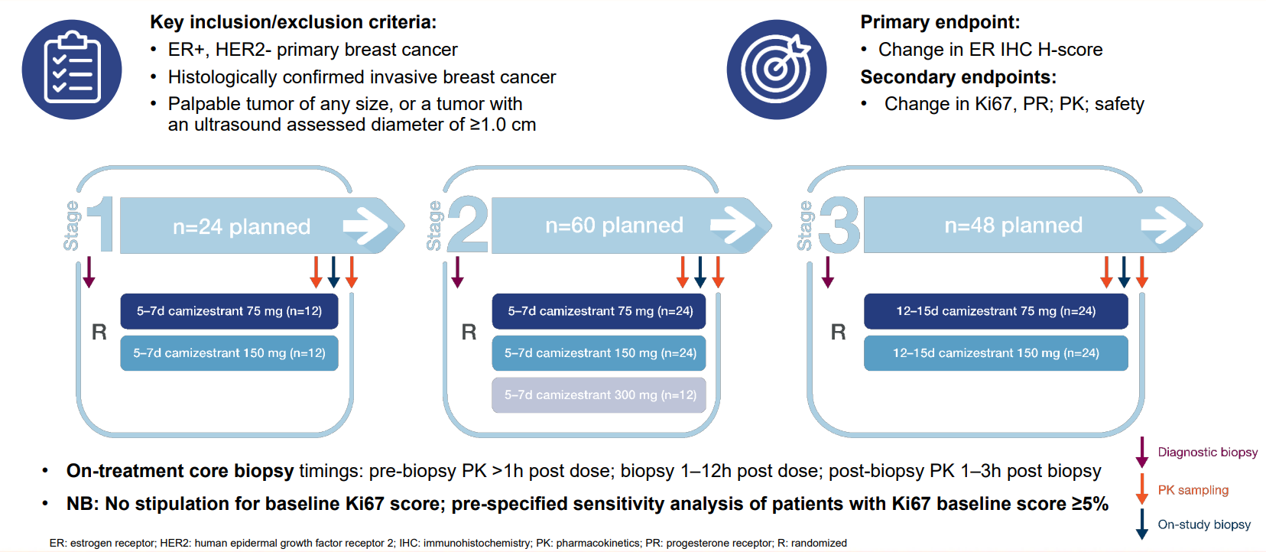
SERENA-3: A randomized pre-surgical window of opportunity study assessing dose and duration of camizestrant treatment in post-menopausal women with ER-positive, HER2-negative primary breast cancer
Enrolled
92.6% Ductal
Stage I (34.8%) or Stage II (57.8%)
Mostly G2 (66.7%)
N0 (69.6%) or N1 (26.7%)
Robertson J et al. SERENA-3: A randomized pre-surgical window of opportunity study assessing dose and duration of camizestrant treatment in post-menopausal women with ER-positive, HER2-negative primary breast cancer. San Antonio Breast Cancer Symposium 2023;Abstract RF01-01.

Slide 15
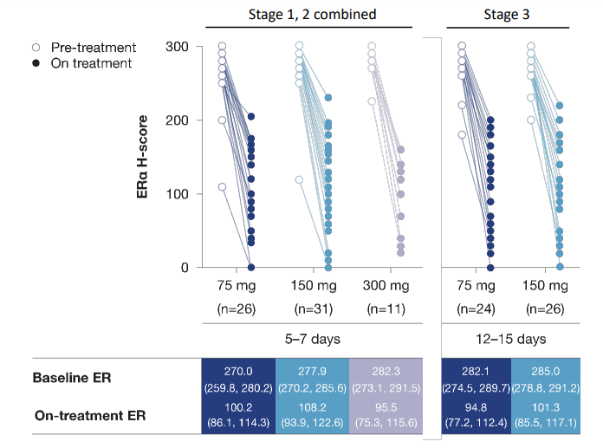
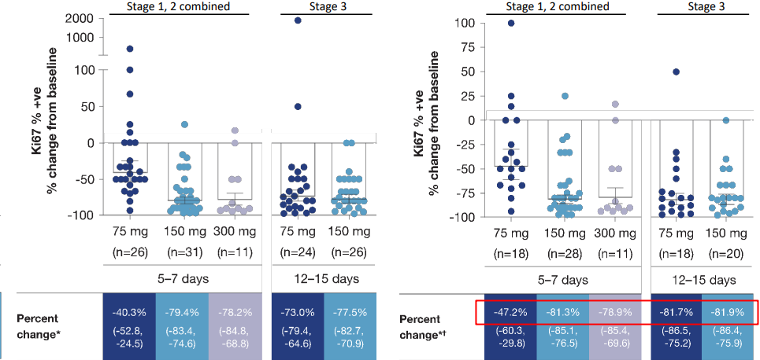
SERENA-3: A randomized pre-surgical window of opportunity study assessing dose and duration of camizestrant treatment in post-menopausal women with ER-positive, HER2-negative primary breast cancer
Camizestrant effectively degrades ERα on treatment across stages, treatment doses & duration of exposure
After 5-7 days of exposure, ki-67 is reduced; more effectively at 150 and 300 mg than at 75 mg. After 12-15 days of exposure, ki-67 reduced ~82% for both 75 and 150 mg doses
Robertson J et al. SERENA-3: A randomized pre-surgical window of opportunity study assessing dose and duration of camizestrant treatment in post-menopausal women with ER-positive, HER2-negative primary breast cancer. San Antonio Breast Cancer Symposium 2023;Abstract RF01-01.
Notes:
Context: Who Cares? In IMPACT Trial, after 2 weeks of neoadj endocrine therapy, a reduction in ki67 correlated with recurrence free survival. This has not always been reproducable in other studies. Notably, ki67 is one of the “21 genes” in the 21-gene recurrence score and factors heavily into high-risk scores.
Dowsett M, Smith IE, Ebbs SR, Dixon JM, Skene A, A'Hern R, Salter J, Detre S, Hills M, Walsh G; IMPACT Trialists Group. Prognostic value of Ki67 expression after short-term presurgical endocrine therapy for primary breast cancer. J Natl Cancer Inst. 2007 Jan 17;99(2):167-70. doi: 10.1093/jnci/djk020. PMID: 17228000.

Slide 16
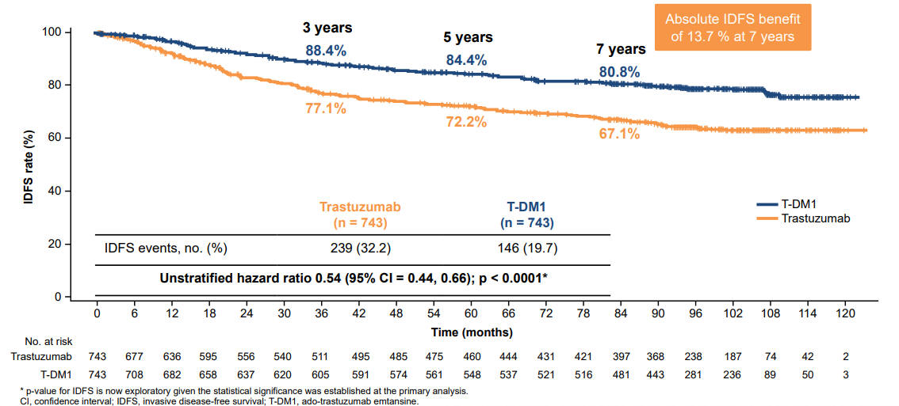
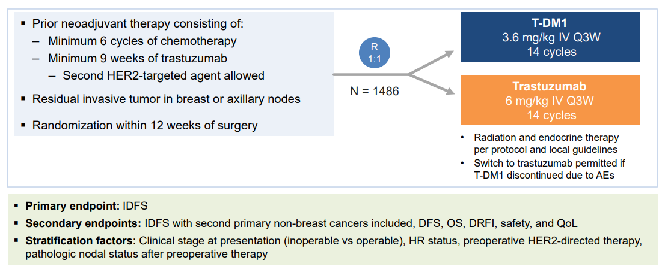
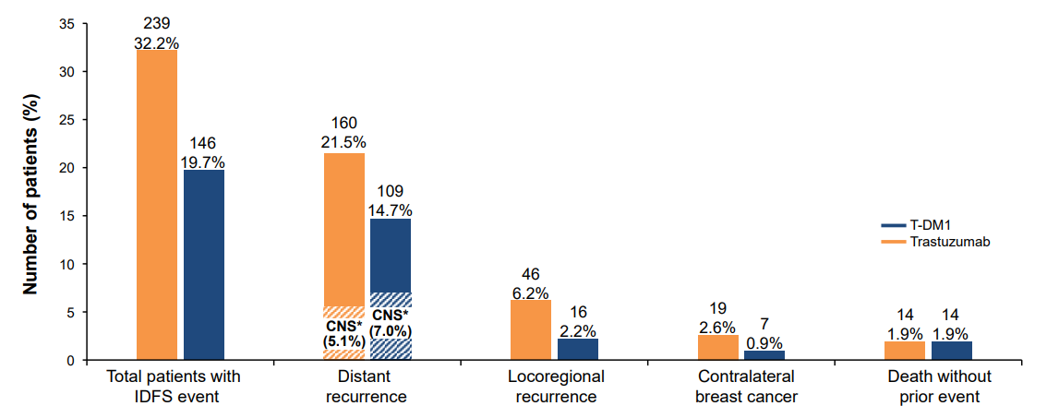
Phase III study of adjuvant ado-trastuzumab emtansine vs trastuzumab for residual invasive HER2-positive early breast cancer after neoadjuvant chemotherapy and HER2-targeted therapy: KATHERINE final IDFS and updated OS analysis
Median Follow up 8.4 years
72% of patient population was HR+ and HER2+
IDFS 80.8% vs 67.1% (∆ 13.7%). HR = 0.54
  For HR+ cohort, IDFS HR = 0.52
Absolute OS benefit of 4.7 % at 7 years (89.1% vs 84.4%; HR 0.66)
Small reduction in risk of CNS recurrence (7.0% vs 5.1%)
Phase III study of adjuvant ado-trastuzumab emtansine vs trastuzumab for residual invasive HER2-positive early breast cancer after neoadjuvant chemotherapy and HER2-targeted therapy: KATHERINE final IDFS and updated OS analysis. Loibl S, Mano MS, Untch M, Huang CS, Mamounas EP, Wolmark N, Knott A, Siddiqui A, Boulet T, Nyawira B, Restuccia E, Geyer CE. SABCS 2023
Notes:
72% of the patient population was ER/PR positive

Slide 17
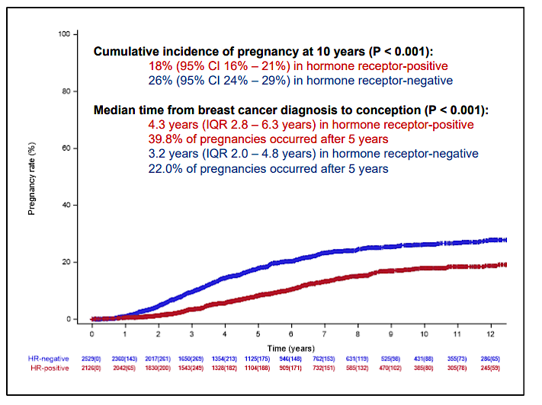
Pregnancy after Breast Cancer in Young Women with
Germline BRCA Pathogenic Variants: Results from an
International Cohort Study
International multicenter retrospective cohort
Stage I-III breast cancer diagnosed 1/2000 - 12/2020
Age <40 at diagnosis
Known gBRCA1/BRCA2 mutation
Included 5,457 patients with matching cohort—4732 with pregnancy
Pregnancy occurred more in TNBC, LN negative, younger patients (median age 30)
22% Cumulative incidence of pregnancy at 10 years
  Lower in HR+ 18% vs 26%
  Median time BC to conception longer in HR+ 4.3 years vs 3.2 years
No significant difference in pregnancy outcomes as compared to the general population
Lambertini M, et al. Pregnancy After Breast Cancer in Young BRCA Carriers: An International Hospital-Based Cohort Study. JAMA. 2024 Jan 2;331(1):49-59.

Slide 18
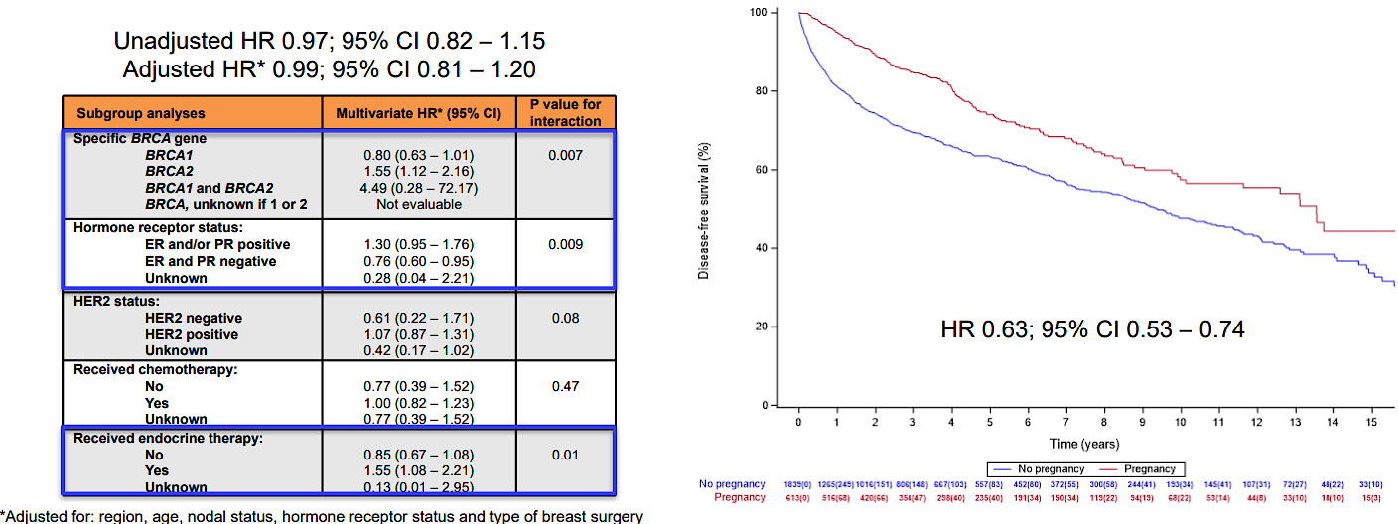
Pregnancy after Breast Cancer in Young Women with
Germline BRCA Pathogenic Variants: Results from an
International Cohort Study
While pregnancy seemed to offer a protective effect for HR-negative breast cancer (HR 0.76 95%CI 0.60-0.95), there was no effect in HR+BC (HR 1.30, 95%CI 0.95-1.76)
Lambertini M, et al. Pregnancy After Breast Cancer in Young BRCA Carriers: An International Hospital-Based Cohort Study. JAMA. 2024 Jan 2;331(1):49-59.
Notes:
Primary Analysis – Extended Cox model with occurrence of pregnancy as a time-varying covariate
Secondary Matched Analysis
No detrimental effect of pregnancy in patients with BRCA mutations after breast cancer and 22% of these patients go on to pregnancy

