Slide 1


2023 Year in Review:
HER2-Positive Breast Cancer
Ian Krop MD PhD
Yale Cancer Center
January 2024

Slide 2
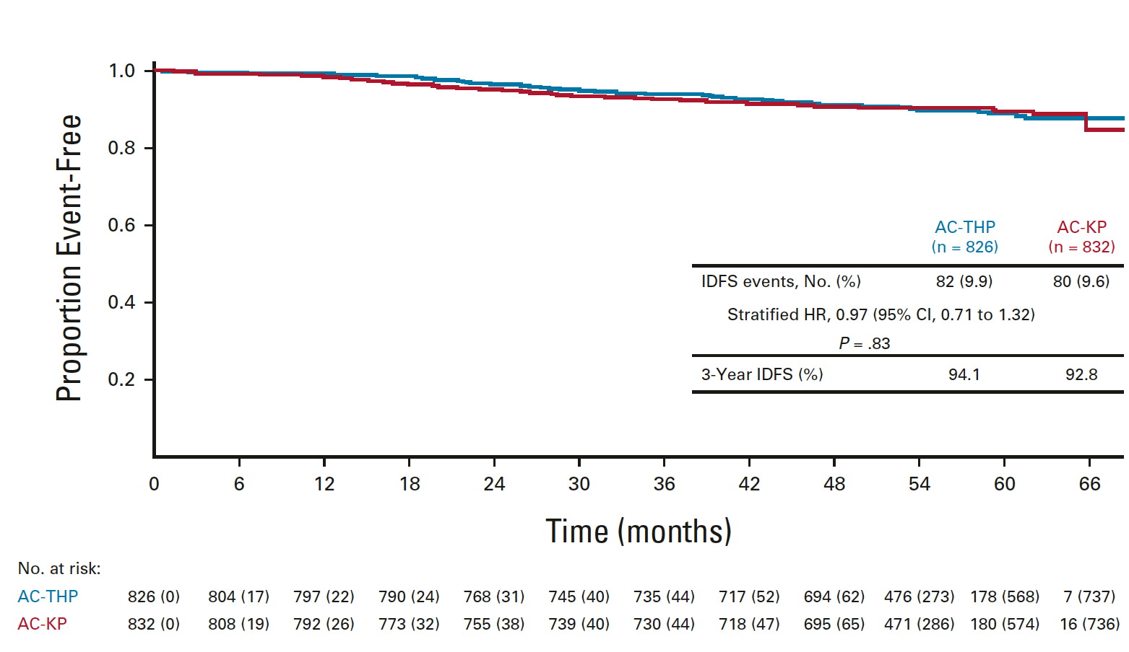
Patients with HER2+ early breast cancer now have generally favorable outcomes
Results from node positive subgroup (38% ≥4+nodes) of KAITLIN study treated with ACTHP or AC-TDM1/P
Krop et al, JCO 40:438 2021

Slide 3
The era of personalized medicine in HER2+ EBC
The favorable outcomes of HER2+ breast cancers provide opportunity to:
  De-escalate therapy for lower risk patients to reduce the toxicities of treatment
  Escalate therapy for minority of patients who are risk for recurrence despite maximal current management

Slide 4
APT: Can we leverage the effectiveness of trastuzumab to de-escalate chemotherapy in low-risk HER2+ breast cancer?
HER2+
ER+ or ER-
Node Negative
< 3 cm
PS 0-1
Adequate organ fx
Enroll
P
P
P
P
P
P
P
P
P
P
P
P
T
T
T
T
T
T
T
T
T
T
T
T
12 WEEKS OF PACLITAXEL/TRASTUZUMAB
413 patients enrolled
T
T
T
T
T
T
T
T
T
T
T
T
T
FOLLOWED BY 13 EVERY 3 WEEK DOSES OF TRASTUZUMAB
Trial designed to determine if treatment with paclitaxel/trastuzumab is
associated with a low (5%) rate of recurrence after 3 years
Notes:
4

Slide 5
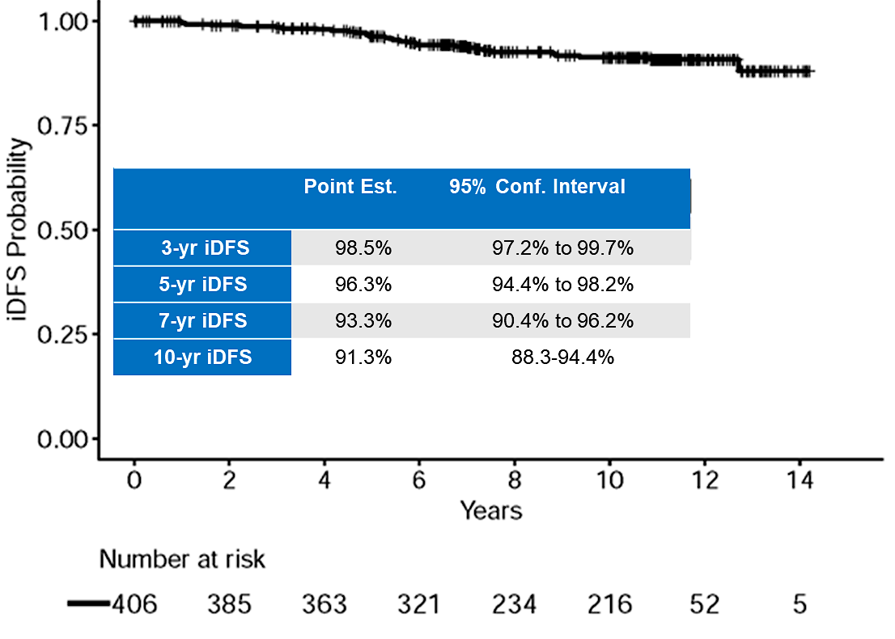
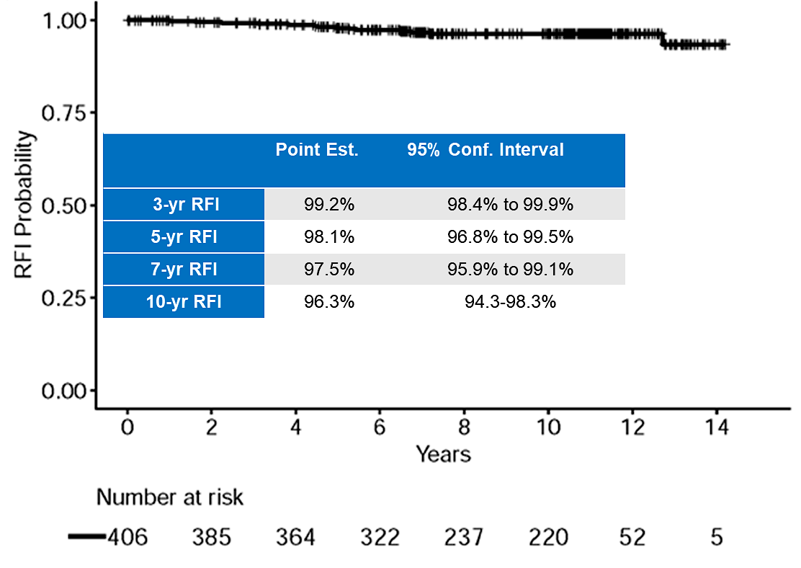
APT: Outcomes at 10 yrs
DISEASE-FREE SURVIVAL
RECURRENCE FREE INTERVAL
6 (1.5%) distant recurrence events
RFI Events=
Invasive Local/Regional Recurrence
Distant Recurrence
Death from Breast Cancer
Tolaney SM et al, Lancet Onc 2023
Notes:
The study demonstrated very few recurrences, with a 7 yr invasive disease free survival of 93.3% and a 7 yr recurrence free interval of 97.5%

Slide 6
APT: Outcomes at 10 yrs
By Tumor Size
By Hormone receptor Status
RFI Events=
Invasive Local/Regional Recurrence
Distant Recurrence
Death from Breast Cancer
Tolaney SM et al, Lancet Onc 2023
Notes:
The study demonstrated very few recurrences, with a 7 yr invasive disease free survival of 93.3% and a 7 yr recurrence free interval of 97.5%

Slide 7
Conclusions
Paclitaxel and trastuzumab (TH) is associated with excellent outcomes and is a standard of care for patients with stage I HER2+ breast cancer
  Favorable outcomes for both ER+ and ER- HER2+ cancers and for T1C cancers
  Not all patients require adjuvant trastuzumab-based chemotherapy (particularly T1aN0)
Is there a role for T-DM1 in stage I pts?

Slide 8

PHERGain: Can PET response be used to guide therapy
de-escalation in HER2+ EBC?
AFTER CYCLE 2 (6 weeks)
AFTER CYCLE 6 or 8
BASAL: PET Scan (Total Body)
Breast MRI / Biopsy
GROUP A
TCHP
x2
TCHP
x4
PH (ETx)
x12
Key Eligibility Criteria
Centrally confirmed HER2[+] stage I-IIIA EBC.
Tumor diameter ≥ 1.5 cm by MRI or ultrasound.
Presence of a breast PET-evaluable lesion.
N=71
R
1:4
N=356
pCR
PH (ETx)
x10
Response
PH (ETx) x6
PET (Total Body) Scan
SURGERY
First Primary Endpoint
pCR in PET Responders (Arm B)
Second Primary Endpoint
3-year iDFS rate in Arm B
Stratification factors
Hormonal receptor status (+/-)
Non-pCR
TCHP x6 –
PH (ETx) x4
PH (ETx)^{ⱡ} x2
FOLLOW UP
GROUP B
No Response
TCHP
x6
N=285
PH (ETx)
x10
Tissue/blood samples
Tissue/blood samples
Tissue/blood samples
If subclinical PET M1
TCHP
x6
Surgery (Y/N)
PH (ETx)
x12
GROUP C
C: Carboplatin; D: Docetaxel; EBC: Early breast cancer; ETx: Endocrine therapy (letrozole post-menopausal/tamoxifen pre-menopausal), Adjuvant ETx up to 3 years from surgery; PET: ¹⁸F-fluorodeoxyglucose positron emission tomography/computed tomography; H: Trastuzumab SC; HER2: Human Epidermal Growth Factor Receptor 2; iDFS: Invasive disease-free survival; MRI: Magnetic resonance Imaging; P: Pertuzumab IV; R: Randomization; TCHP: Trastuzumab, pertuzumab, docetaxel, and carboplatin. ^{ⱡ} All hormonal receptor-positive patients received ETx concomitantly with PH (except on chemotherapy).
PET RESPONDERS: RECIST responders after cycle 2 with SUV_{max} reduction ≥40%.
pCR, Pathological complete response (ypT0/isN0)
Dr. JAVIER CORTÉS MD PhD

Slide 9
PHERGain Study Design
AFTER CYCLE 2 (6 weeks)
BASAL: PET Scan (Total Body)
Breast MRI / Biopsy
GROUP A
TCHP
x2
TCHP
x4
PH (ETx)
x12
Key Eligibility Criteria
Centrally confirmed HER2[+] stage I-IIIA EBC.
Tumor diameter ≥ 1.5 cm by MRI or ultrasound.
Presence of a breast PET-evaluable lesion.
N=71
R
1:4
N=356
pCR
PH (ETx)
x10
Response
PH (ETx) x6
FOLLOW UP
PET (Total Body) Scan
SURGERY
Stratification factors
Hormonal receptor status (+/-)
Non-pCR
TCHP x6 –
PH (ETx) x4
PH (ETx)^{ⱡ} x2
GROUP B
No Response
TCHP
x6
N=285
PH (ETx)
x10
C: Carboplatin; D: Docetaxel; EBC: Early breast cancer; ETx: Endocrine therapy (letrozole post-menopausal/tamoxifen pre-menopausal), Adjuvant ETx up to 3 years from surgery; PET: ¹⁸F-fluorodeoxyglucose positron emission tomography/computed tomography; H: Trastuzumab SC; HER2: Human Epidermal Growth Factor Receptor 2; iDFS: Invasive disease-free survival; MRI: Magnetic resonance Imaging; P: Pertuzumab IV; R: Randomization; TCHP: Trastuzumab, pertuzumab, docetaxel, and carboplatin. ^{ⱡ} All hormonal receptor-positive patients received ETx concomitantly with PH (except on chemotherapy).
PET RESPONDERS: RECIST responders after cycle 2 with SUV_{max} reduction ≥40%.
pCR, Pathological complete response (ypT0/isN0).
Dr. JAVIER CORTÉS MD PhD

Slide 10
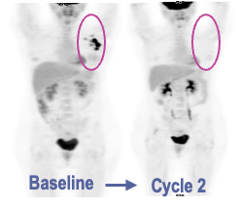
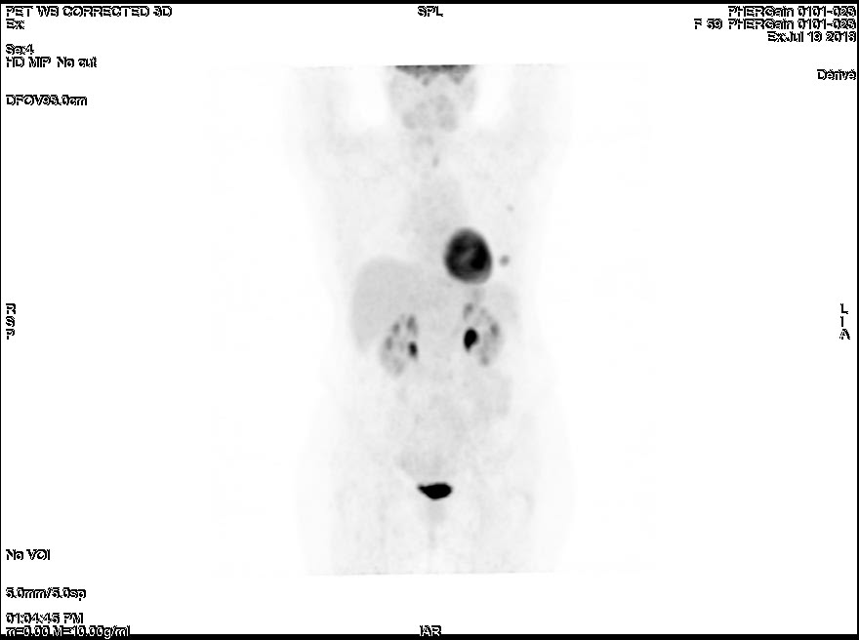
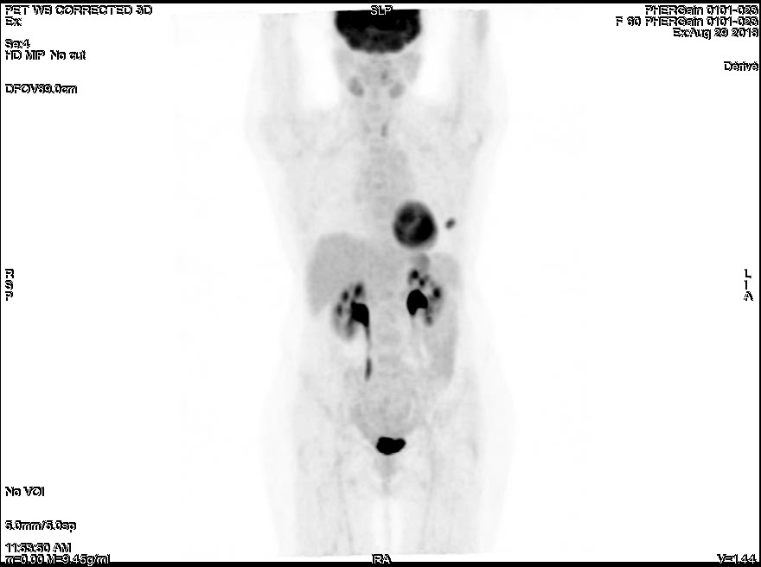
PHERGain Study Design
AFTER CYCLE 2 (6 weeks)
AFTER CYCLE 8
BASAL: PET Scan (Total Body)
Breast MRI / Biopsy
GROUP A
TCHP
x2
TCHP
x4
PH (ETx)
x12
Key Eligibility Criteria
Centrally confirmed HER2[+] stage I-IIIA EBC.
Tumor diameter ≥ 1.5 cm by MRI or ultrasound.
Presence of a breast PET-evaluable lesion.
N=71
R
1:4
N=356
pCR
PH (ETx)
x10
Response
PH (ETx) x6
FOLLOW UP
PET (Total Body) Scan
SURGERY
Stratification factors
Hormonal receptor status (+/-)
Non-pCR
TCHP x6 –
PH (ETx) x4
PH (ETx)^{ⱡ} x2
GROUP B
No Response
TCHP
x6
N=285
PH (ETx)
x10
Baseline
Cycle 2
C: Carboplatin; D: Docetaxel; EBC: Early breast cancer; ETx: Endocrine therapy (letrozole post-menopausal/tamoxifen pre-menopausal), Adjuvant ETx up to 3 years from surgery; PET: ¹⁸F-fluorodeoxyglucose positron emission tomography/computed tomography; H: Trastuzumab SC; HER2: Human Epidermal Growth Factor Receptor 2; iDFS: Invasive disease-free survival; MRI: Magnetic resonance Imaging; P: Pertuzumab IV; R: Randomization; TCHP: Trastuzumab, pertuzumab, docetaxel, and carboplatin. ^{ⱡ} All hormonal receptor-positive patients received ETx concomitantly with PH (except on chemotherapy).
PET RESPONDERS: RECIST responders after cycle 2 with SUV_{max} reduction ≥40%.
pCR, Pathological complete response (ypT0/isN0).
Dr. JAVIER CORTÉS MD PhD

Slide 11
PHERGain Study Design
AFTER CYCLE 2 (6 weeks)
AFTER CYCLE 8
BASAL: PET Scan (Total Body)
Breast MRI / Biopsy
GROUP A
TCHP
x2
TCHP
x4
PH (ETx)
x12
Key Eligibility Criteria
Centrally confirmed HER2[+] stage I-IIIA EBC.
Tumor diameter ≥ 1.5 cm by MRI or ultrasound.
Presence of a breast PET-evaluable lesion.
N=71
R
1:4
N=356
pCR
PH (ETx)
x10
Response
PH (ETx) x6
FOLLOW UP
PET (Total Body) Scan
SURGERY
Stratification factors
Hormonal receptor status (+/-)
Non-pCR
TCHP x6 –
PH (ETx) x4
PH (ETx)^{ⱡ} x2
GROUP B
No Response
TCHP
x6
N=285
PH (ETx)
x10
C: Carboplatin; D: Docetaxel; EBC: Early breast cancer; ETx: Endocrine therapy (letrozole post-menopausal/tamoxifen pre-menopausal), Adjuvant ETx up to 3 years from surgery; PET: ¹⁸F-fluorodeoxyglucose positron emission tomography/computed tomography; H: Trastuzumab SC; HER2: Human Epidermal Growth Factor Receptor 2; iDFS: Invasive disease-free survival; MRI: Magnetic resonance Imaging; P: Pertuzumab IV; R: Randomization; TCHP: Trastuzumab, pertuzumab, docetaxel, and carboplatin. ^{ⱡ} All hormonal receptor-positive patients received ETx concomitantly with PH (except on chemotherapy).
PET RESPONDERS: RECIST responders after cycle 2 with SUV_{max} reduction ≥40%.
pCR, Pathological complete response (ypT0/isN0).
Dr. JAVIER CORTÉS MD PhD

Slide 12
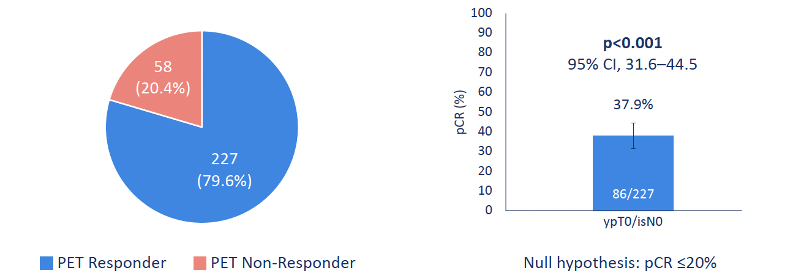
12
Primary Endpoint: pCR in ¹⁸F-FDG-PET responders in group B
PET Responders and Non-Responders
pCR rate
pCR was observed in patients with both HER2++ and HER2+++, pts with stage II and stage III, and pts ER+ and ER-.
Pérez-García, JM, et al. (2021). Lancet Oncol, 22(6), 858-871.
CI: Confidence interval; PET: ¹⁸F-fluorodeoxyglucose positron emission tomography/computed tomography; pCR: Pathological complete response (ypT0/isN0).
Dr. JAVIER CORTÉS MD PhD
Notes:
Copiar el formato del PALMIRA

Slide 13
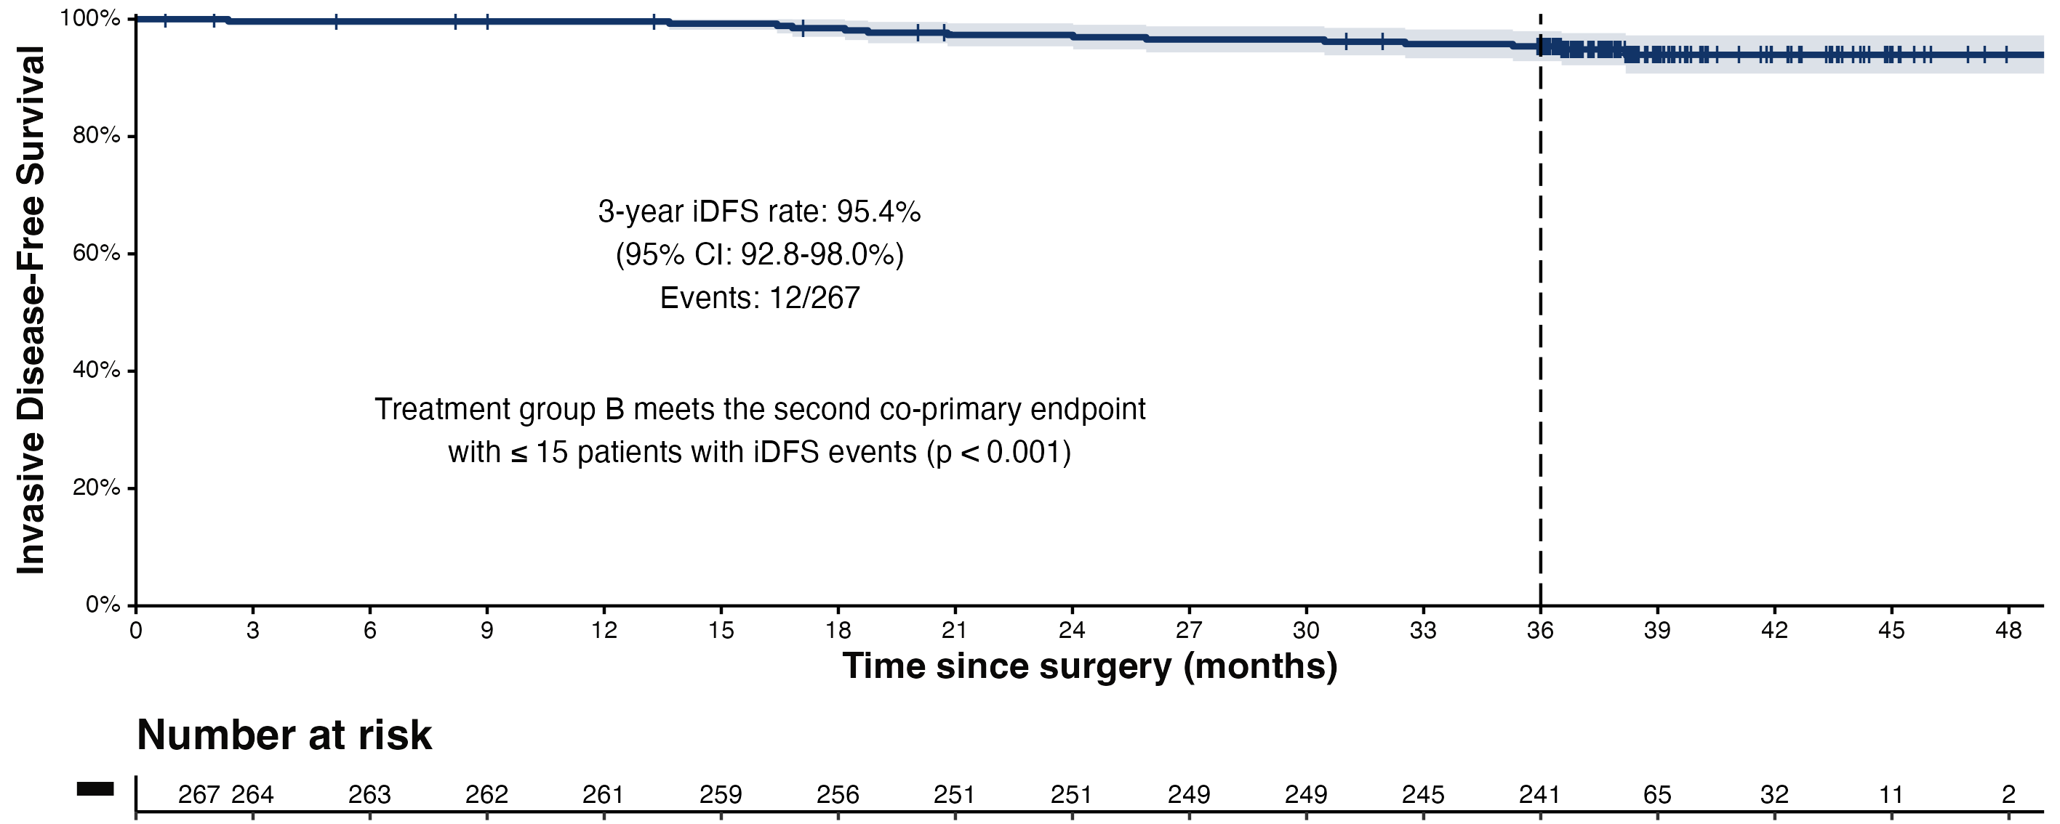
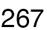
Primary Endpoint: 3-year iDFS rate in group B
ITT population
3-year iDFS rate: 95.4%
(95% CI: 92.8-98.0%)
Events: 12/267
Second primary endpoint was met
with ≤ 15 patients with iDFS events (p < 0.001)
Dr. JAVIER CORTÉS MD PhD

Slide 14
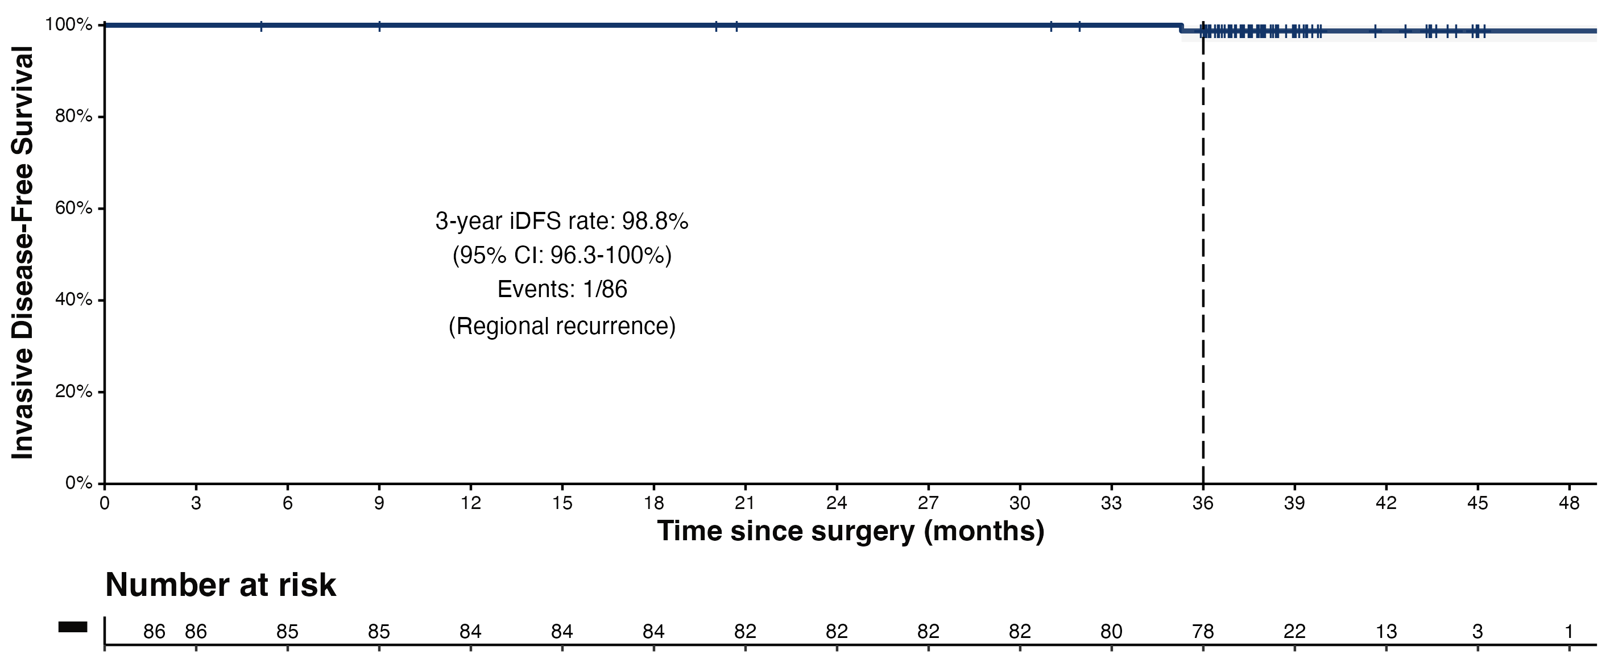
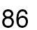
Subgroup analysis:
3-y iDFS rate without CT in PET responders with pCR (n=86)
3-year iDFS rate: 98.8%
(95% CI: 96.3-100%)
Events: 1/86
(Regional recurrence)
iDFS event (1.2%): Regional invasive breast cancer recurrence
Dr. JAVIER CORTÉS MD PhD

Slide 15
Conclusions
PET-guided de-escalation approach yields generally favorable overall outcome: 3-year iDFS of 95.4%
  Allows 30% of pts to omit chemotherapy
  Note relatively short-term follow-up
How does this compare to short course of neoadj chemo (eg THP) with pCR rate of ≈55% and presumably no need for additional chemotherapy (eg COMPASS pCR trial)?
Can we use upfront biomarker selection to enrich these types of approaches with patients most likely to do well with de-escalation approach?

Slide 16
ExteNET: Can extended adjuvant therapy with the pan-HER TKI neratinib improve outcomes in HER2+ EBC?
HER2+ breast cancer (local)
  IHC 3+ or ISH amplification
Prior adjuvant trastuzumab & chemotherapy
Lymph node –/+ or residual invasive disease after neoadjuvant therapy
ER/PR + or –
Part A
Part B
Part C
Neratinib x 1 year
240mg/day
1:1 randomization
N=2840
2-year follow-up for iDFS
5 + year survival
5-year follow-up for iDFS
Placebo x 1 year
Primary endpoint: invasive disease-free survival (iDFS)
Secondary endpoints: DFS-DCIS, time to distant recurrence, distant DFS, CNS metastases, overall survival, safety
Other analyses: biomarkers, health outcome assessment (FACT-B, EQ-5d)
Stratified by: nodes 0, 1–3 vs 4+, ER/PR status, concurrent vs sequential trastuzumab
Chan et al, ASCO Breast 2015

Slide 17
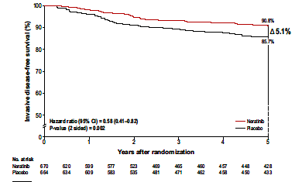
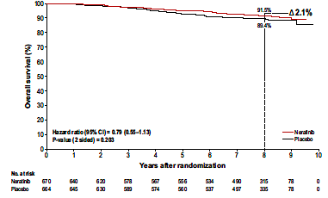
Benefit of neratinib in patients HR+ and
≤1 year from trastuzumab
iDFS at 5yrs
Overall Survival (median f/u 8y)
Approximately 40% Gr 3 diarrhea
(without any prophylaxis)
Chan et al Clin Breast Cancer 2021 Feb;21(1):80-91.e7.

Slide 18
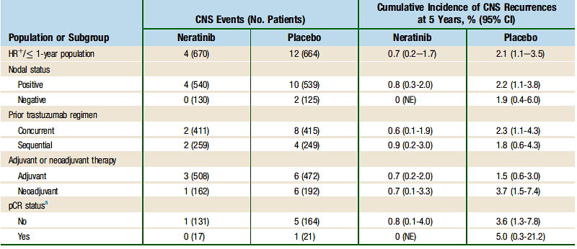
Cumulative incidence of CNS disease as 1st site of recurrence
Chan et al Clin Breast Cancer 2021 Feb;21(1):80-91.e7.

Slide 19
Benefit of neratinib in HR+ patients (8yr follow-up)
8yr OS:
91.6% Neratinib
90.1% Placebo
Holmes et al. European Journal of Cancer 184 (2023) 48

Slide 20
Who Should Receive Neratinib?
Neratinib benefit (relative and absolute) in ER+HER2+ high risk patients
  Must be balanced against toxicity risk
No data giving neratinib after pertuzumab or T-DM1
  All patients at sufficiently high risk to receive neratinib will have received pertuzumab and T-DM1
So who should receive it?
  Unclear, but my opinion is that it is reasonable option to consider in ER+ patients with positive nodes after neoadjuvant therapy

Slide 21
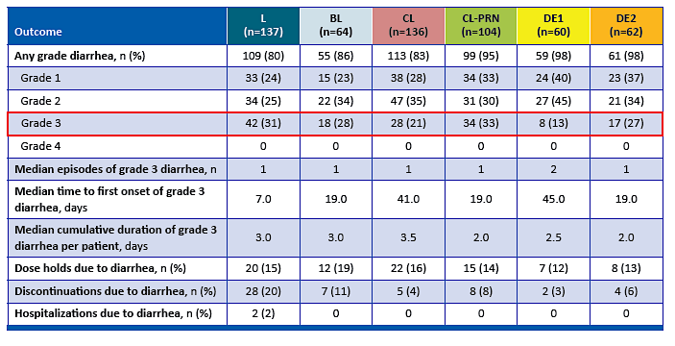
CONTROL study: Can dose escalation of neratinib minimize Grade 3 diarrhea?
DE1:
120 mg x 7d
160 mg x 7d
240 mg qd
Adapted from Chan A, et al. 2022 ESMO Breast: Abstract 73P and Chan A, et al. The Breast 67 (2023) 94–101

Slide 22
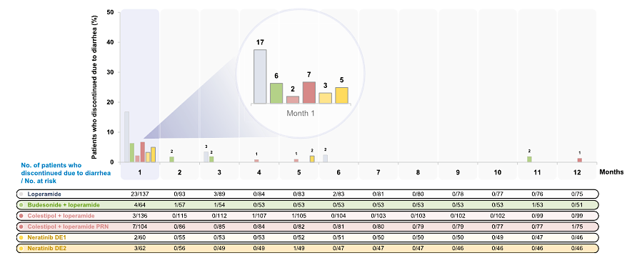
CONTROL study: Majority of drug discontinuations occur in 1st cycle
Chan A, et al. The Breast 67 (2023) 94–101

Slide 23
How to mitigate neratinib induced diarrhea?
Neratinib dose escalation, along with loperamide, is associated with relatively low rates of gr3 diarrhea
Most pts who get through 1st cycle have low rate of drug discontinuation due to diarrhea
  Patient education is key

Slide 24
SUMMIT: Does neratinib have activity in breast cancers with somatic HER2 mutations?
Somatic HER2 mutations seen in 3-5% of HR+ HER2 non-amplified cancers
  More common in lobular cancers (5-8%)
  May be acquired with endocrine resistance
SUMMIT trial is basket study evaluating neratinib alone and in combination in patients with HER2 mutant breast cancer
  Initial results showed single agent activity: 17% ORR in HR+ HER2mutant MBC
  Combination of neratinib and fulvestrant: 30% ORR
  ctDNA data suggested secondary HER2 mutations or HER2 amplification as mechanism of resistance
Data led to cohort of neratinib + fulvestrant + trastuzumab (NFT) performed (n=71) in pts previously treated with CDK4/6 inhibitor
  Randomized subset: F vs FT vs NFT (n=21)
Jhaveri et al, Annals of Oncology 34:885 2023

Slide 25
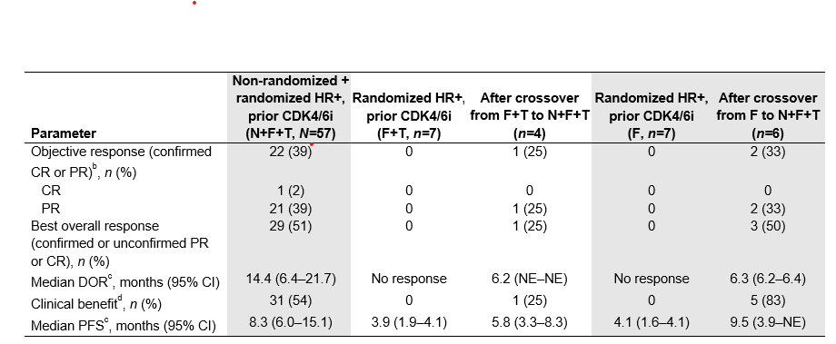
SUMMIT: Does neratinib have activity in breast cancers with somatic HER2 mutations?
ORR: 63% V777L 24% L755S 80% dual mutation
HER2 expression level or FISH amplification were not assoc with ORR
Grade 3 diarrhea was 53% with triplet despite loperamide prophylaxis
Jhaveri et al, Annals of Oncology 34:885 2023

Slide 26
SUMMIT: Conclusion
Neratinib + fulvestrant has clinically meaningful activity in patients with ER+HER2mutant MBC
  Addition of trastuzumab may further increase benefit
  Substantial Gr3 diarrhea – consider neratinib dose escalation
Neratinib based therapy can be considered an effective treatment option for ER+HER2mutant MBC
  Included in NCCN guidelines
These data provide additional support for obtaining somatic tumor sequencing (tissue or ctDNA) in the MBC setting

Slide 27
Updated OS Analysis of DESTINY-Breast03
Randomized, open-label, multicenter study (NCT03529110)
T-DXd
5.4 mg/kg Q3W
(n = 261)
Primary endpoint
PFS (BICR)
Key secondary endpoint
OS^{c}
Secondary endpoints
ORR (BICR and investigator)
DoR (BICR)
Safety
Patients (N = 524)
Unresectable or metastatic HER2-positiveª breast cancer
Previously treated with trastuzumab and a taxane in metastatic or (neo)adjuvant setting with recurrence within 6 months of therapy^{b}
R
1:1
T-DM1
3.6 mg/kg Q3W
(n = 263)
Stratification factors
Hormone receptor status
Prior treatment with pertuzumab
History of visceral disease
The prespecified OS interim analysis was planned with 153 events. At the time of data cutoff (July 25, 2022),
169 OS events were observed and the P value to achieve statistical significance was 0.013
BICR, blinded independent central review; DoR, duration of response; HER2, human epidermal growth factor receptor 2; IHC, immunohistochemistry; ISH, in situ hybridization; ORR, objective response rate; OS, overall survival; PFS, progression-free survival; Q3W, every 3 weeks; R, randomization; T-DM1, trastuzumab emtansine; T-DXd, trastuzumab deruxtecan.
ªHER2 IHC 3+ or IHC 2+/ISH+ based on central confirmation. ^{b}Progression during or within 6 months after completing adjuvant therapy involving trastuzumab and a taxane. ^{c}80% powered at 2-sided significance level of 5%.
Hurvitz SA et al. Lancet 2023;401:105

Slide 28
Key Secondary Endpoint: Overall Survival
T-DXd: 94.1% (95% CI, 90.4-96.4)
T-DM1: 86.0% (95% CI, 81.1-89.8)
100
T-DXd: 77.4% (95% CI, 71.7-82.1)
T-DM1: 69.9% (95% CI, 63.7-75.2)
80
mOS, mo (95% CI)
NR (40.5-NE)
60
Overall Survival Probability ,%
NR (34.0-NE)
40
HR, 0.64
(95% CI, 0.47-0.87)
P = 0.0037^{a,b}
Of the patients who discontinued study drug,
64/182 (35.2%) received T-DM1 after T-DXd
and 42/243 (17.3%) received T-DXd after T-DM1 in the posttrial setting.
20
Censor
T-DXd (n = 261)
0
T-DM1 (n = 263)
0
1
2
3
4
5
6
7
8
9
10
11
12
13
14
15
16
17
18
19
20
21
22
23
24
25
26
27
28
29
30
31
32
33
34
35
36
37
38
39
40
41
42
43
44
45
46
47
Patients still at risk:
Time, months
T-DXd
261
256
256
255
254
251
249
244
243
241
238
236
236
236
231
224
218
213
211
206
201
200
196
193
187
182
173
156
142
124
109
91
73
64
51
44
38
30
22
18
11
9
7
6
1
1
1
0
T-DM1
263
257
252
248
243
242
237
233
232
227
224
217
211
203
199
197
191
186
183
179
172
169
167
164
164
158
140
129
117
106
90
70
59
45
41
38
27
20
15
8
7
4
3
3
1
1
0
HR, hazard ratio; mOS, median overall survival; NE, not estimable; NR, not reached; T-DM1, trastuzumab emtansine; T-DXd, trastuzumab deruxtecan.
There were 19 patients (7.3%) treated with T-DXd and 28 patients (10.6%) treated with T-DM1 who were lost to follow-up.
ªThe P value for overall survival crossed the prespecified boundary (P = 0.013) and was statistically significant. ^{b}Two-sided.
Hurvitz SA et al. Lancet 2023;401:105

Slide 29
Updated Primary Endpoint: PFS by BICR
100
HR, 0.33
(95% CI, 0.26-0.43)
P < 0.000001^{a,b}
T-DXd: 75.2% (95% CI, 69.3-80.2)
T-DM1: 33.9% (95% CI, 27.7-40.2)
80
T-DXd: 53.7% (95% CI, 46.8-60.1)
T-DM1: 26.4% (95% CI, 20.5-32.6)
60
Progression-Free Survival Probability, %
mPFS, mo (95% CI)
28.8 (22.4-37.9)
40
~4X
20
6.8 (5.6-8.2)
Censor
T-DXd (n = 261)
0
T-DM1 (n = 263)
0
1
2
3
4
5
6
7
8
9
10
11
12
13
14
15
16
17
18
19
20
21
22
23
24
25
26
27
28
29
30
31
32
33
34
35
36
37
38
39
40
41
42
43
44
45
Patients still at Risk:
Time, months
T-DXd
261
256
250
244
240
225
216
207
205
191
176
173
167
154
146
140
134
131
130
125
123
117
113
107
99
96
90
82
73
64
55
41
32
28
23
20
18
13
7
5
4
2
1
0
T-DM1
263
253
201
164
156
134
111
99
96
81
69
67
63
58
54
51
49
49
47
47
42
41
39
37
36
32
28
27
22
19
15
14
8
7
6
4
2
2
2
1
1
1
1
1
1
0
BICR, blinded independent central review; HR, hazard ratio; mo, month; mPFS, median progression-free survival; PFS, progression-free survival; T-DM1, trastuzumab emtansine; T-DXd, trastuzumab deruxtecan.
ªTwo-sided. ^{b}Nominal P value.
Hurvitz SA et al. Lancet 2023;401:105

Slide 30
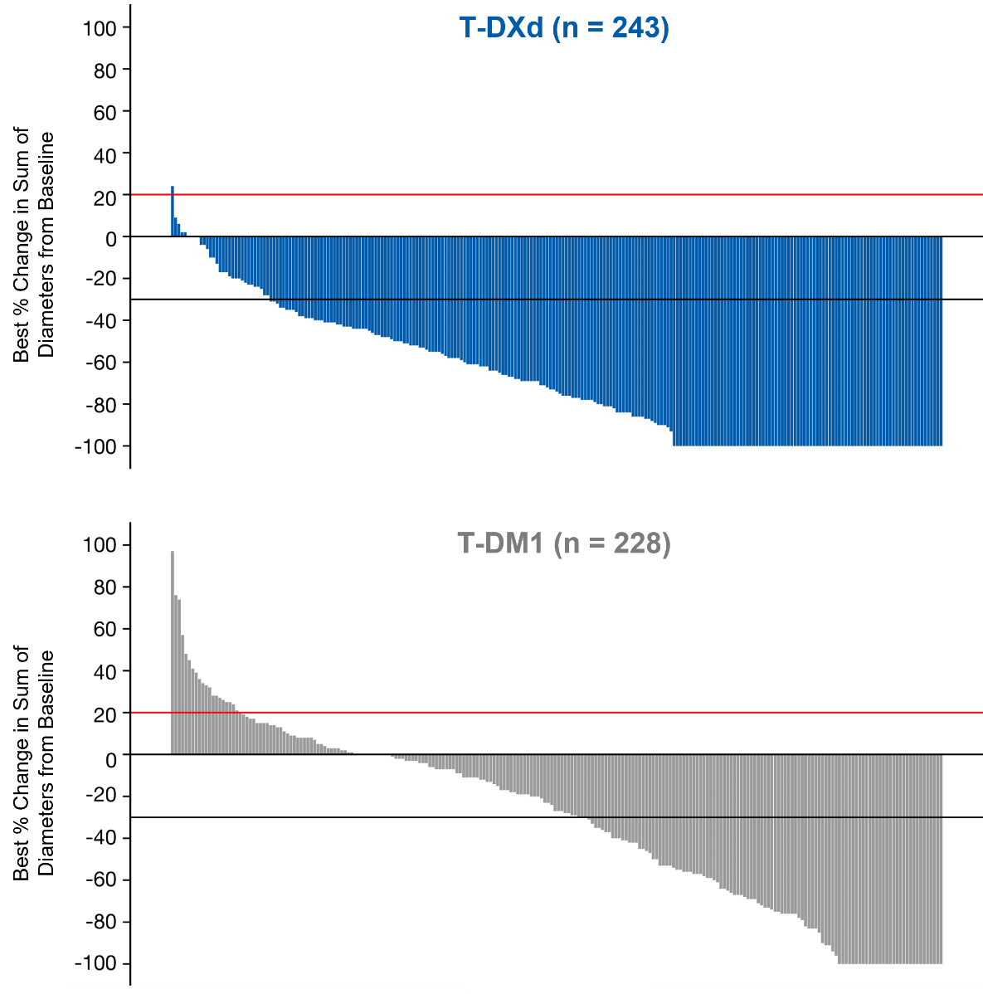
Confirmed ORR and Other Efficacy Endpoints
 | T-DXd | T-DM1
 | n = 261ª | n = 263ª
Confirmed ORR by BICR
n (%) | 205 (78.5) | 92 (35.0)
[95% CI] | [73.1-83.4] | [29.2-41.1]
Nominal P value | < 0.0001
CR, n (%) | 55 (21.1) | 25 (9.5)
PR, n (%) | 150 (57.5) | 67 (25.5)
SD, n (%) | 47 (18.0) | 110 (41.8)
PD, n (%) | 3 (1.1) | 47 (17.9)
NE, n (%) | 6 (2.3) | 14 (5.3)
CBR, n (%) [95% CI] | 233 (89.3) [84.9-92.8] | 122 (46.4) [40.2-52.6]
Nominal P value | < 0.0001
mDoR by BICR, months (95% CI) | 36.6 (22.4-NE) | 23.8 (12.6-34.7)
BICR, blinded independent central review; CBR, clinical benefit rate; CR, complete response; mDoR, median duration of response; NE, not evaluable; ORR, objective response rate; PD, progressive disease; PR, partial response; SD, stable disease;
T-DM1, trastuzumab emtansine; T-DXd, trastuzumab deruxtecan.
Red line at 20% indicates progressive disease; black line at −30% indicates partial response.
ªOnly patients with measurable disease at baseline and at least 1 postbaseline target lesion assessment were included.
Hurvitz SA et al. Lancet 2023;401:105

Slide 31
Most Common TEAEs in ≥20% of Patients
System Organ Class Preferred Term, n (%) | T-DXd n = 257 |  | T-DM1 n = 261
System Organ Class Preferred Term, n (%) | Any grade | Grade ≥3 | Any grade | Grade ≥3
Blood and lymphatic system disorders
Anemia | 95 (37.0) | 24 (9.3) | 51 (19.5) | 17 (6.5)
Neutrophil count decreased | 79 (30.7) | 41 (16.0) | 30 (11.5) | 8 (3.1)
Platelet count decreased | 64 (24.9) | 20 (7.8) | 114 (43.7) | 52 (19.9)
White blood cell count decreased | 60 (23.3) | 16 (6.2) | 16 (6.1) | 2 (0.8)
Gastrointestinal disorders
Nausea | 198 (77.0) | 18 (7.0) | 79 (30.3) | 1 (0.4)
Vomiting | 133 (51.8) | 4 (1.6) | 28 (10.7) | 2 (0.8)
Constipation | 96 (37.4) | 0 | 51 (19.5) | 0
Diarrhea | 83 (32.3) | 3 (1.2) | 21 (8.0) | 2 (0.8)
General disorders
Fatigue | 79 (30.7) | 15 (5.8) | 53 (20.3) | 2 (0.8)
Headache | 61 (23.7) | 1 (0.4) | 40 (15.3) | 0
Investigations
Aspartate aminotransferase increased | 72 (28.0) | 2 (0.8) | 108 (41.4) | 14 (5.4)
Alanine aminotransferase increased | 59 (23.0) | 4 (1.6) | 83 (31.8) | 12 (4.6)
Metabolism and nutrition disorders
Decreased appetite | 78 (30.4) | 4 (1.6) | 46 (17.6) | 1 (0.4)
Weight decreased | 58 (22.6) | 6 (2.3) | 23 (8.8) | 2 (0.8)
Skin and subcutaneous tissue disorders
Alopecia | 102 (39.7) | 1 (0.4)ª | 9 (3.4) | 0
T-DM1, trastuzumab emtansine; T-DXd, trastuzumab deruxtecan; TEAE, treatment-emergent adverse event.
Adverse events were managed according to the protocol. ªCases of alopecia reported during the study were graded based on the clinical judgement of the investigator. 1 case of alopecia was categorized as grade 3 by the investigator despite grade 3 alopecia not being recognized by the NCI Common Terminology criteria. The event outcome was reported as recovered by the investigator.
Hurvitz SA et al. Lancet 2023;401:105

Slide 32
Adjudicated Drug-Related Interstitial Lung Disease/Pneumonitis
 | Grade 1 | Grade 2 | Grade 3 | Grade 4 | Grade 5 | Any grade
T-DXd (n = 257) | 11 (4.3) | 26 (10.1) | 2 (0.8) | 0 | 0 | 39 (15.2)
T-DM1 (n = 261) | 4 (1.5) | 3 (1.1) | 1 (0.4) | 0 | 0 | 8 (3.1)
Adjudicated drug-related ILD/pneumonitis rates were similar to other mBC trials with T-DXd^{1,2}
With longer treatment exposure and follow-up, the ILD/pneumonitis rate increased from 10.5% in the PFS interim analysis³ to 15.2%
  There were 4 additional grade 1, 8 additional grade 2, and no additional grade 3 events
The overall incidence of grade 3 events (0.8%) was the same as in the PFS interim analysis³
There were no adjudicated drug-related grade 4 or 5 events
ILD, interstitial lung disease; mBC, metastatic breast cancer; T-DM1, trastuzumab emtansine; T-DXd, trastuzumab deruxtecan.
1. Modi S et al. N Engl J Med 2020; 382(7): 610-21. 2. Powell CA et al. ESMO Open 2022; 7(4): 100554. 3. Cortes J et al. N Engl J Med. 2022;386:1143-1154.
Hurvitz SA et al. Lancet 2023;401:105

Slide 33
DB-03 Conclusions
Establishes T-DXd role as preferred 2nd line SOC for most patients
  Unprecedented levels of activity and reassuring ILD data
Should there be a different SOC for pts with active CNS metastases?

Slide 34
DESTINY-Breast02
Randomized phase 3, open-label, multicenter study (NCT03523585)
T-DXd
5.4 mg/kg Q3W
(n = 406)
Primary endpoint
PFS (BICR^{b})
Key secondary endpoint
OS
Secondary endpoints
ORR (BICR^{b})
DoR (BICR^{b})
PFS (investigator)
Safety
Exploratory endpoints
CBR (BICR^{b})
PFS2^{c} (investigator)
Key eligibility criteriaª
Centrally confirmed HER2-positive (IHC 3+ or IHC 2+/ISH+) unresectable or metastatic breast cancer
Documented radiographic progression after most recent treatment
Previously treated with T-DM1
R
2:1
TPC
Per label (n = 202)
Trastuzumab / Capecitabine or
Lapatinib / Capecitabine
Stratification factors
Hormone receptor status
Prior treatment with pertuzumab
History of visceral disease
Protocol-prespecified statistical analysis plan
At data cutoff (June 30, 2022), the median duration of follow-up^{d} was:
21.5 months (range, 0.1-45.6 months) in the T-DXd arm
18.6 months (range, 0-45.7 months) in the TPC arm
    Primary analysis planned for ~372 BICR PFS events observed or 18 months from the last patient randomized, whichever came first
    Group sequential testing was used to compare OS between treatment groups hierarchically, provided PFS was significant
BICR, blinded independent central review; CBR, clinical benefit rate; DoR, duration of response; HER2, human epidermal growth factor receptor 2; IHC, immunohistochemistry; ISH, in situ hybridization; mRECIST, modified Response Evaluation Criteria in Solid Tumors version 1.1; ORR, objective response rate; OS, overall survival; PFS, progression-free survival; PFS2; progression-free survival on the next line of therapy; Q3W, every 3 weeks; R, randomization, T-DM1, trastuzumab emtansine; T-DXd, trastuzumab deruxtecan; TPC, treatment of physician’s choice.
ªPatients with clinically inactive brain metastases and patients with treated brain metastases that were no longer symptomatic and who require no treatment with corticosteroids or anticonvulsants could be included. ^{b}BICR assessed per mRECIST 1.1.
^{c}PFS2 was defined as the time from date of randomization to the first documented progression on the next line of therapy or death due to any cause, whichever came first. ^{d}Duration of follow up is defined as study duration = the date last known alive minus date of randomization plus 1.
André F et al. Lancet 2023;401:1773

Slide 35
Primary Endpoint: PFS by BICR
100
Median (95% CI), months
100
T-DXd
T-DXd
TPC
17.8 (14.3-20.8)
6.9 (5.5-8.4)
80
HR (95% CI): 0.3589 (0.2840-0.4535)
80
P < 0.000001
T-DXd: 62.3% (95% CI, 57.0-67.1)
TPC: 27.2% (95% CI, 20.1-34.8)
60
60
Progression-Free Survival Probability, %
T-DXd: 42.2% (95% CI, 36.5-47.8)
TPC: 13.9% (95% CI, 7.9-21.6)
40
40
20
20
+
Censor
T-DXd (n = 406)
TPC (n = 202)
0
0
0
1
2
3
4
5
6
7
8
9
10
11
12
13
14
15
16
17
18
19
20
21
22
23
24
25
26
27
28
29
30
31
32
33
34
35
36
37
38
39
40
41
42
43
44
45
46
0
1
2
3
4
5
6
7
8
9
10
11
12
13
14
15
16
17
18
19
20
21
22
23
24
25
26
27
28
29
30
31
32
33
34
35
36
37
38
39
40
41
42
43
44
45
46
Patients still at risk
Time, months
T-DXd (406)
T-DXd (406)
406
400
374
359
355
330
296
278
260
239
213
203
194
179
170
161
149
141
132
119
109
88
83
76
65
60
55
47
38
35
31
27
23
19
15
14
12
10
6
4
4
3
1
1
1
1
0
406
400
374
359
355
330
296
278
260
239
213
203
194
179
170
161
149
141
132
119
109
88
83
76
65
60
55
47
38
35
31
27
23
19
15
14
12
10
6
4
4
3
1
1
1
1
0
TPC (202)
TPC (202)
202
180
148
126
118
95
78
72
64
48
39
37
32
28
24
20
17
13
11
9
9
8
8
6
3
3
3
2
2
2
2
2
1
1
1
1
1
0
202
180
148
126
118
95
78
72
64
48
39
37
32
28
24
20
17
13
11
9
9
8
8
6
3
3
3
2
2
2
2
2
1
1
1
1
1
0
BICR, blinded independent central review; HR, hazard ratio; mo, month; PFS, progression-free survival; T-DXd, trastuzumab deruxtecan; TPC, treatment of physician’s choice.
André F et al. Lancet 2023;401:1773

Slide 36
Key Secondary Endpoint: OS
100
T-DXd: 89.4% (95% CI, 85.9-92.1)
TPC: 74.7% (95% CI, 67.4-80.4)
80
T-DXd: 65.9% (95% CI, 60.7-70.7)
TPC: 54.3% (95% CI, 46.3-61.6)
60
Overall Survival Probability, %
40
Median (95% CI), months
T-DXd
TPC
20
39.2 (32.7-NE)
26.5 (21.0-NE)
+
Censor
HR (95% CI): 0.6575 (0.5023-0.8605)
T-DXd (n = 406)
P =0.0021ª
0
TPC (n = 202)
0
1
2
3
4
5
6
7
8
9
10
11
12
13
14
15
16
17
18
19
20
21
22
23
24
25
26
27
28
29
30
31
32
33
34
35
36
37
38
39
40
41
42
43
44
45
46
Patients still at risk
Time, months
T-DXd (406)
406
404
400
390
385
382
374
366
357
352
350
346
339
331
317
306
295
282
277
257
234
215
196
183
160
144
139
122
93
82
72
63
51
40
34
29
25
19
10
8
6
3
1
1
1
0
104
TPC (202)
202
192
187
182
178
173
167
161
157
151
142
136
130
124
118
114
111
110
106
95
89
79
76
72
61
53
50
46
38
33
29
28
25
22
22
18
15
13
12
7
6
5
4
3
1
1
0
In the TPC arm
69.3% (140/202) of patients received a new systemic anticancer treatment
25.7% (52/202) of patients received T-DXd in the post-trial setting
ªThe boundary for statistical significance is 0.0040. HR, hazard ratio; mo, month; NE, not estimable; OS, overall survival; T-DXd, trastuzumab deruxtecan; TPC, treatment of physician’s choice.
André F et al. Lancet 2023;401:1773

Slide 37
Adverse Events of Special Interest: ILD and LV Dysfunction
Adjudicated as Drug-related ILDª
n (%) | Grade 1 | Grade 2 | Grade 3 | Grade 4 | Grade 5 | Any Grade
T-DXd (n = 404) | 11 (2.7) | 26 (6.4) | 3 (0.7) | 0 | 2 (0.5) | 42 (10.4)
TPC (n = 195) | 0 | 0 | 1 (0.5) | 0 | 0 | 1 (0.5)
Median time to onset of adjudicated drug-related ILD was 209.5 days (range, 41-638 days)
with T‑DXd
In the T-DXd arm, 18 (4.5%) patients experienced an LV dysfunction event^{c}
  2 (0.5%) patients had a grade ≥3 event
In the TPC arm, 3 (1.5%) patients experienced an LV dysfunction^{d}
  1 (0.5%) patient had a grade ≥3 event
LV dysfunction^{b}
ILD, interstitial lung disease; LV, left ventricular; T-DXd, trastuzumab deruxtecan; TPC, treatment of physician’s choice.
ªThe safety analysis set includes all randomly assigned patients who received at least 1 dose of study treatment. ^{b}Left ventricular dysfunction included preferred terms of acute left ventricular failure, acute right ventricular failure, cardiac failure, cardiac failure acute, cardiac failure chronic, cardiac failure congestive, chronic left ventricular failure, chronic right ventricular failure, ejection fraction decreased, left ventricular failure, right ventricular failure, ventricular failure, and left ventricular dysfunction. ^{c}17 ejection fraction decreased (2 grade ≥3), 1 LV dysfunction (grade 1). ^{d}1 ejection fraction decreased (grade 1), 2 cardiac failure (1 grade ≥3).
André F et al. Lancet 2023;401:1773

Slide 38
DB-02 Conclusions
Confirms T-DXd highly active in 3rd+ line setting with no new safety signals
  In context of DB-03 data, T-DXd should be used in 2nd line
  In patients who already received T-DM1 in 2nd line, these data support use of T-DXd in next line
These data do NOT imply T-DXd should be reserved for late line use
  Benefits greater in earlier line
  Significant attrition in each line of therapy mean some pts would never receive T-DXd

Slide 39
DB-02 Conclusions
Provides first randomized data demonstrating benefit of one ADC after cancer has progressed on a different ADC
  Provides support for paradigm of treating pts with HER2+ breast cancer with sequential ADCs with different payloads

Slide 40
Does age impact efficacy or tolerability of T-DXd?
Older patients experience higher rates of toxicity from chemotherapy
To determine if this effect is observed with T-DXd, an analysis of pts <65yo vs ≥65 was conducted in pooled data from DB-01, -02, 03

Slide 41
Medical History and Comorbiditiesª
 | T-DXd Pool | Full analysis set |  | TPC (DB-02) | Full analysis set |  | T-DM1 (DB-03) | Full analysis set
 | <65 (n = 673) | ≥65 (n = 178) | ≥75 (n = 34) | <65 (n = 164) | ≥65 (n = 38) | ≥75 (n = 8) | <65 (n = 206) | ≥65 (n = 57) | ≥75 (n = 8)
Disorders
Blood and lymphatic system disorders (SOC) | 73 (10.8) | 26 (14.6) | 5 (14.7) | 12 (7.3) | 6 (15.8) | 1 (12.5) | 14 (6.8) | 6 (10.5) | 1 (12.5)
Anemia | 41 (6.1) | 18 (10.1) | 3 (8.8) | 9 (5.5) | 4 (10.5) | 1 (12.5) | 6 (2.9) | 2 (3.5) | 1 (12.5)
Cardiac disorders (SOC) | 57 (8.5) | 21 (11.8) | 4 (11.8) | 7 (4.3) | 3 (7.9) | 0 | 8 (3.9) | 5 (8.8) | 0
Diabetes mellitus | 29 (4.3) | 17 (9.6) | 4 (11.8) | 7 (4.3) | 3 (7.9) | 2 (25.0) | 6 (2.9) | 8 (14.0) | 1 (12.5)
Renal and urinary disorders (SOC) | 23 (3.4) | 16 (9.0) | 6 (17.6) | 3 (1.8) | 4 (10.5) | 1 (12.5) | 3 (1.5) | 11 (19.3) | 0
Vascular disorders (SOC) | 174 (25.9) | 109 (61.2) | 28 (82.4) | 43 (26.2) | 24 (63.2) | 5 (62.5) | 52 (25.2) | 31 (54.4) | 6 (75.0)
Hypertension | 123 (18.3) | 93 (52.2) | 26 (76.5) | 30 (18.3) | 24 (63.2) | 5 (62.5) | 35 (17.0) | 28 (49.1) | 5 (62.5)
Baseline renal function^{b}
Normal function | 432 (64.2) | 34 (19.1) | 0 | 104 (63.4) | 8 (21.1) | 0 | 124 (60.2) | 8 (14.0) | 0
Mild renal impairment | 205 (30.5) | 91 (51.1) | 14 (41.2) | 54 (32.9) | 22 (57.9) | 3 (37.5) | 77 (37.4) | 28 (49.1) | 3 (37.5)
Moderate renal impairment | 35 (5.2) | 53 (29.8) | 20 (58.8) | 6 (3.7) | 8 (21.1) | 5 (62.5) | 4 (1.9) | 21 (36.8) | 5 (62.5)
Baseline hepatic function^{c}
Normal function | 406 (60.3) | 101 (56.7) | 20 (58.8) | 78 (47.6) | 21 (55.3) | 2 (25.0) | 162 (78.6) | 50 (87.7) | 8 (100.0)
Mild hepatic impairment | 260 (38.6) | 75 (42.1) | 14 (41.2) | 86 (52.4) | 17 (44.7) | 6 (75.0) | 43 (20.9) | 7 (12.3) | 0
Moderate hepatic impairment | 2 (0.3) | 2 (1.1) | 0 | 0 | 0 | 0 | 0 | 0 | 0
Comorbidities were generally low in the overall population due to selection criteria
ªMedical history and comorbidities are on the pooled analysis of patients treated with T-DXd from all 3 trials (DB-01, DB-02, and DB-03). ^{b}Renal impairment status is determined by baseline creatine clearance as calculated using the Cockcroft-Gault equation. ^{c}Adequate hepatic function is defined as total bilirubin ≤ULN and AST≤ULN, mild hepatic dysfunction is defined as total bilirubin ≤ ULN and AST>ULN regardless of Gilbert Syndrome; moderate hepatic dysfunction is defined as total bilirubin >1.5 x ULN, ≤ 3.0 x ULN and any AST except for subjects with Gilbert syndrome.
AST, aspartate transaminase; DB, DESTINY-Breast; SOC, system organ class; T-DM1; trastuzumab emtansine; T-DXd, trastuzumab deruxtecan; TPC, treatment of physician’s choice; ULN, upper limit of normal.
Ian Krop, MD, PhD

Slide 42
Descriptive Efficacy According to Age for T-DXdª
Median Overall Survival
 | DESTINY-Breast01 |  | DESTINY-Breast02 |  | DESTINY-Breast03
 | <65 (n = 140) | ≥65 (n = 44) | <65 (n = 321) | ≥65 (n = 85) | <65 (n = 212) | ≥65 (n = 49)
mOS, months (95% CI) | 28.1 (23.3-36.1) | 30.9 (21.9-NE) | NR (35.5-NE) | 30.2 (22.3-39.2) | NR (40.5-NE) | NR (26.3-NE)
Efficacy in patients aged <65 and ≥65 years treated with T-DXd was generally similar; however no formal comparison was made
ªEfficacy data was not pooled due to bias induced by the heterogeneity of the study population. Trial data cutoffs; DESTINY-Breast01: March 26, 2021; DESTINY-Breast02: June 30, 2022; DESTINY-Breast03: July 25, 2022.
mOS, median overall survival; NE, not estimable; NR, not reached; T-DXd, trastuzumab deruxtecan.
Ian Krop, MD, PhD
Notes:
We can not pool the efficacy data due to two major issues which is the bias induced by the heterogeneity of the study populations.

Slide 43
Confirmed ORR by BICRª with T-DXd
DESTINY-Breast01
DESTINY-Breast02
DESTINY-Breast03
Complete Response
77.6%
Partial Response
62.1%
65.9%
21.7
18.4
13.7
15.3
7.1
6.8
57.0
50.6
57.1
59.2
55.0
54.8
 | <65 (n = 140) | ≥65 (n = 44) | <65 (n = 321) | ≥65 (n = 85) | <65 (n = 212) | ≥65 (n = 49)
Stable disease | 49 (35.0) | 16 (36.4) | 69 (21.5) | 26 (30.6) | 38 (17.9) | 9 (18.4)
Progressive disease | 3 (2.1) | 0 | 17 (5.3) | 2 (2.4) | 3 (1.4) | 0
Not evaluable | 1 (0.7) | 1 (2.3) | 8 (2.5) | 1 (1.2) | 4 (1.9) | 2 (4.1)
Duration of response, months (95% CI) | 20.8 (14.8-NE) | 15.5 (9.7-NE) | 19.6 (15.6-NE) | 19.4 (12.2-NE) | 36.6 (26.3-NE) | 20.3 (12.5-NE)
Disease control rate, n (%) | 136 (97.1) | 43 (97.7) | 296 (92.2) | 82 (96.5) | 205 (96.7) | 47 (95.9)
ªTrial data cutoffs; DESTINY-Breast01: March 26, 2021; DESTINY-Breast02: June 30, 2022; DESTINY-Breast03: July 25, 2022.
BICR, blinded independent central review; DB, DESTINY-Breast; NE, not estimable; ORR, objective response rate; T-DXd, trastuzumab deruxtecan.
Ian Krop, MD, PhD

Slide 44
Relative Dose Intensity
TPC (DB-02)
Relative dose intensity was similar between <65 and ≥65 age groups, regardless of treatment received
ªRelative dose intensity (%) = (dose intensity/planned dose intensity) ×100.
DB, DESTINY-Breast; T-DM1, trastuzumab emtansine; T-DXd, trastuzumab deruxtecan; TPC, treatment of physician’s choice.
Ian Krop, MD, PhD

Slide 45
Most Common Grade ≥3 Drug-related TEAEs in ≥5% of Patients
 | T-DXd Pool | Full analysis set |  | TPC (DB-02) | Full analysis set |  | T-DM1 (DB-03) | Full analysis set
 | <65 (n = 668) | ≥65 (n = 177) | ≥75 (n = 33) | <65 (n = 157) | ≥65 (n = 38) | ≥75 (n = 8) | <65 (n = 204) | ≥65 (n = 57) | ≥75 (n = 8)
Grade ≥3ª drug-related TEAEs, n (%) | 291 (43.6) | 96 (54.2) | 13 (39.4) | 48 (30.6) | 12 (31.6) | 5 (62.5) | 82 (40.2) | 28 (49.1) | 3 (37.5)
Neutropenia^{b} | 117 (17.5) | 41 (23.2) | 4 (12.1) | 5 (3.2) | 1 (2.6) | 1 (12.5) | 6 (2.9) | 3 (5.3) | 0
Fatigue^{c} | 52 (7.8) | 20 (11.3) | 5 (15.2) | 1 (0.6) | 1 (2.6) | 1 (12.5) | 2 (1.0) | 0 | 0
Nausea | 43 (6.4) | 15 (8.5) | 4 (12.1) | 3 (1.9) | 0 | 0 | 0 | 1 (1.8) | 0
Anemia^{d} | 42 (6.3) | 20 (11.3) | 3 (9.1) | 1 (0.6) | 0 | 0 | 6 (2.9) | 6 (10.5) | 1 (12.5)
Leukopenia^{e} | 42 (6.3) | 15 (8.5) | 2 (6.1) | 0 | 0 | 0 | 3 (1.5) | 0 | 0
Lymphopenia^{f} | 28 (4.2) | 11 (6.2) | 1 (3.0) | 2 (1.3) | 0 | 0 | 2 (1.0) | 1 (1.8) | 0
Thrombocytopenia^{g} | 28 (4.2) | 9 (5.1) | 0 | 2 (1.3) | 0 | 0 | 47 (23.0) | 19 (33.3) | 2 (25.0)
Transaminases increased^{h} | 18 (2.7) | 1 (0.6) | 0 | 1 (0.6) | 1 (2.6) | 0 | 16 (7.8) | 4 (7.0) | 0
Diarrhea | 9 (1.3) | 4 (2.3) | 0 | 10 (6.4) | 2 (5.3) | 1 (12.5) | 2 (1.0) | 0 | 0
Patients ≥65 years of age experienced more grade ≥3 TEAEs across all trials
ªGrade ≥3 drug-related TEAEs present in ≥5% of patients, sorted in descending order of frequency in the T-DXd pooled arm for the <65 years age group. Grade ≥3 drug-related TEAEs calculated in all patients in the analysis set. ^{b}Neutropenia includes the preferred terms neutrophil count decreased and neutropenia. ^{c}Fatigue includes the preferred terms fatigue, asthenia, malaise, and lethargy. ^{d}Anemia includes the preferred terms hemoglobin decreased, red blood cell count decreased, anemia, and hematocrit decreased. ^{e}Leukopenia includes the preferred terms white blood cell count decrease and leukopenia. ^{f}Lymphopenia includes the preferred terms lymphocute count decreased and lymphopenia. ^{g}Thrombocytopenia includes the preferred terms platelet count decreased and thrombocytopenia. ^{h}Transaminases increased includes the preferred terms transaminases increased, aspartate aminotransferase increased, alanine aminotransferase increased, gamma-glutamyltransferase increased, liver function test abnormal, hepatic function abnormal, and liver function test increased.
T-DM1, trastuzumab emtansine; T-DXd, trastuzumab deruxtecan; TEAE, treatment emergent adverse event; TPC, treatment of physician’s choice.
Ian Krop, MD, PhD

Slide 46
Adjudicated Drug-related ILD/Pneumonitisª
 | T-DXd Pool | Full analysis set |  | TPC (DB-02) | Full analysis set |  | T-DM1 (DB-03) | Full analysis set
 | <65 (n = 668) | ≥65 (n = 177) | ≥75 (n = 33) | <65 (n = 157) | ≥65 (n = 38) | ≥75 (n = 8) | <65 (n = 204) | ≥65 (n = 57) | ≥75 (n = 8)
Any grade, n (%) | 79 (11.8) | 31 (17.5) | 5 (15.2) | 0 | 1 (2.6) | 0 | 6 (2.9) | 2 (3.5) | 1 (12.5)
1 | 21 (3.1) | 7 (4.0) | 0 | 0 | 0 | 0 | 3 (1.5) | 1 (1.8) | 0
2 | 48 (7.2) | 20 (11.3) | 5 (15.2) | 0 | 0 | 0 | 2 (1.0) | 1 (1.8) | 1 (12.5)
3 | 4 (0.6) | 3 (1.7) | 0 | 0 | 1 (2.6) | 0 | 1 (0.5) | 0 | 0
4 | 0 | 0 | 0 | 0 | 0 | 0 | 0 | 0 | 0
5 | 6 (0.9) | 1 (0.6) | 0 | 0 | 0 | 0 | 0 | 0 | 0
Rates of adjudicated ILD/pneumonitis were generally higher in patients ≥65 years of age across all trials compared to patients <65 years of age
Most drug-related ILD/pneumonitis cases were of low grade
ªNo ILD/pneumonitis cases were pending adjudication at the respective data cutoff dates (DESTINY-Breast01: March 26, 2021; DESTINY-Breast02: June 30, 2022; DESTINY-Breast03: July 25, 2022).
ILD, interstitial lung disease; T-DM1, trastuzumab emtansine; T-DXd, trastuzumab deruxtecan; TPC, treatment of physician’s choice.
Ian Krop, MD, PhD

Slide 47
Conclusion
Results of this pooled analysis indicate that T-DXd remains an effective treatment option for patients ≥65 years of age
  mPFS and confirmed ORR by BICR were similar with T-DXd in patients <65 and ≥65 years of age within each trial
The safety profile of T-DXd was acceptable across all age subgroups
  Patients ≥65 years of age experienced more grade ≥3 TEAEs across all trials
Further research/real-world evidence studies for older patients, also addressing aspects of comorbidities and frailty, would be informative
T-DXd may be considered as an effective option for patients
across all age subgroups with an acceptable safety profile
BICR, blinded independent central review; HER2, human epidermal growth factor receptor 2; mBC, metastatic breast cancer; mPFS, median progression free survival; ORR, objective response rate; T-DXd, trastuzumab deruxtecan; TEAE, treatment emergent adverse event.
Ian Krop, MD, PhD

Slide 48
Management of HER2+ CNS metastases
CNS metastases occur in up to 50% of pts with HER2+ MBC and risks continue over time
Tucatinib is HER2-selective tyrosine kinase inhibitor that has CNS penetration
Olson et al, The Breast 22:525 2013; Brufsky et al, CCR 2011; Lin et al, JCO 2008; Lin et al, CCR 2009; Boccardo et al, ASCO 2008;
Sutherland et al, Br J Ca 2010; Metro et al, Ann Oncol 2011; Lin et al J Neurooncol 2011; Bachelot et al, ASCO 2011
Moulder et al. AACR-NCI-EORTC 2011; Koch et al. AACR 2011

Slide 49
HER2CLIMB Trial Design
Key Eligibility Criteria
HER2+ metastatic breast cancer
Prior treatment with trastuzumab, pertuzumab, and T-DM1
ECOG performance status 0 or 1
Brain MRI at baseline
  Previously treated stable brain metastases
  Untreated brain metastases not needing immediate local therapy
  Previously treated progressing brain metastases not needing immediate local therapy
  No evidence of brain metastases
Tucatinib + Trastuzumab + Capecitabine
(21-day cycle)
Tucatinib 300 mg PO BID
+
Trastuzumab 6 mg/kg Q3W (loading dose 8 mg/kg C1D1)
+
Capecitabine 1000 mg/m² PO BID (Days 1-14)
N=410
R*
(2:1)
Placebo + Trastuzumab + Capecitabine
(21-day cycle)
Placebo
+
Trastuzumab 6 mg/kg Q3W (loading dose 8 mg/kg C1D1)
+
Capecitabine 1000 mg/m² PO BID (Days 1-14)
N=202
*Stratification factors: presence of brain metastases (yes/no), ECOG status (0 or 1), and region (US or Canada or rest of world)
https://clinicaltrials.gov/ct2/show/NCT02614794

Slide 50
HER2CLIMB Updated OS results
Curigliano et al, Annals Oncology 2022 33:321

Slide 51
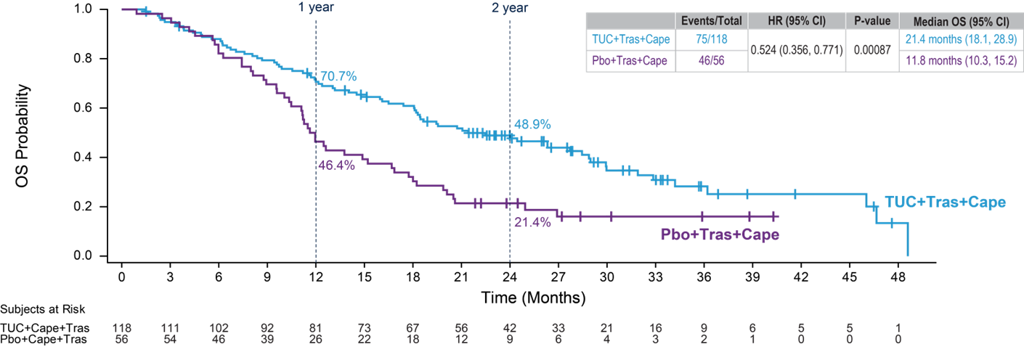
HER2CLIMB Updated OS results in patients with active brain metastases
NU Lin et al, SABCS 2021
JAMA Oncol. 2023;9(2):197

Slide 52
HER2CLIMB Updated ORR results in patients with active brain metastases
NU Lin et al, JAMA Oncol. 2023;9(2):197

Slide 53
HER2CLIMB Conclusions
Addition of tucatinib to capecitabine/trastuzumab improves outcomes with modest increase in toxicity
First large study to include substantial population of pts with active brain metastases
  Tucatinib particularly effective in this subset
Results established tuc/tras/cape as a SOC for patients with active brain mets
Should T-DXd be 2nd-line SOC for pts with active CNS metastases?

Slide 54
Are there other options for active brain mets besides TKIs?
Does trastuzumab deruxtecan have activity in HER2+ brain metastases?
Dogma had been that large biologics like ADCs cannot cross the blood brain barrier

Slide 55
Retrospective Exploratory Pooled Analysis Plan¹⁻³
DESTINY-Breast01 (N = 253)^{a,b}
Phase II study
Patients previously treated with T-DM1
Patients with asymptomatic and previously locally treated BM eligible
Prior BM therapy within 60 days prohibited
T-DXd^{e}
(Total n = 184)
(With BM n = 19)
T-DXd pool (N = 851)
T-DXd BM pool (n = 148)
T-DXd non-BM pool (n = 703)
T-DXd^{e}
(Total n = 406)
(With BM n = 83)
Endpoints:
IC-ORR (CR+PR in brain) per BICR per RECIST v1.1
IC-DoR per BICR
CNS-PFS per BICR
Safety and tolerability
DESTINY-Breast02 (N = 608)^{a,c}
Phase III study
Patients previously treated with T-DM1
Patients with asymptomatic and previously treated/untreated BM eligible
Prior BM therapy within 14 days of randomization prohibited
R
2:1
TPC per label
Trastuzumab/Capecitabine
or
Lapatinib/Capecitabine
(Total n = 202)
(With BM n = 41)
2:1
Comparator pool (N = 465)
Comparator BM pool (n = 83)
Comparator non-BM pool (n = 382)
DESTINY-Breast03 (N = 524)^{a,d}
Phase III study
Patients previously treated with trastuzumab and a taxane in metastatic or (neo)adjuvant setting with recurrence within 6 months of therapy
Patients with asymptomatic and previously treated/untreated BM eligible
Prior BM therapy within 14 days of randomization prohibited
T-DXd^{e}
(Total n = 261)
(With BM n = 46)
R
1:1
T-DM1^{f}
(Total n = 263)
(With BM n = 42)
The BM and non-BM pools were determined by BICR at baseline among all patients based on mandatory brain CT/MRI screening
BICR, blinded independent central response; BM, brain metastasis; CNS, central nervous system; CR, complete response; CT, computed tomography; DB, DESTINY-Breast; DoR, duration of response; HER2, human epidermal growth factor receptor 2; IC, intracranial; mBC, metastatic breast cancer; MRI, magnetic resonance imaging; ORR, objective response rate; PFS, progression-free survival; PR, partial response; R, randomization; RECIST v1.1, Response Evaluation Criteria in Solid Tumors version 1.1; T-DM1, trastuzumab emtansine; T-DXd, trastuzumab deruxtecan; TPC, treatment of physician’s choice (trastuzumab/capecitabine or lapatinib/capecitabine).
Data for patients in the 5.4 mg/kg T-DXd arms were pooled from the DB-01, DB-02, and DB-03 trials. Comparator data were pooled from the DB-02 and DB-03 trials. All three studies were conducted in unresectable/mBC; HER2 status was confirmed centrally; and a documented radiographic progression after most recent treatment was required.
ªThe presence of BMs was not a stratification factor. ^{b}Data Cutoff: March 26, 2021. ^{c}Data Cutoff: June 30, 2022. ^{d}Data Cutoff: May 21, 2021. ^{e}5.4 mg/kg Q3W. ^{f}3.6 mg/kg Q3W.
1. Modi S et al. N Engl J Med. 2020; 382:610-621 [article and supplementary appendix]. 2. André F et al. The Lancet. 2023. https://doi.org/10.1016/S0140-6736(23)00725-0 [article and supplementary appendix]. 3. Cortes J et al. N Engl J Med. 2022; 368(12):1143-1154 [article and supplementary appendix].
Sara A. Hurvitz, MD
Notes:
Speaker notes:
Baseline brain CT/MRI screening was mandatory for all patients, allowing BICR to identify patients with baseline BM even among those the investigators considered as not having baseline BM. Because follow-up brain scans were only required for patients with baseline BM per investigator assessment, BICR was unable to assess intracranial response for patients assessed as having BM by BICR but not by investigator, however these patients were continued to be followed for CNS-PFS until a new brain lesion was detected, or death
Brain imaging was performed every 6 weeks in patients with BMs at baseline

Slide 56
Exploratory Best IC Response, ORR, and DoR per BICR
Intracranial ORRª
T-DXd BM Pool
Comparator BM Pool
 | Treated/stable BMs (n = 104) | Untreated/active BMs (n = 44) | Treated/stable BMs (n = 58) | Untreated/active BMs (n = 25)
Best overall IC response, n (%) Stable disease Progressive disease Not evaluable/Missing | 48 (46.2) 3 (2.9) 6 (5.8) | 15 (34.1) 1 (2.3) 8 (18.2) | 28 (48.3) 7 (12.1) 7 (12.1) | 15 (60.0) 5 (20.0) 2 (8.0)
IC-DoR, median, months (95% CI) | 12.3 (9.1-17.9) | 17.5 (13.6-31.6) | 11.0 (5.6-16.0) | NA^{b}
Treated/stable BMs
Untreated/active BMs
Treated/stable BMs
Untreated/active BMs
T-DXd consistently demonstrated superior rates of IC responses over comparator in patients with treated/stable and untreated/active BMs
A trend in prolonged median IC-DoR was most pronounced in the untreated/active BMs subgroup
BM, brain metastasis; BICR, blinded independent central review; DoR, duration of response; IC, intracranial; NA, not available; ORR, objective response rate; T-DXd, trastuzumab deruxtecan.
This table considers both target and non-target lesions at baseline. Lesions in previously irradiated areas were not considered measurable target lesions unless there was demonstrated progression in the lesion.
ªIC-ORR was assessed per RESIST v1.1. ^{b}IC-DoR NA due to small number of responders (n < 10).
Sara A. Hurvitz, MD
Notes:
Note that this slide contains animation
Speaker notes:
Different outcomes were observed in the T-DXd arm for patients with treated/stable and untreated/active BMs
With T-DXd, patients with untreated/active BMs responded better, whereas with comparator, patients with treated/stable BMs responded better, which may be due to exposure to prior RT

Slide 57
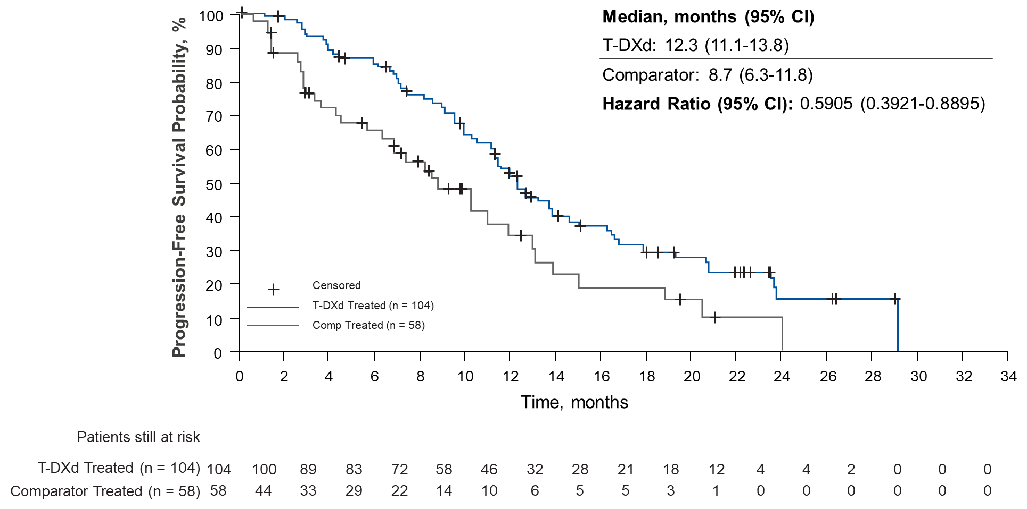
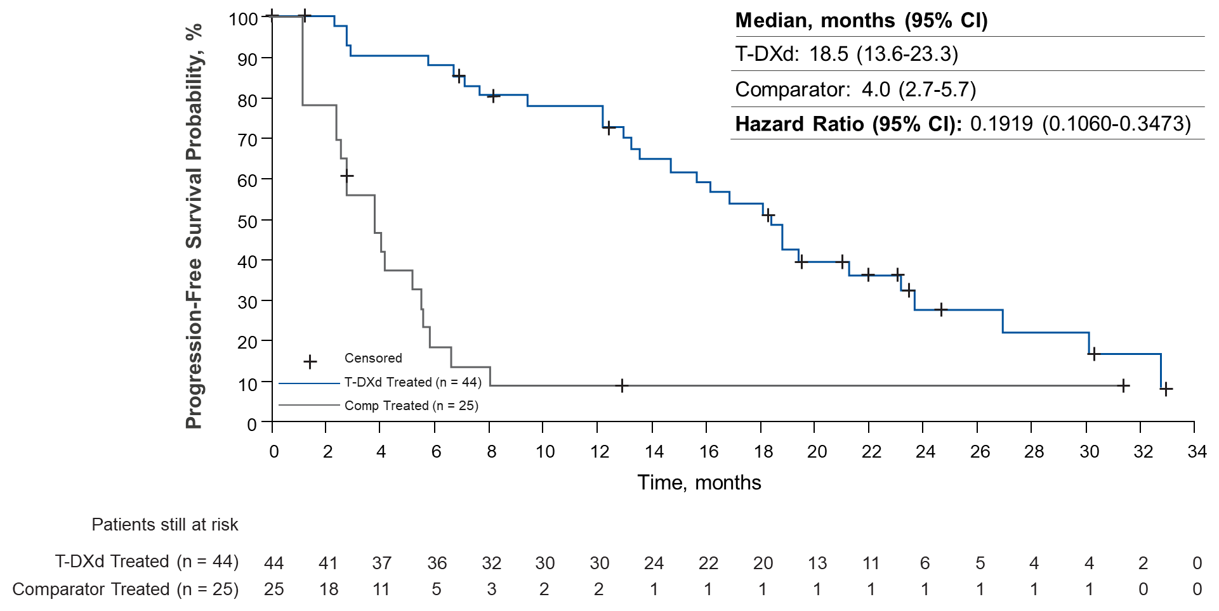
Exploratory CNS-PFS per BICR
Treated/Stable BMs
Untreated/Active BMs
T-DXd demonstrated a trend towards prolonged CNS-PFS over comparator, with a noticeably greater advantage for patients with untreated/active BMs
BICR, blinded independent central review; BM, brain metastasis; CNS, central-nervous system; PFS, progression-free survival; T-DXd, trastuzumab deruxtecan.
CNS-PFS was defined by BICR as only radiological progression.
Sara A. Hurvitz, MD
Notes:
Speaker notes:
Some possible reasons why patients with untreated/active BMs do not do as well in the comparator arm:
Small number of patients within each subgroup
Prior RT, which could make the brain more amenable to benefit from T-DM1
Additional unknown confounders

Slide 58
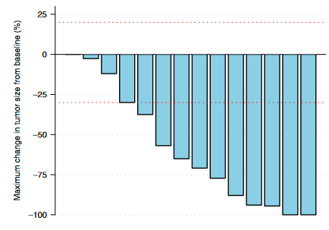
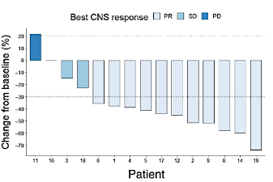
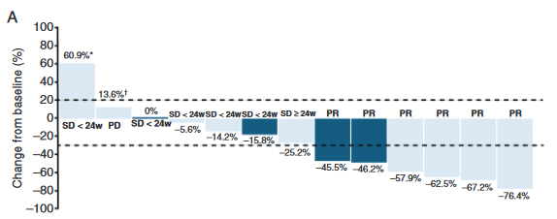
Small studies of T-DXd in patients with HER2+ progressive brain metastases
TUXEDO-1
DFCI/MDACC/Duke case series
DEBBRAH trial
Intracranial RR: 73%
n=15
Intracranial RR: 73%
n=15
Intracranial RR: 50% (untreated/asymptomatic)
Intracranial RR: 44% (progressing)
n=4/9
Bartsch R, et al. Nat Med. 28:1840. 2022
Kabraji S, et al. Clin Cancer Res. 29:174. 2023
Pérez-García et al. Neuro-Oncology 25:157. 2023

Slide 59
T-DXd CNS Studies Conclusions
Pooled analysis of DB-01,-02,-03 show strong evidence of activity of T-DXd in patients with both stable and active brain mets
  Most pts had previously untreated and asymptomatic brain mets
Several additional studies (all small) of T-DXd also demonstrate intracranial activity of T-DXd in patients with progressive brain mets
Together, these studies provide compelling evidence of intracranial activity of T-DXd

Slide 60
Approach to Therapy for Metastatic HER2+ Disease
Current Approach for Metastatic HER2+ Breast Cancer
1st Line
Taxane + trastuzumab + pertuzumab
Active CNS
CNS dominant disease
Active CNS
Extracranial dominant
No or stable CNS disease
2nd Line
Trastuzumab deruxtecan
Tucatinib
Tras/cape
Trastuzumab deruxtecan
3rd Line
Tucatinib
T-DM1
Trastuzumab deruxtecan
Tucatinib
T-DM1
4th Line
Trastuzumab+ chemotherapy
T-DM1
Trastuzumab+ chemotherapy
5th Line+
Trastuzumab+ chemotherapy (or endrocrine therapy if HR+)
Margetuximab+ chemotherapy (if low affinity FcR genotype)
Notes:
So with all these new agents, where do we stand with our current treatment approach for metastatic HER2+ disease, and where may we be heading?
The first line standard remains a taxane with trastuzumab and pertuzumab with use of endocrine therapy after discontinuation of taxane in hormone + disease, followed by T-DM1 in the 2nd line setting, and chemotherapy with anti-HER2 therapy in the 3rd line and beyond setting. Endorcine therapy with dual anti HER2 therapy can also be incorporating along the way for pts with hormone receptor positive disease, but should be reserved primarily for pts with limited tumor burden and pts with contraindications to chemotherapy.
What therapies may we see in the future?
There is interest in exploring the use of checkpoint inhibition with first line THP.
There are also studies exploring use of cdk 4/6 inhibitors in the first and later line setting for patients with metastatic hormone receptor positive, HER2+ disease.
The new drug Ab conjugates may replace T-DM1 in the 2nd line seeing, or may be utilized in 3rd line and beyond setting after progression on T-DM1.
The new tyrosine kinase inhibitors are being explored with capecitabine and may demonstrate activity in the 3rd line setting.
And finally
Margetiuxmab is a Fc optimized monoclonal antibody that binds to the same epitope as trastuzumab but may have enhanced immune effector function and is being studies in the 3rd line registrational study with chemotherapy.
This list demonstrates much hope for continued improvement in outcomes for our patients living with metastatic HER2+ disease.

Slide 61
HER2CLIMB-02 Study Design
San Antonio Breast Cancer Symposium®, December 5-9, 2023
HER2+ LA/MBC
with progression after trastuzumab and taxane in any settingª
ECOG PS ≤1
Previously treated stable, progressing, or untreated brain metastases not requiring immediate local therapy
T-DM1 + Tucatinib
T-DM1 3.6 mg/kg IV and Tucatinib 300 mg PO BID
Outcomes
Primary
PFS by investigator assessment per RECIST v1.1
Key Secondary (hierarchical)
OS
PFS in patients with brain metastases
cORR per RECIST v1.1
OS in patients with brain metastases
N≈460
R 1:1
Stratification factors:
T-DM1 + Placebo
T-DM1 3.6 mg/kg IV and Placebo PO BID
Line of treatment for metastatic disease (1L vs other)
Hormone receptor status (positive vs negative)
Presence or history of brain metastases (yes vs no)
ECOG PS (0 vs 1)
The primary analysis for PFS was planned after ≈331 PFS events to provide 90% power for hazard ratio of 0.7 at two-sided alpha level of 0.05.
The first of two interim analyses for OS was planned at the time of the primary PFS analysis, if the PFS result was significantly positive^{b}.
No prior HER2 TKI or T-DXd
NCT03975647. https://www.clinicaltrials.gov/study/NCT03975647. Accessed Oct 5, 2023.
a Patients who received prior tucatinib, afatinib, T-DXd, or any investigational anti-HER2, anti-EGFR, or HER2 TKIs were not eligible. Patients who received lapatinib and neratinib were not eligible if the drugs were received within 12 months of starting study treatment, and patients who received pyrotinib for recurrent or metastatic breast cancer were not eligible. These patients were eligible if the drugs were given for ≤21 days and were discontinued for reasons other than disease progression or severe toxicity. b Subsequent OS analyses are planned upon 80% and 100% of required events for the final OS analysis.
1L, first-line; BID, twice daily; cORR, confirmed objective response rate; ECOG PS, Eastern Cooperative Oncology Group performance status; IV, intravenously; LA/MBC, locally advanced or metastatic breast cancer; OS, overall survival; PFS, progression-free survival; PO, orally; R, randomization; RECIST, Response Evaluation Criteria in Solid Tumors; T-DM1, trastuzumab emtansine; T-DXd, trastuzumab deruxtecan; TKIs, tyrosine kinase inhibitors.
Date of data cutoff: Jun 29, 2023. Patients were enrolled from Oct 8, 2019, to Jun 16, 2022.

Slide 62
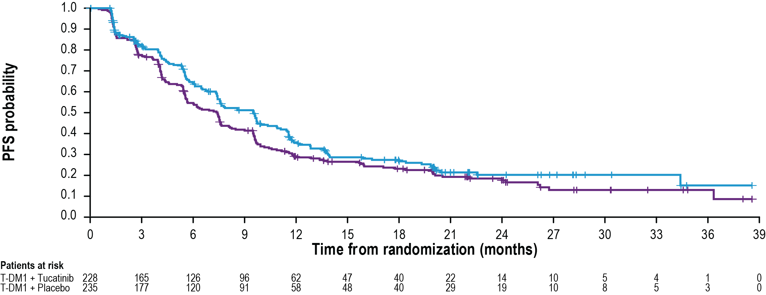
Progression-Free Survival
San Antonio Breast Cancer Symposium®, December 5-9, 2023
 | T-DM1 + Tucatinib (N=228) | T-DM1 + Placebo (N=235)
# of events | 151 | 182
Median PFS (95% CI) | 9.5 months (7.4, 10.9) | 7.4 months (5.6, 8.1)
 | HR (95% CI): 0.76 (0.61, 0.95) P=0.0163
HR, hazard ratio; PFS, progression-free survival; T-DM1, trastuzumab emtansine. Date of data cutoff: Jun 29, 2023.

Slide 63
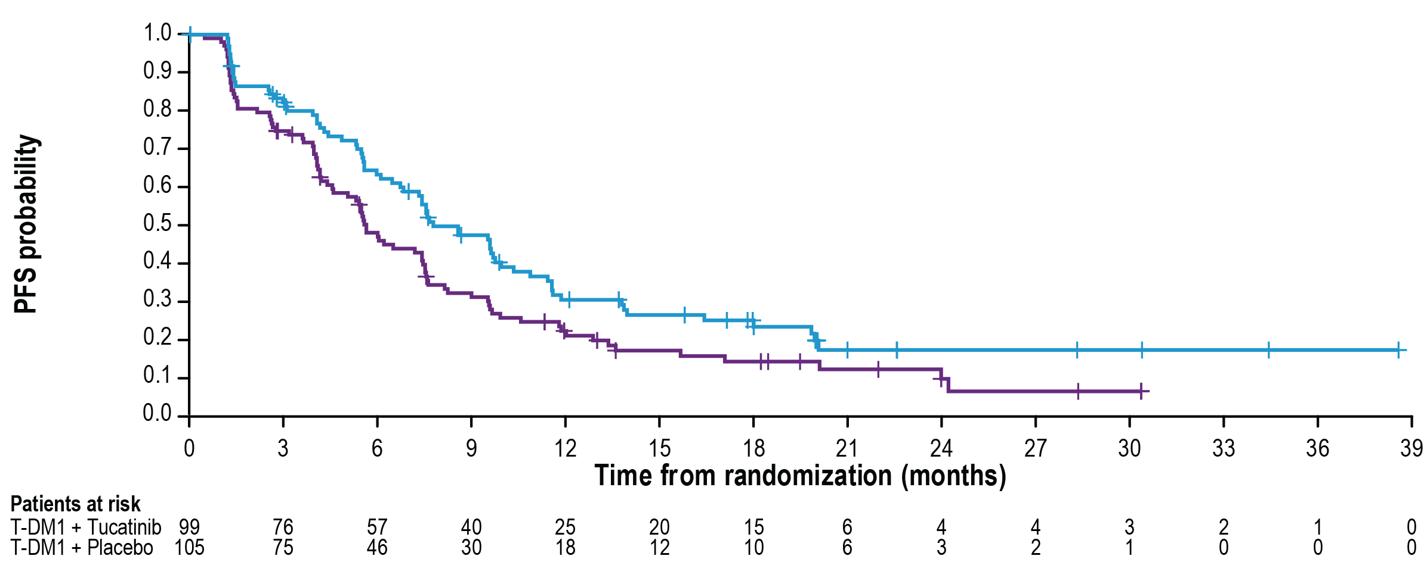
PFS in Patients with Brain Metastases
San Antonio Breast Cancer Symposium®, December 5-9, 2023
 | T-DM1 + Tucatinib (N=99) | T-DM1 + Placebo (N=105)
# of events | 70 | 85
Median PFS (95% CI) | 7.8 months (6.7, 10.0) | 5.7 months (4.6, 7.5)
 | HR (95% CI)ª: 0.64 (0.46, 0.89)
a The outcome was not formally tested.
HR, hazard ratio; PFS, progression-free survival; T-DM1, trastuzumab emtansine. Date of data cutoff: Jun 29, 2023.

Slide 64
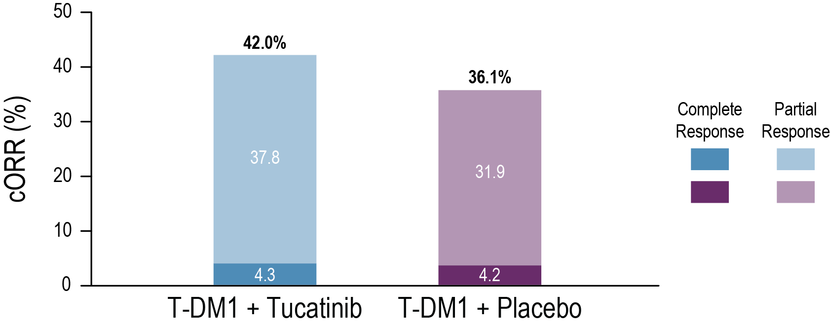
Confirmed Objective Response Rate
San Antonio Breast Cancer Symposium®, December 5-9, 2023
42.0%^{b}
b
36.1%
cORR (%)ª
a The outcome was not formally tested. Only patients with measurable disease were included in the analysis (N=188 for T-DM1 + Tucatinib arm and N=191 for T-DM1 + Placebo arm).
b Percentages for complete and partial response do not add up to the cORR due to rounding. cORR, confirmed objective response rate; T-DM1, trastuzumab emtansine.
Date of data cutoff: Jun 29, 2023.

Slide 65
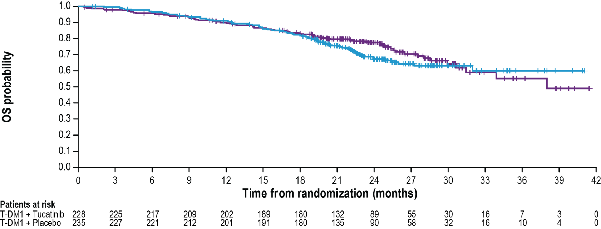
Overall Survival
San Antonio Breast Cancer Symposium®, December 5-9, 2023
 | T-DM1 + Tucatinib (N=228) | T-DM1 + Placebo (N=235)
# of events | 71 | 63
Median OS (95% CI) | NR (NR, NR) | 38.0 months (31.5, NR)
 | HR (95% CI)ª: 1.23 (0.87, 1.74)
Median follow-up was 24.4 months. As of data cutoff, 134 out of 253 (53%) prespecified events for the OS final analysis were observed.
Interim OS results did not meet the prespecified crossing boundary of P≤0.0041.
a The proportional hazard assumption was not maintained post-18 months, with extensive censoring on both arms. HR, hazard ratio; NR, not reached; OS, overall survival; T-DM1, trastuzumab emtansine.
Date of data cutoff: Jun 29, 2023.

Slide 66
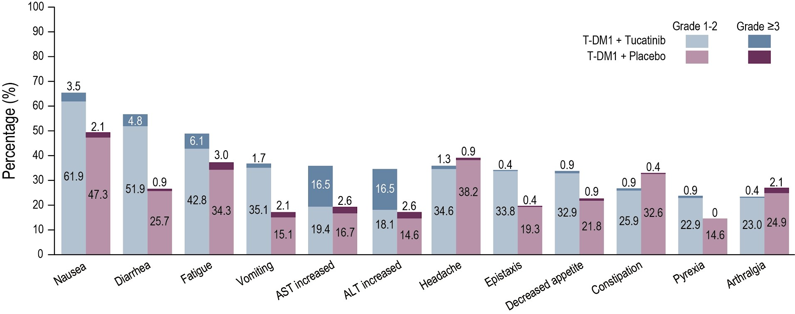
Most Common TEAEs (≥20%)
Most common (≥5%) grade ≥3 TEAEs (T-DM1 + Tucatinib vs T-DM1 + Placebo) : ALT increased (16.5% vs 2.6%), AST increased (16.5% vs 2.6%), anemia (8.2% vs 4.7%), thrombocytopenia (7.4% vs 2.1%), and fatigue (6.1% vs 3.0%)
TEAEs occurring in ≥20% of patients in T-DM1 + Tucatinib arm are shown.
ALT, alanine aminotransferase; AST, aspartate aminotransferase; T-DM1, trastuzumab emtansine; TEAEs, treatment-emergent adverse events. Date of data cutoff: Jun 29, 2023.

Slide 67
Conclusion
Addition of tucatinib to T-DM1 modestly improves PFS
  Relative benefit larger in patients with CNS disease
  No OS benefit, but data immature
  Increased toxicity appears manageable, but ≈20% drug discontinuation
  Caveat: data are in T-DXd naïve patients
Unclear whether tucatinib should be used with T-DM1 or trastuzumab/capecitabine
  Is there a role for using it in both combinations sequentially?

