Slide 1
Promising Investigational Agents and Strategies for Patients with Metastatic
Non-Small Cell Lung Cancer Who Experience Disease Progression on Immune Checkpoint Inhibitor Therapy
Edward B Garon, MD, MS
Professor
Director of Thoracic Oncology Program
David Geffen School of Medicine at UCLA
January 3, 2022

Slide 2
What is the Current Standard?
In patients who receive frontline immunotherapy only, platinum based chemotherapy is standard, albeit with essentially no comparative data supporting the approach
Often in the United States, the immunotherapy is also continued despite even less supportive data

Slide 3
How about in patients who received chemoimmunotherapy?

Slide 4
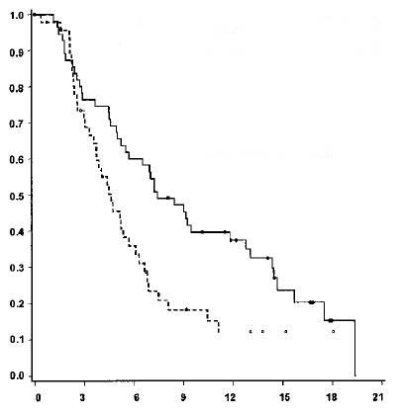
Docetaxel in Previously Treated NSCLC
TAX 317 Trial
Median OS
  Docetaxel 7.0 mo
  BSC 4.6 mo
  Log-rank P = 0.047
Median TTP
  Docetaxel 10.6 wk
  BSC 6.7 wk
  P < 0.001
Docetaxel ORR 7.1%
Docetaxel 75 mg/m² (n = 55)
BSC (n = 49)
Cumulative Probability of Survival
Months
Shepherd FA, et al. J Clin Oncol. 2000;18:2095-2193.
Notes:
4

Slide 5
Phase III REVEL: Study Design
1:1
R
A
N
D
O
M
I
Z
E
Ramucirumab 10 mg/kg
+
Docetaxel 75 mg/m² q3wks
N=628
Stage IV NSCLC after one platinum- based chemo +/- maintenance
Prior Bev allowed
All histologies
PS 0 or 1
Treated brain mets allowed
Treatment until disease progression
or unacceptable toxicity
Placebo
+
Docetaxel 75 mg/m² q3wks
N=625
Stratification factors:
ECOG PS 0 vs 1
Gender
Prior maintenance
East-Asia vs. ROW
Primary endpoint: Overall Survival
Secondary endpoints:
PFS, ORR, safety, patient-reported outcomes
Abbreviations: Bev=bevacizumab; ECOG PS=Eastern Cooperative Oncology Group performance status; ORR=objective response rate; PFS=progression-free survival; ROW=rest of the world; q3wks=every 3 weeks.
Garon E et al. The Lancet. 384 (9944): 665–673, 23 August 2014

Slide 6
Progression-Free Survival
ITT Population, Investigator Assessment
100
Median (95% CI)
Censoring Rate
RAM+DOC
4.5 (4.2-5.4)
11.1%
80
PL+DOC
3.0 (2.8-3.9)
6.7%
RAM+DOC vs PL+DOC
60
Stratified HR (95% CI) = 0.762 (0.677-0.859)
Progression-Free Survival (%)
Stratified log-rank P < .0001
40
20
RAM+DOC
PL+DOC
0
Censored
0
3
6
9
12
15
18
21
24
27
30
33
36
Survival Time (months)
Number at risk
RAM+DOC
628
383
204
120
59
38
11
7
3
3
0
0
0
PL+DOC
625
301
172
95
37
17
9
4
3
2
0
0
0
Perol M, ASCO 2014; Garon EB et al. The Lancet. 384 (9944): 665–673, 23 August 2014

Slide 7
Overall Survival
ITT Population
Median (95% CI)
Censoring Rate
RAM+DOC
10.5 (9.5-11.2)
31.8%
100
PL+DOC
9.1 (8.4-10.0)
27.0%
RAM+DOC vs PL+DOC
80
Stratified HR (95% CI) = 0.857 (0.751-0.979)
Stratified log-rank P = .0235
60
Overall Survival (%)
40
20
RAM+DOC
PL+DOC
0
Censored
0
3
6
9
12
15
18
21
24
27
30
33
36
Survival Time (months)
Number at risk
RAM+DOC
628
527
415
329
231
156
103
70
45
23
11
2
0
PL+DOC
625
501
386
306
197
129
86
56
36
23
9
0
0
Perol M, ASCO 2014; Garon EB et al. The Lancet. 384 (9944): 665–673, 23 August 2014

Slide 8
LUME-Lung 1 Study Design
RANDOMIZE
Nintedanib 200mg BID p.o., D2–21,
+ Docetaxel 75mg/m² IV, D1,
21-day cycles (n=655)
PD
Stage IIIB/IV
or recurrent
NSCLC patients after 1st line chemotherapy
(all histologies)
1:1
Placebo BID p.o., D2–21,
+ Docetaxel 75mg/m² IV, D1,
21-day cycles (n=659)
PD
N=1314
Number of docetaxel cycles not restricted
Monotherapy allowed after ≥4 cycles of combination therapy
Stratification: ECOG PS (0 vs 1)
Prior bevacizumab (yes vs no)
Histology (squamous vs non-squamous)
Brain metastases (yes vs no)
Regions: Europe / Asia / South Africa
Accrual: Dec 23, 2008 to Feb 9, 2011
Reck M. Lancet Oncol. 2014 Feb;15(2):143-55.

Slide 9
LUME Primary Endpoint: PFS
Independent Central Review in All Patients
100
 | Nintedanib + docetaxel | Placebo + docetaxel
Median, mo | 3.4 | 2.7
HR (95% CI) | 0.79 (0.68 to 0.92)
p-value | 0.0019
80
60
Probability of progression free survival (%)
40
20
0
0 1 2 3 4 5 6 7 8 9 10 11 12 13 14 15 16 17 18
Time (months)
No. at risk
Nintedanib 565 470 295 194 155 9 57 19 4 4 3 1 0
Placebo 569 478 250 144 116 70 43 21 2 1 1 0 0
Reck M. Lancet Oncol. 2014 Feb;15(2):143-55.

Slide 10
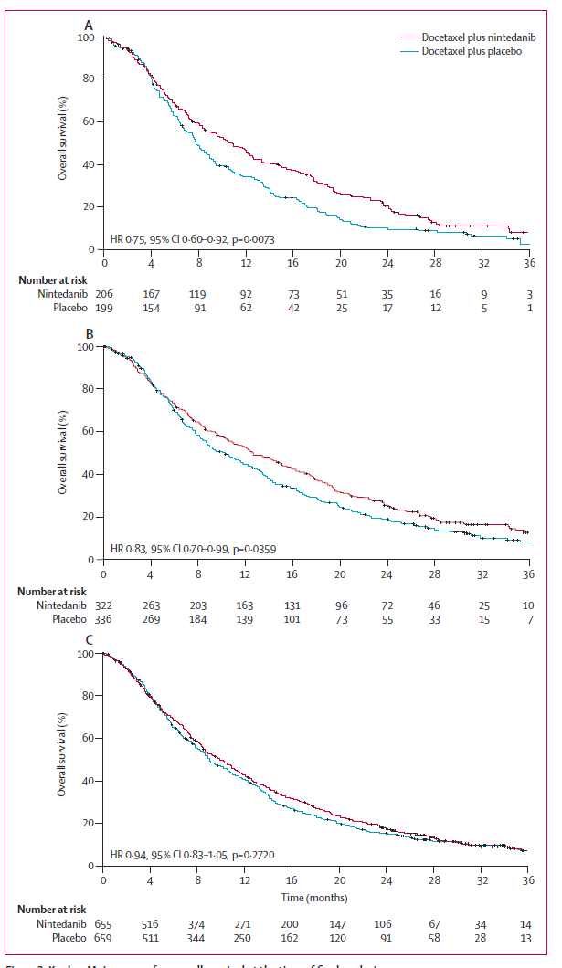
LUME Secondary Analysis- OS
A- Adeno 9 mos
B- Adeno
C- All
Reck M. Lancet Oncol. 2014 Feb;15(2):143-55.

Slide 11
LUME Secondary Analysis- OS
A- Adeno 9 mos
B- Adeno
C- All
Despite REVEL and LUME-Lung 1, S1400 and most of the registration studies to date use single agent docetaxel as the comparator arm
Reck M. Lancet Oncol. 2014 Feb;15(2):143-55.

Slide 12
Approaches to Replace the Current
Standard of Care
Add on to the current standard of care
Replace the current standard of care

Slide 13
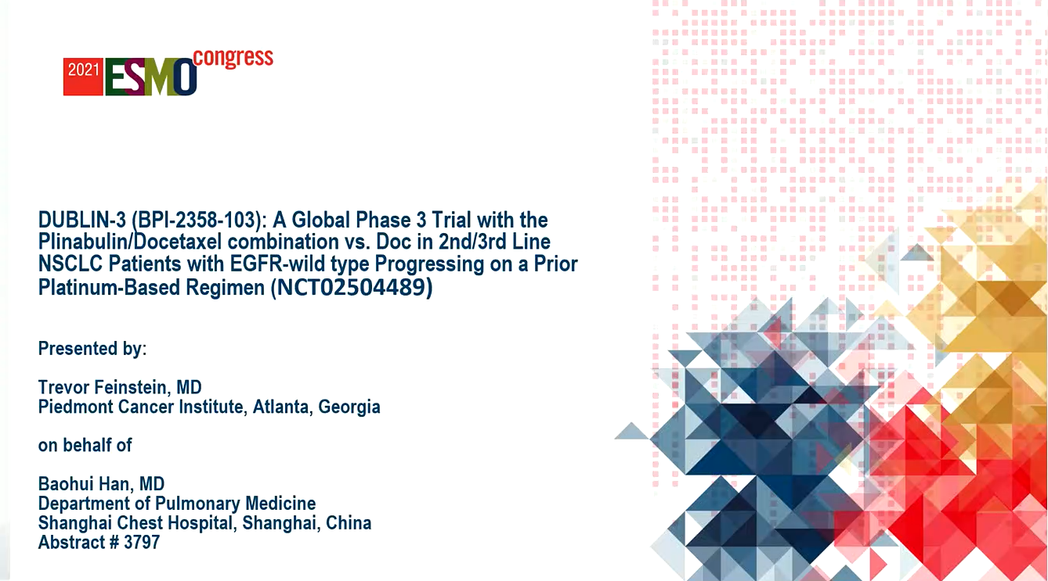

Slide 14
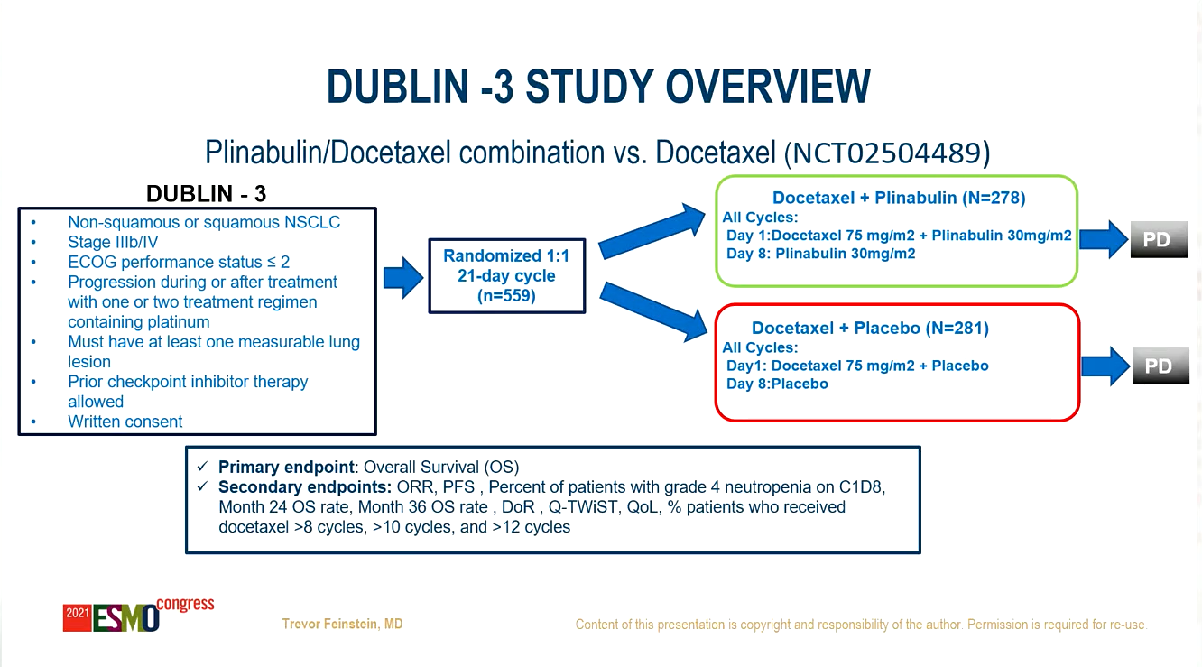

Slide 15
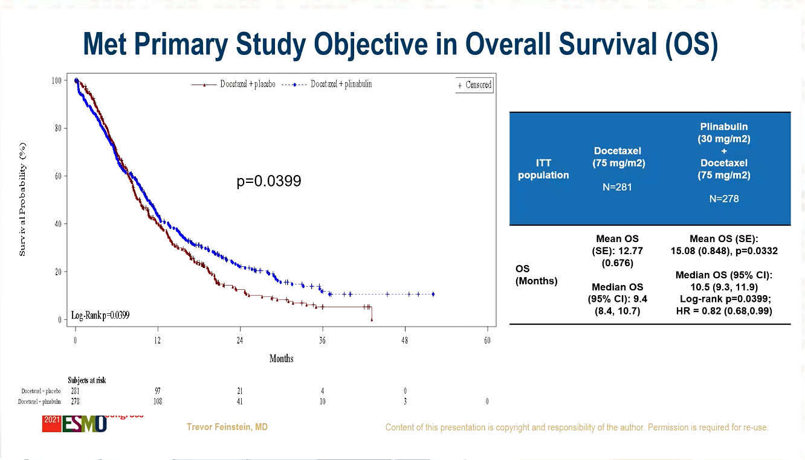

Slide 16
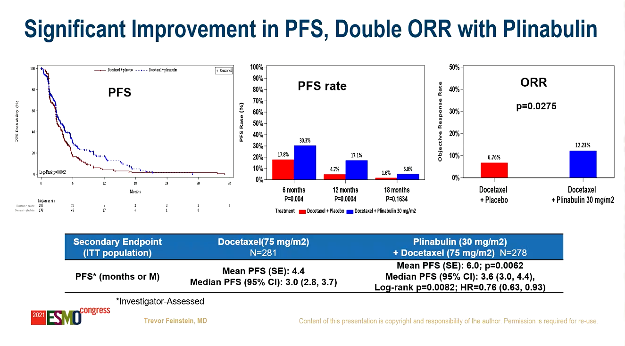

Slide 17
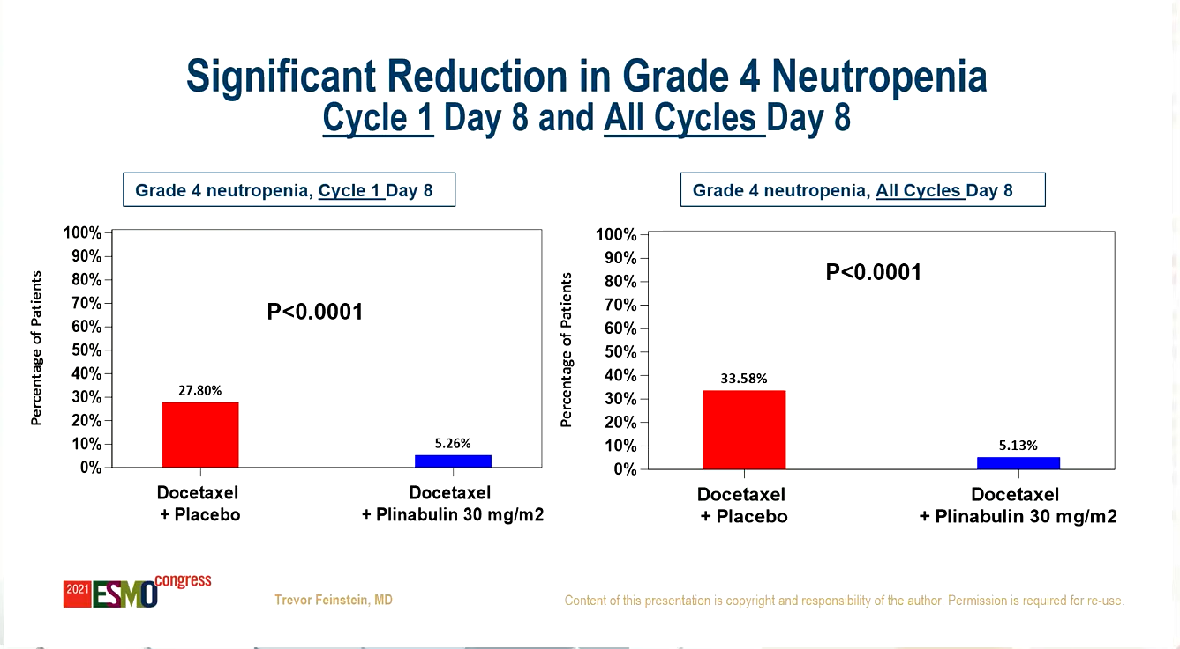

Slide 18
Approaches to Replace the Current
Standard of Care
Add on to the current standard of care
Replace the current standard of care

Slide 19
PD-L1 + CTLA4 Blockade
Garon EB et al. ASCO 2018

Slide 20

MRTX-500: Phase 2 Trial of Sitravatinib + Nivolumab in Patients With Nonsquamous Non–Small-Cell Lung Cancer Progressing on or After Prior Checkpoint Inhibitor Therapy
Ticiana A. Leal¹, David Berz², Igor I. Rybkin³, Wade T. Iams⁴, Debora S. Bruno⁵,
Collin M. Blakely⁶, Alexander I. Spira⁷, Manish R. Patel⁸, David M. Waterhouse⁹, Donald A. Richards¹⁰, Anthony Pham¹¹, Robert Jotte¹², Edward B. Garon¹³,
David S. Hong¹⁴, Ronald Shazer¹⁵, Xiaohong Yan¹⁵, Lisa Latven¹⁵, Kai He¹⁶
¹University of Wisconsin Carbone Cancer Center, Madison, WI, USA; Emory University, Atlanta, GA,USA; ²Department
of Cellular Therapeutics, Beverly Hills Cancer Center, Beverly Hills, CA, USA; ³Henry Ford Cancer Institute, Detroit, MI, USA; ⁴Vanderbilt-Ingram Cancer Center, Nashville, TN, USA; ⁵University Hospitals Seidman Cancer Center, Case Comprehensive Cancer Center, Case Western Reserve University, Cleveland, OH, USA; ⁶Department of Medicine, University of California, San Francisco, and Helen Diller Family Comprehensive Cancer Center, University of California San Francisco, San Francisco, CA, USA; ⁷Virginia Cancer Specialists, Fairfax, VA, USA; US Oncology Research, The Woodlands, TX, USA; ⁸Division of Hematology, Oncology and Transplantation, University of Minnesota Masonic Cancer Center, Minneapolis, MN, USA; ⁹OHC, Cincinnati, OH, USA; Texas Oncology; ¹⁰Texas Oncology Tyler, Tyler, TX, USA; US Oncology Research Network, The Woodlands, TX, USA; ¹¹Northwest Cancer Specialists, Tigard, OR, USA; ¹²Rocky Mountain Cancer Centers, Denver, CO, USA; US Oncology Research, The Woodlands, TX, USA; ¹³Department of Medicine, Division of Hematology/Oncology, David Geffen School of Medicine at the University of California, Los Angeles, CA, USA; ¹⁴The University of Texas MD Anderson Cancer Center, Houston, TX, USA; ¹⁵Mirati Therapeutics, Inc., San Diego, CA, USA; ¹⁶The Ohio State University Comprehensive Cancer Center, Columbus, OH, USA.
Copies of this presentation can be obtained through Quick Response (QR). Copies are for personal use only and may not be reproduced without permission of the authors.

Slide 21
MRTX-500: Phase 2, Open-Label Study of Sitravatinib + Nivolumab in Patients With Nonsquamous NSCLC With Prior Clinical Benefit From Checkpoint Inhibitor Therapy
MRTX-500: Sitravatinib + Nivolumab in Nonsquamous NSCLC After CPI Therapy
Key Eligibility Criteria
(n=68)
Advanced/metastatic nonsquamous NSCLCª
No actionable driver mutations
Anti–PD-1/L1 must be the most recent line of therapy
Prior Clinical Benefit (PCB) to CPI: CR, PR, or SD ≥12 weeks from prior CPI therapy
No uncontrolled brain metastases
ECOG PS 0-2
Sitravatinib 120 mg QD + nivolumab
Primary Endpoint:
Objective Response Rate^{b} (ORR), as defined by RECIST 1.1
Secondary Endpoints:
Safety and tolerability
DOR
CBR
PFS
OS
1-year survival rate
Here we report updated efficacy and safety with sitravatinib + nivolumab in the 2L or 3L setting in patients with nonsquamous NSCLC who have experienced clinical benefit on a prior CPI and subsequent disease progression
  Data as of 1 June 2021
ª Additional cohorts included a CPI-experienced cohort that did not receive prior clinical benefit from CPI therapy (radiographic progression of disease ≤12 weeks after initiation of treatment with CPI) and a CPI-naive cohort in patients that were previously treated with platinum-based chemotherapy. ^{b}Objective response rate based on investigator assessment. Dosing: sitravatinib free base formulation; nivolumab, 240 mg Q2W or 480 mg Q4W. Treatment discontinuation could be due to (but is not limited to) disease progression, global health deterioration, AEs, protocol violation, lost to follow-up, refusal of further treatment, study termination, or death.
Presented at the European Society for Medical Oncology (ESMO) Congress, 18 September 2021

Slide 22
Duration of Treatment With Sitravatinib + Nivolumab in Patients With
Nonsquamous NSCLC With Prior Clinical Benefit From CPI Therapy
MRTX-500: Sitravatinib + Nivolumab in Nonsquamous NSCLC After CPI Therapy
Duration of Treatment (n=58)
PR
CR
PR
SD
CR
PD
SD
SD
PR
Progression
First Response
Treatment Ongoing
Death
PR
PR
PR
SD
SD
SD
SD
SD
SD
PR
PR
SD
SD
SD
SD
SD
SD
SD
SD
SD
PR
SD
SD
SD
SD
ORR was 18% (12/68), including 2 CRs (3%) and 10 PRs (15%)ª
  DCR was 78% (53/68)
Median DOR was 12.8 months
Median duration of treatment:
  Sitravatinib: 4.8 months (range: 0, 40)
  Nivolumab: 5.2 months (range: 0, 41)
SD
SD
SD
SD
SD
PR
SD
SD
SD
SD
PD
SD
SD
SD
SD
SD
PD
SD
PD
SD
SD
SD
PD
0
SD
7
14
21
28
35
42
Duration of Treatment, months
ª10 (14.7%) patients were not evaluable for ORR: 8 patients without post-baseline scan, 1 patient without measurable disease at baseline, and 1 patient for whom all post-baseline scans were NE. The study did not meet the primary endpoint of ORR.
Median follow-up in the PCB cohort was 33.6 months. Data as of 1 June 2021.
Presented at the European Society for Medical Oncology (ESMO) Congress, 18 September 2021

Slide 23

Progression-Free Survival With Sitravatinib + Nivolumab in Patients With Nonsquamous NSCLC With Prior Clinical Benefit From CPI Therapy
MRTX-500: Sitravatinib + Nivolumab in Nonsquamous NSCLC After CPI Therapy
100
Progression-Free Survival in Patients With NSCLC (n=68)
90
 | Sitravatinib + Nivolumab (n=68)
Median PFS (95% CI) | 5.7 (4.9, 7.6)
Events/censored, n (%) | 53 (78)/15 (22)
80
79%
70
60
50
Progression-Free Survival, %
45%
40
31%
30
20
10
0
0
6
12
18
24
30
36
42
Patients at risk:
Sitravatinib + nivolumab
Time, months
68
25
10
4
3
2
1
0
Median follow-up in PCB cohort: 33.6 months.
Data as of 1 June 2021.
Presented at the European Society for Medical Oncology (ESMO) Congress, 18 September 2021

Slide 24

Overall Survival With Sitravatinib + Nivolumab in Patients With Nonsquamous NSCLC With Prior Clinical Benefit From CPI Therapy
MRTX-500: Sitravatinib + Nivolumab in Nonsquamous NSCLC After CPI Therapy
100
Overall Survival in Patients With NSCLC (n=68)
90
 | Sitravatinib + Nivolumab (n=68)
Median OS (95% CI) | 14.9 (9.3, 21.1)
Events/censored, n (%) | 46 (68)/22 (32)
80
70
60
56%
50
45%
Overall Survival, %
40
32%
30
20
10
0
0
6
12
18
24
30
36
42
Patients at risk:
Sitravatinib + nivolumab
Time, months
68
52
34
26
16
11
4
0
Median follow-up in PCB cohort: 33.6 months.
Data as of 1 June 2021.
Presented at the European Society for Medical Oncology (ESMO) Congress, 18 September 2021

Slide 25
Incidence of Treatment-Related Adverse Events
MRTX-500: Sitravatinib + Nivolumab in Nonsquamous NSCLC After CPI Therapy
Most Frequent (≥15%) TRAEs (n=68) | 2L/3L Sitra + Nivo
TRAEs Any TRAEs | Any Grade 93% | Grade 3-4 66%
Most frequent TRAEs, % Diarrhea Fatigue Nausea Hypertension Decreased appetite Weight decreased Vomiting Hypothyroidism Dysphonia ALT increase AST increase Stomatitis PPE syndrome Dehydration | 62% 52% 44% 40% 35% 31% 31% 22% 19% 18% 16% 15% 15% 15% | 16% 4% 2% 22% 0% 9% 0% 0% 0% 2% 0% 2% 3% 3%
The most frequent immune-related TRAES included hypothyroidism, diarrhea, ALT increase, AST increase, TSH increase maculopapular rash, and pancreatitisª
No grade 5 events occurred in the CPI-experienced cohort^{b}
ªInvestigator-assessed AE causality as immune-related. ^{b}1 grade 5 TRAE (cardiac arrest) occurred in the CPI-naive patient population.
Data as of 1 June 2021.
Presented at the European Society for Medical Oncology (ESMO) Congress, 18 September 2021

Slide 26
SAPPHIRE: Phase 3, Randomized, Open-Label Trial of 2L/3L Sitravatinib + Nivolumab vs Docetaxel After Progression on or Following CPI in Advanced NSCLC
Key Eligibility Criteria
(n=532)
Advanced, nonsquamous NSCLC
Prior PD-1/L1 therapy for ≥4 months (prior anti–CTLA-4 therapy allowed)
Progression on or following
PD-1/L1 inhibitor in combination with or following chemotherapy
Excludes patients with known driver mutations
Sitravatinib 100 mg QDª +
nivolumab 240 mg Q2W or 480 mg Q4W (n=266)
R
1:1
Docetaxel 75 mg/m² Q3W
(n=266)
Primary Endpoint:
OS
Secondary Endpoints:
PFS
ORR
Safety
ªNewly randomized patients will receive sitravatinib malate capsule formulation administered orally at starting dose of 100 mg once daily (QD). Patients enrolled in the United States who began treatment with the sitravatinib free-base capsule formulation will remain on the free-base capsule formulation throughout the duration of the study; the starting dose of sitravatinib free-base capsule formulation is 120 mg QD.
Presented at the European Society for Medical Oncology (ESMO) Congress, 18 September 2021

Slide 27
Introduction and Methods
Patients with advanced or metastatic NSCLC represent a high unmet need¹
TROP2 is highly expressed in NSCLC and has been associated with poor prognosis²⁻⁴
Datopotamab deruxtecan (Dato-DXd) is an antibody drug conjugate composed of a humanized anti-TROP2 monoclonal antibody conjugated to a potent topoisomerase I inhibitor payload via a stable tetrapeptide-based cleavable linker; this enables a bystander tumor effect resulting in elimination of both target tumor cells and surrounding cells^{5,6}
Previous results from the TROPION-PanTumor01 first-in-human study of Dato-DXd (NCT03401385) demonstrated highly encouraging antitumor activity with a manageable safety profile in patients with NSCLC.^{6,7} Here we present updated results from the NSCLC cohort, with a data cutoff of April 6, 2021ª
TROPION-PanTumor01 Study Design
Key Inclusion Criteria
Dose Escalation
Dose Expansion^{b}
NSCLC cohort
Relapsed/refractory advanced/metastatic NSCLC
Unselected for TROP2 expression^{c}
Age ≥18 (US) or ≥20 (Japan) years
ECOG PS 0-1
Measurable disease per RECIST version 1.1
Stable, treated brain metastases allowed
Dato-DXd 0.27
to 10 mg/kg Q3W^{d}
MTD established:
8 mg/kg Q3W
50 patients at 4 mg/kg
Primary objectives
Establish MTD; safety, tolerability
Secondary objectives^{e}
Efficacy,^{f} PK, ADAs
50 patients at 6 mg/kg
80 patients at 8 mg/kg
TNBC, HR+/HER2−, and other tumor types
6-mg/kg dose chosen for further development^{6,7}
ADA, antidrug antibody; ECOG PS, Eastern Cooperative Oncology Group performance status; HER2, human epidermal growth factor receptor 2; HR, hormone receptor; MTD, maximum tolerated dose; NSCLC, non-small cell lung cancer; PK, pharmacokinetics; Q3W, every 3 weeks; RECIST, Response Evaluation Criteria in Solid Tumors; TNBC, triple-negative breast cancer; TROP2, trophoblast cell-surface antigen 2.
ª This analysis in the NSCLC cohort was performed 6 months after the last patient received their first dose of study drug on October 6, 2020. ^{b} Includes patients treated in the dose-escalation and dose-expansion portions. ^{c} Pretreatment tumor tissue was required for retrospective analysis of TROP2 expression. ^{d} The 4-, 6-, and 8-mg/kg dose levels are being further evaluated for safety and efficacy. ^{e} Additional exploratory objectives include analyses of biomarkers associated with response. ^{f} Response assessments are based on RECIST v1.1.
1. Simeone JC, et al. Future Oncol. 2019;15(30):3491-3502. 2. Mito R, et al. Pathol Int. 2020;70(5):287-294. 3. Inamura K, et al. Oncotarget. 2017;8(17):28725-28735. 4. Jiang A, et al. Oncol Lett. 2013;6(2):375-380. 5. Okajima D, et al. AACR-NCI-EORTC 2019. Abstract C026. 6. Meric-Bernstam F, et al. ASCO 2021. Abstract 9058. 7. Spira A, et al. WCLC 2020. Abstract 3407.
Garon EB et al. WCLC 2021

Slide 28
Antitumor Activity of Dato-DXd
Best Overall Response (BICR)
Best Change in Sum of Diameters (per BICR)
Patientsª | Dato-DXd dose
 | 4 mg/kg (n=50) | 6 mg/kg (n=50) | 8 mg/kg (n=80)
ORR, n (%)^{b} | 12 (24) | 14 (28) | 19 (24)
CR, n (%) | 0 | 0 | 1 (1)
PR, n (%)^{b} | 12 (24) | 14 (28) | 18 (23)
SD, n (%) | 25 (50) | 20 (40) | 42 (53)
Non-CR/PD, n (%) | 1 (2) | 2 (4) | 2 (3)
PD, n (%) | 7 (14) | 10 (20) | 8 (10)
NE, n (%) | 5 (10) | 5 (10) | 9 (11)
DOR, median (95% CI), mo | NE (2.8-NE) | 10.5 (5.6-NE) | 9.4 (5.8-NE)
80
60
40
20
0
Best change in SOD from baseline, %
-20
-40
-60
Dose level
-80
4 mg/kg
-100
6 mg/kg
8 mg/kg
Change in Sum of Diameters of Target Lesion (per BICR) Over Time
100
4 mg/kg
100
6 mg/kg
100
8 mg/kg
-80
■ Ongoing
■ Discontinued
-80
■ Ongoing
■ Discontinued
-80
■ Ongoing
■ Discontinued
Antitumor activity was observed at 4-, 6-, and 8-mg/kg doses of Dato-DXd
Most responses were durable over time, including a median duration of response of 10.5 months in the 6-mg/kg cohort
-60
-60
-60
-40
-40
-40
Best change in SOD over time, %
-20
-20
-20
0
0
0
-20
-20
-20
-40
-40
-40
-60
-60
-60
-80
-80
-80
-100
2
4
6
8
10
12
14
16
18
20
22
24
-100
2
4
6
8
-100
2
4
6
8
26
10
12
14
16
18
20
22
24
26
10
12
14
16
18
20
22
24
26
Data cutoff: April 6, 2021.
BICR, blinded independent central review; CR, complete response; DOR, duration of response; NE, not evaluable; ORR, objective response rate; PD, progressive disease; PR, partial response; SOD, sum of diameters; SD, stable disease.
ª Includes response-evaluable patients who had ≥1 postbaseline tumor assessment or discontinued treatment. ^{b} ORR and CR/PR include 1 response in the 6-mg/kg cohort that is pending confirmation.
Garon EB et al. WCLC 2021

Slide 29
Safety
Overall Safety Summary
TEAEs in ≥15% of Patients^{b}
Patients, n (%) | Dato-DXd dose
 | 4 mg/kg (n=50) | 6 mg/kg (n=50) | 8 mg/kg (n=80)
TEAE | 49 (98) | 49 (98) | 80 (100)
Grade ≥3 | 15 (30) | 27 (54) | 46 (58)
Drug-related TEAE | 47 (94) | 41 (82) | 78 (98)
Grade ≥3 | 7 (14) | 13 (26) | 28 (35)
Serious TEAE | 10 (20) | 24 (48) | 40 (50)
Grade ≥3 | 10 (20) | 18 (36) | 37 (46)
Dose adjustments
TEAEs associated with discontinuation | 8 (16) | 7 (14) | 19 (24)
TEAEs associated with dose interruption | 4 (8) | 15 (30) | 29 (36)
TEAEs associated with dose reduction | 1 (2) | 5 (10) | 23 (29)
ILD adjudicated as drug relatedª | 5 (10) | 3 (6) | 11 (14)
Grade ≤2 | 4 (8) | 2 (4) | 7 (9)
Grades 3-4 | 1 (2) | 1 (2) | 1 (1)
Grade 5 | 0 | 0 | 3 (4)
Nausea
Stomatitis
Alopecia
Fatigue
Vomiting
Decreased appetite
Constipation
Infusion-related reaction
Dato-DXd dose
Anemia
4 mg/kg
6 mg/kg
Dry eye
8 mg/kg
Mucosal inflammation
Grade
1-2
Rash
≥3
Cough
The safety profile was manageable with mainly mild/moderate toxicity; TEAEs were primarily nonhematologic
Diarrhea
Dyspnea
0
10
20
30
40
50
60
70
Patients, %
Data cutoff: April 6, 2021.
ILD, interstitial lung disease; TEAE, treatment-emergent adverse event.
ª Cases of ILD adjudicated as drug related comprised 5 patients in the 4-mg/kg cohort (1 grade 1, 3 grade 2, 1 grade 3), 3 patients in the 6-mg/kg cohort (2 grade 2, 1 grade 4), and 11 patients in the 8-mg/kg cohort (2 grade 1, 5 grade 2, 1 grade 3, 3 grade 5). ^{b} Of 180 patients (4 mg/kg [n=50]; 6 mg/kg [n=50]; 8 mg/kg [n=80]).
Garon EB et al. WCLC 2021

Slide 30
In Summary…
Best results are with docetaxel plus anti-angiogenic therapy, but single agent docetaxel is regulatory control
Plinabulin has positive but odd data
PD-1 inhibition plus multi-targeted tyrosine kinase inhibition has impressive data, but no randomized data to date
Impressive data from datopotamab deruxtecan in non-randomized data

Slide 31
Additional promising strategies and novel agents for the management of metastatic NSCLC

Slide 32
KEYNOTE-146: Phase IB/II Trial of Lenvatinib/Pembrolizumab in Advanced Solid Cancers
Efficacy in the Metastatic NSCLC Population
N | Line of therapy | ORR | Median DOR | Median PFS
21 | Any | 33% | 10.9 mo | 5.9 mo
DOR = duration of response
Summary of Treatment-Related Adverse Events (TREAs): All Patients
Parameter | (N = 137)
Serious AEs | 26%
TREAs leading to pembrolizumab dose interruption | 45%
TREAs leading to pembrolizumab discontinuation | 15%
TREAs leading to lenvatinib dose reduction and/or interruption | 85%
TREAs leading to lenvatinib discontinuation | 13%
Taylor MH et al. J Clin Oncol 2020;38:154-63.

Slide 33
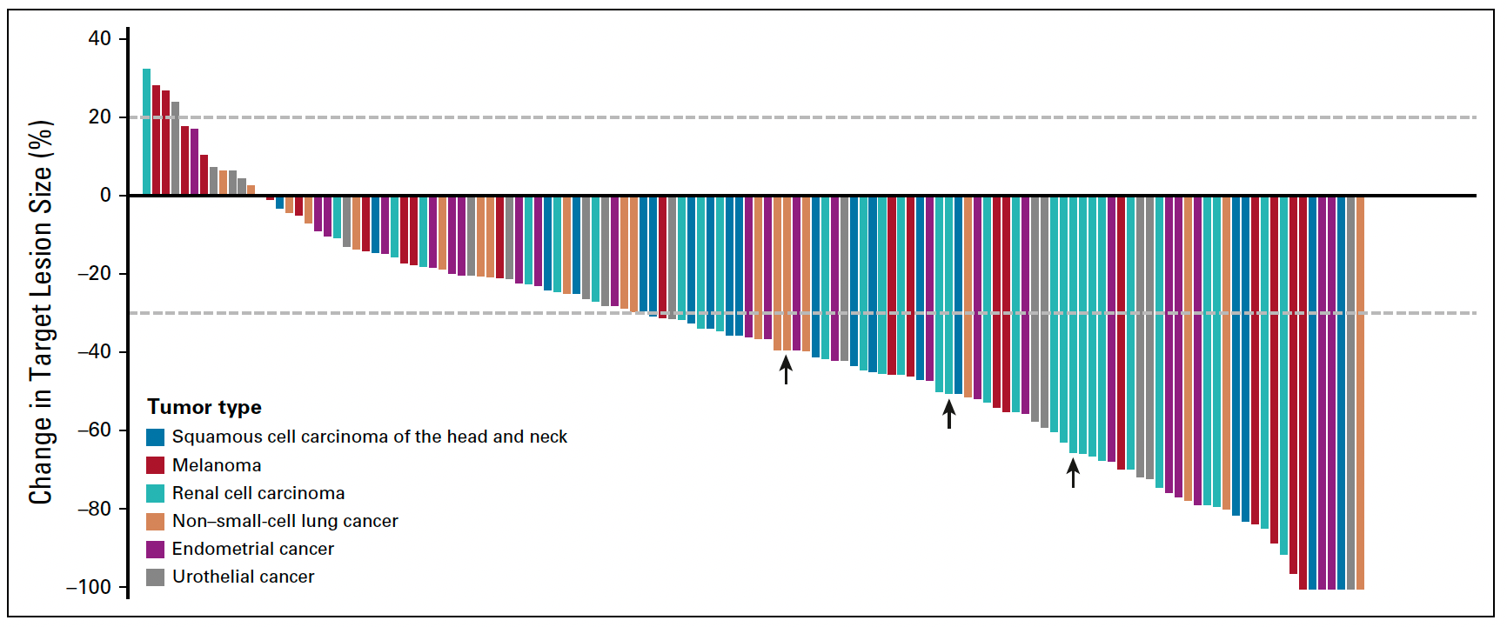
KEYNOTE-146: Maximum Change in Target Lesion Size (All Patients)
Taylor MH et al. J Clin Oncol 2020;38:154-63.

Slide 34
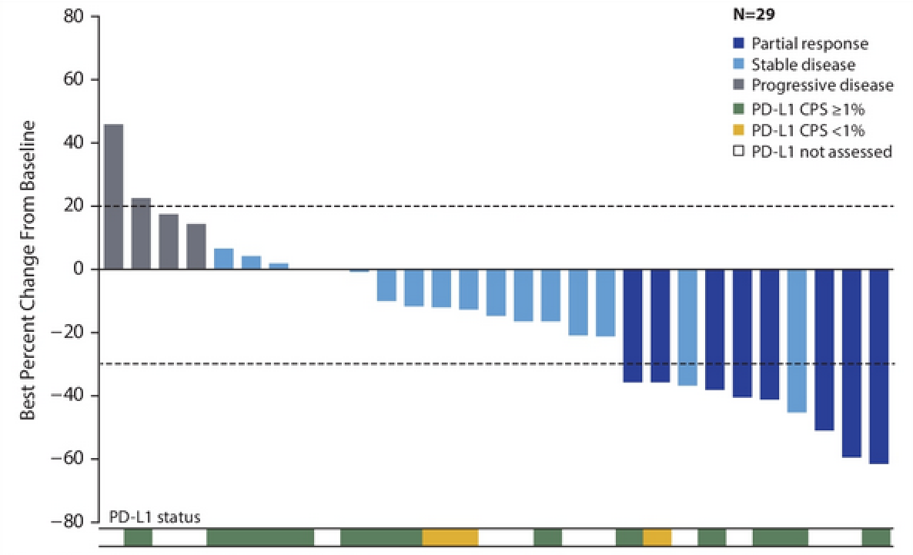
COSMIC-021 (Cohort 7): Best Change from Baseline with Cabozantinib/Atezolizumab for Metastatic NSCLC
Patient population
Radiographic progression on or after 1 prior ICI treatment
≤2 lines of prior systemic anticancer therapy for metastatic NSCLC
No EGFR mutations, ALK or ROS1 rearrangements or BRAF V600E mutation
ORR: 27%
Disease Control Rate: 83%
DOR: 5.7 months
No apparent correlation between responses and PD-L1 status
Neal JW et al. ASCO 2020;Abstract 9610.

Slide 35
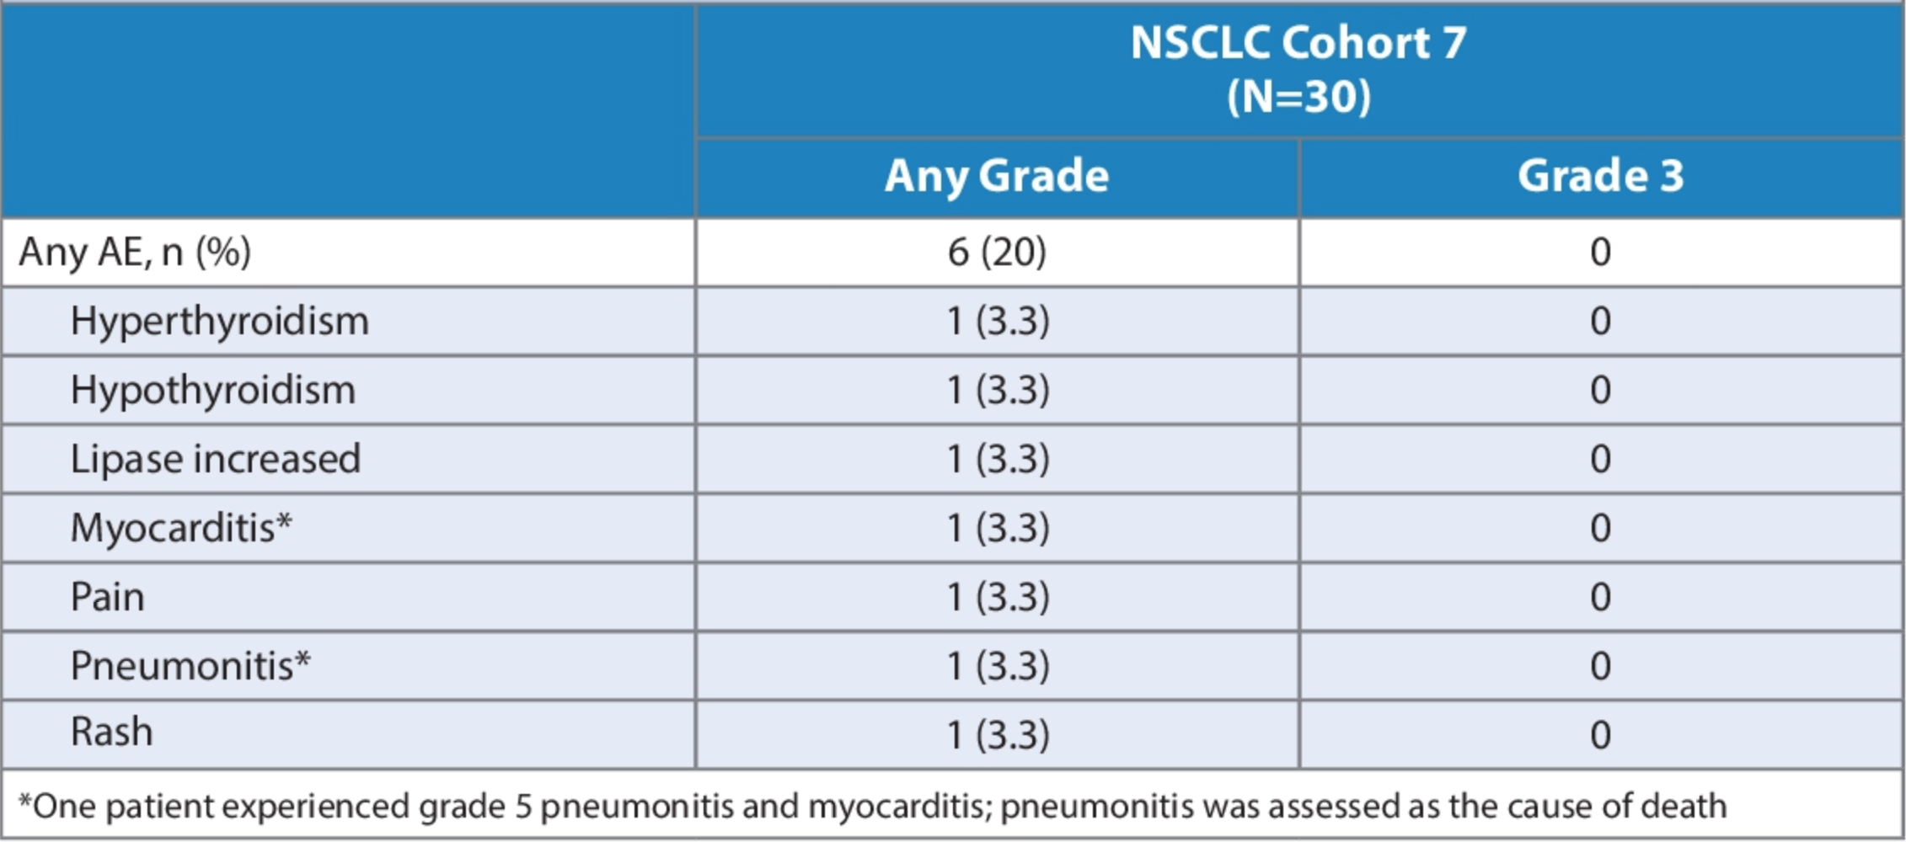
COSMIC-021 (Cohort 7): Immune-Related Adverse Events with Cabozantinib/Atezolizumab for Metastatic NSCLC
Neal JW et al. ASCO 2020;Abstract 9610.

Slide 36
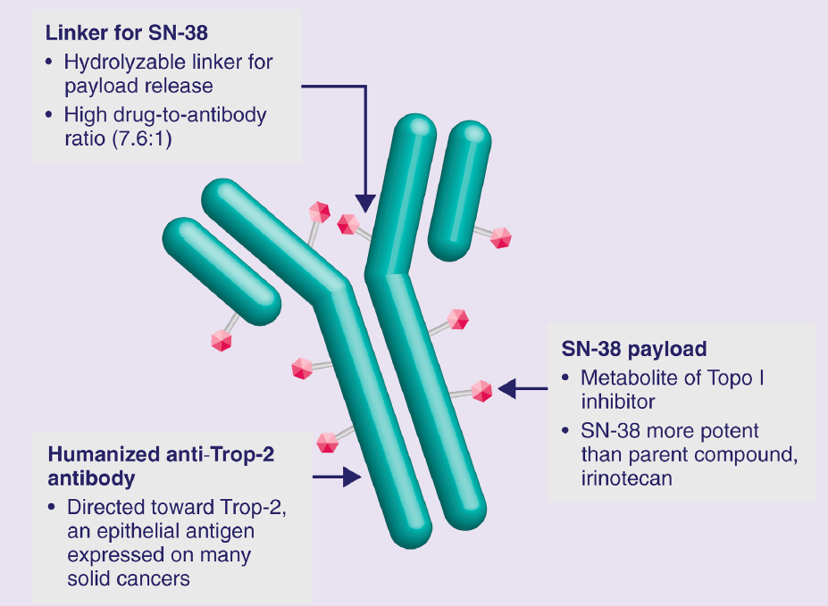
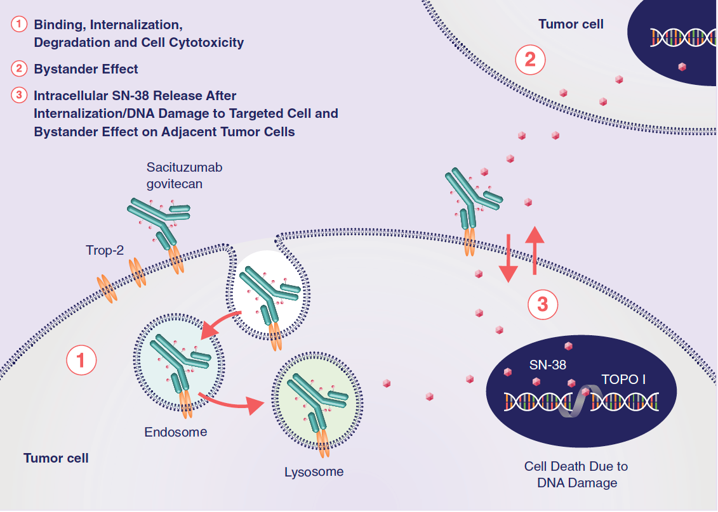
Sacituzumab Govitecan Is a First-in-Class TROP-2-Directed Antibody-Drug Conjugate
Rugo H et al. Future Oncol 2020;16(12):705-15.

Slide 37
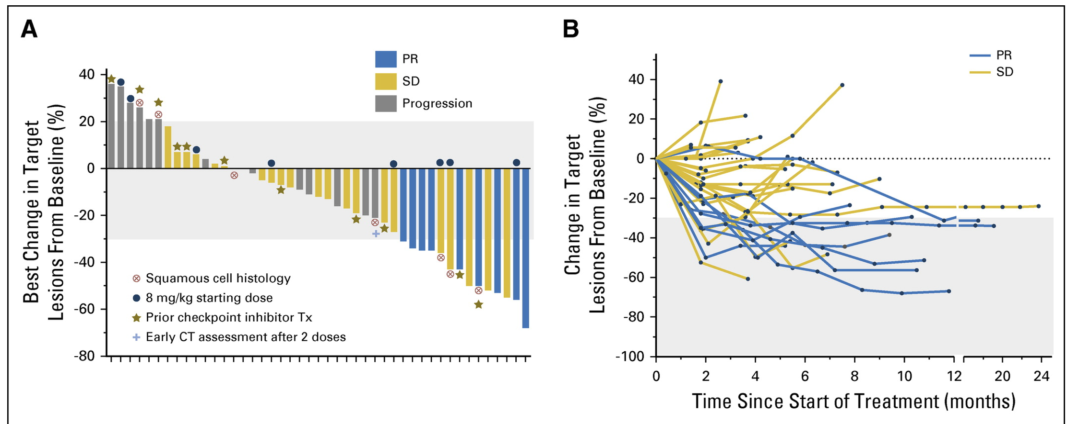
Phase I/II study of Sacituzumab Govitecan in patients with heavily pre-treated metastatic NSCLC
Heist R, et al. J Clin Oncol. 2017
Notes:
Graphic representation of response assessments. (A) Waterfall plot that illustrates the best percentage change in the target lesions for patients with non–small-cell lung cancer who had at least one radiologic response assessment. One patient had a computed tomography (CT) assessment after just two doses, whereas all other patients had CT assessments after five to six doses (approximately 8 weeks from start of therapy). Patients treated with 8 mg/kg sacituzumab govitecan were identified, with others receiving a starting dose of 10 mg/kg. Patients who received prior checkpoint inhibitor therapy and those with squamous cell histology also are identified. (B) Graph showing the dynamics of target lesion response in patients with a best overall response of stable disease (SD) or partial response (PR). (C) Plot of the duration of response for patients with SD and PR. The time of first evidence of ≥ 30% shrinkage is marked for the patients with PR and those with SD who achieved ≥ 30% shrinkage that was not subsequently confirmed. Arrows signify patients who were continuing treatment at the time of this analysis, with one patient continuing treatment after brain metastases were discovered while maintaining an overall shrinkage of 44% from baseline after a best response of 50% reduction. Tx, therapy.

Slide 38
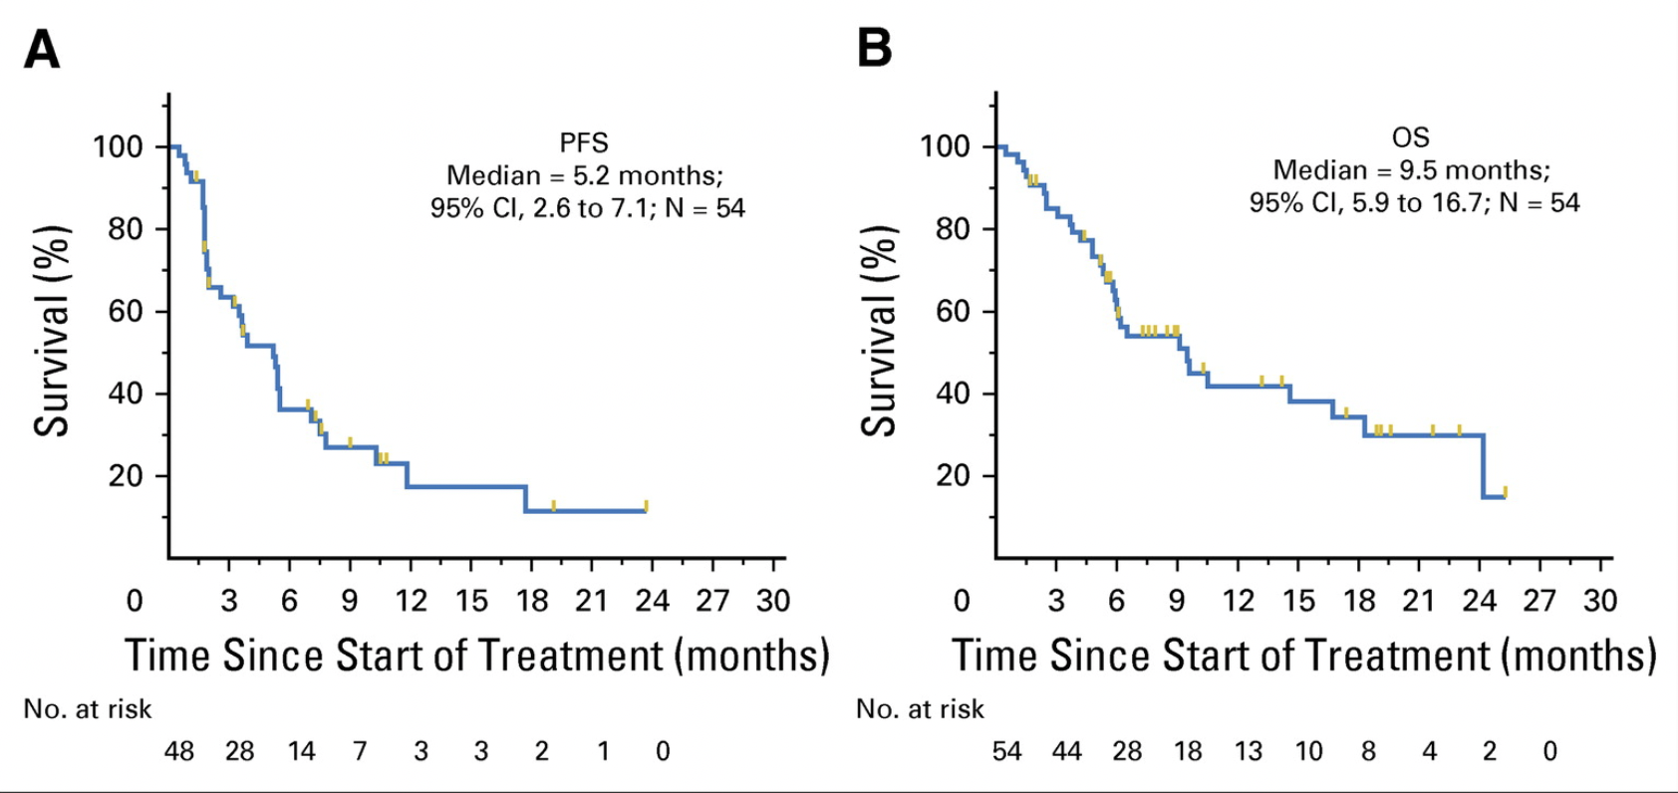
Heist R, et al. J Clin Oncol. 2017

Slide 39
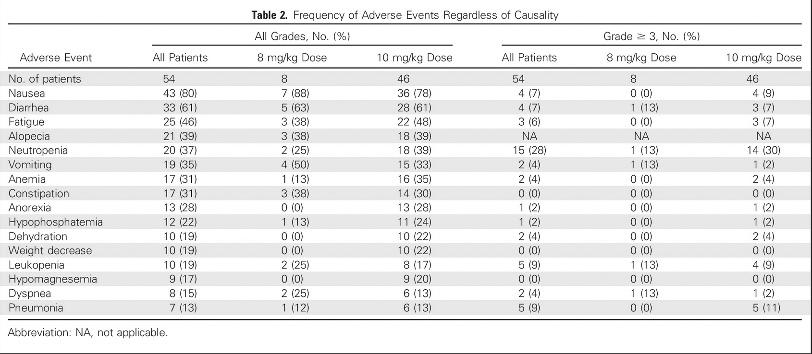
Heist R, et al. J Clin Oncol. 2017

Slide 40
Ongoing studies of Sacituzumab Govitecan for patients with progressive NSCLC
A Phase I/II Study of Sacituzumab Govitecan Plus Berzosertib in Small Cell Lung Cancer and Homologous Recombination-Deficient Cancers Resistant to PARP Inhibitors
Study of Sacituzumab Govitecan-hziy (SG) Versus Docetaxel in Participants With Advanced or Metastatic Non-Small Cell Lung Cancer (NSCLC) With Progression on or After Platinum-Based Chemotherapy and Anti-programmed Death Protein 1 (PD-1)/Programmed Death Ligand 1 (PD-L1) Immunotherapy (EVOKE-01)

Slide 41
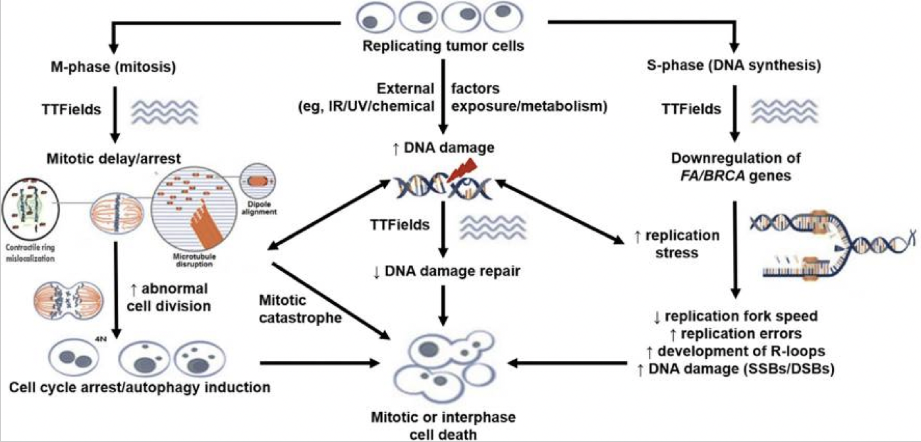
Mechanism of Tumor Treating Fields (TTFs)
Ghiaseddin AP, et al. Curr Treat Options Oncol. 2020

Slide 42
Phase III LUNAR trial of TTFs for patients with progressive, metastatic NSCLC
“Results from a prespecified interim update to the phase 3 LUNAR trial (NCT02973789) of tumor-treating fields (TTFields) in patients with stage IV non–small cell lung cancer (NSCLC) after progression on or after platinum-base chemotherapy concluded with a favorable recommendation to continue.
The interim analysis included data taken from 210 patients with a data monitoring committee (DMC) recommendation to reduce the sample size to approximately 276 patients. Continued accrual and randomization of 534 patients, which was formerly set at the target enrollment for the study, was deemed to be unnecessary or possibly unethical given the available data. Of note, there was no evidence of increased systemic toxicity when patients were treated with TTFields.”
https://www.cancernetwork.com/view/phase-3-trial-of-tumor-treating-fields-for-nsclc-impresses-at-interim-analysis

