Slide 1
Chronic Lymphocytic Leukemia Friday, April 29, 2022 12:15 PM – 1:45 PM PT
What I Tell My Patients: New Treatments and Clinical Trial Options
An NCPD Hybrid Symposium Series Held During the 47th Annual ONS Congress
Faculty
Lesley Camille Ballance, MSN, FNP-BC
Amy Goodrich, CRNP Lowell L Hart, MD
Anthony R Mato, MD, MSCE
Moderator
Neil Love, MD

Slide 2
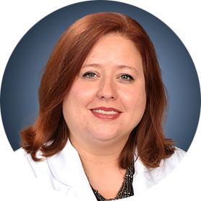
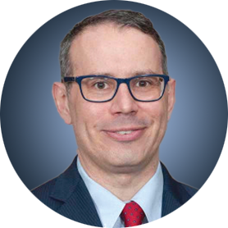
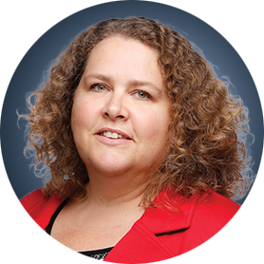
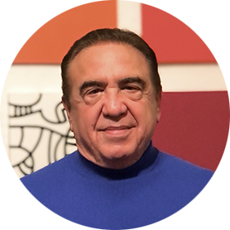
Faculty
Lesley Camille Ballance, MSN, FNP-BC
Sarah Cannon Center for Blood Cancer
Tennessee Oncology
Nashville, Tennessee
Anthony R Mato, MD, MSCE
Associate Attending
Director, Chronic Lymphocytic Leukemia Program
Memorial Sloan Kettering Cancer Center
New York, New York
Amy Goodrich, CRNP
Nurse Practitioner
The Sidney Kimmel Comprehensive Cancer Center
Johns Hopkins Medicine
Baltimore, Maryland
Moderator Neil Love, MD Research To Practice Miami, Florida
Lowell L Hart, MD
Scientific Director of Clinical Research
Florida Cancer Specialists and Research Institute
Fort Myers, Florida
Associate Professor of Internal Medicine, Hematology and Oncology
Wake Forest University School of Medicine
Winston-Salem, North Carolina

Slide 3
Ms Ballance — Disclosures
Consulting Agreement | AbbVie Inc
Speakers Bureau | AbbVie Inc, AstraZeneca Pharmaceuticals LP, Seagen Inc

Slide 4
Ms Goodrich — Disclosures
No relevant conflicts of interest to disclose

Slide 5
Dr Hart — Disclosures
Advisory Committee | Boehringer Ingelheim Pharmaceuticals Inc, G1 Therapeutics Inc, Novartis
Speakers Bureau | Circulogene

Slide 6
Dr Mato — Disclosures
Consultant and/or Advisor | AbbVie Inc, Acerta Pharma — A member of the AstraZeneca Group, Adaptive Biotechnologies Corporation, Celgene Corporation, DTRM Biopharma Co Ltd, Genentech, a member of the Roche Group, Genmab, Johnson & Johnson Services Inc, Nurix Therapeutics Inc, Octapharma Plasma, Pharmacyclics LLC, an AbbVie Company, Sunesis Pharmaceuticals Inc, TG Therapeutics Inc, Verastem Inc
Data Safety Monitoring Board | AbbVie Inc, Acerta Pharma — A member of the AstraZeneca Group, Adaptive Biotechnologies Corporation, Celgene Corporation, DTRM Biopharma Co Ltd, Genentech, a member of the Roche Group, Genmab, Johnson & Johnson Services Inc, Nurix Therapeutics Inc, Octapharma Plasma, Pharmacyclics LLC, an AbbVie Company, Sunesis Pharmaceuticals Inc, TG Therapeutics Inc, Verastem Inc
Grant/Research Support | AbbVie Inc, Acerta Pharma — A member of the AstraZeneca Group, Adaptive Biotechnologies Corporation, DTRM Biopharma Co Ltd, Genentech, a member of the Roche Group, Genmab, Johnson & Johnson Services Inc, Loxo Oncology Inc, a wholly owned subsidiary of Eli Lilly & Company, Nurix Therapeutics Inc, Octapharma Plasma, Pharmacyclics LLC, an AbbVie Company, Regeneron Pharmaceuticals Inc, Sunesis Pharmaceuticals Inc, TG Therapeutics Inc

Slide 7
Commercial Support
This activity is supported by educational grants from AstraZeneca Pharmaceuticals LP, Genentech, a member of the Roche Group, and Pharmacyclics LLC, an AbbVie Company and Janssen Biotech Inc, administered by Janssen Scientific Affairs LLC.
Research To Practice CME Planning Committee Members, Staff and Reviewers
Planners, scientific staff and independent reviewers for Research To Practice have no relevant conflicts of interest to disclose.

Slide 8
How was it different to take care of this patient versus another patient in the same oncologic setting?
What unique biopsychosocial factors (eg, attitude, comorbidities, social support) were considered in the overall management of this case?

Slide 9
I feel very satisfied with my work.
Never
A few times per year
Once a month
A few times per month
Once a week
A few times per week
Every day

Slide 10
Faculty
Lesley Camille Ballance, MSN, FNP-BC
Sarah Cannon Center for Blood Cancer
Tennessee Oncology
Nashville, Tennessee
Anthony R Mato, MD, MSCE
Associate Attending
Director, Chronic Lymphocytic Leukemia Program
Memorial Sloan Kettering Cancer Center
New York, New York
Amy Goodrich, CRNP
Nurse Practitioner
The Sidney Kimmel Comprehensive Cancer Center
Johns Hopkins Medicine
Baltimore, Maryland
Moderator Neil Love, MD Research To Practice Miami, Florida
Lowell L Hart, MD
Scientific Director of Clinical Research
Florida Cancer Specialists and Research Institute
Fort Myers, Florida
Associate Professor of Internal Medicine, Hematology and Oncology
Wake Forest University School of Medicine
Winston-Salem, North Carolina

Slide 11
Chronic Lymphocytic Leukemia Friday, April 29, 2022 12:15 PM – 1:45 PM PT
What I Tell My Patients: New Treatments and Clinical Trial Options
An NCPD Hybrid Symposium Series Held During the 47th Annual ONS Congress
Faculty
Lesley Camille Ballance, MSN, FNP-BC
Amy Goodrich, CRNP Lowell L Hart, MD
Anthony R Mato, MD, MSCE
Moderator
Neil Love, MD

Slide 12
Agenda
Module 1 – Overview of CLL
Module 2 – Bruton Tyrosine Kinase Inhibitors
Module 3 – Venetoclax and Anti-CD20 Antibody Therapy
Module 4 – Future Strategies

Slide 13
Agenda
Module 1 – Overview of CLL
Module 2 – Bruton Tyrosine Kinase Inhibitors
Module 3 – Venetoclax and Anti-CD20 Antibody Therapy
Module 4 – Future Strategies

Slide 14
Patients with newly diagnosed chronic lymphocytic leukemia (CLL) who feel well and are asymptomatic require treatment if…
Del(17p)/TP53 mutation is detected
White blood cell count exceeds 200,000 mm³
Both 1 and 2
Neither 1 nor 2
I don’t know

Slide 15
Patients with CLL and which of the following prognostic factors generally do not respond well to chemoimmunotherapy?
Del(17p)
TP53 mutation
IGHV mutation
All of the above
Del(17p) or TP53 mutation only
TP53 or IGHV mutations only
Del(17p) or IGHV mutation only
I don’t know

Slide 16
Which of the following patients with CLL should receive the Evusheld antibody?
All patients, including those on observation
All patients receiving active treatment for CLL
Both 1 and 2
Neither 1 nor 2
I don’t know

Slide 17
CLL Impacts a Significant Number of Patients Worldwide, Predominantly Affecting Older Patients
With an estimated 191,000 new cases globally, CLL represents 22% to 30% of all leukemia worldwide, being the most common leukemia in Western countries^{1,2}
Median age at diagnosis³:
Men are ~2X more likely to develop CLL⁵
72
~90% of patients diagnosed
with CLL are >55 years old⁴
1. Union for International Cancer Control. https://www.who.int/selection_medicines/committees/expert/20/applications/CLL.pdf. Accessed November 6, 2019. 2. Combest AJ, et al. J Hematol Oncol Pharm. 2016;6(2):54-56. 3. Eichhorst B, et al. Ann Oncol. 2015;26(suppl 5):v78-v84. 4. Lymphoma Coalition. https://lymphomacoalition.org/images/subtype-reports/CLL_Europe _2017_Report.pdf. Accessed November 6, 2019. 5. Scarfò L, et al. Crit Rev Oncol Hematol. 2016;104:169-182.
Courtesy of John M Pagel, MD, PhD

Slide 18
Indications for treatment:
Disease-related symptoms
Fatigue can by tricky
Progressive bulky disease
spleen > 6 cm below costal margin; LN > 10 cm
Progressive bone marrow failure, manifesting as anemia or thrombocytopenia
Autoimmune complications poorly responsive to steroids
Progressive lymphocytosis: Lymphocyte doubling time < 6 months, or increase in ≥ 50% in a two-month period
*Note: Absolute lymphocyte count alone not an indication for treatment
Courtesy of Brad S Kahl, MD

Slide 19
Potential clinical manifestions of CLL
None
Marrow failure syndrome
Anemia, Thrombocytopenia
Autoimmune cytopenias
Anemia, thrombocytopenia, neutropenia
Immunodeficiency (low Ig levels)
Recurrent infections
Symptoms
Fatigue, night sweats, weight loss, fevers, pain
Courtesy of Brad S Kahl, MD

Slide 20
CLL special consideration
High frequency of AI complications
ITP, AIHA, neutropenia
High frequency of infections
Check Ig levels
Consider IVIg replacement therapy if recurrent infections and IgG < 300
High rate of skin cancer
Low threshold to send to Dermatology
Courtesy of Brad S Kahl, MD

Slide 21
Patients with abnormal routine CBC found to have CLL
Questions — Lowell L Hart, MD
How is it determined whether therapy should be initiated, and how do patients react to the idea of “watch and wait”?

Slide 22
CLL and COVID-19
Questions — Lesley Camille Ballance, MSN, FNP-BC
How has COVID-19 impacted your clinical management of chronic lymphocytic leukemia?
What are some of the psychosocial issues that arise in this situation?

Slide 23
CLL and COVID-19
Commentary — Lesley Camille Ballance, MSN, FNP-BC
CLL Management
Infection risk and mortality rate
Vaccine timing
Treatment decisions
Comorbidities
Example: 51-year-old male with CLL on 2nd line treatment w/ Venetoclax and Obinutuzumab in early February 2020
Psychosocial Issues
Social distancing
Isolation
Increased anxiety and depression
Personal beliefs about vaccines
Family and friends’ COVID beliefs and practices

Slide 24
Agenda
Module 1 – Overview of CLL
Module 2 – Bruton Tyrosine Kinase Inhibitors
Module 3 – Venetoclax and Anti-CD20 Antibody Therapy
Module 4 – Future Strategies

Slide 25
Ibrutinib…
Often initially increases white blood cell count in patients with CLL
Results in significant objective responses in most patients with CLL
Generally does not result in a complete clinical response in patients with CLL
All of the above
None of the above
I don’t know

Slide 26
Ibrutinib should be temporarily discontinued for patients scheduled to undergo surgical procedures.
Agree
Disagree
I don’t know

Slide 27
A new preparation of acalabrutinib has been reported, which will allow patients to receive acalabrutinib concurrently with….
Corticosteroids
Proton pump inhibitors
CYP3A inhibitors
I don’t know

Slide 28
Which of the following cardiac issues has been reported in patients with CLL receiving BTK (Bruton tyrosine kinase) inhibitors?
Atrial fibrillation
Ventricular arrhythmias
Both 1 and 2
Neither 1 nor 2
I don’t know

Slide 29
Mechanism of Action of Ibrutinib
BCR
LYN
SYK
Ibrutinib
┬
PI3K
delta
BTK
PLCγ2
AKT
GSK-3
NF-kβ
pathway
PKC
mTOR
p70s6k
elf4E
Woyach JA et al. Blood 2012;120(6):1175-84.

Slide 30
Long-Term Results of Alliance A041202 Show Continued Advantage of Ibrutinib-Based Regimens Compared with Bendamustine Plus Rituximab (BR) Chemoimmunotherapy
Woyach JA et al.
ASH 2021;Abstract 639.

Slide 31
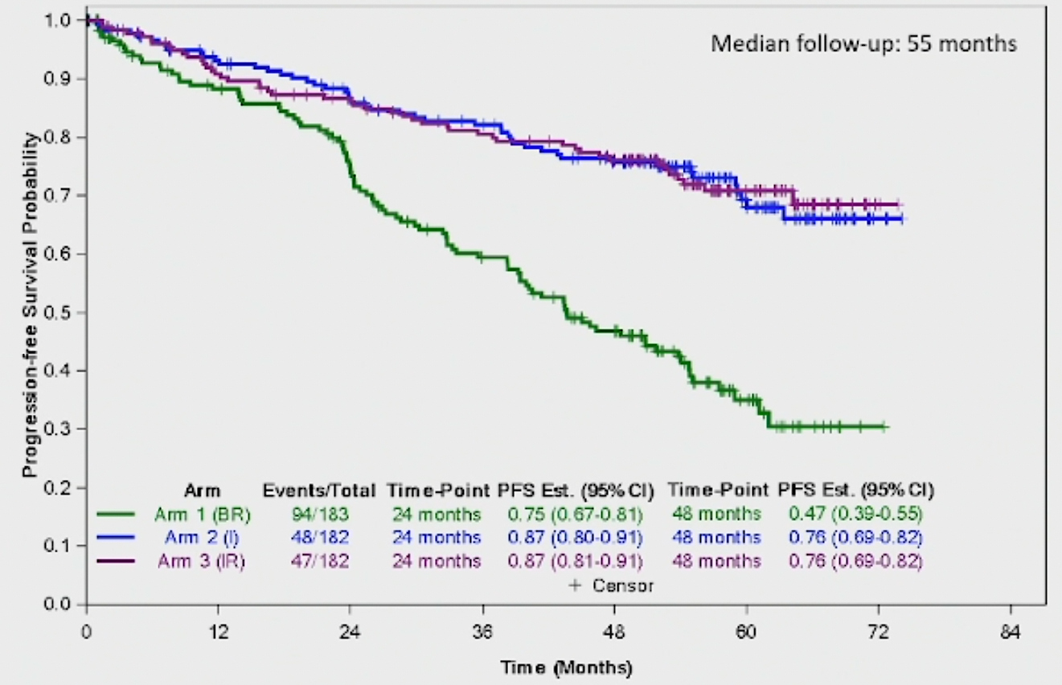
Alliance A041202: First-Line Ibrutinib-Based Regimens versus Bendamustine and Rituximab (BR) Progression-Free Survival
Pairwise comparisons | Hazard ratio | p-value
I vs BR | 0.36 | <0.0001
IR vs BR | 0.36 | <0.001
IR vs I | 0.99 | 0.96
Woyach JA et al. ASH 2021;Abstract 639.

Slide 32
Ibrutinib and Rituximab Provides Superior Clinical Outcome Compared to FCR in Younger Patients with Chronic Lymphocytic Leukemia (CLL): Extended Follow-Up from the E1912 Trial
Shanafelt TD et al. ASH 2019;Abstract 33.

Slide 33
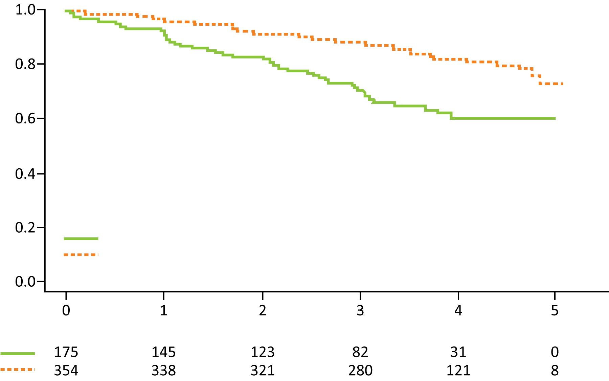
ECOG-ACRIN E1912 Extended Follow-Up: Up-Front Ibrutinib/Rituximab (IR) Compared to Fludarabine/ Cyclophosphamide/Rituximab (FCR) for Younger Patients with CLL
PFS
Probability
HR = 0.39 p < 0.0001
3-year rates: 89%, 71%
FCR (52 events/175 cases)
IR (58 events/354 cases)
Years
Number at risk
Grade ≥3 treatment-related adverse events were reported in 70% of patients receiving IR and 80% of patients receiving FCR (odds ratio = 0.56; p = 0.013).
Among the 95 patients who discontinued ibrutinib, the most common cause was adverse event or complication.
Shanafelt TD et al. ASH 2019;Abstract 33.

Slide 34
Leukemia 2022;[Online ahead of print].

Slide 35
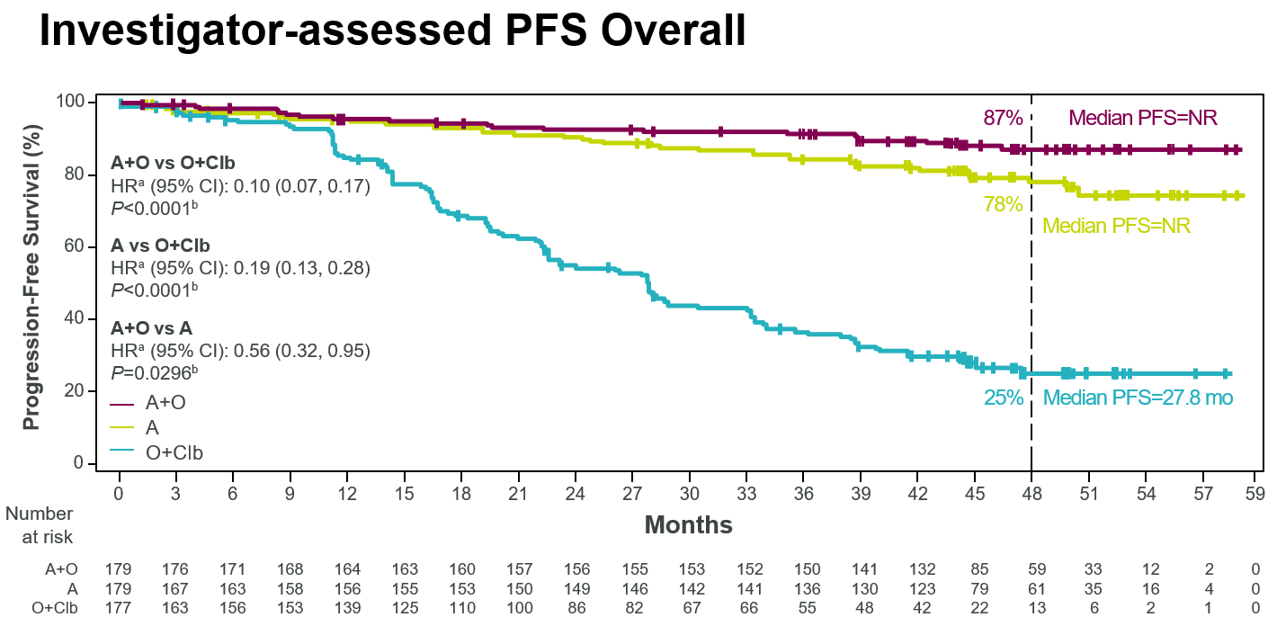
ELEVATE-TN: Investigator-Assessed PFS (Overall)
4-Year Follow-Up
Sharman JP et al. Leukemia 2022;[Online ahead of print].

Slide 36
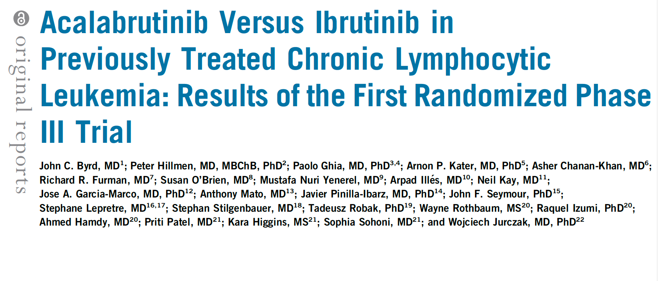
J Clin Oncol 2021;39(31):3441-52.

Slide 37
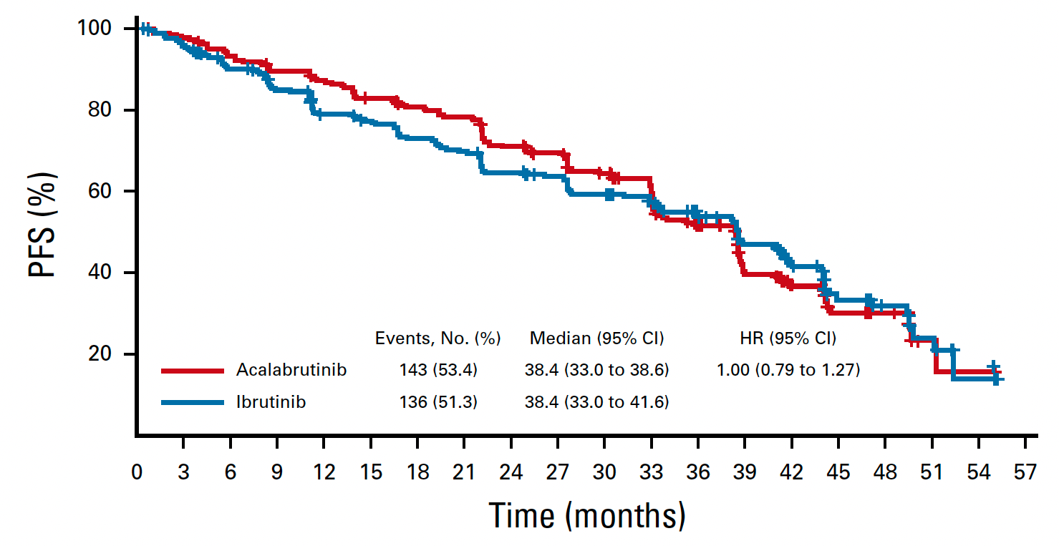
ELEVATE-RR: Acalabrutinib versus Ibrutinib for Relapsed CLL Independent Review Committee-Assessed Progression-Free Survival (PFS)
Byrd JC et al. J Clin Oncol 2021;39(31):3441-52.

Slide 38
New Acalabrutinib Formulation Enables Co-Administration with Proton Pump Inhibitors and Dosing in Patients Unable to Swallow Capsules (ELEVATE-PLUS)
Sharma S et al. ASH 2021;Abstract 4365.
Author Conclusions: Acalabrutinib maleate, administered as a tablet or suspension, is safe and well tolerated. Based on the PK (and associated variability), BTK-TO, and established exposure-efficacy/safety relationship, AMT clinical effect is expected to be comparable to acalabrutinib capsules at the approved 100-mg BID dosing, regardless of use of PPIs and ingestion of food. Additionally, AMT improves swallowing ability given the film coating and a 50% reduced volume compared with the capsule, and can be easily suspended in a small amount of water to allow dosing in patients unable to swallow tablets.

Slide 39
SEQUOIA: Results of a Phase 3 Randomized Study of Zanubrutinib versus Bendamustine + Rituximab (BR) in Patients with Treatment-Naïve (TN) Chronic Lymphocytic Leukemia/Small Lymphocytic Lymphoma (CLL/SLL)
Tam CS et al.
ASH 2021;Abstract 396.

Slide 40
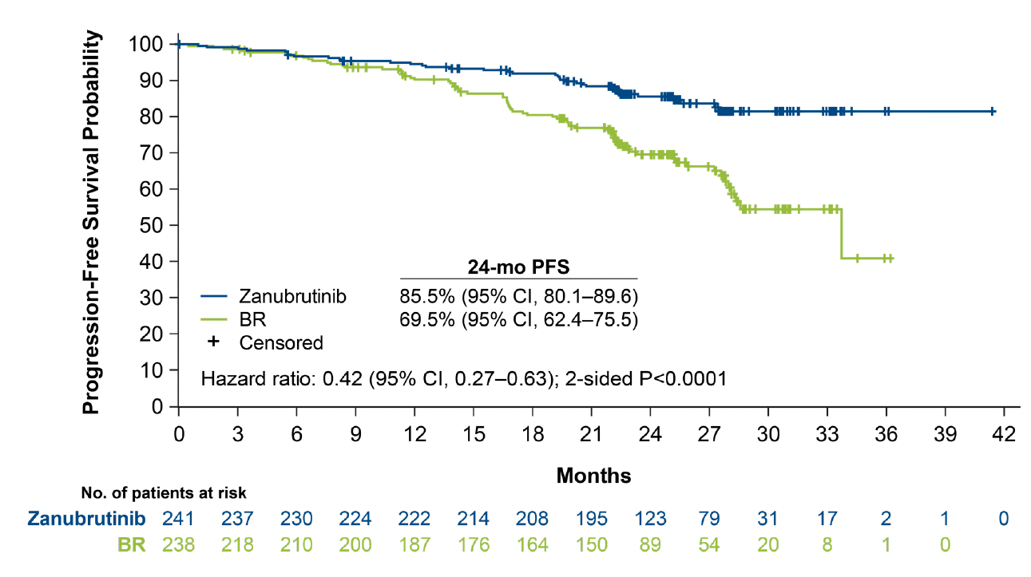
SEQUOIA: First-Line Zanubrutinib versus Bendamustine and Rituximab (BR) Progression-Free Survival by IRC
Tam CS et al. ASH 2021;Abstract 396.

Slide 41
Patients with CLL starting on a BTK inhibitor
Questions — Anthony R Mato, MD, MSCE
How do you explain to patients what a Bruton tyrosine kinase (BTK) inhibitor is and the potential benefits and risks of these agents?
How do you select which BTK inhibitor to use?

Slide 42
Patients with CLL starting on a BTK inhibitor
Commentary — Anthony R Mato, MD, MSCE
How do you explain to patients what a BTK inhibitor is and the potential benefits and risks of these agents?
Review mechanism of action
Review long term follow up data for ibrutinib in the front line and R/R settings
Review BTK specific adverse profile common to all BTK inhibitors
How do you select which BTK inhibitor to use?
Review long term follow up data for ibrutinib
Review RCTs front line and R/R for ibrutinib
Review long term follow up for acalabrutinib and RCTs (ASCEND and ELEVATE-TN)
Review head to head comparisons for BTKis (ELEVATE-RR and ALPINE)
Review treatment schedules for BTKis with and without CD20 abs
Review DDIs for difference BTKis
Review emerging data for ncBTKis

Slide 43
Commentary — Anthony R Mato, MD, MSCE
Actual clinical experiences with patients starting on a BTK inhibitor
35-year-old patient with del17p and complex karyotype starting ibrutinib in the front line setting
67-year-old patient with IGHV mutated CLL on acalabrutinib presents with palpitations and symptomatic HTN
73-year-old patient with standard risk CLL treated with FCR → Ibrutinib presents with progression of disease. Molecular panel shows new C481 mutation
49-year-old patient with IGHV unmutated del13q CLL considering Acalabrutinib vs Acalabrutinib + Obinutuzumab

Slide 44
Patients with CLL starting on a BTK inhibitor
Questions — Amy Goodrich, CRNP
What are some of the issues you discuss with patients who are about to begin a BTK inhibitor?
How do you assess and monitor adherence to BTK inhibitors?
What are some of the psychosocial issues that arise in this situation?

Slide 45
Patients with CLL starting on a BTK inhibitor
Commentary — Amy Goodrich, CRNP
What I discuss when starting BTKi
Chronic therapy
Common and severe side effects (lymphocytosis, GI, heme, bleeding, A-fib; headache with acalabrutinib)
Strategies to reduce and manage side effects (antiemetics, antimotility agents, acetaminophen, bleeding precautions, holding for procedures, s/sx a-fib)
Drug-drug interactions
Adherence
Spacing antacids with acalabrutinb

Slide 46
Commentary — Amy Goodrich, CRNP
How I assess and monitor adherence
Shared decision-making
Health literacy
Open communication
No judgment
How many doses have you missed?

Slide 47
Commentary — Amy Goodrich, CRNP
Patient #1
66 yo, diagnosed in 2010, Mutated IgVH, normal FISH, no TP53 abnormality
Starts ibrutinib 1st line in 2016
Experienced fatigue and low level nausea despite multiple antiemetics
No weight loss
3 months into treatment, responding well, admits skipping doses to reduce side effects
Dose reduced to 280 mg daily
Nausea improved on reduced dose
Continues on ibrutinib, declines switching to acalabrutinib

Slide 48
Commentary — Amy Goodrich, CRNP
Patient #1 Psychosocial issues
Initially had difficulty working due to nausea, caused the skipped doses
Some antiemetics worked well but caused drowsiness and impeded work
Supportive wife, teenage daughter
Long term relationship with health care team beneficial
Fatigue improved, nausea well controlled
Currently satisfied with side effect management

Slide 49
Agenda
Module 1 – Overview of CLL
Module 2 – Bruton Tyrosine Kinase Inhibitors
Module 3 – Venetoclax and Anti-CD20 Antibody Therapy
Module 4 – Future Strategies

Slide 50
Which of the following side effects may be experienced by patients receiving the CLL14 regimen (venetoclax combined with obinutuzumab)?
Tumor lysis syndrome (TLS)
Rapid reduction in white blood cell (WBC) count
Both TLS and rapid reduction in WBC count
Neither TLS nor rapid reduction in WBC count
I don’t know

Slide 51
The anti-CD20 monoclonal antibody obinutuzumab…
Has a similar mechanism of action to rituximab
Is indicated as first-line treatment for CLL in combination with chlorambucil, ibrutinib or venetoclax
Both 1 and 2
Neither 1 nor 2
I don’t know

Slide 52
Mechanism of Action of Venetoclax (ABT-199)
Bcl-2 functions to prevent cell death by apoptosis
Venetoclax is specific for Bcl-2 and inhibits its function, thereby removing the block on apoptosis
ABT-199
Bcl-2
Bcl-XL
Tumor cell
Platelet
Adapted from Davids MS, Letai A. Cancer Cell 2013;23(2):139-41.

Slide 53
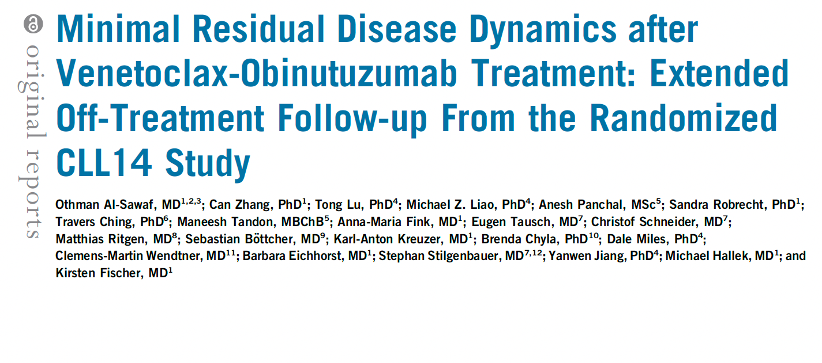
J Clin Oncol 2021;39(36):4049-60.

Slide 54
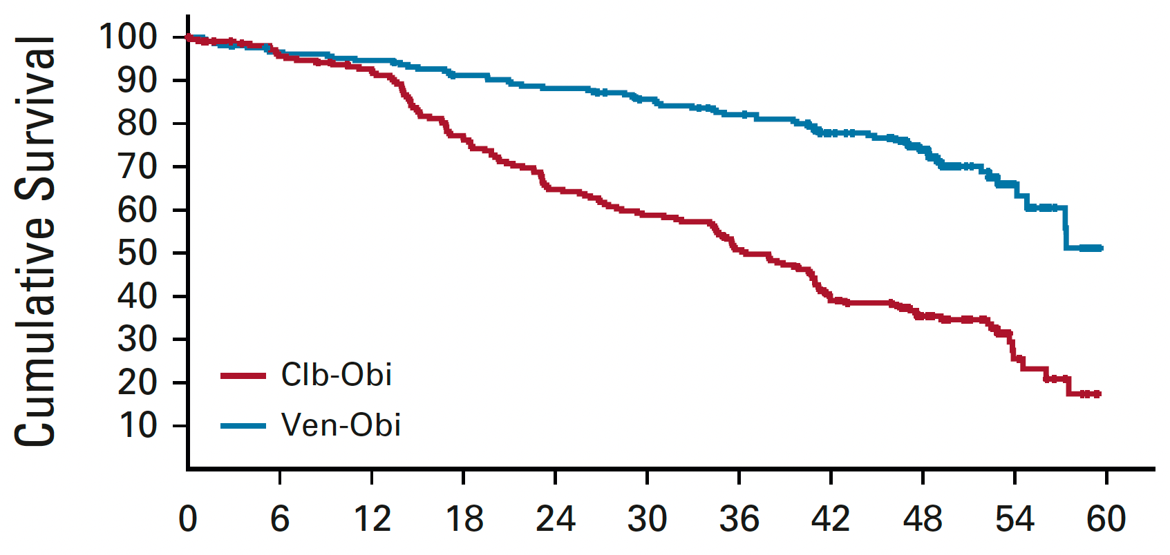
CLL14 Update: Progression-Free Survival
Median F/U: 52.4 months
PFS significantly longer for Ven-Obi in patients with TP53 aberrations and for those with and without IGHV mutations
 | Ven-Obi (n = 216) | Clb-Obi (n = 216)
Median PFS | Not reached | 36.4 mo
 | HR: 0.33, p < 0.0001
Time in Months from Randomization
Al-Sawaf O et al. J Clin Oncol 2021;39(36):4049-60.

Slide 55
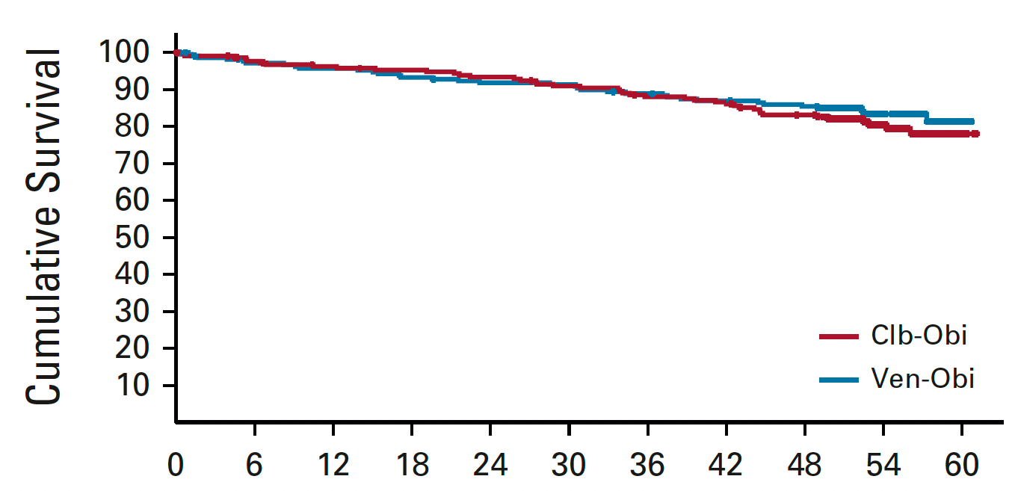
CLL14 Update: Overall Survival
Median F/U: 52.4 months
4-y OS estimate: 85.4% vs 83.1%
HR: 0.85, p = 0.49
Time in Months from Randomization
Al-Sawaf O et al. J Clin Oncol 2021;39(36):4049-60.

Slide 56
Venetoclax Dose Initiation
Courtesy of Matthew S Davids, MD, MMSc

Slide 57
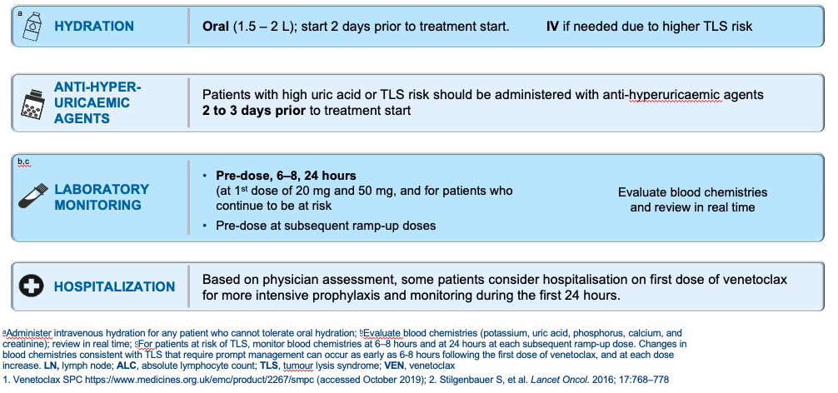
Venetoclax: TLS Prophylaxis and Monitoring
Courtesy of Matthew S Davids, MD, MMSc

Slide 58
Fixed-Duration (FD) Ibrutinib (Ibr) + Venetoclax (Ven) for First-Line Treatment of Chronic Lymphocytic Leukemia (CLL) in Patients (pts) with High-Risk Features: Phase 2 CAPTIVATE Study
Allan JN et al.
AACR 2022;Abstract CTMS02.

Slide 59
CAPTIVATE Study Design
Ghia P et al. ASCO 2021;Abstract 7051.

Slide 60
CAPTIVATE: Efficacy and Safety Summary of Fixed-Duration First-Line Ibrutinib and Venetoclax
Efficacy outcomes | Pts with high-risk features (N = 129)
Overall response rate | 98%
Complete response | 59%
18-mo DoR rate | 95%
uMRD <10⁻⁴ by flow – peripheral blood | 88%
uMRD <10⁻⁴ by flow – bone marrow | 72%
24-mo PFS rate | 94%
24-mo OS rate | 98%
Grade 3/4 adverse events
Neutropenia | 29%
Hypertension | 9%
Neutrophil count decreased | 7%
Allan JN et al. AACR 2022;Abstract CT028.

Slide 61
Fixed-Duration Ibrutinib and Venetoclax (I + V) versus Chlorambucil plus Obinutuzumab (Clb + O) for First-Line (1L) Chronic Lymphocytic Leukemia (CLL): Primary Analysis of the Phase 3 GLOW Study
Kater A et al. EHA 2021;Abstract LB1902.

Slide 62
GLOW: Study Design and Endpoints
Kater A et al. EHA 2021;Abstract LB1902.

Slide 63
GLOW: First-Line Ibrutinib/Venetoclax versus Obinutuzumab/ Chlorambucil IRC-Assessed Progression-Free Survival (PFS)
30-month PFS: 80.5% for Ibr+Ven vs 35.8% for Clb+O
Munir T et al. ASH 2021;Abstract 70.

Slide 64
GLOW: uMRD Rate <10⁻⁴
Munir T et al. ASH 2021;Abstract 70.

Slide 65
Patients with CLL starting on venetoclax/anti-CD20 antibody
Questions — Lowell L Hart, MD
How do you explain to patients what venetoclax is and the potential benefits of this agent and how it is combined with an anti-CD20 antibody?

Slide 66
Patients with CLL starting on venetoclax/anti-CD20 antibody
Questions — Lesley Camille Ballance, MSN, FNP-BC
What are some of the issues you discuss with patients about to begin a venetoclax/anti-CD20 antibody combination?
How do you explain the process to prevent tumor lysis syndrome?
What are some of the psychosocial issues that arise in this situation?

Slide 67
Patients with CLL starting on venetoclax/anti-CD20 antibody
Commentary — Lesley Camille Ballance, MSN, FNP-BC
Potential Problems
TLS
Neutropenia
B-cell aplasia
Treatment intensity
Pt Example: 71-year-old female with SLL started on front-line therapy with Venetoclax and Obinutuzumab
Psychosocial Issues
Anxiety over new therapy
Financial worries
Travel
Family support

Slide 68
Agenda
Module 1 – Overview of CLL
Module 2 – Bruton Tyrosine Kinase Inhibitors
Module 3 – Venetoclax and Anti-CD20 Antibody Therapy
Module 4 – Future Strategies

Slide 69
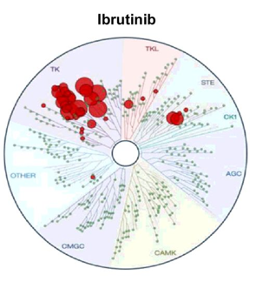
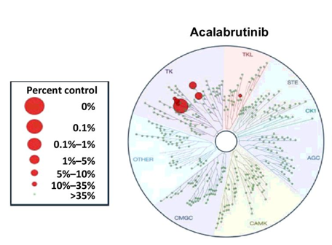
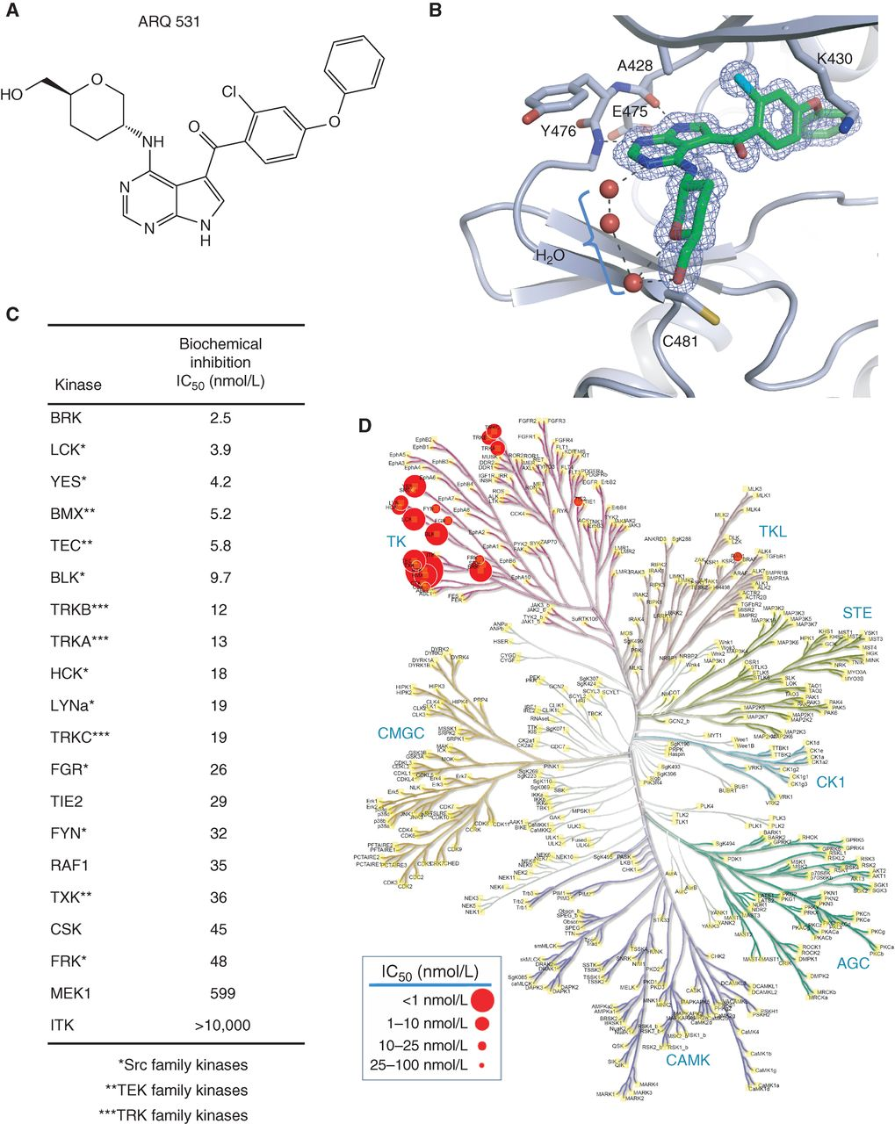
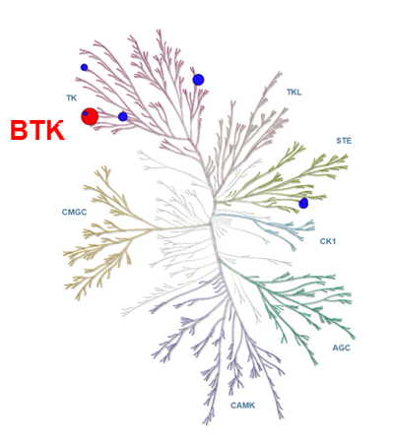
Overview of BTK Inhibitors in CLL
Irreversible
Zanubrutinib
Reversible
ARQ-531 (MK-1026)
Pirtobrutinib (LOXO-305)
Courtesy of Matthew S Davids, MD, MMSc

Slide 70
Pirtobrutinib, a Next Generation, Highly Selective, Non-Covalent BTK Inhibitor in Previously Treated CLL/SLL: Updated Results from the Phase 1/2 BRUIN Study
Mato AR et al.
ASH 2021;Abstract 391.

Slide 71
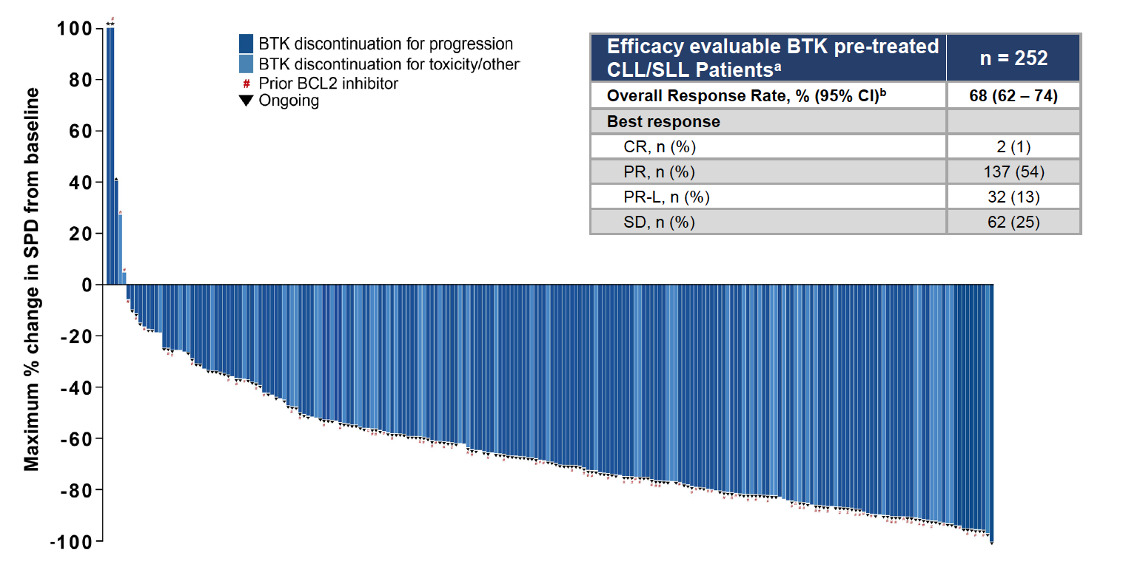
BRUIN: Pirtobrutinib Efficacy in Patients with BTK-Pretreated CLL or Small Lymphocytic Lymphoma (SLL)
Mato AR et al. ASH 2021;Abstract 391.

Slide 72
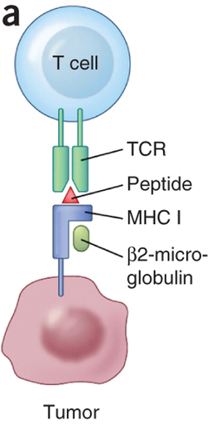
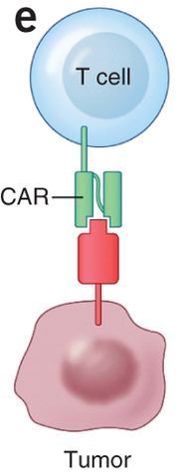
Chimeric Antigen Receptor (CAR) Modified T Cells
Normal T cell
CAR T cell
Genetically engineered T cells altered to express an artificial receptor, CAR
Signaling domain
Ag-recognition domain
Target antigen
Courtesy of Sattva S Neelapu, MD
Adapted from Hinrichs & Restifo. Nat Biotech 2013

Slide 73
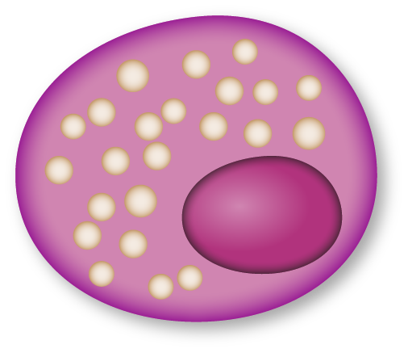
CAR T Cells: Mechanism of Action
T cell
Tumor cell
CAR enables T cell to recognize tumor cell antigen
Expression of CAR
Viral DNA Insertion
Antigen
CAR T cells multiply and release cytokines
Tumor cell apoptosis
Notes:
Slide created by E Squared Communications

Slide 74
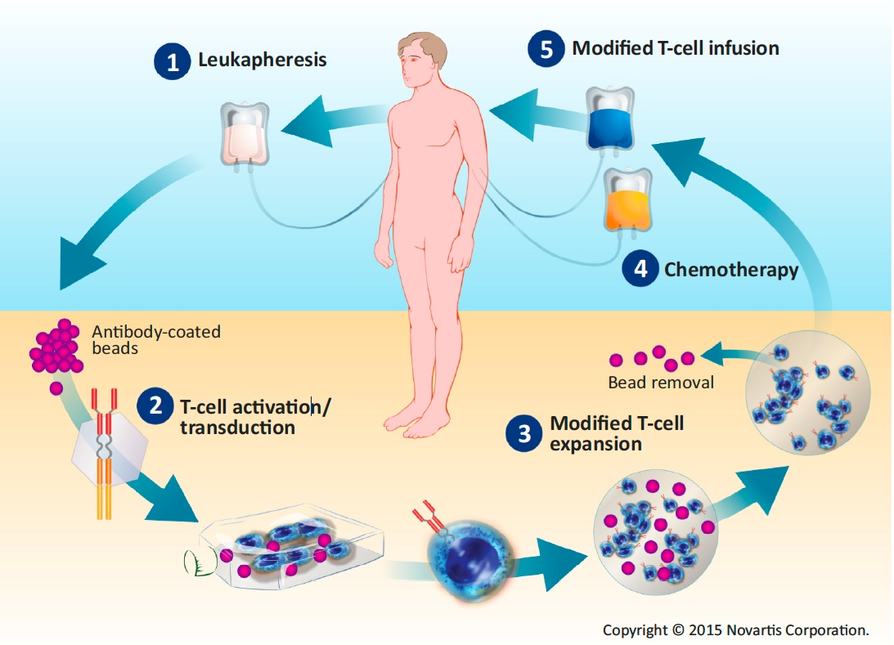
Overview of CAR T-Cell Therapy
7-14 days
Modification, Courtesy, David Porter, MD

Slide 75
Patients with CLL who have exhausted all approved treatment options: Future directions
Questions — Anthony R Mato, MD, MSCE
What are your thoughts about these novel strategies: pirtobrutinib, CAR T-cell therapy and bispecific antibodies?
How do you explain to patients who are eligible for clinical trials with these agents how they work?

Slide 76
Patients with CLL who have exhausted all approved treatment options: Future directions
Commentary — Anthony R Mato, MD, MSCE
What are your thoughts about these novel strategies: pirtobrutinib, CAR T-cell therapy and bispecific antibodies?
Discuss emerging data for Pirtobrutinib in terms of clinical activity / safety profile from BRUIN trial
Focus on low discontinuation rate due to AEs and BTK specific toxicities
Focus on data for Pirtobrutinib in cBTK treated patients
Focus on data for Pirtobrutinib in double exposed patients
Discuss emerging mechanisms of resistance to Pirtobrutinib and emerging strategies to address resistance
Discuss data for CAR-T (Liso-Cel) in R/R CLL
Discuss data for Epcoritamab in R/R CLL
How do you explain to patients who are eligible for clinical trials with these agents how they work?
Discuss MOA for ncBTK (focus on Pirtobrutinib) and how it is both similar and different

Slide 77
Commentary — Anthony R Mato, MD, MSCE
Actual clinical experiences with patients who have exhausted all approved treatment options
> 100 pts treated with Pirtobrutinib at MSKCC as monotherapy and in combination
Discuss experience as lead PI on BRUIN trial
US lead for Epcoritamab in R/R CLL study. Discuss patient with R/R CLL who is on Epo > 12 months and is MRD undetectable
Discuss clinical data for Liso-Cel in R/R CLL – particular focus on patients with double refractory CLL

Slide 78
Patients with CLL who have exhausted all approved treatment options: Future directions
Questions — Amy Goodrich, CRNP
What do you say about potential benefits to patients who are considering clinical trial participation?
How do you dispel common misperceptions of clinical trial participation?
What are some of the psychosocial issues that arise in this situation?

Slide 79
Patients with CLL who have exhausted all approved treatment options: Future directions
Commentary — Amy Goodrich, CRNP
What I say about clinical trials
New drug classes/targets have changed the outlook for patients with CLL
New generations of agents have been successful in many drug classes
Many patients have been on and have had benefit from drugs that were not FDA approved when they were initially diagnosed
Opportunity to get something new, balanced with standard of care options, including sequencing
Can withdraw at any time

Slide 80
Commentary — Amy Goodrich, CRNP
Dispelling common misperceptions
Chronic nature of CLL allows for repeated discussions about trials, new agents, new combinations
Many R/R patients have been on agents/regimens that did not exist when they were initially diagnosed
For TN patients, the observation period allows for questions, education, patients doing their own research
Can withdraw at any time

Slide 81
Commentary — Amy Goodrich, CRNP
Patient #2 with benefit from clinical trial participation
42 yo diagnosed with CLL in 1997, 17p deletion
FCR (1997)
Allo transplant (1998)
DLI (2009)
Lenalidomide on trial 2010
Bendamustine 2010
Ofatumumab 2010
DLI 2010
CAR-T on trial 4 infusions 2011-2012
Bendamustine 2012
Ibrutinib on trial 2013-2018
Venetoclax 2018, obinutuzumab added 2019
Chlorambucil + prednisone 2021
Alemtuzumab 2021
Died at age 66 of infection trying to get on another CAR-T study

Slide 82
Commentary — Amy Goodrich, CRNP
Psychosocial issues
Multiple providers across the country
In constant contact with most of his providers
Ultra educated on disease and trials (open and coming)
Minimized symptoms and side effects
Single, estranged from siblings, no children, little social support
Never believed he would run out of treatment options

Slide 83
Appendix

Slide 84
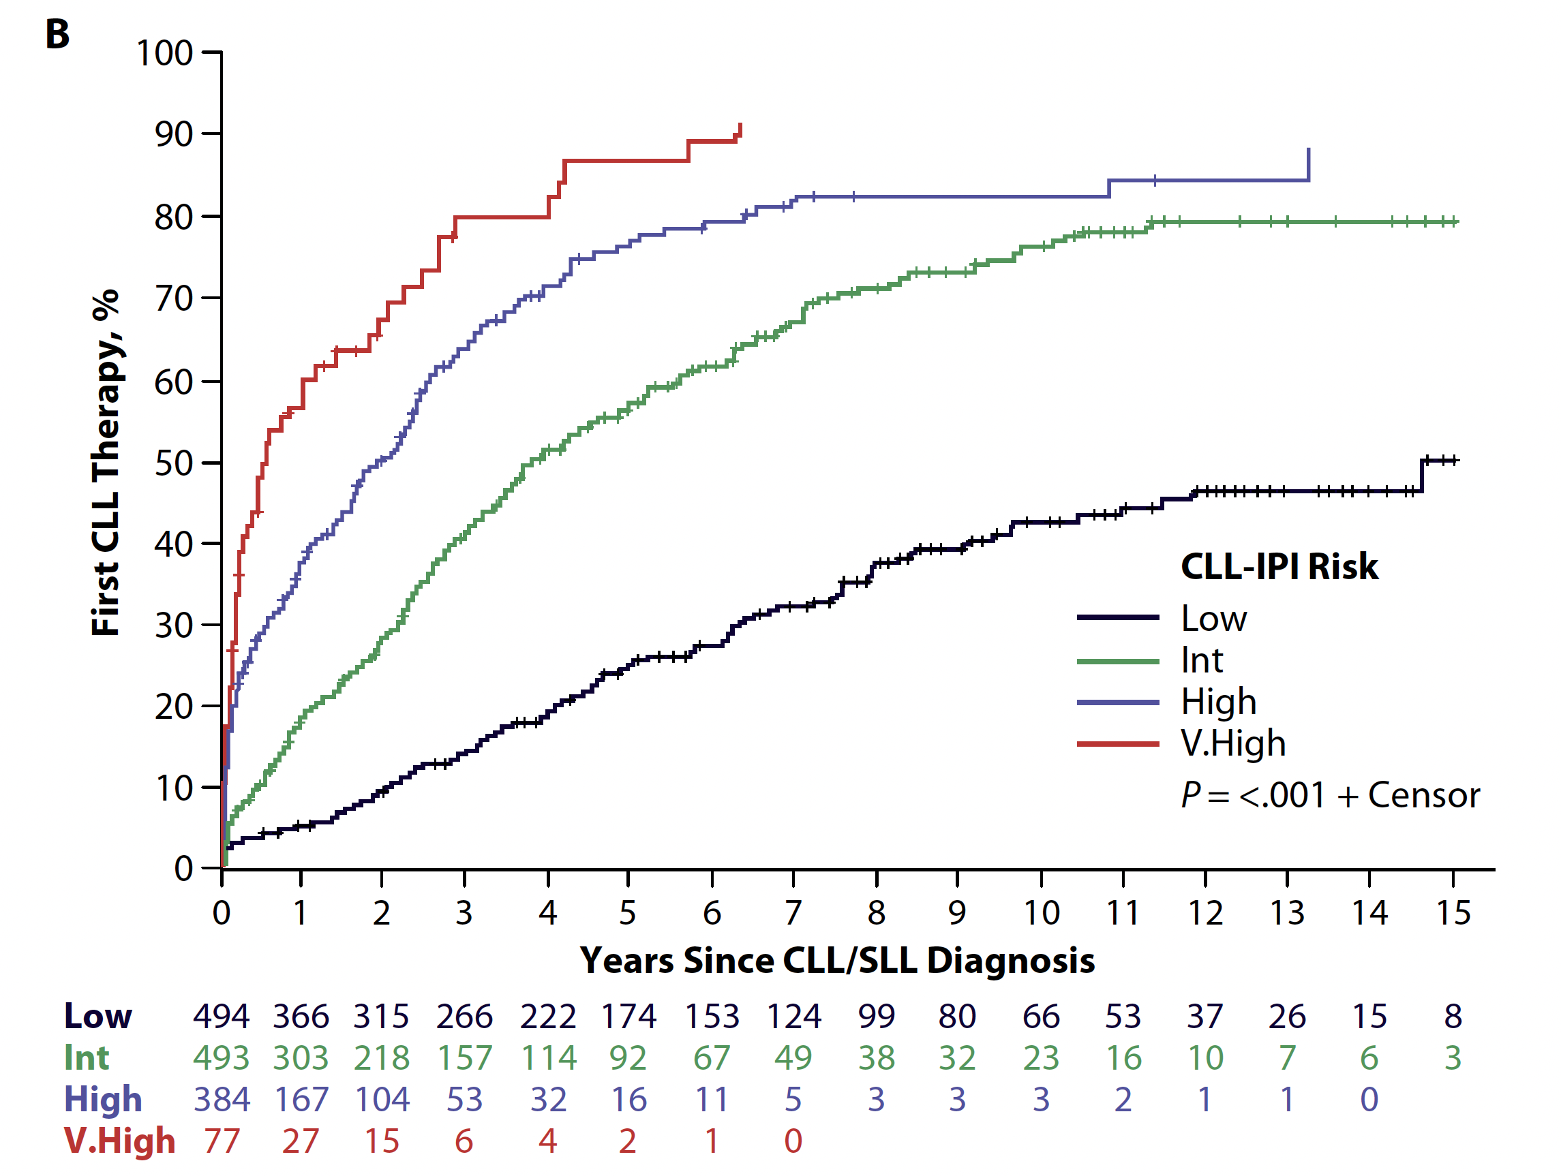
Time to First Therapy Since Chronic Lymphocytic Leukemia (CLL)/Small Cell Lymphoma (SLL) Diagnosis According to CLL-IPI
Muchtar E et al. Clin Adv Hematol Oncol 2021;19(2):92-103.

Slide 85
Patient Education: Ibrutinib
Teaching points
Common side effects
Nausea, diarrhea, arthralgias, fatigue, minor bleeding
Prescription and OTC meds to manage; lifestyle/diet changes; holding for procedures
Uncommon side effects
Major bleeding
A-fib/flutter
Potential for lymphocytosis
Contact/emergency numbers
Monitoring schedule
I see/touch base weekly until good symptom management
Frequent initial labs, we did TLS monitoring due to bulky adenopathy
Courtesy of Amy Goodrich, CRNP

Slide 86
Patient Education: Ibrutinib
Adverse events are common and are often managed by briefly holding for 7 days or less or with supportive care. These include cutaneous toxicities, increased risk for infection (fungal infections), headaches, and myalgias and arthralgias.
During the first 4-6 weeks patients tend to feel fatigued. It is usually better tolerated after the first month.
Weekly labs for the first month to monitor for tumor lysis and organ function. Peripheralization is common in the first weeks to months. Patients should not be alarmed if WBC count increases.
There is an increased bleeding risk. Will have to hold ibrutinib at least 3-7 days prior to procedures and inform the medical team.
Hypertension and atrial fibrillation can occur at any time. New medications should be reported to avoid drug interactions, especially antiplatelet medications.
Courtesy of Kristen E Battiato, AGNP-C

Slide 87
Acalabrutinib
2nd Generation BTK inhibitor
More selective kinase inhibitor = less AE’s
Highly effective
Activity appears comparable to ibrutinib
No 5 year follow up at this point
Better tolerated (my opinion)
Less arthralgia, myalgia, HTN, Afib, Bleeding
Does cause headache – caffeine helps
Other issues
100 mg po BID
Can’t be on proton pump inhibitor
Should take on empty stomach
Courtesy of Brad S Kahl, MD

Slide 88
Patient Education: Acalabrutinib/Obinutuzumab
Pharmacy consultation re potential drug interactions
CYP3A4 interactions - Avoid strong inhibitors & inducers
Azole antifungals, mycin antibiotics, protease inhibitors, etc
Moderate – consider dose adjustment
Avoid grapefruit/juice and Seville oranges
Avoid antacids or calcium supplements and H2 receptor antagonists for 2 hours before and after acalabrutinib
Avoid proton pump inhibitors due to potential decrease in drug exposure
Take with water, with or without food
Possible tumor lysis syndrome
Allopurinol x 10 days at start of therapy
Courtesy of Robin Klebig, APRN, CNP, AOCNP

Slide 89
Patient Education: Acalabrutinib/Obinutuzumab
Acalabrutinib is typically very well tolerated
Bleeding tendency with BTK inhibitors
May note easy bleeding/bruising/petechiae
Avoid NSAIDs, ASA, vitamin E, fish oil
Hold acalabrutinib 3 days prior to and 3 days following minor procedure; 7 days for major procedure
Headache is likely
Usually temporary, first month or so
Typically easily managed with acetaminophen
Courtesy of Robin Klebig, APRN, CNP, AOCNP

Slide 90
Patient Education: Acalabrutinib/Obinutuzumab
Risk for atrial fibrillation
Watch for palpitations, lightheadedness, syncope, dyspnea, irregular rapid pulse
Risk for hypertension
Diarrhea
Loperamide prn
Record # stools per day at baseline
Myalgia/arthralgia
Recommend increase activity, movement, stretching
Treat symptomatically
Nausea
Rash
Cytopenias
Anemia
Typically not transfusion requiring
Leukopenia, neutropenia, lymphocytopenia
Increased infection risk
Thrombocytopenia
Monitor weekly during 1st month
Consider dose adjustment if limiting
Take acalabrutinib indefinitely, as long as responding if no CR
Courtesy of Robin Klebig, APRN, CNP, AOCNP

Slide 91
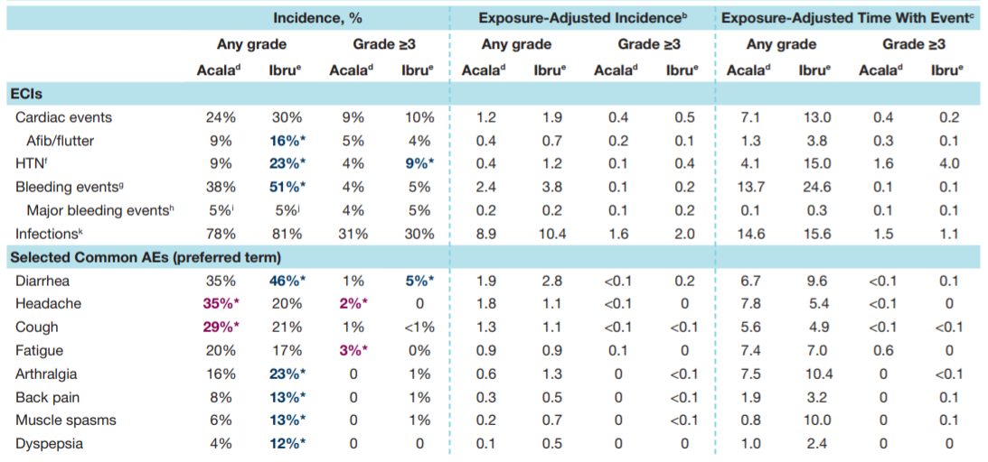
ELEVATE-RR: Characterization of Adverse Events with Acalabrutinib versus Ibrutinib
Seymour JF et al. ASH 2021;Abstract 3721.

Slide 92
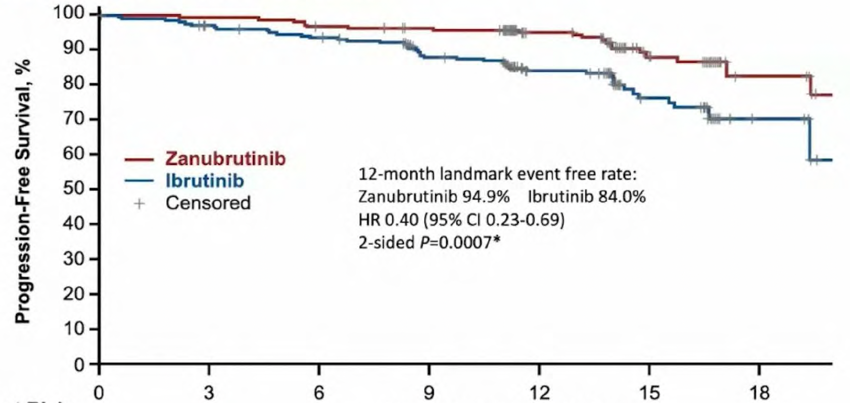
ALPINE: Zanubrutinib versus Ibrutinib for Relapsed CLL Response and Investigator-Assessed Progression-Free Survival
 | Zanubrutinib (n = 207) | Ibrutinib (n = 208)
12-month event-free rate | 94.9% | 84.0%
 | HR: 0.40, p = 0.0007
ORR | 78.3% | 62.5%
ORR for del(17p) | 83.3% | 53.8%
Months from Randomization
Hillmen P et al. EHA 2021;Abstract LBA1900.

Slide 93
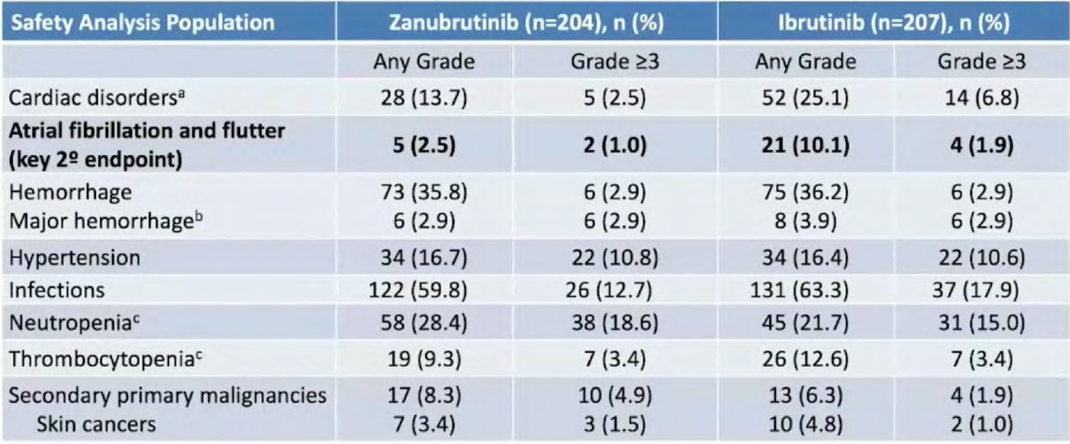
ALPINE: Adverse Events of Special Interest
Hillmen P et al. EHA 2021;Abstract LBA1900.

Slide 94
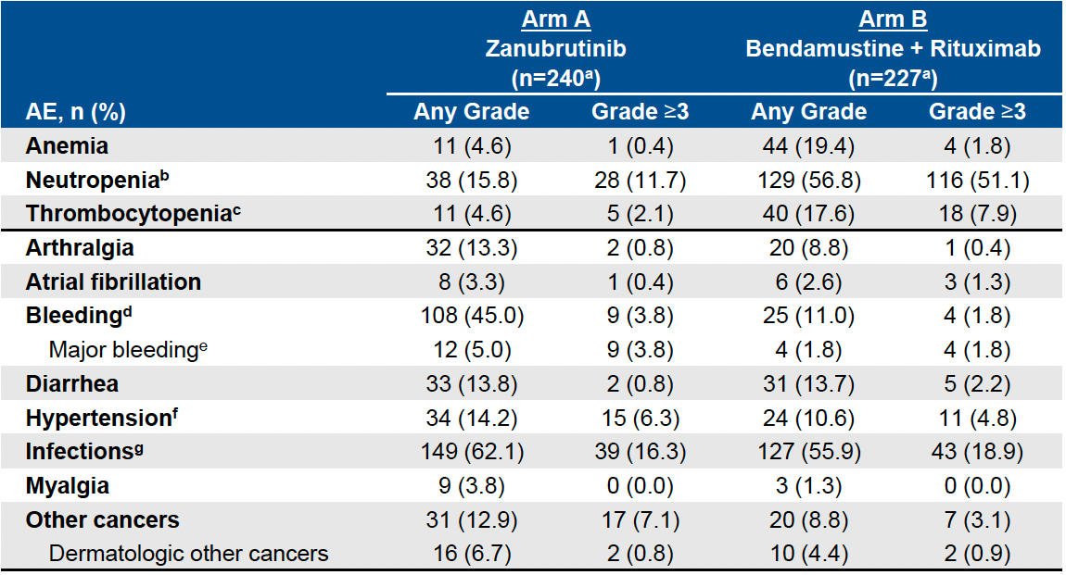
SEQUOIA: Adverse Events (AEs) of Interest
Tam CS et al. ASH 2021;Abstract 396.

Slide 95
Obinutuzumab
Anti-CD20 MoAb
Designed to be a new and improved rituximab
Better than rituximab for CLL
Dosing: 1000 mg flat dose
Cycle 1: Day 1 (100mg), 2 (900mg), 8, 15
Cycle 2-6 Day 1
When to use it
If using venetoclax 12-month time limited therapy, combine with obinutuzumab
If using BTKi obinutuzumab, use is optional
Improves outcomes marginally
Adds some toxicity (mostly infections)
Courtesy of Brad S Kahl, MD

Slide 96
Venetoclax
BCL-2 inhibitor
No lymphocytosis
Highly effective
Remission “deeper" than with BTKi’s
More complete responses. More MRD negativity.
Developed as a 12-month “time limited therapy” when used with obinutuzumab in 1st line
Responses in ~90%. No 5-year data yet.
Generally well tolerated
GI side effects, cytopenias
Tumor Lysis Syndrome
Courtesy of Brad S Kahl, MD

Slide 97
Patient Education: Venetoclax
Pharmacy consultation re potential drug interactions
CYP3A4 interactions - Avoid strong inhibitors & inducers
Azole antifungals, mycin antibiotics, protease inhibitors, etc
Moderate – consider dose adjustment
Avoid grapefruit/juice, Seville oranges, and starfruit
Take with food and water, same time each day
Courtesy of Robin Klebig, APRN, CNP, AOCNP

Slide 98
Patient Education: Venetoclax
Potential for tumor lysis syndrome
5 week ramp up to goal dose
Hospitalization for weekly ramp up (bulky)
TLS lab monitoring q8h x 24 hours
Allopurinol
Hydration
Nausea
prn antiemetic
Diarrhea
Loperamide prn
Record # stools per day at baseline
Cytopenias
Neutropenia
Increased infection risk
Thrombocytopenia
Bleeding risk
Anemia
Typically not transfusion requiring
Courtesy of Robin Klebig, APRN, CNP, AOCNP

Slide 99
Patient Education: Venetoclax/Obinutuzumab
Teaching points and challenges
Obinutuzumab toxicity (infusion reaction, cytopenias, infection risk)
Venetoclax toxicity (mainly TLS, some nausea)
Relatively new combination regimen, health care teams still gaining expertise on patterns of toxicity and management, not typically using obinutuzumab widely
Mother and children were unaware of diagnosis
Continuing to work full time was a priority
Symptomatic anemia
Daughter active in travel sports, timed transfusions around tournaments
Courtesy of Amy Goodrich, CRNP

Slide 100
Venetoclax: Drug Interactions
Strong CYP3A inhibitors: avoid during escalation, later 75% dose reduction
Moderate CYP3A inhibitor or P-gp inhibitors: avoid during escalation, later 50% dose reduction
No contra-indication to anticoagulation in general, but will increase serum warfarin concentration

Slide 101
TLS Risk with Venetoclax Is a Continuum Based on Multiple Factors
Courtesy of Matthew S Davids, MD, MMSc

Slide 102
GLOW: Safety
Kater A et al. EHA 2021;Abstract LB1902.

Slide 103
CAR T-Cell Therapy-Associated Cytokine Release Syndrome (CRS)
CRS — May be mild or life-threatening
Occurs with CART19 activation and expansion
Dramatic cytokine elevations (IL-6, IL10, IFNɤ, CRP, ferritin)
Fevers initially (can be quite high: 105˚F)
Myalgias, fatigue, nausea/anorexia
Capillary leak, headache, hypoxia and hypotension
CRS-related mortality 3% to 10%
Varadarajan I, Lee DW. Cancer J 2019;25(3):223‐30.
Abramson JS et al. ASCO 2019 Education Book.

Slide 104
Cytokine Release Syndrome (CRS): Common Symptoms
CRS
High fevers
Rigors
Myalgia/
arthralgias
Nausea/vomiting/ anorexia
Hypotension
Dyspnea/ tachypnea/ hypoxia
Fatigue
Headache
Escalating fevers
Based on CAR T-cell experience
Diagnosis based on clinical symptoms and events

Slide 105
CAR T-Cell Therapy-Associated Neurologic Toxicity
Neurologic toxicity — May be mild or life-threatening
Mechanism unclear, referred to as immune effector cell-associated neurotoxicity syndrome (ICANS)
Encephalopathy
Seizures
Delirium, confusion, aphasia, agitation, sedation, coma
Varadarajan I, Lee DW. Cancer J 2019;25(3):223‐30.
Abramson JS et al. ASCO 2019 Education Book.

Slide 106
CARTOX App for Grading and Management of CRS and ICANS
Smart phone app available free on both App Store (iPhone) and Google Play (Android)
Sherry Adkins
Neelapu et al. Nat Rev Clin Oncol, Jan 2018
Courtesy of Sattva S Neelapu, MD
Lee et al. Biol Blood Marrow Transplant, 2019 Apr;25 (4):625-638

Slide 107
Patient Education Regarding CAR T-Cell Therapy
CRS
Fever
Neurotoxicity
Tremors
Management of Toxicities
Tocilizumab
Steroids
Hypotension
Tachycardia
Hypoxia
Chills
Dizziness
Delirium
Confusion
Agitation
Cerebral Edema
Adkins S. J Adv Pract Oncol 2019;10(Suppl 3):21-8.

Slide 108
Patient Education Regarding CAR T-Cell Therapy
Logistics
Stay locally for 30 days
Pancytopenia
When to come to ER
Inpatient vs outpatient
Frequent visits to hospital
Local Oncologist to coordinate care
Decreased blood counts
Blood and Platelet Transfusions
Growth Factor Support
Infections
Prophylactic Antibiotics
Other
When to call the clinic
Caregiver 24 hours a day
Ensure caregivers are present
Contact local oncologist
Adkins S. J Adv Pract Oncol 2019;10(Suppl 3):21-8.

Slide 109
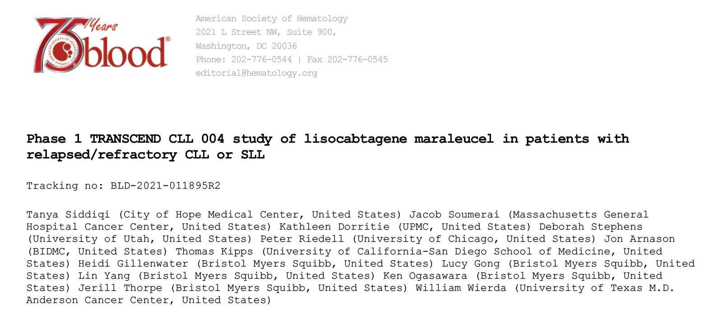
Blood 2022;139(12):1794-806

Slide 110
TRANSCEND CLL 004: Rates of Cytokine Release Syndrome (CRS), Neurologic Events (NE) and Rehospitalization After Liso-cel Infusion
 | All patients (N = 23) | Dose level 1 50 x 10⁶ (n = 9) | Dose level 2 100 x 10⁶ (n = 14)
CRS any grade | 17 (74%) | 7 (78%) | 10 (71%)
CRS Grade ≥3 | 2 (9%) | 0 | 2 (14%)
NE any grade | 9 (39%) | 2 (22%) | 7 (50%)
NE Grade ≥3 | 5 (21%) | 2 (22%) | 2 (14%)
Reasons for patient rehospitalization
Adverse events | 11 (48%) | 3 (33%) | 8 (57%)
CRS and/or NE | 5 (22%) | 1 (11%) | 4 (29%)
CRS and NE | 2 (9%) | 0 | 2 (14%)
NE only | 3 (13%) | 1 (11%) | 2 (14%)
Siddiqi T et al. Blood 2022;139(12):1794-806

Slide 111
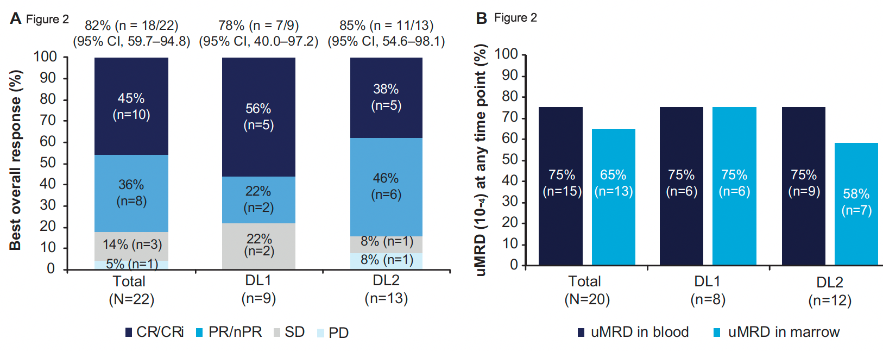
TRANSCEND CLL 004: Response and uMRD (10⁻⁴) Rates
Siddiqi T et al. Blood 2022;139(12):1794-806

