Slide 1
Consensus or Controversy? Investigators Discuss
Clinical Practice Patterns and Available Research
Data Guiding the Management of Hematologic Cancers
Acute Myeloid Leukemia
Friday, December 4, 2020
3:00 PM – 4:30 PM Pacific Time
Faculty
Mark Levis, MD, PhD
Alexander Perl, MD
Daniel A Pollyea, MD, MS
Eytan M Stein, MD
Andrew H Wei, MBBS, PhD
Moderator
Neil Love, MD

Slide 2




Faculty
Mark Levis, MD, PhD
Director, Adult Leukemia Program
Co-Division Director, Hematologic Malignancies
Professor of Oncology
The Sidney Kimmel Comprehensive Cancer Center
Johns Hopkins Medicine
Baltimore, Maryland
Daniel A Pollyea, MD, MS
Associate Professor of Medicine
Clinical Director of Leukemia Services
Robert H Allen, MD Chair in Hematology Research
Division of Hematology
University of Colorado School of Medicine
Aurora, Colorado
Alexander Perl, MD
Associate Professor of Medicine
Perelman School of Medicine at the University of Pennsylvania
Member, Leukemia Program
Abramson Cancer Center of the University of Pennsylvania
Philadelphia, Pennsylvania
Eytan M Stein, MD
Assistant Attending Physician
Director, Center for Drug Development in Leukemia
Leukemia Service, Department of Medicine
Memorial Sloan Kettering Cancer Center
New York, New York

Slide 3


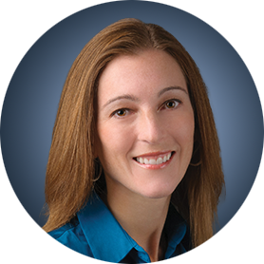

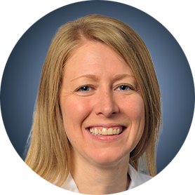
Faculty
Andrew H Wei, MBBS, PhD
Adjunct Professor, Department of Haematology
Alfred Hospital and Monash University
Melbourne, Australia
Moderator
Neil Love, MD
Research To Practice
Miami, Florida
Consensus or Controversy Survey Participants
(in Addition to Our Faculty)
Courtney D DiNardo, MD, MSCE
The University of Texas
MD Anderson Cancer Center
Houston, Texas
Eunice S Wang MD
Roswell Park Comprehensive Cancer Institute
Buffalo, New York
Alice S Mims, MD
The James Cancer Hospital at The Ohio State University
Columbus, Ohio

Slide 4
Commercial Support
This activity is supported by educational grants from AbbVie Inc, Astellas, Bristol-Myers Squibb Company, Daiichi Sankyo Inc, Genentech, a member of the Roche Group, Helsinn Healthcare SA and Pfizer Inc.

Slide 5
Dr Love — Disclosures
Dr Love is president and CEO of Research To Practice. Research To Practice receives funds in the form of educational grants to develop CME activities from the following commercial interests: AbbVie Inc, Acerta Pharma — A member of the AstraZeneca Group, Adaptive Biotechnologies Corporation, Agendia Inc, Agios Pharmaceuticals Inc, Amgen Inc, Array BioPharma Inc, a subsidiary of Pfizer Inc, Astellas, AstraZeneca Pharmaceuticals LP, Bayer HealthCare Pharmaceuticals, Biodesix Inc, bioTheranostics Inc, Blueprint Medicines, Boehringer Ingelheim Pharmaceuticals Inc, Bristol-Myers Squibb Company, Celgene Corporation, Clovis Oncology, Daiichi Sankyo Inc, Dendreon Pharmaceuticals Inc, Eisai Inc, EMD Serono Inc, Epizyme Inc, Exelixis Inc, Foundation Medicine, Genentech, a member of the Roche Group, Genmab, Genomic Health Inc, Gilead Sciences Inc, GlaxoSmithKline, Grail Inc, Guardant Health, Halozyme Inc, Helsinn Healthcare SA, ImmunoGen Inc, Incyte Corporation, Infinity Pharmaceuticals Inc, Ipsen Biopharmaceuticals Inc, Janssen Biotech Inc, administered by Janssen Scientific Affairs LLC, Jazz Pharmaceuticals Inc, Karyopharm Therapeutics, Kite, A Gilead Company, Lexicon Pharmaceuticals Inc, Lilly, Loxo Oncology Inc, a wholly owned subsidiary of Eli Lilly & Company, Merck, Merrimack Pharmaceuticals Inc, Myriad Genetic Laboratories Inc, Natera Inc, Novartis, Oncopeptides, Pfizer Inc, Pharmacyclics LLC, an AbbVie Company, Prometheus Laboratories Inc, Puma Biotechnology Inc, Regeneron Pharmaceuticals Inc, Sandoz Inc, a Novartis Division, Sanofi Genzyme, Seagen Inc, Sirtex Medical Ltd, Spectrum Pharmaceuticals Inc, Sumitomo Dainippon Pharma Oncology Inc, Taiho Oncology Inc, Takeda Oncology, Tesaro, A GSK Company, Teva Oncology, Tokai Pharmaceuticals Inc and Verastem Inc.

Slide 6
Research To Practice CME Planning Committee Members,
Staff and Reviewers
Planners, scientific staff and independent reviewers for Research To Practice have no relevant conflicts of interest to disclose.

Slide 7
Dr Levis — Disclosures
Advisory Committee | AbbVie Inc, Agios Pharmaceuticals Inc, Amgen Inc, Astellas, Bristol-Myers Squibb Company, Daiichi Sankyo Inc, FUJIFILM Pharmaceuticals USA Inc, Menarini Group, Takeda Oncology
Contracted Research | Astellas, FUJIFILM Pharmaceuticals USA Inc

Slide 8
Dr Perl — Disclosures
Advisory Committee | AbbVie Inc, Actinium Pharmaceuticals Inc, Astellas, Daiichi Sankyo Inc, FORMA Therapeutics, Loxo Oncology Inc, a wholly owned subsidiary of Eli Lilly & Company, NewLink Genetics
Consulting Agreements | AbbVie Inc, Arog Pharmaceuticals Inc, Astellas, Daiichi Sankyo Inc
Contracted Research | AbbVie Inc, Astellas, Bayer HealthCare Pharmaceuticals, Daiichi Sankyo Inc, FUJIFILM Pharmaceuticals USA Inc
Data and Safety Monitoring Board/Committee | Leukemia & Lymphoma Society

Slide 9
Dr Pollyea — Disclosures
Advisory Committee | AbbVie Inc, Amgen Inc, Bristol-Myers Squibb Company, Celgene Corporation, Genentech, a member of the Roche Group, Karyopharm Therapeutics, Kiadis Pharma, Novartis, Syndax Pharmaceuticals Inc, Syros Pharmaceuticals Inc, Takeda Oncology
Contracted Research | AbbVie Inc
Data and Safety Board/Committee | GlycoMimetics Inc, Takeda Oncology

Slide 10
Dr Stein — Disclosures
Advisory Committee | AbbVie Inc, Agios Pharmaceuticals Inc, Astellas, Bristol-Myers Squibb Company, Celgene Corporation, Daiichi Sankyo Inc, Genentech, a member of the Roche Group, Janssen Biotech Inc, Novartis, Ono Pharmaceutical Co Ltd, Syndax Pharmaceuticals Inc, Syros Pharmaceuticals Inc
Contracted Research | Agios Pharmaceuticals Inc, Bayer HealthCare Pharmaceuticals, BioTheryX Inc, Bristol-Myers Squibb Company, Celgene Corporation, Loxo Oncology Inc, a wholly owned subsidiary of Eli Lilly & Company, Prelude Therapeutics, Syndax Pharmaceuticals Inc, Syros Pharmaceuticals Inc

Slide 11
Dr Wei — Disclosures
Advisory Committee | AbbVie Inc, Amgen Inc, Astellas, AstraZeneca Pharmaceuticals LP, Celgene Corporation, Genentech, a member of the Roche Group, Janssen Biotech Inc, MacroGenics Inc, Novartis, Pfizer Inc, Servier
Consulting Agreement | Servier
Contracted Research | AbbVie Inc, Amgen Inc, AstraZeneca Pharmaceuticals LP, Celgene Corporation, Novartis, Servier
Royalties | Former employee of the Walter and Eliza Hall Institute of Medical Research receiving a fraction of its royalty stream related to venetoclax
Speakers Bureau | AbbVie Inc, Genentech, a member of the Roche Group

Slide 12
ASH AML 2020 Presentation Library
Optimizing the Management of AML in Older Patients or Those Ineligible for Intensive Chemotherapy Andrew H Wei, MBBS, PhD
Treatment Options for Patients with AML Harboring FLT3 Mutations Alexander Perl, MD
Management of Newly Diagnosed and Previously Treated AML with IDH Mutations Eytan M Stein, MD
Tailoring Induction and Maintenance Therapy for Younger Patients with AML without Targetable Tumor Mutations Mark Levis, MD, PhD
Other Novel Agents and Investigational Strategies for Patients with AML Daniel A Pollyea, MD, MS
Download Slides
Download Slides
Download Slides
Download Slides
Download Slides

Slide 13
Agenda
Module 1: Optimizing the Management of AML in Older Patients or Those Ineligible for
Intensive Chemotherapy — Dr Wei
Module 2: Treatment Options for Patients with AML Harboring FLT3 Mutations — Dr Perl
Module 3: Management of Newly Diagnosed and Previously Treated AML with
IDH Mutations — Dr Stein
Module 4: Tailoring Induction and Maintenance Therapy for Younger Patients with
AML without Targetable Tumor Mutations — Dr Levis
Module 5: Other Novel Agents and Investigational Strategies for Patients with AML —
Dr Pollyea

Slide 14
Life expectancy in older people
Courtesy of Andrew H Wei, MBBS, PhD
SSA USA 2017

Slide 15
Recent FDA-approved drugs for AML (Survival Outcomes)
7+3 + midostaurin¹ | CPX-351² | LDAC + glasdegib³ | AZA + enasidenib⁴
7+3 + GO⁵ | Gilteritinib⁶ | CC-486⁷ | AZA + venetoclax⁸
100
100
100
100
ENA + AZA, n=68: 22.0 months
80
80
80
80
60
60
60
60
Survival (%)
Survival (%)
HR=0.46 (95% CI=0.3–0.71)
p=0.0002
Survival (%)
AZA, n=33:
22.3 months
40
40
40
40
20
20
HR=0.69
One-sided p=0.003
20
20
0
0
0
0
0
12
24
36
48
60
72
84
90
0
3
6
9
12
15
18
21
24
27
30
33
36
0
4
8
12
16
20
24
28
32
36
0
3
6
9
12
15
18
21
24
27
30
33
Time since random assignment (months)
Time (months)
Time (months)
100
GO arm, n=135:
27.5 months
100
100
1.0
Gilteritinib, n=247: 9.3 months
CC-486, n=238:
24.7 months
Ven + AZA, n=286:
14.7 months
80
80
80
0.8
Control arm, n=136: 21.8 months
Salvage chemo, n=124: 5.6 months
Placebo, n=234:
14.8 months
Placebo + AZA, n=145:
9.6 months
60
60
60
0.6
Survival (%)
Survival (%)
Survival (probability)
40
40
40
0.4
20
20
20
Δ 9.9 months
0.2
HR=0.81 (95% CI=0.60–1.09)
Two-sided p=0.16
HR=0.64 (95% CI=0.49–0.83); p<0.001
HR=0.69 (95% CI=0.55–0.86)
p=0.0009
0
0
0
0.0
0
3
6
9
12
15
18
21
24
27
30
33
0
6
12
18
24
30
36
42
48
54
60
66
72
0
3
6
9
12
15
18
21
24
27
30
33
0
6
12
18
24
30
36
42
48
54
60
66
Time (months)
78
Time (months)
AZA, azacitidine; ENA, enasidenib; GO, gemtuzumab ozogamicin; LDAC, low-dose cytarabine; Ven, venetoclax.
1. Stone M, et al. N Engl J Med 2017; 377:454–464; 2. Lancet JE, et al. J Clin Oncol 2018; 36:2684–2692; 3. Norsworthy KJ, et al. Clin Cancer Res 2019; 25:6021–6025;
4. DiNardo CD, et al. EHA 2020; oral presentation S139 5. Lambert J, et al. Haematologica 2019; 104:113–119; 6. Perl AE, et al. N Engl J Med 2019; 381:1728–1740;
7. Wei AH, et al. ASH 2019; oral presentation LBA3; 8. DiNardo CD, et al. N Engl J Med 2020; 383:617–629.

Slide 16
Comparison of HMA or LDAC + venetoclax responses
VIALE-C
VIALE-A
 |  | VEN (n=143) | PBO (n=68) | VEN (n=286) | PBO (n=145)
Response | CR/CRi | 48% | 13% | 66% | 28%
 | CR | 28% | 7% | 37% | 18%
 | Duration of CR | 17 mo | 8 mo | 17.5 mo | 13.5 mo
Courtesy of Andrew H Wei, MBBS, PhD
Wei et al, Blood 2020; EHA 2020, Di Nardo et al, EHA 2020

Slide 17
Uncertainties with targeting BCL2 in AML
7-day pre-phase
7 days
  Role of monotherapy
  Safety in MF-associated AML
  Optimal dose in combination with anti-fungal agents
  Role of VEN in prior HMA failure
  Management of VEN-AZA treatment failure
Venetoclax
D1-5
Ara-C 100mg/m²/d cIV
D2-3
Idarubicin 12mg/m²/d IV
7d of Ven monotherapy
Chua C, et al, JCO 2020
Courtesy of Andrew H Wei, MBBS, PhD

Slide 18
Future directions
More intensive combinations
Combinations with targeted therapies
  Targeted drugs
  Immunotherapy
Maintenance therapy
More convenient regimens- with CC-486, ASTX727 (decitabine + cedazuridine)
Courtesy of Andrew H Wei, MBBS, PhD

Slide 19
What initial treatment would you generally recommend for an
80-year-old patient with AML and intermediate-risk cytogenetics?
N = 168
Survey of live webinar audience

Slide 20
What initial treatment would you generally recommend for an 80-year-old patient with AML and intermediate-risk cytogenetics?
Azacitidine + venetoclax
Azacitidine + venetoclax
Azacitidine + venetoclax
Azacitidine + venetoclax
Azacitidine + venetoclax
Azacitidine + venetoclax
Azacitidine + venetoclax
Azacitidine + venetoclax
Azacitidine + venetoclax
LDAC, low-dose cytarabine

Slide 21
What initial treatment would you generally recommend for an 80-year-old patient with AML and poor-risk cytogenetics?
Azacitidine + venetoclax
Azacitidine + venetoclax
Azacitidine + venetoclax
Azacitidine + venetoclax
Azacitidine + venetoclax
Azacitidine + venetoclax
Azacitidine + venetoclax
Azacitidine + venetoclax
Azacitidine + venetoclax
LDAC, low-dose cytarabine

Slide 22
What initial treatment would you recommend for a 65-year-old patient with AML with a performance status (PS) of 2 and a history of hypertension, coronary artery disease and diabetes mellitus, assuming organ function is normal?
7 + 3 induction
7 + 3 induction if
non-adverse cytogenetics
7 + 3 induction
Azacitidine + venetoclax
Azacitidine + venetoclax
7 + 3 induction or azacitidine + venetoclax
Azacitidine + venetoclax
Azacitidine + venetoclax
Azacitidine + venetoclax, 7 + 3 induction

Slide 23
How would you compare the global efficacy of venetoclax/HMA or venetoclax/low-dose cytarabine to that of glasdegib/low-dose cytarabine in patients with AML?
Venetoclax-based therapy
is more efficacious
Venetoclax-based therapy
is more efficacious
Venetoclax-based therapy
is more efficacious
Venetoclax-based therapy
is more efficacious
Venetoclax-based therapy
is more efficacious
Venetoclax-based therapy
is more efficacious
Venetoclax-based therapy
is more efficacious
Venetoclax-based therapy
is more efficacious
Venetoclax-based therapy is more efficacious

Slide 24
How would you compare the tolerability/toxicity of venetoclax/HMA or venetoclax/low-dose cytarabine to that of glasdegib/low-dose cytarabine in patients with AML?
Venetoclax-based therapy
has less toxicity
Glasdegib/LDAC has
less toxicity
Venetoclax-based therapy
has less toxicity
About the same
Not enough data to answer
About the same
Venetoclax-based therapy
has less toxicity
Glasdegib/LDAC has
less toxicity
Venetoclax-based therapy has less toxicity

Slide 25
Case Presentation – Dr Wei: A 78-year-old woman with AML with 34% marrow blasts
78yo lady
Dec 2014: AML 34% blasts (IDH2 R140Q)
  Rx LDAC + VEN → CR
  Ceased in July 2016 (15 cycles)
  IDH2 R140Q still present
Jan 2020: Relapse 51% blasts (IDH2 R140Q,
new SRSF2)
  Rx enasidenib → MLFS EOC4 2% blasts
FLT3-ITD relapse
  Rx gilteritinib
Learning points
Patient able to cease therapy
Relapse 3.5 years after ceasing therapy
Important to look for targetable causes of clonal evolution with targeted therapy
Courtesy of Andrew H Wei, MBBS, PhD

Slide 26
Agenda
Module 1: Optimizing the Management of AML in Older Patients or Those Ineligible for
Intensive Chemotherapy — Dr Wei
Module 2: Treatment Options for Patients with AML Harboring FLT3 Mutations — Dr Perl
Module 3: Management of Newly Diagnosed and Previously Treated AML with
IDH Mutations — Dr Stein
Module 4: Tailoring Induction and Maintenance Therapy for Younger Patients with
AML without Targetable Tumor Mutations — Dr Levis
Module 5: Other Novel Agents and Investigational Strategies for Patients with AML —
Dr Pollyea

Slide 27
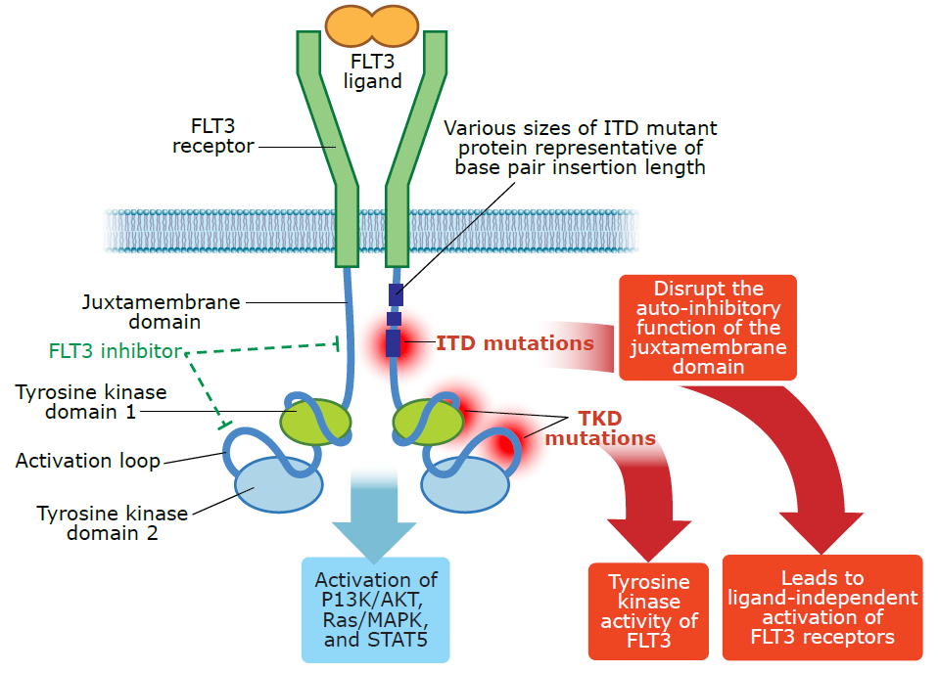
FLT3 mutations in AML
Incidence
  FLT3-ITD 20-25%
  FLT3-TKD 5-10%
Clinical features
  Leukocytosis
  High marrow blast percent
  Proliferative disease
Genetic associations
  Diploid karyotype
  NPM1 mutation
  t(6;9)
  t(15;17)
Frequently subclonal
  gained at relapse/progression
  sometimes lost at relapse/progression
ITD= internal tandem duplication
TKD= tyrosine kinase domain
Slide courtesy of Ashkan Emadi
Courtesy of Alexander Perl, MD

Slide 28
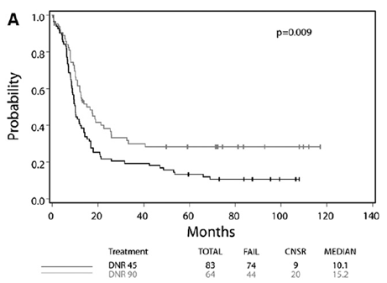
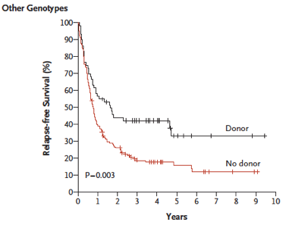
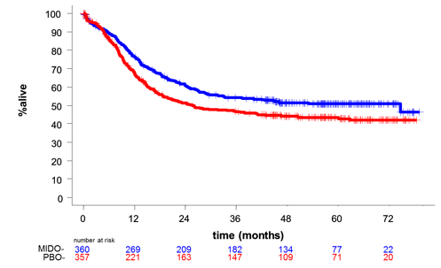
3 therapies improve FLT3-ITD+ AML cure rates
High dose daunorubicin
First remission AlloHSCT
Midostaurin
Note: includes FLT3-ITD (77%) and FLT3-D835 (23%)
57% underwent alloHSCT
Luskin MR, et al. Blood. 2016 Mar 24;127(12):1551-8
Schlenk RF, et al. N Engl J Med. 2008 May 1;358(18):1909-18.
Stone RM, et al. N Engl J Med. 2017 Aug 3;377(5):454-464
Courtesy of Alexander Perl, MD

Slide 29


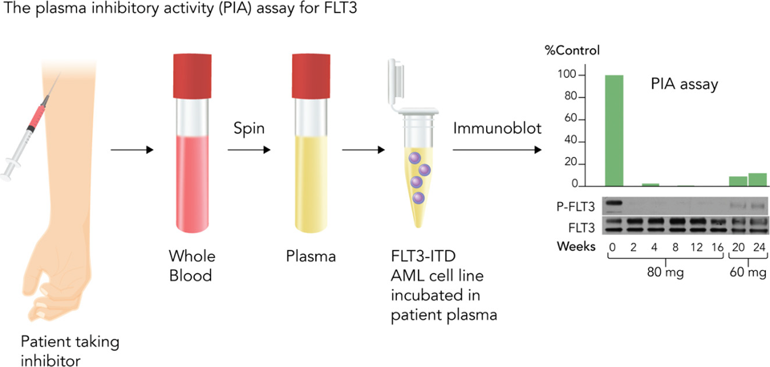
Potency and selectivity of FLT3 inhibitors
 | IC₅₀ (medium) | IC₅₀ (plasma) | Single agent clinical activity | Kinase inhibition
Lestaurtinib | 2 nM | 700 nM | - | Type 1
Midostaurin | 6 nM | ~1000 nM | - | Type 1
Sorafenib | 3 nM | ~265 nM | +/- | Type 2
Quizartinib | 1 nM | 18 nM | + | Type 2
Crenolanib | 2 nM | 48 nM | + | Type 1
Gilteritinib | 3 nM | 43 nM | + | Type 1
Type 2 inhibitors: resistance due to FLT3-D835
Type 1 inhibitors: active against FLT3-D835, limited potential for on-target resistance
1st gen
Class 3 RTK’s:
FLT3, KIT, CSF1R, PDGFRA/B
2nd gen
Midostaurin
Quizartinib
Pratz KW, et al. Blood 2010;115(7):1425-32
Zarrinkar PP, et al. Blood. 2009 Oct 1;114(14):2984-92
Galanis A, et al. Blood 2014 Jan 2;123(1):94-100
Levis M, Perl AE. Blood Adv. 2020 Mar 24;4(6):1178-1191
Smith CC, et al. Nature. 2012 Apr 15;485(7397):260-3
Tarver TC, et al. Blood Adv. 2020 Feb 11;4(3):514-524
Courtesy of Alexander Perl, MD

Slide 30
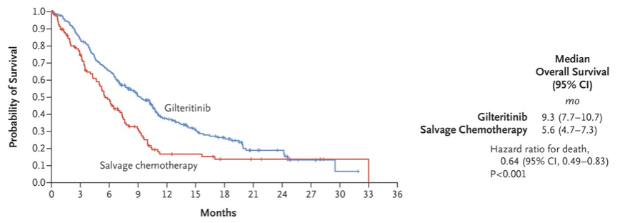
Current relapsed/refractory standard of care: gilteritinib
Gilteritinib Phase 3 (ADMIRAL)
Gilteritinib n = 247
HSCT
Gilteritinib
R/R FLT3-mut+ AML
R
2:1
Chemotherapy; n = 124
HSCT
High intensity (MEC or FLAG-IDA)
Low intensity (LDAC or azactidine)
CR/CRh
34%
15.3%
Gilteritinib toxicities:
  Cytopenias, elevation of LFTs, CPK, fevers/rashes (Sweet’s syndrome)
  Uncommon toxicities: differentiation syndrome, QT prolongation
Courtesy of Alexander Perl, MD
Perl AE, et al. N Engl J Med. 2019;381:1728-1740.

Slide 31
Ongoing questions in the FLT3 world
The NCCN guidelines only recommend midostaurin for intermediate risk karyotype FLT3^{mut+}--does it work in other patients?
Do FLT3-TKD+ patients benefit from midostaurin?
Which FLT3^{mut+} patients need transplant?
Should I give TKI maintenance after transplant?
Should I give midostaurin or a newer FLT3 inhibitor with induction?
What should newly diagnosed FLT3^{mut+} unfit patients receive?
Courtesy of Alexander Perl, MD

Slide 32
Newer FLT3 inhibitors in frontline intensive therapy?
Combination: gilteritinib + intensive chemotherapy for newly diagnosed FLT3mut+ AML
Response FLT3^{mut+} (n=33†) | N (%)
CR | 22 (66.7)
CRp | 1 (3.0)
CRi | 8 (24.2)
PR | 0
NR | 2 (6.1)
CRc‡ | 31 (93.9)
HSCT
up to 2 induction cycles permitted; HSCT followed by maintenance allowed without leaving study
Trial | Phase (N) | Control | Maintenance | Primary endpoint | status
Quantum-FIRST (quizartinib)¹ | 3 (539) | Placebo | 1-3 years | EFS, OS | Enrollment complete
ARO-021 (crenolanib)² | 3 (510) | Midostaurin | 1 year | EFS | Ongoing (US)
PrECOG 0905 (gilteritinib)³ | 2 (170) | Midostaurin | None | FLT3^{mut}(-) CRc | Ongoing (US)
HOVON 156 (gilteritinib)⁴ | 3 (768) | Midostaurin | 1 year | EFS | Ongoing (Europe)
Pratz KW, et al. Blood 2018; 132 (Supplement 1): 564
NCT02668653
NCT03258931
NCT03836209
NCT04027309
Courtesy of Alexander Perl, MD

Slide 33
VIALE-A Response Rates (CR+CRi) by Subgroups
AZA + venetoclax vs. AZA/placebo
CR=37%
CR/CRi= 66%
HMA + ven: median OS= 14.7 mo
HMA + PBO: median OS=9.6 mo
Age >60 unfit or age >75 fit/unfit
All non-CBF subtypes, no prior HMA
Courtesy of Alexander Perl, MD
DiNardo CD, et al. EHA 2020, #LB2601

Slide 34
What would you recommend as first-line therapy to a
60-year-old patient who presents with intermediate-risk AML and a FLT3-TKD mutation?
7 + 3 induction +
midostaurin
7 + 3 induction + midostaurin
7 + 3 induction +
midostaurin
7 + 3 induction + midostaurin
7 + 3 induction +
midostaurin
7 + 3 induction + midostaurin
7 + 3 induction +
midostaurin
7 + 3 induction + midostaurin
7 + 3 induction + midostaurin

Slide 35
What would you recommend as first-line therapy to a 60-year-old patient who presents with intermediate-risk AML and a FLT3-ITD mutation?
7 + 3 induction + midostaurin
7 + 3 induction + midostaurin
7 + 3 induction + midostaurin
7 + 3 induction + midostaurin OR 7 + 3 + gilteritinib
7 + 3 induction + midostaurin
7 + 3 induction + midostaurin
7 + 3 induction + midostaurin
7 + 3 induction + midostaurin
7 + 3 induction + midostaurin

Slide 36
What would you recommend as first-line therapy to a 78-year-old patient (PS 0) who presents with intermediate-risk AML with a
FLT3-ITD mutation?
N = 120
HMA = hypomethylating agent
Survey of live webinar audience

Slide 37
What would you recommend as first-line therapy to a 78-year-old patient (PS 0) who presents with intermediate-risk AML with a FLT3-ITD mutation?
Azacitidine + venetoclax x 2 → azacitidine + gilteritinib x 2 → gilteritinib
Azacitidiine + venetoclax + gilteritinib
Azacitidine + venetoclax
Azacitidine + venetoclax + gilteritinib
Azacitidine + venetoclax
Azacitidine + gilteritinib
Azacitidine + venetoclax
Azacitidine + venetoclax
Azacitidine + venetoclax

Slide 38
What would you recommend as first-line therapy to a
78-year-old patient with a history of cardiac and renal abnormalities (PS 2) who presents with intermediate-risk AML with a FLT3-ITD mutation?
Azacitidine + venetoclax x 2 → azacitidine + gilteritinib x 2 → gilteritinib
Low-dose cytarabine + venetoclax + gilteritinib
Azacitidine + venetoclax
Gilteritinib or azacitidine + gilteritinib
Azacitidine + venetoclax
Azacitidine + gilteritinib
Azacitidine + venetoclax
Azacitidine + venetoclax
Azacitidine + venetoclax

Slide 39
A 60-year-old patient with AML with a FLT3 mutation receives 7 + 3 induction and midostaurin, achieves remission and receives consolidation with 3 cycles of modified high-dose cytarabine and midostaurin. Four months after completion of therapy he experiences disease progression, and a FLT3 ITD mutation (allelic burden of 0.4) is confirmed. What would you recommend?
Gilteritinib + venetoclax if I can get it approved, else gilteritinib + azacitidine
Gilteritinib OR Azacitidine + venetoclax + gilteritinib
Venetoclax + gilteritinib
Azacitidine + venetoclax + gilteritinib
Gilteritinib
Gilteritinib
Gilteritinib
Gilteritinib
Gilteritinib
MEC = mitoxantrone/etoposide/cytarabine

Slide 40
Case Presentation – Dr Perl: A 53-year-old woman with AML with a FLT3-ITD mutation
53 YO previously well woman presents (in early 2017) with progressive DOE of 2 weeks duration
  laboratory tests show hyperleukocytosis ( WBC= 301K) with >95% blasts and she is leukapheresed
Marrow biopsy diagnoses her with AML with myelodysplasia-related changes
  Karyotype: 46,XX,i(17)(q10)
  PCR: FLT3-ITD+ (ITD:WT allelic ratio: 0.5), no other mutations on 68 gene NGS panel
She is induced with 7 + 3 but is refractory after two cycles, genetics unchanged from dx.
She enrolls on a phase 3 clinical trial of a FLT3 inhibitor vs. standard chemotherapy
  randomizes to control arm and does not respond
She receives sorafenib and azacitidine
  peripheral blasts clear and marrow blasts decrease to <10% after two cycles.
  FLT3-ITD remains detectable by PCR
She undergoes a myeloablative HSCT from her HLA-identical sibling.
  she tolerates transplant well, engrafts with full donor chimerism, and has no detectable FLT3-ITD in marrow
  She is started on post-HSCT sorafenib maintenance on day +50.
Courtesy of Alexander Perl, MD

Slide 41
Case Presentation – Dr Perl: A 53-year-old woman with AML with a FLT3-ITD mutation (continued)
Resistance to FLT3 inhibitors can be from several causes
  Immunologic/loss of GVL
  Clonal evolution with new on-target mutations (e.g. FLT3-D835 on sorafenib; FLT3-F691L on gilteritinib)
  Clonal evolution with new off-target mutations (e.g. ras pathway)
  Selection for FLT3-WT clones
Therapy for cases with prior TKI is uncertain
  Only 12% of patients on ADMIRAL had prior TKI
  Ras pathway mutations commonly emerge at gilteritinib progression
  If Ras pathway mutations were present at study gilteritinib remained active
This patient enrolled on a clinical trial of venetoclax + gilteritinib and entered CR2.
  She remains on study therapy at 14 months duration without relapse and with full donor chimerism
McMahon CM, et al. Cancer Discov. 2019 Aug;9(8):1050-1063
Smith CC, et al. Blood; 134(Suppl. 1), 14
Perl AE, et al. Blood 2019; 134 : 3910
Courtesy of Alexander Perl, MD

Slide 42
Agenda
Module 1: Optimizing the Management of AML in Older Patients or Those Ineligible for
Intensive Chemotherapy — Dr Wei
Module 2: Treatment Options for Patients with AML Harboring FLT3 Mutations — Dr Perl
Module 3: Management of Newly Diagnosed and Previously Treated AML with
IDH Mutations — Dr Stein
Module 4: Tailoring Induction and Maintenance Therapy for Younger Patients with
AML without Targetable Tumor Mutations — Dr Levis
Module 5: Other Novel Agents and Investigational Strategies for Patients with AML —
Dr Pollyea

Slide 43
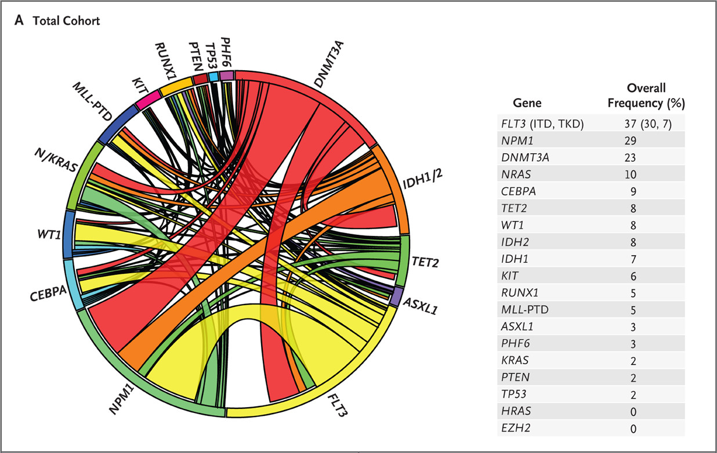
Recurring Mutations in Patients with AML
Courtesy of Eytan M Stein, MD
Patel JP et al. N Engl J Med 2012;366:1079-1089.

Slide 44
IDH2m and IDH1m: Distinct Genetically Defined Populations
IDH Mutations Seen in Multiple Cancer Types
Target | Indication | IDHm (%)
 | AML | 15%
 | MDS/MPN | 5%
 | Angio-immunoblastic NHL | 25%
 | Others (melanoma, glioma, chondro) | 3-5%
 | Type II D-2HG Aciduria (inborn error of metabolism) | 100%
 | Low-grade glioma & 2^{ary} GBM | 70%
 | Chondrosarcoma | >50%
 | AML | 7.5%
 | MDS/MPN | 5%
 | Intrahepatic cholangiocarcinoma | 20%
 | Others (colon, melanoma, lung) | 1-2%
IDH2m
IDH1m
¹Includes 8.5% of Primary GBM
²Includes “basket” of emerging unconfirmed indications
Courtesy of Eytan M Stein, MD
Notes:
Mutations in IDH1 and IDH2 can be seen across cancer types. Mutations in IDH-2 predominate in hematologic malignancies and are found commonly in 25% of angioimmunoblastic non-hodgkins lymphoma, 10-15% of Acute Myeloid Leukemia and 5% of Myelodysplastic syndromes and myeloproliferative neoplasms. Mutations in the IDH-1 gene are most commonly found in solid tumors and are present in 70% of gliomas, and over 50% of chondrosarcomas. IDH-1 mutations are also found in 7.5% of AML and 5% of patients with MDS/MPN.

Slide 45
Efficacy of Enasidenib in R/R AML
 | Relapsed/Refractory AML
 | Enasidenib 100 mg/day (n=214) | All patients (N=280)
Overall response rate, n (%) | 38·8% (83/214) | 39·6% (111/280)
CR + CRi/CRp | 62 (29·0) | 78 (27·9)
Best response, n (%)
Complete remission | 42 (19·6) | 53 (18·9)
CR with incomplete count recovery (CRi/CRp) | 20 (9·3) | 25 (8·9)
Partial remission, n (%) | 9 (4·2) | 17 (6·1)
Morphologic leukemia-free state, n (%) | 12 (5·6) | 16 (5·7)
Stable disease, n (%) | 98 (45·8) | 122 (43·6)
Progressive disease, n (%) | 19 (8·9) | 26 (9·3)
Not evaluable, n (%) | 3 (1·4) | 4 (1·4)
Courtesy of Eytan M Stein, MD
Stein EM, Dinardo CD, Blood 2017

Slide 46
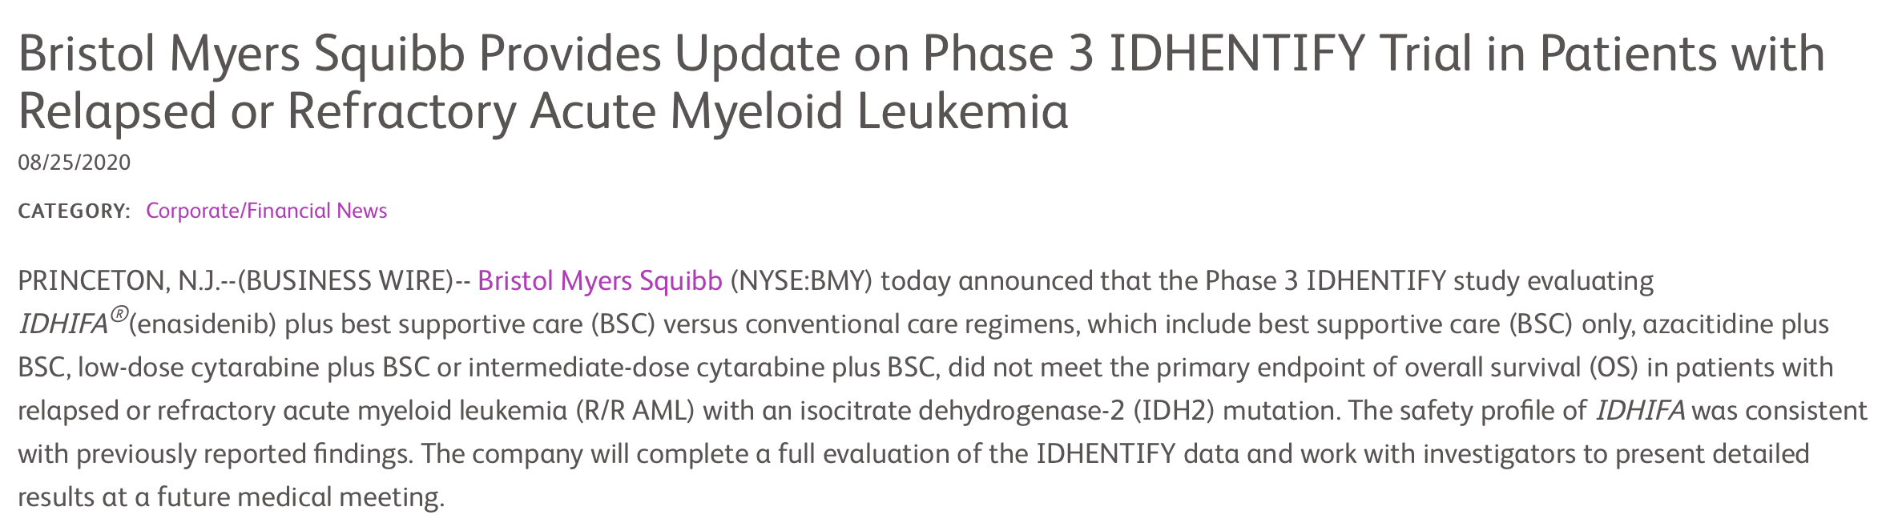
IDHentify – Randomized Enasidenib versus SOC
Update on Phase 3 IDHENTIFY Trial in Patients with Relapsed or Refractory Acute Myeloma Leukemia
PRINCETON, N.J.—(BUSINESS WIRE)– (NYSE:BMY) The Phase 3 IDHENTIFY study evaluating enasidenib plus best supportive care (BSC) versus conventional care regimens, which include best supportive care (BSC) only, azacitadine plus BSC, low-dose cytarabine plus BSC or intermediate-dose cytarabine plus BSC, did not meet the primary endpoint of overall survival (OS) in patients with relapsed or refractory acute myeloid leukemia (R/R AML) with an isocitrate dehydrogenase-2 (IDH2) mutation. The safety profile of enasidenib was consistent with previously reported findings. The company will complete a full evaluation of the enasidenib data and work with investigators to present detailed results at a future medical meeting.
Courtesy of Eytan M Stein, MD
https://news.bms.com/news/details/2020/Bristol-Myers-Squibb-Provides-Update-on-Phase-3
-IDHENTIFY-Trial-in-Patients-with-Relapsed-or-Refractory-Acute-Myeloid-Leukemia/default.aspx

Slide 47
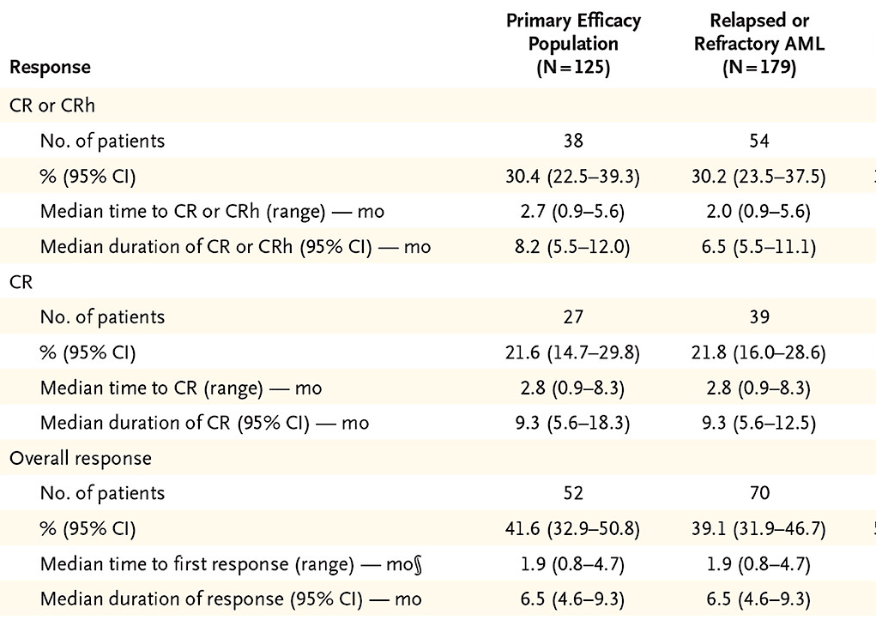

Ivosidenib – Response and Response Duration.*
Courtesy of Eytan M Stein, MD
CD Dinardo, EM Stein, S deBotton et. al. N Engl J Med 2018.

Slide 48
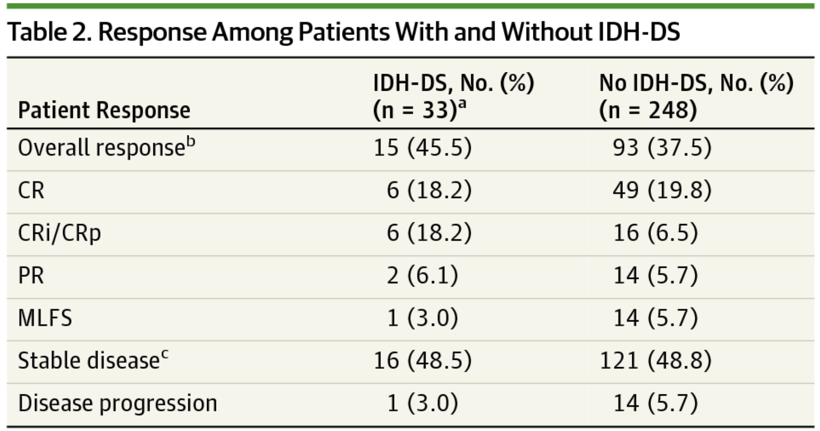
Response Among Patients With and Without IDH-DS
Date of download: 5/1/2018
Fathi A, Dinardo CD, et al, JAMA Oncology 2018
Courtesy of Eytan M Stein, MD

Slide 49
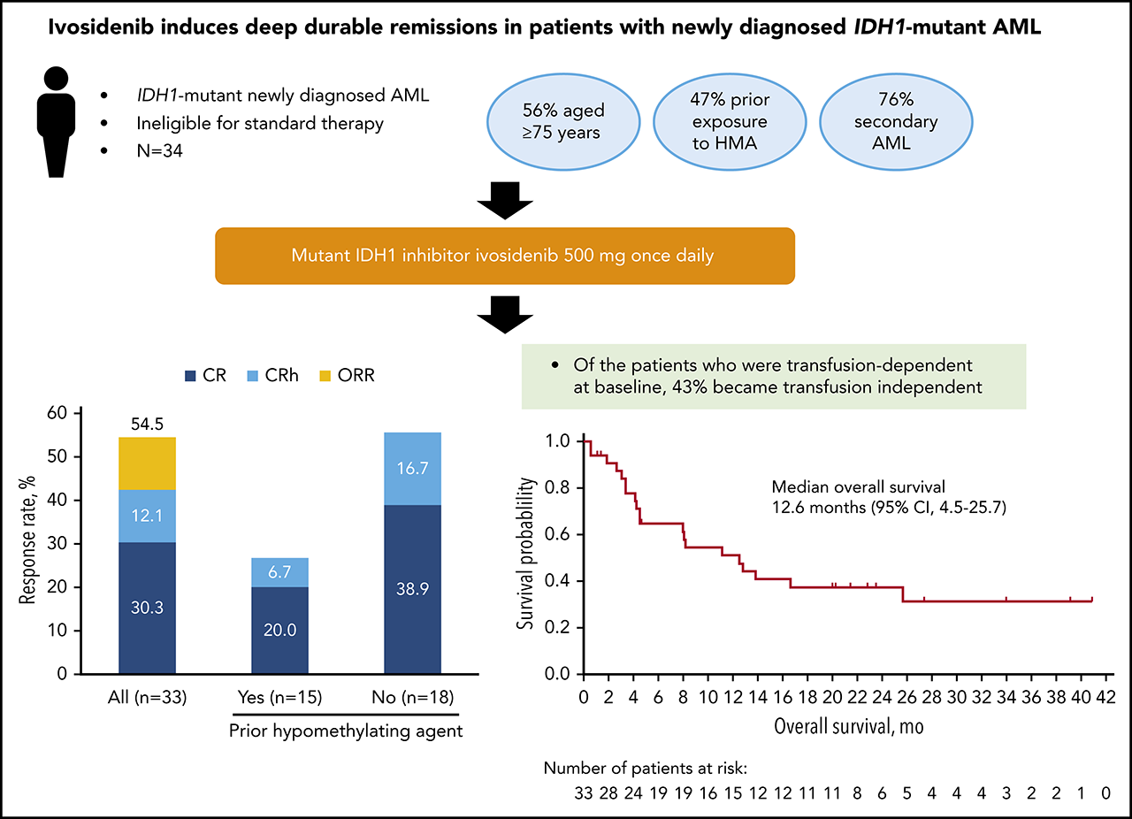
Ivosidenib – Newly Diagnosed AML
Survival probability
Overall survival, mo
Courtesy of Eytan M Stein, MD
Roboz G, et. Al, Blood 2020

Slide 50
Enasidenib/Ivosidenib with Induction Chemotherapy
INDUCTION
(1–2 cycles)
CONSOLIDATION
MAINTENANCE
ivosidenib 500mg +
ARA-C (200mg/m²/d x 7d) +
DNR (60mg/m²/d x 3d)
ivosidenib
500mg +
ARA-C
(up to 4 cycles)
or mitoxantrone + etoposide (ME)
CR CRi CRp
mIDH1
ivosidenib 500mg +
ARA-C (200mg/m²/d x 7d) +
IDR (12mg/m²/d x 3d)
Single-agent ivosidenib or enasidenib
daily until the
end of studyª
CR
CRi
CRp
SCREENING
enasidenib 100mg +
ARA-C (200mg/m²/d x 7d) +
DNR (60mg/m²/d x 3d)
enasidenib 100mg +
ARA-C
(up to 4 cycles) or mitoxantrone + etoposide (ME)
CR CRi CRp
mIDH2
enasidenib 100mg +
ARA-C (200mg/m²/d x 7d) +
IDR (12mg/m²/d x 3d)
Ivosidenib and enasidenib are discontinued and not resumed in patients who proceed to transplant
ARA-C = cytarabine; DNR = daunorubicin; IDR = idarubicin
Courtesy of Eytan M Stein, MD

Slide 51
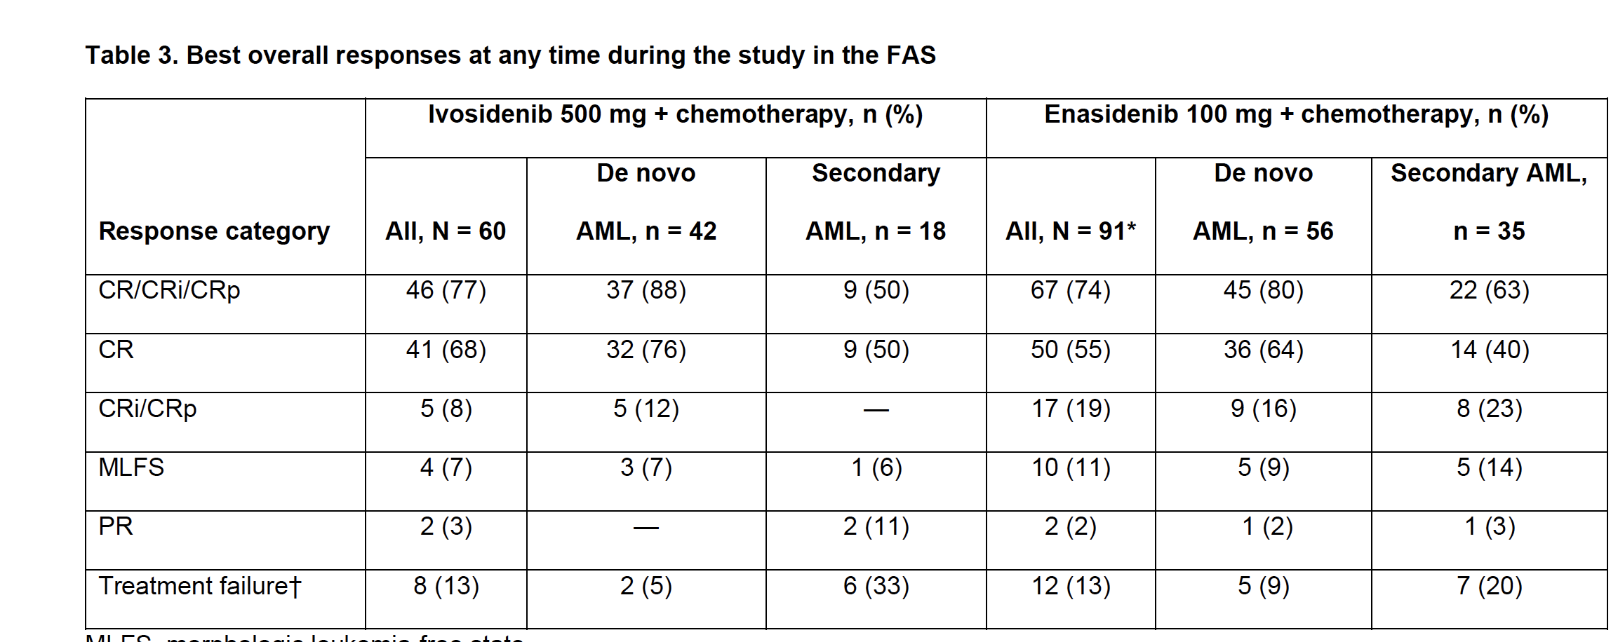
Enasidenib/Ivosidenib with Induction Chemotherapy
Courtesy of Eytan M Stein, MD
Stein EM, et al, Blood 2020

Slide 52
What would you recommend as first-line therapy to a 60-year-old patient who presents with intermediate-risk AML with an IDH1 mutation?
7 + 3 induction
7 + 3 induction
7 + 3 induction
7 + 3 induction or intensive chemotherapy + venetoclax
7 + 3 induction
Azacitidine + venetoclax
7 + 3 induction
7 + 3 induction
7 + 3 induction

Slide 53
What would you recommend as first-line therapy to a 78-year-old patient (PS 0) who presents with intermediate-risk AML with an
IDH1 mutation?
N = 128
Survey of live webinar audience

Slide 54
What would you recommend as first-line therapy to a 78-year-old patient (PS 0) who presents with intermediate-risk AML with an IDH1 mutation?
Azacitidine + ivosidenib
Azacitidine + venetoclax
Azacitidine + venetoclax
Azacitidine + ivosidenib
Azacitidine + venetoclax
Ivosidenib
Azacitidine + venetoclax
Azacitidine + venetoclax
Azacitidine + venetoclax, Ivosidenib

Slide 55
What would you recommend as first-line therapy to a 78-year-old patient with a history of cardiac and renal abnormalities (PS = 2) who presents with intermediate-risk AML with an IDH1 mutation?
Azacitidine + ivosidenib
Ivosidenib
Azacitidine + venetoclax
Ivosidenib
Azacitidine + venetoclax
Ivosidenib
Azacitidine + venetoclax
Ivosidenib
Ivosidenib, Azacitidine + venetoclax

Slide 56
What would you generally recommend as the next line of treatment for a 60-year-old patient with AML with an IDH2 mutation who has experienced disease progression after 7 + 3 induction, consolidation therapy and transplant?
Azacitidine + enasidenib
Azacitidine + venetoclax
Azacitidine + venetoclax
Azacitidine + venetoclax
Enasidenib
Enasidenib
Enasidenib
Azacitidine + venetoclax
Enasidenib

Slide 57
What would you generally recommend as the next line of treatment for a 78-year-old patient with AML with an IDH2 mutation who has experienced disease progression after venetoclax/azacitidine?
Enasidenib
Enasidenib
Enasidenib
Azacitidine + venetoclax + enasidenib or enasidenib
Enasidenib
Enasidenib
Enasidenib
Enasidenib
Enasidenib

Slide 58
A 65-year-old patient presents with new-onset shortness of breath, hypoxemia and fever 3 weeks into therapy with ivosidenib for relapsed AML. Chest CT reveals diffuse ground glass infiltrates. The patient has an ANC of 600, 27% blasts in the blood and has been receiving prophylaxis with levofloxacin and acyclovir only. What would you recommend?
Continue ivosidenib and begin antibiotics and corticosteroids
Continue ivosidenib and begin antibiotics and corticosteroids
Test for COVID-19; Continue ivosidenib and begin antibiotics and corticosteroids
Continue ivosidenib and begin antibiotics and corticosteroids
Continue ivosidenib and begin antibiotics and corticosteroids
Continue ivosidenib and begin antibiotics and corticosteroids
Continue ivosidenib and begin antibiotics and corticosteroids
Continue ivosidenib and begin antibiotics and corticosteroids
Continue ivosidenib and begin antibiotics and corticosteroids

Slide 59
Case Presentation – Dr Stein: An 86-year-old woman with newly diagnosed AML with an IDH2 mutation
86 year old woman with newly diagnosed AML associated with mutations in IDH2, RUNX1 and DNMT3A.
Physical exam is normal. Peformance status is 1.
Labs notable for pancytopenia with WBC of 3 (ANC of 0.5), Hgb of 8 and platelets of 13.
Started on treatment with aza/ven. Achieves a complete remission with the presence of MRD after one cycle of therapy
Develops COVID pneumonia, 3 week hospitalization, survives.
Receives another cycle of aza/ven and relapses with 30% blasts
Started on enasidenib 100 mg daily. Has brief onset of differentiation syndrome a month into therapy, with lower extremity edema and shortness of breath. Steroids given.
Achieves an MRD negative complete remission at cycle 3 day 1.
Courtesy of Eytan M Stein, MD

Slide 60
Case Presentation – Dr Stein: A 76-year-old woman with AML with a IDH1 mutation
76 year old woman presents with fatigue, shortness of breath, petechiae.
Exam shows scattered bruising and a petechial rash.
Labs notable for WBC of 6, hgb of 6.4, platelets of 5.
Bone marrow biopsy confirms a diagnosis of AML with 55% blasts and mutations in IDH1 and DNMT3A.
Patient wants to take oral medication – does not want aza or aza/ven– and is started on ivosidenib 500mg qd.
At cycle 4 day 1, achieves an MRD negative complete remission.
Is now in a continuous MRD negative complete remission at cycle 60 (5 years!).
Courtesy of Eytan M Stein, MD

Slide 61
Agenda
Module 1: Optimizing the Management of AML in Older Patients or Those Ineligible for
Intensive Chemotherapy — Dr Wei
Module 2: Treatment Options for Patients with AML Harboring FLT3 Mutations — Dr Perl
Module 3: Management of Newly Diagnosed and Previously Treated AML with
IDH Mutations — Dr Stein
Module 4: Tailoring Induction and Maintenance Therapy for Younger Patients with
AML without Targetable Tumor Mutations — Dr Levis
Module 5: Other Novel Agents and Investigational Strategies for Patients with AML —
Dr Pollyea

Slide 62
Phase III VIALE-A Trial
Patients with newly-diagnosed AML
  Age 75 or older…or…
  ..”unfit” for intensive chemotherapy
Randomization (2:1):
  Azacitidine + venetoclax
  Azacitidine + placebo
Primary endpoint: Overall Survival
431 patients enrolled from Feb 2017 to May 2019
  Median age 76
  Poor-risk cytogenetics in 36%
Courtesy of Mark Levis, MD, PhD

Slide 63
VIALE-A Trial
Courtesy of Mark Levis, MD, PhD
N Engl J Med 2020;383:617-29

Slide 64
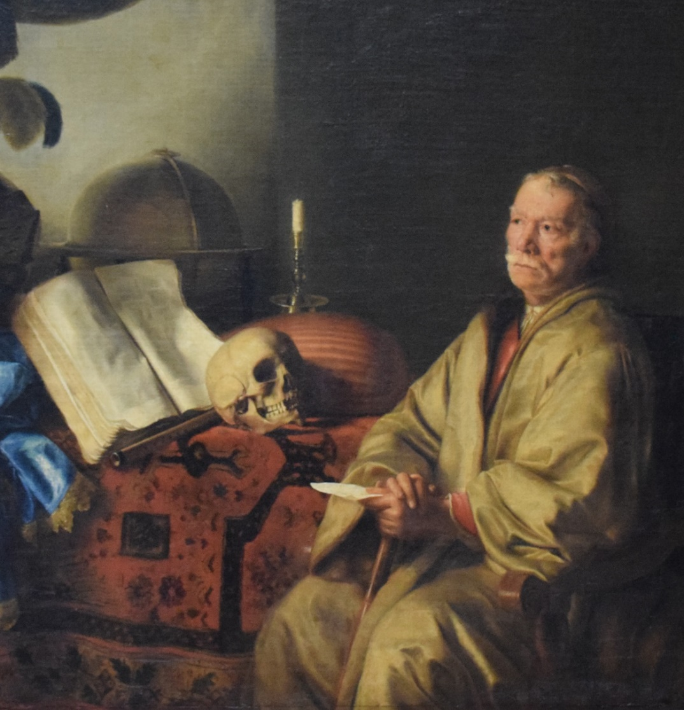
What do we know about maintenance therapy for AML?
Courtesy of Mark Levis, MD, PhD

Slide 65
“…the benefit of maintenance seems more apparent after suboptimal induction and consolidation. This may be relevant to patients who cannot tolerate consolidation (e.g., some elderly patients or those who develop serious complications during induction).”
Courtesy of Mark Levis, MD, PhD
Blood. 2016; 128:763-773

Slide 66
Azacitidine
J Clin Oncol. 2011; 29:2521-2527
45 patients with MDS or AML
First cycle treated with SQ aza
Second cycle and beyond:
  Oral azacitidine (CC-486)
Overall response rate in untreated patients:
  73%
Courtesy of Mark Levis, MD, PhD

Slide 67
The Phase III QUAZAR AML-001 Study
Multi-center, randomized, double-blinded, placebo-controlled
Patients age 55+ with AML
  Within 4 months of achieving CR or CRi after intensive induction
472 randomized
  Median age 68
  Most (65%) had received 0 or 1 cycle consolidation
Primary endpoint:
  Overall survival
Courtesy of Mark Levis, MD, PhD

Slide 68
Maintenance therapy with oral azacitidine after partially-completed intensive therapy for AML prolongs survival
HR = 0.69
p-value = 0.0009
24.7 months
14.8 months
CC-486
On September 1, 2020, the FDA approved oral azacitidine (CC-486) for the continued treatment of AML in patients who attain first complete remission (CR) or CR with incomplete blood count recovery (CRi) after intensive induction chemotherapy and who are not able to complete intensive curative therapy.
Approval was based on the results of the QUAZAR AML-001 trial.
Courtesy of Mark Levis, MD, PhD

Slide 69
Conclusions
AML patients without obvious targetable mutations can still clearly benefit from newer induction regimens with targeted drugs.
  Venetoclax with azacitidine/decitabine is a “targeted” regimen with broad applicability.
Maintenance therapy with a hypomethylating agent seems to be most effective in AML patients who have been unable to complete a standardized course of intensive chemotherapy
Oral azacitidine appears to offer a more patient-friendly version of this type of maintenance.
Question going forward:
  Can oral azacitidine (or oral decitabine) be substituted for the SQ/IV versions in a venetoclax-based induction?
Courtesy of Mark Levis, MD, PhD

Slide 70
What initial treatment would you recommend for a 65-year-old man with AML with a PS of 1 and pancytopenia, 35% marrow myeloblasts, a complex karyotype and a TP53 mutation?
Azacitidine + venetoclax
Azacitidine + venetoclax → SCT
Azacitidine + venetoclax
Azacitidine + APR-246 OR Azacitidine + magrolimab
Azacitidine + venetoclax
Azacitidine + venetoclax
Azacitidine + venetoclax
Decitabine + venetoclax
Azacitidine + venetoclax

Slide 71
A 65-year-old patient with intermediate-risk AML, no actionable mutations and a PS of 0 receives standard 7 + 3 induction. He achieves a complete remission after 2 cycles of induction and then receives 2 cycles of high-dose cytarabine as consolidation but ultimately declines transplant. Would you offer this patient maintenance therapy?
Yes, oral azacitidine
(CC-486)
Yes, oral azacitidine
(CC-486)
Yes, oral azacitidine
(CC-486)
Yes, oral azacitidine
(CC-486)
Yes, oral azacitidine
(CC-486)
Yes, oral azacitidine
(CC-486)
Yes, oral azacitidine
(CC-486)
Yes, oral azacitidine
(CC-486)
No

Slide 72
Reimbursement issues aside, do you believe your patients with AML would prefer to receive an all-oral regimen like venetoclax/CC-486 rather than venetoclax/standard intravenous azacitidine?
Yes, all patients
Yes, all patients
Yes, select patients
Yes, all patients
Yes, all patients
Yes, all patients
Yes, select patients
Yes, all patients
Yes, all patients

Slide 73
Case Presentation – Dr Levis: A 70-year-old man with AML, complex
karyotype and a TP53 mutation
70 yo man, recently retired
  Travelling around country with spouse
Notices unusual fatigue while hiking...
  …and an infected tooth not responding to antibiotics.
Sees internist on return from trip
  Blood work ordered:
    WBC 2.2, ANC 670, Hgb 9.1, platelets 143
Referred to a hematologist
Bone marrow biopsy:
  AML with dysplastic granulocytes
  60% blasts
Molecular analysis:
  Monosomal/complex karyotype
    45XY, -3; del5q22q33; t(3;6)(q26;p25); t(9;15)(p24;q22); -14; 15; add (17)(p11.2);-22
  NGS:
    TP53 H179Q VAF 36.8%
Courtesy of Mark Levis, MD, PhD

Slide 74
Case Presentation – Dr Levis: A 70-year-old man with AML, complex
karyotype and a TP53 mutation (continued)
HGB
ANC
Marrow blasts fall to 5% after cycle 1
Marrow blasts fall to 1% after cycle 2
Other than protocol-mandated admission on Day 1 Cycle 1, no further admissions.
  After cycle 3, resumes active lifestyle, including travel
Completes 12 cycles, then progresses.
14
D1
C1
D1
C2
D1
C3
3000
1
12
2500
10
2000
8
1500
6
1000
4
500
2
0
10
20
30
40
50
60
70
80
Treatment Day
Courtesy of Mark Levis, MD, PhD

Slide 75
Case Presentation – Dr Levis: A 73-old-man with newly diagnosed AML
73 yo man, still working
  MDS (mild anemia) diagnosed three years previously, no treatment required so far
Develops dyspnea on exertion
  CBC shows Hgb 8.3, platelets 56K, white blood cells 26K, 40% blasts
Diagnosed with AML
  Normal karyotype
  NGS: STAG2, TET2, NRAS mutations
Initiated on azacitidine and venetoclax
Achieves a prompt remission after 1 cycle, normalization of counts
  Bone marrow biopsy normal, no mutations detected
Bone marrow biopsy after 10 cycles (~14 months):
  Mutations re-emerging, dysplasia evident
Allogeneic transplant is offered:
  Non-myeloablative
  Successful engraftment
Courtesy of Mark Levis, MD, PhD

Slide 76
Case Presentation – Dr Levis: A 73-old-man with newly diagnosed AML
(continued)
At age 78, in early relapse 2.5 years post-transplant
Counts normalized after 2 cycles of SQ azacitidine
Begins therapy with oral azacitidine (CC-486)
Courtesy of Mark Levis, MD, PhD

Slide 77
Agenda
Module 1: Optimizing the Management of AML in Older Patients or Those Ineligible for
Intensive Chemotherapy — Dr Wei
Module 2: Treatment Options for Patients with AML Harboring FLT3 Mutations — Dr Perl
Module 3: Management of Newly Diagnosed and Previously Treated AML with
IDH Mutations — Dr Stein
Module 4: Tailoring Induction and Maintenance Therapy for Younger Patients with
AML without Targetable Tumor Mutations — Dr Levis
Module 5: Other Novel Agents and Investigational Strategies for Patients with AML —
Dr Pollyea

Slide 78
Definition of Secondary AML
AML from an antecedent hematological disorder
  Most commonly MDS (1/3 of MDS patients will develop AML)
  Could also be from MPN or a non-malignant antecedent disorder (e.g. aplastic anemia)
Treatment-related AML
  WHO defined as history of exposure to alkylating agents and/or topoisomerase II inhibitors and/or ionizing radiation to large fields including bone marrow
  Other implicated therapies include antimetabolites or antitubulin agents but their relationship is less certain.
Greenberg et al, Blood 1997
Arber et al, Blood 2016
Courtesy of Daniel A Pollyea, MD, MS

Slide 79
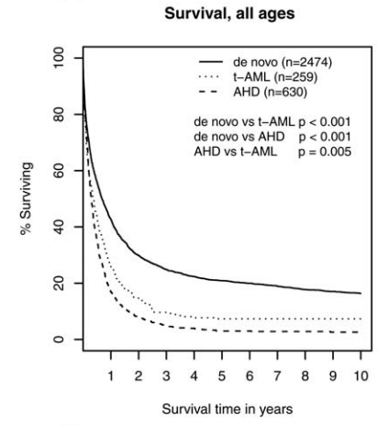
De Novo AML vs Secondary AML
Secondary AML patients are older, have more adverse biological risk factors (cytogenetics/TP53)
Lower response rates to conventional treatments
Worse overall survival
Incurable without an allogeneic stem cell transplantation
Courtesy of Daniel A Pollyea, MD, MS
Hulegardh et al, AJH 2015

Slide 80
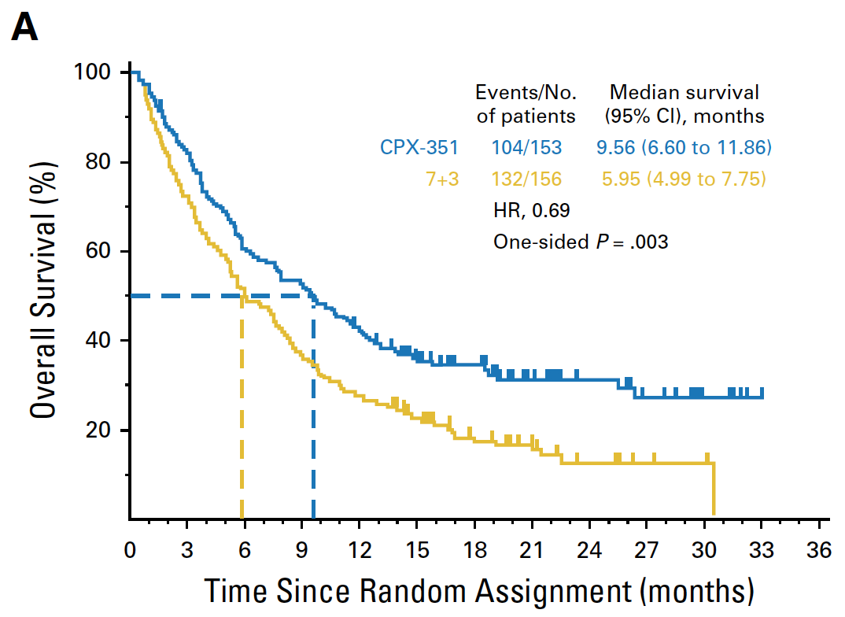
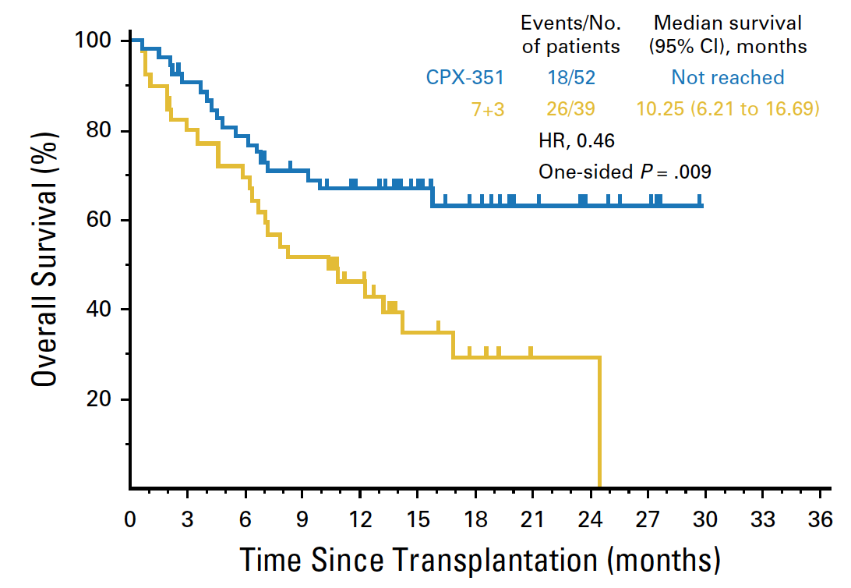
Phase III Study 301: CPX-351 vs 7+3 for Older Patients
with Newly Diagnosed Secondary AML
Lancet et al, JCO 2018
Lancet et al, JCO 2018
Consider CPX-351 for newly diagnosed, induction eligible secondary AML patients, particularly if they would be suitable candidates for a transplant
How can you tell if they have secondary AML? Probably OK to wait (up to 15 days) for marrow results (Rollig et al, Blood 2020)
Caution if TP53+ (Lindsley et al, ASH 2019)
Courtesy of Daniel A Pollyea, MD, MS
Notes:
Confirmatory study for 7+3 vs CPX in secondary AML
Also showing OS after transplant for those who went to transplant…seems much better for CPX than 7+3. Maybe because of a deeper response? No MRD testing done.

Slide 81
CD33 Antibody Drug Conjugate:
Gemtuzumab Ozogamicin
Growth Factors, Cytokines
Monoclonal anti-CD33 antibody linked to calicheamicin
Internalized and cleaved in lysosomes to release calicheamicin
Calicheamicin enters nucleus and interacts with DNA causing double-strand breaks initiating apoptosis
Approved in 2000 based on 30% ORR in R/R AML
CD33
Drug Transporter
Activity
GO
Target
Levels
Survival
Signaling
P13K/AKT
MDR-1/MRP-1
MEK/ERK
JAK/STAT
GO-Induced
DNA Damage
GO-Induced
Apoptosis and Cell Death
Mitochondria
GO
Internalization/ Processing
p-CHk2
c-Casp3
γH2AX
c-PARP
Cell Death
Rosen DB, et al. PLoS One. 2013;8:e53518.
Sievers et al, JCO 2001
Courtesy of Daniel A Pollyea, MD, MS

Slide 82
Gemtuzumab in AML: Select Phase III Results
Study | N | Treatment | Results of GO vs Comparator
MRC/NCRI AML1 (2011) | 1113 | GO (3 mg/m²) + either ADE, DA, or FLAG-IDA | Improved 5-yr OS for favorable-risk group No difference in ORR, TRM, relapse, survival
ALFA 0701 (2012) | 280 | GO (3 mg/m²) + DA | Improved 2-yr EFS, RFS, OS No difference in ORR or mortality
MRC/NCRI AML (2012) | 1115 | GO (3 mg/m²) + either DA or DCLo | Reduced 3-yr relapse risk, and superior DFS and OS No difference in TRM
SWOG S0106 (2013) | 637 | GO (6 mg/m²) + DA induction vs DA | No difference in CR, DFS, OSs
Courtesy of Daniel A Pollyea, MD, MS
Notes:
As a result of these findings, and hepatotoxicity/prolonged cytopenias, GO was withdrawn in 2010

Slide 83
Antibody-Drug Conjugates
Target | Drug(s) | Clinical Experience | Citation
CD33 | Gemtuzumab ozogamicin | Extensive, previously reviewed | Multiple
 | IMG779 | Modest activity | Cortes et al, Blood 2018
CD123 | IMGN632 | Blast reduction and modest response rates | Daver et al, ASH 2019
 | SGN-CD123A | Not reported
CD25 | Camidanlumab tesirine | Minimal responses, manageable toxicity | Goldberg et al, Leukemia Research 2020
CD30 | Brentuximab vedotin | Used with chemotherapy for R/R AML; ~40% ORR | Narayan et al, Cancer 2020
CLL-1 | Several | Pre-clinical
Courtesy of Daniel A Pollyea, MD, MS

Slide 84
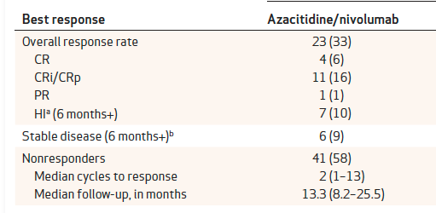
Immune Checkpoint Inhibitors
PD-1/PD-L1 inhibitors with azacitidine in R/R AML
Ongoing work with pembrolizumab and durvalumab in combinations and in various settings…
Daver et al, Cancer Discovery 2019
Courtesy of Daniel A Pollyea, MD, MS

Slide 85
Phase III PRAN-16-52 Trial Design
Pracinostat
+
azacitidine
Eligibility (N = 406)
Newly diagnosed AML (including de novo, secondary to hematologic disorders or treatment-related disease with intermediate or unfavorable-risk cytogenetics) Ineligibility for intensive chemotherapy ECOG PS 0-2
R
Placebo
+
azacitidine
1:1
Primary endpoint: Overall survival
Secondary endpoints include morphologic CR rate, CR without MRD, cytogenetic CR rate and transfusion independence
www.clinicaltrials.gov (NCT03151408) – Accessed November 2020. Garcia-Manero G et al. ASCO 2018;Abstract TPS7078.

Slide 86
Phase III PRAN-16-52 Trial Discontinued After Completing Interim Analysis
Press Release: July 02, 2020
“An interim futility analysis of the ongoing Phase 3 study of pracinostat in combination with azacitidine in patients with AML who are unfit to receive standard intensive chemotherapy, undertaken by the study Independent Data Monitoring Committee (‘IDMC’), has demonstrated it was unlikely to meet the primary endpoint of overall survival compared to the control group.
Based on the outcome of the interim analysis, the decision was made to discontinue the recruitment of patients and end the study. The decision was based on a lack of efficacy and not on safety concerns.
Pending further evaluation, patients currently enrolled in other pracinostat studies will continue treatment.”
https://www.globenewswire.com/news-release/2020/07/02/2056824/0/en/Helsinn-Group-and-MEI-Pharma-Discontinue-the-Phase-3-Study-with-Pracinostat-in-AML-after-Completing-Interim-Analysis.html

Slide 87
A 65-year-old patient with a history of myelodysplastic syndrome treated with azacitidine for 10 months presents 1 year later with AML with 35% marrow blasts, trisomy 8 and ASXL1, NRAS and U2AF1 mutations (VAFs 45, 20 and 45, respectively). What would you recommend?
CPX-351
CPX-351 → SCT
CPX-351
CPX-351
Azacitidine + venetoclax
CPX-351
CPX-351
CPX-351
CPX-351

Slide 88
What initial treatment would you recommend for a 64-year-old woman with a history of breast cancer, for which she received adjuvant chemotherapy, who now presents with bone marrow findings consistent with therapy-related AML?
CPX-351
Azacitidine + venetoclax
CPX-351
CPX-351
Azacitidine + venetoclax
CPX-351
CPX-351
CPX-351
CPX-351, Azacitidine + venetoclax

Slide 89
Case Presentation – Dr Pollyea: A 79-year-old man with newly diagnosed AML and intermediate cytogenetics
79 year old healthy male with newly diagnosed AML. Had intermediate cytogenetics with a trisomy 8 and mutations in ASXL1, BCORL1, TET2 and RUNX1. He started venetoclax + azacitidine and experienced a CRi after cycle 1. He continued therapy and after 10 cycles had a routine bone marrow biopsy that showed 10% blasts. No new mutations on repeat sequencing. He stopped venetoclax and azacitidine and had two cycles of decitabine; a repeat bone marrow biopsy showed 30% blasts. No new mutations on repeat sequencing; he was CD33+. He had a course of gemtuzumab ozogamicin (three doses over 28 days) and a repeat bone marrow biopsy now showed 50% blasts. No new mutations on repeat sequencing. The patient opted for hospice and passed away 3 weeks later.
Courtesy of Daniel A Pollyea, MD, MS

