Slide 1
DATA + PERSPECTIVES
Clinical Investigators Explore the Biology
Underlying the Role of PARP Inhibition in the Management of Common Cancers
Tuesday, June 23, 2020
7:00 PM – 8:00 PM ET
Faculty
Maha Hussain, MD, FACP, FASCO
Ursula Matulonis, MD
Philip A Philip, MD, PhD, FRCP
Hope S Rugo, MD
Moderator
Neil Love, MD

Slide 2




Faculty
Maha Hussain, MD, FACP, FASCO
Genevieve Teuton Professor of Medicine
Division of Hematology/Oncology
Deputy Director
Robert H Lurie Comprehensive
Cancer Center
Northwestern University Feinberg
School of Medicine
Chicago, Illinois
Philip A Philip, MD, PhD, FRCP
Kathryn Cramer Endowed Chair in Cancer Research
Professor of Oncology and Pharmacology
Leader, GI and Neuroendocrine Oncology
Karmanos Cancer Institute
Wayne State University
Detroit, Michigan
Ursula Matulonis, MD
Chief, Division of Gynecologic Oncology
Brock-Wilson Family Chair
Dana-Farber Cancer Institute
Professor of Medicine
Harvard Medical School
Boston, Massachusetts
Hope S Rugo, MD
Professor of Medicine
Director, Breast Oncology and Clinical Trials Education
University of California, San Francisco
Helen Diller Family Comprehensive Cancer Center
San Francisco, California

Slide 3
Dr Love — Disclosures
Dr Love is president and CEO of Research To Practice. Research To Practice receives funds in the form of educational grants to develop CME activities from the following commercial interests: AbbVie Inc, Acerta Pharma — A member of the AstraZeneca Group, Adaptive Biotechnologies, Agendia Inc, Agios Pharmaceuticals Inc, Amgen Inc, Array BioPharma Inc, a subsidiary of Pfizer Inc, Astellas, AstraZeneca Pharmaceuticals LP, Bayer HealthCare Pharmaceuticals, Biodesix Inc, bioTheranostics Inc, Blueprint Medicines, Boehringer Ingelheim Pharmaceuticals Inc, Boston Biomedical Inc, Bristol-Myers Squibb Company, Celgene Corporation, Clovis Oncology, Daiichi Sankyo Inc, Dendreon Pharmaceuticals Inc, Eisai Inc, EMD Serono Inc, Exelixis Inc, Foundation Medicine, Genentech, a member of the Roche Group, Genmab, Genomic Health Inc, Gilead Sciences Inc, GlaxoSmithKline, Grail Inc, Guardant Health, Halozyme Inc, Helsinn Healthcare SA, ImmunoGen Inc, Incyte Corporation, Infinity Pharmaceuticals Inc, Ipsen Biopharmaceuticals Inc, Janssen Biotech Inc, administered by Janssen Scientific Affairs LLC, Jazz Pharmaceuticals Inc, Kite, A Gilead Company, Lexicon Pharmaceuticals Inc, Lilly, Loxo Oncology Inc, a wholly owned subsidiary of Eli Lilly & Company, Merck, Merrimack Pharmaceuticals Inc, Myriad Genetic Laboratories Inc, Natera Inc, Novartis, Oncopeptides, Pfizer Inc, Pharmacyclics LLC, an AbbVie Company, Prometheus Laboratories Inc, Puma Biotechnology Inc, Regeneron Pharmaceuticals Inc, Sandoz Inc, a Novartis Division, Sanofi Genzyme, Seattle Genetics, Sirtex Medical Ltd, Spectrum Pharmaceuticals Inc, Taiho Oncology Inc, Takeda Oncology, Tesaro, A GSK Company, Teva Oncology, Tokai Pharmaceuticals Inc, Tolero Pharmaceuticals and Verastem Inc.

Slide 4
Dr Hussain — Disclosures
Consulting Agreements | Bayer HealthCare Pharmaceuticals, Genentech, a member of the Roche Group
Contracted Research | AstraZeneca Pharmaceuticals LP, Bayer HealthCare Pharmaceuticals, Genentech, a member of the Roche Group, Pfizer Inc
CME and Educational Activity | Aptitude Health, Astellas, Sanofi Genzyme

Slide 5
Dr Matulonis — Disclosures
Advisory Committee | Novartis
Consulting Agreement | Merck
Contracted Research | FUJIFILM Pharmaceuticals USA Inc, ImmunoGen Inc, Merck, Mersana Therapeutics, SQZ Biotech
Data and Safety Monitoring Board/Committee | Advaxis Inc
Travel (unpaid advisory board) | AstraZeneca Pharmaceuticals LP

Slide 6
Dr Philip — Disclosures
No financial interests or affiliations to disclose.

Slide 7
Dr Rugo — Disclosures
Consulting Agreements | Puma Biotechnology Inc, Samsung Bioepis
Contracted Research | Daiichi Sankyo Inc, Eisai Inc, Genentech, a member of the Roche Group, Immunomedics Inc, Lilly, MacroGenics Inc, Merck, Novartis, OBI Pharma Inc, Odonate Therapeutics, Pfizer Inc, Seattle Genetics
Paid Travel | AstraZeneca Pharmaceuticals LP, Daiichi Sankyo Inc, MacroGenics Inc, Merck, Mylan NV, Novartis, Pfizer Inc

Slide 8
Commercial Support
This activity is supported by educational grants from AstraZeneca Pharmaceuticals LP and Merck.

Slide 9
Agenda
Module 1: Overview of PARP Inhibitors: Biologic Rationale and Mechanism of Action
Module 2: Side Effects and Toxicities of PARP Inhibitors
Module 3: PARP Inhibitors for Ovarian Cancer – Dr Matulonis
Key data sets: SOLO-1, PRIMA, PAOLA-1, VELIA
Module 4: PARP Inhibitors for Breast Cancer – Dr Rugo
Key data sets: EMBRACA, OlympiAD, BROCADE3
Module 5: PARP Inhibitors for Pancreatic Cancer – Dr Philip
Key data sets: POLO, RUCAPANC
Module 6: PARP Inhibitors for Prostate Cancer – Dr Hussain
Key data sets: PROfound, TRITON2, GALAHAD

Slide 10
Module 1: Overview of PARP Inhibitors: Biologic Rationale and Mechanism of Action
Genomic assays, PARP sensitivity and biologic rationale for PARP inhibitors
Germline versus somatic testing
Role of liquid biopsy
Mechanism of action, potency of PARP inhibitors; PARP trapping
Approved PARP inhibitors

Slide 11
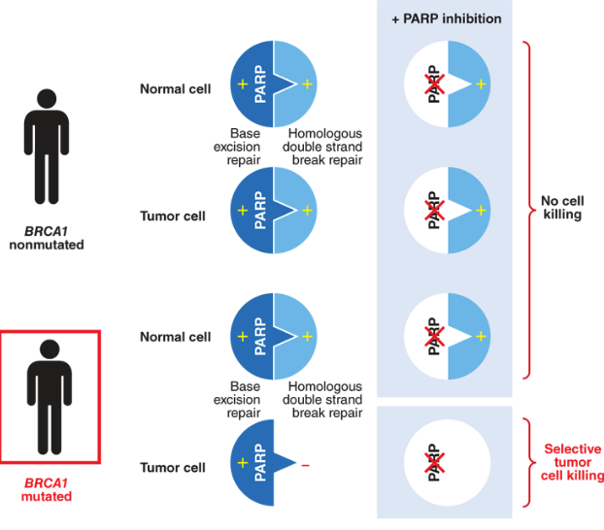
PARP inhibitors in DNA repair defect: concept of synthetic lethality
Courtesy of Philip A Philip, MD, PhD, FRCP

Slide 12
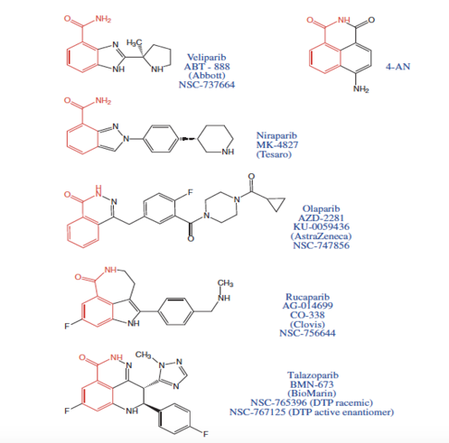
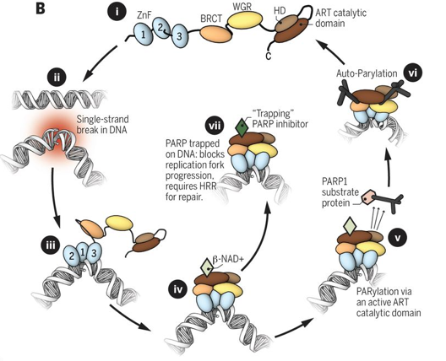
PARP Inhibitors and Mechanism of Action
Veliparib
Niraparib
Auto-PARylation
Olaparib
Rucaparib
Talazoparib
Murai J, Pommier Y. Classification of PARP Inhibitors Based on PARP Trapping and Catalytic Inhibition, and Rationale for Combinations with Topoisomerase I Inhibitors and Alkylating Agents. In: Curtin NJ, Sharma RA, eds. PARP Inhibitors for Cancer Therapy. New York: Springer International Publishing;2015:261-274.
Courtesy of Hope Rugo, MD
Notes:
There are a number of PARP inhibitors that have been investigated in breast cancer, with olaparib and talazoparib garnering FDA approvals in 2018.

Slide 13
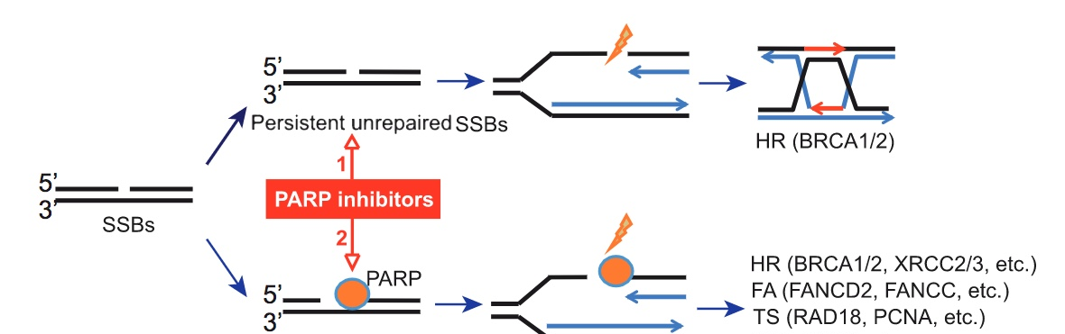
Dual Mechanisms of Action of PARP Inhibitors
Catalytic inhibition
Trapping of
PARP-DNA complexes
 | Catalytic inhibition IC₅₀ in wild-type DT40 cells (nM) | Catalytic inhibition IC₅₀ in wild-type DT40 cells (µM) | PARP-trapping potency (relative to olaparib) | Class
Veliparib | 30 | >50 | <0.2 | Type 1
Olaparib | 6 | 4.5 | 1 | Type 2
Rucaparib | 21 | 3 | 1 | Type 2
Niraparib | 60 | 2.3 | ~2 | Type 2
Talazoparib | 4 | 0.04 | ~100 | Type 2
Murai J, Pommier Y. Classification of PARP Inhibitors Based on PARP Trapping and Catalytic Inhibition, and Rationale for Combinations with Topoisomerase I Inhibitors and Alkylating Agents. In: Curtin NJ, Sharma RA, eds. PARP Inhibitors for Cancer Therapy. New York: Springer International Publishing;2015:261-74.

Slide 14
PARP Targeting Potency: High to Low
Talazoparib
Niraparib
Rucaparib, olaparib
Veliparib
Adapted from: Lord CJ, et al. Science. 2017;355:1152-1158.
Courtesy of Philip A Philip, MD, PhD, FRCP

Slide 15
FDA-Approved and Late-Stage Investigational PARP Inhibitors
 | Olaparib | Niraparib | Rucaparib | Talazoparib | Veliparib
Ovarian | Front line Plat-sensitive recurrent Multiply relapsed | Front line Plat-sensitive recurrent Multiply relapsed | Plat-sensitive recurrent Multiply relapsed | — | VELIA Ph3
Breast | Metastatic | BRAVO Ph3 | — | Metastatic | —
Pancreatic | Metastatic | — | — | — | —
Prostate | Metastatic CRPC | Breakthrough therapy (GALAHAD) MAGNITUDE Ph3 | Metastatic CRPC | TALAPRO-2 Ph3 | —
Olaparib PI, rev 5/2020; Niraparib PI, rev 4/2020; Rucaparib PI, rev 5/2020; Talazoparib PI, rev 3/2020; Clinicaltrials.gov, Accessed 6/2020

Slide 16
Agenda
Module 1: Overview of PARP Inhibitors: Biologic Rationale and Mechanism of Action
Module 2: Side Effects and Toxicities of PARP Inhibitors
Module 3: PARP Inhibitors for Ovarian Cancer – Dr Matulonis
Key data sets: SOLO-1, PRIMA, PAOLA-1, VELIA
Module 4: PARP Inhibitors for Breast Cancer – Dr Rugo
Key data sets: EMBRACA, OlympiAD, BROCADE3
Module 5: PARP Inhibitors for Pancreatic Cancer – Dr Philip
Key data sets: POLO, RUCAPANC
Module 6: PARP Inhibitors for Prostate Cancer – Dr Hussain
Key data sets: PROfound, TRITON2, GALAHAD

Slide 17
Module 2: Side Effects and Toxicities of PARP Inhibitors
  Cytopenia
  Gastrointestinal toxicity
  Creatinine elevation
  ALT/AST elevation
  Risk of MDS/AML

Slide 18
Adverse Events: Class Effects and Specific Drug Differences
 | Notes | Olaparib | Niraparib | Rucaparib | Talazoparib | Veliparib
Fatigue | 50%-70%, mainly Gr1-2 | ✓ | ✓ | ✓ | ✓ | ✓
Hematologic AEs
Anemia | 40%-60% | ✓ | ✓ | ✓ | ✓ | ✓--
Thrombocytopenia | Niraparib dose adjustment, based on platelet counts | ✓ | ✓++ | ✓ | ✓ | ✓
Neutropenia | ~20% | ✓ | ✓ | ✓ | ✓ | ✓
Gastrointestinal AEs
Nausea/vomiting | Moderately emetic >30% | ✓ | ✓ | ✓ | ✓ | ✓
Diarrhea | ~33% | ✓ | ✓ | ✓ | ✓ | ✓
Laboratory abnormalities
ALT/AST elevation | 5%-10% olaparib, niraparib; 34% rucaparib | ✓-- | ✓-- | ✓++ | ✓++ | ?
Creatinine elevation | 10%-12% | ✓ | ✓ | ✓ | NR | NR
Olaparib PI, rev 5/2020; Niraparib PI, rev 4/2020; Rucaparib PI, rev 5/2020; Talazoparib PI, rev 3/2020;
Madariaga A et al. Int J Gyn Cancer 2020 April 9;[Online ahead of print]; Litton JK et al. NEJM 2018;379:753-63.
NR, not reported

Slide 19
Adverse Events: Class Effects and Specific Drug Differences
 | Notes | Olaparib | Niraparib | Rucaparib | Talazoparib | Veliparib
Respiratory disorders
Dyspnea +/- cough | 10%-20%, usually Gr 1-2 | ✓ | ✓ | ✓ | ✓ | NR
Nasopharyngitis | ~10% | ✓ | ✓ | ✓ | ✓ | NR
Nervous system and psychiatric disorders
Insomnia/headache | 10%-25%, usually Gr 1-2 | ✓ | ✓ | ✓ | ✓ | ✓
Dermatologic toxicity
Rash, photosensitivity |  | <1% | ✓ | ✓++ | NR | NR
Cardiovascular toxicity
Hypertension, tachycardia, palpitation |  | 1% | ✓++ | NR | NR | NR
Rare AEs
MDS/AML | ~1% of pts | ✓ | ✓ | ✓ | ✓ | ✓
Olaparib PI, rev 5/2020; Niraparib PI, rev 4/2020; Rucaparib PI, rev 5/2020; Talazoparib PI, rev 3/2020;
Madariaga A et al. Int J Gyn Cancer 2020 April 9;[Online ahead of print]; Litton JK et al. NEJM 2018;379:753-63.
NR, not reported

Slide 20
Agenda
Module 1: Overview of PARP Inhibitors: Biologic Rationale and Mechanism of Action
Module 2: Side Effects and Toxicities of PARP Inhibitors
Module 3: PARP Inhibitors for Ovarian Cancer – Dr Matulonis
Key data sets: SOLO-1, PRIMA, PAOLA-1, VELIA
Module 4: PARP Inhibitors for Breast Cancer – Dr Rugo
Key data sets: EMBRACA, OlympiAD, BROCADE3
Module 5: PARP Inhibitors for Pancreatic Cancer – Dr Philip
Key data sets: POLO, RUCAPANC
Module 6: PARP Inhibitors for Prostate Cancer – Dr Hussain
Key data sets: PROfound, TRITON2, GALAHAD

Slide 21
Module 3: PARP Inhibitors for Ovarian Cancer – Dr Matulonis
Genomic profile
Prior trials in relapse setting: maintenance and monotherapy
Key recent up-front data sets: SOLO-1, PRIMA, PAOLA-1, VELIA
Current practice patterns
Ongoing trials

Slide 22
In general, what is the optimal approach to mutation testing for possible use of a PARP inhibitor for a patient with newly diagnosed ovarian cancer and no family history?
Germline BRCA; if negative, multigene somatic (NGS)
Multigene germline and somatic/NGS
Germline BRCA
Multigene germline panel
Survey of 50 US-based general medical oncologists June 2020

Slide 23
A 60-year-old woman with Stage IIIC ovarian cancer and a germline BRCA mutation is s/p suboptimal debulking surgery with elevated CA-125. Regulatory and reimbursement issues aside, what would you recommend as postoperative systemic therapy?
Carboplatin/paclitaxel + bev → bev + olaparib
Carboplatin/paclitaxel +
bev → olaparib
Carboplatin/paclitaxel → olaparib
Carboplatin/paclitaxel +
bev → niraparib
Carboplatin/paclitaxel → niraparib
Carboplatin/paclitaxel
Carboplatin/paclitaxel + bev → bev + niraparib
Survey of 50 US-based general medical oncologists June 2020

Slide 24
A 60-year-old woman with Stage IIIC ovarian cancer and a germline BRCA mutation is s/p optimal debulking surgery with a normal CA-125 level. Regulatory and reimbursement issues aside, what would you recommend as postoperative systemic therapy?
Carboplatin/paclitaxel → olaparib
Carboplatin/paclitaxel + bev → bev + olaparib
Carboplatin/paclitaxel +
bev → olaparib
Carboplatin/paclitaxel
Carboplatin/paclitaxel → niraparib
Carboplatin/paclitaxel + bev → bev + niraparib
Carboplatin/paclitaxel +
bev → niraparib
Carboplatin/paclitaxel +
bev → bev
Survey of US-based general medical oncologists June 2020

Slide 25
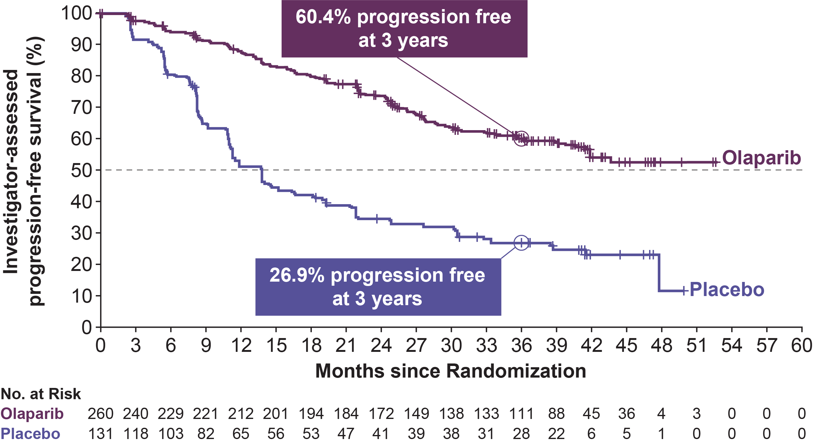
SOLO-1: PFS
 | Olaparib (N=260) | Placebo (N=131)
Events (%) [50.6% maturity] | 102 (39.2) | 96 (73.3)
Median PFS, mo | NR | 13.8
 | HR 0.30
 | 95% CI 0.23, 0.41; P<0.0001
Moore K, et al. N Engl J Med. 2018;379:2495-2505.

Slide 26
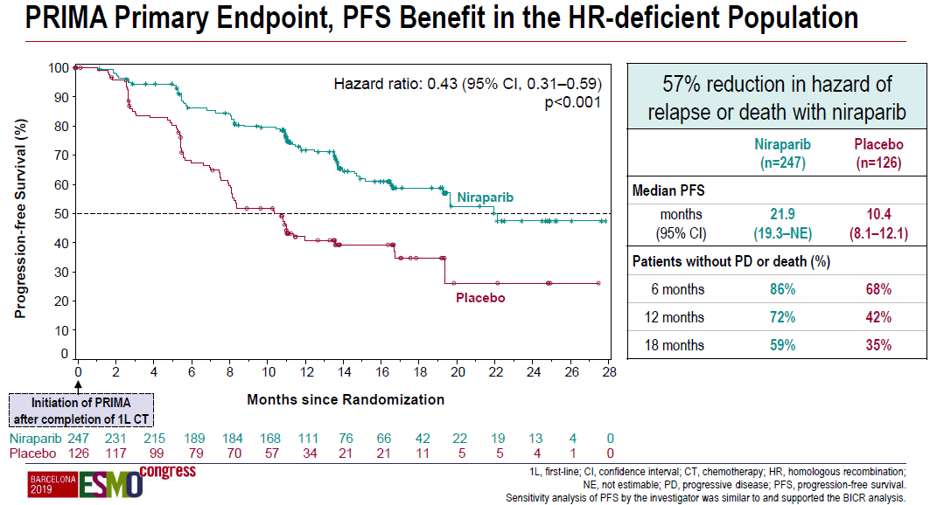
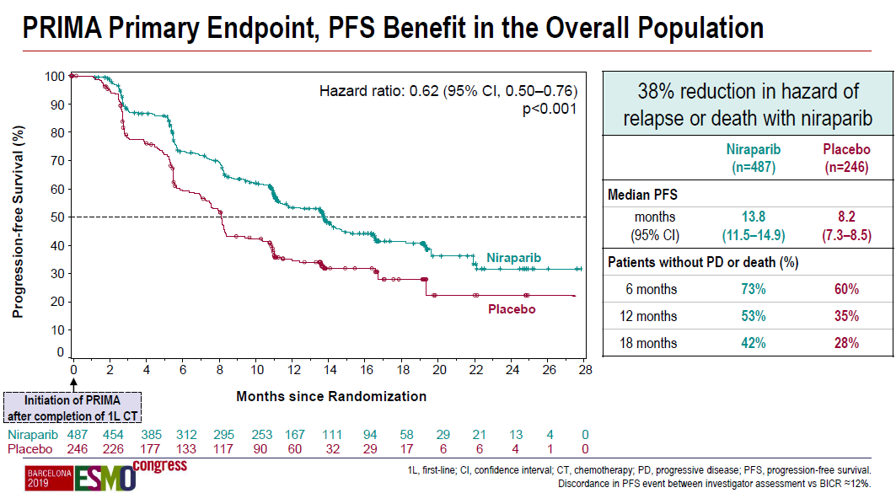
PRIMA: Primary endpoints
Gonzalez-Martin et al., N Engl J Med 2019, ESMO 2019

Slide 27
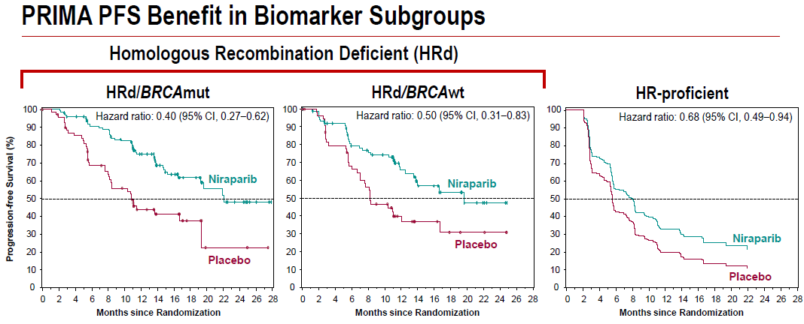
Subgroup | PFS (niraparib) | PFS (placebo) | HR (95% CI)
HRd/BRCAmut | 22.1 | 10.9 | 0.40 (0.27-0.62)
HRd/BRCAwt | 19.6 | 8.2 | 0.50 (0.31-0.83)
HRp | 8.1 | 5.4 | 0.68 (0.49-0.94)
HR unknown | NR | NR | 0.85 (0.51-1.43)
Gonzalez-Martin et al., N Engl J Med 2019, ESMO 2019

Slide 28
FDA approves niraparib for first-line maintenance of advanced ovarian cancer
Press Release – April 29, 2020
“The Food and Drug Administration approved niraparib for the maintenance treatment of adult patients with advanced epithelial ovarian, fallopian tube, or primary peritoneal cancer who are in a complete or partial response to first-line platinum-based chemotherapy.
Efficacy was investigated in PRIMA (NCT02655016), a double-blind, placebo-controlled trial that randomized 733 patients to niraparib or matched placebo. Patients were in a complete or partial response to first-line platinum-based chemotherapy.”
https://www.fda.gov/drugs/drug-approvals-and-databases/fda-approves-niraparib-first-line-maintenance-advanced-ovarian-cancer

Slide 29
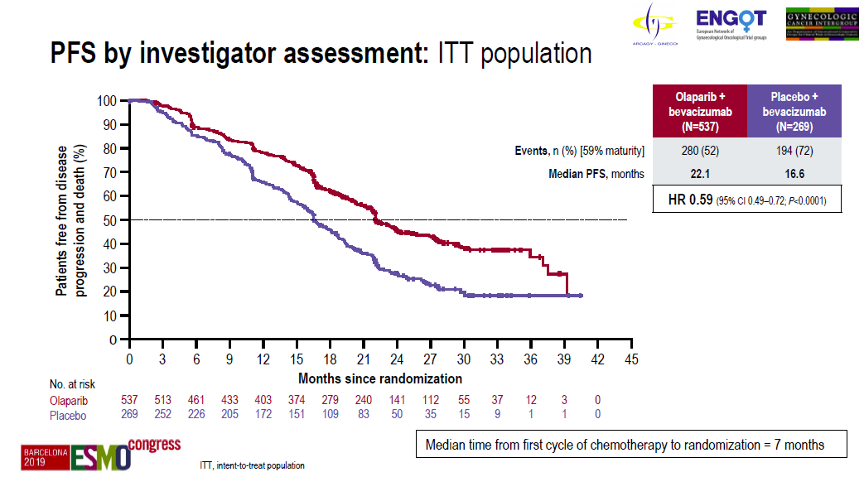
PAOLA-1: PFS in ITT population
Ray-Coquard et al., ESMO 2019, N Engl J Med 2019; 381:2416-2428

Slide 30
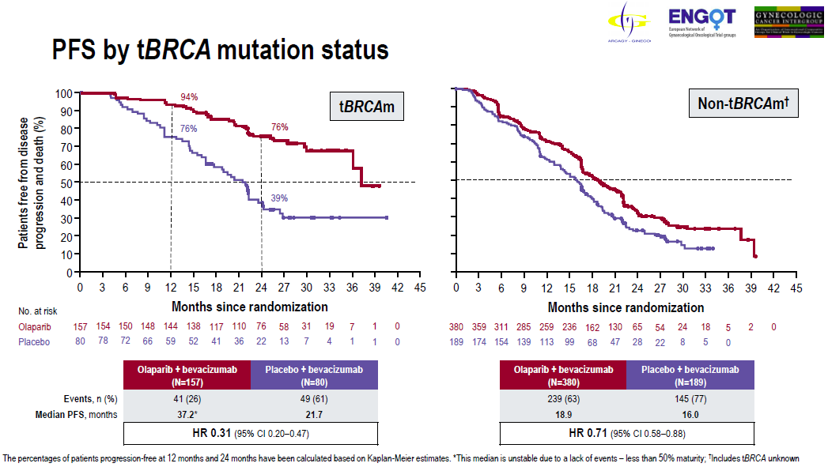

PAOLA-1: PFS by tumor BRCA status
Ray-Coquard et al., ESMO 2019, N Engl J Med 2019; 381:2416-2428

Slide 31
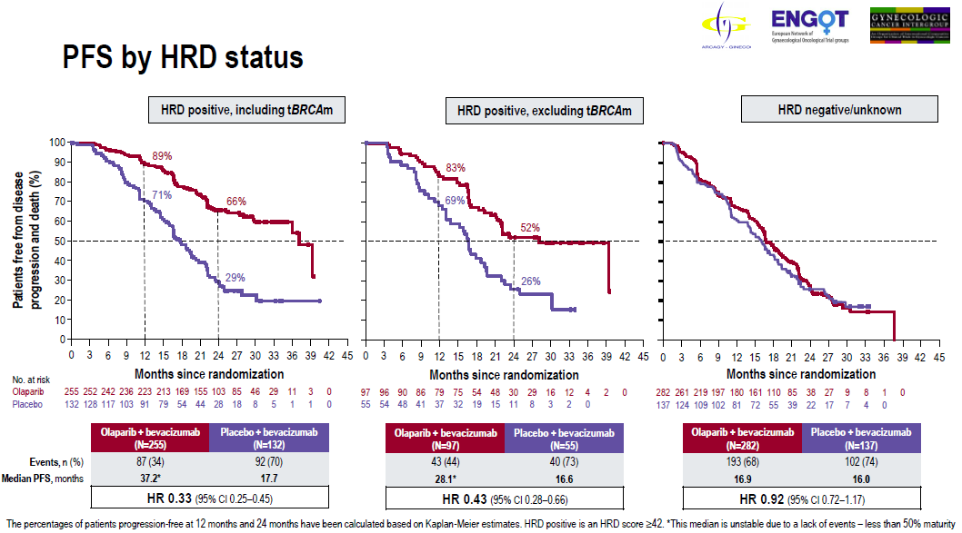
PAOLA-1: PFS by HRD status
Ray-Coquard et al., ESMO 2019, N Engl J Med 2019; 381:2416-2428

Slide 32
FDA approves olaparib with bevacizumab as maintenance treatment for ovarian, fallopian tube, or primary peritoneal cancers
Press Release – May 28, 2020
“The Food and Drug Administration expanded the indication of olaparib to include its combination with bevacizumab for first-line maintenance treatment of adult patients with advanced epithelial ovarian, fallopian tube, or primary peritoneal cancer who are in complete or partial response to first-line platinum-based chemotherapy and whose cancer is associated with homologous recombination deficiency positive status defined by either a deleterious or suspected deleterious BRCA mutation, and/or genomic instability.
FDA also approved the Myriad myChoice® CDx (Myriad Genetic Laboratories, Inc.) as a companion diagnostic for olaparib.
Efficacy of this new indication was investigated in PAOLA-1 (NCT03737643), a randomized, double-blind, placebo-controlled, multi-center trial comparing olaparib with bevacizumab versus placebo plus bevacizumab in patients with advanced high-grade epithelial ovarian cancer, fallopian tube, or primary peritoneal cancer following first-line platinum-based chemotherapy and bevacizumab.”
https://www.fda.gov/drugs/drug-approvals-and-databases/fda-approves-olaparib-plus-bevacizumab-maintenance-treatment-ovarian-fallopian-tube-or-primary

Slide 33
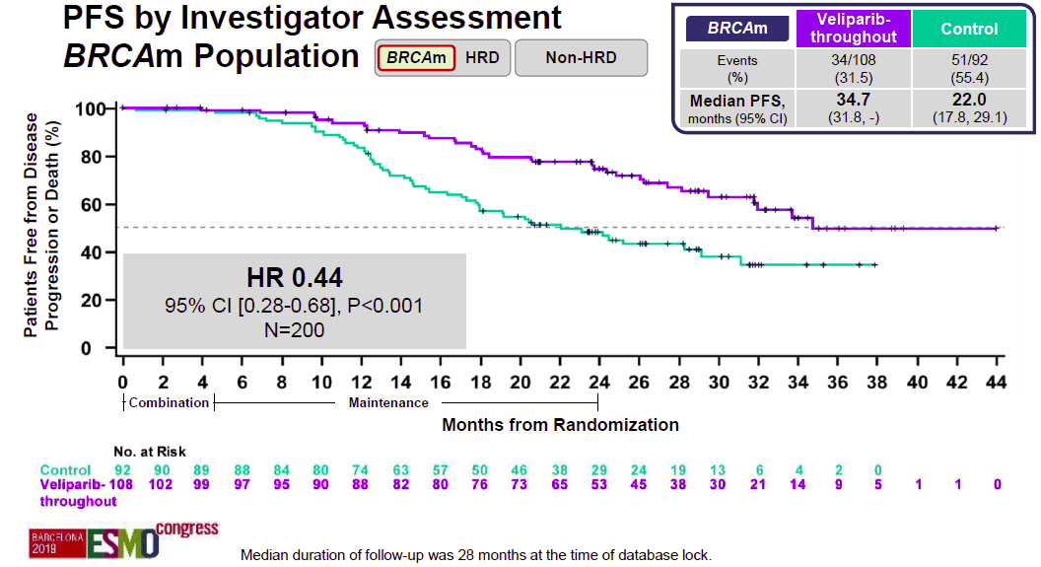
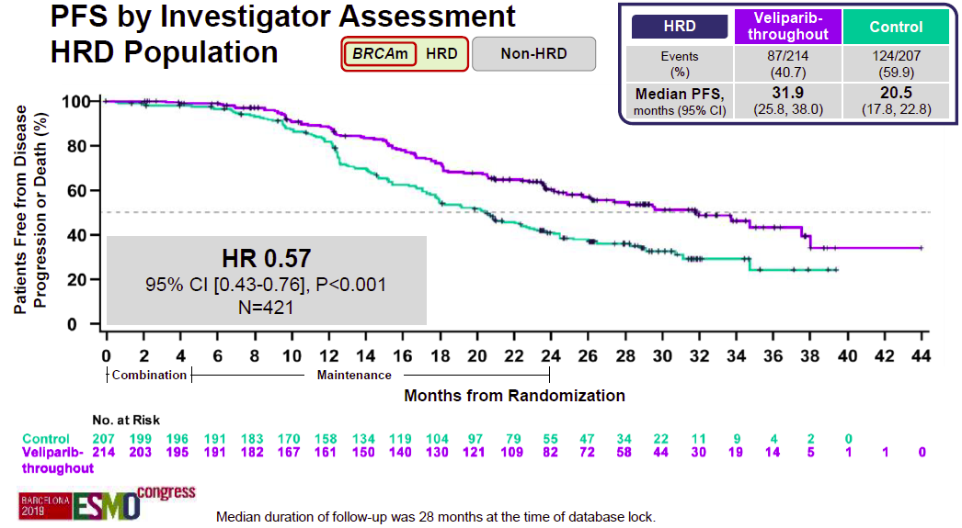
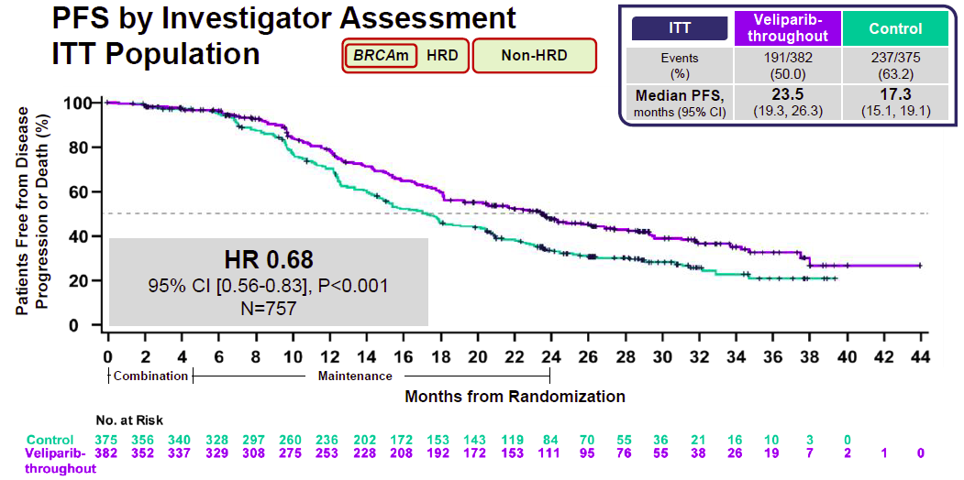
VELIA: PFS primary endpoints
BRCA and HRD+
BRCA only
All patients
Coleman et al., N Engl J Med 2019, ESMO 2019

Slide 34
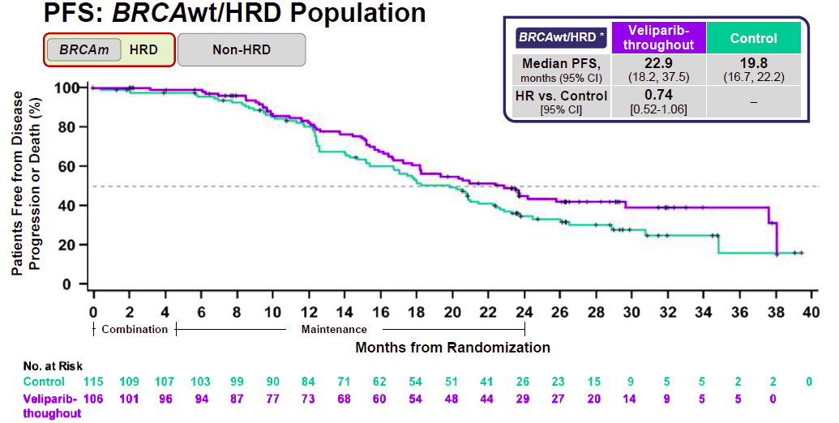
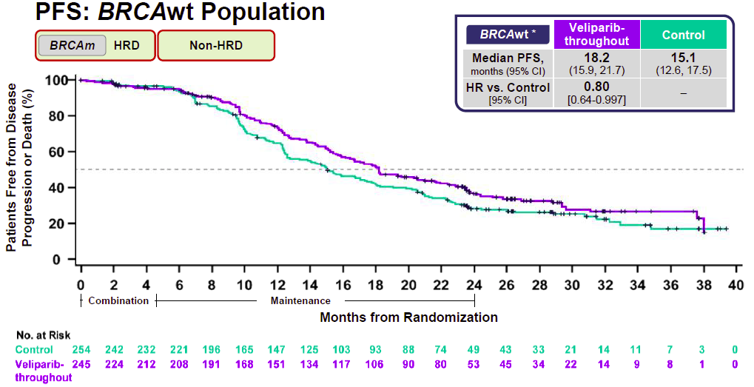
VELIA: No PFS benefit in non-BRCAmt patients (exploratory)
Coleman et al., N Engl J Med 2019, ESMO 2019

Slide 35
Dr Matulonis Case Presentation: 85 yo F
Self palpated an abdominal mass in 2018
CT scan showed bilateral ovarian masses, omental caking and peritoneal carcinomatosis.
Went to laparoscopy in August 2018 and found to have miliary tumor deposits on the right hemidiaphragm, anterior abdominal wall, small and large bowel mesentery, and outside surface of lower colon, omental caking, bilateral ovarian masses; she was deemed not a surgical candidate, and an omental biopsy showed high grade serous carcinoma
Her PMHx included HTN, Afib, small CVA with transient visual loss in the past, hypercholesterolemia, and DJD; Meds include apixaban, atorvastatin, and amlodipine.

Slide 36
Dr Matulonis Case Presentation: 85 yo F (cont)
Started IV weekly carboplatin AUC 2 and weekly paclitaxel 80 mg/m²
CA125 was 112 at start of chemotherapy and dropped to 15 after 9 weeks. Found to have a germline BRCA1 mutation
After 9 weeks of chemotherapy, she underwent R0 interval debulking surgery
~4 weeks after surgery, she restarted weekly carbo and weekly paclitaxel but completed only 6 weeks of treatment (missed 3 weeks); stopped for fatigue, mild neuropathy. CA125 was 10 at the completion of chemotherapy in Feb 2019
Omental caking
pre-chemotherapy
After 9 weeks of
weekly carbo and weekly paclitaxel

Slide 37
Dr Matulonis Case Presentation: 85 yo F (cont)
Started Olaparib 300 mg BID in March 2019
Had some mild nausea (grade 1) and fatigue (grade 1, occ grade 2) during first 2 months of treatment; but this has mostly abated.
March 2019 Hgb 12.8 g/dl and Hct 38.4%; checked monthly for one year.
March 2020: Hgb 11.8 g/dl and Hct 34.8%, plts and WBC all WNL
April 2020: CA125 is stable at 9
Plan is for a total of 2 years of olaparib, then stop.
She is currently NED

Slide 38
Dr Matulonis Case Presentation: 61 yo F
Presented with abdominal pain in 2019, and a CT scan showed small volume ascites, peritoneal carcinomatosis, omental caking and a pelvic mass; CA125 was 320
Went to laparoscopy; deemed not an upfront debulking candidate, and multiple biopsies showed high grade serous carcinoma
Germline and somatic BRCA wild-type
Started IV carboplatin AUC 6 and paclitaxel 175 mg/m² in August 2019
CA125 fell to 24 after 3 cycles of chemotherapy

Slide 39
Dr Matulonis Case Presentation: 61 yo F (cont)
Pre-
chemotherapy
After 3 cycles of carboplatin
and paclitaxel: near normal CT

Slide 40
Dr Matulonis Case Presentation: 61 yo WF (cont)
Underwent surgery in October 2019 and had R0 resection
Completed 3 additional cycles of carboplatin and paclitaxel IV which she completed in late December 2019
Had tumor HRD testing and was HRD
Weight 62 kg, so started niraparib 200 mg PO daily in Feb 2020
Date ANC Hgb Hct Plts
start niraparib
200 mg/d
2/6/20 | 2490 | 13.1 | 38.5 | 264
2/13/20 | 3290 | 13.7 | 40.4 | 239
2/20/20 | 3090 | 13.4 | 39.9 | 148
2/27/20 | 1470 | 12.9 | 38.4 | 118
3/5/20 | 2000 | 11.8 | 34.2 | 157
3/12/20 | 3130 | 12.6 | 37.8 | 315
3/19/20 | 4100 | 11.7 | 35.5 | 242
3/26/20 | 2930 | 12.9 | 37.8 | 206
4/2/20 | 3550 | 12.9 | 38.2 | 222
5/15/20 | 2680 | 13 | 38.3 | 233
Hold niraparib
Restart
Niraparib
100 mg/d
June 2020:
Doing well on
Niraparib 100 mg
per day

Slide 41
Agenda
Module 1: Overview of PARP Inhibitors: Biologic Rationale and Mechanism of Action
Module 2: Side Effects and Toxicities of PARP Inhibitors
Module 3: PARP Inhibitors for Ovarian Cancer – Dr Matulonis
Key data sets: SOLO-1, PRIMA, PAOLA-1, VELIA
Module 4: PARP Inhibitors for Breast Cancer – Dr Rugo
Key data sets: EMBRACA, OlympiAD, BROCADE3
Module 5: PARP Inhibitors for Pancreatic Cancer – Dr Philip
Key data sets: POLO, RUCAPANC
Module 6: PARP Inhibitors for Prostate Cancer – Dr Hussain
Key data sets: PROfound, TRITON2, GALAHAD

Slide 42
Module 4: PARP Inhibitors for Breast Cancer – Dr Rugo
Genomic profile
Key recent data sets: EMBRACA, OlympiAD, BROCADE
Current practice patterns
Ongoing trials

Slide 43
In general, what is the optimal approach to mutation testing for possible use of a PARP inhibitor for a patient with de novo metastatic triple-negative breast cancer and no family history?
Germline BRCA; if negative, multigene somatic (NGS)
Multigene germline and somatic/NGS
Germline BRCA
Multigene germline panel
Survey of 50 US-based general medical oncologists June 2020

Slide 44
Reimbursement and regulatory issues aside, what would be your preferred treatment approach for a 60-year-old patient with a germline BRCA mutation and de novo metastatic triple-negative breast cancer that is PD-L1-positive?
Atezolizumab/nab paclitaxel
Chemotherapy → PARP inhibitor maintenance
Platinum-containing chemotherapy regimen
Olaparib or talazoparib — coin flip
Olaparib
Talazoparib
Chemotherapy combined with a PARP inhibitor
Nonplatinum chemotherapy regimen
Survey of 50 US-based general medical oncologists June 2020

Slide 45
Reimbursement and regulatory issues aside, what would be your preferred treatment approach for a 60-year-old patient with a germline BRCA mutation and de novo metastatic triple-negative breast cancer that is PD-L1-negative?
Platinum-containing chemotherapy regimen
Chemotherapy → PARP inhibitor maintenance
Olaparib
Olaparib or talazoparib — coin flip
Atezolizumab/nab paclitaxel
Talazoparib
Chemotherapy combined with a PARP inhibitor
Nonplatinum chemotherapy regimen
Survey of 50 US-based general medical oncologists June 2020

Slide 46
Epidemiology of gBRCA Mutations
Female breast cancer
  ~3%–6% of all breast cancer patients¹⁻⁴
  2.7%–4.3% among MBC patients^{1,2}
  9.3%–15.4% in TNBC⁵⁻⁷
Male breast cancer
  16% of all male breast cancers⁸
Hereditary breast cancer
  ~25% of hereditary breast cancers⁹
Lifetime risks of breast cancer by age 70
  ~57% for BRCA1 mutation carriers; ~49% for BRCA2 mutation carriers
Younger age at diagnosis
Individuals with gBRCA mutations are diagnosed with breast cancer ~20 years younger than the overall breast cancer population¹⁰
Women with gBRCA mutations are more likely to develop a second breast cancer¹¹
BRCA=breast cancer susceptibility gene; MBC=metastatic breast cancer; TNBC=triple-negative breast cancer.
1. Meynard G, et al. Ann Oncol. 2017;28(suppl 5):v74-v108. 2. Fasching PA, et al. Abstract PD1-02. SABCS 2017. 3. Tung N, et al. J Clin Oncol. 2016 May 1;34(13):1460-8. 4. Nelson HD, et al. Risk assessment, genetic counseling, and genetic testing for BRCA-related cancer: systematic review to update the U.S. Preventive Services Task Force recommendation. Evidence Synthesis No. 101. Rockville, MD: Agency for Healthcare Research and Quality; 2013. AHRQ Publication No. 12-05164-EF-1. 5. Wong-Brown MW, et al. Breast Cancer Res Treat. 2015 Feb;150(1):71-80. 6. Couch FJ, et al. J Clin Oncol. 2015 Feb;33(4):304-11. 7. Sharma P, et al. Breast Cancer Res Treat. 2014 Jun;145(3):707-14. 8. Giordano SH. N Engl J Med. 2018 Jun 14;378(24):2311-20. 9. Arpino G, et al. BMC Cancer. 2016 Nov 29;16(1):924. 10. Kim R, et al. Poster P5-08-28. SABCS 2016. 11. Godet I, Gilkes DM. Integr Cancer Sci Ther. 2017 Feb;4(1). doi:10.15761/ICST.1000228.
Notes:
Meynard/2017/abst/p1/para2 (Results)
Fasching/abst PD1-02/2017/p1/col2/figure1;col3/para1
Calculation:
((20+43)/1462)*100=4.3
Tung/p1462/col1/para5
Nelson/p30/para1
Meynard/2017/abst/p1/para2
Fasching/abst PD1-02/2017/p1/col2/figure1;col3/para1
Calculation:
((20+43)/1462)*100=4.3
Wong/2015/p77/col2/para3-p78/col1/ para1
Couch/2015/p306/col1/para4-col2/ para1
Calculation:
((155+49)/1824)*100=11.2%
Sharma/2014/p4/para1; p6/para4
Giordano/2018/p2311/para3
Arpino/2016/p1/col1/para1
Kim/2016/abst p5-08-28/ p1/col4/conclusion/bullet1
Godet/2017/p7/para4

Slide 47
Progression Free Survival
EMBRACA
OlympiAD
Extracted from Litton JK, et al. N Engl J Med. 2018 Aug 23;379(8):753-63. (EMBRACA)
Robson M et al. N Engl J Med 2017;377:523-33. (OlympiAD)

Slide 48
EMBRACA and OlympiAD:
Talazoparib significantly improved PFS in both HR+ and TNBC compared to TPC

Slide 49
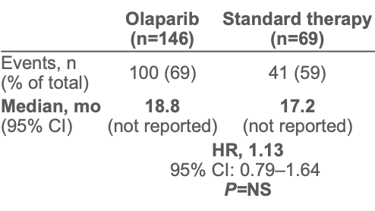
OlympiAD: OS Results
OS: Prior chemotherapy for MBC (2/3L)²
OS: No prior chemotherapy for MBC (1L)²
 | Olaparib (n=59) | Standard therapy (n=28)
Events, n (% of total) | 30 (51) | 21 (75)
Median, mo (95% CI) | 22.6 (not reported) | 14.7 (not reported)
 | HR, 0.51 95% CI: 0.29–0.90 P=0.02
100
100
90
90
80
80
70
70
60
60
OS (%)
50
OS (%)
50
40
40
30
30
20
20
10
Olaparib
Olaparib
Standard therapy
10
Standard therapy
0
0
0
4
8
12
16
20
24
28
32
36
40
0
4
8
12
16
20
24
28
32
36
40
Number at risk
Months since randomization
Months since randomization
Olaparib
146
142
125
102
84
60
38
16
6
2
0
Number at risk
Standard therapy
69
60
54
45
36
31
23
11
4
2
0
Olaparib
59
57
53
44
40
32
17
7
5
4
0
Median duration of follow-up for OS*: 25.3 months (olaparib), 26.3 months (standard therapy)
Standard therapy
28
25
20
17
12
9
7
4
1
0
0
Median duration of follow-up for OS*: 25.3 months (olaparib), 26.3 months (standard therapy)
From Annals of Oncology. Robson ME, Tung N, Conte P, et al. OlympiAD final overall survival and tolerability results: olaparib versus chemotherapy treatment of physician’s choice in patients with a germline BRCA mutation and HER2-negative metastatic breast cancer, vol. 30, 558-566. Copyright © 2019 Massachusetts Medical Society. Reprinted with permission from the Massachusetts Medical Society.
*Final analysis for OS. 1L=first line; 2/3L=second/third line; CI=confidence interval; HR=hazard ratio; ITT=intent-to-treat; MBC=metastatic breast cancer; mo=months; NS=not significant; OS=overall survival; PFS=progression-free survival.
1. Extracted from Robson M, et al. N Engl J Med. 2017 Aug 10;377(6):523-33. 2. Extracted from Robson ME, et al. Ann Oncol. 2019 Apr 1;30(4):558-566.
Notes:
Robson/2017/p526(PDF527)/col2/para2;p529(PDF530)/figure2A;p530(PDF531)/figure3
Robson/2017/p526(PDF527)/col2/para1
Robson/2019/p559/col2/para2
Robson/2019/p560/figure1B
Robson/2019/p562/figure2 (n’s)

Slide 50
OlympiAD Extended Follow-Up
14 patients still on olaparib
8.8% received olaparib >3 years
No statistically significant differences in survival curves in:
  Overall population and > 1 line of chemotherapy in metastatic setting
  Tissue receptor subtype
  Prior exposure to platinums
No new safety signal –No AML/MDS
Robson M et al. N Engl J Med 2017;377:523-533
Robson M, et al. SABCS 2019

Slide 51
EMBRACA: Final OS — Results From This Prespecified Analysis Found No Statistically Significant Difference Between The Treatment Groups*
100
Talazoparib
Median OS, 19.3 months
95% CI, 16.6-22.5
Chemotherapy
Median OS, 19.5 months
95% CI, 17.4-22.4
Hazard ratio, 0.848
95% CI, 0.670-1.073
P = 0.17
Survival probability | Talazoparib | Chemotherapy
At Month 12 (95% CI) | 0.71 (0.66-0.76) | 0.74 (0.66-0.81)
At Month 24 (95% CI) | 0.42 (0.36-0.47) | 0.38 (0.30-0.47)
At Month 36 (95% CI) | 0.27 (0.22-0.33) | 0.21 (0.14-0.29)
At Month 48 (95% CI) | 0.19 (0.14-0.25) | 0.07 (0.02-0.15)
90
80
70
60
50
OS probability (%)
40
30
20
10
0
0
3
6
9
12
15
18
21
24
27
30
33
36
39
42
45
48
51
54
57
60
Time (months)
Number of patients at risk
Talazoparib
Chemotherapy
287
144
280
125
264
116
232
105
199
96
163
86
143
71
128
58
113
48
101
44
85
34
68
25
54
18
41
8
35
7
27
4
20
2
15
2
9
2
6
1
2
0
*ITT population
Litton et al, AACR 2020

Slide 52
BROCADE 3: Combining PARPi with Chemotherapy in gBRCA-Associated Breast Cancer
Dieras et al, ESMO 2019

Slide 53
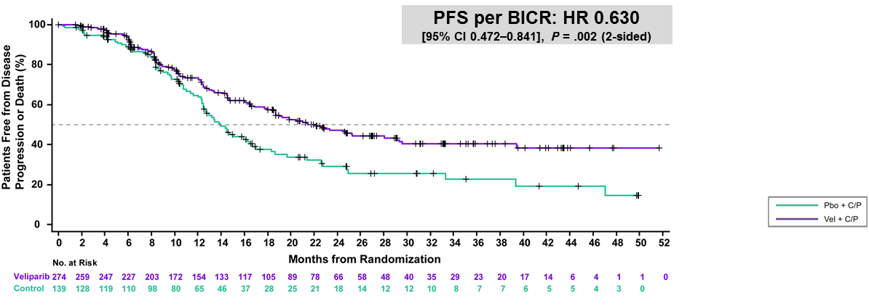
Grade 3+ toxicity
Thrombocytopenia
  40% vs 28%
No change in neutropenia
(80-81%), anemia (40-42%)
First phase III trial to evaluate the addition of a PARPi to platinum based chemotherapy in patients with MBC and gBRCA mutations
Maintenance after chemotherapy
  42.5% monotherapy with veliparib
  32.4% monotherapy with placebo
44% cross over with PD from placebo to veliparib
Patients With No Cytotoxic Therapy in the Metastatic Setting
PFS2 defined as time from randomization until
disease progression on subsequent therapy or death
Arun et al, SABCS 2019

Slide 54
SWOG-S1416: Cisplatin +/- Veliparib in Metastatic TNBC and/or BRCA Associated MBC
N=321
37
99
110
Sharma et al, ASCO 2020

Slide 55
Results: PFS and OS
gBRCA: no difference in PFS (6.3 mo) or OS (14.4 mo) with veliparib
  ?small subset?
Non-BRCA-like: no differences
BRCA-like:
Comments and questions:
Role of somatic mutations versus HRD?
Small differences in PFS
No real maintenance therapy

Slide 56
TBCRC 048: Olaparib Expanded
R
E
G
I
S
T
E
R
Tumor
assessment
Q 6 wks
x 24 wks
then q 12 wks
CR, PR,
SD
Continue
Olaparib
300 mg BID
Q 3 wks
Cohort A: Germline Mutation
Cohort B: Somatic Mutation
PD,
toxicity
requiring
discontinuation
Off study
Research
biopsy
Eligibility: germline or somatic pathogenic mutation in ATM, ATR, BARD1, BRIP1 (FANCJ), CHEK2 , FANC genes, MRE11A, NBN, PALB2, RAD50, RAD51C, RAD51D
(+ others)*; somatic mutation in BRCA1/2
Optional research biopsy
Evidence of activity in prostate cancer and ovarian cancer with HRD
PI: Nadine Tung
ASCO 2020;Abstract 1002

Slide 57
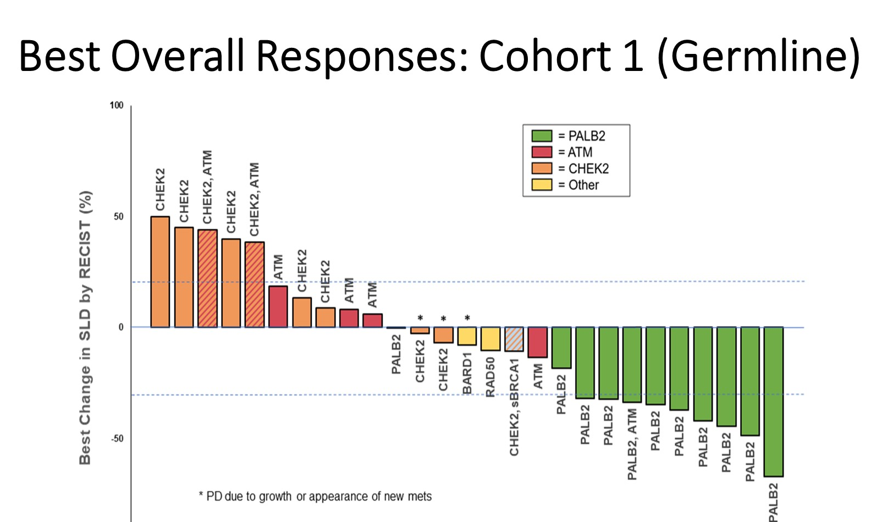
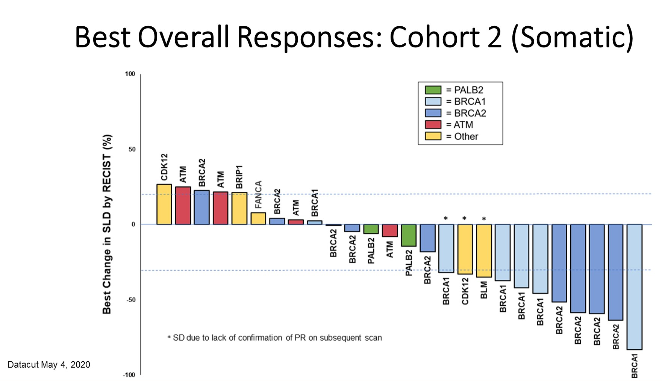
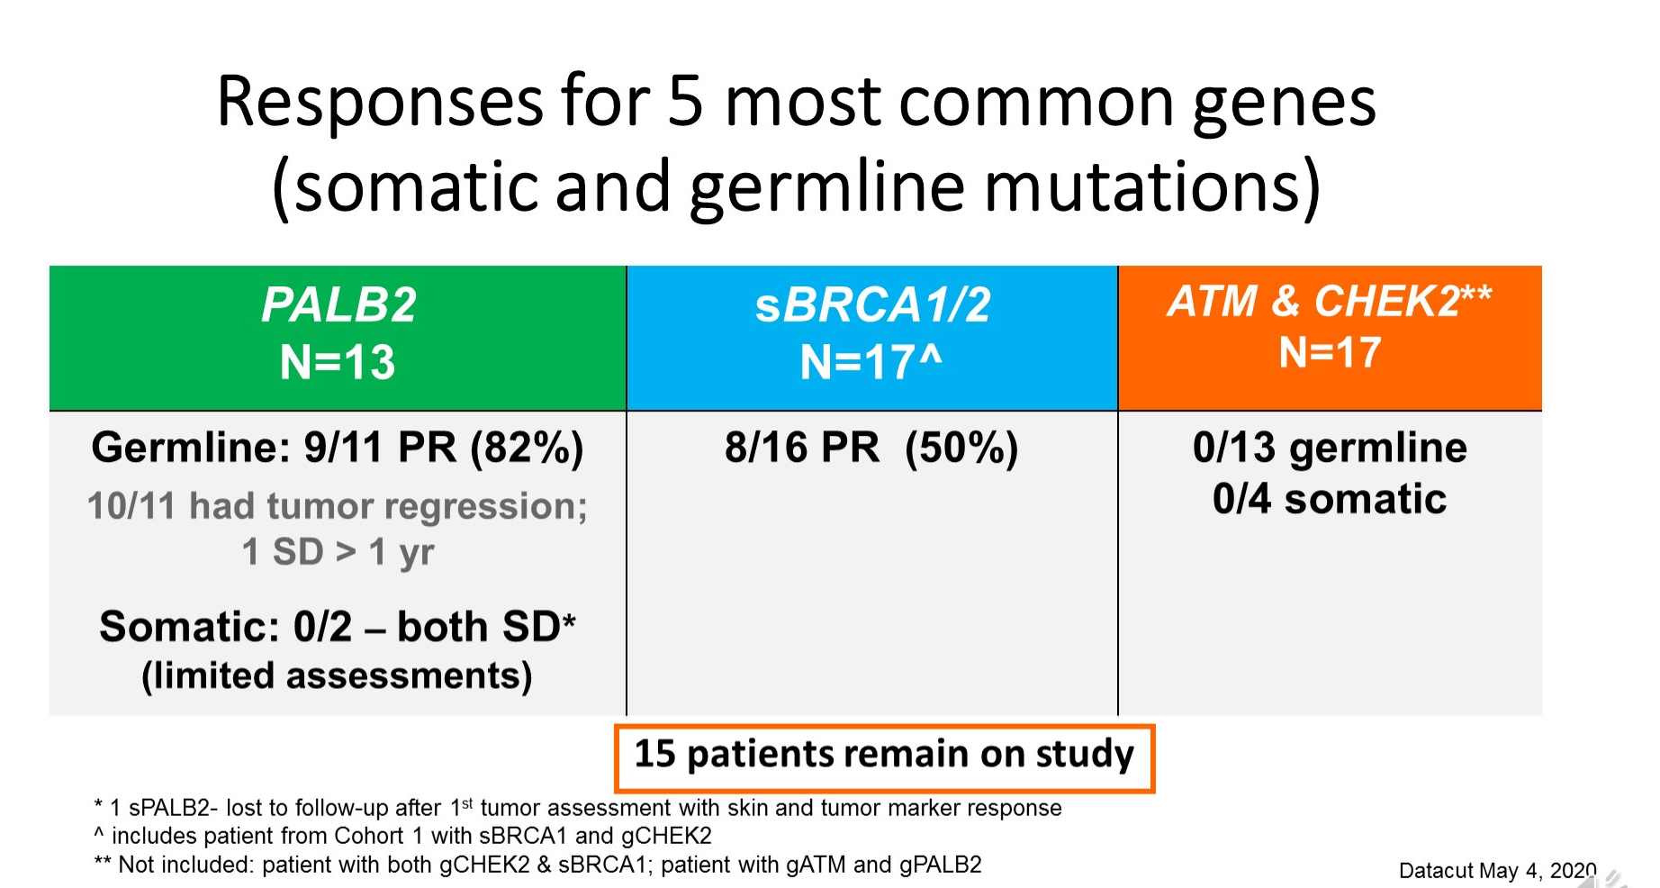
Tung NM et al. ASCO 2020;Abstract 1002.

Slide 58
Dr Rugo Case Presentation: 30 yo F
Age 30, juvenile diabetes
2016: diagnosed with T2N1 grade 2 ER+/PRneg/HER2neg breast cancer
Genetic testing: BRCA1+
Treated on I-SPY 2 phase II clinical trial with NAC including weekly paclitaxel and pembrolizumab followed by AC x 3 (stopped early due to toxicity with neutropenic fevers)
Surgery: bilateral mastectomies with stage III residual disease: T1N2 (7+ nodes)
12/2016 Ovarian suppression and AI
Small focus of disease in chest wall before radiation therapy
6/2017 Palbociclib added post radiation therapy, dose reduced due to cytopenia
11/2018 diagnosed with metastatic disease to bone and liver, spinal cord compression due to pathologic compression fracture at T7
Liver biopsy: ER 90%/PR and HER2 neg

Slide 59
Dr Rugo Case Presentation: 30 yo F (cont)
Fulvestrant
Urgent neurosurgery: decompression T7 etc followed by RT to T7
11/24/2018 – 3/14/2019 Talazoparib 1 mg/d, dose reduced 2/22/2019 due to severe anemia requiring 2U PRBC every other week
CR in liver and PR in bone, resolution of bone pain
3/14/19 – 10/14/2019 olaparib (change due to anemia, N/V)
4/2019 Olaparib dose reduced to 400 mg due to anemia/nausea. Anemia resolved.
8/2019 – 10/14/2019 olaparib increased to 600 mg a day without recurrent anemia but with worsening nausea
10/23/2019 – 12/3/2019 talazoparib 1 mg (change due to mild progression in bone, nausea), tolerated better with nausea but only moderate anemia
Progression in bone and slight progression in liver: found to have PIK3CA mutation
12/23/2019 alpelisib and continued fulvestrant

Slide 60
Dr Rugo Case Presentation: 48 yo F
2013 Age 48
Diagnosed with left breast cancer:
1.2 cm node negative grade 3 ER 80%/PR 10%/HER2 3+
BRCA1+
4/1/14 - 6/14 weekly paclitaxel and trastuzumab x 12
6/24/14 - 12/4/14: every 3 week trastuzumab, STOPPED d/t EF drop 46% (received 9 months trastuzumab total)
8/28/14: BSO - atypical cells in fallopian tube
9/16/14 - 12/9/14: letrozole, stopped d/t suicidal ideations, refused additional hormone therapy

Slide 61
Dr Rugo Case Presentation: 48 yo F (cont)
7-8/2017 diagnosed with extensive bone metastases, and destruction of right acetabulum/comminuted fracture of medial acetabular wall
7/31/17 bone biopsy: ER+/PR-/HER2+
8/14/17 total right hip replacement
8/1/17-8/8/19: olaparib 400 mg BID with fulvestrant
(EF 48-50%)
8/2019 progression in bone
Palliative RT to T9, change to anastrozole and palbociclib
On cardiac meds, EF returned to normal
8/2019 – 4/2020 trastuzumab
4/2020 progression in bone, changed to T-DM1 on continued cardiac medications
Stopped trastuzumab, anastrozole and palbociclib

Slide 62
Agenda
Module 1: Overview of PARP Inhibitors: Biologic Rationale and Mechanism of Action
Module 2: Side Effects and Toxicities of PARP Inhibitors
Module 3: PARP Inhibitors for Ovarian Cancer – Dr Matulonis
Key data sets: SOLO-1, PRIMA, PAOLA-1, VELIA
Module 4: PARP Inhibitors for Breast Cancer – Dr Rugo
Key data sets: EMBRACA, OlympiAD, BROCADE3
Module 5: PARP Inhibitors for Pancreatic Cancer – Dr Philip
Key data sets: POLO, RUCAPANC
Module 6: PARP Inhibitors for Prostate Cancer – Dr Hussain
Key data sets: PROfound, TRITON2, GALAHAD

Slide 63
Module 5: PARP Inhibitors for Pancreatic Cancer – Dr Philip
Genomic profile
Key recent data sets: POLO, RUCAPANC
Current practice patterns
Ongoing trials

Slide 64
In general, what is the optimal approach to mutation testing for possible use of a PARP inhibitor for a patient with metastatic pancreatic cancer and no family history?
Germline BRCA; if negative,
multigene somatic (NGS)
Multigene germline and somatic/NGS
Germline BRCA
Multigene germline panel
Multigene somatic/NGS
Other
Survey of 50 US-based general medical oncologists June 2020

Slide 65
Have you administered or would you administer PARP inhibitor maintenance to a patient with unresectable locally advanced pancreatic cancer and a germline BRCA mutation?
I have
I have not, but I would for the right patient
I have not and would not
Survey of 50 US-based general medical oncologists June 2020

Slide 66
How would you compare the gastrointestinal toxicity associated with PARP inhibitor use in patients with pancreatic cancer to that in patients with other tumor types?
They are about the same
PARP inhibitors have more gastrointestinal toxicity in pancreatic cancer
PARP inhibitors have more gastrointestinal toxicity in other tumor types
I don’t know
Survey of 50 US-based general medical oncologists June 2020

Slide 67

BRCA mutations in pancreatic cancer
4-7% have BRCA1 or BRCA2
Germline mutations
Significant geographical variations
Disparities in testing
Family history is not sufficient to rule out BRCA mutation

Slide 68
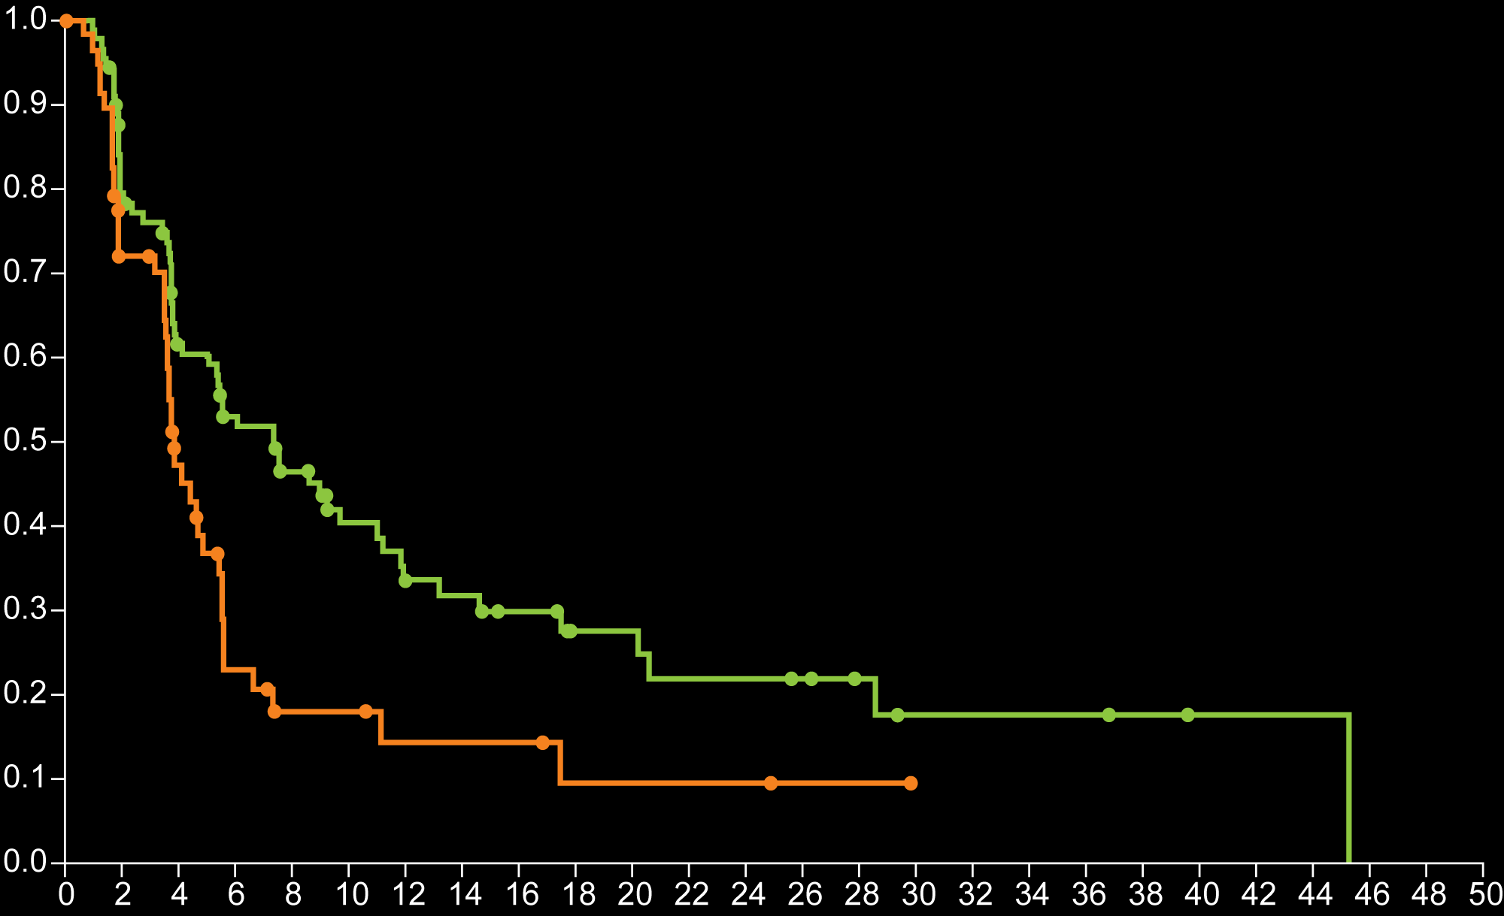
POLO: A Phase III Trial of Maintenance Olaparib for Metastatic Pancreatic Cancer with BRCA Mutation
Progression-free Survival
Progression-free survival mo | Olaparib group | Placebo group
6 | 53.0% | 23%
12 | 33.7% | 14.5%
18 | 27.6% | 9.6%
24 | 22.1% | 9.6%
Probability of Progression-free Survival
Median, 7.4 mo vs 3.8 mo
Hazard ratio, 0.53 (95% CI, 0.35-0.82)
P = 0.004
Olaparib (N = 92; 60 events)
Placebo (N = 62; 44 events)
Months since Randomization
An interim analysis of overall survival showed no difference between olaparib and placebo (median 18.9 mo vs 18.1 mo, HR 0.91, p 0.68)
Golan T et al. N Engl J Med 2019;381(4):317-27.

Slide 69
Objective Response* in Patients With Measurable Disease by Blinded Independent Central Review
Two patients in the olaparib arm had a complete response
Both complete responses were ongoing at the data cut-off†
Olaparib
5.4 months
23.1%
Placebo
3.6 months
Median time to onset of response
11.5%
Olaparib
24.9 months
n = 18
n = 6
3.7 months
Placebo
Olaparib
N = 78
Placebo
N = 52
Median duration of response
*By modified RECIST v1.1.
†January 15, 2019.
Kindler HL, et al. J Clin Oncol. 2019;37(suppl): Abstract LBA4; Golan T, et al. N Engl J Med. 2019;381(4):317-327.

Slide 70
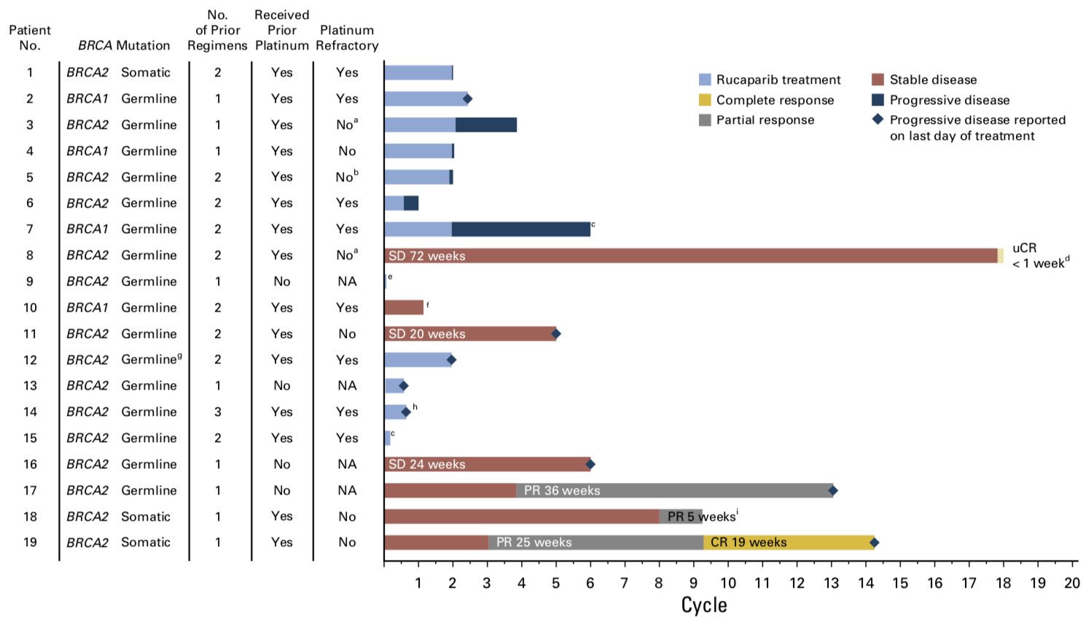
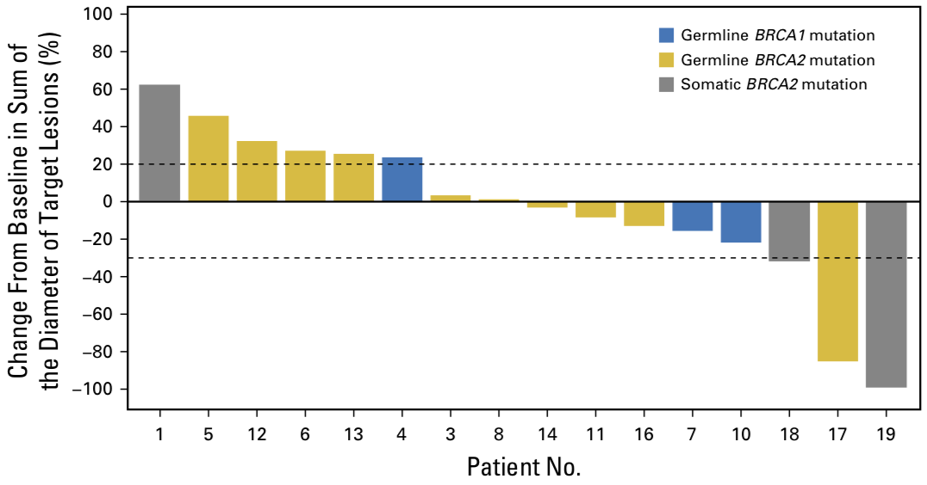
RUCAPANC: Rucaparib Monotherapy in Patients With Pancreatic Cancer and a Known Deleterious BRCA Mutation
Shroff RT, et al. JCO Precis Oncol. 2018;2018.

Slide 71
Dr Philip Case Presentation: 51 yo M
51-year-old software engineer whose father had prostate cancer presented with epigastric abdominal pain. He had weight loss of 5 lbs. CT scan showed a 3 cm mass in the pancreas which was considered resectable. At laparotomy few small liver metastases were seen that were histologically positive for pancreatic adenocarcinoma. CA 19-9 was 150 IU/L. Initial workup showed no abnormalities in liver function and normal CBC. C-reactive protein was within normal range. Patient was seen by supportive care team to optimize pain management and subsequently started on modified FOLFIRINOX. CT scan after 2 months showed significant shrinkage of the pancreatic mass and reduction in CA199 by 80%. He did undergo genetic testing and was found to have BRCA2 mutation. His father was subsequently tested and indeed he also had the BRCA2 mutation so did one of the patient’s two daughters who were tested. After 5 months of treatment with modified FOLFIRINOX he was switched to olaparib 300 mg per day at which point in time he had side effects from the FOLFIRINOX in the form of fatigue grade 2 and sensory neuropathy grade 2. He stayed on olaparib for 8.5 months before disease progression with increase liver metastases during which he tolerated treatment well except for the continued fatigue. His treatment was switched to 5FU/LCV/Liposomal irinotecan because of the persistent neuropathy.

Slide 72
Dr Philip Case Presentation: 59 yo M
59-year-old pediatric emergency doctor presented with obstructive jaundice, abdominal pain, back pain, and weight loss of 15 pounds and PS of 2. He was also very depressed. CT scan showed a pancreatic head mass of 3 cm, multiple hypodense lesions in the liver, and marked intra- and extrahepatic bile duct dilatation. ERCP failed to place a bile duct stent so he underwent percutaneous external drainage with multiple complications and including cholangitis. Biopsy of the liver lesion showed an adenocarcinoma of the pancreatic-biliary type. His bilirubin dropped from 12 mg/dL to 5 mg/dL and stayed around that level without further dropping. He was started on gemcitabine and cisplatin combination. He had a significant improvement of his symptoms with normalization of the serum bilirubin after several weeks. After six (three-weekly) cycles of gemcitabine and cisplatin he was switched to gemcitabine single agent. Of note CT scan at 9 weeks after starting gemcitabine/cisplatin showed significant partial response. He had somatic BRCA1 mutation on genomic profiling and later confirmed to have germline BRCA1 mutation. After 2 months of gemcitabine alone he was started on rucaparib 600 mg BID orally and continued on it for 9 months before progressing in the liver. He underwent a new liver biopsy which showed exactly the same BRCA2 mutation. He received gemcitabine and cisplatin but progressed after 2 months. He was switched to 5FU/LCV/Nano liposomal irinotecan and had stable disease for approximately six months.

Slide 73
Agenda
Module 1: Overview of PARP Inhibitors: Biologic Rationale and Mechanism of Action
Module 2: Side Effects and Toxicities of PARP Inhibitors
Module 3: PARP Inhibitors for Ovarian Cancer – Dr Matulonis
Key data sets: SOLO-1, PRIMA, PAOLA-1, VELIA
Module 4: PARP Inhibitors for Breast Cancer – Dr Rugo
Key data sets: EMBRACA, OlympiAD, BROCADE3
Module 5: PARP Inhibitors for Pancreatic Cancer – Dr Philip
Key data sets: POLO, RUCAPANC
Module 6: PARP Inhibitors for Prostate Cancer – Dr Hussain
Key data sets: PROfound, TRITON2, GALAHAD

Slide 74
Module 6: PARP Inhibitors for Prostate Cancer – Dr Hussain
Genomic profile
Key recent data sets: PROfound, TRITON2, GALAHAD
Current practice patterns
Ongoing trials

Slide 75
In general, what is the optimal approach to mutation testing for possible use of a PARP inhibitor for a patient with metastatic prostate cancer and no family history?
Germline BRCA; if negative,
multigene somatic (NGS)
Multigene germline and somatic/NGS
Germline BRCA
Multigene germline panel
I do not generally order mutation
assays for these patients
Survey of 50 US-based general medical oncologists June 2020

Slide 76
At what point, if any, do you generally recommend a PARP inhibitor to a patient with metastatic prostate cancer and a germline BRCA mutation?
After at least 1 line of both hormonal therapy and chemotherapy
After 1 line of hormonal therapy
After 1 line of chemotherapy
I generally would not
administer a PARP inhibitor
Survey of 50 US-based general medical oncologists June 2020

Slide 77
For a patient with metastatic prostate cancer and a germline BRCA mutation to whom you would administer a PARP inhibitor at some point, what treatment strategy would you likely use?
PARP inhibitor monotherapy
PARP inhibitor maintenance therapy
after response to chemotherapy
PARP inhibitor in combination with hormonal therapy
I generally would
not administer a PARP inhibitor
Survey of 50 US-based general medical oncologists June 2020

Slide 78
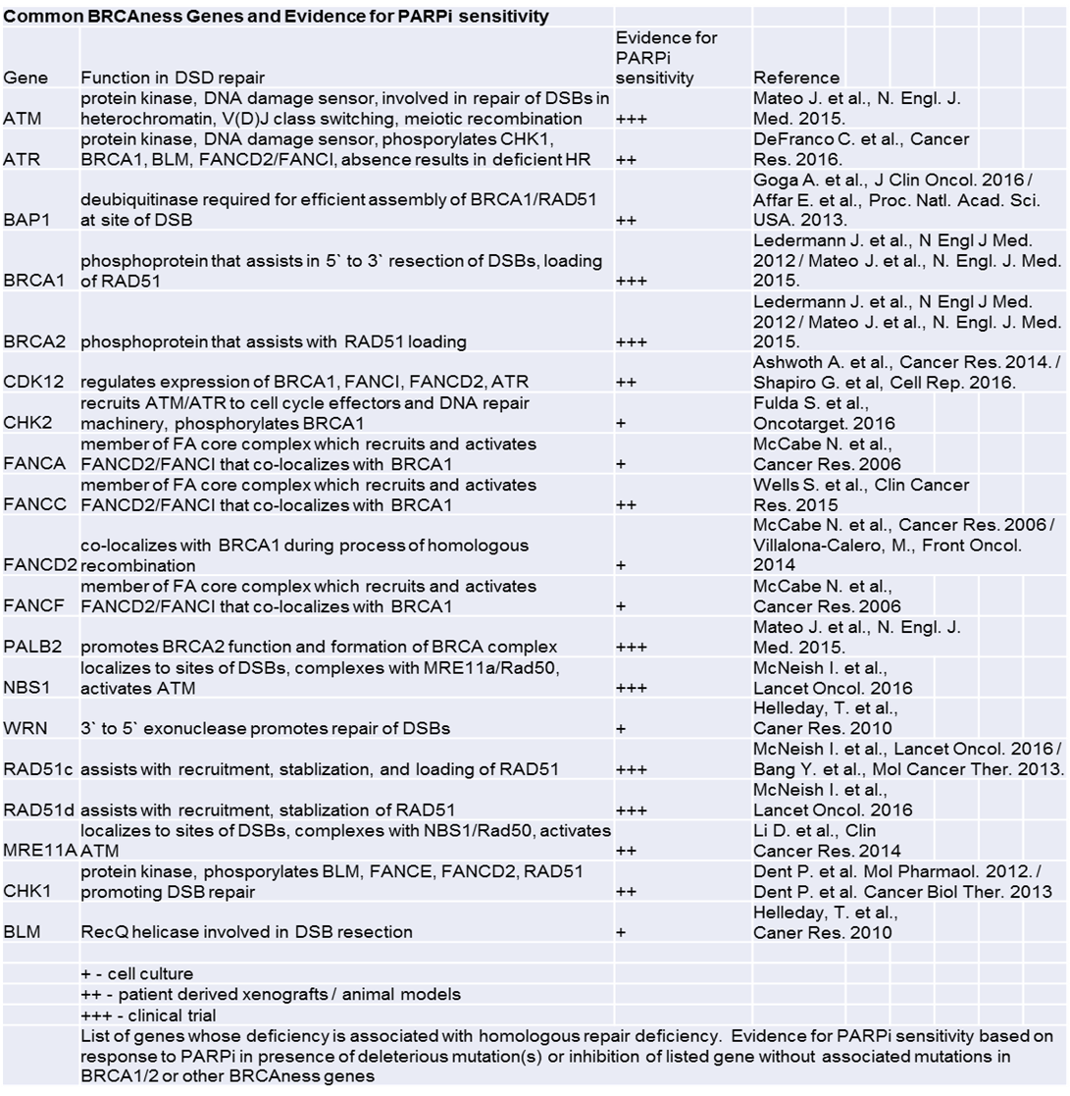
Common
BRCAness
Genes &
Evidence
for PARPi
Sensitivity
PARPi in PCa
Olaparib
Rucaparib
Niraparib
Talazoparib
BGB-290 (Pamiparib)
Rimar KJ, et al. Cancer.
2017;123(11):1912-1924.

Slide 79

PROfound Study design
Olaparib 300 mg bid
n=162
Primary Endpoint
Radiographic progression-free survival (rPFS) in Cohort A (RECIST 1.1 & PCWG3 by BICR)
Key eligibility criteria
mCRPC with disease progression on prior NHA, eg abiraterone or enzalutamide
Alterations in ≥1 of any qualifying gene with a direct or indirect role in HRR*
Cohort A:
BRCA1, BRCA2 or ATM
N=245
Physician’s choice‡
n=83
Upon BICR progression, physician's choice patients were allowed to cross over to olaparib
2:1 randomization
Open-label
Key Secondary Endpoints
rPFS in Cohorts A+B Confirmed radiographic objective response rate (ORR) in Cohort A Time to pain progression (TTPP) in Cohort A Overall survival (OS) in Cohort A
Olaparib 300 mg bid
n=94
Cohort B:
Other alterations
N=142
Physician’s choice‡
n=48
Stratification factors
Previous taxane
Measurable disease
*An investigational Clinical Trial Assay, based on a next-generation sequencing test
Used to prospectively select patients harboring alterations in BRCA1, BRCA2, ATM, BARD1, BRIP1, CDK12, CHEK1, CHEK2, FANCL, PALB2, PPP2R2A, RAD51B, RAD51C, RAD51D and/ or RAD54L in their tumor tissue
‡Physician’s choice of either enzalutamide (160 mg qd) or abiraterone (1000 mg qd + prednisone [5 mg bid])
BICR, blinded independent central review
Hussain M et al. ESMO 2019;Abstract 5059.

Slide 80
INDIVIDUAL AND CO-OCCURRING GENE ALTERATIONS IN PATIENTS SCREENED IN THE PROfound STUDY
Gene | Patients with HRR gene alterations (screened) | Proportion of total screened patients successfully tested for HRR gene alterations (n=2792), % | Proportion of total HRR gene alterations in screened population (n=778), % | Patients with HRR gene alterations (randomized) | Proportion of total HRR gene alterations in randomized population (n=387), %
Any qualifying HRR gene | 778 | 27.9 | − | − | −
BRCA2 only | 242 | 8.7 | 31.1 | 128 | 33.1
ATM only | 164 | 5.9 | 21.1 | 86 | 22.2
BRCA1 only | 27 | 1.0 | 3.5 | 13 | 3.4
CDK12 only | 175 | 6.3 | 22.5 | 89 | 23.0
CHEK2 only | 34 | 1.2 | 4.4 | 12 | 3.1
PPP2R2A only | 29 | 1.0 | 3.7 | 10 | 2.6
BRIP1 only | 12 | 0.4 | 1.5 | 3 | 0.8
PALB2 only | 9 | 0.3 | 1.2 | 4 | 1.0
RAD54L only | 8 | 0.3 | 1.0 | 5 | 1.3
RAD51B only | 7 | 0.3 | 0.9 | 5 | 1.3
BARD1 only | 5 | 0.2 | 0.6 | 1 | 0.3
RAD51D only | 4 | 0.1 | 0.5 | 1 | 0.3
CHEK1 only | 2 | 0.1 | 0.3 | 2 | 0.5
FANCL only | 1 | 0.0 | 0.1 | 0 | 0.0
RAD51C only | 0 | 0.0 | 0.0 | 0 | 0.0
Co-occurring genes | 59 | 2.1 | 7.6 | 28 | 7.2
Cohort A genes
Cohort B genes

Slide 81
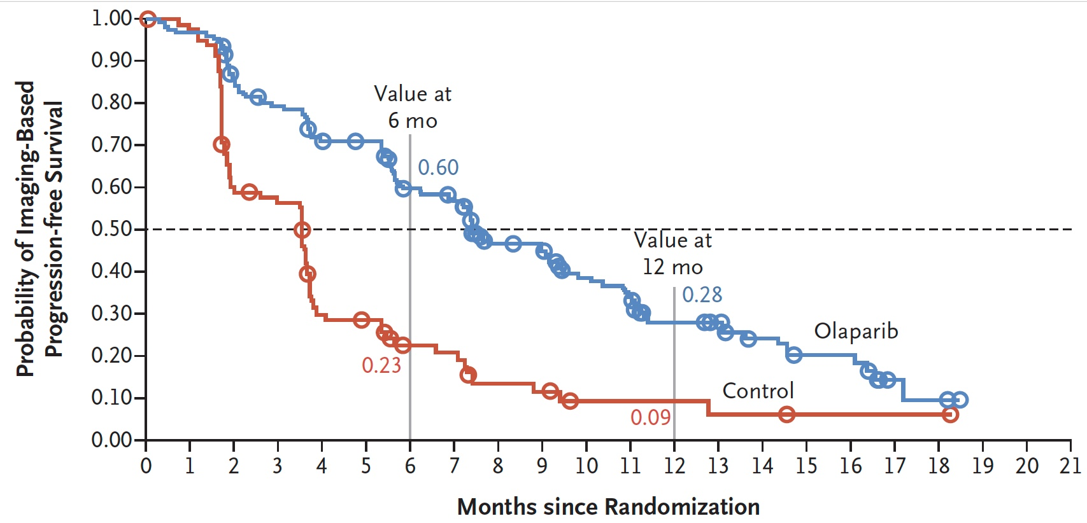
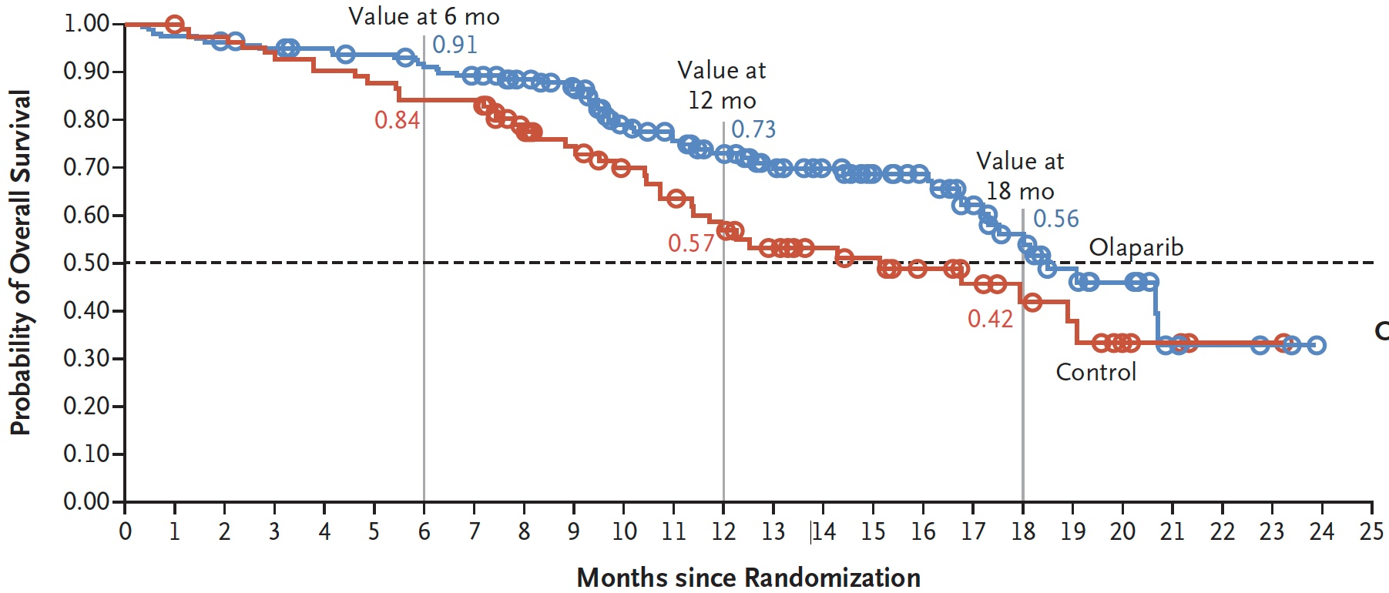
PROfound: Imaging-Based PFS and OS in Cohort A
 | Olaparib (n = 162) | Control (n = 83) | HR | P-value
mPFS | 7.4 mo | 3.6 mo | 0.34 | <0.001
 | Olaparib (n = 162) | Control (n = 83) | HR | P-value
mOS | 18.5 mo | 15.1 mo | 0.64 | 0.02
De Bono J et al. N Engl J Med 2020 May 28;382(22):2091-2101.

Slide 82
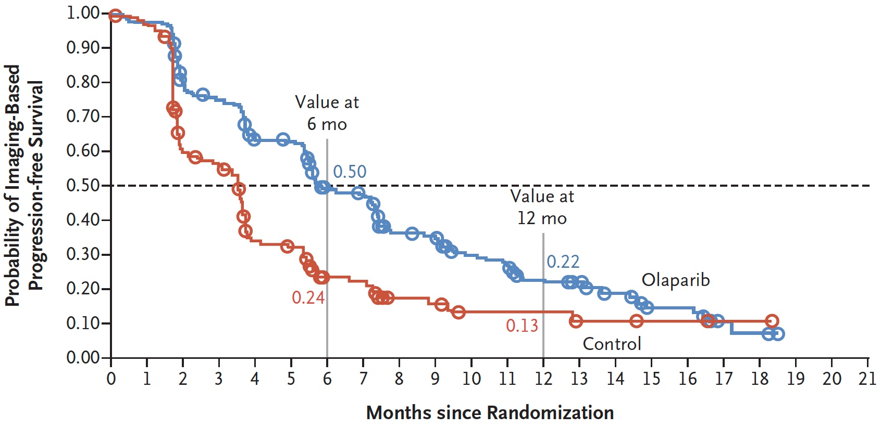
PROfound: Imaging-Based PFS in Cohort A and B
 | Olaparib (n = 256) | Control (n = 131) | HR | P-value
mPFS | 5.8 mo | 3.5 mo | 0.49 | <0.001
De Bono J et al. N Engl J Med 2020 May 28;382(22):2091-2101.

Slide 83
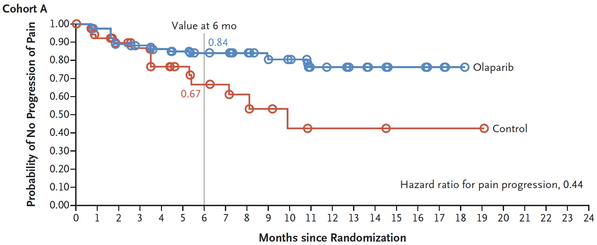
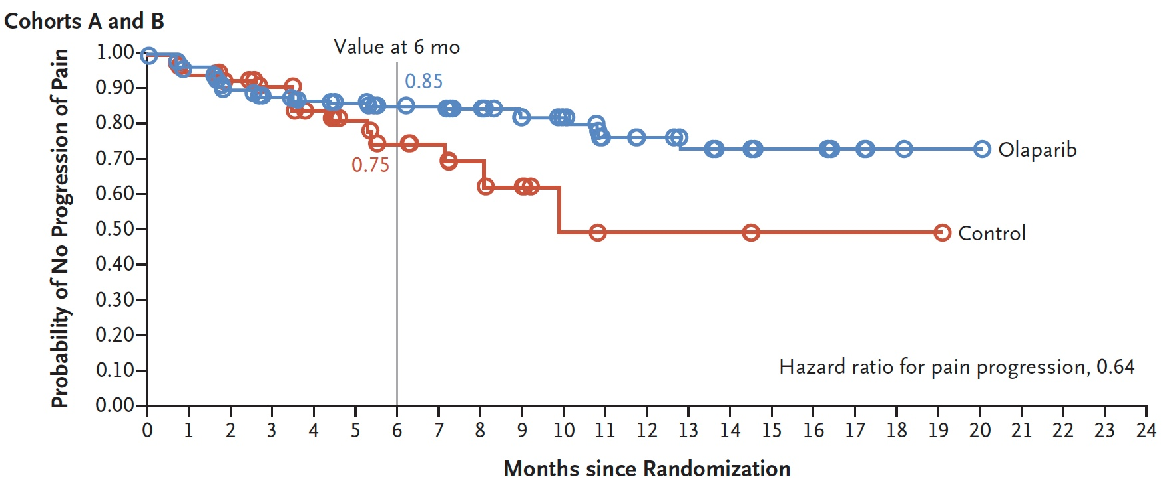
PROfound: Time to Pain Progression
De Bono J et al. N Engl J Med 2020 May 28;382(22):2091-2101.

Slide 84
FDA approves olaparib for HRR gene-mutated metastatic castration-resistant prostate cancer
Press Release – May 19, 2020
“The Food and Drug Administration approved olaparib for adult patients with deleterious or suspected deleterious germline or somatic homologous recombination repair (HRR) gene-mutated metastatic castration-resistant prostate cancer (mCRPC), who have progressed following prior treatment with enzalutamide or abiraterone.
Today, the FDA also approved FoundationOne® CDx for selection of patients with mCRPC carrying HRR gene alterations and BRACAnalysis CDx® test for selection of patients with mCRPC carrying germline BRCA1/2 alterations as companion diagnostic devices for treatment with olaparib.
Efficacy was investigated in PROfound (NCT02987543), an open-label, multicenter trial randomizing (2:1) 256 patients to olaparib 300 mg twice daily and 131 patients to investigator’s choice of enzalutamide or abiraterone acetate. All patients received a GnRH analog or had prior bilateral orchiectomy. Patients were divided into two cohorts based on their HRR gene mutation status. Patients with mutations in either BRCA1, BRCA2, or ATM were randomized in Cohort A (N=245); patients with mutations among 12 other genes involved in the HRR pathway were randomized in Cohort B (N=142); those with co-mutations (Cohort A gene and a Cohort B gene) were assigned to Cohort A.”
https://www.fda.gov/drugs/drug-approvals-and-databases/fda-approves-olaparib-hrr-gene-mutated-metastatic-castration-resistant-prostate-cancer

Slide 85
Preliminary Results from the TRITON2 Study of Rucaparib in Patients with DNA Damage Repair (DDR)-Deficient
Metastatic Castration-Resistant Prostate Cancer (mCRPC): Updated Analyses
Abida W et al.
ESMO 2019; Abstract 846PD.

Slide 86
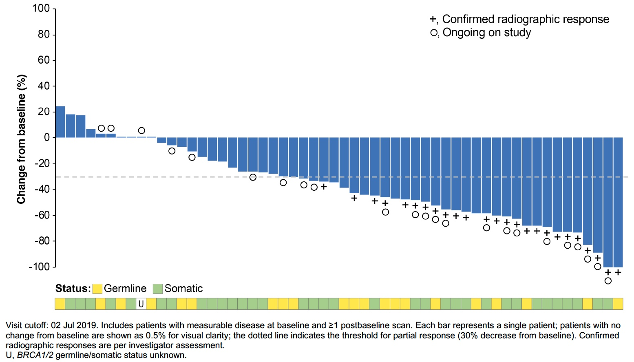
TRITON2: Best Change from Baseline in Sum of Target Lesions in Rucaparib-Treated Patients with a BRCA1/2 Alteration (N = 56)¹ and ORR in Patients with Non-BRCA DNA Damage Repair Gene Alterations (N = 78)²
 |  | Non-BRCA DNA Repair Gene Alterations
 | BRCA1/2¹ (n = 56) | ATM² (n = 49) | CDK12² (n = 15) | CHEK2² (n = 12) | Other² (n = 14)
ORR | 44% | 11% | 0% | 11% | 29%
¹Abida W et al. ESMO 2019; Abstract 846PD; ²Abida W et al. Clin Cancer Res 2020;26:2487-96.

Slide 87
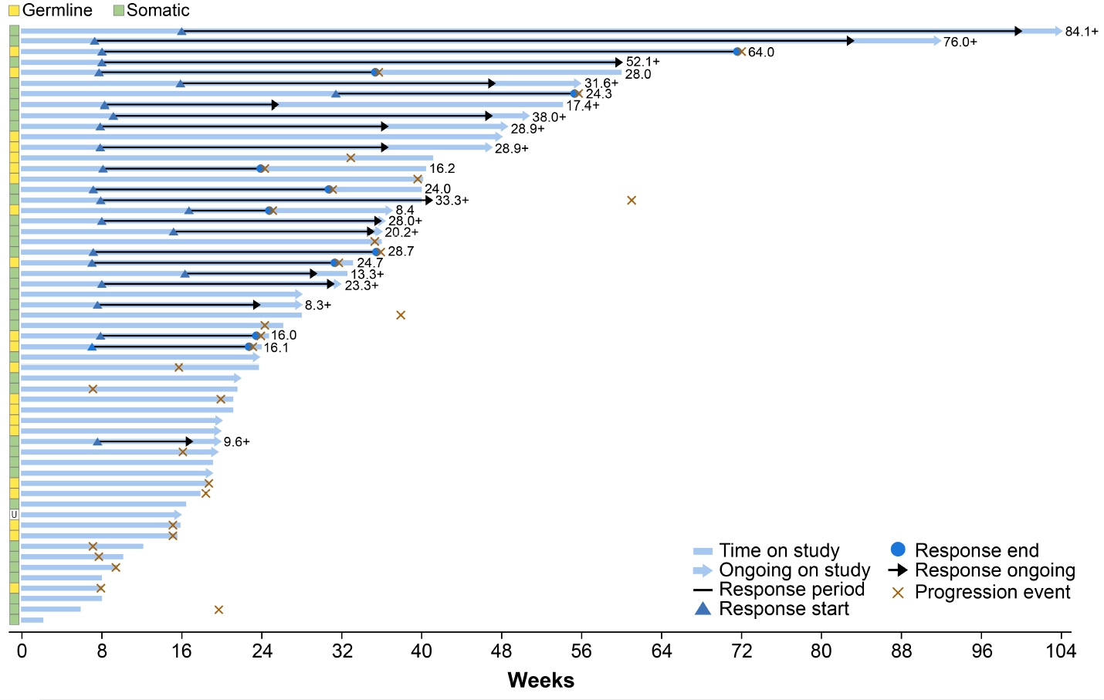
TRITON2: Treatment Duration and Duration of Modified Response in Rucaparib-Treated Patients with a BRCA1/2 Alteration and Measurable Disease at Baseline (N = 57)
Abida W et al. ESMO 2019; Abstract 846PD.

Slide 88
FDA grants accelerated approval to rucaparib for BRCA-mutated metastatic castration-resistant prostate cancer
Press Release – May 15, 2020
“On May 15, 2020, the Food and Drug Administration granted accelerated approval to rucaparib for patients with deleterious BRCA mutation (germline and/or somatic)-associated metastatic castration-resistant prostate cancer (mCRPC) who have been treated with androgen receptor-directed therapy and a taxane-based chemotherapy.
Efficacy was investigated in TRITON2 (NCT02952534), an ongoing, multi-center, single arm clinical trial in 115 patients with BRCA-mutated (germline and/or somatic) mCRPC who had been treated with androgen receptor-directed therapy and taxane-based chemotherapy. Patients received rucaparib 600 mg orally twice daily and concomitant GnRH analog or had prior bilateral orchiectomy.”
https://www.fda.gov/drugs/fda-grants-accelerated-approval-rucaparib-brca-mutated-metastatic-castration-resistant-prostate

Slide 89
GALAHAD: An Ongoing Phase II Trial of Niraparib in Metastatic Castration-Resistant Prostate Cancer and DNA Repair Anomalies
Trial identifier: NCT02854436 (Open)
Eligibility (Target N = 301)
Metastatic castration-resistant prostate cancer Biomarker-positive for DRD Progressed on or after ≥ 1 line of taxane-based chemo and ≥ 1 line of AR signaling inhibitor No prior PARP inhibitor No prior platinum-based chemotherapy No symptomatic brain mets
Niraparib
300 mg daily
Primary endpoint: Objective response rate
www.clinicaltrials.gov. Accessed June 2020.

Slide 90
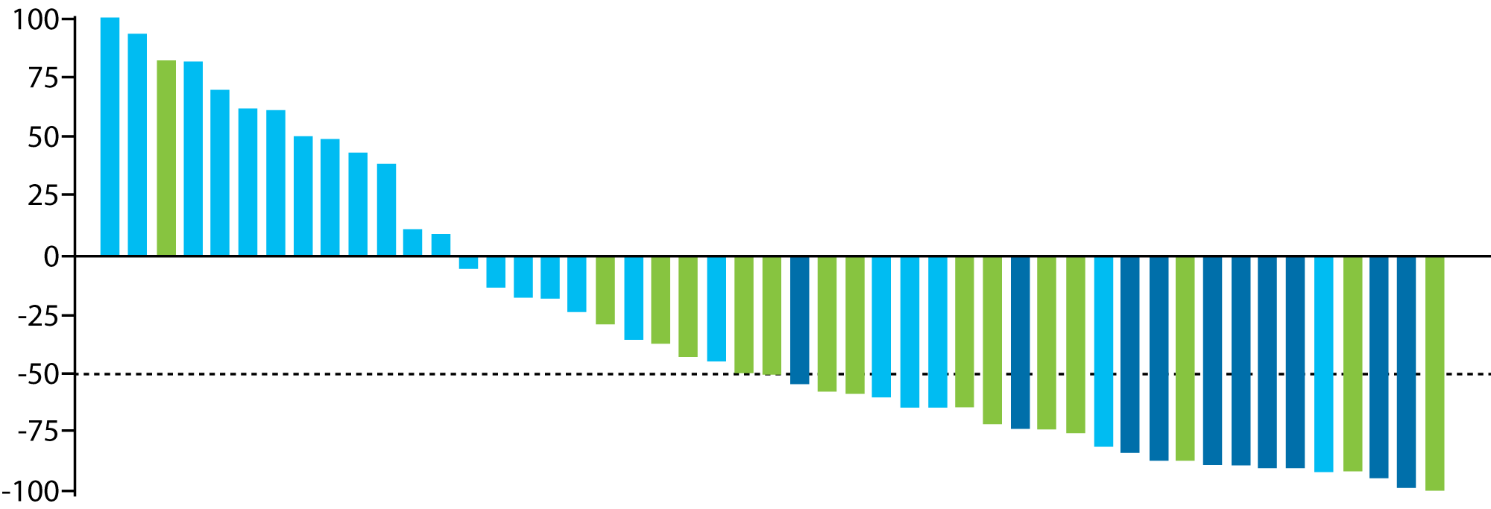
GALAHAD: Maximum Change in PSA from Baseline in Patients with BRCA Mutation-Positive mCRPC
Waterfall plot of maximum change in PSA from baseline any time on the study. All BRCA patients.
CTC = 0
CTC conv.
Non CTC conv.
Maximum change in PSA
from baseline (%)
Patients
CTC = circulating tumor cells; CTC0 = CTC at baseline; CTC conversion = CTC conversion from unfavorable to favorable
Smith MR et al. Genitourinary Cancers Symposium 2020;Abstract 118.

Slide 91
GALAHAD: Study Outcomes
CTC at baseline (CTC0) and CTC decrease on treatment (CTC conversion) are early indicators of response associated with longer time on therapy¹
Niraparib demonstrates clinical activity in patients with treatment-refractory mCRPC with durable responses particularly in biallelic BRCA mutation carriers²
Outcome² | All biallelic DRD (n = 81)
 | BRCA (n = 46) | Non-BRCA (n = 35)
Objective response rate | 12/29 (41%) | 2/22 (9%)
PSA₅₀ | 23/46 (50%) | 1/35 (3%)
CTC conversion* | 18/38 (47%) | 5/24 (21%)
Composite response rate | 29/46 (63%) | 6/35 (17%)
Median duration of objective response | 5.6 months | Not reported
Median radiographic PFS | 8.2 mo | 5.3 months
Median OS | 12.6 months | 14.0 months
*CTC conversion from unfavorable to favorable
¹Smith MR et al. Genitourinary Cancers Symposium 2020;Abstract 118; ²Smith MR et al. ESMO 2019;Abstract LBA50.

Slide 92
MAGNITUDE: An Ongoing Phase III Trial of Niraparib + Abiraterone Acetate and Prednisone (AAP) in Metastatic Prostate Cancer
Trial identifier: NCT03748641 (Open)
Niraparib
AAP
Primary endpoint:
rPFS
Secondary endpoints:
OS
Time to symptomatic progression
Time to cytotoxic chemotherapy
Eligibility (Target N = 1,000)
Metastatic Prostate Cancer Known DRD status No prior PARP inhibitor No systemic brain mets
Cohort
with DRD
(n = 400)
R
1:1
Placebo +
AAP
Niraparib
AAP
Cohort
without DRD
(n = 600)
R
1:1
Placebo +
AAP
AAP = abiraterone acetate plus prednisone; DRC= DNA repair gene defects; rPFS = radiographic progression-free survival; OS = overall survival
Primary endpoint: Radiographic progression-free survival
www.clinicaltrials.gov. Accessed June 2020; Chi KN et al. ASCO 2020;Abstract TPS5588.

Slide 93
Dr Hussain Case Presentation: 69 yo WM
Patient is a 69-year-old white male
09/2008: diagnosed with GS 4+3 prostate cancer.
12/2008: Radical prostatectomy/bilateral pelvic lymph node dissection. pT3N1 GS 4+4 PCa.
02/27/2009: Bone scan revealed metastatic disease in the sacrum (2.5 x 1.2 cm in diameter).
02/2009: Started ADT (Leuprolide).
03/13/2013: PSA detected 0.1 ng/mL.
09/11/2014: Rising PSA, 04/2015: PSA 2.0 ng/mL. now castration resistant prostate cancer.
05/04/2015 – 06/29/2015: Received 3 Sipuleucel-T infusions and a round of palliative radiotherapy to
sacral metastasis on part of IIT of Sipuleucel-T versus Sipuleucel-T plus radiotherapy. Given stable osseous disease on serial restaging scans with slowly rising PSA, patient elected to defer therapy and continue leuprolide only.
08/2017 – 02/2018: Rising PSA and INVITAE testing identified a germline pathogenic mutation in BRCA2.
• 08/2017: PSA 8.4 ng/mL, 02/2018: PSA 23.6 ng/mL
03/2018: Enrolled on BRCAAway trial and randomized to olaparib only (Arm 2). Responded by PSA
and imaging.
01/2020: Rising PSA and new bone scan lesion of pelvis. Progression of disease and was taken off treatment.

Slide 94
Dr Hussain Case Presentation: 79 yo WM
Patient is 79 yo white male
- At age 63 he was diagnosed with GS 3+3 prostate cancer 5/2004, s/p brachytherapy.
11/2015 had PSA 32, repeat prostate biopsy showed Gleason 5+4 prostate cancer.
Restaging scans (12/15) focal finding in the left inferior pubic ramus and was started on ADT
4/2017: PSA Progression and increased uptake in the left inferior pubic ramus, s/p radiation treatment to osseous pubic ramus.
8/2017: Progression in bone, elected clinical trial (NU-16U05), underwent a bone
Bx - Germ line: BRCA2 mutation,
9/2017 randomized to Arm 3: Olaparib 300 mg po bid + Abiraterone 1000 mg + prednisone 5 mg po bid. Responded by PSA and imaging
7/2019 rising PSA and new hip pain, progression by imaging

