Slide 1
Oncology Grand Rounds
New Agents and Strategies in PARP Inhibition
in the Management of Common Cancers
Thursday, June 25, 2020
5:00 PM – 6:30 PM ET
Faculty
Emmanuel S Antonarakis, MD
Gretchen Santos Fulgencio, MSN, FNP-BC
Kathleen Moore, MD
Joyce O’Shaughnessy, MD
Michael J Pishvaian, MD, PhD
Deborah Wright, MSN, APRN, CNS
Moderator
Neil Love, MD

Slide 2
Dr Love — Disclosures
Dr Love is president and CEO of Research To Practice. Research To Practice receives funds in the form of educational grants to develop CME activities from the following commercial interests: AbbVie Inc, Acerta Pharma — A member of the AstraZeneca Group, Adaptive Biotechnologies, Agendia Inc, Agios Pharmaceuticals Inc, Amgen Inc, Array BioPharma Inc, a subsidiary of Pfizer Inc, Astellas, AstraZeneca Pharmaceuticals LP, Bayer HealthCare Pharmaceuticals, Biodesix Inc, bioTheranostics Inc, Blueprint Medicines, Boehringer Ingelheim Pharmaceuticals Inc, Boston Biomedical Inc, Bristol-Myers Squibb Company, Celgene Corporation, Clovis Oncology, Daiichi Sankyo Inc, Dendreon Pharmaceuticals Inc, Eisai Inc, EMD Serono Inc, Exelixis Inc, Foundation Medicine, Genentech, a member of the Roche Group, Genmab, Genomic Health Inc, Gilead Sciences Inc, GlaxoSmithKline, Grail Inc, Guardant Health, Halozyme Inc, Helsinn Healthcare SA, ImmunoGen Inc, Incyte Corporation, Infinity Pharmaceuticals Inc, Ipsen Biopharmaceuticals Inc, Janssen Biotech Inc, administered by Janssen Scientific Affairs LLC, Jazz Pharmaceuticals Inc, Kite, A Gilead Company, Lexicon Pharmaceuticals Inc, Lilly, Loxo Oncology Inc, a wholly owned subsidiary of Eli Lilly & Company, Merck, Merrimack Pharmaceuticals Inc, Myriad Genetic Laboratories Inc, Natera Inc, Novartis, Oncopeptides, Pfizer Inc, Pharmacyclics LLC, an AbbVie Company, Prometheus Laboratories Inc, Puma Biotechnology Inc, Regeneron Pharmaceuticals Inc, Sandoz Inc, a Novartis Division, Sanofi Genzyme, Seattle Genetics, Sirtex Medical Ltd, Spectrum Pharmaceuticals Inc, Taiho Oncology Inc, Takeda Oncology, Tesaro, A GSK Company, Teva Oncology, Tokai Pharmaceuticals Inc, Tolero Pharmaceuticals and Verastem Inc.

Slide 3
Dr Antonarakis — Disclosures
Consulting Agreements | Amgen Inc, Astellas, Clovis Oncology, Dendreon Pharmaceuticals Inc, ESSA Pharma Inc, Janssen Biotech Inc, Lilly, Medivation Inc, a Pfizer Company, Merck, Sanofi Genzyme
Contracted Research | AstraZeneca Pharmaceuticals LP, Bristol-Myers Squibb Company, Celgene Corporation, Clovis Oncology, Dendreon Pharmaceuticals Inc, Genentech, a member of the Roche Group, Janssen Biotech Inc, Johnson & Johnson Pharmaceuticals, Merck, Novartis, Sanofi Genzyme, Tokai Pharmaceuticals Inc
Other Remunerated Activities | Licensed patented technology to QIAGEN

Slide 4
Ms Fulgencio — Disclosures
No financial interests or affiliations to disclose.

Slide 5
Dr Moore — Disclosures
Advisory Committee | AbbVie Inc, Aravive Inc, AstraZeneca Pharmaceuticals LP, Clovis Oncology, Eisai Inc, Genentech, a member of the Roche Group, GlaxoSmithKline, ImmunoGen Inc, Merck, Mereo BioPharma, Tarveda Therapeutics, Tesaro, A GSK Company, Vavotar Life Sciences
Contracted Research | Clovis Oncology, Genentech, a member of the Roche Group, Merck, PTC Therapeutics
Employment | GOG Foundation/Partners

Slide 6
Dr O’Shaughnessy — Disclosures
Advisory Committee and Consulting Agreements | AbbVie Inc, Agendia Inc, Amgen Inc, AstraZeneca Pharmaceuticals LP, Bristol-Myers Squibb Company, Celgene Corporation, Daiichi Sankyo Inc, Eisai Inc, Genentech, a member of the Roche Group, Genomic Health Inc, Grail Inc, Halozyme Inc, Heron Therapeutics, Immunomedics Inc, Ipsen Biopharmaceuticals Inc, Jounce Therapeutics, Lilly, Merck, Myriad Genetic Laboratories Inc, Novartis, Odonate Therapeutics, Pfizer Inc, Puma Biotechnology Inc, Roche Laboratories Inc, Seattle Genetics, Syndax Pharmaceuticals Inc

Slide 7
Dr Pishvaian — Disclosures
Consulting Agreements | AstraZeneca Pharmaceuticals LP, Caris Life Sciences, Celgene Corporation, Foundation Medicine, Halozyme Inc, Ipsen Biopharmaceuticals Inc, Merck, Merrimack Pharmaceuticals Inc, Perthera, Rafael Pharmaceuticals Inc, RenovoRx, Sirtex Medical Ltd
Contracted Research | AbbVie Inc, ARMO BioSciences, AstraZeneca Pharmaceuticals LP, Bavarian Nordic, Bayer HealthCare Pharmaceuticals, Boston Biomedical Inc, Bristol-Myers Squibb Company, Calithera Biosciences, Celgene Corporation, Celldex Therapeutics, Curegenix, FibroGen, Genentech, a member of the Roche Group, Gilead Sciences Inc, GlaxoSmithKline, Halozyme Inc, Karyopharm Therapeutics, Lilly, Merck, Novartis, Pfizer Inc, Pharmacyclics LLC, an AbbVie Company, Regeneron Pharmaceuticals Inc, Tesaro, A GSK Company
Ownership Interest | Perthera
Patent Pending | AbbVie Inc

Slide 8
Commercial Support
This activity is supported by educational grants from AstraZeneca Pharmaceuticals LP and Merck.

Slide 9
Agenda
Module 1: Overview of PARP Inhibitors — Biologic Rationale and Mechanism of Action
Case Presentation: 47-year-old woman with ovarian cancer
Module 2: Side Effects and Toxicities of PARP Inhibitors
Module 3: PARP Inhibitors for Ovarian Cancer
Module 4: PARP Inhibitors for Breast Cancer
Case Presentation: 34-year-old woman with ER-positive, HER2-negative breast cancer
Module 5: PARP Inhibitors for Pancreatic Cancer
Case Presentation: 67-year-old man with metastatic pancreatic cancer
Case Presentation: 68-year-old man with metastatic pancreatic cancer
Module 6: PARP Inhibitors for Prostate Cancer
Case Presentation: A man in his early 50s with metastatic prostate cancer
Case Presentation: A 71-year-old man with metastatic prostate cancer

Slide 10
Module 1: Overview of PARP Inhibitors — Biologic Rationale and Mechanism of Action
Genomic assays, PARP sensitivity and biologic rationale for PARP inhibitors
Germline versus somatic testing
Role of liquid biopsy
Mechanism of action, potency of PARP inhibitors; PARP trapping
Approved PARP inhibitors

Slide 11


Each type of DNA damage is repaired by a specific process
CH₃
A
G
Base
alkylation
DNA single
strand breaks
Bulky
adducts
Base mismatches,
insertions and deletions
DNA double
strand breaks
Non-homologous
end joining
(NHEJ)
Repair
pathway
Direct
reversal
Base
excision
repair
(BER)
Nucleotide
excision
repair
(NER)
Mismatch
repair
DSB
repair
Homologous
recombination
repair (HRR)
Involves PARP
Involves
BRCA1/2
Courtesy of Kathleen N Moore, MD
1. Lord CJ and Ashworth A. Nature. 2012;481:287–293; 2. O’Connor MJ. Mol Cell. 2015;60:547–60
Notes:
Each type of DNA damage is repaired by a specific process that involves multiple proteins and enzymes. For example, DNA single strand breaks are repaired by the base excision repair pathway. Because DNA double strand breaks are potentially so lethal, there are multiple pathways that have evolved to deal with this. These include the non-homologous end joining pathway, which is error-prone but can be used throughout the cell cycle, or the homologous recombination repair pathway, which is both accurate and effective but requires that DNA is being replicated and that an undamaged template can be used.

Slide 12



PARP facilitates single strand break repair
PARP
PARP recruitment
1. Lord CJ and Ashworth A. Nature. 2012;481:287–293; 2. De Lorenzo SB et al. Front Oncol. 2013;3:228; 3. Curtin NJ. Nature Rev Cancer. 2012;12:801–817
Courtesy of Kathleen N Moore, MD
Notes:
The way that PARP facilitates single strand break repair is by identifying the single strand break and binding to it.

Slide 13



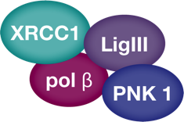

PARP facilitates single strand break repair
Assembly of repair factors on DNA
NAD+
PARP
Repair of DNA
single strand break
poly(ADP)ribose
PARP dissociation from DNA
PAR degradation
...and recycling of PARP
Liglll=LIG3alpha; NAD+=donor nicotinamide adenine dinucleotide; PAR=poly (ADP-ribose); PARG= poly (ADP-ribose) glycohydrolase; PARP=poly (ADP-ribose) polymerase; PNK=PaNtothenate Kinase 1; pol β=DNA polymerase β; XRCC1=X-ray repair cross-complementing protein 1
1. Lord CJ and Ashworth A. Nature. 2012;481:287–293; 2. De Lorenzo SB et al. Front Oncol. 2013;3:228; 3. Curtin NJ. Nature Rev Cancer. 2012;12:801–817; Javle N and Curtin NJ., Br J Cancer. 2011 Oct 11;105(8):1114-22
Courtesy of Kathleen N Moore, MD
Notes:
This in turn facilitates the binding of repair factors to the break, allowing the repair process to occur. Following the repair of the single strand break, the poly ADP-ribose chains are broken down by a glycohydrolase, and then PARP is free to go and bind to another single strand break.

Slide 14




Vulnerabilities in the ability of a cancer cell to repair dsDNB when paired with a PARP inhibitor can lead to faulty repair and cell death
PARPi
Increase in double-strand breaks in replicating cells
PARP
Trapped PARP on single strand breaks
PARP
PArPi
Double strand breaks
HRR deficient cancer cell
Normal cell

Reliance on error prone pathways leads to accumulation of genomic instability and cell death
Repair of double strand breaks via the HRR pathway and cell survival
✓
HRD=homologous recombination deficient; HRR=homologous recombination repair; PARP=poly (ADP-ribose) polymerase; SSB=single strand break
O’Connor MJ. Mol Cell. 2015;60:547–60
Courtesy of Kathleen N Moore, MD
Notes:
In normal cells, these DNA double strand breaks will be repaired by the homologous recombination repair pathway and the cells will survive. However, in HRR-deficient cancer cells there is a need to use error-prone pathways to repair the damage and this will lead to DNA errors, the accumulation of genomic instability and ultimately to cancer cell death. Consequently, the treatment of HRR-deficient cancers with a PARP inhibitor such as olaparib can lead to cancer-specific cell death.

Slide 15
PARP Targeting Potency: High to Low
Talazoparib
Niraparib
Rucaparib, olaparib
Veliparib
Adapted from: Lord CJ, et al. Science. 2017;355:1152-1158.
Courtesy of Philip A Philip, MD, PhD, FRCP

Slide 16
FDA Approved and Late-Stage Investigational PARP Inhibitors
 | Olaparib | Niraparib | Rucaparib | Talazoparib | Veliparib
Ovarian | Front line Plat-sensitive recurrent Multiply relapsed | Front line Plat-sensitive recurrent Multiply relapsed | Plat-sensitive recurrent Multiply relapsed | — | VELIA Ph3
Breast | Metastatic | BRAVO Ph3 | — | Metastatic | —
Pancreatic | Metastatic | — | — | — | —
Prostate | Metastatic CRPC | Breakthrough therapy (GALAHAD) MAGNITUDE Ph3 | Metastatic CRPC | TALAPRO-2 Ph3 | —
Olaparib PI, rev 5/2020; Niraparib PI, rev 4/2020; Rucaparib PI, rev 5/2020; Talazoparib PI, rev 3/2020; Clinicaltrials.gov, Accessed 6/2020

Slide 17
47-year-old woman with ovarian cancer (from the practice of
Ms Wright)
During routine robotic cholecystectomy, carcinomatosis noted
  Pathology: Adenocarcinoma PAX8-positive, ER/PR-positive
  Imaging: Large amount of ascites, peritoneal carcinomatosis with bilateral adnexal masses.
Neo-adjuvant carboplatin/paclitaxel and oral BMI1 inhibitor x 3 cycles → interval cytoreductive surgery to no gross residual disease (Stage IIIC HGSOC), BRCA2 mutation
Imaging after 3 more cycles of platinum doublet/study drug: CR, CA 125 normalized
Olaparib maintenance 300 mg po bid
  After 2 weeks: Stomatitis (Magic Mouthwash) → resolved
  After 6 weeks: Hgb: 7.1, increased GERD after dosing (pantoprazole)
    Dose reduction of olaparib due to transfusion x 2, Hgb now 10.0
4/30/2020: Dose reduced olaparib to 150mg po bid due to increased GERD
Currently, patient has completed 5 cycles of maintenance therapy (CA 125: 6.7)
  Considering prophylactic bilateral mastectomy with reconstruction

Slide 18
Agenda
Module 1: Overview of PARP Inhibitors — Biologic Rationale and Mechanism of Action
Case Presentation: 47-year-old woman with ovarian cancer
Module 2: Side Effects and Toxicities of PARP Inhibitors
Module 3: PARP Inhibitors for Ovarian Cancer
Module 4: PARP Inhibitors for Breast Cancer
Case Presentation: 34-year-old woman with ER-positive, HER2-negative breast cancer
Module 5: PARP Inhibitors for Pancreatic Cancer
Case Presentation: 67-year-old man with metastatic pancreatic cancer
Case Presentation: 68-year-old man with metastatic pancreatic cancer
Module 6: PARP Inhibitors for Prostate Cancer
Case Presentation: A man in his early 50s with metastatic prostate cancer
Case Presentation: A 71-year-old man with metastatic prostate cancer

Slide 19
Module 2: Side Effects and Toxicities of PARP Inhibitors
  Cytopenia
  Gastrointestinal toxicity
  Creatinine elevation
  ALT/AST elevation
  Risk of MDS/AML

Slide 20
Gastrointestinal side effects and cytopenias are class effects of PARP inhibitors, but the frequencies vary among available agents.
Agree
Disagree
I don’t know

Slide 21
Adverse Events: Class Effects and Specific Drug Differences
 | Notes | Olaparib | Niraparib | Rucaparib | Talazoparib | Veliparib
Fatigue | 50%-70%, mainly Gr1-2 | ✓ | ✓ | ✓ | ✓ | ✓
Hematologic AEs
Anemia | 40%-60% | ✓ | ✓ | ✓ | ✓ | ✓--
Thrombocytopenia | Niraparib dose adjustment, based on platelet counts | ✓ | ✓++ | ✓ | ✓ | ✓
Neutropenia | ~20% | ✓ | ✓ | ✓ | ✓ | ✓
Gastrointestinal AEs
Nausea/vomiting | Moderately emetic >30% | ✓ | ✓ | ✓ | ✓ | ✓
Diarrhea | ~33% | ✓ | ✓ | ✓ | ✓ | ✓
Laboratory abnormalities
ALT/AST elevation | 5%-10% olaparib, niraparib; 34% rucaparib | ✓-- | ✓-- | ✓++ | ✓++ | ?
Creatinine elevation | 10%-12% | ✓ | ✓ | ✓ | NR | NR
Olaparib PI, rev 5/2020; Niraparib PI, rev 4/2020; Rucaparib PI, rev 5/2020; Talazoparib PI, rev 3/2020;
Madariaga A et al. Int J Gyn Cancer 2020 April 9;[Online ahead of print]; Litton JK et al. NEJM 2018;379:753-63.
NR, not reported

Slide 22
Adverse Events: Class Effects and Specific Drug Differences
 | Notes | Olaparib | Niraparib | Rucaparib | Talazoparib | Veliparib
Respiratory disorders
Dyspnea +/- cough | 10%-20%, usually Gr 1-2 | ✓ | ✓ | ✓ | ✓ | NR
Nasopharyngitis | ~10% | ✓ | ✓ | ✓ | ✓ | NR
Nervous system and psychiatric disorders
Insomnia/headache | 10%-25%, usually Gr 1-2 | ✓ | ✓ | ✓ | ✓ | ✓
Dermatologic toxicity
Rash, photosensitivity |  | <1% | ✓ | ✓++ | NR | NR
Cardiovascular toxicity
Hypertension, tachycardia, palpitation |  | 1% | ✓++ | NR | NR | NR
Rare AEs
MDS/AML | ~1% of pts | ✓ | ✓ | ✓ | ✓ | ✓
Olaparib PI, rev 5/2020; Niraparib PI, rev 4/2020; Rucaparib PI, rev 5/2020; Talazoparib PI, rev 3/2020;
Madariaga A et al. Int J Gyn Cancer 2020 April 9;[Online ahead of print]; Litton JK et al. NEJM 2018;379:753-63.
NR, not reported

Slide 23
Agenda
Module 1: Overview of PARP Inhibitors — Biologic Rationale and Mechanism of Action
Case Presentation: 47-year-old woman with ovarian cancer
Module 2: Side Effects and Toxicities of PARP Inhibitors
Module 3: PARP Inhibitors for Ovarian Cancer
Module 4: PARP Inhibitors for Breast Cancer
Case Presentation: 34-year-old woman with ER-positive, HER2-negative breast cancer
Module 5: PARP Inhibitors for Pancreatic Cancer
Case Presentation: 67-year-old man with metastatic pancreatic cancer
Case Presentation: 68-year-old man with metastatic pancreatic cancer
Module 6: PARP Inhibitors for Prostate Cancer
Case Presentation: A man in his early 50s with metastatic prostate cancer
Case Presentation: A 71-year-old man with metastatic prostate cancer

Slide 24
Module 3: PARP Inhibitors for Ovarian Cancer
Genomic profile
Prior trials in relapse setting: maintenance and monotherapy
Key recent up-front data sets: SOLO-1, PRIMA, PAOLA-1, VELIA
Current practice patterns
Ongoing trials

Slide 25
A PARP inhibitor should be offered to or discussed as an option for patients with Stage III or Stage IV ovarian cancer, regardless of genomic profile.
Agree
Disagree
I don’t know

Slide 26
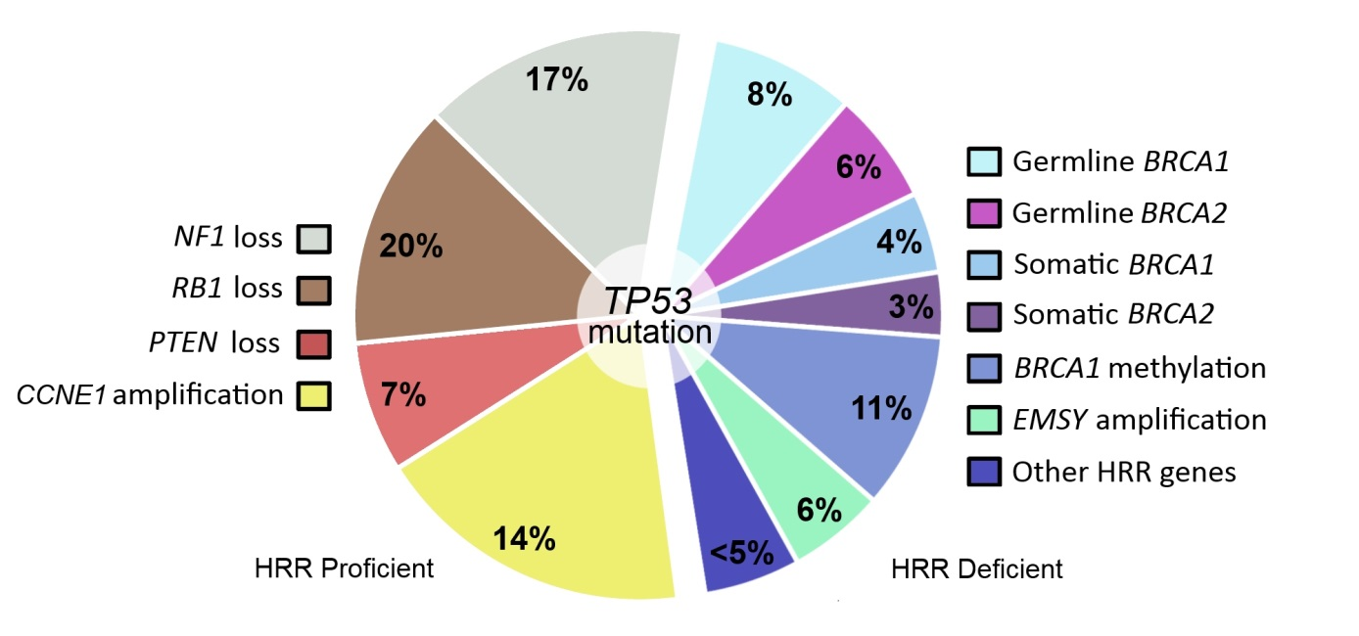
Rationale for PARP inhibitors in ovarian cancer: high grade serous ovarian cancer biology
HRR Proficient
HRR Deficient
Hollis RL, et al. Cancer Biol Med. 2016; 13:236-247
Courtesy of Kathleen N Moore, MD
Notes:
Figure 1: Common molecular events identified in HGS OC, including genetic and epigenetic defects in HRR pathway components
Hollis RL, Gourley C. Genetic and molecular changes in ovarian cancer. Cancer Biol Med. 2016

Slide 27
PARP inhibitor indications
 | oLAPARIB¹⁻³ | TALAZOPARIB⁴⁻⁶ | Rucaparib⁷ | Niraparib⁸
MoA | PARP-1, PARP-2, PARP-3 inhibitor | Dual-mechanism PARP inhibitor | PARP-1, PARP-2, PARP-3 inhibitor | PARP-1, PARP-2 inhibitor
Treatment Indication | Second-line or greater chemotherapy with deleterious or suspected gBRCAm HER2– mBC | Deleterious or suspected deleterious gBRCAm, HER2– locally advanced or mBC | Second-line or greater chemotherapy with deleterious g/sBRCAm OC | 4th line or greater, HRD+, Plat sensitive
 | Third-line or greater chemotherapy with deleterious or suspected gBRCAm OC
Maintenance Indication | Second-line maintenance for recurrent EOC, FTC, PPC | Not indicated | Second-line maintenance for recurrent EOC, FTC, PPC | Second-line maintenance for recurrent EOC, FTC, PPC First Line Maintenance following PR or CR – all comers
 | First-line maintenance for high-risk advanced (FIGO stage III-IV) BRCAm high-grade EOC, FTC, PPC or with bevacizumab for HRD+
Recommended Dose | 300 mg PO BID | 1 mg PO QD | 600 mg PO BID | 300 mg PO QD
Approval Date(s) | January 2018; December 2014; August 2017; December 2018, May 2019 | October 2018 | December 2016 and April 2018 | March 2017
BID, twice daily; FIGO, International Federation of Gynecology and Obstetric; FTC, fallopian tube cancer; g/sBRCAm, germline and/or somatic BRCA mutant; HER2–, human epidermal growth factor receptor 2 negative; HGSOC, high-grade serous ovarian cancer; MoA, mechanism of action; PPC, primary peritoneal cancer; PO, by mouth; QD, once daily.
1. Robson M, et al. Presented at: AACR 2018; April 14-18, 2018; Chicago, IL. 2. LYNPARZA [prescribing information]. Wilmington, DE: AstraZeneca Pharmaceuticals LP; 2017. 3. www.clinicaltrials.gov/NCT01844986. 4. www.clinicaltrials.gov/NCT01945775. 5. Litton J, et al. Presented at: San Antonio Breast Cancer Symposium 2017. December 4-8, 2017; San Antonio, TX. Abs GS6-07. 6. https://www.fda.gov/Drugs/InformationOnDrugs/ApprovedDrugs/ucm623540.htm
7. RUBRACA [prescribing information]. Boulder, CO: Clovis Oncology, Inc., 2016. 8. ZEJULA [prescribing information]. Waltham, MA: TESARO, Inc, 2017.
Courtesy of Kathleen N Moore, MD
Notes:
Speaker Notes:
There are currently 4 PARPis (approved and pending approval) used in the treatment and maintenance of solid tumors
Olaparib:
Approved: ≥2L chemotherapy with deleterious or suspected gBRCAm HER2– mBC
Approved: ≥3L chemotherapy with deleterious or suspected gBRCAm OC
Pending Approval (SOLO-1): 1L maintenance for advanced BRCAm high-grade EOC, FTC, PPC
Talazoparib:
Approved: Locally advanced or metastatic gBRCAm HER2– BC
Rucaparib:
Approved: ≥2L chemotherapy with deleterious g/sBRCAm OC
Approved: 2L maintenance for for recurrent EOC, FTC, PPC
Niraparib:
Approved: 2L maintenance for for recurrent EOC, FTC, PPC

Slide 28
GI Toxicities are Common with all PARP Inhibitors (% of pts)
Toxicities | Grade of Tox | Olaparib ¹ | Rucaparib² | Niraparib³
Nausea | All Grades | 64 | 77 | 73.6
 | Grade 3 and 4 | 3 | 5 | 3.0
Constipation | All | 20.6⁵ | 40 | 39.8
 | Grades 3 and 4 | 0 | 2 | 0.5
Vomiting | All | 43 | 46 | 34.3
 | Grades 3 and 4 | 4 | 4 | 1.9
Decreased appetite | All | 22 | 39 | 25.3
 | Grades 3 and 4 | 1 | 3 | 0.3
Abdominal pain | All | 43 | 32 | 22.6
 | Grades 3 and 4 | 8 | 3 | 1.1
Diarrhea | All | 31 | 34 | 19.1
 | Grades 3 and 4 | 1 | 2 | 0.3
Dyspepsia | All | 25 | 10⁴ | 11.4
 | Grades 3 and 4 | 0 | <1% | 0
Dysgeusia | All | 21⁵ | 39 | 10.1
 | Grades 3 and 4 | 0 | 0.3 | 0
¹FDA insert, ²FDA insert, ³NOVA NEJM 2016, ⁴Swisher Lancet Onc 2016, ⁵Ledermann Lancet Oncology 2014
Courtesy of Kathleen N Moore, MD

Slide 29
Hematologic Toxicities
(% of pts)
Toxicities | Grade of Tox | Olaparib¹ | Rucaparib² | Niraparib³
Decrease in hemoglobin | All Grades | 90 | 67 | 50.1
 | Grades 3 and 4 | 15 | 23 | 25.3
Decrease in platelets | All | 30 | 39 | 61.3
 | Grades 3 and 4 | 3 | 6 | 33.8
Decrease in neutrophil count | All | 25 | 35 | 30.2
 | Grades 3 and 4 | 7 | 10 | 19.6
¹FDA package insert, ²FDA package insert, ³NOVA NEJM 2016
Courtesy of Kathleen N Moore, MD

Slide 30
General Symptoms Common with all PARP Inhibitors
(% of pts)
Toxicities | Grade of Tox | Olaparib ¹ | Rucaparib² | Niraparib³
Fatigue | All Grades | 66 | 77 | 59.4%
 | Grade 3 and 4 | 8 | 11 | 8.2%
Insomnia | All | NR | 12% | 24.3%
 | Grades 3 and 4 | NR | 0 | 0.3%
Headaches | All Grades | 25⁵ | 17⁴ | 25.9
 | Grades 3 and 4 | 0 | 0⁴ | 0.3
¹FDA insert, ²FDA insert, ³NOVA NEJM 2016, ⁴Swisher Lancet Onc 2016
⁵Ledermann Lancet Oncology 2014
Courtesy of Kathleen N Moore, MD

Slide 31
Agenda
Module 1: Overview of PARP Inhibitors — Biologic Rationale and Mechanism of Action
Case Presentation: 47-year-old woman with ovarian cancer
Module 2: Side Effects and Toxicities of PARP Inhibitors
Module 3: PARP Inhibitors for Ovarian Cancer
Module 4: PARP Inhibitors for Breast Cancer
Case Presentation: 34-year-old woman with ER-positive, HER2-negative breast cancer
Module 5: PARP Inhibitors for Pancreatic Cancer
Case Presentation: 67-year-old man with metastatic pancreatic cancer
Case Presentation: 68-year-old man with metastatic pancreatic cancer
Module 6: PARP Inhibitors for Prostate Cancer
Case Presentation: A man in his early 50s with metastatic prostate cancer
Case Presentation: A 71-year-old man with metastatic prostate cancer

Slide 32
Module 4: PARP Inhibitors for Breast Cancer
Genomic profile
Key recent data sets: EMBRACA, OlympiAD, BROCADE
Current practice patterns
Ongoing trials

Slide 33
34-year-old woman with ER-positive, HER2-negative breast cancer (from the practice of Ms Fulgencio)
2016: Stage 3, ER-positive, PR-negative, HER2-negative left IDC
  High-risk via Mammaprint, BRCA1 mutation
Neoadjuvant paclitaxel/pembrolizumab → dd-AC on ISPY2 trial → Bilateral mastectomy/ALND
  1.8-cm Grade 3 residual cancer, 7/17 positive nodes, 2 foci of LVI
Goserelin + letrozole (switched to anastrozole due to joint pain) → RT → Palbocicilb x 1.5 yrs
11/2018: Liver and bone metastases
Continued goserelin + fulvestrant
T7 compression fracture → Laminectomy, spinal fusion
Talazoparib + RT to spine
  Worsening nausea, fatigue; Grade 3 anemia requiring transfusions
Switched to olaparib, with continued fatigue and anemia → dose reduced to 450 mg/d
7 months later: New spinal mets → Olaparib dose increased to 600 mg/d
Switched back to talazoparib (headaches, malaise, epigastric pain, anemia) x 6 weeks
NGS: PIK3CA mutation
Alpelisib x 5 months → PD in liver → capecitabine

Slide 34
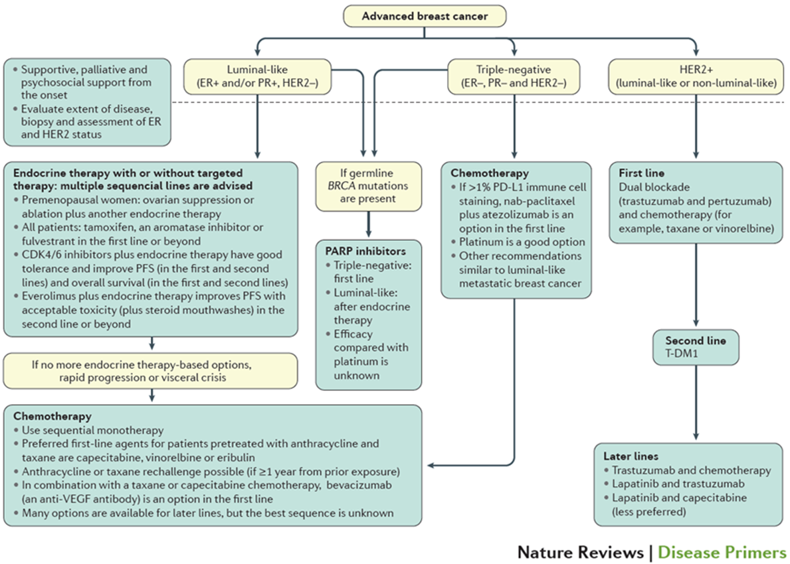
Metastatic breast cancer: Treatment strategies
Harbeck et al, 2019
Courtesy of Joyce O’Shaughnessy, MD

Slide 35
Genetic epidemiology of hereditary breast cancer
5-10% Hereditary
Weitzel, 2019 (Personal communciation)
Courtesy of Joyce O’Shaughnessy, MD

Slide 36
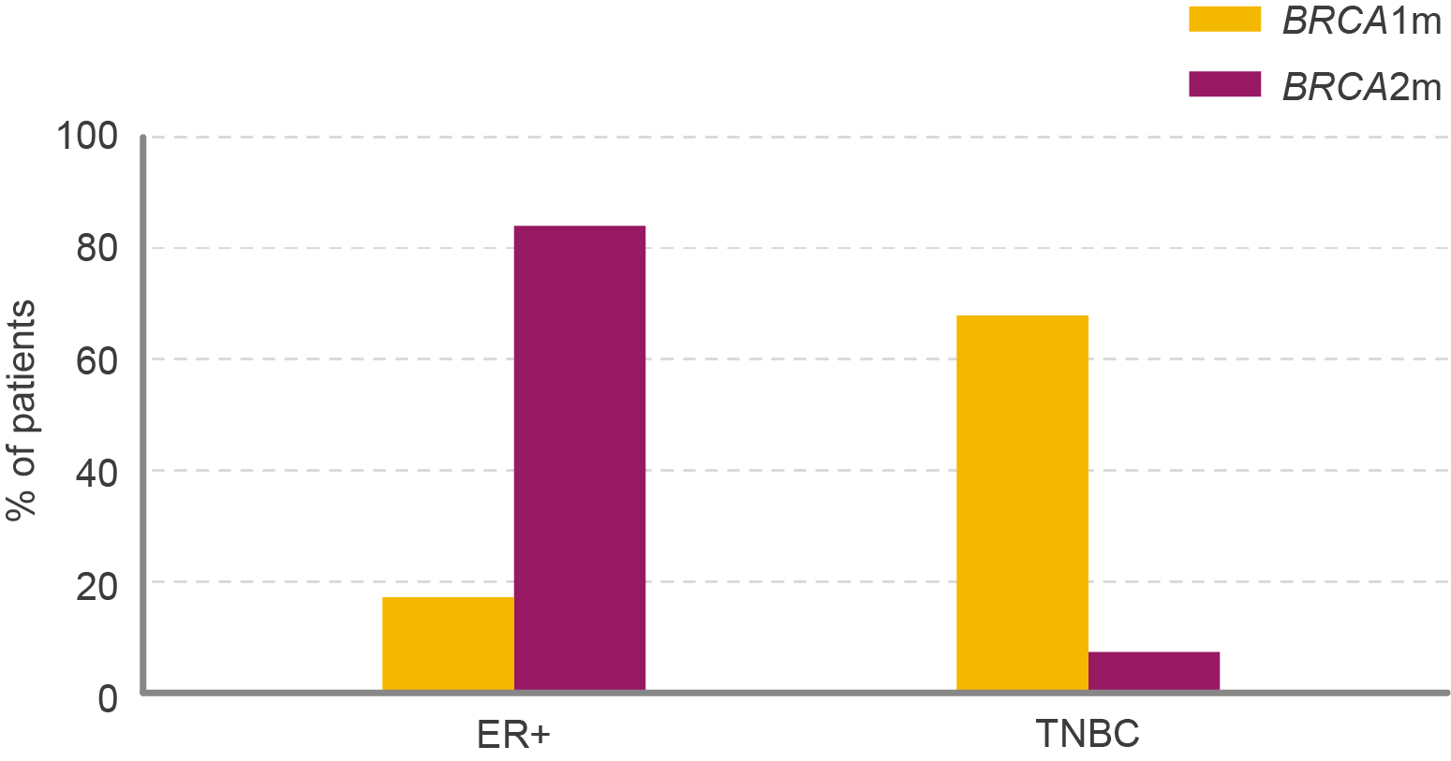
A higher proportion of TNBC patients have BRCA mutations than HR+ patients… 1,2
The majority of TNBC are BRCA1m and HR+ tumours are BRCA2m ^{1,2}
TNBC patients
Hormone receptor status in BC patients by BRCA status
~17%
85.2
have BRCA mutations
67.4
HR+ patients
~6%
17
7.4
have BRCA mutations
Note that these calculations are based on very small patient populations.
Detailed analysis of BRCAm prevalence, age of onset and survival outcomes are currently lacking for breast cancer subtypes.
BRCAm=BRCA mutation; TNBC=triple negative breast cancer; HR+=hormone receptor positive; ER+=oestrogen receptor positive
1. Winter et al. Ann Oncol. 2016 Aug; 27(8): 1532–1538; 2. Aleskandarany M, et al. Breast Cancer Res Treat. 2015;150:81-90
Courtesy of Joyce O’Shaughnessy, MD
Notes:
ER+ 105 pts/555 pts
TNBC 124/270 pts

Slide 37

… But due to the relative prevalence, the majority of BRCA mutations are found in HR+ patients rather than TNBC
Many more breast cancer patients have HR+ disease than TNBC
TNBC
HR+/HER2-
HR-/HER2+
HR+/HER2+
g: Germline BRCAm
s: Somatic BRCAm
Estimated prevalence of BRCAm within mBC segments
Note that these calculations are based on very small patient populations.
Detailed analysis of BRCAm prevalence, age of onset and survival outcomes are currently lacking for breast cancer subtypes.
BRCAm=BRCA mutation; mBC=metastatic breast cancer; TNBC=triple negative breast cancer; HR+=hormone receptor positive
Winter et al. Ann Oncol. 2016 Aug; 27(8): 1532–1538
Courtesy of Joyce O’Shaughnessy, MD
Notes:
https://oup.silverchair-cdn.com/oup/backfile/Content_public/Journal/jnci/106/5/10.1093_jnci_dju055/2/dju055.pdf?Expires=1491159800&Signature=W5xG7Bg8B55F8fEeqMHDw4iTFvT7-DcPJGHM-4fZ50hje1ZCVTw-6INC2Qry49asIi-5UA-QZ64rm479KHGxPRR46ISPF25QjvwyWhgmcihukuH36N-pMQllUmOQopyNQBn9gxdO4Z9pmeynGEzbdPn07YcxuYYRA-XFuvkN4ApIx~bS7kU-6AlW-jhrAcRfcn9QkDzui6KkbYSnqwX5KBee8uy8UwCKjBAoyQXfAuYOQAG04zag1hk~VC09UExcDUWT77CwQJ2xXT3~i2-S6ted91eY-3-n1DP9HIOLBUqDnExCiGRrdT8RxnuMd1kLBze69TgA-qz6~C~i0dlaQA__&Key-Pair-Id=APKAIUCZBIA4LVPAVW3Q
https://www.ncbi.nlm.nih.gov/pmc/articles/PMC4959927/

Slide 38
When and Who to test for BRCA1/2 mutations?
NCCN Guidelines Recommendations (ABC4 & NCCN)
National Comprehensive Cancer Network:
Invasive Breast Cancer¹
CLINCAL
STAGE
WORK-UP
History and physical exam
Discuss goals of therapy, adopt shared decision-making,
and document course of care
CBC
Comprehensive metabolic panel, including liver function tests
and alkaline phosphatase
Chest diagnostic CT with contrast
Abdominal ± pelvic diagnostic CT with contrast or MRI with
contrast
Brain MRI with contrast if suspicious CNS symptoms
Spine MRI with contrast if back pain or symptoms of cord compression
Bone scan or sodium fluoride PET/CT (Category 2B)
FDG PET/CT (optional)
X-rays of symptomatic bones and long and weight-bearing bones abnormal on bone scan
First recurrence of disease should be biopsied
Determination of tumour ER/PR and HER2 status on metastatic site
For patients with HER2-negative tumours under consideration for chemotherapy, strongly consider germline BRCA1/2 testing
Genetic counselling if patient is high-risk for hereditary breast cancer
Recurrent
or
Stage IV (M1)
Courtesy of Joyce O’Shaughnessy, MD
1. National Comprehensive Cancer Network (NCCN). Breast Cancer. Version 1.2019.
Notes:
NTRK fusion in breast cancer
735 A simple majority of the ABC4 panelists (47.3%; abstain: 23.6%) did not think that there are sufficient data for use of a
Page 19 of 42 18-01-05 abc4-BC-final.docx/47078
Birgit-Kristin Pohlmann
Auf den Äckern 15 - 59394 Nordkirchen - Tel. 02596/93767
specific TRK inhibitor (entrectinib) in pa-
tients with advanced or metastatic 740 breast cancer and NTRK gene fusion (NTRK = neurotrophic tyrosine receptor kinase). Less than a third of the ABC4 panelists (28.9%) would possibly con- sider use of a TRK inhibitor on these pa- 745 tients. - From a German perspective, NTRK fusion currently does not play a role in clinical routine. Furthermore, the incidence is very low. The discussion of this topic at ABC4 reflects a future devel- 750 opment where molecular tumor boards are gaining importance. This again em- phasizes the need to set up tumor regis- tries with the corresponding tumor data in Germany in order to advance preci- 755 sion medicine for increasingly individual-
ized therapy decisions.

Slide 39
Phase III trials of PARP Inhibitors in gBRCA
HER2-negative metastatic breast cancer patients
OlympiAD¹
EMBRACA²
gBRCAm HER2- mBC
≤2 prior chemotherapy lines for mBC
Previous treatment with anthracycline and taxane in either the (neo)adjuvant or metastatic setting
gBRCAm HER2- LABC or ABC
≤3 prior lines of chemotherapy
Previous treatment with a taxane, an anthracycline, or both, unless this treatment was contraindicated
Randomise 2:1
Randomise 2:1
Olaparib
300mg po bid
Treatment of Physician’s Choice (TPC)
Talazoparib
1mg po qd
Treatment of Physician’s Choice (TPC)
Primary endpoint
PFS (BICR)
Primary endpoint
PFS (BICR)
1. Robson et al. N Engl J Med. 2017; 377:523-533;
2. Litton J et al. N Engl J Med 2018; 379:753–763
Courtesy of Joyce O’Shaughnessy, MD

Slide 40
Agenda
Module 1: Overview of PARP Inhibitors — Biologic Rationale and Mechanism of Action
Case Presentation: 47-year-old woman with ovarian cancer
Module 2: Side Effects and Toxicities of PARP Inhibitors
Module 3: PARP Inhibitors for Ovarian Cancer
Module 4: PARP Inhibitors for Breast Cancer
Case Presentation: 34-year-old woman with ER-positive, HER2-negative breast cancer
Module 5: PARP Inhibitors for Pancreatic Cancer
Case Presentation: 67-year-old man with metastatic pancreatic cancer
Case Presentation: 68-year-old man with metastatic pancreatic cancer
Module 6: PARP Inhibitors for Prostate Cancer
Case Presentation: A man in his early 50s with metastatic prostate cancer
Case Presentation: A 71-year-old man with metastatic prostate cancer

Slide 41
Module 5: PARP Inhibitors for Pancreatic Cancer
Genomic profile
Key recent data sets: POLO, RUCAPANC
Current practice patterns
Ongoing trials

Slide 42
67-year-old man with metastatic pancreatic cancer (from the practice of Tammy Triglianos, RN, MS, ANP-BC, AOCNP)
Stage IV BRCA1-mutated pancreatic adenocarcinoma with peritoneal carcinomatosis
FOLFIRINOX, with response, increasing fatigue → FOLFOX, with progressive neuropathy → maintenance 5-FU → PD
FOLFIRI, with SD and CA19-9: 161 → 49.5
Olaparib
  Dysgeusia, Grade 2 fatigue (olaparib dose reduced to 300 → 250 mg BID)
  Restaging after 2 months: SD and CA19-9: 49.5 → 39.1
  After additional 2 months: Progressive GI symptoms → 2-week treatment break, with symptom improvement
  Re-started olaparib, with recurrent GI symptoms, rising CA19-9 (39.1→96.9→269)
IV chemotherapy
  Struggled through last treatment course, passed away

Slide 43
68-year-old man with metastatic pancreatic cancer (from the practice of Ms Triglianos)
2013: Stage IV BRCA1-mutated pancreatic adenocarcinoma with liver metastases
Multiple lines of systemic chemotherapy with one 6-month holiday in 2017
  CA19-9 never elevated, so not a reliable marker
5/2019: Olaparib 200mg BID, dose reduced due to renal insufficiency from focal segmental glomerulosclerosis
  Initially tolerated treatment fairly well over 5-months
  Short treatment break due to cervical discectomy from cervical spondylosis
  After restarting: Fatigue, progressive dysgeusia, decreased appetite with associated weight loss (slight rise in creatinine) → Olaparib held for 1 month (extended due to Christmas holiday)
Restarted Olaparib at 200 mg BID
Currently, he continues on therapy with fairly good tolerance, without disease progression

Slide 44
Germline BRCA1/2 Mutations in
Pancreatic Cancer
5%-7% of pancreatic cancer patients have a germline BRCA1 or BRCA2 mutation
  Ashkenazi Jewish: 5%-16%
  Familial PDAC: 5%-19%
  Familial breast/ovary cancer: 5%-10%
40% of patients who are germline BRCA gene mutation carriers do NOT have a family history
Courtesy of Michael Pishvaian, MD, PhD
Hahn SA et al. Gastroenterology. 2003;124:544-560; Murphy KM et al. Cancer Res. 2002;62:3789-3793; Ozçelik H et al. Nat Genet. 1997;16:17-18; Lal G et al. Cancer Res. 2000;60:409-416; Lucas AL et al. Clin Cancer Res. 2013;19:3396-3403; Ferrone C et al. J Clin Oncol. 2009;27:433-438; Stadler ZK et al. Cancer. 2012;118:493-499; Brose MS et al. J Natl Cancer Inst. 2002;94:1365-1372; Holter S et al. J Clin Oncol. 2015;33:3124-3129; Chaffee KG et al. Genet Med. 2018;20:119-127; Petersen GM et al. Semin Oncol. 2016;43:548-553

Slide 45
2019 NCCN Guidelines on
Pancreatic Cancer
“Germline testing is recommended for any patient with confirmed pancreatic cancer, using comprehensive gene panels for hereditary cancer syndromes”
Courtesy of Michael Pishvaian, MD, PhD
NCCN Guidelines. Pancreatic Adenocarcinoma. Version 2.2019; https://www.nccn.org/professionals/physician_gls/pdf/pancreatic_blocks.pdf. Accessed April 25, 2019

Slide 46
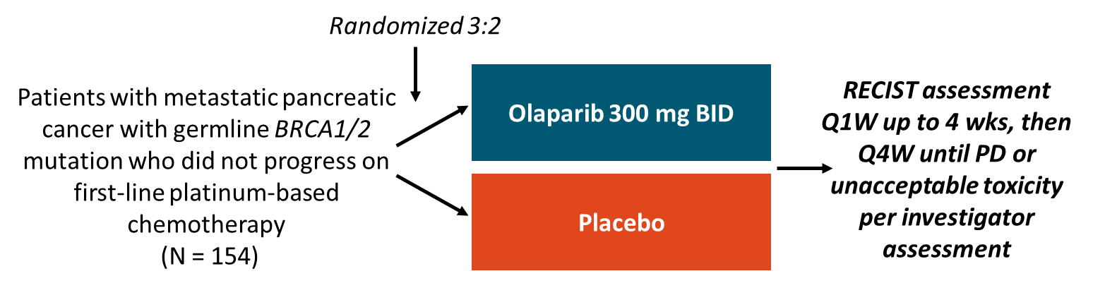
PARP Inhibitors: Phase III Trial
POLO: Olaparib as Maintenance Therapy in Germline BRCA1/2-Mutated Pancreatic Cancer
Randomized, double-blind phase III trial
  Improved PFS with olaparib vs. placebo
1º endpoint: investigator-assessed PFS (RECIST v1.1)
2º endpoints: safety, OS, PFS2, TFST, TSST, TDT, OR, DCR, QoL
Olaparib FDA approved for patients with metastatic pancreatic cancer and a germline BRCA1/2 mutation for use as maintenance therapy after platinum-based therapy
Courtesy of Michael Pishvaian, MD, PhD
Golan T, NEJM, 2019

Slide 47



Rucaparib Maintenance for Advanced, Platinum Sensitive BRCA or PALB2 Related Pancreatic Cancer:
An Interim Analysis
Kim A. Reiss Binder, Rosemarie Mick, Mark O'Hara, Ursina Teitelbaum, Thomas Karasic, Charles Schneider, Peter J. O'Dwyer, Erica Carpenter, Austin Pantel, Mehran Makvandi, David Mankoff, Katherine Nathanson, Kara Maxwell, Stacy Cowden, Mary Jane Fuhrer, Janae Romeo, Gregory L. Beatty, Susan Domchek.
American Association for Cancer Research
2019 Annual Meeting
Courtesy of Michael Pishvaian, MD, PhD
Notes:
Thank you to AACR for the opportunity to present this data today. On behalf of the investigators, it is my privilege to share: Rucaparib Maintenance for Advanced, Platinum Sensitive BRCA or PALB2 related pancreatic cancer, an interim analysis.

Slide 48
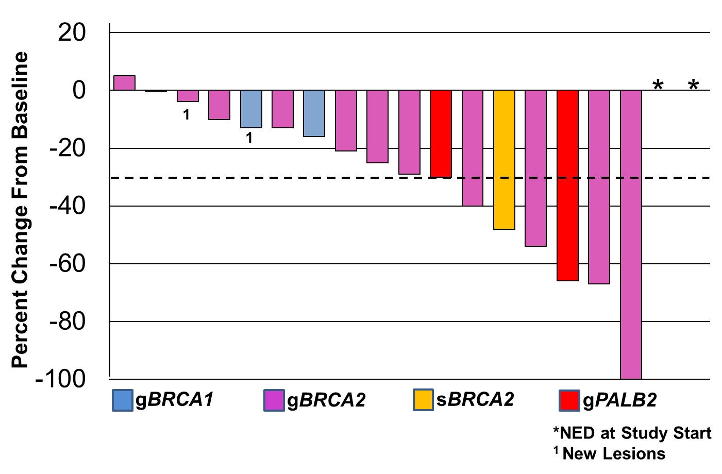
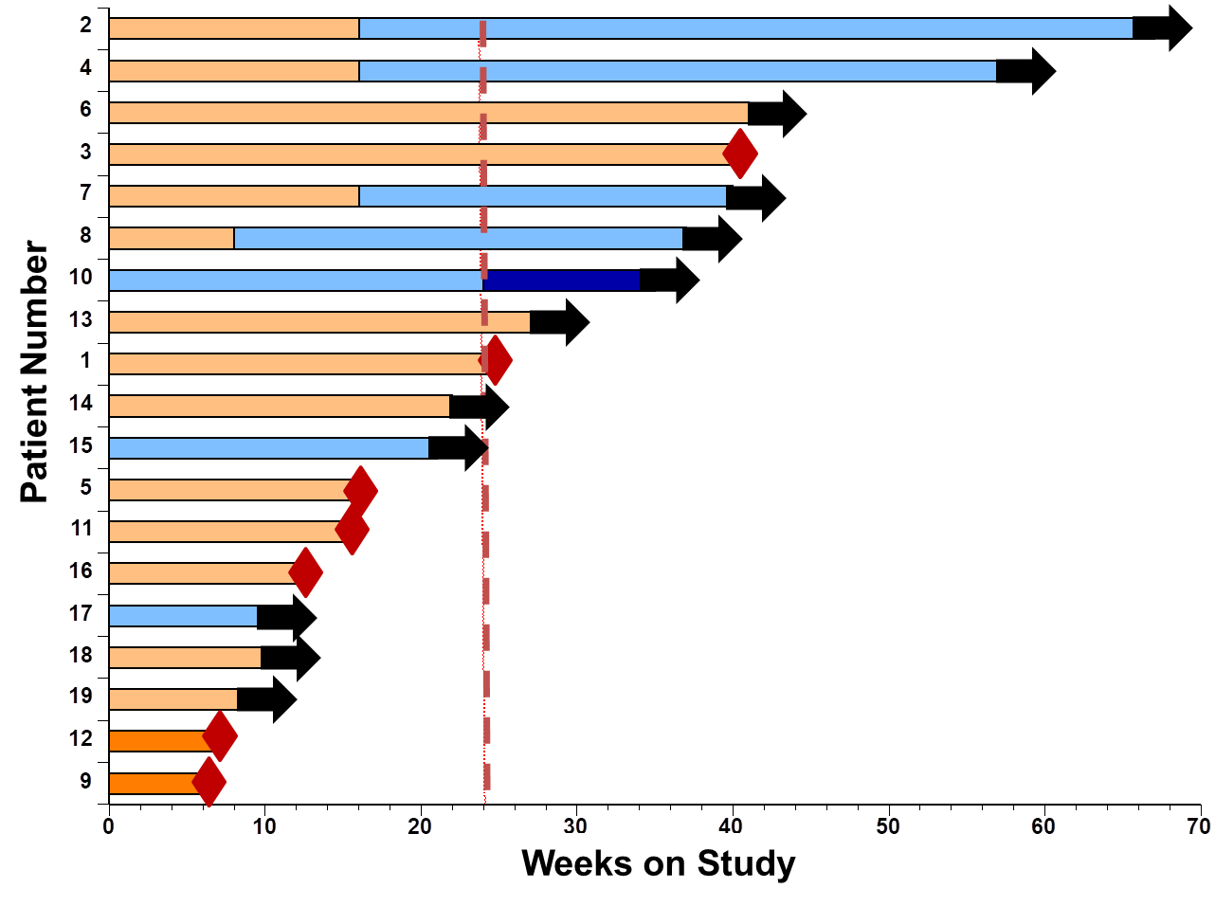
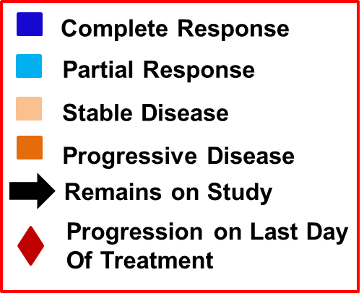
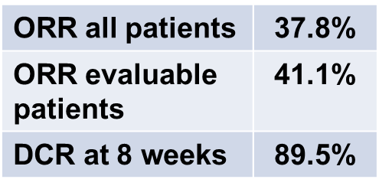
Maintenance Rucaparib
Reiss Binder KA et al. AACR 2019;Abstract CT234.
Courtesy of Michael Pishvaian, MD, PhD
Notes:
Thank you to AACR for the opportunity to present this data today. On behalf of the investigators, it is my privilege to share: Rucaparib Maintenance for Advanced, Platinum Sensitive BRCA or PALB2 related pancreatic cancer, an interim analysis.

Slide 49
PARP Inhibitors for Other DDR
Mutations: Beyond BRCA1/2
Mateo et al – olaparib for prostate cancer
16/49 (33%) responded
16/49 DDR-deficient and 14 responded (88%)
Most were NON-BRCA1/2 mutated
Courtesy of Michael Pishvaian, MD, PhD
Mateo J et al. N Engl J Med. 2015;373:1697-1708

Slide 50
2019 NCCN Guidelines on
Pancreatic Cancer
“Tumor/somatic gene profiling is recommended for patients with locally advanced/metastatic disease [80% of patients] who are candidates for anti-cancer therapy to identify uncommon but actionable mutations”
Courtesy of Michael Pishvaian, MD, PhD
NCCN Guidelines. Pancreatic Adenocarcinoma. Version 2.2019; https://www.nccn.org/professionals/physician_gls/pdf/pancreatic_blocks.pdf. Accessed April 25, 2019

Slide 51
Agenda
Module 1: Overview of PARP Inhibitors — Biologic Rationale and Mechanism of Action
Case Presentation: 47-year-old woman with ovarian cancer
Module 2: Side Effects and Toxicities of PARP Inhibitors
Module 3: PARP Inhibitors for Ovarian Cancer
Module 4: PARP Inhibitors for Breast Cancer
Case Presentation: 34-year-old woman with ER-positive, HER2-negative breast cancer
Module 5: PARP Inhibitors for Pancreatic Cancer
Case Presentation: 67-year-old man with metastatic pancreatic cancer
Case Presentation: 68-year-old man with metastatic pancreatic cancer
Module 6: PARP Inhibitors for Prostate Cancer
Case Presentation: A man in his early 50s with metastatic prostate cancer
Case Presentation: A 71-year-old man with metastatic prostate cancer

Slide 52
Module 6: PARP Inhibitors for Prostate Cancer
Genomic profile
Key recent data sets: PROfound, TRITON2, GALAHAD
Current practice patterns
Ongoing trials

Slide 53
A man in his early 50s with metastatic prostate cancer (from the practice of Erika Meneely, APRN, BC)
Presents with de novo metastatic prostate cancer (PSA: 591), BRCA2 mutation
01/2017 GnRH agonist therapy + bicalutamide + early docetaxel x 6
08/2017 Developed castration-resistant disease – GnRH agonist indefinite
8/2017 – 6/2018: Enzalutamide (PSA 20→ nadir 0.85)
6/2018 – 8/2018: Cabazitaxel (PSA 92 → 313)
8/2018 – 10/2018: Abiraterone/prednisone (PSA 391 → 1,110)
10/2018: Genetic testing: Somatic BRCA2 mutation
10/2018 – 5/2019: Olaparib (PSA 1,110 → nadir 134)
5/2019 – 9/2019: Docetaxel (PSA 780 → 17)
10/2019 – 12/2019: Carboplatin + docetaxel (PSA 113 → nadir 56)
1/2020: Mitoxantrone → discontinued due to PD, transitioned to supportive care/Hospice
NOTE: PSA progression always associated with intractable nausea/vomiting requiring multiple hospital admissions

Slide 54
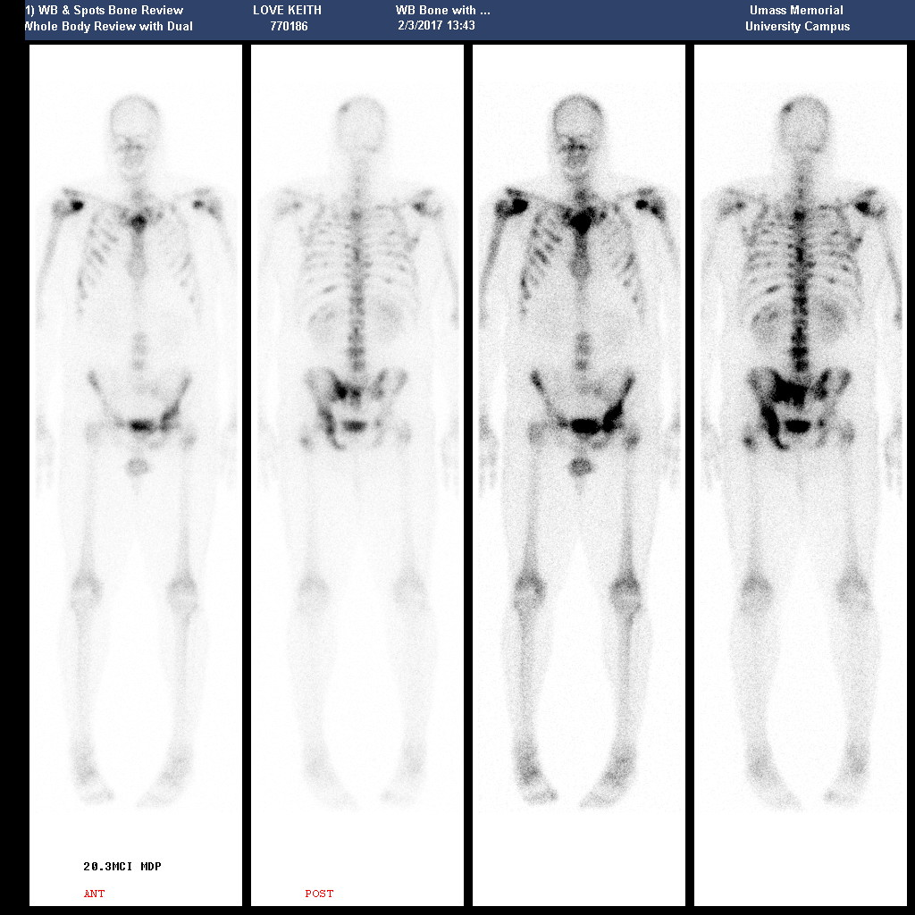
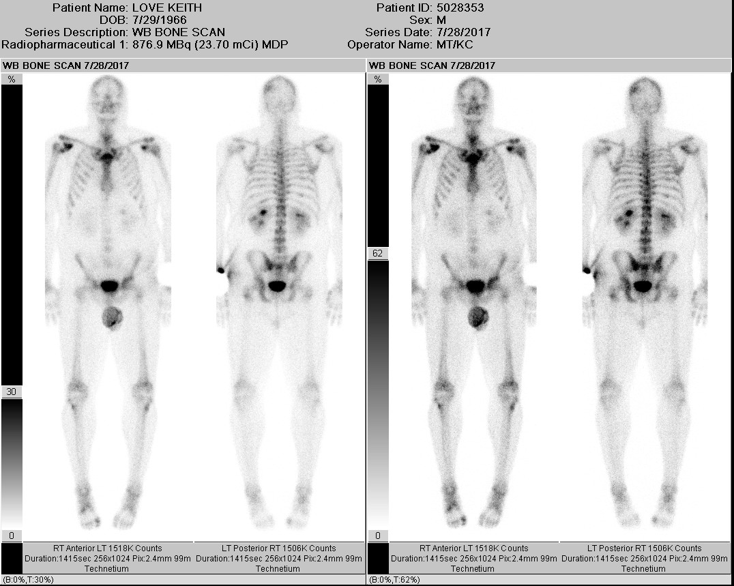
A man in his early 50s with metastatic prostate cancer (from the practice of Ms Meneely)
February 2017 (initial bone scan) July 2017 (post early docetaxel)

Slide 55
A 71-year-old man with metastatic prostate cancer (from the practice of Ms Meneely)
Intermediate risk (3+4=7) localized prostate cancer (PSA <10), BRCA2 carrier
2004: Definitive EBRT with ADT x 7 months
10/2015: Biopsy-proven bone metastases
  Initiated life-long ADT (Pretreatment PSA: 6)
2/2017: Developed castration-resistant disease
3/2016 – 3/2017: Olaparib (PSA 13 → nadir 5)
  Cough, fatigue and anorexia → dose reduction

Slide 56
DNA Repair Mutations in Advanced Prostate Ca
 | SOMATIC | GERMLINE
BRCA2 | 8-9% | 5%
BRCA1 | 1-2% | 1%
ATM | 5-6% | 2%
All Other | 6-7% | 2-3%
TOTAL | 20-25% | 10-12%
Robinson D, et al. CELL. 2015; 5: 1215-1228. Pritchard CC, et al. NEJM. 2016;375:443-453.
Courtesy of Emmanuel S. Antonarakis, MD

Slide 57

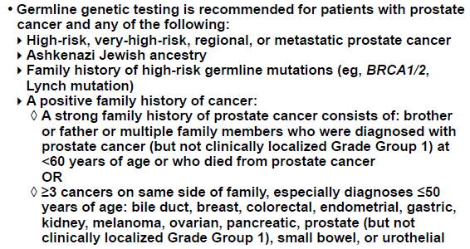
NCCN PCa Guidelines (v1.2020, 3/16/2020): Germline
NCCN Prostate Cancer Guidelines, Version 1.2020 — March 16, 2020.
Courtesy of Emmanuel S. Antonarakis, MD

Slide 58
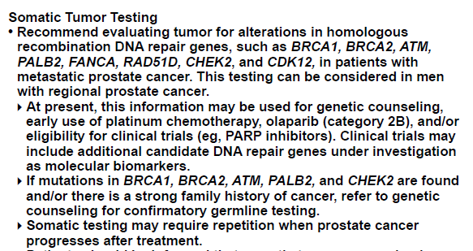
NCCN PCa Guidelines (v1.2020, 3/16/2020): Somatic
NCCN Prostate Cancer Guidelines, Version 1.2020 — March 16, 2020.
Courtesy of Emmanuel S. Antonarakis, MD

Slide 59
Testing Platforms (panel-based NGS preferred)
Germline genetic testing
  Blood (leukocytes), or saliva
Somatic genomic testing
  Tissue/biopsy-based
  Blood-based/ctDNA
Courtesy of Emmanuel S. Antonarakis, MD

Slide 60

Olaparib in mCRPC
19 May 2020 – Olaparib was FDA approved for mCRPC patients with a HRR gene mutation, who have previously received abiraterone or enzalutamide
Courtesy of Emmanuel S. Antonarakis, MD

Slide 61
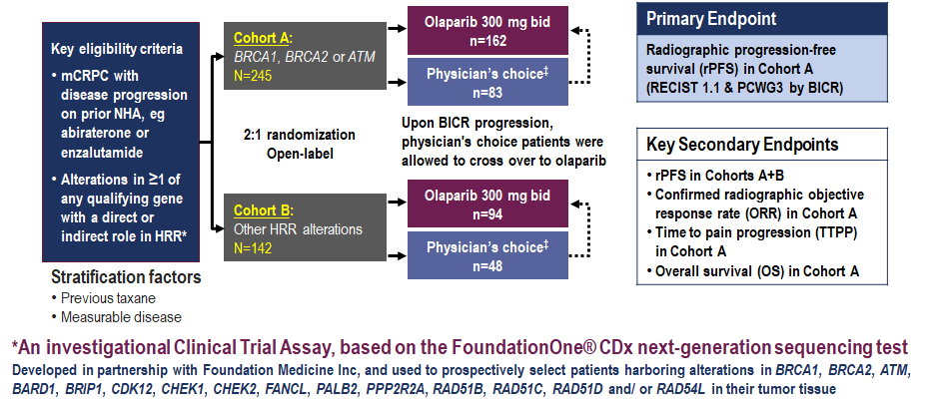
PROfound (phase 3 study): Olaparib vs Enza or Abi in mCRPC with somatic HRD mutations
ClinicalTrials.gov. NCT02987543
Courtesy of Emmanuel S. Antonarakis, MD

Slide 62
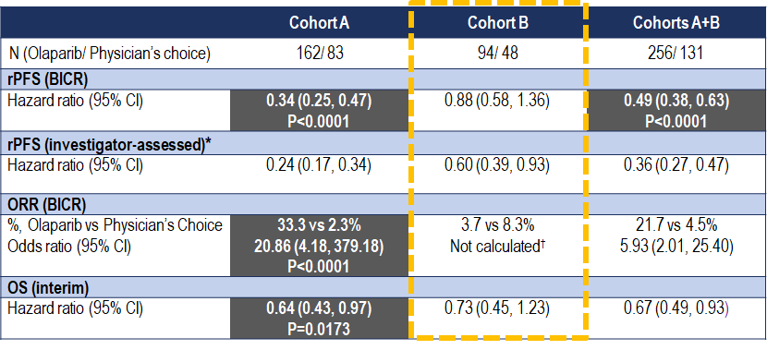
PROfound: Summary by Cohort
Cohort A = Patients with at least 1 alteration in BRCA1, BRCA2 or ATM
Cohort B = Patients with alterations in any of 12 other prespecified genes
Hussain M, et al. ESMO 2019; Ann Oncol 30(suppl 5): v851-v934. De Bono J, et al. NEJM 2020; epub ahead of print
Courtesy of Emmanuel S. Antonarakis, MD
Notes:
62
62

Slide 63
Rucaparib in mCRPC
15 May 2020 – Rucaparib was FDA approved for mCRPC patients with a BRCA1/2 mutation, who have previously received both a novel hormonal agent and a taxane-based chemotherapy
Courtesy of Emmanuel S. Antonarakis, MD

Slide 64
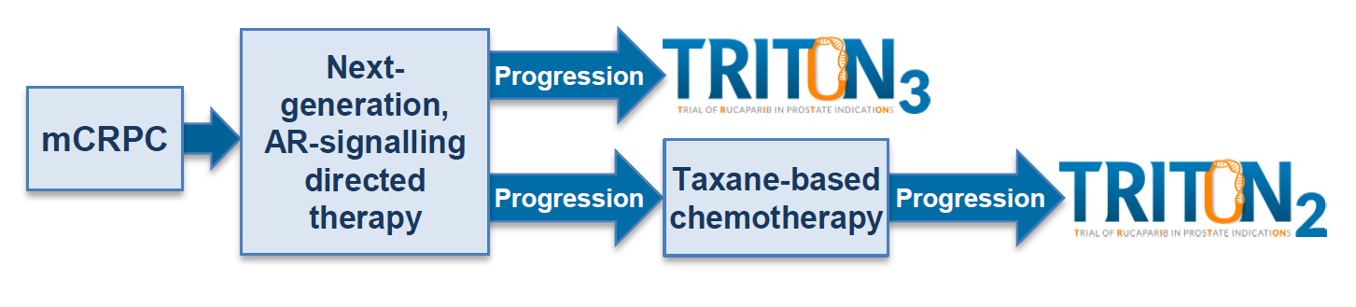
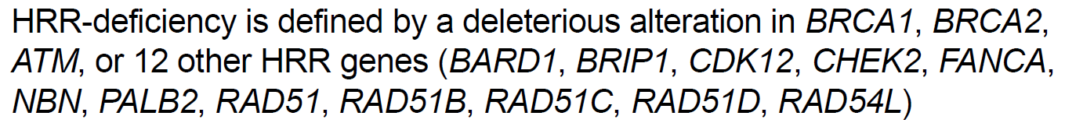
Rucaparib (TRITON2 and TRITON3)
Chowdhury S, et al. ESMO 2018; abstract 795PD.
Courtesy of Emmanuel S. Antonarakis, MD
Notes:
64
64

Slide 65
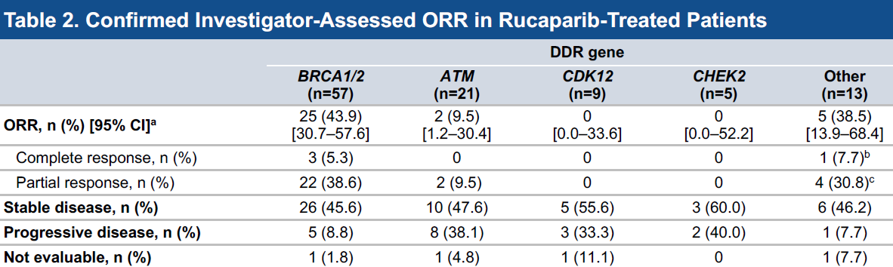
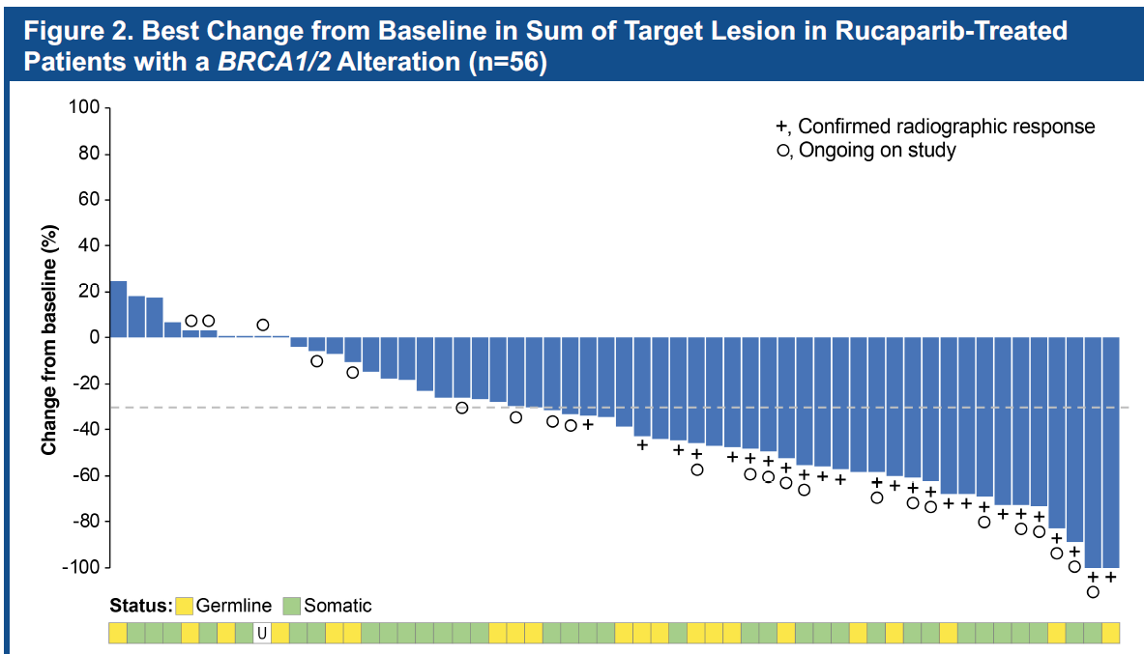
Rucaparib: TRITON2, objective responses
Figure 2. Best Change from Baseline in Sum of Target Lesions in Rucaparib-Treated
Patients with BRCA1/2 Alteration (n=56)
Courtesy of Emmanuel S. Antonarakis, MD
Abida W, et al. ESMO 2019; Ann Oncol 30(suppl 5):v325-v355.
Notes:
65
65

Slide 66
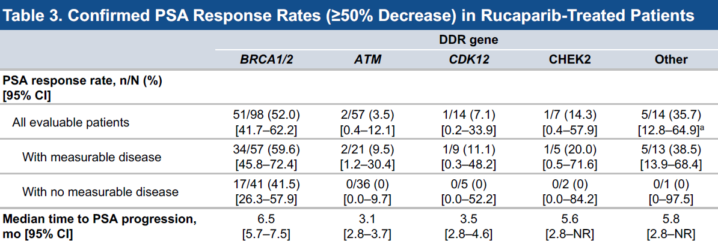
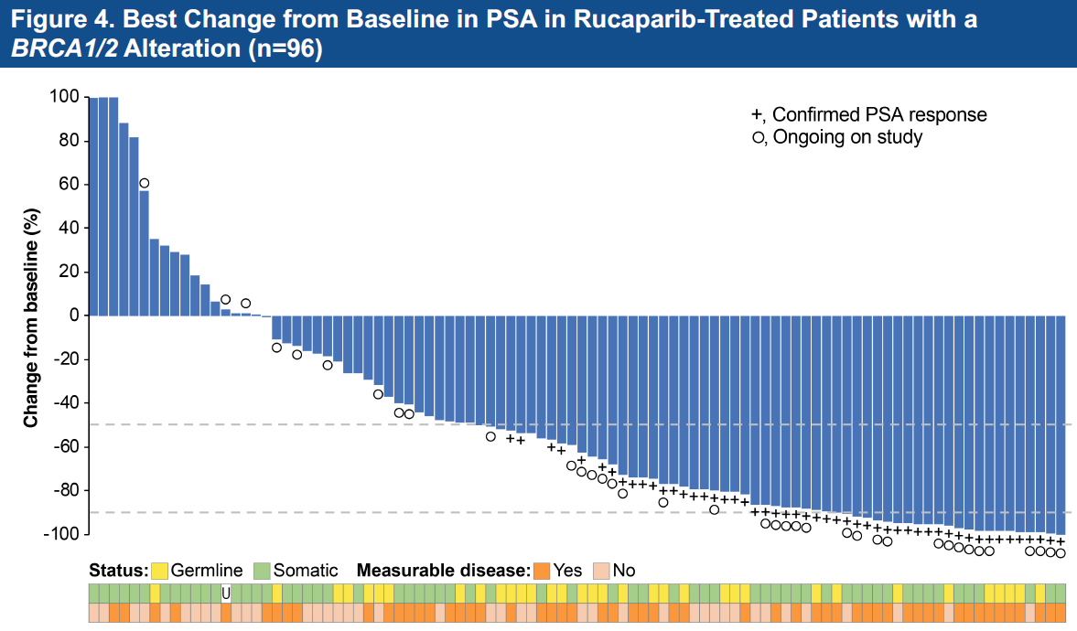
Rucaparib: TRITON2, PSA responses
Courtesy of Emmanuel S. Antonarakis, MD
Abida W, et al. ESMO 2019; Ann Oncol 30(suppl 5):v325-v355.
Notes:
66
66

