Slide 1
Oncology Grand Rounds
New Agents and Strategies in
Locally Advanced Non-Small Cell Lung Cancer
Tuesday, June 16, 2020
5:00 PM – 6:30 PM ET
Faculty
Benjamin Levy, MD
Stephen V Liu, MD, PhD
Beth Sandy, MSN, CRNP
Elizabeth S Waxman, RN, MSN, ANP-BC
Moderator
Neil Love, MD

Slide 2
Dr Love — Disclosures
Dr Love is president and CEO of Research To Practice. Research To Practice receives funds in the form of educational grants to develop CME activities from the following commercial interests: AbbVie Inc, Acerta Pharma — A member of the AstraZeneca Group, Adaptive Biotechnologies, Agendia Inc, Agios Pharmaceuticals Inc, Amgen Inc, Array BioPharma Inc, Astellas, AstraZeneca Pharmaceuticals LP, Bayer HealthCare Pharmaceuticals, Biodesix Inc, bioTheranostics Inc, Blueprint Medicines, Boehringer Ingelheim Pharmaceuticals Inc, Boston Biomedical Inc, Bristol-Myers Squibb Company, Celgene Corporation, Clovis Oncology, Daiichi Sankyo Inc, Dendreon Pharmaceuticals Inc, Eisai Inc, EMD Serono Inc, Exelixis Inc, Foundation Medicine, Genentech, a member of the Roche Group, Genmab, Genomic Health Inc, Gilead Sciences Inc, GlaxoSmithKline, Guardant Health, Halozyme Inc, ImmunoGen Inc, Incyte Corporation, Infinity Pharmaceuticals Inc, Ipsen Biopharmaceuticals Inc, Janssen Biotech Inc, administered by Janssen Scientific Affairs LLC, Jazz Pharmaceuticals Inc, Kite, A Gilead Company, Lexicon Pharmaceuticals Inc, Lilly, Loxo Oncology Inc, a wholly owned subsidiary of Eli Lilly & Company, Merck, Merrimack Pharmaceuticals Inc, Myriad Genetic Laboratories Inc, Natera Inc, Novartis, Oncopeptides, Pfizer Inc, Pharmacyclics LLC, an AbbVie Company, Prometheus Laboratories Inc, Puma Biotechnology Inc, Regeneron Pharmaceuticals Inc, Sandoz Inc, a Novartis Division, Sanofi Genzyme, Seattle Genetics, Sirtex Medical Ltd, Spectrum Pharmaceuticals Inc, Taiho Oncology Inc, Takeda Oncology, Tesaro, A GSK Company, Teva Oncology, Tokai Pharmaceuticals Inc and Tolero Pharmaceuticals.

Slide 3
Ms Goodwin— Disclosures
No financial interests or affiliations to disclose

Slide 4
Ms Lee — Disclosures
Consulting Agreement | Pfizer Inc

Slide 5
Dr Ramalingam — Disclosures
Consulting Agreements | AbbVie Inc, Amgen Inc, AstraZeneca Pharmaceuticals LP, Bristol-Myers Squibb Company, Genentech, a member of the Roche Group, Merck, Roche Laboratories Inc, Takeda Oncology
Contracted Research | Advaxis Inc, Amgen Inc, AstraZeneca Pharmaceuticals LP, Bristol-Myers Squibb Company, Merck, Takeda Oncology, Tesaro, a GSK Company

Slide 6
Mr Riely — Disclosures
Advisory Committee and Consulting Agreements | Daiichi Sankyo Inc, Takeda Oncology
Contracted Research | Merck, Mirati Therapeutics, Novartis, Pfizer Inc, Roche Laboratories Inc, Takeda Oncology

Slide 7
Commercial Support
This activity is supported by an educational grant from AstraZeneca Pharmaceuticals LP.
Notes:
7
7

Slide 8
Agenda
Overview: Localized Lung Cancer; Staging; History of Treatment
Case Presentation: Ms Waxman – 60-year-old woman
Module 1: PACIFIC Trial: Benefits of Postchemoradiation Durvalumab Consolidation
Case Presentation: Ms Sandy – 71-year-old woman
Module 2: PACIFIC Trial: Side Effects Associated with Chemoradiation Therapy and Durvalumab Consolidation
Case Presentation: Ms Waxman – 81-year-old woman
Module 3: Management of Immune-Mediated Toxicity
Case Presentation: Ms Sandy – 68-year-old woman
Module 4: Recent Relevant Data Sets
ASCO 2020 Plenary: ADAURA study of adjuvant osimertinib for EGFR-mutated NSCLC

Slide 9
Overview: Localized Lung Cancer; Staging; History of Treatment
Case Presentation: Ms Waxman – 60-year-old woman

Slide 10
What year was the first checkpoint inhibitor approved for the treatment of lung cancer?
2005
2010
2013
2015
2016
2017

Slide 11
FDA Approves First Immunotherapy Treatment for Lung Cancer
Press Release – March 4, 2015
“The Food and Drug Administration (FDA) approved nivolumab to treat patients with advanced non-small cell lung cancer (NSCLC) that has progressed during or after treatment with platinum-based chemotherapy. Nivolumab, which was initially approved for the treatment of metastatic melanoma, is the first immunotherapy drug to be approved to treat lung cancer. The FDA based the approval on findings from a randomized phase III trial that enrolled 272 patients with advanced NSCLC who were assigned to receive either nivolumab or the chemotherapy drug docetaxel. Participants who received nivolumab had a 41% reduction in the risk of death and lived on average 3.2 months longer than those who received docetaxel. Approximately 30 percent of patients treated with nivolumab were alive 2 years after beginning treatment compared to 13 percent of patients treated with docetaxel.
The FDA also cited safety and efficacy data from a Phase II trial that included 117 participants whose cancer had progressed after they had received a platinum-based chemotherapy and at least one other prior systemic treatment. According to updated results from the trial, 17 participants (14.5 percent) experienced a reduction in tumor size, of whom 59 percent had response durations of 6 months or longer. Median overall survival was 8.2 months and overall survival at 1 year was 40.8 percent.”
https://www.cancer.gov/news-events/cancer-currents-blog/2015/fda-opdivo

Slide 12
60-year-old woman (from the practice of Ms Waxman)
4/2018: Flu-like symptoms resolved, followed by persistent cough
12/2018: Admitted to hospital following episode of severe coughing with hemoptysis
  Work up: Left adenocarcinoma, Stage IIIB (T2b N3 M0), No driver mutation identified
2/2019: Completes concurrent platinum/taxane chemotherapy and radiation therapy
  3/2019 CT chest: Decrease in the primary tumor in the LLL, improvement in adenopathy
3/2019: Maintenance durvalumab
  After 2 infusions: Cough flares, prescribed Z-pak → improvement but not resolved
  Durvalumab held x 6 weeks
2nd opinion
  Scans: Residual small lymph nodes and evolving changes related to the previous radiation therapy, but no findings suggestive of drug-related pneumonitis
  Recommendation: Resume durvalumab

Slide 13
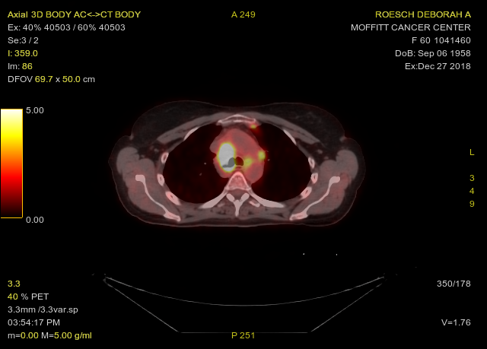
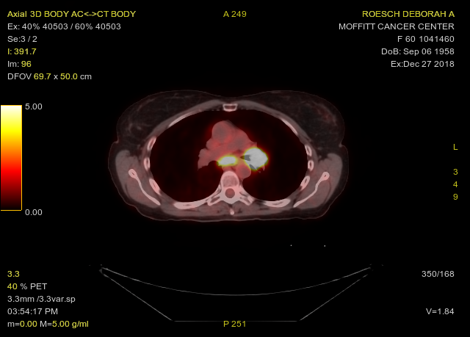
60-year-old woman and nonsmoker (from the practice of Ms Waxman)
Baseline Images

Slide 14
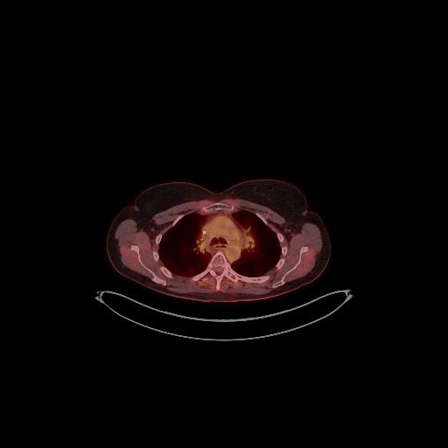
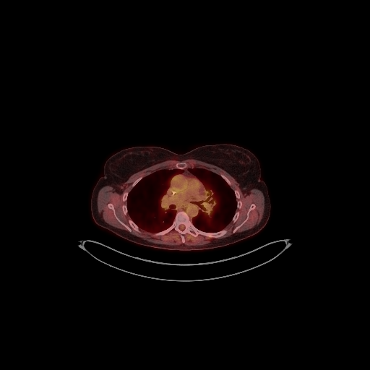
60-year-old woman and nonsmoker (from the practice of Ms Waxman)
After Concurrent Chemo/RT, on Durvalumab

Slide 15
Staging Regional Lymph Nodes in Lung Cancer
NX | Regional lymph nodes cannot be assessed
N0 | No regional node metastasis
N1 | Metastasis in ipsilateral peribronchial and/or ipsilateral hilar lymph nodes and intrapulmonary nodes, including involvement by direct extension
N2 | Metastasis in ipsilateral mediastinal and/or subcarinal lymph node(s)
N3 | Metastasis in the contralateral mediastinal, contralateral hilar, ipsilateral or contralateral scalene or supraclavicular lymph node(s)

Slide 16
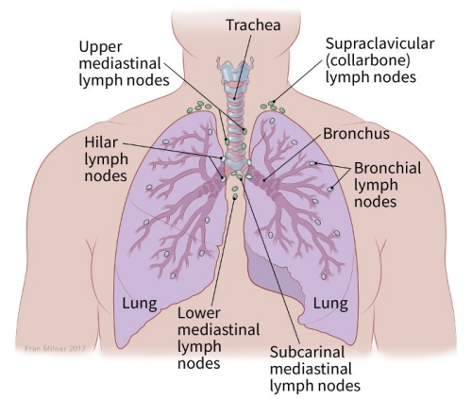
Lung Anatomy: Distribution of Lymph Nodes

Slide 17
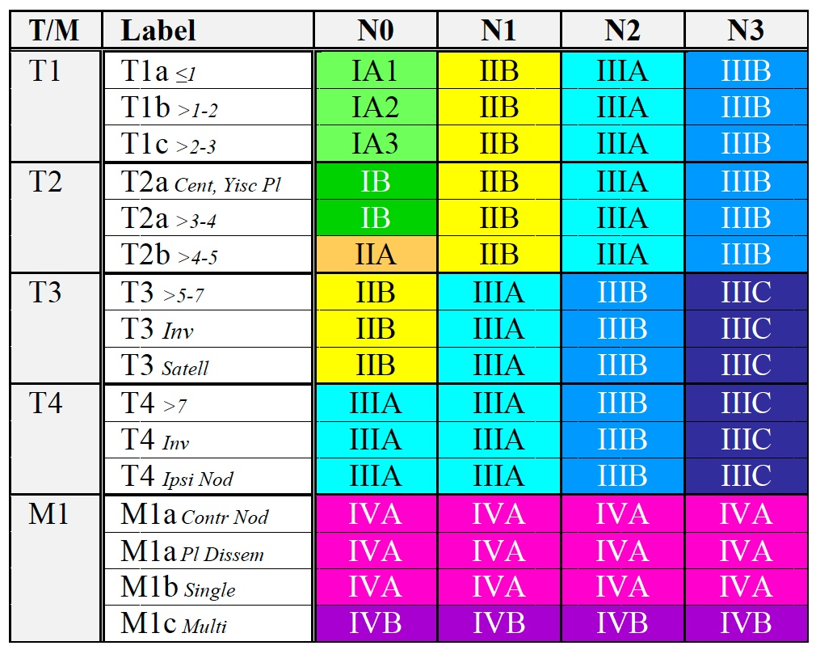
Lung Cancer Stage Grouping (AJCC 8th Edition)
Detterbeck FC et al. Chest 2017;151(1):193-203.

Slide 18
Stage Distribution at Diagnosis of Patients with Lung Cancer
SEER Analysis: (2004-2010, N = 344,797)
Stage at Diagnosis (AJCC, 7th Edition) | I | II | III | IV | Unknown
% of Patients | 18% | 7% | 19% | 49% | 5%
Est No. of Patients in USA, 2019 | 41,067 | 15,971 | 43,349 | 111,794 | 11,408
Occult disease accounts for approximately 1.5%
Chen VW et al. Cancer 2014;120:3781-92. Siegel RL et al. CA Cancer J Clin. 2019 Jan;69(1):7-34.

Slide 19
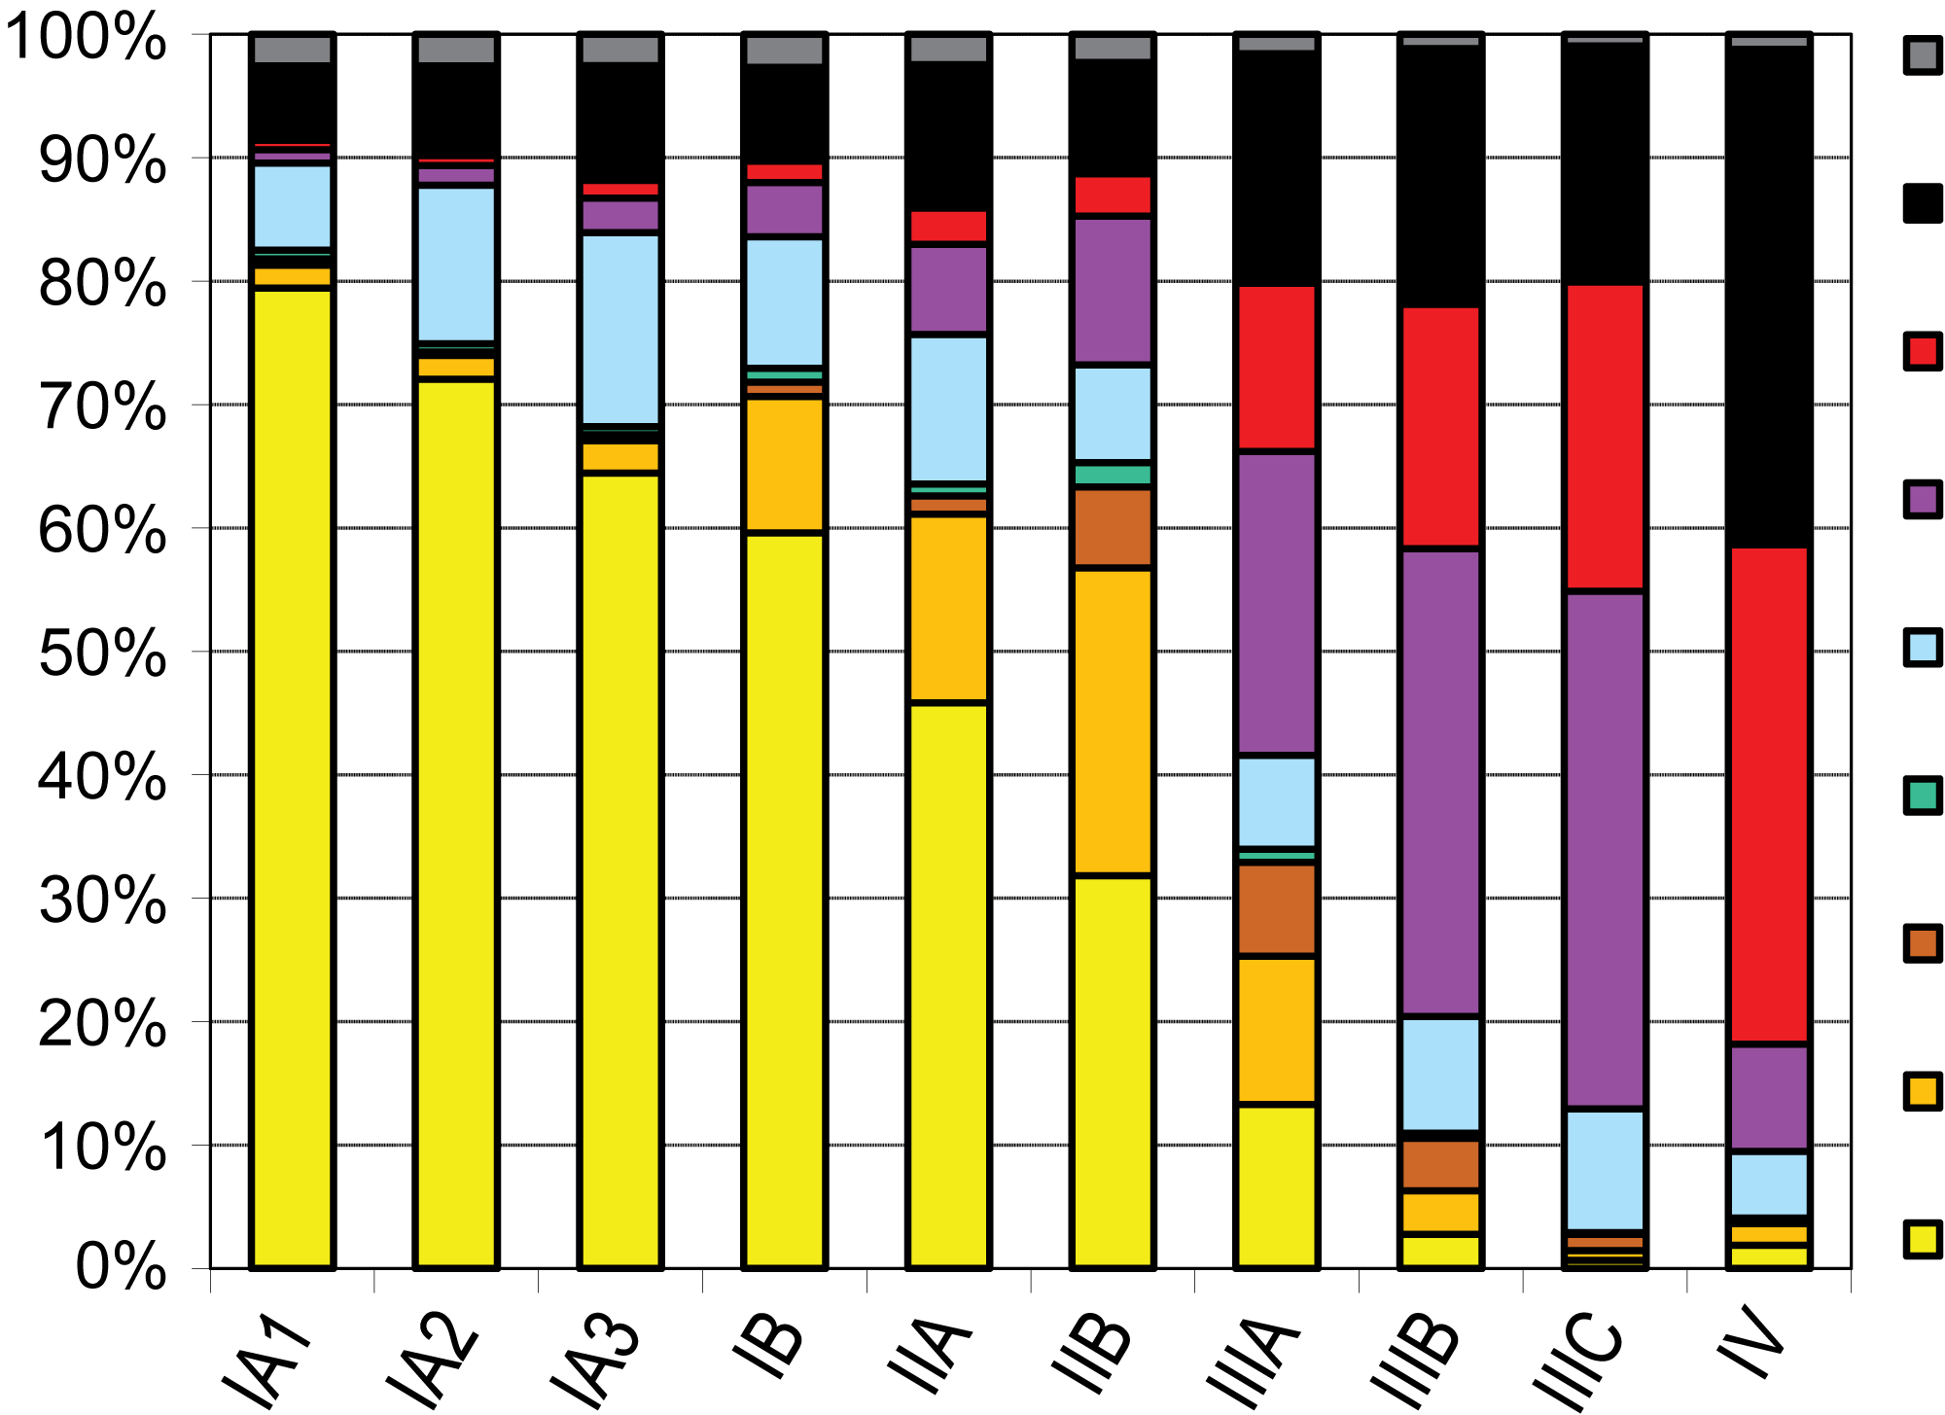
Treatment Received for NSCLC (2000-2012, N = 780,294)
Based on the National Cancer Data Base (NCDB) according to TNM 8th Edition
Unknown
No Treatment
Chemo only
ChemoRT
% of Patients within Subgroup
RT only
Surgery followed by RT
Surgery followed by ChemoRT
Surgery followed by Chemo
Surgery only
Best Stage
Chansky K et al. J Thorac Oncol 2017;12(7):1109-21.

Slide 20
Selected Negative Trials after concurrent chemotherapy + radiation
TRIAL | DESIGN | MEDIAN OS | HR | P VALUE
CALGB 39801¹ | Induction chemo CRT vs. cCRT | 14 vs 12 | N/R | 0.3
LUN 01-24² | cCRT docetaxel vs cCRT | 23.2 vs 21.2 | N/R | 0.883
SWOG S0023³ | cCRT docetaxel placebo vs cCRT docetaxel gefitinib | 35 vs 23 | 0.63 | .0013
RTOG 0617⁴ | cCRT chemo vs cCRT + cetuximab chemo | 24 vs 25 | 1.07 | 0.29
START⁵ | Sequential or cCRT placebo vs Sequential or cCRT tecemotide | 25.6 vs 22.3 | 0.88 | .123
1. Vokes et al J Clin Oncol 2007
2. Hanna et al J Clin Oncol 2008
3. Kelly et al J Clin Oncol 2008
4. Bradley et al Lancet Oncol 2015
5. Butts et al Lancet Oncol 2014
Courtesy of Benjamin Levy, MD

Slide 21
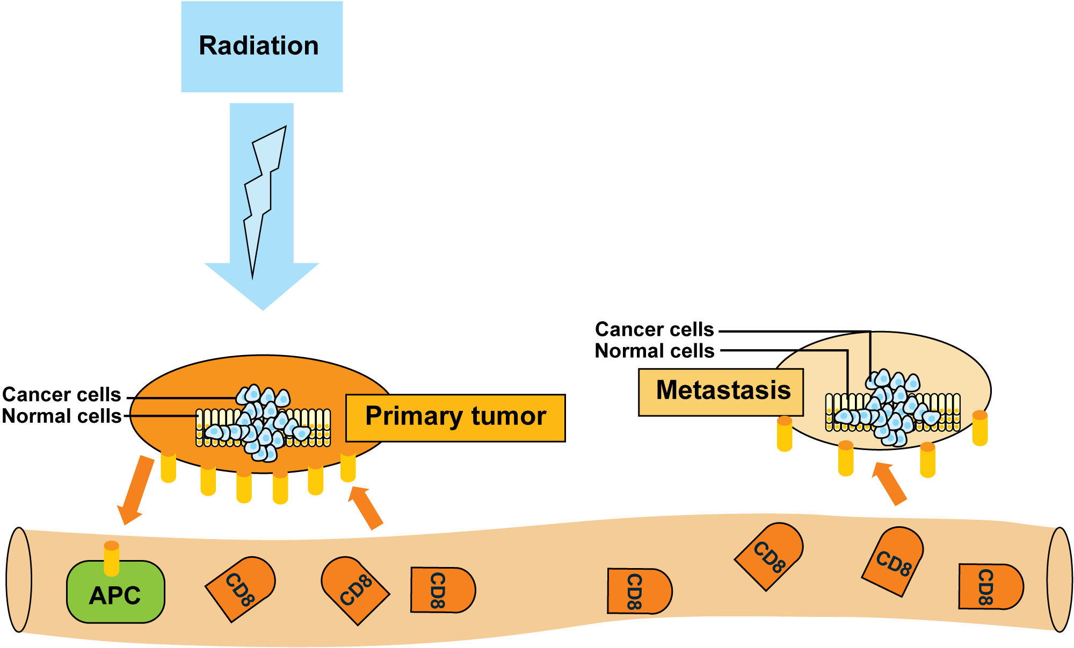
Proposed Mechanism for the Abscopal Effect
b) Metastasis destroyed by abscopal effect
a) Primary kill by radiation
Destroy secondary
b) Antigen-presenting cells (APCs) present tumor antigens to CD8 T cells
c) CD8 T cells circulate through the body, destroying both directly irradiated tumor and metastasis by abscopal effect
Wani SQ et al. Cureus 2019;11(2):e4100.

Slide 22
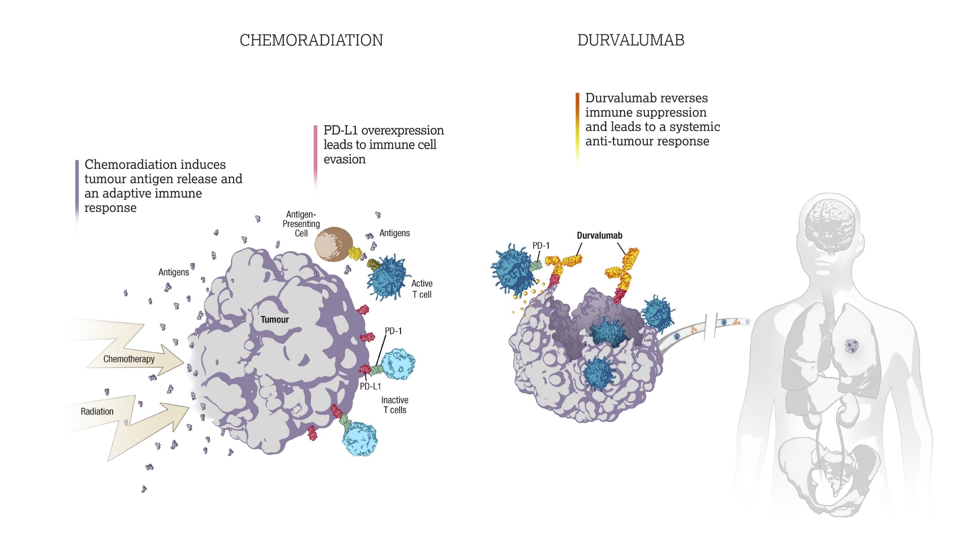
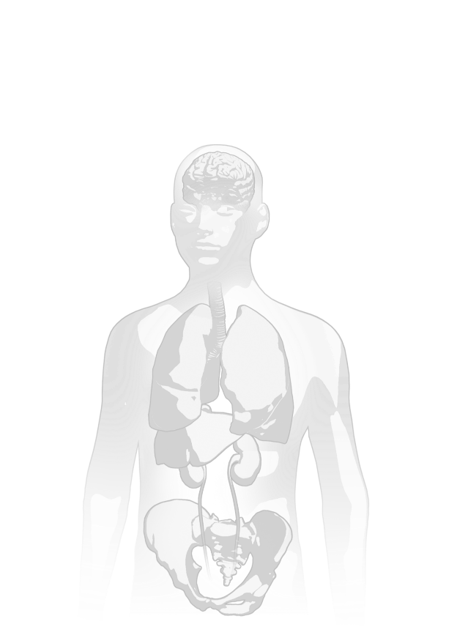


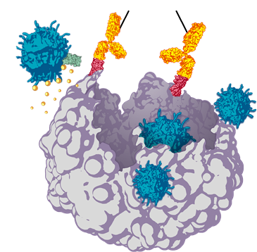




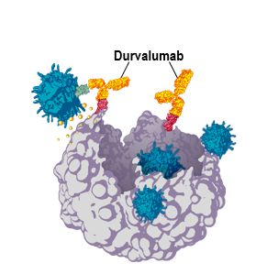



Rationale of checkpoint inhibitors after chemoradiation^{1–6}
Checkpoint inhibitor
chemoradiation
PD-1/PD-L1 inhibitors reverse immune suppression and lead to a systemic antitumor response
PD-L1 overexpression
leads to immune
cell evasion
Chemoradiation induces
tumor antigen release and
an adaptive immune response
Antigen-presenting
Cell
Checkpoint inhibitors
Antigens
Antigens
Active
T cell
Tumor
PD-L1
Chemotherapy
PD-1
Radiation
Inactive
T cells
1. Deng L, et al. J Clin Invest 2014;124:687–695; 2. Dovedi SJ, et al. Cancer Res 2014;74:5458–5468; 3. Chacon JA, et al. Vaccines (Basel) 2016;4:E43; 4. Formenti SC, Demaria S. J Natl Cancer Inst 2013;105:256–265; 5. Funaki S, et al. Oncol Rep 2017;38:2277−2284; 6. Antonia SJ, et al. N Engl J Med 2017;377:1919–29.
Courtesy of Benjamin Levy, MD

Slide 23
Agenda
Overview: Localized Lung Cancer; Staging; History of Treatment
Case Presentation: Ms Waxman – 60-year-old woman
Module 1: PACIFIC Trial: Benefits of Postchemoradiation Durvalumab Consolidation
Case Presentation: Ms Sandy – 71-year-old woman
Module 2: PACIFIC Trial: Side Effects Associated with Chemoradiation Therapy and Durvalumab Consolidation
Case Presentation: Ms Waxman – 81-year-old woman
Module 3: Management of Immune-Mediated Toxicity
Case Presentation: Ms Sandy – 68-year-old woman
Module 4: Recent Relevant Data Sets
ASCO 2020 Plenary: ADAURA study of adjuvant osimertinib for EGFR-mutated NSCLC

Slide 24
Module 1: PACIFIC Trial: Benefits of Postchemoradiation Durvalumab Consolidation
Case Presentation: Ms Sandy – 71-year-old woman

Slide 25
When was the last time that you encountered a patient with lung cancer who continued to smoke after their diagnosis?
Within the last week
1 week to 4 weeks ago
1 month to 6 months ago
6 months to 12 months ago
More than 1 year ago
Never

Slide 26
71-year-old woman (from the practice of Ms Sandy)
8/2018: Stage IB NSCLC → Resected 2.3-cm RLL
  PMH of PVD, COPD and HTN
10/2019: Recurrence, with hilar adenopathy
12/2019 Bronchoscopy: Poorly differentiated carcinoma
12/2019 - 2/2020: Concurrent weekly paclitaxel/carboplatin x 8
  Moderate esophagitis, no weight loss
  SOB worsened on chemo/radiation
  CINV significant after week 1, added IV aprepitant
  HTN (compliance issues), increased amlodipine to 10mg
Patient stopped smoking; previously 2 packs per day
3/2020 CT chest: Stable disease → S/P maintenance durvalumab x 2 → 4/22/20 monthly durvalumab due to COVID-19

Slide 27
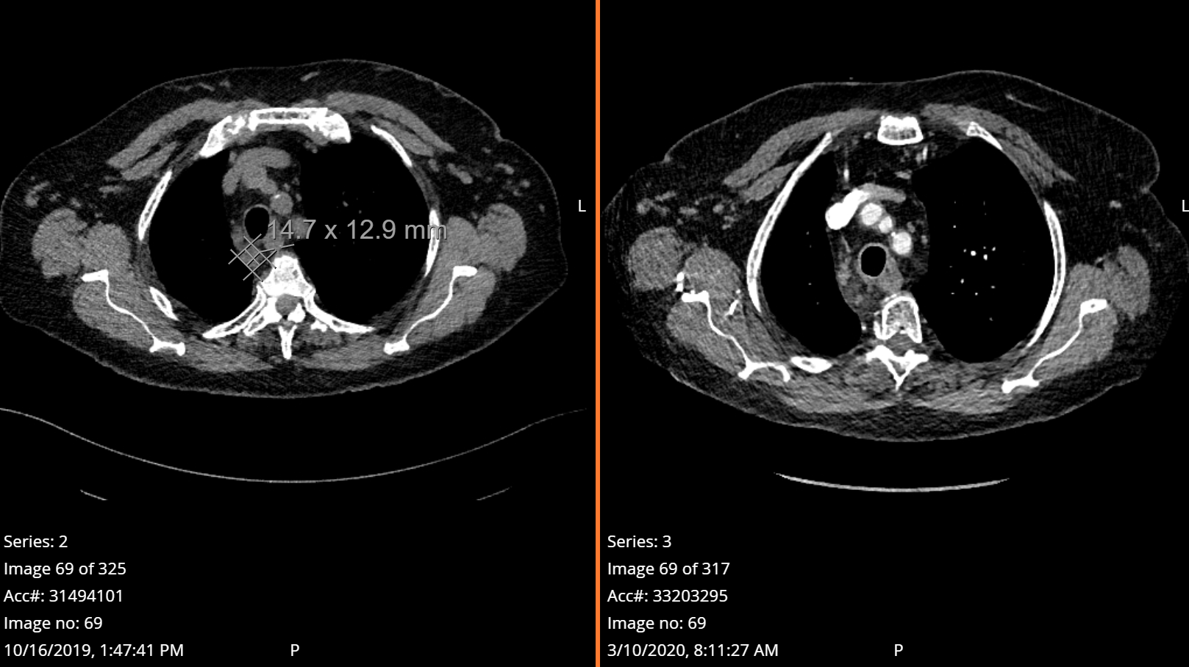
71-year-old woman (from the practice of Ms Sandy)
Recurrence on 10/2019 CT chest with hilar lymphadenopathy
CT chest 3/10/2020 stable disease

Slide 28
PACIFIC: Study Design
Phase 3, Randomized, Double-blind, Placebo-controlled, Multicenter, International Study¹
Unresectable, Stage III NSCLC without progression after definitive platinum-based cCRT (≥2 cycles)
18 years or older
WHO PS score 0 or 1
If available, archived pre-cCRT tumor tissue for PD-L1 testing*
All-comers population
(i.e. irrespective of PD-L1 status)
N=713 randomized
Durvalumab
10 mg/kg q2w for
up to 12 months
N=476
Primary endpoints
PFS by BICR using RECIST v1.1†
OS
1–42 days
post-cCRT
2:1 randomization,
stratified by age, sex, and smoking history
R
Key secondary endpoints
ORR, DoR and TTDM by BICR
PFS2 by investigator
Safety
PROs
Placebo
10 mg/kg q2w for
up to 12 months
N=237
*Using the Ventana SP263 immunohistochemistry assay
†Defined as the time from randomization until the date of objective disease progression or death by any cause in the absence of progression. BICR, blinded independent central review; cCRT, concurrent CRT; PFS2, time to second progression; RECIST, Response Evaluation Criteria in Solid Tumors; TTDM, time to death or distant metastasis. ClinicalTrials.gov number: NCT02125461
1. Antonia SJ, et al. N Engl J Med 2017;377:1919–29.
Courtesy of Benjamin Levy, MD

Slide 29
Updated Progression-free Survival by BICR* (ITT)
PFS HR = 0.51
95% CI, 0.41–0.63†
1.0
0.9
 | No. of events / No. of patients (%) | Median PFS (95% CI) months
Durvalumab | 243/476 (51.1) | 17.2 (13.1–23.9)
Placebo | 173/237 (73.0) | 5.6 (4.6–7.7)
0.8
0.7
55.7%
0.6
49.5%
0.5
Probability of Progression-free Survival
0.4
0.3
34.4%
0.2
26.7%
0.1
0.0
0
3
6
9
12
15
18
21
24
27
30
33
36
39
Time from Randomization (months)
No. at Risk
Durvalumab
476
377
302
268
213
188
163
143
116
83
43
23
1
0
Placebo
237
163
106
86
67
55
46
39
32
24
10
5
0
0
Antonia SJ et al. N Engl J Med 2018;379(24):2342-50.
Courtesy of Benjamin Levy, MD
*Median duration of follow-up was 25.2 months (range 0.2–43.1)
†No formal statistical comparison was made because the study had achieved significance for PFS at the first planned IA (data cutoff of Feb 13, 2017)

Slide 30
Updated Time to Death or Distant Metastasis (TTDM) by BICR* (ITT)
Updated Incidence of
New Lesions by BICR* (ITT)
 | Median TTDM (95% CI) months
Durvalumab | 28.3 (24.0–34.9)
Placebo | 16.2 (12.5–21.1)
New Lesion Site† | Durvalumab (N=476) | Placebo (N=237)
Patients with any new lesion, n (%) | 107 (22.5) | 80 (33.8)
Lung | 60 (12.6) | 44 (18.6)
Lymph nodes | 31 (6.5) | 27 (11.4)
Brain | 30 (6.3) | 28 (11.8)
Liver | 9 (1.9) | 8 (3.4)
Bone | 8 (1.7) | 7 (3.0)
Adrenal | 3 (0.6) | 5 (2.1)
Other | 10 (2.1) | 5 (2.1)
1.0
0.9
0.8
0.7
0.6
0.5
Probability of Death or Distant Metastasis
0.4
0.3
0.2
TTDM HR = 0.53
95% CI, 0.41–0.68
0.1
0.0
0
3
6
9
12
15
18
21
24
27
30
33
36
39
No. at Risk
Time from Randomization (months)
Durvalumab
476
419
357
316
259
223
194
163
129
92
46
25
1
0
Placebo
237
189
139
118
95
77
64
54
39
27
12
5
0
0
Antonia SJ et al. N Engl J Med 2018;379(24):2342-50.
Courtesy of Benjamin Levy, MD
*Median duration of follow-up was 25.2 months (range 0.2–43.1)
†A patient may have had more than one new lesion site

Slide 31
Overall Survival* (ITT)
OS HR = 0.68
99.73% CI, 0.469–0.997†
P=0.00251
1.0
83.1%
0.9
0.8
66.3%
0.7
0.6
75.3%
0.5
Probability of Overall Survival
55.6%
 | No. of events / No. of patients (%) | Median OS (95% CI) months
Durvalumab | 183/476 (38.4) | NR (34.7–NR)
Placebo | 116/237 (48.9) | 28.7 (22.9–NR)
0.4
0.3
0.2
0.1
0.0
0
3
6
9
12
15
18
21
24
27
30
33
36
39
42
45
Time from Randomization (months)
No. at Risk
Durvalumab
476
464
431
415
385
364
343
319
274
210
115
57
23
2
0
0
Placebo
237
220
198
178
170
155
141
130
117
78
42
21
9
3
1
0
Antonia SJ et al. N Engl J Med 2018;379(24):2342-50.
Courtesy of Benjamin Levy, MD
*Median duration of follow-up for OS was 25.2 months (range 0.2–43.1)
†Adjusted for interim analysis
NR, not reached

Slide 32
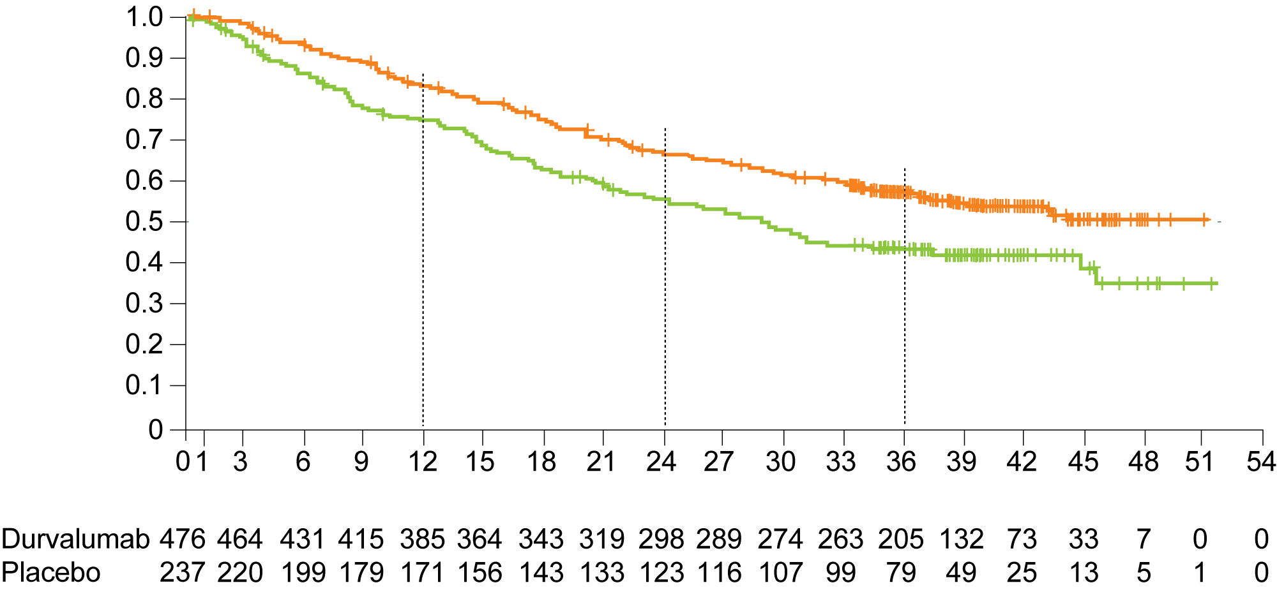
PACIFIC: 3-Year Overall Survival Analysis in the Intention-to-Treat Population
 | No. of events/ total no. of patients (%) | Median OS (95% CI) months | 12-month OS rate (95% CI) % | 24-month OS rate (95% CI) % | 36-month OS rate (95% CI) %
Durvalumab | 210/476 (44.1) | NR (38.4-NR) | 83.1 (79.4-86.2) | 66.3 (61.8-70.4) | 57.0 (52.3-61.4)
Placebo | 134/237 (56.5) | 29.1 (22.1-35.1) | 74.6 (68.5-79.7) | 55.3 (48.6-61.4) | 43.5 (37.0-49.9)
Stratified hazard ratio for death, 0.69 (95% CI, 0.55-0.86)
Stratified hazard ratio for death from the primary analysis, 0.68 (95% CI, 0.53-0.87)
Probability of OS
Durvalumab
Placebo
No. at risk
Time from randomization (months)
Gray JE et al. J Thorac Oncol 2020;15(2):288-93.

Slide 33
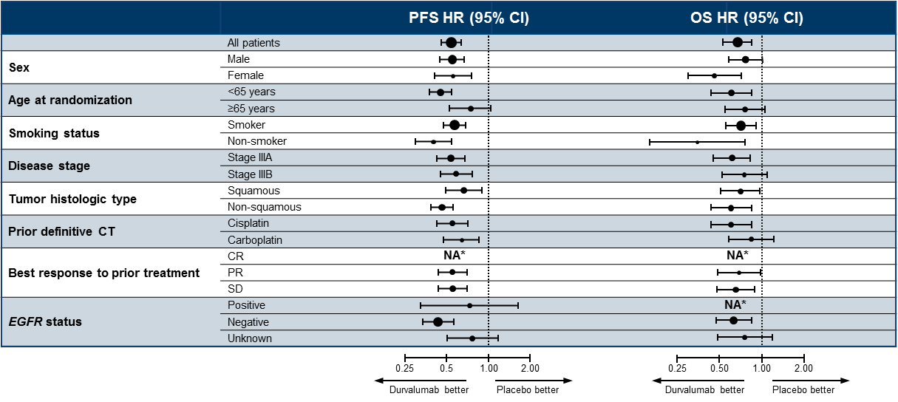
Progression-free and Overall Survival by Subgroup (ITT)
*Not calculated if subgroup has <20 events
Antonia SJ et al. N Engl J Med 2018;379(24):2342-50.
Courtesy of Benjamin Levy, MD
Note: PFS data based on data cutoff of Feb 13, 2017, and OS data based on data cutoff of March 22, 2018
NA, not available

Slide 34
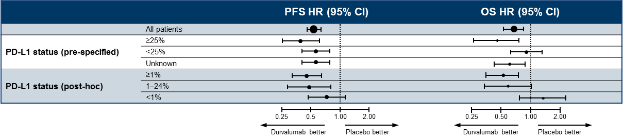
PACIFIC Trial: Subgroup Analysis by PD-L1 Status
Important facts regarding PD-L1 status:
  PD-L1 testing was not required
  37% of patients with unknown PD-L1 status
  PD-L1 status was obtained pre-CRT (getting a sample post-CRT medically not feasible)
  PD-L1 expression-level cutoff of 1% was part of an unplanned post-hoc analysis requested by
  a health authority
Antonia SJ et al. N Engl J Med 2018;379(24):2342-50.
Courtesy of Benjamin Levy, MD
Note: PFS data based on data cutoff of Feb 13, 2017, and OS data based on data cutoff of March 22, 2018

Slide 35
Immunotherapy in EGFR-Positive Patients¹
Key eligibility criteria
Advanced NSCLC
EGFR mutation positive
PD-L1 ≥1%
TKI naïve
Pembrolizumab
200 mg Q3W
Until PD or total of 35 study infusions
Post-progression
EGFR TKI
Safety/efficacy analysis
N = 25
Primary objective: ORR of pembrolizumab prior to TKI
Secondary objectives: safety, PFS, OS of pembrolizumab; safety and efficacy of subsequent EGFR TKI therapy
Planned enrollment: 25 patients
Closed (October 2017): 11 patients (8 with PD-L1 >50%) enrolled
RR: 0%
Courtesy of Benjamin Levy, MD
1. Lisberg AE et al. J Clin Oncol. 2018;36(suppl 15):9014.

Slide 36
Studies of Immune Checkpoint Inhibition in Unresectable and/or Locally Advanced NSCLC
Study | Phase (N) | Study population | Treatment
Hoosier CRN LUN 14-179 (NCT02343952) | II (N = 92) | Unresectable Stage III NSCLC | CRT → Pembrolizumab
Rutgers Cancer Institute (NCT02621398) | I (N = 23) | Unresectable Stage II or Stage IIIA/IIIB NSCLC | CRT + Pembrolizumab at start of CRT, 2 weeks before end of CRT or 2-4 weeks after CRT
PACIFIC-2 (NCT03519971) | III (N = 300) | Unresectable Stage III NSCLC | CRT + Durvalumab → Durvalumab until PD CRT + Placebo → Placebo until PD
CRT = chemoradiation therapy
Durm G et al. ASCO 2018;Abstract 8500; Jabbour SK et al. ASCO 2019;Abstract 8511; www.clinicaltrials.gov

Slide 37
Agenda
Overview: Localized Lung Cancer; Staging; History of Treatment
Case Presentation: Ms Waxman – 60-year-old woman
Module 1: PACIFIC Trial: Benefits of Postchemoradiation Durvalumab Consolidation
Case Presentation: Ms Sandy – 71-year-old woman
Module 2: PACIFIC Trial: Side Effects Associated with Chemoradiation Therapy and Durvalumab Consolidation
Case Presentation: Ms Waxman – 81-year-old woman
Module 3: Management of Immune-Mediated Toxicity
Case Presentation: Ms Sandy – 68-year-old woman
Module 4: Recent Relevant Data Sets
ASCO 2020 Plenary: ADAURA study of adjuvant osimertinib for EGFR-mutated NSCLC

Slide 38
Module 2: PACIFIC Trial: Side Effects Associated with Chemoradiation Therapy and Durvalumab Consolidation
Case Presentation: Ms Waxman – 81-year-old woman

Slide 39
A 75-year-old patient with metastatic non-small cell lung cancer and a PD-L1 level of 60% is being started on pembrolizumab. How often should treatment be administered?
Every 3 weeks
Every 6 weeks

Slide 40
81-year-old woman (from the practice of Ms Waxman)
10-11/2018: Presents with weakness, SOB, and weight loss
  Work up: T1a N2 adenocarcinoma of the lung, no driver mutations identified
12/2018 – 1/2019: Concurrent weekly carboplatin/paclitaxel and radiation therapy
2/2019 – 1/2020: Maintenance durvalumab
  1/2020 PET/CT: Multiple new bilateral pulmonary nodules, suspicious for metastatic disease
  Durvalumab held
  Biopsy of left lung nodule: Lung parenchyma with features of organizing pneumonia, no evidence of malignancy

Slide 41
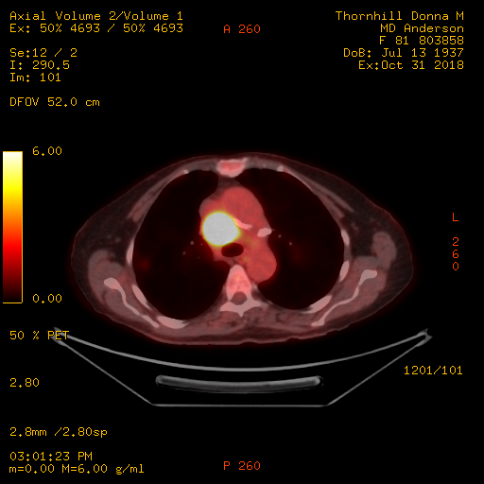
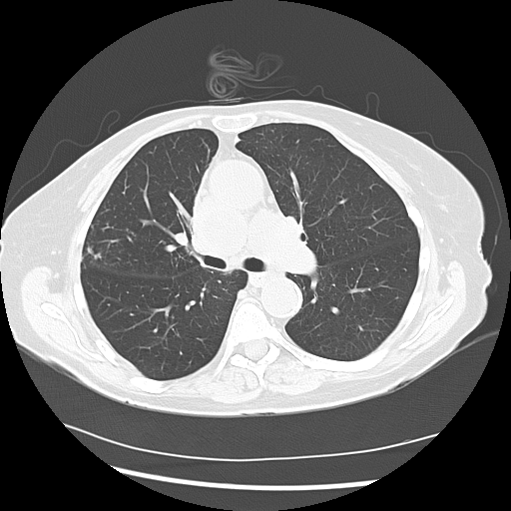
81-year-old woman (from the practice of Ms Waxman)
Baseline Findings

Slide 42
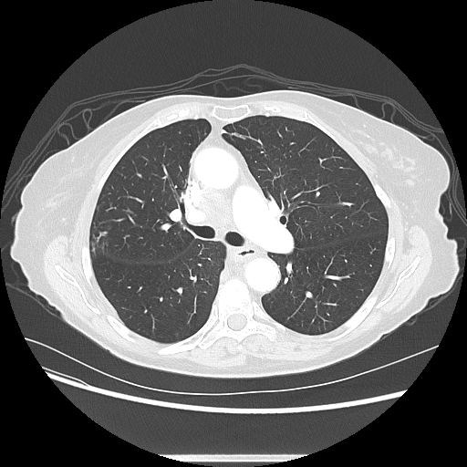
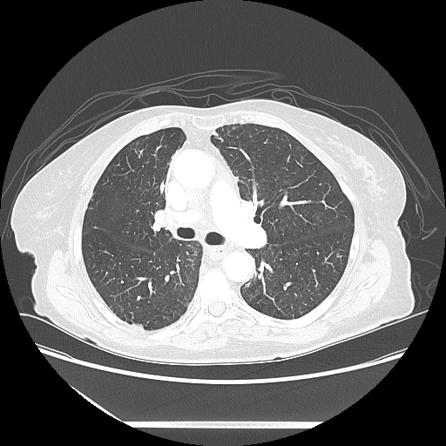
81-year-old woman (from the practice of Ms Waxman)
Response to Treatment

Slide 43
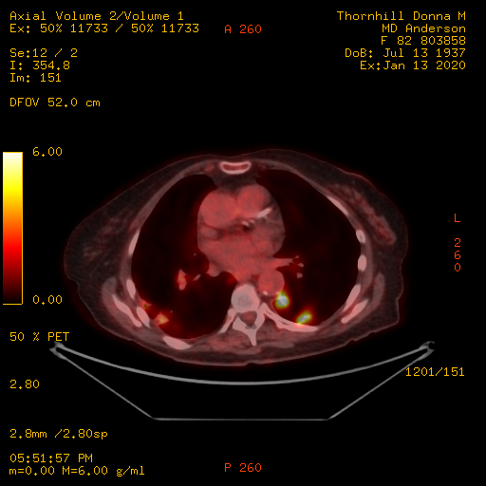
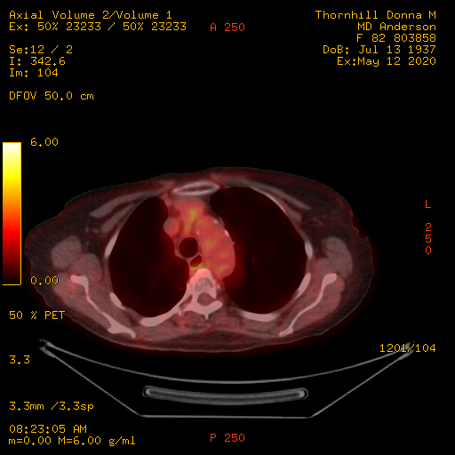
81-year-old woman (from the practice of Ms Waxman)
Suspicious Findings
Newest Scan

Slide 44
PACIFIC: Overall Toxicity
PACIFIC (12 months durvalumab consolidation)
  Grade 3-4 AEs seen in 30.5% (vs. 26.1% with placebo)
  Immune toxicity in 24.4% (vs. 8.1% with placebo)
  Discontinuation due to AE was 15.4% (vs. 9.8% with placebo)
Common AEs (any cause, any grade)
 | Durvalumab | Placebo
Cough | 35.2% | 25.2%
Fatigue | 24.0% | 20.5%
Dyspnea | 22.3% | 23.9%
Diarrhea | 18.5% | 19.7%
Antonia, NEJM 2018
Naidoo, ASCO 2020
Courtesy of Stephen V Liu, MD, PhD

Slide 45
PACIFIC: Incidence and Time to Onset of Pneumonitis, and Treatment Exposure
Pneumonitis | Durvalumab (N = 475) | Placebo (N = 234)
Any grade pneumonitis or radiation pneumonitis | 96.8% | 94.9%
Grade 3/4 pneumonitis or radiation pneumonitis | 29.9% | 26.1%
Median time to onset from 1st dose | 55.0 days | 55.0 days
Median time to onset from radiotherapy | 73.0 days | 76.5 days
Median duration | 64.0 days | 57.0 days
Overall treatment exposure was similar for patients with or without pneumonitis
Durvalumab with pneumonitis
(n = 161)
Placebo with pneumonitis
(n = 58)
Durvalumab without pneumonitis
(n = 314)
Placebo without pneumonitis
(n = 176)
Vansteenkiste JF et al. Proc IASLC/WCLC 2018;Abstract MA05.02.

Slide 46
Multi-institutional Study of Pneumonitis After Durvalumab and Chemoradiotherapy: Impact on Survival Outcomes
N = 36 patients with NSCLC (89% Stage III) treated according to PACIFIC paradigm
Grade ≥2 pneumonitis
  3-months: 26%
  6-months: 29%
Median time to development of pneumonitis after completion of RT: 71 days
(range: 29-270)
The development of pneumonitis did not impact survival outcomes
 | Pneumonitis | No pneumonitis | p-value
PFS at 9 months | 70% | 66% | 0.94
OS at 9 months | 100% | 83.3% | 0.32
Sita T et al. IASLC North America 2019;Abstract OA03.03.

Slide 47
Agenda
Overview: Localized Lung Cancer; Staging; History of Treatment
Case Presentation: Ms Waxman – 60-year-old woman
Module 1: PACIFIC Trial: Benefits of Postchemoradiation Durvalumab Consolidation
Case Presentation: Ms Sandy – 71-year-old woman
Module 2: PACIFIC Trial: Side Effects Associated with Chemoradiation Therapy and Durvalumab Consolidation
Case Presentation: Ms Waxman – 81-year-old woman
Module 3: Management of Immune-Mediated Toxicity
Case Presentation: Ms Sandy – 68-year-old woman
Module 4: Recent Relevant Data Sets
ASCO 2020 Plenary: ADAURA study of adjuvant osimertinib for EGFR-mutated NSCLC

Slide 48
Module 3: Management of Immune-Mediated Toxicity
Case Presentation: Ms Sandy – 68-year-old woman

Slide 49
68-year-old woman (from the practice of Ms Sandy)
Screening CT → PET/Bronch/EBUS: RUL mass, LN levels 4R and 11R: Adenocarcinoma
  PMH of anxiety, PAC c BL iliac arterial stents
Concurrent paclitaxel/carboplatin weekly x 6 with daily RT x 7
  Tolerated quite well, moderate esophagitis on last week of chemo/rads
  Post chemo/rads scan: No disease progression
Late 3/2020: Initiates maintenance durvalumab
4/10/2020: SOB, progressively worsened
4/21/2020 CT chest: Pneumonitis, attributed to RT due to timing, appearance
  Held durvalumab, Prednisone 60mg (tapered off 5/13)
  COVID-19 testing: Negative
5/15/2020 CT chest: Pneumonitis now more consistent with radiation fibrosis than GGO’s
5/18/2020 telehealth visit: Doing well, still coughing
  Due to substantial radiation changes, waiting 2 more weeks before resuming durvalumab

Slide 50
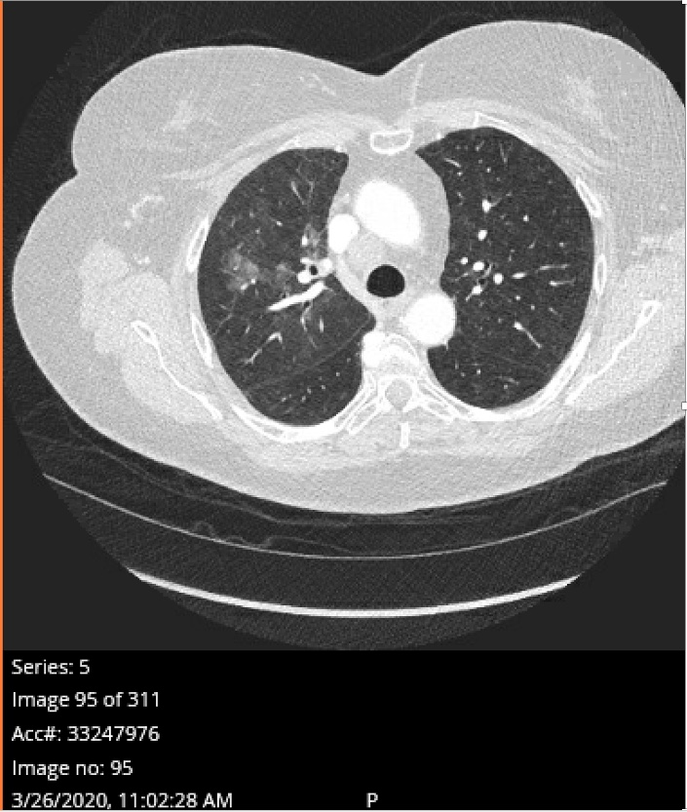
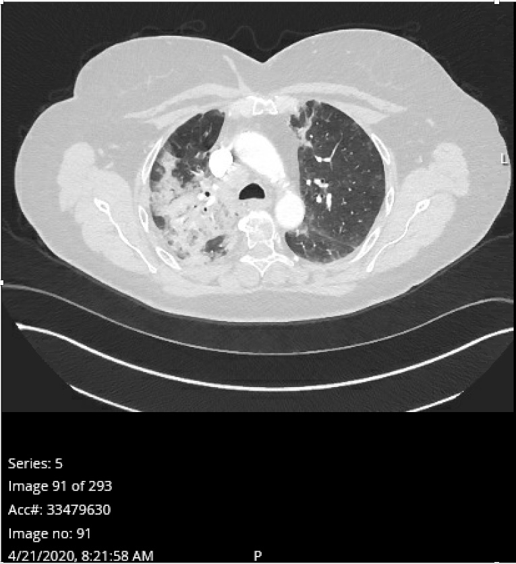
68-year-old woman (from the practice of Ms Sandy)
3/26/2020 CT chest: 1-month post-RT scan, pre-durvalumab
4/21/2020 CT chest: Pneumonitis

Slide 51
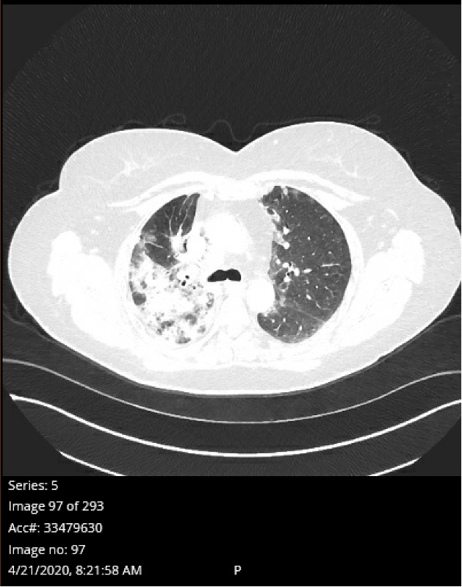
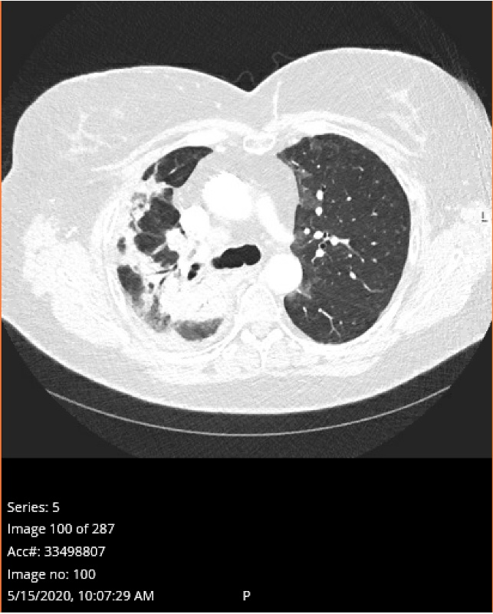
68-year-old woman (from the practice of Ms Sandy)
4/21/2020 CT chest
5/15/2020 CT chest

Slide 52

At the Jersey Shore with her husband on their boat

Slide 53
Immune Mediated Toxicity
Use of checkpoint inhibitors (including durvalumab)
  Restore the ability of a patient’s T-cells to attack tumors
  Generate an immune-mediated anti-tumor response
  The same checkpoints also prevent auto-immunity
  Inhibiting those checkpoints can lead to autoimmune toxicity
June, Nat Med 2017
Courtesy of Stephen V Liu, MD, PhD

Slide 54
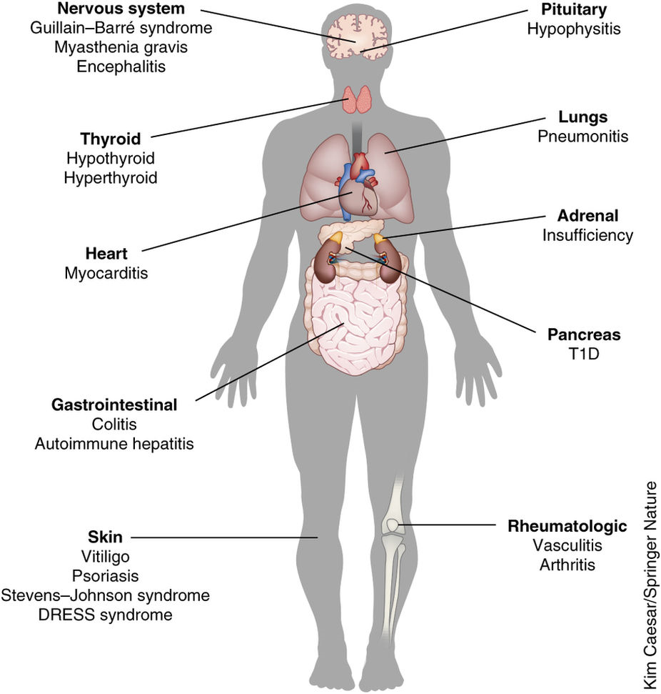
Immune Mediated Toxicity
Any organ/system can be affected
  Special concern in stage III NSCLC for the lungs
  Radiation alone can cause pneumonitis
  Generally low grade, if any
  Potential for serious toxicity
  Early recognition is the key to avoiding poor outcomes
June, Nat Med 2017
Courtesy of Stephen V Liu, MD, PhD

Slide 55
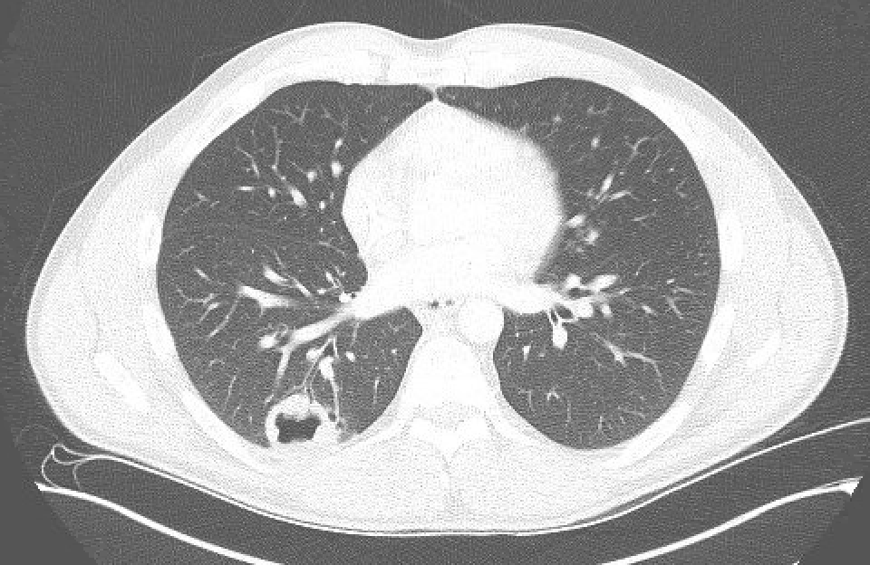
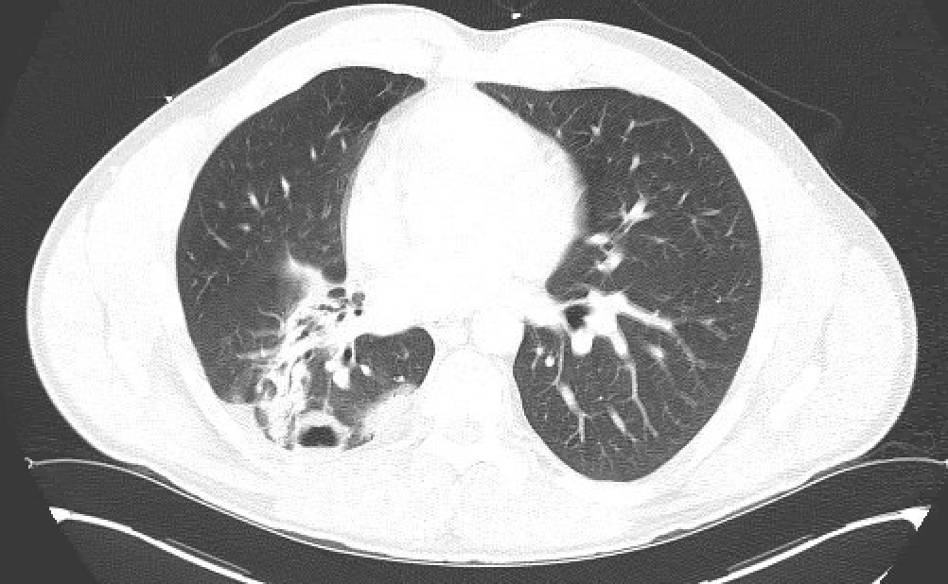
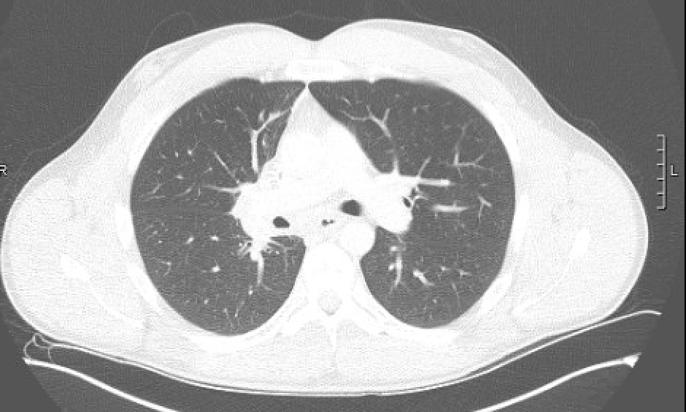
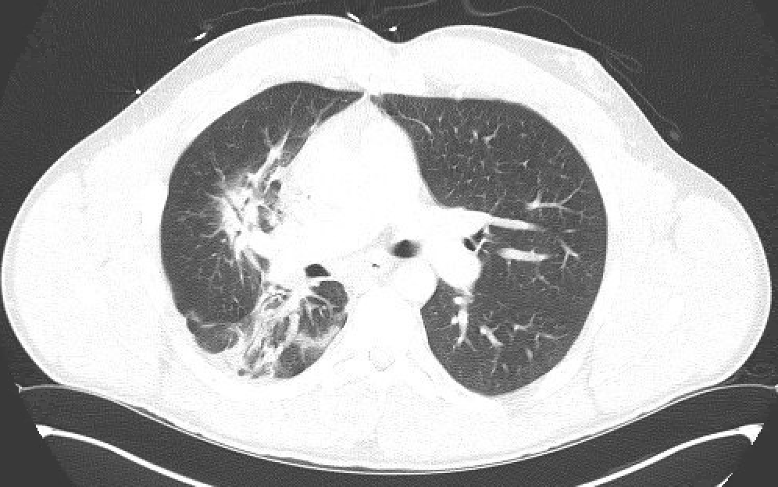
Pneumonitis
Images from Stephen Liu, MD
Courtesy of Stephen V Liu, MD, PhD

Slide 56
Pneumonitis
Pneumonitis differential
  Radiation pneumonitis (consider radiation fields)
  Immune mediated pneumonitis (consider timing)
  Pneumonia or infection (consider other symptoms)
If non-infectious, initial management of radiation pneumonitis and immune mediated pneumonitis is similar (steroid therapy)
Courtesy of Stephen V Liu, MD, PhD

Slide 57
Pneumonitis Management
Symptoms must be monitored closely
  Engage entire medical team and caregivers
  New dyspnea/cough, new hypoxia warrant workup
    Low threshold to hold therapy for evaluation
Management guided by grade of pneumonitis
  Grade 1: asymptomatic, no intervention needed
  Grade 2: symptomatic, intervention required
  Grade 3: severe symptoms, limiting ADLs, oxygen indicated
  Grade 4: life threatening
Brahmer, JCO 2018
Courtesy of Stephen V Liu, MD, PhD

Slide 58
Pneumonitis Management
Grade 2 symptomatic pneumonitis
  Hold immunotherapy
  Radiographic imaging
  Steroids: prednisone 1-2 mg/kg/d, taper over 4-6 weeks
  Consider antibiotics
  Monitor every 3 days, should improve in 2-3 days
Brahmer, JCO 2018
Courtesy of Stephen V Liu, MD, PhD

Slide 59
Pneumonitis Management
Grade 3 severe pneumonitis
  Inpatient management
  Permanently discontinue therapy
  CT scan
  Start IV steroids (methylprednisolone 1-2 mg/kg/d)
    Escalate immunosuppression if not improving within 48h
  Pulmonary and ID consultations
Brahmer, JCO 2018
Courtesy of Stephen V Liu, MD, PhD

Slide 60
Other Immune Mediated Adverse Events
Non-pneumonitis immune mediated events with durvalumab
  56.3% occur within 3 months; 83.1% within 6 months
  Thyroid disorders (seen in 11.4% of patients)
  Rash/dermatitis (seen in 1.9%)
  Diarrhea/colitis (seen in 1.1%)
 | Thyroid | Rash | Diarrhea
Time to Onset | 85 days | 37 days | 61 days
Duration | 63.5 days | 117 days | 74 days
Time to Resolution | 56 days | 104 days | 47.5 days
Naidoo, ASCO 2020
Courtesy of Stephen V Liu, MD, PhD

Slide 61
Immune Mediated Adverse Events
Hormone replacement if indicated
For severe immune related side effects, treatment is immune suppression (steroids)
  Early and aggressive intervention important for severe cases
  When steroids tapered off, side effects may return
    Long courses of steroids may be needed
    Potential risk of infection and other complications of steroid use
  Lowering the dose or changing schedule is not effective
Roth, JCO 1992
Courtesy of Stephen V Liu, MD, PhD

Slide 62
Monitoring with Immunotherapy
History and physical
  New symptoms, new findings, vital signs
Regular blood tests when receiving immunotherapy
  CBC, BMP, LFTs, TSH
Symptom directed evaluation as needed
  Cortisol, troponin, CPK, gonadotropins
Direct and open communication with the team
  Not just during treatment visits
Anything notable and new needs to be reported!
Courtesy of Stephen V Liu, MD, PhD

Slide 63
Agenda
Overview: Localized Lung Cancer; Staging; History of Treatment
Case Presentation: Ms Waxman – 60-year-old woman
Module 1: PACIFIC Trial: Benefits of Postchemoradiation Durvalumab Consolidation
Case Presentation: Ms Sandy – 71-year-old woman
Module 2: PACIFIC Trial: Side Effects Associated with Chemoradiation Therapy and Durvalumab Consolidation
Case Presentation: Ms Waxman – 81-year-old woman
Module 3: Management of Immune-Mediated Toxicity
Case Presentation: Ms Sandy – 68-year-old woman
Module 4: Recent Relevant Data Sets
ASCO 2020 Plenary: ADAURA study of adjuvant osimertinib for EGFR-mutated NSCLC

Slide 64
Module 4: Recent Relevant Data Sets
ASCO 2020 Plenary: ADAURA study of adjuvant osimertinib in EGFR-mutated NSCLC

Slide 65
Osimertinib as Adjuvant Therapy in Patients (pts) with Stage IB–IIIA EGFR Mutation Positive (EGFRm) NSCLC After Complete Tumor Resection: ADAURA
Herbst RS et al.
ASCO 2020;Abstract LBA5.
Discussion of LBA5
Discussant: David R Spigel, MD, FASCO | Sarah Cannon Research Institute

Slide 66
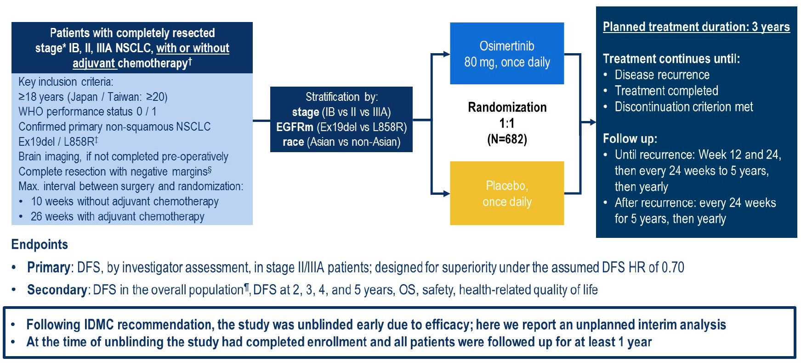
ADAURA Phase III Trial Schema
Herbst RS et al. ASCO 2020;Abstract LBA5.

Slide 67
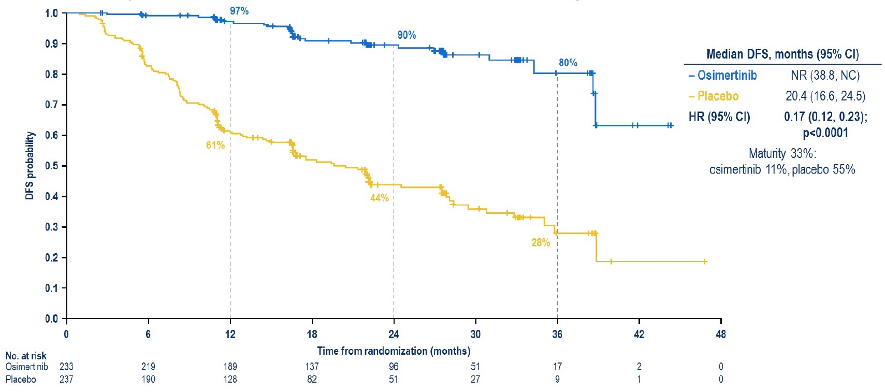
ADAURA Primary Endpoint: Inv-Assessed DFS (Stage II/IIIA)
Herbst RS et al. ASCO 2020;Abstract LBA5.

Slide 68
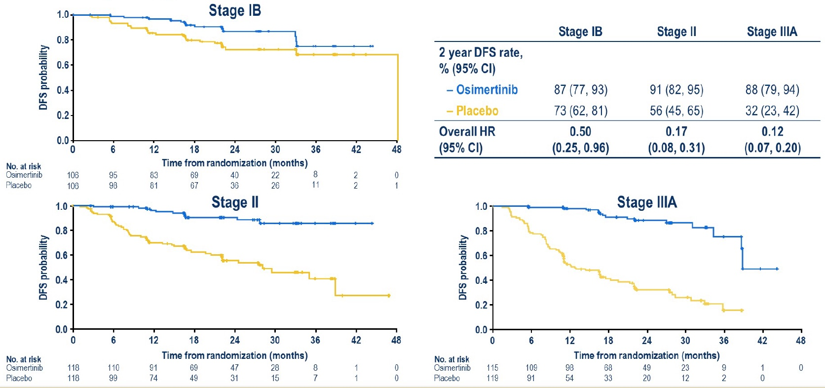
ADAURA: DFS by Stage
Herbst RS et al. ASCO 2020;Abstract LBA5.

Slide 69
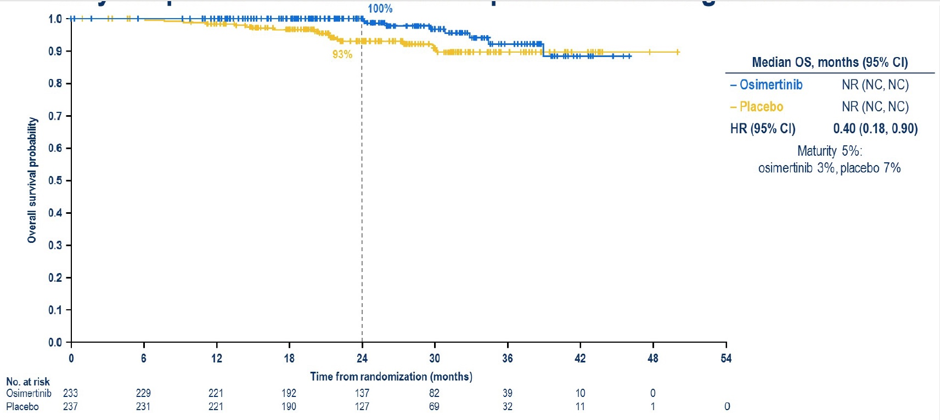
ADAURA: Early Snapshot of OS (Stage II/IIIA)
Herbst RS et al. ASCO 2020;Abstract LBA5.

Slide 70
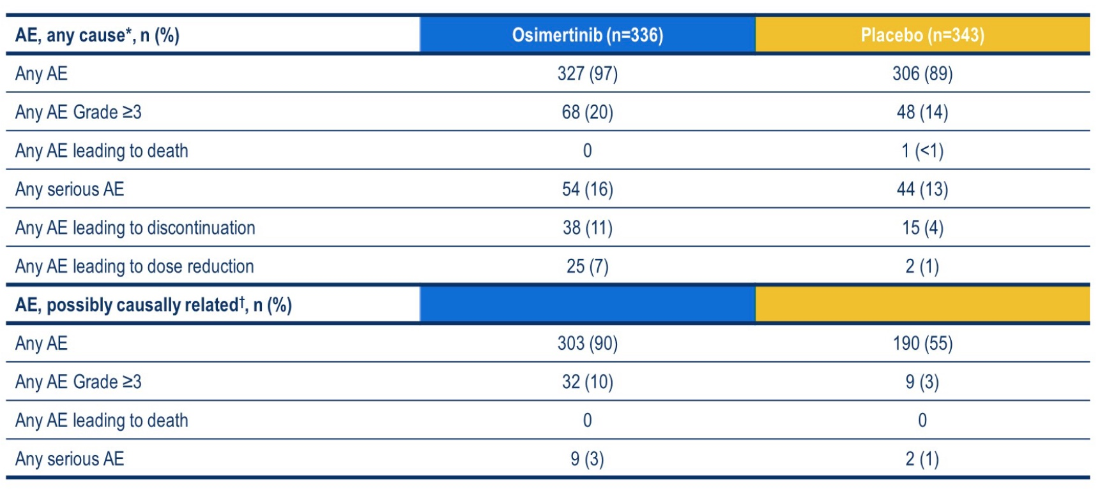
ADAURA: Safety Summary
Herbst RS et al. ASCO 2020;Abstract LBA5.

