Slide 1
Beyond the Guidelines
Perspectives on the Role of PARP Inhibition in the Management of Ovarian Cancer
This program was recorded on May 18, 2020
Faculty: Robert L Coleman, MD, Stephanie Lheureux, MD, PhD, Joyce F Liu, MD, MPH and Kathleen Moore, MD
Prior to the recording, we conducted a survey of 25 gynecologic and medical investigators and about 50 community-based physicians and meeting registrants, querying them about their usual practice patterns.

Slide 2
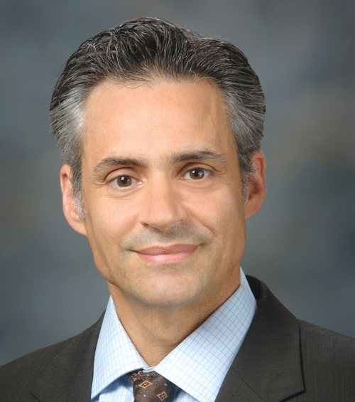
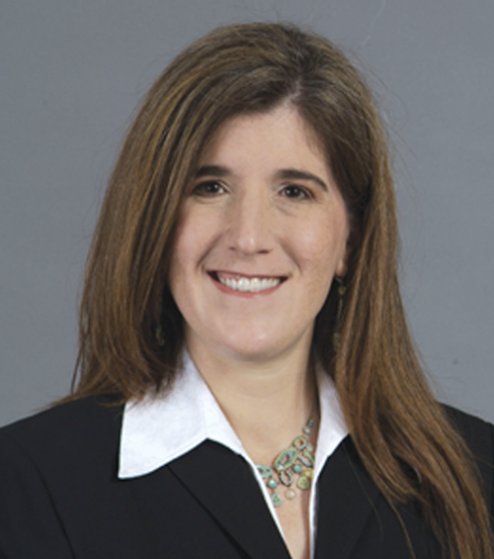
Faculty
Robert L Coleman, MD Chief Scientific Officer
US Oncology Research
Gynecologic Oncology
McKesson The Woodlands, Texas
Joyce F Liu, MD, MPH Assistant Professor of Medicine Harvard Medical School Director of Clinical Research Division of Gynecologic Oncology Dana-Farber Cancer Institute Boston, Massachusetts
Stephanie Lheureux, MD, PhD
Clinician Investigator
Drug Development Program - Gynecology Division of Medical Oncology and Hematology
Gynecology Site Lead Princess Margaret Cancer Centre
Assistant Professor
University of Toronto
Toronto, Canada
Kathleen Moore, MD The Virginia Kerley Cade Endowed Chair in Cancer Development
Associate Director, Clinical Research
Director, Oklahoma TSET Phase I Program Stephenson Cancer Center Associate Professor, Section of Gynecologic Oncology
Director, Gynecologic Oncology Fellowship Department of Obstetrics and Gynecology
University of Oklahoma Health Sciences Center
Oklahoma City, Oklahoma

Slide 3
Dr Love — Disclosures
Dr Love is president and CEO of Research To Practice. Research To Practice receives funds in the form of educational grants to develop CME activities from the following commercial interests: AbbVie Inc, Acerta Pharma — A member of the AstraZeneca Group, Adaptive Biotechnologies, Agendia Inc, Agios Pharmaceuticals Inc, Amgen Inc, Array BioPharma Inc, Astellas, AstraZeneca Pharmaceuticals LP, Bayer HealthCare Pharmaceuticals, Biodesix Inc, bioTheranostics Inc, Blueprint Medicines, Boehringer Ingelheim Pharmaceuticals Inc, Boston Biomedical Inc, Bristol-Myers Squibb Company, Celgene Corporation, Clovis Oncology, Daiichi Sankyo Inc, Dendreon Pharmaceuticals Inc, Eisai Inc, EMD Serono Inc, Exelixis Inc, Foundation Medicine, Genentech, a member of the Roche Group, Genmab, Genomic Health Inc, Gilead Sciences Inc, GlaxoSmithKline, Guardant Health, Halozyme Inc, ImmunoGen Inc, Incyte Corporation, Infinity Pharmaceuticals Inc, Ipsen Biopharmaceuticals Inc, Janssen Biotech Inc, administered by Janssen Scientific Affairs LLC, Jazz Pharmaceuticals Inc, Kite, A Gilead Company, Lexicon Pharmaceuticals Inc, Lilly, Loxo Oncology Inc, a wholly owned subsidiary of Eli Lilly & Company, Merck, Merrimack Pharmaceuticals Inc, Myriad Genetic Laboratories Inc, Natera Inc, Novartis, Oncopeptides, Pfizer Inc, Pharmacyclics LLC, an AbbVie Company, Prometheus Laboratories Inc, Puma Biotechnology Inc, Regeneron Pharmaceuticals Inc, Sandoz Inc, a Novartis Division, Sanofi Genzyme, Seattle Genetics, Sirtex Medical Ltd, Spectrum Pharmaceuticals Inc, Taiho Oncology Inc, Takeda Oncology, Tesaro, A GSK Company, Teva Oncology, Tokai Pharmaceuticals Inc and Tolero Pharmaceuticals.

Slide 4
Dr Coleman — Disclosures
Advisory Committee and Consulting Agreements | AbbVie Inc, AstraZeneca Pharmaceuticals LP, Clovis Oncology, Genentech, a member of the Roche Group, GlaxoSmithKline, ImmunoGen Inc, Janssen Biotech Inc, Merck, Novocure, Roche Laboratories Inc, Takeda Oncology, Tesaro, A GSK Company
Contracted Research | AbbVie Inc, AstraZeneca Pharmaceuticals LP, Clovis Oncology, Genentech, a member of the Roche Group, Janssen Biotech Inc, Merck, Roche Laboratories Inc
Data and Safety Monitoring Board/Committee | AstraZeneca Pharmaceuticals LP, VBL Therapeutics

Slide 5
Dr Lheureux — Disclosures
Advisory Committee | AstraZeneca Pharmaceuticals LP, GlaxoSmithKline, Merck, Roche Laboratories Inc
Consulting Agreements | AstraZeneca Pharmaceuticals LP, GlaxoSmithKline
Contracted Research | AstraZeneca Pharmaceuticals LP, GlaxoSmithKline, Merck, Regeneron Pharmaceuticals Inc, Roche Laboratories Inc

Slide 6
Dr Liu — Disclosures
Advisory Committee | AstraZeneca Pharmaceuticals LP, Clovis Oncology, Genentech, a member of the Roche Group, Merck, Regeneron Pharmaceuticals Inc, Tesaro, A GSK Company
Contracted Research | Agenus Inc, Aravive Inc, Arch Oncology, AstraZeneca Pharmaceuticals LP, Bristol-Myers Squibb Company, Clovis Oncology, CytomX Therapeutics, Genentech, a member of the Roche Group, Oncology Venture A/S, Regeneron Pharmaceuticals Inc, Surface Oncology, Tesaro, A GSK Company, Vigeo Therapeutics

Slide 7
Dr Moore — Disclosures
Advisory Committee | AbbVie Inc, AstraZeneca Pharmaceuticals LP, Aravive Inc, Clovis Oncology, Eisai Inc, Genentech, GlaxoSmithKline, ImmunoGen Inc, Merck, Mereo BioPharma, Tarveda Therapeutics, Tesaro, A GSK Company, Vavotar Life Sciences
Contracted Research | Clovis Oncology, Genentech, Merck, PTC Therapeutics
Employment | GOG Foundation/Partners

Slide 8
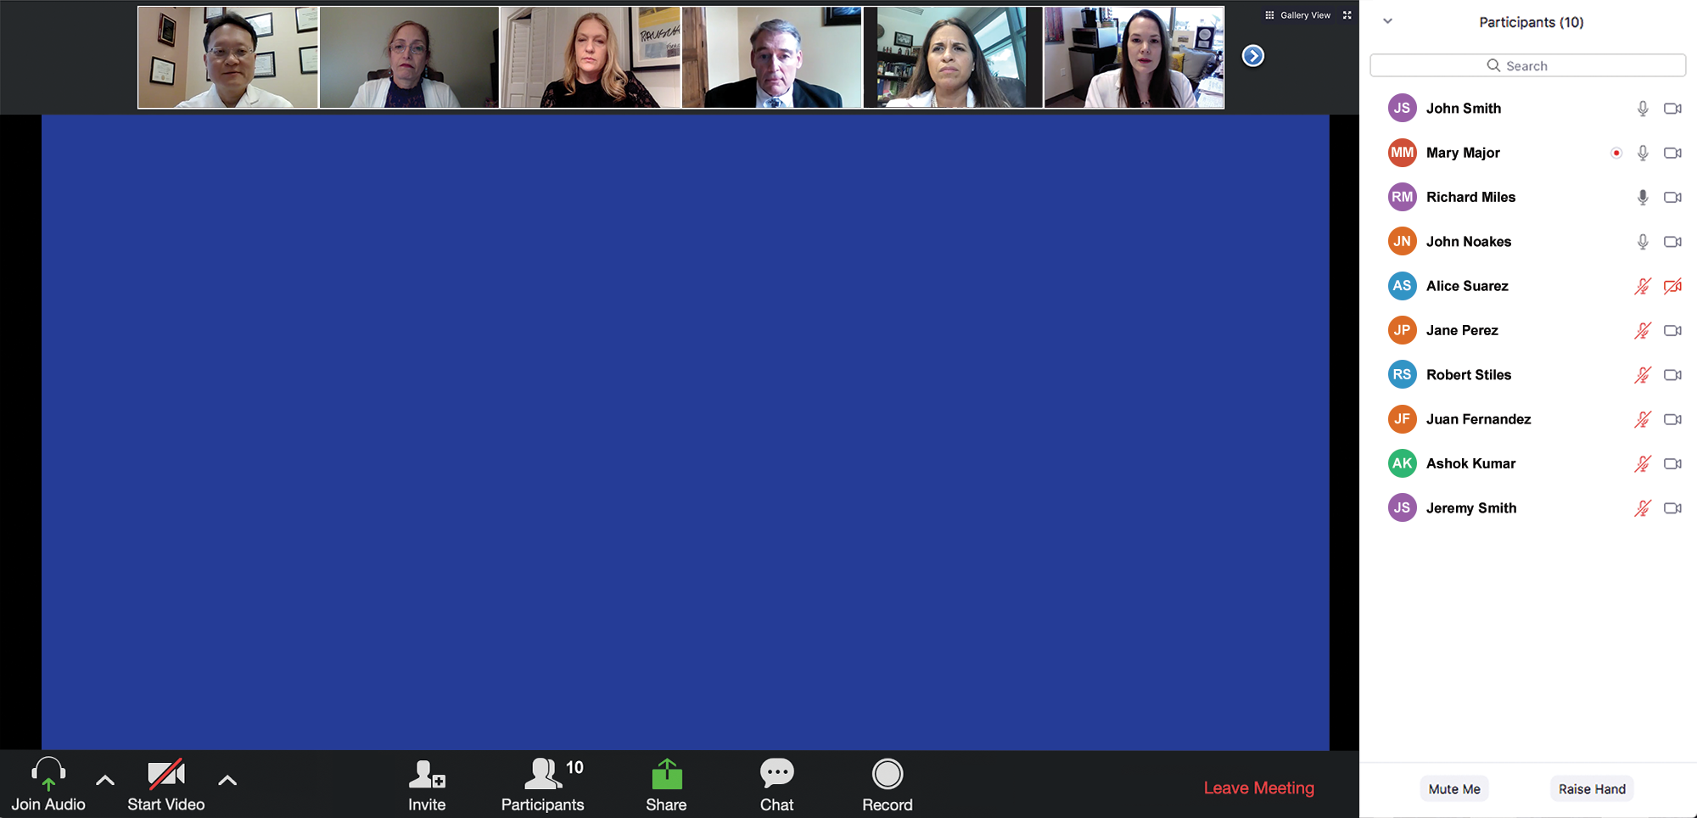
Familiarizing yourself with the Zoom interface
How to participate in the chat
Join the chat to send in questions or troubleshoot

Slide 9
RTP SGO 2020 Virtual Satellite Series
Faculty lecture series (8)
Beyond the Guidelines program (2 – 1 hour each)
Faculty roundtable webinar (2 – 90 minutes each)
Breakout discussion webinar (4 – 1 hour each)

Slide 10
Agenda
Module 1 – Dr Liu: Genetic Testing in Ovarian Cancer (OC) and Biologic Basis for the Use of PARP Inhibitors
Module 2 – Dr Moore: Integration of PARP Inhibitor Maintenance into the Management of Newly Diagnosed OC
Module 3 – Dr Lheureux: Practical Considerations with the Use of PARP Inhibitors in Advanced OC
Module 4 – Dr Coleman: Potential Role of PARP Inhibitors with Chemotherapy; Other Investigational Combination Approaches in Clinical Development for Advanced OC
Module 5: SGO Review 2020

Slide 11
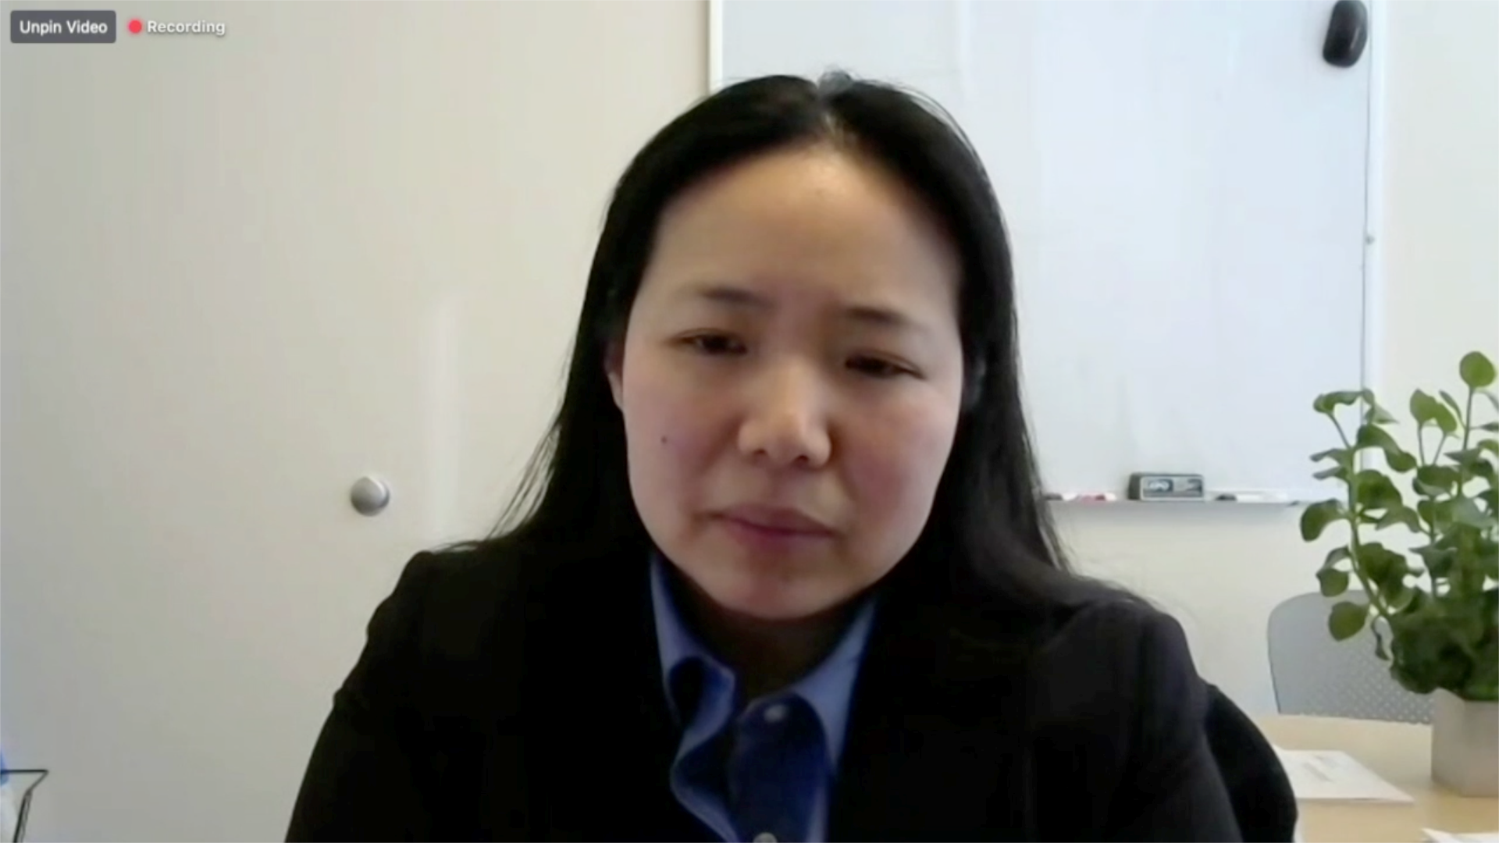
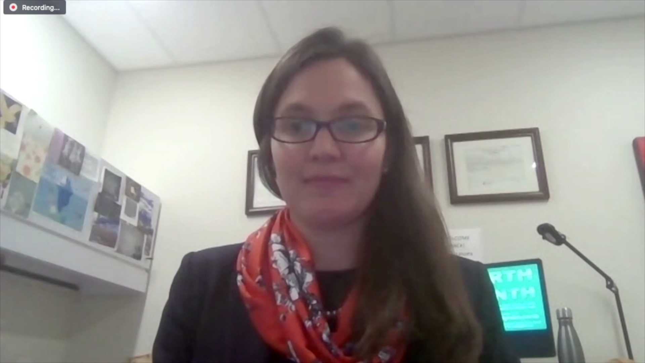
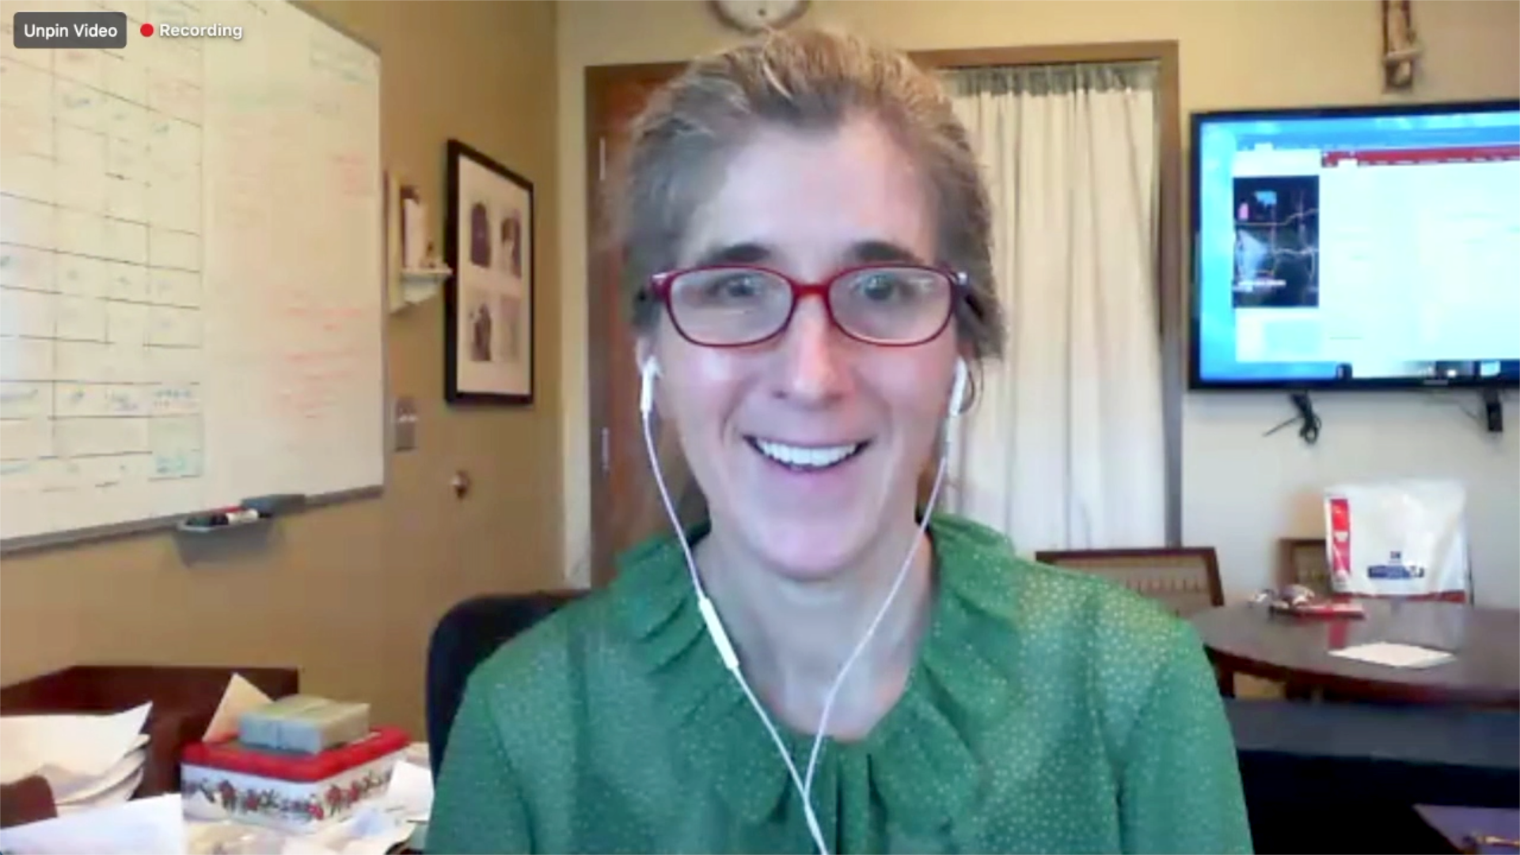

Slide 12
Survey Respondents (N = 25)
Ronald D Alvarez, MD, MBA
Andrew Berchuck, MD
Michael J Birrer, MD, PhD
Susana M Campos, MD, MPH
Robert L Coleman, MD
Stephanie L Gaillard, MD, PhD
Rachel N Grisham, MD
Thomas Herzog, MD
Angela Jain, MD
Beth Karlan, MD
Professor Jonathan A Ledermann
Douglas A Levine, MD
Stephanie Lheureux, MD, PhD
Joyce F Liu, MD, MPH
Ursula Matulonis, MD
Mansoor Raza Mirza, MD
Bradley J Monk, MD
Kathleen Moore, MD
David M O’Malley, MD
Ana Oaknin, MD, PhD
Matthew A Powell, MD
Professor Isabelle Ray-Coquard, MD, PhD
Krishnansu S Tewari, MD
Professor Ignace Vergote
Robert M Wenham, MD

Slide 13
Data + Perspectives The Current and Future Role of Immune Checkpoint Inhibitors and Other Novel Therapies in the Management of Gynecologic Cancers
Wednesday, May 20, 2020
Moderator
Neil Love, MD
Faculty
Michael J Birrer, MD, PhD Ursula Matulonis, MD David M O'Malley, MD Krishnansu S Tewari, MD

Slide 14
Agenda
Module 1 – Dr Birrer: Checkpoint Inhibitor Therapy for Microsatellite Instability (MSI)-High and Microsatellite-Stable (MSS) Endometrial Cancer
Module 2 – Dr Tewari: Current Indications for and Future Role of Immune Checkpoint Inhibitors in Cervical Cancer
Module 3 – Dr Matulonis: Current and Potential Role of Immune Checkpoint Inhibitor Therapy in Ovarian Cancer Management
Module 4 – Dr O’Malley: Novel Targeted Agents and Strategies Under Investigation for Gynecologic Cancers

Slide 15
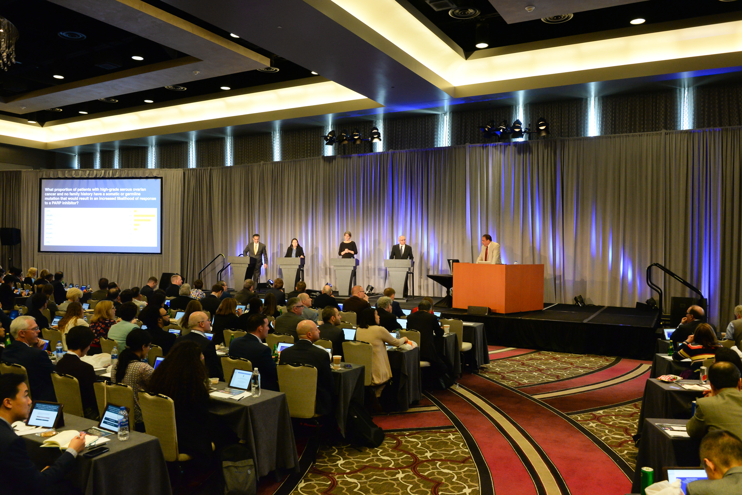

Slide 16
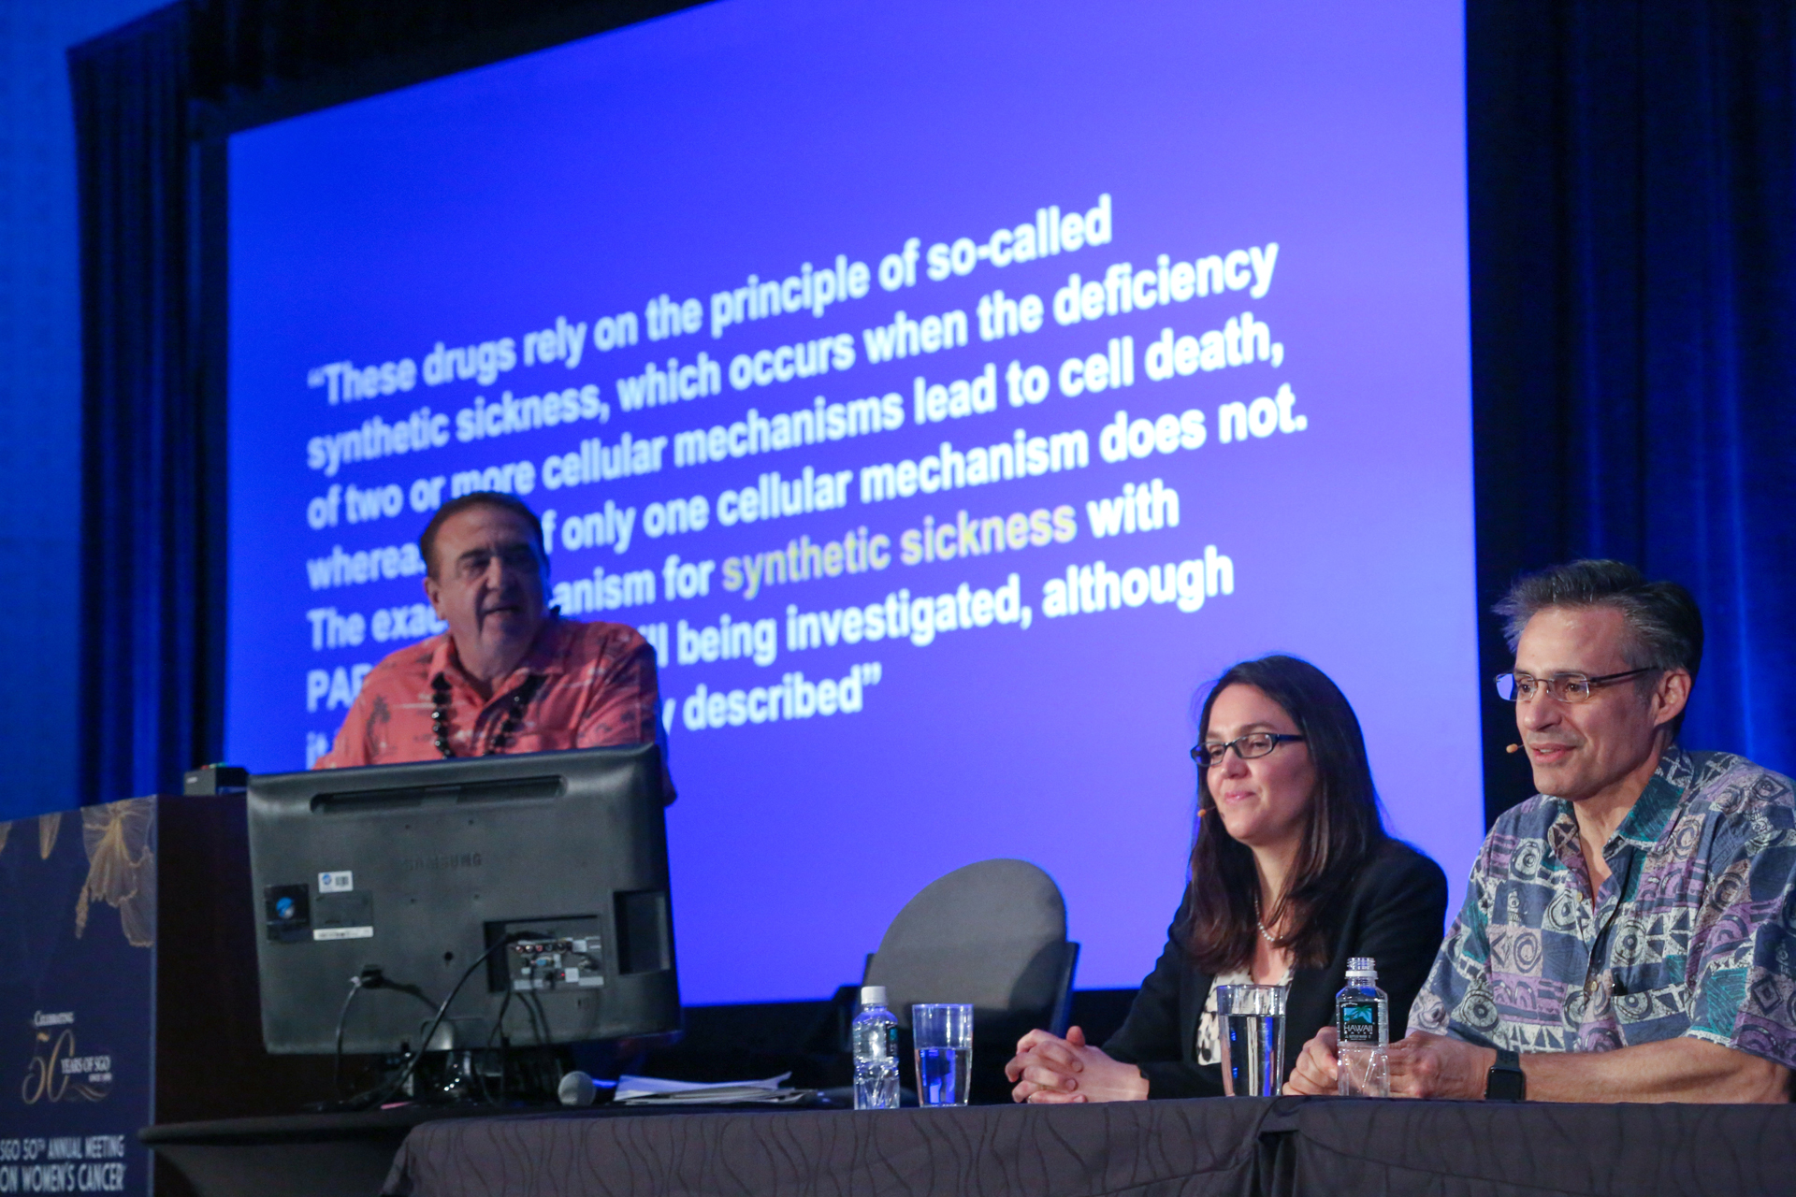
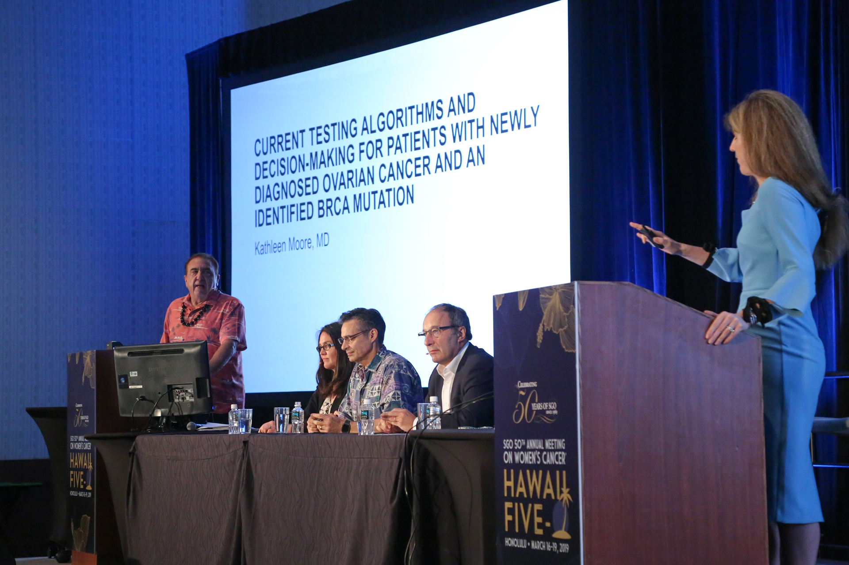

Slide 17
MODULE 1: Genetic Testing in Ovarian Cancer (OC) and Biologic Basis for the Use of PARP Inhibitors

Slide 18
Dr Liu: Case #1 - Frontline maintenance PARPi
58yo woman, newly diagnosed ovarian cancer
Optimal cytoreductive surgery with multiple bowel resections
Tumor testing negative for BRCA mutation, but germline testing with pathogenic mutation (deletion of BRCA1 exon 3)
Completed 6 cycles of adjuvant carboplatin/paclitaxel chemotherapy
Started on maintenance olaparib

Slide 19
Dr Liu: Case #2 - Frontline maintenance PARPi
52yo woman, newly diagnosed ovarian cancer
Received neoadjuvant chemotherapy with carboplatin/paclitaxel x 3 cycles
Optimal interval cytoreductive surgery with complete pathologic response in the omentum; residual high-grade serous carcinoma involving bilateral tubes/ovaries
Completed 3 additional cycles of adjuvant carboplatin/paclitaxel chemotherapy
Germline testing negative for BRCA mutation. Myriad myChoice® CDx negative for BRCA mutation but with high genomic instability score
Started on maintenance niraparib

Slide 20
In general, which of the following mutation assays do you order for a patient with newly diagnosed ovarian cancer and no family history?
Germline Testing
gBRCA
6
Multigene panel germline
17
Somatic Testing
Multigene somatic/NGS
21
HRD Testing
7
Gynecologic oncologists
Medical oncologists

Slide 21
In general, which of the following mutation assays do you order for a patient with newly diagnosed ovarian cancer and no family history?
Germline Testing
gBRCA mutation
Multigene germline panel*
Somatic Testing
Multigene somatic/NGS*
Homologous recombination deficiency (HRD) assay
*Includes those who responded: multigene germline and somatic/NGS
NGS, next-generation sequencing
Survey of general medical and gynecologic oncologists May 2020

Slide 22
Regulatory and reimbursement issues aside, have you offered or would you offer a PARP inhibitor to a patient with ovarian cancer and the following germline mutation as you would for a patient with a BRCA germline mutation?
 | PALB2 |  | RAD51C |  | ATM
 | Gyn Onc | Med Onc | Gyn Onc | Med Onc | Gyn Onc | Med Onc
I have not and would not | 1 | 2 | 0 | 1 | 3 | 4
I have not, but I would for the right patient | 7 | 7 | 7 | 4 | 11 | 6
I have | 6 | 2 | 7 | 6 | 0 | 1

Slide 23
Regulatory and reimbursement issues aside, have you offered or would you offer a PARP inhibitor to a patient with ovarian cancer and the following germline mutations as you would for a patient with a BRCA germline mutation?
PALB2
RAD51C
ATM
I have not and would not
I have not, but I would for the right patient
I have
Survey of general medical and gynecologic oncologists May 2020

Slide 24
Has the primary approach to genetic counseling for a patient with newly diagnosed ovarian cancer and a germline BRCA mutation changed at your institution in the current era of COVID-19?
Yes
18
No
7
Gynecologic oncologists
Medical oncologists

Slide 25
Has the primary approach to genetic counseling for a patient with newly diagnosed ovarian cancer and a germline BRCA mutation changed at your institution in the current era of COVID-19?
Yes
No
Survey of general medical and gynecologic oncologists May 2020

Slide 26
How has the primary approach to genetic counseling for a patient with newly diagnosed ovarian cancer and a germline BRCA mutation changed at your institution in the current era of COVID-19?
More telehealth
All remote (tele) visits with the genetic counselor
All virtual visits
Almost all use telemedicine
The patients and family need to wait longer
Universally, virtual-based or delayed visits
Video visits

Slide 27
MODULE 2: Integration of PARP Inhibitor Maintenance into the Management of Newly Diagnosed OC

Slide 28
Dr Moore: Case 1
53 year old who presented with abdominal bloating , decreased urination and difficulty with defecation starting 10/2019. She was treated with laxatives which didn’t help and presented to her Ob/Gyn where a mass was appreciated on exam.
TVUS demonstrated a large complex adnexal mass, free fluid
Ca-125 = 953.6
She was referred to gynecologic oncology where a CT was ordered.

Slide 29
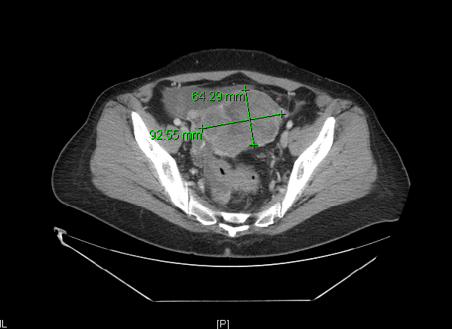
Dr Moore: Case 1
Notes:
Diagnostic laparoscopy with peritoneal biopsies. Exploratory laparotomy, radical resection of ovarian cancer, which included supracervical abdominal hysterectomy, bilateral salpingo-oophorectomy, resection of rectovaginal septum, radical resection of large bowel mesentery peritoneum, mobilization of rectosigmoid colon, mobilization of splenic flexure, radical peritonectomy, total omentectomy, and complete tumor reductive surgery to no gross residual disease.

Slide 30
Dr Moore: Case 1 Pathology and Molecular Characterization
Pathology
High grade serous ovarian cancer
Comprehensive Genomic Profile:
Loss of heterozygosity score > 16%
Tumor mutational burden 4mut/Mb, MSS, BRAF D594G, NF1 loss, RB1 loss, TP53 H179R
Genetics
BRCA wt

Slide 31
Dr Moore: Case 1 – Treatment
Treated with carboplatin AUC 6 and paclitaxel 175mg/mg² IV every 21 days x 6 cycles
Ca-125 was 31 post cytoreductive surgery, ended at 9
Cycle 6 on 4/9/2020, nl Ca125 and neg CT scan = NED
Now questions regarding maintenance?

Slide 32
NCCN 2020 Guidelines
Niraparib^{u}

Slide 33
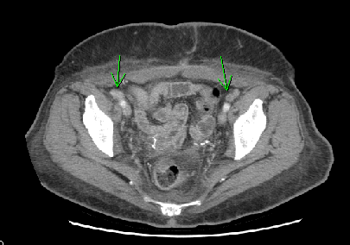
Dr Moore: Case 2
63 year old who had surgery at an outside facility and not by a cancer specialist but was found to have advanced stage, epithelial ovarian cancer
Chest CT with pleural effusion, mediastinal LN that did not meet RECIST criteria but were concerning
CT Abd pelvis with multiple enlarged LN
Pathology: HG Endometrioid
Comprehensive Genomic Profile
LOH < 16%, MSS, BRAF K483E, TP53, ARID1A
BRCA wt

Slide 34
Dr Moore: Case 2: Treatment
Patient treated with carboplatin AUC 6 and paclitaxel 175mg/m² and bevacizumab 15mg/kg every 21 days x 6 completed 12/2019
Ca-125 went from 729 to 464 after 6 cycles
CT with partial response to therapy
Bevacizumab discontinued after cycle 6 due to grade 3, uncontrolled HTN
Since we had started bevacizumab – we planned to treat per PAOLA-1 but didn’t end up continuing the bev – so now just on olaparib
Ca125 down to 187 after 4 cycles maintenance - ongoing

Slide 35
NCCN 2020 Guidelines
Niraparib^{u}

Slide 36
Has the approach to primary debulking surgery for patients with Stage III ovarian cancer changed at your institution during the COVID-19 pandemic?
Yes
No
Survey of general medical and gynecologic oncologists May 2020

Slide 37
Are you currently administering more neoadjuvant treatment for patients with Stage III ovarian cancer at your institution than you were before the COVID-19 pandemic?
Yes
No
Survey of general medical and gynecologic oncologists May 2020

Slide 38
A 60-year-old woman with Stage IIIC ovarian cancer and a germline BRCA mutation is s/p optimal debulking surgery with a normal CA-125 level. Regulatory and reimbursement issues aside, what would you recommend as postoperative systemic therapy?
Carboplatin/paclitaxel → olaparib
15
Carboplatin/paclitaxel + bevacizumab → bevacizumab + olaparib
6
Carboplatin/paclitaxel → niraparib
2
Other
2
Gynecologic oncologists
Medical oncologists

Slide 39
A 60-year-old woman with Stage IIIC ovarian cancer and a germline BRCA mutation is s/p optimal debulking surgery with a normal CA-125 level. Regulatory and reimbursement issues aside, what would you recommend as postoperative systemic therapy?
Carboplatin/paclitaxel → olaparib
Carboplatin/paclitaxel + bevacizumab → olaparib
Carboplatin/paclitaxel + bevacizumab → bevacizumab + olaparib
Carboplatin/paclitaxel
Carboplatin/paclitaxel + bevacizumab → niraparib
Other
Survey of general medical and gynecologic oncologists May 2020

Slide 40
A 60-year-old woman with Stage IIIC ovarian cancer and a germline BRCA mutation is status post (s/p) suboptimal debulking surgery with elevated CA-125. Regulatory and reimbursement issues aside, what would you recommend as postoperative systemic therapy?
Carboplatin/paclitaxel + bevacizumab → bevacizumab + olaparib
11
Carboplatin/paclitaxel + bevacizumab → olaparib
6
Carboplatin/paclitaxel → olaparib
8
Gynecologic oncologists
Medical oncologists

Slide 41
A 60-year-old woman with Stage IIIC ovarian cancer and a germline BRCA mutation is status post (s/p) suboptimal debulking surgery with elevated CA-125. Regulatory and reimbursement issues aside, what would you recommend as postoperative systemic therapy?
Carboplatin/paclitaxel → olaparib
Carboplatin/paclitaxel + bevacizumab → olaparib
Carboplatin/paclitaxel + bevacizumab → bevacizumab + olaparib
Carboplatin/paclitaxel
Other
Survey of general medical and gynecologic oncologists May 2020

Slide 42
Is there a patient age beyond which you would generally not administer bevacizumab for ovarian cancer?
No
23
Yes
2
(80 years old)
Gynecologic oncologists
Medical oncologists

Slide 43
Is there a patient age beyond which you would generally not administer bevacizumab for ovarian cancer?
No
Yes
(75 years)
Survey of general medical and gynecologic oncologists May 2020

Slide 44
A 60-year-old woman with Stage IIIC ovarian cancer and a somatic BRCA mutation is s/p optimal debulking surgery with a normal CA-125 level. Regulatory and reimbursement issues aside, what would you recommend as postoperative systemic therapy?
Carboplatin/paclitaxel → olaparib
16
Carboplatin/paclitaxel + bevacizumab → bevacizumab + olaparib
6
Other
3
Gynecologic oncologists
Medical oncologists

Slide 45
A 60-year-old woman with Stage IIIC ovarian cancer and a somatic BRCA mutation is s/p optimal debulking surgery with a normal CA-125 level. Regulatory and reimbursement issues aside, what would you recommend as postoperative systemic therapy?
Carboplatin/paclitaxel → olaparib
Carboplatin/paclitaxel + bevacizumab → olaparib
Carboplatin/paclitaxel
Carboplatin/paclitaxel + bevacizumab → bevacizumab + olaparib
Carboplatin/paclitaxel → niraparib
Carboplatin/paclitaxel + bevacizumab → niraparib
Carboplatin/paclitaxel + bevacizumab → bevacizumab
Survey of general medical and gynecologic oncologists May 2020

Slide 46
A 60-year-old woman with Stage IIIC ovarian cancer and a somatic BRCA mutation is s/p suboptimal debulking surgery with an elevated CA-125 level. Regulatory and reimbursement issues aside, what would you recommend as postoperative systemic therapy?
Carboplatin/paclitaxel + bevacizumab → bevacizumab + olaparib
13
Carboplatin/paclitaxel → olaparib
7
Carboplatin/paclitaxel + bevacizumab → olaparib
3
Carboplatin/paclitaxel → niraparib
2
Gynecologic oncologists
Medical oncologists

Slide 47
A 60-year-old woman with Stage IIIC ovarian cancer and a somatic BRCA mutation is s/p suboptimal debulking surgery with an elevated CA-125 level. Regulatory and reimbursement issues aside, what would you recommend as postoperative systemic therapy?
Carboplatin/paclitaxel → olaparib
Carboplatin/paclitaxel + bevacizumab → olaparib
Carboplatin/paclitaxel + bevacizumab → bevacizumab + olaparib
Carboplatin/paclitaxel
Carboplatin/paclitaxel + bevacizumab → niraparib
Carboplatin/paclitaxel + bevacizumab → bevacizumab
Carboplatin/paclitaxel → niraparib
Survey of general medical and gynecologic oncologists May 2020

Slide 48
A 60-year-old woman with Stage IIIC ovarian cancer (BRCA wild type, HRD-negative) is s/p optimal debulking surgery with a normal CA-125 level. Regulatory and reimbursement issues aside, what would you recommend as postoperative systemic therapy?
Carboplatin/paclitaxel
10
Carboplatin/paclitaxel → niraparib
5
Carboplatin/paclitaxel + bevacizumab → bevacizumab
6
Other
4
Gynecologic oncologists
Medical oncologists

Slide 49
A 60-year-old woman with Stage IIIC ovarian cancer (BRCA wild type, HRD-negative) is s/p optimal debulking surgery with a normal CA-125 level. Regulatory and reimbursement issues aside, what would you recommend as postoperative systemic therapy?
Carboplatin/paclitaxel
Carboplatin/paclitaxel + bevacizumab → bevacizumab
Carboplatin/paclitaxel → niraparib
Carboplatin/paclitaxel + bevacizumab → olaparib
Carboplatin/paclitaxel → olaparib
Carboplatin/paclitaxel + bevacizumab → niraparib
Carboplatin/paclitaxel + bevacizumab → bevacizumab + niraparib
Survey of general medical and gynecologic oncologists May 2020

Slide 50
A 60-year-old woman with Stage IIIC ovarian cancer (BRCA wild type, HRD-negative) is s/p suboptimal debulking surgery with an elevated CA-125 level. Regulatory and reimbursement issues aside, what would you recommend as postoperative systemic therapy?
Carboplatin/paclitaxel + bevacizumab → bevacizumab
17
Carboplatin/paclitaxel + bevacizumab → bevacizumab + olaparib
3
Carboplatin/paclitaxel → niraparib
2
Other
3
Gynecologic oncologists
Medical oncologists

Slide 51
A 60-year-old woman with Stage IIIC ovarian cancer (BRCA wild type, HRD-negative) is s/p suboptimal debulking surgery with an elevated CA-125 level. Regulatory and reimbursement issues aside, what would you recommend as postoperative systemic therapy?
Carboplatin/paclitaxel + bevacizumab → bevacizumab
Carboplatin/paclitaxel → olaparib
Carboplatin/paclitaxel + bevacizumab → olaparib
Carboplatin/paclitaxel
Carboplatin/paclitaxel + bevacizumab → niraparib
Carboplatin/paclitaxel + bevacizumab → bevacizumab + olaparib
Carboplatin/paclitaxel → niraparib
Survey of general medical and gynecologic oncologists May 2020

Slide 52
A 60-year-old woman with Stage IIIC ovarian cancer (BRCA wild type, HRD-positive) is s/p optimal debulking surgery with a normal CA-125 level. Regulatory and reimbursement issues aside, what would you recommend as postoperative systemic therapy?
Carboplatin/paclitaxel → niraparib
10
Carboplatin/paclitaxel + bevacizumab → bevacizumab + olaparib
7
Carboplatin/paclitaxel → olaparib
3
Carboplatin/paclitaxel + bevacizumab → niraparib
2
Other
3
Gynecologic oncologists
Medical oncologists

Slide 53
A 60-year-old woman with Stage IIIC ovarian cancer (BRCA wild type, HRD-positive) is s/p optimal debulking surgery with a normal CA-125 level. Regulatory and reimbursement issues aside, what would you recommend as postoperative systemic therapy?
Carboplatin/paclitaxel → olaparib
Carboplatin/paclitaxel + bevacizumab → olaparib
Carboplatin/paclitaxel → niraparib
Carboplatin/paclitaxel + bevacizumab → bevacizumab + olaparib
Carboplatin/paclitaxel
Carboplatin/paclitaxel + bevacizumab → bevacizumab
Carboplatin/paclitaxel + bevacizumab → niraparib
Survey of general medical and gynecologic oncologists May 2020

Slide 54
A 60-year-old woman with Stage IIIC ovarian cancer (BRCA wild type, HRD-positive) is s/p suboptimal debulking surgery with an elevated CA-125 level. Regulatory and reimbursement issues aside, what would you recommend as postoperative systemic therapy?
Carboplatin/paclitaxel + bevacizumab → bevacizumab + olaparib
14
Carboplatin/paclitaxel → niraparib
6
Carboplatin/paclitaxel + bevacizumab → niraparib
2
Carboplatin/paclitaxel → olaparib
2
Other
1
Gynecologic oncologists
Medical oncologists

Slide 55
A 60-year-old woman with Stage IIIC ovarian cancer (BRCA wild type, HRD-positive) is s/p suboptimal debulking surgery with an elevated CA-125 level. Regulatory and reimbursement issues aside, what would you recommend as postoperative systemic therapy?
Carboplatin/paclitaxel + bevacizumab → bevacizumab + olaparib
Carboplatin/paclitaxel → olaparib
Carboplatin/paclitaxel + bevacizumab → olaparib
Carboplatin/paclitaxel + bevacizumab → niraparib
Carboplatin/paclitaxel + bevacizumab → bevacizumab
Carboplatin/paclitaxel
Carboplatin/paclitaxel → niraparib
Survey of general medical and gynecologic oncologists May 2020

Slide 56
Regulatory and reimbursement issues aside, which starting dose of niraparib would you use for a 125-lb patient with advanced ovarian cancer and a platelet count of 200,000 after a response to front-line platinum-based chemotherapy?
200 mg daily
24
300 mg daily
1
Gynecologic oncologists
Medical oncologists

Slide 57
Regulatory and reimbursement issues aside, which starting dose of niraparib would you use for a 125-lb patient with advanced ovarian cancer and a platelet count of 200,000 after a response to front-line platinum-based chemotherapy?
300 mg daily
200 mg daily
100 mg daily
Survey of general medical and gynecologic oncologists May 2020

Slide 58
MODULE 3: Practical Considerations with the Use of PARP Inhibitors in Advanced OC

Slide 59
Maintenance Strategies in Phase III Clinical Trials Assessing PARP Inhibitor Treatment in Ovarian Cancer
Madariaga A et al. Int J Gynecol Cancer 2020;[Online ahead of print].

Slide 60
Dr Liu - PARPi toxicity: Case
74yo woman with recurrent platinum-sensitive ovarian cancer
Germline testing with RAD51C mutation
Received carboplatin/PLD with complete response
Started on maintenance olaparib at 300mg BID
~4 weeks after initiation, noted to have increasing fatigue, diarrhea. Platelet count decreased to 99K (from 183K at treatment initiation)
Drug held, re-initiated with dose reduction to olaparib 250mg BID 2 weeks later after platelet recovery to 165K
~4 weeks at this dose, with increasing intolerable fatigue
Drug held, re-initiated with dose reduction to olaparib 200mg BID 2 weeks later
Continues on maintenance olaparib at 200mg BID

Slide 61
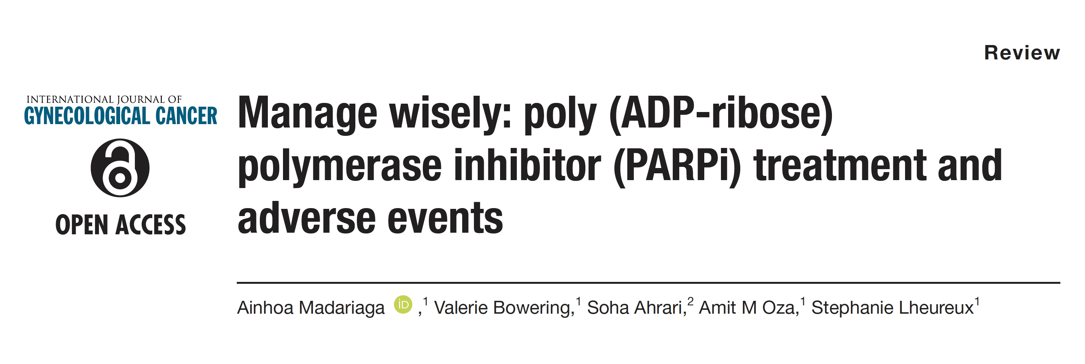
Int J Gynecol Cancer 2020;[Online ahead of print].

Slide 62
How would you respond to a patient with Stage III ovarian cancer who is about to begin a PARP inhibitor as maintenance therapy after suboptimal debulking surgery and chemotherapy and asks you to estimate the chance that during the first year of treatment she will…
Gyn Oncs
Med Oncs
“Sail through” treatment
Experience side effects that lead to dose reduction
Experience side effects that require discontinuation
Median %

Slide 63
How would you respond to a patient with Stage III ovarian cancer who is about to begin a PARP inhibitor as maintenance therapy after suboptimal debulking surgery and chemotherapy and asks you to estimate the chance that during the first year of treatment she will…
“Sail through” treatment
Experience side effects that lead to dose reduction
Experience side effects that require discontinuation
Median %
Survey of general medical and gynecologic oncologists May 2020

Slide 64
How would you respond to a patient with Stage III ovarian cancer who is about to begin a PARP inhibitor as maintenance therapy after suboptimal debulking surgery and chemotherapy and asks you to estimate the chance that during the first year of treatment she will…
Gyn Oncs
Med Oncs
Experience upper GI side effects that require clinical management
Develop anemia that requires clinical management
Develop anemia that requires a blood transfusion
Median %

Slide 65
How would you respond to a patient with Stage III ovarian cancer who is about to begin a PARP inhibitor as maintenance therapy after suboptimal debulking surgery and chemotherapy and asks you to estimate the chance that during the first year of treatment she will…
Experience upper GI side effects that require clinical management
Develop anemia that requires clinical management
Develop anemia that requires a blood transfusion
Median %
Survey of general medical and gynecologic oncologists May 2020

Slide 66
A woman in her mid-60s with recurrent high-grade serous ovarian cancer begins rucaparib monotherapy (600 mg BID). Within a few weeks, her serum creatinine increases from 0.86 mg/dL to 1.6 mg/dL. What would be the optimal management approach?
Continue rucaparib at the same dose
15
Hold rucaparib until creatinine returns to normal, and restart at the same dose
5
Hold rucaparib until creatinine returns to normal, and restart at a reduced dose
3
Other
1
Gynecologic oncologists
Medical oncologists

Slide 67
A woman in her mid-60s with recurrent high-grade serous ovarian cancer begins rucaparib monotherapy (600 mg BID). Within a few weeks, her serum creatinine increases from 0.86 mg/dL to 1.6 mg/dL. What would be the optimal management approach?
Hold rucaparib until creatinine returns to normal, and restart at a reduced dose
Continue rucaparib at a reduced dose
Continue rucaparib at the same dose
Hold rucaparib until creatinine returns to normal, and restart at the same dose
Discontinue rucaparib
Survey of general medical and gynecologic oncologists May 2020

Slide 68
In general, what is your approach to antiemetic therapy for a patient with ovarian cancer who is starting treatment on a PARP inhibitor?
Recommend antiemetic if the patient experiences nausea
21
Prophylactic antiemetic therapy prior to administration of PARP inhibitor
4
Gynecologic oncologists
Medical oncologists

Slide 69
In general, what is your approach to antiemetic therapy for a patient with ovarian cancer who is starting treatment on a PARP inhibitor?
Recommend antiemetic/ reduce dose of PARP inhibitor if the patient experiences nausea
Prophylactic antiemetic therapy prior to administration of PARP inhibitor
Survey of general medical and gynecologic oncologists May 2020

Slide 70
For a patient with Stage IIIC ovarian cancer and a germline BRCA mutation who has undergone optimal debulking surgery followed by chemotherapy and 2 years of PARP inhibitor maintenance therapy, do you believe the risk of developing MDS or AML is increased by the PARP inhibitor?
Yes
18
No
2
It is not known
5
Median Risk Estimate:
Gyn Onc: 1%
Med Onc: 1%
Gynecologic oncologists
Medical oncologists

Slide 71
For a patient with Stage IIIC ovarian cancer and a germline BRCA mutation who has undergone optimal debulking surgery followed by chemotherapy and 2 years of PARP inhibitor maintenance therapy, do you believe the risk of developing MDS or AML is increased by the PARP inhibitor?
Yes
No
It is not known
Median estimated risk of developing MDS or AML = 3%
Survey of general medical and gynecologic oncologists May 2020

Slide 72
According to your clinical experience, do PARP inhibitors cause insomnia?
Yes
18
No
5
I don't know
2
Gynecologic oncologists
Medical oncologists

Slide 73
According to your clinical experience, do PARP inhibitors cause insomnia?
Yes
No
I don’t know
Survey of general medical and gynecologic oncologists May 2020

Slide 74
MODULE 4: Potential Role of PARP Inhibitors with Chemotherapy; Other Investigational Combination Approaches in Clinical Development for Advanced OC

Slide 75
Dr Coleman: Case
Hx: 60 y/o woman with recurrent high grade serous ovarian cancer (BRCA-wt)
Initial diagnosis 2/2012: Stage IIIC (gross intraperitoneal disease, ascites); CA125: 2151 U/mL
Cytoreduction to < 1cm
IV: Paclitaxel/Carboplatin q 3 week x 6 cycles [clinical CR]
First recurrence: 3/2015: multifocal pelvic and abdominal disease, CA125: 367 U/mL
IV: Paclitaxel/carboplatin x 8; [PR], consolidated with IV: Carboplatin AUC5 x 6 months [SD] but developed HSR
CA125: 69 U/mL
Persistent small volume measurable disease: Eligible for Phase II trial (ARIEL2: Rucaparib)

Slide 76
Dr Coleman: Case (Cont’d)
Hx: 60 y/o woman with recurrent high grade serous ovarian cancer
Started rucaparib 600 mg BID, sCr: 0.8, CA125: 69 U/mL
Gr 1 GI controlled with anti-emetics
Cycle 2 – sCR: 1.83 (Gr2) – dose held 1 week sCr: 0.97
Cycle 3 – imaging [SD], sCr: 1.65 (Gr2), CA125: 44 U/mL, dose reduction, held – sCr: 1.19

Slide 77
Dr Coleman: Case (Cont’d)
Hx: 60 y/o woman with recurrent high grade serous ovarian cancer
Cycle 4 – imaging [PR], sCr: 1.67 (Gr2), CA125: 32 U/mL, dose held – renal function studies

Slide 78
Dr Coleman: Case (Cont’d)
sCr: 1.51
Est CrCl: 44 mL/min
GFR: 97.9

Slide 79
Dr Coleman: Case (Cont’d)
Hx: 60 y/o woman with recurrent high grade serous ovarian cancer
Patient went on to receive 22 total cycles of therapy
One further dose delay and dose reduction
Close of trial estimated CrCl: 45 ml/min coincided with renal scan (42 ml/min)

Slide 80
Dr Coleman: Case Patient Receiving Concomitant Therapy
56 y.o. with high grade serous ovarian cancer
gBRCA-wt
Heavy disease burden with involvement of omentum, diaphragm, and peritoneal lining
Grossly enlarged pelvic nodes
Ovarian masses bilaterally
CA-125: 6713 U/mL
Enrolled onto VELIA/GOG-3005

Slide 81
Dr Coleman: Case Patient Receiving Concomitant Therapy
56 y.o. with high grade serous ovarian cancer
NACT: Paclitaxel 80 mg/m² + carboplatin AUC6 + placebo/veliparib
3 cycles of therapy (CA-125: 72 U/mL)
Imaging prior to surgery
Near complete resolution of omental/diaphragm disease, post-treatment peritoneal thickening
Nodal disease near normal (largest short axis dimension: 1.2 cm)
Ovaries irregular but markedly smaller
Interval resection accomplished with near complete gross resection
Small volume miliary mesenteric disease

Slide 82
Dr Coleman: Case Patient Receiving Concomitant Therapy
56 y.o. with high grade serous ovarian cancer
Completed 6 cycles of chemotherapy plus placebo/veliparib
CA-125: 15 U/mL
Initiated and completed maintenance phase
NED
Sequencing from interval cytoreduction: Rad51D mutation

Slide 83
A 70-year-old woman with advanced ovarian cancer and a germline BRCA mutation undergoes debulking surgery followed by chemotherapy with carboplatin/paclitaxel and experiences disease relapse 1 year later. Which treatment would you likely recommend?
Platinum doublet → maintenance olaparib
14
Platinum doublet → maintenance rucaparib
6
Platinum doublet → maintenance niraparib
3
Other
2
Gynecologic oncologists
Medical oncologists

Slide 84
A 70-year-old woman with advanced ovarian cancer and a germline BRCA mutation undergoes debulking surgery followed by chemotherapy with carboplatin/paclitaxel and experiences disease relapse 1 year later. Which treatment would you likely recommend?
Platinum doublet → maintenance olaparib
Platinum doublet → maintenance niraparib
Platinum doublet + bevacizumab → maintenance bevacizumab + olaparib
Platinum doublet + bevacizumab → maintenance bevacizumab
Platinum doublet → maintenance rucaparib
Other
Survey of general medical and gynecologic oncologists May 2020

Slide 85
A 70-year-old woman with advanced ovarian cancer (BRCA wild type, HRD-negative) undergoes debulking surgery followed by chemotherapy with carboplatin/paclitaxel and experiences disease relapse 1 year later. Which treatment would you likely recommend?
Platinum doublet + bevacizumab → maintenance bevacizumab
8
Platinum doublet → maintenance olaparib
2
Platinum doublet
3
Platinum doublet → maintenance niraparib
5
Platinum doublet → maintenance rucaparib
2
Platinum doublet + bevacizumab → maintenance bevacizumab + PARP inhibitor
3
Other
2
Gynecologic oncologists
Medical oncologists

Slide 86
A 70-year-old woman with advanced ovarian cancer (BRCA wild type, HRD-negative) undergoes debulking surgery followed by chemotherapy with carboplatin/paclitaxel and experiences disease relapse 1 year later. Which treatment would you likely recommend?
Platinum doublet + bevacizumab → maintenance bevacizumab
Platinum doublet → maintenance olaparib
Platinum doublet
Platinum doublet → maintenance niraparib
Platinum doublet → maintenance rucaparib
Platinum doublet + bevacizumab → maintenance bevacizumab + olaparib
Survey of general medical and gynecologic oncologists May 2020

Slide 87
A 70-year-old woman with advanced ovarian cancer and a germline BRCA mutation undergoes debulking surgery, then receives carboplatin/paclitaxel/ bevacizumab followed by maintenance therapy with a PARP inhibitor for 2 years and experiences disease relapse 1 year later. Which treatment would you likely recommend?
Platinum doublet + bevacizumab → maintenance bevacizumab
5
Platinum doublet → maintenance niraparib
6
Platinum doublet + bevacizumab → maintenance bevacizumab + PARP inhibitor
3
Platinum doublet
3
Platinum doublet → maintenance rucaparib
3
Other
5
Gynecologic oncologists
Medical oncologists

Slide 88
A 70-year-old woman with advanced ovarian cancer and a germline BRCA mutation undergoes debulking surgery, then receives carboplatin/paclitaxel/bevacizumab followed by maintenance therapy with a PARP inhibitor for 2 years and experiences disease relapse 1 year later. Which treatment would you likely recommend?
Platinum doublet → maintenance olaparib
Platinum doublet → maintenance niraparib
Platinum doublet
Platinum doublet + bevacizumab → maintenance bevacizumab
Olaparib monotherapy
Platinum doublet → maintenance rucaparib
Platinum doublet + bevacizumab → maintenance bevacizumab + olaparib
Platinum doublet + bevacizumab → maintenance bevacizumab + rucaparib
Other
Survey of general medical and gynecologic oncologists May 2020

Slide 89
Based on available data, do you believe that chemotherapy/ veliparib → veliparib should be an FDA-endorsed initial treatment option for patients with Stage IIIC ovarian cancer?
Yes
15
No
10
Gynecologic oncologists
Medical oncologists

Slide 90
Based on available data, do you believe that chemotherapy/veliparib → veliparib should be an FDA-endorsed initial treatment option for patients with Stage IIIC ovarian cancer?
Yes
No
Survey of general medical and gynecologic oncologists May 2020

Slide 91
A patient with advanced ovarian cancer and a germline BRCA mutation who is receiving PARP-inhibitor maintenance therapy is scheduled to undergo hip replacement surgery. Would you discontinue the PARP inhibitor in advance of the surgery?
Yes
23
No
2
Median Number of Days PARP Inhibitor Discontinued Prior to Surgery:
Gyn Onc: 12 days
Med Onc: 7 days
Gynecologic oncologists
Medical oncologists

Slide 92
A patient with advanced ovarian cancer and a germline BRCA mutation who is receiving PARP-inhibitor maintenance therapy is scheduled to undergo hip replacement surgery. Would you discontinue the PARP inhibitor in advance of the surgery?
Yes
No
Median number of days to discontinue PARP inhibitor prior to surgery: 7 days
Survey of general medical and gynecologic oncologists May 2020

Slide 93
MODULE 5: SGO Review 2020

Slide 94
Genetic Testing in Ovarian Cancer (OC) and Biologic Basis for the Use of PARP Inhibitors
D’Indinosante M et al. BRCA tumor-testing in a tertiary referral center: Are we missing something or not? SGO 2020; Abstract 59.
Li L et al. Clinical indication of BRCA1 variation: Time for reassessment. SGO 2020; Abstract 60.
Wallbillich JJ et al. Comparing mutation frequencies for homologous recombination genes in uterine serous and high-grade serous ovarian carcinomas: A case for homologous recombination deficiency testing in uterine serous carcinoma. SGO 2020; Abstract 61.
Weiss AS et al. Inherited mutations in fallopian tube, ovarian, and primary peritoneal carcinoma: Changes in diagnoses and mutational frequency over 20 years. SGO 2020; Abstract 62.

Slide 95
Integration of PARP Inhibitor Maintenance into the Management of Newly Diagnosed OC
Poveda A et al. Final overall survival (OS) results from SOLO2/ENGOT-ov21: A phase III trial assessing maintenance olaparib in patients (pts) with platinum-sensitive, relapsed ovarian cancer and a BRCA mutation. ASCO 2020; Abstract 6002.
Vergote IB et al. Population adjusted indirect comparison of the SOLO1 and PAOLA-1/ENGOTov25 studies of olaparib with or without bevacizumab, bev alone and placebo in the maintenance treatment of women with newly diagnosed stage III/IV ovarian cancer with BRCA mutation. SGO 2020; Abstract 35.
Ray-Coquard I. Phase III PAOLA-1/ENGOT-ov25: Maintenance olaparib with bevacizumab in patients with newly diagnosed, advanced ovarian cancer treated with platinum-based chemotherapy and bevacizumab as standard of care. SGO 2020; Abstract 33.

Slide 96
Integration of PARP Inhibitor Maintenance into the Management of Newly Diagnosed OC (continued)
Grimm C et al. Maintenance olaparib plus bevacizumab (bev) after platinum-based chemotherapy plus bev in patients (pts) with newly diagnosed advanced high-grade ovarian cancer (HGOC): Efficacy by timing of surgery and residual tumor status in the Phase III PAOLA-1 trial. SGO 2020; Abstract 34.
Loverix L et al. Randomized phase II CLIO study on olaparib monotherapy versus chemotherapy in platinum-sensitive recurrent ovarian cancer. SGO 2020; Abstract 30.

Slide 97
Practical Considerations with the Use of PARP Inhibitors in Advanced OC
Hardesty MM et al. Phase II OVARIO study of niraparib + bevacizumab therapy in advanced ovarian cancer following front-line platinum-based chemotherapy with bevacizumab. SGO 2020; Abstract 4.
Monk BJ and Gonzalez Martin A. Efficacy of niraparib therapy in patients with newly diagnosed advanced ovarian cancer by BRCA and homologous recombination status: PRIMA/ENGOT-OV26/GOG-3012 study. SGO 2020; Abstract 31.
Han SN et al. Time to first subsequent therapy (TFST) and progression-free survival 2 (PFS2) from the phase 3 randomized, double-blind PRIMA/ENGOT-OV26/GOG-3012 study in patients with newly diagnosed ovarian cancer. SGO 2020; Abstract 32.
Pothuri B et al. Patient-reported outcomes (PRO) in patients receiving niraparib in the PRIMA/ENGOT-OV26/GOG-3012 trial. SGO 2020; Abstract 83.

Slide 98
Potential Role of PARP Inhibitors with Chemotherapy; Other Investigational Combination Approaches in Clinical Development for Advanced OC
Coleman RL. Integration of veliparib (V) with front-line chemotherapy and maintenance in women with high-grade serous carcinoma of ovarian, fallopian tube, or primary peritoneal origin (HGSC). SGO 2020; Abstract 36.
Swisher EM et al. Exploring the relationship between homologous recombination score and progression-free survival in BRCA wildtype ovarian carcinoma: Analysis of veliparib plus carboplatin/paclitaxel in the VELIA study. SGO 2020; Abstract LBA6.
O'Malley DM et al. Anti-tumor activity of veliparib during combination phase with chemotherapy in VELIA study. SGO 2020; Abstract LBA9.
Swisher EM et al. Safety of veliparib in combination with chemotherapy and as maintenance in front-line ovarian cancer: Results in BRCAm, hrd, and whole populations from the VELIA trial. SGO 2020; Abstract 37.

Slide 99
Potential Role of PARP Inhibitors with Chemotherapy; Other Investigational Combination Approaches in Clinical Development for Advanced OC (continued)
Gillen J et al. Tolerability and adverse events experienced by women with ovarian cancer treated with intravenous or intraperitoneal chemotherapy plus veliparib and bevacizumab based on BRCA status. SGO 2020; Abstract 26.
Washington CR et al. Outcomes based on treatment regimen in newly diagnosed ovarian, primary peritoneal and fallopian tube cancer receiving intravenous or intraperitoneal platinum-based chemotherapy in combination with veliparib and bevacizumab. SGO 2020; Abstract 27.
O’Malley DM et al. Postprogression outcomes in patients with ovarian carcinoma associated with a mutation in a non-BRCA homologous recombination repair gene receiving rucaparib maintenance treatment: Results from the phase III study ARIEL3. SGO 2020; Abstract 80.

Slide 100
Has the approach to primary debulking surgery for patients with Stage III ovarian cancer changed at your institution during the COVID-19 pandemic?
Yes
15
No
10
Gynecologic oncologists
Medical oncologists

Slide 101
Are you currently administering more neoadjuvant treatment for patients with Stage III ovarian cancer at your institution than you were before the COVID-19 pandemic?
Yes
15
No
10
Gynecologic oncologists
Medical oncologists

Slide 102
Thank you for joining us! CME credit information will be emailed to each participant tomorrow morning.

