Slide 1
Data + Perspectives
The Current and Future Role of Immune
Checkpoint Inhibitors and Other Novel Therapies
in the Management of Gynecologic Cancers
Wednesday, May 20, 2020
Moderator
Neil Love, MD
Faculty
Michael J Birrer, MD, PhD
Ursula Matulonis, MD
David M O'Malley, MD
Krishnansu S Tewari, MD

Slide 2
Dr Love — Disclosures
Dr Love is president and CEO of Research To Practice. Research To Practice receives funds in the form of educational grants to develop CME activities from the following commercial interests: AbbVie Inc, Acerta Pharma — A member of the AstraZeneca Group, Adaptive Biotechnologies, Agendia Inc, Agios Pharmaceuticals Inc, Amgen Inc, Array BioPharma Inc, Astellas, AstraZeneca Pharmaceuticals LP, Bayer HealthCare Pharmaceuticals, Biodesix Inc, bioTheranostics Inc, Blueprint Medicines, Boehringer Ingelheim Pharmaceuticals Inc, Boston Biomedical Inc, Bristol-Myers Squibb Company, Celgene Corporation, Clovis Oncology, Daiichi Sankyo Inc, Dendreon Pharmaceuticals Inc, Eisai Inc, EMD Serono Inc, Exelixis Inc, Foundation Medicine, Genentech, a member of the Roche Group, Genmab, Genomic Health Inc, Gilead Sciences Inc, GlaxoSmithKline, Guardant Health, Halozyme Inc, ImmunoGen Inc, Incyte Corporation, Infinity Pharmaceuticals Inc, Ipsen Biopharmaceuticals Inc, Janssen Biotech Inc, administered by Janssen Scientific Affairs LLC, Jazz Pharmaceuticals Inc, Kite, A Gilead Company, Lexicon Pharmaceuticals Inc, Lilly, Loxo Oncology Inc, a wholly owned subsidiary of Eli Lilly & Company, Merck, Merrimack Pharmaceuticals Inc, Myriad Genetic Laboratories Inc, Natera Inc, Novartis, Oncopeptides, Pfizer Inc, Pharmacyclics LLC, an AbbVie Company, Prometheus Laboratories Inc, Puma Biotechnology Inc, Regeneron Pharmaceuticals Inc, Sandoz Inc, a Novartis Division, Sanofi Genzyme, Seattle Genetics, Sirtex Medical Ltd, Spectrum Pharmaceuticals Inc, Taiho Oncology Inc, Takeda Oncology, Tesaro, A GSK Company, Teva Oncology, Tokai Pharmaceuticals Inc and Tolero Pharmaceuticals.

Slide 3




Faculty
Michael J Birrer, MD, PhD
Director, Winthrop P Rockefeller
Cancer Institute
Director, Cancer Service Line
University of Arkansas
Little Rock, Arkansas
David M O'Malley, MD
Professor
Division Director, Gynecologic Oncology
Co-Director, Gynecologic Oncology Phase I Program
The Ohio State University and the James
Cancer Center
Columbus, Ohio
Ursula Matulonis, MD
Chief, Division of Gynecologic Oncology
Brock-Wilson Family Chair
Dana-Farber Cancer Institute
Professor of Medicine
Harvard Medical School
Boston, Massachusetts
Krishnansu S Tewari, MD
Professor and Division Director
Division of Gynecologic Oncology
University of California, Irvine
Irvine, California

Slide 4
Dr Birrer — Disclosures
Consulting Agreements | AstraZeneca Pharmaceuticals LP, Clovis Oncology, Tesaro, A GSK Company

Slide 5
Dr Matulonis — Disclosures
Advisory Committee and Consulting Agreement | Novartis

Slide 6
Dr O’Malley — Disclosures
Advisory Committee | AbbVie Inc, Agenus Inc, Ambry Genetics, AstraZeneca Pharmaceuticals LP, Clovis Oncology, Eisai Inc, Genelux, Genentech, a member of the Roche Group, GOG Foundation Inc, ImmunoGen Inc, Janssen Biotech Inc, Leap Therapeutics Inc, Merck, Myriad Genetic Laboratories Inc, Novocure, Regeneron Pharmaceuticals Inc, Tarveda Therapeutics, Tesaro, A GSK Company
Consulting Agreements | AbbVie Inc, Agenus Inc, Ambry Genetics, AstraZeneca Pharmaceuticals LP, Clovis Oncology, Eisai Inc, Genentech, a member of the Roche Group, Genmab, GOG Foundation Inc, ImmunoGen Inc, Novocure, Regeneron Pharmaceuticals Inc, Seattle Genetics, Tesaro, A GSK Company
Contracted Research | AbbVie Inc, Agenus Inc, Ajinomoto Co Inc, Amgen Inc, Array BioPharma Inc, AstraZeneca Pharmaceuticals LP, Bristol-Myers Squibb Company, Clovis Oncology, Daré Bioscience, Eisai Inc, EMD Serono Inc, Ergomed Plc, Genentech, a member of the Roche Group, Genmab, GlaxoSmithKline, GOG Foundation Inc, ImmunoGen Inc, Iovance Botherapeutics Inc, Janssen Biotech Inc, Johnson & Johnson Pharmaceuticals, Ludwig Institute for Cancer Research Ltd, Merck, New Mexico Cancer Care Alliance, Novocure, PRA Health Sciences, Regeneron Pharmaceuticals Inc, Seattle Genetics, Stemcentrx, Syneos Health, Tesaro, A GSK Company, TRACON Pharmaceuticals Inc, VentiRx Pharmaceuticals Inc
Data and Safety Monitoring Board/Committee | Marker Therapeutics Inc

Slide 7
Dr Tewari — Disclosures
Advisory Committee | AstraZeneca Pharmaceuticals LP, Clovis Oncology, Eisai Inc, Genentech, a member of the Roche Group, Tesaro, A GSK Company
Contracted Research (institution only) | AbbVie Inc, AstraZeneca Pharmaceuticals LP, Clovis Oncology, Genentech, a member of the Roche Group, Regeneron Pharmaceuticals Inc ,Tesaro, A GSK Company
Data and Safety Monitoring Board/Committee | Iovance Biotherapeutics
Speakers Bureau | AstraZeneca Pharmaceuticals LP, Clovis Oncology, Merck, Roche Laboratories Inc, Tesaro, A GSK Company

Slide 8
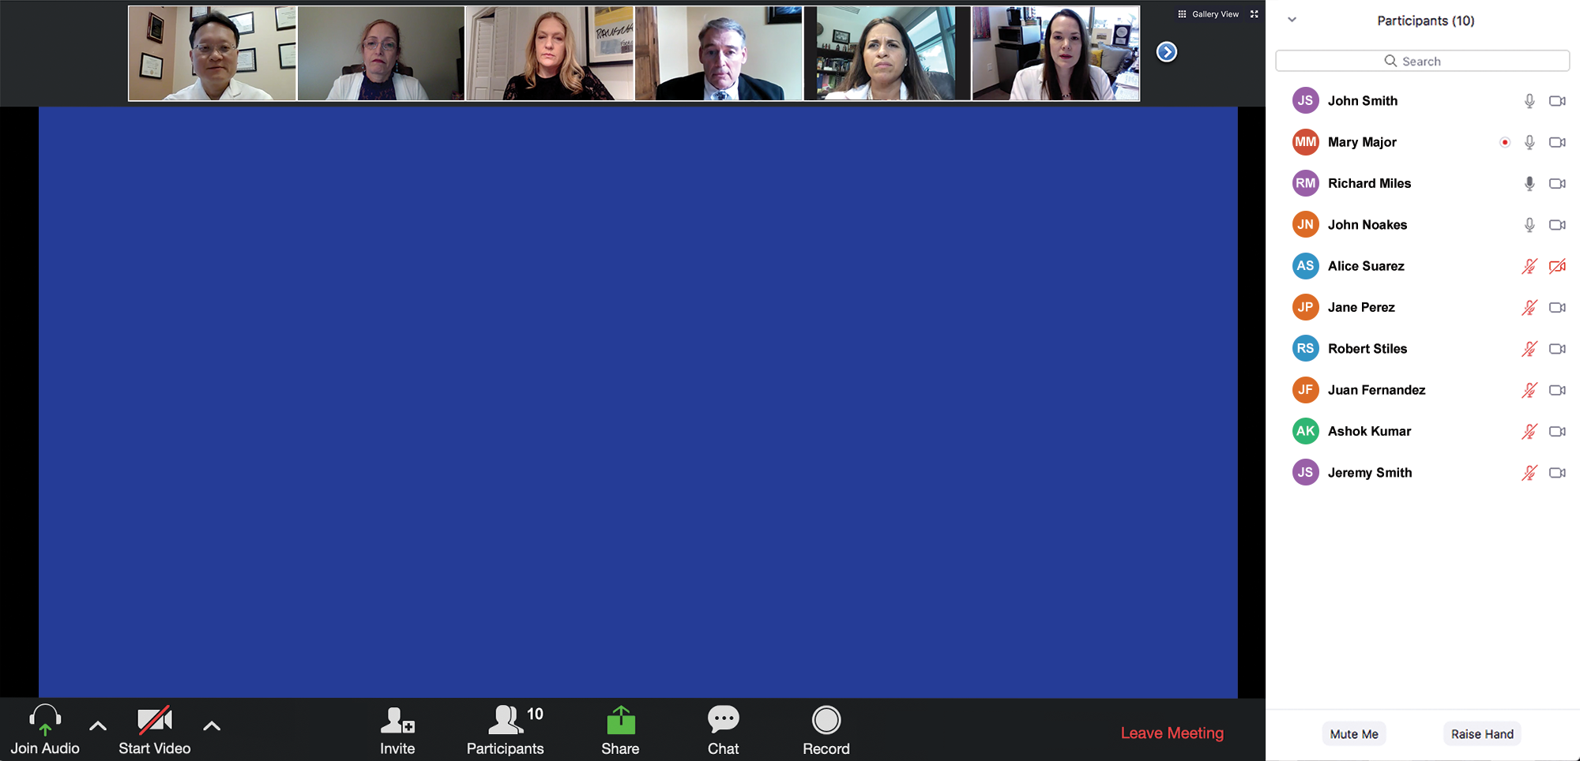

Familiarizing yourself with the Zoom interface
How to participate in the chat
Join the chat to send in questions or troubleshoot

Slide 9

SGO 2020 Satellite Virtual Programs
Virtual presentations/interviews
Live/enduring discussions
Live breakout sessions

Slide 10
Agenda
Module 1 – Dr Birrer: Checkpoint Inhibitor Therapy for Microsatellite Instability (MSI)-High and Microsatellite-Stable (MSS) Endometrial Cancer
Module 2 – Dr Tewari: Current Indications for and Future Role of Immune Checkpoint Inhibitors in Cervical Cancer
Module 3 – Dr Matulonis: Current and Potential Role of Immune Checkpoint Inhibitor Therapy in Ovarian Cancer Management
Module 4 – Dr O’Malley: Novel Targeted Agents and Strategies Under Investigation for Gynecologic Cancers
Module 5: SGO/ASCO 2020 Review
Module 6: COVID-19 and Gynecologic Cancers

Slide 11
Beyond the Guidelines
Perspectives on the Role of
PARP Inhibition in the Management
of Ovarian Cancer
Monday, May 18, 2020
Moderator
Neil Love, MD
Faculty
Robert L Coleman, MD
Stephanie Lheureux, MD, PhD
Joyce F Liu, MD, MPH
Kathleen Moore, MD

Slide 12
Agenda
Module 1 – Dr Liu: Genetic Testing in Ovarian Cancer (OC) and Biologic Basis for the Use of PARP Inhibitors
Module 2 – Dr Moore: Integration of PARP Inhibitor Maintenance into the Management of Newly Diagnosed OC
Module 3 – Dr Lheureux: Practical Considerations with the Use of PARP Inhibitors in Advanced OC
Module 4 – Dr Coleman: Potential Role of PARP Inhibitors with Chemotherapy; Other Investigational Combination Approaches in Clinical Development for Advanced OC
Module 5: SGO Review 2020

Slide 13
Survey Respondents (N = 25)
Ronald D Alvarez, MD, MBA
Andrew Berchuck, MD
Michael J Birrer, MD, PhD
Susana M Campos, MD, MPH
Robert L Coleman, MD
Stephanie L Gaillard, MD, PhD
Rachel N Grisham, MD
Thomas Herzog, MD
Angela Jain, MD
Beth Karlan, MD
Professor Jonathan A Ledermann
Douglas A Levine, MD
Stephanie Lheureux, MD, PhD
Joyce F Liu, MD, MPH
Ursula Matulonis, MD
Mansoor Raza Mirza, MD
Bradley J Monk, MD
Kathleen Moore, MD
David M O’Malley, MD
Ana Oaknin, MD, PhD
Matthew A Powell, MD
Professor Isabelle Ray-Coquard, MD, PhD
Krishnansu S Tewari, MD
Professor Ignace Vergote
Robert M Wenham, MD

Slide 14
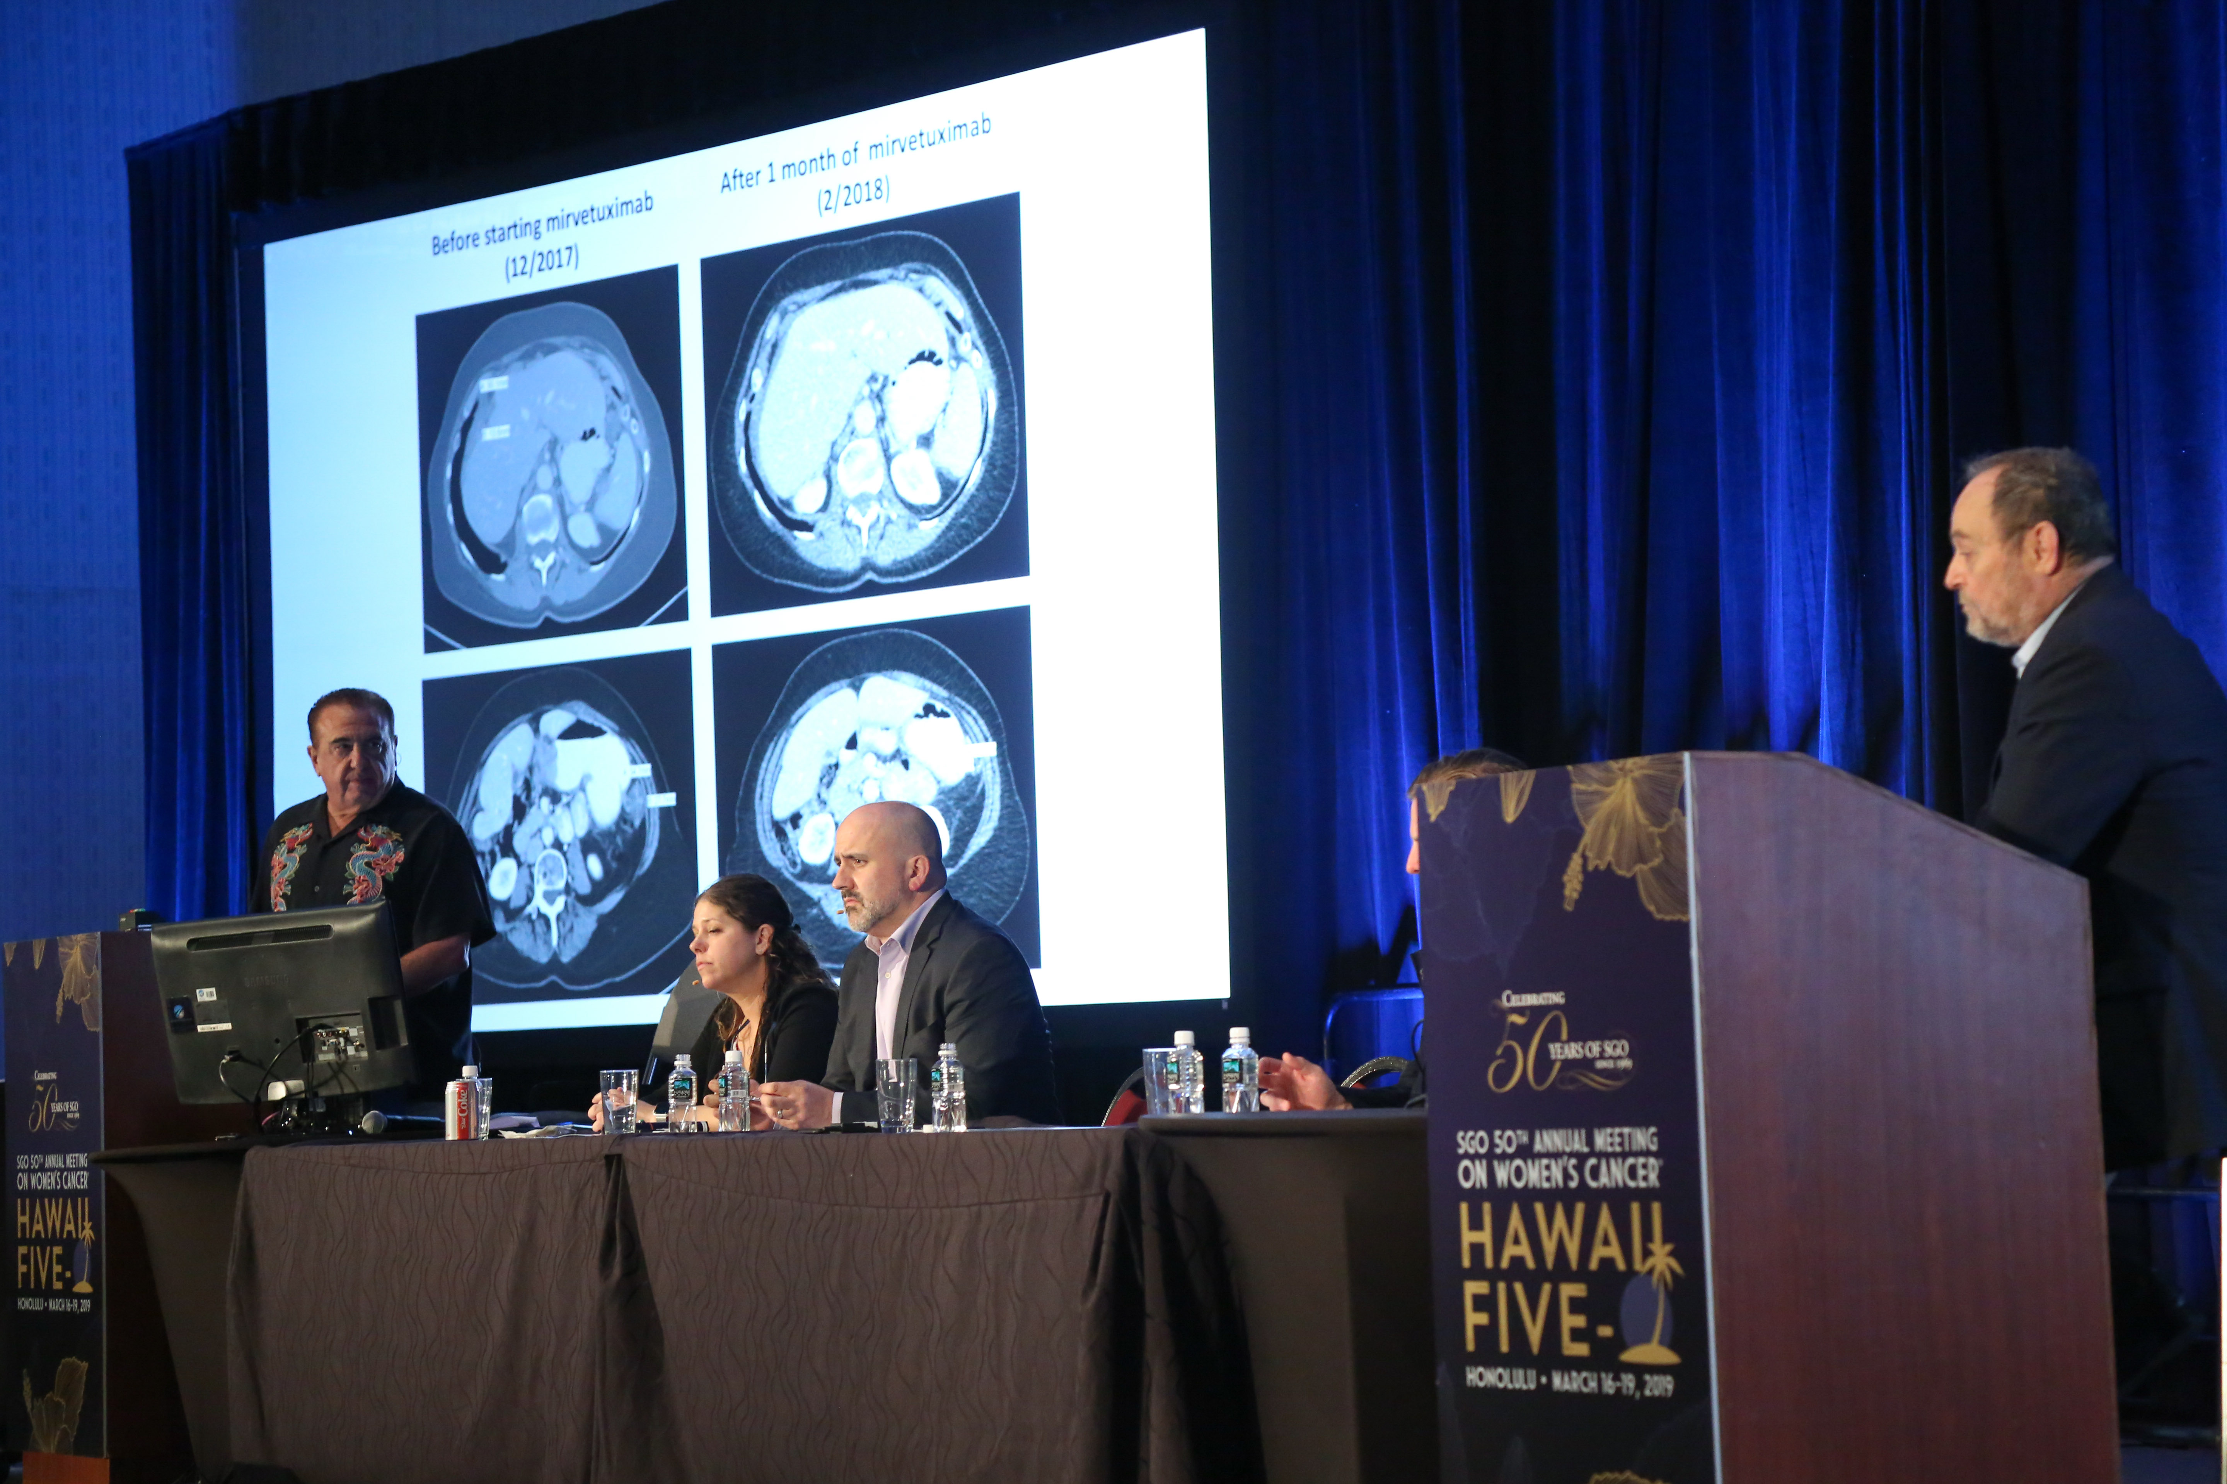
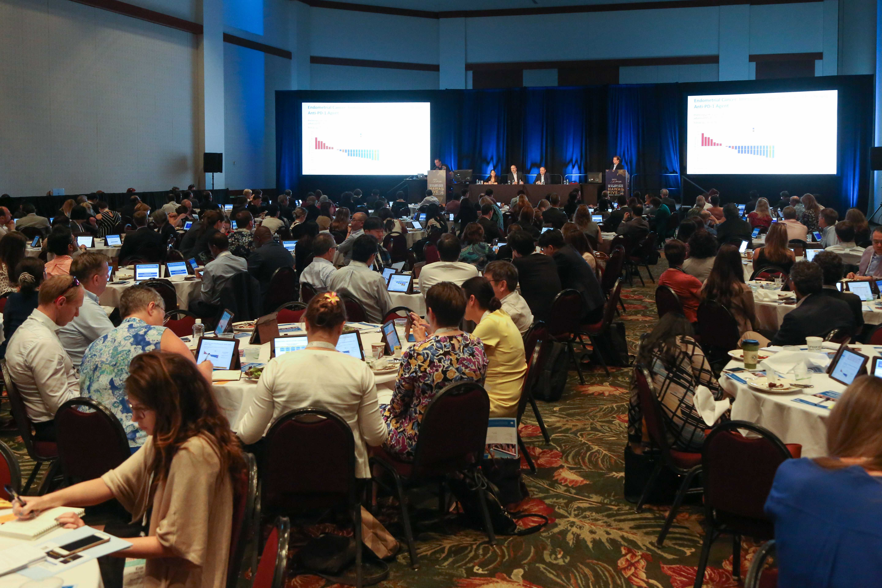


Slide 15
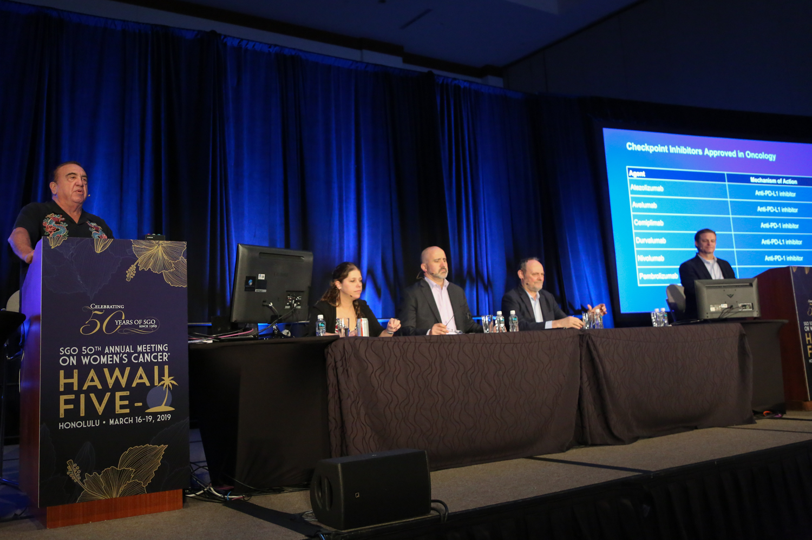
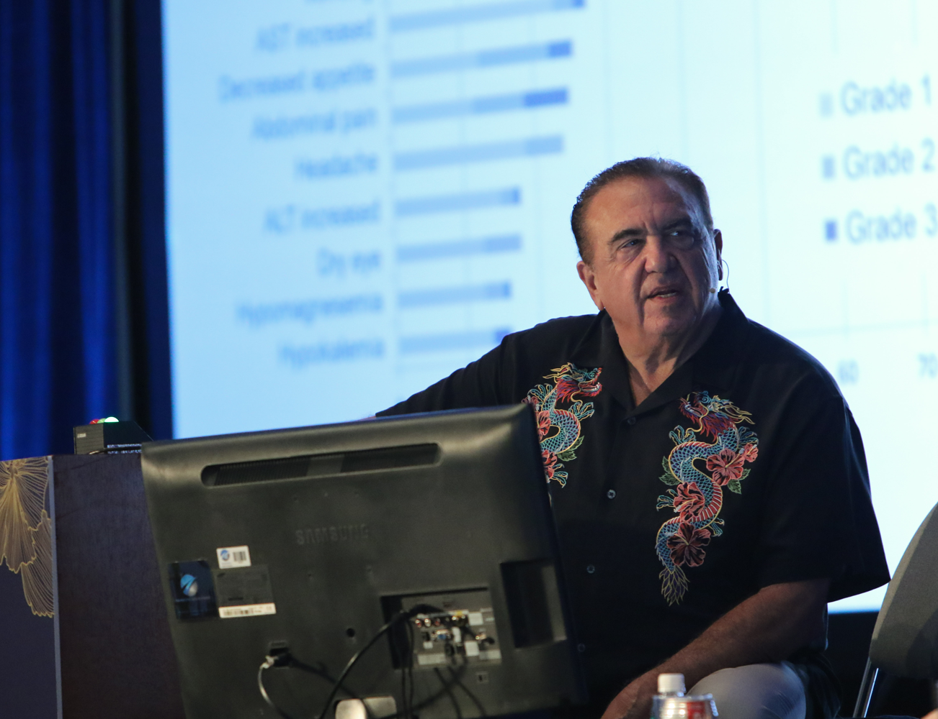


Slide 16
LIVE WEBINAR: Thursday, May 21, 2020
5:00 PM – 6:00 PM
Understanding the Impact of COVID-19 on the
Care of Patients with Chronic Lymphocytic Leukemia
— A Live CME Webinar
Faculty
Matthew S Davids, MD, MMSc
Anthony R Mato, MD, MSCE
Jeff Sharman, MD
http://www.researchtopractice.com/Meetings/COVID19/CLL
A link to register for this event will be provided in the CME email you will receive after today's meeting.

Slide 17
MODULE 1: Checkpoint Inhibitor Therapy for Microsatellite Instability (MSI)-High and Microsatellite-Stable (MSS) Endometrial Cancer

Slide 18
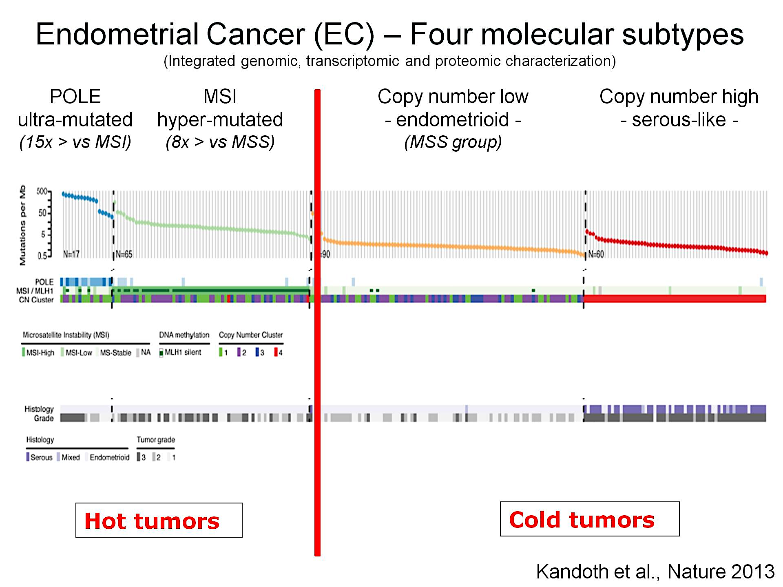
Endometrial Cancer (EC) – Four molecular subtypes<br />(Integrated genomic, transcriptomic and proteomic characterization)
GOG 210 Endometrioid (Cosgrove 2018)
Incidence: 49% CNS, 4% POLE mutant, 39% MMR deficient, 8% copy number altered (CNA).
Cancer-specific mortality: 5%=CNS ; 2.6% =POLE tumors; 7.6%=MMR deficient tumors; 19% with CNA tumors.

Slide 19
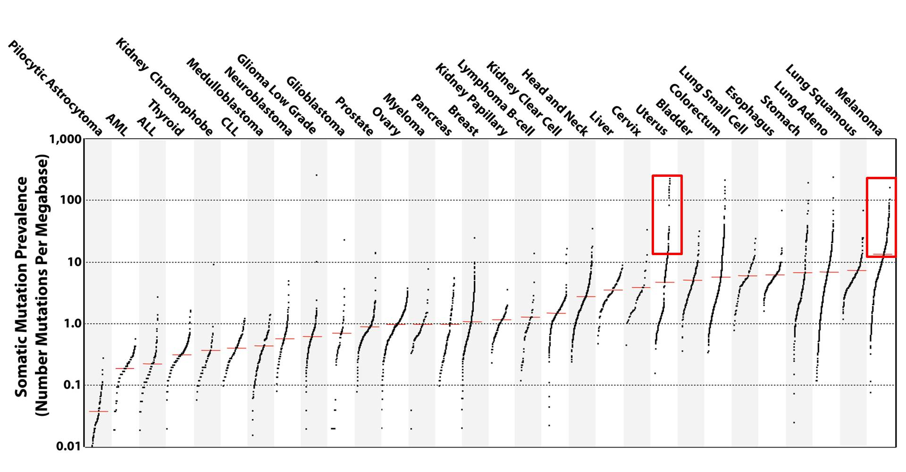
Slide 11
POLE mutant and MSI-high resemble melanoma in
mutation prevalence
Alexandrov et al, Nature 2013

Slide 20
All Patients with Endometrial Cancer Should be Tested for dMMR!
PCR Assay for selected PolyA microsatellites
MLH1/PMS2 and MSH2/MSH6 IHC
5% false positive and negative rate

Slide 21
Checkpoint Inhibitors Have Shown Activity in Endometrial Cancer, Particularly in MSI-H Tumors
 | Fader et al¹ | KEYNOTE-028² | NCT01375842³ | NCT02501096⁴ | GARNET⁵ | Pooled MSI-H⁶
Phase(s) | 2 | 1b | 1 | 2 | 1 | —
Population | Previously treated dMMR, recurrent/ persistent EC | Previously treated LA/metastatic PD-L1 positive EC | Recurrent EC | Advanced EC | Previously treated recurrent/advanced MSI-H EC | Previously treated MSI-H/dMMR EC^{d}
Patients, n | 9 | 24 | 15 | 53 | 35 | 14
Treatment | Pembrolizumab | Pembrolizumab | Atezolizumab | Pembrolizumab + lenvatinib | Dostarlimab (TSR-042) | Pembrolizumab
ORR, % | 56ª (criteria not specified) | 13.0^{a,b} (RECIST v1.1) | 13 (RECIST v1.1) | 39.6ª (irRECIST) | 52^{a,c} (irRECIST) | 36e (RECIST v1.1^{f})
DCR, % | 89 | 26.0 | 13 | 86.8 | 64 | —
DOR | — | — | — | NE | NRª | Range: 4.2+–17.3+ mo^{e}
mPFS | — | 1.8 mo | 1.4 mo | 7.4 mo | — | —
mOS | NR | NR | 9.6 mo | — | — | —
Safety summary | No AEs Gr >3 | Gr ≥3 TRAEs: 16.7% | Gr ≥3 TRAEs: 47% | Gr ≥3 TRAEs: 70% | Gr ≥3 TRAEs: 11.4% | See PI
Median follow-up | 9.1 mo | 76.2 wk | Min: 11.2 mo | — | — | —
+ Indicates ongoing response. ª Primary endpoint. ^{b} Efficacy analysis included 23 patients. ^{c} Efficacy analysis included 25 patients. ^{d} Data pooled across 5 trials; these data led to approval of pembrolizumab for advanced or unresectable MSI-H/dMMR tumors. ^{e} Major efficacy outcome.
^{f} Modified to follow a maximum of 10 target lesions and a maximum of 5 target lesions per organ.
AE, adverse event; DCR, disease control rate; dMMR, deficient mismatch repair; DOR, duration of response; EC, endometrial cancer; Gr, grade; irRECIST, immune-related RECIST; LA, locally advanced; Min, minimum; mOS, median overall survival; mPFS, median progression-free survival; MSI-H, high microsatellite instability; NR, not reached; ORR, overall response rate; RECIST, Response Evaluation Criteria In Solid Tumors;
TRAE, treatment-related adverse event.
1. Fader AN, et al. Presented at SGO Annual Meeting, 2016. Late-Breaking Abstract 3. 2. Ott PA, et al. J Clin Oncol. 2017;35(22):2535-41.
3. Fleming GF, et al. Presented at ASCO Annual Meeting, 2017. Abstract 5585. 4. Makker V, et al. Presented at ASCO Annual Meeting, 2018. Abstract 5596. 5. Oaknin A, et al. Presented at ESMO Annual Meeting, 2018. Abstract 935PD. 6. Pembrolizumab package insert. February 2019.

Slide 22

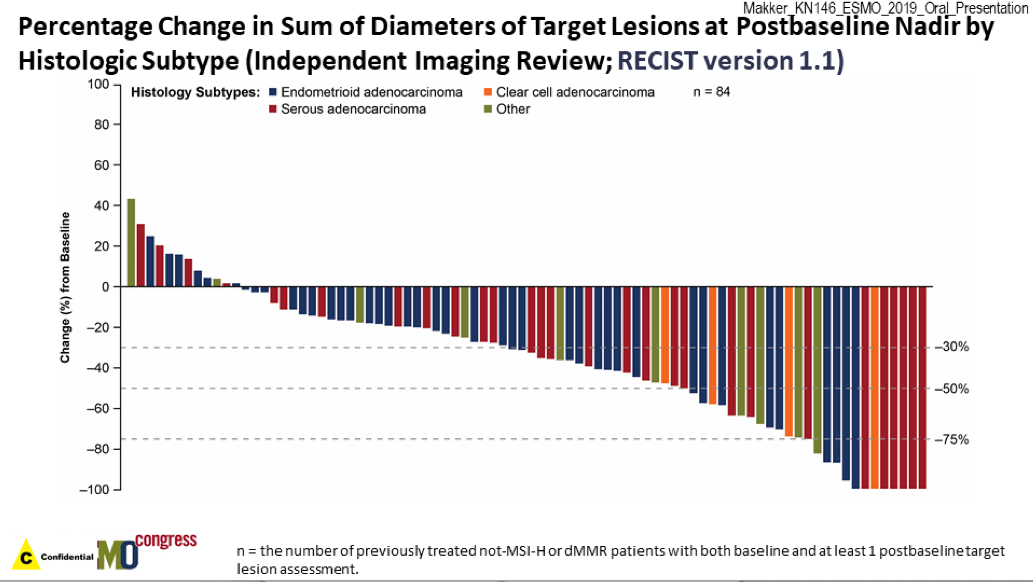
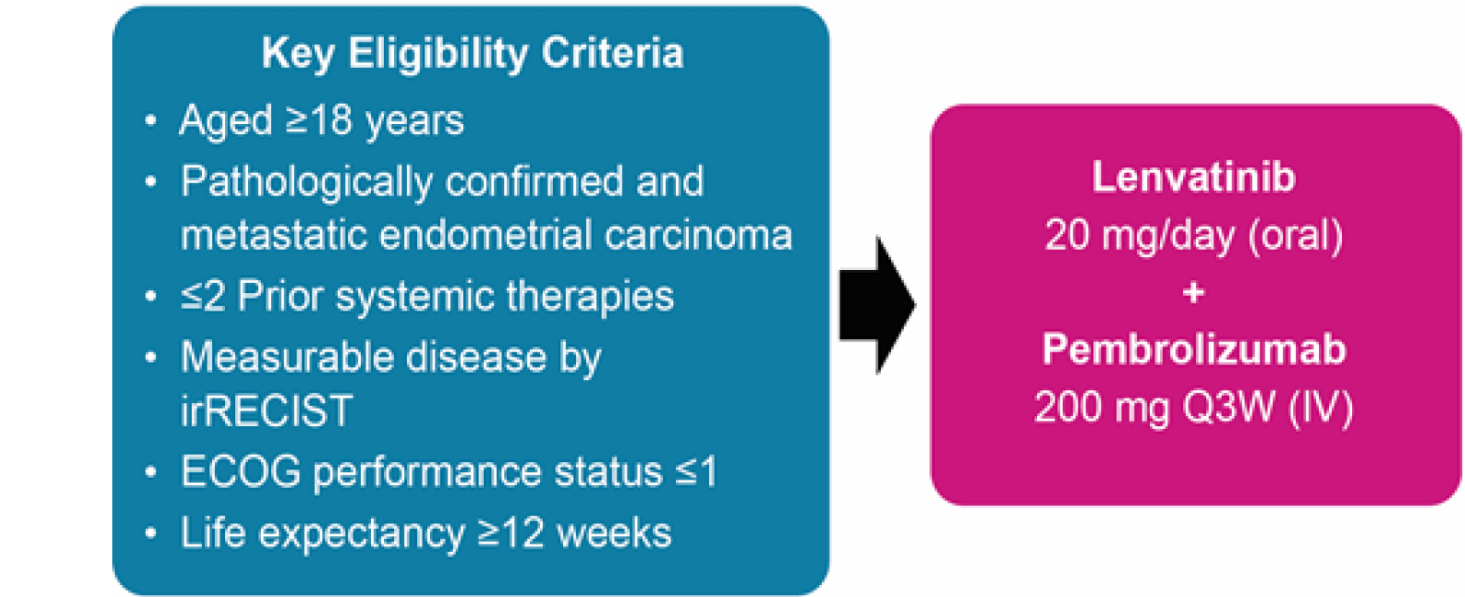
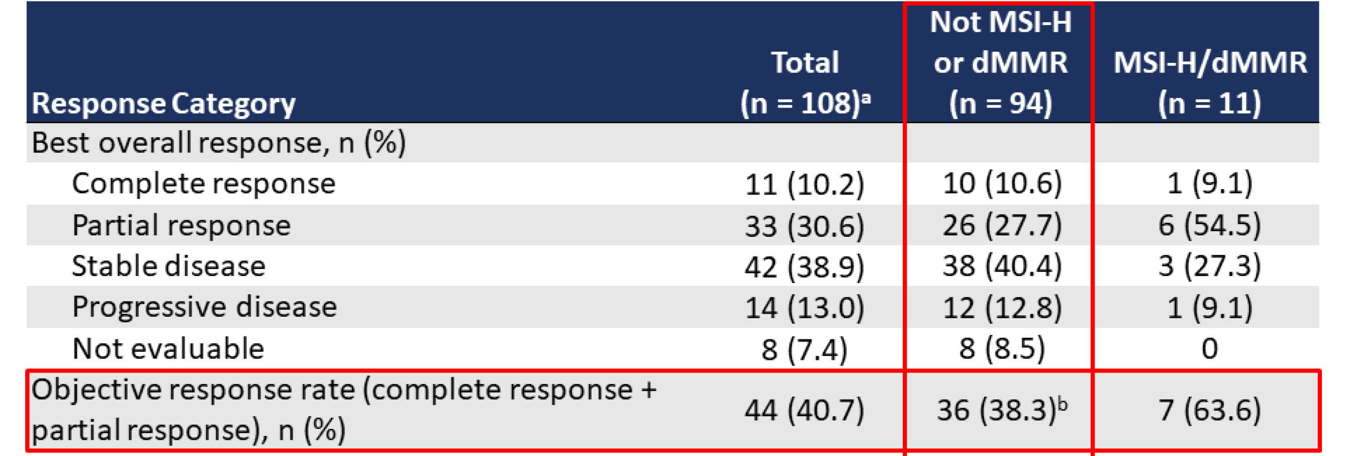
Makker V, et al. Presented at ESMO Annual Meeting, 2019

Slide 23
Lenvatinib/Pembro: Challenges
> 50% HTN, fatigue, diarrhea
Grade 3 toxicities HTN (34%) and diarrhea (8%)
HTN develops quickly
60% of patients had dose reduction of lenvatinib
Average dose 14 mg

Slide 24
Dostarlimab TSR-042
A humanized monoclonal antibody directed against the negative immunoregulatory human cell surface receptor programmed cell death 1 (PD-1; programmed death-1),
IgG4
Dosing 1000 mg every 6 weeks
Toxicities similar to other immune checkpoint inhibitors

Slide 25
GARNET Study: Best Overall Tumor Response
Dostarlimab demonstrated clinically meaningful response rates regardless of MSI status, with an ORR of 30%, 49% in the MSI-H cohort, and 20% in the MSS cohort)
Best Overall Response | MSI-H EC (n=41) | MSS EC (n=79) | MSI status unknown (n=5) | Total (N=125)
Overall response rate ^{n (%)} (95% Cl) | 20 (49%) (32.9, 64.9) | 1 6 (20.%) (12.0, 30.8) | 1(20.%) (0.5,71.6) | 37 (30%) (21.8, 38.4)
Complete response n (%) Partial response n (%) | 2 (4.9%) 181> (43.9%) | 4 (5.1%) 12 (15.2%) | 0 (0%) 1 (20.0%) | 6 (4.8%) 31 (24.8%)
Disease control rated % (95% Cl) | 63.4% (46.9, 77.9) | 46.8% (35.5, 58.4) | 60.0% (14.7, 94.7) | 52.8% (43.7, 61.8)
Response ongoing % | 85.0% | 81.3% | 100% | 83.8%
•Based on centraltesting,MSI status could not be determined;⁰17 confirmed and 1 stillon treatment and yet to be confirmed;"11 confirmed and 1stillon treatment and yet to be confirmed;"irCR+irPR+uirPR+irSD.
irCR: immune-related complete response;irPR: immune-related partialresponse;irSD: immune-related stable disease;uirPR: unconfirmed immune­ related partialresponse. Cl: confidenceinterval.
Data extract date: January 21, 2019.
Oaknin A et al. SGO 2019;Abstract 33.

Slide 26







In general, what treatment would you recommend for a patient with microsatellite-stable (MSS) metastatic endometrial cancer who experienced disease progression on carboplatin/paclitaxel?
Lenvatinib/pembrolizumab
22
Test for PD-L1 combined positive
score (CPS) and administer
pembrolizumab if 1% or higher
1
Cisplatin/doxorubicin
1
Doxorubicin
1
Gynecologic oncologists
Medical oncologists

Slide 27
In general, what treatment would you recommend for a patient with microsatellite-stable (MSS) metastatic endometrial cancer who experienced disease progression on carboplatin/paclitaxel?
Test for PD-L1 combined positive score (CPS) and administer pembrolizumab if 1% or higher
Lenvatinib/pembrolizumab
Carboplatin/docetaxel
Pembrolizumab
Cisplatin/doxorubicin
Other
Survey of general medical and gynecologic oncologists, May 2020

Slide 28

In general, what treatment would you recommend for a patient with high microsatellite instability (MSI-H) metastatic endometrial cancer who experienced disease progression on carboplatin/paclitaxel?
Pembrolizumab
24
Gynecologic oncologists
Medical oncologists

Slide 29
In general, what treatment would you recommend for a patient with high microsatellite instability (MSI-H) metastatic endometrial cancer who experienced disease progression on carboplatin/paclitaxel?
Pembrolizumab
Lenvatinib/pembrolizumab
Carboplatin/docetaxel
Cisplatin/doxorubicin
Survey of general medical and gynecologic oncologists, May 2020

Slide 30

For a patient with MSI-H metastatic endometrial cancer, outside of a clinical trial setting and regulatory and reimbursement issues aside, what is the earliest point at which you would introduce an anti-PD-1/PD-L1 antibody?
First line
10
Second line
14
Gynecologic oncologists
Medical oncologists

Slide 31
What dose and schedule of pembrolizumab are you currently administering to your patients with metastatic endometrial cancer?
400 mg every 6 weeks
13
200 mg every 3 weeks
12
Gynecologic oncologists
Medical oncologists

Slide 32
Dr Birrer: Case – MSI-high Endometrial Cancer
51 year old with G2 EMCA → CT scan negative for metastatic disease
RTLH/BSO/LND → Stage IIIC2 (positive pelvic/paraaortic lymph nodes)
Adjuvant treatment: carbo/paclitaxel x 6 cycles followed by whole pelvic xRT
Post treatment scan: NED
12 month f/u visit – CT scan shows intra-abdominal recurrence
She was treated with anti-PD-1 single agent

Slide 33
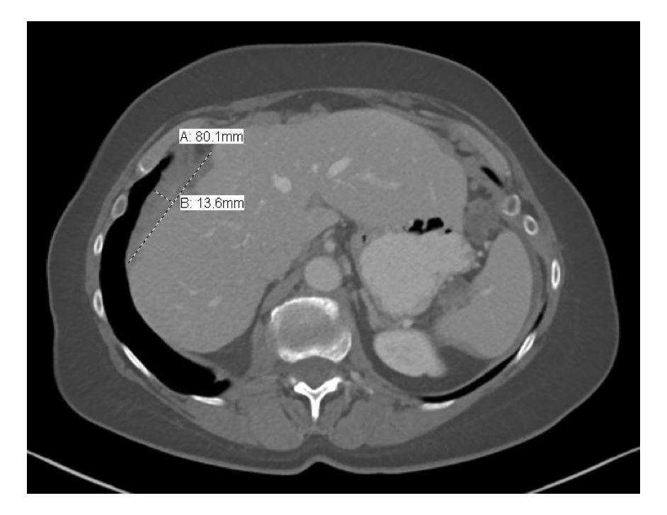
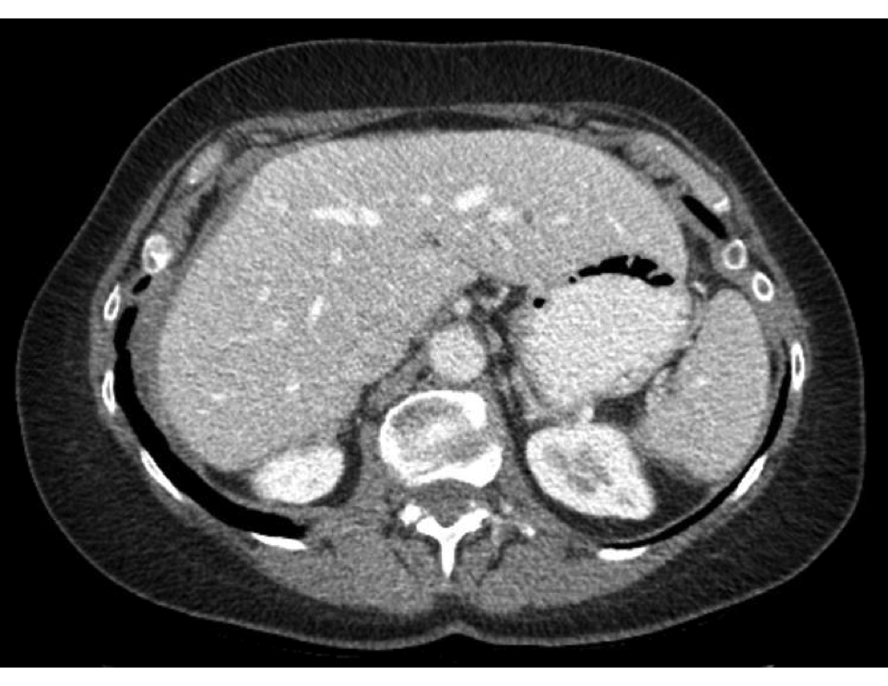
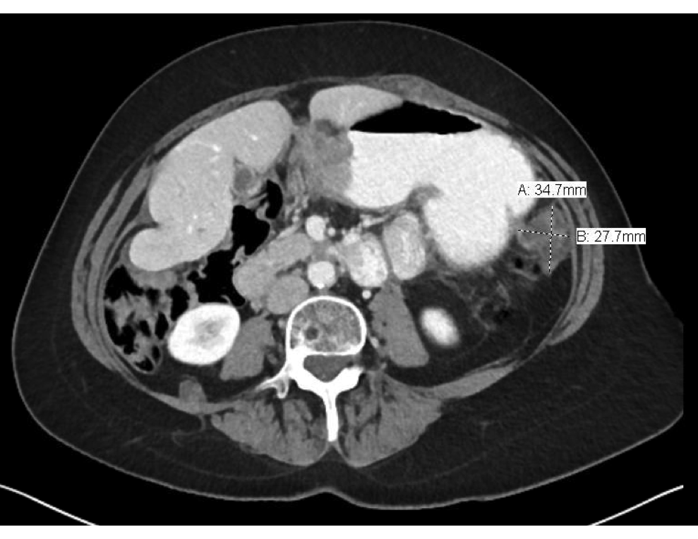
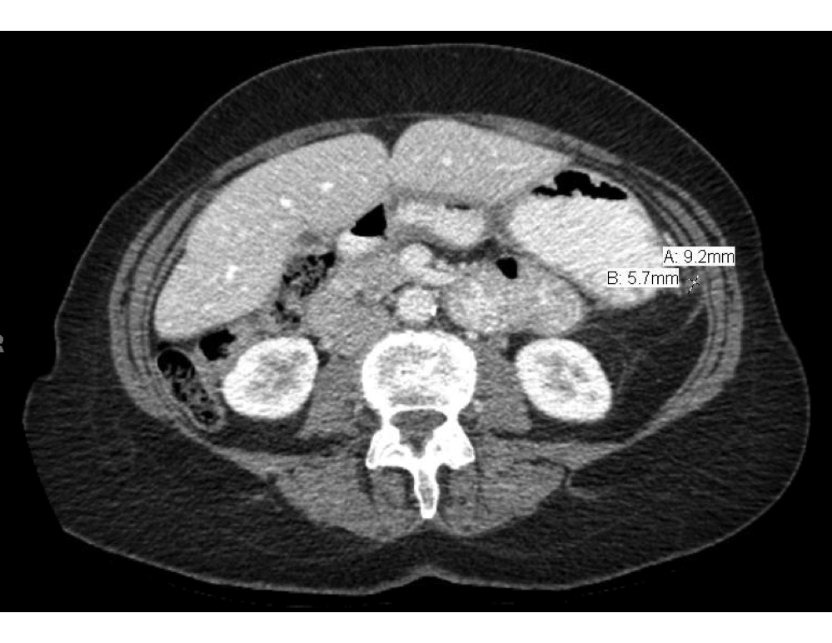
Before starting anti PD-1
After 12 months of anti-PD-1

Slide 34
Dr Birrer: Case – MSS Endometrial Cancer
41 year old biopsy proven G3 EMCA → CT scan negative for metastatic disease → proceed with surgery
Surgery: RTLH/BSO/blSLND → Stage IIIC1 (positive pelvic lymph node)
Adjuvant treatment: carbo/paclitaxel x 6 cycles
Post treatment scan: NED
3 f/u month visit – she is in pain, frequent nausea → CT scan

Slide 36
Dr Birrer: Case – MSS (cont’d)
Biopsy done → metastatic high-grade carcinoma consistent with known uterine primary
IHC: ER neg
NGS: amplification of AKT2, FGFR1, CCNE, MSI-S, TMB low
Started her on Lenvatinib/pembro
Developed HTN controlled by two anti-HTNs; grade 2 diarrhea—dose reduced to 14 mg lenvatinib
Re-scan after 4 months

Slide 38
MODULE 2: Current Indications for and Future Role of Immune Checkpoint Inhibitors in Cervical Cancer

Slide 39
PD-L1+ Cohort (CPS ≥ 1)
ENDPOINT | N=77
ORR (95% CI) | 14.3% (7.4 - 24.1)
Complete response | 2.6%
Partial response | 11.7%
Median duration (mos) | Not reached (4.1 - 18.6+)
% with duration ≥ 6 mos | 91%
Median follow-up (mos) | 11.7 (0.6 – 22.7)
COMBINED POSITIVE SCORE:
PD-L1+ cells (tumor cells, lymphocytes, macrophages)
Total number of tumor cells x 100
Chung HC, et al. J Clin Oncol 2019;37:1470-8.
Notes:
In Key-Note 158, among 77 women with PD-L1+ tumors, the objective response was 14.3% and included some women with CRs. PD-L1 was determine by a combined positive score greater than or equal to 1.

Slide 40
US FDA Accelerated Approval of Pembrolizumab
First Immunotherapy Approved for Cervical Cancer (June 12, 2018)
Companion Diagnostic
PD-L1 IHC 22C3
U.S. FDA Press Release, June 12, 2018. https://www.fda.gov/Drugs/InformationOnDrugs/ApprovedDrugs/ucm610572.htm
Notes:
Based on KeyNote-158, the USFDA granted pembrolizumab accelerated approval for PD-L1 positive platinum-refractory tumors. The companion diagnostic was also approved. This is the first immunotherapy approval for cervical cancer.

Slide 41
BEATcc
Phase III Randomized Frontline Trial of Atezolizumab (anti-PD-L1)
Primary Stage IVB, persistent or recurrent carcinoma of the cervix
Measurable disease by RECIST v1.1
ECOG-PS: 0-1
No previous systemic chemotherapy for advanced or recurrent disease
N=404 pts
Cisplatin + paclitaxel + bevacizumab (GOG#240) until disease progression, unacceptable toxicity, death or withdrawal of consent
R 1:1
Cisplatin + paclitaxel + bevacizumab + atezolizumab until disease progression, unacceptable toxicity, death or withdrawal of consent
Safety run-in cohort: 12 pts after 2 cycles of treatment
Primary Endpoints:
Overall survival (OS)
Secondary Endpoints:
PFS
ORR
DOR
Safety
HR-QOL
Stratification Factors:
Prior concurrent Cisplatin-RDT
Histology: SCC vs ADK (including AdenoSquamous)
Chemotherapy Backbone: Cisplatin vs Carboplatin
ClinicalTrials.gov Identifier: NCT03556839
Notes:
The BEATcc is another frontline trial studying triplet therapy with or without the anti-PD-L1 atezolizumab. The primary endpoint is OS.

Slide 42
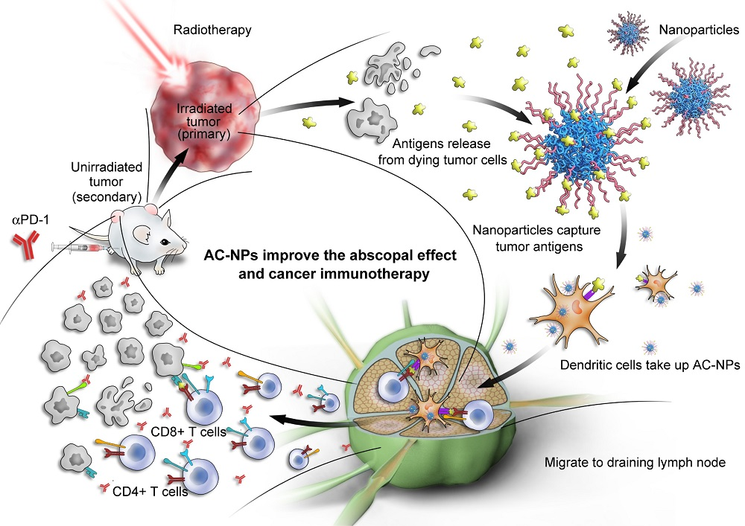
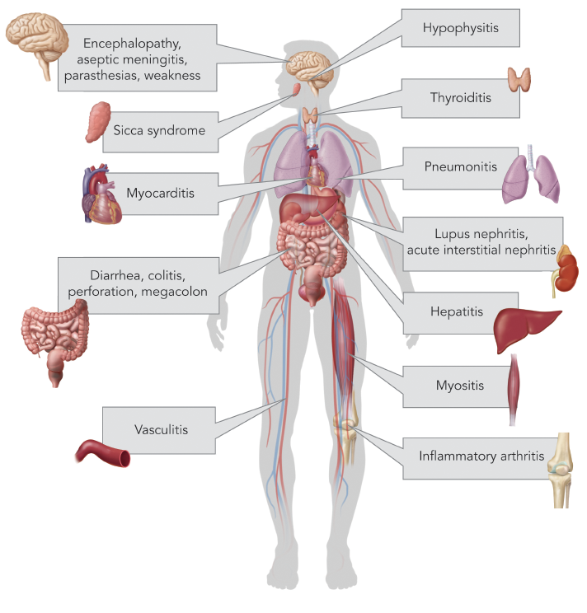
Checkpoint Inhibition
Key Concepts
Abscopal effect of hypofractionated radiotherapy
Endocrinopathies
Hodi FS, et al. J Clin Oncol 2018;36:850-8.
Minion LE, Tewari KS. Gynecol Oncol 2018;148:609-21.
Wolford JE, Tewari KS. Expert Opin Drug Discov 2018;13:445-57.
Notes:
As these trials accrue, we anticipate learning more about some novel phenomenon associated with immunotherapy. These include the abscopal response outside of the radiation field, pseudoprogression and delayed response, and also the endocrinopathies that may manifest.

Slide 43

In general, what would be your preferred first-line therapy for a patient with MSS metastatic cervical cancer who has received no prior systemic treatment?
Cisplatin/paclitaxel/
bevacizumab
18
Carboplatin/paclitaxel/
bevacizumab
5
Carboplatin/paclitaxel
2
Gynecologic oncologists
Medical oncologists

Slide 44
In general, what would be your preferred first-line therapy for a patient with MSS metastatic cervical cancer who has received no prior systemic treatment?
Cisplatin/paclitaxel/bevacizumab
Carboplatin/paclitaxel
Carboplatin/paclitaxel/bevacizumab
Cisplatin/paclitaxel
Test for PD-L1 CPS and administer pembrolizumab if 1% or higher
Other
Survey of general medical and gynecologic oncologists, May 2020

Slide 45
In general, what would be your preferred first-line therapy for a patient with MSS metastatic cervical cancer who experienced relapse 12 months after receiving cisplatin-based chemoradiation therapy for Stage IIIB disease?
23
Carboplatin/
paclitaxel/
bevacizumab
Cisplatin/
paclitaxel/
bevacizumab
2
Gynecologic oncologists
Medical oncologists

Slide 46
In general, what would be your preferred first-line therapy for a patient with MSS metastatic cervical cancer who experienced relapse 12 months after receiving cisplatin-based chemoradiation therapy for Stage IIIB disease?
Test for PD-L1 CPS and administer pembrolizumab if 1% or higher
Carboplatin/paclitaxel/bevacizumab
Carboplatin/paclitaxel
Pembrolizumab
Other chemotherapy
Survey of general medical and gynecologic oncologists, May 2020

Slide 47
In general, what would be your preferred second-line therapy for a patient with MSS metastatic cervical cancer who experienced disease progression on carboplatin/paclitaxel/bevacizumab?
20
Test for PD-L1 CPS and
administer pembrolizumab
if 1% or higher
Pembrolizumab
1
Other
4
Gynecologic oncologists
Medical oncologists

Slide 48
Dr Tewari: Case 1 – Recurrent Cervical Cancer
36 year old Caucasian married mother of two small children, living in rural Georgia
PMH unremarkable
Screening – sporadic cervical cancer screening 2014-2019
2018
  Post-coital vaginal bleeding (hemoglobin 9.5 mg/dL), dyspareunia, pelvic pain
  5 cm friable cervical lesion biopsied: poorly differentiated squamous cell carcinoma (SCCA)
  PET/CT: FIGO stage IB3 SCCA cervix
  Management:
    Cisplatin-based chemoradiation (40 mg/m² BSA weekly with 50.4 Gy IMRT) plus high-dose-rate intracavitary brachytherapy for total dose 85 Gy to Point A
    Missed 8 radiotherapy sessions due to transportation issues
    Complete clinical response

Slide 49
Dr Tewari: Case 1 (cont’d) – Recurrent Cervical Cancer
2019
  Presents 14 months following chemoradiation with severe pelvic and right flank pain
  Cachetic, unable to work as a medical assistant, confined to her apartment [ECOG PS 2]
  Pelvic examination – large, fixed mass with right pelvic side wall extension
  PET/CT: large necrotic pelvic mass, right hydronephrosis; CT-guided bx confirms pulmonary metastasis of SCCA cervix
  Serum creatinine = 1.7 mg/dL
  Travel limited by geography
  Management:
    Moore score = 3
    Percutaneous right nephrostomy and anterograde right ureteral placement
    Ensure® (3 cans/day)
    Carboplatin (AUC 6) + Paclitaxel (175 mg/m² BSA) + Bevacizumab (15 mg/kg) x 7 cycles
    Complete clinical response

Slide 50
Dr Tewari: Case 1 (cont’d) – Recurrent Cervical Cancer
2020
  Presents with left supraclavicular lymphadenopathy and mild hemoptysis
  PET/CT
    Supraclavicular node (SUV 12)
    Bilateral pulmonary metastasis measuring 2 cm and 4 cm (SUV 6-9)
  CT-guided bx confirms recurrent disease
  PD-L1+
    Combined Positive Score = 16
  Management:
    Pembrolizumab 200 mg IV q3 wks (January – February 2020)
    Surveillance PET/CT (March 2020) demonstrates pulmonary metastases enlarged
    Pembrolizumab 200 mg IV q3 wks (March – April 2020)
    Surveillance PET/CT (May 2020) demonstrates partial response (pseudo-progression)
    Pembrolizumab 400 mg IV q6 wks (begins May 2020 per COVID-19 US FDA guidance)
      Hypothyroidism managed with thyroid hormone supplementation

Slide 51
Dr Tewari: Case 2 – Metastatic Cervical Cancer
45 y/o Hispanic married mother of four, housekeeper
Lives in Orange County, CA
Lack of access to healthcare (no prior cervical cancer screening)
Presents with vaginal bleeding and pelvic pain [ECOG PS = 1]
Physical exam notable for cervical expansion with tumor eroding into the proximal third of the vagina
  Biopsy confirms adenocarcinoma
PET/CT demonstrates para-aortic metastases (SUV 8)
Referred to the University of California, Irvine NCI-Designated Comprehensive Cancer Center
Management:
  Screened and enrolled on KEYNOTE-826; still remains on trial and appears to be doing well
  Randomized to cisplatin (50 mg/m² BSA) + paclitaxel (175 mg/m² BSA) + bevacizumab (15 mg/kg) plus/minus pembrolizumab 200 mg/placebo q21 days

Slide 52
MODULE 3: Current and Potential Role of Immune Checkpoint Inhibitor Therapy in Ovarian Cancer Management

Slide 53
FDA-approved indications for immunotherapy in ovarian cancer
Pembrolizumab: 2017 FDA approval for MSI-high/MMR deficient cancers
The incidence of germline MMR gene mutations in high grade serous cancers is 1-8%
MMR deficiency is more common in non-serous ovarian cancer
2020 ASCO ovarian cancer genetics guidelines re MMR testing:
Women diagnosed with clear cell, endometrioid, or mucinous ovarian cancer should be offered somatic tumor testing for mismatch repair deficiency
Testing for MMR deficiency may be offered to women diagnosed with other histologic types of epithelial ovarian cancer
Xiao X, et al. Gynecol Oncol. 2014.; Morice P, et al. N Engl J Med. 2019.; Konstantinopoulos PA, et al, J Clin Oncol. 2020
Murphy MA Cancer 2011

Slide 54
Possible ways to improve the effectiveness of immune checkpoint inhibition in ovarian cancer
Combination with other agents
  Cytotoxic agents
  Targeted agents
  Other immune checkpoint inhibitors
  Antiangiogenic therapies

Slide 55
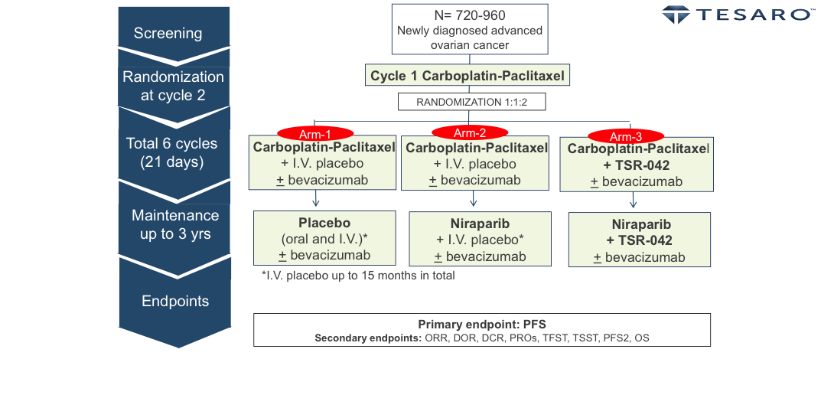
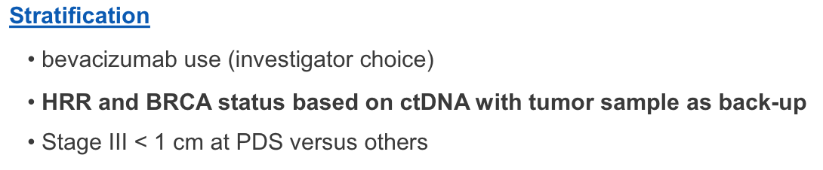
FIRST Trial of Dostarlimab (TSR-042)
ClinicalTrials.gov Identifier: NCT03602859

Slide 56
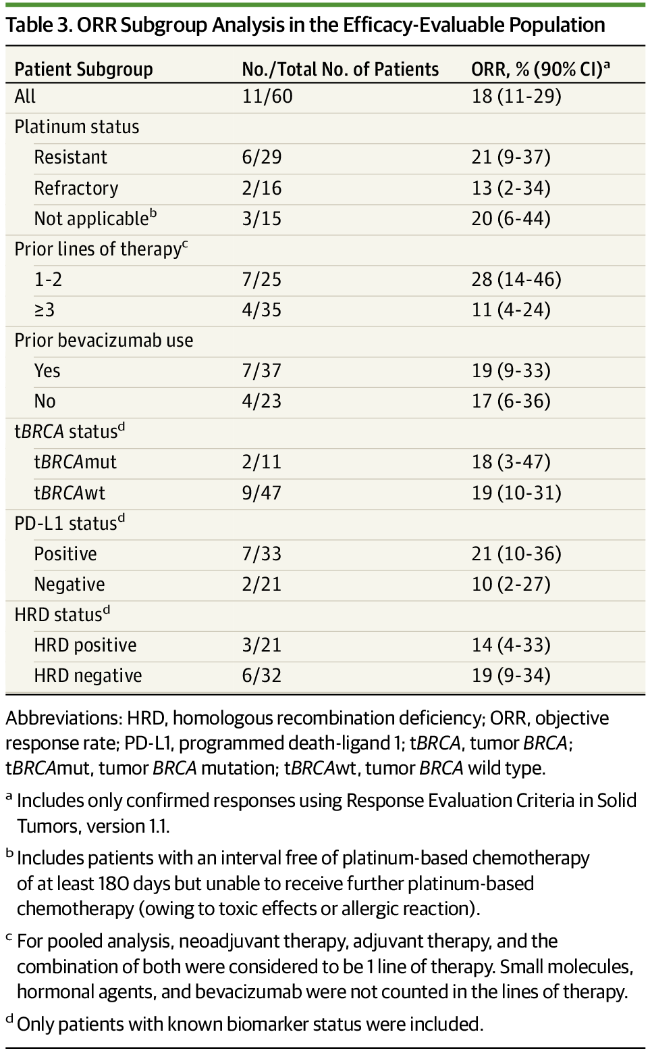
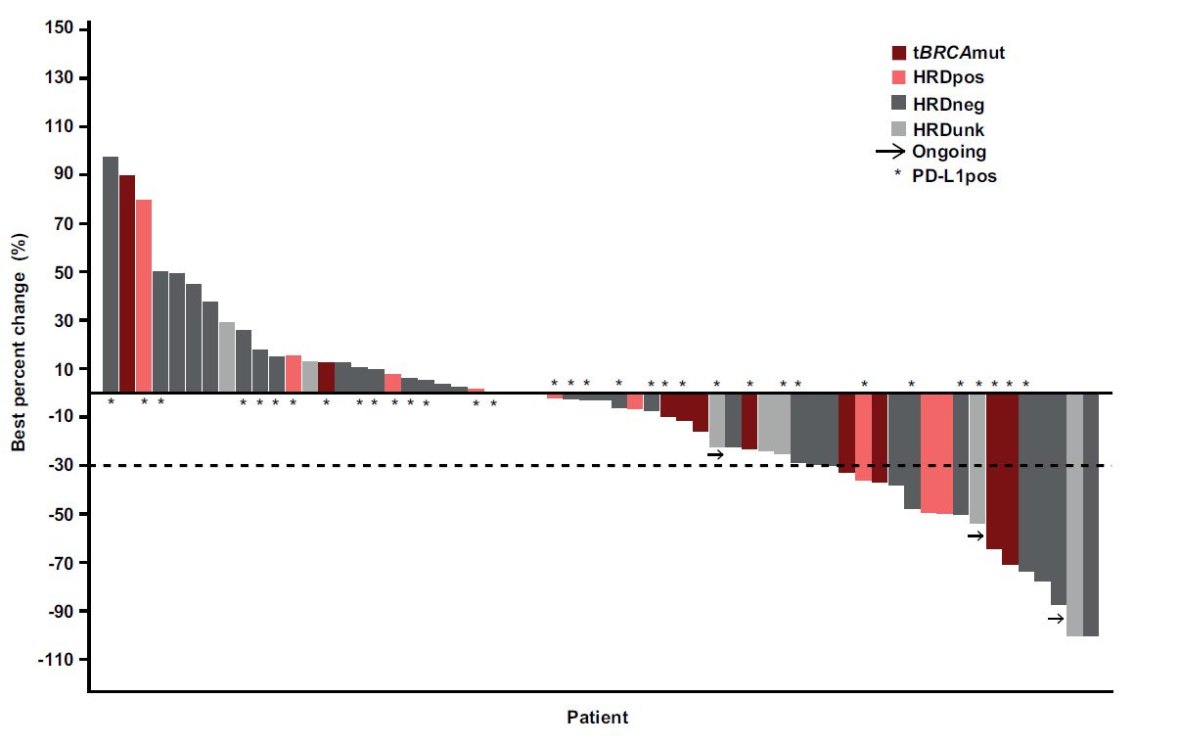
Niraparib and Pembrolizumab Resulted in Clinical Activity Across a Broad Study Population
HRD negative/ unknown
PD-L1 negative/unknown
Konstantinopoulos PA, et al. JAMA Oncol. 2019.

Slide 57
Now open….
A Phase 2 Open-Label, Single-Arm Study to Evaluate the Efficacy and Safety of the Combination of Niraparib and Dostarlimab (TSR-042) in Patients With Platinum Resistant Ovarian Cancer (MOONSTONE)
ClinicalTrials.gov Identifier: NCT03955471

Slide 58
Do you generally evaluate microsatellite instability status in your patients with advanced ovarian cancer?
Yes
12
No
13
Gynecologic oncologists
Medical oncologists

Slide 59
Do you generally evaluate microsatellite instability status in your patients with advanced ovarian cancer?
Yes
No
Survey of general medical and gynecologic oncologists, May 2020

Slide 60
How would you respond to a patient with MSI-H metastatic endometrial cancer who is about to begin treatment with pembrolizumab and asks you to estimate the chance that during the first year of treatment she will…
Gyn Oncs
Med Oncs
“Sail through” treatment
Experience side effects that require drug to be held
Experience side effects that require discontinuation
Median %

Slide 61
How would you respond to a patient with MSI-H metastatic endometrial cancer who is about to begin treatment with pembrolizumab and asks you to estimate the chance that during the first year of treatment she will…
Gyn Oncs
Med Oncs
Develop immune-related colitis that requires clinical management
Develop immune-related pneumonitis that requires clinical management
Develop immune-related neurologic side effects that require clinical management
Median %

Slide 62
How would you respond to a patient with MSS metastatic endometrial cancer who is about to begin treatment with lenvatinib/pembrolizumab and asks you to estimate the chance that during the first year of treatment she will…
Gyn Oncs
Med Oncs
“Sail through” treatment
Experience side effects that lead to dose reduction
Experience side effects that require discontinuation
Median %

Slide 63
How would you respond to a patient with MSS metastatic endometrial cancer who is about to begin treatment with lenvatinib/pembrolizumab and asks you to estimate the chance that during the first year of treatment she will…
Gyn Oncs
Med Oncs
Develop hypertension that
requires clinical management
Develop gastrointestinal toxicity
that requires clinical management
Median %

Slide 64
For a patient with MSI-H metastatic endometrial cancer and Crohn’s disease well controlled with infliximab, regulatory and reimbursement issues aside, what is the earliest point at which you would introduce an anti-PD-1/PD-L1 antibody?
First line
1
Second line
5
Third line or beyond
4
I would not use an anti-PD-1/
PD-L1 antibody for this patient
14
Gynecologic oncologists
Medical oncologists

Slide 65
For a patient with MSI-H metastatic endometrial cancer and Crohn’s disease well controlled with infliximab, regulatory and reimbursement issues aside, what is the earliest point at which you would introduce an anti-PD-1/PD-L1 antibody?
First line
Second line
Third line or beyond
I would not use an anti-PD-1/PD-L1 antibody for this patient
Survey of general medical and gynecologic oncologists, May 2020

Slide 66
For a patient with MSI-H metastatic endometrial cancer and mild psoriasis not requiring active treatment, regulatory and reimbursement issues aside, what is the earliest point at which you would introduce an anti-PD-1/PD-L1 antibody?
First line
1
Second line
20
Third line or beyond
2
I would not use an anti-PD-1/
PD-L1 antibody for this patient
2
Gynecologic oncologists
Medical oncologists

Slide 67
For a patient with MSI-H metastatic endometrial cancer and mild psoriasis not requiring active treament, regulatory and reimbursement issues aside, what is the earliest point at which you would introduce an anti-PD-1/PD-L1 antibody?
First line
Second line
Third line or beyond
I would not use an anti-PD-1/PD-L1 antibody for this patient
Survey of general medical and gynecologic oncologists, May 2020

Slide 68
Dr Matulonis Case: 74 yo WF
2011: diagnosed with advanced ovarian cancer, high grade serous, received 6 cycles of carbo/paclitaxel IV
2014: recurrence, surgery, and received 3 cycles of IP cisplatin and IV/IP paclitaxel followed by 3 cycles of carboplatin and paclitaxel IV
2016: recurrence and received single agent carboplatin IV
CT after 3 cycles showed PD
2017: went on trial 16-257 (NCT02865811), PLD and pembrolizumab;
off study in 2019 because of 2 year mark for pembro (per study, pembro max is 2 years) and continued doxorubicin alone

Slide 69
Dr Matulonis Case: 65 yo WF
2017: Presented with chronic lower back pain and found to RTP adenopathy and bilateral adnexal masses
Underwent optimal cytoreductive surgery; stage IIIC HGSC (BRCA wild type)
Receives 6 cycles of carbo/paclitaxel
9 months later – recurrence with adenopathy and peritoneal disease on CT, elevated CA125, carbo/PLD
CA125 starts to rise during cycle 5, and CT shows PD
18-303 March 2019: OPAL, TSR-042, niraparib, and bev (NCT03574779)
Required DR to 200 of niraparib, PR after 4 cycles
Developed covid19 in April 2020 (exposed to +family member in same house), hospitalized and now recovering

Slide 70
MODULE 4: Novel Targeted Agents and Strategies Under Investigation for Gynecologic Cancers

Slide 71
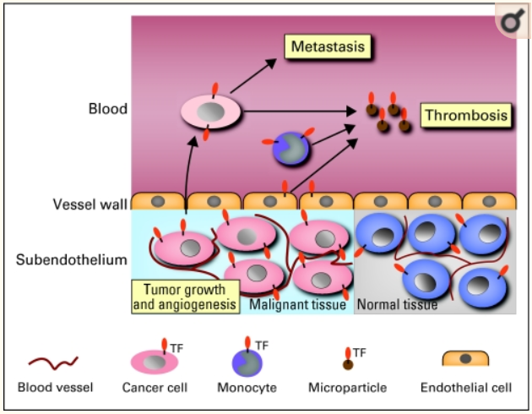

Rationale for targeting Tissue Factor
TF is normally ubiquitously present in the sub-endothelium
In tumors TF is co-opted to promote tumor initiated thrombosis and cancer metastasis.

Slide 72
Mechanism of action of tisotumab vedotin
Tissue factor (TF) is aberrantly expressed in a broad range of solid tumours, including cervical cancer,^{1,2} and TF expression has been associated with higher tumour stage and grade, higher metastatic burden and poor prognosis²
TF expression in cervical cancer makes TF a novel target for patients with cervical cancer
ADC targets TF
  Monoclonal Antibody targets TF
  Payload: Microtubule disrupting MMAE
Allowing for direct cytotoxicity and bystander killing, as well as antibody-dependent cellular cytotoxicity^{3,4}
1. Förster Y, et al. Clin Chim Acta, 2006. 2. Cocco E, et al. BMC Cancer, 2011. 3. Breij EC, et al. Cancer Res, 2014. 4. De Goeij BE, et al. Mol Cancer Ther, 2015.

Slide 73
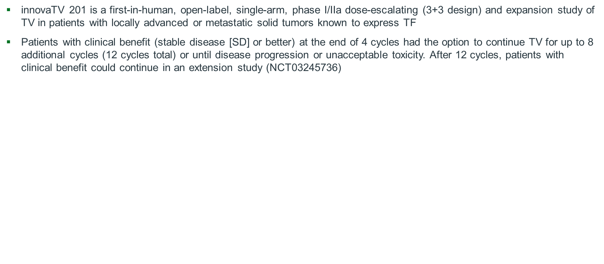
Background - innovaTV 201 Study Design
Tisotumab Vedotin first studied in multiple solid tumors, with specific expansion cohort in Cervical Cancer
innovaTV 201 Study Design
Dose-Escalation Phaseª
TV 0.3-2.2 mg/kg IV Q3W
N=27
Cervical
Bladder
Endometrial
Oesophageal
NSCLC
SCCHN^{b}
Ovarian
Prostate
Dose-Expansion Phase^{c}
TV 2.0 mg/kg IV Q3W
N=168
Bladder (n=15)
Endometrial (n=14)
Oesophageal (n=15)
NSCLC (n=15)
Ovarian (n=36)
Prostate (n=18)
Cervical Cohort (N=55)
Primary Endpoint:
Safety and Tolerability^{d}
Selected Secondary Endpoint:
Investigator-assessed ORR by RECIST v1.1e
Cervical (n=55)
IV, intravenous; NSCLC, non–small-cell lung cancer; Q3W, every 3 weeks; RECIST, Response Evaluation Criteria In Solid Tumours; SCCHN, squamous cell carcinoma of the head and neck.
ªSubjects were enrolled into cohorts at increasing dose levels of TV in 21-day treatment cycles. ^{b}The SCCHN cohort was closed by a protocol amendment due to an event of pharyngeal tumour haemorrhage with fatal outcome. The event was deemed to be most likely related to the disease itself. ^{c}In phase II, ovarian and cervical cohorts were expanded to include more patients based on preliminary efficacy observed in the first 14 patients enrolled. ^{d}AE severity graded per Common Terminology Criteria for Adverse Events [CTCAE] v4.0. ^{e}Computed tomography or magnetic resonance imaging was performed at baseline and every 6 weeks during the study for tumour assessments.
Vergote I, Concin N, Dean E, Lassen U, Drew Y, Machiels JP, Nielsen D, Arkenau T, Forster M, Jones R, Slomovitz B, Spicer J, Johnson M, Cornez N, Gennigens C, Fulton B, Basse L, Lisby S, Coleman RL, Hong DS ESMO 2018
Notes:
Figure, footnote ‘b’, ‘c’ and ‘d’:
Data on file/ESMO2017upd2/slide 1
Data on file/ESMO presentation_additional data by Henning_090617/p2
Bullet 1/2, footnotes ‘e’ and ‘f’:
Data on file/ESMO2017upd2/slide 7
Bullet 1 95% CI:
Data on file/ESMO presentation_additional data by Henning_081817/p2/bullet #5

Slide 74
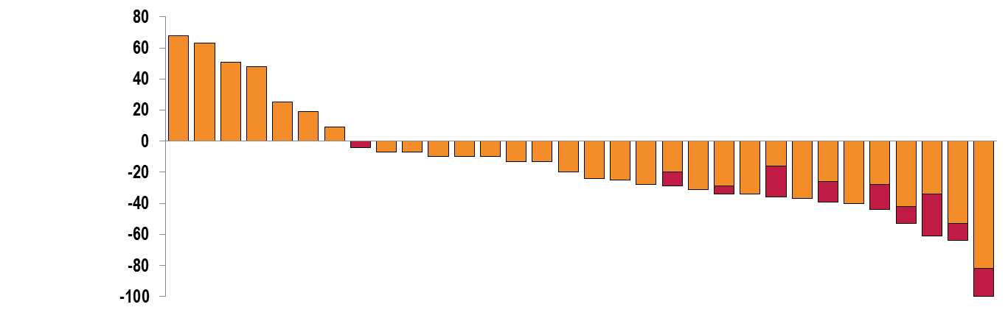
innovaTV 201 – Response Rate
N=34ª
Change at first scan
Maximum reduction
Confirmed response
Best Percent Change
From Baseline, %
^{b}
^{b}
^{b}
^{b}
PR
  50% (17 of 34 patients; 95% CI, 35%-65%) achieved clinical benefit after 12 weeks (DCR)^{c,d}
  32% (11 of 34 patients; 95% CI, 17%-50%) achieved response (ORR)^{d}
    8 PR, confirmed
    3 PR, unconfirmed^{e}
    CI=confidence interval; CR=complete response; CT=computed tomography; DCR=disease control rate; ORR=overall response rate; PD=progressive disease; PR=partial response;
    RECIST=Response Evaluation Criteria in Solid Tumors; SD=stable disease.
    ªTwo patients were withdrawn prior to CT scan, and so are not represented in the graph. ^{b}PD due to new lesion at same scan. ^{c}Clinical benefit was defined as the DCR rate, the proportion of patients who achieved a CR, PR, or SD after 12 weeks. ^{d}Response was as assessed by investigators using standard RECIST 1.1 criteria. ^{e}One of which is still ongoing. Data cutoff date July 24, 2017.
Vergote I, Concin N, Dean E, Lassen U, Drew Y, Machiels JP, Nielsen D, Arkenau T, Forster M, Jones R, Slomovitz B, Spicer J, Johnson M, Cornez N, Gennigens C, Fulton B, Basse L, Lisby S, Coleman RL, Hong DS ESMO 2018
Notes:
Figure, footnote ‘b’, ‘c’ and ‘d’:
Data on file/ESMO2017upd2/slide 1
Data on file/ESMO presentation_additional data by Henning_090617/p2
Bullet 1/2, footnotes ‘e’ and ‘f’:
Data on file/ESMO2017upd2/slide 7
Bullet 1 95% CI:
Data on file/ESMO presentation_additional data by Henning_081817/p2/bullet #5

Slide 75
innovaTV 201 – Adverse events of special interest
AEOSI Term | N=34
 | Any Grade, n (%) | Grade ≥3, n (%)
Ocular (any)ª | 18 (53%) | 1 (3%)
Conjunctivitis | 17 (50%) | 1 (3%)
Conjunctivitis scar | 1 (3%) | 0
Conjunctivitis viral | 1 (3%) | 0
Conjunctival ulceration | 0 | 0
Keratitis | 1 (3%) | 0
Ulcerative keratitis | 2 (6%) | 0
Symblepharon | 0 | 0
Neuropathy (any) | 12 (35%) | 2 (6%)
AESOI = adverse events of special interest.
ªMost patients who experienced other events than conjunctivitis also experienced conjunctivitis.
Vergote I, Concin N, Dean E, Lassen U, Drew Y, Machiels JP, Nielsen D, Arkenau T, Forster M, Jones R, Slomovitz B, Spicer J, Johnson M, Cornez N, Gennigens C, Fulton B, Basse L, Lisby S, Coleman RL, Hong DS ESMO 2018
Notes:
Data on file/ESMO presentation_additional data by Henning_081017

Slide 76
innovaTV 205 (GOG 3024): Recurrent or Metastatic Cervical Cancer

Slide 77
CheckMate 358 Summary
  The results suggest clinical benefit with both regimens of nivolumab + ipilimumab in patients with R/M cervical cancer
    While patient subgroups were small, responses were noted regardless of tumor cell PD-L1 expression
    Across both regimens, efficacy was better in patients without prior systemic therapy versus with prior systemic therapy for R/M disease
  Responses were durable; at median follow-up >10 mo, median duration of response was not reached for either regimen in patients without prior systemic therapy
  The treatment regimens had a manageable safety profile; no new safety signals were detected
  Given the limited treatment options for patients with R/M cervical cancer, these data with nivolumab + ipilimumab are of strong clinical interest and warrant further investigation in this patient population

Slide 78
Randomized phase II trial of carboplatin-paclitaxel versus
carboplatin-paclitaxel-trastuzumab in uterine serous carcinoma that overexpresses HER2/neu: Updated Survival Analysis
Primary objective: To estimate whether the addition of trastuzumab to paclitaxel and carboplatin chemotherapy improves PFS compared to paclitaxel and carboplatin alone
Eligibility:
  FIGO stage III-IV USC or recurrent USC
  HER2/neu+ USC as defined by IHC score of 3+ (ASCO/CAP 2007 criteria) or 2+ with gene amplification confirmed by FISH
  Patients diagnosed with recurrence were required to have measurable disease, defined as at least one target lesion per RECIST 1.1
  Patients with recurrent disease may not have received >3 prior chemotherapies for treatment of their EC and a treatment-free interval of >6 months from last C/T was required for patients with recurrent disease
Design
  Originally designed to accrue 100 subjects
  Power calculations for the trial assumed median PFS would be 6 months on the carboplatin/paclitaxel arm and 10.5 months on the carboplatin/paclitaxel/trastuzumab arm, equivalent to a hazard ratio (HR) of 0.57 with trastuzumab addition
  First subject enrolled in August of 2011, after which (1) the accrual rate was slower than planned, and (2) observed PFS exceeded original expectations
  Because of this, interim futility analysis was performed. Study closed to further accrual in March of 2017 with 61 enrolled subjects.
Paclitaxel 175 mg/m² and carboplatin AUC 5 IV q 21 days x 6 cycles
Eligible USC HER2+ Patients
Randomization 1:1
Paclitaxel 175 mg/m² and carboplatin AUC 5
+ Trastuzumab (at 8 mg/kg 1st dose & then 6 mg/kg in subsequent cycles) x 6 cycles f/b trastuzumab maintenance at 6 mg/kg until disease progression or prohibitive toxicity
Optimal or suboptimal CRS status allowed
EBRT allowed prior to enrollment
Amanda N. Fader, Dana M. Roque, Eric Siegel, Natalia Buza, Pei Hui, Osama Abdelghany, Setsuko K. Chambers, Angeles Alvarez Secord, Laura Havrilesky, David M. O’Malley, Floor Backes, Nicole Nevadunsky, Babak Edraki, Dirk Pikaart, William Lowery, Karim S. ElSahwi, Paul Celano, Stefania Bellone, Masoud Azodi, Babak Litkouhi, Elena Ratner, Dan-Arin Silasi, Peter E. Schwartz, and Alessandro D. Santin SGO 2020
Notes:
Eligible patients with HER2 overexpressed or amplified uterine serous carcinoma were randomized 1/1 to receive either intravenous paclitaxel and carboplatin at usual dosing guidelines for 6 cycles.
Versus this same regimen in addition to intravenous trastuzumab initially dosed at 8 mg/kg with the first cycle, and then 6 mg/kg in subsequent cycles. Those patients who were tolerating treatment and had progressed after the first 6 cycles of treatment were then continued on maintenance trastuzumab at 6 mg/kg until disease progression or prohibitive toxicity.

Slide 79
OVERALL SURVIVAL
Benefit was particularly striking in the stage III-IV pts, with a median OS of 25.4 mos (control) compared with an unreached median OS (experimental; p=0.0406, HR: 0.492, 90%CI 0.249-0.974)
There was no significant OS benefit observed in the recurrence cohort
HR 0.492, 90%
CI 0.249-0.974,
p=0.0406
HR 0.864,
90% CI 0.355─2.100,
p=0.3929

Slide 80
Carboplatin-paclitaxel-trastuzumab - Summary
First trial of targeted therapy in USC ONLY pts
Demonstration that HER2 is an important prognostic and actionable target in USC
NCCN designation of C/T/Trastuzumab as a preferred regimen in HER2+ USC (Level IIA)
Amanda N. Fader, Dana M. Roque, Eric Siegel, Natalia Buza, Pei Hui, Osama Abdelghany, Setsuko K. Chambers, Angeles Alvarez Secord, Laura Havrilesky, David M. O’Malley, Floor Backes, Nicole Nevadunsky, Babak Edraki, Dirk Pikaart, William Lowery, Karim S. ElSahwi, Paul Celano, Stefania Bellone, Masoud Azodi, Babak Litkouhi, Elena Ratner, Dan-Arin Silasi, Peter E. Schwartz, and Alessandro D. Santin SGO 2020

Slide 81
Randomized double-blind placebo controlled trial of primary maintenance vigil immunotherapy (VITAL study) in stage III/IV ovarian cancer: Efficacy assessment in BRCA1/2-wt patients
Vigil is an autologous tumor cell vaccine constructed from autologous harvested tumor tissue
  transfected with a DNA plasmid encoding GMCSF
  transfected with bi-shRNA-furin
Rocconi et al. SGO 2020

Slide 82
Vigil MOA
Senzer et al. Mol Ther. 2012 Mar;20(3):679-86 | Senzer et al. J Vaccines Vaccine 2013; 4: 209

Slide 83
Dr O’Malley Case 1: A woman in her 20s
2016 - Diagnosed with stage IIIB cervical cancer
Received chemoradiation with HDR
2018 - multiple pulmonary masses - biospy confirmed lung recurrence;
2018 - cisplatin + paclitaxel + Bev x 6 cycles with progression
New bone lesion treated with RT
Screen Fail for Iovance C-145-04 TILs trial (due to PFTs)
2019 : started on innovaTV 204 – GOG 3023 ((Genmab).
PD-L1 testing negative; Foundation One with TERT promotor abnormality

Slide 84
Screening
Cycle 2
Cycle 10
Continues on therapy with persistent lesion
>16 months
Approx. 60% regression

Slide 85
Dr O’Malley Case 2: A woman in her 40s
2018: Diagnostic laparoscopy – biopsy omental
  Poorly differentiated squamous cell carcinoma consistent with metastatic cervical cancer.
Cisplatin and paclitaxel x 4 cycles. CT scan with partial response and resolution of bowel obstruction.
2018: Cisplatin, paclitaxel, and bevacizumab started (avastin added after cycle 5, received 8 cycles total) – Mixed response
2019: 12 cycles of Pembro
Palliative RT to the pelvis
Tumor testing: Anti-PD-1 Result: High positive for PD-1; Positive for PD-L1 expression (TPS 1-49%); Tumor proportion score (TPS)*: 5%.

Slide 86
innovaTV 205 (GOG 3024) Arm F (TV & pembro)
Screening
Cycle 2
11% decrease RECIST
Removed off trial due to recurrent SBO

Slide 87
MODULE 5: SGO/ASCO 2020 Review

Slide 88
MODULE 6: COVID-19 and Gynecologic Cancers

Slide 89
Do you believe that receiving an anti-PD-1/PD-L1 antibody makes a patient more susceptible to contracting COVID-19?
Yes
2
No
13
I don’t know
10
Gynecologic oncologists
Medical oncologists

Slide 90
Do you believe that receiving an anti-PD-1/PD-L1 antibody increases a patient’s risk of developing complications associated with COVID-19?
Yes
7
No
6
I don’t know
12
Gynecologic oncologists
Medical oncologists

Slide 91
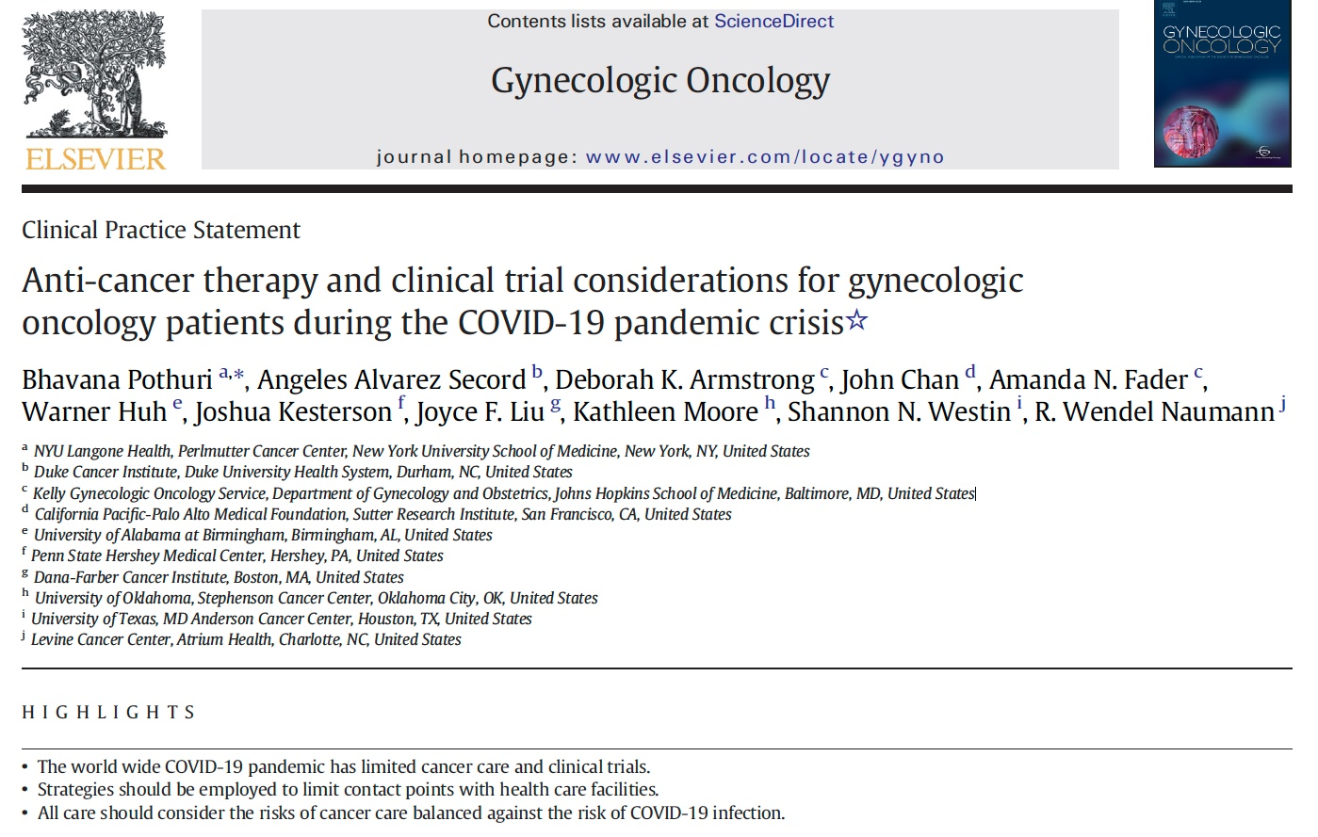
Gynecol Oncol 2020;[Online ahead of print].

Slide 92
SGO Clinical Practice Statement
Regardless of geographic location, COVID-19 will impact all practitioners; however, the degree will vary based on COVID-19 burden and available local resources.
Pothuri B et al. Gynecol Oncol 2020;[Online ahead of print].

Slide 93
SGO Clinical Practice Statement: Considerations for Immunotherapy
COVID-19 infection and early immunotherapy-related pneumonitis have similar presentations. In the case of suspected pneumonitis, test for COVID-19 before starting steroids and collaborate with pulmonary consultants.
Access to PFTs and bronchoscopy may be limited and decisions may need to be made based on clinical findings and severity of symptoms.
Pothuri B et al. Gynecol Oncol 2020;[Online ahead of print].

Slide 94
SGO Clinical Practice Statement: Considerations for Immunotherapy
Consider less-frequent dosing intervals with immune checkpoint inhibitors:
  Pembrolizumab 400 mg IV q6wk
  Nivolumab 480 mg IV q4wk
  Atezolizumab 1,680 mg IV q4wk
Pothuri B et al. Gynecol Oncol 2020;[Online ahead of print].

Slide 95
SGO Clinical Practice Statement: Considerations for Immunotherapy
Currently no evidence demonstrates that immunotherapy, in cancer patients, increases COVID-19 susceptibility. Strong overlap exists between immune-related pneumonitis and COVID-19 infection, including cough, dyspnea, fever and CT findings of ground-glass opacities and interstitial changes.
Pre-existing lymphopenia is associated with lower immunotherapy response and predicts more severe COVID-19 infections.
Pothuri B et al. Gynecol Oncol 2020;[Online ahead of print].

Slide 96
SGO Clinical Practice Statement: Considerations for Immunotherapy
Currently, the WHO and CDC recommend that corticosteroids not be used in treatment of COVID-19 viral pneumonia or ARDS unless indicated for another reason (asthma, COPD, septic shock).
Pre-existing lymphopenia is associated with lower immunotherapy response and predicts more severe COVID-19 infections.
Pothuri B et al. Gynecol Oncol 2020;[Online ahead of print].

Slide 97
SGO Clinical Practice Statement: Clinical Trial Considerations
Prioritize Tier 1 studies where there is high potential benefit (ie, trial that offers a drug when alternative treatments are limited) in resource-stratified environments.
Pothuri B et al. Gynecol Oncol 2020;[Online ahead of print].

Slide 98
Thank you for joining us!
CME credit information will be emailed to each participant tomorrow morning.

